Slide 1
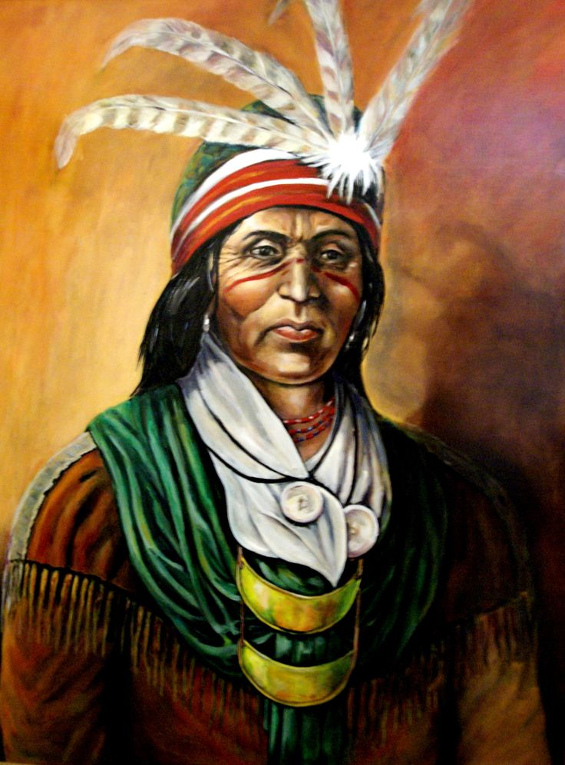
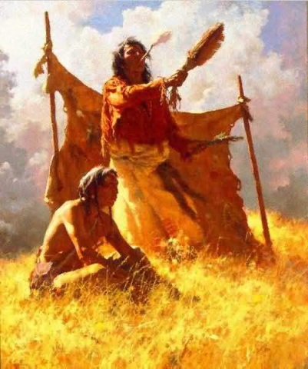
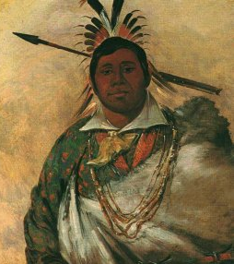
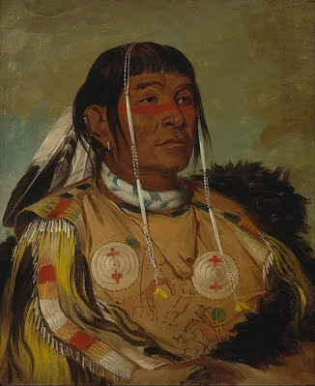
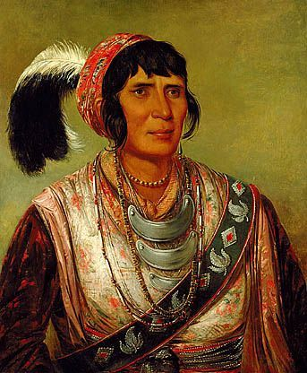
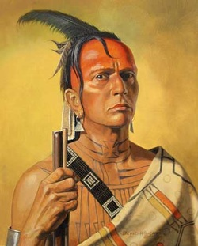
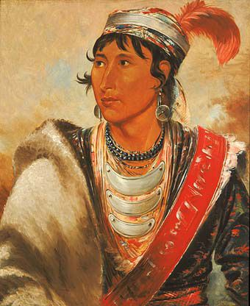
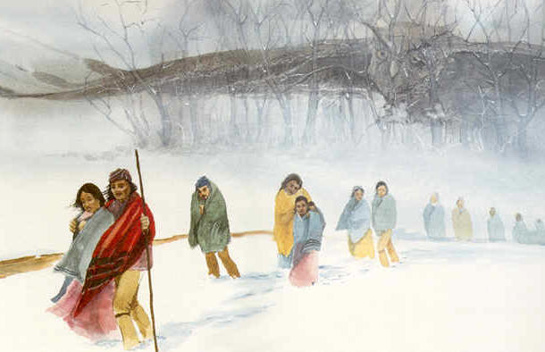
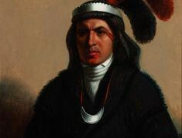
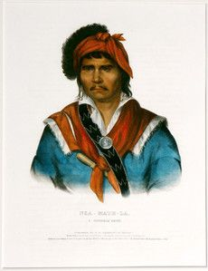
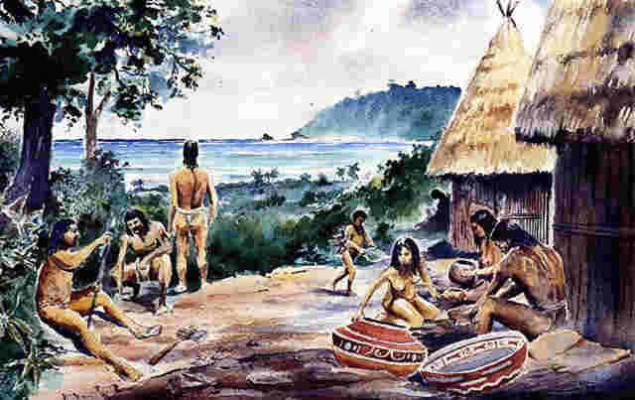
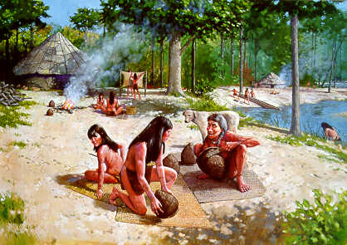
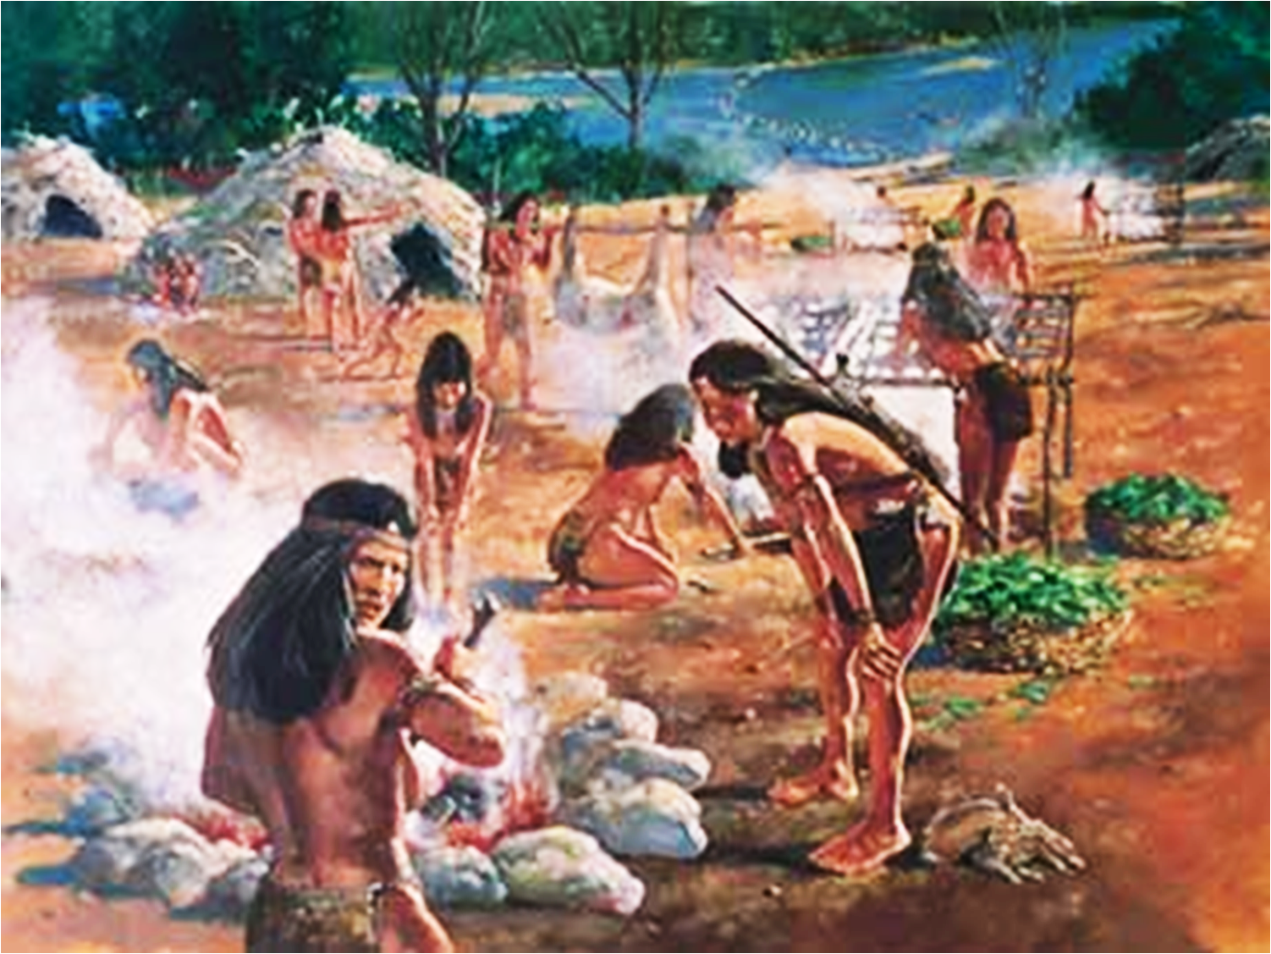
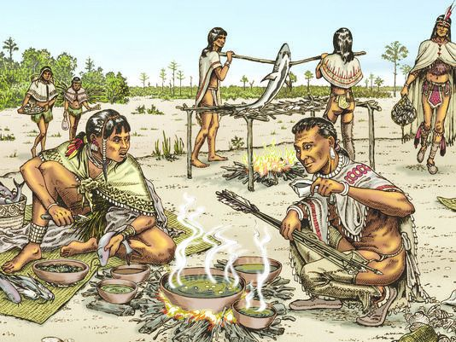
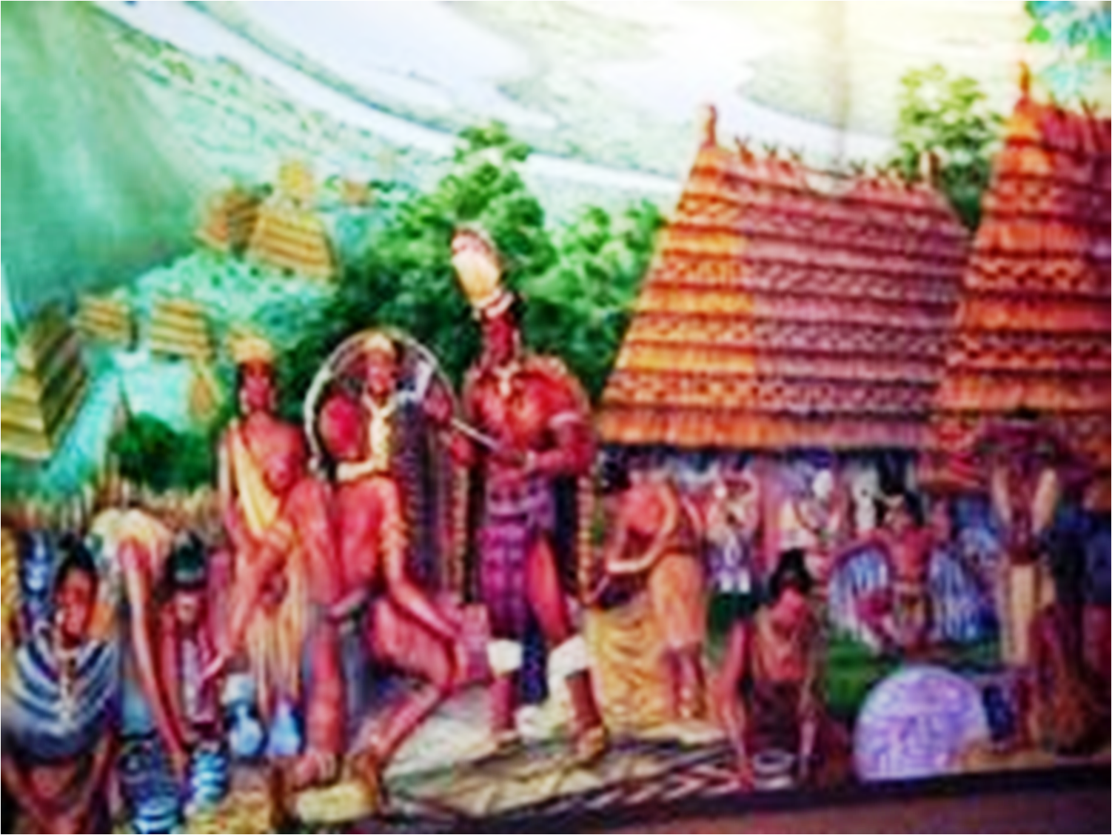
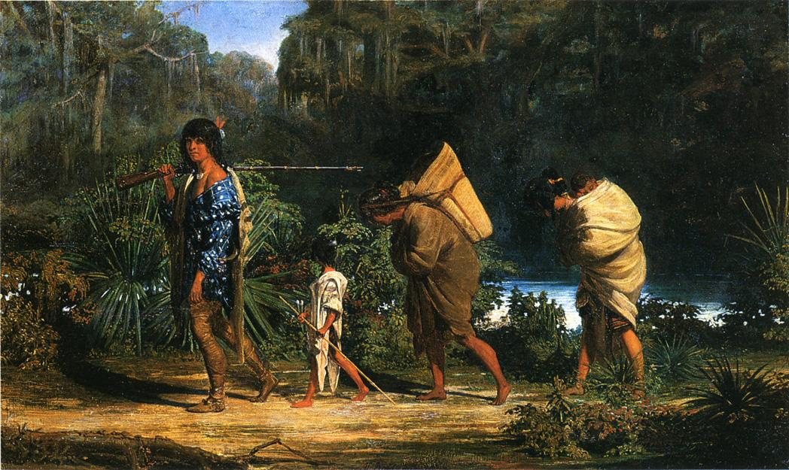
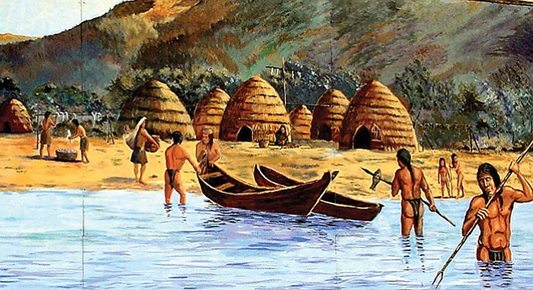
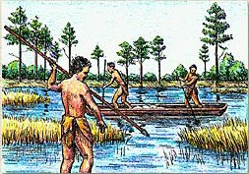
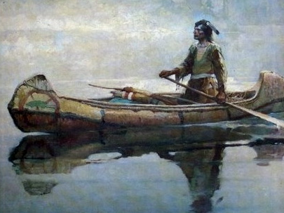
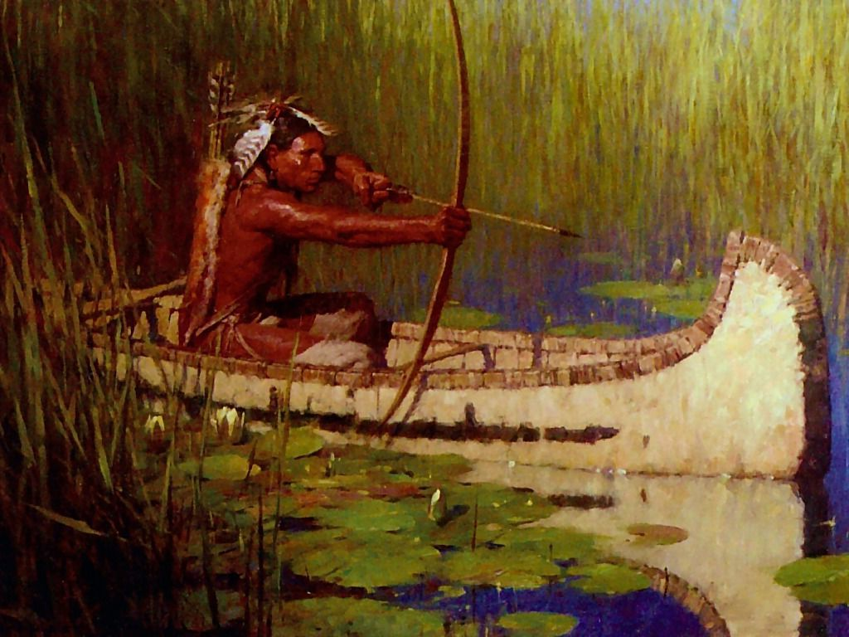
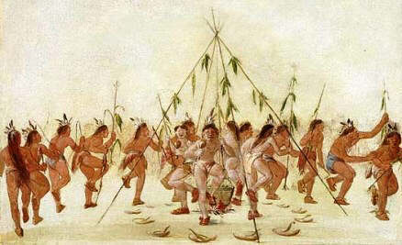
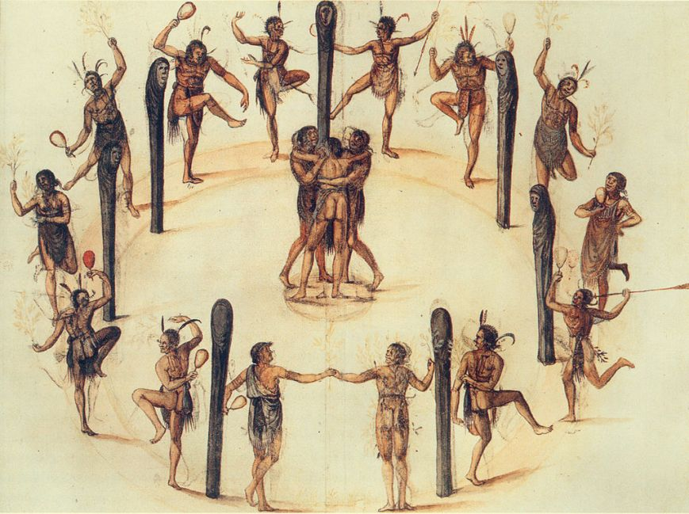
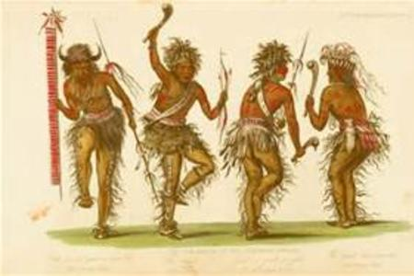
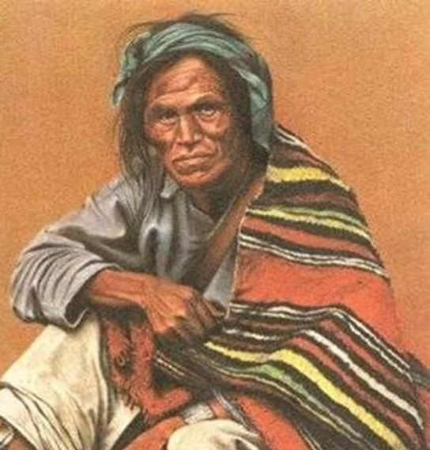
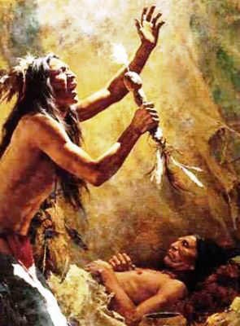
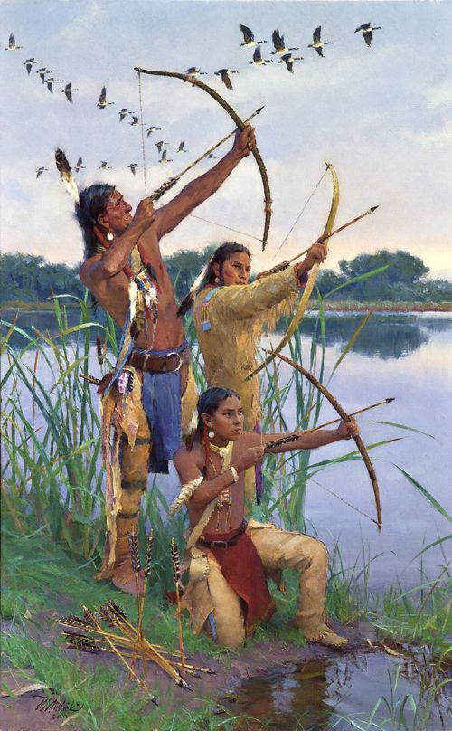
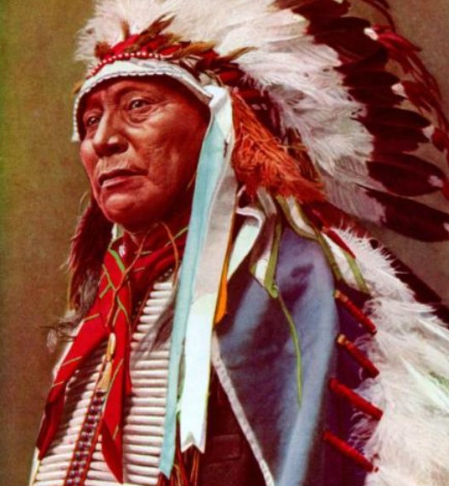
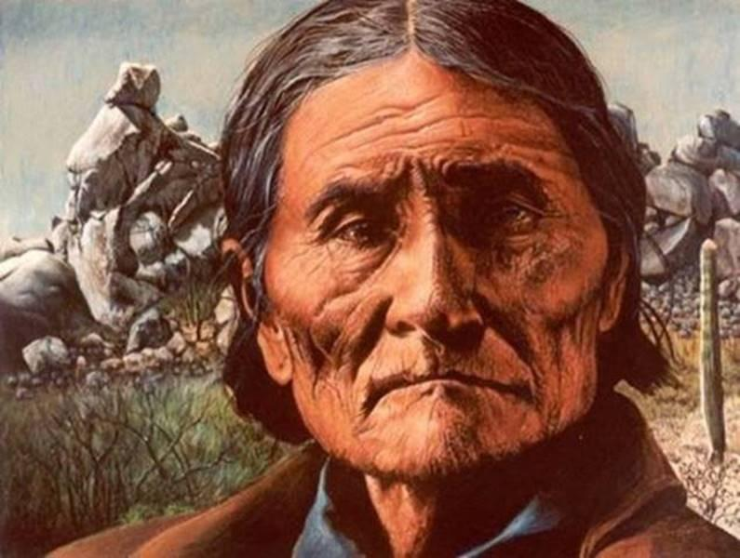
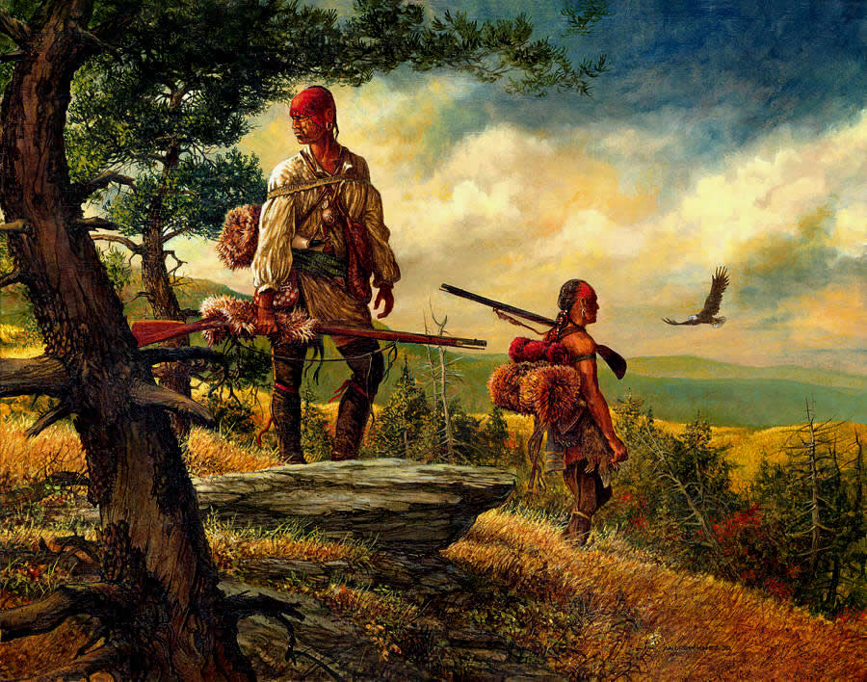
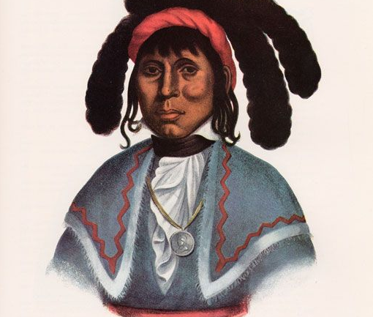
Southwest Journeys . . . .
Southwest Journeys
TRAIL OF TEARS

Slide 2
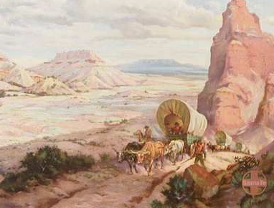
Southwest Journeys
Santa Fe Trail
Trail of Tears

Slide 3
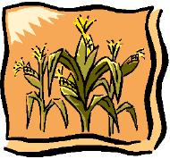
Southwest Journeys
Santa Fe Trail
Trail of Tears
Green Corn Festival
Enjoy it anytime during our class!

Slide 4
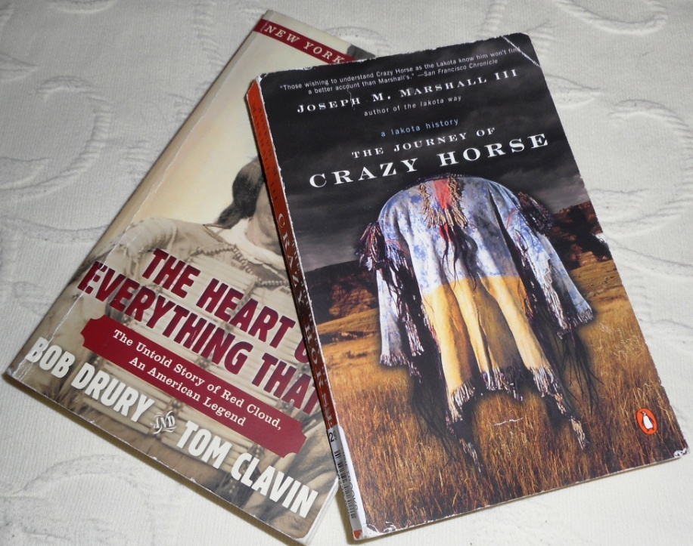
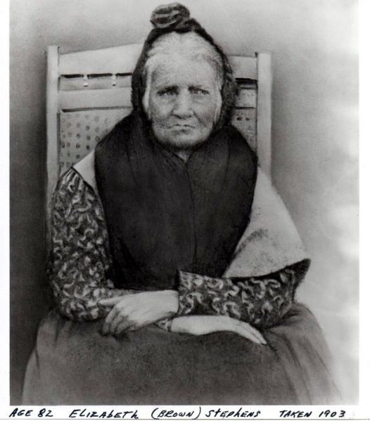
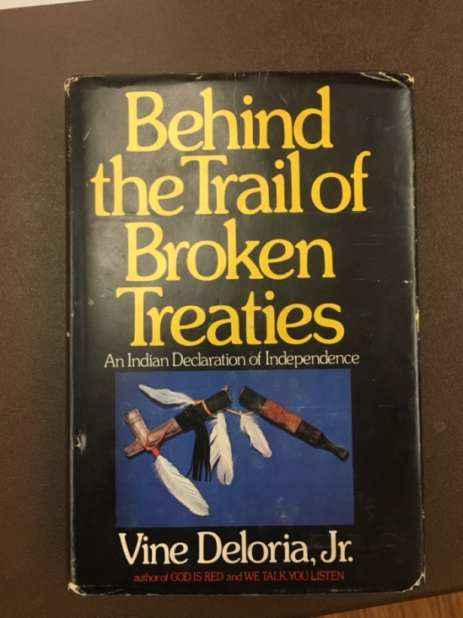
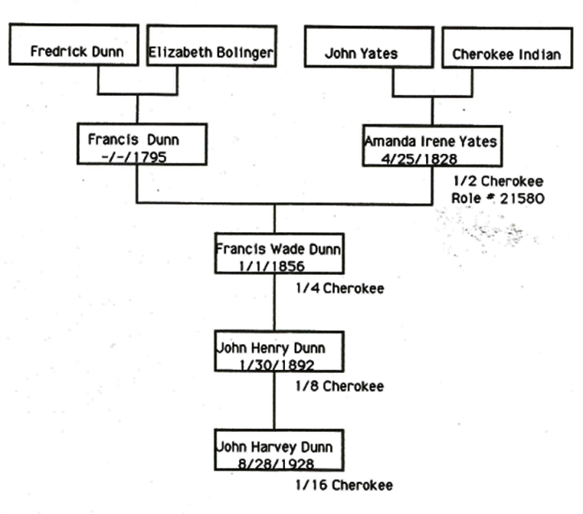
Southwest Journeys
Santa Fe Trail
Trail of Tears
Green Corn Festival
please share your stories with us
Enjoy it anytime during our class!

Slide 5
Southwest Journeys
Santa Fe Trail
Trail of Tears
please share your stories with us

Slide 6
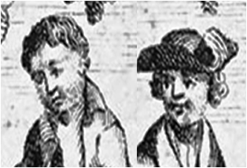
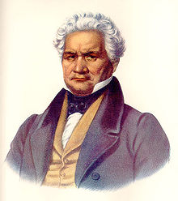
Southwest Journeys
-Trail of Tears
Arbuckle
Milly
Ridge
Sequoyah

Slide 7
Southwest Journeys
-Trail of Tears
a FORCED removal from native homelands
TRAIL OF TEARS
Arbuckle
Milly
Ridge
Sequoyah

Slide 8
Southwest Journeys
-Santa Fe Trail
-Trail of Tears
a FORCED removal from native homelands
Magoffin
Bent Brothers
TRAIL OF TEARS
Shelby
Becknell

Slide 9
Southwest Journeys
-Santa Fe Trail
SANTA FE TRAIL
Magoffin
Bent Brothers
Shelby
Becknell
a COMMERCIAL & SETTLER trail into SW

Slide 10
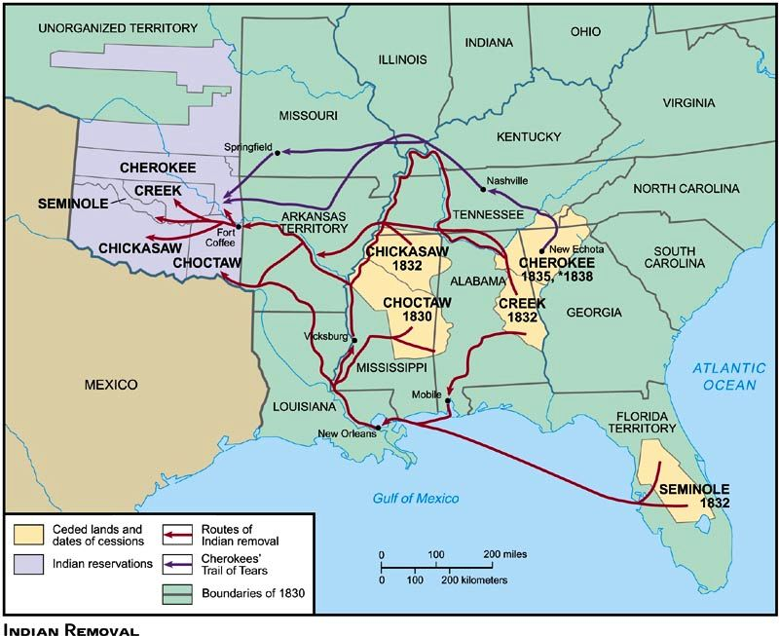
TRAIL OF TEARS

Slide 11
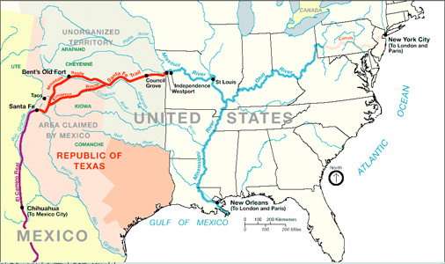
SANTA FE TRAIL

Slide 12
Southwest Journeys
-Santa Fe Trail
a FORCED removal from native homelands
SANTA FE TRAIL
TRAIL OF TEARS
a COMMERCIAL & SETTLER trail into SW

Slide 13
Trail of Tears - Beginnings
Southwest Journeys
Session 1: Before the Trails
Session 2: Trail of Tears – Beginnings
Trail of Tears
Trail of Tears - Beginnings
Session 3: Santa Fe Trail – Beginnings
Santa Fe Trail
Trail of Tears – Endings
Session 4:
Santa Fe Trail Endings
Session 5:
Session 6: After the Trails

Slide 14
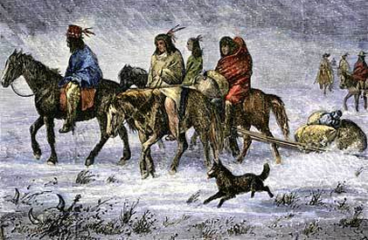
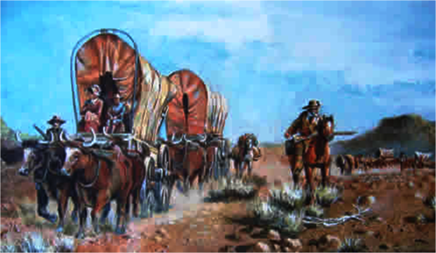
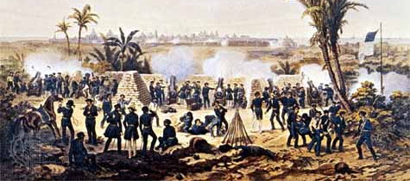
Trail of Tears - Beginnings
3 consequences of ‘Manifest Destiny’
‘Manifest Destiny’
American belief that
Euro-American
settlers
are destined to
expand across
North America

Slide 15
Trail of Tears - Beginnings
3 consequences of ‘Manifest Destiny’
. . . Native American removal
American belief that
Euro-American
settlers
are destined to
expand across
North America
. . . Settling of the west
. . . War with Mexico

Slide 16
Trail of Tears - Beginnings
- The Five ‘Civilized’ Tribes
- Geology of the Homelands
Milly
Ridge
Sequoyah

Slide 17
Trail of Tears - Beginnings
The Five ‘Civilized’ Tribes
The Five ‘Civilized’ Tribes
- The Five ‘Civilized’ Tribes
- Geology of the Homelands
- Early Contact with Europeans
‘Civilizing’ the Tribes?
Treaties and Land Cessions
Indian Removal Act

Slide 18
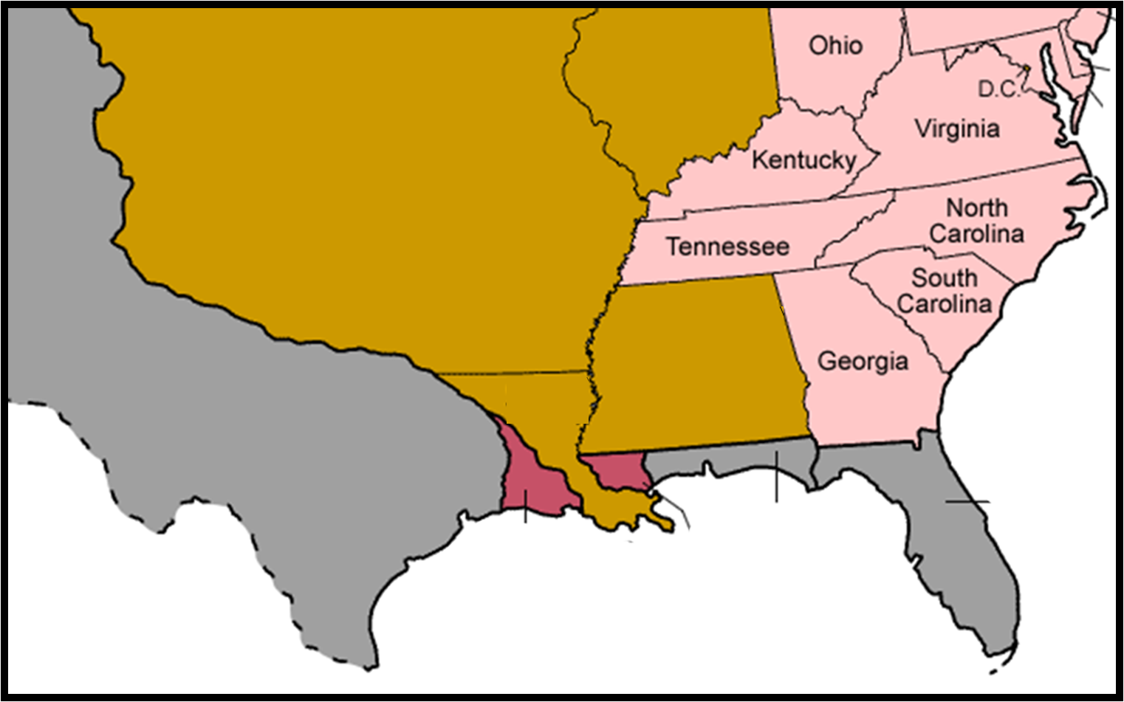
The Five ‘Civilized’ Tribes

Slide 19
The Five ‘Civilized’ Tribes
Blackfeet
Hidatsa
Mandan
Clatsop
Nez Perce
Shoshone
Arikara
Sioux
Osage
Corps of Discovery: 1803-06
Cherokee
Chickasaw
Creek
Choctaw
Seminole
Trail of Tears

Slide 20
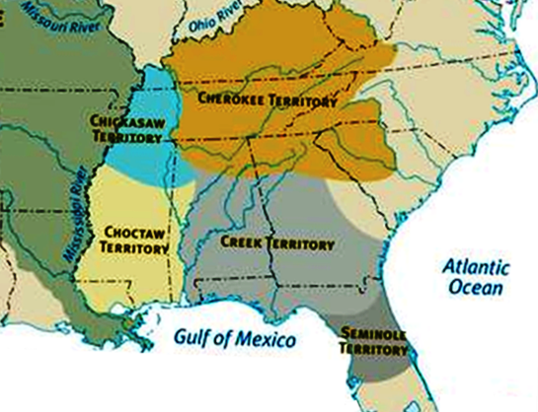
The Five ‘Civilized’ Tribes
Cherokee
Chickasaw
Creek
Choctaw
Seminole
HOMELANDS
Trail of Tears

Slide 21
The Five ‘Civilized’ Tribes
Homeland territories include – agrarian villages
- hunting grounds
CHEROKEE
CHICKASAW
Ridge
What are these homelands like?
CREEK
CHOCTAW
Sequoyah
SEMINOLE
Milly
HOMELANDS

Slide 22
Trail of Tears - Beginnings
The Five ‘Civilized’ Tribes
Geology of the Homelands
Homeland territories include – agrarian villages
- hunting grounds
CHEROKEE
- The Five ‘Civilized’ Tribes
- Geology of the Homelands
- Early Contact with Europeans
‘Civilizing’ the Tribes?
Treaties and Land Cessions
Indian Removal Act
Geology of the Homelands
CHICKASAW
What are these homelands like?
CREEK
CHOCTAW
SEMINOLE
HOMELANDS

Slide 23
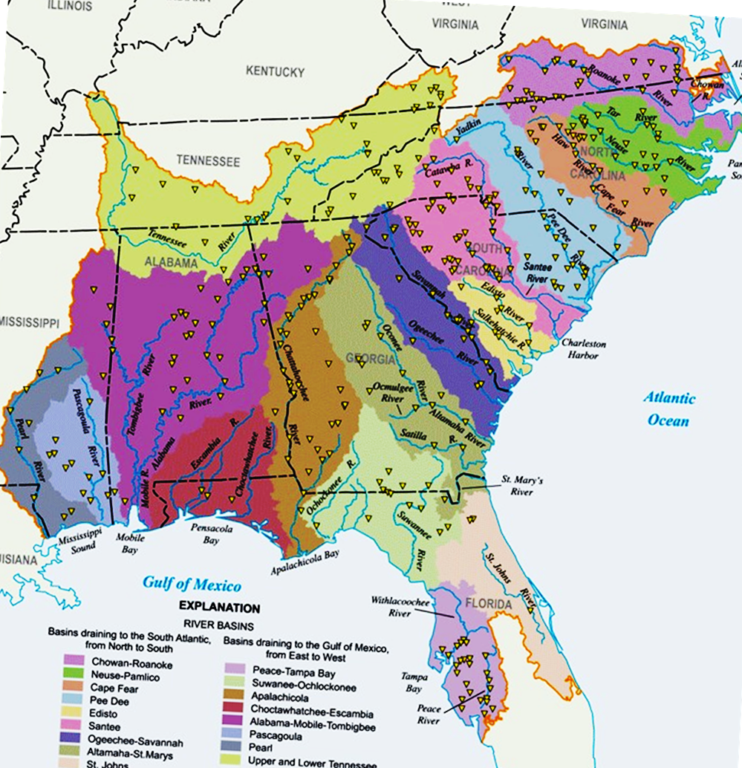
Download
Geology of the Homelands
Where is the Eastern Continental Divide?
River Basins
of
the Southeast
HOMELANDS
Notes:
https://www.researchgate.net/figure/223137286_fig1_Figure-1-The-Southeastern-US-Study-Area-Including-Major-River-Basins-Draining-to-the-atlantic
Catch Basin – river basin – water shed --

Slide 24
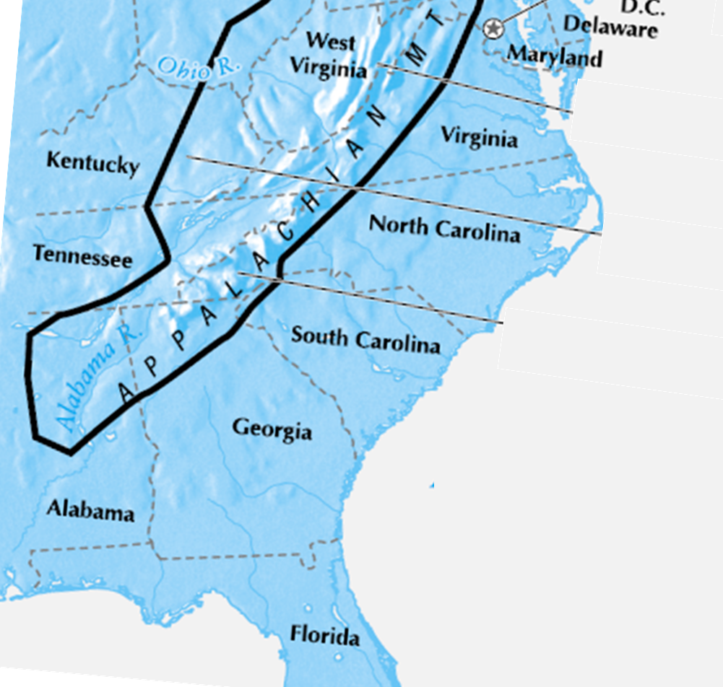
Download
Geology of the Homelands
Where is the Eastern Continental Divide?
What do RIVERS contribute to the Homelands?
River Basins
of
the Southeast
HOMELANDS

Slide 25
Geology of the Homelands
What do RIVERS contribute to the Homelands?
?
- rivers move weathered sediment downstream
- during high water, rivers overflow their banks
decaying vegetation
&
rock debris
- sediments deposit in the river flood plains
River Basins
of
the Southeast
- water recedes leaving a layer of sediment (soil & rocks)
HOMELANDS
- many cycles, layers of fertile soils develop

Slide 26
http://slideplayer.com/slide/9332522/28/images/12/Formation+of+flood+plains.jpg

Slide 27
Geology of the Homelands
What are the ELEVATIONS of the Homelands?
CHEROKEE
CHICKASAW
CREEK
CHOCTAW
many rivers drainage basins
SEMINOLE
fertile soils in flood plains
HOMELANDS
some mountainous terrain

Slide 28
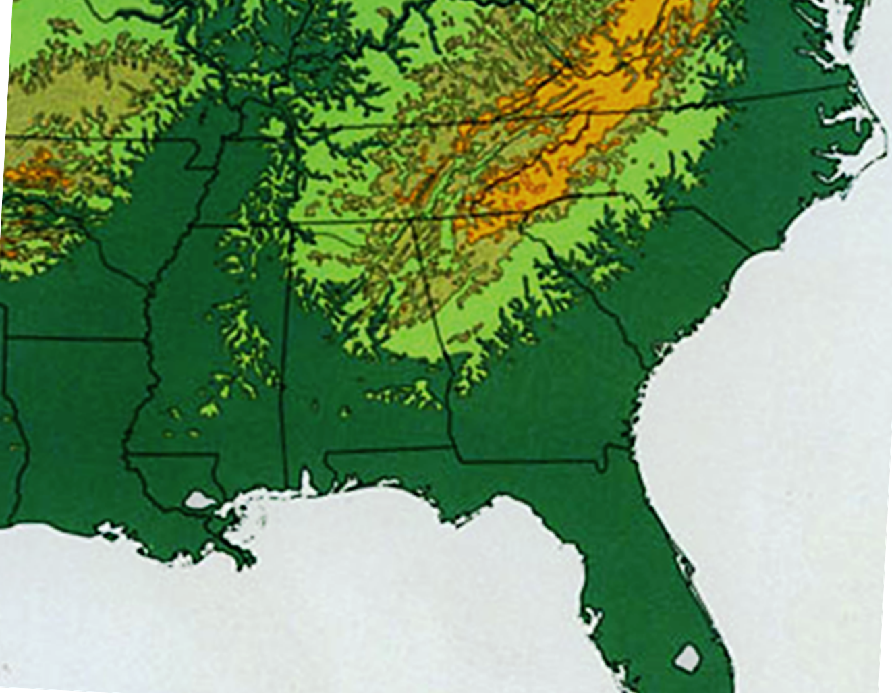
Geology of the Homelands
What are the ELEVATIONS of the Homelands?
CHEROKEE
2000-5000 ft
500 - 2000 ft
0 – 500 ft
HOMELANDS
Topographic map

Slide 30
Geology of the Homelands
What about RAINFALL in the Homelands?
What are the ELEVATIONS of the Homelands?
most are less than 2000’
high elevations limited
to Cherokee homeland
HOMELANDS
Topographic map

Slide 31
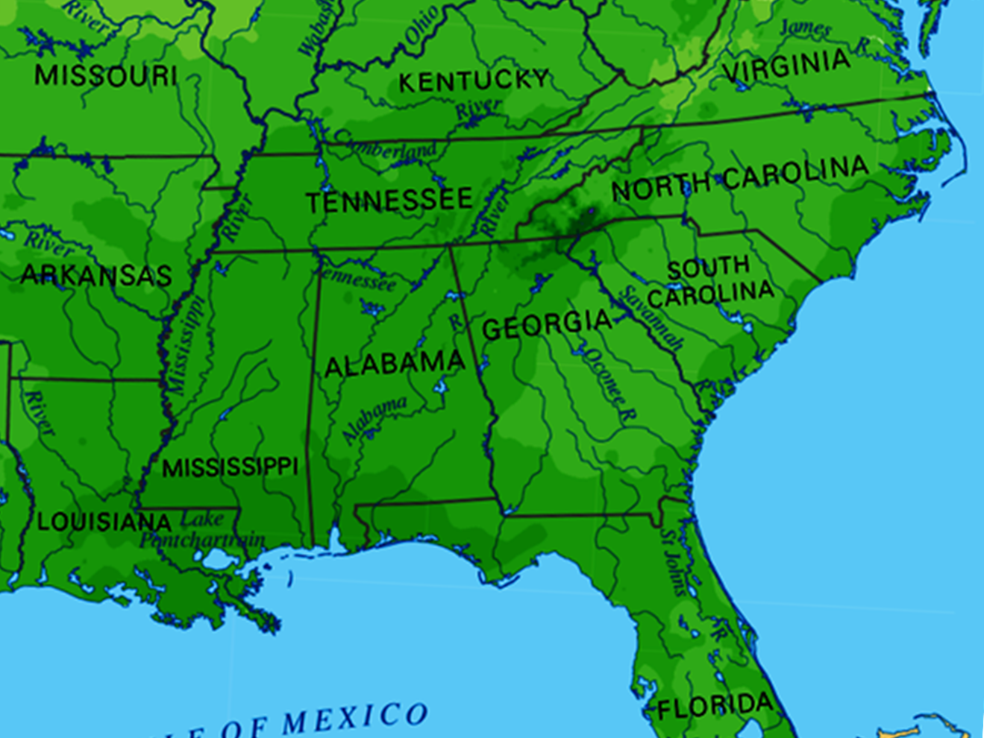
Geology of the Homelands
What about RAINFALL in the Homelands?
average 40-100” per year
most areas 40-60”
HOMELANDS
Annual Rainfall in inches
Topographic map

Slide 32
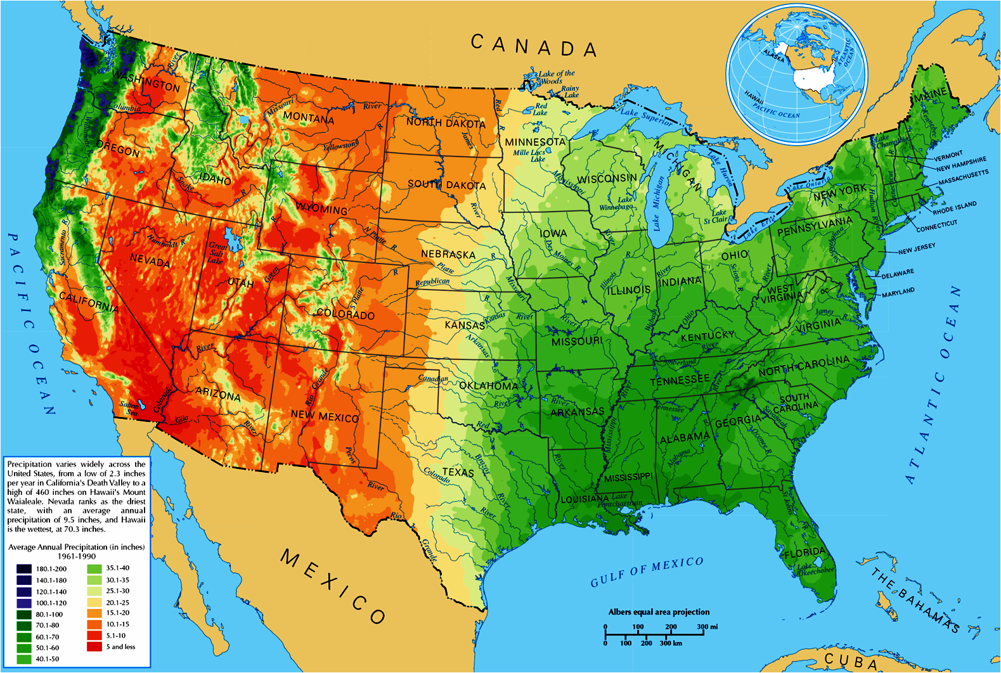
https://upload.wikimedia.org/wikipedia/commons/thumb/d/d3/Average_precipitation_in_the_lower_48_states_of_the_USA.png/1200px-Average_precipitation_in_the_lower_48_states_of_the_USA.png

Slide 33
Geology of the Homelands
Geology - SUMMARY
ideal environment for - wild game - agriculture
CHEROKEE
CHICKASAW
CREEK
- southern Appalachians merge to coastal plains
CHOCTAW
- continental divide diverts water east/west
- elevations → moderate
- climate → temperate
- rainfall → sufficient & consistent
SEMINOLE
- rivers → plentiful water
HOMELANDS
- floodplains → rich soils

Slide 34
Geology - SUMMARY
Early Contact with Europeans
ideal environment for - wild game - agriculture
CHEROKEE
- The Five ‘Civilized’ Tribes
- Geology of the Homelands
- Early Contact with Europeans
‘Civilizing’ the Tribes?
Treaties and Land Cessions
Indian Removal Act
CHICKASAW
Early Contact with Europeans
CREEK
CHOCTAW
SEMINOLE
HOMELANDS

Slide 35
Early Contact with Europeans
1st European land claim in the Southeast
Juan Ponce de Leon: 1513
- claims the peninsula for Spain
- names the area ‘La Florida’
HOMELANDS

Slide 36
https://en.wikipedia.org/wiki/Juan_Ponce_de_Leon
Juan Ponce de León (1474 – July 1521) was a Spanish explorer and conquistador. He became the first Governor of Puerto Rico by appointment of the Spanish crown. He led the first known European expedition to La Florida, which he named during his first voyage to the area in 1513.
Ponce de León returned to southwest Florida in 1521 to lead the first large-scale attempt to establish a Spanish colony in what is now the continental United States. However, the native Calusa people fiercely resisted the incursion, and de León was seriously wounded in a skirmish. The colonization attempt was abandoned, and its leader died from his wounds soon after returning to Cuba.
Ponce de León equipped three ships with at least 200 men at his own expense and set out from Puerto Rico on March 4, 1513. After leaving Puerto Rico, they sailed northwest along the great chain of Bahama Islands, known then as the Lucayos. On March 27, Easter Sunday, they sighted an island that was unfamiliar to the sailors on the expedition. Because many Spanish seamen were acquainted with the Bahamas, which had been depopulated by slaving ventures, some scholars believe that this "island" was actually Florida, as it was thought to be an island for several years after its formal discovery. Other scholars have speculated that this island was one of the northern Bahama islands, perhaps Great Abaco.
For the next several days the fleet crossed open water until April 2, 1513, when they sighted land which Ponce de León believed was another island. He named it La Florida in recognition of the verdant landscape and because it was the Easter season, which the Spaniards called Pascua Florida (Festival of Flowers). The following day they came ashore to seek information and take possession of this new land.
Although Ponce de León is widely credited with the discovery of Florida, he almost certainly was not the first European to reach the peninsula. Spanish slave expeditions had been regularly raiding the Bahamas since 1494 and there is some evidence that one or more of these slavers made it as far as the shores of Florida. Another piece of evidence that others came before Ponce de León is the Cantino Map from 1502, which shows a peninsula near Cuba that looks like Florida's and includes characteristic place names.

Slide 37
https://en.wikipedia.org/wiki/Spanish_Florida
Spanish Florida refers to the Spanish territory of La Florida, which was the first major European land claim and attempted settlement in North America during the European Age of Discovery. La Florida formed part of the Captaincy General of Cuba, the Viceroyalty of New Spain, and the Spanish Empire during Spanish colonization of the Americas. While it had no clearly defined boundaries, the territory was much larger than the present-day state of Florida, extending over much of what is now the southeastern United States, including all of present-day Florida plus portions of Georgia, Alabama, Mississippi, South Carolina, and southeastern
Louisiana. Spain's claim to this vast area was based on several wide-ranging expeditions mounted during the 16th century. However, Spain never exercised real control over La Florida much beyond several settlements and forts which were predominantly located in present-day Florida.
Spanish Florida was established in 1513, when Juan Ponce de León claimed peninsular Florida for Spain during the first official European expedition to North America. This claim was enlarged as several explorers (most notably Pánfilo Narváez and Hernando de Soto) landed near Tampa Bay in the mid-1500s and wandered as far north as the Appalachian Mountains and as far west as Texas in largely unsuccessful searches for gold and other riches.
The presidio of St. Augustine was founded on Florida's Atlantic coast in 1565; a series of missions were established across the Florida panhandle, Georgia, and South Carolina during the 1600s; and Pensacola was founded on the western Florida panhandle in 1698, strengthening Spanish claims to that section of the territory.

Slide 38
Early Contact with Europeans
1st onshore European Exploration of Southeast
Pánfilo de Naveraz: 1527
- starting from Spain with 600 men & 5 ships
- traveled inland along Florida’s west coast
- many hostile encounters and no treasure
- shipwrecks, desertions, casualties, starvation
- 4 men survived the journey (Cabeza de Vaca)
HOMELANDS

Slide 39
www.en.wikipedia.org/wiki/Pánfilo_de_Narváez
Pánfilo de Narváez (147?–1528) was a Spanish conquistador and soldier in the Americas. In 1527 Narváez embarked for Florida with five ships and 600 men, among them Álvar Núñez Cabeza de Vaca who later described the expedition in his Naufragios. A storm south of Cuba wrecked several of the ships; the rest of the expedition continued on to Florida, where the men were eventually stranded among hostile natives. The survivors worked their way along the US gulf coast trying to get to the province of Pánuco. During a storm Narváez and a small group of men were carried out to sea on a raft and were not seen again. Only four men survived the Narváez expedition including Cabeza de Vaca.
The expedition arrived on the west coast of Florida in April 1528, weakened by storms and desertions. He landed with 300 men near Tampa Bay among hostile natives.
From there, his expedition marched northward through interior Florida until it reached the territory of the powerful Apalachee Indians. Unable to find the gold and other riches and tired of the hostilities with the Indians, Narváez ordered the construction of four rafts to return to the sea from the interior. He manned one raft for himself with the strongest men, the other led by Álvar Núñez Cabeza de Vaca the second in command, who had had several heated confrontations with Narvaez over his strategy. Cabeza de Vaca pleaded with Narváez not to let the rafts become separated, but Narváez did so anyway. Narváez party moved slowly westwards with some men on land and others on the raft. As the party was crossing a river the wind pulled the raft to sea, with Narváez on board, and he was never seen again.
The storm wrecked two of the four rafts, and the other two made it to the island of Galveston where they were captured by the local Indians. Only four of the 86 survivors escaped their captivity, the others having been either killed or starved to death. The four men who survived the trek: Álvar Núñez Cabeza de Vaca, Andrés Dorantes de Carranza, Alonso del Castillo Maldonado and the Berber slave Estevanico (Esteban).

Slide 40
Early Contact with Europeans
1st European exploration through Southeast
CHEROKEE
Hernando de Soto Expedition: 1539-1542
CHICKASAW
CREEK
CHOCTAW
SEMINOLE
- numerous encounters with ancestors of 5 tribes
HOMELANDS

Slide 41
https://en.wikipedia.org/wiki/Hernando_de_Soto
Hernando de Soto (c. 1495 – May 21, 1542) was a Spanish explorer and conquistador who led the first European expedition deep into the territory of the modern-day United States (Florida, Georgia, Mississippi, Alabama and most likely Arkansas). He is the first European documented as having crossed the Mississippi River.
De Soto's North American expedition (1539-1542) was a vast undertaking. It ranged throughout the southeastern United States, both searching for gold, reported by various Indian tribes and earlier explorers, and a passage to China or the Pacific coast. De Soto died in 1542 on the banks of the Mississippi River.
From the point of view of the Spanish, de Soto's excursion to Florida was a failure. They acquired neither gold nor prosperity and founded no colonies. But the expedition had several major consequences.
The records of the expedition contributed greatly to European knowledge about the geography, biology, and ethnology of the New World. The de Soto expedition's descriptions of North American natives are the earliest-known source of information about the societies in the Southeast. They are the only European description of the culture and habits of North American native tribes before these peoples encountered other Europeans. De Soto's men were both the first and nearly the last Europeans to witness the villages and civilization of the Mississippian culture.
For the Native Americans, De Soto was instrumental in contributing to the development of a hostile relationship between many Native American tribes and Europeans. When his expedition encountered hostile natives in the new lands, more often than not it was his men who instigated the clashes.
More devastating than the battles were the diseases carried chronically by the members of the expedition. Because the indigenous people lacked the immunity which the Europeans had acquired through generations of exposure to these Eurasian diseases, the Native Americans suffered epidemics of illness after exposure to such diseases as measles, smallpox, and chicken pox. Several areas that the expedition crossed became depopulated by disease caused by contact with the Europeans. Seeing the high fatalities and devastation caused, many natives fled the populated areas for the surrounding hills and swamps. In some areas, the social structure changed because of high population losses due to epidemics.

Slide 42
https://en.wikipedia.org/wiki/Hernando_de_Soto

Slide 43
Early Contact with Europeans
Spanish Missions 1565-1763
RESULTS
For Spain:
- find no gold; establish no colonies
- costly loss of life: conflicts, starvation, etc
- new knowledge of geography, ethnology
- claim southeastern territory for Spain
For Native Americans:
- hostile relationships develop
- measles, small pox, chicken pox
- population losses from conflicts/diseases
- tribe dispersals
HOMELANDS

Slide 44
Early Contact with Europeans
Spanish Missions 1565-1763
What happens in 1763?
THREE GOALS:
1) religious conversion
to Catholicism
2) Spanish control
3) prevent colonization
by other countries
RESULTS:
- Indian population declines
- foreign encroachment
- Spanish control ends
in 1763
France
England
1763?
1763?
HOMELANDS
Notes:
https://cdn.thinglink.me/api/image/710912564543881217/1240/10/scaletowidth

Slide 45
https://en.wikipedia.org/wiki/Spanish_missions_in_Florida
Beginning in the second half of the 16th century, the Kingdom of Spain established a number of missions throughout La Florida in order to convert the Indians to Christianity, to facilitate control of the area, and to prevent its colonization by other countries, in particular, England and France. Spanish Florida originally included much of what is now the Southeastern United States, although Spain never exercised long-term effective control over more than the northern part of what is now the State of Florida from present-day St. Augustine to the area around Tallahassee, southeastern Georgia, and some coastal settlements, such as Pensacola, Florida. A few short-lived missions were established in other locations, including Mission Santa Elena in present-day South Carolina, around the Florida peninsula, and in the interior of Georgia and Alabama.
The missions of what are now northern Florida and southeastern Georgia were divided into main four provinces where the bulk of missionary effort took place. These were Apalachee, comprising the eastern part of what is now the Florida Panhandle; Timucua, ranging from the St. Johns River west to the Suwanee; Mocama, the coastal areas east of the St. Johns running north to the Altamaha River; and Guale, north of the Altamaha River along the coast to the present-day Georgia Sea Islands. These provinces roughly corresponded to the areas where those dialects were spoken among the varying Native American peoples, thus, they reflected the territories of the peoples. Missionary provinces were relatively fluid and evolved over the years according to demographic and political trends, and at various times smaller provinces were established, abandoned, or merged with larger ones. There were also ephemeral attempts to establish missions elsewhere, particularly further south into Florida.
https://www.georgiaencyclopedia.org/articles/arts-culture/spanish-missions
Spanish missions were explicitly established for the purpose of religious conversion and instruction in the Catholic faith. However, the mission system actually served as the primary means of integrating Indians into the political and economic structure of Florida's colonial system. Missions were normally established at the political center of local chiefdoms, in the villages where the chiefs lived and where the council houses were located. Each mission was only a small compound within a much larger Indian community. The mission typically included a church structure (where Mass was celebrated and where Indian converts were buried) and a convent, or friary, where a single friar lived alone. Because chiefdoms were made up of a number of outlying satellite villages and hamlets, friars normally served a much larger group of Indians within their visitation rounds. Some subordinate communities had uninhabited secondary church structures as well.
Over the course of the mission period Indian population levels declined rapidly and substantially, plummeting well over 90 percent in many areas.

Slide 46
Early Contact with Europeans
What happens in 1763?
France
England
LEGEND
1762
England
France
Spain

Slide 47
https://en.wikipedia.org/wiki/Royal_Proclamation_of_1763#/media/File:NorthAmerica1762-83.png

Slide 48
Early Contact with Europeans
What happens in 1763?
The Seven Years’ War ends
LEGEND
1762
England
France
Spain

Slide 49
Early Contact with Europeans
What happens in 1763?
Treaty of Paris 1763
France cedes land east of Miss. River to England
France cedes land west of Miss. River to Spain
Spain cedes La Florida to England
Royal Proclamation of 1763
England creates a Proclamation Line for an
‘Indian Reserve’ west of the Appalachian Mts
colonials are forbidden to settle on Native lands
private purchase of Native land is outlawed
The Seven Years’ War ends

Slide 50
https://en.wikipedia.org/wiki/Royal_Proclamation_of_1763#/media/File:NorthAmerica1762-83.png
The Treaty of Paris was the official conclusion of the Seven Years' War, of which the French and Indian War was the North American theater. Under this treaty, France ceded ownership to Britain all of continental North America east of the Mississippi River, including Quebec, and the rest of Canada. Spain received all French territory west of the Mississippi.
Both Spain and Britain received some French islands in the Caribbean. France kept a few small islands used by fishermen, modern-day Haiti and the rich sugar island of Guadeloupe.
At the outset, the Royal Proclamation of 1763 defined the jurisdictional limits of the occupied territories of North America. Explaining parts of the Frontier expansion in North America, in Colonial America.
The proclamation created a boundary line (often called the proclamation line) between the British colonies on the Atlantic coast and American Indian lands (called the Indian Reserve) west of the Appalachian Mountains. The proclamation line was not intended to be a permanent boundary between the colonists and Aboriginal lands, but rather a temporary boundary which could be extended further west in an orderly, lawful manner. It was also not designed as an uncrossable boundary; people could cross the line, just not settle past it. Its contour was defined by the headwaters that formed the watershed along the Appalachians. All land with rivers that flowed into the Atlantic was designated for the colonial entities, while all the land with rivers that flowed into the Mississippi was reserved for the native Indian population. The proclamation outlawed the private purchase of Native American land, which had often created problems in the past. Instead, all future land purchases were to be made by Crown officials "at some public Meeting or Assembly of the said Indians". Furthermore, British colonials were forbidden to settle on native lands, and colonial officials were forbidden to grant ground or lands without royal approval. The proclamation gave the Crown a monopoly on all future land purchases from American Indians.
British colonists and land speculators objected to the proclamation boundary since the British government had already assigned land grants to them. Many settlements already existed beyond the proclamation line some of which had been temporarily evacuated during Pontiac's War, and there were many already granted land claims yet to be settled. For example, George Washington and his Virginia soldiers had been granted lands past the boundary. Prominent American colonials joined with the land speculators in Britain to lobby the government to move the line further west. Their efforts were successful, and the boundary line was adjusted in a series of treaties with the Native Americans. In 1768 the Treaty of Fort Stanwix and the Treaty of Hard Labour, followed in 1770 by the Treaty of Lochaber, opened much of what is now Kentucky and West Virginia to British settlement.
The influence of the Royal Proclamation of 1763 on the coming of the American Revolution has been variously interpreted. Many historians argue that the proclamation ceased to be a major source of tension after 1768, since the aforementioned treaties opened up extensive lands for settlement. Others have argued that colonial resentment of the proclamation contributed to the growing divide between the colonies and the mother country. Some historians argue that even though the boundary was pushed west in subsequent treaties, the British government refused to permit new colonial settlements for fear of instigating a war with Native Americans, which angered colonial land speculators. Others argue that the Royal Proclamation imposed a fiduciary duty of care on the Crown.

Slide 51
https://en.wikipedia.org/wiki/East_Florida
Britain formed East and West Florida out of territory it had received from Spain and France following the Seven Years' War. Finding its new acquisitions in the southeast too large to administer as a single unit, the British divided them into two colonies separated by the Apalachicola River.
East Florida comprised the bulk of what had previously been the Spanish territory of Florida. East Florida was a colony of Great Britain from 1763 to 1783 and a province of Spanish Florida from 1783 to 1821.
Britain ceded both Floridas to Spain following the American Revolutionary War. Spain maintained them as separate colonies, although the majority of West Florida was gradually occupied and annexed by the United States from 1810 to 1813. Spain ceded East Florida and the remainder of West Florida to the US in 1819. In 1822 the United States organized them as a single unit, the Florida Territory.

Slide 52
Early Contact with Europeans
What happens in 1763?
England
Spain
Indian Reserve
LEGEND
1763
England
France
Spain

Slide 54
Early Contact with Europeans
What happens in 1763?
Indian Reserve
Indian Reserve

Slide 55
Early Contact with Europeans
CHEROKEE
CHICKASAW
Indian Reserve
CREEK
CHOCTAW
SEMINOLE
Are lands of the Five ‘Civilized’ Tribes inviolate?
HOMELANDS

Slide 56
Early Contact with Europeans
‘Civilizing’ the Tribes?
?
‘Civilized’
Are lands of the Five ‘Civilized’ Tribes inviolate?
Five ‘Civilized’ Tribes
What does mean?
- The Five ‘Civilized’ Tribes
- Geology of the Homelands
- Early Contact with Europeans
‘Civilizing’ the Tribes?
Treaties and Land Cessions
Indian Removal Act
CHEROKEE
CHICKASAW
‘Civilizing’ the Tribes?
CREEK
CHOCTAW
SEMINOLE
HOMELANDS

Slide 57
‘Civilizing’ the Tribes?
‘Civilized’
What does mean?
“a stage of social, cultural, and moral development
considered to be more advanced”
- defined by the early Euro-Americans,
according to their ethnocentric world view
- refers to the Five Tribes integrating
Euro-American practices into their cultures
- used historically to differentiate these Five
Tribes from others described as ‘wild’ or ‘savage’
When do these changes start?

Slide 58
https://en.wikipedia.org/wiki/Five_Civilized_Tribes
FOR MORE INFO, SEE WEBSITE BELOW:
https://en.wikipedia.org/wiki/Cultural_assimilation_of_Native_Americans
The term "Five Civilized Tribes" derives from the colonial and early federal period in the history of the United States. It refers to five Native American nations—the Cherokee,
Chickasaw, Choctaw, Creek (Muscogee), and Seminole. These are the first five tribes that Anglo-European settlers generally considered to be "civilized" according to their own worldview. Examples of colonial attributes adopted by these five tribes include: Christianity, centralized governments, literacy, market participation, written constitutions, intermarriage with white Americans, and plantation slavery practices. The Five Civilized Tribes tended to maintain stable political relations with the Europeans. The term has been criticized for its ethnocentric definition of civilization.
George Washington and Henry Knox pursued an agenda of cultural transformation in relation to Native Americans. The Cherokee and Choctaw tended, in turn, to adopt and appropriate certain cultural aspects of the federation of colonies. At the time of the Declaration of Independence, the culture of the United States as a nation was, itself, emergent. Many of the cultural practices appropriated by The Five Tribes were ones that they found useful.
Washington promulgated a doctrine that held that American Indians were equals, but that their society was inferior. He formulated and implemented a policy to encourage the "civilizing" process, which Thomas Jefferson continued. The noted Andrew Jackson historian Robert Remini wrote "they presumed that once the Indians adopted the practice of private property, built homes, farmed, educated their children, and embraced Christianity, these Native Americans would win acceptance from white Americans. Washington's six-point plan included impartial justice toward Indians; regulated buying of Indian lands; promotion of commerce; promotion of experiments to civilize or improve Indian society; presidential authority to give presents; and punishing those who violated Indian rights. The government appointed agents, like Benjamin Hawkins, to live among Indians and to encourage them, through example and instruction, to live like whites. The tribes of the southeast adopted Washington's policy as they established schools, took up yeoman farming practices, converted to Christianity, and built homes similar to those of their colonial neighbors.
How different would be the sensation of a philosophic mind to reflect that instead of exterminating a part of the human race by our modes of population that we had persevered through all difficulties and at last had imparted our Knowledge of cultivating and the arts, to the Aboriginals of the Country by which the source of future life and happiness had been preserved and extended. But it has been conceived to be impracticable to civilize the Indians of North America – this opinion is probably more convenient than just.
— Henry Knox, Notes to George Washington from Henry Knox.
The use of the term "civilized" has historically been employed to differentiate the Five Tribes from other tribes that, by contrast, were referred to during the same period as "wild." Non-indigenous historical texts have used terms like "savages" and "wild" as an identifier of Indian tribes that, after European Contact, maintained their traditional practices, such as hunting for food. Accordingly, the term has virtually fallen out of use in contemporary academic arenas and is increasingly less favored.
Use of the term "civilized" is of particular significance, however, in reference to the Five Tribes collectively, given that during a particular period of history they had a collective tendency to integrate Anglo-European cultural practices into their cultures. This common tendency is itself of interest. Sociological, anthropological and interdisciplinary scholars do explore questions of how and why various cultures and sub-cultures adopt, appropriate, and adapt to features of other cultures in their proximity. Suggestions do exist that the concept of "civilization" was itself to a degree internalized among members of the Five Nations, who themselves even used the term. However, much of Native North American history is of the oral tradition, which makes this assertion difficult to substantiate. Scholarly research on this particular point is also scarce.
The term "civilized" in a present-day discussion of Native American culture, nationhood, or people, is nonetheless contentious and has largely fallen out of common use. At various places and times (for example in the writings of Vine Deloria, Jr.) the term has been identified as insulting or derogatory, with its implication that the various nations of people indigenous to the North American continent were objectively "uncivilized" without the influence of Anglo-European ways of life. As such, the term raises questions of what constitutes "civilization" and assumes that qualitative "degrees" of civilization exist between peoples. It is therefore regarded as a judgment-laden term at worst, or highly perspective-dependent at best. Accordingly, its application in contemporary scholarly, journalistic, or political narrative puts those who would use it at risk of criticism for ethnocentricity or bias.
Owing to its historical usage; however, the Five "Civilized" Tribes is a term that can be used to advantage in a piece of writing provided that an explanation addresses the notion of "civilized" at its first mention. "The Five Tribes" functions as a more neutral form of the term after that.

Slide 59
‘Civilizing’ the Tribes?
When do these changes start?
George Washington's
six-point "civilizing" plan:
- impartial justice toward Indians
- regulate buying of Indian lands
- promotion of commerce
- experiments to civilize or improve Indian society
- presidential authority to give presents
- punishment of those who violate Indian rights
What colonial attributes do these Five Tribes adopt?

Slide 60
http://nativeamericannetroots.net/diary/1077
George Washington is often revered as the first President of the United States. As the first president, he established many of the protocols for the office. From an Indian perspective, his presidency also established much of the basis for the federal Indian policies. Like other non-Indians of this era, he viewed Indians as a vanishing people, or at least a people who at some time in the near future would cease to exist in the United States. Indians were to either die out, migrate, or become totally assimilated.
Before the Revolutionary War:
George Washington’s first combat experience came in 1754 as the leader of a combined Virginia and Seneca force which had marched against the French forces in Ohio. The French had constructed Fort Duquesne in an attempt to gain influence over the tribes in the region. Seneca leader Tanacharison (Half King) reported to the British Virginia forces under George Washington what the French were attempting to do. He also provided Washington with a delegation of warriors. The combined Virginian and Seneca forces surrounded a French camp, killing 10 and taking 21 prisoners. When the wounded French leader attempted to explain that he was on a diplomatic peace mission, Tanacharison, who was more fluent in French than Washington, killed him before Washington understood the nature of his message.
Seneca leader Tanacharison (Half King) arranged a council between tribal leaders and George Washington. Washington, realizing that he needed the support of the tribes, explained that the purpose of the British military efforts were to maintain Indian rights to the region and to prevent the French from taking their lands. The chiefs, however, were not persuaded and viewed any alliance with Washington’s troops as a bad gamble.
Following the English victory over the French in 1763, the English King issued a Royal Proclamation which set a boundary line from Nova Scotia to Florida following the Appalachians. This boundary was supposed to separate the Indians from the colonists. The Royal Proclamation temporarily reserved a vast territory as exclusive Indian hunting grounds and curtailed colonial charters at the boundary. The European colonists were forbidden to settle west of the boundary line.
The Proclamation also assumed imperial authority over the Indians, thus claiming the continent while allowing Indians to live upon it at their grace and favor. The Royal Proclamation of 1763 prohibited the purchase of Indian lands by private individuals.Many of the European colonists, such as George Washington, simply viewed the proclamation as a temporary expedient to calm the Indians. George Washington regarded the Indian tribes of the region as temporary: he felt that they were destined to be displaced by the growing wave of European settlers that would soon cross over the Alleghenies seeking to establish themselves on Indian land. The European settlers simply ignored the new line and continued to settle on Indian land, to build blockhouses, and to dare the Indians to force them out.
The Revolutionary War:
When the Revolutionary War broke out, both sides looked to recruit Indian allies. The Continental Congress passed a resolution to call on Indians for support in case of real necessity. Several Indian nations in Maine-particularly the Penobscot and the Maliseet-quickly allied themselves with the colonists feeling that the colonists would recognize their aboriginal rights. In 1776, General George Washington asked the Passamaquoddy of Maine to send him warriors.
In 1778, 30 Stockbridge (a Christian Indian community) soldiers died fighting for the American revolutionaries against the British at White Plains, New York. Among those killed were chief Daniel Nimham. As a result of bravery in this battle, General George Washington promoted Hendrick Aupaumut to the rank of captain.
While many Indians aided the Americans in their struggle for independence, in 1779 George Washington sent 5,000 American troops under the command of General John Sullivan to destroy the villages of the Onondaga, Cayuga, and Seneca as punishment for aid which they had supposedly given to the British. Washington’s orders are for “the total destruction and devastation of [the Indian] settlements and capture as many prisoners as possible.” The American forces made no distinction between those who had been American allies and those who had aided the British. The Americans destroyed 40 villages and 160,000 bushels of corn.
The Constitution and Congressional Action:
The Constitution of the United States was adopted in 1787. Article I, Section 8, Clause 3 delegated to Congress the power
“to regulate commerce with foreign nations, and among the several states, and with the Indian tribes”
Thus dealings with the tribes are to be federal. Congressional action, according to those who wrote the Constitution, was to be superior to state law and Congress was to have the exclusive authority to deal with Indian tribes.
Congress passed the Northwest Ordinance in 1787 which provided for the administration of the northwestern portion of the former colonies (now the Midwest east of the Mississippi River). Congress viewed the Indian presence in this area as temporary and made it clear that the United States intended to settle the area. However, the Act indicates that the federal government is not to invade or disturb Indian nations unless there is a “just” war. Section 14, Article III of the Ordinance also states:
“laws bounded in justice and humanity shall, from time to time be made for preventing wrongs being done to them, and for preserving peace and friendship with them.”
At this time, George Washington called for the purchase of land from the Indians rather than driving them by force out of the country. He described Indians as being like the “Wild Beast of the Forest” and the “Wolf” as he viewed them as beasts of prey.
President George Washington:
George Washington became the first President of the new United States in 1789. Like other Americans at this time, he believed that Euro-American culture was more advanced than Indian culture. He believed that Indians would eventually assimilate into the dominant American culture.
Under the new U.S. Constitution, the American leadership-President George Washington, Secretary of State Thomas Jefferson, and Secretary of War Henry Knox-assumed that Indian policies were now vested in the federal government rather than in the state governments. Furthermore, they saw Indian affairs being directed by the executive branch. They saw Indian policy as a branch of foreign policy and viewed Indian tribes as foreign nations.
Secretary of War Henry Knox, recognizing that war with the Indians would be prohibitively expensive, and that war without prior negotiation would be unjust, began a policy of negotiation. This reversed the “conquest theory” (that the United States has title to Indian land because of its victory over England) and recognized Indian rights to the land. He felt that it was important for Indians to be introduced to the idea of a love for exclusive property and suggested the appointment of Christian missionaries to live among the Indians as one way of introducing this idea.
Henry Knox lobbied President George Washington to make the reform of American Indian policy a priority of his presidency. Consequently, the two men developed a new Indian policy for the United States. As foreign nations, Indian policy should be part of foreign policy under the Secretary of State, but since Knox had been doing the job and had the information about Indians at his fingertips, they decided it should be under the Department of War. Subsequently, Congress gave authority over Indian affairs to the Department of War.
Knox and Washington viewed treaties with Indian nations as being binding on both parties in perpetuity. The power and the honor of the federal government would be pledged to their enforcement. In addition, all treaties were to contain a provision which would provide the Indians with agricultural implements so that they could make the transition from savagery (meaning hunting) to civilization (meaning farming).
President Washington’s first experience with Indian treaties came in 1789 when Henry Knox persuaded him to make diplomatic overtures to the Creek. Since this would be the first treaty with an Indian nation since the ratification of the Constitution, Washington had to interpret the constitutional requirement to obtain “the advice and consent” of the Senate. He interpreted this to mean that he must appear before the Senate in person prior to the treaty negotiations. The result was uncomfortable for both Washington, who was not an orator, and the Senate. This was the first and last time that a president would appear in person to seek the advice and consent of the Senate on a treaty. Hereafter, treaties would simply be sent to the Senate for ratification after they had been ratified.
In 1790, Seneca leaders Cornplanter, Big Tree, and Halftown traveled to Philadelphia to complain to President George Washington about non-Indian encroachment on tribal lands. Referring to their 1784 treaty, they asked Washington: “Does this promise bind you?” Washington guaranteed their boundaries and control of their lands by telling them that
“…all the lands secured to you, by the treaty of fort [sic] Stanwix, excepting such parts as you may since have fairly sold, are yours, and that only your own acts can convey them away.” The federal government agreed to provide Cornplanter with an annual pension of $250.
Federal and State Conflicts over Indian Affairs:
Secretary of War Henry Knox reported to President Washington that:
“The independent nations and tribes of Indians ought to be considered as foreign nations, not as the subjects of any particular state.” This set the stage for ongoing conflicts between the states and the federal government regarding the jurisdiction for Indian affairs. These conflicts not only plagued Washington’s Presidency, but have continued until the present time.
Congress passed the Indian Trade and Intercourse Act in 1790 which forbade the private purchase of Indian land; provided for the punishment of non-Indians who committed crimes in Indian country; and licensed those who traded with Indians. Purchase of Indian land was to be done at a treaty council held under federal auspices. Congress clearly viewed Indian affairs as being under federal jurisdiction, not state jurisdiction. It was soon, clear, however, that the states did not agree.
In 1790, the Georgia state legislature announced the sale of 24 million acres of land which they had acquired from the Creek to three private companies, collectively called the Yazoo Companies. President George Washington and Secretary of War Henry Knox viewed Georgia’s actions as a blow to federal sovereignty and to the assumption that Indian policy is a branch of American foreign policy. Creek leader Alexander McGillivray saw this action as a potential invasion of Creek territory.
Alexander McGillivray and 26 other Creek chiefs signed a treaty with President George Washington in New York. While Washington did not love Indians, he treated the Creek delegation to dinners, parades, and diplomatic ceremonies that equaled, and some say exceeded, those accorded to any European diplomatic mission.
Georgia denounced the treaty as a violation of state’s rights since the treaty stipulated that the Creek Nation would not hold any treaty with an individual state. To reinforce the Creek treaty, President George Washington issued an executive order forbidding private or state encroachments on all Indian lands under treaties with the United States. The Georgia legislature simply defied the proclamation and sold more than 15 million acres of Creek land. In 1794, the Georgia Assembly appropriated Creek lands for the payment of state troops in spite of the fact that these lands had been guaranteed to the Creek by the federal government.
In 1791, the New York state legislature pursued its own Indian policy by authorizing emissaries to visit the Seneca and open up land negotiations. President George Washington raged about this action:
“the interferences of States and the speculations of Individuals will be the bane of all our public measures.”
In 1796, the Penobscot signed a treaty with Massachusetts in which they retained title to the islands for thirty miles above Oldtown, Maine . Maine at this time was still a part of Massachusetts. The treaty was negotiated and signed in violation of both the Constitution and the 1790 Trade and Intercourse Act.
In 1796, President George Washington published an open letter to the Cherokee Nation. Washington promised the Cherokee that the federal government would enforce treaties honorably and ensure Cherokee survival as a people and a nation. Washington describes his commitment to this as both a matter of law and a personal promise. It was clear that Washington meant every word and the Cherokee accepted it as a sacred vow of the federal government. Despite Washington’s sincerity and personal commitment, the promises to the Cherokee were not kept.

Slide 61
https://indiancountrymedianetwork.com/history/events/george-washington-first-author-of-federal-indian-policy/
When Washington was elected as president in 1789, he brought to the office the uneasy conviction that Native Americans were destined to be displaced as white settlers moved westward. He also brought a nickname: Members of the Iroquois Confederacy called him “Conotocarious,” which means “devourer of villages.”
Born in Virginia in 1732, Washington’s first career was surveying, but he also earned a reputation as a military commander in the French and Indian and Revolutionary wars. He served in the First Continental Congress and the Constitutional Convention before being unanimously elected as president of the United States. As the first president of a new country, Washington inherited a problem already hundreds of years in the making: what to do with the indigenous population. During his two terms as president, Washington forged the first relationships between the federal government and Native Americans, setting the tone for the next 227 years of federal Indian policy.
“Indians were part of Washington’s life from the time he was 16 years old until he retired from the presidency,” said Mary Thompson, a research historian at Mount Vernon. “He was the first president to worry about boundaries, about white people encroaching on Indian land, about the treaty-making process.”
Near the beginning of his first term, Washington declared that one of his highest priorities was an Indian policy “directed entirely by the great principles of justice and humanity.” The first federal Indian policy was enunciated in June 1789, two months after Washington took office.
During his eight years in power, Washington oversaw seven treaties, including the Treaty of Greenville, which granted the U.S. most of the present-day state of Ohio. Yet he also worked tirelessly with Secretary of War Henry Knox to create sovereign “homelands” for Indians, believing that Indians were “prior occupants” and should be considered as foreign nations rather than subjects of the state.
In July 1790, Congress passed the first Indian Trade and Intercourse Act, which “articulated a sharp divide between settlers’ lands and Indian country, and restricted access to Indian country only to federal agents and licensed Indian traders,” states the 2004 “Encyclopedia of United States Indian Policy and Law.” The law also introduced federal policies regarding the prosecution of non-Indians who commit crimes in Indian country and federal oversight of Indian land.
Washington’s Indian policies were pragmatic, supporting limited contact between Indians and settlers. But the President also pushed to change Indian behavior, believing that the federal government could not hold back the avalanche of white settlers.
In 1796, Washington concluded that settlers, not the government, controlled the national agenda regarding Indians. “I believe scarcely anything short of a Chinese wall or a line of troops will restrain land jobbers and the encroachment of settlers upon the Indian territory,” he wrote.
Washington knew the government didn’t have a strong enough army to keep the settlers out, Thompson said. Instead, he initiated treaties with individual tribes and sought audiences with others, recommending they “settle down and live like white people.” This “civilization policy” became an essential part of Indian policy into the 19th and 20th centuries.
“Washington was ready to put money into buying farm equipment and spinning wheels,” Thompson said. “He wanted to pay people to teach them how to live the settled agricultural lives. He encouraged the sending of missionaries. He really felt that as cultures got closer together and got more alike, it would make it easier for them to live together.”
Yet Washington also warned that to dispossess the Indians of their land would constitute a moral failure that would “stain the character of the nation.” In an open letter to the Cherokee Nation in 1796, Washington promised that if the Cherokee did their part, the federal government would enforce the treaties and ensure Cherokee survival. Washington meant the commitment to be a matter of law and personal promise, but it was one he could not keep.
“The irony is that the Indians did what they were told,” Thompson said. “They bought land, lived on plantations, had slaves, raised crops, wore the same clothing as the white settlers, and then Andrew Jackson came along with the extermination policies.”
http://www.mountvernon.org/digital-encyclopedia/article/native-american-policy/
Washington and Knox sought to provide safe havens for native tribes while also assimilating them into American society. Washington and Knox believed that if they failed to at least make an effort to secure Indian land, their chances of convincing Native Americans to transform their hunting culture to one of farming and herding would be undermined. As the two reluctantly came to recognize, however, it was the settlers pouring into the western frontier that controlled the national agenda regarding Native Americans and their land. By 1796 even Washington had concluded that holding back the avalanche of settlers had become nearly impossible, writing that "I believe scarcely anything short of a Chinese wall, or a line troops, will restrain Land jobbers, and the encroachment of settlers upon the Indian territory."

Slide 62
http://www.mountvernon.org/digital-encyclopedia/article/native-american-policy/
Washington believed that Native Americans were equals, but that their society was inferior. He formulated a policy to encourage the "civilizing" process, and Thomas Jefferson continued it. The historian Robert Remini wrote, "They presumed that once the Indians adopted the practice of private property, built homes, farmed, educated their children, and embraced Christianity, these Native Americans would win acceptance from white Americans.“ Washington's six-point plan included impartial justice toward Indians; regulated buying of Indian lands; promotion of commerce; promotion of experiments to civilize or improve Indian society; presidential authority to give presents; and punishing those who violated Indian rights.

Slide 63
https://en.wikipedia.org/wiki/Nonintercourse_Act
The Intercourse Act is The collective name given to six statutes passed by the Congress in 1790, 1793, 1796, 1799, 1802, and 1834 to set Amerindian boundaries of reservations. The various Acts also regulate commerce between Americans and Native Americans. The most notable provisions of the Act regulate the inalienability of aboriginal title in the United States, a continuing source of litigation for almost 200 years. The prohibition on purchases of Indian lands without the approval of the federal government has its origins in the Royal Proclamation of 1763 and the Confederation Congress Proclamation of 1783.
The original Act, passed on July 22, 1790 provides:
No sale of lands made by any Indians, or any nation or tribe of Indians within the United States, shall be valid to any person or persons, or to any state, whether having the right of pre-emption to such lands or not, unless the same shall be made and duly executed at some public treaty, held under the authority of the United States.
The 1793 Act provides:
[N]o purchase or grant of lands, or of any title or claim thereto, from any Indians or nation or tribe of Indians, within the bounds of the United States, shall be of any validity in law or equity, unless the same be made by a treaty or a convention entered into pursuant to the constitution …
The 1796 Act provides:
[N]o purchase, grant, lease, or other conveyance of lands, or of any title or claim thereto, from any Indian, or nation or tribe of Indians, within the bounds of the United States, shall be of any validity, in law or equity, unless the same be made by treaty, or convention, entered into pursuant to the constitution …
The 1799 Act provides:
No purchase, grant, lease, or other conveyance of lands, or of any title or claim thereto, from any Indian, or nation or tribe of Indians, within the bounds of the United States, shall be of any validity, in law or equity, unless the same be made by treaty or convention, entered into pursuant to the constitution …
The 1802 Act provides
No purchase, grant, lease, or other conveyance of lands, or of any title or claim thereto, from any Indian, or nation, or tribe of Indians, within the bounds of the United States, shall be of any validity, in law or equity, unless the same be made by treaty or convention, entered into pursuant to the constitution …
The 1834 Act, currently codified at 25 U.S.C. § 177, provides:
No purchase, grant, lease, or other conveyance of land, or of any title or claim thereto, from any Indian nation or tribe of Indians, shall be of any validity in law or equity, unless the same be made by treaty or convention entered into pursuant the constitution.

Slide 64
‘Civilizing’ the Tribes?
What colonial attributes do these Five Tribes adopt?
religious conversion to Christianity
literacy – written language & schools
centralized tribal government
written constitution
intermarriage with Euro-Americans
farming & plantation slavery practices
market participation – ‘Factory System’
religious conversion to Christianity

Slide 65
‘Civilizing’ the Tribes?
What colonial attributes do these Five Tribes adopt?
religious conversion to Christianity
traditional beliefs
focused on nature
- seasonal cycles
- symbolism within
animal kingdom
honoring ancestors
reconciling grievances
asking forgiveness
ceremonies & festivals
Traditional Green Corn Festival

Slide 66
‘Civilizing’ the Tribes?
What colonial attributes do these Five Tribes adopt?
celebrating new beginnings
& first fruits of harvest
eating the remains of the last year’s crop
still celebrated today by some native Americans
fasting, dancing, &
ceremonial bathing
traditional beliefs
focused on nature
- seasonal cycles
- symbolism within
animal kingdom
honoring ancestors
reconciling grievances
asking forgiveness
ceremonies & festivals
Traditional Green Corn Festival

Slide 67
https://en.wikipedia.org/wiki/Green_Corn_Ceremony
The Green Corn Ceremony (Busk) is an annual ceremony practiced among various Native American peoples associated with the beginning of the yearly corn harvest. Busk is a term given to the ceremony by white traders, the word being a corruption of the Creek word puskita for "a fast". These ceremonies have been documented ethnographically throughout the North American Eastern Woodlands and Southeastern tribes. Historically, it involved a first fruits rite in which the community would sacrifice the first of the green corn to ensure the rest of the crop would be successful. Green Corn festivals are still held today by many different Southeastern Woodland tribes. The Green Corn Ceremony typically occurs in late July–August, determined locally by the ripening of the corn crops.
The ceremony is marked with dancing, feasting, fasting and religious observations.
The Green Corn Ceremony is a celebration representing new beginnings. Also referred to as the Great Peace Ceremony, it is a celebration of thanksgiving to Hsaketumese (The Breath Maker) for the first fruits of the harvest, and a New Year festival as well.
It is the celebration of the New Year, so at this time all offenses are forgiven except for rape and murder, which are executable or banishable offenses.
DAY 1, people set up their campsites on one of the square ceremonial grounds.
Following this, there is a feast of the remains of last year's crop, after which all the men of the community begin fasting (historically, the women were considered too weak to participate). That night there is a social stomp dance.
DAY 2, four brush-covered arbors are set up on the edges of the ceremonial grounds, one in each of the sacred directions. For the first dance of the day, the women of the community participate in a Ribbon or Ladies Dance, which involves fastening rattles and shells to their legs perform a purifying dance with special ribbon-clad sticks to prepare the ceremonial ground for the renewal ceremony. The ceremonial fire is set in the middle of four logs laid crosswise, so as to point to the four directions. The Mico (head priest) takes out a little of each of the new crops (not just corn, but beans, squash, wild plants, and others) rubbed with bear oil, and it is offered together with some meat as "first-fruits" and an atonement for all sins. The fire (which has been re-lit and nurtured with a special medicine by the Mico will be kept alive until the following year's Green Corn Ceremony. In traditional times, the women would sweep out their cook-fires and the rest of their homes and collect the filth from this, as well as any old clothing and furniture to be burnt and replaced with new items for the new year. The women then bring the coals of the fire into their homes, to rekindle their home fires. They can then bake the new fruits of the year over this fire (also to be eaten with bear oil). Many Creeks also practice the sapi or ceremonial scratches, a type of bloodletting in the mid morning, and in many tribes the men and women might rub corn milk, ash, white clay, or analogous mixtures over themselves and bathe as a form of purification.
They also drink a medicine referred to as passv, also referred to as the "White Drink." (English traders referred to it as the "Black Drink" due to its dark liquid which froths white when shaken before drinking). This White Drink, known to strangers as Carolina Tea, is a caffeine-laden mixture of seven to fourteen different herbs, the main ingredient being assi-luputski, "small leaves" of Yaupon Holly. This medicine was intended to help receive purification, as it is a purgative when consumed in mass amounts. (Historically, only men drank enough of the liquid to throw up.) The purgative was consumed to clean the dietary tract of last year's crop and to truly renew oneself for the new year.
DAY 3, after the purification of the second day, men of the community perform the Feather Dance to heal the community. The fasting usually ends by supper-time after the word is given by the women that the food is prepared, at which time the men march in single-file formation down to a body of water, typically a flowing creek or river for a ceremonial dip in the water and private men’s meeting. They then return to the ceremonial square and perform a single Stomp Dance before retiring to their home camps for a feast. During this time, the participants in the medicine rites are not allowed to sleep, as part of their fast. At midnight a Stomp Dance ceremony is held, which includes feasting and continues on through the night. This ceremony usually ends shortly after dawn.
DAY 4 has friendship dances at dawn, games, and people later pack up and return home with their feelings of purification and forgiveness. Fasting from alcohol, sexual activity, and open water will continue for another four days.
In modern tribal towns and Stomp Dance societies only the ceremonial fire, the cook fires and certain other ceremonial objects will be replaced. Everyone usually begins gathering by the weekend prior to the ceremony, working, praying, dancing and fasting off and on until the big day. The whole festival tends to last seven-eight days
Several tribes still participate in these ceremonies each year, but tribes who have historic tradition within the ceremony include the Iroquois, Cherokee, Creek, Choctaw, and Seminole tribes. Each of these tribes may have their own variations of celebration, dances and traditions, but each performs a new-year's ceremony involving fasting and several other comparisons each year.

Slide 68
http://sde.ok.gov/sde/sites/ok.gov.sde/files/documents/files/Tribes_of_OK_Education%20Guide_Seminole_Nation.pdf
For Seminole people who continue to observe pre-Christian ceremonial practices, life revolves around activities at the “ceremonial or stomp grounds.” In modern times these are religious centers where ceremonial dances, dinners and ball games take place mainly during weekends throughout the spring, summer and early fall months. Originally the individual tribes or etvlwv, as they are termed in the language, that would come to comprise the confederacy known as the Seminole Nation would physically organize themselves around the ceremonial ring. Seminole ceremonialism guided every aspect of Seminole life. Although not as complete, ceremonial teachings still continue to guide those who actively participate in modern times. Today the “ceremonial cycle” consists of four or five dances throughout the “dance season” of which Green Corn or Posketv-rakko (Big fast) is the most important. Depending on the ceremonial ground, Green Corn can last from four days (Thursday – Sunday) to seven days (Sunday – Sunday). Friday is known as Hoktak-‘pvnkv Nettv (Women’s Dance Day) when Ribbon Dance occurs. Friday is also the day that Yvnvsv ‘Pvnkv (Buffalo Dance) occurs at the ceremonial grounds that perform this dance. The signature dance that occurs during the daytime on Saturday is the Cetvhayv ‘Pvnkv or the Feather Dance as it’s commonly referred to in English. During Green Corn, as well as the other ceremonies, the participating members must commit themselves to dancing, fasting, medicine taking, work and other activities that are to be performed. The purifying herbal medicine is accompanied by “scratching” of the participants’ bodies. Generally administered to the arms and legs, but not limited to these areas, of the participants, “scratching” is performed to alleviate spiritual and medical ailments by strengthening the individual. Green Corn can be likened to the combined equivalent of the holidays of Thanksgiving, Easter and New Years. During Green Corn strained relationships are to be reconciled and the wrongs that occurred during the year are to be forgiven. The nighttime songs include such things as recognition of tribal ancestors, spiritual entities, historical events, thanksgiving and well wishing or prayers for the coming year. Daybreak on Sunday marks the completion of the Green Corn ceremony and the beginning of the new year for the ground members.

Slide 69
‘Civilizing’ the Tribes?
‘Civilizing’ the Tribes?
Traditional Green Corn Festival
What colonial attributes do these Five Tribes adopt?
religious conversion to Christianity
celebrating new beginnings
& first fruits of harvest
eating the remains of the last year’s crop
still celebrated today by some native Americans
fasting, dancing, &
ceremonial bathing
Moravian Spring Place Mission
GOALS OF THE MISSIONS . . .
convert to Christianity
teach ‘civilizing skills’ – English, RRR,
farming, weaving, sewing
GOALS OF THE TRIBES . . .
not interested in conversion
learn to speak/write English
gain tools for negotiating
with Euro-Americans
Moravians, Congregationalists, Presbyterians, Baptists
and Methodists send missionaries

Slide 70
‘Civilizing’ the Tribes?
What colonial attributes do these Five Tribes adopt?
religious conversion to Christianity
Moravian Spring Place Mission
1801: Cherokee leaders, including
Major Ridge, invite the
Moravians to open a school
CHEROKEE GOAL: create an educated elite to ‘resist the
(settler) encroachment on their land & resources’
- operates from 1804-1833
- most students board at the school
total of 114 Cherokee children educated
40 Christian converts by 1833

Slide 71
‘Civilizing’ the Tribes?
What colonial attributes do these Five Tribes adopt?
religious conversion to Christianity
American Board of Commissioners
for Foreign Missions
Brainerd Mission
- established 1817; 50 acres, 40 buildings
- most students board at the school
ABCFM GOAL: “make the whole tribe: English in their language,
civilized in their habits, and Christian in their religion."
- operates from 1817-1838
- serves over 300 students
- few native Indians convert
- cemetery is all that remains,
mostly graves of staff

Slide 72
https://en.wikipedia.org/wiki/Cherokee_Nation_(1794–1907)
The Ridge and two other important Cherokee–American wars veterans made up the 'Cherokee Triumvirate' —advocating acculturation of the people, formal education of the young, and the introduction of modern farming methods. In 1801 they invited Moravian missionaries to their territory from North Carolina to teach Christianity and the 'arts of civilized life.' The Moravian, and later Congregationalist, missionaries ran boarding schools, with a select few students chosen to be educated at the American Board of Commissioners for Foreign Missions school in Connecticut.
https://www.georgiaencyclopedia.org/articles/history-archaeology/indian-missions
Missions and missionaries to Georgia's Native Americans, namely the peoples of the Creek and Cherokee nations, is a history dominated not only by Euro-American wars and politics but also by the Indians' determined control over their own destinies. Through mutual invitations issued by non-Indian and Indian governments Moravians, Congregationalists
(sometimes known as Presbyterians), Baptists, and Methodists lived among Georgia's indigenous tribes to teach them the "arts of civilization" and convert them to Christianity. With conversion and the teaching of other useful "civilizing" skills such as weaving, sewing, and European farming techniques, missionaries reasoned that they could change Indians into "whites." Before true assimilation could take place, Anglo society believed Indians needed to resemble white America and to become accountable and predictable.
The history of Georgia's Indian missions (1735-1838) is a story of war, politics, assimilation, and displacement—a reflection of national and international events taking place near as well as far from mission premises. The spiritual element of the missions paled in the light of circumstances beyond the control of Georgia Indians and missionaries. All mission work came to a close in Georgia by the mid-1830s, as the removal of Southeastern Indians became inevitable.
Indians looked to these religious groups as tools to aid them in negotiating with the white world. A prevailing concern among Indians was the fear of being cheated and knowing, in fact, that that was the reality. The Indians reasoned that by learning the white man's language, they could control the trade more effectively, live peacefully with frontier whites, and perhaps even deter white settlement.
But the indigenous peoples were caught between opposite American powers working simultaneously; one was to create "Anglo" Indians, and the other was to remove all Indians. Therefore, the missionaries' tasks as "bringers of civilization" were greatly hampered due to forces beyond their control. Between the years 1733 and 1838, the time of the Cherokees' coerced removal to Indian Territory (present-day Oklahoma), Georgia's Indian missions bore the brunt of Anglo encroachment on Native American land and resources, as cotton production and plantation slavery expanded south and southwestward.
Moravian Missions
War played a major role in the ousting of the first mission. In 1735 the Unity of the Brethren, commonly called Moravians in the New World, was the first group to establish a mission in the newly formed British colony. In an effort to escape the persecution and oppression in central Europe for their stances on pacifism and separation of church and state, they came to British North America expressly to evangelize Native Americans. Moravian missionaries Brother Peter Rose and his wife, Sister Catherine, founded Irene, a spiritual outpost about a mile from Savannah. Irene lasted until January 1739, when war clouds began to gather as England and Spain commenced hostilities, and the War of Jenkins' Ear (1739-43) ensued. Since the Moravians refused to bear arms, Georgia officials forced them to leave the colony in 1740. They went to Pennsylvania, where they eventually founded Bethlehem and ministered to Indians in the middle colonies.
In 1753 a group of Moravians in Wachovia, the region surrounding Winston-Salem, North Carolina, made religious forays into the Cherokee Nation, which was then located in the Appalachian Mountains of the Carolinas, Georgia, Alabama, and Tennessee. During the Revolutionary era, they failed to establish a mission enterprise.
By the 1790s, however, as war subsided in the new republic, U.S. policymakers, beginning with George Washington, encouraged Christian missions. At this time most of the Cherokees and some Creeks resided in Georgia. The Cherokees particularly, and the Creeks to a certain extent, were amenable to such missions for the purpose of teaching English and other useful "civilization" arts but were unfriendly toward Christianity.
Flint River Mission
In 1804 Indian agent Benjamin Hawkins and a few Creek leaders proposed to the Salem Moravians the establishment of a mission at the old Indian agency, Fort Lawrence, just west of the Flint River, near Reynolds. Both Hawkins and the Creeks opposed the teaching of Christianity but agreed that they should become acquainted with craftsmen's skills and English. Acquiescing to their demands, the Moravians in 1807 sent Christian Burkhardt, a weaver, and Karsten Petersen, a turner, joiner, and gunsmith, to the Creek Nation.
While teaching the "arts of civilization," the Brethren also taught the Gospel, taking extended forays beyond the Chattahoochee River into Alabama, where more Creeks lived. The Moravians were unsuccessful on all fronts; the Creeks and Hawkins disliked the pietistic religion. The mission closed in August 1813, after Creeks attacked Fort Mims (above Mobile on the Alabama River), and warlike hostilities developed. Burkhardt and Petersen returned to North Carolina. The War of 1812 prevented further evangelization.
As part of the War of 1812 General Andrew Jackson campaigned against the Creek Red Sticks, which brought about the Creek Civil War of 1813-14. The fragmentation of the Creek Nation and the consequent loss of 23 million acres of land left the Creeks with little hope in a future with Anglo values. By 1825 Georgia and U.S. officials had coerced most Creeks to leave the state, while some joined other Creeks in Alabama. In the 1820s the Baptists and Methodists established missions in Alabama before Creek removal to Indian Territory in the 1830s. Facing dangers on all sides, the Cherokees embarked on a course to expand their worldview to include Western virtues. Missionaries were vital to such efforts.
In 1801, at the invitation of Cherokee leaders, the Moravians established Spring Place Mission in northwest Georgia, near Chatsworth. As a nonacquisitive people, they held the longest tenure of any missionary society in the Cherokee Nation before Cherokee displacement in 1838. Spring Place, a site along the Federal Road connecting Augusta with Nashville, Tennessee, was a center for hospitality (a feature of the Cherokee ethic also), and Moravians welcomed visitors from all parts of the Cherokee Nation and the United States. For the Cherokee youth to receive the full benefit of the mission's educational goal, most of them roomed and boarded at Spring Place. The mission housed some 114 Cherokee children from 1804 to 1833, when Georgia citizens forced its closing.
During those vibrant years some of its students were the offspring of Cherokee leaders, who believed that the best way for the Cherokees to preserve their independent homeland was to create an educated elite who could lead the efforts of the Cherokee Nation to resist the persistent encroachment on their lands and resources. Major Ridge's son, John Ridge, were well served by Moravian education, as he became a leader of the Cherokees in the 1820s after attending Cornwall, the American Board of Commissioners for Foreign Missions (ABCFM) school for higher learning in Connecticut. The Moravians also influenced Cherokees in spiritual matters. By 1830 the Moravians had converted some forty persons.
Generally, the accomplishments of the Moravians lay in the fact that their missions not only opened their doors to all visitors, including African slaves from nearby Cherokee plantations, but also functioned as model farms for European agricultural techniques. Particularly, the Spring Place Mission served as an exemplar for other missionary enterprises to emulate.
In 1817 the ABCFM founded Brainerd (near Chattanooga, Tennessee), their central station, and they also established other missions throughout Georgia. These missions maintained day schools at Pumpkin Vine; Etowah, or Hightower (south of Cartersville and across the river from the Etowah Mounds); Haweis, or Turnip Mountain (twenty miles west of Rome); the Cherokee capital, New Echota (Calhoun); and Taloney, or Carmel (thirty miles southeast of Spring Place on the Ellijay Road and Talking Rock Creek). Mission churches were founded at a few sites, but it was the mission schools, which taught an average of twenty to thirty students annually to 1833, that primarily influenced the Cherokees.
Generally, Presbyterians and Moravians had few converts because of their Calvinistic doctrine. Even though Baptists had similar policies, they gained more converts. The most successful Cherokee Baptist mission was located in Valley Towns, North Carolina. The Baptists put their converts at ease with the use of total immersion, a ceremony similar to the Cherokees' purification rite. "Going to Water" won converts and made sense to the Cherokees.
It was the Methodists who had the most success among the Georgia Cherokees.
With their uneducated but caring circuit riders and their "four-day" or protracted camp meetings that resembled Cherokee all-night dances and extended camping, Methodists converted more Cherokees than all the other denominations combined. Their Arminian approach minimized atonement and the recognition of saints. Salvation was an open door, and sinners had free wills. In 1823 the first circuit riders were appointed in Tennessee south of Chattanooga. Their emphasis was not on model farms and boarding schools but rather on itinerant and emotional ministry.
However, the Methodists, yielding to Cherokee wishes, did open six-month day schools at Oothcaloga and Pinelog, along with semipermanent churches: barely literate but enthusiastic, the four main ministers all married Cherokee women. Within four years Methodists accepted Cherokees as licensed preachers and traveling exhorters. By 1830 Methodists had claimed more than 1,000 members.
The history of Georgia's Indian missions (1735-1838) is a story of war, politics, assimilation, and displacement—a reflection of national and international events taking place near as well as far from mission premises. The spiritual element of the missions paled in the light of circumstances beyond the control of Georgia Indians and missionaries. All mission work came to a close in Georgia by the mid-1830s, as the removal of Southeastern Indians became inevitable.

Slide 73
http://www.timesfreepress.com/news/opinion/columns/story/2014/mar/09/the-brainerd-mission-and-chattanooga-history/133605/
In its short 20 years of operations, the Brainerd Mission played an important role in influencing future Cherokee leaders and the history of our region. Established in 1817 by Rev. Cyrus Kingsbury of the American Board of Commissioners for Foreign Missions, it was located on South Chickamauga Creek on land purchased from John McDonald, former Scots trader and grandfather of John Ross, the future principal chief of the Cherokee Nation. The site was located on what is now Brainerd Village, Osborne Office Park and the Brainerd Walmart. All that remains of the mission is the cemetery which is cared for by the Daughters and Sons of the American Revolution.
The goal of the mission and Lancastrian-style boarding school for Cherokee children was to educate and Christianize the Cherokees living in the area. Missionaries taught students to speak and read English and to read the Bible. Girls learned spinning, knitting, and sewing; and boys learned husbandry, farming and mechanical skills.
Students at Brainerd included: Elias Boudinot, who became editor of the Cherokee Phoenix and signer of the 1835 New Echota removal treaty; John Ridge, son of Major Ridge, who became a member of the National Council and a pro-removal leader; David Brown, who translated the New Testament from Greek to Cherokee; and Brown's sister Catharine, a pious instructor at the Creek Path school in Alabama.
The mission began with an old, dilapidated gristmill and a few buildings but quickly added a residence for missionaries, separate schoolhouses and dwellings for boys and girls, a cemetery, sawmill, blacksmith shop, wash house, meat house, corn house and stables. Within a year, more than 40 acres had been cleared, fenced and placed under cultivation.
Livestock included horses, oxen, cattle, sheep, hogs and pigs. In 1820, the missionaries decided to build a canal and dam to provide water for their rehabilitated mill. They also established a ferry and built a road to the Tennessee River. President James Monroe and Gen.Edmund P. Gaines visited the Brainerd Mission in May 1819. The president was so impressed with the mission that he pledged additional support for the school.
The missionaries traveled frequently and preached at various homes in the Cherokee Nation. They established new mission stations and schools at Candy's Creek, Red Clay, Runningwater, Amohee, Haweis, Creek Path, Hightower, Carmel and Wills-town in Alabama, Georgia and Tennessee.
Cherokee students like John Arch, who is buried in the mission cemetery, served as translators in both school and church. The mission established a separate school for blacks and allowed slaves to become members of the church.
The Brainerd missionaries knew many Cherokee leaders including John Ross, Major Ridge, Charles Hicks and Pathkiller. By 1831, most of the missionaries had become devoted to the Cherokee people and their fight against the Georgia government and removal.
One missionary, Rev. Samuel Worcester, first ministered at Brainerd in 1825 and later moved to New Echota to work with Elias Boudinot on a Cherokee version of the Bible. Worcester was involved in the purchase of a printing press for the Cherokee Nation and with Boudinot served as co-editor of the Cherokee Phoenix, a newspaper published in both Cherokee and English.
Worcester raised the ire of Col. Thomas McKenney of the Bureau of Indian Affairs, who accused him of writing inflammatory articles in the Phoenix.
Between 1835 and 1838, the missionaries reported many periods of illness in the area including deaths from influenza and a case of smallpox. Rev. Daniel S. Butrick developed a prolonged case of fever and dysentery. Mrs. Ainsworth Blunt suffered from bilious attacks and liver problems. The missionaries blamed the sluggish Chickamauga Creek for the frequency of illness and for causing a malarial environment because it often flooded the area for miles. At one point, the missionaries considered moving their operations to another area because of the unhealthy atmosphere.
The mission was officially closed on Oct. 2, 1838. As members prepared for the removal. Rev. Daniel Butrick, and several of the missionaries who served at Brainerd and her sister missions, went west with the Cherokees and continued their work in Oklahoma.
https://en.wikipedia.org/wiki/Brainerd_Mission
The Brainerd Mission was a Christian mission to the Cherokee in Chattanooga, Tennessee. The associated Brainerd Mission Cemetery is the only part that still remains, and is listed on the National Register of Historic Places.
Brainerd Mission was established in 1817 on behalf of the American Board of Commissioners for Foreign Missions (ABCFM). Its aims were to provide a basic education to Cherokee children, while also instilling Christian religious values. The mission ended with the Cherokee removal in 1838. In total, the Brainerd Mission served over 300 male and female Cherokee over its 21 years of operation. It was modestly successful in reaching its stated goals, providing many of its students with a basic level of English proficiency. It was less successful in its goal of religious conversion, with only a few Cherokee joining the church.
Today, the only remaining part of the mission is its cemetery, the site of the mission itself now occupied by the Eastgate Shopping Center. The cemetery is one of the oldest in Hamilton County and consists of 60 graves, most of which are of missionary workers.
https://en.wikipedia.org/wiki/Samuel_Worcester
The goal of the ABCFM was, "...make the whole tribe English in their language, civilized in their habits and Christian in their religion."

Slide 74
‘Civilizing’ the Tribes?
What colonial attributes do these Five Tribes adopt?
religious conversion to Christianity
literacy – written language & schools
centralized tribal government
written constitution
intermarriage with Euro-Americans
farming & plantation slavery practices
market participation – ‘Factory System’
religious conversion to Christianity
literacy – written language & schools

Slide 75
‘Civilizing’ the Tribes?
What colonial attributes do these Five Tribes adopt?
literacy – written language & schools
THE CHEROKEE
- Cherokee silversmith & blacksmith
calls English writing, ‘talking leaves’
about 1809 he begins developing a
Cherokee language writing system
1st attempt: symbol for every word
SEQUOYAH
2nd attempt: symbol for every idea
- 3rd attempt: symbol for every syllable; in one month it
is complete with 86 characters
- this phonetic writing system is called a SYLLABARY
SYLLABARY

Slide 76
‘Civilizing’ the Tribes?
What colonial attributes do these Five Tribes adopt?
Let’s try it!
literacy – written language & schools
THE CHEROKEE
SYLLABARY
SEQUOYAH
HE
LLO
→
heˈlō
→

Slide 77
‘Civilizing’ the Tribes?
What colonial attributes do these Five Tribes adopt?
literacy – written language
THE CHEROKEE
SYLLABARY
Sequoyah teaches his daughter to read
In 1821, Sequoyah and his daughter
begin teaching other Cherokees
within a few months thousands of
Cherokee are literate
SEQUOYAH
In 1825, the Cherokee Nation adopts
Sequoyah’s Syllabary
- In 1828, first issue of the ‘Cherokee Phoenix’ newspaper,
written in English and Cherokee Sylabary

Slide 78
https://en.wikipedia.org/wiki/Sequoyah
Sequoyah, named in English George Gist
or George Guess) (c.1770—1843), was a Cherokee
silversmith. In 1821 he completed his independent
creation of a Cherokee syllabary, making reading and
writing in Cherokee possible. This was one of the very few times in recorded history that a member of a pre-literate people created an original, effective writing system. After seeing its worth, the people of the Cherokee Nation rapidly began to use his syllabary and officially adopted it in 1825. Their literacy rate quickly surpassed that of surrounding European-American settlers.
Sequoyah's heroic status has led to several competing accounts of his life that are speculative, contradictory, or fabricated. As noted by John B. Davis, there were very few primary documents describing facts of Sequoyah's life. Some anecdotes were passed down orally, but these often conflict or are vague about times and places.
Sequoyah was born in the Cherokee town of Tuskegee circa 1770. James Mooney, a prominent anthropologist and historian of the Cherokee people, quoted a cousin as saying that as a little boy, he spent his early years with his mother. Estimates of his birth year ranged from 1760 to 1776. His name is believed to come from the Cherokee word siquameaning 'hog'. However, Davis says the name may have been derived from sikwa (either a hog or an opossum) and vi meaning a place or an enclosure. This is a reference either to a childhood deformity or to a later injury that left Sequoyah disabled.
His mother, Wut-teh, was known to be Cherokee. Mooney stated that she was the niece of a Cherokee chief. McKinney and Hall noted that she was a niece of chiefs who have been identified as the brothers Old Tassel and Doublehead. Since John Watts (also known as Young Tassel) was a nephew of the two chiefs, it is likely that Wut-teh and John Watts were cousins.
Sources differ as to the identity of Sequoyah's father. Davis cites Emmet Starr's book, Early History of the Cherokees, as the source for saying that Sequoyah's father was a peddler from Swabia named Guyst, Guist, or Gist. According to Goodpasture, some believe the father was an unlicensed German peddler named George Gist, who came into the Cherokee Nation in 1768, where he married and fathered a child. Grant Foreman identified him as Nathaniel Gist, son of a Christopher Gist, who later became a commissioned officer with the Continental Army associated with George Washington. Mooney and others suggested that he was possibly a fur trader, who would have been a man of some social status and financial backing. Josiah C. Nott claimed he was the "son of a Scotchman". An article in the Cherokee Phoenix, published in 1828, stated that Sequoyah's father was a half-blood and his grandfather a white man.
The New Georgia Encyclopedia presents another version of Sequoyah's origins, from the 1971 book, Tell Them They Lie: The Sequoyah Myth, by Traveller Bird, who claims to be a Sequoyah descendant. Bird says that Sequoyah was a full-blood Cherokee who always opposed the submission and assimilation of his people into the white man's culture. The encyclopedia noted that Bird presented no documentary evidence, but has gained some credibility in academic circles.
In any case the father was absent before Sequoyah was born. Various explanations have been proposed, but the reason is unknown. Wuteh did not remarry afterward (assuming she married her son's father in the first place). There were no siblings, and Sequoyah was raised by his mother alone. According to Davis, Sequoyah never went to school and never learned English. He and Wuteh spoke only Cherokee. As a youth, he spent much of his time tending cattle and working in their garden, while his mother ran a trading post.
Sequoyah became lame early in life, though why, when and where are not known. Some reports indicate this may have been caused by injury in battle; others say the cause was a hunting accident. Davis wrote that an early issue of the Cherokee Advocate said that "...he was the victim of a hydrarthritic trouble of the knee joint, commonly called 'white swelling'. The lameness prevented him from being a successful farmer or warrior.
Despite his lack of schooling, Sequoyah displayed a good deal of natural intelligence. As a child, he had devised and built milk troughs and skimmers for the dairy house that he had constructed. As he grew older and came in contact with more white men, he learned how to make jewelry. He became a noted silversmith, creating various items from the silver coins that trappers and traders carried. He never signed his pieces, so there are none that can be positively identified as his work.
Sequoyah may have taken over his mother's trading post after her death, which Davis claimed occurred about the end of the 18th Century. His store became an informal meeting place for Cherokee men to socialize and, especially, drink whiskey. Sequoyah developed a great fondness for alcohol and soon spent much of his time drunk. After a few months he was rarely seen sober, neglecting his farm and trading business and spending his money buying liquor by the keg.
Fortunately, he realized that he was ruining his life, and took up new interests. He began to draw. Then he took up blacksmithing, so he could repair the iron farm implements that had recently been introduced to the area. Self-taught as usual, he made his own tools, forge and bellows. He was soon doing a good business either repairing items or selling items he had created himself. His spurs and bridle bits were in great demand because he liked to decorate them with silver. Although he maintained his store, he not only stopped drinking but stopped selling alcohol.
It is unclear when Sequoyah moved to Alabama from Tennessee. Some sources claim he went with his mother, though there is no confirmed date for her death. Others have stated that it was before 1809, when he started his work on the Cherokee Syllabary. Another source claims it was in 1818. However, this date is too late, because he was already living in Alabama when he enlisted in the army. In 1813–14, Sequoyah served as a warrior of the Cherokee Regiment (Col. Gideon Morgan, Commander) at the Battle of Horseshoe Bend against the "Red Sticks" (Creek, or Muskogee, renegades). His white comrades called him either George Guess or George Gist. The Encyclopedia of Alabama states that Sequoyah married Sally Benge in 1815.
As a silversmith, Sequoyah dealt regularly with whites who had settled in the area. He was impressed by their writing, referring to their correspondence as "talking leaves". He knew that they represented a way to transmit information to other people in distant places. However, a majority of the Cherokees believed that writing was either sorcery, a special gift, or a pretense. Sequoyah accepted none of these explanations. He said that he could invent a way for Cherokees to talk on paper, even though his friends and family thought the idea was ridiculous.
Around 1809, Sequoyah began creating a system of writing for the Cherokee language. At first he sought to create a character for each word in the language. He spent a year on this effort, leaving his fields unplanted, so that his friends and neighbors thought he had lost his mind. His wife is said to have burned his initial work, believing it to be witchcraft. He realized that this approach was impractical because it would require too many pictures to be remembered. He tried making a symbol for every idea, but this also caused too many problems to be practical.
Sequoyah decided to develop a symbol for each syllable in the language. After approximately a month, he had a system of 86 characters, some of which were Latin letters he obtained from a spelling book. "In their present form, many of the syllabary characters resemble Roman, Cyrillic or Greek letters or Arabic numerals," says Janine Scancarelli, a scholar of Cherokee writing, "but there is no apparent relationship between their sounds in other languages and in Cherokee."
Sequoyah first taught the syllabary to his six-year old daughter, Ayokeh (also spelled Ayoka), because he could not find adults willing to learn it. He traveled to the Indian Reserves in the Arkansaw Territory where some Cherokee had settled. When he tried to convince the local leaders of the syllabary's usefulness, they doubted him. Sequoyah asked each leader to say a word, which he wrote down, and then called his daughter in to read the words back. This demonstration convinced the leaders to let him teach the syllabary to a few more people. This took several months, during which it was rumored that he might be using the students for sorcery. After completing the lessons, Sequoyah wrote a dictated letter to each student, and read a dictated response. This test convinced the western Cherokee that he had created a practical writing system.
When Sequoyah returned east, he brought a sealed envelope containing a written speech from one of the Arkansas Cherokee leaders. By reading this speech, he convinced the eastern Cherokee also to learn the system, after which it spread rapidly.
In 1824, the General Council of the Eastern Cherokees awarded Sequoyah a large silver medal in honor of the syllabary. According to Davis, one side of the medal bore his image surrounded by the inscription in English, "Presented to George Gist by the General Council of the Cherokee for his ingenuity in the invention of the Cherokee Alphabet." The reverse side showed two long-stemmed pipes and the same inscription written in Cherokee. Supposedly, Sequoyah wore the medal throughout the rest of his life and it was buried with him.
In 1825 the Cherokee Nation officially adopted the writing system. In 1826, the Cherokee National Council commissioned George Lowrey and David Brown to translate and print eight copies of the laws of the Cherokee Nation in the Cherokee language using Sequoyah's new system. From 1828 to 1834, American missionaries assisted the Cherokee in using Sequoyah's syllabary to develop type characters and print the Cherokee Phoenix, the first newspaper of the Cherokee Nation, with text in both Cherokee and English.
The news that an illiterate Cherokee had created a syllabary spread throughout the USA. A missionary working in northern Alaska read about it and created a syllabary, what has become known as Cree syllabics. This syllabic writing inspired other groups across Canada to adapt the syllabics to their languages. A literate Cherokee emigrated to Liberia and told about their syllabary, leading a Bassa language speaker of Liberia to create his own syllabary, which led others groups in West Africa to follow suit, creating their own syllabaries. A missionary in China read about the Cree syllabary and was inspired to follow that example in writing a local language in China. The result of all the diffusion of Sequoyah's work is that it has led to 21 scripts devised, used for over 65 languages.
After the Nation accepted his syllabary in 1825, Sequoyah traveled to the Cherokee lands in the Arkansas Territory. There he set up a blacksmith shop and a salt works. He continued to teach the syllabary to anyone who wished.
In 1828, Sequoyah journeyed to Washington, D.C., as part of a delegation to negotiate a treaty for land in the planned Indian Territory. While in Washington, D.C., he sat for a formal portrait painted by Charles Bird King. He holds a copy of the syllabary in his left hand and is smoking a long-stemmed pipe . During his trip, he met representatives of other Native American tribes. Inspired by these meetings, he decided to create a syllabary for universal use among Native American tribes. Sequoyah began to journey into areas of present day Arizona and New Mexico, to meet with tribes there.
In 1829, Sequoyah moved to a location on Big Skin Bayou, near the present city of Sallisaw, Oklahoma, where he built Sequoyah's Cabin that became his home for the rest of his life. It was declared a National Historic Landmark in 1965. It was operated by the Oklahoma Historical Society until it was purchased by the Cherokee Nation November 9, 2016.
In 1839, when the Cherokees were bitterly divided over the issue of removal to Indian Territory, Sequoyah joined with Jesse Bushyhead to try to reunite the Cherokee Nation. Sequoyah, representing the Western Cherokees, and Bushyhead representing the Eastern Cherokees, made a joint plea at a tribal council meeting at Takatoka on 20 June 1839, where they succeeded in getting a voice vote to hold a new council of all Cherokees to resolve the reunification issues.
In addition, Sequoyah dreamed of seeing the splintered Cherokee Nation reunited. In the spring of 1842, Sequoyah began a trip to locate other Cherokee bands who were believed to have fled to Mexico and persuade them return to the Cherokee Nation in the United States. He was accompanied by his son, Teesy (Chusaleta), as well as other Cherokees identified as Co-tes-ka, Nu-wo-ta-na, Cah-ta-ta, Co-wo-si-ti, John Elijah, and The Worm. Sometime between 1843 and 1845, he died during a trip to San Fernando, Tamaulipas, Mexico, when he was seeking Cherokee who migrated there at the time of Indian Removal. His resting place is believed to be in Zaragoza near the Mexico-Texas border.
The following letter gives an account of the death of Sequoyah:
“Warren's Trading House, Red River,April 21st, 1845.
We, the undersigned Cherokees, direct from the Spanish Dominions, do hereby certify that George Guess of the Cherokee Nation, Arkansas, departed this life in the town of San-fernando in the month of August, 1843, and his son Chusaleta is at this time on the Brasos River, Texas, about thirty miles above the falls, and he intends returning home this fall. Given under our hands the day and date written.
STANDING X ROCK (his mark)
STANDING X BOWLES (his mark)
WATCH X JUSTICE (his mark)
WITNESSESDaniel G. WatsonJ esse Chisholm”
In 1938, the Cherokee Nation Principal Chief J. B. Milam funded an expedition to find Sequoyah's grave in Mexico. A party of Cherokee and non-Cherokee scholars embarked from Eagle Pass, Texas, on January 1939. They found a grave site near a fresh water spring in Coahuila, Mexico, but could not conclusively determine the grave site was that of Sequoyah.
In 2011, the Muskogee Phoenix published an article relating a discovery in 1903 of a gravesite in the Wichita Mountains by Hayes and Fancher which they believed was Sequoyah's. The two men said the site was in a cave and contained a human skeleton with one leg shorter than the other, a long-stemmed pipe, two silver medals, a flintlock rifle and an ax. However, the site was far north of the Mexican border.

Slide 79
http://www.languagesandnumbers.com/articles/en/Sequoyah-Cherokee-syllabary/
First issue of the Cherokee Phoenix (ᏣᎳᎩ ᏧᎴᎯᏌᏅᎯ, Tsalagi Tsulehisanvhi), the first newspaper published in Cherokee and English. It will be published until May, 31 1834 in New Echota, the capital of the Cherokee Nation from 1825 to 1835.

Slide 80
‘Civilizing’ the Tribes?
What colonial attributes do these Five Tribes adopt?
religious conversion to Christianity
literacy – written language & schools
centralized tribal government
written constitution
intermarriage with Euro-Americans
farming & plantation slavery practices
market participation – ‘Factory System’
literacy – written language & schools
centralized tribal government
written constitution

Slide 81
‘Civilizing’ the Tribes?
What colonial attributes do these Five Tribes adopt?
centralized tribal government
written constitution
Choctaw
pre-1776: loose confederation of villages
each with chief
1825: gov’t with written constitution
1800
1825
1900
2000

Slide 82
‘Civilizing’ the Tribes?
What colonial attributes do these Five Tribes adopt?
centralized tribal government
written constitution
Cherokee
pre-1776: autonomous towns
loosely affiliated in
geographic groups
1822: supreme court
1827: government &
written constitution
OVER HILL
MIDDLE
LOWER
1825
1800
1825
1900
2000
Notes:
http://cherokee.wildsouth.org/atlas/cherokee-towns/

Slide 83
‘Civilizing’ the Tribes?
What colonial attributes do these Five Tribes adopt?
centralized tribal government
written constitution
Chickasaw
pre-1776: independent villages
with chief in each village
1856: written constitution w/three-
branch system of government
1825
1800
1825
1856
1900
2000

Slide 84
‘Civilizing’ the Tribes?
What colonial attributes do these Five Tribes adopt?
centralized tribal government
written constitution
Creek
Pre-1776: a union of autonomous
tribes in a confederacy
in 2 geographic areas
1867: written constitution & national gov’t
w/judicial/bicameral legislature
Upper
Creeks
Lower Creeks
1825
1800
1825
1856
1867
1900
2000

Slide 85
‘Civilizing’ the Tribes?
What colonial attributes do these Five Tribes adopt?
centralized tribal government
written constitution
Seminole
Pre-1776: heterogenous bands of
Lower Creeks, remnants of
other tribes, runaway slaves
migrate to Florida in 1700s
1969: ratify a constitution
Upper
Creeks
Lower Creeks
Seminoles
1825
1800
1825
1856
1867
1900
1969
2000

Slide 86
‘Civilizing’ the Tribes?
What colonial attributes do these Five Tribes adopt?
centralized tribal government
written constitution
Choctaw
Chickasaw
Cherokee
Creek
Seminole
1825
1800
1825
1856
1867
1900
1969
2000

Slide 87
chickasaw.tv
Creek / Muskogee Indian Sam Perryman,
1834 (George Catlin)
Seminole Os-ce-o-lá, the Black Drink,
1838 (George Catlin)
Chickasaw Tishominga, chief
about 1818 (Mike Larson)
Cherokee Cól-lee, a Band Chief,
1834 (George Catlin)
Choctaw Snapping Turtle,
1834 (George Catlin)

Slide 88
CHOCTAW
http://www.fivecivilizedtribes.org/Five-Tribes/Choctaw/Choctaw-History
Choctaw Indian Nation traces its ancestry to Mississippi and
some sections of Alabama. Legends tell that the Choctaw people
originated from "Nanih Waya", a sacred hill near what is now known
as Noxapter, Mississippi. "Nanih Waiya" means "Productive Mound"
and is often referred to as "The Mother Mound".
Culturally, the Choctaws have always honored their women
as the head of every family household. They were, and still are today,
considered the care-takers of our children, our elders, and the home.
The Choctaws were the first of the five great southern tribes of the United States to be moved to Oklahoma by the Treaty of Dancing Rabbit Creek in 1830. Over 20,000 Choctaws moved on this long journey, with many of the Choctaw people not surviving this removal on what has come to be called "THE TRAIL OF TEARS".
The Choctaws adjusted quickly to their new homeland. Missionaries were sent to Oklahoma Territory representing several denominations, including the Southern Baptists, Congregationalists, and Presbyterians. These missionaries established good rapport with the Choctaws, and early impressed upon the Choctaws the importance and need for formal education if they were to co-exist with the white man.
At that time there were three Districts in Oklahoma where the Choctaws resided; Pushmataha, Apukshunubbee and Mushulatubbee. Here, largely through the efforts of early missionaries, the Choctaws accepted an alien religion and code of morals, established a completely foreign educational system, adopted the constitution and legal system of an unrelated racial experience, and modified their agricultural and commercial practices to conform with a complex economic system.
The Choctaw "public school" system was started in 1821 before removal to what became Oklahoma. Immediately upon arrival to the western lands, schools began to spring up.
The Wheelock Academy was founded in 1831. One of the most prominent of the Choctaw schools was established in 1843 and known as Armstrong Academy. This academy for education of Indian youths was known as Armstrong Academy and was situated in the vicinity north of the present town of Bokchito, Bryan County, Oklahoma. When the Civil War broke out, the Choctaws moved their capitol to the Armstrong Academy so that it would be removed from the war zone. By 1883 the Choctaw Capitol had moved to Tuskahoma and Armstrong Academy was again used as a boarding school for orphaned Choctaw boys.
By 1894 Calvin Institute, another school for Indian youths, was established in Durant, Bryan County, Oklahoma. Though this school was to change its name twice more, by 1899 it had already attracted an enrollment of 300. The school eventually became known as Oklahoma Presbyterian College. This was accomplished shortly after Oklahoma was admitted to the Union as a State. The support for the school came from the Choctaw Tribe, the federal government, and several denominational missionary boards. Because of financial difficulties, the school was closed as a learning institution in the late 1960's.
Early Political Organization The early political organization of the Choctaw Tribe can be described as a loose confederation of three political districts. Each of the districts had a District Chief who attained his position through demonstrated leadership potential, as was the case with Chief Pushmataha, although family inheritance had sometimes been the decisive factor. The District Chief would usually have one or two assistants to aid him in administrative matters.
Each town had its own Village Chief. In addition, each town had an Assistant Chief who organized the festivals, dances, and a War Chief who acted as leader of the town's warriors. It was customary for the War Chief to appoint two assistants who became the town's military captains.
Each District Chief called together a Council consisting of town representatives to consider matters of importance within his District. However, after a thorough discussion of the issues by Council members, the recommendations of the District Chief usually prevailed. The Council dealt in such matters as war and peace, and occasionally served as judge over civil matters. In times of crisis involving the entire Tribe, the three District Chiefs would meet to decide a common course of action.
However, before removal to "Oklahoma", the first Choctaw Constitution was written in 1825 and served as the governing document for the Tribe.
In 1829, the Mississippi State Legislature passed laws abolishing Choctaw Tribal Government and thereby extending the laws of Mississippi over Choctaws and their lands.
Recognizing the impossibility of managing their own affairs, the Tribe agreed to yield to increasing pressure by the U. S., Government to relocate on Indian territory west of the Mississippi River. The removal of the Tribe began in 1831 and was completed by 1833.

Slide 89
CHEROKEE
http://www.fivecivilizedtribes.org/Five-Tribes/Cherokee/Cherokee-History
Since earliest contact with European explorers in the 1500’s,
the Cherokee Nation has been identified as one of the most advanced
among Native American tribes. Cherokee culture thrived for thousands
of years in the southeastern United States before European contact.
After contact, Cherokee society and culture continued to
develop, progressing with acquisitions from European settlers. Soon,
we had shaped a bicultural government and a society that matched
the most ‘civilized’ of the time.
The primary unit of government among the Cherokee was the town. Each town-perhaps 50 at the time of first European contact-was autonomous. The government of each town was not tied to the government of other towns. The Cherokee towns were loosely affiliated into three groups: (1) the Lower Towns on the headwaters of the Savannah River (including the towns of Keowee and Estatoe), (2) the Middle Towns on the headwaters of the Little Tennessee River (including Etchoe, Stecoe), and (3) the Upper Towns (Overhill and Valley) on the Lower Little Tennessee River and the headwater of the Hiwassee River (including Settico and Tellico).
Each Cherokee village had two governments: a white government which governed when the village was at peace, and a red government which governed during times of war. The white government included the chief who was given the title Beloved Man, the chief’s advisor, counselors from each clan, a council of elders, a speaker, messengers, and ceremonial officers. The red government included the Great War Chief, the Great War Chief’s Second, seven war counselors, a War Woman, the Chief War Speaker, messengers, ceremonial officers, and scouts. The fate of captives and war prisoners was decided by the War Woman.
With his friend and neighbor John Ross, Ridge helped establish a Cherokee Nation with three branches of government in 1827. He served as counselor, and Ross became principal chief, the equivalent of president.
The Cherokee Nation—East had first created electoral districts in 1817. By 1822, the Cherokee Supreme Court was founded. Lastly, the Cherokee Nation adopted a written constitution in 1827 creating a government with three branches: legislative, executive, and judicial. The Principal Chief was elected by the National Council, which was the legislature of the Nation. A similar constitution was adopted by the Cherokee Nation—West in 1833.
The Constitution of the reunited Cherokee Nation was ratified at Tahlequah, Oklahoma on September 6, 1839.
In the 1830’s, gold was discovered in Georgia. The settlers began to covet the Cherokee homelands, and a period of Indian Removals began to make way for more white settlement. In 1838, thousands of Cherokee men, women and children were rounded up and marched 1,000 miles to Indian Territory, known today as the state of Oklahoma. Thousands died in the internment camps, on the trail, and after arrival (due to the effects of the journey.)

Slide 90
CHICKASAW
http://www.fivecivilizedtribes.org/Five-Tribes/Chickasaw/Chickasaw-History
The Chickasaw Nation occupied original homelands in
what are now the states of Mississippi, Kentucky, Tennessee and
Alabama. The earliest recorded history of the Chickasaw Nation
began in 1540, when Hernando de Soto encountered the tribe on
his travels throughout the southeastern portion of the continent.
The Chickasaw had decentralized political power,
meaning that each of the villages had their own chief and other
leaders.
Under President Andrew Jackson, the Chickasaw Nation
was moved to its present location, but as part of the Choctaw Nation. This move took place during the late 1830s. The people were dissatisfied with being part of the Choctaw Nation and, by treaty with the Choctaws
and the United States, severed their relations with the Choctaw Nation and formed their own government. The boundaries of the Chickasaw Nation were established by treaty, and continue to be recognized by the United States.
https://en.wikipedia.org/wiki/Chickasaw
Treaty of Hopewell (1786)
The Chickasaw signed the Treaty of Hopewell in 1786. Article 11 of that treaty states: "The hatchet shall be forever buried, and the peace given by the United States of America, and friendship re-established between the said States on the one part, and the Chickasaw nation on the other part, shall be universal, and the contracting parties shall use their utmost endeavors to maintain the peace given as aforesaid, and friendship re-established." Benjamin Hawkins attended this signing.
Treaty of 1818
In 1818, leaders of the Chickasaw signed a treaty ceding all claims to land north of the southern border of Tennessee. The Chickasaw were allowed to retain a four-square-mile reservation, but were required to lease the land to European immigrants.
Treaty of Pontotoc Creek
In 1832 after the state of Mississippi declared its jurisdiction over the Chickasaw Indians, outlawing tribal self-governance, Chickasaw chiefs assembled at the national council house on October 20, 1832 and signed the Treaty of Pontotoc Creek, ceding their remaining Mississippi territory to the U.S. and agreeing to find land and relocate west of the Mississippi River.
Between 1832 and 1837, the Chickasaw would make further negotiations and arrangements for their removal. Resisting European-American settlers encroaching on their territory, they were forced by the US to sell their country in 1832 Treaty of Pontotoc Creek and move to Indian Territory (Oklahoma) during the era of Indian Removal in the 1830s.
https://chickasaw.net/Our-Nation/Government/Chickasaw-Constitution.aspx
The Chickasaw clan system, as a social and government structure, had been disintegrating slowly since the mid 1700s with European contact. By the time of Removal in 1837, the Chickasaw people had developed and were operating under a code of written laws. These laws were abandoned when the Chickasaw Nation was placed as a district within the government of the Choctaws in Indian Territory. Unhappy with this arrangement, Chickasaw leadership campaigned for separation. This was granted with a treaty agreement signed in 1855.
In 1856, the Chickasaw people gathered at Good Spring on Pennington Creek in Tishomingo to draft their own constitution. It provided for a three-branch system of government—executive, legislative and judicial. With minor changes over the years, the document served the Chickasaw people well until its dissolution in 1906 in preparation for Oklahoma statehood.
The Chickasaw gathered at Memphis, Tennessee, on July 4, 1837, with all of their portable assets: belongings, livestock, and enslaved African Americans. Three thousand and one Chickasaw crossed the Mississippi River, following routes established by the Choctaw and Creek. During the journey, often called the Trail of Tears by all the Southeast tribes that had to make it, more than 500 Chickasaw died of dysentery and smallpox.
When the Chickasaw reached Indian Territory, the United States began to administer to them through the Choctaw Nation, and later merged them for administrative reasons. The Chickasaw wrote their own constitution in the 1850s, an effort contributed to by Holmes Colbert.
After several decades of mistrust between the two peoples, in the twentieth century, the Chickasaw re-established their independent government. They are federally recognized as the Chickasaw Nation. The government is headquartered in Ada, Oklahoma.
https://study.com/academy/lesson/chickasaw-tribe-history-facts-quiz.html
The Chickasaw Indian community was known for being extremely organized. They originally lived in tents, and each village had a town meeting center for ceremonies and civil meetings. Their society was organized matrilineally, which means that the ancestry was traced only through the mother's line. The Chickasaw also had decentralized political power, meaning that each of the villages had their own chief and other leaders.

Slide 91
CREEK (MUSCOGEE)
http://www.fivecivilizedtribes.org/Five-Tribes/Creek/Creek-History
The Creeks (Muscogee) were not one tribe but a union of
several. This union evolved into a confederacy that, in the Euro-American
described "historic period," was the most sophisticated political
organization north of Mexico. Member tribes were called tribal towns.
Within this political structure, each tribal town maintained political
autonomy and distinct land holdings.
The confederacy was dynamic in its capacity to expand. New tribal towns were born of "Mother towns" as populations increased. The confederation was also expanded by the addition of tribes conquered by towns of the confederacy, and , in time, by the incorporation of tribes and fragments of tribes devastated by the European imperial powers. Within this confederacy, the language and the culture of the founding tribal towns became dominant.
Throughout the period of contact with Europeans, most of the Muscogee population was concentrated into two geographical areas. The English called the Muscogee peoples occupying the towns on the Coosa and the Tallapoosa rivers, Upper Creeks, and those to the southeast, on the Chattahoochee and Flint rivers, the Lower Creeks. The distinction was purely geographical. Due in part to their proximity to the English, the Lower towns were substantially effected by intermarriage and its consequent impact on their political and social order. The Upper towns remained less effected by European influences and continued
to maintain distinctly traditional political and social institutions.
In 1867, the Muscogee people adopted a written constitution that provided for a Principal Chief and a Second Chief, a judicial branch and a bicameral legislature composed of a House of Kings and a House of Warriors. Representation in both houses of this Legislative assembly was determined by tribal town.

Slide 92
SEMINOLE
https://en.wikipedia.org/wiki/Seminole
The Seminole were a heterogeneous tribe made up of mostly
Lower Creeks from Georgia, who by the time of the Creek Wars
(1812–1813) numbered about 4,000 in Florida.
At that time, numerous refugees of the Red Sticks migrated
south, adding about 2,000 people to the population. They were
Creek-speaking Muscogee, and were the ancestors of most of the
later Creek-speaking Seminole. In addition, a few hundred escaped African-American slaves had settled near the Seminole towns and, to a lesser extent, Native Americans from other tribes, and some white Americans.
They were led by a dynasty of chiefs of the Alachua chiefdom, founded in eastern Florida in the 18th century. After the independent United States acquired Florida from Spain in 1819, its settlers increased pressure on Seminole lands. During the period of the Seminole Wars (1818–1858), the tribe was first confined to a large reservation in the center of the Florida peninsula by the Treaty of Moultrie Creek (1823) and then evicted from the territory altogether according to the Treaty of Payne's Landing (1832). By 1842, most Seminoles and Black Seminoles had been coerced or forced to move to Indian Territory west of the Mississippi River.
http://dos.myflorida.com/florida-facts/florida-history/seminole-history/
Seminole history begins with bands of Creek Indians from Georgia and Alabama who migrated to Florida in the 1700s. Conflicts with Europeans and other tribes caused them to seek new lands to live in peace. Groups of Lower Creeks moved to Florida to get away from the dominance of Upper Creeks. Some Creeks were searching for rich, new fields to plant corn, beans and other crops. For a while, Spain even encouraged these migrations to help provide a buffer between Florida and the British colonies. The 1770s is when Florida Indians collectively became known as Seminole, a name meaning "wild people" or "runaway.“
In addition to Creeks, Seminoles included Yuchis, Yamasses and a few aboriginal remnants. The population also increased with runaway slaves who found refuge among the Indians.
Run-ins with white settlers were becoming more regular by the turn of the century. Settlers wanted Indian land and their former slaves back. In 1817, these conflicts escalated into the first of three wars against the United States. Future U.S. President Andrew Jackson invaded then-Spanish Florida, attacked several key locations, and pushed the Seminoles farther south into Florida
After passage of the Indian Removal Act in 1830, the U.S. government attempted to relocate Seminoles to Oklahoma, causing yet another war -- the Second Seminole War.
After defeating the U.S. in early battles of the Second Seminole War, Seminole leader Osceola was captured by the United States in Oct. 20, 1837, when U.S. troops said they wanted a truce to talk peace.
By May 8, 1858, when the United States declared an end to conflicts in the third war with the Seminoles, more than 3,000 of them had been moved west of the Mississippi River. That left roughly 200 to 300 Seminoles remaining in Florida, hidden in the swamps.
For the next two decades, little was seen of Florida Seminole. At least not until trading posts opened in late 19th century at Fort Lauderdale, Chokoloskee and other places, that's when some Seminoles began venturing out to trade.
The Seminole Nation ratified a constitution in 1969, which the Commission of Indian Affairs approved. The Nation is comprised of 14 matrilineal bands, including two Freedman bands. Each band has an elected band chief and assistant band chief and meets monthly. Each band is governed by a set of bylaws which originate from the band. The Nation has been developing a new tribal constitution that will eliminate the role of the BIA in tribal government operations.

Slide 93
‘Civilizing’ the Tribes?
What colonial attributes do these Five Tribes adopt?
religious conversion to Christianity
literacy – written language & schools
centralized tribal government
written constitution
intermarriage with Euro-Americans
farming & plantation slavery practices
market participation – ‘Factory System’
centralized tribal government
written constitution
intermarriage with Euro-Americans

Slide 94
‘Civilizing’ the Tribes?
What colonial attributes do these Five Tribes adopt?
intermarriage with Euro-Americans
- Indian women with traders, trappers, missionaries, or
government agents
- Euro-American man gains access to tribal resources
- Native American woman gains economic benefit
- tribe gains preferential treatment in transactions
- offspring benefit from dual cultural knowledge; english
SEQUOYAH
- MATRILINEAL: offspring belong to the mother's clan
THE RIDGE
MILLY FRANCIS
Notes:
https://www.ssc.wisc.edu/cde/cdewp/85-26.pdf

Slide 95
http://www.encyclopedia.com/history/dictionaries-thesauruses-pictures-and-press-releases/indian-intermarriage
As America sought to assimilate American Indians, intermarriages became more acceptable and frequent. In fact, one solution to the "Indian problem" was to dilute Indian blood (and Indian cultures) through intermarriage. In turn, tribes in propinquity to numbers of whites responded by bringing intermarried spouses into the tribe: the Cherokee constitution of 1839, for example, granted tribal membership to intermarried whites. In Canada, intermarriages produced a legally, racially, and culturally distinct people—the Métis. In the United States, unique, isolated groups developed, typically in the mid-Atlantic and southern states. Included here are the Brass Ankles, Cajuns and Creoles, Croatans, Guineas, Issues, Jackson Whites, Melungeons, Moors, Nanticokes, Red Bones, and Wesorts. The well-known Lumbees could also be included in the list. In Oklahoma, mixed Indians and blacks were often designated as "red-black." In the Southwest and California, Spaniards and Mexicans—often racially mixed themselves—moved northward from Mexico and intermarried with native populations. In the missions that were established throughout the area, however, Indian women were forced into sexual relations without the formalities of marriage.
By the early twentieth century, intermarriages were becoming relatively common in some states. They produced more offspring than Indian–Indian unions, and U.S. policy makers realized that American Indians as a distinctive race might disappear through intermarriage and differential fertility. But as health conditions for "full bloods" improved, so did fertility rates. Eventually, the fertility of Indian–Indian marriages surpassed that of both Indian mixed marriages and the general U.S. population.
The American Indian population of the United States and Canada also reached its nadir of some 400,000 by the early twentieth century, down from more than 7 million around 1492. The American Indian population has increased since, more or less steadily, and in large part because of intermarriage. The 2000 U.S. Census enumerated some 2.5 million American Indians (plus more than 1.6 million reporting themselves as racially mixed); the 1996 Census of Canada enumerated some 800,000 Native Americans in Canada (554,000 American Indians, 41,000 Inuit [Eskimo], and 210,000 Métis). The total then becomes around 3.5 million (or around 5 million, if racially mixed Native Americans in the U.S. Census are included).
At the beginning of the twenty-first century, around two-thirds of all married American Indians in the United States were married to non-Indians, with intermarriage less prevalent in Canada. Rates varied by state and urbanization: they were higher in urban areas, lower on reservations or reserves; rates were higher in California and the Midwestern states, lower in Alaska and the Southwest and Northern Plains. If high intermarriage rates continue, at a future point American Indians may cease being a racial group and become an ethnic group with Indian ancestry and distinctive social and cultural characteristics.

Slide 96
‘Civilizing’ the Tribes?
What colonial attributes do these Five Tribes adopt?
religious conversion to Christianity
literacy – written language & schools
centralized tribal government
written constitution
intermarriage with Euro-Americans
farming & plantation slavery practices
market participation – ‘Factory System’
intermarriage with Euro-Americans
farming & plantation slavery practices

Slide 97
‘Civilizing’ the Tribes?
What colonial attributes do these Five Tribes adopt?
farming & plantation slavery practices
1803 -- President Thomas Jefferson writes . . . .
“ we wish to draw them to agriculture. . . (W)hen they withdraw . . .to the culture of a small piece of land, they will perceive how useless . . . are their extensive forests, and will be willing to pare them . . . in exchange for necessaries for their farms and families.”
by early 1800s, The Tribes
are producing cash crops:
tobacco, corn, cotton
become farmers . . .
become farmers . . .
trade former hunting grounds . . .
for farm tools & equipment

Slide 98
https://www.jstor.org/stable/2198101?seq=1#page_scan_tab_contents

Slide 99
‘Civilizing’ the Tribes?
What colonial attributes do these Five Tribes adopt?
plantation slavery practices
favors American acculturation
invites Moravians to open school
- becomes a homesteader
plantation house & 300 cleared acres
MAJOR RIDGE
Federal Indian agent provides farm
equip’t, spinning wheel & loom
cash crops are corn, tobacco,
and cotton
?
Ridge buys 30 African slaves for
plantation work

Slide 100
https://www.jstor.org/stable/2198101?seq=1#page_scan_tab_contents
PATHKILLER II (THE RIDGE) 1772– 1839
The Ridge was born about 1772 into the Deer clan of his
mother, Oganotota (O-go-nuh-to-tua), a Scots-Cherokee woman,
in the Cherokee town of Great Hiwassee, along the Hiwassee River
(an area later part of Tennessee). His father was believed to be
full-blood Cherokee. His maternal grandfather was a Scots trader
who returned to Europe and left a Cherokee wife and daughter
behind in America.
He was the third son born, but the first to survive to adulthood. He had two younger brothers. From his early years, Ridge was taught patience and self-denial, and to endure fatigue. On reaching the proper age, he was initiated as a warrior. The Cherokee believed that a man's achievements as a warrior were a sign of his spiritual power and part of his leadership.
During the Cherokee–American wars (1776-1795), the young man was known as Nunnehidihi, meaning "He Who Slays The Enemy In His Path" or "The Pathkiller“. White men knew him by the simplified English name, "The Ridge".
In 1792 Ridge married Sehoya, also known as Suzannah Catherine Wickett, a mixed-blood Cherokee of the Wild Potato clan. Her name was also spelled Sehoyah; she was the daughter of Kate Parris and Ar-tah-ku-ni-sti-sky ("Wickett"). The couple had several children.
Also in 1792 at age 21, Pathfinder II was chosen as a member of the new Cherokee Council. He proved a valuable counselor, and at the second session proposed many useful laws. Ridge had no formal education and could neither read nor write. But he was known as a noted orator and dynamic speaker. He appreciated the value of education and believed that the Cherokee must learn to communicate with European Americans and to understand their ways in order to survive as a nation.
Ridge was part of the a group of young Cherokee chiefs in the early nineteenth century who supported acculturation and other changes in how the people dealt with the United States. All were of mixed race and had some exposure to European-American culture, but identified as Cherokee.
During the Cherokee–American wars (1776-1795), Pathfinder II took part in small raids and other actions including a campaign in 1793 that resulted in a massacre. After these wars, he changed his name to Ganundalegi, which in English was translated as "The Ridge“. The Ridge and his family moved to Oothcaloga, near what developed as the modern city of Calhoun, Georgia where he became a planter and began to acquire slaves to work his plantation.
In 1807, Chief Doublehead was bribed by white speculators to cede some Cherokee communal land without approval by the Cherokee National Council. The Council determined this to be a capital crime against the nation, and directed Ridge, James Vann, and Alexander Sanders to execute Doublehead. (Vann became too drunk to participate. The other two men used guns, knives, and a tomahawk to kill the old chief on August 9, 1807 at the Hiwassee Garrison in Tennessee).
Shortly before the War of 1812, Shawnee chief 'Tecumseh' and his brother, Tenskawatawa (also called "The Prophet"), came south to recruit followers from other tribes to prevent the sale of their hunting grounds to white immigrants. Tecumseh urged his listeners to reject the agrarian life and take up weapons to defend their land. Ridge attended as an observer when Tecumseh spoke to the Creek living nearby. Ridge reportedly confronted Tecumseh after the meeting and warned that he would kill Tecumseh if he tried to spread that message to the Cherokee.
Ridge acquired the title "Major" in 1814, during his service leading the Cherokee alongside the United States General Andrew Jackson at the Battle of Horseshoe Bend during the Creek War against the Red Sticks. This was a civil war within the Creek Nation between the Upper Towns and Lower Towns, who differed in their interaction with European Americans and hold on tradition. Ridge had joined the campaign as an unofficial militia lieutenant. (Jackson was involved with the larger War of 1812 against Great Britain.) Ridge used Major as his first name for the rest of his life. He also served with Jackson in the First Seminole War in 1818, leading Cherokee warriors on behalf of the US government against the Seminole Indians. His war achievements added to his stature among the Cherokee.
After the war, Ridge moved his family to the Cherokee town of Head of Coosa (present-day Rome, Georgia). He developed a plantation, owned 30 African-American slaves as laborers, and became a wealthy planter. The plantation consisted of nearly three hundred cleared acres whose main cash crops were corn, tobacco and cotton. He built his house. Major Ridge also developed and owned a profitable ferry that carried wagons and their teams across the Oostanuaula River. As another business, Ridge founded a trading post in partnership with George Lavender, a white man; the post provided staples and luxury European-American goods such as calico and silk fabrics.
In 1816, Andrew Jackson tried to get the Chickasaw and Cherokee to sell their lands in the Southeast and move west of the Mississippi River. He was rebuffed by most of the Cherokee chiefs at a council in Mississippi. They told him that he must meet with Chief Pathkiller at a Cherokee council in Turkeytown.
About 1819, they moved near the Cherokee town of Chatuga (modern-day Rome) at the confluence of the Oostanaula and Etowah rivers, which forms the Coosa River. Ridge acquired 223 acres that fronted on the Oostanaula River, upstream of the confluence. Starting with a log dogtrot house on the property, Ridge expanded the house to a two-story white frame house with extensions on either end. Ridge used enslaved African Americans to work the cotton fields on his plantation. Nearby was the home and plantation of Ridge's protégé, John Ross.
He sent his son John to a mission boarding school at Springhill.
Ridge had long opposed U.S. government proposals for the Cherokee to sell their lands and remove to the West. But, Georgia efforts to suppress the Cherokee government and the pressure of rapidly expanding European-American settlements caused him to change his mind. Advised by his son John Ridge, Major Ridge came to believe the best way to preserve the Cherokee Nation was to get good terms from the U.S. government and preserve their rights in Indian Territory.
Under increasing pressure for removal from the federal government, Ridge and others of the Treaty Party signed the controversial Treaty of New Echota of 1835. They believed removal was inevitable and tried to protect Cherokee rights. It required the Cherokee to cede their remaining lands in the Southeast to the US and relocate to the Indian Territory. Opponents protested to the US government and negotiated a new treaty the following year, but were still forced to accept removal.
On December 29, 1835, Ridge made his mark on the Treaty of New Echota, which ceded the remainder of Cherokee tribal land east of the Mississippi River for land in Indian Territory, to be supplemented by the payment of annuities for a period of time, plus support from the government in terms of supplies, tools and food. The tribe was bitterly divided over this decision. Reportedly, Ridge said as he finished, "I have signed my death warrant."
The National Party of Chief John Ross and a majority of the Cherokee National Council rejected the treaty, but it was ratified by the US Senate. The next year Ross negotiated changes with the US government, but essentially Cherokee removal was confirmed.
Ridge, his family, and many other Cherokee emigrate to the West in March 1837. The treaty had been signed in December 1835 and was amended and ratified in March 1836. Georgia put Cherokee lands in a lottery and auctioned them off before the Cherokee removal date; settlers started arriving and squatting on Cherokee-occupied land. Georgia supported the settlers against the Cherokee. After 1838, the US government forcibly rounded up the remaining Cherokee (along with their slaves) on tribal lands. They were the last people to make the journey that became known as the "Trail of Tears," during which nearly 4,000 Cherokee died.
Accompanied by his wife, daughter, and one of son John's children, Major Ridge traveled by flatboat and steamer to a place in Indian Territory called Honey Creek, near the Arkansas-Missouri Border. The land Ridge had chosen was fifty miles from the territory assigned to the Cherokee. He no longer wished to live among his people. His son John Ridge and Major Ridge's cousin Elias Boudinot followed six months later.
In the West, the Ross faction blamed Ridge and the other signers of the Treaty of New Echota for the 4,000 deaths along the trail in the Removal as well as the loss of communal lands. In June 1839, Major Ridge, his son John, and nephew Elias Boudinot, were executed in accordance with the Cherokee Blood Law by Cherokee of the Ross faction. They tried to kill Elias' brother Stand Watie, but he survived. Other Treaty Party members were later killed, starting a wave of violence within the nation.
Among Ridge's killers was Bird Doublehead. Ridge had killed his father Chief Doublehead under orders by the National Council. Another of his killers was James Foreman, Bird's half-brother. In 1842 Stand Watie, Ridge's nephew, killed Foreman. In 1845 opponents killed his younger brother, Thomas Watie. The cycle of retaliatory violence within the Cherokee resulted in the deaths of all the other Watie family males of that generation. Stand Watie survived the violence of the 1840s, when the Cherokee conflict descended into virtual civil war. In the 1850s, Watie was tried in Arkansas for Foreman's murder but was acquitted on grounds of self-defense; he was defended by his brother Elias' son, Elias Cornelius Boudinot.
Tribal divisions were exacerbated by the outbreak of the American Civil War. Many Cherokee supported the Confederacy, despite the Southern governments having pushed them out. The Confederacy officials now suggested they would recognize an independent Indian state if successful in creating an independent nation. Stand Watie served as Principal Chief (1862-1866) of the pro-Confederate Cherokee after Ross and many Union-supporters withdrew to another location. He served as a Confederate general and was the last to surrender to Union troops.

Slide 101
https://www.georgiaencyclopedia.org/articles/history-archaeology/major-ridge-ca-1771-1839
As a result of U.S. president George Washington's "civilization" policy for Native Americans, the government agent Benjamin Hawkins provided The Ridge with new farm implements and Susanna with a spinning wheel and loom, so that the young couple could learn "white" ways of working. (Traditionally, Cherokee women farmed, and the men hunted, fished, conducted politics, and fought wars.) With his military experience and brilliant command of the Cherokee language, The Ridge soon became a successful politician. Purchasing African slaves to work as field laborers enabled the Ridge family to enlarge their agricultural production to plantation status.

Slide 102
‘Civilizing’ the Tribes?
What colonial attributes do these Five Tribes adopt?
?
plantation slavery practices
common infrastructure in southeastern U.S.
high manpower requirements
status symbol of success
assimilation into Euro-American society

Slide 103
https://en.wikipedia.org/wiki/Native_American_slave_ownership
African slaves were owned by Native American from the colonial period until the United States' Civil War. Although, chattel slavery was a primarily European institution several North American indigenous groups adopted slave ownership for several purposes, the predominant as a tactic to assimilate into European colonial society. Most of the indigenous tribes who participated in this practice resided in the Southeast where white European infrastructure thrive off of slave ownership. Following the Indian removal of the 1830s, these tribes were relocated to Indian Territory (present-day Oklahoma) and brought their slaves with them.
The interactions between African Slaves and Native Americans in antebellum United States is a complicated portion of history as slavery played a significant role in the creation and construction of America. This slavery institution relied largely on the enslavement of Africans and Native Americans owned by white European colonists and later white Americans after the United States gained independence from Great Britain. However, white men were not the only slave holders in America as over time, some Native American tribes began to keep slaves as well, specifically the Five Civilized Tribes (Cherokee, Choctaw, Chickasaw, Creek, and Seminole).
In an effort to avoid removal, some Native American tribes attempted to assimilate into white European society through strategies such as formal schooling, adopting Christianity, moving off the reservation, or even owning slaves. The Five Civilized Tribes implemented some of these practices which they had seen as beneficial; they were working to get along with the Americans to keep their territory. These 5 nations made the largest efforts of all the Native American peoples to assimilate into white society adoption of slavery was one of them. They were the most receptive to whites pressures to adopt European cultures. The pressures from European Americans to assimilate, the economic shift of furs and deerskins, and the government's continued attempts to civilize native tribes in the south led to them adopt an economy based on agriculture.
Slavery itself was not a new concept to indigenous American peoples as in inter-Native American conflict tribes often kept prisoners of war, but these captures often replaced slain tribe members. Native American “versions” of slavery prior to European contact came nowhere close to fitting the European definition of slavery as Native Americans did not originally distinguish between groups of people based on color, but rather traditions. There are conflicting theories as to what caused the shift between traditional Native American servitude to the oppressive racialized enslavement the Five Civilized tribes adopted. One theory is that the civilized tribes adopted slavery as means to defend themselves from federal pressure believing that it would help them maintain their southern lands. Another narrative postulates that Native Americans began to feed into the European belief that Africans were somehow inferior to whites and themselves. Some indigenous nations such as the Chickasaws and the Choctaws began to embrace the concept that African bodies were property, and equated blackness to hereditary inferiority. In either case “The system of racial classification and hierarchy took shape as Europeans and Euro-Americans sought to subordinate and exploit Native Americans' and Africans' land, bodies, and labor. Whether strategically or racially motivated the slave trade promoted interactions between the Five Civilized Tribes and African Slaves which led to new power relations among Native societies, elevating groups such as the Five Civilized Tribes to power and serving, ironically, to preserve native order.
The writer William Loren Katz suggests that Native Americans treated their slaves better than European Americans in the Southeast. Federal Agent Hawkins considered the form of slavery the tribes were practicing to be inefficient because the majority didn't practice chattel slavery. Travelers reported enslaved Africans "in as good circumstances as their masters.“ A white Indian Agent, Douglas Cooper, upset by the Native Americans failure to practice a harsher form of bondage, insisted that Native Americans invite white men to live in their villages and "control matters.“ One observer in the early 1840s wrote, "The full-blood Indian rarely works himself and but few of them make their slaves work. A slave among wild Indians is almost as free as his owner." Frederick Douglass stated in 1850”, The slave finds more of the milk of human kindness in the bosom of the savage Indian, than in the heart of his Christian master.”
Katz thought that slaveholding contributed to divisiveness among tribes of the Southeast and promoted a class hierarchy based on "white blood.“ Some historians believe that class division was related more to the fact that several of the leadership clans accepted mixed-race chiefs, who were first and foremost of these tribes, and promoting assimilation or accommodation. The Choctaw and Chickasaw nations were also exceptions to the Cherokee, Creek, and Seminole nations; as these tribes abolished slavery immediately after the end of the Civil War the Chickasaw and Choctaw didn't free all of their slaves until 1866.

Slide 104
‘Civilizing’ the Tribes?
What colonial attributes do these Five Tribes adopt?
religious conversion to Christianity
literacy – written language & schools
centralized tribal government
written constitution
intermarriage with Euro-Americans
farming & plantation slavery practices
market participation – ‘Factory System’
farming & plantation slavery practices
market participation – ‘Factory System’

Slide 105
‘Civilizing’ the Tribes?
What colonial attributes do these Five Tribes adopt?
market participation – ‘Factory System’
U.S. government sanctioned trading posts
- built throughout the Indian territories
PURPOSES:
- fairly priced goods to bind tribes to U.S.
- sold ‘at cost’ by government agents
- steady & available source of goods
- monopoly on all trade & commercial
relationships with Indian Nations
- protects tribes from exploitation by
independent traders, trappers, & private merchants

Slide 106
https://papers.ssrn.com/sol3/Delivery.cfm?abstractid=135523
In 1795, Congress enacted into law the federal factory system at the request of President George Washington. The “factory system” was in reality a chain of trading posts that the federal government operated across the Indian frontier. Congress used these factories to exercise its power over Indian affairs and to completely monopolize all trade and commercial relationships with the Indian Nations. Thereafter, Congress established twenty-eight federal trading posts to conduct all the trade with Indians and their tribal governments. President Washington’s rationale for suggesting the factory system was that fairly priced goods and shopping at federal trading posts would bind Indians and their tribes to the United States and would avoid the friction, fraud, and problems that private traders had so often caused for the English and Americans in the past. Congress repeatedly reauthorized this law at the suggestion of Washington and later presidents.
The factories were not designed to make a profit for the federal government but were operated at cost just to maintain the original amount of money Congress appropriated to start the program. The federal program was not designed to make or to lose money.
Many tribes and Indians were happy to have a steady and available source of trade goods. They often supported a trading post by offering protection and providing food to keep them open. Several treaties with various Indian Nations even required the United States to build a trading post within the tribe’s territory.
When Thomas Jefferson was president, he was a strong advocate for expanding the federal trading program to exclude the private traders from the Indian trade and to help control and befriend the Indian Nations through trade and commerce. But Jefferson also had his own unfriendly and underhanded strategy in mind to use in conjunction with the federal factories. Jefferson used them to get Indians into debt to the federal trading posts so that Indians would be inclined to sell off tribal lands to pay their debts. Jefferson wrote several different times to various federal officials that the job of the trading posts was “[t]o establish among [the Indians] a factory or factories for furnishing them with all the necessaries and comforts . . . encouraging these and especially their leading men, to run in debt for these beyond their individual means of paying; and whenever in that situation, they will always cede lands to rid themselves of debt.” He was successful with this policy because several tribes signed treaties which expressly stated that the tribe was selling land to the United States to pay off debts they had run up at the federal factory.
Ultimately, the federal government operated twenty-eight federal factories or trading posts across the western frontier from 1795-1822. There were several objections raised over the decades to this federal program. The complaints came primarily from private commercial interests who no doubt wanted to gain profits for themselves from the Indian trade. These objections led Congress to terminate the federal factory system in 1822.

Slide 107
‘Civilizing’ the Tribes?
What colonial attributes do these Five Tribes adopt?
market participation – ‘Factory System’
U.S. government sanctioned trading posts
- built throughout the Indian territories
Creek
Colerain
Fort Mitchell
Fort Hawkins
Fort Wilkinson
Choctaw:
Fort St. Stephens
Fort Confederation
Fort Arkansas
Fort Chickasaw Bluffs
Cherokee:
Fort Tellico
Fort Hiwassee
Fort Wayne
Fort Hawkins

Slide 108
https://en.wikipedia.org/wiki/Factory_(trading_post)
The United States government sanctioned a factory system from 1796 to 1822, with factories scattered through the mostly territorial portion of the country.
The factories were officially intended to protect Indians from exploitation through a series of legislation called the Indian Intercourse Acts. However, in practice, numerous tribes conceded extensive territory in exchange for the trading posts, as happened in the Treaty of Fort Clark in which the Osage Nation ceded most of Missouri at Fort Clark.
A blacksmith was usually assigned to the factory to repair utensils and build or maintain plows. The factories frequently also had some sort of milling operation associated with them.
The factories marked the United States' attempt to continue a process originally pioneered by the French and then by the Spanish to officially license the fur trade in Upper Louisiana.
Factories were frequently called "forts" and often had numerous unofficial names. Legislation was often passed calling for military garrisons at the fort but their de facto purpose was a trading post.
Creek:
Colerain, 1795-97
Fort Wilkinson, 1797-1806
Ocmulgee Old Fields, 1806-9
Fort Hawkins, 1809-16
Fort Mitchell, 1816-20
Cherokee:
Fort Tellico, 1795-1807
Fort Hiwassee, 1807-10
Fort Wayne, 1802-12
Choctaw:
Fort St. Stephens, 1802-15
Fort Confederation, 1816-22
Fort Chickasaw Bluffs, 1802–18
Fort Arkansas, 1805–10

Slide 109
https://indiancountrymedianetwork.com/history/events/thomas-jefferson-architect-of-indian-removal-policy/
Jefferson was the author of a more ominous strategy to acquire Indian land: the use of trading posts to drive Indians into debt, forcing them to relinquish acreage to pay their bills.
Jefferson outlined this plan in a letter to William Henry Harrison, the territorial governor of Indiana: “To promote this disposition to exchange lands, which they have to spare and we want… we shall push our trading uses and be glad to see the good and influential individuals among them run in debt,” he wrote in February 1803. “We observe that when these debts get beyond what the individuals can pay, they become willing to lop them off by a cession of lands.”
Near the end of his presidency—and as the War of 1812 approached—Jefferson offered only two options to Indian people. Indians could “be absorbed” into the United States or face military obliteration.
http://www.digitalhistory.uh.edu/active_learning/explorations/indian_removal/jefferson_to_harrison.cfm
President Thomas Jefferson to William Henry Harrison, Governor of the Indiana Territory, 1803
You will receive from the Secretary of War … from time to time information and instructions as to our Indian affairs. These communications being for the public records, are restrained always to particular objects and occasions; but this letter being unofficial and private, I may with safety give you a more extensive view of our policy respecting the Indians, that you may the better comprehend the parts dealt out to you in detail through the official channel, and observing the system of which they make a part, conduct yourself in unison with it in cases where you are obliged to act without instruction. Our system is to live in perpetual peace with the Indians, to cultivate an affectionate attachment from them, by everything just and liberal which we can do for them within the bounds of reason, and by giving them effectual protection against wrongs from our own people. The decrease of game rendering their subsistence by hunting insufficient, we wish to draw them to agriculture, to spinning and weaving. The latter branches they take up with great readiness, because they fall to the women, who gain by quitting the labors of the field for, those which are exercised within doors. When they withdraw themselves to the culture of a small piece of land, they will perceive how useless to them are their extensive forests, and will be willing to pare them off from time to time in exchange for necessaries for their farms and families. To promote this disposition to exchange lands, which they have to spare and we want, for necessaries, which we have to spare and they want, we shall push our trading uses, and be glad to see the good and influential individuals among them run in debt, because we observe that when these debts get beyond what the individuals can pay, they become willing to lop them off by a cession of lands. At our trading houses, too, we mean to sell so low as merely to repay us cost and charges, so as neither to lessen or enlarge our capital. This is what private traders cannot do, for they must gain; they will consequently retire from the competition, and we shall thus get clear of this pest without giving offence or umbrage to the Indians. In this way our settlements will gradually circumscribe and approach the Indians, and they will in time either incorporate with us a citizens or the United States, or remove beyond the Mississippi. The former is certainly the termination of their history most happy for themselves; but, in the whole course of this, it is essential to cultivate their love. As to their fear, we presume that our strength and their weakness is now so visible that they must see we have only to shut our hand to crush them, and that all our liberalities to them proceed from motives of pure humanity only. Should any tribe be foolhardy enough to take up the hatchet at any time, the seizing the whole country of that tribe, and driving them across the Mississippi, as the only condition of peace, would be an example to others, and a furtherance of our final consolidation.

Slide 110
http://www.alabamapioneers.com/col-hawkins-was-on-george-washingtons-staff/
Colonel Benjamin Hawkins was born in Warren County, N. C., August 15, 1754, died June 6, 1816. He was on George Washington’s staff, a Delegate in the Continental Congress, a Senator from North Carolina, and appointed by President Washington as Agent for Indian Affairs from the Spring of 1796 until his death. His parents farmed and operated a plantation in what was then Granville County, North Carolina, but is now Warren County.
He attended the College of New Jersey (later to become Princeton University), but he left college in his last year to join the Continental Army. Hawkins was commissioned a Colonel and served for several years on George Washington’s staff as his main interpreter of French.
When he was appointed Agent for Indian Affairs by President Washington, Hawkins began to teach European-American agricultural practices to the Creek, and started a farm at his and Lavinia’s home on the Flint River. They built a sawmill, gristmill and a trading post for the agency. Hawkins expanded his operation to include more than 1,000 head of cattle and a large number of hogs. For years, he met with chiefs on his porch and discussed matters there. His personal hard work and open-handed generosity won him such respect that reports say that he never lost an animal to Indian raiders.
“He remained Superintendent until his death
on June 6, 1816. At the end of his life, he formally married
Lavinia Downs in a European-American ceremony, making
their children legitimate in United States society. They
already belonged to Downs’ clan among the Creek, who
had a matrilineal kinship system. The children gain status
from their mother’s clan and people, and their mother’s
eldest brother is usually more important in their lives
than their biological father.”
“They had a total of six daughters: Georgia,
Muscogee, Cherokee, Carolina, Virginia, and Jeffersonia,
and one son, Madison Hawkins.”
https://en.wikipedia.org/wiki/Chickasaw
The government appointed Indian agents, such as Benjamin Hawkins, who became Superintendent of Indian Affairs for all the territory south of the Ohio River. He and other agents lived among the Indians to teach them, through example and instruction, how to live like whites. Hawkins married a Muscogee Creek woman and lived with her people for decades.

Slide 111
‘Civilizing’ the Tribes?
What colonial attributes do these Five Tribes adopt?
market participation – ‘Factory System’
- operates in the Creek Nation 1806-1824
Lower Creeks
- Lower Creek Pathway: becomes the Federal Road
- troops, settlers, visitors encroach on Creek territory
Notes:
https://en.wikipedia.org/wiki/Fort_Benjamin_Hawkins
http://colonialquills.blogspot.com/2017/06/georgias-two-federal-roads.html

Slide 112
http://colonialquills.blogspot.com/2017/06/georgias-two-federal-roads.html
Lower Creek Trading Path -- Old Federal Road Map

Slide 113
https://en.wikipedia.org/wiki/Fort_Benjamin_Hawkins
Fort Hawkins was a fort built in 1806-1810 in the historic Creek Nation by the United States government under President Thomas Jefferson and used until 1824. Built in what is now Georgia at the Fall Line on the east side of the Ocmulgee River, the fort overlooked the sacred ancient earthwork mounds of the Ocmulgee Old Fields, now known as the Ocmulgee National Monument, and the Lower Creek Pathway. A trading settlement and later the city of Macon, Georgia, developed in the area prior to the construction of the fort, with Scottish fur traders being in the area as early as the 1650s. Later, the fort would become important to the Creek Nation, the United States, and the state of Georgia for economic, military, and political reasons.
The fort originally had a tall log palisade surrounding a 1- 2-acre (8,100 m²) complex. It had living and working quarters as well as two blockhouses on diagonal corners. A replica of the southeast blockhouse was constructed in 1938 after archeological excavations in 1936 showed the appropriate site. It has become an icon of Macon. The Fort Hawkins Archeological Site is listed on the National Register of Historic Places and is included within the boundaries of the Fort Hill Historic District, also listed on the NRHP.
Fort Hawkins was built by the United States in 1806 and through 1824, it was a Nation, it was a center of the deerskin trade with European Americans, who had a trading post or factory there, but for them it was most important as related to their sacred grounds at Ocplace of "relatively great economic, military, and political importance.“ For the Creek mulgee Old Fields. This continued to be a significant social and ceremonial center.
The US government used the fort as a military command headquarters on the southeastern frontier, "a major troop garrison and bivouac point for regular troops and state militia in several important campaigns, and a major trade factory for regulating the Creek economy." President Thomas Jefferson had forced the Creek Nation to cede its lands east of the Ocmulgee River, except for the sacred Ocmulgee Old Fields. The fort was built at the fall line of the river, about a mile uphill, at the end of navigable water from the Low Country to the Piedmont. It was to be a point for the government's "civilization" of the Creek through introduction of European-American farming and cultural practices. To the north of the fort passed the Lower Creek Pathway, which was improved as part of the Federal Road to connect the nation's capital city with the ports of Mobile, Alabama, and New Orleans, Louisiana. This change encouraged the travel of many more troops, settlers, and visitors to the area and encroached on the Creek Nation territory.
The fort was named for Benjamin Hawkins, who was still serving as the General Superintendent of Indian Affairs (1796–1816) south of the Ohio River, as well as principal US Indian agent to the Creek. A former US Senator from North Carolina, Hawkins had been appointed by President George Washington to deal with the Choctaw, Cherokee and Chickasaw in the larger territory, and helped
gain years of peace between the Creek and European-American settlers. He married Lavinia Downs, the daughter of Isaac Downs, a veteran of the American Revolutionary War.
The fort was used during US military campaigns of the War of 1812 against Great Britain. General Andrew Jackson visited the Fort and used it successfully as a staging area for the Battle of New Orleans of 1814-15, as well as during the Creek and Seminole wars. After the frontier moved farther west, the military threat in inland Georgia essentially ceased. Through the treaties of 1825 and 1826 signed with the US, the Creek were forced to move west of the Chattahoochee River the following year. The city of Macon was founded in 1823, and by 1828, the fort was in private ownership.
During its active years, Fort Benjamin Hawkins was used as a Georgia Militia headquarters and muster ground. It was a point of interaction with "the US Army, the Creek Nation, the Georgia militia and the Georgia government." The fort helped reinforce Georgia's western frontier until the state took control by getting the Creek removed to the west, while filling much of the land with European-American settlers.
Ancient cultures of indigenous peoples had long settled near the river. Evidence of 17,000 years of continuous human habitation has been found at Ocmulgee National Monument. Historically, Native American peoples from the Cherokee, Chickasaw, Choctaw, Creek, and Seminole nations; ethnic European Americans from England, Germany, Ireland, Scotland, and Spain; and West African-descended peoples originally speaking numerous languages from a variety of ethnic cultures, were all represented at the fort. Nearly 40,000 artifacts from trading and residence have been found in 21st-century archaeological excavations at the fort site.

Slide 114
‘Civilizing’ the Tribes?
What colonial attributes do these Five Tribes adopt?
market participation – ‘Factory System’
- operates in the Creek Nation 1806-1824
PURPOSES:
- fairly priced goods to bind tribes to U.S.
- sold ‘at cost’ by government agents
- steady & available source of goods
- monopoly on all trade & commercial relationships
with Indian Nations
- protects tribes from exploitation by independent
traders, trappers, & private merchants
- palisade surrounds 2 acres with
block houses at diagonal corners
Do the ‘factories’ help the Native Americans?
Lower Creeks
- used as a trading post, military command headquarters,
& supply depot until privatized in 1828
- Lower Creek Pathway: becomes the Federal Road
- troops, settlers, visitors encroach on Creek territory

Slide 115
‘Civilizing’ the Tribes?
What colonial attributes do these Five Tribes adopt?
market participation – ‘Factory System’
Do the ‘factories’ help the Native Americans?
PURPOSES:
- fairly priced goods to bind tribes to U.S.
- sold ‘at cost’ by government agents
- steady & available source of goods
- monopoly on all trade & commercial relationships
with Indian Nations
- protects tribes from exploitation by independent
traders, trappers, & private merchants
monopoly of fairly priced goods sold ‘at cost’
fairly priced goods
sold ‘at cost’
monopoly

Slide 116
‘Civilizing’ the Tribes?
What colonial attributes do these Five Tribes adopt?
market participation – ‘Factory System’
Do the ‘factories’ help the Native Americans?
monopoly of fairly priced goods sold ‘at cost’
Why?
1803 -- President Thomas Jefferson writes . . . .
“To exchange lands, which (native tribes) have to spare
and we want,
for necessaries, which we have to spare and they want,
we shall push our trading uses, and be glad to see
. . .them run into debt, because
...when these debts get beyond what (they) can pay,
they become willing to lop them off by a cession of lands.”
exchange lands
exchange lands for necessaries by a cession of lands
for necessaries
by a cession of lands
Notes:
Letter from President Thomas Jefferson to William Henry Harrison, Governor of 1803

Slide 117
‘Civilizing’ the Tribes?
What colonial attributes do these Five Tribes adopt?
market participation – ‘Factory System’
Do the ‘factories’ help the Native Americans?
The ‘Factory System’ is ONE cause of territory loss
tribe
factory
exchange lands for necessaries by a cession of lands
NO!

Slide 118
‘Civilizing’ the Tribes?
What colonial attributes do these Five Tribes adopt?
The ‘Factory System’ is ONE cause of territory loss
- factors encourage Native Tribes to buy on credit
- tribes purchase more than they can re-pay by
trading animal hides or crops
- when the debt is not repaid, the U.S. government
demands land cession to cancel debt
exchange lands for necessaries by a cession of lands

Slide 119
‘Civilizing’ the Tribes?
What colonial attributes do these Five Tribes adopt?
religious conversion
written language & schools
centralized government
written constitution
intermarriage w/Americans
farming/plantation slavery
‘Factory System’
American acculturation . . . .
Are lands of the Five ‘Civilized’ Tribes inviolate?
‘adapting to & borrowing traits
from the Euro-American culture’
HOMELANDS
Notes:
http://www.americanyawp.com/text/17-conquering-the-west/

Slide 120
‘Civilizing’ the Tribes?
Treaties and Land Cessions
Are lands of the Five ‘Civilized’ Tribes inviolate?
- The Five ‘Civilized’ Tribes
- Geology of the Homelands
- Early Contact with Europeans
‘Civilizing’ the Tribes?
Treaties and Land Cessions
Indian Removal Act
Treaties and Land Cessions
NO!
HOMELANDS

Slide 121
Treaties and Land Cessions
The ‘Factory System’ causes territory loss
Wars lead to land cessions
American Revolution (1775-1783)
Cherokee Wars (1776-1795)
War of 1812 (1812-1815)
Creek War (1813-1814)
1st Seminole War (1817-1818)
American Revolution (1775-1783)

Slide 122
Treaties and Land Cessions
American Revolution (1775-1783)
1775-1783
1775
on-going settler
encroachment from
the Colonies
Five Tribes generally
support the British,
against this settler
encroachment
GREAT BRITAIN
13 Colonies
Spain
Indian Reserve

Slide 123
http://www.encyclopediaofalabama.org/article/h-1133
Southeastern Indians participated in the American Revolution for a variety of reasons and with varying results. Throughout the colonial period in North America, wars between European powers forced Indian peoples to choose sides or find ways to stay neutral, and the American Revolution was no exception. Most of the southeastern Indians who fought in the war supported Britain against the United States or Spain, but some gave aid to the Americans and the Spanish. The Cherokee, Creeks, Chickasaws, and Choctaws generally supported Britain. However, many factions and individuals among the South's Indian groups also pursued their own policies and actions based on what they perceived to be their best interests. Thus no southeastern Indian group can be accurately termed "pro-British," "pro-American," or "pro-Spanish" because none blindly followed orders from any single foreign power. Cherokees
In the Southeast, the American Revolution proved most disastrous for the Cherokees. With a population of about 8,500, the Cherokees began sending out war parties against outlying white settlements in the Carolinas and Georgia in the spring of 1776 in retaliation for illegal encroachments on their lands. Their primary leader was a young warrior named Dragging Canoe, the son of the venerable Cherokee chief Attakullakulla. Dragging Canoe had warned other Cherokees and the British at the signing of the Sycamore Shoals Treaty in March 1775 in eastern Tennessee that the Cherokees should resist any further encroachments on their land or risk being overrun. The willingness of Dragging Canoe and other warriors to take the fight to white settlers stemmed in part from a generational split among the Cherokees: young warriors increasingly distrusted their elders' abilities to prevent further land loss. After initial successes in their attacks, the Cherokees soon witnessed four American armies from Virginia, North Carolina, South Carolina, and Georgia invade nearly all of their villages during the summer and fall of 1776. Cherokee chiefs sued for peace in spring 1777 and agreed to still more land cessions, while Dragging Canoe and hundreds of other Cherokees moved south and west to establish new villages on Chickamauga Creek. There they became known as the Chickamauga Cherokees and continued to resist the Americans.
Creeks
As one of the South's largest Indian groups, with a population of around 15,000, the Creeks could have dramatically affected the direction of the war in the South. Factionalism played a role in preventing a unified Creek stance in the war, however, because Creek towns were divided among the Upper Towns and Lower Towns, with each pursuing its own foreign policies. Access to European manufactured goods through the deerskin trade concerned the Creeks more than any other single issue, with American and British traders seeking Creek deerskins and loyalties. The Revolutionary War both threatened the viability of the trade and provided opportunities for Creek men to acquire trade goods by providing military services, especially on behalf of Britain against Spain during the Mobile and Pensacola campaigns of 1780–81. Still other Creeks, most notably the mixed-race leader Alexander McGillivray, used the Anglo-American conflict to strengthen their political positions by taking leadership roles in diplomacy. McGillivray continued to gather political power and influence among the Creeks in dealings with the United States after the war. Yet, the Creeks never employed their large population in significant sustained fighting during the war, preferring to protect their sovereignty and trade through cautious participation. Choctaws
As with the Creeks, Choctaw concerns during the American Revolution centered around keeping access to European trade goods. Additionally, the Choctaws were one the South's largest Indian groups with a population of around 15,000 that was divided into about 50 villages and three distinct and independent political divisions. At the start of the Revolutionary War the British hired Choctaw warriors to patrol the Mississippi River against American attacks. Despite these efforts, in February 1778 American Captain James Willing led an expedition down the Mississippi River that attacked British settlements, such as Natchez, all the way to New Orleans. The British responded the only way they could—by organizing a force of Choctaw Indians to march to Natchez and protect the town. The Choctaw force of 155 men never fought against the Americans, who had retreated to Spanish New Orleans, but they did convince Natchez residents to remain pro-British. When Spain declared war on Britain in 1779, hundreds of Choctaw warriors helped the British defend Mobile in 1780 and Pensacola in 1780–81, even as a much smaller number of Choctaws supported Spain. Ultimately British forces in those towns surrendered to Spain, and the Choctaws were left after the war seeking trade with Spain, the United States, and individual American states. Chickasaws
The Chickasaws were Britain's staunchest southeastern allies throughout the eighteenth century. Though at about 4,000 their numbers were significantly fewer than the Choctaws and Creeks, the Chickasaws also patrolled the Mississippi River to prevent American attacks, and some of their warriors engaged in fighting against American Colonel George Rogers Clark in present-day Illinois. The Chickasaws also sent small groups of warriors to assist Britain in defending Mobile and Pensacola against Spain. Most famously, Chickasaw chiefs responded to a threat from the state of Virginia to stay out of the war by challenging Virginia forces to meet them half way between Virginia and their north Mississippi homeland and suffer defeat, as had all Chickasaw enemies in the eighteenth century. After the war, the Chickasaws also sought trade relations with Spain and the new United States.

Slide 124
Treaties and Land Cessions
Treaty of Paris
ends the Revolution
- 1783
American Revolution (1775-1783)
SPAIN
WHERE IS . . .
Proclamation Line?
Indian Reserve?
GONE!
Great Britain
GONE!
Where are the Five
Tribes?
UNITED
STATES
SPAIN
dispute w/Spain
SPAIN
regains Florida
Notes:
https://en.wikipedia.org/wiki/Treaty_of_Paris_(1783)
The Treaty of Paris, signed in Paris by representatives of King George III of Great Britain and representatives of the United States of America on September 3, 1783, ended the American Revolutionary War. The treaty set the boundaries between the British Empire and the new country, on lines "exceedingly generous" to the United States.^{[2]} Details included fishing rights and restoration of property and prisoners of war.

Slide 125
https://en.wikipedia.org/wiki/Treaty_of_Paris_(1783)
The Treaty of Paris, signed in Paris by representatives of King George III of Great Britain and representatives of the United States of America on September 3, 1783, ended the American Revolutionary War. The treaty set the boundaries between the British Empire and the new country, on lines "exceedingly generous" to the United States. Details included fishing rights and restoration of property and prisoners of war.
This treaty, along with the separate peace treaties between Great Britain and the nations that supported the American cause—France, Spain, and the Dutch Republic—are known collectively as the Peace of Paris.
Regarding the American Treaty, the key episodes came in September, 1782, when the French Foreign Minister Vergennes proposed a solution that was strongly opposed by his ally the United States. France was exhausted by the war, and everyone wanted peace except Spain, which insisted on continuing the war until it could capture Gibraltar from the British. Vergennes came up with the deal that Spain would accept instead of Gibraltar. The United States would gain its independence but be confined to the area east of the Appalachian Mountains. Britain would take the area north of the Ohio River. In the area south of that would be set up an independent Indian state under Spanish control. It would be an Indian barrier state.
However, the Americans realized that they could get a better deal directly from London. John Jay promptly told the British that he was willing to negotiate directly with them, cutting off France and Spain. The British Prime Minister Lord Shelburn agreed. He was in full charge of the British negotiations (some of which took place in his study at Lansdowne House, now a bar in the Lansdowne Club) and he now saw a chance to split the United States away from France and make the new country a valuable economic partner. The western terms were that the United States would gain all of the area east of the Mississippi River, north of Florida, and south of Canada. The northern boundary would be almost the same as today. The United States would gain fishing rights off Canadian coasts, and agreed to allow British merchants and Loyalists to try to recover their property. It was a highly favorable treaty for the United States, and deliberately so from the British point of view. Prime Minister Shelburne foresaw highly profitable two-way trade between Britain and the rapidly growing United States, as indeed came to pass.
Great Britain also signed separate agreements with France and Spain, and (provisionally) with the Netherlands. In the treaty with Spain, the territories of East and West Florida were ceded to Spain (without a clear northern boundary, resulting in a territorial dispute resolved by the Treaty of Madrid in 1795). Spain also received the island of Minorca; the Bahama Islands, Grenada, and Montserrat, captured by the French and Spanish, were returned to Britain. The treaty with France was mostly about exchanges of captured territory (France's only net gains were the island of Tobago, and Senegal in Africa), but also reinforced earlier treaties, guaranteeing fishing rights off Newfoundland. Dutch possessions in the East Indies, captured in 1781, were returned by Britain to the Netherlands in exchange for trading privileges in the Dutch East Indies, by a treaty which was not finalized until 1784.
The United States Congress of the Confederation ratified the Treaty of Paris on January 14, 1784. Copies were sent back to Europe for ratification by the other parties involved, the first reaching France in March 1784. British ratification occurred on April 9, 1784, and the ratified versions were exchanged in Paris on May 12, 1784.
https://www.quora.com/What-were-the-boundaries-of-the-u-s-in-1783
The Treaty of Paris that ended the American Revolutionary War was signed in 1783 and, in part, created the recognized boundaries of the United States. In general, this included almost all of the current United States east of the Mississippi river with a few exceptions - Florida belonged to Spain and Vermont was, at the time, an independent republic.
If only things were so simple.
One problem was that the definition of the southern boundary in the Treaty of Paris did not match current agreements with Spain, and this led to disputes over what are now parts of Alabama and Mississippi.
Another was that the treaty assumed that the Mississippi River flowed farther north than it really did, and created some impossible configurations in the vicinity of northern Minnesota.
Border disputes arose south of Lake Superior and along northern Maine, that would not be resolved for quite some time.
Lastly, there is the question of exactly what the United States was at that point. The treaty recognized all of the 13 original colonies as being part of the US, but the individual states did not all ratify the new US Constitution until 1789, so some may argue that from the time period of 1783 - 1789, the country we now know as the United States did not yet exist and that the individual colonies were de facto independent until that time.

Slide 126
Treaties and Land Cessions
Treaty of Paris
- 1783
ends the Revolution
WHERE IS . . .
Proclamation Line?
Indian Reserve?
GONE!
GREAT BRITIAN
GONE!
Where are the Five
Tribes?
Va
SPAIN
NC
SC
GA
Notes:
https://en.wikipedia.org/wiki/Treaty_of_Paris_(1783)
The Treaty of Paris, signed in Paris by representatives of King George III of Great Britain and representatives of the United States of America on September 3, 1783, ended the American Revolutionary War. The treaty set the boundaries between the British Empire and the new country, on lines "exceedingly generous" to the United States.^{[2]} Details included fishing rights and restoration of property and prisoners of war.

Slide 127
Treaties and Land Cessions
Treaty of Paris
- 1783
ends the Revolution
WHERE IS . . .
Proclamation Line?
Indian Reserve?
GONE!
GREAT BRITIAN
GONE!
Where are the Five
Tribes?
WITHIN –
Virginia
North Carolina
South Carolina
Georgia
Spanish Florida
Va
SPAIN
NC
SC
GA
settler encroachment continues
Notes:
https://en.wikipedia.org/wiki/Treaty_of_Paris_(1783)
The Treaty of Paris, signed in Paris by representatives of King George III of Great Britain and representatives of the United States of America on September 3, 1783, ended the American Revolutionary War. The treaty set the boundaries between the British Empire and the new country, on lines "exceedingly generous" to the United States.^{[2]} Details included fishing rights and restoration of property and prisoners of war.

Slide 128
Treaties and Land Cessions
Wars lead to land cessions
American Revolution (1775-1783)
Cherokee Wars (1776-1795)
War of 1812 (1812-1815)
Creek War (1813-1814)
1st Seminole War (1817-1818)
Cherokee Wars (1776-1795)

Slide 129
Treaties and Land Cessions
Cherokee Wars (1776-1795)
battles, ambushes, & massacres
between Cherokee & militia of
settlers in KY, NC, SC, TN, GA
annihilating Cherokee villagers,
villages, crops, & livestock
America’s quest for expansion
overwhelms the Cherokee
Manifest Destiny!!
Notes:
http://mrnussbaum.com/chickamauga-war-for-kids/

Slide 130
https://en.wikipedia.org/wiki/Cherokee%E2%80%93American_wars
The Cherokee–American wars, also known as the Chickamauga Wars, were a series of back-and-forth raids, campaigns, ambushes, minor skirmishes, and several full-scale frontier battles in the Old Southwest from 1776 to 1795 between the Cherokee and the Americans on the frontier. Most of the events took place in the Upper South. While their fight stretched across the entire period, there were times, sometimes ranging over several months, of little or no action.
The wars of the Cherokee and the Americans divide into two phases.
In the first phase, lasting 1776–1783, the Cherokee also fought as allies of the Kingdom of Great Britain against its rebellious colonies. This first part of this phase, from summer 1776 to summer of 1777, involved all sections of the entire Cherokee nation, and is often referred to as the "Cherokee War of 1776". At the end of 1776, the only militant Cherokees were those who migrated with headman Dragging Canoe to the Chickamauga towns, for which they were known to the frontiers people as the "Chickamauga" or "Chickamauga Cherokee".
In the second phase, lasting 1783–1794, the Cherokee served as proxies of the Viceroyalty of New Spain against the new United States of America. Because of their relocation westward to new homes initially known as the "Five Lower Towns", they then
became known as the Lower Cherokee, a moniker which persisted well into the nineteenth century.
http://mrnussbaum.com/chickamauga-war-for-kids/
The Chickamauga Wars were a series of battles, ambushes, and massacres staged between Cherokee forces and the many militias comprised of Scotch-Irish settlers in Kentucky, the Carolinas, Tennessee, and Georgia during and after the Revolutionary War. By the 1780’s, the Chickamauga Wars had sort of spread and merged with other wars being fought between Indian nations and settlers throughout much of America.
Like most of the Indian Wars, the Chickamauga Wars occurred with increased White encroachment on Indian lands. The Chickamauga Wars coincided with the Revolutionary War. As a result, American forces were forced to fight the combined forces of the British, Cherokees, and many other united tribes in the war’s southern theater and in the western territories. As the Americans gained ground in the southern colonies, military detachments were sent that annihilated Cherokee villagers, villages, crops, orchards, and livestock along the Chickamauga River in Tennessee and Georgia in 1777 and 1778.
While the Cherokees were successful in staging raids and ambushes on settlements and along the various trails established to guide settlers into the region, they were eventually overwhelmed by the American presence and many lost the will to continue the fight. Near the end of the Revolution, Dragging Canoe and his supporters were forced to move west and merge with other tribes to maintain the resistance, without the arms and financing of the defeated British. Meanwhile, other Indian tribes that had banded together fought the settlers in more northern latitudes.
The Chickamauga Wars soon spread throughout the south and into the Midwest
where the Cherokees, Shawnee, Miami, Muskogee, and dozens of other tribes united in the fight. By the early 1790’s, and through the first and second decades of the 19th century, wars, battles, ambushes, and guerilla warfare between the Indians and settlers scarred much of the interior of America. Tens of thousands of Indians and natives were killed in the skirmishing. Along with Dragging Canoe, many other incredible native leaders emerged in the conflict such as Blue Jacket, Little Turtle, and eventually, the great Shawnee chief Tecumseh. While many nations and tribes resisted for years to come, they were eventually overwhelmed by the sheer number of settlers and the quest for expansion initiated by the U.S. Government.

Slide 131
http://www.mountvernon.org/digital-encyclopedia/article/cherokee/
The Cherokee had a long history of peaceful interactions with British settlers, beginning when the two groups became trading partners in the late seventeenth century. Their economic partnership eventually evolved into a military alliance, with the Cherokee aiding British forces in 1712 in battle against the Tuscarora. At the outbreak of the French and Indian War in 1754, Cherokees once again fought alongside the British, working largely to protect the southern Appalachian Mountains. However, the British-Cherokee alliance was not without its problems. In 1760, the Cherokee War broke out after underpaid and dissatisfied Cherokee warriors began to rob Virginia farms and raid settlements in the modern-day Carolinas. This dispute was brief, ending with a peace treaty in 1761. King George III issued a proclamation in 1763 prohibiting European settlement west of the Blue Ridge Mountains into Cherokee land. Although this law was widely ignored, the effort—along with the Cherokee's history of alliance with the British—likely contributed to the tribe's decision to side with British forces during the Revolutionary War.
From the beginning of the war, Cherokee efforts met limited success. Early attacks by the tribe on Georgia, the Carolinas, and Virginia led to a counter-operation by a southern detachment of the Continental Army led by General Charles Lee. Known as the Cherokee Campaign of 1776, Lee's operation devastated tribal settlements. In September 1776, Patrick Henry's correspondence with Washington included references to "some hot Skirmishes" with the Cherokee and noted that Continental forces had defeated the tribe despite having "inferiour Numbers."
The Cherokee Campaign left nearly fifty Cherokee towns destroyed and thousands of survivors without homes or access to food. In exchange for peace, the tribe relinquished vast amounts of land to the Americans, including some of its oldest settlements. The Cherokee had been conquered and were forced into their first major cession of land. Following their peace agreements with the Americans, the tribe was able to maintain a degree of cultural and political independence.
George Washington's treatment of the Cherokee nation during the Revolutionary War was one of a strict military enemy. In a letter to John Hancock on February 5, 1777, Washington referenced orders he had given to Captain Nathaniel Guest, who led a regiment through Virginia and the Carolinas. In the orders, Washington directed Guest to "bring a Company or two of Cherokee Indians" during his attacks on these areas to serve as scouts as well as hostages in order to “secure the good behaviour of their Nation.”
Washington's openly hostile approach to the Cherokee dissolved following the Revolutionary War. Near the beginning of his presidency, Washington asserted "to the commissioners for negotiating a treaty with the southern Indians . . . That the Government of the United States are determined that their Administration of Indian Affairs shall be directed entirely by the great principles of Justice and humanity."
The policy resulted in the Treaty of Holston between the Cherokee nation and the United States government in 1791. The treaty served as a declaration of peace, outlining the specific boundaries of Cherokee land and giving the tribe the right to enforce those boundaries and punish trespassers. However, it also placed the Cherokee under the official protection of the United States, granting the government the right to control the tribe's trade and foreign relations. The Cherokee agreed to some level of cultural assimilation, particularly in regards to a move toward sedentary subsistence agriculture.
The conditions laid out in the Treaty of Holston illustrated President Washington's desire to maintain peaceful relations with the Cherokee while also promoting American interests. The Cherokee were appeased by official sovereign borders, while the United States gained access to tribal lands. The Cherokee transition to farming opened the tribe's vast hunting grounds for use by European settlers.

Slide 132
Treaties and Land Cessions
Cherokee Wars (1776-1795)
battles, ambushes, & massacres
between Cherokee & militia of
settlers in KY, NC, SC, TN, GA
annihilating Cherokee villagers,
villages, crops, & livestock
America’s quest for expansion
overwhelms the Cherokee
TREATY OF HOLSTON
defines boundaries of Cherokee land
gives Cherokees official protection by U.S.
U.S. controls the tribe's trade and foreign relations

Slide 133
https://en.wikipedia.org/wiki/Treaty_of_Holston
Treaty of Holston between the Cherokee nation & United States served as a declaration of peace, outlining the specific boundaries of Cherokee land and giving the tribe the right to enforce those boundaries and punish trespassers. It also placed the Cherokee under the official protection of the United States, granting the government the right to control the tribe's trade and foreign relations.
Treaty of Holston 1791: Terms
This treaty mentions the following:
Establishment of perpetual peace and friendship between the two peoples.
Cherokees acknowledge protection of United States.
Prisoners of war to be returned.
Boundaries established between the Cherokee lands and the United States.
Stipulation of a road by the United States.
United States to regulate trade.
Guarantees by the United States that the lands of the Cherokee people have not been ceded to the United States.
No U.S. citizens may settle within the Cherokee lands; those who do may be punished by the Cherokee.
No U.S. citizens may hunt within the Cherokee lands.
The Cherokee must deliver up criminals to the United States.
U.S. citizens committing crimes within the Cherokee areas are to be punished.
Retaliation restrained by both nations.
Cherokees to give notice of pending attacks by other tribes against the United States.
United States to make presents to the Cherokees for the promotion of having the Cherokees take up an agrarian culture.
Both peoples to cease any animosities held against each other.

Slide 134
Treaties and Land Cessions
Wars lead to land cessions
American Revolution (1775-1783)
Cherokee Wars (1776-1795)
War of 1812 (1812-1815)
Creek War (1813-1814)
1st Seminole War (1817-1818)
War of 1812 (1812-1815)

Slide 135
Treaties and Land Cessions
War of 1812 (1812-1815)
United States Great Britain
Reasons for the War
- trade restrictions
- impressment of American merchant sailors
- U.S. attempts to annex Canada
- British support of Native Tribes in their fight against American expansion
RESULTS of the War
Manifest Destiny!!

Slide 136
Treaties and Land Cessions
War of 1812 (1812-1815)
United States Great Britain
RESULTS of the War
Britain stops supporting the American Indians
in their fight against settler encroachment
U.S. negotiates more than 200 treaties with Native
Americans ceding lands
beginning of the end for Native homelands

Slide 137
https://indiancountrymedianetwork.com/history/events/the-war-of-1812-could-have-been-the-war-of-indian-independence/
The War of 1812 formally began on June 18, 1812 when President James Madison signed the Declaration of War against the United Kingdom. The war was fought for a number of reasons including trade restrictions, the impressment of American merchant sailors into the Royal Navy, the United States trying to annex Canada, but also because the British were supporting Native Americans in their fight against American expansion.
Many history books miss the main point of the War of 1812 and some even have said the most important thing to come out of the War of 1812 was “The Star Spangled Banner.” The war was in fact a major turning point for Native Americans who were struggling to stop white settlers from encroaching on their land.
After the War of 1812, the United States negotiated more than 200 treaties with Indian nations that involved ceding land, 99 of those resulted in the creation of reservations west of the Mississippi River, reports PBS.org. The Treaty of Ghent—signed on December 24, 1814—ended the war and returned things between the United States and Britain to the way they were before the war.
Loewen also says most history books miss the key outcome of the War of 1812, that in exchange for the United States leaving Canada alone, Britain stopped supporting the American Indians in its fight against the encroaching settlers. “Without was materiel and other aid from European allies, future Indian wars were transformed from major international conflicts to domestic mopping-up operations,” Loewen says.
This isn’t to say Native Americans didn’t win any battles at all after the War of 1812 this was just a major turning point in favor of the United States. The biggest tipping point was Tecumseh, a Shawnee leader who brought Native nations together to fight against encroachment. He brought the nations together around his brother’s teachings. Tenskwatawa—also known as the Prophet—believed the nations had angered the Master of Life and they needed to go back to the traditional Shawnee way of life.
“What Tecumseh is fighting for is the ability of Indian people east of the Mississippi to hold onto their homelands. Their lands are under siege in the period after the American Revolution. The white frontier is moving into the Ohio Valley, it’s also moving onto the gulf plains in the south.” R. David Edmund, a historian, says in We Shall Remain. “Tecumseh says this has got to stop, we have to stand and all realize that we’re in this together… he was a very inspirational man that was able to bring out the very best in those people who supported him and to see beyond any particular tribal affiliation and to realize that this was a struggle that was of greater magnitude.”
In a letter to U.S. General William Henry Harrison in 1810, Tecumseh says: “the only way to stop this evil [white settlement of the Indians’ land], is for all the red men to unite in claiming a common and equal right in the land as it was at first, and should be now – for it never was divided, but belongs to all… Sell a country! Why not sell the air, the clouds and the great sea, as well as the earth? Did not the Great Spirit [Master of Life] make them all for the use of his children?”
By 1811, there were some two dozen Indian nations following Tecumseh, but to have any chance of protecting their lands against the U.S. an alliance with Britain was needed. That need became even more evident after the Battle of Tippecanoe when Harrison destroyed Tecumseh’s home base of Prophetstown in Indiana Territory, that same year.
Tecumseh’s Confederacy then fought alongside the British to protect Canada from the onslaught of American forces during the War of 1812. Had they not, Canada could look very different today.
“In early August [1812], Shawnee warriors from the Ohio Valley under the great war chief, Tecumseh, fought and won a number of battles with American troops around Fort Detroit,” says The Globe and Mail. “Ontario, and probably a good part of the rest of present day Canada, would now be part of the United States were it not for the native warriors who overwhelmingly came to the defence of the British Crown in the first year of the War of 1812-1814.”
But Tecumseh’s defeat at the Battle of Thames in Canada in 1813 was the beginning of the end for Native nations. Tecumseh was mortally wounded and with his death his confederacy fell apart, as did his vision of driving back the white settlers.
“He had a vision to make sure that Indian way of life was going to continue at whatever cost,” Andrew Warrior, Absentee Shawnee, says in We Shall Remain.
But the tides had turned dramatically for the Native Americans. Many wonder what could have been had Tecumseh not been defeated.
“He and his brother were trying to get the Shawnee people back to their roots and trying to keep their lands from being taken. He was a visionary,” Kevin Williams, Absentee Shawnee, says in We Shall Remain. “And I think today what would have happened if he had succeeded in his plan, it would have changed history.”
And in a way history was changed, by the way it has been presented for so many years. Loewen says the War of 1812 took away part of our history. “As historian Bruce Johansen puts it, ‘A century of learning [from Native Americans] was coming to a close. A century and more of forgetting—of calling history into service to rationalize conquest—was beginning.’ After 1815 American Indians could no longer play what sociologists call the role of conflict partner—an important other who must be taken into account—so Americans forgot that Natives had ever been significant in our history. Even terminology changed: Until 1815 the word Americans had generally been used to refer to Native Americans; after 1815 it meant European Americans.”
https://en.wikipedia.org/wiki/War_of_1812
Historians generally agree that the real losers of the War of 1812 were the Indians (called First Nations in Canada). Hickey says:
The big losers in the war were the Indians. As a proportion of their population, they had suffered the heaviest casualties. Worse, they were left without any reliable European allies in North America ... The crushing defeats at the Thames and Horseshoe Bend left them at the mercy of the Americans, hastening their confinement to reservations and the decline of their traditional way of life.
The Indians of the Old Northwest (the modern Midwest) had hoped to create an Indian state to be a British protectorate. American settlers into the Middle West had been repeatedly blocked and threatened by Indian raids before 1812, and that now came to an end. Throughout the war the British had played on terror of the tomahawks and scalping knives of their Indian allies; it worked especially at Hull's surrender at Detroit. By 1813 Americans had killed Tecumseh and broken his coalition of tribes. Jackson then defeated the Creek in the Southwest. Historian John Sugden notes that in both theatres, the Indians' strength had been broken prior to the arrival of the major British forces in 1814. The one campaign that the Americans had decisively won was the campaign in the Old Northwest, which put the British in a weak hand to insist upon an Indian state in the Old Northwest.
Notwithstanding the sympathy and support from commanders (such as Brock, Cochrane and Nicolls), the policymakers in London reneged in assisting the Indians, as making peace was a higher priority for the politicians. At the peace conference the British demanded an independent Indian state in the Midwest, but, although the British and their Indian allies maintained control over the territories in question (i.e. most of the Upper Midwest), British diplomats did not press the demand after an American refusal, effectively abandoning their Indian allies. The withdrawal of British protection gave the Americans a free hand, which resulted in the removal of most of the tribes to Indian Territory (present-day Oklahoma). In that sense according to historian Alan Taylor, the final victory at New Orleans had "enduring and massive consequences". It gave the Americans "continental predominance" while it left the Indians dispossessed, powerless, and vulnerable.
The Treaty of Ghent technically required the United States to cease hostilities and "forthwith to restore to such Tribes or Nations respectively all possessions, rights and privileges which they may have enjoyed, or been entitled to in 1811"; the United States ignored this article of the treaty and proceeded to expand into this territory regardless; Britain was unwilling to provoke further war to enforce it. A shocked Henry Goulburn, one of the British negotiators at Ghent, remarked:
“Till I came here, I had no idea of the fixed determination which there is in the heart of every American to extirpate the Indians and appropriate their territory.”
The Creek War came to an end, with the Treaty of Fort Jackson being imposed upon the Indians. About half of the Creek territory was ceded to the United States, with no payment made to the Creeks. This was, in theory, invalidated by Article 9 of the Treaty of Ghent. The British failed to press the issue, and did not take up the Indian cause as an infringement of an international treaty. Without this support, the Indians' lack of power was apparent and the stage was set for further incursions of territory by the United States in subsequent decades.
he U.S. suppressed the Native American resistance on its western and southern borders.
After the decisive defeat of the Creek Indians at the battle of Horseshoe Bend in 1814, some Indian warriors escaped to join the Seminoles in Florida. The remaining Creek chiefs signed away about half their lands, comprising 23,000,000 acres, covering much of southern Georgia and two thirds of modern Alabama. The Creeks were now separated from any future help from the Spanish in Florida, or from the Choctaw and Chickasaw to the west. During the war the United States seized Mobile, Alabama, which was a strategic location providing oceanic outlet to the cotton lands to the north. Jackson invaded Florida in 1818, demonstrating to Spain that it could no longer control that territory with a small force. Spain sold Florida to the United States in 1819 in the Adams-Onís Treaty following the First Seminole War. Pratt concludes:
Thus indirectly the War of 1812 brought about the acquisition of Florida.... To both the Northwest and the South, therefore, the War of 1812 brought substantial benefits. It broke the power of the Creek Confederacy and opened to settlement a great province of the future Cotton Kingdom.

Slide 138
Treaties and Land Cessions
Wars lead to land cessions
American Revolution (1775-1783)
Cherokee Wars (1776-1795)
War of 1812 (1812-1815)
Creek War (1813-1814)
1st Seminole War (1817-1818)
Creek War (1813-1814)

Slide 139
Treaties and Land Cessions
Creek War (1813-1814)
Creeks are divided on how to stop Euro-Amerian
settler encroachment from KY, TN, AL
Upper Creeks – violence
Lower Creeks – diplomacy
Upper Creeks attack settlers;
350 settlers are killed
US military retaliates, led
by Andrew Jackson with
help from Lower Creeks
Upper Creek resistance is annihilated
Upper
Creeks
Lower Creeks
TREATY OF FORT JACKSON

Slide 140
http://mrnussbaum.com/history-2-2/creekwar/
The Creek War was a localized war between the settlers in Kentucky, Alabama, and Tennessee and the Creek Indians. It is sometimes considered part of the War of 1812, a larger conflict between the United States and Great Britain, though in reality the two events were totally separate. U.S. military intervention in 1814 quickly brought an end to the hostilities.
As White settlers invaded the ancestral lands of the Creeks, leadership within the tribe differed on how to approach the problem.
The upper Creeks favored violence, while the lower Creeks favored diplomacy. In August of 1813, the upper Creeks took matters into their own hands by massacring settlers at Ft. Mims on the Alabama River. Over 350 settlers were killed in the ambush. The ambush quickly provoked various militia groups into action, along with the U.S. military. Tennessee militiamen, Lower Creek warriors, and other forces commanded by Andrew Jackson staged retaliatory attacks on the Upper Creeks at Talladega and Auttosee, killing hundreds and scorching many villages.
On March 27, 1814, Jackson and his forces annihilated Creek resistance at Horseshoe Bend, Alabama, killing over 900 Creek warriors and capturing 500 women and children as prisoners. This battle ended the Creek War and caused many in the resistance to flee and join the Seminoles in Florida. The Lower Creeks, who remained loyal to Jackson, were forced to sign the 1814 Treaty of Fort Jackson, which ceded 20 million acres of Creek territory in Georgia and Alabama to the U.S. Government. By 1836, virtually all Creeks were removed from the area and forced into reservations in Oklahoma

Slide 141
https://en.wikipedia.org/wiki/Creek_War
The Creek War (1813-1814), also known as the Red Stick War and the Creek Civil War, was a regional war between opposing Creek factions, European empires, and the United States, taking place largely in today's Alabama and along the Gulf Coast. The major conflicts of the war took place between state militia units and the "Red Stick" Creeks.
The Creek War was part of the four-century long Indian Wars. It is usually considered part of the War of 1812 because it was influenced by Tecumseh's War in the Old Northwest, was concurrent with the American-British war and involved many of the same participants, and the Red Sticks had sought British support and aided Admiral Cochrane's advance towards New Orleans.
The Creek War began as a conflict within the Creek Confederation, but local white militia units quickly became involved. British traders in Florida as well as the Spanish government provided the Red Sticks with arms and supplies because of their shared interest in preventing the expansion of the United States into their areas.
The war effectively ended with the Treaty of Fort Jackson (August 1814), where General Andrew Jackson forced the Creek confederacy to surrender more than 21 million acres in what is now southern Georgia and central Alabama. These lands were taken from allied Creek as well as Red Sticks.
The Red Stick militancy was a response to the increasing United States cultural and territorial encroachment into their traditional lands. The alternate designation as the Creek Civil War comes from the divisions within the tribe over cultural, political, economic, and geographic matters. The Creek War, the Upper Creeks controlled the Coosa, Tallapoosa, and Alabama Rivers that led to Mobile, while the Lower Creeks controlled the Chattahoochee River, which flowed into Apalachicola Bay. The Lower Creek were trading partners with the United States, and unlike the Upper Creeks had adopted more of their cultural practices.
During and after the Revolution, the United States wished to maintain the Indian Line which had been established by the Royal Proclamation of 1763. The Indian Line created a boundary for colonial settlement in order to prevent illegal encroachment on Indian lands, and also helped the U.S. government maintain control over the Indian trade. Traders and settlers often violated the terms of the treaties establishing the Indian Line, and frontier settlements by colonials in Indian lands was one of the arguments the United States used to expand its territory.
In the Treaty of New York (1790), Treaty of Colerain (1796), Treaty of Fort Wilkinson (1802), and the Treaty of Fort Washington (1805), the Creek ceded their Georgia territory east of the Ocmulgee River. In 1804, the United States claimed the city of Mobile under the Mobile Act. The 1805 treaty with the Creek had also allowed the creation of a Federal Road that linked Washington to the newly acquired portcity of New Orleans, which partially stretched through Creek territories.
The splintering of the Creek Nation along progressive and nativist lines had roots dating back to the eighteenth century, but came to a head after 1811. Red Stick militancy was a response to the economic and cultural crises in Creek society caused by the adoption of Western trade goods and culture. From the sixteenth century, the Creek had formed successful trade alliances with European empires, but the drastic fall in the price of deerskins from 1783-1793 made it more difficult for individuals to repay their debt, while at the same time the assimilation process made American goods more necessary. The Red Sticks particularly resisted the civilization programs administered by the U.S. Indian Agent Benjamin Hawkins, who had stronger alliances among the towns of the Lower Creek. Some of the "progressive" Creek began to adopt American farming practices as their game disappeared, and as more Anglo settlers assimilated into Creek towns and families.
Before the Creek War and the War of 1812, most US politicians saw removal to the only alternative to the assimilation of native peoples into western culture. The Creeks, on the other hand, blended their own culture with adopted trade goods and political terms, and had no intention of abandoning their land.
The Americanization of the Creeks was more prevalent in western Georgia among the Lower Creeks than in Upper Creek Towns, and came from internal and external processes. The US government's and Benjamin Hawkins' pressure on the Creeks to assimilate stood in contrast to the more natural blending of cultures that came from a long tradition of cohabitation and cultural appropriation, beginning with white traders in Indian country. Many of the most prominent Creek chiefs before the Creek War were "mixed-bloods" like William McGillivray and William McIntosh (who were on opposing sides of the Creek Civil War).
The militant faction of Creek stood in opposition of the Creek National Council's official policies, particularly in regard to foreign relations with the United States. The rising war party began to be called Red Sticks at this time (in Creek culture red 'sticks' or war clubs symbolize war while white sticks represent peace.)

Slide 142
Treaties and Land Cessions
Creek War (1813-1814)
TREATY OF FORT JACKSON
20 million acres in GA & AL
to the U.S. Government
Andrew Jackson’s military success gains him popular support to win presidential election in 1829

Slide 143
https://en.wikipedia.org/wiki/Creek_War
On August 9, 1814, Andrew Jackson forced headmen of both the Upper and Lower Towns of Creek to sign the Treaty of Fort Jackson. Despite protest of the Creek chiefs who had fought alongside Jackson, the Creek Nation ceded 21,086,793 acres (85,335 km²) of land—approximately half of present-day Alabama and part of southern Georgia—to the United States government. Even though the Creek War was largely a civil war among the Creek, Andrew Jackson recognized no difference between his Lower Creek allies and the Red Sticks who fought against him. He took the lands of both for what he considered the security needs of the United States.^{[1]} Jackson forced the Creek to cede 1.9 million acres (7,700 km²) that was claimed as territory of the Cherokee Nation, who had also fought as U.S. allies during the Creek War.
As a result of these victories, Jackson became a
national figure and eventually rose to become the
seventh President of the United States in 1829.
As President, Andrew Jackson advocated the
Indian Removal Act, passed by Congress in 1830,
which authorized negotiation of treaties for exchange
of land and payment of annuities, and authorized
removal of the Southeastern tribes to the
Indian Territory, west of the Mississippi River.

Slide 144
https://en.wikipedia.org/wiki/Red_Sticks
Red Sticks, the name deriving from the red-painted war clubs of some Native American Creeks—refers to an early 19th-century traditionalist faction of these people in the American Southeast. Made up mostly of Creek of the Upper Towns that supported traditional leadership and culture, as well as the preservation of communal land for cultivation and hunting, the Red Sticks arose at a time of increasing pressure on Creek territory by European-American settlers.
Made up mostly of Creek of the Upper Towns that supported traditional leadership and culture, as well as the preservation of communal land for cultivation and hunting, the Red Sticks arose at a time of increasing pressure on Creek territory by European-American settlers. Creek of the Lower Towns were closer to the settlers, had more mixed-race families, and had already been forced to make land cessions to the Americans. In this context, the Red Sticks led a resistance movement against European-American encroachment and assimilation, tensions that culminated in the outbreak of the Creek War in 1813. Initially a civil war among the Creek, the conflict drew in United States state forces while the nation was already engaged in the War of 1812 against the British.
The time in question was one of increasing pressure on Creek territory by European-American settlers. The Creeks of the Lower Towns, who were closer to the settlers and had more mixed-race families, had already been forced to make numerous land cessions to the Americans. The Red Stick War, more commonly called the Creek War (1813–1814), was essentially a civil war as the Creeks struggled among themselves for their future; after the Lower Creeks issued a statement of "unqualified and unanimous friendship for the United States", tensions broke out into violence. Red Sticks attacked the Lower Creek towns. The Red Sticks were backed by the British, who were engaged in the War of 1812 against the United States, and the Spanish, who were trying to retain a foothold in Florida and in territories to the west of the Louisiana Territory.

Slide 145
https://en.wikipedia.org/wiki/Treaty_of_Fort_Jackson
TREATY OF FORT JACKSON – TERMS
Articles of agreement and capitulation, made and concluded this ninth day of August, one thousand eight hundred and fourteen, between major general Andrew Jackson, on behalf of the President of the United States of America, and the chiefs, deputies, and warriors of the Creek Nation.
WHEREAS an unprovoked, inhuman, and sanguinary war, waged by the hostile Creeks against the United States, hath been repelled, prosecuted and determined, successfully, on the part of the said States, in conformity with principles of national justice and honorable warfare—And whereas consideration is due to the rectitude of proceeding dictated by instructions relating to the re-establishment of peace: Be it remembered, that prior to the conquest of that part of the Creek nation hostile to the United States, numberless aggressions had been committed against the peace, the property, and the lives of citizens of the United States, and those of the Creek nation in amity with her, at the mouth of Duck river, Fort Mimms, and elsewhere, contrary to national faith, and the regard due to an article of the treaty concluded at New-York, in the year seventeen hundred ninety, between the two nations: That the United States, previously to the perpetration of such outrages, did, in order to ensure future amity and concord between the Creek nation and the said states, in conformity with the stipulations of former treaties, fulfill, with punctuality and good faith, her engagements to the said nation: that more than two-thirds of the whole number of chiefs and warriors of the Creek nation, disregarding the genuine spirit of existing treaties, suffered themselves to be instigated to violations of their national honor, and the respect due to a part of their own nation faithful to the United States and the principles of humanity, by impostures [impostors,] denominating themselves Prophets, and by the duplicity and misrepresentation of foreign emissaries, whose governments are at war, open or understood, with the United States. Wherefore,
1st—The United States demand an equivalent for all expenses incurred in prosecuting the war to its termination, by a cession of all the territory belonging to the Creek nation within the territories of the United States, lying west, south, and south-eastwardly, of a line to be run and described by persons duly authorized and appointed by the President of the United States:
Beginn at a point on the eastern bank of the Coosa river, where the south boundary line of the Cherokee nation crosses the same; running from thence down the said Coosa river with its eastern bank according to its various meanders to a point one mile above the mouth of Cedar creek, at Fort Williams, thence east two miles, thence south two miles, thence west to the eastern bank of the said Coosa river, thence down the eastern bank thereof according to its various meanders to a point opposite the upper end of the great falls, (called by the natives Woetumka,) thence east from a true meridian line to a point due north of the mouth of Ofucshee, thence south by a like meridian line to the mouth of Ofucshee on the south side of the Tallapoosa river, thence up the same, according to its various meanders, to a point where a direct course will cross the same at the distance of ten miles from the mouth thereof, thence a direct line to the mouth of Summochico creek, which empties into the Chatahouchie river on the east side thereof below the Eufaulau town, thence east from a true meridian line to a point which shall intersect the line now dividing the lands claimed by the said Creek nation from those claimed and owned by the state of Georgia: Provided, nevertheless, that where any possession of any chief or warrior of the Creek nation, who shall have been friendly to the United States during the war and taken an active part therein, shall be within the territory ceded by these articles to the United States, every such person shall be entitled to a reservation of land within the said territory of one mile square, to include his improvements as near the centre thereof as may be, which shall inure to the said chief or warrior, and his descendants, so long as he or they shall continue to occupy the same, who shall be protected by and subject to the laws of the United States; but upon the voluntary abandonment thereof, by such possessor or his descendants, the right of occupancy or possession of said lands shall devolve to the United States, and be identified with the right of property ceded hereby.2nd—The United States will guarantee to the Creek nation, the integrity of all their territory eastwardly and northwardly of the said line to be run and described as mentioned in the first article.
3d—The United States demand, that the Creek nation abandon all communication, and cease to hold any intercourse with any British or Spanish post, garrison, or town; and that they shall not admit among them, any agent or trader, who shall not derive authority to hold commercial, or other intercourse with them, by license from the President or authorized agent of the United States.
4th—The United States demand an acknowledgment of the right to establish military posts and trading houses, and to open roads within the territory, guaranteed to the Creek nation by the second article, and a right to the free navigation of all its waters.
5th—The United States demand, that a surrender be immediately made, of all the persons and property, taken from the citizens of the United States, the friendly part of the Creek nation, the Cherokee, Chickasaw, and Choctaw nations, to the respective owners; and the United States will cause to be immediately restored to the formerly hostile Creeks, all the property taken from them since their submission, either by the United States, or by any Indian nation in amity with the United States, together with all the prisoners taken from them during the war.
6th—The United States demand the caption and surrender of all the prophets and instigators of the war, whether foreigners or natives, who have not submitted to the arms of the United States, and become parties to these articles of capitulation, if ever they shall be found within the territory guaranteed to the Creek nation by the second article.
7th—The Creek nation being reduced to extreme want, and not at present having the means of subsistence, the United States, from motives of humanity, will continue to furnish gratuitously the necessaries of life, until the crops of corn can be considered competent to yield the nation a supply, and will establish trading houses in the nation, at the discretion of the President of the United States, and at such places as he shall direct, to enable the nation, by industry and economy, to procure clothing.
8th—A permanent peace shall ensue from the date of these presents forever, between the Creek nation and the United States, and between the Creek nation and the Cherokee, Chickasaw, and Choctaw nations.
9th—If in running east from the mouth of Summochico creek, it shall so happen that the settlement of the Kennards, fall within the lines of the territory hereby ceded, then, and in that case, the line shall be run east on a true meridian to Kitchofoonee creek, thence down the middle of said creek to its junction with Flint River, immediately below the Oakmulgee town, thence up the middle of Flint river to a point due east of that at which the above line struck the Kitchofoonee creek, thence east to the old line herein before mentioned, to wit: the line dividing the lands claimed by the Creek nation, from those claimed and owned by the state of Georgia. The parties to these presents, after due consideration, for themselves and their constituents, agree to ratify and confirm the preceding articles, and constitute them the basis of a permanent peace between the two nations; and they do hereby solemnly bind themselves, and all the parties concerned and interested, to a faithful performance of every stipulation contained therein.
In testimony whereof, they have hereunto, interchangeably, set their hands and affixed their seals, the day and date above

Slide 146
Treaties and Land Cessions
Wars lead to land cessions
American Revolution (1775-1783)
Cherokee Wars (1776-1795)
War of 1812 (1812-1815)
Creek War (1813-1814)
1st Seminole War (1817-1818)
1st Seminole War (1817-1818)

Slide 147
Treaties and Land Cessions
Milly Francis
1st Seminole War (1817-1818)
REMINDERS:
- Spain re-gained Florida after American Revolution
- Seminole Tribe lives in Florida
1817 – Andrew Jackson w/4000 soldiers & 2000
Creek warriors invade Florida to capture run-away
slaves & renegade Upper
Creeks who escaped
after the Creek War
including the family of
Milly Francis
Milly Francis

Slide 148
http://mrnussbaum.com/seminole-wars/
The Seminole Wars were three separate conflicts between the Seminole Indians and their allies and the U.S. Military. The First Seminole War began sometime between 1814 and 1817 when U.S. forces began capturing runaway slaves who had integrated with the Seminoles. Led by future president Andrew Jackson, 4,000 soldiers, including 2,000 Creek Indians, burned Seminole villages and crops and killed hundreds. Jackson proceeded to capture the Spanish towns of St. Mark’s and Pensacola. After Spain ceded Florida to the United States in 1821, thousands of settlers rushed into Florida, invading Seminole lands.
As American settlers crowded the Seminoles out of their land in the 1820’s and 1830’s, they banded together under Osceola, a half-White war chief whose bravery and determination inspired the resistance. The Seminoles lashed out against the settlers by destroying white plantations and routing a military detachment under the command of Major Francis Dade. As a result, the Seminoles temporarily regained control of a portion of their ancestral land. Up to 40,000 soldiers, volunteers, and Indians, under Zachary Taylor, Winfield Scott and others eventually dislodged the Seminoles from their positions, captured key Seminole leaders, stamped out Seminole ambush parties, and effectively surrounded the remaining resistance in the swamps of southern Florida. By 1842, the few remaining hostile bands of Seminoles, ragged and starving, were forced to surrender. Other bands of Seminoles persisted in the Everglades region for another decade and a half.
In 1857, the Seminoles made their last stand in what was known as the Third Seminole War, in which Seminole warriors were gradually defeated by various volunteer armies and militias. In all, over two thousand American soldiers were killed in the Seminole Wars along with many thousands of Seminoles. Most of the Seminoles would eventually be moved to reservations in Oklahoma.
https://en.wikipedia.org/wiki/Second_Seminole_War
The United States and Spain were at odds over Florida after the Treaty of Paris ended the American Revolutionary War and returned East and West Florida to Spanish control. The United States disputed the boundaries of West Florida (which had been established while the territory was under British control). They accused the Spanish authorities of harboring fugitive slaves and of failing to restrain the Native Americans living in Florida from raiding into the United States. Starting in 1810, the United States occupied and annexed parts of West Florida. In 1818 Andrew Jackson led an invasion of the Floridas, leading to the First Seminole War.
The United States acquired Florida from Spain through the Adams-Onís Treaty in 1819 and took possession of the territory in 1821. Now that Florida belonged to the United States, the government was pressured by settlers to remove the Seminoles. In 1823 the government negotiated the Treaty of Moultrie Creek with the Seminoles, establishing a reservation for them in the middle of the territory. Six chiefs, however, were allowed to keep their villages along the Apalachicola River.

Slide 149
http://mrnussbaum.com/seminole-wars/

Slide 150
Treaties and Land Cessions
Milly Francis
REMINDER: Milly’s father is Upper Creek ‘Prophet Francis’ who
opposes American acculturation & expansion
after Creek War, family flees to Florida
during the Seminole conflict, Creek
warriors loyal to ‘Prophet Francis’
capture an American soldier
Milly, now 13 years old, begs warriors
to spare soldier’s life; he is released
‘Milly’s Story’ is publicized across U.S.
many donations for Milly’s family
the soldier returns to FL w/donations
for Milly
Does Milly marry the American Soldier?
. . . WEEK FIVE
and . . . .a marriage proposal !

Slide 151
http://www.exploresouthernhistory.com/millyfrancis.html
CHECK THIS SITE FOR MORE INFO
http://www.exploresouthernhistory.com/millyfrancis2.html
MILLY FRANCIS (1803-1848)
Milly Francis was born in the Upper Creek villages of Alabama around 1803. Although some writers have speculated that her name was really Malee, a Creek word, there is no evidence that this was the case. Milly's father, Josiah Francis, gave all of his children English names and there is no reason to suppose that he did any different in her case.
Milly's father, Josiah Francis, was the son of a white silversmith and trader and a Native American woman. Josiah Francis is remembered as the Prophet Francis or Hillis Hadjo, the religious leader of the Red Stick movement in the Creek Nation. A relative and associate of the noted Creek leader Alexander McGillivray and a follower of the Shawnee prophet Tenskwatawa, he became known for his teachings of a return to traditional ways and Native American unity in the face of westward expansion by the whites.
These teachings helped spark the Creek civil war that eventually spilled over to the whites and became known to history as the Creek War of 1813-1814. His teachings played a critical role in the outbreak of the Creek War of 1813-1814 and he led warriors against three white armies during that conflict.
In March of 1818, a remarkable incident took place on the banks of
the Wakulla River in what is now Wakulla County, Florida. A young Native American
woman named Milly Francis, the daughter of a Creek prophet, saved the life of a
Georgia militiaman named Duncan McCrimmon. The First Seminole War was then
at its height and her act of courage captivated the nation. Within weeks she had
rightfully been labeled "a new Pocahontas."
When Andrew Jackson finally overwhelmed the Creeks at the Battle of
Horseshoe Bend on March 27, 1814, the Prophet fled to Florida with his family and
surviving followers. Armed and reinforced by the British, they continued to fight
against Jackson and his soldiers until the end of the War of 1812. Homeless and
hungry, Francis' followers (including Milly, her mother and sister) settled on the
Wakulla River, built new homes and planted corn while the Prophet went to England
to plead the case of his people with leaders there.
When he returned in 1817, Francis found that the fighting was far from
over . A series of incidents that fall led to the outbreak of the First Seminole War,
sparked when U.S. troops attacked the Creek village of Fowltown near today's
Bainbridge, Georgia. Francis and his followers joined the conflict and took part
in several battles, although he remained hopeful that the British would intervene
to save the Creeks and their Seminole allies
Ordered to the frontier, Andrew Jackson invaded Florida in March of 1818 and occupied the former site of a British post on the Apalachicola River where he built a new work named Fort Gadsden. It was here, sometime in March, that a soldier from the Georgia militia wandered from camp and was captured by warriors loyal to the Prophet.
A resident of Milledgeville, Georgia, Duncan McCrimmon (sometimes spelled McRimmon or McKrimmon) was a member of a Scottish family that had settled in Georgia over the previous decades. Taken to the Prophet's village on the Wakulla, he was interrogated for information on the strength and intentions of Jackson's army. His captors then prepared to execute him.
One of the warriors responsible for capturing McCrimmon had suffered the loss of two sisters in the Creek War. Under the laws of the nation, he was expected to retaliate for their deaths by taking the lives of those responsible. As a soldier, McCrimmon was an acceptable target for the warrior's revenge. When Milly realized what was happening, she pleaded with her father to save the young man's life. The Prophet explained that under Creek law the decision was beyond his authority. He told Milly that McCrimmon's fate was in the hands of his captor, but also suggested that she speak with that warrior. She did so and by her entreaties convinced the warrior that killing McCrimmon would serve no purpose. The young man's death, she said, would not bring the warrior's sisters back to life. Moved by her reasoning, he relented and agreed to spare the life of the young soldier. McCrimmon was turned over to the Spanish at San Marcos de Apalache (Fort St. Marks) and was rescued by U.S. forces just days later.
Milly's father was not so lucky. Captured when he went aboard the USS Thomas Shields, a U.S. Navy warship that had appeared off St. Marks, the Prophet Francis was turned over to the American army. Andrew Jackson had seized the fort of San Marcos from its Spanish garrison. Sent ashore by the sailors who had thrown them in irons, Francis and a second Red Stick chief - Homathlemico - were hanged without trial just outside the gate of the fort. Milly watched as her father died. Jackson, however, was in his tent when the Prophet was killed and did not watch as his orders were carried out.
Ordered to Fort Gadsden to be supplied for their return to the Creek Nation in Alabama, Milly walked across today's Apalachicola National Forest with her mother and sister. They took with them only what they could carry on their backs. By the time they arrived there, the story of how she had rescued Duncan McCrimmon was spreading from newspaper to newspaper across the United States. Milly was hailed by newspaper editors as a "New Pocahontas" and people far and wide sent money to help her family survive its desperate situation.
Having already returned to his home near Milledgeville, McCrimmon was entrusted with these funds and carried them with him as he went back down to Fort Gadsden. Readers across the nation waited with anticipation to learn the results of his plan to propose marriage to the woman who had saved his life. Milly, however, declined the offer, explaining that she had acted from feelings of humanity alone. A Florida legend that she married McKrimmon and raised a family on the Suwannee River is just that, a legend. In reality, Milly returned to the Creek Nation with her mother and sister. She eventually married a Creek warrior, but he died of fever in 1836 while serving with the Creek Brigade against the Seminoles in Florida.
Milly Francis walked the Trail of Tears as a member of Tuckabatchee Hadjo's party. Eyewitnesses described seeing her pass through Little Rock, Arkansas, in November of 1838. She arrived at Fort Gibson in present-day Oklahoma in January of 1838 and soon settled with her children in a dirt-floored log cabin at the site of today's Bacone College in Muskogee, Oklahoma. She was living there in abject poverty five
years later when Lt. Col. Ethan Allen Hitchcock met her and heard the true story of the Pocahontas incident from her own lips. Moved by her situation, he wrote to the War Department to ask that something be done to relive her suffering.
After a two year debate, the U.S. Congress in 1844 approved a bill that gave a pension of $96 per year for the "Milly, a Creek woman." The act also awarded a special "medal of honor" to Milly Francis for saving the life of Duncan McCrimmon. Many people consider Milly Francis to have been the first woman ever to receive a Congressional Medal of Honor, although she is not included on the master list as it was not created until the Civil War. Sadly, Milly Francis died of tuberculosis in Oklahoma before ever receiving either her pension or the medal that was struck in her honor. A monument noting the site of her grave was funded by the students of Bacone College during the 1930s and can be seen on the campus today.

Slide 152
Treaties and Land Cessions
Milly Francis
1st Seminole War (1817-1818)
1819: Spain agrees to cede Florida to U.S. with
Adams-Onis Treaty (1821)
1823: Treaty of Moultrie Creek
- Seminoles cede all lands in
Florida to U.S. government
- Seminoles move to 4M acre
reserve in central Florida
- U.S. government provides
farm equipment, livestock,
schools, cash payments
- Seminoles must allow gov’t
roads through reservation lands
Does Milly marry the American Soldier?
. . . WEEK FIVE

Slide 153
https://en.wikipedia.org/wiki/History_of_Florida
Seminole Indians based in East Florida had been raiding Georgia settlements, and runaway American slaves were their allies; Negro Fort, an abandoned British fortification in the far west of the territory, was manned by both Indians and blacks. The United States Army would lead increasingly frequent incursions into Spanish territory, including the 1817–1818 campaign against the Seminole Indians by Andrew Jackson that became known as the First Seminole War.
The United States now effectively controlled East Florida. Control was necessary, according to Secretary of State John Quincy Adams, because Florida had become "a derelict open to the occupancy of every enemy, civilized or savage, of the United States, and serving no other earthly purpose than as a post of annoyance to them.“ Florida had become a burden to Spain, which could not afford to send settlers or garrisons. Madrid therefore decided to cede the territory to the United States through the Adams-Onís Treaty, which took effect in 1821.
Florida became an organized territory of the United States on March 30, 1822. The Americans merged East Florida and West Florida (although the majority of West Florida was annexed to Territory of Orleans and Mississippi Territory), and established a new capital in Tallahassee, conveniently located halfway between the East Florida capital of St. Augustine and the West Florida capital of Pensacola. The boundaries of Florida's first two counties,
Escambia and St. Johns, approximately coincided with the boundaries of West and East Florida respectively.
The free blacks and Indian slaves, Black Seminoles, living near St. Augustine, fled to Havana, Cuba to avoid coming under US control. Some Seminole also abandoned their settlements and moved further south. Hundreds of Black Seminoles and fugitive slaves escaped in the early nineteenth century from Cape Florida to The Bahamas, where they settled on Andros Island.
As settlement increased, pressure grew on the United States government to remove the Indians from their lands in Florida. Many settlers in Florida developed plantation agriculture, similar to other areas of the Deep South. To the consternation of new landowners, the Seminoles harbored and integrated runaway blacks, and clashes between whites and Indians grew with the influx of new settlers.
In 1832, the United States government signed the Treaty of Payne's Landing with
some of the Seminole chiefs, promising them lands west of the Mississippi River if they agreed to leave Florida voluntarily. Many Seminoles left then, while those who remained prepared to defend their claims to the land. White settlers pressured the government to remove all of the Indians, by force if necessary, and in 1835, the U.S. Army arrived to enforce the treaty.
The Second Seminole War began at the end of 1835 with the Dade Massacre, when Seminoles ambushed Army troops marching from Fort Brooke (Tampa) to reinforce Fort King (Ocala). They killed or mortally wounded all but one of the 110 troops. Between 900 and 1,500 Seminole warriors effectively employed guerrilla tactics against United States Army troops for seven years. Osceola, a charismatic young war leader, came to symbolize the war and the Seminoles after he was arrested by Brigadier General Joseph Marion Hernandez while negotiating under a white truce flag in October 1837, by order of General Thomas Jesup. First imprisoned at Fort Marion, he died of malaria at Fort Moultrie in South Carolina less than three months after his capture. The war ended in 1842. The U.S. government is estimated to have spent between $20 million ($507,172,414 in 2017 dollars) and $40 million ($1,014,344,828 in 2017 dollars) on the war; at the time, this was considered a large sum. Almost all of the Seminoles were forcibly exiled to Creek lands west of the Mississippi; several hundred remained in the Everglades.

Slide 154
https://en.wikipedia.org/wiki/Treaty_of_Moultrie_Creek
TREATY OF MOULTRIE CREEK - 1823
The Treaty of Moultrie Creek was an agreement signed in 1823 between the government of the United States and the chiefs of several groups and bands of Indians living in the present-day state of Florida. The treaty established a reservation in the center of the Florida peninsula.
The indigenous peoples of Florida had largely died out by early in the 18th century, and various groups and bands of Muskogean-speakers (commonly called Creek Indians) and other groups such as Yamasee and Yuchi moved into the area, often with the encouragement of the Spanish colonial government. These groups, which often lived on both sides of the border between Florida and Georgia, came into increasing conflict with white settlers after the United States became independent. When the United States acquired Florida from Spain in 1821 (by means of the Adams-Onís Treaty), the conflict increased. In 1823, the United States government decided to settle the Seminoles on a reservation in the central part of the territory.
A meeting to negotiate a treaty was scheduled for early September 1823 at Moultrie Creek, south of St. Augustine. About 425 Seminoles attended the meeting, choosing Neamathla, a prominent Mikasuki chief, to be their chief representative. Under the terms of the treaty negotiated there, the Seminoles were forced to place themselves under the protection of the United States and to give up all claim to lands in Florida, in exchange for a reservation of about four million acres (16,000 km²).
The reservation ran down the middle of the Florida peninsula from just north of present-day Ocala to a line even with the southern end of Tampa Bay. The boundaries were well inland from both coasts, to prevent contact with traders from Cuba and the Bahamas. Neamathla and five other chiefs, however, were allowed to keep their villages along the Apalachicola River.
TERMS OF the Treaty of Moultrie Creek,
- the United States government was obligated to protect the Seminoles as long as they remained peaceful and law-abiding.
- The government was supposed to distribute farm implements, cattle and hogs to the Seminoles, compensate them for travel and losses involved in relocating to the reservation, and provide rations for a year, until the Seminoles could plant and harvest new crops.
- The government was supposed to pay the tribe US$5,000 a year for twenty years, and provide an interpreter, a school and a blacksmith for the same twenty years.
- The Seminoles had to allow roads to be built across the reservation and had to apprehend any runaway slaves or other fugitives and return them to United States jurisdiction

Slide 155
Treaties and Land Cessions
→ 1721-1830
CHEROKEE
Treaty of 1721, with Colony of South Carolina
Treaty of Nov.24, 1755, with Colony of South Carolina
Treaty of Oct. 14, 1768, with British Indian Affairs
Treaty of Oct. 14, 1770 with Colongy of South Carolina
Treaty of 1772, with Colony of Virginia
Treaty of June 1, 1773, w/ British Indian Affairs
Treaty of March 17, 1775, with Richard Henderson, et al.
Treaty of May 20, 1777, with South Carolina and Georgia
Treaty of July 20, 1777, with Virginia and North Carolina
Treaty of May 31, 1783, with Georgia
Treaty of Nov 28, 1785, with the United States
Treaty of July 2, 1791, with United States
Treaty of Oct. 2, 1798, with United States
Treaty of Oct. 24, 1804, with United States
Treaty of Oct. 25, 1805, with United States
Treaty of Oct, 27, 1805, with United States
Treaty of Jan. 7, 1806, with United States
Treaty of Mar. 22, 1816, with United States
Treaty of Sept. 14, 1816, with United States
Treaty of July 8, 1817, with United States
Treaty of Feb. 27, 1819, with United States
CREEK
Treaty of Savannah 1733, with Colony of Georgia
Treaty of Coweta Town 1739, with Colony of Georgia
Treaty of Savannah 1757, with Colony of Georgia
Treaty of Shoulder-bone Creek 1786, with State of Georgia
Treaty of New York 1790, with United States
Treaty of Colerain 1796, with United States
Treaty of Fort Wilkinson 1802, with United States
Treaty of Washington 1805
Treaty of Fort Jackson 1814, with United States
Treaty of the Creek Agency 1818
Treaty of the Indian Spring 1821
Treaty of Indian Spring 1825
Treaty of Washington 1826
Treaty of the Creek Indian Agency 1827
CHOCTAW
Treaty of Charleston 1738, with Great Britain
Treaty of Mobile 1749, with France
Treaty of Grandpre 1750, with France
Treaty of Augusta 1763, with Colony of Georgia
Treaty of Mobile 1783, with Great Britain
Treaty of Mobile 1783, with Spain
Treaty of Charleston 1783, with Great Britain
Treaty of Pensacola 1784, with Spain
Treaty of Hopewell 1786, with United States
Treaty of San Lorenzo 1795, between Spain & United States
Treaty of Fort Adams 1801, with United States
Treaty of Fort Confederation 1802, with United States
Treaty of Hoe Buckintoopa 1803, with United States
Treaty of Mount Dexter 1805, with United States
Treaty of Fort St. Stephens 1816, with United States
Treaty of Doak's Stand 1820, with United States
Treaty of Washington City 1825, with United States
CHICKASAW
Treaty of Chickasaw Nation 1805, with United States
Treaty of Chickasaw Nation 1816, with United States
Treaty of Chickasaw Nation 1818, with United States
SEMINOLE
Treaty of Moultrie Creek 1823, with United States

Slide 156
CHEROKEE
No. | Date and designation of Cherokee Treaties. | Description of Cession | Color.
1. | Treaty of 1721 with South Carolina. | Tract in South Carolina between Santee, Saluda, and Edisto Rivers. | Red.
2. | Treaty of Nov.24, 1755 with South Carolina. | Tract in South Carolina between Wateree and Savannah Rivers. | Blue.
3. | Treaty of Oct. 14, 1768, with British Superintendent of Indian Affairs. a | Tract in Southwestern Virginia. | Mauve.
4. | Treaty of Oct. 14, 1770 at Lochabar, S.C. | Tract in Virginia, West Virginia, Northeastern Tennessee, and Eastern Kentucky, which is overlapped by No. 7. | Red.
5. | Treaty of 1772 with Virginia | Tract in Virginia, West Virginia, and Eastern Kentucky. | Yellow.
6. | Treaty of June 1, 1773 with British Superintendent of Indian Affairs. | Tract in Georgia, north of Broad River. | Mauve.
7. | Treaty of March 17, 1775, with Richard Henderson, et al. | Tract in Kentucky, Virginia, and Tennessee (overlaps No. 4). | Blue.
8. | Treaty of May 20, 1777, with South Carolina and Georgia. | Tract in Northwestern South Carolina. | Red.
9. | Treaty of July 20, 1777, with Virginia and North Carolina. | Tract in Western North Carolina and Northeastern Tennessee. | Green.
10. | Treaty of May 31, 1783, with Georgia. | Tract in Georgia, between Oconee and Tugaloo Rivers. | Green.
10a. | Treaty of nov.28, 1785, with the United States. | Tract in Western North Carolina. | Yellow.
10b. | ...do... | Tract in Southern and Western Kentucky and Northern Tennessee. | Green.
11. | Treaty of July 2, 1791, with United States. | Tract in Western North Carolina and Eastern Tennessee. | Brown.
12. | Treaty of Oct. 2, 1798, with United States. | Tract in Tennessee, between Hawkin’s Line, Tennessee River, and Chilhowee Mountain. | Red.
13. | ...do... | Tract in North Carolina, between Pickens and Meigs line. | Red.
14. | ...do... | Tract in Tennessee, between Clinch River and Cumberland Mountain. | Red.
15. | Treaty of Oct. 24, 1804, with United States. | Tract in Georgia, known as Wafford’s Settlement. | Red.
16. | Treaty of Oct. 25, 1805, with United States. | Tract in Kentucky and Tennessee, west of Tennessee River and Cumberland Mountain. | Yellow.
17. | Treaty of Oct, 27, 1805, with United States. | Tract in Tennessee of one section at Southwest Point. | Green.
18. | ...do... | First island in Tennessee River above the mouth of the Clinch River. | Mauve.
19. | Treaty of Jan. 7, 1806, with United States. | Tract in Tennessee and Alabama, between Tennessee and Duck Rivers. | Red.
20. | ...do... | Long or Great Island in Holston River. | Red.
21. | Treaty of Mar. 22, 1816, with United States. | Tract in Northwest corner of South Carolina. | Blue.
22. | Treaty of Sept. 14, 1816, with United States. | Tract in Alabama and Mississippi. | Green.
23. | Treaty of July 8, 1817, with United States. | Tract in Northeastern Georgia. | Yellow.
24. | ...do... | Tract in Southern Tennessee. | Green.
25. | ...do... | Tract in Northern Alabama, between Cypress and Elk River. | Blue.
26. | ...do... | Tract in Northern Alabama, above the mouth of Spring Creek on Tennessee River. | Blue.
27. | Treaty of Feb. 27, 1819, with United States. | Tract in Nothern Alabama and Southern Tennessee. | Yellow.
28. | ...do... | Tract in Southern Tennessee, on Tennessee River. | Red.
29. | ...do... | Tract in Tennessee, North Carolina, and Georgia. | Mauve.
30. | ...do... | Jolly’s Island, in Tennessee River. | Red.
31. | ...do... | Small tract in Tennessee, at and below the mouth of Clinch River. | Green.
32. | ...do... | Tract of 12 miles square, on Tennessee River, in Alabama. | Mauve.
33. | ...do... | Tract 1 mile square, in Tennessee, at foot of Cumberland Mountain. | Green.
34. | ...do... | Tract of 1 mile square, at Cherokee Talootiske’s residence. | Green.
35. | ...do... | Tract of 3 square miles, opposite mouth of Hiwassee River. | Green.
36. | Treaty of Dec. 29, 1835, with United States. | Tract in Alabama, Georgia and Tennessee, being all the remaining lands east of the Mississippi River. | Blue.
Notes:
http://www.tngenweb.org/cessions/cherokee.html

Slide 157
CREEK (MUSCOGEE)
Treaty | Year | Signed with | Where | Purpose | Ceded Land
Treaty of Savannah | 1733 | Colony of Georgia | ? | ? | ?
Treaty of Coweta Town | 1739 | Colony of Georgia | ? | ? | ?
Treaty of Savannah | 1757 | Colony of Georgia | ? | ? | ?
Treaty of Shoulder-bone Creek | 1786 | State of Georgia | Sparta, Georgia | Land cession | All lands east of the Oconee River
Treaty of New York | 1790 | United States | New York City | Boundaries defined, Civilization of Creek, Animosities to cease | ?
Treaty of Colerain | 1796 | United States | Colerain (Camden County, Georgia) | Boundary lines, Animosities to cease | ?
Treaty of Fort Wilkinson | 1802 | United States | Fort Wilkinson | Land cession | ?
Treaty of Washington | 1805 | ? | ? | ? | ?
Treaty of Fort Jackson | 1814 | United States | Fort Jackson near Wetumpka, Alabama | Land cession | 23 million acres (93,000 km²)
Treaty of the Creek Agency | 1818 | ? | ? | ? | ?
Treaty of the Indian Spring | 1821 | ? | ? | ? | ?
Treaty of Indian Springs | 1825 | ? | ? | ? | ?
Treaty of Washington | 1826 | ? | ? | ? | ?
Treaty of the Creek Indian Agency | 1827 | ? | ? | ? | ?
Treaty of Cusseta | 1832 | United States | Washington City | create allotments
Treaty With The Creeks | 1833 | ? | ? | ? | ?
Treaty With The Creeks | 1838 | ? | ? | ? | ?
Treaty With The Creeks And Seminole | 1845 | ? | ? | ? | ?
Treaty With The Creeks | 1854 | ? | ? | ? | ?
Treaty With The Creeks, Etc., | 1856 | ? | ? | ? | ?
Treaty With The Creeks | 1866 | ? | ? | ? | ?

Slide 158
https://en.wikipedia.org/wiki/List_of_Choctaw_treaties
CHOCTAW
Treaty | Year | Signed with | Location | Purpose | Ceded Land
Charleston | 1738 | Great Britain | Charleston, SC | Trade and Alliance | n/a
Mobile | 1749 | France | Mobile, AL | Trade and Alliance | n/a
Grandpre | 1750 | France | Choctaw Nation | Ended Choctaw Civil War | n/a
Augusta | 1763 | Georgia | Augusta, GA | Established "Indian/White" boundaries | n/a
Mobile | 1783 | Great Britain | Mobile, AL | Land Cession, Boundaries defined | n/a
Mobile | 1783 | Spain | Mobile, AL | Trade and Alliance | n/a
Charleston | 1783 | Great Britain | Charleston, SC | Trade and Amity | n/a
Pensacola | 1784 | Spain | Pensacola, FL | Trade and Alliance | n/a
Hopewell | 1786 | United States | Hopwell, SC | U.S. to serve as protectorate, Choctaw Nation boundaries defined | n/a
San Lorenzo | 1795 | Between Spain and United States | San Lorenzo de El Escorial, Spain | The treaty, without Choctaw participation, put Choctaw country under U.S. control | n/a
Fort Adams | 1801 | United States | Mississippi Territory | Re-defined Choctaw cession to England and permission for Natchez Trace | 2,641,920 acres (10,691.5 km²)
Fort Confederation | 1802 | United States | Mississippi Territory | Boundary re-defined, and lands ceded | 10,000 acres (40 km²)
Hoe Buckintoopa | 1803 | United States | Choctaw Nation | Small cession of Tombigbee River and redefined English treaty of 1765 | 853,760 acres (3,455.0 km²)
Mount Dexter | 1805 | United States | Choctaw Nation (Mississippi) | Large cession from Natchez District to the Tombigbee Alabama River watershed | 4,142,720 acres (16,765.0 km²)
Fort St. Stephens | 1816 | United States | Fort St. Stephens (Alabama) | Ceded all Choctaw land east of Tombigbee River | 10,000 acres (40 km²)
Doak's Stand | 1820 | United States | Natchez Trace, Choctaw Nation (Mississippi) | Exchanged cession in Mississippi for parcel in Arkansas and prepare the Choctaws to become citizens of the United States | 5,169,788 acres (20,921.39 km²)
Washington City | 1825 | United States | Washington, D.C. | Exchanged Arkansas land for Oklahoma parcel | 2,000,000 acres (8,100 km²)
Dancing Rabbit Creek | 1830 | United States | Choctaw Nation (Mississippi) | Removal and granting U.S. citizenship | 10,523,130 acres (42,585.6 km²)
Comanche | 1835 | United States | Muscogee Nation (Indian Territory) | Peace and friendship among various tribes | n/a
Bowles Village | 1836 | Republic of Texas | Texas Cherokees and Twelve Associated Bands-Yowani Choctaw (Texas) | Acquisition of Title for east Texas lands based upon previous 1822 Mexican grant | 1,500,000 acres (6,100 km²)
Choctaws and Chickasaws | 1861 | Confederate States of America | Creek Nation (Indian Territory) | Serve as protectorate, admit Indian Nations as Confederate states | n/a
Choctaw & Chickasaws | 1866 | United States | Washington, D.C | Besides granting amnesty for past crimes against the U.S. Government, this treaty also encourages the Choctaws and Chickasaws to seek cooperation from the plains Indians to the west. | n/a

Slide 159
https://www.chickasaw.tv/events/first-chickasaw-land-cession
CICKASAW debt
Chickasaws participated in the U.S. attempt to “civilize” them in the hope that they could retain their ancestral land base and maintain their sovereignty. When the U.S. approached George Colbert and Chinnubbee in 1805 to request a land cession the two Chickasaw leaders said they had no land to sell. Subsequently, the U.S. agent to the Chickasaws discovered or revealed that tribal members owed more than $20,000 to trading companies. George Colbert met the U.S. representatives at Chokkilissa', the principal Chickasaw village at the time. The Treaty of the Chickasaw Nation was signed on July 23, 1805. The federal government paid off $20,000 in Chickasaw trading debts in return for 2.25 million acres of hunting land in present-day Kentucky, central Tennessee and northern Alabama.
http://thaumazein-albert.blogspot.com/2016/07/the-chikasaw-chikasa-nation-in.html
Treaty of Chickasaw Nation 1805, with United States
Treaty of Chickasaw Nation 1816, with United States
Treaty of Chickasaw Nation 1818, with United States

Slide 160
Treaty of Charleston 1783, with Great Britain
Treaty of Pensacola 1784, with Spain
Treaty of Hopewell 1786, with United States
Treaty of San Lorenzo 1795, between Spain & United States
Treaty of Fort Adams 1801, with United States
Treaty of Fort Confederation 1802, with United States
Treaty of Hoe Buckintoopa 1803, with United States
Treaty of Mount Dexter 1805, with United States
Treaty of Fort St. Stephens 1816, with United States
Treaty of Doak's Stand 1820, with United States
Treaty of Washington City 1825, with United States
CHICKASAW
Treaty of Chickasaw Nation 1805, with United States
Treaty of Chickasaw Nation 1816, with United States
Treaty of Chickasaw Nation 1818, with United States
SEMINOLE
Treaty of Moultrie Creek 1823, with United States
Treaties and Land Cessions
→ 1721-1830

Slide 161
Treaties and Land Cessions
Cherokee Cessions
1721-1830
CHEROKEE
CHICKASAW
CREEK
CHOCTAW
SEMINOLE
HOMELANDS

Slide 162
Treaties and Land Cessions
Cherokee Cessions
1720-1830
Cherokee War: 1776-1795
1770-1780
1780-1790
1800-1810
1810-1820
1830
1720-1770
1790-1800
5
4
7
3
14
33-34
9
11
16-18
12
19-20
29-31
13
25 26
24
28
32
27
21
8
2
22
15
10
6
23
1

Slide 163
http://www.tngenweb.org/cessions/cherokee.html CHEROKEE

Slide 164
Treaties and Land Cessions
Cherokee Cessions
1721-1830
CHEROKEE
1830
5
4
7
CREEK
3
14
33-34
9
11
16-18
12
19-20
29-31
13
25 26
24
28
32
27
21
8
2
22
15
10
HOMELANDS
6
23
1

Slide 165
Treaties and Land Cessions
30
CREEK
HOMELANDS

Slide 166
https://en.wikipedia.org/wiki/Muscogee
CREEK (MUSCOGEE)
Land was the most valuable asset, which the Native Americans held in collective stewardship. The southern English colonies, US government and settlers systematically obtained Muscogee land through treaties, legislation, and warfare.
https://en.wikipedia.org/wiki/Treaty_of_Fort_Jackson
The Treaty of Fort Jackson ( Treaty with the Creeks, 1814)
was signed on August 9, 1814 at Fort Jackson near Wetumpka,
Alabama following the defeat of the Red Stick (Upper Creek)
resistance by United States allied forces at the Battle of Horseshoe Bend. It occurred on the banks of the Tallapoosa River near the present city of Alexander City, Alabama. The U.S. force, led by General Andrew Jackson, consisted mainly of the West Tennessee Militia and 39th United States Infantry, allied with several groups of Cherokee and Lower Creek friendly to the American side. The Upper Creek were led by Chief Menawa, who fled with hundreds of survivors into Florida, where they allied with the Seminole. The surrender ended the Creek War, which the United States was fighting simultaneously with the War of 1812.
By the terms of the treaty, the Creek were forced to cede 23 million acres (93,000 km²) of their territory: their remaining land in Georgia and much of central Alabama, to the United States government. This definitive victory freed Jackson to continue southwest to Louisiana, where he defeated the British forces at the Battle of New Orleans. His victories against Native American forces and then his decisive victory at New Orleans won Jackson an enormous amount of popular support, helping him win his first presidential campaign.

Slide 167
Treaties and Land Cessions
1817
30
1830
1802
1733-1790
1821
1790
1825
1804
1814
1818
Creek War: 1813-14
1802
1814

Slide 168
https://commons.wikimedia.org/wiki/File:Creek_land_cessions_1733-1832.jpg
http://images.slideplayer.com/29/9478348/slides/slide_8.jpg
1832
1814
1814

Slide 169
Treaties and Land Cessions
30
1830
CHICKASAW
CREEK
HOMELANDS

Slide 170
Treaties and Land Cessions
Chickasaw Cessions
1805-1830
CHICKASAW
HOMELANDS

Slide 171
Treaties and Land Cessions
Chickasaw Cessions
1805-1830
1830
1818
1805
1816

Slide 172
http://thaumazein-albert.blogspot.com/2016/07/the-chikasaw-chikasa-nation-in.html
CICKASAW
1818
1805
1816
1832
1832

Slide 173
Treaties and Land Cessions
Chickasaw Cessions
1805-1830
1830
CHICKASAW
1818
1805
CHOCTAW
1816
HOMELANDS

Slide 174
Treaties and Land Cessions
Choctaw Cessions
1801-1830
CHOCTAW
HOMELANDS

Slide 175
Treaties and Land Cessions
Choctaw Cessions
1801-1830
1830
1820
1816
1801
1805
1803

Slide 176
https://en.wikipedia.org/wiki/List_of_Choctaw_treaties
CHOCTAW
1830
1820
1816
1805
1803
1801

Slide 177
Treaties and Land Cessions
Choctaw Cessions
1805-1818
1830
CHOCTAW
SEMINOLE
1803
HOMELANDS

Slide 178
Treaties and Land Cessions
Seminole Cessions
1823 -1830
SEMINOLE
HOMELANDS

Slide 179
https://en.wikipedia.org/wiki/Seminole_Wars
The remaining Seminoles in Florida were allowed to stay on an informal reservation in southwest Florida at the end of the Second Seminole War in 1842.
The Treaty of Moultrie Creek provided for a reservation in central Florida for the Seminoles.

Slide 180
Treaties and Land Cessions
1823
1st Seminole War
reserve
Seminole Cessions
1823 -1830
1830

Slide 181
Treaties and Land Cessions
SEMINOLE
1830
HOMELANDS

Slide 182
Treaties and Land Cessions
1830
Cherokee
Chickasaw
Choctaw
Creek
1830
SEMINOLE
HOMELANDS

Slide 183
Indian Removal Act
1830
- The Five ‘Civilized’ Tribes
- Geology of the Homelands
- Early Contact with Europeans
‘Civilizing’ the Tribes?
Treaties and Land Cessions
Indian Removal Act
Indian Removal Act

Slide 184
Indian Removal Act
1830
Congressional Record -- May 28, 1830
“Be it enacted by the Senate and
House of Representatives
of the United States of America,
in Congress assembled . . . “
“An act to provide for the exchange of lands
with the Indians residing in
any of the states or territories,
and for their removal west of the river Mississippi.”

Slide 185
Indian Removal Act
1830
What will happen to the Five Tribes?
Congressional Record -- May 28, 1830
“Be it enacted by the Senate and
House of Representatives
of the United States of America,
in Congress assembled . . . “
“An act to provide for the exchange of lands
with the Indians residing in
any of the states or territories,
and for their removal west of the river Mississippi.”
. . . and our new friends?
Session 4: ‘the Trail of Tears’

Slide 186
Next week : Santa Fe Trail
The Spanish explorers
arrive in the Southwest . . .
Session 4: ‘the Trail of Tears’

Slide 187
https://en.wikipedia.org/wiki/Indian_Removal_Act
The Indian Removal Act was signed by President Andrew Jackson on May 28, 1830. The law authorized the president to negotiate with southern Indian tribes for their removal to federal territory west of the Mississippi River in exchange for their lands. The act enjoyed strong support from the non-Indian peoples of the South, but there was a large amount of resistance from the Indian tribes, the Whig Party, and whites in the northeast, especially New England. The Cherokee worked together as an independent nation to stop this relocation, but they were unsuccessful.
In the early 1800s, the United States government began a systematic effort to remove American Indian tribes from the southeast. The Chickasaw, Choctaw, Muscogee-Creek, Seminole, and Cherokee Nations had been established as autonomous nations in the southeastern United States.
This acculturation was originally proposed by George Washington and was well under way among the Cherokee and Choctaw by the turn of the 19th century. In an effort to assimilate with American culture, Indians were encouraged to "convert to Christianity; learn to speak and read English; and adopt European-style economic practices such as the individual ownership of land and other property (including, in some instances, the ownership of African slaves).“ Thomas Jefferson's policy echoed Washington's proposition: respect the Indians' rights to their homelands, and allow the Five Tribes to remain east of the Mississippi provided that they adopt behavior and cultural practices that are compatible with those of other Americans. Jefferson encouraged practicing an agriculture-based society.
However, Andrew Jackson sought to renew a policy of political and military action for the removal of the Indians from these lands and worked toward enacting a law for Indian removal. In his 1829 State of the Union address, Jackson called for removal.
The Indian Removal Act was put in place to give to the southern states the land that Indians had settled on. The act was passed in 1830, although dialogue had been ongoing since 1802 between Georgia and the federal government concerning such an event. Davis states that "the federal government had promised Georgia that it would extinguish Indian title within the state's borders by purchase 'as soon as such purchase could be made upon reasonable terms'". As time passed, southern states began to speed up the process by posing the argument that the deal between Georgia and the federal government had no contract and that southern states could pass the law themselves. This scheme forced the national government to pass the Indian Removal Act on May 28, 1830, in which President Jackson agreed to divide the United States territory west of the Mississippi into districts for tribes to replace the land from which they were removed.
In the 1823 case of Johnson v. M'Intosh, the United States Supreme Court handed down a decision which stated that Indians could occupy lands within the United States but could not hold title to those lands. Jackson viewed the union as a federation of sovereign states, as was common before the American Civil War. He opposed Washington's policy of establishing treaties with Indian tribes as if they were foreign nations. Thus, the creation of Indian jurisdictions was a violation of state sovereignty under Article IV, Section 3 of the Constitution. As Jackson saw it, either Indians comprised sovereign states (which violated the Constitution) or they were subject to the laws of existing states of the Union. Jackson urged Indians to assimilate and obey state laws. Further, he believed that he could only accommodate the desire for Indian self-rule in federal territories, which required resettlement west of the Mississippi River on federal lands.
The Removal Act was strongly supported in the South, especially in Georgia which was the largest state in 1802 and was involved in a jurisdictional dispute with the Cherokee. President Jackson hoped that removal would resolve the Georgia crisis. Besides the Five Civilized Tribes, additional people affected included the Wyandot, the Kickapoo, the Potowatomi, the Shawnee, and the Lenape.
The Indian Removal Act was controversial. Many Americans during this time favored its passage, but there was also significant opposition. Many Christian missionaries protested it, most notably missionary organizer Jeremiah Evarts. In Congress, New Jersey Senator Theodore Frelinghuysen and Tennessee Congressman Davy Crockett spoke out against the legislation. The Removal Act passed only after bitter debate in Congress.
Jackson viewed the demise of Indian tribal nations as inevitable, pointing to the advancement of settled life and demise of tribal nations in the American northeast. He called his northern critics hypocrites, given the North's history. Indian tribes had become nearly extinct, Indian hunting grounds had been replaced with family farms, and state law had replaced tribal law. If the Indians of the south were to survive and their culture be maintained, they faced powerful historical forces that could only be postponed. He dismissed romantic portrayals of lost Indian culture as a sentimental longing for a simpler time in the past, stating that "progress requires moving forward."
Humanity has often wept over the fate of the aborigines of this country and philanthropy has long been busily employed in devising means to avert it, but its progress has never for a moment been arrested, and one by one have many powerful tribes disappeared from the earth.… But true philanthropy reconciles the mind to these vicissitudes as it does to the extinction of one generation to make room for another.… Philanthropy could not wish to see this continent restored to the condition in which it was found by our forefathers. What good man would prefer a country covered with forests and ranged by a few thousand savages to our extensive Republic, studded with cities, towns, and prosperous farms, embellished with all the improvements which art can devise or industry execute, occupied by more than 12,000,000 happy people, and filled with all the blessings of liberty, civilization, and religion?
According to historian H. W. Brands, Jackson sincerely believed that his population transfer was a "wise and humane policy" that would save the Indians from "utter annihilation". Brands writes that, given the "racist realities of the time, Jackson was almost certainly correct in contending that for the Cherokees to remain in Georgia risked their extinction". Jackson portrayed his paternalism and federal support as a generous act of mercy.
On April 24, 1830, the Senate passed the Indian Removal Act by a vote of 28 to 19. On May 26, 1830, the House of Representatives passed the Act by a vote of 101 to 97. On May 28, 1830, the Indian Removal Act was signed into law by President Andrew Jackson.
The Removal Act paved the way for the forced expulsion of tens of thousands of American Indians from their land into the West in an event widely known as the "Trail of Tears," a forced resettlement of the Indian population. The first removal treaty signed was the Treaty of Dancing Rabbit Creek on September 27, 1830, in which Choctaws in Mississippi ceded land east of the river in exchange for payment and land in the West. The Treaty of New Echota was signed in 1835 and resulted in the removal of the Cherokee on the Trail of Tears.
The Seminoles and other tribes did not leave peacefully, as they resisted the removal along with fugitive slaves. The Second Seminole War lasted from 1835 to 1842 and resulted in the government allowing them to remain in the south Florida swamplands. Only a small number remained, and around 3,000 were removed in the war.

Slide 188
https://history.state.gov/milestones/1830-1860/indian-treaties
Removal Act of 1830
The U.S. Government used treaties as one means to displace Indians from their tribal lands, a mechanism that was strengthened with the Removal Act of 1830. In cases where this failed, the government sometimes violated both treaties and Supreme Court rulings to facilitate the spread of European Americans westward across the continent.
As the 19th century began, land-hungry Americans poured into the backcountry of the coastal South and began moving toward and into what would later become the states of Alabama and Mississippi. Since Indian tribes living there appeared to be the main obstacle to westward expansion, white settlers petitioned the federal government to remove them. Although Presidents Thomas Jefferson and James Monroe argued that the Indian tribes in the Southeast should exchange their land for lands west of the Mississippi River, they did not take steps to make this happen. Indeed, the first major transfer of land occurred only as the result of war.
In 1814, Major General Andrew Jackson led an expedition against the Creek Indians climaxing in the Battle of Horse Shoe Bend (in present day Alabama near the Georgia border), where Jackson’s force soundly defeated the Creeks and destroyed their military power. He then forced upon the Indians a treaty whereby they surrendered to the United States over twenty-million acres of their traditional land—about one-half of present day Alabama and one-fifth of Georgia. Over the next decade, Jackson led the way in the Indian removal campaign, helping to negotiate nine of the eleven major treaties to remove Indians.
Under this kind of pressure, Native American tribes—specifically the Creek, Cherokee, Chickasaw, and Choctaw—realized that they could not defeat the Americans in war. The appetite of the settlers for land would not abate, so the Indians adopted a strategy of appeasement. They hoped that if they gave up a good deal of their land, they could keep at least some a part of it. The Seminole tribe in Florida resisted, in the Second Seminole War (1835–1842) and the Third Seminole War (1855–1858), however, neither appeasement nor resistance worked.
From a legal standpoint, the United States Constitution empowered Congress to “regulate commerce with foreign nations, and among the several States, and with the Indian tribes.” In early treaties negotiated between the federal government and the Indian tribes, the latter typically acknowledged themselves “to be under the protection of the United States of America, and of no other sovereign whosoever.” When Andrew Jackson became president (1829–1837), he decided to build a systematic approach to Indian removal on the basis of these legal precedents.
To achieve his purpose, President Andrew Jackson encouraged Congress to adopt the Removal Act of 1830. The Act established a process whereby the President could grant land west of the Mississippi River to Indian tribes that agreed to give up their homelands. As incentives, the law allowed the Indians financial and material assistance to travel to their new locations and start new lives and guaranteed that the Indians would live on their new property under the protection of the United States Government forever. With the Act in place, Jackson and his followers were free to persuade, bribe, and threaten tribes into signing removal treaties and leaving the Southeast.
In general terms, Jackson’s government succeeded. By the end of his presidency, he had signed into law almost seventy removal treaties, the result of which was to move nearly 50,000 eastern Indians to Indian Territory—defined as the region belonging to the United States west of the Mississippi River but excluding the states of Missouri and Iowa as well as the Territory of Arkansas—and open millions of acres of rich land east of the Mississippi to white settlers. Despite the vastness of the Indian Territory, the government intended that the Indians’ destination would be a more confined area—what later became eastern Oklahoma.
The Cherokee Nation resisted, however, challenging in court the Georgia laws that restricted their freedoms on tribal lands. In his 1831 ruling on Cherokee Nation v. the State of Georgia, Chief Justice John Marshall declared that “the Indian territory is admitted to compose a part of the United States,” and affirmed that the tribes were “domestic dependent nations” and “their relation to the United States resembles that of a ward to his guardian.” However, the following year the Supreme Court reversed itself and ruled that Indian tribes were indeed sovereign and immune from Georgia laws. President Jackson nonetheless refused to heed the Court’s decision. He obtained the signature of a Cherokee chief agreeing to relocation in the Treaty of New Echota, which Congress ratified against the protests of Daniel Webster and Henry Clay in 1835. The Cherokee signing party represented only a faction of the Cherokee, and the majority followed Principal Chief John Rossin a desperate attempt to hold onto their land. This attempt faltered in 1838, when, under the guns of federal troops and Georgia state militia, the Cherokee tribe were forced to the dry plains across the Mississippi. The best evidence indicates that between three and four thousand out of the fifteen to sixteen thousand Cherokees died en route from the brutal conditions of the “Trail of Tears.”
With the exception of a small number of Seminoles still resisting removal in Florida, by the 1840s, from the Atlantic to the Mississippi, no Indian tribes resided in the American South. Through a combination of coerced treaties and the contravention of treaties and judicial determination, the United States Government succeeded in paving the way for the westward expansion and the incorporation of new territories as part of the United States.

Slide 189
https://www.loc.gov/rr/program/bib/ourdocs/Indian.html
Indian Removal Act
LC-USZC4-3156The Indian Removal Act was signed into law by President Andrew Jackson on May 28, 1830, authorizing the president to grant unsettled lands west of the Mississippi in exchange for Indian lands within existing state borders. A few tribes went peacefully, but many resisted the relocation policy. During the fall and winter of 1838 and 1839, the Cherokees were forcibly moved west by the United States government. Approximately 4,000 Cherokees died on this forced march, which became known as the "Trail of Tears."
Digital Collections
A Century of Lawmaking for a New Nation: U.S. Congressional Documents and Debates, 1774-1875
This collection contains congressional publications from 1774 to 1875, including debates, bills, laws, and journals.
February 22, 1830 - Senator Hugh White, from the Committee on Indian Affairs, reported A Bill to provide for an exchange of lands with the Indians residing in any of the States or Territories, and for their removal West of the river Mississippi (S. 102).
February 22, 1830 - The Committee on Indian Affairs issued a report (S.doc.61).
April 9, 1830 - Debated in the Senate.
April 15, 1830 - Debated in the Senate.
April 17, 1830 - Debated in the Senate.
April 20, 1830 - Debated in the Senate.
April 21, 1830 - Debated in the Senate.
April 22, 1830 - Debated in the Senate.
April 23, 1830 - Debated in the Senate.
April 24, 1830 - The Senate voted 28 to 19 to pass the Indian Removal Act (S. 102).
May 15, 1830 - Debated in the House of Representatives.
May 17, 1830 - Debated in the House of Representatives.
May 18, 1830 - Debated in the House of Representatives
(additional speeches from May 18 were published separately in the back of the volume)
May 19, 1830 - Debated in the House of Representatives.
May 24, 1830 - Debated in the House of Representatives.
May 26, 1830 - The House of Representatives voted 102 to 97 to pass the Indian Removal Act (S. 102).
May 26, 1830 - The Senate concurred in the House amendments.
May 28, 1830 - The Indian Removal Act was signed into law by President Andrew Jackson.
December 6, 1830 - President Andrew Jackson outlined his Indian removal policy in his Second Annual Message to Congress. Jackson's comments on Indian removal begin with the words, "It gives me pleasure to announce to Congress that the benevolent policy of the Government, steadily pursued for nearly thirty years, in relation to the removal of the Indians beyond the white settlements is approaching to a happy consummation. Two important tribes have accepted the provision made for their removal at the last session of Congress, and it is believed that their example will induce the remaining tribes also to seek the same obvious advantages." Additional copies of Andrew Jackson's Second Annual Message to Congress can be found in the House Journal and the Senate Journal.
Andrew Jackson Papers
The Andrew Jackson Papers contain more than 26,000 items dating from 1767 to 1874. Included are memoranda, journals, speeches, military records, land deeds, and miscellaneous printed matter, as well as correspondence reflecting Jackson’s personal life and career as a politician, military officer, president, slave holder and property owner.
A selection of references to the Indian Removal Act includes:
Alfred Balch to Andrew Jackson, January 8, 1830, "I flatter myself that Mr Bell will do justice to the interesting subject committed to his charge as Chairman of the committee of Indian Affairs— The removal of the Indians would be an act of seeming violence—But it will prove in the end an act of enlarged philanthropy. These untutored sons of the Forest, cannot exist in a state of Independence, in the vicinity of the white man. If they will persist in remaining where they are, they may begin to dig their graves and prepare to die."
Andrew Jackson to John Pitchlynn, August 5, 1830 " I beg of you to say to them, that their interest happiness peace & prosperity depends upon their removal beyond the jurisdiction of the laws of the State of Mississippi. These things have been [often times] explained to them fully and I forbear to repeat them; but request that you make known to them that Congress to enable them to remove & comfortably to arrange themselves at their new homes has made liberal appropriations. It was a measure I had much at heart & sought to effect because I was satisfied that the Indians could not possibly live under the laws of the States. If now they shall refuse to accept the liberal terms offered, they only must be liable for whatever evils & dificulties may arise. I feel conscious of having done my duty to my red children and if any failure of my good intention arises, it will be attributable to their want of duty to themselves, not to me."
Andrew Jackson to Chickasaw Chiefs, August 23, 1830, "Brothers! If you are disposed to remove say so, and state the terms you may consider just and equitable."
Andrew Jackson, December 6, 1830, 2nd Annual Message - Drafts regarding Indian Affairs

Slide 190
our website: www.VagabondGeology.com
Contemporary
Cherokee
Flute
Matthew Tooni
‘Bartram’s Visit’
REFERENCES
MAPS:
Overland Trails: Opening the American West; Oregon-California Trail Association
MUSEUMS & SITES:
Fort Washita Historic Site & museum – Durant, Ok
Chickasaw Council House Museum – Tishomingo, Ok
Fort Towson Historical Site – Fort Towson, Ok
Choctaw Nation Museum – Tuskahoma, Ok
Fort Smith National Historic Site – Fort Smith, Ar
Lake Dardanelle State Park – Russellville, Ar
Arkansas River Visitor Center – Russellville, Ar
Holla Bend National Wildlife Refuge – Dardanelle, Ar
Mt Nebo State Park – Dardanelle, Ar
La Petit Roche (Julius Breckling Riverfront) – Little Rock, Ar
Louisiana Purchase State Park – Holly Grove, Ar
Village Creek State Park (Belle Route ruts) – Wynne, Ar
Parkin Mississippian Indian State Park – Parken, Ar
Tennessee River Museum – Savannah, Tn
Waterloo Landing Park – Waterloo, Al
Tuscumbia Landing – Sheffield, Al
David Crockett State Park Trail Segment & Museum – Lawrenceburg, Tn
Giles County Trail of Tears Interpretive Center – Pulaski, Tn
Audubon Acres - East Brainerd, Tn
Brainerd Mission Cemetery – Chattanooga, Tn
Ross's Landing – Chattanooga, Tn
Red Clay State Historic Park – Cleveland, Tn
Chief John Ross House – Rossville, Ga
Hiwassee River Heritage Center – Charleston, Tn
Cherokee Removal Memorial Park & Blythe's Ferry – Birchwood, Tn
Reinhardt University, Funk Heritage Center – Waleska, Ga
New Echota State Historic Site - Calhoun, Ga
Vann House State Historic Site – Chatsworth, Ga
Chieftains Museum & Major Ridge Home – Rome, Ga
Vann Cherokee Cabin - Cave Spring, Ga
Cedartown Removal Camp – Cedar Town, Ga
Etowah Indian Mounds SHS – Carterville, Ga
Cherokee County Historical Museum – Murphy, NC
Junaluska Memorial and Museum – Robbinsville, NC
Clay County Historical and Arts Museum - Hayesville, NC
Cherokee Homestead Exhibit – Hayesville, NC
Museum of Cherokee Indian – Cherokee, NC
Oonaluftee Indian Village – Cherokee, NC
Unto These Hills Outdoor Drama – Cherokee, NC
Sequoyah Birthplace Museum – Vonore, Tn
University of Tennessee, McClung Museum – Knoxville, Tn
The Hermitage – Hermitage, Tn
Trail of Tears Commemorative Park - Hopkinsville, Ky
Mantle Rock Preserve – Joy, Ky
Big Spring – Princeton, Ky
Wagner Farm Trail of Tears Rut Segment – Golconda, Il
Camp Ground Cemetery – Anna, Il
Cahokia Mounds State Historical Site – Collinsville, Il
Trail of Tears State Park – Jackson, Mo
Massey Iron Works, Maramec Spring Park - St James, Mo
Snelson/Brinker Cabin – Steelville, Mo
Robidoux Springs, Laughlin Park – Waynesville, Mo
Fitzgerald Station and Farmstead - Springdale , Ar
Fort Gibson Historic Site – Fort Gibson, Ok
Sequoyah's Cabin Museum – Sallisaw, Ok
Five Civilized Tribes Museum – Muskogee, Ok
Cherokee National Museum - Park Hill, Ok
George Murrell House Museum - Park Hill, Ok
BOOKS:
Beneath the Window; Patricia Clothier, 2013
Choctaw Nation of Oklahoma; Donovin Sprague,2007
Creek Country; Robbie Ethridge, 2003
The Five Civilized Tribes; Grand Forman, 1934
Four Centuries of Southern Indians; Charles M. Hudson, 2007
Indian Removal; Grant Forman, 1932
Pushmataha – a Choctaw Leader & His People; Gideon Lincecum, 2004
The Packhorseman; Charles Hudson,2009
Voices from the Trail of Tears; Vicki Rozena, 2003
MOVIE DVDs:
Arkansas – The Natural State; Camera One, 2004
The Cherokee Nation – Story of New Echota;
First Encounter; Chickwaw Nation Production
The Southeastern Indians; Reinhardt College
Streets of Laredo (Texas Rangers); Hollywood Scrap Heap; 1949
Trail of Tears; Octapixx, 2009 (COPY 1)
Trail of Tears; Octapixx, 2009 (COPY 2)
Walking in Two Worlds; Georgia Dept Nat’l Resources, 1995
The War of 1812; PBS, 2001
WEBSITES:
http://www.alabamapioneers.com/col-hawkins-was-on-george-washingtons-staff/
http://www.americanyawp.com/text/17-conquering-the-west/
http://www.cherokee.wildsouth.org/atlas/cherokee-towns/
http://www.colonialquills.blogspot.com/2017/06/georgias-two-federal-roads.html
http://www.digitalhistory.uh.edu/active_learning/explorations/indian_removal/jefferson_to_harrison.cfm
http://www.dos.myflorida.com/florida-facts/florida-history/seminole-history/
http://www.en.wikipedia.org/wiki/Pánfilo_de_Narváez
http://www.encyclopediaofalabama.org/article/h-1133
http://www.exploresouthernhistory.com/millyfrancis.html
http://www.fivecivilizedtribes.org/Five-Tribes/Cherokee/Cherokee-History
http://www.fivecivilizedtribes.org/Five-Tribes/Chickasaw/Chickasaw-History
http://www.fivecivilizedtribes.org/Five-Tribes/Choctaw/Choctaw-History
http://www.fivecivilizedtribes.org/Five-Tribes/Creek/Creek-History
http://www.images.slideplayer.com/29/9478348/slides/slide_8.jpg
http://www.languagesandnumbers.com/articles/en/Sequoyah-Cherokee-syllabary/
http://www.mountvernon.org/digital-encyclopedia/article/cherokee/
http://www.mountvernon.org/digital-encyclopedia/article/native-american-policy/
http://www.mrnussbaum.com/chickamauga-war-for-kids/
http://www.mrnussbaum.com/chickamauga-war-for-kids/
http://www.mrnussbaum.com/history-2-2/creekwar/
http://www.mrnussbaum.com/seminole-wars/
http://www.nativeamericannetroots.net/diary/1077
http://www.sde.ok.gov/sde/sites/ok.gov.sde/files/documents/files/Tribes_of_OK_Education%20Guide_Seminole_Nation.pdf
http://www.slideplayer.com/slide/9332522/28/images/12/Formation+of+flood+plains.jpg
http://www.thaumazein-albert.blogspot.com/2016/07/the-chikasaw-chikasa-nation-in.html
http://www.timesfreepress.com/news/opinion/columns/story/2014/mar/09/the-brainerd-mission-and-chattanooga-history/133605/
http://www.tngenweb.org/cessions/cherokee.html
http://www.tngenweb.org/cessions/cherokee.htmlhttps://en.wikipedia.org/wiki/Muscogee
https://cdn.thinglink.me/api/image/710912564543881217/1240/10/scaletowidth
https://chickasaw.net/Our-Nation/Government/Chickasaw-Constitution.aspx
https://commons.wikimedia.org/wiki/File:Creek_land_cessions_1733-1832.jpg
https://en.wikipedia.org/wiki/Brainerd_Mission
https://en.wikipedia.org/wiki/Cherokee%E2%80%93American_wars
https://en.wikipedia.org/wiki/Cherokee_Nation_(1794–1907)
https://en.wikipedia.org/wiki/Chickasaw
https://en.wikipedia.org/wiki/Creek_War
https://en.wikipedia.org/wiki/Cultural_assimilation_of_Native_Americans
https://en.wikipedia.org/wiki/East_Florida
https://en.wikipedia.org/wiki/Factory_(trading_post)
https://en.wikipedia.org/wiki/Five_Civilized_Tribes
https://en.wikipedia.org/wiki/Fort_Benjamin_Hawkins
https://en.wikipedia.org/wiki/Green_Corn_Ceremony
https://en.wikipedia.org/wiki/Hernando_de_Soto
https://en.wikipedia.org/wiki/History_of_Florida
https://en.wikipedia.org/wiki/Indian_Removal_Act
https://en.wikipedia.org/wiki/Juan_Ponce_de_Leon
https://en.wikipedia.org/wiki/List_of_Choctaw_treaties
https://en.wikipedia.org/wiki/Muscogee
https://en.wikipedia.org/wiki/Native_American_slave_ownership
https://en.wikipedia.org/wiki/Nonintercourse_Act
https://en.wikipedia.org/wiki/Red_Sticks
https://en.wikipedia.org/wiki/Royal_Proclamation_of_1763#/media/File:NorthAmerica1762-83.png
https://en.wikipedia.org/wiki/Samuel_Worcester
https://en.wikipedia.org/wiki/Second_Seminole_War
https://en.wikipedia.org/wiki/Seminole
https://en.wikipedia.org/wiki/Seminole_Wars
https://en.wikipedia.org/wiki/Sequoyah
https://en.wikipedia.org/wiki/Spanish_Florida
https://en.wikipedia.org/wiki/Spanish_missions_in_Florida
https://en.wikipedia.org/wiki/Treaty_of_Fort_Jackson
https://en.wikipedia.org/wiki/Treaty_of_Holston
https://en.wikipedia.org/wiki/Treaty_of_Moultrie_Creek
https://en.wikipedia.org/wiki/Treaty_of_Paris_(1783)
https://en.wikipedia.org/wiki/War_of_1812
https://history.state.gov/milestones/1830-1860/indian-treaties
https://indiancountrymedianetwork.com/history/events/george-washington-first-author-of-federal-indian-policy/
https://indiancountrymedianetwork.com/history/events/the-war-of-1812-could-have-been-the-war-of-indian-independence/
https://indiancountrymedianetwork.com/history/events/thomas-jefferson-architect-of-indian-removal-policy/
https://papers.ssrn.com/sol3/Delivery.cfm?abstractid=135523
https://study.com/academy/lesson/chickasaw-tribe-history-facts-quiz.html
https://upload.wikimedia.org/wikipedia/commons/thumb/d/d3/Average_precipitation_in_the_lower_48_states_of_the_USA.png/1200px-Average_precipitation_in_the_lower_48_states_of_the_USA.png
https://www.chickasaw.tv/events/first-chickasaw-land-cession
https://www.georgiaencyclopedia.org/articles/arts-culture/spanish-missions
https://www.georgiaencyclopedia.org/articles/history-archaeology/indian-missions
https://www.georgiaencyclopedia.org/articles/history-archaeology/major-ridge-ca-1771-1839
https://www.jstor.org/stable/2198101?seq=1#page_scan_tab_contents
https://www.loc.gov/rr/program/bib/ourdocs/Indian.html
https://www.quora.com/What-were-the-boundaries-of-the-u-s-in-1783
https://www.researchgate.net/figure/223137286_fig1_Figure-1-The-Southeastern-US-Study-Area-Including-Major-River-Basins-Draining-to-the-atlantic
https://www.ssc.wisc.edu/cde/cdewp/85-26.pdf

