Slide 1
The U.S. Navy’s Role
in the
American Civil War
Planning & Direction
Leadership
Industry & Technology
The Fleets
This material was researched and compiled by Mark Picker at the request of Dr. Don Beaumont to enhance the student’s understanding and appreciation of material related to the Civil War.

Slide 2
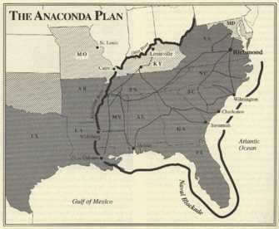
The U.S. Navy’s Role
in the
American Civil War
Planning & Direction
The Anaconda Plan or Scott’s Great Snake
From April 1 through early May 1861
General-in-Chief Winfield Scott briefed
Pres. Lincoln on the first military
strategy to crush the Southern rebellion.
The “Anaconda Plan,” as it came to be
known, was based on an existing plan
put down a limited domestic insurrection
by closing ports and river commerce, and using the Army to press civilians into submission. It was never meant to deal with a political organization supported by a regular army.
This material was researched and compiled by Mark Picker at the request of Dr. Don Beaumont to enhance the student’s understanding and appreciation of material related to the Civil War.

Slide 3
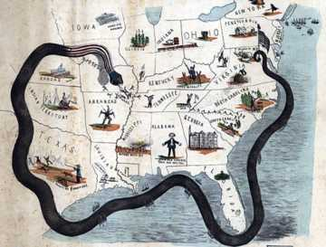
The U.S. Navy’s Role
in the
American Civil War
Planning & Direction
The Anaconda Plan or Scott’s Great Snake
Around May 3 Gen. Scott described his
strategy to his protégé, Maj. Gen.
George McClellan.
“Blockade” Southern ports,
Make a strong thrust down the
Mississippi Valley with a large
force, and
Establish a line of strong Federal positions to isolate the Confederacy “and bring it to terms.”
It is said that McClellan called it Scott’s “boa-constrictor.”
This material was researched and compiled by Mark Picker at the request of Dr. Don Beaumont to enhance the student’s understanding and appreciation of material related to the Civil War.

Slide 4
The U.S. Navy’s Role
in the
American Civil War
Planning & Direction
The Anaconda Plan or Scott’s Great Snake-Mississippi Valley
Scott proposed to Pres. Lincoln that
60,000 troops move down the
Mississippi River with gunboats from
Cairo, IL to the Gulf.
Concurrently, an effective blockade
would seal off the south.
The press used McClellan’s metaphor,
using the name of another snake.
The plan was not adopted. It would reappear early in 1862 with the joint operations of Gen. Ulysses S. Grant and Admirals Andrew Hull Foote and David G. Farragut.
This material was researched and compiled by Mark Picker at the request of Dr. Don Beaumont to enhance the student’s understanding and appreciation of material related to the Civil War.

Slide 5
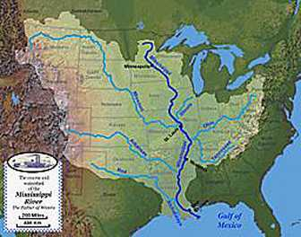
The U.S. Navy’s Role
in the
American Civil War
Planning & Direction
The Anaconda Plan or Scott’s Great Snake-Mississippi Valley
Between late 1861 and early 1863 the
Mississippi River and it’s navigable
tributaries; the Ohio, Tennessee,
Cumberland, Yazoo, Tombigbee,
Missouri, Arkansas, Red and Atchafalaya
Rivers were brought under Union control.
The Confederate States Army’s Trans-
Mississippi Department was isolated west of the Mississippi River, and the movement of commerce, troops and supplies east of the river ground to a halt.
This material was researched and compiled by Mark Picker at the request of Dr. Don Beaumont to enhance the student’s understanding and appreciation of material related to the Civil War.

Slide 6
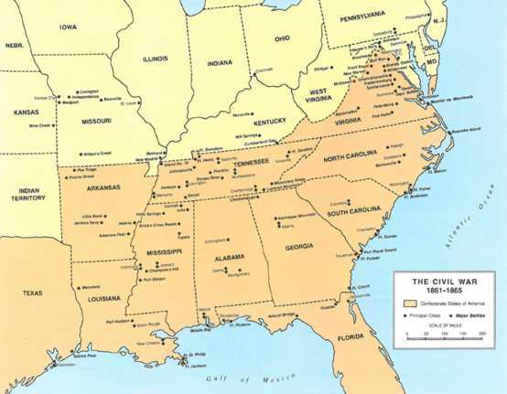
The U.S. Navy’s Role
in the
American Civil War
Planning & Direction
The Union’s Mississippi River Campaign-Complete Success
Early in the war Confederate President Jefferson Davis said “Vicksburg is the nail head
that holds the South’s two halves together.”
St. Charles-Jun. 1862
Lucas Bend-Jan. 1862
Fort Donelson-Dec. 1861
Fort Henry-Feb. 1862
Island No. 10-Feb. 1862
Fort Pillow-Apr. 1864
Plum Point-May 1862
Memphis-Jun. 1862
Fort Pemberton (Yazoo Pass)-Mar. 1863
Fort Hindman-Jan. 1863
Vicksburg-Jul. 1863
Port Gibson-Jul. 1863
Forts Jackson & St. Philip
New Orleans-1862
Head of Passes-1861
This material was researched and compiled by Mark Picker at the request of Dr. Don Beaumont to enhance the student’s understanding and appreciation of material related to the Civil War.

Slide 7
The U.S. Navy’s Role
in the
American Civil War
Planning & Direction
The Union’s Mississippi River Campaign
Opening of the Mississippi River in 1864, and the end of the war just one year away, President Abraham Lincoln commented that “The Father of waters again goes unvexed to the sea“ .
This material was researched and compiled by Mark Picker at the request of Dr. Don Beaumont to enhance the student’s understanding and appreciation of material related to the Civil War.

Slide 8
The U.S. Navy’s Role
in the
American Civil War
Planning & Direction
The Anaconda Plan, whether intentional or inadvertent, was a key strategy or the military leadership in the west, among them General Ulysses S. Grant who would head east and bring about the end.
This material was researched and compiled by Mark Picker at the request of Dr. Don Beaumont to enhance the student’s understanding and appreciation of material related to the Civil War.

Slide 9
The U.S. Navy’s Role
in the
American Civil War
Planning & Direction
The Anaconda Plan or Scott’s Great Snake-Blockade
Never before in naval history had a blockade with the scope of that contemplated for southern ports been attempted. The plan, often spoken of as a strategy, did not consider the ships, men and supplies available, or needed in the future, to close down 3,000 miles of coastline.
Many of these questions were eventually answered by the Blockade Strategy Board, at the request of the Navy Department. The “Board” was comprised of Naval staff with representation of the Army and the Coast Survey division of the Treasury Department.
This material was researched and compiled by Mark Picker at the request of Dr. Don Beaumont to enhance the student’s understanding and appreciation of material related to the Civil War.

Slide 10
The U.S. Navy’s Role
in the
American Civil War
Planning & Direction
The Anaconda Plan or Scott’s Great Snake-Blockade
The strategy that emerged considered 3 important elements:
Coastal topography;
A hierarchy of southern ports by their commercial value, and ease of entry and exit;
Assumed defense by Confederate land and naval forces.
This material was researched and compiled by Mark Picker at the request of Dr. Don Beaumont to enhance the student’s understanding and appreciation of material related to the Civil War.

Slide 11
The U.S. Navy’s Role
in the
American Civil War
Planning & Direction
The Anaconda Plan or Scott’s Great Snake-Blockade
The plans and reports coming out of the “Board” were followed closely for the Atlantic and the Gulf coast to New Orleans. The Texas coast, however, was hardly planned for.
April 19, 1861 – Six days after the fall of Fort Sumter, President Lincoln declared a coastal blockade from So. Carolina to Texas.
April 27, 1861 – The coast of North Carolina and Virginia were added to the blockade.
This material was researched and compiled by Mark Picker at the request of Dr. Don Beaumont to enhance the student’s understanding and appreciation of material related to the Civil War.

Slide 12
The U.S. Navy’s Role
in the
American Civil War
Planning & Direction
The Anaconda Plan or Scott’s Great Snake-Blockade
The proclamation of a blockade forced consideration of the question; was the South’s action a rebellion or a war?
The legal basis for the Civil War was muddied from the outset:
The insurgents encouraged an armed insurrection….treason;
From the beginning, the defined area of conflict and governmental organization looked precisely like war;
And, the “blockade” was clearly an act of war.
This material was researched and compiled by Mark Picker at the request of Dr. Don Beaumont to enhance the student’s understanding and appreciation of material related to the Civil War.

Slide 13
The U.S. Navy’s Role
in the
American Civil War
Planning & Direction
The Anaconda Plan or Scott’s Great Snake-Blockade
The blockade created a diplomatic conundrum. How could interdiction of foreign ships trading with the South be done without compromising foreign neutrality?
The Federal government maintained that the U.S. was in rebellion and the Confederacy was not a sovereign nation.
England and France, maintained official neutrality throughout the war , often under very trying circumstances, on the premise that the conflict was a rebellion, never recognizing the South as being independent.
This material was researched and compiled by Mark Picker at the request of Dr. Don Beaumont to enhance the student’s understanding and appreciation of material related to the Civil War.

Slide 14
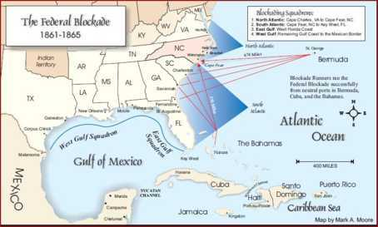
The U.S. Navy’s Role
in the
American Civil War
Planning & Direction
The Anaconda Plan or Scott’s Great Snake-Blockade
The Union deployed 4 squadrons:
North Atlantic, South Atlantic,
East Gulf, and West Gulf.
By wars end, as many as 500
vessels were commissioned
for the blockade.
This material was researched and compiled by Mark Picker at the request of Dr. Don Beaumont to enhance the student’s understanding and appreciation of material related to the Civil War.

Slide 15
The U.S. Navy’s Role
in the
American Civil War
Planning & Direction
The Anaconda Plan or Scott’s Great Snake-Blockade
The value of the blockade is still questioned by some historians, and considered event-changing by others.
The Union Navy brought in more that 1,100 prizes, of which 210 were steamers.
355 more were sunk, burned or driven on shore, of which 85 were steamers.
The total, exceeding 1,500 vessels of all types(1,428 were privateers) , may have been as little as 15% of the blockade runners.
The direct cost to the Confederacy was at least $31-million in vessel and cargo value, a cost they could not afford.
This material was researched and compiled by Mark Picker at the request of Dr. Don Beaumont to enhance the student’s understanding and appreciation of material related to the Civil War.

Slide 16
The U.S. Navy’s Role
in the
American Civil War
Planning & Direction
The Anaconda Plan or Scott’s Great Snake-Blockade
The Confederacy was force to break their voyages at neutral ports in the Bahamas, Bermuda and Cuba creating delays and concentrating the routes available to blockade runners.
By 1863 only 3 Atlantic ports were in Confederate hands; Charleston, SC, Wilmington, NC and Savannah, GA.
Norfolk, VA, Fernandina, FL and Port Royal, SC had become shelter and supply points for the Union.
This material was researched and compiled by Mark Picker at the request of Dr. Don Beaumont to enhance the student’s understanding and appreciation of material related to the Civil War.

Slide 17
The U.S. Navy’s Role
in the
American Civil War
Planning & Direction
The Anaconda Plan or Scott’s Great Snake-Blockade
Cotton exports had been shut down, the main source of revenue for the South had been eliminated, their ability to purchase war material and supplies was severely restricted, and rampant inflation was crushing buying power at home.
European stayed neutral and never recognized the Confederacy.
This material was researched and compiled by Mark Picker at the request of Dr. Don Beaumont to enhance the student’s understanding and appreciation of material related to the Civil War.

Slide 18
The U.S. Navy’s Role
in the
American Civil War
Planning & Direction
The Anaconda Plan or Scott’s Great Snake-Blockade
Blockade runners entering the Gulf had to run the Florida Strait. The Union Naval Station at Key West guarded the strait from the start of the war.
Only Mobile, New Orleans and Galveston were defended. Galveston fell to the Union in Oct. 1862, but was retaken a year later.
In Sept. 1861 the Union Blockade Commission recommended taking Ship Island, between Mobile and New Orleans. The island was abandoned by the Confederates who feared they would be cut off from the mainland.
This material was researched and compiled by Mark Picker at the request of Dr. Don Beaumont to enhance the student’s understanding and appreciation of material related to the Civil War.

Slide 19
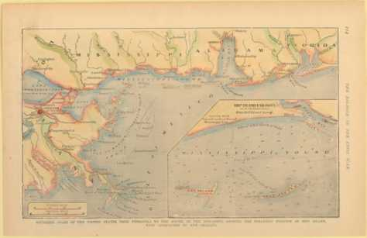
The U.S. Navy’s Role
in the
American Civil War
Planning & Direction
The Anaconda Plan or Scott’s Great Snake-Blockade
Ship Island was turned into a base, coaling station and staging area for the attack on forts guarding the mouth of the Mississippi River in Apr. and May 1862.
Union control of Ship Island
virtually closed Mobile,
Pascagoula and Pensacola to
the sea.
Ship Island’s dark side was its
use as a small, but notorious,
Union prison.
This material was researched and compiled by Mark Picker at the request of Dr. Don Beaumont to enhance the student’s understanding and appreciation of material related to the Civil War.

Slide 20
The U.S. Navy’s Role
in the
American Civil War
Planning & Direction
The Anaconda Plan or Scott’s Great Snake-Blockade
The Blockade, in general, and loss of the Mississippi River, in particular, severely impacted the already dwindling availability of troops.
The South was physically divided and Trans-Mississippi resources were isolated.
The movement of Southern forces was constrained within its own territory.
This material was researched and compiled by Mark Picker at the request of Dr. Don Beaumont to enhance the student’s understanding and appreciation of material related to the Civil War.

Slide 21
The U.S. Navy’s Role
in the
American Civil War
Leadership
The U.S. and C.S. Navies were brothers-in arms separated by the Civil War. Their transformation during this tragic period, and ultimate reunion at its end, set the stage for the United States to become the world power it is today.
Several profound changes occurred in Union and Confederate Navy.
The resignation of Naval Academy trained officers was the North’s loss and the South's gain.
The crucial need for trained, or experienced, officers by both sides drove the final elimination of politics and nepotism as the basis for appointment and promotion.
This material was researched and compiled by Mark Picker at the request of Dr. Don Beaumont to enhance the student’s understanding and appreciation of material related to the Civil War.

Slide 22
The U.S. Navy’s Role
in the
American Civil War
Leadership
The rapid growth of both navies necessitated the enlistment of experienced Masters and Mates, regardless of their family, political or business affiliation.
Each adopted a system of merit-based appointment and promotion, and eliminated, for the most part, political appointments.
The Civil War would see the emergence of common men with extraordinary abilities as heroes and great leaders.
This material was researched and compiled by Mark Picker at the request of Dr. Don Beaumont to enhance the student’s understanding and appreciation of material related to the Civil War.

Slide 23
The U.S. Navy’s Role
in the
American Civil War
Leadership
Early on in both navies the senior ranking system that is used today.
Admiral – Congressional appointment (the 1st in the U.S. in 1862) – established to create parity with senior officers in foreign navies; to avoid disputes between senior Captains; and, to enable growth in the command structure.
Captain – A senior officer, generally in command of a larger ship.
Commodore – Generally, a senior officer in command of more than one ship; not necessarily a Captain or Commander.
This material was researched and compiled by Mark Picker at the request of Dr. Don Beaumont to enhance the student’s understanding and appreciation of material related to the Civil War.

Slide 24
The U.S. Navy’s Role
in the
American Civil War
Leadership
The CSN was managed by a succession of 5 Secretaries of the War, reporting directly to President Jefferson Davis and subject to his political manipulation.
Leroy Pope served from April to August 1861, marginally effective and beginning with captured and commandeered ships.
Judah P. Benjamin served from September 1861 until April 1862, called “Davis’ Jew” he was pushed upstairs to Secretary of State.
George Randolph served from May through October 1862, reforming procurement.
This material was researched and compiled by Mark Picker at the request of Dr. Don Beaumont to enhance the student’s understanding and appreciation of material related to the Civil War.

Slide 25
The U.S. Navy’s Role
in the
American Civil War
Leadership
James Seddon served from November 1862 to February 1865, the longest tenure and most significant effect on the CSN.
John Breckinridge served from February 1865 until the war ended in May 1865, exiled until granted amnesty in 1868.
This material was researched and compiled by Mark Picker at the request of Dr. Don Beaumont to enhance the student’s understanding and appreciation of material related to the Civil War.

Slide 26
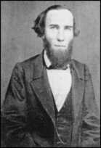
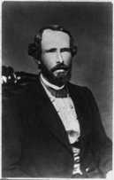
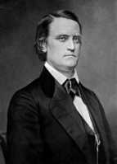
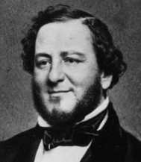
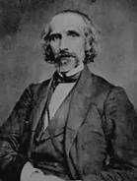
The U.S. Navy’s Role
in the
American Civil War
Leadership
Confederate States Navy
Secretaries of War
Leroy Pope Walker
Apr. 1861-Aug. 1861
George W. Randolph
May 1862-Oct, 1862
John C. Breckinridge
Feb. 1865-May 1865
Judah Phillip Benjamin
Sept. 1861-Apr, 1862
James Seddon
Nov. 1862-Feb, 1865
This material was researched and compiled by Mark Picker at the request of Dr. Don Beaumont to enhance the student’s understanding and appreciation of material related to the Civil War.

Slide 27
The U.S. Navy’s Role
in the
American Civil War
Leadership
The Naval Academies at Annapolis (U.S.) and aboard the steamship Patrick Henry at Richmond (C.S.) embraced the merit system, and wove it into the education of ships officers, that was
adopted from the English, then masters of the sea.
The training and values shared by the officers and seaman of the USN and CSN facilitated their re-unification after the Civil War, creating the world’s new greatest navy.
This material was researched and compiled by Mark Picker at the request of Dr. Don Beaumont to enhance the student’s understanding and appreciation of material related to the Civil War.

Slide 28
The U.S. Navy’s Role
in the
American Civil War
Leadership
Confederate States Navy
Stephen R. Mallory, Secretary of the Department of the Navy (former US Senator and Chair of the Naval Affairs Committee). An experienced admiralty lawyer, Mallory’s was from Florida.
Commodore Samuel Barron, Chief of the Bureau of Orders and Detail. He was a career U.S, Naval Officer with command experience, accused of trying to gain control of the U.S. Navy after Lincoln’s inauguration.
Commander George Minor, Chief of Ordnance and Hydrography. Minor was officer with little experience, who’s greater interest was musical composition.
This material was researched and compiled by Mark Picker at the request of Dr. Don Beaumont to enhance the student’s understanding and appreciation of material related to the Civil War.

Slide 29
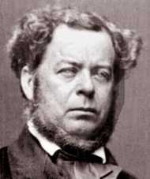
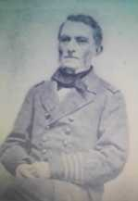
The U.S. Navy’s Role
in the
American Civil War
Leadership
Confederate States Navy
Secretary Of The Navy & Staff
No Photo
Stephen R. Mallory
Secretary of the Navy
Mar. 1861-May 1865
Commodore
Samuel Barron
Chief, Bureau of
Orders & Detail
Commander
George Minor
Chief, Ordnance
& Hydrography
This material was researched and compiled by Mark Picker at the request of Dr. Don Beaumont to enhance the student’s understanding and appreciation of material related to the Civil War.

Slide 30
The U.S. Navy’s Role
in the
American Civil War
Leadership
Confederate States Navy
In the early stages of the Confederacy a naval Officer Corps of 4 admirals, 10 captains, 31 commanders, 100 1st lieutenants, 25 2nd lieutenants, 20 masters-in-line-of-promotion, and various other ranks and rating was created.
Many of these ranks were filled by Union officers resigning their positions and volunteering for the Confederacy.
This material was researched and compiled by Mark Picker at the request of Dr. Don Beaumont to enhance the student’s understanding and appreciation of material related to the Civil War.

Slide 31
The U.S. Navy’s Role
in the
American Civil War
Leadership
Confederate States Navy
During the South’s Admirals in command were:
Commodore Lawrence Rousseau, New Orleans. A veteran of the War of 1812.
Commodore Josiah Tattnall, Savannah. After the War of 1812, he achieved acclaim commanding the East India Squadron.
Commodore French Forest, Norfolk. A veteran of the War of 1812, he commanded the Brazil Squadron until secession, but never got the reward he deserved from the Confederacy.
Commodore Duncan N. Ingraham, Charleston.
Captain Victor Randolph, Mobile.
This material was researched and compiled by Mark Picker at the request of Dr. Don Beaumont to enhance the student’s understanding and appreciation of material related to the Civil War.

Slide 32
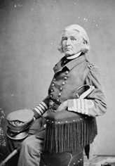
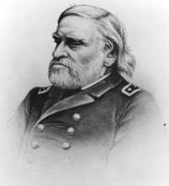
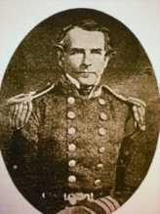
The U.S. Navy’s Role
in the
American Civil War
Leadership
Confederate States Navy
The Admirals In-Charge
No Photo
No Photo
Commodore
Lawrence Rousseau
New Orleans, LA
Commodore
Forrest French
Norfolk, VA
Commodore
Victor Randolph
Mobile, AL
Commodore
Josiah Tatnall
Savannah, GA
Commodore
Duncan N. Ingraham
Charleston, SC
This material was researched and compiled by Mark Picker at the request of Dr. Don Beaumont to enhance the student’s understanding and appreciation of material related to the Civil War.

Slide 33
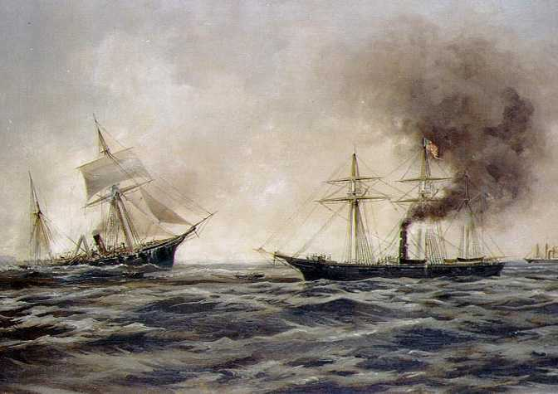
The U.S. Navy’s Role
in the
American Civil War
Leadership
Confederate States Navy
By the end of 1861, 373 commissioned officers, warrants and midshipmen resigned or were dismissed from the US Navy to join the Confederacy.
When many of the officers reported for duty there were few ships ready for command and manning. Most were detailed to command shore batteries in the states that claimed them. They we often conferred with Army rank, and much dissension developed while they waited for shipboard assignment.
This material was researched and compiled by Mark Picker at the request of Dr. Don Beaumont to enhance the student’s understanding and appreciation of material related to the Civil War.

Slide 34
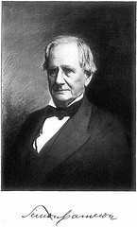
The U.S. Navy’s Role
in the
American Civil War
Leadership
United States Secretary of War
Compared to the South’s five Secretary’s of War, and the instability implied by a continuous change of leadership, the Union saw only two.
The first, Simon Cameron, was President Lincoln’s original Secretary of War. He served for about one year, until
January 1862. Pressured by allegations of
corruption, he resigned from office.
This material was researched and compiled by Mark Picker at the request of Dr. Don Beaumont to enhance the student’s understanding and appreciation of material related to the Civil War.

Slide 35
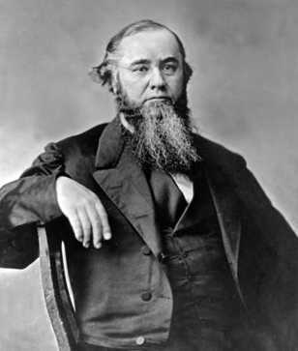
The U.S. Navy’s Role
in the
American Civil War
Leadership
United States Secretary of War
The second, Edwin McMasters Stanton, managed the Union’s military expansion through the Civil War and beyond, serving until the end of 1869. He accepted his
appointment to “help save the country,”
which he did.
Lincoln described him as “the rock on the
beach of our national ocean against which
the breakers dash and roar, dash and roar
without ceasing”.
This material was researched and compiled by Mark Picker at the request of Dr. Don Beaumont to enhance the student’s understanding and appreciation of material related to the Civil War.

Slide 36
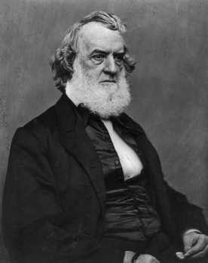
The U.S. Navy’s Role
in the
American Civil War
Leadership
United States Secretary of the Navy
Gideon Welles served as Secretary of the Navy, under War Secretary Edwin M. Stanton, from March 1861 through the war. He continued his service after the
assassination of President Lincoln, until 1869.
He originally opposed the idea of a blockade,
but embraced its prosecution and devoted
his role to the creation of a world-class navy,
composed of the finest ships, latest
technology, professional officers and
seamen, and aggressive strategy.
This material was researched and compiled by Mark Picker at the request of Dr. Don Beaumont to enhance the student’s understanding and appreciation of material related to the Civil War.

Slide 37
The U.S. Navy’s Role
in the
American Civil War
Leadership
United States Secretary of the Navy
Gideon Welles became the civilian head of the Union Navy in 1861. There were less than 80 ships, 1,300 officers and 7,500 enlisted men in service. Most ships were on foreign station, in poor condition, or laid up for decommissioning and salvage.
By 1865 there were 671 ships, 6,700 officers and 51,500 enlisted men.
Welles came with experience as Chief of the Bureau of Provisions and Clothing for the Navy Department from 1846 to 1849. His skills and experience would be tested by the war.
This material was researched and compiled by Mark Picker at the request of Dr. Don Beaumont to enhance the student’s understanding and appreciation of material related to the Civil War.

Slide 38
The U.S. Navy’s Role
in the
American Civil War
Leadership
United States Secretary of the Navy
During the course of the war, Gideon Welled directed the expenditure of $123 million, and harnessed the size and industrial strength of the North to created a naval force that equaled or surpassed any other in the world.
What cost
$123,000,000 (U.S. currency) in 1861
Would cost
$3,097,747,102 (U.S. currency) in 2012
This material was researched and compiled by Mark Picker at the request of Dr. Don Beaumont to enhance the student’s understanding and appreciation of material related to the Civil War.

Slide 39
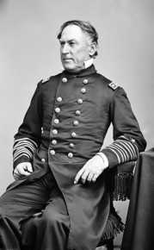
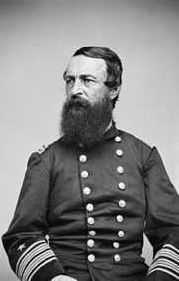
The U.S. Navy’s Role
in the
American Civil War
Leadership
United States Navy
The Admirals
The superiority of U.S. Naval leadership, in terms of number and ability, is evident in its roster of fighting officers.
Admiral
James Glasgow Farragut
Western Gulf
Blockading Squadron
New Orleans
Mobile Bay
Admiral
David Dixon Porter
Pensacola
Western Flotilla
Vicksburg
Red River
This material was researched and compiled by Mark Picker at the request of Dr. Don Beaumont to enhance the student’s understanding and appreciation of material related to the Civil War.

Slide 40
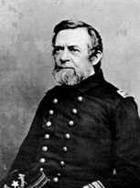
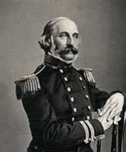
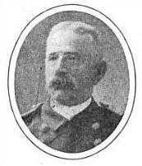
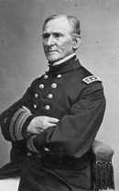
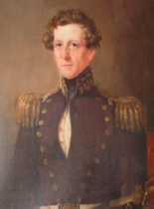
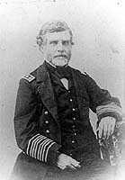
The U.S. Navy’s Role
in the
American Civil War
Leadership
United States Navy
The Admirals In – The Gulf and Mississippi River Squadrons
Rear Adm.
Andrew Hull Foote
Mississippi
Squadron
Rear Adm.
Charles Henry
Davis
Blockade Strategy
Board
Western Gunboat
Flotilla
Rear Adm.
Nehemiah M. Dyer
West Gulf
Blockading
Squadron
Rear Adm.
Henry H. Bell
Fleet Capt. Western
Blockading
Squadron
Rear Adm.
William Mervine
Gulf Blockading
Squadron
Rear Adm.
Samuel P. Lee
North Atlantic
Blockading &
Mississippi River
Squadron
This material was researched and compiled by Mark Picker at the request of Dr. Don Beaumont to enhance the student’s understanding and appreciation of material related to the Civil War.

Slide 41
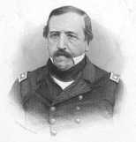
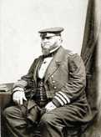
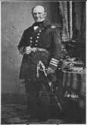
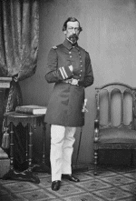
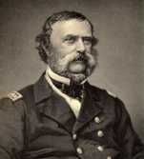
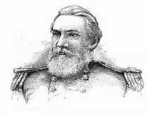
The U.S. Navy’s Role
in the
American Civil War
Leadership
United States Navy
The Admirals – The North & South Atlantic Squadrons
Rear Adm.
Henry Knox
Thatcher
North Atlantic
Blockading
Squadron
&
West Gulf
Squadron
Rear Adm.
Louis M
Goldsborough
North Atlantic
Blockading
Squadron
Rear Adm.
Silas H.
Stringham
Atlantic
Blockading
Squadron &
Boston Navy
Yard
Rear Adm.
Robert H. Wyman
North Atlantic
Blockading
Squadron
Rear Adm.
Samuel Francis
du Pont
South Atlantic
Blockading
Squadron
Rear Adm.
Edmund Colhoun
North Atlantic &
South Atlantic
Blockading
Squadron
This material was researched and compiled by Mark Picker at the request of Dr. Don Beaumont to enhance the student’s understanding and appreciation of material related to the Civil War.

Slide 42
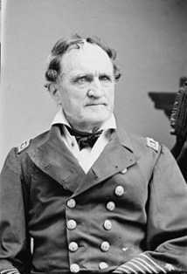
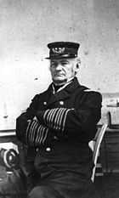
The U.S. Navy’s Role
in the
American Civil War
Leadership
United States Navy
The Admirals – The Builders
Rear Adm.
Francis Hoyt Gregory
Superintendent
of Shipbuilding
And Fitting-out
At Private Shipyards
Rear Adm.
Hiram Paulding
New York Navy Yard
USN Ironclad Board
This material was researched and compiled by Mark Picker at the request of Dr. Don Beaumont to enhance the student’s understanding and appreciation of material related to the Civil War.

Slide 43
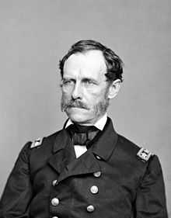
The U.S. Navy’s Role
in the
American Civil War
Leadership
United States Navy
The Admirals In – “The Father of American Naval Ordnance”
Rear Adm. John A. Dahlgren, Chief, USN Bureau of Ordnance
John Dahlgren established the Navy’s
Ordnance Department while at the
Washington Navy Yard, prior to the war.
He wrote ”The System of Boat Armaments
in the United States Navy,” among others.
He developed a percussion firing mechanism
for shipboard use; established a Navy
foundry; and, above all, perfected the casting
process for his famous “Dahlgren” gun.
This material was researched and compiled by Mark Picker at the request of Dr. Don Beaumont to enhance the student’s understanding and appreciation of material related to the Civil War.

Slide 44
The U.S. Navy’s Role
in the
American Civil War
Leadership
United States Navy
Despite the considerable drain of officers to the South at the commencement of hostilities, the Union retained a cadre that developed and expanded the U.S. Navy to a position of dominance domestically and internationally.
Many of the Union’s Naval leaders, from the Secretary of the Navy through the Admirals and senior ranks, made a material contribution to the war’s final outcome, some becoming historic icons.
This material was researched and compiled by Mark Picker at the request of Dr. Don Beaumont to enhance the student’s understanding and appreciation of material related to the Civil War.

Slide 45
The U.S. Navy’s Role
in the
American Civil War
Industry &Technology
If necessity is the mother of invention, then the American Civil War was the military breeding ground.
The first half of the 19th century saw the invention of the steam engine; development of America’s forest and mineral resources; creation of ‘modern’ smelting and forging technology; the invention of powered farming and manufacturing tools; expansion of our railroad system; and, increased access to scientific education.
The side that made something of these developments had a distinct advantage effecting the outcome of the war.
This material was researched and compiled by Mark Picker at the request of Dr. Don Beaumont to enhance the student’s understanding and appreciation of material related to the Civil War.

Slide 46
The U.S. Navy’s Role
in the
American Civil War
Industry &Technology
It is both sad and ironic that among the great human endeavors war, in this case the American Civil War, create periods of great resourcefulness and invention, above all others.
The Civil War period brought to bear ideas in manufacturing, communication, logistics, medicine, metallurgy, engineering and destruction that propelled the post-war re-United States to world greatness.
The list is long, and cannot fail to make a deep impression. We will address those ideas having the greatest impact on naval warfare.
This material was researched and compiled by Mark Picker at the request of Dr. Don Beaumont to enhance the student’s understanding and appreciation of material related to the Civil War.

Slide 47
The U.S. Navy’s Role
in the
American Civil War
Industry &Technology
Maximum Firepower
In 1861, Commander John A. B. Dahlgren, USN, had been at the Washington Navy Yard for 14 years where he developed a percussion lock firing mechanism, wrote several authoritative books and established the U.S. Navy’s Ordnance Department.
Dahlgren’s genius choice was for smooth-bore naval guns, rather than rifles. He reasoned that naval engagements were over short distances. Rifles better-served long range artillerists.
The U.S. Navy showed their dominance by pounding the south with superior guns on with steam-driven iron ships, manned by trained and disciplined officers and enlisted men.
This material was researched and compiled by Mark Picker at the request of Dr. Don Beaumont to enhance the student’s understanding and appreciation of material related to the Civil War.

Slide 48
The U.S. Navy’s Role
in the
American Civil War
Industry &Technology
Maximum Firepower
1849 Dahlgren Boat Howitzer – A light-weight, medium caliber,
artillery piece suitable use from launches and other small craft.
1855 Dahlgren Shell Guns – Smooth-bore and rifled guns, design to throw a large caliber explosive or incendiary ‘shells’ long distances with accuracy. These muzzle-loaded guns could also fire solid and canister shot. These large cast iron guns are recognizable by their distinctive bottle-shape.
1855-1864 Dahlgren Smooth-bored & Rifled Guns
This material was researched and compiled by Mark Picker at the request of Dr. Don Beaumont to enhance the student’s understanding and appreciation of material related to the Civil War.

Slide 49
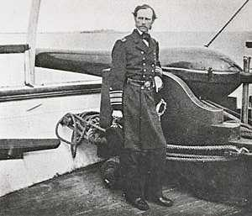
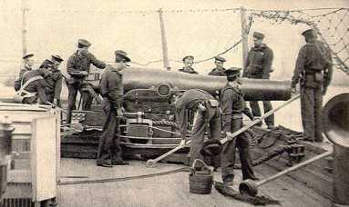
The U.S. Navy’s Role
in the
American Civil War
Industry &Technology
Maximum Firepower
9” Dahlgren Smoothbore – Full Crew
USS Mendota
Rear Admiral John A. Dahlgren
50-pounder Dahlgren Rifle
USS Pawnee
This material was researched and compiled by Mark Picker at the request of Dr. Don Beaumont to enhance the student’s understanding and appreciation of material related to the Civil War.

Slide 50
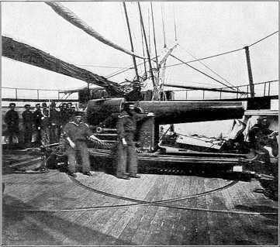
The U.S. Navy’s Role
in the
American Civil War
Industry &Technology
Naval Ordnance – Looking Into the Future
1860-1864 Parrott Rifle – Large caliber (20, 30, 60, 100 & 200 lb. Projectile) rifled guns. A single 300-pounder was cast and deployed
against Fort Sumter in 1863, at Morris Island in Charleston Harbor.
The 300-pounder rifle could send a 10-inch
round about 9,000 yards, about 5 miles.
Compared to a 24-pounder round shot, the
300-pounder rifled shot had nearly 20-times
the penetrating energy when fired from
3,500 yards from the target.
This material was researched and compiled by Mark Picker at the request of Dr. Don Beaumont to enhance the student’s understanding and appreciation of material related to the Civil War.

Slide 51
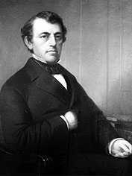
The U.S. Navy’s Role
in the
American Civil War
Industry &Technology
Naval Ordnance – Looking Into the Future
1836 – Captain Robert Parker Parrot resigned his Army rank and joined the civilian run West Point Foundry at Cold Spring, NY as superintendent. Over 40 years he perfected the rifled cannon and ingenious companion projectile.
The round was called a sabot (sā-bō), a cast projectile
with a soft metal disk or cup attached to the base.
Upon ignition the breech pressure caused the
disk to expand into the rifling, filling the space of an
under-sized or ill-fitting projectile. The sabot is used
with the most modern artillery.
This material was researched and compiled by Mark Picker at the request of Dr. Don Beaumont to enhance the student’s understanding and appreciation of material related to the Civil War.

Slide 52
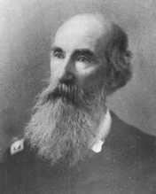
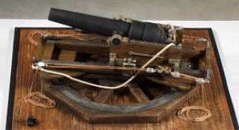
The U.S. Navy’s Role
in the
American Civil War
Industry &Technology
The Naval Brooke Rifle
1861-1864 Brooke Rifle – Medium and large caliber
rifled guns, manufactured principally at the famous
Tredegar Iron Works, Richmond, VA and the Selma
Naval Ordnance Works, Selma, Al.
Designed by Commander John Mercer Brooke, CSN.
The Brooke Rifle is distinguish by one or more wrought
iron bands at the breech-end of the gun.
The “Brooke” mimicked the Parrott Rifle,
with its’ wrought-iron reinforcing band
surrounding the breech-end of a cast-iron
barrel.
This material was researched and compiled by Mark Picker at the request of Dr. Don Beaumont to enhance the student’s understanding and appreciation of material related to the Civil War.

Slide 53
The U.S. Navy’s Role
in the
American Civil War
Industry &Technology
Iron, Steam and Firepower
From the early warships of the 14th century to the opening shot of the Civil War little had change in naval combat. With the launch of the first Union Monitor everything changed.
Three technologies central to modern warship design converged in the design of the Union Monitors:
Driven by efficient steam, providing the advantage of speed and maneuverability without sail.
Armored with rolled iron plate and mounting a revolving gun turret to protect the crew, engines and munitions.
Mounting powerful guns and firing projectiles capable of pounding and penetrating the enemy’s ships.
This material was researched and compiled by Mark Picker at the request of Dr. Don Beaumont to enhance the student’s understanding and appreciation of material related to the Civil War.

Slide 54
The U.S. Navy’s Role
in the
American Civil War
Industry &Technology
Iron, Steam and Firepower
The North’s industrial power out-stripped the limited capability of the South.
Only the North’s foundry's could produce rolled iron plate, providing the basis for the design and construction of new vessel forms and ingenious mechanical devices like rotating turrets
The South’s limited foundry capability, and inability to produce rolled iron plate in any volume, constrained their production of steam boilers and armor plate. The alternative to rolled iron plate was used rail and hammered bar stock, driving the direction of ironclad ship design to the “casemate.”
This material was researched and compiled by Mark Picker at the request of Dr. Don Beaumont to enhance the student’s understanding and appreciation of material related to the Civil War.

Slide 55
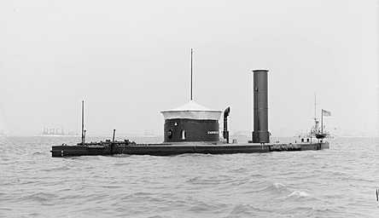
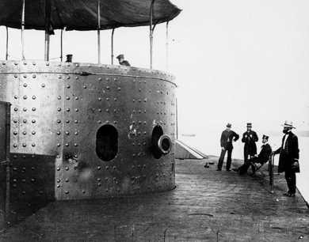
The U.S. Navy’s Role
in the
American Civil War
Industry &Technology
Iron, Steam and Firepower
The Monitor Class – “Cheese Box On A Raft”
Union Canonicus Class Monitor
9 ships; 2 x 15” Dahlgren Smoothbores
2 Gun Monitor Turret
Showing Impact Marks
This material was researched and compiled by Mark Picker at the request of Dr. Don Beaumont to enhance the student’s understanding and appreciation of material related to the Civil War.

Slide 56
The U.S. Navy’s Role
in the
American Civil War
Industry &Technology
Iron, Steam and Firepower
“Monitor versus Merrimack”
The most well-known naval engagement of the Civil War is the battle between the USS Monitor and the CSS Virginia at Hampton Roads, VA – known as the battle between The Monitor and The Merrimack.
The CSS Virginia was built from the USS Merrimack, scuttled at Norfolk, raised, armored and re-fit with new guns.
The historic confrontation was a draw, but marked the end of the wooden-hulled warship era.
This material was researched and compiled by Mark Picker at the request of Dr. Don Beaumont to enhance the student’s understanding and appreciation of material related to the Civil War.

Slide 57
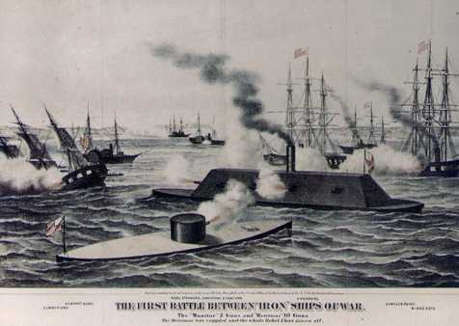
The U.S. Navy’s Role
in the
American Civil War
Industry &Technology
Iron, Steam and Firepower
The Monitor Class – “Cheese Box On A Raft”
The USS Monitor, after which the Monitor Class was named, was based on a design by John Ericsson.
Ericsson’s design ingenuity also applied to the revolving turret, single screw with a recessed propeller, an steam engine.
This material was researched and compiled by Mark Picker at the request of Dr. Don Beaumont to enhance the student’s understanding and appreciation of material related to the Civil War.

Slide 58
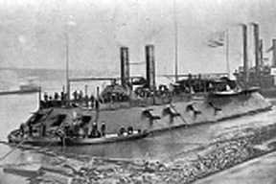
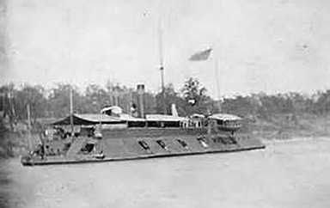
The U.S. Navy’s Role
in the
American Civil War
Industry &Technology
Iron, Steam and Firepower
Union Casemate-type Ships
USS Cairo, casemate gunboat
18 guns; plate armor reinforced with rail
USS Louisville – City Class
Constructed by Samuel Pook
This material was researched and compiled by Mark Picker at the request of Dr. Don Beaumont to enhance the student’s understanding and appreciation of material related to the Civil War.

Slide 59
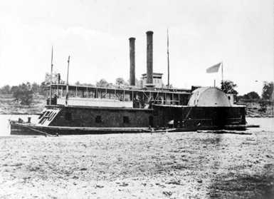
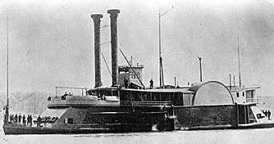
The U.S. Navy’s Role
in the
American Civil War
Industry &Technology
Iron, Steam and Firepower
Union “Tinclads”
USS Fort Hindman, “Tinclad” gunboat
Converted Side-wheel Steamer
USS Peosta, “Tinclad” #36
Converted Side-wheel Ferry
This material was researched and compiled by Mark Picker at the request of Dr. Don Beaumont to enhance the student’s understanding and appreciation of material related to the Civil War.

Slide 60
The U.S. Navy’s Role
in the
American Civil War
Industry &Technology
Iron, Steam and Firepower
Union “Timberclads”
USS Tyler, “Timberclad”
Converted Side-wheel Steamer
USS Commodore Barney, “Timberclad” Converted Ferry
This material was researched and compiled by Mark Picker at the request of Dr. Don Beaumont to enhance the student’s understanding and appreciation of material related to the Civil War.

Slide 61
The U.S. Navy’s Role
in the
American Civil War
Industry &Technology
At the beginning of the war the U.S. abandoned the Gosport Naval Shipyard at Portsmouth/Norfolk, Virginia. Union Naval Secretary recognized that Gosport could be lost, but failed to create a defensive force in time.
Captain Charles S. McCauley, commanding at Gosport, lost most of his staff and the loyalty of the 1,400 workers at the shipyard. When Union control was given up they failed to burn the facilities, destroy the supplies or remove the ships in-port.
One of the Unions losses was the scuttled screw frigate USS Merrimack, raised by the Confederacy, ironclad with rail, and renamed CSS Virginia.
This material was researched and compiled by Mark Picker at the request of Dr. Don Beaumont to enhance the student’s understanding and appreciation of material related to the Civil War.

Slide 62
The U.S. Navy’s Role
in the
American Civil War
Industry &Technology
Iron, Steam and Firepower
Confederate Ironclads
CSS Virginia
(Built on the USS Merrimack, 350-ton steam frigate, salvaged at Gosport)
4 Brooke Rifles; 6 Dahlgren smooth-
bores; 2 howitzers.
Belt, deck and casemate plate armor
4,000-ton displacement after
conversion.
Very poor steerage. A 180°-turn
required 40-minutes.
Guns fired through elliptical ports.
This material was researched and compiled by Mark Picker at the request of Dr. Don Beaumont to enhance the student’s understanding and appreciation of material related to the Civil War.

Slide 63
The U.S. Navy’s Role
in the
American Civil War
Industry &Technology
Iron, Steam and Firepower
Confederate Ironclad Casemate-type Ships
CSS Manassas, Ironclad Ram
Converted Ice-breaker Tug, 1 64-pounder gun
CSS Selma-Gunboat
Converted Coastal Packet Boat, 4 guns
This material was researched and compiled by Mark Picker at the request of Dr. Don Beaumont to enhance the student’s understanding and appreciation of material related to the Civil War.

Slide 64
The U.S. Navy’s Role
in the
American Civil War
Industry &Technology
Iron, Steam and Firepower
Submarines
The story of submersible vessels did not begin with the American Civil War.
However, the concept was proven on February 17, 1864 when the CSS H.L. Hunley sank the USS Housatonic, a screw-sloop on blockade duty, in the outer harbor at Charleston, SC.
The Hunley was 40-feet long, displaced just less than 8-tons, and was armed with a single spar torpedo with a charge of 130-pounds of black powder.
The Housatonic was 140-feet long, displaced nearly 2,000-tons, and was armed with 11 rifles and smoothbores.
This material was researched and compiled by Mark Picker at the request of Dr. Don Beaumont to enhance the student’s understanding and appreciation of material related to the Civil War.

Slide 65
The U.S. Navy’s Role
in the
American Civil War
Industry &Technology
Iron, Steam and Firepower
Submarines
The Hunley may have taken the prize as the first submarine to sink and enemy warship. It was not the limit to designer imagination during the Civil War.
May 1, 1862 – USS Alligator (47-feet long, 275-tons displacement)
Designed by French inventor
Brutus De Villeroi for the US Navy.
Oar-powered (replace by a hand-
cranked screw in 1863).
Never saw combat. Lost while
under tow to Charleston, SC.
This material was researched and compiled by Mark Picker at the request of Dr. Don Beaumont to enhance the student’s understanding and appreciation of material related to the Civil War.

Slide 66
The U.S. Navy’s Role
in the
American Civil War
Industry &Technology
Iron, Steam and Firepower
Submarines
1861 – CSS Pioneer (20-feet long)
Designed and built by James McClintock in New Orleans, LA, with backing from H. L. Hunley,
Screw propeller, hand-cranked, crew of 3 (2 on crank, 1 steering).
Scuttled in April, 1862 with the fall of New Orleans to the Union.
Successfully tested in Lake Ponchartrain when it sank a barge
while submerged.
It never saw combat.
This material was researched and compiled by Mark Picker at the request of Dr. Don Beaumont to enhance the student’s understanding and appreciation of material related to the Civil War.

Slide 67
The U.S. Navy’s Role
in the
American Civil War
Industry &Technology
Iron, Steam and Firepower
Submarines
1863 – American Diver (CSS Pioneer II)
Designed and built by the James McClintock/H. L. Hunley consortium in Mobile, AL
Screw propeller, hand-cranked (An
unsuccessful attempt was made to
provide power with an electric motor).
Sank in Mobile Bay.
It never saw combat.
This material was researched and compiled by Mark Picker at the request of Dr. Don Beaumont to enhance the student’s understanding and appreciation of material related to the Civil War.

Slide 68
The U.S. Navy’s Role
in the
American Civil War
Industry &Technology
Iron, Steam and Firepower
Submarines
August, 1863 – CSS H. L. Hunley (then called “Fish Boat”)(39.5-feet long, 7.5-tons)
Designed and built by James McClintock/H. L. Hunley in Mobile, AL
Screw propeller, hand-cranked.
Shipped by rail to Charleston, SC, requested
by Gen. PGT Beauregard to break the
blockade at Charleston.
Sank twice during trials and training with the
loss of 13 crew, including Horace L Hunley.
Sank the USS Housatonic with a spar
torpedo on February 17, 1864.
This material was researched and compiled by Mark Picker at the request of Dr. Don Beaumont to enhance the student’s understanding and appreciation of material related to the Civil War.

Slide 69
The U.S. Navy’s Role
in the
American Civil War
Industry &Technology
Iron, Steam and Firepower
Submarines
April, 1866 – USS Intelligent Whale (28-feet 8-inches long, 4,000-pounds)
Designed by Scoville Merriam and
built by American Submarine
Company of Newark, NJ.
Finally tested with success, it soon
earned the reputation of “Disastrous Jonah”.
Oar-powered by a crew of 6.
Never saw combat.
This material was researched and compiled by Mark Picker at the request of Dr. Don Beaumont to enhance the student’s understanding and appreciation of material related to the Civil War.

Slide 70
The U.S. Navy’s Role
in the
American Civil War
Industry &Technology
Mines (Torpedoes) and Spar Torpedoes
December 12, 1862 - The USS Cairo became the first armored warship to be sunk by an electronically detonated torpedo (water-mine).
February 17, 1864 - USS Housatonic was sunk by a Spar Torpedo delivered by the CSS (submarine) H. L. Hunley outside the bar at Charleston, SC.
August 5, 1864- USS (Monitor) Tecumseh sunk by a tethered mine at the Battle of Mobile Bay.
By the end of the war the Union had lost 40 ships and other vessels to this innovation by the Confederacy.
This material was researched and compiled by Mark Picker at the request of Dr. Don Beaumont to enhance the student’s understanding and appreciation of material related to the Civil War.

Slide 71
The U.S. Navy’s Role
in the
American Civil War
Industry &Technology
Rapid-fire & Volley-fire Guns
1862 Gatling Gun – 9 Gunboats were fitted with these 6- barreled rapid-fire guns in .58 caliber. Guns as large as 1.00 caliber were tested.
The one inch 1865 battery gun model was tested at length in July of 1866 by Captain T.G. Baylor who found, "The moral effect of the Gatling Gun would be very great in repelling an assault, as there is not a second of time for the assailants to advance between the gun’s discharges."
This material was researched and compiled by Mark Picker at the request of Dr. Don Beaumont to enhance the student’s understanding and appreciation of material related to the Civil War.

Slide 72
The U.S. Navy’s Role
in the
American Civil War
Industry &Technology
Target Illumination
July 18, 1863 Calcium Flood Lights (Lime lights) were used to illuminate Fort Wagner and the batteries on Morris Island in Charleston Harbor. The lights were requested by Rear Adm. John A. Dahlgren, in cooperation with Brig. Gen. Quincy Gilmore.
Colonel Lawrence M. Keitt, of the 20th South Carolina, commanding the Morris Island garrison, wrote, “Throughout the night, the enemy’s calcium light threw its bright, silvery rays upon our front.” Recording the night time events of September 5-6, 1863).
This material was researched and compiled by Mark Picker at the request of Dr. Don Beaumont to enhance the student’s understanding and appreciation of material related to the Civil War.

Slide 73
The U.S. Navy’s Role
in the
American Civil War
The Fleets – The Union
The first weeks after the attack on Fort Sumter, April 15, 1861 were a hectic time for the newly elected President Lincoln and his principle advisors. A rebellion had to be quelled and the Union had to be repaired, and the military force available was totally inadequate for the task.
The President called for 75,000 3-month volunteers, and soon called for another 42,000 for 3-year enlistments. Funds for expansion of the Army and Navy were made available, but little planning had been done.
By July the Union Navy had grown by 18,000 men. But, more men would not be enough.
This material was researched and compiled by Mark Picker at the request of Dr. Don Beaumont to enhance the student’s understanding and appreciation of material related to the Civil War.

Slide 74
The U.S. Navy’s Role
in the
American Civil War
The Fleets – The Confederacy
For the most part, the South was in worse shape than the North. However, some thought had preceded secession and it was quickly recognized that the South lacked the essential ingredients of skilled manpower, industrial base, material resources and facilities to create a fighting navy.
With all of these limitations Secretary of the Navy Stephan R. Mallory got right to work.
By August 1861 the construction of several Ironclads had been contracted with western builders, and the shipbuilding industry was put into action.
This material was researched and compiled by Mark Picker at the request of Dr. Don Beaumont to enhance the student’s understanding and appreciation of material related to the Civil War.

Slide 75
The U.S. Navy’s Role
in the
American Civil War
The Fleets – Where Were The Resources
During the decade before the Civil War more than 8,000 ships, of all kinds, were built in the United State. Of this great number only 1,600, or 20%, were built in the south.
This material was researched and compiled by Mark Picker at the request of Dr. Don Beaumont to enhance the student’s understanding and appreciation of material related to the Civil War.

Slide 76
The U.S. Navy’s Role
in the
American Civil War
The Fleets – Where Were The Resources
Shipyards
Of the 10 U.S. Navy Yards only 2, Norfolk (Gosport), VA and Pensacola, FL, were in the South. Norfolk was highly productive, having launched 16 major warships in the decade prior to the war.
New Orleans five private shipyards built or converted more than 30 warships before it fell to the Union in 1862. This, however, still waned in comparison to the productivity of the North’s Naval and private shipbuilding capability.
This material was researched and compiled by Mark Picker at the request of Dr. Don Beaumont to enhance the student’s understanding and appreciation of material related to the Civil War.

Slide 77
The U.S. Navy’s Role
in the
American Civil War
The Fleets – Where Were The Resources
Building A Fleet At Home
With the fall of New Orleans to the Union, the South’s shipbuilding capability at Norfolk and Pensacola, was largely represented by river-based yards or slipways that produced small numbers of riverine and coastal vessels.
The Confederacy saw three options to building a fleet at home:
Acquisition and conversion of commercial vessels – from the outset of the war commercial vessels we pressed into service-for-fee, purchased, or confiscated. Some were armored with rail iron, others became “cottonclads,” all were inadequate to the task when faced by the force of the Union Navy.
This material was researched and compiled by Mark Picker at the request of Dr. Don Beaumont to enhance the student’s understanding and appreciation of material related to the Civil War.

Slide 78
The U.S. Navy’s Role
in the
American Civil War
The Fleets – Where Were The Resources
Building A Fleet Abroad
Confederate President Jefferson Davis sent agents to England and France very early in the war. They had two goals; gain recognition of the South as an independent country, and to supply the navy with ships. These goals were tightly intertwined.
The agents never succeeded in achieving recognition. The European powers, led by England, held fast to neutrality despite diplomacy being tested at every turn.
This material was researched and compiled by Mark Picker at the request of Dr. Don Beaumont to enhance the student’s understanding and appreciation of material related to the Civil War.

Slide 79
The U.S. Navy’s Role
in the
American Civil War
The Fleets – Where Were The Resources
Building A Fleet Abroad
In 1861 the Confederate Congress allocated $2 million to buy ironclads overseas. During the course of the war millions more, perhaps hundreds of millions in gold, cotton and currency, were committed to building ships and buying influence in the capitols of Europe.
While some fighting ships were built in England, most notably the CSS Alabama, CSS Shenandoah and CSS Alexandria, only the Alabama and Shenandoah saw action. The Alexandria was seized at her birth in Liverpool.
Among the most severe tests was the construction of ships at Birkenhead and Liverpool, at great expense.
Authorization of Privateers, by issuing “Letters of Marque.”
This material was researched and compiled by Mark Picker at the request of Dr. Don Beaumont to enhance the student’s understanding and appreciation of material related to the Civil War.

Slide 80
The U.S. Navy’s Role
in the
American Civil War
The Fleets – Where Were The Resources
Building A Fleet Abroad
The CSS Alabama and CSS Shenandoah did their part as commerce raiders, costing the Union ships, cargo and the expense of increased risk insurance.
They also made their mark in naval history with the Alabama challenging the USS Kearsage off Cherbourg, France and sinking, and the Shenandoah firing the final shot of the war on a raiding cruise in the Aleutians after the surrender at Appomattox. She surrendered to a British cruiser and brought back to Liverpool.
For this the South spent untold millions and achieved little.
This material was researched and compiled by Mark Picker at the request of Dr. Don Beaumont to enhance the student’s understanding and appreciation of material related to the Civil War.

Slide 81
The U.S. Navy’s Role
in the
American Civil War
The Fleets – Where Were The Resources
Building A Fleet Abroad
Confederate President Jefferson Davis sent agents to England and France very early in the war. They had two goals; gain recognition of the South as an independent country, and to supply the navy with ships.
They never succeeded in achieving recognition. The European
powers, led by England, held fast to neutrality despite diplomacy being tested at every turn. Among the most severe tests was the construction of ships at Birkenhead and Liverpool, at great expense.
This material was researched and compiled by Mark Picker at the request of Dr. Don Beaumont to enhance the student’s understanding and appreciation of material related to the Civil War.

Slide 82
The U.S. Navy’s Role
in the
American Civil War
The Fleets – Where Were The Resources
Privateers
President Jefferson Davis asked private interests to apply for Letters of Marque. This had been the way for warring nations to create a privateer fleet, seen by some as legalized piracy.
Davis was unsure of his authority. On April 29, his Congress formally authorized privateers. The 1856 Declaration of Paris, signed by England and France outlawed privateers. Neither the Union or Confederacy were signatories.
This material was researched and compiled by Mark Picker at the request of Dr. Don Beaumont to enhance the student’s understanding and appreciation of material related to the Civil War.

Slide 83
The U.S. Navy’s Role
in the
American Civil War
The Fleets – Where Were The Resources
Privateers
Davis authorization of Privateers brought out the opportunists and adventurers that were prepared to harass Union merchant ships for the “prize value.”
Confederate Privateers became so numerous, and so effective, that President Lincoln was forced to declare them Pirates, with the appropriate consequences if caught.
This material was researched and compiled by Mark Picker at the request of Dr. Don Beaumont to enhance the student’s understanding and appreciation of material related to the Civil War.

Slide 84
The U.S. Navy’s Role
in the
American Civil War
USS Kearsage versus CSS Alabama
The background portrays the epic battle between the USS Kearsage, Capt. John A. Winslow commanding, and the CSS Alabama, Capt. Raphael Semmes commanding.
It has been set in our minds that the greatest naval battle of the Civil War was the meeting of the USS Monitor and the CSS Virginia (formerly the USS Merrimack). This was a story of emerging technology. The greater event was the story of emerging power.
The dominance of the USS Kearsage over the CSS Alabama was a message to the world that the United States Navy could reach out to any ocean with the best ships, officers, seamen and arms and express its will.
This material was researched and compiled by Mark Picker at the request of Dr. Don Beaumont to enhance the student’s understanding and appreciation of material related to the Civil War.

Slide 85
The U.S. Navy’s Role
in the
American Civil War
USS Kearsage versus CSS Alabama
The Alabama was a new cruiser of 1,050 tons, built in secrecy by John Laird & Sons in Birkenhead, England as a merchantman. Escaping England, she met supply ships and was fitted out as a war-fighter at sea.
She was commanded by Capt. Raphael Semmes, arguably the most effective commerce raider of the Civil War with 65 ships burned and expeditions throughout the world’s oceans.
Screw-driven, she was powered by 2 engines, excellent for their time.
Manned by 145 men and officers, she carried 8 heavy English-made guns.
She was a wooden ship, throughout.
This material was researched and compiled by Mark Picker at the request of Dr. Don Beaumont to enhance the student’s understanding and appreciation of material related to the Civil War.

Slide 86
The U.S. Navy’s Role
in the
American Civil War
USS Kearsage versus CSS Alabama
The Kearsarge was a steam-powered sloop-of-war, of 1,550 tons, built at the Portsmouth Navy Yard in Kittery, Maine, commissioned in January 1862.
She was immediately deployed European waters, under the command of Capt. John A. Winslow, where she hunted Confederate raiders for 3 years.
Screw-drive and armed with two 11-inch Dahlgren pivot guns, she was a wooden ship. Prior to confronting the CSS Alabama she was fitted with chain armor and sheathed with timbers to hide her improvements.
She is considered by some historians to be the best Union ship of the Civil War.
This material was researched and compiled by Mark Picker at the request of Dr. Don Beaumont to enhance the student’s understanding and appreciation of material related to the Civil War.

Slide 87
The U.S. Navy’s Role
in the
American Civil War
The Confrontation At Cherbourg, France
The Kearsage was sent to Gibraltar to join in the blockade of the Confederate raider CSS Sumter, under Capt. Raphael Semmes. The CSS Sumter was abandoned in December 1862.
Semmes commissioned the CSS Alabama off the Azores in August 1862 and raided until June 1864, when she entered Cherbourg load coal and refit from more then a year at sea.
Several months prior to the confrontation at Cherbourg Capt. John Winslow had the Kearsage improved with hull armor, composed of a mid-ship curtain of 2-inch chain links, about 6-feet high by 60-feet long.
It is significant that Winslow had the chain armor covered by wooden planking painted to match the Kearsage’s hull, creating a secret defense.
This material was researched and compiled by Mark Picker at the request of Dr. Don Beaumont to enhance the student’s understanding and appreciation of material related to the Civil War.

Slide 88
The U.S. Navy’s Role
in the
American Civil War
The Confrontation At Cherbourg, France
On the morning of June 19, 1864 Semmes brought the Alabama out of Cherbourg. He knew he was in for a tough fight.
The Alabama fired first as the ships moved on opposing courses in seven spiraling circles. The Kearsage held her fire as the range closed to less than 1,000 yards.
The Alabama’s powder, shells and fuses had deteriorated from months at sea, and Capt. Semmes did not know about the Kearsarge’s disguised chain-armor.
While the Kearsage was out-gunned, she wasn’t out-manned. The well-trained and disciplined crew had the Alabama reduced to a sinking wreck within an hour. The Kearsage’s 1-inch Dahlgren smoothbores, well-manned, did their job.
Semmes struck his colors and surrendered to Winslow.
This material was researched and compiled by Mark Picker at the request of Dr. Don Beaumont to enhance the student’s understanding and appreciation of material related to the Civil War.

Slide 89
The U.S. Navy’s Role
in the
American Civil War
The Confrontation At Cherbourg, France
The Battle of Cherbourg (1864) by Édourd Manet, the French modernist, is now in the Philadelphia Museum of Art. This was Manet’s first “war” piece, and may have been witnessed by him.
This material was researched and compiled by Mark Picker at the request of Dr. Don Beaumont to enhance the student’s understanding and appreciation of material related to the Civil War.

