Slide 1
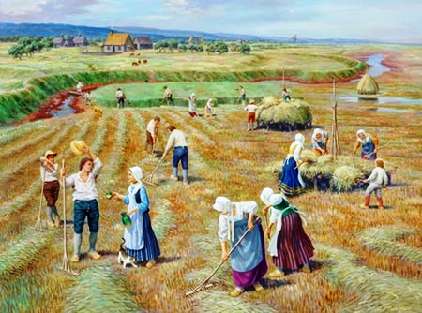
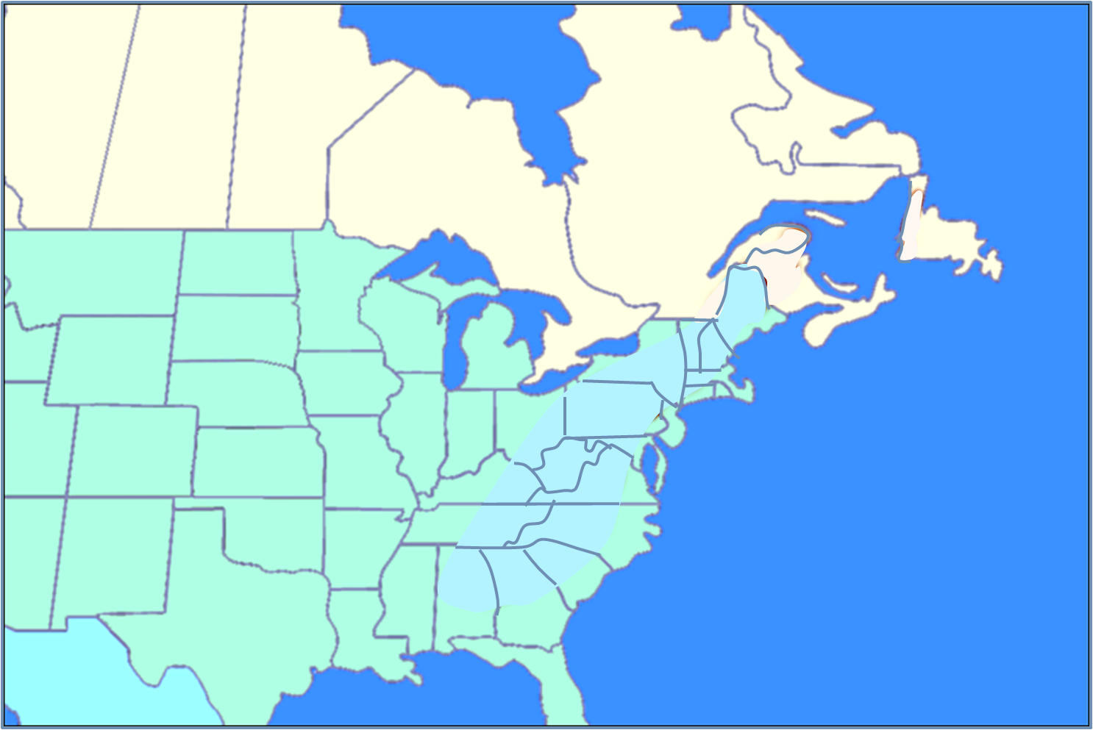
The Acadians
Migration Encore
The Acadians
Notes:
https://en.wikipedia.org/wiki/Blomidon_Formation The Blomidon Formation is a unit of Upper Triassic sedimentary rocks, which outcrops in Nova Scotia. At outcrop they reach a maximum thickness of 365 metres (1,198 ft). Cape Blomidon features distinctive reddish-coloured cliffs that reach up to 100 metres in height above the Minas Basin, which stretches out to the east.

Slide 2
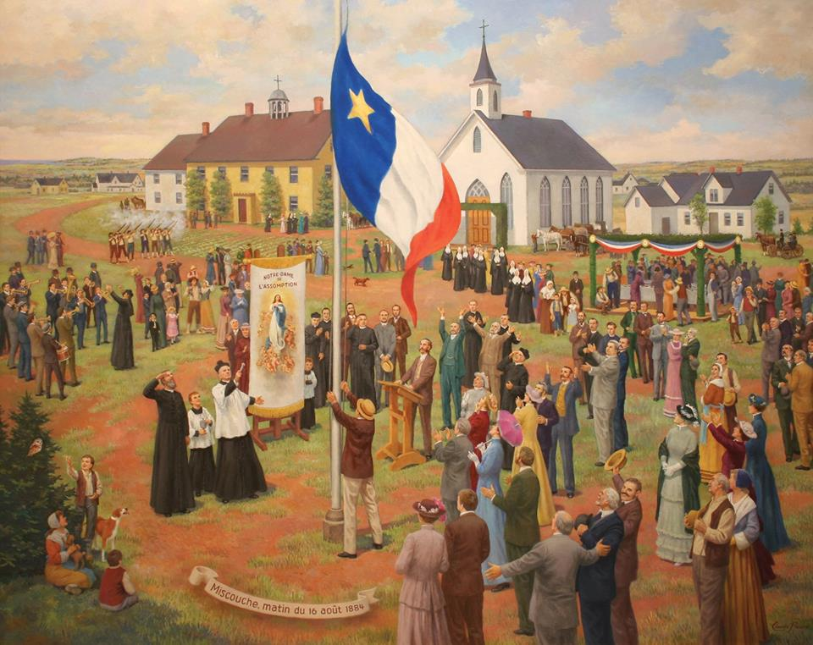
Migration Encore
Evangeline:
A Tale of Acadie
- Henry Wadsworth Longfellow
Welcome once more, my friends,
who long have been friendless and homeless,
Welcome once more to a home, that is
better perchance than the old one!
Here no hungry winter congeals our blood like the rivers;
Here no stony ground
provokes the wrath of the farmer.
Smoothly the ploughshare
runs through the soil,
as a keel through the water.
All the year round the orange-groves
are in blossom; and grass grows
More in a single night than
a whole Canadian summer.
Here, too, numberless herds run wild
and unclaimed in the prairies;
Here, too, lands may be had for the asking, and forests of timber
With a few blows of the axe are hewn
and framed into houses.
After your houses are built,
and your fields are yellow with harvests,
No King George of England
shall drive you away from your homesteads,
Burning your dwellings and barns, and stealing your farms and your cattle.
- Henry Wadsworth Longfellow
The Acadians

Slide 3
Migration Encore
The Acadians
Acadians: 1800-1950
Week 1 Setting the Stage: Before 1600
Week 2 French Migration to Acadie: 1600-1755
Week 3 Le Grand Dérangement: 1755-1756
Week 4 The Acadien Diaspora: 1755-1800
Week 5 Acadians of Canada & Louisiana: 1800-1950
Week 6 Acadians Today: 1950-today
Acadians: 1800-1950
The Acadians

Slide 4
SOME ADMINISTRATIVE BUSINESS TO ATTEND TO…
-REMINDER-
PLEASE RETURN LIBRARY
BOOKS & DVD’S
NEXT WEEK

Slide 5
SOME ADMINISTRATIVE BUSINESS TO ATTEND TO…
Thank you for the sand samples from around the world:
Denny & Terri Borczk,
Ed & Susan Luukko, &
Karen Morrison
Thanks to
Gary & Jo Bryant
for the scientific mags they collect and hold till our return each yr!

Slide 6
THE ACADIANS: 1800-1950
TODAY’S TOPICS
LOUISIANA’S FOREIGN OCCUPATION
LOUISIANA’S ACADIAN CULTURE
LOUISIANA’S ACADIAN SETTLEMENTS
a
a
a

Slide 7
THE ACADIANS: 1800-1950
REVIEW WHAT’S HAPPENED TO THE ACADIANS TO THIS POINT

Slide 8
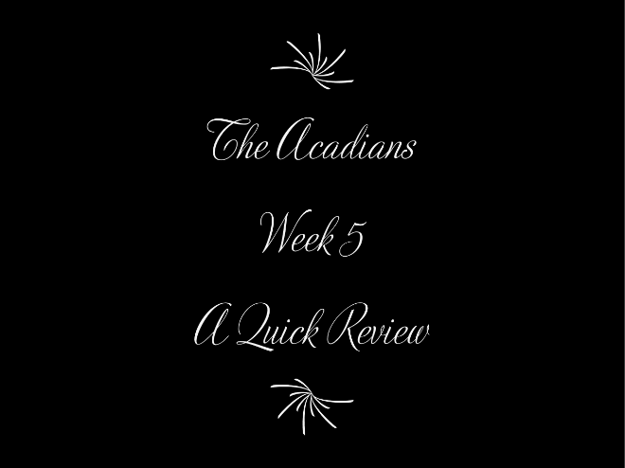
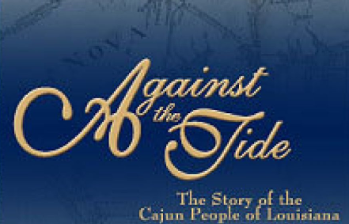
THE ACADIANS: 1800-1950
A quick review of last weeks events in the story of Acadian’s History
4:45 min Video

Slide 9
This slide is linked to start automatically and show Zachary Richard’s Week 5 Review – DO NOT DELETE
Notes:
This slide is linked to start automatically and show Zachary Richard’s Week 5 Review – DO NOT DELETE

Slide 10
THE ACADIANS: 1800-1950
WE’RE GOING TO FOLLOW THE ACADIANS TO LOUISIANA

Slide 11
Displaced acadians in louisiana
What French were already in NOLA?
Why were the spanish there & invite acadians in?
Where did the Acadians go & why?

Slide 12
Is louisiana french or spanish WHEN ACADIANS ARRIVE?

Slide 13
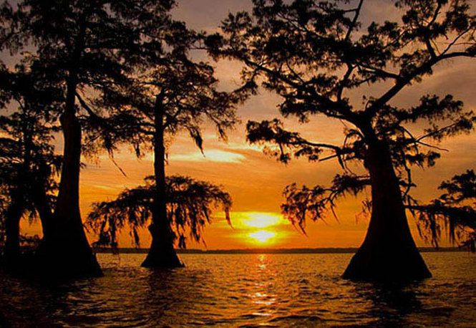
FRENCH & SPANISH OWNERSHIP OF LOUISIANA
1660s - The French first explored Lower Louisiana (AR, LA, MS, & AL) and a few trading posts were established in following years
1682 - had originally been claimed and controlled by
a
France, which had named it “La Louisiane” in honor of King Louis XIV
1699 - serious attempt at settlement began with the establishment of Fort Maurepas, near modern Biloxi, Mississippi. A colonial government soon emerged, with its capital originally at Mobile, later at Biloxi and finally in
1722 - Capital moved to New Orleans

Slide 14
FRENCH & SPANISH OWNERSHIP OF LOUISIANA
1762 – As negotiations began to end the Seven Years' War, Louis XV of France secretly proposed to his cousin, Charles III of Spain, that France give Louisiana to Spain
a
1764 – Spain's acquisition of Louisiana from France was formally announced, however,…
Spain manages Louisiana from Havana and hires French officials in Louisiana to manage the country
1768 – (new Gov) Antonio de Ulloa becomes the first Spanish governor of Louisiana. He is forced to leave by a pro-French mob in the Rebellion of 1768

Slide 15
FRENCH & SPANISH OWNERSHIP OF LOUISIANA
1769 – (new Gov) Alejandro O'Reilly suppresses the rebellion, executes its leaders, and sends some plotters to prison in Havana. He establishes Spanish law
1770 – (new Gov) Luis de Unzaga frees the imprisoned
a
1800 – Napoleon secretly acquires Louisiana, but Spain continues to administer it
1803 – On November 30, 1803, Spanish officials formally convey Louisiana to France
1803 – France turns over New Orleans, the historic colonial capital, to the United States on December 20, 1803

Slide 16
SOUND FAMILIAR?
MULTIPLE GOVERNORS,
MULTIPLE COUNTRY OWNERSHIP

Slide 17
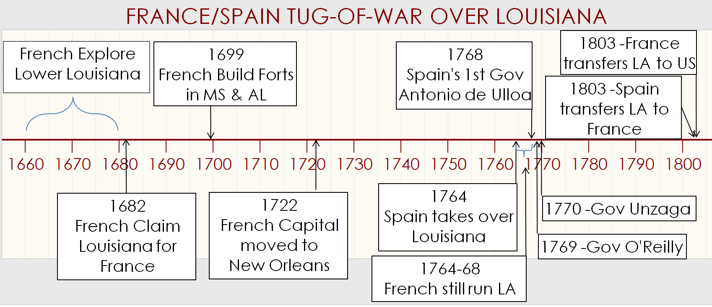
FRANCE/SPAIN TUG-O-WAR OVER LOUISIANA
At the time of Acadian arrival – Louisiana has Spanish ownership but French Rule!
108 YEARS OF FRENCH RULE
35 YEARS

Slide 18
Where did JOSEPH BROUSSARD SETTLE?

Slide 19
BEAUSOLEIL ARRIVES WITH FIRST ACADIAN FAMILIES
Joseph Broussard, Beausoleil, was captured by the British in 1762 and was sent to prison in Halifax
Released in 1764 he contracted 3 ships & took 193 Acadians first to Saint
a
Where is the Attakapas District?
Domingue and then on to Louisiana
He arrived in Feb 1765 & the French Commissaire provided the immigrants w/ food, tools, muskets & building materials
Needing a dependable supply of food in New Orleans, it was agreed that the newly arriving Acadians would settle in the Attakapas District on land owned by a former French Officer
Notes:
From http://attakapasgazette.org/vol-3-2014/initial-acadian-settlement/ :
The Beausoleil group remained in New Orleans for about seven weeks. Nine baptisms and three marriages were performed in the city’s Catholic Church.[6] An attempt was made to redeem outdated French Canadian card-monies, a type of promissory notes that was held by thirty-two destitute Acadians.[7] Discussions and agreements concerning a settlement location took place between officials, established colonists, and the newcomers. Supplies were issued to the impoverished recent immigrants.[8] Preparations were completed for a move to a new, southern Acadian homeland.
from C. Brasseaux’s book “Founding of New Acadia” pg 75:
Several Creole families had migrated from Fort Toulouse & Mobil. The treeless Attakapas region could be settled quickly and their grasslands could support cattle & New Orleans needed a dependable supply of cattle. Attakapas would not be exposed to the front lines of any British raids from the east.
Eight leaders of the Beausoleil party agreed to raise cattle property of Antoine Bernard Dauterive, retired French military officer and a large Attakapas landholder. Under the terms of the contract, Acadians agreed to tend Dauterive’s livestock for 6 yrs; in consideration for their labor, they would receive not only half of the herd’s increase but also the land grant Dauterive and his partner, Edouard Masse, had acquired in 1760

Slide 20
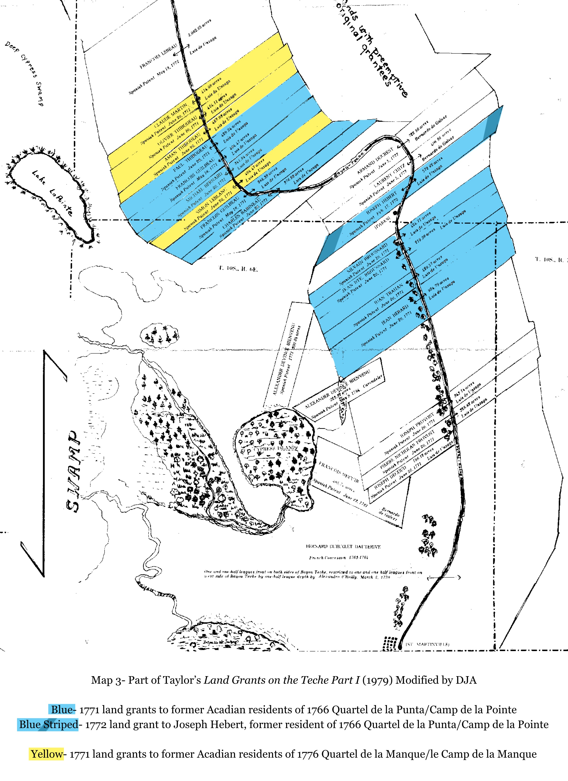
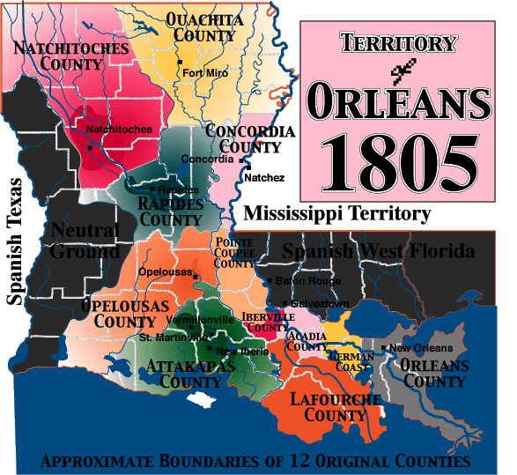
BEAUSOLEIL ARRIVES WITH FIRST ACADIAN FAMILIES
SPANISH TEXAS TO WEST
NEUTRAL
AREA
WEST FLORIDA PARISH
Notes:
From http://www.thecajuns.com/oldnew.htm:
Divisions of Colonial French and Spanish Louisiana
In 1721, French Colonial Louisiana was divided into nine districts: Alibamos, Mobile, Biloxi, New Orleans, Natchez, The Yazoo, Illinois, Arkansas and Natchitoches [which included Ayoyelles].
In 1769, O'Reilly abolished the old organizations and established a new political and military unit which he called the Province of Louisiana. The Province was divided into eleven districts with a Commandant who was usually taken from the army or the militia. The eleven districts [also called Posts] were: Illinois, Natchitoches, first half of the German Coast [parish of St. Charles]; second half of the German Coast [parish of St. John the Baptist], Pointe Coupee [including Avoyelles], Opelousas [included Attakapas], Iberville Coast, the Fourche of Chitimachas, Kabahan [Cabanocey], Rapides [in 1805, Avoyelles was combine with Rapides and became Rapides Country. In December 1807, the Avoyelles District of Rapides became Ayoyelles Parish] and St. Genevieve.
In 1763, The Mississippi Valley east of the river, except for New Orleans, was lost to England at the end of the French and Indian War. Galvez later recaptured Baton Rouge and the West Florida parishes. In 1803, under American Control, Louisiana was divided into the Orleans Territory and the District of Louisiana which later became all the states west of the Mississippi River. In 1805, the Orleans Territory was divided into 12 Counties [see map] and the Counties divided into Parishes in 1807. In 1812, the Orleans Territory became the State of Louisiana.

Slide 21
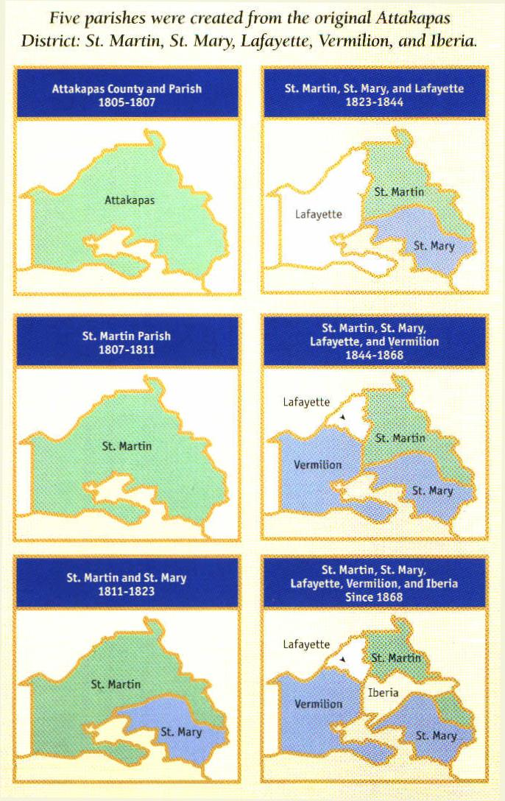
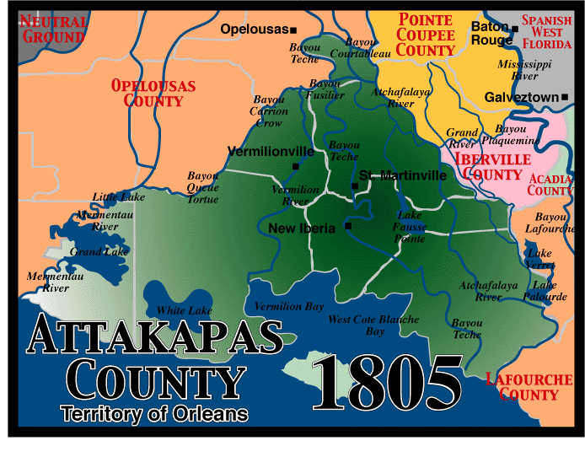
BEAUSOLEIL ARRIVES WITH FIRST ACADIAN FAMILIES
3 important rivers/bayous run thru here
ATTAKAPAS
DISTRICT
Territory of Orleans

Slide 22
BEAUSOLEIL ARRIVES WITH FIRST ACADIAN FAMILIES
Atchafalaya River
Vermillion Bayou
ATTAKAPAS
DISTRICT
Territory of Orleans
Bayou Teche

Slide 23
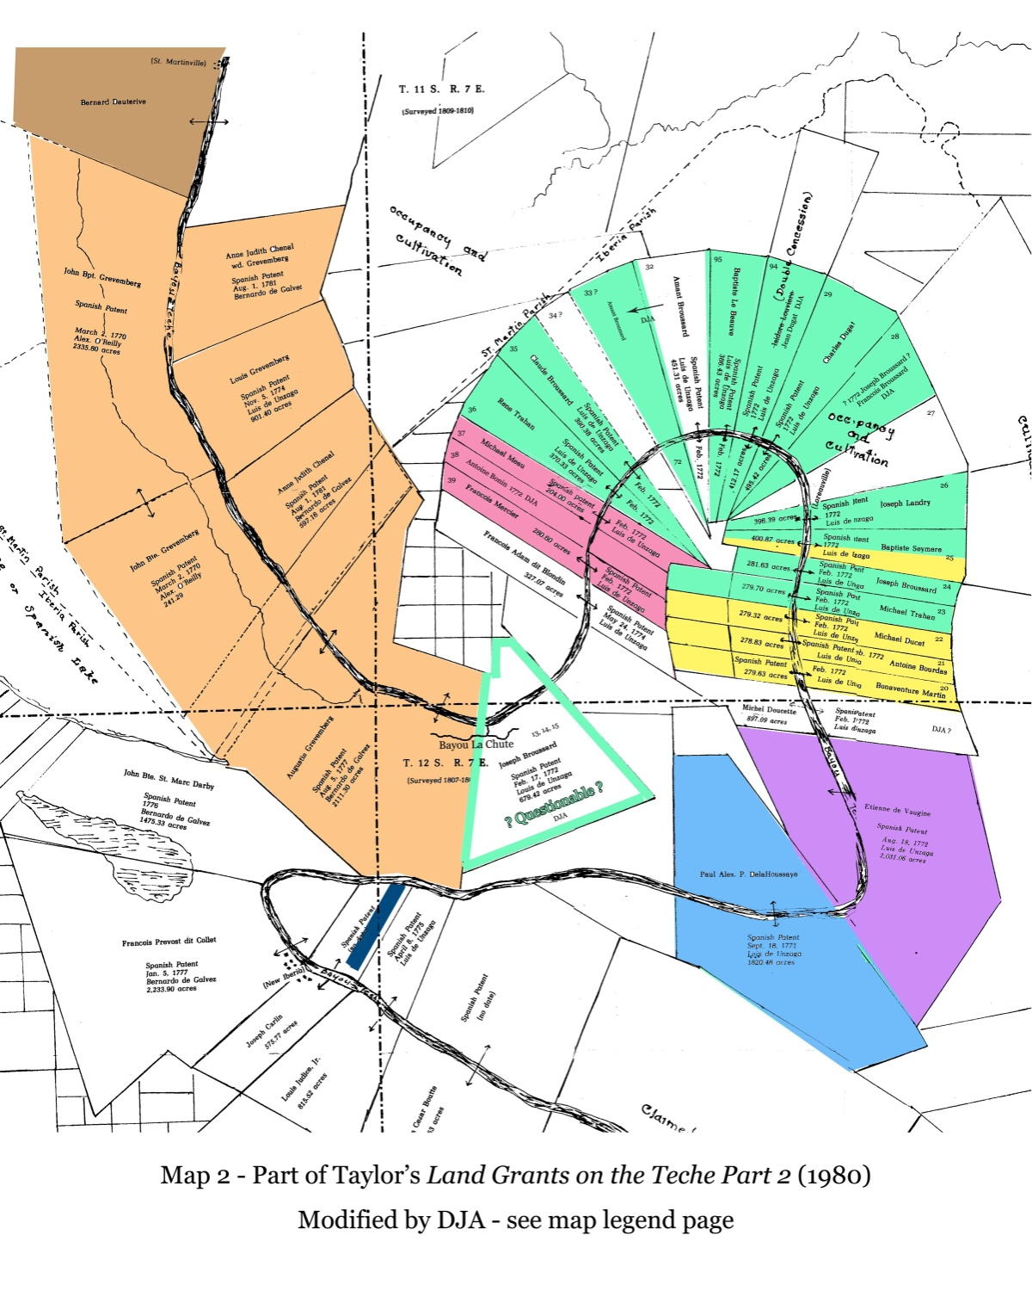
BEAUSOLEIL ARRIVES WITH FIRST ACADIAN FAMILIES
Let’s look at a map of the bend in Bayou Teche
Amazingly, historians have sorted thru Spanish & French land grants & deed records & have isolated where first settlements were located
SIDE NOTE: Fr. Jean-Francois accompanied the Halifax Acadians to Attakapas and christened the post, “New Acadia”
a
Copyright 2013-14 © The Attakapas Historical Association

Slide 24
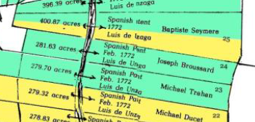
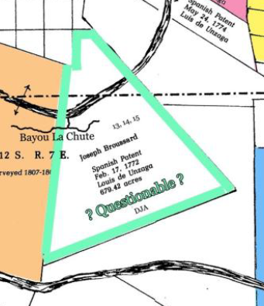
BEAUSOLEIL ARRIVES WITH FIRST ACADIAN FAMILIES
Let’s look at a map of the bend in Bayou Teche
Amazingly, historians have sorted thru Spanish & French land grants & deed records & have isolated where the first settlements were located
a
So which location is the actual 1st settlement?
Find out NEXT WEEK!
Copyright 2013-14 © The Attakapas Historical Association

Slide 25
Where did LATER Acadian immigrants go?

Slide 26
ONGOING ACADIAN ARRIVALS & NEW SETTLEMENTS
Early arriving Acadians dealt with an acting French Governor
Prior to March 1768, the French Governor of Louisiana did what was best for the Acadians – let them resettle
a
where THEY wanted
Let’s look at where these early settlements are located…
Notes:
The settlement of Natchitoches (along the Red River in present-day northwest Louisiana) was established in 1714 by Louis Juchereau de St. Denis, making it the oldest permanent settlement in the territory that then composed the Louisiana colony.

Slide 27
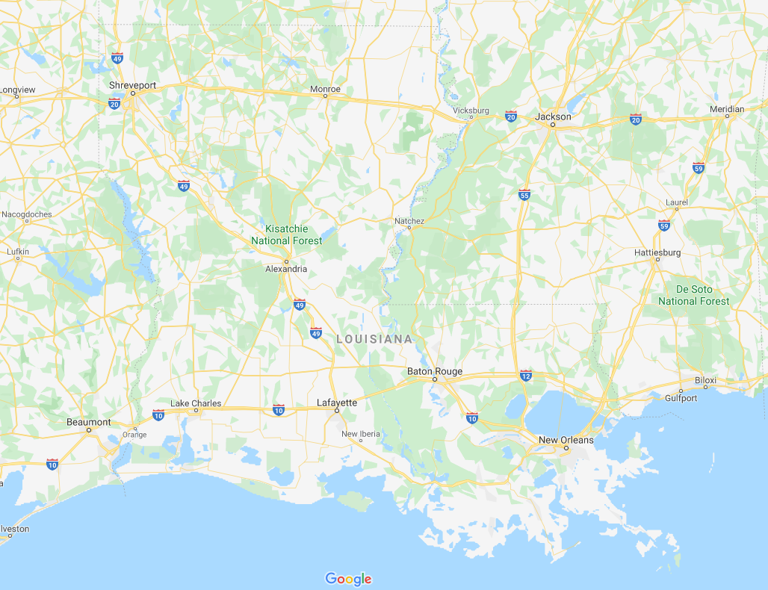
ACADIAN SETTLEMENTS IN LOUISIANA
Natchitoches
Founded 1714
LOUISIANA
MISSISSIPPI
TEXAS
GULF OF MEXICO
Notes:
Settlements before 1785 is actually 1766
The settlement of Natchitoches (along the Red River in present-day northwest Louisiana) was established in 1714 by Louis Juchereau de St. Denis, making it the oldest permanent settlement in the territory that then composed the Louisiana colony.
Natchitoches was founded as a French outpost on the Red River for trade with Spanish-controlled Mexico; French traders settled there as early as 1699. The post was established near a village of Natchitoches Indians, after whom the city was named. Early settlers were French Catholic immigrants and creoles (originally meaning those ethnic French born in the colony). French creoles acquired lands that were developed in the antebellum years as cotton-producing Magnolia Plantation and Oakland Plantation.
The French settlement had two purposes: to establish trade with the Spanish in Texas via the Old San Antonio Road (sometimes called El Camino Real, or Kings Highway)—which ended at Nachitoches—and to deter Spanish advances into Louisiana. The settlement soon became a flourishing river port and crossroads. Sugar cane plantations were developed first. In the nineteenth century, cotton plantations were developed along the river. Over time, planters developed large plantations but also lived in fine homes in a growing town, a pattern repeated in New Orleans and other places.

Slide 28
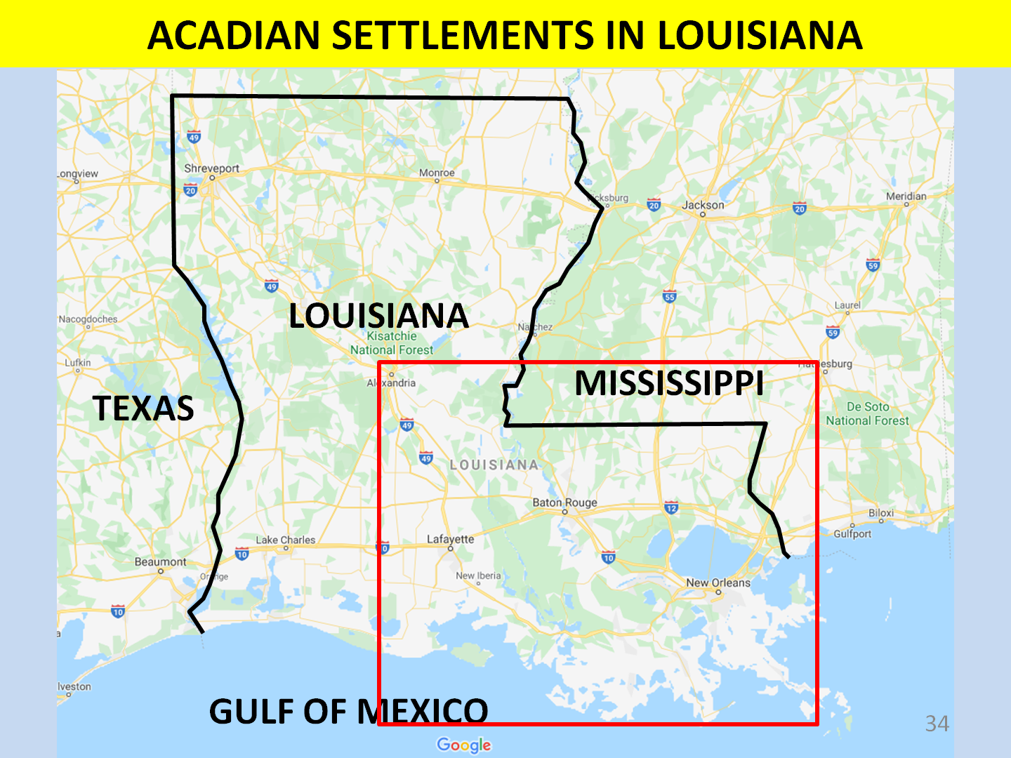
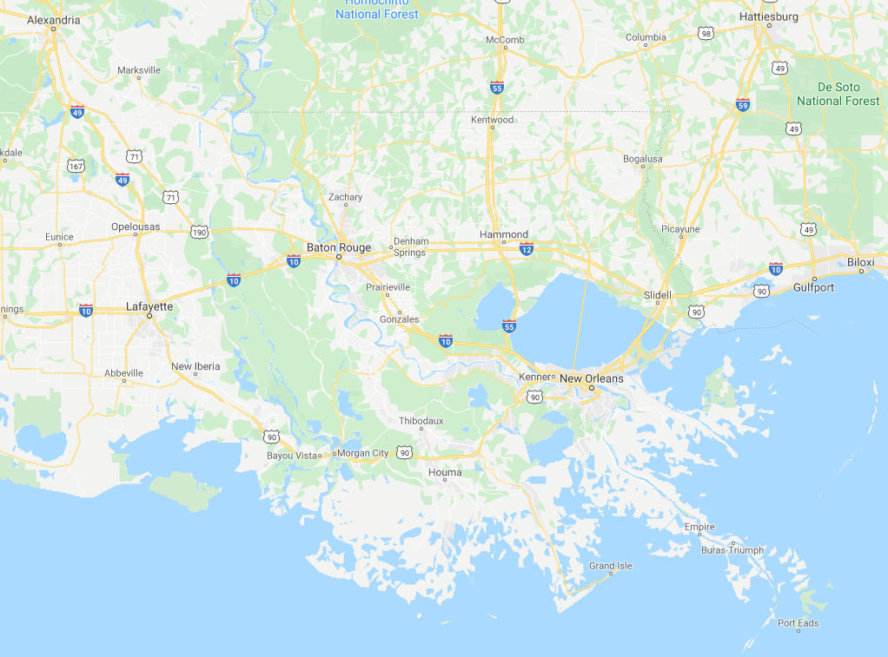
ACADIAN SETTLEMENTS IN LOUISIANA
MISSISSIPPI
LOUISIANA
Opelousas
Baton Rouge
Lafayette
New Orleans
Notes:
Settlements before 1785 is actually 1766 – see maps on side

Slide 29
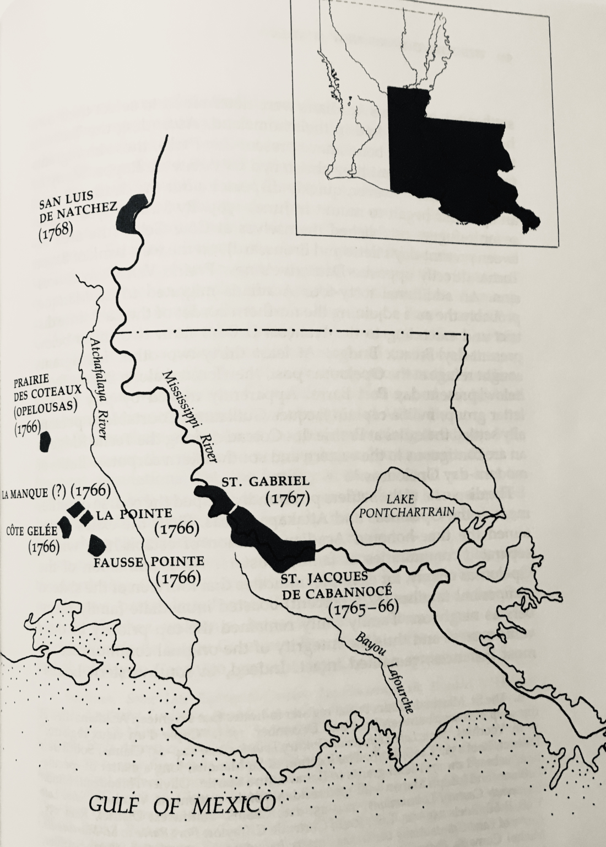
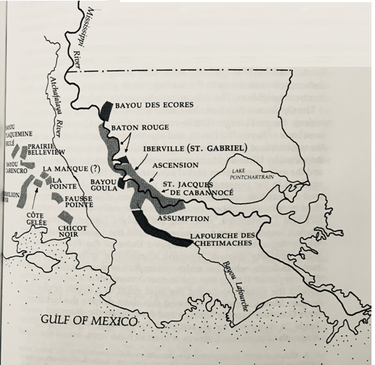
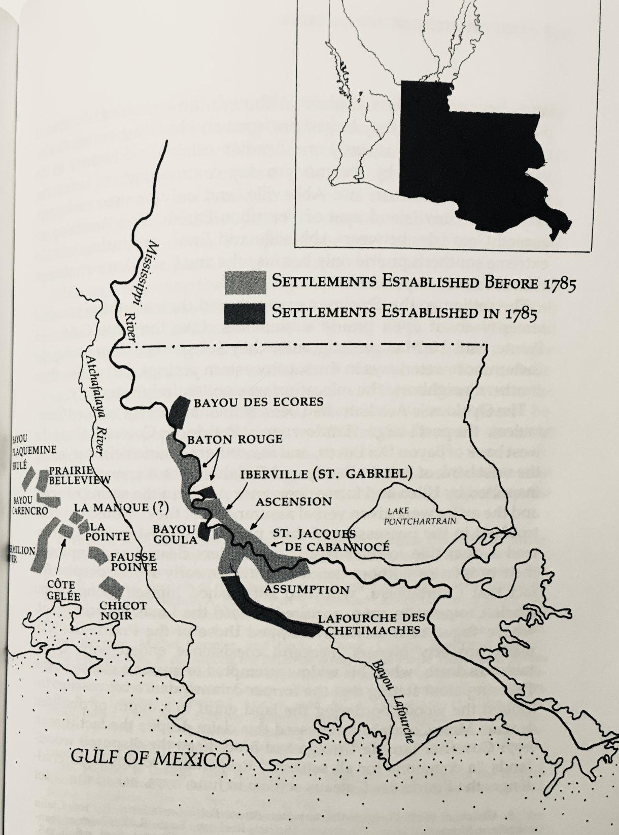
ACADIAN SETTLEMENTS IN LOUISIANA
Mississippi River
Baton Rouge
Lafayette
New Orleans
Bayou Teche
Mississippi
Atchafalaya
GULF OF MEXICO
Bayou Lafourche
Notes:
Settlements before 1785 is actually 1766 – see maps on side

Slide 30
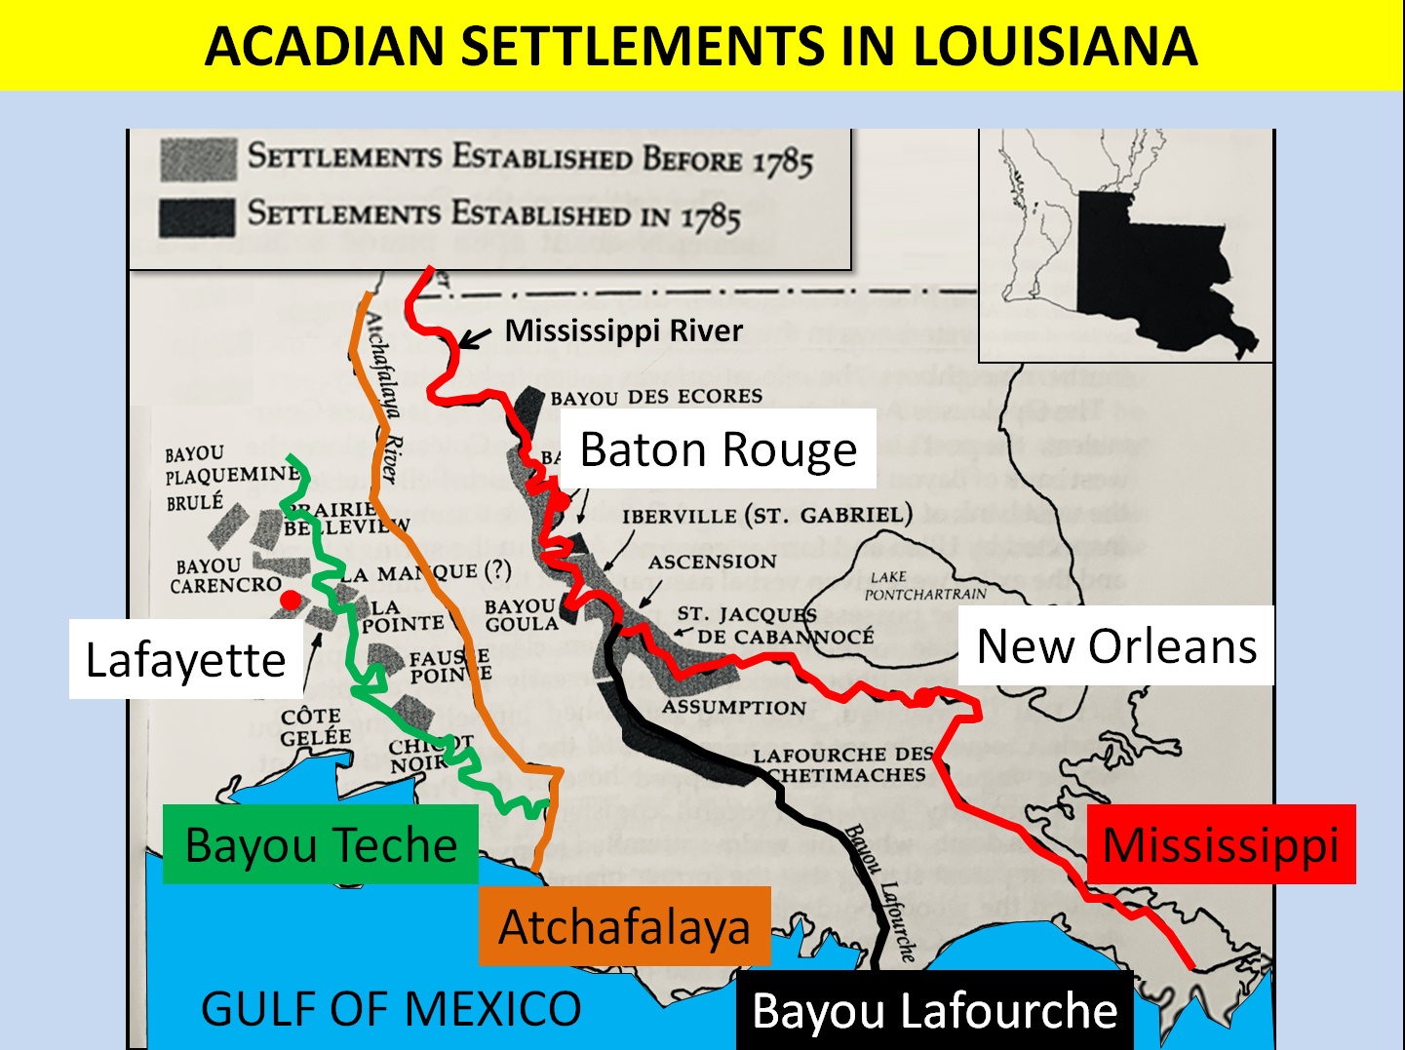
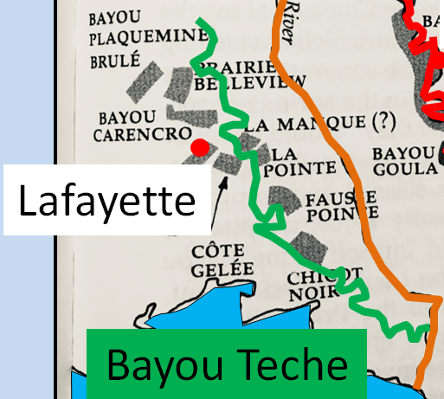
ACADIAN SETTLEMENTS IN LOUISIANA

Slide 31
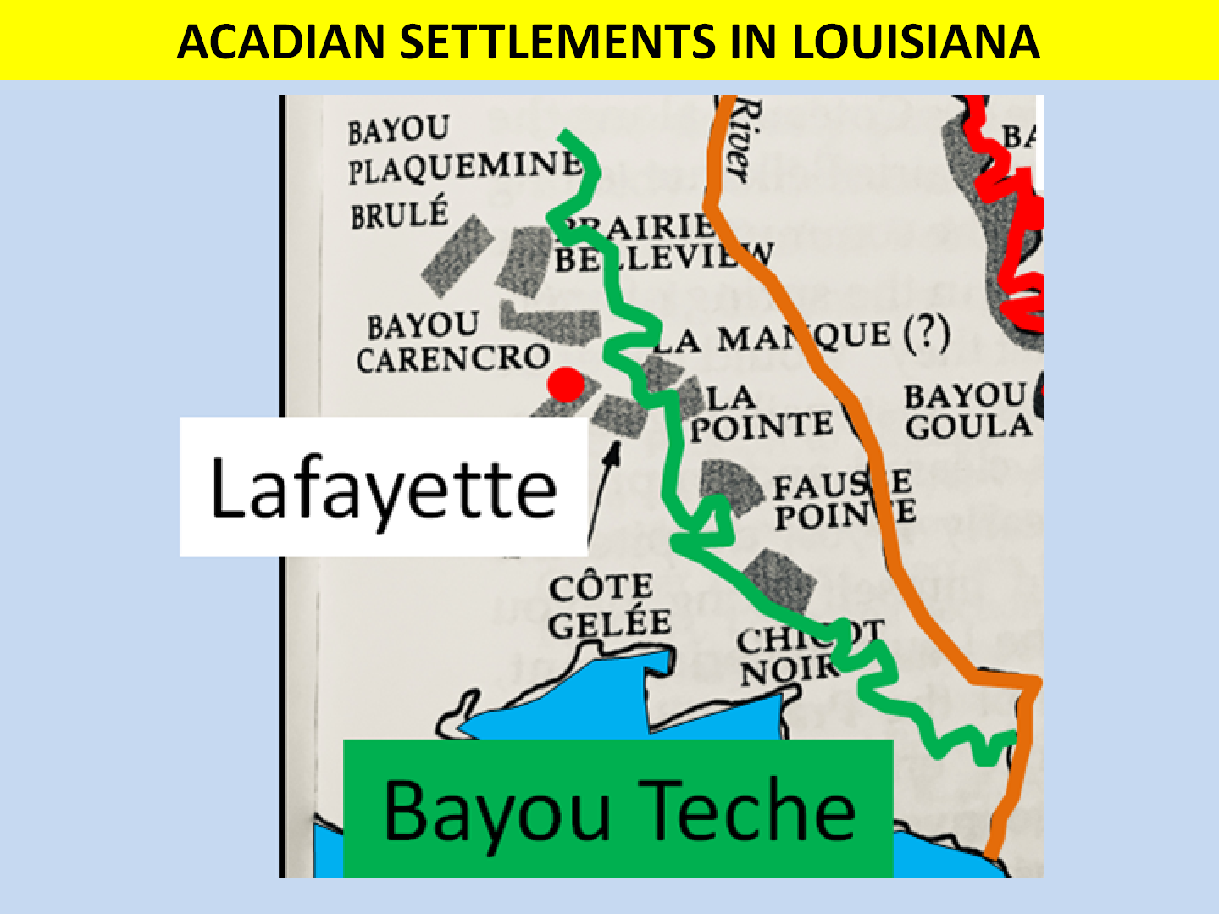
ACADIAN SETTLEMENTS IN LOUISIANA
~1766-Opelousas Post (Port Barre)
Late 1760s-Bayou Carencro
~1766-La Manque (Breaux Bridge)
1775-Prairie des Coteaux (Opelousas)
1765-La Pointe de Repos (Parks)
1765-Fausse Pointe (Loureauville)
1766-Côte Gelée (Broussard)
1778-Chicot Noir (Jeanerette)

Slide 32
ACADIAN SETTLEMENTS IN LOUISIANA
Remember: “Prior to March 1768, the French Governor of Louisiana did what was best for the Acadians – let them resettle where THEY wanted”
Earliest 5 settlements are called
a
“le dernier camp d’en bas”
Settlement pattern generally was
Acadians select their own location
Bring 30-50 family members
Spread out family clusters along a waterway (bayou or coulee)
Top priority was family unity

Slide 33
ONGOING ACADIAN ARRIVALS & NEW SETTLEMENTS
In March 1768, a new Spanish Governor, Antonio de Ulloa arrives
Although sympathetic to the plight of arriving Acadians, he did what was best to protect Louisiana from any future
a
British attack – he told the Acadians where HE wanted them to settle – where settlements bolster colonial defenses
Given that to the east of the Mississippi was British Territory, Gov. Ulloa would encourage settlements on or near the Mississippi River and particularly near forts he was building

Slide 34
ONGOING ACADIAN ARRIVALS & NEW SETTLEMENTS
This means that subsequent arrivals will likely be settled to Louisiana’s eastern boundary – as a buffer zone
1766 – 224 exiles from Maryland are settled in St. James & Ascension parishes
a
Let’s look at where these eastern settlements are located…
1767 – 210 more exiles from Maryland are sent to Ft. St. Gabriel
1768 – 149 more exiles, origination unknown, are settled at Ft. San Luis near Natchez
The Spanish treated the Acadians well & tended to their needs; the Acadians worked hard for the Spanish

Slide 35
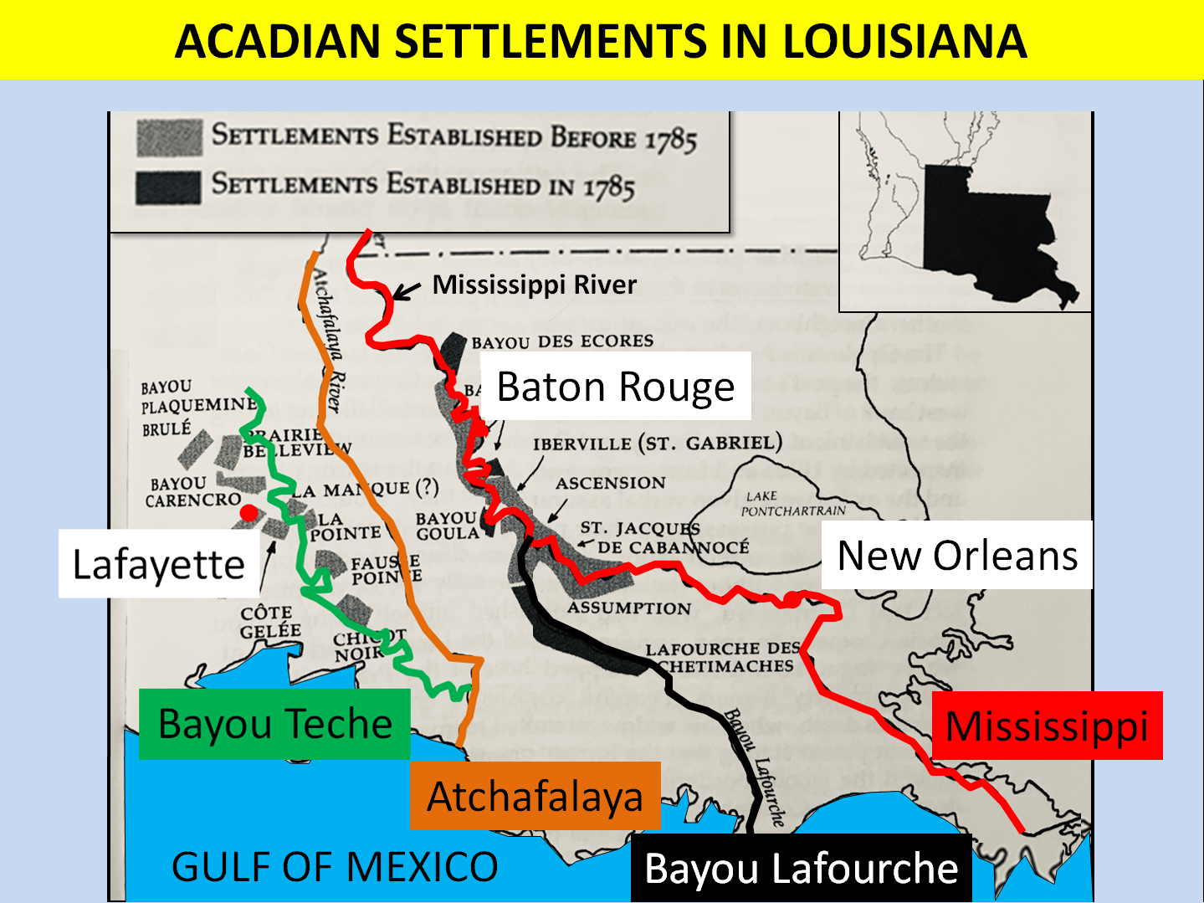
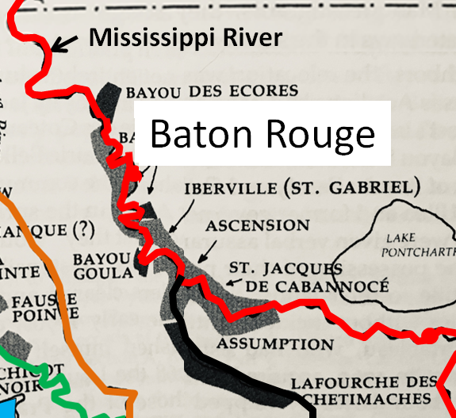
ACADIAN SETTLEMENTS IN LOUISIANA

Slide 36
Mississippi Settlements AFTER to 1785:
Bayou des Ecores
Baton Rouge
Bayou Goula
Mississippi Settlements PRIOR to 1785:
Baton Rouge
St. Gabriel
Ascension
Cabannocé
Assumption
a
But this doesn’t show where Fort St. Luis de Natchez is located…
In 1785
another 1,598 Acadian immigrants arrived from France
Bayou Lafourche Settlements AFTER to 1785

Slide 37
ACADIAN SETTLEMENTS IN LOUISIANA
Ft. San Luis de Natchez
(Vidalia, La)
Vicksburg, MS
LOUISIANA
MISSISSIPPI
TEXAS
Baton Rouge
New Orleans
Lafayette
GULF OF MEXICO
Notes:
Settlements before 1785 is actually 1766 – see maps on side

Slide 38
1920-50
Bayou settlementS

Slide 39
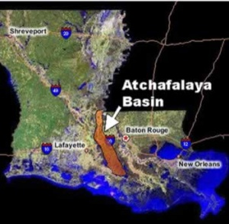
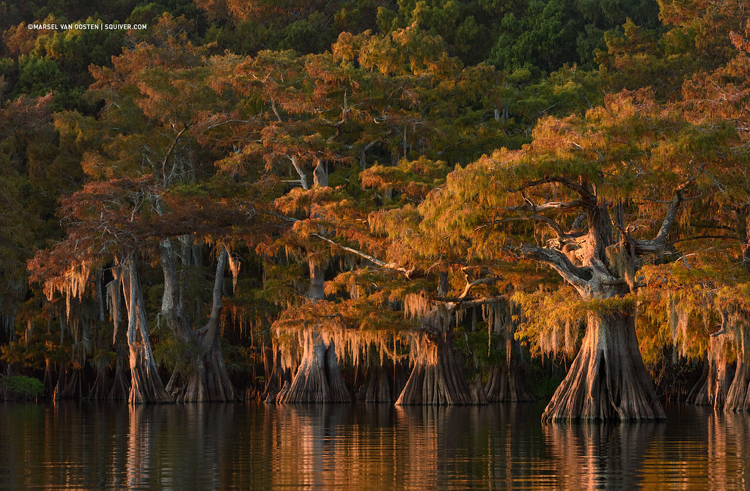
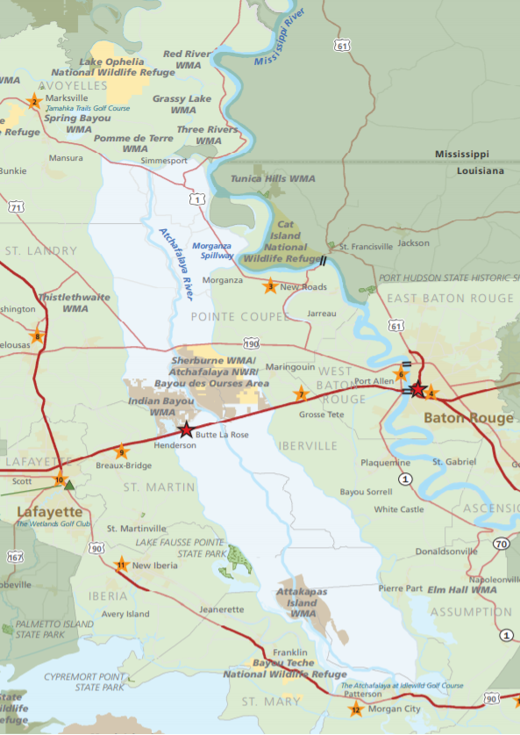
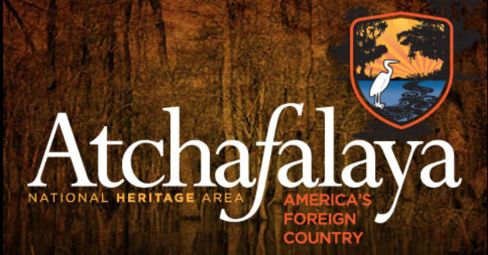
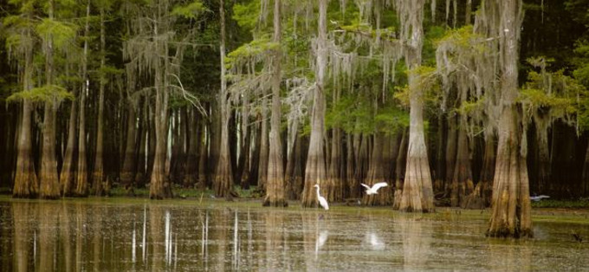
AT-CHA-FA-LA-YA BASIN
MISSISSIPPI
RIVER
Baton Rouge
Lafayette
ATCHAFALAYA
RIVER

Slide 40
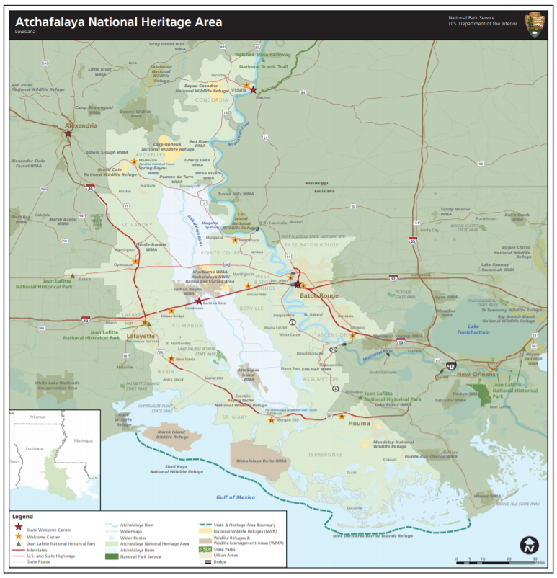
BROADER ATCHAFALAYA NAT’L HERITAGE AREA

Slide 41
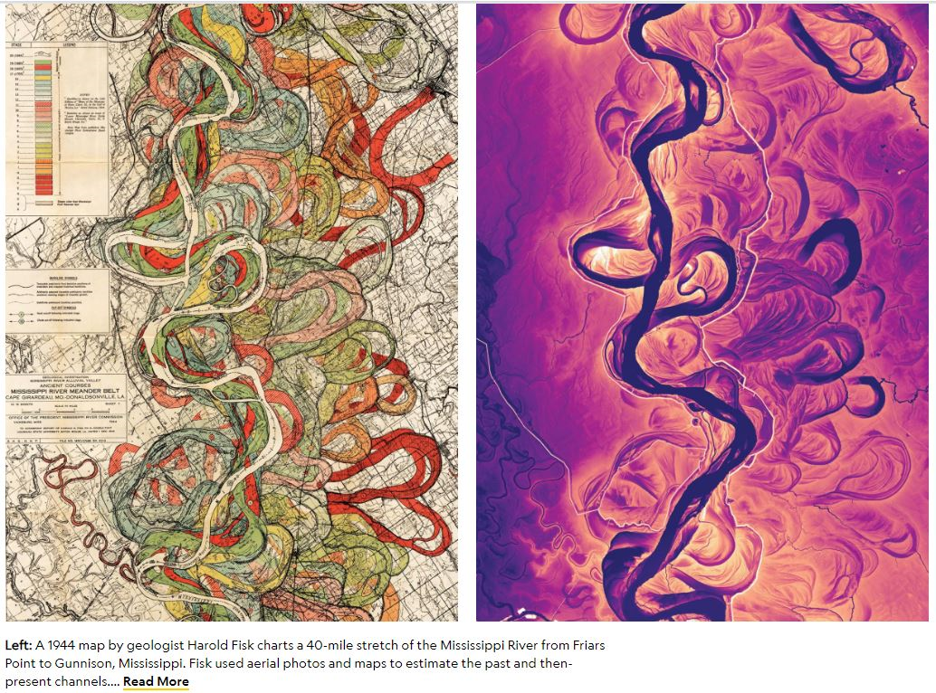
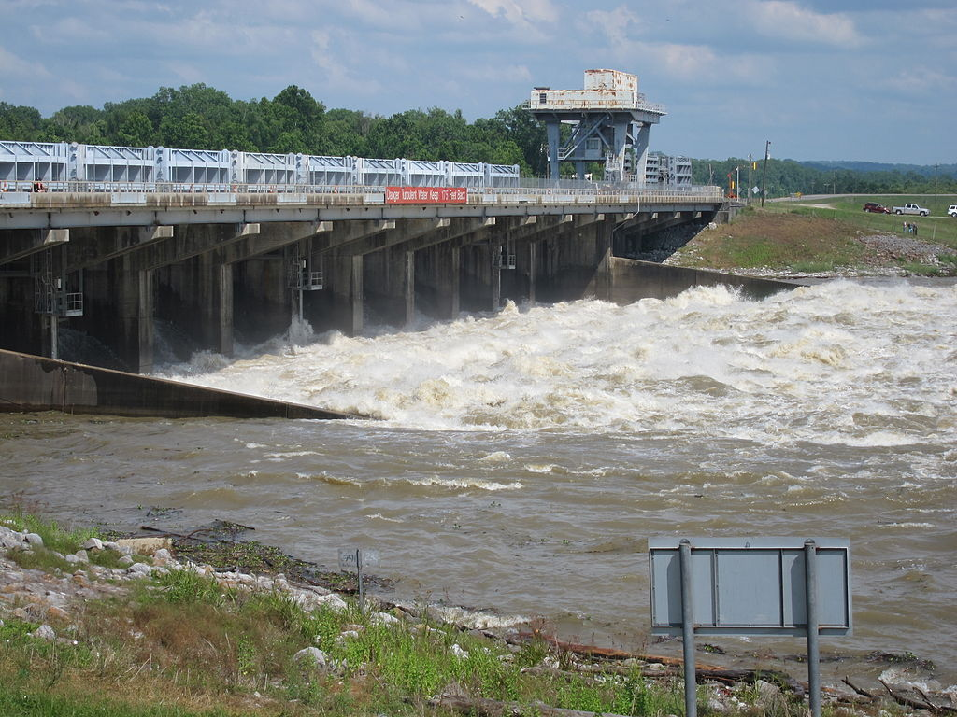
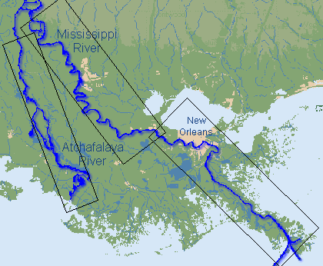
AT-CHA-FA-LA-YA BASIN
Atchafalaya means “Long River” in the Choctaw language
The Basin is approximately 150 miles long and 20 mi wide
It is as large as the Everglades & is America’s greatest river basin swamp
It is a flood control area for the Mississippi River & regularly drains 30% of the Mississippi R
To keep the Mississippi from overflowing it’s banks, in some years more water is diverted
This is a famous drawing by geologist Harold Fisk made in 1944 where he used all available data to plot the different paths the Mississippi River had taken over time.
The River changes paths a lot…and changes about every 1,000 yrs
a
Historically, this natural process of course change has occurred about every 1,000 years, and is overdue. The Mississippi Flood of 1973 almost caused the control structure to fail.
Some researchers believe the likelihood of this event increases each year, despite manmade artificial control efforts.
Today’s Mississippi River Path
In 1953, the U.S. Army Corps of Engineers concluded that the Mississippi River could change its course to the Atchafalaya River by 1990 if it were not controlled, since this alternative path to the Gulf of Mexico through the Atchafalaya River is much shorter.
Mississippi
Length
Control Structure discharging Mississippi River water into the Atchafalaya River
Atchafalaya
Length
Automatic Lidar
Hand drawn
Notes:
Everglades is America’s largest
Atchafalaya Basin
From Wikipedia, the free encyclopedia
Jump to navigationJump to searchThis article is about a wetlands basin in Louisiana. For other uses of the term "Atchafalaya", see Atchafalaya (disambiguation).
A swamp in the Atchafalaya Basin.
The Atchafalaya Basin, or Atchafalaya Swamp (/əˌtʃæfəˈlaɪə/; Louisiana French: L'Atchafalaya, [latʃafalaˈja]), is the largest wetland and swamp in the United States. Located in south central Louisiana, it is a combination of wetlands and river delta area where the Atchafalaya River and the Gulf of Mexico converge. The river stretches from near Simmesport in the north through parts of eight parishes to the Morgan City southern area.
The Atchafalaya is different among Louisiana basins because it has a growing delta system (see illustration) with wetlands that are almost stable.^{[1]} The basin contains about 70% forest habitat and about 30% marsh and open water. It contains the largest contiguous block of forested wetlands remaining (about 35%) in the lower Mississippi River valley and the largest block of floodplain forest in the United States. Best known for its iconic cypress-tupelo swamps, at 260,000 acres (110,000 ha), this block of forest represents the largest remaining contiguous tract of coastal cypress in the United States.^{[2]}
Contents
Geographical features[edit]
Time lapsed animation of basin from 1956 to 1993.
The Atchafalaya Basin and the surrounding plain of the Atchafalaya River is filled with bayous, bald cypress swamps, and marshes, which give way to brackish estuarine conditions, and end in the Spartina grass marshes where the Atchafalaya River meets the Gulf of Mexico. It includes the Lower Atchafalaya River, Wax Lake Outlet, Atchafalaya Bay, and the Atchafalaya River and bayous Chêne, Boeuf, and Black navigation channel. See maps and photo views of the Atchafalaya Deltas centered on 29°26′30″N 91°25′00″W.
The basin, which is susceptible to long periods of deep flooding, is sparsely inhabited. The Basin is about 20 miles (32 km) in width from east to west and 150 miles (240 km) in length.^{[3]} The Basin is the largest existing wetland in the United States with an area of 1,400,000 acres (5,700 km²), including the surrounding swamps outside of the levees that historically were connected to the Basin.^{[4]} The Basin contains nationally significant expanses of bottomland hardwoods, swamplands, bayous, and back-water lakes.^{[5]} The Basin's thousands of acres of forest and farmland are home to the Louisiana black bear (Ursus americanus luteolus), which has been on the United States Fish and Wildlife Service threatened list since 1992.^{[6]}
The few roads that cross the Basin follow the tops of levees. Interstate 10 crosses the basin on elevated pillars on a continuous 18.2 mile (29,290 m) bridge from Grosse Tete, Louisiana, to Henderson, Louisiana, near the Whiskey River Pilot Channel at 30°21′50″N 91°38′00″W.
The Atchafalaya National Wildlife Refuge was established in 1984 to improve plant communities for endangered and declining species of wildlife, waterfowl, migratory birds and alligators.^{[7]}
Basin geology and flooding[edit]
The Atchafalaya Basin has a long relationship with the Mississippi River throughout the Holocene epoch, and the geology of the modern basin is a direct manifestation of that relationship.^{[2]} The Atchafalaya Basin has been part of three historic depositional lobes (Sale-Cypremort, Teche, and Lafourche lobes) of the Mississippi River Delta Plain that formed south Louisiana, and active delta lobe development is currently occurring at the mouth of the Atchafalaya River and Wax Lake Outlet. The geology of the current basin has been driven by flows of Atchafalaya River water and sediment that flowed into open water areas through relict Mississippi River distributary channels.^{[2]}
The Atchafalaya Basin contains lacustrine and coastal delta landscapes. Natural filling of the basin with sediment was accentuated with the building of the flood control levees that were completed in the 1940s. After the levees, sediment was directed into an area about one-third the size of the original basin. An example of the lacustrine delta development can be seen at Lake Fausse Pointe State Park, where levees severed the connection between the Grand Bayou distributary and the lake, and delta development was frozen in time.^{[2]}
Geologically, the Atchafalaya River has been a backswamp, low area between the paths of the Mississippi River through the process of delta switching, which has built the extensive delta plain of Louisiana. The natural levees of the Mississippi River (on the east) and the levees along its previous course (now Bayou Teche) on the west define the Atchafalaya Basin.^{[8]} The central basin is further bordered by man-made levees designed to contain and funnel floodwaters released from the Mississippi at the Old River Control Structure and the Morganza Spillway south toward Morgan City and eventually to the Gulf of Mexico. Historically there were small and few channel connections to the Mississippi River. The historic lack of significant channel connection indicates that the Atchafalaya River Basin did not receive significant sediment from the Mississippi except during large floods.
During the mid-19th century, manmade channel alterations, including the removal of a large log jam and dredging, permanently connected the Atchafalaya River to the Mississippi River. From then until the completion of the Old River Control Structure in 1963, the Mississippi was increasingly diverting flow into the shorter and steeper path of the Atchafalaya channel. By law, a regulated 30 percent of the latitudinal flow water from the Mississippi, Red and Black rivers is diverted into the Atchafalaya at the Old River Control Structure. This flow diverts on average 25 percent of the Mississippi River flow down the Atchafalaya.
In times of extreme flooding, the US Army Corps of Engineers may open the Morganza Spillway and other spillways to relieve pressure on levees and control structures along the Mississippi. On May 13, 2011, in the face of a rising Mississippi River that threatened to flood New Orleans and other heavily populated parts of Louisiana, the USACE ordered the Morganza Spillway opened for the first time since 1973. This water floods the Atchafalaya Basin between the levees along the western and eastern limits of the Morganza and Atchafalaya basin floodways.^{[9]}
Further information: Atchafalaya River
Degradation of the swamps[edit]
The control of the river's floods, along with those of the Mississippi River, has become a controversial issue in recent decades. The US Geological Survey (USGS) reports that Mississippi River delta salt marshes are wetlands degrading at a rate of 29 square miles per year.^{[10]} The Atchafalaya River Deltas are the only locations of land growth along the Louisiana Gulf Coast.
During the early 20th century, the Atchafalaya River Basin was designated as a spillway for floods of the Mississippi River. In order to facilitate this emergency plan without flooding adjacent agriculture and towns, protective levees were built dividing the Atchafalaya Basin Floodway from large portions of the historic swamp boundaries. A central channel was dredged through some existing channels and in some places through swamp forest. At that point the isolated Atchafalaya River Basin was permanently connected to a very large, sediment-rich river.^{[11]}
From 1850 to 1950 open water decreased from 490 km² to 290 km². From 1950 to 2005 the amount of open water decreased to 190 km².^{[11]} When the Atchafalaya Basin flow plan was implemented (1950–1974), 30 percent of the total Atchafalaya River flow was designated to be directed off the main channel, 15 percent to the east and 15 percent to the west side. As a result of the Atchafalaya River channel bed incision, in the early 21st century the flow distribution is 13 percent of the total flow, with a flow distribution of 7 percent to the east side and 6 percent to the west side as reported by the USGS. This decrease in flow across the floodplain, in conjunction with high organic deposition from trees and floating vegetation and high water temperature, has resulted in large areas of low-dissolved oxygen water. Where once the water was black (1850), the water became brown (1927). Where the water was formerly brown (1927), it is now black (2009).^{[12]}
During the period of 1960–1980, oil and gas exploration and development in Louisiana increased dramatically. Numerous large access canals and pipeline canals were dredged through deep swamp areas, across bayous, and across the Atchafalaya River. In some areas of the Basin, there are 2 km or more of access canals to every 1 km of natural bayou. These large channels (30–50 m wide by 2–3 m deep) have fundamentally changed the hydrology of the swamps. Deep swamp areas that were hydraulically isolated from sediment were connected directly to the river and its sediment and suffered rapid filling. The USGS has measured sediment deposition rates of up to 30 cm per year where these channels enter open water, and 4 cm per year on adjacent floodplains. In some places natural bayous have filled in due to flow capture by access canals.
Spoil material from the canals was deposited adjacent to the canals, further impeding the natural flow across the floodplain.
The Bayou Chene Community[edit]
From 1830 to 1953, the community of Bayou Chene thrived as a center for logging, hunting, trapping, and fishing in the heart of the Atchafalaya Basin. Now buried underneath at least twelve feet of silt, Bayou Chene is one of several abandoned communities in the midst of the basin.
The earliest settlers of the Bayou Chene region were the native Chitimacha tribe. Several villages important to the Chitimacha were located around Bayou Chene including the Village of Bones or Namu Katsi and the Cottonwood Village, known as Kushuh Namu in the Chitimacha language.^{[13]} One of the earliest written accounts of the Bayou Chene region comes from French explorer C.C. Robin who, while paddling through the Basin in 1803, wrote:
"After long sinuosities which form innumerable islands, among which the inexperienced traveler would require the thread of Ariadne in order not to wander forever, the river opens suddenly into a magnificent lake of several leagues extent. The sudden light surprises the traveler and the beauty of the water, set about with tall trees, forms an enchanting sight."^{[14]}
By 1841, between fifteen and twenty families were farming along the banks of "Oak Bayou" or Bayou Chene. The population rose quickly over the next twenty years, as the United States Census of 1860 counted 675 residents in the community.^{[13]} By the 1870s, a majority of those living along Bayou Chene were involved in logging bald cypress, tupelo, and other bottomland hardwoods in the basin.
By the early twentieth century, Bayou Chene was the center of the Atchafalya Basin's cypress and fur industry and housed many of the 1,000 full-time fisherman who fished the swamp's shallow bottoms.^{[15]} Writing about her family's experiences in the region, Gwen Roland describes how the community relied upon the basin's waters for everything, including transportation:
"Out here on the Chene, our skiffs flare out on the sides so they float high like an acorn cap; it makes them quick to steer with an extra push on one oar or the other. This skiff floated deep and straight like a water trough or a coffin."^{[16]}
The Great Mississippi Flood of 1927 nearly demolished the community. Rising seven feet above natural levees, the floodwaters inundated Bayou Chene for weeks.^{[17]} Local folklore says a village goat survived in the Methodist Church during this period on hymnals and wallpaper.^{[16]}
The Great Depression hit the residents of Bayou Chene hard, but many former residents look fondly on the massive flood control projects promulgated by the U.S. Army Corps of Engineers that provided gainful employment during the period. As a result of the 1927 flood, the entire Atchafalaya Basin was designated an official floodway and a series of man-made levees were built that would permanently alter flooding patterns in the region. Further flooding in 1937 encouraged many residents to move their homes to higher ground, but even these measures were not enough to protect the community from annual flooding.^{[15]} After years of rising waters, the community came to an end with the closing of the United States Post Office at Bayou Chene in 1952. Most of Bayou Chene's former residents relocated to the fringes of the basin in towns like New Iberia, St. Martinville, and Breaux Bridge. Today, little remains of the swamp community buried underneath the murky waters of the Atchafalaya.
From Audubon.org/important-bird-areas
Atchafalaya Basin
Louisiana
The Atchafalaya Basin is the nation?s largest river swamp, providing almost one and a half million acres of primarily bottomland hardwood and baldcypress-water tupelo swamp habitat interlaced by braided streams and bayous. The Atchafalaya Basin is rich with a myriad of species of plant, animal, and bird life, including about 60 species of reptiles and amphibians, over 270 species of birds, and almost 100 species of aquatic life.
Atchafalaya is a word from the Choctaw language meaning ?Long River?. The river itself stretches from Simmesport, LA about 140 miles to the Gulf of Mexico. The site includes 4 WMA?s: Attakapas Island, Elm Hall, Sherburne, and Thistlethwaite, as well as the Corps' Indian Bayou Recreation Area. It also includes Atchafalaya NWR and Bayou Teche Scenic Byway, otherwise known as Lake Fausse Point State Park.
The site includes the Morganza Floodway system, which is to be used to divert flood waters to protect New Orleans in the event of a monumental flood, and the East and West Atchafalaya Basin Protection Levees. The Army Corps partners with Louisiana Department of Wildlife and Fisheries (LDWF) and the U.S. Fish & Wildlife Service in managing the 600,000 acres that the Atchafalaya Basin Floodway System encompasses. Many of the divisions of this site share management and ownership with different entities, providing a collaborative effort to protect this site.
Another area of interest is Lake Fausse Pointe State Park. It occupies a 6,000-acre site which was once part of the Atchafalaya Basin. The construction of levees isolated the former Atchafalaya swampland. This park site lies within this isolated swamp, bounded on the east by the protection levee and on the west by the natural levee of Bayou Teche.
Ornithological Summary
Bald Eagles nest in the tall cypress trees surrounding Lake Verret, and in many other locations throughout the IBA. There are many birds of prey in the basin, including forest inhabitants such as the Red-shouldered Hawk, Broad-winged Hawk, and Cooper's Hawk, Mississippi and Swallow-tailed Kites, Osprey, Barred, Great Horned, and Eastern Screech-Owls, American Kestrels, Merlin, and the occasional Peregrine Falcon and Northern Harrier.
A globally significant number of Wood Storks wander through the basin in late summer and early fall, and are the focus of The joint U.S. Army Corps of Engineers/LDWF fall Wood Stork Day. Several wading bird rookeries exist in the basin, with globally important numbers of White Ibis occurring at one large rookery. Yellow-crowned Night-Herons breed in large numbers in the cypress swamps, which are also home to many species of woodpeckers. Over 30 species of rails and shorebirds have been found in the wetland habitats in the basin.
The Atchafalaya Basin is world-famous for the numbers of American Woodcock resident in the Basin, which is central in the range of the bird. There are tens of thousands of American Woodcock that winter in the damp, brushy woods of hte Basin.
The Atchafalaya Basin also provides valuable stopover habitat for millions of Neo-tropical migrants, including many species of thrushes, vireos, flycatchers, warblers, buntings, and tanagers.
The site provides important breeding habitat for several Audubon WatchList species including Prothonotary, Kentucky, and Swainson?s Warblers, Wood Thrush,and Painted Bunting, and common birds such as Summer Tanager, Indigo Bunting, Great Crested Flycatcher, Eastern Tufted Titmouse, Carolina Chickadee, and Carolina Wren. During the winter migratory waterfowl species are present.
Conservation Issues
The most pervasive threats to the ecological functioning of the Atchafalaya Basin are altered hydrology and sediment delivery. The natural process of new land accretion has been rapidly accelerated since the 1950s, and increased sedimentation results in increased acreage of bottomland hardwood forest. Changes in hydrology, flooding regime, and elevation are resulting in degradation, loss, and lack of recruitment of baldcypress. Altered hydrology also leads to hypoxia and water stagnation, which impacts the aquatic species on which both humans and birds rely.
Agricultural pollution causes unnaturally high nutrient loads in the habitats of the Atchafalaya Basin. The basin can act as a sink for these nutrients, helping to reduce hypoxia in the Gulf of Mexico. However, the nutrient load adds further stress to fragile cypress-tupelo swamps.
While oil and natural gas activity has a reduced footprint compared to the past, it causes hydrologic alteration, habitat fragmentation and loss, and pollution. Canals from historical oil and gas practices fragment habitat and provide a conduit for invasive species, pollution, and saltwater intrusion.
Invasive species in the Basin include Giant Salvinia, Water Hyacinth, Hydrilla, Silver Carp, Chinese Tallow, and Nutria. Nutria kill cypress seedlings and saplings, further harming recruitment. Extensive growth by aquatic invasives can slow water movement, outcompete native plant species, and increase hypoxia.
Logging may be used for good forest management or may negatively impact habitats and species. Some prescriptions disrupt soils, leading to erosion, and can result in even-aged stands and young forests lacking trees of high wildlife value, particularly impacting endangered Louisiana Black Bear and birds that build large nests such as Bald Eagles. Tallow colonizes disturbed sites, reducing species diversity and the abundance of native wildlife trees. Logging further reduces the acreage of declining cypress-tupelo swamp.
Ownership
A small portion of the Atchafalaya Basin IBA, Atchafalaya NWR, is owned by the federal government, as well as the Corps' Indian Bayou Recreation Area. The State of Louisiana owns several wildlife management areas within this IBA, including Attakapas Island WMA, Elm Hall WMA, Sherburne WMA, and Thistlewaite WMA. Bayou Teche Scenic Bayou, including Lake Fausse Point State Park, is also state-owned land in this IBA. The U.S. Army Corps of Engineers currently has 50,000 acres of land under fee management, some of which is included in the state WMA system at Sherburne and Attakapas (the Shatters Bayou area). The Corps is currently looking to purchase another 20,000 acres from willing sellers in the Basin. Much of the land within the Atchafalaya Basin IBA is privately owned.
Habitat
The Atchafalaya Basin is mainly bottomlands and swamp habitat. The swamps mostly stay flooded year round with only periodic flooding in the bottomland hardwood portions. The terrain is flat swampland that floods regularly and receives siltation from the Atchafalaya River. The siltation is slowly increasing the land to water ratio in the Basin, and is leading to loss of some older cypress-tupelo swamps.
Forest cover on the upland areas is mostly oak, such as water oak, willow oak, overcup oak, cherrybark oak, nuttall oak, cow oak, and post oak. Cottonwood and sycamore are also present on the slightly higher areas, especially on the banks of oilfield canals. Other tree species present on upland sites are bitter pecan, sweet pecan, hickory, hackberry, sweetgum, ash, elm and maple. Midstory species encompass seedlings of dominant species along with boxelder, maple, red mulberry, and rough-leaf dogwood.
Predominant upper story trees of the lower-elevation areas are baldcypress and tupelo gum. Ground cover is sparse except in the areas where habitat modification such as timber management has taken place. In those places the ground cover is dense. Common species found include swamp dogwood, spice bush, French mulberry, greenbriar, rattan, blackberry, and many others. Japanese honeysuckle grows profusely in disturbed areas.
In 1992, Hurricane Andrew caused wide-scale destruction to the trees and land especially of Attakapas Island Wildlife Management Area. Many of the higher areas along the Atchafalaya River were reforested with cypress, ash, elm, water oak, nuttall oak, cherrybark oak, cow oak and other upland species. Also, roughly 30 miles of trails have been created and maintained around these reforested plots on the east and west sides of the Atchafalaya River.
Land Use
Hunting is allowed on all publicly-owned lands except for Lake Fausse Point State Park. Hunted species include: migratory game birds such as American Woodcock and Wood Duck, small game such as rabbits, and large game such as deer. Beaver, nutria, otter, mink, muskrat, raccoon, bobcat, opossum, and alligator are trapped, and sport fishing is allowed. Major fish caught in the area include catfish, mullet, bass, bluegill, gar, bowfin, and freshwater drum. Crawfish are harvested commercially and recreationally: the state estimates that close to 22 million pounds of crawfish are harvested from the Basin annually.
Other commercial activities in the basin include timber harvest, oil and natural gas exploration and extraction, and energy production at the hydroelectric plant at the Old River Control Complex. There is a hazardous waste disposal site within the floodway. Agriculture occurs on the upland sites at the northern end of the Atchafalaya Basin.
Some residential and commercial development exists outside of the protection levees, but development in the basin is minimal. Habitats are fragmented by transportation and service corridors such as extensive pipeline networks, levees, roads, canals and power lines. These linear features change hydrology, nutrient, and sediment flow, and they result in changes in elevation, sometimes only of a few feet, that change species composition dramatically in a system that is a distributary of river waters.
Research activities occur in the basin. Other activities include nature walks, hiking, environmental education, boating, bird-watching, photography, environmental education, and natural area conservation. The Atchafalaya Basin is designated a Natural Heritage Area. Ecotourism centers around Acadian culture, food, and history. Sherburne WMA is managed and famous for Wild Turkey hunting and is the site of an outdoor festival, Step Outside Day, which occurs there every year on International Migratory Bird Day.

Slide 42
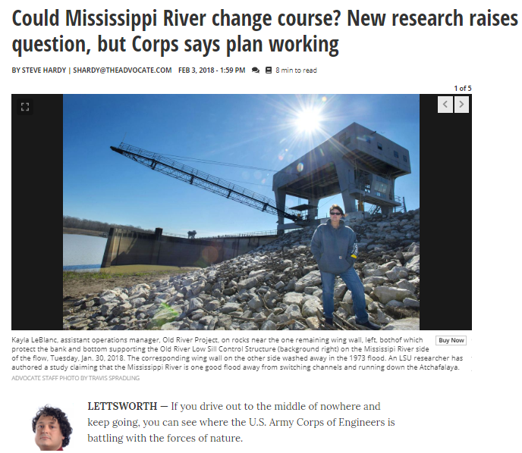
COULD MISSISSIPPI RIVER CHANGE COURSE?
https://www.theadvocate.com/baton_rouge/news/environment/article_d5a29f26-06a9-11e8-abde-8b9660c81021.html?utm_medium=social&utm_source=twitter&utm_campaign=user-share

Slide 43
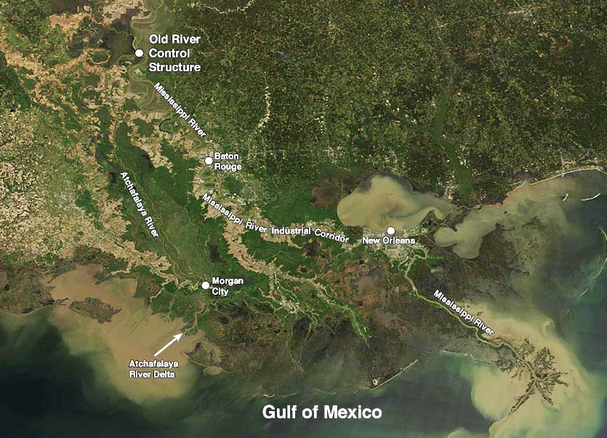

Slide 44
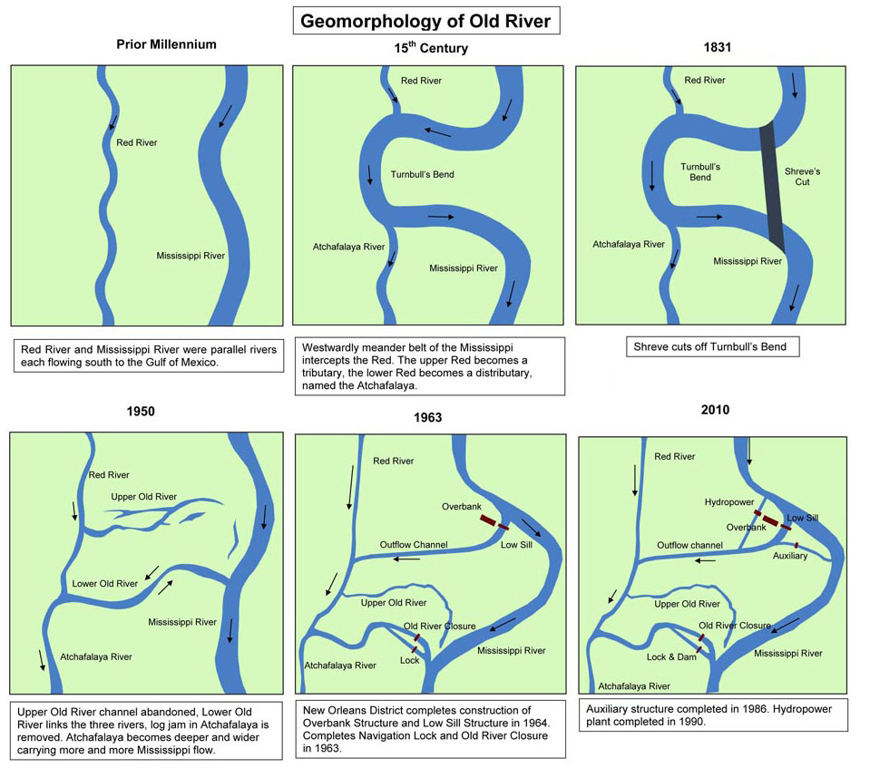
MISSISSIPPI RIVER CAPTURES RED RIVER

Slide 45
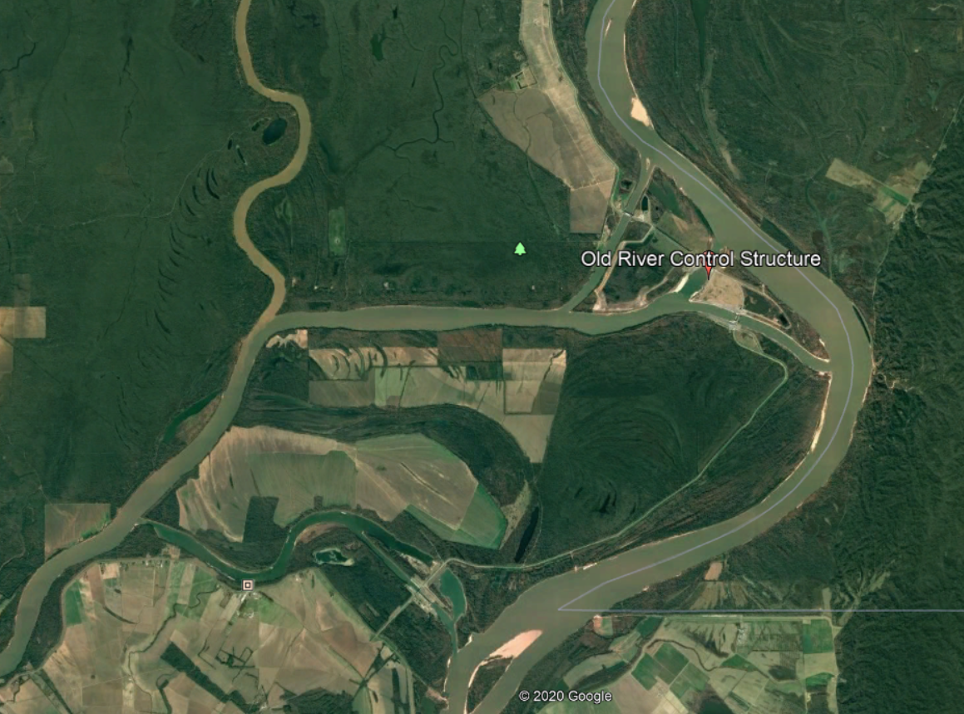

Slide 46
DISTRIBUTION OF RIVER WATERS DURING FLOOD
Notes:
Old River Control Structure
From Wikipedia, the free encyclopedia
Jump to navigationJump to search
The Old River Control Structure complex. View is to the east-southeast, looking downriver on the Mississippi, with the three dams across channels leading to the Atchafalaya River to the right of the Mississippi. Concordia Parish, Louisiana is in the foreground, on the right, and Wilkinson County, Mississippi, is in the background, across the Mississippi on the left.
Old River Control Structure discharging water into the Atchafalaya, May 2011
The Old River Control Structure is a floodgate system in a branch of the Mississippi River in central Louisiana. It regulates the flow of water from the Mississippi into the Atchafalaya River, thereby preventing the Mississippi River from changing course. Completed in 1963, the complex was built by the U.S. Army Corps of Engineers in a side channel of the Mississippi known as "Old River", between the Mississippi's current channel and the Atchafalaya Basin, a former channel of the Mississippi.^{[1][2][3][4][5]} The Old River Control Structure is a complex containing the original low-sill^{[6]} and overbank^{[7]} structures, as well as the auxiliary structure that was constructed after the low-sill structure was damaged during the Mississippi River Flood of 1973. The complex also contains a navigation lock and the Sidney A. Murray Jr. Hydroelectric Station.^{[8]}
Contents
Old River[edit]
Formation of the Atchafalaya River and construction of the Old River Control Structure.
Before the 15th century, the Red River and Mississippi River were entirely separate and flowed more or less parallel to one another.^{[3]} Beginning in the 15th century, the Mississippi River created a small, westward, oxbow loop, later called Turnbull's Bend, near present-day Angola, Louisiana. This loop eventually intersected the Red River, making the downstream part of the Red River a distributary of the Mississippi; this distributary came to be called the Atchafalaya River.^{[3]}
In the heyday of steamboats along the Mississippi River, such a vessel would need several hours to travel the 20 miles (32 km) of Turnbull's Bend, after which it would have progressed only about 1 mile (1.6 km) from the entrance to the bend. To reduce travel time, Captain Henry M. Shreve, a river engineer and namesake of Shreveport, Louisiana, dug a canal in 1831 through the neck of Turnbull's Bend; this canal became known as Shreve's Cut. At the next high water, the Mississippi roared through this channel.^{[9]} The upper portion of Turnbull's Bend was referred to as Upper Old River, while the larger, lower portion became known as the larger Lower Old River.
At first, the Lower Old River would flow eastward, to the Mississippi, until 1839, when locals began removing the Great Raft, a natural log jam that was obstructing the Atchafalaya River. The project was finished in 1840. After that, the Lower Old River would flow eastward to the Mississippi when the Red River was high and the Mississippi was low, and westward to the Atchafalaya when the Mississippi was high and the Red River was low. Over time, the number of days when the river flowed east to the Mississippi decreased and the number of days when the river flowed west increased, until eventually the Lower Old River flowed west over half the time. By 1880, it rarely flowed eastward and was rapidly capturing more and more of the flow of the Mississippi. With this increased water flow, the channel of the Atchafalaya River was worn deeper and wider throughout the 1800s and early 1900s.^{[9]}
The U.S. Army Corps of Engineers measured the amount of water flowing through the Mississippi River and compared it to the amount entering the Atchafalaya Basin by monitoring "latitude flow" at the latitude of the Red River Landing, located five miles (8.0 km) downstream of Old River. In this case, latitude flow is a combination of the flows of the Mississippi and Atchafalaya rivers as they cross an imaginary line at that latitude.^{[3]}
Between 1850 and 1950, the percentage of latitude flow entering the Atchafalaya River had increased from less than 10 percent to about 30 percent. By 1953, the U.S. Army Corps of Engineers concluded that the Mississippi River could change its course to the Atchafalaya River by 1990 if it were not controlled, since this alternative path to the Gulf of Mexico through the Atchafalaya River is much shorter and steeper.
The Corps completed construction on the Old River Control Structure in 1963 to prevent the main channel flow of the Mississippi River from altering its current course to the Gulf of Mexico through the natural geologic process of avulsion.^{[3][10]} Historically, this natural process of course change has occurred about every 1,000 years, and is overdue. Some researchers believe the likelihood of this event increases each year, despite manmade artificial control efforts.^{[11]}
If the Mississippi diverts its main channel to the Atchafalaya Basin and the Atchafalaya River, it would develop a new delta south of Morgan City in southern Louisiana, greatly reducing water flow to its present channel through Baton Rouge and New Orleans, with adverse economic effects on both port cities.^{[4]} The Mississippi Flood of 1973 almost caused the control structure to fail. Maintenance of the integrity of the Old River Control Structure, the nearby Morganza Spillway, and other levees in the area is essential to prevent such a diversion. Jeff Masters of Weather Underground noted that failure of that complex "would be a serious blow to the U.S. economy."^{[12]}
Components[edit]
A diagram that depicts river flows associated with Project Design Flood.
The present Old River Control Structure was completed in 1964 and expanded in 1990. The first two floodgates are the Low Sill Control Structure, which regulates routine flow in the waterway, and the Overbank Control Structure, in use only when the Mississippi exceeds its banks. A navigation channel and lock were also part of the original facility design. Subsequent expansion created what is now known as the Old River Control Complex, when the Auxiliary Structure, which became operational in 1986, was added to reduce pressure on the original floodgates after extensive damage caused by the flood of 1973. The Sidney A. Murray Jr. Hydroelectric Station, completed in 1990, also provides an additional measure of control at the site.^{[3]}
Operation[edit]
Water from the Mississippi is normally diverted into the Atchafalaya Basin only at Old River, where floodgates are routinely used to redirect the Mississippi's flow into the Atchafalaya River, such that the volume of the two rivers is split 70%/30%, respectively, as measured at the latitude of Red River Landing.^{[13][14]} This flow split was not based on science, but rather was based on the approximate flow allocation between the two rivers that existed at the time of construction.^{[8]}
Water diverted at Old River flows into the Atchafalaya Basin, first entering the Red River, then continuing down the Atchafalaya River to the Gulf of Mexico, bypassing Baton Rouge and New Orleans (see diagram).
The Morganza Floodway, between the Mississippi and the Atchafalaya Basin nearby downstream, is normally closed. It can be opened in an emergency to relieve water levels and water-pressure stress on various levees and other flood-control structures, including the Old River Control Structure. The floodway can reduce stress by diverting additional water from the Mississippi into the Atchafalaya.^{[15]} The Morganza Floodway was never used before the construction of Old River Control Structure, and as of 2016 has been opened only twice ^{[16]} for flood control since completion of the Old River Control Structure.

Slide 47
AT-CHA-FA-LA-YA BASIN
The Basin is about 70% forest & 30% marsh/open water
The Basin has an extensive & diverse wetland habitats:
Bottomland hardwoods to the north,
cypress-tupelo swamp in the center (largest contiguous coastal cypress tract in US)
freshwater to brackish to saline marshes to the south
The Basin drains to the Gulf of Mexico at Morgan City
a

Slide 48
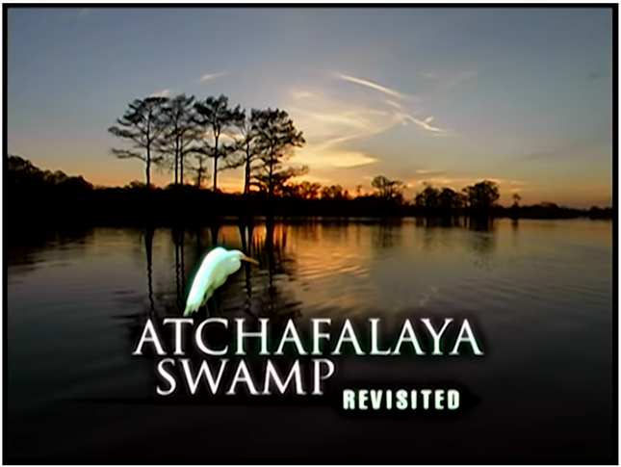
AT-CHA-FA-LA-YA BASIN
The Basin supports, white-tail deer, black bear, beaver, otter, mink, alligator
100 species of aquatic life,
270 species of birds including Bald Eagles, osprey, wild turkey, songbirds and a plethora of migratory birds/ducks/geese
Ecological threats are long-lasting changes in water level; extremes in sedimentation; habitat fragmentation; invasive species; agricultural pollution
a
Let’s look at a couple of Acadian settlements in the Atchafalaya Basin…
Notes:
The Atchafalaya Basin is rich with a myriad of species of plant, animal, and bird life, including about 60 species of reptiles and amphibians, over 270 species of birds, and almost 100 species of aquatic life.

Slide 49
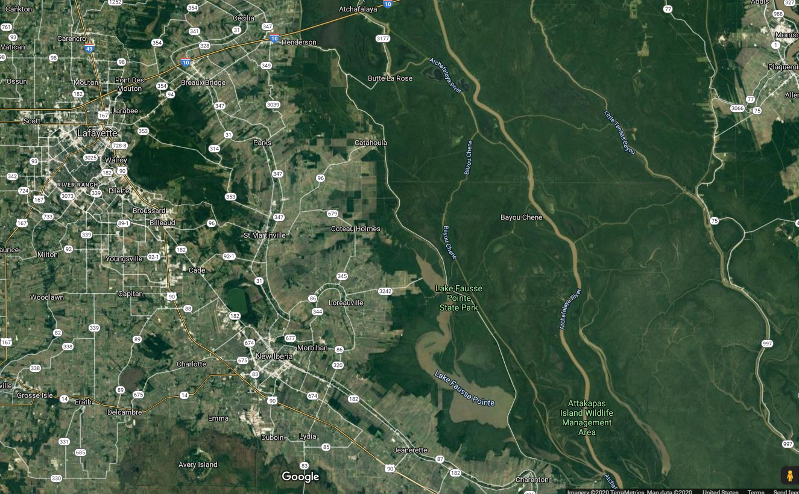
ATCHAFALAYA BASIN
BAYOU CHENE SETTLEMENT
a
Atchafalaya Basin
Baton Rouge
Lafayette
New Orleans
Bayou Chene Settlement
Bayou Chene Settlement

Slide 50
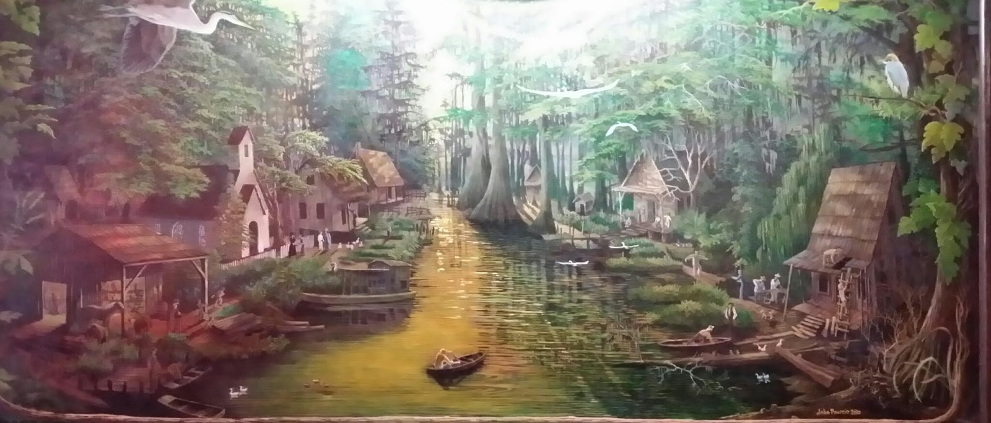
BAYOU CHENE SETTLEMENT
a
IDEALIZED VIEW OF WHAT
BAYOU CHENE MIGHT HAVE LOOKED LIKE…

Slide 51
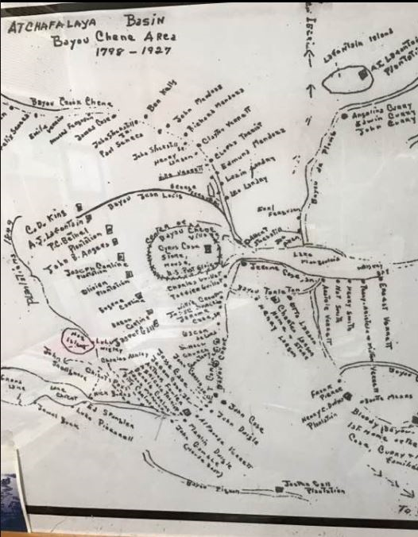
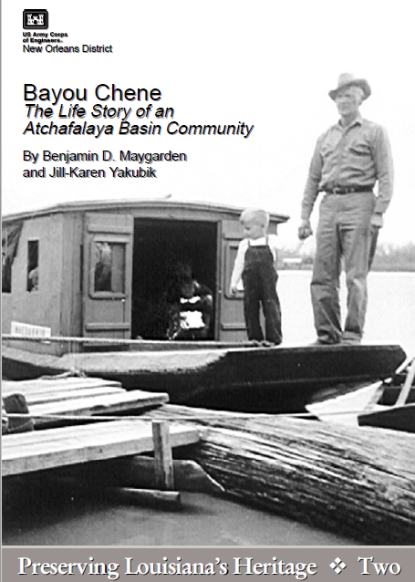
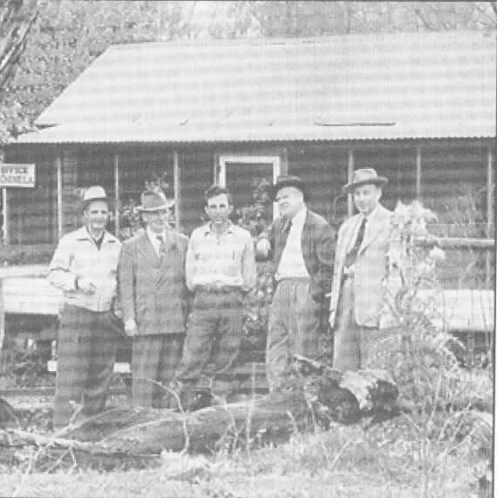
BAYOU CHENE SETTLEMENT
Post Office with Post Master in center surrounded by Washington DC post office officials that
“had to see it for themselves!”
Bayou Chene translates to “Oak Bayou”
Home where their ancestors lived for more than THREE generations
Every year Atchafalaya River spring floods leave more silt and sand behind, burying the basin’s past further beneath surface
1841, at least 16 planters were homesteading there
1848-1ST land claims were registered in Bayou Chene
1850-Total population: ~277
1860-Total population: ~675
a

Slide 52
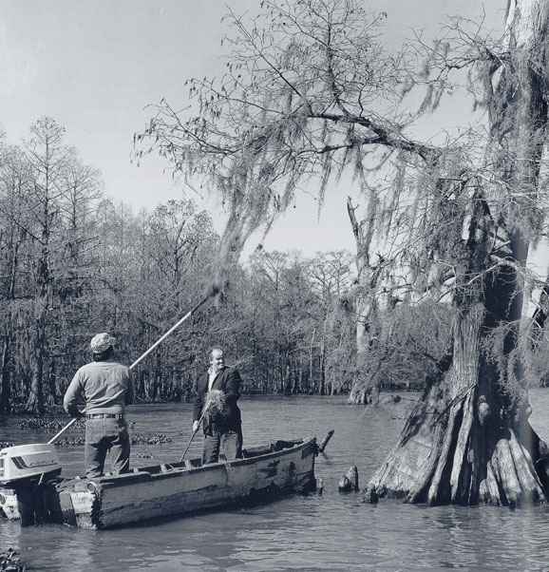
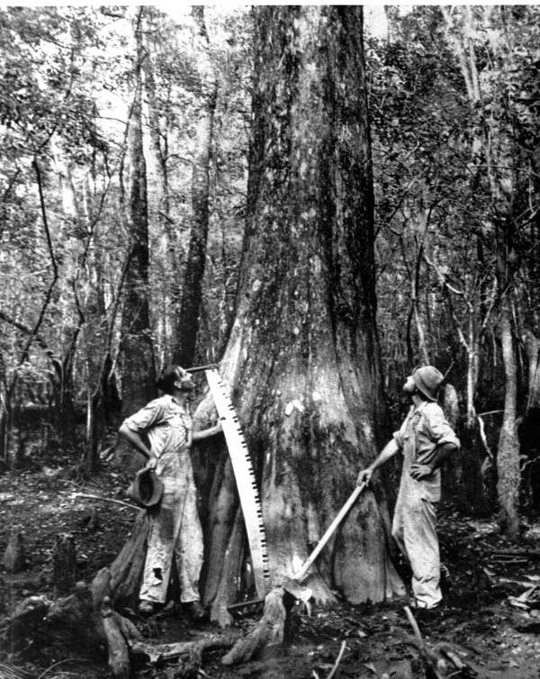
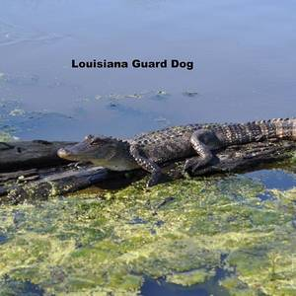
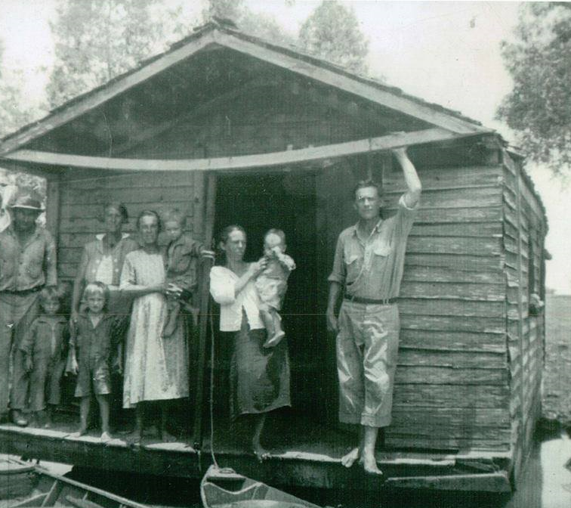
BAYOU CHENE SETTLEMENT
Settlers hunted, fished, collected Spanish moss
By 1870 most were involved in logging the bottomland hardwoods of the basin
Early 20th century, Bayou Chene was center of the Atchafalaya Basin’s cypress & fur industy with as many as 1000 full-time fishermen
Because of regular flooding of the area, some chose to live on houseboats
a
Louisiana Guard Dog

Slide 53
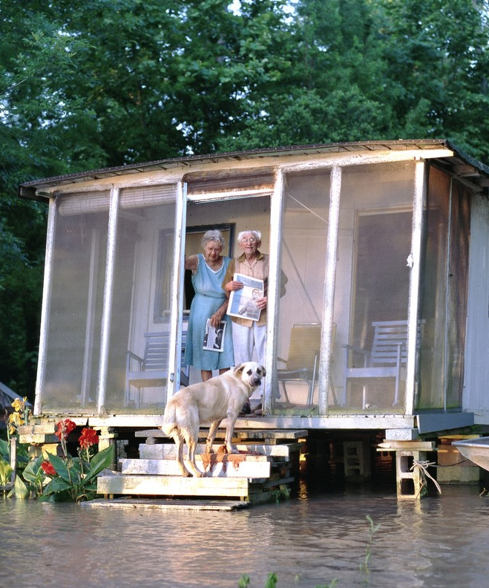
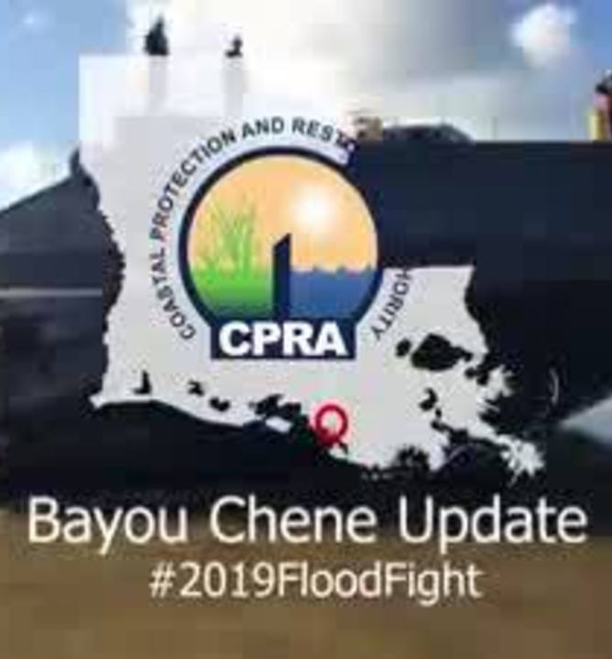
BAYOU CHENE SETTLEMENT
The Great Mississippi Flood of 1927 ruined community
Water was 7 ft above natural levees & inundated Bayou Chene for weeks
Local folklore says a village goat survived in Methodist Church by eating hymnals & wallpaper
Regular flooding, residents started moving out
Post Office was closed in 1952 & today, Bayou Chene lies under 12 ft sand & mud
a

Slide 54
BAYOU CHENE SETTLEMENT
a
Bayou Chene’s
“Little Brown Church” could be towed to different locations
Bayou Chene’s
School “Boat” picked up and delivered kids
One last look at the independent spirit of the Acadians…
The Biglers
Notes:
In the early 1940s, a house boat was converted into a worship sanctuary which could travel up and down the waterways of the Atchafalaya Basin. This vessel, affectionately known as “the Little Brown Church on the Water,” formed the beginning stages of what eventually became Bayou Plaquemine Baptist Church. This mobile meeting place, navigated by missionary Ira Marks, moved through rivers and canals in order to bring the gospel of Jesus Christ to people living along the bayou. Missionaries and members of “the Little Brown Church” would invite community residents aboard to join in worship services, Vacation Bible Schools, and weddings. Some of the founding members of Bayou Plaquemine Baptist Church can still remember the sound of gospel hymns rising up in the warm night air as “the Little Brown Church” moved through the swamp.
In 1941, a mission location was established on land through the help of First Baptist Church of Baton Rouge (Eastland Bible Class) and was called Bayou Plaquemine Mission. A group of Christians who met in this place decided to particularize and formed an independent church on July 28, 1946. This congregation was named Bayou Plaquemine Baptist Church, which remains in existence over 70 years later. Our current church facility is located roughly 7 miles from the town of Plaquemine along the Grand River. We are situated on a stretch of Highway 75 around the corner from Jack Miller’s Landing and across the street from Verret Shipyard.
Bayou Plaquemine Baptist Church (BPBC) has an extensive outreach ministry to families and youth along the bayou, a bus ministry for those in need of transportation, an annual Vacation Bible School, and weekly Sunday School classes, in addition to children’s programs, music programs, and women’s ministry programs throughout the year. We strive by God’s grace to be a pillar and foundation of the truth (1 Tim. 3:15), calling the lost to repentance and faith while also building up believers in the teaching and commandments of Jesus Christ. We are blessed to be in gospel partnership with three other area churches, the “Unity Churches,” which consist of BPBC, First Baptist Church of Plaquemine, First Baptist Church of White Castle, and Bayou Sorrel Baptist Church. We have bi-monthly worship services together and partner in hosting a one-day Bible conference each year.
VIDEO: To watch a video that describes the history of “the Little Brown Church” and early missionary efforts in the Atchafalaya Basin, click here.

Slide 55
ATCHAFALAYA BASIN
BIGLER SETTLEMENT
a
Atchafalaya Basin
Baton Rouge
Lafayette
New Orleans
Bigler Settlement
Bigler Settlement
Notes:
Biglers were 5 mi south of Bayou Chene from Greg Guirard’s “Cajun Families of the Atchafalaya” pg 79

Slide 56
BIGLER SETTLEMENT
Harold & Myrtle Bigler
Myrtle was born in 1900 and moved into the Swamp at age 7
She meet Harold and they were married
They lived in a house that once was on a barge
The house was 12 miles by boat to a landing then another 15 miles to the nearest store
They shopped once/mo
Harold fished & worked in the timber industry harvesting cypress trees in the swamp
a
Myrtle & Harold Bigler – Photography by Greg Guirard
Notes:
The house was on a wooden barge. During the flood of 1927, 7ft of water was over this property and the barge floated into the woods. After it all receded, Harold took the house off the barge and they lived in it. The barge is still down by the water.

Slide 57
ATCHAFALAYA SWAMP DWELLERS
Harold & Myrtle Bigler
Featured in a couple of books and one film, they became known for their honesty & integrity
A famous quote of Myrtle
“Some people think we’re crazy to be livin’ out here on the river by ourselves. I think people that lives in the city must be crazy.”
Harold died in 1990, Myrtle lived till 1995; they were the last couple to live full time in the Atchafalaya Swamp
a

Slide 58
ATCHAFALAYA SWAMP DWELLERS
Greg Guirard used to stop & visit while photographing the swamp & he says this:
“Their life wasn’t so much about the struggles & suffering,
But more about their joy, their beautiful vision of what life can be…”
Thoreau says “our life is frittered away by details …simplify, simplify”
& “I went to the woods because I chose to live deliberately…”
Thoreau would have been proud of the Biglers
a
Notes:
“I went to the woods because I wished to live deliberately, to front only the essential facts of life, and see if I could not learn what it had to teach, and not, when I came to die, discover that I had not lived.

Slide 59
a
Cajun culture
acculturation & assimilation
Civil war’s impact on Acadians
French language in school – a curse?
French language revival–new admiration
CAJUN TV STAR
CAJUN CUISINE & CAJUN MUSIC
RELIGIOUS celebrations (mardi gras)

Slide 60
ACCULTURATION & ASSIMILATION
SOCIOLOGICAL TERMS:
Adaptation: Adaptation is the process of adjusting to one’s environment so as to become better suited to that environment
Values Transmission: Process of passing values on to children for future generations
Acculturation: Acculturation is the transfer of values and customs from one group to another; often 2-way
a
Assimilation: Assimilation is the cultural absorption of a minority group into the main cultural body; usually 1-way
A
Notes:
Acculturation is a two way transfer
Assimilation is a one way transfer

Slide 61
ACCULTURATION & ASSIMILATION
Here’s a 2:04 min video on how the newly arriving Acadians had to deal with adaptation and how they subsequently handled values transmission, acculturation, & assimilation

Slide 62
ACCULTURATION & ASSIMILATION

Slide 63
ACCULTURATION & ASSIMILATION
Adaptation:
Adjusting to new climate, new crops, new foods, new houses, new clothing
a
Values Transmission:
Use of song to passing on beliefs
Importance of Women in transferring/transmitting values, beliefs, & language for the future
Acculturation:
Other nationalities marry into the Acadian family, strong close-knit, family values absorbed
Assimilation:
Not much Acadian assimilation into American culture

Slide 64
IMPACT OF THE CIVIL WAR ON LOUISIANA ACADIANS
3:40 min Video

Slide 65
IMPACT OF THE CIVIL WAR ON LOUISIANA ACADIANS

Slide 66
IMPACT OF THE CIVIL WAR ON LOUISIANA ACADIANS
In the Civil War, Acadians wanted to stay neutral just as they had tried to do in Nova Scotia
They are reduced from farm OWNERS to TENANT farmers
America decides the best way to deal with the Acadians
a
is to do away with their culture – ASSIMILATION
Once again the host country of the Acadians are trying to eliminate the Acadian culture!
Notes:
Some give up their farms and become tenant farmers

Slide 67
SPEAKING FRENCH ONCE AGAIN BECOMES A CURSE?
5:19 min Video

Slide 68
SPEAKING FRENCH ONCE AGAIN BECOMES A CURSE?

Slide 69
SPEAKING FRENCH ONCE AGAIN BECOMES A CURSE?
Fierce Nationalism in US
Teddy Roosevelt states
English should be the only language
No hyphenated Americans; no French-, Spanish-Americans, etc
a
This philosophy leads America to outlaw the French language
At same time laws are passed requiring all kids to go to school BUT kids are forbidden to speak French in the School
Whole generation is being taught that their French speaking culture made them inferior to other Americans
Their French language is now a stigma
Notes:
Some give up their farms and become tenant farmers

Slide 70
SPEAKING FRENCH ONCE AGAIN BECOMES A CURSE?
Kids are ridiculed, punished and/or whipped in school for speaking French
Kids aren’t able to ask to go to the bathroom because they can’t ask to go to the restroom
a
By mid-20th century, is speaking French a curse?
NO!
Situation that causes one to embarrass themselves starts driving people away from their own language
Then WWII happens and Cajun GI’s are able to talk to the French citizens; military notices and starts squadrons of “FRENCHY” interpreters. French language pride gradually starts to return
Notes:
Some give up their farms and become tenant farmers
What I saw was one of these earlier Acadians; a ’62 or ’63 Invader. The “Acadian” was obviously a Chevy II badge-engineered so that Canada’s large Pontiac-Buick dealer group had a compact to sell, as the Tempest was off-limits, due to restrictions of the APTA agreements between the US and Canada. Since the Chevy II was made in Canada (the Tempest wasn’t), the solution was…this.
And starting with 1964, the top of the line, analogous to the Nova, was called the Canso. And the Sport was obviously one half of the Super Sport; the better half. I don’t know if the Canadian Cansos got the same wide engine palette as the US Chevy II did, from the 153 four all the way to the 275hp 327.

Slide 71
FRENCH LANGUAGE REVIVAL – NEW ADMIRATION
CAJUN MUSICIANS AS FOLK HEROES!
4:55 min Video

Slide 72
FRENCH LANGUAGE REVIVAL – A KEY TRADITION
CAJUN MUSICIANS AS FOLK HEROES!

Slide 73
FRENCH LANGUAGE REVIVAL – A KEY TRADITION
Returning soldiers reconsider what they had been taught about their Cajun language
At same time, country is exploring it’s own DIVERSITY; a kind of self-introspection
1964 Newport Folk Festival Acadians are invited to play
CAJUN MUSICIANS AS FOLK HEROES!
Mississippi
Atchafalaya
Presuming that they would be laughed at, Cajun musicians perform and are considered Heroes of Cultural Preservation
About same time politicians/activists develop the Council for the Development of French in Louisiana – CODIFIL
This is a program to save French language from the top down
Bayou Teche
Bayou Lafourche
Notes:
Regarding the High French speakers in Calcasieu Parish – Just to the West, Texans refer to the triangle of the Acadian colonies of Beaumont, Port Arthur, and Orange as Cajun Lapland because that is where Louisiana "laps over" into Texas

Slide 74
FRENCH LANGUAGE REVIVAL – A KEY TRADITION
However, a grassroots surge from the bottom up is waiting to happen
This surge will be led by Cajun musicians
Can’t just preserve French; have to have something to do with the French
CAJUN MUSICIANS AS FOLK HEROES!
a
1974 1st Cajun Music Festival is held to celebrate “Cajun-ness”- their unique local food, culture, music and language
This is a Acadian/Cajun revival spurred on by the “lost generation” leading to a cultural movement alongside a linguistic education
Notes:
Some give up their farms and become tenant farmers

Slide 75
a
Cajun culture
acculturation & assimilation
Civil war’s impact on Acadians
French language in school – a curse?
French language revival–new admiration
CAJUN TV STAR
CAJUN CUISINE & CAJUN MUSIC
RELIGIOUS celebrations (mardi gras)

Slide 76
CAJUN TV STAR
Mr. Justin Wilson
In 1972, Justin Wilson’s Louisiana Cookin’ made “Cajun cuisine” a household phrase– along with his unforgettable line, “I gar-on-tee (guarantee)!”
a
Paul Prudhomme's maternal ancestors include early Acadian settlers Martin Aucoin (c. 1651 – 1711) and Marie Gaudet (c. 1657 – 1734)
"Cajun cooking is the ability to take what you have and create a good dish and season it right. It isn't all that hard, but so few people know how to take what they have and put it together and season it properly. It's creative cooking — that's all it is,“
Watch for his purposeful mispronunciations…

Slide 77
CAJUN TV STAR

Slide 78
a
Cajun culture
acculturation & assimilation
Civil war’s impact on Acadians
French language in school – a curse?
French language revival–new admiration
CAJUN TV STAR
CAJUN CUISINE & CAJUN MUSIC
RELIGIOUS celebrations (mardi gras)

Slide 79
LAISSEZ LES BONS TEMPS ROULER! - CAJUN CUISINE
a
Before talking about Cajun Cuisine, we need to talk about
CAJUN vs CREOLE

Slide 80
CAJUN vs CREOLE
WHAT IS CAJUN?
a
an ethnic group consisting in part of the descendants of the original Acadian
exiles—French-speakers from Acadia (L'Acadie)
Notes:
Cajun and Creole label have been mistaken to be the same, but the origins of Creole cooking began in New Orleans, and Cajun cooking came 40 years after the establishment of New Orleans.^{[4]} Today, most restaurants serve dishes that consist of Cajun styles, which Paul Prudhomme dubbed "Louisiana cooking".^{[5]} In home-cooking, these individual styles are still kept separate.^{[5]} However, there are fewer and fewer people cooking the classic Cajun dishes that would have been eaten by the original settlers.

Slide 81
CAJUN vs CREOLE
WHAT IS CREOLE?
a
Very difficult to figure out…
Consulted 5 dictionaries,
2 online dictionaries,
1 newspaper article
1 magazine article
A total of 16 definitions!
No two definitions are the same

Slide 82
CAJUN vs CREOLE
a

Slide 83
CAJUN vs CREOLE
a
The 16 Definitions stated one or more of these attributes in their definition
56% Race
60% Ethnic Origins
44% Birth Location
25% Language Use
6% Timing
ATTRIBUTE
Race
Ethnic Origins
Birth Location
Language Use
Timing

Slide 84
CAJUN vs CREOLE
Chose these two Creole definitions:
1) French Creole is someone of European ancestry born in Louisiana
2) Louisiana Creole is someone of mixed racial ancestry born in Louisiana

Slide 85
LAISSEZ LES BONS TEMPS ROULER! - CAJUN CUISINE
Creole food had it’s start in the New Orleans area
Creole food is a blend of the various cultures of New Orleans, including Italian, Spanish, African, German, Caribbean, Native American,
a
and Portuguese, etc.
Because of the access to a much wider variety of spices, meats, and techniques, Creole cuisine is thought of as a little higher-brow or aristocratic when compared to Cajun.
A vastly over-simplified way to describe the two cuisines is to deem Creole cuisine "city food" and Cajun cuisine "country food."

Slide 86
LAISSEZ LES BONS TEMPS ROULER! - CAJUN CUISINE
The “holy trinity of Cajun/Creole cuisine” utilizes onion, celery, and bell pepper (rather than carrots) to provide a flavor base for many dishes
Garlic is never far away from
a
any stove, either
Paprika, thyme, filé (ground sassafras leaves), parsley, and green onions are also very common ingredients
Creole cuisine tends to be tomato based and Cajun cuisine is not – case in point is Crawfish Étouffée – which might be the Creole version??
Creole roux made with butter and flour, while a Cajun roux is made with oil and flou
you find tomatoes in Creole jambalaya and not in Cajun jambalaya

Slide 87
LAISSEZ LES BONS TEMPS ROULER! - CAJUN CUISINE
Cajun & Creole Dishes…
A bowl o Cracklings

Slide 88
LAISSEZ LES BONS TEMPS ROULER! - CAJUN CUISINE
Stuffed Mirliton
Notes:
For Sandi, Cajun pronounce Court bouillon = cou-be-yon
Mirliton = mel-lee-ton

Slide 89
LAISSEZ LES BONS TEMPS ROULER! - CAJUN CUISINE
Rice & Gravy
Notes:
Fricassee or fricassée /ˈfrɪkəsiː/^{[1]} is a method of cooking meat in which it is cut up and braised, and served with its sauce (usually a white sauce but some Spanish variations are made with a tomato and olive oil base).
Fricassee of chicken is commonly found, both in modern recipes and antique ones, but virtually all kinds of meat, poultry, seafood, and even vegetables alone, can be found in fricassee dishes
Julia Child in Mastering the Art of French Cooking describes it as "halfway between a sauté and a stew" in that a saute has no liquid added, while a stew includes liquid from the beginning. In a fricassee, cut-up meat is first sauteed (but not browned), then liquid is added and it is simmered to finish cooking.
Crawfish pie is a type of baked savory pie common in the Cajun and Creole cuisine of Louisiana. It is similar in appearance to a pot pie and contains crawfish

Slide 90
LAISSEZ LES BONS TEMPS ROULER! - CAJUN CUISINE
White Boudin
Dirty Rice (Rice Dressing)

Slide 91
LAISSEZ LES BONS TEMPS ROULER! - CAJUN CUISINE
Doberge Cake

Slide 92
LAISSEZ LES BONS TEMPS ROULER! - CAJUN CUISINE
A bowl o Cracklings

Slide 93
LAISSEZ LES BONS TEMPS ROULER! - CAJUN MUSIC
a
Notes:
Rod Bernard, Warren Storm, Irma Thomas, T.K. Hulin, Belton Richard
Creedence Clearwater Revival, John Fogerty, The Doobie Brothers

Slide 94
a
Cajun culture
acculturation & assimilation
Civil war’s impact on Acadians
French language in school – a curse?
French language revival–new admiration
CAJUN TV STAR
CAJUN CUISINE & CAJUN MUSIC
RELIGIOUS celebrations (mardi gras)

Slide 95
WHAT IS Mardi gras?

Slide 96
MARDI GRAS
Mardi Gras is French for "Fat Tuesday”
It is celebrated as the last night of eating rich, fatty foods & partying before ritual fasting associated with the Catholic Lenten season
a
In the United Kingdom, Mardi Gras is also known as Shrove Tuesday, which is derived from the word shrive, meaning "to administer the sacrament of confession to; to absolve“
The first Mardi Gras in “Louisiana” was held in March 1699 as the French arrived and settled Mobile, Alabama (capital of French Louisiana)

Slide 97
MARDI GRAS
In 1722, the capital of Louisiana was moved to New Orleans
New Orleans traditional Mardi Gras involves parades and masked balls of social clubs called Krewes
a
And culminates in a parade of the King & Queen Rex
Today, Mardi Gras celebrations are embraced by residents of New Orleans beyond those of French or Catholic heritage
The debauchery associated with Mardi Gras is usually limited to the French Quarter area of downtown New Orleans
Celebrations in the suburbs are suitable for children

Slide 98
MARDI GRAS
In the rural Acadiana area, many Cajuns celebrate the “Courir de Mardi Gras”, a tradition that dates to medieval celebrations in France
In such cases, masked Cajuns
a
ride horses between family farms/homes gathering ingredients to make a chicken and sausage gumbo or some other suitable Cajun dish
In the small, Cajun towns, masked Cajuns ride through town on horseback (or today, in convertibles) giving out beads and various trinkets to the crowds
As the parade ends, the Fais do-do begins
Notes:
”Courir de Mardi Gras”, = Mardi Gras Run
In 1993, documentary filmmaker Pat Mire chronicled the tradition with his film Dance for a Chicken: The Cajun Mardi Gras
People escape from ordinary life through the alcohol and the roles they portray in costume
The costumes not only conceal the identities of the participants, but also allow them to parody authority figures and society. Role reversals can be employed such men dressing up like women or the rich to pose as the poor.^{[4]} The costumes also directly mock the nobility, the clergy and the educated; celebrants wear miter hats, mortarboards and capuchons,^{[26]} which were initially designed to mock the tall pointy hats worn by noble women. These hats are still worn, primarily by men
Originally the costumes were made from old work clothes decorated with cloth remnants and pieces of feed sack material, as many of the participants could not afford to buy material strictly for the event. This led to a patchwork style that has become associated with the costuming of the event.^{[38]} The shirts and pants of the costume are made by sewing together various pieces of cloth in a patchwork style. The strips of cloth are cut into fringing, and are sewn onto the sleeves, up and down the legs, and on the capuchon.^{[28]} The end effect is a riot of color and pattern. These costumes are also believed to have originated in Medieval times.^{[28]} The masks are made by taking ordinary wire mesh window screen and attaching large protruding noses and painting on features such as eyes and mouths. The masks are almost see through, but usually not enough to discern the wearer's identity. Many costumes and masks include animal features like beaks, feathers, hair, fur or tails.

Slide 99
MARDI GRAS
While not observed nationally throughout the United States, a number of traditionally ethnic French cities and regions in the country have notable celebrations
a
Mardi Gras celebrations are part of the basis of the slogan
Laissez les bons temps rouler!
("Let the good times roll!")

Slide 100
ending

Slide 101
Next Week: WEEK 6
Acadians Today: 1950-today

Slide 102
WANT TO SEE MORE…
Sandi & Rocky
The Vagabonds
All class material is
on our website at:
www.vagabondgeology.com

Slide 103
last week Sandi asked the questions
What’s Mardi Gras?
Where’s the Party?
Notes:
Henri Membertou, Pierre Dugua de Monts, Samuel de Champlain, Governor Charles Lawrence, Beausoliel Broussard

Slide 104
Session 2: French Migration to Acadie
1600-1717
QUESTIONS?

Slide 105
WEBSITE: www.vagabondgeology.com
REFERENCES
BOOKS
Acadian Redemption: From Beausoleil Broussard to the Queen’s Royal Proclamation
Warren Perrin, Andrepont Publishing, 2004
Acadie Then and Now Warren & Mary Perrin & Phil Comeau,
Andrepont Publishing, 2014
Cajun Families of the Atchafalaya Greg Guirard, Friesens of Canada, 1989
Evangeline, a Tale of Acadie Henry Wadsworth Longfellow,
Nimbus Publishing, 2003
The Founding of New Acadia, the Beginnings of Acadian Life in Louisiana
Carl Brasseaux, Louisiana State University Press, 1987
If They Could Talk, Acadiana’s Buildings & Their Biographies Mario Mamalakis, Lafayette Centennial Commission, 1983
They Tasted Bayou Water Maurine Bergerie, Firebird Press, 2000
CD MUSIC
Afternoon in Paris, Compass Productions 2005
Bayou Deluxe – Best of Michael Doucet & Beausoleil, Rhino Records 1993
Boudreau & Tibodeau, Mel Potier, Cajun Heritage Productions 1997
A History of the Cajuns, Charlo, Swallow Publications 2003
Ma Petite Femme, Lee Benoit, Old Man Records, 2005
Feet Don’t Fail Me Now, Rockin’ Dorsie & Zydeco Twisters, AIM 1995
Roots of Cajun, Master Song 2000
I’m a Woman, Rosie Ledet, Maison de Soul Records, 1999
DVD VIDEOS
Against the Tide: The Cajun People of Louisiana, Louisiana Public Broadcasting
Atchafalaya Swamp Revisited with Bill Rodman, Louisiana Public Broadcasting
Danser Avec Nous, Cal and Lou Courville, 2003
Grand-Pre’, Society for Promotion of Grand Pre, www.grand-pre.com
Where Tide and River Collide, www.centralnovascotia.com
CONTACTS
Lou & Cal Courville, Dance Instructors Lafayette, Louisiana
www.dancecajun.com 337-234-6709
Warren Perrin, Acadian Museum 203 S. Broadway Erath, Louisiana
Perrin@plddo.com 337-233-5832
Deanna Soriez, Acadian Museum 203 S. Broadway Erath, Louisiana
MUSEUMS
Acadian Culture Center of Jean Lafitte National Historic Park, 501 Fisher Road,
Lafayette, Louisiana
Acadian Museum, 23 Main Dr E, Miscouche, Prince Edward Island, Canada
Acadian Museum, 203 South Broadway St. Erath, Louisiana
Acadian Village, 200 Greenleaf Drive Lafayette, Louisiana
Capitol Park Museum, 660 N. Fourth St. Baton Rouge, Louisiana
Musée Acadien, University of Moncton 18, avenue Antonine-Maillet, Moncton, Ca
Grand-Pré National Historic Site, 2205 Grand Pré Rd, Grand Pré, Nova Scotia, Canada
Prairie Acadian Cultural Center, 250 Park Ave, Eunice, Louisiana
Vermilionville Heritage & Folklife Park, 300 Fisher Road, Lafayette, Louisiana
WEBSITES
www.en.wikipedia.org/wiki/Huguenots
www.en.wikipedia.org/wiki/Jacques_Cartier
www.en.wikipedia.org/wiki/John_Cabot
www.en.wikipedia.org/wiki/Mi%EA%9E%8Ckmaq
www.en.wikipedia.org/wiki/Pierre_Dugua,_Sieur_de_Mons
www.en.wikipedia.org/wiki/Religion_in_France
www.en.wikipedia.org/wiki/St._Lawrence_Iroquoians
www.en.wikipedia.org/wiki/Timeline_of_First_Nations_history
www.everyculture.com/multi/A-Br/Acadians.html
www.heritage.nf.ca/articles/aboriginal/beothuk.php
www.heritage.nf.ca/articles/aboriginal/mikmaq-history.php
www.historymuseum.ca/cmc/exhibitions/aborig/fp/fpz3c01e.html
www.hosted.learnquebec.ca/societies/societies/mikmaq-around-1980/the-mikmaq-gaspes-first-settlers/ www.inquestiatimes.blogspot.com/2013/04/acadian-prehistory-medieval-religion.html
www.mikmaweydebert.ca/home/ancestors-live-here/debert/an-ice-age-world/
www.mikmaweydebert.ca/home/ancestors-live-here/debert/understanding-and-protecting-the-sites/
www.mikmaweydebert.ca/home/wp-content/uploads/2015/06/Mikmawel_Tan_Telikinamuemk_Final_Online.pdf www.n.wikipedia.org/wiki/Timeline_of_First_Nations_history
www.nationalhumanitiescenter.org/pds/amerbegin/contact/text4/norse.pdf
www.novascotia.ca/abor/aboriginal-people/community-info/ www.novascotia.ca/museum/mikmaq/default.asp?section=thumb&page=17&region=&period=
www.poets.org/poem/evangeline-tale-acadie www.quora.com/Where-did-French-Acadians-originally-come-from www.thecanadianencyclopedia.ca/en/article/aboriginal-people-eastern-woodlands
www.thecanadianencyclopedia.ca/en/article/beothuk
www.thecanadianencyclopedia.ca/en/article/history-of-acadia
www.thecanadianencyclopedia.ca/en/article/micmac-mikmaq
www.thecanadianencyclopedia.ca/en/article/pierre-du-gua-de-monts
www.utpjournals.press/doi/abs/10.3138/9616-83R9-8772-1G2J
www.youtube.com/watch?v=cpvNH3jLuJA
Happy Mardi Gras!
From
Sandi & Rocky
(free King Cake next door! ➔)

Slide 106
IMAGE USE DISCLAIMER
All copyrighted materials included within this presentation are in accordance with Title 17 U.S.C. Section 107 related to Copyright and “Fair Use” for Non-Profit educational institutions, which permits The Vagabonds, to utilize copyrighted materials to further scholarship, education, and inform the public. The Vagabonds make every effort to conform to the principles of fair use and to comply with copyright law.
For more information go to: http://www.law.cornell.edu/uscode/17/107.shtml
If you wish to use copyrighted material from this site for purposes of your own that go beyond fair use, you must obtain permission from the copyright owner.

Slide 108
End of talk
Extra slides follow

Slide 109
Travel is fatal to prejudice, bigotry,
and narrow-mindedness…
Broad, wholesome, charitable views of men and things cannot be acquired by vegetating in one little corner of the earth all one's lifetime.
- Mark Twain

Slide 110
“Twenty years from now
you will be more disappointed by
the things you didn’t do than by
the ones you did do.
So throw off the bowlines,
sail away from the safe harbor.
Catch the trade winds in your sails.
Explore. Dream. Discover.”
– Mark Twain

