Slide 1
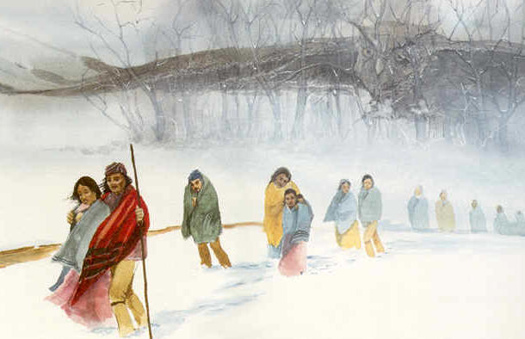
Southwest Journeys . . . .

Slide 2
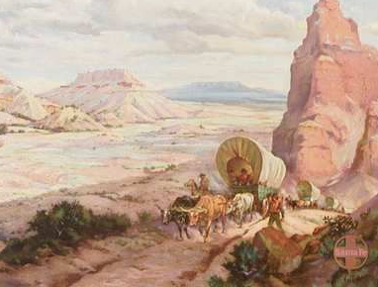
Southwest Journeys . . . .
Santa Fe Trail
Trail of Tears

Slide 3
Southwest Journeys . . . .
Session 4: Trail of Tears
Session 1: Before the Trails
Session 2: Trail of Tears – beginnings
Session 3: Santa Fe Trail – beginnings
Session 4: Trail of Tears – endings
Session 4: Trail of Tears
Session 5: Santa Fe Trail – endings
Session 6: After the Trails
Trail of Tears

Slide 4
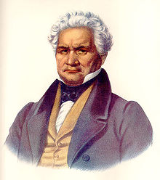
1830
1806
Session 4: Trail of Tears
34 year old Cherokee planter,
homesteading on Oothcaloga Creek
36 year old Cherokee
silversmith living in Mill Town (Al)
3 year old Creek girl, daughter of Prophet Francis
28 year old Virginian,
Captain in 2nd Infantry
24 years pass . . .
Arbuckle
Milly
Ridge
Sequoyah

Slide 5
1830
Session 4: Trail of Tears
IL
IN
MO
What’s happened to our new friends?
MS
AL
LA
2 new territories
6 new states
, 2 west of Miss. River
Spain ceded Florida to U.S.

Slide 6
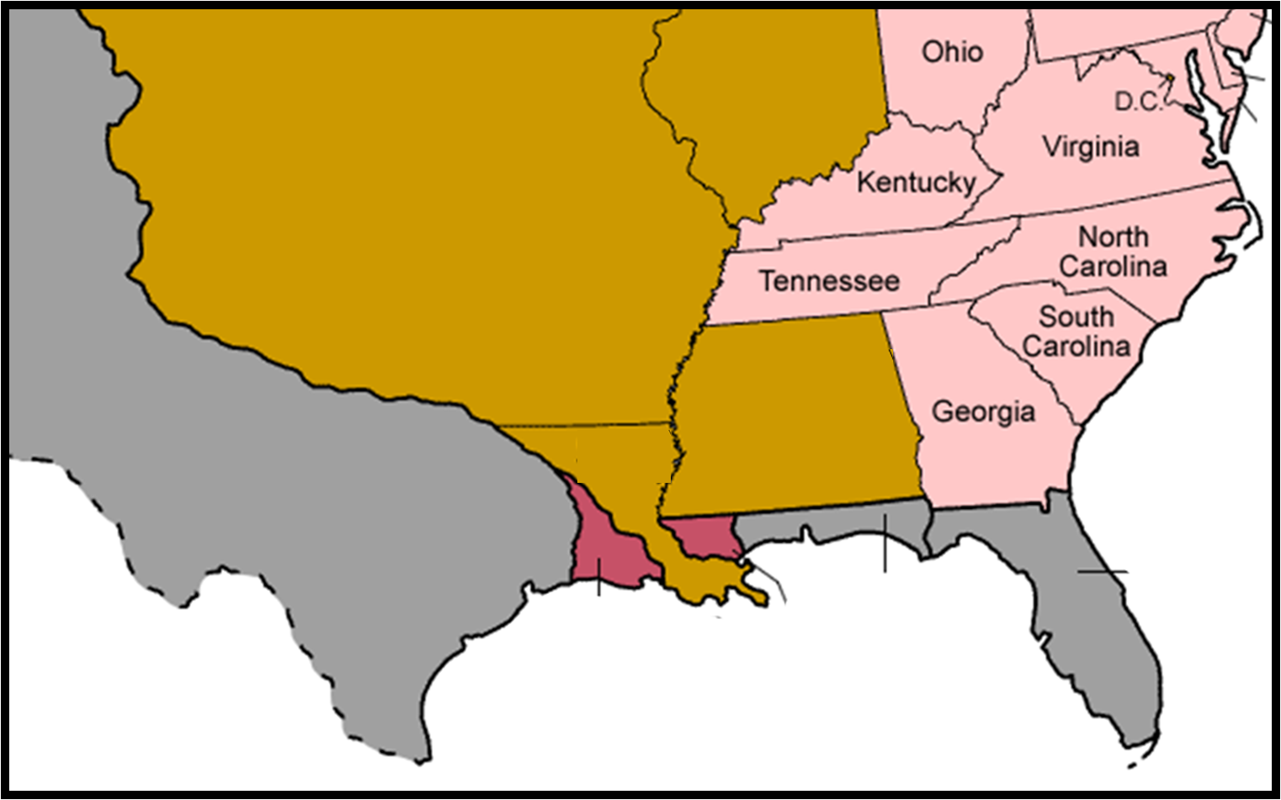
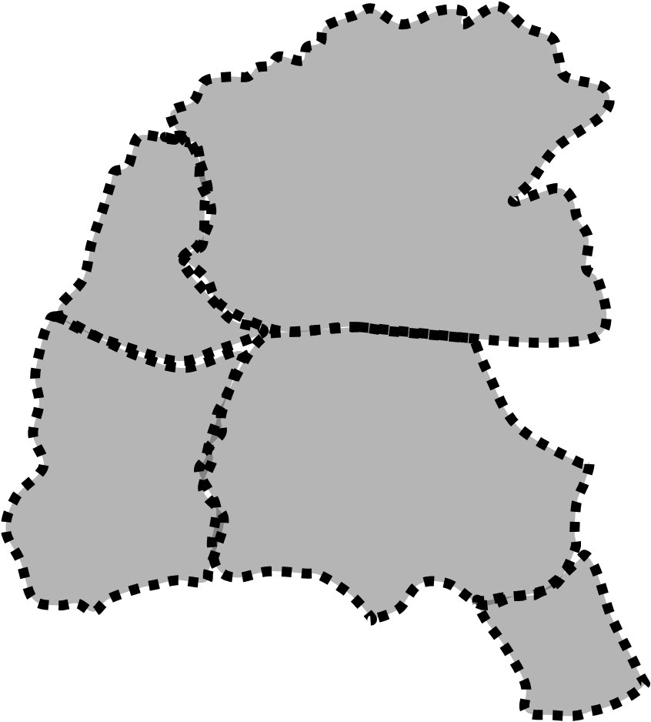
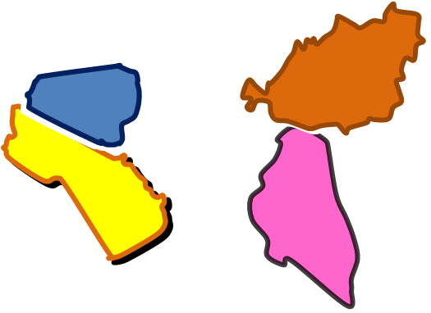
https://commons.wikimedia.org/wiki/File:United_States_1821-07-1821-08.png
Chickasaw
Cherokee
Choctaw
Creek
Seminole

Slide 7
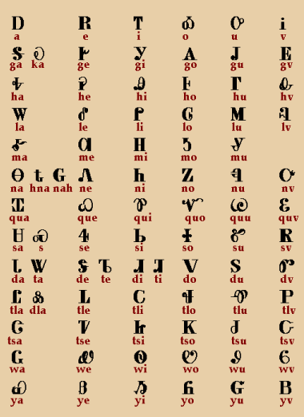
1830
Session 4: Trail of Tears
created Cherokee Syllabary,
taught Cherokees to read,
fought Creek War w/Americans,
60 years old
What’s happened to our new friends?
Ridge
Sequoyah

Slide 8
1830
Session 4: Trail of Tears
fought Seminoles w/Jackson,
Cherokee plantation owner
with 30 slaves,
58 years old
at 13, saved life of US soldier,
returns to Creek nation (AL),
marries
has children, 27 years old
?
- a Creek man
Arbuckle
Ridge
Milly

Slide 9
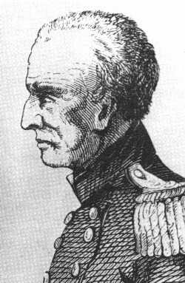
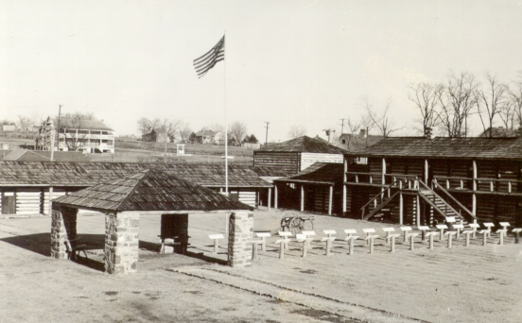
1830
Session 4: Trail of Tears
1820: promoted to Colonel, sent to Fort Smith
1824: builds & commands Fort Gibson
(1st military post in Indian Territory)
52 years old
Arbuckle

Slide 10
1830
Session 4: Trail of Tears
1820: promoted to Colonel, sent to Fort Smith
1824: built & command of Fort Gibson (OK)
(1st military post in Indian Territory)
Where were the Native Homelands?
52 years old
Ridge
Arbuckle
Sequoyah
Milly

Slide 11
1830
Session 4: Trail of Tears
Where were the Native Homelands?
Where are they now?
Ridge
Sequoyah
Milly

Slide 12
1830
Session 4: Trail of Tears
Indian Removal Act
?
Chickasaw
Cherokee
Choctaw
Creek
Ridge
- Where will they go?
- How will they get there?
- What will they find there?
Seminole
Sequoyah
Milly

Slide 13
1830
Session 4: Trail of Tears
Indian Removal Act
- Where will they go?
- How will they get there?
- What will they find there?
?
- Where will they go?
- How will they get there?
- What will they find there?

Slide 14
Session 4: Trail of Tears
- Where will they go?
- How will they get there?
- What will they find there?
Indian Territory
Geology of new lands
- How will they get there?
- What will they find there?

Slide 15
Session 4: Trail of Tears
Indian Territory
‘What do the founding fathers say
about ‘Indian Territory’?
- Where will they go?
Indian Territory
Geology of new lands
- How will they get there?
- What will they find there?

Slide 16
Indian Territory
1776: Push the Tribes WEST OF THE MISSISSIPPI River
1776: “Nothing will reduce those wretches
(Cherokee) so soon as pushing the war
into the heart of their country. But I
would not stop there. I would never
cease pursuing them while one of them
remained on this side of the Mississippi.”
1803: Encourage INDIAN DEBT to gain their HOMELANDS
Thomas Jefferson
Push the Tribes WEST OF THE MISSISSIPPI River
1803: “when (their) debts get beyond what the
individuals can pay, they become willing to lop
them off by a cession of lands.”
Encourage INDIAN DEBT to gain their HOMELANDS

Slide 17
https://en.wikipedia.org/wiki/Indian_removal
Indian removal was a policy of the United States government in the 19th century whereby Native Americans were forcibly removed from their ancestral homelands in the eastern United States to lands west of the Mississippi River, thereafter known as Indian Territory. In a matter that remains one of debate by scholars, description of the policy—which clearly contributed to devastation in numbers, freedom and prosperity for those displaced—is sometimes elevated to being one of long-term genocide of Native Americans. In any case, Indian removal was a consequence of actions first by European settlers to North America in the colonial period, then by the United States government and its citizens until the mid-20th century] The policy traced its direct origins to the administration of James Monroe, though it addressed conflicts between European Americans and Native Americans that had been occurring since the 17th century, and were escalating into the early 19th century as white settlers were continually pushing westward. The Indian Removal Act was the key law that forced the removal of the Indians, and was signed into law by President Andrew Jackson on May 28, 1830.
The Revolutionary background
American leaders in the Revolutionary and Early National era debated whether the American Indians should be treated officially as individuals or as nations in their own right. Some of these views are summarized below.
Benjamin Franklin
In a draft, "Proposed Articles of Confederation", presented to the Continental Congress on May 10, 1775, Benjamin Franklin called for a "perpetual Alliance" with the Indians for the nation about to take birth, especially with the Six Nations of the Iroquois Confederacy:
Article XI. A perpetual Alliance offensive and defensive, is to be entered into as soon as may be with the Six Nations; their Limits to be ascertained and secured to them; their Land not to be encroached on, nor any private or Colony Purchases made of them hereafter to be held good; nor any Contract for Lands to be made but between the Great Council of the Indians at Onondaga and the General Congress. The Boundaries and Lands of all the other Indians shall also be ascertained and secured to them in the same manner; and Persons appointed to reside among them in proper Districts, who shall take care to prevent Injustice in the Trade with them, and be enabled at our general Expense by occasional small Supplies, to relieve their personal Wants and Distresses. And all Purchases from them shall be by the Congress for the General Advantage and Benefit of the United Colonies.
Thomas Jefferson
In his Notes on the State of Virginia (1785), Thomas Jefferson defended American Indian culture and marveled at how the tribes of Virginia "never submitted themselves to any laws, any coercive power, any shadow of government" due to their "moral sense of right and wrong". He would later write to the Marquis de Chastellux in 1785, "I believe the Indian then to be in body and mind equal to the whiteman". His desire, as interpreted by Francis Paul Prucha, was for the Native Americans to intermix with European Americans and to become one people. To achieve that end, Jefferson would, as President, offer U.S. citizenship to some Indian nations, and propose offering credit to them to facilitate their trade—with the expectation, as Bernard Sheehan argues, that they would be unable to honor their debts and thereby allow the United States to acquire their land.
George Washington
President George Washington, in his address to the Seneca nation in 1790, describing the pre-Constitutional Indian land sale difficulties as "evils", asserted that the case was now entirely altered, and publicly pledged to uphold their "just rights". In March and April of 1792, Washington met with 50 tribal chiefs in Philadelphia—including the Iroquois—to discuss closer friendship between them and the United States. Later that same year, in his Fourth Annual Message to Congress, Washington stressed the need for building peace, trust, and commerce with America's Indian neighbors:
I cannot dismiss the subject of Indian affairs without again recommending to your consideration the expediency of more adequate provision for giving energy to the laws throughout our interior frontier, and for restraining the commission of outrages upon the Indians; without which all pacific plans must prove nugatory. To enable, by competent rewards, the employment of qualified and trusty persons to reside among them, as agents, would also contribute to the preservation of peace and good neighbourhood. If, in addition to these expedients, an eligible plan could be devised for promoting civilization among the friendly tribes, and for carrying on trade with them, upon a scale equal to their wants, and under regulations calculated to protect them from imposition and extortion, its influence in cementing their interests with our’s [sic] could not but be considerable.
In 1795, in his Seventh Annual Message to Congress, Washington intimated that if the U.S. government wanted peace with the Indians, then it must give peace to them, and that if the U.S. wanted raids by Indians to stop, then raids by American "frontier inhabitants" must also stop.
Early Congressional Acts
The Confederation Congress passed the Northwest Ordinance of 1787, which would serve broadly as a precedent for the manner in which the United States' territorial expansion would occur for years to come, calling for the protection of Indians' "property, rights, and liberty": The U.S. Constitution of 1787 (Article I, Section 8) makes Congress responsible for regulating commerce with the Indian tribes. In 1790, the new U.S. Congress passed the Indian Nonintercourse Act (renewed and amended in 1793, 1796, 1799, 1802, and 1834) to protect and codify the land rights of recognized tribes.
Jeffersonian policy
Main article: Thomas Jefferson and Indian removal
As president, Thomas Jefferson developed a far-reaching Indian policy that had two primary goals. First, the security of the new United States was paramount, so Jefferson wanted to assure that the Native nations were tightly bound to the United States, and not other foreign nations. Second, he wanted "to civilize" them into adopting an agricultural, rather than a hunter-gatherer lifestyle. These goals would be achieved through the development of trade and the signing of treaties.
Jefferson initially promoted an American policy that encouraged Native Americans to become assimilated, or "civilized". As President, Jefferson made sustained efforts to win the friendship and cooperation of many Native American tribes, repeatedly articulating his desire for a united nation of both whites and Indians, as in a letter to the Seneca spiritual leader, Handsome Lake, dated November 3, 1802:
Go on then, brother, in the great reformation you have undertaken.... In all your enterprises for the good of your people, you may count with confidence on the aid and protection of the United States, and on the sincerity and zeal with which I am myself animated in the furthering of this humane work. You are our brethren of the same land; we wish your prosperity as brethren should do. Farewell.
When a delegation from the Upper Towns of the Cherokee Nation lobbied Jefferson for the full and equal citizenship George Washington had promised to Indians living in American territory, his response indicated that he was willing to accommodate citizenship for those Indian nations that sought it. In his Eighth Annual Message to Congress on November 8, 1808, he presented to the nation a vision of white and Indian unity:
With our Indian neighbors the public peace has been steadily maintained.... And, generally, from a conviction that we consider them as part of ourselves, and cherish with sincerity their rights and interests, the attachment of the Indian tribes is gaining strength daily... and will amply requite us for the justice and friendship practiced towards them.... [O]ne of the two great divisions of the Cherokee nation have now under consideration to solicit the citizenship of the United States, and to be identified with us in laws and government, in such progressive manner as we shall think best.
As some of Jefferson's other writings illustrate, however, he was ambivalent about Indian assimilation, even going so far as to use the words "exterminate" and "extirpate" regarding tribes that resisted American expansion and were willing to fight to defend their lands. Jefferson's intention was to change Indian lifestyles from hunter-gatherering to farming, largely through "the decrease of game rendering their subsistence by hunting insufficient". He expected that the switch to agriculture would make them dependent on white Americans for trade goods and therefore more likely to give up their land in exchange, or else be removed to lands west of the Mississippi. In a private 1803 letter to William Henry Harrison, Jefferson wrote:
When they withdraw themselves to the culture of a small piece of land, they will perceive how useless to them are their extensive forests, and will be willing to pare them off from time to time in exchange for necessaries for their farms and families. To promote this disposition to exchange lands, which they have to spare and we want, for necessaries, which we have to spare and they want, we shall push our trading uses, and be glad to see the good and influential individuals among them run in debt, because we observe that when these debts get beyond what the individuals can pay, they become willing to lop them off by a cession of lands. At our trading houses, too, we mean to sell so low as merely to repay us cost and charges, so as neither to lessen or enlarge our capital. This is what private traders cannot do, for they must gain; they will consequently retire from the competition, and we shall thus get clear of this pest without giving offence or umbrage to the Indians. In this way our settlements will gradually circumscribe and approach the Indians, and they will in time either incorporate with us as citizens of the United States, or remove beyond the Mississippi. The former is certainly the termination of their history most happy for themselves; but, in the whole course of this, it is essential to cultivate their love. As to their fear, we presume that our strength and their weakness is now so visible that they must see we have only to shut our hand to crush them, and that all our liberalities to them proceed from motives of pure humanity only. Should any tribe be foolhardy enough to take up the hatchet at any time, the seizing the whole country of that tribe, and driving them across the Mississippi, as the only condition of peace, would be an example to others, and a furtherance of our final consolidation.
Elsewhere in the same letter, Jefferson spoke of protecting the Indians from injustices perpetrated by whites:
Our system is to live in perpetual peace with the Indians, to cultivate an affectionate attachment from them, by everything just and liberal which we can do for them within... reason, and by giving them effectual protection against wrongs from our own people.
By the terms of the treaty of February 27, 1819, the U.S. government would again offer citizenship to the Cherokees who lived east of the Mississippi River, along with 640 acres of land per family.] Native American land was sometimes purchased, either via a treaty or under duress. The idea of land exchange, that is, that Native Americans would give up their land east of the Mississippi in exchange for a similar amount of territory west of the river, was first proposed by Jefferson in 1803 and had first been incorporated in treaties in 1817, years after the Jefferson presidency. The Indian Removal Act of 1830 incorporated this concept.
Calhoun's plan
Under President James Monroe, Secretary of War John C. Calhoun devised the first plans for Indian removal. By late 1824, Monroe approved Calhoun's plans and in a special message to the Senate on January 27, 1825, requested the creation of the Arkansaw Territory and Indian Territory. The Indians east of the Mississippi were to voluntarily exchange their lands for lands west of the river. The Senate accepted Monroe's request and asked Calhoun to draft a bill, which was killed in the House of Representatives by the Georgia delegation. President John Quincy Adams assumed the Calhoun–Monroe policy and was determined to remove the Indians by non-forceful means, but Georgia refused to submit to Adams' request, forcing Adams to make a treaty with the Cherokees granting Georgia the Cherokee lands. On July 26, 1827, the Cherokee Nation adopted a written constitution modeled after that of the United States which declared they were an independent nation with jurisdiction over their own lands. Georgia contended that it would not countenance a sovereign state within its own territory, and proceeded to assert its authority over Cherokee territory. When Andrew Jackson became president as the candidate of the newly organized Democratic Party, he agreed that the Indians should be forced to exchange their eastern lands for western lands and relocate to them, and enforced Indian removal policy vigorously.
When Andrew Jackson assumed office as president of the United States in 1829, his government took a hard line on Indian Removal policy. Jackson abandoned the policy of his predecessors of treating different Indian groups as separate nations. Instead, he aggressively pursued plans against all Indian tribes which claimed constitutional sovereignty and independence from state laws, and which were based east of the Mississippi River. They were to be removed to reservations in Indian Territory west of the Mississippi (now Oklahoma), where their laws could be sovereign without any state interference. At Jackson's request, the United States Congress opened a debate on an Indian Removal Bill. After fierce disagreements, the Senate passed the measure 28–19, the House 102–97. Jackson signed the legislation into law May 30, 1830.
In 1830, the majority of the "Five Civilized Tribes"—the Chickasaw, Choctaw, Creek, Seminole, and Cherokee—were living east of the Mississippi. The Indian Removal Act of 1830 implemented the federal government's policy towards the Indian populations, which called for moving Native American tribes living east of the Mississippi River to lands west of the river.While it did not authorize the forced removal of the indigenous tribes, it authorized the President to negotiate land exchange treaties with tribes located in lands of the United States.
Choctaw
On September 27, 1830, the Choctaw signed the Treaty of Dancing Rabbit Creek and by concession, became the first Native American tribe to be removed. The agreement represented one of the largest transfers of land that was signed between the U.S. Government and Native Americans without being instigated by warfare. By the treaty, the Choctaw signed away their remaining traditional homelands, opening them up for European-American settlement in Mississippi Territory. When the Choctaw reached Little Rock, a Choctaw chief referred to the trek as a "trail of tears and death".
In 1831, Alexis de Tocqueville, the French historian and political thinker, witnessed an exhausted group of Choctaw men, women and children emerging from the forest during an exceptionally cold winter near Memphis, Tennessee, on their way to the Mississippi to be loaded onto a steamboat, and wrote:
In the whole scene there was an air of ruin and destruction, something which betrayed a final and irrevocable adieu; one couldn't watch without feeling one's heart wrung. The Indians were tranquil, but sombre and taciturn. There was one who could speak English and of whom I asked why the Chactas were leaving their country. "To be free," he answered, could never get any other reason out of him. We ... watch the expulsion ... of one of the most celebrated and ancient American peoples.
Cherokee
Main article: Cherokee removal
While the Indian Removal Act made the move of the tribes voluntary, it was often abused by government officials. The best-known example is the Treaty of New Echota, which was negotiated and signed by a small faction of only twenty Cherokee tribal members, not the tribal leadership, on December 29, 1835. Most of the Cherokees later blamed them and the treaty for the forced relocation of the tribe in 1838. An estimated 4,000 Cherokees died in the march, now known as the Trail of Tears. Missionary organizer Jeremiah Evarts urged the Cherokee Nation to take their case to the U.S. Supreme Court.
The Marshall court heard the case in Cherokee Nation v. Georgia (1831), but declined to rule on its merits, instead declaring that the Native American tribes were not sovereign nations, and had no status to "maintain an action" in the courts of the United States. In Worcester v. Georgia (1832), the court held, in an opinion written by Chief Justice Marshall, that individual states had no authority in American Indian affairs.
Yet the state of Georgia defied the Supreme Court ruling, and the desire of white settlers and land speculators for Indian lands continued unabated. Some whites claimed that the Indian presence was a threat to peace and security; the Georgia legislature passed a law that after March 31, 1831, forbade whites from living on Indian territory without a license from the state, in order to exclude white missionaries who opposed Indian removal.
Seminole
In 1835, the Seminole people refused to leave their lands in Florida, leading to the Second Seminole War. Osceola was a war leader of the Seminole in their fight against removal. Based in the Everglades of Florida, Osceola and his band used surprise attacks to defeat the U.S. Army in many battles. In 1837, Osceola was seized by deceit upon the orders of U.S. General Thomas Jesup when Osceola came under a flag of truce to negotiate a peace near Fort Peyton. Osceola died in prison of illness. The war would result in over 1,500 U.S. deaths and cost the government $20 million. Some Seminole traveled deeper into the Everglades, while others moved west. Removal continued out west and numerous wars ensued over land.
Muskogee (Creek)
In the aftermath of the Treaty of Fort Jackson and the Treaty of Washington, the Muscogee were confined to a small strip of land in present-day east central Alabama. Following the Indian Removal Act, in 1832 the Creek National Council signed the Treaty of Cusseta, ceding their remaining lands east of the Mississippi to the U.S., and accepting relocation to the Indian Territory. Most Muscogee were removed to Indian Territory during the Trail of Tears in 1834, although some remained behind.
Friends and Brothers – By permission of the Great Spirit above, and the voice of the people, I have been made President of the United States, and now speak to you as your Father and friend, and request you to listen. Your warriors have known me long. You know I love my white and red children, and always speak with a straight, and not with a forked tongue; that I have always told you the truth ... Where you now are, you and my white children are too near to each other to live in harmony and peace. Your game is destroyed, and many of your people will not work and till the earth. Beyond the great River Mississippi, where apart of your nation has gone, your Father has provided a country large enough for all of you, and he advises you to remove to it. There your white brothers will not trouble you; they will have no claim to the land, and you can live upon it you and all your children, as long as the grass grows or the water runs, in peace and plenty. It will be yours forever. For the improvements in the country where you now live, and for all the stock which you cannot take with you, your Father will pay you a fair price ...
— President Andrew Jackson addressing the Creek, 1829.
Chickasaw
Unlike other tribes who exchanged land grants, the Chickasaw were to receive mostly financial compensation of $3 million from the United States for their lands east of the Mississippi River. In 1836, the Chickasaw reached an agreement that purchased land from the previously removed Choctaw after a bitter five-year debate, paying them $530,000 for the westernmost part of Choctaw land. Most of the Chickasaw moved in 1837–1838. The $3,000,000 that the U.S. owed the Chickasaw went unpaid for nearly 30 years.
Aftermath
As a result, the Five Civilized Tribes were resettled in the new Indian Territory in modern-day Oklahoma. The Cherokee occupied the northeast corner of the Territory, as well as a strip of land seventy miles wide in Kansas on the border between the two. Some indigenous nations resisted forced migration more strongly.[Those few that stayed behind eventually formed tribal groups, including the Eastern Band of Cherokee based in North Carolina, the Mississippi Band of Choctaw Indians, the Seminole Tribe of Florida, and the Creeks in Alabama, including the Poarch Band
Details on removals
The North
Tribes in the Old Northwest were far smaller and more fragmented than the Five Civilized Tribes, so the treaty and emigration process was more piecemeal. Bands of Shawnee,Ottawa, Potawatomi, Sauk, and Meskwaki (Fox) signed treaties and relocated to the Indian Territory. In 1832, a Sauk leader named Black Hawk led a band of Sauk and Fox back to their lands in Illinois; in the ensuing Black Hawk War, the U.S. Army and Illinois militia defeated Black Hawk and his warriors, resulting in the Sauk and Fox being relocated into what would become present day Iowa.
Tribes further to the east, such as the already displaced Lenape (or Delaware tribe), as well as the Kickapoo and Shawnee, were removed from Indiana, Michigan, and Ohio in the 1820s. The Potawatomi were forced out in late 1838 and resettled in Kansas Territory. Many Miami were resettled to Indian Territory in the 1840s.
By the terms of the Second Treaty of Buffalo Creek (1838), the Senecas transferred all their land in New York, excepting one small reservation, in exchange for 200,000 acres of land in Indian Territory. The U.S. federal government would be responsible for the removal of those Senecas who opted to go west, while the Ogden Land company would acquire their lands in New York. The lands were sold by government officials, however, and the money deposited in the U.S. Treasury. The Senecas asserted that they had been defrauded, and sued for redress in the U.S. Court of Claims. The case was not resolved until 1898, when the United States awarded $1,998,714.46 in compensation to "the New York Indians". In 1842 and 1857, the U.S. signed treaties with the Senecas and the Tonawanda Senecas, respectively. Under the treaty of 1857, the Tonawandas renounced all claim to lands west of the Mississippi in exchange for the right to buy back the lands of the Tonawanda reservation from the Ogden Land Company. Over a century later, the Senecas purchased a nine-acre plot (part of their original reservation) in downtown Buffalo to build the "Seneca Buffalo Creek Casino".
Changing perspective of policy
Historical views regarding the Indian Removal have been re-evaluated since that time. Widespread acceptance at the time of the policy, due in part to an embracing of the concept of Manifest destiny by the general populace, have since given way to somewhat harsher views. Descriptions such as "paternalism",ethnic cleansing, and even genocide^{[1]} have been ascribed by historians past and present to the motivation behind the Removals.
Jackson's reputation
Andrew Jackson's reputation took a blow for his treatment of the Indians. Historians who admire Jackson's strong presidential leadership, such as Arthur Schlesinger, Jr., would skip over the Indian question with a footnote. Writing in 1969, Francis Paul Prucha argued that Jackson's removal of the Five Civilized Tribes from the very hostile white environment in the Old South to Oklahoma probably saved their very existence.In the 1970s, however, Jackson came under sharp attack from writers, such as Michael Paul Rogin and Howard Zinn, chiefly on this issue. Zinn called him "exterminator of Indians";In the 21st century, his reputation has improved somewhat: both Paul R. Bartrop and Steven Leonard Jacobs argue that Jackson's policies did not meet the criterion for genocide or cultural genocide.

Slide 18
https://indiancountrymedianetwork.com/history/events/thomas-jefferson-architect-of-indian-removal-policy/
The third president of the United States was also the first to propose broad policies that called for the removal of Indians from their homelands.
Jefferson took office in March 1801 and served two terms as president in a political system that viewed tribes as international sovereign entities. During his eight years in office, however, Jefferson pushed relentlessly for westward expansion, believing “Indian country belonged in white hands,” James Rhonda wrote in his 1997 book, Thomas Jefferson and the Changing West.
As president, Jefferson exhibited a “passion for land,” Rhonda wrote. That passion became the central feature of federal Indian policy—what Jefferson called “our final consolidation” or the acquisition of lands east of the Mississippi River and removal of Indians to territories in the West.
Yet Jefferson and his contemporaries never pretended the West was empty, Rhonda wrote. In fact, they referred to it as “the crowded wilderness,” signaling both concern about the indigenous population and a fantasy about the West that would fuel everything from homesteading to dude ranches in the coming centuries.
“Jefferson invented much of what we call ‘the American West,’” Rhonda wrote. Although he never ventured west of the Blue Ridge Mountains, Jefferson held on to a vision of a “garden of boundless fertility” where “the American republic would thrive and remain forever free.”
Born in Virginia in 1743, Jefferson gained a reputation as an attorney who defended freedom-seeking slaves. He retired from law to serve on the Second Continental Congress, where he quickly emerged as a leader and helped draft the Declaration of Independence.
Jefferson later served as state legislator and governor of Virginia, minister to France and secretary of state under President George Washington. A member of the newly formed Democratic-Republican Party, Jefferson came in second to John Adams during the election of 1796 and served as vice president before being elected as president in 1800.
Jefferson was known as a “man of Indian enlightenment,” said Gaye Wilson, a senior historian at the Robert H. Smith International Center for Jefferson Studies at Monticello, Jefferson’s historic plantation home in Virginia, which now operates as a museum and education center. As an intellectual outside the public sphere, Jefferson sought a deeper understanding, Wilson said.
“From his boyhood in Virginia, he was fascinated by Indians,” she said. “He had a curiosity, an admiration. He had a romantic streak and the Indians caught his imagination, so he was interested in studying them, being with them, collecting languages and determining their origins.”
But as a leader, Jefferson wrangled with the conflicting interests of Indian nations and white settlers. Removal of the Indians was his answer to questions of national security, Wilson said.
“Overall, Jefferson had to do what was best for security, the economy,” she said. “He was pushing westward and if the Indians resisted, they would have to be dealt with.”
Jefferson first wrote about Indian removal in 1776, 15 years before he was president. Frustrated by growing conflicts between settlers and the Cherokee, Jefferson, then at work with the Continental Congress, reacted harshly.
“Nothing will reduce those wretches so soon as pushing the war into the heart of their country,” he wrote. “But I would not stop there. I would never cease pursuing them while one of them remained on this side of the Mississippi.”
In 1803, two years into his presidency, Jefferson was more succinct. He outlined his administration’s policy toward Indians with two objectives: “The preservation of peace” and “obtaining lands.”
During his presidency, Jefferson orchestrated the Louisiana Purchase (nearly doubling the size of the United States), sent four groups of explorers on western expeditions (including the famous cross-country journey of Meriwether Lewis and William Clark) and oversaw 33 treaties with Indian nations.
Jefferson was also the author of a more ominous strategy to acquire Indian land: the use of trading posts to drive Indians into debt, forcing them to relinquish acreage to pay their bills. The result was treaties with a dozen tribal groups that ceded to the United States nearly 200,000 square miles of land in nine states.
Jefferson outlined this plan in a letter to William Henry Harrison, the territorial governor of Indiana: “To promote this disposition to exchange lands, which they have to spare and we want… we shall push our trading uses and be glad to see the good and influential individuals among them run in debt,” he wrote in February 1803. “We observe that when these debts get beyond what the individuals can pay, they become willing to lop them off by a cession of lands.”
Near the end of his presidency—and as the War of 1812 approached—Jefferson offered only two options to Indian people, Clifford Trafzer wrote in his 2009 book American Indians/American Presidents. Indians could “be absorbed” into the United States or face military obliteration.
In response to growing resistance among the Shawnee and other tribes in the Great Lakes region, Jefferson in January 1809 invited Native leaders to Washington. There, he warned that “the tribe which shall begin an unprovoked war against us, we will extirpate from the earth or drive to such a distance as they shall never again be able to strike us.”
“In time you will be as we are,” Jefferson told them. “You will become one people with us; your blood will mix with ours, and will spread with ours over this great land.”
Jefferson left office in 1809 and was succeeded by James Madison. He died in 1826 at age 83.

Slide 19
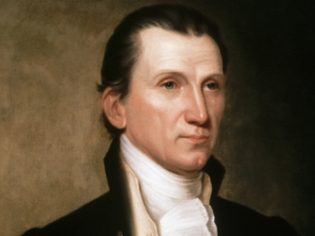
Indian Territory
1776: Push the Tribes WEST OF THE MISSISSIPPI River
1803: Encourage INDIAN DEBT to gain their HOMELANDS
1825: Remove the tribes, with THEIR CONSENT
1825: “The great object to be accomplished
is the removal of these tribes to the
territory designated on conditions
which shall be satisfactory to them-
selves and honorable to the United
States.”
“This can be done only by conveying
to each tribe a good title to an adequate portion of
land to which it may consent to remove . . .”
James Monroe
Remove the tribes, with THEIR CONSENT

Slide 20
https://indiancountrymedianetwork.com/history/events/james-monroe-pushed-tribes-off-land-but-boosted-indian-education/
When James Monroe took office in 1817, the country was experiencing an unprecedented sense of euphoria.
Monroe, the fifth president of the United States and the last of the founding fathers to hold the office, inherited a nation suddenly freed from foreign powers and ready to focus on domestic issues. Elected two years after the War of 1812 ended, Monroe immediately began pushing for the acquisition of Indian lands.
“Monroe took office after the British and French were defeated and serious Indian resistance was removed,” said Dan Preston, editor of The Papers of James Monroe, an editorial project at the University of Mary Washington. “America started looking more internally and there was really this euphoria about progress, this unspoken feeling that they could get on with things.”
Born in Virginia in 1758, Monroe was 18 when he enlisted in the Continental Army and served as an officer during the Revolutionary War. After being severely wounded in combat, he pursued a career in law. A member of the Democratic-Republican Party, Monroe served as ambassador to France and governor of Virginia, then secretary of state during the War of 1812. He was elected as president in 1816.
The American landscape changed drastically during Monroe’s two terms as president, from 1817 to 1825, Preston said. Five states were admitted to the Union, territories were organized, canals filled with water, steamboats churned on rivers and roads cut through western frontiers. Monroe also oversaw 40 treaties with Indian nations—23 of which involved land acquisition—and the formation of the Bureau of Indian Affairs.
Indian policy during Monroe’s presidency was largely dictated by lingering fears among the white settlers about security on the northern and southern borders, Preston said. That fear was most pronounced in the South where the Seminole, allied with the Spanish, continued to wage war on the United States.
During his first months in office, Monroe sent Gen. Andrew Jackson to the South on a successful campaign against the Seminole, which included the recapture of black slaves living among the tribes. Monroe also pushed for the “voluntary” removal of the Cherokee from Georgia, promising them land in Arkansas if they cooperated.
In the north, Monroe contended with the Seneca of western New York, the largest nation within the Iroquois Confederacy. Monroe pushed for the Seneca—who lived on 11 reservations—to consolidate into one, clearing the way for construction of the Erie Canal.
The Seneca successfully resisted, and Chief Red Jacket, wearing a silver peace medal given to him by George Washington, protested. “We had thought that all the promises made by one president were handed down to the next,” he said. “Now the tree of friendship is decaying; its limbs are fast falling off, and you are at fault.”
Oswego.edu
Chief Red Jacket spoke out against Monroe's plan to consolidate the Seneca reservations.
Although Monroe expressed concern for the Indians, he believed their best chance at survival was “amalgamation,” Preston said. With his “absolute belief in the superiority of the political, social and economic system of the United States,” Monroe saw little value in Native lifestyles.
During his first message to Congress, in December 1817, Monroe recommended that federal Indian policy include provisions for “their improvement in the arts of civilized life,” thus loosening their hold on land.
“The earth was given to mankind to support the greatest number of which it is capable,” Monroe said. “No tribe or people have a right to withhold from the wants of others more than is necessary for their own support and comfort.”
In the following years, treaties poured into Washington and were sent in batches to the Senate, where they were almost always unanimously approved, Francis Paul Prucha wrote in his 1994 book, “American Indian Treaties.”
Some were peace-making treaties or “treaties of friendship,” Preston said. Others called for the cessation of land and relocation of eastern tribes to territories west of the Mississippi River.
“The treaties vary,” Preston said. “We had white Americans on one side, pushing for immediate removal. On the other side, we had tribes. Some were willing to relocate west of the Mississippi while others wanted to stay put. And in the middle, Monroe is resisting forcible action and insisting removal has to be voluntary.”
A solution came in 1819 when Congress approved $10,000 yearly for Indian Education through the Indian Civilization Act. The act, designed to provide “against the further decline and final extinction of the Indian tribes,” granted the president authority to “employ capable persons of good moral character” to teach Indian children.
The act led to the formation of 52 schools during the next 11 years, administered by the federal government or Christian missions. The goal was to civilize the Indians by teaching them “in the mode of agriculture suited to their situation,” as well as reading, writing and arithmetic.
By the end of his first term, facing continued pressure from Georgia to remove the Cherokee, Monroe was less optimistic. During his second inaugural address, in 1821, he admitted that the government had failed in treating tribes as independent nations “without their having any substantial pretensions to that rank.” That distinction has “flattered their pride, retarded their improvement and in many instances paved the way to their destruction,” he said.
When he left office four years later, Monroe had reluctantly embraced forced removal. In a special message to Congress in January 1825, he recommended all Indians east of the Mississippi be relocated to settlements in the west.
“Experience has clearly demonstrated that, in their present state, it is impossible to incorporate them in such masses, in any form whatever, into our system,” he said. “Their degradation and extermination will be inevitable.”
Monroe left office in 1825 and was succeeded by John Quincy Adams. He died in 1831 at the age of 73.

Slide 21
http://www.presidency.ucsb.edu/ws/?pid=66430
Special Message from James Monroe January 27, 1825 To the Senate and House of Representatives of the United States:
Being deeply impressed with the opinion that the removal of the Indian tribes from the lands which they now occupy within the limits of the several States and Territories to the country lying westward and northward thereof, within our acknowledged boundaries, is of very high importance to our Union, and may be accomplished on conditions and in a manner to promote the interest and happiness of those tribes, the attention of the Government has been long drawn with great solicitude to the object. For the removal of the tribes within the limits of the State of Georgia the motive has been peculiarly strong, arising from the compact with that State whereby the United States are bound to extinguish the Indian title to the lands within it whenever it may be done peaceably and on reasonable conditions. In the fulfillment of this compact, I have thought that the United States should act with a generous spirit; that they should omit nothing which should comport with a liberal construction of the instrument and likewise be in accordance with the just rights of those tribes. From the view which I have taken of the subject I am satisfied that in the discharge of these important duties in regard to both the parties alluded to the United States will have to encounter no conflicting interests with either. On the contrary, that the removal of the tribes from the territory which they now inhabit to that which was designated in the message at the commencement of the session, which would accomplish the object for Georgia, under a well-digested plan for their government and civilization, which should be agreeable to themselves, would not only shield them from impending ruin, but promote their welfare and happiness. Experience has clearly demonstrated that in their present state it is impossible to incorporate them in such masses, in any form whatever, into our system. It has also demonstrated with equal certainty that without a timely anticipation of and provision against the dangers to which they are exposed, under causes which it will be difficult, if not impossible, to control, their degradation and extermination will be inevitable.
The great object to be accomplished is the removal of these tribes to the territory designated on conditions which shall be satisfactory to themselves and honorable to the United States. This can be done only by conveying to each tribe a good title to an adequate portion of land to which it may consent to remove, and by providing for it there a system of internal government which shall protect their property from invasion, and, by the regular progress of improvement and civilization, prevent that degeneracy which has generally marked the transition from the one to the other state.
I transmit herewith a report from the Secretary of War, which presents the best estimate which can be formed, from the documents in that Department, of the number of Indians within our States and Territories and of the amount of lands held by the several tribes within each; of the state of the country lying northward and westward thereof, within our acknowledged boundaries; of the parts to which the Indian title has already been extinguished, and of the conditions on which other parts, in an amount which may be adequate to the object contemplated, may be obtained. By this report it appears that the Indian title has already been extinguished to extensive tracts in that quarter, and that other portions may be acquired to the extent desired on very moderate conditions. Satisfied I also am that the removal proposed is not only practicable, but that the advantages attending it to the Indians may be made so apparent to them that all the tribes, even those most opposed, may be induced to accede to it at no very distant day.
The digest of such a government, with the consent of the Indians, which should be endowed with sufficient power to meet all the objects contemplated--to connect the several tribes together in a bond of amity and preserve order in each; to prevent intrusions on their property; to teach them by regular instruction the arts of civilized life and make them a civilized people--is an object of very high importance. It is the powerful consideration which we have to offer to these tribes as an inducement to relinquish the lands on which they now reside and to remove to those which are designated. It is not doubted that this arrangement will present considerations of sufficient force to surmount all their prejudice in favor of the soil of their nativity, however strong they may be. Their elders have sufficient intelligence to discern the certain progress of events in the present train, and sufficient virtue, by yielding to momentary sacrifices, to protect their families and posterity from inevitable destruction. They will also perceive that they may thus attain an elevation to which as communities they could not otherwise aspire.
To the United States the proposed arrangement offers many important advantages in addition to those which have been already enumerated. By the establishment of such a government over these tribes with their consent we become in reality their benefactors. The relation of conflicting interests which has heretofore existed between them and our frontier settlements will cease. There will be no more wars between them and the United States. Adopting such a government, their movement will be in harmony with us, and its good effect be felt throughout the whole extent of our territory to the Pacific. It may fairly be presumed that, through the agency of such a government, the condition of all the tribes inhabiting that vast region may be essentially improved; that permanent peace may be preserved with them, and our commerce be much extended.
With a view to this important object I recommend it to Congress to adopt, by solemn declaration, certain fundamental principles in accord with those above suggested, as the basis of such arrangements as may be entered into with the several tribes, to the strict observance of which the faith of the nation shall be pledged. I recommend it also to Congress to provide by law for the appointment of a suitable number of commissioners who shall, under the direction of the President, be authorized to visit and explain to the several tribes the objects of the Government, and to make with them, according to their instructions, such arrangements as shall be best calculated to carry those objects into effect.
A negotiation is now depending with the Creek Nation for the cession of lands held by it within the limits of Georgia, and with a reasonable prospect of success. It is presumed. however, that the result will not be known during the present session of Congress. To give effect to this negotiation and to the negotiations which it is proposed to hold with all the other tribes within the limits of the several States and Territories on the principles and for the purposes stated, it is recommended that an adequate appropriation be now made by Congress.
JAMES MONROE

Slide 22
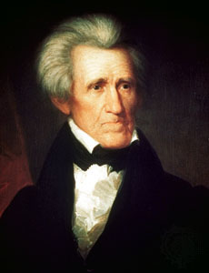
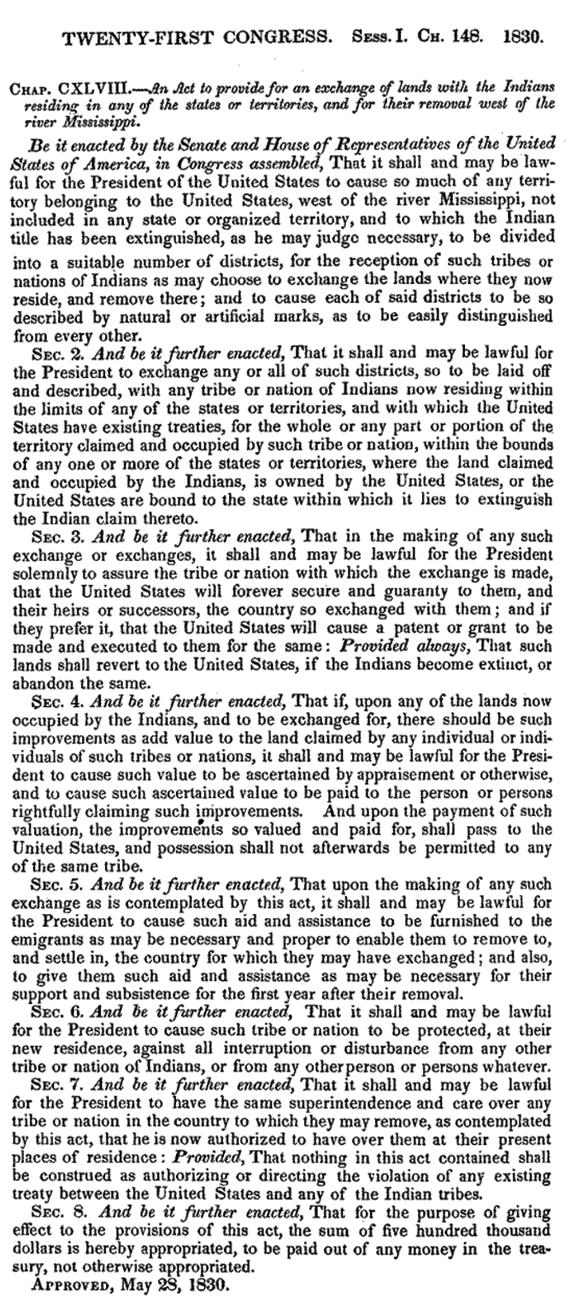
Indian Territory
1776: Push the Tribes WEST OF THE MISSISSIPPI River
1803: Encourage INDIAN DEBT to gain their HOMELANDS
1825: Remove the tribes, with THEIR CONSENT
1830: INDIAN REMOVAL ACT
1830:
An exchange of lands between the Native
Americans and the U.S. government
The U.S. forever secures & guarantees the
new land to the tribes
Improvements of property in the homelands
will be appraised and the value paid
Aid & assistance to remove to the new lands
and subsistence for 1 year afterward
Protection from other tribes in the new land
INDIAN REMOVAL ACT
Andrew Jackson

Slide 23
https://en.wikipedia.org/wiki/Indian_Removal_Act
The Indian Removal Act was signed by President Andrew Jackson on May 28, 1830. The law authorized the president to negotiate with southern Indian tribes for their removal to federal territory west of the Mississippi River in exchange for their lands. The act enjoyed strong support from the non-Indian peoples of the South, but there was a large amount of resistance from the Indian tribes, the Whig Party, and whites in the northeast, especially New England. The Cherokee worked together as an independent nation to stop this relocation, but they were unsuccessful.
In the early 1800s, the United States government began a systematic effort to remove American Indian tribes from the southeast. The Chickasaw, Choctaw, Muscogee-Creek, Seminole, and Cherokee Nations had been established as autonomous nations in the southeastern United States.
This acculturation was originally proposed by George Washington and was well under way among the Cherokee and Choctaw by the turn of the 19th century. In an effort to assimilate with American culture, Indians were encouraged to "convert to Christianity; learn to speak and read English; and adopt European-style economic practices such as the individual ownership of land and other property (including, in some instances, the ownership of African slaves).“ Thomas Jefferson's policy echoed Washington's proposition: respect the Indians' rights to their homelands, and allow the Five Tribes to remain east of the Mississippi provided that they adopt behavior and cultural practices that are compatible with those of other Americans. Jefferson encouraged practicing an agriculture-based society.
However, Andrew Jackson sought to renew a policy of political and military action for the removal of the Indians from these lands and worked toward enacting a law for Indian removal. In his 1829 State of the Union address, Jackson called for removal.
The Indian Removal Act was put in place to give to the southern states the land that Indians had settled on. The act was passed in 1830, although dialogue had been ongoing since 1802 between Georgia and the federal government concerning such an event. Davis states that "the federal government had promised Georgia that it would extinguish Indian title within the state's borders by purchase 'as soon as such purchase could be made upon reasonable terms'". As time passed, southern states began to speed up the process by posing the argument that the deal between Georgia and the federal government had no contract and that southern states could pass the law themselves. This scheme forced the national government to pass the Indian Removal Act on May 28, 1830, in which President Jackson agreed to divide the United States territory west of the Mississippi into districts for tribes to replace the land from which they were removed.
In the 1823 case of Johnson v. M'Intosh, the United States Supreme Court handed down a decision which stated that Indians could occupy lands within the United States but could not hold title to those lands. Jackson viewed the union as a federation of sovereign states, as was common before the American Civil War. He opposed Washington's policy of establishing treaties with Indian tribes as if they were foreign nations. Thus, the creation of Indian jurisdictions was a violation of state sovereignty under Article IV, Section 3 of the Constitution. As Jackson saw it, either Indians comprised sovereign states (which violated the Constitution) or they were subject to the laws of existing states of the Union. Jackson urged Indians to assimilate and obey state laws. Further, he believed that he could only accommodate the desire for Indian self-rule in federal territories, which required resettlement west of the Mississippi River on federal lands.
The Removal Act was strongly supported in the South, especially in Georgia which was the largest state in 1802 and was involved in a jurisdictional dispute with the Cherokee. President Jackson hoped that removal would resolve the Georgia crisis. Besides the Five Civilized Tribes, additional people affected included the Wyandot, the Kickapoo, the Potowatomi, the Shawnee, and the Lenape.
The Indian Removal Act was controversial. Many Americans during this time favored its passage, but there was also significant opposition. Many Christian missionaries protested it, most notably missionary organizer Jeremiah Evarts. In Congress, New Jersey Senator Theodore Frelinghuysen and Tennessee Congressman Davy Crockett spoke out against the legislation. The Removal Act passed only after bitter debate in Congress.
Jackson viewed the demise of Indian tribal nations as inevitable, pointing to the advancement of settled life and demise of tribal nations in the American northeast. He called his northern critics hypocrites, given the North's history. Indian tribes had become nearly extinct, Indian hunting grounds had been replaced with family farms, and state law had replaced tribal law. If the Indians of the south were to survive and their culture be maintained, they faced powerful historical forces that could only be postponed. He dismissed romantic portrayals of lost Indian culture as a sentimental longing for a simpler time in the past, stating that "progress requires moving forward."
Humanity has often wept over the fate of the aborigines of this country and philanthropy has long been busily employed in devising means to avert it, but its progress has never for a moment been arrested, and one by one have many powerful tribes disappeared from the earth.… But true philanthropy reconciles the mind to these vicissitudes as it does to the extinction of one generation to make room for another.… Philanthropy could not wish to see this continent restored to the condition in which it was found by our forefathers. What good man would prefer a country covered with forests and ranged by a few thousand savages to our extensive Republic, studded with cities, towns, and prosperous farms, embellished with all the improvements which art can devise or industry execute, occupied by more than 12,000,000 happy people, and filled with all the blessings of liberty, civilization, and religion?
According to historian H. W. Brands, Jackson sincerely believed that his population transfer was a "wise and humane policy" that would save the Indians from "utter annihilation". Brands writes that, given the "racist realities of the time, Jackson was almost certainly correct in contending that for the Cherokees to remain in Georgia risked their extinction". Jackson portrayed his paternalism and federal support as a generous act of mercy.
On April 24, 1830, the Senate passed the Indian Removal Act by a vote of 28 to 19. On May 26, 1830, the House of Representatives passed the Act by a vote of 101 to 97. On May 28, 1830, the Indian Removal Act was signed into law by President Andrew Jackson.
The Removal Act paved the way for the forced expulsion of tens of thousands of American Indians from their land into the West in an event widely known as the "Trail of Tears," a forced resettlement of the Indian population. The first removal treaty signed was the Treaty of Dancing Rabbit Creek on September 27, 1830, in which Choctaws in Mississippi ceded land east of the river in exchange for payment and land in the West. The Treaty of New Echota was signed in 1835 and resulted in the removal of the Cherokee on the Trail of Tears.
The Seminoles and other tribes did not leave peacefully, as they resisted the removal along with fugitive slaves. The Second Seminole War lasted from 1835 to 1842 and resulted in the government allowing them to remain in the south Florida swamplands. Only a small number remained, and around 3,000 were removed in the war.

Slide 24
https://history.state.gov/milestones/1830-1860/indian-treaties
Removal Act of 1830
The U.S. Government used treaties as one means to displace Indians from their tribal lands, a mechanism that was strengthened with the Removal Act of 1830. In cases where this failed, the government sometimes violated both treaties and Supreme Court rulings to facilitate the spread of European Americans westward across the continent.
As the 19th century began, land-hungry Americans poured into the backcountry of the coastal South and began moving toward and into what would later become the states of Alabama and Mississippi. Since Indian tribes living there appeared to be the main obstacle to westward expansion, white settlers petitioned the federal government to remove them. Although Presidents Thomas Jefferson and James Monroe argued that the Indian tribes in the Southeast should exchange their land for lands west of the Mississippi River, they did not take steps to make this happen. Indeed, the first major transfer of land occurred only as the result of war.
In 1814, Major General Andrew Jackson led an expedition against the Creek Indians climaxing in the Battle of Horse Shoe Bend (in present day Alabama near the Georgia border), where Jackson’s force soundly defeated the Creeks and destroyed their military power. He then forced upon the Indians a treaty whereby they surrendered to the United States over twenty-million acres of their traditional land—about one-half of present day Alabama and one-fifth of Georgia. Over the next decade, Jackson led the way in the Indian removal campaign, helping to negotiate nine of the eleven major treaties to remove Indians.
Under this kind of pressure, Native American tribes—specifically the Creek, Cherokee, Chickasaw, and Choctaw—realized that they could not defeat the Americans in war. The appetite of the settlers for land would not abate, so the Indians adopted a strategy of appeasement. They hoped that if they gave up a good deal of their land, they could keep at least some a part of it. The Seminole tribe in Florida resisted, in the Second Seminole War (1835–1842) and the Third Seminole War (1855–1858), however, neither appeasement nor resistance worked.
From a legal standpoint, the United States Constitution empowered Congress to “regulate commerce with foreign nations, and among the several States, and with the Indian tribes.” In early treaties negotiated between the federal government and the Indian tribes, the latter typically acknowledged themselves “to be under the protection of the United States of America, and of no other sovereign whosoever.” When Andrew Jackson became president (1829–1837), he decided to build a systematic approach to Indian removal on the basis of these legal precedents.
To achieve his purpose, President Andrew Jackson encouraged Congress to adopt the Removal Act of 1830. The Act established a process whereby the President could grant land west of the Mississippi River to Indian tribes that agreed to give up their homelands. As incentives, the law allowed the Indians financial and material assistance to travel to their new locations and start new lives and guaranteed that the Indians would live on their new property under the protection of the United States Government forever. With the Act in place, Jackson and his followers were free to persuade, bribe, and threaten tribes into signing removal treaties and leaving the Southeast.
In general terms, Jackson’s government succeeded. By the end of his presidency, he had signed into law almost seventy removal treaties, the result of which was to move nearly 50,000 eastern Indians to Indian Territory—defined as the region belonging to the United States west of the Mississippi River but excluding the states of Missouri and Iowa as well as the Territory of Arkansas—and open millions of acres of rich land east of the Mississippi to white settlers. Despite the vastness of the Indian Territory, the government intended that the Indians’ destination would be a more confined area—what later became eastern Oklahoma.
The Cherokee Nation resisted, however, challenging in court the Georgia laws that restricted their freedoms on tribal lands. In his 1831 ruling on Cherokee Nation v. the State of Georgia, Chief Justice John Marshall declared that “the Indian territory is admitted to compose a part of the United States,” and affirmed that the tribes were “domestic dependent nations” and “their relation to the United States resembles that of a ward to his guardian.” However, the following year the Supreme Court reversed itself and ruled that Indian tribes were indeed sovereign and immune from Georgia laws. President Jackson nonetheless refused to heed the Court’s decision. He obtained the signature of a Cherokee chief agreeing to relocation in the Treaty of New Echota, which Congress ratified against the protests of Daniel Webster and Henry Clay in 1835. The Cherokee signing party represented only a faction of the Cherokee, and the majority followed Principal Chief John Rossin a desperate attempt to hold onto their land. This attempt faltered in 1838, when, under the guns of federal troops and Georgia state militia, the Cherokee tribe were forced to the dry plains across the Mississippi. The best evidence indicates that between three and four thousand out of the fifteen to sixteen thousand Cherokees died en route from the brutal conditions of the “Trail of Tears.”
With the exception of a small number of Seminoles still resisting removal in Florida, by the 1840s, from the Atlantic to the Mississippi, no Indian tribes resided in the American South. Through a combination of coerced treaties and the contravention of treaties and judicial determination, the United States Government succeeded in paving the way for the westward expansion and the incorporation of new territories as part of the United States.

Slide 25
https://www.loc.gov/rr/program/bib/ourdocs/Indian.html
Indian Removal Act
LC-USZC4-3156The Indian Removal Act was signed into law by President Andrew Jackson on May 28, 1830, authorizing the president to grant unsettled lands west of the Mississippi in exchange for Indian lands within existing state borders. A few tribes went peacefully, but many resisted the relocation policy. During the fall and winter of 1838 and 1839, the Cherokees were forcibly moved west by the United States government. Approximately 4,000 Cherokees died on this forced march, which became known as the "Trail of Tears."
Digital Collections
A Century of Lawmaking for a New Nation: U.S. Congressional Documents and Debates, 1774-1875
This collection contains congressional publications from 1774 to 1875, including debates, bills, laws, and journals.
February 22, 1830 - Senator Hugh White, from the Committee on Indian Affairs, reported A Bill to provide for an exchange of lands with the Indians residing in any of the States or Territories, and for their removal West of the river Mississippi (S. 102).
February 22, 1830 - The Committee on Indian Affairs issued a report (S.doc.61).
April 9, 1830 - Debated in the Senate.
April 15, 1830 - Debated in the Senate.
April 17, 1830 - Debated in the Senate.
April 20, 1830 - Debated in the Senate.
April 21, 1830 - Debated in the Senate.
April 22, 1830 - Debated in the Senate.
April 23, 1830 - Debated in the Senate.
April 24, 1830 - The Senate voted 28 to 19 to pass the Indian Removal Act (S. 102).
May 15, 1830 - Debated in the House of Representatives.
May 17, 1830 - Debated in the House of Representatives.
May 18, 1830 - Debated in the House of Representatives
(additional speeches from May 18 were published separately in the back of the volume)
May 19, 1830 - Debated in the House of Representatives.
May 24, 1830 - Debated in the House of Representatives.
May 26, 1830 - The House of Representatives voted 102 to 97 to pass the Indian Removal Act (S. 102).
May 26, 1830 - The Senate concurred in the House amendments.
May 28, 1830 - The Indian Removal Act was signed into law by President Andrew Jackson.
December 6, 1830 - President Andrew Jackson outlined his Indian removal policy in his Second Annual Message to Congress. Jackson's comments on Indian removal begin with the words, "It gives me pleasure to announce to Congress that the benevolent policy of the Government, steadily pursued for nearly thirty years, in relation to the removal of the Indians beyond the white settlements is approaching to a happy consummation. Two important tribes have accepted the provision made for their removal at the last session of Congress, and it is believed that their example will induce the remaining tribes also to seek the same obvious advantages." Additional copies of Andrew Jackson's Second Annual Message to Congress can be found in the House Journal and the Senate Journal.
Andrew Jackson Papers
The Andrew Jackson Papers contain more than 26,000 items dating from 1767 to 1874. Included are memoranda, journals, speeches, military records, land deeds, and miscellaneous printed matter, as well as correspondence reflecting Jackson’s personal life and career as a politician, military officer, president, slave holder and property owner.
A selection of references to the Indian Removal Act includes:
Alfred Balch to Andrew Jackson, January 8, 1830, "I flatter myself that Mr Bell will do justice to the interesting subject committed to his charge as Chairman of the committee of Indian Affairs— The removal of the Indians would be an act of seeming violence—But it will prove in the end an act of enlarged philanthropy. These untutored sons of the Forest, cannot exist in a state of Independence, in the vicinity of the white man. If they will persist in remaining where they are, they may begin to dig their graves and prepare to die."
Andrew Jackson to John Pitchlynn, August 5, 1830, " I beg of you to say to them, that their interest happiness peace & prosperity depends upon their removal beyond the jurisdiction of the laws of the State of Mississippi. These things have been [often times] explained to them fully and I forbear to repeat them; but request that you make known to them that Congress to enable them to remove & comfortably to arrange themselves at their new homes has made liberal appropriations. It was a measure I had much at heart & sought to effect because I was satisfied that the Indians could not possibly live under the laws of the States. If now they shall refuse to accept the liberal terms offered, they only must be liable for whatever evils & dificulties may arise. I feel conscious of having done my duty to my red children and if any failure of my good intention arises, it will be attributable to their want of duty to themselves, not to me."
Andrew Jackson to Chickasaw Chiefs, August 23, 1830, "Brothers! If you are disposed to remove say so, and state the terms you may consider just and equitable."
Andrew Jackson, December 6, 1830, 2nd Annual Message - Drafts regarding Indian Affairs

Slide 26
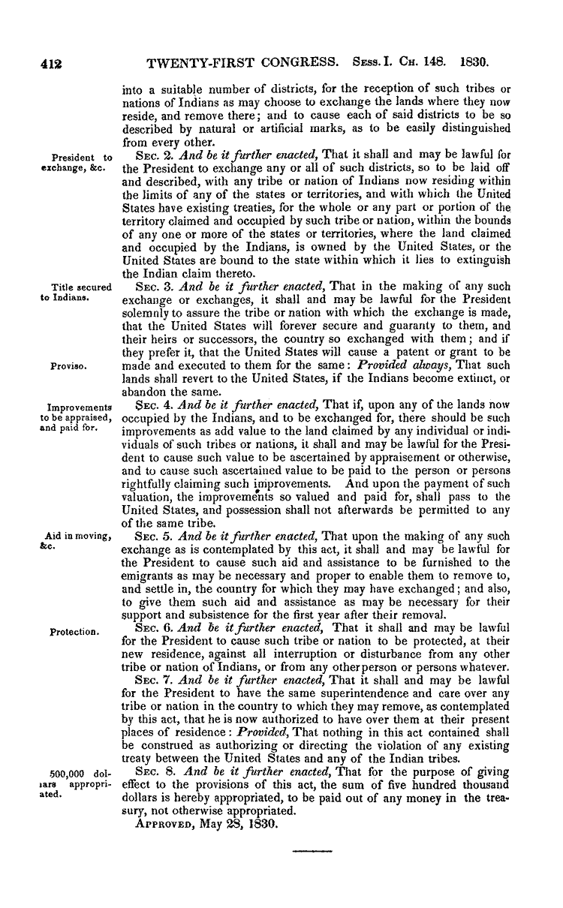
Indian Removal Act: May 28, 1830 – Congressional Record

Slide 27
Indian Territory
1776: Push the Tribes WEST OF THE MISSISSIPPI River
1803: Encourage INDIAN DEBT to gain their HOMELANDS
1825: Remove the tribes, with THEIR CONSENT
1830: INDIAN REMOVAL ACT
1834: Non-Intercourse Act
An exchange of lands between the Native
Americans and the U.S. government
The U.S. forever secures & guarantees the
new land to the tribes
Improvements of property in the homelands
will be appraised and the value paid
Aid & assistance to remove to the new lands
and subsistence for 1 year afterward
Protection from other tribes in the new land
“An act to provide for the
exchange of lands with the
Indians residing in any
of the states or territories,
and for their removal
west of the river Mississippi.”
Andrew Jackson
where?

Slide 28
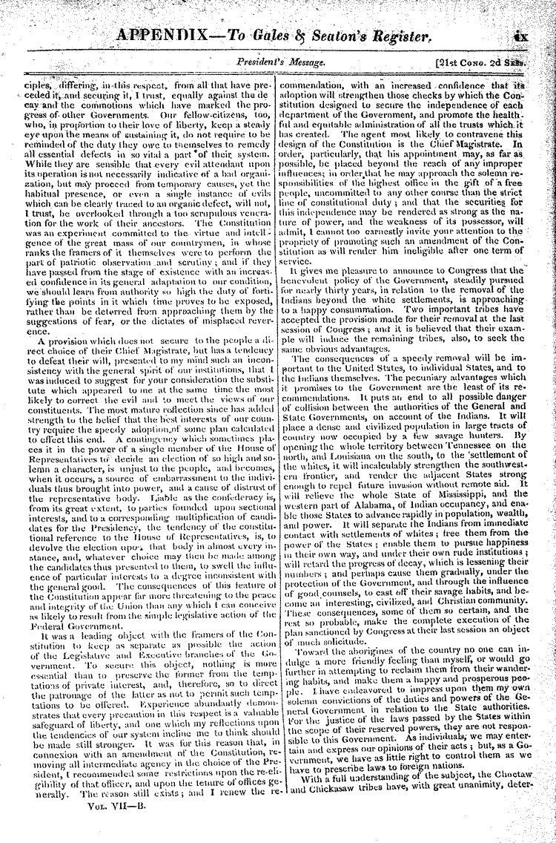
https://memory.loc.gov/cgi-bin/ampage?collId=llrd&fileName=010/llrd010.db&recNum=438
Library of Congress – President Andrew Jackson’s 2nd Annual Address to Congress, Dec 6, 1830

Slide 29
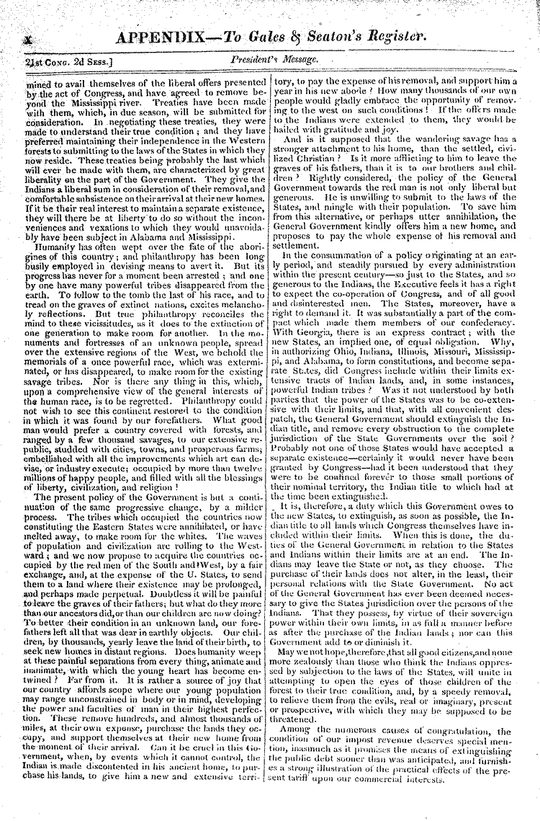
https://memory.loc.gov/cgi-bin/ampage?collId=llrd&fileName=010/llrd010.db&recNum=438
CONTINUED -- Library of Congress – President Andrew Jackson’s 2nd Annual Address to Congress Dec 6, 1830

Slide 30
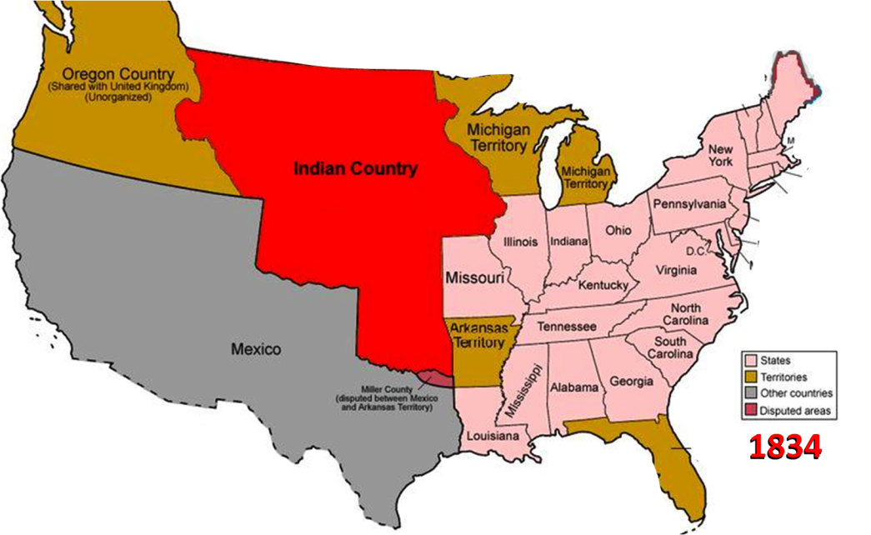
Indian Territory
1776: Push the Tribes WEST OF THE MISSISSIPPI River
1803: Encourage INDIAN DEBT to gain their HOMELANDS
1825: Remove the tribes, with THEIR CONSENT
1830: INDIAN REMOVAL ACT
1834: Non-Intercourse Act
"Indian country . . . all that
part of the United States
west of the Mississippi and
not within the states of
Missouri and Louisiana,
or the territory of Arkansas."
Andrew Jackson

Slide 31
https://en.wikipedia.org/wiki/Nonintercourse_Act
Definition of Indian country[edit]
In addition to regulating relations between Indians living on Indian land and non-Indians, the 1834 Non-Intercourse Act identified an area known as "Indian country". This land was described as being "all that part of the United States west of the Mississippi and not within the states of Missouri and Louisiana, or the territory of Arkansas." This is the land that became known as Indian Territory.

Slide 32
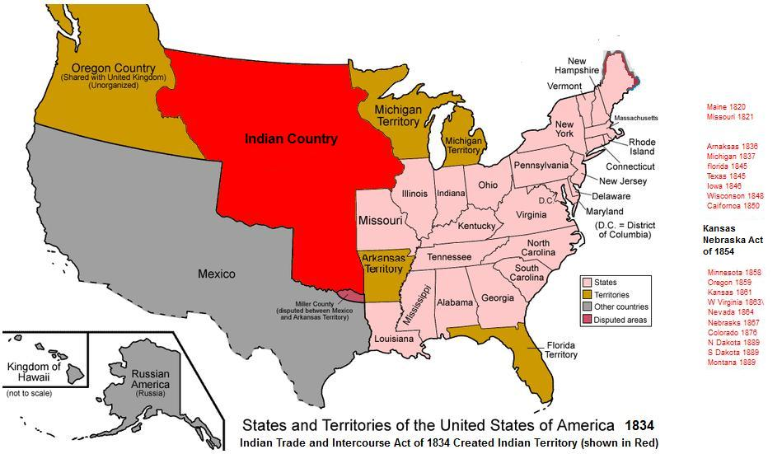
https://en.wikipedia.org/wiki/Indian_Territory

Slide 33
Indian Territory
1776: Push the Tribes WEST OF THE MISSISSIPPI River
1803: Encourage INDIAN DEBT to gain their HOMELANDS
1825: Remove the tribes, with THEIR CONSENT
1830: INDIAN REMOVAL ACT
INDIAN
COUNTRY
1834: Non-Intercourse Act
"Indian country . . . all that
part of the United States
west of the Mississippi and
not within the states of
Missouri and Louisiana,
or the territory of Arkansas."
western border

Slide 34
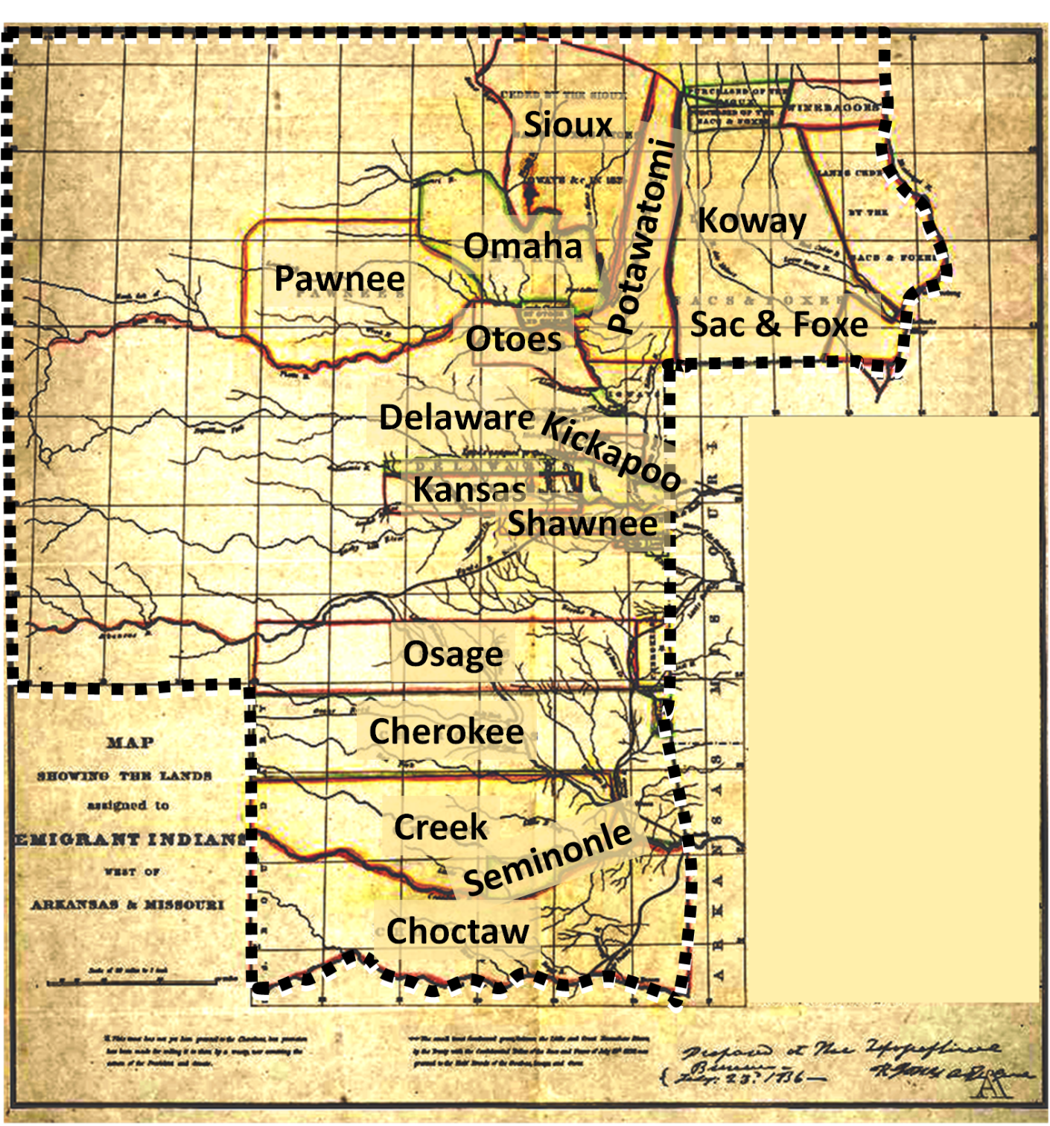
Indian Territory
MAP
SHOWING THE LANDS
assigned to
EMIGRANT INDIANS

Slide 35
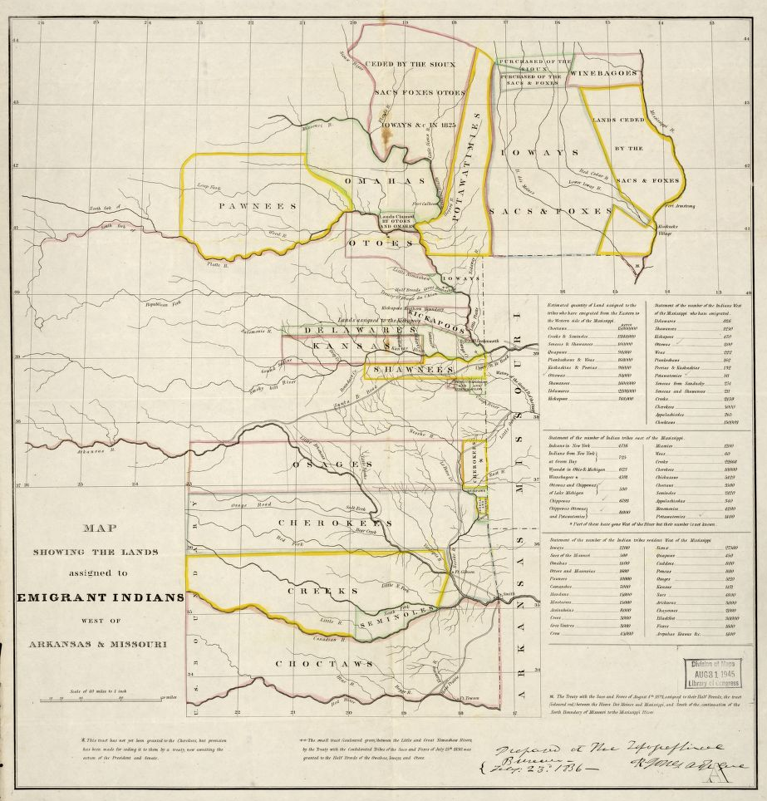
https://www.loc.gov/item/99446197/

Slide 36
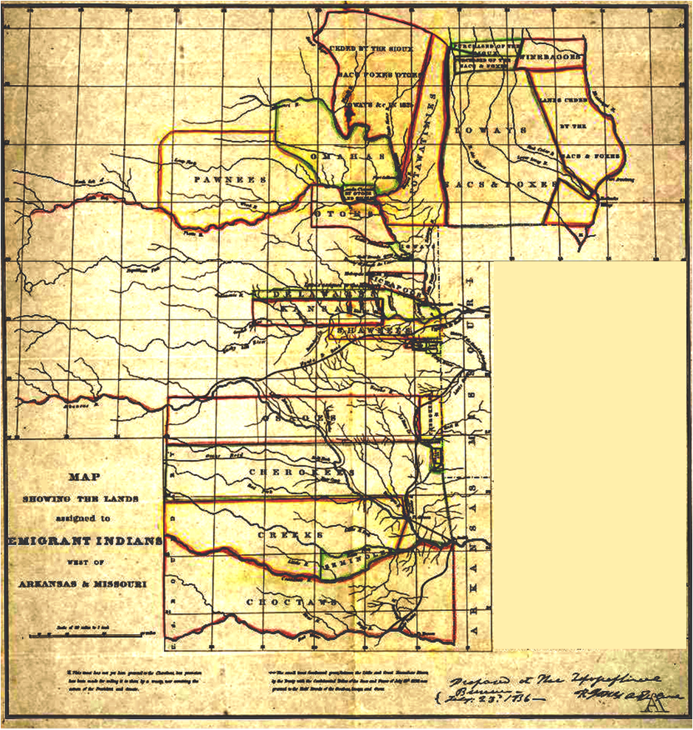
Indian Territory
Indian Territory
Sioux
Koway
Omaha
Potawatomi
Pawnee
Otoes
Sac & Foxe
Delaware
Kickapoo
Kansas
Chickasaw??
Shawnee
Osage
Cherokee
Creek
Seminole
Choctaw

Slide 37
Indian Territory
Sioux
Koway
Omaha
Potawatomi
Pawnee
Indian Territory
Otoes
Sac & Foxe
Delaware
Kickapoo
Kansas
Shawnee
Osage
Cherokee
Chickasaw??
Creek
Seminole
Choctaw

Slide 38
Indian Territory
?

Slide 39
Indian Territory
OTHER
TRIBES
Cherokee
?
Creek
ARKANSAS
TERRITORY
Seminole
Chickasaw
Cherokee
MEXICO
Choctaw
Choctaw
Creek
Seminole
What are these new lands like?

Slide 40
Session 4: Trail of Tears
Indian Territory
Geology of New Lands
- Where will they go?
Indian Territory
Geology of new lands
- How will they get there?
- What will they find there?
Cherokee
Creek
Seminole
Choctaw
What are these new lands like?

Slide 41
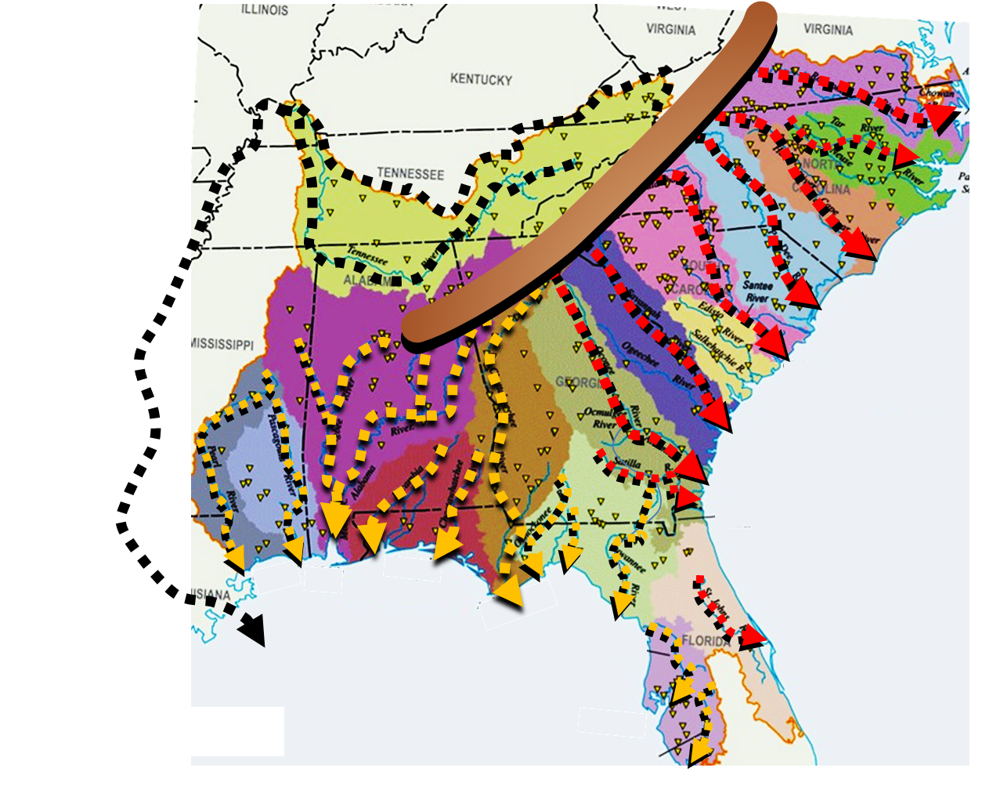
Geology of New Lands
Are there rivers?
River watersheds of the Southeast
many river drainage basins
many flood plains

Slide 42
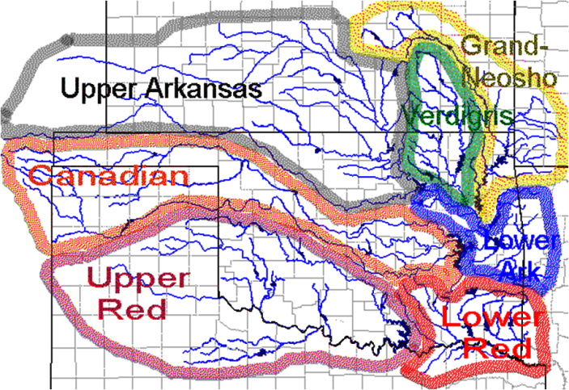
Geology of New Lands
Are there rivers?
watersheds of new lands
River watersheds of the Southeast
Arkansas
Canadian
Red
three main rivers:
Arkansas
Canadian
Red
many river drainage basins
some flood plains
many flood plains

Slide 43
Geology of New Lands
Are there rivers?
What about elevations?
watersheds of new lands
River watersheds of the Southeast
Arkansas
farmland?
Canadian
excellent farmland
Red
three main rivers:
Arkansas
Canadian
Red
many river drainage basins
some flood plains
many flood plains

Slide 44
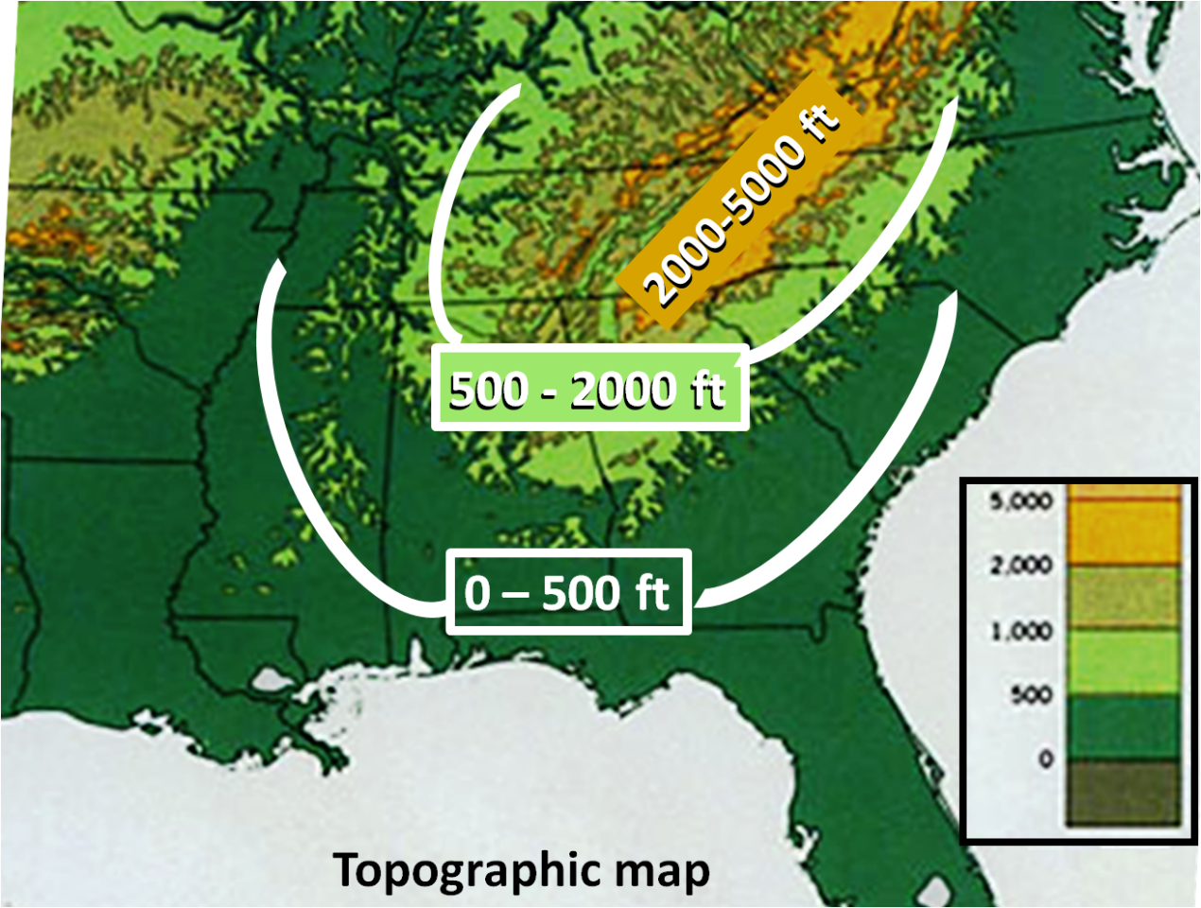
Geology of New Lands
What about elevations?
- no coastal plain
- moderate elevations
- much coastal plain < 500’
- most less than 2000’
2000’ 500’

Slide 45
Geology of New Lands
What about elevations?
What about rainfall?
- no coastal plain
- moderate elevations
- much coastal plain < 500’
- most less than 2000’
moderate
mostly moderate
2000’ 500’

Slide 46
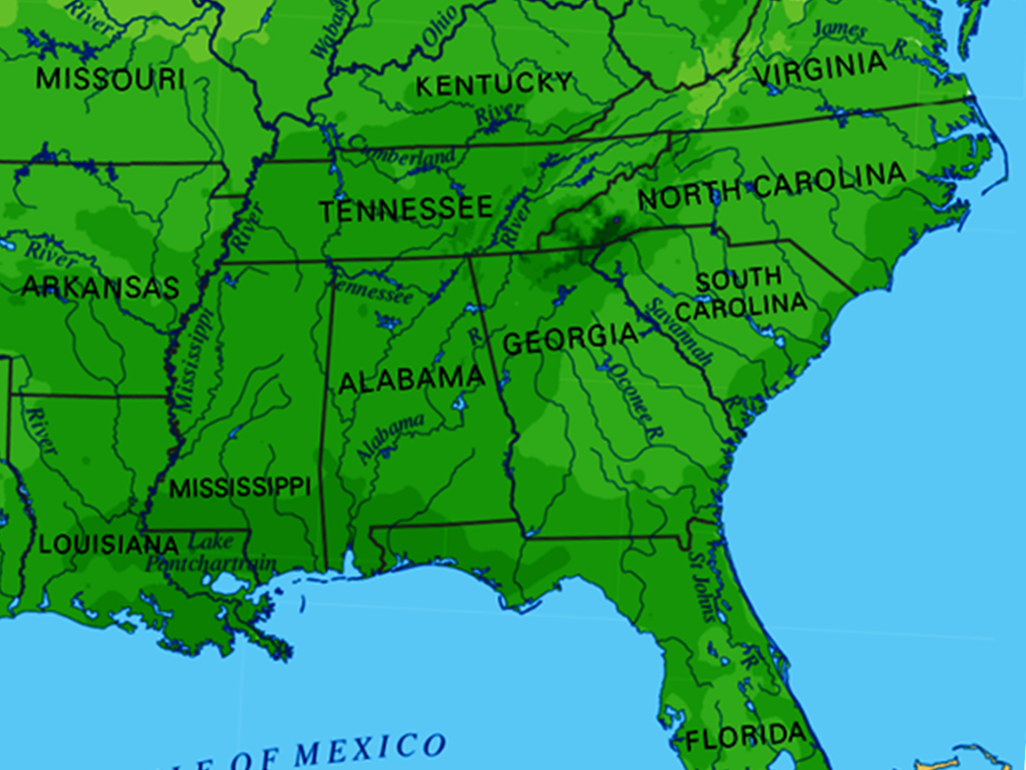
Geology of New Lands
What about rainfall?
Rainfall: 20-50” /year
Rainfall average: 40-100” /year

Slide 47
https://upload.wikimedia.org/wikipedia/commons/thumb/d/d3/Average_precipitation_in_the_lower_48_states_of_the_USA.png/1200px-Average_precipitation_in_the_lower_48_states_of_the_USA.png

Slide 48
Geology of New Lands
What about rainfall?
What about forests?
Rainfall: 20-50” /year
Rainfall average: 40-100” /year
sufficient?
sufficient

Slide 49
Geology of New Lands
What about forests?
wildlife?
animal habitat
scarce forest cover
much forest cover
Virgin Forest (1850)

Slide 50
https://image.slidesharecdn.com/virginforestppt-100126130925-phpapp01/95/virgin-forests-cover-in-the-us-2-728.jpg?cb=1264519700

Slide 51
Geology of New Lands
Geology - SUMMARY
HOMELANDS
NEW LANDS
What about forests?
few ← RIVERS → plentiful
wildlife?
some ← FLOODPLAINS → many
animal habitat
moderate ← ELEVATIONS → moderate to mtns
scarce forest cover
much forest cover
FARMING?
HUNTING?
temperate ← CLIMATE → temperate
scarce/drought ← RAINFALL → sufficient/consistent
Virgin Forest (1850)
sparse ← FORESTS → dense

Slide 52
Geology - SUMMARY
Time to go!
HOMELANDS
NEW LANDS
What about forests (animal habitat)?
little/no forest cover
Cherokee
much forest cover
Creek
Seminole
Choctaw
FARMING?
HUNTING?
scarce/drought ← RAINFALL → sufficient/consistent
Virgin Forest (1850)
sparse ← FORESTS → dense

Slide 53
Session 4: Trail of Tears
How will they get there?
HOMELANDS
NEW LANDS
- Where will they go?
Indian Territory
Geology of new lands
- How will they get there?
- What will they find there?
Cherokee
Creek
Seminole
Choctaw

Slide 54
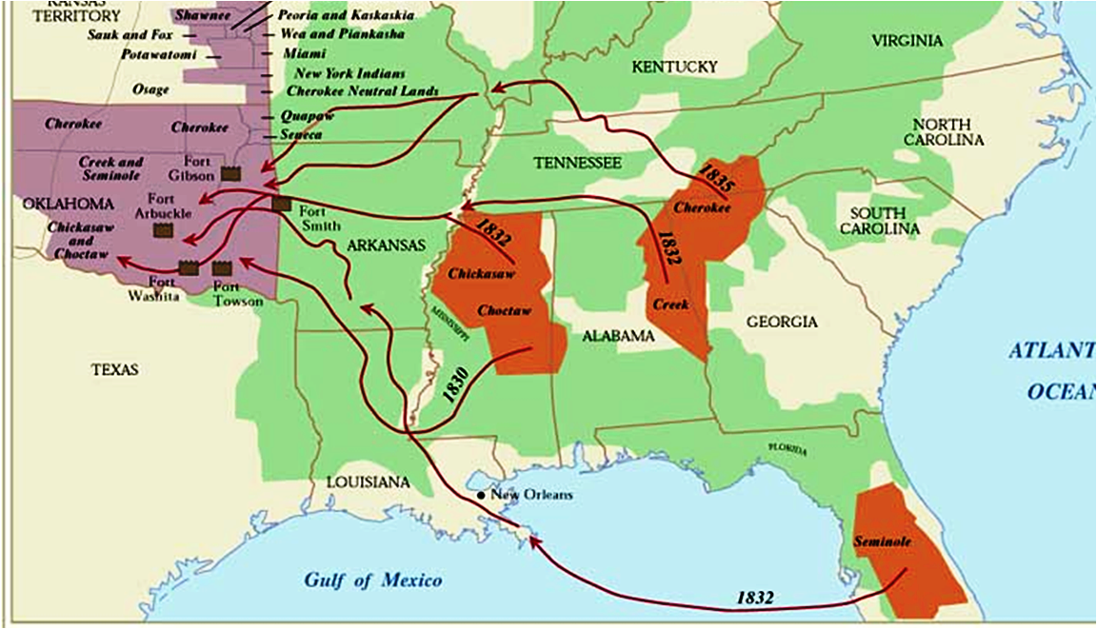
How will they get there?
Routes of the Trail of Tears
Cherokee
Chickasaw
Choctaw
Creek
Seminole

Slide 55
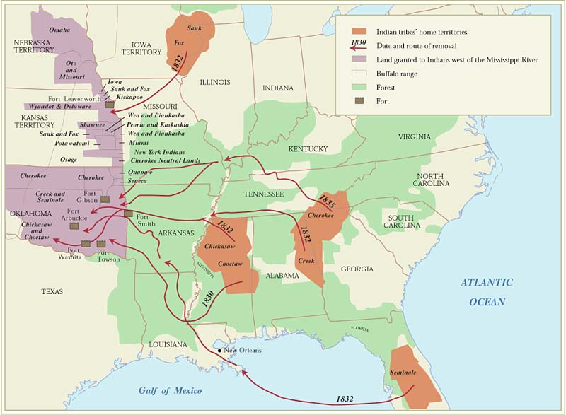
https://www.warpaths2peacepipes.com/history-of-native-americans/trail-of-tears-map.htm

Slide 56
https://www.britannica.com/event/Trail-of-Tears
Trail of Tears, in U.S. history, the forced relocation during the 1830s of Eastern Woodlands Indians of the Southeast region of the United States (including Cherokee, Creek, Chickasaw, Choctaw, and Seminole, among other nations) to Indian Territory west of the Mississippi River. Estimates based on tribal and military records suggest that approximately 100,000 indigenous people were forced from their homes during that period, which is sometimes known as the removal era, and that some 15,000 died during the journey west. The term Trail of Tears invokes the collective suffering those people experienced, although it is most commonly used in reference to the removal experiences of the Southeast Indians generally and the Cherokee nation specifically. The physical trail consisted of several overland routes and one main water route and, by passage of the Omnibus Public Lands Management Act in 2009, stretched some 5,045 miles (about 8,120 km) across portions of nine states (Alabama, Arkansas, Georgia, Illinois, Kentucky, Missouri, North Carolina, Oklahoma, and Tennessee).
The roots of forced relocation lay in greed. The British Proclamation of 1763 designated the region between the Appalachian Mountains and the Mississippi River as Indian Territory. Although that region was to be protected for the exclusive use of indigenous peoples, large numbers of Euro-American land speculators and settlers soon entered. For the most part, the British and, later, U.S. governments ignored these acts of trespass.
In 1829 a gold rush occurred on Cherokee land in Georgia. Vast amounts of wealth were at stake: at their peak, Georgia mines produced approximately 300 ounces of gold a day. Land speculators soon demanded that the U.S. Congress devolve to the states the control of all real property owned by tribes and their members. That position was supported by Pres. Andrew Jackson, who was himself an avid speculator. Congress complied by passing the Indian Removal Act (1830). The act entitled the president to negotiate with the eastern nations to effect their removal to tracts of land west of the Mississippi and provided some $500,000 for transportation and for compensation to native landowners. Jackson reiterated his support for the act in various messages to Congress, notably On Indian Removal (1830) and A Permanent Habitation for the American Indians (1835), which illuminated his political justifications for removal and described some of the outcomes he expected would derive from the relocation process.
Indigenous reactions to the Indian Removal Act varied. The Southeast Indians were for the most part tightly organized and heavily invested in agriculture. The farms of the most populous tribes—the Choctaw, Creek, Chickasaw, Seminole, and Cherokee—were particularly coveted by outsiders because they were located in prime agricultural areas and were very well developed. This meant that speculators who purchased such properties could immediately turn a profit: fields had already been cleared, pastures fenced, barns and houses built, and the like. Thus, the Southeast tribes approached federal negotiations with the goal of either reimbursement for or protection of their members’ investments.
The Choctaw were the first polity to finalize negotiations: in 1830 they agreed to cede their real property for western land, transportation for themselves and their goods, and logistical support during and after the journey. However, the federal government had no experience in transporting large numbers of civilians, let alone their household effects, farming equipment, and livestock. Bureaucratic ineptitude and corruption caused many Choctaw to die from exposure, malnutrition, exhaustion, and disease while traveling.
The Chickasaw signed an initial removal agreement as early as 1830, but negotiations were not finalized until 1832. Skeptical of federal assurances regarding reimbursement for their property, members of the Chickasaw nation sold their landholdings at a profit and financed their own transportation. As a result, their journey, which took place in 1837, had fewer problems than did those of the other Southeast tribes.
The Creek also finalized a removal agreement in 1832. However, Euro-American settlers and speculators moved into the planned Creek cessions prematurely, causing conflicts, delays, and fraudulent land sales that delayed the Creek journey until 1836. Federal authorities once again proved incompetent and corrupt, and many Creek people died, often from the same preventable causes that had killed Choctaw travelers.
A small group of Seminole leaders negotiated a removal agreement in 1832, but a majority of the tribe protested that the signatories had no authority to represent them. The United States insisted that the agreement should hold, instigating such fierce resistance to removal that the ensuing conflict became known as the Second Seminole War (1835–42). Although many were eventually captured and removed to the west, a substantial number of Seminole people managed to elude the authorities and remain in Florida.
The Cherokee chose to use legal action to resist removal. Their lawsuits, notably Cherokee Nation v. Georgia (1831) and Worcester v. Georgia (1832), reached the U.S. Supreme Court but ultimately provided no relief. As with the Seminole, a few Cherokee leaders negotiated a removal agreement that was subsequently rejected by the people as a whole. Although several families moved west in the mid-1830s, most believed that their property rights would ultimately be respected. This was not to be the case, and in 1838 the U.S. military began to force Cherokee people from their homes, often at gunpoint. Held in miserable internment camps for days or weeks before their journeys began, many became ill, and most were very poorly equipped for the arduous trip. Those who took the river route were loaded onto boats in which they traveled parts of the Tennessee, Ohio, Mississippi, and Arkansas rivers, eventually arriving at Fort Gibson in Indian Territory. Not until then did the survivors receive much-needed food and supplies. Perhaps 4,000 of the estimated 15,000 Cherokee died on the journey, while some 1,000 avoided internment and built communities in North Carolina.
Traditionally, the Northeast Indian nations tended to be more mobile and less politically unified than those of the Southeast. As a result, literally dozens of band-specific removal agreements were negotiated with the peoples of that region between 1830 and 1840. Many of the groups residing in the coniferous forests of the Upper Midwest, such as various bands of Ojibwa and Ho-Chunk, agreed to cede particular tracts of land but retained in perpetuity the right to hunt, fish, and gather wild plants and timber from such properties. Groups living in the prairies and deciduous forests of the Lower Midwest, including bands of Sauk, Fox, Iowa, Illinois, and Potawatomi, ceded their land with great reluctance and were moved west in small parties, usually under pressure from speculators, settlers, and the U.S. military. A few groups attempted armed resistance, most notably a band led by the Sauk leader Black Hawk in 1832. Although their experiences are often overshadowed by those of the more-populous Southeast nations, the peoples of the Northeast constituted perhaps one-third to one-half of those who were subject to removal.
In 1987 the U.S. Congress designated the Trail of Tears as a National Historic Trail in memory of those who had suffered and died during removal. As mentioned above, the original trail was more than doubled in size in 2009 to reflect the addition of several newly documented routes, as well as roundup and dispersion sites.

Slide 57
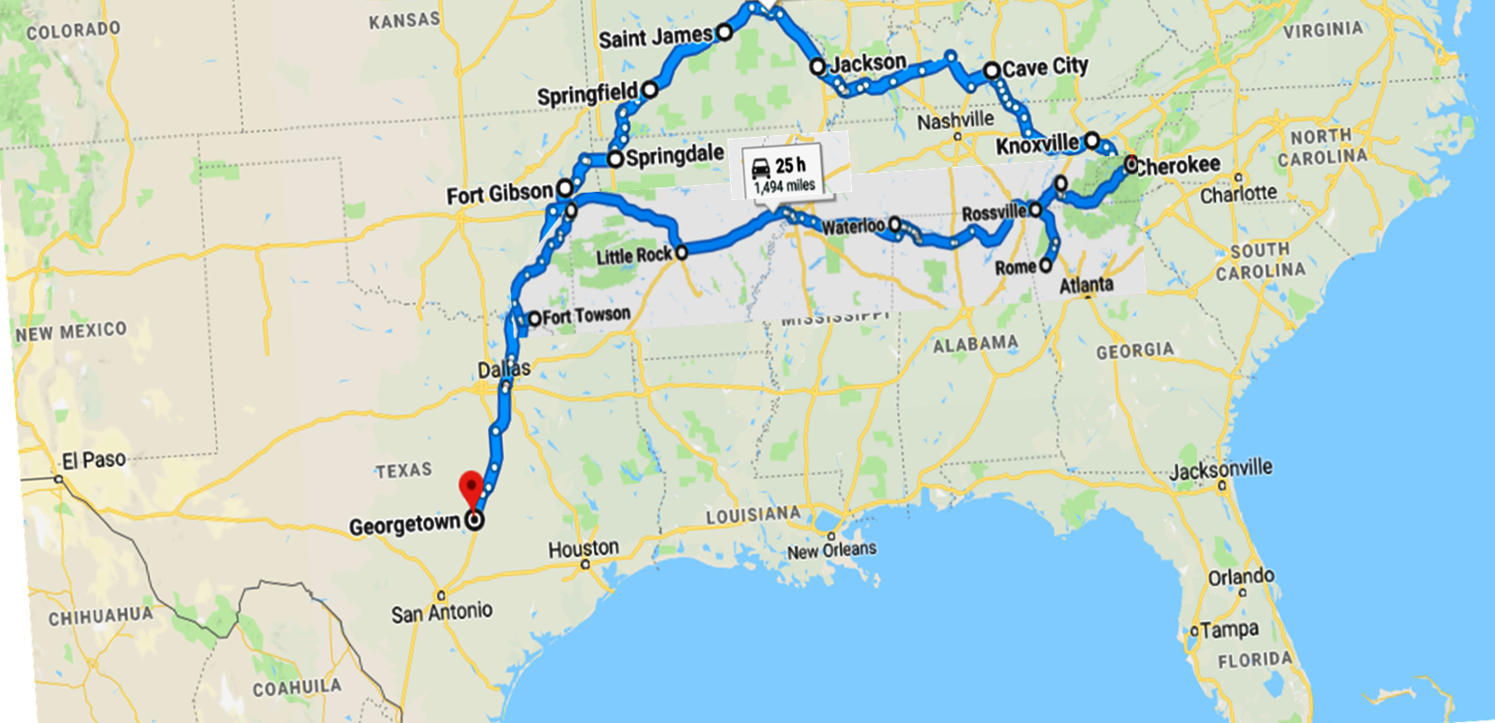
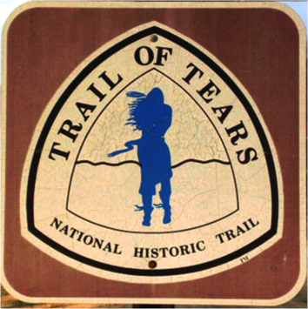
How will they get there?
Routes of the Trail of Tears
Our route . . .
Cherokee
Cherokee
Chickasaw
Choctaw
Creek
Trail of Tears
National Historic Trails
Georgetown
2,950 miles, 2 months
Seminole

Slide 58
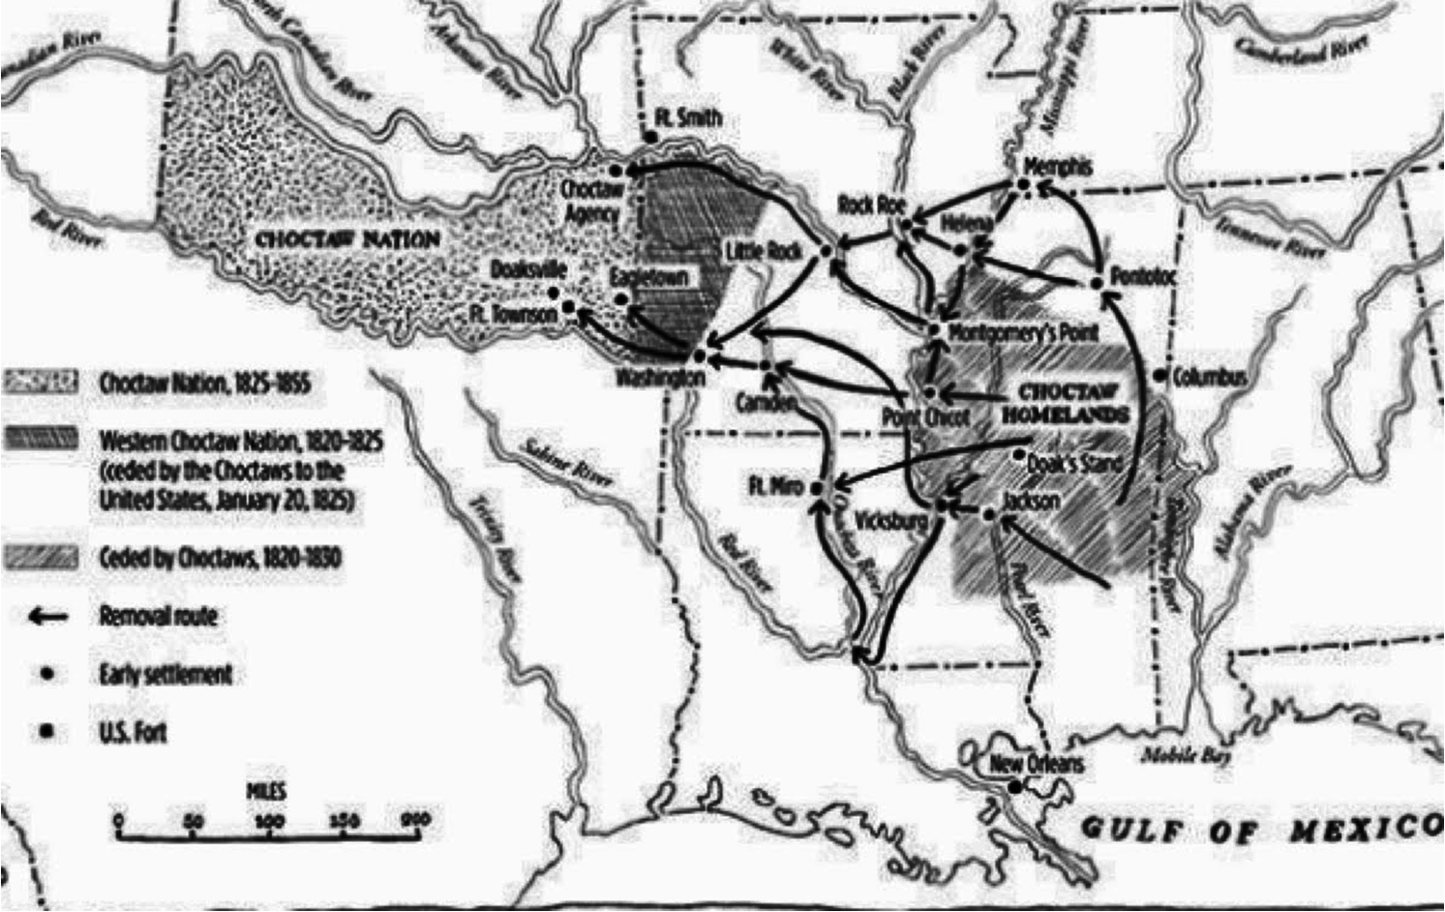
How will they get there?
Removal of the Choctaw
Routes of the Trail of Tears
Removal of the Choctaw
Arkansas
Territory
Indian Country
MS
500 miles
Cherokee
Choctaw
Chickasaw
Choctaw
Creek
MEXICO
LA
Seminole

Slide 59
https://en.wikipedia.org/wiki/Choctaw
The Choctaw were the first Native American tribe forced to relocate under the Indian Removal Act. The Choctaw were exiled because the U.S. was wanting to use its resources, and sell it for settlement and agricultural development by European Americans. Some US leaders believed that by reducing conflict between the peoples, they were saving the Choctaw from extinction. The Choctaw negotiated the largest area and most desirable lands in Indian Territory. Their early government had three districts, each with its own chief, who together with the town chiefs sat on their National Council. They appointed a Choctaw Delegate to represent them to the US government in Washington, DC.
By the 1831 Treaty of Dancing Rabbit Creek, those Choctaw who chose to stay in the newly formed state of Mississippi were to be considered state and U.S. citizens; they were one of the first major non-European ethnic groups to be granted citizenship. (Article 14 in the 1830 treaty with the Choctaw stated Choctaws may wish to become citizens of the United States under the 14th Article of the Treaty of Dancing Rabbit Creek on all of the combined lands which were consolidated under Article I from all previous treaties between the United States and the Choctaw.
The Indian commissioners met with the chiefs and headmen on September 15, 1830, at Dancing Rabbit Creek. In a carnival-like atmosphere, they tried to explain the policy of removal to an audience of 6,000 men, women, and children. The Choctaws faced migration or submitting to U.S. law as citizens. The treaty required them to cede their remaining traditional homeland to the United States; however, a provision in the treaty made removal more acceptable.
ART. XIV. Each Choctaw head of a family being desirous to remain and become a citizen of the States, shall be permitted to do so, by signifying his intention to the Agent within six months from the ratification of this Treaty, and he or she shall thereupon be entitled to a reservation of one section of six hundred and forty acres of land ...
— Treaty of Dancing Rabbit Creek, 1830
On September 27, 1830, the Treaty of Dancing Rabbit Creek was signed. It represented one of the largest transfers of land that was signed between the U.S. Government and Native Americans without being instigated by warfare. By the treaty, the Choctaw signed away their remaining traditional homelands, opening them up for European-American settlement. Article 14 allowed for some Choctaw to stay in Mississippi, and nearly 1,300 Choctaws chose to do so. They were one of the first major non-European ethnic group to become U.S. citizens. Article 22 sought to put a Choctaw representative in the U.S. House of Representatives. The Choctaw at this crucial time split into two distinct groups: the Choctaw Nation of Oklahoma and the Mississippi Band of Choctaw Indians. The nation retained its autonomy, but the tribe in Mississippi submitted to state and federal laws.

Slide 60
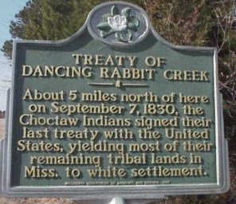
Removal of the Choctaw
Treaty of Dancing Rabbit Creek: September 1830
U.S. receives >11M acres of land
a Choctaw may choose to stay
all others will be removed
removal to finish by 1833
?
Choctaw
within 6 months, a Choctaw
must announce intent to stay
must give up tribal customs
must become U.S. citizen
will receive 640 acres
loses right to Choctaw annuity
The Removal Routes

Slide 61
Removal of the Choctaw
Removal of the Choctaw 1830-1832
1830-1832
2000-4000 die from cholera
removed
<10,500
12,500
remain
1830: 400 leaders/warriors,
sell land at profit & move
7,000
1831: 4000 transported by
steamship, 5 month trip
1832: remainder by military removal
NOTE: 1000 slaves are taken too
The Removal Routes
Notes:
Routes
Red – Arkansas R. to little Rock, Ft Smith
pink – down Mississippi, up Ouachita R., overland from Camden, AR
Green - overland

Slide 62
https://en.wikipedia.org/wiki/Indian_removal
The following is a compilation of the statistics, many containing rounded figures, regarding the Southern removals.
Nation | Population east of the Mississippi before removal treaty | Removal treaty & year signed | Years of major emigration | Total number emigrated or forcibly removed | Number stayed in Southeast | Deaths during removal | Deaths from warfare
Choctaw | 19,554^{[100]} + white citizens of the Choctaw Nation + 500 black slaves | Dancing Rabbit Creek (1830) | 1831–1836 | 12,500 | 7,000^{[101]} | 2,000–4,000+ (Cholera) | none
Creek | 22,700 + 900 black slaves^{[102]} | Cusseta (1832) | 1834–1837 | 19,600^{[103]} | 100s | 3,500 (disease after removal)^{[104]} | ? (Second Creek War)
Chickasaw | 4,914 + 1,156 black slaves | Pontotoc Creek (1832) | 1837–1847 | over 4,000 | 100s | 500–800 | none
Cherokee | 21,500 + 2,000 black slaves | New Echota (1835) | 1836–1838 | 20,000 + 2,000 slaves | 1,000 | 2,000–8,000 | none
Seminole | 5,000 + fugitive slaves | Payne's Landing (1832) | 1832–1842 | 2,833^{[105]} | 250^{[105]} 500^{[106]} |  | 700 (Second Seminole War)

Slide 63
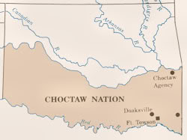
http://dougdawg.blogspot.com/2010/10/maps-and-history-of-oklahoma-county.html
The Choctaws were the first of the Five Tribes to relocate to Indian Territory during 1825-1831, followed in 1832 by the Creeks. Each of these tribe's areas would shortly be co-occupied by another of the Five Tribe
Initial Choctaw Area 1825-1831

Slide 64
https://en.wikipedia.org/wiki/List_of_Choctaw_treaties
CHOCTAW
By the early 19th century pressure from U.S. southern states, like Georgia, encouraged the procurement of Native American lands. The Treaty of Fort Adams was the first in a series of treaties that ceded Choctaw lands. The Choctaws were relocated from their homeland, now known as the Deep South, to lands west of the Mississippi River. Approximately 15,000 Choctaws made the move to what would be called Indian Territory and then later Oklahoma. About 2,500 died along the trail of tears.
The Treaty of Dancing Rabbit Creek required the Choctaws to sign away the remaining traditional homeland to the United States. There would be three waves of removals starting in 1831. After the final wave of removal in 1833, nearly 6,000 Choctaws chose to stay in the newly formed state of Mississippi. Despite the grant of citizenship and land to Choctaws that chose to stay, the newly settled European-Americans persistently urged the Mississippi Choctaws to remove, but they refused. Although smaller Choctaw groups can be found throughout the U.S. south, Choctaws are mainly found in Florida, Oklahoma,
and Mississippi.
https://en.wikipedia.org/wiki/Treaty_of_Dancing_Rabbit_Creek
The Choctaw were the first of the "Five Civilized Tribes" to be removed from the southeastern United States, as the federal and state governments desired Indian lands to accommodate a growing agrarian American society. The Treaty of Dancing Rabbit Creek was a treaty signed on September 27, 1830, and proclaimed on February 24, 1831, between the Choctaw American Indian tribe and the United States Government. T
This was the first removal treaty carried into effect under the Indian Removal Act. The treaty ceded about 11 million acres (45,000 km²) of the Choctaw Nation in what is now Mississippi in exchange for about 15 million acres (61,000 km²) in the Indian territory, now the state of Oklahoma. The principal Choctaw negotiators were Chief Greenwood LeFlore, Musholatubbee, and Nittucachee; the U.S. negotiators were Colonel John Coffee and Secretary of War John Eaton.
The site of the signing of this treaty is in the southwest corner of Noxubee County; the site was known to the Choctaw as Bok Chukfi Ahilha (creek "bok" rabbit "chukfi" place to dance "a+hilha" or Dancing Rabbit Creek). The Treaty of Dancing Rabbit Creek was the last major land cession treaty signed by the Choctaw. With ratification by the U.S. Congress in 1831, the treaty allowed those Choctaw who chose to remain in Mississippi to become the first major non-European ethnic group to gain recognition as U.S. citizens.
The commissioners met with the chiefs and headmen on September 15, 1830, at Dancing Rabbit Creek. In a carnival-like atmosphere, the US officials explained the policy of removal through interpreters to an audience of 6,000 men, women and children. The Choctaws faced migration west of the Mississippi River or submitting to U.S. and state law as citizens. The treaty would sign away the remaining traditional homeland to the United States; however, a provision in the treaty made removal more acceptable.
The Treaty of Dancing Rabbit Creek was one of the largest land transfers ever signed between the United States Government and American Indians in time of peace. The Choctaw ceded their remaining traditional homeland to the United States. Article 14 allowed for some Choctaw to remain in the state of Mississippi, if they wanted to become citizens:
"ART. XIV. Each Choctaw head of a family being desirous to remain and become a citizen of the States, shall be permitted to do so, by signifying his intention to the Agent within six months from the ratification of this Treaty, and he or she shall thereupon be entitled to a reservation of one section of six hundred and forty acres of land, to be bounded by sectional lines of survey; in like manner shall be entitled to one half that quantity for each unmarried child which is living with him over ten years of age; and a quarter section to such child as may be under 10 years of age, to adjoin the location of the parent. If they reside upon said lands intending to become citizens of the States for five years after the ratification of this Treaty, in that case a grant in fee simple shall issue; said reservation shall include the present improvement of the head of the family, or a portion of it. Persons who claim under this article shall not lose the privilege of a Choctaw citizen, but if they ever remove are not to be entitled to any portion of the Choctaw annuity.“
After ceding nearly 11,000,000 acres (45,000 km²), the Choctaw emigrated in three stages: the first in the fall of 1831, the second in 1832 and the last in 1833. Around 15,000 Choctaws left the old Choctaw Nation for the Indian Territory – much of the state of Oklahoma today. The Choctaw word Oklahoma means "red people".
Late twentieth-century estimates are that between 5,000–6,000 Choctaws remained in Mississippi in 1831 after the first removal. For the next ten years they were objects of increasing legal conflict, harassment, and intimidation. The Choctaw describe their situation in 1849,
The removals continued well into the early 20th century. In 1903, three hundred Mississippi Choctaws were persuaded to move to the Nation in Oklahoma. The Choctaw did not gain a delegate on the floor of the U.S. House of Representative. Greenwood LeFlore, a Choctaw leader, stayed in Mississippi, where he was elected to the Mississippi House of Representatives and Senate.
The Choctaw Nation continued to thrive until Oklahoma was created as a state. Their government was dismantled under the Curtis Act, along with those of other Native American nations in the former Indian Territory, in order to permit the admission of Oklahoma as a state. Their communal lands were divided and allotted to individual households under the Dawes Act to increase assimilation as American-style farmers. The US declared communal land remaining after allotment to be surplus and sold it to American settlers. In the twentieth century, the Choctaw reorganized and were recognized by the government as the Choctaw Nation.
The descendants of the Choctaw who stayed in Mississippi reorganized themselves as the Mississippi Band of Choctaw Indians in 1945 and gained federal recognition.

Slide 65
http://nativeamericannetroots.net/diary/1034
The Choctaw Removals:
In December of 1830, 400 individuals left for the west. This initial group was composed of Choctaw captains and high-ranking warriors who felt that they could sell their lands for a handsome price at this time and feared that if they delayed the land values would decrease.
A second group of about 4,000 left in 1831. They were transported by steamboat as far as possible up the Arkansas and Ouachita Rivers. They arrived at their new homes after a five month journey. Many of them were sick and all of them were exhausted and discouraged.
In 1832, the removal of the remaining Mississippi Choctaw was turned over to the army. Under orders to economize, rations were decreased and transportation was provided only for the very young and those who were very sick. 9,000 Choctaw were removed, most of whom walked all the way to their new homes. They had no time to prepare for the trip and were told that the American government would provide all supplies. They were issued one blanket per family (there were an average of six people per family). They were forced by the government to leave during the winter and en route they encountered a snow storm. Ice flows prevented them from crossing the Mississippi River and they huddled in the freezing rain for several days. Many died of starvation and exposure. During the 350 mile forced march, in which many did not have shoes to wear, it was estimated that 2,500 died. The Choctaw were not allowed to care for the bodies of the dead in their traditional way. Instead, the Americans forced them to bury the dead in a European fashion.

Slide 66
http://www.mshistorynow.mdah.ms.gov/articles/12/mushulatubbee-and-choctaw-removal-chiefs-confront-a-changing-world
The Mississippi Legislature passed a resolution that went into effect in January 1830 extending its jurisdiction over Choctaw and Chickasaw territories within the state. Many Indians opposed this move and appealed to the United States government for assistance. Others accepted this new state of affairs and sought the best terms possible. With the passage by
the U.S. Congress of the Indian Removal Act that same year, the legal mechanisms were put in place for President Andrew Jackson to negotiate with Indian groups for their deportation.
The Choctaws, Mississippi's largest Indian group, were the first southeastern Indians to accept removal with the Treaty of Dancing Rabbit Creek in September 1830. The treaty provided that the Choctaws would receive land west of the Mississippi River in exchange for the remaining Choctaw lands in Mississippi. The Choctaws were given three years to leave Mississippi.
In the winter of 1830, Choctaws began migrating to Indian Territory (later Oklahoma) along the “trail of tears.” The westward migrations continued over the following decades, and Indians remaining in Mississippi were forced to relinquish their communal land-holdings in return for small individually owned allotments.
Non-Indians rushed into the former Choctaw lands in Mississippi after 1830, producing the era often referred to in Mississippi history as the “flush times.” Removal was a complicated process that found Indians and Euro-Americans on both sides of the fence: some people of both groups opposed removal, while others supported it.
Any attempt to understand Indian removal must include the role of Indian leaders such as Choctaw Chief Mushulatubbee. Even though other Choctaws made their voices heard, chiefs negotiated with the United States government and signed the removal treaty. The reasons they agreed to such a drastic measure tells us much about their priorities and about their reactions to a rapidly changing world.
During his career, Mushulatubbee, a leading chief of the Choctaw eastern division, supported three treaties that yielded Choctaw lands to the United States. From at least the eighteenth century there existed among the Choctaws three principal geographic and political divisions: the western, eastern, and Six Towns (or southern) divisions. The western division villages were scattered around the upper Pearl River watershed, the eastern division towns were located around the upper Chickasawhay River and lower Tombigbee River watersheds, and the Six Towns were distributed along the upper Leaf River and mid-Chickasawhay River watersheds.
These divisions reflected the diverse ethnic origins and makeup of the Choctaws. Originally, the Choctaws were separate societies located throughout east-central Mississippi and west-central Alabama. These independent societies first joined together sometime after 1540 (when Hernando de Soto's expedition ravaged the Southeast with disease) and before 1699 (when the French arrived on the Gulf Coast). Each district maintained its own group of chiefs and other leaders well into the nineteenth century.
Mushulatubbee had become a chief after the death of his maternal uncle Mingo Homastubby in 1809. Mushulatubbee had earned the right to represent the eastern division as a chief by following the traditional Choctaw route to male success: he had distinguished himself in the spiritual realm by becoming an accomplished warrior and war leader, particularly during fighting against the Osage and Caddo Indians west of the Mississippi River.
Until the late 1700s, Choctaws and their chiefs acquired European manufactured items, such as essential guns and wool cloth, by trading deerskins and other items to fur traders. By the early 1800s, however, deer were becoming scarce within present-day Mississippi, requiring the Choctaws to hunt west of the Mississippi River.
Because of the scarcity of deer and the mounting Choctaw trade debts incurred by the Choctaws as a whole, chiefs such as Mushulatubbee sought new ways to maintain access to Euro-American goods, to generate income, and to augment their high status. Chiefs and other Choctaws who gained access to large quantities of manufactured goods could redistribute them to family and followers, thus securing power through reciprocal obligations. Moreover, early nineteenth-century chiefs recognized that American society paid the greatest respect to persons who controlled the most wealth. They knew that they must have material wealth to be taken seriously by the United States.
Thus, Choctaws, like Mushulatubbee and his family, entered the emerging market economy of early nineteenth-century America by raising and selling livestock and horses, owning African-American slaves, cultivating cotton, and marketing food products, baskets, and other sundry items. Beginning in 1819, Mushulatubbee and other chiefs welcomed Christian missionaries into the Choctaw nation. From the missionaries, Choctaw chiefs and their families learned the English language, basic math, Christian teachings, new farming techniques, and other business-related skills.
Although nearly every chief and elite Choctaw family pursued this basic outline of economic reform in the early nineteenth century, it did not mean they agreed with one another on other important issues. Factionalism ran rampant among Choctaw leaders as some of them sought to enhance their own position and power at the expense of more traditionally minded chiefs like Mushulatubbee.
Even though Mushulatubbee realized the deerskin trade was nearing its end, he remained devoted to a traditional political arrangement. Tradition required that leadership positions be inherited through the female line, that each of the three divisions retain autonomy, and that chiefs distributed goods and favors to their family and friends. His opponents, such as David Folsom and his family, claimed the right to lead even though they had never demonstrated their mastery of spiritual powers through war exploits or other traditional means.
Folsom was a son of deerskin trader Nathaniel Folsom and his Choctaw wife, and a distant cousin of Mushulatubbee. His wife, Rhoda Nail, was also the offspring of a European trader and Choctaw mother. Mushulatubbee's opponents' claim to power rested wholly within the material realm. These aspiring rulers sought a constitutional government that established a council of chiefs over the entire nation, supported private property ownership, initiated a new police force, and promoted inheritance through the male line.
As both sides sought to gain their peoples' confidence, Mushulatubbee ended up supporting removal and land cessions as a tactic to bolster his notion of leadership. Beginning with the 1816 treaty between the Choctaws and the United States, Mushulatubbee was a signatory to land cessions that brought him gifts from the Americans. He then doled out these gifts to his supporters in the eastern division and to similarly minded folks in the western division. Traditionally, chiefs used such offerings to build up good will and reciprocal obligations.
In 1820 Mushulatubbee supported the Treaty of Doak's Stand that provided the Choctaws with land west of the Mississippi River (present-day Arkansas) in exchange for another cession of land in Mississippi and Alabama to the United States. Because few Choctaws emigrated to the new territory and since Americans had illegally claimed much of that land, Mushulatubbee and other leaders journeyed to Washington, D.C., in 1824 to cede that land back to the United States in return for further payments.
Meanwhile, the Folsoms and other opponents of Mushulatubbee set themselves up as defenders of Choctaw lands and rights by publicly deriding him for this cession. The tactic worked in the short run. Mushulatubbee was deposed from power and replaced by his nemesis David Folsom.
In the five years leading up to the Treaty of Dancing Rabbit Creek, Mushulatubbee let it be known to the Americans that he would support removal if they would, in turn, recognize him as the legitimate leader of the eastern division. Conversely, he also began to condemn the Christian missionaries and leaders like Folsom for abandoning traditional Choctaw ideology in favor of the cultural and moral traits of Americans.
Although he supported removal, Mushulatubbee appealed to the majority of Choctaw people as a champion of traditional rights. Thus, when the new western division leader Greenwood LeFlore, with the support of his allies the Folsoms, named himself head of the entire Choctaw nation in early 1830, Mushulatubbee condemned him so vociferously that the two sides nearly fought a pitched battle before LeFlore backed down.
Greenwood LeFlore's father, Louis, was French and his mother, Rebecca, was of mixed French-English-Choctaw heritage and related to the Six Towns leader Pushmataha. Leaders such as LeFlore and Folsom promoted American-style education for their children and participated eagerly in the developing plantation economy of early Mississippi. Their attempts to replace traditional Choctaw notions of inheritance, government, and culture brought them into conflict with other chiefs like Mushulatubbee who, although also participating in the new market economy, espoused traditional notions of culture and authority.
Indeed, Mushulatubbee embodied contradiction. He supported removal and traditional prerogatives at the same time. Even though he signed the Treaty of Dancing Rabbit Creek and migrated with his people to the west, Mushulatubbee blamed men like Folsom and LeFlore for the event. He also steadfastly refused to allow missionaries among his eastern division people in the west. He died of smallpox in 1838.
Once Choctaw chiefs became enmeshed in the American market system, they found their options severely limited as Americans tightened their grip on Choctaw lands. The key question with regard to Indian removal is not whether or not chiefs like Mushulatubbee were “sell-outs.” Instead, the question is whether they realized that their successful participation in the economy and politics of the United States would only increase their dependence upon that same nation and thus help to create the mess they found themselves in by 1830.

Slide 67
https://en.wikipedia.org/wiki/Choctaw_Trail_of_Tears
After ceding nearly 11,000,000 acres (45,000 km²), the Choctaw emigrated in three stages: the first in the fall of 1831, the second in 1832 and the last in 1833. The Treaty of Dancing Rabbit Creek was ratified by the U.S. Senate on February 25, 1830, and the U.S. President Andrew Jackson was anxious to make it a model of removal.
The first wave of removal suffered the most. The second and third wave "sowed their fields promptly and experienced fewer hardships than the Indians of most of the other expatriated tribes.“ Removal continued throughout the 19th century. In 1846 1,000 Choctaw removed, and by 1930 1,665 remained in Mississippi.
Nearly 15,000 Choctaws together with 1000 slaves made the move to what would be called Indian Territory and then later Oklahoma. The population transfer occurred in three migrations during the 1831-33 period including the devastating winter blizzard of 1830-31 and the cholera epidemic of 1832. About 2,500 died along the trail of tears. Approximately 5,000–6,000 Choctaws remained in Mississippi in 1831 after the initial removal efforts. For the next ten years they were objects of increasing legal conflict, harassment, and intimidation. The removals continued well into the early 20th century. In 1903, three hundred Mississippi Choctaws were persuaded to move to the Nation in Oklahoma.
https://www.warpaths2peacepipes.com/history-of-native-americans/trail-of-tears-map.htm
In 1831, tens of thousands of Choctaw walked the 800-kilometer journey to Oklahoma and many died. Like the Creek, Cherokee, Chickasaw, and Seminole who followed them, the Choctaw attempted to resurrect their traditional lifestyle and government in their new homeland.
The Choctaw at this crucial time became two distinct groups: the Nation in Oklahoma and the Tribe in Mississippi. The nation retained its autonomy to regulate itself, but the tribe left in Mississippi had to submit to state and U.S. laws. Under article XIV, in 1830 the Mississippi Choctaws became the first major non-European ethnic group to gain U.S. citizenship. The Choctaw sought to elect a representative to the U.S. House of Representatives.
The following terms of the treaty were:
1. Perpetual peace and friendship. 2. Lands (in what is now Oklahoma) west of the Mississippi River to be conveyed to the Choctaw Nation. 3. Lands east of the Mississippi River to be ceded and removal to begin in 1831 and end in 1833. 4. Autonomy of the Choctaw Nation (in Oklahoma) and descendants to be secured from laws of U.S. states and territories forever. 5. U.S. will serve as protectorate of the Choctaw Nation. 6. Choctaw or party of Choctaws part of violent acts against the U.S. citizens or property will be delivered to the U.S. authorities. 7. Offenses against Choctaws and their property by U.S. citizens and other tribes will be examined and every possible degree of justice applied. 8. No harboring of U.S. fugitives with all expenses to capture him or her paid by the U.S. 9. Persons ordered from Choctaw Nation. 10. Traders require a written permit.
John Eaton was a close personal friend of Andrew Jackson. He was Secretary of War for the Jackson administration. Painted 1873 by Robert Weir.
11. Navigable streams will be free for Choctaws, U.S. post-offices will be established in the Choctaw Nation, and U.S. military posts and roads may be created. 12. Intruders will be removed from the Choctaw Nation. U.S. citizens stealing Choctaw property shall be returned and offender punished. Choctaw offending U.S. laws shall be given a fair and impartial trial. 13. U.S. agent appointed to the Choctaws every four years. 14. Choctaws may become U.S. citizens and are entitled to 640 acres (2.6 km²) of land (in Mississippi) with additional land for children. 15. Lands granted to the Choctaw chiefs (Greenwood LeFlore, Musholatubbee, and Nittucachee) with annuities granted to each of them. 16. Transportation in wagons and steamboats will be provided at the costs of the U.S. Ample food will be provided during the removal and 12 months after reaching the new homes. Reimbursements will be provided for cattle left in Mississippi Territory. 17. Annuities to Choctaws to continue from other treaties. Additional payments after removal. 18. Choctaw Country to be surveyed 19. Lands granted to I. Garland, Colonel Robert Cole, Tuppanahomer, John Pytchlynn, Charles Juzan, Johokebetubbe, Eaychahobia, and Ofehoma. 20. Improve the Choctaw condition with Education. Provide tools, weapons, and steel. 21. Choctaw Warriors who marched and fought in the army of U.S. General Wayne during the American Revolution and Northwest Indian War will receive an annuity. 22. Choctaw delegate on the floor of the U.S. House of Representatives.

Slide 68
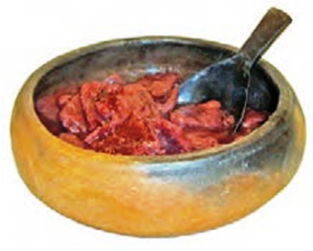
Removal of the Choctaw 1830-1832
Choctaw are allowed only minimal supplies on journey
2000-4000 die from cholera
removed
<10,500
12,500
remain
1830: 400 leaders/warriors,
sell land at profit & move
7,000
small clay eating bowls
- useful on trip & after arrival
- made with clay from their
‘homeland’ -- ties them to
the land of their heritage
1831: 4000 transported by
steamship, 5 month trip
1832: 9000 in military removal
NOTE: 1000 slaves are taken too

Slide 69
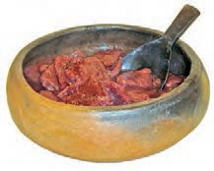
http://www.choctawschool.com/home-side-menu/iti-fabvssa/choctaw-resistance-to-removal-from-ancient-homeland-(part-iv).aspx
Many of the Choctaw people who traveled the Trail of Tears in the
1830s had the opportunity to take very little with them. Many were
only able to take what they could carry in their hands. In surviving
collections of Choctaw family heirlooms brought from Mississippi to
what is now Oklahoma on the Trail of Tears, one of the most common
objects are small, carefully crafted clay eating bowls. These are made in the traditional Choctaw style, except that they are smaller than the communal eating bowls usually used in Choctaw households during this time period.
Why were these small bowls carried west 550 miles to what is now Oklahoma in relatively large numbers? The functional purpose of the bowls is obvious, but there is probably a deeper reason. From a traditional Choctaw perspective, the earth, and particularly the Choctaw homeland are sacred. The earth is seen as the mother of all life. The course of life follows a circle, and after death, an individual's body returns to the earth to decompose and then to be reincorporated into the bodies of new plants and animals. From a traditional perspective, the Choctaw ancestors are literally a part of the earth of the home land, as well as the plants and animals there. The respect that early Choctaw people had for the earth is seen in the care and effort that was put into building large earth mounds.
That same respect is also evidenced in the small, unassuming eating bowls that were carried across the Trail of Tears. These bowls, made from native clay, sand, and burned animal bone, are literally a small part of the Choctaw homeland, but they are more than just that. Their raw materials were mixed together and shaped according to a pottery tradition developed by the hands of 100 generations of Choctaw potters living in the Choctaw homeland. When Choctaw people brought these bowls with them on the Trail of Tears, they were bringing objects that were simultaneously pieces of the homeland and symbols of the ancient indigenous relationship that Choctaw people maintained with that homeland. By carrying these small, but highly
signiﬁ cant clay bowls, Choctaw people were able to resist being removed from at least a small part of the homeland on both a physical and an intellectual level.

Slide 70
How will they get there?
Removal of the Choctaw 1830-1832
Choctaw are allowed only minimal supplies on journey
Routes of the Trail of Tears
<10,500
Cherokee
Chickasaw
Choctaw
small clay eating bowls
- useful on trip & after arrival
- made with clay from their
‘homeland’ -- ties them to
the land of their heritage
Creek
Seminole

Slide 71
How will they get there?
Routes of the Trail of Tears
Removal of the Creek
Cherokee
Chickasaw
Choctaw
Choctaw
Creek
Seminole

Slide 72
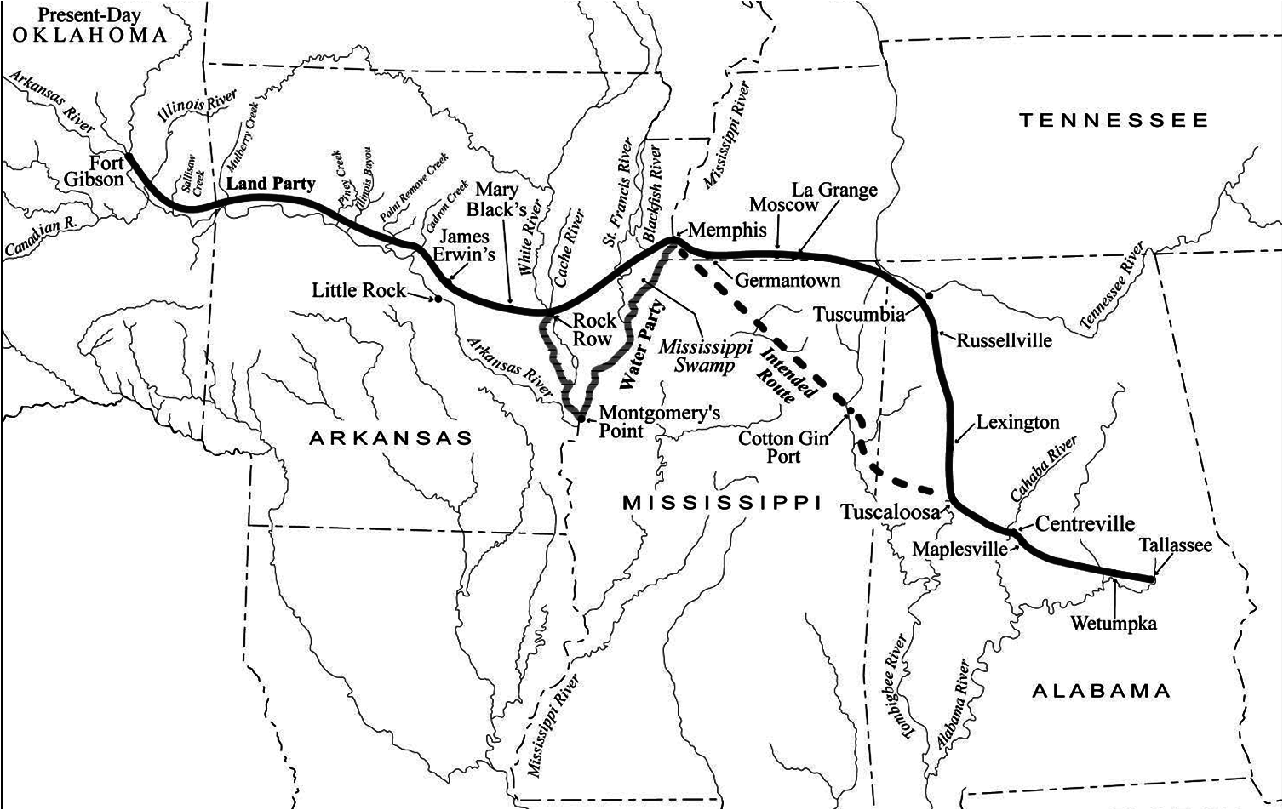
How will they get there?
Removal of the Creek
Treaty of Cusseta: March 1832
Removal of the Creek
Indian
Country
TN
Arkansas
Territory
800 miles
Creek
Creek
MEXICO
LA
MS
AL

Slide 73
http://www.cr.nps.gov/seac/benning-book/ch11.htm
MUSCOGEE (CREEK) REMOVAL
After the Revolutionary War, a new wave of American settlers poured into Georgia seeking claims to rich river bottomland. This land was perfect for growing cotton, a crop made highly profitable by the invention of the cotton gin in 1793. The Creek Indians, who had always been excellent farmers, adapted quickly to a cotton-based economy. But American settlers wanted the land for themselves and saw the Creek Indians as obstacles to “progress.” Pressure increased on the federal government to remove all Indians to areas west of the Mississippi River. In an attempt to protect themselves the Creek Council passed a law providing the death penalty for anyone ceding land without the Council’s authority.
The Creeks were divided over the issue of removal. Many, including Chief William McIntosh, remained loyal to the United States government, believing voluntary removal was the only way to escape complete annihilation. Others, however, wanted to go back to their way of living before the settlers’ influences. This division eventually led to civil war. The “Red Sticks,” so called because of the red club that they carried, became militant, preferring to remain in their homeland and pursue their traditional way of life. The Creek Indian War, begun in 1813, was a result of these conflicts. The Red Sticks attacked settlers and loyalist Creeks and the United States struck back with forces led by General Andrew Jackson. Ultimately the Red Sticks lost and the war ended with the Treaty of Fort Jackson in 1814, which ceded 23 million acres of Creek land to the United States.
PUSHED OUT OF GEORGIA
After 1814 a series of treaties whittled away at the Creek lands, pushing them further and further out of Georgia. By 1823 Georgia Governor George Troup saw the Creeks as a serious problem. At one time the “savagery” of the Indians had helped justify the acquisition of land, but many Indians were following the European model of civilization. Settlers feared resting land from these “civilized” Indians would be more difficult. Troup and his constituents wanted the Indians to be moved to the Western Territory of the Louisiana Purchase, an idea proposed by Thomas Jefferson in 1803. They wanted all Indians out of Georgia.
In 1825 the second Treaty of Indian Springs, signed by Chief William McIntosh, ceded all Lower Creek land in Georgia. Not only had Troup and members of the state government manipulated McIntosh into signing, but McIntosh did so without a clear mandate from his people. He and several other leaders were killed for their involvement.
President John Quincy Adams declared the treaty illegal and in January 1826 negotiated the second Treaty of Washington with the Creeks. Although this treaty was nearly as corrupt as the Treaty of Indian Springs, Governor Troup refused to honor it and continued forced removal. When Adams threatened Troup with federal intervention, Troup prepared the state militia, and Adams backed down, saying “The Indians are not worth going to war over.” By 1827, the Creeks were gone from Georgia.
FEDERAL INVOLVEMENT IN REMOVAL
Andrew Jackson was elected president of the United States in 1829, and with his inauguration the government stance toward Indians turned harsher. Jackson abandoned the policy of his predecessors of treating different Indian groups as separate nations. Instead, he aggressively pursued plans to move all Indian tribes living east of the Mississippi River to Oklahoma. At Jackson's request, the United States Congress opened a fierce debate on an Indian Removal Bill. In the end, the bill passed, but the vote was close. The Senate passed the measure 28 to 19, while in the House it squeaked by, 102 to 97. Jackson signed the legislation into law June 30, 1830.
For those who migrated, the government agreed to pay transportation costs and to finance their subsistence for one year. About 1,300, mostly members of the McIntosh faction, resettled to the valley of the Arkansas River in “Indian Territory,” now the state of Oklahoma, on lands given to them in perpetuity under the government’s removal program. Some of the Creeks joined their Seminole relatives in Florida; many moved into Alabama. But most opposed the idea of moving west. They had no desire to leave their homelands and many had adopted European ways as the federal government once urged. They owned farms and cattle, and some owned slaves.
Voluntary removal proved too slow for the ever-growing tide of settlers, and the government stepped up its efforts to get the Creek Chiefs to sign a treaty removing them to Indian Territory. On March 24, 1832, Indian delegates signed a treaty giving up part of their land in Alabama, the rest would be allotted – 320 acres for each family and 640 acres for each chief. The families could stay on their allotments or sell them and move west at government expense to lands where they were promised autonomy. Those who staid were subjected to the violence of white settlers who invaded Indian farmsteads, beating, murdering, raping, and driving the natives off. Other Indians lost their land to the speculators swindles and the state government supported it all.
In retaliation several chiefs, including Eneah Emathla, and Jim Henry, led warriors in attacks on white settlements. Their most devastating assault came at the small community of Roanoke, just south of the Fort Benning area, in Stewart County, Georgia, where Hitchiti Indians killed 12 people and torched the town. Thus began the Creek War of 1836. On at least two occasions, Creek Indians also attacked steamboats carrying troops. However, the Creeks and their allies were soon overwhelmed. Many were rounded up and held at Fort Mitchell to await transportation out of the area
TRAIL OF TEARS
When the war ended in July 1836 about 2,500 Creeks, including several hundred chained warriors, were marched on foot to Montgomery and onto barges which were pushed down the Alabama River, beginning their forced removal to a new homeland in Indian Territory.
Removal paused when conflicts erupted with the Seminoles further south and a force of 700 Lower Creek warriors agreed to patrol Florida in support of the American military. About 4,000 Creeks, including the warriors’ families, were moved to concentration camps in Mobile, Alabama in March 1837 supposedly for their own protection. However, mobs from Alabama and Georgia broke in and ransacked the camps, raping, killing and enslaving. Some of the Indians fled into nearby swamps, only to be hunted down by the Alabama militia. The Lower Creek warriors returned from Florida in October to find only remnants of their families in the camps. They were promptly herded to New Orleans and loaded onto nine old steamboats for the trip up the Mississippi. During the trip, one steamboat collided with a ship and was cut in half, killing 311 Creeks.
During the summer and winter of 1836 and 1837, over 14,000 Creeks made the three month journey to Oklahoma, a trip of over 800 land miles and another 400 by water. Most left with only what they could carry wearing inadequate clothing for the winter travel. Creeks who had intermarried with the Cherokee or lived within the Chickasaw Nation in Mississippi were hunted out and forced to emigrate. Some of the Creeks, mostly children, were held by whites in bondage as slaves.
The overall effect of the Creek trail of tears was staggering. 21,792 Creeks lived in Georgia and Alabama in 1832. Twenty years after the "removal" ended, only 13,537 Creeks remained in Oklahoma. Some 8,000 people apparently had died. Counted as a percentage of their population, the Creeks and related tribes suffered more deaths than the Cherokee in their own, far better known trail of tears. The once-mighty Creek Nation was down, but its spirit was not destroyed. Despite continued hardships, its citizens carved a new life for themselves in Oklahoma. Today, their descendants remain a proud and sovereign people.

Slide 74
https://www.britannica.com/event/Trail-of-Tears
The Creek finalized a removal agreement in 1832. However, Euro-American settlers and speculators moved into the planned Creek cessions prematurely, causing conflicts, delays, and fraudulent land sales that delayed the Creek journey until 1836. Federal authorities once again proved incompetent and corrupt, and many Creek people died, often from the same preventable causes that had killed Choctaw travelers.
https://en.wikipedia.org/wiki/Muscogee
The Muscogee (Creek), also known as the Creek Confederacy, are a closely related group of native North American tribes or Indigenous peoples of the Southeastern Woodlands. They are originally from a single confederated native land that now comprises southern Tennessee, all of Alabama, western Georgia and part of northern Florida,
Most of the original population of the Muscogee people were forcibly relocated from their native lands in the 1830s during the Trail of Tears to Indian Territory (now Oklahoma). Some Muscogee fled European encroachment in 1797 and 1804 to establish two small tribal territories that continue to exist today in Louisiana and Texas. Another small branch of the Creek Confederacy managed to remain in Alabama and is now known as the Poarch Band of Creek Indians.
A much larger population of Creeks moved into Florida between roughly 1767 and 1821 and these people organized into a new confederacy called the Seminole Indian Nation, thereby establishing a separate identity from the Creek Confederacy. Muskogean (Creek) people in these waves of migration into Florida were fleeing conflict in Creek Confederacy lands, as well as encroachment by European settlers. The great majority of Seminoles were also later forcibly relocated to Oklahoma, where they reside today, although small branches of the nation remain in Florida.
The respective languages of all of these modern day branches, bands and tribes are all closely related variants called Muscogee, Mvskoke and Hitchiti-Mikasuki, all of which belong to the Eastern Muskogean branch of the Muscogean language family. All of these languages are, for the most part, mutually intelligible.
The Muscogee are descendants of the Mississippian culture peoples, who between 800 AD and 1600 AD built complex cities and surrounding networks of satellite towns (suburbs) centered around massive earthwork mounds, some of which had physical footprints larger than the Egyptian pyramids. Some Mississippian city populations may have been larger than later colonial European-American cities. If the highest population estimates are correct, the largest Mississippian city, Cahokia, was larger than any subsequent city in the United States until the 1780s, when Philadelphia's population grew beyond 40,000.
These cities and towns were governed by regional chiefdoms located throughout the enormous Mississippi River valley region and its far flung tributaries. This society was based on organized agriculture, transcontinental trade, copper metalwork, artisanship, hunting and religion.
The later descended Muscogee or Creek Confederacy also included networks of complex town-centered societies also based on systems of agriculture, trade, metalwork, fine artisanship and hunting. Early Spanish explorers encountered ancestors of the Muscogee when they visited Mississippian-culture chiefdoms in the Southeast in the mid-16th century.
The Muscogee were the first Native Americans officially considered by the early United States government to be "civilized" under George Washington's civilization plan. In the 19th century, the Muscogee were known as one of the "Five Civilized Tribes", because they were said to have integrated numerous cultural and technological practices of their more recent European American neighbors. In fact Muscogee confederated town networks were already based on an (at minimum) 900-year-old tradition of complex and well organized farming and town layouts; artisan metal, artisan clothing, artisan implement and religious art production; hunting, fur and hide processing; and long distance trading. Influenced by their prophetic interpretations of the 1811 comet and earthquake, the Upper Towns of the Muscogee, supported by the Shawnee leader Tecumseh, began to resist European-American encroachment. Internal divisions with the Lower Towns led to the Red Stick War (Creek War, 1813–1814); begun as a civil war within the Muscogee Nation, it enmeshed the Northern Creek Bands in the War of 1812 against the United States while the Southern Creeks remained US allies. General Andrew Jackson then seized the opportunity to use the rebellion as an excuse to make war against all Creeks once the northern Creek rebellion had been put down with the aid of southern Creeks. The result was a weakening of the Creek Nation and the forced ceding of Creek lands to the US.
During the Indian Removal of the 1830s, most of the Muscogee Confederacy were forcibly relocated to Indian Territory. The Muscogee (Creek) Nation, Alabama-Quassarte Tribal Town, Kialegee Tribal Town, and Thlopthlocco Tribal Town, all based in Oklahoma, are federally recognized tribes, as are the Poarch Band of Creek Indians of Alabama, the Coushatta Tribe of Louisiana, and the Alabama-Coushatta Tribe of Texas. Most of the Seminole people are also organized into now federally recognized tribes.

Slide 75
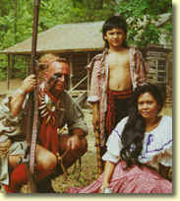
Removal of the Creek
Treaty of Cusseta: March 1832
exchange all land east of Miss. R. - payments of $350K
each Creek given 640/320 acres land in old homeland
each can sell land & emigrate, or stay as U.S. citizen
U.S. pays relocation expenses & 1 year sustenance
speculators defraud Creek of their allotments
Creek

Slide 76
http://www.encyclopediaofalabama.org/article/h-3083
The Treaty of Cusseta was an agreement between the U.S. government and the Creek Nation in which the Creeks ceded the remainder of their land east of the Mississippi River, all of which was located in east Alabama. The treaty, also known as the Third Treaty of Washington or more formally as the Treaty with the Creeks, 1832, followed the passage of state and federal laws aimed at gaining control over Native Americans and their land in the South and removing them west of the Mississippi River.
In the late 1820s, Alabama lawmakers enacted three laws, called "extension laws," that extended the state's jurisdiction over several tracts of Creek territory in the state. They also passed another law that forbade the Creeks from hunting, fishing, and trapping within the state, which essentially limited them to farming as a livelihood. These and similar laws in other states were supported by Pres. Andrew Jackson, who hoped that the Creeks would either become citizens of the United States and accept individual homesteads or remove themselves westward. In May 1830, the federal Indian Removal Act was signed into law, giving the president the authority to exchange lands west of the Mississippi River for Indian lands in the East. Then, in January 1832, the Alabama legislature passed another "extension law" that extended the civil and criminal jurisdiction of the state over all Creek and Cherokee territory within the state. It forbade Indians from passing laws contrary to state law and from meeting in council, thereby undermining the authority of tribal leaders. The law led to new roads being cut through Creek land and more illegal squatting by whites that had begun in earnest after the establishment of the Federal Road approximately 25 years earlier. In addition, it created conflict between the federal government, which had pledged to protect Native American sovereignty, and Alabama officials, who desired the Creek land for settlement. Alabama lawmakers still resented the fact that three million acres ceded to the United States in the 1825 Treaty of Indian Springs had been returned to the Creeks in the Second Treaty of Washington (1826).
In consequence, Jackson invited Creek leaders to Washington to agree upon a treaty that would exchange their remaining land in Alabama (more than five million acres encompassing much of east-central Alabama) for new territory in the West. The treaty was signed March 24. Additional provisions stated that the United States would bear the cost of the Creek relocation west and would provide allotments of 320 acres to each orphan or head of family and 640 acres to each tribal chief and to all town headmen who chose to remain in Alabama. The Creek delegation, however, had pushed for larger and more numerous allotments. Of the five million acres, more than two million were later surveyed and reserved for those Creeks who wanted to stay.
The United States agreed to pay $100,000 at the time of the treaty's signing and annuities of $12,000 annually for five years and $10,000 annually for 15 years. The treaty provided compensation for improvements made to properties and for ferries, bridges, and causeways, at the insistence of the Creek delegates. The accord would make available funds for education and for rifles, ammunition, and other hunting accessories for each emigrating Creek warrior, provided blacksmiths, and established an annual allocation of iron and steel for 20 years.
The treaty was one of many concluded during Jackson's presidency as part of his plan to relocate Native Americans to Indian Territory, which remains a controversial aspect of his legacy. It was signed by Lewis Cass, the secretary of war and an instrumental figure in implementing Jackson's policy of Indian removal. Among the Alabamians present at the signing was U.S. Representative Clement Comer Clay, who, when he was speaker of the Alabama House of Representatives, had pushed for the extension laws and had supported the rights of white squatters who had illegally settled on Creek land. Also present was Alabama senator William Rufus King, then chair of the U.S. Senate Committee on Public Lands, who backed Jackson's land policies and worked to open public lands to settlement.
According to the Senate Executive Journal, members of the Senate Committee on Indian Affairs expressed concern when the treaty was reported out of the committee that any Creeks who signed the treaty should be duly authorized and delegated to do so by the Creek Nation. This sentiment was understandable given the problems encountered with the nullified 1825 Treaty of Indian Springs and its replacement with the Second Treaty of Washington.
The federal government quickly surveyed the land and designated the allotments, drew up regulations, and appointed agents to oversee land sale agreements between Creeks and whites. Neither the treaty nor the ensuing process ended the tension between the Creeks and Alabamians or between Alabama and the federal government. Alabama created eight new counties from the land, a move that enticed land-hungry settlers who illegally squatted before the allotment process was completed and who, afterward, bought up allotments at below-market prices from those Creeks who chose to stay.
The federal government did attempt to keep out or evict white squatters. During the summer of 1832 in Russell County, a white settler was killed by a federal soldier, who was indicted but fled and was never tried. The incident angered Alabama lawmakers over the perceived federal encroachment on the state's rights and would fester for years, while at the same time lessening support for Jackson in the state. Soon, more frequent conflicts between the whites and Creeks would lead to the Second Creek War in 1836 and additional forced removals west.

Slide 77
https://en.wikipedia.org/wiki/Treaty_of_Cusseta
The Treaty of Cusseta was a treaty between the government of the United States and the Creek Nation signed March 24, 1832 (7 Stat. 366). The treaty ceded all Creek claims east of the Mississippi River to the United States.
Creek territory was constrained to a strip in east central Alabama along the Georgia border. President Jackson had signed the Indian Removal Act in 1830, which ultimately led to the deportation of native peoples in the Southeast to the Indian Territory west of the Mississippi River.
Although treaty stipulations had prohibited white settlement of Creek lands, squatters moving into the territory were common and caused significant friction with the Creek. The settlers encroached on their land and competed for game, destroying hunting territory by clearing land and developing farms. Tensions eventually resulted in a party of Creek warriors attacking and burning the town of Roanoke, Georgia.
In response, federal officials met with Creek leaders in the Creek village of Cusseta (Kasihta) on the Chattahoochee River in Georgia. (Lawson Army Airfield in Fort Benning is sited on the former location of Cusseta.) The Creeks were compelled to agree to federal terms as outlined in the Treaty of Cusseta. The treaty was later signed in Washington, D.C..
The Treaty of Cusseta required that the Creek nation relinquish all claims to land east of the Mississippi River, including the territory in Alabama. In return, individual Creeks were to be granted land claims in the former Creek territory. Each of the ninety Creek chiefs was to receive one section (1 mi², 2.6 km²) of land and each Creek family was to receive one half-section (0.5 mi², 1.3 km²) of land of their choosing. Despite the land grants, the treaty made clear the intention of the US government to remove as many Creeks as possible to the west in the least amount of time. The United States agreed to pay expenses for Creek emigrants for the first year after relocation. The treaty also called for the US to make payments to the Creek nation of approximately $350,000 and provide 20 square miles (51 km²) of land to be sold to support Creek orphans.
Once the treaty went into effect, many of the new Creek landowners, not being aware of the value of land, were quickly taken advantage of by settlers who often purchased the treaty-promised land for a pittance. Those Creeks who managed to keep legal title to their lands were soon overwhelmed by squatters, whom state and federal officials generally refused to evict. When individual Creek attempted to enforce their property rights against squatters, they were often retaliated against by the local militia. By 1835, the situation became intractable and open conflict broke out between Creeks and settlers. The US government responded to violations of the treaty by deporting most of the remaining Creek to the Indian Territory.

Slide 78
Removal of the Creek
Treaty of Cusseta: March 1832
speculators defraud Creek of their allotments
squatters invade Creek properties; conflict begins
CREEK WAR OF 1836
U.S. sends troops to quell violence; remove Creeks
Creek
The Removal Routes

Slide 79
https://en.wikipedia.org/wiki/Creek_War_of_1836
The Creek "War" of 1836, also known as the Second Creek War or Creek Alabama Uprising, was a conflict in Alabama at the time of Indian Removal between the Muscogee Creek people and non-native land speculators and squatters. Although the Creek people had been forced from Georgia under the Treaty of Washington of 1826, with many Lower Creeks moving to the Indian Territory, about 20,000 Upper Creeks were still living in Alabama.
The state acted to abolish tribal governments and extend state laws over the Creek. Chief Opothle Yohola appealed to the administration of President Andrew Jackson for protection from Alabama but Jackson supported removal. The Creek signed the Treaty of Cusseta on 24 March 1832, which divided up Creek lands into individual allotments. Creeks could either sell their allotments and receive funds to remove to the west, or stay in Alabama as state and federal citizens, who would have to submit to state laws.
Land speculators and squatters began to defraud Creeks out of their allotments. Some violence broke out, described by U.S. officials as a so-called "war," which they argued forfeited the Creeks' prior treaty rights. Secretary of War Lewis Cass dispatched General Winfield Scott to end the violence by forcibly removing the Creeks to the Indian Territory west of the Mississippi River.
http://www.exploresouthernhistory.com/secondcreekwar.html
During the years 1836-1837, a brutal war was waged for control of the last remaining lands of the Creek Nation east of the Mississippi River. The war initiated one of the greatest tragedies in American history, the Creek Trail of Tears.
The Creek Nation had been greatly reduced in size by the Treaty of Fort Jackson, signed at the end of the Creek War of 1813-1814. More land was lost due to the controversial Treaty of 1826. Then, much to the chagrin of many in the Nation, some leaders signed a final treaty giving up the territorial integrity of their people.
Outrageous frauds followed, as white speculators swarmed into the nation buying up or fraudulently stealing land rights from individual Creek families. Squatters moved onto Indian lands, often forcing families from their own homes. The Creeks appealed to Washington for help and President Andrew Jackson sent Francis Scott Key, the writer of the National Anthem to investigate. Key found whole towns growing on Indian lands and documented numerous cases of fraud.
The situation, however, was out of control and despite the efforts of Key and Deputy U.S. Marshal Jeremiah Austill, the flood of whites pouring into the Creek Nation could not be stopped. Tensions grew and as Creek leaders expressed their outrage over the situation, speculators began to foment tales of a planned uprising in the Nation.
They got what the wanted. In the spring of 1836, several bands of Lower Creeks launched a campaign to drive white intruders from their lands. Led by the warrior Jim Henry and the aging Hitchiti chief Neamathla, the war parties burned homes and farms, killed whole families, disrupted the mail stages and destroyed the town of Roanoke, Georgia by burning it to the ground.
Panic spread throughout the region. Settlers fled into Columbus, Georgia, and rumors of a planned attack on the city kept the people in terror. Armies soon converged on the Creek Nation, led by Major General Winfield Scott.
An attack by Creek warriors on the Georgia town of Roanoke assured that a simmering conflict between part of the Creek Nation and the United States would explode into the final war between the two nations. The Battle of Roanoke, also called the Roanoke Massacre, took place on May 14, 1836. The Yuchi and Hitchiti bands of Lower Creeks had already initiated hostilities against the whites, but it was Roanoke that ignited the full fury of the Creek War of 1836. The warriors of the Creek nation who lived just across the Chattahoochee River in Alabama had a particular hatred for the town. They had lost their traditional Georgia lands in the fraudulent Treaty of Indian Springs, lands that included the site where the town of Roanoke soon grew. That treaty, signed by William McIntosh in 1825, was vehemently opposed by many of the Lower Creeks, particularly the members of the Yuchi and Hitchiti bands who lost lands upon which their people had been living for centuries. A squad of Creek executioners assassinated
McIntosh, but there was nothing that could be done to stop the loss of all of their nation's Georgia lands. White settlers flooded into the new cession to claim the best lands and it did not take long for houses and stores to spring up on riverfront fields that had once belonged to the Indians. From just across the river, angry warriors watched as lands taken from them became a new town. Due to its visibility, Roanoke was a pivotal point for the resentment felt by many Creek warriors over the loss of their lands. When hostilities erupted in the spring of 1836, the town was quickly selected as a target for a major attack. Warriors from the Yuchi and Hitchiti towns west of the Chattahoochee River crossed over into Georgia and scouted Roanoke in early May. Their presence was detected and so alarmed the community that the women and children of the town were evacuated to nearby Lumpkin. A blockhouse had been erected there and militia troops assigned to defend it. The anticipated attack, however, did not come. After days of standing guard around the clock, the men of Roanoke began to develop a false sense of security. By May 14, 1836, many had gone to Lumpkin to visit their families, leaving only 20 men to defend the all but abandoned town. Recognizing the opportunity, a Yuchi warrior named Jim Henry led a large force of Creek warriors across the river and into position surrounding the town. As most of the remaining defenders of Roanoke slumbered, the Indian force attacked from three different directions at 2 a.m. The defenders of Roanoke were awakened by the sounds of gunfire and war cries. They tried to put up a fight, but were so severely outnumbered that there was little they could do. While the exact number of warriors attacking the town was never determined with precision, white survivors believed that more than 300 Indians had participated. The handful of whites and slaves defending Roanoke fought from their homes and other buildings, holding out as long as possible. The Creeks set fires to drive them out and several men died in the flames. At least one man was roasted alive in a chimney after he sought refuge there to escape the flames. The bodies of other men and boys littered the landscape. Some were burned almost beyond recognition, while others were scalped and left lying on the ground. Realizing that further resistance was futile, a few of the defenders took advantage of the darkness and confusion to escape. Colonel Felix Gibson and two other men survived by creek on the outskirts of town. Their noses were the only parts of their bodies exposed above the water and they escaped detection. With the resistance snuffed out, the Creek warriors torched the town. Of the 20 men left at Roanoke to defend the town, only six survived. The massacre at Roanoke, as it was termed by white settlers of the region, exploded into newspaper headlines across the South. Panic spread across the frontier and terrified settlers flooded into such locations as Fort Gaines, Lumpkin and Columbus. Fields and homes were abandoned and the work of destruction initiated by Jim Henry at Roanoke was carried to other settlements and farms in the vicinity. It took an invasion of the Creek Nation by two American armies to finally bring the uprising to an end. The Creek people were forced into "emigration camps" and sent west on the Trail of Tears. Jim Henry and several other leaders of the Roanoke attack were taken prisoner late in the war. Placed on trial before a civilian jury in Columbus, he was acquitted but three brothers from the influential Brown family of Yuchis were convicted and hanged at what is now Phenix City, Alabama. Jim Henry eventually joined his people in what is now Oklahoma. He changed his name to James McHenry, fought for the Confederacy during the War Between the States and became a Methodist minister. The site of Roanoke is now submerged beneath the waters of Lake Eufaula (Walter F. George Lake), but a marker can be seen on Highway 39 a little over 2 miles south of the lorence Marina State Park in Omaha, Georgia.

Slide 80
Removal of the Creek
Indian
Country
TN
AR
Creek
LA
MS
AL
The Removal Routes

Slide 81
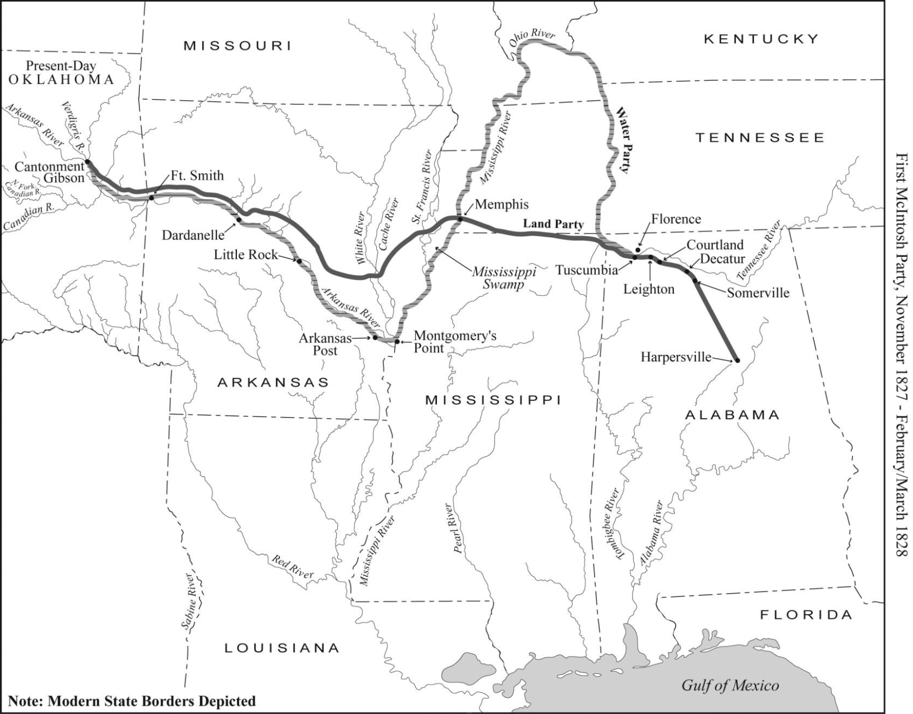
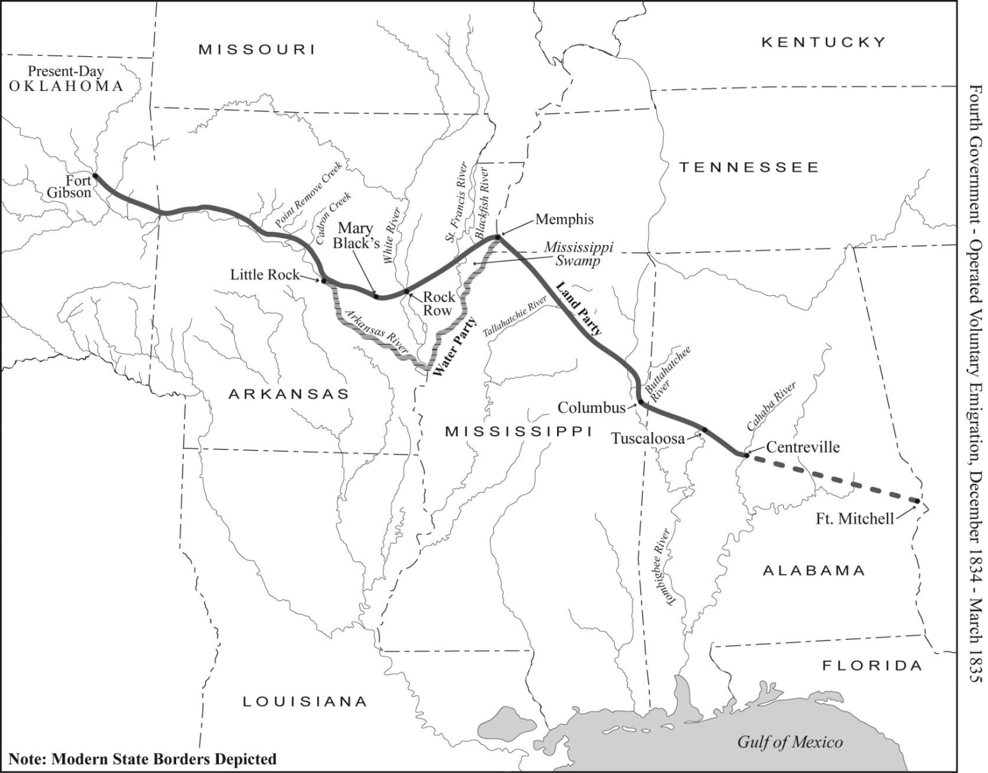
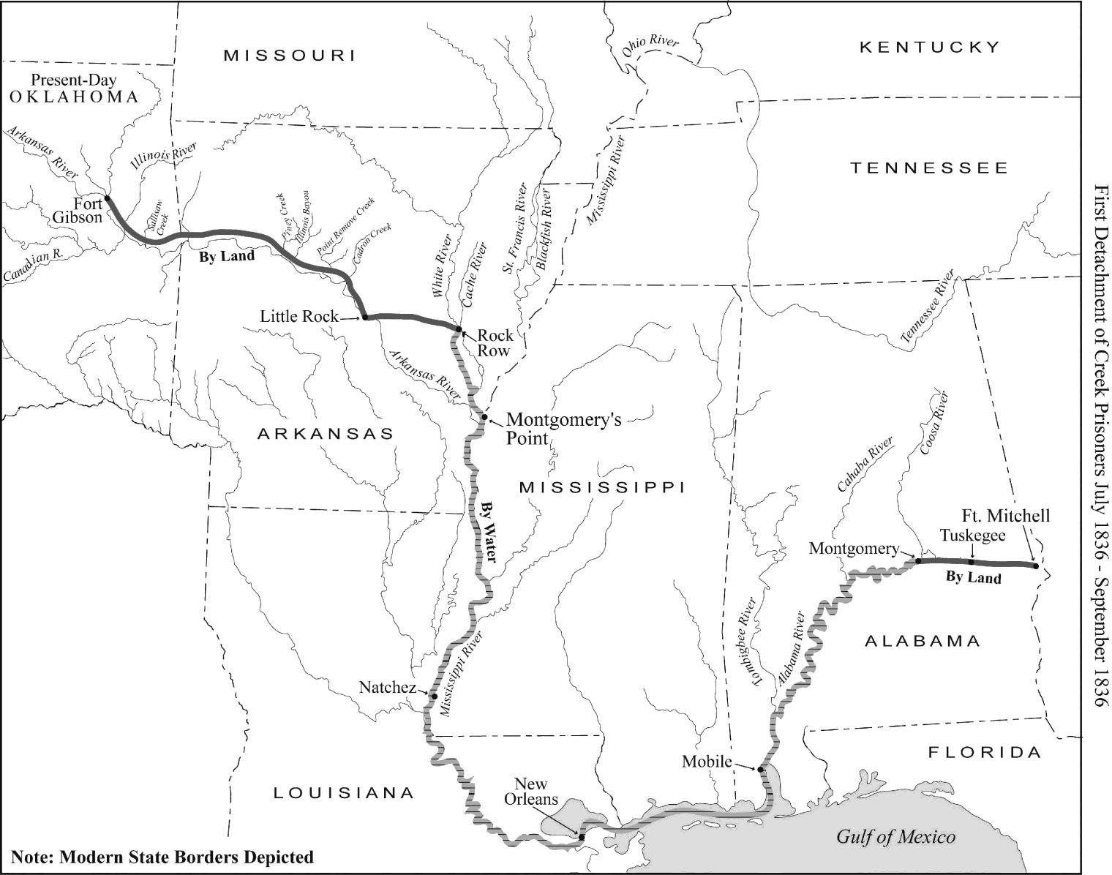
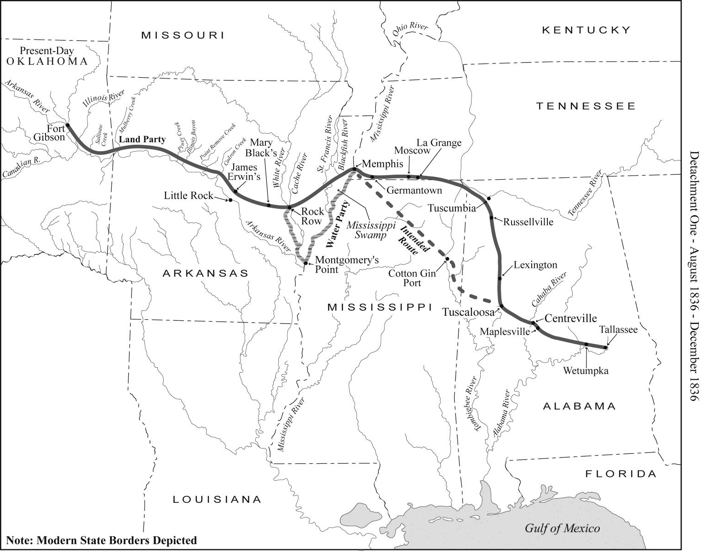
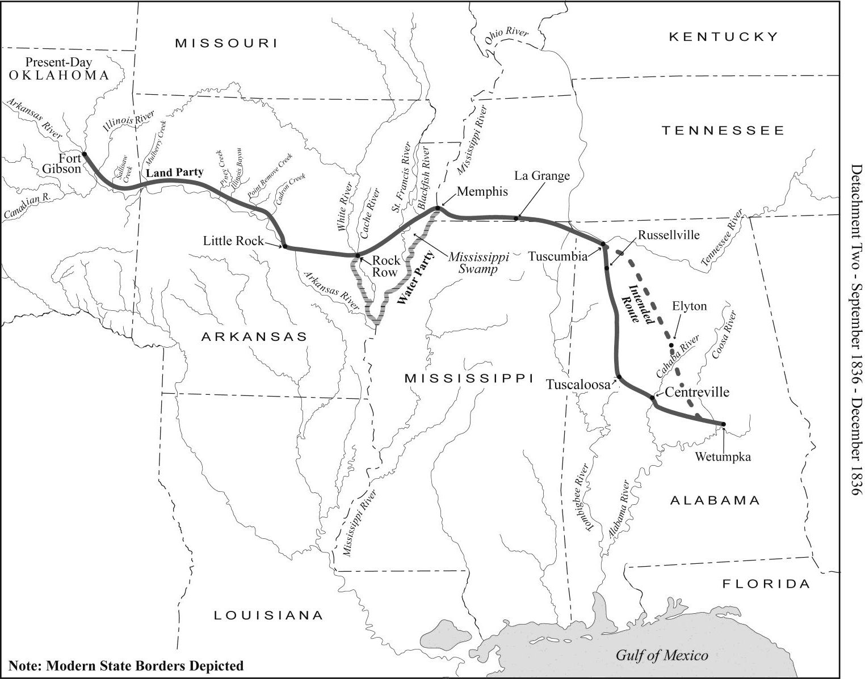
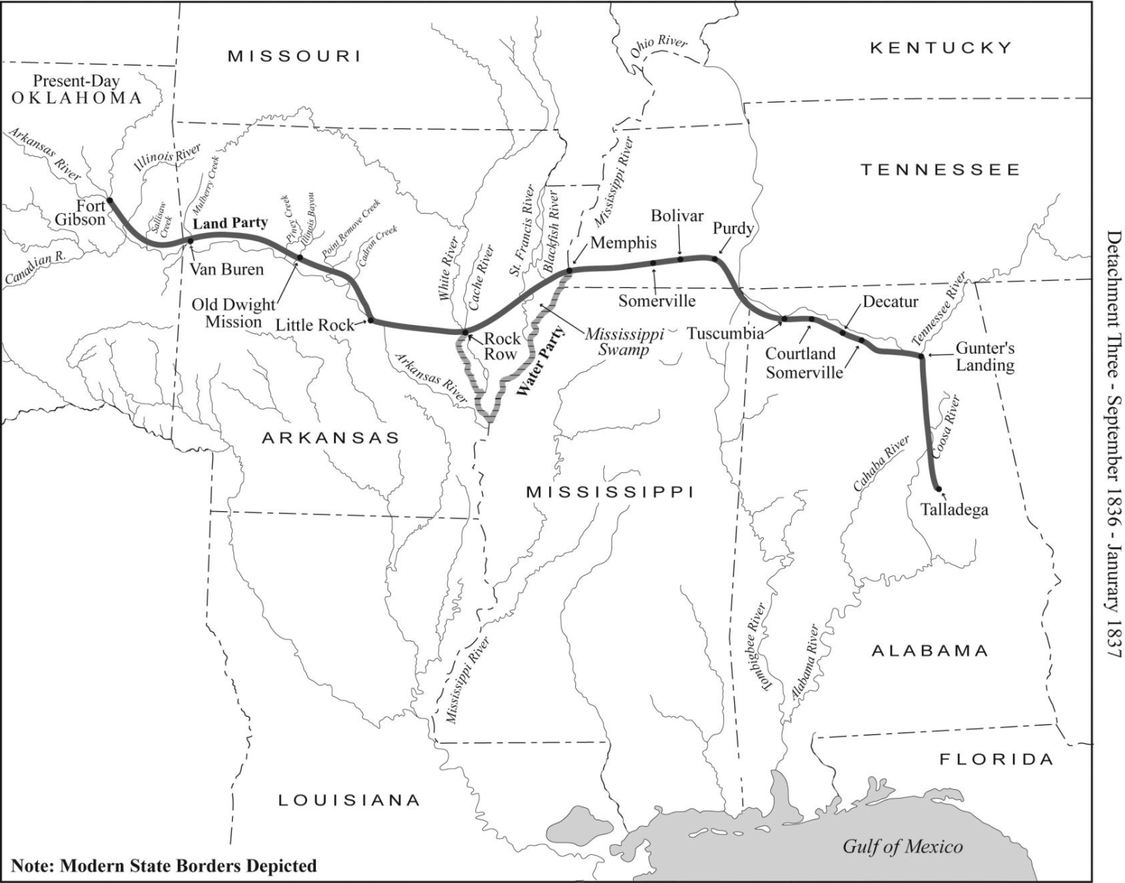
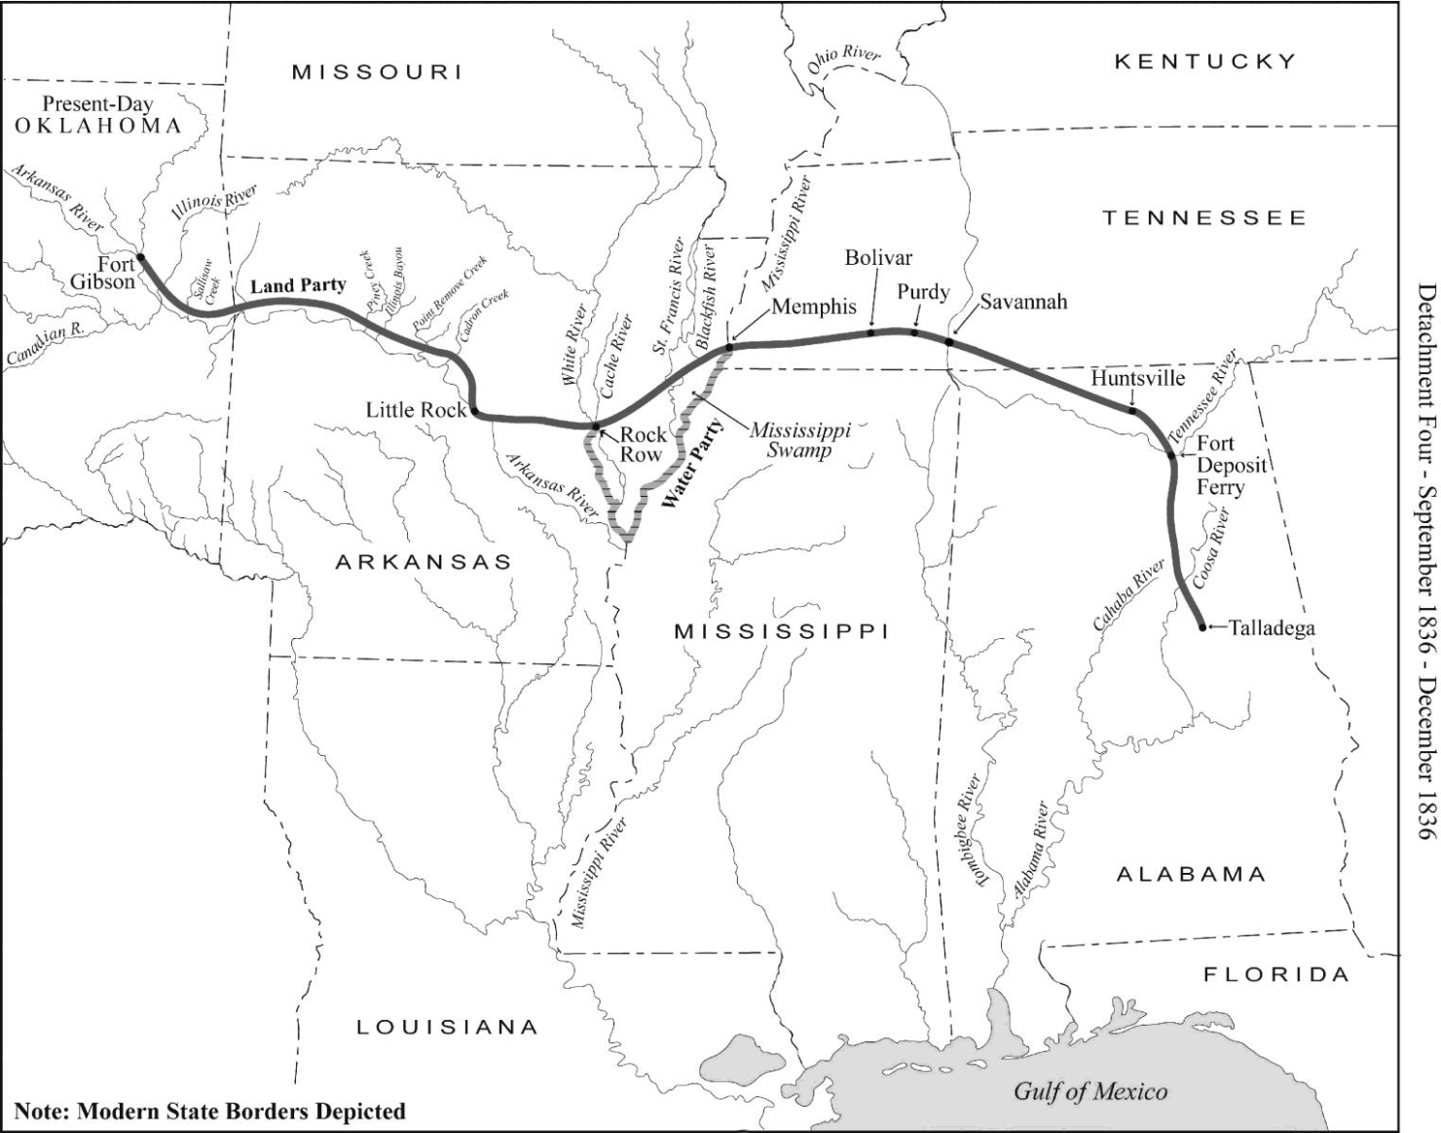
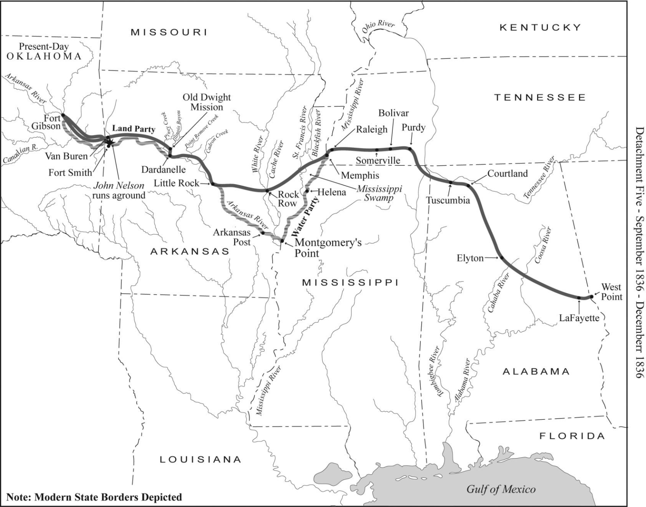
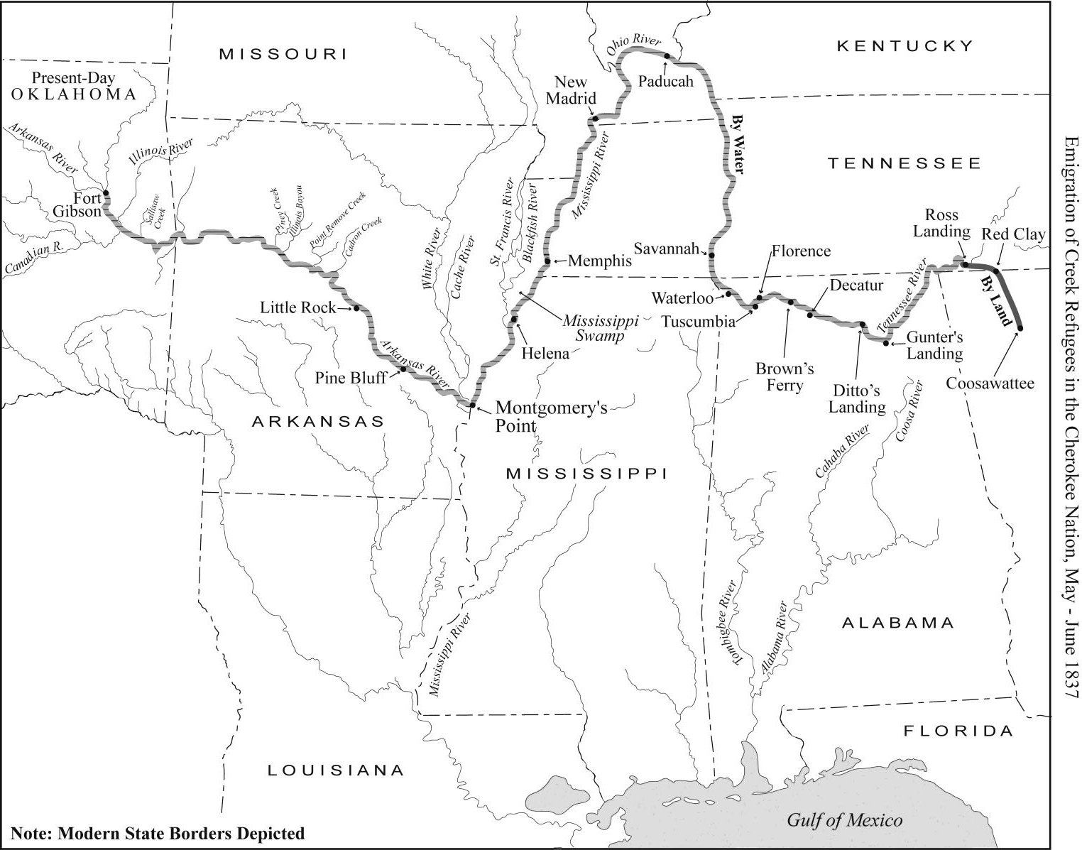
https://etd.auburn.edu/bitstream/handle/10415/2184/Haveman.pdf?sequence=2

Slide 82
Removal of the Creek
Milly Francis’ journey - 1836
Milly
Creek
Tallahassee
Milly’s Creek husband dies in 1836
Sept 5, 1836: Milly & children leave Tallassee
led by Chief Tuckabatchee Hadjo
group of 2000 are accompanied by Lt. John Sprague
The Removal Routes

Slide 83
http://www.exploresouthernhistory.com/millyfrancis.html
CHECK THIS SITE FOR MORE INFO
http://www.exploresouthernhistory.com/millyfrancis2.html
MILLY FRANCIS (1803-1848)
Milly Francis was born in the Upper Creek villages of Alabama in around
1803. Although some writers have speculated that her name was really Malee, a
Creek word, there is no evidence that this was the case. Milly's father, Josiah Francis,
gave all of his children English names and there is no reason to suppose that he did
any different in her case.
Milly's father, Josiah Francis, was the son of a white silversmith and trader
and a Native American woman. Josiah Francis is remembered as the Prophet Francis
or Hillis Hadjo, the religious leader of the Red Stick movement in the Creek Nation.
A relative and associate of the noted Creek leader Alexander McGillivray and a
follower of the Shawnee prophet Tenskwatawa, he became known for his teachings
of a return to traditional ways and Native American unity in the face of westward
expansion by the whites.
These teachings helped spark the Creek civil war that eventually spilled
over to the whites and became known to history as the Creek War of 1813-1814.
His teachings played a critical role in the outbreak of the Creek War of 1813-1814 and he led warriors against three white armies during that conflict.
In March of 1818, a remarkable incident took place on the banks of the Wakulla River in what is now Wakulla County, Florida. A young Native American woman named Milly Francis, the daughter of a Creek prophet, saved the life of a Georgia militiaman named Duncan McCrimmon. The First Seminole War was then at its height and her act of courage captivated the nation. Within weeks she had rightfully been labeled "a new Pocahontas."
When Andrew Jackson finally overwhelmed the Creeks at the Battle of Horseshoe Bend on March 27, 1814, the Prophet fled to Florida with his family and surviving followers. Armed and reinforced by the British, they continued to fight against Jackson and his soldiers until the end of the War of 1812. Homeless and hungry, Francis' followers (including Milly, her mother and sister) settled on the Wakulla River, built new homes and planted corn while the Prophet went to England to plead the case of his people with leaders there.
When he returned in 1817, Francis found that the fighting was far from over . A series of incidents that fall led to the outbreak of the First Seminole War, sparked when U.S. troops attacked the Creek village of Fowltown near today's Bainbridge, Georgia. Francis and his followers joined the conflict and took part in several battles, although he remained hopeful that the British would intervene to save the Creeks and their Seminole allies
Ordered to the frontier, Andrew Jackson invaded Florida in March of 1818 and occupied the former site of a British post on the Apalachicola River where he built a new work named Fort Gadsden. It was here, sometime in March, that a soldier from the Georgia militia wandered from camp and was captured by warriors loyal to the Prophet.
A resident of Milledgeville, Georgia, Duncan McCrimmon (sometimes spelled McRimmon or McKrimmon) was a member of a Scottish family that had settled in Georgia over the previous decades. Taken to the Prophet's village on the Wakulla, he was interrogated for information on the strength and intentions of Jackson's army. His captors then prepared to execute him.
One of the warriors responsible for capturing McCrimmon had suffered the loss of two sisters in the Creek War. Under the laws of the nation, he was expected to retaliate for their deaths by taking the lives of those responsible. As a soldier, McCrimmon was an acceptable target for the warrior's revenge. When Milly realized what was happening, she pleaded with her father to save the young man's life. The Prophet explained that under Creek law the decision was beyond his authority. He told Milly that McCrimmon's fate was in the hands of his captor, but also suggested that she speak with that warrior. She did so and by her entreaties convinced the warrior that killing McCrimmon would serve no purpose. The young man's death, she said, would not bring the warrior's sisters back to life. Moved by her reasoning, he relented and agreed to spare the life of the young soldier. McCrimmon was turned over to the Spanish at San Marcos de Apalache (Fort St. Marks) and was rescued by U.S. forces just days later.
Milly's father was not so lucky. Captured when he went aboard the USS Thomas Shields, a U.S. Navy warship that had appeared off St. Marks, the Prophet Francis was turned over to the American army. Andrew Jackson had seized the fort of San Marcos from its Spanish garrison. Sent ashore by the sailors who had thrown them in irons, Francis and a second Red Stick chief - Homathlemico - were hanged without trial just outside the gate of the fort. Milly watched as her father died. Jackson, however, was in his tent when the Prophet was killed and did not watch as his orders were carried out.
Ordered to Fort Gadsden to be supplied for their return to the Creek Nation in Alabama, Milly walked across today's Apalachicola National Forest with her mother and sister. They took with them only what they could carry on their backs. By the time they arrived there, the story of how she had rescued Duncan McCrimmon was spreading from newspaper to newspaper across the United States. Milly was hailed by newspaper editors as a "New Pocahontas" and people far and wide sent money to help her family survive its desperate situation.
Having already returned to his home near Milledgeville, McCrimmon was entrusted with these funds and carried them with him as he went back down to Fort Gadsden. Readers across the nation waited with anticipation to learn the results of his plan to propose marriage to the woman who had saved his life. Milly, however, declined the offer, explaining that she had acted from feelings of humanity alone. A Florida legend that she married McKrimmon and raised a family on the Suwannee River is just that, a legend. In reality, Milly returned to the Creek Nation with her mother and sister. She eventually married a Creek warrior, but he died of fever in 1836 while serving with the Creek Brigade against the Seminoles in Florida.
Milly Francis walked the Trail of Tears as a member of Tuckabatchee Hadjo's party. Eyewitnesses described seeing her pass through Little Rock, Arkansas, in November of 1838. She arrived at Fort Gibson in present-day Oklahoma in January of 1838.

Slide 84
Removal of the Creek
Milly Francis’ journey - 1836
Milly
Creek
Alabama Emigrating Co handles subsistence
Tallahassee
provide guidance along trail
arrange way-stations
arrange food, foder, fire wood
paid per/traveler by U.S.

Slide 85
Removal of the Creek
Milly Francis’ journey - 1836
Memphis
Milly
Creek
Alabama Emigrating Co handles subsistence
depart camp whether ready or not
forced marches of 20 miles/day
leave stragglers strung along route
October 9: most arrive Memphis
Tallahassee

Slide 86
https://www.nps.gov/trte/learn/management/upload/North%20Little%20Rock%20Site%20Report%2080303.pdf
During November and December of 1836 several groups from the Muscogee Nation emigrated through Arkansas as U. S. officials began systematically to execute the provisions of the removal treaty. These parties had begun staging up in August. A military officer accompanied the parties to ensure that contractors met their obligations. The first to reach the North Little Rock site was a group of about 900 aboard the Steamboat John Nelson. This group was part of a contingent accompanied by Marine Lieutenant John T. Sprague. The original contingent of nearly 2,000 had departed Tallassee on September 5. It consisted of nearly all of the remaining members of Cusseta and Coweta towns, including more than a hundred who had been hiding since the end of the summer’s “war.” Tuckebatche Hadjo, whom Sprague called “the principal Chief” of the region, had delayed preparations for removal because their crops had not been gathered and their livestock had not been sold. Once they reluctantly took up the march, their overland journey to Memphis had been fraught with the usual difficulties of overland travel. Added to these, however, was the indifference of the agents of the Alabama Emigrating Company, who were in charge of subsistence. Concerned for their profits, they departed camp whether the people were ready or not and made forced marches of up to twenty miles a day, leaving stragglers strung out along the route. They were reluctant to give the people a day of rest so that stragglers could catch up. After their arrival at Memphis on October 9, Sprague threatened to rescind the contract and assume responsibility for subsistence himself if the requirements of the contracts were not met. His threat was effective, for he later wrote: “The ready acquiescence of the Agents of my detachment to all my wishes, after crossing the Mississippi, deserves my decided approbation; they were unremitting in every emergency.” Some of the men associated with the Alabama Emigrating Company had been part of the J. W. A. Sanford Emigrating Company. Most were speculators, and some were downright Indian haters. Sanford, for example, had made a name for himself as commander of the Georgia Guard that had for years harassed the Cherokees in their own nation. A generous assessment of his views is that he cared little for the welfare of those Indians who fell under his contract. Tuckabatche Hadjo’s contingent remained at Memphis from October 9 to October 27. When they arrived, two other contingents were already there: Opothleyohola’s contingent, accompanied by Captain M. W. Batman and a second group accompanied by Lieutenant R. B. Screven. And there were two behind Sprague’s: Lieutenant Edward Deas’ and John A. Campbell’s. There were an estimated 13,000 members of the Muscogee Nation awaiting transportation across the Mississippi or down it to the mouth of the White. However, a lack of steamboats delayed movement. Because the Mississippi Swamp on the Arkansas side was impassable for wagons at that time of year, the conductors decided to take wagons, baggage, women, and children to Rock Roe by boat and send the men through the swamp with the horses. The party accompanied by Sprague was the third to leave Memphis, after Batman’s and Screven’s. Sprague, however, sought to get ahead of these groups in order to acquire an advantage in obtaining subsistence. Thus he put about 1,500 women and children with a few men, equipment, and baggage aboard the John Nelson and two flat boats, which would take them directly to Little Rock, and sent between 600 and 700 men with the horses through the Mississippi Swamp. The John Nelson unloaded a part of the group at the North Little Rock site on November 3, 1836. Swift current on the Arkansas had made towing the two flat boats impossible, so Sprague had left the remainder of the party encamped at Arkansas Post. On November 6 the John Nelson returned to bring them up river. Meanwhile the majority of those who had gone overland through the Swamp joined those in camp at the North Little Rock site on November 4 and brought a message with them. Sprague wrote: “Many remained behind and sent word, that ‘when they had got bear skins enough to cover them they would come on.’ Here, they felt independence, game was abundant and they were almost out of the reach of the white-men. At first, it was my determination to remain at Little Rock until the whole party should assemble. But from the scarcity of provisions and the sale of liquor, I determined to proceed up the country about fifty miles and there await the arrival of all the Indians. Tuck-e-batch-e-hadjo refused to go. ‘He wanted nothing from the white-men and should rest.’ Every resting place with him was where he could procure a sufficiency of liquor. The petulant and vindictive feeling which this Chief so often evinced, detracted very much from the authority he once exercised over his people. But few were inclined to remain with him.” Subsequent events suggest that Sprague was likely wrong in his estimation of this man. Thus on November 5 and 6, Sprague’s party took up the march, leaving Tuckebatche Hadjo and a few of his followers, probably his family, behind at the North Little Rock site. Sprague’s party traveled until they reached the supply station at Kirkbride Potts’ place near present day Pottsville and there went into camp to wait until the remainder of his party could catch up. There, as at the North Little Rock site, Tuckebatche Hadjo’s party had members scattered behind them on the road. From Potts’ place up river, Sprague had sent men back along the road as far as the Mississippi Swamp to find stragglers and bring them on. He wrote: “They collected, subsisted and transported all they could get to start by every argument and entreaty. A body of Indians under a secondary Chief, Narticher-tus-tennugge expressed their determination to remain in the swamp in spite of every remonstrance. They evinced the most hostile feelings and cautioned the white-men to keep away from them.” The stragglers that Sprague’s agents picked up reached the North Little Rock site, probably on November 13 or 14, for they reached Potts’ camp on November 17. Meanwhile, the John Nelson, which had gone back to Arkansas Post for the rest of the contingent, picked up Tuckebatche Hadjo at the North Little Rock site, probably on November 13, for it arrived at Lewisburg on November 14, and the chief rejoined his people at Potts’ place. The group arrived at Fort Gibson on December 7. Remarkably, only twenty-nine people died in this group, fifteen children and the rest old, feeble, or “intemperate.”38 But they arrived without Tuckebatche Hadjo. When Sprague’s party left Potts’ place, the chief remained, and was still on the road.

Slide 87
Removal of the Creek
Milly Francis’ journey - 1836
Memphis
Milly
Creek
Tallahassee
Sprague threatens Alabama Emigrating Co
with discharge unless conditions improve
AR swamp impassable; need boat transport
13,000 Creeks at river awaiting steam boats
October 27: 1500 board John Nelson pulling 2 flatboats

Slide 88
Removal of the Creek
Milly Francis’ journey - 1836
Fort Gibson
Memphis
Milly
Little Rock
AK Post
Creek
Tallahassee
steamboat leaves flatboats at AR Post
November 3: steamboat arrives Little Rock
November 4: flatboats & overland group arrive
November 5: begin overland to Indian Country
December 7, 1836: arrive at Fort Gibson

Slide 89
Removal of the Creek
Milly Francis’ journey - 1836
Fort Gibson
Memphis
Milly
Little Rock
AK Post
Creek
Tallahassee
3 months (98 days) of travel
29 people die, including 15 children
What happens to Milly in Indian Country?

Slide 90
Removal of the Creek
Removal of the Creek 1834-1837
1834-1837
~ 3500 die on journey or from disease
removed
16,100
19,600
remain
~3,500

Slide 91
https://en.wikipedia.org/wiki/Indian_removal
The following is a compilation of the statistics, many containing rounded figures, regarding the Southern removals.
Nation | Population east of the Mississippi before removal treaty | Removal treaty & year signed | Years of major emigration | Total number emigrated or forcibly removed | Number stayed in Southeast | Deaths during removal | Deaths from warfare
Choctaw | 19,554^{[100]} + white citizens of the Choctaw Nation + 500 black slaves | Dancing Rabbit Creek (1830) | 1831–1836 | 12,500 | 7,000^{[101]} | 2,000–4,000+ (Cholera) | none
Creek | 22,700 + 900 black slaves^{[102]} | Cusseta (1832) | 1834–1837 | 19,600^{[103]} | 100s | 3,500 (disease after removal)^{[104]} | ? (Second Creek War)
Chickasaw | 4,914 + 1,156 black slaves | Pontotoc Creek (1832) | 1837–1847 | over 4,000 | 100s | 500–800 | none
Cherokee | 21,500 + 2,000 black slaves | New Echota (1835) | 1836–1838 | 20,000 + 2,000 slaves | 1,000 | 2,000–8,000 | none
Seminole | 5,000 + fugitive slaves | Payne's Landing (1832) | 1832–1842 | 2,833^{[105]} | 250^{[105]} 500^{[106]} |  | 700 (Second Seminole War)

Slide 92
https://www.nps.gov/trte/learn/management/upload/North%20Little%20Rock%20Site%20Report%2080303.pdf
A Muscogee whose presence was conspicuous at not only the North Little Rock site but elsewhere in Arkansas was Tuckabatche Hadjo. Chief of the group that Lt. John T. Sprague led through the site in 1836, Tuckabatche Hadjo had been reluctant at times to move on earlier in his journey, but his refusal to move from the North Little Rock site brought threats from the governor of Arkansas. Sprague claimed that the chief wanted to remain at the site in order to be close to a supply of whiskey, but Sprague’s harsh estimation of Tuckabatche Hadjo’s reasons for staying was most likely inaccurate. That he had been reluctant to remove was true, but what Muscogee had not been? And he had preferred to remove beyond the limits of the United States. Just the year before, he had accompanied Opothleyohola, Jim Boy, and other Creeks to Texas to explore and negotiate the purchase of a tract from the Mexican government. But Tuckabatche Hadjo could in no way be considered “hostile.” During the previous summer, he had been one of the leaders who had assisted General Thomas S. Jesup in bringing the Creek “war” to an end and had been one who entered an agreement with General Jesup to send Creek warriors to assist the U. S. forces against the Indians in Florida. And by Sprague’s own account, he was most certainly a party to the decision at Memphis to split up the party and engage the John Nelson. Why would a chief who had been responsible for his people now desert them? Evidence suggests that Sprague’s statement that Tuckbatche Hadjo camped where there was liquor would have been more accurate had it been reversed: Wherever the Muscogees camped, there was whiskey. Not just Muscogees but the people of the other tribes were besieged by whiskey peddlers at every settlement along removal routes. The road from Memphis to Little Rock was punctuated by public houses, such as Strong’s and Black’s, which offered travelers a bed, a meal, and whiskey. The public houses became regular stopping places and supply depots for removal contractors. The North Little Rock site was no exception. The public house at Rorer’s ferry also had its reputation as a tavern. Even the steamboats docked for the night or anchored in the river were approached by peddlers in boats. Sprague also probably misread Tuckebatche Hadjo’s decision to remain behind as an act of a leader without authority. This action was consistent with his actions on the trail from Tallassee to Memphis. He wanted days of rest more frequently than the contractors were willing to grant.3 Tuckabatche Hadjo repeated his action at the depot near Kirkbride Potts’ home at present-day Pottsville, where he later caught up with the main body of his people. When Sprague’s party left Potts’ place, the chief remained. The next three contingents— Batman’s, Campbell’s, and Screven’s—passed, and still he remained. Sprague later claimed that he left Tuckabatche Hadjo and his close followers and family because the chief was ill. As time passed, he was joined by stragglers who reached the Potts encampment. In January, 1837, the Arkansas Gazette reported that in late December, Kirkbride Potts had ordered the chief and his followers to leave, “which they preemptorily refused—saying they were west of the Mississippi, and it was not in the power of any one to compel them to go on. They said threats of the whites might alarm little boys—but they were men!” The commander of the Pope County militia mustered 100 men and marched on the camp only to find that the Muscogees had “taken flight” the night before, January 1, 1837, so the newspaper said. Lieutenant Sprague later stated that to his knowledge Tuckabatche Hadjo had used no defiant language to the whites.4 Tuckabatche Hadjo’s actions at Potts’ camp were consistent with his actions at the North Little Rock site. And Lieutenant Edward Deas later scored the Arkansas press, for the chief had not been driven from the state. He had, in fact, voluntarily joined Deas’ contingent when it reached Potts’ place in December.5 Deas’ party was the last Muscogee contingent to move through the state, and he brought with him all of the stragglers from Rock Roe westward. Among them were probably some of Tuckabatche Hadjo’s original party, without whom he was unwilling to go on to Indian Territory. His actions bear the mark of a man who lived up to his warrior rank as a hacho and to his responsibilities as a leader, unwilling to leave his people scattered along the roads of Arkansas, waiting for some of them to catch up before moving on.

Slide 93
Removal of the Creek 1834-1837
How will they get there?
~ 3500 die on journey or from disease
Routes of the Trail of Tears
removed
16,100
Cherokee
remain
Chickasaw
Choctaw
Creek
~3,500
Seminole

Slide 94
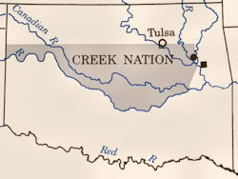
http://dougdawg.blogspot.com/2010/10/maps-and-history-of-oklahoma-county.html
The Choctaws were the first of the Five Tribes to relocate to Indian Territory during 1825-1831, followed in 1832 by the Creeks. Each of these tribe's areas would shortly be co-occupied by another of the Five Tribe
Initial Creek Area 1832

Slide 95
How will they get there?
Routes of the Trail of Tears
Removal of the Chickasaw
Creek
Cherokee
Chickasaw
Choctaw
Creek
Seminole

Slide 96
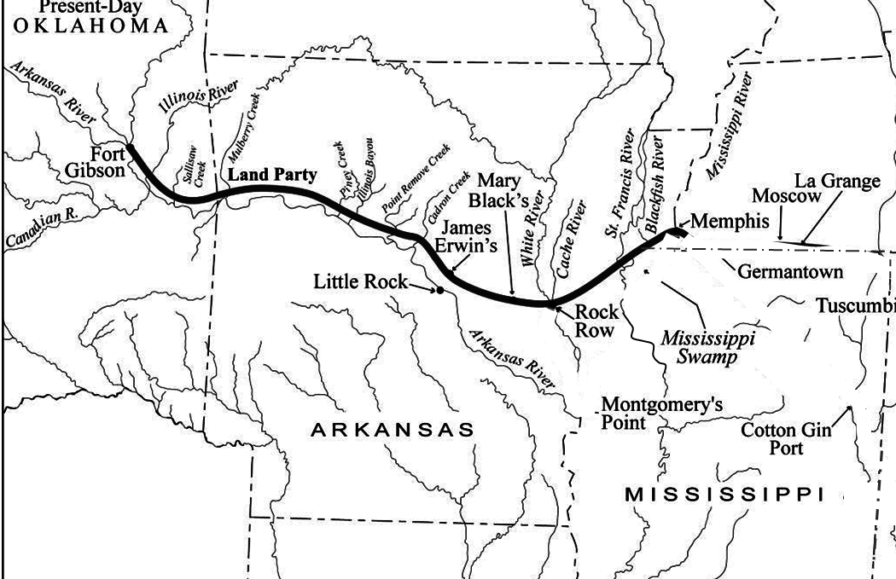
How will they get there?
Removal of the Chickasaw
Removal of the Chickasaw
Creek
Chickasaw
Choctaw

Slide 97
Removal of the Chickasaw
Treaty of Pontotoc: October 1832
TN
Indian
Country
400 miles
Chickasaw
AR
MEXICO
MS
LA
Notes:
Pronounce Pontotoc – PON’-TA-TOCK

Slide 98
Removal of the Chickasaw
Treaty of Pontotoc: October 1832
relinquish all land east of Miss. R. – U.S. payment $3M
Chickasaw agree to SHARE Choctaw lands
?
TN
Indian
Country
Chickasaw
AR
MS
LA

Slide 99
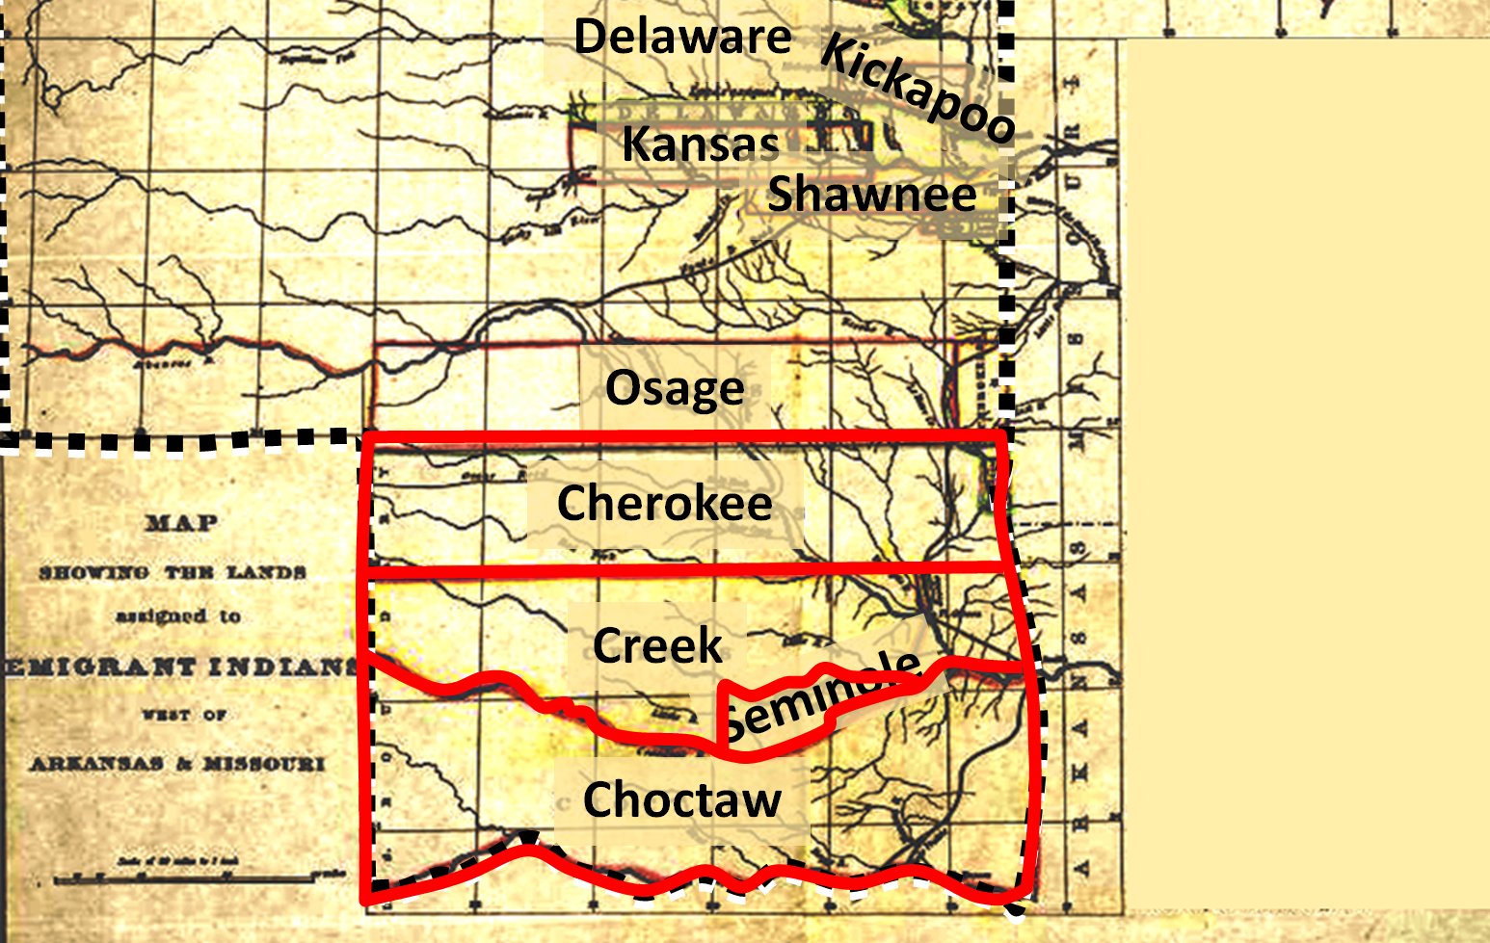
Removal of the Chickasaw
Treaty of Pontotoc: October 1832
relinquish all land east of Miss. R. – U.S. payment $3M
Chickasaw agree to SHARE Choctaw lands
?
TN
Indian
Country
Chickasaw??
Chickasaw
AR
Choctaw-Chickasaw
MS
LA

Slide 100
http://thaumazein-albert.blogspot.com/2016/07/the-chikasaw-chikasa-nation-in.html
(1837)
Although their villages occupied an area of less than twenty square miles, the Chickasaw claimed, and hunted over, a vast region in northern Mississippi and Alabama, western Tennessee and Kentucky.
The Chickasaw were closely related to the Choctaw, Creek and Natchez as well as some of the smaller tribes of the Mississippi Valley. De Soto's Spanish soldiers were the first Europeans to see the Chickasaw, with whom they fought a bloody battle in 1541. After ceding the last of their ancestral lands to the United States, by cajolement and by force, the Chickasaw moved in 1837-47 to Oklahoma "Indian Territory" to become one of the "Five Civilized Tribes.“
Unlike other tribes who received land grants in exchange for ceding territory, the Chickasaw held out for financial compensation: they were to receive $3 million U.S. dollars from the United States for their lands east of the Mississippi River. In 1836 after a bitter five-year debate within the tribe, the Chickasaw reached an agreement to purchase land in Oklahoma, the "Indian Territory" set up by federal statutes, from the previously removed Choctaw. They paid the Choctaw $530,000 for the westernmost part of their land. The process was a form of coercion by an overwhelmingly more powerful bargain partner. Some of the negotiations between the Chickasaw leaders and Andrew Jackson were held in the Colbert mansion near Tupelo. The first group of Chickasaw moved in 1837. For nearly 30 years, the US did not pay the Chickasaw the $3 million it owed them for their historic territory in the Southeast. The Chickasaw gathered in Memphis on July 4, 1837, with all of their portable assets: belongings, livestock, and their African-American slaves. Three thousand and one Chickasaw crossed the Mississippi on that day, following routes established by the Choctaw and the Creek along what is today known as the Trail of Tears. Over five-hundred Chickasaw died along the way from dysentery and smallpox.
CICKASAW

Slide 101
https://en.wikipedia.org/wiki/Chickasaw
In 1832 after the state of Mississippi declared its jurisdiction over the Chickasaw Indians, outlawing tribal self-governance, Chickasaw chiefs assembled at the national council house on October 20, 1832 and signed the Treaty of Pontotoc Creek, ceding their remaining Mississippi territory to the U.S. and agreeing to find land and relocate west of the Mississippi River. Between 1832 and 1837, the Chickasaw would make further negotiations and arrangements for their removal.
Unlike other tribes who received land grants in exchange for ceding territory, the Chickasaw held out for financial compensation: they were to receive $3 million U.S. dollars from the United States for their lands east of the Mississippi River. In 1836 after a bitter five-year debate within the tribe, the Chickasaw had reached an agreement to purchase land in Indian Territory from the previously removed Choctaw. They paid the Choctaw $530,000 for the westernmost part of their land. The first group of Chickasaw moved in 1837. For nearly 30 years, the US did not pay the Chickasaw the $3 million it owed them for their historic territory in the Southeast.
The Chickasaw gathered at Memphis, Tennessee, on July 4, 1837, with all of their portable assets: belongings, livestock, and enslaved African Americans. Three thousand and one Chickasaw crossed the Mississippi River, following routes established by the Choctaw and Creek. During the journey, often called the Trail of Tears by all the Southeast tribes that had to make it, more than 500 Chickasaw died of dysentery and smallpox.
In the 1850s Holmes Colbert(Chickasaw) helped write the constitution of the nation in Indian Territory.
When the Chickasaw reached Indian Territory, the United States began to administer to them through the Choctaw Nation, and later merged them for administrative reasons. The Chickasaw wrote their own constitution in the 1850s, an effort contributed to by Holmes Colbert.
After several decades of mistrust between the two peoples, in the twentieth century, the Chickasaw re-established their independent government. They are federally recognized as the Chickasaw Nation. The government is headquartered in Ada, Oklahoma.
https://en.wikipedia.org/wiki/Treaty_of_Pontotoc_Creek
The Treaty of Pontotoc Creek was a treaty signed on October 20, 1832 by representatives of the United States and the Chiefs of the Chickasaw Nation assembled at the National Council House on Pontotoc Creek, Mississippi. The treaty ceded the 6,283,804 million acres of the remaining Chickasaw homeland in Mississippi in return for Chickasaw relocation on an equal amount of land west of the Mississippi River.
The treaty followed an earlier agreement to move west of the Mississippi in 1830 which the Chickasaw refused to honor after discovering the poor nature of the land they received. Pressured by the aggression of the State of Mississippi to establish its jurisdiction over the Indians, Chickasaw Chiefs relented in 1832 to President Andrew Jackson's and his representatives offer of relocation in the west. The land was ceded to the U.S. with the understanding that the proceeds made in the sale of the land to white settlers would go to the Chickasaw. The treaty led to the Chickasaw Trail of Tears, by which the entire Chickasaw Nation emigrated to new territory in present-day Oklahoma in 1837-1838.
After the act, Jackson received strong legal and judicial resistance from the more law-savvy Creeks and Cherokees, and the Choctaw Chief Greenwood LeFlore, furiously refused any meeting with the president. However, the Chickasaw agreed to meet him in Franklin Tennessee in the summer of 1830. By this point, the State of Mississippi had taken the same measures in dealing with the Chickasaw and Choctaw Indians as Georgia had with the Cherokee, essentially forbidding any exercise of tribal governance and extending state law over the Chickasaw Nation's borders. The Chickasaw came to Franklin to appeal to Jackson for Federal protection from Mississippi. Jackson, however, successfully talked the chiefs into removal after suggesting that by remaining in Mississippi, the Chickasaw would become subject to Mississippi law and their culture would be extinguished by the overwhelming white settlers. He said: "By becoming amalgamated with the whites your national character will be lost... you must disappear and be forgotten.“ On August 27, 1830, after four days of deliberation, the Chickasaw chiefs agreed to exchange their land in Mississippi and relocate to the west.
A Chickasaw delegation assigned to explore the new Chickasaw territory west of the Mississippi stalled removal, much to Jackson's distress, for another two years, after they returned to the Mississippi Chickasaws saying that the new land was unacceptable. The Senate refused to ratify the Franklin treaty and the Chickasaws refused to leave their territory in Mississippi to these lands. After enduring two more years of whites in Mississippi however, and the devastating effects whiskey and squatters on Chickasaw culture, and of Mississippi state law on Chickasaw tribal governance, the Chickasaw National Council assembled to meet John Coffee at the Council House on Pontotoc Creek on October 20, 1832 to sign a Treaty allowing for the sale of the Chickasaw Mississippi territory in exchange for the surveying of new lands in the west. The preamble written by the Chickasaw chiefs read:
"The Chickasaw Nation find themselves oppressed in their present situation, by being made subject to the laws of the States in which they reside. Being ignorant of the laws of the white man, they cannot understand or obey them. Rather than submit to this great evil, they prefer to seek a home in the west, where they may live and be governed by their own laws. And believing that they can procure for themselves a home, in a country suited to their wants and condition, provided they had the means to contract and pay for the same, they have determined to sell their country and hunt a new home. The President has heard the complaints of the Chickasaws and like them believes they cannot be happy, and prosper as a nation, in their present situation and condition, and being desirous to relieve them from the great calamity that seems to await them, if they remain as they are - He has sent his Commissioner General John Coffee, who has met the whole Chickasaw nation in Council, and after mature deliberation, they have entered into the following articles...“
Although further complications had to be resolved, Arrell M. Gibson writes that the Pontotoc Creek Treaty "was the basic Chickasaw removal document providing for the cession of all tribal land east of the Mississippi River.“ In the treaty, the Chickasaw land was ceded in return for the U.S. finding suitable land for resettlement –revealing the chiefs' desperation to regain Chickasaw sovereignty from the aggressions of the state of Mississippi. Chickasaw landholders were to be compensated for the improvements made on his land, and all the proceeds made by the Federal government in the sale of the land were to be turned over to the Chickasaw to pay for finding new territory and the actual removal of the tribe. Unlike other removal treaties, then, the Chickasaw would pay for their own migration. The treaty also provided for the protection the Chickasaw in Mississippi until they emigrated with the allotment of "temporary homesteads." This meant that the Chickasaws were allotted the land they were living on in Mississippi to be protected by the Federal government from squatters, –a benefit not given to the Cherokee when later the Federal government relied on the influx of squatters in Georgia to pressure the Cherokee into removal.
Immediately following the treaty, unalloted Chickasaw land was quickly occupied by white settlers even though the treaty was supposed to stall white settlement until the Chickasaw relocated. Between 1832 and 1837, the Chickasaw made several further negotiations, in part because of the reluctance of the Senate to confirm Pontotoc and in part because of the Chickasaws' dissatisfaction with finding new land. The Treaty of Washington in 1834 confirmed Pontotoc. In addition it even allowed for the enlargement of the Chickasaw temporary homesteads to be sold, and guaranteed the right of the Chickasaw to receive the revenue for each improved homestead sold. The chiefs were concerned to make the best deal in terms of sale and of acquiring new land for the Chickasaw people.
After Pontotoc Chickasaw sent delegations to search for the new land in the Arkansas Territory, reaching an agreement with the Choctaw in 1837. The Chickasaw decided to buy a part of the Choctaw tribe's new western land what became known as the Treaty of Doaksville for $530,000. Although the treaty was really between the two Indian nations, Andrew Jackson got the senate to ratify the treaty. Essentially, they had ceded their eastern land with the Treaty of Pontotoc Creek and acquired western land from the Choctaw in the Treaty of Doaksville.
In 1837-38, with their western lands having been purchased from the Choctaw, 4,914 Chickasaws and their 1,156 slaves emigrated to the new, western Chickasaw Nation. They received over $3 million from the sales of the Mississippi allotments, but with this wealth incurred further external threats from white opportunists coming to the new Chickasaw territory as surveyors and salesmen. The Chickasaw trail of tears was the least traumatic of the removal journeys of any of the Five Civilized Tribes. It was achieved with relative success compared to the Choctaw or Cherokee, yet it still had damaging effects on tribal culture and structure which took decades to heal.

Slide 102
https://www.chickasaw.net/Our-Nation/History/Removal.aspx
The “Great Removal,” or “Chickasaw Removal,” is the saddest chapter in Chickasaw history. As a result of Congress’ Indian Removal Act, our Chickasaw people were forced to remove to Indian Territory. The foresight and skilled negotiating practices of Chickasaw leaders led to favorable sales of Chickasaw lands in Mississippi. This allowed the Chickasaw Nation, unlike other tribes, to pay for our own removal.
Chickasaw families were met with hardship and death along the Removal, traveling hundreds of miles in extreme cold and heat; however, Chickasaws suffered less than other tribes because we controlled our departures and chose favorable seasons to travel. This undoubtedly saved many lives that otherwise could have been lost.
Other tribes removed to Indian Territory were the Cherokee, Choctaw, Muscogee (Creek) and Seminole. The Chickasaws were one of the last to remove. In 1837, we signed the Treaty of Doaksville with the Choctaw Nation and purchased the right for the settlement of our Chickasaw people in our own district within Choctaw Territory. Most Chickasaws removed to Indian Territory from 1837-1851. However, Chickasaw families continued to arrive in Indian Territory up to the 1890s, as evidenced by Chickasaw tribal enrollment in the Dawes Rolls.
As we began to move into our district, we discovered Plains Indian tribes roaming freely across the lands. These tribes still lived a migratory lifestyle and made frequent raids on our homesteads. They did not understand the United States removing other tribes onto their historic homeland. To fulfill the treaty promise to protect the removed Southeastern tribes, the federal government built Fort Washita and Fort Arbuckle to maintain peace between the various tribes. Chickasaws still desired our own separate territory to restore governmental authority for our people and separate affairs from the Choctaws. In 1856, we separated from the Choctaws and created our own constitution for our own separate lands.

Slide 103
https://www.nps.gov/natr/learn/education/classrooms/upload/Chickasaw-Removal-article_final.pdf
Treaty of Pontotoc in 1832 called for our lands east of the Mississippi River to be parceled out among individual families and then sold just before removal. The proceeds from the sales would go into a fund that would pay for transportation and food while removing west. Unfortunately for us, the federal government oversaw and controlled the expenditures of this fund. The fund was severely mismanaged and rapidly depleted, so much so that the federal government ordered an investigation into the issue.
The fund still provided significant advantages. It allowed virtually all of us to move west with many of our possessions and at our own pace. Our first main party was removed in the spring and summer of 1837. The only major problems on this trip were the occasional muddy road, impassible swamp and horse-thievery. The second contingent was removed in the fall and winter of 1837. In a letter to a friend, a young girl described our departure from Mississippi, writing, "…our village presents a different appearance. The Indians are all gone; it was melancholy to see the poor creatures leaving the land of their birth and the graves of their fathers. A deep sadness was imprinted on their countenances.“
It likely was a bleak sight once the second removal party left. In all, roughly 4,000 people made the move in the fall and winter of 1837. Once the second removal party reached Memphis, some of us chose to take steamboats to our destinations, while others chose the overland route. An observer described the image of the overland party just before it crossed the Mississippi River: "I do not think that I have ever been a witness of so remarkable a scene…this immense column of moving Indians, several thousand, with the train of Govt wagons, the multitude of horses…the men in complete Indian dress with showy shawls tied in turban fashion round their heads  dashing about on their horses, like Arabs, many of them presenting the finest countenances & figures that I ever saw….The young women have remarkably mild & soft countenances & are singularly decorous in their dress & comportment.“
Similar to the first removal party, the second party suffered few mishaps. This is not to say that the removals were without tragedy. During the first removal, a 14-year-old girl fell off a steamboat and drowned before anyone could help her. Tishominko, one of our most revered leaders, also died while en route to Indian Territory. In all, our removal took 13 years. The primary removal consisted of the first two parties, and small groups of us continued to filter into Indian Territory until 1850. These removals were not easy, but they did go significantly better than the removals of other tribes.
Settling in Indian Territory, however, would prove to be a difficult task. Food shortages were a major problem once we arrived in the Territory. The U.S. government used our funds to purchase rations for removal and for the first year of settlement. The government expected our entire people to remove in the spring of 1837 and bought far too many rations too soon.20 Furthermore, the government lacked sufficient storage space at Fort Coffee, the depot where most of the rations were sent. The government attempted to build storage, but while doing so, barrels of pork, flour, and corn sat and soured in the hot summer sun. Slone Love, a prominent Chickasaw mixed-blood, remarked that "the pork was so bad that Doctor Walker told me that, if the emigrants continued to use it, it would kill them all off. It gave those who eat it a diarrhea, and it was always my opinion that many poor people died in consequence of it.“ One witness even attested to seeing some of our Chickasaw women flock to an area where horses had been fed the night before, searching for the remaining corn kernels.
The residents of Boggy Depot, a Chickasaw settlement in Indian Territory, suffered severely at the hands of government and contractor blunders. In the spring of 1838, Boggy Depot received already-spoiled rations from Fort Coffee. The government also purchased rations from local contractors, but the contractors failed to deliver them on time. The government agent in charge of disbursing rations at Boggy Depot wrote to his superior, "I am here starving with the Chickasaws, by gross mismanagement on the part of the contractors; and when our situation will that we shall have to starve to death or abandon the country.”
The conditions of our other settlements were hardly better. In the fall of 1838, a number of us in the settlement of Brushy Creek wrote to the government of their starvation, requesting additional rations.24 In a similar letter, a government agent serving us wrote to Washington, stating, "The situation of the Chickasaws required immediate action to save them from starvation; I saw myself their distress…there is neither cattle or hogs in the country…without either corn or beef, they must starve.“
Our leaders repeatedly notified government administrators about the rations issue, as well as other wrongs that occurred in connection with our removal. The government sent Major Ethan Allen Hitchcock to investigate these complaints. Hitchcock found that contractors regularly delivered less food than agreed upon. In fact, in one instance, contractors delivered a herd of cattle, and an on-the-spot verification showed that the contractors overestimated the cattle's weight by one-third.
Contractors also sold us $200,000 in spoiled rations, and they charged us a total of $700,000 for rations that were never delivered. In addition, the contractors were paid more than twice as much per ration as the contractors for the removal of previous tribes. It was also discovered that the steamboat operator that had transported some of us from Memphis overcharged us for luggage and charged us for the transportation even though we took the overland route.
It was clear to Hitchcock that government officials were in collusion with the contractors, although no formal charges ever arose. Major Hitchcock wrote a report on his findings and delivered it to the War Department Secretary, who was then in charge of Indian Affairs. The report was lost in the War Department files. We eventually received modest compensation for he fraudulent actions of the contractors and government agents, though this came almost 50 years later.
In the years after removal, we began to reestablish ourselves in Indian Territory. These times were difficult for us: coming to terms with leaving the land of our ancestors, dealing with starvation, enduring the raids of Texas Rangers and other tribes, and weathering the Civil War and Reconstruction. We persevered and ruled ourselves for more than 40 years, until our sovereignty was again abolished, this time by the Curtis Act of 1898.
Throughout the 20th century, we continued to keep alive our traditions. We are again a self-governing and thriving nation, prospering in programs and services for our people, establishing businesses and practicing a rich culture passed down to us since we inhabited the lower Mississippi Valley, and long before.

Slide 104
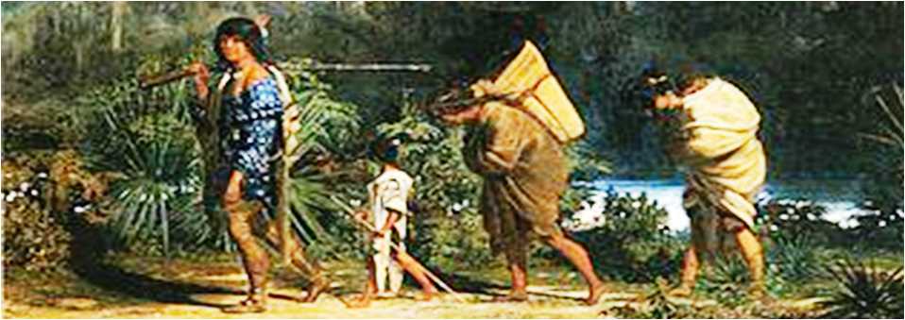
Removal of the Chickasaw
Treaty of Pontotoc: October 1832
relinquish all land east of Miss. R. – U.S. payment $3M
Chickasaw agree to SHARE Choctaw lands
TN
Fort Gibson
Memphis
Indian
Country
Chickasaw
AR
1837: 2 groups (2000 each) remove to Indian Country
travel independently at own pace, with possessions
MS
LA

Slide 105
Removal of the Chickasaw
Removal of the Chickasaw 1837
1837
~ 400-800 die on journey
removed
TN
Fort Gibson
Memphis
> 4000
remain
100s
AR
Will the Chickasaw share Choctaw’s new lands?
MS
LA

Slide 106
https://en.wikipedia.org/wiki/Indian_removal
The following is a compilation of the statistics, many containing rounded figures, regarding the Southern removals.
Nation | Population east of the Mississippi before removal treaty | Removal treaty & year signed | Years of major emigration | Total number emigrated or forcibly removed | Number stayed in Southeast | Deaths during removal | Deaths from warfare
Choctaw | 19,554^{[100]} + white citizens of the Choctaw Nation + 500 black slaves | Dancing Rabbit Creek (1830) | 1831–1836 | 12,500 | 7,000^{[101]} | 2,000–4,000+ (Cholera) | none
Creek | 22,700 + 900 black slaves^{[102]} | Cusseta (1832) | 1834–1837 | 19,600^{[103]} | 100s | 3,500 (disease after removal)^{[104]} | ? (Second Creek War)
Chickasaw | 4,914 + 1,156 black slaves | Pontotoc Creek (1832) | 1837–1847 | over 4,000 | 100s | 500–800 | none
Cherokee | 21,500 + 2,000 black slaves | New Echota (1835) | 1836–1838 | 20,000 + 2,000 slaves | 1,000 | 2,000–8,000 | none
Seminole | 5,000 + fugitive slaves | Payne's Landing (1832) | 1832–1842 | 2,833^{[105]} | 250^{[105]} 500^{[106]} |  | 700 (Second Seminole War)

Slide 107
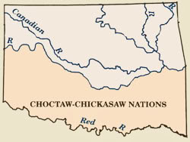
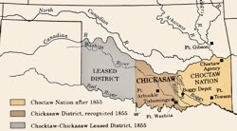
http://dougdawg.blogspot.com/2010/10/maps-and-history-of-oklahoma-county.html
The next of the Five Civilized Tribes to move to Indian Territory were the Chickasaws. Initially, the Choctaws sold Chickasaws the right to settle in the western part of their nation and removal occurred in 1837-1838. Although the preferred area of their settlement was in the west, the Chickasaws could also settle anywhere in the Choctaw Nation. During this time, the Chickasaws were subject to Choctaw law and the tribe had no "nation" to itself. That changed in 1855 when a new treaty set up distinct areas for the Chickasaws and Choctaws and also included a provision that the westernmost part of the area become a "Joint Use" area which was leased to the United States
Joint Choctaw-Chickasaw Area 1837-1838
Choctaw & Chickasaw Areas 1855

Slide 108
Removal of the Chickasaw 1837
How will they get there?
Routes of the Trail of Tears
Creek
Cherokee
Chickasaw
Choctaw
> 4000
Will the Chickasaw share Choctaw’s new lands?
Seminole

Slide 109
How will they get there?
Removal of the Seminole
Routes of the Trail of Tears
Creek
Cherokee
Chickasaw
Choc-Chick
Choctaw
Seminole

Slide 110
https://en.wikipedia.org/wiki/Seminole
During the colonial years, the Seminole were on good terms with both the Spanishand the British. In 1784, after the American Revolutionary War, Britain came to a settlement with Spain and transferred East and West Florida to it. The Spanish Empire's decline enabled the Seminole to settle more deeply into Florida.
After the independent United States acquired Florida from Spain in 1819, its settlers increased pressure on Seminole lands. During the period of the Seminole Wars (1818–1858), the tribe was first confined to a large reservation in the center of the Florida peninsula by the Treaty of Moultrie Creek (1823) and then evicted from the territory altogether according to the Treaty of Payne's Landing (1832). By 1842, most Seminoles and Black Seminoles had been coerced or forced to move to Indian Territory west of the Mississippi River.
During the American Civil War, most of the Oklahoma Seminole allied with the Confederacy, after which they had to sign a new treaty with the U.S., including freedom and tribal membership for the Black Seminole. Today residents of the reservation are enrolled in the federally recognized Seminole Nation of Oklahoma, while others belong to unorganized groups.
Perhaps fewer than 200 Seminoles remained in Florida after the Third Seminole War (1855–1858), but they fostered a resurgence in traditional customs and a culture of staunch independence. In the late 19th century, the Florida Seminole re-established limited relations with the U.S. government and in 1930 received 5,000 acres (20 km²) of reservation lands. Few Seminole moved to reservations until the 1940s; they reorganized their government and received federal recognition in 1957 as the Seminole Tribe of Florida. The more traditional people near the Tamiami Trail received federal recognition as the Miccosukee Tribe in 1962.
The Oklahoma and Florida Seminole filed land claim suits in the 1950s, which were combined in the government's settlement of 1976. The tribes and Traditionals took until 1990 to negotiate an agreement as to division of the settlement, a judgment trust against which members can draw for education and other benefits. The Florida Seminole founded a high-stakes bingo game on their reservation in the late 1970s, winning court challenges to initiate Indian Gaming, which many tribes have adopted to generate revenues for welfare, education and development.
Seminole Wars
After attacks by Spanish colonists on American Indian towns, Natives began raiding Georgia settlements, purportedly at the behest of the Spanish. In the early 19th century, the U.S. Army made increasingly frequent invasions of Spanish territory to recapture escaped slaves. General Andrew Jackson's 1817–1818 campaign against the Seminole became known as the First Seminole War. Following the war, the United States effectively controlled East Florida.
In 1819 the United States and Spain signed the Adams-Onís Treaty, which took effect in 1821. According to its terms, the United States acquired Florida and, in exchange, renounced all claims to Texas. Andrew Jackson was named military governor of Florida. As European-American colonization increased after the treaty, colonists pressured the Federal government to remove Natives from Florida. Slaveholders resented that tribes harbored runaway Black slaves, and more colonists wanted access to desirable lands held by Native Americans. Georgian slaveholders wanted the "maroons" and fugitive slaves living among the Seminoles, known today as Black Seminoles, returned to slavery.
After acquisition by the US of Florida in 1821, many American slaves and Black Seminoles frequently escaped from Cape Florida to the British colony of the Bahamas. Contemporary accounts noted a group of 120 migrating in 1821, and a much larger group of 300 African-American slaves escaping in 1823, picked up by Bahamians in 27 sloops and also by canoes.
Under colonists' pressure, the US government made the 1823 Treaty of Camp Moultrie with the Seminole, seizing 24 million acres in northern Florida and offering them a greatly reduced reservation in the Everglades of about 100,000-acre (400 km²). They and the Black Seminoles moved into central and southern Florida. In 1832, the United States government signed the Treaty of Payne's Landing with a few of the Seminole chiefs. They promised lands west of the Mississippi River if the chiefs agreed to leave Florida voluntarily with their people. The Seminoles who remained prepared for war. White colonists continued to press for their removal.
In 1835, the U.S. Army arrived to enforce the treaty. The Seminole leader Osceola led the vastly outnumbered resistance during the Second Seminole War. Drawing on a population of about 4,000 Seminole and 800 allied Black Seminoles, he mustered at most 1,400 warriors (Andrew Jackson estimated they had only 900). They countered combined U.S. Army and militia forces that ranged from 6,000 troops at the outset to 9,000 at the peak of deployment in 1837. To survive, the Seminole allies employed guerrilla tactics with devastating effect against U.S. forces, as they knew how to move within the Everglades and use this area for their protection. Osceola was arrested (in a breach of honor) when he came under a flag of truce to negotiations with the US in 1837. He died in jail less than a year later. He was decapitated, his body buried without his head.
Other war chiefs continued the Seminole resistance against the army. After a full decade of fighting, the war ended in 1842. Scholars estimate the U.S. government spent about $40,000,000 on the war, at the time a huge sum. An estimated 3,000 Seminole and 800 Black Seminole were forcibly exiled to Indian Territory west of the Mississippi, where they were settled on the Creek reservation. A few hundred survivors retreated into the Everglades. In the end, after the Third Seminole War, the government gave up trying to subjugate the Seminole and left the estimated fewer than 500 survivors in peace.
The Florida Seminole are the only tribe in America to have never signed a peace treaty with the U.S. Government.
SEMINOLE

Slide 111
How will they get there?
Removal of the Seminole
Removal of the Seminole
Removal of the Seminole
Routes of the Trail of Tears
Creek
Cherokee
Choc-Chick
Seminole

Slide 112
Removal of the Seminole
Treaty of Payne’s Landing: May 1832
within 3 yrs, move to Creek reservation west of Miss. R
become part of Creek Nation
return all run-away slaves
send delegation to Creek territory to approve land
1823
after 1st Seminole War
reserve
1833: delegation visits Creek Indian country
delegates coerced to agree (Treaty of Fort Gibson)
1834: return home, refuse to move; conflict escalates
2nd Seminole War

Slide 113
https://en.wikipedia.org/wiki/Treaty_of_Payne%27s_Landing
After the election of Andrew Jackson as President of the United States in 1828, the movement to transfer all Indians in the United States to west of the Mississippi River grew, and in 1830 the United States Congress passed the Indian Removal Act.
Determined to move the Seminoles west, the United States Department of War appointed James Gadsden to negotiate a new treaty with them. In the spring of 1832 the Seminoles on the reservation were called to a meeting at Payne's Landing on the Oklawaha River. The negotiations were conducted in obscurity, if not secrecy. No minutes were taken, nor were any detailed accounts of the negotiations ever published. This was to lead to trouble later.
The U.S. government wanted the Seminoles to move to the Creek Reservation in what was then part of the Arkansas Territory (which later became part of the Indian Territory), to become part of the Creek Nation, and to return all runaway slaves to their lawful owners. None of these demands were agreeable to the Seminoles. They had heard that the climate at the Creek Reservation was harsher than in Florida. The Seminoles of Florida did not consider themselves part of the Creeks. Although many of the groups in Florida had come from what whites called Creek tribes, they did not feel any connection. Some of the groups in Florida, such as the Choctaw, Yamasees and the Yuchis had never been grouped with the Creeks. Finally, runaway slaves, while often held as slaves by the Seminoles (under much milder conditions than with whites), were fairly well integrated into the bands, often inter-marrying, and rising to positions of influence and leadership.
The treaty negotiated at Payne's Landing called for the Seminoles to move west if the land were found to be suitable. The delegation of seven chiefs who were to inspect the new reservation did not leave Florida until October 1832. After touring the area for several months and conferring with the Creeks who had already been settled there, the seven chiefs signed on March 28, 1833 at Fort Gibson, Arkansas Territory a statement that the new land was acceptable. Upon their return to Florida, however, most of the chiefs renounced the statement, claiming that they had not signed it, or that they had been forced to sign it, and in any case, that they did not have the power to decide for all the tribes and bands that resided on the reservation. Even some U.S. Army officers observed that the chiefs "had been wheedled and bullied into signing." Furthermore, "there is evidence of trickery by the whites in the way the treaty is phrased."
Several villages had been allowed to stay in the area of the Apalachicola River after 1823 when the rest of the Seminoles had been forced into the new reservation. Gadsden was able to persuade the chiefs of these villages to move, however, and they went west in 1834. The United States Senate finally ratified the Treaty of Payne's Landing in April 1834.
The treaty had given the Seminoles three years to move west of the Mississippi. The government interpreted the three years as starting in 1832, and expected the Seminoles to move in 1835. Fort King, in what is now Ocala was reopened in 1834. A new Seminole agent, Wiley Thompson, was appointed in 1834, and the task of persuading the Seminoles to move fell to him. He called the chiefs together at Fort King in October 1834 to talk to them about the removal to the west. The Seminoles informed Thompson that they had no intention of moving, and that they did not feel bound by the Treaty of Payne's Landing. Thompson then requested reinforcements for Fort King and Fort Brooke, reporting that, "the Indians after they had received the Annuity, purchased an unusually large quantity of Powder & Lead." Brigadier General Duncan L. Clinch, United States Army commander for Florida, also warned Washington that the Seminoles did not intend to move, and that more troops would be needed to force them to move.
In March 1835 Thompson called the chiefs together to read a letter from Andrew Jackson to them. In his letter, Jackson said, "Should you ... refuse to move, I have then directed the Commanding officer to remove you by force." The chiefs asked for thirty days to respond. A month later the Seminole chiefs told Thompson that they would not move west. Thompson and the chiefs began arguing, and General Clinch had to intervene to prevent bloodshed. Eventually, eight of the chiefs agreed to move west, but asked to delay the move until the end of the year, and Thompson and Clinch agreed.
Five of the most important of the Seminole chiefs, including Micanopy of the Alachua Seminoles, had not agreed to the move. In retaliation, Thompson declared that those chiefs were removed from their positions. As relations with the Seminoles deteriorated, Thompson forbid the sale of guns and ammunition to the Seminoles. Osceola, a young warrior beginning to be noticed by the whites, was particularly upset by the ban, feeling that it equated Seminoles with slaves and said, "The white man shall not make me black. I will make the white man red with blood; and then blacken him in the sun and rain ... and the buzzard live upon his flesh." In spite of this, Thompson considered Osceola to be a friend, and gave him a rifle. Later, though, when Osceola was causing trouble, Thompson had him locked up at Fort King for a night. The next day, in order to secure his release, Osceola agreed to abide by the Treaty of Payne's Landing and to bring his followers in.
The situation grew worse. In August 1835 Private Kinsley Dalton (for whom Dalton, Georgia is named) was killed by Seminoles as he was carrying the mail from Fort Brooke to Fort King. In November Chief Charley Emathla, wanting no part of a war, led his people towards Fort Brooke where they were to board ships to go west. This was considered a betrayal by other Seminoles. Osceola met Emathla on the trail and killed him. The Second Seminole War was beginning.

Slide 114
https://www.floridamemory.com/onlineclassroom/seminoles/sets/1833_fort_gibson/
Treaty of Fort Gibson, 1833
The delegation of Seminole leaders reached the Indian Territory in 1833. They surveyed the lands assigned to them and met with U.S. government officials at Fort Gibson, Arkansas territory. There, at Fort Gibson, the Americans coerced the Seminole delegation into affirming the terms of removal discussed at Payne’s Landing. These strong-arm tactics resulted in the Treaty of Fort Gibson (ratified 1834).

Slide 115
Removal of the Seminole
series of battles between Seminole groups & U.S.
during the war, some Seminole groups remove
war ends with small reservation in south Florida
one of the longest and most costly indian conflicts
2nd Seminole War
1834-1842
2nd Seminole War: 1834-1842

Slide 116
Removal of the Seminole
small reservation in south Florida
series of battles between Seminole groups & U.S.
during the war, some Seminole groups remove
war ends with small reservation in south Florida
one of the longest and most costly indian conflicts
small reservation in south Florida
1823
reserve
1842
2nd Seminole War: 1834-1842

Slide 117
http://www.seminolenation-indianterritory.org/trailoftears.htm
After the passing of the Indian Removal Bill in 1830, the Seminole Indians fought perhaps harder than any other tribe to defend their lands. The Seminoles’ homes and settlements were destroyed and the inhabitants were driven into the nearby swamps where they were hunted for six years. Those who were captured were carried away as prisoners to Indian Territory.
The Treaty of Payne’s Landing, signed May 9, 1832, surrendered the remaining Seminole lands in Florida. A provision of the treaty allowed for the Seminole chiefs to tour Indian Territory for their approval of the proposed relocation grounds. The exploration party reached Fort Gibson in the fall of 1832. The Seminoles were not pleased to see that they would be living next to the Creeks. Nevertheless, the Seminole leaders were forced to sign the Treaty of Fort Gibson, which required the Seminoles to settle in the Creek Nation.
The struggle of the Seminoles against the United States Government to hold on to their land resulted in the Second or Great Seminole War. In January 1837, 10,000 American soldiers were sent to Florida. The Seminoles were defeated; more than 250 Seminoles and Black Seminoles, as well as Seminole prisoners being held at Fort Moultrie, South Carolina, were marched to New Orleans and held at Fort Pike to await transportation to Indian Territory. The prisoners were loaded onto boats that arrived at Fort Gibson in June of 1838.
1832
The exploration party provided by the 1832 Treaty of Payne’s Landing left for Indian Territory late that same year. Seven Seminole leaders, including John Blunt, Charley Emathla, Holahte Emathla, Jumper, and the interpreter Abraham, traveled under the leadership of Colonel James Gadsden. While in Indian Territory they signed the Treaty of Fort Gibson, which was a further agreement to Seminole removal. The treaty was signed even though these seven leaders did not have authority to act on behalf of the entire Seminole tribe.
The party traveled across the Gulf of Mexico to New Orleans and then ascended the Mississippi River on the steamer Little Rock.
Ascend the Mississippi River and the Arkansas River on the Little Rock
• Arrive at Little Rock (b) (c) November 3, 1832
• Depart overland, riding horses, from Little Rock
• Arrive at Fort Gibson (b) (d) a few weeks later
• Sign the Treaty of Fort Gibson March 28, 1833
1836
During the fall of 1835, a Seminole favoring removal was murdered, and his followers fled to Tampa Bay for protection and to await removal. They were members of Emathla’s “friendly Indians” including Fukeluste Hadjo, who was also known as Black Dirt.
They left for New Orleans by steamer on April 11 or 12, 1836, conducted by Lieutenant Joseph W. Harris . The party arrived at New Orleans on April 23. There they boarded the steamer Compromise with a keelboat in tow.
Twenty-five passengers died along the way, and many were sick upon arrival due to heavy rains and poor traveling conditions. Upon reaching their new home, only 320 of the original 407 had survived.
• Ascend the Mississippi River on the Compromise
• Arrive at Montgomery’s Point and ascend the Arkansas River
• Arrive at Little Rock; Harris is ill and stays at Little Rock; Captain Jacob Brown takes charge; he stations the group one-quarter mile below Little Rock to wait for the water level to rise May 5, 1836
• Ascend the Arkansas River under Lieutenant George G. Meade May 7, 1832
• Disembark at McLean’s Bottom below Fort Smith due to low water levels May 9, 1836
• Lieutenant Jefferson Van Horne arrives at the camp and takes charge May 13, 1836
• Depart McLean’s Bottom, traveling overland on bad roads
• Travel 4 miles May 14, 1836
• Travel 6 miles May 15, 1836
• Travel 10 miles; enter a prairie May 18, 1836
• Travel 10 miles; reach the Vache Grasse Creek (15 miles southeast of Fort Smith) May 20, 1836
• Travel 5 miles; stop at Barlins’ May 21, 1836
• Arrive at Fort Smith May, 1836
• Travel 10 miles; reach the Poteau River and go across (d) May 22, 1836
• Arrive at Fort Gibson (d) (b) May 23, 1836
A small Seminole family of eight passed Little Rock on June 1, 1836. They were led by Mr. Sheffield, who was acting superintendent for the removal of the Seminoles. The family was originally assigned to Holata Imathla’s party but had missed the boat at Tampa Bay while they were out fishing. In the summer of 1836, a group of Seminoles that had agreed to leave Florida voluntarily began arriving in Indian Territory. Ninety Black Seminoles were taken by Jesup’s command during the winter of 1836–1837. They were shipped to New Orleans on June 2, 1837.
1838
Two years after the 1836 emigration the next group of Seminoles arrived in Indian Territory . In 1838 many Seminoles were captured by the United States Military and were transported by water to New Orleans. Here they were held in the barracks at Fort Pike to await transportation to the West. By May 1, 1838, 1000 Seminoles, one-third of whom were Black Seminoles, had arrived. On May 14, 1838,
Lieutenant John G. Reynolds reached New Orleans with about 160 more people. A dispute arose between the Indians and the whites as to the ownership of the Black Seminoles. The Seminole Indians were forced to sail from New Orleans, leaving the Black Seminoles behind. The dispute was finally settled in the Seminoles’ favor, and Nathaniel Collins brought them up the Mississippi River by boat following the rest of the Seminoles. Collins’ party arrived at Little Rock on June 9, 1838 and reached Fort Gibson on June 12, 1838.
The Seminole Indians left New Orleans on the Renown, which departed May 19; and the South Alabama, which departed May 22. The Renown carried 453 passengers and was conducted by G. Y. Adde with the assistance of Dr. S. S. Simmons. The South Alabama held 674 passengers, including 249 slaves and chiefs Micanopy, Coa Hadjo, and Philip; Reynolds was the conductor and had the assistance of Lieutenant Terret and Dr. James Simmons.
Ascend the Mississippi River May 19–22, 1838
South Alabama party:
• South Alabama reaches Vicksburg May 26, 1838
• Enter the Arkansas River
• South Alabama arrives at Little Rock; passengers transfer to lighter craft, the Liverpool and the Itasca (d) (i) June 1, 1838
• Depart Little Rock June 4, 1838
• Arrive at Fort Gibson without incident
Renown party:
• Renown arrives at Little Rock (c) (f) (i) May 26, 1838
• Renown arrives at Ft. Gibson (f) (i) June 12, 1838
A party of 117 Seminoles and two Black Seminoles departed Charleston, Florida and arrived at New Orleans on May 28, 1838. The group’s interpreter was named Samuel. They departed New Orleans on the steamer Ozark and ascended the Mississippi and Arkansas rivers.
• Capsize on the Arkansas River just below Pine Bluff; transfer to the steamer Mt. Pleasant
• Continue to ascend the Arkansas River
• Arrive at Little Rock June 11, 1838
• Transfer to the steamer Fox and depart Little Rock (c) (i) June 13, 1838
• Arrive at Fort Gibson (f) (i) June 19, 1838
Another party of Black Seminoles, numbering 33, had been detained in New Orleans due to the attempt of some white people to claim them as slaves. The Black Seminoles were finally allowed to leave. They departed up the Mississippi River and were conducted by J. B. Benjamin.
• Ascend the Mississippi River from New Orleans and enter the Arkansas River
• Arrive at Little Rock somewhere between July 7 and July 10, 1838 (i); board the steamer Tecumseh with Whiteley’s party of Cherokees
• Continue to ascend the Arkansas River
• Arrive at Lewisburg and become stranded due to low water (i); remain until July 18, 1838
• Continue overland to Fort Gibson
On July 11, 1838, 66–67 Seminoles, including Alligator and his family and one Black Seminole, departed New Orleans. They were conducted by Lieutenant John G. Reynolds. A slave was brought along as an interpreter.
• Depart New Orleans by boat; travel aboard the Itasca (i) July 11, 1838
• Enter the Arkansas River
• Arrive at Little Rock; delay temporarily due to low water levels; cannot find overland transportation (i) July 19, 1939
• Resume journey up the Arkansas River July 22, 1838
• Reach Clarksville; pick up some Black Seminoles who had been forced to abandon their boat due to low water levels
• Continue to ascend the Arkansas River
• Disembark at a point 2 miles below Fort Coffee due to low water ; disembark on the north side of the Arkansas River July 27, 1838; July 29, 1838
• Continue the journey overland
• Arrive at Fort Gibson August 5, 1838; August 6, 1838
A party of 250 Seminoles departed Pensacola, Florida on November 29, 1838. The group consisted of the few remaining members of the Apalachicola Tribe and 34 Muscogees from Dog Island. They were conducted by Major Daniel Boyd. The group left Florida on the steamers Vesper and Octavia and arrived at New Orleans November 2, 1838. Here they transferred to the Rodney and started up the Mississippi River.
• Ascend the Mississippi River on the Rodney
• Arrive at Montgomery’s Point on the White River; wait here for the water level to rise on the Arkansas River
• Arrive at Little Rock November 22, 1838; transfer to the steamer North St. Louis
• Depart Little Rock (c) (i) December 23, 1838
• Run aground below Cadron (i); run aground 50 miles up the Arkansas River
• Leave overland for Indian Territory from Cadron
Many other Seminole parties left New Orleans in 1838. A party consisting of 305 Seminoles and 30 Black Seminoles moved to Indian Territory under charge of Captain Pitcairn Morrison. They arrived at New Orleans on June, 14, 1838 where they boarded the Livingston and ascended the Mississippi River. They passed Little Rock June 23, 1838 and arrived at Fort Gibson June 28, 1838. On October 28, 1838, the entire group of Apalachicola Seminoles and a small number of Creeks departed Florida for the West on one steamer and two schooners. Thirty-one Seminoles and two slaves left Florida in November 1838 and arrived in Fort Gibson February 13, 1839.
1839
General Taylor conducted 96 Seminoles to Tampa Bay on February 25, 1839. They were then brought west by Captain Pitcairn Morrison. The party ascended the Mississippi River, stopping at Fort Jackson, Louisiana to switch to the Buckeye. They passed Natchez on March 28, 1839, where a boiler on the steamer exploded and killed a number of passengers. The party arrived at Little Rock on April 2, 1839, where they were delayed by low water levels. They arrived at Fort Gibson April 13, 1839.
Another 1839 removal party consisting of 48 Seminoles departed St. Augustine aboard a schooner conducted by Lieutenant B. Board. They reached New Orleans on November 28, 1839. Here they boarded the steamer Orleans. They passed Little Rock in mid-December. Because the Arkansas River was so low, the boat could go no higher than Fort Smith. Here Lieutenant Board put the Seminoles in the charge of Arnold Harris. The water levels rose a few days later, and they continued upriver and arrived at Fort Gibson December 23, 1839.
1840
Several more Seminole parties left Florida for Indian Territory in 1840. On March 21, 220 captive Tallahassee Indians embarked from Tampa Bay and reached New Orleans on April 4. They ascended the Mississippi River on the steamer President under charge of Major William B. Belknap. On April 19 they landed on the Arkansas River opposite the mouth of the Grand River in Indian Territory.
On April 13, 1840, a party of 205 Seminoles, including several Black Seminoles, left Florida. The group’s interpreter was named Abraham. Another party, conducted by disbursing agent L. E. Capers, left Florida on May 7, 1840 and reached New Orleans six days later. They departed May 16 on the John Jay under charge of Captain H. McKavett and arrived at the Choctaw Agency June 13, 1840.
A delegation of 14 Seminoles, who had already arrived in Indian Territory, returned to Florida to convince more Seminoles to remove. They traveled under Captain John Page and took two interpreters. Two of the Seminoles were chiefs Holahtochee and Nocoseohola. The party left Fort Gibson on October 1, 1840 and descended the Arkansas and Mississippi rivers to New Orleans. From there they traveled to 1932; Paige et al. 2003). Tampa Bay, arriving on November 7, 1840.
1841
In late March, 1841 a party of 221 Tallahassee Indians left Tampa Bay, arriving at New Orleans on March 29. Here they boarded the steamer President and departed up the Mississippi River on April 4. They were under charge of Major William G. Belknap, Lieutenant John T. Sprague, and Dr. Barnes. The group included the band of Echo Imathla and his subchiefs. They passed Little Rock April 10 or 11 and reached Fort Gibson on April 19, 1841.
Also in late March a group of 205 Seminoles and seven Black Seminoles left Florida conducted by LeGrande G. Capers. They landed at Fort Gibson on June 13, 1841. In early June, 1841 Wildcat and his men traveled by boat to New Orleans. They were sent back to Florida to help induce other Seminoles to surrender. On October 11, about 200 Seminoles, including Wildcat, left Florida. The party rode on the steamer Laurence Copeland to New Orleans, where they switched to the Little Rock and ascended the Mississippi River. They passed Little Rock in early November, 1841 and arrived at Fort Gibson November 12.
A party of 206 Seminoles departed Tampa Bay and arrived at New Orleans May 13, 1841. Here they boarded the John Jay and descended the Mississippi River under charge of Captain Henry McKavett. They passed Little Rock June 1, 1841 and arrived in Indian Territory on June 13. In October, 1841 a party of 200 left Tampa Bay and arrived at Fort Gibson in November 1841. The party included 15 Black Seminoles and Billy Factor the interpreter. In early November, 1841, 207 Seminoles passed Little Rock on the steamer Little Rock. They reached Fort Gibson two months later. They had been detained at Little Rock due to low water levels on the Arkansas River.
1842
In the fall and winter of 1841, about 300 Seminoles and their slaves were rounded up and gathered at Tampa Bay. Here they boarded the steamer Laurence Copeland and traveled to New Orleans in the spring of 1842. At New Orleans they boarded the steamer President and ascended the Mississippi River under the charge of Captain T. L. Alexander.
• Ascend the Mississippi River, Spring 1842
• Enter the Arkansas River
• Land at a point 60 miles below Little Rock to wait for the water level to rise
• Arrive at Webber’s Falls in Indian Territory June 1, 1842
More Seminoles were captured during 1842. In April, a party of 102 left Tampa Bay under the charge of Second Lieutenant E. R. S. Canby. They left New Orleans on July 21/22, 1842 on the steamer J. B. Swan. Gopher John (John Coheia) was with this group.
• Ascend the Mississippi River on the J. B. Swan July 22, 1842
• Enter the Arkansas River; water is very low
• Run aground 6 miles below Little Rock and disembark; ground at La Fourche Bar; are delayed here for a week (d); ground at the Barraque’s Bar
• Arrive at Little Rock early August, 1842
• Depart overland; travel overland from Little Rock by way of Fort Smith; follow the military road from Little Rock to Fort Smith
• Arrive at Fort Smith August 25, 1842
• Cross the Arkansas River by ferry at Norristown
• Reach Indian Territory September 6, 1842; August 26, 1842
In February, 1842, under the charge of Capt. T. L. Alexander, 220 Seminoles were escorted to Indian Territory. They went by boat from Tampa Bay to New Orleans. In New Orleans, they camped for nine weeks while waiting for additional Seminole emigrants to arrive . They were joined by a group of 94 Seminoles who had left Tampa Bay April 10, 1842. From New Orleans, they all set sail aboard the steamer President. They traveled up the Mississippi and Arkansas rivers. Due to very low water on the Arkansas River, they were stranded about 60 miles above Little Rock. After camping here for several weeks, the water finally rose and they went on to Webbers Falls, arriving June 1.
1843
Pascofa and his followers, who were Creeks that had fled from Alabama to Florida in 1836, surrendered in November, 1842. In January or February of 1843, Pascofa’s band of 350 embarked from Tampa Bay on the steamer William Gaston under the charge of Lieutenant Henry McKavett. They arrived in New Orleans in February and left on March 4, 1843. They took the steamer Lucy Walker and were conducted by Captain H. M. McKavett.
• Travel up the Mississippi and Arkansas rivers by boat
• Arrive at Little Rock; delay here due to low water March 11, 1843
• Continue to ascend the Arkansas River; encamp on the riverbank 20 miles below Fort Smith one month later
• Land on the south bank of the Arkansas River opposite the mouth of the Illinois River (c) (d); remain at nearby Webber’s Falls while awaiting transportation; travel the rest of the way by wagon April 26
1856-1857
According to Foreman (1932), 165 “hostiles” sailed from Fort Myers, Florida to New Orleans in 1856. From there they ascended the Mississippi River aboard the steamer Quapaw. Foreman later wrote (1948) about a delegation of 40 Seminoles and six Creeks who traveled in the winter of 1856 from Indian Territory to Florida to locate more Seminoles. After spending weeks looking for them, 156 Seminoles were gathered and convinced to move. The party left Fort Myers on May 4, 1857 for New Orleans.
Foreman might possibly have been referring to the same group in both places, as evidenced by the dates below being exactly one year apart and the number of Seminoles seemingly transposed.
• Ascend the Mississippi River by boat
• Ascend the Arkansas River by boat
• Arrive at Fort Smith May 28
• Proceed overland from Fort Smith in charge of Rutherford
• Arrive at the Seminole Agency June 16, 1856 (c); June 16, 1857
1858
In 1858, Billy Bowlegs and about 160 of his people agreed to move West. They left Florida on the steamer Grey Cloud and arrived in New Orleans where they spent a week. They transferred to the Quapaw and arrived at Fort Smith May 28, 1858. In December 1858, Billy Bowlegs returned to Florida and persuaded 75 more Seminoles to move. They departed for New Orleans February 15, 1859, and arrived in Indian Territory by early March, 1859. This was the last removal from Florida under the provisions of the Treaty of Moultrie Creek.

Slide 118
https://www.uswars.net/second-seminole-war/
United States government decides removal of all Indians in Florida to the Indian Territory in the West (present day Oklahoma) was the best solution to continued conflict between the Seminoles and white settlers. By 1834, 3,824 Indians had been removed to the west.
On December 28, 1835, Seminole Indians led by Osceola attacked and killed the Indian agent General Wiley Thompson and six others in his party outside the Fort King stockade. Thompson was shot 14 times and scalped.
That same day, Major Francis Dade and his troops are ambushed by 300 Seminole warriors near Fort King (Ocala), starting the Second Seminole War – beginning of mass removal of the Seminoles to the Indian Territory.
In December 1837 Colonel Zachary Taylor was on his way to Lake Okeechobee to round up Seminole Indians resisting removal. On Christmas day, 25 Dec 1837, Colonel Taylor and about 1,100 U.S. troops were ambushed by some 400 Seminole Indians under chiefs Alligator, Billy Bowlegs and Abiaca. The Seminoles had carefully prepared the site, even cutting the grass to clear a field of fire. The Seminole fire was devastating and Colonel Taylor's direct approach made the situation even worse. The U.S. forces suffered 26 killed and 112 wounded while the Seminoles had only 11 killed and 14 wounded. The Seminoles carefully selected their targets and many of the officers and NCOs were among the dead and wounded. Colonel Taylor was forced to retire to Fort Basinger in what was a tactical victory for the Seminoles. Strategically, Colonel Taylor had demonstrated the ability of U.S. forces to penetrate deep into Seminole territory with large forces and with improved tactics they would certainly prevail in the removal effort. Colonel Taylor was promoted to the rank of Brigadier General soon after the battle and later, in May 1838, assumed command of operations in Florida from Major General Thomas S. Jesup.
In June or July, 1837 U.S. Forces captured Osceola under false flag of truce.
January 30, 1838 Osceola dies at Fort Moultrie, South Carolina.
1842 End of the Second Seminole War – By the end of the war, 4,420 Seminoles had surrendered and been deported to the west.

Slide 119
Removal of the Seminole
small reservation in south Florida
Creek
Cherokee
Choc-Chick
Seminole
Seminole

Slide 120
https://en.wikipedia.org/wiki/Seminole_Wars
The remaining Seminoles in Florida were allowed to stay on an informal reservation in southwest Florida at the end of the Second Seminole War in 1842.
The Treaty of Moultrie Creek provided for a reservation in central Florida for the Seminoles.

Slide 121
Removal of the Seminole
Removal of the Seminole 1834-1842
1834-1842
NOTE: 700 die during 2nd Seminole War
?
removed: 3600, including 800 black Seminoles
Creek
Creek-Sem
Cherokee
Choc-Chick
remain: 750
Seminole

Slide 122
http://dougdawg.blogspot.com/2010/10/maps-and-history-of-oklahoma-county.html
Similarly, the initial area set aside for the Creek Nation was co-occupied by the Seminole Nation, its removal to Indian Territory beginning in 1832-33 but continuing through 1859. The area was divided in 1856 to provide for distinct areas for each tribe. Parts of the areas of these tribes would later become the "Unassigned Lands.
Creek & Seminole Tribes 1833
Seminoles & Creeks 1856

Slide 123
READ THIS FOR EXPLANATION OF 2nd SEMINOLE WAR
https://en.wikipedia.org/wiki/Second_Seminole_War
By the end of 1843, 3,824 Indians (including 800 Black Seminoles) had been shipped from Florida to what became the Indian Territory. They were initially settled on the Creek Reservation, which created tensions. The next year, the Florida people numbered 3,136. As of 1962, their numbers had dropped to 2,343 Seminoles in the Indian Territory and perhaps some 1,500 in Florida.

Slide 124
https://en.wikipedia.org/wiki/Indian_removal
The following is a compilation of the statistics, many containing rounded figures, regarding the Southern removals.
Nation | Population east of the Mississippi before removal treaty | Removal treaty & year signed | Years of major emigration | Total number emigrated or forcibly removed | Number stayed in Southeast | Deaths during removal | Deaths from warfare
Choctaw | 19,554^{[100]} + white citizens of the Choctaw Nation + 500 black slaves | Dancing Rabbit Creek (1830) | 1831–1836 | 12,500 | 7,000^{[101]} | 2,000–4,000+ (Cholera) | none
Creek | 22,700 + 900 black slaves^{[102]} | Cusseta (1832) | 1834–1837 | 19,600^{[103]} | 100s | 3,500 (disease after removal)^{[104]} | ? (Second Creek War)
Chickasaw | 4,914 + 1,156 black slaves | Pontotoc Creek (1832) | 1837–1847 | over 4,000 | 100s | 500–800 | none
Cherokee | 21,500 + 2,000 black slaves | New Echota (1835) | 1836–1838 | 20,000 + 2,000 slaves | 1,000 | 2,000–8,000 | none
Seminole | 5,000 + fugitive slaves | Payne's Landing (1832) | 1832–1842 | 2,833^{[105]} | 250^{[105]} 500^{[106]} |  | 700 (Second Seminole War)

Slide 125
Removal of the Seminole 1834-1842
?
removed: 3600, including 800 black Seminoles
black Indians associated w/Seminole Nation
descendants of free blacks & escaped slaves who
allied w/Seminoles in Spanish Florida
- some are slaves; others intermarry
Creek
Creek-Sem
Cherokee
Choc-Chick

Slide 126
https://en.wikipedia.org/wiki/Black_Seminoles
The Black Seminoles are black Indians associated with the Seminole people in Florida and Oklahoma. They are the descendants of free blacks and of escaped slaves(called
maroons) who allied with Seminole groups in Spanish Florida. Historically, the Black Seminoles lived mostly in distinct bands near the Native American Seminole. Some were held as slaves of particular Seminole leaders; but they had more freedom than did slaves held by whites in the South and by other Native American tribes, including the right to bear arms.
Today, Black Seminole descendants live primarily in rural communities around the Seminole Nation of Oklahoma. Its two Freedmen's bands, the Caesar Bruner Band and the Dosar Barkus Band, are represented on the General Council of the Nation. Other centers are in Florida, Texas, the Bahamas, and northern Mexico.
Since the 1930s, the Seminole Freedmen have struggled with cycles of exclusion from the Seminole Tribe of Oklahoma. In 1990, the tribe received a $46 million judgement trust by the United States, for seizure of lands in Florida in 1823, and the Freedmen have worked to gain a share of it. In 2004 the US Supreme Court ruled the Seminole Freedmen could not bring suit without the Seminole Nation of Oklahoma, which refused to join it on the claim issue.
In 2000 the Seminole Nation voted to restrict membership to those who could prove descent from a Seminole Indian on the Dawes Rolls of the early 20th century, which excluded about 1,200 Freedmen who were previously included as members. They argue that the Dawes Rolls were inaccurate and often classified persons with both Seminole and African ancestry as only Freedmen.

Slide 127
How will they get there?
Removal of the Seminole 1834-1842
Removal of the Cherokee
?
removed: 3600, including 800 black Seminoles
black Indians associated w/Seminole Nation
descendants of free blacks & escaped slaves who
allied w/Seminoles in Spanish Florida
- some are slaves; others intermarry
Creek
Creek-Sem
Cherokee
Choc-Chick
Will the Seminole share Creek’s new lands?

Slide 128
How will they get there?
Removal of the Cherokee
Removal of the Cherokee
Creek
Creek-Sem
Cherokee
Choc-Chick
NEW
SPAIN

Slide 129
Removal of the Cherokee
Let’s go back 15 years
IN
IL
KY
Indian
Country
MO
TN
> 1000 miles
AR
Cherokee
NEW
SPAIN
MS
AL
GA
LA

Slide 130
https://www.google.com/search?q=choctaw+trail+of+tears+route&tbm=isch&tbo=u&source=univ&sa=X&ved=0ahUKEwj6642i4JPZAhXluFkKHROgAH8QsAQIag&biw=1094&bih=484#imgdii=iYOod1FKV4UmOM:&imgrc=ldILbWd-fRyF3M:
NEW
SPAIN

Slide 131
: 1815
Let’s go back 15 years
IN
IL
KY
Indian
Country
Missouri
Territory
MO
TN
Arkansas
Territory
AR
Cherokee
NEW
SPAIN
MS
AL
GA
LA

Slide 132
https://en.wikipedia.org/wiki/Arkansas_Territory

Slide 133
: 1815
Let’s go back 15 years
1815: under pressure from
Georgia, U.S. establishes
a Cherokee reserve in
Arkansas Territory
during next 15 years, 4000
Cherokees voluntarily
move west to avoid conflict
these early Cherokee
Fort Smith
migrants are called the ‘Old Settlers’ or ‘Western Cherokee’
Delaware, Shawnee, & Osage already live in territory
1817: Fort Smith built following Cherokee conflict w/Osage
1825: Osage cede all rights to Missouri/Arkansas land
Sequoyah is one of the Old Settlers!

Slide 134
https://en.wikipedia.org/wiki/Cherokee
CHEROKEE - OLD SETTLERS
Before the final removal to present-day Oklahoma, many Cherokees relocated to present-day Arkansas, Missouri and Texas. Between 1775 and 1786 the Cherokee, along with people of other nations such as the Choctaw and Chickasaw, began voluntarily settling along the Arkansas and Red Rivers.
In 1802, the federal government promised to extinguish Indian titles to lands claimed by Georgia in return for Georgia's cession of the western lands that became Alabama and
Mississippi. To convince the Cherokee to move voluntarily in 1815, the US government established a Cherokee Reservation in Arkansas. The reservation boundaries extended from north of the Arkansas River to the southern bank of the White River. Di'wali (The Bowl), Sequoyah, Spring Frog and Tatsi (Dutch) and their bands settled there. These Cherokees became known as "Old settlers."
The Cherokee, eventually, migrated as far north as the Missouri Bootheel by 1816. They lived interspersed among the Delawares and Shawnees of that area. The Cherokee in Missouri Territory increased rapidly in population, from 1,000 to 6,000 over the next year (1816–1817), according to reports by Governor William Clark. Increased conflicts with the Osage Nation led to the Battle of Claremore Mound and the eventual establishment of Fort Smith between Cherokee and Osage communities. In the Treaty of St. Louis (1825), the Osage were made to "cede and relinquish to the United States, all their right, title, interest, and claim, to lands lying within the State of Missouri and Territory of Arkansas..." to make room for the Cherokee and the Mashcoux, Muscogee Creeks. As late as the winter of 1838, Cherokee and Creek living in the Missouri and Arkansas areas petitioned the War Department to remove the Osage from the area.
A group of Cherokee traditionalists led by Di'wali moved to Spanish Texas in 1819. Settling near Nacogdoches, they were welcomed by Mexican authorities as potential allies against Anglo-American colonists. The Texas Cherokees were mostly neutral during the Texas War of Independence. In 1836, they signed a treaty with Texas President Sam Houston, an adopted member of the Cherokee tribe. His successor Mirabeau Lamar sent militia to evict them in 1839.

Slide 135
http://www.encyclopediaofarkansas.net/encyclopedia/entry-detail.aspx?entryID=553
CHEROKEE - OLD SETTLERS IN ARKANSAS
Migration during the Settlement and Early Statehood Era Cherokee migrated from their homeland to what became Arkansas from the 1780s to the 1820s. Their home territory in Georgia, eastern Tennessee, and western North and South Carolina had been threatened by the expansion of Euro-American settlement, and the Cherokee had lost numerous military and judicial battles with the newcomers. Cherokee had been exploring west of the Mississippi, and as many as a thousand reacted to the setbacks in their home territory by moving west into Spanish Louisiana out of the reach of the English colonies. The first Cherokee focus in Arkansas was the St. Francis River drainage and Crowley’s Ridge, with place names such as Doublehead Bluff in Cross County (named after a leader) and Big and Little Telico Creeks in St. Francis County (named after a major town in the homeland) bearing their imprint. Crow Creek in Cross County was probably not named after the bird but rather after the Crowtown Cherokee settlement. The Crowtown settlement was itself named after another homeland town. Early migrants who led parties of Cherokee families to eastern Arkansas included Connetoo (also known as John Hill), Unacata (also known as White Man Killer), William “Red-Headed Will” Webber, George Duvall, and Moses Price (also known as Wohsi).
The New Madrid Earthquakes of 1811–1812 disrupted these settlements. In June of 1812, Cherokee prophet Skawuaw (also known as the Swan) in a speech at Crowtown warned of further destruction for the Cherokee unless they gave up Anglo-American ways. In response to the quakes and this prophecy, many Cherokee abandoned eastern Arkansas and moved into the Arkansas River Valley west of what is now Little Rock (Pulaski County). This area of mountains and river valleys was similar to the foothills of the Appalachians that had been their homeland. There, unfortunately, they clashed with the Osage, who claimed the area as hunting grounds, and with American settlers moving across the Mississippi River. (Fort Smith in Sebastian County was later established to keep peace between the Cherokee and Osage.) Nonetheless, many groups of families came, along with parties that continued to drift west from the homeland. Major figures included Black Fox, Dutch, Spring Frog, Toluntuskee, and Takatoka. Some also eventually moved to the Red River area, including groups under Du-wa-li (also known as the Bowl) and later under Dutch.
Back in the homeland, increasing federal and state pressure on the remaining Cherokee led to the Turkeytown Treaty of July 8, 1817, in which land in the east was exchanged for land in northwest Arkansas, north of the Arkansas River and south of the White River. The goal of the Arkansas Cherokee was to protect their holdings and thereby create a new homeland in northwest Arkansas, although many of the Eastern Cherokee saw the treaty as a betrayal. The goal of the U.S. government was that all Cherokee would give up their native land and move to Arkansas. As many as 4000 may have done this, becoming known as the Western Cherokee. Emigrants included parties of families led by the principal chief John Jolly (brother to Tolluntuskee), Dick Justice (also known as Dek-keh the Just), the Glass, Walter “Wat” Webber, John Rogers, Tom Graves, John and David Brown, and, in 1829, Sequoyah (also known as George Gist or Guest), inventor of the Cherokee syllabary. The remaining 35,000 or so Cherokee stayed in the homeland.
Because the Cherokee owned the territory together in fee simple—that is, they were given the land as a group instead of in individual parcels—rather than it being managed for them by the U.S. government, the Arkansas land was not considered a reservation. The Western Cherokee established scattered family farmsteads and farms complete with cattle and some even with African-American slaves. The dispersed families were organized in traditional “towns,” spread out along tributaries on the north side of the Arkansas River, places such as Galla Creek, Illinois Bayou, Piney Creek, Spadra Creek, Horsehead Creek, and Mulberry River (from Pope County to Franklin County respectively), as well as Dutch Creek and Spring Creek south of the river (in Yell County). Others settled in the hills and valleys farther into the Ozarks.
Cherokee Life The Arkansas towns were held together by ties brought west from the homeland, principally kinship ties traced through females. Their centers included a council house and a stickball court. The Western Cherokee were moving toward a centralized government, with a governing council and a principal chief—this was John Jolly after 1818. Some Western Cherokee, such as Tolluntuskee, invited Protestant missionaries who founded Dwight Mission in 1820 near what is now Russellville (Pope County) so that Cherokee children could learn Anglo-American ways. Ironically, the mission was in a location firmly under the control of Takatoka, who opposed its goals.
The Cherokee built mills, cleared land for farming and pasture, and generally improved their holdings, becoming the first real agricultural and entrepreneurial pioneers in northwest Arkansas. In what would become Pope County, for example, Sequoyah established a salt works on the north fork of the Illinois Bayou, and the Glass did the same on Hackers Creek.
The British naturalist Thomas Nuttall described the Arkansas Cherokee well in 1819 on his travels up the Arkansas River: “Both banks of the river, as we proceeded, were lined with the houses and farms of the Cherokees, and though their dress was a mixture of indigenous and European taste, yet in their houses, which are decently furnished, and in the farms, which were well fenced and stocked with cattle… argue a propitius [sic] progress in their population. Their superior industry, either as hunters or farmers, proves the value of property among them.” Nuttall’s description of leader John Jolly is particularly telling. Nuttall met Jolly and his wife at Walter Webber’s store at the mouth of Illinois Bayou on April 9, 1819. Reported Nuttall, “I should scarcely have distinguished him from an American, except by his language. He was very plain, prudent, and unassuming in his dress and manners; a Franklin amongst his countrymen, and affectionately called the beloved father.” Jolly and his thousands of Cherokee neighbors were frontiers people, but they also strove to maintain their identity as Native Americans.
Indian Removal and the Civil War Era Pressure on the Western Cherokee by the federal government and the new Arkansas Territory eventually led to the Treaty of Washington on May 6, 1828, which ceded the Arkansas lands to the United States. Most of the Western Cherokee moved to Indian Territory in northeast Oklahoma, leaving houses, farms, orchards, and mills to be occupied by the Anglo-Americans who came to the area. These Western Cherokee became known as the Old Settlers when they were officially reunited with the main group of Cherokee following Indian Removal a few years later.
As many as 30,000 Cherokee passed through Arkansas on their way to Indian Territory in Oklahoma by land or water or a combination of the two between 1834 and 1839 as part of Indian Removal. The Trail of Tears left hundreds of dead buried in shallow graves and weakened others so that they died at the end of the journey. Some Arkansans noted the groups with sorrow, and at least one, Dr. J. C. Roberts, died while tending Cherokee cholera victims at Cadron (Faulkner County). However, Indian Removal also offered many Arkansans a chance to sell food to support the Indians and their animals en route, as well as a chance to profit from providing passage on steamboats on the rivers, wagons when the rivers were too low, and ferries across the many streams for those traveling over land.
The Cherokee Nation persisted in Indian Territory on the western border of Arkansas but not altogether peacefully. For example, factional conflicts among the Cherokee that arose during the final dissolution of the homeland in the 1830s led to civil war that lasted until 1846, though war effectively broke out again as part of the U.S. Civil War, with Cherokee fighting in both Union and Confederate forces in Indian Territory and sometimes in Arkansas. This violence led to disruptions, lawlessness, and refugees moving back and forth across the border, with some remaining in Arkansas. In more peaceful times, Indian Territory provided a market for agricultural produce and manufactured goods, allowing profit to be made by Anglo-American farmers, traders, and shippers. In hard times, Cherokee families sometimes moved into Arkansas looking for work.

Slide 136
: 1815
Let’s go back 15 years
What happens to Sequoyah in Indian Country?
1815: under pressure from
Georgia, U.S. establishes
a Cherokee reserve in
Arkansas Territory
during next 15 years, 4000
Cherokees voluntarily
move west to avoid conflict
these early Cherokee
Cherokee signatures on the treaty
Fort Smith
migrants are called the ‘Old Settlers’ or ‘Western Cherokee’
Delaware, Shawnee, & Osage already live in territory
1817: Fort Smith built following Cherokee conflict w/Osage
1825: Osage cede all rights to Missouri/Arkansas land
1825: moves to Arkansas territory (Polk County, AR)
1828: part of delegation to DC to negotiate Cherokee land
in new Indian Country
1829: moves to Big Skin Bayou in Indian Country
builds ‘Sequoyah’s Cabin’ (Sallisaw, Ok)
Sequoyah is one of the Old Settlers!

Slide 137
https://en.wikipedia.org/wiki/Sequoyah
Sequoyah, named in English George Gist
or George Guess) (c.1770—1843), was a Cherokee silversmith.
In 1821 he completed his independent creation of a Cherokee
syllabary, making reading and writing in Cherokee possible.
This was one of the very few times in recorded history that a
member of a pre-literate people created an original, effective
writing system. After seeing its worth, the people of the
Cherokee Nation rapidly began to use his syllabary and officially adopted it in 1825. Their literacy rate quickly surpassed that of surrounding European-American settlers.
Sequoyah's heroic status has led to several competing accounts of his life that are speculative, contradictory, or fabricated. As noted by John B. Davis, there were very few primary documents describing facts of Sequoyah's life. Some anecdotes were passed down orally, but these often conflict or are vague about times and places.
Sequoyah was born in the Cherokee town of Tuskegee circa 1770. James Mooney, a prominent anthropologist and historian of the Cherokee people, quoted a cousin as saying that as a little boy, he spent his early years with his mother. Estimates of his birth year ranged from 1760 to 1776. His name is believed to come from the Cherokee word siquameaning 'hog'. However, Davis says the name may have been derived from sikwa (either a hog or an opossum) and vi meaning a place or an enclosure. This is a reference either to a childhood deformity or to a later injury that left Sequoyah disabled.
His mother, Wut-teh, was known to be Cherokee. Mooney stated that she was the niece of a Cherokee chief. McKinney and Hall noted that she was a niece of chiefs who have been identified as the brothers Old Tassel and Doublehead. Since John Watts (also known as Young Tassel) was a nephew of the two chiefs, it is likely that Wut-teh and John Watts were cousins.
Sources differ as to the identity of Sequoyah's father. Davis cites Emmet Starr's book, Early History of the Cherokees, as the source for saying that Sequoyah's father was a peddler from Swabia named Guyst, Guist, or Gist. According to Goodpasture, some believe the father was an unlicensed German peddler named George Gist, who came into the Cherokee Nation in 1768, where he married and fathered a child. Grant Foreman identified him as Nathaniel Gist, son of a Christopher Gist, who later became a commissioned officer with the Continental Army associated with George Washington. Mooney and others suggested that he was possibly a fur trader, who would have been a man of some social status and financial backing. Josiah C. Nott claimed he was the "son of a Scotchman". An article in the Cherokee Phoenix, published in 1828, stated that Sequoyah's father was a half-blood and his grandfather a white man.
The New Georgia Encyclopedia presents another version of Sequoyah's origins, from the 1971 book, Tell Them They Lie: The Sequoyah Myth, by Traveller Bird, who claims to be a Sequoyah descendant. Bird says that Sequoyah was a full-blood Cherokee who always opposed the submission and assimilation of his people into the white man's culture. The encyclopedia noted that Bird presented no documentary evidence, but has gained some credibility in academic circles.
In any case the father was absent before Sequoyah was born. Various explanations have been proposed, but the reason is unknown. Wuteh did not remarry afterward (assuming she married her son's father in the first place). There were no siblings, and Sequoyah was raised by his mother alone. According to Davis, Sequoyah never went to school and never learned English. He and Wuteh spoke only Cherokee. As a youth, he spent much of his time tending cattle and working in their garden, while his mother ran a trading post.
Sequoyah became lame early in life, though why, when and where are not known. Some reports indicate this may have been caused by injury in battle; others say the cause was a hunting accident. Davis wrote that an early issue of the Cherokee Advocate said that "...he was the victim of a hydrarthritic trouble of the knee joint, commonly called 'white swelling'. The lameness prevented him from being a successful farmer or warrior.
Despite his lack of schooling, Sequoyah displayed a good deal of natural intelligence. As a child, he had devised and built milk troughs and skimmers for the dairy house that he had constructed. As he grew older and came in contact with more white men, he learned how to make jewelry. He became a noted silversmith, creating various items from the silver coins that trappers and traders carried. He never signed his pieces, so there are none that can be positively identified as his work.
Sequoyah may have taken over his mother's trading post after her death, which Davis claimed occurred about the end of the 18th Century. His store became an informal meeting place for Cherokee men to socialize and, especially, drink whiskey. Sequoyah developed a great fondness for alcohol and soon spent much of his time drunk. After a few months he was rarely seen sober, neglecting his farm and trading business and spending his money buying liquor by the keg.
Fortunately, he realized that he was ruining his life, and took up new interests. He began to draw. Then he took up blacksmithing, so he could repair the iron farm implements that had recently been introduced to the area. Self-taught as usual, he made his own tools, forge and bellows. He was soon doing a good business either repairing items or selling items he had created himself. His spurs and bridle bits were in great demand because he liked to decorate them with silver. Although he maintained his store, he not only stopped drinking but stopped selling alcohol.
It is unclear when Sequoyah moved to Alabama from Tennessee. Some sources claim he went with his mother, though there is no confirmed date for her death. Others have stated that it was before 1809, when he started his work on the Cherokee Syllabary. Another source claims it was in 1818. However, this date is too late, because he was already living in Alabama when he enlisted in the army. In 1813–14, Sequoyah served as a warrior of the Cherokee Regiment (Col. Gideon Morgan, Commander) at the Battle of Horseshoe Bend against the "Red Sticks" (Creek, or Muskogee, renegades). His white comrades called him either George Guess or George Gist. The Encyclopedia of Alabama states that Sequoyah married Sally Benge in 1815.
As a silversmith, Sequoyah dealt regularly with whites who had settled in the area. He was impressed by their writing, referring to their correspondence as "talking leaves". He knew that they represented a way to transmit information to other people in distant places. However, a majority of the Cherokees believed that writing was either sorcery, a special gift, or a pretense. Sequoyah accepted none of these explanations. He said that he could invent a way for Cherokees to talk on paper, even though his friends and family thought the idea was ridiculous.
Around 1809, Sequoyah began creating a system of writing for the Cherokee language. At first he sought to create a character for each word in the language. He spent a year on this effort, leaving his fields unplanted, so that his friends and neighbors thought he had lost his mind. His wife is said to have burned his initial work, believing it to be witchcraft. He realized that this approach was impractical because it would require too many pictures to be remembered. He tried making a symbol for every idea, but this also caused too many problems to be practical.
Sequoyah decided to develop a symbol for each syllable in the language. After approximately a month, he had a system of 86 characters, some of which were Latin letters he obtained from a spelling book. "In their present form, many of the syllabary characters resemble Roman, Cyrillic or Greek letters or Arabic numerals," says Janine Scancarelli, a scholar of Cherokee writing, "but there is no apparent relationship between their sounds in other languages and in Cherokee."
Sequoyah first taught the syllabary to his six-year old daughter, Ayokeh (also spelled Ayoka), because he could not find adults willing to learn it. He traveled to the Indian Reserves in the Arkansaw Territory where some Cherokee had settled. When he tried to convince the local leaders of the syllabary's usefulness, they doubted him. Sequoyah asked each leader to say a word, which he wrote down, and then called his daughter in to read the words back. This demonstration convinced the leaders to let him teach the syllabary to a few more people. This took several months, during which it was rumored that he might be using the students for sorcery. After completing the lessons, Sequoyah wrote a dictated letter to each student, and read a dictated response. This test convinced the western Cherokee that he had created a practical writing system.
When Sequoyah returned east, he brought a sealed envelope containing a written speech from one of the Arkansas Cherokee leaders. By reading this speech, he convinced the eastern Cherokee also to learn the system, after which it spread rapidly.
In 1824, the General Council of the Eastern Cherokees awarded Sequoyah a large silver medal in honor of the syllabary. According to Davis, one side of the medal bore his image surrounded by the inscription in English, "Presented to George Gist by the General Council of the Cherokee for his ingenuity in the invention of the Cherokee Alphabet." The reverse side showed two long-stemmed pipes and the same inscription written in Cherokee. Supposedly, Sequoyah wore the medal throughout the rest of his life and it was buried with him.
In 1825 the Cherokee Nation officially adopted the writing system. In 1826, the Cherokee National Council commissioned George Lowrey and David Brown to translate and print eight copies of the laws of the Cherokee Nation in the Cherokee language using Sequoyah's new system. From 1828 to 1834, American missionaries assisted the Cherokee in using Sequoyah's syllabary to develop type characters and print the Cherokee Phoenix, the first newspaper of the Cherokee Nation, with text in both Cherokee and English.
The news that an illiterate Cherokee had created a syllabary spread throughout the USA. A missionary working in northern Alaska read about it and created a syllabary, what has become known as Cree syllabics. This syllabic writing inspired other groups across Canada to adapt the syllabics to their languages. A literate Cherokee emigrated to Liberia and told about their syllabary, leading a Bassa language speaker of Liberia to create his own syllabary, which led others groups in West Africa to follow suit, creating their own syllabaries. A missionary in China read about the Cree syllabary and was inspired to follow that example in writing a local language in China. The result of all the diffusion of Sequoyah's work is that it has led to 21 scripts devised, used for over 65 languages.
After the Nation accepted his syllabary in 1825, Sequoyah traveled to the Cherokee lands in the Arkansas Territory. There he set up a blacksmith shop and a salt works. He continued to teach the syllabary to anyone who wished.
In 1828, Sequoyah journeyed to Washington, D.C., as part of a delegation to negotiate a treaty for land in the planned Indian Territory. While in Washington, D.C., he sat for a formal portrait painted by Charles Bird King. He holds a copy of the syllabary in his left hand and is smoking a long-stemmed pipe . During his trip, he met representatives of other Native American tribes. Inspired by these meetings, he decided to create a syllabary for universal use among Native American tribes. Sequoyah began to journey into areas of present day Arizona and New Mexico, to meet with tribes there.
In 1829, Sequoyah moved to a location on Big Skin Bayou, near the present city of Sallisaw, Oklahoma, where he built Sequoyah's Cabin that became his home for the rest of his life. It was declared a National Historic Landmark in 1965. It was operated by the Oklahoma Historical Society until it was purchased by the Cherokee Nation November 9, 2016.
In 1839, when the Cherokees were bitterly divided over the issue of removal to Indian Territory, Sequoyah joined with Jesse Bushyhead to try to reunite the Cherokee Nation. Sequoyah, representing the Western Cherokees, and Bushyhead representing the Eastern Cherokees, made a joint plea at a tribal council meeting at Takatoka on 20 June 1839, where they succeeded in getting a voice vote to hold a new council of all Cherokees to resolve the reunification issues.
In addition, Sequoyah dreamed of seeing the splintered Cherokee Nation reunited. In the spring of 1842, Sequoyah began a trip to locate other Cherokee bands who were believed to have fled to Mexico and persuade them return to the Cherokee Nation in the United States. He was accompanied by his son, Teesy (Chusaleta), as well as other Cherokees identified as Co-tes-ka, Nu-wo-ta-na, Cah-ta-ta, Co-wo-si-ti, John Elijah, and The Worm. Sometime between 1843 and 1845, he died during a trip to San Fernando, Tamaulipas, Mexico, when he was seeking Cherokee who migrated there at the time of Indian Removal. His resting place is believed to be in Zaragoza near the Mexico-Texas border.
The following letter gives an account of the death of Sequoyah:
“Warren's Trading House, Red River,April 21st, 1845.
We, the undersigned Cherokees, direct from the Spanish Dominions, do hereby certify that George Guess of the Cherokee Nation, Arkansas, departed this life in the town of San-fernando in the month of August, 1843, and his son Chusaleta is at this time on the Brasos River, Texas, about thirty miles above the falls, and he intends returning home this fall. Given under our hands the day and date written.
STANDING X ROCK (his mark)
STANDING X BOWLES (his mark)
WATCH X JUSTICE (his mark)
WITNESSESDaniel G. WatsonJ esse Chisholm”
In 1938, the Cherokee Nation Principal Chief J. B. Milam funded an expedition to find Sequoyah's grave in Mexico. A party of Cherokee and non-Cherokee scholars embarked from Eagle Pass, Texas, on January 1939. They found a grave site near a fresh water spring in Coahuila, Mexico, but could not conclusively determine the grave site was that of Sequoyah.
In 2011, the Muskogee Phoenix published an article relating a discovery in 1903 of a gravesite in the Wichita Mountains by Hayes and Fancher which they believed was Sequoyah's. The two men said the site was in a cave and contained a human skeleton with one leg shorter than the other, a long-stemmed pipe, two silver medals, a flintlock rifle and an ax. However, the site was far north of the Mexican border.

Slide 138
http://www.cherokee.org/About-The-Nation/History/Biographies/Sequoyah
The completion of the syllabary was accomplished after his arrival in present-day Polk County, Arkansas. He returned east in 1821 to present it to the tribe, and then returned to Indian Territory in 1822, where he first taught the written language in the west. In 1824, the General Council of the Cherokee Nation voted to give Sequoyah a large silver medal as an honor for his creation of the syllabary. Because he did not return east for many years, Chief Path Killer and John Ross had it sent to him. In January 1828, Sequoyah traveled with a group of "Old Settler" Arkansas Cherokees to Washington, D.C. to sign a treaty. Article Five was for the benefit of Sequoyah, "It is further agreed that the United States will pay five hundred dollars for the use of George Guess, a Cherokee, for the great benefit he has conferred upon the Cherokee people in the beneficial results they are now experiencing from the use of the alphabet discovered by him, to whom also in consideration of his relinquishing a valuable saline, the privilege is hereby given to locate and occupy another saline on Lee’s Creek." Lee’s Creek is located in present-day Sequoyah County, Oklahoma. Sequoyah received only $300 of this money. In 1829, Sequoyah and 2500 other Cherokees were moved to the Indian Territory in what is now Oklahoma by the United States government. The land was exchanged for the land they had been occupying in what was later to become Arkansas. The Osage Nation, however, occupied the land. Sequoyah settled near present-day Sallisaw, Oklahoma, where he built a log cabin, which is still standing and open to the public. The Cherokee Advocate, June 26, 1845, gives a report of Sequoyah’s last travels as given by a Cherokee called "The Worm" who had traveled with him. In the spring of 1842, Sequoyah, his son Teesey, The Worm, and six others left Park Hill. They crossed the Arkansas River near Fort Gibson, passed the present town of Holdenville, then Edwards Settlement, and then traveled down the road laid out by Lt. Levensworth. Fifteen days further into their journey, they crossed the Red River near the present town of Sherman, Texas. For approximately 35 days, they traveled among the Wichita villages along the Red River. During this time, Sequoyah became very ill from a lack of food. After purchasing 3 bushels of corn from the Wichitas, his health improved. At that time, all of the party except The Worm and Teesey returned to the Cherokee Nation. The three continued on south to about 80 miles north of San Antonio, Texas, where all their horses were stolen. Instead of attempting to recover them, Sequoyah sent The Worm and Teesey on to San Antonio to see if they could obtain more horses as well as supplies. When they arrived, they were questioned and finally given supplies. However, no horses were to be spared, as they were in use by the U.S. Army. The Worm and Teesey returned to Sequoyah, and he told them he wished to stay where he was while they went on to find Mexican settlements to try and obtain horses. They found a cave where he could have shelter, gathering honey and venison to nourish him while they were on their journey. Their journey south took then nineteen days, at which time they came to a large river. They started working on a raft in order to cross it, and a Mexican on the other side called to them that there was a ferry further downstream. When they arrived at the ferry, The Worm and Teesey were taken to a town six miles away where they were presented to the head man. The next morning, "an officer came and requested us to walk about the town with him, we complied and followed him about for some time. . . . It being after the hour of 12 o’clock, there was but little business doing so nearly all the shops were closed. While yet rambling about the place, a soldier came to request us to go back to our lodgings, upon reaching which we found the soldiers on parade, ready to march off a short distance. By invitation, we joined them and kept along with them until we came to a kind of public square, where there were a number of large kettles containing soup, beef and bread. . . . From these large pots the waiters served the officers, ourselves, and the soldiers in order by taking up pieces of meat with a fork and giving it to us in our hands. What was given me I ate through politeness, but with some difficulty, so highly seasoned was it with pepper, some of which I was so unfortunate as to get in my eyes." ". . . After the second morning, we left and went to a town called San Cranto, about thirty miles away, where we spent the night. Our luck was good and we found a Cherokee, whose name was Standing Rock. He answered many of our questions. We were then assured it would give the Cherokees in Mexico great pleasure to see Sequoyah." Standing Rock then went with Teesey and The Worm to "the Cherokee village, situated within a large prairie, in a grove of timber, held a mile wide, and some three miles long and watered by means of a ditch, from a large spring some two miles distant" which was about 10 miles from San Cranto. Although the Cherokees were glad to see them, they were not able to provide any horses, as all of theirs had perished after their arrival in Mexico. The party then returned to San Cranto where they were able to borrow a horse from the Mexican Army, and was supplied with bread, meat, salt, sugar and coffee for their trip. There were nine in the party. After seventeen days, they reached the Mauluke River and noticed the tracks of a man after they crossed it. They recognized the characteristic tracks of Sequoyah because of his limp. They traveled on to the cave and confirmed that he was not there; he had left a not bound to a tree which said that the water had rose within the cave and had washed away his supplies. He had decided to come on the way and to set fire to the grass as a trail so they could find him. They followed his trail and tracks and found evidence that he acquired a horse and food. The next day, they found his camp because they happened to hear the neighing of a horse. There they found him sitting by a fire. He had suffered greatly. He told them that some Delawares had given the horse and fresh supplies to him. They stayed for five days, long enough to gain a good supply of meat. They all then continued on their journey and reached the river near the Mexican village. Sequoyah stayed in the village while The Worm went to recover the stolen horses. After some time, a party of Caddos returned from Mexico reported that Sequoyah had died. "His death was sudden, having been long confined to the house, he requested one day some food, and while it was preparing, breathed his last." Sequoyah’s death was not reported in the Cherokee Nation for almost two years, when some Cherokees returned from Mexico and gave the following statement to Cherokee agent Pierce M. Butler, "Warrens trading house, Red River, April 21, 1845. . . . We the undersigned Cherokees direct from the Spanish dominions, do hereby certify that George Guess, of the Cherokee Nation, Arkansas, departed this life in the town of San Fernando in the month of August 1843. Given under our hands, day and date above, written Standing Rock, by mark, Standing Bowles, by mark, Watch Justice, by mark, witness Daniel C. Watson and Jesse Chilsom." Another report to agent P.M. Butler, Ou-No-Leh stated that he had met with Teesey, The Worm, Gah-Ne-Nes-Kee, the Standing Man and the Standing Rock. "The Standing Rock. . . attended Sequoyah during his last sickness and also witnessed his death and burial." The statement was dated May 15, 1845, Bayou District. Between the years of 1809 and 1821, he accomplished a feat, which no other person in history has done single-handedly. Through the development of the Cherokee Syllabary, he brought our people literacy and the gift of communicating through long distances and the ages. This one person brought to his people this great gift without hired educators, no books and no cost.

Slide 139
: 1815
Let’s go back 15 years
Removal of the Cherokee
What happens to Sequoyah in Indian Country?
Sequoyah is one of the Old Settlers!
1825: moves to Arkansas territory (Polk Cty)
1828: part of delegation to DC to negotiate Cherokee land
in new Indian country
1829: moves to Big Skin Bayou in Indian Country
builds ‘Sequoyah’s Cabin’ (Sallisaw, Ok)

Slide 140
Removal of the Cherokee
1828: Georgia abolishes
Cherokee right self-gov’t
1829: gold is found on
Cherokee land in GA
Cherokees file lawsuit
1830: Removal Act
Cherokee Nation is divided about removal:
National Party Treaty Party
no ← INEVITABLE → yes
resist ← REMOVAL → prepare
majority ← SUPPORT → minority
principle Chief ← LEADERS → Ridge & son

Slide 141
https://en.wikipedia.org/wiki/Major_Ridge
PATHKILLER II (THE RIDGE) 1772– 1839
The Ridge was born about 1772 into the Deer clan of his
mother, Oganotota (O-go-nuh-to-tua), a Scots-Cherokee woman,
in the Cherokee town of Great Hiwassee, along the Hiwassee River
(an area later part of Tennessee). His father was believed to be
full-blood Cherokee. His maternal grandfather was a Scots trader
who returned to Europe and left a Cherokee wife and daughter
behind in America.
He was the third son born, but the first to survive to adulthood. He had two younger brothers. From his early years, Ridge was taught patience and self-denial, and to endure fatigue. On reaching the proper age, he was initiated as a warrior. The Cherokee believed that a man's achievements as a warrior were a sign of his spiritual power and part of his leadership.
During the Cherokee–American wars (1776-1795), the young man was known as Nunnehidihi, meaning "He Who Slays The Enemy In His Path" or "The Pathkiller“. White men knew him by the simplified English name, "The Ridge".
In 1792 Ridge married Sehoya, also known as Suzannah Catherine Wickett, a mixed-blood Cherokee of the Wild Potato clan. Her name was also spelled Sehoyah; she was the daughter of Kate Parris and Ar-tah-ku-ni-sti-sky ("Wickett"). The couple had several children.
Also in 1792 at age 21, Pathfinder II was chosen as a member of the new Cherokee Council. He proved a valuable counselor, and at the second session proposed many useful laws. Ridge had no formal education and could neither read nor write. But he was known as a noted orator and dynamic speaker. He appreciated the value of education and believed that the Cherokee must learn to communicate with European Americans and to understand their ways in order to survive as a nation.
Ridge was part of the a group of young Cherokee chiefs in the early nineteenth century who supported acculturation and other changes in how the people dealt with the United States. All were of mixed race and had some exposure to European-American culture, but identified as Cherokee.
During the Cherokee–American wars (1776-1795), Pathfinder II took part in small raids and other actions including a campaign in 1793 that resulted in a massacre. After these wars, he changed his name to Ganundalegi, which in English was translated as "The Ridge“. The Ridge and his family moved to Oothcaloga, near what developed as the modern city of Calhoun, Georgia where he became a planter and began to acquire slaves to work his plantation.
In 1807, Chief Doublehead was bribed by white speculators to cede some Cherokee communal land without approval by the Cherokee National Council. The Council determined this to be a capital crime against the nation, and directed Ridge, James Vann, and Alexander Sanders to execute Doublehead. (Vann became too drunk to participate. The other two men used guns, knives, and a tomahawk to kill the old chief on August 9, 1807 at the Hiwassee Garrison in Tennessee).
Shortly before the War of 1812, Shawnee chief 'Tecumseh' and his brother, Tenskawatawa (also called "The Prophet"), came south to recruit followers from other tribes to prevent the sale of their hunting grounds to white immigrants. Tecumseh urged his listeners to reject the agrarian life and take up weapons to defend their land. Ridge attended as an observer when Tecumseh spoke to the Creek living nearby. Ridge reportedly confronted Tecumseh after the meeting and warned that he would kill Tecumseh if he tried to spread that message to the Cherokee.
Ridge acquired the title "Major" in 1814, during his service leading the Cherokee alongside the United States General Andrew Jackson at the Battle of Horseshoe Bend during the Creek War against the Red Sticks. This was a civil war within the Creek Nation between the Upper Towns and Lower Towns, who differed in their interaction with European Americans and hold on tradition. Ridge had joined the campaign as an unofficial militia lieutenant. (Jackson was involved with the larger War of 1812 against Great Britain.) Ridge used Major as his first name for the rest of his life. He also served with Jackson in the First Seminole War in 1818, leading Cherokee warriors on behalf of the US government against the Seminole Indians. His war achievements added to his stature among the Cherokee.
After the war, Ridge moved his family to the Cherokee town of Head of Coosa (present-day Rome, Georgia). He developed a plantation, owned 30 African-American slaves as laborers, and became a wealthy planter. The plantation consisted of nearly three hundred cleared acres whose main cash crops were corn, tobacco and cotton. He built his house. Major Ridge also developed and owned a profitable ferry that carried wagons and their teams across the Oostanuaula River. As another business, Ridge founded a trading post in partnership with George Lavender, a white man; the post provided staples and luxury European-American goods such as calico and silk fabrics.
In 1816, Andrew Jackson tried to get the Chickasaw and Cherokee to sell their lands in the Southeast and move west of the Mississippi River. He was rebuffed by most of the Cherokee chiefs at a council in Mississippi. They told him that he must meet with Chief Pathkiller at a Cherokee council in Turkeytown.
About 1819, they moved near the Cherokee town of Chatuga (modern-day Rome) at the confluence of the Oostanaula and Etowah rivers, which forms the Coosa River. Ridge acquired 223 acres that fronted on the Oostanaula River, upstream of the confluence. Starting with a log dogtrot house on the property, Ridge expanded the house to a two-story white frame house with extensions on either end. Ridge used enslaved African Americans to work the cotton fields on his plantation. Nearby was the home and plantation of Ridge's protégé, John Ross.
He sent his son John to a mission boarding school at Springhill.
Ridge had long opposed U.S. government proposals for the Cherokee to sell their lands and remove to the West. But, Georgia efforts to suppress the Cherokee government and the pressure of rapidly expanding European-American settlements caused him to change his mind. Advised by his son John Ridge, Major Ridge came to believe the best way to preserve the Cherokee Nation was to get good terms from the U.S. government and preserve their rights in Indian Territory.
Under increasing pressure for removal from the federal government, Ridge and others of the Treaty Party signed the controversial Treaty of New Echota of 1835. They believed removal was inevitable and tried to protect Cherokee rights. It required the Cherokee to cede their remaining lands in the Southeast to the US and relocate to the Indian Territory. Opponents protested to the US government and negotiated a new treaty the following year, but were still forced to accept removal.
On December 29, 1835, Ridge made his mark on the Treaty of New Echota, which ceded the remainder of Cherokee tribal land east of the Mississippi River for land in Indian Territory, to be supplemented by the payment of annuities for a period of time, plus support from the government in terms of supplies, tools and food. The tribe was bitterly divided over this decision. Reportedly, Ridge said as he finished, "I have signed my death warrant."
The National Party of Chief John Ross and a majority of the Cherokee National Council rejected the treaty, but it was ratified by the US Senate. The next year Ross negotiated changes with the US government, but essentially Cherokee removal was confirmed.
Ridge, his family, and many other Cherokee emigrate to the West in March 1837. The treaty had been signed in December 1835 and was amended and ratified in March 1836. Georgia put Cherokee lands in a lottery and auctioned them off before the Cherokee removal date; settlers started arriving and squatting on Cherokee-occupied land. Georgia supported the settlers against the Cherokee. After 1838, the US government forcibly rounded up the remaining Cherokee (along with their slaves) on tribal lands. They were the last people to make the journey that became known as the "Trail of Tears," during which nearly 4,000 Cherokee died.
Accompanied by his wife, daughter, and one of son John's children, Major Ridge traveled by flatboat and steamer to a place in Indian Territory called Honey Creek, near the Arkansas-Missouri Border. The land Ridge had chosen was fifty miles from the territory assigned to the Cherokee. He no longer wished to live among his people. His son John Ridge and Major Ridge's cousin Elias Boudinot followed six months later.
In the West, the Ross faction blamed Ridge and the other signers of the Treaty of New Echota for the 4,000 deaths along the trail in the Removal as well as the loss of communal lands. In June 1839, Major Ridge, his son John, and nephew Elias Boudinot, were executed in accordance with the Cherokee Blood Law by Cherokee of the Ross faction. They tried to kill Elias' brother Stand Watie, but he survived. Other Treaty Party members were later killed, starting a wave of violence within the nation.
Among Ridge's killers was Bird Doublehead. Ridge had killed his father Chief Doublehead under orders by the National Council. Another of his killers was James Foreman, Bird's half-brother. In 1842 Stand Watie, Ridge's nephew, killed Foreman. In 1845 opponents killed his younger brother, Thomas Watie. The cycle of retaliatory violence within the Cherokee resulted in the deaths of all the other Watie family males of that generation. Stand Watie survived the violence of the 1840s, when the Cherokee conflict descended into virtual civil war. In the 1850s, Watie was tried in Arkansas for Foreman's murder but was acquitted on grounds of self-defense; he was defended by his brother Elias' son, Elias Cornelius Boudinot.
Tribal divisions were exacerbated by the outbreak of the American Civil War. Many Cherokee supported the Confederacy, despite the Southern governments having pushed them out. The Confederacy officials now suggested they would recognize an independent Indian state if successful in creating an independent nation. Stand Watie served as Principal Chief (1862-1866) of the pro-Confederate Cherokee after Ross and many Union-supporters withdrew to another location. He served as a Confederate general and was the last to surrender to Union troops.

Slide 142
http://www.encyclopediaofarkansas.net/encyclopedia/entry-detail.aspx?entryID=553
The Europeans named the Cherokee as one of the Five Civilized Tribes. (The other four were the Chickasaw, Choctaw, Creek, and Seminole.) At the time of European contact, the Cherokee inhabited a region consisting of what is now western North Carolina and parts of Virginia, Georgia, and eastern Tennessee. Over the next two centuries, the tribe expanded through the southern Appalachians, reaching further into Georgia as well as into South Carolina, northeastern Alabama, and across the Cumberland River into Kentucky and West Virginia; some of this expansion occurred following the displacement of other tribes. By the 1780s, Cherokee migration into Arkansas had begun, largely in response to pressure to move away from Euro-American settlements in the East following the Revolutionary War.
Migration during the Settlement and Early Statehood Era Cherokee migrated from their homeland to what became Arkansas from the 1780s to the 1820s. Their home territory in Georgia, eastern Tennessee, and western North and South Carolina had been threatened by the expansion of Euro-American settlement, and the Cherokee had lost numerous military and judicial battles with the newcomers. Cherokee had been exploring west of the Mississippi, and as many as a thousand reacted to the setbacks in their home territory by moving west into Spanish Louisiana out of the reach of the English colonies. The first Cherokee focus in Arkansas was the St. Francis River drainage and Crowley’s Ridge, with place names such as Doublehead Bluff in Cross County (named after a leader) and Big and Little Telico Creeks in St. Francis County (named after a major town in the homeland) bearing their imprint. Crow Creek in Cross County was probably not named after the bird but rather after the Crowtown Cherokee settlement. The Crowtown settlement was itself named after another homeland town. Early migrants who led parties of Cherokee families to eastern Arkansas included Connetoo (also known as John Hill), Unacata (also known as White Man Killer), William “Red-Headed Will” Webber, George Duvall, and Moses Price (also known as Wohsi).
The New Madrid Earthquakes of 1811–1812 disrupted these settlements. In June of 1812, Cherokee prophet Skawuaw (also known as the Swan) in a speech at Crowtown warned of further destruction for the Cherokee unless they gave up Anglo-American ways. In response to the quakes and this prophecy, many Cherokee abandoned eastern Arkansas and moved into the Arkansas River Valley west of what is now Little Rock (Pulaski County). This area of mountains and river valleys was similar to the foothills of the Appalachians that had been their homeland. There, unfortunately, they clashed with the Osage, who claimed the area as hunting grounds, and with American settlers moving across the Mississippi River. (Fort Smith in Sebastian County was later established to keep peace between the Cherokee and Osage.) Nonetheless, many groups of families came, along with parties that continued to drift west from the homeland. Major figures included Black Fox, Dutch, Spring Frog, Toluntuskee, and Takatoka. Some also eventually moved to the Red River area, including groups under Du-wa-li (also known as the Bowl) and later under Dutch.
Back in the homeland, increasing federal and state pressure on the remaining Cherokee led to the Turkeytown Treaty of July 8, 1817, in which land in the east was exchanged for land in northwest Arkansas, north of the Arkansas River and south of the White River. The goal of the Arkansas Cherokee was to protect their holdings and thereby create a new homeland in northwest Arkansas, although many of the Eastern Cherokee saw the treaty as a betrayal. The goal of the U.S. government was that all Cherokee would give up their native land and move to Arkansas. As many as 4000 may have done this, becoming known as the Western Cherokee. Emigrants included parties of families led by the principal chief John Jolly (brother to Tolluntuskee), Dick Justice (also known as Dek-keh the Just), the Glass, Walter “Wat” Webber, John Rogers, Tom Graves, John and David Brown, and, in 1829, Sequoyah (also known as George Gist or Guest), inventor of the Cherokee syllabary. The remaining 35,000 or so Cherokee stayed in the homeland.
Because the Cherokee owned the territory together in fee simple—that is, they were given the land as a group instead of in individual parcels—rather than it being managed for them by the U.S. government, the Arkansas land was not considered a reservation. The Western Cherokee established scattered family farmsteads and farms complete with cattle and some even with African-American slaves. The dispersed families were organized in traditional “towns,” spread out along tributaries on the north side of the Arkansas River, places such as Galla Creek, Illinois Bayou, Piney Creek, Spadra Creek, Horsehead Creek, and Mulberry River (from Pope County to Franklin County respectively), as well as Dutch Creek and Spring Creek south of the river (in Yell County). Others settled in the hills and valleys farther into the Ozarks.

Slide 143
https://www.warpaths2peacepipes.com/history-of-native-americans/trail-of-tears-map.htm
The Trail of Tears Map
The Trail of Tears Map shows the distance of the routes taken from the tribal homelands of the tribes (in brown) to the Indian reservation in Oklahoma.
Trail of Tears Map
The Trail of Tears was the name used to describe to the 1000 mile route that the Five Civilised Tribes were forced to travel, from their homelands in the Southeastern United States to reservations in Oklahoma. The term 'Trail of Tears' was first used by the Choctaw tribe in 1832. The Trail of Tears Map provides a bird's eye view of the location of the lands covered on their perilous journey.
Trail of Tears Map - Where is the Trail of Tears? The Trail of Tears was the name the Cherokee gave to the route they were forced to travel as a result of the Indian Removal Act. The Trail of Tears route ran from their land in the East to the reservation land west of the Mississippi - it was a 1000 mile march. Their tragic journey and route to the Indian Territory along the Trail of Tears, shown on the above map, was a desperate affair under severe conditions. Men, women, children and babies were forced to make the 1000 mile march as indicated on the Trail of Tears Map. There were few horses and many Cherokee were not prepared for the journey and the terrible cold they would experience on the route of the Trail of Tears. The above Trail of Tears Map shows the location of the lands and the route they followed and answers the question "Where is the Trail of Tears?".
Trail of Tears Map - The Tribes that walked the Trail of Tears The Trail of Tears Map and the key to the map provides details of the routes taken by the Five Civilised Tribes from their homelands in the Deep South to Oklahoma. The Five Civilised Tribes consisted of the Cherokee Tribe, the Choctaw tribe, the Creek tribe, the Seminole tribe and the Chickasaw tribe. The Homelands and route of the march for each of these tribes is shown on the key to the Trail of Tears Map.
Trail of Tears Map - The Story of the Trail of Tears Forced from their traditional homelands men, women and children were forced to walk over 1000 miles facing the most terrible trials. The tragedy of the Trail of Tears was made even worse by the hazards that the people encountered on the journey of misery, sickness, and death. The people suffered from exposure in extremely cold weather conditions, inadequate clothing, malnutrition and starvation and fatal diseases. To walk the Trail of Tears it took 6 long months. The area covered was immense as can be seen from the Trail of Tears Map. One person out of every four died on the forced march across the route which became known as the Trail of Tears.
History of the Cherokee and the Trail of Tears - The Five Civilised Tribes The Cherokee were members of the Five Civilised Tribes who lived in the Southeastern United States until the 1820s. The Five Civilized Tribes consisted of the Cherokee, Creek, Choctaw, Seminole and Chickasaw. The Cherokee tribe referred to themselves as the "Principal People" as they were the largest tribe living in mountain areas of North and South Carolina, Alabama, Georgia and Tennessee.
History of the Trail of Tears - The Name The term 'Trail of Tears' was first used by the Choctaw tribe in 1832. Of the 16,000 Choctaw Indians who walked the Trail of Tear between 5000 and 6,000 Choctaws died on the route. Despite association of the term with the Cherokee Removal, the Choctaws lost the most people on the Trail of Tears and the highest percentage of people during the Indian Removals.
History of the Cherokee and the Trail of Tears - Cherokee Culture The Cherokee tribe and the other Five Civilised Tribes were considered civilized by Anglo-European settlers because they adopted the various cultural and political features of the Anglo Europeans. The history of Cherokee was influenced by the people from the 'Old World' and adopted the following lifestyle and cultural features from the settlers and colonists:
Many Cherokee converted to the Christian religion and built Christian Churches
The Cherokee lived in Anglo-European style houses
The Cherokee adopted the Anglo-European style of dress
The Cherokee adopted Anglo-European farming techniques and methods with herds of cattle, horses, swine and some sheep
The Cherokee adopted Anglo-European farming tools, including the plough and other agricultural tools and implements
The Cherokee adopted produced cotton and owned cotton plantations and black slaves
The Cherokee adopted had several large towns and villages
History of the Cherokee and the Trail of Tears - Government and Political System The Cherokee tribe were self supporting and had their own structure of government and political system which included:
A written constitution
Two legislative chambers
A judiciary system
A public school system
History of the Cherokee and the Trail of Tears It is helpful to understand the different facts about the lifestyle and history of the Cherokee to fully appreciated the fate of these people who were forcibly moved from their homes and lands to strange territory 1000 miles away via the Trail of Tears. Understanding the lifestyle and culture of the Cherokee will dispel any pre-conceived ideas that this tribe could in any way be classed as 'savages'. A word often applied to many Native American Indian Tribes. Their integration with the life style of the Europeans had included inter-racial marriages between the Cherokee and the Europeans.
Andrew Jackson and the Trail of Tears Andrew Jackson (1767-1845) was the 7th president of the United States who was elected president in 1828 and became instrumental in the events leading up to the Trail of Tears. The most controversial aspect of the presidency of Andrew Jackson was his policy regarding Native American Indians, which involved the ethnic cleansing of several Indian tribes. At the time of the inauguration of Andrew Jackson there were many white settlers, particularly those who had experienced frontier wars, who advocated the total extermination of the "savages." Andrew Jackson signed the Indian Removal Act into law in 1830 which authorized the President to negotiate treaties to buy tribal lands in the east in exchange for lands further west, which ultimately led to the Trail of Tears. The Indian Removal Act was the first major legislation that reversed the U.S. policy of respecting the rights of American Indians - it led to the Trail of Tears.
Trail of Tears - The 1830 Indian Removal Act The Indian Removal Act of 1830, signed by Andrew Jackson, started the removal of the Five Civilised tribes, including the Cherokee, on the Trail of Tears from their homelands in the Deep South to reservations in Oklahoma.
The Choctaw were removed in 1831
The Seminole were removed in 1832
The Creek were removed in 1834
The Chickasaw were removed in 1837
The Cherokee were removed in 1838
A limited number of Cherokee in North Carolina remained in their homelands.
Trail of Tears - The Treaty of New Echota Following the signing of the 1830 Indian Removal Act by Andrew Jackson a group of Cherokees known as the Treaty Party began negotiating a treaty with the federal government. This small group led by Major Ridge and his sons and his brother signed a treaty at New Echota in Georgia during 1835. The Treaty of New Echota ceded all Cherokee land to the United States for $5.6 million. In return the entire Cherokee Nation was expected to move west to an Indian reservation - the journey would the infamous Trail of Tears. The Treaty of New Echota was signed by a minority Cherokee political group and not approved by the Cherokee National Council. Many of the Cherokee condemned the treaty and resisted removal but 17,000 Cherokees were eventually forced off their land in 1838 and had to undertake the long journey across the Trail of Tears.
Trail of Tears - The Removal of the Cherokee On 06 April 1838 President Martin Van Buren ordered General Winfield Scott to take charge of the removal of the Indians to start their journey on the Trail of Tears. The 7,000 troops of General Winfield Scott moved into Cherokee country in May 1838, and began disarming the Cherokee and forcing them to leave their homes to embark the long march of the Trail of Tears. Women and children were dragged from their homes with only the clothing they were wearing. The U.S. soldiers forbade them to retrieve extra clothing, food or blankets. Their homes were all burnt and their property stolen. Farms that had belonged to the Cherokees for generations were won by white settlers in a lottery. The people were moved to stockades at the Indian Agency near Charleston, Tennessee. The people of the Cherokee were organized into separate groups of about 1,000 people in preparation for their journey which became known as the Trail of Tears.
Trail of Tears - Preparation for the Journey The help that the Cherokee people had on the journey and route covering the 1000 miles of the Trail of Tears consisted of 600 wagons and carts, 5,000 horses and just over 100 oxen. They had scant clothing, some had no moccasins, and they only had light blankets. The removal of the Cherokee began in November of 1838 with the prospect of facing winter travel to cover the Trail of Tears.
Trail of Tears - The Story of the Trail of Tears The story of Trail of Tears is both appalling and sad. Forced from their home men, women and children were forced to walk over 1000 miles facing the most terrible trials and tribulations. To travel across the Trail of Tears took six months. The story and tragedy of the Trail of Tears was made even worse by the hazards that the people encountered on the journey of misery, sickness, and death.
The Trail of Tears led to exposure in extremely cold weather conditions
Inadequate clothing
Malnutrition and Starvation
Disease
To walk the Trail of Tears it took SIX long months. One person out of every four died on the forced march across the Trail of Tears.
The Story of the Trail of Tears - Transport The type of transport varied considerably along the Trail of Tears. The wealthy members of the Five Civilised Tribes travelled ahead of the huge groups. They were the lucky ones and travelled in warmer weather in carriages and covered wagons across the Trail of Tears. The vast majority suffered through lack of provisions and comfort. However, not everyone walked the whole of the Trail of Tears route. Large numbers of the Choctaw and Creek tribes were taken as close as possible to the Indian Territory by steamboats, then they had to walk the rest of the way. Large numbers of Cherokees were transported by barges and flatboats to Arkansas, then they had to walk the rest of the way. The majority of Cherokees were provided wagons but there was not enough space for everyone so these people had no alternative but to walk. Many of the horses died on the journey so even more people were forced to walk the Trail of Tears.
The Story of the Trail of Tears - The Weather The best way to describe the weather conditions encountered on the Trail of Tears is to read an eye-witness report. On December 26 1938, Martin Davis, Commissary Agent for the Moses Daniel's detachment wrote:
"There is the coldest weather in Illinois I ever experienced anywhere. The streams are all frozen over something like eight or twelve inches thick. We are compelled to cut through the ice to get water for ourselves and animals. It snows here every two or three days at the fartherest. We are now camped in Mississippi swamp four miles from the river, and there is no possible chance of crossing the river for the numerous quantity of ice that comes floating down the river every day. We have only traveled sixty-five miles on the last month, including the time spent at this place, which has been about three weeks. It is unknown when we shall cross the river...."
The Story of the Trail of Tears - Disease and Infection The Cherokee were ill prepared for the march on the Trail of Tears. No provisions had been made for either shelter or sanitation. The camps became infested with disease and the water was polluted. The Cherokee were subject to fatal diseases and infections. The diseases encountered on the Trail of Tears included:
Smallpox
Malaria
Measles
Cholera
Whooping Cough
Influenza
Pneumonia
There was no cure for these diseases. There were no medicines or doctors on the Trail of Tears. The young, weak, elderly and the sick were the first to die. The Trail of Tears was followed by grieving, bereaved families and became littered with unmarked graves that were far away from their traditional homelands.
The Story of the Trail of Tears - The Cherokee Death Toll Nearly 4000 Cherokees died on the Trail of Tears from malnutrition, exposure, and disease. The Cherokee refer to the Trail of Tears as 'Nunna daul Isunyi' which translates to “The Trail Where They Cried”.
Trail of Tears - Detribalization The end of the American Civil War (1861–1865) saw the demise of the Cherokee tribe. The treaties of the tribes who had supported the Confederacy were put aside. Their lands were restricted to Eastern Oklahoma and their black slaves were freed. The federal policy of detribalization followed resulting in the loss of authority of the governmental functions of the Five Civilized Tribes including the Cherokee.
The Story of the Trail of Tears - The Dawes Rolls At the end of the Trail of Tears was the promise of a tribal land but this promise would soon be broken. The U.S. government began a policy of breaking up tribal lands and allotting the lands to individuals. In 1893, President Grover Cleveland appointed a commission, chaired by Senator Henry L. Dawes, to negotiate land with the Cherokee, Creek, Choctaw, Chickasaw and Seminole tribes. An Act of Congress authorized the Commission headed by Henry L. Dawes to determine who was eligible for tribal membership and land allotment. The result of this commission eventually produced what is called, the Dawes Rolls or the Final Rolls of the Five Civilized Tribes. The Dawes Rolls, or the Final Rolls of the Five Civilized Tribes, entitled an allotment of land to tribe members, in return for abolishing their tribal governments and recognizing Federal laws.

Slide 144
Removal of the Cherokee
both groups negotiate w/U.S.
- National Party wants to stay
- Treaty Party wants best terms
for removal
100-400 Treaty Party members
meet U.S. representatives & sign removal agreement
December 29, 1835: Treaty of New Echota
- cede all lands east of Mississippi R.
- $5,000,000, distributed per capita
- $500,000 for educational funds
- equal amt land in Indian Country
- compensation for property left
- if stay: become citizens
allotment 160 acres

Slide 145
https://en.wikipedia.org/wiki/Treaty_of_New_Echota
The Treaty of New Echota (7 Stat. 488) was a treaty signed on December 29, 1835, in New Echota, Georgia by officials of the United States government and representatives of a minority Cherokee political faction, the Treaty Party.
The treaty established terms under which the entire Cherokee Nation ceded its territory in the southeast and agreed to move west to the Indian Territory. Although the treaty was not approved by the Cherokee National Council nor signed by Principal Chief John Ross, it was amended and ratified by the U.S. Senate in March 1836, and became the legal basis for the forcible removal known as the Trail of Tears.
By the late 1720s, the territory of the Cherokee Indian nation lay almost entirely in northwestern Georgia, with small parts in Tennessee, Alabama, and North Carolina. It extended across most of the northern border and all of the border with Tennessee. An estimated 16,000 Cherokee people lived in this territory. Others had emigrated west to present-day Texas and Arkansas. In 1826, the Georgia legislature asked President John Quincy Adams to negotiate a removal treaty.
Adams, a supporter of Indian sovereignty, initially refused, but when Georgia threatened to nullify the current treaty, he approached the Cherokee to negotiate. A year passed without any progress toward removal. Andrew Jackson, a Democrat and supporter of Indian removal, was elected president in 1828.
Shortly after the 1828 election, Georgia acted on its nullification threat. The legislature passed a series of laws abolishing the independent government of the Cherokee and extending state law over their territory. Cherokee officials were forbidden to meet for legislative purposes. White people (including missionaries and those married to Cherokee) were forbidden to live in Cherokee country without a state permit, and Cherokee were forbidden to testify in court cases involving European Americans.
Soon after his inauguration, Jackson wrote an open letter to the Southeastern Indian nations, urging them to move west. After gold was discovered in Georgia in late 1829, the ensuing Georgia Gold Rush increased white residents' determination to see the Cherokee removed. The Cherokee were forbidden to dig for gold, and Georgia authorized a survey of their lands to prepare for a lottery to distribute the land to whites. The state held the lottery in 1832.
In the following session, the state legislature stripped the Cherokee of all land other than their residences and adjoining improvements. By 1834 this exception was also removed. When state judges intervened on behalf of Cherokee residents, they were harassed and denied jurisdiction over such cases.
The new laws targeted the Cherokee leadership in particular. The hereditary chiefs were selected from men who belonged to the important clans of the matrilineal culture. They gained their status from their Cherokee mothers and their clans, although by this time, there were several of mixed race. Principal Chief John Ross was also of mixed race, and had tried to make use of his heritage to benefit the Cherokee in relations with whites. Since the Georgia laws made it illegal for the Cherokee to conduct national business, the National Council (the legislative body of the Cherokee Nation) cancelled the 1832 elections. It declared that current officials would retain their offices until elections could be held, and established an emergency government based in Tennessee.
The Council tried to force Jackson's hand against Georgia by suing the state in federal courts and lobbying Congress to support Cherokee sovereignty. In 1832, the United States Supreme Court struck down Georgia's laws as unconstitutional in Worcester v. Georgia, ruling that only the Federal government had power to deal with the Native American tribes, and the states had no power to pass legislation regulating their activities. However, the state ignored the ruling and continued to enforce the laws.
Shortly after the Supreme Court's ruling, Jackson met with John Ridge, clerk of the Cherokee National Council, who headed a Cherokee delegation that went to Washington, DC to meet with him. When asked whether he would use federal force against Georgia, Jackson said he would not and urged Ridge to persuade the Cherokee to accept removal. Ridge, until then a supporter of the National Council's position, left the White House in despair. John McLean, a Jackson appointee to the Supreme Court, likewise urged the Cherokee representatives in Washington to negotiate.
Jackson quickly dispatched Secretary of War Lewis Cass to present his terms, which included western land titles, self-government, relocation assistance, and several other long-term benefits—all conditioned on a total Cherokee removal. He would allow a small number of Cherokee to stay if they accepted state authority over them.
In the following months, Ridge found supporters for the removal option, including his father Major Ridge and the major's nephews Elias Boudinot and Stand Watie. In October 1832, he urged the National Council to consider Cass's proposal, but the Council was unmoved.
While Ross's delegation continued to lobby Congress for relief, the worsening situation in Georgia drove members of the Treaty Party to Washington to press for a removal treaty. Boudinot and the Ridges had come to believe that removal was inevitable, and hoped to secure Cherokee rights by agreeing to a treaty. In December 1833, the Cherokees supporting removal formed a party, with the former principal chief William Hicks as their head and John McIntosh as his assistant. They sent a delegation led by Andrew Ross, younger brother of Principal Chief John Ross. The administration refused to deal with them, but invited them to return with leaders more involved in the Cherokee Nation's affairs. They returned with Boudinot and Major Ridge, and entered negotiations with Cass.
When Cass urged John Ross to join the negotiations, he denounced his brother's delegation. Andrew Ross and other members signed a harsh treaty in June 1834 without the Ridge family's support.
The progress of separate negotiations finally moved John Ross to discuss terms. He made offers to cede all land except the borders of Georgia, and then to cede all land, on the condition that the Cherokee could remain in the east subject to state laws. Cass refused, saying that he would discuss only removal. Andrew Ross's treaty was submitted to the Senate, where it was rejected as not having the support of all Cherokees. In the October meeting of the Cherokee General Council (comprising all members of the Nation able to attend), a federal representative presented this treaty for consideration. John Ross condemned the treaty. The Ridges and the Waties left the Council, and they and other treaty advocates began holding their own council meetings.
A division developed between Ross supporters (the "National Party") advocating resistance, and the Ridge supporters (the "Treaty Party"), who advocated negotiation to secure the best terms possible for the removal, which they considered inevitable, and later protection of Cherokee rights. The Treaty Party included John Ridge, Major Ridge, Elias Boudinot, David Watie, Stand Watie, Andrew Ross, Willam Coody (Ross's nephew), William Hicks (Ross's cousin), John Walker Jr., John Fields, John Gunter, David Vann, Charles Vann, Alexander McCoy, W. A. Davis, James A. Bell, Samuel Bell, John West, Ezekiel West, Archilla Smith, and James Starr.
Eventually tensions grew to the point that several Treaty advocates, most notably John Walker Jr., were assassinated. In July 1835, hundreds of Cherokee, from both the Treaty Party and the National Party (including John Ross), converged on John Ridge’s plantation, Running Waters (near Calhoun, Georgia). There they met with John F. Schermerhorn, President Jackson's envoy for a removal treaty, Return J. Meigs, Jr., the Commissioner for Indian Affairs, and other U.S. officials.
In October 1835, the General Council rejected the proposed treaty, but appointed a committee to go to Washington to negotiate a better treaty. The committee included John Ross, and also treaty advocates John Ridge, Charles Vann, and Elias Boudinot (later replaced by Stand Watie). They were authorized to make a removal treaty, with the stipulation that the Cherokees would receive more than $5,000,000 in compensation and assistance. Schermerhorn, who was present at the meeting, advocated a meeting at New Echota, the Cherokee capital. The National Council approved a delegation to meet there. Both delegations (U.S. and Cherokee) were specifically charged with negotiating a removal treaty.
100 to 500 men converged on the Cherokee capital in December 1835, almost exclusively from the Upper and Lower Towns. (Heavy snow in the western North Carolina mountains made it nearly impossible for those from the Hill and Valley Towns to travel.) After a week of negotiations, Schermerhorn proposed that in exchange for all Cherokee land east of the Mississippi River, the Cherokees would receive $5,000,000 from the U.S. (to be distributed per capita to all members of the tribe), an additional $500,000 for educational funds, title in perpetuity to land in Indian Territory equal to that given up, and full compensation for all property left behind. (By contrast, the entire Louisiana Territory was purchased from
Napoleon for just over $23,000,000.) The treaty included a clause to allow all Cherokees who so desired to remain and become citizens of the states in which they resided, on individual allotments of 160 acres (0.65 km²) of land. With that clause, it was unanimously approved by the contingent at New Echota, then signed by the negotiating committee of twenty, But that clause was struck out by President Jackson.
The committee reported the results to the full Council gathered at New Echota, which approved the treaty unanimously. In a lengthy preamble, the Ridge party laid out its claims to legitimacy, based on its willingness to negotiate in good faith the sort of removal terms for which Ross had expressed support. The treaty was signed by Major Ridge, Elias Boudinot, James Foster, Testaesky, Charles Moore, George Chambers, Tahyeske, Archilla Smith, Andrew Ross, William Lassley, Caetehee, Tegaheske, Robert Rogers, John Gunter, John A. Bell, Charles Foreman, William Rogers, George W. Adair, James Starr, and Jesse Halfbreed. After Schermerhorn returned to Washington with the signed treaty, John Ridge and Stand Watie added their names. The treaty was concluded at New Echota, Georgia on the 29th of December, 1835 and signed on the 1st of March, 1836.
After news of the treaty became public, the officials of the Cherokee Nation from the National Party representing the large majority of Cherokee objected that they had not approved it and that the document was invalid. John Ross and the Cherokee National Council begged the Senate not to ratify the treaty (and thereby invalidate it) due to it not being negotiated by the legal representatives of the Cherokee Nation. But the Senate passed the measure in May 1836 by a single vote. Ross drew up a petition asking Congress to void the treaty—a petition which he personally delivered to Congress in the spring of 1838 with almost 16,000 signatures attached. This was nearly as many persons as the Cherokee Nation East had within its territory, according to the 1835 Henderson Roll, including women and children, who had no vote.
Ross's petition was ignored by President Martin Van Buren, who directed General Winfield Scott to forcibly move all those Cherokee who had not yet complied with the treaty and moved west. The Cherokee people were almost entirely removed west of the Mississippi (except for the Oconaluftee Cherokee in North Carolina, the Nantahala Cherokee who joined them, and two or three hundred married to whites).
That summer (1839) a council to effect a union between the Old Settlers and the Late Immigrants convened at Double Springs in Indian Territory. It broke up sixteen days later without having reached an agreement when John Brown, Principal Chief of the Cherokee Nation West, became frustrated with Ross's intransigence. The latter insisted that the Old Settlers accept him as Principal Chief over the united Nation without an election and recognize his absolute authority. Ross was easily elected in the following years elections.
Ross’s partisans blamed Brown’s actions on the Treaty Party, particularly those, such as the Ridge and Watie families, who had emigrated prior to the forced removal. They had settled with the Old Settlers. A group of these men targeted members of the Ridge faction for assassination, to enforce the Cherokee law (written by Major Ridge) making it a capital crime for any Cherokee to cede national land for private profit. There is no evidence that John Ross supported or knew of their plans.
The list of targets included Major Ridge, John Ridge, Elias Boudinot, Stand Watie, John A. Bell, James Starr, George Adair, and others. (Notably absent from the list were Treaty Party leaders David Vann, Charles Vann, John Gunter, Charles Foreman, William Hicks, and Andrew Ross. William Hicks died sometime before or in the year 1837. His death was before removal took place.) On 22 June 1839, teams ranging up to twenty-five in number converged on the houses of John Ridge, Major Ridge, and Elias Boudinot, and murdered them; their attempt on Stand Watie was unsuccessful. They did not attack any others, but the assassinations marked the beginning of the Cherokee Civil War; it continued until after the American Civil War. James Starr was also killed during this period. The Ross partisans forced the Old Settlers to give up their established political system and accept the majority vote and John Ross's authority. Ridge Party families fled Oklahoma and found refuge at Mount Tabor Texas near present-day Kilgore, Texas. Many of their descendants still live in the area along with the Thompson-McCoy Choctaws.

Slide 146
https://en.wikipedia.org/wiki/Worcester_v._Georgia
Worcester v. Georgia, was a case in which the United States Supreme Court vacated the conviction of Samuel Worcester and held that the Georgia criminal statute that prohibited non-Native Americans from being present on Native American lands without a license from the state was unconstitutional.
The opinion is most famous for its dicta, which laid out the relationship between tribes and the state and federal governments, stating that the federal government was the sole authority to deal with Indian nations. It is considered to have built the foundations of the doctrine of tribal sovereignty in the United States.
Chief Justice John Marshall laid out in this opinion that the relationship between the Indian Nations and the United States is that of nations. He reasoned that the United States, in the character of the federal government, inherited the rights of Great Britain as they were held by that nation. Those rights, he stated, include the sole right to deal with the Indian nations in North America, to the exclusion of any other European power. This did not include the rights of possession to their land or political dominion over their laws. He acknowledged that the exercise of conquest and purchase can give political dominion, but those are in the hands of the federal government, and individual states had no authority in American Indian affairs. Georgia's statute was therefore invalid.
In a popular quotation that is believed to be apocryphal, President Andrew Jackson reportedly responded: "John Marshall has made his decision; now let him enforce it!" This derives from Jackson's comments on the case in a letter to John Coffee, "...the decision of the Supreme Court has fell still born, and they find that they cannot coerce Georgia to yield to its mandate“.
The Court did not ask federal marshals to carry out the decision, as had become standard. Worcester thus imposed no obligations on Jackson; there was nothing for him to enforce. This may be seen as a prudential decision, for avoiding the possibility of political conflict between the Court and the Executive, while still delivering what appeared to be a pro-Indian decision.
However, the ruling did order that Worcester be freed, and Georgia complied after several months. In 1833, the newly elected governor, Wilson Lumpkin, offered to pardon Worcester and Butler if they ceased their activities among the Cherokee. The two complied and were freed (under the authority of a January 14, 1833 general proclamation by Georgia Governor Wilson Lumpkin,^{[7]} not a formal pardon). They never returned to Cherokee land.
Because Jackson proceeded with Cherokee removal, Worcester did not aid indigenous rights at the time. Forced migration of Indians via the Trail of Tears was one result.
Worcester has been cited in several later opinions on the subject of tribal sovereignty in the United States.

Slide 147
http://www.todayingeorgiahistory.org/content/treaty-new-echota
December 29, 1835 – Treaty of New Echota It cost three men their lives and provided the legal basis for the Trail of Tears, the forcible removal of the Cherokee Nation from Georgia. The Treaty of New Echota was signed on this day in 1835, ceding Cherokee land to the U.S. in exchange for compensation. The treaty had been negotiated by a Cherokee leader, Major Ridge, who claimed to represent the Cherokee Nation when, in fact, he spoke only for a small faction. The discovery of gold in north Georgia led to the Cherokee Removal Bill in 1830, and whites swarmed over Cherokee land. Without authorization from Cherokee Chief John Ross, Ridge and a few other Cherokee signed the Treaty of New Echota and agreed to removal west of the Mississippi in exchange for $5 million. Though ratified by one vote in the U.S. Senate, the Cherokee Nation rejected the treaty, leading directly to forced removal in 1838. In retaliation, Major Ridge, his son John, and Elias Boudinot were all assassinated by other Cherokees in 1839, compounding the tragedy of the treaty signed on December 29, 1835.
https://www.allthingscherokee.com/factionalism-fighting-tragedy-trail/
The alienation and removal of the Cherokee from their ancestral lands was long in the making. White encroachment was an old problem for the Cherokee, but the sovereign right of the Cherokee over their lands had never been more compromised than it was in the 1830s. With Andrew Jackson’s election as President in 1828 and the discovery of gold on Cherokee land that same year, a tide had turned. President Jackson’s popularity and subsequent election were largely attributed to his pro-Indian removal platform, and once in power he began to allow whites to move onto Cherokee land. He also allowed Georgia to extend state law to include the Cherokee Nation. This called into question Cherokee sovereignty and declared their government and laws void.
In 1830, Jackson pushed the Indian Removal Act through Congress and signed it into law. In theory, the Indian Removal Act was intended to encourage voluntary removal of Indian tribes to an area designated as Indian Territory. In order for removal to happen, the U.S. government would have to negotiate a treaty with each tribe. The vast majority of the Cherokee Nation, including then Principle Chief John Ross, had no intention of signing any treaty which would remove them from their land. However, some Cherokee who saw no way to stem the tide of settlement considered a voluntary removal to be the best option for the Cherokee people.
John Ridge, a tribal council member, organized a group of Cherokee who wanted to negotiate a treaty with the U.S. government. He recruited several members of his prominent family who supported this same cause including his father, Major Ridge, also a member of the tribal council, as well as his cousins Elias Boudinot, editor of the Cherokee Phoenix, and Boudinot’s brother Stand Watie. This group and their supporters became known as the Treaty Party. Their opposition was the National Party which was led by Chief John Ross and was fighting to reestablish tribal sovereignty with several cases brought to the U.S. Supreme Court.
The issue of removal so divided the Cherokee Nation that family members often found themselves on opposing sides — the Chief’s own brother, Andrew Ross, supported establishing treaty negotiations. In December of 1835, after several years of disagreement over the issue, about 400 members of the Treaty Party met in the Cherokee capital, New Echota, and agreed unanimously to the terms of a treaty as negotiated with the U.S. envoy to President Jackson. The negotiating committee of twenty signed the Treaty of New Echota and the document was presented to the U.S. government.
The Cherokee National party argued that the Treaty was invalid as it was not approved by the Cherokee Tribal Council. The U.S. Senate, however, did deem it valid and ratified the treaty in May of 1836, giving the Cherokee two years to voluntarily remove themselves west. The Treaty Party members emigrated west to Indian Territory, but the majority of the Cherokee remained east, not believing that the Treaty was valid or that they would be forced west when Jackson’s deadline for voluntary removal passed. In 1838, John Ross carried a petition to the U.S. Congress with the signatures of almost 16,000 Cherokees all opposing removal and calling into question the legitimacy of the Treaty, but then President Martin Van Buren ignored the petition. In May of 1838, the U.S. Army, led by General Winfield Scott, entered the Cherokee Nation, rounded up the Cherokee people and began the forced removal west to Indian Territory. This awful event would become known as the Trail of Tears, and it is estimated that some 16,000 Cherokees started the journey and about 4,000 were lost along the way. Many Cherokee suffered and died from disease, starvation, and the cold. One of those lost was Chief Ross’ wife, Quatie.
By March 1839 the Trail of Tears had concluded and the removed Cherokee found themselves in Indian Territory with their government, culture, and people in shambles. Issues arose once again between the Treaty Party and Old Settlers versus the newly-arrived Cherokee as to how to reunite the Cherokee factions and reestablish leadership roles and government organization. To exacerbate the tension, some newly-arrived Cherokee felt that retribution was in order for the suffering of those forced west by an illegal Treaty.
When Major Ridge signed the Treaty of New Echota, he was quoted as having said, “I have just signed my death warrant.” He was right. At the same time that the tribe as a whole was trying to reunite and heal the divide between the tribal factions, some National Party members organized a group of assassins to target several members of the Treaty Party leadership. They justified this by reasoning that they were enforcing a Cherokee law, ironically written by Major Ridge, which prescribed a death sentence for any Cherokee who ceded national land for profit.
On June 22, 1839, Major Ridge, John Ridge, and Elias Boudinot were all killed. Stand Watie was also targeted for assassination, but he escaped. These killings served to intimidate political rivals of the newly-arrived Cherokee and sparked off hostilities which would continue until 1846 when the U.S. government forced the factions to sign the Treaty of Washington, a unity treaty. However, the hostilities would be reignited with the American Civil War, when Stand Watie and Chief John Ross would again find themselves on opposing sides of the tribal divide.
Today, it might be tempting to pass judgement on one side or the other, to assign contemporary values to the choices each side made. But imagine what it must have been like for the Cherokee leaders having to decide what course of action to take — voluntarily leave your ancestral homeland, or fight to remain despite a rising tide of invaders and U.S. government action to delegitimize your tribal sovereignty. The Cherokee of the 1830s were forced to make impossible decisions, decisions which affected many lives and changed the course of Cherokee history. What would you have done, were you in their place?

Slide 148
http://www.cherokee.org/About-The-Nation/History/Trail-of-Tears/Treaty-of-New-Echota
Articles of a treaty, concluded at New Echota in the State of Georgia on the 29th day of Decr. 1835 by General William Carroll and JohnF. Schermerhorn commissioners on the part of the United States and the Chiefs Head Men and People of the Cherokee tribe of Indians.
WHEREAS the Cherokees are anxious to make some arrangements with the Government of the United States whereby the difficulties they have experienced by a residence within the settled parts of the United States under the jurisdiction and laws of the State Governments may be terminated and adjusted; and with a view to reuniting their people in one body and securing a permanent home for themselves and their posterity in the country selected by their forefathers without the territorial limits of the State sovereignties, and where they can establish and enjoy a government of their choice and perpetuate such a state of society as may be most consonant with their views, habits and condition; and as may tend to their individual comfort and their advancement in civilization.
And whereas a delegation of the Cherokee nation composed of Messrs. John Ross Richard Taylor Danl. McCoy Samuel Gunter and William Rogers with full power and authority to conclude a treaty with the United States did on the 28th day of February 1835 stipulate and agree with the Government of the United States to submit to the Senate to fix the amount which should be allowed the Cherokees for their claims and for a cession of their lands east of the Mississippi river, and did agree to abide by the award of the Senate of the United States themselves and to recommend the same to their people for their final determination.
And whereas on such submission the Senate advised "that a sum not exceeding five millions of dollars be paid to the Cherokee Indians for all their lands and possessions east of the Mississippi river."
And whereas this delegation after said award of the Senate had been made, were called upon to submit propositions as to its disposition to be arranged in a treaty which they refused to do, but insisted that the same "should be referred to their nation and there in general council to deliberate and determine on the subject in order to ensure harmony and good feeling among themselves."
And whereas a certain other delegation composed of John Ridge Elias Boudinot Archilla Smith S. W. Bell John West Wm. A. Davis and Ezekiel West, who represented that portion of the nation in favor of emigration to the Cherokee country west of the Mississippi entered into propositions for a treaty with John F. Schermerhorn commissioner on the part of the United States which were to be submitted to their nation for their final action and determination:
And whereas the Cherokee people at their last October council at Red Clay, fully authorized and empowered a delegation or committee of twenty persons of their nation to enter into and conclude a treaty with the United States commissioner then present, at that place or elsewhere and as the people had good reason to believe that a treaty would then and there be made or at a subsequent council at New Echota which the commissioners it was well known and understood, were authorized and instructed to convene for said purpose; and since the said delegation have gone on to Washington city, with a view to close negotiations there, as stated by them notwithstanding they were officially informed by the United States commissioner that they would not be received by the President of the United States; and that the Government would transact no business of this nature with them, and that if a treaty was made it must be done here in the nation, where the delegation at Washington last winter urged that it should be done for the purpose of promoting peace and harmony among the people; and since these facts have also been corroborated to us by a communication recently received by the commissioner from the Government of the United States and read and explained to the people in open council and therefore believing said delegation can effect nothing and since our difficulties are daily increasing and our situation is rendered more and more precarious uncertain and insecure in consequence of the legislation of the States; and seeing no effectual way of relief, but in accepting the liberal overtures of the United States.
And whereas Genl William Carroll and John F. Schermerhorn were appointed commissioners on the part of the United States, with full power and authority to conclude a treaty with the Cherokees east and were directed by the President to convene the people of the nation in general council at New Echota and to submit said propositions to them with power and authority to vary the same so as to meet the views of the Cherokees in reference to its details.
And whereas the said commissioners did appoint and notify a general council of the nation to convene at New Echota on the 21st day of December 1835; and informed them that the commissioners would be prepared to make a treaty with the Cherokee people who should assemble there and those who did not come they should conclude gave their assent and sanction to whatever should be transacted at this council and the people having met in council according to said notice.
Therefore the following articles of a treaty are agreed upon and concluded between William Carroll and John F. Schermerhorn commissioners on the part of the United States and the chiefs and head men and people of the Cherokee nation in general council assembled this 29th day of Decr 1835.
ARTICLE 1. The Cherokee nation hereby cede relinquish and convey to the United States all the lands owned claimed or possessed by them east of the Mississippi river, and hereby release all their claims upon the United States for spoliations of every kind for and in consideration of the sum of five millions of dollars to be expended paid and invested in the manner stipulated and agreed upon in the following articles But as a question has arisen between the commissioners and the Cherokees whether the Senate in their resolution by which they advised " that a sum not exceeding five millions of dollars be paid to the Cherokee Indians for all their lands and possessions east of the Mississippi river " have included and made any allowance or consideration for claims for spoliations it is therefore agreed on the part of the United States that this question shall be again submitted to the Senate for their consideration and decision and if no allowance was made for spoliations that then an additional sum of three hundred thousand dollars be allowed for the same.
ARTICLE 2. Whereas by the treaty of May 6th 1828 and the supplementary treaty thereto of Feb. 14th 1833 with the Cherokees west of the Mississippi the United States guarantied and secured to be conveyed by patent, to the Cherokee nation of Indians the following tract of country " Beginning at a point on the old western territorial line of Arkansas Territory being twenty-five miles north from the point where the territorial line crosses Arkansas river, thence running from said north point south on the said territorial line where the said territorial line crosses Verdigris river; thence down said Verdigris river to the Arkansas river; thence down said Arkansas to a point where a stone is placed opposite the east or lower bank of Grand river at its junction with the Arkansas; thence running south forty-four degrees west one mile; thence in a straight line to a point four miles northerly, from the mouth of the north fork of the Canadian; thence along the said four mile line to the Canadian; thence down the Canadian to the Arkansas; thence down the Arkansas to that point on the Arkansas where the eastern Choctaw boundary strikes said river and running thence with the western line of Arkansas Territory as now defined, to the southwest corner of Missouri; thence along the western Missouri line to the land assigned the Senecas; thence on the south line of the Senecas to Grand river; thence up said Grand river as far as the south line of the Osage reservation, extended if necessary; thence up and between said south Osage line extended west if necessary, and a line drawn due west from the point of beginning to a certain distance west, at which a line running north and south from said Osage line to said due west line will make seven millions of acres within the whole described boundaries. In addition to the seven millions of acres of land thus provided for and bounded, the United States further guaranty to the Cherokee nation a perpetual outlet west, and a free and unmolested use of all the country west of the western boundary of said seven millions of acres, as far west as the sovereignty of the United States and their right of soil extend:
Provided however That if the saline or salt plain on the western prairie shall fall within said limits prescribed for said outlet, the right is reserved to the United States to permit other tribes of red men to get salt on said plain in common with the Cherokees; And letters patent shall be issued by the United States as soon as practicable for the land hereby guarantied."
And whereas it is apprehended by the Cherokees that in the above cession there is not contained a sufficient quantity of land for the accommodation of the whole nation on their removal west of the Mississippi the United States in consideration of the sum of five hundred thousand dollars therefore hereby covenant and agree to convey to the said Indians, and their descendants by patent, in fee simple the following additional tract of land situated between the west line of the State of Missouri and the Osage reservation beginning at the southeast corner of the same and runs north along the east line of the Osage lands fifty miles to the northeast corner thereof; and thence east to the west line of the State of Missouri; thence with said line south fifty miles; thence west to the place of beginning; estimated to contain eight hundred thousand acres of land; but it is expressly understood that if any of the lands assigned the Quapaws shall fall within the aforesaid bounds the same shall be reserved and excepted out of the lands above granted and a pro rata reduction shall be made in the price to be allowed to the United States for the same by the Cherokees.
ARTICLE 3. The United States also agree that the lands above ceded by the treaty of Feb. 14 1833, including the outlet, and those ceded by this treaty shall all be included in one patent executed to the Cherokee nation of Indians by the President of the United States according to the provisions of the act of May 28 1830. It is, however, agreed that the military reservation at Fort Gibson shall be held by the United States. But should the United States abandon said post and have no further use for the same it shall revert to the Cherokee nation. The United States shall always have the right to make and establish such post and military roads and forts in any part of the Cherokee country, as they may deem proper for the interest and protection of the same and the free use of as much land, timber, fuel and materials of all kinds for the construction and support of the same as may be necessary; provided that if the private rights of individuals are interfered with, a just compensation therefor shall be made.
ARTICLE 4. The United States also stipulate and agree to extinguish for the benefit of the Cherokees the titles to the reservations within their country made in the Osage treaty of 1825 to certain half-breeds and for this purpose they hereby agree to pay to the persons to whom the same belong or have been assigned or to their agents or guardians whenever they shall execute after the ratification of this treaty a satisfactory conveyance for the same, to the United States, the sum of fifteen thousand dollars according to a schedule accompanying this treaty of the relative value of the several reservations.
And whereas by the several treaties between the United States and the Osage Indians the Union and Harmony Missionary reservations which were established for their benefit are now situated within the country ceded by them to the United States; the former being situated in the Cherokee country and the latter in the State of Missouri. It is therefore agreed that the United States shall pay the American Board of Commissioners for Foreign Missions for the improvements on the same what they shall be appraised at by Capt. Geo. Vashon Cherokee sub-agent Abraham Redfield and A. P. Chouteau or such persons as the President of the United States shall appoint and the money allowed for the same shall be expended in schools among the Osages and improving their condition. It is understood that the United States are to pay the amount allowed for the reservations in this article and not the Cherokees.
ARTICLE 5. The United States hereby covenant and agree that the lands ceded to the Cherokee nation in the forgoing article shall, in no future time without their consent, be included within the territorial limits or jurisdiction of any State or Territory. But they shall secure to the Cherokee nation the right by their national councils to make and carry into effect all such laws as they may deem necessary for the government and protection of the persons and property within their own country belonging to their people or such persons as have connected themselves with them: provided always that they shall not be inconsistent with the constitution of the United States and such acts of Congress as have been or may be passed regulating trade and intercourse with the Indians; and also, that they stall not be considered as extending to such citizens and army of the United States as may travel or reside in the Indian country by permission according to the laws and regulations established by the Government of the same.
ARTICLE 6. Perpetual peace and friendship shall exist between the citizens of the United States and the Cherokee Indians. The United States agree to protect the Cherokee nation from domestic strife and foreign enemies and against intestine wars between the several tribes. The Cherokees shall endeavor to preserve and maintain the peace of the country and not make war upon their neighbors they shall also be protected against interruption and intrusion from citizens of the United States, who may attempt to settle in the country without their consent; and all such persons shall be removed from the same by order of the President of the United States. But this is not intended to prevent the residence among them of useful farmers mechanics and teachers for the instruction of Indians according to treaty stipulations.
ARTICLE 7. The Cherokee nation having already made great progress in civilization and deeming it important that every proper and laudable inducement should be offered to their people to improve their condition as well as to guard and secure in the most effectual manner the rights guarantied to them in this treaty, and with a view to illustrate the liberal and enlarged policy of the Government of the United States towards the Indians in their removal beyond the territorial limits of the States, it is stipulated that they shall be entitled to a delegate in the House of Representatives of the United States whenever Congress shall make provision for the same.
ARTICLE 8. The United States also agree and stipulate to remove the Cherokees to their new homes and to subsist them one year after their arrival there and that a sufficient number of steamboats and baggage-wagons shall be furnished to remove them comfortably, and so as not to endanger their health, and that a physician well supplied with medicines shall accompany each detachment of emigrants removed by the Government. Such persons and families as in the opinion of the emigrating agent are capable of subsisting and removing themselves shall be permitted to do so; and they shall be allowed in full for all claims for the same twenty dollars for each member of their family; and in lieu of their one year's rations they shall be paid the sum of thirty-three dollars and thirty-three cents if they prefer it.
Such Cherokees also as reside at present out of the nation and shall remove with them in two years west of the Mississippi shall be entitled to allowance for removal and subsistence as above provided.
ARTICLE 9. The United States agree to appoint suitable agents who shall make a just and fair valuation of all such improvements now in the possession of the Cherokees as add any value to the lands; and also of the ferries owned by them, according to their net income; and such improvements and ferries from which they have been dispossessed in a lawless manner or under any existing laws of the State where the same may be situated.
The just debts of the Indians shall be paid out of any monies due them for their improvements and claims; and they shall also be furnished at the discretion of the President of the United States with a sufficient sum to enable them to obtain the necessary means to remove themselves to their new homes, and the balance of their dues shall be paid them at the Cherokee agency west of the Mississippi. The missionary establishments shall also be valued and appraised in a like manner and the amount of them paid over by the United States to the treasurers of the respective missionary societies by whom they have been established and improved in order to enable them to erect such buildings and make such improvements among the Cherokees west of the Mississippi as they may deem necessary for their benefit. Such teachers at present among the Cherokees as this council shall select and designate shall be removed west of the Mississippi with the Cherokee nation and on the same terms allowed to them.
ARTICLE 10. The President of the United States shall invest in some safe and most productive public stocks of the country for the benefit of the whole Cherokee nation who have removed or shall remove to the lands assigned by this treaty to the Cherokee nation west of the Mississippi the following sums as a permanent fund for the purposes hereinafter specified and pay over the net income of the same annually to such person or persons as shall be authorized or appointed by the Cherokee nation to receive the same and their receipt shall be a full discharge for the amount paid to them viz: the sum of two hundred thousand dollars in addition to the present annuities of the nation to constitute a general fund the interest of which shall be applied annually by the council of the nation to such purposes as they may deem best for the general interest of their people. The sum of fifty thousand dollars to constitute an orphans' fund the annual income of which shall be expended towards the support and education of such orphan children as are destitute of the means of subsistence. The sum of one hundred and fifty thousand dollars in addition to the present school fund of the nation shall constitute a permanent school fund, the interest of which shall be applied annually by the council of the nation for the support of common schools and such a literary institution of a higher order as may be established in the Indian country. And in order to secure as far as possible the true and beneficial application of the orphans' and school fund the council of the Cherokee nation when required by the President of the United States shall make a report of the application of those funds and he shall at all times have the right if the funds have been misapplied to correct any abuses of them and direct the manner of their application for the purposes for which they were intended. The council of the nation may by giving two years' notice of their intention withdraw their funds by and with the consent of the President and Senate of the United States, and invest them in such manner as they may deem most proper for their interest. The United States also agree and stipulate to pay the just debts and claims against the Cherokee nation held by the citizens of the same and also the just claims of citizens of the United States for services rendered to the nation and the sum of sixty thousand dollars is appropriated for this purpose but no claims against individual persons of the nation shall be allowed and paid by the nation. The sum of three hundred thousand dollars is hereby set apart to pay and liquidate the just claims of the Cherokees upon the United States for spoliations of every kind, that have not been already satisfied under former treaties.
ARTICLE 11. The Cherokee nation of Indians believing it will be for the interest of their people to have all their funds and annuities under their own direction and future disposition hereby agree to commute their permanent annuity of ten thousand dollars for the sum of two hundred and fourteen thousand dollars, the same to be invested by the President of the United States as a part of the general fund of the nation; and their present school fund amounting to about fifty thousand dollars shall constitute a part of the permanent school fund of the nation.
ARTICLE 12. Those individuals and families of the Cherokee nation that are averse to a removal to the Cherokee country west of the Mississippi and are desirous to become citizens of the States where they reside and such as are qualified to take care of themselves and their property shall be entitled to receive their due portion of all the personal benefits accruing under this treaty for their claims, improvements and per capita; as soon as an appropriation is made for this treaty.
Such heads of Cherokee families as are desirous to reside within the States of No. Carolina Tennessee and Alabama subject to the laws of the same; and who are qualified or calculated to become useful citizens shall be entitled, on the certificate of the commissioners to a preemption right to one hundred and sixty acres of land or one quarter section at the minimum Congress price; so as to include the present buildings or improvements of those who now reside there and such as do not live there at present shall be permitted to locate within two years any lands not already occupied by persons entitled to pre-emption privilege under this treaty and if two or more families live on the same quarter section and they desire to continue their residence in these States and are qualified as above specified they shall, on receiving their pre-emption certificate be entitled to the right of pre-emption to such lands as they may select not already taken by any person entitled to them under this treaty.
It is stipulated and agreed between the United States and the Cherokee people that John Ross James Starr George Hicks John Gunter George Chambers John Ridge Elias Boudinot George Sanders John Martin William Rogers Roman Nose Situwake and John Timpson shall be a committee on the part of the Cherokees to recommend such persons for the privilege of pre-emption rights as may be deemed entitled to the same under the above articles and to select the missionaries who shall be removed with the nation; and that they be hereby fully empowered and authorized to transact all business on the part of the Indians which may arise in carrying into effect the provisions of this treaty and settling the same with the United States. If any of the persons above mentioned should decline acting or be removed by death; the vacancies shall be filled by the committee themselves.
It is also understood and agreed that the sum of one hundred thousand dollars shall be expended by the commissioners in such manner as the committee deem best for the benefit of the poorer class of Cherokees as shall remove west or have removed west and are entitled to the benefits of this treaty. The same to be delivered at the Cherokee agency west as soon after the removal of the nation as possible.
ARTICLE 13. In order to make a final settlement of all the claims of the Cherokees for reservations granted under former treaties to any individuals belonging to the nation by the United States it is therefore hereby stipulated and agreed and expressly understood by the parties to this treaty--that all the Cherokees and their heirs and descendants to whom any reservations have been made under any former treaties with the United States, and who have not sold or conveyed the same by deed or otherwise and who in the opinion of the commissioners have complied with the terms on which the reservations were granted as far as practicable in the several cases; and which reservations have since been sold by the United States shall constitute a just claim against the United States and the original reservee or their heirs or descendants shall be entitled to receive the present value thereof from the United States as unimproved lands. And all such reservations as have not been sold by the United States and where the terms on which the reservations were made in the opinion of the commissioners have been complied with as far as practicable, they or their heirs or descendants shall be entitled to the same. They are hereby granted and confirmed to them--and also all persons who were entitled to reservations under the treaty of 1817 and who as far as practicable in the opinion of the commissioners, have complied with the stipulations of said treaty, although by the treaty of 1819 such reservations were included in the unceded lands belonging to the Cherokee nation are hereby confirmed to them and they shall be entitled to receive a grant for the same. And all such reservees as were obliged by the laws of the States in which their reservations were situated, to abandon the same or purchase them from the States shall be deemed to have a just claim against the United States for the amount by them paid to the States with interest thereon for such reservations and if obliged to abandon the same, to the present value of such reservations as unimproved lands but in all cases where the reservees have sold their reservations or any part thereof and conveyed the same by deed or otherwise and have been paid for the same, they their heirs or descendants or their assigns shall not be considered as having any claims upon the United States under this article of the treaty nor be entitled to receive any compensation for the lands thus disposed of. It is expressly understood by the parties to this treaty that the amount to be allowed for reservations under this article shall not be deducted out of the consideration money allowed to the Cherokees for their claims for spoilations and the cession of their lands; but the same is to be paid for independently by the United States as it is only a just fulfillment of former treaty stipulations.
ARTICLE 14. It is also agreed on the part of the United States that such warriors of the Cherokee nation as were engaged on the side of the United States in the late war with Great Britain and the southern tribes of Indians, and who were wounded in such service shall be entitled to such pensions as shall be allowed them by the Congress of the United States to commence from the period of their disability. ARTICLE 15. It is expressly understood and agreed between the parties to this treaty that after deducting the amount which shall be actually expended for the payment for improvements, ferries, claims, for spoliations, removal subsistence and debts and claims upon the Cherokee nation and for the additional quantity of lands and goods for the poorer class of Cherokees and the several sums to be invested for the general national funds; provided for in the several articles of this treaty the balance whatever the same may be shall be equally divided between all the people belonging to the Cherokee nation east according to the census just completed; and such Cherokees as have removed west since June 1833 who are entitled by the terms of their enrollment and removal to all the benefits resulting from the final treaty between the United States and the Cherokees east they shall also be paid for their improvements according to their approved value before their removal where fraud has not already been shown in their valuation.
ARTICLE 16. It is hereby stipulated and agreed by the Cherokees that they shall remove to their new homes within two years from the ratification of this treaty and that during such time the United States shall protect and defend them in their possessions and property and free use and occupation of the same and such persons as have been dispossessed of their improvements and houses; and for which no grant has actually issued previously to the enactment of the law of the State of Georgia, of December 1835 to regulate Indian occupancy shall be again put in possession and placed in the same situation and condition, in reference to the laws of the State of Georgia, as the Indians that have not been dispossessed; and if this is not done, and the people are left unprotected, then the United States shall pay the several Cherokees for their losses and damages sustained by them in consequence thereof. And it is also stipulated and agreed that the public buildings and improvements on which they are situated at New Echota for which no grant has been actually made previous to the passage of the above recited act if not occupied by the Cherokee people shall be reserved for the public and free use of the United States and the Cherokee Indians for the purpose of settling and closing all the Indian business arising under this treaty between the commissioners of claims and the Indians.
The United States, and the several States interested in the Cherokee lands, shall immediately proceed to survey the lands ceded by this treaty; but it is expressly agreed and understood between the parties that the agency buildings and that tract of land surveyed and laid off for the use of Colonel R. J. Meigs Indian agent or heretofore enjoyed and occupied by his successors in office shall continue subject to the use and occupancy of the United States, or such agent as may be engaged specially superintending the removal of the tribe.
ARTICLE 17. All the claims arising under or provided for in the several articles of this treaty, shall be examined and adjudicated by such commissioners as shall be appointed by the President of the United States by and with the advice and consent of the Senate of the United States for that purpose and their decision shall be final and on their certificate of the amount due the several claimants they shall be paid by the United States. All stipulations in former treaties which have not been superseded or annulled by this shall continue in full force and virtue.
ARTICLE 18. Whereas in consequence of the unsettled affairs of the Cherokee people and the early frosts, their crops are insufficient to support their families and great distress is likely to ensue and whereas the nation will not, until after their removal be able advantageously to expend the income of the permanent funds of the nation it is therefore agreed that the annuities of the nation which may accrue under this treaty for two years, the time fixed for their removal shall be expended in provision and clothing for the benefit of the poorer class of the nation and the United States hereby agree to advance the same for that purpose as soon after the ratification of this treaty as an appropriation for the same shall be made. It is however not intended in this article to interfere with that part of the annuities due the Cherokees west by the treaty of 1819.
ARTICLE 19. This treaty after the same shall be ratified by the President and Senate of the United States shall be obligatory on the contracting parties.
ARTICLE 20. [Supplemental article. Stricken out by Senate.]
In testimony whereof, the commissioners and the chiefs, head men, and people whose names are hereunto annexed, being duly authorized by the people in general council assembled, have affixed their hands and seals for themselves, and in behalf of the Cherokee nation.
I have examined the foregoing treaty, and although not present when it was made, I approve its provisions generally, and therefore sign it.
Wm. Carroll,
J. F. Schermerhorn.
Major Ridge, his x mark, [L. S.]
James Foster, his x mark, [L. S.]
Tesa-ta-esky, his x mark, [L. S.]
Charles Moore, his x mark, [L. S.]
George Chambers, his x mark, [L. S.]
Tah-yeske, his x mark, [L. S.]
Archilla Smith, his x mark, [L. S.]
Andrew Ross, [L. S.]
William Lassley, [L. S.]
Cae-te-hee, his x mark , [L. S.]
Te-gah-e-ske, his x mark, [L. S.]
Robert Rogers, [L. S.]
John Gunter, [L. S.]
John A. Bell, [L. S.]
Charles F. Foreman, [L. S.]
William Rogers, [L. S.]
George W. Adair, [L. S.]
Elias Boudinot, [L. S.]
James Starr, his x mark, [L. S.]
Jesse Half-breed, his x mark, [L. S.]
Signed and sealed in presence of--
Western B. Thomas, secretary.
Ben. F. Currey, special agent.
M.Wolfe Batman, first lieutenant, sixth U. S. infantry, disbursing agent.
Jon. L. Hooper, lieutenant, fourth Infantry.
C. M Hitchcock, M. D., assistant surgeon, U.S.A.
G. W. Currey,
Wm. H. Underwood,
Cornelius D. Terhune,
John W. H. Underwood.
In compliance with instructions of the council at New Echota, we sign this treaty.
Stand Watie,
John Ridge.
March 1, 1836.
Witnesses:
Elbert Herring,
Alexander H. Everett,
John Robb,
D. Kurtz,
Wm.Y. Hansell,
Samuel J. Potts,
Jno. Litle,
S. Rockwell.

Slide 149
https://www.google.com/search?q=choctaw+trail+of+tears+route&tbm=isch&tbo=u&source=univ&sa=X&ved=0ahUKEwj6642i4JPZAhXluFkKHROgAH8QsAQIag&biw=1094&bih=484#imgdii=iYOod1FKV4UmOM:&imgrc=ldILbWd-fRyF3M:
NEW
SPAIN

Slide 150
Removal of the Cherokee
March 1837: Ridge family & other Treaty folks emigrate independently
both groups negotiate w/U.S.
- National Party wants to stay
- Treaty Party wants best terms
for removal
100-400 Treaty Party members
3/3/37 to 3/27/37 → 24 days of river travel
Paducah
3/15/37
meet U.S. representatives & sign removal agreement
December 29, 1835: Treaty of New Echota
- cede all lands east of Mississippi R.
- $5,000,000, distributed per capita
- $500,000 for educational funds
- equal amt land in Indian Country
- compensation for property left
- if stay: become citizens
allotment 160 acres
3/27/37
Fort
Smith
Cherokee
Little Rock
3/21/37
3/3/37
3/18/37
Texas
Republic
all 500 Cherokee & slaves on the ‘Ridge’ journey survive
two other groups (~2800) use the water route

Slide 151
http://www.paulridenour.com/majorridge.htm
Major Ridge’s Journey from Georgia to Honey Creek
(Honey Creek is near present-day Southwest City, MO)
by Paul Ridenour
Thurman Wilkin’s book Cherokee Tragedy, starting on page 300 to 306: 1. Six-hundred left on the first trip (around January 1837) – mainly treaty party folks
2. They used carriages and wagons with slaves, saddle horses, and droves of oxen
3. The route lay through TN, KY, southern tip of IL, Missouri, northwest corner of Arkansas, to Cherokee West (present-day Oklahoma)
4. Major Ridge and family did not leave with the first group because he was in frail health
5. Major Ridge, his immediate family and the Watie's, with 466 others left on 3/3/1837 in eleven flatboats
6. The boats went 5 miles the first afternoon before stopping to camp for the night
7. On 3/6/1837, the boats reached Gunter’s Landing
8. The steamer Knoxville took them next – most of them were on the decks ($20 for passage), while Major Ridge paid $300 to have a cabin for him and his family. The Major’s journey was in comfort the rest of the trip.
9. At 9 AM on 3/7/1837, the Knoxville reached Decatur, Alabama, where the water was too shallow to permit navigation of Muscle Shoals
10. Most of the Cherokees were put in “open cars” on the Tuscumbia, Courtland, and Decatur Railroad
11. The trains took them to Tuscumbia where they waited for boats that would take them down the river
12. On 3/13, the steamboat Newark arrived with two sixty-ton keelboats - they boarded the boats but did not leave until 4 in the afternoon
13. After all night and all the next day, they reached Paducah, Kentucky, at 10 PM (the keelboats were much better than the flatboats)
14. On 3/16, they had some problems with the boat (a snag) and the wind (difficult to cook) – the Cherokees were getting a bit restless
15. On 3/18, the Newark arrived at Montgomery Point, Arkansas, where a pilot came on board to take the Newark up the muddy Arkansas River
17. The boats reached Little Rock on the evening of 3/21
18. The next day, a lighter steamboat named Revenue took the keelboats in tow
19. On 3/25, Major Ridge and his wife had a severe cough and saw a doctor (no more word of any illness after that)
20. On 3/27, the Ridges reached Fort Smith and the boats landed on the shore so the Ridge family and friends could go the rest of the journey by land
21. The boats and the rest of the Cherokees reached their final destination at Ft. Coffee the following day at noon
22. “The end of a journey unusual in the history of Indian removal; no one had died en route”
23. Major Ridge had already decided to settle in Honey Creek and his wife called it “an entire wilderness”
24. They took the Line Road up to Honey Creek (it doesn’t say how – I am assuming horses and carriages from Ft. Smith or Van Buren)
25 . The road was bad because it had trees laying across it, a number of unbridged streams, and the area was full of desperados
26. Their trip up Line Road was without mishap (Ridge would later be killed on that road)

Slide 152
Removal of the Cherokee
all other Cherokee refuse to migrate to Indian Country
May 26, 1838: Gen Winfield Scott w/7000 soldiers is sent to forcibly remove 15,000 & 2,000 slaves
Scott orders his soldiers to . . .
"show every possible kindness to the Cherokee
and arrest any soldier who gives injury or
insult to any Cherokee man, woman, or child."
Cherokee
all are moved to internment camps, awaiting transfer
Texas
Republic
long wait in camps thru summer until weather cools
most WALK 1,200 miles in groups of 1000-3000 people
traveling along existing roads and paths

Slide 153
https://simple.wikipedia.org/wiki/Trail_of_Tears
The deadline for Cherokees to leave their land voluntarily was on May 23, 1838. President Martin Van Buren sent General Winfield Scott to lead the soldiers who would force the Cherokee to leave. Scott ordered his soldiers to "show every possible kindness to the Cherokee and to arrest any soldier who [gave] a [cruel] injury or insult [to] any Cherokee man, woman, or child."
On May 26th, the operation began. 7,000 soldiers forced about 15,000 Cherokees and 2,000 of their slaves to leave their land. All Cherokees had to leave their homes right away. Within three weeks, the Cherokees were all forced into internment camps. They were forced to stay in these camps for the summer of 1838. 353 Cherokee died from dysentery and other diseases.
Finally Chief Ross got General Scott to agree to a deal. Chief Ross promised that he and other Cherokee leaders would bring the Cherokee people to their new lands on their own. General Scott agreed and even got the U.S. Army to pay the costs for the trip.
The Cherokee travelled in groups of 1000 to 3000 people on three main routes. Different groups started in Chattanooga, Tennessee; Guntersville, Alabama; and Charleston, Tennessee. Most Cherokees had to walk; others, if they were wealthy men, could use wagons. The United States government also gave the Cherokee about 660 wagons.
The trip was about 1,200 miles long. During the trip, the Cherokees had to deal with winter weather, blizzards, and diseases. Not everybody agrees on how many people died on the trip. Some say 2,000 and others say 6,000, but most say about 4,000 people died. This was one out of every four people in the Cherokee population. They died from diseases like pneumonia, from freezing to death, from drinking bad water, and from other causes. About half of them died in camps, and the other half during the trip.
It is said that many Cherokees sang a Cherokee version of the song Amazing Grace, which became a kind of anthem for the Cherokee nation.
Finally the Cherokee who were still alive arrived in what is now Oklahoma.
Water route
This route was taken by three groups, in total 2,800 Cherokees. The first group left on June 6 and reached the territory after 13 days. All groups started at Ross's Landing at the Tennessee River. They used boats to travel to the Ohio River. They then took this river southward, which took them to the Mississippi River. From there they moved through the Arkansas River westwards. They arrived near Fort Coffee, Oklahoma. The second and third group had a lot of problems with diseases, so their trip took longer.
Land routes
All others took land routes. They traveled in groups with a size of 700-1,600 people, all led by conductors chosen by John Ross, except for those, who signed the Treaty of New Enchota. They were led by United States soldiers. They usually took the southern route, and John Ross' groups the northern route. Both sides used already existing "roads". Most Cherokees took the northern route. The route lead through central Tennessee, southwestern Kentucky, and southern Illinois. The groups crossed the Mississippi north of Cape Girardeau, Missouri, then traveled through southern Missouri and west of Arkansas. Many died because of diseases, lack of water and bad road conditions. All land routes usually ended near Westville, Oklahoma. There were many more different land routes only taken by few people. These routes cover more than 2,200 miles in 9 states.

Slide 154
https://www.nps.gov/trte/learn/management/upload/North%20Little%20Rock%20Site%20Report%2080303.pdf
Conditions of Travel
The story of Indian removal was first told for the most part by non-Indian historians during a period when it was popular to believe that Indians were disappearing from the American landscape. Their renderings have been perpetuated and, until recently, have generally remained unchallenged and thus have come down to the present generation. Even some descendants of the Indians who were removed have unfortunately accepted the romantic interpretation. Thus when people think of the Trail of Tears, the image that comes to mind will likely be stereotyped and highly romanticized. Usually, it is an artist’s rendering that shows people—usually Cherokees—trudging through snow, perhaps with mounted soldiers riding herd. Some are staggering, some are falling, some are dying, and all are forlorn. Evidence indicates that such renderings are fraught with misconceptions about the Trail and that, in fact, for the most part, conditions of travel were not like that at all, certainly for those groups who traveled through central Arkansas and the North Little Rock site. Fortunately, such romantic interpretations are now being challenged. Interestingly, it is Indian historians who are doing some of the best revision of the history. A good example is a recent article by Cherokee scholar Lathel Duffield,1 who analyzes romanticized Cherokee removal history, which began in the late nineteenth century with James Mooney, whose content and tone were perpetuated by Grant Foreman and later historians. Duffield shows how these writers have taken individual, isolated outrages and generalized them to apply to most Cherokee families, and he calls for starting over, going back to the original documents in search of a more balanced picture of removal. The balance that Duffield calls for does not mitigate the suffering of the people, nor does it diminish the significance of the questions Why were these people on the trail in the first place? and Why did they have to suffer at all? Evidence related to Indian removal through the North Little Rock site quickly makes inroads into the stereotypical image of the Trail of Tears. One useful strategy in interpreting the conditions of travel, however, might be to indicate in what ways the realities and the popular images differ. Analyses of the following will offer some specifics of the conditions of travel related to the North Little Rock site to help in that process: removal season and weather, subsistence, overland travel, steamboat travel, and health conditions. Removal Season and Weather It is commonly believed that the tribes were forced to remove in cold weather. However, removal literature is rife with references to the “removal season,” an expression that referred to the period roughly between the first of October and the end of March. It was the preferred season because it was healthier. Hot weather was the fever season as well as the season of insects in the South. In the summer, temperatures in Arkansas were high, the lowlands were filled with mosquitoes, and the uplands by biting 64 green flies. There was also a practical reason for removing during the fall and winter: the Indians could reach the West in time to plant crops in the spring. Weather could vary greatly during the removal season, and weather conditions, perhaps more than any other factor, determined in good measure the conditions of travel. How realistic, then, is the popular image of Cherokees trudging through snow under the watchful eyes of soldiers? Without question, the Cherokees did suffer in the winter of 1838-39, as any people would who were traveling overland more than 800 miles in those days. But they rarely experienced snow.2 In fact, few of the removal parties on any of the tribes experienced snow, particularly those who went through central Arkansas, for that region was apparently no more likely to have snow in the 1830s than it is today. Those who did experience snow found it to have short duration. Cold weather, however, was another matter. The winters of the early 1830s were unusually cold, causing much suffering of the people who removed during those seasons. The following examples will illustrate. In December 1831, the Choctaws in camp at Arkansas Post suffered terribly from the cold. Because they brought with them only a limited amount of personal effects, they were ill prepared for such weather. On December 10 the temperature went down to zero degrees, and during the next week, as the Choctaws made their way to the North Little Rock site, the daily average temperature was twelve degrees. The White River froze over at its mouth, and ice was floating in the Mississippi forty to fifty miles below Helena. In November 1832, Choctaws encamped at the North Little Rock site were beset by not only cold but rain and wind that delayed their river crossing.3 Captain Jacob Brown, disbursing agent for removal at Little Rock, understated the conditions of the 1831-32 removal season this way: “The past season was truly unpropitious. There appeared to be a combination of difficulties, which nothing but the zeal and devotedness of the superintendents and agents could have surmounted.”4 Brown gave no credit to the staying power of the Choctaws. The first major Muscogee removal party to move through Arkansas suffered perhaps like no other from the weather. They had with much difficulty reached the North Little Rock site on February 23, 1835. At Memphis, Captain John Page split his party, sending William J. Beatty and 72 Muscogees through the Mississippi Swamp with the party’s horses, while he took the remainder aboard the steamboat Harry Hill, bound for Little Rock. In some places in the swamp, Beatty had to cut a path through the ice wide enough to drive the horses through, and in others they had to tie the horses’ legs together and pull them across the ice. Page and his party aboard the Harry Hill fared little better. When they got to the Arkansas River they found it frozen over from its mouth to about five miles upstream. Page had trees felled into the river to break through the ice and then had the captain run the boat into it to break off a cake of ice at a time until they broke through to open water two and a half days later. It took the Harry Hill thirteen days to reach the North Little Rock site, the time it would take to make a round trip from Little Rock to New Orleans under normal circumstances. When he returned to Rock Roe to get Beatty and his party, he found the White River frozen and had to break the ice there as well. Despite the experience, Page later wrote, “There was not an Indian frozen to death but a considerable number chill blane and I had to have them carried the whole distance after it occurred.”5 The overland trek from the North Little Rock site to Fort Gibson was perhaps worse. Page wrote, “We were up every morning by 4 Ock, let the weather be what it 65 would, preparing for a start and worked hard and suffered much from day light until sun down to get six and sometimes ten miles. It rained, snowed, or hailed almost every day and freezing at the same time. We were compelled to thaw the tents & blankets before we could roll them up to put them in the wagons in the morning. The Indian children and sick Indians had to go in the wagons on top of their baggage and to prevent them from freezing we were compelled to have fires along the road and take them out and warm them, dry their blankets that were wrapped round them and replace them again in the wagons. Strict attention had to be paid to this or some must inevitably have perished and there was a continual crying from morning until night with the children. I used to encourage them by saying that the weather would moderate in a few days and it would be warm but it never happened during the whole trip. On the 9th March when we were about one hundred & fifty miles from Fort Gibson we had a very severe snow storm.”6 Page’s story tells of the most extreme weather-related difficulties suffered by any group of any tribe that removed through Arkansas. Arkansans told Page that they had never experienced a winter like that one before.7 For his part, Page said in retrospect about the trek west, “I never did witness or experience anything to equal the scenes of the trip in my life and hope it will never be my lot to do it again.”8 Like Page’s contingent, in 1838 the Bell Contingent of Cherokees experienced severely cold weather after they left the North Little Rock site and were on the road to the Cherokee Nation. The weather turned cold enough to put a thin coat of floating ice on the river and require “great coats” and “large fires,” said one observer.9 These examples represent a striking contrast to the experience of the Choctaws in late October 1833. From Memphis, Joseph A. Phillips, disbursing agent for the group, said that since they had left the Choctaw Agency in Mississippi, they had had “one continued succession of fair weather; and while crossing the river here we have had what is usually termed the Indian summer.”10 Although numerous examples of coldness and resulting suffering appear in removal literature, the adverse weather phenomenon most remarked, by far, was rain. A good example is recorded in the journal of S. T. Cross, who conducted a group of Choctaws through the Grand Prairie to the North Little Rock site in November 1832: “Novr. 16th—Left Au Grue and traveled 14 miles and encamped in the large Prairie— Issued rations and forage for two days, by noon—left camp traveled 18 miles, that night rained very hard, all night, one death reported. Novr. 17th—Left camp traveled 18 miles, that night rained very hard, all night, one death reported. Novr. 18th—Raining very hard left camp and traveled 15 miles arrived at the Arkansas River, the weather cold and wet—two deaths reported. Novr. 19th—issued rations and forage and commenced crossing the Arkansas River.”11 Subsistence One condition of travel that appears in the popular images of removal is starvation. No evidence has come to light in relation to the North Little Rock site to indicate that starvation was widespread, but, rather, isolated instances in which stragglers or small parties became separated from the main body of the removal contingent. Although one tends to distrust contemporary newspaper reports that the Indians on the Trail appeared well-fed and satisfied, there can be little doubt that, for the most part, the people were fed. Rations for people and forage for animals were either taken with the vignettes of the overland march. “Only the poorest of the squaws,” he wrote, “carrd burthens—nearly all had ponies for that purpose, which they led, riding (on good side saddles) other horses….The fondness for dogs was the most prevalent & amusing. One old woman who had lost her pony was carrying a heavy load on her back with a belt across her forehead—to balance which, she had a basket in front suspended round her neck in which were nine fine puppies; the respectable mother of which, trotted contentedly—though doggedly behind, to see that none were dropped by the way. Some had their cats & litters of kittens—others their favorite chickens ducks & turkeys.”22 Although McIlvaine’s sketches seem to have been drawn at the outset of their trek through Arkansas, his descriptions, despite his romanticism, perhaps give a hint of what life in the camp at the North Little Rock site was like. “It was a striking scene at night— when the multitudes of fires kindled,” he said, “showed to advantage the whole face of the country covered with the white tents & white covered wagons, with all the interstices . . . filled with a dense mass of animal life in the shape of savages, uncouth looking white hunters, the picturesque looking Indian Negroes, with dress belonging to no country but partaking of all, & these changing & mingling with the hundreds of horses hobbled & turned out to feed & the troops of dogs chasing about in search of food--& then you would hear the whoops of Indians calling their family party together to receive their rations, from another quarter a wild song from the Negroes preparing the corn, with the strange chorus that the rest would join in--& then the fires would catch tall dead trees & rushing to the tops throw a strong glare over all this moving scene, deepening the savage traits of the men, & softening the features of the women. . . . It was my delight to wander at will, wherever anything strange led me, going into the tents—making friends with the men by shaking hands & with the women by playing with the little fat naked wild children—dividing apples among them, to their great satisfaction. Great pains were taken by the agents to keep liquor from the men, & few were drunk—the women neither drink nor smoke—but mostly were seated on skins sewing or doing some kind of work— singularly calm & composed—and contrasted with the incessant galloping about of the men.”23 Conditions of Steamboat Travel Conditions aboard steamboats depended in large measure on water levels. Time translated to money for boat captains, who made money only if they kept moving. Removal history records numerous instances of stalled boats as a result of low water. In those instances, removal parties outfitted for water travel were ill prepared to take to the land (See Part IV). When water levels were good, boats often ran day and night, unless their contracts called for scheduled stops. Provisions were taken aboard the steamboat or placed in flatboats or keelboats in tow. With few exceptions, parties traveling by boat reached their final destinations in healthier condition and, thus, with lower mortality rates than those that went overland. There were exceptions, however. A steamboat accident, the sinking of the Monmouth, resulted in the death of more than 300 Muscogees, without question the most disastrous event in removal history.24 The Cherokee contingent conducted by Lt. R. H. K. Whiteley in June 1838 also suffered high casualties, 70 of their number. They were 69 struck not only by illnesses related to summer travel but endured a measles epidemic as well.25 Frequently, boats stopped at night, and the Indians camped on shore. Choctaws aboard the Reindeer in 1832, for example, camped for the night of November 19 a mile up the White River. It rained that day but cleared during the night, and the Choctaws awoke the next morning to a frozen ground. “The Indians were loath to leave their fires this morning,” Lt. I. P. Simonton wrote, “and we had much difficulty in getting them on board.”26 Lt. Edward Deas described his practice with the Muscogees aboard the Alpha in 1835: “The mode of traveling has been to stop before dark & allow the Party to encamp & start again the next morning after daylight. In this way the Indians prefer this mode of conveyance to traveling by land.” Deas intended to follow this practice until he reached Fort Gibson unless circumstances made it necessary to run at night. He issued fresh beef and meal regularly and built temporary hearths on the decks of the two keel boats so that the Muscogees could prepare food and keep themselves warm during the day. The boats were cleaned out every night to ensure the health of the people. 27 Health Conditions Travel during the removal period carried with it the risk of disease. However, the potential for becoming ill or contracting a contagious disease was exacerbated by the rigors of marching outdoors all day, camping in the open at night, exposure to the elements, and unsanitary conditions that attended large masses of people in the nineteenth century. Besides the common diseases, removal parties were vulnerable to the spread of contagious diseases that reached epidemic levels during their journey, like the measles that attacked Whiteley’s party of Cherokees in 1838. Another good example is the cholera epidemic that reached Memphis and Vicksburg at the beginning of the Choctaw removal season of 1832-33. Francis W. Armstrong reported from Memphis on October 31, 1832: “The cholera is actually in our camp, and all through the country, at all the landings and towns even in the rear of this. Therefore you see we must go ahead, for in this matter we cannot stop to look around.” And he predicted its spread among the Choctaws and the great destruction of human life it would cause.28 His prediction proved true when the disease spread rapidly among the party at Rock Roe. The city officials of Little Rock, learning about the outbreak, sent a team of physicians to Rock Roe to assess the epidemic and help treat cases, and they established a pest hospital in Little Rock, anticipating the arrival of the disease with the Choctaws.29 Traveling conditions made the Indians more vulnerable to the disease. Doctors suspected the crowded conditions on the boats as a contributing factor to the spread of the disease. Also, the diet of the Indians was a problem. The foods that “excited” the disease included fruits, vegetables, and river water. Doctors recommended beef, mutton, venison, veal, and poultry, good ham, eggs, Irish potatoes, tea and coffee and suggested that they protect their bodies from cold, especially their stomachs, bowels, and feet.30 These recommendations were impossible to meet under the circumstances of overland travel. The mortality rate was high. Two died aboard the Reindeer. Nineteen died at Rock Roe, and nineteen more after they left Rock Roe. Most of the victims were women 70 and children, the women outnumbering children more than two to one. Death by cholera was a terrible thing to witness. One of the Little Rock doctors sent out to treat the Choctaws at Rock Roe described the death of a young Choctaw youth as follows: “He was lying on his blanket, with his eyes looking wild and unnatural, the whites of them injected with a dark gromous blood; they were as much sunken as usually happens on the 19th or 21st day of fever, surrounded with a blue or lead colored circle; his mouth had the same bluish tinge; his arms were as cold as marble; the skin shriveled; the fingers showing a recession of blood, for they were shrunken, nails deep blue, wrist pulseless, one hand and arm distorted with spasm, great action of the diaphragm, and the bowels contracted and sunken until they assumed the appearance of being conjoined to the spine; legs cold and cramped, slight nausea, but no dysentery; entire suppression of urine. . . .; the voice low and whispering, but he would occasionally shriek as loud and fiercely as a maniac; the tongue perfectly white and cold; the thirst intense and ungovernable.” Treatment was ineffective. The doctors tried to bleed him, to make him vomit by giving him salt and water, bathed his legs and arms with hot brandy, gave him croton tiglium oil, blistered his stomach, rubbed his bowels and legs with flannel and brandy, and gave him calomel and opium.31 Deaths from cholera occurred among this group even after they reached the North Little Rock site (See the account in Part IV above). From Little Rock, on December 2, Armstrong wrote, “No man but one who was present can form any idea of the difficulties that we have encountered owing to the cholera, and the influence occasioned by its dreadful effects. It is true we have been obliged to keep every thing to ourselves, and to browbeat the idea of the disease, although death was hourly among us, and the road lined with the sick. The extra wagons hired to haul the sick are about five to the 1,000; fortunately they are a people that will walk to the last, or I do not know how we would get on.”32 When Captain John Page arrived in Arkansas with his party of Muscogees in 1834, he faced not only extreme weather but an influenza epidemic as well. “The influenza was prevailing in Arkansas Ty,” he wrote, “and as many as six or seven in a family died; it soon got amongst the Indians but we lost but three or four of that complaint and in fact the whole party was remarkably healthy considering our situation. I am well convinced if we had attempted to have laid by in consequence of the severity of the weather that one half would have died of that complaint, it proved so fatal with the inhabitants. I called at a house and found almost every member of the family down with this disease. I was convinced nothing kept it from us but being constantly on the move and exposed to the severity of the winter.”33 Later, he wrote, “Many persons pronounced it murder in the highest degree for me to move Indians or compel them to march in such severe weather when they were dying every day with the influenza, but I am well convinced it was the only thing that kept them alive, notwithstanding their exposure.”34 During their removal the Chickasaws faced the prospect of the great smallpox epidemic that swept through the American West in 1837 and 1838. In June 1838, reports came to Pontotoc, Mississippi, that the disease was raging between Fort Coffee and the Blue and Boggy rivers in the Choctaw Nation, where a party of Chickasaws were preparing to go. A. M. M. Upshaw, the Chickasaw removal agent, contemplated rerouting the group to Fort Towson. “Should I take that route,” he said, “it will be on account of good roads, provisions, and it being free from the small pox.”35 At Memphis, 71 the prospects looked worse. Travelers from the west during the past three months had carried stories of smallpox and various other diseases. Colonel John Moore, who had just returned from Indian Territory convinced Upshaw that he would lose half of his contingent to the disease. These stories alarmed the Chickasaws, some of whom refused to go on.36 They convinced Upshaw that he should send the party by way of Fort Towson. By the time they reached the North Little Rock site, the group had been stricken, not with smallpox but with fever. They crossed the river and remained in camp near Little Rock for two weeks because of illness. Of the 130 in the group 70 were down at one time with the fever. Among them was the wife of Ishtehotopa, the Chickasaw Mingo or the spiritual leader of the people, referred to by Upshaw as the King of the Chickasaws. “By strict attention,” Upshaw wrote, “we only lost two; one of the two was the King’s wife, who was Queen of the Chickasaw Nation.”37 A month later, smallpox hit not only the Chickasaws but the Choctaws in Indian Territory.38 By the early 1840s, removal officials had begun to take preventative measures to protect the Florida Indians from smallpox by having them vaccinated when they arrived at New Orleans.

Slide 155
Removal of the Cherokee
Removal of the Cherokee 1836-1839
1836-1839
Cherokee
Texas
Republic

Slide 157
Removal of the Cherokee 1836-1839
2000-8000 die in camps, journey or disease
removed
22,000
18,000
remain
Cherokee
~1000
Texas
Republic

Slide 158
Removal of the Cherokee 1836-1839
2000-8000 die in camps, journey or disease
removed
22,000
18,000
remain
Creek-Sem
Cherokee
Choc-Chick
~1000

Slide 159
http://dougdawg.blogspot.com/2010/10/maps-and-history-of-oklahoma-county.html
the last Five Civilized Tribe area to be carved out in Indian Territory was in 1835 for the Cherokees and it consisted of two parts -- the primary area for the nation in the northeast and the long horizontal area on the north which was called the Cherokee Outlet.
https://en.wikipedia.org/wiki/Cherokee_Outlet
The Treaty of New Echota assigned the Cherokee Outlet, along with other lands, to the Cherokee Nation. Ratified on May 23, 1836, it was to be a perpetual outlet to use for passage to travel and hunt in the West from their reservation in the eastern part of what became Oklahoma. This was in addition to the land given to the Cherokees for settlement after their arrival from their home in Georgia.

Slide 160
https://en.wikipedia.org/wiki/Indian_removal
The following is a compilation of the statistics, many containing rounded figures, regarding the Southern removals.
Nation | Population east of the Mississippi before removal treaty | Removal treaty & year signed | Years of major emigration | Total number emigrated or forcibly removed | Number stayed in Southeast | Deaths during removal | Deaths from warfare
Choctaw | 19,554^{[100]} + white citizens of the Choctaw Nation + 500 black slaves | Dancing Rabbit Creek (1830) | 1831–1836 | 12,500 | 7,000^{[101]} | 2,000–4,000+ (Cholera) | none
Creek | 22,700 + 900 black slaves^{[102]} | Cusseta (1832) | 1834–1837 | 19,600^{[103]} | 100s | 3,500 (disease after removal)^{[104]} | ? (Second Creek War)
Chickasaw | 4,914 + 1,156 black slaves | Pontotoc Creek (1832) | 1837–1847 | over 4,000 | 100s | 500–800 | none
Cherokee | 21,500 + 2,000 black slaves | New Echota (1835) | 1836–1838 | 20,000 + 2,000 slaves | 1,000 | 2,000–8,000 | none
Seminole | 5,000 + fugitive slaves | Payne's Landing (1832) | 1832–1842 | 2,833^{[105]} | 250^{[105]} 500^{[106]} |  | 700 (Second Seminole War)

Slide 161
Removal of the Cherokee 1836-1839
And so . . . they’re gone,
west of the Mississippi
Cherokee
Creek-Sem
Creek
Cherokee
Choc-Chick

Slide 162
Removal of the Cherokee 1836-1839
And so . . . they’re gone,
west of the Mississippi
Cherokee
. . . 18,000
52,000
1000
Creek-Sem
. . . 16,100 + 4,000
100s
Choc-Chick
. . . 10,500 + 3,600
3500
7,000
750

Slide 163
Session 4: Trail of Tears
What will they find there?
And so . . . they’re gone,
west of the Mississippi
- Where will they go?
Indian Territory
Geology of new lands
- How will they get there?
- What will they find there?
Cherokee
Creek-Sem
Creek
Choc-Chick

Slide 164
What will they find there?
RIVERS?
Arkansas R.
CHEROKEE
NATION
Cherokee
Creek
Creek-Sem
Choc-Chick
Canadian R.
Red R.

Slide 165
http://dougdawg.blogspot.com/2010/10/maps-and-history-of-oklahoma-county.html
The drawing at right from the Historical Atlas of Oklahoma (2006) purports to show Indian Territory circa 1830, inclusive of the portions of Seminole and Creek Nations which would shortly become parts of what would come to be called the "Unassigned Lands." This drawing is NOT representative of Indian Territory as of 1830 but is more accurately what Indian Territory looked like circa 1837-38. It presents in graphic form the areas which the Five Tribes came to occupy before the original Choctaw area was divided between the Choctaws and Chickasaws in 1855 and the original Creek area was divided between the Creeks and Seminoles in 1856.

Slide 167
What will they find there?
FOREST?
RIVERS?
Arkansas R.
CHEROKEE
NATION
Canadian R.
Red R.

Slide 168
COMANCHE
What will they find there?
FOREST?
FORTS
APACHE
Great
Plains
KIOWA
OSAGE

Slide 169
https://en.wikipedia.org/wiki/Osage_Nation
The OSAGE establish dominance in the Plains region by 1750, with control "over half or more of Missouri, Arkansas, Oklahoma, and Kansas," which they maintained for nearly 150 years. They lived near the Missouri River. Together with the Kiowa, Comanche, and Apache, they dominated western Oklahoma.
In the early 19th century, some Cherokee, such as Sequoyah, voluntarily removed from the Southeast to the Arkansas River valley under pressure from European-American settlement in their traditional territory. They clashed there with the Osage, who controlled this area. The Osage regarded the Cherokee as invaders. They began raiding Cherokee towns, stealing horses, carrying off captives (usually women and children), and killing others, trying to drive out the Cherokee with a campaign of violence and fear. The Cherokee were not effective in stopping the Osage raids, and worked to gain support from related tribes as well as whites. The peoples confronted each other in the "Battle of Claremore Mound," in which 38 Osage warriors were killed and 104 were taken captive by the Cherokee and their allies. As a result of the battle, the United States constructed Fort Smith in present-day Arkansas. It was intended to prevent armed confrontations between the Osage and other tribes. The US compelled the Osage to cede additional land to the federal government in the treaty referred to as Lovely's Purchase.
The Osage occupied land in present-day Kansas and in Indian Territory. In the 1830s the US government promised some of this land to the Cherokee and four other southeastern tribes under Indian Removal. When the Cherokee arrived to find that the land was already occupied, many conflicts arose with the Osage over territory and resources.

Slide 170
What will they find there?
Indian Country FORTS
FORTS
1817
Fort Smith

Slide 172
FORTS
1817 – Fort Smith
1824 – Fort Gibson
1824 – Fort Towson
1834 – Fort Coffee
1842 – Fort Washita
CHEROKEE
NATION
Tahlequah
Fort
Smith
Fort Gibson
Fort Coffee
Fort Towson
Fort Washita

Slide 173
Indian Country FORTS
Fort Smith (1817)
REMINDER: 1815 Cherokee ‘Early Settlers’ begin arriving
1817: U.S. military builds a stockade to maintain peace
1822: Colonel Matthew Arbuckle w/7th Regiment arrives
1824: Arbuckle abandons Fort Smith, re-builds to the west
1817
Fort Smith

Slide 174
https://en.wikipedia.org/wiki/Fort_Smith,_Arkansas
https://www.fortsmithhistory.org/archive/chronology.html
The US founded Fort Smith in 1817 as a military post. The soldiers’ initial task was to keep the peace between the Cherokee and Osage tribes. A stockade was built and occupied from 1817 until 1822 by a small troop of regulars commanded by Major William Bradford. A small settlement began forming around the fort.
On March 6, 1824 Maj. Gen. Winfield Scott, commander of the Western District, orders Col. Matthew Arbuckle, then the fort commander, to move the fort from Fort Smith to the mouth of the Verdigris River, establishing what will become Fort Gibson. The Army abandoned the first Fort Smith in 1824. John Rogers, an Army sutler and land speculator, bought up former government-owned lands at this site and promoted growth of the new civilian town of Fort Smith.
Due to the strategic location of this site, the federal government re-established a military presence at Fort Smith during the 1830s era of Indian Removal, primarily of tribes from the American Southeast to west of the Mississippi River in Indian Territory, which is now Oklahoma.
In 1838 the Army moved back into the old military post near Belle Point, and expanded the base. They used troops to escort Choctaw and Cherokee, from their ancestral homelands in the Southeast; they were the last of the tribes to leave.
The army enforced the removal of these peoples to the reserved Indian Territory, where the federal government granted them land. Many displaced Native Americans fell out of the march and settled in Fort Smith and adjoining Van Buren, Arkansas on the other side of the river.
https://www.legendsofamerica.com/ar-fortsmith/
On the isolated edge of the American Frontier, Fort Smith was established on Christmas day, 1817. Under the command of Major William Bradford, the soldiers’ initial task was to keep the peace between the Cherokee and Osage tribes. The site of the new fort was Belle Point, a prominent bluff overlooking the Poteau and Arkansas River.
Sixty-four men of the Rifle Regiment erected temporary shelters in just eight days and then began the work on a permanent fortification. Construction progressed slowly, and upon completion, the fort was a simple log stockade with four sides at 132 feet each and two blockhouses at opposite angles. Barracks, storehouses, shops, a magazine, and a hospital were located within the walls.
Additional quarters were built outside the original fort in 1822 when increased hostilities between the Osage and Cherokee prompted the need for a greater number of soldiers. Just two years later; however, the Federal Government determined that the location of the fort was too far away from the newly redefined Indian Territory (Oklahoma) and established Fort Gibson some 60 miles up the Arkansas River. As a result, the troops departed Fort Smith in 1824.
Three years later; however, the fort was slated to serve as the agency for the western Choctaw Indians, who were also being forced to move to Indian Territory. When Choctaw agent, William McClellan, arrived in February, 1827, he found the post buildings in bad condition. But, it would be four more years before the government would repair the structures. Finally, in April, 1831, Lieutenant Gabriel Rains and a detail of Seventh United States Infantry arrived at the post to begin the repairs.
By August, Choctaw Indians began trickling into the area.
Just east of the post and adjacent to the Choctaw boundary line, a sizeable civilian community emerged on lands owned by a man named John Rogers. Dominating the community were six taverns, where enterprising merchants supplied the emigrating
Choctaw with cheap whiskey. Many of the displaced tribesmen settled nearby and became a source of sustained exploitation. Lieutenant Rains positioned his men on the boundary line to keep peddlers and Choctaw separated, but the situation got worse. In March, 1833, Captain John Stewart and a company of Seventh Infantry were garrisoned at the post to control the contraband trade, known as the “Arkansas Whiskey War.” He too, met with little success as the merchants operated right under his very nose. As a result, Stuart abandoned Fort Smith in June 1834 and established Fort Coffee at a more suitable location in Indian Territory.
As additional tribes were relocated in Indian Territory, fearful residents of the new State of Arkansas requested that a permanent military garrison be placed on their western border. In 1838, Congress authorized construction of a new fort and purchased from John Rogers a 296-acre reservation adjacent to the old fort on Belle Point.
In the spring of 1839, construction of the new fort began. The design called for a pentagonal-shaped fort of stone with a bastion at each angle and enclosing seven acres. Inside the wall, several buildings were to be situated around a parade ground including two enlisted mens barracks, two officer’s quarters, the commandant’s quarters, a hospital, the quartermaster store, and other buildings. This ambitious plan, however, would never be fully realized.
Because of events of the next six years, the army completed Fort Smith along much different lines. It had become apparent to the military that armed warriors would not descend on Arkansas from Indian Territory. Yet, hostilities threatened another frontier, and the Mexican-American War loomed on the horizon. Fort Smith was ideally situated to equip military units marching to the Rio Grande River and to supply frontier posts in Indian Territory. Therefore, in 1845, the half-finished post was formally designated as a supply depot.
http://www.fortwiki.com/Fort_Smith,_AR_Commanders
Commanding Officers of Fort Smith
Major William Bradford, Rifle regiment - Nov. 1817 to Feb. 1822
Colonel Matthew Arbuckle, 7th U.S. Infantry - Feb. 1822 to March 1822
Maj. A.R. Wooley, 7th U.S. Infantry - March 1822 to June 1822
Col. Matthew Arbuckle, 7th U.S. Infantry - June 1822 to January 1823
Capt. William Davenport, 7th U.S. Infantry - January 1823 to May 1823
Col. Matthew Arbuckle, 7th U.S. Infantry - May 1823 to April 1824
(Troops withdrawn from Fort Smith in April 1824; re-occupied March 22, 1833)
Capt. John Stuart, 7th U.S. Infantry - March 1833 to June 1834
(Troops withdrawn June 16, 1834; re-occupied July 27, 1838)
Captain Benjamin L.E. Bonneville, 7th U.S. Infantry - July 1838 to October 1838
Capt. W.G. Belknap, 3rd Infantry - October 1838 to September 1840

Slide 175
https://en.wikipedia.org/wiki/Matthew_Arbuckle_Jr.
NOTE: check NPS site of Fort Gibson for more on Arbuckle
Matthew Arbuckle (1778- 1851) was a career soldier in the US Army closely identified
with the Indian Territory for the last thirty years of his life.
He was born 28 December 1778 in Greenbriar County, Virginia (now West Virginia), the
fourth of six sons of Capt. Matthew Arbuckle Sr. and Frances (Hunter) Arbuckle. The father
was a veteran of the Battle of Point Pleasant during Lord Dunmore's War and later
distinguished himself in the American Revolution.
Little is known of his early life, but on 3 March 1799 he was commissioned
ensign in the 3rd Infantry Regiment, and advanced to first lieutenant within eight months.
In 1802, the Army disbanded the 3rd Infantry and transferred him to the 2nd Infantry
Regiment where he was promoted to captain in 1806.
TO BE CONTINUED . . .
He returned to the 3rd Infantry as a major in 1812. His regiment was assigned to various posts in the American South during the War of 1812. In 1814, he was promoted to lieutenant colonel and became the regiment's second-ranking officer. The 3rd Infantry was under General Andrew Jackson during and after the war. A family story exists that Arbuckle served on Jackson's staff during the Battle of New Orleans in 1815, but no evidence has been found for this claim. Arbuckle led a successful expedition against the "Fowltown Indians" of Southern Georgia in 1817, during the opening phase of the First Seminole War.
In 1820, the Army promoted Arbuckle to colonel and gave him command of the 7th Infantry Regiment, four of whose companies he led in 1821 to reinforce Fort Smith on the Arkansas River. In 1824, he moved the regiment farther west, establishing Cantonments (later Forts) Gibson and later Towson, the first military posts in the Indian Territory (now Oklahoma) . As commander at Fort Gibson, he was responsible for constructing roads and maintaining peaceful relations between the Indian tribes indigenous to the region and those then forced to migrate to Indian Territory. After ten years of this service, he was breveted to brigadier general. In the spring of 1834, on the eve of the First Dragoon Expedition (also called the Dodge-Leavenworth Expedition), Brigadier General Arbuckle was replaced as regional commander by General Henry Leavenworth and returned to Virginia. General Leavenworth, however, unexpectedly died in July 1834, and the Army recalled Brigadier General Arbuckle to command Fort Gibson.
During the Texas Revolution of 1835–1836, the majority of his troops were reassigned to General Zachary Taylor's "Army of Observation" at Fort Jessup, Louisiana, but Arbuckle managed to maintain order even as the pace of Indian removal accelerated. By the end of the decade, the relocation of the southeastern Indian tribes to Oklahoma was largely complete. Though civil war threatened to break out among some of the tribes, in 1841, when he left Fort Gibson for the second time, Arbuckle reported, "I have maintained peace on this frontier."
He was transferred to Baton Rouge, Louisiana, where he headed the military district but commanded no troops directly. He had developed a considerable professional rivalry with Zachary Taylor, which may explain why he played no significant role in the Mexican-American War. In 1848, he was posted to Fort Smith as commander of the newly created Seventh Military District. In 1849, his troops began to provide security for Americans active in the California Gold Rush on the southwestern route to California, which he established south of the Canadian River. The same year, Taylor, having been elected president, urged the War Department to close Fort Smith and retire Arbuckle. Taylor died before this could be accomplished. Arbuckle's superiors immediately confirmed his command and re-designated Fort Smith as headquarters of the Seventh Military District. The General was making plans to extend farther west the security system that he had established to protect Americans traveling to California, when he died suddenly of cholera on 11 June 1851 during an epidemic.
Just before his death, several units of troops under his command had built an outpost on Wildhorse Creek in present-day Garvin County, Oklahoma, and the new post was named Fort Arbuckle in his honor. The name soon transferred in common usage to the nearby hills, which still are known as the Arbuckle Mountains.

Slide 176
Fort Smith

Slide 177
Indian Country FORTS
Fort Gibson (1824)
Fort Smith is in Arkansas Territory, not Indian Country
ARKAN
SAS
1824: Arbuckle moves 70 mi NW of Fort Smith
Fort Gibson: military fort farthest west
- protect SW border of Louisiana Terr.
- maintain tribal peace
1824
Fort Gibson
- point of dispersal for Creeks
1817
Fort Smith

Slide 178
https://en.wikipedia.org/wiki/Fort_Gibson
Fort Gibson is a historic military site located next to the present day city of Fort Gibson, in Muskogee County Oklahoma. It guarded the American frontier in Indian Territory from 1824 until 1888. When constructed, the fort lay farther west than any other military post in the United States; it formed part of the north–south chain of forts intended to maintain peace on the frontier of the American West and to protect the southwestern border of the Louisiana Purchase. The fort succeeded in its peacekeeping mission for more than 50 years, as no massacres or battles occurred there. The fort site is now managed by the Oklahoma Historical Society as the Fort Gibson Historical Site. It is a National Historic Landmark.
Colonel Matthew Arbuckle commanded the 7th Infantry Regiment (United States) from Fort Smith, Arkansas. He moved some of his troops to establish Cantonment Gibson on 21 April 1824 on the Grand River (Oklahoma) just above its confluence with the Arkansas River. This was part of a series of forts which the United States established to protect its western border and the extensive Louisiana Purchase.
Colonel Arbuckle also established Fort Towson in southern Indian Territory. In the early years, troops constructed a stockade, barracks, other facilities, and roads. They also settled strife between the indigenous Osage Nation, which had been in the area since the seventeenth century, and the earliest bands of western Cherokee settlers.
The Army designated the cantonment as Fort Gibson in 1832, reflecting its change from a temporary outpost to a semi-permanent garrison. Soldiers at Fort Gibson increasingly dealt with Indians removed from the eastern states to Indian Territory. These newcomers complained about hostility from the Osage Nation and other Plains Indian tribes indigenous to the region. Montfort Stokes, former governor of North Carolina, convened a commission at Fort Gibson to address these problems, and troops at the fort supported its work.
During th 1830s, the soldiers at Fort Gibson built roads, provisioned incoming American Indians removed from the eastern states, and worked to maintain peace among antagonistic tribes and factions, including the indigenous Osage Nation and the Cherokee Nation, a people removed from the American South to the Indian Territory.
At the height of Indian removal in the 1830s, the garrison at Fort Gibson ranked as the largest in the nation. Notable American soldiers stationed at (or at least visiting) Fort Gibson include Stephen W. Kearny, Robert E. Lee, and Zachary Taylor. The Army stationed Jefferson Davis, later president of the Confederate States of America, and more than 100 other West Point cadets at the fort. The Army also assigned Nathan Boone, son of the famous explorer Daniel Boone, to the post. After leaving Tennessee, Sam Houston owned a trading post in the area; he later moved to Texas.
At a bitterly contentious meeting at Fort Gibson in 1836, the majority faction of the Muscogee (Creek) reluctantly accepted the existing tribal government under the leadership of Chilly McIntosh, son of William McIntosh, and his faction. Colonel Arbuckle tried to prevent intratribal strife within the Cherokee, but Chief John Ross and his followers refused to acknowledge the government that earlier "Old Settlers" had established in Indian Territory. After losing the Seminole Wars against the United States Army in Florida, many of the Seminole arrived in Indian Territory "bitter and dispirited." Officials at Fort Gibson prevented bloodshed and disunity among them.
When Colonel Arbuckle left Fort Gibson in 1841, he reported that despite the arrival of 40,000 eastern Native Americans of decidedly unfriendly disposition, "I have maintained peace on this frontier and at no period have the Whites on our border or the Red people of this frontier been in a more perfect state of quiet and Security than they enjoy now." The removed Native American nations gradually lost their desire for American military protection.
In the 1850s, the Cherokee complained about the liquor and brothels at Fort Gibson. They tried to prevent the sale of alcohol to their people, who could not tolerate it physically. The Cherokee ultimately urged Congress to close Fort Gibson, and the War Department heeded their request. In June 1857, the Army abandoned Fort Gibson for the first time. The Cherokee nation received the deed to the property and improvements, and established the village of Kee-too-wah on the site. It became a center of traditionalists and eventually an independently federally recognized tribe of Cherokee.

Slide 179
Fort Gibson

Slide 180
Indian Country FORTS
Fort Gibson – 1824 – Fort Towson
Fort Gibson (1824)
Fort Towson - 1824
ARKAN
SAS
- protect U.S. border w/Mexico
- quell raids by Plains Tribes
- point of dispersal for Choctaw/Chickasaw
1824
Fort Gibson
Fort Towson
1824
MEXICO

Slide 181
http://www.okhistory.org/sites/forttowson
Fort Towson was established in 1824 to quell conflicts between lawless elements, American Indian peoples, and settlers claiming the area as part of Arkansas Territory. The fort also served as an outpost on the border between the United States and Texas, which at that time was part of Mexico. Connected to the East by road, Fort Towson served as a gateway for settlers bound for Texas during the 1830s. Those passing through the area included Sam Houston, Davy Crockett, and Stephen F. Austin. When the Choctaw and Chickasaw were displaced from their lands in the southeastern United States, the fort served as a point of dispersal upon their arrival in the West. The fort was also an important staging area for US forces during the Mexican War of 1846.
In May 1824 a company of the U.S. Army Seventh Infantry established a camp on Gates Creek near the confluence of the Kiamichi and Red rivers in present Choctaw County, Oklahoma.
The post was established as a fortification on the international boundary with Mexico (Texas), and as a curb to lawlessness in the region. It was also intended to serve as a buffer between Plains Indians to the west and the Choctaw, who were slated for removal to the area from Mississippi.
Operating from a temporary camp of tents and log structures, the troops at the garrison were charged with enforcing the federal law of 1802 that prohibited hunting and unlicensed trading on Indian lands. They were also detailed to the unpopular duty of removing Anglo settlers who believed the area to be a part of Miller County, Arkansas. Other important tasks included the construction of roads connecting the post with Fort Smith, Arkansas, and Fort Jesup, Louisiana.
The post was abandoned in 1829 but was reestablished in 1830 as "Camp Phoenix" when the Treaty of Dancing Rabbit Creek was concluded with the Choctaw. The facility was soon renamed "Fort Towson." Substantial barracks, officers' quarters, and other buildings were constructed. For the next several years the post served as a terminal on the Choctaw Trail of Tears. During the Mexican War (1846–48) Fort Towson served as a staging area for troops headed for Mexico.
https://en.wikipedia.org/wiki/Fort_Towson
Fort Towson was a frontier outpost for Frontier Army Quartermasters along the Permanent Indian Frontier. It was established in May 1824, under Col. Matthew Arbuckle, on the southern edge of Indian Territory to guard the border with Spanish colonial territory to the south. riginally called "Cantonment Towson," it was abandoned in April 1829, and the garrison moved to Fort Jessup. The cantonment was only intended as a temporary facility, having nothing but tents and a few wooden shacks, In November 1830, the Army ordered the construction of a permanent fort in the area assigned for the relocation of the Choctaws. A new site was chosen about 6 miles (9.7 km) from the original site. The new fort was reestablished as "Camp Phoenix" to protect the Choctaw Nation, and was renamed Fort Towson in 1831.
The new Fort Towson was much more substantial. The north side was atop the bluffs of Gates Creek. The fort occupied a rectangle containing about half an acre. The officers' quarters consisted of three buildings on the north side of the rectangle. These structures were built of logs, 1.5 stories tall, had 3 feet (0.91 m) limestone foundations and covered porches facing south. Four other buildings were located on two sides of the rectangle, facing each other. These were one story high, but had higher foundations, effectively creating basements. Those closest to the officers' quarters were a combination of sub-officers' quarters, quartermaster's office, amusement parlor, and school room. The last two buildings were barracks for common soldiers. The kitchens and dining halls were in the basements. All the buildings were painted white. The square in front of the buildings served as a parade ground. A hospital building was on the east side, about 250 feet (76 m) from the last barracks building. Stables, shops and gardens were outside the rectangle on the east. The sutler's building, the dairy and poultry yards were outside the rectangle on the west. The cemetery was about 300 yards (270 m) farther west.
After the construction of Fort Washita 70 miles (110 km) to the west in 1842, Fort Towson lost importance. It was garrisoned until June 1854, when it was turned over to the use of the Choctaw Indian Agency, then run by Indian Agent Douglas H. Cooper. A storm in the same month blew the roofs off several buildings and did some other damage to the facility. A few years later, a fire destroyed all of the buildings except one of the barracks and the hospital

Slide 182
Fort Towson

Slide 183
Indian Country FORTS
1831 – Fort Smith reopens
ARKAN
SAS
- an Indian Agency for the arriving Choctaw
1834 – Fort Coffee is built
- protect Choctaw; stop liquor imports
Fort
Smith
1834
Fort Coffee
MEXICO

Slide 184
http://www.okhistory.org/publications/enc/entry.php?entry=FO031
Fort Coffee was established in April 1834 by soldiers of the Seventh Infantry under the command of Capt. John Stuart. Located about six miles north of present Spiro in Le Flore County, Oklahoma, Fort Coffee was built on a bluff on the south bank of the Arkansas River at a place known as Swallow Rock. Its purpose was to protect the Choctaw and to stop liquor from entering Indian Territory from Arkansas. During the Texas Revolution of 1835–36, troops at Fort Coffee guarded the western boundary of Arkansas, and the fort served as an arms depot for Arkansas militia.
Named after Gen. John Coffee of Tennessee, Fort Coffee was cheaply and poorly constructed. Its log buildings enclosed three sides of a small square, with the fourth side open toward the Arkansas River. Captain Stuart and his men abandoned Fort Coffee in October 1838 and established Fort Wayne on the Illinois River. The Choctaw Nation acquired the property and buildings and allowed Methodist ministers to operate the facility as the Fort Coffee Academy for boys. The school closed during the Civil War and was occupied by Confederate Choctaw troops. The buildings were captured and burned by Union soldiers in October 1863.
Just past the Arkansas border in old Indian Territory, an old military fort existed high on top of a rocky outcropping that overlooked the Arkansas River.
Starting in 1816, the U.S. Army established quite a number of these forts in Oklahoma. At this time, the army was not as we know it today. Being officially less than 50 years old, the entire army consisted of 6,283 active men. Of those, the western division only consisted of 2,458. The majority of the soldiers of the U.S. Army were sent to Florida to help provide aid in the ongoing Seminole wars.
Those remaining men of the western division were ordered to build a defensive wall of forts running north and south. This was a time of great expansion, and also of great suffering. The U.S. had been pushing a campaign to secure Native American lands, which had caused unrest among most of the Native Americans. These forts initially provided protection for the frontier settlements. Later, many of these forts were tasked with providing protection for the resettled members of the Five Civilized Tribes from their new western neighbors.
As a necessity to the construction of these forts, new military roads were established all across eastern Oklahoma. One of the most traveled roads ran from Ft. Smith to Ft. Towsen. These old roads established the basis of today’s modern roads.
Even with the roads, soldiers were required to traverse rough terrain for weeks at a time. Once they finally arrived at the destination of the new fort, they were forced to live in tents and crude shelters. Many died from the weather, illness, or poor diet.
During the 1820’s, the U.S. Government was making plans to resettle large portions of Native Americans into what would become Indian Territory. Mississippi’s largest Native American group, the Choctaws, was the first ones to accept relocation. In September 1830, The Treaty of Dancing Rabbit Creek was finalized. This stated that the Choctaws would receive land west of the Mississippi. In return, they would abandon their lands in Mississippi to the U.S. Government.
Fort Coffee was established on June 16, 1834. Prior to 1838, the western boundary of Arkansas had not been clearly defined. In fact, Indian Territory wasn’t established until 1824; it had been part of Arkansas Territory previously. Indian Territory was further defined with the establishment of Fort Coffee, but the border wasn’t clearly defined until around 1838.
The old fort was built on a high bluff named Swallow Rock that overlooked the Arkansas River. This bluff was nearly surrounded on three sides by the Arkansas River, providing an excellent view of river traffic. It was named in honor of General Coffee from Tennessee. Coffee was a close friend of President Andrew Jackson, a veteran of the war of 1812, and was instrumental in helping with the removal of the Choctaws from Mississippi. He died on July 7, 1833, almost a year before the new fort named in his honor was commissioned.
Soldiers of the Seventh Infantry labored under the command of Captain John Stuart. Stuart served nearly all of his military life in the Indian Territory. He was a precise man, very perceptive and interested in his surroundings, and extremely so in the Native Americans whom he was in contact. He was a well respected captain and his men followed him without question. At Fort Coffee, he had a total of 44 men under his command.
The buildings constructed for the fort were crude. They were one story structures built out of hewed logs with porches in the front and back. They were covered with shingles, used rough cut lumber for the floors, and had batten doors and window shutters. Each building was built 100 feet long and 100 feet wide, with a hollow central area and a wide entryway that faced the river. In the center of each square was a magazine for the fort. Near the edge of the bluff a large guard house had been constructed.
Initially, the fort was constructed to receive the Choctaws and Chickasaws. Two routes into the new Indian Territory were taken; one by land, the other by river. Those who came arrived by steamboat were sent to Ft. Coffee, where they landed at a natural beach just below Swallow Rock.
Shortly after resettlement, representatives from the Choctaw Nation called upon the U.S. War Department to construct a fort along the Arkansas River. They requested this to help stop the flow of illegal contraband into the nation along the river. In addition to protecting the Choctaw Nation, preventing this influx of illegal contraband became one of the top priorities of the fort. Because of the abandonment of Fort Smith earlier, those bringing whiskey and other contraband had easy access to the Choctaw Nation.
Fort Coffee was given a new purpose during the Texas Revolution of 1835 and 1836. Captain Stuart and his men now helped guard the western boundary of Arkansas against Mexican incursion. While no action was seen at the fort, it served as an arms depot for the Arkansas militia.
In October 1838, two years after the end of the Texas Revolution, Ft. Coffee was abandoned. With the re-establishment of Fort Smith, that eliminated the need for Ft. Coffee. Captain Stuart and his men went on to establish Fort Wayne on the Illinois River.
In 1843, the Choctaw Nation purchased the property and the buildings. They worked with the Methodist Episcopal Church to establish a new learning academy, named the Fort Coffee Academy for Boys. This was one of 8 missionary schools established in Indian Territory before 1860. This became one of the most famous training institutions in the region.
New Hope, located just five miles away, was established around the same time. This was the Methodist’s girl’s academy and served as a branch of the Fort Coffee Academy.
During the days of the Butterfield Overland Mail Route, the Fort Coffee Academy was one of many stops along the way from Ft. Smith to California.
Reverend William H. Goode was appointed superintendent, with Henry C. Benson as the instructor. After they arrived at the old fort location, they spent the night on the lower beach and then set to work the following day. Since the fort had been abandoned for some years, many of the structures were in disrepair. Roofs leaked, doors and windows were broken, and the plaster had started coming out of the log walls. All of the porches and floors had to be replaced.
Once the buildings were repaired, a ten acre farm was cultivated to help feed the missionaries and students. This was worked while Rev. Goode returned to Indianapolis to purchase the rest of the supplies for the academy.
By the time it was completed, it served as one of the finest academies in the region.

Slide 185
Fort Coffee

Slide 186
Indian Country FORTS
1831 – Fort Smith reopens
ARKAN
SAS
- an Indian Agency for the arriving Choctaw
1839 – new fort is built to protect fearful
Arkansas citizens from arriving Tribes
Fort Smith 1839
MEXICO

Slide 187
1829
1836
1837
1824
The Tribes are arriving
Indian Country FORTS
59 years old
Arbuckle
Fort Gibson
Milly
34 years old
Fort Smith
Fort Coffee
Sequoyah
65 years old
67 years old
Fort Towson
Ridge

Slide 188
1837
The Tribes are arriving
What will happen to our friends?
WEEK 6 – the new homeland
Arbuckle
Fort Gibson
Milly
Fort Smith
Fort Coffee
Sequoyah
Fort Towson
Ridge

Slide 189
Next week : Santa Fe Trail
William Becknell
arrives in Santa Fe . . . .

Slide 190
our website: www.VagabondGeology.com
REFERENCES
Trail of Tears
MAPS:
Overland Trails: Opening the American West; Oregon-California Trail Association
MUSEUMS & SITES:
Fort Washita Historic Site & museum – Durant, Ok
Chickasaw Council House Museum – Tishomingo, Ok
Fort Towson Historical Site – Fort Towson, Ok
Choctaw Nation Museum – Tuskahoma, Ok
Fort Smith National Historic Site – Fort Smith, Ar
Lake Dardanelle State Park – Russellville, Ar
Arkansas River Visitor Center – Russellville, Ar
Holla Bend National Wildlife Refuge – Dardanelle, Ar
Mt Nebo State Park – Dardanelle, Ar
La Petit Roche (Julius Breckling Riverfront) – Little Rock, Ar
Louisiana Purchase State Park – Holly Grove, Ar
Village Creek State Park (Belle Route ruts) – Wynne, Ar
Parkin Mississippian Indian State Park – Parken, Ar
Tennessee River Museum – Savannah, Tn
Waterloo Landing Park – Waterloo, Al
Tuscumbia Landing – Sheffield, Al
David Crockett State Park Trail Segment & Museum – Lawrenceburg, Tn
Giles County Trail of Tears Interpretive Center – Pulaski, Tn
Audubon Acres - East Brainerd, Tn
Brainerd Mission Cemetery – Chattanooga, Tn
Ross's Landing – Chattanooga, Tn
Red Clay State Historic Park – Cleveland, Tn
Chief John Ross House – Rossville, Ga
Hiwassee River Heritage Center – Charleston, Tn
Cherokee Removal Memorial Park & Blythe's Ferry – Birchwood, Tn
Reinhardt University, Funk Heritage Center – Waleska, Ga
New Echota State Historic Site - Calhoun, Ga
Vann House State Historic Site – Chatsworth, Ga
Chieftains Museum & Major Ridge Home – Rome, Ga
Vann Cherokee Cabin - Cave Spring, Ga
Cedartown Removal Camp – Cedar Town, Ga
Etowah Indian Mounds SHS – Carterville, Ga
Cherokee County Historical Museum – Murphy, NC
Junaluska Memorial and Museum – Robbinsville, NC
Clay County Historical and Arts Museum - Hayesville, NC
Cherokee Homestead Exhibit – Hayesville, NC
Museum of Cherokee Indian – Cherokee, NC
Oonaluftee Indian Village – Cherokee, NC
Unto These Hills Outdoor Drama – Cherokee, NC
Sequoyah Birthplace Museum – Vonore, Tn
University of Tennessee, McClung Museum – Knoxville, Tn
The Hermitage – Hermitage, Tn
Trail of Tears Commemorative Park - Hopkinsville, Ky
Mantle Rock Preserve – Joy, Ky
Big Spring – Princeton, Ky
Wagner Farm Trail of Tears Rut Segment – Golconda, Il
Camp Ground Cemetery – Anna, Il
Cahokia Mounds State Historical Site – Collinsville, Il
Trail of Tears State Park – Jackson, Mo
Massey Iron Works, Maramec Spring Park - St James, Mo
Snelson/Brinker Cabin – Steelville, Mo
Robidoux Springs, Laughlin Park – Waynesville, Mo
Fitzgerald Station and Farmstead - Springdale , Ar
Fort Gibson Historic Site – Fort Gibson, Ok
Sequoyah's Cabin Museum – Sallisaw, Ok
Five Civilized Tribes Museum – Muskogee, Ok
Cherokee National Museum - Park Hill, Ok
George Murrell House Museum - Park Hill, Ok
BOOKS:
Beneath the Window; Patricia Clothier, 2013
Choctaw Nation of Oklahoma; Donovin Sprague,2007
Creek Country; Robbie Ethridge, 2003
The Five Civilized Tribes; Grand Forman, 1934
Four Centuries of Southern Indians; Charles M. Hudson, 2007
Indian Removal; Grant Forman, 1932
Pushmataha – a Choctaw Leader & His People; Gideon Lincecum, 2004
The Packhorseman; Charles Hudson,2009
Voices from the Trail of Tears; Vicki Rozena, 2003
MOVIE DVDs:
Arkansas – The Natural State; Camera One, 2004
The Cherokee Nation – Story of New Echota;
First Encounter; Chickwaw Nation Production
The Southeastern Indians; Reinhardt College
Streets of Laredo (Texas Rangers); Hollywood Scrap Heap; 1949
Trail of Tears; Octapixx, 2009 (COPY 1)
Trail of Tears; Octapixx, 2009 (COPY 2)
Walking in Two Worlds; Georgia Dept Nat’l Resources, 1995
The War of 1812; PBS, 2001
WEBSITES:
https://en.wikipedia.org/wiki/Indian_removal
http://dougdawg.blogspot.com/2010/10/maps-and-history-of-oklahoma-county.html
http://nativeamericannetroots.net/diary/1034
http://thaumazein-albert.blogspot.com/2016/07/the-chikasaw-chikasa-nation-in.html
http://www.cherokee.org/About-The-Nation/History/Biographies/Sequoyah
http://www.cherokee.org/About-The-Nation/History/Trail-of-Tears/Treaty-of-New-Echota
http://www.choctawschool.com/home-side-menu/iti-fabvssa/choctaw-resistance-to-removal-from-ancient-homeland-(part-iv).aspx
http://www.cr.nps.gov/seac/benning-book/ch11.htm
http://www.encyclopediaofalabama.org/article/h-3083
http://www.encyclopediaofarkansas.net/encyclopedia/entry-detail.aspx?entryID=553
http://www.exploresouthernhistory.com/millyfrancis.html
http://www.exploresouthernhistory.com/millyfrancis2.html
http://www.exploresouthernhistory.com/secondcreekwar.html
http://www.fortwiki.com/Fort_Smith,_AR_Commanders
http://www.mshistorynow.mdah.ms.gov/articles/12/mushulatubbee-and-choctaw-removal-chiefs-confront-a-changing-world
http://www.okhistory.org/publications/enc/entry.php?entry=FO031
http://www.okhistory.org/sites/forttowson
http://www.paulridenour.com/majorridge.htm
http://www.presidency.ucsb.edu/ws/?pid=66430
http://www.seminolenation-indianterritory.org/trailoftears.htm
http://www.todayingeorgiahistory.org/content/treaty-new-echota
https://commons.wikimedia.org/wiki/File:United_States_1821-07-1821-08.png
https://en.wikipedia.org/wiki/Arkansas_Territory
https://en.wikipedia.org/wiki/Cherokee
https://en.wikipedia.org/wiki/Chickasaw
https://en.wikipedia.org/wiki/Choctaw
https://en.wikipedia.org/wiki/Choctaw_Trail_of_Tears
https://en.wikipedia.org/wiki/Creek_War_of_1836
https://en.wikipedia.org/wiki/Fort_Gibson
https://en.wikipedia.org/wiki/Fort_Smith,_Arkansas
https://en.wikipedia.org/wiki/Indian_removal
https://en.wikipedia.org/wiki/Indian_Removal_Act
https://en.wikipedia.org/wiki/Indian_Territory
https://en.wikipedia.org/wiki/List_of_Choctaw_treaties
https://en.wikipedia.org/wiki/Major_Ridge
https://en.wikipedia.org/wiki/Matthew_Arbuckle_Jr.
https://en.wikipedia.org/wiki/Muscogee
https://en.wikipedia.org/wiki/Nonintercourse_Act
https://en.wikipedia.org/wiki/Osage_Nation
https://en.wikipedia.org/wiki/Second_Seminole_War
https://en.wikipedia.org/wiki/Seminole
https://en.wikipedia.org/wiki/Seminole_Wars
https://en.wikipedia.org/wiki/Sequoyah
https://en.wikipedia.org/wiki/Treaty_of_Cusseta
https://en.wikipedia.org/wiki/Treaty_of_Dancing_Rabbit_Creek
https://en.wikipedia.org/wiki/Treaty_of_New_Echota
https://en.wikipedia.org/wiki/Treaty_of_Payne%27s_Landing
https://en.wikipedia.org/wiki/Treaty_of_Pontotoc_Creek
https://en.wikipedia.org/wiki/Worcester_v._Georgia
https://etd.auburn.edu/bitstream/handle/10415/2184/Haveman.pdf?sequence=2
https://history.state.gov/milestones/1830-1860/indian-treaties
https://image.slidesharecdn.com/virginforestppt-100126130925-phpapp01/95/virgin-forests-cover-in-the-us-2-728.jpg?cb=1264519700
https://indiancountrymedianetwork.com/history/events/james-monroe-pushed-tribes-off-land-but-boosted-indian-education/
https://indiancountrymedianetwork.com/history/events/thomas-jefferson-architect-of-indian-removal-policy/
https://memory.loc.gov/cgi-bin/ampage?collId=llrd&fileName=010/llrd010.db&recNum=438
https://simple.wikipedia.org/wiki/Trail_of_Tears
https://upload.wikimedia.org/wikipedia/commons/thumb/d/d3/Average_precipitation_in_the_lower_48_states_of_the_USA.png/
https://www.allthingscherokee.com/factionalism-fighting-tragedy-trail/
https://www.britannica.com/event/Trail-of-Tears
https://www.chickasaw.net/Our-Nation/History/Removal.aspx
https://www.floridamemory.com/onlineclassroom/seminoles/sets/1833_fort_gibson/
https://www.fortsmithhistory.org/archive/chronology.html
https://www.google.com/search?q=choctaw+trail+of+tears+route
https://www.legendsofamerica.com/ar-fortsmith/
https://www.loc.gov/item/99446197/
https://www.loc.gov/rr/program/bib/ourdocs/Indian.html
https://www.nps.gov/natr/learn/education/classrooms/upload/Chickasaw-Removal-article_final.pdf
https://www.nps.gov/trte/learn/management/upload/North%20Little%20Rock%20Site%20Report%2080303.pdf
https://www.uswars.net/second-seminole-war/
https://www.warpaths2peacepipes.com/history-of-native-americans/trail-of-tears-map.htm

