Slide 1
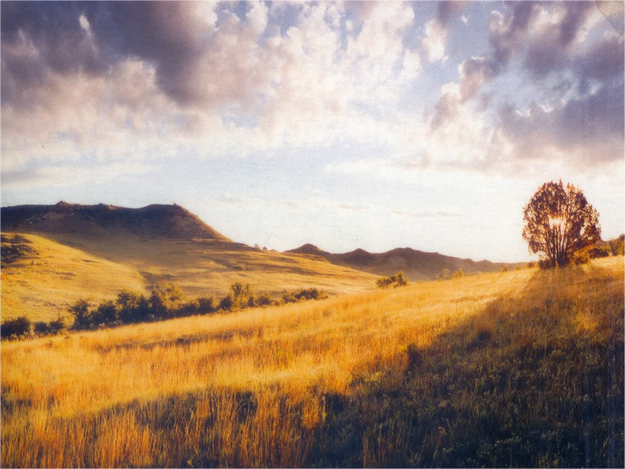
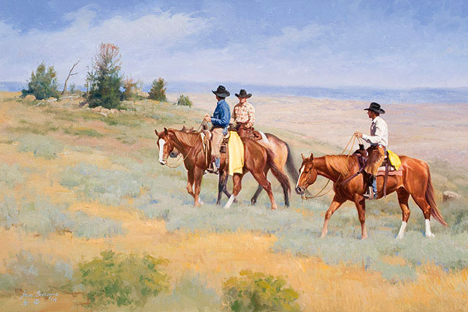
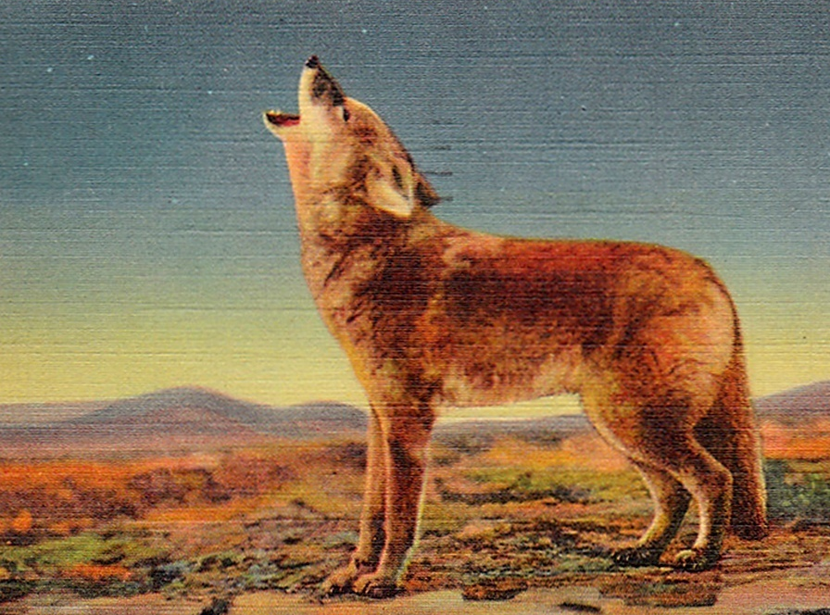
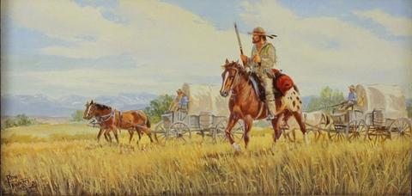
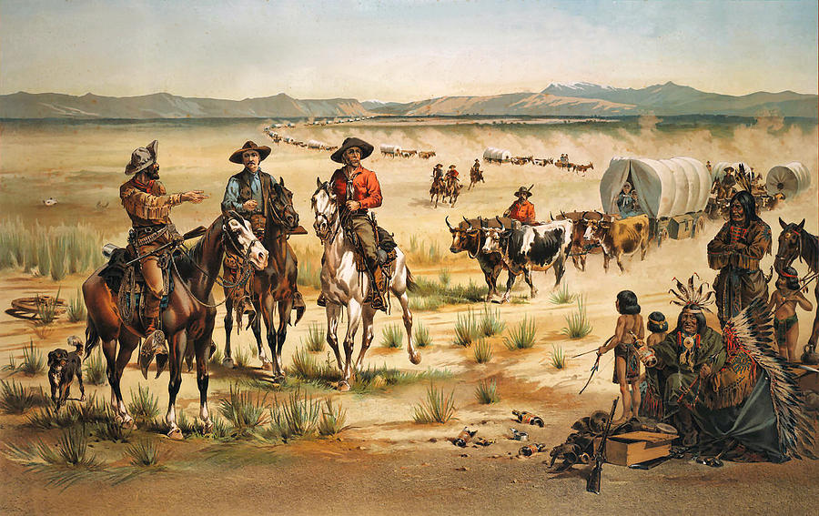
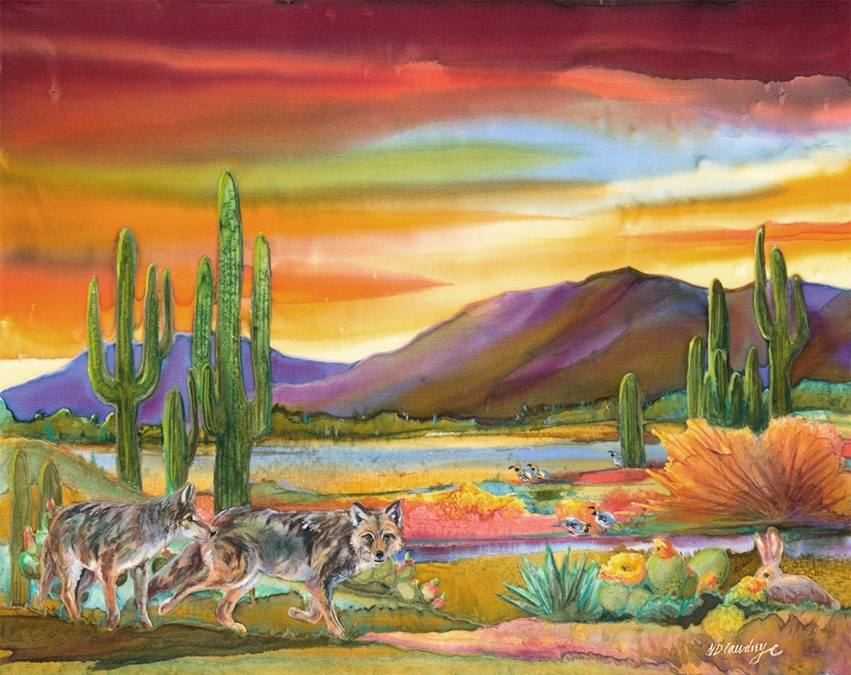
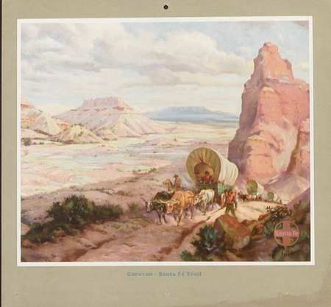
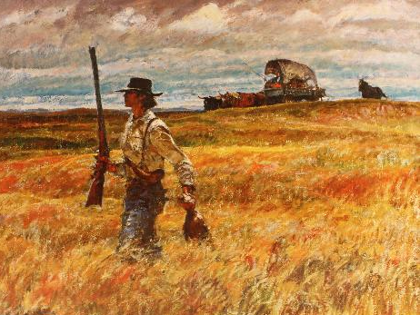
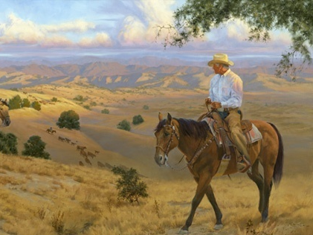
Southwest Journeys . . . .

Slide 2
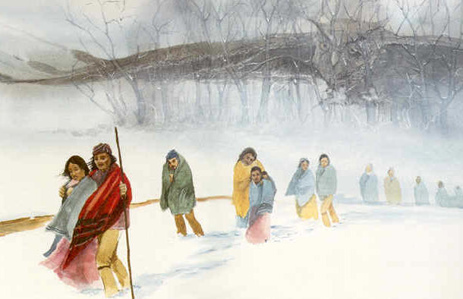
Southwest Journeys . . . .
Santa Fe Trail
Trail of Tears

Slide 3
Southwest Journeys . . . .
Session 6: After the Trails
People we met on the trails
The New Lands . . . .
- Oklahoma
- New Mexico
Trail of Tears

Slide 4
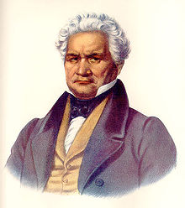
People we met on the trails
Arbuckle
Milly
Ridge
Sequoyah

Slide 5
People we met on the trails
TRAIL OF TEARS
Arbuckle
Milly
Ridge
Sequoyah

Slide 6
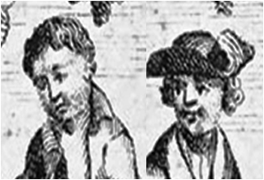
People we met on the trails
SANTA FE TRAIL
Magoffin
Bent Brothers
Shelby
Becknell

Slide 7
People we met on the trails
SANTA FE TRAIL
Milly
Sequoyah
Ridge
Arbuckle
TRAIL OF TEARS
Bent Brothers
Shelby
Magoffin
Becknell

Slide 8
1806
People we met on the trails
Milly
Sequoyah
Ridge
Arbuckle
Bent Brothers
Shelby
Magoffin
Becknell

Slide 9
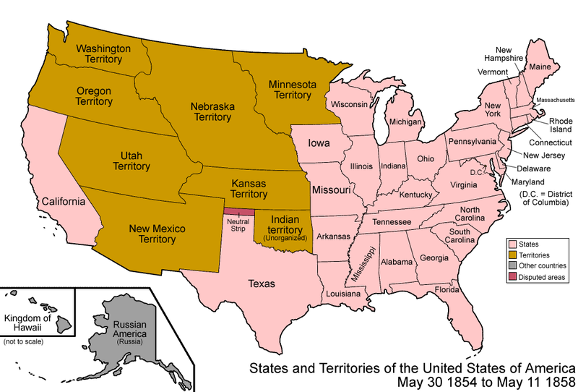
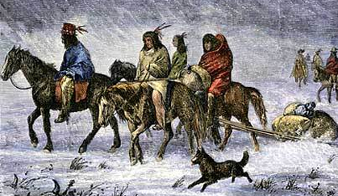
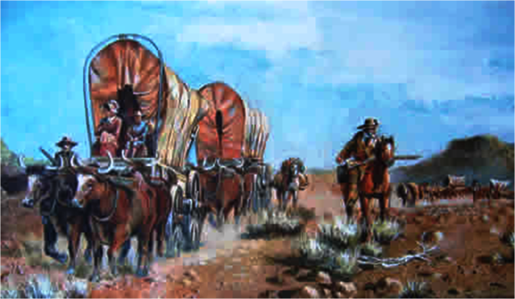
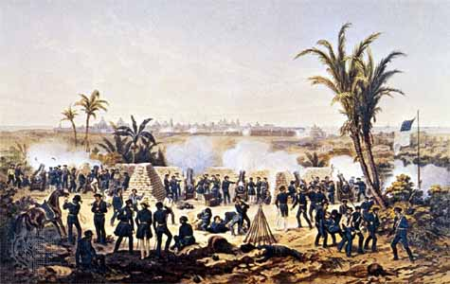
1806
1856
Time goes by . . . .
50 YEARS!!
disputed
Indian Removal
Manifest
Destiny
USA
USA
New Mexico
Territory
Spain
Settling the West
Spain
Indian
Territory
War with Mexico

Slide 10
1806
1856
50 YEARS!!
Session 6: After the Trails
Five Tribes
Five Tribes
The New Lands . . . .
- Oklahoma
- New Mexico
New Mexico
Territory

Slide 11
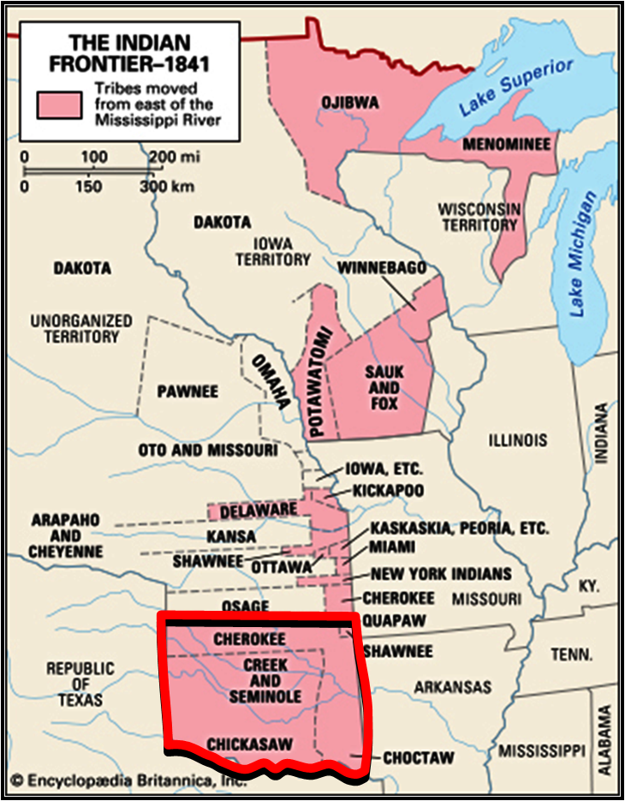
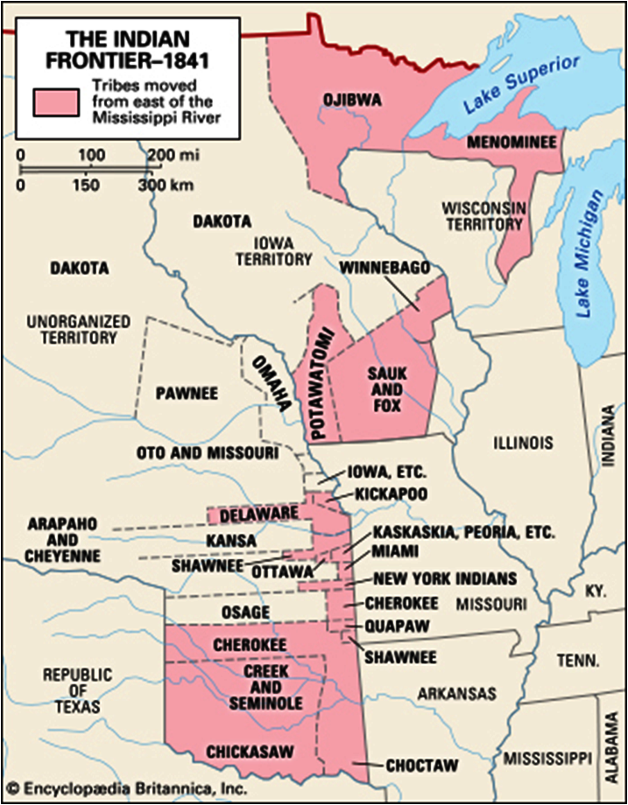
Five Tribes
- NEW LANDS
Other tribes also are moved west of Miss. R.
>50,000
Total 100,000 move following 1830 Removal Act

Slide 12
https://www.britannica.com/topic/Five-Civilized-Tribes
Map showing the movement of some 100,000 Native Americans forcibly relocated to the trans-Mississippi West under the terms of the U.S. Indian Removal Act (1830).

Slide 13
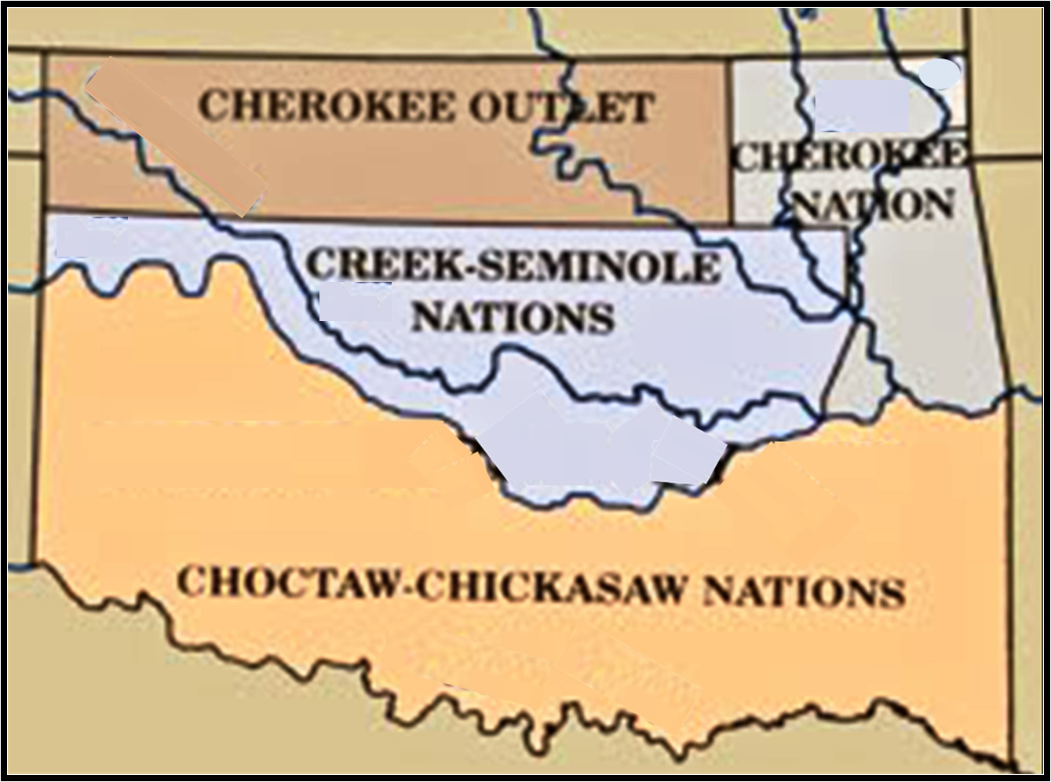
Five Tribes
- NEW LANDS
?
?
Canadian R.
?
Red R.

Slide 14
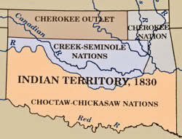
http://dougdawg.blogspot.com/2010/10/maps-and-history-of-oklahoma-county.html
The drawing at right from the Historical Atlas of Oklahoma (2006) purports to show Indian Territory circa 1830, inclusive of the portions of Seminole and Creek Nations which would shortly become parts of what would come to be called the "Unassigned Lands." This drawing is NOT representative of Indian Territory as of 1830 but is more accurately what Indian Territory looked like circa 1837-38. It presents in graphic form the areas which the Five Tribes came to occupy before the original Choctaw area was divided between the Choctaws and Chickasaws in 1855 and the original Creek area was divided between the Creeks and Seminoles in 1856.

Slide 15
Five Tribes
- NEW LANDS
CHEROKEE OUTLET
CHEROKEE
NATION
?
?
Canadian R.
?
Red R.

Slide 16
1817-1871 – Fort Smith
1824-1857 – Fort Gibson
1824-1856 – Fort Towson
1865 – confederate HQ
1834-1838 – Fort Coffee
1842-1860 – Fort Washita
confederat occupy
1851-1870 – Fort Arbuckle
confererate occupy
FORTS
CHEROKEE
NATION
Tahlequah
Fort
Smith
Fort Gibson
Fort Coffee
Fort Arbuckle
Fort Towson
Fort Washita

Slide 17
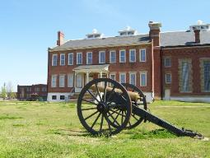
Five Tribes
- THE FORTS
- NEW LANDS
CHEROKEE OUTLET
CHEROKEE
NATION
Fort
Smith
1817-1840
- 1st Indian agency for western Choctaw
- protect citizens of Arkansas from
newly arrived tribes

Slide 18
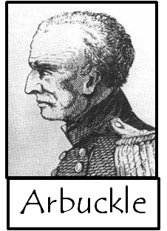
Five Tribes
- THE FORTS
Fort
Smith
Fort
Gibson
Notes:
1822 – arrives Ft Smith
1824 – builds F. Gibson, Towson

Slide 19
https://www.legendsofamerica.com/ar-fortsmith/
On the isolated edge of the American Frontier, Fort Smith was established on Christmas day, 1817. Under the command of Major William Bradford, the soldiers’ initial task was to keep the peace between the Cherokee and Osage tribes. The site of the new fort was Belle Point, a prominent bluff overlooking the Poteau and Arkansas River.
Sixty-four men of the Rifle Regiment erected temporary shelters in just eight days and then began the work on a permanent fortification. Construction progressed slowly, and upon completion, the fort was a simple log stockade with four sides at 132 feet each and two blockhouses at opposite angles. Barracks, storehouses, shops, a magazine, and a hospital were located within the walls.
Additional quarters were built outside the original fort in 1822 when increased hostilities between the Osage and Cherokee prompted the need for a greater number of soldiers. Just two years later; however, the Federal Government determined that the location of the fort was too far away from the newly redefined Indian Territory (Oklahoma) and established Fort Gibson some 60 miles up the Arkansas River. As a result, the troops departed Fort Smith in 1824.
Three years later; however, the fort was slated to serve as the agency for the western Choctaw Indians, who were also being forced to move to Indian Territory. When Choctaw agent, William McClellan, arrived in February, 1827, he found the post buildings in bad condition. But, it would be four more years before the government would repair the structures. Finally, in April, 1831, Lieutenant Gabriel Rains and a detail of Seventh United States Infantry arrived at the post to begin the repairs.
By August, Choctaw Indians began trickling into the area.
Just east of the post and adjacent to the Choctaw boundary line, a sizeable civilian community emerged on lands owned by a man named John Rogers. Dominating the community were six taverns, where enterprising merchants supplied the emigrating Choctaw with
cheap whiskey. Many of the displaced tribesmen settled nearby and became a source of sustained exploitation. Lieutenant Rains positioned his men on the boundary line to keep peddlers and Choctaw separated, but the situation got worse. In March, 1833, Captain John Stewart and a company of Seventh Infantry were garrisoned at the post to control the contraband trade, known as the “Arkansas Whiskey War.” He too, met with little success as the merchants operated right under his very nose. As a result, Stuart abandoned Fort Smith in June 1834 and established Fort Coffee at a more suitable location in Indian Territory.
As additional tribes were relocated in Indian Territory, fearful residents of the new State of Arkansas requested that a permanent military garrison be placed on their western border. In 1838, Congress authorized construction of a new fort and purchased from John Rogers a 296-acre reservation adjacent to the old fort on Belle Point.
In the spring of 1839, construction of the new fort began. The design called for a pentagonal-shaped fort of stone with a bastion at each angle and enclosing seven acres. Inside the wall, several buildings were to be situated around a parade ground including two enlisted mens barracks, two officer’s quarters, the commandant’s quarters, a hospital, the quartermaster store, and other buildings. This ambitious plan, however, would never be fully realized.
Because of events of the next six years, the army completed Fort Smith along much different lines. It had become apparent to the military that armed warriors would not descend on Arkansas from Indian Territory. Yet, hostilities threatened another frontier, and the Mexican-American War loomed on the horizon. Fort Smith was ideally situated to equip military units marching to the Rio Grande River and to supply frontier posts in Indian Territory. Therefore, in 1845, the half-finished post was formally designated as a supply depot.
http://www.fortwiki.com/Fort_Smith,_AR_Commanders
Commanding Officers of Fort Smith
Major William Bradford, Rifle regiment - Nov. 1817 to Feb. 1822
Colonel Matthew Arbuckle, 7th U.S. Infantry - Feb. 1822 to March 1822
Maj. A.R. Wooley, 7th U.S. Infantry - March 1822 to June 1822
Col. Matthew Arbuckle, 7th U.S. Infantry - June 1822 to January 1823
Capt. William Davenport, 7th U.S. Infantry - January 1823 to May 1823
Col. Matthew Arbuckle, 7th U.S. Infantry - May 1823 to April 1824
(Troops withdrawn from Fort Smith in April 1824; re-occupied March 22, 1833)
Capt. John Stuart, 7th U.S. Infantry - March 1833 to June 1834
(Troops withdrawn June 16, 1834; re-occupied July 27, 1838)
Captain Benjamin L.E. Bonneville, 7th U.S. Infantry - July 1838 to October 1838
Capt. W.G. Belknap, 3rd Infantry - October 1838 to September 1840

Slide 20
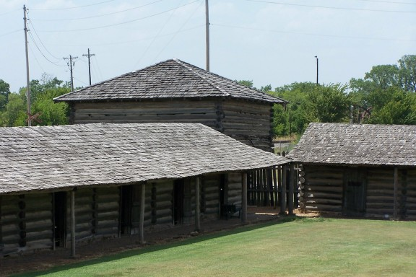
Five Tribes
- THE FORTS
Fort
Smith
Fort
Gibson
1824-1857
1830 - includes Cherokee Indian Agency
1857 – becomes village of traditional Cherokees

Slide 21
https://en.wikipedia.org/wiki/Fort_Gibson
Fort Gibson is a historic military site located next to the present day city of Fort Gibson, in Muskogee County Oklahoma. It guarded the American frontier in Indian Territory from 1824 until 1888. When constructed, the fort lay farther west than any other military post in the United States; it formed part of the north–south chain of forts intended to maintain peace on the frontier of the American West and to protect the southwestern border of the Louisiana Purchase. The fort succeeded in its peacekeeping mission for more than 50 years, as no massacres or battles occurred there. The fort site is now managed by the Oklahoma Historical Society as the Fort Gibson Historical Site. It is a National Historic Landmark.
Colonel Matthew Arbuckle commanded the 7th Infantry Regiment (United States) from Fort Smith, Arkansas. He moved some of his troops to establish Cantonment Gibson on 21 April 1824 on the Grand River (Oklahoma) just above its confluence with the Arkansas River. This was part of a series of forts which the United States established to protect its western border and the extensive Louisiana Purchase.
Colonel Arbuckle also established Fort Towson in southern Indian Territory. In the early years, troops constructed a stockade, barracks, other facilities, and roads. They also settled strife between the indigenous Osage Nation, which had been in the area since the seventeenth century, and the earliest bands of western Cherokee settlers.
The Army designated the cantonment as Fort Gibson in 1832, reflecting its change from a temporary outpost to a semi-permanent garrison. Soldiers at Fort Gibson increasingly dealt with Indians removed from the eastern states to Indian Territory. These newcomers complained about hostility from the Osage Nation and other Plains Indian tribes indigenous to the region. Montfort Stokes, former governor of North Carolina, convened a commission at Fort Gibson to address these problems, and troops at the fort supported its work.
During th 1830s, the soldiers at Fort Gibson built roads, provisioned incoming American Indians removed from the eastern states, and worked to maintain peace among antagonistic tribes and factions, including the indigenous Osage Nation and the Cherokee Nation, a people removed from the American South to the Indian Territory.
At the height of Indian removal in the 1830s, the garrison at Fort Gibson ranked as the largest in the nation. Notable American soldiers stationed at (or at least visiting) Fort Gibson include Stephen W. Kearny, Robert E. Lee, and Zachary Taylor. The Army stationed Jefferson Davis, later president of the Confederate States of America, and more than 100 other West Point cadets at the fort. The Army also assigned Nathan Boone, son of the famous explorer Daniel Boone, to the post. After leaving Tennessee, Sam Houston owned a trading post in the area; he later moved to Texas.
At a bitterly contentious meeting at Fort Gibson in 1836, the majority faction of the Muscogee (Creek) reluctantly accepted the existing tribal government under the leadership of Chilly McIntosh, son of William McIntosh, and his faction. Colonel Arbuckle tried to prevent intratribal strife within the Cherokee, but Chief John Ross and his followers refused to acknowledge the government that earlier "Old Settlers" had established in Indian Territory.
After losing the Seminole Wars against the United States Army in Florida, many of the Seminole
arrived in Indian Territory "bitter and dispirited." Officials at Fort Gibson prevented bloodshed and disunity among them.
When Colonel Arbuckle left Fort Gibson in 1841, he reported that despite the arrival of 40,000 eastern Native Americans of decidedly unfriendly disposition, "I have maintained peace on this frontier and at no period have the Whites on our border or the Red people of this frontier been in a more perfect state of quiet and Security than they enjoy now." The removed Native American nations gradually lost their desire for American military protection.
In the 1850s, the Cherokee complained about the liquor and brothels at Fort Gibson. They tried to prevent the sale of alcohol to their people, who could not tolerate it physically. The Cherokee ultimately urged Congress to close Fort Gibson, and the War Department heeded their request. In June 1857, the Army abandoned Fort Gibson for the first time. The Cherokee nation received the deed to the property and improvements, and established the village of Kee-too-wah on the site. It became a center of traditionalists and eventually an independently federally recognized tribe of Cherokee.

Slide 22
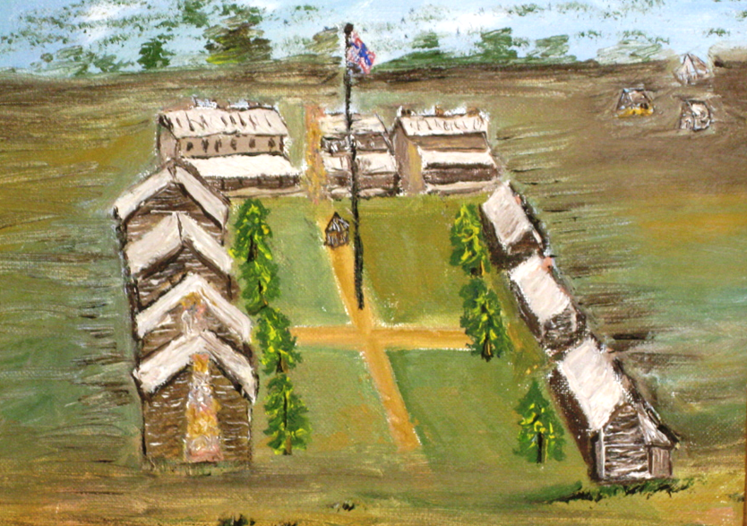
Five Tribes
- THE FORTS
1854 – converted to Choctaw Indian Agency
Fort
Smith
Fort
Gibson
1824-1865
Fort Towson

Slide 23
http://www.okhistory.org/sites/forttowson
Fort Towson was established in 1824 to quell conflicts between lawless elements, American Indian peoples, and settlers claiming the area as part of Arkansas Territory. The fort also served as an outpost on the border between the United States and Texas, which at that time was part of Mexico. Connected to the East by road, Fort Towson served as a gateway for settlers bound for Texas during the 1830s. Those passing through the area included Sam Houston, Davy Crockett, and Stephen F. Austin. When the Choctaw and Chickasaw were displaced from their lands in the southeastern United States, the fort served as a point of dispersal upon their arrival in the West. The fort was also an important staging area for US forces during the Mexican War of 1846.
In May 1824 a company of the U.S. Army Seventh Infantry established a camp on Gates Creek near the confluence of the Kiamichi and Red rivers in present Choctaw County, Oklahoma.
The post was established as a fortification on the international boundary with Mexico (Texas), and as a curb to lawlessness in the region. It was also intended to serve as a buffer between Plains Indians to the west and the Choctaw, who were slated for removal to the area from Mississippi.
Operating from a temporary camp of tents and log structures, the troops at the garrison were charged with enforcing the federal law of 1802 that prohibited hunting and unlicensed trading on Indian lands. They were also detailed to the unpopular duty of removing Anglo settlers who believed the area to be a part of Miller County, Arkansas. Other important tasks included the construction of roads connecting the post with Fort Smith, Arkansas, and Fort Jesup, Louisiana.
The post was abandoned in 1829 but was reestablished in 1830 as "Camp Phoenix" when the Treaty of Dancing Rabbit Creek was concluded with the Choctaw. The facility was soon renamed "Fort Towson." Substantial barracks, officers' quarters, and other buildings were constructed. For the next several years the post served as a terminal on the Choctaw Trail of Tears. During the Mexican War (1846–48) Fort Towson served as a staging area for troops headed for Mexico.
https://en.wikipedia.org/wiki/Fort_Towson
Fort Towson was a frontier outpost for Frontier Army Quartermasters along the Permanent Indian Frontier. It was established in May 1824, under Col. Matthew Arbuckle, on the southern edge of Indian Territory to guard the border with Spanish colonial territory to the south. Originally called "Cantonment Towson," it was abandoned in April 1829, and the garrison moved to Fort Jessup. The cantonment was only intended as a temporary facility, having nothing but tents and a few wooden shacks, In November 1830, the Army ordered the construction of a permanent fort in the area assigned for the relocation of the Choctaws. A new site was chosen about 6 miles (9.7 km) from the original site. The new fort was reestablished as "Camp Phoenix" to protect the Choctaw Nation, and was renamed Fort Towson in 1831.
The new Fort Towson was much more substantial. The north side was atop the bluffs of Gates Creek. The fort occupied a rectangle containing about half an acre. The officers' quarters consisted of three buildings on the north side of the rectangle. These structures were built of logs, 1.5 stories tall, had 3 feet (0.91 m) limestone foundations and covered porches facing south. Four other buildings were located on two sides of the rectangle, facing each other. These were one story high, but had higher foundations, effectively creating basements. Those closest to the officers' quarters were a combination of sub-officers' quarters, quartermaster's office, amusement parlor, and school room. The last two buildings were barracks for common soldiers. The kitchens and dining halls were in the basements. All the buildings were painted white. The square in front of the buildings served as a parade ground. A hospital building was on the east side, about 250 feet (76 m) from the last barracks building. Stables, shops and gardens were outside the rectangle on the east. The sutler's building, the dairy and poultry yards were outside the rectangle on the west. The cemetery was about 300 yards (270 m) farther west.
After the construction of Fort Washita 70 miles (110 km) to the west in 1842, Fort Towson lost importance. It was garrisoned until June 1854, when it was turned over to the use of the Choctaw Indian Agency, then run by Indian Agent Douglas H. Cooper. A storm in the same month blew the roofs off several buildings and did some other damage to the facility. A few years later, a fire destroyed all of the buildings except one of the barracks and the hospital

Slide 24
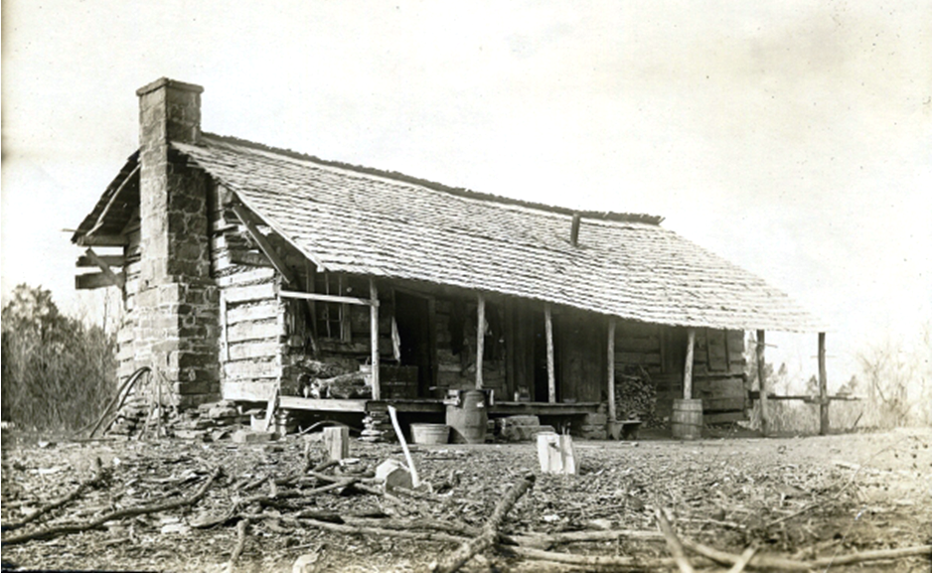
Five Tribes
- THE FORTS
1914 photo: original building at Fort Coffee
Fort
Smith
Fort
Gibson
1834-1838
Fort Coffee
1843 – converted to Fort Coffee Academy for Boys
Fort Towson

Slide 25
http://www.okhistory.org/publications/enc/entry.php?entry=FO031
Fort Coffee was established in April 1834 by soldiers of the Seventh Infantry under the command of Capt. John Stuart. Located about six miles north of present Spiro in Le Flore County, Oklahoma, Fort Coffee was built on a bluff on the south bank of the Arkansas River at a place known as Swallow Rock. Its purpose was to protect the Choctaw and to stop liquor from entering Indian Territory from Arkansas. During the Texas Revolution of 1835–36, troops at Fort Coffee guarded the western boundary of Arkansas, and the fort served as an arms depot for Arkansas militia.
Named after Gen. John Coffee of Tennessee, Fort Coffee was cheaply and poorly constructed. Its log buildings enclosed three sides of a small square, with the fourth side open toward the Arkansas River. Captain Stuart and his men abandoned Fort Coffee in October 1838 and established Fort Wayne on the Illinois River. The Choctaw Nation acquired the property and buildings and allowed Methodist ministers to operate the facility as the Fort Coffee Academy for boys. The school closed during the Civil War and was occupied by Confederate Choctaw troops. The buildings were captured and burned by Union soldiers in October 1863.
Just past the Arkansas border in old Indian Territory, an old military fort existed high on top of a rocky outcropping that overlooked the Arkansas River. Starting in 1816, the U.S. Army established quite a number of these forts in Oklahoma. At this time, the army was not as we know it today. Being officially less than 50 years old, the entire army consisted of 6,283 active men. Of those, the western division only consisted of 2,458. The majority of the soldiers of the U.S. Army were sent to Florida to help provide aid in the ongoing Seminole wars.
Those remaining men of the western division were ordered to build a defensive wall of forts running north and south. This was a time of great expansion, and also of great suffering. The U.S. had been pushing a campaign to secure Native American lands, which had caused unrest among most of the Native Americans. These forts initially provided protection for the frontier settlements. Later, many of these forts were tasked with providing protection for the resettled members of the Five Civilized Tribes from their new western neighbors.
As a necessity to the construction of these forts, new military roads were established all across eastern Oklahoma. One of the most traveled roads ran from Ft. Smith to Ft. Towsen. These old roads established the basis of today’s modern roads. Even with the roads, soldiers were required to traverse rough terrain for weeks at a time. Once they finally arrived at the destination of the new fort, they were forced to live in tents and crude shelters. Many died from the weather, illness, or poor diet.
During the 1820’s, the U.S. Government was making plans to resettle large portions of Native Americans into what would become Indian Territory. Mississippi’s largest Native American group, the Choctaws, was the first ones to accept relocation. In September 1830, The Treaty of Dancing Rabbit Creek was finalized. This stated that the Choctaws would receive land west of the Mississippi. In return, they would abandon their lands in Mississippi to the U.S. Government.
Fort Coffee was established on June 16, 1834. Prior to 1838, the western boundary of Arkansas had not been clearly defined. In fact, Indian Territory wasn’t established until 1824; it had been part of Arkansas Territory previously. Indian Territory was further defined with the establishment of Fort Coffee, but the border wasn’t clearly defined until around 1838.
The old fort was built on a high bluff named Swallow Rock that overlooked the Arkansas River. This bluff was nearly surrounded on three sides by the Arkansas River, providing an excellent view of river traffic. It was named in honor of General Coffee from Tennessee. Coffee was a close friend of President Andrew Jackson, a veteran of the war of 1812, and was instrumental in helping with the removal of the Choctaws from Mississippi. He died on July 7, 1833, almost a year before the new fort named in his honor was commissioned.
Soldiers of the Seventh Infantry labored under the command of Captain John Stuart. Stuart served nearly all of his military life in the Indian Territory. He was a precise man, very perceptive and interested in his surroundings, and extremely so in the Native Americans whom he was in contact. He was a well respected captain and his men followed him without question. At Fort Coffee, he had a total of 44 men under his command.
The buildings constructed for the fort were crude. They were one story structures built out of hewed logs with porches in the front and back. They were covered with shingles, used rough cut lumber for the floors, and had batten doors and window shutters. Each building was built 100 feet long and 100 feet wide, with a hollow central area and a wide entryway that faced the river. In the center of each square was a magazine for the fort. Near the edge of the bluff a large guard house had been constructed.
Initially, the fort was constructed to receive the Choctaws and Chickasaws. Two routes into the new Indian Territory were taken; one by land, the other by river. Those who came arrived by steamboat were sent to Ft. Coffee, where they landed at a natural beach just below Swallow Rock.
Shortly after resettlement, representatives from the Choctaw Nation called upon the U.S. War Department to construct a fort along the Arkansas River. They requested this to help stop the flow of illegal contraband into the nation along the river. In addition to protecting the Choctaw Nation, preventing this influx of illegal contraband became one of the top priorities of the fort. Because of the abandonment of Fort Smith earlier, those bringing whiskey and other contraband had easy access to the Choctaw Nation.
Fort Coffee was given a new purpose during the Texas Revolution of 1835 and 1836. Captain Stuart and his men now helped guard the western boundary of Arkansas against Mexican incursion. While no action was seen at the fort, it served as an arms depot for the Arkansas militia.
In October 1838, two years after the end of the Texas Revolution, Ft. Coffee was abandoned. With the re-establishment of Fort Smith, that eliminated the need for Ft. Coffee. Captain Stuart and his men went on to establish Fort Wayne on the Illinois River.
In 1843, the Choctaw Nation purchased the property and the buildings. They worked with the Methodist Episcopal Church to establish a new learning academy, named the Fort Coffee Academy for Boys. This was one of 8 missionary schools established in Indian Territory before 1860. This became one of the most famous training institutions in the region.
New Hope, located just five miles away, was established around the same time. This was the Methodist’s girl’s academy and served as a branch of the Fort Coffee Academy.
During the days of the Butterfield Overland Mail Route, the Fort Coffee Academy was one of many stops along the way from Ft. Smith to California.
Reverend William H. Goode was appointed superintendent, with Henry C. Benson as the instructor. After they arrived at the old fort location, they spent the night on the lower beach and then set to work the following day. Since the fort had been abandoned for some years, many of the structures were in disrepair. Roofs leaked, doors and windows were broken, and the plaster had started coming out of the log walls. All of the porches and floors had to be replaced.
Once the buildings were repaired, a ten acre farm was cultivated to help feed the missionaries and students. This was worked while Rev. Goode returned to Indianapolis to purchase the rest of the supplies for the academy.
By the time it was completed, it served as one of the finest academies in the region.

Slide 26
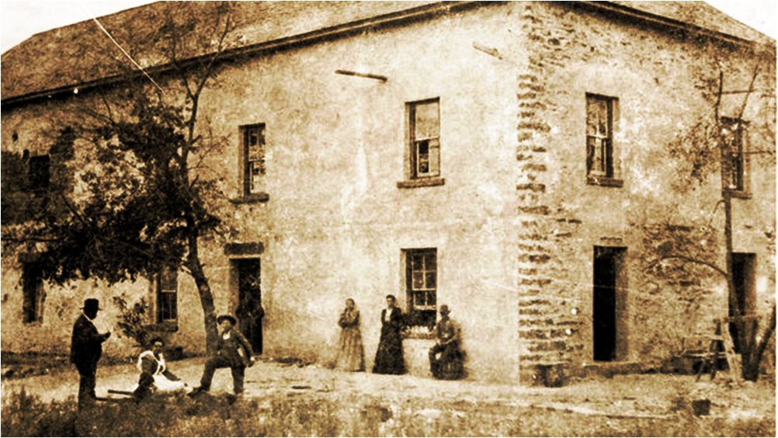
Five Tribes
What happens to Matthew Arbuckle?
Tributes to General Matthew Arbuckle
- THE FORTS
1834 - promoted to Brigadier General
1841 - posted Baton Rouge command
1842 - Ft Washita built to protect Chick.
and Chickasaw Indian Agency
1848 - Arbuckle returns to Fort Smith to
protect CA gold rush traffic
Fort
Smith
Fort
Gibson
1851 - dies at 73 in Cholera epidemic
Fort Coffee
Fort Towson
Fort Washita
Notes:
1822 – arrives Ft Smith
1824 – builds F. Gibson, Towson

Slide 27
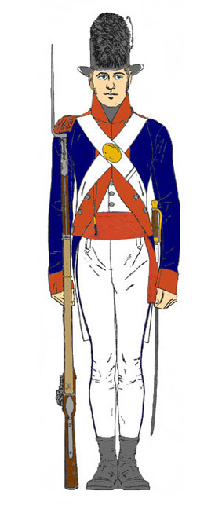
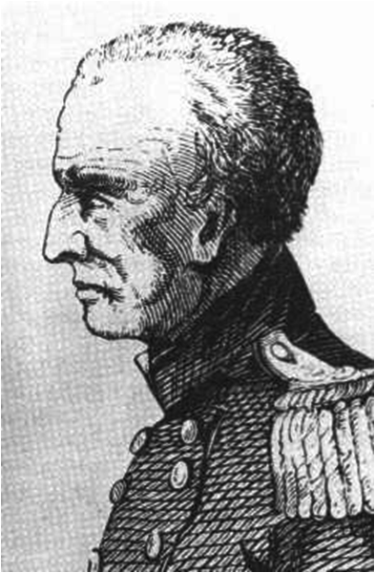
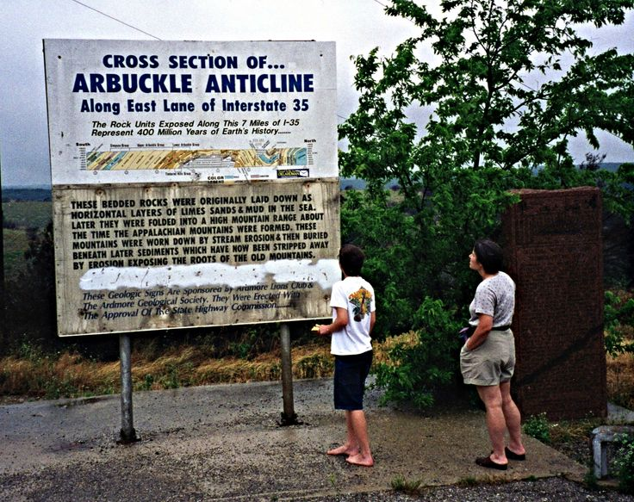
https://en.wikipedia.org/wiki/Matthew_Arbuckle_Jr.
NOTE: check NPS site of Fort Gibson for more on Arbuckle
Matthew Arbuckle (1778- 1851) was a career soldier in the US Army closely identified
with the Indian Territory for the last thirty years of his life.
He was born 28 December 1778 in Greenbriar County, Virginia (now West Virginia), the
fourth of six sons of Capt. Matthew Arbuckle Sr. and Frances (Hunter) Arbuckle. The father
was a veteran of the Battle of Point Pleasant during Lord Dunmore's War and later
distinguished himself in the American Revolution.
Little is known of his early life, but on 3 March 1799 he was commissioned
ensign in the 3rd Infantry Regiment, and advanced to first lieutenant within eight months.
In 1802, the Army disbanded the 3rd Infantry and transferred him to the 2nd Infantry
Regiment where he was promoted to captain in 1806.
He returned to the 3rd Infantry as a major in 1812. His regiment was assigned to various posts in the American South during the War of 1812. In 1814, he was promoted to lieutenant colonel and became the regiment's second-ranking officer. The 3rd Infantry was under General Andrew Jackson during and after the war. A family story exists that Arbuckle served on Jackson's staff during the Battle of New Orleans in 1815, but no evidence has been found for this claim. Arbuckle led a successful expedition against the "Fowltown Indians" of Southern Georgia in 1817, during the opening phase of the First Seminole War.
In 1820, the Army promoted Arbuckle to colonel and gave him command of the 7th Infantry Regiment, four of whose companies he led in 1821 to reinforce Fort Smith on the Arkansas River. In 1824, he moved the regiment farther west, establishing Cantonments (later Forts) Gibson and later Towson, the first military posts in the Indian Territory (now Oklahoma) . As commander at Fort Gibson, he was responsible for constructing roads and maintaining peaceful relations between the Indian tribes indigenous to the region and those then forced to migrate to Indian Territory. After ten years of this service, he was breveted to brigadier general. In the spring of 1834, on the eve of the First Dragoon Expedition (also called the Dodge-Leavenworth Expedition), Brigadier General Arbuckle was replaced as regional commander by General Henry Leavenworth and returned to Virginia. General Leavenworth, however, unexpectedly died in July 1834, and the Army recalled Brigadier General Arbuckle to command Fort Gibson.
During the Texas Revolution of 1835–1836, the majority of his troops were reassigned to General Zachary Taylor's "Army of Observation" at Fort Jessup, Louisiana, but Arbuckle managed to maintain order even as the pace of Indian removal accelerated. By the end of the decade, the relocation of the southeastern Indian tribes to Oklahoma was largely complete. Though civil war threatened to break out among some of the tribes, in 1841, when he left Fort Gibson for the second time, Arbuckle reported, "I have maintained peace on this frontier."
He was transferred to Baton Rouge, Louisiana, where he headed the military district but commanded no troops directly. He had developed a considerable professional rivalry with Zachary Taylor, which may explain why he played no significant role in the Mexican-American War. In 1848, he was posted to Fort Smith as commander of the newly created Seventh Military District. In 1849, his troops began to provide security for Americans active in the California Gold Rush on the southwestern route to California, which he established south of the Canadian River. The same year, Taylor, having been elected president, urged the War Department to close Fort Smith and retire Arbuckle. Taylor died before this could be accomplished. Arbuckle's superiors immediately confirmed his command and re-designated Fort Smith as headquarters of the Seventh Military District. The General was making plans to extend farther west the security system that he had established to protect Americans traveling to California, when he died suddenly of cholera on 11 June 1851 during an epidemic.
Just before his death, several units of troops under his command had built an outpost on Wildhorse Creek in present-day Garvin County, Oklahoma, and the new post was named Fort Arbuckle in his honor. The name soon transferred in common usage to the nearby hills, which still are known as the Arbuckle Mountains.

Slide 28
https://en.wikipedia.org/wiki/Fort_Washita
Fort Washita is the former United States military post. Established in 1842 by General (later President) Zachary Taylor to protect citizens of the Choctaw and Chickasaw Nations from the Plains Indians.
Eager to gain access to the lands of the Five Civilized Tribes in the southern United States the Federal government passed the Indian Removal Act into law on May 26, 1830. The first of the Indians to be removed, the Choctaws, signed the Treaty of Dancing Rabbit Creek on September 27, 1830 effectively ceding their native lands in Mississippi and Alabama to the United States in exchange for lands in the Indian Territory. After traveling on the Choctaw Trail of Tears the Choctaws settled in the new Choctaw Nation, the southern part of the Indian Territory bordering the Red River.
The Cross Timbers, a thick line of nearly impassable trees and brush running from north to south, created an effective east-west barrier separating the flat, dry lands inhabited by the plains Indians to the west from the rolling prairies to the east where the Five Civilized Tribes were locating. These indigenous tribes included the Comanche, Wichita, Caddoes, and Kiowa. They occasionally threatened the removed tribes with raids. The Choctaws mostly settled in the eastern part of their territory since the western end was less secure against raids from the plains Indians, and they had protection from federal troops located at Fort Towson.
The first official contact between the United States and the plains Indians was during the Dodge-Leavenworth Expedition in 1834. Camp Washita, the precursor to Fort Washita, was established near the mouth of the Washita River to serve as a base of operations for the area. Two roads were cleared to the area, one from Fort Gibson to the north and one to Fort Towson to the east. Camp Washita was abandoned later that year.
The Chickasaws were removed to the Indian Territory in 1837, paying $530,000 to the Choctaws for the right to live in their lands. After removal to the Indian Territory the Chickasaws were reluctant to settle in their district, composed of the west and central area of the Choctaw lands. The area was not secure against the plains Indians, since the closest federal garrison, at Fort Towson, was too far away to protect the area effectively. In 1838 the Superintendent of Indian Affairs for the Western Territory, William Armstrong, asked the War Department to build a military post near the mouth of the Washita River to secure the area so the Chickasaws could move into their assigned territory. Captain T. A. Blake led a company of Dragoons from Fort Towson to the site of Fort Washita in late 1841.
In response to the need to defend the removed Indians on the frontier the United States Army authorized the construction of a fort on the Choctaw lands west of Fort Towson. General Zachary Taylor, as commander of the Second Military Department in the Southwest, chose the site for Fort Washita in 1842 on high ground a mile and a half east of the Washita River and 18 miles north of its junction with the Red River. At the time the Red River was the southern border of the Indian Territory with new Republic of Texas. The fort was surrounded by rolling prairie. The nearest military post at this time was Fort Towson 80 miles to the east.
Fort Washita sat at a strategic point on the frontier. In addition to being located near the Red and Washita rivers there existed an ancient north-south trail through the area. In the Indian Territory this route was known as the Texas Road, leading from Missouri to Texas and beyond. This route was called the old Preston Trail after it crossed into Texas on the Red River near Preston Bend at Coffee's Trading Post and later Colbert's Ferry. Fort Washita became a major junction on this road. Later the Shawnee Cattle Trail used this north-south route and, just prior to the Civil War, the Butterfield Overland Stage crossed just east of Fort Washita.
Fort Washita was connected to Fort Towson and Fort Gibson by military roads constructed earlier. Later military roads connected Fort Washita with Forts Arbuckle and Sill.
The Cross Timbers were located near Fort Washita, about 19 miles west of the Washita River
Construction at Fort Washita began in the spring of 1842. The Chickasaw Indian Agency was built early on as a one-story log building with four rooms in a group of trees on the edge of the prairie 600 yards west of Fort Washita near the springs. Construction was carried out mostly by Companies A and F of the Second Dragoons, with a temporary log barracks in 1842. There were supply difficulties, since the fort was located so far on the frontier. Most materials had to be taken from the area, with a few supplies being shipped from Fort Towson.
Troops from Fort Washita were ordered to protect Texas frontier from Indian attacks in 1842 so Texans could muster against a supposed invasion from Mexico.
Fort Washita was almost abandoned in 1843 before it was fully occupied. General Taylor learned in March 1843 that the War Department was considering abandoning it. After Taylor testified to the fort's valuable location the War Department approved the plans to occupy the fort, and the United States Army occupied the post on April 23, 1843.
Bean Starr, one of the Starr gang, died at the hospital at Fort Washita after being wounded at a shootout on the Washita River 25 miles above the fort in the Autumn of 1844.
In 1845 Fort Washita was the only frontier fort not accessible by steamboat and had to rely on the interior for its supply.

Slide 29
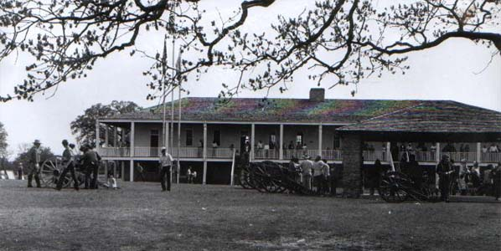
Fort Washita

Slide 30
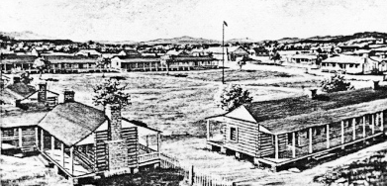
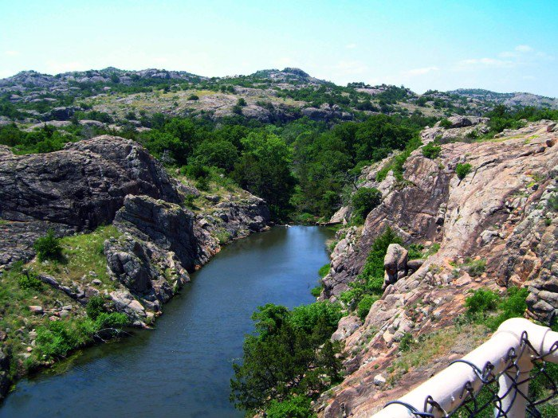
Five Tribes
Tributes to General Matthew Arbuckle
- THE FORTS
1851 - Fort Arbuckle named in honor
Arbuckle Mts named in his honor
30 years of service to the Five Tribes
He reports . . .
‘I have maintained peace
on this frontier.’
Fort
Smith
Fort
Gibson
Fort Arbuckle
Fort Coffee
A Euro-American who leaves a legacy!
Fort Towson
Fort Washita
Notes:
1822 – arrives Ft Smith
1824 – builds F. Gibson, Towson

Slide 31
Five Tribes
CHOCTAW-CHICKASAW NATION
- THE FORTS
- NEW LIVES
CHEROKEE OUTLET
CHEROKEE
NATION

Slide 32
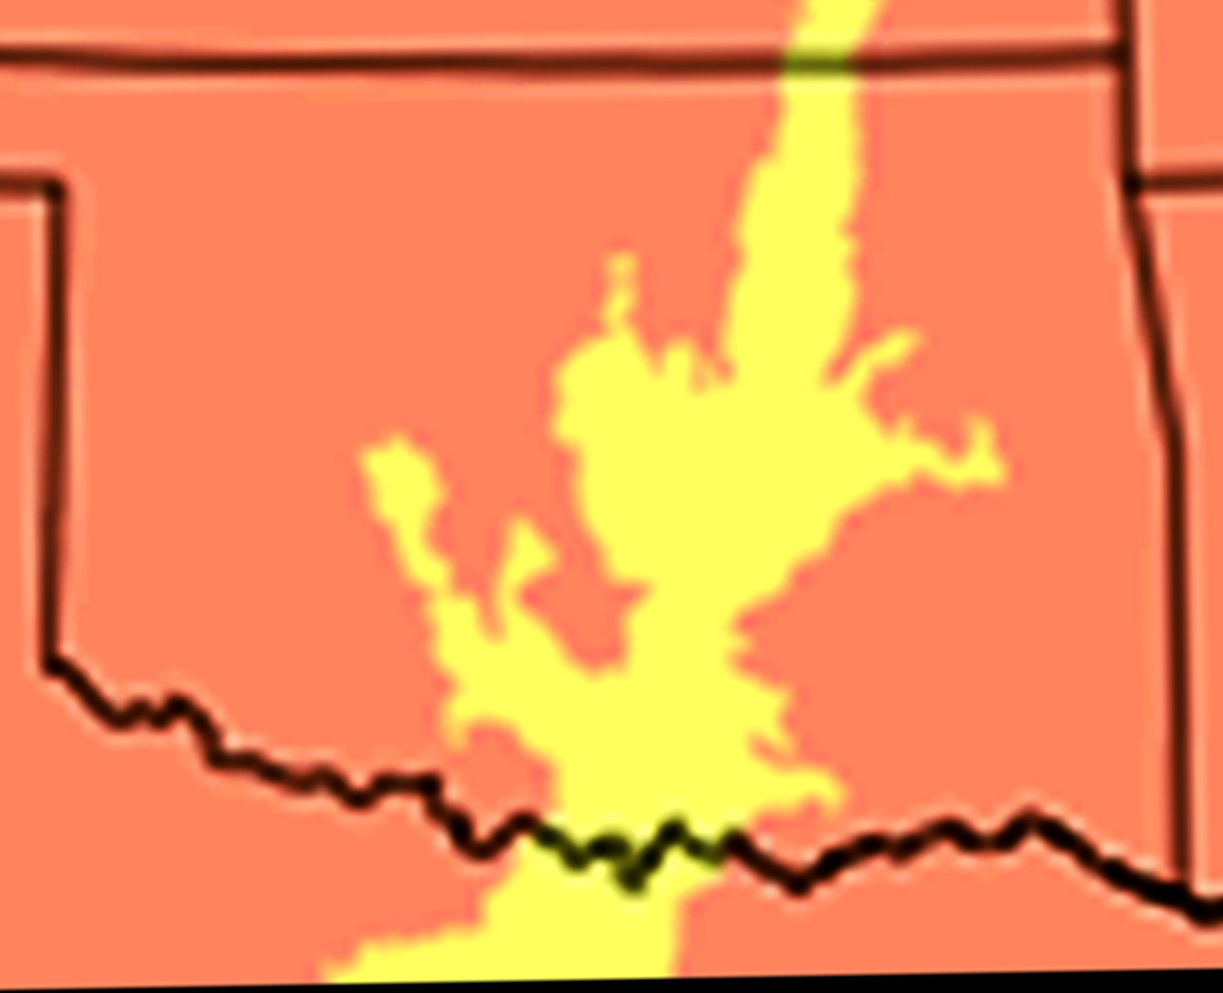
COMANCHE
CHOCTAW-CHICKASAW NATION
1837
Choctaw-Chickasaw Treaty of 1855
1831-1833
1) The Cross Timbers- zone of dense woods
2) isolation in west; danger from Plains Indians
Why?
APACHE
Fort
Smith
Fort Coffee
1834
Fort Arbuckle
1851
Choctaw
Chickasaw
Fort Washita
1842
Fort Towson
KIOWA
Notes:
Choctaw and Chickasaw stay on eastern edge of their new lands.
Fort Coffee -- 1834
East of Cross Timbers and away from the Plains mauraders

Slide 33
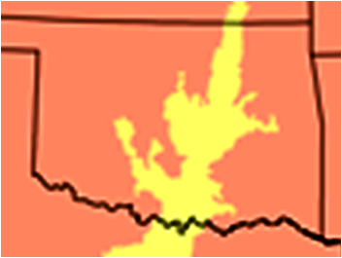
http://www.okhistory.org/publications/enc/entry.php?entry=CR016
The term "Cross Timbers" refers to an ecological region of woodland
and forest vegetation in central and eastern Oklahoma. Although
Cross Timbers also occur in Kansas and Texas, over half of the
estimated 4.8 million hectares of that region are found in Oklahoma,
making it the state's most abundant woody vegetation type. Albeit
the Cross Timbers are the western most extension of the oak-hickory forest of the eastern United States, it is not accurate to describe Cross Timbers simply as forest. In fact, the Cross Timbers is a mosaic of forest, woodland, and prairie.
Nevertheless, the most important tree species in the Cross Timbers are post oak and blackjack. Both are slow growing, low in stature, intolerant of shade, they reproduce from root sprouts and have limited commercial value. A number of other trees and shrubs are also common, such as black hickory, bitternut hickory, black oak, shumard oak, and red cedar. Grasses found in the Cross Timbers are those of surrounding grasslands: little bluestem, big bluestem, and Indiangrass. Animal species such as black bear, bison, Carolina parakeet, and passenger pigeons once roamed freely in the Cross Timbers. Presently, the black-capped vireo and least tern are two federally listed endangered species found in the vegetation.
Cross Timbers forests occur on deep, coarse-textured soils derived from sandstone, whereas fine-textured soils derived from shale and limestone support woodland and grassland vegetation. Whether a stand of Cross Timbers vegetation is woodland or forest in aspect depends upon fire. Fire destroys saplings less than two inches in diameter, thus reducing the number of trees and favoring the growth of grasses.
The origin of the term "Cross Timbers" has been lost over time, but it may refer to the "timber" that expeditions and settlers "crossed" as they moved west. Many early explorers left behind vivid accounts of the Cross Timbers. The entrepreneur Josiah Gregg wrote in 1840 that "the celebrated cross timbers, of which frequent mention has been made, . . . vary in width from five to thirty miles, and entirely cut off the communication betwixt the interior prairies and those of the Great Plains." The Ellsworth expedition, accompanied by Washington Irving, entered the cross timbers in 1832. Irving later wrote, "I shall not easily forget the mortal toil, and the vexations of flesh and spirit, that we underwent occasionally, in our wanderings through the Cross Timber. It was like struggling through forests of cast iron."
However, in 1852, passing across southern Oklahoma, Capt. Randolph B. Marcy also reported, "At six different points where I have passed through it [the Cross Timbers], I have found it characterized by these peculiarities; the trees, consisting primarily of post-oak and black-jack, standing at such intervals that wagons can without difficulty pass between them in any direction." Captain Marcy also noted that "in the early days, traders, trappers, and other travelers in the country employed the Cross Timbers as a datum line for location, and measured distances of places from this well known landmark, as in populated parts of the world reference is made to the meridian of Greenwich," thus denoting the cultural importance of the Cross Timbers.

Slide 34
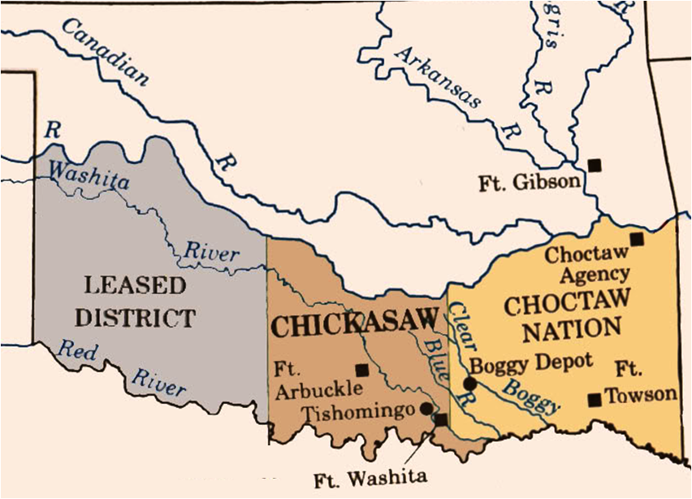
Five Tribes
CHOCTAW-CHICKASAW NATION
- NEW LIVES
Choctaw-Chickasaw Treaty of 1855
- formal separation agreement
- political separation of the 2 nations
- land is divided; with ‘lease’ in far west
leased by U.S. for Plains Indians
Notes:
https://en.wikipedia.org/wiki/Treaty_of_Washington_(1855)
Treaty of Washington also known as the Treaty with the Choctaw and Chickasaw was a treaty conducted in on June 22, 1855, in Washington, DC between the United States, the Choctaws and the Chickasaws. The treaty was ratified on February 21, 1856, and proclaimed by the President on March 4, 1856

Slide 36
https://www.accessgenealogy.com/native/history-of-the-choctaw-and-chickasaw-in-indian-territory.htm
The commissioners sent by the Chickasaw Nation to seek out a new home in the west entered successfully into negotiations with the Choctaws for an interest in their lately acquired lands beyond the Mississippi. In 1837 a treaty between the two tribes was ratified near Fort Towson, in the Choctaw Nation, by which the Chickasaws; for the consideration of $530,000 were ceded a district in the Choctaw country west of the Choctaw Nation proper. The conditions of this sale were that the Chickasaws should participate jointly with the Choctaws in the tribal government, with equal rights and privileges, the land to beheld in common by both, neither tribe having a right to dispose of its interest without the consent of the other. Each tribe reserved to itself the right to control and manage its own funds, invested in Washington. The lands set apart for the Chickasaws were known as the Chickasaw district of the Choctaw Nation, and members of either tribe were given the privilege of locating in either the Choctaw or the Chickasaw country proper.
During the emigration of the Chickasaws to their new home, smallpox broke out, carrying off nearly 700 of the movers. They did not settle in the Chickasaw district, but many scattered through the Choctaw country.
The political relations between the two tribes, under the provisions of the treaty of 1837, were far from amicable, as instead of equal representation, as they expected, they were allowed only in proportion to population, and were therefore a powerless minority, the Choctaws outnumbering and hence outvoting the Chickasaws, thereby controlling the national offices and affairs of government.
The Chickasaws feeling themselves aggrieved, appealed to the President of the United States and on paying $250,009 to the Choctaws obtained by treaty of 1855 a political separation from the Choctaws and a complete title to time Chickasaw district. The Chickasaws then established their own government, and though closely allied by treaty and other relations to the Choctaws, they have maintained au independent government and distinct geographical boundaries.
By a liberal policy extended toward intermarried whites and stock raisers within their boundaries, and through their efforts in the direction of education, the progress of the Chickasaws and Choctaws was gradual until the great civil war. The agents of these nations took sides with the seceding states, and the sympathies’ of the Indians were naturally with the Confederate states. The Choctaw’s and Chickasaws furnished several thousand men for the cause and negotiated treaties with the Confederate government.
The nations suffered considerably by the war, losing nearly one-fourth of their population, much stock, and of course their slaves. The United States -held that by the part taken by the tribal government in -the war they had forfeited all their rights, which, however, were restored under certain conditions, and the treaty of 1866 was made; This treaty, the provisions of which supersede all conflicting provisions of former treaties, is the basis of all laws pertaining to the intercourse of the Choctaws and Chickasaws with the federal government. The allotment and governmental provisions of the treaty of 1866 have never been complied with, and vexed. questions have resulted there from.

Slide 37
https://en.wikipedia.org/wiki/Chickasaw_Nation
During Indian removal of the 1830s, the United States government first assigned the Chickasaw to a part of Indian Territory west of the Mississippi River controlled by the Choctaw Nation; their area in the western area of the nation was called the Chickasaw District. It consisted of Panola, Wichita, Caddo, and Perry counties.
Although originally the western boundary of the Choctaw Nation extended to the 100th meridian, virtually no Chickasaw lived west of the Cross Timbers, due to continual raiding by the Plains Indians of the southern region. The United States eventually leased the area between the 100th and 98th meridians for the use of the Plains tribes. The area was referred to as the "Leased District"."
The division of the Choctaw Nation was ratified by the Choctaw–Chickasaw Treaty of 1854. The Chickasaw constitution establishing the nation as separate from the Choctaws, was signed August 30, 1856, in the new capitol of Tishomingo (now Tishomingo, Oklahoma). The first Chickasaw governor was Cyrus Harris. The nation consisted of five divisions; Tishomingo County, Pontotoc County, Pickens County, and Ponola County. Law enforcement was by the Chickasaw
Lighthorsemen, although non-Indians fell under the jurisdiction of the Federal court at Fort Smith.
Following the Civil War, the United States forced the Chickasaw into new peace treaties because of the support of many of the Five Civilized Tribes for the Confederacy. Under the new treaty, the Chickasaw (and Choctaw) ceded the "Leased District" to the United States. In 1868, the Chickasaw Montford T. Johnson, with Jesse Chisholm's help, secured an agreement with the Plains tribes to establish a ranch on the new western edge of the Nation. His ranch was never raided, although often threatened. He and his family remained the only permanent residents of the area until the settlement of Oklahoma after it was admitted as a state.
Under the Dawes Act, the Chickasaw nation was dissolved, with government functions transferred to the federal government before statehood, by agreement negotiated with the Dawes Commission. Following the breakup of the nation, the Chickasaw became citizens of the United States. The US allotted the communal land in plots for individual households of registered members. Land left over was declared "surplus" and made available for sale to non-Indians, so they lost much of their tribal lands.
In the second half of the 20th century, the Chickasaw reorganized their tribal government. They adopted a new constitution on August 27, 1983 to manage their business affairs.
The Chickasaw Nation is headquartered in Ada, Oklahoma. Their tribal jurisdictional area is in Bryan, Carter, Coal, Garvin, Grady, Jefferson, Johnston, Love, McClain,
Marshall, Murray, Pontotoc, and Stephens counties in Oklahoma. Their tribal governor is Bill Anoatubby.^{[1]}
Governor Bill Anoatubby appointed Charles W. Blackwell as the Chickasaw Nation's first Ambassador to the United States in 1995.^{[6]}(Blackwell had previously served as the Chickasaw delegate to the United States from 1990 to 1995).^{[6]} At the time of his appointment in 1995, Blackwell became the first Native American tribal ambassador to the United States government.^{[6]} Blackwell served in Washington as ambassador from 1995 until his death on January 3, 2013.^{[6]}
Economy[edit]
The tribe owns two off-track wagering facilities, 18 casinos, two bingo halls, 18 tribal smoke shops, seven motor fuel outlets, and two truck stops. They also own and operate Bedré Fine Chocolate in Davis, Lazer Zone Family Fun Center in Ada; WinStar Inn and Suites and Golf Course in Thackerville; Solara Healthcare in Southlake, Texas; Chickasaw Nation Industries in Norman, Oklahoma; Global Gaming Solutions, LLC; KADA (AM), KADA-FM, KCNP, KTLS, KXFC, and KYKC radio stations in Ada; and Treasure Valley Inn and Suites in Davis. Their estimated annual tribal economic impact is over $13.9 billion.^{[1]} In addition, the Chickasaw Nation operates historical sites and museums including the Chickasaw Cultural Center, Chickasaw Nation Capitols, and Kullihoma Grounds.
Their casinos include Ada Gaming Center, Chisholm Trail Casino, Gold Mountain Casino, Newcastle Casino, Riverwind Casino, Treasure Valley Casino, SaltCreek Casino, and WinStar World Casino. They also own Lone Star Park in Grand Prairie, Texas and Remington Park Casino in Oklahoma City.

Slide 38
https://en.wikipedia.org/wiki/Choctaw_Nation_of_Oklahoma
The Choctaw Nation is one of three federally recognized Choctaw tribes; the others are the Jena Band of Choctaw Indians and Mississippi Band of Choctaw Indians. The latter two bands are descendants of Choctaw who resisted the forced relocation to Indian Territory. The Mississippi Choctaw preserved much of their culture in small communities and reorganized as a tribal government under new laws after the Indian Reorganization Act of 1934.
Those Choctaw who removed to the Indian Territory, a process that went on into the early 20th century, are federally recognized as the Choctaw Nation of Oklahoma. The removals became known as the "Trail of Tears.“
On September 27, 1830, the Treaty of Dancing Rabbit Creek was signed. It represented one of the largest transfers of land that was signed between the US government and Native Americans without being instigated by warfare. By the treaty, the Choctaws signed away their remaining traditional homelands, opening them up for European-American settlement. The Choctaw were the first to walk the Trail of Tears. Article XIV allowed for nearly 1300 Choctaws to remain in the state of Mississippi and to become the first major non-European ethnic group to become US citizens. Article 22 sought to put a Choctaw representative in the U.S. House of Representatives. The Choctaw at this crucial time split into two distinct groups: the Choctaw Nation of Oklahoma and the Mississippi Band of Choctaw Indians. The nation retained its autonomy, but the tribe in Mississippi submitted to state and federal laws. Before Oklahoma was admitted as a state to the union in 1907, the Choctaw Nation was divided into three districts: Apukshunnubbee, Moshulatubbee, and Pushmataha. Each district had its own chief from 1834 to 1857; afterward, the three districts were put under the jurisdiction of one chief. The three districts were re-established in 1860, again each with their own chief, with a fourth chief to be Principal Chief of the tribe. These districts were abolished at the time of statehood, as tribal government was dissolved. The tribe later reorganized to re-establish its government.
By the early twentieth century, the United States government had passed laws which depleted much of the Choctaw's sovereignty and tribal rights in preparation for the Indian Territory becoming the State of Oklahoma. In violation of earlier treaties, the Dawes Commission registered tribal members in official rolls, and forced individual land allotments upon the Tribe's members allowing the "surplus" land to be ceded for white settlement. Many of the allotments were given "guardianship" to third parties while the owners were underage. During the oil boom of the early 20th century, the guardianships became very lucrative; there was widespread abuse and financial exploitation of Choctaw individuals. Charles Haskell, the future governor of Oklahoma, among other elites, took advantage of the situation. An Act of 1906 spelled out the final tribal dissolution agreements for all of the five civilized tribes and dissolved the Choctaw government. The Act also set aside a timber reserve, which might be sold at a later time and specifically excluded from allotment coal and asphalt lands. After the 1907 statehood of Oklahoma, tribal chiefs were appointed by the Secretary of the Interior.
Because the terms of the Burke Act of 1906, imposed full citizenship on the tribe 25 years after the law was passed, tribal leaders organized in 1928 by calling a convention of Choctaw and Chickasaw tribe members from throughout Oklahoma. The meeting was held in Ardmore with the purpose of discussing the burdens being placed upon the tribes due to passage and implementation of the Indian Citizenship Act and the Burke Act. Since their tribal governments had been abolished, the tribes were concerned about the inability to secure funds that were due them for their coal and asphalt lands to provide for their tribe members. Czarina Conlan was selected as chair of the convention. They appointed a committee composed of Henry J. Bond, Conlan, Peter J. Hudson, T.W. Hunter and Dr. E. N Wright, for the Choctaw and Ruford Bond, Franklin Bourland, George W. Burris, Walter Colbert and Estelle Ward, for the Chickasaw to determine how to address their concerns. The committee met to prepare the recommendations and broke with precedent, sending Conlan and Estelle Chisholm Ward to Washington, D.C. to argue in favor of passage of a bill proposed by U.S. House Representative Wilburn Cartwright for sale of the coal and asphalt holdings, as well as continuing the restrictions of selling Indian lands. It was the first time that women had been sent to Washington as representatives of their tribes.
As part of the Indian termination policy pursued by the US government from the 1940s through the 1960s, a series of laws was passed to enable the government to end its trust relationships with native tribes. One of the first of these laws passed on 13 August 1946—the Indian Claims Commission Act of 1946, Pub. L. No. 79-726, ch. 959. Its purpose was to settle for all time any outstanding grievances or claims the tribes might have against the U.S. for treaty breaches, unauthorized taking of land, dishonorable or unfair dealings, or inadequate compensation. Claims had to be filed within a five-year period, and most of the 370 complaints that were submitted[26] were filed at the approach of the 5-year deadline in August, 1951^{[31]} In 1946, the government had appropriated funds for the tribal sale of coal and asphalt resources. Though they won their case, they were charged almost 10% of the $8.5 million award in administrative fees. In 1951, the tribe took advantage of the new law and filed a claim for over $750,000 to recover those fees.^{[32]}
When Harry J. W. Belvin was appointed chief in 1948 by the Secretary of the Interior, he realized that only federally recognized tribes were allowed to file a claim with the Commission. If he wanted to get that money back, his tribe needed to reorganize. He created a democratically elected tribal council and a constitution to re-establish a government, but his efforts were opposed by the Area Director of the Bureau of Indian Affairs. Ultimately, the tribe was able to file a claim with the Commission on a technicality in 1951. The suit was classified as a renewal of the 1944 case against the US Court of Claims, but that did not stop the antagonism between Belvin and the area BIA officials^{[27]} The BIA had had management issues for decades. Poorly trained personnel, inefficiency, corruption, and lack of consistent policy plagued the organization almost from its founding.^{[33]} For Belvin, relief from BIA oversight of policies and funds seemed as if it might pave the way for the Choctaw to maintain their own traditional ways of operating and reform their own governing council.^{[27]}
After eleven years as Choctaw chief, Belvin persuaded Representative Carl Albert of Oklahoma to introduce federal legislation to begin terminating the Choctaw tribe.^{[27]} On 23 April 1959, the BIA confirmed that H.R. 2722 had been submitted to Congress at the request of the tribe, and would sell all remaining tribal assets, but would not affect any individual Choctaw earnings. It also provided for retention of half of all mineral rights which could be managed by a tribal corporation.^{[34]}
On 25 August 1959, Congress passed a bill^{[35]} to terminate the tribe, which was later called Belvin's law as he was the main advocate behind it. Belvin created overwhelming support for termination among tribespeople through his promotion of the bill, describing the process and expected outcomes. Tribal members later interviewed said that Belvin never used the word termination for what he was describing, and many people were unaware he was proposing termination.^{[36]} In actuality, the provisions of the bill were intended to be a final disposition of all trust obligations and a final "dissolution of the tribal governments."^{[34]}
The original act was to have expired in 1962, but was amended twice to allow more time to sell the tribal assets. As time wore on, Belvin realized that the bill severed the tribe members' access to government loans and other services, including the tribal tax exemption. By 1967, he had asked Oklahoma Congressman Ed Edmondson to try to repeal the termination act.^{[27]} Public sentiment was changing as well. The Choctaw people had seen what termination could do to tribes, since they witnessed the process with four other tribes in Oklahoma: the Wyandotte Nation, Peoria Tribe of Indians of Oklahoma, Ottawa Tribe of Oklahoma, and Modoc Tribe of Oklahoma. In 1969, ten years after passage of the Choctaw termination bill and one year before the Choctaws were to be terminated, word spread throughout the tribe that Belvin's law was a termination bill. Outrage over the bill generated a feeling of betrayal, and tribal activists formed resistance groups opposing termination. Groups such as the Choctaw Youth Movement in the late 1960s fought politically against the termination law. They helped create a new sense of tribal pride, especially among younger generations. Their protest delayed termination; Congress repealed the law on 24 August 1970.^{[36]}
The 1970s were a crucial and defining decade for the Choctaw. To a large degree, the Choctaw repudiated the more extreme Indian activism. They sought a local grassroots solution to reclaim their cultural identity and sovereignty as a nation.
On August 24, 1970, just hours before it would become law, Richard Nixon signed a bill repealing the Termination Act of 1959.^{[clarification needed]} This close call prompted some Oklahoma Choctaw to spearhead a grassroots movement to change the direction of the tribal government. In 1971, the Choctaw held their first popular election of a chief since Oklahoma entered the Union in 1907.
A group calling themselves the Oklahoma City Council of Choctaws endorsed thirty-one-year-old David Gardner for chief, in opposition to the current chief, seventy-year-old Harry Belvin. Gardner campaigned on a platform of greater financial accountability, increased educational benefits, the creation of a tribal newspaper, and increased economic opportunities for the Choctaw people. Amid charges of fraud and rule changes concerning age, Gardner was declared ineligible to run as he did not meet the new minimum age requirement of thirty-five. Belvin was re-elected to a four-year term as chief.
In 1975, thirty-five-year-old David Gardner defeated Belvin to become the Choctaw Nation's second popularly elected chief. 1975 also marked the year that the United States Congress passed the landmark Indian Self-Determination and Education Assistance Act. This law revolutionized the relationship between Indian Nations and the federal government.^{[citation needed]}
Native American tribes such as the Choctaw were granted the power to negotiate and contract directly for services, as well as to determine what services were in the best interest of their people. During Gardner's term as chief, a tribal newspaper, Hello Choctaw, was established. Along with the Creek and Cherokee, the Choctaw successfully sued the federal and state government over riverbed rights to the Arkansas River.
Discussions began on the issue of drafting and adopting a new constitution for the Choctaw people. A movement began to officially enroll more Choctaws, increase voter participation, and preserve the Choctaw language. In early 1978, David Gardner died of cancer at the age of thirty-seven. Hollis Roberts was elected chief in a special election, serving from 1978 to 1997.
A new publication, the Bishinik, replaced Hello Choctaw in June 1978. Spirited debates over a proposed constitution divided the people. In May 1979, they adopted a new constitution for the Choctaw nation.^{[citation needed]}
Faced with termination as a sovereign nation in 1970, the Choctaws emerged a decade later as a tribal government with a constitution, a popularly elected chief, a newspaper, and the prospects of an emerging economy and infrastructure that would serve as the basis for further empowerment and growth.
In 2014, the Choctaw Nation was criticized by many of its own members when it announced that Oklahoma Governor Mary Fallin would be participating in the tribe's annual Labor Day Festival and unveiling a statue meant to honor strong Native women. The reaction was fast and sharp, with comments such as that of Summer Wesley: "Mary Fallin has demonstrated to not be an ally to Native tribes, yet has been chosen to not only appear at Choctaw Fest, but to unveil a statue in honor of our women," Wesley said. "As a Choctaw woman, I am appalled that she is being given a platform for her insincere pandering and her participation in the unveiling causes the statue to lose all honor to me. Further, I think this sends the wrong message to Indian Country regarding the Choctaw Nation's priorities and loyalties. Fallin's participation implies that our Nation condones her anti-Native policies."^{[37]}

Slide 39
Five Tribes
CHOCTAW-CHICKASAW NATION
- NEW LIVES
CHEROKEE OUTLET
CHEROKEE
NATION
APACHE
leased
CHOCTAW NATION
CHICKASAW NATION

Slide 40
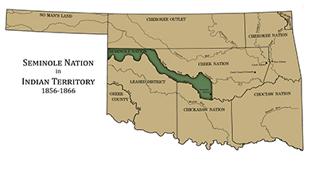
Five Tribes
CREEK-SEMINOLE NATIONS
- NEW LIVES
Treaty with Creeks & Seminoles of 1856
1836-1837
1834-1842
- Seminole frustrated by Creek control
- political/physical separation of the 2 nations
- two Seminole bands migrate to Mexico
CHEROKEE OUTLET
CHEROKEE
NATION
- U.S. payment of $1 million to Seminoles
Creek
Creek
Fort Gibson
Fort
Smith
Seminole
Seminole
leased
CHOCTAW NATION
CHICKASAW NATION

Slide 41
https://www.seminolenationmuseum.org/history/seminole-nation/into-the-west/
After their relocation to the Indian Territory, the Seminole were initially confined to the lands and government of the Creek Nation. The United States allowed them to have only limited self-governance, and only if they adhered to the general laws of the Creeks. Frustrations with these terms and the general conditions in the region led two bands of Seminole under Wild Cat and John Horse to migrate to Mexico in 1849.
In 1856, after nearly twenty years living under Creek rule, a treaty was made with the Creeks and the Federal government establishing a Seminole Nation in Oklahoma.
This nation, recognized as an independent nation within the United States and under its protection, consisted of the land between the South Canadian River and North Canadian River bounded on the East by a line where the present city of Tecumseh, OK now exists, and on the west by the western boundary of the United States (in 1856), which was the 100th meridian.
The Seminoles, under the leadership of Chief John Jumper, moved to their new nation and established a community known as the Green Head Prairie. A council house was located about two miles north and two miles west of the agency. After this settlement was made and the homes were well established, the Civil War erupted and the Seminoles as well as other members of the Five Civilized Tribes (Cherokee, Choctaw, Chickasaw, and Muscogee (Creek), took up arms and fought one against the other.
Under the agreement made with the Federal Government, the Seminoles were to be protected from outside invasion, but with the rumors of war, and before any battles were fought, the Government withdrew all of its forces, leaving the Indian Nations unprotected from invasion from the South.
About one-third of the Tribe, under the leadership of Big John Chupco, voted to remain loyal to the Union and proceeded to move to Kansas. The first skirmishes of the war took place when these Seminoles, along with other tribal members, who favored the North, fought three engagements to reach help in Kansas.
The remainder of the Seminoles under John Jumper joined forces with the Confederacy. The soldiers, with Colonel Jumper as their leader, fought under the command of General Stan Watie.
The war devastated Indian Territory and when it came to an end the Five Civilized Tribes were forced to give up their claim to all their land in the western half of what is now Oklahoma.
In 1866, the Seminoles were required to sign a new treaty. This treaty made certain provisions that included the sale of all the Seminole Nation to the United States at the rate of 15 cents per acre; to free their slaves and give them tribal rights; to give rights of way to the railroads; to make peace among themselves and with other tribes; to help organize a state made up of the Indians in Oklahoma; and the Seminoles were allowed to buy land sold by the Muscogee (Creeks) for a price of 50 cents per acre. This new land was the Second Seminole Nation and existed from 1866 to 1907. This consisted of present day Seminole County with the addition of 175,000 acres that the Seminoles later bought from the Muscogee (Creeks).
With the signing of the Treaty in 1866, the Government commissioned Elijah Brown to bring the Northern Seminoles back to their new nation and set up a new capital city. They chose as their capital the town of Wewoka. Seventeen years earlier, in January of 1849, the Seminole Freedman leader John Horse had made a temporary settlement on the north bank of the Wewoka Creek. They had given the name Wewoka, "Barking Water", to the settlement because of the noise made by the small falls located just east of the settlement.

Slide 42
http://www.firstpeople.us/FP-Html-Treaties/TreatyWithTheCreeksetc1856.html
Treaty with The Creeks etc
August 7, 1856
Articles of agreement and convention between the United States and the Creek and Seminole Tribes of Indians, made and concluded at the city of Washington the seventh day of August, one thousand eight hundred and fifty-six, by George W. Manypenny, commissioner on the part of the United States, Tuck-a-batchee-Micco, Echo-Harjo, Chilly McIntosh, Benjamin Marshall, George W. Stidham, and Daniel N. McIntosh, commissioners on the part of the Creeks; and John Jumper, Tuste-nuc-o-chee, Pars-co-fer, and James Factor, commissioners on the part of the Seminoles:
Whereas the convention heretofore existing between the Creek and Seminole tribes of Indians west of the Mississippi River, has given rise to unhappy and injurious dissensions and controversies among them, which render necessary a readjustment of their relations to each other and to the United States; and
Whereas the United States desire, by providing the Seminoles remaining in Florida with a comfortable home west of the Mississippi River, and by making a liberal and generous provision for their welfare, to induce them to emigrate and become one people with their brethren already west, and also to afford to all the Seminoles the means of education and civilization, and the blessings of a regular civil government; and
Whereas the Creek Nation and individuals thereof, have, by their delegation, brought forward and persistently urged various claims against the United States, which it is desirable shall be finally adjusted and settled; and
Whereas it is necessary for the simplification and better understanding of the relations between the United States and said Creek and Seminole tribes of Indians, that all their subsisting treaty stipulations shall, as far as practicable, be embodied in one comprehensive instrument;
Now, therefore, the United States, by their commissioner, George W. Manypenny, the Creek tribe of Indians, by their commissioners, Tuck-a-batchee-Micco, Echo-Harjo, Chilly Mclntosh, Benjamin Marshall, George W. Stidham, and Daniel N. McIntosh; and the Seminole tribe of Indians, by their commissioners, John Jumper, Tuste-nuc-o-chee, Pars-co-fer, and James Factor, do hereby agree and stipulate as follows, viz:
Article 1.
The Creek Nation doth hereby grant, cede, and convey to the Seminole Indians, the tract of country included within the following boundaries, viz: beginning on the Canadian River, a few miles east of the ninety-seventh parallel of west longitude, where Ock-hi-appo, or Pond Creek, empties into the same; thence, due north to the north fork of the Canadian; thence up said north fork of the Canadian to the southern line of the Cherokee country; thence, with that line, west, to the one hundredth parallel of west longitude; thence, south along said parallel of longitude to the Canadian River, and thence down and with that river to the place of beginning.
Article 2.
The following shall constitute and remain the boundaries of the Creek country, viz: beginning at the mouth of the north fork of the Canadian River, and running northerly four miles; thence running a straight line so as to meet a line drawn from the south bank of the Arkansas River, opposite to the east or lower bank of Grand River, at its junction with the Arkansas, and which runs a course, south, forty-four degrees, west, one mile, to a post placed in the ground; thence along said line to the Arkansas and up the same and the Verdigris River, to where the old territorial line crosses it; thence along said line, north, to a point twenty-five miles from the Arkansas River, where the old territorial line crosses the same; thence running west with the southern line of the Cherokee country, to the north fork of the Canadian River, where the boundary of the session to the Seminoles defined in the preceding article, first strikes said Cherokee line; thence down said north fork, to where the eastern boundary-line of the said cession to the Seminoles strikes the same; thence, with that line, due south to the Canadian River, at the mouth of the Ock-hi-appo, or Pond Creek; and thence down said Canadian River to the place of beginning.
Article 3.
The United States do hereby solemnly guarantee to the Seminole Indians the tract of country ceded to them by the first article of this convention; and to the Creek Indians, the lands included within the boundaries defined in the second article hereof; and likewise that the same shall respectively be secured to and held by said Indians by the same title and tenure by which they were guaranteed and secured to the Creek Nation by the fourteenth article of the treaty of March twenty-fourth, eighteen hundred and thirty-two, the third article of the treaty of February fourteenth, eighteen hundred and thirty-three, and by the letters-patent issued to the said Creek Nation, on the eleventh day of August, eighteen hundred and fifty-two, and recorded in volume four of records of Indian deeds in the Office of Indian Affairs, pages 446 and 447. Provided however, That no part of the tract of country so ceded to the Seminole Indians, shall ever be sold, or otherwise disposed of without the consent of both tribes legally given.
Article 4.
The United States do hereby, solemnly agree and bind themselves, that no State or Territory shall ever pass laws for the government of the Creek or Seminole tribes of Indians, and that no portion of either of the tracts of country defined in the first and second articles of this agreement shall ever be embraced or included within, or annexed to, any Territory or State, nor shall either, or any part of either, ever be erected into a Territory without the full and free consent of the legislative authority of the tribe owning the same.
Article 5.
The Creek Indians do hereby absolutely and forever quit-claim and relinquish to the United States all their right, title, and interest in and to any lands heretofore owned or claimed by them, whether east or west of the Mississippi River, and any and all claim for or on account of any such lands, except those embraced within the boundaries described in the second article of this agreement; and it doth also, in like manner, release and fully discharge the United States from all other claims and demands whatsoever, which the Creek Nation or any individual thereof may now have against the United States, excepting only such as are particularly or in terms provided for and secured to them by the provisions of existing treaties and laws; and which are as follows, viz: permanent annuities in money amounting to twenty-four thousand five hundred dollars, secured to them by the fourth article of the treaty of seventh August, seventeen hundred and ninety, the second article of the treaty of June sixteenth, eighteen hundred and two, and the fourth article of the treaty of January twenty-fourth, eighteen hundred and twenty-six: permanent provision for a wheelwright, for a blacksmith and assistant; blacksmith-shop and tools, and for iron and steel under the eighth article of the last-mentioned treaty; and costing annually one thousand seven hundred and ten dollars; two thousand dollars per annum, during the pleasure of the President, for assistance in agricultural operations under the same treaty and article; six thousand dollars per annum for education for seven years, in addition to the estimate for present fiscal year, under the fourth article of the treaty of January fourth, eighteen hundred and forty-five; one thousand dollars per annum during the pleasure of the President, for the same object, under the fifty article of the treaty of February fourteenth, eighteen hundred and thirty-three; services of a wagon-maker, blacksmith and assistant, shop and tools, iron and steel, during the pleasure of the President, under the same treaty and article, and costing one thousand seven hundred and ten dollars annually; the last instalment of two thousand two hundred and twenty dollars for two blacksmiths and assistants, shops and tools, and iron and steel, under the thirteenth article of the treaty of March twenty-fourth, eighteen hundred and thirty-two, and which last it is hereby stipulated shall be continued for seven additional years. The following shall also be excepted from the foregoing quit-claim, relinquishment, release, and discharge, viz: the fund created and held in trust for Creek orphans under the second article of the treaty of March twenty-fourth, eighteen hundred and thirty-two; the right of such individuals among the Creeks as have not received it, to the compensation in money provided for by the act of Congress of March third, eighteen hundred and thirty-seven, in lieu of reservations of land to which they were entitled, but which were not secured to them, under the said treaty of eighteen hundred and thirty-two; the right of the reservees under the same treaty, who did not dispose of their reservations to the amounts for which they have been or may be sold by the United States; and the right of such members of the tribe to military-bounty lands, as are entitled thereto under existing laws of the United States. The right and interest of the Creek Nation and people in and to the matters and things so excepted, shall continue and remain the same as though this convention had never been entered into.
Article 6.
In consideration of the foregoing quit-claim, relinquishment, release, and discharge, and of the cession of a country for the Seminole Indians contained in the first article of this agreement, the United States do hereby agree and stipulate to allow and pay the Creek Nation the sum of one million of dollars, which shall be invested and paid as follows, viz: two hundred thousand dollars to be invested in some safe stocks, paying an interest of at least five per cent. per annum; which interest shall be regularly and faithfully applied to purposes of education among the Creeks; four hundred thousand dollars to be paid per capita, under the direction of the general council of the Creek Nation to the individuals and members of said nation, except such portion as they shall, by order of said national council, direct to be paid to the treasurer of said nation for any specified national object not exceeding ($100,000) one hundred thousand dollars, as soon as practicable after the ratification of this agreement; and two hundred thousand dollars shall be set apart to be appropriated and paid as follows, viz: ten thousand dollars to be equally distributed and paid to those individuals and their heirs, who, under act of Congress of March third, eighteen hundred and thirty-seven, have received money in lieu of reservations of land to which they were entitled, but which were not secured to them under the treaty of March twenty-fourth, eighteen hundred and thirty-two; one hundred and twenty thousand dollars to be equally and justly distributed and paid, under the direction of the general council, to those Creeks, or their descendants, who emigrated west of the Mississippi River prior to said treaty of eighteen hundred and thirty two, and to be in lieu of and in full compensation for the claims of such Creeks to an allowance equivalent to the reservations granted to the eastern Creeks by that treaty, and seventy thousand dollars for the adjustment and final settlement of such other claims of individual Creek Indians, as may be found to be equitable and just by the general council of the nation: Provided however, That no part of the three last-mentioned sums shall be allowed or paid to any other person or persons, whatsoever, than those who are actual and bona-fide members of the Creek Nation and belonging respectively to the three classes of claimants designated; said sums to be remitted and paid as soon as practicable after the general council shall have ascertained and designated the persons entitled to share therein. And provided further, That any balance of the said sum of seventy thousand dollars, which may be found not to be actually necessary for the adjustment and settlement of the claims for which it is set apart, shall belong to the nation, and be applied to such object or objects of utility or necessity as the general council shall direct. The remaining sum of two hundred thousand dollars shall be retained by the United States, until the removal of the Seminole Indians, now in Florida, to the country west of the Mississippi River herein provided for their tribe; whereupon the same, with interest thereon, at five per cent., from the date of the ratification of this agreement, shall be paid over to, or invested for the benefit of the Creek Nation, as may then be requested by the proper authorities thereof. Provided however, That if so paid over, it shall be equally divided and paid per capita to all the individuals and members of the Creek Nation, or be used and applied only for such objects or purposes of a strictly national or beneficial character as the interests and welfare of the Creek people shall actually require.
Article 7.
It being the desire of the Creeks to employ their own teachers, mechanics, and farmers, all of the funds secured to the nation for educational, mechanical, and agricultural purposes, shall as the same become annually due, be paid over by the United States to the treasurer of the Creek Nation. And the annuities in money due the nation under former treaties, shall also be paid to the same officer, whenever the general council shall so direct.
Article 8.
The Seminoles hereby release and discharge the United States from all claims and demands which their delegation have set up against them, and obligate themselves to remove to and settle in the new country herein provided for them as soon as practicable. In consideration of such release, discharge, and obligation, and as the Indians must abandon their present improvements, and incur considerable expense in re-establishing themselves, and as the Government desires to secure their assistance in inducing their brethren yet in Florida to emigrate and settle with them west of the Mississippi River, and is willing to offer liberal inducements to the latter peaceably so to do, the United States do therefore agree and stipulate as follows, viz: To pay to the Seminoles now in the west the sum of ninety thousand dollars, which shall be in lieu of their present improvements, and in full for the expenses of their removal and establishing themselves in their new country; to provide annually for ten years the sum of three thousand dollars for the support of schools; two thousand dollars for agricultural assistance; and two thousand two hundred dollars for the support of smiths and smith-shops among them, said sums to be applied to these objects in such manner as the President shall direct. Also to invest for them the sum of two hundred and fifty thousand dollars, at five per cent. per annum, the interest to be regularly paid over to them per capita as annuity; the further sum of two hundred and fifty thousand dollars shall be invested in like manner whenever the Seminoles now remaining in Florida shall have emigrated and joined their brethren in the west, whereupon the two sums so invested, shall constitute a fund belonging to the united tribe of Seminoles, and the interest on which, at the rate aforesaid, shall be annually paid over to them per capita as an annuity; but no portion of the principal thus invested, or the interest thereon annually due and payable, shall ever be taken to pay claims or demands against said Indians, except such as may hereafter arise under the intercourse laws.
Article 9.
The United States agree to remove comfortably to their new country west, all those Seminoles now in Florida who can be induced to emigrate thereto; and to furnish them with sufficient rations of wholesome subsistence during their removal and for twelve months after their arrival at their new homes; also, to provide each warrior of eighteen years of age and upwards, who shall so remove, with one rifle-gun, if he shall not already possess one; with two blankets, a supply of powder and lead, a hunting-shirt, one pair of shoes, one and a half yards of strouding, and ten pounds of good tobacco; and each woman, youth, and child with a blanket, pair of shoes, and other necessary articles of comfortable clothing, and to expend for them in improvements, after they shall all remove, the sum of twenty thousand dollars. And to encourage the Seminoles to devote themselves to the cultivation of the soil, and become a sober, settled, industrious, and independent people, the United States do further agree to expend three thousand dollars in the purchase of ploughs and other agricultural implements, axes, seeds, looms, cards, and wheels; the same to be proportionately distributed among those now west, and those who shall emigrate from Florida.
Article 10.
The Seminoles west do hereby agree and bind themselves to furnish, at such time or times as the President may appoint, a delegation of such members of their tribe as shall be selected for the purpose, to proceed to Florida, under the direction of an agent of the Government, to render such peaceful services as may be required of them, and otherwise to do all in their power to induce their brethren remaining in that State to emigrate and join them in the west; the United States agreeing to pay them and such members of the Creek tribe as may voluntarily offer to join them and be accepted for the same service, a reasonable compensation for their time and services, as well as their travelling and other actual and necessary expenses.
Article 11.
It is further hereby agreed that the United States shall pay Foc-te-lus-te-harjo, his heirs or assigns, the sum of four hundred dollars, in consideration of the unpaid services of said Foc-te-luc-te-harjoe, or Black Dirt, rendered by him as chief of the friendly band of Seminole warriors who fought for the United States during the Florida war.
Article 12.
So soon as the Seminoles west shall have removed to the new country herein provided for them, the United States will then select a site and erect the necessary buildings for an agency, including a council-house for the Seminoles.
Article 13.
The officers and people of each of the tribes of Creeks and Seminoles shall, at all times, have the right of safe conduct and free passage through the lands and territory of the other. The members of each shall have the right freely to settle within the country of the other, and shall thereupon be entitled to all the rights, privileges, and immunities of members thereof, except that no member of either tribe shall be entitled to participate in any funds belonging to the other tribe. Members of each tribe shall have the right to institute and prosecute suits in the courts of the other, under such regulations as may, from time to time, be prescribed by their respective legislatures.
Article 14.
Any person duly charged with a criminal offense against the laws of either the Creek or Seminole tribe, and escaping into the jurisdiction of the other, shall be promptly surrendered upon the demand of the proper authority of the tribe within whose jurisdiction the offense shall be alleged to have been committed.
Article 15.
So far as may be compatible with the Constitution of the United States, and the laws made in pursuance thereof, regulating trade and intercourse with the Indian tribes, the Creeks and Seminoles shall be secured in the unrestricted right of self-government, and full jurisdiction over persons and property, within their respective limits; excepting, however, all white persons, with their property, who are not, by adoption or otherwise, members of either the Creek or Seminole tribe; and all persons not being members of either tribe, found within their limits, shall be considered intruders, and be removed from and kept out of the same by the United States agents for said tribes, respectively; (assisted, if necessary, by the military;) with the following exceptions, viz: such individuals with their families as may be in the employment of the Government of the United States; all persons peaceably travelling, or temporarily sojourning in the country, or trading therein under license from the proper authority of the United States; and such persons as may be permitted by the Creeks or Seminoles, with the assent of the proper authorities of the United States, to reside within their respective limits without becoming members of either of said tribes.
Article 16.
The Creeks and Seminoles shall promptly apprehend and deliver up all persons accused of any crime against the laws of the United States, or of any State thereof, who may be found within their limits, on demand of any proper officer of a State or of the United States.
Article 17.
All persons licensed by the United States to trade with the Creeks or Seminoles shall be required to pay to the tribe within whose country they trade, a moderate annual compensation for the land and timber used by them, the amount of such compensation, in each case, to be assessed by the proper authorities of said tribe, subject to the approval of the United States agent therefor.
Article 18.
The United States shall protect the Creeks and Seminoles from domestic strife, from hostile invasion, and from aggression by other Indians and white persons, not subject to their jurisdiction and laws; and for all injuries resulting from such invasion or aggression, full indemnity is hereby guaranteed to the party or parties injured out of the Treasury of the United States, upon the same principle and according to the same rules upon which white persons are entitled to indemnity for injuries or aggressions upon them, committed by Indians.
Article 19.
The United States shall have the right to establish and maintain such military posts, military and post-roads and Indian agencies as may be deemed necessary within the Creek and Seminole country, but no greater quantity of land or timber shall be used for said purposes than shall be actually requisite; and if, in the establishment or maintenance of such posts, roads, or agencies, the property of any Creek or Seminole be taken, destroyed, or injured, or any property of either nation, other than land and timber, just and adequate quate compensation shall be made by the United States. Such persons only as are or may be in the employment of the United States, in any capacity, civil or military, or subject to the jurisdiction and laws of the Creeks and Seminoles, shall be permitted to farm or raise stock within the limits of any of said military posts or Indian agencies. And no offender against the laws of either of said tribes shall be permitted to take refuge therein.
Article 20.
The United States, or any incorporated company, shall have the right of way for railroads, or lines of telegraphs, through the Creek and Seminole countries; but in the case of any incorporated company, it shall have such right of way only upon such terms, and payment of such amount to the Creeks and Seminoles, as the case may be, as may be agreed upon between it and the national council thereof; or, in case of disagreement by making full compensation, not only to individual parties injured, but also to the tribe for the right of way, all damage and injury done to be ascertained and determined in such manner as the President of the United States shall direct. And the right of way granted by either of said tribes for any railroad shall be perpetual or for such shorter term as the same may be granted, in the same manner as if there were no reversion of their lands to the United States provided for, in case of abandonment by them, or of extinction of their tribe.
Article 21.
The United States will cause such portions of the boundaries of the Creek and Seminole countries, as do not consist of well-defined natural boundaries, to be surveyed and permanently marked and established. The Creek and Seminole general councils may each appoint a commissioner from their own people to attend the running of their respective boundaries, whose expenses and a reasonable allowance for their time and services, while engaged in such duty, shall be paid by the United States.
Article 22
That this convention may conduce, as far as possible, to the restoration and preservation of kind and friendly feelings among the Creeks and Seminoles; a general amnesty of all past offences committed within their country, either west or east of the Mississippi, is hereby declared.
Article 23.
A liberal allowance shall be made to each of the delegations signing this convention; including, with the Seminole delegation, George W. Brinton, the interpreter, as a compensation for their travelling and other expenses in coming to and remaining in this city and returning home.
Article 24.
Should the Seminoles in Florida desire to have a portion of the country described in the first article of this agreement, set apart for their residence, it is agreed that the Seminoles west may make such arrangement, not inconsistent with this instrument, as may be satisfactory to their brethren in Florida.
Article 25.
The Creek laws shall be in force and continue to operate in the country herein assigned to the Seminoles, until the latter remove thereto; when they shall cease and be of no effect.
Article 26.
This convention shall supersede and take the place of all former treaties, between the United States and the Creeks, between the United States and the Florida Indians and Seminoles, and between the Creeks and Seminoles, inconsistent herewith; and shall take effect and be obligatory on the contracting parties from the date hereof, whenever it shall be ratified by the Senate and President of the United States.
Article 27.
And it is further agreed, that nothing herein contained shall be so construed as to release the United States from any liability other than those in favor of said nations or individuals thereof.
In testimony whereof, the said George W. Manypenny, commissioner on the part of the United States, and the said commissioners on the part of the Creeks and Seminoles, have hereunto set their hands and seals.
Done in triplicate at the city of Washington, on the day and year first above written.
Geo. W. Manypenny, [L. S.]
United States Commissioner.
Tuck-a-batchee-micco, his x mark, [L. S.]
Echo-harjo, his x mark, [L. S.]
Chilly McIntosh, [L. S.]
Benjamin Marshall, [L. S.]
George W. Stidham, [L. S.]
Daniel N. McIntosh, [L. S.]
Creek Commissioners.
John Jumper, his x mark, [L. S.]
Tus-te-nuc-o-chee, his x mark, [L. S.]
Pars-co-fer, his x mark, [L. S.]
James Factor, his x mark, [L. S.]
Seminole Commissioners.
Executed in presence of -
John W. Allen,
Edward Hanrick,
W. H. Garrett, Creek agent,
J. W. Washbourne, Seminole agent,
G. W. Stidham, United States interpreter,
Geo. W. Brinton, interpreter,
James R. Roche,
Chs. O. Joline.

Slide 43
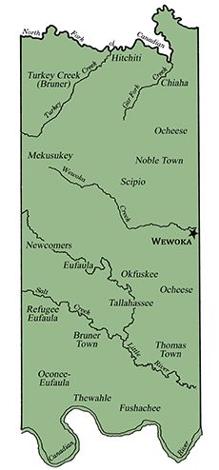

Slide 44
https://en.wikipedia.org/wiki/Seminole_Nation_of_Oklahoma
The Seminole Nation of Oklahoma is a federally recognized Native American tribe based in the U.S. state of Oklahoma. It is the largest of the three federally recognized Seminole governments, which include the Seminole Tribe of Florida and the Miccosukee Tribe of Indians of Florida. Its members are descendants of the 3,000 Seminoles who were forcibly removed from Florida to Indian Territory, along with 800 Black Seminoles, after the Second Seminole War. The Seminole Nation of Oklahoma is headquartered in Wewoka within Seminole County, Oklahoma. Of 18,800 enrolled tribal members, 13,533 live within the state of Oklahoma. The tribe began to revive its government in 1936 under the Indian Reorganization Act. While its reservation was originally larger, today the tribal jurisdictional area covers Seminole County, Oklahoma, within which it has a variety of properties.^{[1]}
The few hundred Seminoles remaining in Florida fought against US forces in the Third Seminole war, and peace was made without their defeat. Today, descendants of those people have formed two federally recognized Seminole tribes. Together, the three tribes and unorganized Traditionals in Florida were awarded a land claims settlement valued in total at $16 million in 1976, for nearly 24 million acres of lands seized by the United States government in Florida in 1823.
After the Second Seminole War of the 1830s, an estimated 3,000 Seminole and 800 Black Seminoles were removed to Indian Territory, with many taken by ship across the Gulf of Mexico and up the Mississippi for part of the journey. They were first put under the Creek on their reservation. The 1830s was the period of removal for the other of the“Five Civilized Tribes” of the American Southeast.
A few hundred Seminole remained in the Florida Everglades. With guerilla warfare, they resisted US forces during the Third and last Seminole War, when the US withdrew. Today their descendants have formed the federally recognized Seminole Tribe of Florida and
Miccosukee Tribe of Indians of Florida. After removal, the Oklahoma and Florida Seminole developed independently and had little contact for nearly 100 years.
Micanopy, who had been principal chief since 1825, led the Seminole struggle to gain an independent reservation, as they were first placed under the Creek in Indian Territory. He died in 1849, after separate lands had been promised by the US for 1855. His sister's sons, John Jumper (1849–1853) and Jim Jumper (1853–1866), succeeded him as principal chiefs before the US began to interfere with tribal government.
While the Seminole maintained political independence from the Creek, the two peoples became closer through the 19th and early 20th centuries, as they shared strong cultural traditions and began to intermarry. The Seminole reservation originally encompassed what is now Seminole County, a roughly 15-mile strip between the Canadian River and North Canadian River, a total of 360,000 acres (1,500 km²). The United States urged the Indians on reservations to adopt subsistence agriculture, but less than half the land was good for agriculture, and a third was not useful for stock raising or agriculture
The Black Seminoles again developed towns near the Seminole as they had in the Florida frontier. Except for the struggle to protect their people against slave raiders from outside their communities, they enjoyed good relations with the Seminole.
After the American Civil War, in which many Seminole, including John Frippo Brown
last Principal Chief of the Seminole Nation, had allied with the Confederacy, they were forced to make some land cessions under a new treaty with the US government. These included allocating a portion of their reservation for the Seminole Freedmen following emancipation of slaves in Indian Territory in 1866. The treaty granted the Black Seminoles who chose to stay on the reservation full citizenship in the tribe.
As they had in Florida, the Seminole strongly discouraged intermarriage with whites or adoption of European-American ways. In 1900 they were still mostly full bloods. They generally had little intermarriage with the Seminole maroons, who were recognized as having their own distinct culture. As the Seminole had a matrilineal kinship system, they believed children belonged to their mother's people. Mixed-race children belonged to the mother's people, whichever race that was.
Following the Seminole Agreement of 1909, the Seminole lands were allotted to individual households registered on the Dawes Rolls, in a federal plan to encourage subsistence farming and assimilation. Numerous interests wanted to extinguish the communal tribal lands to gain admission of Oklahoma (including Indian Territory) as a state. In 1900 the Seminole Freedmen numbered about 1,000, nearly one-third of the total Seminole tribe in Oklahoma. The Dawes Commission established two separate registration rolls for Seminole Indians and Freedmen. They became United States citizens in a racially segregated state.
The Seminole Freedmen suffered extra legal discrimination and restrictions in the state. Some left for Canada or other states. The segregation of the larger society drove a wedge between the communities. The Freedmen quickly lost land through unscrupulous land sharks, as their land sales were not supervised by the Indian Bureau. The Seminole also lost land, sometimes through the actions of overseers who were supposed to help them.
Today the Seminole Nation of Oklahoma is located in Seminole County, Oklahoma. The entire county of Seminole is a portion of the original Seminole Nation jurisdiction, and covers approximately 633 square miles. The county is a checkerboard of tribal trust property, Indian allotments, restricted Indian lands, and dependent Indian communities. Native Americans make up 22% of the population of Seminole County.
The Seminole County service population is 5,315 Tribal citizens, according to the Seminole Nation Tribal Enrollment Office. The total enrollment of the Seminole Nation of Oklahoma is approximately 17,000 members. According to 2000 U.S. Census data for Seminole County, the self-identified Native American (one race only) population is 4,328, and the Native American (one race or combination with other race) population is 5,485.
The Curtis Act suspended US Federal Governmental recognition of the tribe's government, during the time of land allotments in the late 19th and early 20th centuries. With the Indian Citizenship Act of 1924, the Seminole became US citizens and received some services from the Bureau of Indian Affairs. Having enjoyed a unique alliance, the Seminoles (mostly full-blood) and the Seminole Freedmen became part of the segregated state of Oklahoma, which adversely affected their relations.
Under the Indian Reorganization Act of 1934, the Seminoles reorganized their government. At the time some who had been opposed to Freedmen being allocated land also opposed their participation in government. As the Seminole Nation developed their constitution, some members wanted to exclude Seminole Maroons from the tribe, but the Constitution of the 1950s recognizes Freedmen as citizens.
The Seminole Nation ratified a constitution on March 8, 1969, which restructured their government along more traditional lines. The Nation has been composed since the 19th century of 14 itálwa, matrilineal town bands, including two Freedmen bands, which each represent several towns. This social structure is also the basis of the Seminole political and religious life. Each band has an elected band chief and assistant band chief and meets monthly.
Each band elects two representatives to the General Council. Each band is governed by a set of bylaws that originate from the band. This structure was approved by the Commission of Indian Affairs on April 15, 1969.
The Seminole General Council, chaired by the Principal Chief and Assistant Chief, serves at the elected governing body. The Chief and Assistant Chief are elected at large every four years.
On July 1, 2000, the Seminole Nation held a referendum for a constitutional amendment establishing new membership rules: it said that members had to have one-eighth blood quantum (essentially documented descent from an Indian member on the Dawes Rolls). The General Council prohibited representatives from the two Freedmen Bands from participating. As a result of the change, about 1200 Freedmen were excluded from membership and most benefits afforded to the tribe. The BIA said the referendum was invalid. The Nation sued the government, saying in Seminole Nation of Oklahoma v. Babbitt (later Seminole Nation of Oklahoma v. Norton) that it had the right to determine its own membership.
Tribal headquarters are located in Wewoka, Oklahoma, the seat of Seminole County. The general council meets at the council house on the Mekusukey Mission Tribal Grounds south of Seminole. The Nation has been developing a new tribal constitution that will eliminate the role of the Bureau of Indian Affairs (BIA) in tribal government operations.
Tribal government departments include administrative, executive, fiscal affairs, treasury, domestic violence, Indian Child Welfare, family and social services, enrollment, gaming, housing, education, language, communications, elder services, environmental, law enforcement, dialysis, youth, child care, roads, and Head start. Tribal departments are funded with either tribal revenue or federal/ state funding.
Today, the tribe manages 372 acres (1.51 km²) of land held in trust by the federal government as their reservation. They have approximately 53 acres (0.21 km²) of fee-simple land. An additional 35,443 acres (143.43 km²) are allotted to supplement the tribal land base. The Seminole Tribal Jurisdiction Area, where it provides services to its members, includes most of Seminole County in south-central Oklahoma, approximately 45 miles east of Oklahoma City.
The Seminole Nation Tribal Complex is located in the town of Wewoka. The junction of U.S. 270 and Oklahoma Highway 56 is located at the town, approximately 30 miles southeast of the town of Shawnee. Wewoka is the site of several Seminole Nation programs and services.
The Mekusukey Mission (which includes tribal offices, recreational areas, industrial and commercial areas, and a cultural area) is located 2 miles south and 2 miles west of the city of Seminole.
By 1961 the Oklahoma and Florida Seminole independently filed claims with the Indian Claims Commission for compensation for lands seized in Florida in 1823 at the time of the Treaty of Moultrie Creek, by which the Seminoles had moved into a reservation in central Florida, giving up their northern lands.
The federal government combined the claims and in 1976 awarded a total of $16 million to the peoples. They struggled for more than a decade to allocate it, leading to negotiations between the Oklahoma and Florida groups and more sustained contact than they had had for a century. The Miccosukee and Traditionals initially opposed settling for claims rather than seek the return of land.
By this time the Seminole Tribe of Florida and the Miccosukee Tribe of Indians of Florida had achieved federal recognition and the Traditionals had legal representation. Richmond Tiger was Principal Chief of the Seminole Nation of Oklahoma. The settlement was put into trust earning interest.
In 1990, the groups agreed to the Seminole Nation of Oklahoma receiving three-quarters, based on early records from 1906-1914, when members had blood quantum, and the Florida Seminole to receive one-quarter, based on a reconstructed early 20th-century censuses. The Florida tribes and Traditionals had a higher percentage of full-bloods, and blood quantum requirements for membership. By 1990, the total settlement award was valued at $46 million with interest.
The Seminole Nation of Oklahoma declined to share the settlement benefits with Seminole Freedmen members, as the Black Seminoles had not been legally recognized in 1823 as members of the tribe. They contended they also had lost land which they owned and occupied. After failing to gain concessions from the Nation, two Freedmen's Bands filed suit against the Department of Interior in 1996. The BIA noted that, as legal citizens of the Seminole Nation since 1866, the Freedmen were supposed to share in all benefits. Their case was dismissed from federal district court, which said the Freedmen could not bring suit without the Seminole Nation's joining. Their appeal at that level also lost, and in 2004, the US Supreme Court affirmed that they could not sue without participation of the Nation.
In the meantime, in 2000, the Seminole Nation voted to restrict members to those of one-eighth blood quantum, essentially those with documented descent from ancestors listed as Seminole-Indian on the Dawes Rolls. This excluded numerous Freedmen who, although descending from an Indian ancestor, had only a Freedman ancestor listed on the Rolls. The registrars had tended to classify all persons of visible African ancestry as Freedmen, even if the individual had Seminole ancestry and was at the time considered an Indian member of the tribe. About 1200 Freedmen were dropped from tribal membership rolls.
The Seminole Nation of Oklahoma operates three gaming casinos, three tribal smoke shops, three gasoline stations, and a truck stop, which generate revenues for welfare, education, housing and economic development. They operate their own housing authority, an alcohol and substance abuse program, a business and corporate regulatory commission, several family services, a food distribution program, environmental protection program, and social service programs. They issue their own tribal vehicle tags. In addition, the tribe administers their share of the judgment trust from the 1990 land claim settlement, from which members can draw for educational and other benefits. Their annual economic impact was $81 million in 2010.

Slide 45
https://www.nps.gov/trte/learn/management/upload/North%20Little%20Rock%20Site%20Report%2080303.pdf
The Florida Indians were removed by bands, and removal resulted in nationhood in a sense that it had not existed for those people in Florida. There, they were a loosely affiliated group of different tribes and remnants of peoples, including people of Spanish descent and of African descent. In the West, they were united in a common cause: refusal to submit to the authority of the Muscogees as had been called for by the Treaty of Payne’s Landing (1832) and the Treaty of Fort Gibson (1833). They finally achieved separate nationhood as the Seminole Nation through an interim treaty in 1845 and finally in a treaty of 1856 under which the disparate bands merged into a single nation.

Slide 46
http://newsok.com/article/3472197
Once they reached Indian Territory Upper Creeks settled around Deep Fork, North Fork and the Canadian River valleys, whilst Lower Creeks took up residence around the Three Forks area of the Arkansas River. Around 13,000 Creeks made it to Indian Territory.
The American Civil War caused significant disruption to the Creek Nation. After the Civil War the Creek capital moved to Okmulgee, a new government was formed and a new constitution drafted.
Upper and Lower Creeks agreed to a new national government at Council Hill in present day Tulsa in 1940.
https://en.wikipedia.org/wiki/Muscogee_(Creek)_Nation
The Nation includes the Creek people and descendants of their African-descended slaves who were forced by the US government to relocate from their ancestral homes in the Southeast to Indian Territory in the 1830s, during the Trail of Tears. They signed another treaty with the federal government in 1856.
During the American Civil War, the tribe split into two factions, one allied with the Confederacy and the other, under Opothleyohola, who allied with the Union. There were conflicts between pro-Confederate and pro-Union forces in the Indian Territory during the war. The pro-Confederate forces pursued the loyalists who were leaving to take refuge in Kansas. They fought at the Battle of Round Mountain, Battle of Chusto-Talasah, and Battle of Chustenahlah, resulting in 2,000 deaths among the 9,000 loyalists who were leaving.
After defeating the Confederacy, the Union required new peace treaties with the Five Civilized Tribes. The Treaty of 1866 required the Creek to abolish slavery within their territory and to grant tribal citizenship to the Creek Freedmen who chose to stay in the territory; this citizenship included voting rights and shares of annuities and land allotments. If the Creek Freedmen moved out to United States territory, they would be granted United States citizenship, as were other emancipated slaves.
The Creek established a new government in 1866 and selected a new capital of Okmulgee. In 1867 they ratified a new constitution. They built their capitol in 1867 and enlarged it in 1878. Today the Creek National Capitol is a National Historic Landmark and houses the Creek Council House Museum. The Nation built schools, churches, and public houses during the prosperous final decades of the 19th century, when the tribe had autonomy and minimal interference from the federal government.
At the turn of the century, Congress passed the 1898 Curtis Act, which dismantled tribal governments in another attempt at assimilation; and the Dawes Allotment Act, which broke up tribal landholdings to allot communal land to individual households to encourage adoption of the European-American style of subsistence farming and property ownership. In the hasty process of registration, the Dawes Commission registered tribal members in three categories, distinguishing between "Creek by Blood," "Creek Freedmen," into which category they put anyone with visible African ancestry, regardless of their proportion of Creek ancestry; and "Intermarried Whites." They classified some members of the same families into different groups.
The 1906 Five Civilized Tribes Act (April 26, 1906) was passed by the US Congress in anticipation of approving statehood for Oklahoma in 1907. During this time, the Creek had lost more than 2 million acres (8,100 km²) to non-Native settlers and the US government.
Later, when Creek communities organized and set up governments under the 1936 Oklahoma Indian Welfare Act, some former Muscogee tribal towns gained federal recognition.
The Muscogee (Creek) Nation did not reorganize and regain federal recognition until 1970. In 1979 the tribe ratified a new constitution that replaced the 1866 constitution. The pivotal 1976 court case Harjo v. Kleppe helped end US federal paternalism. It ushered in an era of growing self-determination. Using the Dawes Rolls as a basis for determining membership of descendants, the Nation enrolled over 58,000 allottees and their descendants.
From 1981-2001, the Creek had membership rules that allowed applicants to use a variety of documentary sources to establish qualifications for membership.
In 1979 the Muscogee Nation Constitutional Convention voted to limit citizenship in the Nation to persons who could prove descent by blood, meaning that members had to be able to document direct descent from an ancestor listed on the Dawes Commission roll in the category of "Creek by Blood". Persons proving they are descended from persons listed as Creek by blood can become citizens of the Muscogee (Creek) Nation. The 1893 registry was established to identify citizens of the nation at the time of allotment of communal lands and dissolution of the reservation system and tribal government.
The 1979 vote on citizenship excluded descendants of persons recorded only as Creek Freedmen in the Dawes Rolls. This decision has been challenged in court by those descendants, according to the 1866 treaty of "Creek Freedmen."
The Freedmen were listed on the Dawes Rolls. Some descendants can prove by documentation in other registers that they had ancestors with Creek blood. The Freedmen had been listed on a separate register, regardless of their proportion of Creek ancestry. This classification did not acknowledge the unions and intermarriage that had taken place for years between the ethnic groups. Prior to the change in code, Creek Freedmen could use existing registers and the preponderance of evidence to establish qualification for citizenship, and were to be aided by the Citizenship Board. The Creek Freedmen have challenged their exclusion from citizenship in legal actions which are pending.

Slide 47
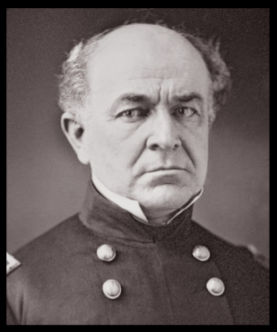
CREEK-SEMINOLE NATIONS
What happens to Milly Francis?
REMINDER:
1837 - Milly arrived at Fort Gibson
moves into a cabin near fort
1842 - Lt Col Ethan Hitchcock finds her living in proverty
Milly
CREEK NATION
Fort
Gibson
SEMINOLE NATION
- He appeals to Arbuckle
- War Dept agrees to help her
1844 - Congress approves $96 monthly stipend &
honorary medal
1848 - Before receiving either, Milly dies at 45 of TB

Slide 48
https://books.google.com/books?id=W7DpCAAAQBAJ&pg=PA338&dq=colonel+hitchcock+and+milly+francis&hl=en&sa=X&ved=0ahUKEwj_sKSq7r7ZAhUSRK0KHWUYBuMQ6AEIMzAC#v=onepage&q=colonel%20hitchcock%20and%20milly%20francis&f=false
MIlly was living there in abject poverty five years later (1842) when Lt. Col. Ethan Allen Hitchcock met her and heard the true story of the incident from her own lips. Moved by her situation, he wrote to the War Department to ask that something be done to relive her suffering. After a two year debate (1844)

Slide 49
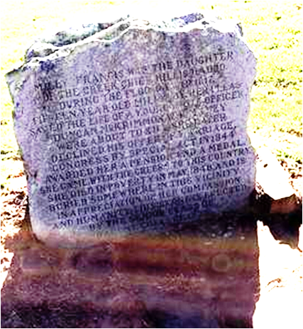
http://www.exploresouthernhistory.com/millyfrancis.html
CHECK THIS SITE FOR MORE INFO
http://www.exploresouthernhistory.com/millyfrancis2.html
MILLY FRANCIS (1803-1848)
Milly Francis was born in the Upper Creek villages of Alabama in around
1803. Although some writers have speculated that her name was really Malee, a
Creek word, there is no evidence that this was the case. Milly's father, Josiah Francis,
gave all of his children English names and there is no reason to suppose that he did
any different in her case.
Milly's father, Josiah Francis, was the son of a white silversmith and trader
and a Native American woman. Josiah Francis is remembered as the Prophet Francis
or Hillis Hadjo, the religious leader of the Red Stick movement in the Creek Nation.
A relative and associate of the noted Creek leader Alexander McGillivray and a
follower of the Shawnee prophet Tenskwatawa, he became known for his teachings
of a return to traditional ways and Native American unity in the face of westward
expansion by the whites.
These teachings helped spark the Creek civil war that eventually spilled
over to the whites and became known to history as the Creek War of 1813-1814.
His teachings played a critical role in the outbreak of the Creek War of 1813-1814 and he led warriors against three white armies during that conflict.
In March of 1818, a remarkable incident took place on the banks of the Wakulla River in what is now Wakulla County, Florida. A young Native American woman named Milly Francis, the daughter of a Creek prophet, saved the life of a Georgia militiaman named Duncan McCrimmon. The First Seminole War was then at its height and her act of courage captivated the nation. Within weeks she had rightfully been labeled "a new Pocahontas."
When Andrew Jackson finally overwhelmed the Creeks at the Battle of Horseshoe Bend on March 27, 1814, the Prophet fled to Florida with his family and surviving followers. Armed and reinforced by the British, they continued to fight against Jackson and his soldiers until the end of the War of 1812. Homeless and hungry, Francis' followers (including Milly, her mother and sister) settled on the Wakulla River, built new homes and planted corn while the Prophet went to England to plead the case of his people with leaders there.
When he returned in 1817, Francis found that the fighting was far from over . A series of incidents that fall led to the outbreak of the First Seminole War, sparked when U.S. troops attacked the Creek village of Fowltown near today's Bainbridge, Georgia. Francis and his followers joined the conflict and took part in several battles, although he remained hopeful that the British would intervene to save the Creeks and their Seminole allies
Ordered to the frontier, Andrew Jackson invaded Florida in March of 1818 and occupied the former site of a British post on the Apalachicola River where he built a new work named Fort Gadsden. It was here, sometime in March, that a soldier from the Georgia militia wandered from camp and was captured by warriors loyal to the Prophet.
A resident of Milledgeville, Georgia, Duncan McCrimmon (sometimes spelled McRimmon or McKrimmon) was a member of a Scottish family that had settled in Georgia over the previous decades. Taken to the Prophet's village on the Wakulla, he was interrogated for information on the strength and intentions of Jackson's army. His captors then prepared to execute him.
One of the warriors responsible for capturing McCrimmon had suffered the loss of two sisters in the Creek War. Under the laws of the nation, he was expected to retaliate for their deaths by taking the lives of those responsible. As a soldier, McCrimmon was an acceptable target for the warrior's revenge. When Milly realized what was happening, she pleaded with her father to save the young man's life. The Prophet explained that under Creek law the decision was beyond his authority. He told Milly that McCrimmon's fate was in the hands of his captor, but also suggested that she speak with that warrior. She did so and by her entreaties convinced the warrior that killing McCrimmon would serve no purpose. The young man's death, she said, would not bring the warrior's sisters back to life. Moved by her reasoning, he relented and agreed to spare the life of the young soldier. McCrimmon was turned over to the Spanish at San Marcos de Apalache (Fort St. Marks) and was rescued by U.S. forces just days later.
Milly's father was not so lucky. Captured when he went aboard the USS Thomas Shields, a U.S. Navy warship that had appeared off St. Marks, the Prophet Francis was turned over to the American army. Andrew Jackson had seized the fort of San Marcos from its Spanish garrison. Sent ashore by the sailors who had thrown them in irons, Francis and a second Red Stick chief - Homathlemico - were hanged without trial just outside the gate of the fort. Milly watched as her father died. Jackson, however, was in his tent when the Prophet was killed and did not watch as his orders were carried out.
Ordered to Fort Gadsden to be supplied for their return to the Creek Nation in Alabama, Milly walked across today's Apalachicola National Forest with her mother and sister. They took with them only what they could carry on their backs. By the time they arrived there, the story of how she had rescued Duncan McCrimmon was spreading from newspaper to newspaper across the United States. Milly was hailed by newspaper editors as a "New Pocahontas" and people far and wide sent money to help her family survive its desperate situation.
Having already returned to his home near Milledgeville, McCrimmon was entrusted with these funds and carried them with him as he went back down to Fort Gadsden. Readers across the nation waited with anticipation to learn the results of his plan to propose marriage to the woman who had saved his life. Milly, however, declined the offer, explaining that she had acted from feelings of humanity alone. A Florida legend that she married McKrimmon and raised a family on the Suwannee River is just that, a legend. In reality, Milly returned to the Creek Nation with her mother and sister. She eventually married a Creek warrior, but he died of fever in 1836 while serving with the Creek Brigade against the Seminoles in Florida.
Milly Francis walked the Trail of Tears as a member of Tuckabatchee Hadjo's party. Eyewitnesses described seeing her pass through Little Rock, Arkansas, in November of 1838. She arrived at Fort Gibson in present-day Oklahoma in Dec-Jan of 1837-1838. She soon settled with her children in a dirt-floored log cabin at the site of today's Bacone College in Muskogee, Oklahoma. She was living there in abject poverty five years later when Lt. Col. Ethan Allen Hitchcock met her and heard the true story of the Pocahontas incident from her own lips. Moved by her situation, he wrote to the War Department to ask that something be done to relive her suffering.
After a two year debate, the U.S. Congress in 1844 approved a bill that gave a pension of $96 per year for the "Milly, a Creek woman." The act also awarded a special "medal of honor" to Milly Francis for saving the life of Duncan McCrimmon. Many people consider Milly Francis to have been the first woman ever to receive a Congressional Medal of Honor, although she is not included on the master list as it was not created until the Civil War. Sadly, Milly Francis died of tuberculosis in Oklahoma before ever receiving either her pension or the medal that was struck in her honor. A monument noting the site of her grave was funded by the students of Bacone College during the 1930s and can be seen on the campus today.

Slide 50
https://books.google.com/books?id=7AQ5nT1ozrQC&pg=PA106&lpg=PA106&dq=lt+colonel+matthew+arbuckle+at+fort+gadsden&source=bl&ots=5DYbY9gN1Y&sig=S19KSFfAOfAvG4wHk_1FQxHUlQY&hl=en&sa=X&ved=0ahUKEwjZ5LzC6r7ZAhUDRKwKHbIwDeQQ6AEINjAC#v=onepage&q=lt%20colonel%20matthew%20arbuckle%20at%20fort%20gadsden&f=false

Slide 51
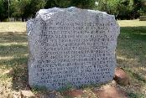
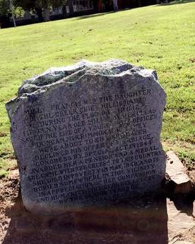
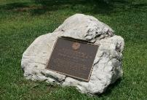
http://www.exploresouthernhistory.com/millyfrancis.html
CHECK THIS SITE FOR MORE INFO
http://www.exploresouthernhistory.com/millyfrancis2.html
This monument to the Creek Pocahontas stands near her burial site at Bacone College in Muskogee, Oklahoma.
A monument to Milly Francis can be found on the grounds of San Marcos de Apalache Historic State Park in St. Marks, Florida.
MILLY FRANCIS (1803-1848)
Word of her rescue of Duncan McCrimmon spread through the U.S. Army
and she received considerable attention from the U.S. officers and soldiers. One of
these, possibly Lt. Col. Matthew Arbuckle of the 7th Infantry Regiment, described
the incident in a letter to McCrimmon's hometown newspaper and the story of
the "New Pocahontas" was printed in newspapers across the United States
throughout the summer and fall of 1818.
Milly and her family traveled across to Fort Gadsden to begin their journey up to the Creek Nation. There she was presented with money that had been collected in her behalf by the citizens of Milledgeville, Georgia, for which she expressed gratitude to Col. Arbuckle. The colonel's surviving letters also indicate that Duncan McCrimmon traveled back to Fort Gadsden during the fall of 1818 and proposed marriage to Milly Francis to express his gratitude for her role in saving his life.
It is difficult to imagine any set of circumstances that would have led Milly to accept McCrimmon's proposal. Her family had twice been driven from its home by war, her father had been hanged by American soldiers and the crew of the Thomas Shields had fired cannon in a deliberate effort to kill her sister. She declined his offer, explaining to Col. Arbuckle that she had acted from feelings of humanity alone and would have done the same for any other person facing such a fate. A Florida legend that she married McCrimmon and raised a family on the Suwannee River is just that, a legend.
In reality, Milly returned to the Creek Nation with her mother and sister. She eventually married a Creek warrior and had at least three children before war once again disrupted her life. Milly's husband volunteered to fight for the United States in the Second Seminole War and is believed to have been killed in that conflict. A faction of the Creeks, meanwhile, rose up against the United States during the spring of 1836. The uprising was crushed by American troops and the government ordered the wholesale removal of the Creek Nation to lands in what is now Oklahoma.
Milly Francis walked the Trail of Tears as a member of Tuckabatchee Hadjo's party. Eyewitnesses described seeing her pass through Little Rock, Arkansas, in November of 1838. She arrived at Fort Gibson in present-day Oklahoma in January of 1838 and soon settled with her children in a dirt-floored log cabin at the site of today' Bacone College in Muskogee, Oklahoma. She was living there in abject poverty five years later when Lt. Col. Ethan Allen Hitchcock met her and heard the true story of the Pocahontas incident from her own lips. Moved by her situation, he wrote to the War Department to ask that something be done to relive her suffering.
After a two year debate, the U.S. Congress in 1844 approved a bill that gave a pension of $96 per year for the "Milly, a Creek woman." The act also awarded a special "medal of honor" to Milly Francis for saving the life of Duncan McCrimmon. Many people consider Milly Francis to have been the first woman ever to receive a Congressional Medal of Honor, although she is not included on the master list as it was not created until the Civil War. Sadly, Milly Francis died of tuberculosis in Oklahoma before ever receiving either her pension or the medal that was struck in her honor. A monument noting the site of her grave was funded by the students of Bacone College during the 1930s and can be seen on the campus today.

Slide 52
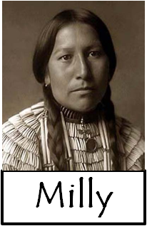
Five Tribes
What happens to Milly Francis?
Milly Francis
- NEW LIVES
1930s – students at Bacone College (OK) erect a
monument to Milly near site of her cabin
CREEK NATION
Another monument in San Marcos de Apalache
Historic Park in St Marks, Florida
A Creek woman who leaves a legacy!

Slide 53
Five Tribes
CHEROKEE NATION
- NEW LIVES
?
CHEROKEE OUTLET
CHEROKEE
NATION
CREEK NATION
SEMINOLE NATION
leased
- extra land assigned to Cherokee by Treaty of New Echota
- pathway to the west for hunting
CHOCTAW NATION
CHICKASAW NATION

Slide 54
https://en.wikipedia.org/wiki/Cherokee_Outlet
The Cherokee Outlet, often mistakenly referred to as the Cherokee Strip, was located in what is now the state of Oklahoma, in the United States. It was a sixty-mile (97 km) wide strip of land south of the Oklahoma-Kansas border between the 96th and 100th meridians. It was about 225 miles (362 km) long and in 1891 contained 8,144,682.91 acres (32,960 km²). Enid
and Woodward fall within the historical boundaries of the Cherokee Outlet.
The Cherokee Strip was a two-mile strip running along the northern border of much of the Cherokee Outlet, and it was the result of a surveying error. This section of land was known as the Cherokee Strip but the term has often been applied to the whole of the Cherokee Outlet.
The Treaty of New Echota assigned the Cherokee Outlet, along with other lands, to the Cherokee Nation. Ratified on May 23, 1836, it was to be a perpetual outlet to use for passage to travel and hunt in the West from their reservation in the eastern part of what became Oklahoma. This was in addition to the land given to the Cherokees for settlement after their arrival from their home in Georgia.
After the Civil War, the United States required a new peace treaty (see Reconstruction Treaties) with the people of the Cherokee Nation due to their alliance with the Confederacy. The new treaty (ratified on July 19, 1866) allowed the United States government to dispose of the land in the Cherokee Outlet: "The United States may settle friendly Indians in any part of the Cherokee country west of 96°... [sale proceeds] to be paid for to the Cherokee Nation..."
The settlement of several tribes in the eastern part of the Cherokee Outlet (including the Kaw, Osage, Pawnee, Ponca, and Tonkawa tribes) separated it from the Cherokee Nation proper and left them unable to use it for grazing or hunting. After the Civil War, Texans began driving their cattle across the Outlet to markets in Kansas. Soon other European-American ranchers began using the land for grazing. In the early 1880s, with the support of the Cherokee, the ranchers using the land got organized and began fencing off individual claims. The Cherokee believed such organization would help them collect rents due them for land use. Also during the 1880s, Bill McDonald, acting as deputy U.S. Marshal for the Southern District of Kansas and the Northern District of Texas, cleared the Cherokee Strip of cattle thieves and train robbers, who had taken to hiding out in what they thought was a kind of "no-man's land".
In March 1883, Kansas cattlemen incorporated under the laws of Kansas to form the Cherokee Strip Live Stock Association. They negotiated a five-year lease for the entire outlet for $100,000 per year, payable semi-annually in advance. At the end of the five years, the Cherokee Nation Tribal Council put the lease up for bid, hoping to get a better price. The Cherokee Strip Live Stock Association eventually got the bid for $200,000 per year, but the lease was nullified by Congress, which then authorized purchasing the land for $1.25 per acre. Having previously rejected a bid from the cattlemen to buy the land for $3.00 per acre, the Cherokee protested in vain that the government price was too low. President Benjamin Harrison forbade all grazing in the Cherokee Outlet after October 2, 1890, which eliminated all profit from leasing the land. After that, the Cherokee sold off the land at prices ranging from $1.40 to $2.50 per acre. The Cherokee Strip Live Stock Association would disband in 1893, the same year the Outlet was opened to non-Indian settlement.
Actual payment did not occur until 1964, when the Cherokee finally settled their claims against the U.S. government for the actual value of the Cherokee Strip land opened to settlement in 1893. This amounted to about $14.7 million, which was paid to the original allotment holders or their heirs. The tribe also received an additional $2 million in accrued interest.
The Organic Act of 1890 incorporated the Unassigned Lands into the new Oklahoma Territory. In 1907 Oklahoma became the 46th state.
In 1889, Congress authorized the Cherokee Commission to persuade the Cherokee to cede their complete title to the Cherokee Outlet. After a great amount of pressure, and confirmed by a treaty Congress approved March 17, 1893, the Cherokee agreed, for "the sum of $8,595,736.12, over and above all other sums" to turn title over to the United States government. On September 16, 1893, the eastern end of the Cherokee Outlet was settled in the Cherokee Strip land run, the largest land run in the United States and possibly the largest event of its kind in the history of the world.

Slide 55
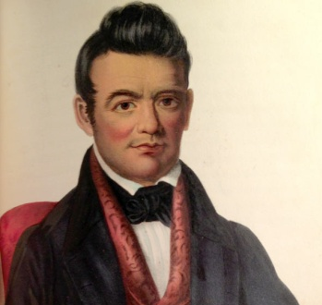
CHEROKEE NATION
Three Waves of Migration
1815-1830: ‘Old Settlers’
1836-1837: Treaty Party w/Ridge
1838-1839: National Party w/Ross
old settlers
Treaty
old settlers
Sequoyah
- old settlers have traditional
government in place
Nat’l Party wants elections
for new Council/gov’t
Treaty
Ridge
National
- Treaty Party sides with Old Settlers
- June 1839: meeting is held to resolve
- no resolution; Sequoyah suggests another
meeting set for July
J. Ross

Slide 56
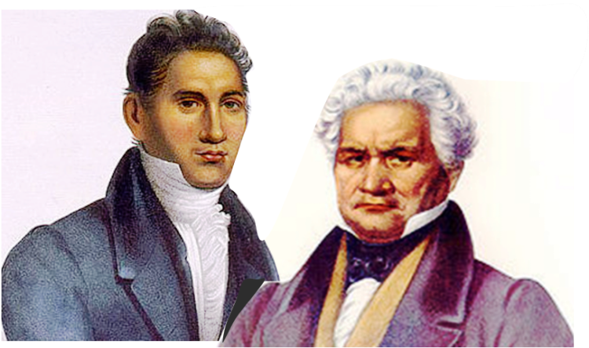
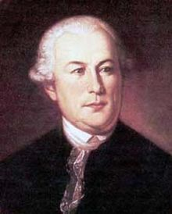
CHEROKEE NATION
What happens to Sequoyah?
Early morning of July 22, 1839
Group of men murder . . .
Major Ridge - traveling
John Ridge – home in bed
Elias Boudinot – providing medicine
(others later)
- Revenge killings for T. of New Echota
- within a few months . . .
- Ross selected Principal Chief
- pardon for those responsible
- new constitution accepted
- sign Act of Union
- years of conflict follow
old settlers
Treaty
Major Ridge
- 68
- 37
Sequoyah
Cherokee
- 37
National
A Cherokee who leaves a legacy!
J. Ross
Notes:
The next day, June 22, 1839, the Cherokee Nation was shocked by the killings of Major Ridge, John Ridge and Elias Boudinot. John was stabbed to death outside his home on Honey Creek, in what is now Delaware County. His father, on his way to Vineyard in Washington County, Ark., was killed near the state line. Boudinot was building his house at Park Hill but left with three men for the home of Rev. Samuel Worcester to secure medicine for them. On the way, his companions killed him near the present-day Little Mission Cemetery and Park Hill Creek.

Slide 57
http://georgiahistory.com/education-outreach/online-exhibits/featured-historical-figures/sequoyah/the-trail-of-tears-and-life-in-the-west/
In 1834, much of the land Cherokees still claimed in Georgia was auctioned off in a land lottery. After returning from a delegation in Washington, D.C., Principal Chief John Ross discovered his elegant mansion was no longer his own. In spite of this, Chief Ross continued to encourage the Cherokee to negotiate with the American government. In March 1835, Major Ridge, John Ridge, and U.S. officials made secret arrangements at the New Echota (by then, no longer the Cherokee capital) home of Elias Boudinot to negotiate terms for the final removal of the Cherokee. Despite Chief John Ross’ objections, a small number of Georgia Cherokee (later known as the Treaty Party) met later in the year to formally accept the Treaty of New Echota in which remaining Cherokee land was ceded for territory in the west for five million dollars, along with some provision for supplies for the journey west and a year’s worth of Federal support for those who moved. The U.S. Senate ratified the treaty, and President Jackson immediately signed it, giving the Cherokee until May 1838 to leave.
As a result, almost 16,000 Cherokee and other Native tribes were forcibly moved from their eastern homeland. Beginning in June 1838, approximately 2,800 Cherokees were loaded on flatboats at Ross’s Landing, Georgia, and sailed down the Tennessee River. The boats were described as being so crammed that they nearly sank. Some rode the train, while others traveled on foot. Over 4,000 died on the long trek to the Oklahoma territory. Survivors arrived exhausted, sick, grief-stricken, and degraded. Many had lost wives, husbands, children, and other loved ones.
Chief Ross and his supporters in the National Party encountered another problem: the construction of a new, combined Cherokee government in the West. In June 1839, approximately 7,000 Cherokees assembled at Takatoka Campground to resolve the problems between the new arrivals (the eastern Cherokee) and the Old Settlers (those who had gone to Oklahoma earlier, usually as a result of earlier treaties and land cessions). The eastern Cherokees had drafted a constitution modeled after the United States, but the Old Settlers created a system based on traditional Cherokee laws. Unable to come to a compromise, Sequoyah, an Old Settler, and Jesse Bushyhead, an eastern Cherokee Baptist minister, made a suggestion for the parties to meet again in July and let the people determine the form of government they preferred.
Before that meeting took place, a group of Cherokee (probably about 150 men of the National Party) plotted to take revenge on those they felt most responsible for signing the Treaty of New Echota. Secretly, they made a list of people they felt deserved the ultimate penalty of death. Of these, three men were killed at approximately the same time: Major Ridge was killed while traveling the road in Washington County, Arkansas; Elias Boudinot was attacked by a group of men claiming they needed medicine; and John Ridge was dragged from his bed and stabbed to death.
In spite of this, Ross proceeded with plans for the July 1 meeting. John Ross’ National Party, with the most representatives in attendance, hurriedly made pardons for those responsible for the murders of the Ridges and Boudinot and declared anyone an outlaw who tried to take vengeance. Amnesty was offered to those responsible if they made a confession by a certain date. They were also banned from office for five years. On July 12, 1839, John Ross and the few representatives of the Old Settlers signed an act of union. On September 6, a compromise was made to accept a constitution similar to the one created in the East. The Treaty Party remained embittered, sending their own delegates to Washington, D.C., to seek government protection and justice for the murders of Boudinot and the Ridges. Under the new government, John Ross was elected as principal chief and an Old Settler as second principal chief.
For the next several years, the Cherokee Nation underwent a series of internal conflicts (sometimes violent) as the Old Settlers, the Treaty Party, and the Latecomers (or National Party) adjusted to life in the federally allotted Indian Territory. Sequoyah worked with John Ross to try and bring peace between the two factions. This civil war ended with a treaty between the factions brokered by the United States Government on August 6, 1846. Signed by delegates from each faction, the 1846 treaty promised the lands ceded to the Cherokee would be available for all members of the Cherokee Nation and offered a general amnesty for crimes committed against the nation or individuals.
“All difficulties and differences heretofore existing between the several parties of the Cherokee Nation are hereby settled and adjusted, and shall, as far as possible, be forgotten and forever buried in oblivion. All party distinctions shall cease, except so far as they may be necessary to carry out this convention or treaty. A general amnesty is hereby declared. All offenses and crimes committed by a citizen or citizens of the Cherokee Nation against the nation, or against an individual or individuals, are hereby pardoned.”
Sequoyah did not live to see the treaty signed. He died in 1843 while traveling in Mexico looking for Cherokee settlements. The trip was part of his continued mission to bring the Cherokee Nation together.

Slide 58
https://en.wikipedia.org/wiki/Major_Ridge
PATHKILLER II (THE RIDGE) 1772– 1839
The Ridge, his family, and many other Cherokee emigrate
to the West in March 1837. The treaty had been signed in December
1835 and was amended and ratified in March 1836. Georgia put
Cherokee lands in a lottery and auctioned them off before the
Cherokee removal date; settlers started arriving and squatting on
Cherokee-occupied land. Georgia supported the settlers against the
Cherokee. After 1838, the US government forcibly rounded up the
remaining Cherokee (along with their slaves) on tribal lands. They were the last people to make the journey that became known as the "Trail of Tears," during which nearly 4,000 Cherokee died.
Accompanied by his wife, daughter, and one of son John's children, Major Ridge traveled by flatboat and steamer to a place in Indian Territory called Honey Creek, near the Arkansas-Missouri Border. The land Ridge had chosen was fifty miles from the territory assigned to the Cherokee. He no longer wished to live among his people. His son John Ridge and Major Ridge's cousin Elias Boudinot followed six months later.
In the West, the Ross faction blamed Ridge and the other signers of the Treaty of New Echota for the 4,000 deaths along the trail in the Removal as well as the loss of communal lands. In June 1839, Major Ridge, his son John, and nephew Elias Boudinot, were executed in accordance with the Cherokee Blood Law by Cherokee of the Ross faction. They tried to kill Elias' brother Stand Watie, but he survived. Other Treaty Party members were later killed, starting a wave of violence within the nation.
Among Ridge's killers was Bird Doublehead. Ridge had killed his father Chief Doublehead under orders by the National Council. Another of his killers was James Foreman, Bird's half-brother. In 1842 Stand Watie, Ridge's nephew, killed Foreman. In 1845 opponents killed his younger brother, Thomas Watie. The cycle of retaliatory violence within the Cherokee resulted in the deaths of all the other Watie family males of that generation. Stand Watie survived the violence of the 1840s, when the Cherokee conflict descended into virtual civil war. In the 1850s, Watie was tried in Arkansas for Foreman's murder but was acquitted on grounds of self-defense; he was defended by his brother Elias' son, Elias Cornelius Boudinot.
Tribal divisions were exacerbated by the outbreak of the American Civil War. Many Cherokee supported the Confederacy, despite the Southern governments having pushed them out. The Confederacy officials now suggested they would recognize an independent Indian state if successful in creating an independent nation. Stand Watie served as Principal Chief (1862-1866) of the pro-Confederate Cherokee after Ross and many Union-supporters withdrew to another location. He served as a Confederate general and was the last to surrender to Union troops.

Slide 59
http://www.cherokeephoenix.org/Article/index/6214
In the early 1800s, the Cherokee Nation was losing its lands in the East. In desperation, the Tribal Council declared in 1829 it would give up no more land and adopted a resolution declaring that any tribal citizen who ceded any part of the tribe’s domain would be punished by death. Major Ridge wrote that law, and he later suffered that penalty prescribed in his law. In spite of the determined stand, the encroachment of white people continued. Finally, in December 1835, Major Ridge, his son, John, and his nephew, Elias Boudinot, and a small number of Cherokees ceded what remained of Cherokee lands to the U.S. government despite not having the authority to do so. In the spring of 1838, thousands of U.S. soldiers came into Cherokee country to drive out the Cherokees. The march of more than 13,000 men, women and children through that winter of 1839 is one of the saddest chapters in American history. It was reported that more than 4,000 people died during the removal process. Upon their arrival to Indian Territory (now Oklahoma) in the spring of 1839, the 13,000 Cherokees immediately began work to re-establish their government and entered into negotiations with earlier Cherokee arrivals to agree upon a common government. A meeting was held at Double Springs, a few miles northwest of where Tahlequah would eventually sit, and an effort was made to agree on articles of union and a government. The “Old Settlers” and “Treaty Party” Cherokees were outnumbered 2-to-1 by the immigrants led by Principal Chief John Ross. However, the smaller factions declined a union with the immigrants except under the government and officers previously established in the West. The Ross faction declined, and the meeting ended. The next day, June 22, 1839, the Cherokee Nation was shocked by the killings of Major Ridge, John Ridge and Elias Boudinot. John was stabbed to death outside his home on Honey Creek, in what is now Delaware County. His father, on his way to Vineyard in Washington County, Ark., was killed near the state line. Boudinot was building his house at Park Hill but left with three men for the home of Rev. Samuel Worcester to secure medicine for them. On the way, his companions killed him near the present-day Little Mission Cemetery and Park Hill Creek. The murderers were never identified nor brought to justice, and the killings ushered in a reign of bloody reprisals that continued for years. Some people alleged that Chief Ross was in some measure guilty or knew of the killers’ plans, but no evidence was ever found to support this. Ross’ son, Allen, provided a new and interesting light on the killings through a statement he made in 1890: “There was some dissention caused by men who had signed the Treaty of 1835 and were opposed to John Ross as chief. After several days of endeavor to get together and having failed, some of the leaders of the emigrants called a secret meeting without the knowledge or consent of my father John Ross at what is now known as Double Springs about four miles north west of Tahlequah for the purpose of making plans to effect an act of union; after much discussion the meeting was called upon to read and to adhere to a law that had been passed by the Cherokee National Council when the first attempt was made to negotiate their lands in the East; when it was ‘provided that who-so-ever should agree or sign an agreement to sell their lands should forfeit their lives.’ “Believing that the same men who had made the Treaty of 1835 were responsible for the failure of the Cherokee people to get together, this meeting decided that these three men should be executed as provided by the law as read. “The meeting further decided that this meeting must be kept from their chief because he would prevent it as he had once before at Red Clay before their removal. “A committee was appointed to arrange details and in response to that committee numbers were placed in a hat for each person present; twelve of these numbers had an X mark after the number, “which indicated the executioners. “All present were asked to draw. When I came to draw the chairman stopped me and told me that I could not draw as the committee had another job for me on that day. “When the drawing was finished I asked the chairman what I was to do. He told me that I was to go to my father’s home on the evening before this execution and for me to stay with my father that night and the next day and if possible to keep him from finding out what was being done. “I went to my fathers as instructed and stayed until I heard that Mr. Boudinot had been killed; I knew that the orders of the committee had been executed. About five o’clock that evening my father and I went to visit with Mr. Arch Campbell and while there some men passed near and as they passed by they threw something into the yard. My father asked what it was. I told him that it was a stick. “I afterwards returned and found that it was a knife, which is still in my possession. These men were some of the full bloods who had participated in the killing of Mr. Boudinot a few minutes before about half a mile west of Arch Campbell’s home. “I know that my father did not know anything about this matter. The last two men who took part in this were Judge Riley W. Keys and Jackson Rattling Gourd. “My father was angry when he learned the facts, and when asked by General Arbuckle to come to Ft. Gibson for conference agreed to go, but his friends fearing for his life would not let him go alone and kept a guard about his home for some time. “The “Act of Union” was formed in a short time and the newly formed council passed an act pardoning all parties connected with this awful affair. “Written by me at my son’s home near Tahlequah, Ind. Ter., Dec. 25th, 1890.” (Signed) Allen Ross.

Slide 60
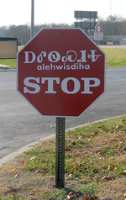
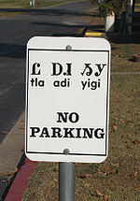
https://en.wikipedia.org/wiki/Tahlequah,_Oklahoma
Tahlequah was established as a capital of the 19th-century Cherokee Nation in 1839, as part of the new settlement in Indian Territory after the Cherokee Native Americans were forced west from the American Southeast on the Trail of Tears.
In 1839, Tahlequah was designated the capital of ancestors of both the Cherokee Nation and the United Keetoowah Band of Cherokee Indians. Initially the government buildings were a complex of log or framed structures. Most of these buildings were destroyed during the Civil War, during which the Cherokee became divided into two bitterly opposing sides.
After the war, a brick capitol was built and first occupied in 1870. In 1907, at the time of Oklahoma statehood, the building was converted into the Cherokee County courthouse. It was returned to the Cherokee Nation in 1970.
Several markers of Cherokee and Native American heritage are found in town: street signs and business signs are noted in both the Cherokee language and English. Such signs use the syllabary created by Sequoyah, a Cherokee scholar of the 1820s who created the writing system.
The Cherokee Supreme Court Building, located in downtown Tahlequah and constructed in 1844, is the oldest public building in Oklahoma.

Slide 61
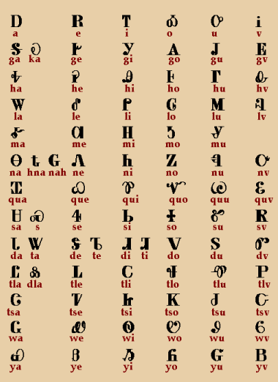
What happens to Sequoyah?
Sequoyah
CHEROKEE NATION
- Sequoyah wants to reunite
the splintered Nation, esp.
those who fled to Mexico
- 1842: Sequoyah (73), his son,
& others walk to Mexico
- 1843: near Zaragoza he
finds Cherokee, but he
dies before return;
- his body is buried in a
cave; his son and the
others return home
Sequoyah
Cherokee
600 miles!
A Cherokee who leaves a legacy!

Slide 62
https://en.wikipedia.org/wiki/Sequoyah
Sequoyah, or George Gist (c.1770—1843),
After the Nation accepted his syllabary in 1825,
Sequoyah traveled to the Cherokee lands in the Arkansas
Territory. There he set up a blacksmith shop and a salt works.
He continued to teach the syllabary to anyone who wished.
In 1828, Sequoyah journeyed to Washington, D.C.,
as part of a delegation to negotiate a treaty for land in the
planned Indian Territory. While in Washington, D.C., he sat
for a formal portrait painted by Charles Bird King. He holds
a copy of the syllabary in his left hand and is smoking a long-stemmed pipe . During his trip, he met representatives of other Native American tribes. Inspired by these meetings, he decided to create a syllabary for universal use among Native American tribes. Sequoyah began to journey into areas of present day Arizona and New Mexico, to meet with tribes there.
In 1829, Sequoyah moved to a location on Big Skin Bayou, near the present city of Sallisaw, Oklahoma, where he built Sequoyah's Cabin that became his home for the rest of his life. It was declared a National Historic Landmark in 1965. It was operated by the Oklahoma Historical Society until it was purchased by the Cherokee Nation November 9, 2016.
In 1839, when the Cherokees were bitterly divided over the issue of removal to Indian Territory, Sequoyah joined with Jesse Bushyhead to try to reunite the Cherokee Nation. Sequoyah, representing the Western Cherokees, and Bushyhead representing the Eastern Cherokees, made a joint plea at a tribal council meeting at Takatoka on 20 June 1839, where they succeeded in getting a voice vote to hold a new council of all Cherokees to resolve the reunification issues.
In addition, Sequoyah dreamed of seeing the splintered Cherokee Nation reunited. In the spring of 1842, Sequoyah began a trip to locate other Cherokee bands who were believed to have fled to Mexico and persuade them return to the Cherokee Nation in the United States. He was accompanied by his son, Teesy (Chusaleta), as well as other Cherokees identified as Co-tes-ka, Nu-wo-ta-na, Cah-ta-ta, Co-wo-si-ti, John Elijah, and The Worm. Sometime between 1843 and 1845, he died during a trip to San Fernando, Tamaulipas, Mexico, when he was seeking Cherokee who migrated there at the time of Indian Removal. His resting place is believed to be in Zaragoza near the Mexico-Texas border.
The following letter gives an account of the death of Sequoyah:
“Warren's Trading House, Red River,April 21st, 1845.
We, the undersigned Cherokees, direct from the Spanish Dominions, do hereby certify that George Guess of the Cherokee Nation, Arkansas, departed this life in the town of San-fernando in the month of August, 1843, and his son Chusaleta is at this time on the Brasos River, Texas, about thirty miles above the falls, and he intends returning home this fall. Given under our hands the day and date written.
STANDING X ROCK (his mark)
STANDING X BOWLES (his mark)
WATCH X JUSTICE (his mark)
WITNESSESDaniel G. WatsonJ esse Chisholm”
In 1938, the Cherokee Nation Principal Chief J. B. Milam funded an expedition to find Sequoyah's grave in Mexico. A party of Cherokee and non-Cherokee scholars embarked from Eagle Pass, Texas, on January 1939. They found a grave site near a fresh water spring in Coahuila, Mexico, but could not conclusively determine the grave site was that of Sequoyah.
In 2011, the Muskogee Phoenix published an article relating a discovery in 1903 of a gravesite in the Wichita Mountains by Hayes and Fancher which they believed was Sequoyah's. The two men said the site was in a cave and contained a human skeleton with one leg shorter than the other, a long-stemmed pipe, two silver medals, a flintlock rifle and an ax. However, the site was far north of the Mexican border.
http://www.cherokee.org/About-The-Nation/History/Biographies/Sequoyah
The completion of the syllabary was accomplished after his arrival in present-day Polk County, Arkansas. He returned east in 1821 to present it to the tribe, and then returned to Indian Territory in 1822, where he first taught the written language in the west. In 1824, the General Council of the Cherokee Nation voted to give Sequoyah a large silver medal as an honor for his creation of the syllabary. Because he did not return east for many years, Chief Path Killer and John Ross had it sent to him. In January 1828, Sequoyah traveled with a group of "Old Settler" Arkansas Cherokees to Washington, D.C. to sign a treaty. Article Five was for the benefit of Sequoyah, "It is further agreed that the United States will pay five hundred dollars for the use of George Guess, a Cherokee, for the great benefit he has conferred upon the Cherokee people in the beneficial results they are now experiencing from the use of the alphabet discovered by him, to whom also in consideration of his relinquishing a valuable saline, the privilege is hereby given to locate and occupy another saline on Lee’s Creek." Lee’s Creek is located in present-day Sequoyah County, Oklahoma. Sequoyah received only $300 of this money. In 1829, Sequoyah and 2500 other Cherokees were moved to the Indian Territory in what is now Oklahoma by the United States government. The land was exchanged for the land they had been occupying in what was later to become Arkansas. The Osage Nation, however, occupied the land. Sequoyah settled near present-day Sallisaw, Oklahoma, where he built a log cabin, which is still standing and open to the public. The Cherokee Advocate, June 26, 1845, gives a report of Sequoyah’s last travels as given by a Cherokee called "The Worm" who had traveled with him. In the spring of 1842, Sequoyah, his son Teesey, The Worm, and six others left Park Hill. They crossed the Arkansas River near Fort Gibson, passed the present town of Holdenville, then Edwards Settlement, and then traveled down the road laid out by Lt. Levensworth. Fifteen days further into their journey, they crossed the Red River near the present town of Sherman, Texas. For approximately 35 days, they traveled among the Wichita villages along the Red River. During this time, Sequoyah became very ill from a lack of food. After purchasing 3 bushels of corn from the Wichitas, his health improved. At that time, all of the party except The Worm and Teesey returned to the Cherokee Nation. The three continued on south to about 80 miles north of San Antonio, Texas, where all their horses were stolen. Instead of attempting to recover them, Sequoyah sent The Worm and Teesey on to San Antonio to see if they could obtain more horses as well as supplies. When they arrived, they were questioned and finally given supplies. However, no horses were to be spared, as they were in use by the U.S. Army. The Worm and Teesey returned to Sequoyah, and he told them he wished to stay where he was while they went on to find Mexican settlements to try and obtain horses. They found a cave where he could have shelter, gathering honey and venison to nourish him while they were on their journey. Their journey south took then nineteen days, at which time they came to a large river. They started working on a raft in order to cross it, and a Mexican on the other side called to them that there was a ferry further downstream. When they arrived at the ferry, The Worm and Teesey were taken to a town six miles away where they were presented to the head man. The next morning, "an officer came and requested us to walk about the town with him, we complied and followed him about for some time. . . . It being after the hour of 12 o’clock, there was but little business doing so nearly all the shops were closed. While yet rambling about the place, a soldier came to request us to go back to our lodgings, upon reaching which we found the soldiers on parade, ready to march off a short distance. By invitation, we joined them and kept along with them until we came to a kind of public square, where there were a number of large kettles containing soup, beef and bread. . . . From these large pots the waiters served the officers, ourselves, and the soldiers in order by taking up pieces of meat with a fork and giving it to us in our hands. What was given me I ate through politeness, but with some difficulty, so highly seasoned was it with pepper, some of which I was so unfortunate as to get in my eyes." ". . . After the second morning, we left and went to a town called San Cranto, about thirty miles away, where we spent the night. Our luck was good and we found a Cherokee, whose name was Standing Rock. He answered many of our questions. We were then assured it would give the Cherokees in Mexico great pleasure to see Sequoyah." Standing Rock then went with Teesey and The Worm to "the Cherokee village, situated within a large prairie, in a grove of timber, held a mile wide, and some three miles long and watered by means of a ditch, from a large spring some two miles distant" which was about 10 miles from San Cranto. Although the Cherokees were glad to see them, they were not able to provide any horses, as all of theirs had perished after their arrival in Mexico. The party then returned to San Cranto where they were able to borrow a horse from the Mexican Army, and was supplied with bread, meat, salt, sugar and coffee for their trip. There were nine in the party. After seventeen days, they reached the Mauluke River and noticed the tracks of a man after they crossed it. They recognized the characteristic tracks of Sequoyah because of his limp. They traveled on to the cave and confirmed that he was not there; he had left a not bound to a tree which said that the water had rose within the cave and had washed away his supplies. He had decided to come on the way and to set fire to the grass as a trail so they could find him. They followed his trail and tracks and found evidence that he acquired a horse and food. The next day, they found his camp because they happened to hear the neighing of a horse. There they found him sitting by a fire. He had suffered greatly. He told them that some Delawares had given the horse and fresh supplies to him. They stayed for five days, long enough to gain a good supply of meat. They all then continued on their journey and reached the river near the Mexican village. Sequoyah stayed in the village while The Worm went to recover the stolen horses. After some time, a party of Caddos returned from Mexico reported that Sequoyah had died. "His death was sudden, having been long confined to the house, he requested one day some food, and while it was preparing, breathed his last." Sequoyah’s death was not reported in the Cherokee Nation for almost two years, when some Cherokees returned from Mexico and gave the following statement to Cherokee agent Pierce M. Butler, "Warrens trading house, Red River, April 21, 1845. . . . We the undersigned Cherokees direct from the Spanish dominions, do hereby certify that George Guess, of the Cherokee Nation, Arkansas, departed this life in the town of San Fernando in the month of August 1843. Given under our hands, day and date above, written Standing Rock, by mark, Standing Bowles, by mark, Watch Justice, by mark, witness Daniel C. Watson and Jesse Chilsom." Another report to agent P.M. Butler, Ou-No-Leh stated that he had met with Teesey, The Worm, Gah-Ne-Nes-Kee, the Standing Man and the Standing Rock. "The Standing Rock. . . attended Sequoyah during his last sickness and also witnessed his death and burial." The statement was dated May 15, 1845, Bayou District. Between the years of 1809 and 1821, he accomplished a feat, which no other person in history has done single-handedly. Through the development of the Cherokee Syllabary, he brought our people literacy and the gift of communicating through long distances and the ages. This one person brought to his people this great gift without hired educators, no books and no cost.

Slide 63
http://nativenorthamericancherokeenationofsequoyah.com/
Website with interesting story of the “Cherokee Nation of Sequoyah” in Mexico
http://www.cherokee.org/About-The-Nation/History/Biographies/Sequoyah
The Cherokee Advocate, June 26, 1845, gives a report of Sequoyah’s last travels as given by a Cherokee called "The Worm" who had traveled with him. In the spring of 1842, Sequoyah, his son Teesey, The Worm, and six others left Park Hill. They crossed the Arkansas River near Fort Gibson, passed the present town of Holdenville, then Edwards Settlement, and then traveled down the road laid out by Lt. Levensworth. Fifteen days further into their journey, they crossed the Red River near the present town of Sherman, Texas. For approximately 35 days, they traveled among the Wichita villages along the Red River. During this time, Sequoyah became very ill from a lack of food. After purchasing 3 bushels of corn from the Wichitas, his health improved.
At that time, all of the party except The Worm and Teesey returned to the Cherokee Nation. The three continued on south to about 80 miles north of San Antonio, Texas, where all their horses were stolen. Instead of attempting to recover them, Sequoyah sent The Worm and Teesey on to San Antonio to see if they could obtain more horses as well as supplies. When they arrived, they were questioned and finally given supplies. However, no horses were to be spared, as they were in use by the U.S. Army. The Worm and Teesey returned to Sequoyah, and he told them he wished to stay where he was while they went on to find Mexican settlements to try and obtain horses. They found a cave where he could have shelter, gathering honey and venison to nourish him while they were on their journey.
Their journey south took then nineteen days, at which time they came to a large river. They started working on a raft in order to cross it, and a Mexican on the other side called to them that there was a ferry further downstream. When they arrived at the ferry, The Worm and Teesey were taken to a town six miles away where they were presented to the head man. The next morning, "an officer came and requested us to walk about the town with him, we complied and followed him about for some time. . . . It being after the hour of 12 o’clock, there was but little business doing so nearly all the shops were closed. While yet rambling about the place, a soldier came to request us to go back to our lodgings, upon reaching which we found the soldiers on parade, ready to march off a short distance. By invitation, we joined them and kept along with them until we came to a kind of public square, where there were a number of large kettles containing soup, beef and bread. . . . From these large pots the waiters served the officers, ourselves, and the soldiers in order by taking up pieces of meat with a fork and giving it to us in our hands. What was given me I ate through politeness, but with some difficulty, so highly seasoned was it with pepper, some of which I was so unfortunate as to get in my eyes." ". . . After the second morning, we left and went to a town called San Cranto, about thirty miles away, where we spent the night. Our luck was good and we found a Cherokee, whose name was Standing Rock. He answered many of our questions. We were then assured it would give the Cherokees in Mexico great pleasure to see Sequoyah." Standing Rock then went with Teesey and The Worm to "the Cherokee village, situated within a large prairie, in a grove of timber, held a mile wide, and some three miles long and watered by means of a ditch, from a large spring some two miles distant" which was about 10 miles from San Cranto. Although the Cherokees were glad to see them, they were not able to provide any horses, as all of theirs had perished after their arrival in Mexico. The party then returned to San Cranto where they were able to borrow a horse from the Mexican Army, and was supplied with bread, meat, salt, sugar and coffee for their trip. There were nine in the party. After seventeen days, they reached the Mauluke River and noticed the tracks of a man after they crossed it. They recognized the characteristic tracks of Sequoyah because of his limp. They traveled on to the cave and confirmed that he was not there; he had left a note bound to a tree which said that the water had rose within the cave and had washed away his supplies. He had decided to come on the way and to set fire to the grass as a trail so they could find him. They followed his trail and tracks and found evidence that he acquired a horse and food. The next day, they found his camp because they happened to hear the neighing of a horse. There they found him sitting by a fire. He had suffered greatly. He told them that some Delawares had given the horse and fresh supplies to him. They stayed for five days, long enough to gain a good supply of meat. They all then continued on their journey and reached the river near the Mexican village. Sequoyah stayed in the village while The Worm went to recover the stolen horses. After some time, a party of Caddos returned from Mexico reported that Sequoyah had died. "His death was sudden, having been long confined to the house, he requested one day some food, and while it was preparing, breathed his last." Sequoyah’s death was not reported in the Cherokee Nation for almost two years, when some Cherokees returned from Mexico and gave the following statement to Cherokee agent Pierce M. Butler,
"Warrens trading house, Red River, April 21, 1845. . . . We the undersigned Cherokees direct from the Spanish dominions, do hereby certify that George Guess, of the Cherokee Nation, Arkansas, departed this life in the town of San Fernando in the month of August 1843. Given under our hands, day and date above, written Standing Rock, by mark, Standing Bowles, by mark, Watch Justice, by mark, witness Daniel C. Watson and Jesse Chilsom." Another report to agent P.M. Butler, Ou-No-Leh stated that he had met with Teesey, The Worm, Gah-Ne-Nes-Kee, the Standing Man and the Standing Rock. "The Standing Rock. . . attended Sequoyah during his last sickness and also witnessed his death and burial." The statement was dated May 15, 1845, Bayou District. Between the years of 1809 and 1821, he accomplished a feat, which no other person in history has done single-handedly. Through the development of the Cherokee Syllabary, he brought our people literacy and the gift of communicating through long distances and the ages. This one person brought to his people this great gift without hired educators, no books and no cost.

Slide 64
CHEROKEE NATION
Five Tribes
- NEW LIVES
CHEROKEE OUTLET
CHEROKEE
NATION
CREEK NATION
SEMINOLE NATION
leased
CHOCTAW NATION
CHICKASAW NATION

Slide 65
Five Tribes - the rest is history!
Five Tribes
- NEW LIVES
CHEROKEE OUTLET
CHEROKEE
NATION
CREEK NATION
SEMINOLE NATION
leased
CHOCTAW NATION
CHICKASAW NATION

Slide 66
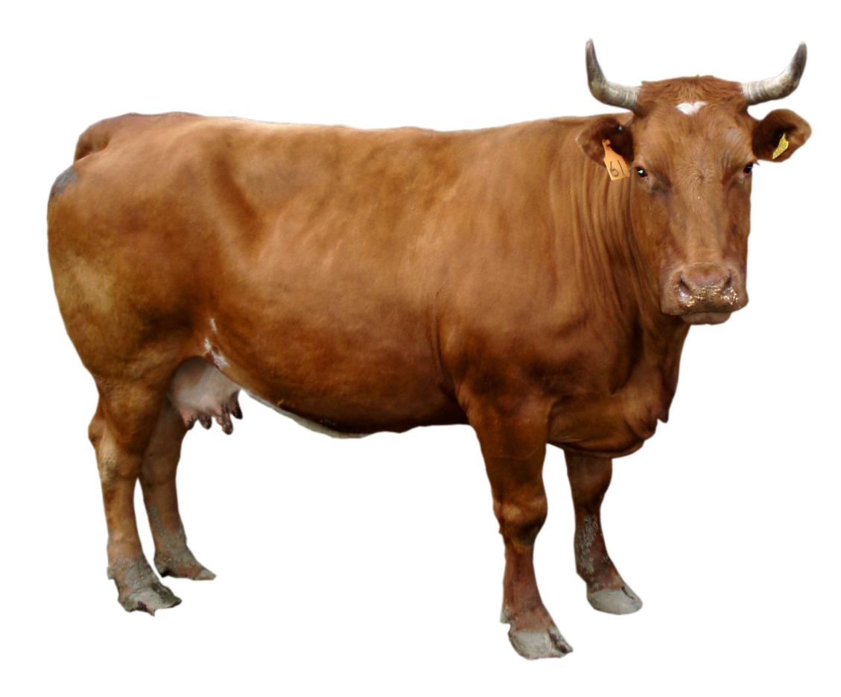
Five Tribes - the rest is history!
1840-1860: THE GROWING ENOMOMY
CHEROKEE OUTLET
CHEROKEE
NATION
CREEK NATION
SEMINOLE NATION
markets to Mississippi R and N.O.
leased
CHOCTAW NATION
CHICKASAW NATION

Slide 67
Five Tribes - the rest is history!
1860-1865: THE CIVIL WAR
Factors determining affiliation
1) market – toward the south
2) slavery (14% pop. slaves)
3) mixed-blood or full-blood
4) lack of support from U.S.
Confederacy sends commissioners to enlist support
CHEROKEE OUTLET
CHEROKEE
NATION
closed
CREEK NATION
SEMINOLE NATION
Confederate
abandoned
THE FORTS
leased
abandoned
closed
Confederate
CHOCTAW NATION
CHICKASAW NATION
closed
Confederate
HQ
abandoned
Confederate

Slide 68
1817-1871 – Fort Smith
1824-1857 – Fort Gibson
1824-1856 – Fort Towson
1865 – confederate HQ
1834-1838 – Fort Coffee
1842-1860 – Fort Washita
confederate occupy
1851-1870 – Fort Arbuckle
confederate occupy
FORTS
CHEROKEE
NATION
Tahlequah
Fort
Smith
Fort Gibson
Fort Coffee
Fort Arbuckle
Fort Towson
Fort Washita

Slide 69
Five Tribes - the rest is history!
1860-1865: THE CIVIL WAR
Confederacy sends commissioners to enlist support
CHEROKEE OUTLET
CHEROKEE
NATION
Aug 1861
CREEK NATION
SEMINOLE NATION
Oct 1861
July 1861
leased
CHOCTAW NATION
CHICKASAW NATION
July 1861
July 1861
Some sub-groups support the Union
, flee to KS
Tribes sign treaties with Confederacy

Slide 70
https://en.wikipedia.org/wiki/Five_Civilized_Tribes
During the American Civil War, the politics of the Five Tribes were divergent. The Choctaw and Chickasaw fought predominantly alongside the Confederates while the Creek and Seminole fought alongside the Union. The Cherokee fought a civil war within their own nation between the majority Confederates and the minority, pro-Union camps. As an element in Reconstruction after the Civil War, new Reconstruction Treaties were signed with the indigenous nations that had entered into treaties with the Confederate States of America. The Civil War was not good to the tribes. The first three battles of the Civil War were fought in Indian territory, with some tribes joining treaties with the Confederates, and others with the Union.
Once the tribes had been relocated to Indian Territory, the United States government promised that their lands would be free of white settlement. Some settlers violated that with impunity, even before 1893, when the government opened the "Cherokee Strip" to outside settlement in the Oklahoma Land Run. In 1907, the Oklahoma Territory and the Indian Territory were merged to form the state of Oklahoma. Relative to other states, all Five Tribes are represented in significant numbers in the population of Oklahoma today.
http://www.okhistory.org/publications/enc/entry.php?entry=CI011
For the Five Civilized Tribes the Civil War proved a disastrous experience. The Cherokee, Chickasaw, Choctaw, Seminole, and Creek had only begun to repair the damage done by intra-tribal factionalism before and during Indian Removal (1830–39), and to fashion a hospitable existence in Indian Territory, when the war came upon them and revived old disagreements. Indeed, it can be argued that no group in the nation suffered more in the Civil War than the Indians of Oklahoma.
In the two decades after removal the Five Tribes formed active economies and adapted to life in Indian Territory. The Chickasaw and Choctaw practiced cotton plantation agriculture, and the Cherokee, Creek, and Seminole engaged in subsistence farming, ranching, and cattle raising. Market connections with New Orleans gave the tribes a Southern orientation. Each had an established government, distinct boundaries to their land, and a United States government representative (an agency) by which the obligations of the removal treaties were met. While the pre–Civil War era was not a "golden age" for the tribes, the trauma of dislocation had healed, and the region seemed destined to enjoy more prosperous times.
A key social institution among the Five Tribes, one that was also crucial in the sectional division of the United States, was the extent of slave holding. Of Indian Territory's approximately one hundred thousand inhabitants, 14 percent were African American slaves. That aspect of tribal culture, as much as any other, explains the willingness of many Indians to side with the Confederate States of America. The Cherokee Confederate general Stand Watie owned nearly one hundred slaves, making him, in the context of the times, an immensely wealthy man.
Little of the debate over slavery's expansion affected the tribes in Indian Territory. However, Indian slaveholders were apprehensive about the Republican victory in 1860 and the party's ultimate designs for "the peculiar institution." Many Indian Territory residents were upset by Secretary of State William H. Seward's remarks when he urged the U.S. government to extinguish tribal land titles and open the West to settlement.
Another condition catastrophically affecting the tribes was continued dissension between mixed-bloods and full bloods over the legacy of removal. Nowhere was this division more apparent than among the Cherokee. Because the mixed-bloods had signed a removal treaty at New Echota in 1835, they were despised by the full bloods, led by Chief John Ross. A leadership contest developed between the factions, pitting Stand Watie, for the mixed-bloods, against Ross. Until 1860, however, Ross and the full bloods had succeeded in holding political control of the tribe, and a working, if not amicable, accommodation between the two parties had been achieved.
The Confederate government, formed by early February 1861, had plans for the West. Jefferson Davis and his councilors saw the need to protect the Mississippi River, use the western Confederacy as a "breadbasket," and eventually establish Indian Territory as a springboard for expansion. Later in 1861 Davis appointed Albert Pike, a noted Arkansas attorney who enjoyed a good reputation with the Five Tribes, as Commissioner of Indian Affairs. Prior to Pike's arrival, other commissioners had gone north to Indian Territory from Texas to enlist the tribes in the southern cause. They found the Choctaw and Chickasaw enthusiastic for the Confederacy, and strong sentiment for the new nation also appeared among the Creek and Seminole. In early 1861 Col. Douglas H. Cooper recruited the Choctaw and Chickasaw into mounted rifle units, which later fought in Arkansas and Missouri. Albert Pike also recruited military units, and after Stand Watie received a colonel's commission in the Confederate army on July 12, 1861, he raised a band of three hundred for service.
The Cherokee, however, held back from formal alliance. John Ross doubted the wisdom of secession and favored neutrality. Had the tribes listened to Ross, they would have weathered the war and enjoyed good relations with the victor. However, tribal divisions among the mixed-blood and full-blood factions, as well as the fact of slaveholding, worked against a policy of neutrality.
Unfortunately for the Union and the Cherokee, the U.S. government did little to engender Indian support. Seeing Confederate activity in Arkansas and Texas, Lt. Col. William H. Emory, commanding the Union troops in Indian Territory, abandoned Forts Washita, Arbuckle, and Cobb in May 1861 and retreated to Kansas. Consequently, Union sympathizers in Indian Territory had no military protection for their allegiance, and they found themselves surrounded by Confederate power. Later, in August 1861 Union forces suffered a defeat at Wilson's Creek in Missouri. Early Confederate victories and the lack of a Union presence made a Confederate alliance compelling.
Albert Pike thus made headway with the Indian Territory tribes. He signed treaties with the Creek (July 10, 1861), the Choctaw and Chickasaw (July 12), the Seminole (August 1), and the Wichita, Caddo, and others (August 12). John Ross stalled, but the military power of the Confederacy rose while that of the Union waned. On October 7 the Confederacy consummated a treaty with the Cherokee and then with the Quapaw, Seneca, Shawnee, and Osage. The mixed-bloods rejoiced over the alliance and quickly signed into the Confederate military.
The Oklahoma Indians were in an impossible position, facing an uncertain and perilous future. A small population, they therefore could neither enforce their will on their neighbors nor defend their borders. Kansas to the north was Union, and Arkansas to the east and Texas to the south were Confederate. Neutrality would have required diplomatic finesse, and military power would have be necessary to have kept the residents of those states from despoiling Indian Territory. Geography and scarce population would make the Indian nations a marching ground for troops in transit elsewhere or make them a target for vengeance. The region itself possessed no particular military advantages save one: both the Confederacy and the Union wanted to insure that the tribes did not support the other.
In terms of tactics the determining factor in the West during the Civil War was the Mississippi River. Union strategy, devised by Gen. Winfield Scott and dubbed the "Anaconda Plan," sought to control the Mississippi River and thus to divide the Confederacy. Most of the warfare in the West, therefore, was connected to furthering or thwarting Brig. Gen. Ulysses S. Grant's advance down the river. Military activity in Indian Territory was marginal to that objective. Confederate Brig. Gen. Ben McCulloch, that army's second-ranking general officer, was ordered from Texas to Arkansas and placed in command of Indian Territory. The Confederate Army of the West, which he was to build, was to be composed of three Indian regiments plus one regiment each from Texas, Louisiana, and Arkansas.
After the treaty making ended, Confederate military companies formed rapidly among the tribes, but resentment toward the Confederacy also surfaced. The Creek leader (and slaveholder) Opothleyahola rejected the Confederate alliance and led some seven thousand followers away from tribal lands. Secessionists perceived him as an enemy, and they pursued, under the leadership of Col. Douglas H. Cooper. The Creeks defended themselves at Round Mountain (November 19, 1861), Chusto-Talasah (December 9), and Chustenalah (December 26). In the last engagement, Opothleyahola's encampment was routed. The remainder of his followers eventually reached Kansas as refugees.
Confederate leaders attempted to use Indian Territory troops to force the federals out of Arkansas. Under Albert Pike, promoted to brigadier general, the Indian regiments joined divisions led by Brig. Gens. Sterling Price and Ben McCulloch to drive out Union troops under Brig. Gen. Samuel R. Curtis. However, at the Battle of Pea Ridge (March 7–8, 1862), Curtis proved the superior strategist and defeated the Confederate command. Pike, upset by McCulloch's charges that the Indian troops had performed in a disorderly manner and had scalped Union soldiers, took his regiments back to Indian Territory. He resigned his commission in May 1862 because in his view the Confederates were failing to uphold their treaty promises. Also in that month the Trans-Mississippi Department of the Confederacy was created, specifically including Indian Territory.
At about the same time, Union commanders in the West then decided to seize Indian Territory. Under Col. William Weer the Union Indian Expedition moved out of Kansas in June 1862. On July 3 they attacked units under Cols. Stand Watie and John Drew at Locust Grove and, by superior use of artillery, defeated the Confederates. Weer then moved down and momentarily took Fort Gibson. However, his subordinates rejected his propositions about further advances and demanded to return to Kansas, eventually deposing Weer of his command. This failed expedition threw the Cherokee into turmoil. John Ross used the occasion to negate the Confederate treaty and to embrace the Union cause. He and his family left the Cherokee Nation and resided in Philadelphia and Washington, D.C. for the remainder of the war.
In October 1862 Union Brig. Gen. James G. Blunt invaded Indian Territory from Arkansas and on October 22 defeated Col. Douglas H. Cooper at Fort Wayne. Blunt made several sorties thereafter and placed Col. William A. Phillips in charge of organizing Cherokee Unionists. In February 1863 Phillips convened the Cowskin Prairie Council, which elected Thomas Pegg as acting Cherokee principal chief and repudiated the Confederate treaty. The Cherokee thereby officially divided their allegiance. One side, led by Pegg, claimed loyalty to the Union, and the other affirmed the Confederate alliance and recognized Stand Watie as chief.
Blunt was determined to rid Indian Territory of the Confederates. Stationing himself at Fort Gibson (renamed Fort Blunt), he engaged the Southern forces under Douglas H. Cooper (now brigadier general) at Honey Springs on July 17, 1863. In this, the most important military engagement in Indian Territory during the Civil War, the Union army was victorious, due to superior artillery and inferior Confederate gunpowder.
After Honey Springs the Civil War in Indian Territory assumed a different form and was, in truth, a minor affair. The fate of the region became similar to that of border areas like Missouri, Kentucky, and Tennessee. Rule of law was lost, and roaming bands of irregular partisans plundered and murdered hapless civilians. William Quantrill and his company of irregulars made their way several times through the land. Stand Watie was active in these years, but he was no guerrilla. Promoted to brigadier general in May 1864, he undertook military missions of strategic value that sought to disrupt the supply lines of Union troops that were stationed in Indian Territory or were moving south. His most famous exploits were the capture of the steamer J. R. Williams on June 15, 1864, and his seizure of a Union supply train at Cabin Creek on September 19, 1864.
Thereafter in the territory, partisan activity on both sides led to retaliatory raids and many cruelties. When either a Confederate or Union force left an area, the civilian population was open to invasion by opposing forces. Fear of retribution led to a massive refugee problem. Some two thousand displaced Cherokee suffered at Fort Scott, Kansas. When Union victory at Honey Springs led to permanent Federal occupation of Forts Gibson and Smith, those who were exiled in Kansas were ordered home. By 1863 perhaps as many as seven thousand refugees surrounded Fort Gibson. At the end of the war, in camps around Red River, Confederate civilians numbering nearly fifteen thousand gathered and suffered. It has been estimated that among the Cherokee by 1863 one-third of the married women had become widows, and one-fourth of the children were orphans.
Added to the misery of refugee camps was the systematic plundering of the tribes' wealth. A system arose to supply federal troops and refugees with meat and other foodstuffs. Looters pillaged the herds of Indian Territory and then sold the livestock to contractors, who then marketed the animals to the army at inflated prices. By war's end three hundred thousand head of cattle had been stolen from Indian Territory, a devastating economic blow. Moreover, the tribes recognized that political forces were operating against them. Kansas Sens. Jim Lane and Samuel Pomeroy sought to transfer Kansas Indians into Indian Territory and abrogate treaties made with the Five Tribes. Iowa Sen. James Harlan proposed a bill to end tribal sovereignty and establish a territorial government for a state of Oklahoma, thereby destroying Indian land titles.
On April 9, 1865, Gen. Robert E. Lee's surrender at Appomatox sealed the Confederacy's fate, but it was some time before western generals accepted its demise. On May 26, 1865, Lt. Gen. Edmund Kirby Smith surrendered the Confederacy's Trans-Mississippi Department, of which Indian Territory was a part. One of the last Confederate generals to capitulate was Stand Watie, who did so on June 23, 1865. From the Oklahoma region some 3,530 men had enlisted in the Union army, and 3,260 in the Confederacy. Approximately ten thousand people had died due to the war. The loss of livestock and the end of slavery dealt a considerable blow to the tribes' economic systems.

Slide 71
https://en.wikipedia.org/wiki/Opothleyahola
Opothleyahola (about 1798 – March 22, 1863) was a Muscogee Creek Indian chief, noted as a brilliant orator. He was a Speaker of the Upper Creek Council and supported traditional culture. Known as a diplomatic chief, he led Creek forces against the United States government during the first two Seminole Wars.
During the American Civil War, he was among the minority of Creek in Indian Territory who supported the Union. He led his followers to Kansas in what became the Trail of Blood on Ice, where they sought refuge at a federal fort but suffered due to inadequate supplies, disease and harsh winters. He died at one of the refugee camps in Kansas.
At the outbreak of the American Civil War, Opothleyahola and the Muscogee-speaking Creek remained loyal to the federal government. While it had passed legislation for Indian removal, they believed that the pressure for this came from Georgia and the southern populations, so did not support the Confederacy. The Lower Creek and some of the other of the Southeastern tribes, who had specialized in cotton production and had more cultural contacts with white settlers, supported the Confederacy, which had promised them an Indian state if they won the war. Tensions within the Creek Nation increased during this period because the Confederacy tried to convince it and other Indian nations to tighten slave codes in Indian Territory.
Creek with African ancestry resented the restrictions of proposed "black codes," increasing their sense of loyalty to the Union. Runaway slaves, free blacks, Chickasaw and Seminole Indians also began gathering at Opothleyahola's plantation, hoping to remain neutral in the conflict between the North and South.
On August 15, 1861, Opothleyahola and tribal chief Micco Hutko contacted President Abraham Lincoln to request help for the loyalists. On September 10, they received a positive response stating the United States government would assist them. The letter directed Opothleyahola to move his people to Fort Row in Wilson County, Kansas, where they would receive asylum and aid.
On November 15, Confederate Col. Douglas H. Cooper, a former US Indian Agent, led 1,400 men, including pro-Confederate Indians, northward; he intended either to convince Opothleyahola and his followers to support the Confederacy or to "drive him and his party from the country." Believing Federal promises of assistance, Opothleyahola led his band (including Seminole under
Halleck Tustenuggee) toward Kansas. Along the way, they had to fight three battles against their pursuers, and had lost many of their goods in their quick departure. At Round Mountain,
Opothleyahola's forces drove back the Confederates to Fort Gibson.
In December, the loyalists suffered a tactical loss at Chusto-Talasah and a crushing defeat at the Battle of Chustenahlah. He lost an estimated 2,000 of his 9,000 followers from the battles, disease, and bitter winter blizzards during their ill-fated trek to Fort Row. The fort lacked adequate medical support and supplies to care for the refugees. The Creek were forced to move to Fort Belmont, but conditions were still very poor. The majority of the Creek had only the clothes on their backs and lacked proper footwear and shelter, as they had left in a hurry. Many Creek died that winter, among them Opothleyahola's daughter.
Conditions for the Creek in Kansas continued to be very harsh. Opothleyahola died in the Creek refugee camp near the Sac and Fox Agency at Quenemo in Osage County, Kansas on March 22, 1863.^{[2]} He was buried beside his daughter near Fort Belmont in Woodson County, Kansas.

Slide 72
https://ipjournal.wordpress.com/2009/12/16/the-indian-policy-of-abraham-lincoln/
Abraham Lincoln dealt directly with issues concerning the Five Civilized Tribes (Choctaw, Chickasaw, Seminole, Creek and Cherokee) in Indian Territory, especially the Cherokees. The Confederacy deliberately sought to win those five tribes to its side. On the other hand, as Viola notes, “The Lincoln administration evidently at first did not regard the five tribes as a serious military threat and so did little to counter the confederate efforts until too late.”24 Prucha writes that after Union troops were removed from Indian Territory, “The Indians were left at the mercy of the Confederacy, and southern officials were quick to capitalize on all the points in their favor.”25 The Confederacy acted much more aggressively than the Union, engaging in treaty making and recruiting tribal members to its military.
Lincoln, however, did have direct contact with Cherokee Principle Chief John Ross who Viola calls the “foremost Cherokee delegate in the Civil War era.”26 Ross stayed in Washington, D.C. from October 1862 to July 1865. Lincoln first met with Ross on September 12, 1862.27 The Cherokee Principle Chief also wrote a steady stream of letters to the President. Lincoln, in his Second Annual Message told Congress that “The chief of the Cherokees has visited this city for the purpose of restoring the former relations of the tribe with the United States. He alleges that they were constrained by superior force to enter into treaties with the insurgents, and that the United States neglected to furnish the protection which their treaty stipulations required.”28
Ross had made that point to Lincoln in a September 1862 letter. Ross wrote that the Cherokees were “forced for the preservation of their country and their existence to negotiate a treaty with the Confederate States. What the Cherokee People now desire is ample military protection…and a recognition by the Government of the obligations of existing treaties.”29 Lincoln responded that he hadn’t been able to “determine the exact treaty relations between the United States and the Cherokee Nation. Neither have I been able to investigate and determine the exact state of facts claimed by you as constituting a failure of treaty obligations on our part, excusing the Cherokee Nation for making a treaty with a portion of the people of the United States in open rebellion against the government thereof.”30 He said that he would “cause” an investigation of the matter. It is clear from other correspondence that issues involving Cherokees were brought to Lincoln’s attention. In a January 1863 letter to Ross, Huckleberry Downing and Tahlahlah told Ross that Justin Harlan, Agent for the Cherokees, “says that the President thinks that the Indians have been badly treated in time passed, & sent him (the Agent) with special instructions to see that every thing was done for them which can be.” 31 Ross himself wrote several Cherokees that same month that “at our interviews with the President & other officers of the Govt. we represented the deplorable condition in which our people are placed, in consequence of the failure on the part of the U. States Govt. to afford them protection, agreeably to their Treaty obligations with the Cherokee Nation.”32
In January1864, the Cherokee National Council sent a petition to the President drawing his attention to the condition of the Cherokee Nation and what, in a separate letter to Lincoln, Ross called “grievances, and the evils which have come upon them.” 33 Further, the Principle Chief wrote, “we beg leave very respectfully to ask the favorable attention of your Excellency to the several points embraced in the prayer of the petitions.” 34 Lincoln and the government did nothing to ameliorate the conditions Cherokees faced.

Slide 73
1860-1865: THE CIVIL WAR
Confederacy sends commisioners to enlist support
Some sub-groups support the Union
, flee to KS
Tribes sign treaties with Confederacy

Slide 74
1860-1865: THE CIVIL WAR
Tribes form Confederate military companies
One Cherokee leader becomes a Confederate general
1862: U.S. Congress passes Statute 528
1862: Cherokees officially divide their allegiance
if a native tribe is . . .
“in a state of actual hostility to the
government of the United States…”
- all treaties with such tribe are abrogated
- appropriations to such tribes are suspended

Slide 75
http://www.okhistory.org/publications/enc/entry.php?entry=CI011
President Abraham Lincoln may have offered "charity for all" in his second inaugural address, but the federal government showed little of that disposition when dealing with the Indians. U.S. officials tried to force a harsh peace on the tribes at the Fort Smith Council in September 1865, but it was rejected by the tribe's leaders. Treaties were finally signed in Washington, D.C., in 1866. The Five Tribes lost the western half of Indian Territory to Kansas tribes, slavery was ended, freedmen obtained citizenship and property rights, and the tribes had to permit railroad construction in the area. Indian Territory was now unofficially called Oklahoma, and while the government did not impose a territorial organization upon the land, the tribes agreed to work toward having a governor and an intertribal council. The pre-war status as separate, independent nations was expected to end.
The tribes unsuccessfully attempted to reclaim the advances made between 1840 and 1860. Although wartime animosities flared between the old Confederate and Union factions, new governmental entities were formed as a spate of constitution making occurred between 1867 and 1872. Railroads penetrated Oklahoma in the 1870s, but in some ways their arrival was a curse rather than a blessing, for they brought whites seeking land.
Farming and ranching returned with some vigor to the area, but the spread of tenant farming was an ominous sign of the loss of independence among farmers. The territory acquired a reputation for lawlessness in the postwar years. The destruction of legal authority and infighting among the tribes made it difficult to police the region. In the absence of law enforcement, terrorists who had operated with impunity during the war returned to continue their rampaging ways—the James Gang, the Younger Gang, and the Dalton Brothers.
It is difficult to gauge the effect of the Civil War upon Indian Territory. Tribal sovereignty was under attack, other states wanted to remove their Indians there, and white settlers coveted the land. But none of these situations were created by the war. Regardless of the conflict, these forces would have been in motion toward the end of the nineteenth century. However, the Civil War did weaken the tribes. It exacerbated long-standing internal divisions and made new ones, and it destroyed needed population and crushed economic advance. Without the war perhaps the tribes might have grown in numbers, in wealth, and in political power. They might then have been better able to ward off later Euroamerican attacks on their land. The only rational assessment that can be made without fear of contravention is that the Civil War crippled the tribes of Indian Territory and took away their strength.

Slide 76
1860-1865: THE CIVIL WAR
1865-1907: TERMINATION OF THE FIVE NATIONS
Tribes form Confederate military companies
One Cherokee leader becomes a Confederate general
1862: U.S. Congress passes Statute 528
1862: Cherokees officially divide their allegiance
1863: Union re-takes Fort Smith; re-opens Ft. Gibson
1864: Union orders return
of tribal members living in
refugee camps in Kansas
1865: War ends –
- 10,000 Indians have died
- 300K livestock stolen
- slaves are freed
- new era begins

Slide 77
1865-1907: TERMINATION OF THE FIVE NATIONS
1866: TREATIES OF WASHINGTON
TO the Tribes
- amnesty for all crimes committed against the U.S.
- no federal legislation could interfere with or annul their
tribal organizations
FROM the Tribes
- all previous treaties ‘null and void’
- abolish slavery and give the freedmen tribal rights
- Cherokee, Creek, Seminole: unqualified rights
- Choctaw, Chickasaw: choice – adopt, remove
- provide rights-of-way for railroad construction
- establish an intertribal council
- give up a land as a penalty for insurrection
(western half of Oklahoma)
?

Slide 78
1865-1905: TERMINATION OF THE FIVE NATIONS
1866: TREATIES OF WASHINGTON
Cherokee
Seminole
Creek
Choctaw
Chickasaw

Slide 79
https://tshaonline.org/sites/default/files/images/handbook/CC/cherokee_reservations.jpg

Slide 80
http://apushcanvas.pbworks.com/w/page/72810365/Oklahoma%20Territory%20on%20unoccupied%20lands%20in%20the%20Indian%20Territory

Slide 81
1871 -- Indian Appropriations Act
- tribes not recognized by US as independent nations
- interactions between tribes and US were no longer
done by Treaty (2 foreign countries)
1885 Act
- allows tribes or indians to sell unoccupied land
1889 Act
- opens unassigned land to settlers (Homestead Act)
1887 – DAWES, 1898 – CURTIS, 1906 – BURKE ACTS
Goals:
- breaking up of tribes as a social unit
- encouraging individual initiatives
- furthering the progress of native farmers
- reducing the cost of native administration,
- securing parts of the reservations as Indian land, and
- opening the remainder of the land to white settlers for profit
Provisions:
abolish tribal governments
register indians as tribal members (Dawes Rolls)
allot communal lands to registered members
sell lands declared surplus
dissolve tribal courts
Consequences:
- tribal land titles extinguished
- Five tribes lost 90M acres of tribal lands to white sales
Some land allotments too small for profitable farming, speculators
break down of social structure
Oklahoma Statehood
- 1890: Oklahoma Organic Act
- create organized incorporated territories in anticipation of statehood
- 1891-1907: Congress passes several laws to join Oklahoma and Indian territories
- 1905: ‘Sequoyah’ statehood attempt
- 1906: Oklahoma Enabling Act
- Nov 16, 1907: OK becomes 46th state
1934 – Indian Reorganization Act
ends land allotment
returns rights to reorganize and form their self-governments
1965 – Economic Opportunity Act
1968 – Indian Civil Rights Act

Slide 82
http://www.okhistory.org/publications/enc/entry.php?entry=RE001
RECONSTRUCTION TREATIES (Treaties of Washington)
On the eve of the Civil War in 1861 the Five Civilized Tribes had well-established homes and tribal governments in Indian Territory (I.T.). These five republics were forced to respond to the crisis in the United States when U.S. troops were withdrawn from I.T., leaving them vulnerable to the Confederacy. The tribes had little choice but to enter into agreements with Albert Pike, representative of the Confederate government. The Choctaw and Chickasaw were united in their support of the Confederacy, but the other three tribes either had an almost equal number of troops fighting on both sides or had more on the side of the Union, as was the case of the Cherokee. As the United States drew up the Reconstruction Treaties at the conclusion of the Civil War, it disregarded the fact that some tribe members had supported the Union. With pressure from Kansas and other midwestern states, politicians were determined to retaliate for the tribes' support of the Confederacy.
Negotiations between the federal government and the Five Civilized Tribes began at the Fort Smith Council in September 1865. Commissioner of Indian Affairs Dennis N. Cooley told the American Indian delegates that new treaties had to be written. It was explained that they had forfeited their rights, annuities, and land claims under the old treaties when they joined the Confederacy. Cooley was joined by Superintendent of Indian Affairs for the Southern Superintendency Elijah Sells and Special Commissioner Ely S. Parker (a Seneca and future commissioner of Indian affairs under Pres. Ulysses S. Grant) in representing the federal government. Cooley insisted that each of the tribes abolish slavery, make homes for the freedmen, and give up part of their lands for the settlement of other American Indians. Because of the differing views and attitudes between the two sides and because some tribal delegates had no authority to accept treaty terms, the council adjourned, and negotiations were not taken up again until spring and summer 1866.
The definitive treaties were finalized in Washington, D.C. in 1866; The Chickasaw and Choctaw signed a joint treaty on July 10, 1866. The Creek and Cherokee treaties were proclaimed on August 11 and the Seminole treaty on August 16. Generally, all the treaties contained
1) amnesty for all crimes committed against the United States prior to the treaties and included specific provisions of peace and friendship toward the United States. The terms of these treaties were more favorable to the Five Civilized Tribes than the offerings at the Fort Smith Council.
At the Washington meeting Cooley, Sells, and Parker joined Secretary of the Interior James Harlan in representing the federal government. The Cherokees had two delegations: the Northern delegation directed by John Ross, who died shortly after the treaty was completed, and the Southern delegation led by former Confederate leaders Elias C. Boudinot and Stand Watie. The Creek and Seminole also had Northern and Southern delegations. The other two tribes had only one delegation each.
Concessions were made by all of the tribes. The first was to
2) abolish slavery and give the freedmen tribal rights. The Cherokee, Creek, and Seminole treaties gave the freedmen unqualified rights, but the Choctaw and Chickasaw treaty gave them the choice of being adopted into their nations or being removed by the federal government and settled elsewhere. The second compromise was to
3) establish an intertribal council. Each tribe would have one representative, with an additional representative for each one thousand tribal members. The superintendent of Indian affairs would serve as the council's chief executive. The third concession was the agreement that all the 4) tribes would give up land in their various domains for rights-of-way for railroad construction through I.T.
The final compromise was that 5) each tribe would give up a considerable amount of land as a penalty for having supported of Confederacy. The Cherokee gave up their "Neutral Lands" in southeastern Kansas and the Cherokee Strip, to be sold to the highest bidder for not less than $1.25 an acre. They also agreed to allow the federal government to settle other tribes in the Cherokee Outlet in exchange for payment made by the government to the Cherokee Nation.
Through their reconstruction treaty the Choctaw and Chickasaw ceded to the United States the Leased District in the western half of their domain for $300,000. A clause in this treaty (July 1866) referred to all the area of the Five Civilized Tribes as the "territory of Oklahoma." This was the first mention of the name Oklahoma in an official document of the United States and had been suggested by Allen Wright, member of the Choctaw delegation.
The Creek ceded the western half of their lands for $975,168. Some of the land was to be used for rebuilding, and the remainder was to be held in trust. The Seminole ceded all of their land to the federal government for fifteen cents an acre. They then had to purchase two hundred thousand acres for fifty cents an acre from the government. Ironically, the government had purchased it for thirty cents from the Creek.
As a result of this final concession, the Five Civilized Tribes lost the western half of present Oklahoma. These treaties had a tremendous impact on future relations between the federal government and the Five Civilized Tribes. The influx of whites moving into Indian Territory after the Civil War pressed for statehood during the 1890s and early 1900s. However, tribe members fought to retain their sovereignty based on the clause in the Reconstruction Treaties that stated that no federal legislation could interfere with or annul their tribal organization.

Slide 83
https://en.wikipedia.org/wiki/Reconstruction_Treaties
On the eve of the American Civil War in 1861, a significant number of Indigenous peoples of the Americas had been relocated from the Southeastern United States to Indian Territory, west of the Mississippi. The inhabitants of the eastern part of the Indian Territory, the Five Civilized Tribes, were suzerain nations with established tribal governments, well established cultures, and legal systems that allowed for slavery. Before European Contact these tribes were generally matriarchial societies, with agriculture being the primary economic pursuit. The bulk of the tribes lived in towns (some covering hundreds of acres and containing thousands of people) with planned streets, residential and public areas. The people were ruled by complex hereditary chiefdoms of varying size and complexity with high levels of military organization.
By the middle of the 19th century, the United States Government had started leasing land from the Five Civilized Tribes (ex. Choctaw and Chickasaw) in the western, more arid, part of Indian Territory. These leased lands were used to resettle several Plains Indian tribes that tended to be nomadic in nature, embracing the Horse cultur. At the extreme, the Comanche society was based on patrilinear and patrilocal extended family sharing a common language; they did not developed the political idea of forming a nation or tribe until their relocation to Indian Territory.
At the beginning of the Civil War, the Union Army was withdrawn from Indian Territory exposing the Five Civilized Tribes to aggression from the Plains Indians. The Confederacy filled the vacuum. All of the Five Civilized Tribes as well as other surrounding tribes signed treaties with the Confederacy. As a part of reconstruction, the Southern Treaty Commission was created by Congress to write new treaties with the Tribes that sided with the Confederacy.
The Choctaw Nation and Chickasaw Nation in Indian Territory strongly support the Confederacy which signed the Treaty with Choctaws and Chickasaws. The Cherokee Nation, Muscogee (Creek) Nation and Seminole Nation had troops fighting on both sides. Other tribes such as Osage, Seneca, Seneca and Shawnee of the Neosho Agency, and Quapaw Tribes also signed treaties with the Confederacy.
During the Civil War, the Union Congress passed a statute that gave the President the authority to suspend the appropriations of any tribe if the tribe is "in a state of actual hostility to the government of the United States… and, by proclamation, to declare all treaties with such tribe to be abrogated by such tribe"(25 U.S.C. Sec. 72).
The term Reconstruction Era typically covers the transformation of the Southern United States in the decade after the Civil War. However, the reconstruction of the Indian Territory lasted significantly longer and fostered policy changes that impacted other tribes in the rest of the country.
As a component of Reconstruction, a "grand council was called by the President of the United States, through the department of the Interior, to which a summons was issued to each of the five tribes to send representatives. This call was mandatory as far as it related to all Indian tribes which had been identified by treaty or otherwise with the late southern confederacy. Word was also given to other tribes, many of whom had reservations in Kansas."The Council, the Southern Treaty Commission, held in Ft. Smith, Arkansas, was attended by hundreds of Indians representing dozens of tribes. Over the next several years the commission negotiated treaties with different tribes that resulted in additional relocations to Indian Territory and the de facto creation (initially by treaty) of an unorganized Oklahoma Territory.
In September 1865, the Southern Treaty Commission, headed by Dennis N. Cooley,
Commissioner of Indian Affairs met with delegates of the Five Civilized Tribes as well as other tribes. At the meeting Cooley informed the Tribes that by joining the Confederacy, their previous treaties were null and void, and that new treaties would need to be negotiated. Key components of new treaties would be the abolishment of slavery, providing homes for the freedmen, and giving up part of their lands for the settlement of other American Indians.
It was stated that it was the policy of the US Government that "all nations and tribes in the Indian Territory be formed into one consolidated government after the plan proposed by the Senate of the United States, in a bill for organizing the Indian territory."
One result of the meeting was an "agreement" (not an officially ratified treaty) that served as a basis for the treaties that were signed the following year. In the agreement, the tribes agreed to "in all things recognize the government of the United States as exercising exclusive jurisdiction over them, and will not enter into any allegiance or conventional arrangement with any state, nation, power or sovereign whatsoever; that any treaty of alliance for cession of land, or any act heretofore done by them, or any of their people, by which they renounce their allegiance to the United States, is hereby revoked, cancelled, and repudiated" The council adjourned, and was called back to order the middle of 1866.
The United States House Committee on Territories was initially formed in 1825. Shortly after the Civil War, the Committee began discussing how best to assimilate the Five Civilized Tribes into the Union. Two significant decisions were made by the committee with regards to how the Union interacted with the Native Americans:
It was decided that Indian removal had limited effectiveness and that the new policy would be one of assimilation. One component of assimilation would be the distribution of property held in-common by the tribe to individual members of the tribe.
In 1871, Congress decided that the United States would no longer deal with Indian tribes through a formal treaty-making process, providing that "[n]o Indian nation or tribe within the territory of the United States shall be acknowledged or recognized as an independent nation . . ."
These decisions were implemented over subsequent years through numerous "reconstruction treaties" and subsequent laws, including the Indian Appropriations Act, Homestead Act (which provided a framework for land runs, Dawes Act, Dawes Commission, Curtis Act of 1898 (which extended the allotment process to the tribes of Indian Territory and limited the scope of tribal courts and governments), Oklahoma organic act in 1890, and the Five Civilized Tribe Act of April 26, 1906 which "Provide for the Final Disposition of the Affairs of the Five Civilized Tribes in Oklahoma.[
Some tribes sent two delegations, one representing a Southern faction and the other representing a Northern faction. The Government typically negotiated only with the Northern delegates.Tribes represented include:
- Choctaw: Colonel RM Jones (President), JR Kingsbury (Secretary), David Birney
Chickasaw: Colbert Carter (President), Lewis Johnson (Secretary), AG Griffith, (Maharda Colbert-Interpreter)
- Cherokee
Northern: headed by John Ross (Cherokee chief), Colonel Reese, Pas-co-fa, Fos-har-go, Cho-Cote Har-go, Fos-hut-she
Southern: headed by Elias Cornelius Boudinot (a colonel in the Confederate States Army, and a territorial representative in the Confederate Congress) and Stand Watie (a brigadier general of the Confederate States Army, and the last Confederate general in the field to surrender.)
- Muscogee (Creek)
Northern: Mik-ko-hut-kee (Little White Chief), Sanford Berryman
Southern: Colonel Daniel N. McIntosh
- Seminole
Northern: John Chupco
Southern: John Brown
Many of the Reconstruction Treaties were titled with the phrase "Treaty of Washington." These treaties replaced the treaties that were voided when the tribes signed treaties with the Confederacy. Some Indian tribes signed treaties at the Ft. Smith conference. The Five Civilized Tribes agreed to draft treaties, but final treaties were signed in Washington, D.C. during the year of 1866.
The Chickasaw and Choctaw signed the Chickasaw and Choctaw Treaty of Washington July 10, 1866
Creek August 11, 1866
Cherokee Reconstruction Treaty of 1866 (August 11)
Seminole treaty ratified on August 16, 1866
All the treaties contained:
amnesty for all crimes committed against the United States prior to the treaties
included specific provisions of peace and friendship toward the United States
notice that previous treaties were null and void
the Tribes acknowledgement of the supremacy of the United States Government, its Constitution, and its laws: past, present and future
clause stating that no federal legislation could interfere with their tribal organization
tribes would provide Land grants in their various domains for rights-of-way for railroad (and sometimes telegraph) construction through Indian Territory
Different tribes addressed freedman tribal rights (resulting from the abolition of slavery) in different ways. The Cherokee, Creek, and Seminole treaties gave the freedmen unqualified rights, while the Choctaw and Chickasaw treaty gave them the choice of being adopted into their nations or being removed by the federal government and settled elsewhere. The Chickasaw however refused to accept the Freedmen into the Chickasaw Nation on the grounds that the Nation was so small that absorbing their Freedmen would dilute the Chickasaw Nation. This refusal resulted in the Chickasaw Freedmen spending a significant number of years being citizens of no country at all.
The Intertribal Council evolved into the Territorial Legislature for the Indian Territory described in the Oklahoma Organic Act which established Oklahoma and Indian Territories. Each tribe would have one representative, with an additional representative for each one thousand tribal members. The superintendent of Indian affairs would serve as the council's chief executive.
The Choctaw and Chickasaw Nations had a single Reconstruction Treaty, the Choctaw and Chickasaw Treaty of Washington (1866). in which they sold land west of the 98 longitude to the United States for $300,000. Much of this land was previously "leased" to the Federal Government and was the home of other Indian tribes.
Cherokee gave up their "Neutral Lands" in southeastern Kansas and the Cherokee Strip, to be sold to the highest bidder for not less than $1.25 an acre. They also agreed sell land to the Osage Nation and to allow the federal government to settle other tribes in the Cherokee Outlet in exchange for payment made by the government to the Cherokee Nation.
The Creek ceded the western half of their lands to the Federal Government for $975,168, about $0.30 per acre
The Seminole sold all of their land in the western part of the territory for $0.15 per acre to the Federal Government. The Seminole then purchased from the Federal Government about two hundred thousand acres of land (the current Seminole County, Oklahoma) for $0.50 per acre (former Creek land).
The Osage tribe sells significant territory in Kansas and Missouri to the US for $1.25 per acre. The Drum Creek Treaty of 1870 provided that the remainder of Osage land in Kansas be sold and the proceeds used to relocate the tribe to the Cherokee Outlet. That Osage purchased the land from the Cherokees, receiving Fee simple title, provided the tribe with a legitimately that later allowed them more autonomy when the State of Oklahoma was formed. The land purchased is now the present Osage County, Oklahoma.
The tribes of the Quapaw Indian Agency are the Eastern Shawnee, Miami, Modoc,
Ottawa, Peoria of the Illinois Confederation, Quapaw Tribe, Seneca and Cayuga of the Iroquois Confederacy, and Wyandotte, and some small remnants of other tribes. The tribes were originally removed from Illinois, Indiana, Ohio and New York to Kansas, Missouri and Arkansas Territory in the 1820s and 1830s. The post-Civil War Treaties negotiated by the Southern Treaty Commission with the various tribes relocated these tribes to an area northeast of the Cherokee nation, chiefly in what is today Ottawa and Delaware Counties in Oklahoma. Many of the tribal governments are located in Miami, Oklahoma.

Slide 84
1865-1907: TERMINATION OF THE FIVE NATIONS
1866: TREATIES OF WASHINGTON
Numerous tribes are relocated to lands of Five Tribes
Indian
Territory
1871: Indian Appropriation Act
- tribes not recognized by U.S. as independent nations
- interactions between tribes & U.S. are no longer
done by Treaty

Slide 85
https://en.wikipedia.org/wiki/Indian_Appropriations_Act
The Indian Appropriation Act is the name of several acts passed by the United States Congress. A considerable number of acts were passed under the same name throughout the 19th and early 20th centuries, but the most notable landmark acts consist of the Appropriation Bill for Indian Affairs of 1851 and the 1871 Indian Appropriations Act.
1871 Act
According to the Indian Appropriation Act of March 3, 1871, no longer was any group of Indians in the United States recognized as an independent nation by the federal government. Moreover, Congress directed that all Indians should be treated as individuals and legally designated "wards" of the federal government. Before this bill was enacted, the federal government signed treaties with different Native American tribes, committing the tribes to land cessions, in exchange for specific lands designated to Indians for exclusive indigenous use as well as annual payments in the form of cash, livestock, supplies, and services. These treaties, which took much time and effort to finalize, ceased with the passage of the 1871 Indian Appropriation Act, declaring that “no Indian nation or tribe” would be recognized “as an independent nation, tribe, or power with whom the United States may contract by treaty.” Thus, it can be argued that this bill made it significantly easier for the federal government to secure lands that were previously owned by Native Americans.
1885 Act
After several attempts by the Boomers to enter Indian Territory, Congress passed the 1885 Act which allowed Indian tribes, and individual Indians to sell unoccupied lands that they claimed to be their own.
1889 Act
After years of trying to open Indian Territory, President Grover Cleveland, on March 2, 1889, signed the 1889 Act which officially opened the Unassigned Lands to white settlers under tenets of the Homestead Act. On a side-note, Grover Cleveland signed the Act into law days before his successor, Benjamin Harrison, took over as President of the United States. However, under a section in this original act, those who entered these unassigned lands illegally, before their respective racing times as designated in the President’s opening proclamation, would be denied the rights to the lands they claimed. These people were termed "Sooners,” with this section of the act being termed as the "sooner clause.” But there was growing political pressure to open these unassigned lands to settlement quickly. Thus, later in 1889, an amendment to the Indian Appropriations Act allowed President Benjamin Harrison to be involved in this historical bill as well, proclaiming unassigned lands were open for settlement under much less stringent rules.

Slide 86
1865-1907: TERMINATION OF THE FIVE NATIONS
Dawes Act (1887) & Curtis Act (1898)
Numerous tribes are relocated to lands of Five Tribes
Note:
tribal interactions with U.S. are no longer
by TREATIES, but by ACTS of CONGRESS
Indian
Territory
1871: Indian Appropriation Act
- tribes not recognized by U.S. as independent nations
- interactions between tribes & U.S. are no longer
done by Treaty

Slide 87
1865-1907: TERMINATION OF THE FIVE NATIONS
Dawes Act (1887) & Curtis Act (1898)
GOALS
- encourage individual initiatives & break tribal units
- further the progress/success of native farmers
- reduce cost of native administration
- open remainder of land to white settlers for profit
Note:
tribal interactions with U.S. are no longer
by TREATIES, but by ACTS of CONGRESS
PROVISIONS (grouped)
- abolish tribal governments
- register Indians as tribal members (Dawes Rolls)
- allot communal lands to registered members
- sell lands declared surplus
- dissolve tribal courts

Slide 88
https://en.wikipedia.org/wiki/Dawes_Act
The Dawes Act of 1887 adopted by Congress in 1887, authorized the President of the United States to survey American Indian tribal land and divide it into allotments for individual Indians. Those who accepted allotments and lived separately from the tribe would be granted United States citizenship. The Dawes Act was amended in 1891, in 1898 by the Curtis Act, and again in 1906 by the Burke Act.
The Act was named for its creator, Senator Henry Laurens Dawes of Massachusetts. The objectives of the Dawes Act were to abolish tribal and communal rights of Native Americans in order to stimulate assimilation of them into mainstream American society, to transfer lands under Indian control to white settlers, and thereby lift Native Americans out of poverty. Individual household ownership of land and subsistence farming on the European-American model was seen as an essential step. The act provided that the government would classify as "excess" those Indian reservation lands remaining after allotments, and sell those lands on the open market, allowing purchase and settlement by non-Native Americans.
The Dawes Commission, set up under an Indian Office appropriation bill in 1893, was created to try to persuade the Five Civilized Tribes to agree to allotment plans. (They had been excluded from the Dawes Act by their treaties.) This commission registered the members of the Five Civilized Tribes on what became known as the Dawes Rolls.
The Curtis Act of 1898 amended the Dawes Act to extend its provisions to the Five Civilized Tribes; it required abolition of their governments, allotment of communal lands to people registered as tribal members, and sale of lands declared surplus, as well as dissolving tribal courts. This completed the extinguishment of tribal land titles in Indian Territory, preparing it to be admitted to the Union as the state of Oklahoma.
During the ensuing decades, the Five Civilized Tribes lost 90 million acres of former communal lands, which were sold to non-Natives. In addition, many individuals, unfamiliar with land ownership, became the target of speculators and criminals, were stuck with allotments that were too small for profitable farming, and lost their household lands. Tribe members also suffered from the breakdown of the social structure of the tribes.
During the Great Depression, the Franklin D. Roosevelt administration supported passage on June 18, 1934 of the US Indian Reorganization Act (also known as the Wheeler-Howard Law). It ended land allotment and created a "New Deal" for Indians, renewing their rights to reorganize and form their self-governments.
BACKGROUND
During the 1850s, the United States federal government's attempt to exert control over the Native Americans expanded. Numerous new European immigrants were settling on the eastern border of the Indian territories, where most of the Native American tribes were situated. Conflicts between the groups increased as they competed for resources and operated according to different cultural systems. Many European Americans did not believe that members of the two racial societies could coexist within the same communities. Searching for a quick solution to their problem, William Medill the Commissioner of Indian Affairs, proposed establishing "colonies" or "reservations" that would be exclusively for the natives, similar to those which some native tribes had created for themselves in the east. It was a form of removal whereby the US government would uproot the natives from their current locations to positions to areas in the region beyond the Mississippi River; this would enable settlement by European Americans in the Southeast in turn opening up new placement for the new white settlers and at the same time protecting them from the corrupt "evil" ways of the subordinate natives.
The new policy intended to concentrate Native Americans in areas away from encroaching settlers, but it caused considerable suffering and many deaths. During the nineteenth century, Native American tribes resisted the imposition of the reservation system and engaged with the United States Army in what were called the Indian Wars in the West for decades. Finally defeated by the US military force and continuing waves of encroaching settlers, the tribes negotiated agreements to resettle on reservations. Native Americans ended up with a total of over 155 million acres (630,000 km²) of land, ranging from arid deserts to prime agricultural land.
The Reservation system, though forced upon Native Americans, was a system that allotted each tribe a claim to their new lands, protection over their territories, and the right to govern themselves. With the Senate supposedly being able to intervene only through the negotiation of treaties, they adjusted their ways of life and tried to continue their traditions.
The traditional tribal organization, a defining characteristic of Native Americans as a social unit, became apparent to the non-native communities of the United States and created a mixed stir of emotions. The tribe was viewed as a highly cohesive group, led by a hereditary, chosen chief, who exercised power and influence among the members of the tribe by aging traditions. The tribes were seen as strong, tight-knit societies led by powerful men who were opposed to any change that weakened their positions. Many white Americans feared them and sought reformation. The Indians' failure to adopt the "Euro-american" lifestyle, which was the social norm in the United States at the time, was seen as both unacceptable and uncivilized.
By the end of the 1880s, a general consensus seem to have been reached among many US stakeholders that the assimilation of Native Americans into American culture was top priority; it was the time for them to leave behind their tribal landholding, reservations, traditions and ultimately their Indian identities.
On February 8, 1887, the Dawes Allotment Act was signed into law by President Grover Cleveland. Responsible for enacting the division of the American native reserves into plots of land for individual households, the Dawes Act was created by reformers to achieve six goals:
- breaking up of tribes as a social unit,
-encouraging individual initiatives,
- furthering the progress of native farmers,
- reducing the cost of native administration,
- securing parts of the reservations as Indian land, and
- opening the remainder of the land to white settlers for profit
The compulsory Act forced natives to succumb to their inevitable fate; they would undergo severe attempts to become "Euro-Americanized" as the government allotted their reservations with or without their consent. Native Americans held very specific ideologies pertaining to their land, to them the land and earth were things to be valued and cared for, for they represented all things that produced and sustained life, it embodied their existence and identity, and created an environment of belonging. In opposition to their white counterparts, they did not see it from an economic standpoint.
But, many natives began to believe they had to adapt to the majority culture in order to survive. They would have to embrace these beliefs and surrender to the forces of progress. They were to adopt the values of the dominant society and see land as real estate to be bought and developed; they were to learn how to use their land effectively in order to become prosperous farmers. As they were inducted as citizens of the country, they would shed their uncivilized discourses and ideologies, and exchange them for ones that allowed them to become industrious self-supporting citizens, and finally rid themselves of their "need" for government supervision.
The important provisions of the Dawes Act were:
1) A head of family would receive a grant of 160 acres (65 ha), a single person or orphan over 18 years of age would receive a grant of 80 acres (32 ha), and persons under the age of 18 would receive 40 acres (16 ha) each;
2) the allotments would be held in trust by the U.S. Government for 25 years;
3) Eligible Indians had four years to select their land; afterward the selection would be made for them by the Secretary of the Interior.
4) Every member of the bands or tribes receiving a land allotment is subject to laws of the state or territory in which they reside. Every Indian who receives a land allotment "and has adopted the habits of civilized life" (lived separate and apart from the tribe) is bestowed with United States citizenship "without in any manner impairing or otherwise affecting the right of any such Indian to tribal or other property".
5) The Secretary of Interior could issue rules to assure equal distribution of water for irrigation among the tribes, and provided that "no other appropriation or grant of water by any riparian proprietor shall be authorized or permitted to the damage of any other riparian proprietor."
The Dawes Act did not apply to the territory of the: Cherokee, Creek, Choctaw, Chickasaw, Seminole, Miami, and Peoria in Indian Territory; Osage, Sac, and Fox, in the Oklahoma Territory; any of the reservations of the Seneca Nation of New York, or
a strip of territory in the State of Nebraska adjoining the Sioux Nation.
Provisions were later extended to the Wea, Peoria, Kaskaskia, Piankeshaw, and Western Miami tribes by act of 1889. Allotment of the lands of these tribes was mandated by the Act of 1891, which amplified the provisions of the Dawes Act.
Dawes Act 1891 AmendmentS
In 1891 the Dawes Act was amended:
1) Allowed for pro-rata distribution when the reservation did not have enough land for each individual to receive allotments in original quantities
2) provided that when land is only suitable for grazing purposes, such land be allotted in double quantities
3) Established criteria for inheritance
4) Does not apply to Cherokee Outlet
Provisions of the Curtis Act
The Curtis Act of 1898 extended the provisions of the Dawes Act to the Five Civilized Tribes in Indian Territory.
It did away with their self-government, including tribal courts.
providing for allotment of lands to tribal members,
authorized the Dawes Commission to make determination of members when registering tribal members
Provisions of the Burke Act
The Burke Act of 1906 amended the sections of the Dawes Act dealing with US Citizenship (Section 6) and the mechanism for issuing allotments. The Secretary of Interior could force the Indian Allottee to accept title for land. US Citizenship was granted unconditionally upon receipt of land allotment (the individual did not need to move off the reservation to receive citizenship). Land allotted to Indians was taken out of Trust and subject to taxation. The Burke Act did not apply to any Indians in Indian Territory.
The Dawes Act had a negative effect on American Indians, as it ended their communal holding of property (with crop land often being privately owned by families or clans), by which they had ensured that everyone had a home and a place in the tribe. The act "was the culmination of American attempts to destroy tribes and their governments and to open Indian lands to settlement by non-Indians and to development by railroads". Land owned by Indians decreased from 138 million acres (560,000 km²) in 1887 to 48 million acres (190,000 km²) in 1934.
Senator Henry M. Teller of Colorado was one of the most outspoken opponents of allotment. In 1881, he said that allotment was a policy "to despoil the Indians of their lands and to make them vagabonds on the face of the earth". Teller also said, "the real aim [of allotment]
was "to get at the Indian lands and open them up to settlement. The provisions for the apparent benefit of the Indians are but the pretext to get at his lands and occupy them. ... If this were done in the name of Greed, it would be bad enough; but to do it in the name of Humanity ... is infinitely worse."
The amount of land in native hands rapidly depleted from some 150 million acres (610,000 km²) to a small 78 million acres (320,000 km²) by 1900. The remainder of the land once allotted to appointed natives was declared surplus and sold to non-native settlers as well as railroad and other large corporations; other sections were converted into federal parks and military compounds. The concern shifted from encouraging private native landownership to satisfying the white settlers' demand for larger portions of land.
By dividing reservation lands into privately owned parcels, legislators hoped to complete the assimilation process by forcing Indians to adopt individual households, and strengthen the nuclear family and values of economic dependency strictly within this small household unit.
Given the conditions on the Great Plains, the land granted to most allottees was not sufficient for economic viability of farming. Division of land among heirs upon the allottees' deaths quickly led to land fractionalization. Most allotment land, which could be sold after a statutory period of 25 years, was eventually sold to non-Native buyers at bargain prices. Additionally, land deemed to be "surplus" beyond what was needed for allotment was opened to white settlers, though the profits from the sales of these lands were often invested in programs meant to aid the American Indians. Over the 47 years of the Act's life, Native Americans lost about 90 million acres (360,000 km²) of treaty land, or about two-thirds of the 1887 land base. About 90,000 Native Americans were made landless.
In 1906 the Burke Act (also known as the forced patenting act) amended the GAA to give the Secretary of the Interior the power to issue allottees a patent in fee simple to people classified "competent and capable". The criteria for this determination is unclear but meant that allottees deemed "competent" by the Secretary of the Interior would have their land taken out of trust status, subject to taxation, and could be sold by the allottee. The allotted lands of Indians determined to be incompetent by the Secretary of the Interior were automatically leased out by the federal government. The act reads:
... the Secretary of the Interior may, in his discretion, and he is hereby authorized, whenever he shall be satisfied that any Indian allottee is competent and capable of managing his or her affairs at any time to cause to be issued to such allottee a patent in fee simple, and thereafter all restrictions as to sale, encumbrance, or taxation of said land shall be removed.
The use of competence opens up the categorization, making it much more subjective and thus increasing the exclusionary power of the Secretary of Interior. Although this act gives power to the allottee to decide whether to keep or sell the land, given the harsh economic reality of the time, and lack of access to credit and markets, liquidation of Indian lands was almost inevitable. It was known by the Department of Interior that virtually 95% of fee patented land would eventually be sold to whites.
The allotment policy depleted the land base, ending hunting as a means of subsistence. According to Victorian ideals, the men were forced into the fields (but the Indians thought this made them take on what in their society had traditionally been the woman's role, and the women were relegated to the domestic sphere). This Act imposed a patriarchal nuclear household onto many matrilineal Native societies, in which women had controlled property and descent.
Native gender roles and relations quickly changed with this policy, since communal living had shaped the social order of Native communities. Women were no longer the caretakers of the land and they were no longer valued in the public political sphere. Even in the home, the Native woman was dependent on her husband. Before allotment, women divorced easily and had important political and social status, as they were usually the center of their kin network. Under the Dawes Act, to receive the full 160 acres (0.65 km²), women had to be officially married.
In 1926, Secretary of the Interior Hubert Work commissioned a study of federal administration of Indian policy and the condition of Indian people. Completed in 1928, The Problem of Indian Administration – commonly known as the Meriam Report after the study's director, Lewis Meriam – documented fraud and misappropriation by government agents. In particular, the Meriam Report found that the General Allotment Act had been used to illegally deprive Native Americans of their land rights.
After considerable debate, Congress terminated the allotment process under the Dawes Act by enacting the Indian Reorganization Act of 1934 ("Wheeler-Howard Act"). However, the allotment process in Alaska, under the separate Alaska Native Allotment Act, continued until its revocation in 1971 by the Alaska Native Claims Settlement Act.
Despite termination of the allotment process in 1934, effects of the General Allotment Act continue into the present. For example, one provision of the Act was the establishment of a trust fund, administered by the Bureau of Indian Affairs, to collect and distribute revenues from oil, mineral, timber, and grazing leases on Native American lands. The BIA's alleged improper management of the trust fund resulted in litigation, in particular the case Cobell v. Kempthorne (settled in 2009 for $3.4 billion), to force a proper accounting of revenues.
For nearly one hundred years, the consequences of federal Indian allotments have developed into the problem of fractionation. As original allottees die, their heirs receive equal, undivided interests in the allottees' lands. In successive generations, smaller undivided interests descend to the next generation. Fractionated interests in individual Indian allotted land continue to expand exponentially with each new generation.
Today, there are approximately four million owner interests in the 10,000,000 acres (40,000 km²) of individually owned trust lands, a situation the magnitude of which makes management of trust assets extremely difficult and costly. These four million interests could expand to 11 million interests by the year 2030 unless an aggressive approach to fractionation is taken. There are now single pieces of property with ownership interests that are less than 0.0000001% or 1/9 millionth of the whole interest, which has an estimated value of .004 cent.
The economic consequences of fractionation are severe. Some recent appraisal studies suggest that when the number of owners of a tract of land reaches between ten and twenty, the value of that tract drops to zero. Highly fractionated land is for all practical purposes worthless.
In addition, the fractionation of land and the resultant ballooning number of trust accounts quickly produced an administrative nightmare. Over the past 40 years, the area of trust land has grown by approximately 80,000 acres (320 km²) per year. Approximately 357 million dollars is collected annually from all sources of trust asset management, including coal sales, timber harvesting, oil and gas leases and other rights-of-way and lease activity. No single fiduciary institution has ever managed as many trust accounts as the Department of the Interior has managed over the last century.
Interior is involved in the management of 100,000 leases for individual Indians and tribes on trust land that encompasses approximately 56,000,000 acres (230,000 km²). Leasing, use permits, sale revenues, and interest of approximately $226 million per year are collected for approximately 230,000 individual Indian money (IIM) accounts, and about $530 million per year are collected for approximately 1,400 tribal accounts. In addition, the trust currently manages approximately $2.8 billion in tribal funds and $400 million in individual Indian funds.
Under current regulations, probates need to be conducted for every account with trust assets, even those with balances between one cent and one dollar. While the average cost for a probate process exceeds $3,000, even a streamlined, expedited process costing as little as $500 would require almost $10,000,000 to probate the $5,700 in these accounts.
Unlike most private trusts, the federal government bears the entire cost of administering the Indian trust. As a result, the usual incentives found in the commercial sector for reducing the number of small or inactive accounts do not apply to the Indian trust. Similarly, the United States has not adopted many of the tools that states and local government entities have for ensuring that unclaimed or abandoned property is returned to productive use within the local community.
Fractionation is not a new issue. In the 1920s, the Brookings Institution conducted a major study of conditions of the American Indian and included data on the impacts of fractionation. This report, which became known as the Meriam Report, was issued in 1928. Its conclusions and recommendations formed the basis for land reform provisions that were included in what would become the IRA. The original versions of the IRA included two key titles, one dealing with probate and the other with land consolidation. Because of opposition to many of these provisions in Indian Country, often by the major European-American ranchers and industry who leased land and other private interests, most were removed while Congress was considering the bill. The final version of the IRA included only a few basic land reform and probate measures. Although Congress enabled major reforms in the structure of tribes through the IRA and stopped the allotment process, it did not meaningfully address fractionation as had been envisioned by John Collier, then Commissioner of Indian Affairs, or the Brookings Institution.
In 1922, the General Accounting Office (GAO) conducted an audit of 12 reservations to determine the severity of fractionation on those reservations. The GAO found that on the 12 reservations for which it compiled data, there were approximately 80,000 discrete owners but, because of fractionation, there were over a million ownership records associated with those owners. The GAO also found that if the land were physically divided by the fractional interests, many of these interests would represent less than one square foot of ground. In early 2002, the Department of the Interior attempted to replicate the audit methodology used by the GAO and to update the GAO report data to assess the continued growth of fractionation; it found that it increased by more than 40% between 1992 and 2002.
Fractionation has become significantly worse. As noted above, in some cases the land is so highly fractionated that it can never be made productive. With such small ownership interests, it is nearly impossible to obtain the level of consent necessary to lease the land. In addition, to manage highly fractionated parcels of land, the government spends more money probating estates, maintaining title records, leasing the land, and attempting to manage and distribute tiny amounts of income to individual owners than is received in income from the land. In many cases, the costs associated with managing these lands can be significantly more than the value of the underlying asset.

Slide 89
https://en.wikipedia.org/wiki/Curtis_Act_of_1898
The Curtis Act of 1898 was an amendment to the United States Dawes Act; it resulted in the break-up of tribal governments and communal lands in Indian Territory (now Oklahoma) of the Five Civilized Tribes of Indian Territory: the Choctaw, Chickasaw, Muscogee (Creek),
Cherokee, and Seminole. These tribes had been previously exempt from the 1887 General Allotment Act (Dawes Act) because of the terms of their treaties. In total, the tribes immediately lost control of about 90 million acres of their communal lands; they lost more in subsequent years.
The act also transferred to the Dawes Commission the authority to determine members of tribes, as part of the registration of members. Thus, individuals could be enrolled as members without tribal consent. By effectively abolishing the remainder of tribal courts, tribal governments, and tribal land claims in the Indian Territory of Oklahoma, the act enabled Oklahoma to be admitted as a state, which followed in 1907.
Officially titled the "Act for the Protection of the People of Indian Territory", the Act is named for Charles Curtis, congressman from Kansas and its author. He was of mixed Native American and European descent: on his mother's side -Kansa, Osage, Potawatomi, and French; and on his father's - three ethnic lines of British Isles ancestry. Curtis was raised in part on the Kaw Reservation of his maternal grandparents, but also lived with his paternal grandparents and attended Topeka High School. He read the law, became an attorney, and later was elected to the United States House of Representatives and Senate. He served as Vice-President under Herbert Hoover.
In the usual fashion, by the time the bill HR 8581 had gone through five revisions in committees in both the House of Representatives and the Senate, there was little left of Curtis' original draft. In his hand-written autobiography, Curtis noted having been unhappy with the final version of the Curtis Act. He believed that the Five Civilized Tribes needed to make changes. He thought that the way ahead for Native Americans was through education and use of both their and the majority cultures, but he also had hoped to give more support to Native American transitions.
Abolition of tribal governments
The Curtis Act called for the abolition of tribal governments on March 6, 1906. It was intended to establish individual land holdings in the European-American model, for subsistence farming by families. The act also provided for the establishment of public schools. Due to the nature of the lands in Indian Territory and dry climate, the 160-acre allotments were often too small to permit profitable farming, and many Indian families had to give up and lost their lands in future years.
Land allotments modification
The Act incorporated the basic points regarding land allotments and termination of tribal governments that had earlier appeared in the Atoka Agreement between the Choctaw
and Chickasaw Nations. The Atoka Agreement had been rejected by a popular vote of the Chickasaw, but accepted by the Choctaw. The Curtis Act required that the Atoka Agreement be resubmitted to a vote of both nations. The agreement was approved in a joint election on August 24, 1898.
Registration of tribal members
The Curtis Act also scrapped the registration of tribal members that had been conducted under the Dawes Act and ordered that new enrollments. This Act extended all provisions of the Dawes Act to the lands of the Five Civilized Tribes. In the end, the large parts declared by the government to be "surplus" to their needs were made available for sale, including to non-Natives. An estimated 90 million acres of land formerly reserved for Native Americans were removed from their control.
Incorporation of towns
The Curtis Act also authorized the incorporation of towns in Indian Territory. This meant that towns had a legal basis for being laid out, surveyed and platted. Any individual could obtain title to the lot in fee simple. The title owner of a lot had the legal right to sell or mortgage the property. An incorporated town or city had the right to self-regulation and levy taxes, allowing them to establish public services. By 1900, the largest towns in Indian Territory had incorporated. These included: Ardmore, with 1,500 residents; Muskogee 4,200; McAlester 3,500; Wagoner 2,300; Tulsa 1,300; and Eufaula 800.
Provision for vote by residents
The Act also provided that residents could vote for city officials. As the area was still a US Territory, residents could not vote for candidates for national office. Since Territorial government officials were appointed by the President of the United States, the question of voting for these officials was moot. After Oklahoma was admitted as a state in 1907, residents could vote for both state and national officials.

Slide 90
https://en.wikipedia.org/wiki/Burke_Act
Burke Act (1906), also known as the Forced Fee Patenting Act, amended the Dawes Act of 1887 (formally known as the General Allotment Act ("GAA"), under which the communal land held by tribes on the Indian reservations was broken up and distributed in severalty to individual households of tribal members. It required the government to assess whether individuals were "competent and capable" before giving them free simple patents to their allotted land.
Because the federal government believed that most Indians were not prepared for United States citizenship, the act further provided that citizenship not be granted to Native American individuals until at the time of the final validation of their trust patents, at the end of the probationary period of 25 years, instead of upon the receipt of the trust patents, as stated in the Dawes Act. It was named for U. S. Congressman Charles H. Burke.
The Burke Act amended the GAA to provide for the Secretary of the Interior to assess individual Native Americans as ‘competent and capable.’ before issuing any person receiving a land allotment a patent in fee simple. Receiving a fee simple patent meant that the land of the allotee would be removed from federal trust status and made subject to taxation. The allotee would be able to sell it on the private market.
The act reads:
“..the Secretary of the Interior may, in his discretion, and he is hereby authorized, whenever he shall be satisfied that any Indian allottee is competent and capable of managing his or her affairs at any time to cause to be issued to such allottee a patent in fee simple, and thereafter all restrictions as to sale, incumbrance [sic], or taxation of said land shall be removed.” Studies have shown that Bureau of Indian Affairs officials tended first to classify people as 'competent and capable' if they were of mixed-race (with some European ancestry). These allotees were deemed ‘competent’ because BIA officials believed that their European ancestry made them mentally superior, that they were more likely to be assimilated culturally, and therefore they were able to take responsibility of their land.
Allowing officials to assess competence made administration of the act more subjective, increasing the exclusionary power of the Secretary of Interior and inviting corruption among those with an opportunity to profit by gaining Indian-owned land. Although the act gave power to the allotee to decide whether to keep or sell the land, provided the harsh economic reality of the time, and lack of access by many Native Americans on reservations to credit and markets, liquidation of Indian-owned lands was almost inevitable. The Department of Interior officials associated with this program expected that virtually 95% of fee patented land would eventually be sold to whites.
The following passage from the 1913 annual report from the Pine Ridge Indian Reservation reveals that the supervisor of the reservation expected eventual dispossession of land after individual Lakota people had been issued fee patent. The Bureau of Indian Affairs (BIA) reservation superintendent characterized this result as a ‘valuable lesson.’
“It is still the conviction of this office that the issue of a patent in fee for a portion of an Indian’s land who is judged as being competent or near-competent, is the proper procedure in dealing with the land question among the Indians… Even if the proceeds derived from the dispossession of the land are squandered he still has plenty of land left and he may have learned a few lessons that will prove of value in the future.” (Department of the Interior, Annual Report of the Pine Ridge Agency, SD, August 1, 1913)
The Burke Act had other consequences. In some cases, individual Indians deemed "competent" were not notified of the status and were not informed that their land's status had shifted from trust land to fee patent. As a result, individual owners did not realize the land was subject to taxation. After a period of taxes being unpaid, local or state jurisdictions could sell the land without the owner's consent to pay past taxes. This process was known as the "forced fee patent process." In this way, the Burke Act contributed to the ongoing fractionation of lands within reservation boundaries and overall loss of Tribal or Indian-owned lands.
Citizenship
The Dawes Act had provided for Native Americans to be granted United States citizenship (for those who did not yet have it) when they received their trust patents to the individual allotment of land. Because of a range of problems that arose during implementation of the allotment program on different reservations, federal officials had concluded that most Indians were not prepared for United States citizenship and its obligations.
The Burke Act was amended to postpone granting of citizenship to Native American individuals in cases related to land allotments until the conclusion of a 25-year probationary period, at the end of which their trust patents would receive final validation. This had numerous adverse results. For one, effectively this meant that Native Americans were given some tools to participate in United States society in an assimilated way (by holding private lands) but they were excluded as voters from the political system and could not draw on it, even to gain help from Congressional or state representatives, to help them through problems arising from the lucrative markets in land.

Slide 91
1865-1907: TERMINATION OF THE FIVE NATIONS
Dawes Act (1887) & Curtis Act (1898)
CONSEQUENCES
- tribal land titles are extinguished
- Five tribes lose 90M acres of tribal lands to settlers
- Some land allotments too small/arid for profitable
farming, sell to speculators, lose home/livelihood
- break down of social structure
GOALS
- encourage individual initiatives & break tribal units
- further the progress/success of native farmers
- reduce cost of native administration
- open remainder of land to white settlers for profit
PROVISIONS (grouped)
- abolish tribal governments
- register Indians as tribal members (Dawes Rolls)
- allot communal lands to registered members
- sell lands declared surplus
- dissolve tribal courts

Slide 92
1865-1907: TERMINATION OF THE FIVE NATIONS
Move toward Statehood – 1889-1907
Dawes Act (1887) & Curtis Act (1898)
LAND RUNS: unclaimed territories open for settlement
( part of Creek Nation, Cherokee Outlet, Neutral Strip)
CONSEQUENCES
- tribal land titles are extinguished
- Five tribes lose 90M acres of tribal lands to settlers
- Some land allotments too small/arid for profitable
farming, sell to speculators, lose home/livelihood
- break down of social structure
Oklahoma Land Rush

Slide 93
https://culturequarks.wordpress.com/2012/04/22/the-1889-land-rush/
The 1889 Land Rush concerns the opening of the Oklahoma District, commonly referred to as ‘The Unassigned Lands’, which comprised some two million acres of public land in the heart of Indian Territory and the center of present-day Oklahoma. The area was ceded to the United States government in the wake of the Civil War by the Creek and Seminole tribes, who had allied themselves with the Confederacy. These tribes, having been previously relocated from their native homelands in the American Southeast, were then forced to relinquish a substantial portion of their Oklahoma landholdings.
Despite the language in the post-Civil War treaties, no other Indian tribes were relocated on or assigned to the area, which subsequently became known as The Unassigned Lands, and by the 1880s, there was a growing clamor to open the territory to non-Indian settlement. Advocates of this policy became known as ‘Boomers’.
The legal foundation for the 1889 Land Rush came earlier that year when Congressman William Springer (Illinois) amended the annual Indian Appropriations Bill, authorizing President Benjamin Harrison to open The Unassigned Lands to settlement, which he signed into law on March 23, 1889. The law followed the terms of The Homestead Act of 1862, which allowed settlers to claim 160 acres of public land and then to qualify for land title in five years time pending the occupation and ‘improvement’ of the land.
According to the proclamation, the area would be opened to the non-Indian public on a first-come, first-served basis beginning at twelve noon on April 22, 1889. Some 50,000 hopeful settlers, ostensibly monitored by the United States Army, gathered along the periphery of the district, waiting to vie for the 12,000 newly-available homesteads. The event attracted national and international attention (see The New York Times article from April 22, 1889). Those who illegally entered the area early – many did so at night, hiding out in ravines until the appointed time – became known as ‘Sooners’, an epithet that also applied to marshals, land surveyors and railroad employees who were able to enter the territory beforehand in an official capacity.
Although the 1889 Land Rush resulted in the permanent transfer of land from Indian to non-Indian hands, not all of the homesteads were claimed by Anglo settlers. While an unknown number of African-Americans were among the 50,000 participants, some fifty families were successful in staking claims, primary in the Cimarron River Valley in present-day Kingfisher County. Three African-American towns, Red Wing, Wanamaker and Lincoln City, were established.
The 1889 Land Run, creating literally overnight the cities of Guthrie, Norman and Oklahoma City, established a legal and demographic footprint in the heart of Oklahoma, which would achieve statehood in 1907.
Today, the 1889 Land Rush remains an important part of Oklahoma’s commemorative imagination. Several local festivals are celebrating the occasion this weekend, including the 82nd Annual ’89 Celebration in Guthrie, the 2012 Norman 89er Day, and the 9th Annual Choctaw Land Run Festival. Among the festivals’ activities are land rush re-enactments for children, who will receive replicas of a historic land deed. Festivities also include a commemorative pilgrimage – the 34th Annual Land Run Ride, comprised of about 100 people and 25 wagons, will make a three-day trek from Lebanon to Norman.
The Land Rush commemorations range from the festive to the monumental. Upon completion in 2015, The Centennial Land Run Monument, located in downtown Oklahoma City, will be one of the largest bronze sculptures in the world. Comprised of forty-five Land Rush participants, though absent of Native American representation, the monument will span a distance of 365 feet in length by 36 feet in width and over 16 feet in height. For the hobbyists, there is a Lucky Luke comic book dedicated to the Land Rush, while geocache fans can cross the entire state following the caches of The Oklahoma Land Run.
According to an April 19, 2012 editorial published in The Oklahoma Daily, ‘around this time each year, many students in Oklahoma schools are treated to re-enactments of their own, celebrating Land Run Day by racing to stake their claim on sections of the playground. The native-Oklahoman members of the editorial board have fond memories of this excuse to play outside. What those memories don’t include is any mention of the native peoples who lived on the land those settlers claimed.
Don’t get us wrong: We understand these celebrations are important traditions that celebrate Oklahoma’s history. They have an important place in many people’s lives and memories, which cannot be ignored.
But they come at a heavy price. In order to enjoy these celebrations comfortably, Oklahomans sanitize the real events. They focus on the land claiming and the Western cultural trappings of the land-runners, ignoring the native peoples who — already displaced once and forced to settle in Oklahoma — were then displaced once again to make way for settlers’ land claims. . . . A cursory glance at the media coverage and advertising for this year’s land run celebrations reveals not one mention of a Native American event, a native speaker or any attempt to educate the crowds about the other side of these events — those who lost everything to encroaching foreign settlers’.
Having laid out its position, the editorial advocates an honest and inclusive dialogue as a way forward in remembering and commemorating its state history:
‘The land run is Oklahoma’s history, and no matter how tarnished, it should be remembered. But that’s exactly the point: No matter how tarnished, our real history should be remembered. Being proud of this state means acknowledging its true legacy — all the good and the bad. It may be difficult to love something while recognizing its faults, but Oklahomans owe that much to the people hurt and the cultures all but destroyed by those ’89ers’.
The dialogue that is needed is one that acknowledges all parties while denying the experiences of none. The annual Land Rush celebrations seem to be a perfect venue for such future conversations.

Slide 94
https://en.wikipedia.org/wiki/History_of_Oklahoma
The history of Oklahoma refers to the history of the state of Oklahoma and the land that the state now occupies. Areas of Oklahoma east of its panhandle were acquired in the Louisiana Purchase of 1803, while the Panhandle was not acquired until the U.S. land acquisitions following the Mexican–American War.
Most of Oklahoma was set aside as Indian Territory before the Civil War. It was opened for general settlement around 1890—the "Sooners" were settlers who jumped the gun. Statehood came to the poor ranching and farming state in Oklahoma, but soon oil was discovered and new wealth poured in.
In 1860, the Indian Territory had a population of 55,000 Indians, 8,400 black slaves owned by Indians, and 3000 whites. In 1861, as the American Civil War began, Texas forces moved north and the United States withdrew its military forces from the territory. Confederate Commissioner Albert Pike signed formal treaties of alliance with all the major tribes, and the territories sent a delegate to the Confederate Congress in Richmond. However, there were minority factions who opposed the Confederacy, with the result that a small-scale Civil War raged inside the territory. A force of Union troops and loyal Indians invaded Indian Territory and won a strategic victory at Honey Springs on July 17, 1863. By late summer 1863, Union forces controlled Fort Smith in neighboring Arkansas, and Confederate hopes for retaining control of the territory collapsed. Many pro-Confederate Cherokee, Creek, and Seminole Indians fled south, becoming refugees among the Chickasaw and Choctaws. However, Confederate Brigadier General Stand Watie, a Cherokee, captured Union supplies and kept the insurgency active. Watie was the last Confederate general to give up; he surrendered on June 23, 1865.
During the Civil War, Congress passed a statute (still in effect) that gave the President the authority to suspend the appropriations of any tribe if the tribe is "in a state of actual hostility to the government of the United States … and, by proclamation, to declare all treaties with such tribe to be abrogated by such tribe.“
Post-Civil War Period
In 1866 the federal government forced the tribes that had allied with the Confederacy into new Reconstruction Treaties. Most of the land in central and western Indian Territory was ceded to the government. Some of the land was given to other tribes, but the central part, the so-called Unassigned Lands, remained with the government. Another concession allowed railroads to cross Indian lands. Furthermore, the practice of slavery was outlawed. Some nations were integrated racially with their slaves, but other nations were extremely hostile to the former slaves and wanted them exiled from their territory. It was also during this time that the policy of the federal government gradually shifted from Indian removal and relocation to one of assimilation.
In the 1870s, a movement began by whites and blacks wanting to settle the government lands in the Indian Territory under the Homestead Act of 1862. They referred to the Unassigned Lands as Oklahoma and to themselves as "Boomers". In 1884, in United States v. Payne, the United States District Court in Topeka, Kansas, ruled that settling on the lands ceded to the government by the Indians under the 1866 treaties was not a crime. The government at first resisted, but Congress soon enacted laws authorizing settlement.
In the 1880s, early settlers of the state's very sparsely populated Panhandle region tried to form the Cimarron Territory but lost a lawsuit against the federal government. This prompted a judge in Paris, Texas, to unintentionally create a moniker for the area. "That is land that can be owned by no man", the judge said, and after that the panhandle was referred to as No Man's Land until statehood arrived decades later.
Congress passed the Dawes Act, or General Allotment Act, in 1887 requiring the government to negotiate agreements with the tribes to divide Indian lands into individual holdings. Under the allotment system, tribal lands left over would be surveyed for settlement by non-Indians. Following settlement, many whites accused Republican officials of giving preferential treatment to ex-slaves in land disputes.
The Land Run of 1889
The United States entered into two new treaties with the Creeks and the Seminoles. Under these treaties, tribes would sell at least part of their land in Oklahoma to the U.S. to settle other Indian tribes and freemen. This land would be widely called the Unassigned Lands or Oklahoma Country in the 1880s due to it remaining uninhabited for over a decade.
In 1879, part-Cherokee Elias C. Boudinot argued that these Unassigned Lands be open for settlement because the title to these lands belonged to the United States and "whatever may have been the desire or intention of the United States Government in 1866 to locate Indians and negroes upon these lands, it is certain that no such desire or intention exists in 1879. The Negro since that date, has become a citizen of the United States, and Congress has recently enacted laws which practically forbid the removal of any more Indians into the Territory".
On March 23, 1889, President Benjamin Harrison signed legislation which opened up the two million acres (8,000 km²) of the Unassigned Lands for settlement on April 22, 1889. It was to be the first of many land runs, but later land openings were conducted by means of a lottery because of widespread cheating—some of the settlers were called Sooners because they had already staked their land claims before the land was officially opened for settlement.
Oklahoma and Indian Territories
Indian Territory (lands owned by the Five Civilized Tribes and other Indian tribes from east of the Mississippi River) and Oklahoma Territory (lands set aside to relocate Plains Indians and other Midwestern tribes, as well as the recently settled "Unassigned Lands" and the Neutral Strip) were formally constituted by Congress on May 2, 1890 in the Oklahoma Organic Act. An Organic Act is a statute used by the U.S. Congress to create organized incorporated territories in anticipation of them being admitted to the Union as state(s). The following 16 years saw Congress pass several laws whose purpose was to join Oklahoma and Indian territories into a single State of Oklahoma.
Land Runs (1891–1895)
In 1893, the government purchased the rights to settle the Cherokee Outlet, or Cherokee Strip, from the Cherokee Nation. The Cherokee Outlet was part of the lands ceded to the government in the 1866 treaty, but the Cherokees retained access to the area and had leased it to several Chicago meat-packing plants for huge cattle ranches. The Cherokee Strip was opened to settlement by land run in 1893. Also in 1893 Congress set up the Dawes Commission to negotiate agreements with each of the Five Civilized Tribes for the allotment of tribal lands to individual Indians. Finally, the Curtis Act of 1898 abolished tribal jurisdiction over all of Indian Territory.
Statehood
In 1902, the leaders of Indian Territory sought to become their own state, to be named Sequoyah. They held a convention in Eufaula, consisting of representatives from the Cherokee, Choctaw, Chickasaw, Muscogee (Creek), and Seminole tribes, known as the Five Civilized Tribes. They met again next year to establish a constitutional convention.

Slide 95
1865-1907: TERMINATION OF THE FIVE NATIONS
Move toward Statehood – 1889-1907
LAND RUNS: unclaimed territories open for settlement
( part of Creek Nation, Cherokee Outlet, Neutral Strip)
Oklahoma Land Rush
45 bronze figures by artist Paul Moore, 2015
Notes:
200 Centennial Ave, Oklahoma City, OK 73102
I-235 Exit 1C – less than 2 miles off freeway

Slide 96
https://uhoklahoma.wikispaces.com/Statehood
From the moment the Sooners started to take over lands in the Western half of Oklahoma, they started arguing for statehood so that they could gain representation in of Congress. The Organic Act of 1890 split the territory into two separate territories: Oklahoma Territory (O.T) and Indian Territory (I.T)
There are had been four proposals for statehood: single statehood where the territories would be combined into one state; double statehood where the territories would be admitted to the Union as separate states; piecemeal absorption into the union; and the admission of the OT without any reference to the IT whatsoever. For fourteen years from 1891-1905, statehood conventions were held all over both territories, resulting in the Oklahoma Enabling Act of 1906, which started the process towards establishing a constitutional government for the proposed state of Oklahoma. There was also an economic factor in settlers' wishes for statehood. Oil and other minerals were discovered in Oklahoma, which spurred the growth of cities such as Oklahoma City and Tulsa. People were pouring into the territory to create their fortunes. As people got richer, the more they wanted representation in the Congress to protect their interests
In general, the Native American tribes were not in favor of statehood. They wanted to retain their territorial governments and control of their lands. Mostly, the Native Americans and the White settlers who lived in Indian Territory supported double statehood. The Native Americans feared that the Oklahoma Territory politicians would dominate policy and ignore what was important to those living in Indian Territory. On the other hand, people who owned businesses in the I.T did not support double statehood because they thought that they would have to carry the burden of the taxes because the tribes in the IT would not have to pay taxes for 25 years. As a result, business owners started to clamor for a single state.
Despite the I.T.'s attempts to create a separate state for themselves, President Roosevelt signed the Oklahoma Enabling Act of 1906, which abolished Native American sovereignty and started the process towards statehood, merging the Oklahoma and Indian Territories. Oklahoma became a state on November 16, 1907.

Slide 97
1865-1907: TERMINATION OF THE FIVE NATIONS
Move toward Statehood – 1889-1907
1905: ‘Sequoyah’ statehood attempt
Four Proposals for Statehood . . .
settlers
Oklahoma
1) Ok Terr. only
2) two states
3) both together
4) piecemeal
OKLAHOMA
Indian
Territory

Slide 98
1865-1907: TERMINATION OF THE FIVE NATIONS
Move toward Statehood – 1889-1907
1905: ‘Sequoyah’ statehood attempt
- delegates from the Five Tribes meet at the new
Hinton Hotel in Muscogee
- draft a constitution
- establish an organizational plan for a government
- propose county designations for their new state
- elect delegates to petition U.S. Congress for “Sequoyah” statehood
- Congress/President want
one-state solution
OKLAHOMA
REJECTED

Slide 99
https://en.wikipedia.org/wiki/History_of_Oklahoma
The Sequoyah Constitutional Convention and statehood attempt
The Sequoyah Constitutional Convention met in Muskogee, on August 21, 1905. General Pleasant Porter, Principal Chief of the Muscogee Creek Nation, was selected as president of the convention. The elected delegates decided that the executive officers of the Five Civilized Tribes would also be appointed as vice-presidents: William Charles Rogers, Principal Chief of the Cherokees; William H. Murray, appointed by Chickasaw Governor Douglas H. Johnston to represent the Chickasaws; Chief Green McCurtain of the Choctaws; Chief John Brown of the Seminoles; and Charles N. Haskell, selected to represent the Creeks (as General Porter had been elected President).
The convention drafted the constitution, established an organizational plan for a government, outlined proposed county designations in the new state, and elected delegates to go to the United States Congress to petition for statehood. If this had happened, the Sequoyah would have been the first state to have a Native American majority population.
The convention's proposals were overwhelmingly endorsed by the residents of Indian Territory in a referendum election in 1905. The U.S. government, however, reacted coolly to the idea of Indian Territory and Oklahoma Territory becoming separate states; they preferred to have them share a singular state.
Murray's Proposal
William Murray (Chickasaw representative to the Convention), known for his eccentricities and political astuteness, foresaw this possibility prior to the constitutional convention. When Johnston asked Murray to represent the Chickasaw Nation during Sequoyah's attempt at statehood, Murray predicted the plan would not succeed in Washington, D.C.. He suggested that if the attempt failed, the Indian Territory should work with the Oklahoma Territory to become one state. President Theodore Roosevelt and Congress turned down the Indian Territory proposal.
Seeing an opportunity for statehood, Murray and Haskell proposed another convention for the combined territories to be named Oklahoma. In 1906, the Oklahoma Enabling Act was passed by the U.S. Congress and approved by President Roosevelt. The act established several specific requirements for the proposed constitution. Using the constitution from the Sequoyah convention as a basis (and the majority) of the new state constitution, Haskell and Murray returned to Washington with the proposal for statehood.
On November 16, 1907 President Theodore Roosevelt signed the proclamation establishing Oklahoma as the nation's 46th state.

Slide 100
1865-1907: TERMINATION OF THE FIVE NATIONS
Move toward Statehood – 1889-1907
November 16, 1907: OKLAHOMA BECOMES 46th STATE
1905: ‘Sequoyah’ statehood attempt
- delegates from the Five Tribes meet at the new
Hinton Hotel in Muscogee
- draft a constitution
- establish an organizational plan for a government
- propose county designations for their new state
- elect delegates to petition U.S. Congress for “Sequoyah” statehood
- Congress/President want
one-state solution
OKLAHOMA
REJECTED
OKLAHOMA

Slide 101
1865-1907: TERMINATION OF THE FIVE NATIONS
1907-TODAY: TRIBAL RENAISSANCE
November 16, 1907: OKLAHOMA BECOMES 46th STATE
1924: Indian Citizenship Act
“ Be it enacted by . . . Congress assembled,
that all non citizen Indians
born within the territorial limits
of the United States
be, and they are hereby, declared to be
citizens of the United States”
OKLAHOMA
the Act stipulates that native Americans
- do not have to apply for citizenship
- do not have to give up tribal citizenship

Slide 102
https://en.wikipedia.org/wiki/Indian_Citizenship_Act
The Indian Citizenship Act of 1924 was proposed by Representative Homer P. Snyder (R) of New York and granted full U.S. citizenship to the indigenous peoples of the United States, called "Indians" in this Act. While the Fourteenth Amendment to the United States Constitution defined as citizens any person born in the U.S., the amendment had been interpreted to restrict the citizenship rights of most Native people. The act was signed into law by President Calvin Coolidge on June 2, 1924. It was enacted partially in recognition of the thousands of Indians who served in the armed forces during World War I.
The text of the 1924 Indian Citizenship Act (43 U.S. Stats. At Large, Ch. 233, p. 253 (1924)) reads as follows:
BE IT ENACTED by the Senate and house of Representatives of the United States of America in Congress assembled, That all non citizen Indians born within the territorial limits of the United States be, and they are hereby, declared to be citizens of the United States: Provided That the granting of such citizenship shall not in any manner impair or otherwise affect the right of any Indian to tribal or other property.“ Approved, June 2, 1924. June 2, 1924
History and background
Under Article One of the United States Constitution, "Indians not taxed" were not counted in assessing the population of a state for purposes of apportionment. Some Native people could become citizens. The Dred Scott decision acknowledged that but linked it to naturalization:
"They [the Indian tribes] may without doubt, like the subjects of any foreign government, be naturalized by the authority of Congress and become citizens of a state and of the United States, and if an individual should leave his nation or tribe, and take up his abode among the white population, he would be entitled to all the rights and privileges which would belong to an emigrant from any other foreign people."
In 1868, under the 14th Amendment, all persons "born or naturalized in the United States, and subject to the jurisdiction thereof" were declared citizens. However, the jurisdiction requirement was interpreted to exclude most Native Americans, and in 1870, the Senate Judiciary committee further clarified the matter: "the 14th amendment to the Constitution has no effect whatever upon the status of the Indian tribes within the limits of the United States." About eight percent of the Native population at the time qualified for U.S. citizenship due to being "taxed.“ Others obtained citizenship by serving in the military, marrying whites or accepting land allotments, such as those granted under the Dawes Act. The exclusion of Native people from US citizenship was further established by Elk v. Wilkins, (1884), when the Court held that a Native person born a citizen of a recognized tribal nation was not born an American citizen and did not become one simply by voluntarily leaving his tribe and settling among whites. The syllabus of the decision explained that a Native person "who has not been naturalized, or taxed, or recognized as a citizen either by the United States or by the state, is not a citizen of the United States within the meaning of the first section of the Fourteenth Article of Amendment of the Constitution."
The Indian Citizenship Act granted citizenship to about 125,000 of 300,000 indigenous people in the United States. To put the numbers in perspective, the U.S. population at that time was less than 125 million. The indigenous people who were not included in citizenship numbers had already become citizens by other means; entering the armed forces, giving up tribal affiliations, and assimilating into mainstream American life were some ways that was done. Citizenship was granted in a piecemeal fashion before the Act, which was the first more inclusive method of granting Native American citizenship. The Act did not include citizens born before the effective date of the 1924 act, or outside of the United States as an indigenous person, however, and it was not until the Nationality Act of 1940 that all born on U.S. soil were citizens.
Even Native Americans who were granted citizenship rights under the 1924 Act may not have had full citizenship and suffrage rights until 1948. According to a survey by the Department of Interior, seven states still refused to grant Indians voting rights in 1938. Discrepancies between federal and state control provided loopholes in the Act’s enforcement. States justified discrimination based on state statutes and constitutions. Three main arguments for Indian voting exclusion were Indian exemption from real estate taxes; maintenance of tribal affiliation; and the notion that Indians were under guardianship, or lived on lands controlled by federal trusteeship. By 1947 all states with large Indian populations, except Arizona and New Mexico, had extended voting rights to Native Americans who qualified under the 1924 Act. Finally, in 1948, the states withdrew their prohibition on Indian voting because of a judicial decision.
Under the 1924 Act, indigenous people did not have to apply for citizenship, nor did they have to give up their tribal citizenship to become a U.S. citizen. Most tribes had communal property, and to have a right to the land, individual Indian people needed to belong to the tribe. Thus, dual citizenship was allowed. Earlier views on granting Indian citizenship had suggested allocating land to individuals. Of such efforts, the Dawes Act was the most prominent. That Act allocated once-tribally-owned land to individual tribal members, and because they were landowners and eventually would pay taxes on the land and become "proficient members of society", they could be granted citizenship. This idea was presented by a group of white American citizens, called "Friends of the Indian," who lobbied for the assimilation of indigenous people into American society. They specifically hoped to do that by elevating indigenous people to the status of US citizens. Though the Dawes Act allocated land, the notion that this should be directly tied to citizenship was abandoned in the early 20th century in favor of a more direct path to American citizenship.
Although some white citizen groups were supportive of Indian citizenship, Indians themselves were mixed in the debate. Those who supported it considered the Act a way to secure a long-standing political identity. Those who rejected it were worried about tribal sovereignty and citizenship. Many leaders in the Native American community at the time, like Charles Santee, a Santee Sioux, were interested in Native American integration into the larger society but adamant about preserving the Native American identity. Many were also reluctant to trust the government that had taken their land and discriminated so violently against them.^{[8]}
With little lobbying effort from Native Americans themselves, two primarily white groups shaped the law: Progressive senators and activists, like the "Friends of the Indians". Progressive senators on the Senate Indian Affairs Committee were for the Act because they thought it would reduce corruption and inefficiency in the Department of Interior and the Bureau of Indian Affairs. Such institutions would no longer be in control of citizenship regulations if citizenship were automatically granted to all indigenous people. They also hoped to empower Indians by citizenship.
Other groups for Native American citizenship supported it because of the "guardianship" status they felt the US government should take to protect indigenous people. They worried Indians were being taken advantage by non-indigenous Americans for their land. They advocated that the government had an obligation to supervise and protect native citizens. The Indian Rights Association, a key group in the development of this legislation, advocated that federal guardianship was a necessary component of citizenship. They pushed for the clause "tribal rights and property" in the Indian Citizenship Act to preserve Indian identity but gain citizenship rights and protection.

Slide 103
1907-TODAY: TRIBAL RENAISSANCE
1924: Indian Citizenship Act
“ Be it enacted by . . . Congress assembled,
that all non citizen Indians
born within the territorial limits
of the United States
be, and they are hereby, declared to be
citizens of the United States”
1934: Indian Reorganization Act
GOALS
- reverse the traditional goal of assimilation
- strengthen, encourage and perpetuate the tribes
New Deal
PROVISIONS
- re-establish sovereignty and self-government
- provide a structure for self-government
- protect Indian traditional religious practices
- provide development money for reservations
the Act stipulates that native Americans
- do not have to apply for citizenship
- do not have to give up tribal citizenship

Slide 104
https://en.wikipedia.org/wiki/Indian_Reorganization_Act
The Indian Reorganization Act of June 18, 1934, or the Wheeler-Howard Act, was U.S. federal legislation that dealt with the status of Native Americans(known in law as American Indians or Indians). It was the centerpiece of what has been often called the "Indian New Deal". The major goal was to reverse the traditional goal of assimilation of Indians into American society and to strengthen, encourage and perpetuate the tribes and their historic traditions and culture.
The Act also restored to Indians the management of their assets—land and mineral rights—and included provisions intended to create a sound economic foundation for the inhabitants of Indian reservations. The law did not apply to Hawaii; Alaska and Oklahoma were added under another law in 1936. (Native American tribes in Oklahoma had their land allotted and land title extinguished, so did not have any reservations left.) The census counted 332,000 Indians in 1930 and 334,000 in 1940, including those on and off reservations in the 48 states. Total spending on Indians averaged $38 million a year in the late 1920s, dropping to an all time low of $23 million in 1933, and reaching $38 million in 1940.
The IRA was the most significant initiative of John Collier, who was President Franklin D. Roosevelt's Commissioner of the Bureau of Indian Affairs (BIA) from 1933 to 1945. He had long studied Indian issues and worked for change since the 1920s, particularly with the American Indian Defense Association. He intended to reverse the assimilationist policies that had resulted in considerable damage to Native American cultures, and to provide a means for American Indians to re-establish sovereignty and self-government, to reduce the losses of reservation lands, and to build economic self-sufficiency. He believed that Indian traditional culture was superior to that of modern America, and thought it worthy of emulation. His proposals were considered highly controversial, as numerous powerful interests had profited from the sale and management of Native lands. Congress revised Collier's proposals and preserved oversight of tribes and reservations by the Bureau of Indian Affairs within the Department of Interior.
The self-government provisions would automatically go into effect for a tribe unless a clear majority of the eligible Indians voted it down. When approved, a tribe would adopt a variation of the model constitution drafted by BIA lawyers.
Background
At the time the Act passed, it was United States policy to eliminate Indian reservations, dividing the communal territory and allotting 160-acre plots to individual heads of households, to be owned in severalty. Before allotment, reservation territory was not owned in the usual European-American sense, but was reserved for the benefit of entire Indian tribes. The communal benefits were apportioned to tribe members according to tribal law and custom. Generally, Indians held the land in a communal fashion. Non-Indians were not allowed to own land on reservations, a fact which limited the value of the land to the Indians. (It reduced the market for it).
The process of allotment started with the General Allotment Act of 1887. By 1934, two thirds of Indian land had converted to traditional private ownership (i.e. it was owned in fee simple). Most of that had been sold by Indian allottees, often because they had no means to pay local taxes on the lands, for which they were newly responsible. The IRA provided a mechanism for the recovery of land that had been sold—including land that had been sold to tribal Indians. They would lose individual property under the law.
John Collier was appointed Commissioner of the Indian Bureau (it is now called the Bureau of Indian Affairs, BIA) in April 1933 by President Franklin Delano Roosevelt. He had the full support of his boss, Secretary of the Interior Harold L. Ickes, who was also an expert on Indian issues.
The federal government held land in trust for many tribes. Numerous claims cases had been presented to Congress because of failures in the government's management of such lands. There were particular grievances and claims due to the government's failure to provide for sustainable forestry. The Indian Claims Act included a requirement that the Interior Department manage Indian forest resources "on the principle of sustained-yield management." Representative Edgar Howard of Nebraska, co-sponsor of the Act and Chairman of the House Committee on Indian Affairs, explained that the purpose of the provision was "to assure a proper and permanent management of the Indian Forest" under modern sustained-yield methods so as to "assure that the Indian forests will be permanently productive and will yield continuous revenues to the tribes."
Implementation and results
The act slowed the practice of allotting communal tribal lands to individual tribal members. It did not restore to Indians land that had already been patented to individuals, but much land at the time was still unallotted or was allotted to an individual but still held in trust for that individual by the U.S. government. Because the Act did not disturb existing private ownership of Indian reservation lands, it left reservations as a checkerboard of tribal or individual trust and fee land, which remains the case today. .
However, the Act also allowed the U.S. to purchase some of the fee land and restore it to tribal trust status. Due to the Act and other actions of federal courts and the government, more than two million acres (8,000 km²) of land were returned to various tribes in the first 20 years after passage.
In 1954, the United States Department of the Interior (DOI) began implementing the termination and relocation phases of the Act, which had been added by Congress. These provisions were the result of the continuing interest by some members of Congress in having American Indians assimilate to the majority society. Among other effects, termination resulted in the legal dismantling of 61 tribal nations within the United States and ending their recognized relationships with the federal government. This also ended the eligibility of the tribal nations and their members for various government programs to assist American Indians. Of the "Dismantled Tribes" 46 regained their legal status as indigenous communities.
Approval by tribes
Section 18 of the IRA required that members of the affected Indian nation or tribe vote on whether to accept it within one year of the effective date of the act (25 U.S.C. 478), and had to approve it by a majority. There was confusion about who should be allowed to vote on creating new governments, as many non-Indians lived on reservations many Indians owned no land there, and also over the effect of abstentions. Under the voting rules, abstentions were counted as yes votes, but in Oglala Lakota culture, for example, abstention had traditionally equaled a no vote. The resulting confusion caused disputes on many reservations about the results. When the final results were in, 172 tribes had accepted the act, and 73 had rejected it. The largest tribe, the Navajo, had been badly hurt by the federal Navajo Livestock Reduction Program, which took away half their livestock and jailed dissenters. They strongly opposed the act, John Collier the chief promoter, and the entire Indian New Deal. Historian Brian Dippie notes that the Indian Rights Association denounced Collier as a 'dictator' and accused him of a "near reign of terror" on the Navajo reservation. Dippie adds that, "He became an object of 'burning hatred' among the very people whose problems so preoccupied him."
Legacy
Historians have mixed reactions to the Indian New Deal. Many praise Collier's energy and his initiative. Philip praised Collier's Indian New Deal for protecting Indian freedom to engage in traditional religious practices, obtaining additional relief money for reservations, providing a structure for self-government, and enlisting the help of anthropologists who respected traditional cultures. However, he concludes that the Indian New Deal was unable to stimulate economic progress nor did it provide a usable structure for Indian politics. Philip argues these failures gave ammunition to the return to the previous policy of termination that took place after Collier resigned in 1945. In surveying the scholarly literature, Schwartz concludes that there is:
“a near consensus among historians of the Indian New Deal that Collier temporarily rescued Indian communities from federal abuses and helped Indian people survive the Depression but also damaged Indian communities by imposing his own social and political ideas on them. Collier's reputation among the Indians was mixed—praised by some, vilified by others. He antagonized the Navajo, the largest tribe, as well as the Seneca people, Iroquois, and many others. Anthropologists criticized him for not recognizing the diversity of Native American lifestyles. Hauptman argues that his emphasis on Northern Pueblo arts and crafts and the uniformity of his approach to all tribes are partly explained by his belief that his tenure as Commissioner would be short, meaning that packaging large, lengthy legislative reforms seemed politically necessary.
The Reorganization Act was wide-ranging legislation authorizing tribal self-rule under federal supervision, putting an end to land allotment and generally promoting measures to enhance tribes and encouraging education.
Having described the American society as "physically, religiously, socially, and aesthetically shattered, dismembered, directionless", Collier was later criticized for his romantic views about the moral superiority of traditional society as opposed to modernity. Philp says after his experience at the Taos Pueblo, Collier "made a lifelong commitment to preserve tribal community life because it offered a cultural alternative to modernity....His romantic stereotyping of Indians often did not fit the reality of contemporary tribal life."
The act has helped conserve the communal tribal land bases. Collier supporters blame Congress for altering the legislation proposed by Collier, so that it has not been as successful as possible. On many reservations, its provisions exacerbated longstanding differences between traditionals and those who had adopted more European-American ways. Many Native Americans believe their traditional systems of government were better for their culture.
Constitutional challenges
Since the late 20th century and the rise of Indian activism over sovereignty issues, as well as many tribes' establishment of casino gambling on reservations as a revenue source, the US Supreme Court has been repeatedly asked to address the IRA's constitutionality. The provision of the Act that is controversial is the one that allows the US government to acquire non-Indian land (by voluntary transfer) and convert it to Indian land ("take it into trust"). In so doing, the US government partially removes the land from the jurisdiction of the state, which makes certain activities, such as casino gambling, possible on the land for the first time. It also makes the land exempt from state property taxes and some other state taxes. Consequently, many people oppose implementation of this part of the Act and, typically represented by state or local governments, they sue to prevent it.
In 1995, South Dakota challenged the authority of the Interior Secretary, under the IRA, to take 91 acres (370,000 m²) of land into trust on behalf of the Lower Brule Sioux Tribe (based on the Lower Brule Indian Reservation), in South Dakota v. United States Dep't of the Interior, 69 F.3d 878, 881-85 (8th Cir. 1995). The Eighth Circuit Court of Appeals found Section 5 of the IRA to be unconstitutional, ruling that it violated the non-delegation doctrine and that the Secretary of Interior did not have the authority to take the land into trust.
The US Department of the Interior (DOI) sought U.S. Supreme Court review. But, as DOI was implementing new regulations related to land trusts, the agency asked the Court to remand the case to the lower court, to be reconsidered with the decision to be based on the new regulations. The US Supreme Court granted Interior's petition, vacated the lower court's ruling, and remanded the case back to the lower court.
Justices Scalia, O'Connor and Thomas dissented, stating that "[t]he decision today—to grant, vacate, and remand in light of the Government's changed position—is both unprecedented and inexplicable." They went on, "[W]hat makes today's action inexplicable as well as unprecedented is the fact that the Government's change of legal position does not even purport to be applicable to the present case." Seven months after the Supreme Court's decision to grant, vacate, and remand, the DOI removed the land in question from trust.
In 1997, the Lower Brulé Sioux submitted an amended trust application to DOI, requesting that the United States take the 91 acres (370,000 m²) of land into trust on the Tribe's behalf. South Dakota challenged this in 2004 in district court, which upheld DOI's authority to take the land in trust. The state appealed to the Eighth Circuit, but when the court reexamined the constitutionality issue, it upheld the constitutionality of Section 5 in agreement with the lower court. The US Supreme Court denied the State's petition for certiorari. Since then, district and circuit courts have rejected non-delegation claims by states. The Supreme Court refused to hear the issue in 2008.
In 2008 (before the US Supreme Court heard the Carcieri case below), in MichGO v Kempthorne, Judge Janice Rogers Brown of the D.C. Circuit Court of Appeals wrote a dissent stating that she would have struck down key provisions of the IRA. Of the three circuit courts to address the IRA's constitutionality, Judge Brown is the only judge to dissent on the IRA's constitutionality. The majority opinion upheld its constitutionality. The U.S. Supreme Court did not accept the MichGO case for review, thus keeping the previous precedent in place. The First, Eighth and Tenth Circuits of the U.S. Court of Appeals have upheld the constitutionality of the IRA.
In 2008, Carcieri v Kempthorne was argued before the U.S. Supreme Court; the Court ruled on it in 2009, with the decision called Carcieri v. Salazar. In 1991, the Narragansett Indian tribe bought 31 acres (130,000 m²) of land. They requested that the DOI take it into trust, which the agency did in 1998, thus exempting it from many state laws. The State was concerned that the tribe would open a casino or tax-free business on the land and sued to block the transfer. The state argued that the IRA did not apply because the Narragansett was not "now under federal jurisdiction" as of 1934, as distinguished from "federally recognized."^{[10]} In fact, the Narragansett had been placed under Rhode Island guardianship since 1709. In 1880, the tribe relinquished its tribal authority to Rhode Island. The tribe did not receive federal recognition until 1980, after the 1934 passage of the IRA. The US Supreme Court agreed with the State.
In a challenge to the U.S. DOI's decision to take land into trust for the Oneida Indian Nation in present-day New York, Upstate Citizens for Equality (UCE), New York, Oneida County, Madison County, the town of Verona, the town of Vernon, and others argue that the IRA is unconstitutional. Most recently, Judge Kahn dismissed UCE's complaint, including the failed theory that the IRA is unconstitutional, on the basis of longstanding and settled law on this issue. The US Court of Appeals for the Second Circuit affirmed the dismissal. Upstate Citizens for Equality v. United States, No. 15-1688 (2d Cir. 2016).

Slide 105
1907-TODAY: TRIBAL RENAISSANCE
1924: Indian Citizenship Act
1934: Indian Reorganization Act
1965: Equal Opportunity Act
Tribes can by-pass Bureau of Indian Affairs
- implement social, educational, economic initiatives
- beginnings of economic self-determination
Great Society
1968: Indian Civil Rights Act
- gives Tribes most of guarantees of the Bill of Rights
- Act does not - forbid religious establishment
- guarantee a republican form of government,
require separation of church and state
require right to a jury trial in civil cases
require right of indigents to appointed counsel

Slide 106
https://indiancountrymedianetwork.com/history/events/lyndon-b-johnson-indians-are-forgotten-americans/
EQUAL OPPORTUNITY ACT 1965
Within months after Lyndon Baines Johnson took office as the 36th president of the United States, he pledged to put Indians at the “forefront” of his war on poverty.
The statistics were grim for the 400,000 Indians living on reservations, Johnson told members of the National Congress of American Indians during a January 1964 speech. The average family income was less than one-third the national average; unemployment rates ranged between 50 and 85 percent; the average young adult had an eighth-grade education; the high school dropout rate was 60 percent; and the average lifespan of an Indian on a reservation was 42, compared with the national average of 62.
“Both in terms of statistics and in terms of human welfare, it is a fact that America’s first citizens, our Indian people, suffer more from poverty than any other group in America,” Johnson said. “That is a shameful fact.”
The speech came 12 days after Johnson, in his first State of the Union address, urged Congress to declare “all-out war on human poverty and unemployment” and to prioritize civil rights.
“Unfortunately, many Americans live on the outskirts of hope—some because of their poverty, and some because of their color, and all too many because of both,” he said. “Our task is to help replace their despair with opportunity.”
This War on Poverty was part of Johnson’s plan to “build a great society, a place where the meaning of man’s life matches the marvels of man’s labor.” This utopia or “Great Society” became Johnson’s central goal, and he pushed for sweeping socio-economic reform that improved education, health care, conservation and economic development.
Two years and 10 months (into his term as Vice-President), Johnson was thrust into the role of president when John F. Kennedy was assassinated. A Democrat, Johnson completed Kennedy’s term and won re-election in 1964. He served just over five years in office, from 1963 to 1969.
Johnson inherited a country embroiled in the Vietnam War, racing to put a man on the moon and buzzing with activism from the Civil Rights Movement. He also inherited ideals from Kennedy that he sought to continue. When Johnson signed the Civil Rights Act on July 2, 1964, he fulfilled Kennedy’s pleas for legislation “giving all Americans the right to be served in facilities which are open to the public.”
The Civil Rights Act of 1964, the first of several landmark pieces of legislation passed during Johnson’s presidency, outlawed discrimination based on race, color, religion, sex or national origin. Designed with African Americans in mind, the act ended racial segregation in schools, workplaces and public accommodations. It also ended unequal application of voter registration requirements, paving the way for all citizens to have equal access to polls.
“Johnson became president upon a tragedy when Kennedy was assassinated, and that impacted just about everything he did,” said Anne Wheeler, communications director at the Lyndon B. Johnson Presidential Library. “The first thing he wanted to do was honor Kennedy’s legacy by passing the Civil Rights Act. That became his first priority.”
Six weeks after signing the Civil Rights Act, on August 20, 1964, Johnson signed the Economic Opportunity Act, which stood as the centerpiece of his War on Poverty. Designed to “eliminate the paradox of poverty in the midst of plenty,” the act established job and youth corps, work-study and adult education programs, community action agencies and assistance programs for needy families and children. Johnson called the act “an opportunity, not an opiate” that would “reach into all the pockets of poverty and help our people find their footing for a long climb toward a better way of life.”
Most of Johnson’s Great Society reforms did not directly identify Indians as recipients but, as economically disadvantaged people, Indians benefited. Amid increasing pressure from the National Congress of American Indians, however, an Indian desk was established in the Office of Economic Opportunity and it began to earmark funds for federally recognized tribes.
In 1966, Johnson broke with tradition when he appointed Robert Bennett as commissioner of Indian Affairs. Bennett, an Oneida Indian, was only the second Native to hold that office. (Ely S. Parker served as commissioner under President Ulysses S. Grant).
In March 1968, Johnson again made history when he became the first president to deliver a special message to Congress on the problems of Native Americans. In the message, titled “The Forgotten American,” Johnson proposed “a new goal that ends the old debate about ‘termination’ of Indian programs and stresses self-determination; a goal that erases old attitudes of paternalism and promotes partnership.”
Johnson pointed to “the words of the Indian” that had become “the names of our states and streams and landmarks.” For more than 200 years, “the American Indian has been a symbol of the drama and excitement of the earliest America,” he said. “But for two centuries, he has been an alien in his own land.”
In his message, Johnson outlined his goals for Indians, including living standards equal to those of other Americans. He declared that Indians should be allowed to choose whether they wanted to live on reservations or in cities, and he called for “full participation in the life of modern America,” along with equal access to economic opportunity.
In short, Johnson proposed an Indian policy of “maximum choice” for Indians, “expressed in programs of self-help, self-development, self-determination.” He also issued an executive order establishing the National Council on Indian Opportunity.
“In our efforts to meet that responsibility, we must pledge to respect fully the dignity and the uniqueness of the Indian citizen,” he said. “That means partnership—not paternalism. We must affirm the right of the first Americans to remain Indians while exercising their rights as Americans.”
Finally, in April 1968, Johnson signed the Indian Civil Rights Act, which granted individual Indians “equal protection of the law” by extending to them the provisions laid out in the Bill of Rights.

Slide 107
https://en.wikipedia.org/wiki/Indian_Civil_Rights_Act_of_1968
Indian Civil Rights Act of 1968 applies to the Indian tribes of the United States and makes many, but not all, of the guarantees of the Bill of Rights applicable within the tribes. The Act appears today in Title 25, sections 1301 to 1303 of the United States Code.
The H.R. 2516 legislation was passed by the 90th U.S. Congressional session and endorsed by the 36th President of the United States Lyndon Johnson on April 11, 1968.[
Events before passage of ICRA
The US Supreme Court had made clear that tribal internal affairs concerning tribal members' individual rights were not covered by the Fifth Amendment to the US constitution. However, the tribes were ultimately subjected to the power of Congress and the Constitution. The court case Talton v. Mayes helped establish the principles. There were other court cases over the following years to continue the thoughts "that tribes were not arms of the federal government when punishing tribal members for criminal acts and that Indian tribes were exempt from many of the constitutional protections governing the actions of state and federal governments".
Later, in the 1960s, Congress held a series of hearings on the subject of the authority of tribal governments. These hearings told about the abuses that many tribal members had endured from the "sometimes corrupt, incompetent, or tyrannical tribal officials". In response, the Indian Civil Rights Act was enacted.
Provisions of the Indian Civil Rights Act
No Indian tribe in exercising powers of self-government –
Shall make or enforce any law prohibiting the free exercise of religion, or abridging the freedom of speech, or of the press, or the right of the people peaceably to assemble and to petition for a redress of grievances;
Can violate the right of the people to be secure in their persons, houses, papers, and effects against unreasonable search and seizures, nor issue warrants, but upon probable cause, supported by oath or affirmation, and particularly describing the place to be searched and the person or thing to be seized;
subject any person for the same offense to be twice put in jeopardy
compel any person in any criminal case to be a witness against himself;
take any private property for a public use without just compensation;
deny to any person in a criminal proceeding the right to a speedy and public trial, to be informed of the nature and cause of the accusation, to be confronted with the witness against him, to have compulsory process for obtaining witnesses in his favor, and at his own expense to have the assistance of a counsel for his defense;this queer
require excessive bail, impose excessive fines, inflict cruel and unusual punishments, and in no event impose for conviction of any one offense any penalty or punishment greater than imprisonment for a term of one year and a fine of $5,000, or both
deny to any person within its jurisdiction the equal protection of its laws or deprive any person of liberty or property without due process of law
pass any bill of attainder or ex post facto law; or
deny to any person accused of an offense punishable by imprisonment the right, upon request, to a trial by jury of not less than six persons.
The act also requires tribal courts to afford due process and other civil liberties. Also, Native American courts try to provide a setting similar to that of a US courtroom, which is familiar to lawyers. That aided the attorneys, and it helped divert non-Indian ridicule and established the view that tribal courts were legitimate courts. Tribal courts adopted rules of evidence, pleading, and other requirements similar to those in state and federal courts.
The ICRA incorporated many constitutional protections but it modified others or did not include them at all. "The law did not impose the establishment clause, the guarantee of a republican form of government, the requirement of a separation of church and state, the right to a jury trial in civil cases, or the right of indigents to appointed counsel in criminal cases." The provisions were excluded because the government recognized the different political and cultural status of the tribes.
Even though the federal government respected their individuality in this respect, the establishment of the ICRA caused the tribal governments to "mirror" modern American courts and procedures.
The impact of ICRA was greatly limited by the Supreme Court by the Santa Clara Pueblo v. Martinez court case (1978). Martinez involved a request to stop denying tribal membership to those children born to female (not male) tribal members who married outside of the tribe. The mother who brought the case pleaded that the discrimination against her child was solely based on sex, which violated the ICRA. The courts decided that "tribal common-law sovereign immunity prevented a suit against the tribe."Martinez ultimately strengthened tribal self-determination by further proving that generally, the federal government played no enforcement role over the tribal governments.

Slide 108
https://en.wikipedia.org/wiki/History_of_Oklahoma
After statehood
The early years of statehood were marked with political activity. In 1910, the Democrats moved the capital to Oklahoma City, three years before the Oklahoma Organic Act allowed, in order to move away from the Republican hotbed of Guthrie. Socialism became a growing force among struggling farmers, and Oklahoma grew to have the largest Socialist population in the United States at the time, with the Socialist vote doubling in every election until the American entry into World War I in 1917. However, the war drove food prices up, allowing the farmers to prosper, and the movement faded away. By the 1920s, the Republican Party, taking advantage of rifts within the Democratic Party, gained control in the state. The economy continued to improve, in the areas of cattle ranching, cotton, wheat, and especially, oil.
OIL
Although the first oil well in the United States was completed July 1850 in the old Cherokee Nation near Salina, it was in the early 20th century the oil business really began to get underway. Huge pools of underground oil were discovered in places like Glenpool near Tulsa. Many whites flooded into the state to make money. Many of the "old money" elite families of Oklahoma can date their rise to this time.
Throughout the 1920s, new oil fields were continually discovered and Oklahoma produced over 1.8 billion barrels of petroleum, valued at over 3.5 million dollars for the decade. In 1920 the spectacular Osage County oil field was opened, followed in 1926 by the Greater Seminole Oil Field. When the Great Depression started, Oklahoma and Texas oil was flooding the market and prices fell to pennies a gallon. In 1931 Governor William H. Murray, acting with characteristic decisiveness, used the National Guard to shut down all of Oklahoma's oil wells in an effort to stabilize prices. National policy became using the Texas Railroad Commission to set allotments in Texas, which raised prices as well for Oklahoma crude.
Prosperous 1920s
The prosperity of the 1920s can be seen in the surviving architecture from the period, such as the Tulsa mansion which was converted into the Philbrook Museum of Art or the art deco architecture of downtown Tulsa.
African Americans
For Oklahoma, the early quarter of the 20th century was politically turbulent. Many different groups had flooded into the state; "black towns", or towns made of groups of African Americans choosing to live separately from whites, sprouted all over the state, while most of the state abided by the Jim Crow laws within each individual city, racially separating people with a bias against any non-white "race". Greenwood, a neighborhood in Northern Tulsa, was known as Black Wall Street because of the vibrant business, cultural, and religious community there. The area was destroyed in the 1921 Tulsa race riot, one of the United States' deadliest race riots.
While many all-black towns sprang up in the early days of Oklahoma, many have disappeared.
CONTINUED ON-LINE. . .

Slide 109
1907-TODAY: TRIBAL RENAISSANCE
TODAY: THE FIVE NATIONS
1924: Indian Citizenship Act
Cherokee Nation
300,000 enrolled
290,000 in OK
1934: Indian Reorganization Act
5%
1965: Equal Opportunity Act
Tribes can by-pass Bureau of Indian Affairs
- implement social, educational, economic initiatives
- beginnings of economic self-determination
6%
1968: Indian Civil Rights Act
- gives Tribes most of guarantees of the Bill of Rights
- Act does not - forbid religious establishment
- guarantee a republican form of government,
require separation of church and state
require right to a jury trial in civil cases
require right of indigents to appointed counsel
How many members of
the Five Tribes live in Oklahoma?

Slide 110
TODAY: THE FIVE NATIONS
Cherokee Nation
300,000 enrolled
290,000 in OK
5%
6%
How many members of
the Five Tribes live in Oklahoma?

Slide 111
TODAY: THE FIVE NATIONS
Cherokee Nation
300,000 enrolled
290,000 in OK
Keetoowah Cherokee
14,300 enrolled
13,300 in OK
?
Creek Nation
81,000
Seminole Nation
17,000
Chickasaw Nation
49,000
Choctaw Nation
224,000 enrolled
85,000 in OK
?
Notes:
Cherokee capitol – Talaquah
Creek capitol – Okmugee
Choctaw – Durant
Chickasaw – Ada
Seminole – Seminole County

Slide 112
Chickasaw capital – Tishomingo, Ok
Choctaw – Tuskahoma, Ok
Cherokee – Talaquah, Ok
Creek Capitol – Okmulgee, Ok
Seminole – Wewoka no Photl

Slide 113
CHEROKEE NATION:
Race and blood quantum are not factors in Cherokee Nation tribal citizenship eligibility. To be considered a citizen in the Cherokee Nation, an individual needs a direct ancestor listed on the Dawes Rolls as a citizen of the Nation, whether as a Cherokee Indian or as one of the Cherokee Freedmen. Over 299,862 people are enrolled in the Cherokee Nation, with 189,228 living within the state of Oklahoma.
The Cherokee Nation controls Cherokee Nation Businesses, a holding company which owns companies in gaming, construction, aerospace and defense, manufacturing, technology, real estate, and healthcare industries. The Nation also operate its own housing authority and issues Tribal vehicle and boat tags. The Cherokee Nation's estimated annual economic impact is $1.06 billion on the state’s economy, $401 million in salaries, and supports 13,527 Cherokee and non-Cherokee jobs. In recent times, the modern Cherokee Nation has experienced an almost unprecedented expansion in economic growth and prosperity for its citizens. The Cherokee Nation has significant business, corporate, real estate, and agricultural interests, helping to produce revenue for economic development and welfare.
The United Keetoowah Band of Cherokee Indians in Oklahoma is a federally recognized tribe of Cherokee Native Americans headquartered in Tahlequah, Oklahoma. According to the UKB website, its members are mostly descendants of "Old Settlers" or "Western Cherokee,“
Today the UKB has over 14,300 members, with 13,300 living within the state of Oklahoma.
The tribe owns and operates Keetoowah Construction in Tahlequah, and the Keetoowah Cherokee Treatment Center in Tulsa, Oklahoma. They have an arts and crafts gallery, showcasing members' work. They run the Keetoowah Cherokee Casino, with over 500 gaming machines, in Tahlequah. The UKB issue their own tribal vehicle tags. Their estimated annual economic impact is $267 million. They host an annual homecoming festival over the first weekend of October.
The Eastern Band of Cherokee Indians (EBCI) is a federally recognized Native American tribe in the United States of America, who are descended from the small group of 800 Cherokee who remained in the Eastern United States after the Indian Removal Act.
The total land area of these parts is 213.934 km² (82.600 sq mi), with a 2000 census resident population of 8,092 persons.
The Qualla Boundary is not strictly a reservation, but rather a "land trust" supervised by the United States Bureau of Indian Affairs. The land was a fragment of the extensive original homeland of the Cherokee Nation. The people had to purchase their land to regain it after it was taken over by the US government through treaty cessions.
Today the tribe earns most of its revenue from a combination of Federal/State funds, tourism, and the Harrah's Cherokee Casino, established in the early 1990s. The casino earned $155 million in yearly profit in 2004, which yielded approximately $6,000 to each tribal member in that same year

Slide 114
https://en.wikipedia.org/wiki/Choctaw_Nation_of_Oklahoma
The Choctaw Nation officially referred to as the Choctaw Nation of Oklahoma, is a Native American territory and a federally recognized tribe with a tribal jurisdictional area comprising twelve tribal districts. The Choctaw Nation maintains a special relationship with both the United States and Oklahoma governments.
As of 2011, the tribe has 223,279 enrolled members, of which 84,670 live within the state of Oklahoma and 41,616 live within the Choctaw Nation's jurisdiction.^{[3]} A total of 233,126 people live within these boundaries. The tribal jurisdictional area is 10,864 square miles (28,140 km²). The tribe has jurisdiction over its own members.
The chief of the Choctaw Nation is Gary Batton, who took office on April 29, 2014, after the resignation of Gregory E. Pyle. The Choctaw Nation Headquarters is located in Durant. The Choctaw Capitol Building is in Tuskahoma; it is now used as the Choctaw Museum and home to the Judicial Department Court System.
The Choctaw Nation is one of three federally recognized Choctaw tribes; the others are the Jena Band of Choctaw Indians and Mississippi Band of Choctaw Indians. The latter two bands are descendants of Choctaw who resisted the forced relocation to Indian Territory. The Mississippi Choctaw preserved much of their culture in small communities and reorganized as a tribal government under new laws after the Indian Reorganization Act of 1934.
Those Choctaw who removed to the Indian Territory, a process that went on into the early 20th century, are federally recognized as the Choctaw Nation of Oklahoma. The removals became known as the "Trail of Tears."

Slide 115
TODAY: THE FIVE NATIONS
The Dawes Rolls
Cherokee Nation
300,000 enrolled
290,000 in OK
Keetoowah Cherokee
14,300 enrolled
13,300 in OK
?
Creek Nation
81,000
Seminole Nation
17,000
Chickasaw Nation
49,000
Choctaw Nation
224,000 enrolled
85,000 in OK
?
Notes:
Cherokee capitol – Talaquah
Creek capitol – Okmugee
Choctaw – Durant
Chickasaw – Ada
Seminole – Seminole County

Slide 116
TODAY: THE FIVE NATIONS
‘Blood Quantum’
The Dawes Rolls
U.S. government list of authorized members of 5 Tribes
- to receive land allotment required by 1898 Curtis Act
- to share in monies from sale of surplus lands
Categories on the Dawes Rolls
- citizen by blood
- citizen by marriage
- freedman – former slave of tribes, or adopted by Cher.
Rolls are used today:
- determine direct descent for applications to Tribes
- determine ‘blood quantum’ for applications and
U.S. government Certificate of Indian Blood
‘blood quantum’

Slide 117
https://en.wikipedia.org/wiki/Dawes_Rolls
The Dawes Rolls (or Final Rolls of Citizens and Freedmen of the Five Civilized Tribes, or Dawes Commission of Final Rolls) were created by the United States Dawes Commission. The Commission, authorized by United States Congress in 1893, forced the Five Civilized Tribes to agree to a land allotment plan and dissolution of the reservation system.
In order to allot the communal lands, all the citizens of the five tribes (Cherokee,
Choctaw, Creek, Chickasaw, and Seminole) had to be registered, including freedmen who had been emancipated after the American Civil War and their descendants. The rolls were needed as the basis to assign the allotments to heads of household and to provide an equitable division of all monies obtained from sales of surplus lands. These rolls became known as the Dawes Rolls. The Dawes Commission was quickly flooded by applicants from all over the country trying to get on the rolls.
The Commission went to the individual tribes to obtain the membership lists but the first attempts were inadequate. Finally Congress passed the Curtis Act of 1898; it provided that a new roll would be taken and supersede all previous rolls.
Tribal citizens were enrolled under several categories:
Citizen by Blood
New Born Citizen by Blood
Minor Citizens by Blood
Citizen by Marriage
Freedmen (formerly enslaved by Native Americans and/or adopted by the Cherokee tribe)
New Born Freedmen
Minor Freedmen
Delaware Indians (those adopted by the Cherokee tribe were enrolled as a separate group within the Cherokee)
More than 250,000 people applied for membership, and the Dawes Commission enrolled just over 100,000. An act of Congress on April 26, 1906, closed the rolls on March 5, 1907. An additional 312 persons were enrolled under an act approved August 1, 1914.
Since that period, the tribes have relied on the Dawes Rolls as part of the membership qualification process, using them as records of citizens at a particular time, and requiring new members to document direct descent from a person or persons on these rolls. Courts have upheld this rule even when it has been proven that a brother or sister of an ancestor was listed on the rolls but not the direct ancestor himself/herself.
The Rolls remain important today, as several tribes use descent from Dawes Roll members as a requirement for tribal membership. The federal government uses them in determining blood-quantum status of individuals for Certificate of Degree of Indian Blood.

Slide 118
great-great
‘Blood Quantum’
1/16
great
1/8
grandparents
1/4
1/2
parent

Slide 119
https://en.wikipedia.org/wiki/Blood_quantum_laws
Blood quantum laws or Indian blood laws are those enacted in the United States and the former colonies to define qualification by ancestry as Native American, sometimes in relation to tribal membership. These laws were developed by Euro-Americans and thus did not necessarily reflect how Native Americans had traditionally identified themselves or members of their in-group, and thus ignored the Native American practices of absorbing other peoples by adoption, beginning with other Native Americans, and extending to children and young adults of European and African ancestry. Blood quantum laws also ignored tribal cultural continuity after tribes had absorbed such adoptees and multiracial children.
A person's blood quantum (abbreviated as BQ) is defined as the percentage of their ancestors, out of their total ancestors, who are documented as full-blood Native Americans.
In some cases, individuals may qualify as tribal members, but not as American Indian for the purposes of certain federal benefits, which are still defined in relation to blood quantum. In the early 21st century some tribes tightened their membership rules and excluded persons who had previously been considered members, as have the Cherokee and Wampanoag. Challenges to such policies have been pursued by those excluded.
Each federally recognized tribe has established its own criteria for membership. Given the new revenues that many tribes are realizing from gambling casinos and other economic development, or from settlement of 19th-century land claims, some have established more restrictive rules to limit membership.
In 2007 the Cherokee Nation voted in the majority to exclude as members those Cherokee Freedmen who had no documented ancestors on the Cherokee-by-blood list of the Dawes Rolls. But, the Cherokee Supreme Court ruled in 2005 that they were legitimate members of the tribe at that time. After the Civil War, the US required the Cherokee and other Indian tribes that had supported the Confederacy to make new treaties. They also required them to emancipate their slaves, and to give full tribal membership to those freedmen who wanted to stay in tribal territory. The Cherokee Freedmen often had intermarried and some had Cherokee ancestry at the time of the Dawes Rolls, qualifying as Cherokee by blood, but registrars typically classified them as Freedmen; registration was often inaccurate.
Similarly, in 2000, the Seminole Nation of Oklahoma attempted to exclude two bands of Seminole Freedmen from membership to avoid including them in settlement of land claims in Florida, where Seminole Freedmen had also owned land taken by the US government.
Since 1942, the Seminole have at times tried to exclude Black Seminoles from the tribe. The freedmen were listed separately on the Dawes Rolls and suffered segregation in Oklahoma. More recently, the Seminole refused to share with them the revenues of 20th-century US government settlements of land claims. The Center for Constitutional Rights has filed an amicus brief, taking up the legal case of the Black Seminoles and criticizing some officials of the Bureau of Indian Affairs for collaborating in this discrimination by supporting tribal autonomy in lawsuits. By treaty, after the American Civil War, the Seminole were required to emancipate slaves and provide Black Seminoles with all the rights of full-blood Indian members.
Tribes requiring 1/2 degree blood quantum for membership
(equivalent to one parent)
Mississippi Band of Choctaw Indians, Mississippi
Tribes requiring 1/4 degree blood quantum for membership
(equivalent to one grandparent)
Poarch Band of Creek Indians, Alabama
Seminole Tribe of Florida, Florida
United Keetoowah Band of Cherokee Indians, Oklahoma
Tribes requiring 1/16 degree blood quantum for membership
(equivalent to one great-great-grandparent)
Eastern Band of Cherokee Indians, North Carolina
Tribes determining membership by lineal descent
These tribes do not have a minimum blood quantum requirement, but members must be able to document descent from original enrollees of tribal rolls.
Cherokee Nation
Chickasaw Nation
Choctaw Nation
Muscogee Creek Nation
Seminole Nation

Slide 120
‘Blood Quantum’
Eastern Cherokee
1/16
Descent on tribal rolls;
no minimum quantum
Cherokee Nation
Chickasaw Nation
Choctaw Nation
Creek Nation
Seminole Nation
1/8
Creek (AL)
Seminole (FL)
Keetoowah Cherokee
1/4
Choctaw (MS)
1/2

Slide 121
TODAY: THE FIVE NATIONS
‘Blood Quantum’
Eastern Cherokee
1/16
The Dawes Rolls
U.S. government list of authorized members of 5 Tribes
Descent on tribal rolls;
no minimum quantum
Cherokee Nation
Chickasaw Nation
Choctaw Nation
Creek Nation
Seminole Nation
- to receive land allotment required by 1898 Curtis Act
- to share in monies from sale of surplus lands
1/8
Categories on the Dawes Rolls
- citizen by blood
- citizen by marriage
- freedman – former slave of tribes, or adopted by Cher.
Creek (AL)
Seminole (FL)
Keetoowah Cherokee
1/4
What’s happens to the ‘Black Seminoles’?
Rolls are used today:
Choctaw (MS)
1/2
- determine direct descent for applications to Tribes
- determine ‘blood quantum’ for applications and
U.S. government Certificate of Indian Blood

Slide 122
TODAY: THE FIVE NATIONS
Tribal Casinos: an Economic Windfall
What’s happens to the ‘Black Seminoles’?
REMINDER: Treaty 1866 – Seminoles are required to free
slaves & provide Black Seminoles with same
rights as full-blood Seminole Indian members
2000: Seminole Nation (Ok) attempts to exclude 2000
Seminole Freedmen from tribal membership
- claim Freedmen are not ‘blood’ Seminole
- freedmen claim Dawes Rolls give legitimacy
Why?
To exclude Freedmen/Black Seminole from:
- cash distributions from land claims
- sharing in tribal gaming profits
?
NEW HOPE: DNA testing for lineage
Each federally recognized tribe has established its own criteria for membership. Given the new revenues that many tribes are realizing from gambling casinos and other economic development, or from settlement of 19th-century land claims, some have established more restrictive rules to limit membership.
More recently, the The Center for Constitutional Rights has filed an amicus brief, taking up the legal case of the Black Seminoles and criticizing some officials of the Bureau of Indian Affairs for collaborating in this discrimination by supporting tribal autonomy in lawsuits.
to avoid including them in settlement of land claims in Florida
the new revenues that many tribes are realizing from gambling casinos and other economic development, or from settlement of 19th-century land claims,

Slide 123
https://leonkwasichronicles.com/2016/04/28/black-history-spotlight-the-black-seminoles/
The black Seminoles are the descendants of both free blacks and escaped slaves, known as the Maroon people. They are black Indians, mostly associated with the Seminole Native Americans of Florida and Oklahoma, but there are members living in Texas, the Bahamas and Mexico.
The black Seminoles lived in their own groups, called freedman bands, that were closely associated with the Seminole Nation. The Black Seminoles and the Native Seminole people united in both of the Seminole wars.
Today the two Freedmen bands of the Black Seminoles; the Caesar Bruner Band and Dosar Barkus Band are represented on the General Council of the Seminole Nation.
Despite being on the General Council of the Nation, as a collective Black Seminoles still deal with racial discrimination from the Native Americans of the Seminole Nation. Since the 1930’s many black Seminoles have had to deal with being excluded from the tribe.
In 2000, approximately twelve hundred Black Seminoles were excluded from the tribe they were previously members of.

Slide 124
https://ccrjustice.org/home/press-center/press-releases/ccr-files-amicus-brief-behalf-black-seminoles
Center for Constitutional Rights filed an amicus brief with the Supreme Court on May 21, 2004, urging the Court to grant a writ of certiorari and review the decision of the Court of Appeals for the Tenth Circuit in Davis v. United States, 343 F.3d 1282 (10th Cir. 2003). The Seminole tribal council determined not to share the millions of dollars that the tribe received in compensation for property confiscated in the 1820s with the African American members of the tribe, and did so in a blatant conspiracy with the federal government’s Bureau of Indian Affairs. CCR’s amicus brief urges the Supreme Court to pierce the veil of tribal sovereign immunity protecting such discriminatory actions by federal officials from the oversight of the federal courts.
Unique among Indian tribes, the Seminoles are not aboriginal. Instead, they were comprised of a group of separatists, refugees and runaways from various Native and African American groups, including many runaway slaves from nearby southern states. In part to cut off the flow of escaped slaves, Americans frequently launched incursions into Spanish Florida and eventually purchased the territory from that flagging imperial power in 1821. Shortly thereafter the tribal lands in Florida were ceded to the United States by Treaty, and by 1842 Presidents Jackson and Van Buren had forcibly removed most of the Seminoles to Oklahoma along the now-infamous “Trail of Tears.” In 1866 Congress imposed treaties on the Seminoles and several other Oklahoma tribes which had large black populations but had been aligned with the Confederacy, mandating among other things that these tribes ban slavery. This was done by treaty, as the post-civil war amendments did not by their terms apply to the tribes. (Thus, for example, challenges to racial discrimination by Indian tribal governments cannot be brought under the same post-Fourteenth Amendment statutes available to plaintiffs challenging similar discrimination by state governments.) The 1866 treaty with the Seminoles specifically mandated that “persons of African descent and blood” among the tribe (known as the “Estelusti,” meaning “Black Seminoles”) “and their descendants … shall have and enjoy all the rights of native citizens.”
Unfortunately, the modern history of the tribe has been one of unrelenting racial discrimination against the Estelusti. Although the African American tribe members had historically lived among and mixed with the other members, the 1906 Dawes Commission (established by Congress to create authoritative rolls of tribal members) created two rosters of tribe members, Natives and Freedmen. The 1907 Oklahoma State Constitution mandated pervasive segregation of blacks throughout civil society, exacerbating the separation. By 1942 the Tribal government was actively attempting to disenfranchise the black members of the tribe.
The current lawsuit challenges the distribution of some 56 million dollars provided by the federal government in 1976 in settlement of claims for lands lost by the tribal members—including Estelusti members—in the 1820s. The district court essentially found that federal officials at the Bureau of Indian Affairs had conspired with the Tribal government to slip past Congress a plan for distributing the funds which excluded the Estelusti. The Tribe enjoys sovereign immunity from suit in federal court, so the only named defendants in the suit were federal officials. However, the Court of Appeals held that since the tribe was an “indispensable party” (under Federal Rule of Civil Procedure 19) to Davis’ lawsuit against the federal government defendants, the suit could not proceed. (A party is indispensable under Rule 19 if it has legitimate interests that might be prejudiced by its absence—say, if the tribe would lose funds despite not being involved as a defendant in the suit—or if complete relief cannot be granted to plaintiffs without the party present.) Usually, under Rule 19 analysis, if a plaintiff has no other way to bring its claims than the lawsuit at hand, a suit will not be thrown out simply because an indispensable party cannot be brought into court as a defendant. However, where Indian tribes are concerned, several Courts of Appeals have ruled that a public policy in favor of tribal autonomy trumps the rights of plaintiffs to vindicate discrimination claims—even where those claims cannot be brought in any other forum if the suit is dismissed under Rule 19.
This ruling essentially means that sovereign immunity shields Tribal governments (and Bureau of Indian Affairs officials who conspire with them) from liability for the sorts of discrimination that are prohibited to state governments under the Fourteenth Amendment. CCR’s amicus brief argues that this violates the intent of Congress in the 1866 treaty; that it abdicates the fiduciary duty of the federal government towards tribal members; and that the tribal government’s interest in racially discriminating against its black members is not a legitimate tribal interest that might be prejudiced by the tribe’s absence from the litigation under Rule 19.

Slide 125
http://www.nytimes.com/2001/01/29/us/who-is-a-seminole-and-who-gets-to-decide.html
Polly Gentry's skin is black. But she says she is an Indian. A black Indian.
For generations, a little-known chapter of America's racial history shows, she and other descendants of escaped slaves have been members of the Seminole Nation of Oklahoma. Even on the tribal council, descendants of slaves have sat alongside descendants of native people.
Until last summer. Then, in the middle of a bitter legal battle over $56 million in federal funds, Seminoles with native blood voted to strip the people who call themselves black Seminoles of tribal membership. Suddenly, Ms. Gentry said, ''My skin makes a difference.''
The battle over the place of the black Seminoles is now at the center of two federal lawsuits that challenge basic notions about race in America. Although the issue has been addressed before, the cases give new currency to the question of who is an Indian. Experts in Indian law say the Seminole cases provide a view of often hidden battles over tribal membership across the country, as gambling revenues and federal land payments have given Indians something to fight over.
''This has become one of the major hot-button issues in Indian Country: Who is an Indian? And, just as important, who decides who is an Indian?'' said Robert A. Williams Jr., director of the Indigenous Peoples Law and Policy Program at the University of Arizona College of Law.
Few tribes share the Seminoles' unusual history. But many are split by race conflicts, which sometimes pit members with more Indian blood against those with less, said Robert B. Porter, director of the Tribal Law and Government Center at the University of Kansas School of Law. ''The future,'' Mr. Porter said, ''has to be tribes clarifying what it means to be an Indian.''
Here, along the dirt roads in the scrubby countryside east of Oklahoma City, the end of a 200-year-old racial partnership is a raw subject. It was here that both black and blood Seminoles were forced to move from Florida by the federal government in the 1840's. So it is here that cousins of different colors, who still live side by side, accuse each other of racism, opportunism and betrayal.
The argument is much the same in courts in Oklahoma City and Washington. The Seminoles' legal battle centers on the $56 million that Congress paid to the tribe in the early 1990's to compensate for the federal government's seizure of much of Florida in the 1820's.
When the government of the 15,000-member tribe began distributing the money a few years ago, only Indians by blood were permitted to receive benefits for such things as school lunches, health care and job training. Black and blood Indians say that decision was guided by Interior Department officials. Interior Department lawyers say they were doing nothing more than advising the tribe as it made its own sovereign decisions.
The other day, Roosevelt W. Davis Sr. pushed up on the collapsed roof of his two-bedroom shack and said that was what it meant to be a black Indian. Mr. Davis, 75, is a retired laborer who collects old cans to add to his $500 monthly Social Security check.
Not long ago, he said, the tribe sent him $5,000 in housing assistance and then demanded he return the check when its officials realized his family was listed on the tribal roll of black Seminoles, not on the roll of blood Seminoles.
Black and blood Seminoles have intermarried over the generations. But some blacks who say they have Seminole blood cannot prove their link to registered blood Seminoles. Others insist on preserving their identity as descendants of Africans.
The eyes of Sylvia M. Davis, Mr. Davis's 46-year-old daughter, filled with tears as she described how the roof collapsed after a storm last summer, forcing her father out of the shack.
Her father, who is staying at a friend's apartment, ''calls me every night,'' she said. ''He just talks about how long does he have to wait till he can get his house fixed.''
The answer to that may depend on how the courts view the claims by the 2,000 black Seminoles that their history shows that they, too, owned the Florida land. Some historians say the escaped slaves lived free as farmers, warriors and political leaders among the Indians, who were themselves exiles and runaways from other tribes. The name Seminole itself, some historians say, meant pioneer or seceder. But Justice Department lawyers and some blood Seminoles argue that some Seminoles owned black slaves before the Civil War.
Because the tribe has sovereign immunity from lawsuits, the black Seminoles sued the Interior Department alone in the first suit, which was filed in 1996. The department's Bureau of Indian Affairs acts as trustee of the $56 million fund, and the black Seminoles said the bureau should assure that they were not the victims of discrimination.
The black Seminoles are represented by a New York lawyer, Franklin B. Velie of Salans Hertzfeld Heilbronn Christy & Viener, and two of his nephews, Jonathan T. Velie and William Velie, lawyers in Norman, Okla.
In legal papers, the black Seminoles' lawyers say federal officials and blood Seminole leaders motivated by racism ''plotted to exclude'' the black Seminoles. Interior Department lawyers and Seminole leaders denied those assertions in interviews, saying that there was no plot and that all decisions had been made in an effort to distribute the money as Congress intended.
But the black Seminoles' lawyers discovered a series of memorandums written by federal officials from the 1970's to the 1990's that they say show an effort to deceive Congress.
In 1976, as the tribe pressed its land claim, Bureau of Indian Affairs officials prepared a history of the black Seminoles. It concluded that in the 1700's some of the blacks ''became essentially free under the Seminoles'' and that the ''very close relationship'' continued in the 1800's.
But that report, which was the basis of the battle to follow, concluded that the former slaves did not own the Florida land at the time the federal government seized it in 1823. The black Seminoles were recognized as members of the tribe in a treaty with the federal government in 1866. Their lawyers now say that simply acknowledged a relationship that already existed, while some blood Seminoles say the post-Civil War federal government forced the tribe to accept the blacks.
The status of the black Seminoles in 1823 is critical. In 1976 the federal Indian Claims Commission concluded that 1823 was the date of the federal seizure of the Florida land. The commission said Congress should make a compensation payment to the ''Seminole Nation as it existed in Florida'' in 1823.
The Bureau of Indian Affairs memorandums show that beginning in the 1970's, blood Seminoles expressed concerns about sharing any eventual payment with the blacks. In an interview, the Seminoles' chief, Jerry G. Haney, described the issue as political rather than racial in nature.
He said the tribe had moved to exclude the black Seminoles partly because modern blacks -- unlike their ancestors, who had dressed as Indians and learned the Seminole language -- had drifted away from cultural identification as Indians. Interior Department officials, he added, had told the blood Indians that the money was to compensate for the stolen lands and ''the blacks were not landowners.''
Dwayne Miller, a full-blood Seminole and a tribal council member, said in an interview that he believed the blacks should be paid by the federal government for their hardship in the forced removal from Florida. But, he said, ''I don't think they should take it out of our money.''
By 1990, the lawyers for the black Seminoles contend, maneuvering to cut the blacks out of the $56 million had become explicit.
A Bureau of Indian Affairs official in Oklahoma wrote a report of a meeting that September in which an Interior Department lawyer named Janet Spaulding conferred with Seminoles. The memorandum said the treatment of the black Seminoles was ''a very sensitive matter'' and hinted that an effort to exclude them might draw resistance in Congress.
The report said Ms. Spaulding outlined ''options'' regarding the black Seminoles. One of them, said the memorandum, was ''Possibility of plan slipping through if Congress is busy with the Middle East crisis on their mind'' -- an apparent reference to the tensions that would soon lead to the Persian Gulf war. That, the black Seminoles' lawyers say in legal papers, suggested an effort to keep Congress from realizing that the tribe planned to exclude the blacks.
In the end, the act appropriating the money said it was ''for the benefit of the Seminole Nation of Oklahoma,'' leaving the status of the black Seminoles murky.
In an interview, Ms. Spaulding, who is still an Interior Department lawyer, denied that she had worked to hide anything from Congress or to exclude the black Seminoles. She said the writer of the 1990 memorandum might have misunderstood the advice she gave the tribe. ''I certainly didn't plot with them in any fashion,'' she said.
A supervising Interior Department lawyer, Robert J. McCarthy, said federal officials always believed that the black Seminoles should share in the money if they could prove that ''their ancestors were members of the tribe in 1823.'' He pointed to a 1991 memorandum suggesting that the tribe be encouraged to permit the black Seminoles to try to prove such membership.
But in the black Seminoles' lawsuit in federal court in Oklahoma last year, Justice Department lawyers representing the Interior Department took a sharply different position.
They suggested that only Seminoles by blood could have been members in 1823. ''Presuming the plaintiffs have no Seminole Indian blood,'' the lawyers wrote, ''they cannot legitimately claim harm from exclusion of funds to which they are not entitled.''
In fact, the federal government lawyers have fought the black Seminoles' case aggressively. In 1998 the government won a trial court ruling that dismissed the case on the grounds that the Seminole tribe was an indispensable party that could not be sued because of its sovereign immunity.
In 1999, the federal appeals court in Denver reversed that ruling and said the trial court had to decide whether in ''good conscience'' the case should proceed even without the tribe.
The trial judge in that case had taken no new action when the battle grew more heated with last summer's referendum stripping the black Seminoles of tribal membership. After the referendum passed, the Interior Department declared that this disenfranchisement was illegal and said the department would not recognize any tribal government that did not include the black Seminoles. Eventually, that action could mean the federal government could freeze payment of federal funds to the tribe.
In October, the tribe responded with its own suit against the Interior Department in federal court in Washington.
In December, with the Seminoles in court because of their own suit, the lawyers for the black Seminoles filed to enter the case, asking the federal court in Washington to use the Seminoles' case as a route around the sovereign immunity barrier. They asked the court in Washington to declare once and for all not only whether the black Seminoles were members of the tribe but also whether they should share the $56 million.
This month, the tribe's lawyers filed papers in that suit arguing, among other things, that it was ''pure fiction'' for the black Seminoles to suggest the vote to exclude them from the tribe was related to the $56 million fund. Instead, the tribe said, it was part of a broader reorganization of the tribe's government structure.
The court in Washington has yet to rule on the black Seminoles' request. But here in Oklahoma, some of the black Seminoles said that whatever happens in court, the racial harmony of their ancestors may be lost forever.
''It takes your pride away,'' said Donnell E. Davis, Roosevelt Davis's 18-year-old grandson. ''You know they don't want you to be part of them. They tell you you're nothing to them.''

Slide 126
https://www.wired.com/2005/09/seminoles/
Even by the pancake-flat standards of Middle America, Stick Ross Mountain is an unimpressive peak. It's more of a gentle hill, really, poking out from behind the Wal-Mart just west of Tahlequah, the capital of the Cherokee Nation of Oklahoma.
But to the Cherokee, the 900-foot crest was remarkable enough to be named for a revered 19th-century member of the tribal council. Stick Ross is thought to be the illegitimate grandson of Chief John Ross, who led the tribe along the Trail of Tears. Ross the younger was a respected Native American and a skilled diplomat who acted as a liaison between tribes and local townsfolk. "He knew sign language and spoke Cherokee and Seminole. He was a trapper and a farmer and a rancher," says Stick's great-grandson, Leslie Ross, a 56-year-old retired civil servant whose greatest joy is recounting the Stick trivia he learned from his family in Muskogee. "And he was sheriff at one time, too. He was pretty renowned in Tahlequah."
Stick may have died an exemplary citizen of the Cherokee Nation, but he was born into slavery. The Cherokee kept black slaves until 1866, when an emancipation treaty freed them from bondage and granted them full tribal citizenship. Known as the Freedmen, these men and women were embraced by the Cherokee as equals, and often married the offspring of their former masters. Like Stick, they identified with local cultures, spoke tribal languages, and took part in tribal religious rites.
And yet, three-quarters of a century after the death of Cherokee legend Stick Ross, there's no room for his great-grandson in the Cherokee Nation. Leslie Ross has been denied citizenship in the tribe on the grounds that he is not truly Indian. "They said I don't have any Indian blood. They say blacks have never had a part in the Cherokee Nation," says Ross, his usually calm voice swelling with anger. "The thing is, there wouldn't be a Cherokee Nation if it weren't for my great-grandfather. Jesus, he was more Indian than the Indians!"
Ross is just one of at least 25,000 direct descendants of Freedmen who cannot join Oklahoma's largest tribes. Once paragons of racial inclusion and assimilation, the Native American sovereign nations have done an about-face and systematically pushed out people of African descent. "There's never been any stigma about intermarriage," says Stu Phillips, editor of The Seminole Producer, a local newspaper in central Oklahoma. "You've got Indians marrying whites, Indians marrying blacks. It was never a problem until they got some money."
These are boom times for the Five Civilized Tribes of Oklahoma – the Cherokee,
Chickasaw, Choctaw, Creek, and Seminole – due in no small part to the 1988 Indian Gaming Regulatory Act that allowed the tribes to construct their own casinos. The Chickasaw's net assets have more than doubled to $315 million in the two years since it opened the mammoth WinStar Casinos complex in Thackerville. The corporate arm of the Cherokee Nation, Cherokee Nation Enterprises, is on track to make nearly $70 million this year thanks to a new casino in Catoosa. Then there's the government reparations fund. In 1990, the Seminoles received a $56 million settlement as compensation for the seizure of the tribe's ancestral lands in Florida almost 200 years ago.
The casino profits and make-good money have increased the standard of living for the recognized members of the tribes who make their homes in some of the poorest areas in the US. Cherokee Nation Enterprises allocates 25 percent of profits to the Cherokee government, which distributes the money in ways designed to help end the cycle of poverty – college scholarships, health care, and low-interest home loans. And the Seminole Nation offers grants for home repairs, which many of the ramshackle structures in Seminole County can sorely use. On the outskirts of Wewoka, the county seat, families loll on wooden porches that seem one gust of wind away from collapse.
And so, in recent years, a rush of Indians has come forward to claim tribal citizenship and get their share of the benefits. In 1980, there were 50,000 members of the Cherokee Nation of Oklahoma; today, there are more than a quarter million. But even as the official ranks of the Five Civilized Tribes have swelled, they've revised membership guidelines to exclude the Freedmen.
For the better part of the 20th century, black Indians were permitted to vote in elections, sit on tribal councils, and receive benefits. Tribal leaders now insist that the Freedmen were never actually citizens and that they will never attain the honor of membership because they don't have Native American blood. In 1983, the Cherokee tribe established a rule requiring citizens to carry a Certificate of Degree of Indian Blood. This federal document is available to anyone whose ancestors are listed on the Dawes Roll – a 1906 Indian census that excludes Freedmen. In 2000, the Seminoles expelled all 2,000 black members and denied their families a cut of the reparations money – never mind that their ancestors joined the tribe in the 18th century, endured the march from Florida to Oklahoma in the 1830s, and have considered themselves Indian for generations.
Outraged, numerous Freedmen have turned to the courts for help. In the most celebrated case, a black tribal leader named Sylvia Davis filed suit against the Seminole tribe in 1994 to get her son a $125 clothing stipend from the Seminole reparations money. But US courts have repeatedly refused to meddle in Indian affairs, noting that the sovereign nations determine their own membership criteria. Davis suffered a serious – and perhaps final – setback last year, when the Supreme Court refused to consider her appeal of a lower court's ruling that the Seminoles could not be sued in federal court. (The Bush administration filed a brief on behalf of the tribe.)
Now, just as the Freedmen's struggle appears all but lost, new hope is emerging from an unlikely place – the front lines of genetic science. Last year, several Freedmen leaders were approached by a molecular biology professor named Rick Kittles. As head of African Ancestry, a company he had recently founded to sell DNA testing services to amateur genealogists, Kittles promised to reveal any customer's pre-slavery roots, whether they stretch to the Tikar of Cameroon or the Mende of Sierra Leone.
Kittles heard about the Freedmen's plight from a friend at the University of Oklahoma and wondered how the black Indians' genetic makeup would compare to other subsets of the African-American population, such as the isolated residents of South Carolina's Gullah Islands. He visited the 2004 conference of the Descendants of the Freedmen of the Five Civilized Tribes, an organization dedicated to ending "discrimination against people of mixed Indian African descent," and offered free DNA tests. There are many light-skinned tribal citizens with less than 1 percent Indian genetic material; most Freedmen claim to have at least that much. So they began taking Kittles' test in hopes that science would succeed where rhetoric, litigation, and historical documents have failed.
"It's important that we be able to establish that we are Indian people, not just African people who were adopted into the tribe," says Marilyn Vann, who is suing the Cherokee Nation for citizenship. "If you're the average tribal member, you don't want to be discriminated against because you look Indian. So how can you discriminate against other people just because they have some African features?"
A linebacker-sized man with a shaved head and a disarming smile, Ron Graham is holding a manila envelope stuffed with hundreds of fuzzy photocopies bearing lists of names and numbers in chicken-scratch script. He ushers me to an empty table in Dale Hall, on the University of Oklahoma campus in Norman. We're here for the third annual meeting of the Descendants, the highlight of which will be Kittles' presentation on the results of last year's DNA tests.
When he's not working in a nearby xanthan gum factory, Graham moonlights as a genealogist-for-hire and vice president of the Descendants. He specializes in helping African-Americans who believe their Native American roots have been obscured by a combination of government racism and tribal avarice. Like Vann, Ross, and Davis, Graham took a DNA test to help prove his heritage and is in the midst of suing the Creeks to gain membership. In the final days of August, just as this issue of Wired hits newsstands, he will present his case, complete with DNA test results, to the tribal council. Graham believes that, in the face of scientific evidence, the Creeks will return his birthright.
Graham admits that money is a factor in his crusade: His three college-age sons could benefit from federal scholarships reserved for Native Americans. But he's not just looking for a handout. He seeks recognition as a Creek because that's how he has always identified himself. Graham fondly remembers his late father, Theodore "Blue" Graham, dancing at the stomp grounds near the town of Arbeka, where Creeks in traditional dress would gather for sacred ceremonies. Blue spoke Creek fluently and handed down some knowledge of the language to his son. During one of his citizenship hearings with Creek Nation officials, Ron was shocked to learn that he was one of the only people in the room who could recognize the word for girlwritten in the tribe's ancestral language. "My nation won't accept me because of skin color," he says, shaking his head.
Graham leafs through documents that he believes will demonstrate his ancestors had considerable Creek blood. He shows me a handwritten testimonial from Keeper Johnson, a full-blooded Creek and member of the Creek National Council, recognizing Blue as a fellow citizen. "I have known Theodore Graham since 1946 as a Creek Indian," the note reads. "He was traditional and spoke our language fluently. I always assumed he was Creek decent [sic]." Graham also dredged up documents known as Proofs of Death and Heirship, which list his father as one-eighth Indian – 12.5 percent.
Then he flips to his trump card. It reads, "Creek Nation, Creek Roll, Card No. 191." The date stamp: Approved by the Secretary of the Interior March 3, 1902. Above the seal is the name Rose McGilbray. When it was completed, likely by a clerk working for the Department of the Interior, McGilbray was 35 years old. In a column headed "Blood," the notation says "Full." "See, this is my great-great-grandmother on my mother's side," Graham says.

Slide 127
TODAY: THE FIVE NATIONS
Tribal Casinos: an Economic Windfall
Cherokee
Choctaw
$15M
$22M
$250,000,000
$367,000,000
STATE FEES
Chickasaw
~ REVENUE
$47M
$785,000,000
Creek
$9M
$150,000,000
Seminole
< $2M
$33,000,000
Notes:
Estimates of REVENUE made using average fees of 6% to calculate

Slide 128
TODAY: THE FIVE NATIONS
Tribal Casinos: an Economic Windfall
Cherokee
Choctaw
- single largest amount of income in Native community
- legal uses by tribal nations:
fund tribal gov’t operations, agencies, programs
provide for general welfare of members
promote tribal economic development
donate to charitable organizations
cash disbursal to tribe members
(hundreds to thousands of dollars)
$15M
$22M
$250,000,000
$367,000,000
STATE FEES
Chickasaw
~ REVENUE
$1.5 BILLION
$47M
$785,000,000
Creek
$9M
$150,000,000
NOTE: some tribes have abandoned cash disbursal . . .
“large per capita payments lead to dependence on
tribal governments, undermine the work ethic, and
discourage young citizens from finishing their educations.”
Seminole
< $2M
$33,000,000
Notes:
Estimates of REVENUE made using average fees of 6% to calculate

Slide 129
https://en.wikipedia.org/wiki/Native_American_gaming
In the early 1970s, Russell and Helen Bryan, a married Chippewa couple living in a mobile home on Indian lands in northern Minnesota, received a property tax bill from the local county, Itasca County.The Bryans had never received a property tax bill from the county before. Unwilling to pay it, they took the tax notice to local legal aid attorneys at Leech Lake Legal Services, who brought suit to challenge the tax in the state courts. The Bryans lost their case in the state district court, and they lost again on appeal in a unanimous decision by the Minnesota Supreme Court. They then sought review in the United States Supreme Court. The Supreme Court granted review, and in a sweeping and unanimous decision authored by Justice Brennan, the Supreme Court held not only that states do not have authority to tax Natives on their reservations, but that they also lack the authority to regulate Native activities on their reservations. As Gaming Law Professor Kevin K. Washburn has explained, the stage was now set for Native gaming. Within a few years, enterprising Natives and tribes began to operate Indian bingo operations in numerous different locations around the United States.
Under the leadership of Howard Tommie, the Seminole Tribe of Florida built a large high-stakes bingo building on their reservation near Fort Lauderdale, Florida. The tribe planned for the bingo hall to be open six days a week, contrary to Florida state law which only allows two days a week for bingo halls to be open, as well as going over the maximum limit of $100 jackpots. The law was enacted from the charity bingo limits set by Catholic Churches. The sheriff of Broward County, where the Native reservation lies, made arrests the minute the bingo hall opened, and the tribe sued the county (Seminole Tribe v. Butterworth), stating that Native tribes have sovereignty rights that are protected by the federal government from interference by state government. A District court ruled in favor of the Natives, citing Chief Justice John Marshall
in Worcester v. Georgia. Here began the legal war of Native gaming with a win for the Seminoles.
Controversy arose when Natives began putting private casinos, bingo rooms, and lotteries on reservation lands and began setting gaming prizes which were above the maximum legal limit of the state. The Natives argued for sovereignty over their reservations to make them immune from state laws such as Public Law 280, which granted states to have criminal jurisdiction over Native reservations. States were afraid that Natives would have a significant competitive advantage over other gambling establishments in the state which were regulated, which would thus generate a vast amount of income for tribes.
In the late 1970s and continuing into the next decade, the delicate question concerning the legality of tribal gaming and immunity from state law hovered over the Supreme Court. The Court addressed the potential gambling had for organized crime through the Organized Crime Control Act of 1970. A report by the Department of Justice presented to the Senate Select Committee on Indian Affairs on March 18, 1992 concluded that through several years of FBI investigation, organized crime had failed to infiltrate Native gaming and that there was no link between criminal activity in Native gaming and organized crime^{[7]}
Cabazon Band, 1980
In the early 1960s, the Cabazon Band of Mission Indians, near Indio, California, were extremely poor and did not have much land because of neglected treaties in the 1850s by state senators. As Stuart Banner states, the Cabazon Band and the neighboring Morongo Reservation had "some HUD buildings and a few trailers, but that was about it.^{[9]} There was nothing really there. The people simply didn't have a lot." The Cabazon Band turned to casino operations, opening bingo and poker halls in 1980. Shortly thereafter, the Indio police and the Riverside County Sheriff shut down the gambling halls and arrested numerous Natives while seizing any cash and merchandise held in the tribe's possession. The Cabazon Band sued in federal court (California v. Cabazon Band) and won, as did the Seminole Tribe in Florida.^{[9]} Although the tribe won in the lower courts, the Supreme Court reviewed the case in 1986 to reach a decision over whether Native reservations are controlled by state law. The Court again ruled that Native gaming was to be regulated exclusively by Congress and the federal government, not state government; with tribal sovereignty upheld, the benefits of gaming became available to many tribes.
Indian Gaming Regulatory Act
In 1988 Congress passed the Indian Gaming Regulatory Act (IGRA) (signed by President Ronald Reagan) which kept tribal sovereignty to create casino-like halls, but the states and Natives must be in Tribal-State compacts and the federal government has the power to regulate the gaming. These compacts have been used by state officials to confiscate Native casino revenue which serves as a "special" tax on Native reservations. Essentially, the tribes still have "exclusive right" to all classes of gaming except when states do not accept that class or it clashes with federal law.
Class III Native gaming became a large issue for the states and federal government, because of these court cases, as Congress debated over a bill for Native gaming called the Indian Gaming Regulatory Act. Currently all attempts to challenge the Indian Gaming Regulatory Act on constitutional grounds have failed.
After President Reagan signed the IGRA, Native gaming revenue skyrocketed from $100 million in 1988 to $16.7 billion in 2006. Following the IGRA, the National Indian Gaming Commission was created as a federal agency in 1988 to regulate high-stakes Native gaming.
The Commission consists of three members: a chairman who is appointed by the US President with consent of the Senate, and two associate members appointed by the Secretary of the Interior. Each member serves a three-year term and must pass a detailed background check by the US Attorney General.
The NIGC withholds certain powers over Class II and Class III gaming. These include budget approval, civil fines, fees, subpoenas, and permanent orders. The NIGC monitors Class II gaming on Native lands on a continuing basis through inspection, investigation, access to records, and contracts. As for Class III gaming, all contracts must be approved by the chairman of the NIGC. 200 of the 562 federally recognized tribes created Class III gaming of large casinos and high jackpots.
This rise of gaming not only brought great revenue, but also corruption. In January 2006, a court case involving lobbyists convicted of felonies such as conspiracy, fraud, and tax evasion. This was known as the Jack Abramoff Indian lobbying scandal. These lobbyists, Jack Abramoff, Ralph Reed, Jr., Grover Norquist, and Michael Scanlon, bribed members of Congress when lobbying for Native casinos, then overcharged their Native clients; this generated around $90 million in fees from the Natives.
2006 legislation
In 2006, Congress introduced legislation to protect their own casino interests from those tribes that are outside reservations. Further, the Bureau of Indian Affairs (BIA) has faced increasing pressure to tighten regulatory policy and oversight of casino approvals. In particular, the BIA has been instructed by Congress to implement new procedures after two decades of IGRA's existence. These procedures would allow local communities to have more influence in the siting of casinos in their community, and would make the process of casino approval more transparent. To many tribes, however, the proposed regulations will further encroach on tribal sovereignty.
Industry
Statistics provided by the National Indian Gaming Commission (NIGC), indicate that there are 460 Native gaming establishments in the US. These casinos are operated by 240 federally recognized tribes and offer Class I, Class II and Class III gaming. Gaming is divided into 3 classes. Class I and Class II are traditional Native gaming such as bingo halls, poker halls, and lotteries, and requires no license. Class III gambling has high jackpots and high-stake games such as casinos, jai alai, and racetracks, and states feared that organized crime would infiltrate the Class III gaming on their reservations. The revenue generated in these establishments was close to $27.1 billion in 2011 up from $12.8 billion in 2001. The regions with largest revenues in 2011 were Sacramento ($6.9 billion) and Washington D. C. ($6.7 billion). The Native American gaming industry has been described as "recession-resistant", although tribes in many states (including Arizona, California, Connecticut and New Mexico) saw revenues fall at a similar rate to commercial casinos during the Great Recession of 2007-2009.
Tribal casinos in the eastern US generated roughly $3.8 billion in FY02. Those in the Central US recorded gross revenues of approximately $5.9 billion, while those in the Western US generated nearly $4.8 billion. Most of the revenues generated in the Native gaming are from casinos located in or near large metropolitan areas. Currently, 12% of Native gaming establishments generate 65% of Native gaming revenues. Native gaming operations located in the populous areas of the West Coast (primarily California) represent the fastest growing sector of the Native gaming industry. As suggested by the above figures, the vast majority of tribal casinos are much less financially successful, particularly those in the Midwest and Great Plains. Many tribes see this limited financial success as being tempered by decreases in reservation unemployment and poverty rates, although socioeconomic deficits remain.
As of 2008 there are 562 federally recognized tribes in the United States, many of which have chosen not to game.
Oklahoma gaming
Native gaming revenues in Oklahoma rose to $3.23 billion in 2010, representing 44 percent of all U.S. casinos. Oklahoma surpassed Connecticut as second in the United States for gaming revenue, according to Alan Meister, an economist with Nathan Associates Inc. Oklahoma has 113 tribal casinos, more than any other state in the U.S. A 2015 report on U.S. Gaming says that Oklahoma has the most gaming machines. WinStar World Casino in Thackerville, Oklahoma, is the third largest casino in North America with more than 500,000 square feet of gaming floor.
The Indian Gaming Regulatory Act of 1988 mandates that net revenues of such gaming be directed to tribes for government, economic development and general welfare use; to charitable organizations and to help fund local governments. Approved by voters in 2004, Oklahoma’s State-Tribal Gaming Act created a tribal gaming compact allowing federally recognized American Indian tribes to operate, electronic bonanza-style bingo games, electronic amusement games, electronic instant bingo games and non house-banked card games. The current compact expires Jan. 1, 2020. The Oklahoma Indian Welfare Act allowed any recognized tribe in Oklahoma to be federally incorporated, have the right to self-determination and make their own bylaws.
Impact on Native American economics
Native American gaming has, in some instances, changed the face of tribal economies, but it has also proven to be very ineffective in other situations. Although tribal victories over the governmental and cultural oppression in the 1950s yielded a dynamic transformation, economic success fell short in comparison. Unemployment was down and personal income had increased, but only a handful of tribes had made economic changes. Their strides were spotty and fluctuated greatly from each Native reservation. This was happening because, for most tribes, their lands were not economically productive, infrastructure was poor, and they were far away from prospering markets of large populations. In order to address the issue of poverty, Native tribes were required to fuel some type of economic development. Natives sold some of their tribal land to prospecting non-Natives in order to stimulate economic growth, but tribal gaming has proved to be the single largest amount of income in the Native community. However, the United States government intervened in tribal affairs throughout the rise of Native gaming.
Many tribal governments have seen substantial improvements in their ability to provide public services to their members, such as building schools, improving infrastructure, and shoring up the loss of native traditions. Tribal gaming operations have not been without controversy, however. A small number of tribes have been able to distribute large per-capita payments, generating considerable public attention. Additionally, the national expansion of Native Gaming has led to a practice critics call reservation shopping. This term describes tribes that, with the backing of casino investors, attempt to locate a casino off their reservation, usually near a large urban center. However, although authorized by the Indian Gaming Regulatory Act, only three "off-reservation" casinos have been built to date.
Indian Gaming Working Group
In June 2004, in an effort to identify and direct resources to Native gaming matters, the FBI and NIGC created the Indian Gaming Working Group (IGWG). The IGWG's purpose is to identify resources to address the most pressing criminal violations in the area of Native gaming. This group consists of representatives from a variety of FBI subprograms (i.e. Economic Crimes Unit, Money Laundering Unit, LCN/Organized Crime Unit, Asian Organized Crime Unit, Public Corruption/Government Fraud Unit, Cryptographic Racketeering Analysis Unit, and Indian Country Special Jurisdiction Unit) and other federal agencies, which include Department of Interior Office of Inspector General (DOI-OIG), NIGC, Internal Revenue Service Tribal Government Section (IRS-TGS), Department of Treasure Financial Crimes Enforcement Network (FINCEN), Department of Justice (DOJ), and Bureau of Indian Affairs Office of Law Enforcement Services (BIA-OLES). The IGWG meets monthly to review Native gaming cases deemed to have a significant impact on the Native gaming industry. As a result of these meetings, several investigations have been initiated and the IGWG, through its member agencies, has provided financial resources, travel funds, liaison assistance, personnel resources, coordination assistance and consultation.
The IGWG works in the following manner:
If suspected criminal activities are taking place in the Native gaming industry and the interested office/agency does not have adequate resources to investigate this matter, the office/agency contacts the Indian Country Special Jurisdiction Unit, FBIHQ. This contact may come from the FBI or an outside source or agency.
A small group of IGWG members will convene to determine if the alleged criminal violation is a matter of "national importance" in its effect(s) on the Native gaming industry. If so, the IGWG will invite representatives from the affected FBI division, other federal agencies (if appropriate), the affected United States Attorney's office, and IGWG member agencies to meet and further review the case.
During this review, the agency eliciting the support of the IGWG will make a case presentation. Following a full review, the IGWG will assist the requesting office/agency to identify and obtain resources to assist in the investigation.
Throughout the investigation, the IGWG will assist by providing "experts" to assist in the investigation; allocating special funding (i.e. facilitating TDY travel, Title III support, special forensic examination, etc.); conducting liaison with other federal agencies; facilitating the establishment of Native gaming task forces, and/or providing consultation.
In order to properly detect the presence of illegal activity in the Native gaming industry law enforcement offices with jurisdiction in Native gaming violations should:
- Identify the Native gaming establishments in their territory.
- Establish appropriate liaison with Tribal Gaming Commission (TGC) members, State Gaming Commission Representatives, State Gaming Regulatory Agency Representatives, and Casino Security Personnel.
- Establish liaison with representatives from the NIGC and regional Native gaming intelligence committees. Both will provide valuable information on scams, allegations of criminal wrongdoing, and other patterns of illegal activity.
- Make proactive attempts during crime surveys to identify criminal activity in Native gaming establishments.
- Send investigators and financial analysts to training which provides them with the knowledge and skills they need to effectively investigate criminal activity in Native gaming establishments.

Slide 130
http://newsok.com/article/5522808
Revenue from tribal gaming in Oklahoma sets record
Thirty Oklahoma Indian tribes conducted casino-style gaming in the state last fiscal year, but nearly two-thirds of the record-breaking $132 million in exclusivity fees paid to the state came from just three tribes.
Leading the way were the Chickasaw Nation, which paid the state nearly $46.9 million in fees, the Choctaw Nation, which paid about $22.4 million, and the Cherokee Nation, which paid nearly $15.3 million.
“The record amount is not only good news for Oklahoma education funding, but also continues an upward trend since the first decline two years ago,” the Oklahoma Office of Management and Enterprise Services stated in an annual report prepared by its gaming compliance unit.
The $132 million in fees was nearly 3 percent more than the $128.4 million that tribes paid the prior fiscal year.
Indian gaming revenues received by the state go to support education, mental health services and state agencies.
The Oklahoma Department of Mental Health and Substance Abuse Services receives $250,000 each year from the exclusivity fees. The Education Reform Revolving Fund (1017 Fund) receives 88 percent of the remainder, and the state's General Revenue Fund receives 12 percent. This past fiscal year, the education fund received nearly $116 million, while about $16 million went into the General Revenue Fund, where it can be appropriated by the Oklahoma Legislature.
The exclusivity fees paid to the state were derived from nearly $2.2 billion in revenue that Oklahoma tribes generated last fiscal year through the operation of Class III, casino-style games.
Classes of games
Based on the terms of negotiated compacts, Oklahoma tribes are required to pay fees to the state based on the amount of revenue they derive from Class III games like slot machines, blackjack, craps and roulette.
Many tribes also operate Class II and Class I games but do not have to share any revenues derived from those games with the state.
Class II games are bingo and bingo-style games, and include electronic versions of bingo that resemble slot machines. Class I games include traditional Indian games that may be a part of tribal ceremonies and celebrations and social gaming for minimal prizes.
The mix between Class III and Class II machines can vary from tribe to tribe, so the relative profitability of the gaming operations of various tribes cannot be accurately determined just by looking at how much they pay the state in fees.
The number of Class III gaming machines operating in the state has risen slightly in recent years, but the number of Class II games has been growing even faster, the state report indicated.
The number of Class III gaming machines in Oklahoma's Indian casinos increased from a monthly average of 40,667 in fiscal year 2015 to 41,099 in fiscal year 20l6, the report said.
In recent years, about 58 percent of the electronic gaming machines in Oklahoma's Indian casinos have been Class III machines, the report indicated, citing data from Casino City's Indian Gaming Industry reports.
Under compacts with the state, tribes are required to pay the state 4 percent of the first $10 million in revenue they receive from Class III electronic games. They pay 5 percent on the next $10 million and 6 percent on any revenue above that. They pay 10 percent of the monthly net win from table games.
Here is a list of the 10 tribes that paid the most money in exclusivity fees to the state last fiscal year and the amounts they paid:
•Chickasaw Nation, $46,861,383
•Choctaw Nation, $22,444,606
•Cherokee Nation, $15,290,046
•Muscogee (Creek) Nation, $8,531,353
•Quapaw Tribe, $5,923,005
•Osage Nation, $5,775,990
•Citizen Potawatomi Nation, $4,079,849
•Comanche Nation, $3,992,720
•Cheyenne & Arapaho Tribes, $2,898,332
•Eastern Shawnee Tribe, $2,593,546

Slide 131
https://en.wikipedia.org/wiki/Impact_of_Native_American_gaming
Gaming can be extremely successful because it stimulates the economy, increases
tourism to reservations, reduces unemployment, raises incomes, and increases tribal independence while reducing dependence upon welfare. Native American gaming has created over 300,000 jobs in the United States.
Revenues, by law, must go toward improving reservation communities. The Indian Gaming Regulatory Act requires that revenues go toward: tribal government operations, promotion of the welfare of the tribe and its citizens, economic development, support of charitable organizations, and compensation to local non-Native governments for support of services provided by those governments.
Tribes sometimes distribute funds on a per capita basis in order to directly benefit its citizens. Because "per caps" have sometimes shown negative effects such as a dependence on tribal government, low attendance in school, and an unwillingness to work, some tribes have experimented with decreasing per caps as punishment.
States also benefit from Native American gaming enterprises. States cannot tax reservations, but they can, under IGRA, negotiate a compact and demand compact payments. Tribes usually pay approximately or less than 10% of profits to states in order to compensate for strains put on the state.
With Native American gaming has come the image of a "rich Indian." This depiction contrasts other images of Native Americans portrayed as savage, pure, connected to nature, and spiritual. The reality (that some Native Americans are powerful entrepreneurs) contradicts the notion of what a Native American is "supposed to be." "Rich Indian" propaganda even circulated in response to Proposition 5 in California in 1998 that perpetuated the stereotype that "the only good Indian is a poor Indian."
Eve Darian-Smith and others have asserted that the impact of gaming on Indian culture in general is a loss of a cultural myth. According to Ronald Wright, these ideas are based on stereotypes and are "construed by the dominant society in an effort to control and justify the enduring inequalities and injustices that permeate our legal system and social landscape."
One perspective is that Native American gaming is not so much damaging Native culture as it is merely changing a cultural myth, the way the general population perceives Native Americans. Additionally, Native American gaming can be viewed as a means to rejuvenate and preserve tribal culture. For instance, many tribes use revenues generated from gaming toward museums and cultural centers. Tribes are not only able to fund themselves independently but can also afford to preserve their individual histories.

Slide 132
http://oiga.org/wp-content/uploads/2018/01/OIGA-2015-Annual-Impact-Report-singlepg2.pdf
Oklahoma Tribal Government Gaming output was $4.2 billion in 2014, representing 2.5% of private production in the Oklahoma economy •
Tribal Gaming Operations and Related Facilities supported 23,277 ongoing jobs in 2014 of which 83.2 percent were full-time positions • Annual wages, salaries, and tips of almost $910 million •
Annual employee benefits of almost $255 million including healthcare, dental, and life insurance, as well as retirement plans • I
In 2014, Oklahoma Tribal Gaming Operations and their employees paid out more than $264 million in payroll related taxes including almost $30 million in income taxes to the State of Oklahoma •
Oklahoma Tribal Gaming Operations had more than 38.2 million visits in 2014, including more than 14.6 million visits from out-of-state •
Oklahoma Tribes have paid the State a total of $980 million in Exclusivity Fees since 2006 •
In 2014 alone, Oklahoma Tribal Gaming Operations spent over $405 million in capital expenditures and improvements, creating an estimated 2,883 jobs and earnings of almost $155 million in the construction industry

Slide 133
https://www.indianz.com/IndianGaming/2017/08/08/tribes-leave-72-billion-impact-on-econom.asp
Gross gaming revenues in 2016 by region. Source: National Indian Gaming Commission

Slide 134
TODAY: THE FIVE NATIONS
Tribal Casinos: an Economic Windfall
Indian Removal 1830-1839
- single largest amount of income in Native community
- legal uses by tribal nations:
fund tribal gov’t operations, agencies, programs
provide for general welfare of members
promote tribal economic development
donate to charitable organizations
cash disbursal to tribe members
(hundreds to thousands of dollars)
---
NOTE: some tribes have abandoned cash disbursal . . .
“large per capita payments lead to dependence on
tribal governments, undermine the work ethic, and discourage young citizens from finishing their educations.”

Slide 135
TODAY: THE FIVE NATIONS
Indian Removal 1830-1839
52,000
12,350
Cherokee
. . . 22,000
. . . . 315,000
. . . . . . . . . . . .. . . . . . . . . . . 1000
8100
Creek
Seminoles
. . . 16,100
. . . 4,000
. . . . . 81,000
. . . . . 17,000
. . . . . . . . . . . . . . . . . . . . . . 3500
2400
. . . . . . . . . . . . . . . . . . . . . . 750
4000
Choctaw
Chickasaw
. . . 10,500
. . .. 3,600
. . . 224,000
. . . . 49,000
. . . . . . . . . . . . . . . . . . . . . 7,000
10,000
. . . . . . . . . . . . . . . . . . . . . . 100s
---
686,000
24,500
TODAY - 21ST CENTURY

Slide 136
TODAY: THE FIVE NATIONS
Indian Removal 1830-1839
52,000
12,350
Cherokee
. . . 22,000
. . . . 315,000
. . . . . . . . . . . .. . . . . . . . . . . 1000
8100
Creek
Seminoles
. . . 16,100
. . . 4,000
. . . . . 81,000
. . . . . 17,000
. . . . . . . . . . . . . . . . . . . . . . 3500
2400
. . . . . . . . . . . . . . . . . . . . . . 750
4000
Choctaw
Chickasaw
. . . 10,500
. . .. 3,600
. . . 224,000
. . . . 49,000
. . . . . . . . . . . . . . . . . . . . . 7,000
10,000
. . . . . . . . . . . . . . . . . . . . . . 100s
---
686,000
24,500
TODAY - 21ST CENTURY

Slide 137
TODAY: THE FIVE NATIONS
TODAY - 21ST CENTURY
686,000
24,500

Slide 138
The Great Seal of the State of Oklahoma consists of a
five-pointed star in a circle. According to a statute adopted
in 1957, the flag of the governor of Oklahoma consists of
a forest green field, fringed in gold, charged with the state
seal surrounded by a pentagram of five white stars
The seal itself contains six seals:
The center of the star contains the seal of the original
Territory of Oklahoma. The seal contains the words Labor
Omnia Vincit, meaning “Labor Conquers All Things”.
Columbia is the central figure, representing justice and
statehood. She is surrounded by an image of the American
pioneer farmer on her right and the aboriginal American
Indian on her left, both of whom are shaking hands beneath
the scales of Justice, symbolizing equal justice between the
Anglo and Native American races in Oklahoma and on the
part of the federal government. Beneath the trio is the cornucopia of plenty and the olive branch of peace, and behind is the sun of progress and civilization.
The five rays of the star hold the seals of the Five Civilized Tribes – Cherokee, Chickasaw,
Choctaw, Creek, and Seminole, all of whom have a major presence in the state.
The Seal of the Cherokee Nation is in the upper left-hand ray. It consists of a large, seven-pointed star surrounded by a wreath of oak leaves. The seven-pointed star represents the seven ancient clans of the Cherokee people. The wreath of oak leaves refers to oak wood, the principal hardwood in the old Cherokee country in the Carolinas that was used in maintaining the perpetually burning sacred fire. In this connection, oak was a symbol of strength and everlasting life.
The Seal of the Chickasaw Nation is in the top ray. It consists of an Indian warrior standing in ancient regalia, carrying two arrows in his right hand, a long bow in his left, and a shield on his left shoulder. The two arrows represent his guard over the two ancient tribal divisions, from which all Chickasaw clan and house names originated. According to old tribal lore, the bow and the shield represent the insignia of the Chickasaw warrior by right of his descent from the “House of Warriors”.
The Seal of the Choctaw Nation is in the upper right-hand ray. It consists of an unstrung bow with three arrows and a pipe-hatchet blended together. The ceremonial pipe-hatchet was passed around and smoked in council when deliberating important tribal matters. Though a peaceable people, the Choctaws were noted for great strength in defending their homes and country. The unstrung bow represents peace yet instant preparedness for defense. The three arrows, always ready, stood for the three great Choctaw chiefs.
The Seal of the Creek (Muscogee) Nation is in the lower left-hand ray. It consists of a sheaf of wheat and a plow. The plow and sheaf of wheat were chosen as modern symbols of agricultural industry, for which the Creeks were noted from earliest times. It is a reference to the prosperity that agriculture brought to the Creek people.
The Seal of the Seminole Nation is in the lower right-hand ray. It consists of a plumed tribesman shown paddling a canoe across the lake to a village with a trading post standing near the shore. This scene represents some of the early customs surrounding the act of gathering, preserving and trading plants that were held sacred in connection with their ancient tribal religious rites and ceremonies. It is symbolic of peace and plenty.
Around the large star are 45 smaller stars, representing the 45 U.S. states that existed prior to Oklahoma's statehood (the large star would be the 46th star in the seal, representing Oklahoma's admission as the 46th state).
The Great Seal of the proposed State of Sequoyah
The seal was adopted by the 1905 constitutional convention of the proposed state of Sequoyah.^{[3]} Sequoyah, named for the inventor of the Cherokee syllabary, was a bid for statehood by Indian Territory, which comprised the eastern half of present-day Oklahoma.

Slide 139
TODAY: THE FIVE NATIONS
OKLAHOMA & THE FIVE TRIBES
TODAY - 21ST CENTURY
Sequoyah
Ridge
Milly
Arbuckle

Slide 140
OKLAHOMA & THE FIVE TRIBES
MYSTERY ON THE SANTA FE TRAIL…
Session 6: After the Trails
- The New Lands
Oklahoma
New Mexico
https://www.redbubble.com/people/backroadsphotog/works/10585024-santa-fe-trail-wagons?p=poster

Slide 141
MYSTERY ON THE SANTA FE TRAIL…
What becomes of William Becknell, “Father of the Santa Fe Trail?”
What will happen to Bent’s Old fort??
What will happen to William Bent’s wives and his children
Who is Col. Kearny & what are the rumors all about??
What horror will Charles Bent’s daughter, Teresina, witness??
Will Susan Shelby Magoffin complete her 5,000 mile trip?
https://www.redbubble.com/people/backroadsphotog/works/10585024-santa-fe-trail-wagons?p=poster

Slide 142
WILLIAM BECKNELL

Slide 143
From last week - William Alexander Becknell
Arrived in Santa Fe eighty-four days later.
The second trip proved to be even more profitable than the first; est $3,000 in goods to Santa Fe, returned a profit of $91,000 dollars
1824 - Becknell made a third profitable trip to Santa Fe
1825 - helped map the trail for surveyors hired by the U.S.
For his efforts in opening up an improved route for regular traffic and military movement, William Becknell became known as the Father of the Santa Fe Trail
5
Notes:
Distances are from Kansas City; add 10 mile from Independence;
Cimarron meant “wild” in Spanish;
This route was also known as the “dry” route because of the total lack of water for some 60 miles after it departed from the Arkansas River to head southwest. And that was during the normal years. If the year was a drought year, which it often was, the availability of water at the Cimarron River (Wagon Bed ) springs was often in doubt and the next expected water was some 20 more miles further south west along the trail. To put things into perspective, a typical wagon train could manage 12 to 20 miles per day. So, just to make it to Wagon Bed springs meant a dry four to five day journey . Each wagon carried two barrels of water for the animals. The people carried canteens. Normally the two barrels, together, would be consumed in two to three days by the animals. So by the end of a five day journey the animals would be desperate for water after having gone one to two days without water. If Wagon Bed springs was dry then they would have go an additional two days more without water. Most mules or oxen could not last that long without water to sustain them. The history of that part of the Trail was replete with stories of the number of abandoned wagons and dead animals along side of the trail. (http://williambecknell.com/?page_id=277)
Mountain Route officially began near the Arkansas River Crossing area. Instead of crossing the river the Mountain Route took the trains along the river westward to Bents Fort. Most wagons traveled on the north side of the river.
The Mountain Route, while usually providing more reliable access to rivers and springs, was not only some 100 miles longer but the rugged 3,000 foot elevation gain in just 32 miles, as it passed from Bent’s Fort Colorado over the Raton Mountains, exerted a physical toll upon men and draft animals alike. The passage over Raton Pass alone required a five day ordeal as the teams struggled up a steep 2,000 foot elevation gain in only twenty seven miles. Until that road was somewhat improved in 1863 by Dick Wooton and turned into a toll road, the previous trail was so narrow at times that it had to be propped-up by long poles supported by the mountainside below and was quite dangerous. Many wagons and draft animals as well as people were lost when one of those prop poles gave way.
Then, once up to the summit of the pass the wagons had to have their wheels chained tight to avoid their turning. This was done, as well as chaining some of the draft animals at the rear of the wagons, in order to control the wagon as it descended some 1,100 feet down into the town of Raton. Quite often the draft animals, which had survived the Raton Mountains passage, were so worn-out that they had to be exchanged at Fort Union for healthier animals. And a profitable business existed at Ft. Union repairing wagons and trading draft animals.

Slide 144
William Alexander Becknell
acres.
1828 elected to the first of two terms in the Missouri House of Representatives
1835 he sold all his Missouri property and business interests and moved to northeast Texas
WILLIAM BECKNELL
BORN IN VIRGINIA, 1797
PIONEERED THE SANTA FE TRAIL
SERVED IN THE ARMY OF THE REPUBLIC OF TEXAS
DIED 1865
Vote
Becknell
He’s your man!
During Texas War of Independence, Becknell organized and led a cavalry unit known as the Red River Blues
Served briefly as a Texas Ranger; member of the legislature in the newly established Republic of Texas
Becknell died on April 30, 1865 and is buried in a private family cemetery a few miles west of Clarksville, Texas
5
Notes:
Distances are from Kansas City; add 10 mile from Independence;
Cimarron meant “wild” in Spanish;
This route was also known as the “dry” route because of the total lack of water for some 60 miles after it departed from the Arkansas River to head southwest. And that was during the normal years. If the year was a drought year, which it often was, the availability of water at the Cimarron River (Wagon Bed ) springs was often in doubt and the next expected water was some 20 more miles further south west along the trail. To put things into perspective, a typical wagon train could manage 12 to 20 miles per day. So, just to make it to Wagon Bed springs meant a dry four to five day journey . Each wagon carried two barrels of water for the animals. The people carried canteens. Normally the two barrels, together, would be consumed in two to three days by the animals. So by the end of a five day journey the animals would be desperate for water after having gone one to two days without water. If Wagon Bed springs was dry then they would have go an additional two days more without water. Most mules or oxen could not last that long without water to sustain them. The history of that part of the Trail was replete with stories of the number of abandoned wagons and dead animals along side of the trail. (http://williambecknell.com/?page_id=277)
Mountain Route officially began near the Arkansas River Crossing area. Instead of crossing the river the Mountain Route took the trains along the river westward to Bents Fort. Most wagons traveled on the north side of the river.
The Mountain Route, while usually providing more reliable access to rivers and springs, was not only some 100 miles longer but the rugged 3,000 foot elevation gain in just 32 miles, as it passed from Bent’s Fort Colorado over the Raton Mountains, exerted a physical toll upon men and draft animals alike. The passage over Raton Pass alone required a five day ordeal as the teams struggled up a steep 2,000 foot elevation gain in only twenty seven miles. Until that road was somewhat improved in 1863 by Dick Wooton and turned into a toll road, the previous trail was so narrow at times that it had to be propped-up by long poles supported by the mountainside below and was quite dangerous. Many wagons and draft animals as well as people were lost when one of those prop poles gave way.
Then, once up to the summit of the pass the wagons had to have their wheels chained tight to avoid their turning. This was done, as well as chaining some of the draft animals at the rear of the wagons, in order to control the wagon as it descended some 1,100 feet down into the town of Raton. Quite often the draft animals, which had survived the Raton Mountains passage, were so worn-out that they had to be exchanged at Fort Union for healthier animals. And a profitable business existed at Ft. Union repairing wagons and trading draft animals.

Slide 145
OBITUARY OF WILLIAM BECKNELL
[Capt. William BECKNELL] DIED at his residence (Clarksville, TX)… on yesterday evening,…
The above announcement will cause feelings of regret to the first settlers of this County, as well as all acquainted with the deceased.
Capt. Becknell was the first that crossed the plains to Santa Fe…
He was elected Captain of the first Company that was formed in Northern Texas in 1836, and
OBITUARY
Clarksville’s “The Standard”
While in the Military service was elected Representative to Congress. Though his old age exempted him from military service, he was present and participated in most of the battles of the country…
…We knew Capt. Becknell well for many years. He was a man of decided character great [ ] and firmness—a model of a pioneer…Long before this, in the War of 1812, and in the Black Hawk war, we believe he did stout service.
The old pioneer is gone, peace to his ashes!
5

Slide 146
MYSTERY ON THE SANTA FE TRAIL…
What becomes of William Becknell, “Father of the Santa Fe Trail?”
What will happen to Bent’s Old fort??
What will happen to William Bent’s wives and his children
Who is Col. Kearny & what are the rumors all about??
What horror will Charles Bent’s daughter, Teresina, witness??
Will Susan Shelby Magoffin complete her 5,000 mile trip?
https://www.redbubble.com/people/backroadsphotog/works/10585024-santa-fe-trail-wagons?p=poster

Slide 147
WILLIAM BENT
5

Slide 148
From Last Week - BENT BROTHERS
1828 – Charles & younger brother, William, take 93 wagon, wagon train to Santa Fe from St. Louis
Sell their wares and make mercantile contacts
Begin a series of trading trips over the SFT
Establish partnership with Ceran St. Vrain of St. Louis
Later they establish store in Taos, NM and a series of fortified trading posts, “Forts”, to facilitate trade with Plains Indians
One of these “forts” is Bent’s Old Fort
5
Notes:
https://www.legendsofamerica.com/we-santafetrailinternationaltrade4.html
Pony express – 1860-1861
…The first of six Santa Fe Trail escorts preceding the Mexican-American War was assigned to the Army in 1829. Although the US government’s policing of the trail suggested that every man carry a gun, in 1829 newly elected president Andrew Jackson declared that an escort or outriders should be provided. This first military escort was comprised of Brevet Major Bennet Riley and 200 troops from Companies A, B, F, and H of the 6th US Infantry. Riley's party hauled a six-pound cannon pulled on a mule-drawn carriage and 20 wagons and four carts of supplies and rations drawn by oxen. This was the first documented use of oxen on the Santa Fe Trail. After rendezvousing with traders at Round Grove in Johnson County, Kansas, the soldiers marched ahead of the civilian freight wagons to the vicinity of Chouteau's Island in the Arkansas River in Kearny County, Kansas. At that time the river in this vicinity marked the boundary between the United States and Mexico, so the soldiers could not continue the escort farther down the trail. The caravan experienced some conflict with Indians, most likely Comanche or Pawnee, soon after departing from the Arkansas River and continued to experience harassment for the next month until a group of approximately 120 Mexican hunters joined the party. On the return trip, the caravan was escorted by a group of Mexican soldiers.

Slide 149
From Last Week - BENT BROTHERS
By 1844 William Bent is a successful businessman & consistent with Cheyenne customs, marries the two sisters of Owl Woman; Yellow Woman & Island
William has 4 children with Owl Woman & 1 child with Yellow Woman, this child grows up to later join the Cheyenne Dog Soldiers after tragic events
William will marry one more time and will never see the child from this union
Charles’ daughter, Teresina, will witness horror
5
Notes:
https://www.legendsofamerica.com/we-santafetrailinternationaltrade4.html
…The first of six Santa Fe Trail escorts preceding the Mexican-American War was assigned to the Army in 1829. Although the US government’s policing of the trail suggested that every man carry a gun, in 1829 newly elected president Andrew Jackson declared that an escort or outriders should be provided. This first military escort was comprised of Brevet Major Bennet Riley and 200 troops from Companies A, B, F, and H of the 6th US Infantry. Riley's party hauled a six-pound cannon pulled on a mule-drawn carriage and 20 wagons and four carts of supplies and rations drawn by oxen. This was the first documented use of oxen on the Santa Fe Trail. After rendezvousing with traders at Round Grove in Johnson County, Kansas, the soldiers marched ahead of the civilian freight wagons to the vicinity of Chouteau's Island in the Arkansas River in Kearny County, Kansas. At that time the river in this vicinity marked the boundary between the United States and Mexico, so the soldiers could not continue the escort farther down the trail. The caravan experienced some conflict with Indians, most likely Comanche or Pawnee, soon after departing from the Arkansas River and continued to experience harassment for the next month until a group of approximately 120 Mexican hunters joined the party. On the return trip, the caravan was escorted by a group of Mexican soldiers.

Slide 150
WILLIAM BENT
1846 William given the title of "Colonel" by the United States (US) Army after supplying US troops & guiding them into New Mexico during the Mexican-American War
1847 frees his slave for his heroic efforts in an Indian revolt at Taos, during which his brother Charles was killed
1849 Cholera epidemic among the Cheyenne takes lives of half the tribe, including Tall Woman, Bent's mother-in-law
Reduced Cheyennes means reduced trading opportunities; also demand for furs is declining; time to move
5
Notes:
https://www.legendsofamerica.com/we-santafetrailinternationaltrade4.html
…The first of six Santa Fe Trail escorts preceding the Mexican-American War was assigned to the Army in 1829. Although the US government’s policing of the trail suggested that every man carry a gun, in 1829 newly elected president Andrew Jackson declared that an escort or outriders should be provided. This first military escort was comprised of Brevet Major Bennet Riley and 200 troops from Companies A, B, F, and H of the 6th US Infantry. Riley's party hauled a six-pound cannon pulled on a mule-drawn carriage and 20 wagons and four carts of supplies and rations drawn by oxen. This was the first documented use of oxen on the Santa Fe Trail. After rendezvousing with traders at Round Grove in Johnson County, Kansas, the soldiers marched ahead of the civilian freight wagons to the vicinity of Chouteau's Island in the Arkansas River in Kearny County, Kansas. At that time the river in this vicinity marked the boundary between the United States and Mexico, so the soldiers could not continue the escort farther down the trail. The caravan experienced some conflict with Indians, most likely Comanche or Pawnee, soon after departing from the Arkansas River and continued to experience harassment for the next month until a group of approximately 120 Mexican hunters joined the party. On the return trip, the caravan was escorted by a group of Mexican soldiers.

Slide 151
WILLIAM BENT
Bent wants to build a new fort closer to Big Timbers, near the winter hunting grounds for many tribes
Unable to agree on a selling price for the old fort, after removing his inventory of
goods, Bent blows up and sets fire to the old fort (it has been rebuilt as a National Heritage Site)
1864-a tragedy, called the Sand Creek Massacre, takes place near Bent’s Fort where the US Military attacked and destroyed a village of Cheyenne and Arapaho in southeastern Colorado Territory
5
Notes:
https://www.legendsofamerica.com/bent-brothers/
…The first of six Santa Fe Trail escorts preceding the Mexican-American War was assigned to the Army in 1829. Although the US government’s policing of the trail suggested that every man carry a gun, in 1829 newly elected president Andrew Jackson declared that an escort or outriders should be provided. This first military escort was comprised of Brevet Major Bennet Riley and 200 troops from Companies A, B, F, and H of the 6th US Infantry. Riley's party hauled a six-pound cannon pulled on a mule-drawn carriage and 20 wagons and four carts of supplies and rations drawn by oxen. This was the first documented use of oxen on the Santa Fe Trail. After rendezvousing with traders at Round Grove in Johnson County, Kansas, the soldiers marched ahead of the civilian freight wagons to the vicinity of Chouteau's Island in the Arkansas River in Kearny County, Kansas. At that time the river in this vicinity marked the boundary between the United States and Mexico, so the soldiers could not continue the escort farther down the trail. The caravan experienced some conflict with Indians, most likely Comanche or Pawnee, soon after departing from the Arkansas River and continued to experience harassment for the next month until a group of approximately 120 Mexican hunters joined the party. On the return trip, the caravan was escorted by a group of Mexican soldiers.

Slide 152
WILLIAM BENT
Estimated 70–160 Native Americans are killed, about two-thirds of whom are women and children
Three Indians who remain in the village are known to have survived the massacre:
William’s son, Charlie Bent, and two of William’s Cheyenne wives
Both wives leave William after this incident
Charlie Bent & his mother, Yellow Woman, join the famed Dog Soldiers, a militant band of Cheyenne, who step up their raids and murders of wagon train traders
5

Slide 153
WILLIAM BENT
Both the Congress and Army investigate, and General Ulysses Grant calls Commander’s actions murder, but no one is punished
Most of the Dog Soldiers
band are killed by US forces in June 1869 in the Battle of Summit Springs
1865 US apologizes to the Arapaho and Cheyenne for the Sand Creek Massacre
1869 William marries Adaline Harvey and they move to his ranch near Las Animas, CO; William dies that year
Adaline Harvey Bent gives birth to their daughter, after his death
5
Notes:
Adaline Harvey
After Yellow Woman and Island had both left him, Bent married Adaline Harvey, the 20-year-old mixed-race daughter of his friend Alexander Harvey, a fur trader based in Kansas City and a Blackfeet mother

Slide 154
MYSTERY ON THE SANTA FE TRAIL…
What becomes of William Becknell, “Father of the Santa Fe Trail?”
What will happen to Bent’s Old fort??
What will happen to William Bent’s wives and his children
Who is Col. Kearny & what are the rumors all about??
What horror will Charles Bent’s daughter, Teresina, witness??
Will Susan Shelby Magoffin complete her 5,000 mile trip?
https://www.redbubble.com/people/backroadsphotog/works/10585024-santa-fe-trail-wagons?p=poster

Slide 155
SUSAN MAGOFFIN

Slide 156
From last week - Susan Shelby Magoffin
Born in 1827 near Danville, Kentucky
Grand-daughter of first Kentucky Governor
Married at 18 to Samuel Magoffin, age 45, wealthy
Santa Fe Trail trader from Kentucky
June 1846, they depart Independence, MO on the Santa Fe Trail. Samuel is wagon train leader.
She writes daily journal along the trail which serves as the only “women’s viewpoint” of the trail
5

Slide 157
Susan Shelby Magoffin
Susan is first white American woman documented to travel the trail, AND, she also plans to travel down the El Camino Real de T.A.
A trip of 5,000 miles in 1846!
When we left her last time, she had just climbed Pawnee Rock to carve initials
So let’s pick up on her trip and see what happens
5

Slide 158
Susan Shelby Magoffin
Have to wait at Pawnee Rock for military escort
Soldiers arrive w/o commander; wagon train now at 150 wagons!
Stay 4 days & gather buffalo meat
Wagon train leaves Pawnee Rock and makes it to Bent’s Fort; she becomes sick (malaria) along way
At Bent’s Fort, still sick; she has a miscarriage; deeply saddens her
3 days later, military commander arrives, Colonel Stephen Watts Kearny; where is he headed??
5
Notes:
Magoffin train is 85 wagons, with military it’s 100-150 wagons

Slide 159
STEPHEN WATTS KEARNY

Slide 160
From Last Week…
We’ve survived the Trail TO Santa Fe
Now we can ponder if we’ll survive the Trail FROM Santa Fe back to Missouri!
For now, it’s haggle time to get our wares sold, find some good mules to bring back & find a place to stay for several months & most of all, to get a long hot bath!
Rumors are flying that a Colonel Kearny is on the Trail and patrons of Santa Fe are nervous…
5
Notes:
https://www.legendsofamerica.com/we-santafetrailinternationaltrade4.html
…The first of six Santa Fe Trail escorts preceding the Mexican-American War was assigned to the Army in 1829. Although the US government’s policing of the trail suggested that every man carry a gun, in 1829 newly elected president Andrew Jackson declared that an escort or outriders should be provided. This first military escort was comprised of Brevet Major Bennet Riley and 200 troops from Companies A, B, F, and H of the 6th US Infantry. Riley's party hauled a six-pound cannon pulled on a mule-drawn carriage and 20 wagons and four carts of supplies and rations drawn by oxen. This was the first documented use of oxen on the Santa Fe Trail. After rendezvousing with traders at Round Grove in Johnson County, Kansas, the soldiers marched ahead of the civilian freight wagons to the vicinity of Chouteau's Island in the Arkansas River in Kearny County, Kansas. At that time the river in this vicinity marked the boundary between the United States and Mexico, so the soldiers could not continue the escort farther down the trail. The caravan experienced some conflict with Indians, most likely Comanche or Pawnee, soon after departing from the Arkansas River and continued to experience harassment for the next month until a group of approximately 120 Mexican hunters joined the party. On the return trip, the caravan was escorted by a group of Mexican soldiers.

Slide 161
STEPHEN WATTS KEARNY
Born: Aug. 30, 1794
From: Newark, NJ
Marries stepdaughter of William Clark (L&C fame)
One of the foremost antebellum frontier officers of the United States Army
Known as the “Father of the US Calvary”; establishes same at Fort Leavenworth
Establishes procedure of escorting wagon trains; becomes official gov’t policy, used for decades
5

Slide 162
STEPHEN WATTS KEARNY
Colonel Kearny is on a mission assigned by the President Polk
“Take New Mexico for the United States”
He is taking 2,500 troops to Santa Fe
And the Magoffin’s wagon train will follow 3-7 days after the military; they will have a front row seat on historic political changes
OR they will get caught in the cross-fire!
5

Slide 163
STEPHEN WATTS KEARNY
Kearny marches into Las Vegas, NM & proclaims from a building’s roof that the town is now US territory
Continues on to Santa Fe; once again, un-opposed!
Has all officials take Oath of Allegiance to the USA
Establishes joint Civil & Military gov’t; appoints Charles Bent (Taos resident) as acting Civil Governor
Leaves 800 soldiers to occupy & maintain order in NM; sends 800 w/Col. Doniphan south to capture Chihuahua
5

Slide 164
STEPHEN WATTS KEARNY
Kearny then departs with a plan to do the same thing in California!
Which he does but with a few major setbacks & the help of US Marines & Navy and a Scout (Kit Carson)
Los Angeles is captured and
fighting in the Western Theater ends
Explorer, John C. Fremont, currently in the military & assisting Kearny, is court-martialed & dishonorably discharged but President commutes sentence
5

Slide 165
STEPHEN WATTS KEARNY
Kearny, after remaining as military governor of Calif. for a few months, then sets out for Washington, DC
He is welcomed as a hero!
He is later appointed Gov of Veracruz, Mexico
Contracts yellow fever there
and dies at the age of 54; buried in St. Louis
Camp Kearny, San Diego (now Naval Air Station Miramar of “Top Gun” fame) & Fort Kearney, Nebraska, are named in his honor
LET’S RETURN TO SUSAN MAGOFFIN’S STORY
5
Notes:
Camp Kearny was one of 32 new camps created by the Army in 1917 as a mobilization and training facility for troops on their way to battlegrounds of World War I.^{[5]} The first commander was Major James Stuart McKnight.^{[6]} Army aircraft occasionally landed on the parade ground, but an actual airfield was not established during World War I.
After the war, the camp was used as a demobilization center; Joseph E. Kuhn commanded the post until it was closed in 1920.^{[2][7]} It was largely abandoned after 1920 but was retained by the government for use as a military and civilian airfield. The U.S. Public Health Service used it for a time.^{[3]} In 1927 the Ryan Aircraft Company used the field to weight-test the plane The Spirit of St. Louis which they were then building for Charles A. Lindbergh. During 1929–1930 the facility was known as Airtech Field, operated by the San Diego Air Service Corp.

Slide 166
Susan Shelby Magoffin
Because of her miscarriage, the Magoffin party stays at Bent’s Fort for 12 days
Depart Bent’s Fort six days after military departed for Santa Fe
Takes five days to get thru Raton Pass; one wagon crashes and breaks up; have to rebuild it
Arrive Santa Fe 22 days after leaving Bent’s Fort
Bent’s Fort
Raton Pass
Santa Fe
Because Kearny has just proclaimed Santa Fe (and all of New Mexico) as American Territory, Susan sees herself as the “1st American lady to ever cross the Plains to Santa Fe”
5
Notes:
Magoffin train is 85 wagons, with military it’s 100-150 wagons

Slide 167
Susan Shelby Magoffin
On arriving in Santa Fe she notices a river running thru it and the “main street” has squares (blocks) with houses, church and sometimes a cornfield… ”fine ornament to a ‘CITY’ ”
She notes that even through Kearny has made his declaration, “he has not molested the habits, religion, etc. of the people who are so far pleased with their truly republican governor”
House rented is “in the shadow of la inglesia”; quite nice little place with earthen floors and planked ceilings
5
Notes:
https://www.legendsofamerica.com/we-santafetrailinternationaltrade4.html
…The first of six Santa Fe Trail escorts preceding the Mexican-American War was assigned to the Army in 1829. Although the US government’s policing of the trail suggested that every man carry a gun, in 1829 newly elected president Andrew Jackson declared that an escort or outriders should be provided. This first military escort was comprised of Brevet Major Bennet Riley and 200 troops from Companies A, B, F, and H of the 6th US Infantry. Riley's party hauled a six-pound cannon pulled on a mule-drawn carriage and 20 wagons and four carts of supplies and rations drawn by oxen. This was the first documented use of oxen on the Santa Fe Trail. After rendezvousing with traders at Round Grove in Johnson County, Kansas, the soldiers marched ahead of the civilian freight wagons to the vicinity of Chouteau's Island in the Arkansas River in Kearny County, Kansas. At that time the river in this vicinity marked the boundary between the United States and Mexico, so the soldiers could not continue the escort farther down the trail. The caravan experienced some conflict with Indians, most likely Comanche or Pawnee, soon after departing from the Arkansas River and continued to experience harassment for the next month until a group of approximately 120 Mexican hunters joined the party. On the return trip, the caravan was escorted by a group of Mexican soldiers.

Slide 168
Susan Shelby Magoffin
“I must say it is truly pleasant to follow after the Mexican style…after dinner to close shutters and take a short siesta; it both refreshens the mind & body”
Brother James (Magoffin,
brother-in-law) received them the night before with a Champagne & oyster supper as it is too late to have a cooked meal
She meets General Kearny; she is very flattered with him as he tells her “as governor…I am to serve you as you wish”; she reflects… “No 1 US Gen’l entirely at my disposal”
5

Slide 169
Susan Shelby Magoffin
Spends 5 weeks in Santa Fe meeting a host of visitors; horseback riding, learning to cook the “Mexican way”; haggling in the market, going to dinners & balls
Susan meets several of the Army officers based there, one of whom is Meriwether Lewis Clark, son of the famed William Clark (of L&C fame)
Susan gets word that her brother-in-law, James Magoffin has been attacked by Apaches and robbed of everything, escaping only with his life
Who is James Magoffin and what does he do?
5

Slide 170
JAMES WILEY MAGOFFIN
5

Slide 171
JAMES WILEY MAGOFFIN
Born: 1799 in Harrodsburg, KY
Father from Ireland
Oldest of 10 children; little known of childhood
he is a prominent
American working as a merchant and businessman in Saltillo, Mexico
Invests in the first attempts to bring cotton ginning to the Rio Grande Valley
1825-appointed American Consul in Saltillo, Mexico by President John Quincy Adams
5

Slide 172
JAMES WILEY MAGOFFIN
Involved with brother, Samuel, in the so-called triangle trade between New Orleans (the U.S.), the Texas coast, and Matamoros, Mex.
Known throughout this region by friends, colleagues, &
assoc. as “Don Santiago”
Mid 1830’s-moves business enterprise and all trade interests to Chihuahua; begins focusing on the Santa Fe and Chihuahua trade routes
1846-President Polk asks Magoffin to be SECRET ENVOY to “smooth the way” for American troops into New Mexico
5

Slide 173
JAMES WILEY MAGOFFIN
Hurries to catch up with Col. Stephen Watts Kearney and his U.S. troops who would be arriving at Bent’s Fort
Departs ahead of military caravan to speak with Nuevo Mexico Gov. Manuel Armijo
Specifics of the conversation are not known, Armijo orders his troops to abandon Santa Fe and withdraw south just prior to Kearny’s arrival
James Wiley Magoffin credited with facilitating what some historians call the “bloodless conquest of Santa Fe”
Again he goes ahead to El Paso del Norte and Chihuahua
5

Slide 174
JAMES WILEY MAGOFFIN
Taken prisoner in Nov 1846 and sent to Chihuahua
Kept in prison till 1848; end of Mexican-American war
1849-Organizes another caravan but on reaching El Paso, tariffs are too high
El Paso, Texas
Decides to sell goods locally and builds a hacienda in present-day El Paso; names it Magoffinville
1854-U.S. Gov’t buys most of his property and creates Army base…named Fort Bliss (exists to this day)
1868-James Magoffin dies in San Antonio de Bexar (at daughter’s home) and is buried there.
LET’S RETURN TO SUSAN MAGOFFIN’S STORY
5
Notes:
https://www.legendsofamerica.com/we-santafetrailinternationaltrade4.html
…The first of six Santa Fe Trail escorts preceding the Mexican-American War was assigned to the Army in 1829. Although the US government’s policing of the trail suggested that every man carry a gun, in 1829 newly elected president Andrew Jackson declared that an escort or outriders should be provided. This first military escort was comprised of Brevet Major Bennet Riley and 200 troops from Companies A, B, F, and H of the 6th US Infantry. Riley's party hauled a six-pound cannon pulled on a mule-drawn carriage and 20 wagons and four carts of supplies and rations drawn by oxen. This was the first documented use of oxen on the Santa Fe Trail. After rendezvousing with traders at Round Grove in Johnson County, Kansas, the soldiers marched ahead of the civilian freight wagons to the vicinity of Chouteau's Island in the Arkansas River in Kearny County, Kansas. At that time the river in this vicinity marked the boundary between the United States and Mexico, so the soldiers could not continue the escort farther down the trail. The caravan experienced some conflict with Indians, most likely Comanche or Pawnee, soon after departing from the Arkansas River and continued to experience harassment for the next month until a group of approximately 120 Mexican hunters joined the party. On the return trip, the caravan was escorted by a group of Mexican soldiers.

Slide 175
Susan Shelby Magoffin
The Magoffins depart Santa Fe now on the El Camino Real de Tierra Adentro trail heading south for Chihuahua
At Rio del Norte (Juarez) it is difficult crossing the sandy river bottom
She meets Pueblo Indians and notes “these are…the descendants of the original inhabitants-principal cultivators of the soil-supplying Mexican inhabitants with fruits & veg.”
They find James’ abandoned wagons; she notes “pulling has been [tedious] thru sand & the animals are quite fatigued…”
5

Slide 176
Susan Shelby Magoffin
As they are heading south, scouts, are heading north; they are constantly getting “information” about developments to the south: troop movements, passes blocked, watering holes dry
Most of the reports are “handed down” reports and often lack any relationship to reality but what is heard causes tension & worry…and planning for the worst!
She meets a young boy -parents have been killed by indians-and wishes to be bought for $7; the debt he owes an old man for feeding him; Susan “buys” him and takes him w/her
5

Slide 177
Susan Shelby Magoffin
Malaria strikes again; Susan first; Samuel rents a house in a village; sends for a doctor some 80 miles away; get medicine & she gets better
Then Samuel & the orphan
Susan receives a letter from
home, sent 9 weeks ago, and she gets it on the trail!
Word comes that Mexican Army is advancing on their location; Susan gets word of a battle than ensued about 80 miles away; “Battle of Brazito” (Little Arm)-Americans won this 1st Battle of Army of the West
Get word of Pueblo Indians rioting in Taos - start packing up
LET’S DIVERT TO FIND OUT ABOUT THE
TAOS REVOLT
5

Slide 178
TAOS RIOTS
The Taos riot is serious
Drunken Pueblos enter town and demand release of 2 Pueblos held for stealing horses
Sheriff & one other person tries to calm them down;
both are murdered
They then march on Governor Charles Bent’s house & start stoning the house; some climb to roof and dig hole in roof
Wife begs Bent to use his weapons; he refuses, hoping to talk the situation down; Indians are beyond reason
Neighbor dig hole in wall; females escape adjoining house
5

Slide 179
TAOS RIOTS
Finally Charles goes thru hole in wall but is shot in back and dies in arms of wife while daughter watches
Pueblos drag him back into Governors house, shoot him with arrows and guns, then
scalp him & parade scalp around town
First American Governor of New Mexico died a martyr!
Bent is buried in the National Cemetery in Santa Fe
LET’S RETURN TO SUSAN MAGOFFIN’S STORY
5

Slide 180
Susan Shelby Magoffin
Magoffins depart quickly and in 2 days make their way to the beginning of the Jornada del Muerto
Sand is very deep & difficult; some areas require double teaming the oxen
Susan notes “the poor animals work so hard. [It’s been] eight months since we started this journey”
Dry grasses of the Jornada catch fire and almost destroy their wagons; start traveling at night to avoid heat of day
They arrive in El Paso; meet some of Samuel’s Mexican friends and continue on
5

Slide 181
Susan Shelby Magoffin
The Mexican friends are sadden by military loses they hear about; rumors abound
Magoffins arrive in Chihuahua and stay 3 wks
Then off to east and Saltillo
In Saltillo she writes that she
saw a company of Virginians marching by; “my heart ached as I looked out on so many…fearless faces, who have left homes and friends..many destined never to return”
One soldier is wearing a ring; she wonders if it might be “from a pledged maiden of his youthful heart or a fond and only sister”
5

Slide 182
Susan Shelby Magoffin
In Saltillo, there is a general notice to citizens to form a militia and form on the top of a hill due to the approach of the Mexican army
Susan says “I’ve heard of wars and rumors of wars…
but this is nearer than ever”
In Saltillo she receives a letter saying that James’ brother has been assassinated; Samuel breaks down in tears
Susan says that “how my heart aches to read the letter, but it aches far more to see the agony and pain of” her husband
A month later they find out James is ok
5

Slide 183
Susan Shelby Magoffin
Susan’s journal ends as they leave Monterey. The Magoffins travel onward to Camarge to “catch a steamboat to New Orleans”
Camage was just one stop before Matamoros where the
steamboats depart
While at Matamoros she contracts yellow fever
Although Susan never says in the journal that she’s pregnant again, while there she gives birth to a son who dies
In 1848 the Magoffin leave Mexico on a vessel to New Orleans, and then go north to live in Lexington, Kentucky
She and her husband later settled at Barrett’s Station near Kirkwood, Missouri, in 1852. Magoffin never fully regained her health, however, and died on October 26, 1855. Her journal remains a valuable record on the development of the West.
5

Slide 184
Susan Shelby Magoffin
1851-Susan gives birth to a third child who survives
1852-She and her husband settle at Barrett’s Station near Kirkwood, MO
1855-Susan never fully regains her health but gives
birth to another daughter
Susan dies after the birth on October 26, 1855 at just 28 years old; her journal remains a valuable record on the development of the West
5

Slide 185
SUSAN MAGOFFIN’S TRAVEL ADVENTURE
So, did Susan make her “journey of a lifetime”
YES!
Will Susan make the entire trip?
But she may have paid a price in terms of her health
5

Slide 186
MYSTERY ON THE SANTA FE TRAIL…
What becomes of William Becknell, “Father of the Santa Fe Trail?”
What will happen to Bent’s Old fort??
What will happen to William Bent’s wives and his children
Who is Col. Kearny & what are the rumors all about??
What horror will Charles Bent’s daughter, Teresina, witness??
Will Susan Shelby Magoffin complete her 5,000 mile trip?
Final words on
TRAIL/TRAINS/SANTA FE
https://www.redbubble.com/people/backroadsphotog/works/10585024-santa-fe-trail-wagons?p=poster

Slide 187
THE TRAIL

Slide 188
THE TRAIL
Peaks Late 1840’s – 4,500 wagons a year (est)
1849 discovery of gold in California, emigrants in increasing numbers, travel the Santa Fe Trail to Bent’s Fort, then journey northward
1850, A monthly stagecoach line is established and the Post Office Department initiates mail delivery between Independence, MO and Santa Fe, NM
Santa Fe Trail - "A Trail of Commerce and Conquest" However, a third dimension could be added. The Santa Fe Trail was also a trail of communication catering to the postal needs of frontier America
1861-1865 Trade was limited again during the Civil War but by the late 1860s, activity along the trail resumes
5

Slide 189
THE TRAIL
1880 a railroad reaches Santa Fe, and use of the Santa Fe Trail declines
A highway route that roughly follows the trail's path through the entire length of Kansas, the southeast corner of Colorado and northern New Mexico is designated as the Santa Fe Trail National Scenic Byway
5

Slide 191
TRAINS

Slide 192
ARRIVAL OF TRAINS
“On February 9, 1880 the first train of the Atchison Topeka and Santa Fe Railway Company pulls into the Santa Fe, New Mexico depot, its arrival celebrated by colorful
speeches and a grand parade. With that train, the treacherous journey by horseback, covered wagon or stage coach on the rutted old Santa Fe Trail comes to an end, and an era of economic and social change begins” from https://www.railyardsantafe.com/history/
5

Slide 193
THE NEW AGE OF RAILROADS
Kansas City
Railroad System completely replaces the
Trail System in 1880-1890
Santa Fe
Published in 1891

Slide 194
CITY OF SANTA FE

Slide 195
Santa Fe, NM
1607- Founded by Spanish colonists as…
La Villa Real de la Santa Fe de San Francisco de Asís (the Royal Town of the Holy Faith of Saint Francis of Assisi)
At the foot of the Sangre de Cristo Mountains
Oldest state capital city in the United States
1680/92-Pueblo Revolt: Native Pueblo are successful in driving the Spaniards out of the region
5
Notes:
https://www.legendsofamerica.com/we-santafetrailinternationaltrade4.html
…The first of six Santa Fe Trail escorts preceding the Mexican-American War was assigned to the Army in 1829. Although the US government’s policing of the trail suggested that every man carry a gun, in 1829 newly elected president Andrew Jackson declared that an escort or outriders should be provided. This first military escort was comprised of Brevet Major Bennet Riley and 200 troops from Companies A, B, F, and H of the 6th US Infantry. Riley's party hauled a six-pound cannon pulled on a mule-drawn carriage and 20 wagons and four carts of supplies and rations drawn by oxen. This was the first documented use of oxen on the Santa Fe Trail. After rendezvousing with traders at Round Grove in Johnson County, Kansas, the soldiers marched ahead of the civilian freight wagons to the vicinity of Chouteau's Island in the Arkansas River in Kearny County, Kansas. At that time the river in this vicinity marked the boundary between the United States and Mexico, so the soldiers could not continue the escort farther down the trail. The caravan experienced some conflict with Indians, most likely Comanche or Pawnee, soon after departing from the Arkansas River and continued to experience harassment for the next month until a group of approximately 120 Mexican hunters joined the party. On the return trip, the caravan was escorted by a group of Mexican soldiers.

Slide 196
Santa Fe, NM
1821-Mexico achieves independence from Spain; Santa Fe is made capital of the Mexican territory of Santa Fe de Nuevo México
1836-Republic of Texas
Santa Fe
Santa Fe
El Paso
Austin
Houston
Texas secedes from Mexico, claims Santa Fe part of western portion of Texas
1841-Texan-Santa Fe Expedition leaves Austin w/intent to take control of Santa Fe Trail; poorly prepared and easily captured by Mexican army
5
Notes:
https://www.legendsofamerica.com/we-santafetrailinternationaltrade4.html
…The first of six Santa Fe Trail escorts preceding the Mexican-American War was assigned to the Army in 1829. Although the US government’s policing of the trail suggested that every man carry a gun, in 1829 newly elected president Andrew Jackson declared that an escort or outriders should be provided. This first military escort was comprised of Brevet Major Bennet Riley and 200 troops from Companies A, B, F, and H of the 6th US Infantry. Riley's party hauled a six-pound cannon pulled on a mule-drawn carriage and 20 wagons and four carts of supplies and rations drawn by oxen. This was the first documented use of oxen on the Santa Fe Trail. After rendezvousing with traders at Round Grove in Johnson County, Kansas, the soldiers marched ahead of the civilian freight wagons to the vicinity of Chouteau's Island in the Arkansas River in Kearny County, Kansas. At that time the river in this vicinity marked the boundary between the United States and Mexico, so the soldiers could not continue the escort farther down the trail. The caravan experienced some conflict with Indians, most likely Comanche or Pawnee, soon after departing from the Arkansas River and continued to experience harassment for the next month until a group of approximately 120 Mexican hunters joined the party. On the return trip, the caravan was escorted by a group of Mexican soldiers.

Slide 197
Santa Fe, NM
1846-U.S. declares war on Mexico; General Kearny leads Army of the West into Santa Fe to claim it and the whole New Mexico Territory for the U.S.
1848-U.S. officially gains New Mexico through the Treaty of Guadalupe Hidalgo
1862-Civil War Battle of Glorieta Pass just to east
1880-Atchison, Topeka and Santa Fe Railway arrives
5
Notes:
https://www.legendsofamerica.com/we-santafetrailinternationaltrade4.html
…The first of six Santa Fe Trail escorts preceding the Mexican-American War was assigned to the Army in 1829. Although the US government’s policing of the trail suggested that every man carry a gun, in 1829 newly elected president Andrew Jackson declared that an escort or outriders should be provided. This first military escort was comprised of Brevet Major Bennet Riley and 200 troops from Companies A, B, F, and H of the 6th US Infantry. Riley's party hauled a six-pound cannon pulled on a mule-drawn carriage and 20 wagons and four carts of supplies and rations drawn by oxen. This was the first documented use of oxen on the Santa Fe Trail. After rendezvousing with traders at Round Grove in Johnson County, Kansas, the soldiers marched ahead of the civilian freight wagons to the vicinity of Chouteau's Island in the Arkansas River in Kearny County, Kansas. At that time the river in this vicinity marked the boundary between the United States and Mexico, so the soldiers could not continue the escort farther down the trail. The caravan experienced some conflict with Indians, most likely Comanche or Pawnee, soon after departing from the Arkansas River and continued to experience harassment for the next month until a group of approximately 120 Mexican hunters joined the party. On the return trip, the caravan was escorted by a group of Mexican soldiers.

Slide 198
Santa Fe, NM
1906-Alice Fletcher, anthropologist & ethnographer of Plains Indians leads creation of School of American Archaeology whose
work leads to the Antiquities Act of 1906
Early 1900’s-Taos Founders form a cohesive group of Eastern educated writers & artist in a tiny, remote village seventy miles north of Santa Fe
1912-New Mexico is admitted as the USA's 47th state, with Santa Fe as its capital
5
Notes:
Alice Cunningham Fletcher (March 15, 1838 in Havana – April 6, 1923 in Washington, D.C.) was an American ethnologist, anthropologist, and social scientist who studied and documented American Indian culture.
On July 19, 1915 Joseph Henry Sharp, E. Irving Couse, Oscar E. Berninghaus, W. Herbert Dunton, Ernest Blumenschein and Bert Phillips formed the Taos Society of Artists. The six founding members were known as the "Taos Six". E. Irving Couse was the Society's first president.

Slide 199
Santa Fe, NM
1942-Internment camp nearby for Japanese-Americans arrested after Pearl Harbor
1994-National Center for Genome Resources
And so, this brings us to the end of Session 6 and we leave you with a couple of thoughts about America’s Westward Expansion
is founded; focus on research at the intersection of bioscience, computing, and mathematics
2005-Santa Fe recognized by UNESCO for it’s strong support of the arts (Creative Cities Network)
2012, the city is listed among 10 best places to retire in the U.S. by CBS MoneyWatch and U.S. News
(2012)
5
Notes:
#1 Austin is a big city in small town disguise. With a population of 790,400, the Texas capital is bigger than all of the "big cities" on the list. But it has managed to maintain the "Keep Austin Weird" credo that has made it a favorite among both retirees and young people. The outdoors is the biggest attraction. The staggeringly beautiful, rough-hewn Hill Country, spring-fed swimming holes, a string of lakes along the Colorado River, and 10 months of warm temperatures (too warm in the summer) draw hikers and boaters and bikers outdoors. For the practical retiree, housing costs (median price: $235,000), good medical facilities, the many programs at the University of Texas, plus no state income tax are the cake

Slide 200
Last thoughts . . .
We loved our trip & the story of the Santa Fe Trail!
Santa Fe Trail trade route was far more than a single line across the countryside,
it was a constellation of roads, constantly changing
to meet the traveling needs of the commercial, postal, and military
entities of the nineteenth century

Slide 201
END

Slide 202
WINTER SEMESTER 2020
WANT TO SEE MORE…
California Trail
Mormon Trail
Oregon Trail
Westward Journeys . . . .
Sandi & Rocky
The Vagabonds
What’s Ahead??

Slide 203
WANT TO SEE MORE…
Sandi & Rocky
The Vagabonds
All class material from the last 10 years
is on our website at:
www.vagabondgeology.com

Slide 204
our website: www.VagabondGeology.com
WEBSITES
http://www.encyclopedia.com/history/news-wires-white-papers-and-books/1600-1754-native-americans-overview http://www.exploresouthernhistory.com/millyfrancis.html http://www.helios.acomp.usf.edu/~esearfos/archaeology.htm http://www.legendsofamerica.com/na-timeline.html http://www.lehrmaninstitute.org/history/founders-land.html http://www.let.rug.nl/usa/outlines/history-2005/early-america/native-american-cultures.php http://www.let.rug.nl/usa/presidents/thomas-jefferson/letters-of-thomas-jefferson/jefl142.php http://www.mcclungmuseum.utk.edu/2009/01/01/prehistoric-american-indians/ http://www.mix-d.org/files/resources/Terminology_Chart_09.pdf http://www.news.ku.dk/all_news/2012/2012.7/clovis_eske_science/ http://www.newsok.com/article/2735006 http://www.theamericanindiancenter.org/oklahoma-tribal-history http://www.unc.edu/depts/diplomat/item/2008/1012/comm/sempa_visionaries.html http://www.u-s-history.com/pages/h1004.html http://www.williambecknell.com/?page_id=202 https.//www.history.com/topics/manifest-destiny https://en.wikipedia.org/wiki/Archaic_period_in_North_America https://en.wikipedia.org/wiki/Charles_Bent https://en.wikipedia.org/wiki/List_of_archaeological_periods_(North_America) https://en.wikipedia.org/wiki/Major_Ridge https://en.wikipedia.org/wiki/Manifest_destiny https://en.wikipedia.org/wiki/Matthew_Arbuckle_Jr. https://en.wikipedia.org/wiki/Mississippian_culture https://en.wikipedia.org/wiki/Mississippian_culture https://en.wikipedia.org/wiki/Names_for_United_States_citizens https://en.wikipedia.org/wiki/Native_American_name_controversy https://en.wikipedia.org/wiki/Paleo-Indians https://en.wikipedia.org/wiki/Population_history_of_indigenous_peoples_of_the_Americas https://en.wikipedia.org/wiki/Sequoyah https://en.wikipedia.org/wiki/Susan_Shelby_Magoffin https://en.wikipedia.org/wiki/Treaty_of_Paris_(1783) https://en.wikipedia.org/wiki/William_Becknell https://history.state.gov/milestones/1750-1775/treaty-of-paris https://wjccschools.org/wp-content/uploads/2014/10/Native-American-Similarities-and-Differences.pdf https://www.accessgenealogy.com/native/chronology-of-plains-tribes-culture.htm https://www.crowcanyon.org/EducationProducts/peoples_mesa_verde/archaic_overview.asp https://www.hindawi.com/archive/2011/549521/
Mark Gardner
&
The Muleskinners
‘Fandango’
REFERENCES
TRAIL OF TEARS
MAPS:
Overland Trails: Opening the American West; Oregon-California Trail Association
MUSEUMS & SITES:
Fort Washita Historic Site & museum – Durant, Ok
Chickasaw Council House Museum – Tishomingo, Ok
Fort Towson Historical Site – Fort Towson, Ok
Choctaw Nation Museum – Tuskahoma, Ok
Fort Smith National Historic Site – Fort Smith, Ar
Lake Dardanelle State Park – Russellville, Ar
Arkansas River Visitor Center – Russellville, Ar
Holla Bend National Wildlife Refuge – Dardanelle, Ar
Mt Nebo State Park – Dardanelle, Ar
La Petit Roche (Julius Breckling Riverfront) – Little Rock, Ar
Louisiana Purchase State Park – Holly Grove, Ar
Village Creek State Park (Belle Route ruts) – Wynne, Ar
Parkin Mississippian Indian State Park – Parken, Ar
Tennessee River Museum – Savannah, Tn
Waterloo Landing Park – Waterloo, Al
Tuscumbia Landing – Sheffield, Al
David Crockett State Park Trail Segment & Museum – Lawrenceburg, Tn
Giles County Trail of Tears Interpretive Center – Pulaski, Tn
Audubon Acres - East Brainerd, Tn
Brainerd Mission Cemetery – Chattanooga, Tn
Ross's Landing – Chattanooga, Tn
Red Clay State Historic Park – Cleveland, Tn
Chief John Ross House – Rossville, Ga
Hiwassee River Heritage Center – Charleston, Tn
Cherokee Removal Memorial Park & Blythe's Ferry – Birchwood, Tn
Reinhardt University, Funk Heritage Center – Waleska, Ga
New Echota State Historic Site - Calhoun, Ga
Vann House State Historic Site – Chatsworth, Ga
Chieftains Museum & Major Ridge Home – Rome, Ga
Vann Cherokee Cabin - Cave Spring, Ga
Cedartown Removal Camp – Cedar Town, Ga
Etowah Indian Mounds SHS – Carterville, Ga
Cherokee County Historical Museum – Murphy, NC
Junaluska Memorial and Museum – Robbinsville, NC
Clay County Historical and Arts Museum - Hayesville, NC
Cherokee Homestead Exhibit – Hayesville, NC
Museum of Cherokee Indian – Cherokee, NC
Oonaluftee Indian Village – Cherokee, NC
Unto These Hills Outdoor Drama – Cherokee, NC
Sequoyah Birthplace Museum – Vonore, Tn
University of Tennessee, McClung Museum – Knoxville, Tn
The Hermitage – Hermitage, Tn
Trail of Tears Commemorative Park - Hopkinsville, Ky
Mantle Rock Preserve – Joy, Ky
Big Spring – Princeton, Ky
Wagner Farm Trail of Tears Rut Segment – Golconda, Il
Camp Ground Cemetery – Anna, Il
Cahokia Mounds State Historical Site – Collinsville, Il
Trail of Tears State Park – Jackson, Mo
Massey Iron Works, Maramec Spring Park - St James, Mo
Snelson/Brinker Cabin – Steelville, Mo
Robidoux Springs, Laughlin Park – Waynesville, Mo
Fitzgerald Station and Farmstead - Springdale , Ar
Fort Gibson Historic Site – Fort Gibson, Ok
Sequoyah's Cabin Museum – Sallisaw, Ok
Five Civilized Tribes Museum – Muskogee, Ok
Cherokee National Museum - Park Hill, Ok
George Murrell House Museum - Park Hill, Ok
BOOKS:
Beneath the Window; Patricia Clothier, 2013
Choctaw Nation of Oklahoma; Donovin Sprague,2007
Creek Country; Robbie Ethridge, 2003
The Five Civilized Tribes; Grand Forman, 1934
Four Centuries of Southern Indians; Charles M. Hudson, 2007
Indian Removal; Grant Forman, 1932
Pushmataha – a Choctaw Leader & His People; Gideon Lincecum, 2004
The Packhorseman; Charles Hudson,2009
Voices from the Trail of Tears; Vicki Rozena, 2003
MOVIE DVDs:
Arkansas – The Natural State; Camera One, 2004
The Cherokee Nation – Story of New Echota;
First Encounter; Chickwaw Nation Production
The Southeastern Indians; Reinhardt College
Streets of Laredo (Texas Rangers); Hollywood Scrap Heap; 1949
Trail of Tears; Octapixx, 2009 (COPY 1)
Trail of Tears; Octapixx, 2009 (COPY 2)
Walking in Two Worlds; Georgia Dept Nat’l Resources, 1995
The War of 1812; PBS, 2001
SANTA FE TRAIL & CAMINO REAL DE TIERRA ADENTRO
MAPS:
Overland Trails: Opening the American West; Oregon-California Trail Association
MUSEUMS & SITES:
Boone's Lick State Historic Site - Glasgow, Mo
Harley Park Overlook - Boonville, Mo
Old Franklin Site (Kingsbury Siding) - Boonville, Mo
Raytown Historical Society Museum - Raytown, MO
Shawnee Indian Museum State Historical Site - Fairway, Ks
Sapling Grove Park - Overland Park, Ks
Alexander Major's House Museum - Kansas City, Mo
National Frontier Trails Museum - Independence, Mo
Upper Independence Landing Overlook - Sugar Creek, Mo
Lone Elm Campground - Olathe Ks
Mahaffie Farmstead & Stagecoach Stop - Olathe, Ks
Gardner Museum - Gardner, Ks
Council Oak – Council Grove, Ks
Neosho River Crossing (River Walk Park) - Council Grove, Ks
Seth Hayes House - Council Grove, Ks
Kaw Mission State Historic Site - Council Grove, Ks
Tall Grass Prairie National Preserve – Strong City, Ks
Coronado-Quivra Museum – Lyons, Ks
Cow Creek Crossing & Buffalo Bill's Well – Lyons, Ks
Fort Harker Guardhouse Museum – Kanopolis, Ks
Barton County Historic Museum – Great Bend, Ks
Pawnee Rock State Historic Site – Pawnee, Ks
Santa Fe Trail Center – Larned, Ks
Fort Larned National Historic Site – Larned, Ks
Fort Dodge – Dodge City, Ks
Boot Hill Museum - Dodge City, Ks
Santa Fe Trail ruts – Dodge City, Ks
Santa Fe Trail ruts (Charlie's Ruts) – Lakin, Ks
Historic Adobe Museum – Ulysess, Ks
Cimarron National Grassland – Elkhart, Ks
John Martin Resevoir, Santa Fe Site - Hasty, Co
Boggsville Historic Site - Las Animas, Co
Bent's Old Fort National Historic Site – Las Animas, Co
Trinidad Lake Visitor Center – Trinidad, Co
Santa Fe Trail Museum & Hough-Baca House – Trinidad, Co
Santa Fe Trail Overlook (Goat Hill) – Raton, NM
Point of Rocks National Historic Site – Springer, NM
Santa Fe Trail Byway Interpretative Center – Cimarron, NM
St James Hotel – Cimarron, NM
Philmont Museum – Cimarron, NM
Kit Carson Museum – Cimarron, NM
Lucien Maxwell House – Cimarron, NM
Santa Fe Trail Interpretative Center – Las Vegas, NM
Las Vegas Museum – Las Vegas, NM
Fort Union National Historic Site – Watrous, NM
Pecos National Historic Park – Santa Fe, NM
Santa Fe Plaza & La Fonda Hotel – Santa Fe, NM
Palace of the Governors Museum – Santa Fe, NM
Fort Marcy ruins – Santa Fe, NM
El Zaguan – Santa Fe, NM
Amelia White Park – Santa Fe, NM
Santa Fe Trail ruts – Santa Fe, NM
School of Advanced Research (American Archeology) – Santa Fe, NM
Spanish Colonial Arts Museum – Santa Fe, NM
Museum of Indian Arts & Culture – Santa Fe, NM
El Rancho de las Golondrinas – Santa Fe, NM
"La Bajadas" escarpment – Santa Fe, NM
Museum of International Folk Art – Santa Fe, NM
Wheelwright Museum of American Indian – Santa Fe, NM
Jemez Historic Site – Jemez, NM
Casa San Ysidro (Gutiérrez-Minge House) – Corrales, NM
Coronodo Historic Site – Bernalillo, NM
Albuquerque Museum of Art & History – Albuquerque, NM
Gutiérrez-Hubbell House – Albuquerque, NM
San Miguel Mission - Socorro, NM
Fort Craig National Historic Site - Socorro, NM
Bosque del Apache Nat'l Wildlife Refuge - San Antonio, NM
El Camino Real Historic Trail Site - San Antonio, NM
Fort Stanton Historic Site – Fort Stanton, NM
Lincoln Historic Site – Lincoln, NM
Gerinmo Springs Museum - Truth or Consequences, NM
Yost Escarpment (El Camino Real trail) - Sierra County, NM
Point of Rocks (El Camino Real trail) - Sierra County, NM
New Mexico Farm & Ranch Heritage Museum – Las Cruces, NM
New Mexico State University Museum – Las Cruces, NM
New Mexico State University Zuhl Museum – Las Cruces, NM
Mesquite Historic District - Las Cruces, NM
Branigan Cultural Center - Las Cruces, NM
Dona Ana Village Historic District – Dona Ana, NM
Fort Seldon Historic Site - Radium Springs, NM
Mesilla Plaza – Mesilla, NM
El Paso Museum of History – El Paso, Tx
Ysleta Mission Church – El Paso, NM
Bosque Redondo/Fort Sumner – Fort Sumner, NM
La Purisima Socorro Mission - Socorro, Tx
Casa Ortiz - Socorro, Tx
Los Portales Museum & San Elceario Catholic Church - San Elizario, Tx
BOOKS:
After Lewis & Clark: Mountain Men & the Paths to the Pacific; Robert Utley, 1997
At the End of the Santa Fe Trail, Sister Blandina Segale; 1932 Columbia Press
Bent’s Fort; David Lavender, 1954
Blood and Thunder – the Epic story of Kit Carson; Hampton Sides,2006
Bosque Redondo: Strength, Survival & New Beginnings New Mexico Dept of Cultural Affairs
Bound for Santa Fe; Stephen Huslop, 1950
Charles Goodnight – Cowman and Plainsman; Evetts Haley, 1936 (COPY 1)
Charles Goodnight – Cowman and Plainsman; Evetts Haley, 1936 (COPY 2)
Down the Santa Fe Trail & Into Mexico; Stella Drumm, 1926
El Camino Real de Tierra Adentro Vol 2, Palmer & Fosberg, 1999
Fort Harker; Leo E. Oliva, 2008
Frontier Crossroads, Fort Davis & the West; Robert Wooster, 2006
Guide to National Parks of the Southwest; Rose Houk, 2014
Images of America: Pecos; Paul R. Secord 2014
Images of America: Early Santa Fe; Ana Pacheco 2017
It Happened on the Santa Fe Trail; Steve Glassman, 2008
Jedediah Smith – No Ordinary Man; Barton Barbour, 2009
Kearny’s March: Epic Creation of the American West; Winston Groom, 2011
Legends of Fort Leaton; Allan Kimball, 2011
New Mexico True Adventure Guide (Magazine)
New Mexico Vacation Guide (Magazine)
One Ranger, a Memoir; Joquin Jackson & David Wilkinson, 2005
On the Santa Fe Trail; Marc Simmons, 1986
Our Hearts Fell to the Ground; Colin Calloway, 1996
Point of Rocks, New Mexico (pamphlet); Harry C. Myers
Road to Santa Fe, George Sibley Diary; Kate Gregg, 1952
Santa Fe Trail, It’s History, Legends, and Lore; David Dary, 2000
Santa Fe Trail: the Story Behind the Scenery; Dan Murphy, 1994
Some of My Heroes are Ladies; Louise George, 2003
Trinidad History Museum – A Capsule History; Colorado Historical Society.2002
Under the 5th Sun - Novel of Pancho Villa; Earl Shorris, 1980
Victorio – Warm Springs Apache; Eve Ball, 2008
Wild Animals I Have Known; Ernest Thompson Seton
MOVIE DVDs:
America’s Lost Landscape: The Tall Grass Prairie; Bullfrog Films, 2005
Bandits, Bootleggers & Businessmen: History of The Big Bend; TexasHistory.com
Big Bend – Life on the Edge, US Dept of Interior;
Cahokia Mounds – Ancient Metropolis; Camera One, 2008
Days of the Pony Express; Pony Express Museum, 2018
Fort Davis – West Texas Military Outpost; TexasHistory.com
Fort Union: Monument to a Young America; Western Nat’l Park Assc, 2011
Great Indian Wars – 1540-1890; Mill Creek Entertainment, 2011
Museum of the Big Bend; Museum of the Big Bend, 2007
Pecos: National Historic Park; National Park Service
Palo Duro Canyon; Lindley-Ockander, 1990
Streets of Laredo; RHI, 1995
Traders, Tribes, & Travelers – The Story of Bent’s Old Fort; Western Nat’l Park Asc, 2009
The War of 1812; PBS, 2001

Slide 205
our website: www.VagabondGeology.com
SANTA FE TRAIL REFERENCES
https://mostateparks.com/park/boones-lick-state-historic-site
https://en.wikipedia.org/wiki/Daniel_Boone
http://www.americanjourneys.org/aj-086/summary/
https://en.wikipedia.org/wiki/Francisco_V%C3%A1zquez_de_Coronado
https://en.wikipedia.org/wiki/Hern%C3%A1n_Cort%C3%A9s
https://en.wikipedia.org/wiki/Spanish_colonization_of_the_Americas
https://i.pinimg.com/736x/cf/60/18/cf601894b54a10c6cd410eee2c2eb04b.jpg
http://www.hyperhistory.com/online_n2/civil_n2/civ_timetable.html
https://www.census.gov/history/www/reference/maps/1820_population_map.html
https://www.census.gov/history/www/reference/maps/1790_population_map.html
http://etc.usf.edu/maps/galleries/us/demographics/index.php?pageNum_Recordset1=1
http://www.u-s-history.com/pages/h980.html
https://en.wikipedia.org/wiki/Missouri_Compromise
https://en.wikipedia.org/wiki/History_of_Florida
https://en.wikipedia.org/wiki/American_frontier
https://mapcollection.wordpress.com/2012/06/20/aztec-mayan-and-inca-empires/
https://en.wikipedia.org/wiki/Aztec_Empire
https://en.wikipedia.org/wiki/Lake_Texcoco
https://en.wikipedia.org/wiki/Spanish_conquest_of_the_Aztec_Empire
https://en.wikipedia.org/wiki/Diego_Columbus
https://en.wikipedia.org/wiki/Christopher_Columbus
https://en.wikipedia.org/wiki/Prehistory
https://en.wikipedia.org/wiki/Mesoamerica
https://en.wikipedia.org/wiki/Olmec
https://en.wikipedia.org/wiki/Marco_Polo
https://en.wikipedia.org/wiki/Codex
https://en.wikipedia.org/wiki/Amerigo_Vespucci
https://en.wikipedia.org/wiki/Timeline_of_imperialism#Colonization_of_North_America
https://en.wikipedia.org/wiki/Timeline_of_imperialism
http://pages.uoregon.edu/dluebke/301ModernEurope/European-exploration.jpg
http://mappinghistory.uoregon.edu/english/US/US11-00.html
https://en.wikipedia.org/wiki/History_of_North_America
https://en.wikipedia.org/wiki/Mexicans
https://en.wikipedia.org/wiki/Chichimeca
https://www.britannica.com/topic/Chichimec
https://en.wikipedia.org/wiki/Maya_civilization
https://en.wikipedia.org/wiki/Three_Sisters_(agriculture)
https://en.wikipedia.org/wiki/Phaseolus_acutifolius
https://en.wikipedia.org/wiki/Aridoamerica
http://www.history.com/topics/mexico/mexico-timeline
http://www.latinamericanstudies.org/colonial/explorers-map.jpg
https://en.wikipedia.org/wiki/List_of_pre-Columbian_cultures
https://en.wikipedia.org/wiki/Mokaya
https://en.wikipedia.org/wiki/Monte_Alto_culture
https://www.revolvy.com/topic/Mokaya%20culture&item_type=topic
https://en.wikipedia.org/wiki/Geography_of_Mexico
https://en.wikipedia.org/wiki/Pico_de_Orizaba
https://en.wikipedia.org/wiki/List_of_peaks_by_prominence
https://www.huffingtonpost.com/2013/02/01/dna-evidence-aztec-genetic-otomi_n_2597996.html
https://dna-explained.com/2013/08/30/mexican-womens-mitochondrial-dna-primarily-native-american/
http://www.newsweek.com/dna-proves-not-all-mexicans-are-created-equal-254642
https://www.ucsf.edu/news/2014/06/115251/mexican-genetics-study-reveals-huge-variation-ancestry
https://www.smithsonianmag.com/science-nature/dna-search-first-americans-links-amazon-indigenous-australians-180955976/
https://en.wikipedia.org/wiki/Ancestral_Puebloans
https://www.britannica.com/topic/Ancestral-Pueblo-culture
https://www.scholastic.com/teachers/articles/teaching-content/anasazi/
http://www.latimes.com/la-op-rodriguez21oct21-column.html
https://en.wikipedia.org/wiki/Mogollon_culture
https://en.wikipedia.org/wiki/Southwestern_archaeology
https://en.wikipedia.org/wiki/Younger_Dryas
https://en.wikipedia.org/wiki/Clovis_culture
http://www.differencebetween.com/difference-between-race-and-ethnicity/
http://www.amerika.estranky.cz/img/original/11/mapa-usa.jpg
http://williambecknell.com/?page_id=277
http://williambecknell.com/?page_id=380
https://commons.wikimedia.org/w/index.php?curid=205879
http://slideplayer.com/slide/10677380/
http://www.latinamericanstudies.org/colonization.htm
https://www.desertusa.com/desert-people/coronado.html
https://historyofponcedeleon.weebly.com/travel-route.html
https://en.wikipedia.org/wiki/Juan_Ponce_de_Le%C3%B3n
https://en.wikipedia.org/wiki/Aztec_Empire#/media/File:Aztec_Indians_Mexico_Tlaxcalan_Cortez.jpg
https://en.wikipedia.org/wiki/Fountain_of_Youth
https://en.wikipedia.org/wiki/File:DeSoto_Map_HRoe_2008.jpg
https://en.wikipedia.org/wiki/Seven_Cities_of_Gold_(myth) https://en.wikipedia.org/wiki/Francisco_V%C3%A1zquez_de_Coronado
https://en.wikipedia.org/wiki/New_Spain
https://www.flickr.com/photos/povdocs/6902469140/?ytcheck=1&new_session=1
http://explorersdieck.weebly.com/uploads/1/0/8/5/10853489/3713861_orig.png
https://tshaonline.org/handbook/online/articles/fon02
https://www.geni.com/projects/Juan-de-O%25C3%25B1ate-Expedition-1598/5321
http://www.santafetrailresearch.com/wet/books-of-the-sft.html
https://tshaonline.org/handbook/online/articles/hdelu
http://shebbyleetours.com/wp-content/uploads/2011/08/El-Camino-Real-map.gif
https://www.worldatlas.com/aatlas/infopage/caminoreal.jpg
http://www.elcaminorealdelostejas.org/wp-content/uploads/2016/02/Los_Caminos_Reales_DQ.jpg
http://www.uintahbasintah.org/swest/swsf.jpg
https://en.wikipedia.org/wiki/Juan_de_O%C3%B1ate
https://en.wikipedia.org/wiki/El_Camino_Real_de_Tierra_Adentro
https://en.wikipedia.org/wiki/Santa_Fe_de_Nuevo_M%C3%A9xico
https://en.wikipedia.org/wiki/Bernal_D%C3%ADaz_del_Castillo
https://www.reference.com/history/were-lasting-effects-spanish-conquest-latin-america-271bf7c47420171c
https://www.reference.com/history/were-effects-spanish-imperialism-latin-america-50eabbf91c7ad7f?qo=contentSimilarQuestions
https://www.shmoop.com/spanish-colonization/summary.html
https://www.thestoryoftexas.com/discover/campfire-stories/conquistadors
http://www.learnnc.org/lp/editions/nchist-twoworlds/1677
https://tshaonline.org/handbook/online/browse/what/exploration/biographies/spanish-explorers
https://tshaonline.org/handbook/online/articles/its02
http://archive.worldhistoria.com/the-legacy-of-spain-in-the-americas_topic20859.html
http://www.historyworld.net/wrldhis/PlainTextHistories.asp?historyid=ab49
http://www.nationsencyclopedia.com/Americas/Mexico-TOPOGRAPHY.html
https://www.nps.gov/elca/learn/photosmultimedia/traveling-the-trail.htm
https://tshaonline.org/handbook/online/articles/nfl01
https://www.nps.gov/nr/travel/caneriver/los.htm
https://en.wikipedia.org/wiki/Spanish_missions_in_the_Americas
https://en.wikipedia.org/wiki/Spanish_missions_in_New_Mexico
https://www.nps.gov/subjects/travelspanishmissions/spanish-missions-in-the-united-states-cultural-and-historical-significance.htm
https://www.scholastic.com/teachers/articles/teaching-content/spanish-missions-us-history/
https://en.wikipedia.org/wiki/Pueblo_Revolt#/media/File:The_Capitol_-_Po%27_Pay.jpg
https://www.shmoop.com/spanish-colonization/summary.html
http://global.oup.com/us/companion.websites/9780199389315/map/maps/mapsch10/
https://www.davidrumsey.com/luna/servlet/detail/RUMSEY~8~1~1304~90115:Reyno-de-la-Nueva-Espana-a-Principi
https://en.wikipedia.org/wiki/Timeline_of_Christian_missions
https://en.wikipedia.org/wiki/Pedro_Vial
http://www.santafetrail.org/the-trail/history/history-of-the-sft/
http://www.mapcruzin.com/historical-prism-precipitaion-maps/
http://onlinemaps.blogspot.com/2012/12/united-states-precipitation-map.html
http://www.enchantedlearning.com/usa/rivers/
https://en.wikipedia.org/wiki/List_of_ecoregions_in_the_United_States_(EPA)
https://en.wikipedia.org/wiki/Chihuahuan_Desert
https://en.wikipedia.org/wiki/Southwestern_Tablelands
https://en.wikipedia.org/wiki/Central_Great_Plains_(ecoregion)
https://en.wikipedia.org/wiki/High_Plains_(United_States)
https://en.wikipedia.org/wiki/William_Becknell
https://www.redbubble.com/people/backroadsphotog/works/10585024-santa-fe-trail-wagons?p=poster
https://www.barnesandnoble.com/w/wagons-on-the-santa-fe-trail-1822-1880-national-park-service/1119123680?ean=9781497529212
https://www.legendsofamerica.com/santa-fe-trail/
https://www.legendsofamerica.com/we-santafetrailtraders.html
http://pueblos-sf2.nm-unlimited.net/
http://a-to-z2-sf2.nm-unlimited.net/w_page.html
http://santafetrailresearch.com/spacepix/0ur-space-link-page.html
http://www.canadianheritage.org/images/large/20061.jpg
https://www.santafetrailresearch.com/research/eightteen-hundered-miles-aggregate.html
https://www.legendsofamerica.com/we-santafetrailinternationaltrade4.html
http://www.santafetrailresearch.com/research/sft-crossings-arkansas-river.html
http://www.santafetrailnm.org/site64.html
https://www.nps.gov/parkhistory/online_books/foun/images/map9.jpg
https://www.nps.gov/parkhistory/online_books/foun/chap6.htm
https://www.encyclopedia.com/history/united-states-and-canada/us-history/wagon-train
http://www.cowboycooking.com/wagon-restoration.html
https://en.wikipedia.org/wiki/Conestoga_wagon
http://newmexicohistory.org/events/1821-santa-fe-trail-opens
https://tshaonline.org/handbook/online/articles/fbe17
https://www.atlasobscura.com/places/becknell-cemtery
https://shsmo.org/historicmissourians/name/m/magoffin/
http://genealogytrails.com/newmex/NM_History/history131-158.htm
http://womenoftaos.org/women/profiles-legends?/item/74/Josefa-Carson-and-Ignacia-Bent
http://www.santafetrailresearch.com/cimarron-cutoff/middle-springs.html
http://williambecknell.com/?page_id=202
https://www.nps.gov/safe/learn/historyculture/upload/Wagons-on-the-Santa-Fe-Trail-by-Mark-Gardner-508.pdf
https://www.railyardsantafe.com/history/
https://en.wikipedia.org/wiki/Camp_Kearny
https://encyclopedia2.thefreedictionary.com/Stephen+W.+Kearny
http://www.thc.texas.gov/historic-sites/magoffin-home/history/james-wiley-magoffin
https://www.findagrave.com/memorial/115450692/james-wiley-magoffin
http://www.encyclopedia.com/history/news-wires-white-papers-and-books/1600-1754-native-americans-overview http://www.exploresouthernhistory.com/millyfrancis.html http://www.helios.acomp.usf.edu/~esearfos/archaeology.htm http://www.legendsofamerica.com/na-timeline.html http://www.lehrmaninstitute.org/history/founders-land.html http://www.let.rug.nl/usa/outlines/history-2005/early-america/native-american-cultures.php http://www.let.rug.nl/usa/presidents/thomas-jefferson/letters-of-thomas-jefferson/jefl142.php http://www.mcclungmuseum.utk.edu/2009/01/01/prehistoric-american-indians/ http://www.mix-d.org/files/resources/Terminology_Chart_09.pdf http://www.news.ku.dk/all_news/2012/2012.7/clovis_eske_science/ http://www.newsok.com/article/2735006 http://www.theamericanindiancenter.org/oklahoma-tribal-history http://www.unc.edu/depts/diplomat/item/2008/1012/comm/sempa_visionaries.html http://www.u-s-history.com/pages/h1004.html http://www.williambecknell.com/?page_id=202 https.//www.history.com/topics/manifest-destiny https://en.wikipedia.org/wiki/Archaic_period_in_North_America https://en.wikipedia.org/wiki/Charles_Bent https://en.wikipedia.org/wiki/List_of_archaeological_periods_(North_America) https://en.wikipedia.org/wiki/Major_Ridge https://en.wikipedia.org/wiki/Manifest_destiny https://en.wikipedia.org/wiki/Matthew_Arbuckle_Jr. https://en.wikipedia.org/wiki/Mississippian_culture https://en.wikipedia.org/wiki/Mississippian_culture https://en.wikipedia.org/wiki/Names_for_United_States_citizens https://en.wikipedia.org/wiki/Native_American_name_controversy https://en.wikipedia.org/wiki/Paleo-Indians https://en.wikipedia.org/wiki/Population_history_of_indigenous_peoples_of_the_Americas https://en.wikipedia.org/wiki/Sequoyah https://en.wikipedia.org/wiki/Susan_Shelby_Magoffin https://en.wikipedia.org/wiki/Treaty_of_Paris_(1783) https://en.wikipedia.org/wiki/William_Becknell https://history.state.gov/milestones/1750-1775/treaty-of-paris https://wjccschools.org/wp-content/uploads/2014/10/Native-American-Similarities-and-Differences.pdf https://www.accessgenealogy.com/native/chronology-of-plains-tribes-culture.htm https://www.crowcanyon.org/EducationProducts/peoples_mesa_verde/archaic_overview.asp https://www.hindawi.com/archive/2011/549521/

