Slide 1
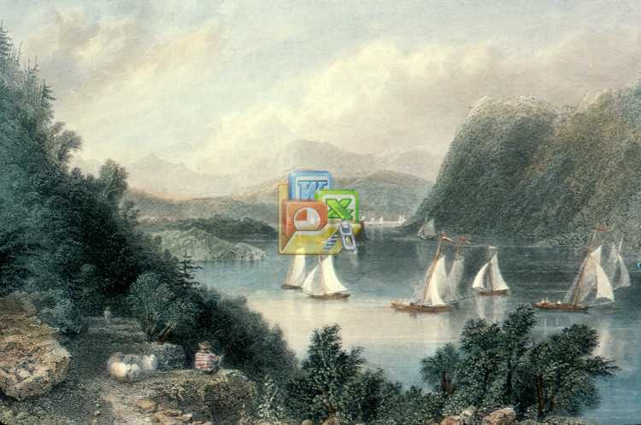
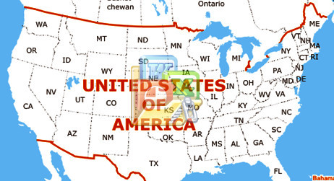
Hudson River Valley
May 15-19, 2014

Slide 2
Hudson River Valley
Newark Airport
Austin

Slide 3
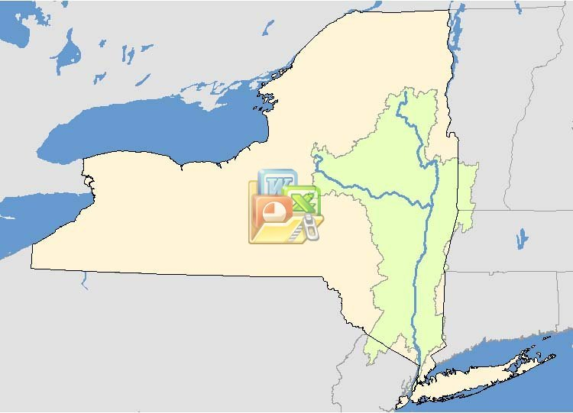
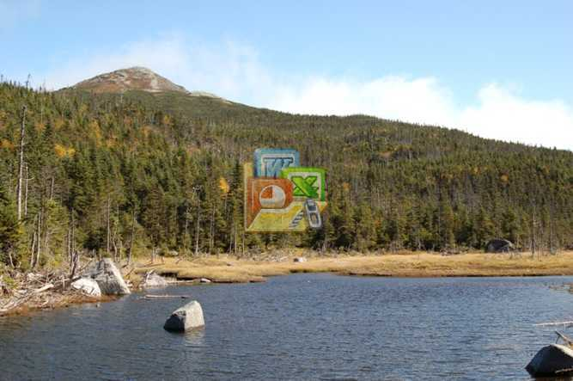
Hudson River Valley
Lake Tear of
the Clouds
Notes:
http://www.dec.ny.gov/lands/66651.html
While the Hudson gathers its water from the entire watershed, its recognized source is Lake Tear of the Clouds on the southwest side of New York's highest peak, Mount Marcy. From Lake Tear, the Hudson journeys 315 miles and drops 4,322 feet in elevation on its way to New York Harbor.

Slide 4

Hudson River Valley
Hudson River watershed
Lake Tear of
the Clouds
Hudson River
Mohawk River
13,400² mi
315 miles
Notes:
en.wikipedia.org/wiki/Hudson_River
The Hudson River is a 315-mile (507 km) watercourse that flows from north to
south primarily through eastern New York State in the United States.
http://www.dec.ny.gov/lands/66655.html
13,390-square-mile watershed - the land from which water drains into the Hudson.

Slide 5
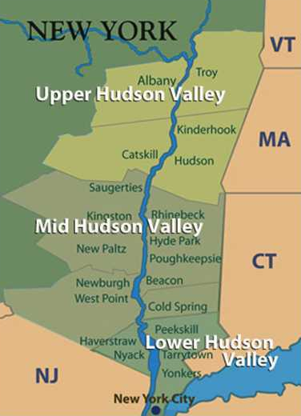
Hudson River Valley
Hudson River watershed
Hudson River
Mohawk River
13,400² mi
~ 1% area of
Mississippi watershed
Notes:
http://www.travelhudsonvalley.com/
http://www.dec.ny.gov/lands/66655.html
13,390-square-mile watershed - the land from which water drains into the Hudson.

Slide 6
Hudson River Valley
TRAVEL . . .
Delamater Inn
Rhinebeck
Kingston
Hyde Park
Mohonk Mt
New Winston
Garrison
West Point
Newark Airport
Sleepy Hollow

Slide 7
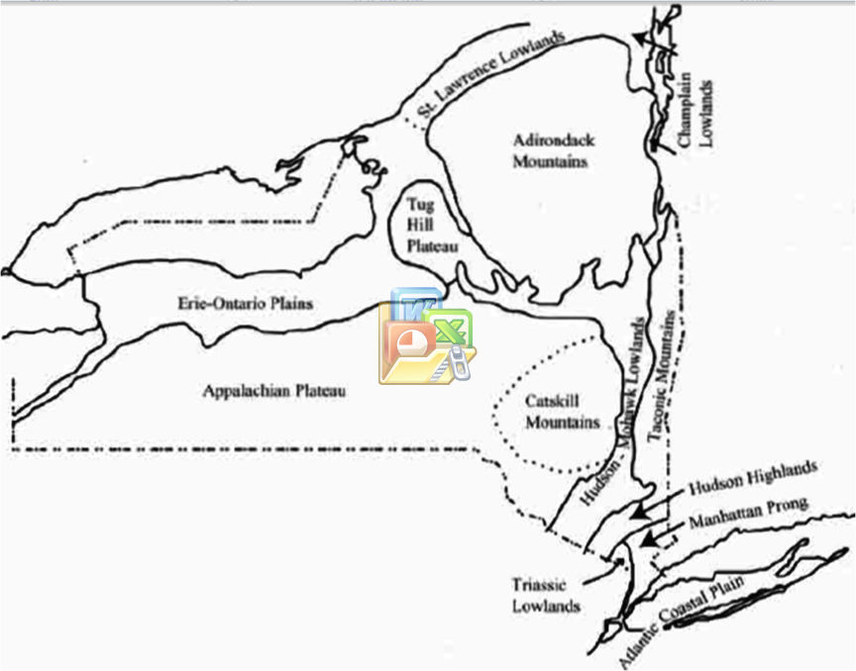
Hudson River Valley
Physiographic map of the Hudson Valley
TRAVEL . . .
Notes:
http://www.esf.edu/efb/limburg/watershedecology/readings/HR_Book_Ch_2_geology.pdf

Slide 8





Physiographic map of the Hudson Valley
physical geography
Adirondack Mts
Lake Tear of
the Clouds
Catskill
Mts
Taconic Mts
Hudson highlands
Manhattan Prong
Hudson-Mohawk Lowlands
Triassic Lowlands
Atlantic Coastal Plain

Slide 9
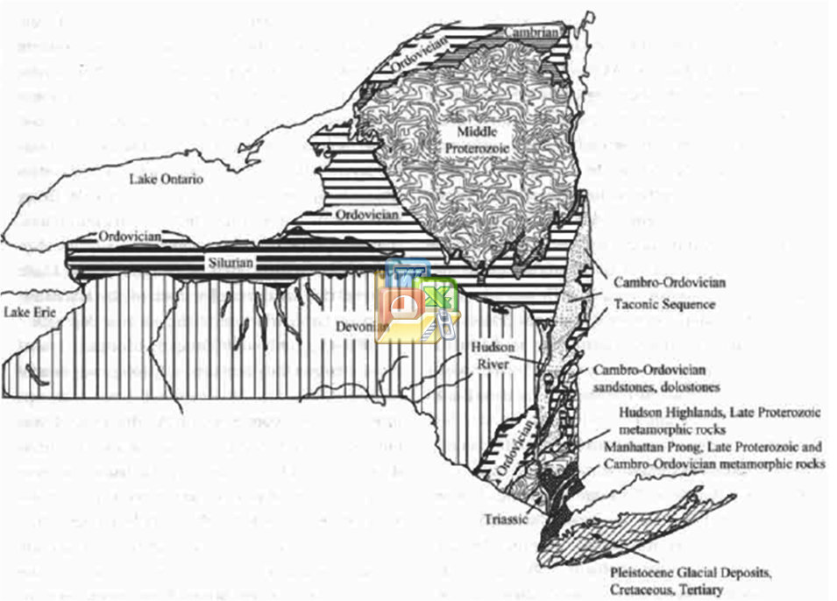
Physiographic map of the Hudson Valley
Geologic map of the Hudson Valley
ages & types of
rocks at surface
Adirondack Mts
Catskill
Mts
Taconic Mts
Hudson highlands
Manhattan Prong
Hudson-Mohawk Lowlands
Triassic Lowlands
Atlantic Coastal Plain
Notes:
http://www.esf.edu/efb/limburg/watershedecology/readings/HR_Book_Ch_2_geology.pdf

Slide 10
Geologic map of the Hudson Valley
Why so many ages of rocks?
1.5 B
500 M
430 M
440 M
380 M
Geologic X-section
220 M
12,000

Slide 11
Geologic map of the Hudson Valley
Geologic X-section of the Hudson Valley
Why so many ages of rocks?
1.5 B
500 M
430 M
440 M
380 M
Geologic X-section
220 M
12,000

Slide 12
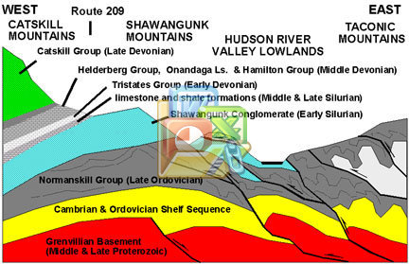
Geologic X-section of the Hudson Valley

Slide 13
Geologic X-section of the Hudson Valley
Mohonk
Mountain
Hudson River
Mohonk
Mountain
river valley
Hudson River
river valley
Vertical scale is greatly exaggerated!

Slide 14
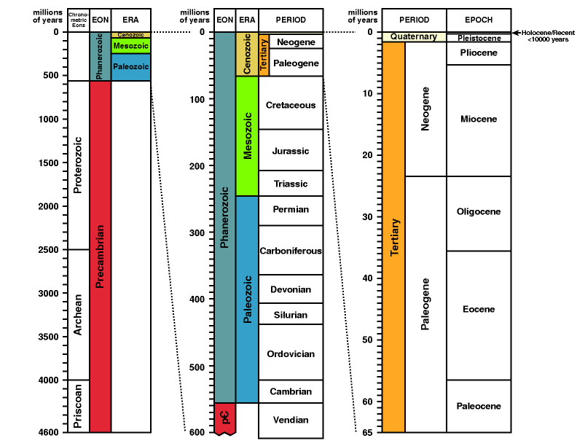
Notes:
http://www.talkorigins.org/faqs/timescale.html

Slide 15
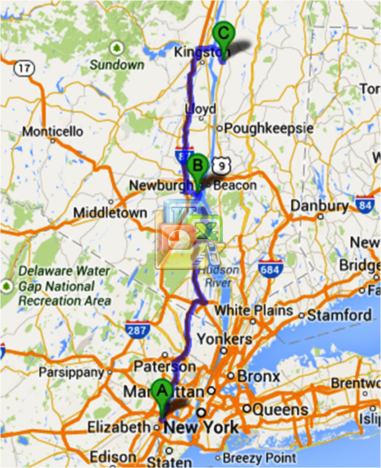
DAY 1: THURSDAY, May 15
Newark Airport → New Windsor → Rhinebeck
Rhinebeck, hotel
Where is the Hudson River?
New Windsor
- Storm King Art Center
The Palisades
Manhattan Island
Newark Airport
Notes:
http://en.wikipedia.org/wiki/George_Washington_Bridge
http://www.dec.ny.gov/lands/66605.html
Lining much of the Hudson's western shore from Haverstraw Bay south to New York City are the magnificent cliffs of the Palisades. In the late 1800s, quarries threatened to ruin the scenic grandeur of the Palisades. Residents of the river's eastern shore and Women's Clubs in New Jersey led a successful campaign to protect the cliffs by persuading New York and New Jersey to purchase the land and manage the area as the Palisades Interstate Park.
http://en.wikipedia.org/wiki/Manhattan
The bedrock underlying much of Manhattan is a mica schist known as Manhattan Schist. It is a strong, competent metamorphic rock created when Pangaea formed.
http://www.dec.ny.gov/lands/66602.html
The Palisades lose height south of the George Washington Bridge, as a skyline of a different sort rears up on the Hudson's eastern bank. The great metropolis of New York once depended on the river for trade, transportation, food, and recreation, but as the city grew it fouled the estuary with its wastes.

Slide 16
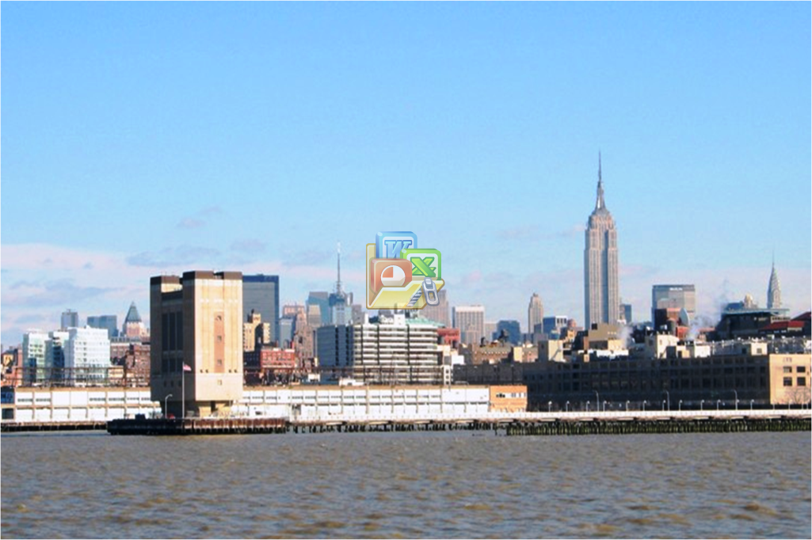
DAY 1: THURSDAY, May 15
JFK Airport → New Windsor → Rhinebeck
The Hudson River flowing past New York City
Chrysler Building
New Windsor
Empire State Building
- Storm King Art Center
The Palisades
Manhattan Island
Manhattan Island is Precambrian rock
Long Island is recent rock
WHY?
Notes:
http://en.wikipedia.org/wiki/George_Washington_Bridge
http://www.dec.ny.gov/lands/66605.html
Lining much of the Hudson's western shore from Haverstraw Bay south to New York City are the magnificent cliffs of the Palisades. In the late 1800s, quarries threatened to ruin the scenic grandeur of the Palisades. Residents of the river's eastern shore and Women's Clubs in New Jersey led a successful campaign to protect the cliffs by persuading New York and New Jersey to purchase the land and manage the area as the Palisades Interstate Park.
http://en.wikipedia.org/wiki/Manhattan
The bedrock underlying much of Manhattan is a mica schist known as Manhattan Schist. It is a strong, competent metamorphic rock created when Pangaea formed.
http://www.dec.ny.gov/lands/66602.html
The Palisades lose height south of the George Washington Bridge, as a skyline of a different sort rears up on the Hudson's eastern bank. The great metropolis of New York once depended on the river for trade, transportation, food, and recreation, but as the city grew it fouled the estuary with its wastes.

Slide 17
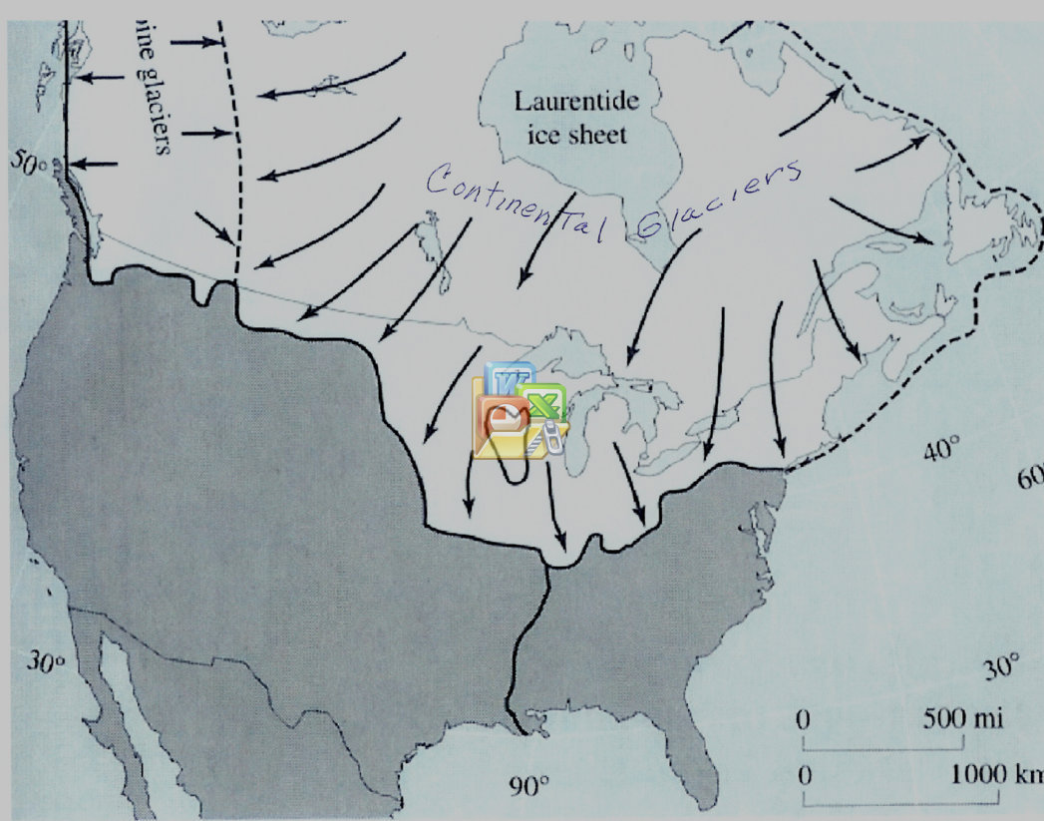
DAY 1: THURSDAY, May 15
JFK Airport → New Windsor → Rhinebeck
The Hudson River flowing past New York City
Chrysler Building
Empire State Building
Glacial ‘drift’ deposited on front edge
Manhattan Island is Precambrian rock
Long Island is recent rock
WHY?
The maximum extent of most recent continental glacier about 110,000 to 12,000 years ago

Slide 18
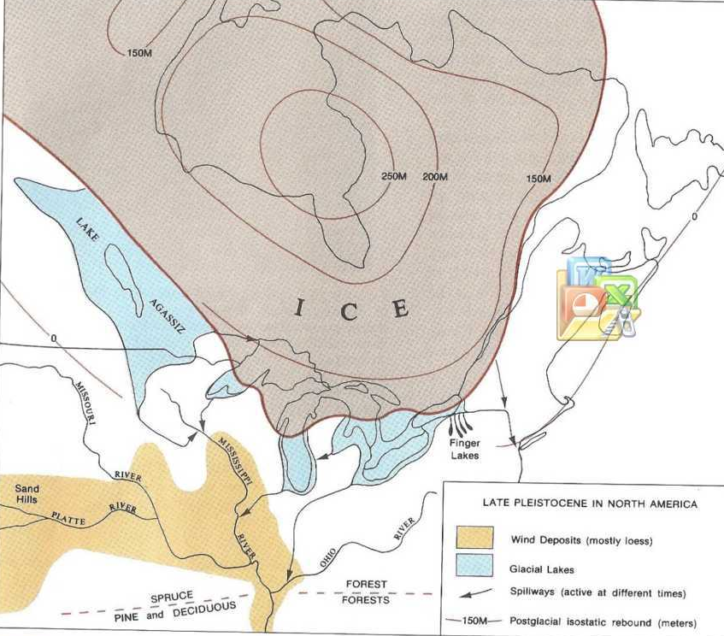
Glacial retreat still-stand created the Great Lakes
and major rivers
Snow
Melting Ice
glacial drift
Hudson-Mohawk
rivers
Glacial ‘drift’ deposited on front edge
The maximum extent of most recent continental glacier about 110,000 to 12,000 years ago
Notes:
The Hudson River valley runs more or less north to south down the eastern edge of New York State, cutting through a series of rock types including Triassic sandstones and redbeds in the south and much more ancient Precambrian gneiss in the north (and east). In the Hudson Highlands, the river enters a fjord cut during previous ice ages. To the west lie the extensive Appalachian highlands. In the Tappan Zee region, the west side of the river has high cliffs produced by an erosion-resistant diabase; these cliffs range from 400–800 feet in height.^{[2]}
The Hudson Valley is one physiographic section of the larger Ridge-and-Valley province, which in turn is part of the larger Appalachian physiographic division.^{[3]} The northern portions of the Hudson Valley fall within the Eastern Great Lakes and Hudson Lowlands Ecoregion.
During the last ice age, the valley was filled by a large glacier that pushed down as far as Long Island. Near the end of the last ice age, the Great Lakes drained south down the Hudson River, from a large glacial lake called Lake Iroquois.^{[4]} Lake Ontario is the remnant of that Lake. Large sand deposits remain from where Lake Iroquois drained into the Hudson; these are now part of the Rome Sand Plains.

Slide 19
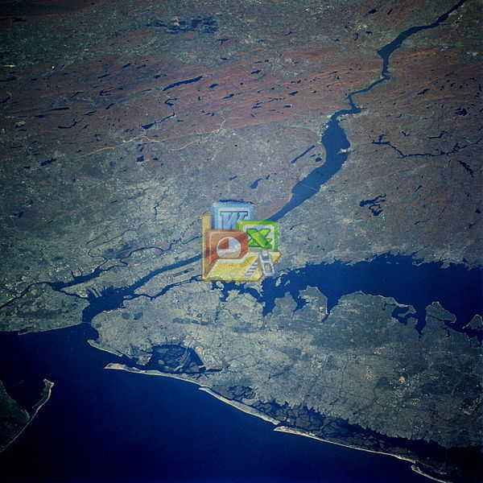
Glacial retreat still-stand created the Great Lakes
and major rivers
Hudson River
Recent deposits scoured off
(Manhattan)
Melting Ice
Glacial Drift
(Long Island)
Hudson-Mohawk
rivers

Slide 20
DAY 1: THURSDAY, May 15
JFK Airport → New Windsor → Rhinebeck
Hudson River
Recent deposits scoured off
(Manhattan)
New Windsor
- Storm King Art Center
Glacial Drift
(Long Island)
The Palisades
Manhattan Island
Notes:
http://en.wikipedia.org/wiki/George_Washington_Bridge
http://www.dec.ny.gov/lands/66605.html
Lining much of the Hudson's western shore from Haverstraw Bay south to New York City are the magnificent cliffs of the Palisades. In the late 1800s, quarries threatened to ruin the scenic grandeur of the Palisades. Residents of the river's eastern shore and Women's Clubs in New Jersey led a successful campaign to protect the cliffs by persuading New York and New Jersey to purchase the land and manage the area as the Palisades Interstate Park.
http://en.wikipedia.org/wiki/Manhattan
The bedrock underlying much of Manhattan is a mica schist known as Manhattan Schist. It is a strong, competent metamorphic rock created when Pangaea formed.
http://www.dec.ny.gov/lands/66602.html
The Palisades lose height south of the George Washington Bridge, as a skyline of a different sort rears up on the Hudson's eastern bank. The great metropolis of New York once depended on the river for trade, transportation, food, and recreation, but as the city grew it fouled the estuary with its wastes.

Slide 21
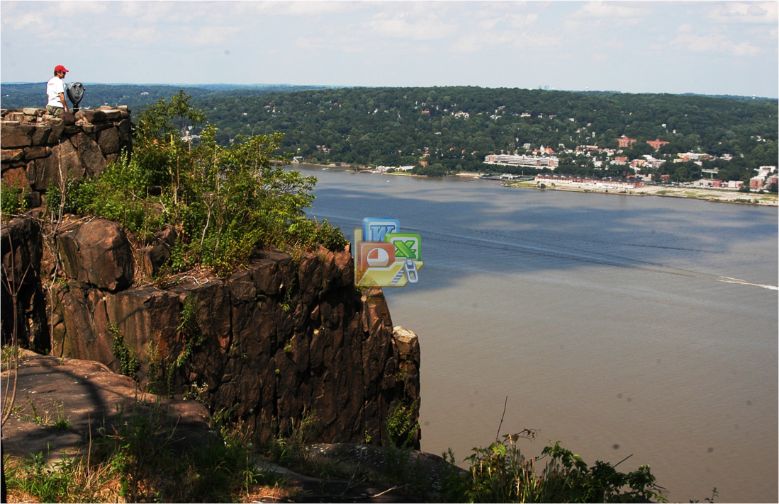
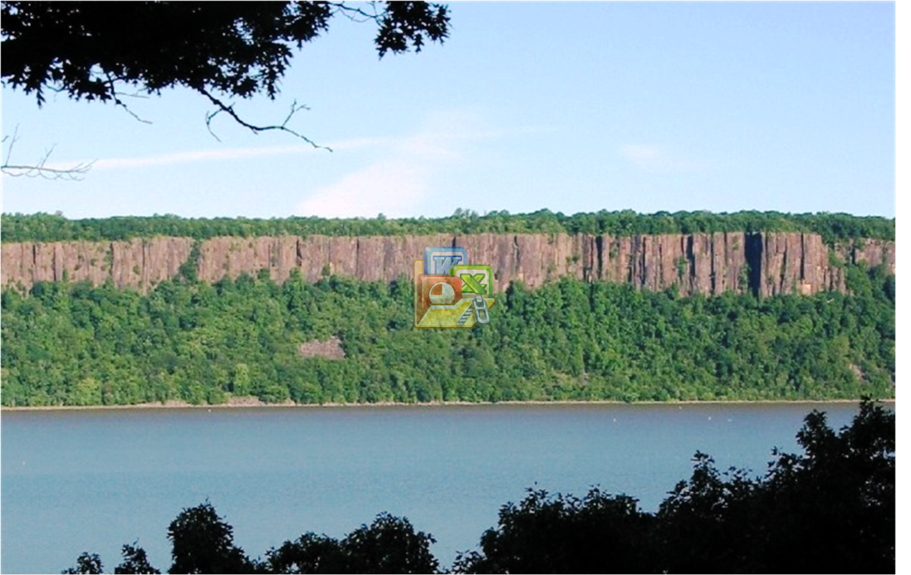
DAY 1: THURSDAY, May 15
Igneous rock
slow cooling
( )
( )
Columnar Jointing in Palisade Diabase Sill
New Windsor
- Storm King Art Center
The Palisades
Manhattan Island
The Palisades cliffs overlooking the Hudson River
Notes:
http://en.wikipedia.org/wiki/George_Washington_Bridge
http://www.dec.ny.gov/lands/66605.html
Lining much of the Hudson's western shore from Haverstraw Bay south to New York City are the magnificent cliffs of the Palisades. In the late 1800s, quarries threatened to ruin the scenic grandeur of the Palisades. Residents of the river's eastern shore and Women's Clubs in New Jersey led a successful campaign to protect the cliffs by persuading New York and New Jersey to purchase the land and manage the area as the Palisades Interstate Park.
http://en.wikipedia.org/wiki/Manhattan
The bedrock underlying much of Manhattan is a mica schist known as Manhattan Schist. It is a strong, competent metamorphic rock created when Pangaea formed.
http://www.dec.ny.gov/lands/66602.html
The Palisades lose height south of the George Washington Bridge, as a skyline of a different sort rears up on the Hudson's eastern bank. The great metropolis of New York once depended on the river for trade, transportation, food, and recreation, but as the city grew it fouled the estuary with its wastes.

Slide 22
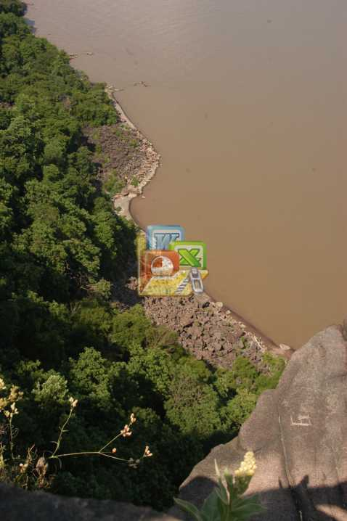
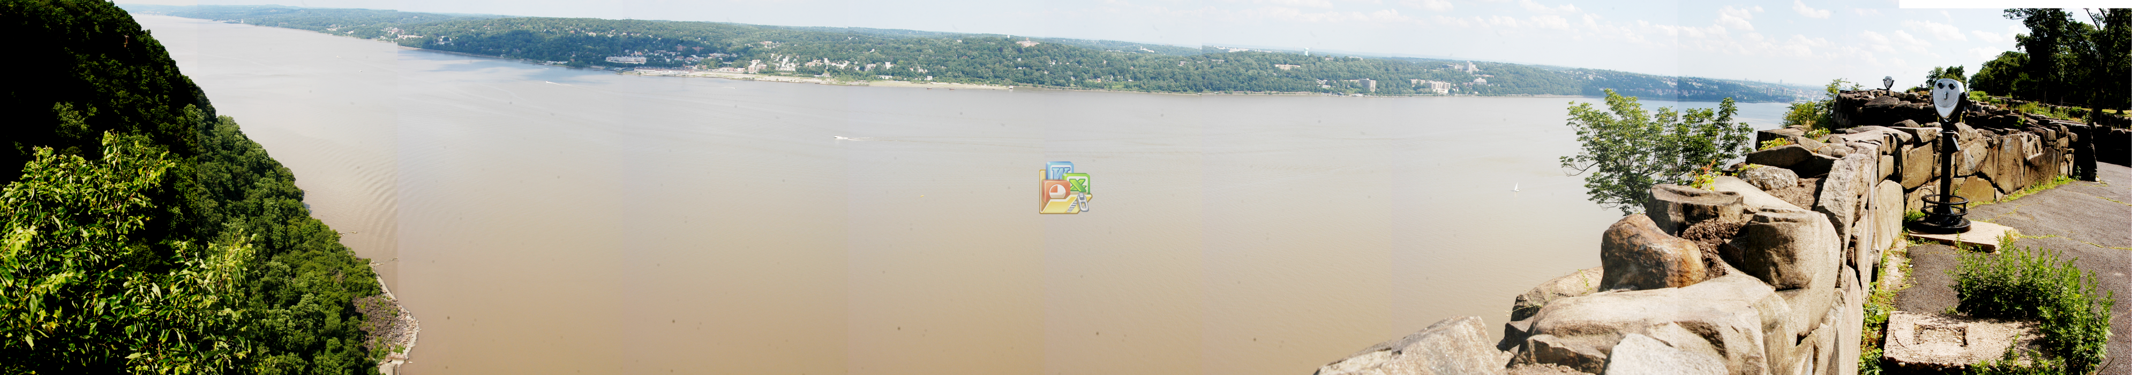
DAY 1: THURSDAY, May 15
Rocks: 220M year old diabase sills (slowly solidifying basalt)

Slide 23
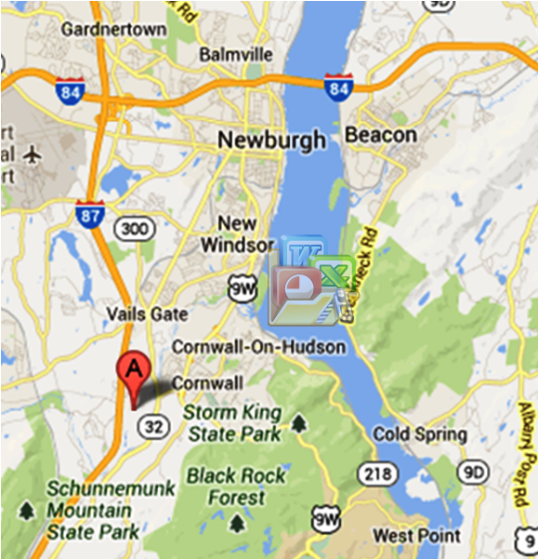
DAY 1: THURSDAY, May 15
New Windsor
- Storm King Art Center
The Palisades
B

Slide 24
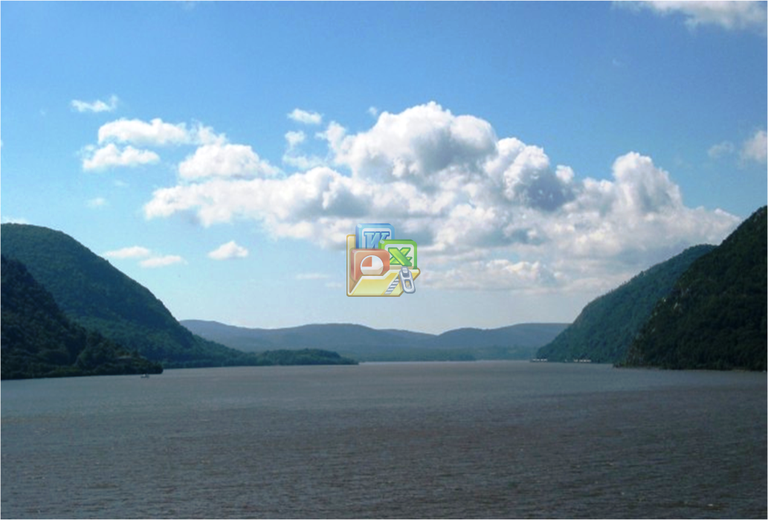

DAY 1: THURSDAY, May 15
JFK Airport → New Windsor → Fishkill
Rocks: Precambrian bedrock more than 1 billion years old
northern entrance of Hudson Highlands
Breakneck Ridge
Storm King Mountain
Storm King
Art Center
fjord
Breakneck Ridge
B
Storm King Mountain
FJORD
Notes:
http://en.wikipedia.org/wiki/Hudson_Highlands
The bedrock of the Highlands is part of the Reading Prong and more than a billion years old, formed during the Grenville Orogeny. It represents the very core of the Applachian range, which has been formed by successive mountain-building events (orogenies). The present mountains have been exposed by the process of isostasy through the late Cenozoic Era.
http://www.dec.ny.gov/lands/66611.html
Storm King marks the northern entrance to the Hudson Highlands, where forested mountains slope steeply into very deep water. The scenery here is reminiscent of Norway's fjords. Fjords are defined as valleys eroded well below sea level by glaciers, and then filled by the sea after the glaciers melt. They are deepest upstream of their mouths, where the erosive power of the glacier was greatest. By this definition, the Hudson qualifies as a fjord: it is deepest in the Highlands - up to 175 feet deep at West Point.
http://en.wikipedia.org/wiki/Hudson_River
The lower half of the river is a tidal estuary^{[5]} occupying the Hudson Fjord, which formed during the most recent period of North American glaciation, estimated at 26,000 to 13,300 years ago.^{[6]} Tidal waters influence the Hudson's flow from as far north as Troy, New York

Slide 25
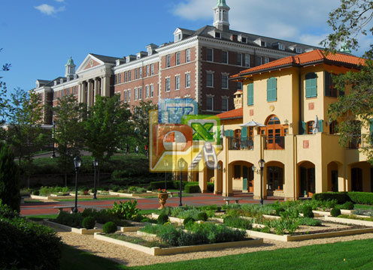
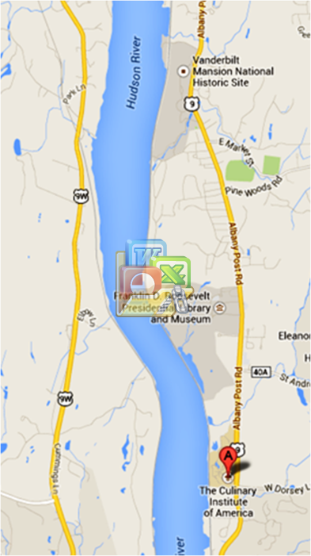
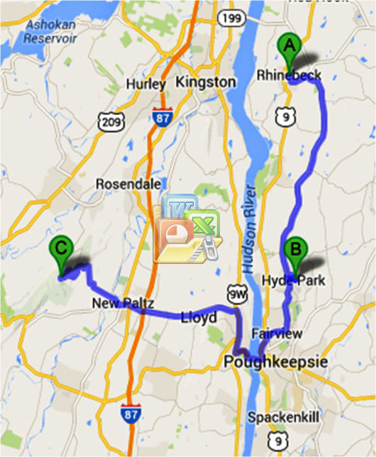
1
DAY 2: FRIDAY, May 16
Rhinebeck → Hyde Park → Mohonk Mountain
1
Rhinebeck
3
Hyde Park
1 - Roosevelt Mansion
2
3
2 - Culinary Institute
(lunch)
3 - Vanderbilt Mansion
2
Monhonk Mnt.

Slide 26
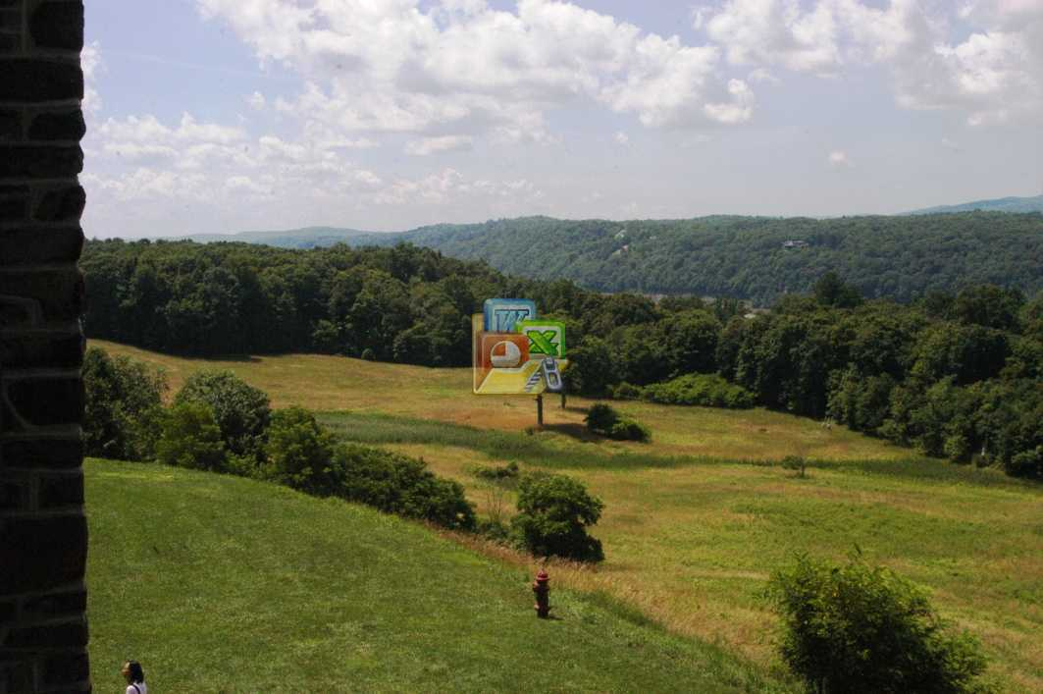
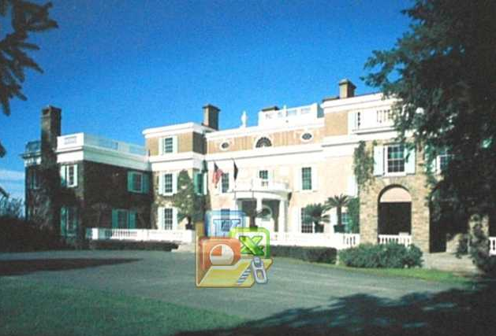

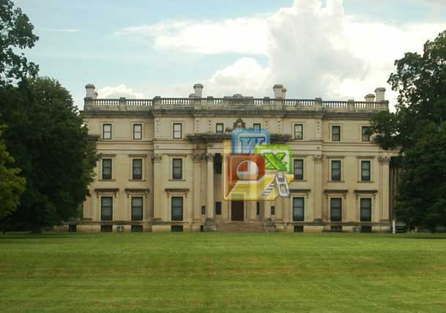
DAY 2: FRIDAY, May 16
3
Hyde Park
1 - Roosevelt Mansion
1
2 - Culinary Institute
(lunch)
3 - Vanderbilt Mansion
2

Slide 27
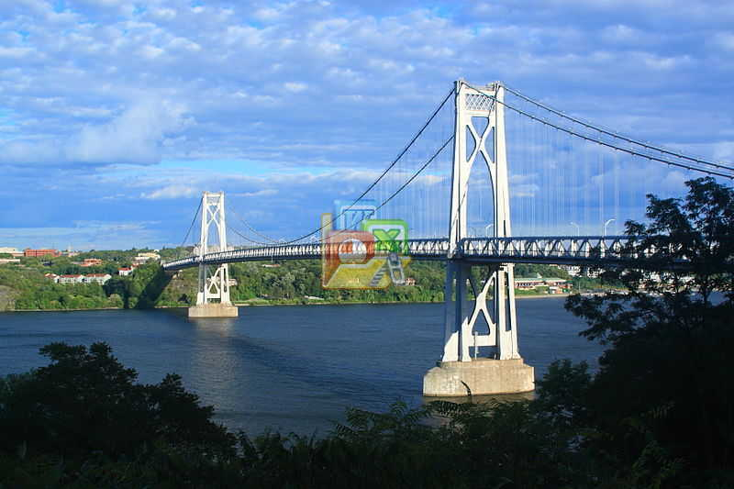
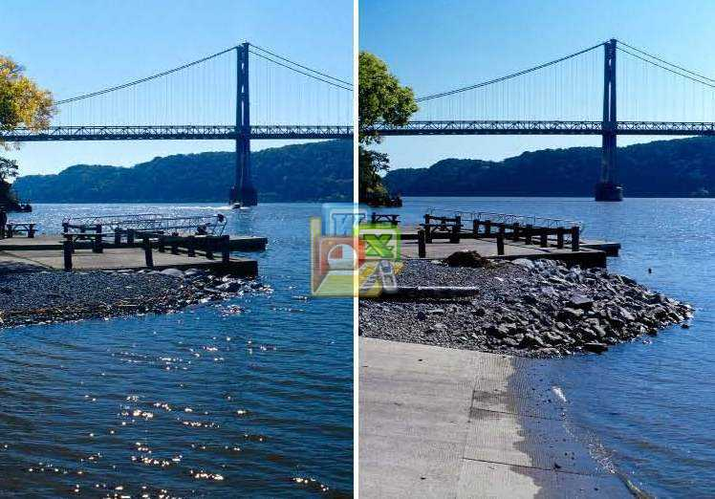
DAY 2: FRIDAY, May 16
Rhinebeck → Hyde Park → Mohonk Mountain
Poughkeepsie Tides
Mid-Hudson Bridge
Poughkeepsie
Hyde Park
Mid-Hudson Bridge
& Poughkeepsie

Slide 28
DAY 2: FRIDAY, May 16
Rhinebeck → Hyde Park → Mohonk Mountain
Poughkeepsie Tides
High tide
Low tide
Low tide
TROY
Notes:
http://www.dec.ny.gov/lands/66641.html
The lower Hudson south of Troy is a long arm of the sea, influenced by the Atlantic Ocean's high and low tides. Rising and falling tides on the Hudson cause the river's currents to switch direction - alternately flowing south towards the sea for a few hours and then north towards Troy.

Slide 29
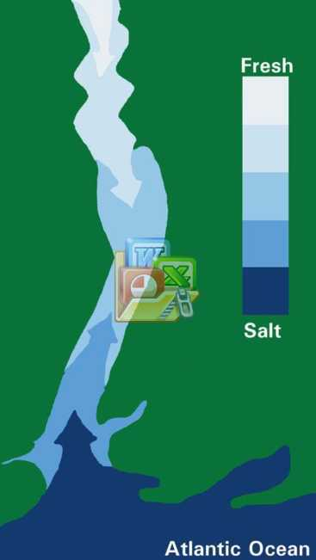
DAY 2: FRIDAY, May 16
Poughkeepsie Tides
The Lower Hudson River is also an Estuary
High tide
Low tide
- salty water pushes upriver
freshwater from the watershed
mixes with the salt water
salt front does not move upriver
as far as the tides
in drought, the salty water can
reach Poughkeepsie
Low tide
Notes:
http://www.dec.ny.gov/lands/66638.html
The lower Hudson is also influenced by salty seawater, which pushes upriver and mixes with freshwater from the watershed. Water bodies in which this happens are called estuaries. The leading edge of dilute seawater entering the Hudson is called the salt front. The front does not move upriver as far as the tides. Salty water often reaches Newburgh in summer, and in droughts it might go as far north as Poughkeepsie. But in spring, or after major rainstorms, fresh water runoff can push the salt front as far south as the Tappan Zee or even Manhattan.

Slide 30
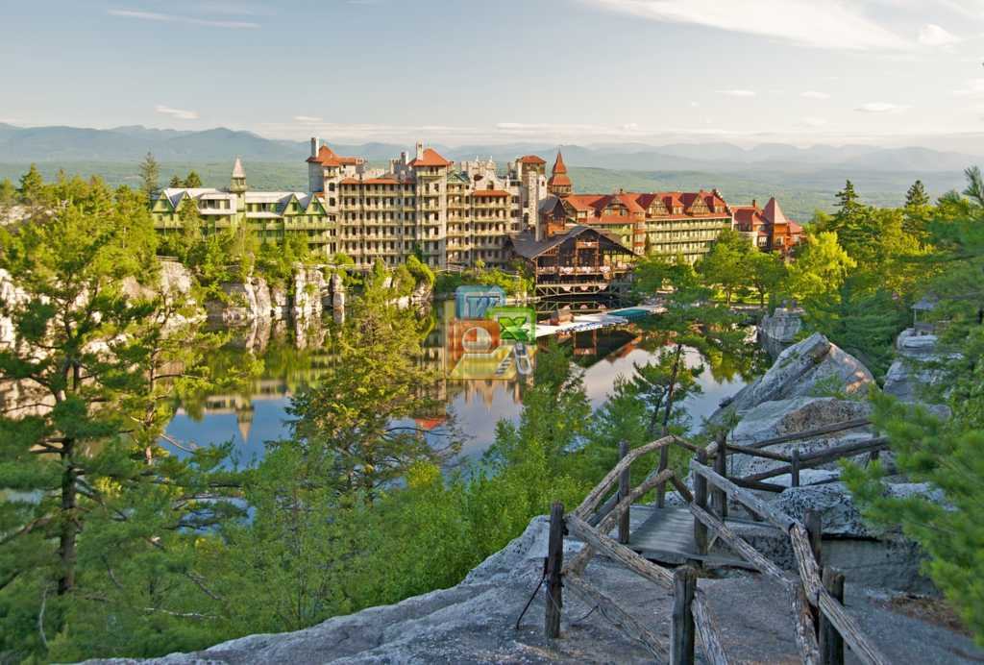
DAY 2: FRIDAY, May 16
Rhinebeck → Hyde Park → Mohonk Mountain
The Mohonk Mountain House
Mid-Hudson Bridge
& Poughkeepsie
Monhonk Mountain

Slide 31
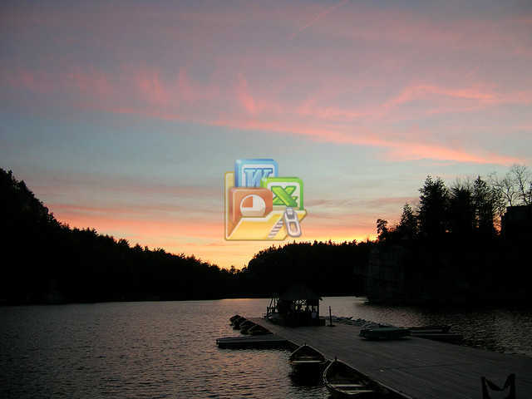
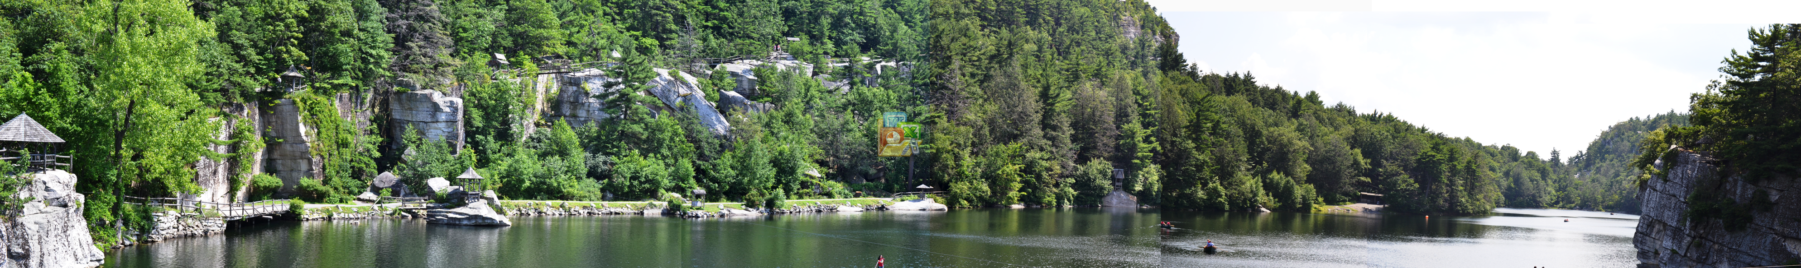
DAY 2: FRIDAY, May 16
The Mohonk Mountain House
Rocks: 420M year old cemented quartz & sandstone
Lake Mohonk : carved depression formed
& water-filled by glaciers in last
ice age (30,000-14,000 YBP)
Notes:
http://en.wikipedia.org/wiki/Shawangunk_Ridge
The ridge is primarily a hard, silica-cemented conglomerate of white quartz pebbles and sandstone that directly overlies the Martinsburg Shale, a thick turbidite sequence of dark gray shale and greywacke sandstone. The Martinsburg Shale was deposited in a deep ocean during the Ordovician (470 million years ago). The Shawangunk Conglomerate was deposited over the Martinsburg Shale in thick braided rivers during the Silurian (about 420 million years ago); both sequences of sedimentary rock were subsequently deformed and uplifted during the Permian (about 270 million years ago). As a result of this deformation, strata within the ridge are involved in a northward plunging series of asymmetric folds (e.g., anticlines and synclines) that dip gently towards the west. The soils are generally thin, highly acidic, low in nutrients, and droughty, but in depressions and other areas where water is trapped by the bedrock or till, there are interspersed lakes and wetland areas.

Slide 32
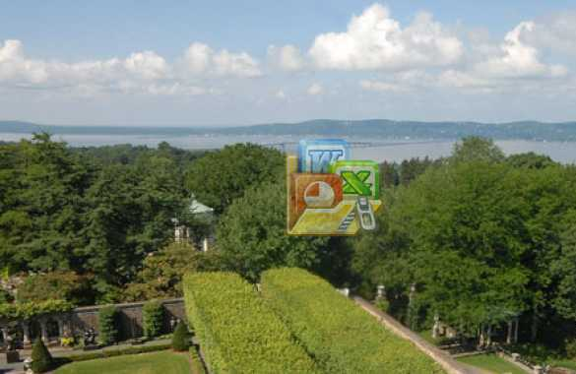
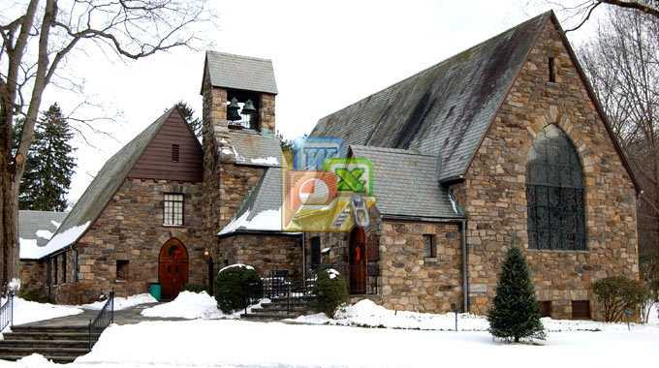
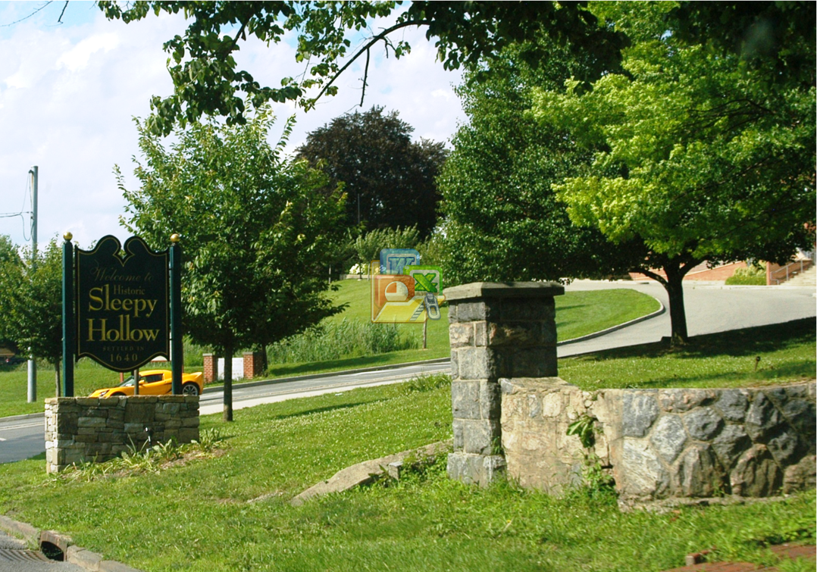
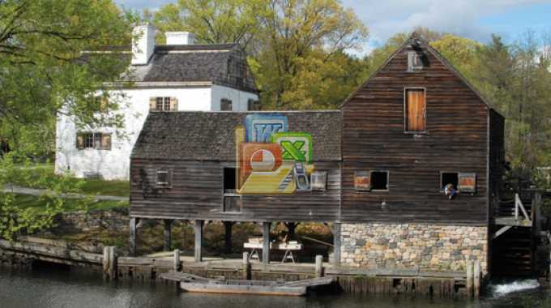
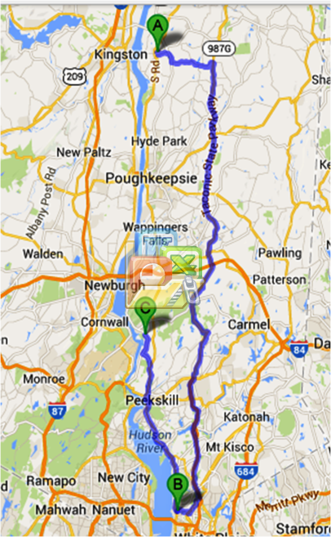
DAY 3: SATURDAY, May 17
Rhinebeck → Sleepy Hollow → Garrison
Kykuit Estate
Philipsburg Manor
Rhinebeck
Sleepy Hollow
- Kykuit Estate
Tappan Zee
Philipsburg Manor
(lunch)
- Union Church
Union Church
Notes:
http://en.wikipedia.org/wiki/Bear_Mountain_(Hudson_Highlands)
The steep eastern face of the mountain overlooks the Hudson River. The eastern side of the mountain consists of a pile of massive boulders, often the size of houses, that culminate in a 50-foot (15 m) cliff face at approximately the 1,000-foot (300 m) level. A direct scramble from the shore of Hessian Lake to Perkins Memorial Drive on the summit requires a gain of about 1,000 feet (300 m) in roughly 0.8 miles (1.3 km) [1]. From the summit, one can see as far as Manhattan Island, and High Point Monument in New Jersey.

Slide 33
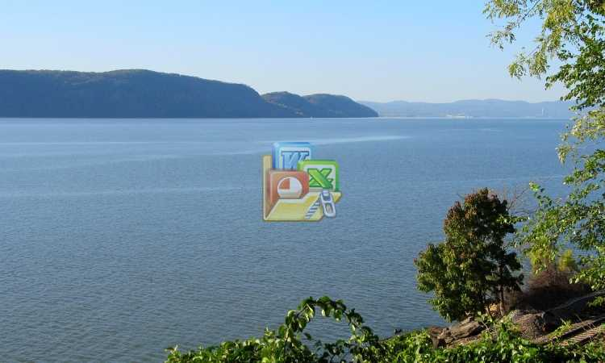
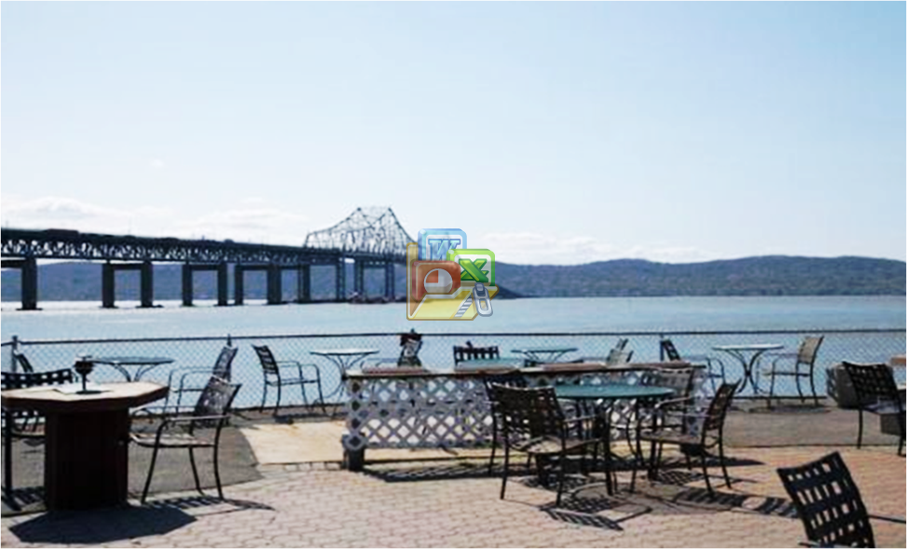
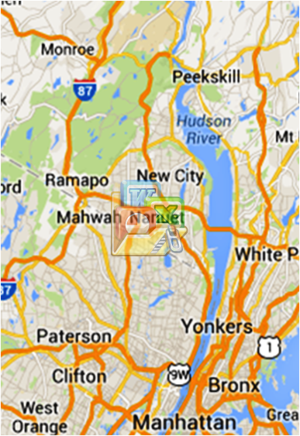
DAY 3: SATURDAY, May 17
Tappan Zee
Tappan Zee Bridge
natural widening of Hudson River
formed in the last ice age as sea level
rose and water filled the depression
caused by retreating glaciers
called a ‘stilling basin’ because the
water from the north slows
entering the wider area
Sleepy Hollow
Notes:
http://www.sunsetcove.net
main dining room looks out over the Hudson River and Tappan Zee Bridge, taking in the Palisades all the way up to Hook Mountain State Park.

Slide 34
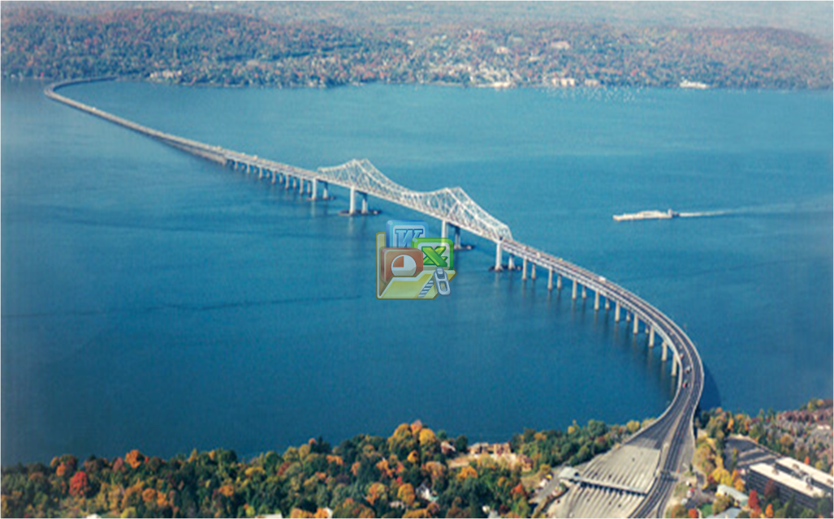
DAY 3: SATURDAY, May 17
Tappan Zee Bridge
New York
New Jersey
Notes:
http://www.structuremag.org/article.aspx?articleID=971

Slide 35
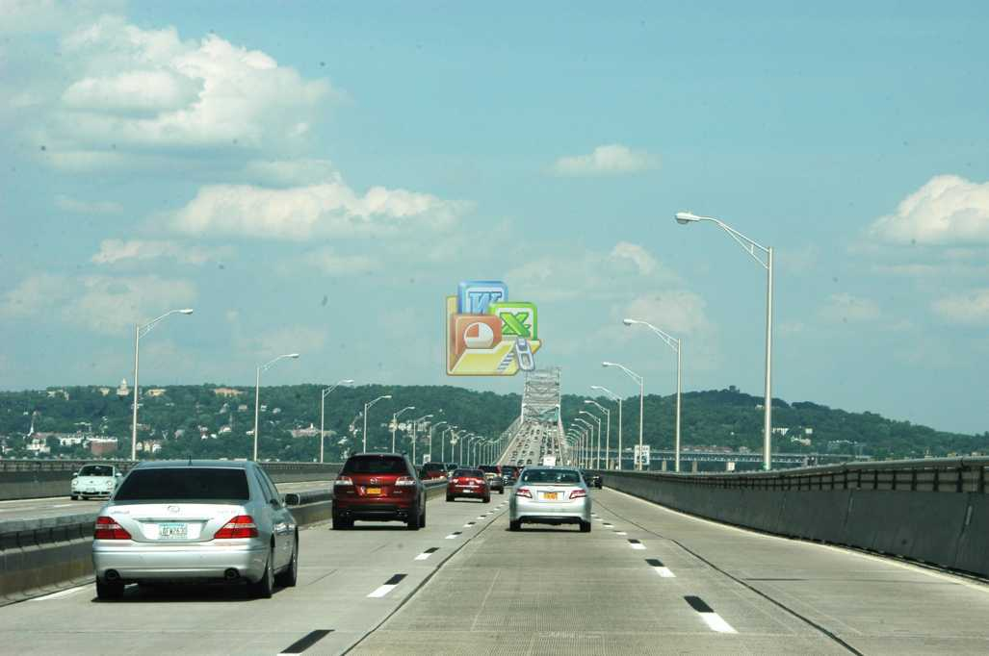
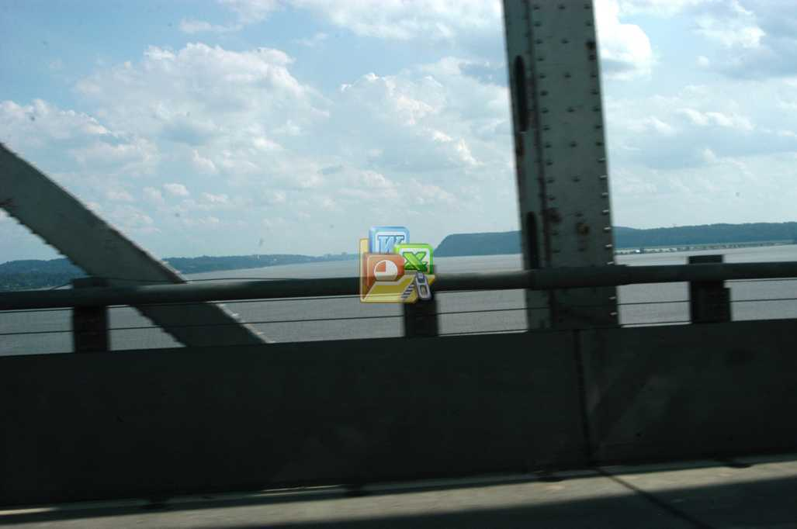
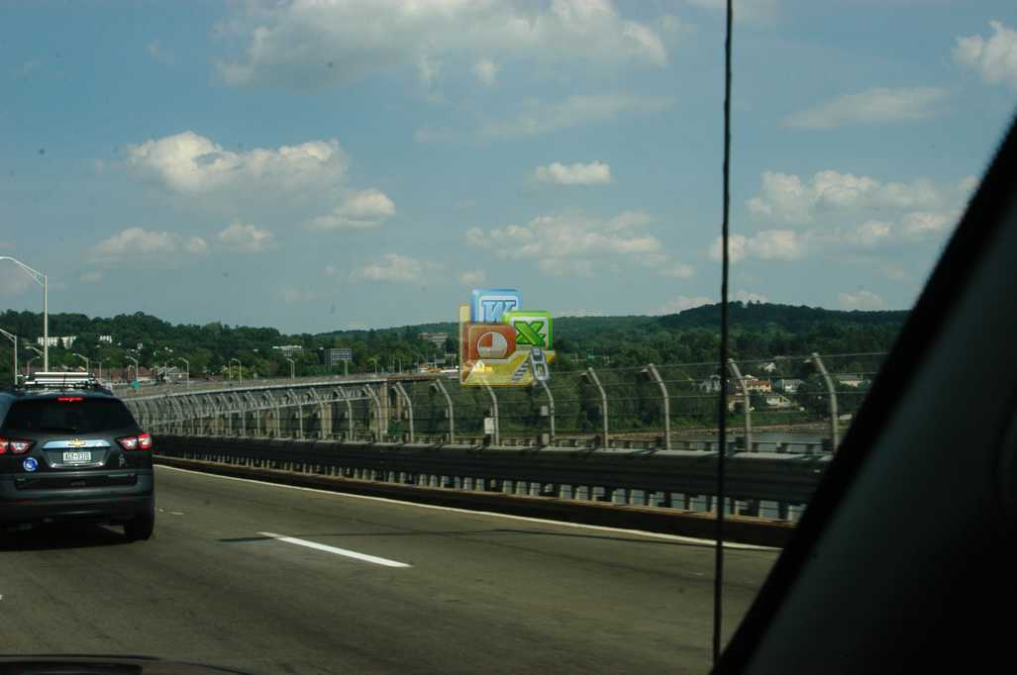
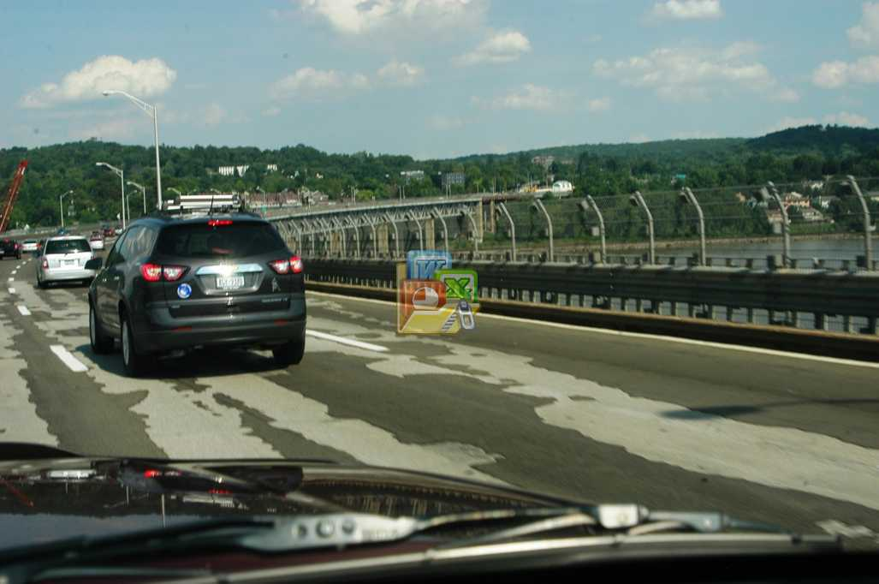
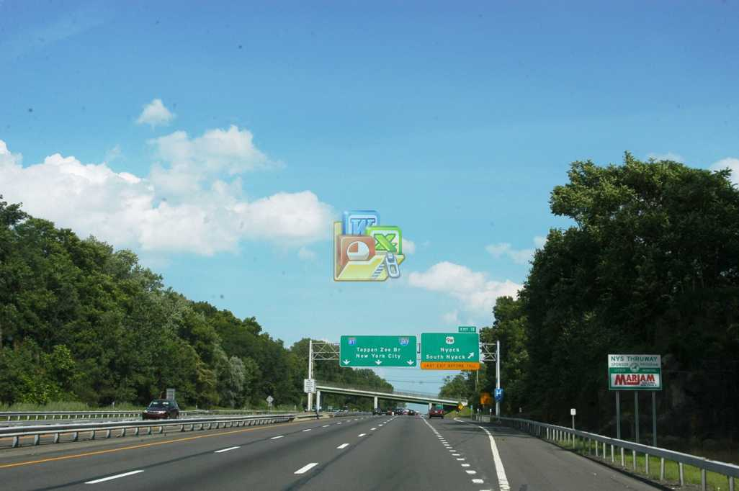
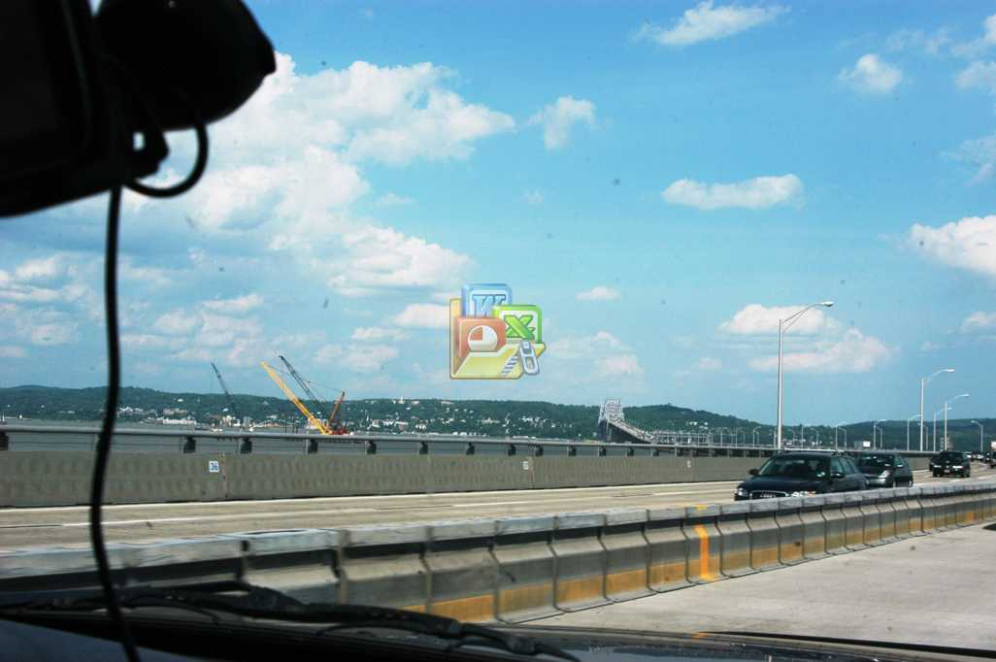
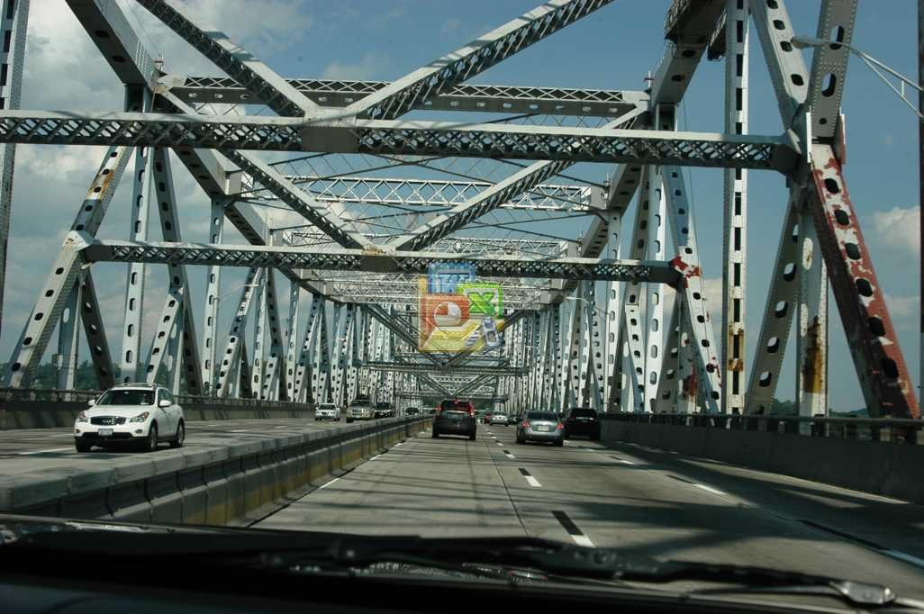
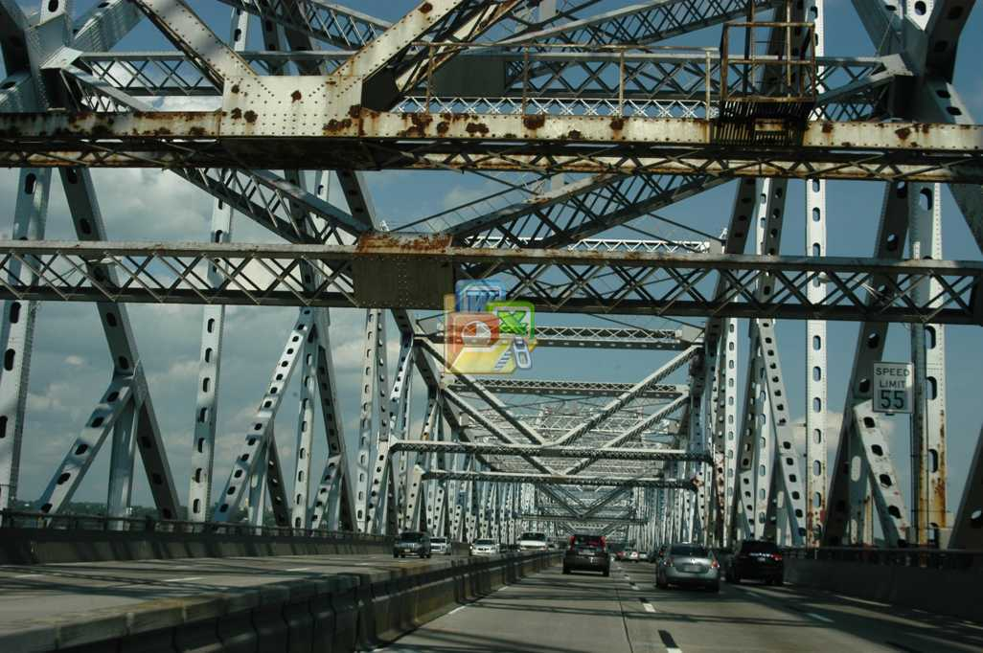
DAY 3: SATURDAY, May 17
Tappan Zee Bridge
New York
New Jersey

Slide 36
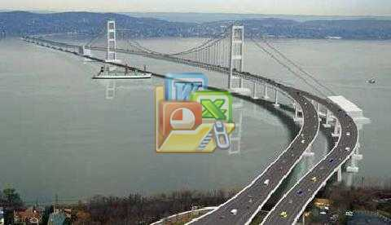
DAY 3: SATURDAY, May 17
Tappan Zee Bridge
3 miles long
built in 1955 with lifespan of 50 years
badly deteriorated & inadequate lanes
48% increase in traffic within 20 years
replacement bridge in progress
- duel spans each 90’ wide
- 1st span completion 2016
- 2nd span complete 2018
Notes:
New York Times, Monday, Jan 20, 2014
New bridge wil be a ‘cable stay’ bridge: cables anchored by mid-river towers will support the weight of the roadway rather than cables anchored to land on both ends.
Two spans will replace the existing bridge. First span, north of existing bridge, will open in Dec 2016, temporarily accommodating 8 lanes of traffic. The current bridge will be torn down and the second, parrallel, span will be built, scheduled to open Summer 2018. When complete, each span will carry 4lanes of traffic plus HOV lane, bus lane, and bike/hike lane.
http://www.nycroads.com/crossings/tappan-zee/
Built in 1955 w/50 year life span. New bridge must cope with the projected 48 percent increase in traffic during the next 20 years.

Slide 37

DAY 3: SATURDAY, May 17
Rhinebeck → Sleepy Hollow → Garrison
Rhinebeck
Garrison
- Boscobel Restoration
Sleepy Hollow
Boscobel west meadow
Notes:
http://en.wikipedia.org/wiki/Bear_Mountain_(Hudson_Highlands)
The steep eastern face of the mountain overlooks the Hudson River. The eastern side of the mountain consists of a pile of massive boulders, often the size of houses, that culminate in a 50-foot (15 m) cliff face at approximately the 1,000-foot (300 m) level. A direct scramble from the shore of Hessian Lake to Perkins Memorial Drive on the summit requires a gain of about 1,000 feet (300 m) in roughly 0.8 miles (1.3 km) [1]. From the summit, one can see as far as Manhattan Island, and High Point Monument in New Jersey.

Slide 38



DAY 4: SUNDAY, May 18
Rhineback → Hyde park → Kingston
Rondout – West Strand waterfront
Rhinebeck
Kingston
- Rondout (lunch)
- River Cruise
Hyde Park
- Val-Kill
Val-Kill
Notes:
http://en.wikipedia.org/wiki/Mid-Hudson_Bridge

Slide 39





DAY 5: MONDAY, May 19
Rhinebeck →West Point → Newark Airport
West Point Military Academy
from Hudson Highlands to the north
Rhinebeck
Trophy Point
West Point
- tour
- lunch
Newark Airport
south toward Tappan Zee

Slide 40


DAY 5: MONDAY, May 19
Rhinebeck →West Point → Newark Airport
Hudson River Valley
West Point Military Academy
The end . . . of your travel!
Rhinebeck
Have a great time!
West Point
Newark Airport

