Slide 1
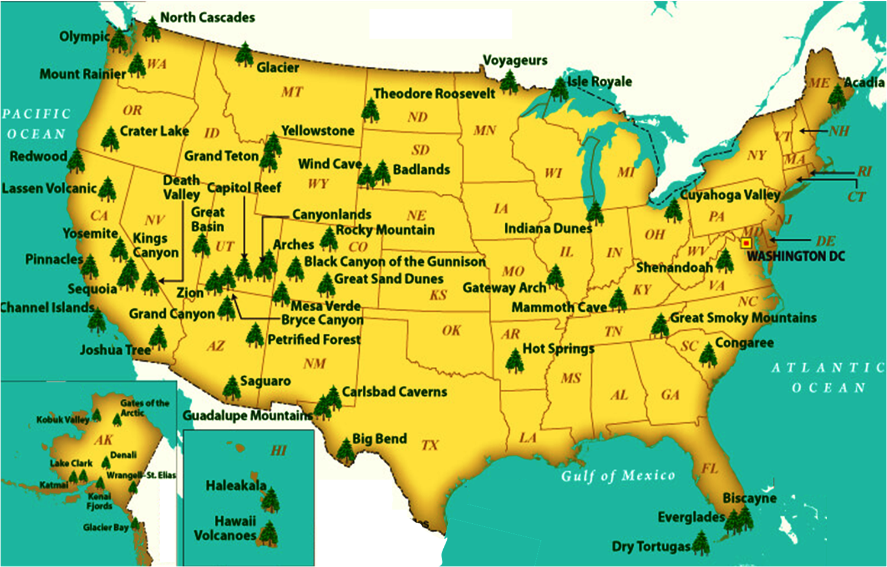

NATIONAL TREASURES
PART 2
New River
White Sands
IN OUR NATURAL WONDERS

Slide 2
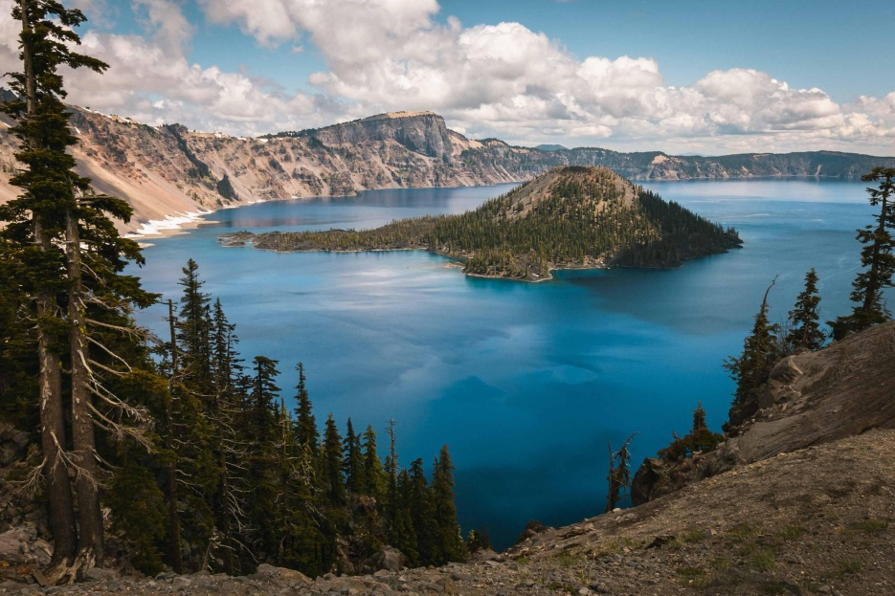
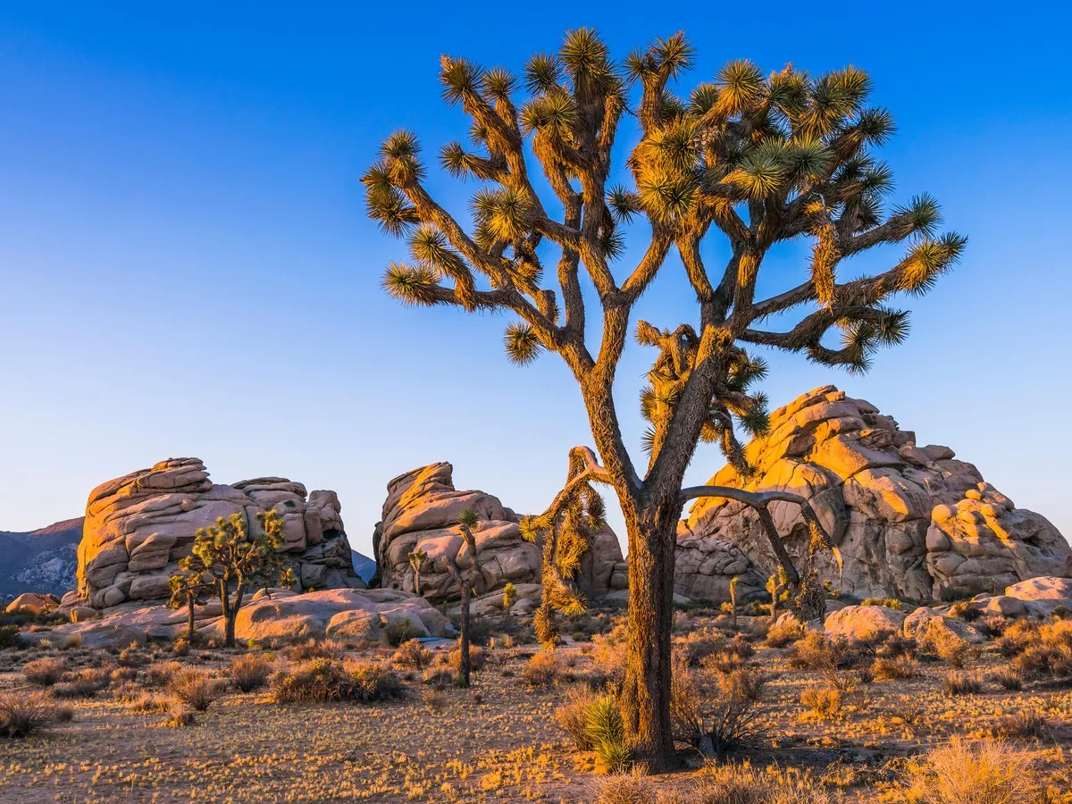
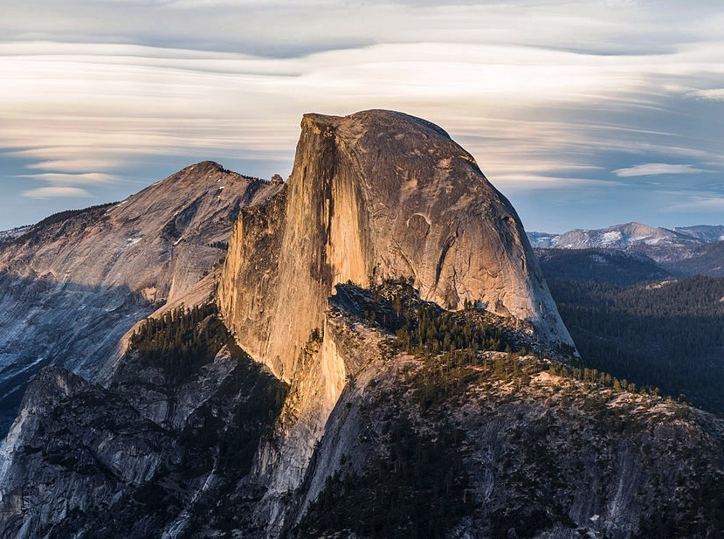
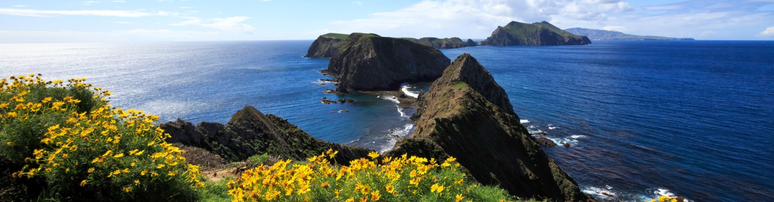
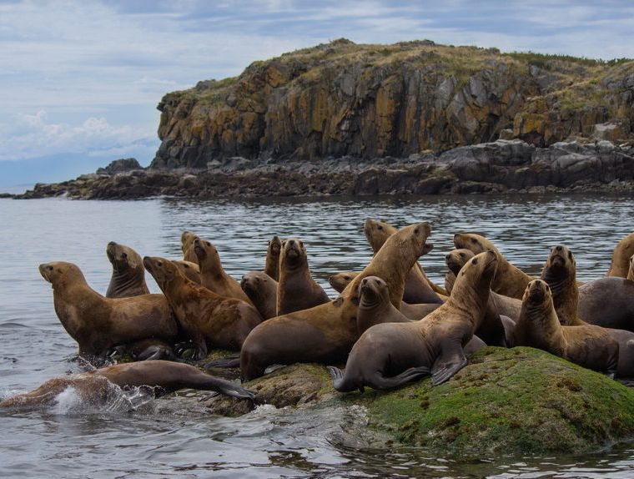

EXOTIC TERRANES OF THE WEST
NATIONAL TREASURES
"This grand show is eternal.
It is always sunrise somewhere;
the dew is never all dried at once;
a shower is forever falling;
vapor ever rising.
Eternal sunrise, eternal sunset,
eternal dawn and gloaming,
on seas and continents and islands,
each in its turn,
as the round earth rolls."
- John Muir, John of the Mountains: Unpublished Journals
PART 2
New River
White Sands
IN OUR NATURAL WONDERS
Notes:
https://pixabay.com/music/search/spring/ Spring Cheer SergeQuadrado

Slide 3
New River
White Sands

Slide 4
NATIONAL TREASURES
LAST YEAR
National Parks & Monuments
showcasing these features
unique features of our continent,
created by geologic processes
New River
White Sands
IN OUR NATURAL WONDERS

Slide 5
NATIONAL TREASURES
EXOTIC TERRANES OF THE WEST
?
LAST YEAR
THIS YEAR
Bryce Canyon
Canyonlands
Trilogy: Part 1
Trilogy: Part 2
Zion
Arches
New River
Colorado Plateau
?
Grand Canyon
Chaco Canyon
White Sands
IN OUR NATURAL WONDERS

Slide 6
EXOTIC TERRANES OF THE WEST
Week 1 – Setting the Stage
Week 1 – Setting the Stage
Week 2 – Coastal Region
Week 3 – Mountain Region
Week 4 – Volcanic Region
Week 5 – Alaskan Region
Week 6 – The Future
New River
White Sands

Slide 7
EXOTIC TERRANES OF THE WEST
Natural Wonders: Geology
Week 1 – Setting the Stage
- Natural Wonders: Geology
Natural Wonders: Geology
- National Treasures: Parks

Slide 8
Natural Wonders: Geology
Geology Overview
TODAY’S TOPICS
OVERVIEW
ALASKA
Rock Cycle
Rock Types
Crust Types
Crustal Movement
Exotic Terranes
Province Overview
NA Glaciation & Sea Levels
WEST COAST
Geologic Provinces
Pacific Border Province
Cascade-Sierra Province

Slide 9
EARTH’S CRUST & IT’S ROCKS

Slide 10
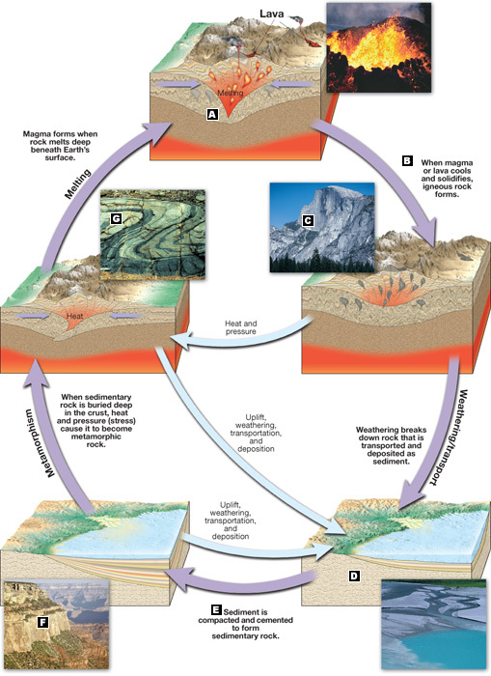
ROCKS & THE ROCK CYCLE
Magma forms when rocks melt deep beneath surface
When magma cools and solidifies, IGNEOUS rocks are formed
Weathering & Erosion breaks down rocks; then deposits sediments at the continental margins
Sediments are compacted & cemented to form SEDIMENTARY rocks
When sedimentary rocks are buried deep, heat &pressure turns them into partially melted METAMORPHIC rocks
Metamorphic rocks are buried deeper & fully melted to become IGNEOUS rocks – cycle starts again!
6
Remember,
3 Types of Rock!
1
5
2
4
3

Slide 11
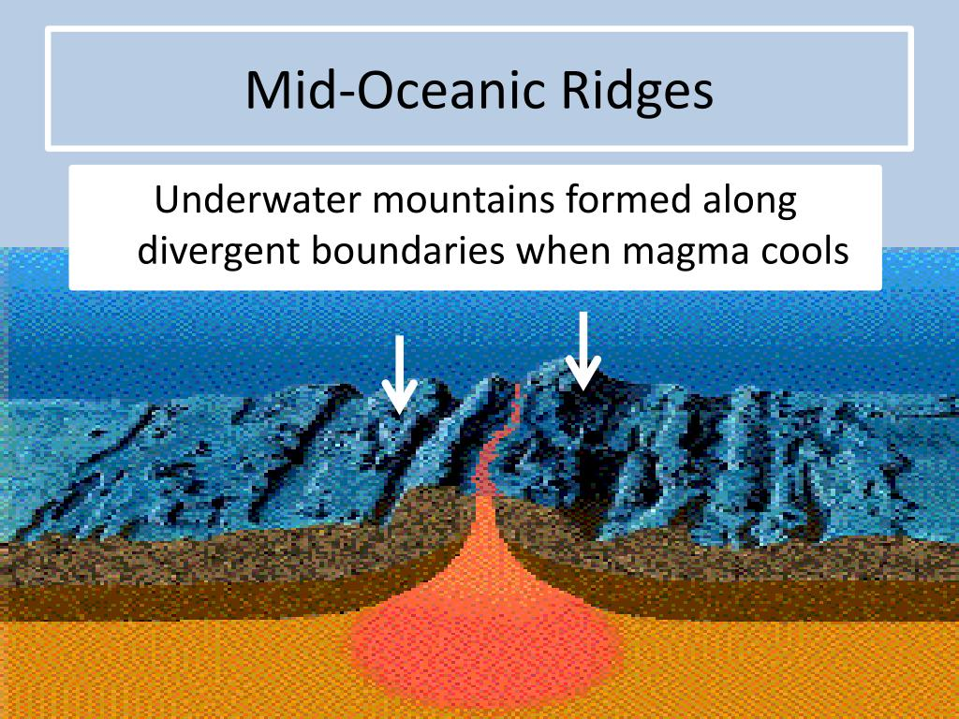
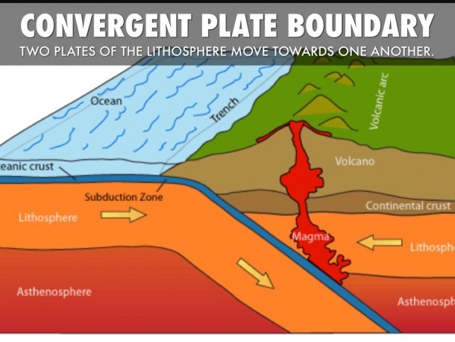
2 TYPES OF CRUST
Oceanic Crust
Made primarily at divergent plate boundaries – release of magma
Heavier than Continental Crust
Has more iron & magnesium
Usually a Basalt type rock
Continental Crust
Made primarily at convergent plate boundaries through a process of fractional differentiation
Lighter than Oceanic Crust
Has more silica & magnesium
Usually a Granite type rock
Notes:
All continental crust is ultimately derived from mantle-derived melts (mainly basalt) through fractional differentiation of basaltic melt and the assimilation (remelting) of pre-existing continental crust. The relative contributions of these two processes in creating continental crust are debated, but fractional differentiation is thought to play the dominant role.^{[11]} These processes occur primarily at magmatic arcs associated with subduction.
There is little evidence of continental crust prior to 3.5 Ga.^{[12]} About 20% of the continental crust's current volume was formed by 3.0 Ga.^{[13]} There was relatively rapid development on shield areas consisting of continental crust between 3.0 and 2.5 Ga.^{[12]} During this time interval, about 60% of the continental crust's current volume was formed.^{[13]} The remaining 20% has formed during the last 2.5 Ga.

Slide 12
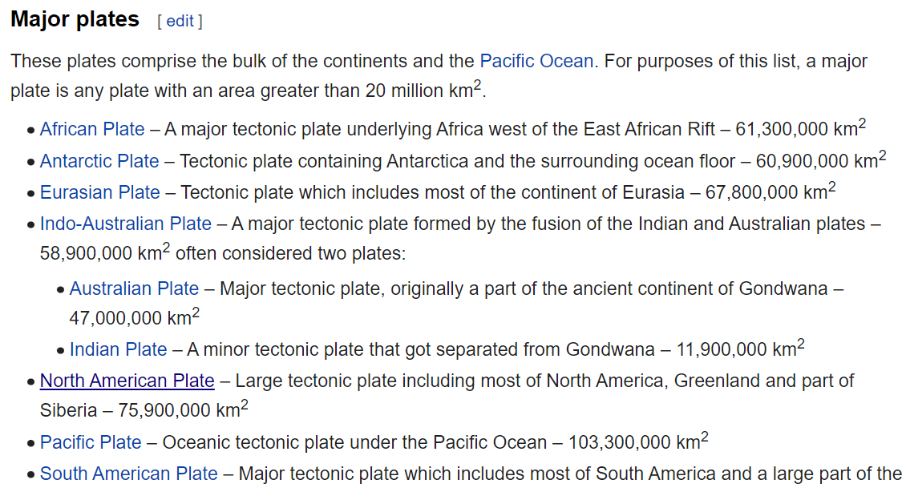
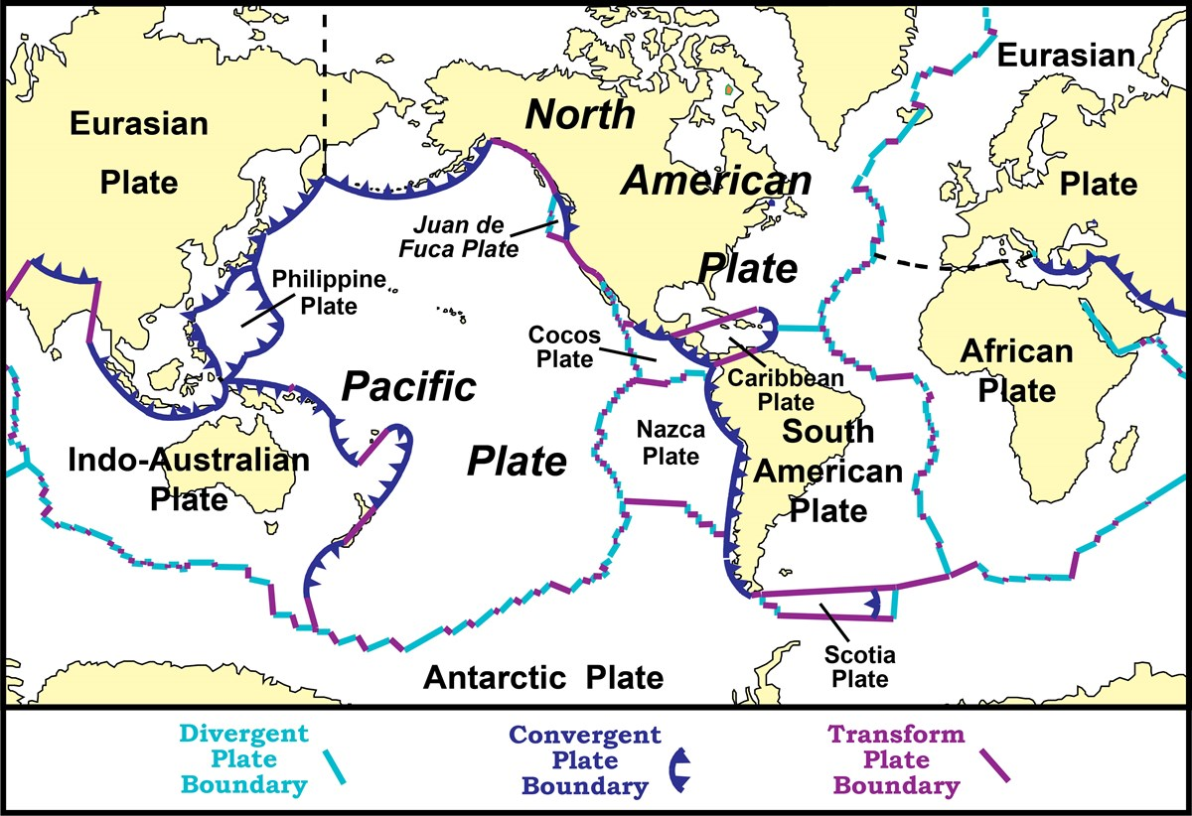
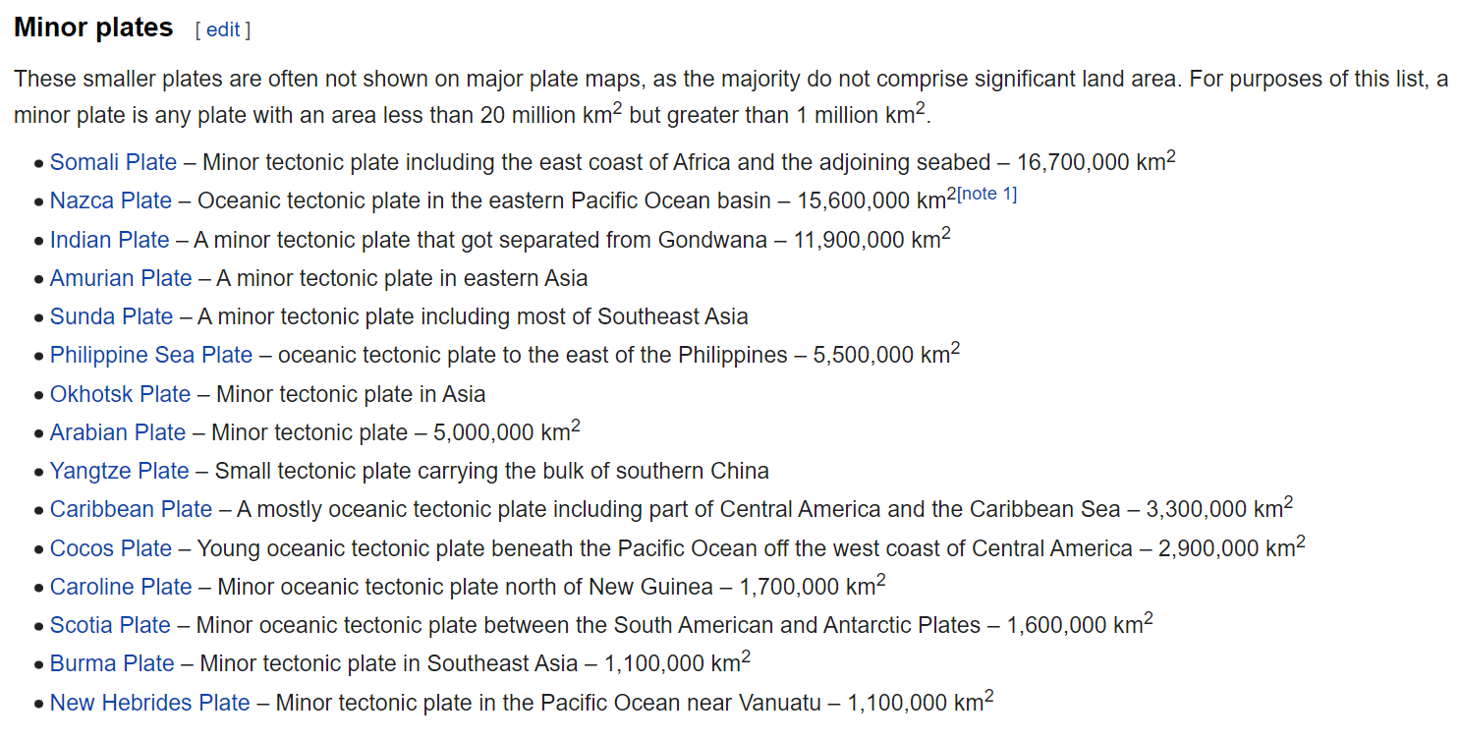
CRUST BROKEN INTO 7 MAJOR PLATES
5
And the plates move in different directions AND at different speeds!
1
1
2
So it’s easy to understand how they might make contact with each other…
7
3
6
4
Notes:
Pacific plate moving to the NW subducting under the Aleutians
NA plate is moving to the SW overriding the Pacific plate
NA plate is Earth's second largest tectonic plate, behind the Pacific Plate (which borders the plate to the west).
the North American Plate moves in roughly a southwest direction away from the Mid-Atlantic Ridge at a rate of about 2.3 centimeters (~1 inch) per year. At the same time, the Pacific Plate is moving to the northwest at a speed of between 7 and 11 centimeters (~3-4 inches) a year.
the driving forces advocated at the moment can be divided into three categories based on the relationship to the movement: mantle dynamics related, gravity related (main driving force accepted nowadays), and earth rotation related.
Gondwana ( /ɡɒndˈwɑːnə/) or Gondwanaland was a supercontinent that existed from the Neoproterozoic (about 550 million years ago) until the Jurassic (about 180 million years ago). formation of Gondwana began c. 800 to 650 Ma with the East African Orogeny, the collision of India and Madagascar with East Africa, and was completed c. 600 to 530 Ma. Gondwana is not considered a supercontinent under the first definition, since the landmasses of Baltica, Laurentia and Siberia were separate at the time.
Gondwana 420 million years ago. View centered on the South Pole.
It was formed by the accretion of several cratons. Eventually, Gondwana became the largest piece of continental crust of the Paleozoic Era, covering an area of about 100,000,000 km² (39,000,000 sq mi), about one-fifth of the Earth's surface. During the Carboniferous Period, it merged with Euramerica to form a larger supercontinent called Pangaea. Gondwana (and Pangaea) gradually broke up during the Mesozoic Era. The remnants of Gondwana make up about two-thirds of today's continental area, including South America, Africa, Antarctica, Australia, Indian Subcontinent and Arabia.
Pangaea or Pangaea ( /pænˈdʒiːə/) was a supercontinent that existed during the late Paleozoic and early Mesozoic eras. It assembled from earlier continental units approximately 335 million years ago, and it began to break apart about 175 million years ago. In contrast to the present Earth and its distribution of continental mass, Pangaea was centered on the Equator and surrounded by the superocean Panthalassa. Pangaea is the most recent supercontinent to have existed

Slide 13
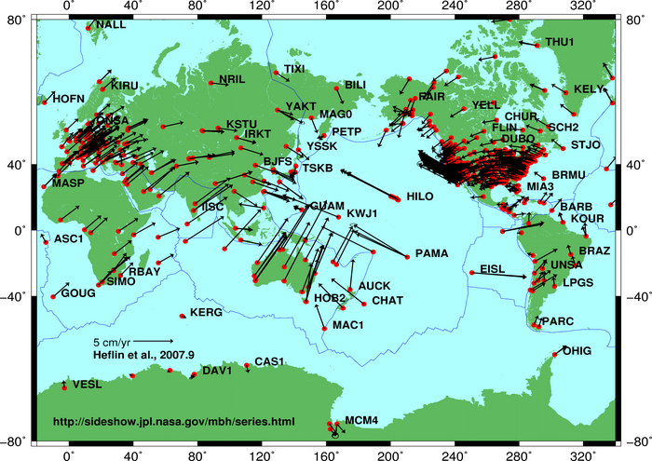
Plate motion based on Global Positioning System (GPS) satellite data from NASA JPL. Each red dot is a measuring point and vectors show direction and magnitude of motion.
Driving forces of plate motion
Plate motion based on Global Positioning System (GPS) satellite data from NASA JPL. Each red dot is a measuring point and vectors show direction and magnitude of motion.
It has generally been accepted that tectonic plates are able to move because of the relative density of oceanic lithosphere and the relative weakness of the asthenosphere. Dissipation of heat from the mantle is acknowledged to be the original source of the energy required to drive plate tectonics through convection or large scale upwelling and doming. The current view, though still a matter of some debate, asserts that as a consequence, a powerful source generating plate motion is the excess density of the oceanic lithosphere sinking in subduction zones. When the new crust forms at mid-ocean ridges, this oceanic lithosphere is initially less dense than the underlying asthenosphere, but it becomes denser with age as it conductively cools and thickens. The greater density of old lithosphere relative to the underlying asthenosphere allows it to sink into the deep mantle at subduction zones, providing most of the driving force for plate movement. The weakness of the asthenosphere allows the tectonic plates to move easily towards a subduction zone.^{[16]} Although subduction is thought to be the strongest force driving plate motions, it cannot be the only force since there are plates such as the North American Plate which are moving, yet are nowhere being subducted. The same is true for the enormous Eurasian Plate. The sources of plate motion are a matter of intensive research and discussion among scientists. One of the main points is that the kinematic pattern of the movement itself should be separated clearly from the possible geodynamic mechanism that is invoked as the driving force of the observed movement, as some patterns may be explained by more than one mechanism.^{[17]} In short, the driving forces advocated at the moment can be divided into three categories based on the relationship to the movement: mantle dynamics related, gravity related (main driving force accepted nowadays), and earth rotation related.

Slide 14
TYPES OF
PLATE TECTONIC BOUNDARY MOVEMENTS

Slide 15
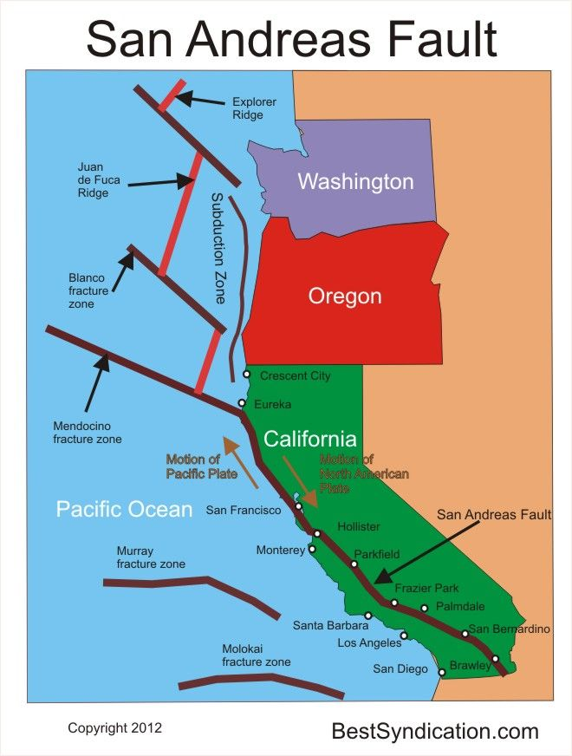
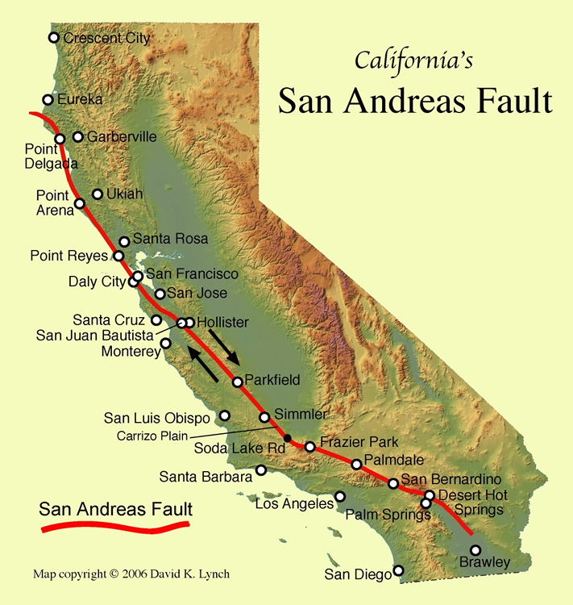
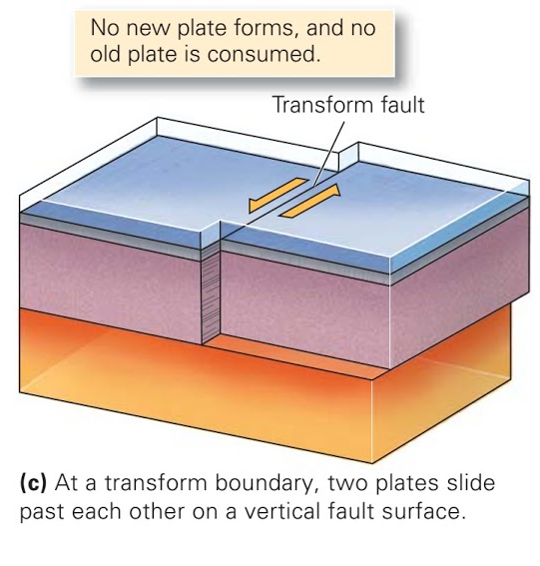
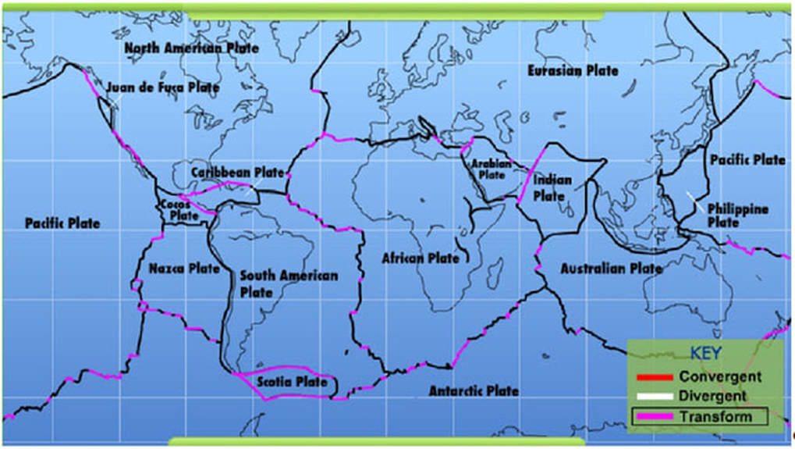
Three types of plate movements
1. TRANSFORM BOUNDARY
https://geology.com/articles/san-andreas-fault.shtml
https://i.pinimg.com/736x/0a/c6/1e/0ac61e13d4e077acafa1ca1d9a576aa6--plate-tectonics-us-national-parks.jpg?b=t

Slide 16
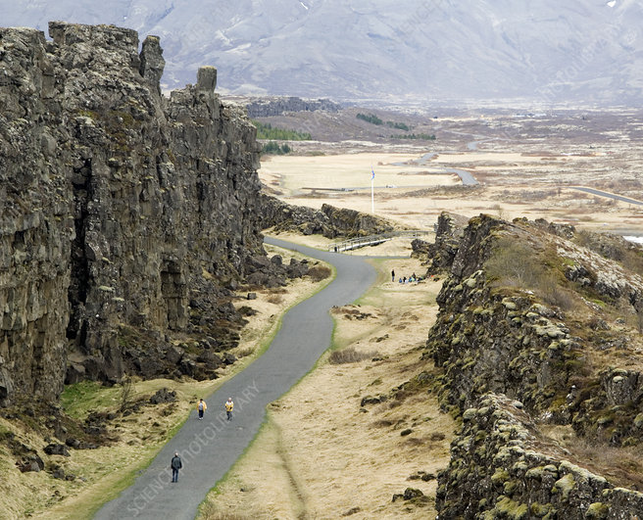
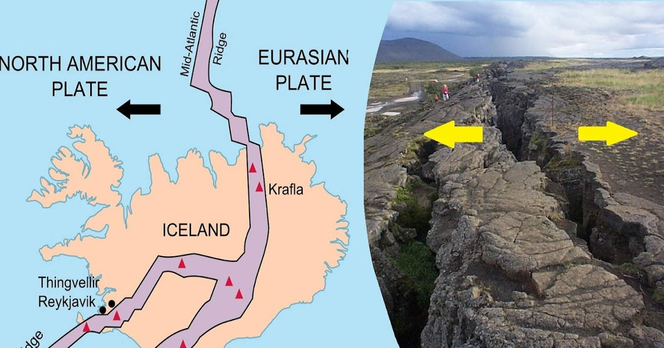
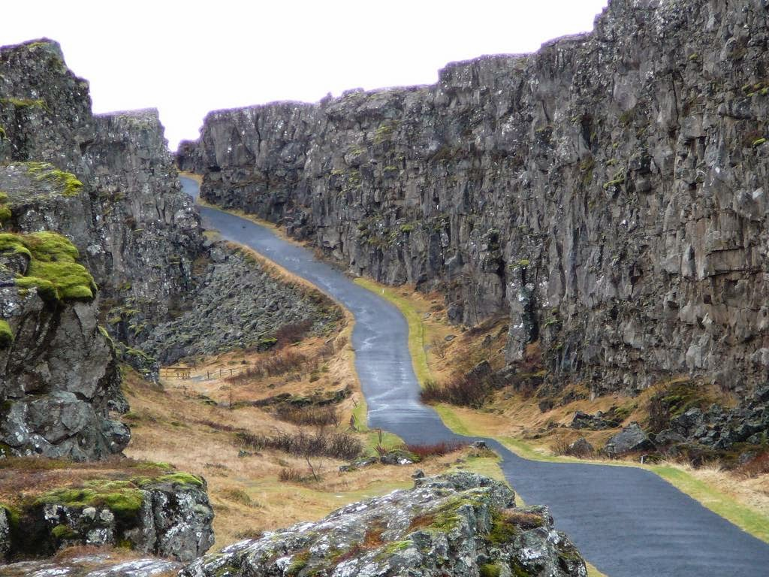
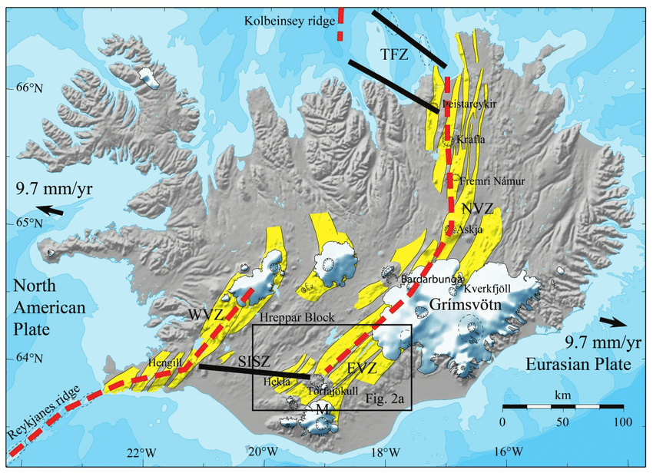
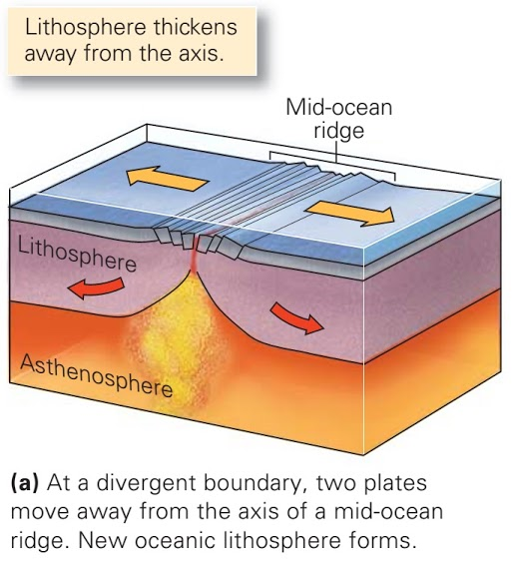
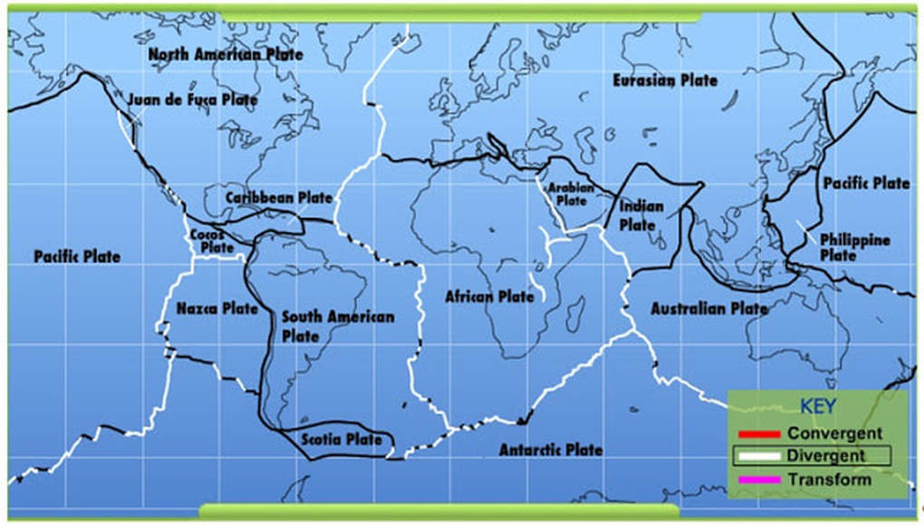
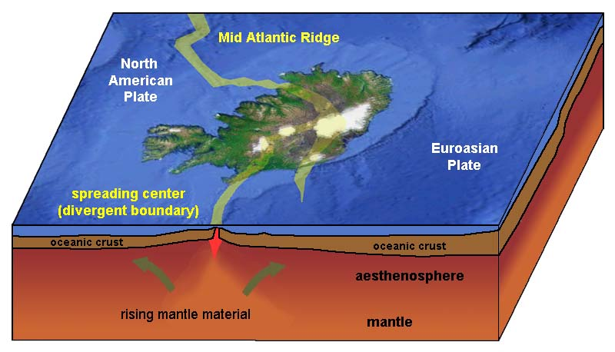
Three types of plate movements
https://www.kuriositas.com/2017/08/a-rift-runs-through-it-icelands.html
Press here to see underwater footage of mantle material oozing out
2. DIVERGENT BOUNDARY
https://www.researchgate.net/publication/303549562_Rheological_response_to_tectonic_and_volcanic_deformation_in_Iceland/figures?lo=1

Slide 17
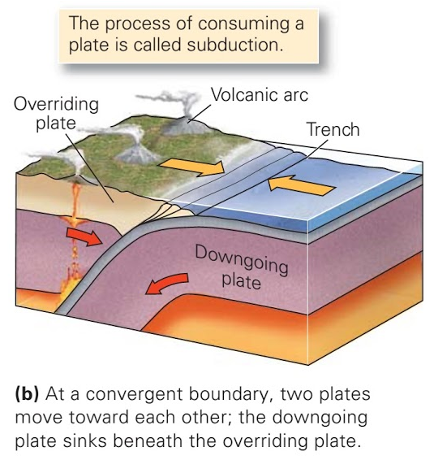
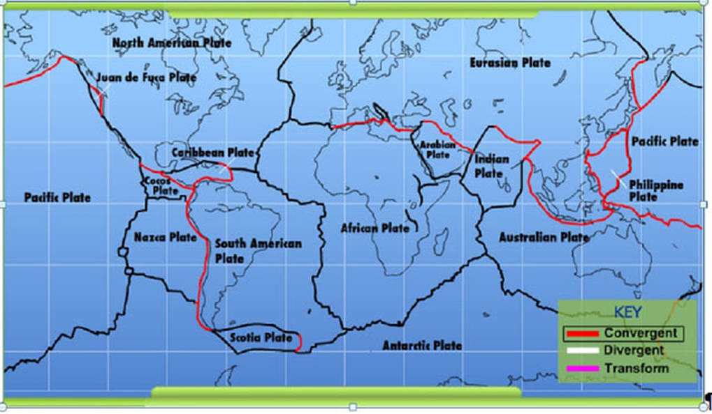
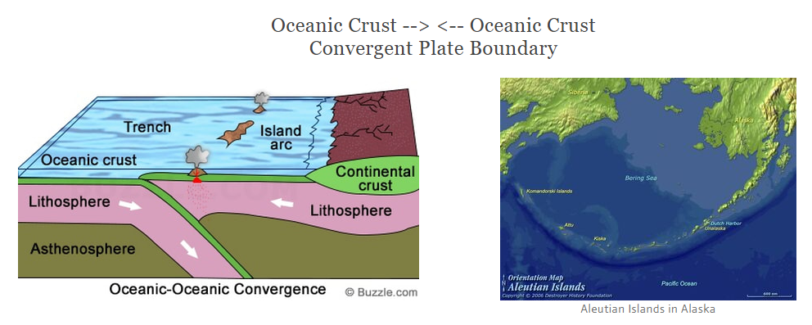
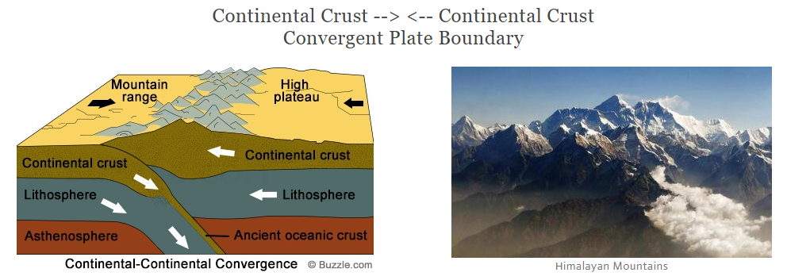
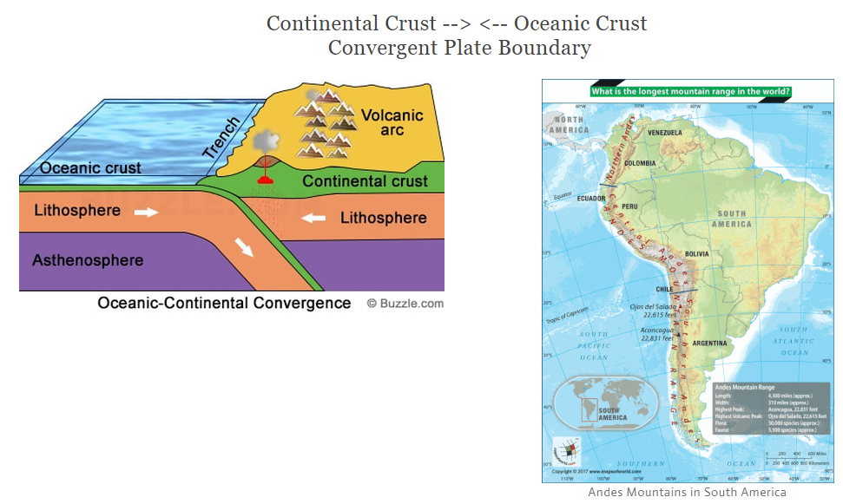
Three types of plate movements
3. CONVERGENT BOUNDARY
You will hear more about this type of boundary movement over the next 5 weeks…
But today we’ll review an important application of it
B.
C.
A.
SUBDUCTION
Notes:
The average density of oceanic crust is 3.0 g/cm3, while continental crust has an average of 2.7 g/cm3. Oceanic Crust is only 11% denser
Mt Everest rising ½ meter per century = 3.25*12/2=19.5in/100=.195”/yr*16=3/16” per yr

Slide 18
UT
PLATE TECTONICS RECONSTRUCTION
Notes:
Major plates
African
Antarctic
Eurasian
Indo-Australian
Australian
Indian
North American
Pacific
South American
Minor plates
Amurian
Arabian
Burma
Caribbean
Caroline
Cocos
Indian
Nazca
New Hebrides
Okhotsk
Philippine
Scotia
Somali
Sunda
Yangtze
Microplates
Adriatic
Aegean Sea
Anatolian
Balmoral Reef
Banda Sea
Bird's Head
Capricorn
Coiba
Conway Reef
Easter
Explorer
Futuna
Galápagos
Gonâve
Gorda
Greenland
Halmahera
Iberian
Iranian
Juan de Fuca
Juan Fernández
Kerguelen
Kermadec
Lwandle
Madagascar
Malpelo
Manus
Maoke
Mariana
Molucca Sea
Niuafo’ou
North Andes
North Bismarck
North Galápagos
Okinawa
Panama
Pelso
Philippine Mobile Belt
Rivera
Rovuma
Sangihe
Seychelles
Shetland
Solomon Sea
South Bismarck
South Sandwich
Timor
Tisza
Tonga
Victoria
Woodlark
Ancient plates
Baltic
Bellingshausen
Charcot
Cimmeria
Farallon
Insular
Intermontane
Izanagi
Kula
Lhasa
Malvinas
Moa
Phoenix

Slide 19
with a focus on…
EXOTIC TERRANES

Slide 20
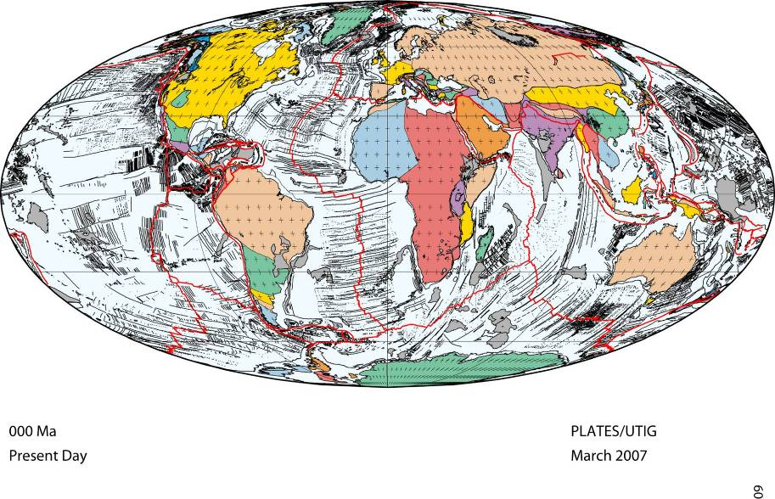
REMEMBER THIS ANIMATION?
North
America
location of
Colorado Plateau
Equator
UT Institute of Geophysics
– Tectonic Plate Reconstruction –
Time clock
Ma = millions of years ago (mya)

Slide 21
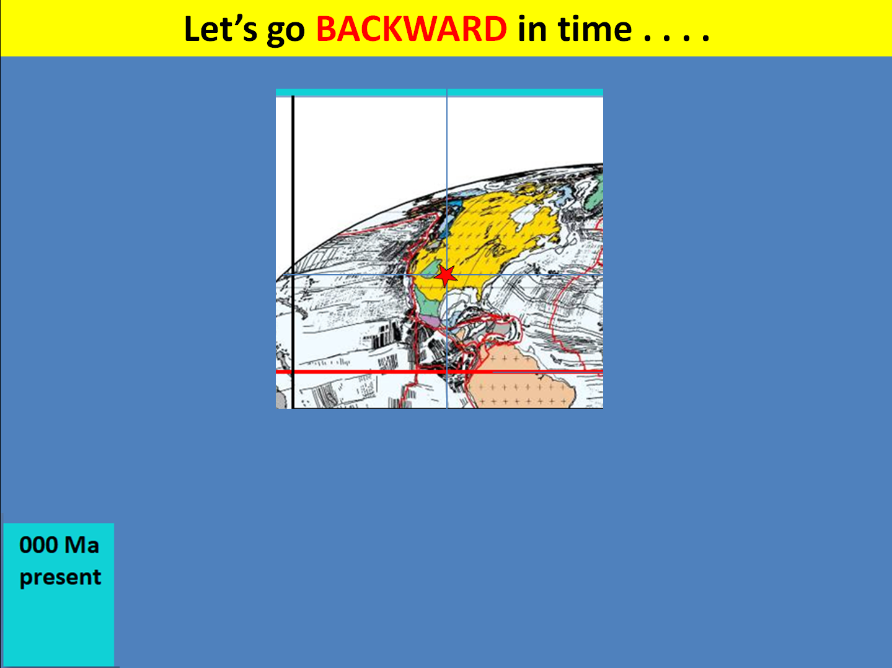
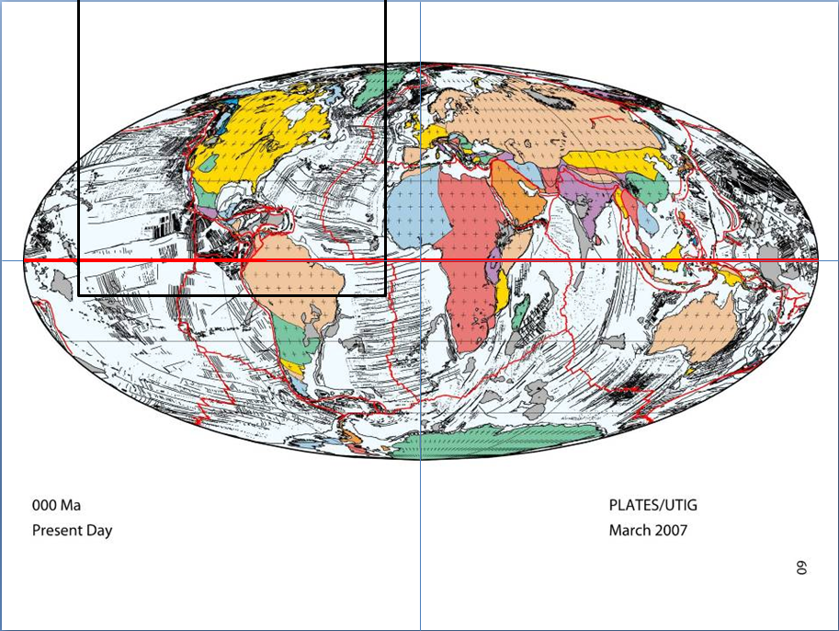

Let’s go BACKWARD in time . . . .
WE’RE ONLY INTERESTED IN THIS PORTION
REMEMBER THIS ANIMATION?
Press here for time travels

Slide 22
AREAS OF STUDY THIS SEMESTER…
“GEOLOGIC PROVINCES”

Slide 23
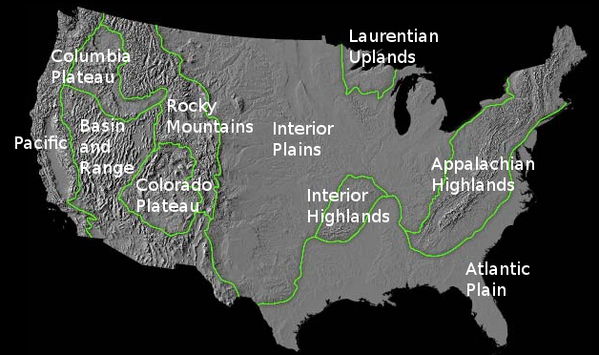


12 Geologic Provinces of USA
Remember this map from last yr?…
Target LAST YEAR was…
Targets for THIS YEAR are…
5
7
6
8
4
9
2
12
3
10
1
Alaska
Hawaii
11

Slide 24
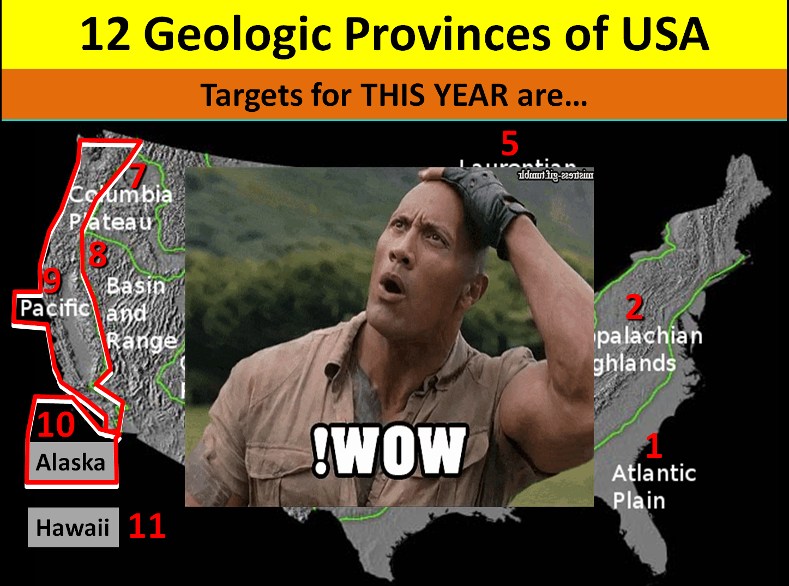
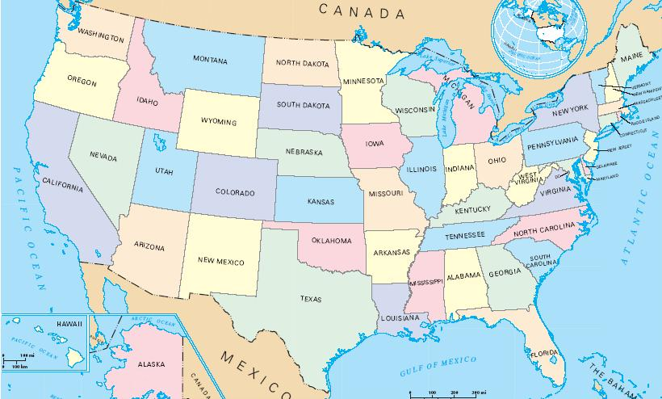
1ST - PACIFIC GEOLOGIC PROVINCE

Slide 25
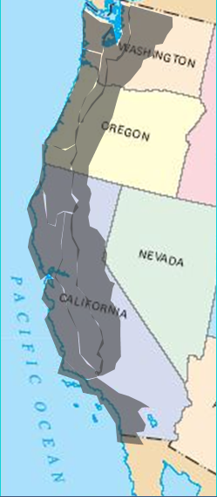
1ST - PACIFIC GEOLOGIC PROVINCE
PACIFIC PROVINCE = 2 SUB-PROVINCES

Slide 26
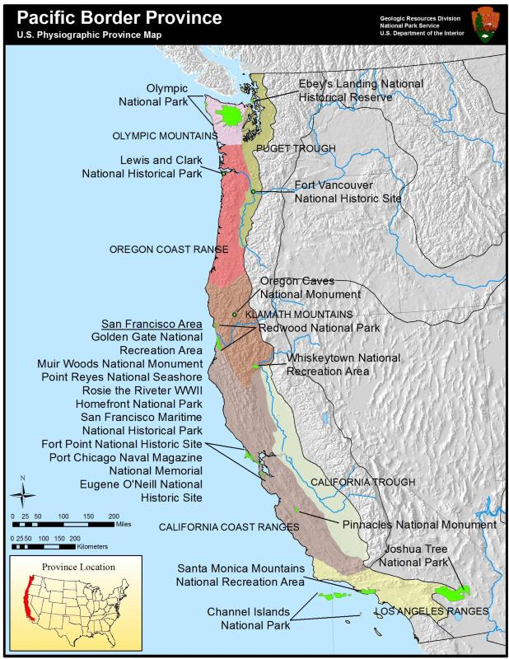
PACIFIC PROVINCE = 2 SUB-PROVINCES
Pacific Border Section
Area is a direct result of pre-historic tectonic forces ramming island-arcs & exotic terranes into western N.A.
Results in two distinct types of topography: lowlands and Mtn. ranges.
The lowlands are a trough on the eastside of the Mtn. ranges
Cascade-Sierra Section
Let’s look at only the
Pacific Border Section first

Slide 27
Olympic Mtn
Puget Trough
Washington
Oregon Coast Range
Oregon
Klamath Mountains
California Coast Range
California Trough
California
Los Angeles Ranges

Slide 28
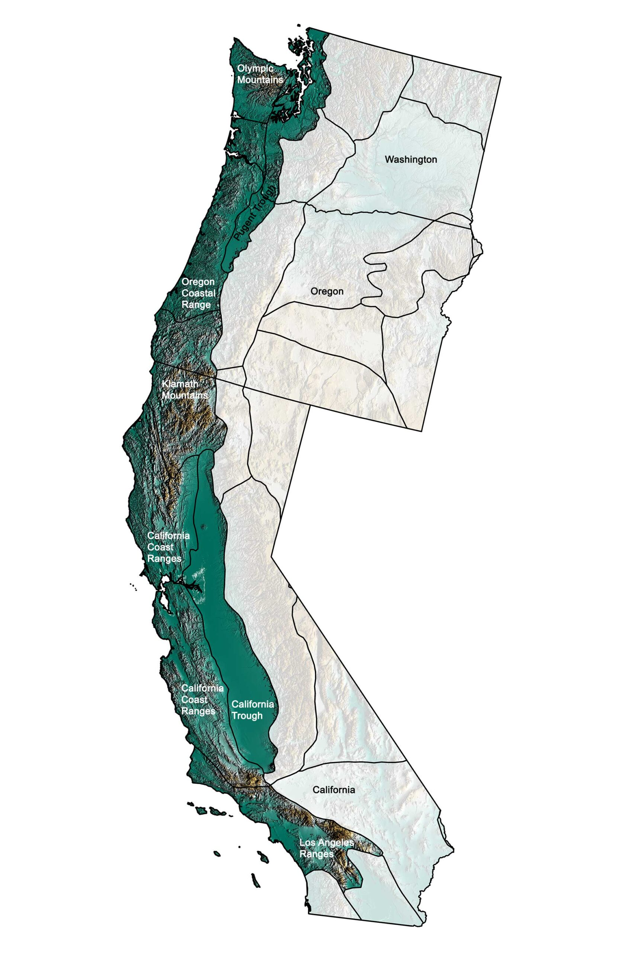
Close-up Aerial View of Province

Slide 29
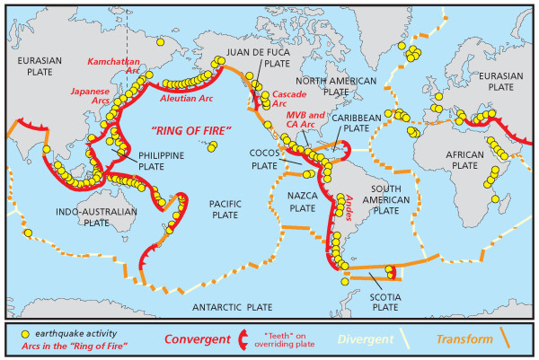
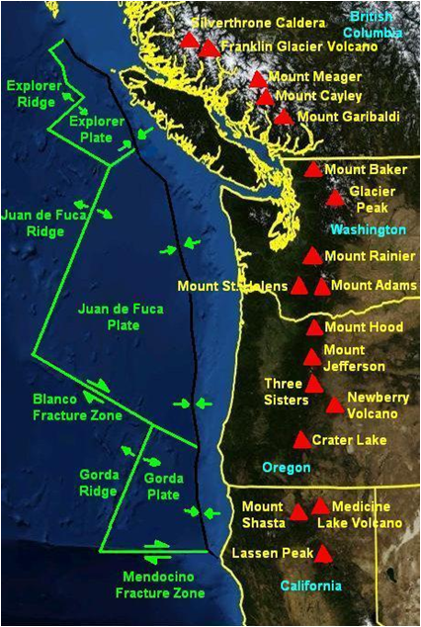
PACIFIC PROVINCE = 2 SUB-PROVINCES
Pacific Border Section
Area is a direct result of pre-historic tectonic forces ramming island-arcs, exotic terranes into western N.A.
Results in two distinct types of topography: lowlands and Mtn ranges.
The lowlands are a trough on the eastside of the Mtn ranges
Cascade-Sierra Section
Area is a direct result of the Ring of Fire subduction of the prehistoric Farallon Plate & it’s pieces
Subduction is along a ~1000 mile long line from Victoria, BC to Mendocino, CA
Mt. St. Helens and Mt Lassen are in this section
PACIFIC
OCEAN

Slide 30
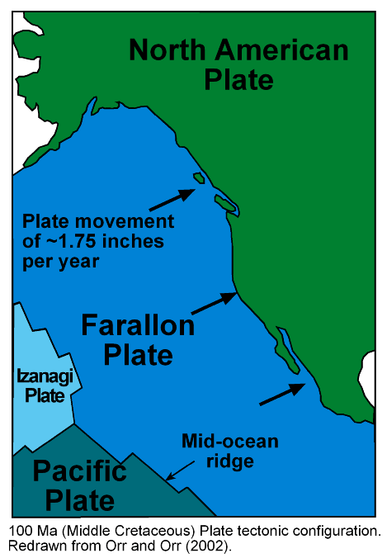
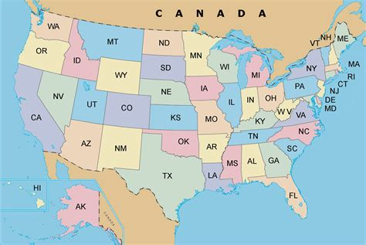
PACIFIC PROVINCE = 2 SUB-PROVINCES
PACIFIC
OCEAN
VIEW OF PACIFIC NORTHWEST COAST
Explorer Plate
(Farallon Piece)
SUBDUCTION ZONE
Juan de Fuca
Plate
(Farallon Piece)
Mt St Helen’s
Let’s look at the OCEAN FLOOR just offshore
Gorda Plate
(Farallon Piece)
Mt Lassen

Slide 31
THE ALASKAN PROVINCE

Slide 32
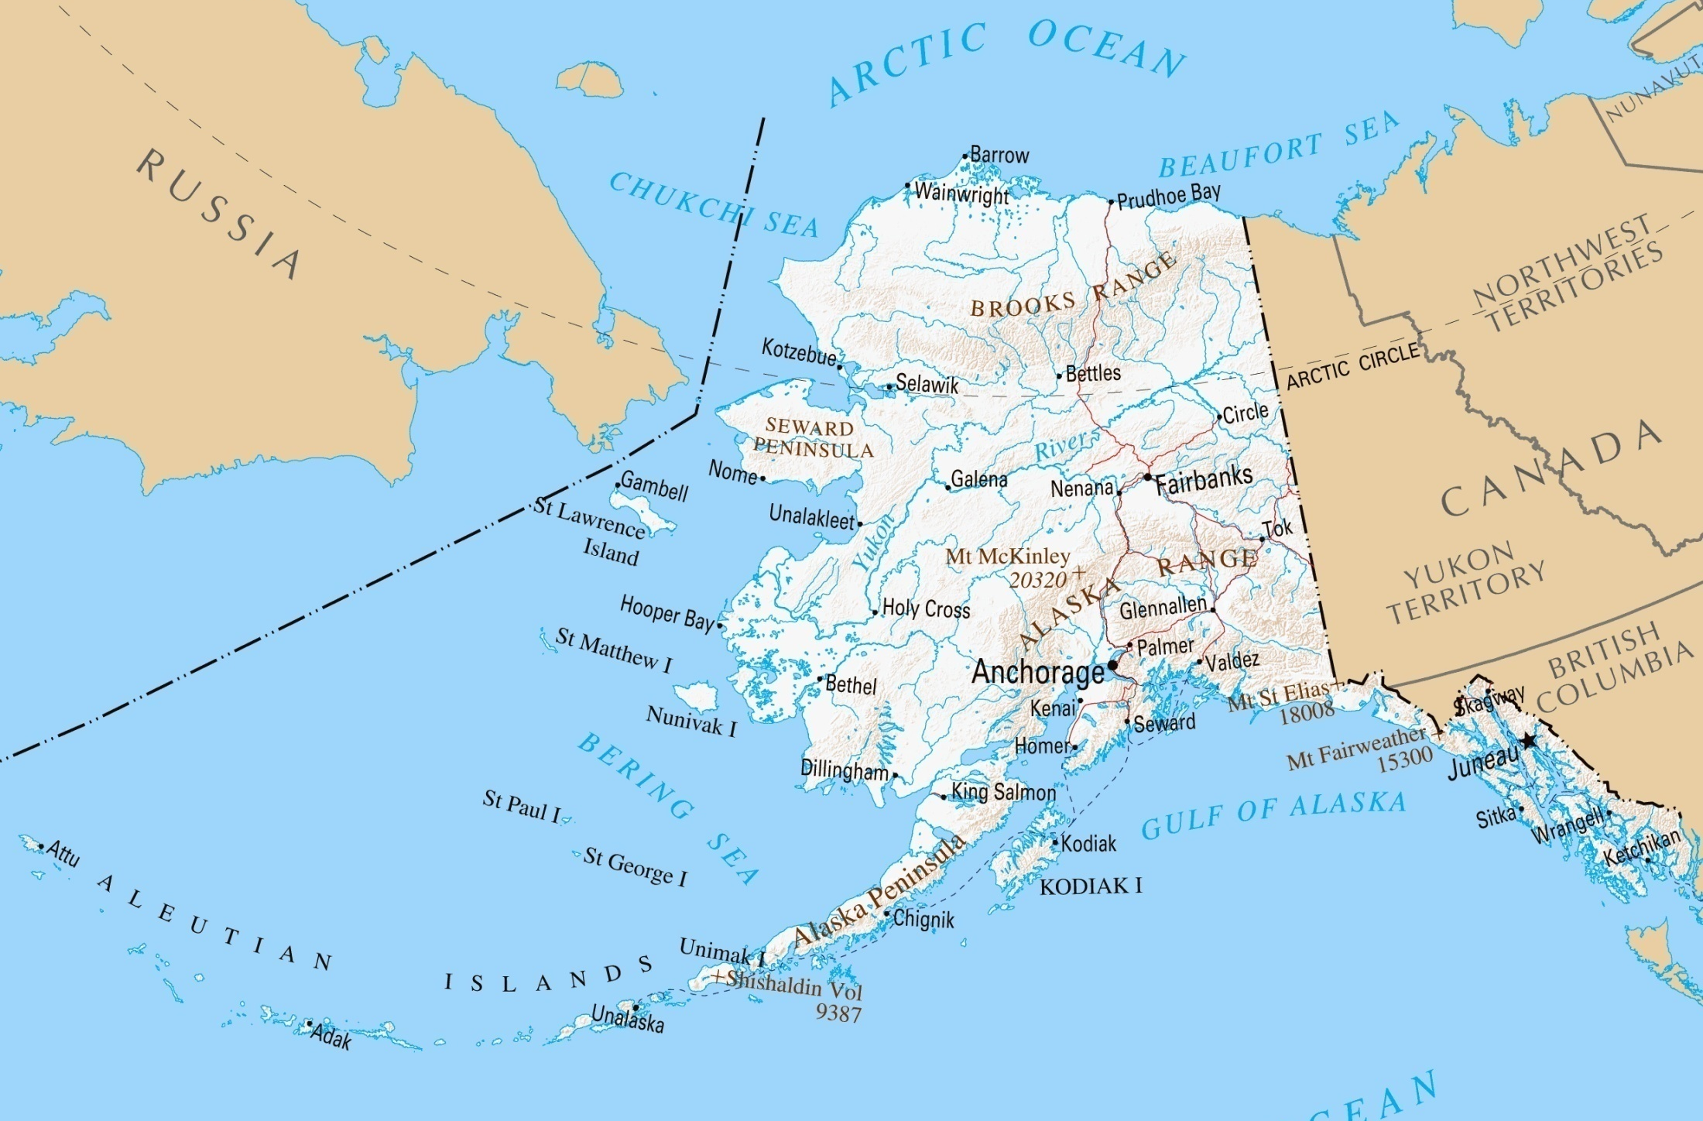
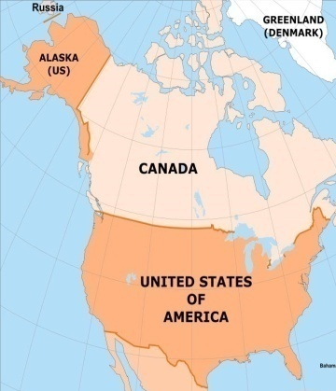
ALASKAN PROVINCE OVERVIEW
North Slope
RUSSIA
CANADA
Fairbanks
Anchorage
Juneau
Aleutian Chain of Islands
ALASKA

Slide 33
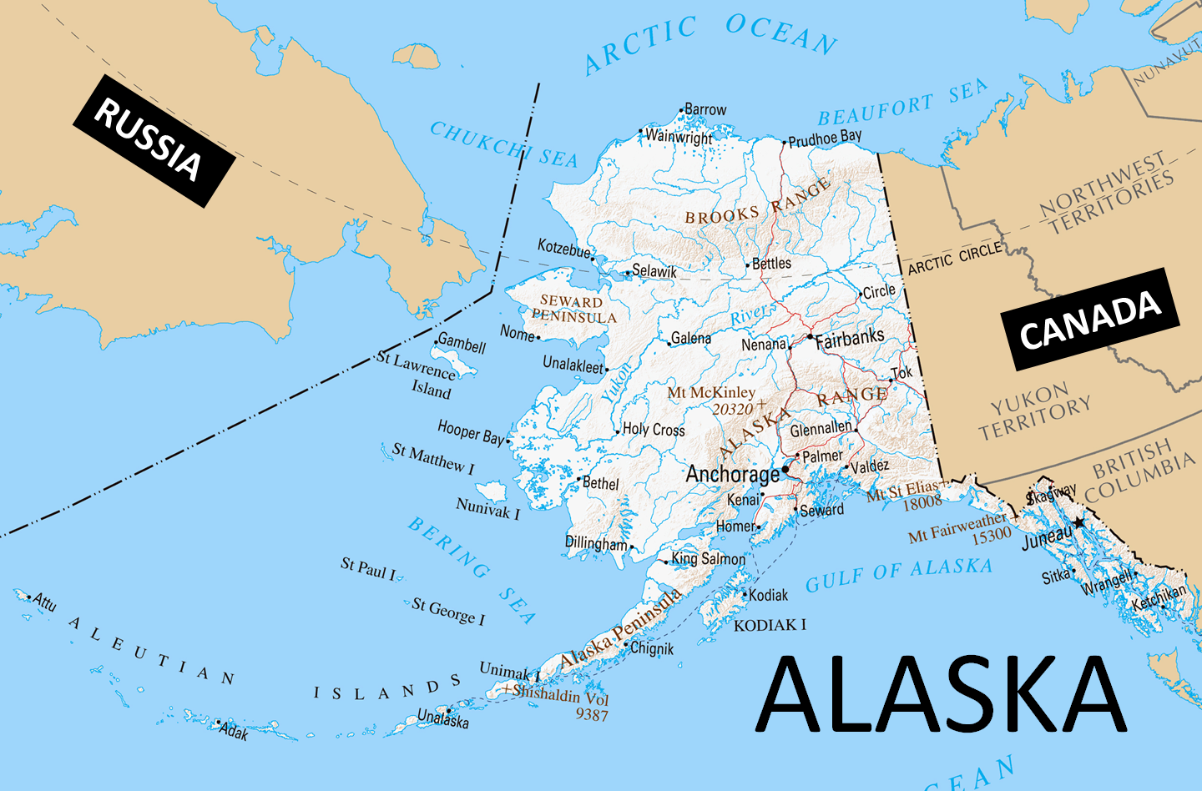
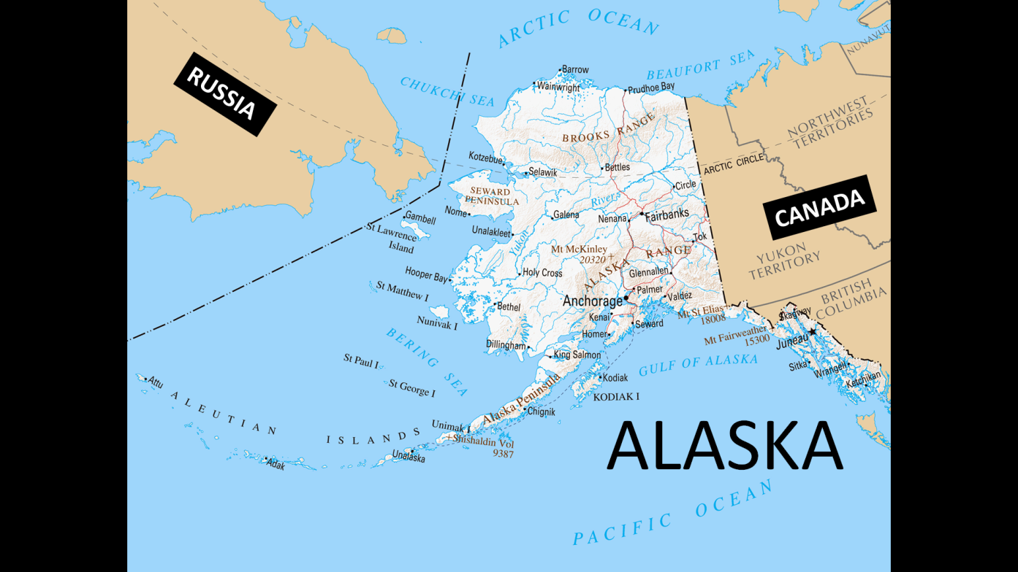

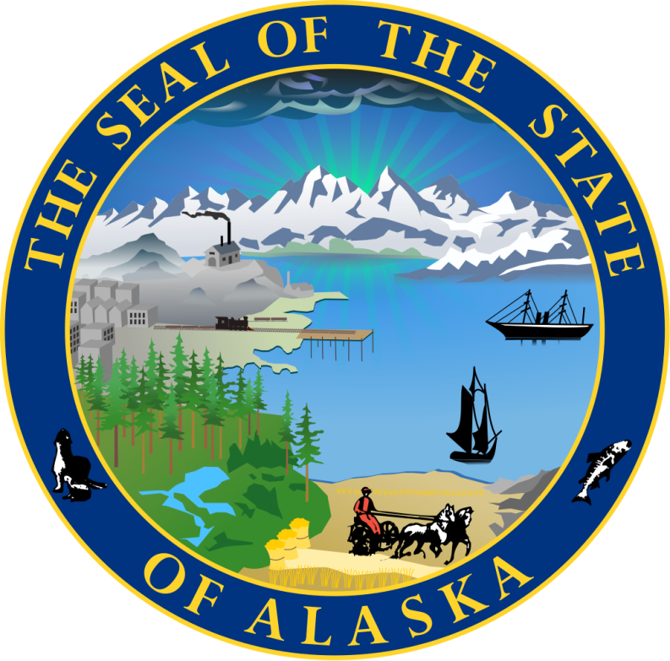
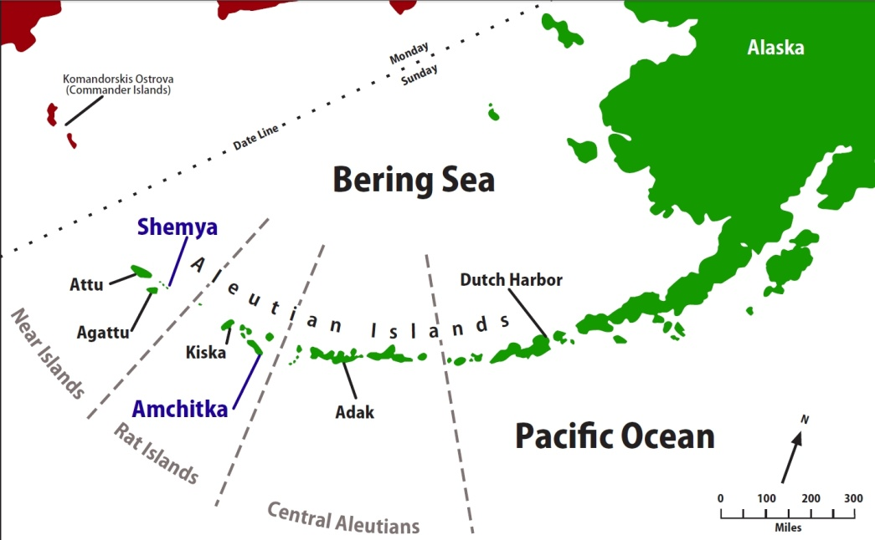
ALASKAN PROVINCE OVERVIEW
. Some of these islands fall in the Eastern Hemisphere, but the International Date Line was drawn west of 180° to keep the whole state, and thus the entire North American continent, within the same legal day.
Organized as a territory on May 11, 1912.
Admitted as the 49th state of the U.S. on Jan 3, 1959
More than 300 small volcanic islands make up this chain, which stretches more
than 1,200 miles into the Pacific Ocean
Two of the islands, Attu & Kiska, were occupied by Japanese forces during WWII
During Japanese occupation, an American civilian & two United States Navy personnel were killed

Slide 34
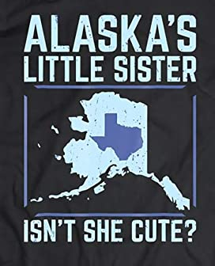
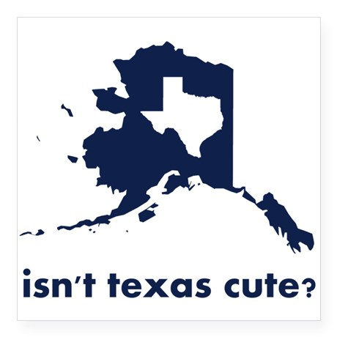



ALASKAN PROVINCE OVERVIEW
Alaska is by far the largest state in the United States
Bigger than Texas, California, and Montana COMBINED!
Alaska has a longer
coastline than all the other U.S. states combined
Alaska has more than three million lakes
Glacial ice covers about 29,000 sq mi
Bering Glacier is the largest glacier in North America, covering 2,008 square miles alone

Slide 35



ALASKAN PROVINCE OVERVIEW
Alaska's territorial waters touch Russia's territorial waters in the Bering Strait; Russia’s Big & Alaska’s Little Diomede Islands are 2 mi apart
Alaska's capital, which had
been in Sitka until 1906, was moved north to Juneau.
Starting in the 1890s and stretching in some places to the early 1910s, gold rushes in Alaska and the nearby Yukon Territory brought thousands of miners and settlers to Alaska.

Slide 36


ALASKAN PROVINCE OVERVIEW
Some of the Exotic Terranes, Volcanic Arcs/Island Chains,& Tidbits that dock to Continent to
build Alaska
As tectonic plates keep bringing surface debris & welding it to the continent, the subducting plates melt and yields volcanoes…lots of magma/lava brought to the surface resulting in this…

Slide 37

More to come about Alaska’s geology in future classes…
Massive glaciers over thousands of years sculpted these mountain ranges into what we see today…

Slide 38
NORTH AMERICAN GLACIATION

Slide 39

present
GLACIAL
OR
INTER-GLACIAL
TIME
- 180,000

Slide 40































Slide 41



GLACIATION & SEA LEVELS
Amount of Glaciers are DOWN!
Sea Levels
Are UP!

Slide 42




GLACIATION & THE BERING STRAITS
21,000 yrs ago, glaciers at max
Sea Levels at minimum
Area in black is today’s water level
Area in RED is Beringia
A land bridge between Russia & USA
RUSSIA
ALASKA

Slide 43
ROCKY’S GEOLOGY
ENDS HERE

Slide 44

National Treasures: Parks
EXOTIC TERRANES OF THE WEST
Week 1 – Setting the Stage
- Natural Wonders: Geology
- National Treasures: Parks
National Treasures: Parks

Slide 45
National Treasures: Parks
SANDI’S PEOPLE
STARTS HERE

Slide 46
WEEK 1 SETTING THE STAGE: OVERVIEW OF EXOTIC TERRANES
- National Treasures: Parks(SBP)
- People of the Parks
- First Peoples
- Pathways to New World
- Land Route (Beringia)
- Sea Route
https://www.academia.edu/34913340/Early_colonization_of_Beringia_and_Northern_North_America_Chronology_routes_and_adaptive_strategies?email_work_card=view-paper
- Native Americans
- Early Explorers
- New World Settlers
- Park Visionaries

Slide 47
National Treasures: Parks
- First Arrivals
- Native Americans
- Early Explorers
- New World Settlers
- American Visionaries
People of the Parks

Slide 48

National Treasures: Parks
- First Arrivals
- possible migration routes
possible
migration
routes
possible
migration
routes
- archeological evidence
- earliest arrivals

Slide 50

ice
Land Route
Atlantic Route
possible
migration
routes
Coastal Route
archeological
evidence?
Open Pacific ??

Slide 51
HYPOTHESES SUMMARY: HUMAN MIGRATION INTO AMERICAS
TECHNICAL SCIENTIFIC SUMMARY
https://www.academia.edu/11227539/The_Origin_of_Native_Americans_from_a_Mitochondrial_DNA_Viewpoint?email_work_card=view-paper
OVERVIEW FOR GENERAL INTEREST
https://en.wikipedia.org/wiki/Settlement_of_the_Americas
The settlement of the Americas began when Paleolithic hunter-gatherers entered North America from the North Asian Mammoth steppe via the Beringia land bridge, which had formed between northeastern Siberia and western Alaska due to the lowering of sea level during the Last Glacial Maximum (26,000 to 19,000 years ago). These populations expanded south of the Laurentide Ice Sheet and spread rapidly southward, occupying both North and South America, by 12,000 to 14,000 years ago. The earliest populations in the Americas, before roughly 10,000 years ago, are known as Paleo-Indians. Indigenous peoples of the Americas have been linked to Siberian populations by linguistic factors, the distribution of blood types, and in genetic composition as reflected by molecular data, such as DNA.
The precise date for the peopling of the Americas is a long-standing open question, and while advances in archaeology, Pleistocene geology, physical anthropology, and DNA analysis have progressively shed more light on the subject, significant questions remain unresolved. While there is general agreement that the Americas were first settled from Asia, the pattern of migration, its timing, and the place(s) of origin in Eurasia of the peoples who migrated to the Americas remain unclear. The "Clovis first theory" refers to the hypothesis that the Clovis culture represents the earliest human presence in the Americas about 13,000 years ago.
However, evidence of pre-Clovis cultures has accumulated and pushed back the possible date of the first peopling of the Americas. Many archaeologists believe that humans reached North America south of the Laurentide Ice Sheet at some point between 15,000 and 20,000 years ago. The theory is that these early migrants moved when sea levels were significantly lowered due to the Quaternary glaciation, following herds of now-extinct Pleistocene megafauna along ice-free corridors that stretched between the Laurentide and Cordilleran ice sheets. Another route proposed is that, either on foot or using primitive boats, they migrated down the Pacific coast to South America as far as Chile. Any archaeological evidence of coastal occupation during the last Ice Age would now have been covered by the sea level rise, up to a hundred metres since then. Some archaeological evidence suggests the possibility that human arrival in the Americas may have occurred prior to the Last Glacial Maximum more than 20,000 years ago.

Slide 52



ice
Land Route: Beringia
Land Route
Siberia
archeological
evidence?
Alaska

Slide 53
Land Route: Beringia
during the last ice age, vast glaciers formed
Today
53 miles of water
Bering Strait
Arctic Ocean
Siberia
Alaska
Pacific Ocean

Slide 54


Land Route: Beringia
during the last ice age, vast glaciers formed
sea level dropped 400 feet
exposing the floor of the Bering Sea
connecting Siberia & Alaska
Beringia
Land
Bridge
Siberia
Alaska

Slide 55
Land Route: Beringia
during the last ice age, vast glaciers formed
Beringia was grassland steppe . . .
with light snowfall . . . . and much plant & animal life
Beringia
Land
Bridge
Siberia
Alaska
The Land Route

Slide 56


Land Route: Beringia
Siberia
Alaska
The Land Route

Slide 57
https://en.wikipedia.org/wiki/Panthera_leo_spelaea
http://www.beringia.com/exhibit/ice-age-animals/beringian-lion
The Beringian lion (Panthera leo spelaea) was the largest and most abundant cat of ice age Yukon, and a member of the well-known "cave lions" from Europe and Asia. Lion fossil bones from Beringia are smaller than the rest of the European cave lions, suggesting that they could be a seperate sub-species.
The ice age lions of Eurasia and Beringia are genetically distinct from the populations that later became the modern African lion, even though their historic ranges may have overlapped in the ancient Near East. Groups of lions expanded their range dramatically out of Africa during the middle of the Ice Age, appearing in Europe and Britain by around 500,000 years ago. It is not certain when lions crossed Beringia and first appeared in North America. Genetic evidence suggests they may have inhabited Alaska around 300,000 years ago. Some of these lions made their way south into the mid-continent of the United States around 150,000 years ago. After thousands of years of seperation from one another due to the continental ice sheets, the southern population evolved into a unique species, the American lion (Panthera leo atrox).
Lions are the only modern large cats that live in groups or prides. Because their closest relatives, tigers and leopards, don't live in groups, scientists believe group living evolved early in lion evolution, back near the start of the Ice Age around two million years ago. Scientists today are continually searching for evidence that Beringian lions and their ice age relatives did in fact live in prides.

Slide 58

Land Route: Beringia

Slide 59

Land Route: Beringia
let’s look at one group who crossed Beringia

Slide 60

Land Route: Beringia
- ancestors of the Alaskan Yupik Nation
- blood type, linguistics, & DNA confirm
common ancestry with the Siberian Yupiks
let’s look at one group who crossed Beringia

Slide 61
Land Route: Beringia
- ancestors of the Alaskan Yupik Nation
- blood type, linguistics, & DNA confirm
common ancestry with the Siberian Yupiks
ALASKA
SIBERIA
Russia
Canada
North
Pole

Slide 62
https://en.wikipedia.org/wiki/Yupik_peoples
The Yupik (plural: Yupiit are a group of indigenous or aboriginal peoples of western, southwestern, and south central Alaska and the Russian Far East. They are related to the Inuit and Iñupiat.
Population
The Yup'ik are by far the most numerous of the various Alaska Native groups. They speak the Central Alaskan Yup'ik language, a member of the Eskimo–Aleut family of languages.
As of the 2002 United States Census, the Yupik population in the United States numbered more than 24,000, of whom more than 22,000 lived in Alaska, the vast majority in the seventy or so communities in the traditional Yup'ik territory of western and southwestern Alaska.[6] United States census data for Yupik include 2,355 Sugpiat; there are also 1,700 Yupik living in Russia. According to 2019-based United States Census Bureau data, there are 700 Alaskan Natives in Seattle, many of whom are Inuit and Yupik, and almost 7,000 in the state of Washington.
Etymology of name
Yup'ik (plural Yupiit) comes from the Yup'ik word yuk meaning "person" plus the post-base -pik meaning "real" or "genuine". Thus, it literally means "real people." The ethnographic literature sometimes refers to the Yup'ik people or their language as Yuk or Yuit. In the Hooper Bay-Chevak and Nunivak dialects of Yup'ik, both the language and the people are known as Cup'ik.
The use of an apostrophe in the name "Yup’ik", compared to Siberian "Yupik", exemplifies the Central Alaskan Yup’ik's orthography, where "the apostrophe represents gemination [or lengthening] of the ‘p’ sound".
Origins
The common ancestors of the Eskimo and Aleut (as well as various Paleo-Siberian groups) are believed by anthropologists to have their origin in eastern Siberia, arriving in the Bering Sea area approximately 10,000 years ago. Research on blood types, supported by later linguistic and DNA findings, suggests that the ancestors of other indigenous peoples of the Americas reached North America before the ancestors of the Eskimo and Aleut. There appear to have been several waves of migration from Siberia to the Americas by way of the Bering land bridge, which became exposed between 20,000 and 8,000 years ago during periods of glaciation. By about 3,000 years ago, the progenitors of the Yupiit had settled along the coastal areas of what would become western Alaska, with migrations up the coastal rivers—notably the Yukon and Kuskokwim—around 1400 AD, eventually reaching as far upriver as Paimiut on the Yukon and Crow Village on the Kuskokwim.

Slide 63


Land Route: Beringia
- ancestors of the Alaskan Yupik Nation
ALASKA
SIBERIA
about 12,000 YBP
LAND BRIDGE
Russia
ik
Canada
North
Pole
Siberian Yupik
Blood type, linguistics,
DNA in common
Alaskan Yupik

Slide 64
Land Route: Beringia
- ancestors of the Alaskan Yupik Nation
Both cultures are Haplogroup ‘A’
DNA in common?
about 12,000 YBP
a haplogroup shares
a common ancestor
LAND BRIDGE
ik
Siberian Yupik
DNA in common?
Blood type, linguistics,
DNA in common
Alaskan Yupik

Slide 65


Land Route: Beringia
Both cultures are Haplogroup ‘A’
DNA in common?
a haplogroup shares
a common ancestor
Siberian Yupik
Alaskan Yupik
HAPLOGROUP DISTRIBUTION
Alaskan
Siberian

Slide 66
?
Land Route: Beringia
Both cultures are Haplogroup ‘A’
A
A
A
A
HAPLOGROUP DISTRIBUTION
Alaskan
Siberian

Slide 67

?
ice
Land Route: Beringia
Coastal Route: Pacific
Land Route
A
A
Alaska Panhandle
Coastal Route
archeological
evidence?
A
Alaska Panhandle
Siberian
Alaskan
A
HAPLOGROUP DISTRIBUTION

Slide 68


Coastal Route: Pacific
CANADA
MOUNTAINS
ALASKA
Alaska Panhandle

Slide 69


Coastal Route: Pacific
1996: Alaskan paleontologists find human remains
FINDINGS: - remains about 10,000-12,000 years old
- ate a marine-based diet
MOUNTAINS
Prince of Wales Island
On-your-knees Cave
Alaska Panhandle
Notes:
http://www.onlyinyourstate.com/alaska/crazy-caves-in-ak/
http://www.nbcnews.com/id/21385733/ns/technology_and_science-science/t/alaskan-tribes-get-ancient-remains/
This undated photo provided by the U.S. Forest Service shows a cast of the humans remains that were found in a cave on Prince of Wales Island, Alaska, in 1996. The original human remains, which included vertebrae, ribs, teeth, a mandible and pelvic bone, are estimated to be more than 10,000 years old.
https://en.wikipedia.org/wiki/On_Your_Knees_Cave
stone tools that were found within the cave were made at the site, but not of materials known to be from the site such as obsidian.^{[1]} Since the cave site is on an island and the lithic material was not known to the site, researchers have suggested that the individual and others at that time were mariners who could cross bodies of water by boats. The evidence from this site suggesting a marine based diet, extralocal artifacts, and a maritime adaptation supports a coastal migration model .
http://indiancountrynews.net/index.php/news/9-news-from-through-out-indian-country/5389-dna-tracks-descendants-of-tlingit-haida-and-tsimshian-in-southeast-alaska

Slide 70
https://en.wikipedia.org/wiki/On_Your_Knees_Cave
On Your Knees Cave is an archaeological site located in southeastern Alaska (Prince of Wales Island). Human remains were found at the site in 1996 that dated between 9,730 ±60 and 9,880±50 radiocarbon YBP (Years Before Present) or a calendrical date of 10,300 YBP. In addition to human skeletal remains, stone tools and animal bones were discovered. DNA analyses performed on the human skeletal remains document the presence of mitochondrial haplogroup D which occurs widely in the Americas. Isotopic analysis indicated that the individual had a primarily marine based diet.
Location
On Your Knees Cave is located on the northern tip of Prince of Wales Island within the Tongass National Forest. Its location is approximately one kilometer from the coast and 125 meters above sea level. Originally, the entrance of the cave was obstructed by large rocks and soil that had fallen from the cliff above, and covered with vegetation. After the obstructions were cleared, the small entrance later gave the cave its name. Inside is a long tunnel with an extremely low ceiling with old bear dens throughout.
Discovery
The site was first discovered in 1993 by the Tongass Cave Project, a joint cooperation between the Tongass National Forest and the National Speleological Society. Starting the following year, old bear dens within the cave were explored and numerous animal bones began to be found. Many different animal species were found during the excavations, including species now extinct on the island. After the discovery of animal bones in 1994, Timothy Heaton, paleontologist with the University of South Dakota-Vermillion at the time, led the research project, assisted in 1996 and after by Fred Grady with the Smithsonian Institution. Brian Kemp, a molecular anthropologist, and E. James Dixon assisted in the analyses. However, the discovery of human skeletal remains in 1996 changed the direction of the research project.
The human skeletal remains included a mandible with all but the incisors, partial remains of a right pelvis and other small fragments, 5 vertebrae, 3 maxillary incisors, and 1 maxillary canine. Stone tools were found among the animal and human bones. The stone tool material, obsidian, suggests trade or movement across water and land boundaries in the area.
Significance
On Your Knees Cave is currently one of the earliest known settlements along the Northwest Coast of North America. DNA (deoxyribonucleic acid) was extracted from one of the individual's molars. The genetic analysis revealed that the individual, dubbed Shuká Káa (Tlingit: Man Ahead Of Us) was a male. Further examination of the teeth indicated that the man died in his mid-twenties. Through mitochondrial DNA (mtDNA), the individual was determined to be a member of a subgroup of haplogroup D, marking the earliest occurrence of this haplogroup. This haplogroup is found in populations along the western coast of the Americas. A tribal group in the area of the discovery, the Tlingit, submitted DNA samples to be compared to the On Your Knees Cave individual. However, no match was found, indicating that the individual and modern Alaska Native American tribes are likely not closely related, although this does not mean that ancient Alaskan Native American groups would not have been closely related to the individual.
Isotopic analyses conducted on the human skeletal remains revealed this individual's diet was almost entirely marine protein. This, given On Your Knees Cave's location on an island, suggests a maritime adaptation was present at an early time level in this region.
One hundred animal bones samples from On Your Knees Cave underwent carbon-14 dating and the results indicated that during the past 40,000 years there was almost continuous occupation and use of the cave by animals, indicating the island was never completely glaciated or uninhabitable during this interval. The stone tools that were found within the cave were made at the site, but not of materials known to be from the site such as obsidian. Since the cave site is on an island and the lithic material was not known to the site, researchers have suggested that the individual and others at that time were mariners who could cross bodies of water by boats. The evidence from this site suggesting a marine based diet, extralocal artifacts, and a maritime adaptation supports a coastal migration model for the first Americans as proposed by K.R. Fladmark in 1979.
NAGPRA and the human skeletal remains
In accordance with the Native American Graves Protection and Repatriation Act of 1990, excavations at On Your Knees Cave were halted after the discovery of human skeletal remains in 1996. After the discovery, Heaton and other project leaders contacted and began consulting with local tribal governments in the area to determine the ownership of the remains. The rightful ownership was deemed to belong to the Tlingit people in Southeastern Alaska. The Tlingit had their reservations about allowing scientists to test the remains, but finally agreed to analyses of the human bones and further excavation if they were notified of any additional discoveries. This led to a 12-year-long partnership between the Tlingit Native American tribe and the scientific community. After the human skeletal remains had been studied for a time, they were repatriated to the Tlingit people for a reburial and a celebration festival.

Slide 71

Coastal Route: Pacific
DNA testing found Haplogroup ‘D’
with genetic relatives along the Pacific coast
On-your-knees Cave
Alaska Panhandle

Slide 72
Coastal Route: Pacific
DNA testing found Haplogroup ‘D’
with genetic relatives along the Pacific coast
CONCLUSION:
“a likely ancient pathway south . . . a COASTAL migration”
California – Mexico – Ecuador – Chile - Argentina

Slide 73
Coastal Route: Pacific
CONCLUSION:
“a likely ancient pathway south . . . a COASTAL migration”
Where are the descendants of
Haplogroup ‘D’
HAPLOGROUP DISTRIBUTION

Slide 74
?
Coastal Route: Pacific
Haplogroup ‘D’
California – Mexico – Ecuador – Chile - Argentina
D
D
D
D
HAPLOGROUP DISTRIBUTION

Slide 75
?
ice
Coastal Route: Pacific
Haplogroup ‘D’
California – Mexico – Ecuador – Chile - Argentina
D
D
Coastal Route
archeological
evidence?
D
D
HAPLOGROUP DISTRIBUTION

Slide 76
ice
Atlantic Route: from Europe
Atlantic Route
Coastal Route
archeological
evidence?
Solutrean hypothesis:
earliest migration to the Americas
was from Europe, traveling
along pack ice of the Atlantic Ocean

Slide 77


SOLUTREAN HYPOTHESIS: ATLANTIC MIGRATION
https://peachstatearchaeologicalsociety.org/index.php/archaeological-site-surveys/469-paleoindian-pre-clovis-evidence
CENTRAL GEORGIA SURFACE SURVEY: PRE-CLOVIS EVIDENCE
The Paleoindian Period 18,000 to 9,900 Years B.P.
Many scientists believe that prehistory in the Southeastern United States began some 20,000 to 30,000 years BP in the frozen tundra of Siberia in northeastern Asia. During the last twenty years, Paleoindian lithic research in the former Soviet Union has revealed a series of new sites containing cultural horizons of the middle and lower Pleistocene and Eopleistocene eras. The lithic components of these sites consisted of unifacial pebble scrapers and choppers. Several newly discovered sites in northern China dating to 35,000 years BP, exhibit similar lithic traits. Fossil remains excavated at the later sites confirm that the people of that day were nomadic hunters who banded together to follow herds of megafauna including the mastodon, woolly mammoth, mammoth rhinoceros, horse, giant sloth, camel, musk-ox and bison.
From their entrance into
the new world, the migration of
Paleoindian people carried them
eastward and southward into
every corner of the Americas
including what is now the
continental United States (Map 1A).
Over the last 20 or so
years, this basic understanding
of the peopling of the Americas
has been challenged.
The American continent
was the last of the world’s
continents to be populated. There
are many contradictory and more
or less well-founded scientific
theories on when this occurred
and where the first immigrants migrated from. The prevailing theory is based on findings of stone tools from the Clovis culture in soil layers dating back to approximately 13,000 BC. According to the theory, people from Siberia migrated, perhaps in search of mammoth, across the land bridge that once connected Siberia and North America. From there, they continued south and spread out across the American continent. The migration passed through a corridor that opened up approximately 14,000 years ago in the giant glacier that covered the American continent.
New findings call this immigration theory into question: Professor Eske Willerslev of the University of Copenhagen was surprised by the results of the DNA tests on samples of what turned out to be fossilized human feces found in deep caves in the Oregon desert. The oldest of the droppings have been carbon-dated to be approximately 14,340 years old. Willerslev’s feces samples clearly contain two main genetic types of Asian origin that are unique to present-day North American Indians. Not only is this proof that the American Indians are descendants of the first immigrants to the continent, it is also proof that immigration took place approximately 1,000 years earlier than otherwise believed. The theory that is currently most widely accepted, and which is supported by genetic, linguistic and archaeological evidence, considers the American continent to have been populated from Asia either via the Bering land bridge or by sea.
The Solutrean hypothesis is an alternative theory about the settlement of the Americas, according to which peoples from Europe may have been among the earliest settlers of the American continent. The Solutrean hypothesis was first proposed in 1998. Its key proponents include Dennis Staniford, of the Smithsonian Institution, and Bruce Bradley, of the University of Exeter.
According to this hypothesis, people associated with the (European) Solutrean culture migrated from Ice Age Europe to North America, bringing their methods of making stone tools with them and providing the basis for the later Clovis technology found throughout North America. The hypothesis rests upon proposed similarities between European Solutean and Early American Clovis lithic technology. Many archaeologists have criticized the proposed similarities as too insignificant and just as likely to be due to chance as to shared origins. As one has said, "few if any archaeologists -- or, for that matter, geneticists, linguists, or physical anthropologists -- take seriously the idea of a Solutrean colonization of America."
Though the proponents cite recent archaeological findings in support of the theory, the hypothesis has generally not been well received. A recent DNA study challenges a genetic argument often made in favor of the hypothesis. The study argues against the apparently anomalous mtDNA Haplogroup X2A having migrated to the Americas via an Atlantic route.
Lithic technology (stone tool making techniques) has been part of the supportive evidence of the Solutrean hypothesis. Solutrean culture was dominant in present-day France and Spain from roughly 21,000 to 17,000 years ago. It was known for its distinctive tool-making characterized by bifacial, percussion and pressure-flaked points. Traces of the Solutrean tool-making industry disappeared almost completely from Europe around 15,000 years ago, when it was replaced by the stone tools of the Magdalenian culture.
Clovis tools are typified by a distinctive type of spear point, known as the Clovis point. Solutrean and Clovis points share common characteristics: points are thin and bifacial, and they share the intentional use of the "outre passé", or overshot flaking technique, which quickly reduces the thickness of a biface without reducing the width.
The Clovis blade differs from the Solutrean in that some of the former have bi-facial fluting (a long depression that occurs on a point, struck from the basal end of the point; the purpose was to better fit the point onto a spear foreshaft). Clovis tool-making technology seems to appear in the archaeological record in eastern North America roughly 13,500 years ago, and similar predecessors in Asia or Alaska, if they exist, have not been discovered.
Stanford and Bradley, in their book "Across Atlantic Ice," make a
variety of claims in support of the Solutrean hypothesis. Among these are
the connection between the Clovis culture and several artifacts found in
Maryland, Pennsylvania, Virginia and Delaware. In addition, they have been
able to carbon date many new findings from the Delmaria Peninsula in
Maryland to between 26000 and 19000 BC, which is contemporary with
the period in Europe during which similar artifacts were being made.
According to their book, no materials from before 15,000 years ago, of any
make or cultural bearing, have been found on the West Coast near where
the first Siberian ancestors of American Indians first arrived.
The hypothesis proposes that Ice Age Europeans could have crossed the North Atlantic along the edge of the pack ice that extended from the Atlantic coast of France to North America during the last glacial maximum. The model envisions these people making the crossing in small watercraft, using skills similar to those of the modern Inuit people, hauling out on ice floes at night, getting fresh water by melting iceberg ice or the first-frozen parts of sea ice, getting food by catching seals and fish, and using seal blubber as heating fuel. Among other evidence backing up this hypothesis is the discovery among the Solutrean toolkit of bone needles, very similar to those traditionally used by the modern-day Inuit. As well as enabling the manufacture of waterproof clothing from animal skins, the technology could, in theory, have been used to construct kayaks from the same animal skins. However, a 2008 study argues that the conditions were not favorable for such a crossing.
The discovery of pre-Clovis remains at sites like Page/Ladson, located along Florida’s Aucilla River, was reported by Jim Dunbar. Seven radiocarbon dates taken from Unit 3 of that site had an average date of 14,245 years before present (BP). The lanceolate blades made on thin flakes, which have been named the Page-Ladson point, bear strong similarities to the pre-Clovis points found at the Cactus Hill site.
The Cactus Hill site in Virginia dates between 15,000 and 17,000 years BP. These discoveries, and the Topper site near Allendale, South Carolina, have strongly suggested a relationship to European lithic technology. The Clovis culture at the Topper site and the pre-Clovis culture beneath it that dates much earlier have yielded evidence of a possible relationship to the Solutrean culture of southern France that dates between 18,000 and 20,000 years BP. The thinly fluted blades of the Clovis culture bear little resemblance to the thick, heavy blades of the Siberian Dyuktai points that date to only 14,000 years BP. These relationships may suggest a migration route from northern Europe along the edge of the glacial face to North America. Perhaps the Vikings of a thousand years ago were not the first Europeans to set foot in the Americas after all.
Since 1960, archaeological studies of the river basin projects in the Southeast as well as statewide studies of Paleoindian point finds and site distribution, have led to refinements in the sequencing of point types and attempts to reconstruct Paleoindian cultural activities. Excavations at Paleoindian sites, better dating techniques, the study of the distribution of Paleoindian point types, and the study of the Late Pleistocene environment have led archeologists to develop a new model for Paleoindian occupation in the Southeast that is now broken down into three sub-periods between 11,500 and 9,900 years BP.
Map 1A: Paleoindian Migration into the New World

Slide 78

ice
Atlantic Route: from Europe
Solutrean hypothesis:
earliest migration to the Americas
was from Europe, traveling
along pack ice of the Atlantic Ocean

Slide 79


ice
Atlantic Route: from Europe
Atlantic Route
North
Pole
Beringia Routes
similar
stone tool
technology
Solutrean Culture:
distinctive stone tool technology
archeological
evidence?
Europe
N. America
??

Slide 80

ice
Open Pacific Route: Australia
Atlantic Route
archeological
evidence?
Open Pacific ??

Slide 81




Open Pacific Route: Australia
1974: Brazil – human scull discovery
- remains 13,500 years old
- forensic reconstruction shows similarity
to aboriginal people of Australia
1998: Australia: watercraft pictograph
17,000-years-old?
high prow suggests ocean travel
???
8,500 miles

Slide 82
AUSTRIALIAN HYPOTHESIS: PACIFIC OCEAN MIGRATION
https://www.youtube.com/watch?v=qmboAKlV6zg
(40 minute Utube video of possible Australian-Brazil route)
https://www.historyfiles.co.uk/FeaturesAmericas/PrehistoricFirstHumans02.htm
Evidence was presented in 1999 that the first Americans were descended from Australian aborigines. The evidence was to be included in a new BBC documentary entitled Ancient Voices. It would show that the dimensions of prehistoric skulls which had been found in Brazil matched those of the aboriginal peoples of Australia and Melanesia. Other evidence suggested that these first Americans were later massacred by invaders from Asia - the ancestors of all later native Americans.
Asian migrants used the ice age land bridge between Siberia and Alaska to reach North America, from where they could migrated further across the whole of the two continents. With the ending of the ice age, the land bridge was gradually flooded until it was cut off entirely.
However, the new evidence showed that these people did not arrive into an empty wilderness. Stone tools and charcoal from the site in Brazil showed evidence of human habitation as long ago as 50,000 years. The site was at Serra Da Capivara in remote north-eastern Brazil. This area is now inhabited by the descendants of European settlers and African slaves who arrived just five hundred years ago. But cave paintings found here provided the first clue to the existence of a much older people.
Ancient animals
Images of giant armadillos, which died out before the last ice age, show that the artists who drew them lived here before the Asian-descended natives who greeted the Europeans. The Asian descendants have facial features which have been described as mongoloid. However, skulls dug from a depth which equates to dates between 10,000-7000 BC are very different.
Walter Neves, an archaeologist from the University of Sao Paolo, took extensive skull measurements from dozens of skulls, including the oldest, a young woman who was named Lucia. The next step was to reconstruct a face from Lucia's skull. First, a CAT scan of the skull was carried out to allow an accurate working model to be made.
Then a forensic artist, Richard Neave from the University of Manchester, UK, created a face for Lucia. The result was surprising - it had all the features of a negroid face.
Boat people
The skull dimensions and facial features matched most closely to the native people of Australia and Melanesia. These people date back at least 60,000 years, and were themselves descended from the first humans to leave Africa in a permanent migratory wave, around 70,000-80,000 years ago.
But how could the early Australians
have travelled more than 13,500 kilometres
(8,450 miles) at that time? The answer came
from more cave paintings, this time from the
Kimberley, a region at the northern tip of
Western Australia. Here, Grahame Walsh, an
expert on Australian rock art, found the
oldest painting of a boat anywhere in the
world. The style of the art meant that it was
at least 17,000 years old, but could be much older.
The crucial detail was in the high prow of the boat. This would have been unnecessary for boats used in calm, inland waters. The design suggests that it was used on the open ocean. Archaeologists speculated that such an incredible sea voyage, from Australia to Brazil, would not have been undertaken knowingly but was instead accidental.
In 1996, five African fishermen were caught in a storm and a few weeks later were washed up on the shores of South America. Two of the fishermen died, but three made it alive - more than enough to prove that such a voyage was possible.
Evidence
But if the first Americans had drifted from Australia, where are their descendants now? Again, the skulls suggested an answer. The shape of the skulls changed between 7,000 BC and 5,000 BC from being exclusively negroid to exclusively mongoloid. Combined with rock art evidence of increasing violence at this time, it appears that the mongoloid (Asian) people from the north invaded and wiped out the original Americans.
The only evidence of any survivors comes from Terra del Fuego, the islands at the remotest southern tip of South America. The pre-European Fuegeans, who lived stone age-style lives until the twentieth century, show hybrid skull features which could have resulted from intermarrying between mongoloid and negroid peoples. Their rituals and traditions also bear some resemblance to the ancient rock art in Brazil.
The identity of the first Americans is an emotive and controversial question. But the evidence from Brazil, and a handful of people who still live at the very tip of South America, suggests that the Americas have been home to a greater diversity of humans than previously thought - and for much longer.
Text copyright © Channel 4 Television or affiliates. Reproduction is made on a 'fair dealing' basis for the purpose of disseminating relevant information to a specific audience. No breach of copyright is intended or inferred

Slide 83

https://en.wikipedia.org/wiki/Luzia_Woman
Luzia Woman (Portuguese pronunciation: [luˈzi.ɐ]) is the name for an Upper Paleolithic period skeleton of a Paleo-Indian woman who was found in a cave in Brazil. Some archaeologists originally thought the young woman may have been part of a migratory wave of immigrants prior to the ancestors of today's Amerindians, though DNA and other evidence has shown this to be improbable. The 11,500-year-old skeleton was found in a cave in the Lapa Vermelha archeological site in Pedro Leopoldo, in the Greater Belo Horizonte region of Brazil, in 1974 by archaeologist Annette Laming-Emperaire. The nickname Luzia was chosen in homage to the Australopithecus fossil Lucy. The fossil was kept at the National Museum of Brazil, where it was shown to the public until it was fragmented during a fire that destroyed the museum on September 2, 2018. On October 19, 2018, it was announced that most of Luzia's remains were identified from the Museu Nacional debris, which allowed them to rebuild part of her skeleton.
Luzia was originally discovered in 1974 in a rock shelter by a joint French-Brazilian expedition that was working not far from Belo Horizonte, Brazil. The remains were not articulated. The skull, which was separated from the rest of the skeleton but was in surprisingly good condition, was buried under more than forty feet (12 meters) of mineral deposits and debris.
There were no other human remains at the site. In 2013, testing of the charcoal recovered from the stratum with Luzia's bones date the remains at an age of 10,030 ± 60 14C yr BP (11,243–11,710 cal BP), Luzia is one of the most ancient American human skeletons ever discovered. Forensics have determined that Luzia died in her early 20s. Although flint tools were found nearby, hers were the only human remains found in Vermelha Cave.
The fossil of Luzia was believed to have been destroyed when the National Museum burned, according to officials, but firefighters later discovered a human skull within the burned museum. On October 19, 2018 it was announced that the Luzia skull was indeed found, but in a fragmented state. 80% of the fragments were identified as being part of the frontal (forehead and nose), side, bones that are more resistant and the fragment of her femur that also belonged to the fossil and was stored. A part of the box that contained Luzia's skull was also recovered. The reassembly of the bones has not yet been undertaken.
Phenotypical analysis
Her facial features included a narrow, oval cranium,
projecting face and pronounced chin, strikingly dissimilar to most
Native Americans and their indigenous Siberian forebears.
Anthropologists variously described Luzia's features as resembling
those of Indigenous Australians, Melanesians and the Negritos
of Southeast Asia. Walter Neves, an anthropologist at the
University of São Paulo, suggested that Luzia's features most
strongly resembled those of Australian Aboriginal peoples.
Neves and other Brazilian anthropologists theorized
that Luzia's Paleo-Indian predecessors lived in South East Asia
for tens of thousands of years after migrating from Africa and
began arriving in the New World as early as 15,000 years ago.
The oldest confirmed date for an archaeosite in the Americas is 18,500 and 14,500 cal BP for the Monte Verde site in southern Chile.[14] Some anthropologists have hypothesized that a population from coastal East Asia migrated in boats along the Kuril island chain, the Beringian coast and down the west coast of the Americas during the decline of the Last Glacial Maximum. In 1998, Neves and archaeologist André Prous studied and dated 11,400 years for the skull of Luzia after naming her.
Neves' conclusions have been challenged by research done by anthropologists Rolando González-José, Frank Williams and William Armelagos, who have shown in their studies that the cranio-facial variability could just be due to genetic drift and other factors affecting cranio-facial plasticity in Native Americans.
A comparison in 2005 of Lagoa Santa specimens with modern Aimoré people of the same region also showed strong affinities, leading Neves to classify the Aimoré as Paleo-Indians.
Researchers recreated the skull of Luzia with 3D printers by studies resumed in a laboratory of the National Institute of Technology (INT) by master's and doctoral students of the Federal University of Rio de Janeiro.
In November 2018, scientists of the University of São Paulo and Harvard University released a study that contradicts the alleged Australo-Melanesian origin of Luzia. Using DNA sequencing, the results showed that Luzia was entirely Amerindian, genetically. It was published in the journal Cell article (November 8, 2018), a paper in the journal Science from an affiliated team also reported new findings on fossil DNA from the first migrants to the Americas.
Lagoa Santa remains from a site nearby to the Luzia remains carry DNA regarded as Native American. Two of the Lagoa Santa individuals carry the same mtDNA haplogroup (D4h3a) also carried by older 12,000+ remains Anzick-1 found in Montana, mtDNA haplogroup A2, B2, C1d1 and three of the Lagoa Santa individuals harbor the same Y chromosome haplogroup Q1b1a1a1-M848 as found in the Spirit Cave genome of Nevada. The bust of Luzia displaying Australo-Melanesian features was created in 1999. André Strauss of the Max Planck Institute, one of the authors of the Journal Science article remarked "However, skull shape isn't a reliable marker of ancestrality or geographic origin. Genetics is the best basis for this type of inference," Strauss explained. "The genetic results of the new study show categorically that there was no significant connection between the Lagoa Santa people and groups from Africa or Australia. So the hypothesis that Luzia's people derived from a migratory wave prior to the ancestors of today's Amerindians has been disproved. On the contrary, the DNA shows that Luzia's people were entirely Amerindian."
Anthropometry
Luzia stood just under five feet (1.5 m) tall; about one-third of her skeleton has been recovered. Her remains seem to indicate that she died when she was approximately 20 years old, either in an accident or as the result of an animal attack. She was a member of a group of hunter-gatherers.
A cast of Luzia's skull at the National Museum of Natural History in Washington DC

Slide 84
https://en.wikipedia.org/wiki/Fuegians
Alongside the Pericúes of Baja California, the Fuegians and Patagonians show the strongest evidence of partial descent from the Paleoamerican lineage, a proposed early wave of migration to the Americas derived from an Australo-Melanesian population, as opposed to the main Amerind peopling of the Americas of Siberian (admixed Ancient North Eurasian and Paleo-East Asian) descent. Further credibility is lent to this idea by research suggesting the existence of an ethnically distinct population elsewhere in South America. According to archaeologist Ricardo E. Latcham the sea-faring nomads of Patagonia (Chonos, Kawésqar, Yaghan) may be remnants from more widespread indigenous groups that were pushed south by "successive invasions" from more northern tribes.
However these previous claims were refuted by multiple genetic and anthropologic studies, such as one study published in the Nature journal in 2018 concluded that all Native Americans descended from a single founding population which initially split from East Asians at about ~36,000 BC, with gene flow between Ancestral Native Americans and Siberians persisting until ~25,000BC, before becoming isolated in the Americas at ~22,000BC. Northern and Southern Native American sub-populations split from each other at ~17,500BC. There is also some evidence for a back-migration from the Americas into Siberia after ~11,500BC.[45][46] Another study published in the Nature journal in 2021, which analysed a large amount of ancient genomes, similarly concluded that all Native Americans descended from the movement of people from Northeast Asia into the Americas. These Ancestral Americans, once south of the continental ice sheets, spread and expanded rapidly, and branched into multiple groups, which later gave rise to the major subgroups of Native American populations. The study also dismissed the existence of an hypothetical distinct non-Native American population (suggested to have been related to Indigenous Australians and Papuans), sometimes called "Paleoamerican". The authors explained that these previous claims were based on a misinterpreted genetic echo, which was revealed to represent early East-Eurasian geneflow (close but distinct to the 40,000BC old Tianyuan lineage) into Aboriginal Australians and Papuans.

Slide 85
ice
Open Pacific Route: Australia
Land Route
1974: Brazil – human scull discovery
- remains 13,500 years old
- forensic reconstruction shows similarity
to aboriginal people of Australia
Atlantic Route
1998: Australia: watercraft pictograph
earliest
arrivals?
Coastal Route
archeological
evidence?
Open Pacific ??
???
8,500 miles

Slide 86




ice
WHEN
WHAT
WHERE
AGE
Land Route
1936
spear points
New Mexico
13,200
Clovis, NM
1959
‘Clovis First’ Hypothesis
human femur
California
13,000
Atlantic Route
1968
human scull
Montana
13,000
earliest
arrivals?
Coastal Route
Open Pacific ??
Site Rio Puerco, NM
Clovis points
Arlington Springs Man

Slide 87
13,200 YBP - “CLOVIS FIRST” THEORY - Clovis, NM (1936)
https://en.wikipedia.org/wiki/Clovis_culture
The Clovis culture is a prehistoric Paleoamerican culture, named
for distinct stone and bone tools found in close association with
Pleistocene fauna, particularly two mammoths, at Blackwater Locality
No. 1 near Clovis, New Mexico, in 1936 and 1937 (though Paleoindian
artifacts had been found at the site since the 1920s). It appears around
11,500–11,000 uncalibrated years before present (YBP) at the end of
the last glacial period and is characterized by the manufacture of "Clovis
points" and distinctive bone and ivory tools. Archaeologists' most precise
determinations at present suggest this radiocarbon age is equal to roughly
13,200 to 12,900 calendar years ago.
The only human burial that has been directly associated with tools from the Clovis culture included the remains of an infant boy researchers named Anzick-1. Paleogenetic analyses of Anzick-1's ancient nuclear, mitochondrial, and Y-chromosome DNA reveal that Anzick-1 is closely related to modern Native American populations, which lends support to the Beringia hypothesis for the settlement of the Americas.
The Clovis culture was replaced by several more localized regional societies from the Younger Dryas cold-climate period onward. Post-Clovis cultures include the Folsom tradition, Gainey, Suwannee-Simpson, Plainview-Goshen, Cumberland, and Redstone. Each of these is thought to derive directly from Clovis, in some cases apparently differing only in the length of the fluting on their projectile points. Although this is generally held to be the result of normal cultural change through time, numerous other reasons have been suggested as driving forces to explain changes in the archaeological record, such as the Younger Dryas postglacial climate change, which exhibited numerous faunal extinctions.
After the discovery of several Clovis sites in eastern North America in the 1930s, the Clovis people came to be regarded as the first human inhabitants who created a widespread culture in the Americas, and the ancestors of most of the indigenous peoples of the Americas. However, several archaeological discoveries have cast significant doubt on the Clovis-first theory, including sites such as Cactus Hill in Virginia, Paisley Caves in the Summer Lake Basin of Oregon, the Topper site in Allendale County South Carolina, Meadowcroft Rockshelter in Pennsylvania, the Friedkin[13] site in Texas, Cueva Fell in Chile, White Sands site in New Mexico, and especially Monte Verde also in Chile. The oldest claimed human archaeological site in the Americas is the Pedra Furada hearths in Brazil, controversially dated to 19,000 to 30,000 years before the earliest Clovis sites.
Description
A hallmark of the toolkit associated with the Clovis culture is the distinctively shaped, fluted-stone spear point, known as the Clovis point. The Clovis point is bifacial and typically fluted on both sides. Clovis tools were produced during a roughly 300-year period.
Archaeologists do not agree on whether the widespread presence of these artifacts indicates the proliferation of a single people, or the adoption of a superior technology by diverse population groups.
The culture is named after artifacts found between 1932 and 1936 at Blackwater Locality No. 1, an archaeological site between the towns of Clovis and Portales, New Mexico. These finds were deemed especially important due to their direct association with mammoth species and the extinct Bison antiquus. The in situ finds of 1936 and 1937 included most of four stone Clovis points, two long bone points with impact damage, stone blades, a portion of a Clovis blade core, and several cutting tools made on stone flakes. Clovis sites have since been identified throughout much of the contiguous United States, as well as in Mexico and parts of Central America, and even into northern South America.
Clovis people are generally accepted to have hunted mammoths, as well as extinct bison, mastodon, gomphotheres, sloths, tapir, camelops, horse, and other smaller animals. More than 125 species of plants and animals are known to have been used by Clovis people in the portion of the Western Hemisphere they inhabited.
The oldest Clovis site in North America is believed to be El Fin del Mundo in northwestern Sonora, Mexico, discovered during a 2007 survey. It features occupation dating around 13,390 calibrated years BP. In 2011, remains of gomphotheres were found; the evidence suggests that humans killed two of them there. Also, the Aubrey site in Denton County, Texas, produced an almost identical radiocarbon date.
Disappearance of Clovis
The most commonly held perspective on the end of the Clovis culture is that a decline in the availability of megafauna, combined with an overall increase in a less mobile population, led to local differentiation of lithic and cultural traditions across the Americas. After this time, Clovis-style fluted points were replaced by other fluted-point traditions (such as the Folsom culture) with an essentially uninterrupted sequence across North and Central America. An effectively continuous cultural adaptation proceeds from the Clovis period through the ensuing Middle and Late Paleoindian periods.
Whether the Clovis culture drove the mammoth, and other species, to extinction via overhunting – the Pleistocene overkill hypothesis – is still an open, and controversial, theory. It has also been hypothesized that the Clovis culture experienced decline in the wake of the Younger Dryas cold phase. This "cold shock", lasting roughly 1,500 years, affected many parts of the world, including North America. This appears to have been triggered by a vast amount of meltwater – possibly from Lake Agassiz – emptying into the North Atlantic, disrupting the thermohaline circulation.
The Younger Dryas Impact hypothesis, or Clovis Comet hypothesis, originally proposed that a large air burst or earth impact from a comet or comets initiated the Younger Dryas cold period about 12,900 BP calibrated (10,900 14C uncalibrated) years ago. This hypothesis has been largely contradicted, with research showing that most of the original findings cannot be replicated by other scientists. This hypothesis is criticized because of its misinterpretation of data and the lack of confirmatory evidence.
However, proponents of the hypothesis have responded, disputing the accusation of irreproducibility of their findings. In 2013, a group from Harvard reported finding a layer of increased platinum (Pt) composition exactly at the Younger Dryas onset in a Greenland ice core, followed in 2017 by a report that the Pt spike had been also been found at an additional 11 continental Younger Dryas sites.
Discovery
On 29 August 1927, the first in place evidence of Pleistocene humans seen by multiple archaeologists in the Americas was discovered near Folsom, New Mexico. At this site they found the first in situ Folsom point with the extinct B. antiquus bones. This confirmation of a human presence in the Americas during the Pleistocene inspired many people to start looking for evidence of early humans. Another earlier example at Folsom was discovered by George McJunkin, a cowboy, who found an ancient bison (Bison antiquus, an extinct relative of the American bison) skeleton in 1908 after a flash flood. The site was first excavated in 1926 under the direction of Harold Cook and Jesse Figgins.
In 1929, 19-year-old Ridgely Whiteman, who had been closely following the excavations in nearby Folsom in the newspaper, discovered the Clovis site near the Blackwater Draw in eastern New Mexico. Despite several earlier Paleoindian discoveries, the best documented evidence of the Clovis complex was collected and excavated between 1932 and 1937 near Clovis, New Mexico, by a crew under the direction of Edgar Billings Howard until 1935 and later by John Cotter from the Academy of Natural Sciences/University of Pennsylvania. Howard's crew left their excavation in Burnet Cave, New Mexico, (the first truly professionally excavated Clovis site) in August, 1932, and visited Whiteman and his Blackwater Draw site. By November, Howard was back at Blackwater Draw to investigate additional finds from a construction project.
The American Journal of Archaeology (January–March, 1932 V36 #1) in its "Archaeological Notes" mentions E. B. Howard's work in Burnet Cave, including the discovery of extinct fauna and a "Folsom type" point 4 ft below a Basketmaker burial. This brief mention of the Clovis point found in place predates any work done at the Dent site in Colorado. The reference is made to a slightly earlier article on Burnet Cave in The University Museum Bulletin of November, 1931.
The first report of professional work at the Blackwater Draw Clovis site was published in the November 25th issue of Science News (V22 #601) in 1932. The publications on Burnet Cave and Blackwater Draw directly contradict statements by several authors (for example see Haynes 2002:56 The Early Settlement of North America) that Dent, Colorado was the first excavated Clovis site. The Dent site, in Weld County, Colorado, was simply a fossil mammoth excavation in 1932. The first Dent Clovis point was found on November 5, 1932, and the in situ point was found July 7, 1933. The in situ Clovis point from Burnet Cave was excavated in late August, 1931 (and was reported in early 1932).
Another Clovis burial site was found in Montana in 1968. There the remains of a two-year-old child were found and studied. These remains have been named as Anzick-1 and recently, in 2014, have been used in scientific research.
Clovis Paleo-Indians
Available genetic data show that the Clovis people are the direct ancestors of roughly 80% of all living Native American populations in North and South America, with the remainder descended from ancestors who entered in later waves of migration. As reported in February 2014, DNA from the 12,600-year-old remains of Anzick boy, found in Montana, has affirmed this connection to the peoples of the Americas. In addition, this DNA analysis affirmed genetic connections back to ancestral peoples of northeast Asia. This adds weight to the theory that peoples migrated across a land bridge from Siberia to North America.
Clovis First
This theory, known as "Clovis First", had been the predominant hypothesis among archaeologists in the second half of the 20th century. According to Clovis First, the people associated with the Clovis culture were the first inhabitants of the Americas. The primary support for this claim was that no solid evidence of pre-Clovis human habitation had been found. According to the standard accepted theory, the Clovis people crossed the Beringia land bridge over the Bering Strait from Siberia to Alaska during the ice age when there was a period of lowered sea levels, then made their way southward through an ice-free corridor east of the Rocky Mountains, located in present-day Western Canada, as the glaciers retreated.
This hypothesis came to be challenged by ongoing studies that suggest pre-Clovis human occupation of the Americas. In 2011, following the excavation of an occupation site at Buttermilk Creek, Texas, a group of scientists identified the existence "of an occupation older than Clovis.“ At the site in Buttermilk, archaeologists discovered evidence of hunter-gatherer grouping living at and making projectile spear points, blades, choppers, and other stone tools. The tools found were made from a local chert and could be dated back to as early as 15,000 years ago.
According to researchers Michael Waters and Thomas Stafford of Texas A&M University, new radiocarbon dates place Clovis remains from the continental United States in a shorter time window beginning 450 years later than the previously accepted threshold (13,200 to 12,900 BP).
Recently, the scientific consensus has changed to acknowledge the presence of pre-Clovis cultures in the Americas, ending the "Clovis first" consensus.
Alternatives to Clovis First
Evidence of human habitation before Clovis
There have been a great number of archaeological findings across the Americas that date the arrival of humans to the Americas as prior to 11,500–11,000 uncalibrated years before present (YBP). The Buttermilk Creek Complex, located in Salado, Texas, is a site where over 15,000 artifacts have been found. These artifacts are composed of a variety of small stone tool assemblages. These artifacts stratigraphically underlie previously excavated Clovis assemblages, meaning that they were deposited prior to the Clovis artifacts. These pre-Clovis assemblages are dated to between 13,200 and 15,500 years ago.
Predecessors of the Clovis people may have migrated south along the North American coastlines, although arguments exist for many migrations along several different routes. Radiocarbon dating of the Monte Verde site in Chile places Clovis-like culture there as early as 18,500 to 14,500 years ago. Remains found at the Channel Islands of California place coastal Paleoindians there 12,500 years ago. This suggests that the Paleoindian migration could have spread more quickly along the Pacific coastline, proceeding south, and that populations that settled along that route could have then begun migrations eastward into the continent.
The Pedra Furada sites in Brazil include a collection of rock shelters, which were used for thousands of years by diverse human populations. The first excavations yielded artifacts with carbon-14 dates of 48,000 to 32,000 years BP. Repeated analyses have confirmed this dating, carrying the range of dates up to 60,000 BP.[63] The best-analyzed archaeological levels are dated between 32,160 ± 1000 years BP and 17,000 ± 400 BP. These claims have become an issue of contention between North American archaeologists and their South American and European counterparts, who disagree on whether it is conclusively proven to be an older human site.
In 2004, worked stone tools were found at Topper in South Carolina that have been dated by radiocarbon techniques possibly to 50,000 years ago. But, there is significant scholarly dispute regarding these dates. Scholars agree that evidence of humans at the Topper Site date back to 22,900 cal yr BP.
A more substantiated claim is that of Paisley Caves, Oregon, where rigorous carbon-14 and genetic testing appear to indicate that humans related to modern Native Americans were present in the caves over 1000 14C years before the earliest evidence of Clovis. Traces and tools made by another people, the "Western Stemmed" tradition, were documented.
A study published in Science presents strong evidence that humans occupied sites in Monte Verde, Chile, at the tip of South America, as early as 13,000 years ago. If this is true, then humans must have entered North America long before the Clovis culture – perhaps 16,000 years ago.
The Tlapacoya site in Mexico is located along the base of a volcanic (remnant) hill on the shore of the former Lake Chalco. Seventeen excavations along the base of Tlapacoya Hill between 1956 and 1973 uncovered piles of disarticulated bones of bear and deer that appeared to have been butchered, plus 2,500 flakes and blades presumably from the butchering activities, plus one unfluted spear point. All were found in the same stratum containing three circular hearths filled with charcoal and ash. Bones of many other animal species were also present, including horses and migratory waterfowl. Two uncalibrated radiocarbon dates on carbon from the hearths came in around 24,000 and 22,000 years ago. At another location, a prismatic microblade of obsidian was found in association with a tree trunk radiocarbon dated (uncalibrated) at roughly 24,000 years ago. This obsidian blade has recently been hydration dated by Joaquín García-Bárcena to 22,000 years ago. The hydration results were published in a seminal article that deals with the evidence for pre-Clovis habitation of Mexico.
Other sites, like White Sands National Park, located in New Mexico, also demonstrate archaeological findings that predate Clovis populations. In White Sands, excavated surfaces uncovered multiple in situ human footprints that were stratigraphically located between layers of material that were radio carbon dated to be from between 21,000 and 23,000 years ago. The findings from this site predate previous theories about the timeline of human migration of the Americas by several thousand years. Archaeologist working on the site believe that their findings indicates that humans had been present in the region since 23,000 years prior. This would mean that humans were occupying North America during the Last Glacial Maximum (LGM) – a theory that had previously been dismissed.
Though it is not currently the "widely-accepted theory", these archaeological sites point support alternative theories of early human migration such as a coastal migration route or the Solutrean hypothesis. This archaeological evidence is also supported by genetic mapping of ancestral mitochondrial DNA.
Archaeological sites that predate Clovis that are well documented include:
Bluefish Caves, Yukon, Canada (24,000 yr BP)
White Sands National Park, New Mexico, USA; (21,000-23,000 BP)
Pedra Furada, Piauí, Brazil (10,500–12,000 yr BP; possibly >50,000 yr BP)
Topper, South Carolina, US (16,000–20,000 yr BP; possibly 50,000 yr BP)
Meadowcroft Rockshelter, Pennsylvania, US (16,000 yr BP)
Buttermilk Creek Complex, Salado, Texas, US (15,500 14C yr BP)
Cactus Hill, Virginia, US (15,070 14C yr BP)
Monte Verde, Chile (18,500 to 14,800[62] 14C yr BP)
Saltville (archaeological site), Virginia, US (14,510 14C yr BP)
Taima-Taima, Venezuela (14,000 yr BP)
Manis Mastodon site, Sequim, Washington, US (13,800 yr BP)
Connley Caves, Oregon, US (13,000 yr BP)
Page–Ladson site, Florida, US (14,550 cal yr BP)
Lapa do Boquete, Brazil (12,070 ±170 14C yr BP)[
Paisley Caves, Oregon, US (14,300 cal yr BP)
Tanana Valley, Alaska, US (13,000–14,000 cal yr BP)
El Abra, Colombia (12,460 ±140 14C yr BP)
Nenana Valley, Alaska, US (12,000 yr BP)
Tibitó, Colombia (11,740 ±110 14C yr BP)
Tagua-Tagua, Chile (11,380 ±380 14C yr BP)
Clovis point

Slide 88
Site Rio Puerco, NM

Slide 89
13,000 YBP - ARLINGTON SPRINGS MAN - Channel Islands, CA (1959)
https://en.wikipedia.org/wiki/Arlington_Springs_Man
https://firstnativeamericans.com/2017/03/26/first-native-americans-4-coastal-theory/
The Arlington Springs man is a set of Late
Pleistocene human remains discovered in 1959 on
Santa Rosa Island, one of the Channel Islands located
off the coast of Southern California. The Arlington
Springs archeological site is protected within northern
Channel Islands National Park, and in Santa Barbara County.
Archaeology
In 1959–1960, two femora were excavated
by Phil C. Orr, curator of anthropology and paleontology
at the Santa Barbara Museum of Natural History, at
Arlington Springs on Santa Rosa Island. Orr believed the
remains were those of a 10,000-year-old man and dubbed them the "Arlington Springs Man".
The Arlington Springs Man was later re-examined in 1989 by Orr's successors at the museum, Dr. John R. Johnson and Don Morris. The two came to the initial assessment that the Arlington Springs Man was actually the "Arlington Springs Woman". Radiocarbon dating determined that the remains dated to 13,000 years BP, making the remains potentially the oldest-known human skeleton in North America. The term "Arlington Springs Woman" was used at that time to refer to these remains.
After further study, Johnson reversed his sex assessment in 2006, concluding that the remains were more likely those of a man, and the name "Arlington Springs Man" was again the more appropriate name.
Geology
The Paleoindian Arlington Springs Man lived on the former Pleistocene epoch Santa Rosae island. During the last ice age, the four northern Channel Islands were held together as the one mega-island of Santa Rosae.
The weather was much cooler and the sea level was 150 feet (46 m) lower than today. His presence on an island at such an early date demonstrates that the earliest Paleoindians had watercraft capable of crossing the Santa Barbara Channel, and lends credence as well to a "coastal migration" theory for the peopling of the Americas, using boats to travel south from Siberia and Alaska.
Arlington Springs Man

Slide 90
13,000 YBP - ANZICK BOY - Wilsall, MT (1968)
https://en.wikipedia.org/wiki/Anzick-1
Anzick-1 is a Paleo-Indian male infant whose remains were found in south central Montana, United States, in 1968, and date to 13,000–12,850 years BP. The child was found with more than 115 tools made of stone and antlers and dusted with red ocher, suggesting an honorary burial. Anzick-1 is the only human who has been discovered from the Clovis Complex, and is the first ancient Native American genome to be fully sequenced.
Paleogenomic analysis of the remains revealed Siberian ancestry and a close genetic relationship to modern Native Americans, including those of Central and South America. These findings support the hypothesis that modern Native Americans are descended from Asian populations who crossed Beringia between 23,000 and 14,000 years ago.
Anzick-1's discovery and subsequent analysis has been controversial. The remains were found on private land, so compliance with the Native American Graves Protection and Repatriation Act (NAGPRA) was not required in their study. Some Native American tribal members in Montana felt they should have been consulted before the researchers undertook analysis of the infant's skeleton and genome. Montana State law does require consultation with Native Americans concerning disposition of ancient skeletal remains.
After consultation Anzick-1 was reburied on June 28, 2014 in the Shields River Valley in an intertribal ceremony.[2] The numerous Clovis artifacts associated with the first burial are curated at the Montana Historical Society in Helena, Montana

Slide 91




13,200
‘Clovis First’ Hypothesis
older than
1973
points,tools
Pennsylvania
|
|
>13,400
|
|
16,000
human footprint
14,500
Pre-Clovis Cultures
1975 --
--- Chile
fossilized feces
18,000?
2006
tool assemblage
Texas
15,500
Site Rio Puerco, NM

Slide 92

16,000 YBP (Pre-Clovis) - MEADOWCROFT ROCK SHELTER - Avela, PA (1973)
https://en.wikipedia.org/wiki/Meadowcroft_Rockshelter
Meadowcroft Rock shelter is an archaeological site located near
Avella in Jefferson Township, Washington County, Pennsylvania, United
States. The site is a rock shelter in a bluff overlooking Cross Creek (a
tributary of the Ohio River), and contains evidence that the area may
have been continually inhabited for more than 19,000 years. If accurately
dated, it would be one of the earliest known sites with evidence of a
human presence and continuous human occupation in the New World.
The site is located 27 miles west-southwest of Pittsburgh[5] in the
Pittsburgh metropolitan area. The site operates as a division of the Heinz
History Center of Pittsburgh and has a museum and a reconstruction of a circa 1570s Monongahela Culture Indian village. Meadowcroft Rock Shelter is recognized as a National Historic Landmark, a Pennsylvania Commonwealth Treasure, and as an official project of Save America's Treasures.
Geology and location
The rock shelter is a natural formation beneath an overhanging cliff of Morgantown-Connellsville sandstone, which is a thick Pennsylvanian-age sandstone, brown in color. Meadowcroft is in the Allegheny Plateau, northwest of the Appalachian Basin.
Archaeology
Excavations
Native Americans left the site during the American Revolutionary War. It was not rediscovered until many years later, when, in 1955, Albert Miller found the first artifacts in a groundhog burrow. Miller delayed reporting his findings so as to not attract vandals, until he contacted James M. Adovasio, who led the first excavations of the site in 1973 until 1979 by the Cultural Resource Management Program of the University of Pittsburgh. Further University of Pittsburgh field school excavations were conducted through 1989. Since the 1990s, more recent work has also been undertaken by Adovasio through the Mercyhurst Archaeological Institute. The methods of excavation used at Meadowcroft are still seen as state-of-the-art. It is viewed as one of the most carefully excavated sites in North America.
Finds - Inside the shelter
Meadowcroft has produced what may be
pre-Clovis remains, found as deep as 11.5 feet
underground. The site also has yielded many tools,
including pottery, bifaces, bifacial fragments, lamellar
blades, a lanceolate projectile point, and chipping
debris. Recoveries of note also include fluted points,
which are a marker of the Paleoindian period.
Remains of flint from Ohio, jasper from eastern
Pennsylvania and marine shells from the Atlantic
coast suggest that the people inhabiting the area
were mobile and involved in long-distance trade. At least one basin-shaped hearth was reused over time.
Meadowcroft has also yielded the largest collection of flora and fauna materials ever recovered from a location in eastern North America.[11] The arid environment provided the necessary and rare conditions that permitted excellent botanical preservation. In total, animal remains representing 149 species were excavated. Evidence shows that people gathered smaller game animals as well as plants, such as corn, squash, fruits, nuts, and seeds.
Dating
Radiocarbon dating of the site indicated occupancy beginning 16,000 years ago and possibly as early as 19,000 years ago. However, the dates are still controversial. A recent (2013) survey carried out by the Society for American Archaeology reported support from 38% of archaeologists, with 20% rejecting the early dates. Criticism of these early radiocarbon dates has focused on the potential for contamination by ancient carbon from coal-bearing strata in the watershed. The samples, tested by an independent third party geomorphologist, concluded that the samples showed no evidence of groundwater activity. Tests performed via accelerator mass spectrometry also support the earlier dates. If authentic, these dates would indicate that Meadowcroft was used in the pre-Clovis era and, as such, provides evidence for very early human habitation of the Americas. Meadowcroft Rockshelter may be one of the oldest known sites of human habitation in North America, providing a unique glimpse into the lives of prehistoric hunters and gatherers. Paleoindian, Archaic, and Woodland remains have all been found at the site.
The Miller complex
An unusual type of arrowhead was found at the site, which has been named the Miller Lanceolate projectile point. Similar unfluted lanceolate points have also been found at the adjacent sites. As Goodyear writes:
Enough lithic artifacts were recovered to define the Miller complex. This complex consists of thin bifaces, including one lanceolate point, the Miller Lanceolate; small prismatic blades; retouched flake tools and blades, and debitage related to late-stage core and biface reduction and tool kit maintenance.
The Miller complex is further defined by surveys done in the Cross Creek watershed, where other lanceolate points, small prismatic blades, and small polyhedral blade cores have been recovered. According to Adovasio et al., this complex has a Eurasiatic and Siberian appearance. These authors also note that small blades and polyhedral cores are absent from subsequent Paleoindian fluted-point assemblages in this region, reinforcing the technological distinctiveness of the Miller complex.
The adjacent Krajacic Site is located about 10 miles southeast of Meadowcroft, and it is also important in defining the Miller complex. This site yielded a great variety of distinctive Meadowcroft-style blade implements and several small, cylindrical polyhedral cores.
At Cactus Hill in Virginia, similar points have been found, where they are dubbed as the Early Triangular type. Some similar finds were made at the Page-Ladson site in Florida as well.
Because of the very long occupational sequence at Meadowcroft, it became a very important site and is seen as quite valuable for comparative analysis: The Pre-Clovis artifacts from Meadowcroft Rockshelter include a lanceolate point (named the Miller Lanceolate), bifaces, unifaces, prismatic blades, core fragments, and debitage. Remains from other Pre-Clovis sites (e.g., Cactus Hill and Saltville, Virginia, Topper, South Carolina, etc.) are usually compared to the Meadowcroft assemblage. In addition, claims for Pre-Clovis inhabitants in other sections of the New World also are evaluated with Meadowcroft in mind.
According to some scholars, Clovis, Folsom, and other fluted point complexes may have derived from such unfluted lanceolate points.
Other relevant northeastern US sites
Other sites in the northeastern United States with evidence of possible pre-Clovis human presence include: Burning Tree Mastodon (Ohio), Mitchell Farm (Delaware), Barton (Barton Village Site, Maryland), Miles Point, and Parson's Island.
Tourism and historical designations
Renovations to the rock shelter in 2008 were made so that visitors can see some of the tools and campfires made by the first Americans thousands of years ago. The rockshelter is recognized as a Pennsylvania Commonwealth Treasure and is an official project of Save America's Treasures. The historic site also includes a recreation of a 16th-century Monongahela village as well as 18th and 19th century buildings from European and United States settlement.

Slide 93
14,500 YBP (18,000?) - MONTE VERDE LOWER LEVEL – Southern Chile (1975)
https://en.wikipedia.org/wiki/Monte_Verde
Monte Verde is an archaeological site in the
Llanquihue Province[1] in southern Chile, located
near Puerto Montt, Southern Chile, which has been
dated to as early as 18,500 cal BP (16,500 BCA).
Previously, the widely accepted date for early
occupation at Monte Verde was about 14,500 years
cal BP. This dating added to the evidence showing that
the human settlement of the Americas pre-dates the
Clovis culture by roughly 1,000 years (or 5,000 years if the 18,500 BP dates are confirmed). This contradicts the previously accepted "Clovis first" model which holds that settlement of the Americas began after 13,500 cal BP. The Monte Verde findings were initially dismissed by most of the scientific community, but the evidence then became more accepted in archaeological circles.
Paleoecological evidence of the coastal landscape's ability to sustain human life further supports a "coastal migration" model. Dating of rock surfaces and animal bones suggests the coastal corridor was deglaciated and became habitable after 17,000 years BP. Although testing coastal migration theories can be difficult due to sea level rise since the last glacial maximum, archaeologists are increasingly willing to accept the possibility that the initial settlement of the Americas occurred via coastlines.
Discovery
The site was discovered in late 1975 when a veterinary student visited the area of Monte Verde, where severe erosion was occurring due to logging. Prior to the logging, the site itself had been preserved well due to the favorable conditions created by the Chinchihuapi creek banks. The student was shown a strange "cow bone" collected by nearby peasants who had found it exposed in the eroded Chinchihuapi Creek. The bone later proved to be from a gomphothere. Tom Dillehay, an American anthropologist and professor at the Universidad Austral de Chile at the time, started excavating Monte Verde in 1977.
The site is situated on the banks of Chinchihuapi Creek, a tributary of the Maullín River located 36 miles (58 km) from the Pacific Ocean. One of the rare open-air prehistoric sites found so far in the Americas, Monte Verde was well preserved because it was located in an anaerobic bog environment near the creek. A short time after the site was originally occupied, the waters of the creek rose and a peat-filled bog formed that inhibited the bacterial decay of organic material and preserved many perishable artifacts and other items for millennia.
Radiocarbon dating of bones and charcoal in 1982 gave the site an average age of 14,800 BP (calibrated), more than 1,000 years earlier than the oldest-known site of human habitation in the Americas at that time.
In the initial excavation, two large hearths and many small ones were found. The remains of local animals were discovered, in addition to wooden posts from approximately twelve huts. Scraps of clothing made of hide were also found. This led archaeologists to estimate the population was around 20–30 inhabitants. A human footprint was also observed in the clay, probably from a 70 kg (150 lb) adult.[12] Inside the camp, archaeologists found a chunk of meat that still had preserved DNA. After a DNA analysis[citation needed], it matched that of a gomphothere, indicating what type of food the inhabitants ate.
Stratigraphy
The Monte Verde site has two distinct levels. The upper level, MV-II, has been extensively characterized. Its occupation is reliably dated to 14,800 – 13,800 BP.
The lower level, MV-I, is less well understood. It was more ephemeral, having come from ancient river sediments. Dillehay found charcoal scatters which may have been the remains of fireplaces next to stone and wood artifacts. These were dated to at least 33,000BP. He acknowledges MV-I has issues, such as uncertain artifacts, doubtful radiocarbon dates, and unreliable contexts. He hesitates to accept this level without additional evidence, including sites of similar age in the Americas.
Monte Verde Level I (MV-I)
Monte Verde I is located under an outwash plain, which formed during the last glaciation. It is not directly below MV-II. It was first concluded to be a site of human occupation because of three clay-lined burned areas and 26 stones, 13 of which may have been modified by humans. In 2013, Dillehay and his team returned to perform another excavation at Monte Verde due to the inadequate previous excavations. In 2015, Monte Verde I was re-dated to around 18,500 to 14,500 BP. Charcoal remains, charred animal bone fragments and several lithic artifacts, about 34% of which were derived from non-local sources, were discovered.
Monte Verde Level II (MV-II)
According to Dillehay and his team, Monte Verde II was occupied around 14,800 – 13,800 BP by about twenty to thirty people. A twenty-foot-long tent-like structure of wood and animal hides was erected on the banks of the creek and was framed with logs and planks staked in the ground, making walls of poles covered with animal hides. Using ropes made of local reeds, the hides were tied to the poles creating separate living quarters within the main structure. Outside the tent-like structure, two large hearths had been built for community usage, most probably for tool making and craftwork.
Each of the living quarters had a brazier pit lined with clay. Around those hearths, many stone tools and remnants of spilled seeds, nuts, and berries were found. A 13,000-year-old specimen of the wild potato, Solanum maglia, was also found at the site; these remains, the oldest on record for any species of potato, wild or cultivated, suggest that southern Chile was one of the two main centres for the evolution of Solanum tuberosum tuberosum, the common potato.[18] Remains of forty-five different edible plant species were found within the site, over a fifth of them originating from up to 150 miles (240 km) away. This suggested that the people of Monte Verde either had traded on or traveled regularly in this extended network.
Other important finds from this site include human coprolites, a footprint, assumed to have been made by a child, stone tools, and cordage. The date for this site was obtained by Dr. Dillehay with the use of radiocarbon dating of charcoal and bone found within the site.
In the May 9, 2008 issue of Science, a team reported that they identified nine species of seaweed and marine algae recovered from hearths and other areas in the ancient settlement. The seaweed samples were directly dated between 14,220 and 13,980 years ago, confirming that MV-II was occupied more than 1,000 years earlier than any other reliably dated human settlements in the Americas.
Associated sites
Another Chinchihuapi Creek site (with two layers labeled CH-I and CH-II), located about 500 meters upstream the same river that the Monte Verde site is on, has been dating to about 14,500 BP.[20] Similar materials such as burned areas and fragmentary scorched animal bones associated with small rock flakes have been recovered. Between the sites, Dillehay and his team excavated test pits and core drillings, finding 12 small burned features directly associate with both burned and unburned animal remains, manuport stones, and anthropologically modified flakes dated between 18,500 BP - 14,500 BP. These findings may represent seasonal activities around the area.[2] As of 2019, Dillehay has led two more excavations at the Chinchihuapi site, finding lithic tools and flakes alongside burned features associated with burned animal and plant remains in CH-I.
Interpretations
Material evidence gathered at Monte Verde has reshaped the way archaeologists think about the earliest inhabitants of the Americas. Radiocarbon dating has provided a date of 14,800 BP and possibly 33,000 BP, establishing Monte Verde as the oldest-known site of human habitation in the Americas. Previously, the earliest accepted site had been determined to be near Clovis, New Mexico, dating between 13,500 and 13,000 BP, over 1,000 years later than Monte Verde.
The new dates supplied by Monte Verde have made the site a key factor in the debate over the first migration route from Asia to North America. Before the discovery of Monte Verde, the most popular and widely accepted theory was the overland route, which speculates that the first American inhabitants migrated from Asia across the Bering Strait and then spread throughout North America. However, the early dates associated with Monte Verde appear to weaken this theory. Prior to 13,000 BP, the Cordilleran Glacier (which covered much of present-day Canada) had not yet melted enough to reveal an ice-free corridor for people to reasonably journey by foot. The Monte Verde radiocarbon dates precede 13,000 BP, despite the fact that before the glacial melt, the vast, desolate, icy landscape of much of the Americas could not possibly have permitted enough vegetation to sustain traveling people or herded animals.
The most prevalent theory today is the coastal migration hypothesis, which argues that people migrated from Asia down along the western coasts of North and South America.[25] Monte Verde is located 8,000 miles south of the Bering Strait. Such a considerable distance was probably unreasonable to trek by foot, especially on ice. Furthermore, remains of 22 varieties of seaweed are referenced in regards to this theory. Modern native inhabitants of the regions use these particular local seaweed varieties for medicinal purposes. Using an ethnographic analogy, this suggests that the Monte Verde residents used these varieties for similar purposes, which further suggests an extensive knowledge of marine resources.Together with a relative lack of stone tools, it appears that these first settlers were maritime-adapted hunter-gatherer-fishermen, and not necessarily big-game hunters like the Clovis. Therefore, it is feasible that they traveled along the coast by boat or along the shoreline, and could survive on marine resources throughout the voyage south.
The presence of non-local items at Monte Verde, such as plants, beach-rolled pebbles, quartz, and tar, indicates possible trade networks and other sites of human habitation of similar age.
Diffusion
Awareness about Monte Verde among the international archaeology community was greatly increased in 1989 when Dillehay delivered a presentation on Monte Verde at a conference on settlement of the Americas at the University of Maine.[30] Archaeologist David J. Meltzer notes on that presentation:
The images Tom Dillehay was showing of the well-preserved remains at Monte Verde—wooden artifacts and house planks, fruits, berries, seeds, leaves, and stems, as well as marine algae, crayfish, chunks of animal hide, and what appeared to be several human coprolites found in three small pits—were unlike anything most of us, who long ago had learned to be used to stone tools and grateful for occasional bits of bone, had ever seen.[30]
Pre-Clovis controversy
Because of the nature of the preservation of Monte Verde, it was one of the first Pre-Clovis sites to be accepted by the academic community. Dillehay, himself, doubted his dates due to the stronghold the Clovis First hypothesis has on the academic community.[1] Monte Verde was one of the most accepted Pre-Clovis sites, according to a survey done by Amber Wheat in 2012.[31] Out of 132 respondents (mainly archaeologists), approximately 65% of them confirmed Monte Verde as a Pre-Clovis site.[32] Still, the early date for the site was not widely accepted until 1997. It had hitherto been generally agreed that ancient people had entered the Americas using the Bering Strait Land Bridge, which was about 13,000 kilometers (8,000 miles) north of the Monte Verde site. Though the Monte Verde site does not disprove the Bering Strait theory, it does support the theory that, instead of going down the ice free corridor as previously hypothesized, people may have populated the Americas through a coastal route.[33] A group of 12 respected archaeologists revisited the site in 1997 and concluded that Monte Verde was an inhabited site and predated the Clovis culture. One of Dillehay's colleagues, Dr. Mario Pino, claimed a lower layer of the site is 33,200 years old, based on the discovery of burned wood several hundred feet to the south of Monte Verde. Radiocarbon dating established the wood as 33,000 years old.[34] Dillehay was cautious of this earlier date,[35] and as of 2007 it has not been verified or accepted by the scientific community.[36]
Comparison to other early Americas sites
MV-I has been radiocarbon dated to 33,000 BP.[37][38] As with other sites that suggest extremely early dates, such as the Topper site in South Carolina and Pedra Furada in Brazil, this deeper layer remains controversial.
The only other archaeological site in Southern Chile comparable in age to Monte Verde is Pilauco Bajo, dated to 12,500–11,000 BP.[39] Researchers postulated that the two sites were complementary – Monte Verde would be a habitation site, and Pilauco Bajo would be a hunting and scavenging site.[40][41] Further south lies the Pali Aike Crater lava tube, dated to 14,000–10,000 BP.[42]
The Chinchorro culture, which was mostly a coastal culture of northern Chile and southern Peru, originated ca. 9,000 years BP, and was long lasting. Other sites on the coast, such as the Quebrada Jaguay, and Quebrada Tacahuay of Peru, seem to go back to ca. 13,000-12,000 BP.[43] Huaca Prieta in northern Peru was occupied as early as 15,000 BP.

Slide 94


15,500 YBP - BUTTERMILK CREEK – Salado, TX (2006)
https://en.wikipedia.org/wiki/Buttermilk_Creek_complex
The Buttermilk Creek complex in Salado, Texas is the remains of a
paleolithic settlement along the shores of Buttermilk Creek in present-day
Salado, Texas, dated to approximately 15,500 years old. If confirmed, the site
represents evidence of human settlement in the Americas that pre-dates the
Clovis culture.
Introduction
The Buttermilk Creek complex found at the Debra L. Friedkin
Paleo-Indian archaeological site in Bell County, Texas, has provided
archaeological evidence of a human presence in the Americas that pre-dates
the Clovis peoples, who until recently were thought to be the first humans to explore and settle North America. The site's pre-Clovis occupation is supported by numerous lines of evidence including optically stimulated luminescence (OSL) dates ranging from 13,200-15,500 before present, undisturbed stratigraphy, and an extensive stone tool assemblage. OSL is a technique that analyzes light energy trapped in sediment particles to identify the last time the soil was exposed to sunlight.
Background
Dr. Michael R. Waters from Texas A&M University along with a group of graduate and undergraduate students began excavating the Debra L. Friedkin Site in Bell County, Texas in 2006. The site is located 250 metres (820 ft) downstream along Buttermilk Creek from the Gault site; a Paleo-Indian site excavated in 1998 and found to have deeply stratified deposits including a Clovis horizon.
Early humans would have been attracted to the area surrounding Buttermilk Creek due its favorable climate, abundance of food resources, a year-round water source, but most importantly because the area was a source of very high quality Edward's Chert stone.[3] They would have made tools out of chert nodules using a technique called flint knapping which employs the striking of hammer stones and antler billets to remove flakes of chert until the nodules are reduced to bifacial shape.
They would have then used smaller antlers to pressure flake these items into spear points, knives, or other tools. Along with bifacial tools they also produced unifacial tools such as blades and bladelets by skillfully working and setting up a platform on blade core and then striking it with an antler billet to remove a blade.
Clovis first model
Beginning in the mid 20th century the consensus among archaeologists was that the first human colonizers of the New World were the Clovis people who migrated from Siberia across Beringia and down into the Americas from 13,200-12,800 BP. It is believed that Clovis peoples with their characteristic fluted lanceolate-shaped points quickly spread throughout all of North and South America.
This theory for the colonization of the New World is known as the "Clovis First" model and has recently come under question by the discovery and acceptance of the Monte Verde, Chile site which has radio-carbon dates going back to 14,600 BP calibrated. This was the first site widely accepted to have pre-Clovis deposits.
The acceptance of Monte Verde has led to a reevaluation of the "Clovis First" model and helped to lead the way for the acceptance of other pre-Clovis sites. Until the discovery of the Buttermilk Creek complex, which appears to have unquestionable evidence of pre-Clovis habitation,[6] there has been a lack of indisputable evidence of pre-Clovis culture in North America.
There are several known sites in the US with possible pre-Clovis remains including:
Meadowcroft Rock Shelter (Pennsylvania)
Topper (South Carolina)
Page-Ladson (Florida)
Cactus Hill (Virginia)
The Schaefer and Hebior mammoth sites
in Kenosha County, Wisconsin
Lovewell (Kansas), at Lovewell Reservoir
La Sena (Nebraska)
Paisley Caves (Oregon)
Although all of these sites have evidence for pre-Clovis
occupations, controversy has surrounded some of them or their
findings have yet to be thoroughly published, which has kept them
from being widely accepted as pre-Clovis sites.
At the Debra L. Friedkin site multiple lines of evidence support its pre-Clovis assignment. The discovery of the Buttermilk Creek complex has helped archaeologists further their quest to identify who the first humans were to reach the New World, when and how they arrived here and where their point of origin was.
Excavations
Excavations at the Debra L. Friedkin site include Block A located on terrace 2 and Block B on terrace 1. The two terraces are Pleistocene floodplain deposits.
The pre-Clovis occupation is found within Block A, which consists of 52 adjacent 1 metre (3 ft 3 in) x 1 metre (3 ft 3 in) squares. Block A is buried under colluvium from a nearby slope and 1.4 metres (4 ft 7 in) of clay sediment deposited gradually during flooding events from nearby Buttermilk Creek.
The Buttermilk Creek complex is found within vertisols. The stratigraphy of block A appears to be undisturbed and non-mixed based on multiple lines of evidence including: the lack of artifact sorting by size from the top to bottom of Block A, pedogenesis forming calcium carbonate present only on artifacts in the deepest layers of Block A, and proper chronological ordering of numerous OSL dates.
Block A consists of 9 soil horizons. The findings of the excavations were analyzed and interpreted using a holistic approach that featured researchers from many different fields including: Steven L. Forman and James Pierson who are experts in OSL dating; Lee C. Nordt, Steven G. Driese, Joshua M. Feinberg, and Anna Lindquist-who are all geologists or geophysicists; Charles T. Hallmark who is a soil scientist; and archaeologists including Michael R. Waters, Thomas A. Jennings, Joshua L. Keene, Jessi Halligan, and Michael B. Collins.
The Folsom horizon in block A is defined within a 2.5 centimetres (0.98 in) thick layer containing 3 Folsom points. The Clovis horizon is found below Folsom within a 2.5 centimetres (0.98 in) thick layer containing Clovis diagnostics. The Buttermilk Creek complex is found below Clovis and defined within a 20 centimetres (7.9 in) thick layer containing artifacts. There were 18 OSL dates ranging from 14,000-17,500 BP taken from this layer. Lanceolate stemmed projectile points are found throughout this layer (OSL dated from around 15,500 to 13,500 years ago), beneath the Clovis horizon. Triangular lanceolate points are found by around 14,000 years ago.
Excavations show that there was nearly continual habitation of the site beginning with the Buttermilk Creek complex occupation and continuing through Clovis, Folsom, Golondrina, Dalton, Early Archaic, Late Archaic, and all the way through Late Prehistoric.
Artifact assemblage
The Buttermilk Creek complex artifact assemblage is much larger and more varied than other North American sites advanced as having a pre-Clovis component. This is one of the main reasons why the claim of a pre-Clovis component at this site has been greeted with much more credibility than at most other potential pre-Clovis sites.
The Buttermilk Creek complex has yielded 15,528 pre-Clovis stone artifacts which have been separated into macrodebitage, microdebitage, and tools. The macrodebitage was counted, analyzed, and further subdivided into additional categories.
Tools were individually analyzed and included 5 blades, 14 bladelets, 12 bifaces, 1 discoidal core, 23 edge-modified tools, 3 radial break tools, and 1 piece of polished hematite.
There has been use-wear analysis done on some of the artifacts found in the Buttermilk Creek assemblage. The 4 artifacts that were analyzed for use-wear show polish and striations indicative of cutting, grooving, or incising of a hard material such as bone, wood, or antler.
There appears to be some connection between the Folsom, Clovis, and Buttermilk Creek assemblages at the site. The debitage found in all 3 horizons is characteristic of late stage lithic reduction, which shows that the site was used for the same purpose by each set of peoples.
However, by analyzing the tool to debitage ratio amongst the 3 assemblages it appears that the Buttermilk Creek peoples were using the site for a greater diversity of tasks than the Folsom and Clovis peoples.
One overshot flake and 3 partial overshot flakes found in the Buttermilk Creek complex suggest the possibility that they were starting to develop the knapping technologies that would be indicative of later Clovis technology.
The Clovis and Buttermilk Creek assemblages also show examples of blades and bladelets. The presence of certain core reduction techniques in the Buttermilk Creek assemblage[10] suggests that Clovis lithic technologies and tool kit could have evolved from the Buttermilk Creek complex.
There are however, some differences in the lithic reduction techniques seen in each assemblage. Unlike the Folsom and Clovis assemblages there is no evidence of fluting or channel flakes in the Buttermilk Creek assemblage.
At the time of publication of the findings of the site in the journal Science in 2011, there had been no comprehensive study on refitting (or rejoining) of artifacts; however, preliminary examination has shown that there are refits present in both the Buttermilk Creek complex and other horizons. These include a total of 5 refits.
Oldest weapons found
The oldest weapons ever found in North America were discovered at the site in 2016 by a team led by Prof. Michael Waters. These are the ancient spear points, about 3-4 inches long, and they are dated to 15,500 years BP. They were made of chert, and were discovered along with some other tools under several feet of sediment. They are believed to have been used for hunting game in the area. These finds were published in 2018.
Dating techniques
Due to poor preservation of organics the site was dated using optically stimulated luminescence (OSL). A total of 63 OSL dates have been obtained from the site, and along with diagnostic artifacts found in each stratigraphic layer they have helped to correctly identify the cultural horizons present at the site.
Samples for OSL dating were taken by hammering into the profile walls a copper pipe 10 centimetres (3.9 in) - 15 centimetres (5.9 in) long and 2.6 centimetres (1.0 in) in diameter. Each sample was examined using 3 different OSL dating techniques.[9] The OSL dates helped to show that the site's stratigraphy and cultural horizons are undisturbed and in the correct chronological order; thus helping to support the claim that the Buttermilk Creek complex at the site is evidence of a Pre-Clovis occupation.
The integrity of the deposit, affected as it is by its vertisol soils, which undergo disturbance during opening and closing of cracks during moisture changes, has been questioned. Also, the very large errors and the researchers' assumptions about water content of the strata over thousands of years in regard to the OSL age estimates, have caused multiple critics to question the dating of the site and that of others of the complex nearby, such as Gault.

Slide 95



13,200
‘Clovis First’ Hypothesis
questionable
unequivocal
|
|
>13,400
|
|
Pre-Clovis Cultures
2013
New Mexico
23,000
broken animal bones
37,000?
Site Rio Puerco, NM
2021
footprints
New Mexico

Slide 96
37,000 YBP - HARTLEY MAMMOTH BUTCHER SITE - Rio Puerco Canyon NM (2013)
FULL SCIENTIFIC ARTICLE:
https://www.frontiersin.org/articles/10.3389/fevo.2022.903795/full
SUMMARY ARTICLE:S
https://www.usatoday.com/story/news/nation/2022/08/03/when-did-humans-settle-north-america/10223278002/
When did humans settle in North America? 20,000 years before we once thought, study says
By Saleen Martin
August 3, 2022
Mammoth remains found in 2013 in New Mexico suggest humans settled in North America about 37,000 years ago. The discovery means humans might have been in North America 20,000 years before scientists previously thought. The fossils were recovered from what appeared to be an ancient butchering area, where bones looked "deliberately broken" by blunt-force fractures.
​​​ One of the most common beliefs among researchers is that humans first settled in North America 16,000 years ago. But according to a recent fossil find, that may not be true. In 2013, a tusk was found in New Mexico, as well as a bashed-in mammoth skull and other bones that looked "deliberately broken" and had blunt-force fractures. Carbon dating analysis suggests the pieces are roughly 37,000 years old, a discovery that could have significant implications in tracing humans' earliest existence in the Americas.
The area where the remains were found is an ancient butchering site where humans appeared to process their kills, although it's hard to determine what was done by humans and what was done naturally, said researchers at the University of Texas at Austin. Researchers also found rodent teeth and the remains of birds, fish, snails and a a lizard at the site.
Earlier research led scientists to believe the first humans that settled in North America belonged to the Clovis culture, who left behind stone-wrought tools 16,000 years ago.
But carbon dating analysis on collagen extracted from the mammoth bones date the
butchering site at 36,250 to 38,900 by ancient humans in North America. The peer-reviewed findings were published in July in Frontiers in Ecology and Evolution.
But that's not the only interesting thing about the discovery, said Timothy Rowe, a professor at the University of Texas at Austin's Jackson School of Geosciences.
Bone blades, hammer stones show how 'thorough' these early humans were
The early humans who used the butchering site shaped bones into blades to break down the animals' carcasses, according to Rowe. There are also signs they rendered the animals' fat over a fire.
"The real evidence that we have has to do with the breakage patterns, and how thorough they are," he told USA TODAY. "They must have used rocks or hammer stones to bust the skeleton apart. ... These people would use whatever they could. This site indicates that humans attained a global distribution a long time ago, much earlier than once thought."
A close up of a bone pile during excavation in New Mexico. This random mix of ribs, broken cranial bones, a molar, bone fragments, and stone cobbles is a refuse pile from the butchered mammoths. It was preserved beneath the adult mammoth’s skull and tusks.
How were humans able to kill and process such large animals?
Rowe said the humans responsible for slaying the mammoths could have been hunter-gatherers. The adults were likely busy breaking down the mammoths' body parts, which is a pretty involved process. They probably skinned them, used their bones to make tools and broke other bones into small pieces and boiled them to extract grease, he said.
The children, if they were present, probably were out catching fish and learning to catch lizards and birds, he said.
He also said there are a couple of ways they ended up with the mammoths. They may have come across the animals once they had already died, or they ambushed the mammoths, or the animals may have been startled and ran over the edge of a cliff.
"We can't tell really which of these scenarios was responsible for killing the two (mammoths)," he said, noting that the most likely scenario is that the humans ambushed them and processed them in that same spot.
Future discoveries about settlement in the Americas
Rowe said similar findings about human settlements dating so far back have been mostly ignored because they conflict with previous research, but now he believes there's a good chance researchers will find evidence of humans further back in time.
Researchers are on their way to rewriting what had been thought about how people actually came to North America, Central America and South America, said Fumi Arakawa, who directs New Mexico State University's University Museum and teaches anthropology.
When he was a student in the 1990s, Arakawa recalls learning about the Bering Strait Land Bridge and how people crossed it 14,000 to 16,000 years ago. In the 2000s, discussions began about how earlier humans may have used a boat to get to North America, he said.
"Those people came from, probably, northeast Asia," he told USA TODAY. "I think the idea has been accepted by several archaeologists nowadays."
The discovery "is not only for North American archeologists, but probably people who are working in northeast Asia, Japan, or people who are very interested in that topic as well," said Arakawa, who is from Japan. years old. That means it's the oldest known site left behind
A bone pile during excavation in New Mexico. This random mix of ribs, broken cranial bones, a molar, bone fragments, and stone cobbles is a refuse pile from the butchered mammoths. It was preserved beneath the adult mammoth’s skull and tusks.
The top rib shows a fracture from blunt force impact; the middle rib shows a puncture wound, probably made by a tool; the bottom rib shows chopping marks.

Slide 97
23,00 YBP – HUMAN FOOTPRINTS - White Sands, NM (2021)
https://news.arizona.edu/story/earliest-evidence-human-activity-found-americas
Sept. 23, 2021
Earliest Evidence of Human Activity Found in the Americas
Footprints at White Sands National Park in New Mexico confirm human presence over at least two millennia, with the oldest tracks dating back 23,000 years.
Human footprints at White Sands
National Park in New Mexico show that
human activity occurred in the Americas as
long as 23,000 years ago – about 10,000
years earlier than previously thought.
Footprints found at White Sands
National Park in New Mexico provide the
earliest unequivocal evidence of human
activity in the Americas and provide insight
into life over 23,000 years ago.
The findings are described in a
Science journal article co-authored by
University of Arizona archaeologist Vance
Holliday.
"For decades, archaeologists have debated when people first arrived in the Americas," said Holliday, a professor in the UArizona School of Anthropology and Department of Geosciences. "Few archaeologists see reliable evidence for sites older than about 16,000 years. Some think the arrival was later, no more than 13,000 years ago by makers of artifacts called Clovis points. The White Sands tracks provide a much earlier date. There are multiple layers of well-dated human tracks in streambeds where water flowed into an ancient lake. This was 10,000 years before Clovis people."
Researchers Jeff Pigati and Kathleen Springer, with the U.S. Geological Survey, used radiocarbon dating of seed layers above and below the footprints to determine their age. The dates range in age and confirm human presence over at least two millennia, with the oldest tracks dating back 23,000 years.
This corresponds to the height of the last glacial cycle, during something known as the Last Glacial Maximum, and makes them the oldest known human footprints in the Americas.
It was previously thought that humans entered America much later, after the melting of the North American ice sheets, which opened up migration routes.
"Our dates on the seeds are tightly clustered and maintain stratigraphic order above and below multiple footprint horizons – this was a remarkable outcome," Springer said.
The footprints tell an interesting tale of what life was like at this time. Judging by their size, the tracks were left mainly by teenagers and younger children, with the occasional adult.
"The footprints left at White Sands give a picture of what was taking place, teenagers interacting with younger children and adults," said lead study author Matthew Bennett from Bournemouth University in England. "We can think of our ancestors as quite functional, hunting and surviving, but what we see here is also activity of play, and of different ages coming together. A true insight into these early people."
Holliday and study co-author Brendan Fenerty, a U Arizona doctoral student in the Department of Geosciences, documented basic geologic layering and dating in trenches on the White Sands Missile Range near the discovery site several years before the tracks were found.
"We were interested in reconstructing the evolution of the landscape in the context of environmental changes and some younger archaeological sites in the area," Holliday said. "We had no idea what was buried nearby."
Tracks of mammoth, giant ground sloth, dire wolves and birds are also all present at the White Sands site.
"It is an important site because all of the trackways we've found there show an interaction of humans in the landscape alongside extinct animals, like mammoths and giant sloths," said study co-author Sally Reynolds of Bournemouth University. "We can see the co-existence between humans and animals on the site as a whole, and by being able to accurately date these footprints, we're building a greater picture of the landscape."
The human tracks at White Sands were first discovered by David Bustos, resources manager at the park.
"It is incredible to have the confirmation on the age of the human prints, and exciting but also sad to know that this is only a small portion of the 80,000 acres where the prints have been revealed bare and are also being rapidly lost to ongoing soil erosion," Bustos said.
The team also pioneered non-invasive geophysical techniques to help locate the site. Tommy Urban, from Cornell University, led this part of the work.
"Detection and imaging with nondestructive technology has greatly expanded our capacity to study these remarkable footprints in their broader context," he said.
Traditional archaeology relies on the discovery of bones and tools but can often be difficult to interpret. Human footprints provide unequivocal evidence of presence and also of behavior.
"White Sands provides the first unequivocal evidence for human presence in the Americas during the Last Glacial Maximum," said study co-author Dan Odess of the National Park Service. "Not all archaeological sites contain such unequivocal evidence. One reason why this discovery is important is that it makes the idea that other purportedly ancient sites really are evidence for human presence that much more plausible, even if the evidence they contain is less unequivocal. This doesn't mean all of those sites are legitimate, but it means they cannot be dismissed out of hand.“`
trackways found there show an interaction of humans in the land-scape alongside extinct animals like mammoths & giant sloths

Slide 98


(CONTINUED) 23,00 YBP – HUMAN FOOTPRINTS - White Sands, NM (2021)
https://news.arizona.edu/story/earliest-evidence-human-activity-found-americas
Tracks of mammoth, giant ground sloth, dire wolves and birds are all present at the site.

Slide 99
ice
WHEN
WHAT
WHERE
AGE
Land Route
Atlantic Route
earliest
arrivals?
Coastal Route
Open Pacific ??
Site Rio Puerco, NM

Slide 100
13,200
‘Clovis First’ Hypothesis
1968
|
|
>13,400
|
|
Pre-Clovis Cultures
2006
Site Rio Puerco, NM

Slide 101
13,200
‘Clovis First’ Hypothesis
questionable
1968
unequivocal
|
|
>13,400
|
|
Pre-Clovis Cultures
2006
2013
New Mexico
23,000
broken animal bones
37,000?
Site Rio Puerco, NM
2021
footprints
New Mexico
10,000 years before Clovis

Slide 102
living with mammoth, giant ground sloth, dire wolves, and birds
13,200
‘Clovis First’ Hypothesis
|
|
>13,400
|
|
Pre-Clovis Cultures
23,000
Site Rio Puerco, NM
10,000 years before Clovis

Slide 103

living with mammoth, giant ground sloth, dire wolves, and birds
The first peoples who entered
& inhabited the Americas
Ancestors of the
Historical Native Americans
10,000 years before Clovis

Slide 104
The first peoples who entered
& inhabited the Americas
Ancestors of the
Historical Native Americans

Slide 105

http://www.virginiaplaces.org/nativeamerican/paleoindians.html
Notes:
http://www.virginiaplaces.org/nativeamerican/paleoindians.html

Slide 106

https://www.researchgate.net/figure/Physiographic-map-of-North-America-with-locations-of-Paleoindian-occupation-sites-that_fig3_328851279
Physiographic map of North America with locations of Paleoindian occupation sites that contributed fluted projectile points to this investigation indicated
Notes:
https://www.researchgate.net/figure/Physiographic-map-of-North-America-with-locations-of-Paleoindian-occupation-sites-that_fig3_328851279

Slide 107

Historical Native Americans
The first peoples who entered
& inhabited the Americas
Ancestors of the
Historical Native Americans
Historical Native Americans

Slide 108
http://gorhistory.com/hist110/na.html
Notes:
http://gorhistory.com/hist110/na.html

Slide 109
Historical Native Americans
Tribes in North America at
1st contact with Europeans
5-10 million people
in 500-600 tribal societies

Slide 110
http://gorhistory.com/hist110/na.html
By the time European explorers landed in North America, the inhabitants of the native communities comprised somewhere between 5 and 10 million people who belonged to between 500-600 different tribal societies - the largest of which are shown in the map (previous page).
When Columbus landed in Hispaniola, it is believed that somewhere between 1-3 million American Indians lived on the island. When compared with the population of Spain - about 6-10 million in an area seven times as large - North America appears quite populous.
Another comparison finds that the Aztec capital had about 165,000 to 250,000 occupants which was larger than many of the great European cities of the day: Constantinople, Naples, Venice, Milan, and Paris.Map of Indian languages spoken before colonization. The tribal peoples of North America spoke more than 700 different languages and made their livings in a wide array of different environments.
Virgin Wilderness Myth: When the European settlers arrived, they found a pristine, virgin wilderness and a people untouched by white civilization.
Reality: When Europeans arrived, American Indians had already altered their various environments to fit their cultural needs, and their numbers had been dramatically decimated by earlier contact with European disease. So, what are the facts? Before Europeans arrived, the indigenous peoples had already altered the environment in at least four ways.
Agriculture. Across the continent, thousands of acres of trees were cleared for the purpose of raising crops. In the Southwest and in the Ohio and Mississippi River Valleys, tribes created a vast and sophisticated system of irrigation ditches and dams that dramatically altered the natural course of rivers and streams.
They grew crops about which the Europeans knew nothing: corn, peanuts, squash, peppers, tomatoes, pumpkins, papayas, avocados, and cacao. Today, plants that were originally cultivated by American Indians make up about 1/3 of the world's food supply.
The white potato migrated to Europe from South America in the 1600s. It came to No. America in the 1700s with the Irish.
Fire. Many tribes used fires to communicate, to clear fields for agriculture, to drive away unwanted insects, to push smaller animals out of the soil, to remove cover for potential enemies, to kill deer by encircling them with fire, and to force deer to go for food where the Indians could control them.
Pre-horse hunting practices. The Plains Indians sometimes caught buffalo by stampeding them over cliffs or into rude corrals which killed many more buffalo than were needed.
Mound building. About 800 years ago, the lower Mississippi Delta was home to some of the most highly organized civilizations in the world - civilizations that lived in cities anchored by incredible earthern monuments which we now call mounds. The Mississippians who lived in this region built dozens - and perhaps thousands - of earthworks across the Delta and the southeast when Europeans were living through the Middle Ages and the Renaissance.
Sometimes one large flat-topped mound dominated a village or ceremonial center. More often, several mounds were arranged around a rectangular plaza with the village at its edges. Structures atop the plaza - temples or official residences - sat on large four-sided flat-topped mounds. All of these mounds dramatically changed the nature of the North American environment as tons of dirt and gravel were moved by hand from riverbeds.

Slide 111
Historical Native Americans
Tribes in North America at
1st contact with Europeans
5-10 million people
in 500-600 tribal societies
Many tribes lived on
The Exotic Terranes

Slide 112


Slide 113
Historical Native Americans
Historical Native Americans
ALASKA
Tribes in North America at
1st contact with Europeans
Washington
Many tribes lived on
The Exotic Terranes
Oregon
California

Slide 114
Historical Native Americans

Slide 115
Historical Native Americans
HYPOTHESES SUMMARY: HUMAN MIGRATION INTO AMERICAS
https://en.wikipedia.org/wiki/Settlement_of_the_Americas
The settlement of the Americas began when Paleolithic hunter-gatherers entered North America from the North Asian Mammoth steppe via the Beringia land bridge, which had formed between northeastern Siberia and western Alaska due to the lowering of sea level during the Last Glacial Maximum (26,000 to 19,000 years ago). These populations expanded south of the Laurentide Ice Sheet and spread rapidly southward, occupying both North and South America, by 12,000 to 14,000 years ago. The earliest populations in the Americas, before roughly 10,000 years ago, are known as Paleo-Indians. Indigenous peoples of the Americas have been linked to Siberian populations by linguistic factors, the distribution of blood types, and in genetic composition as reflected by molecular data, such as DNA.
The precise date for the peopling of the Americas is a long-standing open question, and while advances in archaeology, Pleistocene geology, physical anthropology, and DNA analysis have progressively shed more light on the subject, significant questions remain unresolved. While there is general agreement that the Americas were first settled from Asia, the pattern of migration, its timing, and the place(s) of origin in Eurasia of the peoples who migrated to the Americas remain unclear. The "Clovis first theory" refers to the hypothesis that the Clovis culture represents the earliest human presence in the Americas about 13,000 years ago.
However, evidence of pre-Clovis cultures has accumulated and pushed back the possible date of the first peopling of the Americas. Many archaeologists believe that humans reached North America south of the Laurentide Ice Sheet at some point between 15,000 and 20,000 years ago. The theory is that these early migrants moved when sea levels were significantly lowered due to the Quaternary glaciation, following herds of now-extinct Pleistocene megafauna along ice-free corridors that stretched between the Laurentide and Cordilleran ice sheets. Another route proposed is that, either on foot or using primitive boats, they migrated down the Pacific coast to South America as far as Chile. Any archaeological evidence of coastal occupation during the last Ice Age would now have been covered by the sea level rise, up to a hundred metres since then. Some archaeological evidence suggests the possibility that human arrival in the Americas may have occurred prior to the Last Glacial Maximum more than 20,000 years ago.
Want to learn more??
Read the HIDDEN SLIDES

Slide 116
HYPOTHESES SUMMARY: HUMAN MIGRATION INTO AMERICAS
https://en.wikipedia.org/wiki/Settlement_of_the_Americas
The settlement of the Americas began when Paleolithic hunter-gatherers entered North America from the North Asian Mammoth steppe via the Beringia land bridge, which had formed between northeastern Siberia and western Alaska due to the lowering of sea level during the Last Glacial Maximum (26,000 to 19,000 years ago). These populations expanded south of the Laurentide Ice Sheet and spread rapidly southward, occupying both North and South America, by 12,000 to 14,000 years ago. The earliest populations in the Americas, before roughly 10,000 years ago, are known as Paleo-Indians. Indigenous peoples of the Americas have been linked to Siberian populations by linguistic factors, the distribution of blood types, and in genetic composition as reflected by molecular data, such as DNA.
The precise date for the peopling of the Americas is a long-standing open question, and while advances in archaeology, Pleistocene geology, physical anthropology, and DNA analysis have progressively shed more light on the subject, significant questions remain unresolved. While there is general agreement that the Americas were first settled from Asia, the pattern of migration, its timing, and the place(s) of origin in Eurasia of the peoples who migrated to the Americas remain unclear. The "Clovis first theory" refers to the hypothesis that the Clovis culture represents the earliest human presence in the Americas about 13,000 years ago.
However, evidence of pre-Clovis cultures has accumulated and pushed back the possible date of the first peopling of the Americas. Many archaeologists believe that humans reached North America south of the Laurentide Ice Sheet at some point between 15,000 and 20,000 years ago. The theory is that these early migrants moved when sea levels were significantly lowered due to the Quaternary glaciation, following herds of now-extinct Pleistocene megafauna along ice-free corridors that stretched between the Laurentide and Cordilleran ice sheets. Another route proposed is that, either on foot or using primitive boats, they migrated down the Pacific coast to South America as far as Chile. Any archaeological evidence of coastal occupation during the last Ice Age would now have been covered by the sea level rise, up to a hundred metres since then. Some archaeological evidence suggests the possibility that human arrival in the Americas may have occurred prior to the Last Glacial Maximum more than 20,000 years ago.
Read the HIDDEN SLIDES
National Treasures: Parks
- First Arrivals
- Native Americans
- Early Explorers
- New World Settlers
- American Visionaries
People of the Parks

Slide 117

National Treasures: Parks
- First Arrivals
- Native Americans
- Early Explorers
- New World Settlers
- American Visionaries
People of the Parks

Slide 118

National Treasures: Parks
People of the Parks

Slide 120
WEEKS
PARKS
BIRTH
PEOPLE
2
?
1500
coastal
?
3
mount’n
?
4
volcanic
?
5
?
Alaska
1918

Slide 121
PARKS
PEOPLE
D
1842 – Hudson Bay Company
imports Hawaiian Islanders
to work on San Juan Island.
Po`alima was conscripted

Slide 122


Juan Rodriguez Cabrillo
1500
D
1500
Let’s meet the People!
1918

Slide 123

Juan Rodriguez Cabrillo
1500
- 1500, born in the Iberian Peninsula
- at 19, joins Hernán Cortés expedition
- participates in Spanish expeditions in
Mexico, Guatemala, & El Salvador
at 32, marries Beatriz Ortega, 2 sons
settles in Guatemala, shipbuilder
Where will his ships take him?

Slide 124
Juan Rodriguez Cabrillo
2- Early Explorers
https://www.nps.gov/cabr/learn/historyculture/juan-rodriguez-cabrillo.htm
Born in the Iberian Peninsula, Cabrillo was a conquistador in his
youth. The term “conquistador” is the name applied to the mostly Spanish
soldiers who explored, conquered, and settled in the New World. We know
little of Cabrillo's early years until 1519, when his name appears in the ranks
of those who served in the army of famous conquistador Hernan Cortes. In the terrible battles between the Aztecs and the Spanish, Cabrillo fought as a captain of crossbowmen. After the defeat of the Aztecs, Cabrillo joined other Spanish military expeditions in what is today southern Mexico, Guatemala, and El Salvador. Eventually Cabrillo settled in Guatemala.
After establishing himself, Cabrillo traveled to Spain in 1532 to marry his business partner’s sister, Beatriz Sanchez de Ortega. Cabrillo had a previous relationship and children with an Indigenous Guatemalan woman, but his children from this union could not inherit his wealth because Spain required landowners to be white Spaniards. Beatriz had two sons who inherited much of Cabrillo’s wealth.
By the mid-1530s, Cabrillo established himself as a leading citizen of Guatemala's primary town, Santiago. Cabrillo was one of the Iberian Peninsula-born men who benefited from the “encomienda” system in the New World. In this system, the king of Spain granted long term leases for land that often came with the right to use forced Indigenous labor. In Spanish society, this was viewed as a reward for services to the crown, and it also served as a way to keep Spanish landowners in power. In Cabrillo’s case, he was granted the right to farmlands and mines. Cabrillo’s businesses on land and at sea - and so his resulting wealth - depended on slave labor. Indigenous Guatemalans were enslaved by the Spanish and forced to work not only on his farms and in his mines, but also in his shipyards and on his vessels.
Cabrillo was also known for his shipbuilding operations. Using a port on Guatemala's Pacific Coast, Cabrillo imported and exported goods in the developing trade between Guatemala, Spain, and other parts of the New World. The ships he used for this trade were constructed in Guatemala by skilled laborers from Spain and Indigenous Guatemalans forced into hard physical labor. Some of these ships were used for trade and others were used in Spain’s early exploration efforts.
(continued on website)

Slide 125


Juan Rodriguez Cabrillo
George Vancouver
1500
1550
1650
1757
1700
1600
- 1500, born in the Iberian Peninsula
- at 19, joins Hernán Cortés expedition
- participates in Spanish expeditions in
Mexico, Guatemala, & El Salvador
at 32, marries Beatriz Ortega, 2 sons
settles in Guatemala, shipbuilder
Where will his ships take him?

Slide 126
George Vancouver
1757
- 1757, born in Norfolk, England
- at 13, joins the Royal Navy
at 15, with James Cook on 2nd & 3rd voyages
- 9 years of military service in West Indies
at 35, leads expedition to New World
England
1791
What does he find?
1792
Hawaii
Australia
Tahiti

Slide 127
Captain George Vancouver (1757-1798
4-volcanic-Washington- Mt Rainier – Early Explorers
https://www.britannica.com/biography/George-Vancouver
George Vancouver, (born June 22, 1757, King’s Lynn, Norfolk,
England. Vancouver entered the Royal Navy at age 13 and
accompanied Captain James Cook on his second and third voyages
(1772–75 and 1776–80). After nine years’ service in the West Indies,
he took command of the expedition to the northwest coast of North
America for which he is noted. Departing from England on April 1,
1791, he went by way of the Cape of Good Hope to Australia, where
he surveyed part of the southwest coast. After stops at Tahiti and
the Hawaiian Islands, Vancouver sighted the west coast of North America at 39°27′ N on
April 17, 1792.

Slide 128

England
1791
1792
Hawaii
Australia
Tahiti

Slide 129
George Vancouver
Mathais B. Supan
1757
1827
1800
- 1757, born in Norfolk, England
- at 13, joins the Royal Navy
at 15, with James Cook on 2nd & 3rd voyages
- 9 years of military service in West Indies
at 35, leads expedition to New World
England
1791
What does he find?
1792
Hawaii
Australia
Tahiti

Slide 130





Mathais B. Supan
1827
- 1827, born in Austria
- studies chemistry and medicine
- at 21, immigrates to America
- at 23, marries Angeline Cornelius (20) in Missouri
at 26, they take California Trail west
Will they find GOLD?

Slide 131
Mathias B. Supan (1827-1904) Angeline Cornelius (1830 – 1907)
4-volcanic-California- Lassen Volcanic -
https://road-trips.blog/wp-content/uploads/2020/02/Supan-Bulletin.pdf
Mathias B. Supan was born to Austrian parents on February 22, 1827. In 1848, the Austrian Revolution began, during which Mathias was ordered to execute a fellow solider who had been court-martialed; he refused. For this, Mathias was forced to leave Austria. With money in his pocket, knowledge of several languages, and a background in medicine and chemistry, Mathias set out for a new life.
Mathias (1827) married Angeline Cornelius in 1850 in Missouri and soon the couple was looking west. They set out for California in 1853.
(continued on website)

Slide 132

Mathais B. Supan
Po’alima
1827
1830
- 1827, born in Austria
- studies chemistry and medicine
- at 21, immigrates to America
- at 23, marries Angeline Cornelius (20) in Missouri
at 26, they take California Trail west
Will they find GOLD?

Slide 133


Po’alima
1830
- 1830, born on the Sandwich Islands
at 12, conscripted by Hudson Bay Co
farming near Columbia River
marries a Coast Salish woman (1 son)
at 24, family moves to San Juan Island
Why is he called ‘Friday’?
Hawaii

Slide 134

Po`alima (Peter Friday) (1830-1894)
2- coastal-Washington- San Juan Island-Early Explorers
https://www.nps.gov/people/po-alima-peter-friday.htm
Po`alima also known as Peter Friday (Po`alima means
‘Friday’ in Hawaiian) was a Hawaiian Islander who first came to
the Pacific Northwest in 1842 at the age of 12. Po`alima initially
worked at the Cowlitz Farm, a Hudson's Bay Company agricultural
center near the mouth of the Columbia River in present day
Washington. While there, Po`alima married a Coast Salish woman
and they had a child named Joe Friday. In 1854, the Friday family
moved to San Juan Island where Po`alima worked as one of the
Hudson's Bay Company shepherds, rearing and herding sheep from his home in what is now the village of Friday Harbor.
(continued on website)
.
https://www.byd2.com/history/
Po’alima appears in 1841 when he worked for the Hudson's Bay Company on Cowlitz Farm, located on the Cowlitz River about halfway between the Columbia River and Puget Sound. He was employed as a general laborer or mid-man, which is the Hawaiian term for the paddler in the middle of a canoe, and was probably in his late teens or early 20s.
At that time in the Hawaiian Islands (or Sandwich Islands, as the British called them) jobs were scarce and commoners could not hold land. Therefore the Hudson's Bay Company found it very easy to recruit strong young men, excellent fishermen and sailors, to work for them in the Pacific Northwest.
Hudson's Bay Company records show that Friday's wage was 30 pounds a year. After working at Cowlitz for a year he was transferred to newly established Fort Victoria. He left there by boat on Jan. 10, 1845, and sailed to the Hawaiian Islands. The reason for this trip is unknown, but it must have been a compelling one, for the journey was long and costly. He may have defrayed some of the expense by signing on as part of the crew.
He did not remain in the islands but returned to the Pacific Northwest the same year, signing a three-year contract with Hudson's Bay Company, working at Fort Victoria from 1845 until 1848 when he made another trip to the Sandwich Islands for a visit. This time when he returned he appears to have stayed for good.
He was sent to Fort Rupert at the north end of Vancouver Island, where he worked for two years under contract. From then until 1861, Hudson's Bay Company's Fort Victoria records document him as a part-time worker earning "sundries." During those years, San Juan was considered part of the Fort Victoria operation and it is possible that Joe Friday tended his sheep along the harbor that today bears his name. He may also have become a British subject.
By the time the Pig War ended and the San Juan Islands were awarded to the United States, the Hudson's Bay Company had given up its operations here. In 1872 many of the British on the island, fearful for their rights, drew up a petition asking that Captain Delacomb, a British officer, be sent to watch over their affairs. Joseph Friday's is among the 60 signatures on this document. However, is it likely that Joe Friday, born in the Sandwich Islands around 1820, could write his name? Or is this the signature of another, younger Joe Friday?
(continued on website)

Slide 135

John Muir
Po’alima
1838
1830
- 1830, born on the Sandwich Islands
at 12, conscripted by Hudson Bay Co
farming near Columbia River
marries a Coast Salish woman (1 son)
at 24, family moves to San Juan Island
Why is he called ‘Friday’?
Hawaii

Slide 136



John Muir
1838
- 1838, born in Scotland
at 11, family moves to Wisconsin
almost blinded in a factory accident
decides to study the natural world
briefly attends U. of Wisconsin
at 31, hikes in California High Sierras
studies flora/fauna; sketches scenery
writes My First Summer in the Sierra
What will be his impact on our national parks?

Slide 137
John Muir (1838-1914)
https://www.nps.gov/yose/learn/historyculture/muir.htm
Born in Scotland in 1838, Muir immigrated to Wisconsin with his family
when he was 11 years old. Life on the homestead did not inspire him, and Muir
soon found employment in a factory. The change proved to be inspiring but in an
entirely unexpected way. After he was nearly blinded by an industrial accident,
Muir found himself driven to learn everything he could about a world unaltered by man or machine. He briefly studied natural sciences at the University of Wisconsin but, ultimately, chose to spend his lifetime enrolled in what he called the “University of Wilderness.”
Muir first visited (the Sierra) in 1868. He was so impressed with his week’s visit that he decided to return the following year, finding work as a ranch hand, as he settled in the area. The next year, he landed a shepherd job for $30 per month that suited him fine. While Muir guided a flock of 2,000 sheep to the High Sierra, he studied the flora and fauna and sketched the mountain scenery. (His experiences and illustrations were later published in My First Summer in the Sierra.) After a stint as a shepherd, Muir found regular work at a newly constructed sawmill.
(continued on website)

Slide 138
Toyatte (Tlingit)
John Muir
1838
1840
- 1838, born in Scotland
at 11, family moves to Wisconsin
almost blinded in a factory accident
decides to study the natural world
briefly attends U. of Wisconsin
at 31, hikes in California High Sierras
studies flora/fauna; sketches scenery
writes My First Summer in the Sierra
What will be his impact on our national parks?

Slide 139


Toyatte (Tlingit)
1840
1840, born in coastal Pacific Northwest
elder chief of Stickeen clan of Tlingit Tribe
skilled in woodcraft
and seamanship
Whom will he lead into the wilderness?

Slide 140

Toyatte (1840?-??)
https://opal.ils.unc.edu/~yatesmcc/task03/03-yatesmcc-travels-in-alaska.docx
(1879 – excerpt from Journal of John Muir’s 1st Alaska Expedition)
But it now seemed too late to set out on so long a
voyage. The days were growing short and winter was drawing
nigh when all the land would be buried in snow. On the other
hand, though this wilderness was new to me, I was familiar with
storms and enjoyed them. The main channels extending along
the coast remain open all winter, and, their shores being well
forested, I knew that it would be easy to keep warm in camp,
while abundance of food could be carried. I determined,
therefore, to go ahead as far north as possible, to see and learn what I could, especially with reference to future work. When I made known my plans to Mr. Young, he offered to go with me, and, being acquainted with the Indians, procured a good canoe and crew, and with a large stock of provisions and blankets, we left Wrangell October14, eager to welcome weather of every sort, as long as food lasted.
I was anxious to make an early start, but it was half-past two in the afternoon before I could get my Indians together--Toyatte, a grand old Stickeen nobleman, who was made captain, not only because he owned the canoe, but for his skill in woodcraft and seamanship; Kadachan, the son of a Chilcat chief; John, a Stickeen, who acted as interpreter; and Sitka Charley. Mr. Young, my companion, was an adventurous evangelist, and it was the opportunities the trip might afford to meet the Indians of the different tribes on our route with reference to future missionary work, that induced him to join us.
When at last all were aboard and we were about to cast loose from the wharf, Kadachan's mother, a woman of great natural dignity and force of character, came down the steps alongside the canoe oppressed with anxious fears for the safety of her son. Standing silent for a few moments, she held the missionary with her dark, bodeful eyes, and with great solemnity of speech and gesture accused him of using undue influence in gaining her son's consent to go on a dangerous voyage among unfriendly tribes; and like an ancient sibyl foretold a long train of bad luck from storms and enemies, and finished by saying, "If my son comes not back, on you will be his blood, and you shall pay. I say it."
Mr. Young tried in vain to calm her fears, promising Heaven's care as well as his own for her precious son, assuring her that he would faithfully share every danger that he encountered, and if need be die in his defense. "We shall see whether or not you die," she said, and turned away.
Toyatte also encountered domestic difficulties. When he stepped into the canoe I noticed a cloud of anxiety on his grand old face, as if his doom now drawing near was already beginning to overshadow him. When he took leave of his wife, she refused to shake hands with him, wept bitterly, and said that his enemies, the Chilcat chiefs, would be sure to kill him in case he reached their village. But it was not on this trip that the old hero was to meet his fate, and when we were fairly free in the wilderness and a gentle breeze pressed us joyfully over the shining waters these gloomy forebodings vanished.
(continued on website)

Slide 141
Franklin & Mary Lowell
Toyatte (Tlingit)
1840
1848
1840, born in coastal Pacific Northwest
elder chief of Stickeen clan of Tlingit Tribe
skilled in woodcraft
and seamanship
Whom will he lead into the wilderness?

Slide 142

Franklin & Mary Lowell
1848
Mary
born 1848, Maine
at 11, apprenticed,
sails to Alaska at 15
22 years old . . . MARRY . . . 15 years old
live on Kenai Peninsula, have 9 children
born 1855, Kenai Penn.
Russian-Alutiiq parents
- learns traditional ways
Who gets a namesake mountain?
Notes:
Father – fur trader, mother Alutiiq; lived at English Bay

Slide 143

Franklin Lowell (1848-1923)
https://www.nps.gov/people/franklin-lowell.htm
Franklin G. Lowell was born around 1848 in West Bath, Maine.
His father died before he was five years old and by age 11, Frank was
apprenticed to his mother’s brother, a ship builder. He grew up among
ship builders and sea captains, leaving Maine with an uncle when he was
about 15 years old. They sailed around Cape Horn, came through San
Francisco, and arrived in Sitka between 1867 and 1868. We know that
Frank arrived first in Sitka, Alaska through interviews with Frank’s
daughter, Eva Lowell Revell Simons. Sitka was also the place where most
ships coming up from California entered the new territory. Eva says her
father first married an Aleut woman and they had a son. One year later,
he moved west to the Kenai Peninsula at English Bay, present day
Nanwalek, where he married Mary Forgal Lowell.
Like most sourdoughs, Frank had his hand in many enterprises: taking the census, selling salted salmon, and setting up trading posts. He outfitted Native parties who hunted fur-bearing mammals in return for their supplies and other European goods. With the drop in fur prices, the eruption of Mt. Augustine in 1883, and the economic conditions in the villages along Cook Inlet, Frank and Mary, along with several Native families, moved to the shores of Resurrection Bay. For Frank, it was a short but prosperous period living in the present day area of Seward. Eva tells us Frank had a trading post affiliated with the Alaska Commercial Company, buying fur from Native hunters and selling dried goods. She says the family had several houses in the vicinity, including a cabin beyond Lowell Point, their home on the waterfront, and several other small out-buildings as far inland as Bear Lake.
It is not clear exactly when Frank began working directly for the Alaska Commercial Company, but in 1889 he became the new agent for the Wrangell station on the outer coast of the Alaska Peninsula. As an agent for the Alaska Commercial Company and a private entrepreneur, Frank Lowell employed Alutiiq Natives to hunt sea otters and other fur-bearing mammals (black bear, fox, marten, mink, and river otter).
(continued on website)

Slide 144
Mary Forgal Lowell (1855-1906)
5-coastal-Alaska- Kenai Fjords -European Settlers
https://www.nps.gov/articles/mary-forgal-lowell.htm
One might wonder why, until recently, there were
no peaks named after her. After all, two of the tallest peaks
presiding over the city of Seward, Alaska, bear the names of
daughters, Alice and Eva. As the matriarch of Seward’s “first
family”, and an essential link between two divergent worlds,
Mary Forgal Lowell has certainly earned a place in history.
Born of a Russian father and Alutiiq (Sugpiaq)
mother in 1855, Mary Forgal seemed destined to straddle cultures. She grew up in the vital Russian fur trading station of English Bay (now Nanwalek) on the southern tip of the Kenai Peninsula. She was taught traditional subsistence practices, even while ships bearing western luxuries arrived regularly in her village. This practical knowledge, and her family connections, would serve her well at a time of rapid change in the territory. Alaska was transitioning from Russian to American rule, and white men were moving north to partake of Alaska’s bounty, particularly its access to furs. Women like Mary proved invaluable to these newcomers.
Like many Native and mixed-race girls of her time, Mary married into the white culture at the young age of 15. Her husband, Franklin G. Lowell, was a fur trader and entrepreneur from a prominent family in Maine. The marriage may have been voluntary or arranged. Either way, both parties were to benefit – Mary from Frank’s status as a white male from a wealthy family, and Frank from Mary’s subsistence skills and her access to Native male hunters. The couple had nine children together, some of whom would remain by Mary’s side until the end of her life.
Sometime between 1883 and 1884, Mary and Frank moved from bustling English Bay to the relative wilds of Resurrection Bay. Here they set up a trade station – exchanging dry goods and groceries to Native hunters for furs. They also provided transportation around the Kenai Peninsula to hunters and travelers on their schooner.
This relatively stable existence would not last long, however. By 1892 fur trading in the area was in steep decline. Frank was called to command a more profitable trading station hundreds of miles away on the Alaska Peninsula. According to daughter Eva, however, Mary refused to leave her well-established dwellings. She stayed behind with six of her children. Despite her husband’s absence, the family seems to have fared well, hunting, fishing and cultivating a large garden. They also likely enjoyed some semblance of community. Several other Native families, possibly related to Mary, lived nearby along the coast.
Just 14 years after Frank’s departure, Mary Forgal Lowell witnessed another great cultural shift – this time on the very ground beneath her feet. Once again, she played a key role in the transition. Situated at the head of Resurrection Bay, her land had become coveted property. Shortly before her death in 1906, she sold her holdings to the founders of the new town of Seward. Within a few years, white settlers would be arriving on daily steamships. Many were coming to help build the new railroad from Seward into interior Alaska. Mary’s quiet homestead on the shores of Resurrection Bay would soon be transformed into a bustling American town.
One hundred and thirteen years after her death, Mary did get that namesake mountain. On June 16, 2019 the U.S. Board on Geographic Names dubbed the peak south of Mount Alice, “Mount Mary.” Perhaps fittingly, mounts Mary, Alice and Eva stand side by side, just as the women did in life. Quietly overlooking the town of Seward, they serve as enduring reminders of the prominent role of Native and mixed-race women in Alaska’s history.

Slide 145

Elijah Davidson
Franklin & Mary Lowell
1848
1849
born 1848, Maine
at 11, apprenticed,
sails to Alaska at 15
22 years old . . . MARRY . . . 15 years old
live on Kenai Peninsula, have 9 children
born 1855, Kenai Penn.
Russian-Alutiiq parents
- learns traditional ways
Who gets a namesake mountain?

Slide 146


Elijah Davidson
1849
1849, born in Illinois , moves Oregon
at 21, marries Minerva Farris
trapper/hunter to feed family
at 25, chases his dog Bruno into a cave
- the last match goes out . . . .
What Natural Wonder has he discovered?

Slide 147
Elijah Davidson (1849-1927)
https://www.nps.gov/orca/learn/historyculture/elijah-davidson.htm
Elijah Davidson, born in Schuyler County, Illinois on January 22, 1849 came west with his family to Williams, OR as a small boy. Growing up in Oregon, his father helped establish a university but Elijah learned to hunt, farm, and mine for gold rather than become an astute scholar. Later in life as he broke off on his own, he married Minerva Adelaide Farris on the 4th of July 1870 and began a family. After giving up gold mining in the Illinois Valley, Elijah resolved to feed his family by hunting and trapping bobcats, bears, deer, and mountain lions.
In late November of 1874, Elijah Davidson entered (a cave) in pursuit of his favorite dog Bruno and a bear. The powerful friendship that is built between man and his animal can change the course of history as it did here. After chasing the bear and his dog into the cave, Elijah Davidson was lost in utter darkness as his last match goes out deep inside. Known to have been a small man in stature standing only 5 feet 5 inches, who would wrestle bears, this man had more gumption than most. (He and the dog eventually found a way out)
The cave remained silent until May of 1877 when his younger brother Carter convinces him to explore the cave deeper with more light and supplies. Elijah brought his brother Carter, and friends William Fidler, James Nail, Ira Sparlin, and David Johns along, and they began to go deeper and deeper under the mountain. After many hours of exploration, they reached a solid wall and believed it was the end of the cave. A few years later, a young gold miner, Walter Burch, learns of the caves discovery through Elijah. This engages Burch's imagination and desire to explore the caves.
(continued on website)

Slide 148
Elijah Davidson
Lucinda J. Davis
1849
1852
1849, born in Illinois , moves Oregon
at 21, marries Minerva Farris
trapper/hunter to feed family
at 25, chases his dog Bruno into a cave
- the last match goes out . . . .
What Natural Wonder has he discovered?

Slide 149


Lucinda J. Davis
1852
1852, born in Pennsylvania
in 20s, marries, moves to Nebraska, then Colorado
at 38, divorced w/3 children, joins her brother in WA
builds homestead, opens hotel for gold prospectors
- at 45, her homestead & hotel destroyed by flood
What will Lucinda do now?

Slide 150
Lucinda J. Davis (1852-1931)
https://www.nps.gov/articles/000/lucinda-j-davis.htm
Davis was born in 1852 in Preston, Pennsylvania to
Juliette A. Tallman and George W. Leach, a Methodist minister.
In her twenties, she worked as a school teacher, married Etsyl
Clum Davis, and moved to Milford, Nebraska. During the 1880s,
two of Lucinda Davis’s brothers, George and Will Leach, migrated
to the North Cascades region to stake claims along the Cascade
River. When George drowned in a canoe accident in 1890, Will
wrote to encourage her to come and take up his claim on the
river. Recently divorced and living in Colorado, Davis gathered up
her three children, Frank (13), Idessa (8), and Glee (5), and made
the journey to Washington, travelling by train, boat, wagon, and
foot. Within two years, they had cleared enough land to plant a small garden with a variety of vegetables and grains; they grew raspberries, had a cow for milk, and raised chickens. During the summers of 1893 and 1895, Davis and her family ran a small store and hotel at Goodell’s Landing while the regular operators of the hotel were off prospecting for gold; many customers were themselves passing through to get to the gold fields. During the winter months, Davis would go down river to Mount Vernon or Sedro-Woolley with their animals to keep them out of the harsh winter conditions and so her children could attend school. In 1897, a flood ruined most of their homestead.
(continued on website)

Slide 151

William Gladstone Steel
Lucinda J. Davis
1852
1854
1852, born in Pennsylvania
in 20s, marries, moves to Nebraska, then Colorado
at 38, divorced w/3 children, joins her brother in WA
builds homestead, opens hotel for gold prospectors
- at 45, her homestead & hotel destroyed by flood
What will Lucinda do now?

Slide 152


William Gladstone Steel
1854
1854, born in Ohio
at 14, family moves to KS
at 18, to Portland, OR
postman with passion for mtn. climbing
at 40, on summit of Mt. Hood, he
founds ‘The Mazamas’ climbing club
REQUIREMENT: climb a glaciated peak

Slide 153

William Gladstone Steel (1854-1934)
https://en.wikipedia.org/wiki/William_Gladstone_Steel
William Steel was born on September 7, 1854,
in Stafford, Ohio, to Elizabeth Lawrie and William Steel,
Scottish-born abolitionists who were active in the
Underground Railroad. Steel's brother, George A. Steel,
became Oregon State Treasurer. His sister, Jane,
attended St. Mary's School in Medford, Oregon.
On March 25, 1868 the Steel family moved
from Pittsburgh, Pennsylvania to a farm near Oswego, Kansas.
Steel was a member of the Portland Alpine Club, the first alpine club in the West, and then helped found Mazamas after the Portland Alpine Club folded. Steel hosted the Mazamas convention and mountain climbing tour in 1896. Hundreds of people, including politicians, scientists and climbers, spent three weeks in the area. At the close of the convention, fireworks were lit on Wizard Island, and the group ceremoniously christened the volcano that once stood where the lake is, which the Klamath people had called giiwas for 10,000 years, calling it Mount Mazama.
https://mazamas.org/history/
The Mazamas (was founded) in 1894 when William G. Steel organized and founded the Mazamas on the summit of Mount Hood. The American Alpine Club followed in 1902. While not Steel's first attempt at a mountaineering organization, the Mazamas has endured and continues to live up to the standards set by the organization's founders. Several of those founding members are worth noting.
The Mazamas and its members were among the early leaders of Oregon, and they figure prominently in the epic story of the state. William Gladstone Steel, a no-nonsense postman, was the driving force behind the Mazamas. Steel wanted to establish a climbing organization run by climbers for climbers. He was adamant that summiting a glaciated peak be a requirement for membership, a threshold that remains today.
https://www.oregonencyclopedia.org/articles/steel_william_1854_1934_/#.Y7QJFHbMKyI
Born in Ohio on September 7, 1854, William Gladstone Steel was raised in an abolitionist family that provided refuge for escaped slaves on the Underground Railroad. In 1872, he moved with his family to Portland, where he graduated from high school and then apprenticed as a pattern maker in an iron works. By 1885, when Steel was employed in Portland's post office.
He married Lydia Hatch in 1900 and the couple had one daughter, Jean. Although his characteristic zeal and perseverance reflected Calvinist roots, he sent his daughter to a Catholic high school in Medford to defy the Ku Klux Klan’s hold on southern Oregon following World War I.
He joined forces with John B. Waldo, the former chief justice of the Oregon Supreme Court, to persuade President Grover Cleveland to proclaim the first federal forest reserves in the state by 1893. Those early reserves formed the basis for national forests in the Cascade Range, but also roused opposition from speculators and sheep interests who wanted to retain free pasture on public land. Led by Steel and Waldo, supporters of the reserves prevailed in 1896, and legislation passed by Congress the following year led to hiring the first forest rangers.
President Cleveland’s proclamation put more than four million acres in the Cascade Range Forest Reserve in response to a petition from the Oregon Alpine Club, a group Steel started in 1887. Although the club sponsored an expedition to the Olympic Mountains two years later and attracted the support of some influential Portlanders, Steel wanted more commitment to climbing and conservation from its members. In 1894, he and others started a new club, the Mazamas, whose requirement for membership included climbing a glaciated peak. The Mazamas immediately eclipsed the alpine club in its influence, and political support from that group proved crucial to winning the battle for federal forests.
(continued on website)

Slide 154


Antone & Josepha Kestner
William Gladstone Steel
1854
1858
1854, born in Ohio
at 14, family moves to KS
at 18, to Portland, OR
postman with passion for mtn. climbing
at 40, on summit of Mt. Hood, he
founds ‘The Mazamas’ climbing club
REQUIREMENT: climb a glaciated peak

Slide 155


Antone & Josepha Kestner
Antone
Josepha
1858
1858 . . . . . . born in Austria . . . . . . . 1861
at 25 . . . . . . . . . . marriage . . . . . . . . at 22
family immigrates to USA
1891: Antone starts subsistence homestead, WA
1892: Josepha arrives with
sons Joe (7) & Otto (2)
1894-1905: 4 more children
50 years: live/die on farm
Where are they buried in a national park?

Slide 156


Antone and Josepha Kestner
http://npshistory.com/publications/olym/nr-kestner-homestead.pdf
By the time white settlers reached the Olympic Peninsula, five Indian reservations had been established at the Makah, Quileute, Hoh, Quinault, and Skokomish river mouths. During the 1850s, settlers began claiming land around the east and north coastal fringes of the peninsula in about 20 areas. Some of these were at Port Townsend, Sequim, and Dungeness. During the 1860s-1880s, small colonies were established in La Push, Clallam Bay, and Pysht. During the 1880s-1890s, isolated settlements and individual homesteaders circled the uninhabited core of the peninsula. In 1891 homesteaders interested in farming began to move inland where land was still available. Favored sites were around Lake Crescent, Lake Ozette, Lake Quinault, and Lake Cushman, and along creek and river drainages such as the Elwha, Sol Due, Bogachiel, Hoh, Queets, and Quinault.
White settlement of the upper Quinault River Valley, like
other interior river valleys on the Olympic Peninsula, did not begin
until the late 1880s. The three earliest known settlers arrived in 1888
and claimed land at the northeast end of the lake and on bottomland
about two miles northeast of the lake. Ziegler Creek, emptying into
Lake Quinault on the northeast, is presumably named for pioneering
settler Frank Ziegler. By the end of 1890, nineteen others had settled
In the Quinault Valley northeast of the lake and at the north and east
end of Lake Quinault. This community of early Quinault settlers included
those whose names appear on present-day maps of the area, such as
Antone Kestner (Kestner Creek), A.R. Merriman (Merriman Creek and Merriman Falls), and a Mr. Gatton (Gatton Creek).
Subsistence farming was the primary pursuit of settlers with the ambition of permanent occupancy. After initially constructing a house, settlers immediately turned to clearing, slashing, and cultivating the land. Early surveyors reported that bottom and bench land had abundant, rich, black loam alluvial soil, well adapted to agriculture. Quinault settlers planted good-sized fields of grain, clover, and hay for grazing, as well as smaller parcels of vegetables. Within 20 years of initial settlement, cultivated fields ranged in size from three to thirty acres. Several settlers planted small orchards. Both cleared and cultivated acres were fenced. Nearly every homestead had one or more barns. Sheds, shops, root houses, and other outbuildings typified these early homestead farm units.
Settlers in the upper Quinault Valley faced problems similar to those encountered elsewhere in the interior west side of the Olympic Peninsula: isolation from the outside world; thick, dense forests and underbrush along the river bottom; and long months of heavy precipitation. In addition to geographic and climatic constraints, an approximately 200,000-acre swath of land, taking in much of the lower lake itself, as well as a portion of land on the southwestern end of Lake Quinault, was established as the Quinault Indian reservation in 1873 and thus closed to homesteading.
The Kestner Homestead Site, built 1897, is the oldest surviving settler-built homestead still extant on the Olympic Peninsula The Kestners built their homestead on the northeast side of Lake Quinault over a period of years, clearing the dense forest north of the Quinault River. In addition to the forest, which provided building materials, the site also had a water supply. As the site developed, the spatial organization of the Kestner Homestead focused on the cluster of buildings in the center of the cleared area. Although the number of structures within this area fluctuated over the years, the general use and function remained the same throughout the historic period. Primary buildings in this area included the main residence, storage buildings, and a number of smaller outbuildings. Immediately surrounding the complex were a number of informal work areas connecting the pastures (north) and croplands (domestic garden) (east), and a relatively large fruit orchard to the south with pear, cherry, and apple trees. Documentation suggests that all three pastures, the orchard, and the garden were fenced. Historically, primary access to the site was from the south, crossing a bridge over Kestner Creek. Another access road entered the site from the west.
Activities on the Kestner property focused on subsistence, agriculture, and ranching. Early on in the development of the site, land was cleared to provide space for buildings, pasture, crops, and an orchard. Beef cattle, milk cows, sheep and work horses grazed in the pastures
and forest. The land within the building cluster was used for kitchen and flower gardens and for raising chickens, geese, and pigs.
Most of the land cleared by the Kestners was used for pasture and hay production. The field east of the complex, across Kestner Creek, was used for hay. The north and west fields totaled about 10 acres and historically were the largest in the Quinault Valley. Remnant tree stumps supporting young conifer trees (nurse logs) are present at the east end of the east field: these features are characteristic of homesteading in a forest—if the stump was too large to remove by hand, crops were planted around it. The open field across from the house historically had a vegetable garden with potatoes, carrots, cabbage, corn, and other vegetables. Oats and corn were grown and harvested for livestock feed. The fenced area south of the house was set aside for the orchard. During the historic period, there were approximately 30 trees, a combination of apple, cherry, crabapple, and pear. The small kitchen garden was located between the house and barn. A fenced flower garden contained geraniums, bleeding heart, and a rose bush; the rose bush remains south of the house, supported by the orchard fence. It is the only ornamental plant in the building cluster. Scattered remnant daffodils south of the orchard and west of the North Shore Road entrance mark the location of a school house once located on the property.
Anton Kestner built a small cabin and cleared a vegetable plot on the property in 1897. This was a requirement of the government in giving individuals property: settlers were required to build on and cultivate their land in order to claim it as an official homestead. When it was demolished in a flood, a second house was built in 1900-1905. It was a simple building, rectangular in shape, 1-1/2 stories in height, and had a gable roof covered with shakes. Nearly every homestead had one or more barns. Anton Kestner erected three barns on his property along Kestner Creek one mile northeast of Quinault Lake: one, measuring 54' by 112', was among the largest in the valley.

Slide 157
Antone and Josepha Kestner
https://www.quinaultrainforest.com/pages/history.html
“In 1891, Anton Kestner took a homestead at Quinault. The following year, 1892, Josepha with their two sons joined him. They landed at Oyehut, followed the beach to Taholah, and took a canoe up the Quinault River. The journey to their claim on the north side of the valley above the lake, consumed about a week.”
https://www.ancestry.com/antone-kestner-24-4jb0g
Antone Kestner married Josephine koch and had 6 children.
Antone Kestner
BIRTH 23 Jun 1858 Austria
DEATH 17 Jun 1936 (aged 77) Quinault, Grays Harbor County, Washington, USA
BURIAL Quinault Cemetery Quinault, Grays Harbor County, Washington, USA
Josephine Koch Kestner
BIRTH May 1861 Austria
DEATH 22 Aug 1937 (aged 76) Hoquiam, Grays Harbor County, Washington, USA
BURIAL Quinault Cemetery Quinault, Grays Harbor County, Washington, USA
CHILDREN BORN BETWEEN 1884-1905
Joseph Antone Kestner 1884–1959
Otto H Kestner 1889–1966
Josephine Ida Kestner Dickey 1894–1988
Carrie M Kestner Bryant 1897–1978
John W Kestner 1900–1972
Rose Mary Kestner Briem 1905–1994
https://www.myheritage.com/names/josepha_koch
Josepha Kestner (born Koch), 1861 - 1937
Josepha Kestner (born Koch) was born on month day 1861, in birth place , to Herman Koch and Josepha Koch (born Pollock) .
Josepha married Antone Kestner circa 1883, at age 21.
Antone was born on June 22 1858, in Unter Krain, Nesselthal, Austria.
They had one daughter: Carrie Mary Bryant (born Kestner) .
Josepha passed away in 1937, at age 76 in Washington.

Slide 158

Antone & Josepha Kestner
Henry T. Allen
1858
1859
1858 . . . . . . born in Austria . . . . . . . 1861
at 25 . . . . . . . . . . marriage . . . . . . . . at 22
family immigrates to USA
1891: Antone starts subsistence homestead in WA
1892: Josepha arrives with
sons Joe (7) & Otto (2)
1894-1905: 4 more children
50 years: live/die on farm
Where are they buried in a national park?

Slide 159



Henry T. Allen
1859
- 1859, born in Kentucky
- at 23, graduates from West Point
and begins military service
- at 26, leads Alaskan expedition
?
“where no westerner has successfully gone before”

Slide 160

Lt. Henry T. Allen (1859-1930)
https://www.nps.gov/wrst/learn/historyculture/upload/Allen-Expedition-508-compliant.pdf
Alaska’s ‘Lewis and Clark Expedition’
Henry Tureman Allen, born in 1859 in Kentucky (11 years prior to the
death of the last member of the Lewis and Clark Expedition), graduated from
West Point in 1882. During the next 41 years, he would serve his country in
various military capacities, ending his distinguished career as commander of the
American Occupation Forces in Germany during 1919-1923 after World War I.
Yet arguably his most exciting assignment was one he received in his
mid-20s as a young lieutenant serving as an aide to veteran Indian fighter, Gen.
Nelson A. Miles. In 1880, Miles was put in charge of the U.S. Army’s operations
in the Pacific Northwest. This was after leading numerous campaigns against
Indians in the American West, including the Cheyenne, Comanche, Sioux tribes
under Sitting Bull (who defeated Gen. Custer in 1876), and Chief Joseph and the
Nez Perce in 1877. However, Miles had other interests as well, including
exploration. He was fascinated with reports of Alaska Territory and in 1883 sent
Army Lt. Frederick Schwatka on an expedition to explore the Yukon River basin,
an area only partly traversed earlier by the Russians, British and Americans. The
trip was a success.
With the encouraging results of the Schwatka Expedition, Miles set his
sites on a new and much more ambitious goal to explore an area of Alaska
where no westerner had successfully gone before — the Copper River country
and points beyond. The plan was to send a party to ascend the Copper River
and find a passable route through the unexplored Alaska Range to the Yukon drainage. If successful, it would be a major achievement.
The trip was not without danger and uncertainty. Earlier, at least three groups of Russian explorers had perished in the Copper River country, where the Ahtna Indians of the Copper River were known to be fiercely territorial. Also, no British or Americans had successfully made the formidable journey despite some attempts. To Miles and the military, it was a challenge with no guarantee of success. It was in this less-than optimistic setting that the Allen expedition was launched and its start clouded even further.
Lt. Allen was not Miles’ first choice to follow up on the successes of the more modest Schwatka Expedition. That assignment had gone to Lt. William Abercrombie who left in 1884. But as weeks passed with no word of his fate, Gen. Miles became concerned and sent Lt. Allen to investigate. Accordingly, he sailed north in late 1884, thereby getting his first taste of adventure in Alaska. While Abercrombie and his men did return safely, they nonetheless failed in their quest. Abercrombie’s report painted a gloomy prospect for further exploration in the region. He concluded that the route they had tried to pioneer was not practical due to overwhelming obstacles of high mountains, glacier-filled valleys, and daunting rivers beset with swift rapids which had forced the group to turn back. This was certainly discouraging news. Had it not been for Gen. Miles’ continuing interest in Alaska and Lt. Allen’s newly-found excitement for the territory, it would have ended there.
Instead, Miles persisted and soon was able to win support for one more attempt to explore the Copper River country and beyond. But it was to be a more modest expedition of only three men. Lt. Allen was selected to lead it and he handpicked two other men to come along. They were Cavalry Sgt. Cady Robertson, a fellow soldier from his own unit, and Pvt. Frederick W. Fickett, a signal corpsman, whom Allen had met in Sitka during his trip to determine Abercrombie’s fate. Both turned out to be good choices.
The small party wasted little time in starting north to Alaska. Lt. Allen received official orders on Jan. 27, 1885 authorizing the trip. Two days later the three men were on a steamer headed for Alaska.
(continued on website)

Slide 161

Charles Young
Henry T. Allen
1859
1864
- 1859, born in Kentucky
- at 23, graduates from West Point
and begins military service
- at 26, leads Alaskan expedition
?
“where no westerner has successfully gone before”

Slide 162




Charles Young
1864
- 1864, born a slave in Kentucky
- first black graduate of Ripley, Ohio high school
- at 20, wins appointment to West Point
- at 39, captain of all-black
cavalry regiment at
San Francisco’s Presidio
Is he destined for a National Park?

Slide 163
Colonel Charles Young (1864-1922)
https://www.nps.gov/seki/learn/historyculture/young.htm
Born into slavery in Kentucky during the Civil War, Young's
life took him to places where a Black man was rarely welcome. He was the
first African American to graduate from the white high school in Ripley, Ohio.
Through competitive examination, he won an appointment to the US Military
Academy at West Point in 1884. After years of struggle, he went on to
graduate with his commission, only the third Black man to do so.
Young’s military career flourished in the cavalry. In 1903, he is a Captain of an all-Black regiment at San Francisco’s Presidio.

Slide 164

Minerva Hamilton Hoyt
Charles Young
1864
1866
- 1864, born a slave in Kentucky
- first black graduate of Ripley, Ohio high school
- at 20, wins appointment to West Point
- at 39, captain of all-black
cavalry regiment at
San Francisco’s Presidio
Is he destined for a National Park?

Slide 165

Minerva Hamilton Hoyt
1866
- 1866, born on a Mississippi plantation
- attends finishing schools and music conservatories
- marries Sherman Hoyt, moves to NYC, then CA
- dedicated to protecting desert landscapes
- founds International Deserts Conservation League
Will she save the ‘yucca brevifolia’?

Slide 166
Minerva Hamilton Hoyt (1866-1945)
https://www.nps.gov/jotr/learn/historyculture/mhoyt.htm
Few park visitors give much thought to how national parks are
established, but dedicated park boosters will probably mention the names
of Ferdinand Hayden (Yellowstone), John Muir (Yosemite), and Enos
Mills (Rocky Mountain) when asked to name people who promoted the
founding of national parks. These were outdoorsmen in keeping with the
rugged and heroic western landscapes. Asked to name a woman connected with the founding of a national park, a few might offer Marjorie Stoneman Douglas as a champion of Everglades National Park. Not many will recall Minerva Hamilton Hoyt
Minerva Hamilton led a genteel early life attending finishing schools and music conservatories. Her marriage to Dr. Sherman Hoyt led her away from the deep south to New York and eventually to South Pasadena where she immersed herself in southern California high society and civic causes. She demonstrated talent as an organizer of special charity events and developed a passion for gardening, which introduced her to some of the native desert vegetation commonly used in southern California landscaping. Trips to the desert instilled in Ms. Hoyt a strong appreciation for the austere beauty and wonderful inventiveness of desert plants that somehow managed to thrive in the harsh climate. She also saw the widespread destruction of native desert plants by thoughtless people who dug up, burned, and other wise destroyed so many of the cacti and Joshua trees that Minerva found beautiful.
Following the deaths of her son and husband, Minerva dedicated herself to the cause of protecting desert landscapes. She organized exhibitions of desert plants that were shown in Boston, New York, and London. She founded the International Deserts Conservation.
(continued on website)

Slide 167

Minerva Hamilton Hoyt
Ira A. Williams
1866
1876
- 1876, born on a Mississippi plantation
- attends finishing schools and music conservatories
- marries Sherman Hoyt, moves to NYC, then CA
- dedicated to protecting desert landscapes
- founds International Deserts Conservation League
Will she save the ‘yucca brevifolia’?

Slide 168



Ira A. Williams
1876
- 1876, born in Iowa to Euro-American parents
- attends Iowa State College, Ohio State, Columbia U.
- receives Master of Science degree in geology
- 1913, establishes/heads geology dept at Iowa State
his 1923 geology study names a monument

Slide 169
Ira A. Williams (1876-1934)
https://archives.datapages.com/data/meta/bull_memorials/018/018007/pdfs/967a_firstpage.pdf
Ira A. Williams was born in Worth County, Iowa, December 24, 1876. His father, David Williams, was born in New York, and his mother, Christene Beyer Williams, was born in Pennsylvania. He graduated from Iowa State College at Ames, Iowa, in 1898, majoring in the science department, and later attended Ohio State University, taking special work in ceramics.
In 1903 he received the degree of Master of Science from Iowa State College, where he had been acting as instructor of geology after completing his course at Ohio State University. He was granted a scholarship to Columbia University, then went (there) for further post-graduate study as a fellow in 1903 and 1904, receiving the degree of Master Arts. He attended the Harvard Summer School in 1905 and, returning to Iowa State University, became an assistant professor of geology and mining until 1906. Following this he was associate professor of ceramic engineering at Iowa State College until 1913.
Ira Williams in 1913 was asked to establish and take charge of the department of geology in the Oregon State College and was professor of geology.
https://en.wikipedia.org/wiki/Lava_River_Cave
The presence of obsidian flakes near the cave has led archaeologists to conclude that Native Americans knew about the caves long before any pioneers arrived in the Oregon country. The first recorded discovery is credited to a local settler named Leander Dillman, who found the cave opening on a hunting trip in 1889. Legend has it that Dillman found the cave entrance while following a wounded deer. After its discovery, he used the cave to cool his venison. The cave acquired its name from a 1923 geology study published by Ira A. Williams. The study also provided the first map of the cave.

Slide 170

Ira A. Williams
Walter Harper
1876
1892
- 1876, born in Iowa to Euro-American parents
- attends Iowa State College, Ohio State, Columbia U.
- receives Master of Science degree in geology
- 1913, establishes/heads geology dept at Iowa State
his 1923 geology study names a monument

Slide 171




Walter Harper
1892
- 1892, born in Tanana, Alaska
- mother is Koyukon-Athabascan;
father a successful gold prospector
boards at Saint Mark’s Mission School
becomes mt. guide and outdoorsman
1918, marries Frances Wells, missionary nurse
they board the Princess Sofia for trip to the lower 48
What happens next?

Slide 172


Walter Harper (1892-1918)
https://www.nps.gov/articles/dena-history-harper.htm
Walter Harper was born in late 1892 and was the son of a
Koyukon-Athabascan mother, Seentaána, and a legendary gold
prospector father, Arthur Harper. Walter was raised by his mother and
was fluent in Koyukon-Athabascan. Tanana was his home village and he
eventually attended the Saint Mark’s Mission school in Nenana before
becoming skilled guide and outdoorsman. Harper’s physical abilities and
character were respected by those he encountered and many believed
he was destined to be a future leader in Interior Alaska.
In 1914, the New York Times published a story about Harper’s incredible display of strength as well as shooting and throwing accuracy when he visited the Coney Island amusement park. He slammed a 20-pound hammer onto the strength-measuring machine and hit the block so hard it spun the dial twice around the scale, ringing the bell twice and breaking the machine. He apologized for wrecking the machine and walked over to a shooting gallery where he left onlookers in disbelief by shooting three tiny moving balls in succession. The impressed Times reporter remarked, “Harper hadn’t even seemed to aim at them, he had shot so quickly.” According to the article, Harper, who never threw a baseball in his life, walked to the dunk tank and tossed consecutive strikes to knock a man off the platform and into the water. As he wandered the amusement park from game to game, Harper’s athleticism and strength became a local sensation.
In 1918 Harper was traveling to the contiguous United States to be trained as a medical missionary. His plan was to return to Interior Alaska to help people in need. Harper had just been married to Frances Wells, a missionary nurse from the Philadelphia area who was stationed at Fort Yukon. Frances was with Walter on the Princess Sophia.
https://vilda.alaska.edu/digital/collection/cdmg11/id/685/
St Mark’s Episcopal Mission School: Clipping from a publication with the caption: This picture is taken from the rear. The hills in the distance are on the other side of the Tanana River. Tortella Hall is to the right, and the new woodshed and workroom is seen in the center of the picture. The hospital is to the left. The fence of the big vegetable garden can just be seen in the center of the picture. It stands in front of any of the buildings except the school. The windows of the school can be distinguished at the extreme left of the picture. Note particularly the glass-covered porch on the hospital, which is of great service, especially in the spring and fall.
https://www.jstor.org/stable/42612013

Slide 173



Walter Harper
1892
Harry R. Truman
1896
- 1892, born in Tanana, Alaska
- mother is Koyukon-Athabascan;
father a successful gold prospector
boards at Saint Mark’s Mission School
becomes mt. guide and outdoorsman
1918, marries Frances Wells, missionary nurse
they board the Princess Sofia for trip to the lower 48
What happens next?

Slide 174





Harry R. Truman
1896
1896, born to foresters in WV
family moves to farm in WA
military service in WW1
prospector, bootlegger
leases RR wilderness land
opens a gas station/store
with 3rd wife Eddie, opens a
wilderness lodge
Will he stay or will he go?

Slide 175


Harry R. Truman (1896-1980)
https://en.wikipedia.org/wiki/Harry_R._Truman
Truman was born to foresters in Ivydale, West Virginia, in
October 1896. He said he did not know his exact date of birth, but gave
it as October 1896. Some non-contemporaneous sources have given
his middle name as Randall, but Truman stated that he did know his
middle name, just the initial R. Truman's World War II draft registration
card, dated April 27, 1942, lists his full name as "Harry Rainel Truman"
and his date of birth as "Oct. 30, 1896."
Truman's family moved west to Washington, drawn to the promise
of cheap land and the successful timber industry in the Pacific Northwest;
they settled on 160 acres (65 ha) of farmland in the eastern portion of
Lewis County, Washington.
He attended high school in the city of Mossyrock, Washington
then enlisted in the U.S. Army as a private in August 1917. He was assigned
to the 100th Aero Squadron, 7th Squad, and trained as an aero-mechanic.
He served in France during World War I.
During his service, he reportedly sustained injuries due to his
audacious and independent nature. According to Washington State
Archives, Truman served overseas from January 24, 1918, until February 1,
1919, but this record states he did not have wounds or injuries received in
action and did not participate in any engagements. It also states he had a
disability rating of zero at the time he was discharged.
While en route to Europe, his troopship, Tuscania, was sunk by a German U-boat in a torpedo attack off the coast of Ireland. Truman was honorably discharged on June 12, 1919, and he began prospecting, but failed to achieve his goal of becoming rich. He later became a bootlegger, smuggling alcohol from San Francisco to Washington during the Prohibition era.
At some point, Truman returned to Chehalis, Washington, where he ran an automotive service station called Harry's Sudden Service. He also married the daughter of a sawmill owner; they had one daughter.
Truman grew tired of civilization after a few years and leased 50 acres (20 ha) from the Northern Pacific Railroad. He settled near the base of (a) mountain and opened a gas station and a small grocery store.
During the 1930s, Truman divorced his first wife; he remarried in 1935. The second marriage was short, as he reportedly attempted to win arguments by throwing his wife into (the) lake, despite her inability to swim. He began dating a local girl, though he eventually married the girl's sister Edna, whom he called Edie. This third marriage held, and he and Edna operated (their) Lodge together until her death from a heart attack in 1978.
Truman became notorious for his antics, once getting a forest ranger drunk so that he could burn a pile of brush. He poached, stole gravel from the U.S. Forest Service, and fished on American Indian land with a fake game warden badge. Despite their knowledge of these criminal activities, local rangers failed to catch him in the act. The Washington state government later changed the state sales tax, but Truman kept charging the same rate at his lodge. A tax agency employee rented a boat from him, but refused to pay his tax rate, so Truman pushed him into (the) lake.
Truman was a fan of the cocktail drink consisting of Schenley whiskey and Coca-Cola. He owned a pink 1957 Cadillac, and he swore frequently. He loved discussing politics and reportedly hated Republicans, hippies, young children, and the elderly. He once refused to allow Supreme Court Justice William O. Douglas to stay at his lodge, dismissing him as an "old coot". He changed his mind when he learned Douglas' identity, chased him for 1 mile (1.6 km), to a neighboring lodge and convinced him to stay. When his wife Edna died in 1978, Truman closed his lodge and afterward only rented out a handful of boats and cabins during the summer.
(continued on website)
https://military-history.fandom.com/wiki/Harry_Randall_Truman
Truman was married three times: to Helen Irene (née Hughes), Marjorie (née Bennett), and Edna O. (née Henrickson). It is not clear when he married or separated from Hughes, but he married Bennett in 1935 and Henrickson in 1947.[1]
With Hughes, Truman had one daughter, Betty. She died August 4, 1961 in Sumner, Washington at the age of 39, predeceasing Truman by 19 years.

Slide 176

Lucille Vinyard
1900
1918
Harry R. Truman
1910
1896
1896, born to foresters in WV
family moves to farm in WA
military service in WW1
prospector, bootlegger
leases RR wilderness land
opens a gas station/store
with 3rd wife Eddie, opens a
wilderness lodge
Will he stay or will he go?

Slide 177




Lucille Vinyard
1918
  1918, born in California
  environmental activist & conservationist
  founder of Northcoast Environmental Center
  works to designate:
Wild and Scenic Smith River
California Wilderness Act
Russian Wilderness Areas
Marble Mountains Wilderness
Trinity Alps Wilderness
Lyndon & Lady Bird
What’s the connection?

Slide 178
Lucille Vinyard (1918-2016)
https://www.legacy.com/amp/obituaries/times-standard/179651111
Lucille Bartlett (Hull) Vinyard was born Dec. 17, 1918 and died
Dec. 30, 2015 in her home above Moonstone Beach, at the age of 97.
Lucille was born in Santa Cruz to Gerald and Gladys Bartlett, the second
of six children. Lucille was competitive in amateur skiing and golf. Later in her life she enjoyed fishing, hunting, hiking and backpacking.
During the 1970's she was elected chair of the North Group
and held this position for 8 years. Lucille was founding board member
of the Northcoast Environmental Center, and she began working for passage of the California Coastal Zone Protection Act. During this time she also worked for the Wild and Scenic Smith River, the passage of the California Wilderness Act, and the designation of the Trinity Alps, Marble Mountains and Russian Wilderness Areas. From 1985 to 1990 Lucille coordinated the annual Coastal Clean-up Day for Humboldt and Del Norte Counties.
She held memberships in the following organizations: The Sierra Club, The Wilderness Society, American Wilderness Alliance, Defenders of Wildlife, California Wilderness Coalition, Friends of the River, The Nature Conservancy, Save-the-Redwoods League, The Audubon Society, League for Coastal Protection, Planning and Conservation League, Friends of Del Norte, Friends of the Earth; and others. Her awards included: Special Service Award (National Sierra Club), Woman of the Year Award, Certificate of Recognition from the State of California, and many others.
(continued on website)

Slide 179
People of the Parks
Lucille Vinyard
1918
  1918, born in California
  environmental activist & conservationist
  founder of Northcoast Environmental Center
  works to designate:
Lyndon & Lady Bird
What’s the connection?

Slide 180

People of the Parks
Where will we meet them?
First Arrivals
by LAND (Beringia) or by SEA
Native Americans
Walter Harper, Toyatte
Early Explorers
Lt. Henry Allen, Juan Cabrillo,
Po`alima, Cpt. George Vancouver
New World Settlers
Elijah Davidson, Lucinda Davis, Anton & Josepha Kestner
Franklin & Mary Lowell, Mathias Supan
American Visionaries
Minerva Hoyt , John Muir, William Steel, Harry Truman,
Lucille Vinyard, Ira Williams, Colonel Charles Young

Slide 181




SAN JUAN
ISLAND
MOUNT
ST. HELENS
LAVA RIVER
CAVE
OREGON
CAVES
Notes:
https://morethanjustparks.com/west-coast-national-parks/

Slide 182
Week 2
San Juan Island
Olympic
Redwoods
Channel Islands
Week 3
North Cascades
Oregon Caves
Yosemite
Sequoia/Kings C.
Joshua Tree
Week 4
Mt Rainier
Mt St. Helens
Lava River Cave
Crater Lake
Lassen Volcano
Coast
Mountains
Volcanoes

Slide 183

Week 2
San Juan Island
Olympic
Redwoods
Channel Islands
Week 3
North Cascades
Oregon Caves
Yosemite
Sequoia/Kings C.
Joshua Tree
Week 4
Mt Rainier
Mt St. Helens
Lava River Cave
Crater Lake
Lassen Volcano
Week 5
Glacier Bay
Kenai Fjords
Wrangell-St. Elias
Denali
Coast
Mountains
Volcanoes
Alaska

Slide 184
Notes:
https://www.denali101.com/denalinationalpark/alaska_national_parks.html

Slide 185
Week 5
. . . NEXT WEEK
Coastal Treasures
Glacier Bay
Kenai Fjords
Wrangell-St. Elias
Denali
Coast
Mountains
Volcanoes
Alaska

Slide 187
National Treasures: Parks
SANDI’S PEOPLE
ENDS HERE

Slide 188




. . . NEXT WEEK
Coastal Treasures
San Juan Island NHP
the ‘Pig War’
tallest trees
sea stacks
Olympic NP
Redwood NP
Channel Islands NP
Arlington
Springs man

Slide 189


What about a field trip?
Chaco Canyon, Aztec Ruins, Canyon of the Ancients, Mesa Verde
Spring, 2024

Slide 190


What about a field trip?
Did you miss the Cajun Field Trip?
“The Cajun Story”
Nov 14-19, 2023
Chaco Canyon, Aztec Ruins, Canyon of the Ancients, Mesa Verde
Spring, 2024
Interested? flyers on back table

Slide 191

WEBSITE: www.VagabondGeology.com
Sandi & Rocky
The Vagabonds
WANT TO SEE MORE…
All class material is on our website

Slide 192

WEBSITE: www.VagabondGeology.com
REFERENCES
BOOKS
Complete National Parks of the United States, Mel White, National Geographic, 2nd edition
My First Summer in the Sierra, John Muir, 2004, Dover Books, ebook
Travels in Alaska, John Muir, 2011, Harold Wood and Andrew Sly, ebook
The Wilderness Essays, John Muir. 2018, ebook
WEBSITES
https://archives.datapages.com/data/meta/bull_memorials/018/018007/pdfs/967a_firstpage.pdf https://en.wikipedia.org/wiki/Anzick-1 https://en.wikipedia.org/wiki/Arlington_Springs_Man https://en.wikipedia.org/wiki/Buttermilk_Creek_complex https://en.wikipedia.org/wiki/Clovis_culture https://en.wikipedia.org/wiki/Fuegians https://en.wikipedia.org/wiki/Harry_R._Truman https://en.wikipedia.org/wiki/Luzia_Woman https://en.wikipedia.org/wiki/Meadowcroft_Rockshelter https://en.wikipedia.org/wiki/Monte_Verde https://en.wikipedia.org/wiki/On_Your_Knees_Cave https://en.wikipedia.org/wiki/Panthera_leo_spelaea https://en.wikipedia.org/wiki/Settlement_of_the_Americas https://en.wikipedia.org/wiki/Yupik_peoples https://firstnativeamericans.com/2017/03/26/first-native-americans-4-coastal-theory/ https://gorhistory.com/hist110/na.html https://news.arizona.edu/story/earliest-evidence-human-activity-found-americas https://npshistory.com/publications/olym/nr-kestner-homestead.pdf https://peachstatearchaeologicalsociety.org/index.php/archaeological-site-surveys/469-paleoindian-pre-clovis-evidence https://pixabay.com/music/search/spring/ Spring Cheer SergeQuadrado https://www.academia.edu/11227539/The_Origin_of_Native_Americans_from_a_Mitochondrial_DNA_Viewpoint?email_work_card=view-paper https://www.academia.edu/34913340/Early_colonization_of_Beringia_and_Northern_North_America_Chronology_routes_and_adaptive_strategies?email_work_card=view-paper https://www.beringia.com/exhibit/ice-age-animals/beringian-lion https://www.blm.gov/programs/national-conservation-lands/national-monuments/oregon-washington/san-juan-islands https://www.blm.gov/sites/blm.gov/files/documents/files/San_Juan_Islands_20x28_Update080818.pdf https://www.britannica.com/biography/George-Vancouver https://www.frontiersin.org/articles/10.3389/fevo.2022.903795/full https://www.historyfiles.co.uk/FeaturesAmericas/PrehistoricFirstHumans02.htm https://www.legacy.com/amp/obituaries/times-standard/17965111 https://www.nps.gov/articles/000/lucinda-j-davis.htm https://www.nps.gov/cabr/learn/historyculture/juan-rodriguez-cabrillo.htm https://www.nps.gov/jotr/learn/historyculture/mhoyt.htm https://www.nps.gov/orca/learn/historyculture/elijah-davidson.htmhttps://www.nps.gov/yose/learn/historyculture/muir.htm https://www.nps.gov/people/po-alima-peter-friday.htm https://www.nps.gov/seki/learn/historyculture/young.htm https://www.nps.gov/subjects/geology/plate-tectonics-accreted-terranes.htm https://www.researchgate.net/figure/Physiographic-map-of-North-America-with-locations-of-Paleoindian-occupation-sites-that_fig3_328851279 https://www.usatoday.com/story/news/nation/2022/08/03/when-did-humans-settle-north-america/10223278002/ https://www.virginiaplaces.org/nativeamerican/paleoindians.html https://www.virginiaplaces.org/regions/physio.html https://www.youtube.com/watch?v=qmboAKlV6zg
“Spring Cheer”
Serge Quadrado
https://www.usgs.gov/publications/eastern-california-shear-zone-northward-extension-southern-san-andreas-fault https://en.wikipedia.org/wiki/Sierra_Nevada https://www.quora.com/What-is-the-world-s-tallest-mountain?no_redirect=1 https://vimeo.com/25686844 https://www.quora.com/How-geologically-do-the-Sierra-Nevada-mountains-look-different-from-the-Inyo-White-Mountains https://www.quora.com/What-is-the-Eastern-California-shear-zone?share=1 https://pubs.geoscienceworld.org/books/book/919/chapter-abstract/4816651/Active-tectonics-of-the-eastern-California-shear?redirectedFrom=fulltext https://opentextbc.ca/geology/wp-content/uploads/sites/110/2015/08/reverse-normal-and-strike-slip-faults.png https://www.scec.org/publication/1131 https://agupubs.onlinelibrary.wiley.com/action/downloadSupplement?doi=10.1002%2F2015JB012678&file=jgrb51523-sup-0001-SuppInfo.pdf https://agupubs.onlinelibrary.wiley.com/doi/full/10.1002/2015JB012678 https://www.usgs.gov/publications/eastern-california-shear-zone-northward-extension-southern-san-andreas-fault https://www.sciencedaily.com/releases/2005/10/051019002624.htm https://written-in-stone-seen-through-my-lens.blogspot.com/search/label/Basin and Range https://en.wikipedia.org/wiki/Basin_and_Range_Province https://www.researchgate.net/profile/Robert-Lillie https://daynamann43.blogspot.com/2019/09/pdf-parks-and-plates-geology-of-our.html https://www.ebay.com/sch/i.html?_from=R40&_trksid=p2380057.m570.l1313&_nkw=Parks+and+Plates%3A+The+Geology+of+Our+National+Parks%2C+Monuments%2C+and+Seashores&_sacat=0 https://americastectonics.weebly.com/juan-de-fuca-explorer-and-gorda-plates.html https://www.universetoday.com/75895/why-is-the-center-of-the-earth-hot/ https://en.wikipedia.org/wiki/Pacific_Border_province#/media/File:Physiographic_Provinces_48_Conterminous_US-v1.svg https://en.wikipedia.org/wiki/Klamath_Mountains https://earthathome.org/hoe/w/topography-pb/ https://en.wikipedia.org/wiki/Geologic_timeline_of_Western_North_America https://www.burkemuseum.org/geo_history_wa/New%20Lands%20Along%20an%20Old%20Coast%20v.2.7.htm https://www.researchgate.net/publication/223343165_Mesozoic_evolution_of_exotic_terranes_and_marginal_seas_western_North_America https://www.researchgate.net/publication/269633414_Mesozoic_assembly_of_the_North_American_Cordillera https://www.researchgate.net/publication/283298636_Dismemberment_and_northward_migration_of_the_Cordilleran_orogen_Baja-BC_resolved https://en.wikipedia.org/wiki/North_American_Cordillera https://en.wikipedia.org/wiki/Intermontane_Plate https://en.wikipedia.org/wiki/Pacific_Northwest https://en.wikipedia.org/wiki/Western_North_America https://youtu.be/fibDx4CDNRc https://earthathome.org/hoe/w/topography-pb/ https://www.nps.gov/articles/cascadesierra.htm https://en.wikipedia.org/wiki/Geologic_timeline_of_Western_North_America https://en.wikipedia.org/wiki/Pacific_Plate https://en.wikipedia.org/wiki/Farallon_Plate https://en.wikipedia.org/wiki/Klamath_Mountains https://www.nps.gov/articles/pacificborderprovince.htm https://duckduckgo.com/?q=PHYSIOGRAPHIC+SECTION+PACIFIC+PROVINCE&atb=v314-1&ia=web https://www.nps.gov/subjects/geology/tectonic-landforms.htm https://www.nps.gov/subjects/geology/plate-tectonics.htm https://www.nps.gov/subjects/geology/plate-tectonics-inner-earth-model.htm http://www-udc.ig.utexas.edu/external/plates/recons.htm https://repositories.lib.utexas.edu/handle/2152/65408 https://duckduckgo.com/?q=Atlas+of+Plate+Reconstructions+750+Ma+to+Present+Day&atb=v314-1&ia=web https://en.wikipedia.org/wiki/Pacific_Border_province#/media/File:Physiographic_Provinces_48_Conterminous_US-v1.svg https://www.nps.gov/subjects/geology/plate-tectonics-continental-hotspots.htm https://www.nps.gov/subjects/geology/plate-tectonics-oceanic-hotspots.htm https://www.nps.gov/subjects/geology/plate-tectonics-transform-plate-boundaries.htm https://www.nps.gov/subjects/geology/plate-tectonics.htm https://www.nps.gov/subjects/geology/plate-tectonics-passive-continental-margins.htm https://www.nps.gov/subjects/geology/plate-tectonics-tectonic-settings-of-nps-sites-master-list.htm#collapseCollapsible1580945848951 https://www.nps.gov/subjects/geology/plate-tectonics-divergent-plate-boundaries.htm https://www.nps.gov/subjects/geology/plate-tectonics-continental-rift.htm https://www.nps.gov/subjects/geology/plate-tectonics-divergent-plate-boundaries.htm https://www.nps.gov/subjects/geology/plate-tectonics-convergent-plate-boundaries.htm https://www.nps.gov/subjects/geology/plate-tectonics-collisional-mountain-ranges.htm https://www.nps.gov/subjects/geology/plate-tectonics-accreted-terranes.htm https://www.nps.gov/subjects/geology/plate-tectonics-subduction-zones.htm https://en.wikipedia.org/wiki/Pacific_Coast_Ranges#Major_icefields https://home.nps.gov/articles/nps-geodiversity-atlas-oregon-caves-national-monument-preserve-oregon.htm https://cdn.shopify.com/s/files/1/2470/7498/products/Oregon-Hand-Painted-Map_2048x.jpg?v=1594418299 https://duckduckgo.com/?q=map+oregon+national+parks&atb=v314-1&ia=web https://www.nps.gov/articles/cascadesierra.htm https://www.nps.gov/articles/pacificborderprovince.htm https://en.wikipedia.org/wiki/Pacific_Coast_Ranges#Major_icefields https://www.researchgate.net/search.Search.html?query=Bedrock+geology+and+tectonic+evolution+of+the+Wrangellia%2C+Peninsular%2C+and+Chugach+terranes+along+the+Trans-Alaska+Crustal+Transect+in+the+Chugach+Mountains+and+southern+Copper+River+Basin%2C+Alaska&type=publication https://www.nps.gov/glba/learn/nature/tectonic-terranes-of-glacier-bay.htm https://keckgeology.org/2013/11/tectonic-evolution-of-the-chugach-prince-william-terrane-south-central-alaska-4/ http://geology.teacherfriendlyguide.org/index.php/rocks-w/rocks-region6-w http://geology.teacherfriendlyguide.org/index.php/rocks-w/rocks-region4-w file:///C:/Users/romer/Downloads/Pechaetal2016YTT.pdf https://www.researchgate.net/publication/305629738_Detrital_zircon_U-Pb_geochronology_and_Hf_isotope_geochemistry_of_the_Yukon-Tanana_terrane_Coast_Mountains_southeast_Alaska http://mstecker.com/images/NorthAmerica/Alaska/AlaskaHP/alaskamap1d.JPG https://en.wikipedia.org/wiki/Geology_of_Alaska http://www.affairsguru.com/wp-content/uploads/2019/01/North-America.jpg https://en.wikipedia.org/wiki/Cascade-Sierra_province https://gotbooks.miracosta.edu/geology/images2/provinces_names_large.jpg https://en.wikipedia.org/wiki/Beringia#/media/File:Beringia_land_bridge-noaagov.gif

Slide 193

USE OF COPYRIGHTED MATERIALS
FAIR USE NOTICE
This lecture may make use of copyrighted material the use of which has not always been specifically authorized by the copyright owner. This constitutes a “fair use” of any such copyrighted material as provided for in Section 107 of the US Copyright law.
In accordance with Title 17 U.S.C., Section 107, the material in this lecture is offered publicly and without profit, to our class attendees and to the public users of the internet for comment and nonprofit educational and informational purposes.
Copyright Disclaimer Under Section 107 of the Copyright Act 1976, allowance is made for “fair use” for purposes such as criticism, comment, news reporting, teaching, scholarship, and research. Fair use is a use permitted. No copyright(s) is/are claimed. The content is given for Study, Research, and Education purposes.
The lecturer(s) gains no profit from included content, so it falls under “Fair Use” guidelines: https://www.copyright.gov/title17/92chap1.html#107

Slide 194
Austin, TX
The Equator; it will move up or down as the North American Continent goes below or above equator
000 Ma
present

Slide 195
000 Ma
present

Slide 196

Going BACKWARDS in time . . . .
010 Ma

Slide 197

Going BACKWARDS in time . . . .
020 Ma

Slide 198

Going BACKWARDS in time . . . .
030 Ma

Slide 199

Going BACKWARDS in time . . . .
040 Ma

Slide 200

Going BACKWARDS in time . . . .
050 Ma

Slide 201

Going BACKWARDS in time . . . .
Keep an eye on this area; building up Alaska
Keep an eye on this area; building up the western USA.
Just for fun, watch this area as parts of Africa & South America are welded to North America
060 Ma

Slide 202

Going BACKWARDS in time . . . .
070 Ma

Slide 203

Going BACKWARDS in time . . . .
080 Ma

Slide 204

Going BACKWARDS in time . . . .
Exotic Terranes previously “welded” on to North America and coming off
090 Ma

Slide 205

Going BACKWARDS in time . . . .
100 Ma

Slide 206

Going BACKWARDS in time . . . .
110 Ma

Slide 207

Going BACKWARDS in time . . . .
120 Ma

Slide 208

Going BACKWARDS in time . . . .
130 Ma

Slide 209

Going BACKWARDS in time . . . .
140 Ma

Slide 210

Going BACKWARDS in time . . . .
South America
Africa
150 Ma

Slide 211

Going BACKWARDS in time . . . .
160 Ma

Slide 212

Going BACKWARDS in time . . . .
170 Ma

Slide 213

Going BACKWARDS in time . . . .
180 Ma

Slide 214

Going BACKWARDS in time . . . .
190 Ma

Slide 215

Going BACKWARDS in time . . . .
200 Ma

Slide 216

Going BACKWARDS in time . . . .
210 Ma

Slide 217

Going BACKWARDS in time . . . .
220 Ma

Slide 218

Going BACKWARDS in time . . . .
230 Ma

Slide 219

Going BACKWARDS in time . . . .
240 Ma

Slide 220

Going BACKWARDS in time . . . .
250 Ma

Slide 221

Going BACKWARDS in time . . . .
260 Ma

Slide 222

Going BACKWARDS in time . . . .
270 Ma

Slide 223

Going BACKWARDS in time . . . .
280 Ma

Slide 224

Going BACKWARDS in time . . . .
290 Ma

Slide 225

Going BACKWARDS in time . . . .
300 Ma

Slide 226

Going BACKWARDS in time . . . .
310 Ma

Slide 227

Going BACKWARDS in time . . . .
Florida and some SW US states were welded on but now are coming off
320 Ma

Slide 228

Going BACKWARDS in time . . . .
330 Ma

Slide 229

Going BACKWARDS in time . . . .
340 Ma

Slide 230

Going BACKWARDS in time . . . .
350 Ma

Slide 231

Going BACKWARDS in time . . . .
360 Ma

Slide 232

Going BACKWARDS in time . . . .
370 Ma

Slide 233

Going BACKWARDS in time . . . .
380 Ma

Slide 234

Going BACKWARDS in time . . . .
390 Ma

Slide 235

Going BACKWARDS in time . . . .
400 Ma

Slide 236

Going BACKWARDS in time . . . .
410 Ma

Slide 237

Going BACKWARDS in time . . . .
420 Ma

Slide 238

Going BACKWARDS in time . . . .
430 Ma

Slide 239

Going BACKWARDS in time . . . .
440 Ma

Slide 240

Going BACKWARDS in time . . . .
450 Ma

Slide 241

Going BACKWARDS in time . . . .
460 Ma

Slide 242

Going BACKWARDS in time . . . .
470 Ma

Slide 243

Going BACKWARDS in time . . . .
480 Ma

Slide 244

Going BACKWARDS in time . . . .
490 Ma

Slide 245

Going BACKWARDS in time . . . .
500 Ma

Slide 246

Going BACKWARDS in time . . . .
510 Ma

Slide 247

Going BACKWARDS in time . . . .
520 Ma

Slide 248

Going BACKWARDS in time . . . .
530 Ma

Slide 249

Going BACKWARDS in time . . . .
540 Ma

Slide 250

Going BACKWARDS in time . . . .
600 Ma

Slide 251

Going BACKWARDS in time . . . .
650 Ma

Slide 252

Going BACKWARDS in time . . . .
700 Ma

Slide 253

END OF THE “REVERSE VIEW”
750 Ma

Slide 254
NOW MOVING FORWARD IN TIME: 750 Ma TO TODAY
750 Ma

Slide 255
Going FORWARD in time . . . .
700 Ma

Slide 256
Going FORWARD in time . . . .
650 Ma

Slide 257
Going FORWARD in time . . . .
600 Ma

Slide 258
Going FORWARD in time . . . .
540 Ma

Slide 259
Going FORWARD in time . . . .
530 Ma

Slide 260
Going FORWARD in time . . . .
520 Ma

Slide 261
Going FORWARD in time . . . .
510 Ma

Slide 262
Going FORWARD in time . . . .
500 Ma

Slide 263
Going FORWARD in time . . . .
490 Ma

Slide 264
Going FORWARD in time . . . .
480 Ma

Slide 265
Going FORWARD in time . . . .
470 Ma

Slide 266
Going FORWARD in time . . . .
460 Ma

Slide 267
Going FORWARD in time . . . .
450 Ma

Slide 268
Going FORWARD in time . . . .
440 Ma

Slide 269
Going FORWARD in time . . . .
430 Ma

Slide 270
Going FORWARD in time . . . .
420 Ma

Slide 271
Going FORWARD in time . . . .
410 Ma

Slide 272
Going FORWARD in time . . . .
400 Ma

Slide 273
Going FORWARD in time . . . .
390 Ma

Slide 274
Going FORWARD in time . . . .
380 Ma

Slide 275
Going FORWARD in time . . . .
370 Ma

Slide 276
Going FORWARD in time . . . .
360 Ma

Slide 277
Going FORWARD in time . . . .
350 Ma

Slide 278
Going FORWARD in time . . . .
340 Ma

Slide 279
Going FORWARD in time . . . .
330 Ma

Slide 280
Going FORWARD in time . . . .
The Oceanic Plate that these islands are riding on is being SUBDUCTED below the North American Continent
Side note: Florida and the SW US are about to be welded on
The forces are so great that the rocks are partially melted (“welded”) onto the continent
320 Ma
320 Ma

Slide 281
Going FORWARD in time . . . .
310 Ma

Slide 282
Going FORWARD in time . . . .
300 Ma

Slide 283
Going FORWARD in time . . . .
290 Ma

Slide 284
Going FORWARD in time . . . .
280 Ma

Slide 285
Going FORWARD in time . . . .
270 Ma

Slide 286
Going FORWARD in time . . . .
260 Ma

Slide 287
Going FORWARD in time . . . .
250 Ma

Slide 288
Going FORWARD in time . . . .
240 Ma

Slide 289
Going FORWARD in time . . . .
230 Ma

Slide 290
Going FORWARD in time . . . .
220 Ma

Slide 291
Going FORWARD in time . . . .
210 Ma

Slide 292
Going FORWARD in time . . . .
200 Ma

Slide 293
Going FORWARD in time . . . .
190 Ma

Slide 294
Going FORWARD in time . . . .
180 Ma

Slide 295
Going FORWARD in time . . . .
170 Ma

Slide 296
Going FORWARD in time . . . .
160 Ma

Slide 297
Going FORWARD in time . . . .
Exotic Terranes are being added to the continent and Alaska and the Aleutian Chain are forming
150 Ma

Slide 298
Going FORWARD in time . . . .
140 Ma

Slide 299
Going FORWARD in time . . . .
130 Ma

Slide 300
Going FORWARD in time . . . .
120 Ma

Slide 301
Going FORWARD in time . . . .
110 Ma

Slide 302
Going FORWARD in time . . . .
100 Ma

Slide 303
Going FORWARD in time . . . .
090 Ma

Slide 304
Going FORWARD in time . . . .
080 Ma

Slide 305
Going FORWARD in time . . . .
070 Ma

Slide 306
Going FORWARD in time . . . .
060 Ma

Slide 307
Going FORWARD in time . . . .
050 Ma

Slide 308
Going FORWARD in time . . . .
040 Ma

Slide 309
Going FORWARD in time . . . .
030 Ma

Slide 310
Going FORWARD in time . . . .
020 Ma

Slide 311
Going FORWARD in time . . . .
010 Ma

Slide 312
Going FORWARD in time . . . .
000 Ma
present

Slide 313
Press here to return
This re-creation model shows us how Exotic Terranes from far off lands weld onto the North American Continent giving us California, Oregon, Washington, British Columbia, and Alaska
000 Ma
present

Slide 314

EXCELLENT SUMMARY OF EXOTIC TERRANES (ACCRETED TERRANES)
https://www.nps.gov/subjects/geology/plate-tectonics-accreted-terranes.htm
Accreted terranes are the blocks of continental fragments and oceanic islands that have collided with a continent and are now permanently attached. All continents, including North America, tend to be older in their interiors and grow outward over geologic time, as terranes are added to the edges of the continent.
North America has been growing outward over time as terranes are added along the edges. Numbers are the ages (in billions of years) of the igneous and metamorphic rocks that are exposed at the surface or lie beneath younger sedimentary layers.

Slide 315

PHYSIOGRAPHIC PROVINCES OF USA
http://www.virginiaplaces.org/regions/physio.html
The science of studying landscapes is called geomorphology (geo- meaning "earth" and -morphology meaning "shape"). A physiographic province is a geographic region with a characteristic geomorphology in which climate and geologic factors—over time—have given rise to a variety of landforms different from those of surrounding regions. Continents are subdivided into various physiographic provinces, and each province has specific characteristics, topographic relief, and physical environments which contributes to its uniqueness.

Slide 316

TERRANES ALONG WEST COAST OF NORTH AMERICA
https://www.nps.gov/subjects/geology/plate-tectonics-accreted-terranes.htm

