Slide 1
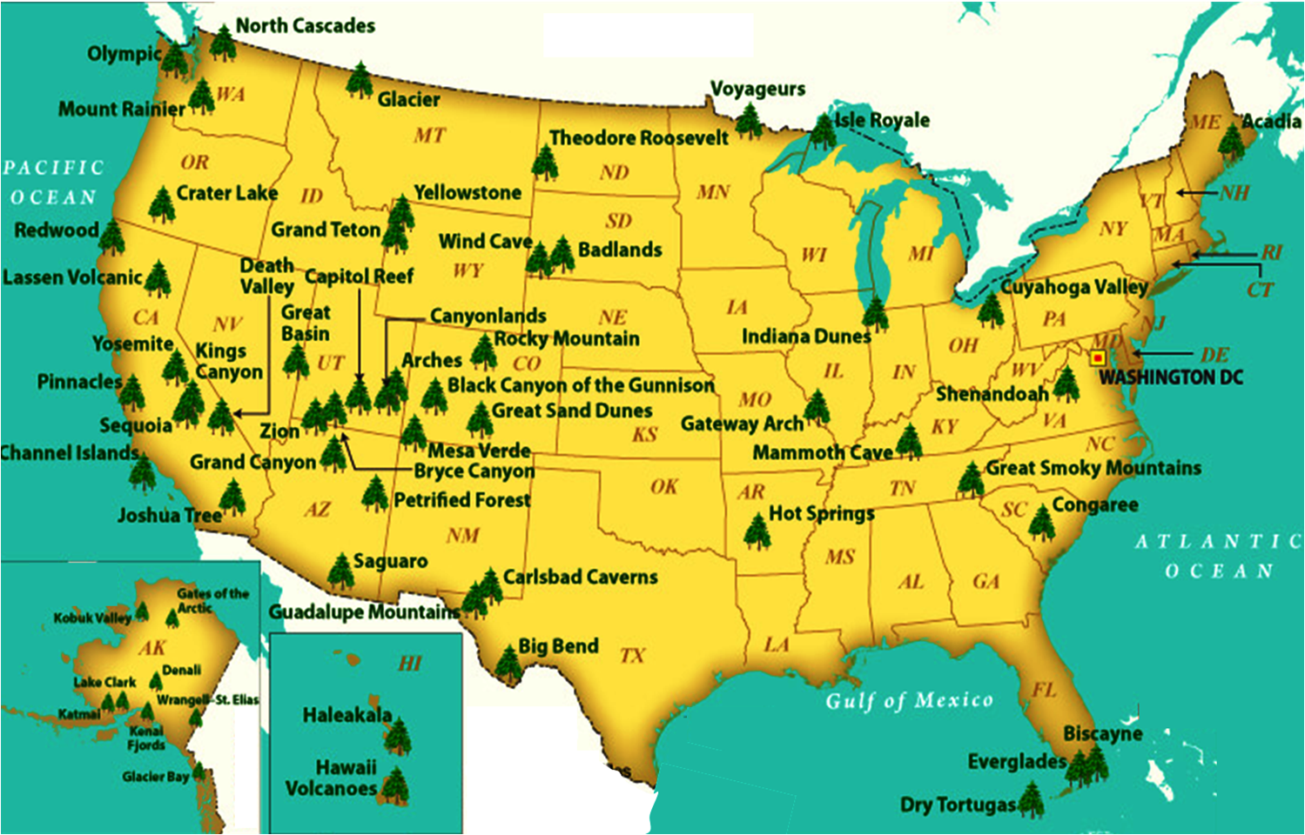
NATIONAL TREASURES
PART 3
New River
White Sands
IN OUR NATURAL WONDERS

Slide 2
Week 2 – Newfoundland
EASTERN NORTH AMERICA
Week 1 – Setting the Stage
Week 2 – Newfoundland
Week 3 – US Appalachians
Week 4 – Florida
Week 5 – the Future
Week 6 – Days Gone By
New River
White Sands

Slide 3
OPENING

Slide 4
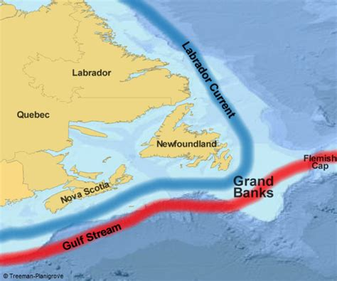

Slide 5
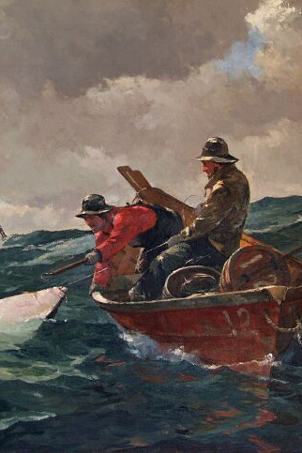
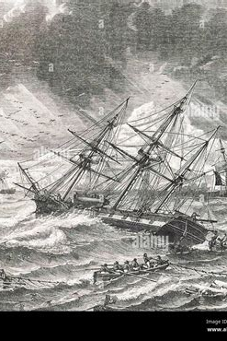
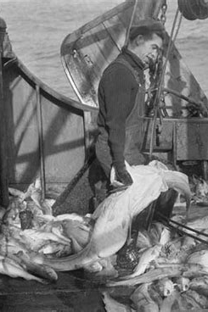
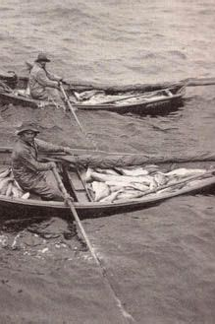
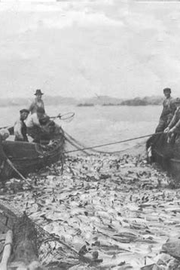
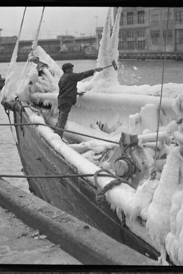
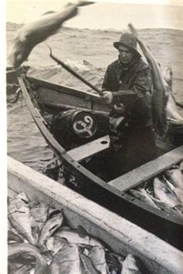
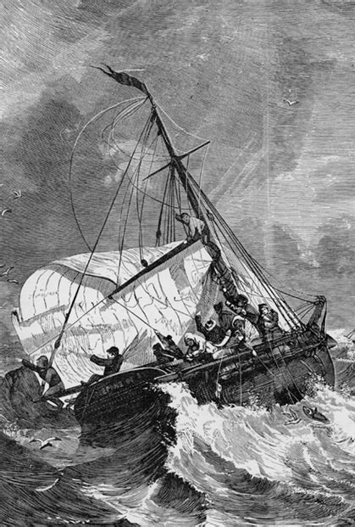
Shores of Newfoundland Lyrics (Kieran Wade)
We are the Irish fishermen who work out on the deep Through the storms and winter gales
Trying to make a living pulling codfish from the sea And hunting for the big black whale
We work out on the Grand Banks in the sun and wind and rain Two thousand miles from our own land
To fill our holds with salt fish before heading back again From the shores of Newfoundland
Ah, but nine long months away from home no man on board can bear It's a loneliness too hard to stand
We're gathering up our families and we're going to settle here On the shores of Newfoundland CHORUS And we brought along our stories and we brought along our songs To warm us in the winter cold
And we won’t forget our history, boys, nor forget where we came from Through all the trials that time will bring through the years as we grow old
The English guns have brought our troubled country to despair And rule it with an iron hand
We seek out some safe harbor and forget about our cares On the shores of Newfoundland
INSTRUMENTAL The seas are full of codfish and woods are full of deer There's a peace that's hard to understand
We'll take our chance of not being caught and make our home right here On the shores of Newfoundland
CHORUS And we brought along our stories and we brought along our songs To warm us in the winter cold
And we wont forget our history, boys, nor forget where we came from Through all the trials that time will bring through the years as we grow old
We are the Irish fishermen who work out on the deep And it's here we'll make our stand We're going to make a living pulling codfish from the sea On the shores of Newfoundland On the shores of Newfoundland

Slide 6
OVERVIEW

Slide 7
GEOGRAPHY

Slide 8
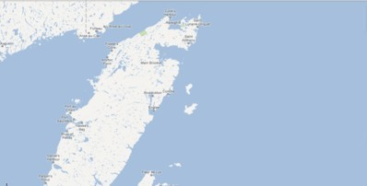
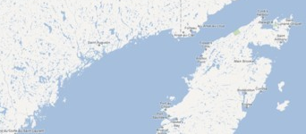
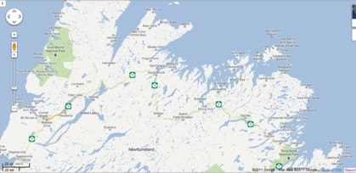
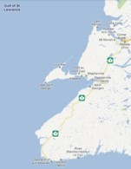
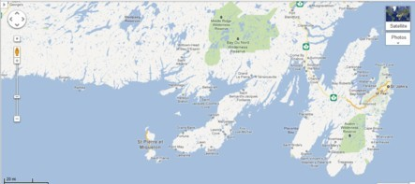
NEWFOUNDLAND GEOGRAPHY
Gros Morne
310 mi wide X 325 mi long; 42,000 sq mi; the fourth-largest island in the world
70 miles from Nova Scotia; only 8.5 miles from Labrador
Coastline of 3,810 miles
2 World Class National Parks: Gros Morne & Terra Nova
Tablelands
Notes:
1 square kilometer = 0.386102159 square mile
34Ohio44,824.9035 Virginia42,774.2036 Tennessee42,143.2737 Kentucky40,409.02

Slide 9
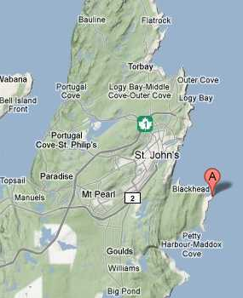
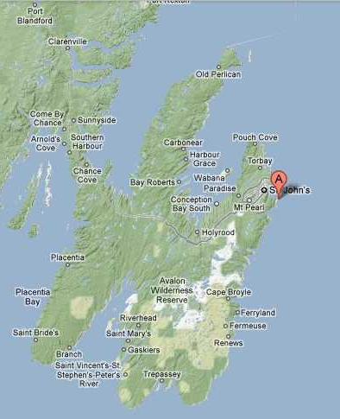
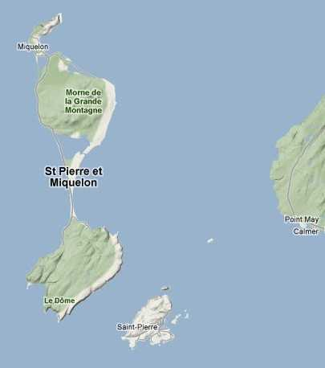
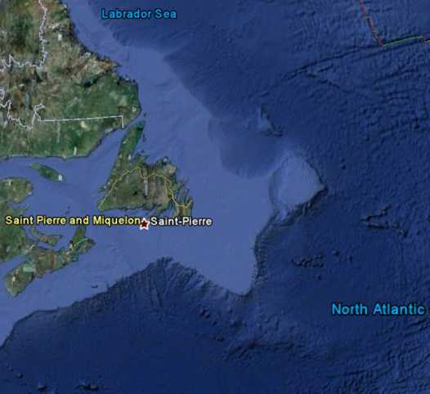
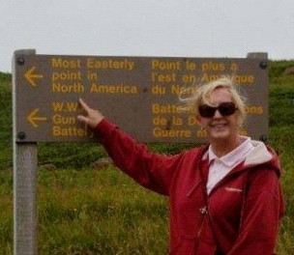
NEWFOUNDLAND GEOGRAPHY
310 mi wide X 325 mi long; 42,000 sq mi; the fourth-largest island in the world
70 miles from Nova Scotia; only 8.5 miles from Labrador
Coastline of 3,810 miles
2 World Class National Parks: Gros Morne & Terra Nova
High point is 2,664 ft
French Territory: Ile St. Pierre & Miquelon
Cape Spear is eastern most point of North America
Famous fishing: Grand Banks
Nickname “The Rock”
14 miles
“THE
ROCK”
Grand Banks
Notes:
1 square kilometer = 0.386102159 square mile
34Ohio44,824.9035 Virginia42,774.2036 Tennessee42,143.2737 Kentucky40,409.02

Slide 10
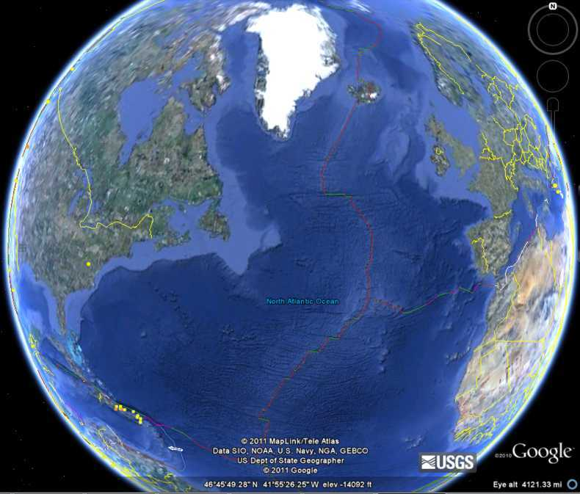
NEWFOUNDLAND GEOGRAPHY
Greenland
975 mi
Ottawa
1,080 mi
Washington
1,330 mi
Ireland
1,930 mi
- Newfoundland and Labrador - only province in Canada that has its own unique time zone
Austin
2,610 mi
Vancouver
3,100 mi

Slide 11
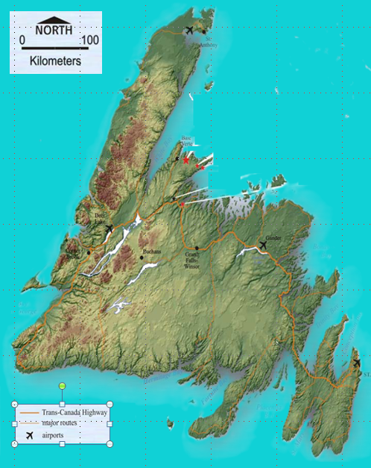
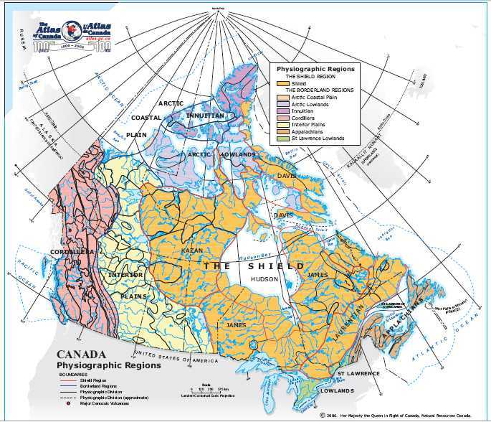
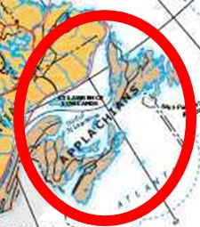
MOUNTAIN RANGES
Long Range Mountains
APPALACHIAN MOUNTAINS
Lewis “Hills”
Anguille Mountains
Annieopsquotch Mountains

Slide 12
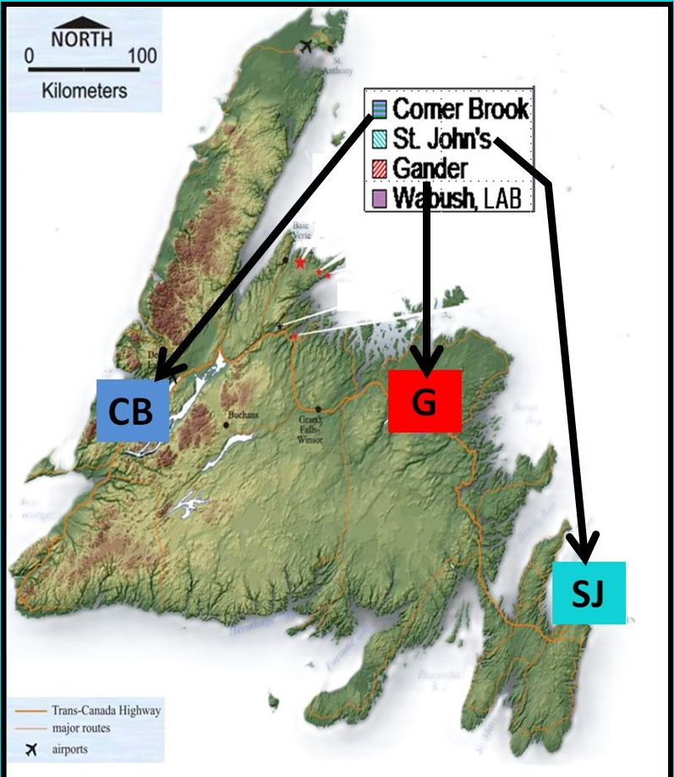
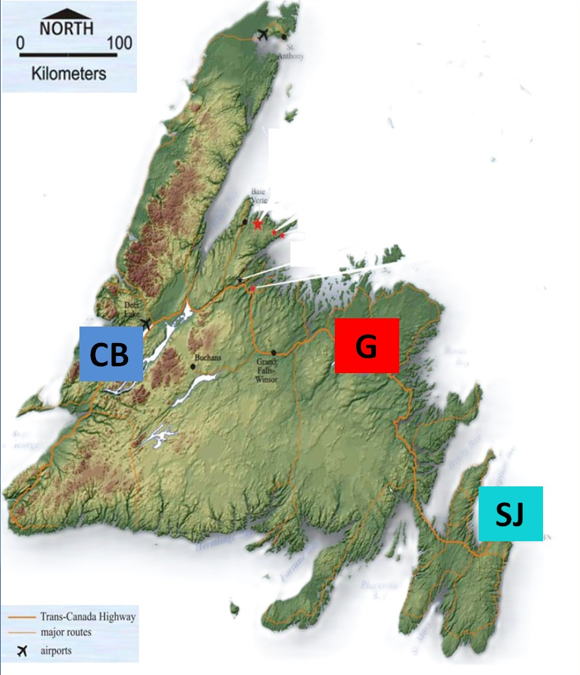
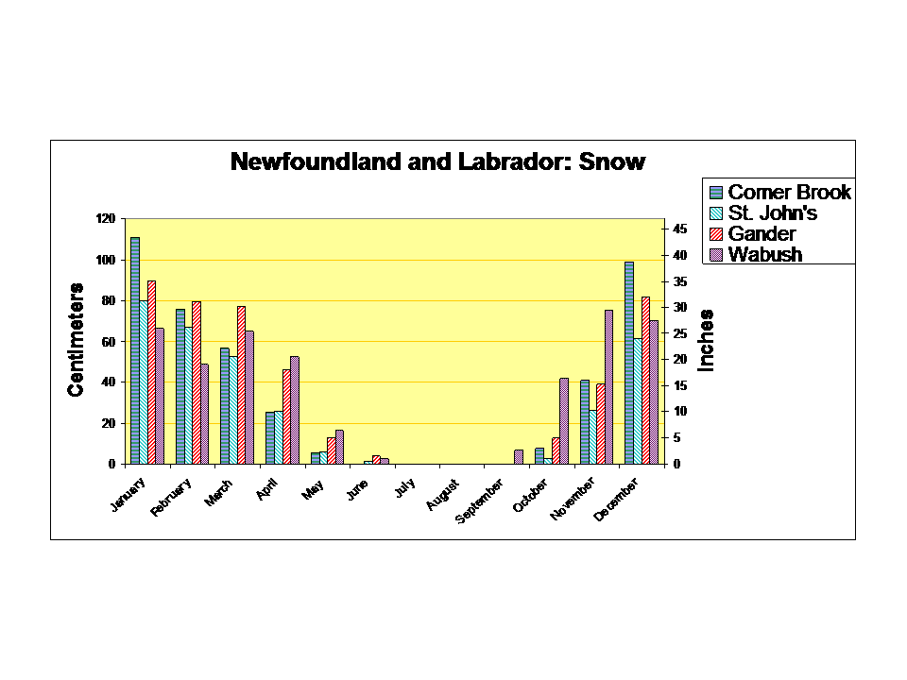
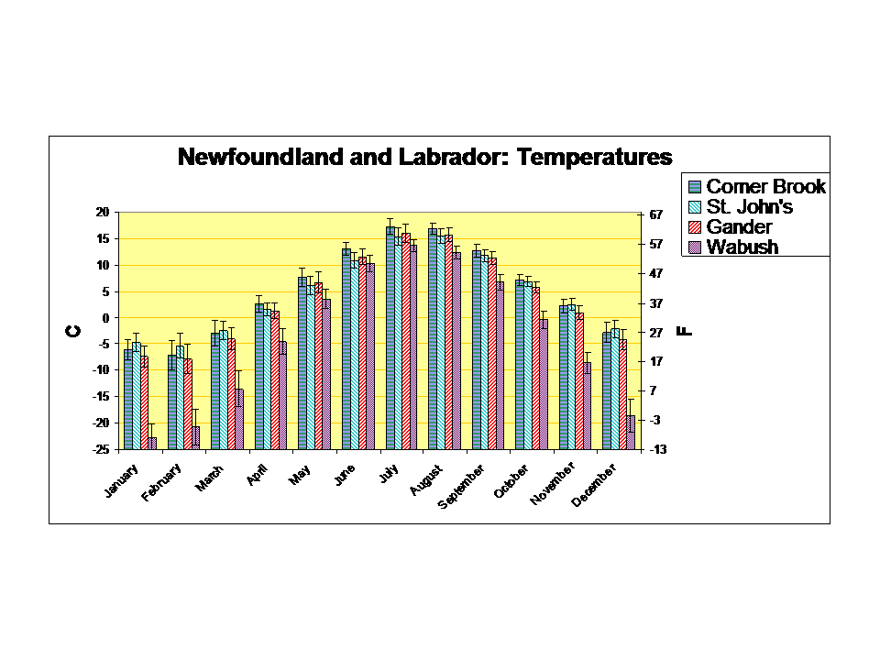
NEWFOUNDLAND WEATHER
, LAB
, LAB

Slide 13
HISTORY &
DEMOGRAPHICS

Slide 14
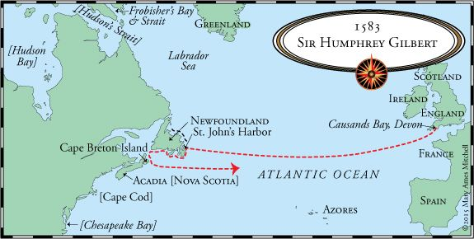
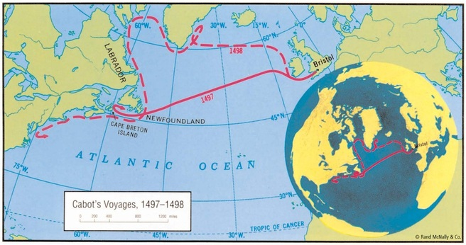
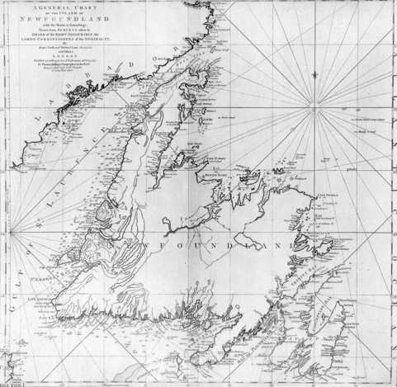
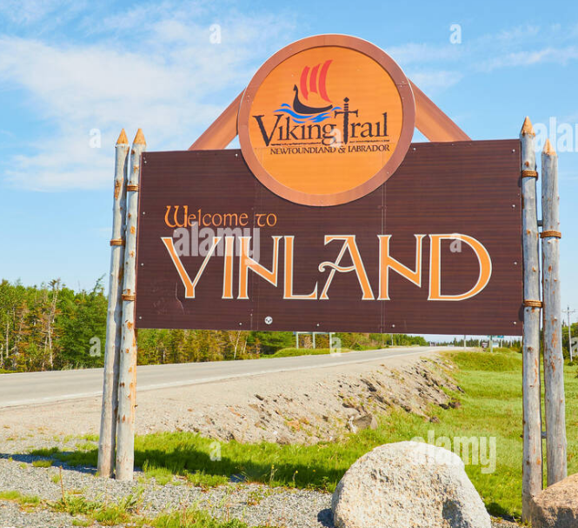
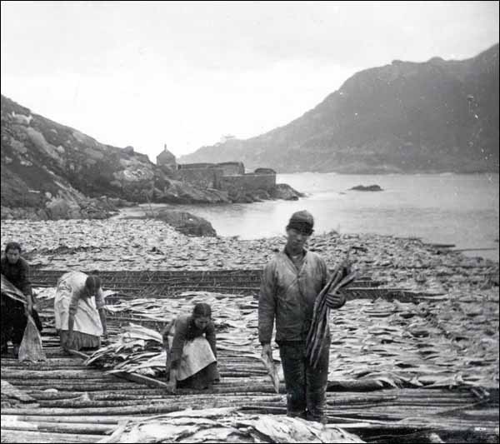
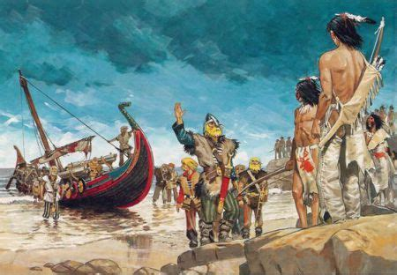
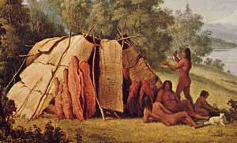
NEWFOUNDLAND HISTORY
First inhabitants: Beothuk Indians
999 to 1001 - Permanent Norse settlement known as Vinland founded by Leif Erikson
1006 - First contact with Norsemen at L’Anse aux Meadows
1497 - John Cabot expedition
1583 - Sir H. Gilbert claimed Newfoundland for England
1610 - first year-round Europeans: Portuguese, Spanish, French & English in 17th century
Notes:
The first inhabitants of Newfoundland were the probable ancestors of the Beothuk inhabitants at the time of European contact. Beothuk means "people" in the Beothuk language. The origins of the Beothuks are uncertain, but it appears that they were a native group that came from Labrador. The culture is now extinct, remembered only in museum, historical and archaeological records. Shanawdithit, the last known Beothuk (a woman), died in St. John's in 1829 of tuberculosis.

Slide 15
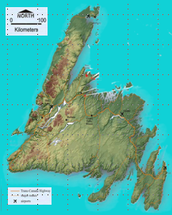
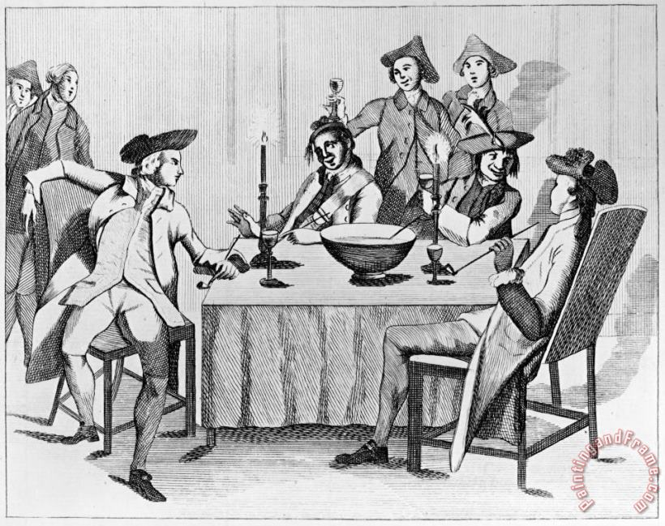
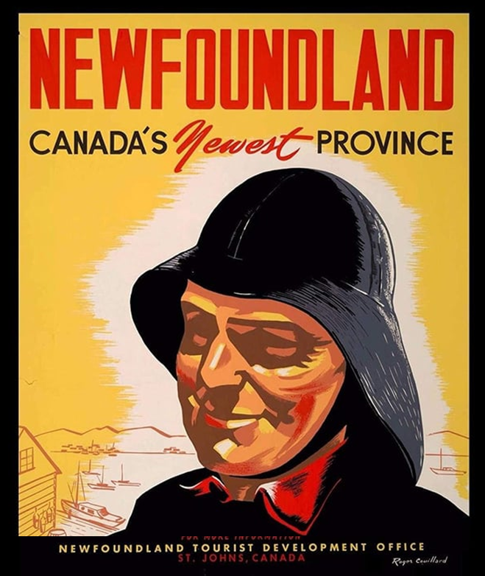
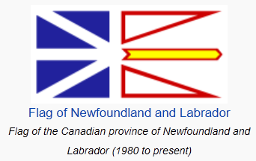
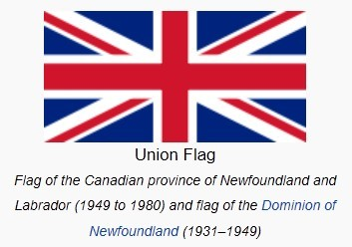
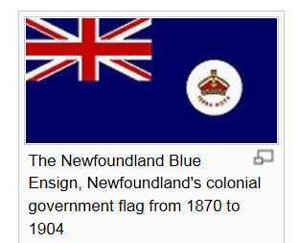
NEWFOUNDLAND HISTORY
1763 - The Treaty of Paris definitively awarded Newfoundland and Labrador to Great Britain.
1832 Representative government was introduced and parliamentary government in 1855.
1930s- During the Depression Britain suspended Newfoundland's self-government and assumed administrative and financial control.
1949 it became Canada's 10th province
Notes:
The first inhabitants of Newfoundland were the probable ancestors of the Beothuk inhabitants at the time of European contact. Beothuk means "people" in the Beothuk language. The origins of the Beothuks are uncertain, but it appears that they were a native group that came from Labrador. The culture is now extinct, remembered only in museum, historical and archaeological records. Shanawdithit, the last known Beothuk (a woman), died in St. John's in 1829 of tuberculosis.
It is probable that the natives described by the Norsemen as skraelings were Beothuk people of Labrador and Newfoundland. The first conflicts between Europeans and native peoples may have occurred around 1006 at L'Anse aux Meadows when parties of Norsemen attempted to establish permanent settlements along the coast of Newfoundland. According to the Icelandic sagas, the native skraelings responded so ferociously that the newcomers eventually withdrew and apparently gave up their original intentions to settle.
When other Europeans arrived, beginning with John Cabot in 1497, contact with the Beothuks was established. Estimates of the number of Beothuks on the island at this time vary, ranging from 1,000 to 5,000.
As European settlement became year-round and expanded to new areas of the coast the area available to the Beothuks to harvest the marine resources they relied upon was diminished. By the beginning of the 19th century there were few Beothuks remaining, many having been killed by settlers or having died as a result of starvation and diseases brought on by the European settlers which their immune systems could not handle. Government attempts to open a dialogue with the native peoples of Newfoundland came too late to save them.
Some Newfoundland residents can trace a clear Native American ancestry, mostly Mi'kmaq.
The Treaty of Paris of 1763 definitively awarded Newfoundland and Labrador (where the French had established trading posts) to Great Britain.
France retained the fishing rights on the northwest coast of Newfoundland that had been granted by the Peace of Utrecht in 1713 and was also awarded St. Pierre and Miquelon.
In 1783 the “French Shore” was redefined to include the entire western coast.
In the early 19th cent. the Hudson's Bay Company developed the fur trade, and this, together with the expansion of the fishing industry, led to increased immigration from Europe, particularly Ireland.
Representative government was introduced in 1832 and parliamentary government in 1855.
The port of Heart's Content became the western terminus of the transatlantic cable in 1866.
In 1869, Newfoundland voters rejected union with Canada; in 1895, after a disastrous fire in St. John's and the failure of local banks, negotiations to join Canada resumed but were unsuccessful.
Relatively little attention had been paid to Labrador, but in 1895 iron ore was discovered in the Grand Falls (now Churchill Falls) region.
As part of the Anglo-French Entente Cordiale of 1904, France abandoned the French Shore.
Possession of Labrador was disputed by Quebec and Newfoundland until 1927, when the British privy council demarcated the western boundary, enlarged Labrador's land area, and confirmed Newfoundland's title to it.
During the depression of the 1930s, Britain suspended Newfoundland's self-government and assumed administrative and financial control. Actual authority was exercised by a joint commission of Newfoundlanders and British.
During World War II, U.S. and British military bases were established in Labrador and on Newfoundland.
After the war Newfoundland voted to join Canada, and in 1949 it became Canada's 10th province.
Joseph Smallwood, a Liberal who led the drive to join Canada, became premier and held office until 1972, when the Conservatives gained a majority under Frank Moores and later (1979) A. Brian Peckford. Peckford was displaced 10 years later by Liberal Clyde K. Wells, and Wells was succeeded in 1996 by Liberal Brian Tobin, who was reelected in 1999.
In the mid-1990s the province faced high unemployment and was hurt by the collapse of the cod-fishing industry, although a 1992 government ban on all cod fishing was partly lifted in 1997.
Read more: Newfoundland, province, Canada: History and Politics http://www.infoplease.com/ce6/world/A0859944.html#ixzz1aoQAgYNK

Slide 16
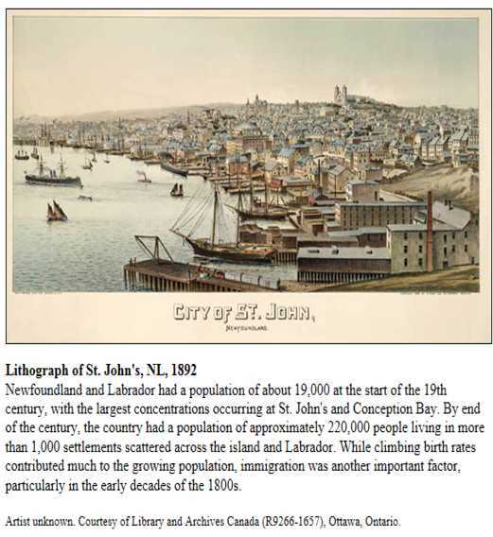
NEWFOUNDLAND DEMOGRAPHICS
The largest ethnic groups in Newfoundland and Labrador are:
English (39.4%)
Irish (19.7%)
Scottish (6.0%)
French (5.5%)
First Nations (3.2%)

Slide 17
SIGHTS

Slide 18
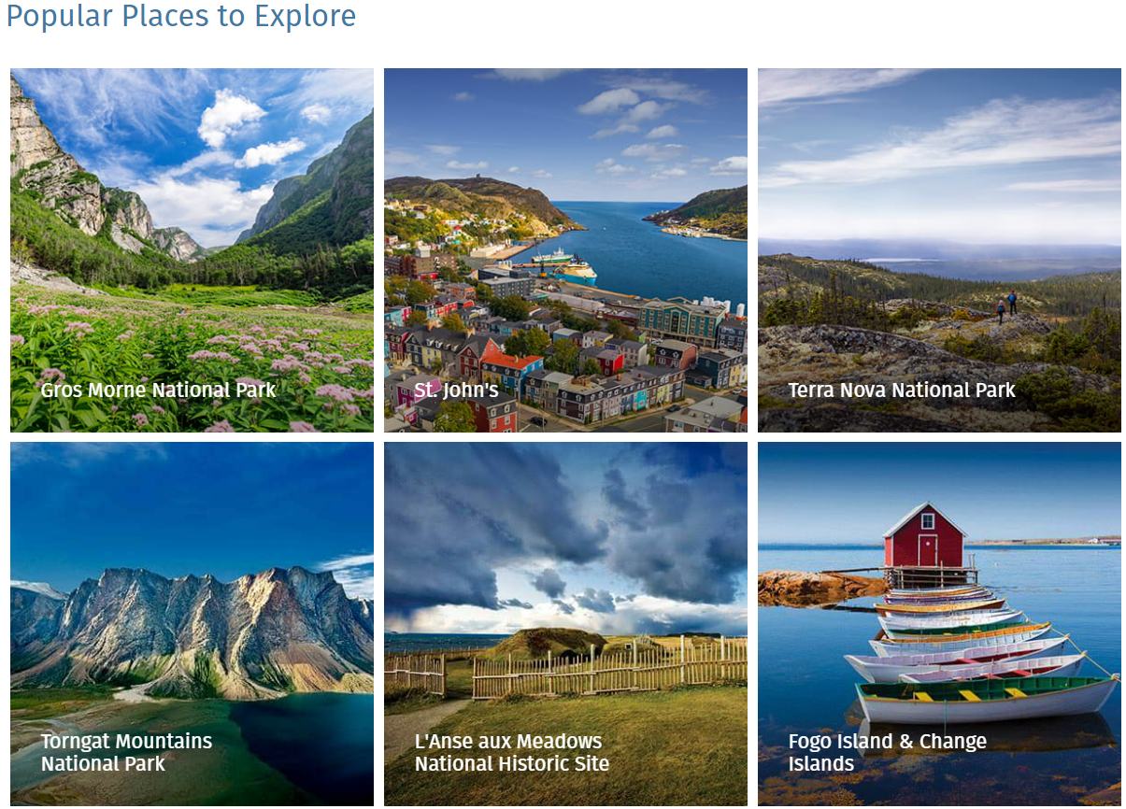
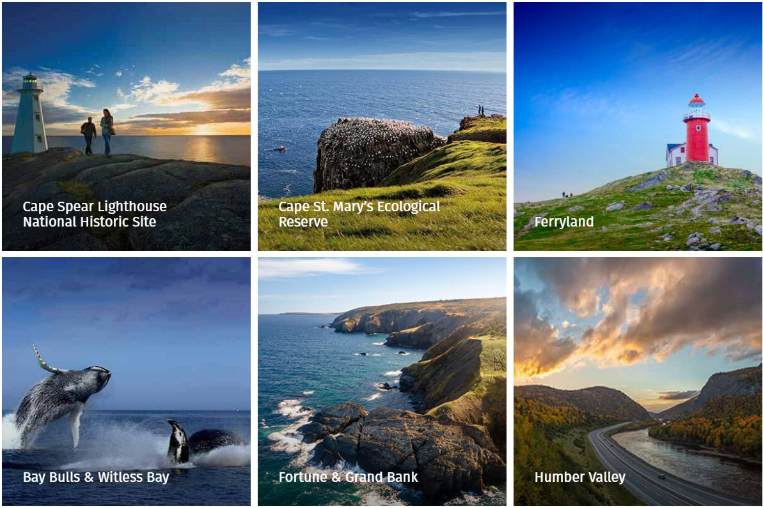
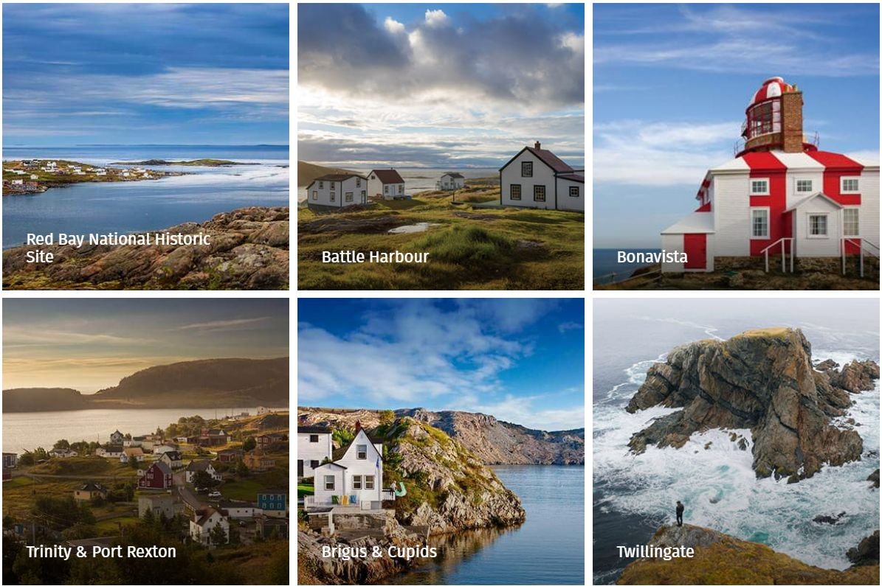
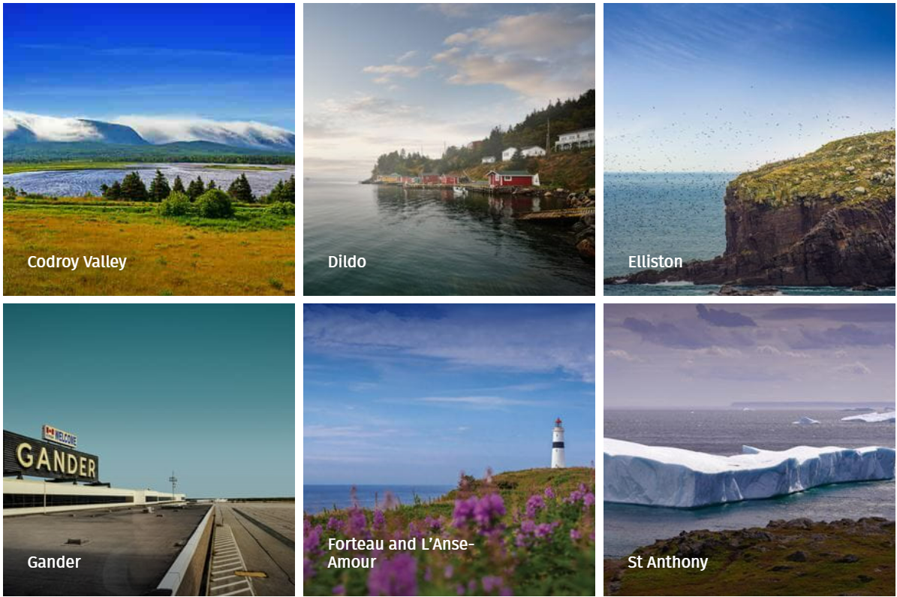
NEWFOUNDLAND SIGHTS
NEWFOUNDLAND

Slide 19
THINGS TO DO IN NEWFOUNDLAND
NEWFOUNDLAND
FOOD & DINING
WATER ACTIVITIES
FISHING
CAMPING
ICEBERG VIEWING
WHALE WATCHIN’
HIKING & WALK’IN
SNOW ACTIVITIES
GEOLOGY & FOSSILS
BOAT TOURS
BIRD WATCHING
HISTORY & CULTURE
FESTIVALS
MUSEUMS

Slide 20
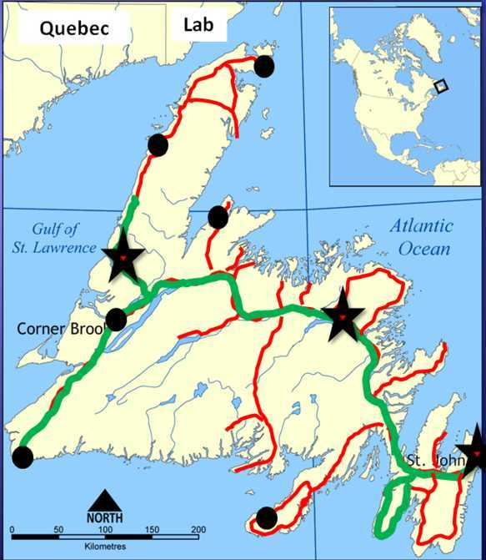
NEWFOUNDLAND

Slide 21
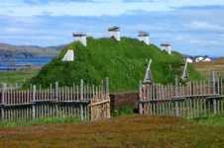
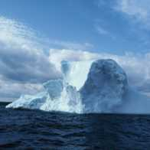
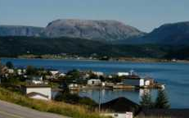
NEWFOUNDLAND
L’Anse Aux Meadows
Iceberg Alley
Gros Morne (Tablelands) National Park
Terra Nova National Park
Mistaken Point
Ediacaran
Fossils
Port aux Basques
Ferry Terminal
St. John’s
Gander
Argentia Ferry Terminal
Cape St. Mary Bird
Cape Spear
Signal Hill

Slide 22
GEOLOGIC
OVERVIEW

Slide 23
GENERALIZED INTERPRETIVE MAP
ISLAND FORMATION OVERVIEW
Notes:
The Humber Zone of the western Newfoundland Appalachians represents a Cambrian-Ordovician passive continental margin which was deformed in Taconian (mid-Ordovician) and Acadian (Silurian-Devonian) orogenic events.

Slide 24
GENERALIZED INTERPRETIVE MAP
ISLAND FORMATION OVERVIEW
Notes:
The Humber Zone of the western Newfoundland Appalachians represents a Cambrian-Ordovician passive continental margin which was deformed in Taconian (mid-Ordovician) and Acadian (Silurian-Devonian) orogenic events.

Slide 25
GENERALIZED INTERPRETIVE MAP
ISLAND FORMATION OVERVIEW
Humber
Dunnage
Gander
Avalon
Notes:
The Humber Zone of the western Newfoundland Appalachians represents a Cambrian-Ordovician passive continental margin which was deformed in Taconian (mid-Ordovician) and Acadian (Silurian-Devonian) orogenic events.

Slide 27
ISLAND FORMATION OVERVIEW
CONTINENTAL CRUST
DIVIRGENT BOUNDARY
CONTINENTAL
CRUST
OCEANIC CRUST
OCEANIC CRUST
A COMBINATION PLATE
(both continent & oceanic crust)
MID-OCEAN RIDGE
A COMBINATION PLATE
(both continent & oceanic crust)

Slide 28
ISLAND FORMATION OVERVIEW
Proto-North American Continent
540 Million Years Ago
Africa
Future
Western Zone
Future
Eastern Zone
Notes:
From Newfoundland and Labrador; Travelers Guide to the Geology
Newfoundland in the middle Cambrian (540 mya)
In the Middle Cambrian two ancient continents, Laurentia & Godwana, were separated by the Iapetus Ocean. The Western Zone of Newfoundland lay on the eastern edge of Laurentia while the Eastern Zone was part of Gondwana. For those who study Greek mythology, you’ll know that Iapetus, after whom this ancient ocean was named, was the father of Atlas, after whom the present-day Atlantic Ocean is named.
From Geology of the West Coast of Newfoundland A. B. Ryan Mineral Development Division, Newfoundland Department of Mines and Energy (from Newfoundland Journal of Geological Education, v7, n2, 1983)
Mountains, Plates and Iapetus The island of Newfoundland occurs at the northeastern terminus of the Appalachian Mountain system, a mountain chain which once paralleled the east coast of North America from Newfoundland to Alabama, and rivaled the present-day Rockies in their beauty. The forces of erosion, however, have taken their toll, and our Appalachians have been worn down to a gently rolling terrain, with only a few upland areas remaining to remind us of their former magnificence. Even though we have been robbed of our Rocky Mountain highs, the erosion of the Appalachians has revealed in Newfoundland a superb cross-section of the core of an ancient mountain belt, and made it the Mecca for earth scientists from around the world. To understand why Newfoundland attracts such hordes of geoscientists we must consider plate tectonics, that concept which has revolutionized geology since the mid-1960's. It has been recognized that the earth's surface is in constant motion, that it is composed of giant crustal plates that break, separate, rub side-by-side against each other or collide, just the way the ice pans around our coastline do in Spring. Newfoundland marks the site where one of the earth's great continental plates split apart about 600 million years ago and then collided again some 200 million years later. When this ancient continental plate split, the two smaller plates began to drift away from each other, and in the space between them an ocean was formed. This ocean has been termed the Iapetus Ocean, and it reached at least 1000 km in width before the wayward drift of the continental pieces was halted, and the two began to come together again. Warm Waters in the West What was Western Newfoundland like during the time when the Iapetus Ocean lapped its shores? To understand this, we must study the 500-600 million year old sedimentary rocks that were deposited when the Iapetus Ocean formed. Such rocks are well preserved in the western part of Newfoundland as far east as a line running northeast through Grand Lake - a chunk of Newfoundland which geologists refer to as the Humber Zone (Figure 1). The oldest rocks of the Humber Zone are the 1200-1800 million year old gneisses, granites and anorthosites which constitute the Long Range Mountains of the Great Northern Peninsula, and underlie Indian Head and Steel Mountain near Stephenville. These are remnants of the old Canadian Shield which split apart 600 million years ago, and they formed the basement on which the sediments of Iapetus were laid down. These sedimentary rocks, which were deposited between 600 million and 400 million years ago, are predominantly sandstones and carbonate rocks (limestones), and are well-exposed in roadside outcrops and along the coastline of the Port au Port Peninsula and the Great Northern Peninsula. These rocks represent ancient beach sands and shallow marine carbonates. The marine environment at this time probably resembled the present-day Bahamas Banks - and there was no need to go south in winter! It teemed with shelly animals, whose fossil remains can be found in limestones all along the west coast. East of this carbonate bank which covered the present-day Great Northern Peninsula, there was a continental slope, much like the tail of the Grand Banks, which gave way to the deep ocean floor. Along this slope were deposited shale, sandstone, deep-water limestone, volcanic rocks, and giant debris falls resulting from material breaking off the carbonate bank and rolling down the slope. Such rocks can be observed between White Bay and the Baie Verte highway. Ophiolites and West Coast Splendor When Iapetus began to close some 450 million years ago and the Appalachian Mountains were built up along the east coast of North America, the ocean floor became wrinkled and uplifted. Giant slabs (up to 40 x 10 km) of ocean floor (the ophiolite complexes) were squeezed out between the continental plates and obducted or emplaced across the old continental margin (Figure 2). Some of the best examples of these ophiolites in the world can be seen on the west coast. They form the scenic brown mountains of Western Newfoundland - Blow Me Down, North Arm Mountain, the Lewis Hills and Table Mountain - and the White Hills near St. Anthony. The discovery of these transported oceanic slabs led Dr. E.R.W. Neale, an eminent geologist and at one time vice-president (academic) of Memorial University of Newfoundland, to exclaim several years ago, "Surely this has to be the eighth wonder of the world!" Cross-section of the geology of Western Newfoundland Deer Lake and Death Valley The Iapetus Ocean had closed by 400 million years ago, and Western Newfoundland was an upland area in which vertical movements of crustal blocks along major fault zones led to the formation of two major basins in which accumulations of sediments occurred between 345 million and 280 million years ago. One of these basins extended from Deer Lake to Conche (the Deer Lake Basin) and the other extended from Stephenville to the Codroy Valley (the St. George's Bay Basin). These basins probably resembled the present-day Death Valley of California, surrounded by mountains and with great alluvial fans extending from the mountain scarps across a lowland with shallow lakes. Sedimentary rocks deposited in both basins are conglomerate, sandstone, siltstone and shale, commonly containing fossils of fish, plants and trees. Thin coal seams and oil shales occur in the Deer Lake Basin, and evaporites (gypsum, potash and salt) as well as coal and oil, occur in the St. George's Bay Basin. Atlantic Ocean Forms When Iapetus closed 400 million years ago, what was eventually to become North America and Europe were welded together as one land mass. Alas, this would not be for long - in geological terms. One hundred million years later the old continental plate split again, this time to form the Atlantic Ocean which we know today. Even now Europe is moving away from us at about 3 cm per year. For those who study Greek mythology, you'll know that Iapetus, after whom the old ocean was named, was the father of Atlas, after whom the present day ocean is named. West Coast Mineral Wealth The rocks of Western Newfoundland are important to the province's commerce. For instance, the carbonate rocks hosted the zinc mine at Daniel's Harbour, which closed in 1990, and are the source of limestone for the cement manufacturing plant at Corner Brook. The ophiolite complexes contain copper-bearing minerals which were once mined at York Harbour in the Bay of Islands, and they also contain chromite and asbestos prospects in the Lewis Hills. Gypsum is mined at Flat Bay, and the salt and potash deposits of the St. George's Bay basin may prove to be commercial in the future. Coal was mined near Howley and Robinsons during the early days of the Newfoundland Railway. Uranium exploration has been carried out in both Deer Lake and St. George's Bay Basins, but no economic deposits have yet been found. Onshore oil and gas seepages have been known on the west coast since the early 1800's when a resident of Parson's Pond found oil floating on the water there. About 50 wells have been drilled during the past century, and about one-half showed varying indications of hydrocarbons. In the early 1980s the Government of Newfoundland and Labrador designated 500,000 acres of the west coast available for oil and gas exploration. So, rocks of the ancient continental margin of Iapetus may one day generate activity rivaling the present-day offshore continental margin of the Atlantic.
Ultramafic rocks - very low silica content (less than 45%), generally >18% MgO, high FeO, low potassium, and are composed of usually greater than 90% mafic minerals (dark colored, high magnesium and iron content). The Earth's mantle is composed of ultramafic rocks.

Slide 29
ISLAND FORMATION OVERVIEW
NEWFOUNDLAND AND THE FRENCH
Ophiolitic suite of rocks were scrapped off the subducting plate and deposited on the surface at Corner Brook, NL. A slab of the ultramafic (mantle) rock forms… TABLELANDS!
Oceanic crustal movement REVERSES
490 Million Years Ago
WHILE WE’RE ON THE SUBJECT OF
GEOLOGY, LET’S LOOK AT…
TABLELANDS
450 Million Years Ago
Newfoundland has been assembled!

Slide 30
HIBERNIA
OIL FIELD

Slide 31
HIBERNIA OIL FIELD
HIBERNIA
Located 190 mi. east of St. John’s in 260 ft. water depth
Approx 3 Billion barrels of OIP; 1.2 billion recoverable of light sweet crude
Started Production in 1997 after 10 yrs of Government negotiations
Produced 160,000 bopd; 1 billion barrels thru 2022
Operated by ExxonMobil; owned by ExxonMobil (33%), Chevron (27%), Suncor (20%), Canadian Gov’t (8.5%), Murphy Oil(6.5%), Norsk Hydro (5%)

Slide 32
HIBERNIA OIL FIELD
Designed to withstand collision with 1-million ton iceberg (1:500 yrs event) with no damage and a direct hit from a 6-million ton iceberg (1:10,000yr event) with repairable damage
450,000 ton Gravity Based Structure (GBS) – 346ft dia. concrete caisson surrounded by a 5ft thick “icewall” with 16 “teeth” to breakup colliding ice
Caisson is closed on top and bottom; inside is storage for 1.3 million bbl oil
4-17ft dia. shafts run thru the caisson; filled with support equip.
Accommodations for 185 workers
Total weight is over 1 million TONS!
Notes:
1 MILLION TONS = 1X10^6 TONS X 2000#/TON = 2X10^9 LBS / 60#/CUFT = 33,333,333 CUFT ^ 1/3 = 322’X322’X322’ AT 60#/CUFT FOR ICE
6 MILLION TON = 6,000,000 TONS X 2,000 #/TON = 1.2X10^10 # / 60#/CUFT = 200X10^6 CUFT ^ 1/3 = 585’X585’X585

Slide 33
HIBERNIA OIL FIELD
Working Cranes (2)
Drilling Rigs (2)
HIBERNIA
Heliport
Flare Boom
Accommodations hotel
Drilling & Production Modules
Emergency Evacuation capsules
Gravity Base
(450,000 tons)

Slide 34
HIBERNIA OIL FIELD – ICEBERG MANAGEMENT
http://www.habeeb.com/iceberg.photos.1.html

Slide 35
HIBERNIA OIL FIELD – ICEBERG MANAGEMENT
Notes:
Hibernia's aggressive Ice Management Strategy, a combination of science, technology, teamwork and old-fashioned seafaring skill. Information about approaching icebergs is gathered through a variety of means:
the International Ice Patrol of the US Coast Guard and the Canadian Ice Service of Environment Canada both provide airborne surveillance briefings;
data is gathered by satellite and radar technology, as well as Hibernia's own state-of-the-art platform radar system, which can identify approaching icebergs up to 18 nautical miles away;
helicopters use radio signals to precisely pinpoint an iceberg's position;
platform support vessels are equipped with technology that allows them to collect ocean current information as they steam toward the iceberg and transmit it back to St. John's via satellite;
using side scan sonar, the vessels will go alongside the iceberg and record a detailed profile to measure its draught.
Services provided by Provincial Airlines of St. John's includes the following: Weather forecasting Ice management Physical and environmental data management
Data collected is entered into Provincial Airlines' ice management trajectory modeling program. Using complex mathematical modeling systems, combining wind and wave elements of the weather forecast with the physical and environmental information gathered in the field, they can predict iceberg movement and identify those which may drift close to the production area.
Icebergs that require intervention are tackled proactively while they are still 20 km or more away from the platform. The platform support vessels encircle the iceberg with a long cable or rope - much like a giant lasso - and tow the iceberg into a different trajectory. It is not necessary to tow the iceberg very far, as even a slight nudge to an iceberg at that distance will change its course considerably over a 20 km drift.
Close encounters with icebergs could, however, force the platform to stop production and actual contact may require repairs afterward. As well, any bottom-scouring iceberg could potentially cause damage to the platform's Offshore Loading System (OLS), a network of oil transmission pipelines on the ocean floor. For this reason, the OLS pipeline has been encased in concrete for additional protection. A redundant OLS system is in place to serve as an auxiliary, in the unlikely event that the other system is damaged.
Hibernia's approach to ice management then is two-fold. Firstly, state-of-the-art technology is being deployed to prevent iceberg collision. Secondly, both the platform and the OLS are designed to withstand such a collision - if it should ever happen - with an overriding emphasis on safety and the environment

Slide 36
HIBERNIA OIL FIELD – ICEBERG MANAGEMENT
ICEBERG MANAGEMENT
Lasso’ed iceberg
ACTIVE
PASSIVE
24 hr radar surveillance
Airborne surveillance
Satellite photos
Real time wind & ocean current info
Side scan sonar
Iceberg trajectory modeling software
Iceberg trajectory adjustment using support ships
Gravity based platform’s resistance to movement due to enormous weight
concrete coated pipelines
Subsurface well control valves allowing well to be sheared off with minimal damage
Number of ships involved depends on size of berg
Notes:
Hibernia's aggressive Ice Management Strategy, a combination of science, technology, teamwork and old-fashioned seafaring skill. Information about approaching icebergs is gathered through a variety of means:
the International Ice Patrol of the US Coast Guard and the Canadian Ice Service of Environment Canada both provide airborne surveillance briefings;
data is gathered by satellite and radar technology, as well as Hibernia's own state-of-the-art platform radar system, which can identify approaching icebergs up to 18 nautical miles away;
helicopters use radio signals to precisely pinpoint an iceberg's position;
platform support vessels are equipped with technology that allows them to collect ocean current information as they steam toward the iceberg and transmit it back to St. John's via satellite;
using side scan sonar, the vessels will go alongside the iceberg and record a detailed profile to measure its draught.
Services provided by Provincial Airlines of St. John's includes the following: Weather forecasting Ice management Physical and environmental data management
Data collected is entered into Provincial Airlines' ice management trajectory modeling program. Using complex mathematical modeling systems, combining wind and wave elements of the weather forecast with the physical and environmental information gathered in the field, they can predict iceberg movement and identify those which may drift close to the production area.
Icebergs that require intervention are tackled proactively while they are still 20 km or more away from the platform. The platform support vessels encircle the iceberg with a long cable or rope - much like a giant lasso - and tow the iceberg into a different trajectory. It is not necessary to tow the iceberg very far, as even a slight nudge to an iceberg at that distance will change its course considerably over a 20 km drift.
Close encounters with icebergs could, however, force the platform to stop production and actual contact may require repairs afterward. As well, any bottom-scouring iceberg could potentially cause damage to the platform's Offshore Loading System (OLS), a network of oil transmission pipelines on the ocean floor. For this reason, the OLS pipeline has been encased in concrete for additional protection. A redundant OLS system is in place to serve as an auxiliary, in the unlikely event that the other system is damaged.
Hibernia's approach to ice management then is two-fold. Firstly, state-of-the-art technology is being deployed to prevent iceberg collision. Secondly, both the platform and the OLS are designed to withstand such a collision - if it should ever happen - with an overriding emphasis on safety and the environment

Slide 37
PARKS

Slide 38
GROS MORNE

Slide 39
Gros Morne

Slide 40
GROS MORNE NATIONAL PARK
St. Paul’s Bay
Western Brook Pond
Baker’s Brook Pond
Big Level
GMNP
Bonne Bay
Gros Morne Mountain
Long Point Pond and Trout River
Tablelands

Slide 41
GROS MORNE NATIONAL PARK
The Tablelands and rocks around Trout River Pond are a slice of ancient ocean floor. The orange-brown rock, called peridotite, is one of the best and most accessible examples of exposed mantle material in the world
Around Bonne Bay, the pink quartzite mountaintops and limestone cliffs were once sandy beaches and tropical reefs that formed the shoreline and continental shelf of this ancient ocean
The massive cliffs of Western Brook Pond were formed by glaciers carving through this 1.2 bya granite block. Rock is a fragment of the continent that once bordered this ancient ocean
The layers of rock along the park’s northern coast were deposited in the ocean at the base of a continental shelf. These rocks contain fossils like graptolites that help define geologic time periods
The volcanic rocks of Green Gardens erupted onto the earth as a continent split apart and an ocean formed more than 600 mya

Slide 42
ALSO IN GMNP-MOHO DISCONTINUITY
Section of Earth
Notes:
Mohorovičić discontinuity
From Wikipedia, the free encyclopedia
Jump to: navigation, search
Earth cross-section showing location of the Mohorovičić discontinuity
Two paths of a P-wave, one direct and one refracted as it crosses the Moho.^{[1]}
Ordovician ophiolite in Gros Morne National Park, Newfoundland. This rock which formed the Ordovician Moho is exposed on the surface.
The Mohorovičić discontinuity (Croatian pronunciation: [mɔhɔˈrɔvitʃitɕ]) (MOE-HOE-ROE-vee-cheech), usually referred to as the Moho, is the boundary between the Earth's crust and the mantle. Named after the pioneering Croatian seismologist Andrija Mohorovičić, the Moho separates both oceanic crust and continental crust from underlying mantle. The Moho mostly lies entirely within the lithosphere; only beneath mid-ocean ridges does it define the lithosphere – asthenosphere boundary. The Mohorovičić discontinuity was first identified in 1909 by Mohorovičić, when he observed that seismograms from shallow-focus earthquakes had two sets of P-waves and S-waves, one that followed a direct path near the Earth's surface and the other refracted by a high velocity medium.^{[1]}
The Mohorovičić discontinuity is 5 to 10 kilometres (3–6 mi) below the ocean floor and 20 to 90 kilometres (10–60 mi) beneath typical continents, with an average of 35 kilometres (22 mi) beneath them.^{[2]}
Contents
[show]
1 Nature of the Moho
2 Exploration
3 See also
4 References
4.1 Bibliography
4.2 Notes
5 External links
[edit] Nature of the Moho
Immediately above the Moho the velocities of primary seismic waves (P-waves) are approximately those of basalt (6.7 – 7.2 km/s), and below they are that of peridotitic or dunitic Earth-materials (7.6 – 8.6 km/s).^{[3]} That suggests the Moho marks a change of composition, but the interface appears to be too even for any believable sorting mechanism within the Earth. Near-surface observations suggest such sorting produces an irregular surface. Some history of suggestions that the boundary marks instead a phase change controlled by a temperature gradient in the Earth can be found in Howell.^{[4]}
[edit] Exploration
During the late 1950s and early 1960s, a proposal was taken up in the executive committee of the National Science Foundation to drill a hole through the ocean floor to reach this boundary. However the operation, named Project Mohole, never received sufficient support and was mismanaged; it was canceled by the United States Congress in 1967. Simultaneous efforts were made by the Soviet Union at the Kola Institute, which reached a depth of 12,260 metres (40,220 ft) over 15 years, the world's deepest hole until 2011, before that attempt was also abandoned in 1989.^{[5]}
Reaching the discontinuity remains an important scientific objective. A more recent proposal considers a self-descending tungsten capsule heated by radiogenic heat to explore Earth's interior near the Moho discontinuity and in the upper mantle.^{[6]} The Japanese project Chikyu Hakken ("Earth Discovery") also aims to explore this general area.

Slide 43
Tablelands

Slide 44
GMNP – THE SIZE OF TABLELANDS…
6 mi
9 mi
Notes:
Gros Morne National Park
From Wikipedia, the free encyclopedia
Jump to: navigation, search
For other uses, see Gros Morne (disambiguation).
Gros Morne National ParkIUCN Category II (National Park)
The Tablelands in Gros Morne National Park
Location of Gros Morne National ParkLocation Newfoundland and Labrador, CanadaNearest cityCorner BrookCoordinates49°41′22″N 57°44′17″W﻿ / ﻿49.68944°N 57.73806°W﻿ / 49.68944; -57.73806﻿ (Gros Morne National Park)Area1,805 km² (697 sq mi)Established1973Governing bodyParks CanadaUNESCO World Heritage Site
Type:NaturalCriteria:vii, viiiDesignated:1987 (11th session)Reference #:419State Party: CanadaRegion:Europe and North AmericaGros Morne National Park is a world heritage site located on the west coast of Newfoundland. At 1,805 km² (697 sq mi), it is the second largest national park in Atlantic Canada (surpassed by Torngat Mountains National Park at 9,600 km²/3,700 sq mi).
The park takes its name from Newfoundland's second-highest mountain peak (at 2,644 ft/806 m) located within the park. Its French meaning is "large mountain standing alone," or more literally "great sombre." Gros Morne is a member of the Long Range Mountains, an outlying range of the Appalachian Mountains, stretching the length of the island's west coast. It is the eroded remnants of a mountain range formed 1.2 billion years ago. "The park provides a rare example of the process of continental drift, where deep ocean crust and the rocks of the earth's mantle lie exposed."^{[1]}
The Gros Morne National Park Reserve was established in 1973. It wasn't until October 1, 2005 that the National Parks Act was applied to the reserve, thereby making it a Canadian national park.
The park was the subject of a short film in 2011's National Parks Project, directed by Sturla Gunnarsson and scored by Melissa Auf der Maur, Sam Shalabi and Jamie Fleming.
Geology
The park's rock formations, made famous by Robert Stevens and Harold Williams, include oceanic crust and mantle rock exposed by the obduction process of plate tectonics, as well as sedimentary rock formed during the Ordovician, Precambrian granite and Paleozoic igneous rocks.^{[2]}
Soils
The many soil associations mapped in the park reflect the wide variety of bedrock. The Silver Mountain soil association, dominant in the northeastern area, is a very stony sandy loam developed on glacial till overlying granite, granitic gneiss and schist. Similar rocks underlie the St. Paul's Inlet association farther west. Sedimentary rocks (including some dolomitic limestone) in the southeastern sector support the North Lake association of stony sandy loam. An association of mostly-shallow loam, the Cox's Cove, occupies a discontinuous band over shale, slate, limestone and sandstone near the coast. The coastal strip north of Bonne Bay is mostly underlain by the peaty Gull's Marsh association and the coarse Sally's Cove association except for an area of clay (Wood's Island association) around Rocky Harbour. The stony infertile soils of the ultramafic tablelands south of Bonne Bay belong to the Serpentine Range association.^{[3]}
Western Brook Pond
Western Brook Pond is a fresh water fjord which was carved out by glaciers during the most recent ice age from 25,000 to about 10,000 years ago. Once the glaciers melted, the land, which had been pushed down by the weight of the ice sheet, rebounded and the outlet to the sea was cut off. The 30-kilometre (19 mi) long narrow "pond" then filled in with fresh water. The water in the fjord is extremely pure and is assigned the highest purity rating available for natural bodies of water. Pissing Mare Falls, the highest waterfall in eastern North America and 199th highest in the world,^{[4]} flow into Western Brook Pond.
The Tablelands seen from Route 431
The Tablelands, found between the towns of Trout River and Woody Point in Gros Morne National Park, look more like a barren desert than traditional Newfoundland. This is due to the ultramafic rock – peridotite – which makes up the Tablelands. It is thought to originate in the Earth's mantle and was forced up from the depths during a plate collision several hundred million years ago. Peridotite lacks the usual nutrients required to sustain most plant life, hence its barren appearance. The rock is very low in calcium, very high in magnesium, and has toxic amounts of heavy metals. Peridotite is also high in iron, which accounts for its brownish colour (rusted colour). Underneath this weathered zone, the rock is really a dark green colour.
Nature and wildlife
Along the coast are forests of stunted and twisted spruce and balsam fir trees, known locally as "tuckamores," battered by storms and winds blowing from the sea. The forest growth is more productive, but not by much, in granitic areas farther east. The best forests, in places lent luxuriance by the presence of yellow birch, grow over mixed sedimentary rock in sheltered areas.
Wildlife in the park includes lynx, black bear, caribou, arctic hare, marten and a booming population of introduced moose. The coastal region supports whales and sea ducks including the Harlequin Duck.
World Heritage Site
In 1987, the park was designated a UNESCO World Heritage Site for both its geological history and its exceptional scenery. The geology of the Park in particular illustrates the concept of plate tectonics^{[5]} , and has shed important light on geological evolution and its processes.
James Callaghan Trail
The James Callaghan Trail was named after the former British Prime Minister James Callaghan who visited in 1976. A small controversy arose after the Prime Minister did not visit the trail that had been named in his honour, as Kaya Burgess writes in The Times of London

Slide 45
Western Brook Pond

Slide 46
WESTERN BROOK POND
Western Brook Pond
Gros Morne NP

Slide 47
WESTERN BROOK POND
Glacial cut fjord with granite walls 2,200 high; water depth 540ft
“Pond” is 9.6 miles long x 1.2 miles wide (at mouth of gorge)
Once glaciers melted, crust rose forming a ledge at the front of the fjord; 1000’s of years of rain runoff purged fjord ; now only fresh water

Slide 48
WESTERN BROOK POND

Slide 49
WESTERN BROOK POND
Notes:
Western Brook Pond
From Wikipedia, the free encyclopedia
The Western Brook Pond is a Canadian fjord or lake located in Gros Morne National Park on the west coast of the island of Newfoundland. It is in the Long Range Mountains, the most northern section of the Appalachian Mountains.
Rock walls
Eastern dead end
Rock walls
It is surrounded by steep rock walls 600 m (2,000 ft) high.^{[1]}, having been carved from the surrounding plateau by glaciers. After the glaciers melted, the land rebounded and the fjord was cut off from the sea. Salty water was eventually flushed from the fjord leaving it fresh. The catchment area is composed of igneous rock with relatively thin soil, so the waters feeding Western Brook Pond are low in nutrients and the lake is classified as ultraoligotrophic.^{[1]} It is fed by Stag Brook at the extreme eastern end of the lake and by numerous waterfalls cascading from the plateau above. One of these, Pissing Mare Falls at 350 m (1,150 ft), is one of the highest in eastern North America.
The lake is accessible by a moderate-easy 3 km (1.9 mi) hiking trail over coastal bogs and low limestone ridges.^{[2]} Two tour boats, one with a capacity of 70 passengers and the other 90 passengers, cruise the lake from June to mid-October.^{[3]} The lake waters are pristine, having had very little impact from human activities. The tour boat operators had to undergo special certification to ensure that their operations would have minimal impact on the environment.^{[4]}
In the early part of the 20th century, a part of the surrounding cliff broke off and fell into the lake, causing a 30 m (98 ft) tsunami.^{[5]}
Western Brook Pond of Gros Morne National Park, a 30 m tsunami was created when 'Broke Off Cliff' let go in the Fall of about 1905-1910. FROM http://museum.gov.ns.ca/mma/research/tsunamitalk.html

Slide 50
Over 100 glacier advances/retreats carved fjord
“Pond” scoured
Coastal Lowland
uplift & blocked ocean
Freshwater
Western Brook Pond
formed

Slide 51
WESTERN BROOK POND

Slide 52
WESTERN BROOK POND

Slide 53
TERRA NOVA

Slide 54
Terra
Nova

Slide 55
TERRA NOVA NATIONAL PARK
Notes:
Where’s the moose, ah?
On the edge of the water, ah!

Slide 56
TERRA NOVA NATIONAL PARK
Park is 3 hr drive from St. John’s
154 sq miles
Established 1957
1st NP in N&L
Name is Latin for “New Land”
Located on Bonavista Bay
24 hiking trails
Visitor centre at Salton's Brook
it is also the original Portuguese name given to the region
three-hour drive from the provincial capital of St. John’s
ragged-shaped oceanside park of sheltered inlets, islands, headlands, ponds, forests and bogs across 400 square kilometres (154 square miles); located on Bonavista Bay, Nfld
park's watery nature provides opportunities for sailing, canoeing, kayaking, swimming, scuba diving, and fishing.
Visitors can enjoy picnics, golf, camping, scenic lookouts, or hiking on over 100 km of trails
Ten hiking trails; wheelchair-friendly nature stroll
kayak rugged shorelines; Canoe or swim in Sandy Pond
winter, strap on snowshoes or cross-country skis for a backcountry experience.
main visitor centre is located at Salton's Brook
two campgrounds that offer front country camping: Newman Sound and Malady Head
Animals that inhabit this national park are coyotes, black bears, moose, caribou, black ducks, red foxes, beavers, bald eagles, red squirrels, river otters, lynxes, puffins, snowshoe hares, ospreys, pine martens, and minks. Marine animals that inhabit offshore are humpback whales, minke whales, fin whales, pilot whales, harp seals, orcas and dolphins.
Numerous peat bogs provide an ideal environment for orchids and pitcher plants, sprouting from a mat of sphagnum moss.
Terra Nova also protects an area containing remnants of the Beothuk Nation, as well as many of the early pioneer European settlements in the region.
https://www.alltrails.com/parks/canada/newfoundland-and-labrador/terra-nova-national-park

Slide 57
TERRA NOVA NATIONAL PARK
TERRA NOVA NATIONAL PARK MAIN VISITOR CENTER

Slide 58
TERRA NOVA NATIONAL PARK

Slide 59
L’ANSE AUX MEADOW

Slide 60
L’Anse aux Meadows

Slide 61
L’ANSE AUX MEADOWS NATIONAL HISTORIC SITE

Slide 62
L’ANSE AUX MEADOWS NATIONAL HISTORIC SITE

Slide 63
L’ANSE AUX MEADOWS NATIONAL HISTORIC SITE
Spans 30.85 sq mi of land and sea
Site contains the remains of eight buildings
Buildings constructed with sod over a wood frame
To date, in excess of 800
first excavated in the 1960s, of a Norse settlement dating to approximately 1,000 years ago.
With carbon dating estimates between 990 – 1050 CE,^{[1][2][3]} tree-ring analysis dating to the year 1021^{[4][5]} and a mean carbon date of 1014 overall,^{[2]} L'Anse aux Meadows is the only undisputed site of pre-Columbian trans-oceanic contact of Europeans with the Americas outside of Greenland
notable as evidence of the Norse presence in North America and for its possible connection with Leif Erikson as mentioned in the Saga of the Greenlanders and the Saga of Erik the Red,^{[6]} which were written down in the 13th century.
Archaeological evidence found at the site indicates that L’Anse aux Meadows may have served as a base camp for Norse exploration of North America, including regions to the south.
site contains the remains of eight buildings constructed with sod over a wood frame. In excess of 800 Norse objects have been unearthed at the site.
site was designated a National Historic Site of Canada in 1968 and a World Heritage Site by UNESCO in 1978
L'Anse aux Meadows is a French-English name which can be translated as "Grassland Bay“
evidence of occupations by five Indigenous groups at the site of L'Anse aux Meadows, the oldest dated at roughly 6,000 years ago.
there are no findings of burials, tools, agriculture or animal pens—suggesting the inhabitants abandoned the site in an orderly fashion.
a 2019 PNAS study, there may have been Norse activity in L'Anse aux Meadows for as long as a century. Anthropologist John Steinberg has suggested that the site may have been "occupied at least sporadically for perhaps 20 years“. a lecturer in medieval history and literature at Durham University,^{[21]} suggests the site was not a permanent settlement, but was instead a temporary boat repair facility.
archaeological evidence of the dwellings suggests it had the capacity of supporting 30 to 160 people.
1000 years ago there were forests that were convenient for boatbuilding, housebuilding and iron extraction.^{[27]: 135} The remains of eight buildings (labeled from A–J) were found. They are believed to have been constructed of sod placed over a wooden frame. Based on associated artifacts, the buildings were identified as dwellings or workshops. The largest dwelling (F) measured 28.8 m × 15.6 m (94 ft × 51 ft) and consisted of several rooms.^{[18]} Three small buildings (B, C, G) may have been workshops or living quarters for lower-status crew or slaves. Workshops were identified as an iron smithy (building J) containing a forge and iron slag,^{[22]} a carpentry workshop (building D), which generated wood debris and a specialized boat repair area containing worn rivets.
Other things found at the site consisted of common everyday Norse items, including a stone oil lamp, a whetstone, a bronze fastening pin, a bone knitting needle and part of a spindle. Stone weights, which were found in building G, may have been part of a loom. The presence of the spindle and needle suggests that women as well as men inhabited the settlement.
Food remains included butternuts, which are significant because they do not grow naturally north of New Brunswick. Their presence probably indicates the Norse inhabitants traveled farther south to obtain them.^{[29]} discovery of butternuts in the Norse stratum of the bog on the site
There is evidence to suggest that the Norse hunted an array of animals that inhabited the area. These included caribou, wolf, fox, bear, lynx, marten, many types of birds and fish, seal, whale and walrus.
Norse objects have been unearthed at the site
Evidence of iron production and bronze, bone and stone artifacts have been identified
Designated a National Historic Site of Canada in 1968 and
A World Heritage Site by UNESCO in 1978
Dylan Kereluk from White Rock, Canada - Flickr

Slide 64
L’ANSE AUX MEADOWS NATIONAL HISTORIC SITE

Slide 65
L’ANSE AUX MEADOWS NATIONAL HISTORIC SITE
Dylan Kereluk from White Rock, Canada - Flickr
Torbenbrinker - Own work

Slide 66
The fourth complex, an iron-smelting hut, was built into the bank of the stream, closer to the shore. This open-ended hut had a small stone-and-clay furnace where iron was smelted from small deposits of ore found in bogs. Nearby was a pit for making charcoal to be used as fuel in the furnace.
Two of the smaller huts were sunken featured buildings – i.e. they were constructed with a sunken area, or pit. This type of building ceased to be constructed in Scandinavia in the latter part of the 11th century.
A third hut (building C) was a round dwelling typical of quarters for low-status people, such as slaves, in Scandinavia.
L’ANSE AUX MEADOWS NATIONAL HISTORIC SITE
marked by remnants of low turf walls.
Eight buildings on site,
Buildings organized into four complexes,
The halls were constructed in a distinctly Icelandic style of late 10th and early 11th centuries
Building were set about 300ft from the shore
two of which consisted of a large hall flanked by a small hut (D-E complex and F-G complex)
A third consisted of a large hall, a hut, and a small house (ABC complex).
two of which consisted of a large hall flanked by a small hut (D-E complex and F-G complex) .
A third consisted of a large hall, a hut, and a small house (ABC complex).
The halls were constructed in a distinctly Icelandic style of the late 10th and early 11th centuries.
Two of the smaller huts were sunken featured buildings – i.e. they were constructed with a sunken area, or pit. This type of building ceased to be constructed in Scandinavia in the latter part of the 11th century.
A third hut (building C) was a round dwelling typical of quarters for low-status people, such as slaves, in Scandinavia
The Buildings
There were eight buildings on the L’Anse aux Meadows site,
marked by remnants of low turf walls.
These buildings were organized into four complexes,
two of which consisted of a large hall flanked by a small hut (D-E complex and F-G complex) .
A third consisted of a large hall, a hut, and a small house (ABC complex).
The halls were constructed in a distinctly Icelandic style of the late 10th and early 11th centuries.
Two of the smaller huts were sunken featured buildings – i.e. they were constructed with a sunken area, or pit. This type of building ceased to be constructed in Scandinavia in the latter part of the 11th century.
A third hut (building C) was a round dwelling typical of quarters for low-status people, such as slaves, in Scandinavia.
The building complexes were about 100 m from the shore, set on a narrow terrace encircling a bog. A small stream still cuts through the terrace.
The fourth complex, an iron-smelting hut, was built into the bank of the stream, closer to the shore. This open-ended hut had a small stone-and-clay furnace where iron was smelted from small deposits of ore found in bogs. Nearby was a pit for making charcoal to be used as fuel in the furnace.
The Finds
The site produced quantities of wood, including hundreds of wood chips and about 50 discarded wood objects including a floor plank from a boat.
There was also smelting slag and smithing slag and discarded iron nails from boat repair.
Personal items included eleven worn-out fire strikers of red jasper, stones used with an iron “fire steel” to create a spark, which were found within and nearby the hall buildings. There were also a spindle and a whetstone.
Dating evidence came from a ringed pin of a type in use during the 10th and early 11th centuries
The artifacts, the nature of the buildings and over 50 radiocarbon dates give a date of c.1000 AD for the Norse part of the site. The cultural deposits, the size of the midden heaps and lack of rebuilding all indicate a short period of occupation, probably only ten years or so.
set on a narrow terrace encircling a bog. A small stream still cuts through the terrace.
The site produced quantities of wood, wood chips and about 50 discarded wood objects
There was also smelting slag and smithing slag and discarded iron nails from boat repair.
Personal items found included fire strikers of red jasper, stones used with an iron “fire steel” to create a spark, spindle and a whetstone.

Slide 67
L’ANSE AUX MEADOWS NATIONAL HISTORIC SITE

Slide 68
L’ANSE AUX MEADOWS NATIONAL HISTORIC SITE
Viking longhouse
Small house (blacksmith?)
Hut (slave quarter)
B
A
C

Slide 69
L’ANSE AUX MEADOWS NATIONAL HISTORIC SITE
The spaces partitioned off at either end of the longhouse might have been used to house livestock during the winter, as a storeroom for crops and tools, or as a workroom where a family member might use a loom…
A. Viking longhouse
Central long hall that formed the main living space
Ends partitioned off into separate rooms
Built-in benches along the walls of the main space not only helped support the walls, but also served as sleeping platforms, places to sit, and as a workspace.
A stone hearth was situated either in the center of the long hall or to one side of the main corridor, and it provided heat, light and a means to cook the food.
B
A
such as this vertical loom that was on display in one longhouse. Stone weights such as those used in this loom were found when excavating the site, as well as the spindle and needle, which supports the presence of women in the encampment.
C
Based on artifacts found, it is known that there was a carpentry workshop and an iron smithy
3 smaller dwellings that provided shelter for lower status crew or slaves, and several smaller buildings that served as workshops

Slide 70
NORSTEAD – REPLICA VIKING PORT OF TRADE
Norstead: A Viking Village and Port of Trade
A non-profit organization that was created to take history out of the exhibit case and place it in the hands of visitors. Join costumed interpreters in the dim light of the Viking-style Chieftain's Hall and listen to mysterious Viking tales.Check out info on the blacksmith forging iron. Step aboard the full-scale replica of the Viking ship "Snorri". Learn how the Vikings mastered the North Atlantic. Use a simple notched stick to measure distance by the stars. Get you "Runes" told by the wise women. Shape clay into pottery the way the Vikings did. Spin sheep fleece into yarn using ancient drop spindle technology, dye the yarn bright purple, pink, or rusty yellow using local plants and berries....weave it into cloth at the loom. It’s in your hands to explore! Located about two km from L'Anse aux Meadows UNESCO World Heritage Viking Site, the only authenticated Viking site in North America, Norstead replicates a Viking port of trade as it may have looked during the Viking era (790-1066 AD). The four-hectare site has a boat shed with its very own Viking ships, including the 54 foot replica Viking knarr which sailed from Greenland to L’Anse aux Meadows in 1998 with a crew of only nine men. There is also a chieftain's hall, church, and a workshop, with costumed interpreters who bring the site to life. All buildings, which consist of wood paneled walls and earthen floors, have been created to convey the look and feel of the Viking Era. Norstead, which won the provincial Attractions Canada award for “Best New Attraction”, was the centerpiece of a series of events held in 2000 to mark the 1,000th anniversary of the Vikings' arrival in the New World.

Slide 71
L’ANSE AUX MEADOWS NATIONAL HISTORIC SITE
THE ARCHAEOLOGIST
Helge Marcus Ingstad, Norwegian b.1899, d.2001 at 101 yrs old
Lawyer by training
Sold practice in 1926 to become a trapper in Canada’s NW Territories
Returned to Norway, wrote a best seller “Trapper’s Life”
Appointed governor of Svalbard in the Norwegian arctic
He met Anne in Svalbard; she had read his books and had a crush on him. She was 19yrs his junior. They were married in 1941
They settled in the suburbs of Oslo. They continued to travel and he continued to write books (9)
He catalogued 141 recordings he had made of Nunamuit culture (AK)

Slide 72
L’ANSE AUX MEADOWS NATIONAL HISTORIC SITE
THE ARCHAEOLOGIST
Anne Stine Ingstad, Norwegian archaeologist, b.1918, d. 1997
She studied at the Univ of Oslo and received her masters degree in archaeologist in 1960
She led the work at LAM for which she was awarded and an honorary Doctorate Degree in Newfoundland
She became a State Research Fellow in 1977 and took up a new
field of research, textiles from excavation sites. She corroborated with peers on a book on the subject
She was made a member of the Norwegian Academy of Science, 1990
1992 – awarded an Honorary Doctorate at the Univ of Bergen

Slide 73
http://viking.archeurope.com/settlement/vinland/lanse-aux-meadows/complex-de/
The Buildings
There were eight buildings on the L’Anse aux Meadows site, marked by remnants of low turf walls. These buildings were organized into four complexes, two of which consisted of a large hall flanked by a small hut (D-E complex and F-G complex) . A third consisted of a large hall, a hut, and a small house (ABC complex). The halls were constructed in a distinctly Icelandic style of the late 10th and early 11th centuries.
Two of the smaller huts were sunken featured buildings – i.e. they were constructed with a sunken area, or pit. This type of building ceased to be constructed in Scandinavia in the latter part of the 11th century.
A third hut (building C) was a round dwelling typical of quarters for low-status people, such as slaves, in Scandinavia.
The building complexes were about 100 m from the shore, set on a narrow terrace encircling a bog. A small stream still cuts through the terrace.
The fourth complex, an iron-smelting hut, was built into the bank of the stream, closer to the shore. This open-ended hut had a small stone-and-clay furnace where iron was smelted from small deposits of ore found in bogs. Nearby was a pit for making charcoal to be used as fuel in the furnace.
The Finds
The site produced quantities of wood, including hundreds of wood chips and about 50 discarded wood objects including a floor plank from a boat.
There was also smelting slag and smithing slag and discarded iron nails from boat repair.
Personal items included eleven worn-out fire strikers of red jasper, stones used with an iron “fire steel” to create a spark, which were found within and nearby the hall buildings. There were also a spindle and a whetstone.
Dating evidence came from a ringed pin of a type in use during the 10th and early 11th centuries
The artifacts, the nature of the buildings and over 50 radiocarbon dates give a date of c.1000 AD for the Norse part of the site. The cultural deposits, the size of the midden heaps and lack of rebuilding all indicate a short period of occupation, probably only ten years or so.

Slide 74
http://viking.archeurope.com/settlement/vinland/lanse-aux-meadows/complex-de/
Building A
This hall has two large and one small room where people ate and slept, and one large room were some smithing was done, although it is probable that people also slept in this room.
Building B
This is a small house – it may be where the iron-workers lived.
Building C
This is a small irregular building, which was the home of people lowest on the social scale at L’Anse aux Meadows – probably slaves

Slide 75
Building D
This hall has a large living-sleeping room, a large storage room, and a small workshop where wood-working took place.
Building E
It has been suggested that this hut may have been for women.

Slide 76
Building F
This hall is the biggest structure on the site, comprising with six rooms and a lean-to shed. The central row of rooms is all sitting/eating/living rooms. On the western side of this row is a small kitchen and two large storage rooms. On the eastern side is a shed where a boat was repaired.
Building G
This is a small hut.

Slide 77
VIKING SHIPS

Slide 78
Viking ships or longships were essentially constructed the same as the smaller rowboats but were on a much larger scale to enable the Norsemen to ply the world’s oceans. Above is a snapshot of a group of Viking ships landing at l’Anse aux Meadows in a reenactment ceremony.
L’ANSE AUX MEADOWS NATIONAL HISTORIC SITE
referred to as Faerings. These flexible slender boats have a unique design that originated with the Vikings. Construction consists of overlapping planks that are riveted together.
In one of the archaeological digs, worn iron rivets were found in an unearthed workshop.
Viking, the very first Viking ship replica, was built by the Rødsverven shipyard in Sandefjord, Norway. In 1893 it sailed across the Atlantic Ocean to Chicago in the United States for the World's Columbian Exposition.
A Faering is a rowboat manned by 2 oarsmen, and in fact, the word Faering comes from the Norse word meaning “four oaring”.

Slide 79
L’ANSE AUX MEADOWS NATIONAL HISTORIC SITE
COULD VIKINGS REALLY SAIL THESE LONGSHIPS ALL THE WAY TO NFL?

Slide 80
VIKING ARRIVAL

Slide 81
L’ANSE AUX MEADOWS NATIONAL HISTORIC SITE
WHAT YEAR WERE THE VIKINGS AT LAM?
Dating evidence came from a ringed pin of a type in use during the 10th and early 11th centuries
Carbon dated to between 990 – 1050 CE
The artifacts, the nature of the buildings and over 50 radiocarbon dates give a date of c.1000 AD for the Norse part of the site
The cultural deposits, the size of the midden heaps and lack of rebuilding all indicate a short period of occupation, probably only ten years or so

Slide 82
L’ANSE AUX MEADOWS NATIONAL HISTORIC SITE
WHAT YEAR WERE THE VIKINGS AT LAM?
Sun spots happen on an 11 yr cycle
Massive solar flares happen rarely
Massive solar flares disturb the natural carbon, C12, on
earth and creates tiny amounts of C14 (1 atom in a trillion)
The changes in carbon are stored in living things…trees rings
Small changes in carbon of trees rings due to massive solar flares can now be measured
A massive solar flare has been found to have occurred in the year 993 and is evident in tree rings around the world

Slide 83
L’ANSE AUX MEADOWS NATIONAL HISTORIC SITE
WHAT YEAR WERE THE VIKINGS AT LAM?
When Vikings arrived at LAM, only they had steel axes
Trees samples, cut down by a steel axe, were obtained from LAM
Dating L’Anse aux Meadows
Dating from the excavations at L’Anse aux Meadows had shown that the site was occupied by Norse around the year 1000 AD.
However, recent work carried out by a team of archaeologists led by the University of Groningen in the Netherlands has enabled a precise date to be assigned to Norse presence on the site.
Several pieces of wood which had been cut by a metal axe – a tool used by Vikings, but not by the indigenous population, have been dated to exactly 1021 AD.
This precision is possible because of the effect of solar storms on tree rings. Occasionally a large ‘spike’ of carbon 14 occurs which fades over a period of years.
These spikes of radiocarbon are caused by solar flares which greatly increase the amount of C14 reaching the earth, and their date can be exactly determined by dendrochronology.
One such spike which is known from samples around the world can be dated to 992 to 993 AD. Four pieces of wood from L’Anse aux Meadows show evidence of this spike and counting from this ring to the bark gives the exact felling date of 1021 AD
See also:
The wood was analyzed looking for the special C14 atoms
The wood samples did in fact show the YR 993 peak in C14
Remainder of tree rings counted after the YR993 ring to determine what year that tree was cut down…
Year was 1021

Slide 84
L’ANSE AUX MEADOWS NATIONAL HISTORIC SITE
“Meeting of Two Worlds” embodies the history of this internationally renowned site
Created by Newfoundlander Luben Boykov and Swedish artist Richard Brixel
Sculpture represents Norsemen departure from their homeland and arrival in New World – human migration
Symbolizes first contact made between Europeans and the NA aboriginal people

Slide 85
L’ANSE AUX MEADOWS NATIONAL HISTORIC SITE
WE SAY GOODBYE TO
NEWFOUNDLAND!

Slide 86
END OF PARKS

Slide 87
WEBSITE: www.VagabondGeology.com
Sandi & Rocky
The Vagabonds
WANT TO SEE MORE…
All class material is on our website

Slide 88
REFERENCES
NEWFOUNDLAND ADD’L REFERENCES
https://en.wikipedia.org/wiki/L%27Anse_aux_Meadows
https://www.newfoundlandlabrador.com/destinations
https://www.youtube.com/watch?v=hHL6scMh-tg
https://parks.canada.ca/pn-np/nl/grosmorne/nature/enviro/geo
https://en.wikipedia.org/wiki/Gros_Morne_National_Park
https://www.adventurecanada.com/newfoundland-and-labrador/gros-morne-national-park-where-the-earth-tells-its-story
https://scitechdaily.com/a-geologists-dream-a-short-journey-to-the-center-of-the-earth/
https://www.heritage.nf.ca/articles/environment/geology.php
https://iugs-geoheritage.org/geoheritage_sites/mohorovicic-discontinuity-at-gros-morne-national-park-newfoundland/
https://www.smithsonianmag.com/science-nature/go-deep-5-places-earth-see-seriously-old-rocks-180960010/
https://www.smithsonianmag.com/science-nature/how-the-earths-mantle-sends-water-up-toward-the-surface-180980276/
https://earthscience.stackexchange.com/questions/25615/from-how-deep-in-the-mantle-has-any-rock-ever-been-brought-to-the-surface-have
https://geology.com/articles/mohorovicic-discontinuity.shtml
https://alchetron.com/cdn/iapetus-ocean-c7ce6dc0-49a2-41df-93d8-736bdcc5c0f-resize-750.jpeg
https://www.britannica.com/place/Iapetus-Ocean
https://www.researchgate.net/search.Search.html?query=Early+Paleozoic+ophiolite+complexes+of+the+Newfoundland+Appalachians+as+mantle-oceanic+crust+sequences&type=publication&subfilter%5Bfulltext%5D=ft
https://www.scribendi.com/academy/articles/free_online_journal_and_research_databases.en.html
https://agupubs.onlinelibrary.wiley.com/doi/abs/10.1029/JB076i005p01460
https://www.mapletrails.de/wp-content/uploads/2017/07/Gros-Morne-Mountain-Map.jpg
https://www.heritage.nf.ca/articles/environment/geology.php
https://link.springer.com/chapter/10.1007/978-94-024-1528-5_33
https://www.nationalgeographic.com/travel/article/gros-morne-canada-park
https://earthobservatory.nasa.gov/images/147917/a-short-journey-to-the-center-of-the-earth
https://whc.unesco.org/en/list/419
https://scitechdaily.com/images/Gros-Morne-National-Park.jpg
https://scitechdaily.com/a-geologists-dream-a-short-journey-to-the-center-of-the-earth/
https://www.newfoundlandlabrador.com/things-to-do/geology-and-fossils#sc-940C3446A9FD4D278FF8F1CB5878EDD4
https://www.newfoundlandlabrador.com/trip-ideas/travel-stories/explore-the-discovery-unesco-global-geopark
https://www.newfoundlandlabrador.com/trip-ideas/road-trips-landing/eastern/heritage-run
https://www.newfoundlandlabrador.com/things-to-do
https://www.newfoundlandlabrador.com/trip-ideas/travel-stories/five-unesco-sites
https://en.wikipedia.org/wiki/Saga_of_Erik_the_Red
https://www.smithsonianmag.com/history/did-viking-woman-named-gudrid-really-travel-north-america-1000-years-ago-180977126/
https://alchetron.com/cdn/iapetus-ocean-c7ce6dc0-49a2-41df-93d8-736bdcc5c0f-resize-750.jpeg
https://www.youtube.com/watch?v=l6EIC83xcQk (Dr Scotsee)
https://www.leiferikson.org/Saga_of_the_Statue.htm
https://en.wikipedia.org/wiki/Vinland
https://youtu.be/MQmEO49_iwE
https://link.springer.com/chapter/10.1007/978-3-540-88558-0_15
http://cws.amscotta.ca/resources/CdnGeo-TPNP/Terra-Nova-NP.pdf
https://parks.canada.ca/pn-np/nl/terranova/info
https://www.trailingaway.com/exploring-terra-nova/
https://www.todocanada.ca/top-10-things-terra-nova-national-park/
https://en.wikipedia.org/wiki/Norse_colonization_of_North_America
https://whc.unesco.org/en/list/4/documents/
https://whc.unesco.org/en/list/4/maps/
https://frametoframe.ca/2017/10/in-the-footsteps-of-vikings-at-lanse-aux-meadows/
http://viking.archeurope.com/settlement/vinland/lanse-aux-meadows/complex-de/
https://aeon.co/videos/a-viking-axe-struck-a-newfoundland-tree-in-the-year-1021-heres-how-scientists-proved-it
https://www.sciencedaily.com/releases/2021/01/210119114334.htm
https://youtu.be/kb2HDL-tMq0

Slide 89
USE OF COPYRIGHTED MATERIALS
FAIR USE NOTICE
This lecture may make use of copyrighted material the use of which has not always been specifically authorized by the copyright owner. This constitutes a “fair use” of any such copyrighted material as provided for in Section 107 of the US Copyright law.
In accordance with Title 17 U.S.C., Section 107, the material in this lecture is offered publicly and without profit, to our class attendees and to the public users of the internet for comment and nonprofit educational and informational purposes.
Copyright Disclaimer Under Section 107 of the Copyright Act 1976, allowance is made for “fair use” for purposes such as criticism, comment, news reporting, teaching, scholarship, and research. Fair use is a use permitted. No copyright(s) is/are claimed. The content is given for Study, Research, and Education purposes.
The lecturer(s) gains no profit from included content, so it falls under “Fair Use” guidelines: https://www.copyright.gov/title17/92chap1.html#107

Slide 93
87 total
-14 hidden
=========
73 net
=➔10 min short

