Slide 1
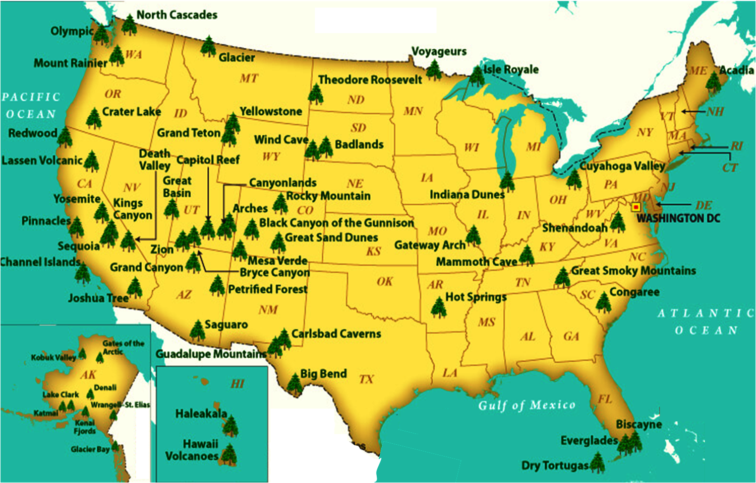
NATIONAL TREASURES
a
New River
White Sands
IN OUR NATURAL WONDERS

Slide 2
The Colorado Plateau
NATIONAL TREASURES
MUSIC STARTS
PHOTOS START
New River
White Sands
IN OUR NATURAL WONDERS

Slide 3
The Colorado Plateau
Week 3 – Arches & Canyonlands
Week 1 – Setting the Stage
Week 2 – Escalante & 3 Archaeologic Sites
Week 3 – Arches &
Canyonlands
Week 4 – Bryce Canyon
& Zion
Week 5 – Grand Canyon
Week 6 – Future of the Plateau
Week 3 - Arches &
Canyonlands
New River
White Sands

Slide 4
NW Colorado Plateau National Parks
TODAY’S TOPICS
OVERVIEW
ARCHES
National Park
CANYONLAND
National Park
Week 2 geology
New geology
Park area overview
Basic Info
Watershed
Physiography/Orient.
Surface Geology
History
Photo tour
Basic Info
Watershed
Physiography/Orient.
Surface Geology
History
Photo tour

Slide 5
Earth’s
Make-up
Supercontinents
Formation/Breakup
Plate
Movements
Micro-continents &
Exotic Terranes
Geologic
Timescale
Cratonic
Development
Orogenies
Plate
Tectonics
Orientation
Other
Rock
Deformation
Components
Of Geologic
Study
Geologic
Structures
Rocks
Earth’s
Storybook
Rock Cycle
Sedimentary
Sequences
Rock Types
General
Surface
Processes
Radical
Surface
Processes
Fossil Record
Unconformities
Weathering
Earthquakes
Rift Zones
Water
Erosion
Evaporation
Volcanoes
Ice
Hot Spots
Deposition:
Geosynclines
Wind
Basalt Floods

Slide 6
NEW GEOLOGY TOPICS
Historical Supercontinents
Exotic Terrane Accretion
Faults & Folds

Slide 7
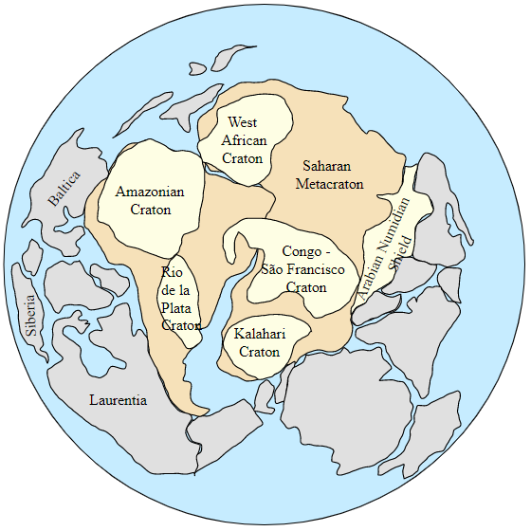
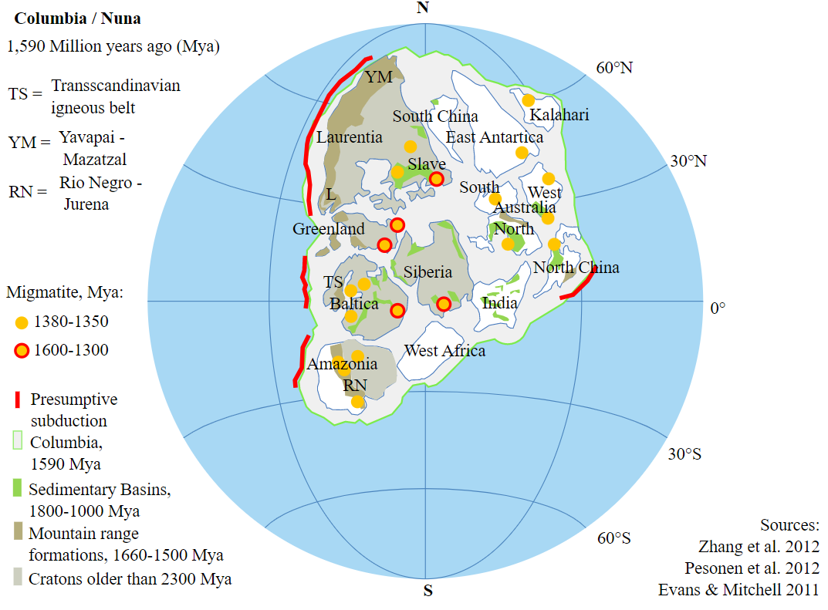
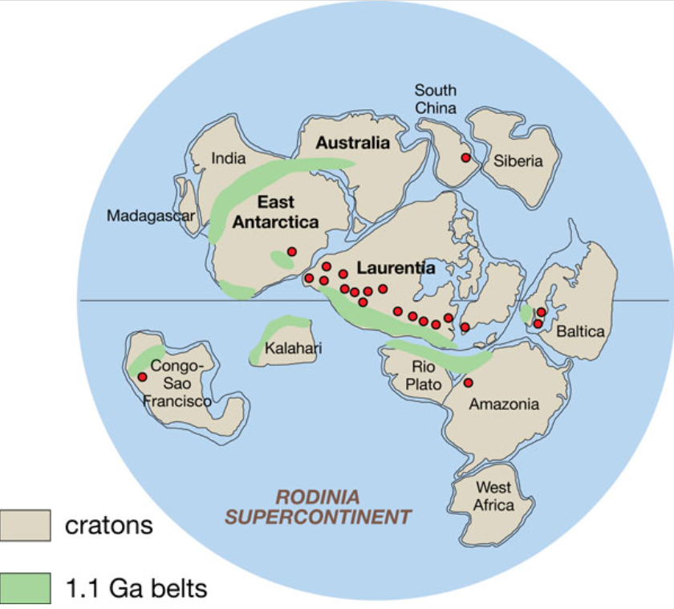
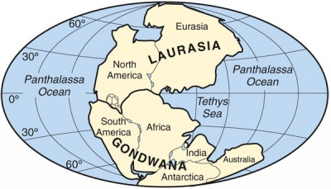
Over geologic time, all of the continental plates on the planet have come together to form SUPERCONTINENTS
Impact of Historical Supercontinents
Each time a SUPERCONTINENT assembles, there are crushing forces welding continents onto to each other
These geologic “scars” carry forward in a rock’s history and often in the history of that region
And these geologic “scars” played a role in the formation of the wonderful geology of Arches & Canyonlands NPs
Over geologic time, all of the continental plates on the planet have come together to form SUPERCONTINENTS
These forces bend, break, fracture, suture, warp, etc. the continental plates
Each time a SUPERCONTINENT assembles, there are crushing forces welding continents onto to each other
PANGAEA SUPERCONTINENT
225 Ma
PANNOTIA SUPERCONTINENT
545 Ma
RODINIA SUPERCONTINENT
750 Ma
These forces bend, break, fracture, suture, warp, etc. the continental plates
These geologic “scars” carry forward in a rock’s history and often in the history of that region
These geologic “scars” include faults, folds, joints, horst & grabens…
And these geologic “scars” played a role in the formation of the wonderful geology of Arches & Canyonlands NPs
COLUMBIA SUPERCONTINENT
1,750 Ma
Notes:
The enormous landmass of the Supercontinents profoundly influenced the Earth’s geosphere, atmosphere, hydrosphere and biosphere
estimated to range from 100 to 230 meters of sea level change. Spanning 60 million years, the late Paleozoic ice age was the most severe glaciation in the Phanerozoic, far exceeding the more familiar ice ages of the Pleistocene in the northern latitudes.
Why South Polar glaciation was triggered during the late Paleozoic has a great deal to do with the formation of Pangaea. Stretching from pole to pole, ocean and atmospheric circulation was drastically altered. Mountain ranges were uplifted that altered wind patterns and precipitation. Climate determinants, however, were not only terrestrial but extra-terrestrial.
consensus is that the sea level changes were caused by regular climate fluctuations that triggered the alternating accumulation and melting of glacial ice in Pangaea’s South Polar region. While the waxing and waning of Pennsylvanian polar ice is the source of the cyclic changes in sea level, the cause of the fluctuations of the climate is thought to be extra-terrestrial or astronomical. Our planet derives its energy from the sun, but the amount of energy we receive is not always the same. The late Paleozoic sun was less bright than it is today, 3% less than modern values. But solar luminosity (the amount of energy that reaches us) is also related to sunspots and the Earth’s orbit. The Earth gyrates and wobbles in its solar orbit such that the amount of sun reaching our planet varies. Milutin Milankovitch, a Serbian geophysicist in the 1920’s and 30’s, hypothesized that climatic fluctuations are related to the position of the Earth as it travels about the sun. Orbital factors such as precession (axis wobble), obliquity (axis tilt) and eccentricity (roundness) effect the amount of light reaching the Earth’s surface (solar insolation), and hence affect the planet’s climate. Each of these motions possesses a time period, the sum of which affects climate by driving the hot and cold cycles that produce glaciation. Orbital variations clearly had a substantial impact on Pangaean ice volume. Within the cyclothems of the Paradox basin, the repetitive successions (cyclicity) of Pennsylvanian marine and non-marine sediments are considered to be the stratigraphic signature of orbitally-controlled ice volume fluctuations during the late Paleozoic.
Rodinia was the supercontinent that preceded Pangaea by half a billion years, give or take. When Antarctica separated from Rodinia’s southwest paleo-shore in the Late Proterozoic-Early Cambrian, the rifting event sent extensional shockwaves through the craton. Notice the orientation of the normal faults within Rodinia's interior (below). The NW-SE trend of the Ancestral’s ranges and basins reflects these deep-seated, basement-penetrating structures. These zones of structural weakness were predisposed to future re-activation during Pennsylvanian-Permian compressional tectonics and even Cretaceous-Tertiary age Laramide contractional structures (such as monocline orientation). Tectonic inheritance of structural features in continental cycles, especially with intraplate orogenesis, is a recurring theme in the science of plate tectonics. Incidentally, the Late Proterozoic rifts that formed throughout Rodinia when it fractured apart likely induced "inversion" tectonics (extensional faults rejuvenating contractionally) in cratonic platforms of its rifted siblings worldwide.
The Ancestral Rocky Mountains, named after the modern Rockies that would eventually reside in roughly the same locale, rose from the sea in western equatorial Pangaea beginning in the Late Mississippian, reached their greatest intensity in the Middle Pennsylvanian, and ended their ascent in the Early Permian. An enigma to this day, they rose amagmatically (without volcanism) in an intra-cratonic and intra-plate setting far from any known plate boundary (1,500 km). They consisted of a collection of crystalline, Precambrian basement-cored, NW-SE-trending ranges (referred to as highlands and uplifts) and paired fault-bounded depressions (referred to as basins and troughs) from Chihuahua, Mexico, through Oklahoma, Texas, Colorado, Utah and up to British Columbia, Canada. Initially, the many basins were in communication with the marine waters of the Panthalassic Ocean.

Slide 8
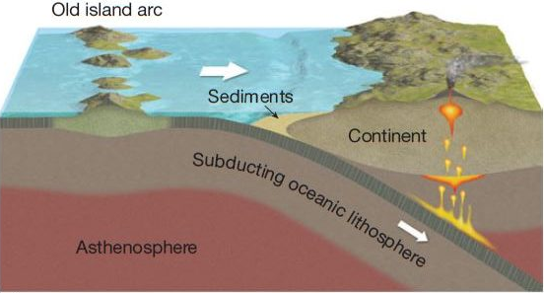
Exotic Terrane Accretion to Continental Crust
Oceanic Plate, with old island arc attached, moving to the right, is being subducted beneath the Continental Plate
Sediments are being scraped of the Oceanic Plate and are accumulating at the front edge of the Continental Plate
CONTINENTAL PLATE
OCEANIC PLATE

Slide 9
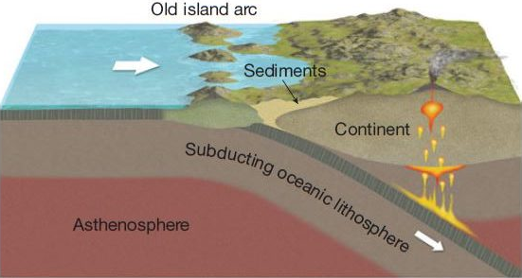
Exotic Terrane Accretion to Continental Crust
The tremendous forces ramming the island arc into the Continental Plate has “welded” new land onto the continent; the continent has grown and is now larger
https://digitallylearn.com/hotspots-mantle-plumes-and-accreted-terranes-upsc-ias/

Slide 10
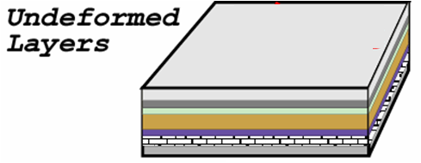
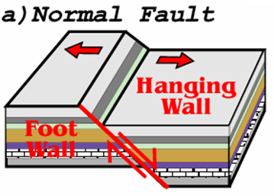
GEOLOGIC STRUCTURAL “FAULTS”
We have a slab of layered rock as shown above
The slab develops a crack along this line
What will happen?
It DEPENDS on the forces (STRAIN) acting on this slab
If forces are PULLING on the left and right sides of the slab, trying to pull it apart (TENSION)…
RESULTING FRACTURE creates a…
HOWEVER…
Parks and Plates
©2005 Robert J. Lillie

Slide 11
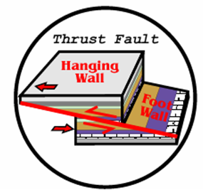
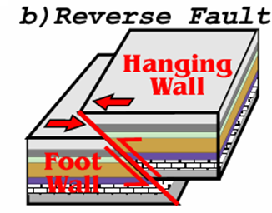
GEOLOGIC STRUCTURAL “FAULTS”
We have a slab of layered rock as shown above
The slab develops a crack along this line
What will happen?
It DEPENDS on the forces (STRAIN) acting on this slab
If forces are PUSHING on the left and right sides of the slab, trying to squeeze it together (COMPRESSION)…
IF the fracture angle is shallow, then its called..
RESULTING FRACTURE creates a…
BUT…
HOWEVER…
Parks and Plates
©2005 Robert J. Lillie

Slide 12
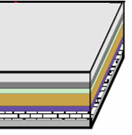
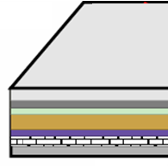
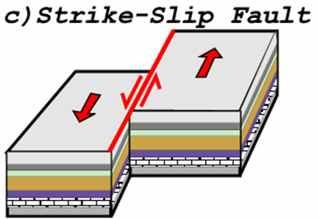
GEOLOGIC STRUCTURAL “FAULTS”
c) Strike-Slip Fault
We have a slab of layered rock as shown above
The slab develops a crack along this line
What will happen?
It DEPENDS on the forces (STRAIN) acting on this slab
If forces are PUSHING the right side away and PULLING the left side towards us (SHEAR)…
RESULTING FRACTURE creates a…
Parks and Plates
©2005 Robert J. Lillie

Slide 13
IN SUMMARY, GEOLOGIC STRUCTURAL “FAULTS”
Normal Fault
Hanging wall moves downward, relative to the foot wall
Extensional (tensional) forces
Divergent plate boundaries
Reverse Fault
Hanging wall moves upward, relative to the foot wall
Compressional forces
Convergent plate boundaries
Strike-Slip Fault
Two blocks slide laterally past one another
Shearing forces
Transform plate boundaries
Parks and Plates
©2005 Robert J. Lillie

Slide 14
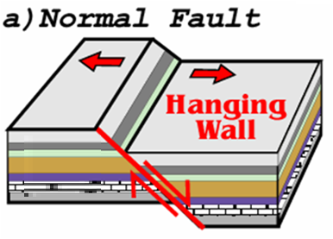
GEOLOGIC STRUCTURAL “FAULTS”-SPECIAL CASE
“HORST & GRABEN”
GRABEN
HORST
HORST

Slide 15
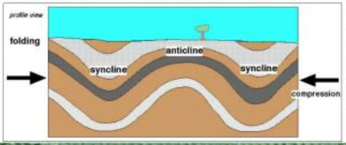
GEOLOGIC STRUCTURAL “FOLDS”
CROSS-SECTION OF SEDIMENTARY
LAYERS
MONOCLINE
ANTICLINE
SYNCLINE

Slide 16
GEOLOGIC STRUCTURAL “FOLDS”
CROSS-SECTION OF SEDIMENTARY
LAYERS
Normal
Fault
MONOCLINE

Slide 17
GEOLOGIC STRUCTURAL FOLDS

Slide 18
GEOLOGIC STRUCTURAL “FOLDS”

Slide 19
IN SUMMARY, GEOLOGIC STRUCTURAL FOLDS
ANTICLINE
SYNCLINE
MONOCLINE
BASIN
DOME

Slide 20
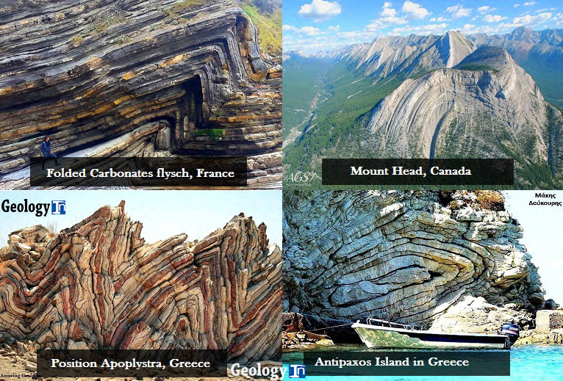
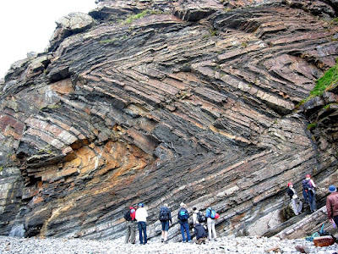
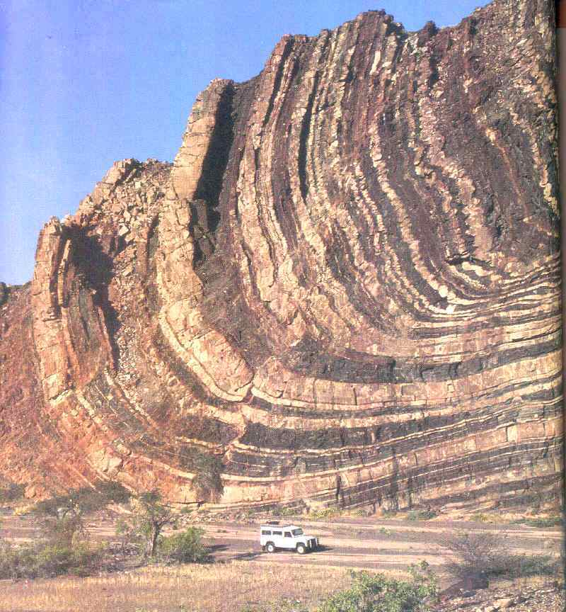
EXAMPLES OF GEOLOGIC STRUCTURAL “FOLDS”
End of New Geology on to
Arches Overview

Slide 21
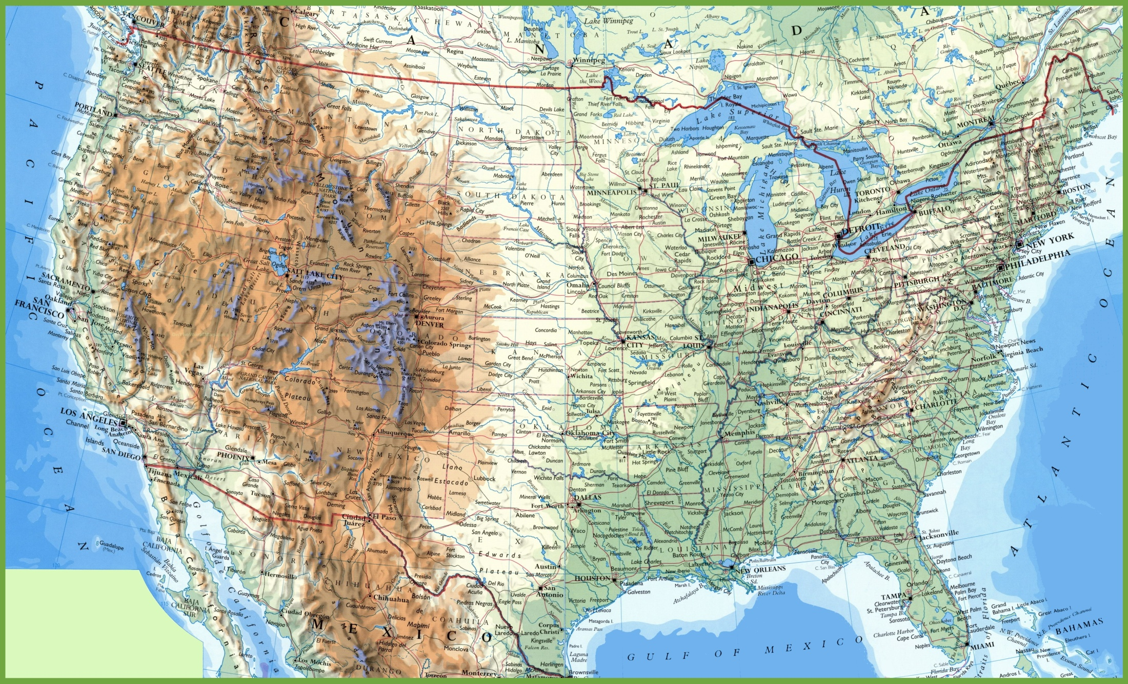
Location of National Parks for Today’s Discussion
UTAH
COLORADO
a
ARIZONA
NEW MEXICO

Slide 22
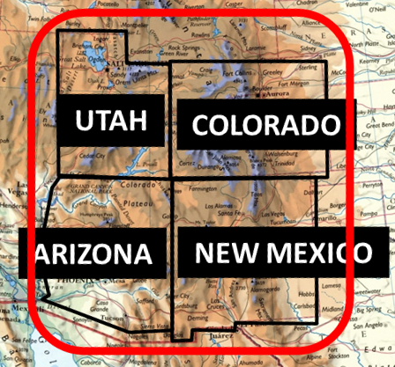
Location of National Parks for Today’s Discussion
UTAH
COLORADO
a
ARIZONA
NEW MEXICO

Slide 23
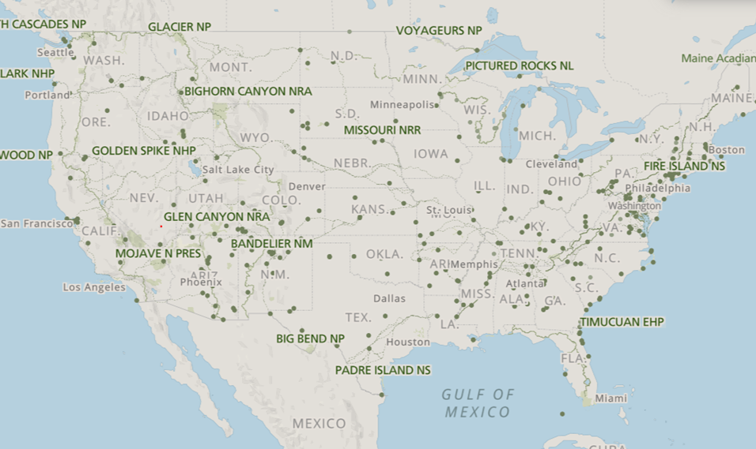
Colorado Plateau Province
Location of National Parks for Today’s Discussion
UTAH
COLORADO
a
ARIZONA
NEW MEXICO

Slide 24
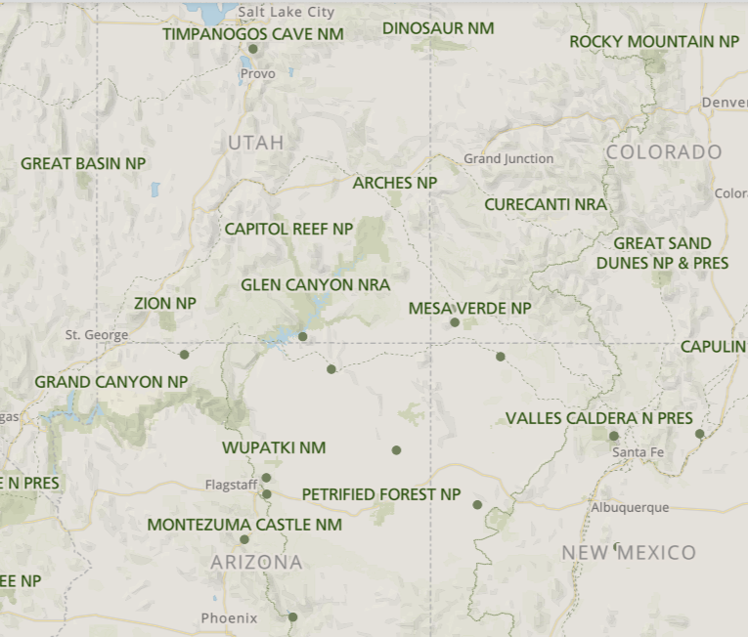
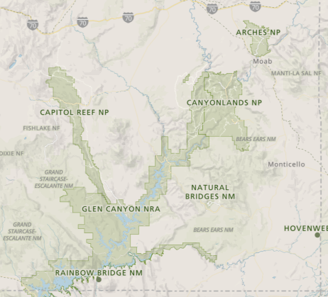
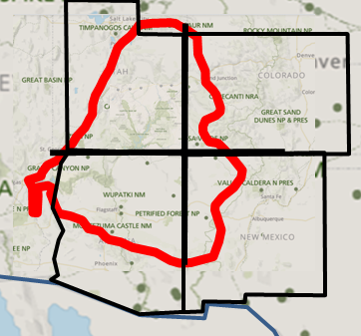
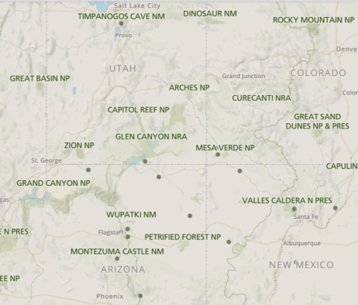
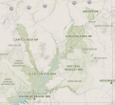
Colorado Plateau Province
Location of National Parks for Today’s Discussion
UTAH
COLORADO
a
ARIZONA
NEW MEXICO

Slide 25
Location of National Parks for Today’s Discussion
UTAH
COLORADO
a
ARIZONA
NEW MEXICO

Slide 26
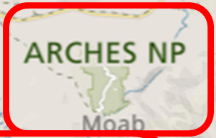
Location of National Parks for Today’s Discussion
ARCHES NATIONAL PARK
UTAH
COLORADO
a
ARIZONA
NEW MEXICO

Slide 27
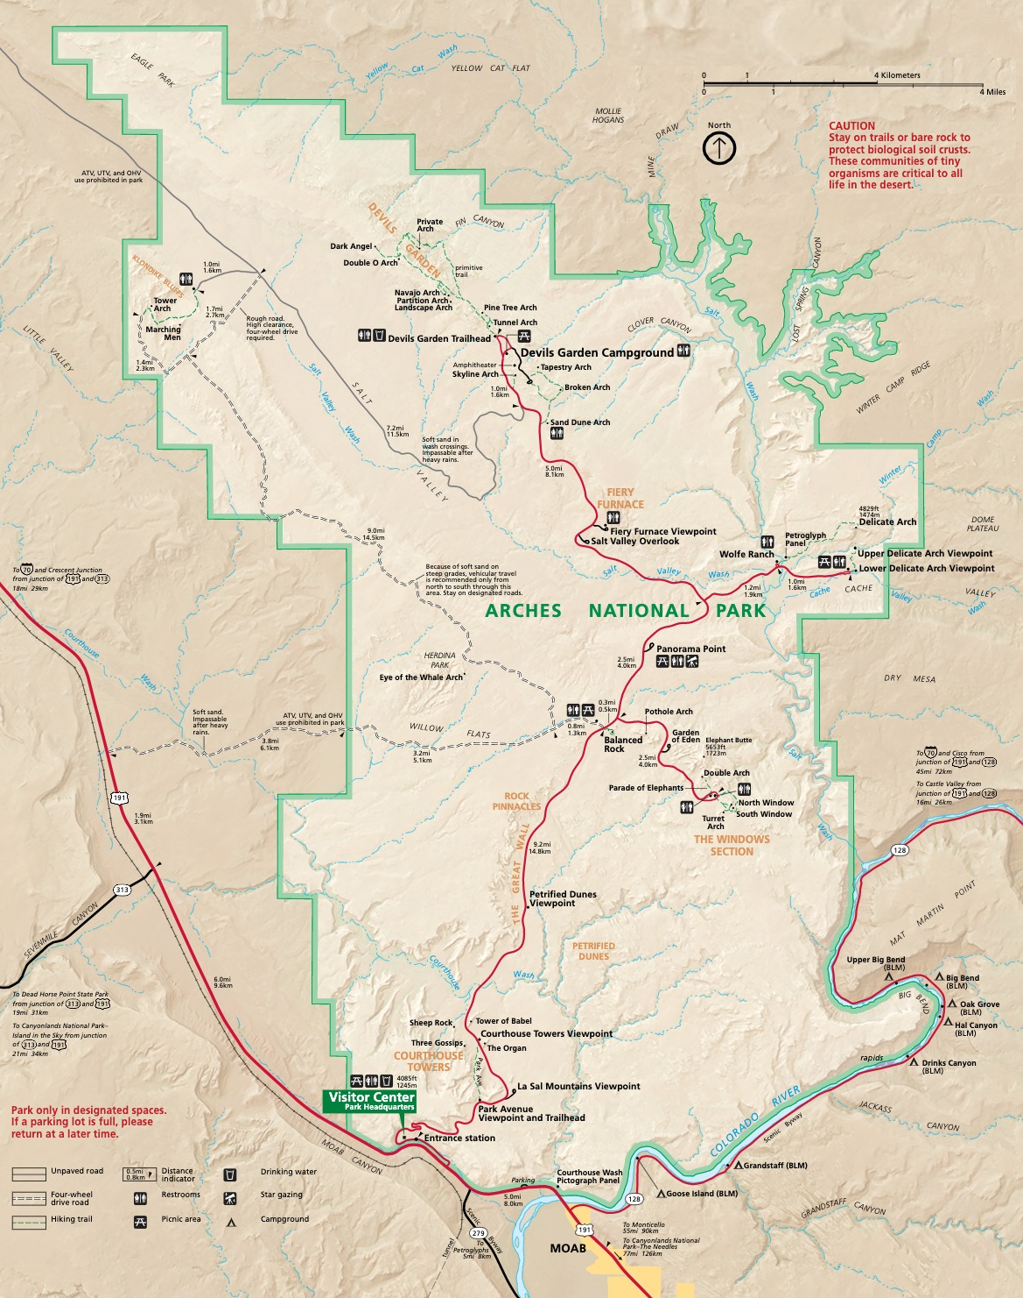

Slide 28
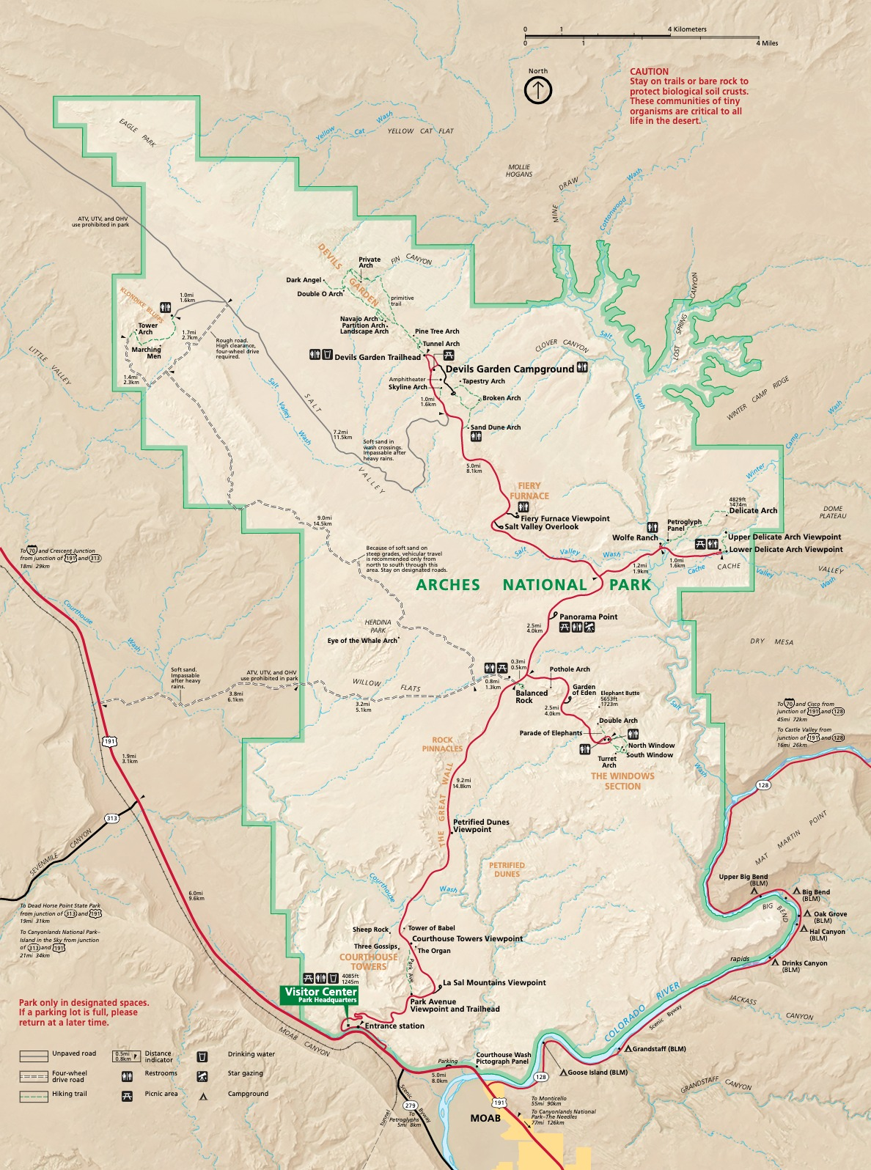
ARCHES NP - OVERVIEW
Hunter-gatherer tribes frequently came this area as early as 10,000 years ago for seasonal hunting
Nomadic Shoshone, Ute, and Paiute eventually took their place.
Early tribes left their mark on the region through their exquisite displays of petroglyphs which are viewable today at Wolfe Ranch in the park
Let’s go look at some of these
EARLY NA PETROGLYPHS
a

Slide 29
PETROGLYPHS OF ARCHES NP

Slide 30
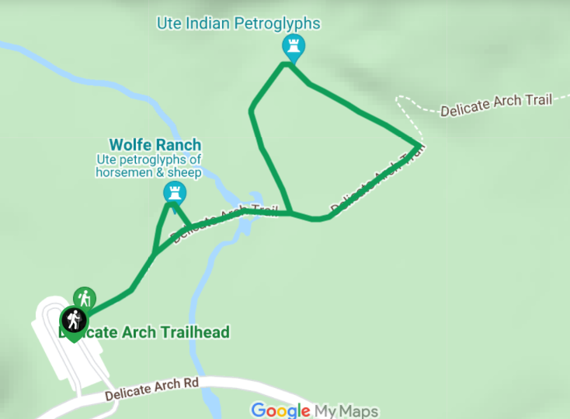
ARCHES NP PETROGLYPHS
Ute Petroglyphs
Delicate Arch Area
Entrance &
Visitor Center
As you will see in a few minutes, there is a location called Delicate Arch. From there, it is a short walk to PETROGLYPHS

Slide 31
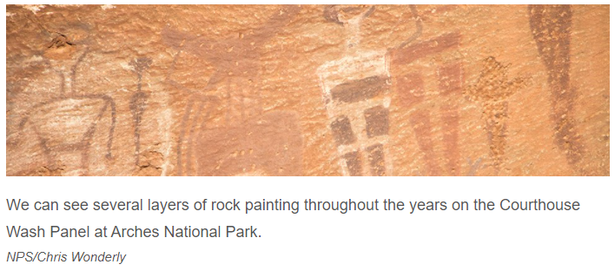
ARCHES NP PETROGLYPHS
The stylized horse and rider surrounded by bighorn sheep and dog-like animals is typical of Ute Indian art work.
These petroglyphs were carved sometime between A.D. 1650 and 1850 since it shows people on horseback, and horses were adopted by the Utes only after they were introduced by the Spanish
This rock art panel is important to many Native Americans in this region because it was created by their ancestors
This wall of petroglyphs is located in Arches National Park, just off the Delicate Arch hiking trail. As you make you way up the trail to Delicate Arch you will see a small trail that forks off the main trail. The trail to the petroglyphs is very short and adds approx 10 minutes to your hike, but its well worth it
This rock art panel is important to many Native Americans in this region because it was created by their ancestors. When you visit this area please help protect this rock art by not touching it. The oils from your skin hasten deterioration of these fragile and irreplaceable cultural resources.

Slide 32
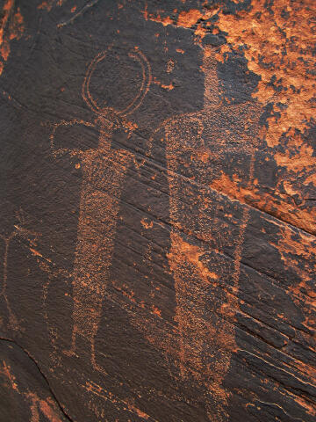
ARCHES NP PETROGLYPHS
Dark Angel Petroglyphs
Near Devil’s Garden Area Dark Angel Pictographs are hidden away is an enchanting corner of Arches National Park. There is no trail to the actual collection of amazing rock art panels, and the rangers will not tell you where the rock art is located. The petroglyphs are guarded by a simple sign stating "You've found something unique please preserve it".
The technique used by the UTE Native American’s was to chisel away the surface layer of desert varnish to expose brighter areas
For lines they just scratched away the desert varnish with the points of their tools
Several specimens have been found in the area. They are made of Chalcedony rock, a type of local flint
Back to
Arches Overview

Slide 33
ARCHES NP - OVERVIEW
Hunter-gatherer tribes frequently came this area as early as 10,000 years ago for seasonal hunting
Nomadic Shoshone, Ute, and Paiute eventually took their place.
Early tribes left their mark on the region through their exquisite displays of petroglyphs which are viewable today at Wolfe Ranch in the park
Arches was initially established as a
a
National Monument in 1929 by President Herbert Hoover and was made a park in 1971
It is approximately 18.5mi long by 11mi wide but it covers only approximately 76,500 acres (119 sq miles)

Slide 34
ARCHES NP - OVERVIEW
Hunter-gatherer tribes frequently came this area as early as 10,000 years ago for seasonal hunting
Nomadic Shoshone, Ute, and Paiute eventually took their place.
Early tribes left their mark on the region through their exquisite displays of petroglyphs which are viewable today at Wolfe Ranch in the park
Arches was initially established as a
a
National Monument in 1929 by President Herbert Hoover and was made a park in 1971
It is approximately 18.5mi long by 11mi wide but it covers only approximately 76,500 acres (119 sq miles)

Slide 35
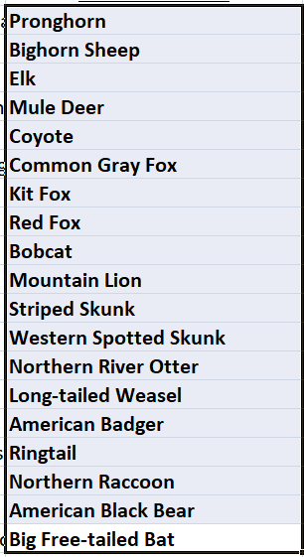
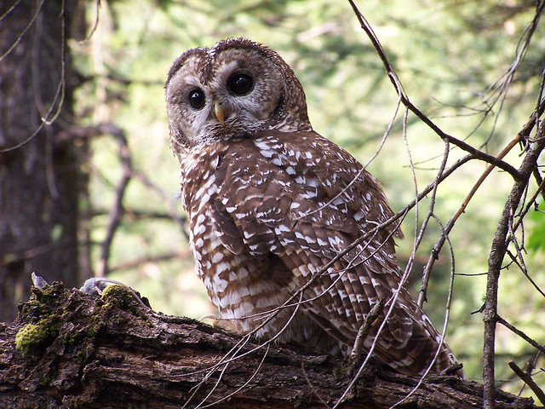
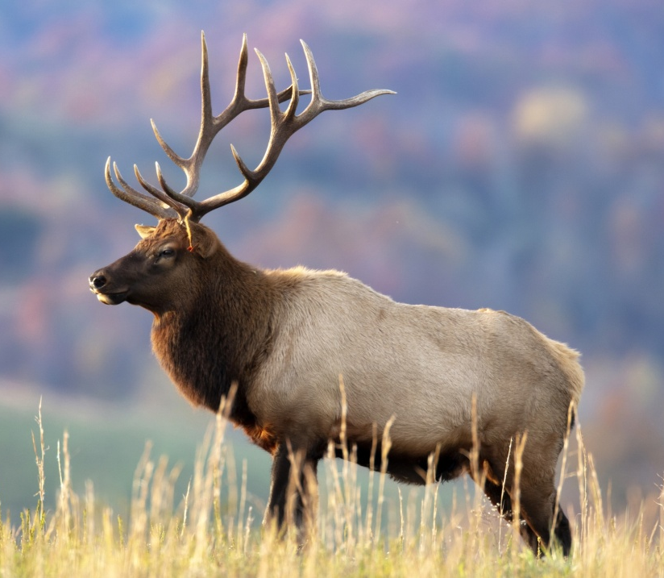
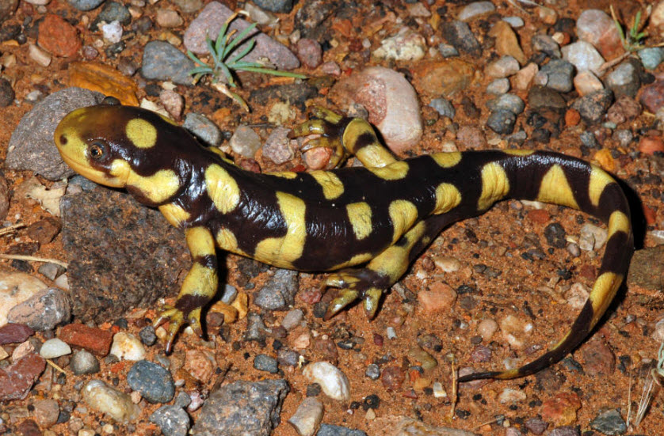
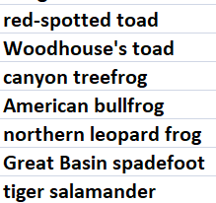
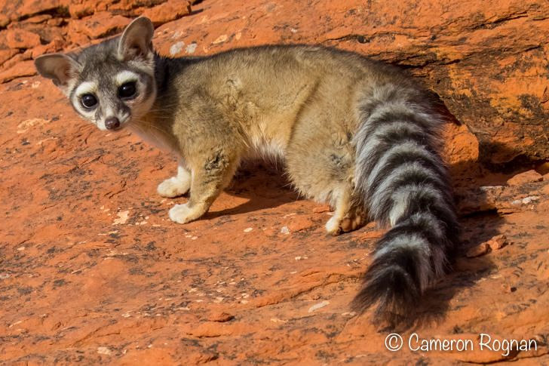
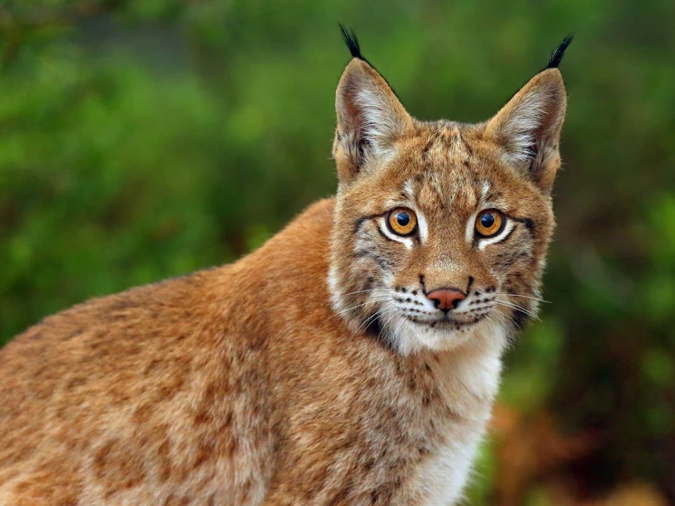
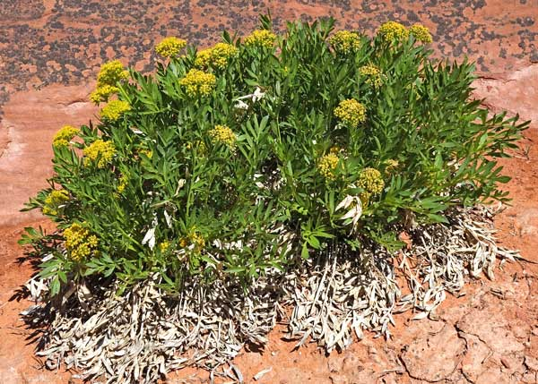
ARCHES NP - OVERVIEW
56 species of mammals
188 species of birds
Threatened species: Bald Eagle, Mexican Spotted Owl
7 species of amphibians
15 species of reptiles
10 species of fish
Endangered species: Bonytail Chub, Colorado Pikeminnow, Humpback Chub, Razorback Sucker
566 species of plants
Rare species: Canyonlands Biscuitroot
https://www.nps.gov/articles/arch-quick-facts.htm

Slide 36
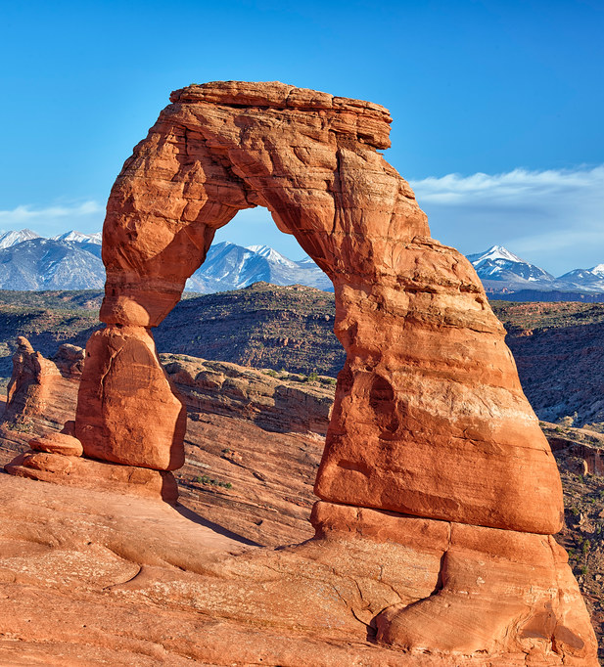
ARCHES NP - OVERVIEW
It has the densest concentration of natural stone arches in the world.
There are over 2,000 documented arches in the park!
BUT…
But that is not what Arches is most famous for…
…AT LEAST NOT TO GEOLOGIST!
a
It’s most famous for its exposed salt anticline!
LET ME EXPLAIN…

Slide 37
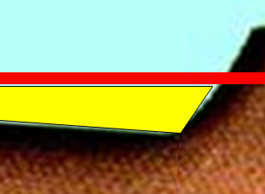
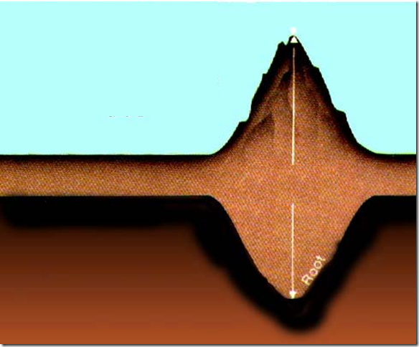
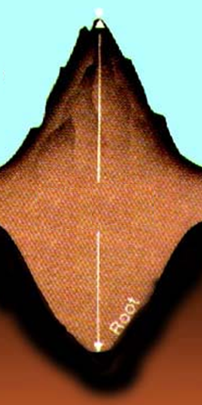
SIDE EFFECT OF MOUNTAIN BUILDING
This is a mountain range that has risen above the continental crust
A side effect of this growth is a flexure of the lithosphere, a down-warping of the crust…like this…
Estimated basin depth of…
As it grew, it grew in two directions; above ground and
10,000+ ft,
2 miles!
BASINS HAVE BEEN CREATED
below ground or in this case, into the lithosphere
This is due to buoyancy of the rock in the lithosphere
Lithosphere
Notes:
Paradox Basin is a foreland basin located predominately in Utah and Colorado, but also branching into Arizona and New Mexico.
Unlike most Rocky Mountain basins, the Paradox Basin is an evaporite basin containing sediments from alternating cycles of deep marine and very shallow water.
A foreland basin is a structural basin that develops adjacent and parallel to a mountain belt. Foreland basins form because the immense mass created by crustal thickening associated with the evolution of a mountain belt causes the lithosphere to bend, by a process known as lithospheric flexure
1) Traditionally, the uplift of the Ancestral Rocky Mountains has been ascribed to a continent-continent collision of the conjoined masses of Laurussia and Gondwana. But not all tectonic aficionados agree with the intraplate geometry of a South American collision from the southeast having raised a range that trends NW-SE and so far-afield from the effects of the Ouachita-Marathon convergent margin.
2) Opponents advocate for a volcanic arc-collision occurring somewhere from the southwest, likely within Mexico, which fits better with the Ancestral’s orientation and the compressionally-derived, foreland structure of its basins.
3) A third hypothesis (and there’s undoubtedly more) evokes pre-existing weaknesses within the craton that, when compressed, uplifted the range along deep Proterozoic basement lineaments, a Precambrian "inherited" defect,
Paradox Basin is a marine basin that has been filled in for about 300 million years
salt deposits occurred during the Middle Pennsylvanian time period, and result in the Paradox basin being considered an evaporite basin. Salt tectonics have played a large role in shaping the basin, as thick deposits make up roughly 12,000 square miles of the basin (equivalent to about 40% of the entire basin).

Slide 38
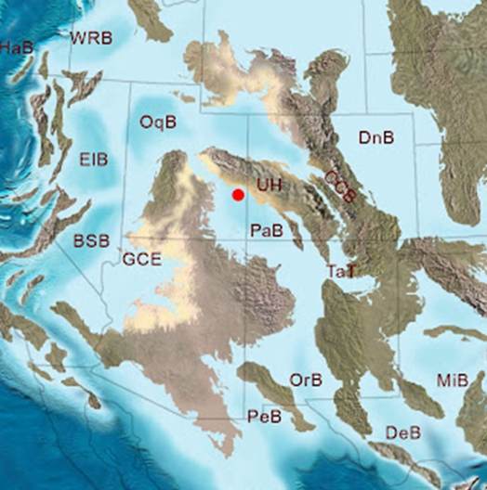
Prehistoric Location of Paradox Basin

Slide 39
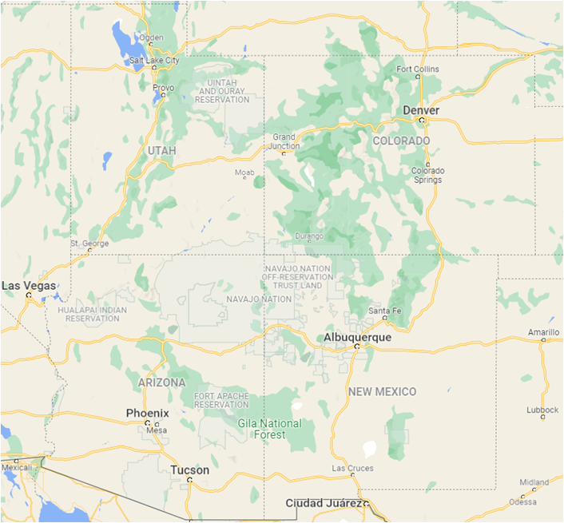
PARADOX BASIN
Colorado Plateau
UTAH
COLORADO
Paradox Basin
ARIZONA
NEW MEXICO

Slide 40
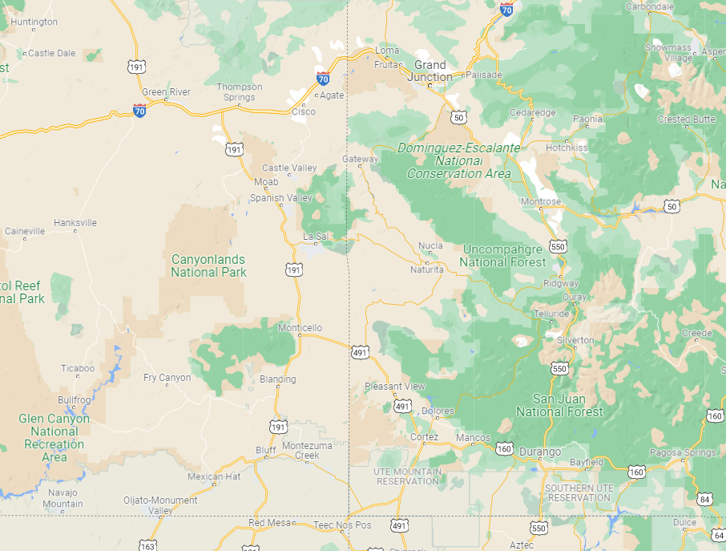
NATIONAL PARKS IN PARADOX BASIN
Arches NP
PARADOX BASIN
“A”
“B”
- 190 miles long
95 miles wide
12,000 sq mi
Canyonlands NP
Notes:
The 12,000 square mile (190 by 95 miles) extent of the Paradox basin (BLACK line) is defined by evaporite (salt) deposits of the Middle Pennsylvanian (315Ma) Paradox Formation.
1875, when geologist Albert Charles Peale discovered and surveyed the valley. He chose the name Paradox due to the fact that the Dolores River had a “desire to preform strange and unexpected things
Natural resources extracted from the basin include petroleum, uranium, copper, and potash.

Slide 41
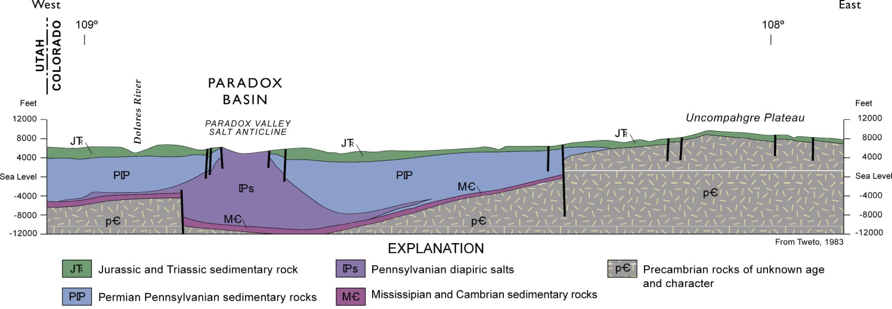
THE PARADOX BASIN – SALT EVAPORITES
A portion of the PARADOX BASIN
Uncompahgre Mountains
Plateau!
“B”
“A”
Notes:
this land of geological enigmas, paradoxes and contradictions
Permian and Triassic clastic deposits came off the Uncompahgre highlands to the northeast, one of a series of mountain ranges belonging to the Ancestral Rocky Mountains that reached its greatest intensity between the Middle Pennsylvanian and Early Permian.

Slide 42
THE PARADOX BASIN – SALT EVAPORITES
320-250 Ma sediments
320-300 Ma SALT sediments
250-145 Ma sediments
Outline of
Pre-Cambrian rocks (basement layer)
540-320 Ma sediments
Notes:
halite, NaCl in its crystalline form. In the depositional environment of the Paradox basin, "salt" includes additional evaporites such as anhydrite, gypsum and potash. These "salts" precipitated directly from sea water as it was reduced by evaporation, and in a highly predictable sequence. Halite crystallizes after 90% of the water has evaporated.

Slide 43
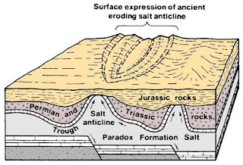
THE PARADOX BASIN – SALT EVAPORITES
BUT OF COURSE, IT WASN’T ALWAYS THIS WAY…LET’S GO BACK 315 MILLION YEARS!
As global warming & cooling cycled back and forth, the oceans would rise & fall
Eroded top of a Salt Anticline,
Paradox Basin
Notes:
Cut off from the sea, the basin became a hypersaline lake as water evaporated within the restricted basin in the hot, arid Pennsylvanian climate of western Pangaea. Salt brines precipitated from the briny solution and settled to the deepest depression of the basin where they accumulated.
These events repeated an amazing 33 times with pulse-like regularity and are recorded within the multiple evaporite-cycles of the Paradox Formation, called cyclothems. The deepest portion of the basin received as much as 6,000 feet of evaporite-dominated sequences
Paradox Formation was conformably succeeded by the alternating terrestrial eolian and fluvial, and marine shales and limestones
16,000 feet of the Uncompahgre’s arkosic, Precambrian sediments were shed into the Paradox basin as it rapidly subsided

Slide 44
Side Note - LIMESTONE, SHALES, & SANDSTONE DEPOSITS
Let’s move on
now to a
MAP of
ARCHES NP
Side Note : Ancient algal mounds in Utah & Australia is the only place in the world where the living algal mounds called stromatolites approach the dimensions and the variety of shapes they achieved during their heyday in the Precambrian.
The 33 recorded cycles of global warming and cooling also lead to coral growth at various times resulting in large amounts of limestone deposits over the area
The ever changing climate also had periods of intense rainfall which lead to rapid weathering/erosion of adjacent mountain ranges and that lead to increased deposition over the area
Notes:
Although greatly eroded in the Triassic, the remnants of the Ancestral Rockies (assisted by the Mogollon highlands to the south and the distant Southern Appalachians to the east) covered the Paradox basin in its entirety with the Lower Triassic Moenkopi Formation’s deep red mix of tidal flat and coastal plain sandstones, mudstones and shales.

Slide 45
Fiery Furnace Area
Devil’s Garden Area
Ute Petroglyphs
Devil’s
Garden
Marching Men Area
On to ELEVATION PROFILES
of Arches NP
Delicate Arch Area
Green Outline of Arches National Park
The Windows Area
Courthouse Towers Area
Colorado River
Petrified
Sand
Dunes
Petrified Sand Dunes
Entrance &
Visitor Center
Moab, UT

Slide 46
ARCHES NP – ELEVATION PROFILES
NW
SE
Less than 1% downward slope from the NW to the SE
This is the area of exposed SALT ANTICLINE surface

Slide 47
ARCHES NP – ELEVATION PROFILES
NE
SW
Topped out at 5,400 ft
Total weathering of 722 ft
722 ft
The SALT ANTICLINE has weathered down 413 ft from SW
It is probable that the SALT ANTICLINE surface was like this

Slide 48
ARCHES NATIONAL PARK – PHYSICAL MAP REVIEW

Slide 49
ARCHES NATIONAL PARK –FLYOVER

Slide 50
FORMATION OF A ROCK ARCH
The process starts with a block of the Entrada Sandstone standing out in the weather…and what does it do?
Small parallel cracks (joints) start appearing on the surface.
It starts to weather & erode from the sun, rain, snow, wind, & ice
FUTURE FINS/ARCHES?
Weathering & erosion start “eating” at those cracks making them wider; wind & rain carries away sand particles enlarging the space between sections; FINS are created
Portions of some of the FINS collapse (mass wasting). Hard resistant rock remains
AN ARCH IS FORMED…and continues to weather & erode
Notes:
Cracks between closely spaced vertical joints become enlarged by chemical & physical weathering a water seeps down, dissolving iron oxide cement & loosening sand grains. Frost action, with its alternating freezing, expanding, and thawing, also breaks up the sandstone. Loose sediment is removed by wind and runoff. The joint spaces gradually enlarge into narrow valleys that separate the narrow walls, now call FINS

Slide 51
BEAUTIFUL PHOTOS OF ARCHES FROM NAT’L GEO
https://www.nationalgeographic.com/travel/national-parks/article/arches-national-park

Slide 52
PANORAMA OF ARCHES NATIONAL PARK

Slide 53
THIS NATIONAL PARK IS FAMOUS FOR ITS ARCHES
PARADE OF ELEPHANTS
LANDSCAPE ARCH
NAVAJO ARCH
DOUBLE ARCH
NORTH WINDOW WITH TOWER ARCH IN BACKGROUND
BALANCED ROCK
COURTHOUSE TOWERS
BROKEN ARCH
TUNNEL ARCH
NORTH & SOUTH WINDOWS IN ARCHES NP
DELICATE E ARCH
Notes:
Landscape Arch in Devil’s Garden is the longest in the Park at 306ft long, the 5th longest in the world. It is only 11 ft thick at the middle. In 1991 a 60ft section dropped off.

Slide 54
ARCHES AT NIGHT
Say Goodbye to
ARCHES NP,
And hello
CANYONLANDS NP

Slide 55
CANYONLANDS NP

Slide 57
Location of National Parks for Today’s Discussion
CANYONLANDS NATIONAL PARK
a

Slide 58
CANYONLANDS NATIONAL PARK

Slide 59
CANYONLANDS NP - OVERVIEW
Canyonlands was established as a National Park in 1964 and in 1971 Congress expanded the park to its current size
It is approximately 38.4 mi long by 14.3 mi wide and covers approximately 257, 640 acres (402 sq miles)
Canyonlands is made up of three land districts; Island in the Sky in the north, The Maze in the central section, and
a
The Needles in the southern section
The upper half of the park is bounded by the Green River on the West and the Colorado River on the East

Slide 60
CANYONLANDS NP - OVERVIEW
Canyonlands resides in the western portion of the Paradox Basin as shown previously
This park also has some arches but typically the rocks here weather & erode differently than at Arches NP
Major John Wesley Powell, famous US explorer, geologist, Army officer camped at the confluence of the Green & Colorado Rivers
a
Butch Cassidy and his Wild Bunch used to hide out in the nooks and crannies of Canyonlands
Class III-IV rapids in Cataract Canyon at some times of the yr

Slide 61
CANYONLANDS NP - OVERVIEW
205 species of birds
6 species of amphibians
20 species of reptiles
33 species of fish
664 species of plants
55 species of mammals
Hedgehog cactus

Slide 62
CANYONLANDS NP – NORTHERN AREA
ISLAND IN THE SKY AREA
A triangular plateau 2,000 ft above the Green & Colorado R.
Best location in the park to gain a perspective on the geological processes that have created the park’s “LAYER CAKE architecture”
Let’s divert for a moment and learn about this
“LAYER CAKE ARCHITECTURE”

Slide 63
CANYONLANDS NP – NORTHERN AREA
ISLAND IN THE SKY AREA
A triangular plateau 2,000 ft above the Green & Colorado R.
Best location in the park to gain a perspective on the geological processes that have created the park’s “LAYER CAKE architecture”
This point at the edge of a mesa is called
“Grand View Point”
…for a reason!
Let’s zoom onto this area

Slide 64
CANYONLANDS NP – GEOLOGIC MAP OF ISLAND AREA
Island in the Sky Area has incredibly big vista views of the sediment layering of our earth – Enjoy it!
3
Start
1
4
2
6
End
5
One last look at the big vista views
1
2
3
9
4
7
5
End
6
7
8
8
9
“Layer Cake Architecture”
Layer Tracker
Start

Slide 65
CANYONLANDS GEOLGIC MAP

Slide 66
CANYONLANDS NP – GEOLOGIC MAP OF ISLAND AREA
CANYONLANDS NP –PANO ISLAND IN THE SKY AREA

Slide 67
CANYONLANDS NP – NORTHERN AREA
ISLAND IN THE SKY AREA
A triangular plateau 2,000 ft above the Green & Colorado R.
Best location in the park to gain a perspective on the geological processes that have created the park’s “LAYER CAKE architecture”
Predominate rock color is red, red sandstone of varying hues. The red color comes from iron oxide that is cementing sand grains together
In this area is one of the most important, an controversial, geologic spots in the park…THE UPHEAVAL DOME

Slide 68
CANYONLANDS NP – NORTHERN AREA
ISLAND IN THE SKY AREA
Aerial View
This area on our previous map is the location of Upheaval Dome
An aerial view shows the bull's-eye outline of the rocks
It shows up on the geologic maps like this – 3 mi diameter
3 mile
What is this?

Slide 69
CANYONLANDS NP – UPHEAVAL DOME
ISLAND IN THE SKY AREA
Oldest & deepest Paradox Basin Salt is exposed & dome shaped
Flipped up edges of over-lying, sedimentary layers
Aerial View
This area on our previous map is the location of Upheaval Dome
An aerial view shows the bull's-eye outline of the rocks
It shows up on the geologic maps like this – 3 mi diameter
3 mile
What is this?
Downwarping of sedimentary layers forming a syncline
WHAT COULD HAVE CAUSED THIS?

Slide 70
CANYONLANDS NP – UPHEAVAL DOME
TWO THEORIES
SALT TECTONICS
METEORITE IMPACT
pressure from thousands of feet of overlying rock, salt can flow plastically, like tooth paste.
salt being less dense than sandstone, results in salt flowing up through rock layers as a "salt bubble“ – a salt dome
It rises to the surface and deforms the surrounding rock
The erosion of the rock layers above the dome itself is what we see today
60 million years ago a 600 yd diameter meteor impacted at this location
The impact initially created an unstable 3mi diameter crater that has partially collapsed
Rebound in the center of the crater came from the Paradox Basin salts thousand feet below
Erosion of the crater is what we see today
BOOM!
You have a hole in the ground!
So which theory do you think might be correct ?

Slide 71
CANYONLANDS NP – UPHEAVAL DOME
SALT TECTONICS
pressure from thousands of feet of overlying rock, salt can flow plastically, like tooth paste.
salt being less dense than sandstone, results in salt flowing up through rock layers as a "salt bubble“ – a salt dome
It rises to the surface and deforms the surrounding rock
The erosion of the rock layers above the dome itself is what we see today
Rock layers likely would have been connected to both sides of the depression and then eroded away
PLAUSIBLE?
Paradox
Basin
Salt

Slide 72
CANYONLANDS NP – UPHEAVAL DOME
METEORITE IMPACT
60 million years ago a 600 yd diameter meteor impacted at this location
The impact initially created an unstable 3mi diameter crater that has partially collapsed
Rebound in the center of the crater came from the Paradox Basin salts thousands of feet below
Erosion of the crater is what we see today
PLAUSIBLE?

Slide 73
CANYONLANDS NP – UPHEAVAL DOME
TWO THEORIES
SALT TECTONICS
METEORITE IMPACT
pressure from thousands of feet of overlying rock, salt can flow plastically, like tooth paste.
salt being less dense than sandstone, results in salt flowing up through rock layers as a "salt bubble“ – a salt dome
It rises to the surface and deforms the surrounding rock
The erosion of the rock layers above the dome itself is what we see today
60 million years ago a 600 yd diameter meteor impacted at this location
The impact initially created an unstable 3mi diameter crater that has partially collapsed
Rebound in the center of the crater came from the Paradox Basin salts thousands of feet below
Erosion of the crater is what we see today
On to
“THE MAZE”
Area in the central region of the park
Meteorite Impact Theory seems to be the correct theory… For now!

Slide 74
CANYONLANDS NP – CENTRAL AREA
THE MAZE AREA
Land of Standing Rocks
(Maze Area), Canyonlands
Park brochure describes this area as a “30 sq mile puzzle in sandstone”!
River down-cutting over geologic time was at about the same rate as the region was being uplifted
On to
“THE NEEDLES”
Area in the southern region of the park
http://bobrehak.com/portfolio-item/maze-canyonlands-np/
This allowed rivers to maintain their normal “dendritic” stream pattern producing this Maze area
Outstanding examples of prehistoric rock art are hidden in some of the deepest canyons
Land of Standing Rocks is in this area
https://www.faucherphotography.com/photo/land-of-standing-up-rocks/
http://cedarandsand.blogspot.com/2013/07/the-land-of-standing-rocks-chocolate.html
https://thetrekplanner.com/land-of-standing-rocks-and-dollhouse-maze-district-canyonlands/
Land of Standing Rocks (Maze Area), Canyonlands
Land of Standing Rocks (Maze Area), Canyonlands
Land of Standing Rocks (Maze Area), Canyonlands

Slide 75
CANYONLANDS NP – SOUTHERN AREA
THE NEEDLES AREA
NEEDLES are similar to FINS, but have more crisscross fractures & therefore weather differently
Needles tend to weather into pillars. Where they develop, they tend to do so in a line
https://rroberts.photoshelter.com/image/I0000VLyLtzYKZaA
Needles Area, Canyonlands
Area was named for the colorful spires of Cedar Mesa Sandstone that dominate the area.
“Probably my favorite part of Canyonlands, the Needles has incredible hiking and views. The Needles are up-close and personal and still a bit mind bending.” by CopperLeah

Slide 76
CANYONLANDS NP – SOUTHERN AREA
Say goodbye to
CANYONLANDS NP
next week…
Needles Area, Canyonlands
https://www.rockymtnrefl.com/NeedlesDistrictcd723002335.html
https://utahscanyoncountry.wordpress.com/2010/12/11/paul-bunyans-potty-tower-ruin-canyonlands-national-park/
https://i0.wp.com/internetbrothers.org/wp-content/uploads/2014/12/elephant_needles.jpg
Needles Area, Canyonlands
https://www.reddit.com/r/EarthPorn/comments/6448pg/needles_district_canyonlands_national_park_utah/?utm_source=ifttt
https://utahscanyoncountry.wordpress.com/2010/12/11/paul-bunyans-potty-tower-ruin-canyonlands-national-park/
https://utahscanyoncountry.wordpress.com/2010/12/11/paul-bunyans-potty-tower-ruin-canyonlands-national-park/
https://www.flickr.com/photos/nwchadwik/49827971946/
Needles Area, Canyonlands
Meanderthrals (Needles Area, Canyonlands)
Arch in the making (Needles Area, Canyonlands)
Native American Ruins (Needles Area, Canyonlands)
Unnamed (Needles Area, Canyonlands)
Paul Bunyan’s Potty (Needles Area, Canyonlands)
http://www.mountainphotography.com/photo/needles-reflection-2/

Slide 77
ENDING

Slide 78
The Colorado Plateau
Week 1 – Setting the Stage
Week 2 – Escalante & 3 Archaeologic Sites
Week 3 – Arches &
Canyonlands
Week 4 – Bryce Canyon
& Zion
Week 5 – Grand Canyon
Week 6 – Future of the Plateau
New River
White Sands

Slide 79
WEBSITE: www.VagabondGeology.com
REFERENCES
BOOKS
Undaunted, The Miracle of the Hole in the Wall Pioneers, by Gerald Lund, 2009, Anchor Point LLC
Official Guide to America’s National Parks, Fodor’s 12th Edition, 2004
Roadside Geology of New Mexico, Halka Cronic, Mountain Press Publishing, 1987
Colorado Rockhounding, Stephen M. Voynick, Mountain Press Publishing, 9th printing, 2011
Colorado, A Four Seasons Guide 2nd Edition, Fodor’s, 1996
Tour Book: Colorado and Utah, AAA, 2014
Tour Book: Colorado and Utah, AAA, 2007
Arizona: Complete Guide, Fodor’s, 1994
Utah: Complete Guide 1st Edition, Fommer’s, 1996
Utah Handbook 4th Edition, Bill Weir & Robert Blake, 1996
Chaco: a Cultural Legacy, Michal Strutin, Western Nat’l Parks Assoc, 1994
Geology and America’s National Park Areas, Brooks B. Ellwood, Prentice Hall, 1996
The Evolution of North America, Phillips B. King, Princeton University Press, 1977
WEBSITES
https://ehillerman.unm.edu/node/3050#sthash.MiqpgxNP.dpbs
https://en.wikipedia.org/wiki/Geology_of_the_United_States- Geology of the Colorado Plateau
https://watershed.ucdavis.edu/education/classes/files/content/page/1%20Trexler%20- %20Tectonic%20Evolution%20of%20the%20Colorado%20Plateau_0.pdf
http://www.riversimulator.org/Resources/NPS/FoosPlateauGeology.pdf
https://www.outdoorproject.com/articles/history-stone-basic-geology-colorado-plateau
volcanism in the Plateau
https://agupubs.onlinelibrary.wiley.com/doi/full/10.1002/2014GC005641
https://www.moabhappenings.com/Archives/Geology201803MoabAndTheColoradoPlateau.htm
https://en.wikipedia.org/wiki/Chaco_Culture_National_Historical_Park
https://www.nps.gov/articles/coloradoplateaus.htm
https://www.nps.gov/common/uploads/photogallery/nri/park/geology/49177B13-1DD8-B71B- 0BF120CC77B24F45/49177B13-1DD8-B71B-0BF120CC77B24F45-large.jpg
https://www.outdoorproject.com/articles/history-stone-basic-geology-colorado-plateau
https://en.wikipedia.org/wiki/National_Conservation_Lands
https://en.wikipedia.org/wiki/Grand_Staircase%E2%80%93Escalante_National_Monument
https://www.nps.gov/grca/learn/education/human-history.htm
https://en.wikipedia.org/wiki/Canyons_of_the_Ancients_National_Monument
https://en.wikipedia.org/wiki/Grand_Staircase%E2%80%93Escalante_National_Monument
https://en.wikipedia.org/wiki/John_F._Asmus
https://www.nps.gov/articles/cany-rock-markings-photo.htm
https://www.legacy.com/us/obituaries/thereporter/name/bud-turner-obituary?id=20387615
http://archives.lib.byu.edu/agents/people/15686
https://en.wikipedia.org/wiki/Bryce_Canyon_National_Park
https://books.google.com/books?id=xZd9AgAAQBAJ&pg=PA236&lpg=PA236&dq=Chief+Tau-gu+history&source=bl&ots=opo1vz_8f&sig=ACfU3U27Ac5PTUBU6kfIUn9q6t9L69ayAw&hl=en&sa=X&ved=2ahUKEwj1mrCM7L70AhUMk2oFHROTBgkQ6AF6BAgIEAM#v=onepage&q=Chief%20Taugu%20history&f=false
https://www.azcentral.com/story/travel/arizona/grand-canyon/2019/02/22/grand-canyon-pioneers-powell-kolb-harvey-colter/2782343002/
https://www.nps.gov/azru/learn/management/upload/Aztec-Chaco-Fact-Sheet-2021-508.pdf

Slide 80
RRR Web References
https://www.nps.gov/carto/app/#!/maps/alphacode/ARCH
https://en.wikipedia.org/wiki/Arches_National_Park
https://www.nps.gov/arch/learn/nature/geologicformations.htm
https://www.nps.gov/articles/arch-rock-stars.htm
https://www.nps.gov/articles/nps-geodiversity-atlas-arches-national-park-utah.htm
https://commons.wikimedia.org/wiki/Category:Photographs_by_George_L._Beam
https://history.denverlibrary.org/news/acclaimed-western-photographers-george-beam#PhotoSwipe1643303485336
https://sova.si.edu/search/digital?f=online_visual_material%3Atrue&q=George+L.+Beam+photographs
https://www.nps.gov/arch/learn/nature/plants.htm
https://irma.nps.gov/DataStore/DownloadFile/616748
https://irma.nps.gov/NPSpecies/Search/SpeciesList/ARCH
https://www.nps.gov/arch/learn/nature/animals.htm
https://irma.nps.gov/DataStore/DownloadFile/426450
https://conservationgardenpark.org/plants
http://www.stratigraphyhelp.com/salt-tectonics-and-turbidites/
https://written-in-stone-seen-through-my-lens.blogspot.com/2013/06/a-curious-intra-formational-angular.html
https://en.wikipedia.org/wiki/Arkose
https://en.wikipedia.org/wiki/Feldspar
http://www.geokem.com/earths_average_composition.html
https://wiki.seg.org/wiki/Paradox_basin
https://en.wikipedia.org/wiki/Foreland_basin
https://digitallylearn.com/wp-content/uploads/2019/03/dasadsdsasda-e1552404711478.jpg
https://instruct.uwo.ca/earth-sci/300b-001/archean.htm
https://en.wikipedia.org/wiki/Wyoming_Craton
https://upload.wikimedia.org/wikipedia/commons/a/a7/North_america_basement_rocks.png
http://www.riversimulator.org/Resources/NPS/FoosPlateauGeology.pdf
https://www.nationalparkreservations.com/article/arches-national-park-a-land-of-unusual-beauty-and-history/
https://www.nationalparkreservations.com/article/arches-national-park/
https://www.nationalgeographic.com/travel/national-parks/article/arches-national-park
https://www.nps.gov/articles/arch-olympic-torch.htm
https://certmapper.cr.usgs.gov/data/noga95/prov21/text/prov21.pdf
https://web.archive.org/web/20100723184930/http://etd.lsu.edu/docs/available/etd-1105102-162215/unrestricted/Brown_dis.pdf
https://www.sciencedirect.com/topics/earth-and-planetary-sciences/crustal-thickening
https://www.pinterest.com/pin/122441683599855227/
https://www.geologyin.com/2016/09/10-amazing-geological-folds-you-should.html
https://www.geologyin.com/2021/11/scientists-figure-out-what-happens-to.html
https://www.geologyin.com/2017/06/geology-biology-agree-on-pangaea.html
https://geologistsofjacksonhole.org/wp-content/uploads/2017/09/Algal-Mounds-Walk-SummaryInfo.pdf
https://en.wikipedia.org/wiki/Algae
https://www.utahoutdooractivities.com/utepetroglyphs.html
https://climb-utah.com/Moab/darkangel.htm
https://www.slideshare.net/mohammedalmusawi666666/ch10-structural-geologyfall2007
https://en.wikipedia.org/wiki/Monocline
https://timpanogos.blog/2013/11/08/something-about-a-campfire-in-arches-national-park/
https://www.nps.gov/thingstodo/arches-hike-landscape-arch.htm
https://www.goodfreephotos.com/united-states/utah/arches-national-park/panoramic-of-arches-national-park-with-supermoon.jpg.php
https://www.nationalparkreservations.com/article/arches-national-park-a-land-of-unusual-beauty-and-history/
CANYONLANDS
https://www.visitutah.com/plan-your-trip/recommended-itineraries/the-complete-canyonlands-trip
https://www.moabcanyontours.com/post/the-impressive-history-of-canyonlands-national-park
https://www.nps.gov/cany/learn/historyculture/parkfounders.htm
https://www.nps.gov/cany/planyourvisit/cataractcanyon.htm
https://en.wikipedia.org/wiki/John_Wesley_Powell
https://en.wikipedia.org/wiki/Butch_Cassidy
https://pubs.geoscienceworld.org/gsa/geology/article-abstract/36/3/227/29673/Upheaval-Dome-Utah-USA-Impact-origin-confirmed?redirectedFrom=fulltext
https://www.nps.gov/articles/cany-upheaval-dome.htm
http://npmaps.com/wp-content/uploads/canyonlands-vegetation-map.jpg
https://zionpark.org/wp-content/uploads/2018/08/GEO-MAP-2.jpg
http://www.passc.net/EarthImpactDatabase/Images/upheaval%20dome/Uphe004.jpg
https://craterexplorer.ca/upheaval-dome-impact-crater/
Upheaval Dome, Utah, USA: Impact origin confirmed | Geology | GeoScienceWorld
https://tedmuller.us/Outdoor/Hiking/2017/img/Oct16b/03.jpg
https://tedmuller.us/Outdoor/Hiking/2017/171016-UpheavalDome.htm
https://written-in-stone-seen-through-my-lens.blogspot.com/2011/05/enigma-of-upheaval-dome-diapiric-salt.html
https://npmaps.com/canyonlands/
https://www.nps.gov/thingstodo/cany-mesa-arch.htm

Slide 81
USE OF COPYRIGHTED MATERIALS
FAIR USE NOTICE
This lecture may make use of copyrighted material the use of which has not always been specifically authorized by the copyright owner. This constitutes a “fair use” of any such copyrighted material as provided for in Section 107 of the US Copyright law.
In accordance with Title 17 U.S.C., Section 107, the material in this lecture is offered publicly and without profit, to our class attendees and to the public users of the internet for comment and nonprofit educational and informational purposes.
Copyright Disclaimer Under Section 107 of the Copyright Act 1976, allowance is made for “fair use” for purposes such as criticism, comment, news reporting, teaching, scholarship, and research. Fair use is a use permitted. No copyright(s) is/are claimed. The content is given for Study, Research, and Education purposes.
The lecturer(s) gains no profit from included content, so it falls under “Fair Use” guidelines: https://www.copyright.gov/title17/92chap1.html#107

