Slide 1
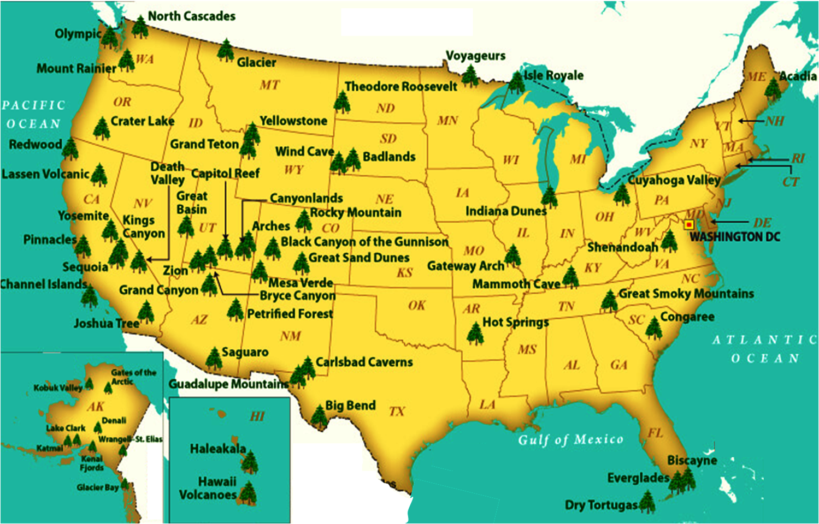
NATIONAL TREASURES
New River
White Sands
IN OUR NATURAL WONDERS

Slide 2
WEEK 6 PLATEAU SUMMARY & FUTURE
1 – PARKS OF THE PLATEAU - REVISITED (SBP)
- Geology Revisited
review major take-aways – sedimentary rocks/plateaus/strategraphy/faults
- People Revisited
review featured people in historical context
- Comparisions of Sites/Parks on Plateau
- Size, elevations, geologic/physiographic features, etc
- Facilities
- Activities
- Visitation
- etc
2 - PARKS OF THE PLATEAU - THE FUTURE (R3)
- Threats, Vulnerabilities, Challenges, Opportunities
- Antiquities Act allowing Presidents to create/expand/contract Nat'l sites
example - Esclante NP (Obama-Trump-Biden)
- Oil/gas exploration?
https://en.wikipedia.org/wiki/Canyons_of_the_Ancients_National_Monument
- Climate Change - weather, water, etc
- Colorado River --
excellent video of raindrop on Co river
https://www.goodnewsnetwork.org/watch-the-path-of-a-raindrop-from-anywhere-in-the-world/
- Human Actions (industries, tourism, etc)
- Possible future limits to Park access
- Possible New Parks/Monuments
3 – WHAT’S AHEAD --- the 2nd course in the trilogy (R3)

Slide 3
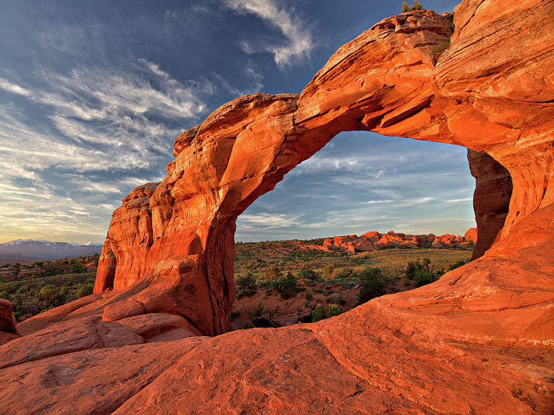
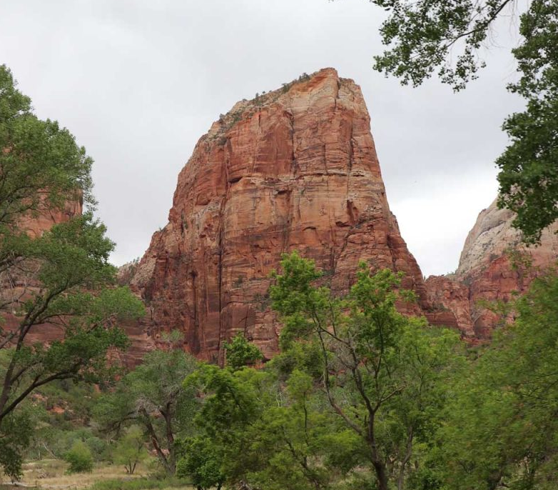
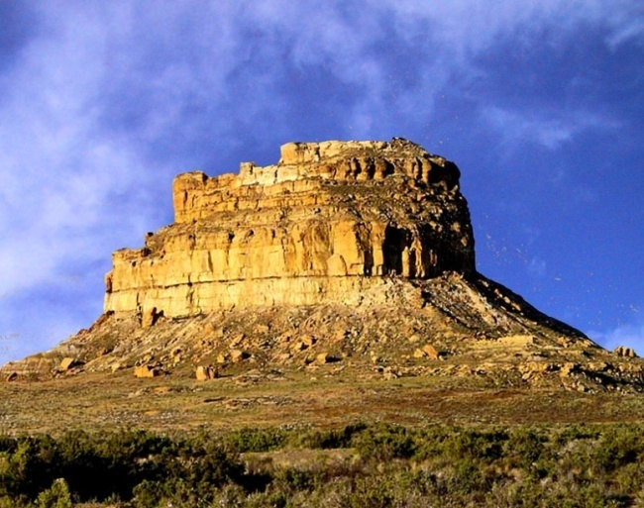
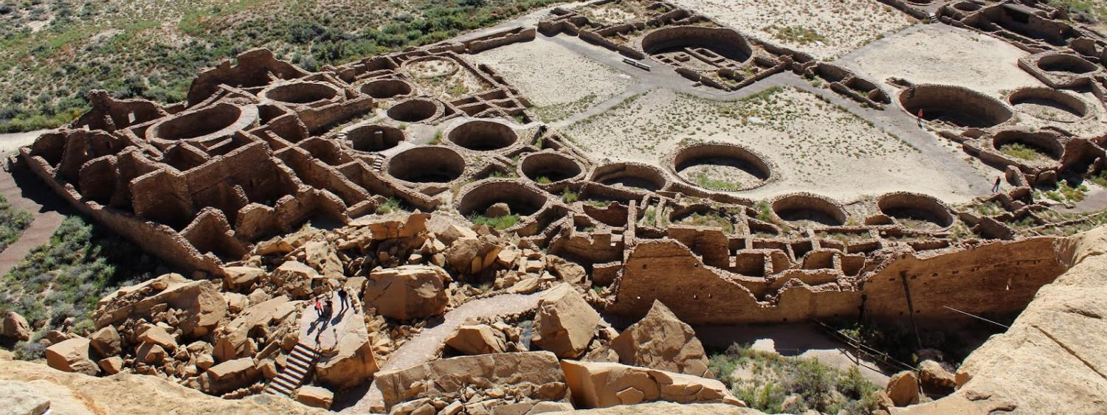
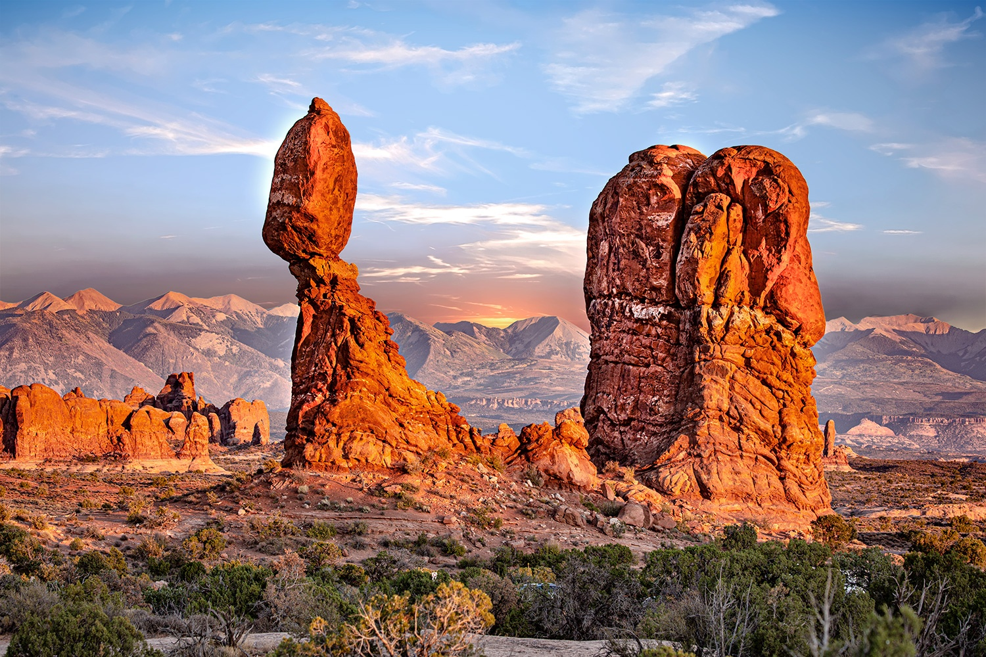
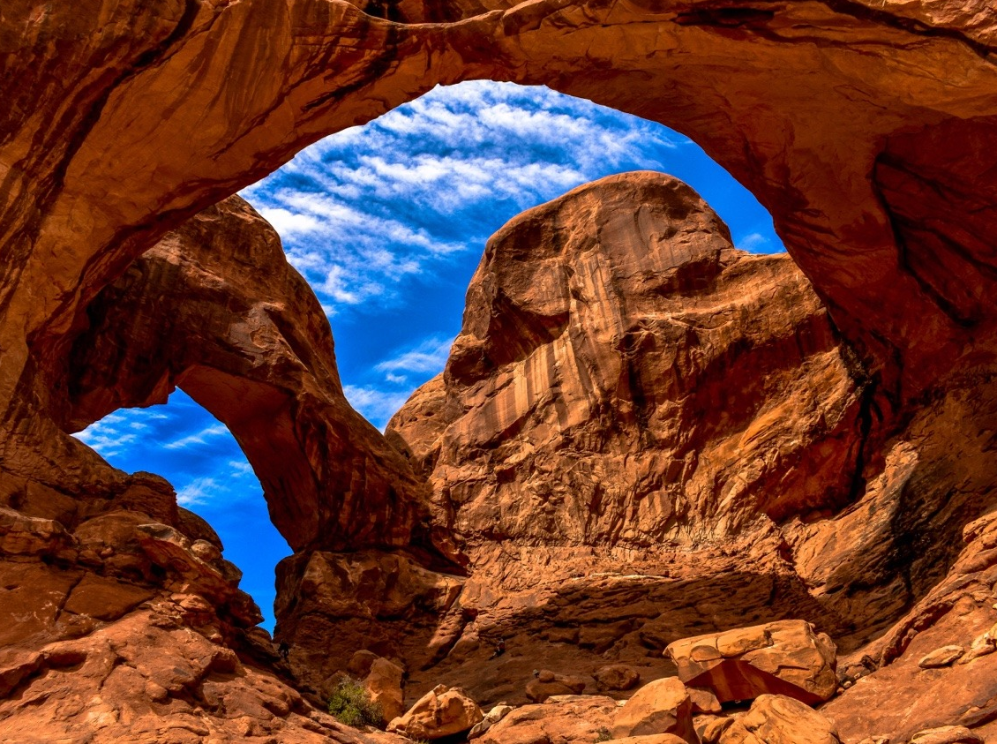
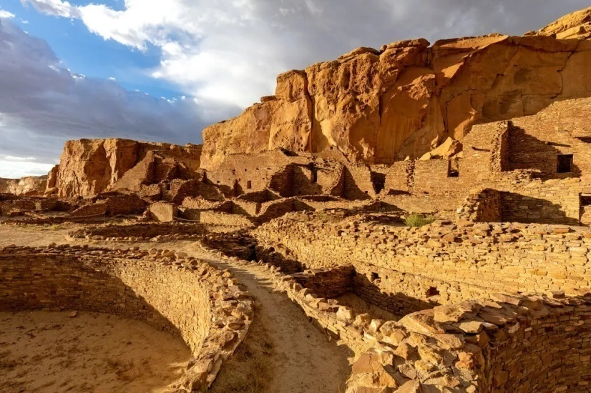
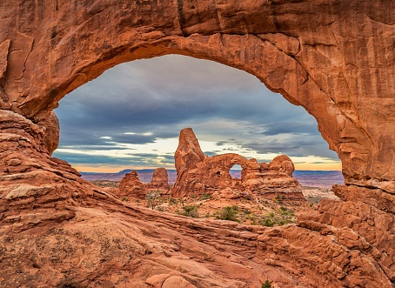
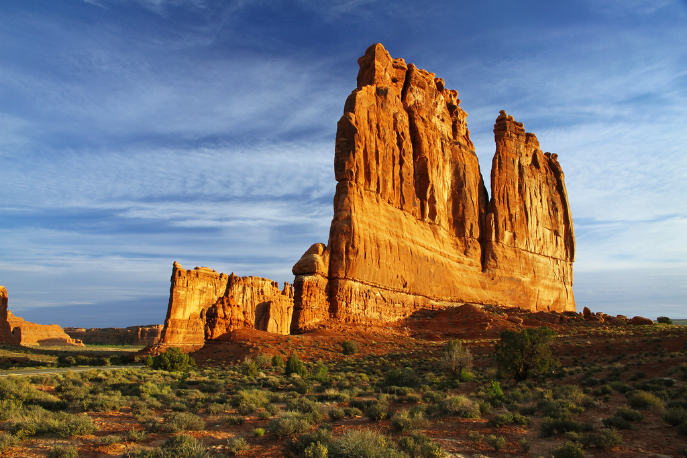
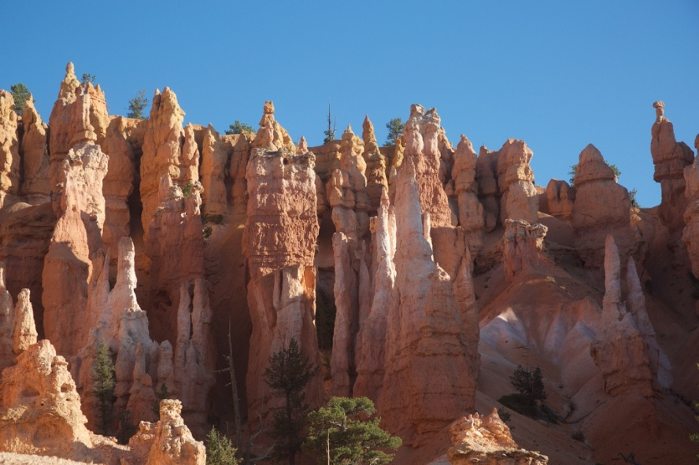
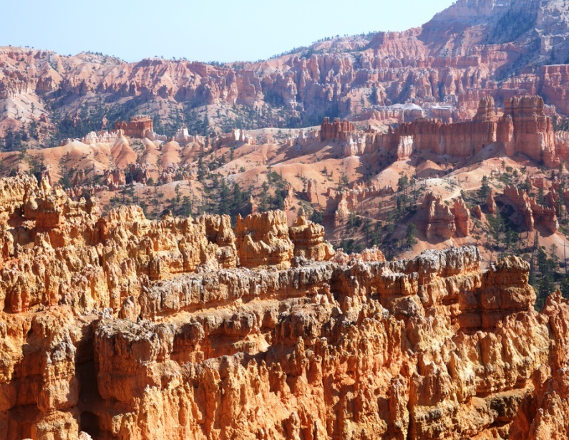
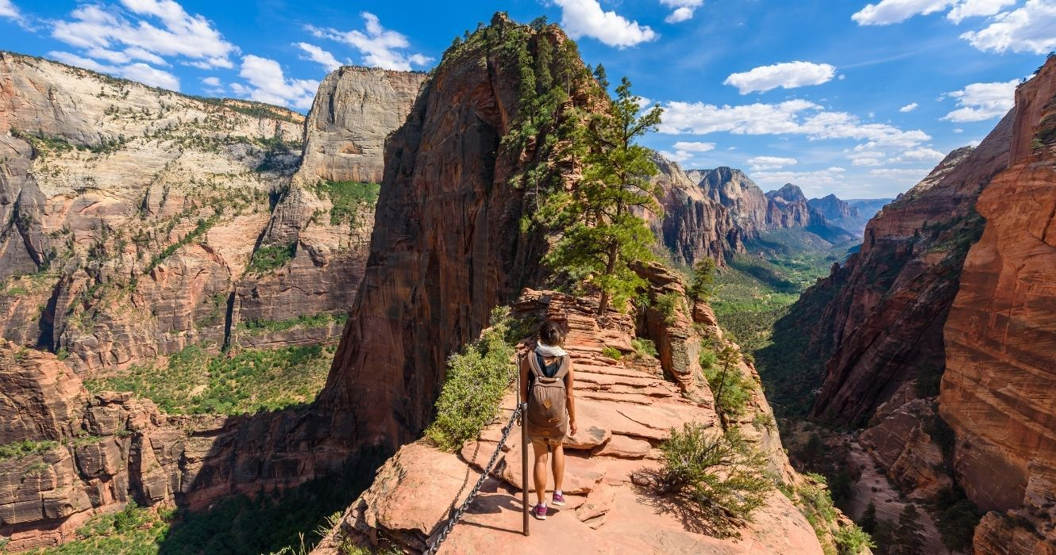
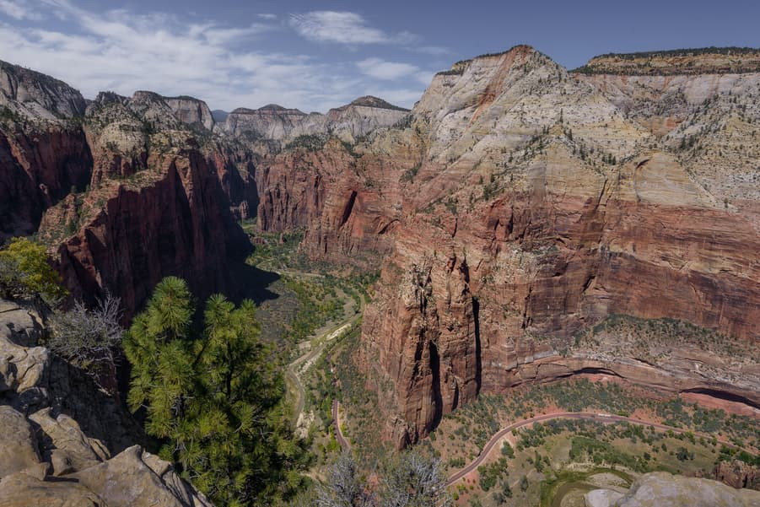
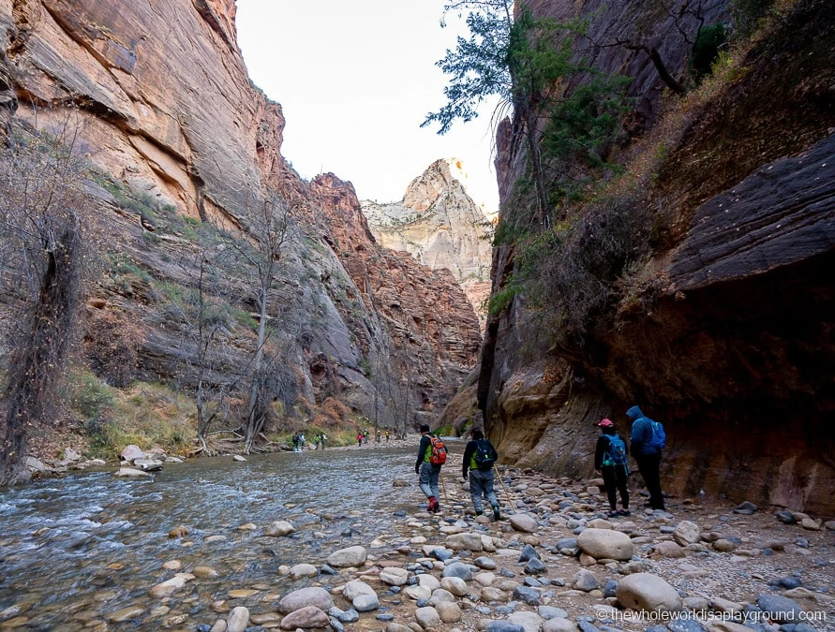
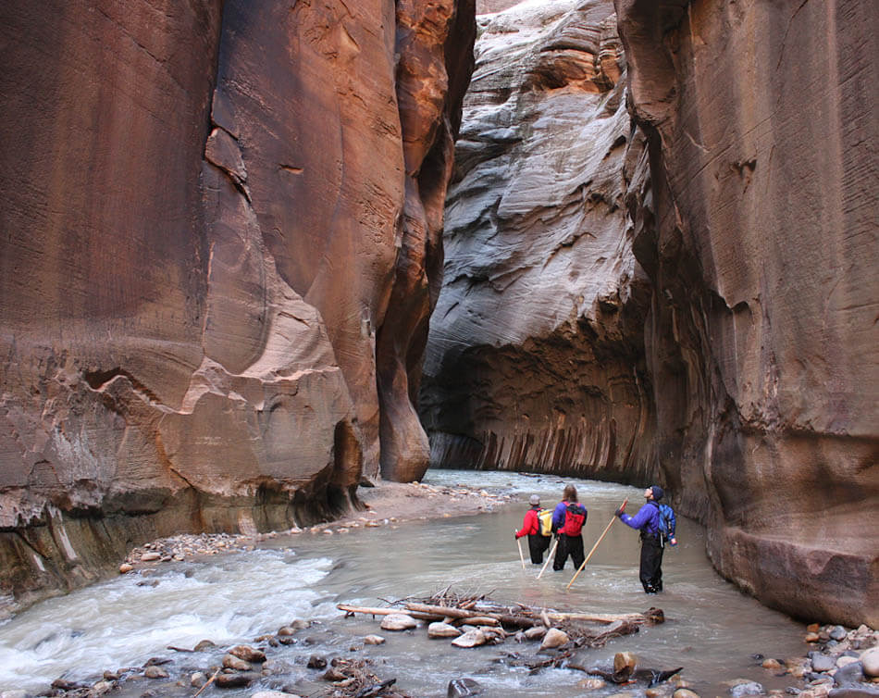
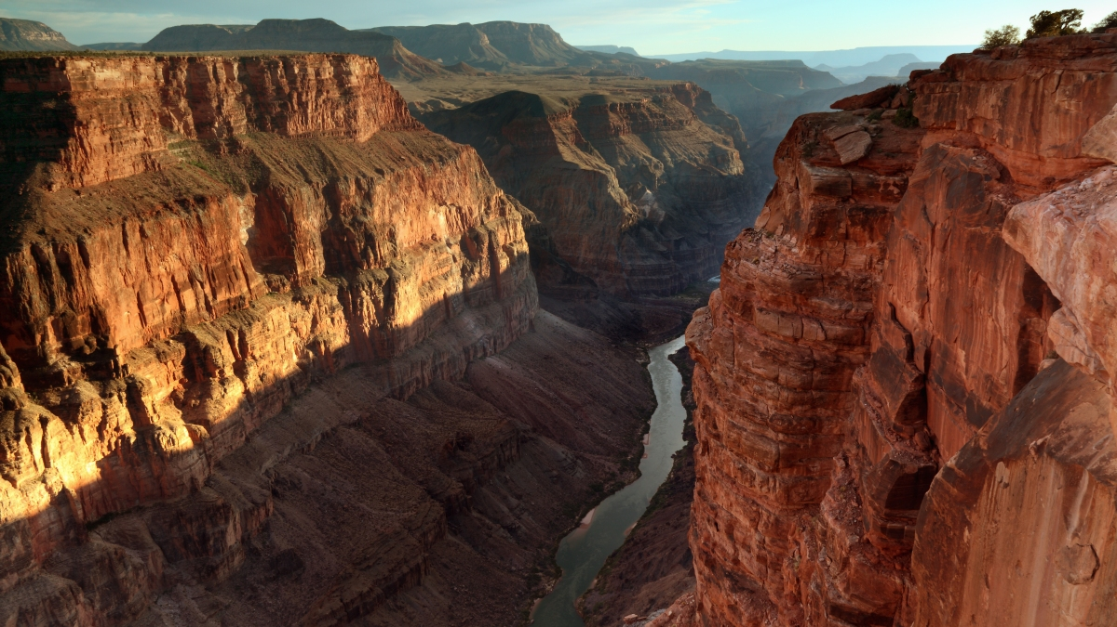
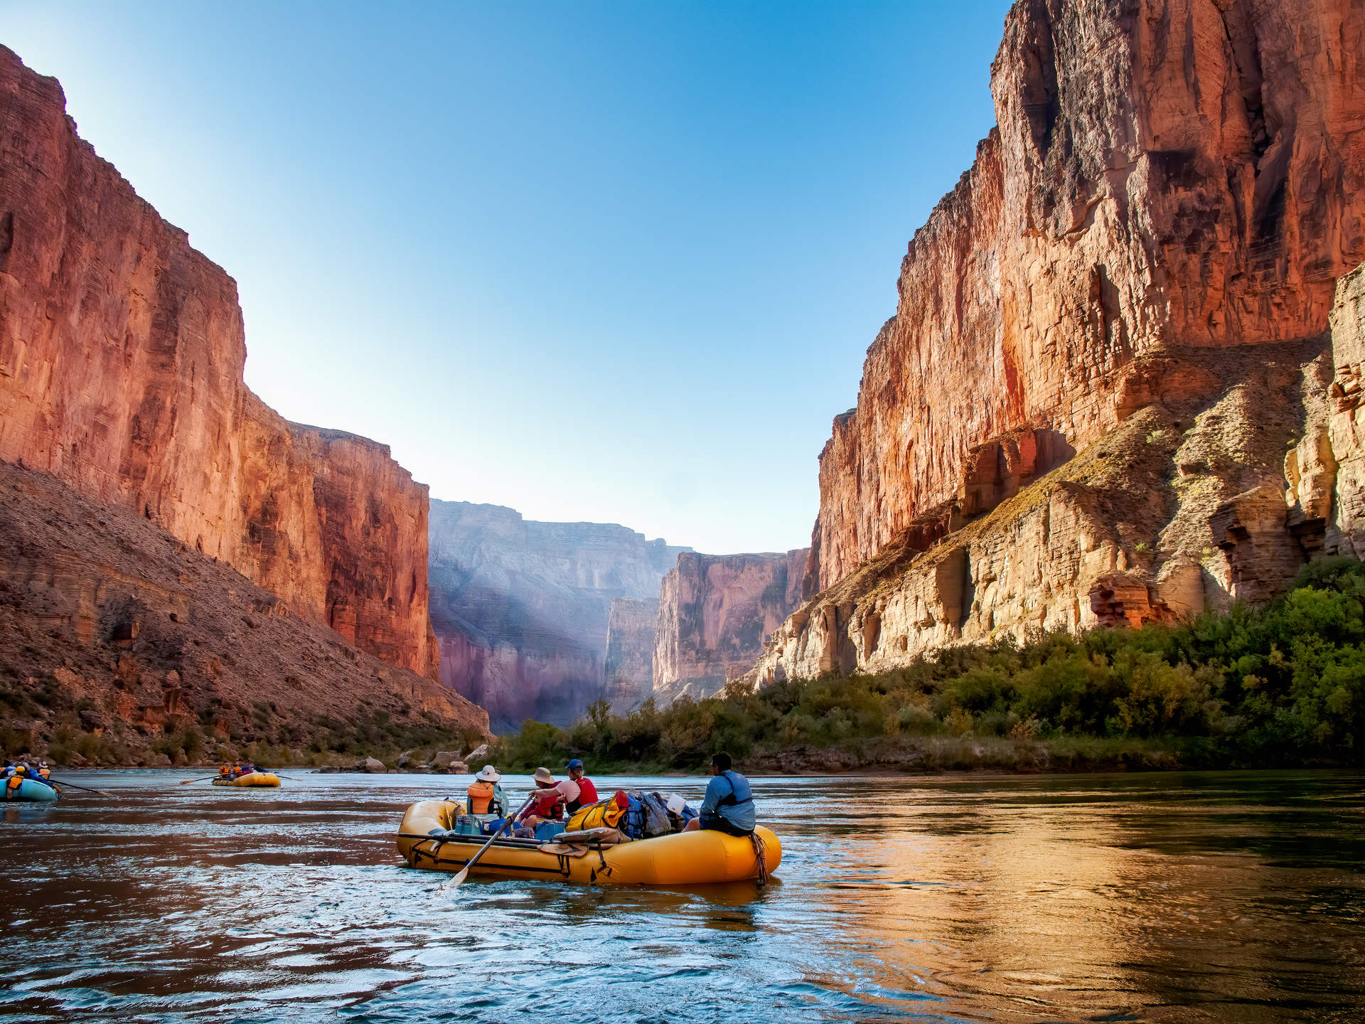
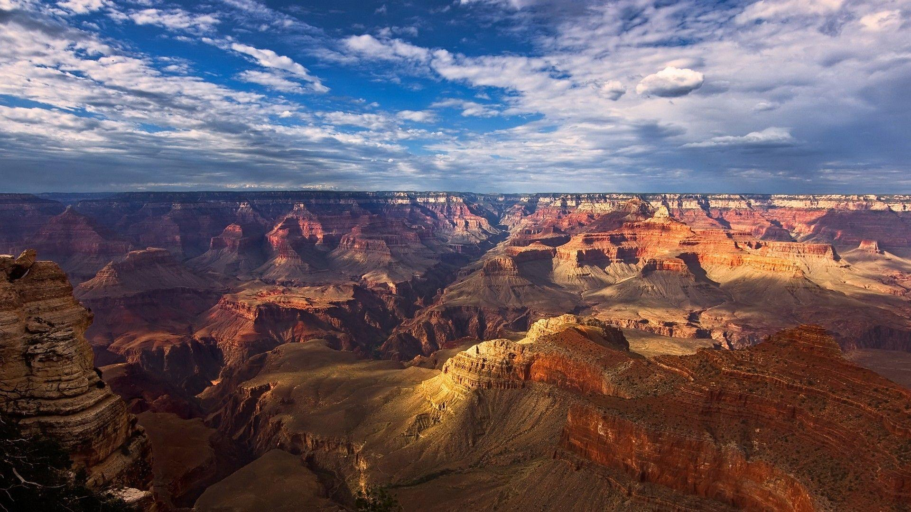
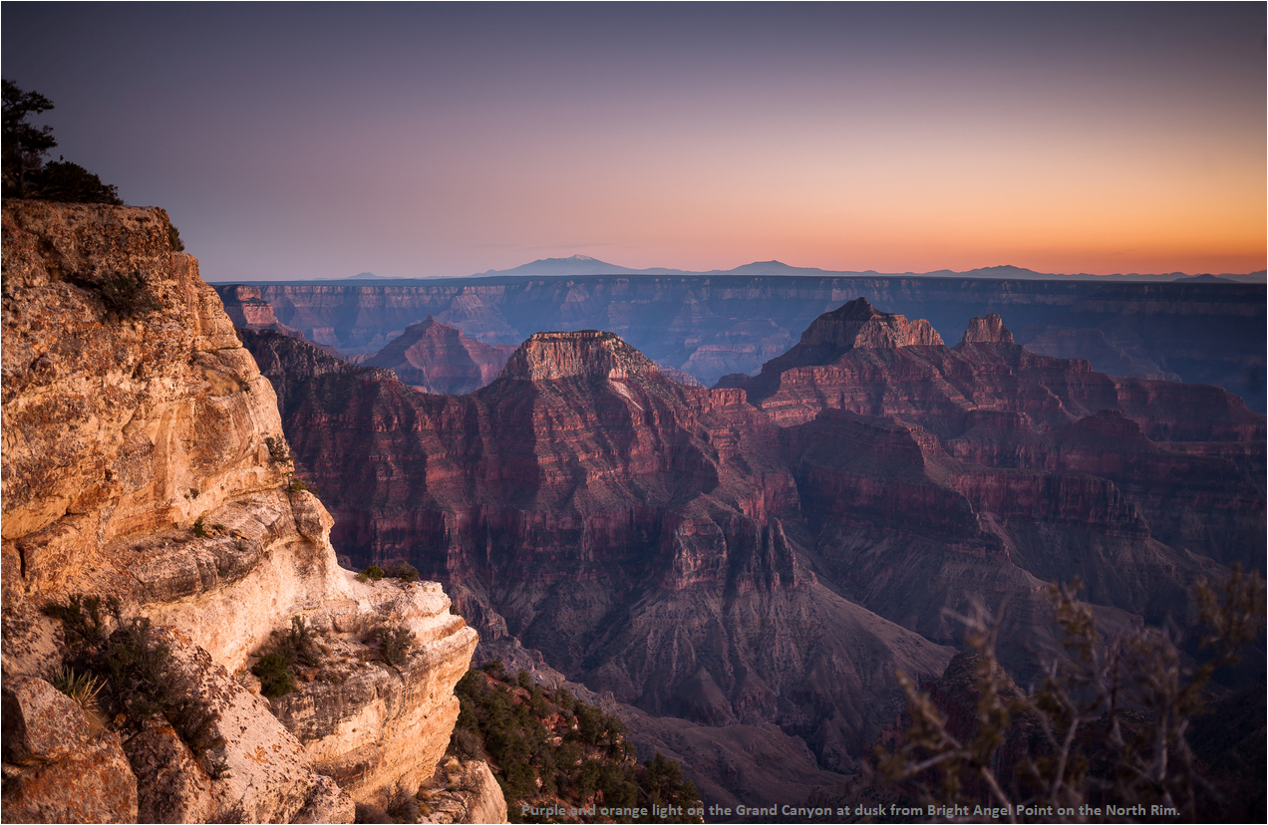
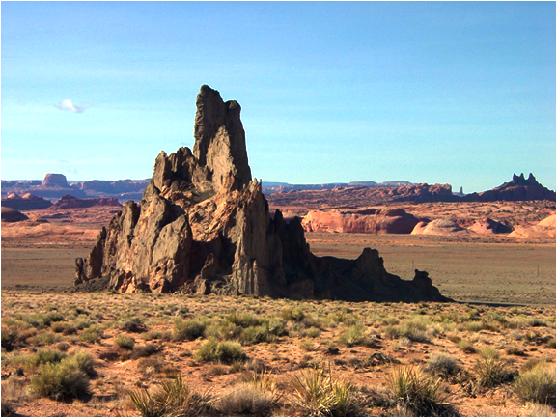
The Colorado Plateau
NATIONAL TREASURES
New River
White Sands
IN OUR NATURAL WONDERS

Slide 4
The Colorado Plateau
Week 6 – Future of the Plateau
Week 1 – Setting the Stage
Week 2 – Escalante & 3 Archeologic Sites
Week 3 – Canyonlands, Arches
Week 4 – Bryce Canyon
& Zion
Week 5 – Grand Canyon
Week 6 – Future of the Plateau
New River
White Sands
Week 6 – Future of the Plateau

Slide 5
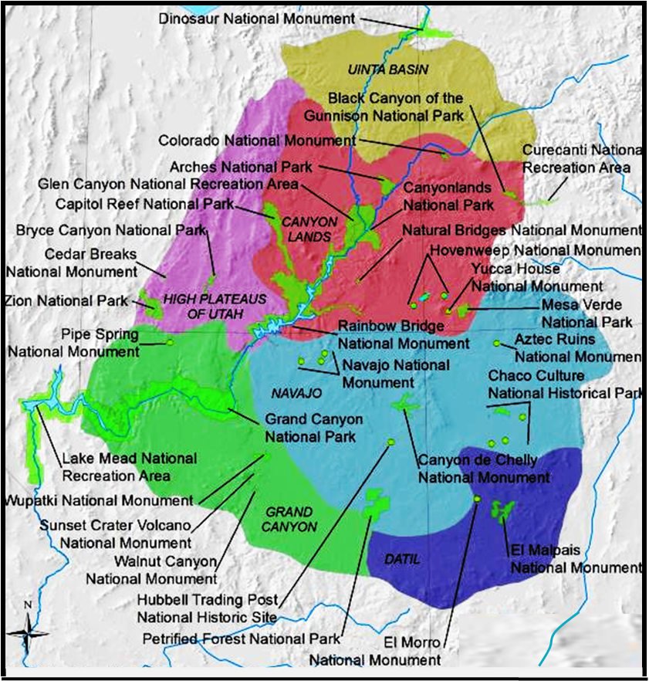
The Plateau: Putting it All Together
Week 6 – Future of the Plateau
- The Plateau: Putting It All together
The Plateau: Putting It All Together
The Plateau: the Future
What’s Ahead Next Year?

Slide 6
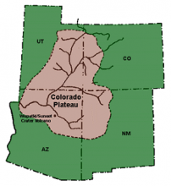
https://ehillerman.unm.edu/node/3050#sthash.MiqpgxNP.dpbs
Colorado Plateau, Arizona, Colorado, New Mexico and Utah
A physiographic province that stretches across 130,000 square
miles in the Four Corners Region of the American Southwest. The
topographic features of this plateau include: high mountain ranges,
deep canyons, river valleys, high plateaus, mesas, deserts, basins, and
buttes. The highest elevation in the Colorado Plateau is the La Sal Mountains in Utah at 12,700 feet, and the lowest elevation is the Grand Canyon in Arizona at 2,000 feet. This vast difference in elevation means that the ecology of this landform is varied based on altitude and precipitation, from the alpine tundra of the higher elevations to the riparian areas along the Colorado River. This also means that there is variation in the animal communities based on changes in elevation and vegetation.
This landscape encompasses portions of two prehistoric cultural areas: the Great Basin and the American Southwest. This area has been continuously occupied since Paleoindian times, with the Clovis culture hunting game as far back as 10,000 B.C. Some of the most well-known structures of the Colorado Plateau are the cliff dwellings found in Mesa Verde, in southwestern Colorado. Around 1150 to 1200 B.C. Ancestral Puebloans began occupying these large alcoves, building stunning dwellings with hundreds of rooms. Around late A.D. 1200 through A.D. 1300 there was a massive migration from the Colorado Plateau south towards the Hopi, Zuni, and the Rio Grande Valleys. It is generally believed that an environmental catastrophe and subsequent collapse of societal organization caused this huge migration. Today, about one third of the Colorado Plateau is Native American reservation land designated to 31 tribes. The tribes that currently occupy the plateau include: Ute Mountain Ute, Southern Ute, various Pueblo groups, Yavapai, Paiute, Apache, Havasupai, and others.

Slide 7
the geology
The Plateau: Putting It All Together
the geology
the geology
the people
the parks

Slide 8
the geology
Geologic
Province
Physiographic
Sections
COLORADO
UNITA BASIN
SECTION
UTAH
lowest structural
area of basin
HIGH
PLATEAU
CANYONLANDS
SECTION
north-trending
plateaus, separated
by faults
deep canyons,
Monoclines,
laccoliths
NAVAJO SECTION
GRAND
CANYON
SECTION
scarped
plateaus
deep canyon
bisecting block
plateaus
DATIL
SECTION
largely volcanic
in origin
ARIZONA
NEW MEXICO

Slide 9
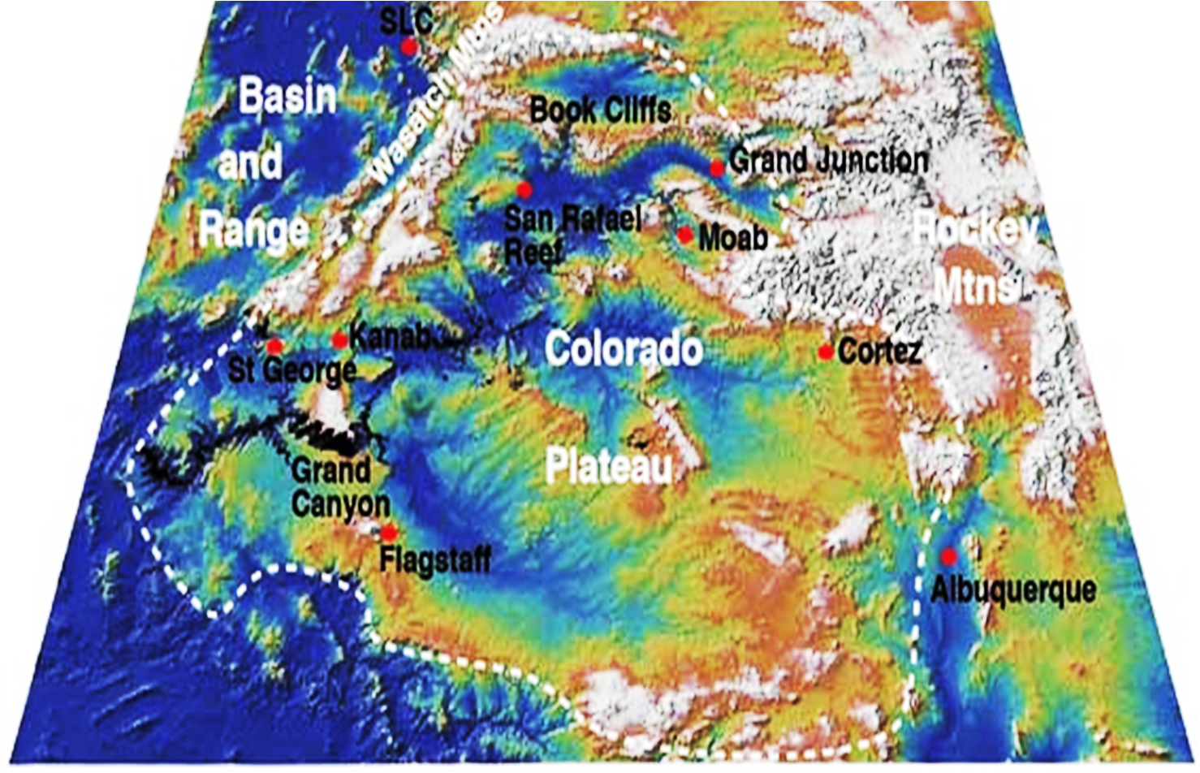
the geology
Geologic
Province
Basin & Range
Rocky
Mnts
Colorado
Plateau

Slide 10
the geology
Geologic
Province
The Colorado Plateau:
a series of plateaus
separated by north-south
trending faults
New River
White Sands

Slide 11
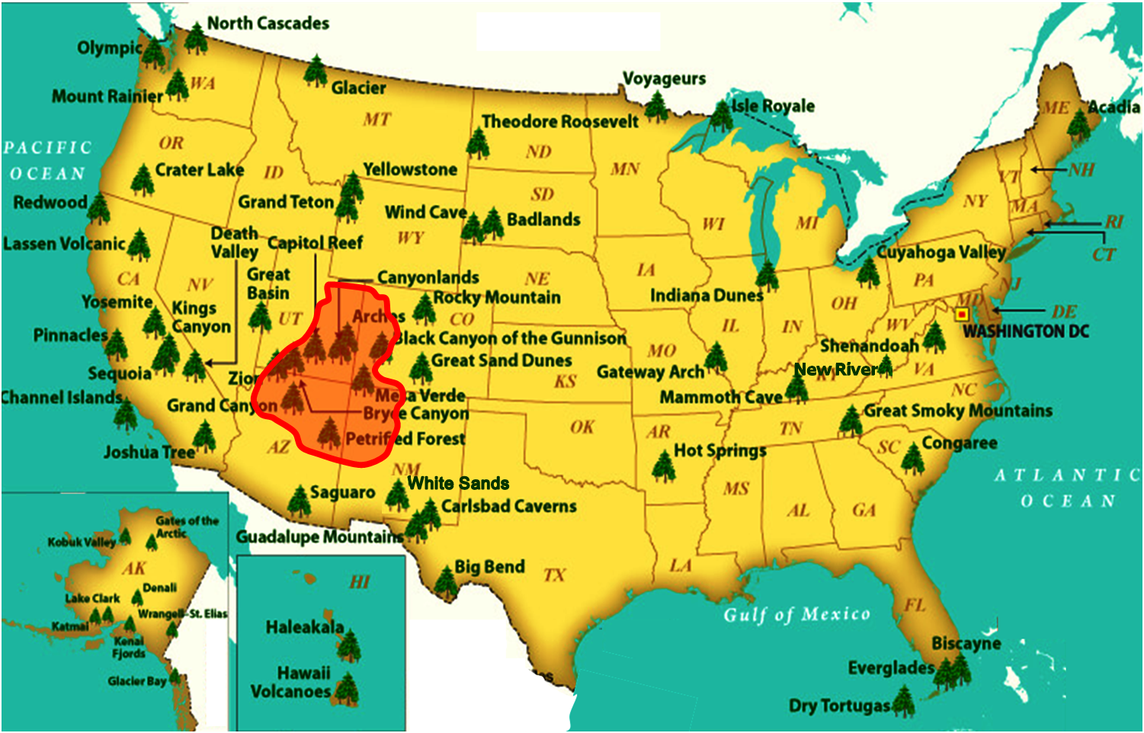
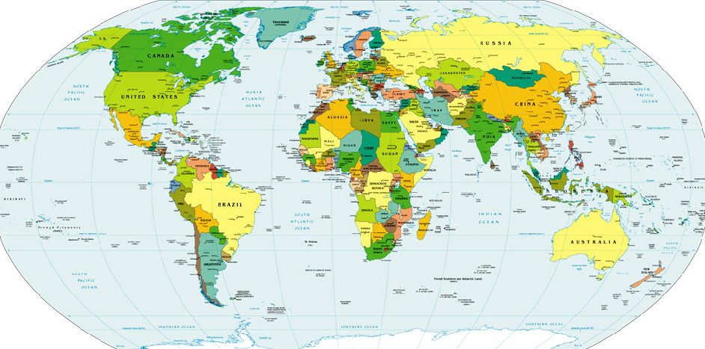
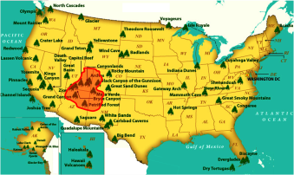
the geology

Slide 12
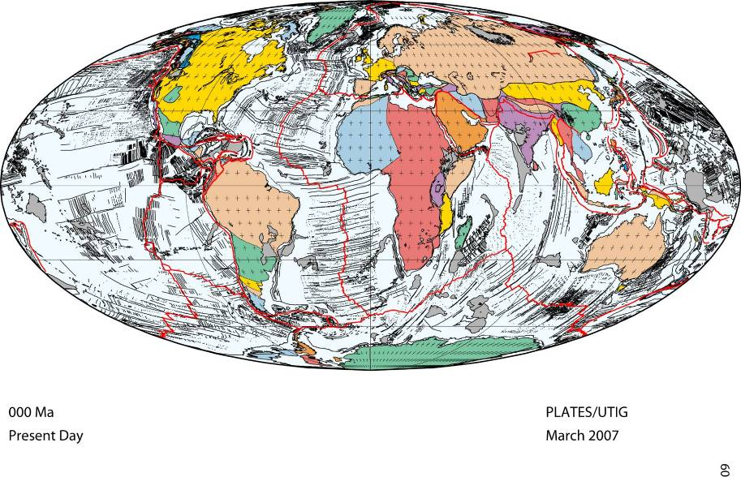
the geology
Colorado Plateau

Slide 13
focus on the land masses . . .
North
America
Eurasia
Africa
South
America
Aus
Antarctica
Colorado Plateau

Slide 14
focus on the land masses . . .
North
America
Eurasia
Africa
South
America
Aus
Antarctica
000 Ma
present
. . . focus on the tectonic plates

Slide 15
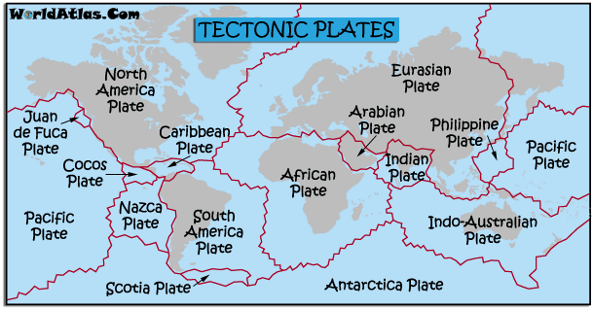
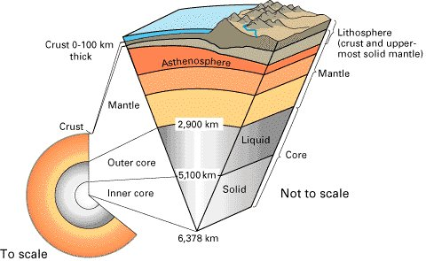
3-D Schematic View of the Earth
000 Ma
present
. . . focus on the tectonic plates
What are these tectonic plates?

Slide 16
3-D Schematic View of the Earth
000 Ma
present
. . . focus on the tectonic plates
What are these tectonic plates?

Slide 17
3-D Schematic View of the Earth
Ocean
Continental Crust
Oceanic Crust
crust
mantle
outer core
tectonic
plates
inner core
Notes:
Thickness of crust: oceanic – 4 miles, continental 25 miles https://en.wikipedia.org/wiki/Mantle_(geology)
The interior of Earth, similar to the other terrestrial planets, is chemically divided into layers.
The inner core is solid, the outer core is liquid, and the mantle solid/plastic. This is because of the relative melting points of the different layers (nickel–iron core, silicate crust and mantle) and the increase in temperature and pressure as depth increases. At the surface both nickel–iron alloys and silicates are sufficiently cool to be solid. In the upper mantle, the silicates are generally solid (localised regions with small amounts of melt exist); however, as the upper mantle is both hot and under relatively little pressure, the rock in the upper mantle has a relatively low viscosity. In contrast, the lower mantle is under tremendous pressure and therefore has a higher viscosity than the upper mantle. The metallic nickel–iron outer core is liquid because of the high temperature, despite the high pressure. As the pressure increases, the nickel–iron inner core becomes solid because the melting point of iron increases dramatically at these high pressures.

Slide 18
3-D Schematic View of the Earth
Heat convection cells are in the Mantle.
Heat
convection
occurs here
radio-active
heat
generated
here
mantle
Notes:
https://en.wikipedia.org/wiki/Mantle_(geology)
The interior of Earth, similar to the other terrestrial planets, is chemically divided into layers. The mantle is a layer between the crust and the outer core. Earth's mantle is a silicate rocky shell with an average thickness of 2,886 kilometres (1,793 mi).^{[13]} The mantle makes up about 84% of Earth's volume.^{[14]} It is predominantly solid but in geological time it behaves as a very viscous fluid. The mantle encloses the hot core rich in iron and nickel, which makes up about 15% of Earth's volume.^{[14]} Past episodes of melting and volcanism at the shallower levels of the mantle have produced a thin crust of crystallized melt products near the surface, upon which we live.^{[15]}Information about structure and composition of the mantle either result from geophysical investigation or from direct geoscientific analyses on Earth mantle derived xenoliths and on mantle exposed by mid-oceanic ridge spreading.
Two main zones are distinguished in the upper mantle: the inner asthenosphere composed of plastic flowing rock of varying thickness, on average about 200 km (120 mi) thick,^{[16]} and the lowermost part of the lithosphere composed of rigid rock about 50 to 120 km (31 to 75 mi) thick.^{[17]} A thin crust, the upper part of the lithosphere, surrounds the mantle and is about 5 to 75 km (3.1 to 46.6 mi) thick.^{[18]}Recent analysis of hydrous ringwoodite from the mantle suggests that there is between one^{[19]} and three^{[20]} times as much water in thetransition zone between the lower and upper mantle than in all the world's oceans combined.
In some places under the ocean the mantle is actually exposed on the surface of Earth.^{[21]} There are also a few places on land where mantle rock has been pushed to the surface by tectonic activity, most notably the Tablelands region of Gros Morne National Park in theCanadian province of Newfoundland and Labrador and St. John's Island, Egypt or Zabargad in the Red Sea.
The mantle is divided into sections which are based upon results from seismology. These layers (and their thicknesses/depths) are the following: the upper mantle (starting at the Moho, or base of the crust around 7 to 35 km (4.3 to 21.7 mi) downward to 410 km (250 mi)),^{[22]} the transition zone (410–660 km or 250–410 mi), the lower mantle (660–2,891 km or 410–1,796 mi), and anomalous core–mantle boundary with a variable thickness (on average ~200 km (120 mi) thick).^{[15][23][24][25]}
The top of the mantle is defined by a sudden increase in seismic velocity, which was first noted by Andrija Mohorovičić in 1909; this boundary is now referred to as the Mohorovičić discontinuity or "Moho".^{[23][26]} The uppermost mantle plus overlying crust are relatively rigid and form the lithosphere, an irregular layer with a maximum thickness of perhaps 200 km (120 mi). Below the lithosphere the upper mantle becomes notably more plastic. In some regions below the lithosphere, the seismic shear velocity is reduced; this so-called low-velocity zone (LVZ) extends down to a depth of several hundred km. Inge Lehmann discovered a seismic discontinuity at about 220 km (140 mi) depth;^{[27]} although this discontinuity has been found in other studies, it is not known whether the discontinuity is ubiquitous. The transition zone is an area of great complexity; it physically separates the upper and lower mantle.^{[25]} Very little is known about the lower mantle apart from that it appears to be relatively seismically homogeneous. The D" layer at the core–mantle boundary separates the mantle from the core.
The mantle differs substantially from the crust in its mechanical properties which is the direct consequence of chemical composition change (expressed as different mineralogy). The distinction between crust and mantle is based on chemistry, rock types, rheology andseismic characteristics. The crust is a solidification product of mantle derived melts, expressed as various degrees of partial melting products during geologic time. Partial melting of mantle material is believed to cause incompatible elements to separate from the mantle, with less dense material floating upward through pore spaces, cracks, or fissures, that would subsequently cool and solidify at the surface. Typical mantle rocks have a higher magnesium to iron ratio and a smaller proportion of silicon and aluminium than the crust. This behavior is also predicted by experiments that partly melt rocks thought to be representative of Earth's mantle.
In the mantle, temperatures range between 500 to 900 °C (932 to 1,652 °F) at the upper boundary with the crust; to over 4,000 °C (7,230 °F) at the boundary with the core.^{[32]} Although the higher temperatures far exceed the melting points of the mantle rocks at the surface (about 1200 °C for representative peridotite), the mantle is almost exclusively solid.^{[32]} The enormous lithostatic pressure exerted on the mantle prevents melting, because the temperature at which melting begins (the solidus) increases with pressure.
Because of the temperature difference between the Earth's surface and outer core and the ability of the crystalline rocks at high pressure and temperature to undergo slow, creeping, viscous-like deformation over millions of years, there is a convective material circulation in the mantle.^{[23]} Hot material upwells, while cooler (and heavier) material sinks downward. Downward motion of material occurs at convergent plate boundaries called subduction zones. Locations on the surface that lie over plumes are predicted to have high elevation (because of the buoyancy of the hotter, less-dense plume beneath) and to exhibit hot spot volcanism. The volcanism often attributed to deep mantle plumes is alternatively explained by passive extension of the crust, permitting magma to leak to the surface (the "Plate" hypothesis).
The convection of the Earth's mantle is a chaotic process (in the sense of fluid dynamics), which is thought to be an integral part of the motion of plates. Plate motion should not be confused withcontinental drift which applies purely to the movement of the crustal components of the continents. The movements of the lithosphere and the underlying mantle are coupled since descending lithosphere is an essential component of convection in the mantle. The observed continental drift is a complicated relationship between the forces causing oceanic lithosphere to sink and the movements within Earth's mantle.

Slide 19
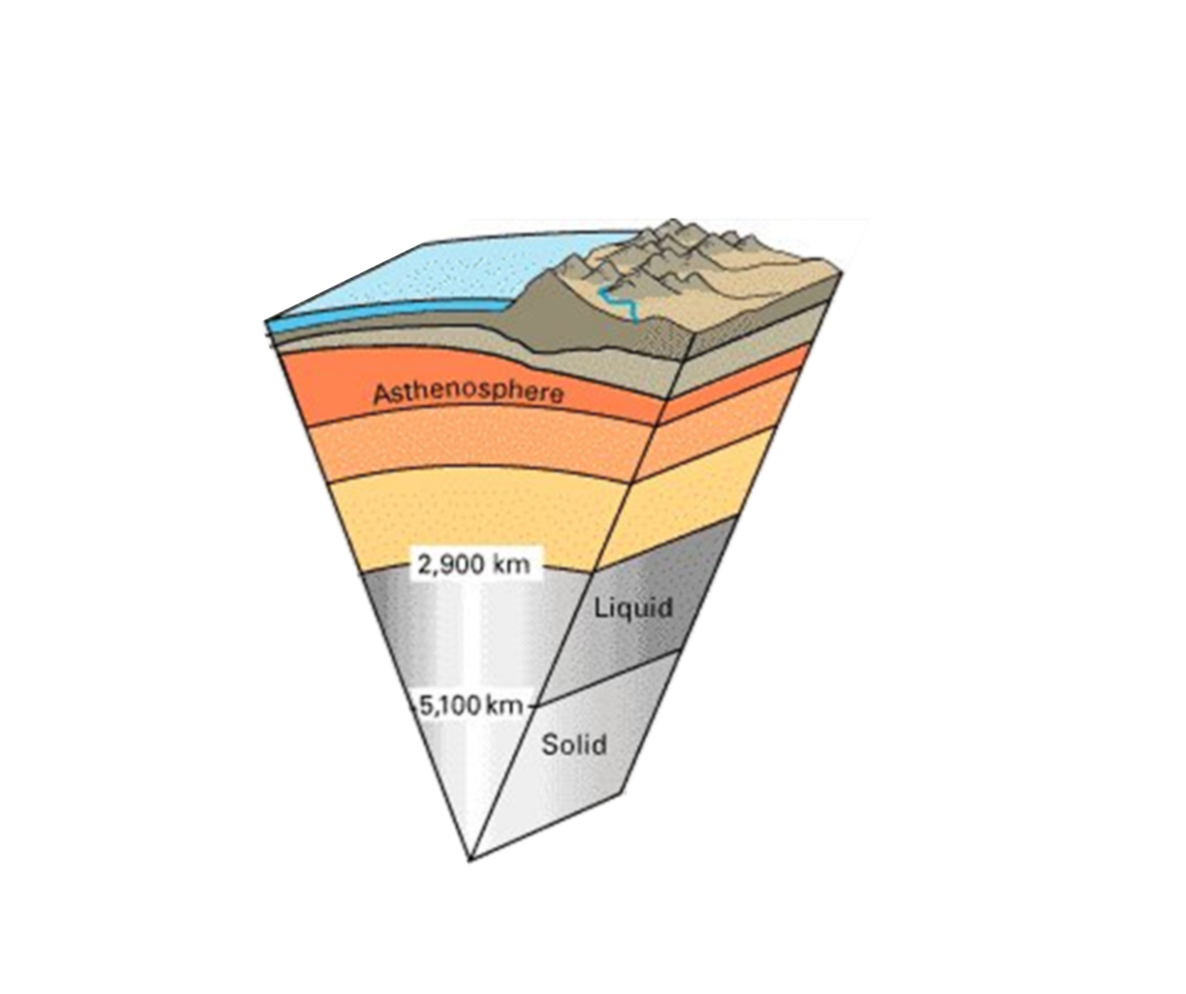
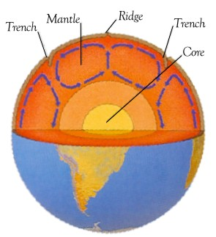
3-D Schematic View of the Earth
Heat convection cells are in the Mantle.
Mantle
convection
occurs here
radio-active
heat
generated
here
mantle

Slide 20
Heat convection cells are in the Mantle.
Convection cells move the crustal plates.
Mantle
COOLED
COOLED
HEATED
What happens when convection cells
are below Oceanic crust?

Slide 21
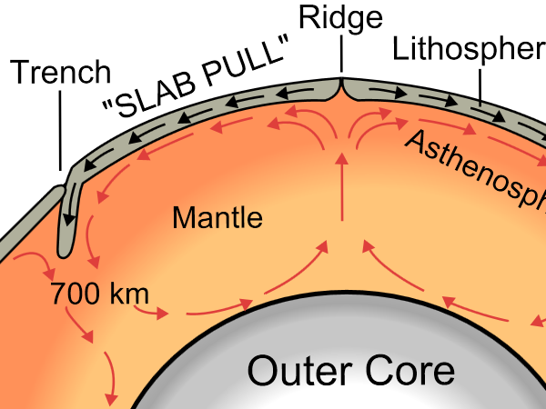
heat convection cells are in the Mantle
convection cells move the crustal plates
Mantle
What happens when convection cells
are below Oceanic crust?

Slide 22
Ocean
Oceanic crust
Mantle

Slide 23
new Oceanic crust is constantly formed by molten
rock extruded in deep oceans along oceanic ridges
new Oceanic crust is formed
Mantle
old Oceanic crust is destroyed (melted)
Notes:
https://en.wikipedia.org/wiki/Mid-Atlantic_Ridge
The Mid-Atlantic Ridge (MAR) is a mid-ocean ridge, a divergent tectonic plate or constructive plate boundary located along the floor of the Atlantic Ocean, and part of the longest mountain range in the world. In the North Atlantic, it separates the Eurasian and North American Plates, whereas in the South Atlantic it separates the African and South American Plates. The Ridge extends from a junction with the Gakkel Ridge (Mid-Arctic Ridge) northeast of Greenland southward to the Bouvet Triple Junction in the South Atlantic. The ridge sits atop a geologic feature known as the Mid-Atlantic Rise, which is a progressive bulge that runs the length of the Atlantic Ocean, with the ridge resting on the highest point of this linear bulge. This bulge is thought to be caused by upward convective forces in the asthenospherepushing the oceanic crust and lithosphere.
https://en.wikipedia.org/wiki/Mariana_Trench
The Mariana Trench is part of the Izu-Bonin-Mariana subduction system that forms the boundary between two tectonic plates. In this system, the western edge of one plate, the Pacific Plate, is subducted (i.e., thrust) beneath the smaller Mariana Plate that lies to the west. Crustal material at the western edge of the Pacific Plate is some of the oldest oceanic crust on earth (up to 170 million years old), and is therefore cooler and more dense; hence its great height difference relative to the higher-riding (and younger) Mariana Plate. The deepest area at the plate boundary is the Mariana Trench proper.

Slide 24
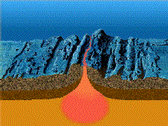
new Oceanic crust is constantly formed by molten
rock extruded in deep oceans along oceanic ridges
DEEP OCEAN
Mantle
What happens when mantle convection
cells are below Continental crust?

Slide 25
Continental Crust
Mantle
heat convection UPLIFTS crust
crust begins to RIFT (pull apart)

Slide 26
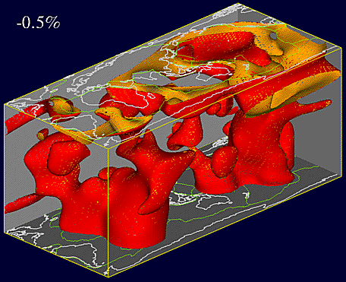
Mantal convection cells have complex shapes
Mantle
heat convection UPLIFTS crust
crust begins to RIFT (pull apart)

Slide 27
Mantle Convection Cells have complex shapes
Crust
Mantle
Convection Cells

Slide 28
This convection causes tectonic plates to move
South
America
Mantle
heat convection UPLIFTS crust
crust begins to RIFT (pull apart)
000 Ma
present
. . . focus on the tectonic plates

Slide 29
This convection causes tectonic plates to move
going BACKWARD in time . . . .
North
America
location of
Colorado Plateau
000 Ma
present
000 Ma
present
Time clock
Ma = millions of years ago (mya)
Let’s watch the tectonic plates move thru time...

Slide 30
going BACKWARD in time . . . .
000 Ma
present

Slide 31
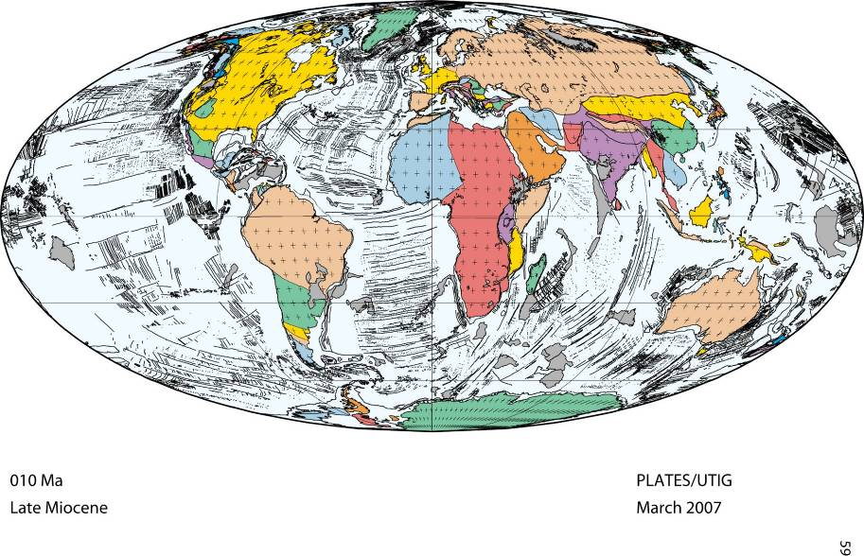
010 Ma

Slide 32
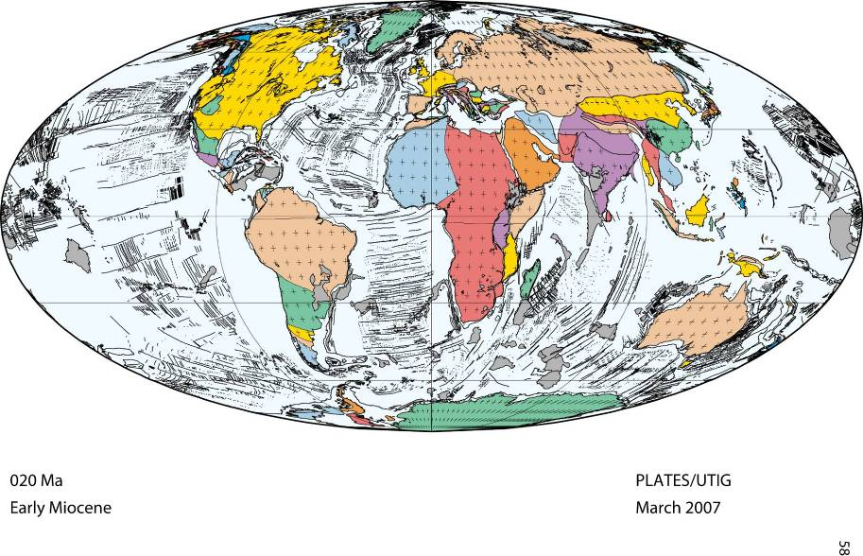
020 Ma

Slide 33
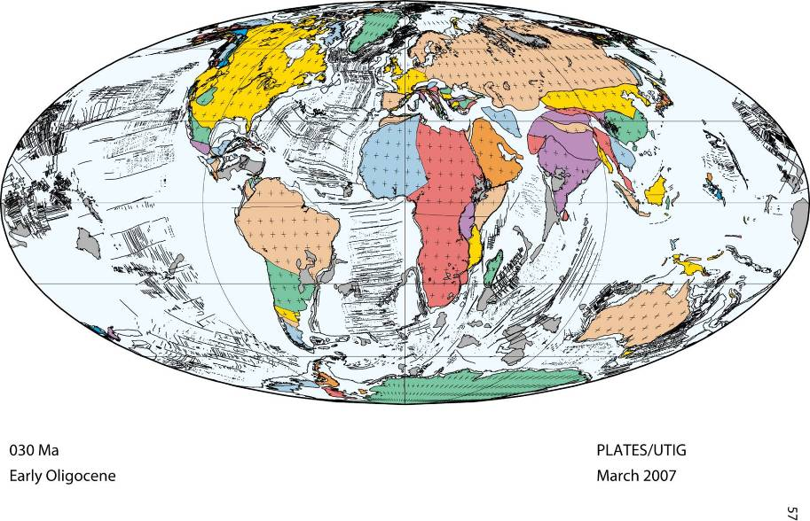
030 Ma

Slide 34
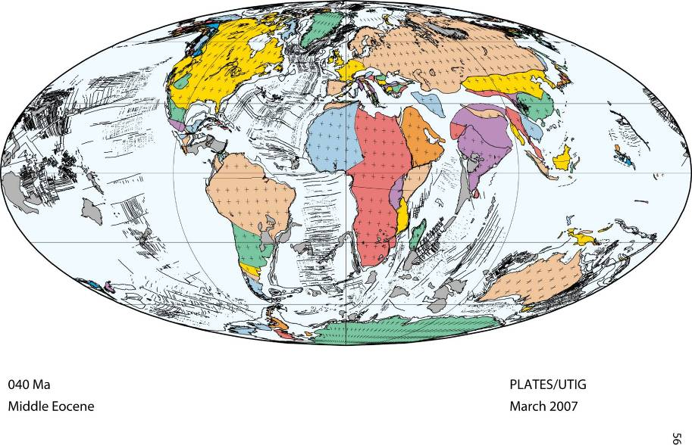
040 Ma

Slide 35
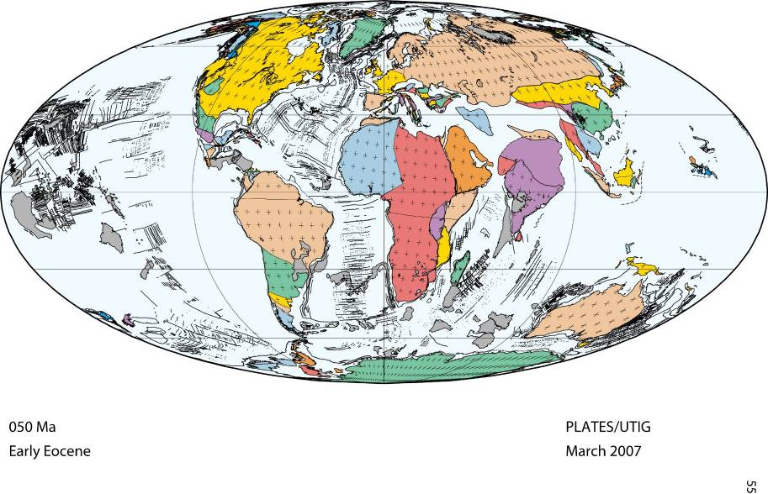
050 Ma

Slide 36
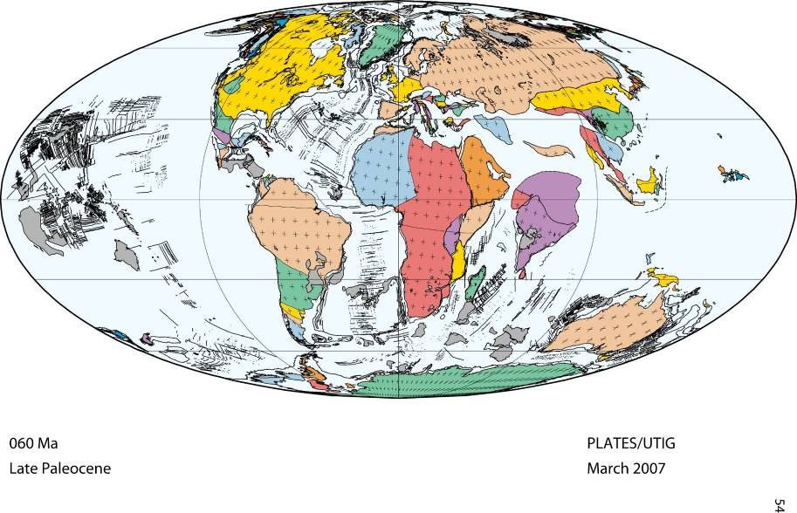
060 Ma

Slide 37
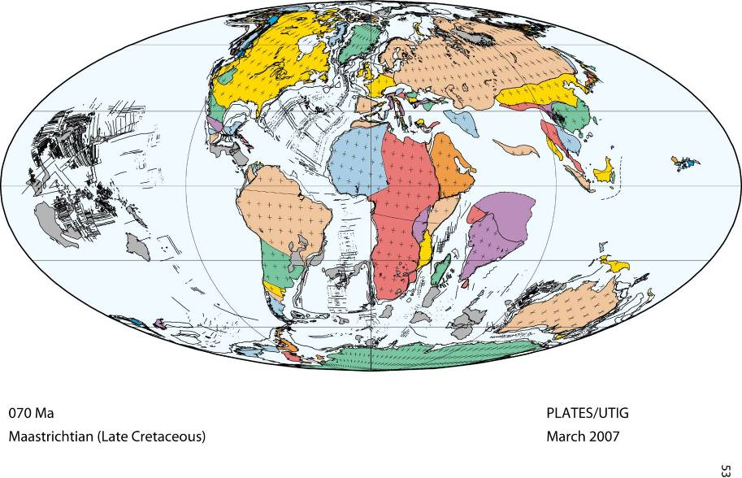
070 Ma

Slide 38
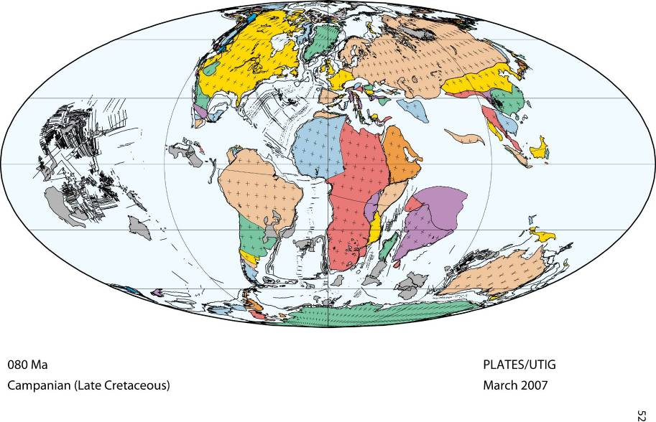
080 Ma

Slide 39
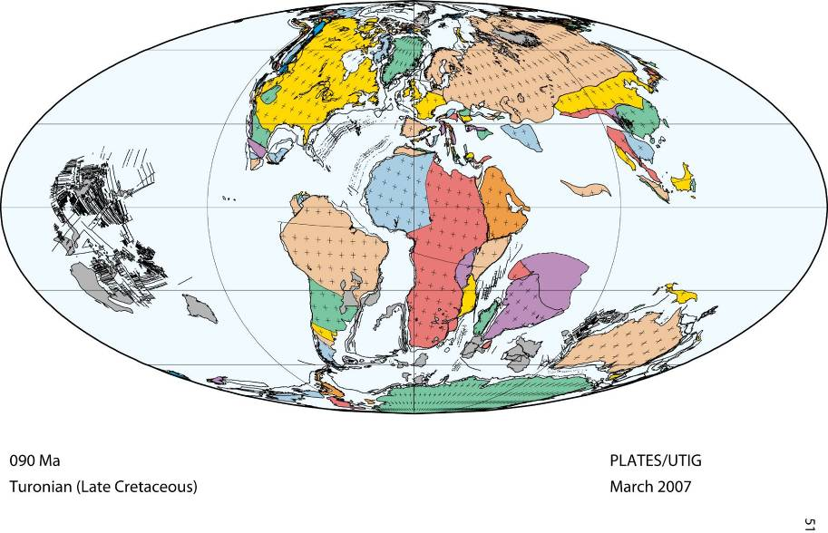
090 Ma

Slide 40
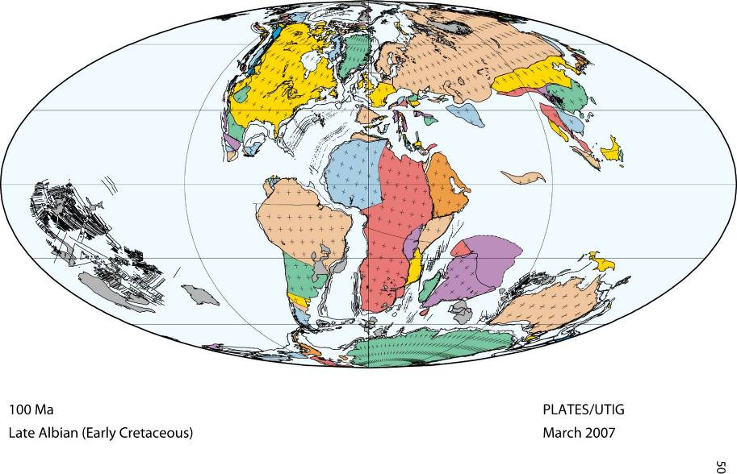
100 Ma

Slide 41
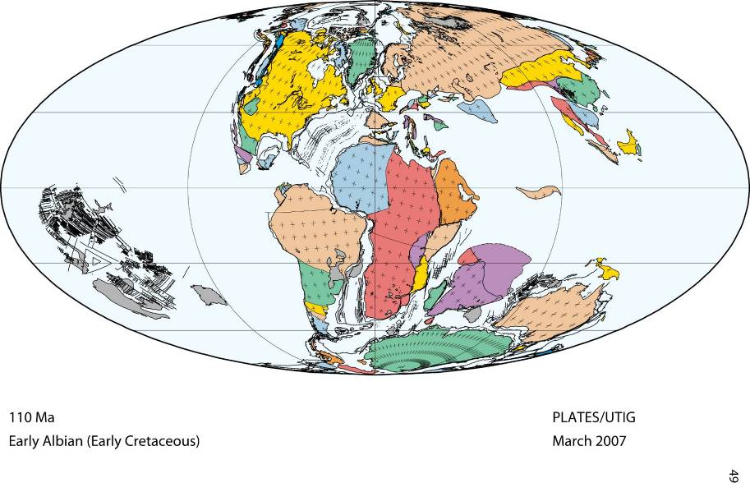
110 Ma

Slide 42
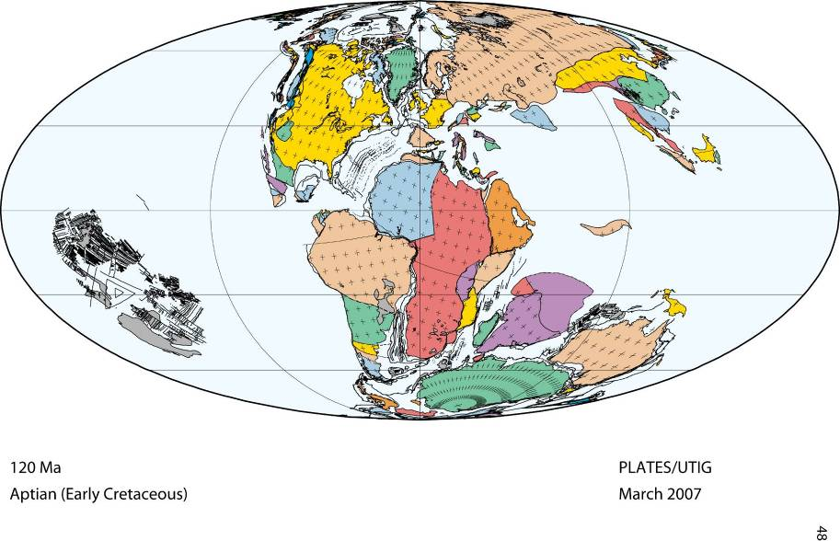
120 Ma

Slide 43
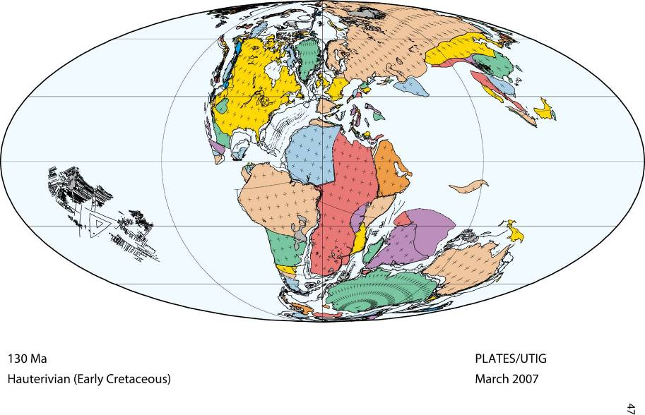
130 Ma

Slide 44
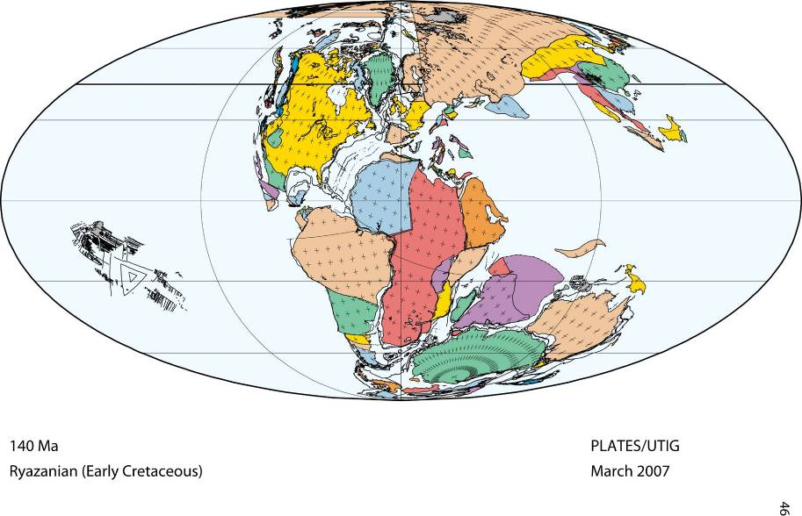
140 Ma

Slide 45
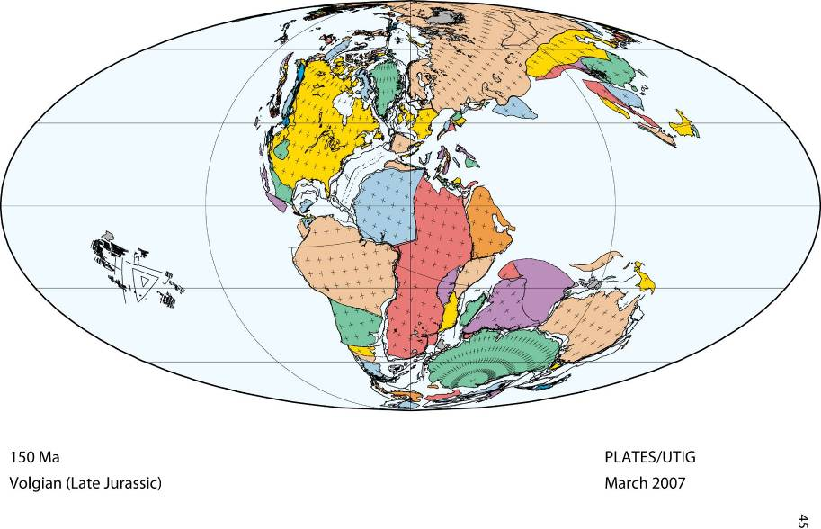
150 Ma

Slide 46
160 Ma

Slide 47
170 Ma

Slide 48
180 Ma

Slide 49
190 Ma

Slide 50
200 Ma

Slide 51
210 Ma

Slide 52
220 Ma

Slide 53
230 Ma

Slide 54
240 Ma

Slide 55
250 Ma

Slide 56
260 Ma

Slide 57
270 Ma

Slide 58
280 Ma

Slide 59
290 Ma

Slide 60
300 Ma

Slide 61
310 Ma

Slide 62
320 Ma

Slide 63
330 Ma

Slide 64
340 Ma

Slide 65
350 Ma

Slide 66
360 Ma

Slide 67
370 Ma

Slide 68
380 Ma

Slide 69
390 Ma

Slide 70
400 Ma

Slide 71
410 Ma

Slide 72
420 Ma

Slide 73
430 Ma

Slide 74
440 Ma

Slide 75
450 Ma

Slide 76
460 Ma

Slide 77
470 Ma

Slide 78
480 Ma

Slide 79
490 Ma

Slide 80
500 Ma

Slide 81
510 Ma

Slide 82
520 Ma

Slide 83
530 Ma

Slide 84
540 Ma

Slide 85
600 Ma

Slide 86
650 Ma

Slide 87
700 Ma

Slide 88
750 Ma

Slide 89
going FORWARD in time . . . .
750 Ma

Slide 90
750 Ma
Notes:
https://en.wikipedia.org/wiki/Rodinia
Rodinia is the name of a hypothetical supercontinent, a continent which contained most or all of Earth's landmass.
According toplate tectonic reconstructions, Rodinia existed between 1.1 billion and 750 million years ago. Rodinia is hypothesized to have broken up in the Neoproterozoic with its continental fragments re-assembled to form Pannotia 600–550 million years ago. In contrast with Pannotia, little is known yet about the exact configuration and geodynamic history of Rodinia.Paleomagnetic evidence provides some clues to the paleolatitude of individual pieces of the Earth's crust, but not to their longitude, which geologists have pieced together by comparing similar geologic features, often now widely dispersed.
The extreme cooling of the global climate around 700 million years ago (the so-called Snowball Earth of the Cryogenian Period) and the rapid evolution of primitive life during the subsequent Ediacaran and Cambrian periods are thought to have been triggered by the breaking up of Rodinia or to a slowing down of tectonic processes.

Slide 91
700 Ma

Slide 92
650 Ma

Slide 93
Notes:
https://en.wikipedia.org/wiki/Pannotia
Pannotia, first described by Ian W. D. Dalziel in 1997, is a hypothetical supercontinent that may have existed from the lateNeoproterozoic Pan-African orogeny, about 600 million years ago, to the end of the Precambrian, about 541 million years ago. It is also known as the Vendian supercontinent. After that, it split into the islands of Laurentia, Siberia and Baltica, with the main landmass, Gondwana, south of it.
About 750 million years ago (750 Ma), the previous supercontinent Rodinia rifted apart into three continents: Proto-Laurasia(which broke apart and eventually re-formed as Laurasia), the continental craton of Congo, and Proto-Gondwana (all ofGondwana except the Congo craton and Atlantica).
Proto-Laurasia rotated southward toward the South Pole. Proto-Gondwana rotated counterclockwise. The Congo craton came between Proto-Gondwana and Proto-Laurasia about 600 Ma. This formed Pannotia. With so much landmass around the poles, evidence suggests that there were more glaciers during this time than at any other time ingeologic history.
Pannotia was short-lived. The collisions that formed Pannotia were glancing collisions, and the continents composing Pannotia already had active rifting. By about 540 Ma, or only about 60 million years after Pannotia formed, Pannotia disintegrated into four continents: Laurentia, Baltica, Siberia and Gondwana. Later, altered landmasses would recombine to form the most recent supercontinent, Pangaea.

Slide 95
530 Ma

Slide 96
520 Ma

Slide 97
510 Ma

Slide 98
500 Ma

Slide 99
490 Ma

Slide 100
480 Ma

Slide 101
470 Ma

Slide 102
460 Ma

Slide 103
450 Ma

Slide 104
440 Ma

Slide 105
430 Ma

Slide 106
420 Ma

Slide 107
410 Ma

Slide 108
400 Ma

Slide 109
390 Ma

Slide 110
380 Ma

Slide 111
370 Ma

Slide 112
360 Ma

Slide 113
350 Ma

Slide 114
340 Ma

Slide 115
330 Ma

Slide 116
320 Ma

Slide 117
310 Ma
Notes:
http://www.britannica.com/place/Pangea
Pangea was surrounded by a global ocean called Panthalassa, and it was fully assembled by the Early Permian Period (some 299 million to 272 million years ago). The supercontinent began to break apart about 200 million years ago, during the Early Jurassic Period (201 million to 174 million years ago), eventually forming the modern continents and theAtlantic and Indian oceans.
The mechanism for the breakup of Pangea is now explained in terms of plate tectonics rather than Wegener’s outmoded concept of continental drift, which simply stated that Earth’s continents were once joined together into the supercontinent Pangea that lasted for most of geologic time. Plate tectonics states that Earth’s outer shell, or lithosphere, consists of large rigid plates that move apart atoceanic ridges, come together at subduction zones, or slip past one another along fault lines. The pattern of seafloor spreading indicates that Pangea did not break apart all at once but rather fragmented in distinct stages. Plate tectonics also postulates that the continents joined with one another and broke apart several times in Earth’s geologic history.
The first oceans formed from the breakup, some 180 million years ago, were the central Atlantic Oceanbetween northwestern Africa and North America and the southwestern Indian Ocean between Africa and Antarctica. The South Atlantic Ocean opened about 140 million years ago as Africa separated fromSouth America. About the same time, India separated from Antarctica and Australia, forming the central Indian Ocean. Finally, about 80 million years ago, North America separated from Europe, Australia began to rift away from Antarctica, and India broke away from Madagascar. India eventually collided with Eurasia approximately 50 million years ago, forming the Himalayas.
During Earth’s long history, there probably have been several Pangea-like supercontinents. The oldest of those supercontinents is called Rodinia and was formed during Precambrian time some one billion years ago. Another Pangea-like supercontinent, Pannotia, was assembled 600 million years ago, at the end of the Precambrian. Present-day plate motions are bringing the continents together once again. Africa has begun to collide with southern Europe, and the Australian Plate is now colliding withSoutheast Asia. Within the next 250 million years, Africa and the Americas will merge with Eurasia to form a supercontinent that approaches Pangean proportions.

Slide 118
300 Ma

Slide 119
290 Ma

Slide 120
280 Ma

Slide 121
270 Ma

Slide 122
260 Ma

Slide 123
250 Ma

Slide 124
240 Ma
Notes:
https://en.wikipedia.org/wiki/Gondwana
Gondwana /ɡɒndˈwɑːnə/,^{[1][2]} is the more southerly of two supercontinents (the other being Laurasia) that were part of the Pangaea supercontinent that existed from approximately 300 to 180 million years ago (Mya). Gondwana formed prior to Pangaea, then became part of Pangaea, and finally broke up after the breakup of Pangaea. Gondwana is believed to have sutured between about 570 and 510 Mya, thus joining East Gondwana to West Gondwana.^{[3]} It separated from Laurasia 200-180 Mya (the mid-Mesozoic era) during the breakup of Pangaea, drifting farther south after the split.
Gondwana included most of the landmasses in today's Southern Hemisphere, including Antarctica, South America, Africa,Madagascar, and the Australian continent, as well as the Arabian Peninsula and the Indian Subcontinent, which have now moved entirely into the Northern Hemisphere.
The assembly of Gondwana starting in 570Mya was a protracted process. Several orogenies led to its final amalgamation 550–500 Mya at the end of the Ediacaran, and into the Cambrian.^{[3]} These include the Brasiliano Orogeny, the East African Orogeny, the Malagasy Orogeny, and the Kuunga Orogeny. The final stages of Gondwanan assembly overlapped with the opening of the Iapetus Ocean between Laurentia and western Gondwana. During this interval, the Cambrian explosion occurred.
Gondwana was formed from the following earlier continents and microcontinents, among others, colliding in the following orogenies:
Azania: much of central Madagascar, the Horn of Africa and parts of Yemen and Arabia (Named by Collins and Pisarevsky (2005): "Azania" was a Greek name for the East African coast.)
The Congo–Tanzania–Bangweulu Block of central Africa;
Neoproterozoic India: India, the Antongil Block in far eastern Madagascar, the Seychelles, and the Napier and Rayner Complexes in East Antarctica
The Australia/Mawson continent: Australia west of Adelaide and a large extension into East Antarctica
Other blocks which helped to form Argentina and some surrounding regions, including a piece transferred from Laurentia when the west edge of Gondwana scraped against southeast Laurentia in the Ordovician.^{[6][7]} This is the Famatinian block (named after Famatina in northwest Argentina) and it formerly continued the line of the Appalachians southwards.
One of the major sites of Gondwanan amalgamation was the East African Orogeny (Stern, 1994), where these^{[which?]} two major orogenies are superimposed. The East African Orogeny at about 650–630 Mya affected a large part of Arabia, north-eastern Africa, East Africa, and Madagascar.
Other large continental masses, including the core cratons of North America (the Canadian Shield or Laurentia), Europe (Baltica), and Siberia, were added over time to form the supercontinent Pangaea by Permian time (300-180Mya). When Pangaea broke up (mostly during the Jurassic), two large masses, Gondwana and Laurasia, were formed.
The reformed Gondwanan continent was not precisely the same as that which had existed before Pangaea formed; for example, most of Florida and southern Georgia and Alabama is underlain by rocks that were originally part of Gondwana, but that were left attached to North America when Pangaea broke apart.

Slide 125
230 Ma

Slide 126
220 Ma

Slide 127
210 Ma

Slide 128
200 Ma

Slide 129
190 Ma

Slide 130
180 Ma

Slide 131
170 Ma

Slide 132
160 Ma

Slide 133
150 Ma

Slide 134
140 Ma

Slide 135
130 Ma

Slide 136
120 Ma

Slide 137
110 Ma

Slide 138
100 Ma

Slide 139
090 Ma

Slide 140
080 Ma

Slide 141
070 Ma

Slide 142
060 Ma

Slide 143
050 Ma

Slide 144
040 Ma

Slide 145
030 Ma

Slide 146
020 Ma

Slide 147
010 Ma

Slide 148
000 Ma
present

Slide 149
PLATES 2006 Atlas of Plate Reconstructions (750 Ma to Present Day) L.A. Lawver, I.W.D. Dalziel, & L.M. Gahagan ©2007, University of Texas Institute for Geophysics
PLATE TECTONICS
North
America
Eurasia
Africa
South
America
Aus
Antarctica
CAUSES: continents to warp
mountains to rise
volcanoes to erupt
000 Ma
present

Slide 150
PLATE TECTONICS
North
America
Eurasia
continental warping
Africa
“layer cake”
of sand
mud, shells
South
America
Aus
Antarctica
CAUSES: continents to warp
mountains to rise
volcanoes to erupt
sandstone
shale
limestone

Slide 151
PLATE TECTONICS
‘Layer Cake’ Sedimentary rocks

Slide 152
PLATE TECTONICS
THE ROCKS
mountain building
warping
volcanics

Slide 153
THE ROCKS

Slide 154
THE ROCKS
Bryce Canyon
Zion Canyon
Grand Canyon
weathering & erosion
?
Sedimentary rock layers
deeply buried
near surface

Slide 155
THE ROCKS
Bryce Canyon
Zion Canyon
Grand Canyon
weathering & erosion
?
deeply buried
near surface

Slide 157
Week 1 – Setting the Stage
People of the Plateau
Geology of the Plateau

Slide 158
PEOPLE REVISIT
STARTS HERE

Slide 159
the people
the geology
the geology
the people
the people
the parks

Slide 160
PEOPLE OF INTEREST
CHRONOLOGICAL BIRTHS ----------- ACTIVITY OF INTEREST
Silvestre Escalante (1750-1780)-------- 1776 –- expedition on Plateau
Isaac (1803-1881) & Elmina Behunin – 1863 – called to Zion Valley
John Wesley Powell (1834-1902) ----- 1869 – expedition down Col. Riv.
Chief Tau-Gu (1870s) --------------------- 1869 – traveled w/Powell
Jens (1821 – 1906) & Elsie Nielson ----1875 – called to Plateau, Bluff
Ebenezer (1830-1913) & Mary Bryce –1875 – called to Paria R. (Bryce)
Edgar Lee Hewett (1865–1946) -------- 1906 – (Santa Fe) Antiquities Act
H. D. (1866-1925) & Rosa Adams --- 1907-bought Aztec Ruins, 1923deed
John Fredrich Asmus (1937-) -- 1980 – technology to repair rock art
Bud Turner (1943-2011) – 2007 – infrared photos to uncover details

Slide 161
Jens Nielson
Elmira & Isaac Behunin
Jens Nielson family
Isaac Behunin family

Slide 162
Edgar Hewitt
Ebenezer & Mary Bryce
Edgar Hewitt field trip
Family of Ebenezar Bryce
H. D. & Rosa Adams

Slide 163
the people
>100 CE: hunter-gatherers roam the Plateau
300 CE: pit houses, agriculture
500 CE: mud/stick jacals, crop irrigation
1000 CE: Ancestral Pueblo, ‘Chaco Phenomenon’

Slide 164
the people
>100 CE: hunter-gatherers roam the Plateau
Ute
300 CE: pit houses, agriculture
500 CE: mud/stick jacals, crop irrigation
1000 CE: Ancestral Pueblo, ‘Chaco Phenomenon’
Paiute
Ute
What evidence is there of their lives?
Chaco
Navajo
Hopi
Apache
1300: Ancestral Pueblos move east & south
1000-1200: hunter-gatherer tribes

Slide 165
Rock Art
the people
Petroglyph
Pictograph
Ute
Paiute
Ute
What evidence is there of their lives?
“The Colorado Plateau is one of the greatest places in the world to see and study rock art. The sandstone cliffs [are] ideal canvases for petroglyphs, and rock overhangs have protected painted images for thousands of years.“
- Museum of Western Colorado
Navajo
Hopi
Apache

Slide 166
https://museumofwesternco.com/rock-art/
ROCK ART AND CULTURES OF THE COLORADO PLATEAU
Rock art is one of man’s oldest forms of communication and one of the most universal. Rock art can be found on every continent except for Antarctica and some rock art sites in Europe have been dated as far back as 30,000 years old. By studying the images that our ancestors have left behind, we can get a fascinating and intimate glimpse into our past. The carved and painted images, both very old and very recent, show us what was important, what everyday life was like, and can draw a clear line to how we live our lives today.
The Colorado Plateau is one of the greatest places in the entire world to see and study rock art. The abundance of sandstone cliffs has created thousands of ideal canvases for petroglyphs and rock overhangs have protected painted images for thousands of years. Over 10,000 years of cultural habitation and contemporary Native American groups such as the Navajo and Ute have left thousands of images, making the region an intriguing mix of different ages and styles.
Yet for all that rock art can teach us, it leaves us with many more unanswered questions. In this exhibit we will look at not only some stunning examples of rock art found on the Colorado Plateau but also explore the cultures that made them. By combining the physical remains and images that each culture left we may be better able to understand what life was like many generations ago and today.

Slide 167
https://www.hachettebookgroup.com/travel/national-parks/ancient-rock-art-on-the-colorado-plateau/
ANCIENT ROCK ART ON THE COLORADO PLATEAU
The Colorado Plateau contains a rich tapestry of pictographs (drawings painted on rock using natural dyes) and petroglyphs (images carved into stone). Searching out rock-art panels can easily become an obsession, and it’s a good one, since it will lead you far off the beaten path and deep into canyons that were once central for the area’s ancient inhabitants.
Boynton Overlook: Stop at this overlook between the towns of Escalante and Boulder and scan the cliff face across the river to see a pictograph of many handprints.
Fremont Petroglyphs: Easily viewed along Highway 24 in Capitol Reef’s Fremont River Canyon, these petroglyphs depict horned mountain sheep and humans in headdresses.
Newspaper Rock: This easily reached showcase of rock art with an astonishing variety of images is located just outside Canyonlands’ Needles District.
Great Gallery: One of the most important rock-art sites in the United States is found at the end of a half-day hike in Canyonlands’ Horseshoe Canyon Unit.
Delicate Arch: On this popular hiking trail in Arches National Park, look for an often-overlooked panel of Ute-style rock-art images.
Holly Ruins: You’ll find many petroglyphs in this portion of Hovenweep National Monument, one of Utah’s best-preserved Ancestral Puebloan villages.

Slide 168
Rock Art
Petroglyph
Pictograph
Petro - glyph
Greek
'petra‘ = rock
Greek
gluphe‘ = carving
Rock - carving
“The Colorado Plateau is one of the greatest places in the world to see and study rock art. The sandstone cliffs [are] ideal canvases for petroglyphs, and rock overhangs have protected painted images for thousands of years.“
- Museum of Western Colorado
Images created by pecking and carving into rock by striking the surface with a hard rock and hammerstone.

Slide 169
https://museumofwesternco.com/rock-art/
HOW IS ROCK ART MADE?
There are several different ways to create rock art. Petroglyphs and pictographs are the two most common types found on the Colorado Plateau. Petroforms, the arrangement of rocks on the ground to create shapes, and geoglyphs, extremely large images carved into the Earth’s surface, are two rare styles.
Petroglyphs are the most common form of rock art. Images are created by pecking and carving into rock by striking the surface with a hard rock and hammerstone. Petroglyphs are commonly found on sandstone cliffs that have a high amount of dark staining known as desert varnish. When an image is carved into the dark patina the image will have the same light color of the native rock which creates high contrast that is easy to see.

Slide 170
Rock Art
Petroglyph
Pictograph
Picto - graph
Petro - glyph
Latin
‘picto’ = paint
Greek
'petra‘ = rock
Greek
gluphe‘ = carving
Latin
‘graph’ = write
Paint - writing
Rock - carving
Painting
Images painted on rocks with pigmentation from ground minerals.

Slide 171
https://museumofwesternco.com/rock-art/
HOW IS ROCK ART MADE? (continued)
Pictographs are images that are painted onto rocks. The pigmentation generally comes from ground minerals and a binding agent such as animal blood or fat or sap is used to hold the paint to the rock surface. Different minerals create different colors and fascinating information can be found by examining what minerals were used on a panel and where the nearest supply of that mineral can be found. Pictographs tend to be found under rock overhangs or caves which have protected the images from the weather.
NOTE: see website for much more detail about ages and figures

Slide 172
Rock Art
Petroglyph
Pictograph
PAINTED
Arches National Park
CARVED
Pre-1980
Some rock art on the Plateau has been there 3,000 years, but these artifacts are
in danger. It is rare to come across a rock art panel that has not been vandalized.
- Museum of Western Colorado

Slide 173
Rock Art
John F. Asmus
Arches National Park
Pre-1980
Courthouse Wash Pictograph
Some rock art on the Plateau has been there 3,000 years, but these artifacts are
in danger. It is rare to come across a rock art panel that has not been vandalized.
- Museum of Western Colorado
Archaeologists estimate:
- 8000-1000 BCE early hunter-gathers painted narrow figures
1000 CE Ancestral Pueblos or Utes added white ‘shields’
1980: vandals defaced the art with abrasive kitchen cleaner
Art panel was repaired by John F. Asmus
?

Slide 174
https://www.nps.gov/arch/learn/historyculture/courthouse-wash.htm
Rock art is often found at crossroads and near waterways. One such site can be seen a few miles north of Moab, where Courthouse Wash joins the Colorado River. This large and colorful panel displays evidence of people's passage for hundreds of years.
Although rock art cannot be dated, it is thought that Archaic Indians first painted the long, tapered figures in what archeologists call the Barrier Canyon style. Later, ancestral Puebloans or Utes added bright white circular forms that resemble shields. Petroglyphs - images pecked, incised or abraded on stone - by Utes appear elsewhere on the wall and adjacent boulder.
In 1980, this ancient rock art was vandalized. The National Park Service cleaned the panel, and restoration work ( ASMUS) revealed older pictographs beneath the white shields. While the original brilliant pigments are gone forever, their absence provided an opportunity to use new technologies to gather additional information about the panel. In 2008, as part of the Multi-Spectral Imaging Project (TURNER), the panel was photographed in the infrared spectrum, and a comparison with a regular photograph revealed figures not previously visible to the naked eye. Archeologists are using this exciting information to establish a new baseline from which to monitor change in the panel and analyze the order in which individual elements were painted.

Slide 175
John F. Asmus
What’s this?
after 1980 cleaning
Pre-1980
Pre-1980
Courthouse Wash Pictograph
PhD research physicist at U. of California, San Diego
Pioneered use of holography, lasers, ultrasonic imaging,
digital image processing, and NMR in art conservation
- 1980: called by NPS, he used these technologies to,
‘successfully remove most of the cleanser’
- But . . . all the brilliant pigments were gone!
Archaeologists estimate:
- 8000-1000 BCE early hunter-gathers painted narrow figures
1000 CE Ancestral Pueblos or Utes added white ‘shields’
1980: vandals defaced the art with abrasive kitchen cleaner
Art panel was repaired by John F. Asmus
?

Slide 176
https://en.wikipedia.org/wiki/John_F._Asmus
JOHN FREDRICH ASMUS (born 1937) is a research physicist who has focused his work on the use of scientific techniques in art conservation. As of 2020, he taught at the Institute for Pure and Applied Physical Science at the University of California, San Diego, where he began working in 1974.
Asmus is widely published, with over 125 articles published in professional journals and 25 patents to his name. Having received his PhD from the California Institute of Technology, he initially applied his knowledge of high-energy excimer lasers in private sector organizations such as General Atomic, where he contributed to the ORION nuclear spaceship program. Asmus then pioneered the use of holography, lasers, ultrasonic imaging, digital image processing, and nuclear magnetic resonance in art conservation, working to preserve or investigate works as diverse as the statues in Venice, frescoes of the California State Capitol, petroglyphs in Utah's Arches National Park, portraits by Rembrandt, the Terracotta Army in Xi'an, China, and the Mona Lisa.
In 1980, after vandals attempted to use an abrasive kitchen cleanser to deface ancient petrog`lyphs in Arches National Park in Utah, Asmus was called in to use his technology to repair the damage, and "succeeded in removing most of the cleanser".
Pictograph panel before 1980 defacement and restoration

Slide 177
Bud Turner
John F. Asmus
What’s this?
2007- infrared photo
after 1980 cleaning
Pre-1980
PhD research physicist at U. of California, San Diego
pioneered use of holography, lasers, ultrasonic imaging,
digital image processing, and NMR in art conservation
- 1980: called by NPS, he used these technologies to,
‘successfully remove most of the cleanser’
- But . . . all the brilliant pigments were gone!
The Multi-Spectral Imaging Project
2007: volunteered at Arches/Canyonlands to take high
resolution photographs of prehistoric rock markings
Some paint pigments reacted to the infrared wavelength
photography, making new images visible
- Ancient images were exposed at Courthouse Wash

Slide 178
Bud Turner (1943-2011) - baseline digital images of artifacts
https://www.nps.gov/articles/cany-rock-markings-photo.htm
In 2007, Bud Turner showed up at park headquarters in Moab looking for a volunteer opportunity that would allow him to contribute something to the park while experimenting with his passion for digital cameras, filters and different photographic techniques. He was especially interested in photographing prehistoric rock markings. We settled on Barrier Canyon Style rock art as the subject of his project. This pictograph style is spectacular, and Canyonlands National Park contains a majority of known panels, including the Great Gallery in Horseshoe Canyon, the type site for the style. In many cases, the documentation of the panels is poor or non-existent, so the project has a great benefit to park managers. It is also potentially interesting to archeologists and amateur enthusiasts because there is very little hard science regarding dating, pigment compositions, subtle stylistic differences, and a host of other possible research topics.
Turner agreed to provide the park with a high-resolution photographic record of all the Barrier Canyon Style pictograph panels located in Canyonlands and in nearby Arches National Park. These digital and film images will be used as a baseline to help park managers determine the long-term effects of weathering and aging. The images can also assist researchers interested in investigating how the panels were created, what pigments and paint binders were used, and what changes to the panels were made by later artists. Selected images can also be used in educational displays to aid in the understanding and preservation of these important resources.
In addition to the baseline record, Turner also photographed the panels in infrared wavelengths, and this is where things really become interesting. Rock marking pigments react differently in infrared wavelengths, which are invisible to the human eye, than they do in visible light. Our initial expectation was that lighter pigments, such as white, would become transparent, while darker colors, such as red, would become even darker, allowing the observer to see beneath a white outer layer of pigment to the darker image beneath. This would help reveal vandalized or eroded red pigments that could no longer be seen with the naked eye. What we have discovered, however, is that rock marking pigments don’t always follow expectations.
In the first set of pictures, the Courthouse Wash Panel at Arches National Park was photographed in both visible and infrared wavelengths. True to expectations, the white circular figures became transparent in the infrared wavelengths and the red figures became much darker. The amount of detail that can be seen in the infrared image is striking when compared to what can be seen in visible light.
two images of a rock wall with a long row of white painted dots and two round painted figures. In one image, large human shapes are visible behind these white figures.
The second set of photos, however, confounded our initial expectations. The pigments at the Peekaboo Panel at The Needles did not react as expected to the infrared wavelengths. The white images did not become transparent and the red images did not get darker and more visible. However, some details became much more visible, such as the large trapezoidal figure in the upper right of the panel.
Turner’s contribution allowed us to “see” just how little we understand about the processes prehistoric people used to turn minerals into paint. Pigment composition is only one of the interesting areas we plan to research in the future. We are finding these ancient artworks to be more complex and enigmatic than we imagined, and every time we point a camera at another panel, something new and unexpected is revealed.
Turner's work was completed in 2007 thanks to a Discovery Pool Grant from the Canyonlands Natural History Association.

Slide 179
Bud Turner (1943-2011) - baseline digital images of artifacts
https://www.legacy.com/us/obituaries/thereporter/name/bud-turner-obituary?id=20387615
Bud F. Turner, a former Vacaville resident, died from a heart attack on Tuesday, July 26, 2011. Bud graduated from Vacaville High School in 1961 and promptly joined the Navy, serving on the nuclear submarine the Stonewall Jackson. After completing his submarine service, he worked for IBM for 18 years and retired from McKesson Corporation in 2000.
A self-described jack-of-all-trades, master of none, Bud's passions, hobbies and interests were endless and only matched by his love for his girls. Technology, writing and photography were just a few of his favorite pursuits. Bud spent much of his free time outdoors exploring the wilderness and capturing beautiful images in film and digital media. In 2008, Bud bought a home in Moab, Utah, and in 2009, he realized a lifelong dream by appearing on the National Geographic documentary, "Canyonlands, Wild Spaces," sharing his research associated with the Multi-spectral Imaging Project, a long-term volunteer effort he created for the National Park Service.

Slide 180
Panel photographed in visible light
Panel photographed in infrared light
https://www.nps.gov/articles/cany-rock-markings-photo.htm
Before-after photos of art
https://www.roadtripryan.com/go/t/utah/moab/courthouse-wash-panel
DIRECTIONS TO SITE OF Courthouse Wash Panel
https://www.roadtripryan.com/go/t/utah/moab/courthouse-wash-panel
DETAILED DIRECTIONS

Slide 181
Bud Turner
1979 - Archaeological Resources Protection Act
2007- infrared photo
Pre-1980
Pre-1980
The Multi-Spectral Imaging Project
WHY?
Photo documentation of ancient rock art
Baseline for long-term effects of weathering & aging
Data for research into dating, pigment compositions,
and stylistic differences
- Photo evidence for court cases involving vandalism
2007: volunteered at Arches/Canyonlands to take high
resolution photographs of prehistoric rock markings
Some paint pigments reacted to the infrared wavelength
photography, making new images visible
- Ancient images were exposed at Courthouse Wash

Slide 182
https://mega-vision.com/news/Petroglyphs.html
SANTA BARBARA, Calif., Oct. 2009 - MegaVision today announced the use of its multi-spectral technique to image petroglyphs--or rock art--in the canyons of Utah.
Little is known of the people who produced this artwork, and it is difficult to date, although some dating suggests that it is as much as 2,000 years old. It is believed that various Native American cultures contributed over a long period of time. Over the years, damage caused by weather and vandals has concerned park staff. So a documentation effort is underway to preserve the images and to chronicle the petroglyphs using multi- spectral digital imaging.
MegaVision President Ken Boydston and Equipoise President Bill Christens-Barry accompanied photographer Bud Turner on the imaging exhibition. Turner, who has been recording the rock art of the canyons for years, had requested the collaboration to test the MegaVision equipment for imaging the petroglyphs.
The Utah Canyonlands are the site of
the ongoing imaging project of Turner and the
Canyonlands Natural History Association (CNHA).
The CNHA was established to assist the U.S.
National Park Service, the U.S. Bureau of Land
Management, and the USDA Forest Service of
southeast Utah.
The photographing of rare artifacts
is an area of expertise for MegaVision. Private
organizations and governmental agencies have
engaged the company's services for a variety of
cultural heritage imaging.
Santa Barbara - based MegaVision
introduced the first professional-quality digital camera in 1987 and continues its legacy of imaging excellence, providing the highest quality camera systems for the professional, scientific, cultural, and medical industries.

Slide 183
the Peekaboo panel at The Needles district, Canyonlands National Park: visible light (top) and infrared (bottom).
The Courthouse Wash panel at Arches National Park: visible light (top) and infrared (bottom).

Slide 184
1979 - Archaeological Resources Protection Act
strengthens
Antiquities Act
of 1906
Pre-1980
provides effective legal protection for archeological sites
established civil penalties for non-criminal violations
established felony-level criminal penalties:
resource value < $1000: $100,000 fine, 1 year jail
resource value > $1000: $250,000 fine, 10 years jail

Slide 185
https://www.nps.gov/archeology/tools/laws/arpa.htm#:~:text=The%20main%20focus%20of%20ARPA,loot%20or%20vandalize%20archeological%20resources.
THE ARCHAEOLOGICAL RESOURCES PROTECTION ACT OF 1979
The primary impetus behind ARPA was the need to provide more effective law enforcement to protect public archeological sites. Two improvements over the Antiquities Act, which was the statute designed to provide this protection prior to ARPA's enactment, were more detailed descriptions of the prohibited activities and larger financial and incarceration penalties for convicted violators. Section 6 of the statute describes the range of prohibited actions, including damage or defacement in addition to unpermitted excavation or removal. Also prohibited are selling, purchasing, and other trafficking activities whether within the United States or internationally. Section 6(c) prohibits interstate or international sale, purchase, or transport of any archeological resource excavated or removed in violation of a State or local law, ordinance, or regulation.
ARPA also substantially increased the penalties that can be levied against convicted violators. For a felony offense, first time offenders can be fined up to $20,000 and imprisoned for up to one year. Second time felony offenders can be fined up to $100,000 and imprisoned for up to 5 years. These criminal penalties were substantial increases from those set in the Antiquities Act of $500 and 90 days imprisonment. In addition, Section 7 of ARPA enables Federal or Indian authorities to prosecute violators using civil fines, either in conjunction with or independent of any criminal prosecution. Section 8 (b) of the statute allows the court or civil authority to use forfeiture of vehicles and equipment used in the violation of the statute as another means of punishment against convicted violators.
The main focus of ARPA is on regulation of legitimate archeological investigation on public lands and the enforcement of penalties against those who loot or vandalize archeological resources.

Slide 186
https://scholarworks.umt.edu/cgi/viewcontent.cgi?article=1074&context=etd
The theft of government property statute protects federal government property by
prohibiting the injury, damage, or destruction of federal property including its theft from federal
land. If the value of the stolen government property is $1,000 or less, the misdemeanor penalty is one year imprisonment and or a $100,000 fine. If the value of the property is greater than $1,000, felony penalty is ten years imprisonment and or a $250,000 fine. The misdemeanor and felony thresholds and penalties are the same as for theft of government property (18 USC § 641). These government property statutes can be charged in archaeological violations cases in addition to ARPA, or alone when ARPA is inapplicable.

Slide 187
the people
1979 - Archaeological Resources Protection Act
1300 CE
1776 CE
Ute
strengthens
Antiquities Act
of 1906
Paiute
Ute
What evidence is there of their lives?
Pre-1980
provides effective legal protection for archeological sites
established civil penalties for non-criminal violations
established felony-level criminal penalties:
resource value < $1000: $100,000 fine, 1 year jail
resource value > $1000: $250,000 fine, 10 years jail
Navajo
Escalante Expedition
Hopi
Apache
1776 - the Escalante-Dominguez Expedition

Slide 188
the people
1776 CE
1847 CE
Ute
1847
Mormons
Paiute
Ute
Navajo
Hopi
Apache
1776 - the Escalante-Dominguez Expedition

Slide 189
the people
1847 CE
1863 CE
Ute
1847
Mormons
Paiute
Ute
1863
ZION
Navajo
Hopi
Apache

Slide 190
the people
1863 CE
1869 CE
Ute
1847
Mormons
Paiute
Ute
1863
ZION
1869
River
Navajo
Hopi
Apache

Slide 191
the people
1869 CE
1875 CE
Ute
1847
Mormons
Paiute
1875
BLUFF
Ute
1863
ZION
1869
River
Navajo
Hopi
Apache

Slide 192
the people
1875 CE
Ute
1847
Mormons
Paiute
1875
BLUFF
Ute
1863
ZION
1875
BRYCE
1869
River
Navajo
Hopi
Apache

Slide 193
the people
1875 CE
1906 CE
Ute
1847
Mormons
Paiute
1875
BLUFF
Ute
1863
ZION
1875
BRYCE
1869
River
Navajo
Hopi
1906
Santa Fe
Apache

Slide 194
the people
1906 CE
1907 CE
Ute
1847
Mormons
Paiute
1875
BLUFF
Ute
1863
ZION
1875
BRYCE
1907
Aztec
1869
River
Navajo
Hopi
1906
Santa Fe
Apache

Slide 195
the people
1907 CE
Ute
1847
Mormons
Paiute
1875
BLUFF
Ute
1863
ZION
1875
BRYCE
1907
Aztec
1869
River
Navajo
Hopi
1906
Santa Fe
Apache
What’s happened to the Native tribes?

Slide 196
the people
1868-1891
1907 CE
Native American
Reservations on
the Colorado Plateau
Ute
Paiute
Ute
Navajo
Hopi
Apache
What’s happened to the Native tribes?

Slide 197
the people
The Plateau Revisited
1868-1891
1900
Native American
Reservations on
the Colorado Plateau
the geology
UTE
PAIUTE
the people
NAVAJO
HOPI
the parks
PUEBLO
APACHE

Slide 198
https://www.fgdc.gov/grants/2005CAP/projects/05HQAG0140_map/image_view_fullscreen
Native American Reservations
On the Colorado Plateau
MOVE TO RESERVATIONS:
Navajo –---- 1868
Utes --------- 1869
Apache –---- 1872
Havasupai – 1980
Hopi --------- 1882
Pauite ------- 1891

Slide 199
Info about population density
STATE | POPULATION | SQ MILES | PEOPLE/MI | LARGEST TOWN | POPULATION | POP LESS BIG TOWN | DENSITY w/o TOWN | % change
Arizona | 7,641,000 | 113,990 | 67 | Phoenix | 1,760,000 | 5,881,000 | 52 | 23%
Colorado | 5,961,000 | 104,093 | 58 | Denver | 715,000 | 5,246,000 | 50 | 13%
New Mexico | 2,109,000 | 121,590 | 17 | Albuquerque | 563,000 | 1,546,000 | 13 | 25%
Utah | 3,363,000 | 84,896 | 41 | Salt Lake City | 200,000 | 3,163,000 | 37 | 9%
Texas | 30,097,000 | 268,596 | 115 | Houston | 2,300,000 | 27,797,000 | 103 | 10%

Slide 200
PEOPLE REVISIT ENDS HERE,
PARKS REVIST
STARTS HERE

Slide 201
the parks
The Plateau Revisited
the geology
the people
the parks
the parks

Slide 202
the parks
What’s in a name?
National Monuments?
National Historic Park?
National Parks?
1964
Canyonlands
1971
Capitol Reef
1971
Arches
1928
Bryce Canyon
2000
Canyon of Ancients
1919
Zion
1996
Escalante
1923
Aztec Ruins
1919
Grand Canyon
1980
Chaco Culture
What’s in a name?

Slide 203
NATIONAL PARKS/MONUMENTS STATUS
1907 - Chaco Canyon
1919 - Grand Canyon
1919 - Zion
1923 - Aztec Ruins
1928 - Bryce Canyon
1937 - Capital Reefs
- Canyonlands
1996 - Grand-Staircase Escalante
1971 - Arches
2000 - Canyon of the Ancients

Slide 204
What’s in a name?
NATIONAL PARK SYSTEM DESIGNATIONS & DEFINITIONS
https://www.nps.gov/articles/nps-designations.htm
The diversity of the parks is reflected in the variety of titles given to them. These include such designations as national park, national preserve, national monument, national memorial, national historic site, national seashore, and national battlefield park. Although some titles are self explanatory, others have been used in many different ways. For example, the title “national monument” has been given to natural reservations, historic military fortifications, prehistoric ruins, fossil sites, and to the Statue of Liberty. In recent years, both Congress and the National Park Service have attempted to simplify the nomenclature and to establish basic criteria for use of the different official titles. Brief definitions of the most common titles follow.
NATURAL VALUE
Areas added to the National Park System for their natural values are expanses or features of land or water of great scenic and scientific quality and are usually designated as national parks, monuments, preserves, seashores, lakeshores, or riverways. Such areas contain one or more distinctive attributes like forest, grassland, tundra, desert, estuary, or river systems; they may contain windows on the past for a view of geological history; they may contain imposing landforms like mountains, mesas, thermal areas, and caverns; and they may be habitats of abundant or rare wildlife and plantlife.
Generally, a NATIONAL PARK contains a variety of resources and encompasses large land or water areas to help provide adequate protection of the resources.
A NATIONAL MONUMENT is intended to preserve at least one nationally significant resource. It is usually smaller than a national park and lacks its diversity of attractions.
In 1974, Big Cypress and Big Thicket were authorized as the first NATIONAL PRESERVES. This category is established primarily for the protection of certain resources. Activities like hunting and fishing or the extraction of minerals and fuels may be permitted if they do not jeopardize the natural values. NATIONAL RESERVES are similar to the preserves. Management may be transferred to local or state authorities. The first reserve, City of Rocks, was established in 1988.
Preserving shoreline areas and offshore islands, the NATIONAL LAKESHORES and NATIONAL SEASHORES focus on the preservation of natural values while at the same time providing water-oriented recreation. Although national lakeshores can be established on any natural freshwater lake, the existing four are all located on the Great Lakes. The national seashores are on the Atlantic, Gulf, and Pacific coasts.
NATIONAL RIVERS and WILD AND SCENIC RIVERWAYS preserve free flowing streams and their immediate environment with at least one outstandingly remarkable natural, cultural, or recreational value. They must flow naturally without major alteration of the waterway by dams, diversion, or otherwise alteration. Besides protecting and enhancing rivers, these areas provide opportunities for outdoor activities like hiking, canoeing, and hunting.
NATIONAL SCENIC TRAILS are generally long distance footpaths winding through areas of natural beauty. NATIONAL HISTORIC TRAILS recognize original trails or routes of travel of national historical significance.
IMPORTANCE IN HISTORY
Although best known for its great scenic parks, over half the areas of the National Park System preserve places and commemorate persons, events, and activities important in the nation’s history. These range from archeological sites associated with prehistoric Indian civilizations to sites related to the lives of modern Americans. Historical areas are customarily preserved or restored to reflect their appearance during the period of their greatest historical significance.
In recent years, NATIONAL HISTORIC SITE has been the title most commonly applied by Congress in authorizing the addition of such areas to the National Park System. A wide variety of titles—national military park, national battlefield park, national battlefield site, and national battlefield—has been used for areas associated with American military history. But other areas like national monuments and national historical parks may include features associated with military history. NATIONAL HISTORICAL PARKS are commonly areas of greater physical extent and complexity than national historic sites. The lone international historic site refers to a site relevant to both U.S. and Canadian history.
The title NATIONAL MEMORIAL is most often used for areas that are primarily commemorative. They need not be sites or structures historically associated with their subjects. For example, the home of Abraham Lincoln in Springfield, Ill., is a national historic site, but the Lincoln Memorial in the District of Columbia is a national memorial. Several areas whose titles do not include the words “national memorial” are nevertheless classified as memorials. These are Franklin Delano Roosevelt Memorial, Korean War Veterans Memorial, Lincoln Memorial, Lyndon Baines Johnson Memorial Grove, Theodore Roosevelt Island, Thomas Jefferson Memorial, Vietnam Veterans Memorial, Washington Monument, and World War II Memorial in the District of Columbia; Jefferson National Expansion Memorial in Missouri; Perry’s Victory in Ohio; and Arlington House in Virginia.
Originally, NATIONAL RECREATION AREAS in the park system were units surrounding reservoirs impounded by dams built by other federal agencies. The National Park Service manages many of these areas under cooperative agreements. The concept of recreational areas has grown to encompass other lands and waters set aside for recreational use by acts of Congress and now includes major areas in urban centers. There are also national recreation areas outside the National Park System that are administered by the Forest Service, U.S. Department of Agriculture.
NATIONAL PARKWAYS encompass ribbons of land flanking roadways and offer an opportunity for driving through areas of scenic interest. They are not designed for high speed travel. Besides the four areas set aside as parkways, other units of the National Park System include parkways within their boundaries.
One area of the National Park System has been set aside primarily as a SITE FOR THE PERFORMING ARTS. This is Wolf Trap National Park for the Performing Arts, Virginia, America’s first such national park. Two historical areas, Ford’s Theatre National Historic Site, in Washington, D.C., and Chamizal National Memorial, Texas, also provide facilities for the performing arts.
“There are no specific guidelines for park designations in the National Park System. Congress has wide latitude when assigning titles in each unit’s establishing legislation.“
- Laura B. Comay
Analyst in Natural Resources Policy

Slide 205
NAMING CONVENTIONS:
https://www.rei.com/blog/news/bears-ears-grand-staircase-escalante-the-ins-and-outs-of-a-national-monument
16 presidents have used the Antiquities Act of 1906 to establish or enlarge national monuments. The Antiquities Act can be utilized to protect natural, cultural and historical places as national monuments; to expand current monument boundaries; to designate current monuments as national parks; and to allocate resources for monument management. Congress, too, can declare a national monument, which has happened 45 times, according to the National Park Service. In addition, Congress has used the Antiquities Act to redesignate more than two dozen national monuments as national parks.
National Monuments
Comparable to national parks, designated national monuments are one of the highest levels of protection for public lands. This also means they are more restrictive for use, by both recreationalists and other users, like ranchers, loggers, etc. Monument designations do not always include language about recreation access. Many monuments allow activities like camping, horseback riding, motorized vehicles (on designated roads), etc.
National monuments can be managed by the National Park Service, the U.S. Forest Service, the U.S. Fish and Wildlife Service, the Bureau of Land Management or the National Oceanic and Atmospheric Administration. National monument designation grandfathers in “existing rights,” such as oil leases, access to private property, mining claims and livestock grazing. However, it does protect the land from additional extraction leases.
Mission (Antiquities Act): “to preserve for present and future generations the historic, scientific, commemorative, and cultural values of the archaeological and historic sites and structures on these lands.” Primary resources managed by National Monuments are Land, wildlife and historical conservation.
Bureau of Land Management Land (BLM)
Although some land management agencies focus on a single use, like recreation or historical preservation, BLM land is mandated for multiple use. This includes a wider range of outdoor recreation, resource extraction, livestock grazing, logging, renewable energy development, wild horse management and more. These activities are allowed on BLM land unless there is a special designation otherwise. Many recreationalists seek out BLM land for dispersed camping.
The BLM administers all regions of the Grand Staircase-Escalante National Monument. It was the first national monument to be managed by the BLM.
Mission: “… to sustain the health, diversity and productivity of the public lands for the use and enjoyment of present and future generations.” Primary resources managed by BLM Land: Domestic grazing, mining, timber, energy extraction, fish and wildlife habitat
Wilderness Study Areas (WSA)
These undeveloped, roadless federal lands are maintained by the BLM in their natural conditions. WSAs have been inventoried by Congress and found to have qualifying characteristics including size, naturalness and solitude opportunities. They are not designated wilderness, the highest level of protection for federal lands, but have the potential to become so with congressional approval. WSAs are generally managed in the same way as wilderness areas, though some have permitted mechanized activities, like mountain biking.
You can camp in wilderness study areas, and engage in low-impact, non-mechanized activities like hiking, horseback riding, fishing and hunting.
Mission: To retain land’s primeval character without permanent improvements, structures or human habitation. Primary resources managed in Wilderness Study Areas are Land and wildlife.
National Forests
Managed by the U.S. Forest Service, national forests are landscapes protected under a multiple use concept. This means they can be used for everything from recreation and logging to mineral extraction and grazing. National forests are often located near national parks, often as a “protective buffer zone,” according to the Department of Interior. The U.S. Forest Service manages 154 national forests and 20 grasslands.
Mission (USDA): “… to sustain the health, diversity, and productivity of the Nation’s forests and grasslands to meet the needs of present and future generations.” Primary resources managed in National Forests are Forest products, domestic grazing, fish and wildlife habitat.
Trust Land
According to the School and Institutional Trust Lands Administration (SITLA): “Unlike public lands, trust lands are parcels of land held in trust to support 12 state institutions, primarily public schools, but also state hospitals, teaching colleges, and universities.

Slide 206
What’s in a name?
“There are no specific guidelines for park designations in the National Park System. Congress has wide latitude when assigning titles in each unit’s establishing legislation.“
- Laura B. Comay
Analyst in Natural Resources Policy
Want to see more?
. . . check the hidden slides

Slide 207
https://sgp.fas.org/crs/misc/R41816.pdf
National Park System: What Do the Different Park Titles Signify?
SUMMARY
Congress names individual units of the National Park System in the enabling legislation for each
unit. In so doing, Congress establishes the range of titles used in the park system. The system’s
398 units currently bear a wide range of titles—national park, national monument, national
preserve, national historic site, national recreation area, national battlefield, and many others.
This report addresses the significance of the different titles and discusses potential advantages
and disadvantages of systemwide recommendations to simplify park nomenclature.
Legislators are concerned with park titles in several ways. First, Congress must determine
appropriate titles for individual units when parks are established. Although the laws, regulations,
and policies governing the National Park System generally apply to all units regardless of title,
some meaningful differences nonetheless exist among the designations. Congress has grouped
similar units under similar titles and has authorized resource-intensive activities, such as sport
hunting or off-road vehicle use, in some types of units more than in others. In particular, Congress
has been reluctant to allow such activities in national parks, but has authorized them in national
preserves, national recreation areas, and national seashores and lakeshores, among other areas. A
few unit titles are further associated with specific statutory authorities that govern their creation
or development. National monuments, for example, can be proclaimed by the President under the
Antiquities Act of 1906 (whereas other types of units cannot). National scenic trails and wild and
scenic rivers are subject to requirements of the National Trails System Act of 1968 (P.L. 90-543)
and the Wild and Scenic Rivers Act of 1968 (P.L. 90-542), respectively, as well as general park
authorities.
In addition to naming units when they are established, Congress also considers many proposals to
retitle existing park units. Among other things, such proposals may aim to increase visitation at a
given unit and thus to boost local and regional economies. For example, studies have suggested
that the “national park” title attracts visitors and may bring economic benefits. Partly for this
reason, local stakeholders have sometimes advocated for a name change to “national park” in
units bearing other titles. Those opposing redesignations may be concerned that unwanted
restrictions would be pursued along with a change in title.
An issue for Congress is whether the current wide array of park titles should be consolidated. The House Natural Resources Committee explored this question in 2010 hearings. The National Parks Second Century Commission, and the National Park Service (NPS) itself, have recommended
reducing the number of park titles to better “brand” the units and make them more recognizable as part of the park system. Such branding could potentially bring more visitors to underrecognized units and thus help businesses in surrounding communities. On the other hand, the current, more loosely structured system maximizes Congress’s flexibility to title units to reflect their unique features.
(additional material here on the website……)
CONCLUSION
There are no specific guidelines for park designations in the National Park System. Congress has
wide latitude when assigning titles in each unit’s establishing legislation. However, Congress has
followed certain patterns in designating park units, and the title may thus signal important
information about the unit. Moreover, the title can influence congressional decision making:
legislators may be more willing, for example, to allow hunting in a national preserve than in a
national park, or to consider management partnerships in a proposed reserve or preserve. Titles
may influence the public as well: tourists may be more drawn to a national park than a national
monument, for instance, so that the choice of title can have local economic consequences.
Congress may consider these elements when determining titles for new park units or weighing
proposals to retitle existing units.
A further issue for Congress is whether to simplify park nomenclature by reducing the number of
titles currently in use. A consolidated nomenclature could potentially increase public knowledge
of and interest in park units that are currently hard to identify as part of the National Park System.
On the other hand, more rigid naming conventions could restrict Congress’s flexibility to choose
the most appropriate name for a unit.

Slide 208
https://www.nps.gov/iceagefloods/pdf/f.pdf
Criteria for New Park Designation
DETAILED INFORMATION ON RESTRICTIONS FOR SELECTION
https://www.doi.gov/blog/americas-public-lands-explained
US Dept of Interior
America’s Public Lands Explained
DETAILED INFORMATION ABOUT NAMING CONVENTIONS

Slide 209
What’s in a name?
youngest
10
“There are no specific guidelines for park designations in the National Park System. Congress has wide latitude when assigning titles in each unit’s establishing legislation.“
- Laura B. Comay
Analyst in Natural Resources Policy
9
Want to see more?
. . . check the hidden slides
youngest
3
8
1
oldest
2

Slide 210
What’s in a name?
“There are no specific guidelines for park designations in the National Park System. Congress has wide latitude when assigning titles in each unit’s establishing legislation.“
- Laura B. Comay
Analyst in Natural Resources Policy
Want to see more?
. . . check the hidden slides
youngest
Is this true for all national parks?
TIME GAP?

Slide 211
67%
10
15

Slide 212
the parks
National Park Lodges
13%
1870 to 1950: 29 parks, 20 lodges = 69%
Let’s take one last look!
2
1951 to 2020: 34 parks, 6 lodges = 18%
15
All Parks: 43%

Slide 214
the parks
Island in the Sky
Balanced Rock
Hole in the Rock
Arches
Pueblo Bonito
Canyonlands
Escalante Pueblo
Canyon of Ancients
Aztec Ruins
Escalante
Chaco Culture
Restored Great Kiva

Slide 215
the parks
Colorado River
View from South Rim
Sunrise Point
Capitol Reef
Arches
Capitol Reef
Canyonlands
Bryce Canyon
Canyon of Ancients
Zion
Aztec Ruins
Escalante
Grand Canyon
Chaco Culture

Slide 216
Week 6 – Future of the Plateau
the parks
Arches
The Plateau: Putting It All Together
The Plateau: The Future
What’s Ahead Next Year?
Capitol Reef
Canyonlands
The Plateau: The Future
Bryce Canyon
Canyon of Ancients
Zion
Aztec Ruins
Escalante
Grand Canyon
Chaco Culture

Slide 217
The Plateau: The Future
START PLATEAU
FUTURE HERE

Slide 218
FUTURE OF THE COLORADO PLATEAU
The Plateau: The Future

Slide 219
THE COLORADO PLATEAU AVG TEMPERATURE
TWO CONCLUSIONS
Projections of any variable, like TEMP, based on short durations datasets is dangerous
Average temperature in the Colorado River Basin has definitely risen

Slide 220
THE COLORADO PLATEAU AVG PRECIPITATION
Three multi-decadal precipitation regimes are apparent in the precipitation history: 1905–1941, 1942–1977, and 1978–1998.
Gov’t scientist found a moderate correlation with the El Niño/La Niña cycle & a very low probability that it was not correlated
A change to drier climate—particularly reduced winter rainfall—would have a variety of interrelated effects on plateau ecosystems. These may include reduced groundwater recharge, lower baseflow in perennial streams, increased frequency of dust storms and strong winds, weakening of biological soil crusts, reduction of plant cover and possible changes in species composition, remobilization of sand from previously stable dunes, and increased frequency of forest and range fires.
During El Niño, the frequency of above-normal cool-season precipitation increased above the background climate; on the other hand, precipitation during La Niña is typically less than precipitation during El Niño.

Slide 221
COLORADO RIVER ANNUAL FLOW VOLUMES
Hydrology is the study of the flow of water. Hydrologists measure water volume in units of ACRE-FEET
ACRE-FOOT is an area of 1 acre filled to a depth of 1 foot
1 acre-foot is about equal to 325,000 gallons
15 million acre-feet is about 5 trillion gallons

Slide 222
COLORADO RIVER ANNUAL FLOW VOLUMES
Precipitation is down,
Annual Flow is down…
WHY?
Chart is the ANNUAL FLOW VOLUME of the Colorado River from 1896 to 2003 – Red/Green/Grey are different datasets
Yellow bars are recorded periods of major drought
The dashed line is the Annual Flow Trend – which is heading down and has been for a long time

Slide 223
NATIONAL DROUGHT MAP OVER TIME
So what does this tell us?
Changes have been going on but no obvious pattern – work is needed
Feb 2002
Feb 2000
Feb 2020
Feb 2016
Feb 2014
Feb 2011
Feb 2012
Feb 2022
Feb 2007
Feb 2019
Feb 2008
Feb 2015
Feb 2001
Feb 2009
Feb 2021
Feb 2010
Feb 2004
Feb 2003
Feb 2013
Feb 2005
Feb 2006
Feb 2018
https://droughtmonitor.unl.edu/Maps/MapArchive.aspx
Feb 2017

Slide 224
LET’S TRANSFORM THE DROUGHT INFO
Have to give a relative weighting to the intensity colors
D0 (yellow) = 1
D1 (tan) = 2
D2 (orange) = 4
D3 (red) = 7
D4 (brown) = 10
Estimate how much coverage within RED CIRCLE (COLORADO PLATEAU) is:
Yellow ~ 5%
Tan ~ 10%
Orange ~ 50%
Red ~ 35%
Brown ~ 0%

Slide 225
NATIONAL DROUGHT MAP OVER TIME
Trend Line
17 years between peaks
One thing is for sure,
lack of moisture can & does lead to …
Anything known that could be causing this?
Difficult Time
Sunspot Cycle?
Milankovich Cycles?
El Niño/La Niña Cycle?
Global Climate Change?
Notes:
El Niño, lit. 'The Boy' (/ɛl ˈniːn.joʊ/; Spanish: [el ˈniɲo]) is the warm phase of the El Niño–Southern Oscillation (ENSO) and is associated with a band of warm ocean water that develops in the central and east-central equatorial Pacific (approximately between the International Date Line and 120°W), including the area off the Pacific coast of South America. The ENSO is the cycle of warm and cold sea surface temperature (SST) of the tropical central and eastern Pacific Ocean. El Niño is accompanied by high air pressure in the western Pacific and low air pressure in the eastern Pacific. El Niño phases are known to last close to four years; however, records demonstrate that the cycles have lasted between two and seven years. During the development of El Niño, rainfall develops between September–November.^{[clarification needed][1]} The cool phase of ENSO is Spanish: La Niña, lit. 'The Girl', with SSTs in the eastern Pacific below average, and air pressure high in the eastern Pacific and low in the western Pacific. The ENSO cycle, including both El Niño and La Niña, causes global changes in temperature and rainfall.^{[2][3]}
Developing countries that depend on their own agriculture and fishing, particularly those bordering the Pacific Ocean, are usually most affected. In this phase of the Oscillation, the pool of warm water in the Pacific near South America is often at its warmest about Christmas.^{[4]} The original phrase, El Niño de Navidad, arose centuries ago, when Peruvian fishermen named the weather phenomenon after the newborn Christ.^{[5][6]}
It is believed that El Niño has occurred for thousands of years.^{[11]} For example, it is thought that El Niño affected the Moche in modern-day Peru. Scientists have also found chemical signatures of warmer sea surface temperatures and increased rainfall caused by El Niño in coral specimens that are around 13,000 years old.^{[12]} Around 1525, when Francisco Pizarro made landfall in Peru, he noted rainfall in the deserts, the first written record of the impacts of El Niño.^{[12]} Modern day research and reanalysis techniques have managed to find at least 26 El Niño events since 1900, with the 1982–83, 1997–98 and 2014–16 events among the strongest on record

Slide 226
NATIONAL DROUGHT MAP OVER TIME
Notes:
El Niño, lit. 'The Boy' (/ɛl ˈniːn.joʊ/; Spanish: [el ˈniɲo]) is the warm phase of the El Niño–Southern Oscillation (ENSO) and is associated with a band of warm ocean water that develops in the central and east-central equatorial Pacific (approximately between the International Date Line and 120°W), including the area off the Pacific coast of South America. The ENSO is the cycle of warm and cold sea surface temperature (SST) of the tropical central and eastern Pacific Ocean. El Niño is accompanied by high air pressure in the western Pacific and low air pressure in the eastern Pacific. El Niño phases are known to last close to four years; however, records demonstrate that the cycles have lasted between two and seven years. During the development of El Niño, rainfall develops between September–November.^{[clarification needed][1]} The cool phase of ENSO is Spanish: La Niña, lit. 'The Girl', with SSTs in the eastern Pacific below average, and air pressure high in the eastern Pacific and low in the western Pacific. The ENSO cycle, including both El Niño and La Niña, causes global changes in temperature and rainfall.^{[2][3]}
Developing countries that depend on their own agriculture and fishing, particularly those bordering the Pacific Ocean, are usually most affected. In this phase of the Oscillation, the pool of warm water in the Pacific near South America is often at its warmest about Christmas.^{[4]} The original phrase, El Niño de Navidad, arose centuries ago, when Peruvian fishermen named the weather phenomenon after the newborn Christ.^{[5][6]}
It is believed that El Niño has occurred for thousands of years.^{[11]} For example, it is thought that El Niño affected the Moche in modern-day Peru. Scientists have also found chemical signatures of warmer sea surface temperatures and increased rainfall caused by El Niño in coral specimens that are around 13,000 years old.^{[12]} Around 1525, when Francisco Pizarro made landfall in Peru, he noted rainfall in the deserts, the first written record of the impacts of El Niño.^{[12]} Modern day research and reanalysis techniques have managed to find at least 26 El Niño events since 1900, with the 1982–83, 1997–98 and 2014–16 events among the strongest on record

Slide 227
NATIONAL DROUGHT MAP OVER TIME
Feb 2012
Feb 2000
Feb 2003
Feb 2006
Feb 2009
Feb 2014
Feb 2017
Feb 2020
DO NOT DELETE
https://droughtmonitor.unl.edu/Maps/MapArchive.aspx
Feb 2001
Feb 2004
Feb 2010
Feb 2021
Feb 2007
Feb 2015
Feb 2018
Feb 2002
Feb 2005
Feb 2008
Feb 2011
Feb 2016
Feb 2019
Feb 2022
Feb 2013

Slide 228
ARE NUMBER OF WILDFIRES INCREASING?
NO SPECIFIC PATTERN OBSERVED
WILDFIRES!
BUT, there are 5 yrs with above normal drought, and 1 yr, worst in 20 yrs
NO SPECIFIC PATTERN OBSERVED
Colorado Wildfire Frequency
*
HOW WILL THIS TREND AFFECT OUR
NATIONAL TREASURES?
Drought Severity
Notes:
Using Colorado Wildfires as a proxy for Plateau fires in general. No data on other states

Slide 229
CLIMATE CHANGE IMPACT TO NATIONAL PARKS
Climate models predict that over the next 100 years, Plateau
will become warmer and even more arid
with more extreme droughts
Likely impact will be:
Higher rates of species plant loss at higher elevations than at lower elevations
Slow-growing vegetation of semi-arid grasslands, shrublands, and woodlands may succumb
Lack of vegetation may lead to increased soil erosion

Slide 230
CLIMATE CHANGE IMPACT TO NATIONAL PARKS
Relative dominance of plant species could be altered
Plants are likely to have an increased vulnerability to exotic-species invasion
Increased temperatures may lead to prolonged time between two precipitation seasons; Snow & Monsoon
Likely multiple effects on aquatic ecosystems: disruption of natural flood regimes; increased water temps; increased risk of invasion & persistence of non-native aquatic organisms

Slide 231
CLIMATE CHANGE IMPACT TO NATIONAL PARKS
Change in amt, timing, & distribution of rain & snow likely to affect aquifier recharge rates; diminish spring flows
Likely to change composition & structure of aquatic & riparian plant and animal communities
Southern Colorado Plateau Network of the NPS Inventory and Monitoring Program has set up a network of 148 monitoring plots in 12 ecosystems in 9 parks,
and has plans to expand to additional ecosystems and parks in order to monitor impact of Climate Change on vegetation and soils, which are reliable indicators of upland ecosystem integrity.
Riparian ecosystems impact likely to experience; changes to nutrient cycling, plant reproduction, evaporation, transpiration, runoff, soil-water storage & stream-flow
Stream-flow changes likely to impact geomorphology of area

Slide 232
COLORADO PLATEAU POPULATION 2010 VS 2020
COLORADO PLATEAU
UT
CO
13% more people means 13% more water needed!
NM
AZ
https://www.census.gov/programs-surveys/popest/technical-documentation/research/evaluation-estimates/2020-evaluation-estimates/2010s-counties-total.html

Slide 233
COLORADO PLATEAU ARABLE LAND – CROP PRODUCTION
COLORADO PLATEAU
Lack of green, arable lands on the Plateau would infer that water usage associated with crop production will not change significantly
Map of USA – Croplands (green) are identified using 30meter wavelength LANDSAT data

Slide 234
COLORADO PLATEAU GRASSLANDS & RANGE
UPDATED: 2019
Acres
Acres
States with high level of grassland pasture & range will be highly dependent on regular precipitation
Acres
Acres

Slide 235
COLORADO PLATEAU CATTLE GRAZING
So let’s summarize…

Slide 236
TO SUMMARIZE SO FAR…
TEMPS
DROUGHTS
PRECIPITATION
RIVER FLOWS
WATER
WILDFIRES
GRASSLANDS
ARABLE LANDS
NAT’L PARKS
RANCHING
PEOPLE

Slide 237
WATER SOURCES FOR COLORADO PLATEAU
THREE SOURCES OF WATER FOR THE COLORADO PLATEAU RESIDENTS
AQUIFIERS
(UNDERGROUND)
RIVER WATER
RAIN/ SNOW
COLORADO RIVER

Slide 238
The Colorado river
The Colorado River
Watershed
The Colorado River

Slide 239
The Colorado river
It begins in the Rocky Mountains of Colorado more than 10,000 feet above S.L.
It drains about 242,000 sq mi along the border between Nevada/ Arizona/ California, in theory, to the Gulf of California (Sea of Cortez)
Several dams are on the river, the two largest are the Glen Canyon Dam & Hoover Dam
Glen Canyon impounds Lake Powell
The Colorado River Basin
Notes:
In 1987, according to a USGS pamphlet, it was flowing 8 million gpm at Lee’s Ferry and 2 million gpm at it’s mouth.
It ran dry at the mouth in XXXX
2014 it rec’d a pulse of water & in 2021 after new negotiations it rec’d another pulse that kept water there for 8 weeks.
The construction of Hoover Dam in the 1930s marked the beginning of the modern era for the Colorado River Delta. For six years, as Lake Mead filled behind the dam, virtually no freshwater reached the delta. Even spring flooding was captured. This ecologically devastating event was repeated from 1963 to 1981 as Lake Powell filled behind the Glen Canyon Dam.

Slide 240
The Colorado river
Hoover Dam impounds Lake Mead
Water take off for central California is with 242 mile long Colorado River Aqueduct
Water take off for Arizona with the 336 mi long Central Arizona Project (CAP)
Serves 40 million people in seven U.S. states and Mexico
70 percent or more of its water siphoned off to irrigate 5.5 million acres of cropland
WHY IS ITS WATER BEING SIPHONED OFF?
For a video tour of the Aqueduct copy and paste this into your browser:
https://www.youtube.com/watch?v=KipMQh5t0f4&ab_channel=MetropolitanWaterDistrictofSouthernCalifornia
Notes:
The aqueduct includes 92 miles of tunnels, 63 miles of concrete canals, 54 miles of concrete conduits, 29 miles of siphons and five pumping stations. Using electricity generated from Hoover Dam, Parker Dam and other sources, pumps lift water over 1,600 feet so the aqueduct can carry it across vast deserts, contributing to the growth of cities in Southern California.
Today, the aqueduct has the capacity to deliver more than 1.2 million acre-feet of water each year.
Aqueduct is capable of transporting 1 billion gallons of water daily to Southern California's urban regions, according to the Bureau of Reclamation.
In 1987, according to a USGS pamphlet, it was flowing 8 million gpm at Lee’s Ferry and 2 million gpm at it’s mouth.
It ran dry at the mouth in XXXX
2014 it rec’d a pulse of water & in 2021 after new negotiations it rec’d another pulse that kept water there for 8 weeks.
The construction of Hoover Dam in the 1930s marked the beginning of the modern era for the Colorado River Delta. For six years, as Lake Mead filled behind the dam, virtually no freshwater reached the delta. Even spring flooding was captured. This ecologically devastating event was repeated from 1963 to 1981 as Lake Powell filled behind the Glen Canyon Dam.

Slide 242
COLORADO RIVER COMPACT
OF 1922 & ITS IMPACT ON THE
COLORADO PLATEAU

Slide 243
COLORADO RIVER COMPACT OF 1922
In 1922, an agreement among seven U.S. states was signed governing the allocation of the Colorado River water rights
Agreement partners were grouped as:
*
*
*
*
UPPER BASIN:
Colorado
Utah
Wyoming
New Mexico
LOWER BASIN:
California
Nevada
Arizona
*
*
*
The right to water withdrawal had a specific formula in which each “Basin” could withdraw one half of the expected flow of the Colorado River: 7.5 million acre-ft/yr to each

Slide 244
COLORADO RIVER COMPACT OF 1922
BUT, by agreement, Upper Basin states are REQUIRED to send 7.5 million acre-feet (MAF)/yr south
Initially it was thought the C.River could deliver 16.5 MAF/yr
That would have left 1.5 MAF/yr as a buffer ===============➔
The 16.5 MAF was specified by analyzing the CR flow over the 5 years prior to the signing
They did not know that this was one of the wettest periods on record for the river basin
As a result, and over time, the CR became OVER allocated
16.5 MAF
-2x7.5=15.0
----------------------------------------------------------------
1.5 buffer

Slide 245
COLORADO RIVER COMPACT OF 1922
Here’s how…
Tree ring studies showed that the max number should have been 12.5 MAF/yr =============➔
Evaporation should have been deducted before the allocation; another 1.5 MAF/yr =======➔
Upper Basin still required to send 7.5 MAF/yr south… ========➔
So now the Upper Basin only gets 3.5 MAF/yr or a 53% loss! ==➔
Plus, since Colorado has a 51.75% share of the Upper Basin, as Lake Mead & Lake Powell levels get low, Colorado will take the biggest cut
16.5 MAF
-2x7.5=15.0
----------------------------------------------------------------
1.5 buffer
16.5 MAF
12.5 actual
- 1.5 evap
------------------------------------------------------------------
11.0 really
- 7.5 south
------------------------------------------------------------------
3.5! Upper

Slide 246
COLORADO RIVER COMPACT OF 1922
z
Under a 1944 treaty, an additional 1.5 MAF in annual flows was made available to Mexico
A 1963 Supreme Court ruling confirmed that Congress designated the Secretary of the Interior as the water master for the Lower Basin; manager of all water below Hoover Dam
On August 16, 2021, Reclamation declared the first-ever Tier One shortage condition in the Lower Basin beginning in 2022, which reduces deliveries to water contractors in Arizona and Nevada, as well as to Mexico
16.5 MAF
12.5 actual
- 1.5 evap
------------------------------------------------------------------
11.0 really
- 7.5 south
------------------------------------------------------------------
3.5! Upper

Slide 247
COLORADO RIVER COMPACT OF 1922
z
The federal government pushed states to sign agreements in 2003, 2007 and 2019 to sort out allocation issues
In 2019, Drought Contingency Plans (DCPs) for the Upper and Lower Basins were developed
This provided specific trigger points for Lake Mead water level:
“Tier Zero” = 1190 ft
“Level One” Cutbacks = 1075ft
“Level Two” Cutbacks = 1050ft
“Level Three” Cutbacks=1025ft
Tier One Cutbacks affect primarily Arizona & to some degree Nevada – Colorado Plateau safe for now
16.5 MAF
12.5 actual
Lake Mead, the largest reservoir in the US by volume, has drained at an alarming rate this year. At around 1,067 feet above sea level and 35% full, the Colorado River reservoir is at its lowest since the lake was filled after the Hoover Dam was completed in the 1930s.
- 1.5 evap
------------------------------------------------------------------
11.0 really
TRIGGERED – 2020
- 7.5 south
------------------------------------------------------------------
3.5! Upper
TRIGGERED – AUGUST 2021
Short video by NPR on dealing with cutbacks
Notes:
In a first-ever action, the United States’ Department of the Interior declared a Tier 1 Shortage for freshwater resources on the Colorado River.
This decree carries enormous ramifications for Southwestern states, particularly Arizona and Nevada, which will see curtailment of their water allotments fall by 18 and 7 percent, respectively. Mexico will see a 5 percent reduction. Restrictions are set to go into effect in January 2022, with Arizona farmers facing the brunt of the cuts. Both states have already also signed an agreement to voluntarily reduce their take from the river by 500,000 acre-feet each for the next two years.
Arizona receives 36 percent of the state’s overall water portfolio from the river, which means that in future years, stakeholders will need to plan for contingencies related to reduced water supplies.

Slide 248
7:21 NPR dealing with cutbacks

Slide 249
SUMMARIZING THE FUTURE OF THE PLATEAU
Geologic history has shown some of us that we have been warming for 1.8 million years & will continue to do so
Even in upward warming periods, there have been Little Ice Ages, so there’s hope
PLANT WATER CONSUMPTION:
- Lettuce ~8 inches
- Sweet corn ~20 inches
- Potatoes ~24 inches
- Cotton plant ~41 inches
The Colorado Plateau will face warming challenges but people will adapt or move away; farms may convert to solar fields; skies may get seeded to increase precipitation…
New heat tolerant plants will replace cool climate plants
Low water usage plant will replace heavy water usage plants
Heat tolerant aquatic life (AL) will replace cool adapted AL

Slide 250
SUMMARIZING THE FUTURE OF THE PLATEAU
National Parks will become so crowded that a lottery system will be required; may be better!
State Parks will be upgraded to compete for people’s need for “time with nature”
Increasing cutbacks on water
withdrawals from the Colorado River will cause state governments to force hard choice to reduce the amount of wasted water; to become more “water conscience”
Increasing number of cities will get serious about storm-water containment & reuse; increased water recycling
Wildfires will remove underbrush that has been piling up

Slide 251
SUMMARIZING THE FUTURE OF THE PLATEAU
People will stop building homes in wildfire prone areas
Science will continue to explore and understand the causes of changes in climate
This knowledge will help guide adaptation on the Plateau
Western cities will finally have to pay real market costs for water & other utilities
Weathering, Erosion and Deposition will always be with us; less ice-wedge weathering will occur; more sand dunes
Humans will adapt on and off the Plateau as they always have

Slide 252
END OF
PLATEAU FUTURE

Slide 253
Week 6 – Future of the Plateau
What’s Ahead Next Year?
The Plateau: Putting It All Together
The Plateau: The Future
What’s Ahead Next Year?
What’s Ahead Next Year?

Slide 254
What’s Ahead Next Year?
NATIONAL TREASURES
Exotic Terranes of the West Coast
PART 2
New River
White Sands
IN OUR NATURAL WONDERS

Slide 255
Next Year
Exotic Terranes of the West Coast
COASTAL GEOLOGY
San Juan Islands Nat’l Historic Park
Olympic National Park
Redwood National Park
Channel Islands National Park
VOLCANIC GEOLOGY
Mount Rainier National Park
Mount St Helens National Park
Crater Lake National Park
Oregon Caves National Monument
Newberry Volcanic Nat’l Monument
Lava Beds National Monument
Lassen Volcanic National Park
An exotic terrane (not "terrain") is a piece of the Earth's crust that has merged with another landmass that usually has a separate and entirely different geologic history.
MOUNTAIN GEOLOGY
North Cascades National Park
Yosemite National Park
Devil’s Postpile Nat’l Monument
Kings Canyon National Park
Sequoia National Park
Joshua Tree National Park
https://www.nps.gov/subjects/geology/plate-tectonics-accreted-terranes.htm
Regions in the western part of the country, such as the Olympic Mountains in Washington and the Klamath Mountains in Oregon, were affixed to North America in fairly recent times. Olympic National Park and Oregon Caves National Monument are part of this “accreted terrane”, as are the North Cascades in Washington State . The parks are within the North American Cordillera, a broad region that has been the site of terrane accretion and other tectonic activity over the past 200 million years.
https://www.nps.gov/articles/pacificborderprovince.htm
The Pacific Border Province is a long region running along the western margin of the United States, as the name implies. It can be divided into two distinct types of topography: lowlands and mountains. The lowlands are in the form of a trough on the eastern side of the region, separated in the middle by the Klamath Mountains. The Puget trough slopes to the north, eventually plunging into the waters of Puget Sound. It was covered by ice during the Pleistocene and is underlain by glacial deposits. The California trough to the south is underlain by alluvial sediments and is one of the world’s most productive agricultural areas.
The various mountain ranges of the Pacific Border Province trend north-south, except for the aptly-named Transverse Ranges which trend east-west. The Transverse Ranges are also the most variable range in rock type and elevation. In the west, the Transverse Ranges are largely Tertiary sedimentary beds upon Mesozoic and older rocks. Toward the east are older and more complex metamorphic rocks with large granitic intrusions. The elevation ranges from 900 m (3,000 ft) to more than 3,000 m (10,000 ft).
The Olympic Mountains in the northern extent of the province are the most rugged of the coastal ranges, with an average elevation of 1,500 m (5,000 ft), and valleys that have been deepened by glaciers. The tallest peak is Mt Olympus at 2.4 km (7,965 ft). The rocks of the Olympic Mountains are sandstones, shales, conglomerates and basalts of Cenozoic age that have been metamorphosed to slates, phyllites, and greenstone. South of the Olympics are the Oregon Coast Ranges, made of Tertiary sandstones, shales, and limestones intruded by igneous bodies.
The California Coast Ranges are Cretaceous sedimentary and metamorphic rocks with Mesozoic granitic intrusions. These mountains have been deformed by ongoing faulting, including the well-known San Andreas Fault zone.
Higher and more rugged than either of the Coast Ranges above and below, the Klamath Mountains are hard metamorphic Paleozoic rocks with Mesozoic beds of sedimentary rocks and volcanics present. The Klamath Mountains connect the mountains of the Pacific Border Province with the Sierra Nevada Mountains to form a crude letter ‘H.’
The Pacific Border Province includes several National Parks. Olympic National Park covers 900,000 acres of designated wilderness and includes the most rugged portion of the Olympic Mountains, including the peaks of Mt Olympus, Mt Tom, Mt Anderson, Mt Constance and Mt Mystery. Redwood National Park is home to the three tallest trees on the planet; Howard Libbey Tree, Harry W. Cole Tree, and National Geographic Tree all tower over 110 m (360 ft) above the forest floor. Channel Islands National Park is the submerged continuation of the Santa Monica Mountains in the Pacific Ocean. Additionally, Point Reyes north of San Francisco has been designated a National Seashore.
Beyond the scenic value of the Pacific Border Province, which also includes the Rancha La Brea Tar Pits and Santa Catalina Island,

Slide 256
Exotic Terranes of the West Coast
COASTAL GEOLOGY
San Juan Islands Nat’l Historic Park
Olympic National Park
Redwood National Park
Channel Islands National Park
MOUNTAIN GEOLOGY
North Cascades National Park
Yosemite National Park
Devil’s Postpile Nat’l Monument
Kings Canyon National Park
Sequoia National Park
Joshua Tree National ParK
VOLCANIC GEOLOGY
Mount Rainier National Park
Mount St Helens National Park
Newberry Volcanic Nat’l Monument
Crater Lake National Park
Oregon Caves National Monument
Lava Beds National Monument
Lassen Volcanic National Park
Pinnacles National Park
San Juan Islands NHP
Mount St Helens NM
Newberry Volcanic NM
Oregon Caves NM
Lava Beds NM
Devil’s
Postpile NM

Slide 258
Thanks to all that have helped!
Thanks to all who have
passed on articles and/or
lent us magazines to use
in this 6 week series
It certainly is wonderful having “another set of eyes” out there watching for important data & breaking science new ideas!

Slide 259
WEBSITE: www.VagabondGeology.com
Sandi & Rocky
The Vagabonds
WANT TO SEE MORE…
All class material is on our website

Slide 260
WEBSITE: www.VagabondGeology.com
Thank you for your attention

Slide 261
WEBSITE: www.VagabondGeology.com
REFERENCES
BOOKS
Undaunted, The Miracle of the Hole in the Wall Pioneers, by Gerald Lund, 2009, Anchor Point LLC
Official Guide to America’s National Parks, Fodor’s 12th Edition, 2004
Roadside Geology of New Mexico, Halka Cronic, Mountain Press Publishing, 1987
Colorado Rockhounding, Stephen M. Voynick, Mountain Press Publishing, 9th printing, 2011
Colorado, A Four Seasons Guide 2nd Edition, Fodor’s, 1996
Tour Book: Colorado and Utah, AAA, 2014
Tour Book: Colorado and Utah, AAA, 2007
Arizona: Complete Guide, Fodor’s, 1994
Utah: Complete Guide 1st Edition, Fommer’s, 1996
Utah Handbook 4th Edition, Bill Weir & Robert Blake, 1996
Chaco: a Cultural Legacy, Michal Strutin, Western Nat’l Parks Assoc, 1994
Geology and America’s National Park Areas, Brooks B. Ellwood, Prentice Hall, 1996
The Evolution of North America, Phillips B. King, Princeton University Press, 1977
WEBSITES
https://ehillerman.unm.edu/node/3050#sthash.MiqpgxNP.dpbs
https://en.wikipedia.org/wiki/Geology_of_the_United_States- Geology of the Colorado Plateau
https://watershed.ucdavis.edu/education/classes/files/content/page/1%20Trexler%20- %20Tectonic%20Evolution%20of%20the%20Colorado%20Plateau_0.pdf
http://www.riversimulator.org/Resources/NPS/FoosPlateauGeology.pdf
https://www.outdoorproject.com/articles/history-stone-basic-geology-colorado-plateau
volcanism in the Plateau
https://agupubs.onlinelibrary.wiley.com/doi/full/10.1002/2014GC005641
https://www.moabhappenings.com/Archives/Geology201803MoabAndTheColoradoPlateau.htm
https://en.wikipedia.org/wiki/Chaco_Culture_National_Historical_Park
https://www.nps.gov/articles/coloradoplateaus.htm
https://www.nps.gov/common/uploads/photogallery/nri/park/geology/49177B13-1DD8-B71B- 0BF120CC77B24F45/49177B13-1DD8-B71B-0BF120CC77B24F45-large.jpg
https://www.outdoorproject.com/articles/history-stone-basic-geology-colorado-plateau
https://en.wikipedia.org/wiki/National_Conservation_Lands
https://en.wikipedia.org/wiki/Grand_Staircase%E2%80%93Escalante_National_Monument
https://www.nps.gov/grca/learn/education/human-history.htm
https://en.wikipedia.org/wiki/Canyons_of_the_Ancients_National_Monument
https://en.wikipedia.org/wiki/Grand_Staircase%E2%80%93Escalante_National_Monument
https://en.wikipedia.org/wiki/John_F._Asmus
https://www.nps.gov/articles/cany-rock-markings-photo.htm
https://www.legacy.com/us/obituaries/thereporter/name/bud-turner-obituary?id=20387615
http://archives.lib.byu.edu/agents/people/15686
https://en.wikipedia.org/wiki/Bryce_Canyon_National_Park
https://books.google.com/books?id=xZd9AgAAQBAJ&pg=PA236&lpg=PA236&dq=Chief+Tau-gu+history&source=bl&ots=opo1vz_8f&sig=ACfU3U27Ac5PTUBU6kfIUn9q6t9L69ayAw&hl=en&sa=X&ved=2ahUKEwj1mrCM7L70AhUMk2oFHROTBgkQ6AF6BAgIEAM#v=onepage&q=Chief%20Taugu%20history&f=false
https://www.azcentral.com/story/travel/arizona/grand-canyon/2019/02/22/grand-canyon-pioneers-powell-kolb-harvey-colter/2782343002/
“Time Passes By”
Kathy Mattea

Slide 262
“Time Passes By”
Kathy Mattea

Slide 263
RRR ONLINE REFERNECES
https://droughtmonitor.unl.edu/CurrentMap.aspx
https://www.grandcanyontrust.org/sites/default/files/resources/Advocate_Spring_2016.pdf
https://en.wikipedia.org/wiki/Colorado_Plateau
https://www.kunc.org/news/2019-02-06/what-is-happening-with-the-colorado-river-drought-plans#stream/0
https://www.grandcanyontrust.org/sites/default/files/resources/Emissions_Inventory_Lotus_Short_Report_July2021_FINAL.pdf
https://www.nps.gov/articles/southern-colorado-climate-change.htm
https://en.wikipedia.org/wiki/Colorado_River_Water_Conservation_District
https://www.youtube.com/watch?v=tLkv6n1KEJ0&ab_channel=60Minutes
https://www.youtube.com/watch?v=Tu32N_Lwk5M
https://waterfootprint.org/en/water-footprint/product-water-footprint/water-footprint-crop-and-animal-products/
https://msfagriculture.com/2020/01/18/which-crops-consume-the-most-water/
https://waterfootprint.org/en/
https://cfimoab.org/why-choose-cfi-mission-values/
https://www.nps.gov/articles/the-colorado-plateau.htm
https://www.census.gov/programs-surveys/popest/technical-documentation/research/evaluation-estimates/2020-evaluation-estimates/2010s-counties-total.html
https://www.usgs.gov/media/images/map-croplands-united-states
https://www.croplands.org/app/map?lat=37.38762&lng=-100.15136718750001&zoom=5
https://www.nps.gov/cagr/upload/CAGR-3-Desert-Farmers.pdf
https://en.wikipedia.org/wiki/List_of_Colorado_wildfires
https://blm-egis.maps.arcgis.com/apps/webappviewer/index.html?id=6be0174d44f04f1c853197cadcfa89f0
https://www.ers.usda.gov/data-products/major-land-uses/maps-and-state-rankings-of-major-land-uses/
https://www.nature.org/en-us/about-us/where-we-work/united-states/colorado/stories-in-colorado/colorado-sustainable-grazing/
https://rangemanagement.extension.colostate.edu/stocking-rate/
https://rangemanagement.extension.colostate.edu/drought-ranch-planning-colorado/
https://ag.colorado.gov/animals/livestock-wildlife-interface-resources
https://www.blm.gov/sites/blm.gov/files/documents/files/Utah_LandOwnership_PublicRoomMap.pdf
https://www.nps.gov/articles/southern-colorado-climate-change.htm
https://databasin.org/maps/new/#datasets=a6ea725b8b284b1ebb82fc6362d313d8
https://cronkitenews.azpbs.org/2021/07/09/you-feel-like-you-cant-get-a-break-the-colorado-river-struggles-to-water-the-west-after-two-decades-of-drought/
https://cronkitenews.azpbs.org/2021/06/24/another-dry-year-on-the-colorado-could-force-states-and-feds-back-to-negotiating-table/
https://thehill.com/policy/energy-environment/568075-federal-government-announces-first-ever-water-shortage-in-lake-mead
https://www.grandcanyontrust.org/sites/default/files/resources/Advocate_Spring_2016.pdf
https://upload.wikimedia.org/wikipedia/commons/7/77/Colorado-River-Aqueduct-Map1.jpg
https://www.asce.org/about-civil-engineering/history-and-heritage/historic-landmarks/colorado-river-aqueduct/
https://www.watereducation.org/aquapedia-background/colorado-river-aqueduct
https://www.govexec.com/management/2021/08/analysis-colorado-river-basin-states-confront-water-shortages-its-time-focus-reducing-demand/184610/
https://www.ers.usda.gov/data-products/major-land-uses/maps-and-state-rankings-of-major-land-uses/
https://storymaps.arcgis.com/stories/b7b28dd4c36a413e8d533ba540f998cb
https://www.slideshare.net/MavensManor/historic-american-engineering-record-colorado-river-aqueduct
https://pubs.usgs.gov/fs/2004/3062/
https://news.arizona.edu/story/historic-colorado-river-streamflows-reconstructed-back-1490
https://www.usgs.gov/special-topics/water-science-school/science/what-hydrology
https://nwis.waterdata.usgs.gov/nwis/uv?cb_00060=on&format=gif_stats&site_no=09380000&period=&begin_date=2000-02-20&end_date=2022-02-27
https://nwis.waterdata.usgs.gov/nwis/annual?search_site_no=09380000&format=sites_selection_links
https://www.usgs.gov/centers/colorado-water-science-center/colorado-annual-water-data-reports
https://nhd.usgs.gov/userGuide/Robohelpfiles/Point_of_Withdrawal.bmp
https://en.wikipedia.org/wiki/Colorado_River_Compact
https://www.yesmagazine.org/environment/2021/08/24/colorado-river-runs-again
https://crsreports.congress.gov/product/pdf/R/R45546
https://www.smithsonianmag.com/science-nature/the-colorado-river-runs-dry-61427169/
https://en.wikipedia.org/wiki/Colorado_River_Delta
https://www.youtube.com/watch?v=KipMQh5t0f4&ab_channel=MetropolitanWaterDistrictofSouthernCalifornia
https://www.cnn.com/2021/08/16/us/lake-mead-colorado-river-water-shortage/index.html
https://pagosadailypost.com/2019/04/02/editorial-whiskey-is-for-drinking-water-is-for-fighting-part-three/

Slide 264
Travel is fatal to prejudice, bigotry,
and narrow-mindedness…
Broad, wholesome, charitable views of men and things cannot be acquired by vegetating in one little corner of the earth all one's lifetime.
- Mark Twain

Slide 265
“Twenty years from now
you will be more disappointed by
the things you didn’t do than by
the ones you did do.
So throw off the bowlines,
sail away from the safe harbor.
Catch the trade winds in your sails.
Explore. Dream. Discover.”
– Mark Twain

Slide 266
USE OF COPYRIGHTED MATERIALS
FAIR USE NOTICE
This lecture may make use of copyrighted material the use of which has not always been specifically authorized by the copyright owner. This constitutes a “fair use” of any such copyrighted material as provided for in Section 107 of the US Copyright law.
In accordance with Title 17 U.S.C., Section 107, the material in this lecture is offered publicly and without profit, to our class attendees and to the public users of the internet for comment and nonprofit educational and informational purposes.
Copyright Disclaimer Under Section 107 of the Copyright Act 1976, allowance is made for “fair use” for purposes such as criticism, comment, news reporting, teaching, scholarship, and research. Fair use is a use permitted. No copyright(s) is/are claimed. The content is given for Study, Research, and Education purposes.
The lecturer(s) gains no profit from included content, so it falls under “Fair Use” guidelines: https://www.copyright.gov/title17/92chap1.html#107

