Slide 1
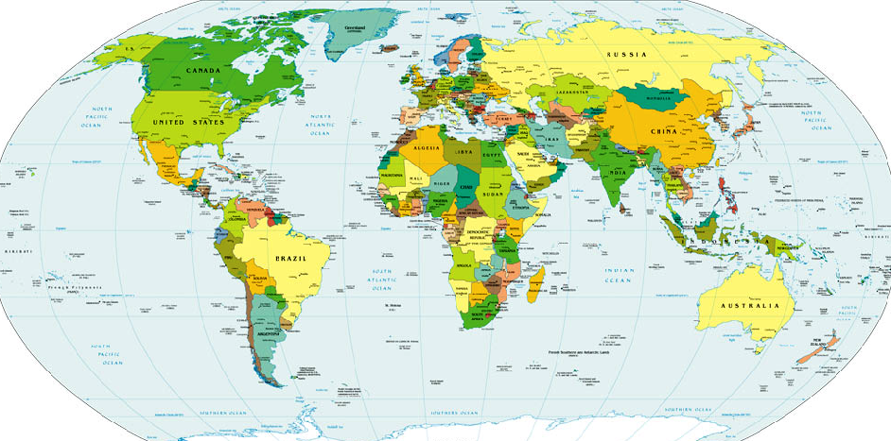




We’re the Vagabonds!
Sandi Phillips & Rocky Romero

Slide 2

We’re the Vagabonds!
Rocky
Louisiana
England
Ireland
Wales
Scotland
Denmark
Norway
Germany
Sweden
Italy
Finland
Netherlands
1996
France
Iceland
USA
Angola
Canada
Korea
Indonesia
England
Alaska
Germany
Dubai
Germany
Saudi Arabia
England
Zaire
Netherlands
Trinidad
Denmark
France
Trinidad
Brazil
Angola
Italy
Portugal

Slide 3



We’re the Vagabonds!
Rocky
Sandi
Illinois
Louisiana
New Jersey
England
South Dakota
New York
Ireland
North Carolina
Wales
Missouri
Scotland
Vermont
Denmark
Louisiana
Norway
Kentucky
Germany
Michigan
Sweden
Italy
Connecticut
Finland
Netherlands
1996
Texas
France
Iceland
Russia
Netherlands
USA
Angola
France
USA
Canada
Korea
Indonesia
England
Canada
Alaska
Germany
Dubai
Germany
Mexico
Saudi Arabia
England
Zaire
Netherlands
Caribbean
Trinidad
Denmark
France
Trinidad
Colombia
Brazil
Angola
Italy
Portugal
Angola

Slide 4
We’re the Vagabonds!
Rocky
Sandi
Illinois
Louisiana
New Jersey
England
South Dakota
New York
Ireland
North Carolina
Wales
Missouri
Scotland
Vermont
Denmark
Louisiana
Norway
Kentucky
Germany
Michigan
Sweden
Italy
Connecticut
1996
1997
1998
1999
Texas
Finland
Netherlands
2000
France
Iceland
Russia
Netherlands
USA
Angola
France
USA
Canada
Korea
Indonesia
England
Canada
Alaska
Germany
Dubai
Germany
Mexico
Saudi Arabia
England
Zaire
Netherlands
Caribbean
Trinidad
Denmark
France
Trinidad
Colombia
Brazil
Angola
Italy
Portugal
Angola

Slide 5
We’re the Vagabonds!
Our 15 Year Plan
List of things to DO, SEE, LEARN
2000
let’s plan a life together!

Slide 6
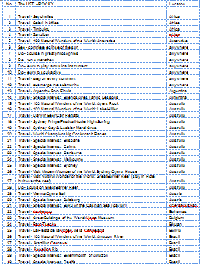
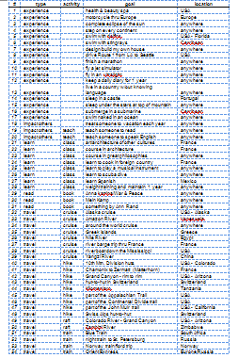
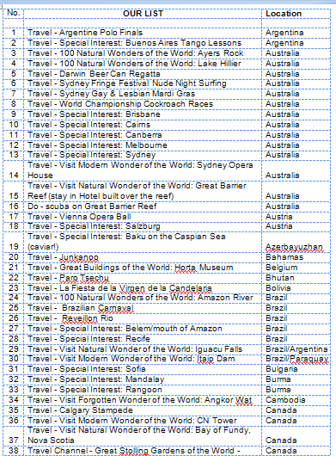
Our 15 Year Plan
Do - course in great philosophies | anywhere
Do - run a marathon | anywhere
Do - learn to play a musical instrument | anywhere
Do - learn to scuba dive | anywhere
Travel - step on every continent | anywhere
Travel - submerge in a submarine | anywhere
Travel - Argentine Polo Finals | Argentina
Travel - Special Interest: Buenos Aires Tango Lessons | Argentina
travel | visit | Big Ben - London | England
experience |  | motorcycle thru Europe | Europe
travel | train | Orient Express | Europe/Russia
learn | class | art/architecture of other cultures | France
learn | class | course in architecture | France
learn | class | learn to cook in foreign country | France
travel | cruise | river barge trip thru France | France
travel | hike | Chamonix to Zermatt (Matterhorn) | France
Our Shared List
Sandi’s List
Rocky’s List
List of things to DO, SEE, LEARN

Slide 7
Our 15 Year Plan
North America
Europe
Asia
Equator
Africa
Central &
South America
Malaysia &
Australia
Our List – 235 Activities- 72 Countries

Slide 8
Our 15 Year Plan
North America
North America
Europe
Europe
Asia
Asia
Equator
Africa
Africa
Our List
Malaysia &
Australia
Central &
South America
Malaysia &
Australia
Central &
South America
7 Ancient Wonders
12 Natural Wonders
19 Forgotten Wonders
144 UNESCO countries

Slide 9
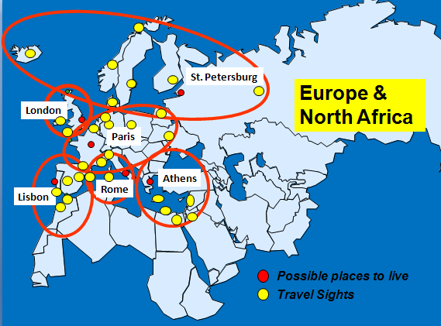
Our 15 Year Plan
Europe &
North Africa
North America
Asia
Equator
Central &
South America
Africa
Malaysia &
Australia

Slide 10
Our 15 Year Plan
Vagabond Preparations
Europe &
North Africa
North America
Asia
Equator
Central &
South America
Africa
Malaysia &
Australia
15 places to live

Slide 11
Vagabond Preparations
?
- Houses and Cars
- Furniture, Accessories, Tools
- Things we will need
- Logistics for vagabonding

Slide 12
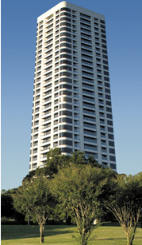
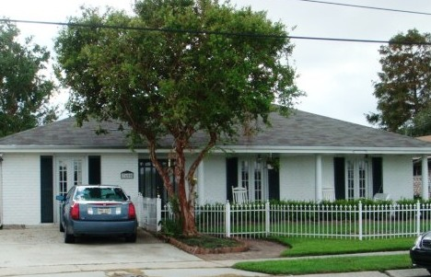
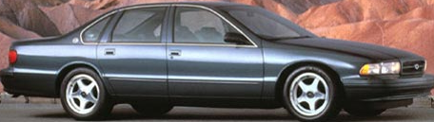

Vagabond Preparations
Houses and Cars . . . .
Sold!

Slide 13

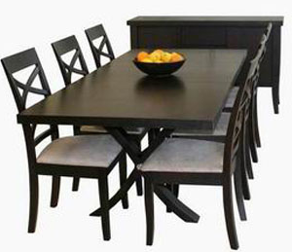




Vagabond Preparations
Furniture, Accessories, Tools . . .
The ‘Great
Give-Away’

Slide 14
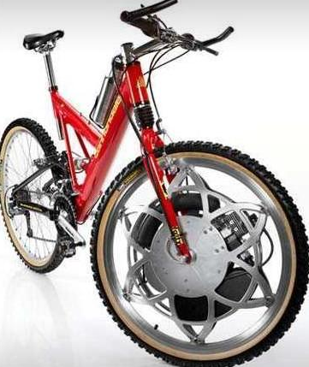











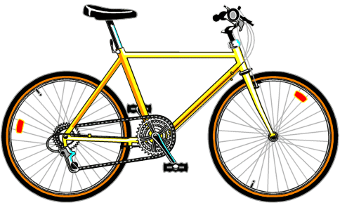
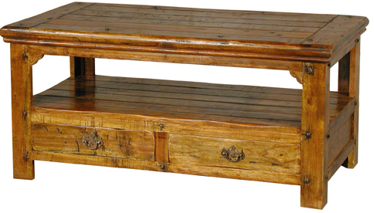
Vagabond Preparations
Furniture, Accessories, Tools . . .
The ‘Great
Give-Away’

Slide 15
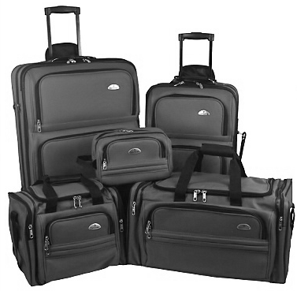
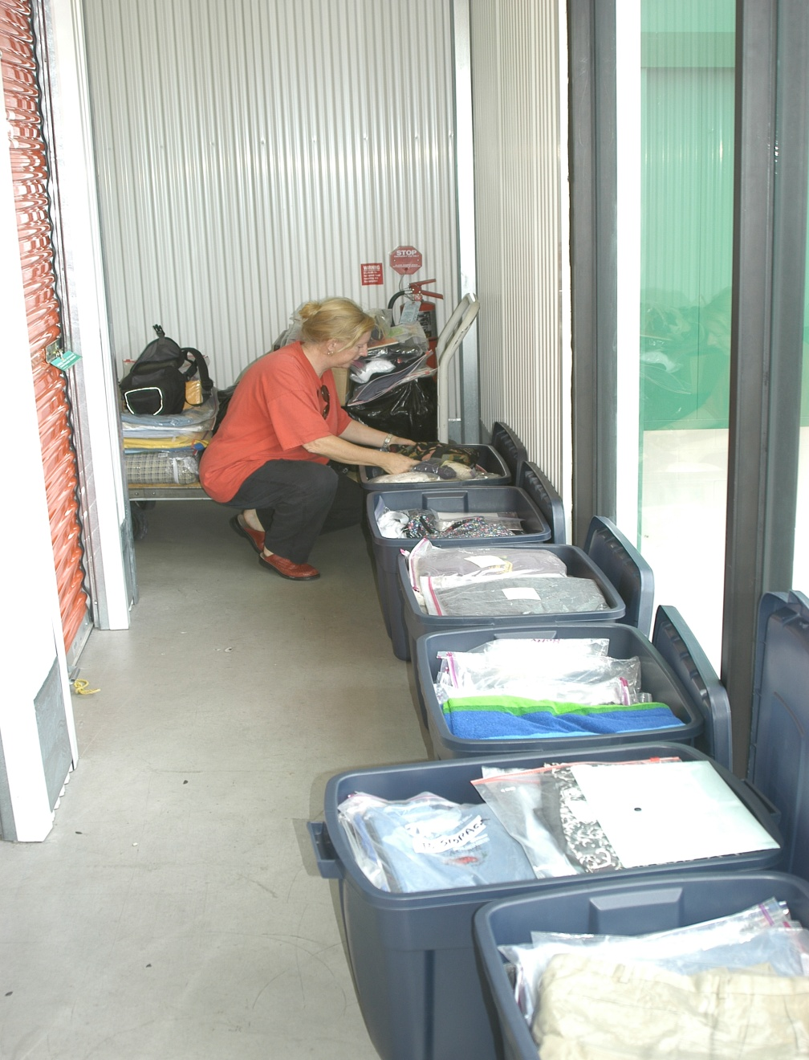
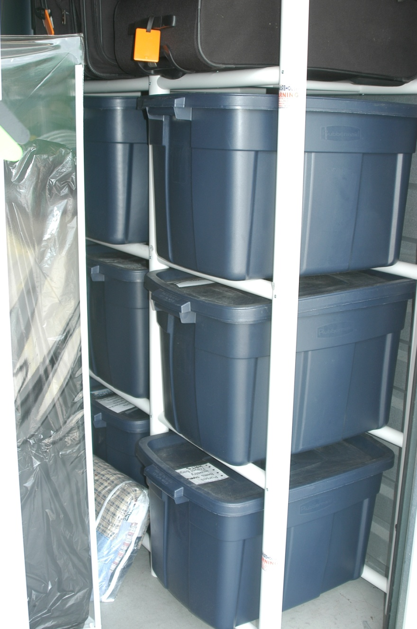
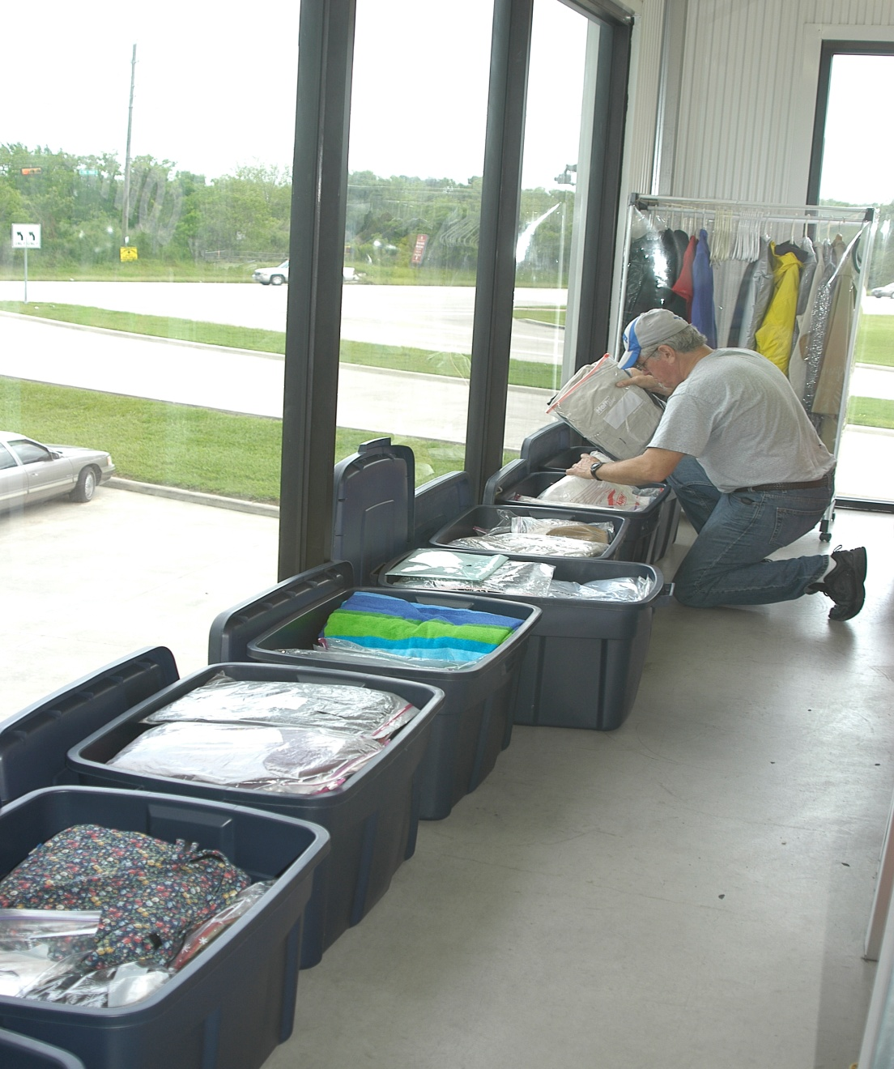

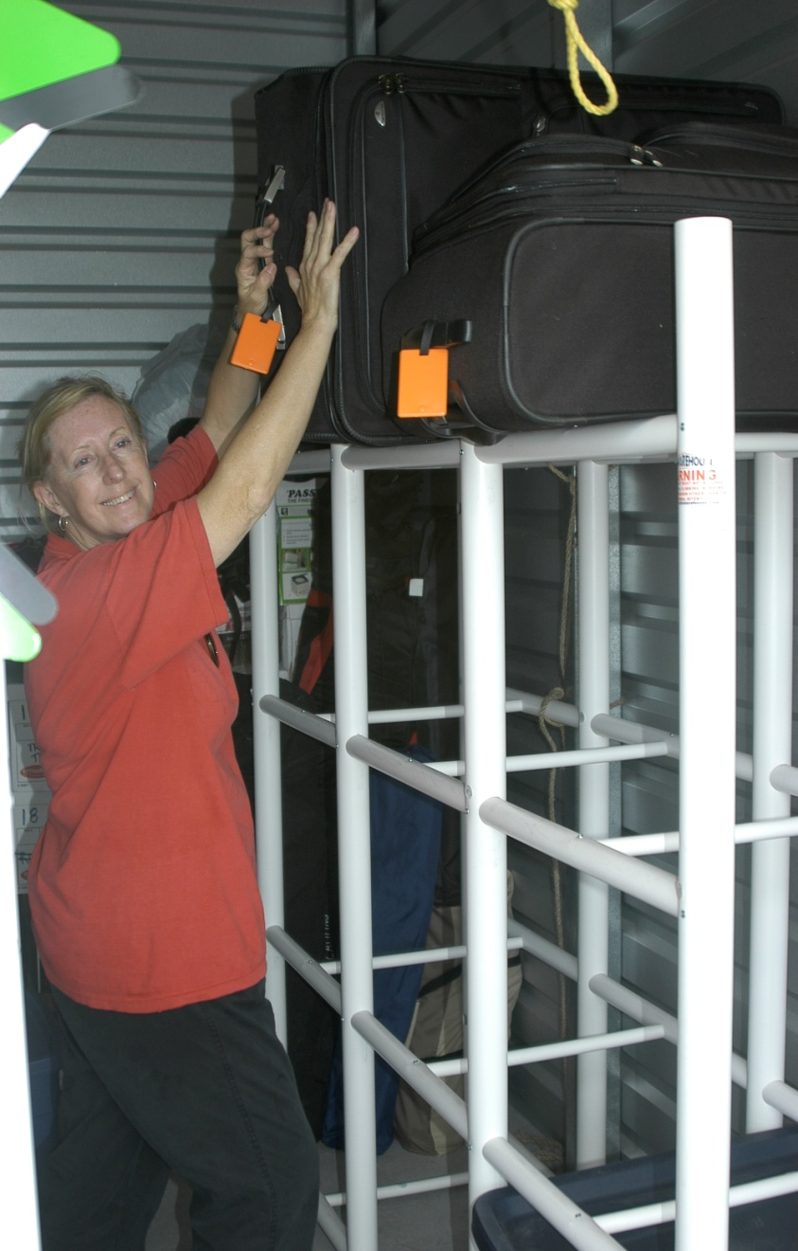
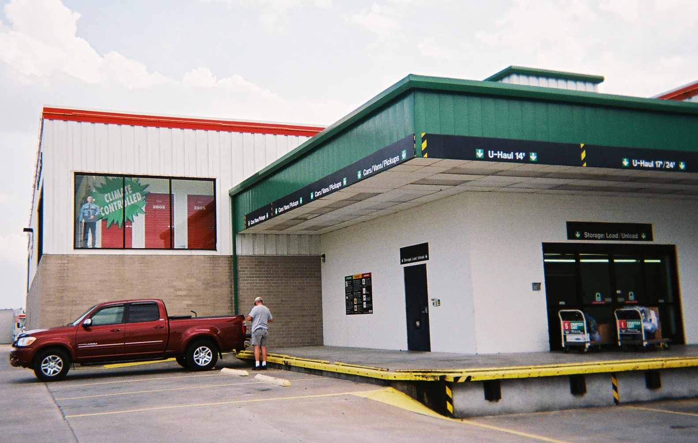
Vagabond Preparations
Things We Will Need . . .
Logistics for vagabonding. . .
Our ‘Trunk-ables’

Slide 16



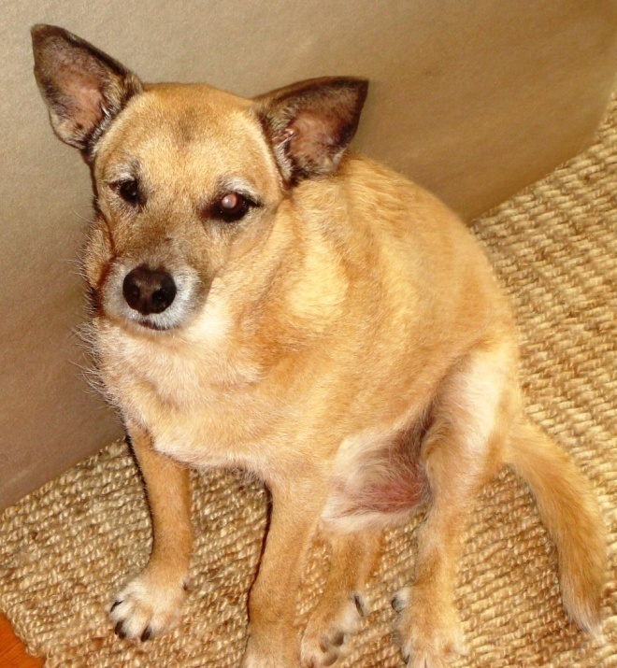
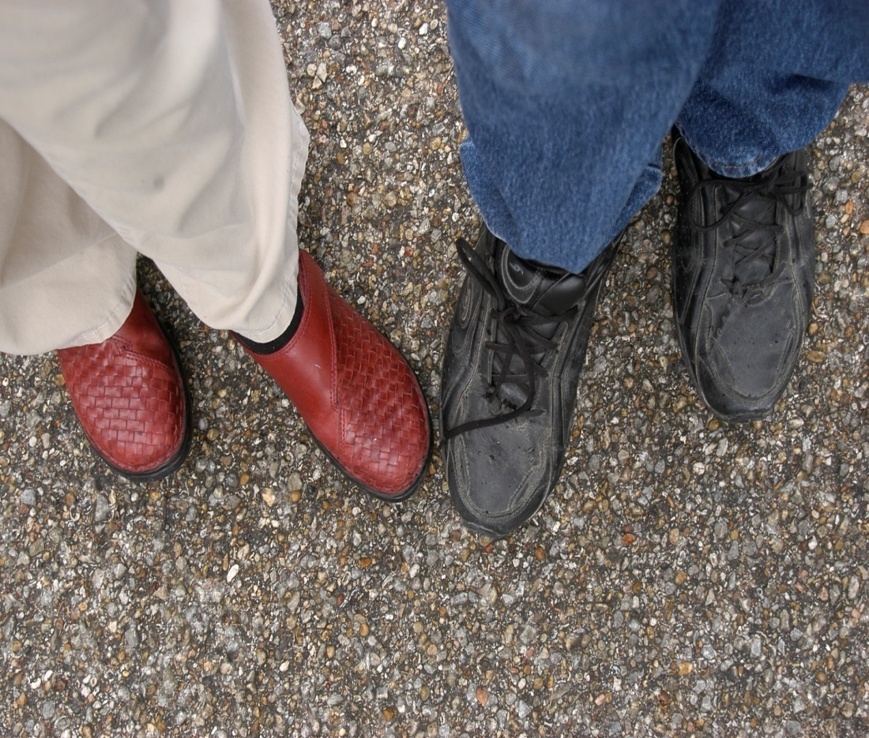

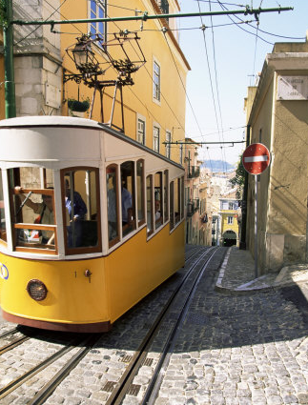
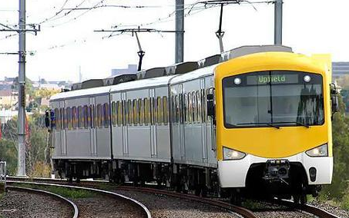





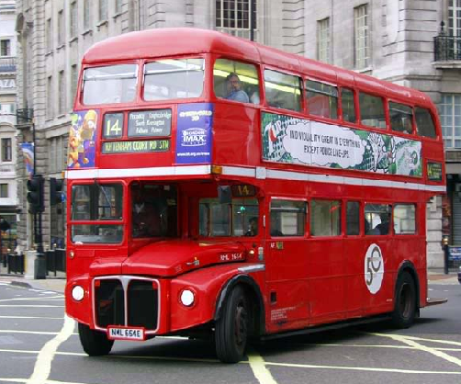



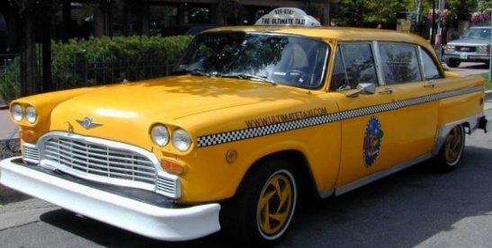
Vagabond Preparations
Logistics for vagabonding. . .
- housing
- transportation
- mail
- bills/banking
- the dog

Slide 17

Vagabond Preparations
Off to
See, do, learn

Slide 18
Vagabonds Travels
So we were
VAGABONDS . . .
“ wanderers who have
no established residence.”

Slide 19

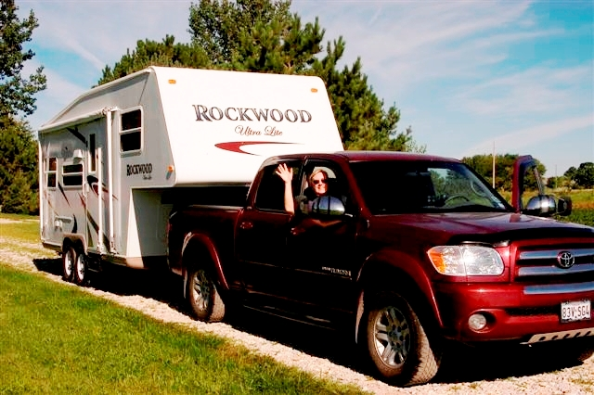
Vagabonds Travels
Truck & Camper
USA
Caribbean
Panama
Costa Rico
Mexico
Portugal
Spain
China
France
Tibet/Nepal
Angola
England
England
Macau
Switzerland
Italy
Australia
Germany
Japan
Austria
Norway
France
Vietnam (R3)
Belgium
Egypt
South Africa
2000-2015
Zimbabwe
Namibia
Kenya
Botswana
Tanzania

Slide 20
Vagabonds Travels
USA
Caribbean
Panama
Costa Rico
Mexico
Portugal
Alaska
Spain
Canada
Hungary
Czech Republic
China
France
Tibet/Nepal
Angola
England
England
Macau
Switzerland
Italy
Australia
Germany
Japan
Austria
Norway
France
Vietnam (R3)
Belgium
Egypt
South Africa
2000-2015
Zimbabwe
Namibia
Kenya
Botswana
Tanzania

Slide 21
Vagabonds Travels
We’re the Vagabonds!
USA
Caribbean
Panama
Costa Rico
Mexico
Portugal
So far we’ve lived . . . . .
in 6 countries, on 4 continents
Alaska
Spain
Canada
Hungary
Czech Republic
China
France
Tibet/Nepal
Angola
England
England
Macau
Switzerland
Italy
Australia
Germany
Japan
Austria
Norway
France
Vietnam (R3)
Belgium
Egypt
South Africa
2000-2015
Zimbabwe
Sandi Phillips & Rocky Romero
Namibia
Kenya
Botswana
Tanzania

Slide 22
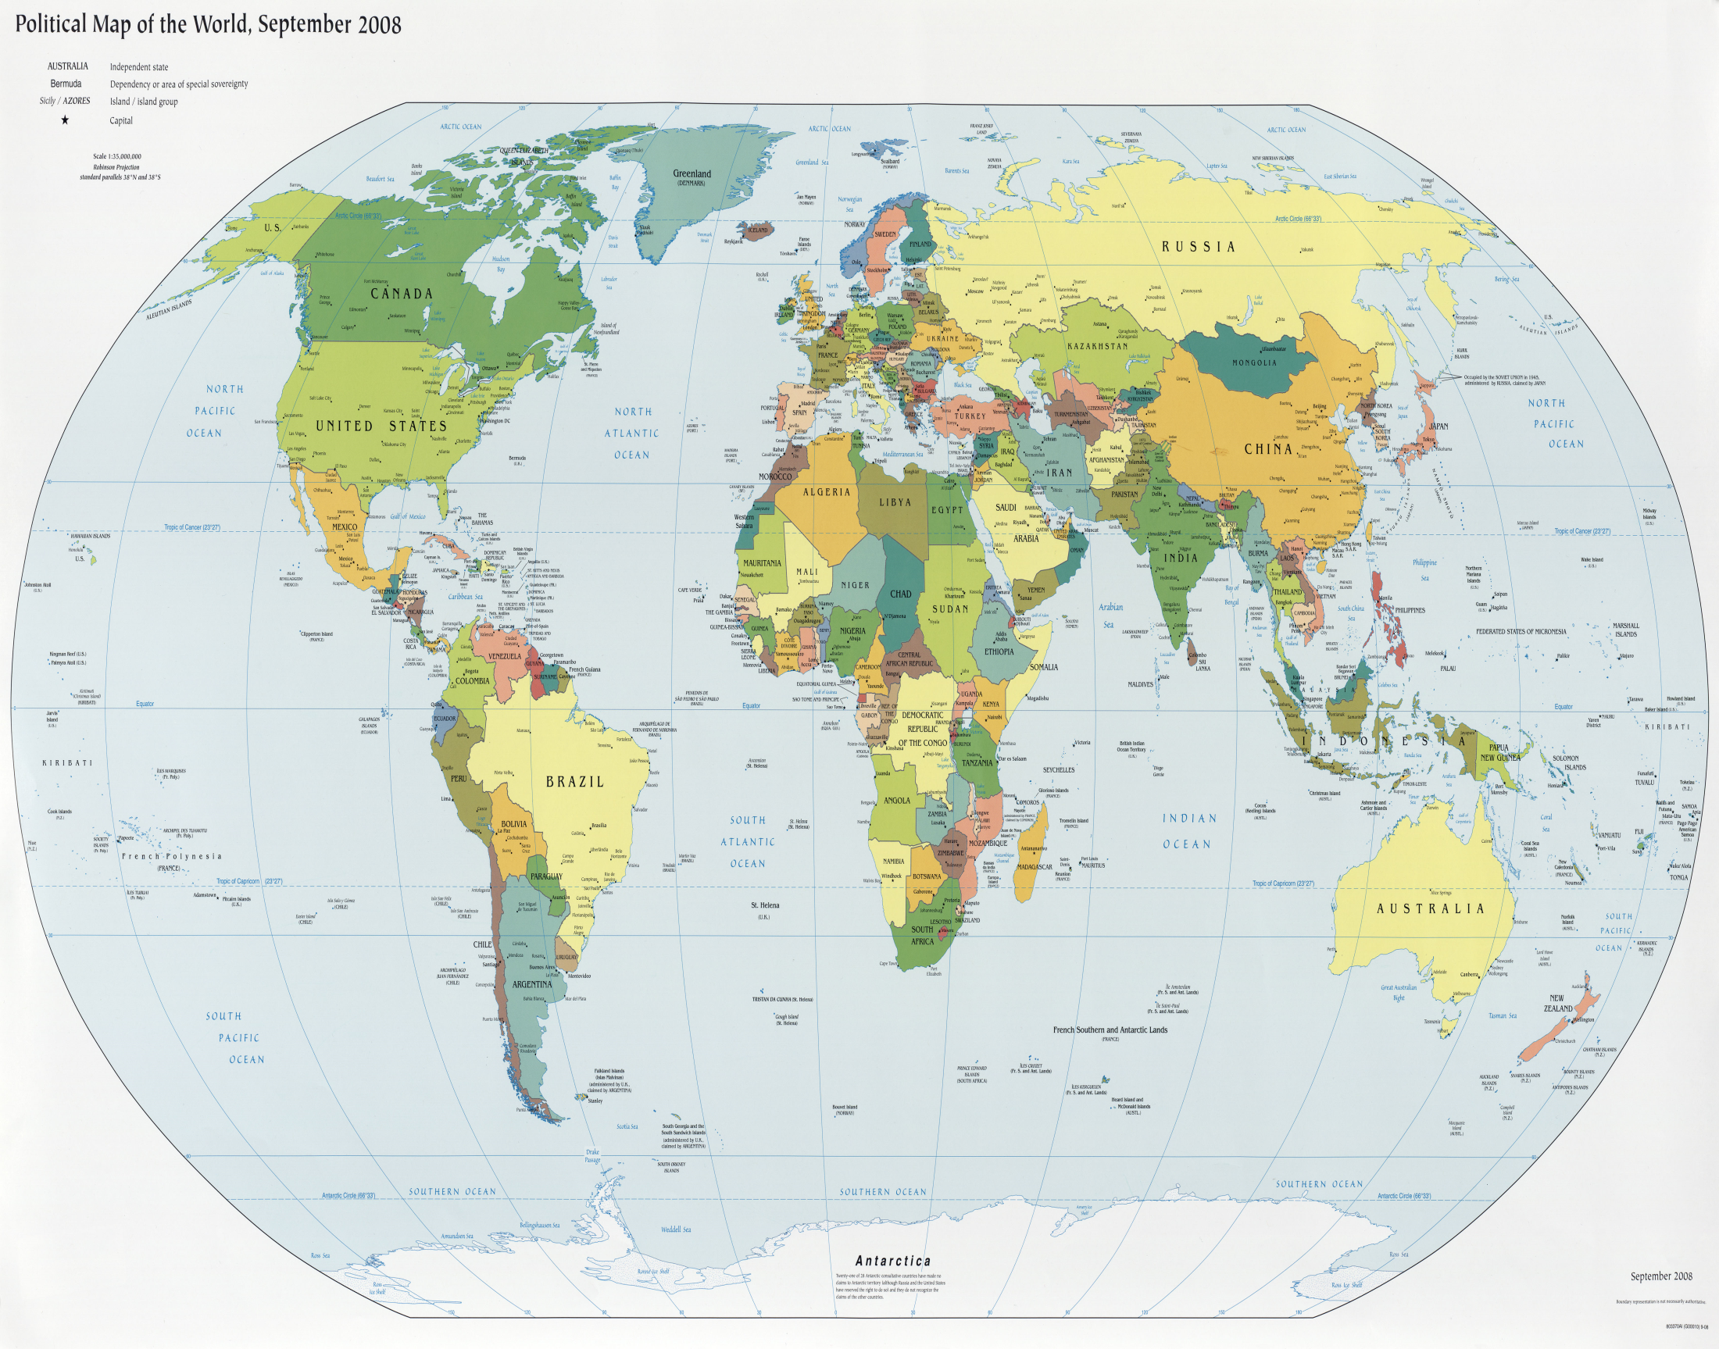
Travel is fatal to prejudice, bigotry,
and narrow-mindedness…
Broad, wholesome, charitable views of men and things cannot be acquired by vegetating in one little corner of the earth all one's lifetime.
~Mark Twain

Slide 23
“Twenty years from now
you will be more disappointed by the things you didn’t do than by the ones you did do. So throw off the bowlines, sail away from the safe harbor. Catch the trade winds in your sails.
Explore. Dream. Discover.”
– Mark Twain

