Slide 1
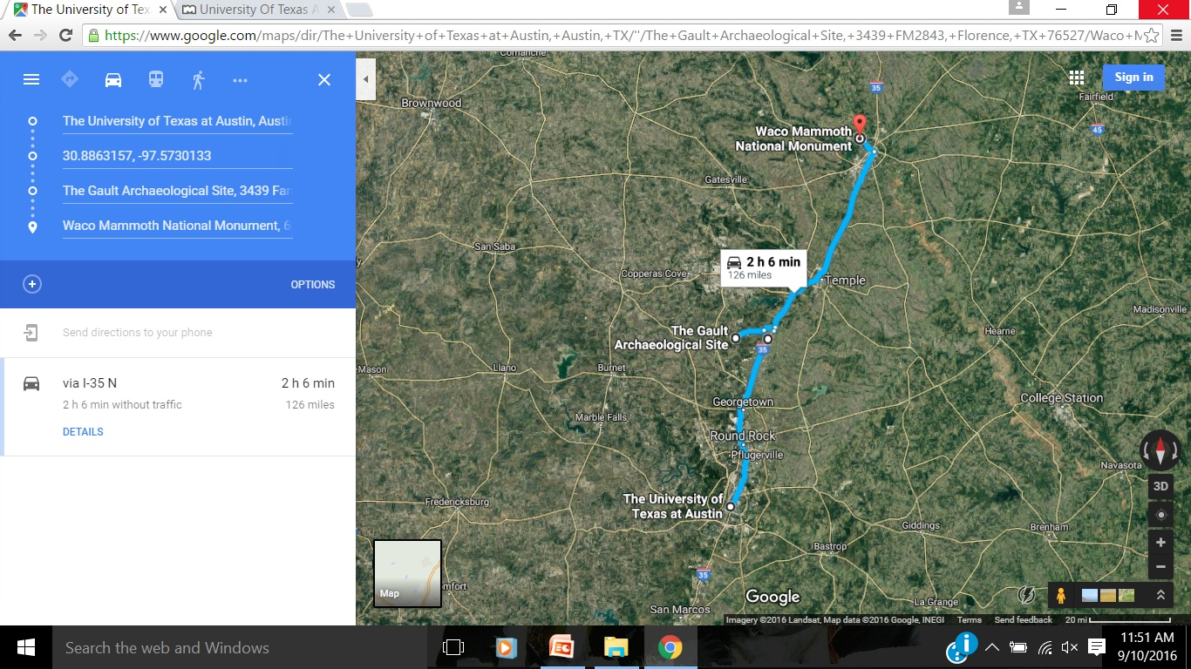
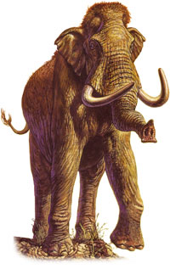
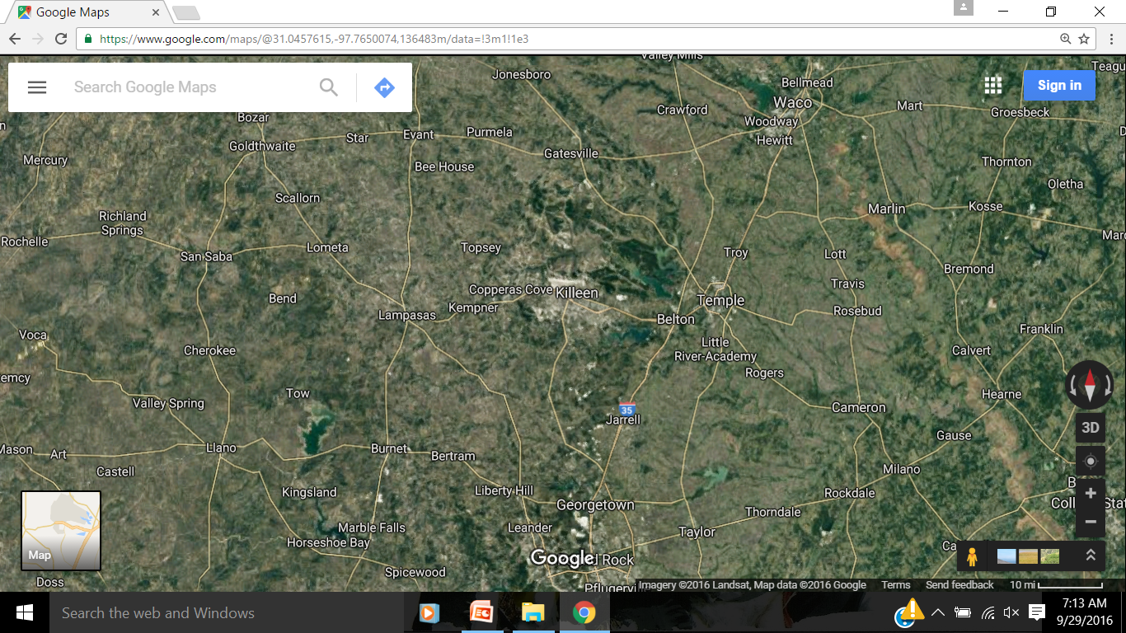
Don’t Forget the Field Trip!
Gault Archeological Site
& Waco Mammoth
National Monument
Thursday
Nov 3
8:30-5:00
sign up: http://www.senioruniv.org/
Georgetown

Slide 2

Darwin to DNA
the Evolution of Homo Sapiens
Darwin to DNA
LAST SESSION . . .
website: www.VagabondGeology.com

Slide 3
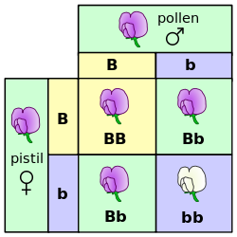
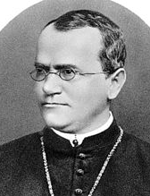
LAST SESSION . . .
Question from last week . . . .
Gregor Mendel
Czech Republic
Austrian Empire
X
Whoops, he did not live in France!

Slide 4

LAST SESSION . . .
Question from last week . . . .
Why does hair on our human head grow long?
Evolutionary changes to the head hair:
- faster rate of growth
- longer growing phase
- increased density
- greater resistance to physical damage

Slide 5
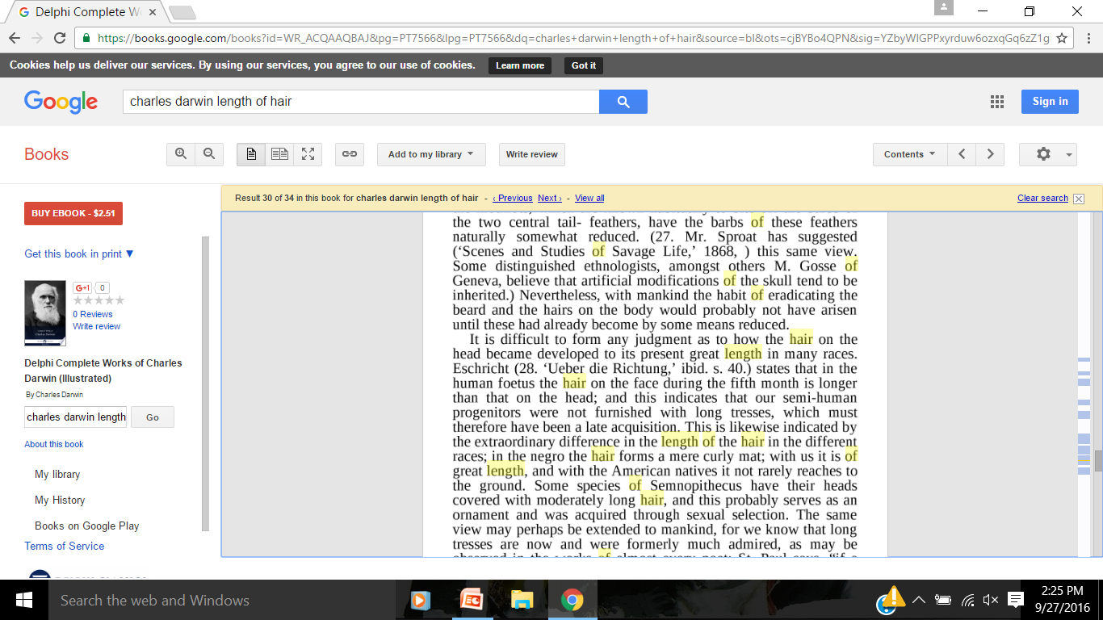
Question from last week . . . .
Why does hair on our human head grow long?
Charles Darwin, 1875: The Descent of Man, Chapter 20
- Sexual selection
- enhanced attractiveness
- signifies health (mate-ability)
- protect the head from effects of the sun
- provide air gap for evaporation of sweat
Evolutionary changes to the head hair:
- faster rate of growth
- longer growing phase
- increased density
- greater resistance to physical damage
Sexual selection
(Long hair)

Slide 6
LAST SESSION . . .
https://www.wired.com/2015/04/hair-only-in-some-places/
Early hominids (our über-great grandparents), the story goes, made their living foraging for fruits, nuts, tubers, and vegetation in the cool shade of forest trees. Then, about three million years ago, a global cooling period dried out the regions of Central Africa where those early family members were living.
The fur that had once kept them warm became a liability, as forests changed into grasslands and early hunters spent long hours striding or running across the savanna in pursuit of dinner. From natural selection’s point of view, the ability to sweat and quickly dissipate heat became the neatest trick on the block. So, by and large, humans lost their hair.
Happily though, the gods of evaporative cooling didn’t demand the sacrifice of all our pilatory plumage. We’ve still got some hair left, and it (mostly) seems to serve a purpose—starting with the most highly-groomed bits.
Like your eyebrows, for example. Aside from being good for raising, furrowing, and piercing, the hair there keeps the sweat out of your eyes. And the hair on your head shields your noggin from the direct force of the sun. It also leaves an area of air between your scalp and hair’s hot surface, so sweat can evaporate and cool things down. (Curly hair, Tuttle says, does the best job at performing this task.) Head hair grows longer than other hair because these follicles remain in an active growth (or anagen) phase longer than other other hair follicles—generally a couple of years instead of just a couple of months.
That hair’s useful. But what about all the soft, downy stuff that barely shows up on your body? It’s called vellus hair, and it’s a safe bet that it’s an evolutionary relic. Humans don’t need it anymore, but it’s not doing any harm either, so there it stays. Vellus hair is closely related to another type of hair that definitely serves a purpose, though. Add just a little androgenic hormone (which starts circulating in both boys and girls around puberty) and voila—it becomes thicker and darker.
What that did, says Russell Tuttle, anthropologist and evolutionary biologist at the University of Chicago and author of Apes and Human Evolution, is give humans the ability to be out hunting in the heat of the day when other predators (i.e. LIONS!) “are resting and trying to keep themselves cool, because all they can do is pant.”
http://evoandproud.blogspot.com/2008/04/why-is-human-head-hair-so-long.html
Why is human head hair so long?
Head hair is much longer than hair elsewhere on the body. This lengthening has involved several evolutionary changes: faster rate of growth, longer growing phase, increased density, and greater resistance to physical damage (Khumalo, 2005; Loussouarn et al., 2005). The multiplicity of these changes is consistent with sexual selection: the selective pressure seems to have acted on an overall visual effect rather than on one incidental factor. In some non-human primates, head hair has lengthened for apparently similar reasons, perhaps because visual attention tends to focus, as in humans, on the face and its surrounding frame (Darwin, 1936 [1888], p. 906).
Head hair has lengthened only in those human populations that have lived in the temperate and Arctic zones, including some that have back-migrated to the tropical zone, e.g., Austronesians in Southeast Asia and Oceania, Amerindians in the tropical New World. Darwin noted "the extraordinary difference in the length of the hair in the different races; in the negro the hair forms a mere curly mat; with us it is of great length, and with the American natives it not rarely reaches to the ground" (Darwin, 1936 [1888], p. 906).
This point seems to be lost on those who think that hominids acquired long head hair at a very early date. Advocates of the 'Aquatic Ape Hypothesis', for example, believe that head hair lengthened during a putative aquatic phase of human evolution when an infant would have to hang on to its mother's hair while in the water "and if the hair floated around her for a yard or so on the surface [the infant] wouldn't have to make so accurate a beeline in swimming towards her" (Morgan, 1972, p. 36). Yet such lengthening could not have occurred until modern humans had begun spreading out of Africa—some 50,000 years ago at the earliest. This same point is also lost on those who argue that long head hair improved mating success among ancestral humans because it signified health and hence mate quality (Hinsz et al., 2001; Mesko and Bereczkei, 2004). Fine. But does health matter less in the Tropics?
In the literature, this lengthening of head hair outside the tropical zone is often ascribed to relaxation of natural selection: short frizzy hair helps dissipate body heat and thus loses its adaptive value in colder climates. But why would a colder climate cause head hair—and only head hair—to lengthen to such an extent and over such a short span of evolutionary time? If we turn to the sexual selection model, we see that non-tropical climates do alter selective pressures, but indirectly so—by altering human demography. When early modern humans left the Tropics, they entered an environment that reduced the supply of mateable men, thus making them a limited resource. This new environment intensified sexual selection of women and would have favored physical traits that retain visual attention, particularly from men.
Why would sexual selection favor longer-haired women? We know that most societies consider a greater amount of head hair to be an appropriate female characteristic (Synnott, 1987). Even in sub-Saharan Africa, where people are naturally shorthaired, women have traditionally lengthened their head hair with vegetable fiber, sinew, or hair from relatives, apparently to enhance their beauty (Bernolles, 1966; Sieber and Herreman, 2000). Head hair is identified with femininity partly because men begin to go bald as early as their 20s, but also because the scalp hairs of women seem to have a higher mean diameter and hence more volume, even in the naturally shorthaired New Guineans (Walsh and Chapman, 1966). It may be that men perceived a greater amount of head hair as more feminine from an early date, and this perceptual bias could have influenced male mate-choice wherever female-female rivalry for mates had become sufficiently intense.
Question from last week . . . .
Why does hair on our human head grow long?
- Sexual selection
- enhanced attractiveness
- signifies health (mate-ability)
- protect the head from effects of the sun
- provide air gap for evaporation of sweat

Slide 7
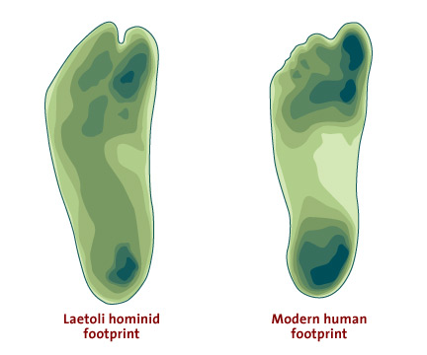
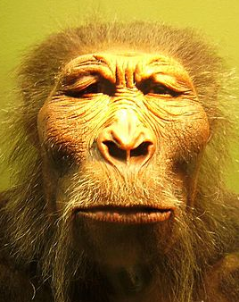
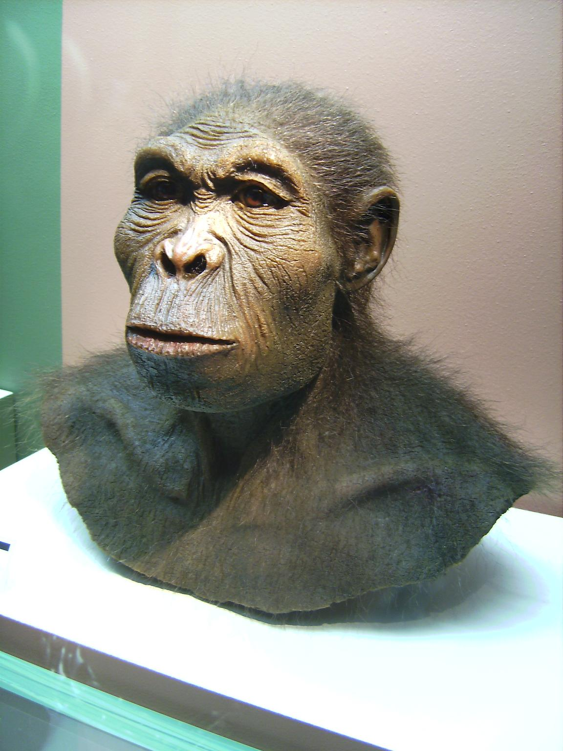
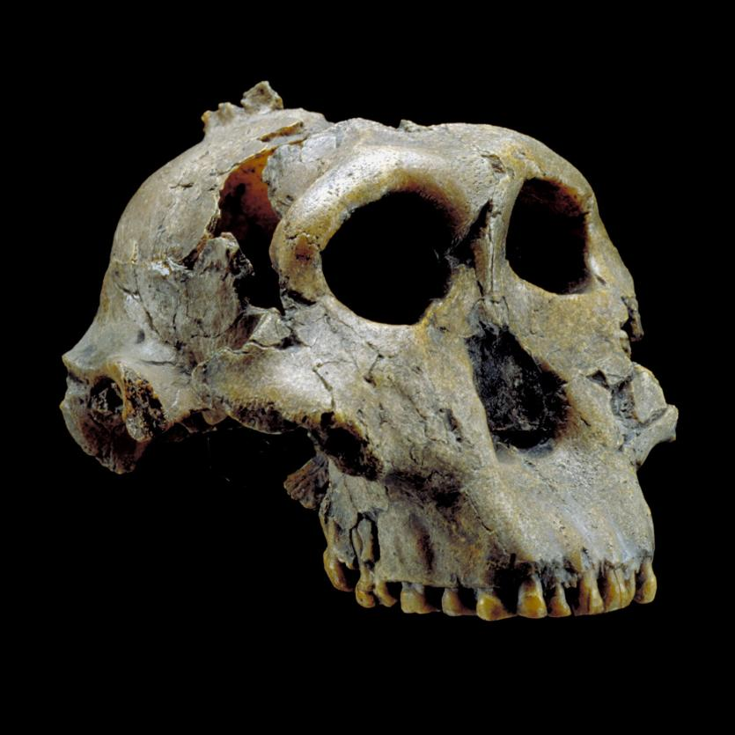
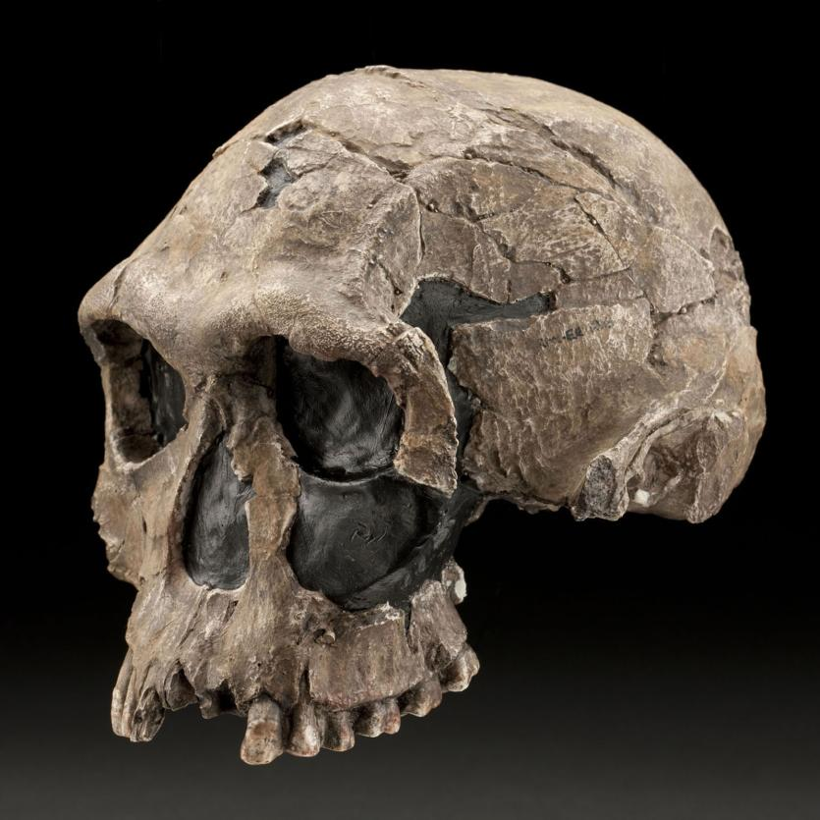
LAST SESSION . . .
How are these reconstructions made?
Laetoli footprint
Nutcracker Man
Handy Man

Slide 8
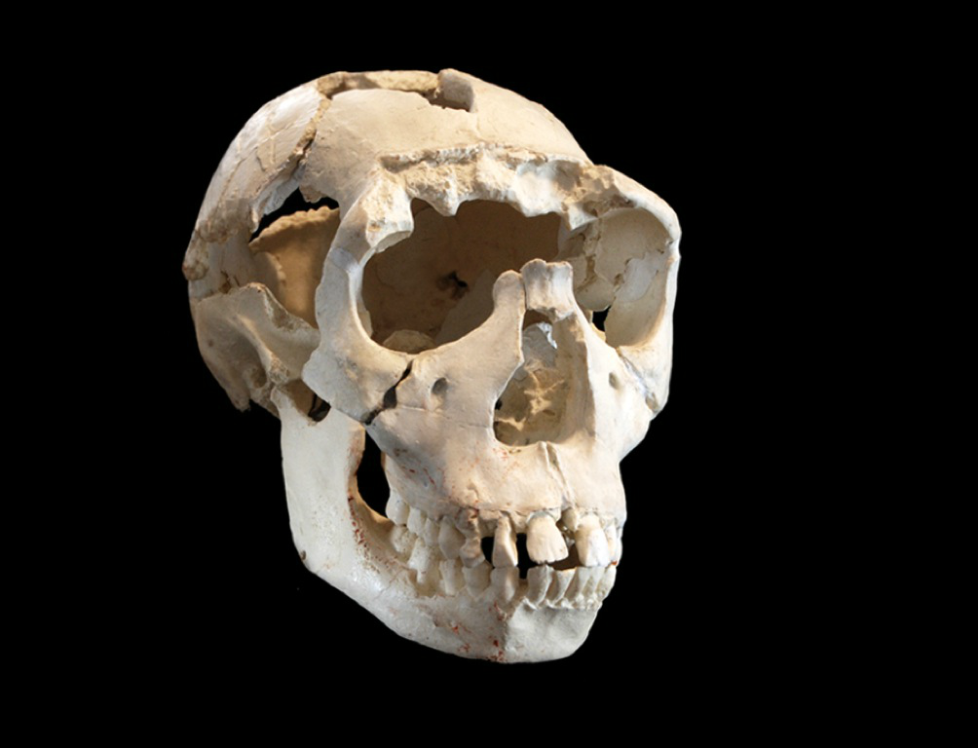
LAST SESSION . . .
How are these reconstructions made?
Laetoli footprint
Nutcracker Man
Handy Man

Slide 9
LAST SESSION . . .
Paleoartist Viktor Deak reconstructs . . .
Turkana Boy – A. africanus
Click here to
show animation
Laetoli footprint
Nutcracker Man
Handy Man

Slide 10
Darwin to DNA
LAST SESSION . . .
SESSION 2
- Timeline & Family Tree
- Hominins Disperse into Africa
- ‘Cradle of Humankind’ in S.A.
- Age Dating Ancient Remains
- Extinction of Early Hominin Genera
Session 6: into Americas
Session 5: across Beringia
Session 4: into Asia
Session 3: into Europe
Session 2: into Africa
Session 1: beginning in East Africa
Laetoli footprint
Nutcracker Man
Handy Man

Slide 11
SESSION 2
The Stone Age: 2.5 million to 4000 YBP (years before present)
TODAY
- Timeline & Family Tree
- Hominins Disperse into Africa
- ‘Cradle of Humankind’ in S.A.
- Age Dating Ancient Remains
- Extinction of Early Hominin Genera
2.5 MILLION

Slide 12
The Stone Age: 2.5 million to 4000 YBP (years before present)
?
TODAY
400,000 YBP
2.5 MILLION
400,000 YBP
EARLY STONE AGE – stone tools, fire
What 3 Genera lived during the Early Stone Age?

Slide 13
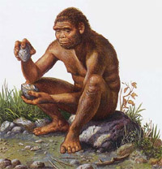
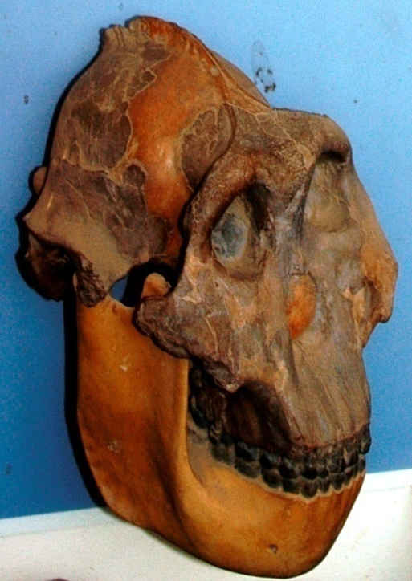

The Stone Age: 2.5 million to 4000 YBP (years before present)
3.5M – footprints
TODAY
1.8M – ‘Nutcracker Man’
2.5 MILLION
1.7M – ‘Handy Man’
400,000 YBP
2 MILLION
1.4 MILLION
EARLY STONE AGE – stone tools, fire
Session 1
TANZANIA
- Laetoli Site
- Olduvai Gorge
Where does ‘Turkana Boy’ fit?
What 3 Genera lived during the Early Stone Age?
Australopithecus
Paranthropus
Homo Genus
sapiens

Slide 14
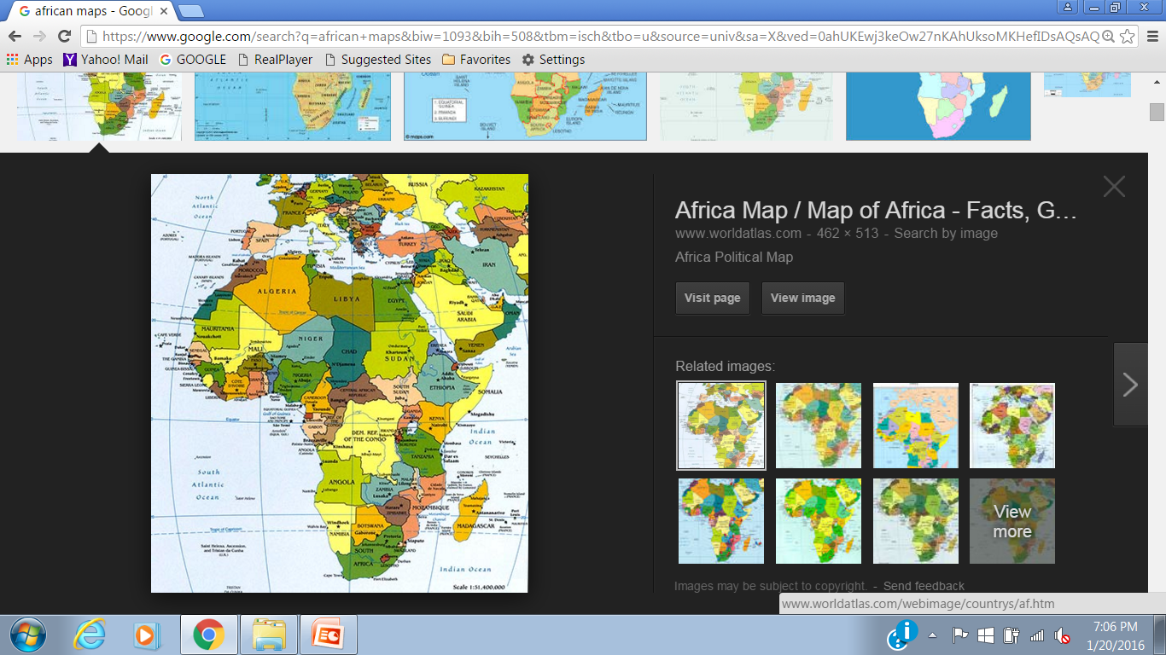
The Stone Age: 2.5 million to 4000 YBP (years before present)
3.5M – footprints
TODAY
1.8M – ‘Nutcracker Man’
2.5 MILLION
1.7M – ‘Handy Man’
400,000 YBP
2 MILLION
1.4 MILLION
EARLY STONE AGE – stone tools, fire
Where does ‘Turkana Boy’ fit?
‘Turkana Boy’
Australopithecus
Paranthropus
Homo Genus
sapiens

Slide 15
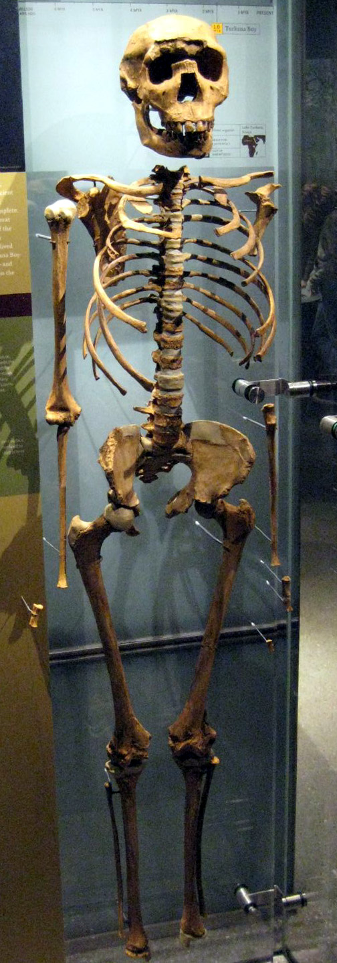
‘Turkana Boy’
The Stone Age: 2.5 million to 4000 YBP (years before present)
3.5M – footprints
TODAY
- 1984: found at LakeTurkana by Richard Leakey’s team
1.8M – ‘Nutcracker Man’
1.7M – ‘Handy Man’
400,000 YBP
- Identified at species Homo erectus
2.5 MILLION
2 MILLION
1.4 MILLION
- aged at 1.5-1.6 million years old
EARLY STONE AGE – stone tools, fire
Kenya
Tanzania
Australopithecus
“The most complete early
human skeleton ever found”
Paranthropus
Homo Genus
sapiens
Notes:
https://en.wikipedia.org/wiki/Turkana_Boy
Turkana Boy, now called, Nariokotome Boy, is the common name of fossil KNM-WT 15000,^{[nb 1]} a nearly complete skeleton of a hominin youth who lived during the earlyPleistocene. This specimen is the most complete early human skeleton ever found. It is believed to be between 1.5 and 1.6 million years old.
Estimates of his age at death range from seven to 18 years old; the most recent scientific review suggests eight years.^{[1]} It was initially suggested that he would have grown into a 185 centimetres (73 in) tall adult, but the most recent analysis argues for the much shorter stature of 163 centimetres (64 in). The reason for this shift has been research showing that his growth maturation differed from that of modern humans in that he would have had a briefer and smaller adolescent growth spurt.^{[1]}
The skeleton was discovered in 1984 by Kamoya Kimeu, a member of a team led byRichard Leakey, at Nariokotome near Lake Turkana in Kenya.

Slide 16
The Stone Age: 2.5 million to 4000 YBP (years before present)
3.5M – footprints
TODAY
1.8M – ‘Nutcracker Man’
2.5 MILLION
1.7M – ‘Handy Man’
400,000 YBP
1.6-1.5M – ‘Turkana Boy’
2 MILLION
1.4 MILLION
EARLY STONE AGE – stone tools, fire
Australopithecus
Paranthropus
Homo Genus
sapiens

Slide 17
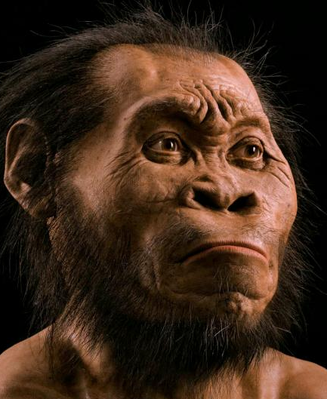
The Stone Age: 2.5 million to 4000 YBP (years before present)
3.5M – footprints
TODAY
2.5M – ‘Ms Ples’, ‘Little Foot’
1.8M – ‘Nutcracker Man’
2.5 MILLION
1.7M – ‘Handy Man’
400,000 YBP
2 MILLION
1.4 MILLION
our family tree . . . .
EARLY STONE AGE – stone tools, fire
?????? naledi
this session
SOUTH AFRICA
Cradle of Humankind
Australopithecus
Paranthropus
Homo Genus
sapiens

Slide 18
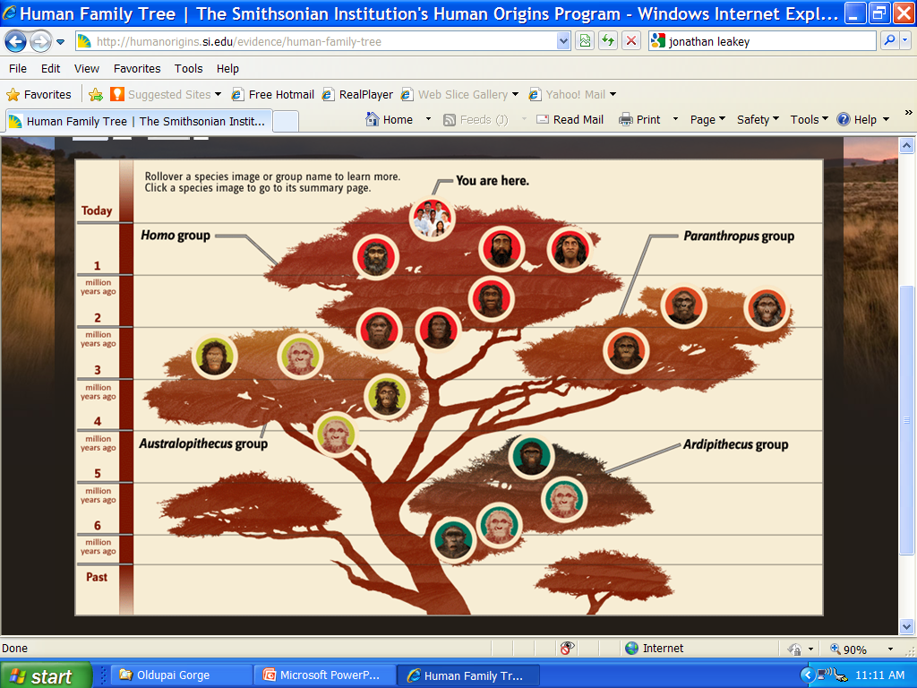
The Stone Age: 2.5 million to 4000 YBP (years before present)
The Stone Age: 2.5 million to 4000 YBP (years before present)
TODAY
homo
2.5 MILLION
400,000 YBP
2 MILLION
1.4 MILLION
our family tree . . . .
EARLY STONE AGE – stone tools, fire
Australopithecus
Paranthropus
Homo Genus
sapiens

Slide 19
The Stone Age: 2.5 million to 4000 YBP (years before present)
Homo
homo
4,000 YBP
Paranthropus
STONE AGE
‘Handy-man’ (habilis)
2.5M YBP
‘Nutcracker Man’ (boisei)
Footprints (afarensis)
Australopithecus
Session 1
TANZANIA
- Laetoli Site
- Olduvai Gorge

Slide 20
What did they eat?
The Stone Age: 2.5 million to 4000 YBP (years before present)
Homo
homo
Paranthropus
Vegatation & meats
TOOLS
‘Handy-man’ (habilis)
‘Nutcracker Man’ (boisei)
SAVANNAH
nut grass, sedge, worms
Footprints (afarensis)
soft foods: plants and fruit
Australopithecus
this session
SOUTH AFRICA
Session 1
TANZANIA
- Laetoli Site
- Olduvai Gorge
TROPICAL

Slide 21
Question from last session: Did these pre-humans eat meat?
Australopithecus afarensis: teeth and jaw were robust enough to chew hard foods, but dental microwear studies show that they ate soft foods like plants and fruit.
- Smithsonian Institute: www.HUMANORIGINS.si.edu
Paranthropus boisei: mainly ate tiger-nuts (also known as nut grass, chufa sedge, yellow nutsedge or earth almond), and may have sought additional nourishment from fruits and invertebrates, like worms and grasshoppers.
- Science News January 12, 2014
Homo Habilis: teeth were adapted chewing some hard foods, capable of eating a broad range of foods, including some tougher foods like leaves, woody plants, and some animal tissues.
Also traces of butchery of large animals, direct evidence of meat and marrow eating, with the earliest appearance of the genus Homo, including H. habilis.
- Smithsonian Institute: www.HUMANORIGINS.si.edu
Notes:
http://humanorigins.si.edu/evidence/human-fossils/species/australopithecus-afarensis
http://www.sci-news.com/othersciences/anthropology/science-paranthropus-boisei-tiger-nut-diet-01680.html
http://humanorigins.si.edu/evidence/human-fossils/species/homo-habilis

Slide 22
South Africa!
The Stone Age: 2.5 million to 4000 YBP (years before present)
homo
Let’s go to South Africa!
STONE AGE
2.5M
2.5 million YBP
Australopithecus africanus
this session
SOUTH AFRICA
- Cradle of Humankind

Slide 23
South Africa!
How did pre-humans get to South Africa?
homo
- follow rivers?
- along the coast?
STONE AGE
- across hilltops?
2.5 million YBP
TANZANIA
Australopithecus africanus
this session
SOUTH AFRICA
SOUTH AFRICA
- Cradle of Humankind

Slide 24
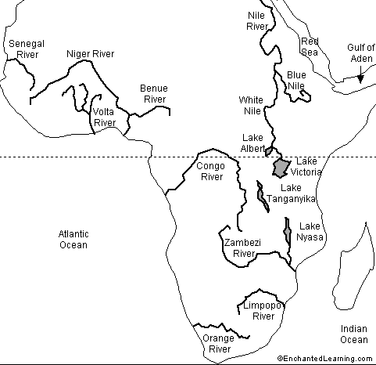
South Africa!
How did pre-humans get to South Africa?
- follow rivers?
no major rivers flow south to S.A.
Tanzania
Major Rivers
in Africa

Slide 25
South Africa!
How did pre-humans get to South Africa?
- follow rivers?
- along the coast?
no major rivers
flow south to S.A.
- across hilltops?
Tanzania
Major Rivers
in Africa
Major Rivers
In Africa

Slide 26
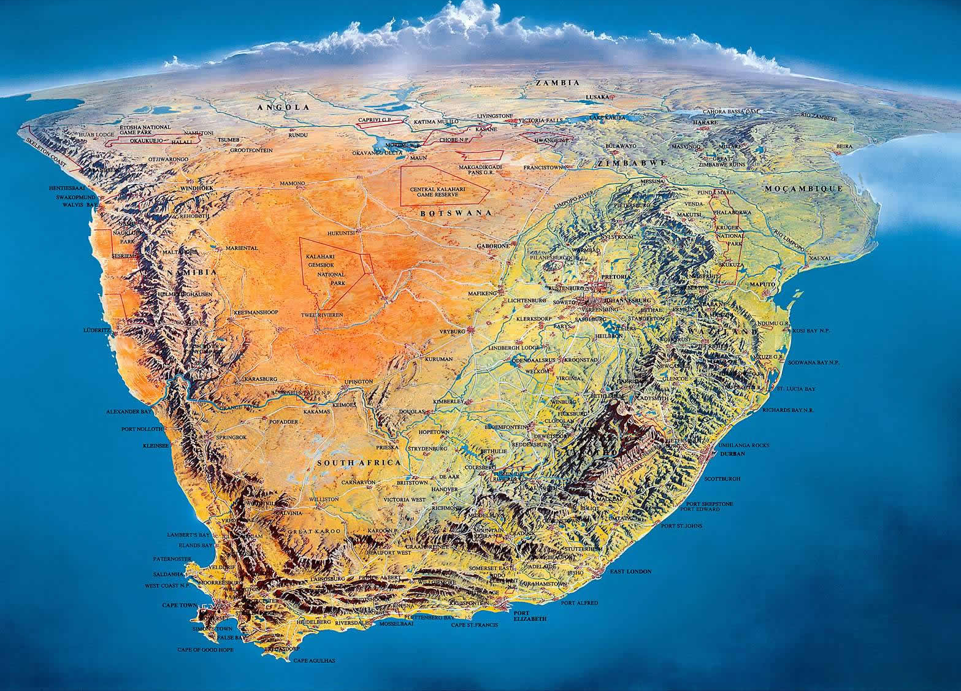
South Africa!
Tanzania
How did pre-humans get to South Africa?
- along the coast?
- across hilltops?
close to sea level
2000 miles
hot, tropical
lack of food sources
mt barrier to interior
South Africa

Slide 27
How long would it take?
- across hilltops?
plateau elevations
similar climate
familiar food sources
no mt barriers
LIKELY PATH:
in the hills where hunting & gathering
support the stone age population

Slide 28
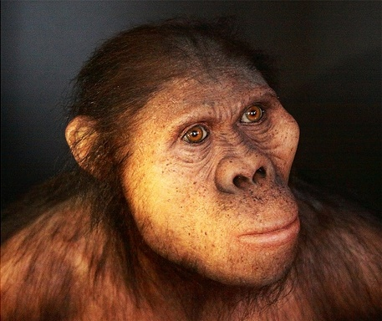
How long would it take?
Let’s meet ‘Mrs. Ples’
Let’s estimate . . . . .
dispersal about 1/2 mile per generation =
(2000miles / 0.5) = 4000 generations
1 generation about . . .. 20 years
80,000 YEARS!
4000
X 20
2000 miles
HOME RANGE: region encompassing
all the resources required to survive and reproduce

Slide 29
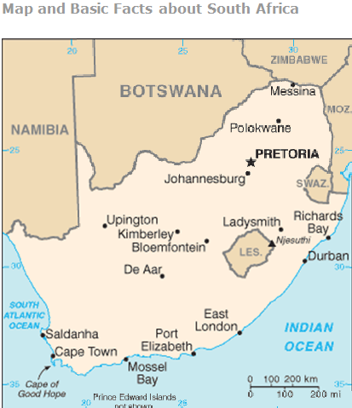
Australopithecus africanus
Let’s meet ‘Mrs. Ples’
afarensis
SOUTH AFRICA

Slide 30
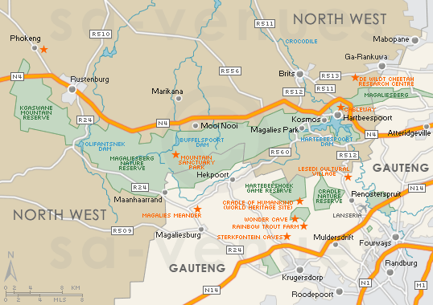
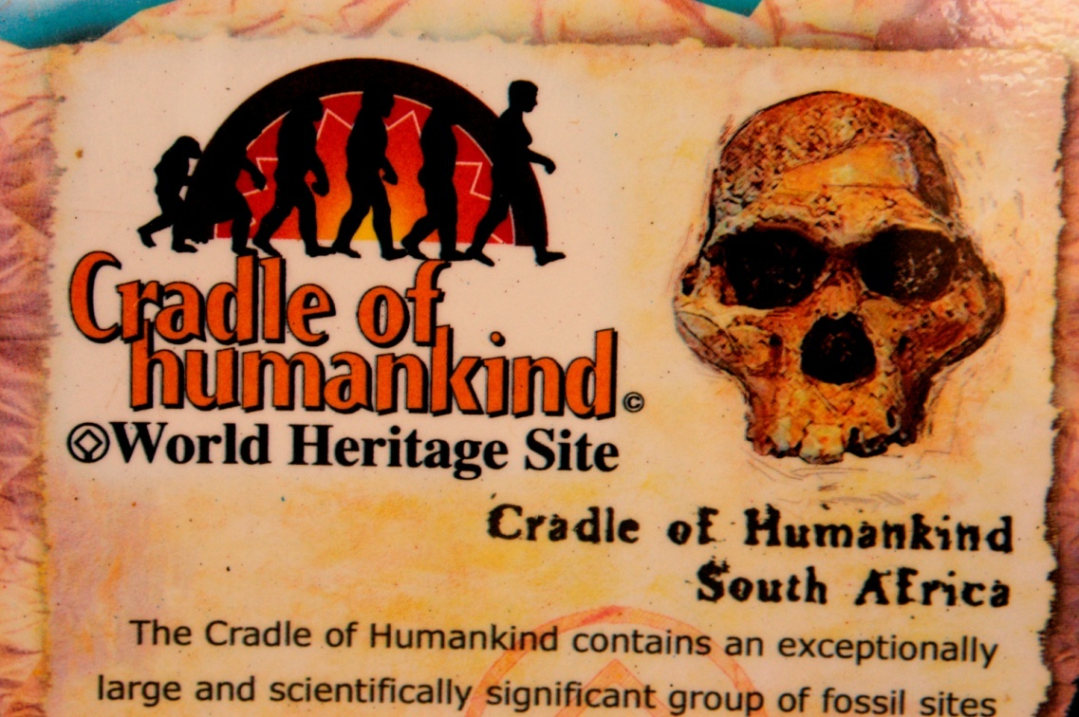
Australopithecus africanus
Cradle of Humankind
designated a UNESCO World Heritage Site in 1999
- Protected area covers 182 sq miles in 2 provinces
PRETORIA
- Area of limestone caves
Johannesburg
Sterkfontein Caves
Notes:
NOTE: pronunciation of Gauteng – Gow-tang

Slide 31
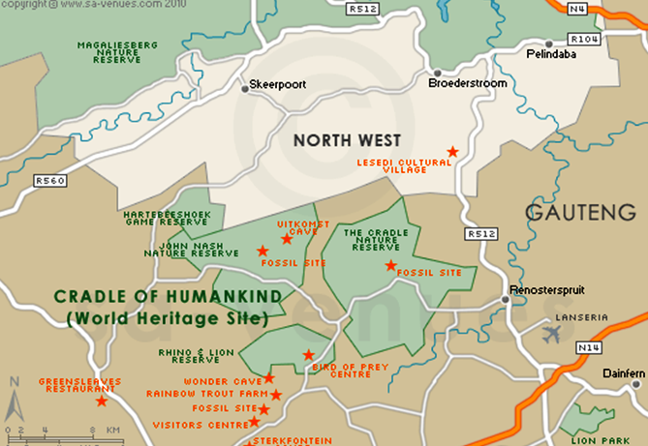
Australopithecus africanus
- More than 800 early hominin fossils 2M to 3M years old
Cradle of Humankind
designated a UNESCO World Heritage Site in 1999
- Protected area covers 182 sq miles in 2 provinces
- Area of limestone caves
Sterkfontein Caves

Slide 32
Australopithecus africanus
- More than 800 early hominin fossils 2M to 3M years old
Fossil Site
Fossil Site
Fossil Site
Fossil Site
Fossil Site
Sterkfontein Caves

Slide 33
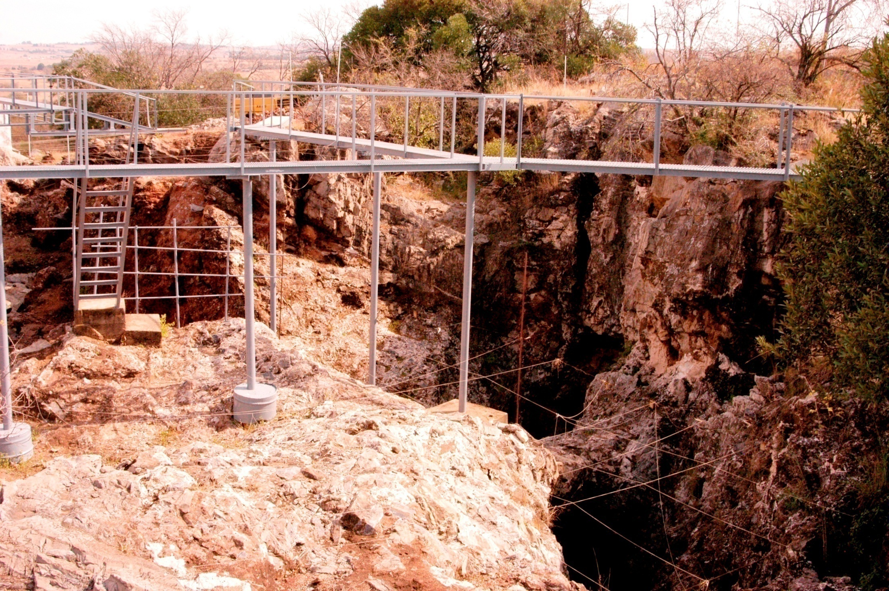
Australopithecus africanus
- More than 800 early hominin fossils 2M to 3M years old
Fossil Site
Fossil Site
Fossil Site
Fossil Site
Fossil Site
Sterkfontain Caves

Slide 34
http://www.cradleofhumankind.co.za/exploretoday/Pages/_SterkfonteinCaves.aspx
Sterkfontein Caves
Situated some 50 kilometres north-west of J’oburg, Sterkfontein Caves is the most famous of the 13 excavated fossil sites in the Cradle of Humankind World Heritage Site.
During the late 19th and 20th century, caves in the area were mined for lime unearthing fossils which attracted the interest of scientists. In 1947 Dr. Robert Broom extracted a well preserved fossils skull, “Mrs. Ples”, estimated to be around 2.3 million years old, from the world famous Sterkfontein Caves. More recently, in 1997, Professor Ron Clarke discovered “Little Foot”, an almost complete hominin skeleton aged at about 3.5 million years. Professor Clark describes the discovery of “Little Foot” as amongst the most significant palaeoanthropological finds ever made.
Today Sterkfontein is recognised as the most longstanding continuous palaeoanthropological dig in the whole world. Hominin fossils have also been found at other sites. These fossils, together with the finds of fossilised plants and animals, have helped scientists to reconstruct past habitats. Using these exciting clues we can reconstruct the environment around the Cradle of Humankind from our the earliest beginnings to our present.
Designed to blend into the unspoilt natural landscape, the Sterkfontein Visitor Centre sits among indigenous grassland which gives way to plants and trees concentrated towards the top of the koppie where the main cave lies.
Signposted with a 20 metre tall concrete monolith, the visitors centre houses an extraordinary hominin exhibition hall with highly informative displays, a 128-seat auditorium, a charming souvenir shop and a restaurant offering spectacular views of the surrounding countryside.
This cave-like complex leads to a walkway from which excavations can be viewed, as well as a working laboratory where you may observe scientists examining fossil finds.
For a memorable and informative experience, you can also take in a guided tour of the caves themselves, which descend 60 metres below the ground

Slide 35
http://en.wikipedia.org/wiki/Sterkfontein
Sterkfontein (Afrikaans for Strong Spring) is a set of limestone caves of special interest to paleo-anthropologists located in Gauteng province, Northwest of Johannesburg, South Africa near the town of Krugersdorp. The archaeological sites of Swartkrans (Afrikaans for Black Cliff) and Kromdraai (Afrikaans and Dutch for Crooked Turn) (and the Wonder Cave) are in the same area. Sterkfontein was declared a World Heritage Site in 2000 and the area in which it is situated, was named the Cradle of Humankind.
Numerous early hominin remains have been found at the site over the last few decades. These have been attributed to Australopithecus, early Homo and Paranthropus.
Modern excavation of the caves began in the late 1890s by limestone miners who noticed the fossils and brought them to the attention of scientists.
It was not until 1936 that students of Professor Raymond Dart and Dr. Robert Broom from the University of the Witwatersrand began concerted excavations. In 1936, the Sterkfontein caves yielded the first adult Australopithecine, substantially strengthening Raymond Dart's claim that the skull known as the Taung child (an Australopithecus africanus) was a human ancestor. There was a pause in excavation during World War II, but after the war Dr. R. Broom continued excavations. In 1947 he found the almost complete skull of an adult female (Sts 5) A. africanus (or possibly that of an adolescent male). Robert Broom initially named the skull Plesianthropus transvaalensis (near-man from Transvaal), but it became better known by its nickname, Mrs. Ples. Mrs Ples is now defined as a member of A. africanus.
In 1997 a near complete skeleton of a second species of Australopithecus (StW 573) was found in the caves by Ronald J. Clarke; extraction of the remains from the surrounding breccia is ongoing. The skeleton was named Little Foot, since the first parts found (in 1995, in storage) were the bones of a foot. Excavations continue to this day and finds now total some 500 hominids, making Sterkfontein one of the richest site in the world for early hominids. The Palaeo-Anthropology Scientific Trust (PAST),^{[1]} a non-profit trust fund established in 1994, sponsors over 90% of the research undertaken at Sterkfontein and was instrumental in its nomination as a World Heritage Site.
[edit] Dating of the deposits
The Member 4 deposits containing the Australopithecus africanus fossils have been dated by a combination of palaeomagnetism,^{[2]} electron spin resonance and uranium lead methods to between 2.6 to 2 Ma. ^{[3]} A. africanus fossil Sts 5 (Mrs. Ples) is estimated to be between 2.2 to 2 million years old placing it in the early Pleistocene and identifying it as the youngest A. africanus yet discovered. The StW 573 partial skeleton (Little Foot) was recovered from a separate infill at the site within the confines of the Silberberg Grotto. It is estimated to be around 2.3 to 2.2 million years old. A slightly younger deposit (StW 53 infill) dated to between 1.8 to 1.5 Ma has revealed the remains of a specimen of early Homo (StW 53). StW 53 has been described as similar to Homo habilis or as a novel new species Homo gautengensis. ^{[4]} No stone tools were associated with the fossil but StW 53 itself has evidence for stone tool cut-marks. ^{[5]} Member 5 contains Oldowan and Acheulian stone tools as well as specimens of early Homo and Paranthropus and is dated to between 1.6 and 1.1 Ma

Slide 36
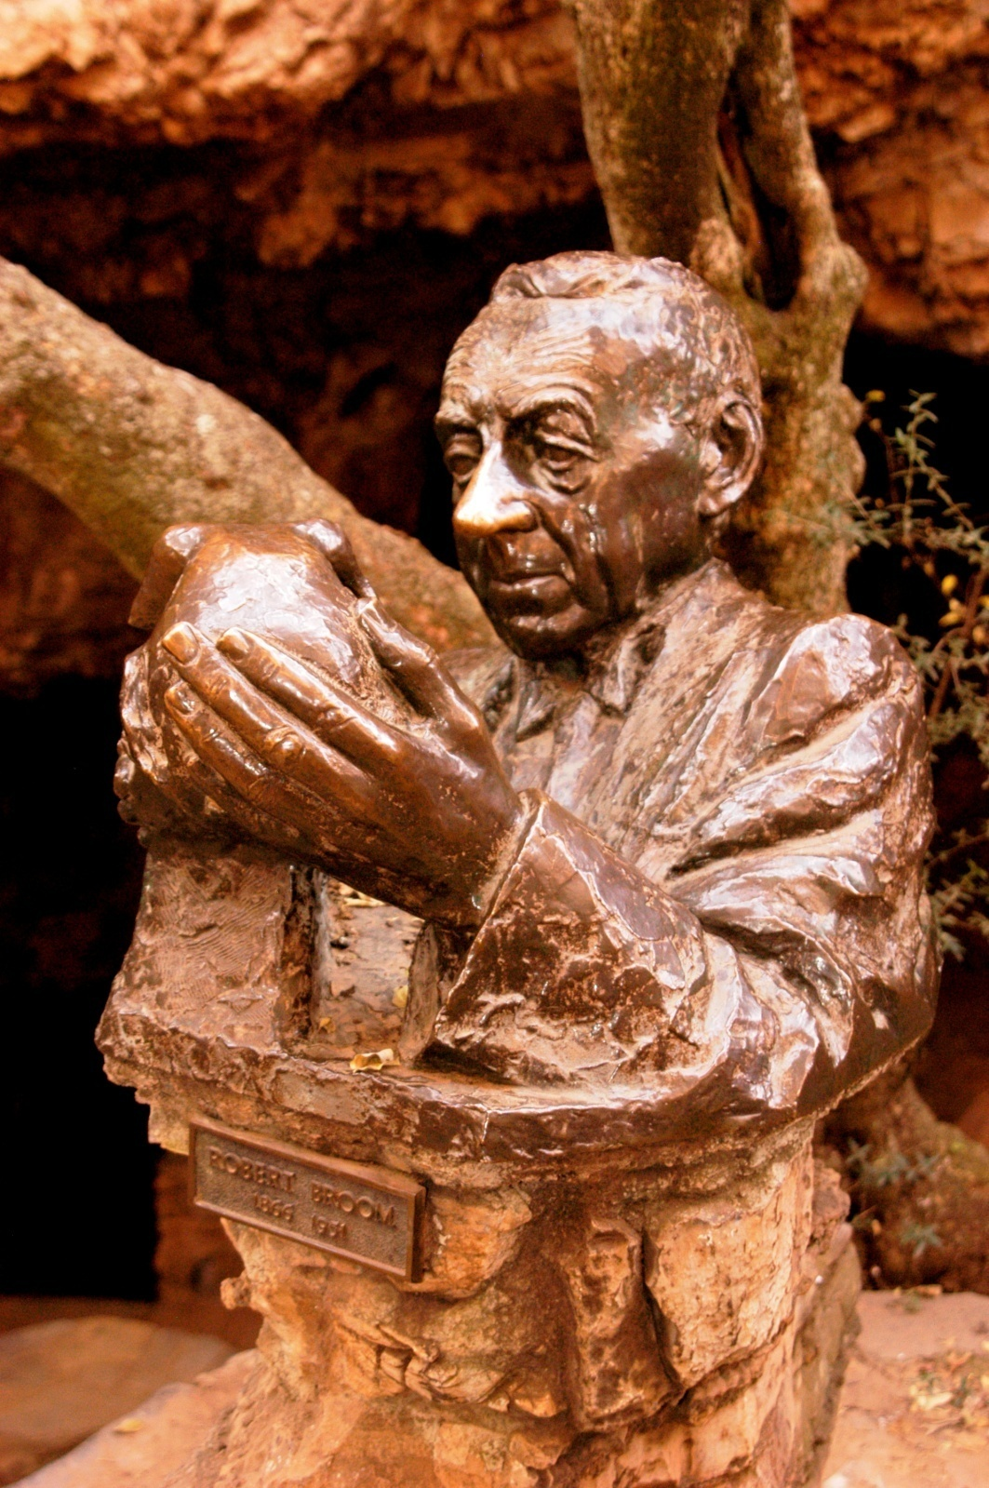
Australopithecus africanus
- More than 800 early hominin fossils 2M to 3M years old
- 1800’s: miners digging for lime unearthed 1st fossils
- 1936: professors at U. of Witwatersrand began excavations
- 1947: Dr. Robert Broom found a skull over 2M years old

Slide 37
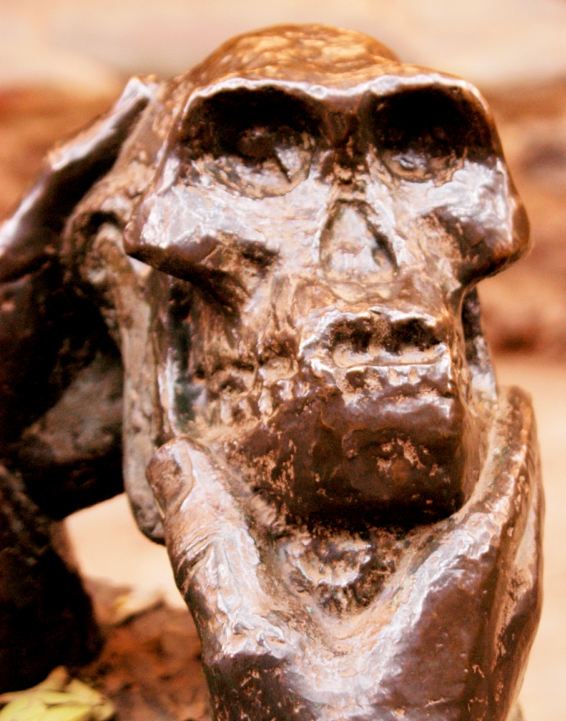
Australopithecus africanus
- originally classified as
‘plesanthropus Transvaalensis’
. . . . thus ‘Mrs. Ples’
later reclassified as
Australopithecus africanus

Slide 38
http://www.talkorigins.org/faqs/homs/rbroom.html
Robert Broom was born in Scotland in 1866 to a poor family. Educated as a doctor specializing in midwifery, he used that profession to support himself while travelling the world. Fascinated by the origin of the mammals, he travelled to Australia in 1892. Five years later, he went to South Africa, where he would stay for the rest of his life. In 1910 Broom's insistence on the theory of evolution cost him his position at the University of Stellenbosch, an extremely conservative religious institution, and he started practicing medicine in the remote Karroo region of South Africa. He also practised paleontology, becoming the world's leading expert on the mammal-like reptiles which were found in abundance in the region. His paleontological work was so highly regarded that in 1920 he was made a Fellow of the Royal Society.
In 1934, aged 68, he gave up his medical practice to take a position at the Transvaal Museum in Pretoria. In 1936 he decided to search for more of Dart's australopithecines, and in the same year found a fragmentary skull of an adult at Sterkfontein (which he initially placed in a new genus, Plesianthropus). In 1938, he found the first robust australopithecine skull at Kromdraai after a schoolboy discovered some teeth at the site. Further finds followed, but it was not until Broom published a major monograph on the australopithecines in 1946 and the influential British scientist W. E. Le Gros Clark examined the fossils in 1947 that most scientists finally accepted that the australopithecines were hominids. Other major finds included Sts 5, a superb fossil skull, and Sts 14, a partial skeleton which consisted of much of a pelvis, femur, and vertebral column and proved convincingly that australopithecines had walked upright.
In 1948 he started excavating at Swartkrans, which yielded remains of what was later determined to be Homo erectus, as well as further australopithecine fossils.
Somewhat of an eccentric, Broom, conscious of his standing as a medical man, always dressed in a formal dark suit even when fossil hunting, but would strip naked when it got too hot. He remained prodigiously energetic until the end of his life. Broom had promised that he would "wear out, not rust out", and was true to his word. In 1951, after writing the finishing lines of his monograph on the australopithecines, he whispered "Now that's finished ... and so am I". He died moments later at the age of 85

Slide 39
http://en.wikipedia.org/wiki/Mrs._Ples
Mrs. Ples is the popular nickname for the most complete skull of an Australopithecus africanus specimen ever found in South Africa. Many fossils of this species, which are considered to be the distant relatives of all humankind, have been found in the Sterkfontein area, in what has been designated the Cradle of Humankind World Heritage Site, which is situated approximately 70 kilometres southwest of Pretoria. Mrs. Ples was discovered by Dr. Robert Broom and John T. Robinson on 18 April 1947. The cranial capacity is about 485 cubic centimeters.¹ The catalog number for Mrs. Ples is STS 5.
Archaeologists at Sterkfontein cave, where Mrs. Ples was found.
The nickname Mrs. Ples was derived from the scientific designation Plesianthropus transvaalensis (near-man from the Transvaal), initially given to the skull by Dr. Broom; the nickname itself was coined by young coworkers of Dr. Broom.
The sex of the skull is not completely certain and so Mrs. Ples may in fact be Mr. Ples. In addition, X-ray analysis of the roots of the teeth of Mrs. Ples has suggested that it was a sub-adult, so a designation of Miss Ples or Master Ples is also possible.
Some experts have suggested that a partial skeleton, known only by its catalogue number of STS 14 that was discovered in the same year, in the same geological deposit and in proximity to it, may belong to this skull. If correct, this would make Mrs. Ples the South African counterpart to the famous Lucy fossil.
The fossil has been dated by a combination of palaeomagnetism and uranium-lead techniques to around 2.05 million years

Slide 40
http://blogs.smithsonianmag.com/hominids/2012/04/mrs-ples-a-hominid-with-an-identity-crisis/
In 1934, paleontologist Robert Broom set out to find the first fossil of an adult Australopithecus. Discovering a grown-up version of Raymond Dart’s Taung Child, the first Australopithecus specimen ever found, would help sway skeptics who doubted the fossil was a human ancestor, Broom thought. Throughout the 1930s, Broom found bits of australopithecine fossils in several caves in South Africa. But his most spectacular find came in 1947.
After blasting through limestone with dynamite at a cave called Sterkfontein, Broom recovered a nearly complete skull, missing only the teeth. He determined that it belonged to a middle-aged female of the species Plesianthropous transvaalensis (later scientists placed the skull in the species Australopithecus africanus). Known formally as Sts 5, the approximately 2.5-million-year-old skull is better known today as Mrs. Ples.
Paleoanthropologists agree that Mrs. Ples is the most complete, undistorted A. africanus skull ever found, but they quibble over whether the fossil is really a he or a she. Researchers who published a new study in the Journal of Human Evolution conclude that Broom was right all along, and anthropologists should continue to address the fossil as “Mrs.”
Doubts over Mrs. Ples’ sex first popped up in the 1980s. The most recent challenge came from Francis Thackeray of the University of the Witwatersrand in South Africa and colleagues. Over the past decade, they have argued that Mrs. Ples was a juvenile male. One reason for the confusion: The hole where the canine tooth sat was eroded away after the boy died, making it appear smaller and more feminine.
To address these claims, Frederick Grine of Stony Brook University in New York and his colleagues looked at virtual reconstructions made with CT scans of Mrs. Ples and several other A. africanus fossils. The fossils, representing both adults and youngsters, were all discovered at Sterkfontein. First, they concluded that Mrs Ples was an adult at the time of death. The roots of the individual’s wisdom teeth were fully formed. People today reach this stage of development between the ages of 17 and 21.
http://www.maropeng.co.za/index.php/exhibition_guide/australopithecus/
“Mrs Ples” is the most complete skull of an Australopithecus africanus specimen ever discovered. The skull was found encased in breccia (a rocky matrix) at Sterkfontein in 1947, by palaeontologist Dr Robert Broom and his assistant, John Robinson.
The discovery of “Mrs Ples” helped to highlight the view that humankind was born in Africa – a theory that most scientists were sceptical of at the time.
Mrs Ples was so named by The Star newspaper when Broom said it was an elderly female of the species Plesianthropus transvaalensis (“near-human from the Transvaal”), although the skull was later identified as belonging to the same species as the Taung Child, Australopithecus africanus, a distant ancestor of humankind.
Broom suggested that the skull of “Mrs Ples” represented a female, based on the small size of the sockets for the canine teeth.
Dr Francis Thackeray of the Transvaal Museum has argued that “Mrs Ples” is the fossil of a young male, although others, including University of the Witwatersrand Professor Ron Clarke, disagree.
Whatever gender she or he was, the individual was an adolescent. If that individual had in fact been male, he would have been relatively small.
“Mrs Ples” was clearly on the road to humanity. This hominid could walk upright, but had a small brain, similar in size to that of a modern chimpanzee.
At about 2.1-million years old, “Mrs Ples” is one of the youngest known fossils representing Australopithecus africanus. Not long after that, Australopithecus africanus became extinct.

Slide 41
http://www.ncbi.nlm.nih.gov/pubmed/22459766
Journal of Human Evolution: 2012 May;62(5):593-604. doi: 10.1016/j.jhevol.2012.01.010. Epub 2012 Mar 27.
Sex at Sterkfontein: 'Mrs. Ples' is still an adult female.
Grine FE, Weber GW, Plavcan JM, Benazzi S.
Department of Anthropology, Stony Brook University, Stony Brook, NY 11794-4364, USA. frederick.grine@stonybrook.edu
Abstract
The important question of whether the Australopithecus africanus hypodigm is taxonomically heterogeneous revolves largely around the interpretation of the morphological variation exhibited by the fossils from Sterkfontein. The sex assignment of these specimens is a critical component in the evaluation of their morphological variability. The Sts 5 cranium is pivotal in this regard because it is the most complete and undistorted specimen attributed to A. africanus. Although it has traditionally been regarded as an adult female, this view has been challenged. In particular, it has been argued recently that Sts 5 is a juvenile and that this, together with alveolar bone loss that has supposedly reduced the size of the canine socket, has led to its misinterpretation as a female. Virtual reconstruction of the M(3) roots (and/or alveoli) contradicts arguments that these teeth were erupting at the time of death. Regardless, canine emergence and root completion are well ahead of M(3) development in juvenile australopiths from Sterkfontein. Thus, even if the M(3) root of Sts 5 was incomplete, its canine root would have been fully formed. Measurements of palate depth indicate that the alveolar margins of Sts 5 have not suffered from much (if any) bone loss in the region of the C/P(3); any additional bone would result in a palate of truly exceptional depth. Therefore, the dimensions of the canine alveolus of Sts 5 can be regarded as proxies for those of the canine root. The canine root of Sts 5 is among the smallest recorded for any Sterkfontein australopith, which provides strong support for Robert Broom's initial attribution of sex to this specimen. There is no evidence to contradict the assertion that 'Mrs. Ples' is an adult female.

Slide 42
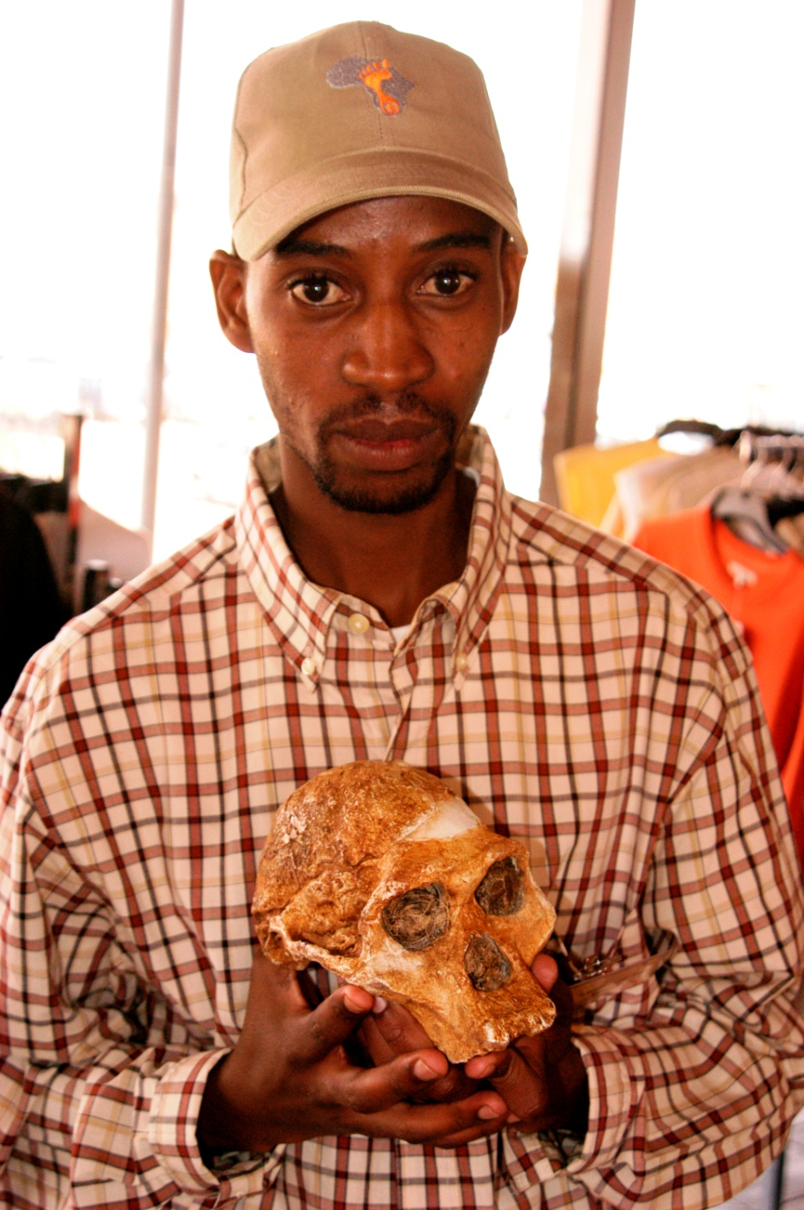
Australopithecus africanus
- originally classified as
‘plesanthropus Transvaalensis’
. . . . thus ‘Mrs. Ples’
later reclassified as
Australopithecus africanus

Slide 43
Australopithecus africanus
Dr Broom identified this
fossil as an adult female
based on:
    body size
    size of teeth cavities
later x-rays of the teeth
cavities showed emerging
permanent teeth at death;
predicted a sub-adult male
- 2012 evaluation by Stony
Brook University using 3D
virtual reconstruction of the
roots of the teeth found
evidence of a adult female
- originally classified as
‘plesanthropus Transvaalensis’
. . . . thus ‘Mrs. Ples’
?
Ms Ples!
later reclassified as
Australopithecus africanus

Slide 44
https://en.wikipedia.org/wiki/Mrs._Ples
Mrs. Ples is the popular nickname for the most complete skull of an Australopithecus africanus ever found in South Africa. Many Australopithecus fossils have been found nearSterkfontein, about 40 kilometres northwest of Johannesburg, in a region of the Transvaalnow designated as the Cradle of Humankind World Heritage Site. Mrs. Ples was discovered by Robert Broom and John T. Robinson on April 18, 1947. Because of Broom's use of dynamite and pickaxe while excavating, Mrs. Ples’ skull was blown into two pieces and some fragments are missing. Nonetheless, Mrs./Mr. Ples is one of the most perfect pre-human skulls ever found.
The nickname ″Mrs. Ples″ was coined by Broom's young co-workers. It derives from the scientific designation Plesianthropus transvaalensis (near-man from the Transvaal), that Broom initially gave the skull, later subsumed into the species Australopithecus africanus.In scientific publications the specimen is referred to by its catalogue number, STS 5.^{[1]}
The genus Australopithecus, of which there are several species, is considered the likely precursor of the genus Homo, to which all humanity belongs. Though its cranium is comparable to a chimpanzee's, Australopithecus walked upright, as humans do. This was a surprise to anthropologists at the time, because it had been assumed that the big brain of Homo had preceded, or at least evolved in tandem with our upright gait. Mrs. Ples, whose cranial capacity is only about 485 cubic centimetres,^{[2]} was one of the first fossils to reveal that upright walking had evolved well before any significant growth in brain size.
The sex of the specimen is not completely certain and so Mrs. Ples may in fact be Mr. Ples. Moreover, X-ray analysis of the specimen's teeth (see below) has suggested it was an adolescent. Hence a designation of Miss Ples or Master Ples is also possible.
The paleoanthropologist, Prof. Federick E. Grine, has studied the dental morphology of Mrs./Mr. Ples with a view to finally establishing Mrs./Ms. Ples' sex.^{[3]} Using the Computed Tomography (CT) scans of STS 5 from the experiments of Weber et. al., they compared them to CT scans of more recently discovered A. africanus skulls from Sterkfontein. These scans allowed Grine to reconstruct images of the roots of the teeth, in order to see how the molar and canine teeth developed. This study concluded that Mrs./Mr. Ples was indeed a middle-aged female. However, the question is not entirely settled, since other studies have come to the opposite conclusion.
Some experts have suggested that a partial skeleton, known only by its catalogue number of STS 14, which was discovered in the same year, in the same geological deposit and in proximity to Mrs. Ples, may belong to this skull. If correct, this would make Mrs. Ples the South African counterpart to the famous Lucy fossil. This skull, along with others discovered at Taung, Sterkfontien, and Makapangsgatoffered compelling evidence in favour of Charles Darwin's hypothesis that humanity's origin lay in Africa.^{[4]}
The fossil has been dated by a combination of palaeomagnetism and uranium-lead techniques to around 2.05 million years.

Slide 45
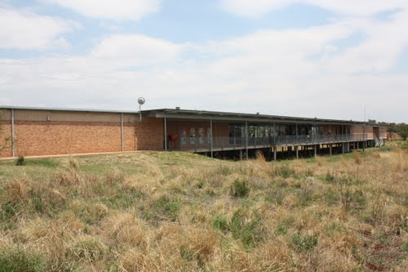
Australopithecus africanus
50 years later, in 1997 . . . .
- at the Sterkfontein archives
Ms Ples!

Slide 46
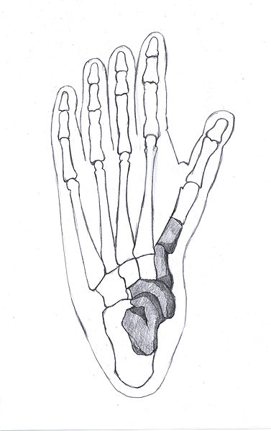
Australopithecus africanus
Australopithecus africanus
50 years later, in 1997 . . . .
at the Sterkfontein archives
Dr. Ron Clarke, looking in a box
of fossils, came across four
foot-bone fossils
He recognized these fossils
as probably from the same foot
3 years later, in a box of monkey
fossils, he came across more
bones from the same body
Because of the small foot size,
he called this find ‘Little Foot’

Slide 47
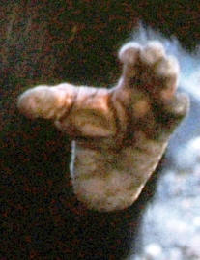
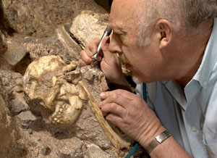
Australopithecus africanus
Slight divergence of the big toe
indicates an early species
of Australopithecus, living
between 3M & 4M YBP
50 years later, in 1997 . . . .
at the Sterkfontein archives
Dr. Ron Clarke, looking in a box
of fossils, came across four
foot-bone fossils
He recognized these fossils
as probably from the same foot
By 1998, Clarke had excavated
the skull, jaw, & other limbs of
‘Little Foot’ in Sterkfontein Cave
3 years later, in a box of monkey
fossils, he came across more
bones from the same body
Because of the small foot size,
he called this find ‘Little Foot’

Slide 48
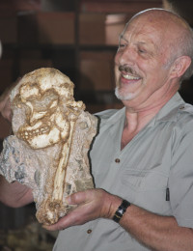
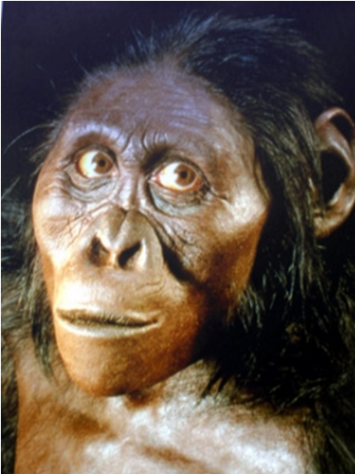
Australopithecus africanus
Where was he found?
‘Little Foot’

Slide 49
http://en.wikipedia.org/wiki/Little_Foot
‘Little Foot’
In 1994 while searching through museum boxes labelled 'Cercopithecoids' containing fossil fragments, paleoanthropologist Ronald J. Clarke identified several that were unmistakably hominin. He spotted four left foot bones (the talus, navicular, medial cuneiform and first metatarsal) that were most likely from the same individual. These fragments came from the Silberberg Grotto, a large cavern within the Sterkfontein cave system. They were described as belonging to the genus Australopithecus, and catalogued as Stw 573.¹
Due to the diminutive nature of the bones, they were dubbed "Little Foot". Dr. Clarke found further foot bones from the same individual in separate bags in 1997, including a right fragment of the distal tibia that had been clearly sheared off from the rest of the bone. Two fossil preparators and assistants of Dr. Clarke, Stephen Motsumi and Nkwane Molefe, were sent to the Silberberg Grotto to try to find the matching piece of tibia that attached to this fragment. Amazingly, within two days they found the remaining part of the bone protruding from the rock in the lower part of the grotto. Careful excavation by Dr. Clarke and his team lead to the uncovering of a complete skull and jaw in articulation, as well as other limb bones.
These were announced to the press in 1998, resulting in considerable media attention around the world.²
Subsequent work has uncovered a relatively complete skeleton, including a complete forearm and hand in articulation, parts of the pelvis, ribs and vertebrae, a complete humerus and most of the lower limb bones. This sensational discovery is still being excavated and is likely to be far more complete than the famous Australopithecus afarensis skeleton, "Lucy", from the site of Hadar, Ethiopia.
Clarke now suggests that Little Foot does not belong to the species Australopithecus afarensis or Australopithecus africanus, but to a unique Australopithecus species previously found at Makapansgat and Sterkfontein Member Four.³
The complex geology of Sterkfontein makes precise dating of Stw 573 difficult. There are no volcanic tuffs to ensure accurate radiometric dating, and the paleomagnetic sequences are incomplete. Further to this, there has been considerable debate in the scientific literature as to how old Stw 573 is. Estimates range from almost 4 Ma based on cosmogenic 26Al and 10Be radiometric dating ⁴ to 2.2 Ma ⁵ based on uranium-lead dating. A magnetochronology estimate places the fossil at about 3.3 Ma

Slide 50
http://www.maropeng.co.za/index.php/exhibition_guide/sterkfontein/little_foot/
“Little Foot”, an extraordinary fossilised skeleton of an early form of Australopithecus, is between 4.1-million and 3.3-million years old, making it the oldest known hominid from the Cradle of Humankind. The finding of Little Foot, deep inside a Sterkfontein cavern, was one of the most remarkable discoveries ever made in the field of palaeoanthropology
The story of how Little Foot was found, more than 3-million years after he fell into the cave, is almost as remarkable as the skeleton itself.
In 1994, palaeoanthropologist Professor Ron Clarke was in the workroom at Sterkfontein, sorting through a box of animal bones from the Silberberg Grotto in the caves, when he came across four foot bones which he realised belonged to an Australopithecus. The following year, he and esteemed palaeoanthropologist Professor Phillip Tobias, also of the University of the Witwatersrand, announced the discovery of the fossil Stw 573, nicknamed “Little Foot”, consisting of four articulating foot bones. The bones had actually been found in 1980, but had not been recognised.
Then, in 1997, Clarke discovered more bones in a box of monkey fossils, which he realised also belonged to Stw 573. Thebones had originally been blasted out by lime miners, and the broken bone from the second leg was among them. Clarke guessed that because there were bones from two feet, the rest of the skeleton could still be in the caves.
He approached his technical assistants, Stephen Motsumi and Nkwane Molefe, with a cast of the broken tibia, or shin bone, and asked them to search for the piece from which it had been snapped in the vast and dark Silberberg Grotto – a task akin to finding the proverbial needle in a haystack. Searching with only hand-held lamps, the two men astonishingly found the matching bone after just two days. It was embedded in breccia, deep inside the Silberberg Grotto.
Clarke said he realised there was an australopithecine skeleton lying somewhere in the Sterkfontein Caves when he found the broken bone from the second leg, which lime miners had blasted from the breccia a century before.
Describing the extraordinary discovery, Clarke said:
“When I found the second tibia, that’s when I knew [there was a skeketon]. I realised we had both legs. I didn’t know that we’d find it, but I knew the skeleton must be there and we must look for it. But the chances were almost nil. No-one was more surprised than me when Stephen said, ‘We think we’ve found the bone!’ He seemed low-key, though. The impact of what it meant was like a dream.I said to him ‘am I dreaming?’”
He added: “Alun Hughes [Clarke’s predecessor who excavated Sterkfontein] had a recurrent dream of breaking through into a cavern and finding a complete skeleton. By chance we made his dream a reality.”
Little Foot is still lying partially in breccia, while Clarke painstakingly excavates it. Once fully revealed, Little Foot will present unique insights into the world of our australopithecine ancestors.
Who was Little Foot and how did he get into the cave?
Little Foot lived in the Cradle of Humankind sometime between 4.1-million and 3.3-million years ago. An early form of Australopithecus, he was smaller than most modern humans, and had a smaller brain. He walked upright but, thanks to his powerful hands and a slightly divergent big toe, was better at climbing than we are. This was important as he probably slept in the safety of trees at night, to escape the prowling predators, like sabre-toothed cats and hunting hyenas that roamed his world.
Little Foot probably fell into a deep shaft that was covered with undergrowth. Perhaps he was fleeing from a beast of prey and didn’t see where he was going, or was running in pursuit of, or away from, a rival australopithecine. He would have originally fallen at least 10 m (about 30 ft) into the cave. He never got out.
Many of his bones are fractured and slightly displaced. Much of this damage was caused when the middle of his skeleton collapsed into a cavity many thousands of years ago and, over time, rocks tumbled onto his bones. As his bones are still articulated, his body was apparently mummified before being covered by sediments. The sediments were subsequently calcified, and the skeleton was preserved in breccia for millions of years.
Little Foot appears not to belong to Australopithecus africanus, but probably to an earlier species yet to be determined after the skeleton is fully excavated.
What makes Little Foot so special is that, at between 4.1-million and 3.3-million years old, he is not only one of the most ancient human ancestors yet discovered, but, also, his skeleton is almost complete – a rare find. Usually, fossil hominid bones are found in fragments, their relationships to one another the subject of scientific hypothesis. Because Little Foot is so complete, this specimen can be studied in its totality, without conjecture.
This almost complete australopithecine is one of the most important hominid discoveries ever made, and contributed to the Cradle of Humankind being declared a World Heritage Site in 1999

Slide 51
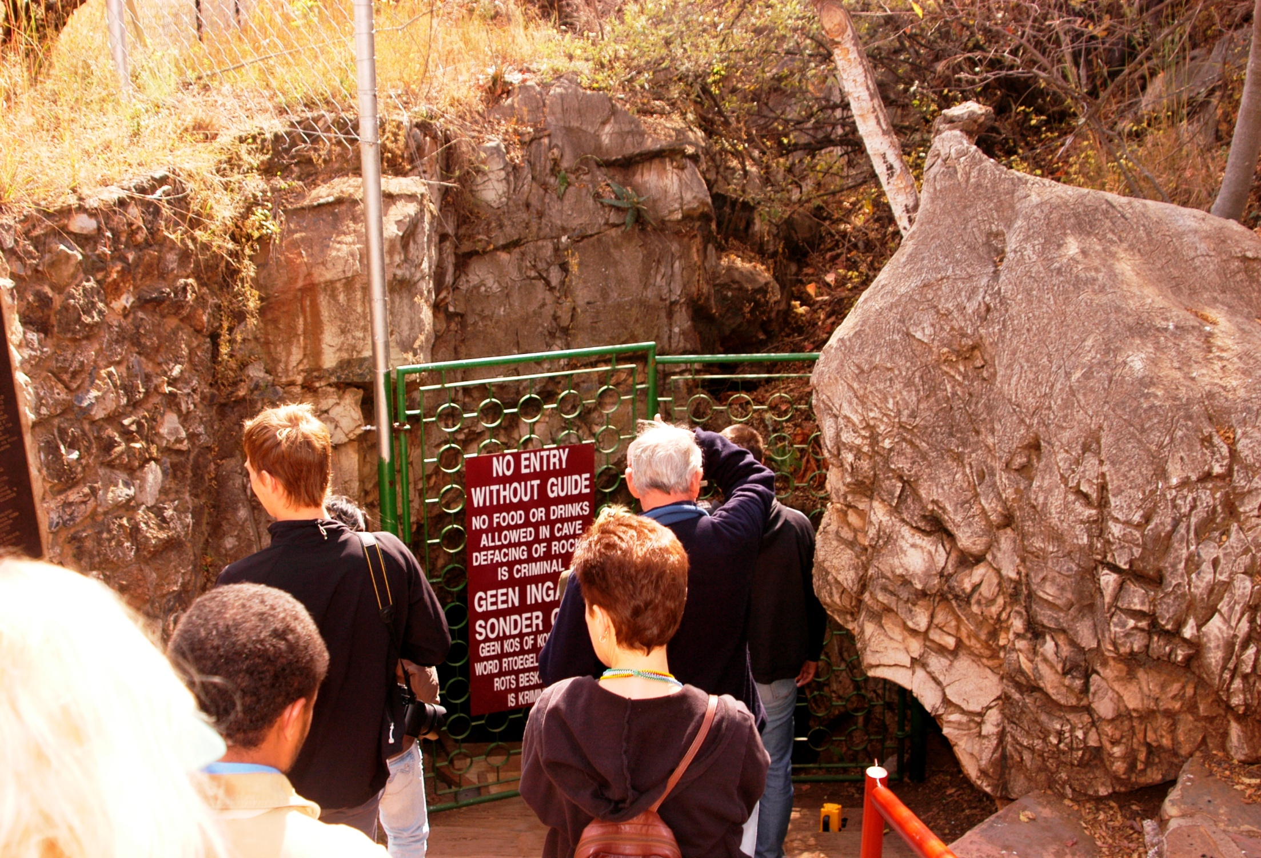
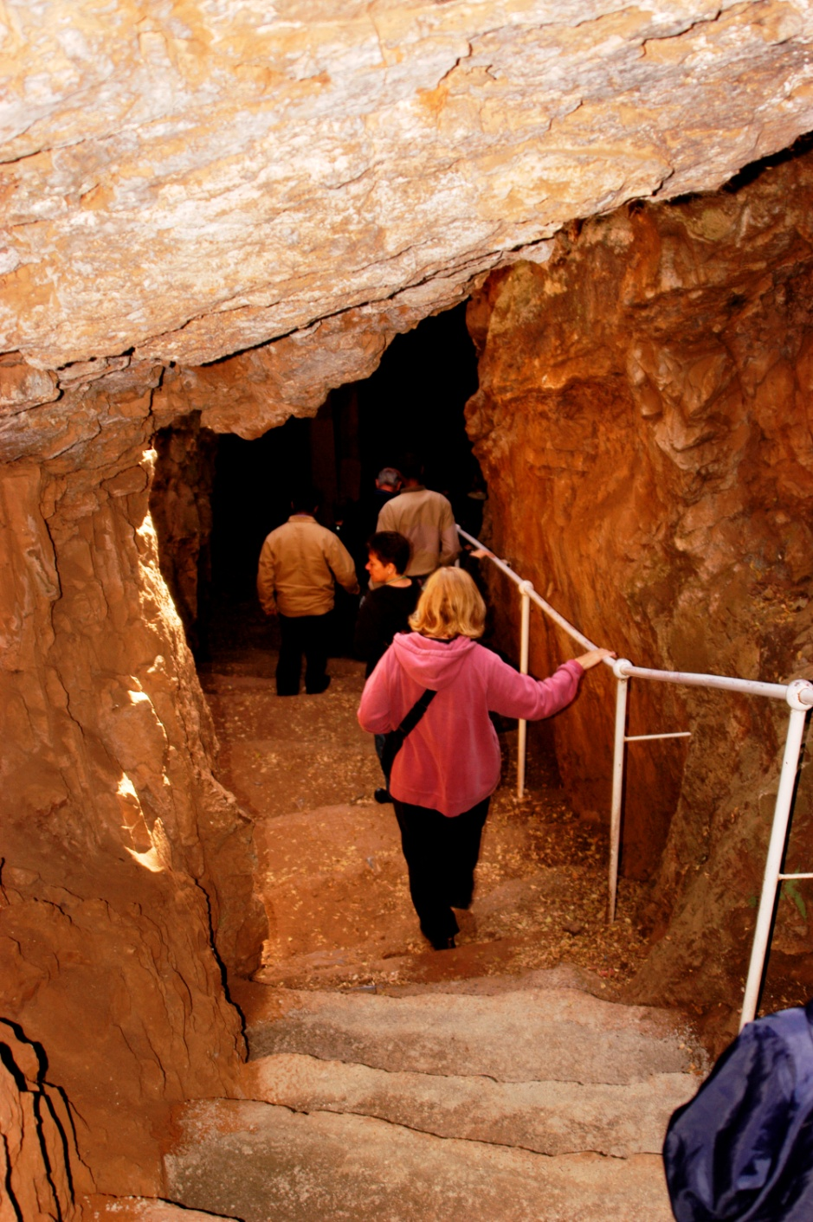
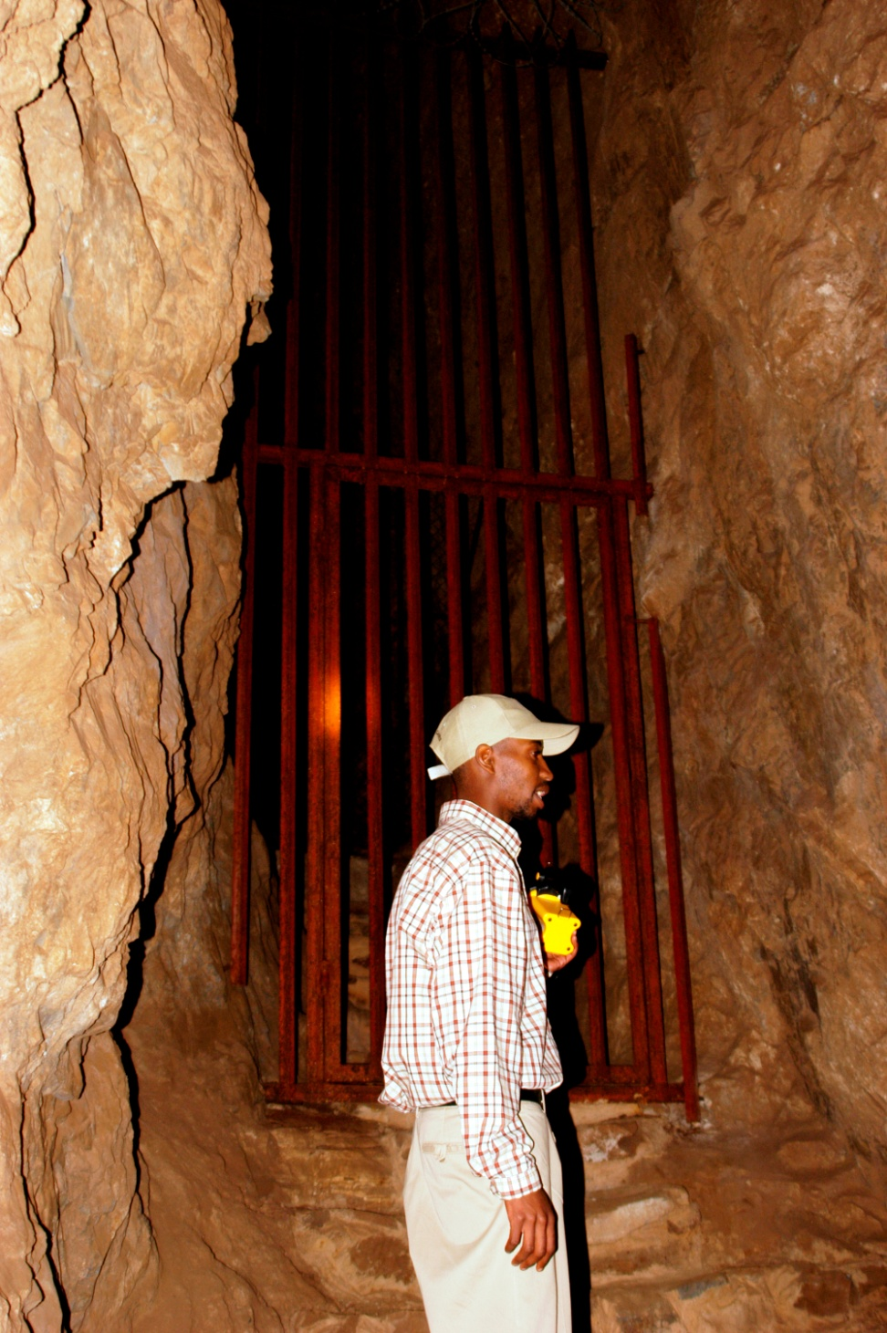
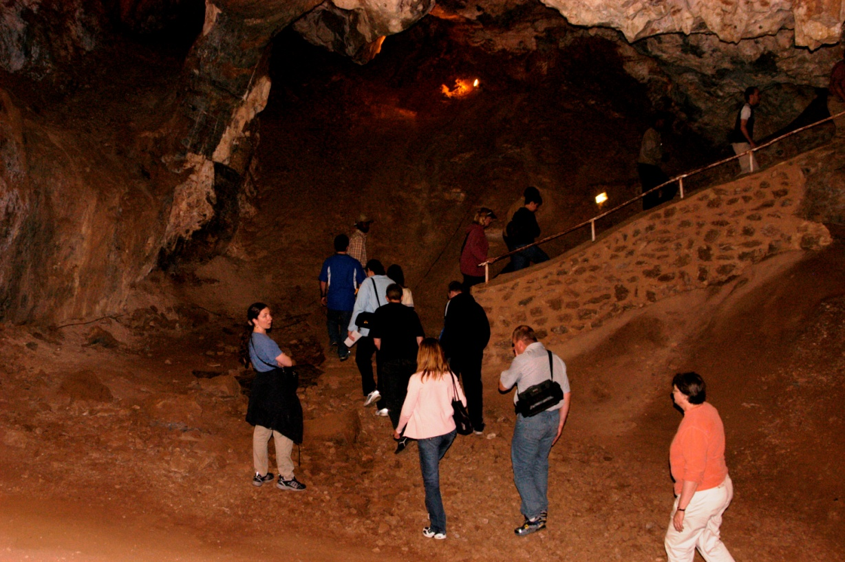
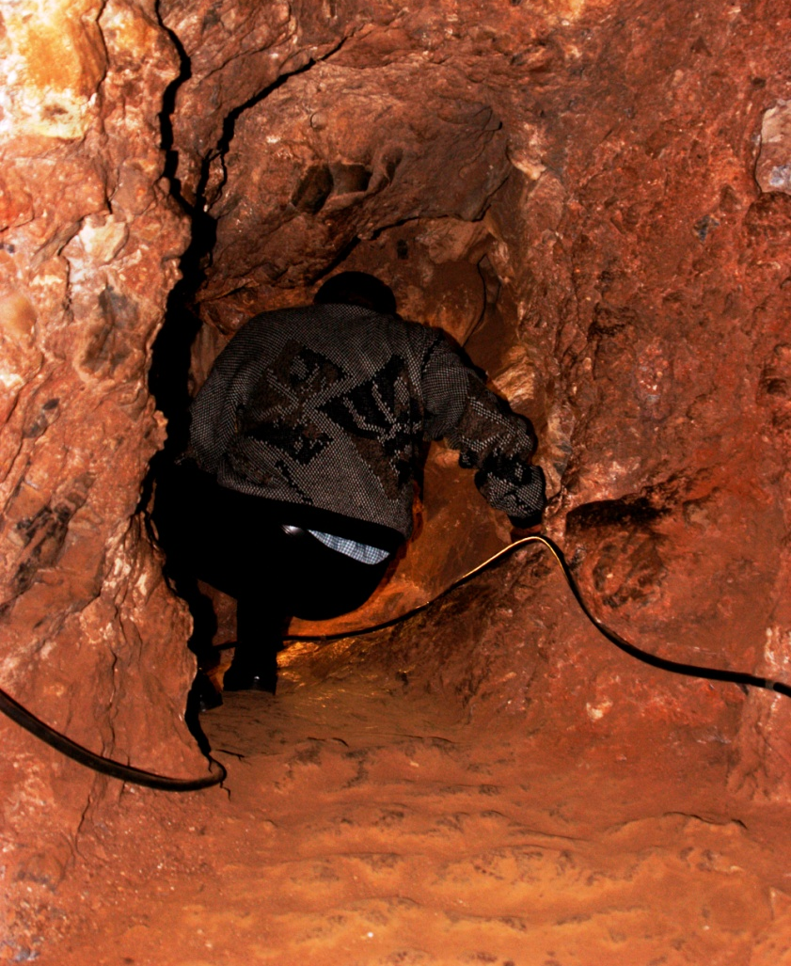
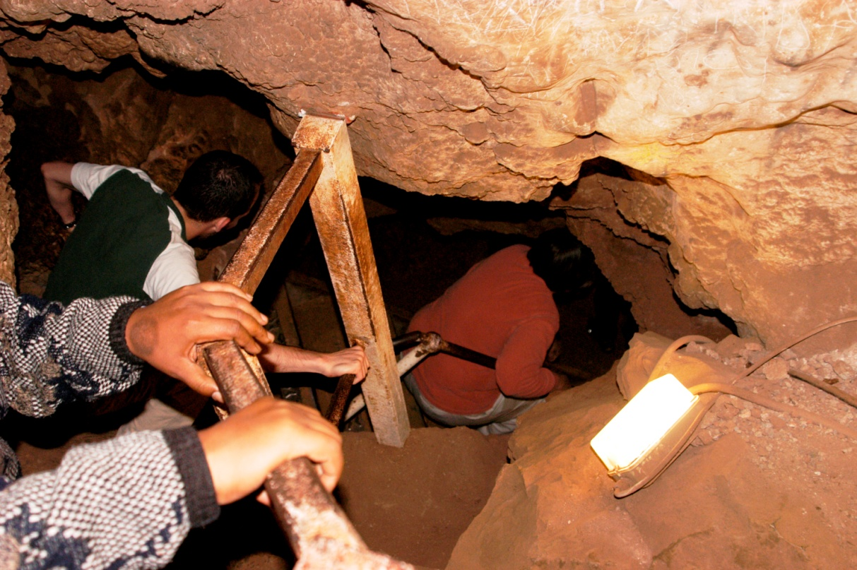
Australopithecus africanus
Where was he found?
How did he get here?

Slide 52
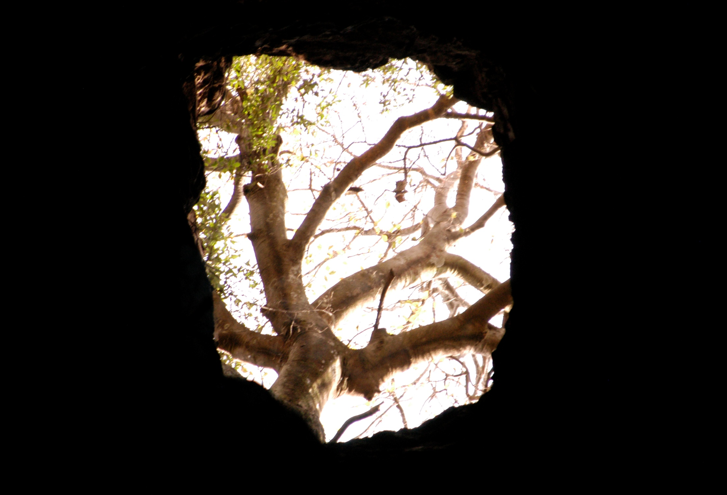
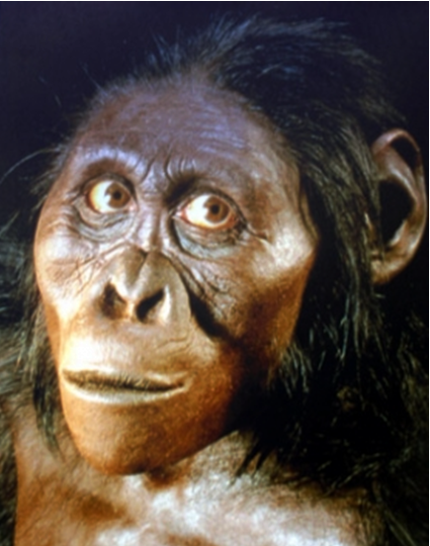
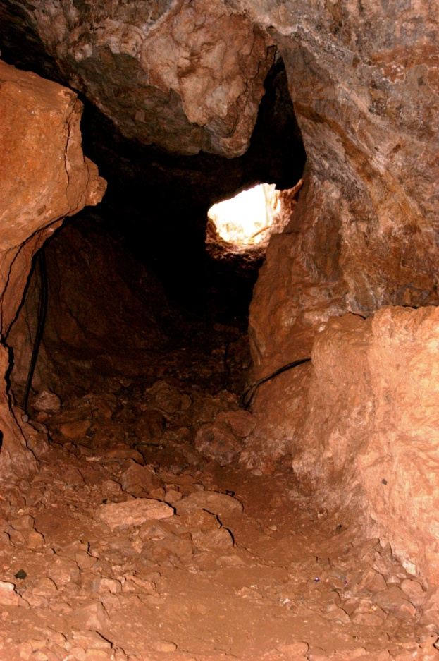
Australopithecus africanus
3M YBP ‘Little Foot’ fell through a brush-covered cave shaft
“this skeleton is one of the earliest
& most important hominid discoveries
in paleoanthropology”
falling at least 30’, he fractured many bones and died
sediments & rocks covered his body and solidified
the skeleton was preserved, embedded in rock
Why?
How did he get here?
africanus

Slide 53
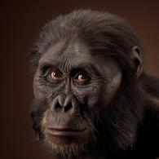
Australopithecus africanus
“this skeleton is one of the earliest
& most important hominid discoveries
in paleoanthropology”
. . . africanus fossils are more human-like than
are Australopithecus afarensis fossils:
1) more human-like cranium; larger brain
2) more human-like facial features
Why?
africanus
afarensis

Slide 54
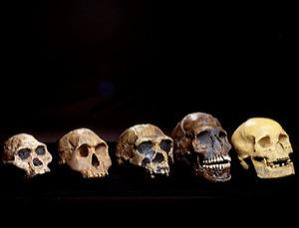
Australopithecus africanus
. . . africanus fossils are more human-like than
are Australopithecus afarensis fossils:
1) more human-like cranium; larger brain
2) more human-like facial features
H. sapiens
(Cro-Magnon)
A. africanus
H. habilis
HOMO GENUS
africanus
africanus
afarensis

Slide 55
Australopithecus africanus
. . . africanus fossils are more human-like than
are Australopithecus afarensis fossils:
1) more human-like cranium; larger brain
2) more human-like facial features
EXTINCTION: 2M YBP
- global cooling
- competition with Homo genus
. . . may be a direct ancestor to modern humans . .
H. sapiens
(Cro-Magnon)
A. africanus
H. habilis
HOMO GENUS
Why?

Slide 56
http://en.wikipedia.org/wiki/Australopithecus_africanus
Australopithecus africanus was an early hominid, an australopithecine, who lived between ~3.03 and 2.04 million years ago in the later Pliocene and early Pleistocene.^{[2]} In common with the older Australopithecus afarensis, Au. africanus was of slender build, or gracile, and was thought to have been a direct ancestor of modern humans. Fossil remains indicate that Au. africanus was significantly more like modern humans than Au. afarensis, with a more human-like cranium permitting a larger brain and more humanoid facial features. Au. africanus has been found at only four sites in southern Africa — Taung (1924), Sterkfontein (1935), Makapansgat (1948) and Gladysvale (1992).
Raymond Dart became interested in fossils found at the lime mine at Taung near Kimberley, South Africa in 1924.^{[3][4]} The most promising of these was a skull of an odd ape-creature sharing human traits such as eye orbits, teeth, and, most importantly, the hole at the base of the skull over the spinal column (the foramen magnum) indicating a human-like posture. Dart assigned the specimen the name Australopithecus africanus ("southern ape of Africa").^{[1]}
This was the first time the word Australopithecus was assigned to any hominid. Dart claimed that the skull must have been an intermediate species between ape and humans, but his claim about the Taung Child was rejected by the scientific community at the time due to the belief that a large cranial capacity must precede bipedal locomotion.^{[1]} This was exacerbated by the widespread acceptance of the Piltdown Man. Sir Arthur Keith, a fellow anatomist and anthropologist, suggested that the skull belonged to a young ape, most likely from an infant gorilla. It was not until 20 years later that the public accepted the new genus and that australopithecines were a true member of Homininae
Dart's theory was supported by Robert Broom.^{[5]} In 1938 Broom classified an adult endocranial cast having a brain capacity of 485 cc, which had been found by G. W. Barlow, as Plesianthropus transvaalensis. On April 18, 1947, Broom and John T. Robinson discovered a skull belonging to a middle-aged female,^{[6]} (catalogue number STS 5), while blasting at Sterkfontein. Broom classified it also as Plesianthropus transvaalensis, and it was dubbed Mrs. Ples by Broom's young coworkers (though the skull is now thought to have belonged to a young male). The lack of facial projection in comparison to apes was noted by Raymond Dart (including from Taung Child), a trait in common with more advanced hominines. Both fossils were later classified as Australopithecus africanus.
Like Au. afarensis, Au. africanus the South African counterpart was generally similar in many traits, a bipedal hominid with arms slightly larger than the legs (a physical trait also found in chimpanzees). Despite its slightly more human-like cranial features, seen for example in the crania Mrs. Ples and STS 71, other more primitive features including ape-like curved fingers for tree climbing are also present.
Due to other more primitive features visible on Au. africanus, some researchers believe the hominin, instead of being a direct ancestor of more modern hominins, evolved into Paranthropus. One robust australopithecine seen as a descendent of Au. africanus is Paranthropus robustus. Both P. robustus and Au. africanus crania seem very alike despite the more heavily built features of P. robustus that are adaptations for heavy chewing like a gorilla. Au. africanus, on the other hand, had a cranium which quite closely resembled that of a chimp, yet both their brains measure about 400 cc to 500 cc and probably had an ape-like intelligence.^{[5]} Au. africanus had a pelvis that was built for slightly better bipedalism than that of Au. afarensis.
Recent evidence regarding modern human sexual dimorphism (physical differences between men and women) in the lumbar spine has been seen in pre-modern primates such as Au. africanus. This dimorphism has been seen as an evolutionary adaptation of females to better bear lumbar load during pregnancy, an adaptation that non-bipedal primates would not need to make.^{[7][8]}
A 2011 study using ratios of strontium isotopes in teeth suggested that Au. africanus and Paranthropus robustus groups in southern Africa were patrilocal: women tended to settle farther from their region of birth than men did.
Based on current data Au. africanus dates to between 3.03 and 2.04 million years ^{[11]} based on a combination of palaeomagnetism (Andy Herries, La Trobe University, Australia, Uranium-lead (Robyn Pickering (U. Melbourne, Australia), electron spin resonance (Darren Curnoe, UNSW, Australia) and faunal dating.^{[12]} The Makapansgat fossils date to between 3.03 and 2.58 million years with fossils MLD37/38 likely dating close to 2.58 million years; Sterkfontein dates to between 2.58 and 2.04 million years with the Sts 5 Mrs Ples fossil dating to around 2.04 million years; and Gladysvale dates to between 2.4 and 2.0 million years. The age of the Taung child remains more difficult to determine and is the focus of a current project by Brian Kuhn (U. Witwatersrand, S. Africa), Phil Hopley (Birkbeck College, UK), Colin Menter (U. Johannesburg, S. Africa) and Andy Herries (La Trobe University, Australia).

Slide 57
http://www.newscientist.com/article/dn9989-timeline-human-evolution.html
Five skulls belonging to some ancestors and relatives of modern humans. From left to right, the skulls are: Australopithecus africanus (3-1.8 mya); Homo habilis (or H. rudolfensis, 2.1-1.6 mya); Homo erectus (or H. ergaster, 1.8-0.3 mya, although the ergaster classification is generally recognised to mean the earlier part of this period); a modern human (Homo sapiens sapiens) from the Qafzeh site in Israel, which is around 92,000 years old; and a French Cro-Magnon human from around 22,000 years ago (Image: Pascal Goetcheluck / SPL)

Slide 58
Australopithecus africanus
The Stone Age: 2.5 million to 4000 YBP (years before present)
EXTINCTION: 2M YBP
- global cooling
- competition with Homo genus
homo
. . . may be a direct ancestor to modern humans . .
HOMO GENUS

Slide 59
The Stone Age: 2.5 million to 4000 YBP (years before present)
Two genera that are now extinct . . .
homo
Paranthropus
‘Nutcracker Man’ (boisei)
‘Little Foot’
‘Ms Ples’
(africanus)
footprints (afarensis)
Australopithecus
How dispersed were these two genera?

Slide 60
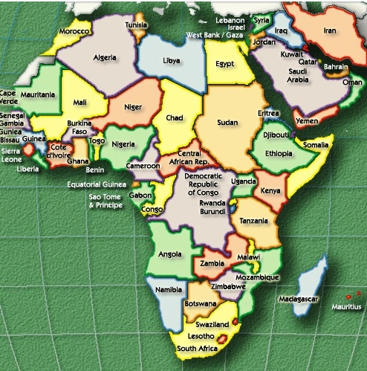
The Stone Age: 2.5 million to 4000 YBP (years before present)
homo
Paranthropus
Australopithecus
How dispersed were these two genera?

Slide 61
How dispersed were these two genera?
Footprints – 3.5M
Nutcracker Man- 1.8M
Ms Ples - 2.5M
Little Foot - 3M
A. Afarensis
P. Boisei
TANZANIA
SOUTH AFRICA
A. Africanus

Slide 62
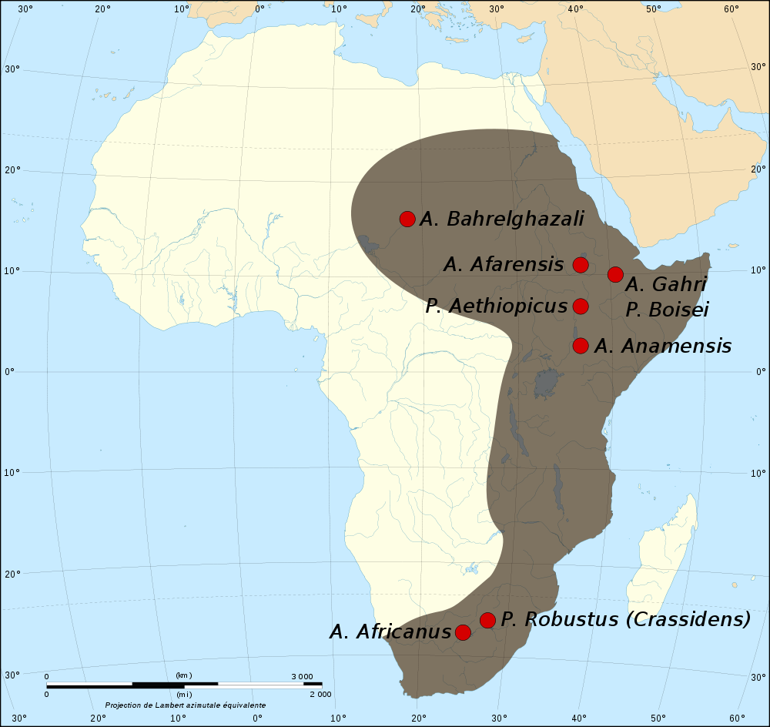
How dispersed were these two genera?
Fossil sites & spread of Genera . . . .
Australopithcus & Paranthropus
So who left Africa???
?
Footprints – 3.5M
Nutcracker Man- 1.8M
Sahara
Ms Ples - 2.5M
Little Foot - 3M
A. Afarensis
A. Afarensis
P. Boisei
P. Boisei
TANZANIA
Neither genus spread beyond Africa!?!
?
Kalahari
SOUTH AFRICA
A. Africanus
Notes:
http://popular-archaeology.com/issue/june-2011/article/ancient-nutcracker-man-had-no-taste-for-nuts
Map of the fossil sites and spread of the genus Paranthropus and genus Australopithecus
from 4.3 million years B.P. to 1 million years B.P. Image courtesy Kameraad Pjotrand and Sting. Wikimedia Commons.

Slide 63
Fossil sites & spread of Genera . . . .
Australopithcus & Paranthropus
The Stone Age: 2.5 million to 4000 YBP (years before present)
So who left Africa???
homo
Paranthropus
‘Nutcracker Man’ (boisei)
‘Little Foot’
‘Ms Ples’
(africanus)
A. Afarensis
P. Boisei
footprints
(afarensis)
Australopithecus
Neither genus spread beyond Africa!?!

Slide 64
http://www.sciencedaily.com/releases/2010/04/100408105147.htm
Australopithecus sediba
Apr. 8, 2010 — Two partial skeletons unearthed from a cave in South Africa belong to a previously unclassified species of hominid that is now shedding new light on the evolution of our own species, Homo sapiens, researchers say. The newly documented species, called Australopithecus sediba, was an upright walker that shared many physical traits with the earliest known Homo species -- and its introduction into the fossil record might answer some key questions about what it means to be human.
The fossils are between 1.95 and 1.78 million years old, and in this week's issue of Science, the peer-reviewed journal published by AAAS, the nonprofit science society, two reports describe both the physical characteristics of this new Australopithecus species as well as the ancient environment in which it lived and died. The emerging picture is one of a hominid with a bone structure similar to the earliest Homo species, but who employed it more as an Australopithecus, like the famed "Lucy," would have.
These new fossils, however, represent a hominid that appeared approximately one million years later than Lucy, and their features imply that the transition from earlier hominids to the Homo genus occurred in very slow stages, with various Homo-like species emerging first.
"It is not possible to establish the precise phylogenetic position of Australopithecus sediba in relation to various species assigned to early Homo," wrote Lee Berger, a lead author of one of the Science reports. "We can conclude that… this new species shares more derived features with early Homo than any other known australopith species, and thus represents a candidate ancestor for the genus, or a sister group to a close ancestor that persisted for some time after the first appearance of Homo."
Many scientists believe that the human genus Homo evolved from Australopithecus a little more than two million years ago -- but the origin has been widely debated, with other experts proposing an evolution from the Kenyanthropus genus. This new Australopithecus sediba species might eventually clear up that debate, and help to reveal our direct human ancestors.
"Before this discovery, you could pretty much fit the entire record of fossils that are candidates for the origin of the genus Homo from this time period onto a small table. But, with the discovery of Australopithecus sediba and the wealth of fossils we've recovered -- and are recovering -- that has changed dramatically," Berger said.
The name itself, "sediba," means "fountain" or "wellspring" in the seSotho language, spoken in South Africa, and indeed, researchers do believe that the new fossils will provide a wealth of information about our human origins.
For now, these new hominid fossils make it clear that the evolutionary transition from small-bodied, and perhaps more tree-dwelling, ancestors to larger-bodied, full-striding bipeds occurred in gradual steps.
Berger, from the University of Witwatersrand in South Africa, along with Paul Dirks from James Cook University in Australia began a study on the distribution of cave deposits in the Cradle of Humankind -- a World Heritage Site, set aside for its physical and cultural significance -- in January 2008. Months later, Berger discovered the two partial skeletons in cave deposits at Malapa, South Africa, and analyzed the remains, including most of a skull, pelvis, and ankle of the new species with colleagues from the U.S., Switzerland, and Australia.
The two Australopithecus sediba -- an adult female and a juvenile male -- were found close together in a portion of the cave system that had been protected from scavengers, so the fossils are very well-preserved. The researchers describe the hominid's physical traits, highlighting the unique pelvic features and small teeth that it shared with early Homo species. Based on its physique, they suggest that the new species descended from Australopithecus africanus, and that the hominid's appearance signified the dawn of more energy-efficient walking and running.
"These fossils give us an extraordinarily detailed look into a new chapter of human evolution, and provide a window into a critical period when hominids made the committed change from dependency on life in the trees to life on the ground," said Berger. "Australopithecus sediba appears to present a mosaic of features demonstrating an animal comfortable in both worlds."

Slide 65

The Stone Age: 2.5 million to 4000 YBP (years before present)
So who left Africa???
Homo Genus
homo
X
Paranthropus
X
‘Nutcracker Man’ (boisei)
‘Little Foot’
‘Ms Ples’
(africanus)
footprints
(afarensis)
Australopithecus

Slide 66
Homo Genus
The Stone Age: 2.5 million to 4000 YBP (years before present)
So who left Africa???
Homo Genus
Homo
homo

Slide 67
Homo Genus
2010 . . .
Homo
homo
Remember last week?
‘Handy-man’ (habilis)
Until 2010, earliest known
species of Homo Genus
2010 . . .

Slide 68
Homo Genus
2010 . . .
Homo
homo
- Anthropologist Darren Curnoe proposed a new Homo species
‘Handy-man’ (habilis)
- fossils, discovered decades earlier at Sterkfontain Cave
- originally classified as early H. Habilis or late Australopithicus
- ‘structurally too distinct’ to fit these other categories
New species: Homo gautengensis??
named for the S.A. Province

Slide 69
http://en.wikipedia.org/wiki/Homo_gautengensis
Homo gautengensis is a hominin species proposed by biological anthropologist Darren Curnoe in 2010. The species is composed of South African hominin fossils previously attributed to Homo habilis, Homo ergaster or in some cases Australopithecus and is argued by Curnoe to be the earliest species in the genus Homo.[
Discovery and analysis
Analysis announced in May 2010 of a partial skull found decades earlier in South Africa's Sterkfontein Caves in Gauteng near Johannesburg identified the species, named Homo gautengensis by anthropologist Dr. Darren Curnoe of the UNSW School of Biological, Earth and Environmental Sciences. The species has been considered by Lee Berger and co-workers to be an invalid taxon because it conflicts with their interpretations of "Australopithecus sediba". The species' first remains were discovered in the 1930s by Broom and Robinson, and the most complete skull (species Holotype Stw 53) was recovered in 1977 and was argued to belong to the species “Homo habilis”.^{[2]} The type specimen has been discussed in some refereed publications as being synonymous with “A. africanus”, but most analyses have considered it to belong in the genus "Homo", and several have suggested it sampled a novel species prior to Curnoe's description.
[edit] Geochronology
Identification of H. gautengensis was based on partial skulls, several jaws, teeth and other bones found at various times and cave sites in the Cradle of Humankind. The oldest specimens are those from Swartkrans Member 1 (Hanging Remnant) between 1.9 and 1.8 Ma .^{[3]} The type specimen StW 53 from Sterkfontein is dated to sometime between 1.8 and 1.5 Ma.^{[4]} A specimen from Gondolin Cave is dated to ~1.8 Ma.^{[5][6]} Other specimens from Sterkfontein Member 5 date to between 1.4 and 1.1 Ma, with the youngest specimens from Swartkrans Member 3 dated to sometime between 1.0 and 0.6 Ma.^{[7]}
[edit] Description
According to Curnoe, Homo gautengensis had big teeth suitable for chewing plant material.^{[8]} It was "small-brained" and "large-toothed," and was "probably an ecological specialist, consuming more vegetable matter than Homo erectus, Homo sapiens, and probably even Homo habilis." It apparently produced and used stone tools and may even have made fire, as there is evidence for burnt animal bones associated with H. gautengensis' remains.
Curnoe believes H. gautengensis stood just over 3 feet (0.91 m) tall and weighed about 110 pounds (50 kg). It walked on two feet when on the ground, "but probably spent considerable time in trees, perhaps feeding, sleeping and escaping predators," Curnoe said.
The researchers believe it lacked speech and language skills. Due to its anatomy and geological age, researchers think that it was a close relative of Homo sapiens but not necessarily a direct ancestor.
[edit] Implications
Earlier in 2010, the discovery of a new fossil primate species Australopithecus sediba was announced. A. sediba seems "much more primitive than H. gautengensis, and lived at the same time and in the same place," according to Curnoe, and as a result, "Homo gautengensis makes Australopithecus sediba look even less likely to be the ancestor of humans.
One reason for the sudden increase in the discovery of Homo species is improved analysis methods, often based on prior finds, DNA work, and a better understanding of where such remains might exist.^{[8]}
Curnoe instead proposes that Australopithecus garhi, found in Ethiopia and dating to about 2.5 million years ago, is a better possibility for the earliest non-Homo direct ancestor in the human evolutionary line.
Bones even older than those of Homo gautengensis await study and classification. According to Colin Groves, a professor in the School of Archaeology and Anthropology at the Australian National University in Canberra, "Here were a number of distinctive, perhaps short-lived, species of proto-humans living in both eastern and southern Africa in the period between 2 and 1 million years ago."

Slide 70
Homo Genus
Sept 2015 . . .
2010 . . .
Homo
homo
‘Handy-man’ (habilis)
?
Homo gautengensis??

Slide 71
Homo Genus
Age Dating Ancient Remains
Sept 2015 . . .
Homo
homo
- Lee Berger & team of 60 scientists announced another new species
?
Homo? naledi
?
- discovered by spelunkers in a cave at the ‘Cradle of Humankind’
- ‘largest sample of any hominin species at a single African site’
?
- age of this new species is still to be determined
Another new species: Homo? naledi

Slide 72
https://en.wikipedia.org/wiki/Homo_naledi
http://www.nytimes.com/2015/09/11/science/south-africa-fossils-new-species-human-ancestor-homo-naledi.html
SCIENCE
Homo Naledi, New Species in Human Lineage, Is Found in South African Cave
By JOHN NOBLE WILFORDSEPT. 10, 2015
Acting on a tip from spelunkers two years ago, scientists in South Africa discovered what the cavers had only dimly glimpsed through a crack in a limestone wall deep in the Rising Star Cave: lots and lots of old bones.
The remains covered the earthen floor beyond the narrow opening. This was, the scientists concluded, a large, dark chamber for the dead of a previously unidentified species of the early human lineage — Homo naledi.
The new hominin species was announced on Thursday by an international team of more than 60 scientists led by Lee R. Berger, an American paleoanthropologist who is a professor of human evolution studies at the University of the Witwatersrand in Johannesburg. The species name, H. naledi, refers to the cave where the bones lay undisturbed for so long; “naledi” means “star” in the local Sesotho language.
In two papers published this week in the open-access journal eLife, the researchers said that the more than 1,550 fossil elements documenting the discovery constituted the largest sample for any hominin species in a single African site, and one of the largest anywhere in the world. Further, the scientists said, that sample is probably a small fraction of the fossils yet to be recovered from the chamber. So far the team has recovered parts of at least 15 individuals.
“With almost every bone in the body represented multiple times, Homo naledi is already practically the best-known fossil member of our lineage,” Dr. Berger said.
The finding, like so many others in science, was the result of pure luck followed by considerable effort.
Two local cavers, Rick Hunter and Steven Tucker, found the narrow entrance to the chamber, measuring no more than seven and a half inches wide. They were skinny enough to squeeze through, and in the light of their headlamps they saw the bones all around them. When they showed the fossil pictures to Pedro Boshoff, a caver who is also a geologist, he alerted Dr. Berger, who organized an investigation.
Just getting into the chamber and bringing out samples proved to be a huge challenge. The narrow opening was the only way in.
Paul Dirks, a geologist at James Cook University in Australia, who was lead author of the journal paper describing the chamber, said the investigators first had a steep climb up a stone block called the Dragon’s Back and then a drop down to the entrance passage — all of this in the total absence of natural light.
For the two extended investigations of the chamber in 2013 and 2014, Dr. Berger rounded up the international team of scientists and then recruited six excavating scientists through notices on social media. One special requirement: They had to be slender enough to crawl through that crack in the wall.
One of the six, who were all women and were called “underground astronauts,” was Marina Elliott of Simon Fraser University in British Columbia. She said the collection and removal of the fossils involved “some of the most difficult and dangerous conditions ever encountered in the search for human origins.”
Besides introducing a new member of the prehuman family, the discovery suggests that some early hominins intentionally deposited bodies of their dead in a remote and largely inaccessible cave chamber, a behavior previously considered limited to modern humans. Some of the scientists referred to the practice as a ritualized treatment of their dead, but by “ritual” they said they meant a deliberate and repeated practice, not necessarily a kind of religious rite.
“It’s very, very fascinating,” said Ian Tattersall, an authority on human evolution at the American Museum of Natural History in New York, who was not involved in the research.
“No question there’s at least one new species here,” he added, “but there may be debate over the Homo designation, though the species is quite different from anything else we have seen.”
A colleague of Dr. Tattersall’s at the museum, Eric Delson, who is a professor at Lehman College of the City University of New York, was also impressed, saying, “Berger does it again!”
Dr. Delson was referring to Dr. Berger’s previous headline discovery, published in 2010, also involving cave deposits near Johannesburg. He found many fewer fossils that time, but enough to conclude that he was looking at a new species, which he named Australopithecus sediba. Geologists said the individuals lived 1.78 million to 1.95 million years ago, when australopithecines and early species of Homo were contemporaries.
Researchers analyzing the H. naledi fossils have not yet nailed down their age, which is difficult to measure because of the muddled chamber sediments and the absence of other fauna remains nearby. Some of its primitive anatomy, like a brain no larger than an average orange, Dr. Berger said, indicated that the species evolved near or at the root of the Homo genus, meaning it must be in excess of 2.5 million to 2.8 million years old. Geologists think the cave is no older than three million years.
The field work and two years of analysis for Dr. Berger’s latest discovery were supported by the University of the Witwatersrand, the National Geographic Society and the South African Department of Science and Technology/National Research Foundation. In addition to the journal articles, the findings will be featured in the October issue of National Geographic Magazine and in a two-hour NOVA/National Geographic documentary to air Wednesday on PBS.
Scientists on the discovery team and those not involved in the research noted the mosaic of contrasting anatomical features, including more modern-looking jaws and teeth and feet, that warrant the hominin’s placement as a species in the genus Homo, not Australopithecus, the genus that includes the famous Lucy species that lived 3.2 million years ago. The hands of the newly discovered specimens reminded some scientists of the earliest previously identified specimens of Homo habilis, who were apparently among the first toolmakers.
At a news conference on Wednesday, John Hawks of the University of Wisconsin, Madison, a senior author of the paper describing the new species, said it was “unlike any other species seen before,” noting that a small skull with a brain one-third the size of modern human braincases was perched atop a very slender body. An average H. naledi was about five feet tall and weighed almost 100 pounds, he said.
Tracy Kivell of the University of Kent, in England, an associate of Dr. Berger’s team, was struck by H. naledi’s “extremely curved fingers, more curved than almost any other species of early hominin, which clearly demonstrates climbing capabilities.”
William Harcourt-Smith of Lehman College, another researcher at the Museum of Natural History, led the analysis of the feet of the new species, which he said are “virtually indistinguishable from those of modern humans.” These feet, combined with its long legs, suggest that H. naledi was well suited for upright long-distance walking, Dr. Harcourt-Smith said.
In an accompanying commentary in the journal, Chris Stringer, a paleoanthropologist at the Natural History Museum in London, found overall similarities between the new species and fossils from Dmanisi, in the former Soviet republic of Georgia, dated to about 1.8 million years ago. The Georgian specimens are usually assigned to an early variety of Homo erectus.
Much remains to be discovered in the Rising Star Cave, like determining the ages of the fossils and the evolutionary position of H. naledi in the genus Homo and the human family tree. The discovery chamber has not given up all of its secrets. “There are potentially hundreds if not thousands of remains of H. naledi still down there,” Dr. Berger said.
At the news conference in South Africa on Thursday announcing the findings, Dr. Berger said: “I do believe that the field of paleoanthropology had convinced itself, as much as 15 years ago, that we had found everything, that we were not going to make major discoveries and had this story of our origins figured out. I think many people quit exploring, thought it was safer to conduct science inside a lab or behind a computer.” What the new species Naledi says, Dr. Berger concluded, “is that there is no substitute for exploration.”

Slide 73
Age Dating Ancient Remains
Analysis of the surrounding rocks
- stratigraphic
- electromagnetic
- chemical
- radiometric
Analysis of the fossil
- comparison to different genera
- DNA analysis
homo
?
?

Slide 74
http://www.sourcinginnovation.com/archaeology/Arch08.htm
The various dating techniques available to archaeologists
by Michael G. Lamoureux, March/April 2009
Introduction
Today's archaeologist has a wide variety of natural, electro-magnetic, chemical, and radio-metric dating methodologies available to her that can be used to accurately date objects that are just a few hundred years old as well as objects that are a few million years old with high accuracy in the right circumstances. Furthermore, when you consider that many archaeological sites will contain numerous types of artifacts that permit the use of multiple dating methodologies, a modern archaeologist can often employ cross-dating methodologies which can allow for extremely accurate dating as far back as 10,000 years in some regions.
Natural Dating Techniques
A modern archaeologist has almost half a dozen natural dating techniques that she can apply in the field that she can use to quickly determine an approximate date range, which, in the cases of varve analysis and dendrochronology, can often be used to decrease the date range estimate to a matter of just a few years.
One of the oldest natural dating techniques is geochronology, which is based on the principle of superposition -- an object, or layer, on top must have been placed there at a later point in time. Once a geologist has determined the absolute age of a geological formation, the archaeologist can assign an indirect date to objects found in the formation. In archaeology, geochronology lays the foundations for the dating technique better known as stratigraphy that assesses the age of archaeological materials by their association with geological deposits or formations. For example, the successive formation of post-Pleistocene shorelines at Cape Krusenstern Alaska provided J Louis Giddings with a means of ordering sites chronologically.
A prime example of stratigraphy is varve analysis. A varve is a sedimentary bed, or a sequence of such beds, that are deposited in a body of still water in a year. By dividing the rate of sedimentation in terms of units per year by the number of units deposited following a geologic event, an archaeologist or geologist can roughly establish the age of an event in years. The counting and correlation of varves has been used to measure the age of Pleistocene glacial deposits by way of the strata annually deposited in lakes by retreating glaciers. The upper limit of varve dating is dependent upon the region. A sequence of 17,000 years has been established in Scandinavia and a sequence of 20,000 years has been established in the United States in the state of Alaska.
Another example of stratigraphy is biostratigraphy. Chronological information may be conveyed by the presence, absence and form of the bones from one or more animal groups, which were known to have fixed periods of existence, found in a strata at an archaeological site. This technique is central to palaeoanthropology and the development of voles was crucial to the dating of the English Lower Paleolithic site of Boxgrove.
Stratigraphy is not an absolute dating technique as the best it can do is allow for the generation of terminus post quem (TPQ) dates, that provide the earliest possible date of a deposit, and termins ante quem (TAQ) dates, that provide the latest possible dates for a deposit, but still a very useful one as it provides a good reference check against other dating techniques.
A dating technique closely related to stratigraphy is palynology, the science of pollen analysis. If the history of plant life and the relative distribution is known in a region, palynology can be used to provide a reasonably accurate date range based on the plant life, and the average relative distribution thereof, represented in a set of samples
A more exact dating technique using natural formations is that of dendrochronology, which was first used in the 1930s , and which is based on the number, width, and density of the annual growth rings of certain types of long-lived trees. Dendrochronology has been used with great success in Alaska, the South-West US, Northern Mexico, Germany, Greece, Great Britain, Ireland, Norway, and Switzerland. Dendrochronology has produced master tree-ring indices off of the Douglas Fir and Bristlecone Pine in the south-west US that allows for the accurate dating of events and climatic conditions of the past 4000 years. In Germany, a master tree-ring index has been constructed that dates back 6000 years, and in Ireland an index has been constructed that dates back over 7200 years.
The final "natural" dating technique we will discuss is that of sequence dating which makes use of seriation techniques. Based on the observation that patterns of human behavior continually change, sequence dating is based on the principle that as human behavior changes, so does the material products it produces. This allows an archaeologist, who is able to identify the attributes of a class of artifacts that are the most sensitive to change, to construct a sequence of those artifacts that accurately reflects the passage of time. The technique was first applied successfully by Flinders Petrie who used it on pottery to date tombs at the huge prehistoric cemetery at Diospolis Parva, Egypt in 1902.
Seriation dating can also be frequency-based. Based on the assumption that the frequency of an artifact type typically follows a predictable measure in the form of a "battleship curve" from the time of its origin to the time of its disuse, it allows a sequence of archaeological sites with a number of examples of a given object type to be accurately ordered based on the frequency of an artifact type. The most famous example of frequency-based seriation dating is that of James Deetz and Edwin N. Dethlefsen who applied the methodology to tombstones from 18th and 19th century New England and demonstrated that the popularity of the decorative motifs on the headstones did follow a battleship-shaped distribution over time.
Electromagnetic Dating Techniques
Probably the most well-known electromagnetic dating technique is that of archaeomagnetism. Archaeomagnetism, which uses the fact that the earth's magnetic field varies through time and shifts in the horizontal plane (declination angle) as well as the vertical plane (dip angle), allows materials that contain a sufficient amount of iron content to be dated wherever accurate compass readings are available far enough back in time as iron particles trapped in a matrix, which align to magnetic north, will have their orientation fixed when the matrix is heated above its curie point. In some areas, archaeomagnetic alignments have been calibrated to 5,000 years in the past.
Another electromagnetic dating technique is based on electron spin resonance. In some crystal structures, electrical charges build up at a known rate and can be used to date enamel, shells, and calcite deposits between 50,000 and 1,000,000 years old in dry environments.
The final electromagnetic dating technique in common use is that of thermoluminescence dating. Thermoluminescence dating makes use of the fact that free electrons trapped in a mineral's crystal lattice can escape when the mineral is heated to a temperature below incandescence. If one assumes a relatively constant radiation level, a measure of the thermoluminescent output can be used to provide a date when the object was last heated to the point where its free electrons escaped. The method can be quite accurate and is routinely used to date objects several hundred to several thousand years old.
Chemical Dating Techniques
Although not that widely used, archaeologists do have a number of chemically based dating methods to choose from. Perhaps the most common is that of obsidian hydration (rind) dating, developed in 1960 by Irving Friedman and Robert Smith. If an obsidian (recently deposited volcanic) object is trapped for a long period of time in an area where water is present, water vapor will slowly diffuse into a freshly chipped surface. The cumulative hydration, or absorption, of water will form a hydration layer, measurable in microns, on the exposed surfaces that can be detected microscopically. Since the hydration rate with respect to a specific obsidian composition and water temperature is fairly constant, if the obsidian composition is known and the historical temperature of the area was fairly constant year after year, or if regional correction factors are known, fairly accurate dates can be produced. In the right circumstances, the technique can be used to date objects as recent as 200 years or as ancient as 200,000 years old.
Another chemical dating technique available to archaeologists is that of aspartic amino acid racemization which can be used to date bones, teeth, and shells that are between 1,000 years and 1,000,000 years old (if calibrations to local climates are available). It's based on the fact that the chemical structures of amino acids found in all living things changes over time at a known rate given a known set of environmental conditions. More specifically, it uses the fact that the amino acids of the vast majority of living organisms come in what biologists call the levorotary (left) form, even though a dextrorotary (right) form exists for all amino acids except glycine. These amino acids start to spontaneously convert from their levorotary form to their dextrorotary form as soon as a creature dies in a process called "racemization". When the rate of conversion is known, racemization provides a clock that can be used to determine the time of death.
Another chemical dating technique available to archaeologists for dating bone is the bone-nitrogen dating technique. Bones buried in soil lose organic components, and nitrogen in particular, and gain inorganic components, such as fluorine and uranium, in their place. Since bones buried at the same time in the same deposit will lose nitrogen and gain fluorine and uranium at the same rate, an archaeologist can used this as a relative dating technique to determine if bones found in the same matrix were indeed deposited together. Although this technique can not produce an exact age as the rate of nitrogen loss and fluorine gain differs with local environmental conditions, when used in conjunction with other bone dating techniques, such as amino acid racemization, bone-nitrogen dating allows an archaeologist to accurately date a collection of bones by accurately dating just one bone from the set.
Radiometric Dating Techniques
Radiometric dating techniques are based on the fact that unstable radioactive elements have regular rates of decay, or half-lives, that can be used as virtual clocks. The most common forms of radiometric dating are carbon-14, potassium-argon, and thorium-230, although some archaeologists will also make use of radium-strontium, lead-alpha age, and (spontaneous) fission-track radiometric dating. Radiometric dating techniques can be used on any object if the original amount of radioactive isotope, the current amount of radioactive isotope, and the rate of radioactive decay of the radioactive isotope is known.
Carbon-14 dating, which is based on the decay of carbon 14, with a half-life of 5730 years, to nitrogen-14 through beta-decay, measures the age of an organic object using the ratio of carbon-14 to carbon-12 that remains in the object. Since carbon-14 rapidly disintegrates compared to other radioactive elements, the method is generally limited to 50,000 years, although it can sometimes be used to date objects as old as 70,000 years when correction factors are available.
Although carbon-14 dating is fairly accurate, since the concentration of carbon-14 in the atmosphere to carbon-12 has varied over time (due to changes in the earth's magnetic field, alterations in solar activity, and the industrial activities of humans), dates may only be off by a few decades for more recent objects and dates for objects tens of thousands of years old can be off by as much as 5,000 years, especially if the sample was contaminated (by percolating ground water, for instance). More precisely, without calibrations, radiocarbon age determinations for items older than 3500 years old become increasingly inaccurate as you go back in time. Objects deposited before 1500 BC are generally found to be at least 150 years too recent, while objects deposited before 4000 BC are generally found to be at least 700 years too recent.
One advantage of the carbon-14 method, which was one of the first radiometric dating methods developed, is that only a handful of charcoal, burned bone, shell, hair, wood, or other organic substance is required for laboratory analysis. When it was invented, it allowed the direct dating of small and valuable items such as bone tools, wooden artifacts, papyri, and human fossils for the first time.
Perhaps the most common radiometric dating technique is potassium-argon dating. Based on the presence of potassium-40, which is abundant in micas, feldspars, and hornblendes and has a half-life of 1.3 billion years, potassium-argon dating makes use of the fact that 11 of every 100 potassium atoms that decay become argon 40. The method can be used to accurately date rocks that were formed as early as 20,000 years and as far back as 5,000,000,000 years, as long as the rocks were not heated to 125 Celsius in the interim, as this is the temperature where argon will begin to leak. (In these circumstances, it can tell you the last time the rock was heated.) The method, which is particularly helpful in dating formations associated with the remains of fossil hominids and Lower Paleolithic tools, has been successfully used to date stone flakes and chopping tools from Koobi Fora in Northern Kenya to approximately 2,000,000 years ago and the remains of Zinjanthropus to approximately 1,750,000 years ago.
Another common radiometric dating technique, which is primarily used to date older oceanic settlements, is thorium 230 which has a half-life of 80,000 years. The ionium-thorium dating method, which is based on the assumption that the initial ionium content of accumulating sediments has remained constant for the total section under study, is generally applied to deep-sea sediments formed during the last 300,000 years.
A less common radiometric dating technique, which is primarily used to date ancient igneous and metamorphic terrestrial rocks as well as lunar samples, is that of radium-strontium dating. It's often used to cross-check potassium-argon dates as the strontium element is not diffused by mild heating.
Another less common radiometric dating technique, known as lead-alpha age dating, uses the total lead content and uranium-thorium alpha-particle activity of zircon, monazite, and xenotime concentrates to determine the age of the rock. It is based on the fact that Uranium-235 and Uranium-238 both decay to lead, lead-207 in the first case and lead-206 in the second. Since uranium 238 has a half-life of 4,500,000,000 years, it can be used to date rocks as old as the earth.
The final radiometric dating technique we will cover is that of spontaneous fission-track dating. Primarily used on glass greater than 100,000 years old where a 10%+ error margin is acceptable, it attempts to calculate the age of a mineral or glass by the spontaneous fission of uranium-238 through a calculation of the spontaneous density to the induced density. The method works best on micas, tektites, and meteorites and can date rocks as old as 1,000,000 years. However, rocks that have been subjected to high temperatures or exposed to cosmic-ray bombardment on the earth's surface are prone to yield erroneous ages.
Conclusion
Today's archaeologist has a wide variety of natural, electro-magnetic, chemical, and radio-metric dating methodologies available to her that can be used to accurately date objects that are just a few hundred years old as well as objects that are a few million years old with high accuracy in the right circumstances.

Slide 75
Age Dating Ancient Remains
Potassium-Argon Dating
Analysis of the surrounding rocks
- stratigraphic
- electromagnetic
- chemical
- radiometric
Analysis of the fossil
- comparison to different genera
- DNA analysis
Potassium-Argon Dating
- Potassium-Argon dating
Nutcracker Man – Olduvai Gorge
Analysis of the fossil
- comparison to different genera
- DNA analysis

Slide 76
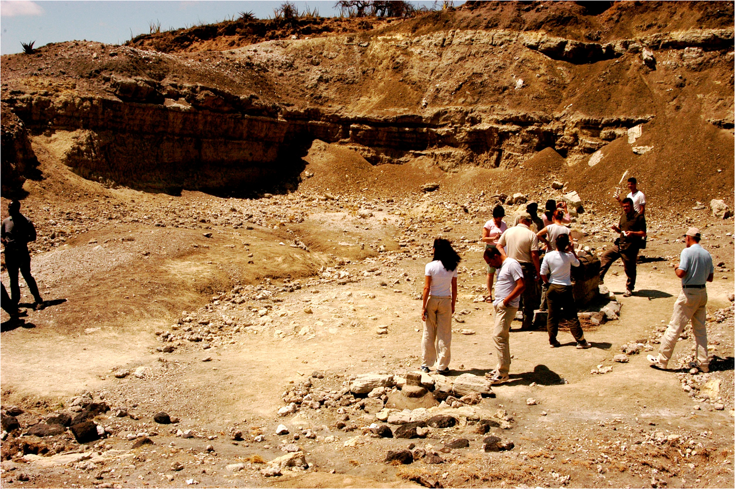
Potassium-Argon Dating
Nutcracker Man – Olduvai Gorge
- Potassium is found in many rocks like micas, clays, & evaporites
- a radioactive isotope of potassium decays into argon & calcium
- the rate of radioactive decay is known
?
1.3 billion years
⁴⁰Ar
⁴⁰K
half life
⁴⁰Ar
⁴⁰Ca
¹⁴Carbon
5730 years
- ratio of the remaining amount of ⁴⁰K to the amount of ⁴⁰Ar shows
how long ago potassium was incorporated into the rock
¹⁴Nitrogen
Notes:
Argon-forty and Calcium-forty are stable isotopes of their elements (no decay)

Slide 77
https://en.wikipedia.org/wiki/K%E2%80%93Ar_dating
Potassium–argon dating, abbreviated K–Ar dating, is a radiometric dating method used in geochronology and archaeology. It is based on measurement of the product of the radioactive decay of an isotope of potassium (K) into argon (Ar). Potassium is a common element found in many materials, such as micas, clay minerals, and evaporites. In these materials, the decay product ⁴⁰Ar is able to escape the liquid (molten) rock, but starts to accumulate when the rock solidifies (recrystallizes ). The amount of Argon sublimation that occurs is a function of the purity of the sample, the composition of the mother material, and a number of other factors. These factors introduce error limits on the upper and lower bounds of dating, so that final determination of age is reliant on the environmental factors during formation, melting, and exposure to decreased pressure and/or open-air. Time since recrystallization is calculated by measuring the ratio of the amount of ⁴⁰Ar accumulated to the amount of ⁴⁰K remaining. The long half-life of ⁴⁰K allows the method to be used to calculate the absolute age of samples older than a few thousand years.
Potassium naturally occurs in 3 isotopes – ³⁹K (93.2581%), ⁴⁰K (0.0117%), ⁴¹K (6.7302%). The radioactive isotope ⁴⁰K decays with a half-life of 1.248×10⁹ years to ⁴⁰Ca and ⁴⁰Ar. Conversion to stable ⁴⁰Ca occurs via electron emission (beta decay) in 89.1% of decay events. Conversion to stable ⁴⁰Ar occurs via electron capture in the remaining 10.9% of decay events.^{[3]}
Argon, being a noble gas, is a minor component of most rock samples of geochronological interest: it does not bind with other atoms in a crystal lattice. When ⁴⁰K decays to ⁴⁰Ar (argon), the atom typically remains trapped within the lattice because it is larger than the spaces between the other atoms in a mineral crystal. But it can escape into the surrounding region when the right conditions are met, such as change in pressure and/or temperature. ⁴⁰Ar atoms are able to diffuse through and escape from molten magma because most crystals have melted and the atoms are no longer trapped. Entrained argon—diffused argon that fails to escape from the magma—may again become trapped in crystals when magma cools to become solid rock again. After the recrystallization of magma, more ⁴⁰K will decay and⁴⁰Ar will again accumulate, along with the entrained argon atoms, trapped in the mineral crystals. Measurement of the quantity of ⁴⁰Ar atoms is used to compute the amount of time that has passed since a rock sample has solidified.

Slide 78
Radiometric dating - Nutcracker man – Paranthropus Borse
https://en.wikipedia.org/wiki/Fossil
radiometric dating. This technique is our only means of giving rocks greater than about 50 million years old an absolute age, and can be accurate to within 0.5% or better. Beds that preserve fossils typically lack the radioactive elements needed for radiometric dating. Although radiometric dating requires careful laboratory work, its basic principle is simple: the rates at which various radioactive elements decay are known, and so the ratio of the radioactive element to its decay products shows how long ago the radioactive element was incorporated into the rock. Radioactive elements are common only in rocks with a volcanic origin, and so the only fossil-bearing rocks that can be dated radiometrically are volcanic ash layers, which may provide termini for the intervening sediments.
https://en.wikipedia.org/wiki/OH_5
Louis wrote "A new fossil skull from Olduvai" for Nature the week following the excavation, detailing the titular find and the "living floor" of Bed I which was replete with fossils of other mammalian fauna. "The Newest Link in Human Evolution: The Discovery by L.S.B. Leakey of Zinjanthropus Boisei", his account of the dig, was published in the January 1960 issue of Current Anthropology. It was annotated by anthropologist Francis Clark Howell, who had been allowed to examine the Leakeys' Olduvai findings before public announcements of their discovery.
Louis also wrote "Finding the World's Earliest Man" for the September 1960 issue of National Geographic, estimating the fossil's age to be 600,000 years old. In 1960 University of California, Berkeley, geochemists Garniss Curtis and Jack Evernden used potassium-argon dating to re-assess the site, finding that Olduvai's Bed I was actually about 1.75 million years old. Such an application of geochronology was unprecedented; OH 5 became the first hominin to be dated by that method.^{[18]} The same process was used for OH 7, the holotype of Homo habilis (handy man).

Slide 79
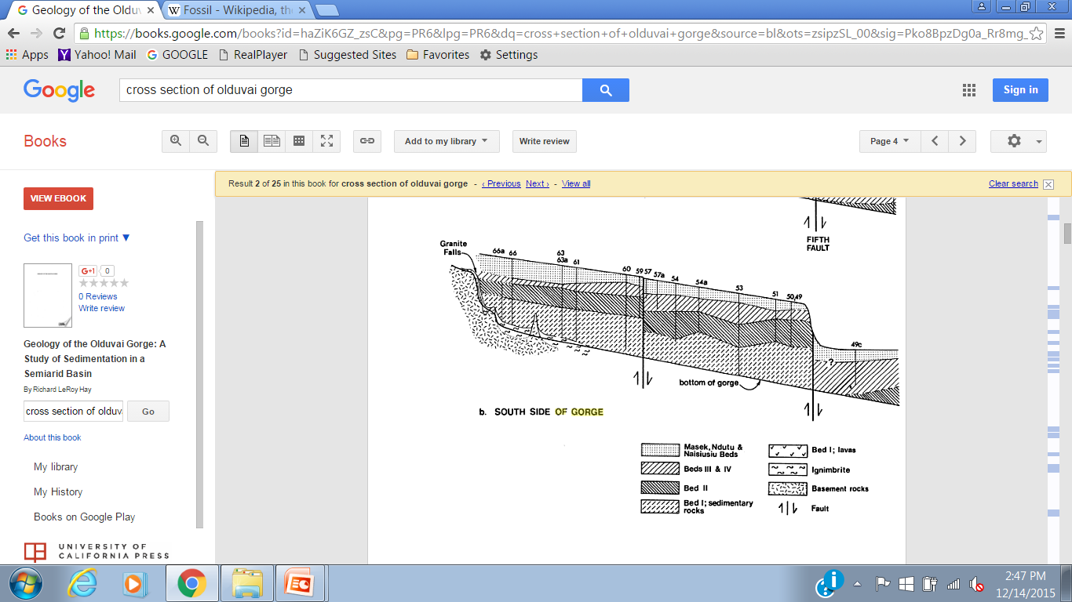

Potassium-Argon Dating
Nutcracker Man – Olduvai Gorge
cross section of Olduvai Gorge – south side
Bed I
Bed 1

Slide 80
Potassium-Argon Dating
Nutcracker Man – Olduvai Gorge
cross section of Olduvai Gorge – south side
Bed I
Bed 1

Slide 81



Potassium-Argon Dating
Nutcracker Man – Olduvai Gorge
1959: Nutcracker Man’s skull discovered by Mary Leakey
Louis Leakey estimated age at 600,000 years old
1960: U. of California geochemists use K-Ar dating to
Nutcracker Man was the 1st hominin
dated with K-Ar process
determine age of Bed I at 1.75my
Bed I
Skull & reconstructed mandible

Slide 82
Potassium-Argon Dating
Nutcracker Man – Olduvai Gorge
Age Dating Ancient Remains
Analysis of the surrounding rocks
- stratigraphic
- electromagnetic
- chemical
- radiometric
Analysis of the fossil
- Comparison to different genera
- DNA
Nutcracker Man was the 1st hominin
dated with K-Ar process
- Potassium-Argon dating
Nutcracker Man - Olduvai Gorge
Analysis of the fossil
- comparison to different genera
- DNA
Skull & reconstructed mandible

Slide 83
Age Dating Ancient Remains
Paleomagnetic dating
Analysis of the surrounding rocks
- stratigraphic
- electromagnetic
- chemical
- radiometric
Analysis of the fossil
- Comparison to other genera
- DNA
Paleomagnetic dating
- Paleomagnetic dating
Little Foot - Sterkfontain Cave
- chemical
- radiometric
- Potassium-Argon dating
Nutcracker Man - Olduvai Gorge
Analysis of the fossil
- comparison to different genera
- DNA
- Potassium-Argon dating
Nutcracker Man - Olduvai Gorge
Analysis of the fossil
- comparison to different genera
- DNA

Slide 84
Electromagnetic technique - paleomagnetic analysis - A. africanus - Sterkfontain Cave)
https://en.wikipedia.org/wiki/Earth%27s_magnetic_field
Earth's magnetic field, also known as the geomagnetic field, is the magnetic field that extends from the Earth's interior to where it meets the solar wind, a stream of charged particles emanating from the Sun. Its magnitude at the Earth's surface ranges from 25 to 65 microteslas(0.25 to 0.65 gauss).^{[3]} Roughly speaking it is the field of a magnetic dipole currently tilted at an angle of about 10 degrees with respect to Earth's rotational axis, as if there were a bar magnet placed at that angle at the center of the Earth. Unlike a bar magnet, however, Earth's magnetic field changes over time because it is generated by a geodynamo (in Earth's case, the motion of molten iron alloys in its outer core).
The North and South magnetic poles wander widely, but sufficiently slowly for ordinary compasses to remain useful for navigation. However, at irregular intervals averaging several hundred thousand years, the Earth's field reverses and the North and South Magnetic Poles relatively abruptly switch places. These reversals of the geomagnetic poles leave a record in rocks that are of value to paleomagnetists in calculating geomagnetic fields in the past. Such information in turn is helpful in studying the motions of continents and ocean floors in the process of plate tectonics.
The study of past magnetic field of the Earth is known as paleomagnetism.^{[8]} The polarity of the Earth's magnetic field is recorded inigneous rocks, and reversals of the field are thus detectable as "stripes" centered on mid-ocean ridges where the sea floor is spreading, while the stability of the geomagnetic poles between reversals has allowed paleomagnetists to track the past motion of continents. Reversals also provide the basis for magnetostratigraphy, a way of dating rocks and sediments.^{[9]} The field also magnetizes the crust, and magnetic anomalies can be used to search for deposits of metal ores.
https://en.wikipedia.org/wiki/Geomagnetic_reversal
A geomagnetic reversal is a change in a planet's magnetic field such that the positions of magnetic north and magnetic south are interchanged. The Earth's field has alternated between periods of normal polarity, in which the direction of the field was the same as the present direction, and reverse polarity, in which the field was the opposite. These periods are called chrons. The time spans of chrons are randomly distributed with most being between 0.1 and 1 million years^{[citation needed]} with an average of 450,000 years. Most reversals are estimated to take between 1,000 and 10,000 years. The latest one, the Brunhes–Matuyama reversal, occurred 780,000 years ago; and may have happened very quickly, within a human lifetime.^{[1]} A brief complete reversal, known as the Laschamp event, occurred only 41,000 years ago during the last glacial period. That reversal lasted only about 440 years with the actual change of polarity lasting around 250 years. During this change the strength of the magnetic field dropped to 5% of its present strength.

Slide 85
https://en.wikipedia.org/wiki/Geomagnetic_reversal CAUSES OF MAGNETIC POLARITY REVERSALS:
The magnetic field of the Earth, and of other planets that have magnetic fields, is generated by dynamo action in which convection of molten iron in the planetary core generates electric currents which in turn give rise to magnetic fields. In simulations of planetary dynamos, reversals often emerge spontaneously from the underlying dynamics. For example, Gary Glatzmaier and collaborator Paul Roberts of UCLA ran a numerical model of the coupling between electromagnetism and fluid dynamics in the Earth's interior. Their simulation reproduced key features of the magnetic field over more than 40,000 years of simulated time and the computer-generated field reversed itself. Global field reversals at irregular intervals have also been observed in the laboratory liquid metal experiment VKS2.
In some simulations, this leads to an instability in which the magnetic field spontaneously flips over into the opposite orientation. This scenario is supported by observations of the solar magnetic field, which undergoes spontaneous reversals every 9–12 years. However, with the Sun it is observed that the solar magnetic intensity greatly increases during a reversal, whereas reversals on Earth seem to occur during periods of low field strength.
Hypothesized triggers
Some scientists, such as Richard A. Muller, think that geomagnetic reversals are not spontaneous processes but rather are triggered by external events that directly disrupt the flow in the Earth's core. Proposals include impact events or internal events such as the arrival of continental slabs carried down into the mantle by the action of plate tectonics at subduction zones or the initiation of new mantle plumes from the core-mantle boundary. Supporters of this hypothesis hold that any of these events could lead to a large scale disruption of the dynamo, effectively turning off the geomagnetic field. Because the magnetic field is stable in either the present North-South orientation or a reversed orientation, they propose that when the field recovers from such a disruption it spontaneously chooses one state or the other, such that half the recoveries become reversals. However, the proposed mechanism does not appear to work in a quantitative model, and the evidence from stratigraphy for a correlation between reversals and impact events is weak. Most strikingly, there is no evidence for a reversal connected with the impact event that caused the Cretaceous–Paleogene extinction event.
Effects on biosphere.
Shortly after the first geomagnetic polarity time scales were produced, scientists began exploring the possibility that reversals could be linked to extinctions. Most such proposals rest on the assumption that the Earth's magnetic field would be much weaker during reversals. Possibly the first such hypothesis was that high energy particles trapped in the Van Allen radiation belt could be liberated and bombard the Earth. Detailed calculations confirm that, if the Earth's dipole field disappeared entirely (leaving the quadrupole and higher components), most of the atmosphere would become accessible to high energy particles, but would act as a barrier to them, and cosmic ray collisions would produce secondary radiation of beryllium-10 or chlorine-36. An increase of beryllium-10 was noted in a 2012 German study showing a peak of beryllium-10 in Greenland ice cores during a brief complete reversal 41,000 years ago which led to the magnetic field strength dropping to an estimated 5% of normal during the reversal.^{[2]} There is evidence that this occurs both during secular variation and during reversals.
Another hypothesis by McCormac and Evans assumes that the Earth's field would disappear entirely during reversals. They argue that the atmosphere of Mars may have been eroded away by the solar wind because it had no magnetic field to protect it. They predict that ions would be stripped away from Earth's atmosphere above 100 km. However, the evidence from paleointensity measurements is that the magnetic field does not disappear. Based on paleointensity data for the last 800,000 years, the magnetopause is still estimated to be at about 3 Earth radii during the Brunhes-Matuyama reversal. Even if the magnetic field disappeared, the solar wind may induce a sufficient magnetic field in the Earth's ionosphere to shield the surface from energetic particles.
Hypotheses have also been advanced linking reversals to mass extinctions. Many such arguments were based on an apparent periodicity in the rate of reversals; more careful analyses show that the reversal record is not periodic. It may be, however, that the ends of superchrons have caused vigorous convection leading to widespread volcanism, and that the subsequent airborne ash caused extinctions.
Tests of correlations between extinctions and reversals are difficult for a number of reasons. Larger animals are too scarce in the fossil record for good statistics, so paleontologists have analyzed microfossil extinctions. Even microfossil data can be unreliable if there are hiatuses in the fossil record. It can appear that the extinction occurs at the end of a polarity interval when the rest of that polarity interval was simply eroded away. Statistical analysis shows no evidence for a correlation between reversals and extinctions.

Slide 86

Paleomagnetic dating
- the Earth has a magnetic field generated by ions in the outer core
- at irregular intervals, Earth's
magnetic field reverses
magnetic field lines
- North and South Magnetic
Poles abruptly switch places
south
- reversals occur about every
100,000 to 1 million years
- reversals of the magnetic
poles leave a record in rocks
north
DURING REVERSAL
REVERSE POLARITY
NORMAL POLARITY
Notes:
https://en.wikipedia.org/wiki/Earth%27s_magnetic_field
https://en.wikipedia.org/wiki/Geomagnetic_reversal

Slide 87

Paleomagnetic dating
TIME
MAGNETIC POLARITY
today’s polarity
reversed polarity
south
- reversals of the magnetic
poles leave a record in rocks
- during deposition, magnetic
grains in sediments align with
the current magnetic field
north
- reversals provide a way to
date the age of rocks
NORMAL POLARITY
REVERSE POLARITY
Notes:
https://en.wikipedia.org/wiki/Earth%27s_magnetic_field
https://en.wikipedia.org/wiki/Geomagnetic_reversal

Slide 88
Paleomagnetic dating
TIME
Little Foot - Sterkfontain Cave
today
MAGNETIC POLARITY
normal polarity
today’s polarity
reversed polarity
1M
2M
- reversals of the magnetic
poles leave a record in rocks
3M
- during deposition, magnetic
grains in sediments align with
the current magnetic field
4M
- reversals provide a way to
date the age of rocks
5M
Notes:
https://en.wikipedia.org/wiki/Earth%27s_magnetic_field
https://en.wikipedia.org/wiki/Geomagnetic_reversal

Slide 89

Paleomagnetic dating
Little Foot - Sterkfontain Cave
discovered in 1997 by Dr. Ron Clark
at the Cradle of Humankind
Let’s look at the fossil remains in the cave
paleomagnetic dating of siltstone
& minerals of embedded rocks
Notes:
http://johnhawks.net/weblog/fossils/africanus/sterkfontein/sterkfontein_age_review_2005.html
http://www.ncbi.nlm.nih.gov/pubmed/21392817
https://www.google.com/search?q=sterkfontein+cave+cross+section&biw=1093&bih=508&tbm=isch&tbo=u&source=univ&sa=X&ved=0ahUKEwjZtvy7jejJAhWJaT4KHb-rBlkQsAQIGw&dpr=1.25#imgdii=yBmrY5bFnU9p8M%3A%3ByBmrY5bFnU9p8M%3A%3BGau_WumlaP0mqM%3A&imgrc=yBmrY5bFnU9p8M%3A
Sts 5 = Mrs Pleas
Stw 573 = little foot

Slide 90

Paleomagnetic dating
Little Foot - Sterkfontain Cave
overlying rocks
Let’s look at the fossil remains in the cave
CAVE
underlying rocks
16 feet

Slide 91
Paleomagnetic dating
Notes:
http://www.nature.com/nature/journal/v522/n7554/full/nature14268.html?WT.ec_id=NATURE-20150604

Slide 92
Paleomagnetic dating
Little Foot
age dating processes
surface sediments
location of remains
rock layers
Notes:
http://www.nature.com/nature/journal/v522/n7554/full/nature14268.html?WT.ec_id=NATURE-20150604

Slide 93
Paleomagnetic dating
_{Little Foot}
Notes:
http://www.nature.com/nature/journal/v522/n7554/full/nature14268.html?WT.ec_id=NATURE-20150604

Slide 94


Paleomagnetic dating

Slide 95
https://en.wikipedia.org/wiki/Paleomagnetism
The study of paleomagnetism is possible because iron-bearing minerals such as magnetite may record past directions of the Earth's magnetic field. Magnetic signatures in rocks can be recorded by several different mechanisms.
Thermoremanent magnetization
Iron-titanium oxide minerals in basalt and other igneous rocks may preserve the direction of the Earth's magnetic field when the rocks cool through the Curie temperatures of those minerals. The Curie temperature of magnetite, a spinel-group iron oxide, is about 580°C, whereas most basalt and gabbro are completely crystallized at temperatures below 900°C. Hence, the mineral grains are not rotated physically to align with the Earth's field, but rather they may record the orientation of that field. The record so preserved is called a thermoremanent magnetization (TRM). Because complex oxidation reactions may occur as igneous rocks cool after crystallization, the orientations of the Earth's magnetic field are not always accurately recorded, nor is the record necessarily maintained. Nonetheless, the record has been preserved well enough in basalts of the ocean crust to have been critical in the development of theories of sea floor spreading related to plate tectonics. TRM can also be recorded in pottery kilns, hearths, and burned adobe buildings. The discipline based on the study of thermoremanent magnetisation in archaeological materials is called archaeomagnetic dating.
Detrital remanent magnetization
In a completely different process, magnetic grains in sediments may align with the magnetic field during or soon after deposition; this is known as detrital remanent magnetization (DRM). If the magnetization is acquired as the grains are deposited, the result is a depositional detrital remanent magnetization (dDRM); if it is acquired soon after deposition, it is a post-depositional detrital remanent magnetization (pDRM).
Chemical remanent magnetization
In a third process, magnetic grains grow during chemical reactions, and record the direction of the magnetic field at the time of their formation. The field is said to be recorded by chemical remanent magnetization (CRM). A common form of chemical remanent magnetization is held by the mineral hematite, another iron oxide. Hematite forms through chemical oxidation reactions of other minerals in the rock including magnetite. redbeds, clastic sedimentary rocks (such as sandstones) are red because of hematite that formed during sedimentary diagenesis. The CRM signatures in redbeds can be quite useful and they are common targets in magnetostratigraphy studies

Slide 96
Electromagnetic technique - paleomagnetic analysis - A. africanus - Sterkfontain Cave)
http://johnhawks.net/weblog/fossils/africanus/sterkfontein/sterkfontein_age_review_2005.html
http://www.ncbi.nlm.nih.gov/pubmed/21392817
J Hum Evol. 2011 May;60(5):523-39. doi: 10.1016/j.jhevol.2010.09.001.
Palaeomagnetic analysis of the Sterkfontein palaeocave deposits: implications for the age of the hominin fossils and stone tool industries.
Herries AI¹, Shaw J.
Author information
¹UNSW Archaeomagnetic Laboratory, Integrative Palaeoecological and Anthropological Studies, School of Medical Sciences, University of New South Wales, Kensington, Sydney 2052, Australia. a.herries@unsw.edu.au
Abstract
Palaeomagnetic analysis was conducted on speleothems (mineral deposits formed from groundwater within underground caverns) from Members 1-5 at Sterkfontein Cave, South Africa. Palaeomagnetic analysis of siltstone and speleothem from the bulk of Member 4 indicate a reversed magnetic polarity that dates the deposits and its Australopithecus africanus fossils to between 2.58 and ~2.16 Ma. Further confirmation of this age comes in the form of two short normal polarity events correlated to the Rèunion (~2.16 Ma) and Huckleberry Ridge (~2.05 Ma) events in speleothem capping the bulk of Member 4 and coeval with deposition of the final phase of Member 4, including A. africanus fossil Sts 5 (Mrs Ples). At ~2.16-2.05 Ma, Sts 5 is the youngest representative of A. africanus yet discovered.
Palaeomagnetic analysis of the Silberberg Grotto deposits identifies a single short geomagnetic field event in flowstone overlying the StW 573 Australopithecus fossil, which is suggested to represent the Rèunion event at ~2.16 Ma. This further supports the uranium lead age estimates of 2.3-2.2 Ma for the StW 573 fossil. Based on a reversed polarity for the deposits below the skeleton it cannot be older than 2.58 Ma. If StW 573 is considered to be a second species of Australopithecus then this indicates that two species of Australopithecus are present at Sterkfontein between 2.6 and 2.0 Ma. All of the Member 5 deposits date to less than 1.8 Ma based on a comparison of palaeomagnetic, faunal, and electron spin resonance age estimates. The StW 53 fossil bearing infill (M5A) is intermediate in age between Member 4 and the rest of Member 5 (B-C) at around 1.78-1.49 Ma. The rest of Member 5 (B-C) containing Oldowan and Acheulian stone tools and Homo and Paranthropus fossils was deposited gradually between 1.40 and 1.07 Ma, much younger than previously suggested.

Slide 97
Paleomagnetic dating
Paleomagnetic RESULTS!
Little Foot - Sterkfontain Cave

Slide 98
Paleomagnetic RESULTS!
Little Foot - Sterkfontain Cave
in rock overlying Little Foot fossil, analysis of cave deposits identifies
a single short geomagnetic event
overlying rock represents normal magnetic field of Rèunion event at
~ 2.16 Ma
2.16M
Reunion
2.58M
deposits below the fossil with reversed polarity suggest that
it cannot be older than . . .
2.58 Ma
Notes:
https://en.wikipedia.org/wiki/Earth%27s_magnetic_field
Source for polarity graph

Slide 99
Paleomagnetic RESULTS!
Age Dating Ancient Remains
Little Foot - Sterkfontain Cave
Analysis of the surrounding rocks
- stratigraphic
- electromagnetic
- Paleomagnetic dating
Little Foot - Sterkfontain Cave
- chemical
- radiometric
- Potassium-Argon dating
Nutcracker Man - Oldevai Gorge
Analysis of the fossil
- comparison to different genera
- DNA analysis
in rock overlying Little Foot fossil, analysis of cave deposits identifies
a single short geomagnetic event
overlying rock represents normal magnetic field of Rèunion event at
~ 2.16 Ma
2.16M
Reunion
2.58M
deposits below the fossil with reversed polarity suggest that
it cannot be older than . . .
2.58 Ma

Slide 100
Age Dating Ancient Remains
‘naledi’ hominins - Where do they fit??
Analysis of the surrounding rocks
- stratigraphic
- electromagnetic
- Paleomagnetic dating
Little Foot - Sterkfontain Cave
- chemical
- radiometric
- Potassium-Argon dating
Nutcracker Man - Oldevai Gorge
Analysis of the fossil
- comparison to different genera
- DNA analysis
Let’s look at a cross-section
of where they were found:
the Rising Star Cave
‘naledi’ hominins
- ‘naledi’ hominin remains – Cradle of Humankind
- DNA

Slide 101



the Rising Star Cave
300’
entry
land surface
access chute - 39 feet long , 8 inches wide!
6 thin, small women were recruited
for the archeological dig
150’
Sedimentary Rocks
limestones, dolomites, clays
What did they find?
location of
fossil remains
Dr. Lee Berger
Notes:
https://en.wikipedia.org/wiki/Homo_naledi
http://elifesciences.org/content/4/e09561

Slide 102
http://elifesciences.org/content/4/e09561
no scientist Lee Berger knew had the physique to squeeze through that chute. So Berger put the word out on Facebook: Skinny individuals wanted, with scientific credentials and caving experience; must be “willing to work in cramped quarters.” Within a week and a half he’d heard from nearly 60 applicants. He chose the six most qualified; all were young women. Berger called them his “underground astronauts.”
With funding from National Geographic he gathered some 60 scientists and set up an aboveground command center, a science tent, and a small village of sleeping and support tents. Local cavers helped thread two miles of communication and power cables down into the fossil chamber. Whatever was happening there could now be viewed with cameras by Berger and his team in the command center. Marina Elliott, then a graduate student at Simon Fraser University in British Columbia, was the first scientist down the chute.
“Looking down into it, I wasn’t sure I’d be OK,” Elliott recalled. “It was like looking into a shark’s mouth. There were fingers and tongues and teeth of rock.”
Elliott and two colleagues, Becca Peixotto and Hannah Morris, inched their way to the “landing zone” at the bottom, then crouched into the fossil chamber. Working in two-hour shifts with another three-woman crew, they plotted and bagged more than 400 fossils on the surface, then started carefully removing soil around the half-buried skull. There were other bones beneath and around it, densely packed. Over the next several days, while the women probed a square-yard patch around the skull, the other scientists huddled around the video feed in the command center above in a state of near-constant excitement. Berger, dressed in field khakis and a Rising Star Expedition cap, would occasionally repair to the science tent to puzzle over the accumulating bones—until a collective howl of astonishment from the command center brought him rushing back to witness another discovery. It was a glorious time.
The bones were superbly preserved, and from the duplication of body parts, it soon became clear that there was not one skeleton in the cave, but two, then three, then five ... then so many it was hard to keep a clear count. Berger had allotted three weeks for the excavation. By the end of that time, the excavators had removed some 1,200 bones, more than from any other human ancestor site in Africa—and they still hadn’t exhausted the material in just the one square yard around the skull. It took another several days digging in March 2014 before its sediments ran dry, about six inches down.
There were some 1,550 specimens in all, representing at least 15 individuals. Skulls. Jaws. Ribs. Dozens of teeth. A nearly complete foot. A hand, virtually every bone intact, arranged as in life. Minuscule bones of the inner ear. Elderly adults. Juveniles. Infants, identified by their thimble-size vertebrae. Parts of the skeletons looked astonishingly modern. But others were just as astonishingly primitive—in some cases, even more apelike than the australopithecines.

Slide 103

the Rising Star Cave
What did they find?
Notes:
https://en.wikipedia.org/wiki/Homo_naledi
http://elifesciences.org/content/4/e09561

Slide 104


the Rising Star Cave
1550 hominin remains from at least 15 individuals
- found deep in the cave away from any cave openings
- bodies appear intact when they arrived in the chamber,
disarticulation occurred during/after deposition.
- no other large animal remains found in the chamber,
bones not damaged by scavengers or predators
How did these remains get here?
one hypothesis: deliberate body disposal in a single
location by a hominin species
Notes:
https://en.wikipedia.org/wiki/Homo_naledi
http://elifesciences.org/content/4/e09561

Slide 105

‘nadeli’ Fossils - Where do they fit??
the Rising Star Cave
How did these remains get here?
?????? naledi
one hypothesis: deliberate body disposal in a single
location by a hominin species

Slide 106
the Rising Star Cave
??? naledi – to what Genus do they belong?
HOMO
H. habilis
??? naledi
?????? naledi
A. africanus
AUSTRALOPITHECUS

Slide 107

??? naledi – to what Genus do they belong?
HOMO
skull shaped like Homo
small teeth
?
H. habilis
?
large 3rd molar
?????? naledi
small brain volume
A. africanus
AUSTRALOPITHECUS
Notes:
https://en.wikipedia.org/wiki/Homo_naledi

Slide 108


??? naledi – to what Genus do they belong?
HOMO
skull shaped like Homo
small teeth
body size & weight
long, slender legs
(modern gait)
primitive flared pelvis
shoulders for climbing
large 3rd molar
?????? naledi
small brain volume
AUSTRALOPITHECUS
Notes:
https://en.wikipedia.org/wiki/Homo_naledi

Slide 109

??? naledi – to what Genus do they belong?
HOMO
HOMO
skull shaped like Homo
small teeth
body size & weight
curved fingers
(shaped for climbing)
long, slender legs
(modern gait)
primitive flared pelvis
H. habilis
shoulders for climbing
large 3rd molar
?????? naledi
small brain volume
A. africanus
wrist/thumb shaped for tool use
AUSTRALOPITHECUS
AUSTRALOPITHECUS
arched feet for long distance stride
Notes:
https://en.wikipedia.org/wiki/Homo_naledi

Slide 110

??? naledi – to what Genus do they belong?
HOMO
HOMO
H. naledi
H. habilis
tentatively assigned to
Homo Genus
?????? naledi
A. africanus
AUSTRALOPITHECUS
Notes:
https://en.wikipedia.org/wiki/Homo_naledi

Slide 111

??? naledi – to what Genus do they belong?
How important is this find?
HOMO
January/February 2016
H. naledi
H. habilis
tentatively assigned to
Homo Genus

Slide 112



How important is this find?
It’s Homo naledi!
January/February 2016

Slide 113
Archaeology, January/February 2016, pp 28-29

Slide 114


Age Dating Ancient Remains
How important is this find?
http://news.nationalgeographic.com/2015/09/150910-human-evolution-change/
https://en.wikipedia.org/wiki/Homo_naledi
Homo naledi is an extinct species of hominin, provisionally assigned to the genusHomo. Discovered in 2013 and described in 2015, fossil skeletons were found in South Africa's Gauteng province, in the Dinaledi Chamber of the Rising Star Cave system, part of the Cradle of Humankind World Heritage Site.^{[1][2]} As of 10 September 2015, fossils of at least fifteen individuals, amounting to 1550 specimens, have been excavated from the cave.^{[2]}
The species is characterized by a body mass and stature similar to small-bodied human populations, a smaller endocranial volume similar to Australopithecus, and a skull shape similar to early Homo species. The skeletal anatomy presents ancestral features known from australopithecines with more recent features associated with later hominins. The fossils have not been dated.^{[3]}
The fossils were discovered by recreational cavers Rick Hunter and Steven Tucker in 2013.^{[2][4][5]} Homo naledi was formally described in September 2015 by a 47-member international team of authors led by American and South African paleoanthropologistLee Berger of the University of the Witwatersrand, who proposed the bones represent a new Homo species.^{[1]} Other experts contend more analysis and evidence is needed to support this classification. There are some indications that the individuals may have been deliberately placed in the cave near the time of their death;^{[4]} other experts state more evidence is needed to support this hypothesis.
On September 13, 2013 while exploring the Rising Star cave system, looking for an extension, recreational cavers Rick Hunter and Steven Tucker of the Speleological Exploration Club (SEC) of South Africa found a narrow, vertically oriented "chimney" or "chute" measuring 12 m (39 ft) long with an average width of 20 cm (7.9 in).^{[2][4][5]} This chute led to a room 30 m (98 ft) underground (Site U.W. 101, the Dinaledi Chamber), the surface of which was littered with fossil bones. Before they entered the cave that day the cavers knew that a scientist in Johannesburg was looking for fossils.^{[2]} When the Dinaledi Chamber was first entered, the sediments along the cave floor consisted largely of loosely packed, semi-moist, clay-rich clumps of varying sizes in which bone material was distributed across the surface in almost every area of the chamber, including narrow side passages and offshoots, with the highest concentration of bone material encountered near the southwest end of the chamber, about 10–12 m downslope from the entry point, where the floor levels out.^{[4][2]} On 1 October 2013 photos were shown to geologist Pedro Boshoff, and then to Lee Berger.
In November 2013, the National Geographic Society and the University of the Witwatersrand funded an expedition called Rising Star Expedition for a twenty-one day excavation at the cave,^{[7]} followed by a second expedition in March 2014 for a 4-week excavation in the Dinaledi Chamber. In total, the expedition retrieved 1,550 pieces of bone belonging to at least fifteen individuals, found within clay-rich sediments.^{[8][1]} The layered distribution of the bones suggests that they had been deposited over a long time, perhaps centuries.^{[2]} Only one square meter of the cave chamber has been excavated; other remains might still be there.^{[9][10][11]}
Around 300 bone fragments were collected from the surface of the Dinaledi Chamber, and ∼1250 fossil specimens were recovered by excavation.^{[4]} The fossils include skulls, jaws, ribs, teeth, bones of an almost complete foot, of a hand, and of an inner ear. The bones of old, young and infants were found.^{[2]} Although much of the fossil material is disarticulated (separated at joints), the deposit containsarticulated or near-articulated examples such as the maxilla and mandible of single individuals and the bones of a complete hand and foot.^{[4]}
The new species description was announced at a press conference on 10 September 2015 held at Maropeng, Cradle of Humankind,Johannesburg, South Africa.^{[1][2][12]} A display case of the fossils was unveiled during the ceremony.
It’s Homo naledi!

Slide 115
Age Dating Ancient Remains
How important is this find?
Age Dating Ancient Remains
Analysis of the surrounding rocks
- stratigraphic
- electromagnetic
- Paleomagnetic analysis
Mrs. Pleas - Sterkfontain Cave
- chemical
- radiometric
- Potassium Argon analysis
Nutcracker Man - Oldevai Gorge
Analysis of the fossil
- Comparison to different genera
- DNA analysis
It’s Homo naledi!
- Homo nadeli – Rising Star Cave
- DNA analysis

Slide 116
Homo Genus
Age Dating Ancient Remains
Analysis of the surrounding rocks
- stratigraphic
- electromagnetic
- Paleomagnetic analysis
Mrs. Pleas - Sterkfontain Cave
- chemical
- radiometric
- Potassium Argon analysis
Nutcracker Man - Oldevai Gorge
Analysis of the fossil
- Comparison to different genera
- DNA analysis
Homo
homo
?
?
- Homo nadeli – Rising Star Cave
- DNA analysis
- SESSION 4

Slide 117

Homo Genus
The Stone Age: 2.5 million to 4000 YBP (years before present)
Homo
homo
?
?

Slide 118
Homo Genus
EUROPE
AFRICA
M YBP
AFRICA
ASIA
AMER.
0.1M
sapien
0.1M
neanderthal
0.5M
rhodesien
100,000 YBP
0.7M
erectus
antecessor
1.3M
1.5M
‘Handy-man’ (habilis)
ergaster
Homo gautengensis??
Homo naledi??
1.8M
2M YBP

Slide 119
Homo Genus
Extinctions
EUROPE
AFRICA
ASIA
AMER.
sapien
neanderthal
erectus
rhodesien
100,000 YBP
antecessor
Why?
ergaster
often attributed to climate change

Slide 120

Homo Genus
Extinctions
Continental Glaciation
TIME
0
neanderthal
erectus
rhodesien
WARM
COLD
antecessor
Why?
ergaster
often attributed to climate change
-800,000

Slide 121
Homo Genus
Extinctions
Continental Glaciation
TIME
Focus on Homo sapiens
?
?

Slide 122
Homo Genus
Homo sapiens
Extinctions
Continental Glaciation
TIME
TIME
Focus on Homo sapiens

Slide 123
Homo sapiens
Uniquely human characteristics
TIME
Abstract thought & use of symbols
Reasoning & language
Conscience (right & wrong)
Adaptable to any climate
Missing Link?

Slide 124
Homo sapiens
time of recorded
World History
TIME
LAST ICE AGE
30,000 years ago?
Sapiens in
Americas
75,000 years ago
Sapiens into
Europe & Asia
Missing Link?
180,000 years ago
Fossil sapiens,
East African Rift

Slide 125


Homo sapiens
time of recorded
World History
TIME
LAST ICE AGE
Conclusions, Humans (Homo sapiens) are:
- very recent advent
- unlike any older species; esp, language
- spread from East African rift through-out world
- a people of the last ice age
- pioneers in exploration and migration

Slide 126
Homo sapiens
Ms Ples
Little Foot
Naledi
Conclusions, Humans (Homo sapiens) are:
- very recent advent
- unlike any older species; esp, language
- spread from East African rift through-out world
- a people of the last ice age
- pioneers in exploration and migration
Laetoli footprint
Nutcracker Man
Handy Man

Slide 127


NEXT SESSION . . .
Meet a French Homo sapien!
Ms Ples
Little Foot
Naledi
Cro-Magnon Man
Session 3: into Europe
Session 2: into Africa
Session 1: beginning in East Africa
Laetoli footprint
Nutcracker Man
Handy Man

Slide 128
Don’t Forget the Field Trip!
Gault Archeological Site
& Waco Mammoth
National Monument
Thursday
Nov 3
8:30-5:00
sign up: http://www.senioruniv.org/
Georgetown

Slide 129
REFERENCES
our website: www.VagabondGeology.com
http://en.wikipedia.org/wiki/Human_evolution http://en.wikipedia.org/wiki/Stone_Age http://en.wikipedia.org/wiki/Neolithic http://en.wikipedia.org/wiki/Paleolithic http://humanorigins.si.edu/evidence/human-family-tree
http://en.wikipedia.org/wiki/Cradle_of_Humankind
http://www.sa-venues.com/attractionsga/cradle-of-humankind.htm
http://www.sa-venues.com/maps/gauteng_cradle_of_humankind.htm
http://geology.com/world/south-africa-satellite-image.shtml
http://pubs.usgs.gov/gip/dynamic/East_Africa.html
http://www.nationsencyclopedia.com/Africa/South-Africa
http://www.maropeng.co.za/index.php/exhibition_guide/australopithecus/
http://www.sa-venues.com/maps/gauteng_magaliesberg.htm
http://en.wikipedia.org/wiki/Australopithecus_africanus
http://en.wikipedia.org/wiki/Mrs._Ples
http://blogs.smithsonianmag.com/hominids/2012/04/mrs-ples-a-hominid-with-an-identity-crisis/
http://www.cradleofhumankind.co.za/exploretoday/Pages/_SterkfonteinCaves.aspx
http://www.ncbi.nlm.nih.gov/pubmed/22459766
http://www.talkorigins.org/faqs/homs/rbroom.html
http://en.wikipedia.org/wiki/Sterkfontein
http://en.wikipedia.org/wiki/Little_Foot
http://www.panoramio.com/photo/62201978
http://www.artlink.co.za/news_article.htm?contentID=28164
http://www.maropeng.co.za/index.php/exhibition_guide/sterkfontein/little_foot/
http://popular-archaeology.com/issue/june-2011/article/ancient-nutcracker-man-had-no-taste-for-nuts
http://en.wikipedia.org/wiki/Human_evolution
http://www.newscientist.com/article/dn9989-timeline-human-evolution.html
http://www.sciencedirect.com/science/article/pii/S0018442X10000727
http://www.sciencedaily.com/releases/2010/04/100408105147.htm
http://en.wikipedia.org/wiki/Homo_gautengensis
http://anthro.palomar.edu/homo/homo_1.htm
http://www.sourcinginnovation.com/archaeology/Arch08.htm
http://en.wikipedia.org/wiki/Neanderthal
http://www.enchantedlearning.com/africa/rivers/outlinemaplabeled/
http://humanorigins.si.edu/evidence/human-fossils/species/australopithecus-afarensis (Image Credit: John Gurche, artist / Chip Clark, photographer)
http://www.telegraph.co.uk/news/uknews/1568938/Meet-Mrs-Ples-a-very-OAP-who-may-be-a-he.html
https://en.wikipedia.org/wiki/homo_naledi
https://en.wikipedia.org/wiki/Earth%27s_magnetic_field
http://www.ncbi.nlm.nih.gov/pubmed/21392817
http://news.nationalgeographic.com/2015/09/150910-human-evolution-change/
http://www.nytimes.com/2015/09/11/science/south-africa-fossils-new-species-human-ancestor-homo-naledi.html
https://en.wikipedia.org/wiki/Homo_naledi
http://elifesciences.org/content/4/e09561
https://en.wikipedia.org/wiki/Fossil
https://en.wikipedia.org/wiki/OH_5
Curnoe, D., A review of early Homo in southern Africa focusing on cranial, mandibular and dental remains, with the description of a new species (Homo gautengensis sp. Nov.), HOMO-J. Comp. Hum. Biol., 61:151–177, 2010; pp 171–172

