Slide 1
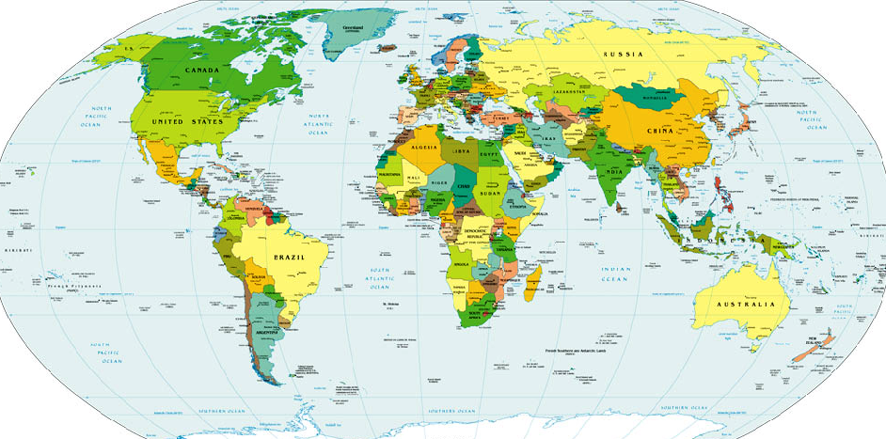
website: www.VagabondGeology.com
Ancient People, Ancient Pathways
Ancient People,
Ancient Pathways
Session 1: beginning in East Africa

Slide 2
Session 3: Into Europe
Ancient People, Ancient Pathways
website: www.VagabondGeology.com
Session 6: into the Americas
Session 5: across Beringia
Session 4: into Asia
Session 3: into Europe
Session 2: into Africa
Session 1: beginning in East Africa

Slide 3




SANDI REALLY SET THE BAR HIGH!!

Slide 4
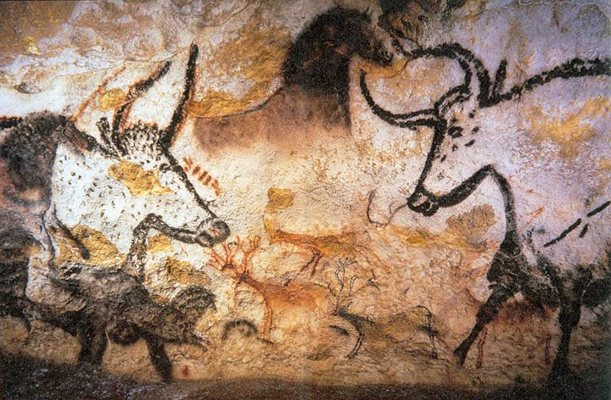
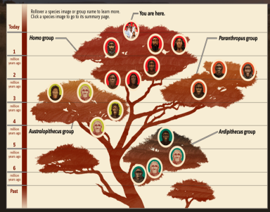
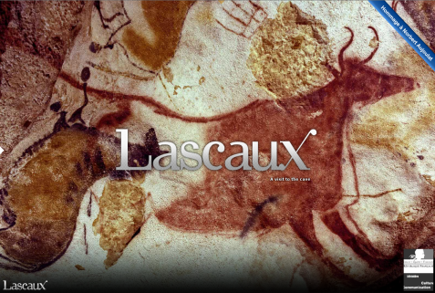
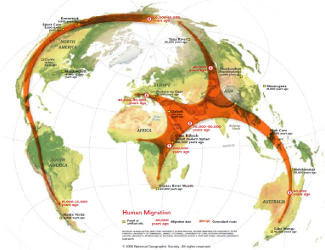
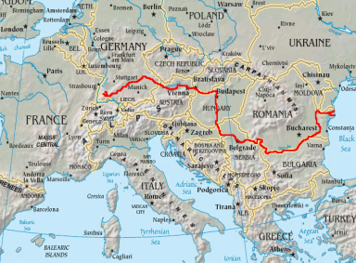
Session 3: Into Europe
TODAY’S
TOPICS
Review
Lascaux Paleolithic Cave Art
Out of Africa
Danube Corridor

Slide 5
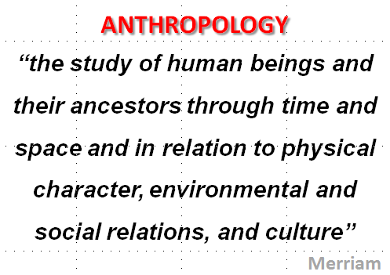
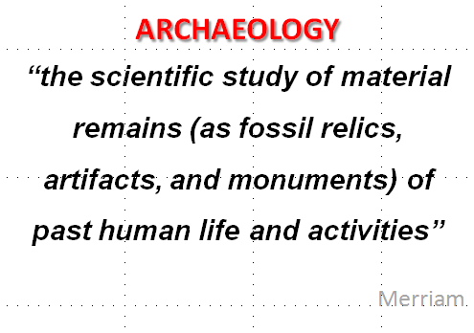
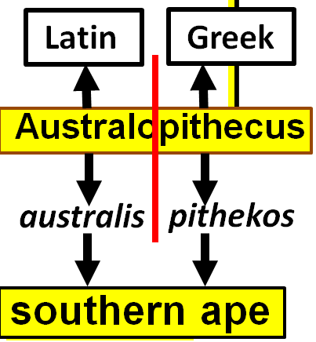
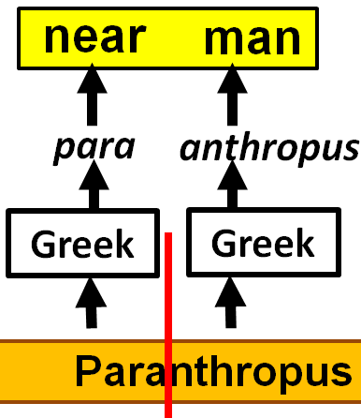
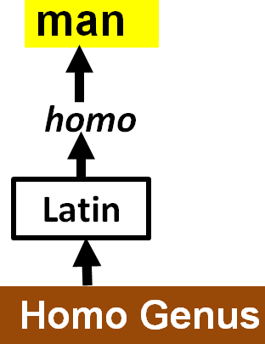


TERMINOLOGY
Homo sapiens =
wise man

Slide 6
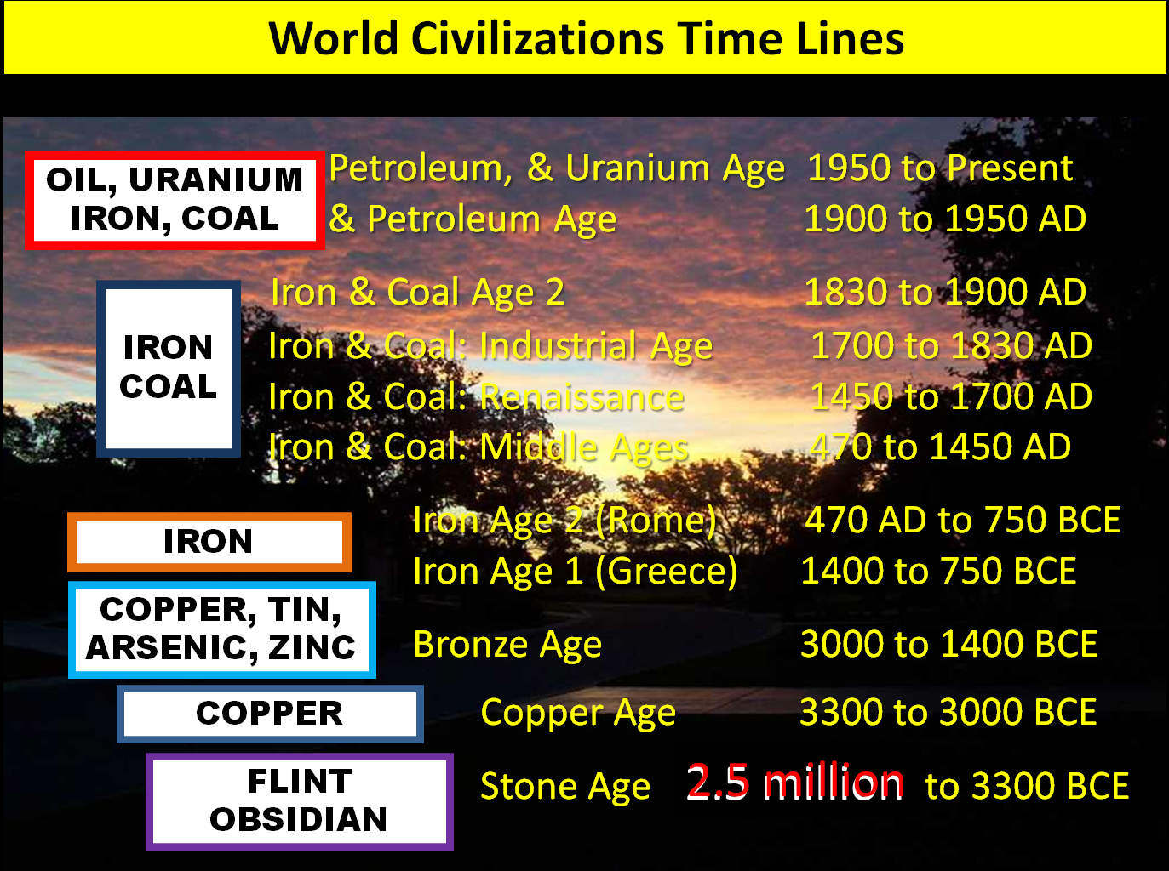
World Civilizations Time Lines

Slide 7


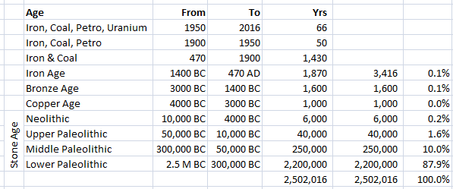
PREHISTORIC PERIODS OF HUMAN HISTORY
EARLY STONE AGE
TIME, YRS
500,000 yrs
-2500 K
-2000 K
-1500 K
-1000 K
-500 K
4
Lower
Paleolithic (88%)
(Early Stone Age)
2.5million to 300k
Middle Paleolithic (10%)
(Middle Stone Age)
300k to 50k yrs
Upper Paleolithic (1.6%)
(Late Stone Age)
50k to 10k yrs
Neolithic (0.2%)
(New Stone Age)
10k to 4k yrs

Slide 8
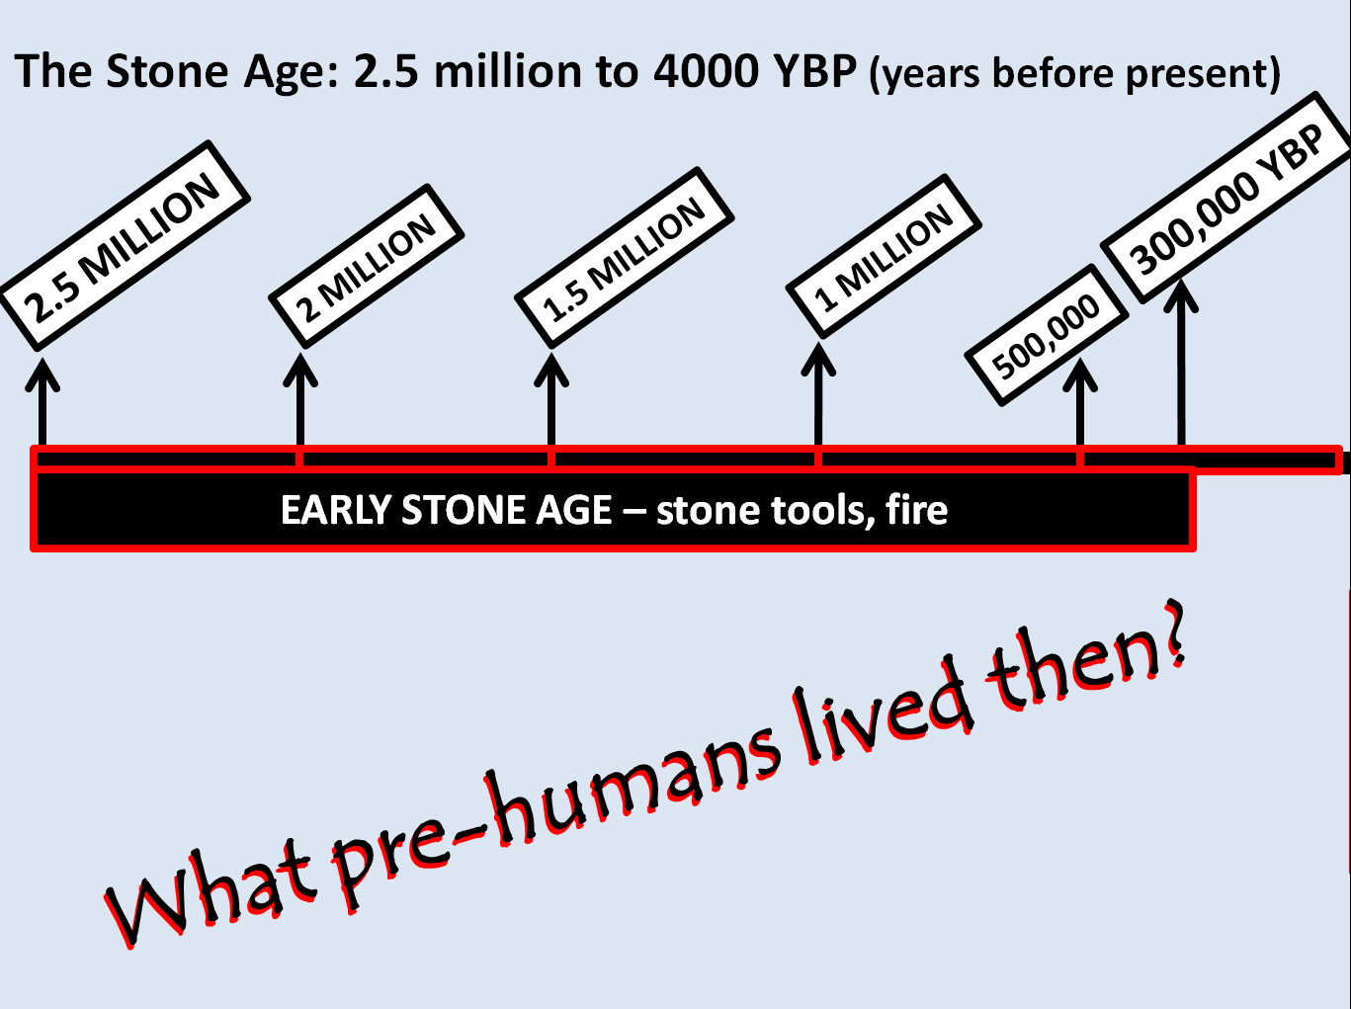
EARLY STONE AGE

Slide 9
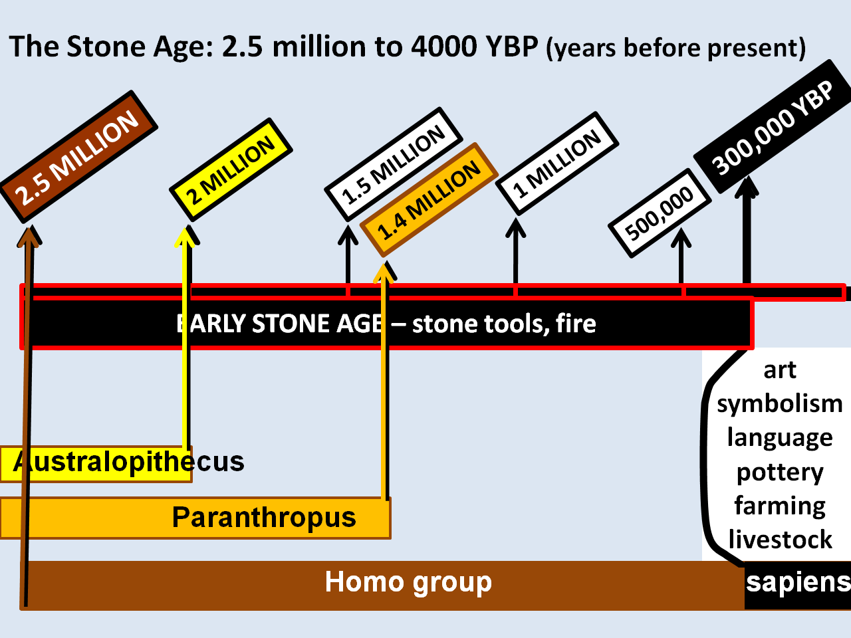
EARLY STONE AGE

Slide 10
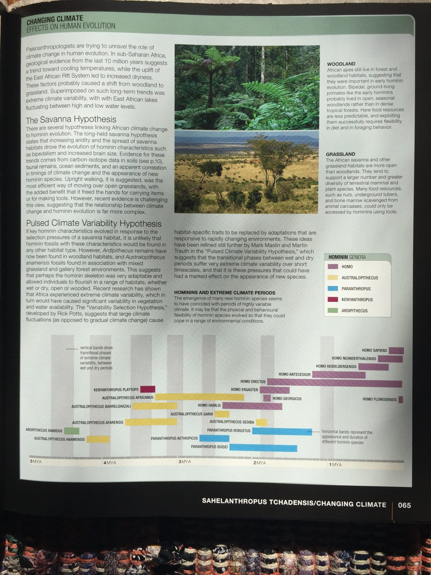
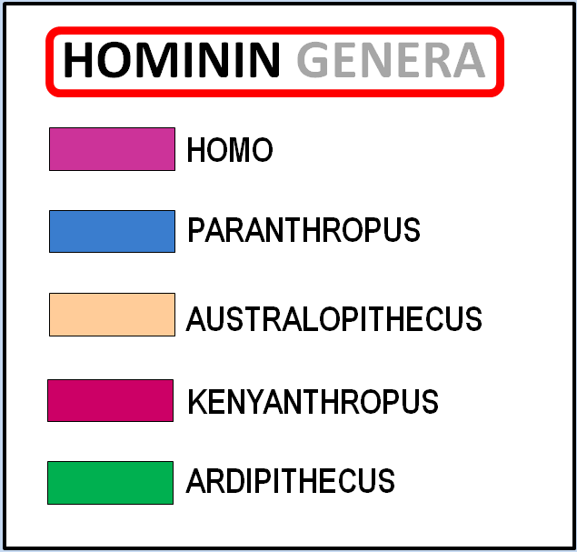
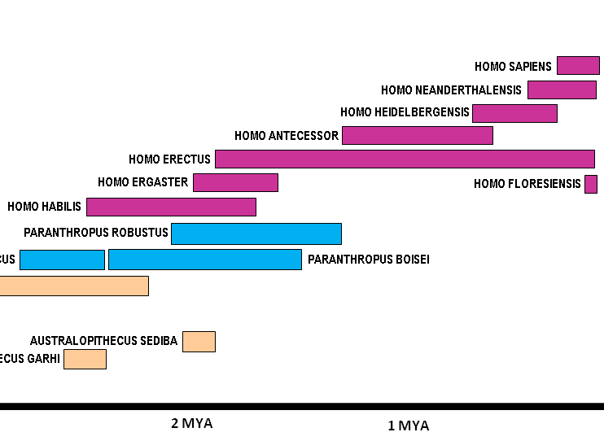
EVOLUTION TIMELINE
STONE AGE
HOMININ GENERA
HOMO SAPIENS
Homo
HOMO NEANDERTHALENSIS
HOMO HEIDELBERGENSIS
HOMO
HOMO ANTECESSOR
HOMO ERECTUS
HOMO ERGASTER
HOMO FLORESIENSIS
HOMO HABILIS
Paranthropus
PARANTHROPUS
PARANTHROPUS ROBUSTUS
PARANTHROPUS AETHIOPICUS
PARANTHROPUS BOISEI
AUSTRALOPITHECUS AFRICANUS
AUSTRALOPITHECUS
Australopithecus
AUSTRALOPITHECUS BAHRELGHAZALI
AUSTRALOPITHECUS AFARENSIS
AUSTRALOPITHECUS SEDIBA
AUSTRALOPITHECUS ANAMENSIS
AUSTRALOPITHECUS GARHI
KENYANTHROPUS
ARDIPITHECUS RAMIDUS
KENYANTHROPUS PLATYOPS
5 MYA
4 MYA
3 MYA
2 MYA
1 MYA
ARDIPITHECUS
Will use this section of chart later…
Focus of our talks is from 2.5 million years ago to now
Vertical bands show the transitional phases of extreme climate variability between wet and dry periods
Horizontal bands represent the appearance and duration of different hominin species

Slide 11
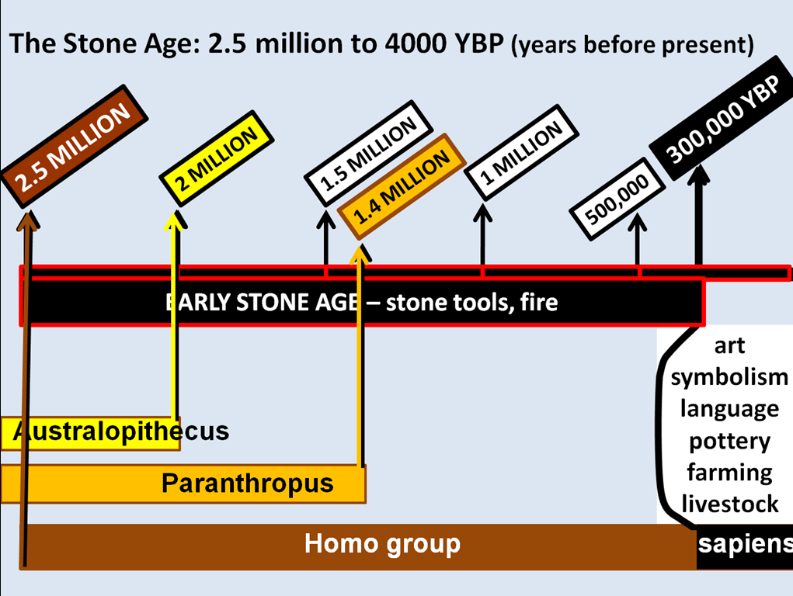
EVOLUTION TIMELINE
STONE AGE
HOMO SAPIENS
HOMO NEANDERTHALENSIS
HOMO HEIDELBERGENSIS
HOMO ANTECESSOR
HOMO ERECTUS
HOMO ERGASTER
HOMO FLORESIENSIS
HOMO HABILIS
PARANTHROPUS ROBUSTUS
PARANTHROPUS AETHIOPICUS
PARANTHROPUS BOISEI
AUSTRALOPITHECUS AFRICANUS
AUSTRALOPITHECUS BAHRELGHAZALI
AUSTRALOPITHECUS AFARENSIS
AUSTRALOPITHECUS SEDIBA
AUSTRALOPITHECUS ANAMENSIS
AUSTRALOPITHECUS GARHI
ARDIPITHECUS RAMIDUS
KENYANTHROPUS PLATYOPS
1.8
2.5
1.4
5 MYA
4 MYA
3 MYA
2 MYA
1 MYA
Focus of our talks is from 2.5 million years ago to now
Matches closely to the chart Sandi used last week

Slide 12
EVOLUTION TIMELINE
STONE AGE
What’s the first thing that stands out in this chart?
Or…
maybe they were on the same continent at the same time…
Ooooo La La!
4
HOMO SAPIENS
HOMO NEANDERTHALENSIS
3
HOMO HEIDELBERGENSIS
HOMO ANTECESSOR
HOMO ERECTUS
6
2
HOMO ERGASTER
5
HOMO FLORESIENSIS
HOMO HABILIS
4
1
PARANTHROPUS ROBUSTUS
3
PARANTHROPUS AETHIOPICUS
2
PARANTHROPUS BOISEI
AUSTRALOPITHECUS AFRICANUS
AUSTRALOPITHECUS BAHRELGHAZALI
AUSTRALOPITHECUS AFARENSIS
AUSTRALOPITHECUS SEDIBA
1
AUSTRALOPITHECUS ANAMENSIS
AUSTRALOPITHECUS GARHI
ARDIPITHECUS RAMIDUS
KENYANTHROPUS PLATYOPS
5 MYA
4 MYA
3 MYA
2 MYA
1 MYA
Several possible parallel species roaming earth!
Species may not be on same continents at the same time…

Slide 13
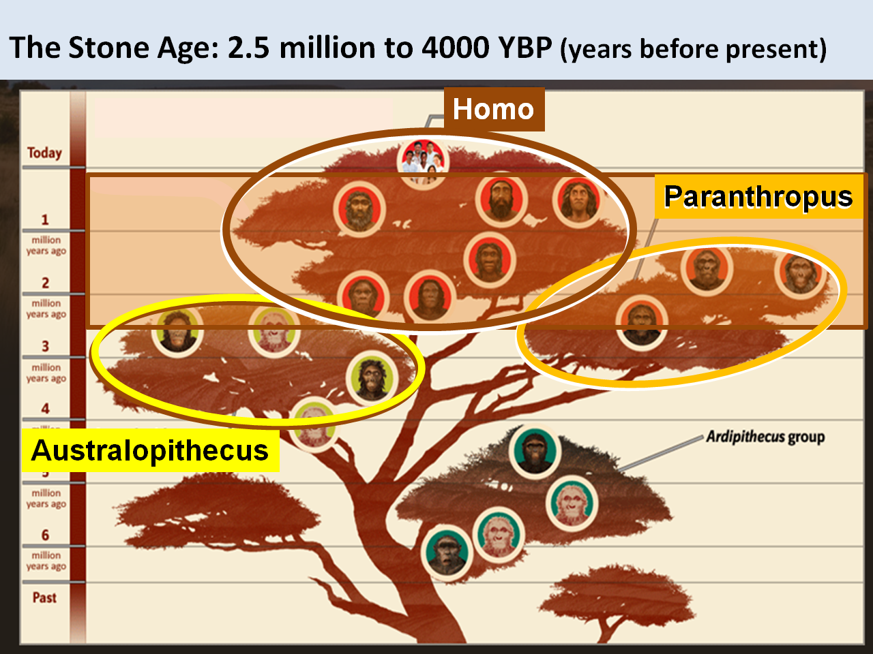
“HOMININ FAMILY TREE”

Slide 14
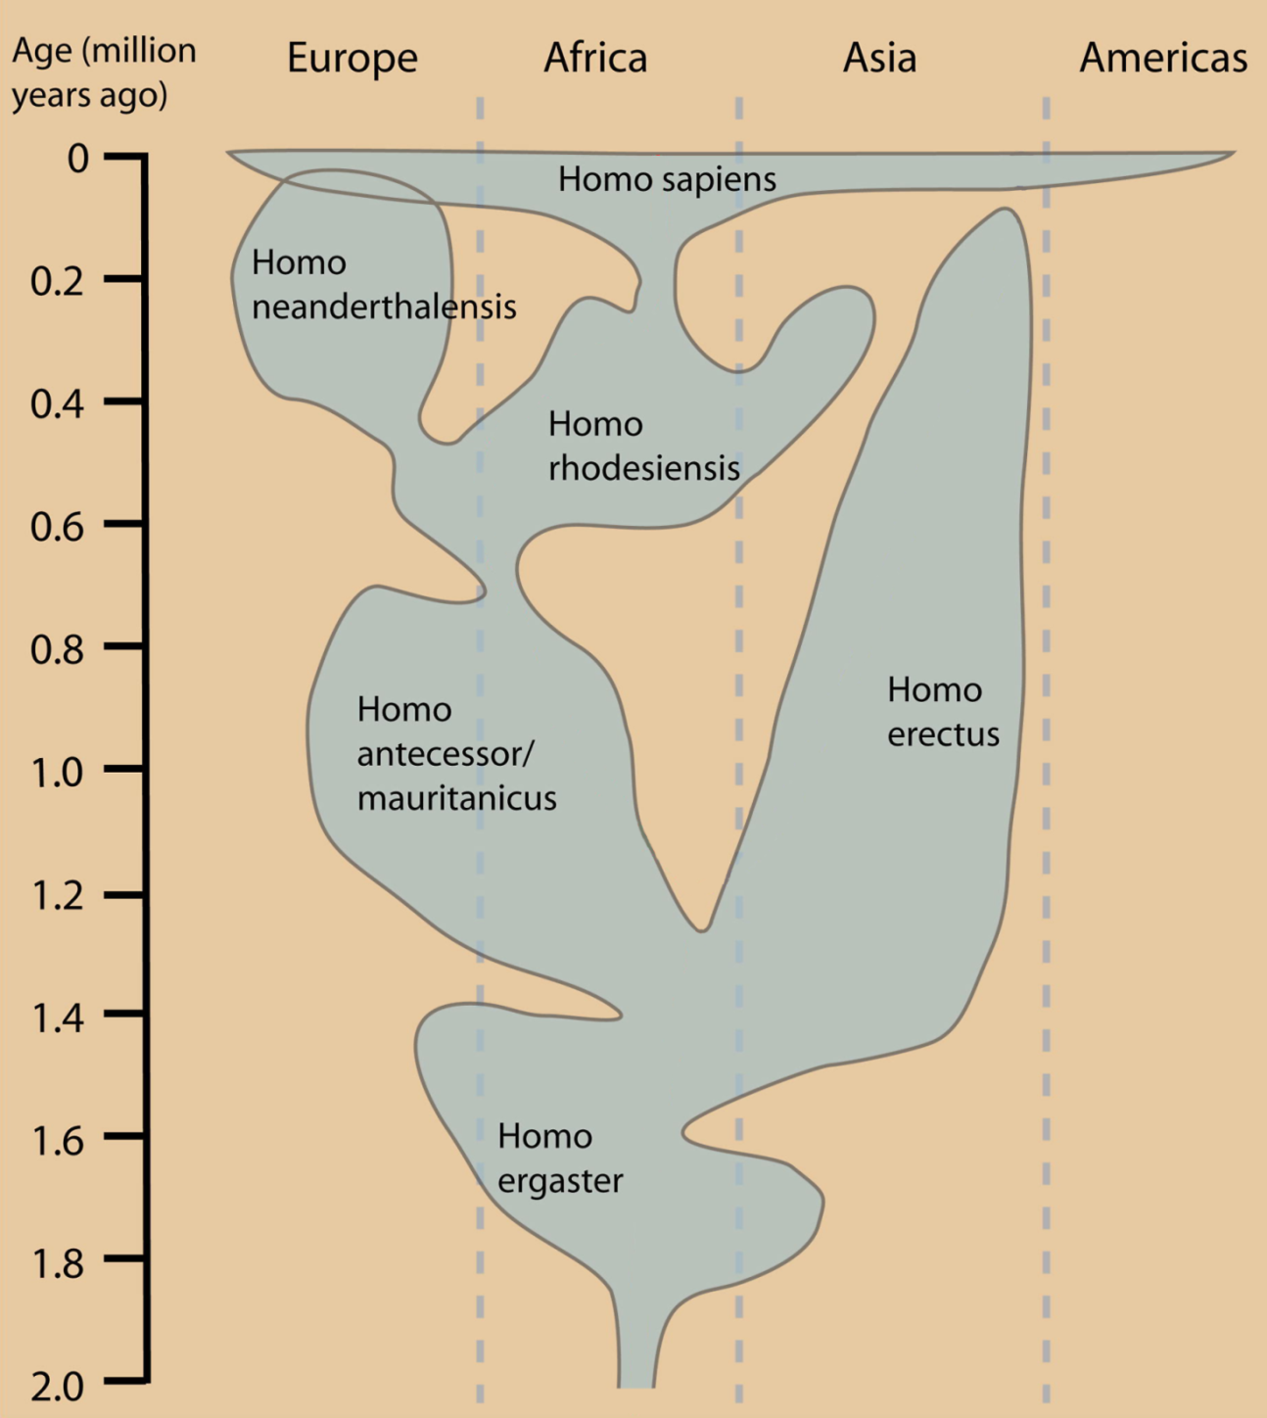
Homo Genus
sapiens
neanderthal
rhodesiensis
erectus
antecessor
ergaster

Slide 15
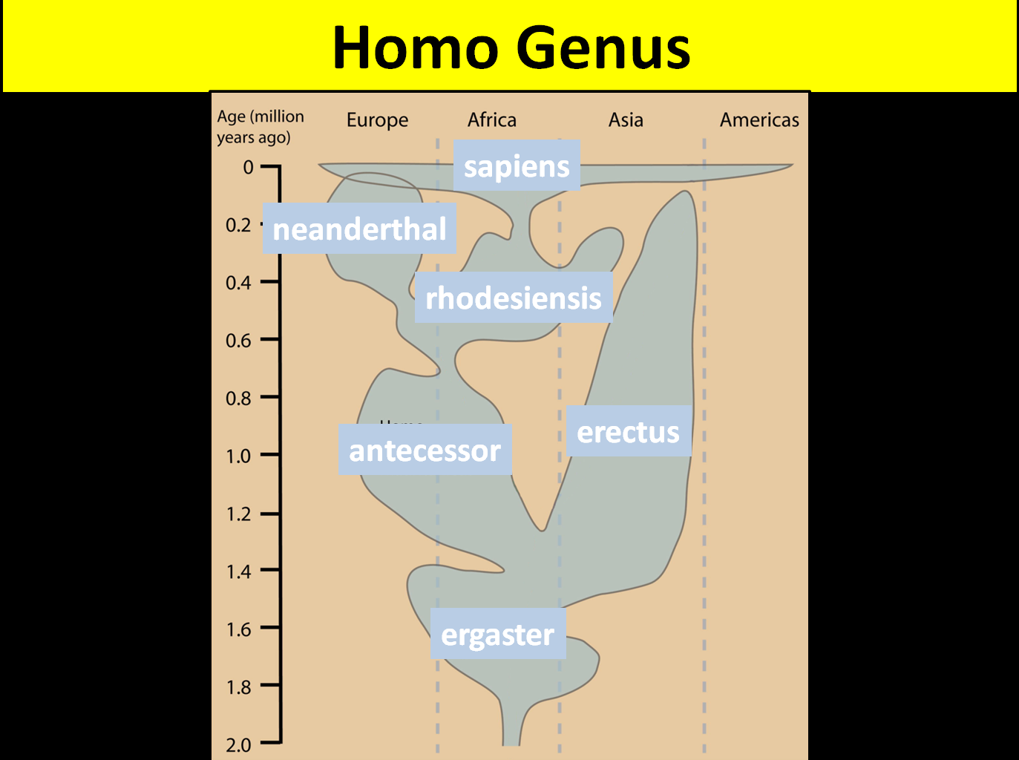
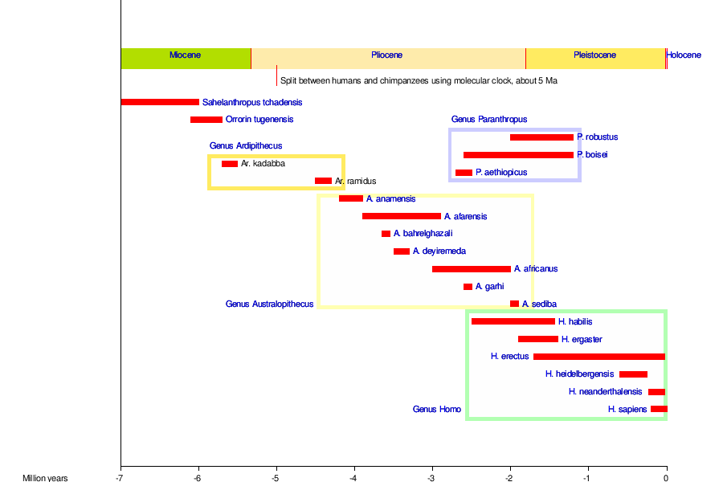
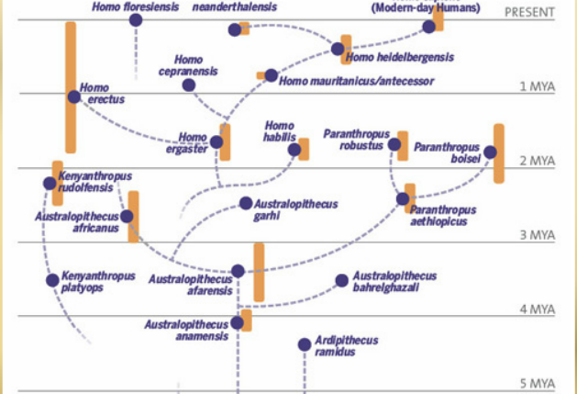
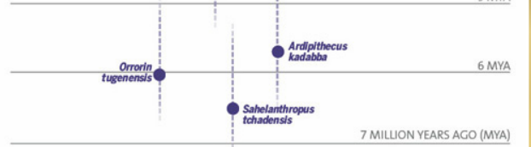
“HOMININ FAMILY TREE”
neanderthal
sapiens
erectus
antecessor
ergaster
Copyright © Myra Salazar
Copyright © Myra Salazar
Copyright © Myra Salazar
rhodesiensis

Slide 16
“HOMININ FAMILY TREE”
Homo
Paranthropus
Australopithecus
Ardipithecus
Copyright © Myra Salazar

Slide 17
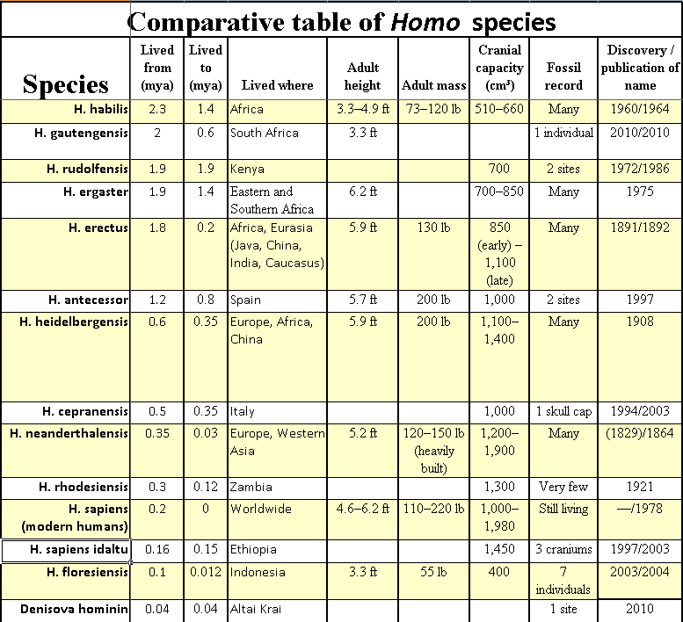
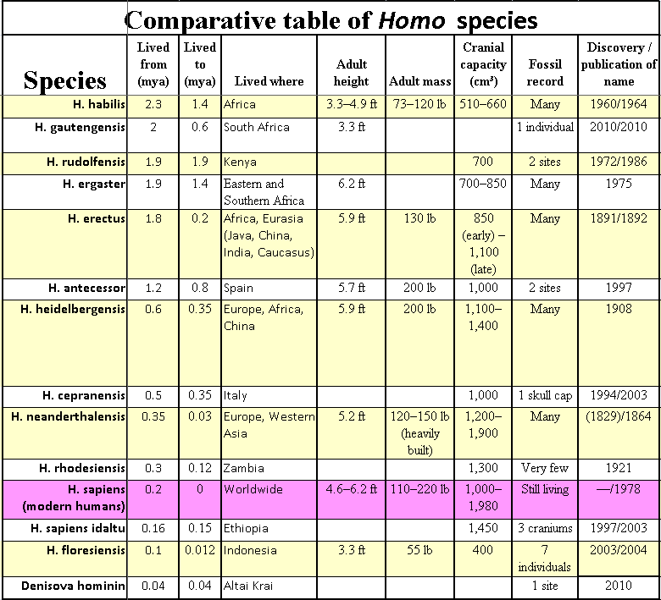
EVOLUTION OF HOMO SAPIEN
15
14 Species of Homo genus!

Slide 18
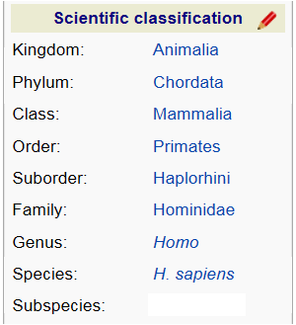
And 2 sub-species of Homo sapiens?
TAXONOMIC CLASSIFICATION

Slide 19
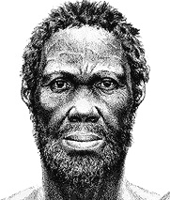

And 2 sub-species of Homo sapiens?
Genus: | Homo
Species: | sapiens
TAXONOMIC CLASSIFICATION
2 Sub-species
Genus: | Homo
Species: | sapiens
Sub-species | idaltu
Genus: | Homo
Species: | sapiens
Sub-species | sapiens
“Herto-man”
“King of Pop”

Slide 20
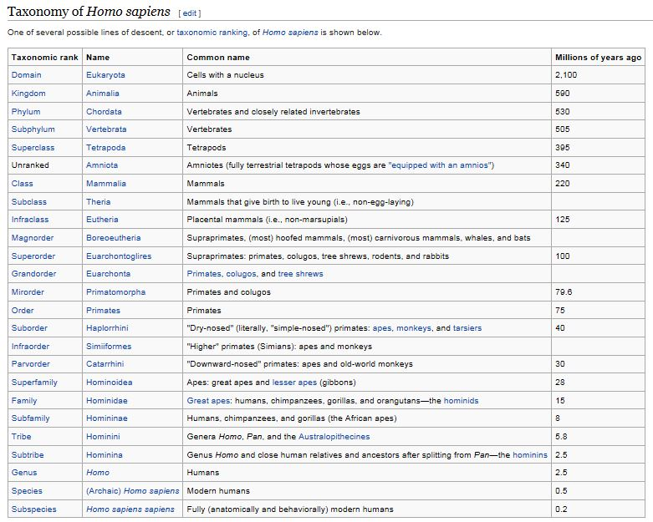
It’s actually a much more complex TAXONOMY to classify Homo sapiens… here’s one example!

Slide 21
“HOMININ FAMILY TREE”
Homo
Paranthropus
Australopithecus
Ardipithecus
Copyright © Myra Salazar

Slide 22
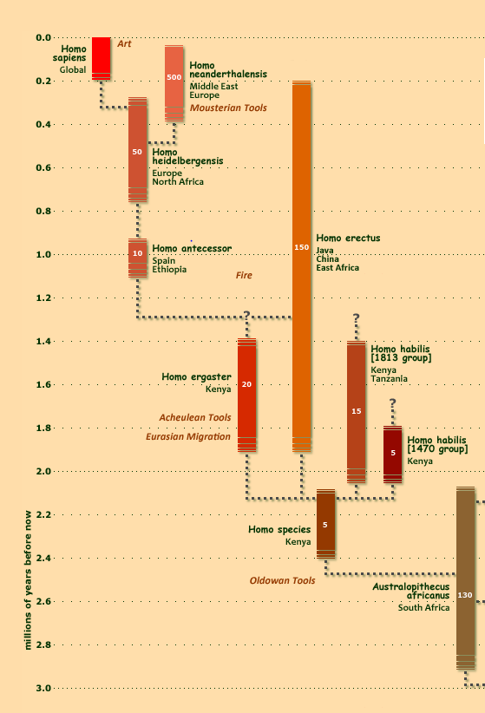
“HOMININ FAMILY TREE”
200
360
450
Relationships shown in this type chart are changing frequently due to ongoing revelations from paleo-genetics…
DNA analysis
200
1700!
500
?

Slide 23
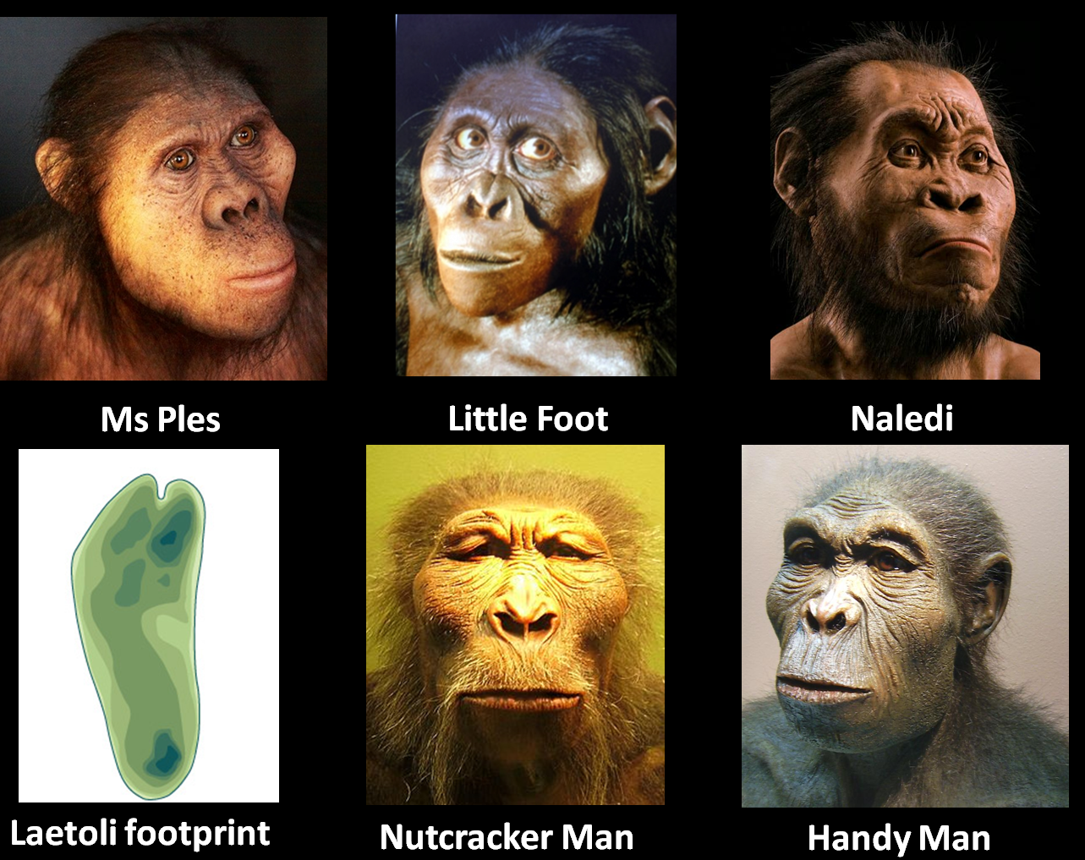
CAST OF CHARACTERS FROM LAST WEEK
Australopithecus africanus
Australopithecus africanus
Homo naledi
Homo habilis
Australopithecus afarensis
Paranthropis boisei

Slide 24
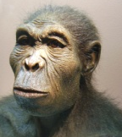
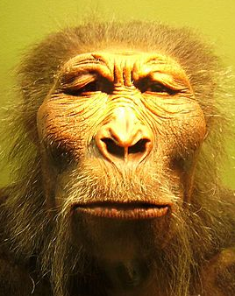
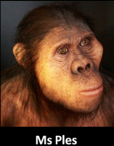

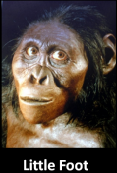
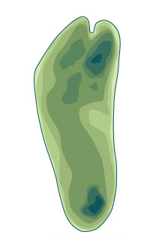
“HOMININ FAMILY TREE”
Moved out of Africa
Stayed inside Africa
Copyright © Myra Salazar
Copyright © Myra Salazar

Slide 25

Session 3: Into Europe
TODAY’S
TOPICS
Lascaux Paleolithic Cave Art
Review
Out of Africa
Danube Corridor

Slide 26

OUT OF AFRICA!
70,000 th ANNIVERSARY EDITION
Starring…
Homo Sapiens as Sandi and
Homo Neanderthalensis as Rocky

Slide 27
TWO COMPETING “OUT OF AFRICA” THEORIES
TWO COMPETING
“OUT OF AFRICA” THEORIES
Regional Continuity Theory (“Multiregional” model)
Recent African Origins Theory (“Out of Africa” or “Mitochondrial Eve” model)

Slide 28
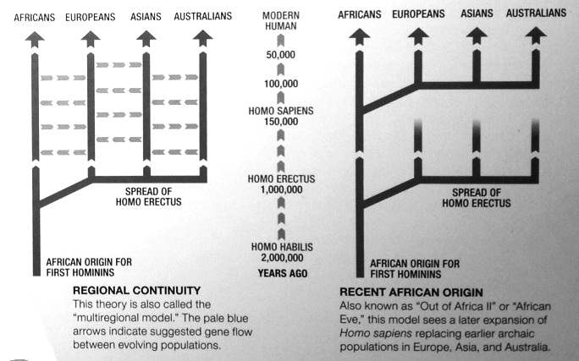
TWO COMPETING “OUT OF AFRICA” THEORIES
TIME
After spreading out, H.sapiens develop independently and in parallel in each separate area of the world

Slide 29

TWO COMPETING “OUT OF AFRICA” THEORIES
How do we know “Mitochondrial Eve’s” relatives spread out to the rest of the world??
But this hominin kept on evolving
This one species spreads out; H.sapiens migrate to all parts of the world
What is implicit with this theory?
These evolutionary hominins die out
“Mitochondrial Eve”

Slide 30
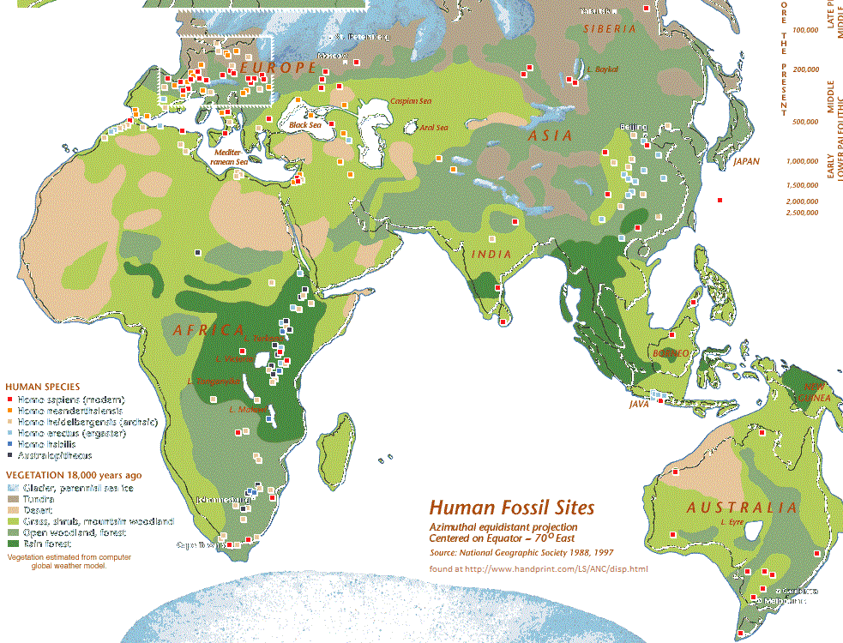
EUROPE
RUSSIA
INDO-CHINA
AFRICA
MIDDLE EAST
HUMAN SPECIES
S.E. ASIA
Homo sapiens (modern)
Homo neanderthalensis
Homo heidelbergensis (archaic)
Homo erectus (ergaster)
Homo habilis
Australopithecus
AUSTRALIA
DISTRIBUTION OF EARLY HUMANS
DISTRIBUTION OF HUMAN FOSSILS

Slide 31
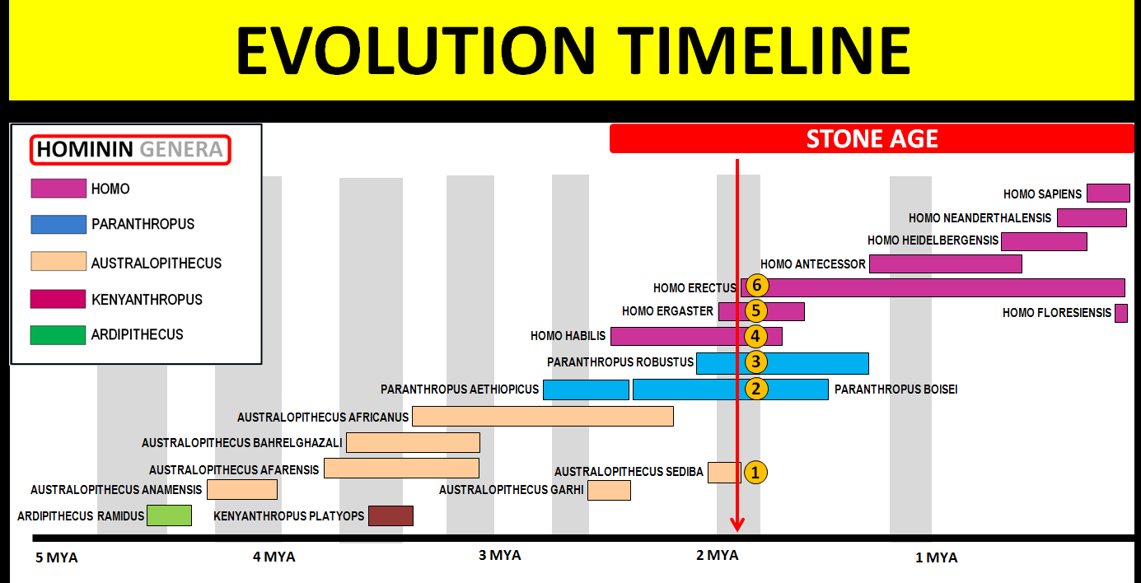
EUROPE
RUSSIA
INDO-CHINA
AFRICA
MIDDLE EAST
S.E. ASIA
Roamed same area at same time
But didn’t leave Africa!
AUSTRALIA
EARLY SPECIES
DISTRIBUTION OF EARLY HUMANS

Slide 32
EUROPE
RUSSIA
INDO-CHINA
AFRICA
MIDDLE EAST
S.E. ASIA
AUSTRALIA
1st out of Africa
DISTRIBUTION OF EARLY HUMANS
Notes:
Homo erectus ("upright man") is believed to have lived in East and Southeast Asia from 1.8 million to 40,000 years ago.^{[3]}

Slide 33
EUROPE
RUSSIA
INDO-CHINA
Hummm?
AFRICA
MIDDLE EAST
Hummm?
S.E. ASIA
Hummm?
Roaming same area at same time…OhhLaLaa!
AUSTRALIA
LATER SPECIES
DISTRIBUTION OF EARLY HUMANS

Slide 34
EUROPE
RUSSIA
INDO-CHINA
Hummm?
Do have evidence of “Romance” here!
AFRICA
MIDDLE EAST
Next week we’ll talk about the result of this “romance” and how it could have had a direct affect on YOU!!
Did GEOLOGY play a role in this “romance”?
Hummm?
S.E. ASIA
Hummm?
Roaming same area at same time…OhhLaLaa!
AUSTRALIA
LATER SPECIES
DISTRIBUTION OF EARLY HUMANS

Slide 35
HOW DID
GEOLOGY
HELP HOMO SAPIENS LEAVE AFRICA?
THE STORY STARTS WITH …

Slide 36
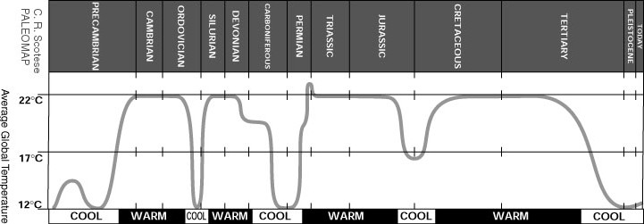
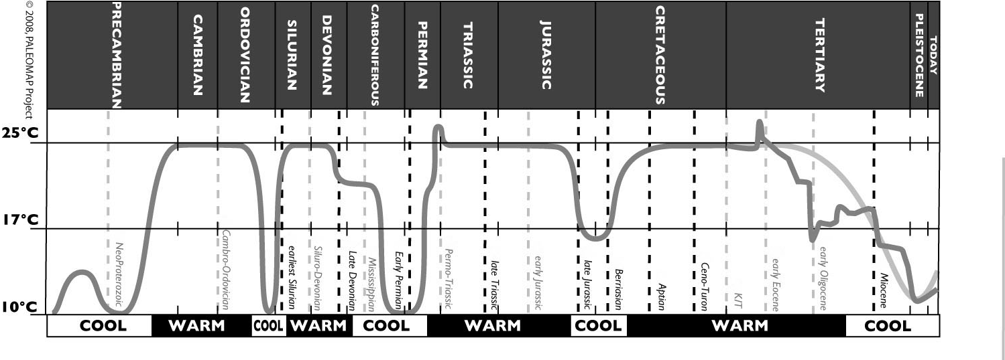
CYLES OF WARMING/COOLING
77⁰
average MAXIMUM temp of Earth
63⁰
AVERAGE temp of Earth
50⁰
average MINIMUM temp of Earth
MYA
500
400
300
200
100
50
3
Chart is by Dr. Christopher Scotese, well-known & well-respected Paleoclimateologist at U. Texas
Geologic Record shows that Earth has gone thru multiple cycles of Cooling/Warming
Cycles typically last tens of millions of years!
Notes:
Warm Periods: avg 114 million yrs
Cold Periods: 26 my

Slide 37

CYLES OF WARMING/COOLING
77⁰
63⁰
50⁰
MYA
500
400
300
200
100
50
3
Last MINIMUM earth temperature was about
2 million years ago
Earth has been warming ever since!

Slide 38
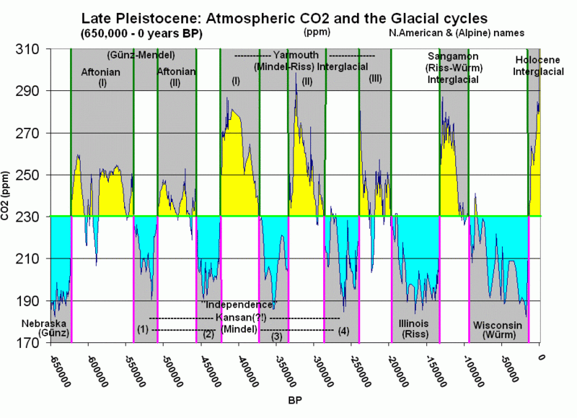
EARTH HAS BEEN WARMING FOR 2 MILLION YEARS
After the Last Global Cooling Period had reached it’s mimimum, temperatures started rising
Even with generally rising temps, there were periods of cooling
Notes:
http://geography.huji.ac.il/personal/Frumkin/pdf/EPSL%20Vaks%20n.Negev2006.pdf
Major humid intervals
occurred during glacials at 190–150 ka, 76–25 ka, 23–13 ka and interglacials at 200–190 ka, 137–123 ka and 84–77 ka… Although during most of the humid periods the vegetation remained steppe with mixed C3+C4 vegetation,Mediterranean C3 type steppe-forest vegetation invaded southward for short periods, and the climate in the northern
Negev became closer to Mediterranean type than at present.
http://insights.wri.org/news/2012/06/400-ppm-carbon-dioxide-levels-cross-sobering-new-threshold
Present (June 2012) global average atmospheric CO2 concentrations, however, are 393.9 ppm…To put this data into context, scientific models show that CO2 concentrations are greater today than at any time in the last 800,000 years

Slide 39
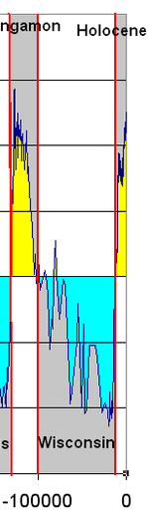
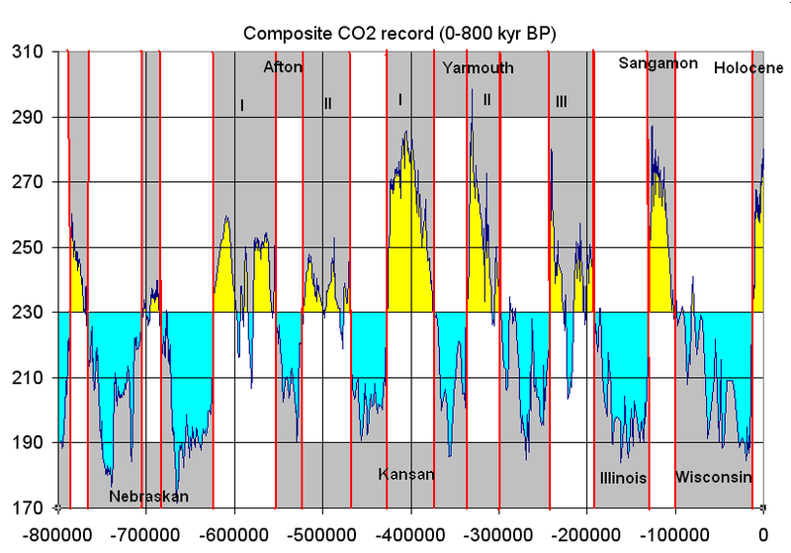
EARTH HAS BEEN WARMING FOR 2 MILLION YEARS
GLACIATION IN LAST 800,000 YRS
After the Last Global Cooling Period had reached it’s mimimum, temperatures started rising
Even with generally rising temps, there were periods of cooling
4 Glaciation Periods in the last 800,000 years
Let’s focus on the last glacial period, the Wisconsin
Years BP
Notes:
http://geography.huji.ac.il/personal/Frumkin/pdf/EPSL%20Vaks%20n.Negev2006.pdf
Major humid intervals
occurred during glacials at 190–150 ka, 76–25 ka, 23–13 ka and interglacials at 200–190 ka, 137–123 ka and 84–77 ka… Although during most of the humid periods the vegetation remained steppe with mixed C3+C4 vegetation,Mediterranean C3 type steppe-forest vegetation invaded southward for short periods, and the climate in the northern
Negev became closer to Mediterranean type than at present.
http://insights.wri.org/news/2012/06/400-ppm-carbon-dioxide-levels-cross-sobering-new-threshold
Present (June 2012) global average atmospheric CO2 concentrations, however, are 393.9 ppm…To put this data into context, scientific models show that CO2 concentrations are greater today than at any time in the last 800,000 years

Slide 40
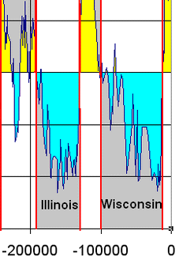
LEAVING AFRICA
Species Homo sapiens is thought to have left Africa at two different times…
two different “Pulses”
First pulse was about 125,000 years ago but this pulse didn’t last as we shall review later
Second pulse was around 60-80,000 yrs ago: a permanent exodus from Africa
Let’s focus on the 2nd Pulse . . .

Slide 41
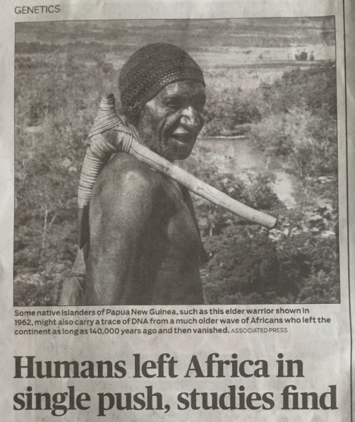
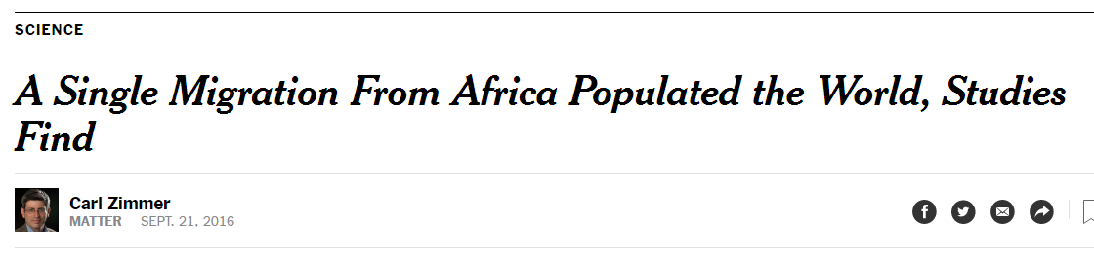
But wait, there’s contradictory data…
Recent Austin American Statesman article showed this pic with this headline…
“SINGLE PUSH” article…hum?
Was it 1 Exit Pulse or 2? Clarification needed…
Two Titles seem to say different things?
Original NYT article
Notes:
NYTimes Article A Single Migration From Africa Populated the World, Studies Find
By Carl Zimmer Sept. 21, 2016
“Modern humans evolved in Africa roughly 200,000 years ago. But how did our species go on to populate the rest of the globe?
The question, one of the biggest in studies of human evolution, has intrigued scientists for decades. In a series of extraordinary genetic analyses published on Wednesday, researchers believe they have found an answer.
In the journal Nature, three separate teams of geneticists survey DNA collected from cultures around the globe, many for the first time, and conclude that all non-Africans today trace their ancestry to a single population emerging from Africa between 50,000 and 80,000 years ago.
“I think all three studies are basically saying the same thing,” said Joshua M. Akey of the University of Washington, who wrote a commentary accompanying the new work. “We know there were multiple dispersals out of Africa, but we can trace our ancestry back to a single one.”
The three teams sequenced the genomes of 787 people, obtaining highly detailed scans of each. The genomes were drawn from people in hundreds of indigenous populations: Basques, African pygmies, Mayans, Bedouins, Sherpas and Cree Indians, to name just a few.
The DNA of indigenous populations is essential to understanding human history, many geneticists believe. Yet until now scientists have sequenced entire genomes from very few people outside population centers like Europe and China.
The new data already are altering scientific understanding of what human DNA looks like, experts said, adding rich variations to our map of the genome.
Each team of researchers tackled different questions about our origins, such as how people spread across Africa and how others populated Australia. But all aimed to settle the controversial question of human expansion from Africa.
In the 1980s, a group of paleoanthropologists and geneticists began championing a hypothesis that modern humans emerged only once from Africa, roughly 50,000 years ago. Skeletons and tools discovered at archaeological sites clearly indicated that modern humans lived after that time in Europe, Asia and Australia.
Early studies of bits of DNA also supported this idea. All non-Africans are closely related to one another, geneticists found, and they all branch from a family tree rooted in Africa.
Yet there are also clues that at least some modern humans may have departed Africa well before 50,000 years ago, perhaps part of an earlier wave of migration.
In Israel, for example, researchers found a few distinctively modern human skeletons that are between 120,000 and 90,000 years old. In Saudi Arabia and India, sophisticated tools date back as far as 100,000 years.
Last October, Chinese scientists reported finding teeth belonging to Homo sapiens that are at least 80,000 years old and perhaps as old as 120,000 years.
In 2011, Eske Willerslev, a renowned geneticist at the University of Copenhagen, and his colleagues came across some puzzling clues to the expansion out of Africa by sequencing the genome of an Aboriginal Australian for the first time.
Dr. Willerslev and his colleagues reconstructed the genome from a century-old lock of hair kept in a museum. The DNA held a number of peculiar variants not found in Europeans or Asians, raising knotty questions about the origins of the people who first came to Australia and when they arrived.
Intrigued, Dr. Willerslev decided to contact living Aboriginals to see if they would participate in a new genetic study. He joined David W. Lambert, a geneticist at Griffith University in Australia, who was already meeting with Aboriginal communities about participating in this kind of research.
In collaboration with scientists at the University of Oxford, the researchers also obtained DNA from people in Papua New Guinea. All told, the team was able to sequence 83 genomes from Aboriginal Australians and 25 from people in Papua New Guinea, all with far greater accuracy than in Dr. Willerslev’s 2011 study.
Meanwhile, Mait Metspalu of the Estonian Biocentre was leading a team of 98 scientists on another genome-gathering project. They picked out 148 populations to sample, mostly in Europe and Asia, with a few genomes from Africa and Australia. They, too, sequenced 483 genomes at high resolution.
David Reich, a geneticist at Harvard Medical School, and his colleagues assembled a third database of genomes from all six inhabited continents. The Simons Genome Diversity Project, sponsored by the Simons Foundation and the National Science Foundation, contains 300 high-quality genomes from 142 populations.
Examining their data separately, all three groups came to the same conclusion: All non-Africans descend from a single migration of early humans from Africa. The estimates from the studies point to an exodus somewhere between 80,000 and 50,000 years.
Despite earlier research, the teams led by Dr. Willerslev and Dr. Reich found no genetic evidence that there was an earlier migration giving rise to people in Australia and Papua New Guinea.
“The vast majority of their ancestry — if not all of it — is coming from the same out-of-Africa wave as Europeans and Asians,” said Dr. Willerslev.
But on that question, Dr. Metspalu and his colleagues ended up with a somewhat different result.
In Papua New Guinea, Dr. Metspalu and his colleagues found, 98 percent of each person’s DNA can be traced to that single migration from Africa. But the other 2 percent seemed to be much older.
Dr. Metspalu concluded that all people in Papua New Guinea carry a trace of DNA from an earlier wave of Africans who left the continent as long as 140,000 years ago, and then vanished.
If they did exist, these early human pioneers were able to survive for tens of thousands of years, said Luca Pagani, a co-author of Dr. Metspalu at the University of Cambridge and the Estonian Biocentre.
But when the last wave came out of Africa, descendants of the first wave disappeared. “They may have not been technologically advanced, living in small groups,” Dr. Pagani said. “Maybe it was easy for a major later wave that was more successful to wipe them out.”
The new research also suggests that the splintering of the human tree began earlier than experts had suspected.
Dr. Reich and his colleagues probed their data for the oldest evidence of human groups genetically separating from one another.
They found that the ancestors of the KhoiSan, hunter-gatherers living today in southern Africa, began to split off from other living humans about 200,000 years ago and were fully isolated by 100,000 years ago. That finding hints that our ancestors already had evolved behaviors seen in living humans, such as language, 200,000 years ago.
Why leave Africa at all? Scientists have found some clues to that mystery, too.
In a fourth paper in Nature, researchers described a computer model of Earth’s recent climatic and ecological history. It shows that changing rainfall patterns periodically opened up corridors from Africa into Eurasia that humans may have followed in search of food.
Follow Carl Zimmer on Twitter @carlzimmer

Slide 42
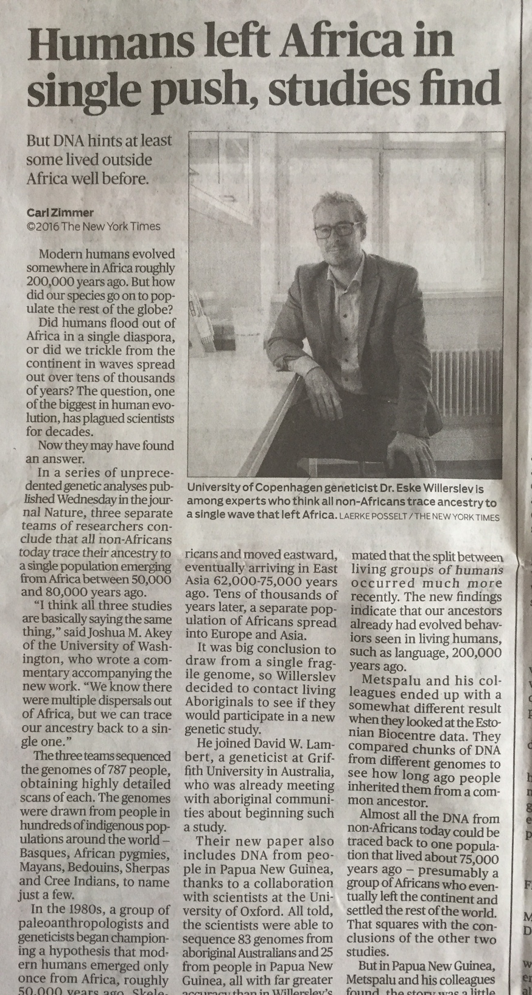
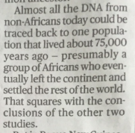


But wait, there’s contradictory data…
Recent Austin American Statesman article showed this pic with this headline…
“SINGLE PUSH” article…hum?
    Was it 1 Exit Pulse or 2? Clarification needed…
Notes:
NYTimes Article A Single Migration From Africa Populated the World, Studies Find
By Carl Zimmer Sept. 21, 2016
“Modern humans evolved in Africa roughly 200,000 years ago. But how did our species go on to populate the rest of the globe?
The question, one of the biggest in studies of human evolution, has intrigued scientists for decades. In a series of extraordinary genetic analyses published on Wednesday, researchers believe they have found an answer.
In the journal Nature, three separate teams of geneticists survey DNA collected from cultures around the globe, many for the first time, and conclude that all non-Africans today trace their ancestry to a single population emerging from Africa between 50,000 and 80,000 years ago.
“I think all three studies are basically saying the same thing,” said Joshua M. Akey of the University of Washington, who wrote a commentary accompanying the new work. “We know there were multiple dispersals out of Africa, but we can trace our ancestry back to a single one.”
The three teams sequenced the genomes of 787 people, obtaining highly detailed scans of each. The genomes were drawn from people in hundreds of indigenous populations: Basques, African pygmies, Mayans, Bedouins, Sherpas and Cree Indians, to name just a few.
The DNA of indigenous populations is essential to understanding human history, many geneticists believe. Yet until now scientists have sequenced entire genomes from very few people outside population centers like Europe and China.
The new data already are altering scientific understanding of what human DNA looks like, experts said, adding rich variations to our map of the genome.
Each team of researchers tackled different questions about our origins, such as how people spread across Africa and how others populated Australia. But all aimed to settle the controversial question of human expansion from Africa.
In the 1980s, a group of paleoanthropologists and geneticists began championing a hypothesis that modern humans emerged only once from Africa, roughly 50,000 years ago. Skeletons and tools discovered at archaeological sites clearly indicated that modern humans lived after that time in Europe, Asia and Australia.
Early studies of bits of DNA also supported this idea. All non-Africans are closely related to one another, geneticists found, and they all branch from a family tree rooted in Africa.
Yet there are also clues that at least some modern humans may have departed Africa well before 50,000 years ago, perhaps part of an earlier wave of migration.
In Israel, for example, researchers found a few distinctively modern human skeletons that are between 120,000 and 90,000 years old. In Saudi Arabia and India, sophisticated tools date back as far as 100,000 years.
Last October, Chinese scientists reported finding teeth belonging to Homo sapiens that are at least 80,000 years old and perhaps as old as 120,000 years.
In 2011, Eske Willerslev, a renowned geneticist at the University of Copenhagen, and his colleagues came across some puzzling clues to the expansion out of Africa by sequencing the genome of an Aboriginal Australian for the first time.
Dr. Willerslev and his colleagues reconstructed the genome from a century-old lock of hair kept in a museum. The DNA held a number of peculiar variants not found in Europeans or Asians, raising knotty questions about the origins of the people who first came to Australia and when they arrived.
Intrigued, Dr. Willerslev decided to contact living Aboriginals to see if they would participate in a new genetic study. He joined David W. Lambert, a geneticist at Griffith University in Australia, who was already meeting with Aboriginal communities about participating in this kind of research.
In collaboration with scientists at the University of Oxford, the researchers also obtained DNA from people in Papua New Guinea. All told, the team was able to sequence 83 genomes from Aboriginal Australians and 25 from people in Papua New Guinea, all with far greater accuracy than in Dr. Willerslev’s 2011 study.
Meanwhile, Mait Metspalu of the Estonian Biocentre was leading a team of 98 scientists on another genome-gathering project. They picked out 148 populations to sample, mostly in Europe and Asia, with a few genomes from Africa and Australia. They, too, sequenced 483 genomes at high resolution.
David Reich, a geneticist at Harvard Medical School, and his colleagues assembled a third database of genomes from all six inhabited continents. The Simons Genome Diversity Project, sponsored by the Simons Foundation and the National Science Foundation, contains 300 high-quality genomes from 142 populations.
Examining their data separately, all three groups came to the same conclusion: All non-Africans descend from a single migration of early humans from Africa. The estimates from the studies point to an exodus somewhere between 80,000 and 50,000 years.
Despite earlier research, the teams led by Dr. Willerslev and Dr. Reich found no genetic evidence that there was an earlier migration giving rise to people in Australia and Papua New Guinea.
“The vast majority of their ancestry — if not all of it — is coming from the same out-of-Africa wave as Europeans and Asians,” said Dr. Willerslev.
But on that question, Dr. Metspalu and his colleagues ended up with a somewhat different result.
In Papua New Guinea, Dr. Metspalu and his colleagues found, 98 percent of each person’s DNA can be traced to that single migration from Africa. But the other 2 percent seemed to be much older.
Dr. Metspalu concluded that all people in Papua New Guinea carry a trace of DNA from an earlier wave of Africans who left the continent as long as 140,000 years ago, and then vanished.
If they did exist, these early human pioneers were able to survive for tens of thousands of years, said Luca Pagani, a co-author of Dr. Metspalu at the University of Cambridge and the Estonian Biocentre.
But when the last wave came out of Africa, descendants of the first wave disappeared. “They may have not been technologically advanced, living in small groups,” Dr. Pagani said. “Maybe it was easy for a major later wave that was more successful to wipe them out.”
The new research also suggests that the splintering of the human tree began earlier than experts had suspected.
Dr. Reich and his colleagues probed their data for the oldest evidence of human groups genetically separating from one another.
They found that the ancestors of the KhoiSan, hunter-gatherers living today in southern Africa, began to split off from other living humans about 200,000 years ago and were fully isolated by 100,000 years ago. That finding hints that our ancestors already had evolved behaviors seen in living humans, such as language, 200,000 years ago.
Why leave Africa at all? Scientists have found some clues to that mystery, too.
In a fourth paper in Nature, researchers described a computer model of Earth’s recent climatic and ecological history. It shows that changing rainfall patterns periodically opened up corridors from Africa into Eurasia that humans may have followed in search of food.
Follow Carl Zimmer on Twitter @carlzimmer

Slide 43

But wait, there’s contradictory data…
Recent Austin American Statesman article showed this pic with this headline…
“SINGLE PUSH” article…hum?
    Was it 1 Exit Pulse or 2? Clarification needed…
    Turns out not to be contradictory at all, in fact the article is supportive of the multiple dispersals theory
    Soooo, back to leaving Africa!
“We know there were multiple dispersals out of Africa, but we can trace our ancestry back to a single one”
Notes:
NYTimes Article A Single Migration From Africa Populated the World, Studies Find
By Carl Zimmer Sept. 21, 2016
“Modern humans evolved in Africa roughly 200,000 years ago. But how did our species go on to populate the rest of the globe?
The question, one of the biggest in studies of human evolution, has intrigued scientists for decades. In a series of extraordinary genetic analyses published on Wednesday, researchers believe they have found an answer.
In the journal Nature, three separate teams of geneticists survey DNA collected from cultures around the globe, many for the first time, and conclude that all non-Africans today trace their ancestry to a single population emerging from Africa between 50,000 and 80,000 years ago.
“I think all three studies are basically saying the same thing,” said Joshua M. Akey of the University of Washington, who wrote a commentary accompanying the new work. “We know there were multiple dispersals out of Africa, but we can trace our ancestry back to a single one.”
The three teams sequenced the genomes of 787 people, obtaining highly detailed scans of each. The genomes were drawn from people in hundreds of indigenous populations: Basques, African pygmies, Mayans, Bedouins, Sherpas and Cree Indians, to name just a few.
The DNA of indigenous populations is essential to understanding human history, many geneticists believe. Yet until now scientists have sequenced entire genomes from very few people outside population centers like Europe and China.
The new data already are altering scientific understanding of what human DNA looks like, experts said, adding rich variations to our map of the genome.
Each team of researchers tackled different questions about our origins, such as how people spread across Africa and how others populated Australia. But all aimed to settle the controversial question of human expansion from Africa.
In the 1980s, a group of paleoanthropologists and geneticists began championing a hypothesis that modern humans emerged only once from Africa, roughly 50,000 years ago. Skeletons and tools discovered at archaeological sites clearly indicated that modern humans lived after that time in Europe, Asia and Australia.
Early studies of bits of DNA also supported this idea. All non-Africans are closely related to one another, geneticists found, and they all branch from a family tree rooted in Africa.
Yet there are also clues that at least some modern humans may have departed Africa well before 50,000 years ago, perhaps part of an earlier wave of migration.
In Israel, for example, researchers found a few distinctively modern human skeletons that are between 120,000 and 90,000 years old. In Saudi Arabia and India, sophisticated tools date back as far as 100,000 years.
Last October, Chinese scientists reported finding teeth belonging to Homo sapiens that are at least 80,000 years old and perhaps as old as 120,000 years.
In 2011, Eske Willerslev, a renowned geneticist at the University of Copenhagen, and his colleagues came across some puzzling clues to the expansion out of Africa by sequencing the genome of an Aboriginal Australian for the first time.
Dr. Willerslev and his colleagues reconstructed the genome from a century-old lock of hair kept in a museum. The DNA held a number of peculiar variants not found in Europeans or Asians, raising knotty questions about the origins of the people who first came to Australia and when they arrived.
Intrigued, Dr. Willerslev decided to contact living Aboriginals to see if they would participate in a new genetic study. He joined David W. Lambert, a geneticist at Griffith University in Australia, who was already meeting with Aboriginal communities about participating in this kind of research.
In collaboration with scientists at the University of Oxford, the researchers also obtained DNA from people in Papua New Guinea. All told, the team was able to sequence 83 genomes from Aboriginal Australians and 25 from people in Papua New Guinea, all with far greater accuracy than in Dr. Willerslev’s 2011 study.
Meanwhile, Mait Metspalu of the Estonian Biocentre was leading a team of 98 scientists on another genome-gathering project. They picked out 148 populations to sample, mostly in Europe and Asia, with a few genomes from Africa and Australia. They, too, sequenced 483 genomes at high resolution.
David Reich, a geneticist at Harvard Medical School, and his colleagues assembled a third database of genomes from all six inhabited continents. The Simons Genome Diversity Project, sponsored by the Simons Foundation and the National Science Foundation, contains 300 high-quality genomes from 142 populations.
Examining their data separately, all three groups came to the same conclusion: All non-Africans descend from a single migration of early humans from Africa. The estimates from the studies point to an exodus somewhere between 80,000 and 50,000 years.
Despite earlier research, the teams led by Dr. Willerslev and Dr. Reich found no genetic evidence that there was an earlier migration giving rise to people in Australia and Papua New Guinea.
“The vast majority of their ancestry — if not all of it — is coming from the same out-of-Africa wave as Europeans and Asians,” said Dr. Willerslev.
But on that question, Dr. Metspalu and his colleagues ended up with a somewhat different result.
In Papua New Guinea, Dr. Metspalu and his colleagues found, 98 percent of each person’s DNA can be traced to that single migration from Africa. But the other 2 percent seemed to be much older.
Dr. Metspalu concluded that all people in Papua New Guinea carry a trace of DNA from an earlier wave of Africans who left the continent as long as 140,000 years ago, and then vanished.
If they did exist, these early human pioneers were able to survive for tens of thousands of years, said Luca Pagani, a co-author of Dr. Metspalu at the University of Cambridge and the Estonian Biocentre.
But when the last wave came out of Africa, descendants of the first wave disappeared. “They may have not been technologically advanced, living in small groups,” Dr. Pagani said. “Maybe it was easy for a major later wave that was more successful to wipe them out.”
The new research also suggests that the splintering of the human tree began earlier than experts had suspected.
Dr. Reich and his colleagues probed their data for the oldest evidence of human groups genetically separating from one another.
They found that the ancestors of the KhoiSan, hunter-gatherers living today in southern Africa, began to split off from other living humans about 200,000 years ago and were fully isolated by 100,000 years ago. That finding hints that our ancestors already had evolved behaviors seen in living humans, such as language, 200,000 years ago.
Why leave Africa at all? Scientists have found some clues to that mystery, too.
In a fourth paper in Nature, researchers described a computer model of Earth’s recent climatic and ecological history. It shows that changing rainfall patterns periodically opened up corridors from Africa into Eurasia that humans may have followed in search of food.
Follow Carl Zimmer on Twitter @carlzimmer

Slide 44
LEAVING AFRICA
60-80K yrs ago environment was much different than today
Glaciers were nearing their maximum for this period
When amount of glacial ice is high, (MAXIMUM)
Sea levels are low, (MINIMUM)
Therefore continental margins will be wider, ocean/sea crossings smaller
Glacial ice is high!
Sea-Levels are low!
Notes:
The current rise in sea level observed from tide gauges, of about 1.8 mm/yr, is within the estimate range from the combination of factors above,^{[6]} but active research continues in this field.

Slide 45


LEAVING AFRICA
shoreline example: HIGH vs LOW WATER
shoreline at high water
shore to shore distance at high water
lower shoreline
smaller crossing
Shoreline at low water
Notes:
2/13 (avg length of ½ a cooling period (we’ve already passed the minimum temp)) x 400 ft (difference in sea level between warm and cool periods = 62ft rise in sea level so far

Slide 46
OUT OF AFRICA

Slide 47

OUT OF AFRICA!
125kya earth is in a WARM PERIOD
1st Departure
BUT
Israel/ Palestine
119,000 BP
Middle East
Depart
~125,000 BP
UAE
120,000 BP
NORTH AFRICA
Rift Valley
Notes:
Migration across Bab al Mandab Strait to Yemen
khul Cave (or es-Skhul, and sometimes misspelled as Skuhl Cave) is a rockshelter, one of four located on the slopes of Mount Carmel in Israel, in Nahal Mearot Canyon and very near the similarly ancient site of Tabun. The site contains the purposeful burial of several early modern humans, which all fall within the time range of 100-130,000 years ago.
Skhul Cave Occupations
Three main layers associated with human occupations were identified in the 1930s by excavator Theodore D. McCown.
Natufian (Layer A)
Mousterian (Layer B)
Aurignacian (Layer C
)
The Natufian and Aurignacian levels are somewhat disturbed and mixed, but Layer B is one of the most important Mousterian occupations in the Levant. Layer B at Skhul included the remains of nine adult and immature human beings, which have been interpreted by different scholars as either transitional between Neanderthal and anatomically modern human (AMH) or an archaic form of AMH.
Human Modernity at Skhul Cave
Naturally perforated shells were discovered associated with the burials, including Nassarius gibbosuslus, Acanthocardia deshayesii, Laevicardium crassum, and Pecten jacobaeus, and are interpreted by scholars as purposeful ornamentation.
Four fragments of what appears to be different yellow-red pigments were discovered attached to breccia from Layer B: that is, not in association with burials or other specifically meaningful locations. However, they seem to represent different recipes of heated and mixed hematite and calcium phosphate to produce different colors of yellow and red.
Dating Skhul Cave
Because of its very early age, and the evidence for what is considered a hallmark of modern human behavior (purposeful burial of the dead, personal ornamentation), much work has attempted to securely date the Layer B occupations, including electronic spin resonance spectroscopy (ESR), Uranium series (U-series), and thermoluminescence. There is some disagreement among these methods, with the ranges for ESR falling under 100,000, U-series under 80,000 years ago, and TL between 99-134,000 years ago. A recent study by Grün et al. suggests all three burials fall within 100,000-134,000 years ago.
Qafzeh Cave is an important multicomponent rockshelter with early modern human remains dated to the Middle Paleolithicperiod. It is located in the Yizrael valley of the Lower Galilee region of Israel, on the slope of Har Qedumim at an elevation of 250 meters (820 feet) above sea level. In addition to the important Middle Paleolithic occupations, Qafzeh has later Upper Paleolithic and Holocene occupations.
The oldest levels are dated to the Mousterian Middle Paleolithic period, about 80,000-100,000 years ago (thermoluminescencedates of 92,000 +/- 5,000; electron spin resonance dates 82,400-109,000 +/- 10,000). In addition to human remains, the site is characterized by a series of hearths; and stone tools from the Middle Paleolithic levels are dominated by artifacts made using the radial or centripetal Levallois technique. Qafzeh cave contains some of the earliest evidence for burials in the world.
Human remains from Qafzeh cave include bones and bone fragments from a minimum of 27 individuals, including eight partial skeletons. Qafzeh 9 and 10 are almost completely intact. Most of the human remains appear to have been purposefully buried: if so, these are very early examples of modern behavior indeed, with the burials direct-dated to ~92,000 years ago (BP). The remains are from anatomically modern humans, with some archaic features; they are directly associated with Levallois-Mousterian assemblage.
Qafzeh cave was first excavated by R. Neuville and M. Stekelis in the 1930s, and again between 1965 and 1979 Ofer Bar-Yosef and Bernard Vandermeersch.

Slide 48


MT. TOBA, INDONESIA, ERUPTION
This is known as the
“Toba Catastrophe Event”
75,000 years ago, Mt. Toba volcano exploded
Largest explosion on earth in 25 million years
sent 2,800 times as much ASH into the atmosphere as Mt. St. Helens
sent 6 billion tons of sulfur dioxide into the atmosphere causing acid rain for decades -
Whew!
Close Call!
-reduced worldwide temperature by 7⁰F (up to 27⁰F at northern latitudes),
causing a 6 year winter!
One theory : 90% of Homo sapiens existing at the time died, leaving only about 10,000 to re-populate the Earth!
Notes:
The eruption
Main article: Toba catastrophe theory
Location of Lake Toba shown in red on map.
The Toba eruption (the Toba event) occurred at what is now Lake Toba about 67,500 to 75,500 years ago.^{[8]} It was the last in a series of at least three caldera-forming eruptions at this location, with earlier calderas having formed around 700,000 and 840,000 years ago.^{[9]} This last eruption had an estimated VEI 8, making it possibly the largest explosive volcanic eruption within the last 25 million years.
Bill Rose and Craig Chesner of Michigan Technological University have estimated that the total amount of material released in the eruption was about 2,800 km³ (670 cu mi)^{[10]}—about 2,000 km³ (480 cu mi) of ignimbrite that flowed over the ground, and approximately 800 km³ (190 cu mi) that fell as ash mostly to the west. The pyroclastic flows of the eruption destroyed an area of 20,000 km² (7,722 sq mi), with ash deposits as thick as 600 m (1,969 ft) by the main vent.^{[10]}
The eruption was large enough to have deposited an ash layer approximately 15 cm (5.9 in) thick over all of South Asia; at one site in central India, the Toba ash layer today is up to 6 m (20 ft) thick^{[11]} and parts of Malaysia were covered with 9 m (30 ft) of ash fall.^{[12]} In addition it has been variously calculated that 10,000 million tonnes (1.1×10¹⁰ short tons) of sulfuric acid^{[13][citation needed]} or 6,000 million tonnes (6.6×10⁹ short tons) of sulfur dioxide^{[14]} were ejected into the atmosphere by the event.
The subsequent collapse formed a caldera that, after filling with water, created Lake Toba. The island in the center of the lake is formed by a resurgent dome.
Landsat photo of Sumatra surrounding Lake Toba
The exact year of the eruption is unknown, but the pattern of ash deposits suggests that it occurred during the northern summer because only the summer monsoon could have deposited Toba ashfall in the South China Sea.^{[15]} The eruption lasted perhaps two weeks, and the ensuing "volcanic winter" resulted in a decrease in average global temperatures by 3.0 to 3.5 °C (5 to 6 °F) for several years. Greenland ice cores record a pulse of starkly reduced levels of organic carbon sequestration. Very few plants or animals in southeast Asia would have survived, and it is possible that the eruption caused a planet-wide die-off.
Evidence from studies of mitochondrial DNA suggests that humans may have passed through a genetic bottleneck around this time that reduced genetic diversity below what would be expected given the age of the species. According to the Toba catastrophe theory, proposed by Stanley H. Ambrose of the University of Illinois at Urbana-Champaign in 1998, the effects of the Toba eruption may have decreased the size of human populations to only a few tens of thousands of individuals.^{[16]} However, this hypothesis is not widely accepted because similar effects on other animal species have not been observed.[

Slide 49

MT. TOBA, INDONESIA, ERUPTION
SIDENOTE:
Academic debate over whether or not Toba “caused” population decline that occurred at same time (correlation vs. causation)
No debate that both occurred
No debate over volume of ash, except estimate might be too low
No debate over length of “winter” period that followed except it might be too short an estimate
Planet was already cooling so actual temperature impact drop due to Toba is debated (1 or 5 or 7 deg)

Slide 50


Slide 51
FACTORS ATTRIBUTING TCE AS DRIVER IN DECLINE OF HOMININ/D POPULATION
(comments shown below are taken from Wikipedia's "Toba catastrophe theory")
Topic | + |  | --
Eruption Significance | erupted mass was 100 times greater than that of the largest volcanic eruption in recent history |  | exact geographic distribution of human populations at the time of the eruption is not known;
Eruption Significance | erupted mass is a minimum value or even an underestimation |  | difficulties in estimating the global and regional climatic impacts of the eruption and lack of conclusive evidence for the eruption preceding the bottleneck.[47]
Atmospheric Impact | assuming an emission of six billion tons of sulphur dioxide, computer simulations concluded that a maximum global cooling of approximately 15 °C occurred for three years after the eruption, and that this cooling would last for decades, devastating life.[21] |  | "many forms of life survived the supereruption, contrary to other research which has suggested significant animal extinctions and genetic bottlenecks".[44]
Atmospheric Impact | scientists agree that a super-eruption of the scale at Toba must have led to very extensive ash-fall layers and injection of noxious gases into the atmosphere, with worldwide effects on climate and weather.[25] |  | Some areas of India and southern Africa don't appear to have been impacted
Ice Core Evidence | Evidence from Greenland ice cores indicates a 1,000-year period of low δ¹⁸O and increased dust deposition immediately following the eruption. |  | no consensus that the eruption directly generated the 1,000-year cold period seen in Greenland or triggered the last glaciation ("correlation does note imply causation")
Impacted Areas | Toba's erupted mass deposited an ash layer about 15 centimetres (6 inches) thick over the whole of South Asia
Impacted Areas | blanket of volcanic ash was also deposited over the Indian Ocean, and the Arabian Sea and South China Sea
Impacted Areas | Deep-sea cores retrieved from the South China Sea have extended the known reach of the eruption;
Impacted Areas | evidence from pollen analysis has suggested prolonged deforestation in South Asia, and some researchers have suggested that the Toba eruption may have forced humans to adopt new adaptive strategies, which may have permitted them to replace Neanderthals and "other archaic human species".^{[45]}
FACTORS ATTRIBUTING TCE AS DRIVER IN DECLINE OF HOMININ/D POPULATION
(comments shown below are taken from Wikipedia's "Toba catastrophe theory")
Topic | + |  | --
Genetic bottleneck | Toba eruption has been linked to a genetic bottleneck in human evolution about 50,000 years ago,^{[33][34]} which may have resulted from a severe reduction in the size of the total human population due to the effects of the eruption on the global climate
Genetic bottleneck | Analyses of mitochondrial DNA have estimated that the major migration from Africa occurred 60,000–70,000 years ago,^{[54]}consistent with dating of the Toba eruption to around 75,000 years ago
Genetic bottleneck | Some evidence points to genetic bottlenecks in other animals in the wake of the Toba eruption: the populations of the Eastern African chimpanzee,^{[49]} Bornean orangutan,^{[50]} central Indian macaque,^{[51]} the cheetah, the tiger,^{[52]}
HERE’S HOW I TRY TO SORT OUT CONTESTED HYPOTHESES
Facts vs Speculation
Correlation vs Causation
Logic vs conjecture

Slide 52



OUT OF AFRICA…AGAIN!
Africa
70,000 years ago
Red Sea was very low
Glacial ice is high!
RED SEA
w/two narrow lobes
WHY?
RED SEA
2nd Departure
Now, only
3 miles
Sea-Levels are low!
Normally,
15 miles
Notes:
70,000 ybp: Narrow water crossing between African continent and Sinai Peninsula because of last global temp minimum

Slide 53
OUT OF AFRICA…AGAIN!
70,000 years ago
Red Sea was very low
w/two narrow lobes
2nd departure
Two Theories . . .
to Israel/Palestine
to Yemen, UAE & beyond
Rift Valley

Slide 54
OUT OF AFRICA…AGAIN!
Romania
36,000 BP
Homo Sapiens have now
departed Africa
and are
permanently in other parts of the world
Danube Corridor
Levantine Corridor
Israel/ Palestine
60,000 BP
Depart
70,000 BP
UAE
62,000 BP
Rift Valley

Slide 55


OUT OF AFRICA…AGAIN!

Slide 56
Week 3: Into Europe
TODAY’S
TOPICS
Quick Review
Lascaux Paleolithic Cave Art
Out of Africa
Danube Corridor

Slide 57
WHY WAS DANUBE CORRIDOR IMPORTANT?
“Path of least resistance”- avoiding hills/mountains
Add mountain ranges…
major East-West corridor
GEOLOGY PROVIDED
SHELTER!
source of water always near-by
animals graze in valleys
and one more reason . . .

Slide 58






GEOLOGY PROVIDED SHELTER
Europe in the Jurassic Age (201 to 146 MYA)
shallow seas covered most of Europe during this Period
shallow seas often form limestone reefs
limestone is carved out by weathering & erosion = CAVES
weathered sections become natural shelters
England
Germany
France

Slide 59
WHY WAS DANUBE CORRIDOR IMPORTANT?
“Path of least resistance”- avoiding hills/mountains
major East-West corridor
source of water always near-by
animals graze
in valleys
naturally carved limestone shelter

Slide 60
CONTINUED TREK TO FRANCE!
France
30,000 BP
Danube
Corridor
Romania
36,000 BP
Dordogne
Region
40,000 yrs
of Migration!
(6,000 mi/40k = 800ft/yr)
Israel
60,000 BP
UAE
62,000 BP
Depart
70,000 BP
Rift Valley
Likely h. sapiens followed the Danube Corridor to its headwaters,
then migrated into FRANCE

Slide 61

INTO FRANCE!
The Danube starts SE of Strasbourg
H. sapiens could have continued on eastern path
On arriving near the Rhone River valley near Lyon
some went south
Others continued until reaching the Dordogne River
Dordogne River

Slide 62





DORDOGNE REGION
Named for the Dordogne River that runs through it
Within the region are several river valleys that have carved the ancient limestone
Particularly, the Vézère RIVER site of many Paleolithic rock shelters
Paris
DORDOGNE
REGION
Bordeaux
Vézère RIVER
Marseille
Dordogne River
Notes:
The role of the overhanging formation was fundamental for the Paleolithic population of the Black Perigord.
Pronunciation Aquitaine = ah-key-tane-ah
Dorgogne = door-don-ya
Vezere = vis-air

Slide 63

Vézère RIVER VALLEY
One of the most significant discoveries is . . .
greatest density of prehistoric remains in Western Europe
no fewer than: 25 decorated caves 148 animal fossils 844 utensils many works of art
147 Paleolithic habitation sites
Several Paleolithic skeletal remains
LASCAUX
Vézère RIVER
Notes:
Pronunciation: Lascaux = las-co

Slide 64



Vézère RIVER VALLEY
Soooo,
let’s go to Lascaux!
Montignac
Bordeaux
Montignac
Bordeaux
Bordeaux
Notes:
Pronunciation: Montignac = mon-tea-nag

Slide 65
Week 3: Into Europe
TODAY’S
TOPICS
Quick Review
Lascaux Paleolithic Cave Art
Out of Africa
Danube Corridor

Slide 66

LA GROTTE DE LASCAUX
“a Versailles of prehistory”
“The first sight of those paintings was simply unbelievable,” he said.
“I was amazed at how the colors held up after thousands of years—like they were painted the day before.
Most people don’t realize how huge some of the paintings are. There are pictures of animals there that are ten, fifteen feet long.”
Quote from Time-Life photographer Ralph Morse, 1947

Slide 67


LA GROTTE DE LASCAUX

Slide 68


LA GROTTE DE LASCAUX
Notes:
Picture top left: From left to right: Leon Laval (teacher), Marcel Ravidat, Jacques Marsal (the two discoverers) and Henri Breuil. Successive alterations would bring about an important widening of the entrance, enlarging it from the sub-vertical shaft through which the discoverers had entered the cave for the first time, to the entire breadth of the gallery.
Photo and text: http://www.american-buddha.com/lascaux.7a.htm

Slide 69




LA GROTTE DE LASCAUX
LA GROTTE DE LASCAUX
entrance when Time Magazine visited in 1947
Entrance to the Lascaux Cave at the end of September, 1940
entrance after modernization in 1948
(taken in 2008)
Notes:
Pronunciation: grotte = grod
Picture top left: From left to right: Leon Laval (teacher), Marcel Ravidat, Jacques Marsal (the two discoverers) and Henri Breuil. Successive alterations would bring about an important widening of the entrance, enlarging it from the sub-vertical shaft through which the discoverers had entered the cave for the first time, to the entire breadth of the gallery.
Photo and text: http://www.american-buddha.com/lascaux.7a.htm

Slide 70





LA GROTTE DE LASCAUX
LA GROTTE DE LASCAUX
LASCAUX II
Open to visitors in 1948
100,000 people/year visited the cave by 1960
CO2 and moisture from people’s breath and fungus from shoes were destroying the painting
Cave closed to public in 1963
Efforts to save/rehabilitate paintings are ongoing
A concrete replica of the cave was built using cutting-edge laser mapping, high-resolution stereoscopic photos, & geodesic modeling of cave walls,
Notes:
Picture top left: From left to right: Leon Laval (teacher), Marcel Ravidat, Jacques Marsal (the two discoverers) and Henri Breuil. Successive alterations would bring about an important widening of the entrance, enlarging it from the sub-vertical shaft through which the discoverers had entered the cave for the first time, to the entire breadth of the gallery.
Photo and text: http://www.american-buddha.com/lascaux.7a.htm
cutting-edge laser mapping, high-resolution stereoscopic photos, and geodesic modeling
The Cave of Lascaux is famous for its prehistoric paintings showing various animals, hunts, and wars. They were discovered by four local boys on Thursday 12-SEP-1940. This is the official date of discovery and generally agreed on. But the story behind is told in many different versions. Here is one of them, which is told in a popular childrens book from the 1950s.
Marcel Ravidat was walking his dog Robot in the woods surrounding Montignac. The dog discovered a hole in the ground and crawled in, to search for its residents. The boy heard a whine and the dog was gone, when he crawled into the hole carefully, he discovered a drop, obviously the dog had fallen down into a bigger cave. He alarmed three friends, Jacques Marsal, Georges Agnel and Simon Coencas, and together they climbed down the drop and rescued the dog. When Ravidat explored another drop at the end of the cave, which turned out to be a dead end, he turned around and saw an extraordinary picture on the wall. It was a sketch of a man who was probably killed during a hunt. The picture was extrordinary, so they told their teacher, Leon Laval, about their discovery. He was so impressed that he wrote Abbe Henri Breuil, at that time the most famous French archaeologist. Breuil explored the cave for years and published his work internationally. Soon the cave became world renowned, was developed as a show cave and in 1948 opened to the public.
Other versions tell, that the boys were looking for a treasure in the area, which was told about in old legends. Some say the dog never fell in, but discovered the entrance four days before, on 08-SEP-1940, and the boys returned four days later to explore the cave. Others say the dog had nothing at all to do with the discovery.
Lascaux is often called the Sixtine Chapel of Prehistory, because of its wealth of pictures. 1,500 engravings and 600 drawings have been documented. They have been dated to be 17,000 years old, and are often dubbed the oldest artworks of mankind and the begin of art. This sounds good, but is obviously nonsense. Of course, Lascaux is one of the most outstanding painted caves, but since the 1940s numerous other caves have been discovered, both older and younger. Such an elaborated work of art does not come into existence from one day to the other. Probably there were thousands of similar paintings outside the cave, which are now destroyed by weathering, and only a small amount - which was protected by the cave - still exists. At least there must have been a culture which allowed the creation of the pictures, some kind of social system which allowed the painters to concentrate on painting while others were hunting. However, the oldest art known at the moment are human figures carved into ivory, which were found in southern Germany and were dated to be about twice as old.
There is a very interesting fact about the drawings: the hunts were drawn on the wall like a comic strip. The story of the hunt goes from the left to the right, until the prey is captured. These pictures were obviously used to tell stories. And they may be called the oldest known comic books!
The first chamber is called the Chamber of Bulls, and is probably the most impressive section with numerous animal paintings on the walls, most of them bulls. The artists were carefull not to cover older pictures with the new one, which otherwise was rather common. The oldest paintings here are 17,000 years old and painted in a single colour, either in red or in yellow. The Great Bull is the center of the chamber, a 5.50m long picture which is the largest painting in the chamber. The cave contains many pictures which simply depict animals, but a few are extraordinary, either with an extremely rare motive or so enigmatic that it is not clear what was depicted. On of this kind is the Unicorn, an animal with unusually large hindquarters, a pronounced abdomen, and two straight elongated horns protruding from the head. There is a sort of optical trick, when the head is viewed from a certain angle it resembles a human face.
The Chamber of Bulls is followed by a passage with a sequence of red cows, which show various aspects of perspectivity. This passage leads to Chamber 3, which once contained hundreds of paintings, but the walls above ground were destroyed over the millennia by erosion. Only the lower part of the wall, which was protected by the debris, is preserved. And it shows an impressive number of 209 figures, 122 horses, 25 wild oxen, two bison, four ibex and a large number of abstract shapes.
The Nave was named so because of its dome like shape, which resembles a cathedral. The rock is yellowisch and softer, thats why the passage widens and it also allowed the creation of engravings. At the left side of the entrace seven ibex look towards the chamber. Remains of colour make clear that they once were painted too, but the colour was destroyed and only faintly scratched outlines remain. A main artwork of this section are the Fighting Bison, two exaggerated bison which seem to be in conflict, and colored strokes are interpreted as detached rear legs, probably as a sign of death. Similar concepts were found in other caves.
This is the end of the former show cave, the following passage called Gallery of the Great Cats has never been open to the public. The narrow passageway is only a metre wide, it is the most secret part of the cave with pictures intended to be viewed by one person at a time. Beneath the engravings of caves it shows the portrait of a bison, a shape resembling the roman numeral XIII, and then a line of red dots.
The paintings are not really very fragile, but their long endurance was a result of the natural climate of the cave. Black colour is charcoal, red and brown colors are various clays. Paintings with such pigments may bleach slowly from ultraviolet light or be washed down from rain water, but both does not happen in caves. In caves the humidity and the low temperature keeps the paintings extremely stable and preserves them. And a cave is a very low energy environment, so there is very little food for any kind of life, which means that there are no biogene threads to the paintings. Nevertheless several paintings were destroyed by layers of rocks falling off the walls, taking the paintings on the surface with them.
But the high amount of visitors - up to 2,000 per day - raised the temperature, changed humidity, brought in dust and seeds of plants, and changed the chemistry of the air. One result was dramatically increased deposition of calcite on to of the paintings, called maladie blanche (white sickness) because of the white colour of fresh calcite. The thin calcite originally protected the paintings, but becoming too thick it went opaque. Another problem was the light, it bleached the paintings and caused the growth of plants, especially algae, an effect called lampenflora. This was called maladie verte (green sickness), because of the green colour of the plants. The negative effects of the visitors on the paintings was first discovered in 1955 and as a result the authorities closed the cave in 1963 to protect the paintings. Climate control equipment was installed inside the cave and in the mid 1970s the situation was under controll. Temperature and humidity were stable again and even a very limited amount of visits was possible, fiver persons per day for about 20 minutes each. The calcite was not removed, but did not grow further, the plants died after the light was off, and the green colour vanished by decomposition.
To allow the visitors to see the cave paintings anyway, an exact facsimile called Lascaux II (faux Lascaux or fake Lascaux), was built just 200m from the original cave. In Lascaux II two galleries have been reproduced: the Chamber of Bulls and the central corridor. This two parts of the Lascaux cave show the majority of the paintings, about 96%.
The construction of the replica was a chance for scientists, to prove their knowledge how the paintings were made. Inside a shell in reinforced concrete, with the contours of the cave inside, the paintings were executed in the same manner, using the same types of materials believed to have been used 19,000 years ago. This were natural pigments like ochre, charcoal, and iron oxides.
Unfortunately this is not the happy end of the story. After decades during which the situation had stabilized, things went bad very fast. In 2008 the United Nations made an urgent appeal to France to take action to preserve the paintings. The dramatic worsening of the situation started in 2000, when the management started to replace the climate control equipment inside the caves. It is unclear why this was necessary, but it is clear that all protocols were violated during the work and the installed machinery was not working as intended. Workers were entering and leaving all the time, the roof over the entrance was removed, and for the work a high energy light system was installed. The renovation was completed in MAY-2001, and at the same time the first patches of white fungus were discovered. The walls were soon covered in a layer of white mould, at the end of the summer white patches were covering huge areas of the wall.
The outbreak of the fungal infection of fusarium covered the walls and was fought by antibiotics, anti fungal substances and by manual removing. All those methods are problematic, as touching the paintings may destroy them as well as spraying chemicals on them. And it pollutes the environment. Additionally the fungus may become resistant. However the paintings were covered with cotton which was then sprayed with special fungicids, specifically designed to destroy this fungus. The results were promising, the fungus reduced, after two years the measures were reduced and the situation seemed stable.
However, the new air conditioning was not redesigned, and the materials introduced into the cave during the installation were not removed. The biogene material is the base of the fungus growth and its removing would stop the growth, unfortunately this is virtually impossible. The modern sensors of the air conditioning were not able to regulate the work of the air condition, because the humidity is always 100% underground. The old air conditioning removed an excess amount of water without regulation, but the humidity was still the natural 100%. In order to control the new air condition with electronic humidity sensors, the humidity was reduced to 95%. Several other changes were made, for example an internal door, the remains of an air lock of the 60s was removed. The resulting changes in the cave climate had very unfortunate effects. In 2006 black spots appeared on the wall, another sort of fungus, which does not grow at 100% humidity, but very well at 95%. It incorporates melanine, the pigment which is responsible for the suntan in human skin. Unfortunately this dark stain will stay, if the fungus is killed by fungizides. So the damage which already happened will be almost irreversible this time.
The end of this story is open, at the moment it seems to us that the paintings will be mostly destroyed in very few years. The UNESCO sees this similar, in 2008 it told the French government, which is responsible for the protection of this French World Heritage site, to ensure the protection of the painitngs. Otherwise the site will be listed on the red list of endangered WH sites.
In 2008 British scientists dated the paintings with the U/Th method for the first time. Before only the carbon of the charcoal in the paintings was used to determine the age of the paintings using the C14 method. Obviously this works only for the black parts of the paintings, which consist of charcoal. Uranium decays to thorium and this process happens in any kind of sinter deposit, if there is a trace of uranium. This method measures the uranium and thorium content in flowstone crusts which grew on top of the painting. As a matter of fact this method only gives a minimum age, but it is usable also for engravings and paintings without charcoal. The results are astonishing: parts of the artworks are between 25,000 and 35,000 years old.

Slide 71



LASCAUX II
Laser survey equipment made a 3D computer model of cave
Expert photographs taken of all wall surfaces
meticulous painting
Notes:
Picture top left: From left to right: Leon Laval (teacher), Marcel Ravidat, Jacques Marsal (the two discoverers) and Henri Breuil. Successive alterations would bring about an important widening of the entrance, enlarging it from the sub-vertical shaft through which the discoverers had entered the cave for the first time, to the entire breadth of the gallery.
Photo and text: http://www.american-buddha.com/lascaux.7a.htm

Slide 72

LASCAUX II
Eleven years of work resulted in exact reproductions of two of the cave’s chambers—Hall of Bulls and Axial Gallery
Opened in 1983 - Lascaux II - 300,000 visitors/yr!
Notes:
Picture top left: From left to right: Leon Laval (teacher), Marcel Ravidat, Jacques Marsal (the two discoverers) and Henri Breuil. Successive alterations would bring about an important widening of the entrance, enlarging it from the sub-vertical shaft through which the discoverers had entered the cave for the first time, to the entire breadth of the gallery.
Photo and text: http://www.american-buddha.com/lascaux.7a.htm
cutting-edge laser mapping, high-resolution stereoscopic photos, and geodesic modeling

Slide 73

LASCAUX II
Entry into Lascaux II
Staging area waiting for next tour through Lascaux II
You don’t have to go to France to see the art of Lascaux…there’s now a traveling Lascaux III
Notes:
Picture top left: From left to right: Leon Laval (teacher), Marcel Ravidat, Jacques Marsal (the two discoverers) and Henri Breuil. Successive alterations would bring about an important widening of the entrance, enlarging it from the sub-vertical shaft through which the discoverers had entered the cave for the first time, to the entire breadth of the gallery.
Photo and text: http://www.american-buddha.com/lascaux.7a.htm

Slide 74


LASCAUX III
Back to the main attraction of
Lascaux!
Lascaux III is traveling the world, currently in transit to Japan. Lascaux IV is being planned as well.
Notes:
Picture top left: From left to right: Leon Laval (teacher), Marcel Ravidat, Jacques Marsal (the two discoverers) and Henri Breuil. Successive alterations would bring about an important widening of the entrance, enlarging it from the sub-vertical shaft through which the discoverers had entered the cave for the first time, to the entire breadth of the gallery.
Photo and text: http://www.american-buddha.com/lascaux.7a.htm
cutting-edge laser mapping, high-resolution stereoscopic photos, and geodesic modeling

Slide 75



LA GROTTE DE LASCAUX

Slide 76

LA GROTTE DE LASCAUX
900 FT OF PASSAGES!
90 major paintings
Axial Gallery
(72FT LONG)
17 paintings
(-43ft)
Hall of Bulls
(63ft long)
18 paintings
Nave
(59 ft long)
5 paintings
Chamber of Felines
(So Shaft -66ft)
9 paintings
Entry & Airlocks
Passage
(56 ft long)
13 paintings
Apse
22 paintings
Shaft & Great Fissure
(98 ft long)
6 paintings
(-63ft)
344 ft above valley floor
Silted Up Chamber
Notes:
hypothesis of a second entrance to the cave of Lascaux at the end of the Great Fissure
other species in particular the frog and the hedgehog were unable to gain access to the upper level, which indicates that these animals were restricted to the Shaft, the Great Fissure and the Silted-up Chamber. This presupposes an opening to the outside world very close to the place of their burial.

Slide 77



LA GROTTE DE LASCAUX
Cross-section of Lascaux Cave
- sinkhole forms at entry, flowing water creates CAVE
- surface weathering & erosion creates sediments that start to restrict entry
- controlling water runoff at entry reduces erosion

Slide 78
THE ART
Notes:
'Recent studies have shown that the 'Palaeolithic paintings in El Castillo cave in Northern Spain date back at least 40,800 years' -- making them Europe's oldest known cave art
The distribution of cave art (art pariétal) is equally patchy, though it is most abundant in areas that are also rich in decorated objects: the Périgord, the French Pyrenees, and Cantabrian Spain. Palaeolithic decorated caves are found from Portugal and the very south of Spain to the north of France. Traces have been found in southwest Germany, and there are concentrations in Italy and Sicily. A handful of caves are also known in Yugoslavia, Romania, and Russia. The current total for Eurasia is about 280 sites. Some contain only one or a few figures on the walls, whereas others like Lascaux or Les Trois Frères have hundreds.
The range of colours Palaeolithic man found in the natural world is quite remarkable – reds in the form of iron ore, blacks in the form of charcoal or manganese, yellows from iron oxide and whites from chalk or even burned bone or shell. Clay ochre too provided some basic colours. The artists displayed incredible ingenuity in applying these pigments to their pictures. At Lascaux, for instance, hundreds of rudimentary pigment crayons were discovered scattered around the floor. Analysis of some of these has revealed that artists used recipes to prepare them, combining the raw colour with talc or feldspar to increase their bulk, and adding animal and plant oils to bind the materials.
Lascaux Cave. These drawings are over 17,000 years old. They are suggested to have astronomical relevance.
At Lascaux, sockets in the walls show that a scaffold system was used for painting the ceiling drawings

Slide 79

THE ART OF LA GROTTE DE LASCAUX

Slide 80

THE ART OF LA GROTTE DE LASCAUX

Slide 81

THE ART OF LA GROTTE DE LASCAUX

Slide 82

THE ART OF LA GROTTE DE LASCAUX
European Bison in winter coat, moulting. Artist used concave walls to make it appear that the bison were running at the viewer! Painting is 8ft long
(bison shown 17 times in Lascaux)

Slide 83

THE ART OF LA GROTTE DE LASCAUX
Unicorn (dated at 17,000 years ago)

Slide 84

THE ART OF LA GROTTE DE LASCAUX

Slide 85

THE ART OF LA GROTTE DE LASCAUX

Slide 86

THE ART OF LA GROTTE DE LASCAUX

Slide 87

THE ART OF LA GROTTE DE LASCAUX
Jump

Slide 88


THE ART OF LA GROTTE DE LASCAUX
Cro-Magnon Oil Lamp
It burned 2oz of deer fat. This one had deer fat still in it when found!

Slide 89

THE ART OF LA GROTTE DE LASCAUX

Slide 90

THE ART OF LA GROTTE DE LASCAUX

Slide 91

THE ART OF LA GROTTE DE LASCAUX

Slide 92

THE ART OF LA GROTTE DE LASCAUX

Slide 93

THE ART OF LA GROTTE DE LASCAUX

Slide 94

THE ART OF LA GROTTE DE LASCAUX
Horse and Bull heads in the Hall of Bulls (by Time photographer, 1947)

Slide 95

THE ART OF LA GROTTE DE LASCAUX

Slide 96

THE ART OF LA GROTTE DE LASCAUX

Slide 97

THE ART OF LA GROTTE DE LASCAUX
Carved Aurochs (extinct wild cattle) about 20,000 yrs old
Notes:
Pronunciation: aurochs = ore-rocks

Slide 98
LA GROTTE DE LASCAUX
1,963 registered Paleolithic paintings
60% of all pictures involve horses
1 bird, 1 bear, 1 rhino, and 1 human are depicted

Slide 99

To what animal does this painting refer?

Slide 100


To what animal does this painting refer?
“Megaloceros”
an extinct genus of deer
lived throughout Eurasia . . . were important herbivores during the Ice Ages
Largest species, Megaloceros giganteus, known as the "Irish Elk" or "Giant elk"
somewhat similar to a cross of European Elk (Moose) and the American Elk”
“Megaloceros (…literally "Great Horn”) is an extinct genus of deer whose members lived throughout Eurasia …and were important herbivores during the Ice Ages. The largest species, Megaloceros giganteus, known as the "Irish Elk" or "Giant elk", is also the best known; somewhat similar in general habitus to the European Elk (Moose) and the American Elk”
(https://en.wikipedia.org/wiki/Megaloceros)
Notes:
Skeleton is on display at Chicago Field Museum

Slide 101
LA GROTTE DE LASCAUX
Who could have painted these cave walls?

Slide 102

CRO-MAGNON
Notes:
Cro-Magnon is the informal word once used by scientists to refer to the people who were living alongside Neanderthals at the end of the last ice age (ca. 35,000-10,000 years ago). They were given the name 'Cro-Magnon' because in 1868, parts of five skeletons were discovered in the rockshelter of that name, located in the famous Dordogne Valley of France.
Scientists compared these skeletons toNeanderthal skeletons which had earlier been found in similarly dated sites such as Paviland, Wales; and a little later atCombe Capelle and Laugerie-Basse in France, and decided they were different enough from the Neanderthals, to give them a different name.
Recent research over the past 20 years or so, however, has led scholars to believe that the physical dimensions of so-called 'Cro-Magnon' are not sufficiently different enough from modern humans to warrant a separate designation. Scientists today use 'Anatomically Modern Human' (AMH) or 'Early Modern Human' (EMH) to designate theUpper Paleolithic human beings who looked a lot like us, but did not have the complete suite of modern human behaviors.

Slide 103

CRO-MAGNON
Cro-Magnon is an informal name for first early Homo sapiens
Earliest remains were found at “Abri de Crô-Magnon”
Remains radiocarbon-dated
to 28,000 YBP
TRAITS
could probably speak
were probably intelligent
average life span ~= 36 years
differed from modern humans:
          more robust physique
          slightly larger cranial capacity
Notes:
hypothesis of a second entrance to the cave of Lascaux at the end of the Great Fissure
other species in particular the frog and the hedgehog were unable to gain access to the upper level, which indicates that these animals were restricted to the Shaft, the Great Fissure and the Silted-up Chamber. This presupposes an opening to the outside world very close to the place of their burial.

Slide 104

STONE AGE COLOR PALETTE
Where did Paleolithic People get their paint pigments?
Notes:
Are All Prehistoric Cave Pictures Painted in Multi-Colours?
No. Some images are executed in one colour only, usually charcoal black or red ochre, but most of the later Magdalenian painting is polychrome. The most common Stone Age pigments are black and red.
How Did Prehistoric Painters Obtain Their Colours?
In Stone Age art, painters relied on several different types of material to make coloured paints. Clay ochre was the main pigment and provided three basic colours: yellow, brown and numerous hues of red. For black pigment, artists typically employed either manganese dioxide or charcoal. These colourants were first ground up to powder (using animal shoulder bones as mortars), then mixed with cave water (high in calcium carbonate) animal fats, vegetable juice, blood and urine to help it adhere to the cave wall. In addition, they used extenders like feldspar and biotite, or ground quartz and calcium phosphate (from crushed animal bone).
Sourcing Colours
Prehistoric painters seem to have discovered that pigments from earthy iron oxide deposits did not fade as fast as colours derived from animal and vegetable sources. As a result, they went to great effort to locate a good supply of these dyes: for instance, the majority of prehistoric settlements show signs of well-beaten trails leading to hematite mines or digswhere such pigments were obtained. Indeed, excavations in the vicinity of the Lascaux Cave complex suggest that Paleolithic artists may have travelled as far as 25 miles for a reliable source of pigments
Stone Age Colour Palette
Nearly all the colours used by Paleolithic artists are founded on mineral oxide (either iron or manganese) or carbon (mostly charcoal). Thus their limited palette was produced from three primary colours: red, black and yellow. Blacks were derived from manganese ores and charcoal; the reds, yellows, and browns came from limonites and hematites (ochres and siennas), in a range from reddish brown to straw colour. Tones of red-violet were probably a result of natural peroxide of iron transformed slowly and naturally into violet oxide.

Slide 105



EARTH PIGMENTS
Color | Source
Yellow | Iron rich yellow Ochre clays (limonite)
Red | Iron Oxides red Ochre clays (hematite)
Black | Charcoal (Carbon Black) or Burnt bones (Bone Black)
Brown/Black | Manganese Dioxide
White | Ground Calcite (lime white)
Paste Binder | Water, blood, urine, animal fat, bone marrow

Slide 106



GRINDING PIGMENTS

Slide 107

STONE AGE COLOR PALETTE
“Lascaux, for instance, hundreds of rudimentary pigment CRAYONS were discovered scattered around the floor.”
“…combined the raw color with talc or feldspar to increase the (crayon’s) bulk and added animal & plant oils to bind the materials.”
http://www.ancient-wisdom.co.uk/caveart.htm

Slide 108
CRO-MAGNON
unknown why they painted caves in and around Lascaux
THREE THEORIES:
  Done by individual hunters to promote good luck in hunting
  done by a Shaman as religious preparation for a big hunt
  result of eating hallucinogenic mushrooms or other substances
  Maybe a 4th reason: Writer Henry Miller in 1941 said “I believe that Cro-Magnon settled here because he was extremely intelligent and had a highly developed sense of beauty.”
Notes:
hypothesis of a second entrance to the cave of Lascaux at the end of the Great Fissure
other species in particular the frog and the hedgehog were unable to gain access to the upper level, which indicates that these animals were restricted to the Shaft, the Great Fissure and the Silted-up Chamber. This presupposes an opening to the outside world very close to the place of their burial.

Slide 109
Week 3: Into Europe
TODAY’S
TOPICS
Quick Review
Lascaux Paleolithic Cave Art
Out of Africa
Danube Corridor

Slide 110

NEXT SESSION . . .
migration into Asia
meet The Banpo: early Chinese Potters

Slide 111
REFERENCES
http://www.mendeley.com/research/late-quaternary-stratigraphy-paleoclimate-neotectonism-persian-arabian-gulf-region/
https://paleonerdish.wordpress.com/2014/08/07/african-paleoclimate-and-early-hominin-evolution/
http://ac.els-cdn.com/S0888754315300410/1-s2.0-S0888754315300410-main.pdf?_tid=d53975b8-84ec-11e6-b85c-00000aacb35d&acdnat=1475006520_9f3ec3452a2514d8c83c9962aa563740
http://archaeology.about.com/cs/glossary/g/multiregional.htm
http://archaeology.about.com/od/oterms/g/outofafrica.htm
http://archaeology.about.com/od/sterms/qt/southern_disper.htm
http://archaeology.about.com/od/temporalstudies/u/human_history.htm
http://archaeology-travel.com/exhibitions/lascaux-international-exhibition-to-travel-the-world/
http://archaeology-travel.com/france/lascaux-ii/
http://blog.education.nationalgeographic.com/2015/04/24/dna-reveals-undiscovered-ancient-migration-route/
http://donsmaps.com/lascaux.html
http://en.wikipedia.org/wiki/Caldera
http://en.wikipedia.org/wiki/Central_asia
http://en.wikipedia.org/wiki/Danubian_corridor
http://en.wikipedia.org/wiki/Dordogne_River
http://en.wikipedia.org/wiki/Eustatic_sea_level_rise
http://en.wikipedia.org/wiki/Geologic_temperature_record
http://en.wikipedia.org/wiki/Indian_ocean
http://en.wikipedia.org/wiki/Lake_Toba
http://en.wikipedia.org/wiki/Lascaux
http://en.wikipedia.org/wiki/List_of_human_evolution_fossils
http://en.wikipedia.org/wiki/Near_east
http://en.wikipedia.org/wiki/Paleoclimate
http://en.wikipedia.org/wiki/Pelagic
http://en.wikipedia.org/wiki/Pleistocene
http://en.wikipedia.org/wiki/Timeline_evolution_of_life
http://essayweb.net/history/ancient/prehistory.shtml
http://genetics.thetech.org/about-genetics/how-do-genes-work
http://genetics.thetech.org/ask/ask83
http://geography.huji.ac.il/personal/Frumkin/pdf/EPSL%20Vaks%20n.Negev2006.pdf
http://ghr.nlm.nih.gov/
http://ghr.nlm.nih.gov/handbook/basics/gene
http://humanorigins.si.edu/evidence/human-evolution-timeline-interactive
http://humanorigins.si.edu/evidence/human-fossils/species/homo-habilis
http://humanorigins.si.edu/research/whats-hot-human-origins
http://humanorigins.si.edu/research/whats-hot-human-origins/oldest-fossil-our-genus
http://insights.wri.org/news/2012/06/400-ppm-carbon-dioxide-levels-cross-sobering-new-threshold
http://joamblog.weebly.com/uploads/2/5/6/7/25674713/4392086_orig.jpg
http://johnhawks.net/taxonomy/term/369
http://lascaux.fieldmuseum.org/behind-the-scenes/the-reproduction
http://life.time.com/culture/inside-lascaux-rare-unpublished/#5
http://neuromuscular.wustl.edu/mitosyn.html#general
http://ngm.nationalgeographic.com/ngm/0603/feature2/images/mp_download.2.pdf
http://scholarcommons.usf.edu/etd/2691/
http://time.com/3879943/lascaux-early-color-photos-of-the-famous-cave-paintings-france-1947/
http://whc.unesco.org/en/list/85
http://www.actionbioscience.org/evolution/johanson.html
http://www.american-buddha.com/lascaux.1.htm
http://www.ancient-wisdom.com/caveart.htm
http://www.bradshawfoundation.com/clottes/themes.php
http://www.broadinstitute.org/education/glossary/genome
http://www.broadinstitute.org/science/programs/genome-biology/genome-biology-and-cell-circuits-program
http://www.dailymotion.com/video/xb1ek1_la-grotte-de-lascaux_school
http://www.dalamatiacity.com/seaLevels.jpg
http://www.donsmaps.com/lascaux.html
http://www.enchantedlearning.com/subjects/ocean/
http://www.fodors.com/world/europe/france/the-dordogne/things-to-do/sights/reviews/grotte-de-lascaux-475215
http://www.france.fr/en/regions-and-cities/aquitaine-cradle-humanity
http://www.genetics.edu.au/Publications-and-Resources/Genetics-Fact-Sheets/FactSheetDNAGenesChromosomes
http://www.geoportail.gouv.fr/accueil
http://www.giwersworld.org/science/MIGRATION/hss-migration.phtml
http://www.indiana.edu/~arch/saa/matrix/ia/ia03_mod_10.html
http://www.lascaux.culture.fr/#/en/00.xml/index3.html
http://www.lascaux-expo.fr/en/
http://www.ldeo.columbia.edu/~peter/site/Papers_files/deMenocal.Tierney.2012.pdf
http://www.ldeo.columbia.edu/~peter/site/Research/Entries/2014/8/19_African_Climate_and_Early_Human_Evolution.html
http://www.metmuseum.org/toah/hd/lasc/hd_lasc.htm#/01/World-Map
http://www.mitchellteachers.net/WorldHistory/MrMEarlyHumansProject/MrMAhttp://www.ancient-wisdom.com/caveart.htmnalyzingPaleolithicArtA
http://www.mitchellteachers.net/WorldHistory/MrMEarlyHumansProject/MrMAnalyzingPaleolithicArtA
http://www.mitchellteachers.net/WorldHistory/MrMEarlyHumansProject/MrMAnalyzingPaleolithicArtAssignment.html
http://www.nature.com/scitable/knowledge/earth-s-climate-past-present-and-future-40378823
http://www.npr.org/2014/10/08/354166930/indonesian-cave-paintings-as-old-as-europes-ancient-art
http://www.pnas.org/content/104/42/16422.full
http://www.projet-lascaux.com/en/lascaux-3
http://www.saps.org.uk/saps-associates/browse-q-and-a/473-how-much-dna-do-plants-share-with-humans-over-99
http://www.sciencedirect.com/science/article/pii/S0025322799000110
http://www.sciencedirect.com/science/article/pii/S003101820700168X
http://www.sciencemag.org/news/2015/09/dna-neandertal-relative-may-shake-human-family-tree
http://www.showcaves.com/english/fr/showcaves/Lascaux.html
http://www.transpacificproject.com/wp-content/uploads/2011/06/GenographicProjectMapBig1.jpg
http://www.transpacificproject.com/wpcontent/uploads/2011/06/MigrationAnatomicallyModHumans1.jpg
http://www.visual-arts-cork.com/artist-paints/prehistoric-colour-palette.htm
http://www.webfamilytree.com/50,000_year_human_history.htm
http://www.wired.com/wiredscience/2010/12/egypt-lake/
https://en.m.wikipedia.org/wiki/Mitochondrial_Eve
https://en.wikipedia.org/wiki/Art_of_the_Upper_Paleolithic
https://en.wikipedia.org/wiki/Cave_painting
https://en.wikipedia.org/wiki/Genome
https://en.wikipedia.org/wiki/List_of_archaeological_periods
https://en.wikipedia.org/wiki/North_African_climate_cycles
https://en.wikipedia.org/wiki/Recent_African_origin_of_modern_humans
https://en.wikipedia.org/wiki/Suez_Canal
https://en.wikipedia.org/wiki/Synoptic_table_of_the_principal_old_world_prehistoric_cultures
https://en.wikipedia.org/wiki/Three-age_system
https://en.wikipedia.org/wiki/Timeline_of_human_evolution
https://en.wikipedia.org/wiki/Toba_catastrophe_theory
https://en.wikipedia.org/wiki/Younger_Dryas
https://genographic.nationalgeographic.com/science-behind/
https://stevengoddard.wordpress.com/tracking-us-temperature-fraud/
https://unlockinglifescode.org/explore/genome-within-us/reading-lifes-code
https://upload.wikimedia.org/wikipedia/commons/thumb/2/27/Spreading_homo_sapiens_la.svg/2000px-Spreading_homo_sapiens_la.svg.png
https://www.khanacademy.org/science/biology/cellular-molecular-biology/mitosis/a/phases-of-mitosis
https://www.ncbi.nlm.nih.gov/pubmed/21273486
https://www.ncdc.noaa.gov/sotc/global/201608
https://www.youtube.com/user/GenomeTV
Rick Steve’s: https://www.youtube.com/watch?v=UnSq0c7jM-A

Slide 112
DEPARTING THOUGHTS…
Travel is fatal to prejudice, bigotry,
and narrow-mindedness…
Broad, wholesome, charitable views of men and things cannot be acquired by vegetating in one little corner of the earth all one's lifetime.
~Mark Twain

Slide 113
All class material either is or
will be on
our website at:
www.vagabondgeology.com
ANY QUESTIONS??

Slide 114
End of talk
Extra slides follow

Slide 115

EUROPEAN CAVE ART

Slide 116

OTHER CAVES AROUND LA GROTTE DE LASCAUX

Slide 117


Slide 118

THE ART OF LA GROTTE DE LASCAUX

Slide 119


THE ART OF LA GROTTE DE LASCAUX

Slide 120

THE ART OF LA GROTTE DE LASCAUX

Slide 121

THE ART OF LA GROTTE DE LASCAUX

Slide 122

STONE AGE COLOR PALETTE
http://instruct.uwo.ca/earth-sci/089g/paintpigment.pdf

Slide 123

EARTH PIGMENTS

Slide 124

STONE AGE COLOR PALETTE

Slide 125


STONE AGE COLOR PALETTE – ADDITIONAL INFO
http://www.webexhibits.org/pigments/intro/early.html
http://www.visual-arts-cork.com/artist-paints/prehistoric-colour-palette.htm
http://instruct.uwo.ca/earth-sci/089g/paintpigment.pdf

Slide 126
EUROPE
RUSSIA
INDO-CHINA
AFRICA
MIDDLE EAST
S.E. ASIA
AUSTRALIA
DISTRIBUTION OF EARLY HUMANS

Slide 127

EUROPE
RUSSIA
INDO-CHINA
AFRICA
MIDDLE EAST
S.E. ASIA
AUSTRALIA
DISTRIBUTION OF EARLY HUMANS

Slide 128
EUROPE
RUSSIA
INDO-CHINA
AFRICA
MIDDLE EAST
S.E. ASIA
AUSTRALIA
DISTRIBUTION OF EARLY HUMANS

Slide 129
EUROPE
RUSSIA
INDO-CHINA
AFRICA
MIDDLE EAST
S.E. ASIA
AUSTRALIA
DISTRIBUTION OF EARLY HUMANS

Slide 130
EUROPE
RUSSIA
INDO-CHINA
AFRICA
MIDDLE EAST
S.E. ASIA
AUSTRALIA
DISTRIBUTION OF EARLY HUMANS

Slide 131
EUROPE
RUSSIA
INDO-CHINA
AFRICA
MIDDLE EAST
S.E. ASIA
AUSTRALIA
DISTRIBUTION OF EARLY HUMANS

Slide 132

OUT OF AFRICA!

Slide 133
CYLES OF WARMING/COOLING
77F
Historical MAXIMUM temp of Earth
But on the issue of “warming cycles”
Let me diverge for a moment!
63F
Historical AVERAGE temp of Earth
50F
Historical MINIMUM temp of Earth
MYA
500
400
300
200
100
50
3
Geologic Record shows that Earth has gone thru multiple cycles of Cooling/Warming
Cycles typically last tens of millions of years!
Chart is by Dr. Christopher Scotese, well-known & well-respected PaleoClimateologist at UT- Arlington
Notes:
(avg 107 million yrs vs 30 my)

Slide 134
CYLES OF WARMING/COOLING
77F
63F
50F
MYA
500
400
300
200
100
50
3
Warming can be interpreted 3 different ways:
  When temps are at or near maximums, as shown here (cool periods in blue) OR

Slide 135
CYLES OF WARMING/COOLING
77F
63F
50F
MYA
500
400
300
200
100
50
3
Warming can be defined as:
  When temps are at or near maximums, as shown here OR
  2. When temps are above the average

Slide 136
CYLES OF WARMING/COOLING
77F
63F
50F
MYA
500
400
300
200
100
50
3
Warming can be defined as:
  When temps are at or near maximums, as shown here OR
  When temps are above average temp
  When temps are rising

Slide 137




CYLES OF WARMING/COOLING
Here is a side by side comparison of the 3 ways to talk about warming cycles…
So, in conclusion, it’s important to clarify which way you are looking at a “warming cycle!”
at or near Maximum
above Average
from Min thru Max…rising

Slide 138


