Slide 1
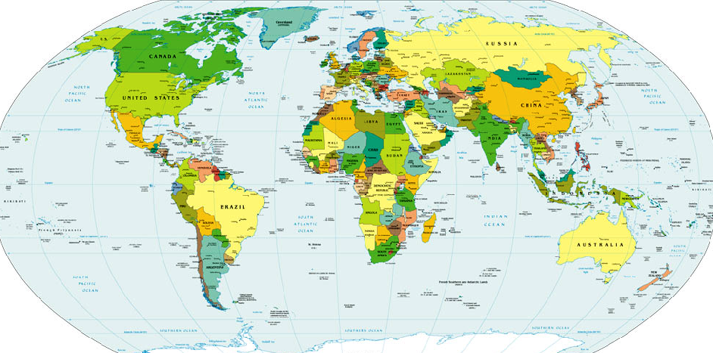
website: www.VagabondGeology.com
Ancient People, Ancient Pathways
Ancient People,
Ancient Pathways
Session 4: into Asia
Session 3: into Europe
Session 2: into Africa
Session 1: beginning in East Africa

Slide 2
Ancient People, Ancient Pathways
SESSION 5
- Stone Age Timeline
- Glaciers & Glacial Ages
- Pathway by Land or by Sea
- Beringia Land Bridge
- People of the Glaciers
Session 6: into Americas
Session 5: across Beringia
Across Beringia
Session 4: into Asia
Session 3: into Europe
Session 2: into Africa
Session 1: beginning in East Africa

Slide 3
SESSION 5
The Stone Age: 2.5 million to 4000 YBP (years before present)
TODAY
Across Beringia
- Stone Age Timeline
- Glaciers & Glacial Ages
- Pathway by Land or by Sea
- Beringia Land Bridge
- People of the Glaciers

Slide 4
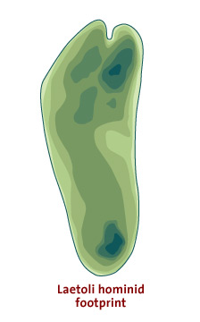
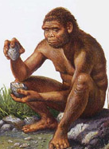
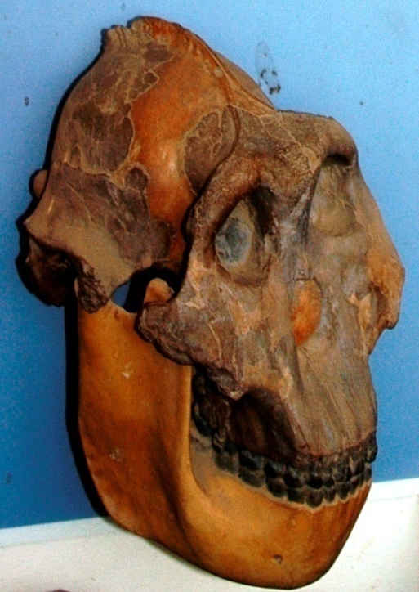
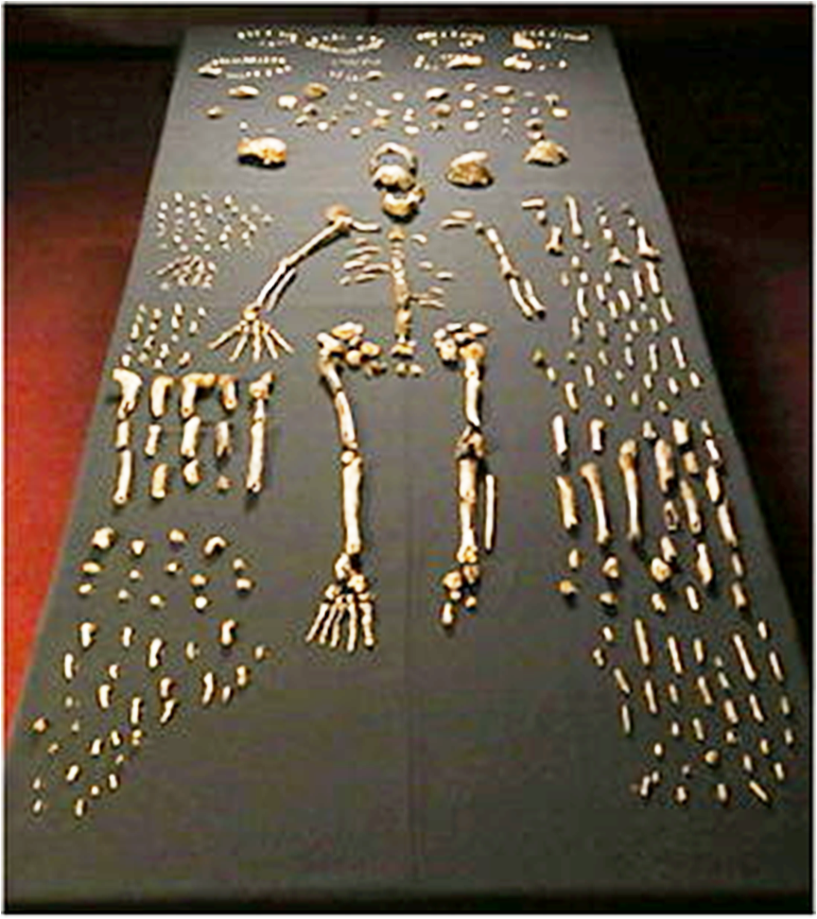
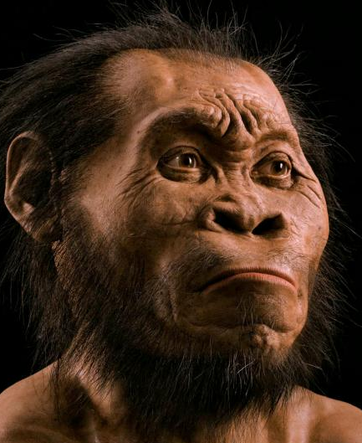
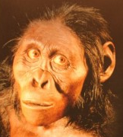
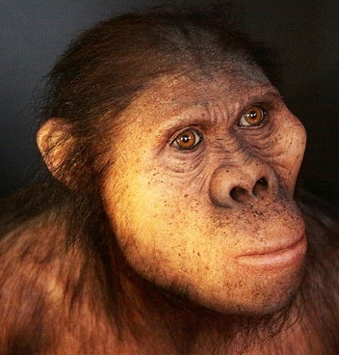

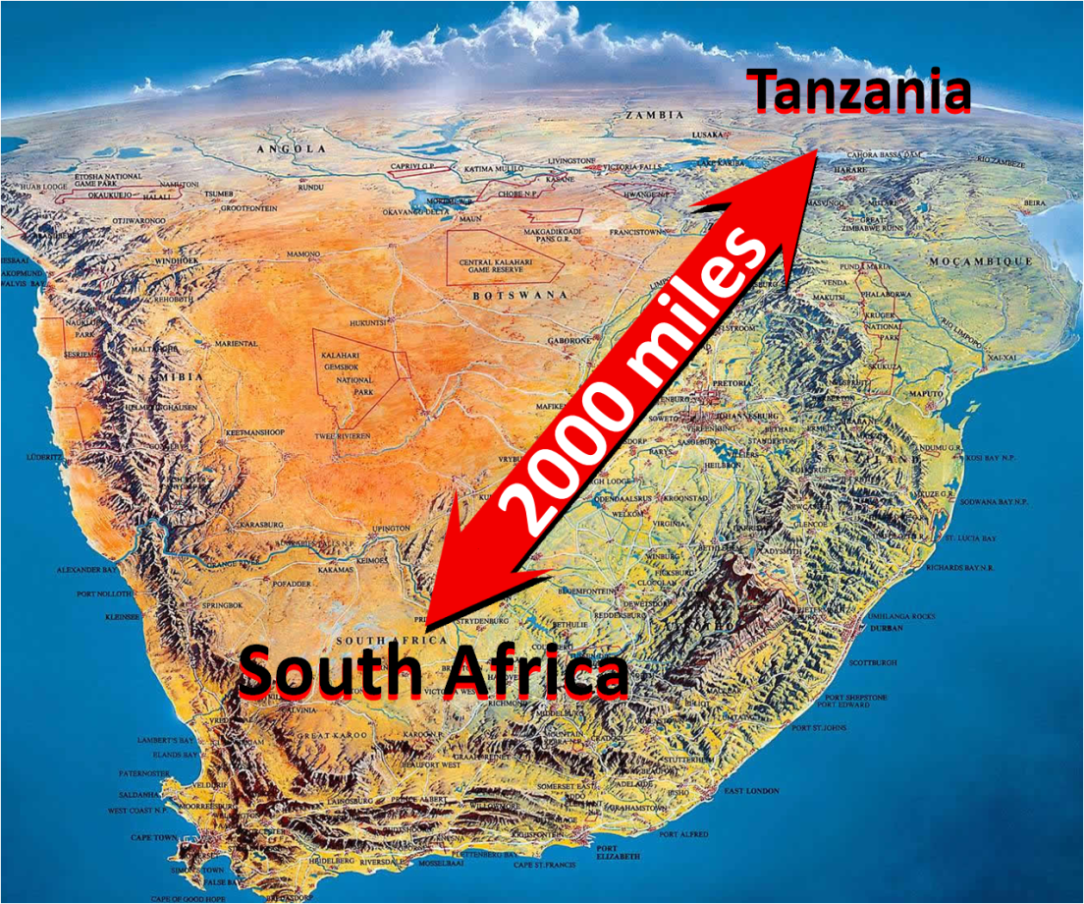
The Stone Age: 2.5 million to 4000 YBP (years before present)
3.5M – footprints
TODAY
2.5M – ‘Little Foot’, ‘Ms Ples’
1.8M – ‘Nutcracker Man’
2.5 MILLION
1.7M – ‘Handy Man’
400,000 YBP
2 MILLION
1.4 MILLION
Homo naledi
EARLY STONE AGE – stone tools, fire
Session 1
(Tanzania)
- Laetoli
- Olduvai Gorge
Session 2
(South Africa)
Cradle of Humk’d
Session 3
Australopithecus
Paranthropus
Homo
sapiens

Slide 5
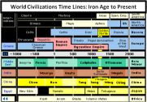
The Stone Age: 2.5 million to 4000 YBP (years before present)
3.5M – footprints
TODAY
Session 3
2.5M – ‘Little Foot’, ‘Ms Ples’
1.8M – ‘Nutcracker Man’
2.5 MILLION
1.7M – ‘Handy Man’
400,000 YBP
2 MILLION
1.4 MILLION
(France)
- Lascaux
50,000
10,000
50,000 YBP
40,000 YBP
30,000 YBP
20,000 YBP
10,000 YBP
4000 YBP
EARLY STONE AGE – stone tools, fire
Week 1
(Tanzania)
- Laetoli
- Oldupai Gorge
Week 2
(South Africa)
Cradle of Civil’n
Session 3
Upper Paleolithic
Neolithic
Australopithecus
(Late Stone Age)
symbolic thought
language
domesticated dogs
(New Stone Age)
pottery
farming
livestock
Paranthropus
Homo
sapiens

Slide 6
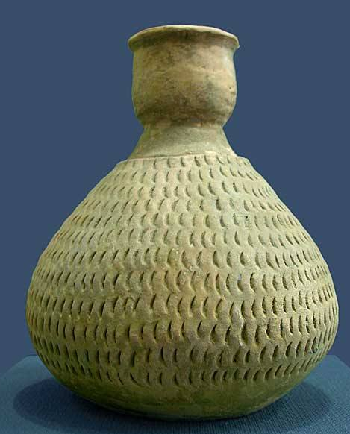
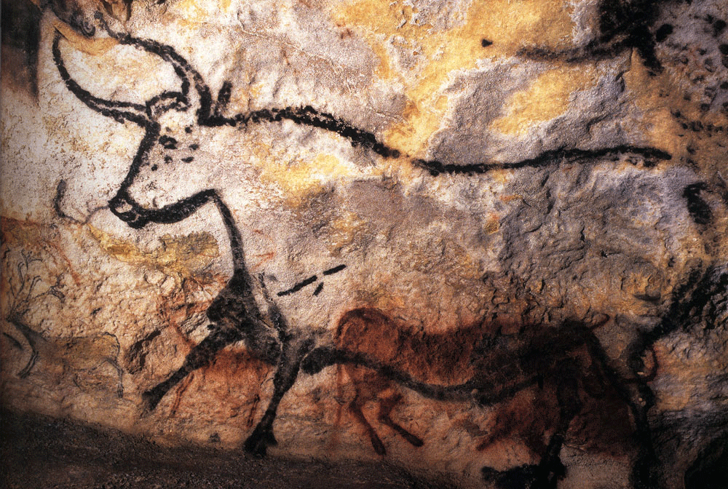
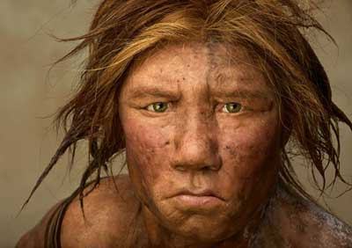
The Stone Age: 2.5 million to 4000 YBP (years before present)
this Session
(Beringia)
Session 4
(China)
- Banpo People
Session 3
(France)
- Lascaux
28,000 –Cro-Magnon Man
17,300 – cave paintings
6,700 – Banpo
10,000
4,000
50,000 YBP
40,000 YBP
30,000 YBP
20,000 YBP
10,000 YBP
4000 YBP
Upper Paleolithic
Neolithic
(Late Stone Age)
symbolic thought
language
domesticated dogs
(New Stone Age)
pottery
farming
livestock

Slide 7
The Stone Age: 2.5 million to 4000 YBP (years before present)
this Session
(Beringia)
- Siberia
-Prince of Wales Is.
>40,000 – X Woman
10,000 – On-Your-Knees
28,000 –Cro-Magnon Man
24,000 – Mal’ta Boy
17,300 – cave paintings
6,700 – Banpo
50,000 YBP
40,000 YBP
30,000 YBP
20,000 YBP
10,000 YBP
4000 YBP
It started with an Ice Age!
Upper Paleolithic
Neolithic
(Late Stone Age)
symbolic thought
language
domesticated dogs
(New Stone Age)
pottery
farming
livestock

Slide 8
Ice Ages
The Stone Age: 2.5 million to 4000 YBP (years before present)
this Session
(Beringia)
- Siberia
-Prince of Wales Is.
>40,000 – X Woman
10,000 – On-Your-Knees
24,000 – Mal’ta Boy
50,000 YBP
40,000 YBP
30,000 YBP
20,000 YBP
10,000 YBP
4000 YBP
It started with an Ice Age!
Upper Paleolithic
Neolithic
(Late Stone Age)
symbolic thought
language
domesticated dogs
(New Stone Age)
pottery
farming
livestock

Slide 9
Glacial Ages
Ice Ages
- long term reduction in temperature of
earth’s surface and atmosphere
- presence or expansion of:
    polar ice sheets
    continental ice sheets
    glaciers
?
?
land glaciers
> 20,000² miles
body of dense ice
lasting multi-years
How do glaciers form?

Slide 10
https://en.wikipedia.org/wiki/Glacier
Glaciers form where the accumulation of snow and ice exceeds ablation. The area in which a glacier forms is called a cirque (corrie or cwm) - a typically armchair-shaped geological feature (such as a depression between mountains enclosed by arêtes) - which collects and compresses through gravity the snow which falls into it. This snow collects and is compacted by the weight of the snow falling above it forming névé. Further crushing of the individual snowflakes and squeezing the air from the snow turns it into 'glacial ice'. This glacial ice will fill the cirque until it 'overflows' through a geological weakness or vacancy, such as the gap between two mountains. When the mass of snow and ice is sufficiently thick, it begins to move due to a combination of surface slope, gravity and pressure. On steeper slopes, this can occur with as little as 15 m (50 ft) of snow-ice.
In temperate glaciers, snow repeatedly freezes and thaws, changing into granular ice called firn. Under the pressure of the layers of ice and snow above it, this granular ice fuses into denser and denser firn. Over a period of years, layers of firn undergo further compaction and become glacial ice. Glacier ice is slightly less dense than ice formed from frozen water because it contains tiny trapped air bubbles.
Glacial ice has a distinctive blue tint because it absorbs some red light due to an overtone of the infrared OH stretching mode of the water molecule. Liquid water is blue for the same reason. The blue of glacier ice is sometimes misattributed to Rayleigh scattering due to bubbles in the ice.
Notes:
https://en.wikipedia.org/wiki/Glacier

Slide 11
https://en.wikipedia.org/wiki/Timeline_of_glaciation
There have been five known ice ages in the Earth's history, with the Earth experiencing the Quaternary Ice Age during the present time. Within ice ages, there exist periods of more severe glacial conditions and more temperate referred to as glacial periods and interglacial periods, respectively. The Earth is currently in such an interglacial period of the Quaternary Ice Age, with the last glacial period of the Quaternary having ended approximately 11,700 years ago with the start of the Holocene epoch.^{[1]} Based on climate proxies, paleoclimatologists study the different climate states originating from glaciation.
The second ice age, and possibly most severe, is estimated to have occurred from 850 to 635 Ma (million years) ago, in theNeoproterozoic Era and it has been suggested that it produced a second^{[2]} "Snowball Earth" in which the earth iced over completely. It has been suggested also that the end of this second cold period^{[2]} was responsible for the subsequent Cambrian Explosion, a time of rapid diversification of multicelled life during the Cambrian Period. However, this hypothesis is still controversial,^{[3][4]} though is growing in popularity among researchers as evidence in its favor has mounted.^{[who?]}
. . . . . A minor series of glaciations occurred from 460 Ma to 430 Ma. There were extensive glaciations from 350 to 250 Ma. The current ice age, called the Quaternary glaciation, has seen more or less extensive glaciation on 40,000 and later, 100,000 year cycles.
The marine record preserves all the past glaciations; the land-based evidence is less complete because successive glaciations may wipe out evidence of their predecessors. Ice cores from continental ice accumulations also provide a complete record, but do not go as far back in time as marine data. Pollen data from lakes and bogs as well as loess profiles provided important land-based correlation data.
. . . . Ice cores are used to obtain a high resolution record of recent glaciation. It confirms the chronology of the marine isotopic stages. Ice core data shows that the last 400,000 years have consisted of short interglacials (10,000 to 30,000 years) about as warm as the present alternated with much longer (70,000 to 90,000 years) glacials substantially colder than present. The new EPICA Antarctic ice core has revealed that between 400,000 and 780,000 years ago, interglacials occupied a considerably larger proportion of each glacial/interglacial cycle, but were not as warm as subsequent interglacials.

Slide 12
https://en.wikipedia.org/wiki/Ice_age#Evidence_for_ice_ages
There are three main types of evidence for ice ages: geological, chemical, and paleontological.
Geological evidence for ice ages comes in various forms, including rock scouring and scratching, glacial moraines, drumlins, valley cutting, and the deposition of till or tillites and glacial erratics. Successive glaciations tend to distort and erase the geological evidence, making it difficult to interpret. Furthermore, this evidence was difficult to date exactly; early theories assumed that the glacials were short compared to the long interglacials. The advent of sediment and ice cores revealed the true situation: glacials are long, interglacials short. It took some time for the current theory to be worked out.
The chemical evidence mainly consists of variations in the ratios of isotopes in fossils present in sediments and sedimentary rocks and ocean sediment cores. For the most recent glacial periods ice cores provide climate proxies from their ice, and atmospheric samples from included bubbles of air. Because water containing heavier isotopes has a higher heat of evaporation, its proportion decreases with colder conditions.^{[29]} This allows a temperature record to be constructed. However, this evidence can be confounded by other factors recorded by isotope ratios.
The paleontological evidence consists of changes in the geographical distribution of fossils. During a glacial period cold-adapted organisms spread into lower latitudes, and organisms that prefer warmer conditions become extinct or are squeezed into lower latitudes. This evidence is also difficult to interpret because it requires (1) sequences of sediments covering a long period of time, over a wide range of latitudes and which are easily correlated; (2) ancient organisms which survive for several million years without change and whose temperature preferences are easily diagnosed; and (3) the finding of the relevant fossils.
Despite the difficulties, analysis of ice core and ocean sediment cores^{[30]} has shown periods of glacials and interglacials over the past few million years. These also confirm the linkage between ice ages and continental crust phenomena such as glacial moraines, drumlins, and glacial erratics. Hence the continental crust phenomena are accepted as good evidence of earlier ice ages when they are found in layers created much earlier than the time range for which ice cores and ocean sediment cores are available.

Slide 13
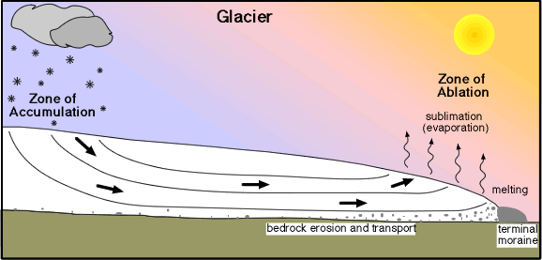
Glacial Ages
- long term reduction in temperature of
earth’s surface and atmosphere
- presence or expansion of:
    polar ice sheets
    continental ice sheets
    glaciers
land glaciers
> 20,000 miles²
body of dense ice
lasting multi-years
How do glaciers form?
Notes:
http://www.columbia.edu/~vjd1/glacier.gif

Slide 14
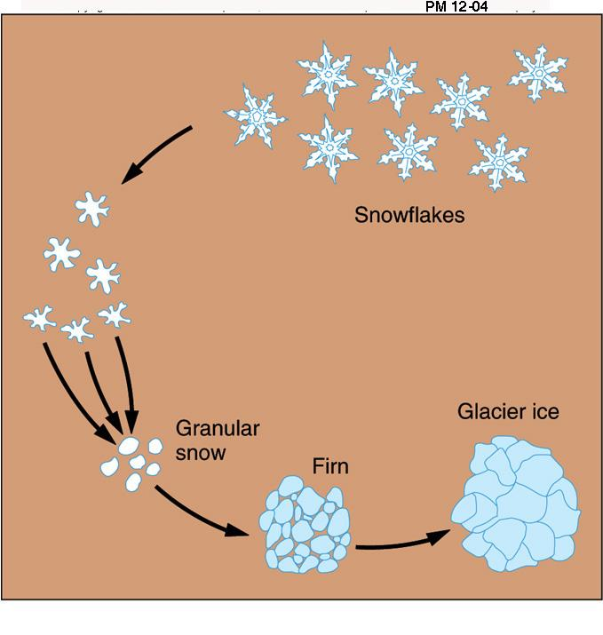

How do glaciers form?
climate cools
snow accumulates
flakes turn to ice
land surface
Notes:
http://www.columbia.edu/~vjd1/glacier.gif
https://classconnection.s3.amazonaws.com/613/flashcards/977613/jpg/glacice1323512659935.jpg

Slide 15


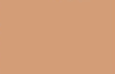
How do glaciers form?
climate cools
accumulate
snow accumulates
flakes turn to ice
glacier forms
compact
crystalize
compress
Notes:
http://www.columbia.edu/~vjd1/glacier.gif
https://classconnection.s3.amazonaws.com/613/flashcards/977613/jpg/glacice1323512659935.jpg

Slide 16
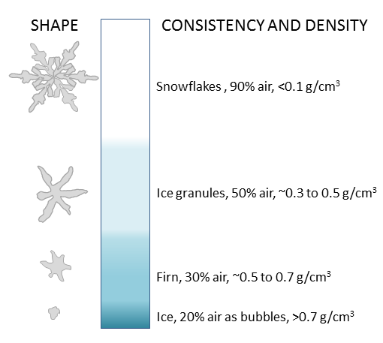
How do glaciers form?
climate cools
SNOWFLAKES
90% air
< 0.1g/cm³
snow accumulates
flakes turn to ice
glacier forms
GRANULAR SNOW
50% air
0.3g-0.5/cm³
FIRN 30% air
0.5g-0.7/cm³
ICE 20% air
> 0.7/cm³
Notes:
http://www.columbia.edu/~vjd1/glacier.gif

Slide 17
How do glaciers form?
climate cools
SNOWFLAKES
90% air
< 0.1g/cm³
snow accumulates
flakes turn to ice
glacier forms
GRANULAR SNOW
50% air
0.3g-0.5/cm³
glacier advances
FIRN 30% air
0.5g-0.7/cm³
ICE 20% air
> 0.7/cm³
Notes:
http://www.columbia.edu/~vjd1/glacier.gif

Slide 18
How do glaciers form?
climate warms
climate cools
ice melts
snow accumulates
glacier retreats
flakes turn to ice
glacier forms
glacier advances

Slide 19
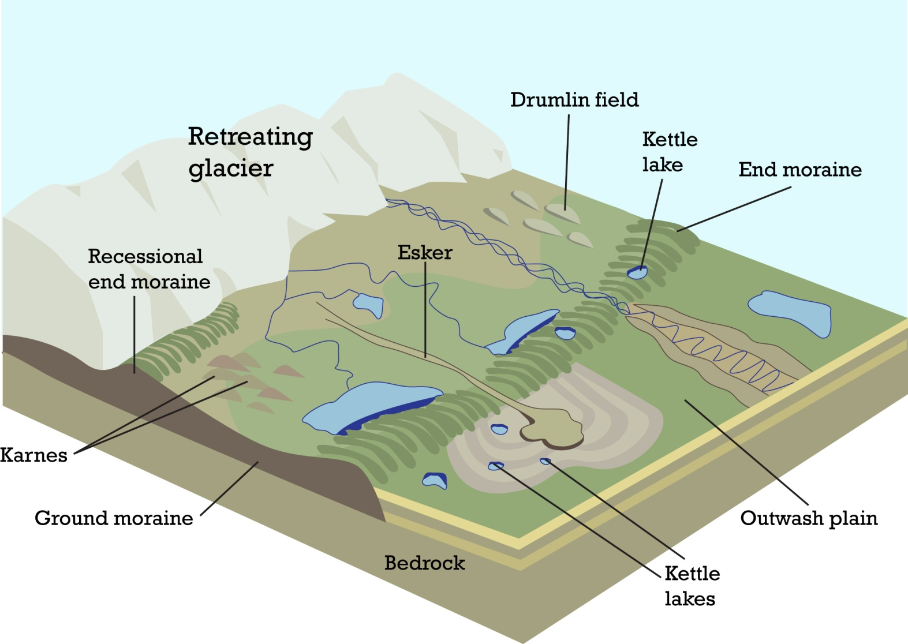
Glacial Ages
How do glaciers form?
climate warms
drumlins
kettle lake
ice melts
moraine
glacier retreats
esker
kames
moraine
kettle lake
outwash

Slide 20
http://geologycafe.com/images/glacial_landscapes.jpg
Outwash, deposit of sand and gravel carried by running water from the melting ice of a glacier and laid down in stratified deposits.
Moraine is any glacially formed accumulation of unconsolidated glacial debris (soil and rock) that occurs in currently glaciated and formerly glaciated regions on Earth.
Eskers, Kames, and Drumlins — These are peculiar forms of glacial accumulations which are found in the peripheral edge.
Esker: long, winding ridge of stratified sand and gravel
Cames: drift build up into low steep hills
Drumlin: smooth elongated hills composed of till
Kettle lake: A glacial feature formed as glaciers melt. Large blocks of ice are left behind. These may become buried in glacial sediment (till). Eventually the ice melts leaving behind a large depression which fills with water

Slide 21
Glacial Ages
- long term reduction in temperature of
earth’s surface and atmosphere
- presence or expansion of:
    polar ice sheets
    continental ice sheets
    glaciers
land glaciers
> 20,000 miles²
Let’s look at the big picture,
starting 650 million years ago . . .
body of dense ice
lasting multi-years

Slide 22
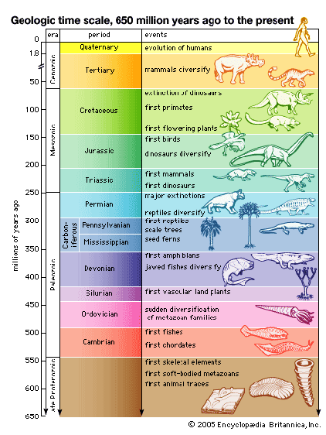
Glacial Ages
Geologic Time Scale
human
evolution
- long term reduction in temperature of
earth’s surface and atmosphere
2.5mya
today
100mya
1st primates
- presence or expansion of:
    polar ice sheets
    continental ice sheets
    glaciers
225mya
1st mammals
370mya
1st amphibians
Let’s look at the big picture,
starting 650 million years ago . . .
500mya
1st fish
650 mya

Slide 23
Glacial Ages
today
650 mya

Slide 24
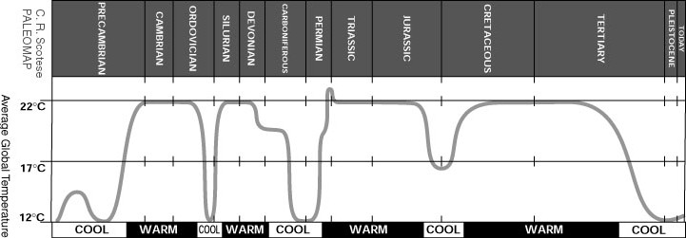
Glacial Ages
average global temperatures
650 mya
today

Slide 25
Glacial Ages
Cryogenerian
Pliocene-Quarternary
How long do these Glacial Ages last?
average global temperatures
today?
Andean-Saharan
Karoo
72º
63º
59º
54º
650 mya
today
450 mya
300mya
150mya

Slide 26
https://www2.ucar.edu/climate/faq/what-average-global-temperature-now
Climatologists prefer to combine short-term weather records into long-term periods (typically 30 years) when they analyze climate, including global averages. Between 1961 and 1990, the annual average temperature for the globe was around 57.2°F (14.0°C), according to the World Meteorological Organization. The average annual temperature for the globe between 1951 and 1980 was around 57.2 degrees Fahrenheit (14 degrees Celsius). In 2015 the temperature was about 1.8 degrees F (1 degree C) warmer than the 1951–1980 base period.
2015 average global temp = 57.2 + 1.8 = 59 degrees Fahrenheit

Slide 27
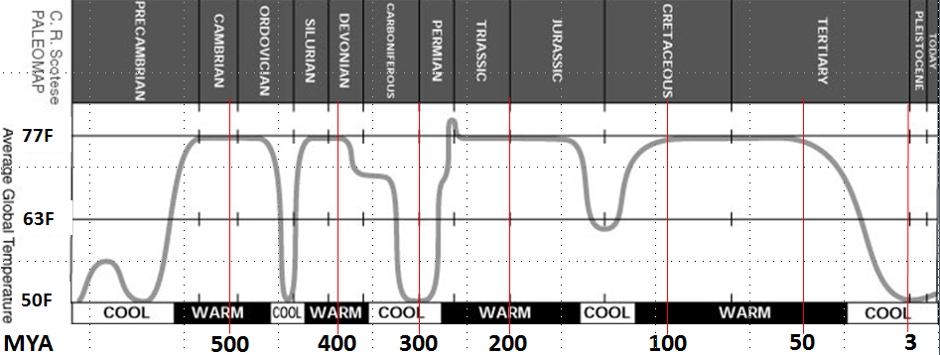
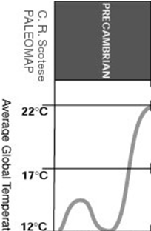



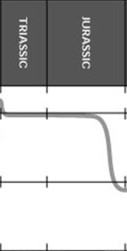

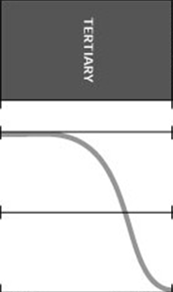
LENGTH OF WARMING/COOLING CYCLES
Glacial Ages
How long do these Glacial Ages last?
100 MY
100 million years
72º
72º
63º
63º
54º
54º
650 mya
today
450 mya
300mya
150mya

Slide 28
LENGTH OF WARMING/COOLING CYCLES
72º
63º
54º
600
500
400
300
200
100
0

Slide 29
LENGTH OF WARMING/COOLING CYCLES
72º
63º
72º
Original graph
54º
63º
72º
54º
63º
600
500
400
300
200
100
Modified graph
54º

Slide 30
LENGTH OF WARMING/COOLING CYCLES
What might cause these Glacial Ages?
Average warm age ~114 million years long
72º
111 million
110 million
123
million
112 million
63º
> 70
13
40
16
34
54º
600
500
400
300
200
100
Average cool age ~ 26 million years long
with a uniform scale, let’s measure . . .
100 million

Slide 31
Glacial Ages
LENGTH OF WARMING/COOLING CYCLES
What might cause these Glacial Ages?
72º
72º
63º
63º
> 70
13
40
16
34
54º
54º
600
500
400
300
200
100
Average cool age ~ 26 million years long

Slide 32
Glacial Ages
What might cause these Glacial Ages?
- Causes are not fully understood
- Probable important factors:
1) Tectonic factors
2) Astronomical factors
3) Atmospheric factors
72º
63º
54º

Slide 33
http://www.lakepowell.net/sciencecenter/paleoclimate.htm
What causes Climate Change?
Although the basic causes of climate change are still not fully understood, many clues have been collected. Possible causes include:
(1) Tectonic Causes
Landmass distribution: Shifting continents (continental drift) causing changes in circulatory patterns of ocean currents. It seems that whenever there is a large land mass at one of the Earth's poles, either the north pole or south pole, there are ice ages.
Undersea ridge activity: "Sea floor spreading" (associated with continental drift) causing variations in ocean displacement.
(2) Astronomical Causes
21,000 year cycle: Elliptical orbit of the Earth around the Sun (precession of the equinoxes)
41,000 year cycle: Cycle of the +/- 1.5° wobble in Earth's orbit
100,000 year cycle: Variations in solar energy output
(3) Atmospheric Causes
Heat retention: Due to gases such as carbon dioxide and methane in Earth's atmosphere-- the "greenhouse effect"
Solar reflectivity: Due to clouds, volcanic dust, polar ice caps

Slide 34
Glacial Ages
http://www.museum.state.il.us/exhibits/ice_ages/why_glaciations1.html
Scientists understand more about why glaciers advance during cool periods than they do about why large scale cool periods occur, because they have gathered large quantities of data about the current cool period. Variation in the Earth's orbit through time causes changes in the amount and distribution of sunlight (and other solar radiation) reaching the Earth's surface. These changes are thought to affect the development of ice sheets. Although the idea that variation in the Earth's orbit causes glacial-interglacial cycles originated in the mid 1800s, Milutin Milankovitch first popularized it in about 1920. Although Milankovitch's hypothesis was not widely accepted initially; data collected during the 1970's have generated broad support for it. Three orbital parameters are especially important in causing ice sheet waxing and waning: 1) Changes in the eccentricity of the Earth's orbit 2) Changes in the tilt of the Earth's axis
3) The precession of the equinoxes. In combination these factors influence the amount and distribution of solar radiation reaching the Earth. Changes vary with both latitude and season. Because of the different periodicities of variation for the three factors, the composite variations in solar radiation are very complex. Although the connections are not obvious and direct, changes in the amount of solar radiation are thought to drive the growth and melting of major ice sheets. Over the last 750,000 years ice sheets have expanded into the midwestern United States at least 8 major times. The timing of the earlier of these advances is not well known. The last glaciation of the midwestern United States had its maximum extent approximately 20,000 years ago..
Eccentricity The Earth's orbit around the sun is not a circle, but rather it is an ellipse. The shape of the elliptical orbit, which is measured by its eccentricity, varies from between one and five percent through time. The eccentricity affects the difference in the amounts of radiation the Earth's surface receives at aphelion and at perihelion. The effect of the radiation variation is to change the seasonal contrast in the northern and southern hemispheres. For example, when the orbit is highly elliptical, one hemisphere will have hot summers and cold winters; the other hemisphere will have warm summers and cool winters. When the orbit is nearly circular, both hemispheres will have similar seasonal contrasts in temperature. Although the amount of change in radiation is very small (less than 0.2%), it is apparently extremely important in the expansion and melting of ice sheets. The eccentricity of the Earth's orbit varies in a periodic manner. The primary periodicity is approximately 100,000 years.
Tilt The Earth's axis is tilted with respect to its orbit around the sun. Today the tilt is approximately 23.5 degrees. The tilt varies from between 21.6 and 24.5 degrees in a periodic manner. A graph of the tilt over the last 750,000 years shows that the dominant period of this variation is approximately 41,000 years. Changes in the tilt of the Earth's axis cause large changes in the seasonal distribution of radiation at high latitudes and in the length of the winter dark period at the poles. Changes in tilt have very little effect on low latitudes.
The effects of tilt on the amount of solar radiation reaching the Earth are closely linked to the effects of precession. Variation in these two factors cause radiation changes of up to 15% at high latitudes. Radiation variation of this magnitude greatly influences the growth and melting of ice sheets.
Precession of the equinoxes Twice a year, the equinoxes, the sun is positioned directly over the equator. Currently the equinoxes occur on approximately March 21 and September 21. However, because the Earth's axis of rotation "wobbles" (like a spinning top), the timing of the equinoxes changes . The change in the timing of the equinoxes is known as precession. Although the timing of the equinoxes is not in itself important in determining climate, the timing of the Earth's aphelion and perihelion also changes. Like the timing of the equinoxes, the timing of the aphelion and perihelion is also affected by the wobble of the axis of rotation. The changing aphelion and perihelion is important for climate because it affects the seasonal balance of radiation. For example, when perihelion falls in January the northern hemisphere winter and southern hemisphere summer are slightly warmer than the corresponding seasons in the opposite hemispheres. The aphelion and perihelion change position on the orbit through a cycle of 360 degrees. The cycle has two periods of approximately 19,000 and 23,000 years. Together these combine to produce a generalized periodicity of about 22,000 years. The effects of precession on the amount of solar radiation reaching the Earth are closely linked to the effects of tilt. Variation in these two factors cause radiation changes of up to 15% at high latitudes. Radiation variation of this magnitude greatly influences the growth and melting of ice sheets.
What might cause these Glacial Ages?
- Causes are not fully understood
- Probable important factors
1) concentrations of CO² and methane
2) changes in earth’s orbit around sun
3) relative location/amount of oceanic
to continental plates
4) variations in solar output
5) impact of meteorites & super-volcanoes
72º
Want to learn more?
63º
54º

Slide 35
Glacial Ages
What might cause these Glacial Ages?
- Causes are not fully understood
- Probable important factors:
1) Tectonic factors
2) Astronomical factors
3) Atmospheric factors
land mass distribution
- land mass distribution
- mid-ocean ridge activity
mid-ocean ridge activity

Slide 36
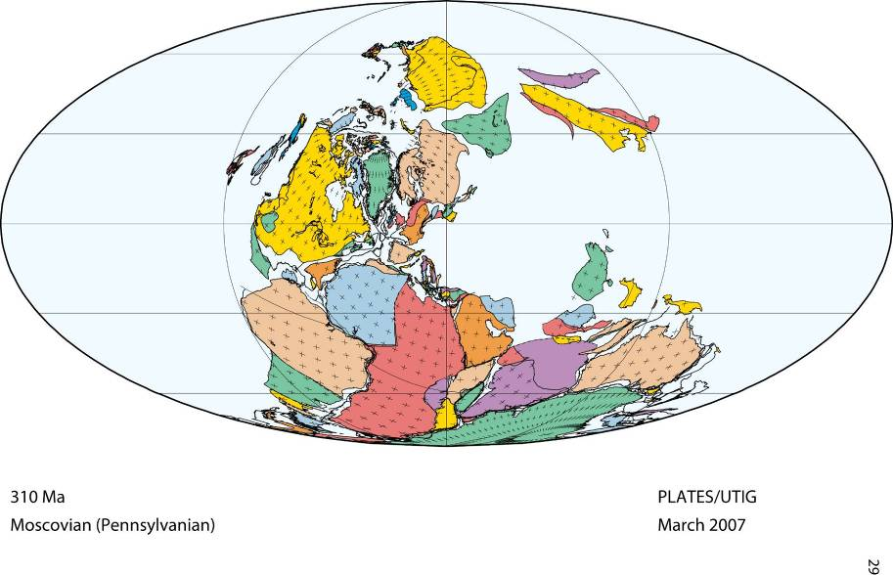
Glacial Ages
What might cause these Glacial Ages?
land mass distribution
massed at pole?
large land mass at pole
predicts glacial age
shifting continents cause
changes in ocean currents
PANGAEA SUPERCONTINENT 310Ma
mid-ocean ridge activity

Slide 37
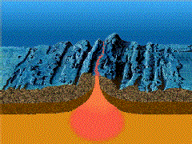
Glacial Ages
What might cause these Glacial Ages?
land mass distribution
massed at pole?
PANGAEA SUPERCONTINENT 310Ma
HEAT FLOW
. . . . changes in ocean displacement
mid-ocean ridge activity
ocean displacement
HEAT FLOW
Notes:
http://www.britannica.com/place/Pangea
Pangea was surrounded by a global ocean called Panthalassa, and it was fully assembled by the Early Permian Period (some 299 million to 272 million years ago). The supercontinent began to break apart about 200 million years ago, during the Early Jurassic Period (201 million to 174 million years ago), eventually forming the modern continents and theAtlantic and Indian oceans.
The mechanism for the breakup of Pangea is now explained in terms of plate tectonics rather than Wegener’s outmoded concept of continental drift, which simply stated that Earth’s continents were once joined together into the supercontinent Pangea that lasted for most of geologic time. Plate tectonics states that Earth’s outer shell, or lithosphere, consists of large rigid plates that move apart atoceanic ridges, come together at subduction zones, or slip past one another along fault lines. The pattern of seafloor spreading indicates that Pangea did not break apart all at once but rather fragmented in distinct stages. Plate tectonics also postulates that the continents joined with one another and broke apart several times in Earth’s geologic history.
The first oceans formed from the breakup, some 180 million years ago, were the central Atlantic Oceanbetween northwestern Africa and North America and the southwestern Indian Ocean between Africa and Antarctica. The South Atlantic Ocean opened about 140 million years ago as Africa separated fromSouth America. About the same time, India separated from Antarctica and Australia, forming the central Indian Ocean. Finally, about 80 million years ago, North America separated from Europe, Australia began to rift away from Antarctica, and India broke away from Madagascar. India eventually collided with Eurasia approximately 50 million years ago, forming the Himalayas.
During Earth’s long history, there probably have been several Pangea-like supercontinents. The oldest of those supercontinents is called Rodinia and was formed during Precambrian time some one billion years ago. Another Pangea-like supercontinent, Pannotia, was assembled 600 million years ago, at the end of the Precambrian. Present-day plate motions are bringing the continents together once again. Africa has begun to collide with southern Europe, and the Australian Plate is now colliding withSoutheast Asia. Within the next 250 million years, Africa and the Americas will merge with Eurasia to form a supercontinent that approaches Pangean proportions.

Slide 38
Glacial Ages
What might cause these Glacial Ages?
- Causes are not fully understood
- Probable important factors:
1) Tectonic factors
orbit around the sun
- land mass distribution
- mid-ocean ridge activity
2) Astronomical factors
- orbit around the sun
- axial tilt of the earth
- solar activity
axial tilt of the earth
orbit around the sun
axial tilt of the earth
solar activity
solar activity

Slide 39
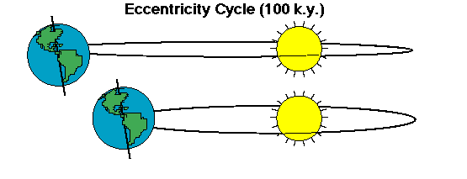
Glacial Ages
What might cause these Glacial Ages?
orbit around the sun
nearly circular to quite elliptical
axial tilt of the earth
solar activity

Slide 40
EARATH’S ORBIT
http://www.indiana.edu/~geol105/images/gaia_chapter_4/milankovitch.htm
Eccentricity is the shape of the Earth's orbit around the Sun. This constantly fluctuating, orbital shape ranges between more and less elliptical (0 to 5% ellipticity) on a cycle of about 100,000 years. These oscillations, from more elliptic to less elliptic, are of prime importance to glaciation in that it alters the distance from the Earth to the Sun, thus changing the distance the Sun's short wave radiation must travel to reach Earth, subsequently reducing or increasing the amount of radiation received at the Earth's surface in different seasons.
AXIAL TILT
oday, the Earth's axis is tilted 23.5 degrees from the plane of its orbit around the sun. But this tilt changes. During a cycle that averages about 40,000 years, the tilt of the axis varies between 22.1 and 24.5 degrees.
http://www.indiana.edu/~geol105/images/gaia_chapter_4/milankovitch.htm
the inclination of the Earth's axis in relation to its plane of orbit around the Sun. Oscillations in the degree of Earth's axial tilt occur on a periodicity of 41,000 years from 21.5 to 24.5 degrees. Today the Earth's axial tilt is about 23.5 degrees, which largely accounts for our seasons. Because of the periodic variations of this angle the severity of the Earth's seasons changes. With less axial tilt the Sun's solar radiation is more evenly distributed between winter and summer. However, less tilt also increases the difference in radiation receipts between the equatorial and polar regions.
One hypothesis for Earth's reaction to a smaller degree of axial tilt is that it would promote the growth of ice sheets. This response would be due to a warmer winter, in which warmer air would be able to hold more moisture, and subsequently produce a greater amount of snowfall. In addition, summer temperatures would be cooler, resulting in less melting of the winter's accumulation. At present, axial tilt is in the middle of its range.

Slide 41
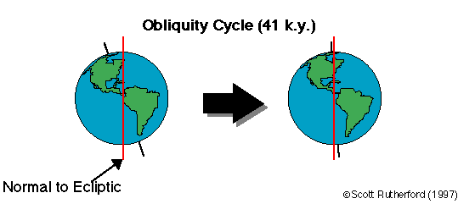
Glacial Ages
What might cause these Glacial Ages?
orbit around the sun
nearly circular to quite elliptical
axial tilt of the earth

Slide 42
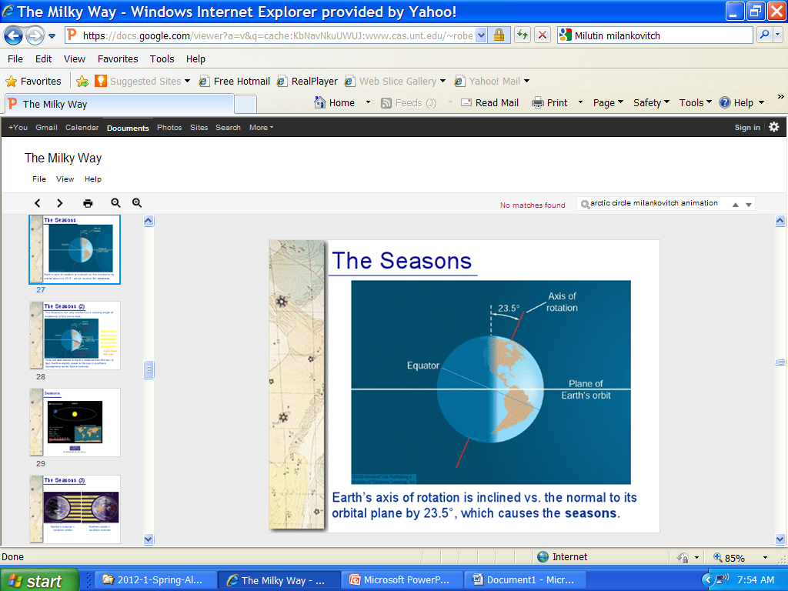
Glacial Ages
What might cause these Glacial Ages?
orbit of the earth
nearly circular to quite elliptical
axial tilt of the earth

Slide 43
Glacial Ages
where is the Earth’s axis of rotation?
23.5º
X
North Pole
plane of
Earth’s orbit
around Sun
axis of rotation

Slide 44
Glacial Ages
small variations
in TILT
22º
23.5º
24.5º
North Pole
plane of
Earth’s orbit
around Sun
axis of rotation

Slide 45
Glacial Ages
What might cause these Glacial Ages?
small variations
in TILT
22º
orbit around the sun
24.5º
nearly circular to quite elliptical
axial tilt of the earth
axis of rotation

Slide 46

Glacial Ages
What might cause these Glacial Ages?
orbit around the sun
nearly circular to quite elliptical
axial tilt of the earth
24.5⁰ < TILT > 22⁰
solar activity
Notes:
http://science.nasa.gov/science-news/science-at-nasa/2013/08jan_sunclimate/
the luminosity of our own sun varies 0.1% over the course of the 11-year solar cycle.
There is a realization among researchers that even these apparently tiny variations can have a significant effect on terrestrial climate.

Slide 47
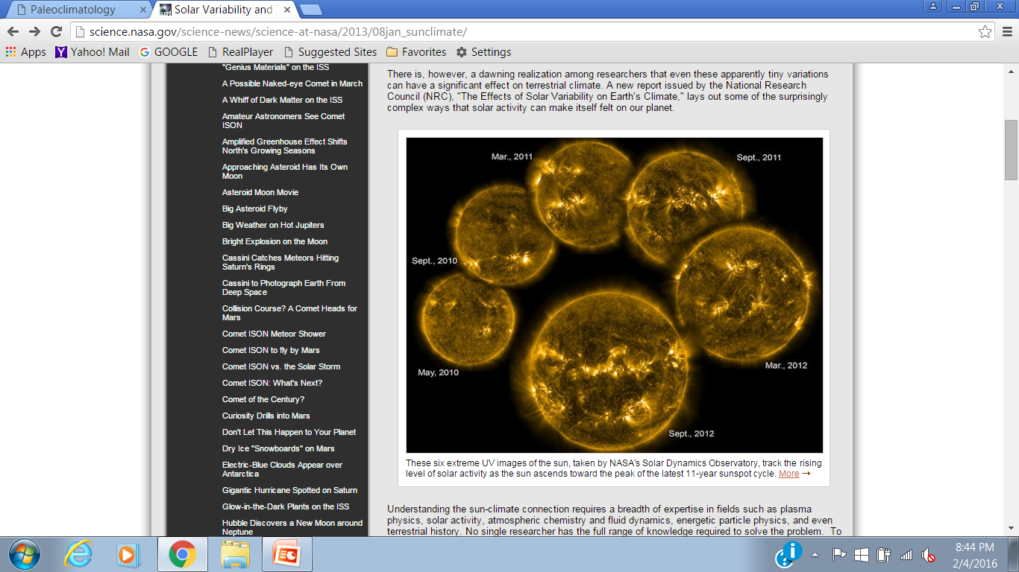
Glacial Ages
What might cause these Glacial Ages?
orbit around the sun
nearly circular to quite elliptical
axial tilt of the earth
24.5⁰ < TILT > 22⁰
solar activity

Slide 48
Glacial Ages

Slide 49

Glacial Ages
What might cause these Glacial Ages?
orbit around the sun
nearly circular to quite elliptical
axial tilt of the earth
24.5⁰ < TILT > 22⁰
solar activity
variations in energy output

Slide 50
Glacial Ages
What might cause these Glacial Ages?
orbit around the sun
nearly circular to quite elliptical
axial tilt of the earth
24.5⁰ < TILT > 22⁰
solar activity
variations in energy output

Slide 51
http://science.nasa.gov/science-news/science-at-nasa/2013/08jan_sunclimate/
Jan. 8, 2013: In the galactic scheme of things, the Sun is a remarkably constant star. While some stars exhibit dramatic pulsations, wildly yo-yoing in size and brightness, and sometimes even exploding, the luminosity of our own sun varies a measly 0.1% over the course of the 11-year solar cycle.
There is, however, a dawning realization among researchers that even these apparently tiny variations can have a significant effect on terrestrial climate. A new report issued by the National Research Council (NRC), "The Effects of Solar Variability on Earth's Climate," lays out some of the surprisingly complex ways that solar activity can make itself felt on our planet.
Understanding the sun-climate connection requires a breadth of expertise in fields such as plasma physics, solar activity, atmospheric chemistry and fluid dynamics, energetic particle physics, and even terrestrial history. No single researcher has the full range of knowledge required to solve the problem. To make progress, the NRC had to assemble dozens of experts from many fields at a single workshop. The report summarizes their combined efforts to frame the problem in a truly multi-disciplinary context.
One of the participants, Greg Kopp of the Laboratory for Atmospheric and Space Physics at the University of Colorado, pointed out that while the variations in luminosity over the 11-year solar cycle amount to only a tenth of a percent of the sun's total output, such a small fraction is still important. "Even typical short term variations of 0.1% in incident irradiance exceed all other energy sources (such as natural radioactivity in Earth's core) combined," he says.
Of particular importance is the sun's extreme ultraviolet (EUV) radiation, which peaks during the years around solar maximum. Within the relatively narrow band of EUV wavelengths, the sun’s output varies not by a minuscule 0.1%, but by whopping factors of 10 or more. This can strongly affect the chemistry and thermal structure of the upper atmosphere.
These six extreme UV images of the sun, taken by NASA's Solar Dynamics Observatory, track the rising level of solar activity as the sun ascends toward the peak of the latest 11-year sunspot cycle.

Slide 52
Glacial Ages
What might cause these Glacial Ages?
- Causes are not fully understood
- Probable important factors:
1) Tectonic factors
heat retention
- land mass distribution
- mid-ocean ridge activity
2) Astronomical factors
- orbit around the sun
- axial tilt of the earth
- solar activity
3) Atmospheric factors
- solar reflectivity
- heat retention
solar reflectivity
solar reflectivity
heat retention

Slide 53
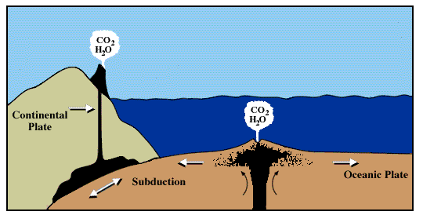
Glacial Ages
What might cause these Glacial Ages?
heat retention
Sea-floor spreading &
volcanoes produce CO₂
rapid spreading & high
vulcanism increase CO₂
CO₂ is a greenhouse gas
solar reflectivity

Slide 54
http://www.lakepowell.net/sciencecenter/paleoclimate.htm
HEAT RETENTION involves the very slow process of "Plate Tectonics" and its influence on the atmospheric greenhouse effect. Over a time scale of 300 million years (back to the last known Great Ice Age - the Gondwanan), the continental plates have moved greatly. The question remains as to why the temperatures dropped. Perhaps the answer lies in changes in the natural (non-biogenic) production rate of carbon dioxide - the number one greenhouse gas. We know that CO₂ is produced in volcanoes and in the mid-ocean trenches. It is lost by being slowly absorbed in the oceans. Both of these processes are very slow - about the right time scales to explain the great Ice Ages.
One theory is that carbon dioxide is produced by a faster rate of sea-floor spreading and an subsequent increase in vulcanism and During times of rapid spreading, the higher volcanic activity, coupled with higher ocean levels and reduced chemical weathering of rocks, may promote global warming by enriching the CO₂ content of the atmosphere. Similarly, global cooling may result from stalled or slowed spreading
http://volcanoes.usgs.gov/vhp/gas.html
the most abundant volcanic gas is water vapor, which is harmless. However, significant amounts of carbon dioxide, sulfur dioxide, hydrogen sulfide and hydrogen halides can also be emitted from volcanoes.
Carbon dioxide constitutes approximately 0.04% of the air in the Earth's atmosphere. In an average year, volcanoes release between about 180 and 440 million tonnes of carbon dioxide.

Slide 55
Glacial Ages
What might cause these Glacial Ages?
heat retention
variations in greenhouse gases (CO₂)
solar reflectivity

Slide 56
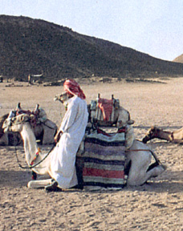
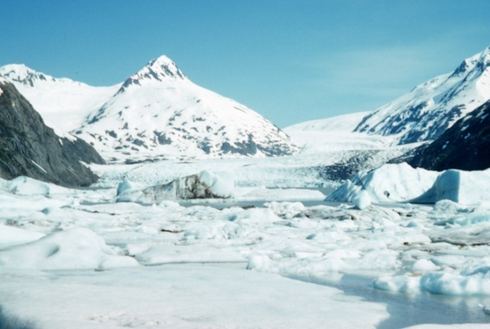
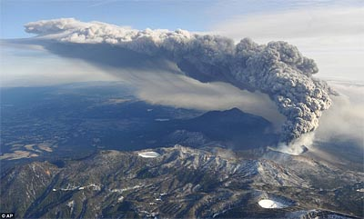

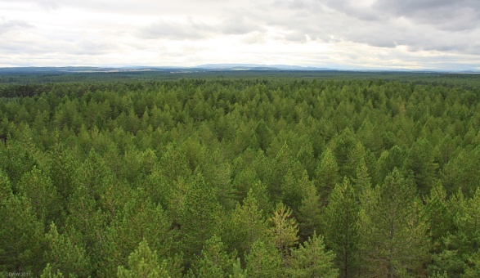
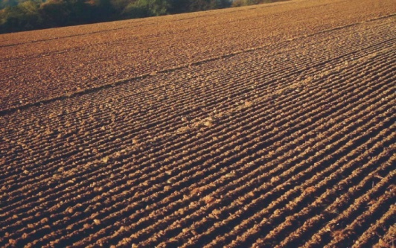

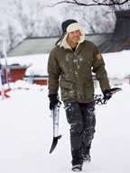
Glacial Ages
What might cause these Glacial Ages?
ALBEDO: amount of solar radiation reflected from object/surface
Reflective surfaces:
snow, glaciers
COOLER!
volcanic ash
clouds
Absorptive surfaces:
forests
soils
WARMER!
oceans
solar reflectivity
Albedo ( ) of earth
30%
Notes:
http://modernsurvivalblog.com/volcano/kirishima-volcano-violently-erupts-in-japan/
http://www.alexsack.com/2014/10/22/clouds/
http://www.drookitagain.co.uk/coppermine/displayimage.php?pid=3258
https://static.pexels.com/photos/6644/sea-water-ocean-waves.jpg
http://cdn.phys.org/newman/gfx/news/hires/2013/policiesusin.jpg

Slide 57
Glacial Ages
What might cause these Glacial Ages?
ALBEDO: amount of solar radiation reflected from object/surface
Reflective surfaces:
snow, glaciers
heat retention
variations in greenhouse gases (CO₂)
COOLER!
volcanic ash
clouds
Absorptive surfaces:
forests
soils
WARMER!
oceans
solar reflectivity
Albedo ( ) of earth
30%
Notes:
http://modernsurvivalblog.com/volcano/kirishima-volcano-violently-erupts-in-japan/
http://www.alexsack.com/2014/10/22/clouds/
http://www.drookitagain.co.uk/coppermine/displayimage.php?pid=3258
https://static.pexels.com/photos/6644/sea-water-ocean-waves.jpg
http://cdn.phys.org/newman/gfx/news/hires/2013/policiesusin.jpg

Slide 58
http://www3.epa.gov/climatechange/science/causes.html
Changes in reflectivity affect how much energy enters Earth’s system
When sunlight reaches Earth, it can be reflected or absorbed. The amount that is reflected or absorbed depends on Earth’s surface and atmosphere. Light-colored objects and surfaces, like snow and clouds, tend to reflect most sunlight, while darker objects and surfaces, like the ocean, forests, or soil, tend to absorb more sunlight.
The term albedo refers to the amount of solar radiation reflected from an object or surface, often expressed as a percentage. Earth as a whole has an albedo of about 30%, meaning that 70% of the sunlight that reaches the planet is absorbed. Absorbed sunlight warms Earth’s land, water, and atmosphere.
Reflectivity is also affected by aerosols. Aerosols are small particles or liquid droplets in the atmosphere that can absorb or reflect sunlight. Unlike greenhouse gases, the climate effects of aerosols vary depending on what they are made of and where they are emitted. Those aerosols that reflect sunlight, such as particles from volcanic eruptions or sulfur emissions from burning coal, have a cooling effect. Those that absorb sunlight, such as black carbon (a part of soot), have a warming effect.
The Role of Reflectivity in the Past
Natural changes in reflectivity, like the melting of sea ice, have contributed to climate change in the past, often acting as feedbacks to other processes.
Volcanoes have played a noticeable role in climate. Volcanic particles that reach the upper atmosphere can reflect enough sunlight back to space to cool the surface of the planet by a few tenths of a degree for several years. These particles are an example of cooling aerosols. Volcanic particles from a single eruption do not produce long-term change because they remain in the atmosphere for a much shorter time than GHGs.
The Recent Role of Reflectivity
Human changes in land use and land cover have changed Earth’s reflectivity. Processes such as deforestation, reforestation, desertification, and urbanization often contribute to changes in climate in the places they occur. These effects may be significant regionally, but are smaller when averaged over the entire globe.
In addition, human activities have generally increased the number of aerosol particles in the atmosphere. Overall, human-generated aerosols have a net cooling effect offsetting about one-third of the total warming effect associated with human greenhouse gas emissions. Reductions in overall aerosol emissions can therefore lead to more warming. However, targeted reductions in black carbon emissions can reduce warming.

Slide 59
Glacial Ages
Which factors can we influence?
What might cause these Glacial Ages?
What might cause these Glacial Ages?
- Causes are not fully understood
- Probable important factors:
1) Tectonic factors
2) Astronomical causes
3) Atmospheric causes
heat retention
variations in greenhouse gases (CO₂)
- land mass distribution
- mid-ocean ridge activity
2) Astronomical factors
- orbit around the sun
- axial tilt of the earth
- solar activity
3) Atmospheric factors
- solar reflectivity
- heat retention
snow, glaciers
forests
solar reflectivity
Albedo ( ) of earth
30%

Slide 60
Glacial Ages
Which factors can we influence?
What might cause these Glacial Ages?
- Causes are not fully understood
- Probable important factors:
1) Tectonic factors Astronomical causes
3) Atmospheric causes
Want to learn more about these topics?
- land mass distribution
- mid-ocean ridge activity
2) Astronomical factors
- orbit around the sun
- axial tilt of the earth
- solar activity
3) Atmospheric factors
- solar reflectivity
- heat retention
72º
63º
Click here
(internet connection needed)
54º
650 mya
today

Slide 61
https://en.wikipedia.org/wiki/Paleoclimatology
Paleoclimatology is the study of changes in climate taken on the scale of the entire history of Earth. It uses a variety of methods from the Earth and life sciences to obtain data previously preserved within: rocks, sediments, ice sheets, tree rings, corals, shells and microfossils;
it then uses these records to determine the past states of the Earth's various climate regions and its atmospheric system. Studies of past changes in the environment and biodiversity often reflect on the current situation, and specifically the impact of climate on mass extinctions and biotic recovery.
Ice
Mountain glaciers and the polar ice caps/ice sheets provide much data in paleoclimatology. Ice-coring projects in the ice caps of Greenland and Antarctica have yielded data going back several hundred thousand years—over 800,000 years in the case of the EPICA project. Air trapped within fallen snow becomes encased in tiny bubbles as the snow is compressed into ice in the glacier under the weight of later years' snow. This trapped air has proven a tremendously valuable source for direct measurement of the composition of air from the time the ice was formed. Layering can be observed due to seasonal pauses in ice accumulation and can be used to establish chronology; associating specific depths of the core with ranges of time.
Changes in the layering thickness can be used to determine changes in precipitation or temperature.
Oxygen-18 quantity changes in ice layers represent changes in average ocean surface temperature. Water molecules containing the heavier O-18 evaporate at a higher temperature than water molecules containing the normal Oxygen-16 isotope. The ratio of O-18 to O-16 will be higher as temperature increases. It also depends on other factors such as the water's salinity and the volume of water locked up in ice sheets. Various cycles in those isotope ratios have been detected.
Pollen has been observed in the ice cores and can be used to understand which plants were present as the layer formed. Pollen is produced in abundance and its distribution is typically well understood. A pollen count for a specific layer can be produced by observing the total amount of pollen categorized by type (shape) in a controlled sample of that layer. Changes in plant frequency over time can be plotted through statistical analysis of pollen counts in the core. Knowing which plants were present leads to an understanding of precipitation and temperature, and types of fauna present. Palynology includes the study of pollen for these purposes.
Volcanic ash is contained in some layers, and can be used to establish the time of the layer's formation. Each volcanic event distributed ash with a unique set of properties (shape and color of particles, chemical signature). Establishing the ash's source will establish a range of time to associate with layer of ice.
Dendroclimatology
Climatic information can be obtained through an understanding of changes in tree growth. Generally, trees respond to changes in climatic variables by speeding up or slowing down growth, which in turn is generally reflected a greater or lesser thickness in growth rings. Different species, however, respond to changes in climatic variables in different ways. A tree-ring record is established by compiling information from many living trees in a specific area. Older intact wood that has escaped decay can extend the time covered by the record by matching the ring depth changes to contemporary specimens. Using this method some areas have tree-ring records dating back a few thousand years. Older wood not connected to a contemporary record can be dated generally with radiocarbon techniques. A tree-ring record can be used to produce information regarding precipitation, temperature, hydrology, and fire corresponding to a particular area.
Rocks
On a longer time scale, geologists must refer to the sedimentary record for data. Sediments, sometimes lithified to form rock, may contain remnants of preserved vegetation, animals, plankton or pollen, which may be characteristic of certain climatic zones. Biomarker molecules such as the alkenones may yield information about their temperature of formation. Chemical signatures, particularly Mg/Ca ratio of calcite in Foraminifera tests, can be used to reconstruct past temperature. Isotopic ratios can provide further information. Specifically, the δ¹⁸O record responds to changes in temperature and ice volume, and the δ¹³C record reflects a range of factors, which are often difficult to disentangle.
Sea floor core sample labelled to identify the exact spot on the sea floor where the sample was taken. Slight variations in location can make a significant difference in the chemical and biological composition of the sediment sample.
Sedimentary facies On a longer time scale, the rock record may show signs of sea level rise and fall; further, features such as "fossilised" sand dunes can be identified. Scientists can get a grasp of long term climate by studying sedimentary rock going back billions of years. The division of earth history into separate periods is largely based on visible changes in sedimentary rock layers that demarcate major changes in conditions. Often these include major shifts in climate.
Sclerochronology Coral "rings" are similar to tree rings, except they respond to different things, such as the water temperature, freshwater influx, pH changes, and wave action. From this source, certain equipment can be used to derive the sea surface temperature and water salinity from the past few centuries. The δ¹⁸O of coralline red algae provides a useful proxy of the combined sea surface temperature and sea surface salinity at high latitudes and the tropics, where many traditional techniques are limited.
Limitations A multinational consortium, the European Project for Ice Coring in Antarctica (EPICA), has drilled an ice core in Dome C on the East Antarctic ice sheet and retrieved ice which dates to roughly 800,000 years ago. The international ice core community has, under the auspices of International Partnerships in Ice Core Sciences (IPICS), defined a priority project to obtain the oldest possible ice core record from Antarctica, an ice core record reaching back to or towards 1.5 million years ago. The deep marine record, the source of most isotopic data, only exists on oceanic plates, which are eventually subducted — the oldest remaining material is 200 million years old. Older sediments are also more prone to corruption by diagenesis. Resolution and confidence in the data decrease over time.

Slide 62
https://nsidc.org/cryosphere/glaciers/life-glacier.html
Most of the world’s glaciers are found near the poles, but glaciers exist on all of the world’s continents, even Africa. Australia does not have any glaciers; however, it is considered part of Oceania, which includes several Pacific island chains and the large islands of Papua New Guinea and New Zealand. Both of these countries have glaciers. Glaciers require very specific climatic conditions. Most are found in regions of high snowfall in winter and cool temperatures in summer. These conditions ensure that the snow that accumulates in the winter is not lost during the summer. Such conditions typically prevail in polar and high alpine regions. The amount of precipitation, whether in the form of snowfall, freezing rain, avalanches, or wind-drifted snow, is important to glacier survival. For instance, in very dry parts of Antarctica, low temperatures are ideal for glacier growth, but the small amount of net annual precipitation causes the glaciers to grow very slowly, or even to disappear due evaporation of the ice (sublimation).
GROWING YEARS A glacier forms when snow accumulates over time, turns to ice, and begins to flow outwards and downwards under the pressure of its own weight. In polar and high-altitude alpine regions, glaciers generally accumulate more snow in the winter than they lose in the summer from melting, evaporation, orcalving. If the accumulated snow survives one melt season, it forms a denser, more compressed layer calledfirn. The snow and firn are further compressed by overlying snowfall, and the buried layers slowly grow together to form a thickened mass of ice. Each year’s new snowfall continues to compact the underlying layers, and the snow grains become larger ice crystals randomly oriented in connected air spaces. These ice crystals can eventually grow to become several centimeters in diameter. As compression continues and the ice crystals grow, the air spaces in the layers decrease, becoming small and isolated. This compaction compresses more air spaces out of the snowpack, and compacts the remaining air into bubbles. At greater depth (hundreds of meters) the air in these bubbles is squeezed into the crystal structure of the ice. Thus dense glacial ice has no air bubbles, but contains trapped air nevertheless.
MOVING FORWARD Under the pressure of its own weight and the forces of gravity, a glacier will begin to move, or flow, outwards and downwards. Valley glaciers flow down valleys, and continental ice sheets flow outward in all directions. Glaciers move by internal deformation of the ice, and by sliding over the rocks and sediments at the base. Internal deformation occurs when the weight and mass of a glacier causes it to spread out due to gravity. Sliding occurs when the glacier slides on a thin layer of water at the bottom of the glacier. This water may come from glacial melting due to the pressure of the overlying ice or from water that has worked its way through cracks in the glacier. Glaciers can also readily slide on a soft sediment bed that has some water in it. This is known as basal sliding and may account for most of the movement of thin, cold glaciers on steep slopes or only 10 to 20 percent of the movement of warm, thick glaciers lying on gentle slopes. When a glacier moves rapidly around a rock outcrop or over a steep area in the bedrock, internal stresses build up in the ice. These stresses can cause cracks, or crevasses, on the glacier surface.
IN RETREAT Glacier retreat, melt, and ablation result from increasing temperature, evaporation, and wind scouring. Ablation is a natural and seasonal part of glacier life. As long as snow accumulation equals or is greater than melt and ablation, a glacier will remain in balance or even grow. Once winter snowfall decreases, or summer melt increases, the glacier will begin to retreat. As they flow, glaciers plow up or push aside rocks and debris, which is then left behind when the glacier recedes. Then, as large glaciers retreat, the underlying ground surface is typically abraded of most materials, leaving only scars and debris on the underlying bedrock surface. Over the past 60 to 100 years, glaciers worldwide have tended to retreat. Alpine glaciers, which are typically smaller and less stable to begin with, seem particularly susceptible to retreat. Over 90 percent of the measured alpine glaciers in the world are retreating, in almost every major glaciated region. The causes of this widespread retreat are varied, but the underlying primary causes are a warming climate and the effects of increased soot and dust in areas of higher agricultural and industrial activity.

Slide 63
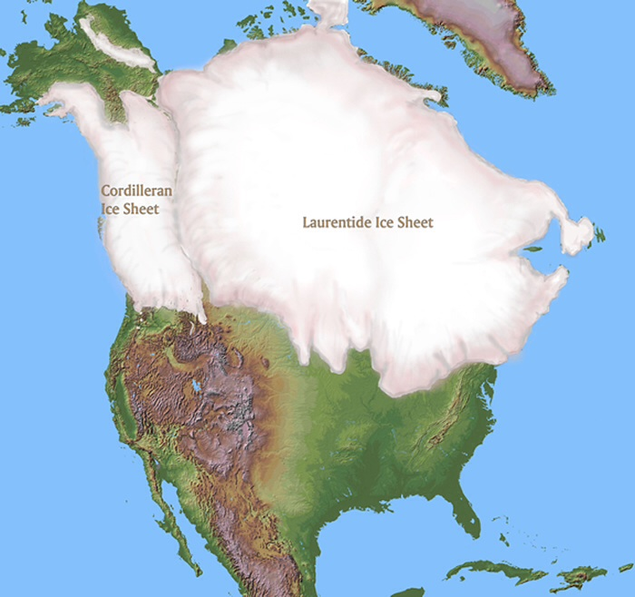
https://en.wikipedia.org/wiki/Cordilleran_Ice_Sheet
The Cordilleran ice sheet was a major ice sheet that periodically covered large parts of North America during glacial periods over the last ~2.6 million years. This included the following areas:
The ice sheet covered up to 2.5 million square kilometres at the Last Glacial Maximum and probably more than that in some previous periods, when it may have extended into the northeast extremity of Oregon and the Salmon River Mountains in Idaho. It is probable, though, that its northern margin also migrated south due to the influence of starvation caused by very low levels of precipitation.
At its eastern end the Cordilleran ice sheet merged with the Laurentide ice sheet at the Continental Divide, forming an area of ice that contained one and a half times as much water as the Antarctic ice sheet does today. At its western end it is believed nowadays that several small glacial refugia existed during the last glacial maximum below present sea level in the now-submerged Hecate Strait and on the Brooks Peninsula in northern Vancouver Island. However, evidence of ice-free refugia above present sea level north of the Olympic Peninsula has been refuted by genetic and geological studies since the middle 1990s. The ice sheet faded north of the Alaska Rangebecause the climate was too dry to form glaciers.
Unlike the Laurentide ice sheet, which is believed to have taken as much as eleven thousand years to fully melt, it is believed the Cordilleran ice sheet, except for areas that remain glaciated today, melted very quickly, probably in four thousand years or less. This rapid melting caused such floods as the overflow of Lake Missoula and shaped the topography of the extremely fertile Inland Empire ofEastern Washington.
Sea levels during glaciation[edit]
Because of the weight of the ice, the mainland of northwest North America was so depressed that sea levels at the Last Glacial Maximumwere over a hundred metres higher than they are today (measured by the level of bedrock).
However, on the western edge at the Haida Gwaii (formerly known as the Queen Charlotte Islands), the lower thickness of the ice sheet meant that sea levels were as much as 170 metres lower than they are today, forming a large lake in the deepest parts of the strait. This was because the much greater thickness of the centre of the ice sheet served to push upwards areas at the edge of the continental shelf in a glacial forebulge. The effect of this during deglaciation was that sea levels on the edge of the ice sheet, which naturally deglaciated first, initially rose due to an increase in the volume of water, but later fell due to rebound after deglaciation. Some underwater features along the Pacific Northwest were exposed because of the lower sea levels, including Bowie Seamount west of the Haida Gwaii which has been interpreted as an active volcanic island throughout the last ice age.
These effects are important because they have been used to explain how migrants to North America from Beringia were able to travel southward during the deglaciation process due purely to the exposure of submerged land between the mainland and numerous continental islands. They are also important for understanding the direction evolution has taken since the ice retreated.
Even today, the region is notable for its rapid changes in sea level, which, however, have little effect on most of the coast due to the numerous fjords.

Slide 64
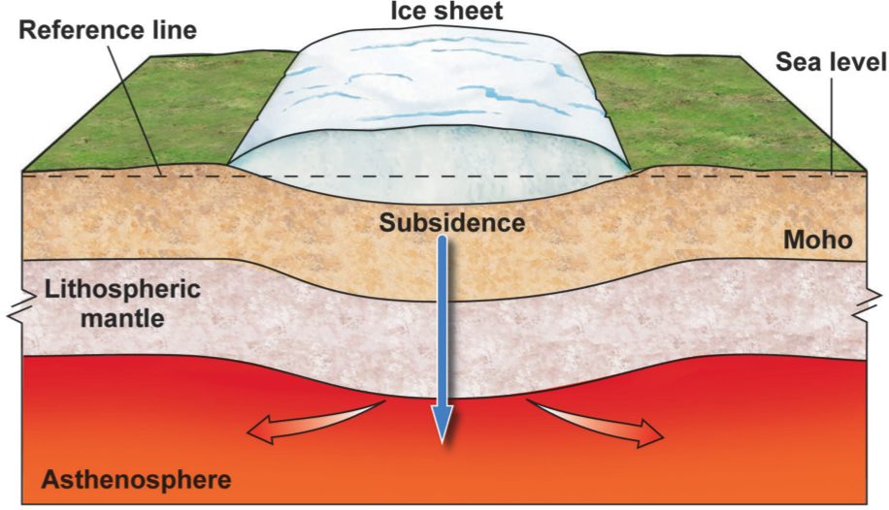
https://classconnection.s3.amazonaws.com/363/flashcards/3970363/png/sub-142C41B6791440E2CD9.png

Slide 65
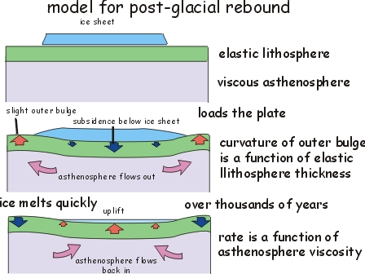

Slide 66
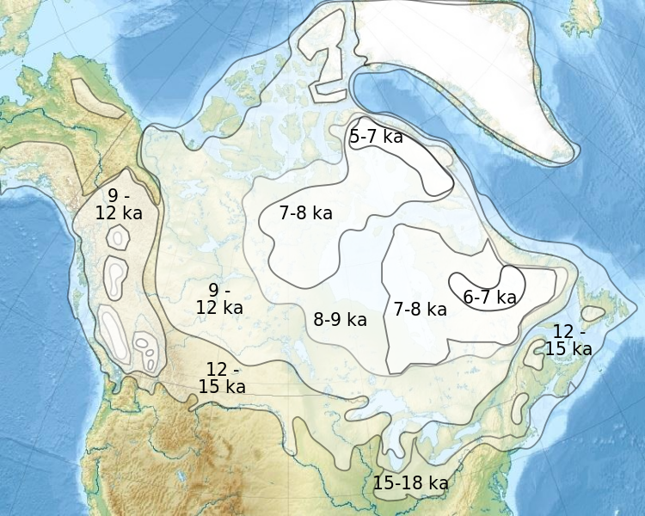
The area is experiencing post-glacial isostatic rebound
Much of Canada was covered in an extensive ice sheet in the last glacial period (the 'Ice Age'), from about 110 ka until 12 ka. The ice in the Hudson Bay area was among the last to melt:
A thick ice sheet depresses the crust (the lithosphere), making a small dent in the uppermost mantle (the asthenosphere) in the process. Well, not that small: p 375 in Gornitz (2009, Encyclopedia of Paleoclimatology and Ancient Environments) says it could be 800 m for a 3000 metre-thick ice sheet!
Since the asthenosphere is highly viscous, it takes a long time time for the depression to 'bounce' back up. This map from Natural Resources Canada shows the current rate:
Ka = 1000 years

Slide 67
How do we reconstruct climate history?
http://www.lakepowell.net/sciencecenter/paleoclimate.htm
How do we reconstruct climate?
Tree Rings
Glacial Ice Cores
Ocean Sediments - The ratio of oxygen 16 to oxygen 18 preserved in the steady rain of dead organisms.
Radiocarbon dates of organic material
Pollen samples found in packrat middens and lake bed samples.
Variations in desert varnish coatings found on rocks in the arid southwest
Variations found in peatbog deposits
Sedimentary rock records.
For much of Earth's history, the world has been ice-free (even at the poles) but these iceless periods have been interrupted by several major
glaciation periods (called glacial epochs) and we are in one now. Each glacial epoch consists of multiple advances and retreats of ice fields. These ice fields tend to wax and wane in approximate 100,000, 41,000, and 21,000 year cycles. Each advance of ice is popularly known in the press as an "ice age" but it is important to note that these multiple events are just variations of the same glacial epoch. The retreat of ice during a glacial epoch is called an inter-glacial period and this is our PRESENT DAY CLIMATE system..
The current Plio-Pleistocene Glacial Epoch had it's beginning about 3.2 million years ago and is probably linked to the tectonic construction of the Isthmus of Panama which prevented the circulation of Atlantic and Pacific waters and ultimately triggered a slow sequence of events that eventually led to cooling of the atmosphere and the formation of new ice fields by about 2.5 million years ago.
So far we have had around 15 to 20 individual major advances and subsequent retreats of the ice field in our current glacial epoch. The last major advance of glacial ice peaked about 18,000 years ago and since that time the ice has generally been retreating (albeit with some short term interruptions).
It is worth remembering that our warm present day inter-glacial climate is the exception, not the rule during a glacial epoch. For as much as 90% of the last 2 million years the ice fields on earth have been more extensive than they are today.
On the other hand, our the current glacial epoch and ice on earth and for the most part is also an abnormality. Our present-day Arctic Ocean is about 10-15°C cooler than it was at the time of the dinosaurs for almost all of the time from about 2 to at least 200 million years ago (Ma) the surface temperature exceeded that of today.
Climatic can change more rapidly than previously thought. The Gulf Stream plays an important role carrying heat from the equator poleward. When this current is disturbed, dramatic climatic changes can occur over a short period of time.

Slide 68
How do we reconstruct climate history?
http://geology.utah.gov/map-pub/survey-notes/glad-you-asked/ice-ages-what-are-they-and-what-causes-them/
How do we know about past ice ages? Scientists have reconstructed past ice ages by piecing together information derived from studying ice cores, deep sea sediments, fossils, and landforms.
Ice and sediment cores reveal an impressive detailed history of global climate. Cores are collected by driving long hollow tubes as much as 2 miles deep into glacial ice or ocean floor sediments. Ice cores provide annual and even seasonal climate records for up to hundreds of thousands of years, complementing the millions of years of climate records in ocean sediment cores.
Within just the past couple of decades, ice cores recovered from Earth’s two existing ice sheets, Greenland and Antarctica, have revealed the most detailed climate records yet.

Slide 69
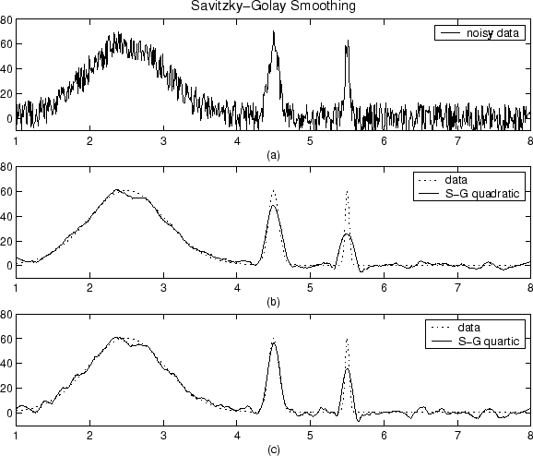
Glacial Ages
First, let’s talk about mathematical filtering & smoothing
Here’s an example . . .
72º
63º
54º
650 mya
today

Slide 70
Glacial Ages
First, let’s talk about mathematical filtering & smoothing
Here’s an example . . .
72º
63º
54º
650 mya
today

Slide 71
Glacial Ages
Let’s look at details . . .the last Glacial Age
72º
63º
54º
within each Glacial Age - intermittent pulses of
extra cold (glacials) & warmer periods (inter-glacials)
650 mya
today
Notes:
https://www2.ucar.edu/climate/faq/what-average-global-temperature-now
Climatologists prefer to combine short-term weather records into long-term periods (typically 30 years) when they analyze climate, including global averages. Between 1961 and 1990, the annual average temperature for the globe was around 57.2°F (14.0°C), according to the World Meteorological Organization.

Slide 72
Glacial Ages
Let’s look at details . . .the last Glacial Age
72º
63º
began: 2.6 mya
54º
Last 4 glacial pulses: 650,000 years ago

Slide 73
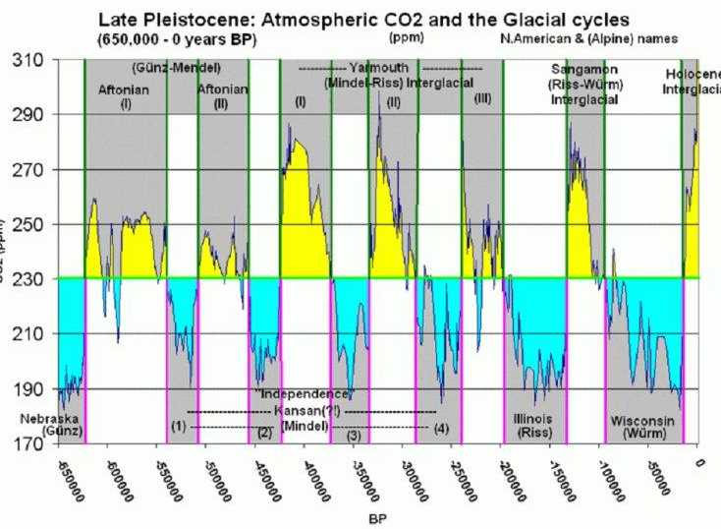
Glacial Ages
Last 4 Glacial Pulses
72º
63º
54º
-650,000
today
Last 4 glacial pulses: 650,000 years ago
Notes:
Scale on ‘last 4 glacial pulses’ graph: x-axis – YBP, y-axis – atmospheric CO2 (parts/million)

Slide 74
Last 4 Glacial Pulses
focus on the last 2 glacial pulses
focus on the last 2 glacial pulses
Nebraska
Kansan
Illinois
Wisconsin
- 180,000
0

Slide 75
focus on the last 2 glacial pulses
- 180,000
0

Slide 76
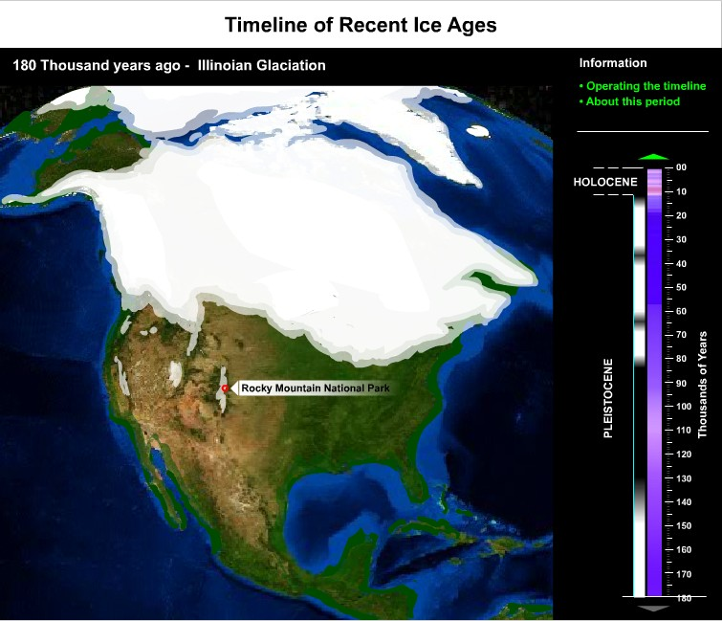
focus on the last 2 glacial pulses
What did North America
look like
during these pulses. . .
starting -180,000 YBP
- 180,000
0
Notes:
https://www.nps.gov/features/romo/feat0001/BasicsIceAges.swf

Slide 77
present
GLACIAL
OR
INTER-GLACIAL
TIME
starting -180,000 YBP
- 180,000
Notes:
https://www.nps.gov/features/romo/feat0001/BasicsIceAges.swf

Slide 78
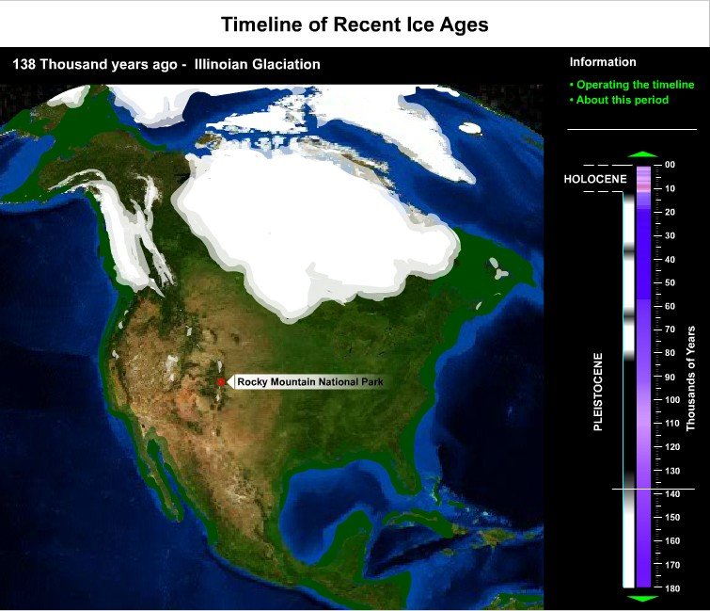
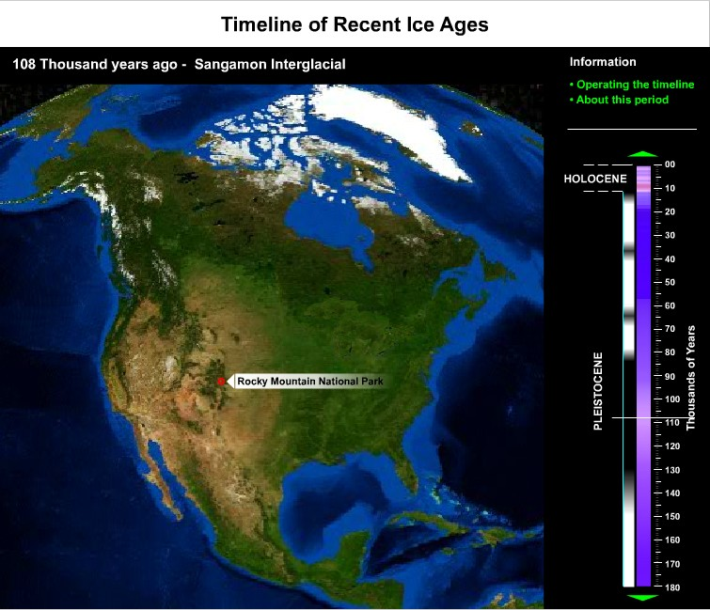
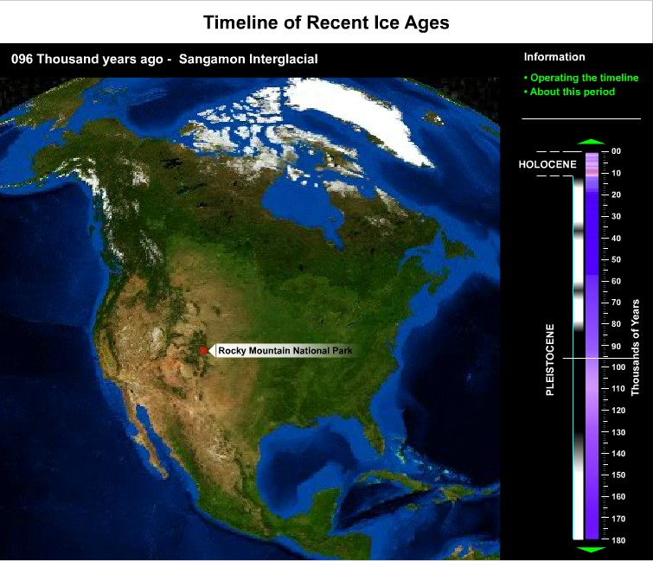
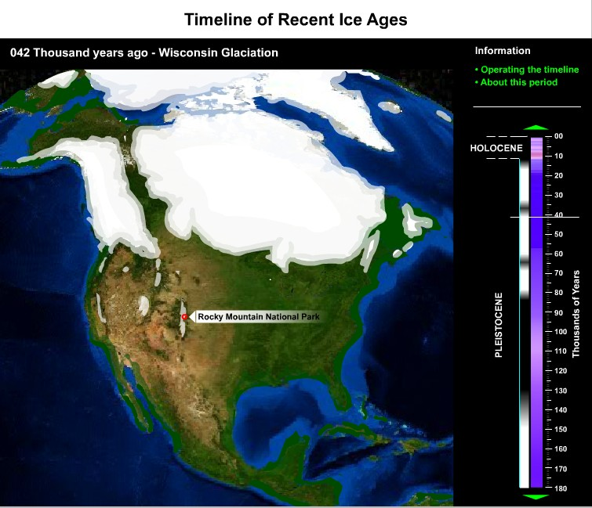
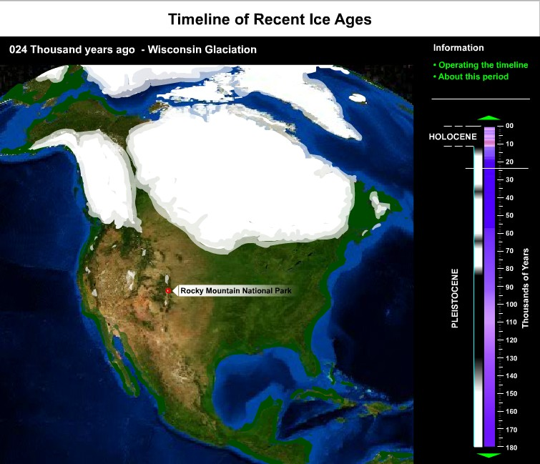


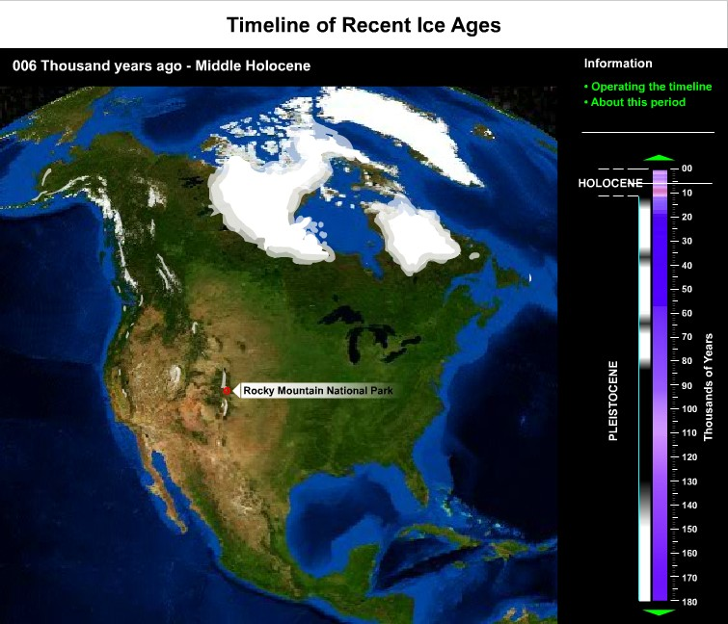






















Laurentide
Icesheet
Cordilleran
Glacier
Notes:
https://www.nps.gov/features/romo/feat0001/BasicsIceAges.swf

Slide 79

Human Migration into North America!
focus on the last 2 glacial pulses
How do these pulses
influence human migration?
- 180,000
0

Slide 80
Human Migration into North America!
migrating into Asia . . .
. . . starting in
East Africa

Slide 81

migrating into Asia . . .
continuing across Asia into the Americas . .
Two theories on migration into the Americas

Slide 82

continuing across Asia into the Americas . .
Asia
North America
Pacific Ocean
THEORY
S.A.
Two theories on migration into the Americas

Slide 83
Land Route
Asia
North America
THEORY
Coastal Route
S.A.
Two theories on migration into the Americas

Slide 84
http://www.nature.com/news/ancient-migration-coming-to-america-1.10562
Nature Journal of Science
Ancient migration: Coming to America
Andrew Curry
02 May 2012
The mastodon was old, its teeth worn to nubs. It was perfect prey for a band of hunters, wielding spears tipped with needle-sharp points made from bone. Sensing an easy target, they closed in for the kill.
Almost 14,000 years later, there is no way to tell how many hits it took to bring the beast to the ground near the coast of present-day Washington state. But at least one struck home, plunging through hide, fat and flesh to lodge in the mastodon's rib. The hunter who thrust the spear on that long-ago day didn't just bring down the mastodon; he also helped to kill off the reigning theory of how people got to the Americas.
For most of the past 50 years, archaeologists thought they knew how humans arrived in the New World. The story starts around the end of the last ice age, when sea levels were lower and big-game hunters living in eastern Siberia followed their prey across the Bering land bridge and into Alaska. As the ice caps in Canada receded and opened up a path southward, the colonists swept across the vast unpopulated continent. Archaeologists called these presumed pioneers the Clovis culture, after distinctive stone tools that were found at sites near Clovis, New Mexico, in the 1920s and 1930s.
As caches of Clovis tools were uncovered across North America over subsequent decades, nearly all archaeologists signed on to the idea that the Clovis people were the first Americans. Any evidence of humans in the New World before the Clovis time was dismissed, sometimes harshly. That was the case with the Washington-state mastodon kill, which was first described around 30 years ago¹ but then largely ignored.
Intense criticism also rained down on competing theories of how people arrived, such as the idea that early Americans might have skirted the coastline in boats, avoiding the Bering land bridge entirely. “I was once warned not to write about coastal migration in my dissertation. My adviser said I would ruin my career,” says Jon Erlandson, an archaeologist at the University of Oregon in Eugene.
But findings over the past few years — and a re-examination of old ones, such as the mastodon rib — have shown conclusively that humans reached the Americas well before the Clovis people. That has sparked a surge of interest in the field, and opened it up to fresh ideas and approaches. Geneticists and archaeologists are collaborating to piece together who came first, when they arrived, whether they travelled by boat or by foot and how they fanned out across the New World.
To test their ideas, some researchers are examining new archaeological sites and reopening old ones. Others are sifting through the DNA of modern people and unearthing the remains of those buried millennia ago in search of genetic clues. “There's a powerful meshing of the archaeology we're pulling out of the ground with genetic evidence,” says Michael Waters, a geographer at Texas A&M University in College Station.
Like those original Americans, researchers are exploring new frontiers, moving into fresh intellectual territory after a long period of stasis. “Clovis has been king for 50 years, and now we have to reimagine what the peopling of the New World looked like,” Erlandson says. “If it wasn't Clovis, what was it?
It took a chance finding halfway around the world to set this reappraisal in motion. In the late 1970s, Tom Dillehay, an archaeologist at Vanderbilt University in Nashville, Tennessee, uncovered the remains of a large campsite in southern Chile, close to the tip of South America (see 'Routes to a new world'). Radiocarbon dating of wood and other organic remains suggested that the site was around 14,600 years old, implying that humans made it from Alaska to Chile more than 1,000 years before the oldest known Clovis tools². But because the remote site was so hard for most researchers to examine, it would take nearly 20 years for Dillehay to convince his colleagues.
The case for pre-Clovis Americans has now gained more support, including from analyses of ancient DNA. One of the first bits of genetic evidence came from preserved faeces, or coprolites, that had been discovered in a cave in south-central Oregon by Dennis Jenkins, an archaeologist at the University of Oregon. Radiocarbon dating showed that the coprolites are between 14,300 and 14,000 years old, and DNA analysis confirmed that they are from humans³. The recovered DNA even shared genetic mutations with modern Native Americans.
Since the coprolite evidence emerged, in 2008, ancient DNA has also been used to reconstruct that long-ago mastodon hunt. Radiocarbon studies in the 1970s had suggested that the mastodon pre-dated the Clovis people, but some researchers explained that away by arguing that the animal had died in an accident. However, DNA studies last year⁴ showed that a fragment of bone embedded in the mastodon's rib had come from another mastodon — strong evidence that it was a spear point made by humans and not a shard that had chipped off a nearby bone in a fall.
The case against Clovis got another major boost last year, when an excavation in Texas unearthed stone tools that pre-dated Clovis-style artefacts by more than a millennium⁵. “We found a solid site with good context, good artefacts and solid dating,” says Waters.
This slow avalanche of findings has all but buried the Clovis model — the problem now is what to replace it with. The abundant Clovis artefacts and sites discovered over the past century have set a high bar. Telling the story of the first Americans means coming up with a plausible explanation and definitive evidence to support it — a combination that researchers are struggling to achieve.
One idea they are exploring is that a small group of big-game hunters made it into the Western Hemisphere over land — but significantly earlier than previously thought. Another, more popular, theory argues that humans used boats to navigate along the coast of Siberia and across to the Americas.
There is also a controversial variant of the coastal migration model, put forward by archaeologists Dennis Stanford at the Smithsonian Institution in Washington DC and Bruce Bradley at the University of Exeter, UK. Called the Solutrean hypothesis, it suggests that coastal migration from Asia could have been supplemented by parallel migrations across the Atlantic, bringing stone-tool technologies from present-day Spain and southern Europe to eastern North America.
DNA studies argue strongly against this hypothesis, and it gets little support from researchers. But some are hesitant to reject the idea outright, recognizing that the community was once before too conservative. “That's what happened with the Clovis paradigm,” says Dillehay.
To move the field forward, researchers are using as many types of data as possible. Some key clues have emerged from studies of population genetics, in which researchers tallied the number of differences between the genomes of modern Native Americans and those of people living in Asia today. They then used estimates of DNA mutation rates as a molecular clock to time how long the diversity took to develop. That provides an estimate for when people split from ancient Asian populations and migrated to the Americas.
Judging from the limited genetic diversity of modern Native Americans, Ripan Malhi, a geneticist at the University of Illinois at Urbana-Champaign, and others have argued that the founding population was small, perhaps just a few thousand hardy settlers. In a study of mitochondrial DNA from modern Native American and Asian populations, Malhi and his colleagues also found hints that the first American colonists paused on their way out of Asia⁶, waiting out the peak of the last ice age on the exposed Bering land bridge for perhaps 5,000 years — long enough to become genetically distinct from other Asian populations. When the glaciers blocking their path into North America began to melt around 16,500 years ago, the Beringians made their way south over land or sea, passing those genetic differences on to their descendants in America.
Other researchers say that there is a major problem with relying on population genetics to answer questions about the peopling of the Americas. At least 80% of the New World's population was wiped out by disease, conflict or starvation after Europeans first arrived some five centuries ago. And the genes of many Native Americans today carry European and African markers, which confounds efforts to piece together the migration story. “If we look pre-contact, we're going to find a lot more indigenous diversity,” says Malhi.
That means going back in time, by studying ancient genomes. “You're going to see a lot of ancient-DNA studies coming out, and that's going to tell a powerful story about the first Americans,” says Waters.
The chances of finding well-preserved bones from the first Americans are slim, but valuable information can be pulled from DNA samples that fall in between then and now, argues Eske Willerslev, who studies ancient DNA at the University of Copenhagen. Willerslev and his colleague Thomas Gilbert proved that point in 2010, when they extracted the first complete ancient-human genome from a 4,000-year-old hank of hair found in Greenland that had languished for decades in a museum storeroom in Copenhagen. The DNA helped to show that there had been multiple waves of migration into Greenland, and that modern Greenlanders arrived more recently⁷. Now, Willerslev's lab is trying to extract similar information about population movements from ancient-human remains from sites all over the Americas.
When paired with sequences from modern populations, ancient DNA can help to refine the calculations made by population geneticists and test the claims made by archaeologists. In 2008, Brian Kemp, now at Washington State University in Pullman, extracted mitochondrial DNA from a 10,300-year-old tooth found in On Your Knees Cave in Alaska. When he compared the DNA sequences with those from modern Native Americans, he found that the mutation rate was faster than previously thought⁸. The results, he says, effectively rule out the possibility that humans came to North America as early as 40,000 years ago — a date based on equivocal evidence from archaeological sites in the eastern United States. The finding also argues against the idea that people used boats before the thaw to go around the glaciers and come down the coast. Instead, the DNA evidence supports the consensus that people didn't migrate into the Americas — whether by boat or over land — until the end of the last glacial maximum, 16,500 years ago at most.
The DNA told researchers a few more things. The ancient man who died in that Alaskan cave had mitochondrial DNA most closely related to Native American groups living today along the west coast of North America. “Most of the people who descended from that type are still living near the coast,” Kemp says. So the first wave of migrants probably came down the coast and then spread east from there, developing tiny variations in their DNA as they went, Kemp says.
Dennis O'Rourke, a geneticist at the University of Utah in Salt Lake City, is using similar comparisons to fill in the map of ancient migrations in the New World. In the past ten years, dozens of similar studies have established a clear trend — comparisons of DNA from modern people with ancient DNA have shown that the geographic distribution of genetic groups in the Americas has been stable for millennia. “The patterns must have been established more than 4,000 years ago,” he says. That helps to constrain the timing of when people spread across the continent and when they stopped migrating, he says.
In Point Barrow, Alaska, O'Rourke recently began studying human remains from a cliff-top cemetery threatened by coastal erosion, where people have been buried for the past 1,000 years. By comparing the samples from ancient Alaskans to populations from Greenland, eastern Canada and elsewhere, O'Rourke hopes to learn more about the colonization of the Arctic, an environment similar to what the first Americans would have encountered towards the end of the last ice age.
O'Rourke's collaborators are also collecting DNA samples from Inupiat people in northern Alaska. By matching up the modern and ancient DNA sequences from that region, they hope to refine the genetic clock and improve estimates for when people arrived in the Americas. Similar work is going on at a cemetery on Prince Rupert Island off northern British Columbia, where local Tsimshian people are working with archaeologists to gather ancient and modern DNA evidence.
While geneticists open up intellectual frontiers, archaeologists are searching for ways to test the migration theories in the field. Direct evidence for coastal migration will be hard to come by, because a rise in the sea level since the end of the last ice age has flooded the ancient coastlines. But researchers are turning up indirect evidence in many locations. Last year, for example, Erlandson demonstrated that humans lived on California's Channel Islands as far back as 12,200 years ago⁹, which shows that they must have mastered the use of boats before that time.
And at the Monte Verde site in Chile, researchers have found evidence that the ancient occupants were fans of seafood¹⁰. “Monte Verde has ten different species of seaweed at the site,” Dillehay says. “Somebody was intimately familiar with seaweeds and the microhabitats where they could be found.” That lends support to the idea that the earliest Americans were seafarers, he says.
Dillehay's recent findings, which came 30 years after the first excavations at Monte Verde, show that previously studied sites can become potential gold mines, says Waters. Because so many sites were either dismissed or forgotten during the 'Clovis-first' era, Waters says that “the field can really be pushed forward by going back and taking a look at sites that were put up on a shelf”. He is already planning to reopen sites in Tennessee and Florida, where evidence of pre-Clovis mammoth hunting was uncovered in the 1980s and 1990s.
Geneticists and archaeologists agree that the death of the Clovis theory has injected the field with excitement and suspense. “There's a sense that there was something before Clovis,” says Jenkins, whose coprolite study shook the field four years ago. “But what it was and how it led to the patterns that we see in North and South America — that's a whole new ball game.”

Slide 85

http://www.nature.com/news/ancient-migration-coming-to-america-1.10562

Slide 86
Land Route
?
?
?
Coastal Route
How can geology help?
Two theories on migration into the Americas

Slide 87
Land Route
Human Migration into North America . . .
?
?
?
The Pre-Clovis people arrived . . .
more than 13,100 years ago.
Coastal Route
So in the last 50,000 years . . .
when did events favor migration?
best chance for
migration: during
glacial recessions
How can geology help?
- 180,000
0
Two theories on migration into the Americas

Slide 88

Human Migration into North America . . .
The Pre-Clovis people arrived . . .
more than 13,100 years ago.
So in the last 50,000 years . . .
when did events favor migration?
best chance for
migration: during
glacial recessions
- 180,000
0

Slide 89
Human Migration into North America . . .
Let’s go & look
glacial
interglacial
Keep in mind ...
Pre-Clovis: < 13,000
Clovis: > 13,000
best chance for
migration: during
glacial recessions
0
-50,000
- 35,000
-13,000

Slide 90
Human Migration into North America . . .
Let’s go & look
glacial
interglacial
Keep in mind ...
Pre-Clovis: < 13,000
Clovis: > 13,000
best chance for
migration: during
glacial recessions
0
-50,000
- 35,000
-13,000

Slide 91

ice-free
Mckenzie Corridor
X
must cross
Bering Strait
53 miles
Beringia
Land Bridge
Clovis
Pre-Clovis
humans??

Slide 92
humans??

Slide 93
Land Route
Coastal Route
land bridge &
ice-free corridor
What were these routes like?
land bridge but
NO corridor

Slide 94

Two theories on migration into the Americas
Land Route
Coastal Route
What were these routes like?
http://www2.nau.edu/rcb7/namQ.jpg

Slide 95
Two theories on migration into the Americas
between the
Cordilleran Laurentide
Glacier Ice sheet
surface view
Land Route
http://www2.nau.edu/rcb7/namQ.jpg

Slide 96

Two theories on migration into the Americas
North
South
edge of the Laurentide Ice Sheet
surface view
treking south through mountains
Land Route
and over icy rivers!
cold, hostile climate!

Slide 97
Two theories on migration into the Americas
North
South
edge of the Laurentide Ice Sheet
surface view
treking south through mountains
Land Route
and over icy rivers!
cold, hostile climate!
http://www2.nau.edu/rcb7/namQ.jpg

Slide 98
Two theories on migration into the Americas
surface view
along 100’s of miles
of frozen coastline
Land Route
Sea Route
http://www2.nau.edu/rcb7/namQ.jpg

Slide 99

Two theories on migration into the Americas
awesome challenge of migrating by sea
along 100’s of miles
of frozen coastline
Sea Route
Notes:
http://www2.nau.edu/rcb7/namQ.jpg

Slide 100
http://www2.nau.edu/rcb7/namQ.jpg
awesome challenge of migrating by sea
Two theories on migration into the Americas
Land Route: BERINGIA
Land Route
Land Route
Sea Route
Notes:
http://www2.nau.edu/rcb7/namQ.jpg

Slide 101


Two theories on migration into the Americas
Land Route: BERINGIA
Land Route
Siberia
Alaska

Slide 102
Land Route: BERINGIA
Today
53 miles of water
Bering Strait
Arctic Ocean
Siberia
Alaska
Yukon
Pacific Ocean

Slide 103


Land Route: BERINGIA
during the last ice age, vast glaciers formed . . . .
. . . sea level dropped 400 feet . . .
. . . exposing the floor of the Bering Sea
. . . connecting Siberia & Alaska
Arctic Ocean
Beringia
Land
Bridge
Siberia
Alaska
Yukon
Pacific Ocean

Slide 104
Beringia Interpretive Center
Land Route: BERINGIA
during the last ice age, vast glaciers formed . . . .
. . . Beringia was grassland steppe . . .
. . . with light snowfall . . . . and much plant & animal life
Beringia
Land
Bridge
Siberia
Alaska
Yukon
Whitehorse
The Land Route

Slide 105


Beringia Interpretive Center

Slide 106



Beringia Interpretive Center
Beringian Lion
- Eurasian cave lions
4’ tall, 6’ long
carnivores
- extinct: 12,400 YBP

Slide 107
https://en.wikipedia.org/wiki/Panthera_leo_spelaea
http://www.beringia.com/exhibit/ice-age-animals/beringian-lion
The Beringian lion (Panthera leo spelaea) was the largest and most abundant cat of ice age Yukon, and a member of the well-known "cave lions" from Europe and Asia. Lion fossil bones from Beringia are smaller than the rest of the European cave lions, suggesting that they could be a seperate sub-species.
The ice age lions of Eurasia and Beringia are genetically distinct from the populations that later became the modern African lion, even though their historic ranges may have overlapped in the ancient Near East. Groups of lions expanded their range dramatically out of Africa during the middle of the Ice Age, appearing in Europe and Britain by around 500,000 years ago. It is not certain when lions crossed Beringia and first appeared in North America. Genetic evidence suggests they may have inhabited Alaska around 300,000 years ago. Some of these lions made their way south into the mid-continent of the United States around 150,000 years ago. After thousands of years of seperation from one another due to the continental ice sheets, the southern population evolved into a unique species, the American lion (Panthera leo atrox).
Lions are the only modern large cats that live in groups or prides. Because their closest relatives, tigers and leopards, don't live in groups, scientists believe group living evolved early in lion evolution, back near the start of the Ice Age around two million years ago. Scientists today are continually searching for evidence that Beringian lions and their ice age relatives did in fact live in prides.

Slide 108


Beringia Interpretive Center
The Wooly Manmonth

Slide 109

Beringia Interpretive Center
The Wooly Manmonth
14 feet tall, 8 tons
- 700 lbs of grasses/day
- adapted to extreme
cold temperature
- 11,000 YBP: extinct
in eastern Beringia
- 3,700 YBP: extinct
in northern Siberia

Slide 110


Beringia Interpretive Center
The Wooly Manmonth
Giant Beavers
14 feet tall, 8 tons
- 700 lbs of grasses/day
- adapted to extreme
cold temperature
- 11,000 YBP: extinct
in eastern Beringia
- 3,700 YBP: extinct
in northern Siberia
- 8 feet long
480 lbs
shoebox size teeth
- extinct: 10,000 YBP

Slide 111


Beringia Interpretive Center
Giant Beavers
Giant Flat Faced Bear
- 8 feet long
480 lbs
shoebox size teeth
- extinct: 10,000 YBP
- 8-10 feet tall
- 1500 lbs
largest land predator
of the Ice Age
almost exclusively
carnivorous

Slide 112






Beringia Interpretive Center
Giant Flat Faced Bear

Slide 113


Beringia Interpretive Center
Who were these Stone Age Homo sapiens?

Slide 114
Who were these Stone Age Homo sapiens?
Let’s look at the big picture . . .

Slide 115
Who were these Stone Age Homo sapiens?
Then . . . two discoveries in Russia!
Until early 2000’s, most anthropologists believed
the earliest Americans were descended from
populations moving from Africa through EAST ASIA
Let’s look at the big picture . . .

Slide 116

Who were these Stone Age Homo sapiens?
discoveries in Russia
Then . . . two discoveries in Russia!
Until early 2000’s, most anthropologists believed
the earliest Americans were descended from
populations moving from Africa through EAST ASIA

Slide 117

discoveries in Russia
discoveries in Russia – X Woman
It’s a romance!
North Pole
Bering Strait
Alaska
S i b e r i a
Denisova Cave
Lake Baikal
X Woman
Mal’ta Boy

Slide 118
HOMO DENISOVAN
Homo denisovan 3: tiny sample of genetic material from a finger bone
2008 - fossils unearthed in Denisova Cave in southern Siberia
2012 - Denisova 3 (X woman) DNA genome sequenced – dark skin/brown hair/eyes
- age 30,000-80,000 ybp
- interbred with Homo sapiens
Interbred with Neanderthals & Homo Sapiens
3% to 5% of the DNA of Melanesians and Aboriginal Australians deriving from Denisovans
comparison with the genome of a Neanderthal from the same cave revealed significant local interbreeding with local Neanderthal DNA representing 17% of the Denisovan genome
This extinct lineage once interbred with ours and lived in a vast range from Siberia to Southeast Asia
Denisova 3 genome has large stretches of DNA shared with the Neandertal toe bone, indicating that the Neandertal population interbred with the ancestors of the Denisovan individuals at some point.
“the first time that a new group of extinct humans was discovered and defined just from DNA sequence evidence and not from the morphology of bones," Pääbo said

Slide 119




discoveries in Russia – X Woman
What’s been found so far?
It’s a romance!
Archeological digs on-going since 1970’s
early 2000’s: first human fossils unearthed in cave
Denisova Cave

Slide 120


discoveries in Russia – X Woman
What’s been found so far?
finger bone
4/10 inch
Notes:
http://www.ancient-origins.net/news-evolution-human-origins/new-dna-tests-ancient-denisovan-people-shows-them-occupying-altai-cave-020532
Finger bone (denisovan woman)

Slide 121



discoveries in Russia – X Woman
What’s been found so far?
finger bone
molar
molar
4/10“
Notes:
http://www.ancient-origins.net/news-evolution-human-origins/new-dna-tests-ancient-denisovan-people-shows-them-occupying-altai-cave-020532
Finger bone (denisovan woman)
http://www.livescience.com/22836-genome-extinct-humans-denisovans.html
Scientists have just completed sequencing the entire genome of a species of archaic humans called Denisovans. The fossils, which consist of a finger bone and two molars, from this extinct lineage were discovered in Denisova Cave in southern Siberia in 2008. Scientists don't know the precise age of the material found, though they estimate it ranges anywhere from 30,000 to 80,000 years of age. Shown here, a distal molar of a Denisovan.
Credit: Max Planck Institute for Evolutionary Anthropology

Slide 122





discoveries in Russia – X Woman
What’s been found so far?
What’s been found so far?
What do we know about these fossils?
finger bone
THAT’S ALL!
toe bone
molar
10mm
molar
Notes:
http://www.ancient-origins.net/news-evolution-human-origins/new-dna-tests-ancient-denisovan-people-shows-them-occupying-altai-cave-020532
Finger bone (denisovan woman)
http://www.livescience.com/22836-genome-extinct-humans-denisovans.html
Scientists have just completed sequencing the entire genome of a species of archaic humans called Denisovans. The fossils, which consist of a finger bone and two molars, from this extinct lineage were discovered in Denisova Cave in southern Siberia in 2008. Scientists don't know the precise age of the material found, though they estimate it ranges anywhere from 30,000 to 80,000 years of age. Shown here, a distal molar of a Denisovan.
Credit: Max Planck Institute for Evolutionary Anthropology
http://news.berkeley.edu/2013/12/18/neanderthal-genome-shows-evidence-of-early-human-interbreeding-inbreeding/
the toe bone (Neanderthal woman) DNA extracted from the bone was used to produce the most complete sequence so far of the genome of this group of early humans.
https://dnaexplained.files.wordpress.com/2013/12/neanderthal-12-22-2013-cropped.png
Toe phalanx, total length 26mm

Slide 123




discoveries in Russia – X Woman
What do we know about these fossils?
finger bone
finger bone
Svante Pääbo
molar
molar
toe bone
toe bone
10mm
10mm
Notes:
Pronounce in Swedish: svan-ti pay-ba

Slide 124

http://www.livescience.com/22833-denisovan-fossils-gallery.html?li_source=LI&li_medium=more-from-livescience
Laboratory where DNA analysis was done on Denisova Cave fossils
http://www.ancient-origins.net/news-evolution-human-origins/new-dna-tests-ancient-denisovan-people-shows-them-occupying-altai-cave-020532
Finger bone (denisovan woman)
http://www.livescience.com/22836-genome-extinct-humans-denisovans.html
Scientists have just completed sequencing the entire genome of a species of archaic humans called Denisovans. The fossils, which consist of a finger bone and two molars, from this extinct lineage were discovered in Denisova Cave in southern Siberia in 2008. Scientists don't know the precise age of the material found, though they estimate it ranges anywhere from 30,000 to 80,000 years of age. Shown here, a distal molar of a Denisovan.
Credit: Max Planck Institute for Evolutionary Anthropology
http://news.berkeley.edu/2013/12/18/neanderthal-genome-shows-evidence-of-early-human-interbreeding-inbreeding/
the toe bone (Neanderthal woman) DNA extracted from the bone was used to produce the most complete sequence so far of the genome of this group of early humans.
https://dnaexplained.files.wordpress.com/2013/12/neanderthal-12-22-2013-cropped.png
Toe phalanx, total length 26mm

Slide 125


discoveries in Russia – X Woman
- Homo denisovan
What do we know about these fossils?
meet ‘X Woman’
finger bone
Denisova 3
through DNA SEQUENCING, she:
            was a young girl
            with dark skin, brown eyes, & brown hair
  lived more than 45,000 years ago
  has some Homo neanderthal DNA,
  but she was NOT a neanderthal
  has some Homo sapiens DNA,
  but she is NOT a sapiens
molar
molar
toe bone
  She is a NEW Homo species:
HOMO DENISOVAN
HOMO DENISOVAN
10mm
Notes:
http://www.ancient-origins.net/news-evolution-human-origins/new-dna-tests-ancient-denisovan-people-shows-them-occupying-altai-cave-020532
Finger bone (denisovan woman)
http://www.livescience.com/22836-genome-extinct-humans-denisovans.html
Scientists have just completed sequencing the entire genome of a species of archaic humans called Denisovans. The fossils, which consist of a finger bone and two molars, from this extinct lineage were discovered in Denisova Cave in southern Siberia in 2008. Scientists don't know the precise age of the material found, though they estimate it ranges anywhere from 30,000 to 80,000 years of age. Shown here, a distal molar of a Denisovan.
Credit: Max Planck Institute for Evolutionary Anthropology
http://news.berkeley.edu/2013/12/18/neanderthal-genome-shows-evidence-of-early-human-interbreeding-inbreeding/
the toe bone (Neanderthal woman) DNA extracted from the bone was used to produce the most complete sequence so far of the genome of this group of early humans.
https://dnaexplained.files.wordpress.com/2013/12/neanderthal-12-22-2013-cropped.png
Toe phalanx, total length 26mm

Slide 126
https://blog.23andme.com/ancestry/find-your-inner-neanderthal/
for some reason Neanderthals —thick boned humans who thrived for hundreds of thousands of years in Europe and parts of Asia— died out about 30,000 years ago, while we modern humans survived.
It may be that the DNA of other prehistoric human groups also are intermixed in our own DNA. Much like with Neanderthals, scientists extracted ancient DNA from the skeletal remains of another ancient cousin known as the Denisovans. The remains — a finger bone — were found in a cave in Siberia and showed that Denisovans were cousins of Neanderthals. They lived in Asia and disappeared about 40,000 years ago. Their DNA is found today in Melanesians.

Slide 127
http://www.livescience.com/22836-genome-extinct-humans-denisovans.html
The genome of a recently discovered branch of extinct humans known as the Denisovans that once interbred with us has been sequenced, scientists said today (Aug. 30).
Genetic analysis of the fossil revealed it apparently belonged to a little girl with dark skin, brown hair and brown eyes, researchers said. All in all, the scientists discovered about 100,000 recent changes in our genome that occurred after the split from the Denisovans. A number of these changes influence genes linked with brain function and nervous system development, leading to speculation that we may think differently from the Denisovans. Other changes are linked with the skin, eyes and teeth.
"This research will help [in] determining how it was that modern human populations came to expand dramatically in size as well as cultural complexity, while archaic humans eventually dwindled in numbers and became physically extinct," said researcher Svante Pääbo at the Max Planck Institute for Evolutionary Anthropology in Leipzig, Germany.
Future research may turn up other groups of extinct humans in Asia "in addition to Neanderthals and Denisovans," Pääbo told LiveScience.
Although our species comprises the only humans left alive, our planet was once home to a variety of other human species. The Neanderthals were apparently our closest relatives, and the last of the other human lineages to vanish.
However, scientists recently revealed another group of extinct humans once lived at the same time as ours. DNA from fossils unearthed in Denisova Cave in southern Siberia in 2008 revealed a lineage unlike us and closely related to Neanderthals. The precise age of the Denisovan material remains uncertain — anywhere from 30,000 to 80,000 years of age.
"The Denisovan genome is particularly close to my heart, because it was the first time that a new group of extinct humans was discovered and defined just from DNA sequence evidence and not from the morphology of bones," Pääbo said.
Now, based on only a tiny sample of genetic material from a finger bone, scientists have sequenced the complete genome of the Denisovans (pronounced deh-NEESE-so-vans), as they are now called.
To make the most of what little genetic material they had, the researchers developed a technique that unzipped the double strands of DNA in the bone, doubling the amount of DNA they could analyze. This enabled them to sequence each position in the genome about 30 times over, generating an extremely thorough genome sequence.
"We have very few errors in the sequences, even less errors than we often have when you sequence a person today," Pääbo said. "With just a few technical reservations, there is actually today then no difference in what we can learn genetically about a person that lived 50,000 years ago and from a person today, provided that we have well-enough preserved bones."
Comparing the Denisovan genome with ours confirmed past research suggesting the extinct lineage once interbred with ours and lived in a vast range from Siberia to Southeast Asia. The Denisovans share more genes with people from Papua New Guinea than any other modern population studied.
In addition, more Denisovan genetic variants were found in Asia and South America than in European populations. However, this likely reflects interbreeding between modern humans and the Denisovans' close relatives, the Neanderthals, rather than direct interbreeding with the Denisovans, researchers said.
Denisovans began to diverge from modern humans in terms of DNA sequences about 800,000 years ago. Among the genetic differences between Denisovans and modern humans are likely changes that "are essential for what made modern human history possible, the very rapid development of human technology and culture that allowed our species to become so numerous, spread around the whole world, and actually dominate large parts of the biosphere," Pääbo said.
Eight of these genetic changes have to do with brain function and brain development, "the connectivity in the brain of synapses between nerve cells function, and some of them have to do with genes that, for example, can cause autism when these genes are mutated," Pääbo added.
It makes a lot of sense to speculate that what makes us special in the world relative to the Denisovans and Neanderthals "is about connectivity in the brain," Pääbo said. "Neanderthals had just as large brains as modern humans had — relative to body size, they even had a bit larger brains. Yet there is, of course, something special in my mind that happens with modern humans. It's sort of this extremely rapid technological cultural development that comes, large societal systems, and so on. So it makes sense that, well, what pops up is sort of connectivity in the brain.“
The fact that differences are seen between modern humans and Denisovans in terms of autism-linked genes is especially interesting, because whole books have been written "suggesting that autism may affect sort of a trait in human cognition that is also crucial for modern humans, for how we put ourselves in the shoes of others, manipulate others, lie, develop politics and big societies and so on," Pääbo said.
The genetic diversity suggested by this Denisovan sample was apparently quite low. This was probably not due to inbreeding, the researchers say — rather, their vast range suggests their population was initially quite small but grew quickly, without time for genetic diversity to increase as well.
"If future research of the Neanderthal genome shows that their population size changed over time in similar ways, it may well be that a single population expanding out of Africa gave rise to both the Denisovans and the Neanderthals," Pääbo said.
Intriguingly, comparing the X chromosome, which is passed down by females, to the rest of the genome, which is passed down equally in males and females, revealed "there is substantially less Denisovan genetic material in New Guinea on the X chromosome than there is on the rest of the genome,"researcher David Reich at Harvard Medical School in Boston told LiveScience.
One possible explanation "is that the Denisovan gene flow into modern humans was mediated primarily by male Denisovans mixing with female modern humans," Reich said. "Another possible explanation is that actually there was natural selection to remove genetic material on the X chromosome that came from Denisovans once that entered the modern human population, perhaps because it caused problems for the people who carried it."
These current Denisovan findings have allowed the researchers to re-evaluate past analysis of the Neanderthal genome. They discovered modern humans in the eastern parts of Eurasia and Native Americans actually carry more Neanderthal genetic material than people in Europe, "even though the Neanderthals mostly lived in Europe, which is really, really interesting," Reich said.
The researchers would now like to upgrade the Neanderthal genome to the quality seen with the Denisovan genome. The genetic techniques they used could also be employed in forensic investigations, and in analyzing other fossil DNA, said researcher Matthias Meyer, also at the Max Planck Institute for Evolutionary Anthropolog..

Slide 128
discoveries in Russia – X Woman
- Homo denisovan
meet ‘X Woman’
finger bone
Denisova 3
through DNA SEQUENCING, she:
            was a young girl
            with dark skin, brown eyes, & brown hair
  lived more than 45,000 years ago
  has some Homo neanderthal DNA,
  but she was NOT a neanderthal
  has some Homo sapiens DNA,
  but she is NOT a sapiens
molar
molar
toe bone
  She is a NEW Homo species:
HOMO DENISOVAN
HOMO DENISOVAN
10mm
Notes:
http://www.ancient-origins.net/news-evolution-human-origins/new-dna-tests-ancient-denisovan-people-shows-them-occupying-altai-cave-020532
Finger bone (denisovan woman)
http://www.livescience.com/22836-genome-extinct-humans-denisovans.html
Scientists have just completed sequencing the entire genome of a species of archaic humans called Denisovans. The fossils, which consist of a finger bone and two molars, from this extinct lineage were discovered in Denisova Cave in southern Siberia in 2008. Scientists don't know the precise age of the material found, though they estimate it ranges anywhere from 30,000 to 80,000 years of age. Shown here, a distal molar of a Denisovan.
Credit: Max Planck Institute for Evolutionary Anthropology
http://news.berkeley.edu/2013/12/18/neanderthal-genome-shows-evidence-of-early-human-interbreeding-inbreeding/
the toe bone (Neanderthal woman) DNA extracted from the bone was used to produce the most complete sequence so far of the genome of this group of early humans.
https://dnaexplained.files.wordpress.com/2013/12/neanderthal-12-22-2013-cropped.png
Toe phalanx, total length 26mm

Slide 129
discoveries in Russia – X Woman
- Homo denisovan
through DNA SEQUENCING, they . . . .
lived at least 110,000 years ago
were not closely related to each other
were Homo denisovans
interbred with other Homo species
interbred with local neanderthals
(17% neanderthal DNA)
also interbred with an unidentified
ancient human lineage, perhaps
Homo erectus
finger bone
Oh, la la!
molar
molar
toe bone
Meet Denisova 4 & Denisova 8
10mm
Notes:
http://www.ancient-origins.net/news-evolution-human-origins/new-dna-tests-ancient-denisovan-people-shows-them-occupying-altai-cave-020532
Finger bone (denisovan woman)
http://www.livescience.com/22836-genome-extinct-humans-denisovans.html
Scientists have just completed sequencing the entire genome of a species of archaic humans called Denisovans. The fossils, which consist of a finger bone and two molars, from this extinct lineage were discovered in Denisova Cave in southern Siberia in 2008. Scientists don't know the precise age of the material found, though they estimate it ranges anywhere from 30,000 to 80,000 years of age. Shown here, a distal molar of a Denisovan.
Credit: Max Planck Institute for Evolutionary Anthropology
http://news.berkeley.edu/2013/12/18/neanderthal-genome-shows-evidence-of-early-human-interbreeding-inbreeding/
the toe bone (Neanderthal woman) DNA extracted from the bone was used to produce the most complete sequence so far of the genome of this group of early humans.
https://dnaexplained.files.wordpress.com/2013/12/neanderthal-12-22-2013-cropped.png
Toe phalanx, total length 26mm

Slide 130
https://en.wikipedia.org/wiki/Denisovan
Denisovan or Denisova homininis an extinct species of human in the genus Homo. The species is sometimes given the name Homo sp. Altai, and Homo sapiens ssp. Denisova. In March 2010, scientists announced the discovery of a finger bone fragment of a juvenile female who lived about 41,000 years ago, found in the remote Denisova Cave in the Altai Mountains in Siberia, a cave which has also been inhabited by Neanderthals and modern humans. Two teeth belonging to different members of the same population have since been reported. In November 2015, a tooth fossil containing DNA was reported to have been found and studied.
Analysis of the mitochondrial DNA (mtDNA) of the finger bone showed it to be genetically distinct from the mtDNAs of Neanderthals and modern humans. Subsequent study of the nuclear genome from this specimen suggests that Denisovans shared a common origin with Neanderthals, that they ranged from Siberia to South-East Asia, and that they lived among and interbred with the ancestors of some modern humans, with about 3% to 5% of the DNA of Melanesians and Aboriginal Australians deriving from Denisovans. DNA discovered in Spain suggests that Denisovans at some point resided in Western Europe, where Neanderthals were previously thought to be the only inhabitants. A comparison with the genome of a Neanderthal from the same cave revealed significant local interbreeding with local Neanderthal DNA representing 17% of the Denisovan genome, while evidence was also detected of interbreeding with an as yet unidentified ancient human lineage. Similar analysis of a toe bone discovered in 2011 is underway, while analysis of DNA from two teeth found in layers different from the finger bone revealed an unexpected degree of mtDNA divergence among Denisovans. In 2013, mitochondrial DNA from a 400,000-year-old hominin femur bone from Spain, which had been seen as either Neanderthal or Homo heidelbergensis, was found to be closer to Denisovan mtDNA than to Neanderthal mtDNA.

Slide 131
http://www.sciencemag.org/news/2015/09/siberian-cave-was-home-generations-mysterious-ancient-humans
In 2010, scientists discovered a new kind of human by sequencing DNA from a girl’s pinky finger found in Denisova Cave in Siberia. Ever since, researchers have wondered when the girl lived, and if her people, called Denisovans, lingered in the cave or just passed through. But the elusive Denisovans left almost no fossil record—only that bit of bone and a handful of teeth—and they came from a site that was notoriously difficult to date.
Now, state-of-the-art DNA analysis on the Denisovan molars and new dates on cave material show that Denisovans occupied the cave surprisingly early and came back repeatedly. The data suggest that the girl lived at least 50,000 years ago and that two other Denisovan individuals died in the cave at least 110,000 years ago and perhaps as early as 170,000 years ago, according to two talks here last week at the meeting of the European Society for the study of Human Evolution. Although the new age estimates have wide margins of error, they help solidify our murky view of Denisovans and provide “really convincing evidence of multiple occupations of the cave,” says paleoanthropologist Fred Spoor of University College London. “You can seriously see it’s a valid species.”
Most of the cave’s key fossils come from a thick band of sandstone called layer 11. When researchers first dated animal bones and artifacts in this layer, the results varied widely, between 30,000 to 50,000 years ago. So Siberian researchers invited geochronologist Tom Higham of the University of Oxford in the United Kingdom to re-date the sequence. Higham’s team collected and radiocarbon-dated about 20 samples of artifacts and animal bones with cut marks, which presumably were discarded by ancient humans. Sediments holding the finger bone, at the bottom of layer 11, came out right at the limit of radiocarbon dating, and are likely older than 48,000 to 50,000 years, reported postdoc and archaeologist Katerina Douka of Oxford.
Another dating expert at the meeting was cautious about these results. “How secure is the association of the Denisovans with the [dated] animal remains?” asked geochronologist Daniel Richter of the Max Planck Institute for Evolutionary Anthropology in Leipzig, Germany, and Leuphana University in Lüneburg. But Douka stressed that the dates were from cut-marked animal bones and ornaments, and were consistent across three cave chambers.
The dates also fit with genetic evidence presented at the meeting that Denisovans were in the cave early. Researchers sequenced nuclear DNA from three molars from layer 11 and a child’s molar from a deeper layer, 22, according to a talk by graduate student Viviane Slon, who works in the lab of paleogeneticist Svante Pääbo at the Max Planck Institute for Evolutionary Anthropology. (A dating method considered experimental for caves, thermoluminescence dating, had suggested that layer 22 is 170,000 years old.)
Slon and her colleagues managed to analyze a significant amount of nuclear DNA from three teeth that turned out to be Denisovan. (A fourth was Neandertal.) By comparing key sites on the tooth DNA with corresponding sites in the high-quality genomes of the Denisova girl, Neandertals, and modern humans, they revealed that the Denisovan inhabitants in that one cave were not closely related. They had more genetic variation among them than all the Neandertals so far sequenced, although Neandertals are known to be similar genetically.
To find out when the Denisovans were in the cave, the team also sequenced their entire mitochondrial DNA (mtDNA) genomes and placed them on a family tree. Then they counted the number of mtDNA differences between individuals and used the modern human mutation rate to estimate how long it might have taken those mutations to appear. They concluded that the girl with the pinky finger was in the cave roughly 65,000 years after the oldest Denisovan, who was there at least 110,000 years ago and possibly earlier.
Neandertals were in Denisova Cave, too—Pääbo’s team has sequenced their DNA from a toe bone and molar found there. And modern humans also were apparently drawn to the large, light-filled cave, given the more recent artifacts found there. “What I found fascinating is the interdigitization of the Neandertals and Denisovans—that both groups were in and out of the cave,” says paleoanthropologist Leslie Aiello of the Wenner-Gren Foundation in New York City.
The challenge now is to get more fossils to flesh out the still-mysterious Denisovans. To that end, Oxford grad student Samantha Brown reported in a poster that she discovered a human bone fragment by using a new technique, called ZooMS, to scan 2315 bones from the cave for uniquely human proteins. Anything she finds will be welcome. “This is a real lineage, and we have to work out what the hell it looks like,” says paleoanthropologist Bernard Wood of George Washington University in Washington. D.C.

Slide 132
discoveries in Russia – X Woman
- Homo denisovan
through DNA SEQUENCING, they . . . .
lived at least 110,000 years ago
were not closely related to each other
were Homo denisovans
interbred with other Homo species
interbred with local neanderthals
(17% neanderthal DNA)
also interbred with an unidentified
ancient human lineage, perhaps
Homo erectus
finger bone
Oh, la la!
molar
molar
toe bone
Meet Denisova 4 & Denisova 8
10mm
Notes:
http://www.ancient-origins.net/news-evolution-human-origins/new-dna-tests-ancient-denisovan-people-shows-them-occupying-altai-cave-020532
Finger bone (denisovan woman)
http://www.livescience.com/22836-genome-extinct-humans-denisovans.html
Scientists have just completed sequencing the entire genome of a species of archaic humans called Denisovans. The fossils, which consist of a finger bone and two molars, from this extinct lineage were discovered in Denisova Cave in southern Siberia in 2008. Scientists don't know the precise age of the material found, though they estimate it ranges anywhere from 30,000 to 80,000 years of age. Shown here, a distal molar of a Denisovan.
Credit: Max Planck Institute for Evolutionary Anthropology
http://news.berkeley.edu/2013/12/18/neanderthal-genome-shows-evidence-of-early-human-interbreeding-inbreeding/
the toe bone (Neanderthal woman) DNA extracted from the bone was used to produce the most complete sequence so far of the genome of this group of early humans.
https://dnaexplained.files.wordpress.com/2013/12/neanderthal-12-22-2013-cropped.png
Toe phalanx, total length 26mm

Slide 133
discoveries in Russia – X Woman
- Homo denisovan
through DNA SEQUENCING, she . . . .
was a woman
lived about 50,000 years ago
was highly in-bred; the daughter of:
- half-siblings or
- uncle/niece or
- aunt/nephew or
- grandparent/grandchild or
- first cousins
interbred with 3 other Homo species
(sapiens, denisovans, perhaps erectus)
a Homo neanderthal
finger bone
molar
Oh la la, again!
molar
toe bone
10mm
Notes:
http://www.ancient-origins.net/news-evolution-human-origins/new-dna-tests-ancient-denisovan-people-shows-them-occupying-altai-cave-020532
Finger bone (denisovan woman)
http://www.livescience.com/22836-genome-extinct-humans-denisovans.html
Scientists have just completed sequencing the entire genome of a species of archaic humans called Denisovans. The fossils, which consist of a finger bone and two molars, from this extinct lineage were discovered in Denisova Cave in southern Siberia in 2008. Scientists don't know the precise age of the material found, though they estimate it ranges anywhere from 30,000 to 80,000 years of age. Shown here, a distal molar of a Denisovan.
Credit: Max Planck Institute for Evolutionary Anthropology
http://news.berkeley.edu/2013/12/18/neanderthal-genome-shows-evidence-of-early-human-interbreeding-inbreeding/
the toe bone (Neanderthal woman) DNA extracted from the bone was used to produce the most complete sequence so far of the genome of this group of early humans.
https://dnaexplained.files.wordpress.com/2013/12/neanderthal-12-22-2013-cropped.png
Toe phalanx, total length 26mm

Slide 134
http://dna-explained.com/2013/12/26/native-americans-neanderthal-and-denisova-admixture/
estimate that the Denisovan contribution to mainland Asian and Native American populations is 0.2%
http://news.berkeley.edu/2013/12/18/neanderthal-genome-shows-evidence-of-early-human-interbreeding-inbreeding/
Neanderthal genome shows evidence of early human interbreeding, inbreeding
The most complete sequence to date of the Neanderthal genome, using DNA extracted from a woman’s toe bone that dates back 50,000 years, reveals a long history of interbreeding among at least four different types of early humans living in Europe and Asia at that time, according to UC Berkeley scientists.
Population geneticist Montgomery Slatkin, graduate student Fernando Racimo and post-doctoral student Flora Jay were part of an international team of anthropologists and geneticists who generated a high-quality sequence of the Neanderthal genome and compared it with the genomes of modern humans and a recently recognized group of early humans called Denisovans.
The comparison shows that Neanderthals and Denisovans are very closely related, and that their common ancestor split off from the ancestors of modern humans about 400,000 years ago. Neanderthals and Denisovans split about 300,000 years ago.
Though Denisovans and Neanderthals eventually died out, they left behind bits of their genetic heritage because they occasionally interbred with modern humans. The research team estimates that between 1.5 and 2.1 percent of the genomes of modern non-Africans can be traced to Neanthertals.
Denisovans also left genetic traces in modern humans, though only in some Oceanic and Asian populations. The genomes of Australian aborigines, New Guineans and some Pacific Islanders are about 6 percent Denisovan genes, according to earlier studies. The new analysis finds that the genomes of Han Chinese and other mainland Asian populations, as well as of native Americans, contain about 0.2 percent Denisovan genes.
The genome comparisons also show that Denisovans interbred with a mysterious fourth group of early humans also living in Eurasia at the time. That group had split from the others more than a million years ago, and may have been the group of human ancestors known as Homo erectus, which fossils show was living in Europe and Asia a million or more years ago.
“The paper really shows that the history of humans and hominins during this period was very complicated,” said Slatkin, a UC Berkeley professor of integrative biology. “There was lot of interbreeding that we know about and probably other interbreeding we haven’t yet discovered.”
The genome analysis will be published in the Dec. 19 issue of the journal Nature.Slatkin, Racimo and Jay are members of a large team led by former UC Berkeley post-doc Svante Pääbo, who is now at the Max Planck Institute for Evolutionary Anthropology in Leipzig, Germany.
In another analysis, Jay discovered that the Neanderthal woman whose toe bone provided the DNA was highly inbred. The woman’s genome indicates that she was the daughter of a very closely related mother and father who either were half-siblings who shared the same mother, an uncle and niece or aunt and nephew, a grandparent and grandchild, or double first-cousins (the offspring of two siblings who married siblings).
Further analyses suggest that the population sizes of Neanderthals and Denisovans were small and that inbreeding may have been more common in Neanderthal groups than in modern populations.
As part of the new study, Racimo was able to identify at least 87 specific genes in modern humans that are significantly different from related genes in Neanderthals and Denisovans, and that may hold clues to the behavioral differences distinguishing us from early human populations that died out.
“There is no gene we can point to and say, ‘This accounts for language or some other unique feature of modern humans,’” Slatkin said. “But from this list of genes, we will learn something about the changes that occurred on the human lineage, though those changes will probably be very subtle.”
According to Pääbo, the list of genes “is a catalog of genetic features that sets all modern humans apart from all other organisms, living or extinct. I believe that in it hide some of the things that made the enormous expansion of human populations and human culture and technology in the last 100,000 years possible”.
The Pääbo group last year produced a high-quality Denisovan genome based on DNA from a pinky finger bone discovered in 2008 in Denisova Cave in the Altai Mountains of Southern Siberia. That bone is from a young woman who lived about 40,000 years ago. The Neanderthal toe bone was found in the same cave in 2010, though in a deeper layer of sediment that is thought to be about 10,000-20,000 years older. The cave also contains modern human artifacts, meaning that at least three groups of early humans occupied the cave at different times. The Pääbo group developed new techniques to extract DNA from these old bones.
Slatkin noted that no one is sure how long the various now-extinct groups lasted, but that there is evidence that Neanderthals and modern humans coexisted in Europe and Asia for at least 30,000 years. Interbreeding was infrequent, though how infrequent is unclear given the genomic information available today.
“We don’t know if interbreeding took place once, where a group of Neanderthals got mixed in with modern humans, and it didn’t happen again, or whether groups lived side by side, and there was interbreeding over a prolonged period,” he said.

Slide 135
discoveries in Russia
through DNA SEQUENCING, she . . . .
was a woman
lived about 50,000 years ago
was highly in-bred; the daughter of
- half-siblings or
- uncle/niece or
- aunt/nephew or
- grandparent/grandchild or
- first cousins
interbred with 3 other Homo species
(sapiens, denisovans, perhaps erectus)
a Homo neanderthal
GENUS
SPECIES
LIVED
finger bone
Homo
denisovan
>45Kya
all found in the SAME cave!
molar
Homo
denisovan
110Kya
all identified by DNA analysis!
Homo
denisovan
110Kya
molar
toe bone
Homo
neanderthal
50Kya
10mm
Notes:
http://www.ancient-origins.netnews-evolution-human-origins/new-dna-tests-ancient-denisovan-people-shows-them-occupying-altai-cave-020532
Finger bone (denisovan woman)
http://www.livescience.com/22836-genome-extinct-humans-denisovans.html
Scientists have just completed sequencing the entire genome of a species of archaic humans called Denisovans. The fossils, which consist of a finger bone and two molars, from this extinct lineage were discovered in Denisova Cave in southern Siberia in 2008. Scientists don't know the precise age of the material found, though they estimate it ranges anywhere from 30,000 to 80,000 years of age. Shown here, a distal molar of a Denisovan.
Credit: Max Planck Institute for Evolutionary Anthropology
http://news.berkeley.edu/2013/12/18/neanderthal-genome-shows-evidence-of-early-human-interbreeding-inbreeding/
the toe bone (Neanderthal woman) DNA extracted from the bone was used to produce the most complete sequence so far of the genome of this group of early humans.
https://dnaexplained.files.wordpress.com/2013/12/neanderthal-12-22-2013-cropped.png
Toe phalanx, total length 26mm

Slide 136
discoveries in Russia
all inter-bred with other species!
GENUS
SPECIES
LIVED
finger bone
Homo
denisovan
>45Kya
all found in the SAME cave!
molar
Homo
denisovan
110Kya
all identified by DNA analysis!
Homo
denisovan
110Kya
all inter-bred with other species!
molar
toe bone
Homo
neanderthal
50Kya
10mm
Notes:
http://www.ancient-origins.netnews-evolution-human-origins/new-dna-tests-ancient-denisovan-people-shows-them-occupying-altai-cave-020532
Finger bone (denisovan woman)
http://www.livescience.com/22836-genome-extinct-humans-denisovans.html
Scientists have just completed sequencing the entire genome of a species of archaic humans called Denisovans. The fossils, which consist of a finger bone and two molars, from this extinct lineage were discovered in Denisova Cave in southern Siberia in 2008. Scientists don't know the precise age of the material found, though they estimate it ranges anywhere from 30,000 to 80,000 years of age. Shown here, a distal molar of a Denisovan.
Credit: Max Planck Institute for Evolutionary Anthropology
http://news.berkeley.edu/2013/12/18/neanderthal-genome-shows-evidence-of-early-human-interbreeding-inbreeding/
the toe bone (Neanderthal woman) DNA extracted from the bone was used to produce the most complete sequence so far of the genome of this group of early humans.
https://dnaexplained.files.wordpress.com/2013/12/neanderthal-12-22-2013-cropped.png
Toe phalanx, total length 26mm

Slide 137
all inter-bred with other species!
modern Homo sapiens
200Kya
neanderthal
denisovan
400Kya
heidelberg
600Kya
erectus
1Mya
Africa
Europe/Near East
Asia
Notes:
https://en.wikipedia.org/wiki/Denisovan

Slide 138
all inter-bred with other species!
modern Homo sapiens
1-4%
17%
0.2-6%
200Kya
neanderthal
denisovan
400Kya
heidelberg
600Kya
?? %
erectus
??
1Mya
Africa
Europe/Near East
Asia
Notes:
https://en.wikipedia.org/wiki/Denisovan

Slide 139
discoveries in Russia
all inter-bred with other species!
modern Homo sapiens
1-4%
17%
0.2-6%
neanderthal
denisovan
heidelberg
?? %
Denisova Cave
erectus
??
Notes:
https://en.wikipedia.org/wiki/Denisovan

Slide 140

https://en.wikipedia.org/wiki/Denisovan
The geographic spread of Denisovans as compared with other groups

Slide 141

Family tree of the four groups of early humans living in Eurasia 50,000 years ago and
the gene flow between the groups due to interbreeding.

Slide 142
http://siberiantimes.com/science/casestudy/features/f0135-first-glimpse-inside-the-siberian-cave-that-holds-the-key-to-mans-origins/
Excellent photos from Siberian Times online, click blue URL above
http://johnhawks.net/weblog/reviews/denisova/sawyer-2015-denisova-8.html
2015 update on latest discoveries in Denisovan cave
https://www.youtube.com/watch?v=BfQnYP_Tzq4
UTUBE video of researcher at Denesova Cave

Slide 143
discoveries in Russia – Mal’ta Boy
discoveries in Russia
discoveries in Russia
– Homo denisovan
a new species of Homo genus!
Alaska
2800 miles
Moscow
Lake Baikal
2700 miles
Denisova Cave
Mal’ta Boy
Notes:
http://dna-explained.com/2013/12/26/native-americans-neanderthal-and-denisova-admixture/

Slide 144
http://www.nytimes.com/2013/11/21/science/two-surprises-in-dna-of-boy-found-buried-in-siberia.html?_r=0
By NICHOLAS WADENOV. 20, 2013
24,000-Year-Old Body Shows Kinship to Europeans and American Indians
The genome of a young boy buried at Mal’ta near Lake Baikal in eastern Siberia some 24,000 years ago has turned out to hold two surprises for anthropologists.
The first is that the boy’s DNA matches that of Western Europeans, showing that during the last Ice Age people from Europe had reached farther east across Eurasia than previously supposed. Though none of the Mal’ta boy’s skin or hair survives, his genes suggest he would have had brown hair, brown eyes and freckled skin.
The second surprise is that his DNA also matches a large proportion — about 25 percent — of the DNA of living Native Americans. The first people to arrive in the Americas have long been assumed to have descended from Siberian populations related to East Asians. It now seems that they may be a mixture between the Western Europeans who had reached Siberia and an East Asian population.
The Mal’ta boy was 3 to 4 years old and was buried under a stone slab wearing an ivory diadem, a bead necklace and a bird-shaped pendant. Elsewhere at the same site about 30 Venus figurines were found of the kind produced by the Upper Paleolithic cultures of Europe. The remains were excavated by Russian archaeologists over a 20-year period ending in 1958 and stored in museums in St. Petersburg.
There they lay for some 50 years until they were examined by a team led by Eske Willerslev of the University of Copenhagen. Dr. Willerslev, an expert in analyzing ancient DNA, was seeking to understand the peopling of the Americas by searching for possible source populations in Siberia. He extracted DNA from bone taken from the child’s upper arm, hoping to find ancestry in the East Asian peoples from whom Native Americans are known to be descended.
But the first results were disappointing. The boy’s mitochondrial DNA belonged to the lineage known as U, which is commonly found among the modern humans who first entered Europe about 44,000 years ago. The lineages found among Native Americans are those designated A, B, C, D and X, so the U lineage pointed to contamination of the bone by the archaeologists or museum curators who had handled it, a common problem with ancient DNA projects. “The study was put on low speed for about a year because I thought it was all contamination,” Dr. Willerslev said.
His team proceeded anyway to analyze the nuclear genome, which contains the major part of human inheritance. They were amazed when the nuclear genome also turned out to have partly European ancestry. Examining the genome from a second Siberian grave site, that of an adult who died 17,000 years ago, they found the same markers of European origin. Together, the two genomes indicate that descendants of the modern humans who entered Europe had spread much farther east across Eurasia than had previously been assumed and occupied Siberia during an extremely cold period starting 20,000 years ago that is known as the Last Glacial Maximum.
The other surprise from the Mal’ta boy’s genome was that it matched to both Europeans and Native Americans but not to East Asians. Dr. Willerslev’s interpretation was that the ancestors of Native Americans had already separated from the East Asian population when they interbred with the people of the Mal’ta culture, and that this admixed population then crossed over the Beringian land bridge that then lay between Siberia and Alaska to become a founding population of Native Americans.
“We estimate that 14 to 38 percent of Native American ancestry may originate through gene flow from this ancient population,” he and colleagues wrote in an article published Wednesday in the journal Nature.
A European contribution to Native American ancestry could explain two longstanding puzzles about the people’s origins. One is that many ancient Native American skulls, including that of the well-known Kennewick man, look very different from those of the present day population. Another is that one of the five mitochondrial DNA lineages found in Native Americans, the lineage known as X, also occurs in Europeans. One explanation is that Europeans managed to cross the Atlantic in small boats some 20,000 years ago and joined the Native Americans from Siberia.
Dr. Willerslev thinks it more likely that European bearers of the X lineage had migrated across Siberia with the ancestors of the Mal’ta culture and joined them in their trek across the Beringian land bridge.
He said his finding does not solve the much-disputed question of when the Americas were first settled. Archaeologists long believed the people of the Clovis culture, dated from 13,000 years ago, were the first Americans, but several recent finds point to an earlier date. “We need the sequencing of more ancient genomes to address this question,” Dr. Willerslev said.
The Mal’ta people built houses that were partly underground, with bone walls and roofs made of reindeer antlers. Their culture is distinguished by its many art objects and its survival in an unforgiving climate.
Dr. Willerslev presented his team’s findings last month at a conference in Santa Fe on Native American origins. “There was a lot of surprise and some skepticism, as is often the case in science toward new findings,” said Dennis H. O’Rourke, an anthropologist at the University of Utah who works on ancient DNA and the North American Arctic.
Dr. O’Rourke said the result would prompt a search for more ancient DNA from Siberia in order to provide a better context for Dr. Willerslev’s reconstruction of early American origins. “I think it’s a very important and really interesting result, but it is from a single individual,” he said.
Theodore G. Schurr, an anthropologist at the University of Pennsylvania, said Dr. Willerslev had provided an interesting new perspective on Native American origins that helped explain the presence of the mitochondrial X lineage in North America and enlarged the understanding of population history in Siberia. But the time and place of the East-West population mixing adduced by Dr. Willerslev is not yet clear, he said.
An unexplained feature of the mixing is that the Mal’ta people did not pass on their mitochondrial DNA since the U lineage is unknown among Native Americans. Since mitochondrial DNA is passed down only through the female line, the population ancestral to Native Americans could have been formed by men of the Mal’ta culture who acquired East Asian wives.
Dr. Willerslev sees this as one possibility, another being that mitochondrial DNA lineages are easily lost through genetic drift, the random change in DNA patterns through the generations. “One has to be careful setting up detailed geographical scenarios at this stage,” Dr. Willerslev said.

Slide 145
Sitnews, Ketchican, Ak
http://www.sitnews.us/1113News/112113/112113_first_humans_ams.html
November 21, 2013
DNA found in Russia suggests first Americans walked through Siberia to Alaska
(SitNews) - Results from a DNA study of a young boy’s skeletal remains believed to be 24,000 years old could turn the archaeological world upside down – it’s been proven that nearly 30 percent of modern Native American’s ancestry came from this youngster’s gene pool, suggesting First Americans came directly from Siberia, according to an international research team.
The DNA work performed on the boy is the oldest complete genome of a human sequenced so far, the study shows. Also found near the boy’s remains were flint tools, a beaded necklace and what appears to be pendant-like items, all apparently placed in the burial as grave goods.
The discovery raises new questions about the timing of human entry in Alaska and ultimately North America, a topic hotly debated in First Americans studies.
“Though our results cannot speak directly to this debate, they do indicate Native American ancestors could have been in Beringia - extreme northeastern Russia and Alaska - any time after 24,000 years ago and therefore could have colonized Alaska and the Americas much earlier than 14,500 years ago, the age suggested by the archaeological record.”
Kelly Graf, assistant professor in the Center for the Study of First Americans and Department of Anthropology at Texas A&M, is part of an international team spearheaded by Eske Willerslev and Maanasa Raghaven from the Centre for GeoGenetics at the University of Copenhagen, Denmark and additional researchers from Sweden, Russia, United Kingdom, University of Chicago and University of California-Berkeley. Their work, funded by the Danish National Science Foundation, Lundbeck Foundation, and the National Science Foundation, is published in the current issue of Nature magazine.
"Representing the oldest anatomically modern human genome reported thus far, the MA-1 individual has provided us with a unique window into the genetic landscape of Siberia some 24,000 years ago", says Dr. Maanasa Raghavan from the Centre for GeoGenetics and one of the lead authors of the study. "Interestingly, the MA-1 individual shows little to no genetic affinity to modern populations from the region from where he originated - south Siberia."
Instead, both the mitochondrial and nuclear genomes of MA-1 indicate that he was related to modern-day western Eurasians. This result paints a picture of Eurasia 24,000 years ago which is quite different from the present-day context. The genome of MA-1 indicates that prehistoric populations related to modern western Eurasians occupied a wider geographical range into northeast Eurasia than they do today.
The most significant finding that the MA-1 genome reveals is its relation to modern Native Americans. This relative of present-day western Eurasians shows close affinity to modern Native Americans, but surprisingly not to East Asians who are regarded as being genetically closely related to Native Americans.
Furthermore, the team finds evidence that this genetic affinity between MA-1 and Native Americans is mediated by a gene flow event from MA-1 into the First Americans, which can explain between 14-38% of the ancestry of modern Native Americans, with the remainder of the ancestry being derived from East Asians. Supported by numerous reasons against these signatures being caused by contamination from modern DNA sources or from post-Columbian admixture (post 1492 AD), the study concludes that two distinct Old World populations led to the formation of the First American gene pool: one related to modern-day East Asians, and the other a Siberian Upper Palaeolithic population related to modern-day western Eurasians.
"The result came as a complete surprise to us. Who would have thought that present-day Native Americans, who we learned in school derive from East Asians, share recent evolutionary history with contemporary western Eurasians? Even more intriguingly, this happened by gene flow from an ancient population that is so far represented only by the MA-1 individual living some 24,000 years ago", says Professor Eske Willerslev from the Centre for GeoGenetics who led the study.
Additionally, results from a second south-central Siberian from Afontova Gora-2 site are presented in order to address human occupation of the region during and after the Last Glacial Maximum (LGM; ca. 26,000 to 19,000 years ago), a climatically cold period when glacial ice sheets extended to their maximum range. At approximately 17,000 years ago, this post-LGM individual demonstrates similar genomic signatures as MA-1, with close affinity to modern western Eurasians and Native Americans and none to present-day East Asians. This result indicates that genetic continuity persisted in south-central Siberia throughout this climatically harsh period, which is a significant consideration for the peopling of Beringia, and eventually the Americas some 15,000 years ago.
Dr. Pontus Skoglund from Uppsala University, and one of the lead authors of the study, explains, "Most scientists have believed that Native American lineages go back about 14,000 years ago, when the first people crossed Beringia into the New World. Our results provide direct evidence that some of the ancestry that characterizes Native Americans is at least 10,000 years older than that, and was already present in Siberia before the last Ice Age."
Professor Kelly Graf from the Center for the Study of the First Americans (Texas A&M University), who together with Professor Willerslev did the sampling, adds, "Our findings are significant at two levels. First, it shows that Upper Paleolithic Siberians came from a cosmopolitan population of early modern humans that spread out of Africa to Europe and Central and South Asia. Second, Paleoindian skeletons with phenotypic traits atypical of modern-day Native Americans can be explained as having a direct historical connection to Upper Paleolithic Siberia."
As such, results from this study contribute a major leap forward for resolving the peopling of the Americas.
First Americans descended from the meeting and admixture of at least two populations, of which one is related to contemporary East Asians and the other to present-day western Eurasians.
These findings may explain the presence of mitochondrial lineage X in Native Americans.
The presence of a population related to western Eurasians further into northeast Eurasia provides a more likely explanation for the presence of non-East Asian cranial characteristics in the First Americans, rather than the Solutrean hypothesis that proposes an Atlantic route from Iberia.
Genetic continuity in south-central Siberia before and after the LGM provides evidence for the presence of humans in the region throughout this cold phase, which is of consequence to population movements into Beringia and ultimately the Americas around 15,000 years ago.
Graf and Willerslev conceived the project and traveled to the Hermitage State Museum in St. Petersburg, Russia, where the remains are now housed to collect samples for ancient DNA. The skeleton was first discovered in the late 1920s near the village of Mal’ta in south-central Siberia, and since then it has been referred to as “the Mal’ta child” because until this DNA study the biological sex of the skeleton was unknown.
“Now we can say with confidence that this individual was a male” says Graf.
Graf helped extract DNA material from the boy’s upper arm and “the results surprised all of us quite a bit,” she explains.
“It shows he had close genetic ties to today’s Native Americans and some western Eurasians, specifically some groups living in central Asia, South Asia, and Europe. Also, he shared close genetic ties with other Ice-Age western Eurasians living in European Russia, Czech Republic and even Germany. We think these Ice-Age people were quite mobile and capable of maintaining a far-reaching gene pool that extended from central Siberia all the way west to central Europe.”
Another significant result of the study is that the Mal’ta boy’s people were also ancestors of Native Americans, explaining why some early Native American skeletons such as Kennewick Man were interpreted to have some European traits.
“Our study proves that Native Americans ancestors migrated to the Americas from Siberia and not directly from Europe as some have recently suggested,” Graf explains.
“What we need to do is continue searching for earlier sites and additional clues to piece together this very big puzzle.”
Edited by Mary Kauffman, SitNews
Texas A&M University
www. University of Copenhagen
http://www.ku.dk/

Slide 146
http://www.nature.com/news/americas-natives-have-european-roots-1.14213
Natire Journal of Science
20 November 2013
The oldest known genome of a modern human solves long-standing puzzles about the New World's genetic heritage.
The 24,000-year-old remains of a young boy from the Siberian village of Mal’ta have added a new root to the family tree of indigenous Americans. While some of the New World's native ancestry clearly traces back to east Asia, the Mal’ta boy’s genome — the oldest known of any modern human — shows that up to one-third of that ancestry can be traced back to Europe.
The results show that people related to western Eurasians had spread further east than anyone had suspected, and lived in Siberia during the coldest parts of the last Ice Age.
“At some point in the past, a branch of east Asians and a branch of western Eurasians met each other and had sex a lot,” says palaeogeneticist Eske Willerslev at the University of Copenhagen, who led the sequencing of the boy’s genome. This mixing, he says, created Native Americans — in the sense of the populations of both North and South America that predated — as we know them. His team's results are published today in Nature¹.
In 2009, Willerslev’s team travelled to Hermitage State Museum in St. Petersburg, where it had arranged to collect a DNA sample from one of the Mal’ta boy’s arm bones. “We hoped that he could tell us something about the early peopling of the Americas, but it was a complete long shot,” he says.
The team found that DNA from the boy's mitochondria — the energy-processing organelles of living cells — belonged to a lineage called haplogroup U, which is found in Europe and west Asia but not in east Asia, where his body was unearthed. The result was so bizarre that Willerslev assumed that his sample had been contaminated with other genetic material, and put the project on hold for a year.
Ancient ancestry
But the boy’s nuclear DNA — the bulk of his genome — told the same story. “Genetically, this individual had no east Asian resemblance but looked like Europeans and people from west Asia,” says Willerslev. “But the thing that was really mind-blowing was that there were signatures you only see in today’s Native Americans.” This signal is consistent among peoples from across the Americas, implying that it could not have come from European settlers who arrived after Christopher Columbus. Instead, it must reflect an ancient ancestry.
The Mal’ta boy’s genome showed that Native Americans can trace 14% to 38% of their ancestry back to western Eurasia, the authors conclude.
“The distribution of genetic lineages 24,000 years ago must have been quite different from what we see today,” says Jennifer Raff, an anthropologist and geneticist from the University of Texas at Austin. “It would be very interesting to see what other genomes from this time period look like.”
Willerslev’s team suggests that after the ancestors of Native Americans split off from those of east Asians, they moved north. Somewhere in Siberia, they met another group of people coming east from western Eurasia — the people to whom the Mal’ta boy belonged. The two groups mingled, and their descendants eventually travelled east into North America.
New origins
“We already had strong evidence of Siberian ancestry for Native Americans; this study is important because it helps us understand who the ancestors of those Siberians might have been,” says Raff.
This new origin story helps to resolve several peculiarities in New World archaeology. For example, ancient skulls found in both North and South America have features that do not resemble those of East Asians. They also carry the mitochondrial haplogroup X, which is related to western Eurasian lineages but not to east Asian ones.
On the basis of these features, some scientists have suggested that Native Americans descended from Europeans who sailed west across the Atlantic. However, says Willerslev, “you don’t need a hypothesis that extreme”. These features make sense when you consider that Native Americans have some western Eurasian roots.
“There remains some debate about whether there was a single expansion of human groups into the Americas or more than one,” says Theodore Schurr, an anthropologist from the University of Pennsylvania in Philadelphia. “The data from this paper support a single-migration scenario,” he says, but still allows for several sequential ones from the same intermingled Siberian gene pool.

Slide 147


discoveries in Russia – Mal’ta Boy
- 1938 to 1958: Mal’ta archeological excavations
- discovered 24,000 year old remains of Mal’ta Boy
Lake Baikal
photo courtesy of State Hermitage Museum, Russia
Notes:
http://donsmaps.com/malta.html
http://www.kunstkamera.ru/en/temporary_exhibitions/virtual/gerasimov/02/
Mikhail Gerasimov during the excavations at Mal'ta, Siberia, 1958. The habitat occupied the edge of the terrace, parallel to the river bed. He is standing on the archaeological layer of Mal'ta, on the terrace, which is 400 metres long, and the archaeological layer had an average width of 20 metres.
http://www.kunstkamera.ru/en/temporary_exhibitions/virtual/gerasimov/02/
Mikhail Gerasimov during the excavations at Mal'ta, Siberia, 1958. The habitat occupied the edge of the terrace, parallel to the river bed. He is standing on the archaeological layer of Mal'ta, on the terrace, which is 400 metres long, and the archaeological layer had an average width of 20 metres.

Slide 148

discoveries in Russia – Mal’ta Boy
CONCLUSIONS:
- 1938 to 1958: Mal’ta archeological excavations
- discovered 24,000 year old remains of Mal’ta Boy
- remains stored in Russian
museum for 50 years
- 2013: DNA sample taken
from arm bone
- FINDINGS:
- 70% DNA relates to
Europeans
- 25% of DNA matches
Native Americans
- NO MATCH to east Asians
photo courtesy of State Hermitage Museum, Russia
Notes:
http://www.nytimes.com/2013/11/21/science/two-surprises-in-dna-of-boy-found-buried-in-siberia.html?_r=0

Slide 149
discoveries in Russia – Mal’ta Boy
CONCLUSIONS:
1) during the last Glacial Age, people of
European extraction reached farther east
across Eurasia than previously supposed
2) Native Americans are related to ancient
east Asians and Europeans
!
3) discovery raises new questions about the timing of human entry into North America

Slide 150
discoveries in Russia – Mal’ta Boy
Why would these early people leave Europe?
CONCLUSIONS:
1) during the last Glacial Age, people of
European extraction reached farther east
across Eurasia than previously supposed
let’s look at the earth 24,000 years ago . . .
2) Native Americans are related to ancient
east Asians and Europeans
Lake Baikal
3) discovery raises new questions about the timing of human entry into North America
Mal’ta Boy

Slide 151


Why would these early people leave Europe?
let’s look at the earth 24,000 years ago . . .
Lake Baikal
Mal’ta Boy
Last Glacial Age – 24,000 YBP

Slide 152
Why would these early people leave Europe?
Laurentide
Ice Sheet
Scandinavian
Ice Sheet
Last Glacial Age – 24,000 YBP

Slide 153
Why would these early people leave Europe?
Last Glacial Age – 24,000 YBP

Slide 154
Why would these early people leave Europe?
Were they escaping the ice & cold in Europe?
Russia
Last Glacial Age – 24,000 YBP

Slide 155
Why would these early people leave Europe?
Who were these Stone Age Homo sapiens?
4000 mi
2000 mi
Last Glacial Age – 24,000 YBP
Notes:
Migration of early people to Beringia from Europe was distance of 4000 miles, twice the distance of the earlier migration 3 million years before from Tanzania to South Africa

Slide 156
Who were these Stone Age Homo sapiens?
descendants of East Asians
and Europeans
evidenced by DNA from
- a few ancient bones in a Siberian cave
- a little boy who lived 24,000 years ago

Slide 157
Who were these Stone Age Homo sapiens?
descendants of East Asians
and Europeans
evidenced by DNA from
- a few ancient bones in a Siberian cave
- a little boy who lived 24,000 years ago
let’s look at one group who crossed Beringia

Slide 158

Who were these Stone Age Homo sapiens?
- ancestors of the Alaskan Yupik Nation
- blood type, linguistics, & DNA confirm
common ancestry with the Siberian Yupiks
let’s look at one group who crossed Beringia

Slide 159
Who were these Stone Age Homo sapiens?
- ancestors of the Alaskan Yupik Nation
- blood type, linguistics, & DNA confirm
common ancestry with the Siberian Yupiks
ALASKA
SIBERIA
Russia
Canada
North
Pole

Slide 160


Who were these Stone Age Homo sapiens?
- ancestors of the Alaskan Yupik Nation
ALASKA
SIBERIA
about 12,000 YPB
LAND BRIDGE
Russia
ik
Canada
North
Pole
Siberian Yupik
Blood type, linguistics,
DNA in common
Alaskan Yupik

Slide 161
Who were these Stone Age Homo sapiens?
- ancestors of the Alaskan Yupik Nation
Both cultures are Haplogroup ‘A’
DNA in common?
about 12,000 YPB
Let’s check our Haplogroup map!
LAND BRIDGE
ik
Siberian Yupik
DNA in common?
Blood type, linguistics,
DNA in common
Alaskan Yupik

Slide 162


Who were these Stone Age Homo sapiens?
Both cultures are Haplogroup ‘A’
DNA in common?
Let’s check our Haplogroup map!
Siberian Yupik
Alaskan Yupik
HAPLOGROUP DISTRIBUTION
Alaskan
Siberian

Slide 163
Who were these Stone Age Homo sapiens?
Both cultures are Haplogroup ‘A’
A
A
HAPLOGROUP DISTRIBUTION
Alaskan
Siberian

Slide 164
Who were these Stone Age Homo sapiens?
Two theories on migration into the Americas
Both cultures are Haplogroup ‘A’
A
A
Land Route
Siberian
Alaskan
Sea Route
HAPLOGROUP DISTRIBUTION
http://www2.nau.edu/rcb7/namQ.jpg

Slide 165
http://www2.nau.edu/rcb7/namQ.jpg
Two theories on migration into the Americas
Sea Route: ALONG THE COAST
Land Route
Sea Route
Sea Route
http://www2.nau.edu/rcb7/namQ.jpg

Slide 166

Sea Route: ALONG THE COAST
Alaska Panhandle
Alaska Panhandle
Sea Route
http://www2.nau.edu/rcb7/namQ.jpg

Slide 167


Sea Route: ALONG THE COAST
CANADA
MOUNTAINS
ALASKA
Alaska Panhandle

Slide 168


Sea Route: ALONG THE COAST
1996: Alaskan paleontologists found human remains
FINDINGS: - remains about 10,000-12,000 years old
- ate a marine-based diet
- cave included extra-local artifacts
(tools made from materials not local to area)
MOUNTAINS
Prince of Wales Island
On-your-knees Cave
Alaska Panhandle
Notes:
http://www.onlyinyourstate.com/alaska/crazy-caves-in-ak/
http://www.nbcnews.com/id/21385733/ns/technology_and_science-science/t/alaskan-tribes-get-ancient-remains/
This undated photo provided by the U.S. Forest Service shows a cast of the humans remains that were found in a cave on Prince of Wales Island, Alaska, in 1996. The original human remains, which included vertebrae, ribs, teeth, a mandible and pelvic bone, are estimated to be more than 10,000 years old.
https://en.wikipedia.org/wiki/On_Your_Knees_Cave
stone tools that were found within the cave were made at the site, but not of materials known to be from the site such as obsidian.^{[1]} Since the cave site is on an island and the lithic material was not known to the site, researchers have suggested that the individual and others at that time were mariners who could cross bodies of water by boats. The evidence from this site suggesting a marine based diet, extralocal artifacts, and a maritime adaptation supports a coastal migration model .
http://indiancountrynews.net/index.php/news/9-news-from-through-out-indian-country/5389-dna-tracks-descendants-of-tlingit-haida-and-tsimshian-in-southeast-alaska

Slide 169
Sea Route: ALONG THE COAST
DNA testing found Haplogroup ‘D’
with genetic relatives along the Pacific coast
California – Mexico – Ecuador – Chile - Argentina
CONCLUSION:
“a likely ancient pathway south . . . a COASTAL migration”
On-your-knees Cave
Alaska Panhandle

Slide 170
Sea Route: ALONG THE COAST
DNA does not show any close Alaskan/Canadian
descendants of ‘On-Your-Knees’ cave man
The ancient remains were transferred for burial to the Tlingit Native American tribe closest to the cave
Where are the descendants of
On-Your-Knees Caveman?
Haplogroup ‘D’
On-your-knees Cave
Tlingits in Ketchikan
Alaska Panhandle

Slide 171
On-Your-Knees Caveman?
Haplogroup ‘D’
California – Mexico – Ecuador – Chile - Argentina
D
D
D
Was this migration by sea?
D
HAPLOGROUP DISTRIBUTION

Slide 172
On-Your-Knees Caveman?
Two theories on migration into the Americas
Haplogroup ‘D’
California – Mexico – Ecuador – Chile - Argentina
D
D
D
Was this migration by sea?
D
HAPLOGROUP DISTRIBUTION

Slide 173
3
Two theories on migration into the Americas
Two theories on migration into the Americas
Land Route
Yupiks
across Beringia?
On-Your-Knees
Caveman
ANCESTORS?
Eastern
Route
Sea Route
along the coast?
Notes:
http://www2.nau.edu/rcb7/namQ.jpg

Slide 174
3
Two theories on migration into the Americas
Two theories on migration into the Americas
Land Route
Let’s review . . .
ANCESTORS?
Eastern
Route
Sea Route
?
our family tree . . . .
Notes:
http://www2.nau.edu/rcb7/namQ.jpg

Slide 175

The Stone Age: 2.5 million to 4000 YBP (years before present)
Homo
X
homo
Paranthropus
STONE AGE
‘Nutcracker Man’ (boisei)
?
‘Little Foot’
‘Ms Ples’
(africanus)
X
footprints
(afarensis)
Australopithecus

Slide 176
Homo Genus
The Stone Age: 2.5 million to 4000 YBP (years before present)
Homo
Homo
homo
X
‘Handy-man’ (habilis)
?
Homo gautengensis??
or Homo naledi??

Slide 177

Homo Genus
Homo
homo

Slide 178
Homo Genus
‘On-Your-Knees’
(sapien)
EUROPE
AFRICA
ASIA
AMER
6,400
sapiens
‘Banpo’ (sapien)
10,300
‘Mal’ta boy’ (sapien)
24,000
‘Cro-magnon man’
(sapien)
28,000
denisovans 3, 4, 8
100,000
‘Heidelberg man’
(heidelberg)
600,000
750,000
‘Peking man’ (erectus)
‘Java man’ (erectus)
1,600,000
‘Handy-man’ (habilis)
1,700,000
Homo (gautengensis)?
or (naledi)??
1,900,000

Slide 179
Homo Genus
‘On-Your-Knees’
(sapien)
sapiens
‘Banpo’ (sapien)
Last Ice Age
‘Mal’ta boy’ (sapien)
Homo sapiens . . .
- explorers of the world
- people of an Ice Age
‘Cro-magnon man’
(sapien)
denisovans 3, 4, 8
‘Heidelberg man’
(heidelberg)
‘Peking man’ (erectus)
‘Java man’ (erectus)
‘Handy-man’ (habilis)
Homo (gautengensis)?
or (naledi)??

Slide 180








Homo Genus
EVOLUTION
Denisova Cave
Last Ice Age
sapiens
On-Your-Knees
Lake Baikal
Homo sapiens . . .
- explorers of the world
- people of an Ice Age
Siberian – Yupiks – Alaskan
to PALEOGENETICS . . .
Naledi
Cro-Magnon
Handy Man
from ANTHROPOLOGY . . . .
Little Foot
Nutcracker Man
Ms Ples
Laetoli footprint

Slide 181
NEXT WEEK . . .
EVOLUTION
Denisova Cave
On-Your-Knees
Lake Baikal
Siberian – Yupiks – Alaskan
to PALEOGENETICS . . .
Session 5: across Beringia
Session 4: into Asia
Session 3: into Europe
Naledi
Cro-Magnon
Session 2: into Africa
Handy Man
from ANTHROPOLOGY . . . .
Little Foot
Nutcracker Man
Session 1: beginning in East Africa
Ms Ples
Laetoli footprint

Slide 182

NEXT WEEK . . .
Session 6: into Americas
Session 5: across Beringia
Meet the Texans!
Session 4: into Asia
Session 3: into Europe
Session 2: into Africa
Session 1: beginning in East Africa

Slide 183
REFERENCES
our website: www.VagabondGeology.com
http://en.wikipedia.org/wiki/Human_evolution
http://en.wikipedia.org/wiki/Stone_Age
http://en.wikipedia.org/wiki/Neolithic
http://en.wikipedia.org/wiki/Paleolithic
http://humanorigins.si.edu/evidence/human-family-tree
http://en.wikipedia.org/wiki/On_Your_Knees_Cave
http://orgs.usd.edu/esci/alaska/oykc.html
http://www.sciencedirect.com/
http://sepmstrata.org/history/vail.html
http://en.wikipedia.org/wiki/Sea_level#Sea_level_change
http://en.wikipedia.org/wiki/Ice_age
https://www.nps.gov/features/romo/feat0001/BasicsIceAges.swf maps of ices ages 180,000-today
http://science.discovery.com/videos/100-greatest-discoveries-shorts-periodic-ice-age.html
http://en.wikipedia.org/wiki/Coast_Range_Arc
http://academic.emporia.edu/aberjame/student/pachuta1/page1.htm - video
http://en.wikipedia.org/wiki/Terrane
http://pubs.usgs.gov/gip/dynamic/Pangaea.html map w/terranes
http://muller.lbl.gov/papers/scicorr.htm
http://www.dggs.alaska.gov/webpubs/usgs/of/text/of89-0554.PDF
http://www.burkemuseum.org/static/geo_history_wa
http://en.wikipedia.org/wiki/On_Your_Knees_Cave
http://orgs.usd.edu/esci/alaska/oykc.htmll
http://en.wikipedia.org/wiki/Beringia
http://en.wikipedia.org/wiki/Yupik_peoples
http://en.wikipedia.org/wiki/Eskimo
https://en.wikipedia.org/wiki/Glacier
http://www.museum.state.il.us/exhibits/ice_ages/why_glaciations1.html
https://en.wikipedia.org/wiki/Paleoclimatology
https://nsidc.org/cryosphere/glaciers/life-glacier.html
https://en.wikipedia.org/wiki/Cordilleran_Ice_Sheet
https://classconnection.s3.amazonaws.com/363/flashcards/3970363/png/sub-142C41B6791440E2CD9.png
http://www.nature.com/news/ancient-migration-coming-to-america-1.10562
http://www.nytimes.com/2013/11/21/science/two-surprises-in-dna-of-boy-found-buried-in-siberia.html?_r=0
http://www.sitnews.us/1113News/112113/112113_first_humans_ams.html
http://www.nature.com/news/americas-natives-have-european-roots-1.14213
http://www.columbia.edu/~vjd1/glacier.gif
https://classconnection.s3.amazonaws.com/613/flashcards/977613/jpg/glacice1323512659935.jpg
http://geologycafe.com/images/glacial_landscapes.jpg
https://www2.ucar.edu/climate/faq/what-average-global-temperature-now
http://donsmaps.com/malta.html
http://www.kunstkamera.ru/en/temporary_exhibitions/virtual/gerasimov/02/
http://www.onlyinyourstate.com/alaska/crazy-caves-in-ak/
http://www.museum.state.il.us/exhibits/ice_ages/why_glaciations1.html
https://en.wikipedia.org/wiki/Paleoclimatology
https://nsidc.org/cryosphere/glaciers/life-glacier.html
https://en.wikipedia.org/wiki/Cordilleran_Ice_Sheet
http://www.sciencemag.org/news/2016/03/our-ancestors-may-have-mated-more-once-mysterious-ancient-humans
https://classconnection.s3.amazonaws.com/363/flashcards/3970363/png/sub-142C41B6791440E2CD9.pnghttp://www.nature.com/news/ancient-migration-coming-to-america-1.10562
http://www.nature.com/news/ancient-migration-coming-to-america-1.10562
http://www.sitnews.us/1113News/112113/112113_first_humans_ams.html
http://www.nytimes.com/2013/11/21/science/two-surprises-in-dna-of-boy-found-buried-in-siberia.html?_r=0

