Slide 1
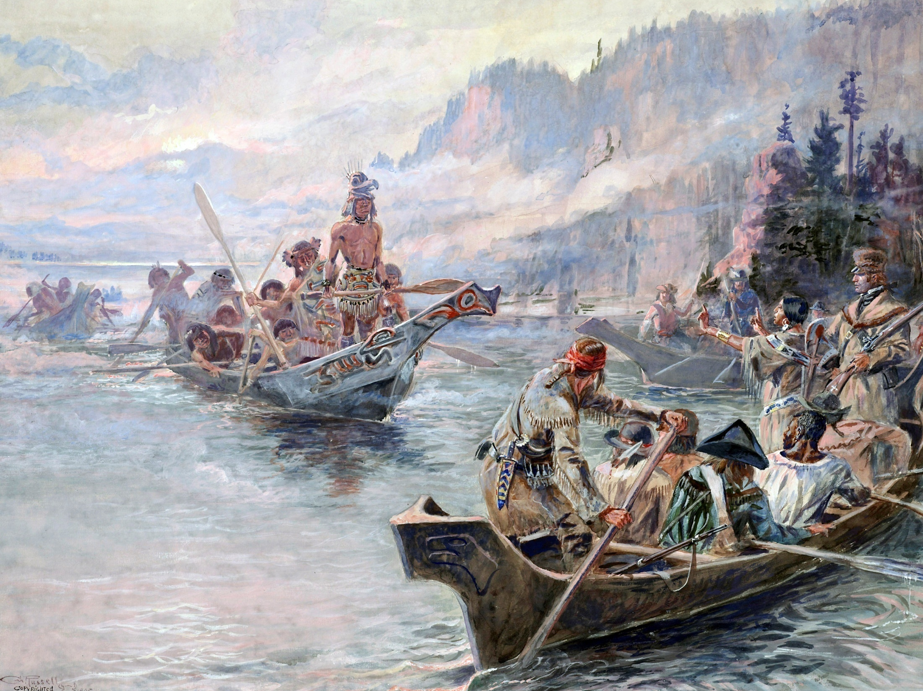
Session 6: The Legend Begins
Northwest Journey - Corps of Discovery
Lewis and Clark Expedition
Session 1: Setting the Stage
Session 2: The Corps Is Formed
Session 3: The River Trip Begins
Session 4: Over the Rockies
Session 5: To the Pacific
Session 6: The Legend Begins
Session 6: The Legend Begins
black Red

Slide 2
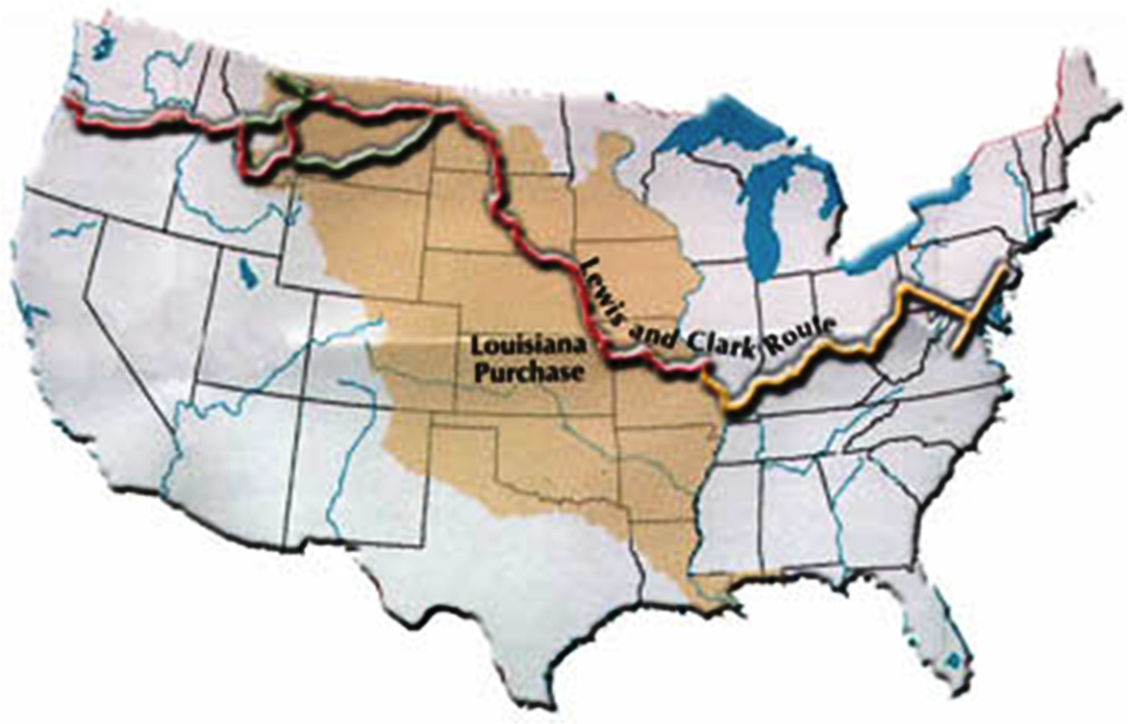
Session 5: The Legend Begins
Heading up the Columbia!
The Pacific
Fort Clatsop
The Atlantic
St Louis
- The Journey is Ending
- Tales Have Just Begun

Slide 3
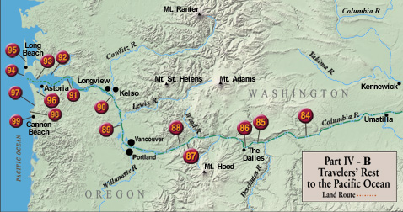
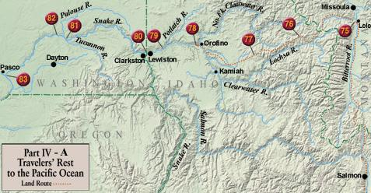
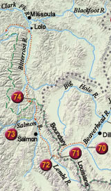
Heading up the Columbia!
March 22 - 31, 1806
75
Leaving in March implies:
There will be no salmon to eat on the journey
There still may be snow in the Bitterroots
Hope to reach the Nez Perce & collect our horses
black Red

Slide 4
Heading up the Columbia!
April 1 - 30, 1806
75
Watlala Indians steal our dog Seaman
send 3 men to rescue him
Lewis writes, “if they give any resistance, kill them”
Indians see rescue party and return our dog
black Red
Notes:
Meriweathers Bay is now called Youngs Bay
Map from:
Discovering Lewis & Clark from the Air
Photography by Jim Wark
Text by Joseph Mussulman
The entire story is told from 1200 feet above the ground.

Slide 5
Heading up the Columbia!
April 1 - 30, 1806
75
Lewis sees a Watlala stealing an iron socket; gives him several blows & has him put out of our camp
He informs this tribe that he will shoot the next person trying to steal from us
black Red
Notes:
Lewis called the Watlalas , War-clel-lars
Map from:
Discovering Lewis & Clark from the Air
Photography by Jim Wark
Text by Joseph Mussulman
The entire story is told from 1200 feet above the ground.

Slide 6
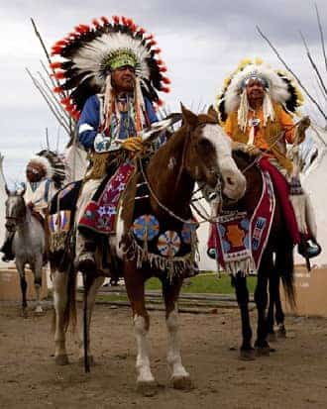
Heading up the Columbia!
April 1 - 30, 1806
75
Chief of the Walla Wallas meets us and treats us very well, bringing cooked food and firewood for us
Walla Wallas tell us of a shorter route thru the mountains that will save us 80 miles; we decide to take it
Clark treats several diseased, sick, and injured Indians
Chief brings beautiful white horse for Captain Clark; Captian gives his sword to Chief in thanks
black Red
Notes:
Picture is from https://www.warpaths2peacepipes.com/indian-tribes/walla-walla-tribe.htm
Map from:
Discovering Lewis & Clark from the Air
Photography by Jim Wark
Text by Joseph Mussulman
The entire story is told from 1200 feet above the ground.

Slide 7
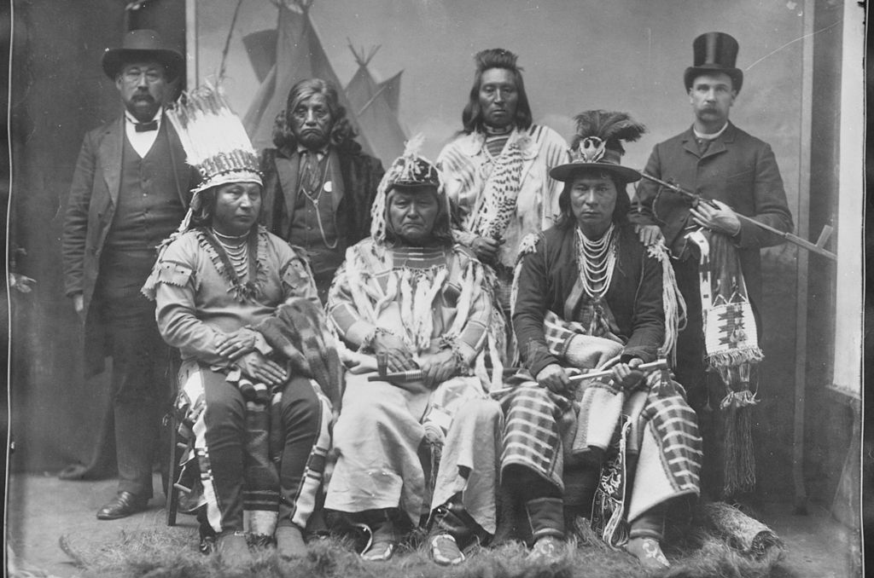
Heading up the Columbia!
May 1 – June 9, 1806
75
Meet two Nez Perce chiefs who had accompanied us down river to the Great Falls of the Columbia
They offer to guide us back through the mountains to see Twisted Hair
black Red
Notes:
Meriweathers Bay is now called Youngs Bay
Map from:
Discovering Lewis & Clark from the Air
Photography by Jim Wark
Text by Joseph Mussulman
The entire story is told from 1200 feet above the ground.

Slide 8
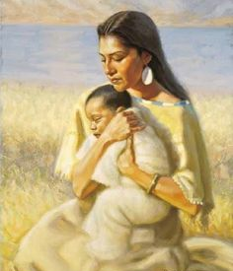
Heading up the Columbia!
May 1 – June 9, 1806
75
Baby Pomp is ill with high fever, his neck & throat are swollen
Capt Lewis gives him cream of tartar and flour of sulfur & applies boiled onions to his neck, as warm as he can bear
black Red
Notes:
Meriweathers Bay is now called Youngs Bay
Map from:
Discovering Lewis & Clark from the Air
Photography by Jim Wark
Text by Joseph Mussulman
The entire story is told from 1200 feet above the ground.

Slide 9
Heading up the Columbia!
May 1 – June 9, 1806
75
Lewis sends Hugh McNeal and slave York with buttons the officers cut off their military jackets to trade for food
black Red
Notes:
Meriweathers Bay is now called Youngs Bay
Map from:
Discovering Lewis & Clark from the Air
Photography by Jim Wark
Text by Joseph Mussulman
The entire story is told from 1200 feet above the ground.

Slide 10
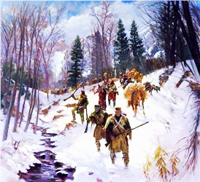
Heading up the Columbia!
Off the Rivers, INTO the Bitterroots!
June 10 - 30, 1806
75
12-15’ of snow in the Bitterroot Mountains; feet and hands numb
George Drouillard, our principal woodsman, doubts we can make it
black Red
Notes:
Meriweathers Bay is now called Youngs Bay
Map from:
Discovering Lewis & Clark from the Air
Photography by Jim Wark
Text by Joseph Mussulman
The entire story is told from 1200 feet above the ground.

Slide 11
Off the Rivers, INTO the Bitterroots!
June 11 - 30, 1806
75
Lewis writes, “if we proceed and get lost, the certainty is that we lose all our horses and consequently our baggage, instruments, papers, and thus eminently risk loss of the discoveries which we have made and maybe our lives”
we conclude it is madness to proceed without an Indian guide who can get us to Traveler’s Rest
must return to the Nez Perce while our horses are still strong
black Red
Notes:
Meriweathers Bay is now called Youngs Bay
Map from:
Discovering Lewis & Clark from the Air
Photography by Jim Wark
Text by Joseph Mussulman
The entire story is told from 1200 feet above the ground.

Slide 12
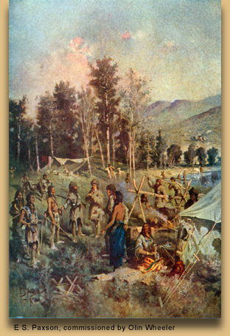
Off the Rivers, INTO the Bitterroots!
June 11 - 30, 1806
75
This is first time since beginning that we are compelled to retreat
Going back, we meet two Indians heading over mountains; they consent to help us and we go forward again
Arrive at Traveler’s Rest
Clark writes, “We leave those tremendous mtns behind us; where I experienced cold & hunger I shall ever remember”
black Red
Notes:
Meriweathers Bay is now called Youngs Bay
Map from:
Discovering Lewis & Clark from the Air
Photography by Jim Wark
Text by Joseph Mussulman
The entire story is told from 1200 feet above the ground.

Slide 13
Separation Plan:!
July 1 - 31, 1806
75
LEWIS’ 2 TEAMS
Lewis to go with small party by most direct route to Great Falls
At Great Falls, leave Thompson, McNeal and Goodrich to prepare carriages and gear for transporting canoes and baggage over portage
Lewis and 6 volunteers to ascend Maria’s River to determine if any branch of river lies as far north as 50deg Lat and then to return & join party who are descending Missouri
black Red
Notes:
Map from:
Discovering Lewis & Clark from the Air
Photography by Jim Wark
Text by Joseph Mussulman
The entire story is told from 1200 feet above the ground.

Slide 14
Separation Plan:!
July 1 - 31, 1806
75
CLARK 2 TEAMS
Clark to proceed to the head of the Jefferson were we left our canoes and supplies
Leave Ordway with 9 men to finish descending the river with the canoes
Clark and rest of men to proceed overland and then descend the Yellowstone River to the Missouri and wait for Lewis at the confluence
black Red
Notes:
Meriweathers Bay is now called Youngs Bay
Map from:
Discovering Lewis & Clark from the Air
Photography by Jim Wark
Text by Joseph Mussulman
The entire story is told from 1200 feet above the ground.

Slide 15
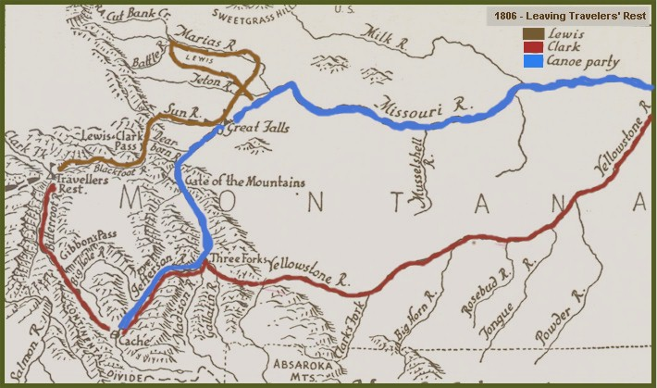
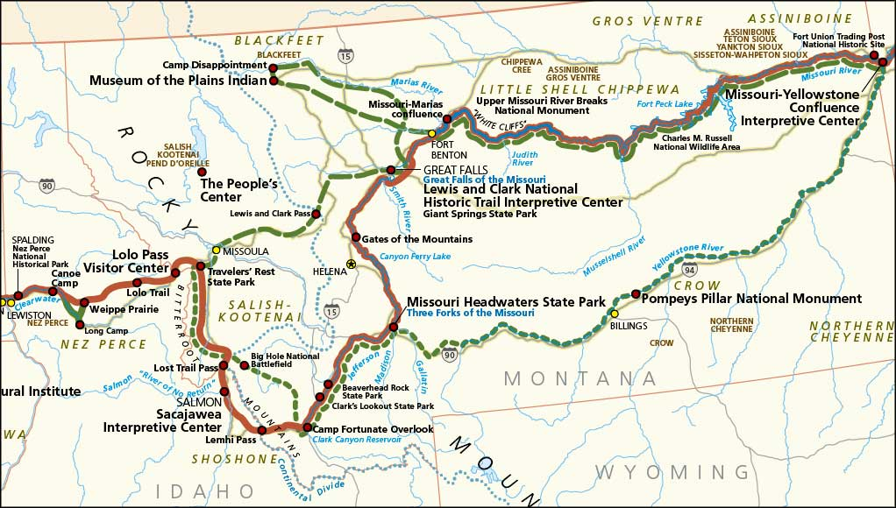
Separation Plan!
July 1 - 31, 1806
Maria’s River
Missouri River
Traveler’s Rest
meet
here
drop off portage team
Yellowstone River
drop off boat team
Camp Fortunate

Slide 16
Separation Plan!
July 1 - 31, 1806
Maria’s River
Missouri River
Traveler’s Rest
meet
here
drop off portage team
Yellowstone River
drop off boat team
Camp Fortunate

Slide 17
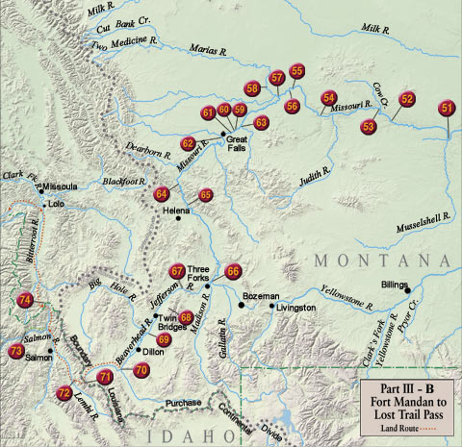
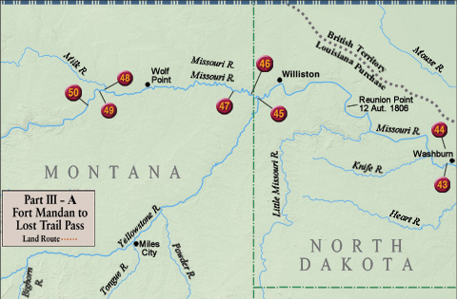
Maria’s River
Traveler’s Rest
Missouri River
Reconnoiter Mission
Yellowstone River
July 1 – Aug 12
Camp Fortunate
July 4 – Nez Perce guides leave Corps; return home
Gass writes, “it is but justice to say that the whole Nez Perce Nation are the most friendly, honest, and ingenuous people that we have seen in the course of our voyage and travels”
black Red
Notes:
Last mention of Seaman
Map from:
Discovering Lewis & Clark from the Air
Photography by Jim Wark
Text by Joseph Mussulman
The entire story is told from 1200 feet above the ground.

Slide 18
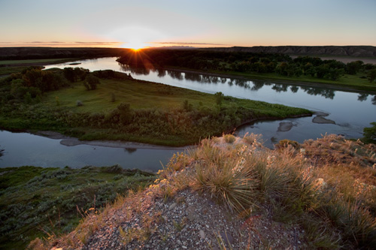
X
Maria’s River
Traveler’s Rest
Missouri River
Missouri River
Maria’s River
Reconnoiter Mission
Yellowstone River
July 1 – Aug 12
Camp Fortunate
Mosquitoes excessively troublesome; dog howls with torture
Jul 18- Lewis arrives mouth of Maria’s River; “Blackfoot Indians are vicious & lawless; I am determine to avoid them at all cost”
Jul 22- “it is unnecessary to proceed further as I have lost hope that the Maria’s River will ever extend to N Latitude 50º; I call this place, Camp Disappointment”
black Red
Notes:
July 15th- Last mention of Seaman
Marias River Main source at 48°29′12″ N 112°13′41″W,
Marias River mouth at 47°55′46″ N 110°28′21″W , elevation=2,559 feet (780 m)
Map from:
Discovering Lewis & Clark from the Air
Photography by Jim Wark
Text by Joseph Mussulman
The entire story is told from 1200 feet above the ground.

Slide 19
Maria’s River
Traveler’s Rest
Missouri River
Reconnoiter Mission
Yellowstone River
July 1 – Aug 12
Camp Fortunate
Jul 26- heading back toward the Missouri, through his spyglass, Lewis sees 30 horses about 1 mi away
several Indians are looking down at the river, presumably at George Drouillard and the supplies; an unpleasant sight
black Red
Notes:
Last mention of Seaman
Map from:
Discovering Lewis & Clark from the Air
Photography by Jim Wark
Text by Joseph Mussulman
The entire story is told from 1200 feet above the ground.

Slide 20
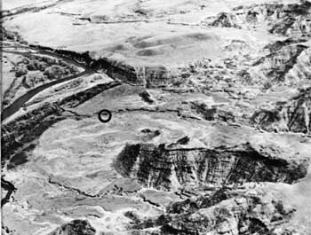
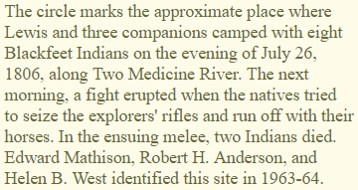
Maria’s River
Traveler’s Rest
Missouri River
2-Medicine River
Reconnoiter Mission
Yellowstone River
July 1 – Aug 12
Camp Fortunate
In the event we attempt our escape, Drouillard, not aware of the Indians, will likely fall sacrifice; Lewis decides to approach them in a friendly manner
We meet them & smoke together; these are the Blackfeet tribe
black Red
Notes:
Last mention of Seaman
Map from:
Discovering Lewis & Clark from the Air
Photography by Jim Wark
Text by Joseph Mussulman
The entire story is told from 1200 feet above the ground.

Slide 21
Maria’s River
Traveler’s Rest
Missouri River
Reconnoiter Mission
Yellowstone River
July 1 – Aug 12
Camp Fortunate
July 27- next morning, 8 Indians crowd around our campfire; Jo Fields has laid his gun down behind him
One Indian slips behind Fields and steals his & Rueben’s guns
two others advance and seize 2 more guns
black Red
Notes:
Last mention of Seaman
Map from:
Discovering Lewis & Clark from the Air
Photography by Jim Wark
Text by Joseph Mussulman
The entire story is told from 1200 feet above the ground.

Slide 22
Maria’s River
Traveler’s Rest
Missouri River
Reconnoiter Mission
Yellowstone River
July 1 – Aug 12
Camp Fortunate
Jo and Reuben take off after the Indians; Reuben seizes his gun and stabs the Indian in the heart, killing him instantly; recovering their guns they run back to assist Lewis
Drouillard sees an Indian take his gun and seizes it; the noise alerts Lewis, he reaches for his gun and finds it missing
black Red
Notes:
Last mention of Seaman
Map from:
Discovering Lewis & Clark from the Air
Photography by Jim Wark
Text by Joseph Mussulman
The entire story is told from 1200 feet above the ground.

Slide 23
Maria’s River
Traveler’s Rest
Missouri River
Reconnoiter Mission
Yellowstone River
July 1 – Aug 12
Camp Fortunate
Lewis grabs his pistol; runs after the Indian who took his gun; bids him to lay down his gun; he does.
When Indians see we are in possession of our guns, they try to drive off our horses; Lewis tells our Corpsmen to kill anyone trying to drive off the horses
black Red
Notes:
Last mention of Seaman
Map from:
Discovering Lewis & Clark from the Air
Photography by Jim Wark
Text by Joseph Mussulman
The entire story is told from 1200 feet above the ground.

Slide 24
Maria’s River
Traveler’s Rest
2 Blackfeet Indians die in ONLY ARMED ENCOUNTER
in which the Corps engages
Missouri River
Reconnoiter Mission
Yellowstone River
July 1 – Aug 12
Camp Fortunate
Being nearly out of breath, Lewis raises his gun and calls out for the Indian to give him his horse, he does not, but turns to shoot at Lewis; Lewis shoots him in the belly!
He falls to his knees and returns fire; Lewis feels the wind of the bullet very distinctly as it passes his head
black Red
Notes:
Last mention of Seaman
Map from:
Discovering Lewis & Clark from the Air
Photography by Jim Wark
Text by Joseph Mussulman
The entire story is told from 1200 feet above the ground.

Slide 25
Maria’s River
Traveler’s Rest
Missouri River
Reconnoiter Mission
Yellowstone River
July 1 – Aug 12
Camp Fortunate
We gather back at camp, pack our horses; take those left by the Indians & hasten toward the mouth of the Maria’s River hoping to meeting the canoes
Lewis believes the Indians will pursue us; Lewis tells the men, “if caught on the plains, fight to the death”
black Red
Notes:
Last mention of Seaman
Map from:
Discovering Lewis & Clark from the Air
Photography by Jim Wark
Text by Joseph Mussulman
The entire story is told from 1200 feet above the ground.

Slide 26
Maria’s River
Traveler’s Rest
Missouri River
Reconnoiter Mission
Yellowstone River
July 1 – Aug 12
Camp Fortunate
We push our horses hard, traveling until 2 am about 100 mi
July 28 - arriving at the Missouri River, we have the great satisfaction of seeing our canoes coming down river
We unload the horses and give them final discharge
black Red
Notes:
Last mention of Seaman
Map from:
Discovering Lewis & Clark from the Air
Photography by Jim Wark
Text by Joseph Mussulman
The entire story is told from 1200 feet above the ground.

Slide 27
Maria’s River
Traveler’s Rest
Missouri River
Reconnoiter Mission
Yellowstone River
July 1 – Aug 12
Camp Fortunate
We descend the river to our principal cache finding it mostly destroyed; our small caches are in good shape
the red pirogue is so decayed that it is impossible to repair; remove nails and other ironworks that might be useful
Departing, we have 1 white pirogue & 5 small canoes
black Red
Notes:
Last mention of Seaman
Map from:
Discovering Lewis & Clark from the Air
Photography by Jim Wark
Text by Joseph Mussulman
The entire story is told from 1200 feet above the ground.

Slide 28
Maria’s River
Traveler’s Rest
Missouri River
Reconnoiter Mission
Yellowstone River
July 1 – Aug 12
Camp Fortunate
Aug 7- Arrive at mouth of Yellowstone; Captain Clark appears to have been here 7-8 days earlier
paper is stuck into a pole saying lack of food and mosquitoes require Clark’s party to travel on
Lewis leaves a note for Colter and Collins, assuming they are still behind
black Red
Notes:
Last mention of Seaman
Map from:
Discovering Lewis & Clark from the Air
Photography by Jim Wark
Text by Joseph Mussulman
The entire story is told from 1200 feet above the ground.

Slide 29
Maria’s River
Traveler’s Rest
Missouri River
Reconnoiter Mission
Yellowstone River
July 1 – Aug 12
Camp Fortunate
On the shore we see wild game hung on a pole
Going ashore we find tracks of two men, a campfire still blazing, Gibson’s hat . . . but no Captain Clark
Lewis and Cruzatte hunt elk; Lewis kills one and Cruzatte wounds one; they split up to find the wounded elk
black Red
Notes:
Last mention of Seaman
Map from:
Discovering Lewis & Clark from the Air
Photography by Jim Wark
Text by Joseph Mussulman
The entire story is told from 1200 feet above the ground.

Slide 30
Maria’s River
Traveler’s Rest
Missouri River
Reconnoiter Mission
Yellowstone River
July 1 – Aug 12
Camp Fortunate
Aug 8- pull pirogue & canoes on a beach, make repairs
fear that something has happened to Colter & Collins
Aug 11- Lewis and Cruzatte hunt elk; Lewis kills one and Cruzatte wounds one; they split up to find the wounded elk
black Red
Notes:
Last mention of Seaman
Map from:
Discovering Lewis & Clark from the Air
Photography by Jim Wark
Text by Joseph Mussulman
The entire story is told from 1200 feet above the ground.

Slide 31
Maria’s River
Traveler’s Rest
Missouri River
Reconnoiter Mission
Yellowstone River
July 1 – Aug 12
Camp Fortunate
Lewis is about to shoot another elk when he suddenly is hit in the thigh with a bullet! It misses the leg bone and artery
Lewis fears he’s been shot by an Indian; calls out for Cruzatte; no answer
black Red
Notes:
Last mention of Seaman
Map from:
Discovering Lewis & Clark from the Air
Photography by Jim Wark
Text by Joseph Mussulman
The entire story is told from 1200 feet above the ground.

Slide 32
Maria’s River
Traveler’s Rest
Missouri River
Reconnoiter Mission
Yellowstone River
July 1 – Aug 12
Camp Fortunate
Fearing for his life, Capt Lewis runs to the pirogue, screaming for Cruzatte to join him
Thinking Cruzatte has fallen into native hands, Lewis yells for his men to take up arms
black Red
Notes:
Last mention of Seaman
Map from:
Discovering Lewis & Clark from the Air
Photography by Jim Wark
Text by Joseph Mussulman
The entire story is told from 1200 feet above the ground.

Slide 33
Maria’s River
Traveler’s Rest
Missouri River
Reconnoiter Mission
Yellowstone River
July 1 – Aug 12
Camp Fortunate
pain in Lewis’ leg is so severe he falls into the pirogue, he writes, “prepare myself with a pistol, rifle, & air gun being determined to sell my life as dearly as possible”
Corpsmen head out to look for Indians; come back with Cruzatte; report no signs of Indians
black Red
Notes:
Last mention of Seaman
Map from:
Discovering Lewis & Clark from the Air
Photography by Jim Wark
Text by Joseph Mussulman
The entire story is told from 1200 feet above the ground.

Slide 34
Maria’s River
Traveler’s Rest
Missouri River
Reconnoiter Mission
Yellowstone River
July 1 – Aug 12
Camp Fortunate
Cruzatte reports that he was shooting at an elk in the willows and was sorry if in fact he shot Lewis by mistake
Lewis notes “I do not believe that Cruzatte did it intentionally but after finding that he had shot me, he was anxious to conceal his knowledge of having done so”
black Red
Notes:
Last mention of Seaman
Map from:
Discovering Lewis & Clark from the Air
Photography by Jim Wark
Text by Joseph Mussulman
The entire story is told from 1200 feet above the ground.

Slide 35
Maria’s River
Traveler’s Rest
Missouri River
Reconnoiter Mission
Yellowstone River
July 1 – Aug 12
Camp Fortunate
It takes 11 days for Lewis to be able to walk again!
Aug 12- Colter & Collins catch up; we all catch up with Captain Clark (~70 miles down river from the mouth of the Yellowstone)
black Red
Notes:
Last mention of Seaman
Map from:
Discovering Lewis & Clark from the Air
Photography by Jim Wark
Text by Joseph Mussulman
The entire story is told from 1200 feet above the ground.

Slide 36
Maria’s River
Lets go back in time and pick up with Captain Clark’s trip down the Yellowstone R.
Traveler’s Rest
Missouri River
Reconnoiter Mission
Yellowstone River
July 1 – Aug 12
Camp Fortunate
Jul 8- arrive old Camp Fortunate; find cache; men rush to cache for tobacco left there 11 months prior!
Jul 10- pack canoes; both parties set out; one by land, one on the Jefferson River
Jul 13- all arrive at Three Forks within 1 hour of each other
black Red
Notes:
Map from:
Discovering Lewis & Clark from the Air
Photography by Jim Wark
Text by Joseph Mussulman
The entire story is told from 1200 feet above the ground.

Slide 37
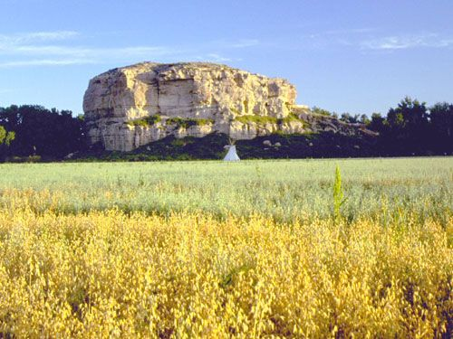
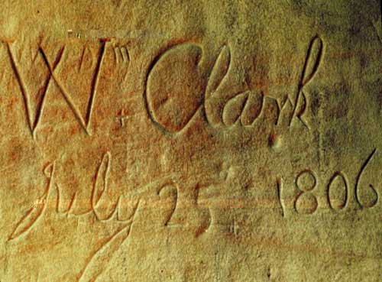
Maria’s River
Traveler’s Rest
Missouri River
Reconnoiter Mission
Yellowstone River
July 1 – Aug 12
Camp Fortunate
Jul 13- Repack canoes and horses and again set out, one party (Ordway) by boat, one party (Clark) by land
Jul 25- Clark finds a remarkable rock on the Yellowstone River; he names it Pompy’s Tower and carves his initials
black Red
Notes:
** This is Lewis’ last journal entry saying “…as writing in my present situation is extreemly painful to me, I shall desist until I recover and leave to my friend Capt C the conintuation of our journal.”
Map from:
Discovering Lewis & Clark from the Air
Photography by Jim Wark
Text by Joseph Mussulman
The entire story is told from 1200 feet above the ground.

Slide 38
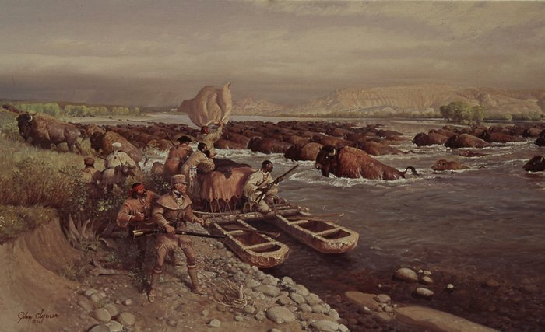
Maria’s River
Traveler’s Rest
Missouri River
Reconnoiter Mission
Yellowstone River
July 1 – Aug 12
Camp Fortunate
Aug 1- Had to stop and pull to shore to let buffalo cross the Yellowstone River. Buffalos crossed continuously for 30 minutes
black Red
Notes:
Map from:
Discovering Lewis & Clark from the Air
Photography by Jim Wark
Text by Joseph Mussulman
The entire story is told from 1200 feet above the ground.

Slide 39
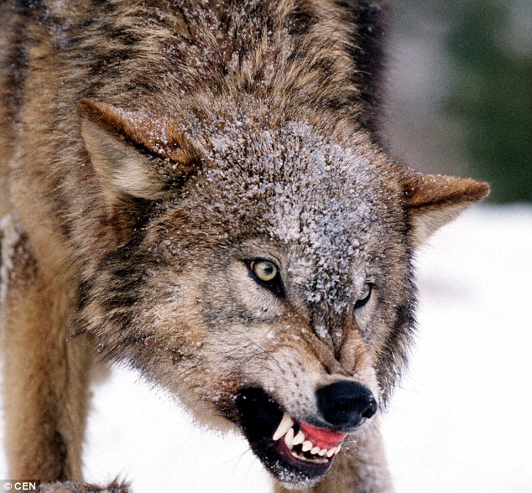
Maria’s River
Traveler’s Rest
Missouri River
Actual Meeting Up Point
Reconnoiter Mission
Yellowstone River
July 1 – Aug 12
Camp Fortunate
Aug 6- While Nathaniel Pryor slept, a wolf mauled his hand; and attack Richard Windsor before it was killed
Aug 12- Meet up with the rest of the Corps
Clark examines Lewis’ wound and repacks it; should be ok
black Red
Notes:
Map from:
Discovering Lewis & Clark from the Air
Photography by Jim Wark
Text by Joseph Mussulman
The entire story is told from 1200 feet above the ground.

Slide 40
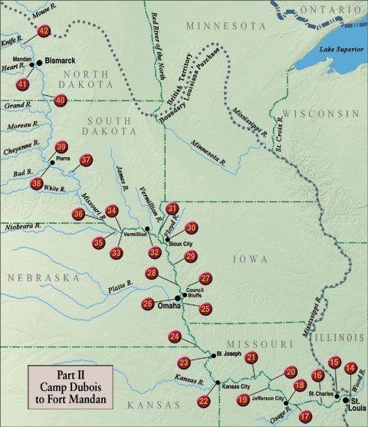
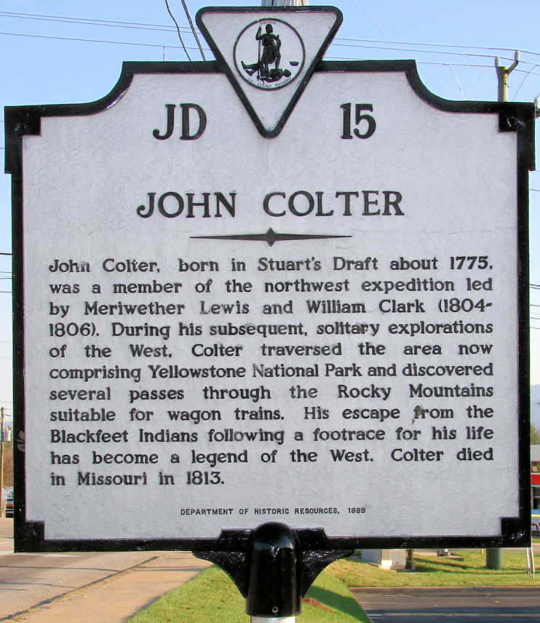
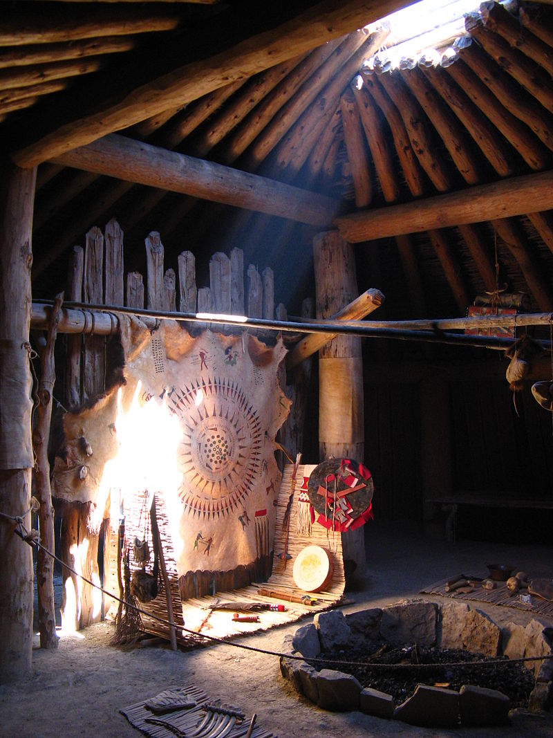
Homeward Bound!
Aug 14 – Sept 23
Aug 14- We all arrive at the Mandan-Hidatsa villages
Aug 15- John Colter wants to join the Illinois trappers; Captains agree and discharge Colter
black Red
Notes:
Map from:
Discovering Lewis & Clark from the Air
Photography by Jim Wark
Text by Joseph Mussulman
The entire story is told from 1200 feet above the ground.

Slide 41
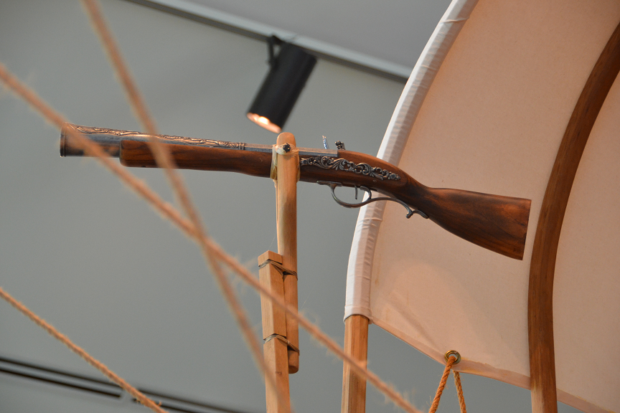
Homeward Bound!
Aug 14 – Sept 23
Aug 14- We all arrive at the Mandan-Hidatsa villages;
Aug 15- John Colter wants to join the Illinois trappers; Captains agree and discharge Colter
Aug 16- Give our swivel gun to Hidatsa chief with a view to
ingratiating Hidatsas more strongly to the USA
the changing Balance of Power!
black Red
Notes:
Map from:
Discovering Lewis & Clark from the Air
Photography by Jim Wark
Text by Joseph Mussulman
The entire story is told from 1200 feet above the ground.

Slide 42
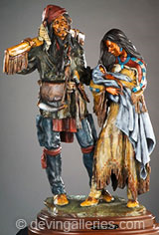
Homeward Bound!
Aug 14 – Sept 23
Aug 17- Touissant Chabonneau & Sacagawea ask to be released from duty; Captains agree; buys a horse and lodge for them
Clark offers to raise Baby Pomp (now 19 months old); they agree, after the child is weaned
They respond, ‘In one year Jean Baptiste will be old enough to leave their care’ and ask Clark to raise him in such a manner as Clark thinks proper
black Red
Notes:
Map from:
Discovering Lewis & Clark from the Air
Photography by Jim Wark
Text by Joseph Mussulman
The entire story is told from 1200 feet above the ground.

Slide 43
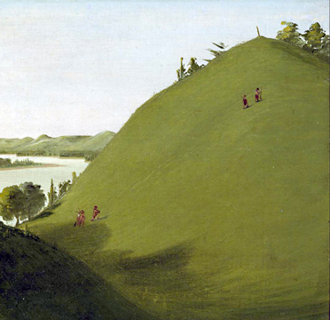
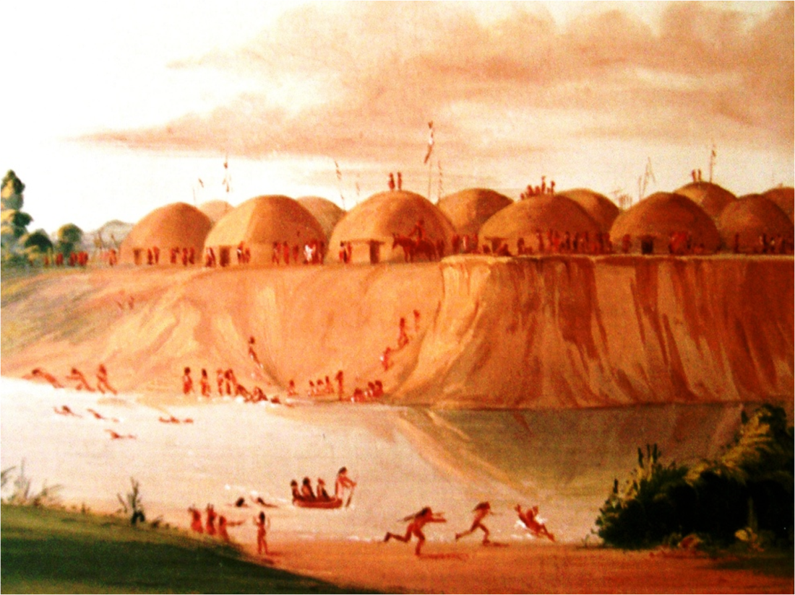
Homeward Bound!
Aug 14 – Sept 23
Aug 17- Pick up Chief Sheheke of the Mandan Village who will travel with the Corps to St. Louis and then to Washington
the changing Balance of Power!
Sept 4- Arrive at Floyd’s Bluff, ascend the hill to find Charlie Floyd’s grave robbed; re-cover the grave and proceed on
black Red
Notes:
Sheheke, Sheheke-shote, translated as White Coyote, and also known as Coyote or Big White (1766–1812), was a Mandan chief.

Slide 44
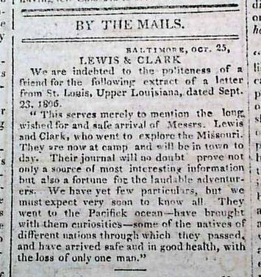
Baltimore, October 25, 1806
LEWIS & CLARK
We are indebted to the politeness of a friend for the following extract of a letter from St. Louis, Upper Louisiana, dated Sept. 23, 1806.
“This serves merely to mention the long wished for and safe arrival of Messrs. Lewis and Clark, who went to explore the Missouri. They are now at camp and will be in town to day. Their journal will no doubt prove not only a source of most interesting information but also a fortune for the laudable adventurers. We have yet few particulars, but we must expect very soon to know all. They went to the Pacifick ocean – have brought with them curiosities – some of he natives of different nations through which they passed, and have arrived safe and in good health, with the loss of only one man.”

Slide 45
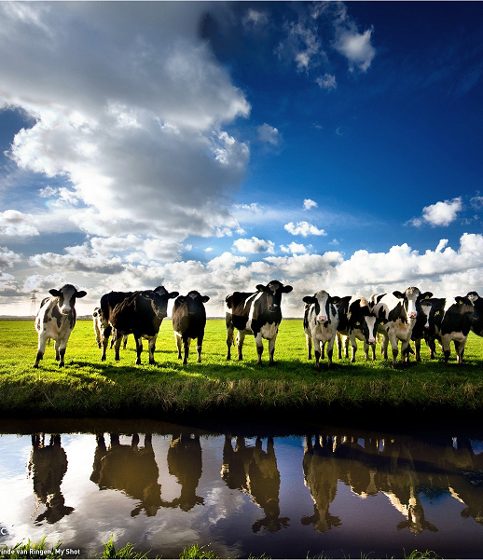
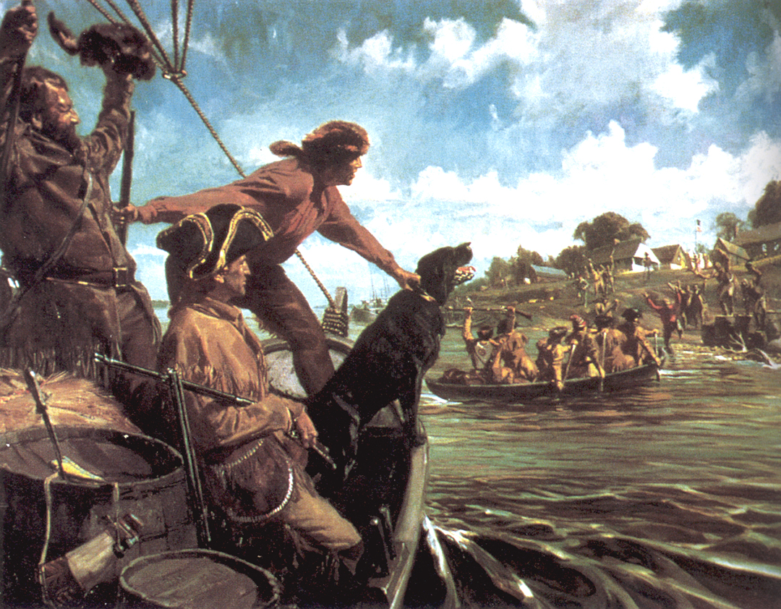
Homeward Bound!
Aug 14 – Sept 23
Sept 17- Meet boat of Army Artillery ascending Missouri River; they advises that we are long forgotten by most citizens of USA, but President Jefferson still has hopes for our return
Sept 20- cows on the river bank - joyful sight, shout for joy
Sept 21- arrive at St. Charles; shoot off 3 rounds of the blunderbust; many inhabitants welcome us
black Red
Notes:
Map from:
Discovering Lewis & Clark from the Air
Photography by Jim Wark
Text by Joseph Mussulman
The entire story is told from 1200 feet above the ground.

Slide 46
Homeward Bound!
O!
the Joy!
Aug 14 – Sept 23
Sept 23- “Descend down the Mississippi to St. Louis at which place we arrive at 12 o’clock; we received a hearty welcome from its inhabitants”
John Ordway writes . . .
“Much rejoiced that we have the EXPEDTION
COMPLETED and now we look for boarding in
town, await our settlement, and then we intend
to return to our native homes to see our parents
once more as we have been so long from them”
Notes:
Map from:
Discovering Lewis & Clark from the Air
Photography by Jim Wark
Text by Joseph Mussulman
The entire story is told from 1200 feet above the ground.

Slide 47
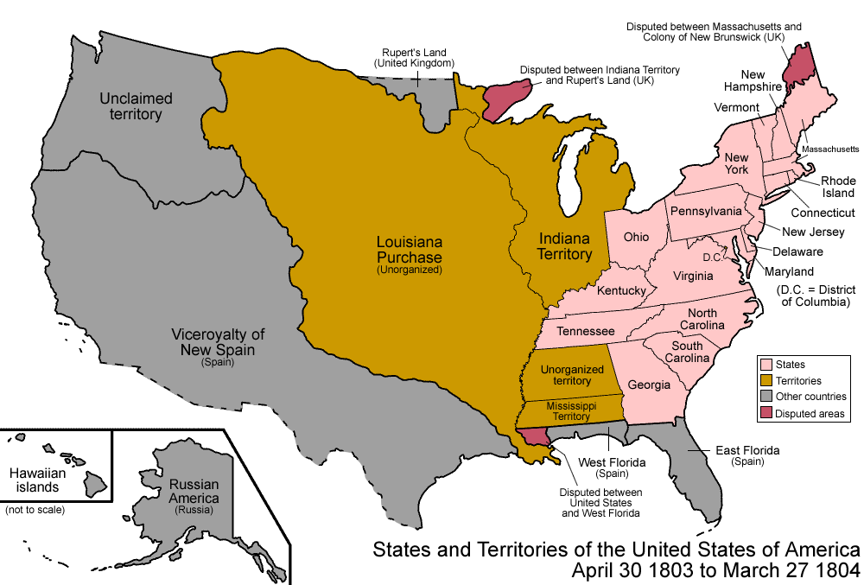
The Journey Home
Tales Have Just Begun
The Pacific
UNITED STATES
OF
AMERICA
- The Journey is Ending
- Tales Have Just Begun
Tales Have Just Begun

Slide 48
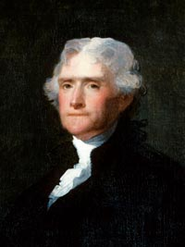
1803
Tales Have Just Begun
The Expedition Began in ??
Who was the president?
United Kingdom
disputed
UNITED STATES
OF
AMERICA
Spain
Spain
Thomas Jefferson
Who were our neighbors?
Thomas Jefferson

Slide 49
1803
Tales Have Just Begun
The Expedition Began in ??
United Kingdom
disputed
Louisiana
Purchase
17
STATES
Spain
Spain
3 territories

Slide 50
1803
1804
The Expedition Began in ??
Time Passes . . .
United Kingdom
disputed
Louisiana
Purchase
17
STATES
Spain
Spain
2 territories
3 territories

Slide 51
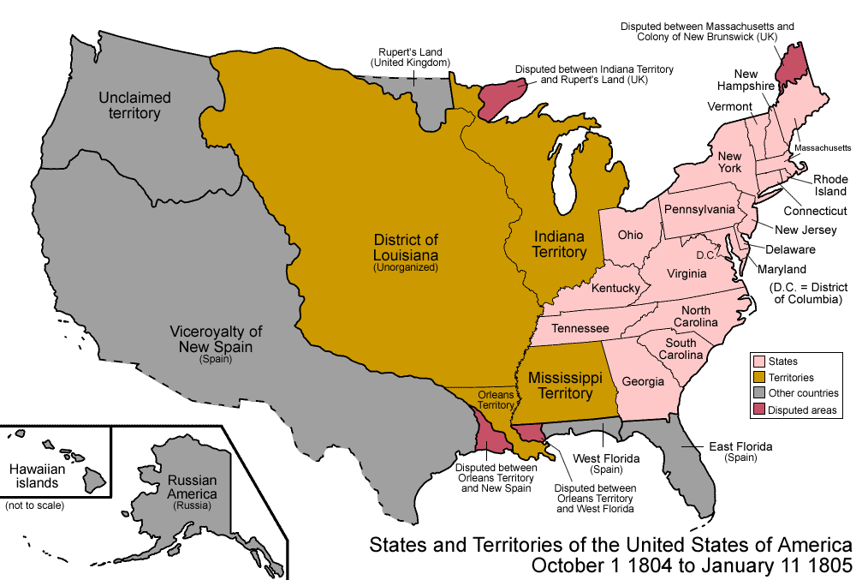
1804
Time Passes . . .
1805
United Kingdom
disputed
Louisiana
Purchase
District of
Louisiana
17
STATES
Spain
new territory
Spain
new dispute w/Spain

Slide 52
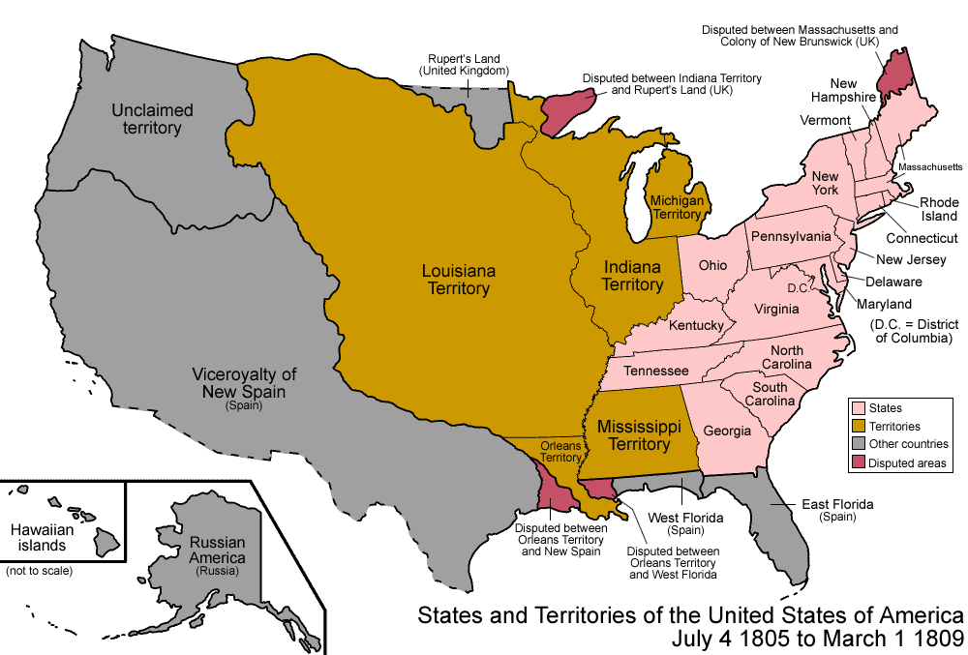
1805
Time Passes . . .
1806
United Kingdom
disputed
District of
Louisiana
Louisiana
Territory
17
STATES
Spain
new territory
Spain
new dispute w/Spain
5 territories

Slide 53
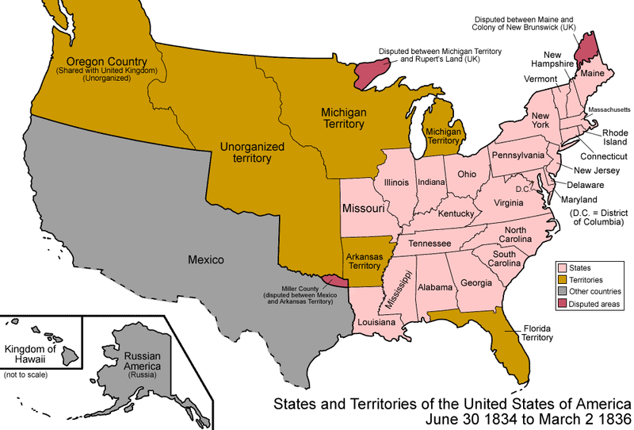
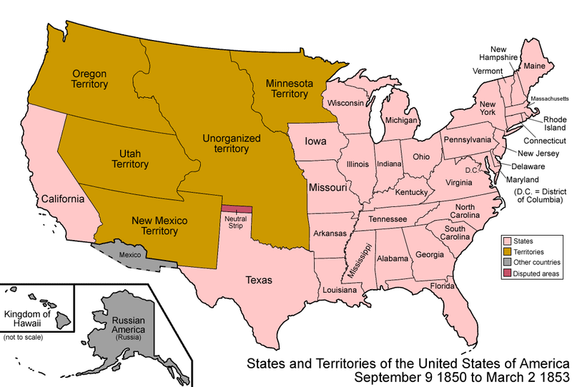
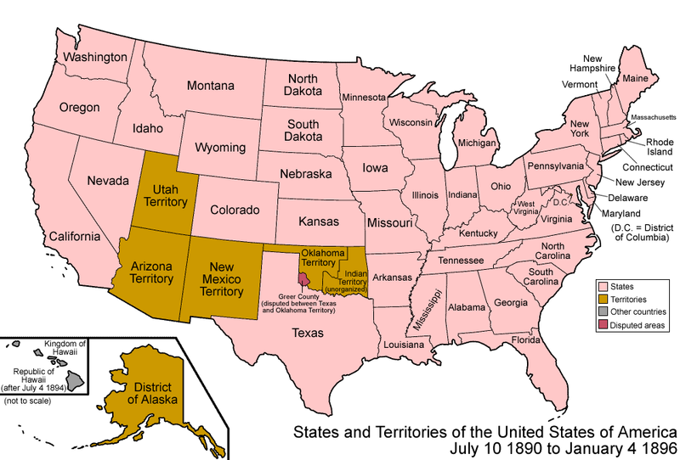
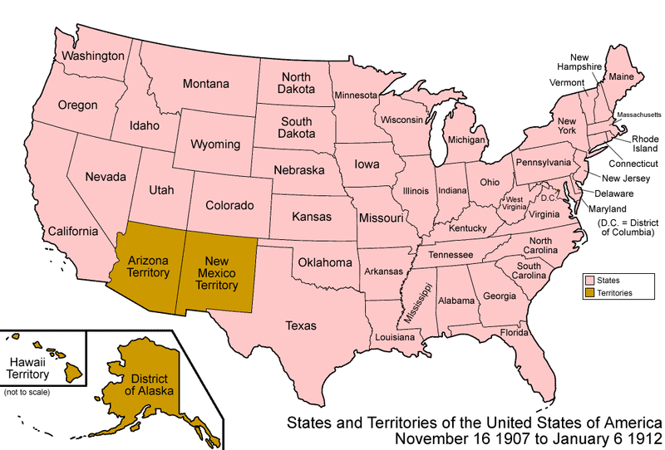
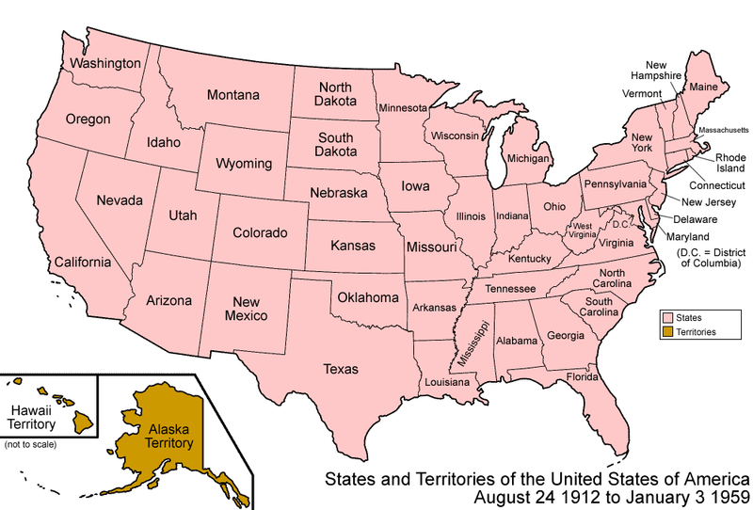
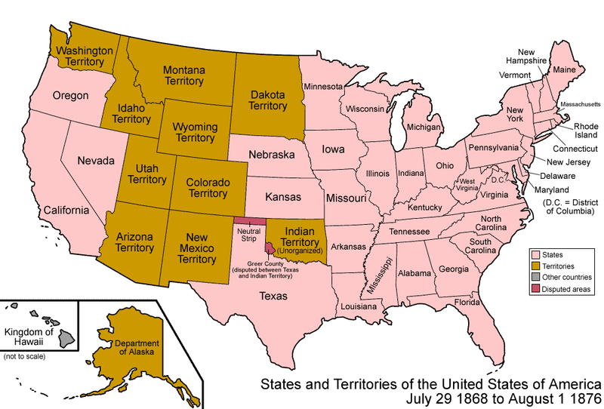
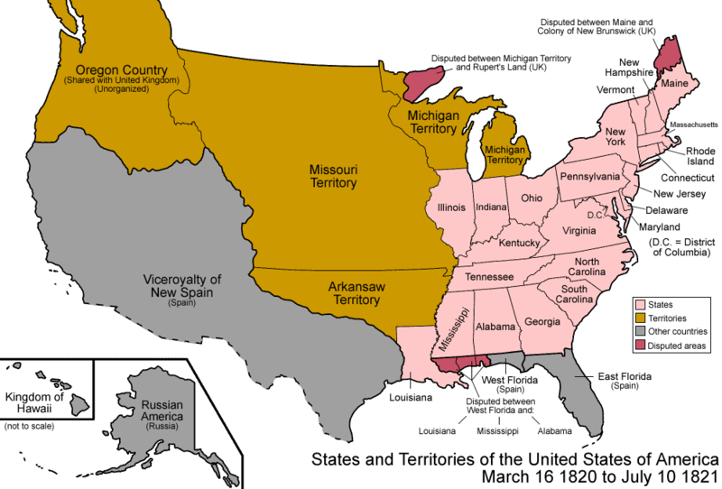
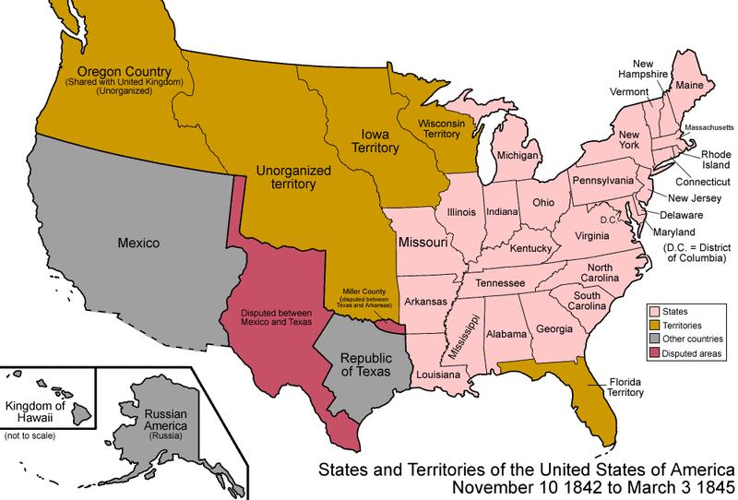
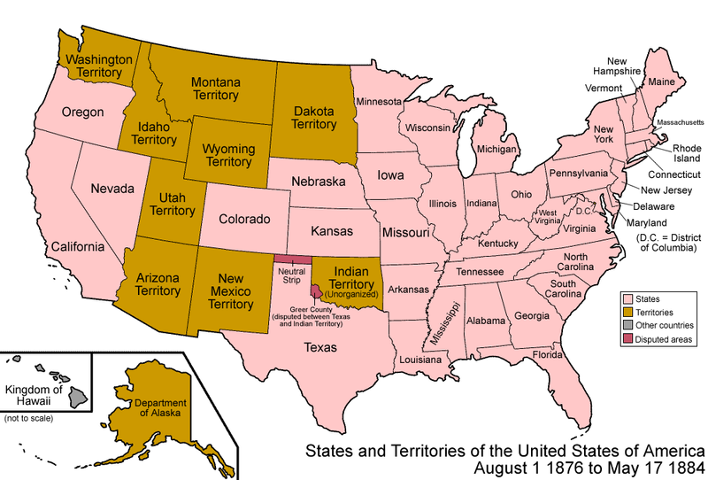
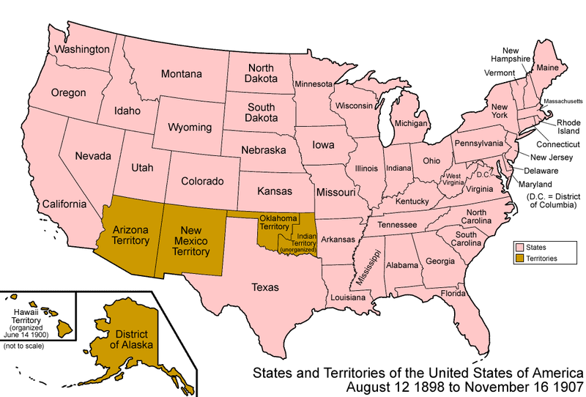
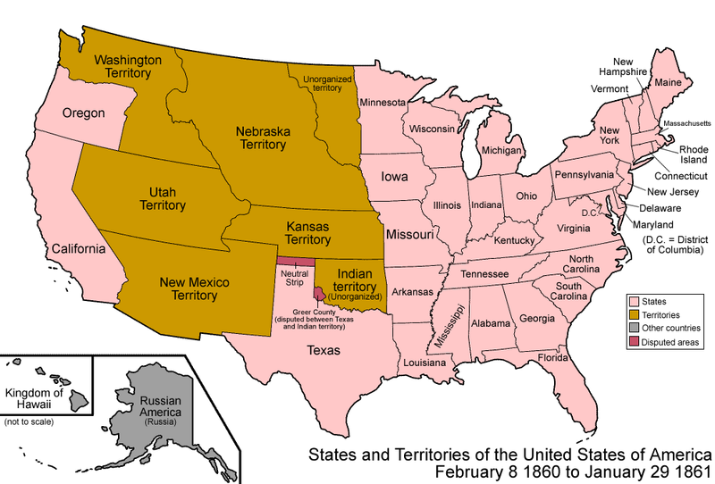
1806
1806
1830
1850
1880
1890
1900
1910
1920
Time Passes . . .
1810
1820
1840
1860
1870
POPULATION:
106 million
6 million

Slide 54
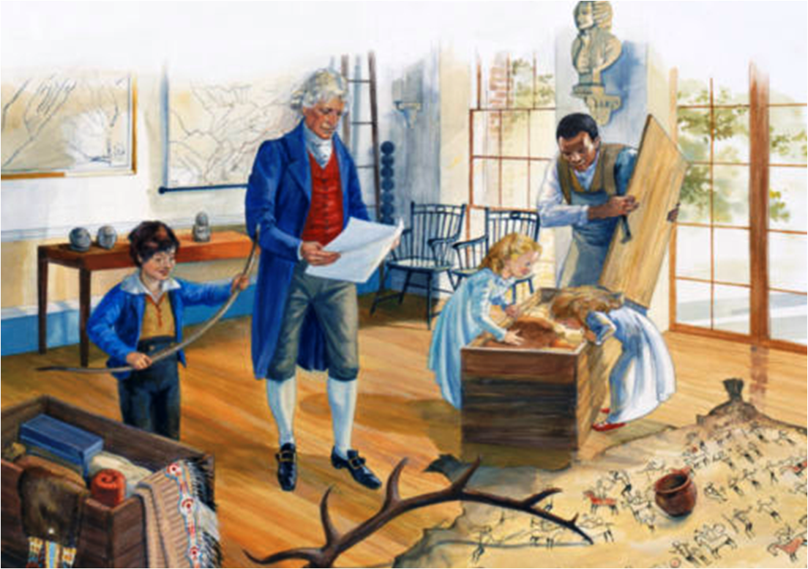
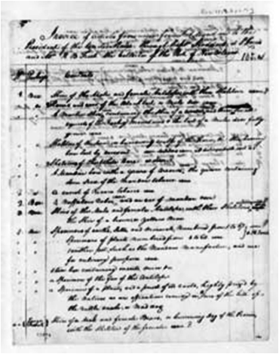
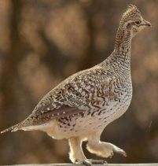
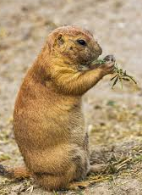
What Happens Next?
1806
Time Passes . . .
Spring 1806: shipment arrives from Fort Mandan
of 6 live animals, two survive – prairie dog, 1 magpie
Distribution of materials:
Peale Museum (Philadelphia)
- live prairie dog and magpie
- animal skins, skeletons, horns
Am. Philosophical Society (Phil)

Slide 55
What Happens Next?
Spring 1806: shipment arrives from Fort Mandan
of 6 live animals, two survive – prairie dog, 1 magpie
Distribution of materials:
Peale Museum (Philadelphia)
- live prairie dog and magpie
- animal skins, skeletons, horns
Am. Philosophical Society (Phil)
- plants, soils, mineral samples
Monticello
horns of elk, deer, antelope,
mountain sheep horns
otter and weasel skins
Indian pipes, bows, arrows
painted buffalo robe

Slide 56
What Happens Next?
Spring 1806: shipment arrives from Fort Mandan
reproduction of the ‘Indian Hall’ at Monticello
of 6 live animals, two survive – prairie dog, 1 magpie
Distribution of materials:
Peale Museum (Philadelphia)
- live prairie dog and magpie
- animal skins, skeletons, horns
Am. Philosophical Society (Phil)
- plants, soils, mineral samples
Monticello
horns of elk, deer, antelope,
mountain sheep horns
otter and weasel skins
Indian pipes, bows, arrows
painted buffalo robe

Slide 57
https://www.monticello.org/site/jefferson/trail-to-monticello
Before they left Ft. Mandan in April 1805, Lewis and Clark packed up a shipment to send President Jefferson. It included Indian objects; animal skins, bones, and antlers; a live prairie dog, four magpies, and a grouse; and plant, soil, and mineral samples. The captains listed the contents on a packing list that they sent ahead of the shipment. The four boxes, two large trunks, and three cages arrived at the President's House in Washington in August while Jefferson was at Monticello; Etienne Lemaire, Jefferson's butler, wrote him that the shipment had come. Having eagerly anticipated its arrival, Jefferson sent instructions for unpacking and caring for the objects.
When Jefferson returned to Washington from Monticello in early October 1805, he annotated the packing list, noting which objects had come. Although we do not know the final destination of every object that arrived in Washington from Ft. Mandan, Jefferson sent material from the shipment to at least three different places: the Peale Museum, the American Philosophical Society, and Monticello.
Jefferson sent a live prairie dog and magpie and some of the animal skins, skeletons, and horns to Charles Willson Peale, the Philadelphia artist and museum impresario, for the Peale Museum, his public gallery of art and natural history. Peale would also receive later donations directly from Lewis and Clark. Jefferson included with Peale's shipment plant, soil, and mineral specimens for the American Philosophical Society in Philadelphia.
Jefferson sent a third group of the objects from Lewis and Clark's shipment to Monticello in March 1806. This included elk, deer, antelope, and mountain sheep horns; otter and weasel skins; Indian pipes, leggings, bows, arrows, pottery, and notably, a painted buffalo robe depicting a battle scene. Included in this shipment as well was an Indian map on a hide representing the Missouri River and its tributaries between the Platte and the Yellowstone Rivers, which was sent to Jefferson by General James Wilkinson, governor of the Louisiana Territory.

Slide 58
https://www.monticello.org/site/jefferson/framing-west-monticello
In an ongoing effort to place Monticello within the larger universe, Jefferson established a museum in his double-story Entrance Hall, complete with maps of the world, European paintings and sculptures, and examples of items from the New World. With the arrival of several boxes and barrels sent back by Lewis and Clark from their journey, Jefferson greatly expanded the representation of North America in this museum with a dramatic display of Native American objects and animal skins, horns, and bones. Unfortunately, the fate of Jefferson's collection of Native American objects after his death remains a mystery. For the Lewis and Clark Bicentennial, Monticello turned this mystery into an opportunity to work with contemporary Native American artists who are preserving traditional art forms. The recreated Indian Hall demonstrates that the Native American art forms encountered by Lewis and Clark and appreciated by Jefferson are still alive today.
"Tokens of Friendship" describes how Lewis and Clark received objects from the Native American Indians they encountered and contrasts that with their more systematic collection of natural history specimens.
From the Trail to Monticello follows the shipment of objects and natural specimens that Lewis shipped to Jefferson in April 1805, just before setting out from Ft. Mandan.
The Indian Hall shows how Jefferson sought to demonstrate, visually, how the culture and geography of North America related to the rest of the world.
Whereabouts of Most of Jefferson's Collection follows the trail of the lost collection that Jefferson displayed at Monticello until his death.
Recreating the Indian Hall contains a gallery of the artifacts now on display at Monticello and explains how they were created.
Before they left Ft. Mandan in April 1805, Lewis and Clark packed up a shipment to send President Jefferson. It included Indian objects; animal skins, bones, and antlers; a live prairie dog, four magpies, and a grouse; and plant, soil, and mineral samples. The captains listed the contents on a packing list that they sent ahead of the shipment. The four boxes, two large trunks, and three cages arrived at the President's House in Washington in August while Jefferson was at Monticello; Etienne Lemaire, Jefferson's butler, wrote him that the shipment had come. Having eagerly anticipated its arrival, Jefferson sent instructions for unpacking and caring for the objects.
When Jefferson returned to Washington from Monticello in early October 1805, he annotated the packing list, noting which objects had come. Although we do not know the final destination of every object that arrived in Washington from Ft. Mandan, Jefferson sent material from the shipment to at least three different places: the Peale Museum, the American Philosophical Society, and Monticello.
Jefferson sent a live prairie dog and magpie and some of the animal skins, skeletons, and horns to Charles Willson Peale, the Philadelphia artist and museum impresario, for the Peale Museum, his public gallery of art and natural history. Peale would also receive later donations directly from Lewis and Clark. Jefferson included with Peale's shipment plant, soil, and mineral specimens for the American Philosophical Society in Philadelphia.
Buffalo Robe
Jefferson sent a third group of the objects from Lewis and Clark's shipment to Monticello in March 1806. This included elk, deer, antelope, and mountain sheep horns; otter and weasel skins; Indian pipes, leggings, bows, arrows, pottery, and notably, a painted buffalo robe depicting a battle scene. Included in this shipment as well was an Indian map on a hide representing the Missouri River and its tributaries between the Platte and the Yellowstone Rivers, which was sent to Jefferson by General James Wilkinson, governor of the Louisiana Territory.
A letter Jefferson wrote to Lewis at the end of the expedition signals his understanding that the goods received by Lewis and Clark were diplomatic gifts, and not simply examples of the arts of Northern Plains Indians gathered by the explorers. When Lewis returned to the east in the last days of 1806, his party included Sheheke (Big White), a chief of the Mandan nation. As their route to Washington would take him through central Virginia, Jefferson wrote Lewis before their arrival in the capital, "Perhaps while in our neighborhood, it may be gratifying to him [Sheheke], & not otherwise to yourself to take a ride to Monticello and see in what manner I have arranged the tokens of friendship I have received from his country particularly as well as from other Indian friends: that I am in fact preparing a kind of Indian hall.“
The Expedition was central to Jefferson's acquisition of his important collection of Native American objects. Jefferson showcased these and the natural history specimens that Lewis and Clark sent him in his newly completed double-story Entrance Hall at Monticello, which he called his "Indian Hall." Placed among the other goods Jefferson collected -- European paintings and sculptures, works of art from eastern Indians, a model of an Egyptian pyramid, mastodon bones excavated by William Clark in Kentucky following the Expedition, and maps of the vicinity and the world -- the western objects contributed to the mélange of objects that Jefferson hoped would demonstrate to his family and visitors the diversity of the world beyond Monticello. His objective in creating his museum was to place himself and Monticello within the context of this larger world.
Image of Buffalo hide with war scene pictographs hanging from Entrance Hall balc
In assembling such a "cabinet of curiosities," Jefferson was in good company, both historically and intellectually. Since the sixteenth century, European collections of animal specimens, ethnographic material, antiquities, and man-made items displaying great technical skill had been accumulated by people ranging from kings and aristocrats to scholars of modest means.
As a product of the Enlightenment, Jefferson's display represented not simply a desire to showcase the marvelous and bizarre, but to work towards a scientific understanding of the world through observation and study. In the Indian Hall, Jefferson sought to demonstrate, visually, that the products of North America could take their places alongside those of the Old World.

Slide 60
https://www.monticello.org/site/jefferson/whereabouts-most-jeffersons-collection
Whereabouts of Most of Jefferson's Collection
In 1825, the year before he died, Jefferson wrote a letter to William Clark in which he clearly signaled his intention to give his collection to the University of Virginia, the foundation of which he referred to as the "hobby of his old age." He wrote Clark to solicit donations for a museum he planned for the University:
"Among other objects of our instn [institution] is the collection of a Museum of Nat. hist. [natural history] Of Minerals, & of curiosities in general of art or nature. Those of Indian arts stand very near to nature itself. Your situation is so favble [favorable] for assisting us in this collection that I cannot help soliciting your attention to us. . . . I give to the Univ. the whole of my collections which is considerable and much indeed of which was furnished me from the expedn. [expedition] of yourself & Govr. Lewis to the Pacific.“
ms that in keeping with Jefferson's statement of his intentions in this letter, his collection of Native American material and natural history specimens ended up at the University of Virginia. The ultimate fate of much of the collection remains a mystery however. In October 1826, according to the records of the meetings of the Visitors (trustees) of the University, a room on the first floor of the Rotunda "was to be finished and fitted for the reception of the natural and artificial curiosities given to the University by the late venerable Rector [Jefferson]; and to have them there suitably arranged for preservation and exhibition." Surprisingly, exhaustive searches at the University over many years have not turned up any records itemizing or cataloguing Jefferson's "natural and artificial curiosities."
The minutes of the meetings of the Visitors record frequent movement of the collection between 1828 and 1848, suggesting that it was forced to give way to the growing spatial needs of the Professors of Natural Philosophy and Chemistry. In 1828 the objects were moved from the first floor of the Rotunda to the basement to make room for scientific apparatus; the next year they moved to the upper gallery. In 1830 the Visitors approved the creation of a Museum in the basement story. In 1831 Franklin Peale, one of the sons of Charles Willson Peale who ran the Peale Museum after his father's death, traveled to Charlottesville to organize and arrange "the collection known under the denomination of Mr. Jefferson's donation." In October of the same year a young woman named Ann Maury recorded in her diary that she visited the University and saw the lecture rooms and library in the Rotunda. She reported seeing "some of Mr. Jefferson's collections of curiosities, Indian utensils & dresses & weapons & a part of a mammoth's skeleton." This is the only known account written by someone who saw Jefferson's Indian collections at the University.
In 1840 the Visitors were again required to make provisions for the collection, this time approving the purchase of additional cases. The following year it appears that the museum's location in the Rotunda was changed again to create space for more lecture rooms. In 1848 the collection seems to have left the Rotunda; former dormitory rooms on the Lawn at the University were "appropriated to the reception of the objects in the Jefferson Museum" as well as other mineralogical and geological collections, suggesting that at this time the Jefferson collection was still understood as a concrete entity.
In 1878 the Brooks Museum opened its doors on the University of Virginia grounds; it was a free standing museum of natural history, given to the University by Lewis Brooks of Rochester, New York. A student publication, the Virginia University Magazine, had reported in 1876 that geological "specimens of Mr. Jefferson's own accumulation" would be incorporated into the new collections that had been purchased for the Brooks Museum. It is certain that other natural history specimens from Monticello's Entrance Hall, most notably the Lewis and Clark elk antlers, moose antlers acquired by Jefferson in 1784, and mastodon bones excavated by William Clark in Kentucky following the expedition, also found a home in the Brooks Museum. It remains unclear whether any Native American objects from Jefferson's collection were in the Brooks Museum.
The Brooks Museum was dismantled in the late 1940s, and its collections dispersed to various University departments. At the time of the dispersal, Jefferson's collection seems to have no longer survived as a recognizable entity. The elk and moose antlers were loaned back to Monticello by the Biology department in 1949 and mastodon bones by the Geology department in 1960. All of these loans remain at Monticello. The elk antlers are thus the only original Lewis and Clark objects from Jefferson's collection to survive at Monticello today.

Slide 61
http://classroom.monticello.org/kids/gallery/image/303/Lewis-and-Clark-Artifacts-Arrive-at-Monticello/
Artist G. B. McIntosh imagines the arrival at Monticello of a shipment of items sent to Thomas Jefferson by Meriwether Lewis and William Clark in the spring of 1806. Seen in the picture from left to right are: Francis Eppes (grandson by his daughter Mary); Thomas Jefferson; Virginia Jefferson Randolph (granddaughter by his daughter Martha); enslaved butler Burwell Colbert; and Mary Jefferson Randolph (granddaugher by his daughter Martha).

Slide 62
http://www.lewis-clark.org/article/3036 Mandan Miscellany
During the winter at Fort Mandan, Lewis and Clark wrote the only true government report that they would ever write. It's really a fascinating document. Unfortunately, it has been almost completely ignored in the Lewis and Clark literature. It deserves intense study because it is a quintessential Jeffersonian document. It consists of charts of rivers; an estimate of "Eastern Indians" in which they name the tribe, then the names the tribe is known by among other tribes and by white people nearby; they talk about where the best possible trade mart or fort sites would be located; what that tribe can produce by way of pelts or other commodities that white people might want; what their exchange rate is. It's a fascinating chart that Lewis and Clark put together over the course of the winter at Fort Mandan. Basically it's a perfect Jeffersonian document—Jefferson loved nothing so much as a big chart. If Jefferson could've lived to see Excel, he would've been in heaven because he just loved to gather and enter data and sort it out and see how it all fits. Jefferson was an admirer of Francis Bacon, who advocated the patient gathering of data, then careful sorting, before any attempt at synthesis was made. Jefferson's chosen agents of discovery, Lewis and Clark, made this immense chart. It's really one of the great documents of Lewis and Clark.
They're basically saying, here is a list of the Indians and here's how we're going to build our economy by knowing what they have (in surplus) and what they want and where they want to trade and how they name themselves and who their enemies are and what rivers they're on and so on. Unfortunately that document can never be reproduced properly. It always appears in a corrupt form in Lewis and Clark books because when it is turned to print it becomes too unwieldy to be displayed as a chart; and when it's not a chart, when the information is spread across more than sixty pages in a text, it makes much less sense. One of the things in this very important interim report, the Mandan Miscellany, is a small chart produced by William Clark, which lists the places where military fortifications are going to have to be built on the upper Missouri in order to fulfill America's geopolitical plans. Clark is creating a display of "The Number of Officers & Men for to protect the Indian trade and Keep the Savages in peace with the U.S. and each other . . . if Soldiers act as Boatmen & Soldiers." Clark's view is not that the United States can simply send out entrepreneurial fur traders, to fan out across the country, and that they will thereby achieve economic success. Clark's view is if the United States wants to compete successfully in the fur trade, it will have to engage in an occupation of the Upper Missouri. He says the number of officers and men required for this occupation will be at least 700 at 12 locations. There's a Lewis and Clark legacy that we don't hear much about, and yet the pragmatic Clark would have regarded this as absolutely essential to any realistic plan for safe trade in the region. You can read the late Stephen Ambrose's magisterial Undaunted Courage, you don't hear about the post-expeditionary occupation plan that Clark has in mind for this. I find that it to be a really interesting and really chilling document.
Here's another one. This is from November 18th, 1804. They've now built Fort Mandan; it's not quite done yet, but it's substantially built and they're trying to make contact with the leaders—at least as they understand the concept of leader—of the five villages. There are two Mandan and three Hidatsa villages in the vicinity of the mouth of the Knife River. That's something of an oversimplification, but it's an oversimplification we can live with. Three Hidatsa, two Mandan. The Hidatsa are farther away, the Mandan are closer to the Fort. The Hidatsa are more skeptical of Lewis and Clark; the Mandan are more friendly. In fact, from a kind of modern anachronistic point of view, the Mandan engaged in a marketing campaign to get the outfitting contract with Lewis and Clark that winter. The Mandan said "why don't you put your fort here where we can supply you easily?" Sheheke-shote's famous, "if we eat you Shall eat, if we Starve you must Starve also," is as much an economic pronouncement as a gesture of Mandan hospitality. The Hidatsa were somewhat resentful that the Mandan had trumped them in their economic negotiations with the newcomers. It is clear that the Mandan were determined to win the trade contract to supply corn and other produce in exchange for whatever was in those boats. Lewis and Clark then called their compound Fort Mandan because of its proximity to the two Mandan, not the three Hidatsa, villages. If they had found a better fort site—and they were looking for one, they swept the river for twenty miles—they might have built Fort Hidatsa not Fort Mandan. That small geographic decision might have changed the future of the Northern Plains, because the Hidatsa remained skeptical about Lewis and Clark, thwarted their diplomatic initiatives, and continued to wage war on their western enemies, principally the Shoshone. The Hidatsa were much more powerful than the Mandan, and they mattered more on the contested plains west of the five villages. The Hidatsa never really came around; the Mandan did.
From a strategic point of view, Lewis and Clark ought to have spent more time working on the Hidatsa who were actually a more aggressive tribe who traveled more, who had more power, and who were the link with the Canadians. When the Canadians came down to the Knife River villages from the Winnipeg area they had to go through the Hidatsa world to get to the Mandan. And the Hidatsa made sure that they didn't go around, that whatever trade occurred was mediated by way of the Hidatsa world.
Here's what happened on November 18th. The leader of the larger of the two Mandan villages was a man named Black Cat, Posecopsahe. We don't really know whether he was the grand chief of the Mandan or not. Such terms don't really apply well to native cultures, but Lewis and Clark regarded him as the principal chief of the Mandan world. Posecopsahe visited Fort Mandan, which was still under construction. Lewis was not keeping a journal during this period. Here's what Clark wrote. It's just fascinating. "Cold morning. Some wind. The Black Cat chief of the Mandans came to see us. He made great inquiries respecting our fashions." Now fashion doesn't mean clothing necessarily, it means culture style or customs. "He also stated the situation of their nation. He mentioned that a council had been held the day before, and it was thought advisable to put up with the recent insults of the Assiniboines and the Cristanos, until they were convinced that what had been told them by us was true."
Lewis and Clark were essentially saying, "You don't have to put up with the insults of the Cree or the Assiniboine any longer because America's here and we're going to make things safe for you. Break your ties with them." At the time of the expedition's visit, the Mandan had trade ties with the Assiniboine and the Cree, tribes that were physically located between the earthlodge villages and the trade forts on the Assiniboine River, but they were bullied by these nations. The Mandan put up with the abuse because the existing trade network, however unpleasant, nevertheless delivered kettles, and blankets, and knives. Lewis and Clark were saying, "Why should you put up with these insults now that we can supply you, not from Winnipeg, but from St. Louis? So just cut your ties with these bad Indians, and throw your lot with us." Black Cat replies, "Well, we had a council, and we've decided it's advisable to put up with the recent insults of the Assiniboines and the Cristanos until we are convinced that what has promised us by you true." Well, just what had Lewis and Clark promised?
They said if you break those ties and agree to an exclusive trade contract with us, we'll supply you all the things you need. Black Cat continues: "Well, Mr. Evans deceived us, and you might also." In other words, the last guy who came from St Louis and talked this way—Welshman John Evans traveling under a Spanish passport in 1794—had said much the same thing. He said, "We'll be back. The Spanish trade network from St. Louis will supply the Mandan, not the British" yet he had left and never come back. And that, said Black Cat to William Clark, was ten years ago. In other words, "How do we know you're ever coming back? We'd better keep this imperfect trade situation going with the Canadians through the intermediary tribes because the last guy who made big promises disappeared and nobody came in his wake." He promised to return, Evans did, and to furnish the village tribes with guns and ammunition, and he didn't. Here's Clark's response to Black Cat's challenge: "We advise them to remain at peace. And that they may depend on getting supplies through the channel of the Missouri from St Louis," but it required time to put the trade in operation. I wonder how much time Clark thought that was going to take. It didn't really happen until 1820. So from 1804 until 1820, at a time when lifetime expectancy in the Hidatsa-Mandan world was about thirty years, the Americans disappeared, just as Black Cat predicted, and didn't come back.
So who's right here? Black Cat was a very shrewd leader. He was thinking, "I have to protect our access to industrial goods, and all this talk . . . I want to see the legacy of this talk, 'cause talk is cheap'." This episode is just really fascinating, I think.

Slide 63
What Happens Next?
Are Jefferson’s Goals Accomplished?
reproduction of the ‘Indian Hall’ at Monticello
Jefferson's Letter to Meriwether Lewis
"To Meriwether Lewis, esquire, Captain of the 1st regiment of infantry of the United States of America.
"Your situation as Secretary of the President of the United States has made you acquainted with the objects of my confidential message of Jan. 18, 1803, to the legislature. You have seen the act they passed, which, tho' expressed in general terms, was meant to sanction those objects, and you are appointed to carry them into execution.
"Instruments for ascertaining by celestial observations the geography of the country thro' which you will pass, have been already provided. Light articles for barter, & presents among the Indians, arms for your attendants, say for from 10 to 12 men, boats, tents, & other travelling apparatus, with ammunition, medicine, surgical instruments & provision you will have prepared with such aids as the Secretary at War can yield in his department; & from him also you will receive authority to engage among our troops, by voluntary agreement, the number of attendants above mentioned, over whom you, as their commanding officer are invested with all the powers the laws give in such a case.
"As your movements while within the limits of the U.S. will be better directed by occasional communications, adapted to circumstances as they arise, they will not be noticed here. What follows will respect your proceedings after your departure from the U.S.
"Your mission has been communicated to the Ministers here from France, Spain, & Great Britain, and through them to their governments: and such assurances given them as to it's objects as we trust will satisfy them. The country of Louisiana having been ceded by Spain to France, the passport you have from the Minister of France, the representative of the present sovereign of the country, will be a protection with all its subjects: and that from the Minister of England will entitle you to the friendly aid of any traders of that allegiance with whom you may happen to meet.
"The object of your mission is to explore the Missouri river, & such principal stream of it, as, by it's course & communication with the water of the Pacific ocean may offer the most direct & practicable water communication across this continent, for the purposes of commerce.
"Beginning at the mouth of the Missouri, you will take observations of latitude and longitude at all remarkable points on the river, & especially at the mouths of rivers, at rapids, at islands & other places & objects distinguished by such natural marks & characters of a durable kind, as that they may with certainty be recognized hereafter. The courses of the river between these points of observation may be supplied by the compass, the log-line & by time, corrected by the observations themselves. The variations of the compass too, in different places should be noticed.
"The interesting points of the portage between the heads of the Missouri & the water offering the best communication with the Pacific ocean should be fixed by observation, & the course of that water to the ocean, in the same manner as that of the Missouri.
"Your observations are to be taken with great pains & accuracy to be entered distinctly, & intelligibly for others as well as yourself, to comprehend all the elements necessary, with the aid of the usual tables to fix the latitude & longitude of the places at which they were taken, & are to be rendered to the war office, for the purpose of having the calculations made concurrently by proper persons within the U.S. Several copies of these as well as of your other notes, should be made at leisure times, & put into the care of the most trustworthy of your attendants, to guard by multiplying them against the accidental losses to which they will be exposed. A further guard would be that one of these copies be written on the paper of the birch, as less liable to injury from damp than common paper.
"The commerce which may be carried on with the people inhabiting the line you will pursue, renders a knowledge of these people important. You will therefore endeavor to make yourself acquainted, as far as a diligent pursuit of your journey shall admit, with the names of the nations & their numbers; the extent & limits of their possessions; their relations with other tribes or nations; their language, traditions, monuments; their ordinary occupations in agriculture, fishing, hunting, war, arts, & the implements for these; their food, clothing, & domestic accommodations; the diseases prevalent among them, & the remedies they use; moral and physical circumstance which distinguish them from the tribes they know; peculiarities in their laws, customs & dispositions; and articles of commerce they may need or furnish, & to what extent.
"And considering the interest which every nation has in extending & strengthening the authority of reason & justice among the people around them, it will be useful to acquire what knowledge you can of the state of morality, religion & information among them, as it may better enable those who endeavor to civilize & instruct them, to adapt their measures to the existing notions & practises of those on whom they are to operate.
"Other objects worthy of notice will be the soil & face of the country, it's growth & vegetable productions, especially those not of the U.S. the animals of the country generally, & especially those not known in the U.S. the remains & accounts of any which may be deemed rare or extinct; the mineral productions of every kind; but more particularly metals, limestone, pit coal & saltpetre; salines & mineral waters, noting the temperature of the last & such circumstances as may indicate their character; volcanic appearances; climate as characterized by the thermometer, by the proportion of rainy, cloudy & clear days, by lightening, hail, snow, ice, by the access & recess of frost, by the winds, prevailing at different seasons, the dates at which particular plants put forth or lose their flowers, or leaf, times of appearance of particular birds, reptiles or insects.
"Altho' your route will be along the channel of the Missouri, yet you will endeavor to inform yourself, by inquiry, of the character and extent of the country watered by its branches, & especially on it's Southern side. The North river or Rio Bravo which runs into the gulph of Mexico, and the North river, or Rio colorado which runs into the gulph of California, are understood to be the principal streams heading opposite to the waters of the Missouri, and running Southwardly. Whether the dividing grounds between the Missouri & them are mountains or flatlands, what are their distance from the Missouri, the character of the intermediate country, & the people inhabiting it, are worthy of particular enquiry. The Northern waters of the Missouri are less to be enquired after, because they have been ascertained to a considerable degree, and are still in a course of ascertainment by English traders & travellers. But if you can learn anything certain of the most Northern source of the Mississippi, & of it's position relative to the lake of the woods, it will be interesting to us. Some account too of the path of the Canadian traders from the Mississippi, at the mouth of the Ouisconsin river, to where it strikes the Missouri, and of the soil and rivers in it's course, is desirable.
"In all your intercourse with the natives treat them in the most friendly & conciliatory manner which their own conduct will admit; allay all jealousies as to the object of your journey, satisfy them of it's innocence, make them acquainted with the position, extent, character, peaceable & commercial dispositions of the U.S., of our wish to be neighborly, friendly & useful to them, & of our dispositions to a commercial intercourse with them; confer with them on the points most convenient as mutual emporiums, & the articles of most desirable interchange for them & us. If a few of their influential chiefs, within practicable distance, wish to visit us, arrange such a visit with them, and furnish them with authority to call on our officers, on their entering the U.S. to have them conveyed to this place at the public expense. If any of them should wish to have some of their young people brought up with us, & taught such arts as may be useful to them, we will receive, instruct & take care of them. Such a mission, whether of influential chiefs, or of young people, would give some security to your own party. Carry with you some matter of the kine pox, inform those of them with whom you may be, of it's efficacy as a preservative from the small pox; and instruct & encourage them in the use of it. This may be especially done wherever you may winter.
"As it is impossible for us to foresee in what manner you will be received by those people, whether with hospitality or hostility, so is it impossible to prescribe the exact degree of perseverance with which you are to pursue your journey. We value too much the lives of citizens to offer them to probably destruction. Your numbers will be sufficient to secure you against the unauthorised opposition of individuals, or of small parties: but if a superior force, authorised or not authorised, by a nation, should be arrayed against your further passage, & inflexibly determined to arrest it, you must decline it's further pursuit, and return. In the loss of yourselves, we should lose also the information you will have acquired. By returning safely with that, you may enable us to renew the essay with better calculated means. To your own discretion therefore must be left the degree of danger you may risk, & the point at which you should decline, only saying we wish you to err on the side of your safety, & to bring back your party safe, even if it be with less information.
"As far up the Missouri as the white settlements extend, an intercourse will probably be found to exist between them and the Spanish posts at St. Louis, opposite Cahokia, or Ste. Genevieve opposite Kaskaskia. From still farther up the river, the traders may furnish a conveyance for letters. Beyond that you may perhaps be able to engage Indians to bring letters for the government to Cahokia or Kaskaskia, on promising that they shall there receive such special compensation as you shall have stipulated with them. Avail yourself of these means to communicate to us, at seasonable intervals, a copy of your journal, notes & observations of every kind, putting into cypher whatever might do injury if betrayed.
"Should you reach the Pacific ocean, inform yourself of the circumstances which may decide whether the furs of those parts may not be collected as advantageously at the head of the Missouri (convenient as is supposed to the waters of the Colorado & Oregon or Columbia) as at Nootka sound or any other point of that coast; & that trade be consequently conducted through the Missouri & U.S. more beneficially than by the circumnavigation now practised.
"On your arrival on that coast, endeavor to learn if there be any port within your reach frequented by the sea-vessels of any nation, and to send two of your trusty people back by sea, in such way as shall appear practicable, with a copy of your notes. And should you be of opinion that the return of your party by the way they went will be eminently dangerous, then ship the whole, & return by sea by way of Cape Horn or the Cape of Good Hope, as you shall be able. As you will be without money, clothes or provisions, you must endeavor to use the credit of the U.S. to obtain them; for which purpose open letters of credit shall be furnished you authorizing you to draw on the Executive of the U.S. or any of its officers in any part of the world, in which draughts can be disposed of, and to apply with our recommendations to the consuls, agents, merchants or citizens of any nation with which we have intercourse, assuring them in our name that any aids they may furnish you shall be honorably repaid, and on demand. Our consuls Thomas Howes at Batavia in Java, William Buchanan of the Isles of France and Bourbon, & John Elmslie at the Cape of Good Hope will be able to supply your necessities by draughts on us.
"Should you find it safe to return by the way you go, after sending two of your party round by sea, or with your whole party, if no conveyance by sea can be found, do so; making such observations on your return as may serve to supply, correct or confirm those made on your outward journey.
"In re-entering the U.S. and reaching a place of safety, discharge any of your attendants who may desire & deserve it: procuring for them immediate paiment of all arrears of pay & cloathing which may have incurred since their departure and assure them that they shall be recommended to the liberality of the legislature for the grant of a souldier's portion of land each, as proposed in my message to Congress: & repair yourself with your papers to the seat of government.
"To provide, on the accident of your death, against anarchy, dispersion & the consequent danger to your party, and total failure of the enterprise, you are hereby authorised, by any instrument signed & written in your own hand, to name the person among them who shall succeed to the command on your decease, & by like instruments to change the nomination from time to time, as further experience of the characters accompanying you shall point out superior fitness: and all the powers & authorities given to yourself are, in the event of your death, transferred to & vested in the successor so named, with further power to him, & his successors in like manner to name each his successor, who, on the death of his predecessor shall be invested with all the powers & authorities given to yourself.
"Given under my hand at the city of Washington, this 20th. day of June 1803."
Th:Jefferson, Pr. U.S. of America
find a water route to the Pacific
find a water route to the Pacific
meet the native peoples
meet the native people
study the natural resources
study the natural resources
make maps of the rivers
make maps of the rivers

Slide 64
Are Jefferson’s Goals Accomplished?
find a water route to the Pacific
meet the native peoples
study the natural resources
make maps of the rivers

Slide 65
Are Jefferson’s Goals Accomplished?
find a water route to the Pacific
rapids/waterfalls
requiring portage
Does this route become the Northwest Passage?
Pacific
Pittsburgh
small gap across
Continental Divide
over Bitterroot Mts

Slide 66
Are Jefferson’s Goals Accomplished?
find a water route to the Pacific
Does this route become the Northwest Passage?
Panama Canal

Slide 67
Are Jefferson’s Goals Accomplished?
find a water route to the Pacific
meet the native peoples
study the natural resources
make maps of the rivers

Slide 68
Are Jefferson’s Goals Accomplished?
meet the native peoples

Slide 69
Are Jefferson’s Goals Accomplished?
Chinook
Nez Perce
Shoshone
Assiniboin
meet the native peoples
Mandan
Yankton Sioux
Arikara
Clatsop
Teton
Sioux
Missouri
Oto

Slide 70
Were Jefferson’s Goals Accomplished?
Chinook
Are Jefferson’s Goals Accomplished?
Shoshone
Nez Perce
Assiniboin
meet the native peoples
Mandan
TRIBES MET ON THE JOURNEY
Alsea Indians
Amahami Indians (Anahami, Ahaharway)
Arikara Indians (Sahnish)
Assiniboin Indians
Atsina Indians (Gros Ventre)
Bannock Indians
Blackfeet Indians
Cathlamet Indians (Kathlamet)
Cayuse Indians
Chehalis Indians (Chilwitz, Chiltz)
Cheyenne Indians
Chinook Indians
Clackamas Indians
Clatskanie Indians
Clatsop Indians
Cowlitz Indians
Crow Indians (Absaroka)
Flathead Indians (Salish)
Hidatsa Indians
Kickapoo Indians
Klickitat Indians (Klikitat)
Kootenai Indians (Kootenay, Kutenai)
Mandan Indians
Minitari Indians (Minnetaree)
Missouri Indians
Multnomah Indians
Nez Perce Indians (Sahaptin, Shahaptin)
Omaha Indians
Oto Indians
Palouse Indians (Palus)
Pawnee Indians
Quinault Indians
Shoshone Indians (Snake)
Siletz Indians
Siuslaw Indians
Skilloot Indians
Tenino Indians
Teton Sioux Indians
Tillamook Indians
Umatilla Indians
Umpqua Indians
Wahkiakum Indians (Wahkiaku)
Walla Walla Indians (Walula)
Wanapum Indians (Wanapam, Sokulks)
Wasco Indians (Kiksht)
Wishram Indians (Wishham, Tlakluits
Yakima Indians
Yankton Sioux Indians (Nakota)
~ 48 native tribes!
Yankton Sioux
Arikara
Clatsop
Teton
Sioux
Missouri
Oto

Slide 71
http://www.pbs.org/lewisandclark/native/
Over the course of the expedition, the Corps of Discovery would come into contact with nearly 50 Native American tribes. Quickly, the captains learned how many different definitions there really were for the word “Indian.” The Mandans lived in earth lodges, farmed corn and were amenable to trade with America. The Teton Sioux slept in tepees, hunted buffalo and guarded their territory fiercely against anyone who passed through, whether foreign or Indian. Some tribes had never seen a white or black man before Lewis and Clark. Others spoke bits of English and wore hats and coats they received from European sea captains.
The Meeting Ceremony
Over the course of the expedition, Lewis and Clark developed a ritual that they used when meeting a tribe for the first time. The captains would explain to the tribal leaders that the their land now belonged to the United States, and that a man far in the east – President Thomas Jefferson – was their new “great father.” They would also give the Indians a peace medal with Jefferson on one side and two hands clasping on the other, as well as some form of presents (often trade goods). Moreover, the Corps members would perform a kind of parade, marching in uniform and shooting their guns.

Slide 72
Are Jefferson’s Goals Accomplished?
Skilloot Indians
Tenino Indians
Teton Sioux Indians
Tillamook Indians
Umatilla Indians
Umpqua Indians
Wahkiakum Indians (Wahkiaku)
Walla Walla Indians (Walula)
Wanapum Indians (Wanapam, Sokulks)
Wasco Indians (Kiksht)
Wishram Indians (Wishham, Tlakluits
Yakima Indians
Yankton Sioux Indians (Nakota)
meet the native peoples
Dr. Benjamin Rush gave Lewis a list of
questions to ask each tribe encountered.
~ 48 native tribes!
some examples:
“What is the state of life as to longevity?
At what age do they marry?
How long do they suckle their children?
Are artificial discharges of blood ever used among them?
In what manner do they induce sweating?
At what time do they rise — their baths?
How do they preserve their food?”
Benjamin Rush
Captain Clark compiles a list of answers from every
tribal encounter

Slide 73
http://exhibits.hsl.virginia.edu/lewisclark/natives/
Benjamin Rush had a series of questions for Lewis on Indian physical history, medicine, morals, and religion that he wanted the expedition to investigate:
- What are the acute diseases of the Indians? Is the bilious fever attended with a black vomit.
- Is Goiture, apoplexy, palsy, Epilepsy, madness…ven. Disease known among them?
- What is their state of life as to longevity?
- At what age do the women begin and cease to menstruate?
- At what age do they marry? How long do they suckle the Children?
- What is the provision of their Children. after being weaned?
The state of the pulse as to frequency in the morning, at noon & at night — before & after
eating? What is its state in childhood. Adult life, & old age? The number of strokes counted
by the quarter of a minute by glass, and multiplied by four will give its frequency in a minute.
- What are their Remidies?
- Are artificial discharges of blood ever used among them?
- In what manner do they induce sweating?
- Do they ever use voluntary fasting?
- At what time do they rise — their Baths?
What is the diet — manner of cooking & times of eating among the Indians? How do they
preserve their food?
Clark utilized Rush’s list and added a few of his own queries concerning the treatment of smallpox and methods of inducing evacuation.

Slide 74
Are Jefferson’s Goals Accomplished?
meet the native peoples
Dr. Benjamin Rush gave Lewis a list of
questions to ask each tribe encountered.
A List of the Names of the different Nations and Tribes . .
some examples:
“What is the state of life as to longevity?
At what age do they marry?
How long do they suckle their children?
Are artificial discharges of blood ever used among them?
In what manner do they induce sweating?
At what time do they rise — their baths?
How do they preserve their food?”
Benjamin Rush
The names of
the Indian
Nations as learned (?)
by speech & pronounce
by the English
primitive Indian
Nick
names
Captain Clark compiles a list of answers from every
tribal encounter
Notes:
https://www.visitthecapitol.gov/.../estimate-eastern-indians-chart-william-clark-1805
In the winter of 1805, William Clark compiled information gathered through interpreters about the populations and commerce of 72 American Indian tribes.

Slide 75
Are Jefferson’s Goals Accomplished?
meet the native peoples
find a water route to the Pacific
meet the native peoples
study the natural resources
make maps of the rivers

Slide 76
Are Jefferson’s Goals Accomplished?
Animals that Corps of Discovery first recorded for science:
study the natural resources
Lewis and Clark are true naturalists . . .
making observations and measurements,
recording their findings for others
In scientific fields as diverse as . . .
astronomy
biology
botany
cartography
ecology
geology
Notes:
https://pubs.usgs.gov/circ/2003/1246/report.pdf
L&C were true naturalists, making observations and measurements related to astronomy (Large, 1979; Bedini, 1984; Plamondon, 1991; Bergantino, 1998), biology (Cutright, 1969), ecology, ethnology (Ronda, 1984a), geology (Bluemle, 2001; Bergantino, 1998), and phenology (study of cycles in climate/plant/animal life), as well as to the general geographical understanding of the arrangements of rivers and other topographical features of the trans-Mississippi West .

Slide 77
Animals that Corps of Discovery first recorded for science:
Aleutian Canada Goose
American (Pale) Goldfinch
American Raven
Audubon's Mountain Sheep
Black-Billed Magpie
Black-Tailed Prairie Dog
Blue Catfish
Bonaparte's Gull
Brewer's Blackbird
Broad-Tailed Hummingbird
Bushy-Tailed Woodrat
Bull Snake
Cabanis's Woodpecker
California Newt
Channel Catfish
Clark's Nutcracker
Columbia River Chub
Columbian Black-Tailed Deer
Columbian Ground Squirrel
Columbian Sharp-Tailed Grouse
Coyote
Cutthroat Trout
Desert Cottontail
Double-Crested Cormorant
Douglas's Squirrel
Dusky Horned Owl
Eastern Spiny Softshell Turtle
Eastern Woodrat
Ermine
Eulachon
Forster's Tern
Franklin's Spruce Grouse
Glaucous-Winged Gull
GoldeyeGray Jay
Greater White-Fronted Goose
Grizzly Bear
Harbor Seal
Harris's Woodpecker
Hutchins's Goose
Least Tern
Lewis's Woodpecker
Loggerhead Shrike
Long-Billed Curlew
Long-Tailed Weasel
McCown's Longspur
Missouri Beaver
Montana Great Horned Owl
Mountain Beaver
Mountain Goat
Mountain Lion
Mountain Quail
Mountain Sucker
Mule Deer
North American Porcupine
Northern Bobcat
Northern Flicker
Northern Pikeminnow
Northern Plains Striped Skunk
Northern Pocket Gopher
Northern Raccoon
Northern Short-Tailed Shrew
Northwestern Crow
Northwestern Garter Snake
Nuttall's Poorwill Oregon Bobcat
Oregon Pronghorn
Oregon Ruffed Grouse
Oregon Spotted Frog
Pacific (Northern) Fulmar
Pacific Loon
Pacific Nighthawk
Pacific Tree Frog
Pigmy Horned Toad
Pinyon Jay
Plains Gray Wolf
Plains Horned Toad
Plains Western Hognose Snake
Prairie Horned Lark
Prairie Rattlesnake
Prairie Sharp-Tailed Grouse
Pronghorn Antelope
Red Fox
Red-Necked Grebe
Red-Spotted Garter Snake
Richardson's Blue Grouse
Richardson's Red Squirrel
Ring-Necked Duck
Roosevelt Elk
Sage Grouse
Sauger
Sea Otter
Shiras's Moose
Starry Flounder
Steelhead Trout
Steller's Jay
Striped Skunk
Swift Fox
Thirteen-Lined Ground Squirrel
Townsend's Chipmunk
Townsend's Mole
Tundra Swan
Water Terrapin
Western Badger
Western Common Crow
Western Fence Lizard
Western Gray Squirrel
Western Grebe
Western Gull
Western Meadowlark
Western Mourning Dove
Western Pileated Woodpecker
Western Rattlesnake
Western Tanager
Western Toad
Western Willet
Western Winter Wren
White Sturgeon
White-Tailed Deer
White-Tailed Jackrabbit
Yellow-Bellied Marmot
Yellow-Bellied Marmot
122 ANIMALS

Slide 78
Animals that Corps of Discovery first recorded for science:
Plants that Corps of Discovery first recorded for science:
Alkali Cordgrass
American Silverberry
Elaeagnus commutata
Antelope Bitterbrush
Aromatic Aster
Arrowleaf Balsamroot
Bear Grass
Bessey's Locoweed
Big Sagebrush
Bigleaf Maple
Bitterroot
Black Cottonwood
Black Hawthorn
Blue Elderberry
Blue Flax
Blue Huckleberry
Broom Snakeweed
Buckbrush
California False Hellebore
California Hazelnut
California Rhododendron
Camas
Canyon Gooseberry
Cascade Oregon-Grape
Cat's Ears
Chocolate Lily
Cluster Rose
Clustered Elkweed
Common Snowberry
Lomatium cous
Curlycup Gumweed
Deerhorn Clarkia
Desertparsley
Disc Mayweed
Dwarf Mountain Fleabane
Eaton's Aster
Edible Thistle
Engelmann's Spruce
Evergreen Huckleberry
False Buckthorn
Fernleaf Desert-Parsley
Fernleaved Lousewort
Four-Wing Saltbush
Fragile Prickly-Pear
Gardner's Saltbush
Geyer's Onion
Giant Rye Grass
Glacier Lily
olden Currant
Golden Yarrow
Grand Fir
ray Rabbitbrush
Greasewood
Great Blanketflower
Green Rabbitbrush
Hair Grass
Hollyleaf Oregon-Grape
Idaho Fescue
Indian Breadroot
Indian Tobacco
Jacob's Ladder
Lacy Tansyaster
Large Monkey Flower
Large-Flower Tritelia
Large-Flowered Clammyweed
Large-Head Clover
Leafy or Dwarf Thistle
Lemon Scurfpea
Lewis Monkeyflower
Lewis's Mock Orange
Philadelphus lewish
Lindley's Silverpuffs
Linear-Leaved Phacelia
Lodgepole Pine
Long-Leaved Mugwort
Long-Tailed Wild Ginger
Lyall's Angelica
Lyall's Nettle
Maiden Blue-Eyed Mary
Menzies' Larkspur
Missouri Milkvetch
Mountain Balm
Mountain Brome
Mountain Death Camas
Mountain Hemlock
Mountain Lady's Slipper
Narrow-Leaved Skullcap
Narrow-Petaled Stonecrop
Narrowleaf Cottonwood
Narrowleaf Mountain-Trumpet
Needle and Thread Grass
Netleaf Hackberry
Nootka Rose
Nuttall's Toothwort
Ocean Spray
Orange Honeysuckle
Oregon Ash
Oregon Boxleaf
Oregon Crab Apple
Oregon White Oak
Oregon Wood Sorrel
Osage Orange Tree
Owl's Clover
Pacific Blackberry
Pacific Dogwood
Pacific Madrone
Pacific Yew
Peach-Leaved Willow
Pestle Parsnip
Ponderosa Pine
Prairie Apple
Prairie Rose
Prairie Smoke
Prickly-Pear Cactus
Purple Coneflower
Purple Wake-Robin
Red Alder
Red Columbine
Red-Flowering Currant
Rocky Mountain Bee Plant
Rocky Mountain Maple
Salal
Salmonberry
Scarlet Globe Mallow
Seashore Lupine
Showy Phlox
Shrubby Beardtongue
Silky Lupine
Silver Sage
Silvery Buffaloberry
Silvery Lupine
Sitka Alder
Sitka Mountain Ash
Sitka Spruce
Skyrocket
Slender Popcorn Flower
Slender Willow
Slimflower Scurfpea
Small-Head Clover
Snow-on-the-Mountain
Spring Birch
Squaw Bush
Stemless Evening-Primrose
Sticky Currant
Straggly Gooseberry
Subalpine Fir
Sugarbowls
Tansy
Tarragon
Thimbleberry
Three-Leaf Bitterroot
Tolmie's Onion
Tufted Evening-Primrose
Twinberry
Umatilla Gooseberry
Varileaf Phacelia
Vine Maple
Water Birch
Western Blue-Flag
Western Bracken
Western Huckleberry
Western Larch
Western Mountain Kittentails
Western Red Barberry
Western Red Cedar
Western Serviceberry
Western Snakeweed
Western Springbeauty
Western Sweetroot
Western Wake-Robin
Western Wallflower
Western White Pine
White Alder
White Milkwort
White Squaw Currant
Whitebark Pine
Wilcox's Beardtongue
Wormwood
Yellow Bell
Yellow-Flowering Pea
178 PLANTS
122 ANIMALS
Notes:
http://www.nationalgeographic.com/lewisandclark/resources_discoveries.html

Slide 79
https://www.loc.gov/exhibits/lewisandclark/lewis-landc.html
The woodpecker displayed above may be the only specimen collected during the Lewis and Clark expedition to survive intact. Lewis first saw the bird on July 20, 1805, but did not get a specimen until the following spring at Camp Chopunnish on the Clearwater River in Idaho. Lewis's description of the bird's belly is still accurate when examining the specimen today: “a curious mixture of white and blood red which has much the appearance of having been artificially painted or stained of that colour.”
Specimen of a “Lewis woodpecker” [Asyndesmus lewis, collected Camp Chopunnish, Idaho, 1806]. Preserved skin and feathers. Courtesy of Harvard University Museum of Comparative Zoology, Boston (71)

Slide 80
http://montanakids.com/history_and_prehistory/lewis_and_clark/plants_animals.htm
"The Corps of Discovery" traveled by foot, on horseback, and by canoe. They pushed over rugged mountain ranges, across endless plains. They fought their way through dense forests, and against powerful currents, cottonwood snags, deadly rattlers, charging grizzlies, and raging waters. They had to endure the scorching sun, irritating mosquitoes, and prickly-pear cactus.
Lewis and Clark were careful and accurate observers. Lewis was well-versed in botanical language, as well as being extremely observant. Lewis’s botanical advancement was a blend of a boyhood fascination with plants, strengthened with information given from his mother, a practicing herbalist. With President Thomas Jefferson’s assistance, Lewis was introduced to experts of the time who trained him in natural history and in the methods of collecting samples of animals and plants.
Throughout the Corps’ more than 4,000-mile journey, Captains Lewis and Clark recorded 178 plants and 122 animals not previously known to science. Lewis recorded and pressed and preserved some 240 different plant species and brought them back to Washington, along with hundreds of animal and bird skins and skeletons. The Corps was also able to trap a prairie dog, a sharp-tailed grouse and four magpies, then send them back to President Thomas Jefferson.
On this perilous journey, Lewis was entrusted with caring for the health of the men. He and Sacagawea were always alert for plants with a medicinal value. They were also constantly on the lookout for those plants they could use for food. For future reference, Lewis described native plants on which the Indians and members of the expedition relied for food and medicine. He knew such information would aid future travelers to the region.

Slide 81
Plants that Corps of Discovery first recorded for science:
Were Jefferson’s Goals Accomplished?
find a water route to the Pacific
meet the native peoples
178 PLANTS
study the natural resources
make maps of the rivers

Slide 82
https://pubs.usgs.gov/circ/2003/1246/report.pdf
THE ROOTS of the U.S. Geological Survey still thrive in the soil prepared two centuries ago by Lewis and Clark. The Lewis and Clark Expedition of 1803-06 was, in the words of John Logan Allen (1975), " ... the first of what was to become a lengthy series of scientific explorations sponsored by the government of the United States ... [in which] trained and intelligent observers gathered and analyzed geographical information in what can only be described as a scientific method and documented the resulting geographical images fully in maps and regional descriptions." Notable successors to those first intrepid explorers were the railroad surveys that crossed the trans-Mississippi west at different latitudes before the Civil War. Then, after the war, came the western exploratory surveys led by Clarence King, Ferdinand Vandeveer Hayden, George Wheeler, and John Wesley Powell. Those four postwar surveys led directly to the creation in 1879 of a permanent government agency to continue to carry out the topographic, geologic, and hydrographic functions of those surveys of exploration-the U.S. Geological Survey. But making the connection between the Lewis and Clark Expedition and the present-day USGS is a deeper matter than the easy tracing of institutional genealogies. Even the casual reader of the scientific and engineering data collected and analyzed by Lewis and Clark will find in them the initial forays of the description and explanation of the topographic, geologic, hydrologic, and biologic characteristics of the landscape that have been the central thread of the work of the USGS for the past 124 years. The work of the modern USGS, like the work of Lewis and Clark, is motivated by the complementary goals of describing and understanding the physical world and providing a scientific basis for planning how society might best live in harmony with the land and its natural resources. This Circular expands on the rich descriptions of the hydrology and geomorphology-two sciences that had yet to be named 200 years ago-produced by Lewis and Clark. This Circular connects their work with 200 years of subsequent observation and knowledge produced by the USGS and other "trained and intelligent observers." Lewis and Clark provided the first major scientific documentation of the American West. The USGS scientists of today are proud to continue that tradition to explore, document, and explain the changing world around us.
Two VERY different men, Meriwether Lewis and William Clark, joined to J, ~ake the first recorded set of scientific observations and measurements of geomorphology and hydrology west of the Mississippi River. They did not limit themselves to these two scientific topics but were true naturalists, making observations and measurements related to astronomy, ecology, ethnology, geology, and phenology, as well as to the general geographical understanding of the arrangements of rivers and other topographical features of the trans-Mississippi West.

Slide 83
Were Jefferson’s Goals Accomplished?
make maps of the rivers
‘The roots of the U.S. Geological Survey thrive
in the soil prepared by Lewis and Clark in 1805’
GEOMORPHOLOGY
study of the characteristics, origin,
& development of landforms
HYDROLOGY
study of the movement, distribution,
& quality of water

Slide 84
GEOMORPHOLOGY
RESULTS
maps
erosion
sediment transfer
deposition
Captain Clark makes the first accurate maps of the rivers adjacent to their route & the surrounding country.
”nformation has been obtained . . . .from a number of individuals, questioned seperately and at different times. The information thus obtained
has been carefully compared, and those points only, in which they generally agreed, have been retained, their distances they give, by days travel, which we have estimated at 25 miles pr. day ...”
- Fort Mandan Miscellany, 1804
personal observations and measurements
discussions with the native people
Nicholas King - 1803

Slide 85
In March of 1803 cartographer Nicholas King was commissioned to prepare a map of the West using the most current cartographic sources. Notes on the map by Lewis suggest that it was probably carried by the expedition. Notice the large blank (unmapped) area between the Pacific coastline (left) and Great Lakes

Slide 86
https://pubs.usgs.gov/circ/2003/1246/report.pdf
William Clark made the first accurate maps of the rivers adjacent to their route and of the surrounding country. These maps (Moulton, 1983, volume 1) were based not only on personal observations and measurements but also on extensive discussions with the native people (Ronda, 1984). During the winter of 1804-05, while at Fort Mandan near the present town of Bismarck, North Dakota, Lewis and Clark wrote "A Summary view of the River and Creeks ... " and in it Lewis mentions the method of obtaining information: ... As we have only ascended the Missouri, a few miles above the Mouth of Knife river, the subsequent discription of this river, and it's subsidiary streams are taken altogether from Indian Information. the existence of these rivers, their connection with each other, and their relative positions with rispect to the Missouri, I conceive are entitled to some confidence. information has been obtained on this subject, in the course of the winter, from a number of individuals, questioned seperately and at different times. the information thus obtained has been carefully compared, and those points only, in which they generally agreed, have been retained, their distances they give, by days travel, which we have estimated at 25 miles pr. day ... Fort Mandan Miscellany, Moulton, 1987, v. 3, p. 362. Clark was the expedition's cartographer. He carefully recorded the magnetic compass bearing for each reach of river and the length of each reach traversed during the day. While descending the Ohio River, he stopped and mapped the confluence with the Mississippi River in November of 1803. He measured the magnetic compass bearing of the Mississippi River shoreline (S 74o W) and the bearing of the Ohio River shoreline (N 52 1/2° W) where they meet at the confluence point.

Slide 87
GEOMORPHOLOGY
data chart
+ drawing =
maps
RESULTS

Slide 88
GEOMORPHOLOGY
data chart
+ drawing =
maps
RESULTS
Another example: Great Falls
Missouri River September 11, 1805
16 miles

Slide 89
GEOMORPHOLOGY
maps
RESULTS
compare profiles:
ACCURACY
Another example: Great Falls
How accurate are these maps?

Slide 90
https://pubs.usgs.gov/circ/2003/1246/report.pdf
They spent about a month (June 16-July 14, 1805) portaging the Great Falls, and during this time Clark measured their profile. He gives the course, horizontal distances in poles and vertical distances in feet. The total horizontal distance is 14.83 miles with a total drop of 360 feet or an average slope of 0.005. Superimposed upon Clark's profile of the Great Falls (next page) are the approximate locations of four dams. The largest fall was 93.75 feet high according to Clark and is now part of the Ryan Dam. Today, Crooked and Rainbow Falls can still be seen and were measured by Clark to be 34 and 47.67 feet high, respectively.

Slide 91
https://pubs.usgs.gov/circ/2003/1246/report.pdf
One way to assess the accuracy of Clark's river distances is to compare them with those measured from the maps published by the Missouri River Commission (1892-95) and based on some topography as early as 1878. We compared the length of a number of unconfined reaches of the Missouri River between the Great Falls and the Mississippi River (figure above). Some differences in reach lengths between 1803-05 and 1892-95 may be explained by geomorphic processes like meander cutoffs. A part of the Missouri River in what is now western Montana passes through a landscape alternating from unconfined rolling prairie reaches near Great Falls to stable canyon reaches near the Gates of the Rockies (now the site of Canyon Ferry Reservoir) to unconfined reaches and back to canyon reaches near Three Forks, Montana, where the Jefferson, Madison, and Gallatin Rivers join to form the Missouri River. Distances within the stable canyon reaches

Slide 92
GEOMORPHOLOGY
compare profiles:
maps
ACCURACY
Another example: Great Falls
excellent match where water is unconfined
USGS
Vertical drops are caused by dams
L&C
ELEVATION
600 ft
DISTANCE
16 miles

Slide 93
https://pubs.usgs.gov/circ/2003/1246/report.pdf

Slide 94
GEOMORPHOLOGY
compare profiles:
maps
ACCURACY
Another example: Great Falls
USGS
another example
L&C

Slide 95
GEOMORPHOLOGY
Big Bend of the Missouri River
maps
ACCURACY
wider river: backwater
of Lake Sharp Reservoir,
upriver of Big Bend Dam
another example
center-pivot irrigation of Brule Indian Tribe
survey error by Clark or change in river channel?
Clark, 1804
Aerial, 1991

Slide 97
GEOMORPHOLOGY
maps
erosion
sediment transfer
deposition
Big Bend of the Missouri River
ACCURACY
wider river: backwater
of Lake Sharp Reservoir,
upriver of Big Bend Dam
center-pivot irrigation of Brule Indian Tribe
survey error by Clark or change in river channel
Aerial, 1991

Slide 98
GEOMORPHOLOGY
maps
erosion
sediment transfer
deposition
Due to time constraints
these sections & HYDROLOGY
will not be presented today.
See HIDDEN SLIDES for this material.

Slide 99
GEOMORPHOLOGY
maps
erosion
sediment transfer
deposition
July 16, 1804
Clark reports . . .
“ . . . . passed a place above the Island l. S.
where about 20 acres of the hill has latterly
sliped into the river above a cliff of Sand
Stone for about two miles ... “

Slide 100
https://pubs.usgs.gov/circ/2003/1246/report.pdf
Lewis and Clark observed within these regional-scale landscapes many specific fluvial, valley-scale geomorphic features. One feature was the character of the flood plains. Early in the expedition Lewis describes the terraces that compose the present and ancient flood plains (page 33, "River Terraces"). While descending the Ohio he described the meander features mentioned above and went on to describe the flood plains and terraces, which he called bottoms: ... on each side of the river there are three banks, or suddon rises from the summets of which the land generally brake off for a certain distance pretty level untill arrives at the high hills before mentioned which appear to give a direction to the river- the fist bank or that which the river washes is generally from twenty to twenty-five feet, and the bottom lying on a level with this is only overflown in remarkable high floods, the consequence is that there is no drowneded or marsh lands on this river; this bottom which is certainly the richest land from it's being liable some times to be overflowed is not esteemed so valuable as the second bottom- The second bottum usually rises from twenty five to thirty feet above the first and is allways safe or secure from inundation; usually good when wide from the 3d bank and contrary when the bottom is narrow or the river brakes against the 2d near the 3rd bank which it sometimes dose what is called the third bottom is more properly the high benches of the large range of hills before noticed and is of a more varied discription as well as it respects the fertility of ifs soil as shape and perpendicular hight~ the river sometimes but very seldom brakes against this bank- the second and third of these banks allways run parrallel with the high hills and that bordering on the river is of course shat'·~d by it ... 2 September 1803 This description indicates that Lewis's insights into geomorphology were similar to those published at nearly the same time by Playfair (1802) in England (page 6, "Science in 1800: Historical Context"). One wonders whether either Jefferson or Lewis had a chance to read Playfair's descriptions before the expedition set out in 1803. Darwin (1846) would later publish a description of coastal terraces in South America and this work would later be extrapolated to rivers (Miller, 1883). One also wonders what impact Lewis's observations would haYe had in molding the yet unnamed field of geomorphology had he published his observations in the early 1800s. Clark added to this description of the flood plains and terraces a description of the typical vegetation that occurred downstream from the Kansas River: ... The Countrey and Lands on each Side of the river is various as usia/ and may be classed as follows. viz: the low or over flown points or bottom land~ of the grath of Cotton & Willow~ the 2nd or high bottom of rich furtile Soils of the grath of Cotton~ Walnut~ Sont ash, Hack berry~ Mulberry~ Lynn & Sycamore. the third or high Lands risees gradually from the 2nd bottom (cauht whin it Coms to the river then from the river) about 80 or 100 foot roleing back Supplied with water the Small runs of (which losees themselves in the brJttom land) and are covered with a variety of timber Such as Oake of different Kinds Blue ash~ walnut &c. &c. as far as the Praries ... 21 June 1804

Slide 101
https://pubs.usgs.gov/circ/2003/1246/report.pdf EROSION
Lewis and Clark also made observations of processes that change the geomorphic features. They made a few observations of hillslope erosion, but the majority of the entries in their journals dealt with bank erosion along the Missouri River.
Clark described the erosion process near the White River in South Dakota: ... The rain Continued the Greater part of the day in My ramble I observed, that all those parts of the hills which was Clear of Grass easily disolved and washed into the river and bottoms, and those hils under which the river run, Sliped into it and disolves and mixes with the water of the river, the bottoms Geomorphology of the river was covered with the water and mud frame the hills about three Inches deep- those bottoms under the hils which is Covered with Grass, also recevies a great quantity of mud ... 14 September 1804
and some bank erosion involved large areas: ...... passed a place above the Island L.S. where about 20 acres of the hill has latterly Sliped into the river above a clift of Sand Stone for about two miles ... 16 July 1804

Slide 102
GEOMORPHOLOGY
sediment transfer
maps
erosion
sediment transfer
deposition
July 16, 1804
Clark reports . . .
“ . . . . passed a place above the Island l. S.
where about 20 acres of the hill has latterly
sliped into the river above a cliff of Sand
Stone for about two miles ... “
AIR
WATER
RIVER BOTTOM

Slide 103
SEDIMENT TRANSPORT
Lewis and Clark made observations of eolian transport, suspended-sediment transport, and bedload transport. Eolian transport was first mentioned in August 1804 near the Big Sioux River and indicated transport to the east: ... The Wind blew hard {another editor probably meant West wind, based on the prevailing winds in Montana and North Dakota] and raised the Sands off the bar in Such Clouds that we Could Scercely this Sand being fine and verry light Stuck to every thing it touched, and in the Plain for a half a mile the distance I was out every Spire of Grass was covered with the Sand or Dust ... 23 August 1804
They observed and described the sediment transport process that today is well known as lateral accretion and is characteristic of many alluvial rivers . ... In every bend the banks are falling in from the Current being thrown against those bends by the Sand points which inlarges and the Soil I believe from unques-tionable appearns. of the entire bottom from one hill to the other being the mud or ooze of the River at Some former Period mixed with Sand and Clay easily melts and Slips into the River, and the mud mixes with the water & the Sand is washed down and lodges on the points ... 5 August 1804
they send back to Thomas Jefferson a sample described in the Fort Mandan Miscellany (Moulton, 1987, v. 3, p. 475) as: 25. Precipitate of one pint of Missouri water weight 80:65 grs
One of the best places to observe bedload transport was at the mouth of the Platte River in the summer during high flow: ... The bed of the river Platte is composes almost entirely of white sand, the particles of which, are remarkably small and light; these collecting, from[form?] large masses, which being partially buoyed up, are hurryed along at the bottom by this impetuous torrent, with irresistible force; sometimes obstructed by each other, suddonly stop; and form large sandbars in the course of a few hours, which are again as suddenly dissipated to form others, and to give place perhaps to the deepest channel of the river ... Fort Mandan Miscellany, Moulton, 1987, v. 3, p. 348.

Slide 104
GEOMORPHOLOGY
sediment transfer
“. . . the bed of the river Platte is composes
almost entirely of white sand, the particles of which, are remarkably small and light; these . . . form large masses, which being partially buoyed up, are hurryed along at the bottom by this impetuous torrent, with irresistible force;
sometimes obstructed by each other, suddenly stop and form large sand- bars in the course of a few hours”
- Mandan Miscellany
SEDIMENTS
AIR
airborne
WATER
dissolved
suspended
bedload
RIVER BOTTOM

Slide 105
GEOMORPHOLOGY
sediment transfer
maps
erosion
sediment transfer
deposition
“. . . the bed of the river Platte is composes
almost entirely of white sand, the particles of which, are remarkably small and light; these . . . form large masses, which being partially buoyed up, are hurryed along at the bottom by this impetuous torrent, with irresistible force;
sometimes obstructed by each other, suddenly stop and form large sand- bars in the course of a few hours”
- Mandan Miscellany
SEDIMENTS
AIR
airborne
WATER
dissolved
suspended
bedload
RIVER BOTTOM

Slide 106
GEOMORPHOLOGY
deposition
maps
erosion
sediment transfer
deposition
Nov 25, 1803 Captain Clark writes . . .
“The Mississippi when full throws large quantitys
of mud into the mouths of these rivers whose
courents not being equal to contend with it's power
become still or eddy for many miles up . . . “

Slide 107
DEPOSITION
Generally, at high flows in the spring and early summer, the Platte and some other tributaries deposited sediment into the Missouri River channel which fed the notorious sandbars and islands downstream. At other times the larger river created backwater conditions and deposited sediment into the mouths of tributaries:
These two journal entries describe one of many processes that are recognized today as flood-plain-forming depositional processes.
The Mississippi when full throws large quantitys of mud into the mouths of these rivers whose courents not being equal to contend with it's power become still or eddy for many miles up them the mud is thus deposited and as they are but comparitively short their courents subside before that of the Mississippi which when it dose subside and leave them free to act they have so small a quantity of water to discharge that it finds it's way to the river in a very small channel which it cuts through this mud; thus in a manner conscealing their magnitude from the passanger along the main river ... 25 November 1803 ... after a delay of two hours we passed a narrow channel of 45 to 80 yds wide five miles to the mouth of (3) Nadawa River, This river Corns in from the North and is navagable for Perogues Some distance. it is about 70 yards wide a little above the mouth, at the mouth not So wide, the mud of the Gut running out of the Missourie is thrown and Settles in the mouth ... 8 July 1804

Slide 108
GEOMORPHOLOGY
deposition
study of the characteristics, origin,
& development of landforms
Nov 25, 1803 Captain Clark writes . . .
“The Mississippi when full throws large quantitys
of mud into the mouths of these rivers whose
courents not being equal to contend with it's power
become still or eddy for many miles up . . . “
HYDROLOGY
study of the movement, distribution
& quality of water

Slide 109
HYDROLOGY
study of the movement, distribution
& quality of water
LEWIS and Clark measure:
- rise and fall of rivers
- width of rivers
- navigability
- size of the bed material
water temperature
water color
water saltiness
water velocity

Slide 110
VELOCITY MEASUREMENTS
The velocity of the Missouri River was an immediate concern to Lewis and Clark as they worked upstream against the current created by the annual spring runoff. Many journal entries give qualitative measures of the velocity of the current. These observations of Lewis and Clark predate many hydrologic studies in the United States. Their stage and velocity measurements are probably the first for these rivers. was not until John Wesley Powell recognized and promoted the importance of the western water resources beyond the 100th meridian in the 1870s (Stegner, 1954) that any serious effort was made to map and measure the water resources of the Louisiana Purchase.

Slide 111
HYDROLOGY
study of the movement, distribution
& quality of water
LEWIS and Clark measure:
- rise and fall of rivers
- width of rivers
- navigability
- size of the bed material
January 4, 1804 Clark writes:
“ . . . a Cold Clear morning, the river Covered with Ice
from the Missouri, the Massissippi above frosed across,
the Wind from the West, The Thermometer this
morning at 19º below freesing . . .”
water temperature
water color
water saltiness
water velocity

Slide 113
HYDROLIC GEOMETRY
Lewis and Clark measured and noted the channel widths of virtually every stream they encountered- many more streams than those for which they listed the navigability, color, or bed material. Their measurements were of bankfull width-the channel width from bank to bank-and not just measurements of the width of the mouth or of the water. Lewis and Clark seemed to have realized that there was a great variability of discharge and perhaps cogitated on which discharge was important in determining channel geometry .
from the quantity of water furnised by this river it must water a large extent of country; perhaps this river also might furnish a practicable and advantageous communication with the Saskashiwan river ... 8 May 1805
Clark inferred a relation between the Size or width of the rivers he had been measuring and the drainage area of those rivers or the extent of country. His observations suggest a relation between the drainage area and the quantity of water or discharge of the river: ... I continued my walk on Shore after dinner, and arrived at the mouth of a river on the St. Side, which appeared to be large, and I concluded to go up this river a few miles to examine it accordingly I Set out North 1 mile thro wood or timbered bottom, 2 miles through a butifull leavel plain, and 1 mile over a high plain about 50 feet higher than the bottom & Came to the little river, which I found to be a butifull clear Stream of about 100 yds. from bank to bank, I waded this river at the narrowest part and made it 112 Steps from bank to bank ... This river we call Porcupine from the great number of those anamals found about it's mouth .... This river from its Size & quantity of water must head at no great distance from the Saskashawan .. .3 May 1805

Slide 116
CHANNELIZATION
Most of the Missouri's length, greater than that of either the Ohio or Snake-lower Columbia River reaches traversed by the Corps of Discovery, was not confined in narrow canyons or valleys and was truly an alluvial river forming and reforming its own channel and flood plain. Subsequent channelization for purposes of navigation has caused many of the changes in the Missouri River. Using Clark's river distances as the basis for comparison, channelization has probably shortened the Missouri River by about 21 percent during the last 200 years. Nearly all of this shortening of the river was in the lower one-third below the Gavins Point Dam in South Dakota. Meander bends were artificially cut off, and wing dikes were built to channelize the flow. Pile dikes were built to trap sediment, bank revetment was installed to stabilize the banks, and levees were built to keep floodwaters off the flood plains. These engineering activities, designed to improve commerce and support agriculture, have resulted in narrower channels but wider flood plains as the great number of islands have been connected to the bank by the deposition of sediment between the pile dikes (photos on opposite page). Channelization has eliminated those shallow braided reaches of the Missouri where Lewis and Clark were at a great loss to find the Channel of the river.
VEGETATION
vegetation into the channel also traps and stores sediment, changing the geomorphic configuration of the river (Friedman and others, 1998). The combined effects of damming, channelization, and vegetation encroachment has changed the character of the Missouri River relative to when Lewis and Clark struggled upstream. It has caused the water-surface area of the Missouri River to decrease by 49 percent, the channel area to decrease by 41 percent, and the number of those formidable sandbars and unconnected islands to decrease by 99 percent

Slide 117
there has been a growing interest in river restoration in the United States. Because so few natural rivers remain, the observations of Lewis and Clark provide some insight into the character and processes of natural rivers that may help guide river restoration efforts. This is especially true for the Missouri River, which for the most part was an alluvial river, unconfined, and forming its own channel and flood plain.

Slide 118
https://www.loc.gov/exhibits/lewisandclark/lewis-landc.html
This was the first published map to display reasonably accurate geographic information of the trans-Mississippi West. Based on a large map kept by William Clark, the engraved copy accompanied Nicholas Biddle's History of the Expedition (1814). As the landmark cartographic contribution of the expedition, this “track map” held on to old illusions while proclaiming new geographic discoveries. Clark presented a West far more topographically diverse and complex than Jefferson ever imagined. From experience, Clark had learned that the Rockies were a tangle of mountain ranges and that western rivers were not the navigable highways so central to Jefferson's geography of hope.
William Clark. “A Map of Lewis and Clarks Track” from History of the Expedition under the Command of Captains Lewis and Clark, to the Sources of the Missouri, thence Across the Rocky Mountains and Down the River Columbia to the Pacific Ocean, 1814. Samuel Lewis, copyist; Samuel Harrison, engraver. Engraved map. Geography and Map Division, Library of Congress (67)

Slide 119
Are Jefferson’s Goals Accomplished?
What happens to our new friends?
HYDROLOGY
study of the movement, distribution
& quality of water
find a water route to the Pacific
meet the native peoples
January 4, 1804 Clark writes:
“ . . . a Cold Clear morning, the river Covered with Ice
from the Missouri, the Massissippi above frosed across,
the Wind from the West, The Thermometer this
morning at 19º below freesing . . .”
study the natural resources
make maps of the rivers

Slide 120
Are Jefferson’s Goals Accomplished?
What happens to our new friends?
find a water route to the Pacific
meet the native peoples
study the natural resources
make maps of the rivers

Slide 121
What happens to our new friends?
EARLY EXPLORERS
Juan Cabillo
John Cabot
Jacques Cartier
Samuel de Champlain
Christopher Columbus
Hernan Cortez
John Davis
Francis Drake
Martin Frobisher
Samuel Hearne
Anthony Henday
Henry Hudson
Henry Kelsey
Pierre La Verendrye
Alexander MacKenzie
Pierre Mallet
Paul Mallet
Peter Pond
David Thompson
Giovanni da Verrazzano
EARLY EXPLORERS
Juan Cabillo
John Cabot
Jacques Cartier
Samuel de Champlain
Christopher Columbus
Hernan Cortez
John Davis
Francis Drake
Martin Frobisher
Samuel Hearne
Anthony Henday
Henry Hudson
Henry Kelsey
Pierre La Verendrye
Alexander MacKenzie
Pierre Mallet
Paul Mallet
Peter Pond
David Thompson
Giovanni da Verrazzano

Slide 122
EARLY EXPLORERS
Juan Cabillo
John Cabot
Jacques Cartier
Samuel de Champlain
Christopher Columbus
Hernan Cortez
John Davis
Francis Drake
Martin Frobisher
Samuel Hearne
Anthony Henday
Henry Hudson
Henry Kelsey
Pierre La Verendrye
Alexander MacKenzie
Pierre Mallet
Paul Mallet
Peter Pond
David Thompson
Giovanni da Verrazzano
POLITICIAN
Thomas Jefferson
TEACHERS
Andrew Ellicott
Benjamin Barton
Robert Patterson
Caspar Wistar
Benjamin Rush
Andrew Ellicott
Benjamin Barton
Thomas Jefferson
Robert Patterson
Caspar Wistar
Benjamin Rush
POLITICIAN
Thomas Jefferson
TEACHERS
Andrew Ellicott
Benjamin Barton
Robert Patterson
Caspar Wistar Benjamin Rush

Slide 123
EARLY EXPLORERS
Juan Cabillo
John Cabot
Jacques Cartier
Samuel de Champlain
Christopher Columbus
Hernan Cortez
John Davis
Francis Drake
Martin Frobisher
Samuel Hearne
Anthony Henday
Henry Hudson
Henry Kelsey
Pierre La Verendrye
Alexander MacKenzie
Pierre Mallet
Paul Mallet
Peter Pond
David Thompson
Giovanni da Verrazzano
FRENCH BOATMEN
Baptiste Deschamps
Joseph De Bartee
E. Cann
Charol Cougee
Pierre Cruzatte
Chaol Hebert
Batiste Jeunesse
La Bartee
Labiche Mallat
Paul Primeau
Francois Rivet
Peter Roi
FRENCH BOATMEN
Baptiste Deschamps
Joseph De Bartee
E. Cann
Charol Cougee
Pierre Cruzatte
Chaol Hebert
Batiste Jeunesse
La Bartee
Labiche Mallat
Paul Primeau
Francois Rivet
Peter Roi
POLITICIAN
Thomas Jefferson
TEACHERS
Andrew Ellicott
Benjamin Barton
Robert Patterson
Caspar Wistar
Benjamin Rush

Slide 124
EARLY EXPLORERS
Juan Cabillo
John Cabot
Jacques Cartier
Samuel de Champlain
Christopher Columbus
Hernan Cortez
John Davis
Francis Drake
Martin Frobisher
Samuel Hearne
Anthony Henday
Henry Hudson
Henry Kelsey
Pierre La Verendrye
Alexander MacKenzie
Pierre Mallet
Paul Mallet
Peter Pond
David Thompson
Giovanni da Verrazzano
CIVILIAN MEMBERS
Toussaint Charbaneau
George Drouillard
York
NATIVE AMERICANS
Chef Shekeke
Sacagewea
Jean Batiste (Pomp)
Chief Kameaweit
Twisted Hair
Chief Cut Nose
OTHERS
Judith Hancock
Mrs. Cane
Seaman
FRENCH BOATMEN
Baptiste Deschamps
Joseph De Bartee
E. Cann
Charol Cougee
Pierre Cruzatte
Chaol Hebert
Batiste Jeunesse
La Bartee
Labiche Mallat
Paul Primeau
Francois Rivet
Peter Roi
CIVILIAN MEMBERS
Toussaint Charbaneau
George Drouillard
York
NATIVE AMERICANS
Chef Shekeke
Sacagewea
Jean Batiste (Pomp)
Chief Kameaweit
Twisted Hair
Chief Cut Nose
OTHERS
Judith Hancock
Mrs. Cane
Seaman
POLITICIAN
Thomas Jefferson
TEACHERS
Andrew Ellicott
Benjamin Barton
Robert Patterson
Caspar Wistar
Benjamin Rush

Slide 125
CORPS OF DISCOVERY
LEADERS
Meriwether Lewis William Clark
SERGEANTS
Charles Floyd Nathaniel Pryor
Patrick Gass Richard Warfington
John Ordway
PRIVATES
John Boley
William Bratton
John Collins
John Colter
John Dame
Joseph Field
Reubin Field
Robert Frazer
George Gibson
Hugh Hall
Thomas Howard
Francois Labiche
Jean Le Page
Hugh McNeal
EARLY EXPLORERS
Juan Cabillo
John Cabot
Jacques Cartier
Samuel de Champlain
Christopher Columbus
Hernan Cortez
John Davis
Francis Drake
Martin Frobisher
Samuel Hearne
Anthony Henday
Henry Hudson
Henry Kelsey
Pierre La Verendrye
Alexander MacKenzie
Pierre Mallet
Paul Mallet
Peter Pond
David Thompson
Giovanni da Verrazzano
CORPS OF DISCOVERY
LEADERS
Meriwether Lewis William Clark
SERGEANTS
Charles Floyd Nathaniel Pryor
Patrick Gass Richard Warfington
John Ordway
PRIVATES
John Boley
William Bratton 1812
John Collins
John Colter
John Dame
Joseph Field
Reubin Field
Robert Frazer
George Gibson
Hugh Hall
Thomas Howard
Francois Labiche
Jean Le Page
Hugh McNeal
FRENCH BOATMEN
Baptiste Deschamps
Joseph De Bartee
E. Cann
Charol Cougee
Pierre Cruzatte
Chaol Hebert
Batiste Jeunesse
La Bartee
Labiche Mallat
Paul Primeau
Francois Rivet
Peter Roi
John Newman
John Potts
Moses Reed
John Robertson
George Shannon
John Shields
John Thompson
Ebeneezer Tuttle
Peter Weiser
William Werner
Issac White
Joseph Whitehouse
Alexander Willar
Richard Windsor
CIVILIAN MEMBERS
Toussaint Charbaneau
George Drouillard
York
NATIVE AMERICANS
Chef Shekeke
Sacagewea
Jean Batiste (Pomp)
Chief Kameaweit
Twisted Hair
Chief Cut Nose
OTHERS
Judith Hancock
Mrs. Cane
Seaman
John Newman
John Potts
Moses Reed
John Robertson
George Shannon
John Shields
John Thompson
Ebeneezer Tuttle
Peter Weiser
William Werner
Issac White
Joseph Whitehouse
Alexander Willar
Richard Windsor
POLITICIAN
Thomas Jefferson
TEACHERS
Andrew Ellicott
Benjamin Barton
Robert Patterson
Caspar Wistar
Benjamin Rush

Slide 126
EARLY EXPLORERS
Juan Cabillo
John Cabot
Jacques Cartier
Samuel de Champlain
Christopher Columbus
Hernan Cortez
John Davis
Francis Drake
Martin Frobisher
Samuel Hearne
Anthony Henday
Henry Hudson
Henry Kelsey
Pierre La Verendrye
Alexander MacKenzie
Pierre Mallet
Paul Mallet
Peter Pond
David Thompson
Giovanni da Verrazzano
CORPS OF DISCOVERY
LEADERS
Meriwether Lewis William Clark
SERGEANTS
Charles Floyd Nathaniel Pryor
Patrick Gass Richard Warfington
John Ordway
PRIVATES
John Boley
William Bratton 1812
John Collins
John Colter
John Dame
Joseph Field
Reubin Field
Robert Frazer
George Gibson
Hugh Hall
Thomas Howard
Francois Labiche
Jean Le Page
Hugh McNeal
FRENCH BOATMEN
Baptiste Deschamps
Joseph De Bartee
E. Cann
Charol Cougee
Pierre Cruzatte
Chaol Hebert
Batiste Jeunesse
La Bartee
Labiche Mallat
Paul Primeau
Francois Rivet
Peter Roi
John Newman
John Potts
Moses Reed
John Robertson
George Shannon
John Shields
John Thompson
Ebeneezer Tuttle
Peter Weiser
William Werner
Issac White
Joseph Whitehouse
Alexander Willar
Richard Windsor
CIVILIAN MEMBERS
Toussaint Charbaneau
George Drouillard
York
NATIVE AMERICANS
Chef Shekeke
Sacagewea
Jean Batiste (Pomp)
Chief Kameaweit
Twisted Hair
Chief Cut Nose
OTHERS
Judith Hancock
Mrs. Cane
Seaman
What happens to these friends?
POLITICIAN
Thomas Jefferson
TEACHERS
Andrew Ellicott
Benjamin Barton
Robert Patterson
Caspar Wistar
Benjamin Rush

Slide 127
Thomas Jefferson
CORPS OF DISCOVERY
LEADERS
Meriwether Lewis William Clark
SERGEANTS
Charles Floyd Nathaniel Pryor
Patrick Gass Richard Warfington
John Ordway
PRIVATES
John Boley
William Bratton 1812
John Collins
John Colter
John Dame
Joseph Field
Reubin Field
Robert Frazer
George Gibson
Hugh Hall
Thomas Howard
Francois Labiche
Jean Le Page
Hugh McNeal
FRENCH BOATMEN
Baptiste Deschamps
Joseph De Bartee
E. Cann
Charol Cougee
Pierre Cruzatte
Chaol Hebert
Batiste Jeunesse
La Bartee
Labiche Mallat
Paul Primeau
Francois Rivet
Peter Roi
Thomas Jefferson
Members of the American Philosophical Society
All make significant contributions to science
in their specialized fields:
Surveying & Navigation
Botany & Natural History
Mathematics & Physics
Chemistry & Anatomy
Medicine
John Newman
John Potts
Moses Reed
John Robertson
George Shannon
John Shields
John Thompson
Ebeneezer Tuttle
Peter Weiser
William Werner
Issac White
Joseph Whitehouse
Alexander Willar
Richard Windsor
Thomas Jefferson
CIVILIAN MEMBERS
Toussaint Charbaneau
George Drouillard
York
NATIVE AMERICANS
Chef Shekeke
Sacagewea
Jean Batiste (Pomp)
Chief Kameaweit
Twisted Hair
Chief Cut Nose
OTHERS
Judith Hancock
Mrs. Cane
Seaman
Andrew Ellicott
Benjamin Barton
Robert Patterson
Caspar Wistar
Benjamin Rush
POLITICIAN
Thomas Jefferson
TEACHERS
Andrew Ellicott
Benjamin Barton
Robert Patterson
Caspar Wistar
Benjamin Rush

Slide 128
https://en.wikipedia.org/wiki/Andrew_Ellicott Andrew Ellicott
In 1803, Jefferson engaged Andrew Ellicott (1754–1820) as a mentor and teacher for Meriwether Lewis, one of the leaders of the Lewis and Clark Expedition that was to start the following year. From April to May 1803, Lewis stayed at Ellicott's home (in Lancaster, PA) and studied survey techniques, and Ellicott made many recommendations on the expedition's equipment and survey procedures that were later followed. The two men apparently got along well.
https://en.wikipedia.org/wiki/Benjamin_Smith_Barton Benjamin Smith Barton
Benjamin Barton (1766-1815) corresponded with naturalists throughout the United States and Europe, and made significant contributions to the scientific literature of his day. In 1803 Barton published Elements of botany, or Outlines of the natural history of vegetables, the first American textbook on botany.. From 1798-1804, Barton published a work on medicinal plants. Lived in Philadelphia.
https://en.wikipedia.org/wiki/Robert_Patterson_(educator) Robert Patterson
Robert Patterson ((1743-1824) was professor of mathematics in the University of Pennsylvania from 1779 to 1814, also serving as vice provost from 1810 to 1813. In 1805, without solicitation, President Jefferson appointed him director of the mint, which position he held until a short time before his death. Always actively interested in the American Philosophical Society, he was its president from 1819 until his death. He published The Newtonian System (1808) and edited various works on mathematics and physics.

Slide 129
https://en.wikipedia.org/wiki/Caspar_Wistar_(physician) Caspar Wistar
Caspar Wistar (1761-1818) was professor of chemistry in the institutes of medicine in the College of Philadelphia from 1789 till 1792, when the faculty of that institution united with the medical department of the University of Pennsylvania, of which he was adjunct professor of anatomy, midwifery, and surgery until 1808. In that year, on the death of his associate, Dr. William Shippen, Jr., he was given the chair of anatomy, which he retained until his death. He was elected a Fellow of the American Academy of Arts and Sciences in 1803.
https://en.wikipedia.org/wiki/Benjamin_Rush Benjamin Rush
Benjamin Rush (1746-1813) was a Founding Father of the United States and a civic leader in Philadelphia, where he was a physician, politician, social reformer, educator and humanitarian and a professor of chemistry, medical theory, and clinical practice at the University of Pennsylvania. As a leading physician, Rush had a major impact on the emerging medical profession. He was committed to organizing all medical knowledge around explanatory theories, rather than rely on empirical methods. Rush argued that illness was the result of imbalances in the body's physical system and was caused by malfunctions in the brain. His approach prepared the way for later medical research.

Slide 130
Thomas Jefferson
1801-1809: President of USA
- limits the size of government
- reduces taxes & national debt
- establishes a military academy
- acquires Louisiana Territory
Thomas Jefferson
- champions Lewis and Clark expedition
denounces the international slave trade as
a "violations of human rights"
Congress responds by approving the
“Act Prohibiting Importation of Slaves”
Does he re-marry?

Slide 131
Thomas Jefferson
Does he re-marry?
REMINDER:
age 29: married Martha Wayles Skelton
age 29-39: the couple had 6 children, 2 survived
age 39: Martha died at age 33
She extracted a promise from Jefferson that he not remarry
Thomas Jefferson

Slide 132
Thomas Jefferson
Does he re-marry?
REMINDER:
age 29: married Martha Wayles Skelton
age 29-39: the couple had 6 children, 2 survived
age 39: Martha died at age 33
She extracted a promise from Jefferson that he not remarry
After Martha’s death, Jefferson lives in France
for several years with his small daughters
Thomas Jefferson
- Some family slaves move with him, including Sally Hemings
Sally is the half-sister of Jefferson’s wife, Martha
Speculation that Sally’s children are fathered by Jefferson
DNA evaluation of Y-chromosomal samples identifies a
link between the Hemings descendants and the Jeffersons
a possible family tree . . .

Slide 133
Thomas Jefferson
Does he re-marry?
The descendants Reunion . . .
After Martha’s death, Jefferson lives in France
for several years with his small daughters
Thomas Jefferson
(slave)
- Some family slaves move with him, including Sally Hemings
Sally is the half-sister of Jefferson’s wife, Martha
Half Sisters
Speculation that Sally’s children are fathered by Jefferson
Jefferson’s wife
?
DNA evaluation of Y-chromosomal samples identifies a
link between the Hemings descendants and the Jeffersons
(slave)
Half Siblings?
a possible family tree . . .

Slide 134
Thomas Jefferson
CORPS OF DISCOVERY
LEADERS
Meriwether Lewis William Clark
SERGEANTS
Charles Floyd Nathaniel Pryor
Patrick Gass Richard Warfington
John Ordway
PRIVATES
John Boley
William Bratton 1812
John Collins
John Colter
John Dame
Joseph Field
Reubin Field
Robert Frazer
George Gibson
Hugh Hall
Thomas Howard
Francois Labiche
Jean Le Page
Hugh McNeal
FRENCH BOATMEN
Baptiste Deschamps
Joseph De Bartee
E. Cann
Charol Cougee
Pierre Cruzatte
Chaol Hebert
Batiste Jeunesse
La Bartee
Labiche Mallat
Paul Primeau
Francois Rivet
Peter Roi
The descendants Reunion . . .
Does he re-marry?
No
Thomas Jefferson
John Newman
John Potts
Moses Reed
John Robertson
George Shannon
John Shields
John Thompson
Ebeneezer Tuttle
Peter Weiser
William Werner
Issac White
Joseph Whitehouse
Alexander Willar
Richard Windsor
(slave)
CIVILIAN MEMBERS
Toussaint Charbaneau
George Drouillard
York
NATIVE AMERICANS
Chef Shekeke
Sacagewea
Jean Batiste (Pomp)
Chief Kameaweit
Twisted Hair
Chief Cut Nose
OTHERS
Judith Hancock
Mrs. Cane
Seaman
Jefferson’s wife
(slave)

Slide 135
https://en.wikipedia.org/wiki/Thomas_Jefferson
Jefferson was sent by the Congress of the Confederation to join Benjamin Franklin and John Adams as ministers in Europe for negotiation of trade agreements with England, Spain, and France. Some believed that the recently widowed Jefferson was depressed and that the assignment would distract him from his wife's death. With his young daughter Patsy and two servants, he departed in July 1784, arriving in Paris the next month.
Jefferson sent for his youngest surviving child, nine-year-old Polly, in June 1787. He brought some of his slaves, including James Hemings whom he had trained in French cuisine and his younger sister Sally Hemings. She lived in the Jefferson household in Paris for about two years. According to her son Madison Hemings, Sally and Jefferson began a sexual relationship in Paris and she became pregnant.^{[77]}She was about 16 at the time. According to this story, she agreed to return to the United States as his concubine after he promised to free her children when they came of age.
Jefferson was sworn in by Chief Justice John Marshall at the new Capitol in Washington, D.C. on March 4, 1801. Upon assuming office, he first confronted an $83 million national debt. He began dismantling Hamilton's Federalist fiscal system with help from Secretary of Treasury Albert Gallatin. Jefferson's administration eliminated the whiskey excise and other taxes after closing "unnecessary offices" and cutting "useless establishments and expenses". They attempted to disassemble the national bank and its effect of increasing national debt, but were dissuaded by Gallatin. Jefferson shrank the Navy, deeming it unnecessary in peacetime. Instead, he incorporated a fleet of inexpensive gunboats used only for defense with the idea that they would not provoke foreign hostilities. After two terms, he had lowered the national debt from $83 million to $57 million.
He signed the Military Peace Establishment Act on March 16, 1802, thus founding the United States Military Academy at West Point.
The Louisiana acquisition as a major accomplishment. He arranged for the exploration and mapping of the uncharted territory. In addition to the Corps of Discovery, Jefferson organized three other western expeditions: the William Dunbar and George Hunter expedition on the Ouachita River (1804–1805), the Thomas Freeman and Peter Custis expedition (1806) on the Red River, and the Zebulon Pike expedition (1806–1807) into the Rocky Mountains and the Southwest. All three produced valuable information about the American frontier.
He refuted the contemporary notion that Indians were an inferior people and maintained that they were equal in body and mind to people of European descent. In keeping with his Enlightenment thinking, President Jefferson adopted an assimilation policy towards American Indians known as his "civilization program" which included securing peaceful U.S. – Indian treaty alliances and encouraging agriculture. Jefferson advocated that Indian tribes should make federal purchases by credit holding their lands as collateral for repayment. Various tribes accepted Jefferson's policies, including the Shawnees led by Black Hoof, the Creek, and the Cherokees.

Slide 136
https://en.wikipedia.org/wiki/Jefferson%E2%80%93Hemings_controversy
Jefferson became a widower at age 39 in 1782; he never remarried and died in 1826. Sally Hemings was his much younger slave and a likely half-sister of his wife, and she accompanied Jefferson during his many travels. Most historians now believe that Jefferson had a relationship with Sally Hemings that lasted nearly four decades, until his death, and that Jefferson fathered her six children. The Monticello website states:
Through his celebrity as the eloquent spokesman for liberty and equality as well as the ancestor of people living on both sides of the color line, Jefferson has left a unique legacy for descendants of Monticello's enslaved people as well as for all Americans.
Sally Hemings had four children who survived. In the antebellum period, hers would have been called a "shadow family“ Sally Hemings was also a child from a shadow family: historians believe her father to be John Wayles, Jefferson's father-in-law, who as a widower had a 12-year liaison with his mulatto slave Betty Hemings and fathered six children with her. These children had three-quarters European, one-quarter African ancestry, and were half-siblings to Jefferson's wife Martha Wayles Skelton Jefferson. Sally Hemings is the youngest child of this shadow family.
Of the four Hemings children who survived to adulthood—William, Beverley, Harriet, Madison,
and Eston Hemings—all but Madison Hemings eventually identified as white and lived as adults in white communities. Under the Virginia law of partus sequitur ventrem, because Sally Hemings was a slave, her children were also born enslaved. They were seven-eighths European, one-eighth African by ancestry.

Slide 137
https://www.monticello.org/site/plantation-and-slavery/thomas-jefferson-and-sally-hemings-brief-account
The claim that Thomas Jefferson fathered children with Sally Hemings, a slave at Monticello, entered the public arena during Jefferson's first term as president, and it has remained a subject of discussion and disagreement for two centuries. Based on documentary, scientific, statistical, and oral history evidence, the Thomas Jefferson Foundation (TJF) Research Committee Report on Thomas Jefferson and Sally Hemings (January 2000) remains the most comprehensive analysis of this historical topic. Ten years later, TJF and most historians believe that, years after his wife’s death, Thomas Jefferson was the father of the six children of Sally Hemings mentioned in Jefferson's records, including Beverly, Harriet, Madison, and Eston Hemings.
In September 1802, political journalist James T. Callender, a disaffected former ally of Jefferson, wrote in a Richmond newspaper that Jefferson had for many years "kept, as his concubine, one of his own slaves." "Her name is Sally," Callender continued, adding that Jefferson had "several children" by her.
Although there had been rumors of a sexual relationship between Jefferson and an enslaved woman before 1802, Callender's article spread the story widely. It was taken up by Jefferson's Federalist opponents and was published in many newspapers during the remainder of Jefferson's presidency.
Jefferson's policy was to offer no public response to personal attacks, and he apparently made no explicit public or private comment on this question (although a private letter of 1805 has been interpreted by some individuals as a denial of the story). Sally Hemings left no known accounts.
Jefferson's daughter Martha Jefferson Randolph privately denied the published reports. Two of her children, Ellen Randolph Coolidge and Thomas Jefferson Randolph, maintained many years later that such a liaison was not possible, on both moral and practical grounds. They also stated that Jefferson's nephews Peter and Samuel Carr were the fathers of the light-skinned Monticello slaves some thought to be Jefferson's children because they resembled him.
The Jefferson-Hemings story was sustained through the 19th century by Northern abolitionists, British critics of American democracy, and others. Its vitality among the American population at large was recorded by European travelers of the time. Through the 20th century, some historians accepted the possibility of a Jefferson-Hemings connection and a few gave it credence, but most Jefferson scholars found the case for such a relationship unpersuasive.
Over the years, however, belief in a Thomas Jefferson-Sally Hemings relationship was perpetuated in private. Two of her children--Madison and Eston--indicated that Jefferson was their father, and this belief has been perpetuated in the oral histories of generations of their descendants as an important family truth.
DNA Evidence and Response
The results of DNA tests conducted by Dr. Eugene Foster and a team of geneticists in 1998 challenged the view that the Jefferson-Hemings relationship could be neither refuted nor substantiated. The study--which tested Y-chromosomal DNA samples from male-line descendants of Field Jefferson (Thomas Jefferson's uncle), John Carr (grandfather of Jefferson's Carr nephews), Eston Hemings, and Thomas Woodson--indicated a genetic link between the Jefferson and Hemings descendants. The results of the study established that an individual carrying the male Jefferson Y chromosome fathered Eston Hemings (born 1808), the last known child born to Sally Hemings. There were approximately 25 adult male Jeffersons who carried this chromosome living in Virginia at that time, and a few of them are known to have visited Monticello. The study's authors, however, said "the simplest and most probable" conclusion was that Thomas Jefferson had fathered Eston Hemings.
The DNA testing found no genetic link between the Hemings and Carr descendants, refuting Jefferson’s grandchildren’s assertion that his Carr nephews fathered Sally Hemings’s children.
Additionally, the DNA study found no link between the descendants of Field Jefferson and Thomas Woodson (1790-1879), whose family members have long held that he was the first son of Thomas Jefferson and Sally Hemings. Madison Hemings, Sally's second-youngest son, said in 1873 that his mother had been pregnant with Jefferson's child (who, he said, lived "but a short time") when she returned from France in 1789. There is no indication in Jefferson's records of a child born to Hemings before 1795, and there are no known documents to support that Thomas Woodson was Hemings's first child.
Shortly after the DNA test results were released in November 1998, the Thomas Jefferson Foundation formed a research committee consisting of nine members of the foundation staff, including four with Ph.D.s. In January 2000, the committee reported that the weight of all known evidence--from the DNA study, original documents, written and oral historical accounts, and statistical data--indicated a high probability that Thomas Jefferson was the father of Eston Hemings, and that he was likely the father of all six of Sally Hemings's children listed in Monticello records--Harriet (born 1795; died in infancy); Beverly (born 1798); an unnamed daughter (born 1799; died in infancy); Harriet (born 1801); Madison (born 1805); and Eston (born 1808).
Since then, a committee commissioned by the Thomas Jefferson Heritage Society, after reviewing essentially the same material, reached different conclusions, namely that Sally Hemings was only a minor figure in Thomas Jefferson's life and that it is very unlikely he fathered any of her children. This committee also suggested in its report, issued in April 2001 and revised in 2011, that Jefferson's younger brother Randolph (1755-1815) was more likely the father of at least some of Sally Hemings's children.
From the Historical Record
The following summarizes what is known about Sally Hemings and her family.
Sally Hemings (1773-1835) was a slave at Monticello; she lived in Paris with Jefferson and two of his daughters from 1787 to 1789; and, she had at least six children.
Sally Hemings's duties included being a nursemaid-companion to Thomas Jefferson's daughter Maria (ca. 1784-1787), lady's maid to daughters Martha and Maria (1787-1797), and chambermaid and seamstress (1790s-1827).
There are no known images of Sally Hemings and only four known descriptions of her appearance or demeanor.
Sally Hemings left no known written accounts. It is not known if she was literate.
In the few scattered references to Sally Hemings in Thomas Jefferson's records and correspondence, there is nothing to distinguish her from other members of her family.
Thomas Jefferson was at Monticello at the likely conception times of Sally Hemings's six known children. There are no records suggesting that she was elsewhere at these times, or records of any births at times that would exclude Jefferson paternity.
There are no indications in contemporary accounts by people familiar with Monticello that Sally Hemings's children had different fathers.
Sally Hemings's children were light-skinned, and three of them (daughter Harriet and sons Beverly and Eston) lived as members of white society as adults.
According to contemporary accounts, some of Sally Hemings's children strongly resembled Thomas Jefferson.
Thomas Jefferson freed all of Sally Hemings's children: Beverly and Harriet were allowed to leave Monticello in 1822; Madison and Eston were released in Jefferson's 1826 will. Jefferson gave freedom to no other nuclear slave family.
Thomas Jefferson did not free Sally Hemings. She was permitted to leave Monticello by his daughter Martha Jefferson Randolph not long after Jefferson's death in 1826, and went to live with her sons Madison and Eston in Charlottesville.
Several people close to Thomas Jefferson or the Monticello community believed that he was the father of Sally Hemings's children.
Eston Hemings changed his name to Eston Hemings Jefferson in 1852.
Madison Hemings stated in 1873 that he and his siblings Beverly, Harriet, and Eston were Thomas Jefferson's children.
The descendants of Madison Hemings who have lived as African-Americans have passed a family history of descent from Thomas Jefferson and Sally Hemings down through the generations.
Eston Hemings's descendants, who have lived as whites, have passed down a family history of being related to Thomas Jefferson. In the 1940s, family members changed this history to state that an uncle of Jefferson's, rather than Jefferson himself, was their ancestor.
According to Madison Hemings, Sally's mother Elizabeth Hemings (1735-1807) was the daughter of an African woman and an English sea captain. By Madison Hemings's and other accounts, Sally Hemings and some of her siblings were the children of John Wayles, Thomas Jefferson's father-in-law, making her the half-sister of Jefferson's wife, Martha Wayles Jefferson (1748-1782). Elizabeth Hemings and her children lived at John Wayles' plantation during his lifetime.
Questions remain about the nature of the relationship that existed between Thomas Jefferson and Sally Hemings; whether she had a child at Monticello shortly after they returned from France in 1789; and whether there is anything to connect Jefferson, Hemings, and Thomas Woodson.

Slide 138
CORPS OF DISCOVERY
LEADERS
Meriwether Lewis William Clark
SERGEANTS
Charles Floyd Nathaniel Pryor
Patrick Gass Richard Warfington
John Ordway
PRIVATES
John Boley
William Bratton 1812
John Collins
John Colter
John Dame
Joseph Field
Reubin Field
Robert Frazer
George Gibson
Hugh Hall
Thomas Howard
Francois Labiche
Jean Le Page
Hugh McNeal
FRENCH BOATMEN
Baptiste Deschamps
Joseph De Bartee
E. Cann
Charol Cougee
Pierre Cruzatte
Chaol Hebert
Batiste Jeunesse
La Bartee
Labiche Mallat
Paul Primeau
Francois Rivet
Peter Roi
John Newman
John Potts
Moses Reed
John Robertson
George Shannon
John Shields
John Thompson
Ebeneezer Tuttle
Peter Weiser
William Werner
Issac White
Joseph Whitehouse
Alexander Willar
Richard Windsor
CIVILIAN MEMBERS
Toussaint Charbaneau
George Drouillard
York
NATIVE AMERICANS
Chef Shekeke
Sacagewea
Jean Batiste (Pomp)
Chief Kameaweit
Twisted Hair
Chief Cut Nose
OTHERS
Judith Hancock
Mrs. Cane
Seaman

Slide 139
CORPS OF DISCOVERY
LEADERS
Meriwether Lewis William Clark
SERGEANTS
Charles Floyd Nathaniel Pryor
Patrick Gass Richard Warfington
John Ordway
PRIVATES
John Boley
William Bratton 1812
John Collins
John Colter
John Dame
Joseph Field
Reubin Field
Robert Frazer
George Gibson
Hugh Hall
Thomas Howard
Francois Labiche
Jean Le Page
Hugh McNeal
John Newman
John Potts
Moses Reed
John Robertson
George Shannon
John Shields
John Thompson
Ebeneezer Tuttle
Peter Weiser
William Werner
Issac White
Joseph Whitehouse
Alexander Willar
Richard Windsor
CIVILIAN MEMBERS
Toussaint Charbaneau
George Drouillard
York
NATIVE AMERICANS
Chef Shekeke
Sacagewea
Jean Batiste (Pomp)
Chief Kameaweit
Twisted Hair
Chief Cut Nose
OTHERS
Judith Hancock
Mrs. Cane
Seaman
d

Slide 140
Some corpsmen continue military service . . .
A few fight in the War of 1812 . . . .
d

Slide 141
Some corpsmen became farmers . . .
US Army Salaries in 1800
Corpsmen . . . $5/month
Sergeants . . . $8/month
Why farmers?
Congress authorizes double pay!
Corpsmen . . . $10/monthX33 . . . . . . $330
Sergeants . . . $16/monthX33 . . . . . . $528
Capt Clark (salary & subsistence) . . . $2113
Capt Lewis (salary & subsistence) . . .$2776
Corpsmen receive 320 acres publicly owned land “anywhere west of the Mississippi”
Captains receive 1600 acres
d
NOTE: York & Sacagawea are not paid

Slide 142
http://www.lewis-clark.org/article/531
What sort of salaries did the men of the Corps of Discovery earn? In 1807 Congress authorized double pay for the 31 officers, enlisted men, and civilian employees of the Corps. Base pay for privates in the U.S. Army was $5 per month, for corporals $7, and for sergeants $8. The majority of the privates were paid a total of $333.33 for 33+ months of service; brothers Joseph and Reubin Field received $383.32-1/3 for 37 months. Each enlisted man received 320 acres of land anywhere west of the Mississippi where surveyed public land was for sale.
Basic pay for captains was $40 per month, plus a subsistence allowance. Meriwether Lewis received a total of $2,776.22, including $893.64 subsistence, for 47 months and two days, beginning April 1, 1803, and ending with his resignation from his commission on March 2, 1807. He was also given 1,600 acres of land.
Clark's pay, at a lieutenant's $30 a month, came to $2,113.74, including $823.74 subsistence, for the 43 months from August 1, 1803, through February 28, 1807. He also received 1,600 acres. The two civilian employees, George Drouillard and Toussaint Charbonneau, earned $1,666.66 and $818.32, respectively. York and Sacagawea received nothing.

Slide 143
Several corpsmen became fur traders & trappers . . .
and John Potts
1808: near Three Forks of Missouri
John Colter
- ambushed by band of Blackfeet
- John Potts is killed
- Colter is stripped naked,
told to run for his life
- he runs 5 miles, killing one
Indian during the escape
- at the Madison River he
hides in a beaver lodge
d
- the next day he walks 11 miles to a trappers’ fort

Slide 144
Several corpsmen became fur traders & trappers . . .
Colter’s Run
and John Potts
John Colter
1808: near Three Forks of Missouri
- ambushed by band of Blackfeet
- John Potts is killed
- Colter is stripped naked,
told to run for his life
- he runs 5 miles, killing one
Indian during the escape
- yearly re-enactment race at Missouri Headwaters
- 7 miles on gravel roads and rugged trails
- at the Madison River he
hides in a beaver lodge
- two river crossings with waist deep water
- the next day he walks 11 miles to a trappers’ fort
- 1st runner to catch ‘John Colter’ wins free lunch!

Slide 145
https://en.wikipedia.org/wiki/John_Colter
Colter teamed up with John Potts, another former member of the Lewis and Clark Expedition, once again in the region near Three Forks, Montana. In 1808, Colter and Potts set out from Fort Raymond once more to negotiate trade agreements with local nations. While leading a group of eight hundred Flathead and Crow Indians back to the trading fort, Colter's party was attacked by a mass of Blackfeet numbering over fifteen-hundred. The Flatheads and Crows managed to force the Blackfeet into retreat, but Colter suffered a leg wound from either a bullet or arrow. This wound was non-serious as Colter quickly recuperated and left Fort Raymond with Potts once more the following year. In 1809, another altercation with the Blackfeet resulted in John Potts' death and Colter's capture. While going by canoe up the Jefferson River, Potts and Colter encountered several hundred Blackfeet who demanded they come ashore. Colter went ashore and was disarmed and stripped naked. When Potts then refused to come ashore he was shot and wounded. Potts in his turn shot one of the Indian warriors and died riddled with bullets fired by the Indians on the shore. His body was brought ashore and hacked to pieces. After a council, Colter was motioned, told in Crow to leave, and encouraged to run. It soon became apparent that he was running for his life pursued by a large pack of young braves. A fast runner, after several miles the still-naked Colter was exhausted and bleeding from his nose but far ahead of most of the group with only one assailant still close to him.^{[11]} He then managed to overcome the lone man:
Again he turned his head, and saw the savage not twenty yards from him. Determined if possible to avoid the expected blow, he suddenly stopped, turned round, and spread out his arms. The Indian, surprised by the suddenness of the action, and perhaps at the bloody appearance of Colter, also attempted to stop; but exhausted with running, he fell whilst endeavouring to throw his spear, which stuck in the ground, and broke in his hand. Colter instantly snatched up the pointed part, with which he pinned him to the earth, and then continued his flight.
Colter got a blanket from the Indian he had killed. Continuing his run with a pack of Indians following he reached the Madison River, five miles (eight km) from his start, and, hiding inside a beaver lodge, escaped capture. Emerging at night he climbed and walked for eleven days to a trader's fort on the Little Big Horn.

Slide 146
A few corpsmen have unusual experiences . . .
1st European to explore Yellowstone
Senator-Missouri
1st journal ready to publish
Indian Agent-Mo.
goes with Lewis to DC as interpreter
d

Slide 147
Several corpsmen fade quietly into history . . .

Slide 148
The others die over the next 70 years . . .
1805-1810
1811-1820
1821-1830
1831-1840
1841-1850
What happens to the Sergeants?
---- -- -----
1861-1870
d

Slide 149
SERGEANTS
The others die over the next 70 years . . .
1806-1810
1811-1820
1821-1830
1831-1840
1841-1850
What happens to the Sergeants?
---- -- -----
1861-1870

Slide 150
http://www.history.army.mil/LC/The%20People/privates.htm
Members of the Expedition - Privates
Private John Boley (Dates Unknown) Pennsylvania First Infantry
Recruited at Fort Kaskaskia from Captain Russell Bissell's company of the First Infantry Regiment, Boley had some disciplinary problems at Camp River Dubois and was designated for the return party. He later accompanied Zebulon Pike's expedition to the upper Mississippi in 1805, and continued with Pike to the southwest and the Rockies in 1806.
Private William Bratton (1778-1841) Virginia / Kentucky
One of the "Nine Young Men from Kentucky," Bratton served the expedition as a hunter, blacksmith, and gunsmith. In the spring of 1806, he was incapacitated for several weeks by a mysterious back ailment, perhaps the longest period of serious illness experienced by any member of the Corps of Discovery. An Indiana sweat bath finally cured Bratton. After the expedition he served in the War of 1812.
Private John Collins (?-1823) Maryland First Infantry
Collins was recruited at Fort Kaskaskia from Captain Russell Bissell's company of the First Infantry Regiment. He was a good hunter, but was frequently drunk and disobedient. He was court-martialed for stealing whiskey from the official supply while detailed to guard it. He received 100 lashes for his misconduct.
Private John Colter (1775-1813) Virginia / Kentucky
One of the "Nine Young Men from Kentucky, " Colter was an excellent hunter and woodsman. On the return trip, he requested permission to leave the expedition at the Mandan villages so he could join a trapping party heading back up the Missouri River. He apparently became the first white man to see the region of present-day Yellowstone Park.
Private Pierre Cruzatte (Dates Unknown)
Half French and half Omaha Indian, Cruzatte was master boatman and fiddle player. Unlike the contract French boatmen, he and Francois Labiche were enlisted members of the expedition's permanent party. Blind in one eye and nearsighted in the other, Cruzatte accidentally shot Lewis while the two were hunting in August 1806. Lewis later paid tribute to Cruzatte's experience as a riverman and to his integrity. His fiddle playing often entertained the Corps of Discovery.
Private John Dame (1784 - ?) New Hampshire Regiment of Artillery
Recruited at Fort Kaskaskia from Captain Amos Stoddard's artillery company, Dame is mentioned only once in the journals. He was a member of the return party
Private Joseph Field (1772-1807) Private Reubin Field (1771-1823?) Virginia / Kentucky
The Field brothers were two of the "Nine Young Men from Kentucky, " They were among the best shots and hunters in the Corps of Discovery and, with George Drouillard, accompanied the captains on special reconnaissance missions. Both were with Lewis in the fight with the Blackfeet on July 17, 1806.
Private Robert Frazer (? - 1837) Virginia
There is no information on when Frazer joined the expedition or if he had previously been in the Army. He was not a first part of the permanent party, but was transferred from the intended return party on October 8, 1804, to replace Moses Reed after the latter's expulsion. Frazer kept a journal and received special permission from the captains to publish it. But the publication never took place and the journal is apparently lost. Frazer's map of the expedition has survived.
Private George Gibson (? - 1809) Pennsylvania / Kentucky
Another of the "Nine Young Men from Kentucky," Gibson was a good hunter and on occasion played the fiddle for the Corps of Discovery. He served as an interpreter, most likely through sign language.
Private Silas Goodrich (Dates Unknown) Massachusetts
The place Goodrich joined the expedition is not known, nor is there information regarding any prior military service he may have had. But he was one of the finest fishermen of the Corps of Discovery. After the expedition, Goodrich re-enlisted in the Army.
Private Hugh Hall (1772- ?) Massachusetts Second Infantry
Recruited at South West Point from Captain John Campbell's company of the Second Infantry Regiment, Hall was court-martialed with Collins for tapping into the official whiskey ration and getting drunk.
Private Thomas Howard (1779- ?) Massachusetts Second Infantry
Recruited at South West Point from Captain John Campbell's company of the Second Infantry Regiment, Howard was the last member of the expedition court-martialed when he climbed over one of the walls of Fort Mandan after the gate had been closed. He was found guilty of "pernicious example" to the Indians, by showing them that the fort wall was easily scaled.
Private François Labiche (Dates Unknown)
Recruited at Fort Kaskaskia, Labiche was an enlisted member of the expedition, not a hired boatman. Like Cruzatte, he was an experienced boatman and Indian trader. He also spoke English, French, and several Indian languages. Lewis noted his services as an interpreter, recommending that he receive a bonus. Labiche accompanied Lewis to Washington after the expedition to interpret for the Indian chiefs.
Private John Baptiste Lepage (Dates Unknown)
Recruited at Fort Mandan, Lepage was a French-Canadian fur trader.
Private Hugh McNeal (Dates Unknown) Pennsylvania
McNeal may have been in the Army prior to joining the expedition on April 1, 1804. A man with that name was on the Army rolls as late as 1811.
Private John Newman (1785-1838) Pennsylvania First Infantry
Recruited at Fort Massac from Captain Daniel Bissell's company of the First Infantry Regiment, Newman was expelled from the expedition following his court-martial for "having uttered repeated expressions of a highly criminal and mutinous nature." He remained with the expedition doing hard labor until sent back with the return party to St. Louis in April 1805.
Private John Potts (1776-1808?) Germany Second Infantry
Recruited at South West Point from Captain Robert Purdy's company of the Second Infantry Regiment, Potts was a miller by trade. Following the expedition, he joined Manuel Lisa's fur-trading venture to the upper Missouri and, with his friend John Colter, was ambushed by Blackfeet near the Three Forks of the Missouri. Potts was killed and Colter narrowly escaped.
Private Moses Reed (Dates Unknown)
Little is known about Reed's origin and background. In August 1804, he attempted to desert, was apprehended, tried, convicted, and expelled from the expedition. He remained with the Corps of Discovery doing hard labor until sent back with the return party to St. Louis in April 1805.
Private John Robertson (1780 -?) New Hampshire Regiment of Artillery
Recruited at Fort Kaskaskia from Captain Amos Stoddard's artillery company, Robertson was initially a corporal when he joined the expedition. Robertson may have had some leadership problems, because on January 4, 1804, Clark admonished him for having "no authority" over his men. Robertson's failure to break up a fight at Camp River Dubois caused Clark to demote him to private. Robertson was most likely the first man to leave the expedition. On June 12, 1804, Joseph Whitehouse recorded in his journal that a private "belonging to Captain Stoddard's company of Artillery" was sent back to St. Louis with a trading party encountered coming down river. Presumably Robertson returned to his artillery company, because there is no further record of him.
Private George Shannon (1785-1836) Pennsylvania / Kentucky
The youngest member of the Lewis and Clark Expedition, Shannon joined Lewis at Maysville, Kentucky, and is listed as one of the "Nine Young Men from Kentucky." In the fall of 1804, he was lost for over two weeks and nearly starved to death. After the expedition, Shannon became a lawyer and later served as a senator from Missouri.
Private John Shields (1769-1809) Virginia / Tennessee
The oldest member of the Corps of Discovery, and one of the few who were married, Shields is one of the "Nine Young Men from Kentucky." During the expedition, he skills as a blacksmith, gunsmith, and carpenter were invaluable. "Nothing was more peculiarly useful to us, in various situations," wrote Lewis, "than the skill of this man as an artist, in repairing our guns, accoutrements, &c." Lewis recommended that Congress give Shields a bonus for his services.
Private John Thompson (Dates Unknown)
This is virtually no information on John Thompson, other than Clark praising him as "a valuable member of our party." Thompson may have been a surveyor before joining the expedition.
Private Ebenezer Tuttle (1773-?) Connecticut Regiment of Artillery
Recruited at Fort Kaskaskia from Captain Amos Stoddard's artillery company, Tuttle was a member of the return party in April 1805. The only mention of him in the journals is in the Detachment Order of May 26, 1804.
Private Peter Weiser (1781 - ?) Pennsylvania First Infantry
Recruited at Fort Kaskaskia from Captain Russell Bissell's company of the First Infantry Regiment, Weiser descended from the noted frontier diplomat Conrad Weiser. After the expedition he joined Manuel Lisa's fur-trading venture up the Missouri.
Private William Werner (Dates Unknown)
Little is known about William Werner. He fought with John Potts at Camp River Dubois, and was convicted of being absent without leave at St. Charles, Missouri. Other than these incidents, the journals reveal little more about him.
Private Isaac White (1774 - ?) Massachusetts Regiment of Artillery
Recruited at Fort Kaskaskia from Captain Amos Stoddard's artillery company, White was a member of the return party to St. Louis in April 1805. The only mention of him in the journals is in the Detachment Order of May 26, 1804.
Private Joseph Whitehouse (1775 - ?) Virginia / Kentucky First Infantry
Recruited at Fort Massac from Captain Daniel Bissell's company of the First Infantry Regiment, Whitehouse was initially expelled from the expedition for misconduct, but allowed to return after repenting. He kept a journal and often acted as a tailor for the other men. Whitehouse later served during the War of 1812, but deserted in 1817.
Private Alexander Willard (1778 - 1865) New Hampshire Regiment of Artillery
Recruited at Fort Kaskaskia from Captain Amos Stoddard's artillery company, Willard was convicted of sleeping while on guard duty, which was punishable by death. He was given 100 lashes instead and detailed to the return party in April 1805. A blacksmith, Willard often assisted Shields in his work during the first year of the expedition. Willard later served during the War of 1812.
Private Richard Windsor (Dates Unknown) First Infantry
Little is known about Richard Windsor, other than the fact that he was recruited at Fort Kaskaskia from Captain Russell Bissell's company of the First Infantry Regiment. Windsor was an experienced woodsman and productive hunter throughout the expedition.

Slide 151
 | died |  | occupation
 |  | military-1812? | Fur trader | farming | other
Meriwether Lewis | 1809 |  |  |  | early death
William Clark | 1838 | X-1812 |  |  | indian agent, Gov MO territory,
OFFICERS
Charles Floyd | 1804
Patrick Gass | 1870 (99 yrs) | X |  | X
John Ordway | 1817 |  |  | X
Nathaniel Pryor | 1831 | X | X |  | indian agent, Pryor, Ok named
Richard Warfington | unknown | X
PRIVATES
John Boley | unknown |  |  |  | explorer w/Zebulon Pike
William Bratton | 1841 | X - 1812 |  | X
John Collins | 1823 |  | X
John Colter | 1813 |  | X |  | explorer, Yellowstone, ambushed w/Potts
Pierre Cruzatte | unknown
John Dame | unknown
Joseph Field | 1807
Reubin Field | 1822 | X |  | X
Robert Frazer | 1837 | X |  | X | 1806 - 1st journal ready (lost) map survived
George Gibson | 1809 | X
Hugh Hall | unknown |  | unknown
Thomas Howard | 1825-28 | X
Francois Labiche | after 1828 |  |  |  | went w/Lewis to DC to interp for indians
Jean Le Page | unknown |  | X
Hugh McNeal | 1828 | X
John Newman | 1838 - killed |  | X
John Potts | 1808 - Blackfeet |  | joined Manuel Lisa's fur trading. W/Colter ambushed by Blackfeet near 3forks, killed
Moses Reed | unknown |  | unknown
John Robertson | unknown |  | left expedition 6/12/1804
George Shannon | 1836 | X |  |  | lawyer, senator Mo
John Shields | 1809 |  | X | X
John Thompson | 1825-28 killed | X
Ebeneezer Tuttle | unknown |  | unknown
Peter Weiser | 1828-killed |  | X
William Werner | after 1828 |  | manuel Lisa's fur trading |  | indian agent- Mo
Issac White | unknown |  | unknown
Joseph Whitehouse | after 1817 | X-1812
Alexander Willard | 1865 | X-1812 |  |  | blacksmith
Richard Windsor | 1825-28 | X |  | X

Slide 152
SERGEANTS
SERGEANTS
- dies 1804 on Expedition
- military & farming, dies 1870 @ 99 years
- farming in New Madrid, Mo; dies 1817
- military; Indian Agent; Pryor Ok
- Keelboat to St Louis; military

Slide 153
http://www.history.army.mil/LC/The%20People/NCO%27s.htm
Members of the Expedition - Non-Commissioned Officers
Sergeant Charles Floyd (1782-1804) Kentucky
One of the "Nine Young Men from Kentucky," Floyd was made a sergeant before the expedition began. Lewis regarded him as "a young man of much merit." Floyd is remembered principally as the only member of the Corps of Discovery lost on the journey. He died on August 20, 1804, near present-day Sioux City, Iowa, probably from what modGass is the last known survivor of the expedition.
Sergeant John Ordway (1775-1817) New Hampshire First Infantry
The only sergeant in the Army before the expedition, Ordway was recruited at Fort Kaskaskia from Captain Russell Bissell's company of the First Infantry. He was well educated and became the senior sergeant of the expedition. He took care of the daily administration and, in the absence of the two captains, was in charge of the expedition. Ordway was the only member of the Corps of Discovery to keep his journal faithfully throughout the expedition. His accounts of Indian life are invaluable.
Sergeant Nathaniel Pryor (1772-1831) Virginia / Kentucky
Pryor was a widower and cousin of Charles Floyd. Pryor was one of the "Nern medical experts believed was a ruptured appendix. Floyd kept a journal until a few days before his death.
Sergeant Patrick Gass (1771-1870) Pennsylvania First Infantry
Recruited at Fort Kaskaskia from Captain Russell Bissell's company of the First Infantry, Gass had joined the Army in 1799 after serving in a volunteer Ranger unit. His skill as a carpenter was of great value to the expedition. Gass was promoted to sergeant In August 1804, following the death of Floyd. In 1807, Gass was the first to publish his journal. He stayed in the Army and served in the War of 1812, but was discharged after losing an eye in an accident. ine Young Men from Kentucky." Lewis and Clark considered him to be "a man of character and ability," and after the expedition helped him secure an officer's commission in the Army. Pryor rose to the rank of captain and participated in the Battle of New Orleans in 1814. He later served as a government agent for the Osage Indians in 1830-31.
Corporal Richard Warfington (1777 - ?) North Carolina Second Infantry
Transferred from Captain John Campbell's company of the Second Infantry Regiment as a corporal, Warfington was both reliable and efficient. When his enlistment expired during the expedition, Lewis and Clark asked him not to take his official discharge, but to retain his rank and authority and command the return party to St. Louis in 1805. The captains believed Warfington was the only trustworthy member of the return party, and wanted to ensure the safety of their dispatches, journals, and specimens sent to President Jefferson. Warfington accepted command of the return party and completed his mission so successfully that he even managed to keep alive a prairie dog and four magpies Lewis had sent to Jefferson. Lewis later recommended Warfington receive a bonus beyond his regular pay.

Slide 154
http://www.history.army.mil/LC/The%20People/officers.htm
Members of the Expedition - Officers
Captain Meriwether Lewis (1774-1809)
Virginia First Infantry
Lewis joined the Army in 1794 and served in the Ohio Valley and the Old Northwest Territory, where he became friends with William Clark. In 1801, Lewis was appointed as President Thomas Jefferson's private secretary, while retaining his military rank. Two years later, Jefferson chose Lewis as commander of the expedition. Following the return of the expedition in 1806, Lewis became governor of the Louisiana Territory, but encountered difficulties that caused him severe emotional problems. On the Natchez Trace in Tennessee, Lewis took his life.
Second Lieutenant William Clark (1770-1838) Virginia / Kentucky
The younger brother of General George Rogers Clark, William had served in the Army for four years, participating in the campaigns of General Anthony Wayne in the Northwest Territory before resigning his commission in 1796 to attend to the family business. Because of the Army seniority system, Clark received a second lieutenant's commission instead of a captaincy when he rejoined the military as Lewis's second-in-command. But he and Lewis concealed this from the members of the expedition, who always referred to him as Captain Clark. After the expedition, Clark had a distinguished political career, including the governorship of the Missouri Territory.

Slide 155
Captain Meriwether Lewis

Slide 156
Captain Meriwether Lewis
From St Louis, Lewis takes the
Mandan-Hidatsa delegation to
meet President Jefferson
March 1807 appointed governor
of Territory of Louisiana
What happened?
Jefferson presses him to finish &
publish the expedition journal
accumulates large debts from
land speculation & is accused of
mishandling gov’t funds
1809 he leaves St Louis for Washington to clear his name
October 11, 1809 he is dead!
In a roadhouse on the Natchez Trace in Tennessee

Slide 157
Captain Meriwether Lewis
THE SITUATION:
- traveling overland along perilous & isolated Natchez
Trace Road; armed with 2 pistols, rifle, & tomahawk
- may be traveling alone or with servants
- night of October 10: arrives at Grinder’s roadhouse
What happened?
- Mrs Grinder claims to have heard gun shots in night
- when discovered alive he has a grazing head wound
& a shot to the chest
- witnesses claim he asks them to finish the job saying,
“I am no coward but I am so strong, so hard to die.”
- dawn, October 11, 1809 – Meriwether Lewis is dead

Slide 158
Captain Meriwether Lewis
What happened?
THE MYSTERY:
MURDER? SUICIDE?
MURDER
SUICIDE
- notoriously dangerous trail
- significant debts
- thieving rampant on trail
- failed marriage proposals
Grinder roadhouse has
questionable reputation
- unfinished journal
- recent new will
- enemies in gov’t, including
his Lt. Governor
- alleged deep depression
- alleged alcohol/drug use
- large amt cash never found
- alleged venereal
diseases & malaria
- vast experience with guns;
unlikely to ‘miss’
- prior suicide attempts

Slide 159
Captain Meriwether Lewis
What happened?
THE MYSTERY:
MURDER? SUICIDE?
MURDER
SUICIDE
- notoriously dangerous trail
- significant debts
THE VERDICT:
- thieving rampant on trail
- failed marriage proposals
- assumed a suicide by friends and officials
Grinder roadhouse has
questionable reputation
- unfinished journal
- most historians now agree Captain Lewis took his life
- recent new will
- some historians still are convinced it was murder
- enemies in gov’t, including
his Lt. Governor
- alleged deep depression
- the truth is still unknown
- alleged alcohol/drug use
Captain Clark’s comment when he hears of the death:
“I fear, O’ I fear the weight of his mind has over come him”
- large amt cash never found
- alleged venereal
diseases & malaria
- vast experience with guns;
unlikely to ‘miss’
- prior suicide attempts

Slide 160
Captain Meriwether Lewis
What happened?
THE MYSTERY:
MURDER? SUICIDE?
AN UPDATE:
THE VERDICT:
- 1990s: descendents of the Lewis family petition to
have his remains exhumed for DNA tests
- assumed a suicide by friends and officials
- most historians now agree Captain Lewis took his life
- confirm that the body is Lewis’s
- analyze gunpowder residue - shot at close range
- examine fracture patterns in the skull
- determine nutritional health; drugs he was using
- determine possible venereal diseases
- some historians still are convinced it was murder
- the truth is still unknown
Captain Clark’s comment when he hears of the death:
“I fear, O’ I fear the weight of his mind has over come him”
- 2008: Nat’l Park Service agrees to allow exhumation
- 2009: New Sec of Interior reverses decision
For now, the Captain Lewis’ remains are undisturbed

Slide 161
http://history.nd.gov/exhibits/lewisclark/lewisafter.html
Meriwether Lewis’s life was marred by tragedy after his triumphant return with the Corps of Discovery in 1806. Widely celebrated for his and William Clark’s achievements, Lewis was made Governor of the Louisiana Territory in 1808. His great abilities as leader of the expedition, however, did not translate into a successful political career. Lewis found himself ill-suited to politics and quickly made enemies with his sometimes imperial manner. His Lt. Governor, one William Bates, hated Lewis and was the source of a number of allegations about his improper use of government funds. Feeling the pressure of these political intrigues, along with Jefferson’s persistent demands that the journals be finished, caused Lewis to apparently sink into a deep depression. In 1809, while traveling to Washington, DC to answer some of these allegations, Meriwether Lewis committed suicide. It was a tragic end to a great life filled with accomplishment and valor.
In the 1990s, descendants of Lewis began petitioning the federal government to exhume him and examine his body yet again. This was complicated by the fact that his grave is now located in a national park. At the very end of the Bush II administration, in 2008, the Park Service agreed to allow the exhumation and examination of Lewis’s remains. After the change of administrations in 2009, however, President Obama’s new Secretary of the Interior reversed the decision. Governor Lewis remains where he is, undisturbed since 1848.

Slide 162
http://www.smithsonianmag.com/history/lewis-and-clark-the-journey-ends-110100664/
Both Lewis and Clark were generously rewarded for their services, each receiving large parcels of land and double pay. President Jefferson appointed Lewis governor of the Territory of Upper Louisiana in March 1807; inexplicably, Lewis waited a year before going to St. Louis to take up his new duties. Once there, he got himself into debt by buying land and in preparing the expedition journals for publication. President James Madison, who had succeeded Jefferson, declined to reimburse him for expense money he requested to return the Mandan and Osage delegation to their homeland, and Secretary of War William Eustis intimated that Lewis would profit from the funds. In August 1809, a distressed Lewis wrote to Eustis: "I have never received a penny of public Money.... I have been informed Representations have been made against me,—all I wish is a full and fair Investigation." In late 1809, Lewis left St. Louis for Washington, D.C. to clear his name. Severely depressed, Lewis attempted suicide twice en route. Upon arriving at a roadhouse in Tennessee on October 10, the 35-year-old explorer ended his life by shooting himself with two pistols.
James Neelly, Indian agent to the Chickasaw Nation, immediately wrote to Thomas Jefferson: "It is with extreme pain that I have to inform you of the death of His Excellency Meriwether Lewis, Governor of upper Louisiana who died on the morning of the 11th Instant and I am sorry to say by Suicide.... [I] had him as decently Buried as I could in that place—if there is any thing wished by his friends to be done to his grave I will attend to their Instructions."
After Lewis' death, the Madison administration agreed to pay the balance of the disputed bills.

Slide 163
http://exhibits.hsl.virginia.edu/lewisclark/corps/
In direct contrast to the expedition’s success, the last years of Lewis’s life were marked by diminished judgment and disappointments. He failed to find a much-desired wife, had trouble preparing his journals for publication, drank heavily and took opium or morphine-laced medicine, accumulated significant debts, and was continuously embroiled in political quarrels as governor of the Louisiana Territory. In September 1809 Lewis began his journey to the nation’s capital to strengthen political relationships and to work on the publication of his journals. He boarded a riverboat in St. Louis and twice made attempts to end his life. On October 11, in a little cabin near Natchez Trace, Tennessee, Meriwether Lewis committed suicide. With one loaded pistol he shot himself in the head, only grazing his skull. Taking another pistol, he shot himself in the breast. When found, he begged his companions to finish the job saying, “I am no coward but I am so strong, so hard to die.”
In the early morning light Meriwether Lewis died. Travel companions buried him without fanfare along the trail. When his friend William Clark learned of the news, he wrote, “I fear O’ I fear the weight of his mind has over come him, what will be the consequence?”
http://www.pbs.org/lewisandclark/inside/mlewi.html
Lewis returned home to Ivy Creek in Albemarle County, Virginia, where he spent Christmas with his mother. Shortly thereafter, he went to Washington to receive his rewards for successfully completing the expedition: double pay while on service with the Corps (amounting to $1,228), a warrant for 1,600 acres of land, and a naming as Governor of the Territory of Upper Louisiana, which was put into effect in early March 1807. Shortly thereafter, Lewis traveled to Philadelphia to seek out editors and publishers for his and Clark’s journals. At the same time, other efforts to publish the accounts of Sergeant Gass and Private Frazer discouraged Lewis, and he never followed through with providing the publishers with the manuscript. The following summer, a couple of attempts at marrying were unsuccessful, and his alcohol consumption became more prevalent. His relationship with Jefferson became problematic, due to his drinking and his delay in returning to St. Louis to take up his duties as governor. It was March 1808 before Lewis made it to St. Louis, one full year after his appointment. By that time, the city was awash with opportunists, land speculators, eager traders, and Native Americans, who were becoming increasingly restless in anticipation of the changes that were to come.
In September 1809, after much difficulty in trying to mediate between the Natives and commercial interests, Lewis fled St. Louis for Washington to plead his case before the new administration. He caught a riverboat to Memphis, during which his feelings of melancholy were enhanced by his continued drinking, and he twice attempted to take his own life. Later, while staying in a roadhouse along the Natchez Trace, Lewis took his own life by shooting himself first in the forehead then in the breast. He was buried next to the tavern, and today the site is marked by a monument that was erected in his honor in 1846.

Slide 164
http://www.smithsonianmag.com/history/meriwether-lewis-mysterious-death-144006713/
SMITHSONIAN.COM OCTOBER 8, 2009
Captain Meriwether Lewis—William Clark’s expedition partner on the Corps of Discovery’s historic trek to the Pacific, Thomas Jefferson’s confidante, governor of the Upper Louisiana Territory and all-around American hero—was only 35 when he died of gunshot wounds sustained along a perilous Tennessee trail called Natchez Trace. A broken column, symbol of a life cut short, marks his grave.
But exactly what transpired at a remote inn 200 years ago this Saturday? Most historians agree that he committed suicide; others are convinced he was murdered. Now Lewis’s descendants and some scholars are campaigning to exhume his body, which is buried on national parkland not far from Hohenwald, Tenn.
“This controversy has existed since his death,” says Tom McSwain, Lewis’s great-great-great-great nephew who helped start a Web site, “Solve the Mystery,” that lays out family members’ point of view. “When there’s so much uncertainty and doubt, we must have more evidence. History is about finding the truth,” he adds. The National Park Service is currently reviewing the exhumation request.
The intrigue surrounding the famous explorer’s untimely death has spawned a cottage industry of books and articles, with experts from a variety of fields, including forensics and mental health, weighing in. Scholars have reconstructed lunar cycles to prove that the innkeeper’s wife couldn’t have seen what she said she saw that moonless night. Black powder pistols have been test-fired, forgeries claimed and mitochondrial DNA extracted from living relatives. Yet even now, precious little is known about the events of October 10, 1809, after Lewis – armed with several pistols, a rifle and a tomahawk – stopped at a log cabin lodging house known as Grinder’s Stand.
Meriwether Lewis’ Mysterious Death
Two hundred years later, debate continues over whether the famous explorer committed suicide or was murdered
SMITHSONIAN.COM OCTOBER 8, 2009
Controversy over Meriwether Lewis' death has descendants and scholars campaigning to exhume his body at his grave site in Tennessee. (Connie Ricca / Corbis)By Abigail Tucker
Captain Meriwether Lewis—William Clark’s expedition partner on the Corps of Discovery’s historic trek to the Pacific, Thomas Jefferson’s confidante, governor of the Upper Louisiana Territory and all-around American hero—was only 35 when he died of gunshot wounds sustained along a perilous Tennessee trail called Natchez Trace. A broken column, symbol of a life cut short, marks his grave.
But exactly what transpired at a remote inn 200 years ago this Saturday? Most historians agree that he committed suicide; others are convinced he was murdered. Now Lewis’s descendants and some scholars are campaigning to exhume his body, which is buried on national parkland not far from Hohenwald, Tenn.
“This controversy has existed since his death,” says Tom McSwain, Lewis’s great-great-great-great nephew who helped start a Web site, “Solve the Mystery,” that lays out family members’ point of view. “When there’s so much uncertainty and doubt, we must have more evidence. History is about finding the truth,” he adds. The National Park Service is currently reviewing the exhumation request.
The intrigue surrounding the famous explorer’s untimely death has spawned a cottage industry of books and articles, with experts from a variety of fields, including forensics and mental health, weighing in. Scholars have reconstructed lunar cycles to prove that the innkeeper’s wife couldn’t have seen what she said she saw that moonless night. Black powder pistols have been test-fired, forgeries claimed and mitochondrial DNA extracted from living relatives. Yet even now, precious little is known about the events of October 10, 1809, after Lewis – armed with several pistols, a rifle and a tomahawk – stopped at a log cabin lodging house known as Grinder’s Stand.
He and Clark had finished their expedition three years earlier; Lewis, who was by then a governor of the large swath of land that constituted the Upper Louisiana Territory, was on his way to Washington, D.C. to settle financial matters. By some accounts, Lewis arrived at the inn with servants; by others, he arrived alone. That night, Mrs. Grinder, the innkeeper’s wife, heard several shots. She later said she saw a wounded Lewis crawling around, begging for water, but was too afraid to help him. He died, apparently of bullet wounds to the head and abdomen, shortly before sunrise the next day. One of his traveling companions, who arrived later, buried him nearby.
His friends assumed it was suicide. Before he left St. Louis, Lewis had given several associates the power to distribute his possessions in the event of his death; while traveling, he composed a will. Lewis had reportedly attempted to take his own life several times a few weeks earlier and was known to suffer from what Jefferson called “sensible depressions of mind.” Clark had also observed his companion’s melancholy states. “I fear the weight of his mind has overcome him,” he wrote after receiving word of Lewis’s fate.
At the time of his death Lewis’s depressive tendencies were compounded by other problems: he was having financial troubles and likely suffered from alcoholism and other illnesses, possibly syphilis or malaria, the latter of which was known to cause bouts of dementia.
Surprisingly, he may also have felt like something of a failure. Though the Corps of Discovery had traversed thousands of miles of wilderness with few casualties, Lewis and Clark did not find the Northwest Passage to the Pacific, the mission’s primary goal; the system of trading posts that they’d established began to fall apart before the explorers returned home. And now Lewis, the consummate adventurer, suddenly found himself stuck in a desk job.
Captain Meriwether Lewis was only 35 when he died of gunshot wounds to the head and abdomen on October 10, 1809.
“At the end of his life he was a horrible drunk, terribly depressed, who could never even finish his [expedition] journals,” says Paul Douglas Newman, a professor of history who teaches “Lewis and Clark and The Early American Republic” at the University of Pittsburgh. An American icon, Lewis was also a human being, and the expedition “was the pinnacle of Lewis’s life,” Newman says. “He came back and he just could not readjust. On the mission it was ‘how do we stay alive and collect information?’ Then suddenly you’re heroes. There’s a certain amount of stress to reentering the world. It was like coming back from the moon.”
Interestingly, John Guice, one of the most prominent critics of the suicide theory, uses a very different astronaut comparison. Lewis was indeed “like a man coming back from the moon,” Guice notes. But rather than feeling alienated, he would have been busy enjoying a level of Buzz Aldrin-like celebrity. “He had so much to live for,” says Guice, professor emeritus of history at The University of Southern Mississippi and the editor of By His Own Hand? The Mysterious Death of Meriwether Lewis. “This was the apex of a hero’s career. He was the governor of a huge territory. There were songs and poems written about him. This wasn’t just anybody who kicked the bucket.” Besides, how could an expert marksman botch his own suicide and be forced to shoot himself twice?
Guice believes that bandits roaming the notoriously dangerous Natchez Trace killed Lewis. Other murder theories range from the scandalous (the innkeeper discovered Lewis in flagrante with Mrs. Grinder) to the conspiratorial (a corrupt Army general named James Wilkinson hatched an assassination plot.)
Though Lewis’s mother is said to have believed he was murdered, that idea didn’t have much traction until the 1840s, when a commission of Tennesseans set out to honor Lewis by erecting a marker over his grave. While examining the remains, committee members wrote that “it was more probable that he died at the hands of an assassin.” Unfortunately, they failed to say why.
But the science of autopsies has come a long way since then, says James Starrs, a George Washington University Law School professor and forensics expert who is pressing for an exhumation. For one thing, with mitochondrial DNA samples he’s already taken from several of Lewis’ female descendants, scientists can confirm that the body really is Lewis’s (corpses were not uncommon on the Natchez Trace). If the skeleton is his, and intact, they can analyze gunpowder residue to see if he was shot at close range and examine fracture patterns in the skull. They could also potentially learn about his nutritional health, what drugs he was using and if he was suffering from syphilis. Historians would hold such details dear, Starrs says: “Nobody even knows how tall Meriwether Lewis was. We could do the DNA to find out the color of his hair.”
Some scholars aren’t so sure that an exhumation will clarify matters.
“Maybe there is an answer beneath the monument to help us understand,” says James Holmberg, curator of Special Collections at the Filson Historical Society in Louisville, Ky., who has published work on Lewis’s life and death. “But I don’t know if it would change anybody’s mind one way or the other.”
The details of the case are so sketchy that “it’s like trying to grab a shadow,” Holmberg says. “You try to reach out but you can never get a hold of it.” Even minor features of the story fluctuate. In some versions, Seaman, Lewis’s loyal Newfoundland who guarded his master against bears on the long journey West, remained by his grave, refusing to eat or drink. In other accounts, the dog was never there at all.
However Lewis died, his death had a considerable effect on the young country. A year and a half after the shooting, ornithologist Alexander Wilson, a friend of Lewis’s, interviewed Mrs. Grinder, becoming one of the first among many people who have investigated the case. He gave the Grinders money to maintain Lewis’s grave and visited the site himself. There, reflecting on the adventure-loving young man who had mapped “the gloomy and savage wilderness which I was just entering alone,” Wilson broke down and wept.
Read more: http://www.smithsonianmag.com/history/meriwether-lewis-mysterious-death-144006713/#fVG7x2QrGELqZS4g.99 Give the gift of Smithsonian magazine for only $12! http://bit.ly/1cGUiGv Follow us: @SmithsonianMag on Twitter

Slide 165
http://xavianthaze.blogspot.com/2013/03/forensic-science-proves-that-famous.html
Lewis was prepared to succeed Wilkinson as the new governor of Louisiana. But Lewis was idealistic and optimistic and reportedly looked forward to taking out the trash corrupting the Louisiana territory. Strangely, Lewis then fell silent for an extended period, much to the dismay of Jefferson and others who awaited the publication of his journals. Various theories have emerged regarding the delay, including that Lewis was given time to recuperate by Jefferson; that he was actively searching for a wife; and that he fell victim to alcoholism, disease, or some other debilitation. Scholars generally concede that a clear answer to what happened to Lewis during this time is unlikely to ever emerge.
This mysterious delay also resulted in scores of volumes of the journals going missing. Gary Moulton, professor and editor of one volume of the published journals of Lewis and Clark, suggests that throughout the years growing evidence indicates that much of what Lewis and Clark wrote about the westward journey was lost. Over the years, numerous documents of the expedition have come to light, some in the most unexpected places. . . . These discoveries seem to support the notion of other lost items yet to be found. No hope of discovery ranks so high as the hope of finding Meriwether Lewis’s diaries, which would fill the large gaps in his writing during and about the expedition. What those journal entries contained, and what truths they may have revealed about the fate of their author, remains a mystery. The other strange anomaly that has come to light are the mysterious gaps in Lewis’s journals, which are extensive and have vexed scholars for two centuries. Curiously, Lewis’s diaries are not included among the works compiled to create the tale of Lewis and Clark’s great journey. During a time when the journals were being compiled and prepared for publishing, correspondence between Jefferson, Clark, and one of the first editors of the corps’ collective journals, Nicholas Biddle, mention no concern about Lewis’s missing diaries.
Despite a preponderance of missing documents, stories of the corps began circulating in 1806 via newspapers, word of mouth, and government documents, including Jefferson’s first report to Congress of the journey. In 1808, with the help of schoolteacher David M’Keehan, the journals of Patrick Gass were published amid public and private protest by Lewis. Biddle was the first to publish an authorized, official account of the journals kept by Lewis and Clark, albeit a paraphrased narrative and not an edited reprinting of the journals. Biddle was chosen by Clark and several advisors to take on the task that Clark conceded he was not literate enough to complete. At the time Biddle was a young Philadelphia lawyer, editor, and publisher and was considered to be qualified to take on the massive project. At first Biddle refused the job offered to him by Clark but was later convinced by one of Lewis’s mentors, botanist Benjamin Smith Barton, to accept the assignment. With the help of Clark, Biddle began work on the project in 1810, supplementing the collective, remaining journals of the corps with face-to-face interviews with Clark, who provided a wealth of additional material from memory during interviews conducted in Fincastle, Virginia. Biddle then returned to Philadelphia to complete the project. In June 1811 Biddle finished the manuscript but delayed publishing the work because the chosen publishing house, Conrad, had recently gone bankrupt. Biddle shopped the manuscript around but eventually passed the project off to one of his cohorts at the Port Folio magazine, Paul Allen. At the time Biddle said he was overwhelmed by duties in the Pennsylvania state legislature, at Port Folio, and in his own law practice. In 1814 the two-volume History Of The Expedition Under The Command Of Captains Lewis And Clark, To The Sources Of The Missouri, Thence Across The Rocky Mountains And Down The River Columbia To The Pacific Ocean. Performed During The Years 1804–5–6. By order of the Government Of The United States was published.
Strangely, Biddle’s name did not appear on the book, which bore the byline “prepared for the press by Paul Allen, Esquire.” Scholars generally consider this edition the first published work to provide a reliable account of the travels of the Corps of Discovery and refer to it as the “Biddle/Allen edition.” It is generally accepted that Biddle took some literary liberties with the story, including a number of omissions regarding some of Lewis’s checkered history, such as his six court martials while serving in the military, and a generalized effort to craft the narrative into a rousing frontier tale. In April of 1818 Biddle claimed to have returned all the journals except Ordway’s to agents of the American Philosophical Society. Ordway’s journal was considered to have been rich with narrative about the daily exploits of the Corps, including strange details such as their encounters with legendary Welsh natives. Since then a number of journals and papers have appeared that indicate Biddle and others may have kept, lost, or miscataloged a number of the original journals given to them to edit.

Slide 166
Captain Meriwether Lewis
What happened?
Captain William Clark
For now, the Captain Lewis’ remains are undisturbed

Slide 167
Captain William Clark
1808: marries 16 year old Julia
Hancock; they have five children;
the oldest named Meriwether
Lewis Clark
1820: After Julia's death, he marries
Julia's cousin, Harriet Radford;
they have three children together
NOTE: there is suggestion of a son, named ‘Daytime Smoke’, born in 1807 to a Nez Perce woman; there appears to have been no contact

Slide 168
Captain William Clark
1807: Jefferson appoints Clark
as brigadier general of the militia
in the Louisiana Territory, & US
Agent for Indian Affairs
1809: Clark arranges publication
of the Expedition Journals
War of 1812: Clark participates
1813: When the Missouri Territory
is formed; Clark is appointed
governor of the Territory
- prepares map of tribal villages in Territory to protect white
settlers from possible British-Indian attacks in War 1812

Slide 169
Captain William Clark
Missouri
Mississippi
from St Louis
St Louis

Slide 170
Captain William Clark
Sioux
Sioux
Sioux
Sioux
Yankton
Sioux
Markham
Nation

Slide 171
https://en.wikipedia.org/wiki/William_Clark
After returning from his cross-country expedition, Clark married Julia Hancock on January 5, 1808, at Fincastle, Virginia. They had five children:^{[15]} Meriwether Lewis Clark, Sr. (1809–1881), named after his friend and expedition partner; William Preston Clark (1811–1840); Mary Margaret Clark (1814–1821); George Rogers Hancock Clark (1816–1858), named after Clark's older brother; and John Julius Clark (1818–1831), named after his oldest brother Jonathan and Clark's wife.
After Julia's death in 1820, William Clark married Julia's first cousin, Harriet Kennerly Radford. They had three children together: Jefferson Kearny Clark (1824–1900), named after the president; Edmund Clark (1826–1827), named after another of his older brothers; and Harriet Clark, named after her mother (dates unknown; died as child). His second wife Harriet died in 1831.
His son by a sister of Chief Red Grizzly Bear, Tzi-Kal-Tza/Halahtookit Clark, was alive in 1866 and features in a photo taken that year. "Oral history says that this man called himself 'Clark', that he was captured at the end of the Nez Perce Indian war of 1877, and that he died of malaria fifteen hundred miles away from home. There are many gaps in the story of Clark's Nez Perce son, many questions for which historians will never find answers. What is undisputed, however, is that sixty years after befriending the men of the Lewis and Clark expedition, the Nez Perce had ceded nine-tenths of their tribal lands to the United States government, and by October 1877, the last of the free Nez Perce were confined to the reservation at Lapwai or held in a prison camp in Indian Territory.”
In 1807, President Jefferson appointed Clark as the brigadier general of the militia in the Louisiana Territory, and the US agent for Indian affairs. At the time, trade was a major goal and the US established the factory system. The government and its appointees licensed traders to set up trading posts in Native American territory. Native American relations were handled in what became the War Department. Clark set up his headquarters in St. Louis, Missouri.
There he became a member of the Freemasons, a secret fraternal group. The records of his initiation do not exist, but on September 18, 1809, Saint Louis Lodge No. 111 issued a traveling certificate for Clark.
As a reward for their contributions during their expedition to the Pacific Lewis and Clark were given government positions. Jefferson appointed Meriwether Lewis territorial governor of Upper Louisiana, commander-in-chief of the militia, and superintendent of Indian Affairs. Although he was in charge of Indian affairs, Clark was under the supervision of the Governor of the Louisiana Territory. The governor had final say of all decisions made in the territory. Although Clark had primary duties in dealing with the Native Americans, "the territorial governor held the title of ex officio superintendent of Indian affairs.
Clark's experiences during his cross-continent expedition gave him the tools to be the ideal candidate for a diplomat to the Native Americans. That was Jefferson's motives behind giving Clark these duties, although it would not be until Madison's presidency that Clark's title became official. President James Madison appointed Clark as Missouri territorial governor and thus ex officio superintendent of Indian affairs in that region, during the summers of 1808 and 1813. In the earlier period, Clark performed the same duties that he would have if he held the title. During the years while Clark held position under Governor Lewis, he was continuously involved in decision making with him. Clark was consulted on affairs on a regular basis. In Louisiana and Missouri, Clark served the United States government for the longest term in history as diplomat to the Native American peoples.
Indian diplomacy occupied much of Clark's time; the dutiful soldier and bureaucrat never wavered in his commitment to an expansionist national agenda that expected Indians to surrender their lands, abandon their traditional ways, and acquiesce to the dictates of the U.S. government. But he was aware of the consequences and he demonstrated genuine concern for the plight of destitute native people increasingly threatened with extinction. Clark's expeditions and frontier settlement gave him unique views and feelings toward Native Americans. He felt as though he held a firm hand when he had to, but at the same time he had passion towards them as people still deserving of rights. At times he was said to be too compassionate. Clark took his position as one of extreme importance to not only the government of the United States, but to the Native American people as well.
Clark recognized Indians' nationalism, their history, language, culture and territory and negotiated treaties between the various nations and his. He tried to protect Indians and preserve their culture by removing them from the evil influences of white society, providing life-saving inoculations, having their portraits painted, and assembling a museum of Indian artifacts. At the same time, he removed Indians from their ancestral lands; encouraged federal "civilization" and "education" programs to change native lifestyles, religious beliefs, and cultural practices; and usually promoted the interests of American citizens over Indian needs and desires.
During the War of 1812, Clark led several campaigns, among them in 1814, one along the Mississippi River, up to the Prairie du Chien-area. He established the short-lived Fort Shelby, the first post in what is now Wisconsin. Soon, the post was captured by the British. When the Missouri Territory was formed in 1813, Clark was appointed as the governor by President Madison. He was reappointed to the position by Madison in 1816, and in 1820 by President Monroe.
William Clark appeared before Supreme Court Judge John B.C. Lucas in St. Louis on July 6, 1813, to take the oath of office as governor of the Missouri Territory. Clark's road to a gubernatorial appointment was long and complex. Upon Lewis' appointment by Jefferson, Clark backed him and at times filled the role of governor without holding official position, due to Lewis' complications in life, whether it was debt, loneliness, or drinking. Upon the death of Lewis in 1809, Clark declined to take office for varying reasons.
By the time he was appointed governor, Clark appreciated his own capabilities and embraced them rather than turning them away. when he took office, America was involved in the War of 1812 with the British. Clark feared the influence the British would have on the Native Americans. British tactics would include the use of Indians as allies in the fighting against the United States. In return for British victory, Indians would either be able to continue to occupy their current land or receive lands back that were taken from them previously by the United States Government. Clark held office for the next seven years until he was voted out of office in 1820, in the first election after Missouri became a state. He was defeated by Alexander McNair.
In 1822, Clark was appointed Superintendent of Indian Affairs by President James Monroe, a new position created by Congress after the factory system was abolished. Clark served in that position until his death; his title changed with the creation of the Office of Indian Affairs in 1824 and finally the Bureau of Indian Affairs in 1829, both within the War Department. From 1824 to 1825, he was additionally appointed surveyor general of Illinois, Missouri and the Territory of Arkansas. It was around this time that Clark received as a gift from a Potowatomi chief in Missouri a rare smoking pipe or calumet that is now in the British Museum's collection.
As the Superintendent of Indian Affairs, Clark was the most important man on Native American matters west of the Mississippi. As superintendent at St. Louis, Clark took on some additional duties: he issued licenses and granted passports to traders and travelers; provided payments for injuries and injustices to both whites and Indians; invoked military force to arrest lawbreakers; prevented or terminated hostilities between tribes; removed unauthorized persons from Indian country or confiscated their property; established, marked, and surveyed boundaries; distributed annuities and made sure that treaty provisions were delivered; and conducted treaty councils. Of the four superintendents of Indian affairs, the others were the governors of Michigan, Florida and Arkansas territories; Clark had by far the largest superintendency.
Though Clark tried to maintain peaceful relations with indigenous nations and negotiated peace treaties, he was involved in President Andrew Jackson's Indian removal policy. This included "his duty to oversee removal". He managed retaliation against Black Hawk and those allied with him in the Black Hawk War, when hostilities arose between them and the Americans. Clark issued "an extermination order", which he gave to Lewis Cass, a man who played a central role in Jackson's removal policy.
Clark believed in the Jeffersonian ideology in which assimilation would be the best course of action for Native Americans. However, in the end, relocation of the Indians from their native lands became the government's primary goal. Clark's government position on Native American affairs kept him at the forefront of countless relocations. He expressed sympathy for those uprooted tribes and promoted their interests as he understood them, nevertheless, he agreed with and implemented the policy of Indian removal, negotiating 37, or one-tenth, of all ratified treaties between American Indians and the United States. Over the course of his career, millions of acres passed from Indian to U.S. ownership through Clark's hand.

Slide 172
http://loreewestron.blogspot.com/2010/03/gathering-historical-research-on.html
During the past year, I have been attempting to gather all available information about William Clark’s supposed Nez Perce son, variously known as Tzi-Kal-Tza, Halahtookit, Al-pa-to-kate, Daytime Smoke(r), and Son of Daytime Smoker. The name I find the most poignant, however, the name that links into my research on personal identity, is the one he is said to have called himself – Clark (Moulton, vol 7, p 241).
The idea for my project started to emerge about ten years ago, when I visited the Nez Perce Historical Museum in my hometown of Lewiston, Idaho. Among the exhibits were collections of artifacts from early white settlers, the Nez Perce tribe, and the Lewis and Clark expedition which passed through the region twice: in September 1805, on their way to the west coast; and in May 1806, on their return journey to St. Louis. As I grew up in Lewiston, I thought I knew the history of the area fairly well, but tucked into a display of beaded gauntlets and stone tools was a piece of information I hadn’t come across before. Pinned to the wall, was a brief narrative claiming that in 1806, William Clark had married a Nez Perce woman, ‘Indian style’. The woman was said to have accompanied him across the mountains into Montana before returning home to Kamiah. Nez Perce oral history claims that she bore a son who had “reddish hair and eyes like the sky”. I was intrigued. When dealing with history, there are things we ‘know’ because of corroborating evidence: one eye-witness account is supported by another, multiple documents contain similar information, and so forth. The more pieces of data there are to support a claim, the stronger that claim becomes. We ‘know’ about the Lewis and Clark Expedition because six men, including the two captains, kept written accounts of their journey. With regards to my research, these are the things I know (this information is generally accepted, so I have not provided source information):
In September, 1805, Lewis and Clark’s Corps of Discovery crossed the Bitterroot Mountains on their way to the Pacific. The trail they followed through the mountains was treacherous in places, taking them along deep ravines into which their horses sometimes fell. Unable to find game along the way, they were half-starved by the time they emerged onto the Weippe Prairie. There, in what is now north-central Idaho, near the Clearwater River, they came to a Nez Perce village.
The men of the Lewis and Clark expedition were the first white people the Nez Perce had ever seen, but they took in these bedraggled strangers, fed them, befriended them, and equipped them for their onward journey. Of the forty-eight tribes that the expedition met during the Voyage of Discovery, the Nez Perce were written about the most warmly. The diaries are filled with praise for their beauty, their horsemanship, their honesty, and their friendship.
In 1855 and 1863, treaties throughout the north-west, relegated native tribes onto reservations in order to open up land for white homesteaders and to encourage the Indians to take up farming, a vocation which was supposed to have a ‘civilizing’ effect. Some Nez Perce bands agreed to move onto the reservation at Lapwai, but five others refused.
In 1877 these non-treaty Nez Perce bands were finally threatened with force. If they did not go to the reservation of their own accord, the military would be sent in, with the likely result that they would lose their horses and cattle. Finally they consented. Just before they got to the reservation at Lapwai, however, three young warriors took revenge for the murder of a Nez Perce man, and killed a number of settlers along the Salmon River. Coming only a year after Custer was defeated at the Battle of Little Bighorn, Nez Perce leaders knew that punishment would be swift and thorough, so they decided to flee to Canada where Sitting Bull had taken refuge.
A number of battles took place between the Nez Perce and government troops -- Big Hole being the worst. Here, beside the Big Hole River, the Indians were attacked in the pre-dawn hours of 9th August, 1877. Between 60 and 90 Nez Perce were killed on this day, but the survivors managed to escape, turning south to Yellowstone, before heading north again, towards Canada.
Note how all of these events involved white participants, each of whom would have passed on their experiences, many of which would have been written down or documented. But what of events at which white people were not present? Because the Nez Perce did not have a written language until relatively recent times, their history – their knowledge – was passed on verbally. Traditionally, oral history has been held in lesser regard. The continued use of phrases such as ‘Nez Perce oral history’ rather than simply ‘Nez Perce history’ shows us that we harbor doubts about its accuracy. This is further complicated by the way oral history, even when it is recounting the same event or the same person, changes over time, much as does information passed during a game of Chinese Whispers.
There is little documented evidence to prove that a child was born as a result of a union between William Clark and a Nez Perce woman on the Weippe Prairie – Clark’s diaries hold only tantalizing clues to the nature of the ‘friendly relations’ he developed with Native women – but historians including Landon Jones, JP Ronda and Stephen Ambrose indicate that such a union is likely to have occurred. And there are certainly numerous accounts, within the oral tradition, of such a child being born. There are, however, discrepancies regarding the whereabouts of this child. In addition, some of the physical descriptions of this child seem unlikely. Below is a list of information I have gleaned from various sources citing oral history:
‘Nez Perce legend asserts that the sister of Red Grizzly Bear bore a son by William Clark. This man, who had light hair, was proud of his ancestry and would proclaim “Me Clark!” He was photographed at least once, in his old age. He was with the famous Nez Perce flight in 1877, and with this group was deported to Indian Territory, where he died. His descendents were known by the name Clark’ (Moulton, vol 7, p 241).
White tourists went to see Old Clark after the non-treaty Nez Perce were incarcerated in Indian Territory (Pearson, 2008, p 122).
‘Captain Clark was liked by the Nez Perce. On the return trip in the spring of 1806, one woman married him Indian style, followed the expedition to Deer Lodge, Montana, and returned to Kamiah. When her son was born he had “reddish hair and eyes like the sky.” The Nez Perce regarded this union as a political alliance. Clark’s son fought in the war of 1877 and later died, a prisoner of war in Oklahoma.’ (Alan Pinkham, LCSC lecture, 3-2002).
‘[T]he old time method of making allies, creating allies with another people, with another tribe, was through intermarriage, and children. And some of the women slept with Lewis and Clark, and York, and maybe some of the other Corps of Discovery. But we know two children that was left with the Nez Perce people that were created in 1806. We had a son of Clark, and we also had a son from York’ (Halfmoon, 2001, Clark’s Nez Perce Son,
www.lewis-clark.org/content/content-channel.asp?ChannelID=140)
When I visited the Big Hole battle site in 2006, and asked about Clark’s son, the park ranger gave me a photocopied newspaper article with a photograph of an elderly Indian man, holding a rifle which was said to have been taken ‘probably by C.A. Zimmerman, 1866-67’. The text reads:
‘Tzi-Kal-Tza – son of Captain William Clark of the Lewis and Clark Expedition of the years 1804-5-6. The date of this man’s birth was either about June, 1806, or March, 1807. Probably he was born about the latter date, for the reason that the Lewis and Clark Expedition camped for a few days only with the Chopunnish or Nez Perce tribe of Indians in the latter part of September, 1805, while on its return in 1806 it made camp with those Indians from May 14 to June 10, enjoying a comfortable period of rest and refreshment. He was engaged in the Nez Perce Indian War in Idaho and Montana, and was made prisoner with Chief Joseph at the Battle of Bear Paw Mountains, and was sent with Joseph and other prisoners to Indian territory, where he died in 1878 or 1879, aged about 79.’ (original source unknown)
Ronda mentions a photograph taken by William H. Jackson, sometime before 1877. Jackson is said to have ‘encountered a Nez Perce band and was introduced to a blue-eyed, sandy-haired man claiming to be William Clark’s son. Sufficiently impressed, Jackson photographed the man.’ Ronda continues: ‘The assertion that Clark left a son behind along the Clearwater persisted, and when Chief Joseph’s band surrendered to General Nelson Miles in 1877, one of the Nez Perce prisoners was pointed out as Clark’s son (p 233). I have not yet been able to locate this photograph.
On July 17, 1905, the New York Times published an article claiming that Clark’s Nez Perce son was killed during a battle with American soldiers in the Bear Paw Mountains in 1877. The article claims that Clark’s ‘bride’ accompanied him to the Pacific coast in 1805, and returned ‘to her own country, where her son was born. A granddaughter called Mary Clark, was said to be living in Montana. The full article is available at:
http://query.nytimes.com/gst/abstract.html?res=9A03E1D9173DE733A25754C1A9619C946497D6CF
For her novel Do Them No Harm, Zoa Swayne carried out intensive research over the course of fifty years, gathering information from many people who were direct descendants of Nez Perce who met with Lewis and Clark. The sources she cites claim that the Nez Perce woman who bore Clark’s son followed him across the Bitterroots on his return east, and remained with a band of Salish Indians.
In his biography, William Clark and the Shaping of the West, Landon Jones writes: ‘Oral histories of the Nez Perces assert that a yellow-haired son called Tzi-kal-tza was born to Clark and a Nez Perce woman named Daytime Smoke (Halahtookit)’ citing Jay H. Buckley’s PhD dissertation William Clark: Superintendent of Indian Affairs at St Louis, 1813-1838 as his source (p 138). This is the only instance in which the name Halahtookit, and its English translation Daytime Smoke, are used in reference to the woman rather than the child she bore. I believe, however, that this is a case of poor syntax and poor editing, on the part of Jones, rather than an error of Buckley’s. See below.
Buckley states that ‘oral tradition says that [Red Grizzly Bear’s] daughter and Clark formalized the American-Nez Perce alliance through intimate relations, and that their union resulted in a son named Daytime Smoker (Hal-lah-too-kit)’ (2008, p 14).

Slide 173
http://www.smithsonianmag.com/history/lewis-and-clark-the-journey-ends-110100664/
Although Clark did not get the captain's commission that Lewis had recommended, Clark was granted two appointments: brigadier general of militia, and superintendent of Indian affairs for the Territory of Upper Louisiana. In 1813 he was appointed governor of the Missouri Territory, a position he held until 1820. After Lewis' death, the expedition journals were sent to Clark, who turned them over to editor Nicholas Biddle. The two-volume journals were presented to the public in 1814, ten years after the corps began its epic journey; their publication caused little stir.
Clark biographer Landon Y. Jones notes: "For 30 years after the expedition, William Clark ranked as the leading federal official in the West, the point man for six Presidents, from Jefferson to Van Buren, who trusted him with protecting American interests on territory bitterly contested by both Britain and Spain." Clark embodied the contradictions of his time; while he urged the government to treat Indians fairly, the treaties he brokered forced the relocation of tens of thousands. Clark died at age 68, in 1838, in the St. Louis home of his firstborn son, Meriwether Lewis Clark.

Slide 174
https://www.loc.gov/exhibits/lewisandclark/lewis-landc.html
After Lewis's death in September 1809, Clark engaged Nicholas Biddle to edit the expedition papers. Using the captains' original journals and those of Sergeants Gass and Ordway, Biddle completed a narrative by July 1811. After delays with the publisher, a two-volume edition of the Corps of Discovery's travels across the continent was finally available to the public in 1814. More than twenty editions appeared during the nineteenth century, including German, Dutch, and several British editions.
[Nicholas Biddle and Paul Allen, eds.] History of the Expedition under the command of Captains Lewis and Clark, to the Sources of the Missouri, then across the Rocky Mountains and down the River Columbia to the Pacific Ocean. Performed during the years 1804-5-6. By order of the Government of the United States. Philadelphia: Bradford and Inskeep; New York: Abm. H. Inskeep. J. Maxwell, Printer, 1814.

Slide 175
https://www.loc.gov/exhibits/lewisandclark/lewis-landc.html
Clark's Map of Midwestern Indian Settlements
Following his appointment as governor of the Missouri Territory in 1813, William Clark sketched this map of various Indian tribes and villages throughout the Missouri and Illinois territories, showing the locations of numerous forts and settlements. He prepared it in response to British incursions on the frontier during the War of 1812, when it was feared that the Indians, many of them allied with the British, would attack white settlements. The map also reflects Clark's continuing post-expedition interest in Indian activities having been appointed superintendent of Indian affairs at St. Louis in 1807.

Slide 176
Captain William Clark
Bellefontaine Cemetery
1807: Jefferson appoints Clark
as brigadier general of the militia
in the Louisiana Territory, & US
Agent for Indian Affairs
1809: Clark arranges publication
of the Expedition Journals
War of 1812: Clark participates
1813: When the Missouri Territory
is formed; Clark is appointed
governor of the Territory
- prepares map of tribal villages in Territory to protect white
settlers from possible British-Indian attacks in War 1812
1822: appointed Superintendent of Indian Affairs, serves in that
position until his death in 1838

Slide 177
CORPS OF DISCOVERY
LEADERS
Meriwether Lewis William Clark
SERGEANTS
Charles Floyd Nathaniel Pryor
Patrick Gass Richard Warfington
John Ordway
PRIVATES
John Boley
William Bratton 1812
John Collins
John Colter
John Dame
Joseph Field
Reubin Field
Robert Frazer
George Gibson
Hugh Hall
Thomas Howard
Francois Labiche
Jean Le Page
Hugh McNeal
Captain William Clark
Bellefontaine Cemetery
1807: Jefferson appoints Clark
as brigadier general of the militia
in the Louisiana Territory, & US
Agent for Indian Affairs
1809: Clark arranges publication
of the Expedition Journals
John Newman
John Potts
Moses Reed
John Robertson
George Shannon
John Shields
John Thompson
Ebeneezer Tuttle
Peter Weiser
William Werner
Issac White
Joseph Whitehouse
Alexander Willar
Richard Windsor
We’ll meet William Clark again next year!
War of 1812: Clark participates
What does it cost?
1813: When the Missouri Territory
is formed; Clark is appointed
governor of the Territory
- prepares map of tribal villages in Territory to protect white
settlers from possible British-Indian attacks in War 1812
1822: appointed Superintendent of Indian Affairs, serves in that
position until his death in 1838

Slide 178
EARLY EXPLORERS
Juan Cabillo
John Cabot
Jacques Cartier
Samuel de Champlain
Christopher Columbus
Hernan Cortez
John Davis
Francis Drake
Martin Frobisher
Samuel Hearne
Anthony Henday
Henry Hudson
Henry Kelsey
Pierre La Verendrye
Alexander MacKenzie
Pierre Mallet
Paul Mallet
Peter Pond
David Thompson
Giovanni da Verrazzano
CORPS OF DISCOVERY
LEADERS
Meriwether Lewis William Clark
SERGEANTS
Charles Floyd Nathaniel Pryor
Patrick Gass Richard Warfington
John Ordway
PRIVATES
John Boley
William Bratton 1812
John Collins
John Colter
John Dame
Joseph Field
Reubin Field
Robert Frazer
George Gibson
Hugh Hall
Thomas Howard
Francois Labiche
Jean Le Page
Hugh McNeal
FRENCH BOATMEN
Baptiste Deschamps
Joseph De Bartee
E. Cann
Charol Cougee
Pierre Cruzatte
Chaol Hebert
Batiste Jeunesse
La Bartee
Labiche Mallat
Paul Primeau
Francois Rivet
Peter Roi
today, about $1.5 million
John Newman
John Potts
Moses Reed
John Robertson
George Shannon
John Shields
John Thompson
Ebeneezer Tuttle
Peter Weiser
William Werner
Issac White
Joseph Whitehouse
Alexander Willar
Richard Windsor
CIVILIAN MEMBERS
Toussaint Charbaneau
George Drouillard
York
NATIVE AMERICANS
Chef Shekeke
Sacagewea
Jean Batiste (Pomp)
Chief Kameaweit
Twisted Hair
Chief Cut Nose
OTHERS
Judith Hancock
Mrs. Cane
Seaman
What does it cost?
POLITICIAN
Thomas Jefferson
TEACHERS
Andrew Ellicott
Benjamin Barton
Robert Patterson
Caspar Wistar
Benjamin Rush
$39,000.00

Slide 179
http://www.history.army.mil/LC/The%20Mission/Facts/cost.htm
Cost of the Expedition
The Corps of Discovery covered 7,689 miles in two years, four months, and ten days.
Lewis received $2,500 from Congress to obtain supplies, materials, and services needed for the expedition. His list of items and their associated cost were:
Mathematical Instruments $217.00
Arms and Accouterments 81.00
Camp Equipment 255.00
Medicine and Packing 55.00
Means of Transportation 430.00
Indian Gifts 696.00
Provisions Extraordinary 224.00
Materials for Portable Packs 55.00
Pay (hunters-guides-interpreters) 300.00
Silver Coin to use along lower Missouri 100.00
Contingencies 87.00
TOTAL $2,500.00
In addition, Jefferson gave Lewis a letter of credit to obtain goods and services for the expedition. Lewis spent about $39,000 (a large sum in the early 1800s).

Slide 180
EARLY EXPLORERS
Juan Cabillo
John Cabot
Jacques Cartier
Samuel de Champlain
Christopher Columbus
Hernan Cortez
John Davis
Francis Drake
Martin Frobisher
Samuel Hearne
Anthony Henday
Henry Hudson
Henry Kelsey
Pierre La Verendrye
Alexander MacKenzie
Pierre Mallet
Paul Mallet
Peter Pond
David Thompson
Giovanni da Verrazzano
CORPS OF DISCOVERY
LEADERS
Meriwether Lewis William Clark
SERGEANTS
Charles Floyd Nathaniel Pryor
Patrick Gass Richard Warfington
John Ordway
PRIVATES
John Boley
William Bratton 1812
John Collins
John Colter
John Dame
Joseph Field
Reubin Field
Robert Frazer
George Gibson
Hugh Hall
Thomas Howard
Francois Labiche
Jean Le Page
Hugh McNeal
FRENCH BOATMEN
Baptiste Deschamps
Joseph De Bartee
E. Cann
Charol Cougee
Pierre Cruzatte
Chaol Hebert
Batiste Jeunesse
La Bartee
Labiche Mallat
Paul Primeau
Francois Rivet
Peter Roi
CIVILIAN MEMBERS
Toussaint Charbonneau
George Drouillard
York
NATIVE AMERICANS
Chef Shekeke
Sacagewea
Jean Batiste (Pomp)
Chief Kameaweit
Twisted Hair
Chief Cut Nose
OTHERS
Judith Hancock
Mrs. Cane
Seaman
- fur trader; killed by Blackfeet, 1810
- gains freedom 1811; operates wagon business in Ky
- visits Jefferson; takes 2 years to return home
John Newman
John Potts
Moses Reed
John Robertson
George Shannon
John Shields
John Thompson
Ebeneezer Tuttle
Peter Weiser
William Werner
Issac White
Joseph Whitehouse
Alexander Willar
Richard Windsor
CIVILIAN MEMBERS
Toussaint Charbonneau
George Drouillard
York
NATIVE AMERICANS
Chef Shekeke
Sacagewea
Jean Batiste (Pomp)
Chief Kameaweit
Twisted Hair
Chief Cut Nose
OTHERS
Judith Hancock
Mrs. Cane
Seaman
POLITICIAN
Thomas Jefferson
TEACHERS
Andrew Ellicott
Benjamin Barton
Robert Patterson
Caspar Wistar
Benjamin Rush

Slide 181
http://www.history.army.mil/LC/The%20People/civilians.htm
Members of the Expedition - Civilians The Charbonneau Family
After Lewis and Clark, the most famous member of the expedition is Sacagawea. She was born around 1788, probably near Lemhi, Idaho, the daughter of a Shoshone chief. As a child she was kidnapped by the Hidatsa and sold into slavery to the Mandan. While with the Mandan, Sacagawea was sold or given to Toussaint Charbonneau, who made her his wife. On February 11, 1805, she gave birth to a son - John Baptiste. Lewis described Toussaint as a man "of no particular merit," while both captains acknowledged the indispensable service Sacagawea provided the Corps of Discovery. As Clark wrote, "a woman with a party of men is a token of peace."
Interpreter George Drouillard (? - 1810) Canada
The son of a French-Canadian and a Shawnee mother, George Drouillard met Lewis at Fort Massac. Captain Daniel Bissell was probably employing Drouillard when Lewis recruited him for the expedition. Drouillard was known for his general skill as a scout, hunter, woodsman, and interpreter. Indeed, he was one of the best hunters of the expedition and often accompanied the captains on special reconnaissance missions. After the expedition, Drouillard became a partner in Manuel Lisa's fur-trading ventures on the upper Missouri and Yellowstone Rivers.
York (1770 - ?) Virginia
York was Clark's companion from childhood, in the fashion of the slaveholding South. Clark legally inherited York in 1799. The journals indicated that he was large, strong, and perhaps overweight. He carried a rifle during the expedition and performed his full share of duties like the other members of the Corps of Discovery. York received his freedom in 1811, and then operated a wagon freight business in Tennessee and Kentucky.

Slide 182
In North Dakota, Mandan peace chief Sheheke in 1805 described to William Clark the country between the Mandan villages on the Knife River and the Rocky Mountains. He described to Clark the Yellowstone River and the tributaries which ran into it. Working with Sheheke, Clark sketched a map of the country which helped guide the Corps of Discovery on their journey. Since Sheheke was viewed by Lewis and Clark as a “friend” of the Americans, he was invited to journey to Washington, D.C..
Two years later, Mandan peace chief Sheheke and his wife Yellow Corn journeyed from North Dakota to visit Washington, D.C., Philadelphia, Baltimore, and New York. The couple spent about ten weeks in the East. Outside of Washington, D.C., Sheheke’s visits attracted little media attention. There was little fanfare when he visited the other cities.
In Washington, D.C. , Sheheke attended a dinner in honor of Meriweather Lewis.
Following his tour of the east, Sheheke travelled to St. Louis where William Clark was the Indian agent for the newly acquired Louisiana Purchase territories. Here the United States government authorized an expedition to return Sheheke and his family to their home in North Dakota. The expedition of more than 100 people included traders August Chouteau and Pierre Dorian.
In South Dakota, the expedition was stopped by the Arikara who are angry with the United States over the death of chief Is-a-Whippoorwill in Washington, D.C. The expedition was told that it can go no farther and that the goods in the boat were to be theirs. A fight broke out. While the Americans were better armed, they were outnumbered and the Arikara warriors were well concealed. After 15 minutes, the military commander ordered a retreat to the boats and had them cast off. Thus Sheheke and his family were returned to St. Louis, not to their Mandan village.
Chief Is-a-Whippoorwill, like Sheheke, had been invited to visit Washington, D.C. and had journeyed from his South Dakota village to St. Louis by keelboat. He initially became ill in St. Louis and had asked to return home. His return, however, was blocked by a hostile encounter between his military escort and the Kansas tribe. Subsequently, he travelled to Washington, D.C. where he met with President Thomas Jefferson. Shortly after this meeting, Is-a-Whippoorwill died. The government designated trader Joseph Gravelines to go to the Arikara villages and break the news to them. The trader was to distribute gifts worth two or three hundred dollars to the deceased chief’s wives and children. The Arikara were not happy with the news and the trader was roughed up before being allowed to leave.
In 1809, the Missouri Fur Company signed an agreement with the federal government to return Sheheke to his village in North Dakota. Under the agreement, the fur company was given an exclusive, though temporary, license to carry on commerce above the Platte River and to act as an official militia of the Louisiana Territory. The company was to provide the chief and his family with accommodations and provisions. Above all else, the chief and his family were to be protected from any harm. After a journey of three years and more than 6,000 miles, Sheheke finally returned to his home. The Mandan villagers came en-mass to greet the barges and their returning chief.
Sheheke was killed in 1812 in a battle between the Mandan and Hidatsa. The Hidatsa, under the leadership of Le Borgne, considered themselves to be allies of the English, while the Mandan, particularly Sheheke, were closely allied with the Americans. Some historians feel that this battle should be considered a part of the larger War of 1812.

Slide 183
http://www.lewis-clark.org/article/2535
The third group of Indian representatives to visit President Jefferson consisted of the Mandan chief, Sheheke, and his family, who accompanied Lewis and Clark from their Knife River village to St. Louis, on to Virginia and thence to Washington City. At the same time, Pierre Chouteau led six Osage chiefs direct from St. Louis to Washington, and later conducted all the Indians back to St. Louis. In the summer of 1807, belligerent Arikara warriors on the middle Missouri blocked the first attempt, to return Sheheke to his home. The second effort, in 1809, required a major military force to fulfill the obligation.
Since early colonial times Indian visitors and tribal emissaries had been welcomed formally in the Eastern seats of government and culture. By 1800 the purposes and protocols for such events were essentially formalized, while the objectives—beyond satisfying public curiosity about the "savages"—the official intention to impress them with the white man's numbers, wealth, military power, and organized urbanity had begun to backfire among the native nations. To the extent that Indian visitors were impressed by what they saw, they were reviled in equal measure by their own people when they returned home. Finally, Jefferson's determination to keep government spending to a minimum compelled him, following the fiasco of the third delegation's visit, to suspend the practice for the duration of his administration.

Slide 184
Our favorite Expedition participant!
CIVILIAN MEMBERS
Toussaint Charbonneau
George Drouillard
York
NATIVE AMERICANS
Chef Shekeke
Sacagewea
Jean Batiste (Pomp)
Chief Kameaweit
Twisted Hair
Chief Cut Nose
OTHERS
Judith Hancock
Mrs. Cane
Seaman
The Charbonneau Family
1806: w/L&C, return to Hidatsa village
1807: Clark invites them to St Louis
1809: Toussaint & Sacagawea go back
- visits Jefferson; takes 2 years to return home
1809-1823: Pomp lives with Clark;
educated at a private school;
moves to Europe at age 18
1829: returns to USA; becomes an
explorer, trader, scout, guide
1812: Sacagawea has daughter, Lizette
1812: Sacagawea dies at Fort Manuel,
(Bismark, ND); there is no record of
Toussaint or Lizette after 1813
We’ll meet ‘Pomp’ again on the Oregon Trail!

Slide 185
https://en.wikipedia.org/wiki/Jean_Baptiste_Charbonneau
Jean Baptiste Charbonneau (February 11, 1805 – May 16, 1866) was an American explorer, guide, fur trapper trader, military scout during the Mexican-American War, alcalde (mayor) of Mission San Luis Rey de Francia and a gold prospector and hotel operator in Northern California. He spoke French and English, and learned German and Spanish during his six years in Europe from 1823 to 1829. He also spoke Shoshone and other western American Indian languages, which he picked up during his years of trapping and guiding.
Jean Baptiste was the son of Sacagawea, a Shoshone, and her Métis French Canadian husband Toussaint Charbonneau, who worked as a trapper and interpreter for the Lewis and Clark Expedition; he was born at Fort Mandan in North Dakota. He was taken by his parents as an infant across the country. The Expedition co-leader William Clark nicknamed the boy Pomp. He lived with Clark in St. Louis, Missouri as a boy, where he attended St. Louis Academy. Clark paid for his education. Sacagawea and Toussaint Charbonneau also had a second child, a daughter named Lizette Charbonneau who, as there is no later record of her among William Clark's papers, is believed to have died in childhood.
In April 1807, about a year after the end of the expedition, the Charbonneau family moved to St. Louis, at Clark's invitation. Toussaint Charbonneau and Sacagawea departed for the Mandan villages in April 1809, and left the boy to live with Clark. In November 1809, the parents returned to St. Louis to try farming, but left again in April 1811. Jean Baptiste continued to reside with Clark. Clark's two-story home, built in 1818, contained an illuminated museum 100 feet (30 m) long by 30 feet (9.1 m) wide. Its walls were decorated with national flags and life-size portraits of George Washington and the Marquis de Lafayette, Indian artifacts and mounted animal heads.
Clark paid for Charbonneau's education at St. Louis Academy, a Jesuit Catholic school, although the expense was considerable for the time. The school's single classroom was then located in the storehouse of Clark's friend, the trader Joseph Robidoux
On June 21, 1823, at age eighteen, Charbonneau met Duke Friedrich Paul Wilhelm of Württemberg, the nephew of King Friedrich I Wilhelm Karl of Württemberg. Charbonneau was working at a Kaw Indian trading post on the Kansas River near present-day Kansas City, Kansas. Wilhelm was traveling in America on a natural history expedition to the northern plains with Jean Baptiste's father as his guide. On October 9, 1823, he invited the younger Charbonneau to return to Europe with him, which was agreed upon.
The two set sail on the Smyrna from St. Louis in December 1823. Jean Baptiste lived at the duke's palace in Württemberg for nearly six years, where he learned German and Spanish, and improved his English and French. The latter was still the dominant language of St. Louis, which had first enabled his conversations with the Duke. According to a 1932 translation of Wilhelm's journal by the historian Louis C. Butscher, Wilhelm wrote that Charbonneau was "…a companion on all my travels over Europe and northern Africa until 1829.“ In 2001, Albert Furtwangler, PhD, questioned the accuracy of Butscher's German translation, noting two more recent translations of the duke's journals, and suggests that Charbonneau's role in Wilhelm's court may have been less intimate than Butscher's perhaps romanticized account implied. Charbonneau may have been hired as a servant, rather than invited as a companion. As support, he notes the apparent lack of further contact between the two men after Charbonneau's return to America. However, lack of contact in itself does not mean Charbonneau was a hired hand. Such an act may have been an insult to Clark, which the duke likely would have avoided. As with many aspects of his life, little is known for certain about Charbonneau's time in Europe.
In November 1829, Charbonneau returned to St. Louis, where he was hired by Joseph Robidoux as a fur trapper for the American Fur Company, to work in Idaho and Utah. He attended the 1832 Pierre's Hole rendezvous while working for the Rocky Mountain Fur Company. There he fought in the bloodiest non-military conflict that preceded the Plains Indian wars, which began in 1854.
From 1833–1840 Charbonneau worked in the fur trade in the Rocky Mountain Trapping System with other mountain men, such as Jim Bridger, James Beckwourth and Joe Meek. From 1840–42 he worked from Fort Saint Vrain, floating bison hides and tongues 2,000 miles (3,200 km) down the South Platte River to St. Louis. On one of the voyages, he camped with Captain John C. Frémont on his cartographic expedition. In 1843, he guided Sir William Drummond Stewart, a Scottish baronet, on his second long trip to the American West, which was a lavish hunting expedition.
Seeking employment again, in 1844 Charbonneau went to Bent's Fort in Colorado, where he was chief hunter, and worked also as a trader with southern Plains Indians. William Boggs, a traveler who met him, wrote that Charbonneau "…wore his hair long, [and] was…very high strung…" He reported, "…it was said Charbenau (sic) was the best man on foot on the plains or in the Rocky Mountains.“
This route and travel method likely took him on a stagecoach over Donner Summit and east along the well-traveled Humboldt River Trail to Winnemucca, Nevada, then north to army Camp McDermitt at the Idaho border. Passing the camp in rugged terrain, the men reached an Owyhee River crossing at present-day Rome, Oregon, where an apparent accident occurred and Charbonneau went into the river.
The accident's cause is unknown, but there are several possibilities. He may have been on a stagecoach operated by the Boise-Silver City-Winnemucca stage company that began its route in 1866 out of Camp McDermitt and in crossing the river, the coach sank. Or he may have been on horseback and fallen off the river bank or slipped out of the saddle while crossing. The Owyhee River in snowmelt may have turned into whitewater. Other possibilities are he was injured on the land journey, inhaled alkali dust, or fell ill from drinking contaminated water.
The ill Charbonneau was taken to Inskip Station in Danner, Oregon, built in 1865, about 33 miles (53 km) from the river and west of Jordan Valley. It is now a ghost town. The former stage coach, mail stop and general store served travelers to Oregon and the California gold fields. It had its own well, and Charbonneau may have deteriorated from drinking the water. After his death there, his body was taken one-quarter mile north and interred at 42.9518°N 117.339°W, which is about 100 miles (160 km) southwest of Ontario.
Charbonneau died on May 16, 1866. A death notice was sent by an unknown writer, likely one of two fellow travelers on the journey east, to the Owyhee Avalanche newspaper and it said he died of pneumonia. This is the first documented evidence of his death. The Placer Herald obituary writer opined that he succumbed to the infamous "Mountain Fever", to which many illnesses in the West were attributed.
.

Slide 186
http://www.smithsonianmag.com/history/lewis-and-clark-the-journey-ends-110100664/
Sacagawea Seven years after her reunion with the Shoshone, Sacagawea and her husband turned up at Fort Manuel, a trading post near present-day Bismark, North Dakota, where Toussaint had found work as an interpreter with the Missouri Fur Company. Journalist Henry Brackenridge wrote that Sacagawea was ill "and longed to revisit her native country." She never got the chance. On December 20, 1812, John Luttig, the fort's chief clerk, wrote in his logbook that Sacagawea "died of a putrid fever she was a good and the best Women in the fort." She would have been about 25. She left behind two biological children: 7-year-old Jean Baptiste and 4-month-old Lisette.
The following year Luttig, possibly representing William Clark (for whom he had worked), petitioned the Orphans' Court in St. Louis for guardianship of Jean Baptiste and Lisette. (By then, Toussaint was presumed dead, having not been seen for six months.) Luttig's name was eventually crossed out on the petition and replaced with that of Clark, who, at the very least, paid for Baptiste's education. (Baptiste later traveled to Europe, where he remained for six years. Upon returning to the United States, he worked as a trapper with Jim Bridger and Kit Carson.) Lisette's fate, and that of Sacagawea's nephew, is unknown.
Jean Baptiste Over the course of the expedition, William Clark grew very fond of Sacagawea's baby, became his guardian and later financed his education at a St. Louis boarding school.
The known facts of Baptiste's life are few. In 1823, Duke Paul Wilhelm Friedrich Herzog of Wurttemberg, Germany, visited a trading post in present-day Kansas City, where he met the then 18-year-old man, who was working as a guide and interpreter. The two traveled to Europe, where Baptiste remained for six years. He fathered a child with a German woman, but the baby, a boy, died after three months, and Baptiste returned to the United States. He headed West, eventually working as a trapper with Jim Bridger and Kit Carson.
Baptiste settled in California, serving as alcalde, or magistrate, at the San Luis Rey Mission. In 1866, he joined gold prospectors headed for the Montana Territory. On the way, he developed pneumonia and died shortly thereafter, at age 61, in Oregon near the Idaho border, having outlived all of the members of the expedition except Sgt. Patrick Gass.
York After the expedition ended, Clark traveled in 1807 to St. Louis to take up duties as chief Indian agent for the Territory of Upper Louisiana, bringing York with him. A rift developed between the two men: York had wanted to remain in Kentucky, near his wife, whom he hadn't seen in almost five years. He also petitioned Clark for his freedom—perhaps thinking of the double pay and 320 acres the other men received for their services on the expedition. These requests struck Clark as presumptuous coming from a slave. Clark eventually allowed York to return to Kentucky in 1808 for a short visit. But Clark wrote to his brother Jonathan: "If any attempt is made by york to run off, or refuse to provorm his duty as a Slave, I wish him Sent to New Orleans and Sold, or hired out to Some Severe master untill he thinks better of Such Conduct."
In a letter (now in the Jonathan Clark Papers—Temple Bodley Collection at the Filson Historical Society in Louisville) to his brother dated a few months later, Clark wrote: "I did wish to do well by him—but as he has got Such a notion about freedom and his emence Services, that I do not expect he will be of much Service to me again; I do not think with him, that his Services has been So great (or my Situation would promit me to liberate him)."
York returned to St. Louis in early 1809, but Clark still viewed him unfavorably. "He is here but of verry little Service to me," Clark wrote to Jonathan. "[York is] insolent and Sulky, I gave him a Severe trouncing the other Day and he has much mended Sence."
The last mention of York in William Clark's letters appears in August 1809; Clark was so displeased with him that he determined to hire him out or sell him. John O'Fallon, Clark's nephew, wrote in 1811: "The term for which [York] was hired to Mr. Young yesterday expired but I believe agreable to request Mr. Fitzhugh has again hired him to a Mr. Mitchell living about seven miles from this place.... I apprehend that he has been indifferently clothed if at all by Young...." O'Fallon further notes that York's wife had moved with her master and the rest of his household to Mississippi; it is unlikely that York and his wife saw each other again. Ten years after the expedition's end, York was still enslaved, working as a wagoner for the Clark family.
In 1832, writer Washington Irving interviewed Clark and asked of York's fate. Clark replied that he had finally freed York and said, astonishingly, that his former slave wasn't happy with his freedom and tried to return to Clark—dying of cholera along the way.
But did he? In 1832, fur trader Zenas Leonard, visiting a Crow village in north-central Wyoming, "found a Negro man, who informed us that he first came to this country with Lewis and Clark—with whom he also returned to the state of Missouri, and in a few years returned again with a Mr. Mackinney, a trader on the Missouri river, and has remained here ever since—which is about ten or twelve years."
On January 17, 2001, President Clinton promoted York posthumously to the rank of honorary sergeant, Regular Army.

Slide 187
Our favorite Expedition participant!
Does he make it to the end?
Lewis’ last Journal entry about Seaman . . .
“July 16, 1806 – My dog even howls with the
torture he experiences from them (mosquitoes).”

Slide 188
Our favorite Expedition participant!
“the Journey Is Now Ended, the Story Just Begun”
Does he make it to the end?
1809: after Lewis’ death, Clark receives his Expedition mat’ls
"The greatest traveller of my species.
My name is SEAMAN,
the dog of captain Meriwether Lewis,
whom I accompanied to the Pacifick ocean
through the interior of
the continent of North America.“
1812: Captain Clark donates a "truly valuable Present” to
the Alexandria Masonic Lodge Museum
1814: Timothy Alden publishes A Collection of American Epitaphs
including inscription on a dog collar found in this museum

Slide 189
http://www.lewis-clark.org/article/2295
What happened to this famous Newfoundland dog? Did he complete the expedition? Did he live happily in St. Louis upon the Corps' return, taking dips in the Mississippi and curling up in front of a cozy fireplace? Or did he perish somewhere along the Missouri River? Was he perhaps left behind in Lewis's flight following his party's skirmish with a band of Blackfoot braves on July 27, 1806?
Various theories have been postulated over the years. Seaman is an enduring subject of fascination for expedition enthusiasts and dog lovers alike. He first appears in the expedition's journals on September 11, 1803, when Lewis notes the breed and qualities of "my dog," including his talent for catching and retrieving swimming squirrels, and vanishes from the record almost three years later, with no hint of what happened to him.2 Although Seaman is mentioned infrequently in the journals, I think it likely that some note would have been made of him perishing during the expedition. The lack of any such entry suggests that he survived it.
Assuming he returned, did he accompany Lewis and Clark back to Louisville? Did he faithfully trot beside Lewis when his master visited Charlottesville and Washington? Given Seaman's presence with Lewis on the expedition, it is plausible that he accompanied his master on his travels east in late 1806 and his return to St. Louis in 1808. If so, Seaman would have followed Lewis from coast to coast over the course of some five years; an explorer in his own right, he was one of the most widely traveled dogs in history.
If Seaman did survive the expedition and accompany Lewis on his subsequent travels, was he with Lewis on his fateful trip east in 1809? This question has intrigued people for years. If he was with Lewis, what happened to him after his master's death at Grinder's Stand on October 11? I recall reading a fictional account that had Seaman refusing to leave his dead master and pining away on his grave. This, of course, was an imagined end, created for its dramatic effect, with no sources cited to give it a basis in fact. Even so, could this really have been Seaman's fate? Could the devoted canine have refused to leave Lewis, remaining with him even in death?
The evidence
There's evidence to suggest so. In 1814, the same year that the long-delayed official history of the Lewis and Clark Expedition was published, a Congregational clergyman and educator named Timothy Alden published A Collection of American Epitaphs and Inscriptions with Occasional Notes.3 Alden had been collecting epitaphs and inscriptions for years. For each listing he provided the source of the epitaph or inscription, stating the city and whether it was from a monument, a headstone, or something else. He collected so many that their publication spanned five volumes.
Alden was a respected man of letters. He was a member of the Massachusetts Historical Society, the New York Historical Society, and the American Antiquarian Society, three of the country's oldest and most prestigious historical organizations. From 1808 to 1810 he worked on a catalog of the New York Historical Society's library. He published various histories and magazines and in 1817 founded Allegheny College.4 His background suggests that he would have been scrupulous about accurately recording the information he found. "This must be distinctly understood," as Charles Dickens tells us, "or nothing . . . can come of the story I am going to relate."
Entry 916 in his American Epitaphs and Inscriptions lists an interesting inscription on a dog collar in an Alexandria, Virginia, museum. It reads,
"The greatest traveller of my species. My name is SEAMAN, the dog of captain Meriwether Lewis, whom I accompanied to the Pacifick ocean through the interior of the continent of North America."
Seaman's collar in an Alexandria museum in 1814 – proof that he survived the expedition! But the entry gets better. Alden includes a note about the collar and its owner. It reads:
The foregoing was copied from the collar, in the Alexandria Museum, which the late gov. Lewis's dog wore after his return from the western coast of America. The fidelity and attachment of this animal were remarkable. After the melancholy exit of gov. Lewis, his dog would not depart for a moment from his lifeless remains; and when they were deposited in the earth no gentle means could draw him from the spot of interment. He refused to take every kind of food, which was offered him, and actually pined away and died with grief upon his master's grave!
Here is the whole story of Seaman's fate. He was indeed Lewis's faithful companion to the end; refusing to leave his dead master even though it meant dying himself: the archetypal example of man's best friend.
There is no reason to doubt Alden's entry concerning Seaman. This information would have been collected no more than five years after Lewis's death. There were people contemporary with Alden, including William Clark and Nicholas Biddle, the first editor of the Lewis and Clark journals, whom he could have contacted about the accuracy of both the collar and Seaman's fate. It's unlikely that the collar was a hoax, for it was probably given to the museum two years before the publication, in 1814, of the Biddle edition of the journals, when the expedition was fading from public consciousness. Apparently there was enough faith in the account that newspapers were repeating it some twenty years after the publication of American Epitaphs and Inscriptions!8
Clark the possible donor
The story's truthfulness is further bolstered by evidence that the collar's donor may have been none other than William Clark. The museum that displayed Seaman's collar almost certainly was part of a Masonic lodge – specifically, Alexandria-Washington Lodge #22 (known simply as Alexandria Lodge until 1805, when the name was changed to honor its late member George Washington). We know that by 1812 the lodge had established a museum, for on August 21 of that year lodge official Thomas Sanford wrote Clark to thank him for the "truly valuable Present made by you to our infant Museum. . . . We esteem them Sir as Curiosities deserving to be ranked amongst the first in our Infant Establishment,"9
The items Clark donated are not described, but one of those "Curiosities" could well have been Seaman's collar. Given his close association with Lewis and his role in examining some of Lewis's effects after his death, it's certainly possible that Clark would have had the collar in his possession. Lewis and Clark were both masons, so it's also reasonable to assume that Clark would have given this keepsake to a Masonic museum.
It would be wonderful to report that the collar, or at least a listing of it in the museum's inventory, still exists. Unfortunately, neither the artifact nor any official record of it can be found. Jack Riddell, a member of Alexandria, Washington Lodge #22 and curator of the replica lodge room of the old Alexandria Lodge #22, checked the lodge's records, including its minute books and museum catalog, but found no mention of either a dog collar or any gifts by William Clark. But Riddell acknowledges that the museum's records, like those of many institutions, are incomplete. A fire in 1871 destroyed many of the museum's artifacts – including, presumably, Seaman's collar – although its catalog and the lodge's minute books were saved.10
Was it Seaman's fate to die keeping vigil at his master Lewis's grave? Perhaps we will never definitely know; but the inscription and note about him recorded in Alden's book, together with Sanford's letter and the information provided by Jack Riddell as supporting facts, provide a creditable explanation of the fate of the Corps of Discovery's faithful canine.

Slide 190
http://history.nd.gov/exhibits/lewisclark/results.html
It is difficult to overstate the long-term ramifications of the Expedition. The most noticeable immediate effect was the rise in the northern plains fur trade between 1806 and 1812. During that period individuals like Manuel Lisa and John Colter–the latter a member of the Corps of Discovery–established short-lived trade from northern South Dakota to Montana. After the War of 1812, the trade was renewed with the advent of the Mountain Man period (1820- 1845), during which time additional posts were erected in the region. Ft. Union was perhaps the flagship of these interests, particularly for its owners, the American Fur Company of St. Louis. Artists quickly followed in the wake of the Expedition, with individuals such as Charles St. Memin, Paul Kane, George Catlin, and Karl Bodmer presenting to the world startling images of life on the Northern Plains. These helped to further popularize the west in the popular imagination and would help fuel immigration in the decades to come. For Native Peoples, the aftermath of the Lewis and Clark was anything but a positive experience. Perhaps the most devastating was the outbreak of smallpox among the Mandan in 1837, an epidemic which all but destroyed the once-powerful group. This catastrophe was a major impetus in further uniting the surviving Mandan and Hidatsa, whom the Arikara joined at Like-A-Fish-Hook village. There the Three Affiliated Tribes engaged in trade, farming, and hunting. Worst of all, during the last quarter of the 19th century, the reservation system was instituted, taking away from the original inhabitants the vast majority of their land. On reservations like Ft. Berthold, residents were forced to convert to Christianity, take up farming in place of hunting, and educate their children in white boarding schools. This terrible pattern was repeated across the trans-Mississippi west and took a devastating toll on all tribes involved. The military also made its presence known by the mid-to late-19th century, eventually building a series of forts across North Dakota in an effort to protect settlers and railroad workers. Ft. McKeen, Ft. Abraham Lincoln, Ft. Rice, Ft. Yates, Ft. Totten, Ft. Abercrombie, Ft. Buford, Ft. Berthold, and Ft. Pembina were among the most notable of these military posts. Some of these forts were the site of later historic events, such as Chief Joseph and Sitting Bull’s giving up their struggle against white incursion on their lands and forced culture change. Economic, political, military, and social forces brought to bear as a result of the expedition forever changed the northern plains that the Native Peoples had known, and would also forever change those who came to the prairie.

Slide 191
“the Journey Is Now Ended, the Story Just Begun”
What’s Ahead??
NEXT YEAR
Southwest Journeys . . .
Trail of Tears
Santa Fe Trail

Slide 192
our website: www.VagabondGeology.com
REFERENCES
MUSEUMS
Lewis &Clark Boat House Center, 1050 S. Riverside Drive, St. Charles, MO
Camp River Dubois State Historical Site, One Lewis & Clark Trail, Hartford, IL
Missouri History Museum, Forest Park, St. Louis , MO
Arrow Rock State Historic Site, Arrow Rock, MO
Fort Osage National Historic Landmark, 107 Osage Street, Sibley, MO
National Frontier Trails Center, 318 West Pacific, Independence, MO
Frontier Army Museum, Metropolitan Ave @ 4th St, Fort Leavenworth KS
Independence Park, 990 Skyway Highway, Atchinson, KS
Pony Express Museum, 914 Penn Street, St. Joseph, MO
Missouri River Basin Lewis &Clark Interpretative Museum, 100 Valmont Dr, Nebraska City, NE
Western Historic Trails Center, 3434 Richard Downing Ave, Council Bluffs, IA
Lewis &Clark Nat'l Historic Trail Headquarters, 601 Riverfront Drive, Omaha, NE
Fort Atkinson State Historic Park, 201 S 7th St, Fort Calhoun, NE
Lewis & Clark State Park, Onawa, IA
Sergeant Floyd Monument, I-29 exit 143, Sioux City, IA
Lewis &Clark Interpretative Center, Larson Park Rd, Sioux City, IA
Lewis & Clark Visitor Center, Lewis and Clark Lake, Yankton, SD
Spirit Mound, Hy 19, 6 miles north Vermillion, SD
Lewis &Clark Keel Boat Center, I-90 exit 263/265 Chamberlain, SD
Akta Lakota Museum, 1301 N Main St, Chamberlain, SD
Fort Abe Lincoln State Park & On-A-Slant Indian Village, 480 Fort Lincoln Rd, Mandan, ND
Lewis &Clark Interpretive Center & Fort Mandan, 2576 8th St SW, Washburn, ND
Knife River Indian Villages Nat’l Historic Site & Big Hidatsa Village Site, County Rd 37, Stanton, ND
Three Affiliated Tribes Museum, 404 Frontage Road, New Town, ND
Missouri-Yellowstone Confluence Interpretive Center, 15349 39th NW, Williston, ND
Fort Buford State Historic Site, 15349 39th NW, Williston, ND
Fort Union Trading Post Nat’l Historic Site, 15550 Hwy. 1804, Williston, ND
Missouri Breaks Interpretive Center, 701 7th Street, Fort Benton, Montana
Lewis & Clark National Historic Trail Interpretive Center, Giant Springs Heritage SP, Great Falls, MT
Missouri Headwaters State Park & Nat'l Historic Landmark, Hwy 286 @ Hwy205, Three Forks, MT
Beaverhead Rock State Park, Hwy 41 south 14 miles from Twin Bridges, MT
Clark's Lookout State Park, 25 Clark's Lookout Rd, Dillon, MT
Travelers' Rest Nat’l Historic Landmark, US 93 one mile south of Lolo, Montana
Lolo Pass Visitor Center, Clearwater National Forest, US-12, ID
Nez Perce Nat’l Historic Park, 39063 US Hwy 95, Spalding, ID
Whitman Mission Nat’l Historic Site, 328 Whitman Mission Rd, Walla Walla, WA
Sacajawea State Park Interpretative Center, 2503 Sacajawea Park Rd, Pasco, WA
Columbia Gorge Discovery Center, 5000 Discovery Dr, The Dalles, OR
Columbia Gorge Interpretive Center, 990 SW Rock Creek Dr, Stevenson, WA
Lewis & Clark State Recreation Site, 1 Jordan Rd, Troutdale, OR
Fort Clatsop Nat'l Memorial, 92343 Fort Clatsop Road, Astoria, OR
Clark's Dismal Nitch, Route 401 east of Astoria-Megler Bridge, WA
Cape Disappointment State Park, 244 Robert Gray Dr, Ilwaco, WA
Columbia Pacific Heritage Museum, 115 SE Lake Street, Ilwaco WA.
Salt Works & End of Trail Monument, Ave U Seaside, OR
Fort Stevens State Park, 100 Peter Iredale Rd, Hammond, OR
PERSONAL CONTACTS
James Harlan, Arrow Rock SHS, HarlanJ@Missouri.edu
James Denny, Arrow Rock SHS, denny2386@gmail.com
Susan Juza, Historian, Fort Atkinson sjuzaA@yahoo.com
Ranger Ryan, (intern), L&C National Park Visitor Center
Rob Hanna, Park Ranger, Fort Mandan, rhanna@nd.gov
WEBSITES
http://www.731louisianapurchase.blogspot.com/2008/05/timeline-of-events-louisiana-purchase.html http://www.ameriquefrancaise.org/en/article-722/Fort_William,_Crossroad_of_a_Fur_Trading_Empire_.html http://www.campdubois.com/html/history.html http://www.exhibits.hsl.virginia.edu/lewisclark/planning/ http://www.fallsoftheohio.org/lewis_and_clark.html http://www.garylucy.com/LCwoodriver.html http://www.hbcheritage.ca/hbcheritage/history/acquisitions/furtrade/nwc http://www.history.org/foundation/journal/winter08/passage.cfm
http://www.history.army.mil/LC/The%20People/contract_boatmen.htm
http://www.historyculturebybicycle.blogspot.com/2014/09/sergeant-floyd-river-museum-red-pirogue.html http://www.hyperphysics.phy-astr.gsu.edu/hbase/Geophys/platemt.html http://www.learningenglish.voanews.com/a/tales-from-the-lewis-and-clark-expedition/2997473.html http://www.lewisandclarkinkentucky.org/places/falls_timeline.shtml http://www.lewisandclarktrail.com/index.html http://www.lewisandclarktrail.com/section3/montanacities/greatfalls/ironboat.htm http://www.lewisandclarktrail.com/trailadventures/e149.htm http://www.lewis-clark.org/article/1887 http://www.lewis-clark.org/article/2295 http://www.lewis-clark.org/article/2851 http://www.lewis-clark.org/article/3072# http://www.lewis-clark.org/article/3098#
http://www.lewis-clark.org/article/2640
http://www.livescience.com/37706-what-is-plate-tectonics.html http://www.mhaynesart.com/Galleries.php?Gallery=LewisClark http://www.nytimes.com/1983/11/29/science/a-great-lost-river-gets-its-due.html http://www.oldfortsteuben.com/admin/data/files/2015%20Brochure%20for%20legacy%20trail2.pdf http://www.pbs.org/lewisandclark/inside/seaman.html http://www.thecanadianencyclopedia.ca/en/article/sir-alexander-mackenzie-explorer/ https://en.wikipedia.org/wiki/Alexander_Mackenzie_(explorer) https://en.wikipedia.org/wiki/Andrew_Ellicott https://en.wikipedia.org/wiki/Anthony_Henday https://en.wikipedia.org/wiki/Benjamin_Rush https://en.wikipedia.org/wiki/Benjamin_Smith_Barton https://en.wikipedia.org/wiki/Caspar_Wistar_(physician https://en.wikipedia.org/wiki/Continental_collision https://en.wikipedia.org/wiki/Continental_divide https://en.wikipedia.org/wiki/Corps_of_Discovery https://en.wikipedia.org/wiki/Eastern_Continental_Divide https://en.wikipedia.org/wiki/Exploration_of_North_America https://en.wikipedia.org/wiki/Falls_of_the_Ohio_National_Wildlife_Conservation_Area https://en.wikipedia.org/wiki/Harpers_Ferry,_West_Virginia https://en.wikipedia.org/wiki/Henry_Kelsey https://en.wikipedia.org/wiki/History_of_Pittsburgh https://en.wikipedia.org/wiki/Hudson%27s_Bay_Company https://en.wikipedia.org/wiki/Lake_Tight https://en.wikipedia.org/wiki/Lewis_and_Clark_Expedition https://en.wikipedia.org/wiki/Mountain_formation https://en.wikipedia.org/wiki/North_West_Company https://en.wikipedia.org/wiki/Ohio_River https://en.wikipedia.org/wiki/Peter_Pond https://en.wikipedia.org/wiki/Pierre_Gaultier_de_Varennes,_sieur_de_La_V%C3%A9rendryePierre Gaultier de Varennes, sieur de La Vérendrye https://en.wikipedia.org/wiki/Prince_of_Wales_Fort https://en.wikipedia.org/wiki/Robert_Patterson_(educator) https://en.wikipedia.org/wiki/Samuel_Hearne https://en.wikipedia.org/wiki/Seaman_(dog) https://en.wikipedia.org/wiki/Teays_River https://en.wikipedia.org/wiki/York_Factory https://www.fortclatsopbookstore.com/shop/art-prints-notecards/notecard-red-and-white-pirogues-traversing-the-missouri-river https://www.franceshunter.wordpress.com/2011/03/09/the-two-wives-of-william-clark/ https://www.i0.wp.com/academic.emporia.edu/aberjame/student/salley3/teays.jpg https://www.markgelbart.wordpress.com/2015/05/15/glaciers-shaped-the-ohio-river https://www.monticello.org/site/jefferson/preparing-expedition https://www.nps.gov/hafe/learn/historyculture/route-from-harpers-ferry-va-to-pittsburgh-pa.htm https://www.nps.gov/media/photo/gallery.htm?id=2A7D3A84-1DD8-B71C-0704CA9F144A0AB9
https://www.nps.gov/nr/travel/lewisandclark/old.htm
https://www.nps.gov/nr/travel/lewisandclark/preparing.htm
https:/www./familysearch.org/wiki/en/Braddock%27s_Road/
https://www.dolack.com/products/lewis-and-clark-and-the-corps-of-discovery-note-card
https://www.timetoast.com/timelines/lewis-and-clark-anchor-hh
http://www.frankhagel.com/lewis-and-clark-1/
http://hoocher.com/Charles_Marion_Russell/Charles_Marion_Russell.htm
BOOKS
Along the Trail with Lewis & Clark, Fifer & Soderberg
Atlas of Native Americans, Dr Ian Barnes,Chartwell Books, 2015
The Geologic Story of the Great Plains, Donald Trimble, The Printers, Inc; 2013
George Drouillard, Skarsten
Lewis & Clark An Illustrated History, Duncan & Burns
The Lewis and Clark Journals, Editor Gary Moulton, University of Nebraska Press, 2003
Mayflower, Nathaniel Philbrick, Penguin Group, 2006
Northwest Exposure: A Geologic Story of the Northwest, David Alt & Donald Hyndman, Mountain Press, 1995
Sacajawea, Howard
Seaman's Journal, Eubank
Sheheke: Mandan & Indian Diplomat, Potter
Traveling the Lewis & Clark Trail , Fanselow
DVDs
Across the Great Divide
Beavers: Biggest Dam Movie You Ever Saw
Clatsop Winter Story
Fossil Lake
Great Ice Age Floods
Hagerman Fossil Beds
Ice Age Fossils
Lewis & Clark: Confluence of Time & Courage
Lewis & Clark: Great Journey West
Lewis & Clark: Pathways
Maxidiwiac
Nez Perce: Portrait of a People
Of One Heart
People of the Upper Missouri: the Mandans
Sculpted by Floods
White Cliffs, Wild River

