Slide 1
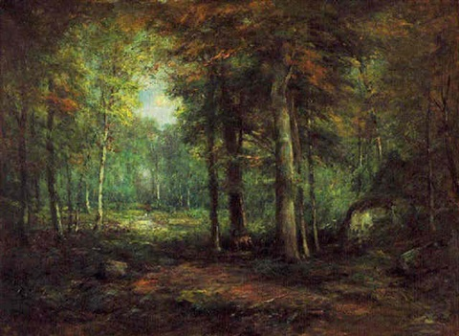
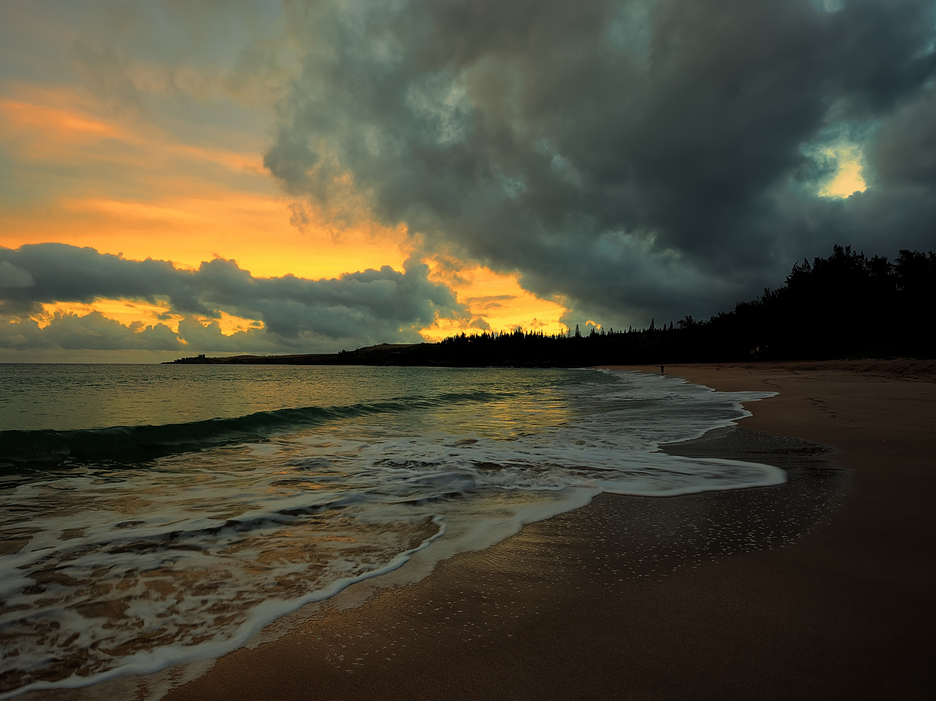
Migration Encore
Evangeline
- Henry Wadsworth Longfellow
:
a Tale of Acadie
This is the forest primeval.
The murmuring pines and the hemlocks,
Bearded with moss, and in garments green,
indistinct in the twilight,
Stand like Druids of eld,
with voices sad and prophetic,
Stand like harpers hoar,
with beards that rest on their bosoms.
Loud from its rocky caverns,
the deep-voiced neighboring ocean
Speaks, and in accents disconsolate
answers the wail of the forest.
- Henry Wadsworth Longfellow
The Acadians

Slide 2
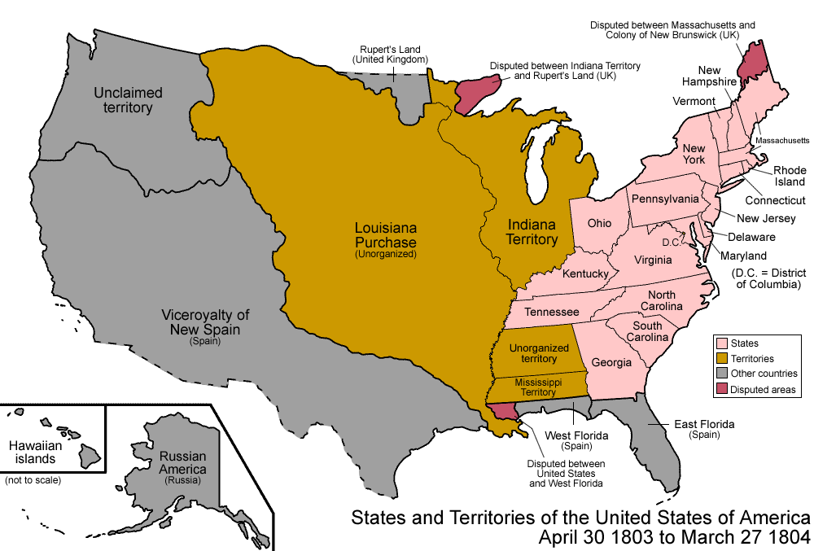
Westward Journeys!
Westward Journeys!
Migration Encore
?
1803
Notes:
https://www.youtube.com/watch?v=07jF_EVink4

Slide 3
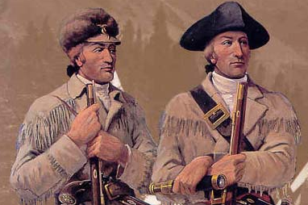
Westward Journeys!
1803
1803-1806
Corps of Discovery
Notes:
Meriwether Lewis & William Clark

Slide 4
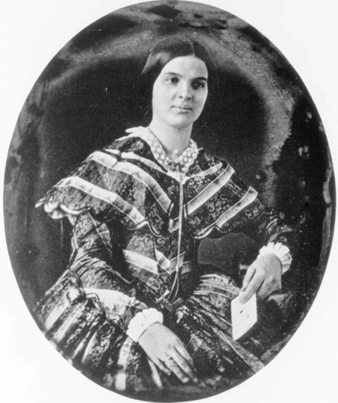
Westward Journeys!
1803
1821
1803-1806
Corps of Discovery
SANTA FE TRAIL
1821-1880
Notes:
Susan Shelby Magoffin

Slide 5
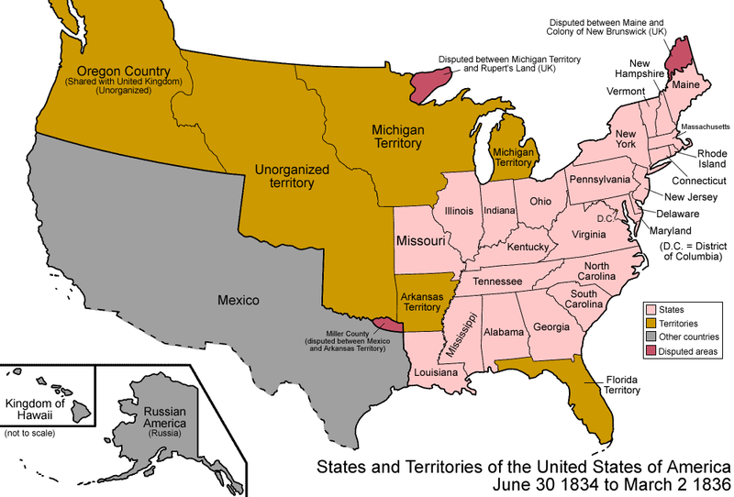
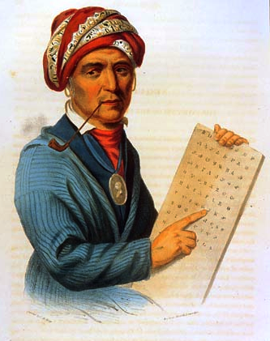
Westward Journeys!
1821
1831
Corps of Discovery
SANTA FE TRAIL
TRAIL OF TEARS
1831-1850
1821-1880
Notes:
Cherokee -- Sequoyah
https://commons.wikimedia.org/wiki/File:United_States_1834-1836-03.png

Slide 6
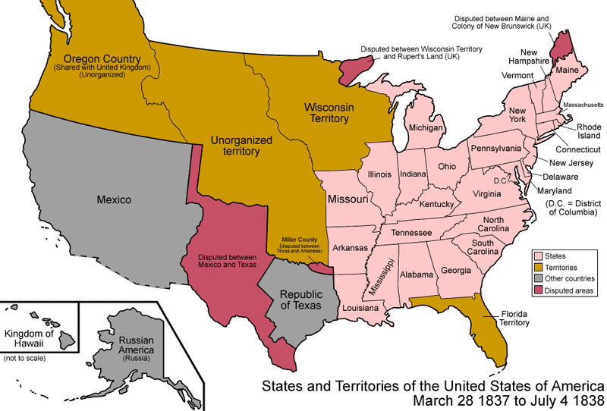
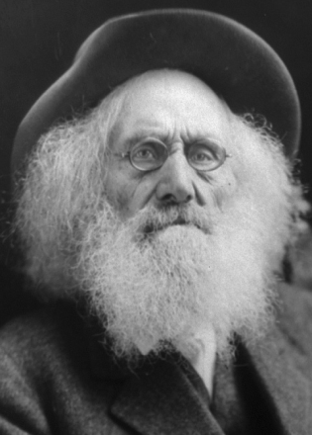
Westward Journeys!
1837
1831
Corps of Discovery
Oregon Trail
1837-1869
SANTA FE TRAIL
TRAIL OF TEARS
1831-1850
Notes:
Ezra Meeker – Meeker Markers
https://commons.wikimedia.org/wiki/File:United_States_1837-03-1838.png

Slide 7
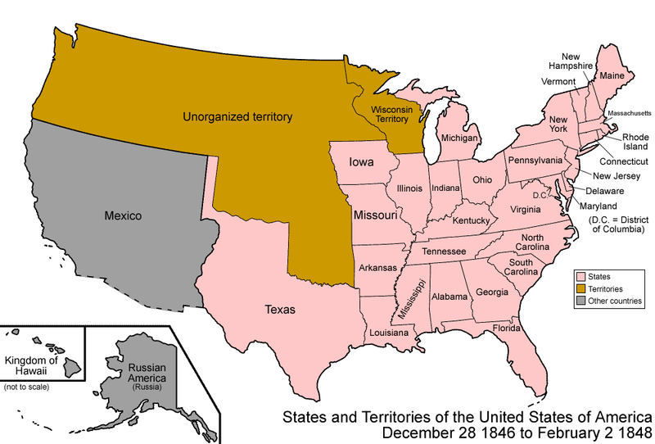
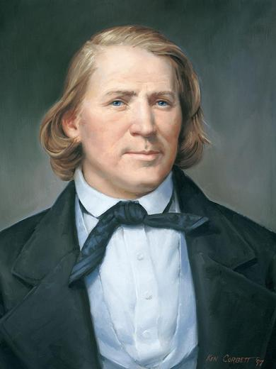
Westward Journeys!
1837
1846
Corps of Discovery
Oregon Trail
1837-1869
Mormon Trail
1846-1869
SANTA FE TRAIL
TRAIL OF TEARS
Notes:
Mormon -- Brigham Young
https://commons.wikimedia.org/wiki/File:United_States_1846-12-1848-02.png

Slide 8
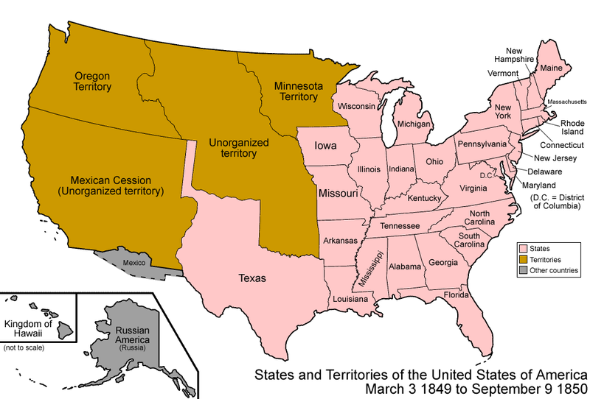
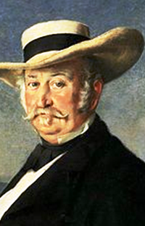
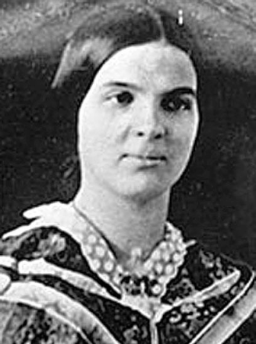
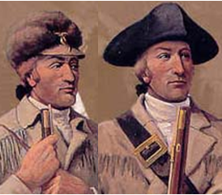
Westward Journeys!
All Journeys are on our website
1846
1849
Corps of Discovery
Did you miss these classes?
Oregon Trail
California Trail
Mormon Trail
1846-1869
1849-1869
SANTA FE TRAIL
TRAIL OF TEARS
Notes:
Gold Rush -- John Sutter
https://commons.wikimedia.org/wiki/File:United_States_1849-1850.png

Slide 9
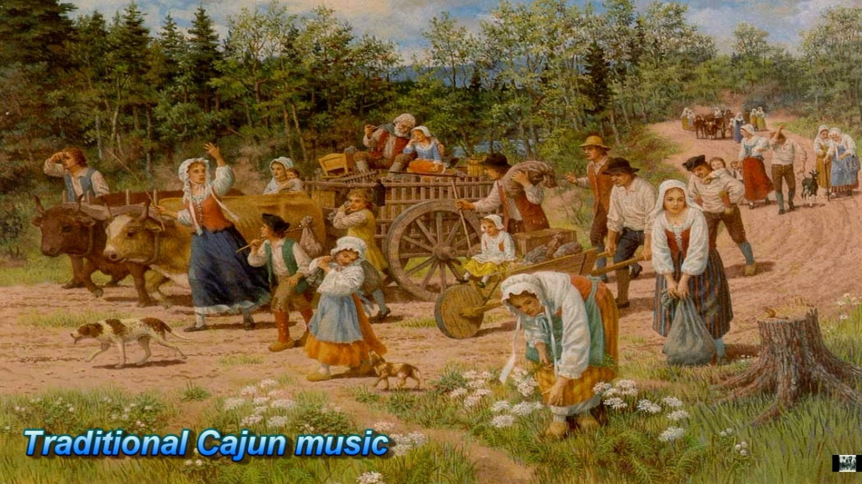
Migration Encore
All Journeys are on our website
Corps of Discovery
Oregon Trail
California Trail
Mormon Trail
SANTA FE TRAIL
TRAIL OF TEARS
Notes:
John Sutter-Brigham Young-Ezra Meeker-Sequoia-Susan Shelby Mcoffin-Merriwether Lewis,William Clark

Slide 10
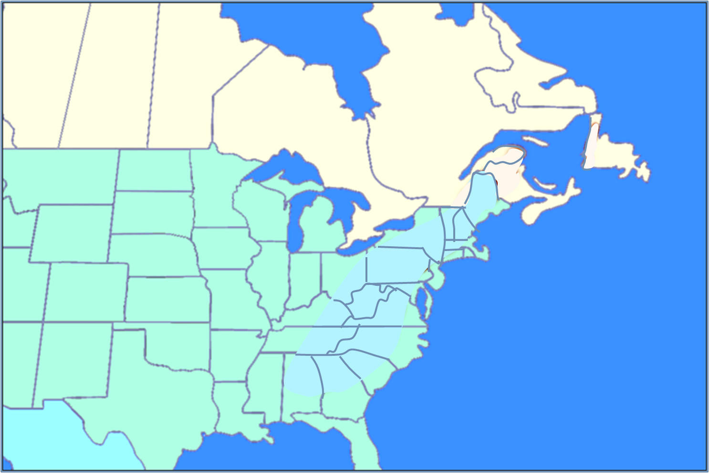
Acadie to Acadiana
Migration Encore
THE ACADIANS
Notes:
https://www.youtube.com/watch?v=07jF_EVink4

Slide 11
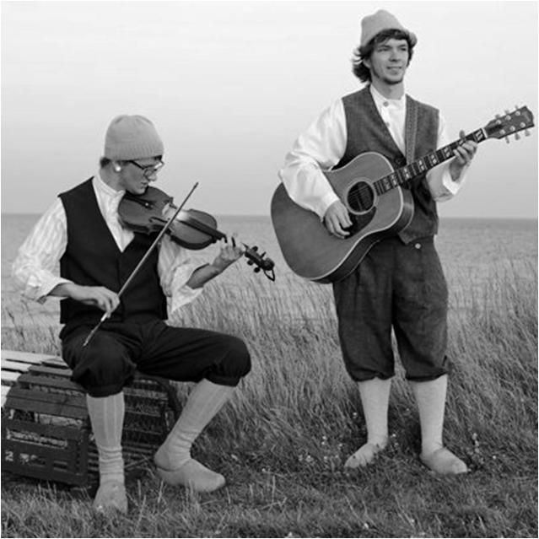
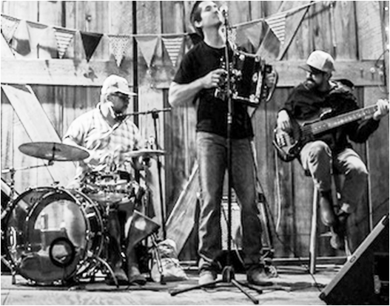
?
?
Acadie to Acadiana
Let’s meet a Cajun of
Acadiens
Acadie
Acadians
Acadiana
Cajuns

Slide 12
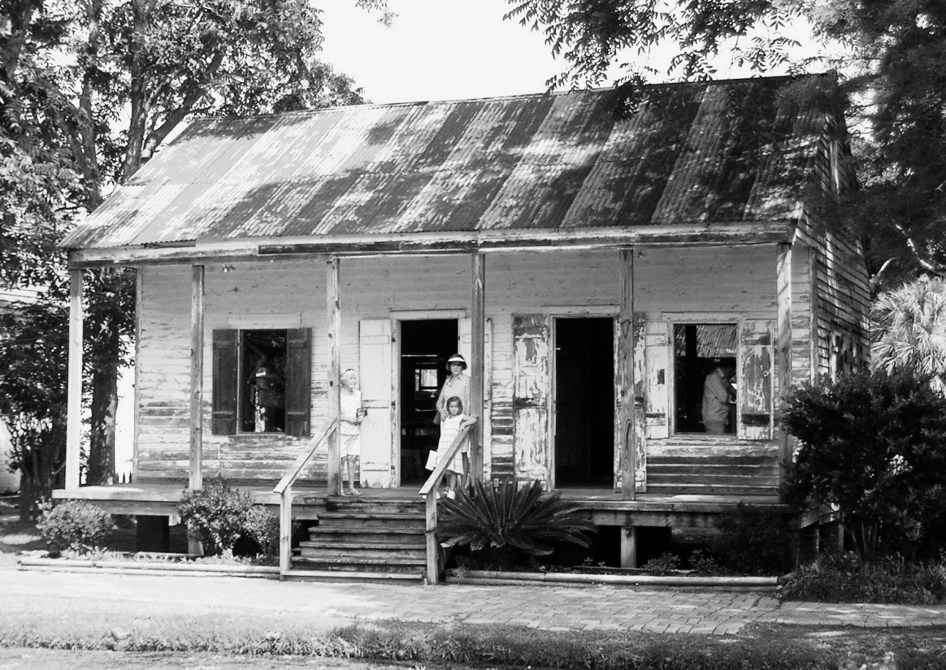
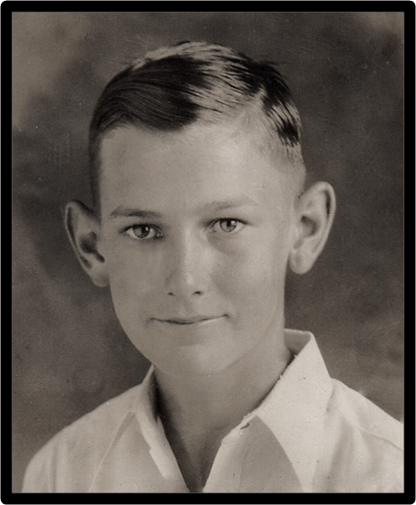
Let’s meet a Cajun of
Acadiana
Leroy Picard
1919: Leroy is born on a sugar plantation in Louisiana
speaks only Cajun French at home

Slide 13
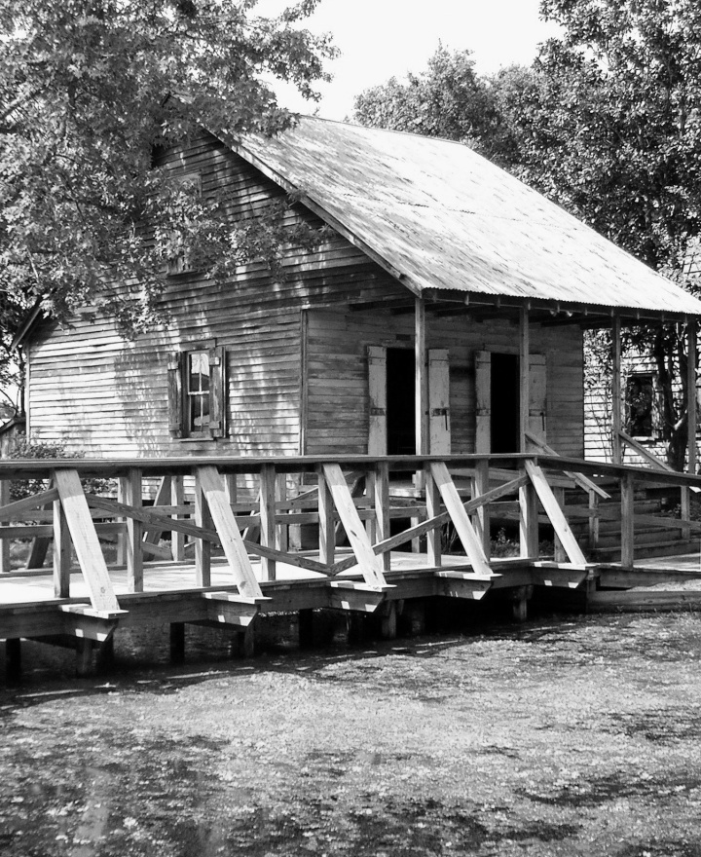
Let’s meet a Cajun of
Acadiana
Leroy Picard
1919: Leroy is born on a sugar plantation in Louisiana
speaks only Cajun French at home
attends a one-room school house

Slide 14
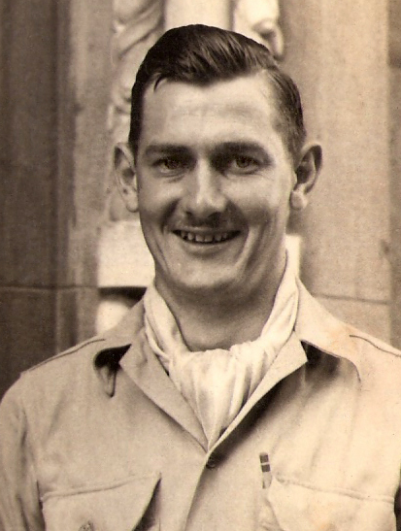
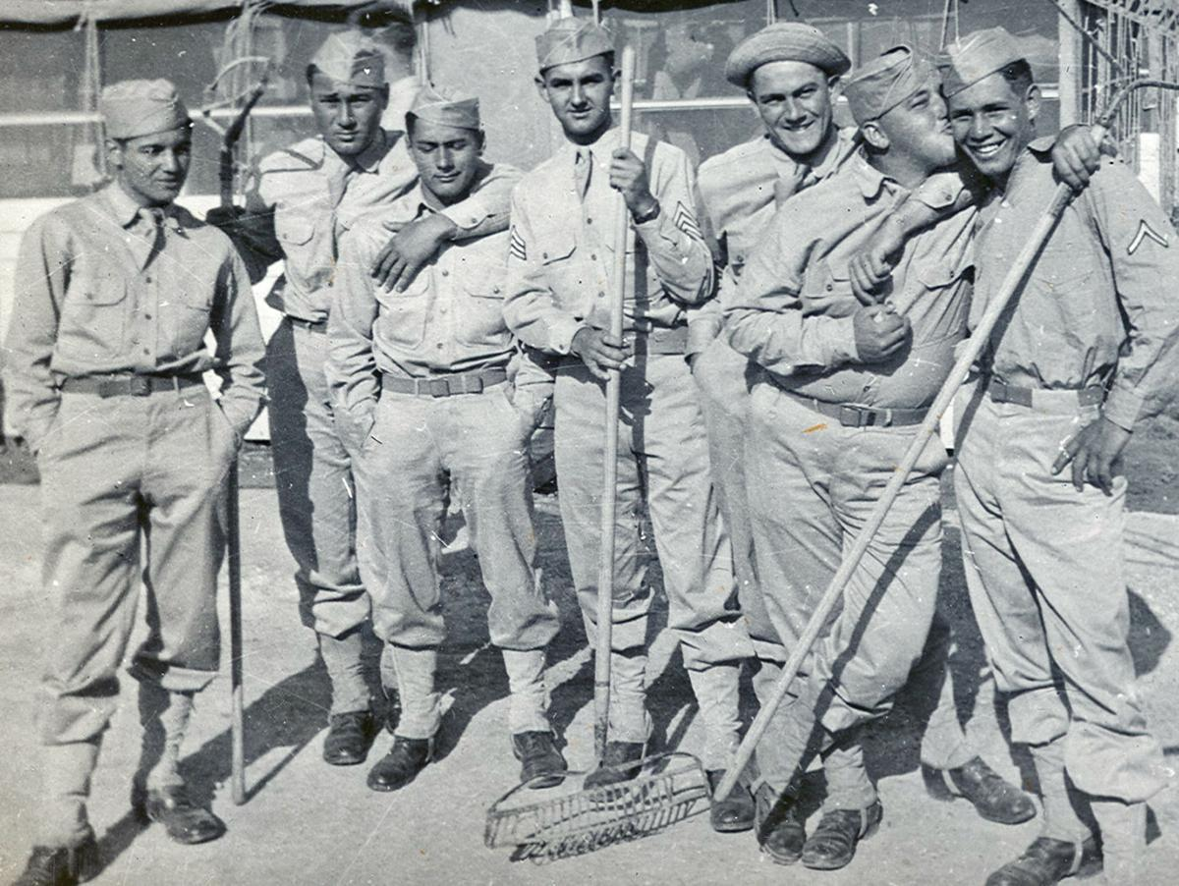
Let’s meet a Cajun of
Acadiana
Leroy Picard
1919: Leroy is born on a sugar plantation in Louisiana
speaks only Cajun French at home
attends a one-room school house
infantry soldier in WW2
one of Cajun ‘Frenchies’

Slide 15
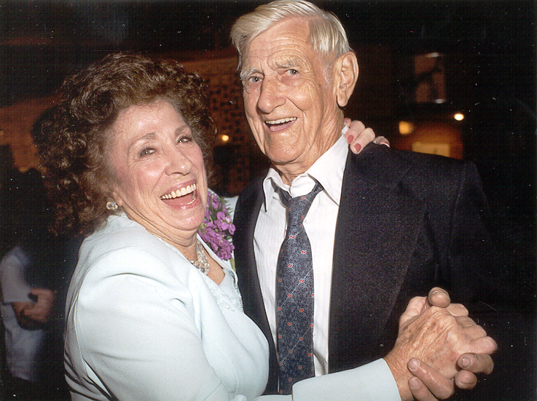
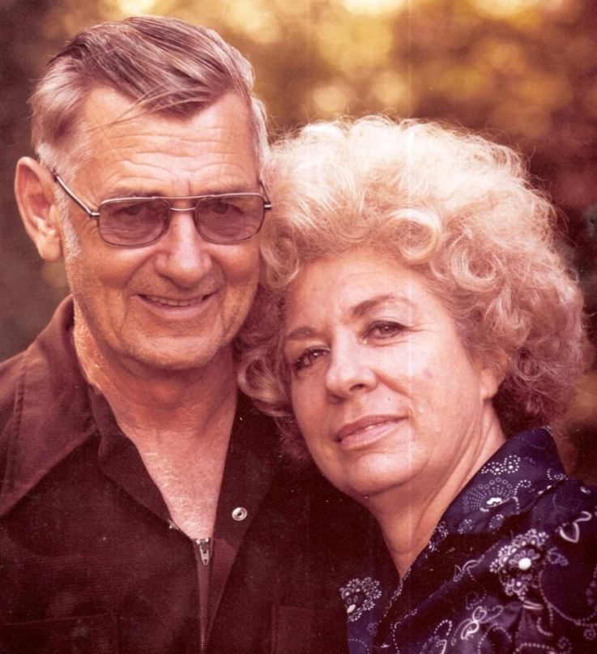
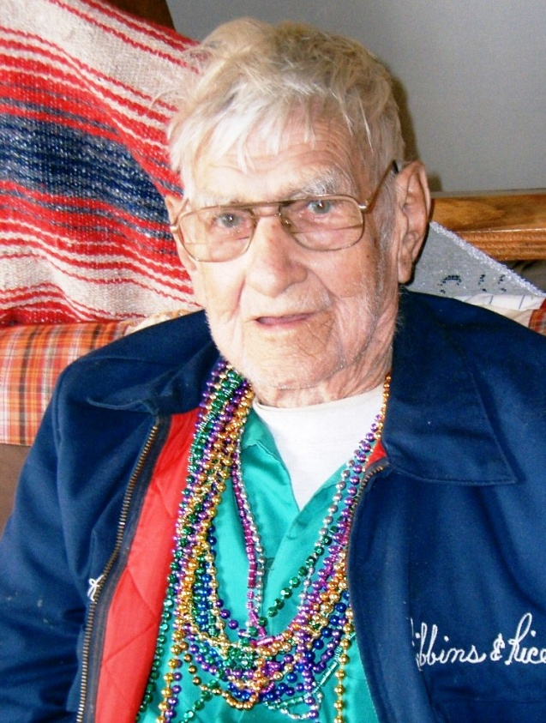
Let’s meet a Cajun of
Acadiana
Leroy Picard
1919: Leroy is born on a sugar plantation in Louisiana
speaks only Cajun French at home
attends a one-room school house
infantry soldier in WW2
one of Cajun ‘Frenchies’
meets & marries a young woman
Leroy & Juanita raise 4 sons
lives his life in Lafayette, La

Slide 16
Let’s meet a Cajun of
Acadiana
Leroy Picard 1919-2010
Leroy Picard
1919: Leroy is born on a sugar plantation in Louisiana
speaks only Cajun French at home
attends a one-room school house
infantry soldier in WW2
one of Cajun ‘Frenchies’
meets & marries a young woman
Leroy & Juanita raise 4 sons
lives his life in Lafayette, La
Leroy’s Story is the Acadian Story

Slide 17
The Acadians
Let’s meet a Cajun of
Acadiana
Leroy Picard 1919-2010
Leroy’s Story is the Acadian Story

Slide 18
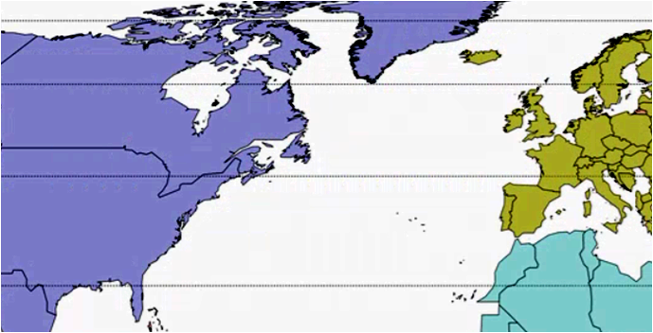
The Acadians
Setting the Stage: before 1600
Week 1 Setting the Stage: before 1600
Week 2 French Migration to Acadie: 1600-1755
Week 3 Le Grand Dérangement: 1755
Week 4 The Acadien Diaspora: 1755-1800
Week 5 Acadians of Louisiana & Canada: 1800-1950
Week 6 Acadians Today: 1950-2020
Setting the Stage: before 1600
Atlantic Ocean

Slide 19
Setting the Stage: before 1600
France: before 1600
Why will French people leave their homeland?
What draws these French to the New World?
France
France
New
World
Atlantic Ocean
Atlantic Ocean
What native people live along Atlantic seaboard?
Who are the earliest European explorers to N.A.?

Slide 20
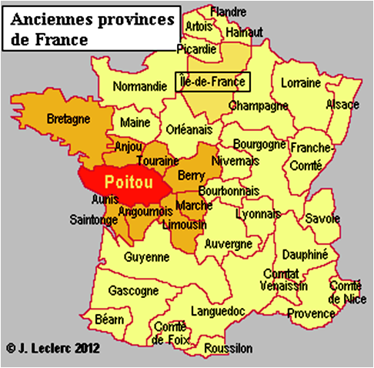
France: before 1600
Most Acadiens emigrate from northwestern France
~ 80% of Acadien settlers migrate from Poitou region
shared society
keep this area in mind →
Poitou
Why will they emigrate?
Atlantic Ocean
Notes:
Poitou = PWAAA-TOE https://www.youtube.com/watch?v=cpvNH3jLuJA
https://www.quora.com/Where-did-French-Acadians-originally-come-from

Slide 21
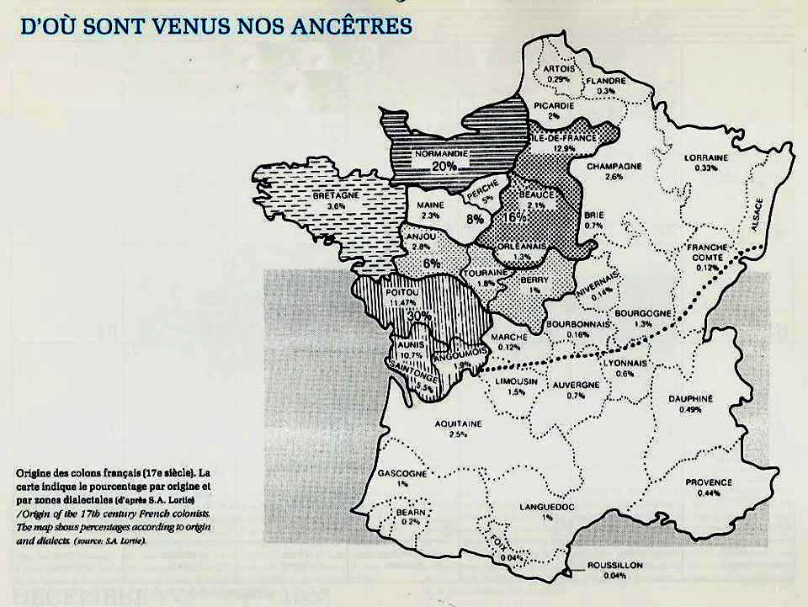
https://www.quora.com/Where-did-French-Acadians-originally-come-from

Slide 22
https://www.everyculture.com/multi/A-Br/Acadians.html
Acadiens are the descendants of a group of French-speaking settlers who migrated from coastal France in the late sixteenth century to establish a French colony called Acadia in the maritime provinces of Canada and part of what is now the state of Maine. Forced out by the British in the mid-sixteenth century, a few settlers remained in Maine, but most resettled in southern Louisiana and are popularly known as Cajuns.
Before 1713, Acadia was a French colony pioneered mostly by settlers from the coastal provinces of Brittany, Normandy, Picardy, and Poitou—a region that suffered great hardships in the late sixteenth and early seventeenth centuries. In 1628, famine and plague followed the end of a series of religious wars between Catholics and Protestants. When social tensions in coastal France ripened, more than 10,000 people left for the colony founded by Samuel Champlain in 1604 known as "La Cadie" or Acadia.

Slide 23
http://www.acadian-cajun.com/colorig.htm
What part of France did the majority of the early settlers of Acadia originate?
Good question. Since Charles Menou d'Aulnay was in charge of Acadia during the 1640's ... when many of the early Acadian settlers arrived, it is thought that they were recruited by his men. Since d'Aulnay's family owned property south of Loudun in France (see Poitou map, right), it has long been assumed that the colonists were common folk from near his home. The exact origins have been the subject of several studies.
LaTour was also known to have brought workers to Acadia. Except for LaTour, the earliest Acadian names probably date back to Razilly's group in 1632 ... though we don't have a list. Since Mathieu Martin was considered the first born in Acadia (1636), the business of settling down and raising a family might not have really begun until after Razilly's death in 1635.
One of the most famous is Genevieve Massignon's work, Les Parlers Français D'Acadie. In this work (done in French), she seeks to establish Acadian origins based on linguistics. She makes the argument that many of the Acadians come from the Poitou region, south of Loudun. To put it simply, the words that the Acadians used were found to be in the Poitou area of France at the time. She also found a number of records in that area that bore surnames found in early Acadia. Some of the villages in the area include Martaize, Aulnay, and La Chaussee. Another work is Les Origines Francaises des Premieres Familles Acadiennes by Nicole T. Bujold & Maurice Caillebeau. Also in French, it looks into the possible origin of the Acadians. This work also identifies Loudunais as the source for a number of the Acadians. Maurice's son Philippe has a website on the subject. I believe that the Centre d'etudes acadiennes plans to do some research on Acadian origins as one of their future projects. Benjamin Sulte, in “Origin of the French Canadians” (1906), p. 99, says that their the Acadian dialect would place their origin around the Bay of Biscay and at the mouth of the Loire River. Massignon (in Les Parlers Francais) suggests that they came from the Loudunais area in NE Poitou (northern section of today’s Vienne dept.).
Another idea of the origins of the Acadians has recently been presented by Michel Poirier. He says that they might have come from Baie de Bourgneuf (about 40 km W of Nantes). His ideas are presented (in French) at the St. Pierre & Miquelon website. Some details that he cites to support his theory include:
- the location of the monastery of the Assumption (on the island Chauvet), which was regularly attended by Richelieu and was the property of his brother, Alphonse.
- Port-Royal and the church of St Jean-Baptiste
- salt-water marshes in the area were drained ... much like the dyke system utilized in Acadia
- it was a zone surrounded by Protestants and enclosing Catholics.

Slide 24
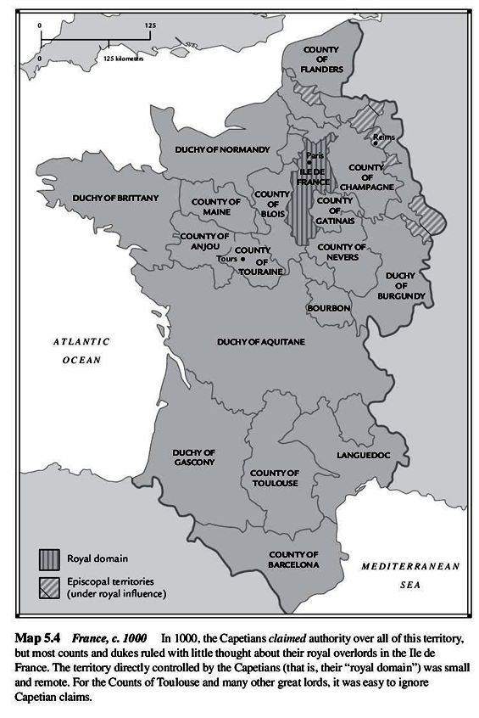
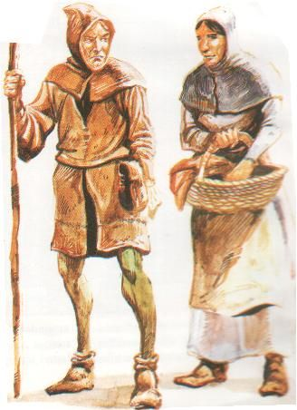
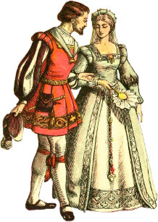
France: before 1600
THE MIDDLE AGES
1000 AD
- isolated Royal Domain
- virtually independent
principalities
- Feudal societies
lords
clergy
peasants (serfs)
France: 1000 AD
Poitou
Why will they emigrate?

Slide 26
https://en.wikipedia.org/wiki/France_in_the_Middle_Ages
The Kingdom of France in the Middle Ages (roughly, from the 9th century to the middle of the 15th century) was marked by the fragmentation of the Carolingian Empire and West Francia (843–987); the expansion of royal control by the House of Capet (987–1328), including their struggles with the virtually independent principalities (duchies and counties, such as the Norman and Angevin regions) that had developed following the Viking invasions and through the piecemeal dismantling of the Carolingian Empire and the creation and extension of administrative/state control (notably under Philip II Augustus and Louis IX) in the 13th century; and the rise of the House of Valois (1328–1589), including the protracted dynastic crisis of the Hundred Years' War with the Kingdom of England (1337–1453) compounded by the catastrophic Black Death epidemic (1348), which laid the seeds for a more centralized and expanded state in the early modern period and the creation of a sense of French identity.
Up to the 12th century, the period saw the elaboration and extension of the seigneurial economic system (including the attachment of peasants to the land through serfdom); the extension of the feudal system of political rights and obligations between lords and vassals; the so-called "feudal revolution" of the 11th century during which ever smaller lords took control of local lands in many regions; and the appropriation by regional/local seigneurs of various administrative, fiscal and judicial rights for themselves. From the 13th century on, the state slowly regained control of a number of these lost powers. The crises of the 13th and 14th centuries led to the convening of an advisory assembly, the Estates General, and also to an effective end to serfdom.

Slide 27
https://en.wikipedia.org/wiki/Feudalism
Feudalism was a combination of legal and military customs in medieval Europe that flourished between the 9th and 15th centuries. Broadly defined, it was a way of structuring society around relationships derived from the holding of land in exchange for service or labour. Although derived from the Latin word feodum or feudum (fief), then in use, the term feudalism and the system it describes were not conceived of as a formal political system by the people living in the Middle Ages. The classic definition, by François-Louis Ganshof (1944), feudalism describes a set of reciprocal legal and military obligations among the warrior nobility revolving around the three key concepts of lords, vassals and fiefs.
A broader definition of feudalism, as described by Marc Bloch (1939), includes not only the obligations of the warrior nobility but also those of all three estates of the realm: the nobility, the clergy, and the peasantry bound by manorialism; this is sometimes referred to as a "feudal society". Since the publication of Elizabeth A. R. Brown's "The Tyranny of a Construct" (1974) and Susan Reynolds's Fiefs and Vassals (1994), there has been ongoing inconclusive discussion among medieval historians as to whether feudalism is a useful construct for understanding medieval society.

Slide 28
France: before 1600
THE MIDDLE AGES
1000 AD
- isolated Royal Domain
- virtually independent
principalities
- Feudal societies
lords
clergy
peasants (serfs)
France: 1000 AD
shared
Catholic religion
Starting in 800 AD,
Roman Catholicism
becomes dominant
religion in France

Slide 29
https://about-france.com/religion.htm
For most of the past thousand years, France has been one of the principal "Catholic" countries of Europe. From the time of Charlemagne (9th century) until the emergence of Protestantism (sixteenth century), France was one of the main powers in a continent where Catholicism was - except in orthodox areas - the only mainstream form of Christianity. After that, most of France, and particularly the French monarchy, maintained the Catholic faith while many other parts of Europe, including England, Switzerland, the Low countries, and much of Germany and Scandinavia, adopted differing forms of Protestantism. After the French Revolution in 1789, religion in France was brought under state control, discouraged as anti-revolutionary, and monastic orders were abolished. But in 1801, Napoleon signed a Concordat with the Vatican, which restored much of the church's former status. For most of the nineteenth century, France was officially a Catholic country; but in 1905 the landmark law was passed, establishing the Separation of the State and the Church. Since then, while Catholicism has remained the predominant religion in France, the Catholic church is constitutionally just one among many religious structures in the country. The "secular" (in French laïc) state recognises the right of individuals to practice whatever religion the wish, and in today's France, Catholicism exists alongside Protestantism, Islam, Buddhism, Judaism and a number of fringe cults..
https://www.history.com/topics/middle-ages/charlemagne
Charlemagne (c.742-814), also known as Karl and Charles the Great, was a medieval emperor who ruled much of Western Europe from 768 to 814. In 771, Charlemagne became king of the Franks, a Germanic tribe in present-day Belgium, France, Luxembourg, the Netherlands and western Germany. He embarked on a mission to unite all Germanic peoples into one kingdom, and convert his subjects to Christianity. A skilled military strategist, he spent much of his reign engaged in warfare in order to accomplish his goals. In 800, Pope Leo III (750-816) crowned Charlemagne emperor of the Romans. In this role, he encouraged the Carolingian Renaissance, a cultural and intellectual revival in Europe. When he died in 814, Charlemagne’s empire encompassed much of Western Europe, and he had also ensured the survival of Christianity in the West. Today, Charlemagne is referred to by some as the father of Europe.

Slide 30
France: before 1600
THE MIDDLE AGES
1000 AD
- isolated Royal Domain
- virtually independent
principalities
- Feudal societies
lords
clergy
peasants (serfs)
France: 1000 AD
shared
Catholic religion
shared
agricultural vocation
Ancestors of Acadiens work the land for themselves & their lords

Slide 31
France: before 1600
http://inquestiatimes.blogspot.com/2013/04/acadian-prehistory-medieval-religion.html
Most of the early French settlers that formed the "first families" of Acadia came primarily from the Poitou, Aunis and Saintonge regions of western France. In fact, since the vast majority of these new settlers originated from Poitou, the Acadian French language of today still preserves most of the archaic sounds, words and characteristics of Poitevin, one of the traditional regional languages (dialects) of France. (Most of the old province of Poitou is located in the present-day department of Poitou-Charentes, although a part of it, which forms a part of the Pays de la Loire, is located within the Vendée department.)
(Why would) these people have wanted to leave Europe behind in the first place, to have risked everything - their lives, any real chance of seeing their families again - to brave it all and to have embarked on such a perilous journey across the Atlantic. And for what reason? Why would they have wanted to leave their European homeland behind for the unknown?
Medieval European society possessed a strong religious feeling, expressed in many ways between the 10th and 15th centuries. This religious fervor that gripped medieval society appeared often while supporting multiple conquests with the sword. This strongly felt religious sentiment can possibly be explained by the fact that during this time the Christian Empire had lost several of its territories to Muslims conquerors. Indeed, the threat of the loss of power and territories by the Church could only but add to the religious sentiment of the epoch.
From the 9th to the 12th centuries, the County of Poitou was under the powerful rule a French dynasty referred to as the House of Poitiers (the capital of Poitou). In the Late Middle Ages, the nobility of Poitou made this region into an extremely powerful one.
In 1152, Henry II of England married Eleanor of Aquitaine, last hier of the House of Poitiers. With this marriage, Poitou came under Enlish control. Consequently, Henry II ruled over an "empire“ -- with semi-independent states- that covered nearly half of medieval France.
Here in the European countryside . . . a phenomenal western expansion and extraordinary development would begin, as a "starting point of the European global domination that lasted until the 20th century.“ Rural and urban development in 12th and 13th century Europe was felt across the continent. From the countryside to the city-centres, the impact of economic development occurred everywhere and therefore greatly contributed in creating what is considered as the commercial revolution of Medieval Europe, reaching its peak during the years 1250-1290 . This period of change and renewal had a great many long-lasting effects. Foremost, this led to an increase in population; the population of France nearly doubled between the late 10th and 12th centuries, an augmentation from 5 to 9.2 million inhabitants.
Other important factors that further stimulated the European economy during this time (12th-13th centuries), was the increase in demand for agricultural and artisanal products (craft industry), because the population growth had consequently generated the demand for a labor force to feed it (Le Jan 1996: 167). There was also the increase in lordships, which may also have in turn directly contributed to an increase in production. The multiplication of the feudal courts due to “the breakdown of powers boosted local consumption and increased aristocratic spending*” which meant that “building castles, parish churches or the reconstruction of large monastic churches stimulated the economy.”
So, in short, it was really cause and effect, since peasant production within the feudal system was being put under extreme pressure at a level of productivity hitherto never seen . Consequently, there were so many adjustments that needed to be made in order to adjust with this exorbitant new demand. The direct impact of this economic boom therefore resulted in a migratory surge to clear some new lands in certain areas, which had the causal effect of contributing to innovation on the part of the laborers who significantly improved their tillage equipment and techniques, revolutionized commercial transportation, and also saw a growing number of markets and fairs to facilitate all trade. In summary, with all of these activities, we can attest that the economic development of both rural and urban areas had as an overall effect on Europe, the necessity to further develop international trade thanks to these local products.
By extension, the emergence of the cities, each one created around a market in turn granted certain freedoms to its citizens. The medieval city “could gain the status as a specific territory which was no longer bound to serfdom and seigniorial lordship.”
By 1204, the French King, Philip II, regained control of the English continental possessions. Despite Philippe II’s success in ridding himself of English rule over the Poitou region along with other former Angevin possessions, this was by far not the end of the conflict between the Kingdom of England and the Kingdom of France.
A rather complicated dynastic conflict, the Hundred Years’ War – lasting from 1337 to 1453 – was a series of bloody conflicts that left the Poitou region in perpetual conflict. By the mid-14th century, not only was the Hundred Years’ War “an economic as well as military struggle that imposed severe financial strain on both sides” but also, in 1348, the Black Death – an outbreak of the bubonic plague – had entered into France, causing millions of deaths, waves of the epidemic which “some historians maintain that up to half the population of France may have succumbed.”
One of the results of the Hundred Years’ War is that it stimulated nationalistic sentiment, in the end leaving France devastated and prostrate, meanwhile not without having “engendered a certain degree of French national feeling toward a common enemy that the kings could use to reestablish monarchical power.” France came out as the victor against the English in the Hundred Years’ War (1337 to 1453) but the conflicts totally ravaged the countryside, ruined agriculture, disrupted trade, caused famine and exacerbated the breakout of the bubonic plague.
THE MIDDLE AGES
1000 AD
- isolated Royal Domain
Want to learn more??
- virtually independent
principalities
- Feudal societies
lords
clergy
peasants (serfs)
France: 1000 AD
Read the HIDDEN SLIDES
shared
agricultural vocation

Slide 32
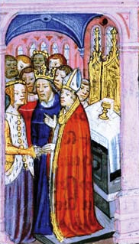
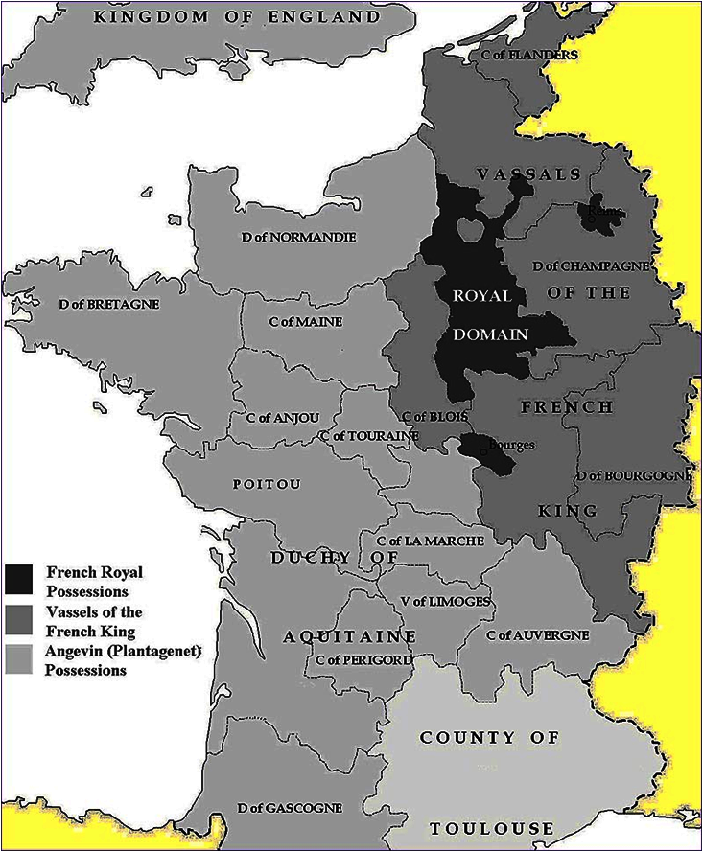
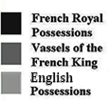
France: before 1600
THE MIDDLE AGES
1000 AD
- isolated Royal Domain
ENGLAND
- virtually independent
principalities
France: 1000 AD
1152 AD - royal marriage
- England gains control
of French lands
shared
English
subjugation
ENGLISH
CONTROL
Poitou
English
1152-1204 English Possessions
Eleanor of Aquitaine & Henry II
Notes:
1152, Henry II of England married Eleanor of Aquitaine, last heir of the House of Poitiers. With this marriage, Poitou came under English control. Consequently, Henry II ruled over an "empire“ -- with semi-independent states- that covered nearly half of medieval France.

Slide 33
https://en.wikipedia.org/wiki/Angevin_Empire
The Angevin Empire describes the possessions of the Angevin kings of England who held lands in England and France during the 12th and 13th centuries. Its rulers were Henry II (ruled 1154–1189), Richard I (r. 1189–1199), and John (r. 1199–1216). The Angevin Empire is an early example of a composite state.[2]
The Angevins of the House of Plantagenet ruled over an area covering roughly half of France, all of England, and parts of Ireland and Wales, and had further influence over much of the remaining British Isles. The empire was established by Henry II, as King of England, Duke of Normandy, Count of Anjou (from which the Angevins derive their name), as well as Duke of Aquitaine by right of his wife, and multiple subsidiary titles. Although their title of highest rank came from the Kingdom of England, the Angevins held court primarily on the continent at Angers in Anjou, and Chinon in Touraine.
The influence and power of the House of Anjou brought them into conflict with the kings of France of the House of Capet, to whom they also owed feudal homage to their French possessions, bringing in a period of rivalry between both dynasties. Despite the extent of Angevin rule, Henry's son, John, was defeated in the Anglo-French War (1213–1214) by Philip II of France following the Battle of Bouvines. John lost control of most of his continental possessions, apart from Gascony in southern Aquitaine. This defeat set the scene for further conflicts between England and France, leading up to the Hundred Years' War.

Slide 34
France: before 1600
THE MIDDLE AGES
1000 AD
- isolated Royal Domain
ENGLAND
- virtually independent
principalities
12th & 13th Centuries
Economic Development
Increases in:
1152 AD - royal marriage
- England gains control
of French lands
shared
English
subjugation
ENGLISH
CONTROL
1204 AD
- France regains its lands
English
1152-1204 English Possessions

Slide 35
France: before 1600
THE MIDDLE AGES
1000 AD
- isolated Royal Domain
- virtually independent
principalities
12th & 13th Centuries
Economic Development
Increases in:
- population 5M → 10M
- demand for products
- technical innovations
- individual freedom
1152 AD - royal marriage
- England gains control
of French lands
farming
innovations
1204 AD
- France regains its lands

Slide 36
http://inquestiatimes.blogspot.com/2013/04/acadian-prehistory-medieval-religion.html
Most of the early French settlers that formed the "first families" of Acadia came primarily from the Poitou, Aunis and Saintonge regions of western France. In fact, since the vast majority of these new settlers originated from Poitou, the Acadian French language of today still preserves most of the archaic sounds, words and characteristics of Poitevin, one of the traditional regional languages (dialects) of France. (Most of the old province of Poitou is located in the present-day department of Poitou-Charentes, although a part of it, which forms a part of the Pays de la Loire, is located within the Vendée department.)
(Why would) these people have wanted to leave Europe behind in the first place, to have risked everything - their lives, any real chance of seeing their families again - to brave it all and to have embarked on such a perilous journey across the Atlantic. And for what reason? Why would they have wanted to leave their European homeland behind for the unknown?
Medieval European society possessed a strong religious feeling, expressed in many ways between the 10th and 15th centuries. This religious fervor that gripped medieval society appeared often while supporting multiple conquests with the sword. This strongly felt religious sentiment can possibly be explained by the fact that during this time the Christian Empire had lost several of its territories to Muslims conquerors. Indeed, the threat of the loss of power and territories by the Church could only but add to the religious sentiment of the epoch.
From the 9th to the 12th centuries, the County of Poitou was under the powerful rule a French dynasty referred to as the House of Poitiers (the capital of Poitou). In the Late Middle Ages, the nobility of Poitou made this region into an extremely powerful one.
In 1152, Henry II of England married Eleanor of Aquitaine, last heir of the House of Poitiers. With this marriage, Poitou came under English control. Consequently, Henry II ruled over an "empire“ -- with semi-independent states- that covered nearly half of medieval France.
Here in the European countryside . . . a phenomenal western expansion and extraordinary development would begin, as a "starting point of the European global domination that lasted until the 20th century.“ Rural and urban development in 12th and 13th century Europe was felt across the continent. From the countryside to the city-centres, the impact of economic development occurred everywhere and therefore greatly contributed in creating what is considered as the commercial revolution of Medieval Europe, reaching its peak during the years 1250-1290 . This period of change and renewal had a great many long-lasting effects. Foremost, this led to an increase in population; the population of France nearly doubled between the late 10th and 12th centuries, an augmentation from 5 to 9.2 million inhabitants.
Other important factors that further stimulated the European economy during this time (12th-13th centuries), was the increase in demand for agricultural and artisanal products (craft industry), because the population growth had consequently generated the demand for a labor force to feed it (Le Jan 1996: 167). There was also the increase in lordships, which may also have in turn directly contributed to an increase in production. The multiplication of the feudal courts due to “the breakdown of powers boosted local consumption and increased aristocratic spending*” which meant that “building castles, parish churches or the reconstruction of large monastic churches stimulated the economy.”
So, in short, it was really cause and effect, since peasant production within the feudal system was being put under extreme pressure at a level of productivity hitherto never seen . Consequently, there were so many adjustments that needed to be made in order to adjust with this exorbitant new demand. The direct impact of this economic boom therefore resulted in a migratory surge to clear some new lands in certain areas, which had the causal effect of contributing to innovation on the part of the laborers who significantly improved their tillage equipment and techniques, revolutionized commercial transportation, and also saw a growing number of markets and fairs to facilitate all trade. In summary, with all of these activities, we can attest that the economic development of both rural and urban areas had as an overall effect on Europe, the necessity to further develop international trade thanks to these local products.
By extension, the emergence of the cities, each one created around a market in turn granted certain freedoms to its citizens. The medieval city “could gain the status as a specific territory which was no longer bound to serfdom and seigniorial lordship.”
By 1204, the French King, Philip II, regained control of the English continental possessions. Despite Philippe II’s success in ridding himself of English rule over the Poitou region along with other former Angevin possessions, this was by far not the end of the conflict between the Kingdom of England and the Kingdom of France.
A rather complicated dynastic conflict, the Hundred Years’ War – lasting from 1337 to 1453 – was a series of bloody conflicts that left the Poitou region in perpetual conflict. By the mid-14th century, not only was the Hundred Years’ War “an economic as well as military struggle that imposed severe financial strain on both sides” but also, in 1348, the Black Death – an outbreak of the bubonic plague – had entered into France, causing millions of deaths, waves of the epidemic which “some historians maintain that up to half the population of France may have succumbed.”
One of the results of the Hundred Years’ War is that it stimulated nationalistic sentiment, in the end leaving France devastated and prostrate, meanwhile not without having “engendered a certain degree of French national feeling toward a common enemy that the kings could use to reestablish monarchical power.” France came out as the victor against the English in the Hundred Years’ War (1337 to 1453) but the conflicts totally ravaged the countryside, ruined agriculture, disrupted trade, caused famine and exacerbated the breakout of the bubonic plague.
Then, suddenly it found itself at war with its own people with the French Wars of Religion (1562-1598) a civil war that broke out between French Catholics and French Calvinist Protestants (Huguenots). As a precursor to later persecutions that would follow, as early as in the 1550s the religious conflict acquired a distinctly political character that would culminate in the St. Bartholomew's Day massacre; when in August 1572, the Roman Catholic Party was responsible for the killing of as many as 8,000 to 10,000 Huguenots across France. During this time of Reformation, Poitou emerged as the centre of Calvinism. In the early sixteenth century, the province of Poitou had been rich, but had been badly hit by the Wars of Religion. At this time in Poitou “disorder was endemic” and “local feuds…had torn Poitou apart.”
In 1604, ot long after the Wars of Religion, Acadia was established “as a proprietary colony” by Pierre Duguay, sieur de Monts, who, “one year earlier, had acquired a tentative monopoly over the region’s fur trade and fisheries.” It has been confirmed that most of the French settlers of the early 17th century that constituted Acadia’s “first families” were former residents of the La Chaussée area of Poitou, where in 1635, Charles de Menou d’Aulnay de Charnisay had recruited the French families living on his and his mother’s lands. The family names that appear in the old parish registers of La Chaussée, located near the village of Aulnay, in France, in the first half of the 17th century, are the same names that would appear transplanted in North America – a world away in Acadia – in the second half of the 17th century .
For the most part, these early seventeenth century settlers “were drawn consistently from a particular stratum of rural French society – the peasant class – and were destined to serve as laborers in the New World.” Therefore, as a consequence of this, “most early French settlers in Acadia thus shared not only the same subregional culture and language, but also the same agrarian background and nonmaterialistic values.
The historical Acadians left France before the French Revolution reorganized the old provincial divisions into the present-day département system which consequently superseded the old provincial divisionst became a true country, before the time when French society underwent an epic transformation into the France we all know today. The Acadians settled in North America when their provincial identity and language were stronger than that of any “French” one. .

Slide 37
France: before 1600
THE MIDDLE AGES
1000 AD
CONFLICT: between England & France
right to rule FRANCE
- 5 generations of kings
- series of battles
- isolated Royal Domain
- virtually independent
principalities
12th & 13th Centuries
Economic Development
Increases in:
- population 5M → 10M
- demand for products
- technical innovations
- individual freedom
1152 AD - royal marriage
- England gains control
of French lands
1204 AD
- France regains its lands
1337-1453
English
- 100 Years’ War
Battle of Agincourt
Battle of La Rochelle
Battle of Patay
Joan of Arc @ Orleans
Notes:
The Battle of La Rochelle (NAVAL), The Battle of Agincourt (Northern France), The Battle of Patay (north-central France), Joan of Arc at the Siege of Orléans (north-central France)

Slide 38
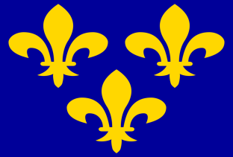
France: before 1600
THE MIDDLE AGES
1000 AD
CONFLICT: between England & France
right to rule FRANCE
5 generations of kings
series of battles
RESULTS
England loses all its
continental possessions
strong national identities
- isolated Royal Domain
ENGLAND
- virtually independent
principalities
1152 AD - royal marriage
- England gains control
of French lands
animosity
to English
FRANCE
1204 AD
Poitou
- France regains its lands
1337-1453
English
- 100 Years’ War
Notes:
1453: end of Middle Ages – Ottoman Empire captures Constantinople and Byzantine Empire ends

Slide 39
https://en.wikipedia.org/wiki/Hundred_Years%27_War
The Hundred Years' War was a series of conflicts from 1337 to 1453, waged between the House of Plantagenet, rulers of England and the French House of Valois, over the right to rule the Kingdom of France. Each side drew many allies into the war. It was one of the most notable conflicts of the Middle Ages, in which five generations of kings from two rival dynasties fought for the throne of the largest kingdom in Western Europe. The war marked both the height of chivalry and its subsequent decline, and the development of strong national identities in both countries.
Tensions between the French and English crowns had gone back centuries to the origins of the English royal family, which was French (Norman, and later, Angevin) in origin. English monarchs had therefore historically held titles and lands within France, which made them vassals to the kings of France. The status of the English king's French fiefs was a major source of conflict between the two monarchies throughout the Middle Ages. French monarchs systematically sought to check the growth of English power, stripping away lands as the opportunity arose, particularly whenever England was at war with Scotland, an ally of France. English holdings in France had varied in size, at some points dwarfing even the French royal domain; by 1337, however, only Gascony was English.
The early years of the war saw resounding English successes (notably at Crécy in 1346 and at Poitiers in 1356 where King John II of France was taken prisoner). But by 1378, the French under King Charles the Wise had reconquered most of the lands they lost in the Treaty of Brétigny (signed in 1360) leaving the English with only a few cities on the continent. In the following decades, the weakening of royal authority, combined with a difficult economic context, led to a period of civil war in both countries, struggles from which England emerged first. The newly crowned Henry V of England seized the opportunity presented by the mental illness of Charles VI of France and the French civil war between Armagnacs and Burgundians to revive the conflict. Overwhelming victories at Agincourt in 1415 and Verneuil in 1424 as well as an alliance with the Burgundians raised the prospects of an ultimate English triumph and persuaded the English to continue the war over many decades. However, a variety of factors such as the death of Henry V, the emergence of Joan of Arc which boosted French morale and the loss of Burgundy as an ally marking the end of the civil war in France prevented it. The Siege of Orléans in 1429 announced the beginning of the end for English hopes of conquest. Even with the eventual capture of Joan by the Burgundians and her execution in 1431, series of crushing French victories such as those at Patay in 1429, Formigny in 1450 and Castillon in 1453 concluded the war in favour of the Valois dynasty. England permanently lost most of its continental possessions, with only the Pale of Calais remaining under its control on the continent until the Siege of Calais in 1558.
Later historians adopted the term "Hundred Years' War" as a historiographical periodisation to encompass all of these events, thus constructing the longest military conflict in European history.

Slide 40
France: before 1600
1562-1598: French Wars of Religion
1000 AD
- isolated Royal Domain
- virtually independent
principalities
1152 AD - royal marriage
- England gains control
of French lands
1204 AD
- France regains its lands
1337-1453
- 100 Years’ War
1562-1598:
1562-1598
French Wars of Religion
- French Wars of Religion

Slide 41
https://en.wikipedia.org/wiki/Religion_in_France
Catholicism is the largest religion in France. During the pre-1789 Ancient Régime, France was traditionally considered the Church's eldest daughter, and the King of France always maintained close links to the Pope. However, the "Gallicanism" policy meant that the king selected bishops.
French Wars of Religion (1562–1598) -- A strong Protestant population resided in France, primarily of Reformed confession. It was persecuted by the state for most of the time, with temporary periods of relative toleration. These wars continued throughout the 16th century, with the 1572 St. Bartholomew's Day massacre as its apex, until the 1598 Edict of Nantes issued by Henry IV.
For the first time, Huguenots were considered by the state as more than mere heretics. The Edict of Nantes thus opened a path for secularism and tolerance. In offering general freedom of conscience to individuals, the edict offered many specific concessions to the Protestants, for instance, amnesty and the reinstatement of their civil rights, including the right to work in any field or for the State and to bring grievances directly to the king.
Post–Edict of Nantes (1598–1789) --- The 1598 Edict also granted the Protestants fifty places of safety (places de sûreté), which were military strongholds such as La Rochelle for which the king paid 180,000 écus a year, along with a further 150 emergency forts (places de refuge), to be maintained at the Huguenots' own expense. Such an innovative act of toleration stood virtually alone in a Europe (except for the Polish-Lithuanian Commonwealth) where standard practice forced the subjects of a ruler to follow whatever religion that the ruler formally adopted – the application of the principle of cuius regio, eius religio.
Religious conflicts resumed in the end of the 17th century, when Louis XIV, the "Sun King", initiated the persecution of Huguenots by introducing the dragonnades in 1681. This wave of violence intimidated the Protestants into converting to Catholicism. He made the policy official with the 1685 revocation of the Edict of Nantes. As a result, a large number of Protestants – estimates range from 200,000 to 500,000 – left France during the following two decades, seeking asylum in England, the United Provinces, Denmark, in the Protestant states of the Holy Roman Empire (Hesse, Brandenburg-Prussia, etc.), and European colonies in North America and South Africa.
The 1685 revocation of the Edict of Nantes created a state of affairs in France similar to that of virtually every other European country of the period, where only the majority state religion was tolerated. The experiment of religious toleration in Europe was effectively ended for the time being.

Slide 42
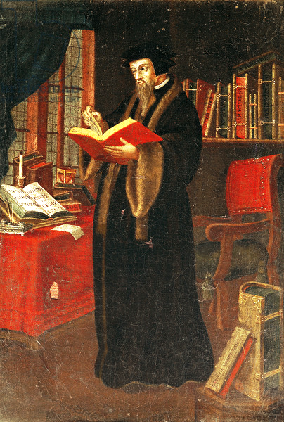
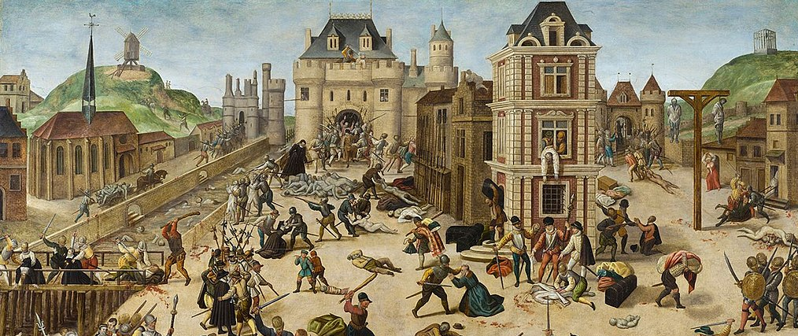
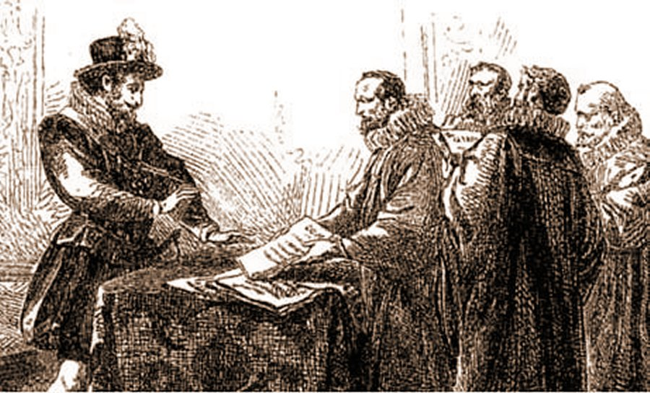
France: before 1600
1562-1598: French Wars of Religion
- French Catholics versus Protestant Huguenots
- 36 years of intermittent fighting & unrest
- foreign allies: Spain (Catholic) & England (Protestant)
- conflict ends with Edict of Nantes
- Huguenots are granted substantial rights & freedoms
- religious hostility continues
?
Followers of John Calvin’s
reformed Protestant tradition
John Calvin
Notes:
Nantes = Naan-t

Slide 43
https://en.wikipedia.org/wiki/French_Wars_of_Religion
The French Wars of Religion were a prolonged period of war and popular unrest between Catholics and Huguenots (Reformed/Calvinist Protestants) in the Kingdom of France between 1562 and 1598. It is estimated that three million people perished in this period from violence, famine, or disease in what is considered the second deadliest religious war in European history (surpassed only by the Thirty Years' War, which took eight million lives).[1]
Much of the conflict took place during the long regency of Queen Catherine de' Medici, widow of Henry II of France, for her minor sons. It also involved a dynastic power struggle between powerful noble families in the line for succession to the French throne: the wealthy, ambitious, and fervently Catholic ducal House of Guise (a cadet branch of the House of Lorraine, who claimed descent from Charlemagne) and their ally Anne de Montmorency, Constable of France (i.e., commander in chief of the French armed forces) versus the less wealthy House of Condé (a branch of the House of Bourbon), princes of the blood in the line of succession to the throne who were sympathetic to Calvinism. Foreign allies provided financing and other assistance to both sides, with Habsburg Spain and the Duchy of Savoy supporting the Guises, and England supporting the Protestant side led by the Condés and by the Protestant Jeanne d'Albret, wife of Antoine de Bourbon, King of Navarre, and her son, Henry of Navarre.
Moderates, primarily associated with the French Valois monarchy and its advisers, tried to balance the situation and avoid open bloodshed. This group (pejoratively known as Politiques) put their hopes in the ability of a strong centralized government to maintain order and harmony. In contrast to the previous hardline policies of Henri II and his father Francis I, they began introducing gradual concessions to Huguenots. A most notable moderate, at least initially, was the queen mother, Catherine de' Medici. Catherine, however, later hardened her stance and, at the time of the St. Bartholomew's Day massacre in 1572, sided with the Guises. This pivotal historical event involved a complete breakdown of state control resulting in series of riots and massacres in which Catholic mobs killed between 5,000 and 30,000 Protestants over a period of weeks throughout the entire kingdom.
At the conclusion of the conflict in 1598, the Protestant Henry of Navarre, heir to the French throne, converted to Catholicism and was crowned Henry IV of France. He issued the Edict of Nantes, which granted Huguenots substantial rights and freedoms though this did not end Catholic hostility towards them or towards him, personally. The wars of religion threatened the authority of the monarchy, already fragile under the rule of Catherine's three sons and the last Valois kings: Francis II, Charles IX, and Henry III. This changed under the reign of their Bourbon successor Henry IV. The edict of Nantes was revoked later in 1685 with the Edict of Fontainebleau by Louis XIV of France. Henry IV's wise governance and selection of able administrators did leave a legacy of a strong centralized government, stability, and economic prosperity that has gained him the reputation as France's best and most beloved monarch, earning him the designation "Good King Henry".

Slide 44
https://en.wikipedia.org/wiki/Huguenots
A term used originally in derision, Huguenot has unclear origins. Various hypotheses have been promoted. The term may have been a combined reference to the Swiss politician Besançon Hugues (died 1532) and the religiously conflicted nature of Swiss republicanism in his time. It used a derogatory pun on the name Hugues by way of the Dutch word Huisgenoten (literally housemates), referring to the connotations of a somewhat related word in German Eidgenosse (Confederates as in "a citizen of one of the states of the Swiss Confederacy").[2]
Geneva was John Calvin's adopted home and the centre of the Calvinist movement. In Geneva, Hugues, though Catholic, was a leader of the "Confederate Party", so called because it favoured independence from the Duke of Savoy. It sought an alliance between the city-state of Geneva and the Swiss Confederation. The label Huguenot was purportedly first applied in France to those conspirators (all of them aristocratic members of the Reformed Church) who were involved in the Amboise plot of 1560: a foiled attempt to wrest power in France from the influential and zealously Catholic House of Guise. This action would have fostered relations with the Swiss.
O. I. A. Roche promoted this idea among historians. He wrote in his book, The Days of the Upright, A History of the Huguenots (1965), that "Huguenot" is:
a combination of a Dutch and a German word. In the Dutch-speaking North of France, Bible students who gathered in each other's houses to study secretly were called Huis Genooten ("housemates") while on the Swiss and German borders they were termed Eid Genossen, or "oath fellows", that is, persons bound to each other by an oath. Gallicised into "Huguenot", often used deprecatingly, the word became, during two and a half centuries of terror and triumph, a badge of enduring honour and courage.
Some disagree with such double or triple non-French linguistic origins. Janet Gray argues that for the word to have spread into common use in France, it must have originated there in French. The "Hugues hypothesis" argues that the name was derived by association with Hugues Capet, king of France,[3] who reigned long before the Reformation. He was regarded by the Gallicians as a noble man who respected people's dignity and lives. Janet Gray and other supporters of the hypothesis suggest that the name huguenote would be roughly equivalent to little Hugos, or those who want Hugo.[3]
In this last connection, the name could suggest the derogatory inference of superstitious worship; popular fancy held that Huguon, the gate of King Hugo, was haunted by the ghost of le roi Huguet (regarded by Roman Catholics as an infamous scoundrel) and other spirits. Instead of being in Purgatory after death, according to Catholic doctrine, they came back to harm the living at night.[4] The prétendus réformés ("these supposedly 'reformed'") were said to gather at night at Tours, both for political purposes, and for prayer and singing psalms.[5] Reguier de la Plancha (d. 1560) in his De l'Estat de France offered the following account as to the origin of the name, as cited by The Cape Monthly:
Reguier de la Plancha accounts for it [the name] as follows: "The name huguenand was given to those of the religion during the affair of Amboyse, and they were to retain it ever since. I'll say a word about it to settle the doubts of those who have strayed in seeking its origin. The superstition of our ancestors, to within twenty or thirty years thereabouts, was such that in almost all the towns in the kingdom they had a notion that certain spirits underwent their Purgatory in this world after death, and that they went about the town at night, striking and outraging many people whom they found in the streets. But the light of the Gospel has made them vanish, and teaches us that these spirits were street-strollers and ruffians. In Paris the spirit was called le moine bourré; at Orleans, le mulet odet; at Blois le loup garon; at Tours, le Roy Huguet; and so on in other places. Now, it happens that those whom they called Lutherans were at that time so narrowly watched during the day that they were forced to wait till night to assemble, for the purpose of praying God, for preaching and receiving the Holy Sacrament; so that although they did not frighten nor hurt anybody, the priests, through mockery, made them the successors of those spirits which roam the night; and thus that name being quite common in the mouth of the populace, to designate the evangelical huguenands in the country of Tourraine and Amboyse, it became in vogue after that enterprise."[6]
Some have suggested the name was derived, with similar intended scorn, from les guenon de Hus (the monkeys or apes of Jan Hus).[7][8] By 1911, there was still no consensus in the United States on this interpretation.

Slide 45
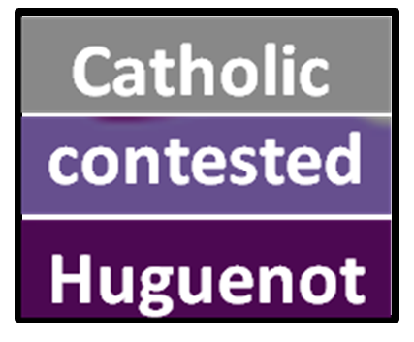
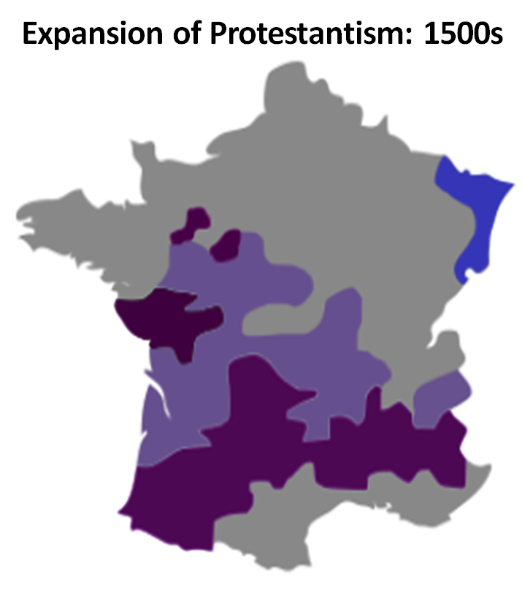
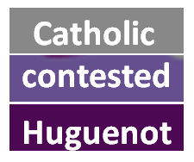
France: before 1600
1562-1598: French Wars of Religion
1000 AD
- French Catholics versus Protestant Huguenots
- 36 years of intermittent fighting & unrest
- foreign allies: Spain (Catholic) & England (Protestant)
- conflict ends with Edict of Nantes
- Huguenots are granted substantial rights & freedoms
- religious hostility continues
- isolated Royal Domain
- virtually independent
principalities
1152 AD - royal marriage
- England gains control
of French lands
shared religious persecution
Protestant strongholds
Poitou
1204 AD
Catholic minorities
- France regains its lands
1337-1453
- 100 Years’ War
1562-1598
- French Wars of Religion

Slide 46
https://en.wikipedia.org/wiki/Religion_in_France

Slide 47
https://en.wikipedia.org/wiki/French_Renaissance
RENAISSANCE IN FRANCE: 1494-1610
The French Renaissance traditionally extends from (roughly) the French invasion of Italy in 1494 during the reign of Charles VIII until the death of Henry IV in 1610. This chronology notwithstanding, certain artistic, technological or literary developments associated with the Renaissance arrived in France earlier (for example, by way of the Burgundy court or the Papal court in Avignon); however, the Black Death of the 14th century and the Hundred Years' War kept France economically and politically weak until the late 15th century.
The French Renaissance was the cultural and artistic movement in France between the 15th and early 17th centuries. The period is associated with the pan-European Renaissance, a word first used by the French historian Jules Michelet to define the artistic and cultural "rebirth" of Europe.
Notable developments during the French Renaissance include the spread of humanism, early exploration of the "New World" (as New France by Giovanni da Verrazzano and Jacques Cartier); the development of new techniques and artistic forms in the fields of printing, architecture, painting, sculpture, music, the sciences and literature; and the elaboration of new codes of sociability, etiquette and discourse.

Slide 48
France: before 1600
French Catholics will leave their homeland
1000 AD
Catholic religion
- isolated Royal Domain
- virtually independent
principalities
English
subjugation
Who will lead them?
1152 AD - royal marriage
- England gains control
of French lands
agricultural innovations
1204 AD
- France regains its lands
1337-1453
animosity
to English
- 100 Years’ War
1562-1598
religious persecution
- French Wars of Religion

Slide 49
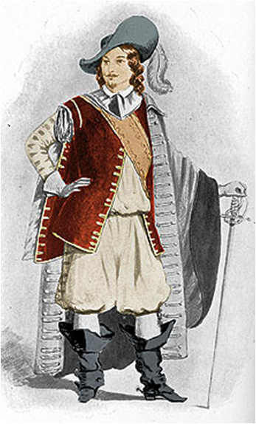
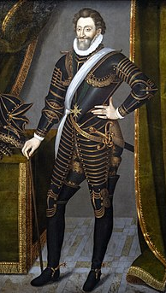
France: before 1600
French Catholics will leave their homeland
THE MIDDLE AGES
Where will they go?
Pierre Dugua
- French merchant & explorer
- born 1558 in Royan, France
Who will lead them?
- a Protestant Huguenot
- fights in Fr. Religious Wars
- marries Judith Chesnel, a
French Catholic
- French king Henri IV grants
- monopoly on fur trade
- w/obligation to colonize
Notes:
Pierre Dugua = Doo-yah or Due-ga Royan = ROY-on

Slide 50
http://www.biographi.ca/en/bio/du_gua_de_monts_pierre_1E.html
PIERRE Dugua de Monts(also known as Du Gua and de Mons), explorer, trader, governor of Acadia, and founder of the first permanent settlement in Canada; b. about 1558 in Saintonge, France, probably at Le Gua; d. 22 Feb. 1628 and was buried near his home, the Château d’Ardennes, at Fléac (Fléac-sur-Seugne, France). READ MORE ONLINE

Slide 51
https://www.thecanadianencyclopedia.ca/en/article/pierre-du-gua-de-monts
Pierre Dugua de Mons (or Du Gua de Monts), colonizer, explorer, trader (born c. 1558 in Royan, France; died 22 February1628 near Fléac-sur-Seugne, France). Pierre Dugua de Mons oversaw the founding of Port Royal, in Acadia (present-day Annapolis Royal), and Quebec City, Quebec. These two places were the first successful French settlements in North America. At a time of significant religious tension in France, there were few people involved in that kingdom’s exploration and settlement of North America that better represent the social, political and religious context of the early 17th century. Both Samuel de Champlain and Mathieu Da Costa, who are better known from this period, were de Mons’s employees and acted under his direction. De Mons’s legacy has been overshadowed by Champlain in part because Champlain wrote extensively about his work, whereas de Mons did not. In addition, in some of Champlain’s writings he replaced de Mons with himself.
De Mons was born into the turmoil of France’s Reformation and Counter-Reformation. During the Reformation, some Europeans chose to break away from the Catholic Church and become Protestants. The Counter-Reformation was a reaction to this movement, as many fought to preserve the Catholic Church’s power. In the late 1500s, France fought the Wars of Religion, a series of conflicts between Catholics and Protestants. During these wars, de Mons fought alongside King Henri IV’s royal forces. Like the King before his conversion to Catholicism in 1593, de Mons was a Protestant (also known as Huguenot). For his commitment to the Crown during the conflict, de Mons received a large pension, governorship of the town of Pons and royal patronage. Upon the King’s assassination in 1610, de Mons was banished from the royal court by Henri’s widow, Queen Marie de Medici. Champlain, however, continued to represent de Mons’s interests at court.
Much like King Henri IV, who converted from Protestantism to Catholicism to maintain the crown, de Mons married a Catholic (Judith Chesnel). When de Mons travelled to North America he went with both Protestants and Catholics.
Pierre Dugua de Mons likely traveled to North America during the late 1500s. He rose to prominence in 1603, however, when King Henri IV granted him a trading monopoly in Acadia. Acadia was a French colony that included parts of what would become Quebec, the Maritime provinces, and Maine. It was common at the time for the state to grant merchants exclusive rights to trade in order to reduce its expenses and exposure to risk. Under his commission, de Mons’s monopoly included all of the North American coastline between present-day Philadelphia and Cape Breton. In addition to trade, de Mons was to “people, cultivate, and settle the said lands as promptly, carefully, and wisely as time, place and circumstances will permit.” Under this commission he founded the Compagnie de Rouen, also known as the Compagnie de Mons.
Before de Mons received this grant, the French were focused on building relationships with the Innu at the fishing station at Tadoussac. De Mons, however, found the climate along the St. Lawrence River too harsh. He cast his eyes further south to Wabanaki and Mi’kmaw homelands, which were increasingly being claimed by the English. The formative years of his monopoly (1604–1607) focused on the area around the Bay of Fundy, specifically the St. Croix River, Saint John River, and Annapolis Basin.

Slide 52
https://en.wikipedia.org/wiki/Pierre_Dugua,_Sieur_de_Mons
Pierre Dugua de Mons (or Du Gua de Monts; c. 1558 – 1628) was a French merchant, explorer and colonizer. A Calvinist, he was born in the Château de Mons, in Royan, Saintonge (southwestern France) and founded the first permanent French settlement in Canada.
Pierre Du Gua de Mons was born about 1558 in Saintonge, France to Guy and Claire Goumard Du Gua. He fought for the cause of Henri IV during the religious wars in France. The king later awarded him an annual pension of 1,200 crowns and the governorship of the town of Pons in Saintonge in recognition of his outstanding service.
In 1603, King Henry granted Du Gua exclusive right to colonize lands in North America between 40°–60° North latitude. The King also gave Du Gua a monopoly in the fur trade for these territories and named him Lieutenant General for Acadia and New France. In return, Du Gua promised to bring 60 new colonists each year.
In 1604, Du Gua organized an expedition, underwritten by merchants in Rouen, Saint-Malo, and La Rochelle, and left France with 79 settlers including François Gravé Du Pont as senior officer, Royal cartographer Samuel de Champlain, the Baron de Poutrincourt, apothecary Louis Hébert, a priest Nicolas Aubry, and Mathieu de Costa: a legendary linguist, the first registered black man to set foot in North America, and a Protestant member of the clergy.
Entering Baie Française (the Bay of Fundy) in June 1604, he and his settlers founded a colony on St. Croix Island. Numerous settlers succumbed to the harsh winter climate and malnutrition disease as they exhausted the limited natural resources on the island. The colony moved to better land on the south shore of Baie Française at Port-Royal in 1605.
Following the disaster of the Saint Croix settlement in the winter of 1604-1605, the French began to look for a more hospitable location for a colony. During this time, they encountered Native Americans along the northeastern coast of the continent, and also had a pair of Native guides in their party, the man who is named as Panounias, and his wife who came from the part of the country they were exploring. Traveling along the coast, Samuel de Champlain is given to have recounted their meetings with the natives, noting when the languages between the groups began to vary. Also, it was noted that the Natives who lived in this area also practiced cultivation, particularly methods of farming that were new to the French explorers. It was from these signs and the trading that occurred between the French and the natives that the explorers felt as though they were on the correct track, for if the Natives were living off of this land, this area offered far more hope than Saint Croix Island ever did.
In 1606, Hendrick Lonck, the Dutch West India Company sea captain boarded two of Du Gua's boats, and pillaged them for furs and munitions. The Port-Royal settlement survived and prospered somewhat until 1607 when other merchants protested the monopoly, which the King had to revoke. As a consequence, Du Gua and the settlers had to abandon the colony and return to France.
Du Gua then turned his attention to the colony of Nouvelle-France in the St. Lawrence River valley, after ceding Port-Royal to Poutrincourt. He never came back to the New World but he sent Champlain to open a colony at Quebec in 1608, thus playing a major role in the foundation of the first permanent French colony in North America.
Henry IV appointed him as Governor of the Protestant city of Pons, Charente-Maritime from 1610 to 1617, when he retired. He then oversaw the construction of the monumental grand staircase along the ramparts near the Keep of Pons.[6] This 6 level staircase connected the once segregated upper city to the lower city. He died in 1628, in the nearby Château d'Ardenne in Fléac-sur-Seugne.

Slide 53
France: before 1600
French Catholics will leave their homeland
THE MIDDLE AGES
Where will they go?
France
Atlantic Ocean

Slide 54
New World: before 1600
France: before 1600
French Catholics will leave their homeland
Where will they go?
France
New
New
World
World
Atlantic Ocean
Who will they find living there?

Slide 55
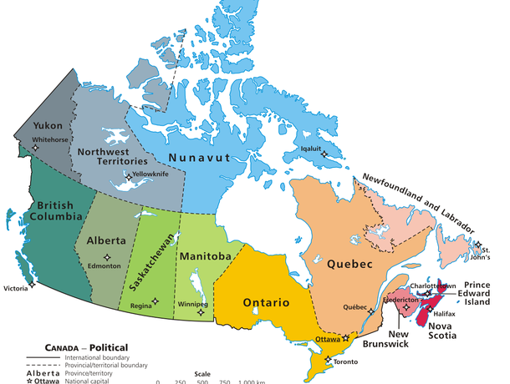
New World: before 1600
Atlantic Ocean
Who will they find living there?

Slide 56
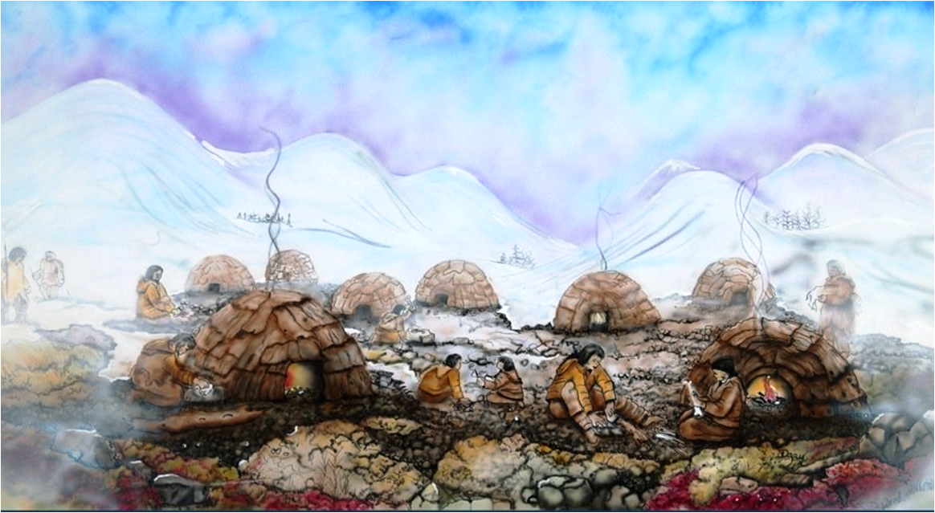
New World: before 1600
hunter-gatherer
tribes following
the caribou
human migration
13,000 years ago . . .
Last Ice Age . . .
1000 years ago . . . .

Slide 57
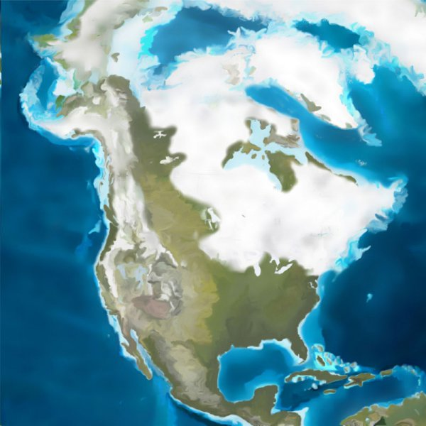
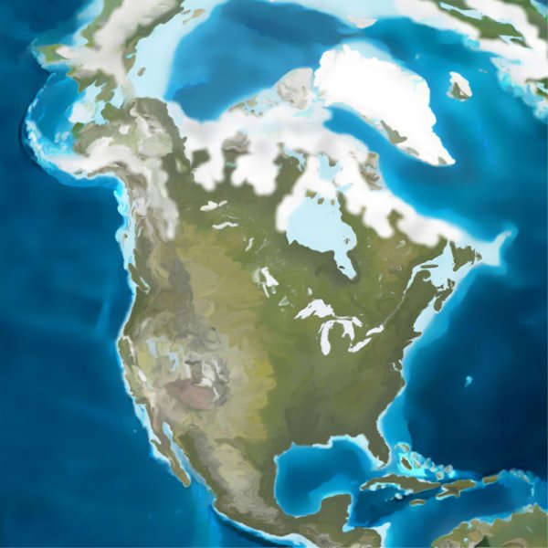
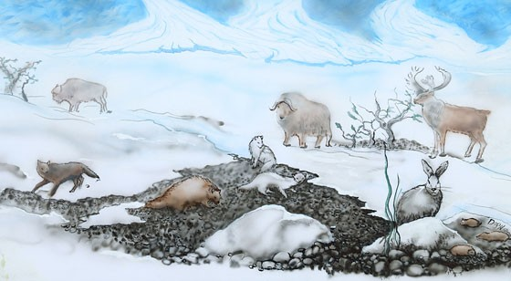

Slide 58
http://www.mikmaweydebert.ca/home/ancestors-live-here/debert/understanding-and-protecting-the-sites/
Revealing one of the largest Palaeoindian sites in North America at the time, the excavations of the original Debert site in the 1960s identified numerous features, such as fire pits (also called hearths), with large quantities of artifacts. The artifacts showed evidence of hunting, hide processing, bone and wood working, as well as more general tasks. Importantly, the excavations also employed a range of “ologists,” including geologists and soil scientists, not just archaeologists. This interdisciplinary approach to understanding the sites has continued to the present. Remarkably, the excavations and research that happened at the original Debert site continue to anchor the understanding of other sites of this age throughout northeastern North America.
https://en.wikipedia.org/wiki/Debert_Palaeo-Indian_Site
The First Peoples are thought to have migrated into the Debert area (site of a major Canadian archeological excavation site) just prior to the Younger Dryas stadial. The Palaeo-Indians possibly crossed the Bering Strait during and following the Wisconsinian Glacial Stage, where they then migrated to the southern regions of North America. Next, the Palaeo-Indians are thought to have gradually migrated east and north into what is now the Canadian Maritimes.
Archaeologists have hypothesized that these early settlers were nomadic big game hunters who relied on migrating herds of caribou for survival. Small game such as fish and fowl would have also been an important food resource for the Palaeo-Indians. To survive the freezing cold climatic conditions, the early settlers likely wore tailored clothing and constructed skin covered tents with wooden frames for shelter.
Evidence of First Peoples settlement at the Debert Palaeo Indian site has been found through examination of stone tools that are distinctive to Palaeo-Indian tool kits. Radiocarbon dating has determined that these distinctive stone tools existed approximately 10,600 years ago. Excavations recovered 4500 artifacts over 22 acres of land and found channel flutes that were consistent with the characteristics of hafted tools present on many Paleo-Indian sites. Channel fluting was a tool constructing method used by the Palaeo-Indians, which involved thinning the base of a tool by removing channel flakes so that stone tools like spear points could be attached to wood or bone shafts.
Large stone knives that were possibly used to butcher caribou were also documented as strong evidence for Palaeo-Indian occupation at the Debert site, along with the small pointed or spurred end scrapers unique to the Palaeo-Indians. These end scrapers were likely used to cleanse animal hides. Further archaeological evidence suggests that the site served as a small seasonal hunting camp, possibly re-occupied over several generations. Due to the decomposition of organic materials, stone artifacts that have survived over many decades are recognized as the most frequently documented forms of evidence at the Debert site. Evidence of organic material has also been recovered from blood residue on hunting tools that archaeologists have identified as caribou.

Slide 59
New World: before 1600
four tribes of
1st Nations people
live here!
?
Canadian name for
earliest people
Beothuk
Mi’kmaq
Maliseet
Iroquois
1000 years ago . . . .
Notes:
Beothuk = BAY-ah-thuk Mi’kmaq = mick-mack Maliseet = mal-ah-SEAT

Slide 61
New World: before 1600
1000 -
the Vikings arrive
1000
New
World
Beothuk
EUROPE
Mi’kmaq
Maliseet
Iroquois
the Vikings arrive
1000
1000 years ago . . . .
Notes:
VIKINGS: speaking the Old Norse language, people who raided and traded from their Scandinavian homelands across wide areas of northern, central and eastern Europe, during the late 8th to late 11th centuries.

Slide 62
New World: before 1600
1000 -
the Vikings arrive
- aboriginal people of Newfoundland
- summers: coastal fishermen
winters: inland hunters
- at 1st contact, population < 1000
Beothuk
- possible violent encounters with
Viking explorers
Beothuk
Mi’kmaq
- in 1500s:
- Beothuk will trade
with European fishermen
Maliseet
Iroquois
- will re-work utensils left
at European seasonal camps
Notes:
https://www.mysteriesofcanada.com/newfoundland/beothuk/

Slide 63
https://www.thecanadianencyclopedia.ca/en/article/beothuk
At the time of European contact in the early 1500s, the Beothuk occupied at least the south and northeast coasts of Newfoundland. Shortly after the Europeans’ arrival, the Beothuk moved away from their coastal homelands and ancestral fishing camps to inland territories. Possible violent encounters with the Vikings between 800 and 1000 CE caused the Beothuk to avoid the European newcomers as much as possible.
http://nationalhumanitiescenter.org/pds/amerbegin/contact/text4/norse.pdf
About 1005 Thorvald Erikson, brother of Leif, sailed from Greenland to explore the region his brother had named “Vinland.” There he and his men encountered the native inhabitants, probably the Beothuk people.
The seasonal camp that the Norse maintained for about three years at L’Anse aux Meadows on the northern tip of Newfoundland is archeologically confirmed to be the first European settlement on the mainland of North America (discovered to date).
“….. They found an anchorage for their ship (on the coast of Newfoundland), and put out the gangway to the land, and Thorvald and all of his companions went ashore. ..
“They then returned to the ship, and discovered on the sands, in beyond the headland, three mounds; they went up to these, and saw that they were three skin-canoes, with three men under each. They thereupon divided their party, and succeeded in seizing all of the men but one, who escaped with his canoe. They killed the eight men, and then ascended the headland again, and looked about them, and discovered within the firth certain hillocks, which they concluded must be habitations.
“They were then so overpowered with sleep that they could not keep awake, and all fell into a [heavy] slumber, from which they were awakened by the sound of a cry uttered above them; and the words of the cry were these: ‘Awake, Thorvald, thou and all thy company, if thou wouldst save thy life; and board thy ship with all thy men, and sail with all speed from the land!’ “A countless number of skin-canoes then advanced toward them from the inner part of the firth, whereupon Thorvald exclaimed: ‘We must put out the war-boards, on both sides of the ship,and defend ourselves to the best of our ability, but offer little attack.’ This they did, and the Skrellings [ugly wretches], after they had shot at them for a time, fled precipitately, each as best he could.”

Slide 64
https://www.heritage.nf.ca/articles/aboriginal/beothuk.php
The Beothuk are the aboriginal people of the island of Newfoundland. They were Algonkian-speaking hunter-gatherers who probably numbered less than a thousand people at the time of European contact. The Beothuk are the descendants of a Recent Indian culture called the Little Passage Complex.
The arrival of migratory European fishermen in the 16th century may have provided new opportunities for the Beothuk. These fishermen erected stages, flakes and wharves during the summer fishery, but after they left the island to return to Europe, they left behind nails, lost fish hooks, and scraps of iron and kettle. Evidence from a number of Beothuk sites indicates that the Beothuk picked up these metal objects and reworked them into arrowheads, lance points, harpoon end blades, awls and hide scrapers.
Everywhere else in North America, native people were usually eager to trade furs for metal cutting and piercing tools. The Beothuk, however, had the unusual opportunity to acquire such goods without having to exchange furs for them. This meant that they did not have to modify their traditional way of life by expending effort in the winter hunting fur-bearing animals such as lynx, marten, and the like--animals that provided little in the way of edible meat. Similarly, unlike the Mi'kmaq of the mainland, the Beothuk did not have to congregate at designated harbours to await the arrival of fur traders. This strategy often meant that the assembled Mi'kmaq would quickly exhaust local supplies of game. By contrast, the Beothuk could make a quick trip to an abandoned European fishing station to acquire the desired metal goods.
The Beothuk acquired great skill at refashioning these objects into useful tools which would have considerably increased the efficiency of their hunting technology. Iron arrow heads were much tougher than those of stone and were easily re-sharpened. Iron harpoon blades would also have been much more effective than those tipped with stone.
While the Beothuk were able to coexist with, and probably to benefit from, a migratory fishery, the beginning of year-round settlement in the 17th century meant the onset of drastic change. As the French established a base at Placentia, and English settlement extended from Conception Bay to Trinity Bay and then Bonavista Bay, the Beothuk withdrew from European contact. Lacking the contacts with traders, missionaries and government agents that were characteristic of the mainland experience, the Beothuk became increasingly isolated.
After the middle of the 18th century, as the growth of English settlement increased, the Beothuk were increasingly denied access to the vital resources of the sea. In addition, the emergence of Newfoundland furriers, or trappers, meant that the Beothuk were now increasingly competing with white Europeans who were familiar with the Newfoundland interior. The presence of trap parts in 18th and early 19th-century Beothuk sites is clear evidence of the Beothuk practice of taking furriers' traps--a practice which inevitably brought retaliation.
By the beginning of the 19th century, the Beothuk were reduced to a small refugee population living along the Exploits River system and attempting to subsist on the inadequate resources of the interior. Although a succession of Newfoundland governors had, since the middle of the 18th century, attempted to establish friendly contact with the Beothuk, it was probably too late to change a pattern which had existed for perhaps 250 years. Shanawdithit, the last known Beothuk, died in St. John's, Newfoundland in 1829.

Slide 65
New World: before 1600
1000 -
the Vikings arrive
?
1497 - Giovanni Caboto exploration
1497 - John Cabot’s exploration
Beothuk
ENGLAND
Mi’kmaq
Maliseet
Iroquois
Notes:
Giovanni Caboto = Geo-van-ee cab-oh-toe

Slide 66
https://en.wikipedia.org/wiki/John_Cabot
John Cabot (Italian: Giovanni Caboto c. 1450 – c. 1500) was an Italian navigator and explorer. His 1497 discovery of the coast of North America under the commission of Henry VII of England is the earliest known European exploration of coastal North America since the Norse visits to Vinland in the eleventh century.
http://www.bbc.co.uk/bristol/content/articles/2006/12/06/cabot_feature.shtml
On 24 June, 34 days after leaving England, Cabot sighted land and called it New-found-land. He believed it was Asia and claimed it for England. He and his crew went ashore in three places and brought back several pieces of evidence of their voyage, including a needle for making nets, a snare for catching animals and the jawbone of a whale. Cabot returned to England, presented his finds to King Henry and with more funding began to plan a second expedition.
https://canadianhistoryworkshop.wordpress.com/indigenous-people-encounter-europeans/mikmaq/
The first recorded encounter of the Mi’kmaq with European, was with John Cabot on June 24, 1497. An Italian-born English explorer, Cabot initially set sail in hopes of finding a quick route to the orient. Instead, he landed on what is now known as North America and met people of the rising sun: the Mi’kmaq, who reside on the north eastern shore of what we now know as Canada! Cabot was sponsored by the English King Henry VIII to find the riches of the orient, but the encounter brought him different riches, oceans full of cod, and land filled with fur bearing animals. These ‘tales of riches’ where brought back to Europe, and captured the interest of many explorers who followed there after.

Slide 67
New World: before 1600
1000 -
the Vikings arrive
2
1497 - John Cabot’s exploration
- Italian explorer, chartered by England’s
King Henry VII
- 1st to explore mainland North America
since Vikings, 500 years before
- Discovers needle for fishing nets,
animal snare, & jawbone of a whale
Beothuk
- RESULTS of exploration:
- shorter (northern) route than
Columbus’ southern route
- facilitates the earliest English
colonies in N. America
- claims Canada for England
Mi’kmaq
Maliseet
Iroquois
Notes:
John Cabot is known today as Giovanni Caboto in Italian

Slide 68
New World: before 1600
1000 -
the Vikings arrive
1497 - John Cabot’s exploration
1524 - G. da Verrazano exploration
- Italian explorer, chartered by French King
to find a ‘sea route to the Pacific Ocean’
?
- RESULTS of exploration:
- meets several Native American Tribes
- does not disembark along Canada
1803
??
Northwest Passage
Beothuk
- names this northern area Arcadia:
“an idyllic, unspoiled wilderness”
Mi’kmaq
Maliseet
Iroquois
Notes:
Giovanni da Verrazzano

Slide 69
New World: before 1600
1000 -
the Vikings arrive
1497 - John Cabot’s exploration
1524 - G. da Verrazano exploration
- Italian explorer, chartered by French King
to find a ‘sea route to the Pacific Ocean’
- RESULTS of exploration:
- meets several Native American Tribes
- does not disembark along Canada
Beothuk
- names this northern area Arcadia:
“an idyllic, unspoiled wilderness”
Mi’kmaq
- cartographers soon ascribe the name
to the area of the Maritime Provinces
Maliseet
Iroquois

Slide 70
https://www.utpjournals.press/doi/abs/10.3138/9616-83R9-8772-1G2J
Acadia is a name that has been used for nearly 400 years in the area of the Maritime Provinces. There is strong evidence that it derives from Archadia (Arcadia), given by Giovanni da Verrazzano in 1524 when he sighted an ideal landscape described in classical literature. Cartographers applied it to a region south of New France. In the early 1600s Sieur de Monts found it to be a useful designation for a new colonization scheme between New France and the Spanish possessions.
https://en.wikipedia.org/wiki/Giovanni_da_Verrazzano
Giovanni da Verrazzano is renowned as the first European to explore the Atlantic coast of North America between Florida and New Brunswick.
Competition in trade was becoming urgent (between European countries), especially with Portugal. King Francis I of France was impelled by French merchants and financiers from Lyon and Rouen who were seeking new trade routes, so he asked (Giovanni da) Verrazzano in 1523 to make plans to explore (on France's behalf) an area between Florida and Terranova, the "New Found Land", with the goal of finding a sea route to the Pacific Ocean.
… Verrazzano's ship La Dauphine departed (Madiera) on January 17, 1524,(heading) for the North American continent. It neared the area of Cape Fear on about March 1.
… Continuing to explore the coast further northwards, Verrazzano and his crew came into contact with Native Americans living on the coast. However, he did not notice the entrances to the Chesapeake Bay or the mouth of the Delaware River.
…. (He) followed the coast up to modern Maine, southeastern Nova Scotia, and Newfoundland, after which he returned to France by 8 July 1524.
https://www.thecanadianencyclopedia.ca/en/article/history-of-acadia
History of the Name "Acadia"
Acadia has its origins in the explorations of Giovanni da Verrazzano, an Italian explorer serving the king of France. In 1524-25 he explored the Atlantic coast of North America and gave the name "Archadia", or “Arcadia” in Italian, to a region near the present-day American state of Delaware. In 1566, the cartographer Bolongnini Zaltieri gave a similar name, "Larcadia," to an area far to the northeast that was to become Nova Scotia and New Brunswick. The 1524 notes of Portuguese explorer Estêvão Gomes also included Newfoundland as part of the area he called “Arcadie”.
https://en.wikipedia.org/wiki/Arcadia_(utopia)
The 16th-century Italian explorer Giovanni da Verrazzano applied the name "Arcadia" to the entire North American Atlantic coast north of Virginia. In time, this mutated to Acadia. The Dictionary of Canadian Biography says: "Arcadia, the name Verrazzano gave to Maryland or Virginia 'on account of the beauty of the trees', made its first cartographical appearance in the 1548 Gastaldo map and is the only name on that map to survive in Canadian usage. . . . In the 17th century Champlain fixed its present orthography, with the 'r' omitted, and Ganong has shown its gradual progress northwards, in a succession of maps, to its resting place in the Atlantic Provinces".
Revival of Mi'kmaw language has provided strong reason to believe that Verrazzano was informed by the name the Mi'kmaq gave to this place. The name Acadie may be derived from the Mi'kmaq, because in their language the word “cadie” means "place of abundance” and can be found in names such as “Tracadie” and “Shubenacadie”

Slide 71
New World: before 1600
1000 -
the Vikings arrive
1497 - John Cabot’s exploration
1524 - G. da Verrazano exploration
1534 - Jacques Cartier’s exploration s
- French explorer, chartered by King Francis 1
Experiences w/ First Nations Tribes
- 1st trip: travels inland, along St Lawrence
- returns to France with two native captives
- 2nd trip: spends bitter winter along River
Beothuk
- 3rd trip: leads French settlers to New World
Mi’kmaq
- RESULTS of exploration:
- French colony fails within 1 year
- no further French exploration for 50 yrs
- claims Canada for France
Maliseet
Iroquois

Slide 72
https://www.britannica.com/biography/Jacques-Cartier
Jacques Cartier, (1491-1557), French mariner, whose explorations of the Canadian coast and the St. Lawrence River (1534, 1535, 1541–42) laid the basis for later French claims to North America (see New France). Cartier also is credited with naming Canada, though he used the name—derived from the Huron-Iroquois kanata, meaning a village or settlement—to refer only to the area around what is now Quebec city.
Cartier appears to have voyaged to the Americas, particularly Brazil, prior to his three major North American voyages. When King Francis I of France decided in 1534 to send an expedition to explore the northern lands in the hope of discovering gold, spices, and a passage to Asia, Cartier received the commission. He sailed from Saint-Malo on April 20, 1534, with two ships and 61 men. Reaching North America a few weeks later, Cartier traveled along the west coast of Newfoundland, discovered Prince Edward Island, and explored the Gulf of St. Lawrence as far as Anticosti Island. Having seized two [Iroquois] Indians at the Gaspé Peninsula, he sailed back to France.
His report piqued the curiosity of Francis I sufficiently for him to send Cartier back the following year, with three ships and 110 men, to explore further. Guided by the two Indians he had brought back, he sailed up the St. Lawrence as far as Quebec and established a base near an Iroquois village. In September he proceeded with a small party as far as the island of Montreal, where navigation was barred by rapids. He was warmly welcomed by the resident Iroquois, but he spent only a few hours among them before returning to winter at his base. He had, however, learned from the Indians that two rivers led farther west to lands where gold, silver, copper, and spices abounded.
The severity of the winter came as a terrible shock; no Europeans since the Vikings had wintered that far north on the American continent, and a mild winter was expected because Quebec lay at a lower latitude than Paris. Scurvy claimed 25 of Cartier’s men. To make matters worse, the explorers earned the enmity of the Iroquois. Thus, in May, as soon as the river was free of ice, they treacherously seized some of the Iroquois chiefs and sailed for France. Cartier was able to report only that great riches lay farther in the interior and that a great river, said to be 800 leagues (about 2,000 miles [3,200 km]) long, possibly led to Asia.
War in Europe prevented Francis I from sending another expedition until 1541. This time, to secure French title against the counterclaims of Spain, he commissioned a nobleman, Jean-François de La Rocque de Roberval, to establish a colony in the lands discovered by Cartier, who was appointed Roberval’s subaltern. Cartier sailed first, arriving at Quebec on August 23; Roberval was delayed until the following year. Cartier again visited Montreal, but as before he remained only a few hours and failed to go even the few miles necessary to get beyond the rapids. The subsequent maps based on the knowledge he provided fail to indicate that he had reached a large island at the confluence of the Ottawa and St. Lawrence rivers.
The winter at his new base above Quebec proved as severe as the earlier one. Cartier appears to have been unable to maintain discipline among his men, and their actions again aroused the hostility of the local Indians. But what were thought to be gold and diamonds were found in abundance. In the spring, not waiting for Roberval to arrive with the main body of colonists, Cartier abandoned the base and sailed for France. En route he stopped at Newfoundland, where he encountered Roberval, who ordered him back to Quebec. Cartier, however, stole away during the night and continued back to France. There, his mineral specimens were found to be valueless. Roberval enjoyed no better success. After one winter he abandoned the plan to found a colony and returned to France. The disappointment at these meager results was very great. Not for more than half a century did France again show interest in these new lands.
Cartier received no new commissions from the crown. He apparently spent his remaining years attending to his business affairs at his estate near Saint-Malo. His claim to fame rests on his exploration of the St. Lawrence River to the height of navigation. Yet his failure to proceed any farther (when it would have been easy to do so), his treacherous dealings with the Iroquois, and his leaving Roberval in the lurch detract somewhat from his stature.

Slide 73
https://en.wikipedia.org/wiki/Jacques_Cartier
On October 17, 1540, Francis ordered the navigator Jacques Cartier to return to Canada to lend weight to a colonization project of which he would be "captain general". However, January 15, 1541, saw Cartier supplanted by Jean-François de La Rocque de Roberval, a Huguenot courtier and friend of the king named as the first lieutenant general of French Canada. Roberval was to lead the expedition, with Cartier as his chief navigator. While Roberval waited for artillery and supplies, he gave permission to Cartier to sail on ahead with his ships.[24]
On May 23, 1541, Cartier departed Saint-Malo on his third voyage with five ships. This time, any thought of finding a passage to the Orient was forgotten. The goals were now to find the "Kingdom of Saguenay" and its riches, and to establish a permanent settlement along the St. Lawrence River.[25]
Anchoring at Stadacona, Cartier again met the Iroquoians, but found their "show of joy" and their numbers worrisome, and decided not to build his settlement there. Sailing a few kilometres up-river to a spot he had previously observed, he decided to settle on the site of present-day Cap-Rouge, Quebec. The convicts and other colonists were landed, the cattle that had survived three months aboard ship were turned loose, earth was broken for a kitchen garden, and seeds of cabbage, turnip, and lettuce were planted. A fortified settlement was thus created and was named Charlesbourg-Royal. Another fort was also built on the cliff overlooking the settlement, for added protection.
The men also began collecting what they believed to be diamonds and gold, but which upon return to France were discovered to be merely quartz crystals and iron pyrites, respectively — which gave rise to a French expression: "faux comme les diamants du Canada" ("As false as Canadian diamonds"). Two of the ships were sent on their journey home with some of these minerals on September 2.
Having set tasks for everyone, Cartier left with the longboats for a reconnaissance in search of "Saguenay" on September 7. Having reached Hochelaga, he was prevented by bad weather and the numerous rapids from continuing up to the Ottawa River.
Returning to Charlesbourg-Royal, Cartier found the situation ominous. The Iroquoians no longer made friendly visits or peddled fish and game, but prowled about in a sinister manner. No records exist about the winter of 1541–1542 and the information must be gleaned from the few details provided by returning sailors. It seems the natives attacked and killed about 35 settlers before the Frenchmen could retreat behind their fortifications. Even though scurvy was cured through the native remedy (Thuja occidentalis infusion), the impression left is of a general misery, and of Cartier's growing conviction that he had insufficient manpower either to protect his base or to go in search of the Saguenay Kingdom.
Cartier left for France in early June 1542, encountering Roberval and his ships along the Newfoundland coast, at about the time Roberval marooned Marguerite de La Rocque. Despite Roberval's insistence that he accompany him back to Saguenay, Cartier slipped off under the cover of darkness and continued on to France, still convinced his vessels contained a wealth of gold and diamonds. He arrived there in October, in what proved to be his last voyage. Meanwhile, Roberval took command at Charlesbourg-Royal, but it was abandoned in 1543 after disease, foul weather and hostile natives drove the would-be settlers to despair.[

Slide 74
New World: before 1600
1534 - Jacques Cartier’s exploration s
Experiences w/ First Nations Tribes
Iroquois
- 1st voyage: takes 2 Iroquois boys as
back to France
Beothuk
- 2st voyage: returns to Iroquois w/boys;
spends winter near Iroquois;
kidnaps 9 Iroquois to France;
8 of 9 Iroquois die in France
Mi’kmaq
Maliseet
Iroquois
- 3rd voyage: relations with Iroquois
deteriorate; little contact

Slide 75
https://en.wikipedia.org/wiki/Jacques_Cartier
FIRST VOYAGE, 1534
On April 20, 1534,[13] Cartier set sail under a commission from the king, hoping to discover a western passage to the wealthy markets of Asia.[14] In the words of the commission, he was to "discover certain islands and lands where it is said that a great quantity of gold and other precious things are to be found".
It took him twenty days to sail across the ocean. Starting on May 10 of that year, he explored parts of Newfoundland, areas that now comprise the Canadian Atlantic provinces and the Gulf of St. Lawrence. During one stop at Îles aux Oiseaux (Islands of the Birds, now the Rochers-aux-Oiseaux federal bird sanctuary, northeast of Brion Island in the Magdalen Islands), his crew slaughtered around 1000 birds, most of them great auks (extinct since 1852). Cartier's first two encounters with aboriginal peoples in Canada on the north side of Chaleur Bay, most likely the Mi'kmaq, were brief; some trading occurred.
His third encounter took place on the shores of Gaspé Bay with a party of St. Lawrence Iroquoians, where on July 24, he planted a cross to claim the land for France.[15] The 10-meter cross bearing the words "Long Live the King of France" took possession of the territory in the name of the king. The change in mood was a clear indication that the Iroquoians understood Cartier's actions. Here he kidnapped the two sons of their captain.[16] Cartier wrote that they later told him this region where they were captured (Gaspé) was called by them Honguedo. The natives' captain at last agreed that they could be taken, under the condition that they return with European goods to trade. Cartier returned to France in September 1534, sure that he had reached an Asian land.
SECOND VOYAGE, 1535–1536
Jacques Cartier set sail for a second voyage on May 19 of the following year with three ships, 110 men, and his two Iroquoian captives. Reaching the St. Lawrence, he sailed up-river for the first time, and reached the Iroquoian capital of Stadacona, where Chief Donnacona ruled.
Cartier left his main ships in a harbour close to Stadacona, and used his smallest ship to continue on to Hochelaga (now Montreal), arriving on October 2, 1535. Hochelaga was far more impressive than the small and squalid village of Stadacona, and a crowd of over a thousand came to the river edge to greet the Frenchmen. The site of their arrival has been confidently identified as the beginning of the Sainte-Marie Sault – where the bridge named after him now stands. The expedition could proceed no further, as the river was blocked by rapids. So certain was Cartier that the river was the Northwest Passage and that the rapids were all that was preventing him from sailing to China, that the rapids and the town that eventually grew up near them came to be named after the French word for China, La Chine: the Lachine Rapids and the town of Lachine, Quebec.
After spending two days among the people of Hochelaga, Cartier returned to Stadacona on October 11. It is not known exactly when he decided to spend the winter of 1535–1536 in Stadacona, and it was by then too late to return to France. Cartier and his men prepared for the winter by strengthening their fort, stacking firewood, and salting down game and fish.
From mid-November 1535 to mid-April 1536, the French fleet lay frozen solid at the mouth of the St. Charles River, under the Rock of Quebec. Ice was over a fathom (1.8 m) thick on the river, with snow four feet (1.2 m) deep ashore. To add to the misery, scurvy broke out – first among the Iroquoians, and then among the French. Cartier estimated the number of dead Iroquoians at 50. On a visit by Domagaya to the French fort, Cartier inquired and learned from him that a concoction made from a tree known as annedda, probably Spruce beer,[20] or arbor vitae, would cure scurvy. This remedy likely saved the expedition from destruction, allowing 85 Frenchmen to survive the winter. In his journal, Cartier states that by mid-February, "out of 110 that we were, not ten were well enough to help the others, a pitiful thing to see". The Frenchmen used up the bark of an entire tree in a week on the cure, and the dramatic results prompted Cartier to proclaim it a Godsend, and a miracle.
Ready to return to France in early May 1536, Cartier decided to kidnap Chief Donnacona and take him to France,[23] so that he might personally tell the tale of a country further north, called the "Kingdom of Saguenay", said to be full of gold, rubies and other treasures. After an arduous trip down the St. Lawrence and a three-week Atlantic crossing, Cartier and his men arrived in Saint-Malo on July 15, 1536, concluding the second, 14-month voyage, which was to be Cartier's most profitable.
THIRD VOYAGE, 1541–1542
On October 17, 1540, Francis ordered the navigator Jacques Cartier to return to Canada to lend weight to a colonization project of which he would be "captain general". However, January 15, 1541, saw Cartier supplanted by Jean-François de La Rocque de Roberval, a Huguenot courtier and friend of the king named as the first lieutenant general of French Canada. Roberval was to lead the expedition, with Cartier as his chief navigator. While Roberval waited for artillery and supplies, he gave permission to Cartier to sail on ahead with his ships.
On May 23, 1541, Cartier departed Saint-Malo on his third voyage with five ships. This time, any thought of finding a passage to the Orient was forgotten. The goals were now to find the "Kingdom of Saguenay" and its riches, and to establish a permanent settlement along the St. Lawrence River.
Anchoring at Stadacona, Cartier again met the Iroquoians, but found their "show of joy" and their numbers worrisome, and decided not to build his settlement there. Sailing a few kilometres up-river to a spot he had previously observed, he decided to settle on the site of present-day Cap-Rouge, Quebec. The convicts and other colonists were landed, the cattle that had survived three months aboard ship were turned loose, earth was broken for a kitchen garden, and seeds of cabbage, turnip, and lettuce were planted. A fortified settlement was thus created and was named Charlesbourg-Royal. Another fort was also built on the cliff overlooking the settlement, for added protection.
The men also began collecting what they believed to be diamonds and gold, but which upon return to France were discovered to be merely quartz crystals and iron pyrites, respectively — which gave rise to a French expression: "faux comme les diamants du Canada" ("As false as Canadian diamonds"). Two of the ships were sent on their journey home with some of these minerals on September 2.
Having set tasks for everyone, Cartier left with the longboats for a reconnaissance in search of "Saguenay" on September 7. Having reached Hochelaga, he was prevented by bad weather and the numerous rapids from continuing up to the Ottawa River.
Returning to Charlesbourg-Royal, Cartier found the situation ominous. The Iroquoians no longer made friendly visits or peddled fish and game, but prowled about in a sinister manner. No records exist about the winter of 1541–1542 and the information must be gleaned from the few details provided by returning sailors. It seems the natives attacked and killed about 35 settlers before the Frenchmen could retreat behind their fortifications. Even though scurvy was cured through the native remedy (Thuja occidentalis infusion), the impression left is of a general misery, and of Cartier's growing conviction that he had insufficient manpower either to protect his base or to go in search of the Saguenay Kingdom.
Cartier left for France in early June 1542, encountering Roberval and his ships along the Newfoundland coast, at about the time Roberval marooned Marguerite de La Rocque. Despite Roberval's insistence that he accompany him back to Saguenay, Cartier slipped off under the cover of darkness and continued on to France, still convinced his vessels contained a wealth of gold and diamonds. He arrived there in October, in what proved to be his last voyage. Meanwhile, Roberval took command at Charlesbourg-Royal, but it was abandoned in 1543 after disease, foul weather and hostile natives drove the would-be settlers to despair.
LEGACY
Having already located the entrance to the St. Lawrence on his first voyage, he now opened up the greatest waterway for the European penetration of North America. He produced an intelligent estimate of the resources of Canada, both natural and human, albeit with a considerable exaggeration of its mineral wealth. While some of his actions toward the St. Lawrence Iroquoians were dishonourable, he did try at times to establish friendship with them and other native peoples living along the St. Lawrence River—an indispensable preliminary to French settlement in their lands.
Cartier was the first to document the name Canada to designate the territory on the shores of the St-Lawrence River. The name is derived from the Huron-Iroquois word "kanata", or village, which was incorrectly interpreted as the native term for the newly discovered land.[29] Cartier used the name to describe Stadacona, the surrounding land and the river itself. And Cartier named "Canadiens" the inhabitants (Iroquoians) he had seen there. Thereafter the name Canada was used to designate the small French colony on these shores, and the French colonists were called Canadiens, until the mid-nineteenth century, when the name started to be applied to the loyalist colonies on the Great Lakes and later to all of British North America. In this way Cartier is not strictly the European discoverer of Canada as this country is understood today, a vast federation stretching a mari usque ad mare (from sea to sea). Eastern parts had previously been visited by the Norse, as well as Basque, Galician and Breton fishermen, and perhaps the Corte-Real brothers and John Cabot (in addition of course to the Natives who first inhabited the territory). Cartier's particular contribution to the discovery of Canada is as the first European to penetrate the continent, and more precisely the interior eastern region along the St. Lawrence River. His explorations consolidated France's claim of the territory that would later be colonized as New France, and his third voyage produced the first documented European attempt at settling North America since that of Lucas Vázquez de Ayllón in 1526–27.
Cartier's professional abilities can be easily ascertained. Considering that Cartier made three voyages of exploration in dangerous and hitherto unknown waters without losing a ship, and that he entered and departed some 50 undiscovered harbors without serious mishap, he may be considered one of the most conscientious explorers of the period.
Cartier was also one of the first to formally acknowledge that the New World was a separate land mass from Europe/Asia.
REDISCOVERY OF CARTIER'S FIRST COLONY
On August 18, 2006, Quebec Premier Jean Charest announced that Canadian archaeologists had discovered the precise location of Cartier's lost first colony of Charlesbourg-Royal.[30] The colony was built at the confluence of the Rivière du Cap Rouge with the St. Lawrence River and is based on the discovery of burnt wooden timber remains that have been dated to the mid-16th century, and a fragment of a decorative Istoriato plate manufactured in Faenza, Italy, between 1540 and 1550, that could only have belonged to a member of the French aristocracy in the colony. Most probably this was the Sieur de Roberval, who replaced Cartier as the leader of the settlement.[31] This colony was the first known European settlement in modern-day Canada since the c.1000 AD L'Anse aux Meadows Viking village in northern Newfoundland. Its rediscovery has been hailed by archaeologists as the most important find in Canada since the L'Anse aux Meadows rediscovery.

Slide 76
New World: before 1600
1534 - Jacques Cartier’s exploration s
Experiences w/ First Nations Tribes
Iroquois
- St Lawrence Iroquois
- < 10,000 tribe members
- permanent walled villages
- extended families live in
‘long houses’
- agrarian society
Iroquois
- grow ‘the Three Sisters’

Slide 78
https://en.wikipedia.org/wiki/St._Lawrence_Iroquoians
The St. Lawrence Iroquoians were an Indigenous people who existed from the 14th century to about 1580. They concentrated along the shores of the St. Lawrence River in present-day Quebec and Ontario, Canada, the American state of New York, and northernmost Vermont. They spoke Laurentian languages, a branch of the Iroquoian family. The Pointe-à-Callière Museum estimated their numbers as 120,000 people in 25 nations occupying an area of 230,000 square kilometres (89,000 sq mi). However, that estimate of the number of St. Lawrence Iroquoians and the area they controlled is believed exaggerated by many scholars. The current archaeological evidence indicates that the largest known village had a population of about 1,000 and their total population was 8,000–10,000. The traditional view is that they disappeared because of late 16th century warfare by the Mohawk nation of the Haudenosaunee, which wanted to control trade with Europeans in the valley.
Knowledge about the St. Lawrence Iroquoians has been constructed from the studies of surviving oral accounts of the historical past from the current Native people, writings of the French explorer Jacques Cartier, earlier histories, and anthropologists' and other scholars' work with archaeological and linguistic studies since the 1950s.
Archaeological evidence has established that the St. Lawrence Iroquoians were a people distinct from the other regional Iroquoian peoples, the Five Nations of the Haudenosaunee and the Wendat (Huron). However, recent archaeological finds suggest distinctly separate groups may have existed among the St. Lawrence Iroquoians as well. The name "St Lawrence Iroquoians" refers to a geographic area in which the inhabitants shared some cultural traits, including a common language, but were not politically united.
The name of the country of Canada is probably derived from the Iroquoian word kanata which means village or settlement.
Since the 1950s, anthropologists, archaeologists, linguists and ethnohistorians have combined multidisciplinary research to conclude that "a wholly indigenous and discrete Iroquoian people were present in the St Lawrence Valley when Cartier arrived. The current anthropological convention is to designate these people St Lawrence Iroquoians, all the while being aware that on-going archaeological research indicates that several discrete Iroquoian political entities were present in a number of widely dispersed geographical regions on the St Lawrence River axis."
As noted, anthropologists and some historians have used definitive linguistic and archaeological studies to reach consensus that the St. Lawrence Iroquoians were a people distinct from nations of the Iroquois Confederacy or the Huron, and likely consisted of numerous groups. Pendergast notes that while Iroquoians and topical academics have mostly reached consensus on this theory, some historians have continued to publish other theories and ignore the archaeological evidence.[11] The St. Lawrence Iroquoians did share many cultural, historical, and linguistic aspects with other Iroquoian groups; for example, their Laurentian languages were part of the Iroquoian family and aspects of culture and societal structure were similar.
The St. Lawrence Iroquoians appear to have disappeared from the St. Lawrence valley some time prior to 1580. Champlain reported no evidence of Native habitation in the valley. By then the Haudenosaunee used it as a hunting ground and avenue for war parties.
As the historian Pendergast argues, the determination of identity for the St. Lawrence Iroquoians is important because, "our understanding of relations between Europeans and Iroquoians during the contact era throughout Iroquoia hinges largely upon the tribe or confederacy to which Stadacona and Hochelaga are attributed.“
By 1250 or 1300 maize was being grown in what would become the Quebec City area. By about 1300, four distinct subculture areas of St. Lawrence Iroquoian culture existed: (1) Jefferson County, New York with a population of about 2,500;, Grenville County, Ontario with a population of 2,500; the Lake St. Francis basin west of Montreal with a population of 1,000; and the Montreal and Quebec city areas with a population of 2,000 to 3,000.[13] There were also settlements in northernmost Vermont and neighboring Ontario near Lake Champlain.
Most of the St. Lawrence Iroquoian villages were located in inland locations a few kilometers from the river itself. By the end of the 15th century they were encircled by earthworks and palisades, indicating a need for defense. The villages usually were 2 hectares (4.9 acres) to 3.25 hectares (8.0 acres) in area. Inside the palisades the St. Lawrence people lived in longhouses, typical of other neighboring Iroquoian peoples. The longhouses were 18 metres (59 ft) to 41 metres (135 ft) in length and each housed several families.[15] Archaeologists have estimated that villages had an average population of 150-250 people although a few larger villages housed considerably more.
The Iroquoians occupied their villages for ten or more years until their longhouses deteriorated and the fertility of the soil for their crops declined. Then, they built a new village and cleared land for crops, usually only a few miles from their previous home[17] The frequent changes of location has given problems to archaeologists in estimating the numbers on the St. Lawrence Iroquoian people. Dating techniques may not be precise enough to determine whether villages were occupied simultaneously or sequentially.
In addition to the characteristic villages, the St. Lawrence Iroquoian peoples had "a mixed economy, in which they drew their subsistence from growing maize, squash, and beans, hunting, fishing, and gathering. These nations also had in common a matrilineal, clan-based social organization, and a political system sufficiently structured to permit confederation at times. Most of them engaged in guerrilla warfare, grew and used tobacco, and produced pottery vessels."[19] Sunflowers were also grown for their oily seeds. Investigations at several former settlements have indicated that their most important foods were maize and fish. They hunted white-tailed deer and other game.
The St. Lawrence Iroquoians were not united politically and villages and cultural groups may have been unfriendly and competitive with each other, as well as being hostile to the neighboring Algonquian peoples and other Iroquoian groups.
By the time the explorer Samuel de Champlain arrived and founded Quebec in 1608, he found no trace of the St. Lawrence Iroquoians and settlements visited by Cartier some 75 years earlier. Historians and other scholars have developed several theories about their disappearance: devastating wars with the Iroquois tribes to the south or with the Hurons to the west, the impact of epidemics of Old World diseases, or their migration westward toward the shores of the Great Lakes.
Archaeological evidence and the historical context of the time point most strongly to wars with the neighbouring Iroquois tribes, particularly the Mohawk. Located in eastern and central New York, they had the most to gain in war against the St. Lawrence Iroquians, as they had the least advantageous territorial position in the area in relation to hunting and the fur trade along the St. Lawrence River. The Mohawk wanted to get more control of the St. Lawrence trade routes connecting to the Europeans. During this period, Champlain reported that the Algonquian peoples were fearful of the powerful Iroquois. The anthropologist Bruce G. Trigger believes the political dynamics were such that the Huron were unlikely to enter Iroquois territory to carry out an attack against the St. Lawrence people to the north. In the mid- to late-16th century, the St. Lawrence Valley was likely an area of open conflict among tribes closer to the river. Because nothing remained of their settlements, the St. Lawrence Iroquoians appeared to have been overwhelmed by other groups. Some St. Lawrence Iroquoian survivors may have joined the neighbouring Mohawk and Algonquin tribes, by force or by mutual agreement. By the time Champlain arrived, the Algonquins and Mohawks were both using the Saint-Lawrence Valley for hunting grounds, as well as a route for war parties and raiding.

Slide 79
New World: before 1600
1534 - Jacques Cartier’s exploration s
Experiences w/ First Nations Tribes
Mi’kmaq
- 2 brief trading encounters w/Mi’kmaq
- meets Henri Membertou
Mi’kmaq
Iroquois

Slide 80
New World: before 1600
Mi’kmaq
- lands of the Mi’kmaq → Mi'kma'ki
- large coastal fishing communities
- seasonal wigwam habitations
Mi’kmaq
- small interior winter hunting camps
- lands of the Mi’kmaq → Mi'kma'ki
Notes:
a dome-shaped hut or tent made by fastening mats, skins, or bark over a framework of poles (as used formerly by some North American Indian people

Slide 81
https://www.heritage.nf.ca/articles/aboriginal/mikmaq-history.php
https://novascotia.ca/museum/mikmaq/default.asp?section=thumb&page=17&region=&period=
https://hosted.learnquebec.ca/societies/societies/mikmaq-around-1980/the-mikmaq-gaspes-first-settlers/
a dome-shaped hut or tent made by fastening mats, skins, or bark over a framework of poles (as used formerly by some North American Indian people

Slide 82
https://www.quora.com/Where-did-French-Acadians-originally-come-from
Unama'gi (Unama'kik), Esge'gewa'gi (Eskikewa'kik), Sugapune'gati (Sipekni'katik), Epegwitg aq Pigtug (Epekwitk aq Piktuk), Gespugwi'tg (Kespukwitk), Signigtewa'gi (Siknikt) and Gespe'gewa'gi (Kespek)

Slide 83
New World: before 1600
Mi’kmaq
Henri Membertou
- lands of the Mi’kmaq → Mi'kma'ki
- pre-contact population ~20,000
- seven traditional districts
- independent governments & borders
- each with district chief & council
- Grand Council of district chiefs

Slide 84
http://www.mikmaweydebert.ca/home/ancestors-live-here/debert/an-ice-age-world/
Present-day Mi’kma’ki was formed largely through the actions of glaciers that have advanced and retreated over large parts of North America for hundreds of thousands of years. Most recently, the glaciers melted away and retreated northward between 13,000 and 9,000 years ago. The movement and melting of the glaciers changed sea levels, temperature, precipitation, and greatly influenced the animals and plants that could survive in Mi’kma’ki.
The period between 13,000 and 9,000 years ago was a time of extreme climate change. After the glaciers reached their greatest extent (about 21,000 years ago), they slowly melted and retreated over thousands of years. By 13,000 years ago, Mi’kma’ki was quite warm (almost as warm as today), but then, very suddenly, the area was plunged into a mini-ice-age, which scientists call the Younger Dryas and lasted for about 1,000 years. Curiously, the dates for this mini-ice age correspond very closely to the dates at the Debert sites. After this time, Mi’kma’ki becomes increasingly warmer.
The process of deglaciation is not just about the ice melting, or retreating. When the ice retreats, it is so heavy that the land actually bounces back—a process called isostatic rebound. In addition, as glaciers melt, they add water to the oceans raising sea levels across the globe. This complex interplay of ice retreat and land and sea levels rising exposes land masses such as Georges Bank at certain times and then covers them with water at other times. It is almost as if the land and sea levels are competing with each other—whether we have new land areas emerging or increasing sea levels is just a question of which one is rising faster at any given time.

Slide 85
https://en.wikipedia.org/wiki/Mi%EA%9E%8Ckmaq
The Miꞌkmaq are a First Nations people of the Northeastern Woodlands, indigenous to the areas now known as Canada's Atlantic Provinces and the Gaspé Peninsula of Quebec as well as the northeastern region of Maine. They call their national territory Miꞌkmaꞌki.
Archaeologist Dean Snow says that the fairly deep linguistic split between the Miꞌkmaq and the Eastern Algonquians to the southwest suggests the Miꞌkmaq developed an independent prehistoric sequence in their territory. It emphasized maritime orientation, as the area had relatively few major river systems. According to ethnologist T. J. Brasser, as the indigenous people lived in a climate unfavorable for agriculture, small semi-nomadic bands of a few patrilineally related families subsisted on fishing and hunting. Developed leadership did not extend beyond hunting parties.
The Miꞌkmaq lived in an annual cycle of seasonal movement between living in dispersed interior winter camps and larger coastal communities during the summer. The spawning runs of March began their movement to converge on smelt spawning streams. They next harvested spawning herring, gathered waterfowl eggs, and hunted geese. By May, the seashore offered abundant cod and shellfish, and coastal breezes brought relief from the biting black flies, stouts, midges and mosquitoes of the interior. Autumn frost killed the biting insects during the September harvest of spawning American eels. Smaller groups would disperse into the interior where they hunted moose and caribou. The most important animal hunted by the Miꞌkmaq was the moose, which was used in every part: the meat for food, the skin for clothing, tendons and sinew for cordage, and bones for carving and tools. Other animals hunted/trapped included deer, caribou, bear, rabbit, beaver, porcupine and small animals.
Bear teeth and claws were used as decoration in regalia. The women also used porcupine quills to create decorative beadwork on clothing, moccasins, and accessories. The weapon used most for hunting was the bow and arrow. The Miꞌkmaq made their bows from maple. They would store lobsters in the ground for later consumption.[citation needed] They ate fish of all kinds, such as salmon, sturgeon, lobster, squid, shellfish, and eels, as well as seabirds and their eggs. They hunted marine mammals: porpoises, whales, walrus, and seals.
Throughout the Maritimes, moose was the most important animal to the Miꞌkmaq. It was their second main source of meat, clothing and cordage, which were all crucial commodities. They usually hunted moose in groups of 3 to 5 men. Before the moose hunt, they would starve their dogs for two days to make them fierce in helping to finish off the moose. To kill the moose, they would injure it first, by using a bow and arrow or other weapons. After it was down, they would move in to finish it off with spears and their dogs. The guts would be fed to the dogs. During this whole process, the men would try to direct the moose in the direction of the camp, so that the women would not have to go as far to drag the moose back. A boy became a man in the eyes of the community after he had killed his first moose. It marked the passage after which he earned the right to marry. Once moose were introduced to the island of Newfoundland, the practice of hunting moose with dogs was used in the Bay of Islands region of the province.
The Miꞌkmaq territory was the first portion of North America that Europeans exploited at length for resource extraction. Reports by John Cabot, Jacques Cartier, and Portuguese explorers about conditions there encouraged visits by Portuguese, Spanish, Basque, French, and English fishermen and whalers, beginning in the early years of the 16th century. Early European fishermen salted their catch at sea and sailed directly home with it. But they set up camps ashore as early as 1520 for dry-curing cod. During the second half of the century, dry curing became the preferred preservation method.
These European fishing camps traded with Miꞌkmaq fishermen; and trading rapidly expanded to include furs. By 1578 some 350 European ships were operating around the Saint Lawrence estuary. Most were independent fishermen, but increasing numbers were exploring the fur trade.
Trading furs for European trade goods changed Miꞌkmaq social perspectives. Desire for trade goods encouraged the men devoting a larger portion of the year away from the coast trapping in the interior. Trapping non-migratory animals, such as beaver, increased awareness of territoriality. Trader preferences for good harbors resulted in greater numbers of Miꞌkmaq gathering in fewer summer rendezvous locations. This in turn encouraged their establishing larger bands, led by the ablest trade negotiators.
The Miꞌkmaq territory was divided into seven traditional districts. Each district had its own independent government and boundaries. The independent governments had a district chief and a council. The council members were band chiefs, elders, and other worthy community leaders. The district council was charged with performing all the duties of any independent and free government by enacting laws, justice, apportioning fishing and hunting grounds, making war and suing for peace.
In addition to the district councils, the Mꞌikmaq had a Grand Council or Santé Mawiómi. The Grand Council was composed of Keptinaq (captains in English), who were the district chiefs. There were also Elders, the Putús (Wampum belt readers and historians, who also dealt with the treaties with the non-natives and other Native tribes), the women's council, and the Grand Chief. The Grand Chief was a title given to one of the district chiefs, who was usually from the Miꞌkmaq district of Unamáki or Cape Breton Island. This title was hereditary within a clan and usually passed on to the Grand Chief's eldest son.
The Grand Council met on a little island on the Bras d'Or lake in Cape Breton called Mniku. Today the site is within the reserve called Chapel Island or Potlotek. To this day, the Grand Council still meets at Mniku to discuss current issues within the Miꞌkmaq Nation. Taqamkuk was defined as part of Unamaꞌkik historically and became a separate district at an unknown point in time. ...
The Miꞌkmaq lived in structures called wigwams. They cut down saplings, which were usually spruce, and curved them over a circle drawn on the ground. These saplings were lashed together at the top, and then covered with birch bark. The Miꞌkmaq had two different sizes of wigwams. The smaller size could hold 10-15 people and the larger size 15-20 people. Wigwams could be either conical or domed in shape.
On June 24, 1610, Grand Chief Membertou converted to Catholicism and was baptised. He concluded an alliance with the French Jesuits which affirmed the right of Miꞌkmaq to choose Catholicism and\or Miꞌkmaq tradition. The Miꞌkmaq, as trading allies with the French, were amenable to limited French settlement in their midst.

Slide 86
https://archives.novascotia.ca/genealogy/mikmaq
One of the most fascinating histories of settlement in Nova Scotia is that of its original inhabitants, the Mi’kmaq. Many historians have chronicled Mi’kmaw history only from written documentation left behind by early European explorers. However, to better understand our past and our homeland requires knowledge of the many different oral stories passed down by generations of Mi’kmaq.
To begin this amazing journey we must go back 13,000 years, to the end of the last Ice Age that covered most of Eastern North America. Archaeological evidence in central Nova Scotia shows that a hunting/gathering group of people followed the caribou to that area at that time, and camped at the foot of the Cobequid Mountains. Mi’kmaw Elders today maintain that these early settlers were our forefathers.
There are over 800 sites of early Mi'kmaw occupation scattered across Nova Scotia, including primary locations at Blomidon, Debert, Kejimkujik, and the Mersey River system. As well, stories of the mythical character Glooscap provide us with a series of messages and lessons giving glimpses into the geological features and creatures who inhabited the area in its earliest years.
The Mi’kmaq occupied and enjoyed all of today’s Atlantic Provinces -- Nova Scotia, New Brunswick, Prince Edward Island and Newfoundland -- as well as portions of the Gaspé Peninsula, for thousands of years. This territory was known to them as Mi’kma’ki.
Before the arrival of the Europeans in the 1500s, Mi’kma’ki was divided into seven districts, each named for the geographical characteristics of that area, and each led by a District Chief. Together, they made up the Mi’kmaw Grand Council, which governed by consensus over the entire territory and its people. The Mi’kmaq Nation was orderly, well-governed, strong, knowledgeable and successful.
The Mi’kmaw language is part of the Algonquin language group, indicating that tribal connections extended far beyond Mi’kma’ki for trade and social relations.
Mi’kmaq people lived close to waterways, as their main source of travel was the birch-bark canoe, carrying them great distances for trade and survival. The natural environment provided everything they needed, and they depended on their knowledge of the seasons, weather, animals, plants, and hunting and preparation skills for survival.
They used their resources sparingly and wisely, with great respect, and learning was passed from generation to generation. Mi’kmaw education included teaching traditional survival skills, as well as knowledge of other tribes within Eastern North America.
https://www.heritage.nf.ca/articles/aboriginal/mikmaq-history.php
In what is now Nova Scotia, Prince Edward Island, a part of the Gaspé Peninsula and eastern New Brunswick, the Aboriginal people who greeted the first European visitors to their coasts were the Mi'kmaq (Micmac).
Human occupation of this region extends back to more than 10,000 years ago, during which time its Native inhabitants adjusted to dramatic climatic change, significant technological development, and the arrival of new groups from the south. None of these things, however, would have as great an effect upon Aboriginal people as the coming of strangers from Europe.
In the century after John Cabot's 1497 voyage to the Gulf of St. Lawrence, the Mi'kmaq would trade furs for copper kettles, woolen blankets, iron knives, and the other products of early modern Europe, as well as shallops (small sailing vessels) to carry the new goods to other Native peoples throughout the Gulf and as far south as New England. During this period, if not earlier, the Mi'kmaq reached the island of Newfoundland.
Scattered references in English and French historical records suggest that during the 17th century (1600-1700), Mi'kmaq families hunted, fished, and trapped from Newfoundland's southwest coast to Placentia Bay. Travelling back and forth between Cape Breton and Newfoundland, these Mi'kmaq incorporated the island of Newfoundland into what one researcher has aptly called a "domain of islands"

Slide 87
http://www.mikmaweydebert.ca/home/wp-content/uploads/2015/06/Mikmawel_Tan_Telikinamuemk_Final_Online.pdf
The Mi’kmaq are the indigenous people of Kekinua’taqn. Mi’kma’ki, the Mi’kmaw homeland which includes all of present-day Nova Scotia, Prince Edward Island, central and eastern New Brunswick, the Gaspé Peninsula and Newfoundland. For at least the last 13,000 years our ancestors have called Mi’kma’ki home.
Our culture and language, Mi’kmaw, are rooted in our land and our people. We are closely related spiritually, culturally and linguistically to the First Nations in our region. We share many cultural traditions as well as linguistic roots with our neighbors, the Abenaki, Wolastoqiyik (Maliseet), Innu, Passamaquoddy, and Penobscot as well as many other Algonquian-speaking First Nations. Together these nations make up theWabanaki Confederacy.
For thousands of years our people have maintained sophisticated strategies and deep knowledge about our world—its animals, plants, seasons, landscapes and seascapes of Mi’kma’ki. This knowledge about our world is contained in our language and our stories and is passed on from generation to generation in visible and not so visible ways. In every corner of Mi’kma’ki, there is physical evidence of our continual presence in the land. This evidence includes ancestral camp sites, petroglyphs etched on rocks, toolstone quarry sites, place names, altered vegetation, and even fish weirs, which are thousands of years old and still visible today.
Mi’kma’ki for more than 11,000 years—we grew up here as a people as did our language, culture, knowledge and attachment to place. The earliest known evidence of our people comes from the Debert archaeological site, which dates between 13,300 and 11,100 years ago, but there is no area that we did not live and grow up from in our homeland. There is evidence of our deep history in every corner of our land. Our attachments to the land and beings of Mi’kma’ki are embedded in our place names, stories, language, governance systems, songs, dance, and our relationships to one another. Nothing is more important than the land, animals, plants, waterways, and people—the web of relationships—out of which we have grown and from which our future will come. Understanding the rich and sophisticated history of our people requires putting the record together from our stories and various “ologies,” particularly history, linguistics, ethnography, archaeology and geology. One

Slide 88
https://en.wikipedia.org/wiki/Timeline_of_First_Nations_history
Paleo-indians "reached Maine by over 11,000
years ago and Debert, Nova Scotia not many years
later.“ The Debert Palaeo-Indian Site was designated
a National Historic Site of Canada in 1974.
1536 – 1632: Documented accounts of Basques whalers in the Strait of Belle Isle Terranova – the "first Europeans to regularly visit North America“ focused on the harbor of Red Bay in the 16th century. In the 16th century there was extensive trade contact overall friendly exchanges between the Basque whalers and the Mi'kmaq which provided the basis for the development of an Algonquian–Basque pidgin in the mid-16th century, with a strong Mi'kmaq imprint, recorded still in use in the early 18th century.
1603: Samuel de Champlain first encountered the Mi'kmaq – whom he referred to the Souriquois after the Shediac River (Jedaick in the original Mi’kmaq which Champlain referred to as the Souricoua River) – on his first expedition to North America in 1603. He visited the traditional lands of the Mi'kmaq people in the Shediac area in southeast New Brunswick including Percé, Quebec Sigsôg ("steep rocks" or "crags") and Pelseg ("fishing place") which he named Isle Percée ("Pierced Island").[91][92] The Mi'kmaq had a large encampment – Gédaique – meaning "running far in." The Mi'kmaq used the copper from a mine in the area which is found in burial sites.[93] Champlain observed that the winter encampment of the Mi'kmaq was on Cape Breton Island. According to archaeological finds – including stone and copper tools – the Shediac watershed "appears to have been a transportation nexus" for "thousands of generations." The material culture of the "first ten thousand years" include "tools, adornments and weapons" made out of stone and copper by pre-contact people.

Slide 89
http://www.dickshovel.com/mic.html
Estimates of the original Micmac population vary between 3,000 and 30,000, with general consensus being somewhere around 20,000. European contact began early, and by 1620 epidemics had reduced the Micmac to less than 4,000. By 1760 their numbers had fallen to around 3,000, reaching a low point of 1,800 during in 1823. Precise counts have been difficult because of extensive intermarriage with the French population. Canada currently lists more than 16,000 registered Micmac, but their actual number in both Canada and the United States is much higher, perhaps as many as 25,000. Canada has 28 separate groups of Micmac, but only one Micmac tribe is recognized in the United States, the 500 member Aroostook Band of Micmac in northern Maine which received state recognition in 1973 with federal status following in 1991. Because of the 1794 Jay Treaty between Great Britain and the United States, the Micmac have the right to move freely back-and forth across the border. Many have chosen to leave the Canadian Maritimes in favor of the northeastern United States. Presently, more than 2,000 Micmac reside in the greater Boston area (making them one of the largest Native American groups in New England). Several hundred more live in New York City.
The Micmac were the dominant tribe in the Canadian Maritimes, but in most ways other than language, they were similar to the Maliseet in New Brunswick and the Abenaki of northern New England. The main difference in their lifestyle was that the Abenaki were able to place greater emphasis on agriculture because of their more southerly location. Because the Micmac language contains some characteristics of Cree, many believe that they moved into the Canadian Maritimes from the north. The date of this migration is uncertain, but it would appear the Micmac had occupied their homeland for a considerable period before 1500. The Micmac did very little farming, because for the most part, they were too far north to grow corn. They were, however, skilled hunter-gatherers with a heavy emphasis on fishing and sea mammals. For this reason, the Micmac were famous for their skill with a canoe. Constructed from birch bark, their distinctive humped-back design was not only light, but capable of crossing open water. Sails were added during the 1600s.
Birch bark was used for a variety of other purposes, including the coverings of their wigwams. There were basically two types: the smaller, conical-shaped style which could hold 10-12 people was used in the winter; and the larger, oblong variety (10-24 occupants) during the warmer months. The Micmac were semi-nomadic in the sense they routinely moved between summer fishing villages near the coast to inland locations for winter hunting. The single-family winter hunting camps were scattered, but during the spring and summer, Micmac families joined others to form villages. Maple sap was gathered in the spring. Some groups farmed a little bit during the summer, but most of their diet at this time of year still came from fish and seafood. Hunting began in the fall. Moose and deer were easier to track then, and the Micmac were able to move about easily in the deep snow by using snowshoes, sleds, and toboggans. The word "toboggan" is borrowed directly from the Micmac word "taba'gan."
Politically, the Micmac were a loose confederacy bound together through a common system of patrilineal (descent traced through one's father) clans. Each clan had its own symbol which individual Micmac frequently used to mark their lodges, canoes, clothing, snowshoes, and other personal possessions. For the most part, Micmac clans (or bands) were independent with their own chiefs and ceremonies, a system which has been remained largely in place to the present day. Political authority began with the local chief who, together with a council of elders, governed the summer villages. Far more important was the district chief (saqamaw) who presided over the council of local chiefs that usually met in spring or fall of the year. In most cases, the saqamaw was the eldest male the most influential Micmac family in the district. Since his authority was based on the relative size of his family, it was quite common for a district chief to have several wives -- a political necessity and frequent source of distress for the early French missionaries.
Most important decisions, such as the assignment of hunting and fishing territories or matters of peace and war, were made at the district level. Women and children, as well as young men who had yet to kill their first moose, could not speak in the district councils. Beyond this, there was one final level of authority for matters which affected the entire Micmac nation. Periodically, all of the district chiefs would convene in a Grand Council to achieve a consensus and elect one of their members Grand Saqamaw (most often the Cape Breton Island saqamaw) to act as their spokesman with outsiders. This relatively informal structure of authority served the Micmac well in times of peace, but during war, allowed them to unite into a formidable antagonist.
Clothing was fringed buckskin commonly used by the other woodland tribes in the region. Men wore little besides breechcloths in the summer but switched to fur robes and leggings with the onset of cold weather. Women wore similar robes and long tunics, but during the 1700s, Micmac women began wearing a distinctive pointed cap. Birch bark was also the material of choice for domestic tools and, like most of their clothing, often decorated with porcupine quills. Elaborately quilled boxes and baskets are uniquely Micmac, and their skill with quillwork is reputedly the best. Large feasts were used to celebrate marriages, funerals, and the beginning of the hunting season. Micmac funerals were unusual in that they were performed before the person actually died. To survive in the harsh climate of the Canadian Maritimes, the Micmac traditionally had abandoned members thought to be incurably ill or injured. Dogs were killed as a sign of grief, but after much singing and dancing, the dying person was allowed to make one final speech of farewell after which no one would help him.
The Micmac religion believed in one supreme being but included a number of lesser gods, some of whom had human form. Best known of the Micmac legends are their stories of Glooscap, a cultural hero. Almost immediately after French Jesuits arrived in Acadia, the Micmac began to convert to the Roman Catholic faith. During the early years, the French brought relatively few of their women to North America, so intermarriage between French and Micmac became very common. These two factors bound the Micmac so closely to the French, that they found it very difficult to accept British rule after France cession of the Maritimes to Great Britain in 1713. Currently, most Micmac have French surnames, and they have remained among the most firmly converted of all Native American groups. At the same time, they have also retained much of their language and culture, and their practice of the Catholic religion has incorporated many of their traditional native beliefs.
History
Together with the Beothuk on Newfoundland, the Micmac were probably the first Native Americans to have regular contact with Europeans. This may have occurred as early as the 11th century with the early Viking settlements on the coast of North America, or perhaps with Basque fishermen who visited the Grand Banks before Columbus' voyage in 1492 but kept quiet about where they were catching all their fish. The first known contact was made in 1497 by John Cabot who took three Micmac with him when he returned to England. The Micmac may not have appreciated this, since Cabot disappeared in the same area during his second voyage a few years later. Contact between Micmac and Europeans became routine immediately afterwards. Beginning in 1501, Basque, Spanish, French, British, and Irish fishing boats visited the Grand Banks every summer. By 1519 the fishermen were coming ashore to dry their catch, and trade began, mainly for furs. The fishermen found the Micmac friendly and eager to trade ...almost too eager.
By 1534 the Micmac had grown so accustomed to trading with the Europeans that when the French explorer, Jacques Cartier, dropped anchor in Chaleur Bay, he suddenly found himself surrounded by hundreds of Micmac in canoes waving beaver skins. Cartier became alarmed and fired cannon over their heads. The Micmac quickly retreated, but 300 returned the following day, and Cartier had calmed down enough by then to begin trading with them. Obviously, Cartier was not the first European to "discover" the Micmac, but France would use his explorations as the basis for their claim to the Canadian Maritimes. During his visit to the region in 1541, Cartier tried, but failed, to establish a permanent settlement on the St. Lawrence River. The French still had much to learn about survival in a wilderness. By 1578 over 400 European fishing boats were gathering every summer off the coast. The Basque established a whaling station during 1527, but no one attempted to stay through a winter. Although there were no permanent settlements at the time, European diseases had begun to decimate the Micmac population. An unknown epidemic struck the region sometime between 1564 and 1570 followed by typhus in 1586.
Sir Humphrey Gilbert and the British attempted to settle Newfoundland in 1583 but failed for the same reasons as Cartier effort in 1541, starvation and bitter cold. However, the result of these failures was that both Britain (Cabot and Gilbert) and France (Verrazano and Cartier) laid claim to the Maritimes by right of discovery. Meanwhile, Spain claimed all of North America and had the military power to discourage permanent settlements by other Europeans. It could not, however, prevent trade. Furs gotten from the Micmac created a new fashion in France of beaver hats.This quickly spread through Europe. The price of fur rose, and the French quickly saw a chance to make a lot of money. Organized fur trade began in 1581 as a private venture of Norman and Breton merchants. Although it happened on the other side of the Atlantic Ocean, the destruction of the Spanish Armada off the coast of England in 1588 was an important event in Native American history. Afterwards, Spanish naval power could no longer keep other Europeans out of the New World.
That same year, Henry III of France granted a monopoly in the North American fur trade to a consortium of French merchants to secure his hold on the French throne. Henry was assassinated the following year and got very little out of this bargain, but the French merchants became rich. Permanent outposts were not built until 1604, but in the interim French trading ships made regular trips to the Micmac homeland for fur. The demand overwhelmed the resources available to the Micmac, but they solved this by becoming middlemen for the Algonquin tribes of the interior, an economic opportunity which they apparently protected through warfare. Already formidable warriors, the metal weapons received through trade with the French gave the Micmac and their allies an enormous advantage over their enemies ...a possible explanation for the sudden disappearance of the Iroquian-speaking peoples Cartier had met on the St. Lawrence River during 1534 and their replacement by Algonquin-speaking Montagnais and Algonkin sometime before 1608.
In 1604 Samuel de Champlain and Pierre De Monts established the first French settlement in North America at the mouth of the St. Croix River, the current boundary between Maine and the New Brunswick. Although it was close to both the Abenaki and Maliseet villages, the location proved a terrible choice, and the French stayed there only one winter. Frozen and flooded, half the party died of scurvy, and Champlain and the survivors moved across the Bay of Fundy to the Nova Scotia's Annapolis Basin in 1605. The new site became known as Port Royal, and was located in Micmac territory. Although this gave the Micmac a definite advantage, the French continued to trade with the Abenaki, particularly the Penobscot. The Penobscot prospered as a result, and their sachem Bashaba was able to form a powerful alliance which threatened the Micmac across the bay. The rivalry over the French fur trade aggravated earlier animosities and by 1607 escalated into the Tarrateen War which broke out between the Bashaba's Penobscot confederacy and the Micmac and their Maliseet allies.
The fighting continued for eight years. Although the French were not pleased with the warfare, they managed to trade with both sides. Meanwhile, the first Jesuit missionaries had arrived at Port Royal in 1610 and met immediate success working among the Micmac. Their first important convert was the sachem Membertou who was baptized with his entire family in 1610. Unfortunately, conversion did not protect him from epidemic, and Membertou died the following year. In spite of their war with the Micmac, the French also built a mission and trading post for the Penobscot at St Sauver Mont-Deserts de Pentagoet (Bar Harbor, Maine) in 1613. It had a brief existence, however, and was destroyed by an English raid from Jamestown, Virginia later that year. In 1615 the Micmac succeeded in killing Bashaba and in so doing won the war. During the next two years, Micmac warriors swept south through the Abenaki villages in Maine in a wave of destruction reaching as far south as Massachusetts.

Slide 90
https://en.wikipedia.org/wiki/Timeline_of_First_Nations_history
1608-1760: "This alliance between French and First Nations forcing each into the others arms, created our first example of intercultural learning in Canadian history. Indians had helped scurvy-ridden men cure themselves with white cedar. Natives taught the French how to survive the winter. They supplied them with valuable geographical information. The French learned the value of birch bark canoes, toboggans, and snowshoes. They learned how to make maple sugar and collect berries.
1610: Henri Membertou also known as Kjisaqmaw Maupeltuk, chief of the Mi'Kmaq, sakmow (Grand Chief) of the Mi'kmaq First Nations – entered into a relationship with the Catholic Church – the Mi'kmaq Concordat. A lay priest - Jessé Fléché - baptized Sakmowk Membertou and twenty-one of his immediate family members was baptized by a lay priest Jessé Fléché on 24 June 1610. Sakmowk Membertou encouraged all of his people to convert.
1611: Henri Membertou was the Grand Chief of the Grand Council made up of chiefs Keptinaq from the seven district councils in Mi'kma'ki, Elders, the Putús, the women's council, and the Grand Chief. He was at least one hundred years old when he died on 18 September 1611. He was originally chief of the Kespukwitk district where the French first overwintered in Port Royal.

Slide 91
New World: before 1600
1000 -
the Vikings arrive
1497 - John Cabot’s exploration
1524 - G. da Verrazano exploration
Mi’kmaq
1534 - Jacques Cartier’s exploration s
Henri Membertou
- Mi’kmaw, born in early 1500s
- 1534: about age 24, meets J. Cartier
Beothuk
- marries; fathers 3 sons & a daughter
. . . will become mentors and
great friends to the Acadiens
- spiritual leader & chief of his district
Mi’kmaq
- by 1600: Grand Chief of Mi’kmaq
Maliseet
Iroquois
How does he get this name?
Notes:
Membertou = member-too

Slide 92
https://en.wikipedia.org/wiki/Henri_Membertou
Henri Membertou (died 18 September 1611) was the sakmow (Grand Chief) of the Mi'kmaq First Nations tribe situated near Port Royal, site of the first French settlement in Acadia, present-day Nova Scotia, Canada. Originally sakmow of the Kespukwitk district, he was appointed as Grand Chief by the sakmowk of the other six districts. He was born 1507 Mi 'Kmaq Nation Acadia. However, Membertou claimed to be a grown man when he first met Jacques Cartier, which would mean that he was probably born in the early years of the sixteenth century.
If he was born 1507, he died at the age of 104. Before becoming grand chief, Membertou had been the District Chief of Kespukwitk, a part of the Mi'kmaq nation which included the area where the French colonists settled Port-Royal. In addition to being sakmow or political leader, Membertou had also been the head autmoin or spiritual leader of his tribe — who believed him to have powers of healing and prophecy.
Membertou was known to have acquired his own French shallop which he decorated with his own totems. He used this ship to trade with Europeans far out at sea, gaining first access to this important market and allowing him to sell goods at more worthwhile exchanges.
Membertou became a good friend to the French. He first met the French when they arrived to build the Habitation at Port-Royal in 1605, at which time, according to the French lawyer and author Marc Lescarbot, he said he was over 100 and recalled meeting Jacques Cartier in 1534.
Both Lescarbot and explorer Samuel de Champlain wrote of having witnessed him conducting a funeral in 1606 for Panoniac, a fellow Mi'kmaw sakmow who had been killed by the Armouchiquois or Passamaquoddy tribe, of what is now Maine. Seeking revenge for this and similar acts of hostility, Membertou led 500 warriors in a raid on the Armouchiquois town, Chouacoet, present-day Saco, Maine, in July, 1607, killing 20 of their people, including two of their leaders, Onmechin and Marchin.
He is described by the Jesuit Pierre Biard as having maintained a beard, unlike other Mi'kmaq males who removed all facial hair. He was larger than the other males and despite his advanced age, had no grey or white hair. Also, unlike most sakmowk who were polygamous, Membertou had only one wife, who was baptised with the name of "Marie". Lescarbot records that the eldest son of Chief Membertou had the name Membertouchis (Membertouji'j, baptised Louis Membertou after the then-King of France, Louis XIII), while his second and third sons were called Actaudin (absent at the time of the baptism) and Actaudinech (Actaudinji'j, baptised Paul Membertou). He also had a daughter, given the name Marguerite.
After building their fort, the French left in 1607, leaving only two of their party behind, during which time Membertou took good care of the fort and them, meeting them upon their return in 1610.
On 24 June 1610 (Saint John the Baptist Day), Membertou became the first native leader to be baptised by the French, as a sign of alliance and good faith. The ceremony was carried out by priest Jessé Fléché, who went on to baptize all 21 members of Membertou's immediate family. It was then that Membertou was given the baptismal name Henri, after the late king of France, Henry IV. Membertou's Baptism was part of the entry by the Mi'kmaq into a relationship with the Catholic Church, known as the Mi'kmaw Concordat.
Membertou was very eager to become a proper Christian as soon as he was baptized. He wanted the missionaries to learn the Algonquian Mi'kmaq language so that he could be properly educated. Biard relates how, when Membertou's son Actaudin became gravely ill, he was prepared to sacrifice two or three dogs to precede him as messengers into the spirit world, but when Biard told him this was wrong, he did not, and Actaudin then recovered. However, in 1611, he contracted dysentery, one of the many infectious diseases spread in the New World by Europeans. By September 1611, he was very ill. Membertou insisted on being buried with his ancestors, something that bothered the missionaries. However; Membertou soon changed his mind and requested to be buried among the French. He died on 18 September 1611. In his final words, he charged his children to remain devout Christians.
Three songs of Membertou survive in written form, and provide the first music transcriptions from the Americas. The melodies for the songs were transcribed in solfège notation by Marc Lescarbot. The time values of each note were recorded in an arrangement of Membertou's songs in mensural notation by Gabriel Sagard-Théodat. The melodies use three notes of the solfege scale - originally transcribed as Re-Fa-Sol by Lescarbot, but more easily sung as La-Do-Re. Transcriptions of these songs are available for Native American flute.
In 2007 Canada Post issued a $0.52 stamp (domestic rate) in its "French Settlement in North America" series in honour of Chief Membertou.

Slide 93
New World: before 1600
Timeline
1600
1000 -
the Vikings arrive
1497 - John Cabot’s exploration
1524 - G. da Verrazano exploration
1534 - Jacques Cartier’s exploration s
- colonists are on the horizon!
Beothuk
Mi’kmaq
Maliseet
Iroquois

Slide 94
Timeline
Four 1st Nations Tribes
1000
French Peasants in Poitou
1000
France
New
World
1600

Slide 95
Timeline
Next week . . . .
World Stage
Acadien Stage
Beothuk meet Vikings
1000
Catholic serfdoms
1152
English subjugation
France
Farm innovations
New
World
1300
100 Years War
1497
Cabot claims for England
England
1524
France
Verrazano claims for France
1534
Iroquois & Mi’kmaq
meet Cartier
1562
Religious wars
Mi’kmaw Membertou
1600
Frenchman Pierre Dugua

Slide 96
WEBSITE: www.VagabondGeology.com
Next week . . . .
France
New
World
Acadie
French Migration to Acadie
1600-1755
Notes:
Henri Membertou, Pierre Dugua de Monts, Samuel de Champlain, Governor Charles Lawrence, Beausoliel Broussard
ON-Ree Mem-bear-too, Pee-air Du-gah,

Slide 97
WEBSITE: www.VagabondGeology.com

Slide 98
WEBSITE: www.VagabondGeology.com
Contemporary Flute
Matthew Tooni
‘THE WARNING’
REFERENCES
BOOKS
The Acadian Diaspora
Christopher Hodson Oxford University Press 2012
Acadian Redemption: From Beausoleil Broussard to the Queen’s Proclamation
Warren Perrin, Andrepont Publishing, 2004
Acadie Then and Now Warren & Mary Perrin & Phil Comeau
Andrepont Publishing, 2014
Atchafalaya Autumn Greg Guirard
Champagne Printing, 1995
Atchafalaya Autumn II Greg Guirard
Champagne Printing, 2010
Cajun Families of the Atchafalaya Greg Guirard, Friesens of Canada, 1989
Cajun Folktales J.J. Reneaux
August House Publishing, 1992
The Cajuns From Acadia to Louisiana William Falkner Rushton
Farrar Straus Giroux, 1979
Evangeline, a Tale of Acadie Henry Wadsworth Longfellow,
Nimbus Publishing, 2003
The Founding of New Acadia, the Beginnings of Acadian Life in Louisiana
Carl Brasseaux, Louisiana State University Press, 1987
If They Could Talk, Acadiana’s Buildings & Their Biographies
Mario Mamalakis, Lafayette Centennial Commission, 1983
Psycho Therapy for Cajuns Greg Guirad
They Tasted Bayou Water Maurine Bergerie, Firebird Press, 2000
The Truth about the Cajuns
Trent Angers, Acadian House Publishing, 1998
CD MUSIC
Afternoon in Paris, Compass Productions 2005
Bayou Deluxe – Best of Michael Doucet & Beausoleil, Rhino Records 1993
Boudreau & Tibodeau, Mel Potier, Cajun Heritage Productions 1997
A History of the Cajuns, Charlo, Swallow Publications 2003
Ma Petite Femme, Lee Benoit, Old Man Records, 2005
Feet Don’t Fail Me Now, Rockin’ Dorsie & Zydeco Twisters, AIM 1995
Roots of Cajun, Master Song 2000
I’m a Woman, Rosie Ledet, Maison de Soul Records, 1999
DVD VIDEOS
Against the Tide: The Cajun People of Louisiana, Louisiana Public Broadcasting
Atchafalaya Swamp Revisited with Bill Rodman, Louisiana Public Broadcasting
Danser Avec Nous, Cal and Lou Courville, 2003
Grand-Pre’, Society for Promotion of Grand Pre, www.grand-pre.com
Where Tide and River Collide, www.centralnovascotia.com
CONTACTS
Jodie Bacque, Jean Lafitte Nat’l Historic Park – Acadian Cultural Center
jodie_bacque@nps.gov 337-232-0789 ext 203
501 Fisher Rd Lafayette, Louisiana
Lou & Cal Courville, Dance Instructors www.dancecajun.com
Lafayette, Louisiana 337-234-6709
Warren Perrin, Acadian Museum Perrin@plddo.com,
203 S. Broadway Erath, Louisiana 337-233-5832
Anita Saville, Prairie Acadian Cultural Center
250 West Park Avenue Eunice, Louisiana 337-457-8499
Angela Rathle, Supervisory Park Ranger
Wetlands Acadian Cultural Center, Nat’l Historic Park & Preserve
314 St. Mary Street Thibodaux, La 985-448-1375
Deanna Soriez, Acadian Museum
203 S. Broadway Erath, Louisiana 337-233-5832a
MUSEUMS
Acadian Culture Center of Jean Lafitte National Historic Park, 501 Fisher Road,
Lafayette, Louisiana
Acadian Museum, 23 Main Dr E, Miscouche, Prince Edward Island, Canada
Acadian Museum, 203 South Broadway St. Erath, Louisiana
Acadian Village, 200 Greenleaf Drive Lafayette, Louisiana
Capitol Park Museum, 660 N. Fourth St. Baton Rouge, Louisiana
Musée Acadien, University of Moncton 18, avenue Antonine-Maillet, Moncton, Ca
Grand-Pré National Historic Site, 2205 Grand Pré Rd, Grand Pré,
Nova Scotia, Canada
Prairie Acadian Cultural Center, 250 Park Ave, Eunice, Louisiana
Vermilionville Heritage & Folklife Park, 300 Fisher Road, Lafayette, Louisiana
WEBSITES
www.en.wikipedia.org/wiki/Huguenots
www.en.wikipedia.org/wiki/Jacques_Cartier
www.en.wikipedia.org/wiki/John_Cabot
www.en.wikipedia.org/wiki/Hundred_Years%27_War
www.en.wikipedia.org/wiki/Mi%EA%9E%8Ckmaq
www.en.wikipedia.org/wiki/Pierre_Dugua,_Sieur_de_Mons
www.en.wikipedia.org/wiki/Religion_in_France
www.en.wikipedia.org/wiki/St._Lawrence_Iroquoians
www.en.wikipedia.org/wiki/Timeline_of_First_Nations_history
www.everyculture.com/multi/A-Br/Acadians.html
www.heritage.nf.ca/articles/aboriginal/beothuk.php
www.heritage.nf.ca/articles/aboriginal/mikmaq-history.php
www.historymuseum.ca/cmc/exhibitions/aborig/fp/fpz3c01e.html
www.hosted.learnquebec.ca/societies/societies/mikmaq-around-1980/the-mikmaq-gaspes-first-settlers/ www.inquestiatimes.blogspot.com/2013/04/acadian-prehistory-medieval-religion.html
www.mikmaweydebert.ca/home/ancestors-live-here/debert/an-ice-age-world/
www.mikmaweydebert.ca/home/ancestors-live-here/debert/understanding-and-protecting-the-sites/
www.mikmaweydebert.ca/home/wp-content/uploads/2015/06/Mikmawel_Tan_Telikinamuemk_Final_Online.pdf www.n.wikipedia.org/wiki/Timeline_of_First_Nations_history
www.nationalhumanitiescenter.org/pds/amerbegin/contact/text4/norse.pdf
www.novascotia.ca/abor/aboriginal-people/community-info/ www.novascotia.ca/museum/mikmaq/default.asp?section=thumb&page=17&region=&period=
www.poets.org/poem/evangeline-tale-acadie www.quora.com/Where-did-French-Acadians-originally-come-from www.thecanadianencyclopedia.ca/en/article/aboriginal-people-eastern-woodlands
www.thecanadianencyclopedia.ca/en/article/beothuk
www.thecanadianencyclopedia.ca/en/article/history-of-acadia
www.thecanadianencyclopedia.ca/en/article/micmac-mikmaq
www.thecanadianencyclopedia.ca/en/article/pierre-du-gua-de-monts
www.utpjournals.press/doi/abs/10.3138/9616-83R9-8772-1G2J
www.youtube.com/watch?v=cpvNH3jLuJA

Slide 99
USE OF COPYRIGHTED MATERIALS
FAIR USE NOTICE
This lecture may make use of copyrighted material the use of which has not always been specifically authorized by the copyright owner. This constitutes a “fair use” of any such copyrighted material as provided for in Section 107 of the US Copyright law.
In accordance with Title 17 U.S.C., Section 107, the material in this lecture is offered publicly and without profit, to our class attendees and to the public users of the internet for comment and nonprofit educational and informational purposes.
Copyright Disclaimer Under Section 107 of the Copyright Act 1976, allowance is made for “fair use” for purposes such as criticism, comment, news reporting, teaching, scholarship, and research. Fair use is a use permitted. No copyright(s) is/are claimed. The content is given for Study, Research, and Education purposes.
The lecturer(s) gains no profit from included content, so it falls under “Fair Use” guidelines: https://www.copyright.gov/title17/92chap1.html#107

Slide 100
WEEK 1 SETTING THE STAGE: BEFORE 1600
- MUSIC – The Warning, Through Their Eyes
- Introduce Leroy Picard
- Review Trilogy western migration (L&C, Trail of Tears, SF Trail, Oregon/Mormon/California)
- (Revert back to pre-European exploration)
- France before 1600 (economic, social, religious, & political climate)
1000 : isolated royal domain; autonomous duchies
1152: Helen of Aquitaine marries into English, England gains ½ France
1204: France regains lands
12-13th centuries: prosperity/innovations
1562-1598: French Religious Wars https://en.wikipedia.org/wiki/French_Wars_of_Religion
- North American eastern seaboard, pre-European
- native Americans (Mikmac & St Lawrence Iroquoian Tribes) - customs, lifestyle
https://www.aadnc-aandc.gc.ca/eng/1100100019246/1100100019247
https://www.historymuseum.ca/cmc/exhibitions/aborig/fp/fpz3c01e.html (map)
https://www.thecanadianencyclopedia.ca/en/article/aboriginal-people-eastern-woodlands
https://novascotia.ca/abor/aboriginal-people/community-info/ (MicMaq today)
https://www.thecanadianencyclopedia.ca/en/article/micmac-mikmaq
- people: Mi'kmaq Chief Membertou (??-1611) Acadie p5
Early Exploration o f New World
- (begin w/big picture of search for 'Northwest Passage' and European explorers pre-1600)
- 10th-14th centuries: Norsemen make sporadic visits to the eastern seaboard
- 1000: Vikings meet Beothuk in Newfoundland
https://www.ancient.eu/Vinland/
- Early 1500s: fur trading by European fishermen on Grand Banks
- 1524: 1st written word for seaboard area, Arcadia (Italian Giavanna de Verrazano) https://www.cbc.ca/acadian/feature_acadian_origin.html
- 1534: 1st French exploration - Jacque Cartier
- 1541: 1st French attempt to settle - Charlesbourg-Royal
(END WITH: WHO WILL BE THE FIRST EUROPEAN SETTLERS IN 'ARCADIA'??)

Slide 101
https://poets.org/poem/evangeline-tale-acadie
This is the forest primeval.
The murmuring pines and the hemlocks,
Bearded with moss, and in garments green,
indistinct in the twilight,
Stand like Druids of eld,
with voices sad and prophetic,
Stand like harpers hoar,
with beards that rest on their bosoms.
Loud from its rocky caverns,
the deep-voiced neighboring ocean
Speaks, and in accents disconsolate
answers the wail of the forest.
- Henry Wadsworth Longfellow

