Slide 1
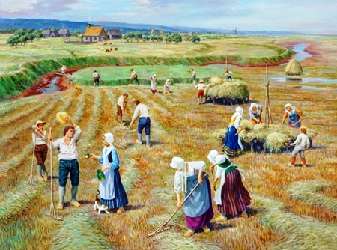
Migration Encore
Evangeline:
A Tale of Acadie
- Henry Wadsworth Longfellow
The Acadians
Distant, secluded, still,
the little village of Grand-Pré Lay in the fruitful valley.
Vast meadows stretched to the eastward, Giving the village its name,
and pasture to flocks without number.
Dikes, that the hands of the farmers
had raised with labor incessant, Shut out the turbulent tides;
but at stated seasons the flood-gates Opened, and welcomed the sea
to wander at will o'er the meadows.
West and south there were fields of flax,
and orchards and cornfields Spreading afar and unfenced
o'er the plain.
And away to the northward Blomidon rose, and the forests old,
and aloft on the mountains Sea-fogs pitched their tents,
and mists from the mighty Atlantic Looked on the happy valley,
but ne'er from their station descended.
- Henry Wadsworth Longfellow

Slide 2
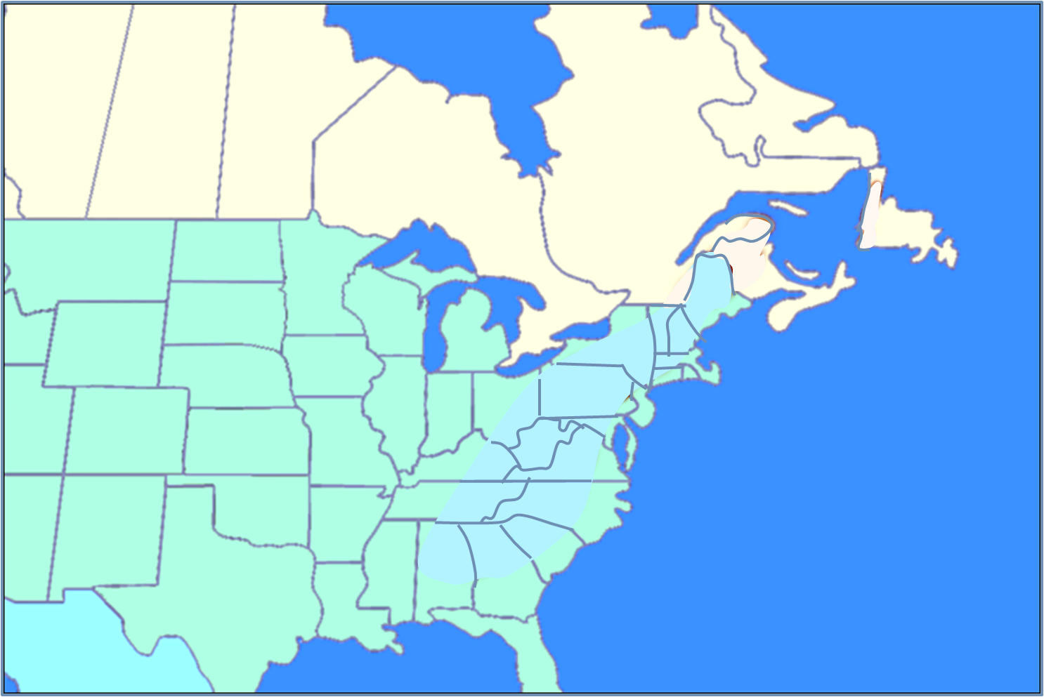
The Acadians
Migration Encore
The Acadians
Notes:
https://en.wikipedia.org/wiki/Blomidon_Formation The Blomidon Formation is a unit of Upper Triassic sedimentary rocks, which outcrops in Nova Scotia. At outcrop they reach a maximum thickness of 365 metres (1,198 ft). Cape Blomidon features distinctive reddish-coloured cliffs that reach up to 100 metres in height above the Minas Basin, which stretches out to the east.

Slide 3
The Acadians
Week 2: French Migration to Acadie
Week 1 Setting the Stage: Before 1600
Week 2 French Migration to Acadie: 1600-1717
Week 3 Le Grand Dérangement: 1717-1756
Week 4 The Acadien Diaspora: 1756-1800
Week 5 Acadians of Canada & Louisiana: 1800-1950
Week 6 Acadians Today: 1950-today
Week 2 French Migration to Acadie

Slide 4
Week 2: French Migration to Acadie
1600-1717
TODAY’S TOPICS
OVERVIEW
SUMMARY
Quick Review
What is New France
Terminology
Key Players
The Tug-O-War
Acadie as a part of New France
Key Players & their impact
Evolution of the Acadian People
BRITISH-FRENCH IMPACT ON ACADIE
Review the history of Acadie from 1604 to 1717 in 8 time slices

Slide 5
AN OVERVIEW
REVIEW LAST
WEEK KEY POINTS

Slide 6
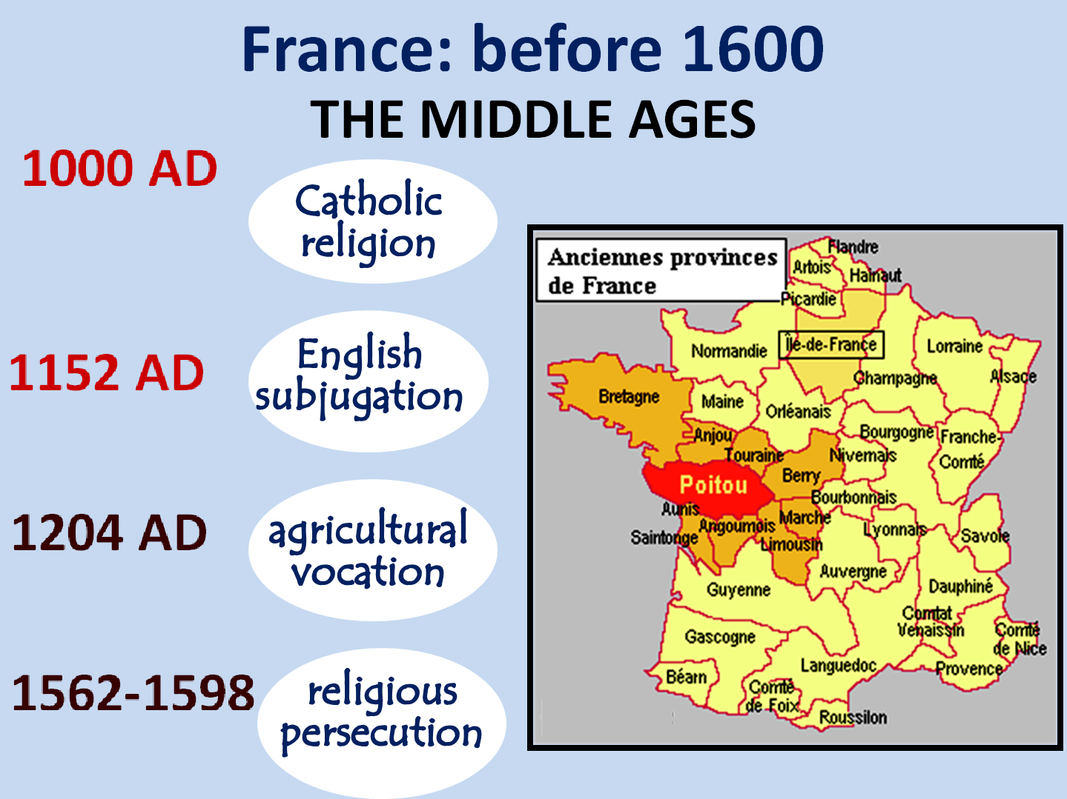
FORCES PUSHING FRENCH POITEVINS TO LEAVE
AN OVERVIEW
1
5
2
ETHNIC CAMARADERIE
3
4

Slide 7
FORCES PUSHING FRENCH POITEVINS TO LEAVE
5
From: “The Founding of New Acadia” by Dr. Carl A. Brasseaux
ETHNIC CAMARADERIE
Far greater degree of social equality as they were basically drawn from same peasant stock
Very protective of belongings, particularly, farmland
Extensive kinship system that facilitated communal labor pools
Oppressed by noble landholding class; suspicious of authority
Social cohesion evidenced by group identity & group loyalty
Sought neither prestige nor affluence, just economic independence

Slide 8
French Migration to Acadie
1600-1717
WHAT IS “NEW FRANCE”

Slide 9
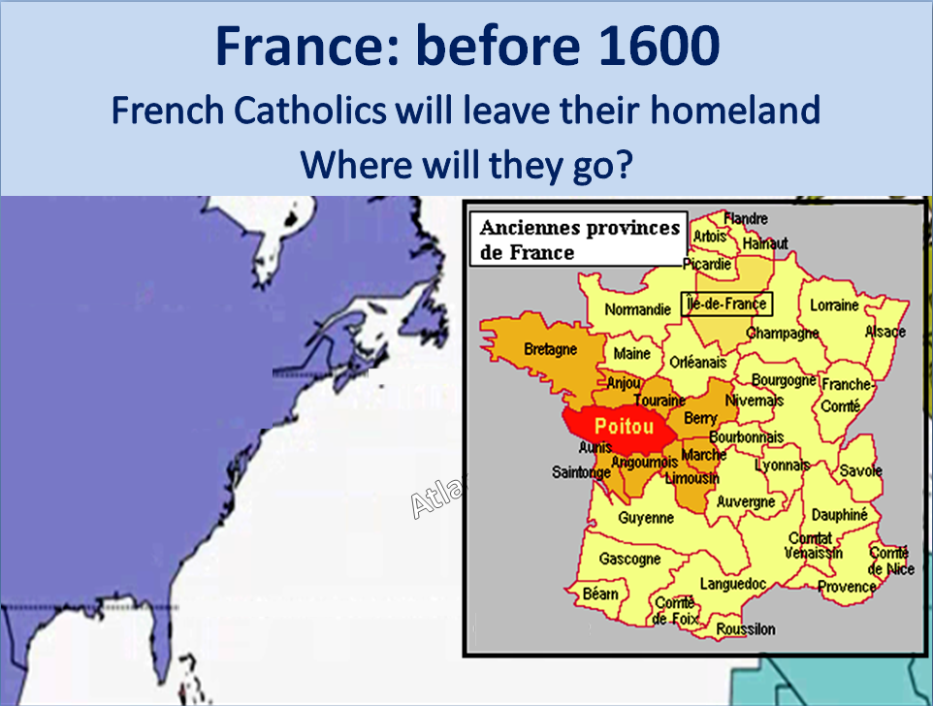
FROM LAST WEEK…
New
World
Is this area called
“New France”?

Slide 10
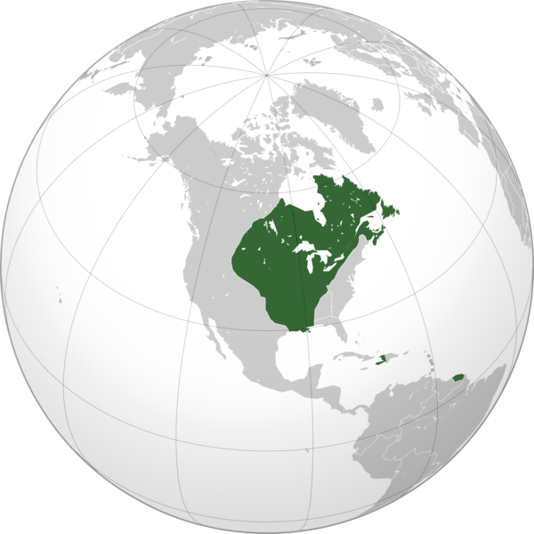
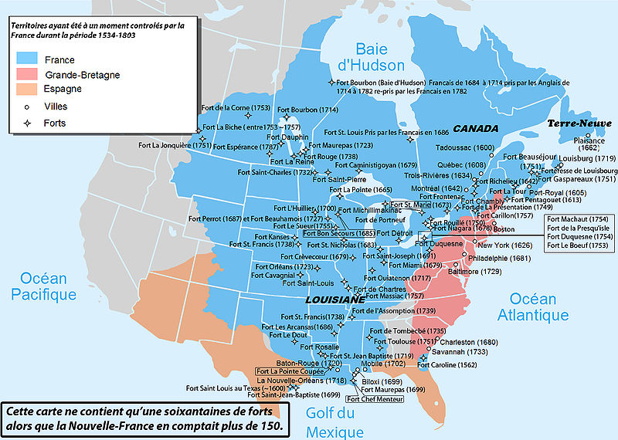
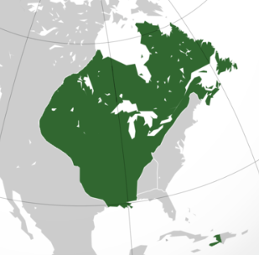
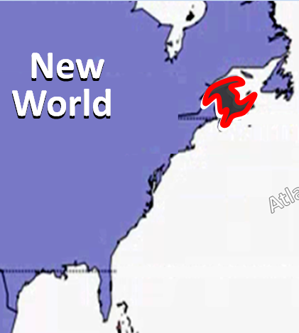
NEW FRANCE (NOUVELLE FRANCE)
Many references to New France but very hard to piece together what is being talked about
The green highlight in this globe is the approx. extent of French influence in the New World –
New France
The area of “New France” changed over time as France won and loss territory

Slide 11
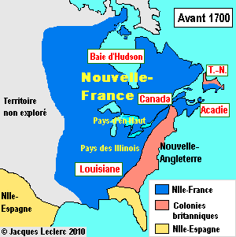
“NEW FRANCE”
(Nouvelle-France)
Composed of 5 regions:
Louisiana
Hudson Bay
“Canada”
Newfoundland (shared with GB; referred to as “Plaisance”)
Acadie

Slide 12
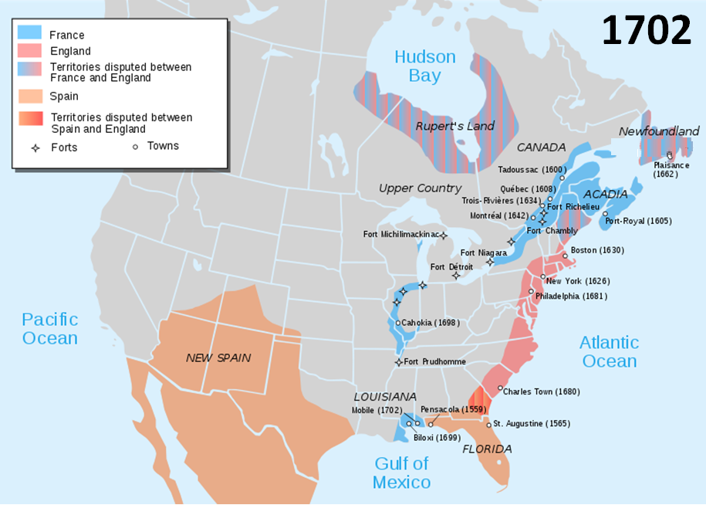
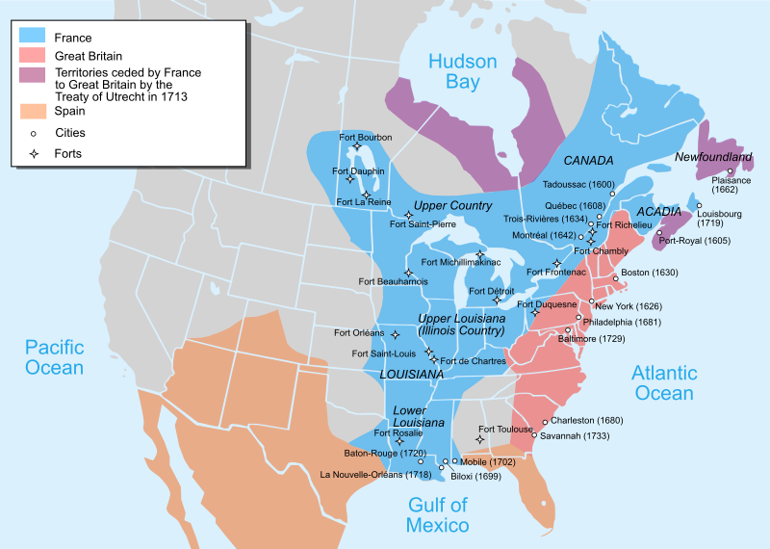
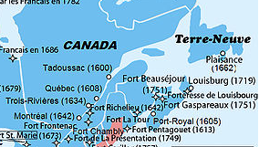
NEW FRANCE (NOUVELLE FRANCE)
1702
1750
Plymouth 1620
Jamestown 1607
Notes:
St. John's is the oldest post-Columbian European settlement in North America, with fishermen setting up seasonal camps in the early 16th century.^{[10]} Sebastian Cabot declares in a handwritten Latin text in his original 1545 map^{[16]} that St. John's earned its name when he and his father, the Venetian explorer John Cabot became the first Europeans to sail into the harbour, in the morning of 24 June 1494 (against British and French historians stating 1497),^{[17]} the feast day of Saint John the Baptist.^{[8]} However, the locations of Cabot's landfalls are disputed.^{[18][19]} A series of expeditions to St. John's by Portuguese from the Azores took place in the early 16th century, and by 1540 French, Spanish and Portuguese ships crossed the Atlantic annually to fish the waters off the Avalon Peninsula. In the Basque Country, it is a common belief the name of St. John's was given by Basque fishermen because the bay of St. John's is very similar to the Bay of Pasaia in the Basque Country, where one of the fishing towns is called St. John (in Spanish, San Juan, and in Basque, Donibane).^{[9]}
The earliest record of the location appears as São João on a Portuguese map by Pedro Reinel in 1519. When John Rut visited St. John's in 1527, he found Norman, Breton and Portuguese ships in the harbour. On 3 August 1527, Rut wrote a letter to King Henry on the findings of his voyage to North America; this was the first known letter sent from North America. St. Jehan is shown on Nicolas Desliens' world map of 1541, and San Joham is found in João Freire's Atlas of 1546.^{[20]}
On 5 August 1583, an English Sea Dog, Sir Humphrey Gilbert, claimed the area as England's first overseas colony under Royal Charter of Queen Elizabeth I.^{[21]} There was no permanent population, however, and Gilbert was lost at sea during his return voyage, thereby ending any immediate plans for settlement.^{[9]} The Newfoundland National War Memorial is on the waterfront in St. John's, at the purported site of Gilbert's landing and proclamation.
By 1620, the fishermen of England's West Country controlled most of Newfoundland's east coast.^{[22]} In 1627, William Payne, called St. John's "the principal prime and chief lot in all the whole country".
Sometime after 1630, the town of St. John's was established as a permanent community.^{[23]} Before this they were expressly forbidden by the English government, at the urging of the West Country fishing industry, from establishing permanent settlements along the English-controlled coast.
The population grew slowly in the 17th century: St. John's was Newfoundland's largest settlement when English naval officers began to take censuses around 1675.^{[20]} The population grew in the summers with the arrival of migratory fishermen.^{[9]} In 1680, fishing ships (mostly from South Devon) set up fishing rooms at St. John's, bringing hundreds of Irish men into the port to operate inshore fishing boats.^{[20]}
The town's first significant defenses were likely erected due to commercial interests, following the temporary seizure of St. John's by the Dutch admiral Michiel de Ruyter in June 1665.
The inhabitants fended off a second Dutch attack in 1673, when it was defended by Christopher Martin, an English merchant captain. Martin landed six cannons from his vessel, the Elias Andrews, and constructed an earthen breastwork and battery near Chain Rock commanding the Narrows leading into the harbour. With only 23 men, the valiant Martin beat off an attack by three Dutch warships. The English government planned to expand these fortifications (Fort William) in around 1689, but construction didn't begin until after the French admiral Pierre Le Moyne d'Iberville captured and destroyed the town in the Avalon Peninsula Campaign (1696). When 1500 English reinforcements arrived in late 1697, they found rubble where the town and fortifications had stood.
In 1762, the British and French fought in the Battle of Signal Hill. It was the last battle of the North American theatre in the Seven Years' War.
The French attacked St. John's again in 1705 (Siege of St. John's), and captured it in 1708 (Battle of St. John's), devastating civilian structures with fire on each instance.^{[20]} The harbour remained fortified through most of the 18th and 19th centuries.^{[9]} The final battle of the Seven Years' War in North America (the French and Indian War) was fought in 1762, in St. John's.^{[9]} Following a surprise capture of the town by the French early in the year, the British responded and, at the Battle of Signal Hill, the French surrendered St. John's to British forces under the command of Colonel William Amherst.^{[20][24]}
In the late 1700s Fort Amherst and Fort Waldegrave were built to defend the harbour entrance.
https://en.wikipedia.org/wiki/Plymouth_Colony
Plymouth Colony (sometimes Plymouth) was an English colonial venture in America from 1620 to 1691 at a location that had previously been surveyed and named by Captain John Smith. The settlement served as the capital of the colony and developed as the town of Plymouth, Massachusetts. At its height, Plymouth Colony occupied most of the southeastern portion of Massachusetts.
Plymouth Colony was founded by a group of Puritan Separatists initially known as the Brownist Emigration, who came to be known as the Pilgrims. It was the second successful colony to be founded by the English in America after Jamestown in Virginia, and it was the first permanent English settlement in the New England region.

Slide 13
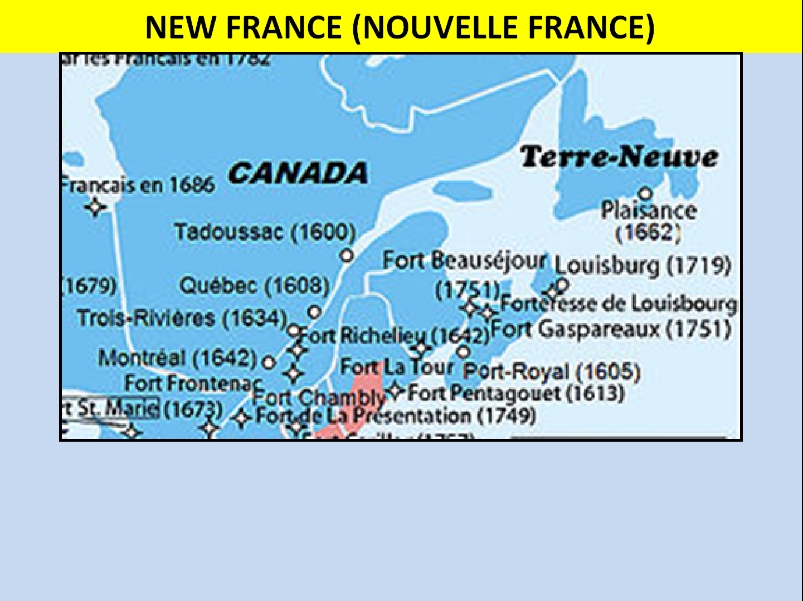
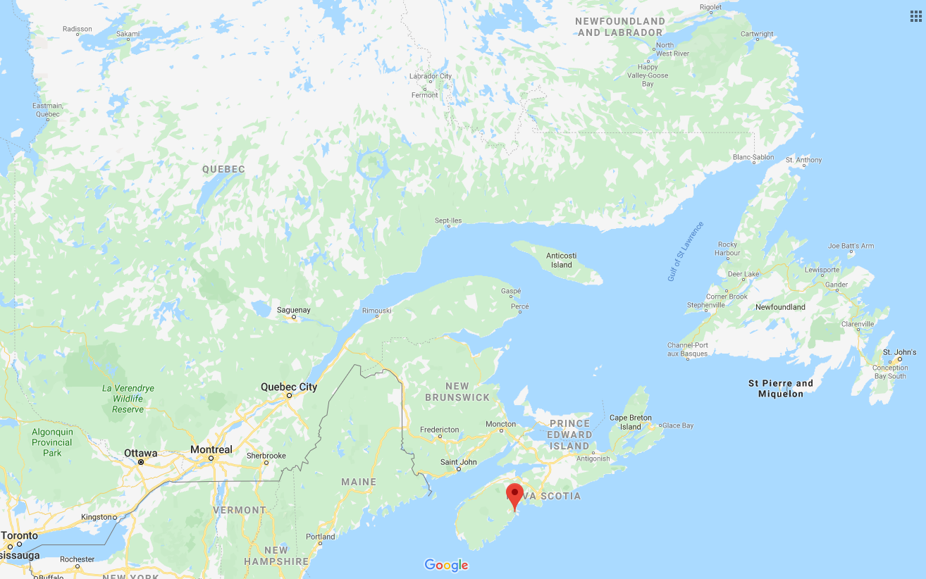
NEW FRANCE (NOUVELLE FRANCE)

Slide 14
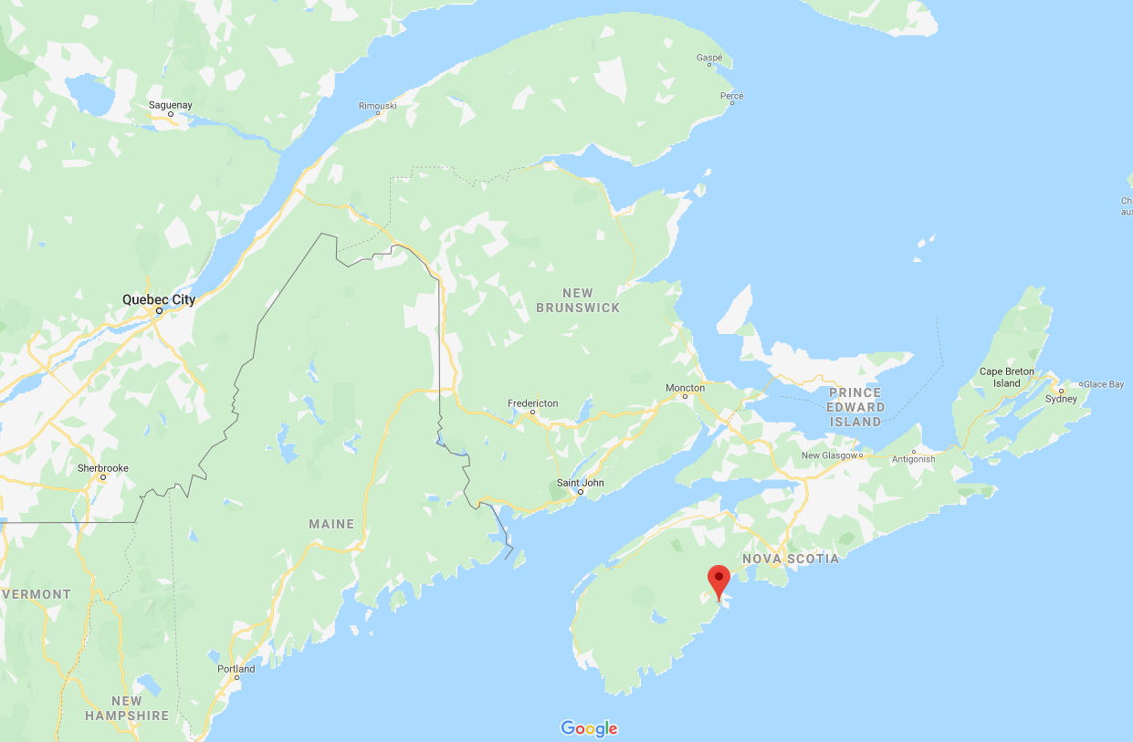
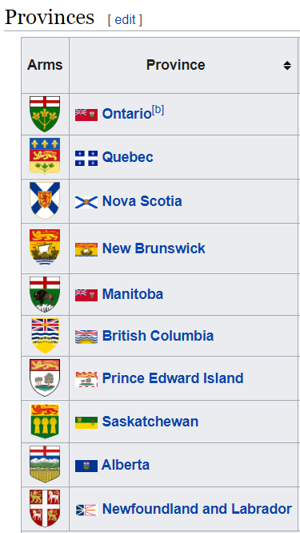
NEW FRANCE (NOUVELLE FRANCE)
With the geography orientation out of the way,
Now let’s talk about Explorers of this region of North America
QUEBEC PROVINCE
PRINCE EDWARD ISLAND (PEI) PROVINCE
(Île Saint-Jean)
Cape
Breton
Island
(Île-Royale)
NEW
BRUNSWICK
PROVINCE
ACADIA (ACADIE)
Quebec City
St. Lawrence River
NOVA SCOTIA PROVINCE
Ottawa
Toronto
Montreal
UNITED STATES

Slide 15
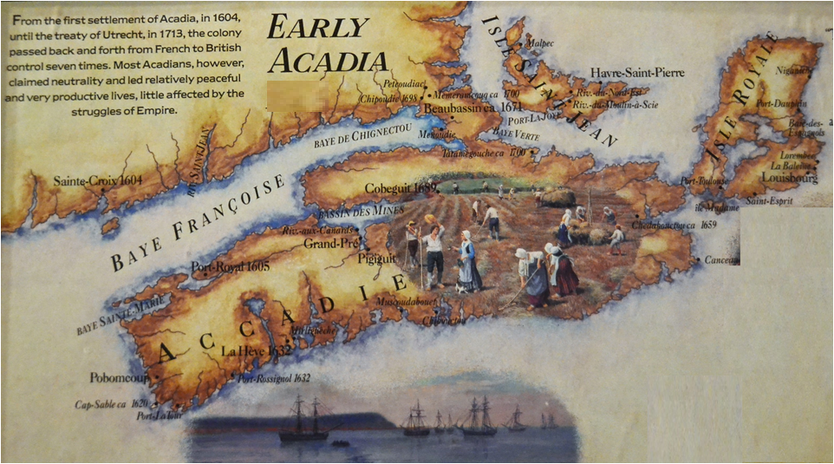
NEW FRANCE (NOUVELLE FRANCE)
ACADIA (ACADIE)

Slide 16
TERMINOLOGY

Slide 17
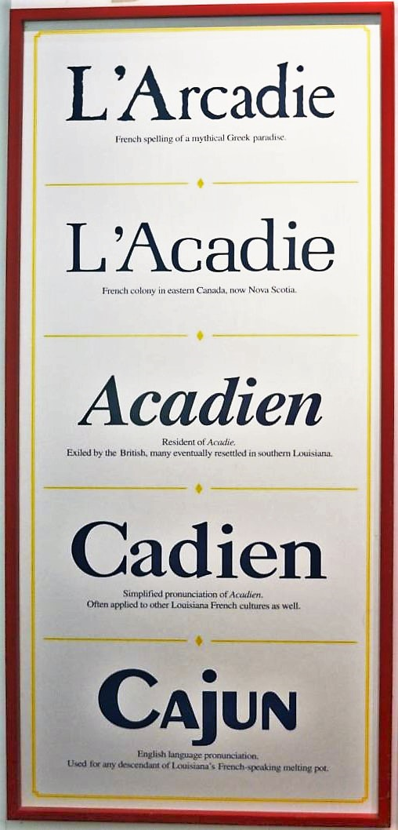
TERMINOLOGY
ENGLISH | FRENCH
Acadia | Acadie
Acadian | Acadien
Nova Scotia | Nouvelle-Écosse
Cape Breton | Isle Royale
Prince Edward Island | Isle St. Jean
Bay of Fundy | Baye Françoise
Annapolis Royal | Port-Royal

Slide 18
French Migration to Acadie
Session 2: French Migration to Acadie
1600-1717
1600-1755
Key players in the development of acadie

Slide 19
KEY PLAYERS IN CREATION/DESTRUCTION OF ACADIE
Key Players
Pierre Dugua
Charles Lawrence
Samuel de Champlain
Joseph Broussard
Isaac de Razzily

Slide 20
French Migration to Acadie
Session 2: French Migration to Acadie
1600-1717
1600-1717
QUICK SUMMARY OF
GEOPOLITICAL TENSIONS
AT THE TIME

Slide 21
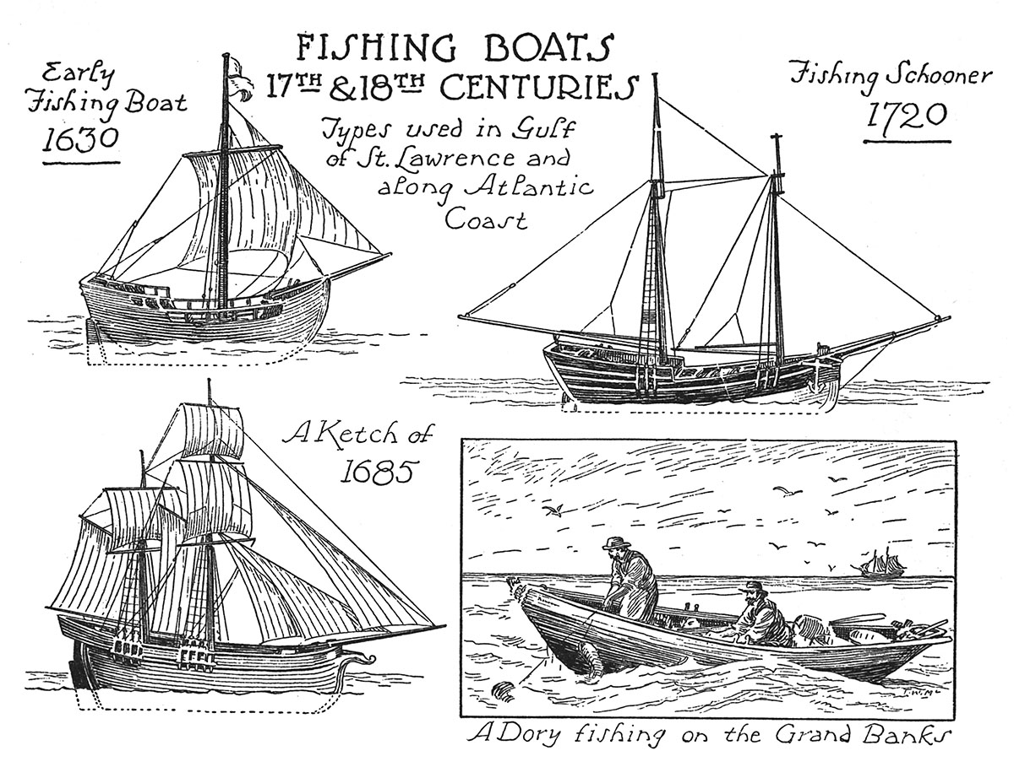
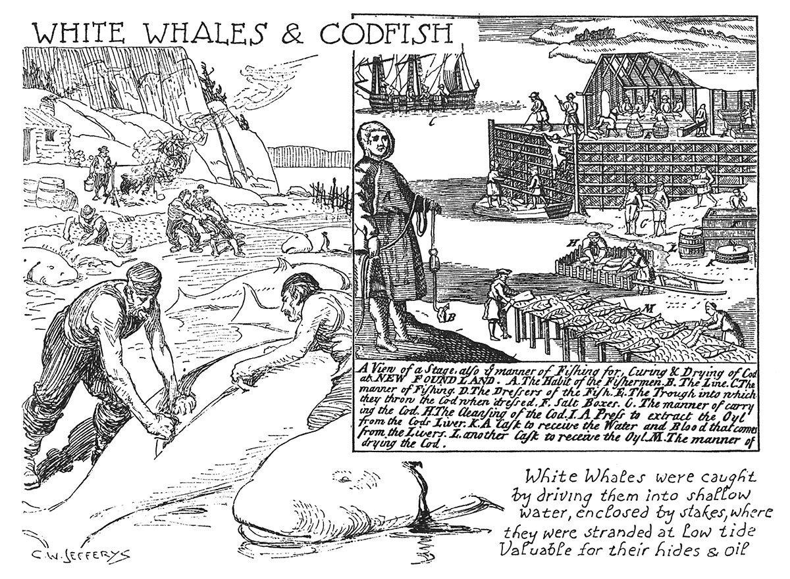
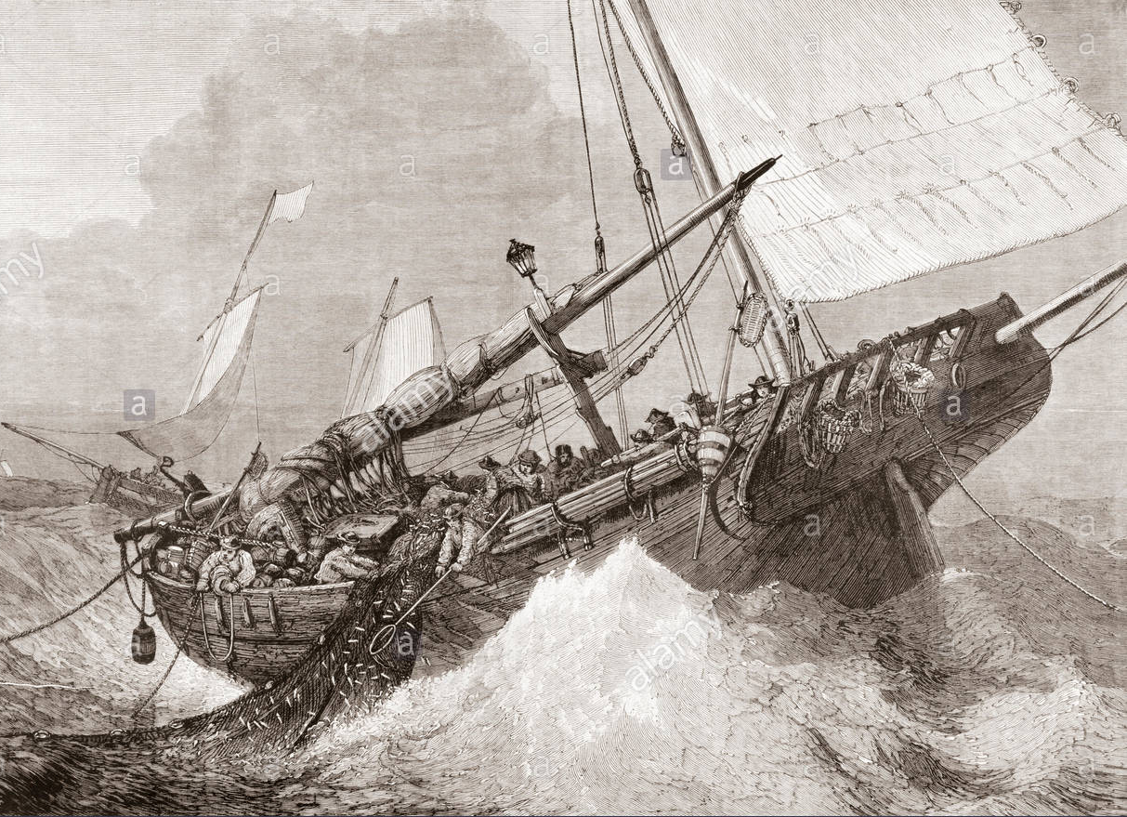
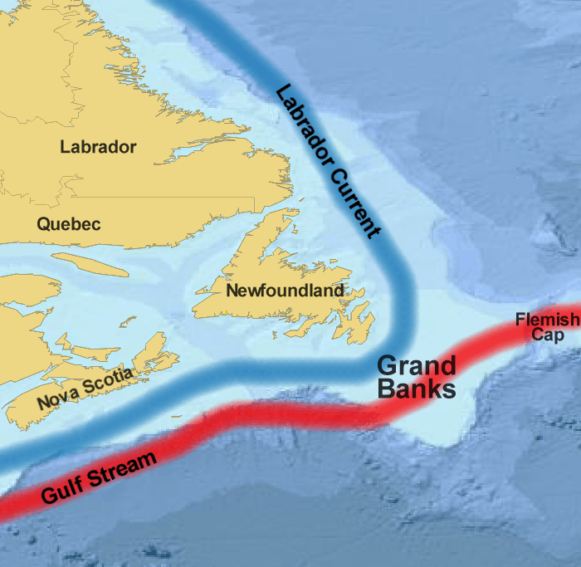
NEW FRANCE GEOPOLITICAL SETTING - EUROPEANS
Early Fishing on the Grand Banks
Some 15th century texts refer to a land called Bacalao, land of the codfish, which is possibly Newfoundland
Evidence suggests ships from Portugal, Basque Region of Spain, and England and others preceded Cabot to North America
A
Treeman, 13 July 2006 (UTC) - basemap from www.planiglobe.com
Existence of fishing grounds on the Grand Banks became generally known in Europe after Cabot’s voyage
Ships from France/Portugal pioneered fishing there, followed by vessels from Spain, while ships from England were scarce in early years. This soon changed

Slide 22
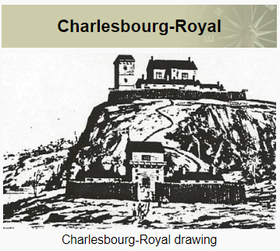
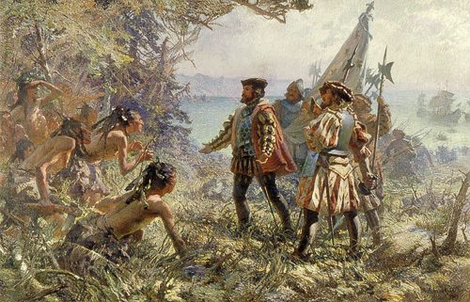
NEW FRANCE GEOPOLITICAL SETTING - EUROPEANS
THERE HAD BEEN PREVIOUS SETTLEMENTS TRIED BEFORE IN THE REGION…
1540 - King Francois Ist issues a mandate to Cartier to create a settlement in North America
1541- Cartier arrives with 400 inhabitants and establishes Fort Charlesbourg near present day Quebec City.
Most survive the first winter
A
despite the severe cold and attacks by the Iroquois. However, the establishment is abandoned in 1542
1600 - François Dupont-Gravé and Pierre de Chauvin found the establishment of Tadoussac, a trading station at confluence of the Saguenay River and St. Lawrence River

Slide 23
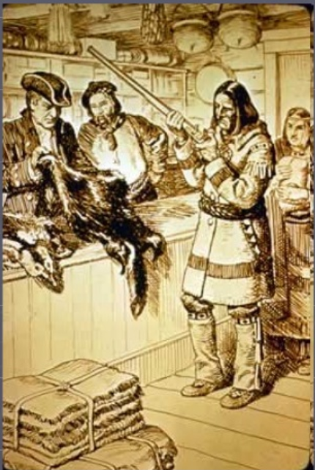
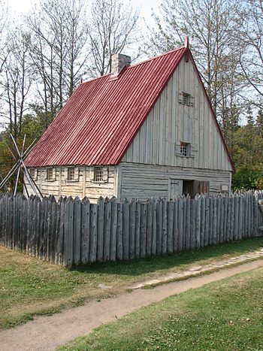
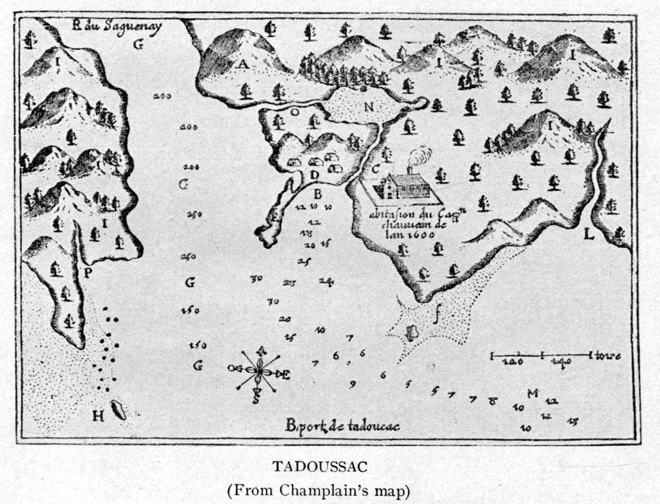
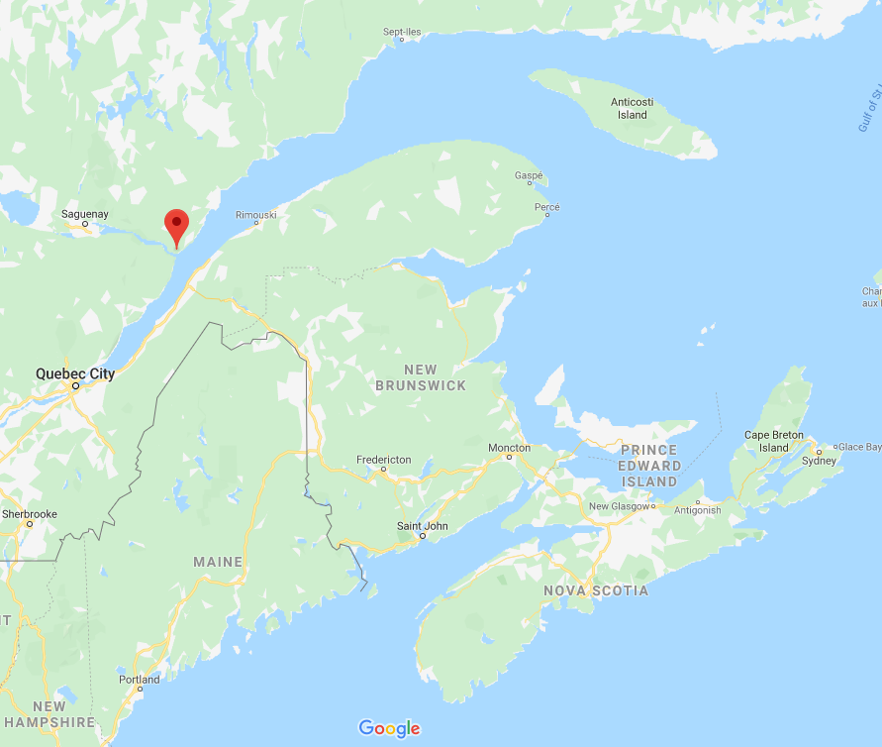
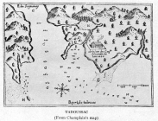
NEW FRANCE GEOPOLITICAL SETTING - EUROPEANS
Tadoussac
St. Lawrence River
Saguenay
River
A
- a focal point of trade in the Maritime Provinces
trading here lasts for over 30 years
Poste de traite, Tadoussac.
Trading Post Reproduction at Tadoussac, Quebec Province
Public Domain, https://commons.wikimedia.org/w/index.php?curid=1760646
Notes:
https://fr.wikipedia.org/wiki/Tadoussac
History [ edit | change code ]
Colonization [ change | change code ]
The port of Tadoussac and the trading post mapped by Samuel de Champlain in 1615
The Tadoussac region was visited by Jacques Cartier in 1535 while he was going up the St. Lawrence River . It was also visited by Pierre de Chauvin , Sieur de Tonnetuit, in 1599 and by Samuel de Champlain in 1603 .
After the failure of the Charlesbourg-Royal and Florida establishments , Tadoussac became the first perennial French colony in North America following the installation of a fur trading post ⁴ . Indeed, in 1599 , King Henri IV granted the monopoly of the fur trade in Tadoussac to François Dupont-Gravé and Pierre de Chauvin who founded the establishment in 1600 . At that time, the Tadoussac region was inhabited during the summer months by an Innu tribe whose chief was Begourat .
Chronology [ edit | change code ]
The October 10 , 1899, the village municipality of Tadoussac is officially created. The November 13 , 1937, the parish municipality of Tadoussac is created by detachment from the village municipality. This is dissolved on April 9 , 1949.
The village of Tadoussac is recognized as the oldest of Quebec , it celebrated its 400 ^{th} anniversary in 2001 .

Slide 24
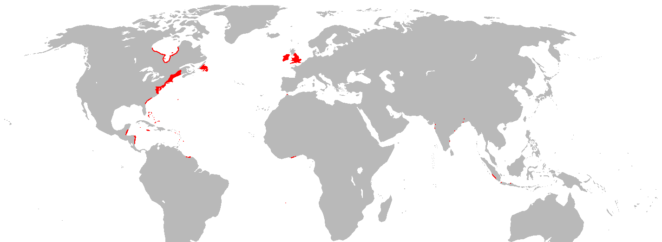
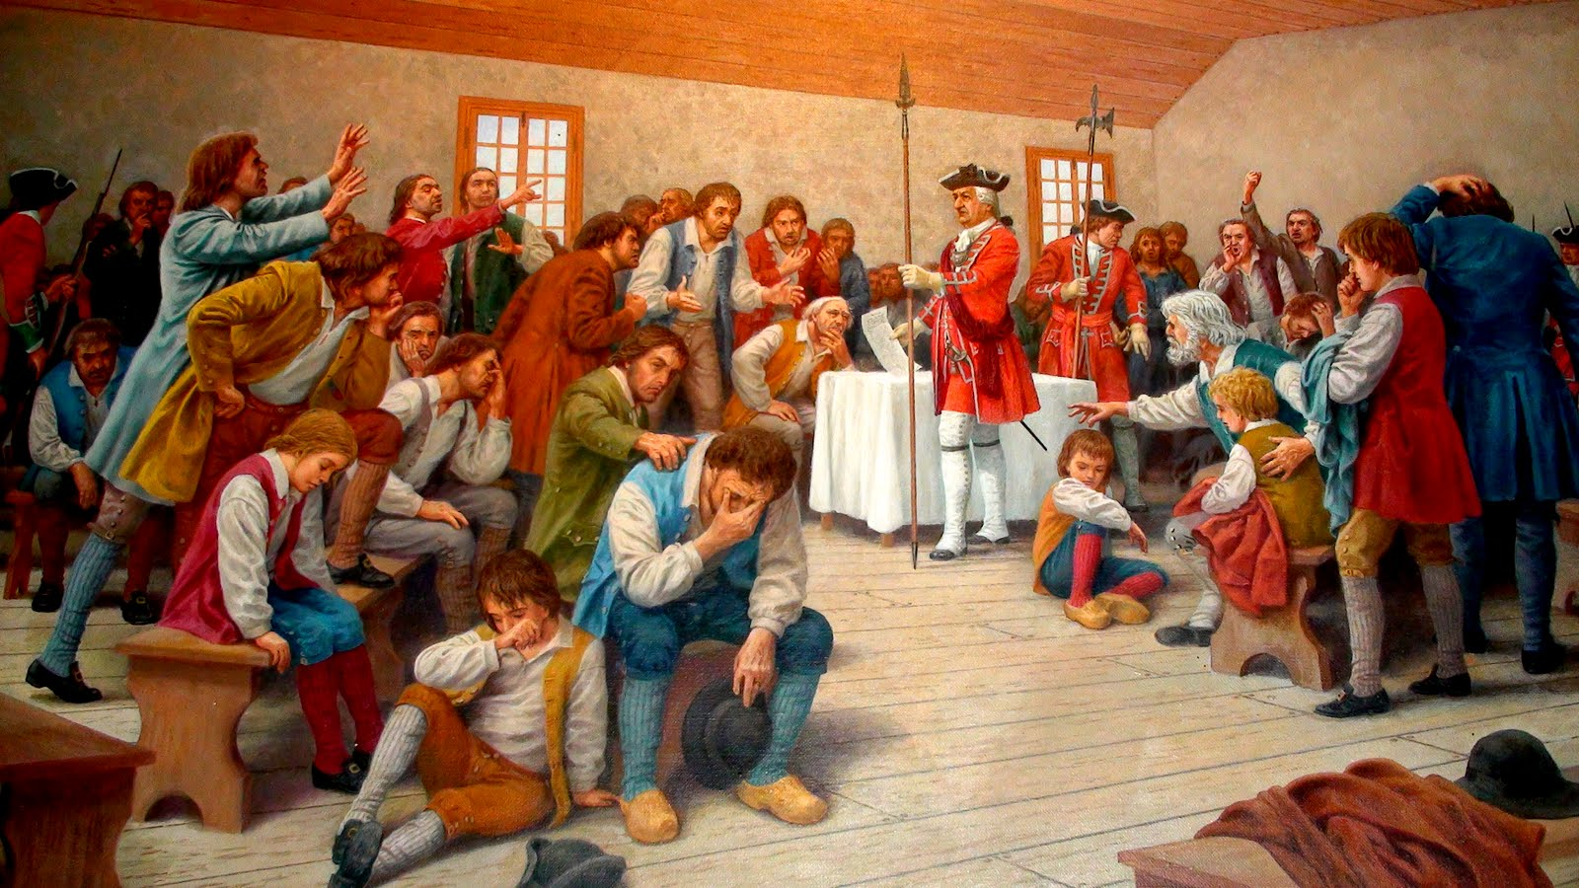
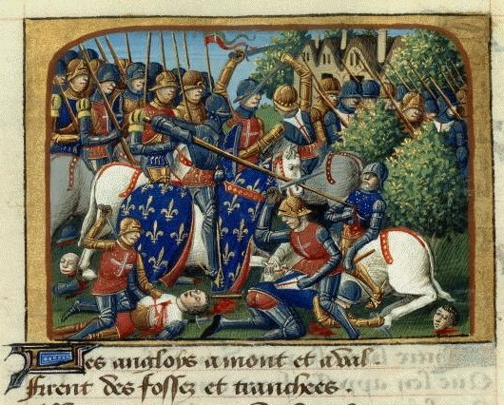
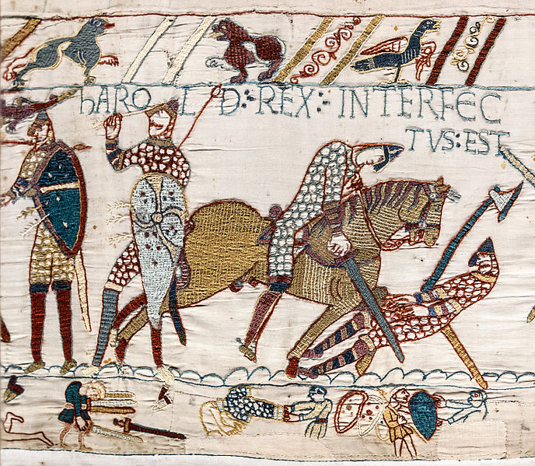
NEW FRANCE GEOPOLITICAL SETTING - EUROPEANS
"historic rivals“
From 1066, England & France were in various conflicts/ wars with each other
Most recent was the Hundred Year’s War: 1337–1453
A
English overseas possessions in 1700
Add to the history of rivalry, and increasing desire for global domination, empire building begins to spread and competition between these nations begins to increase
Armed conflict between France/England ebbs & flows in 17th/18th centuries
The Acadians are caught in the middle
Notes:
https://fr.wikipedia.org/wiki/Acadie_(Nouvelle-France)
La France , while grappling with the wars of religion , focuses late to the colonization of the Americas

Slide 25
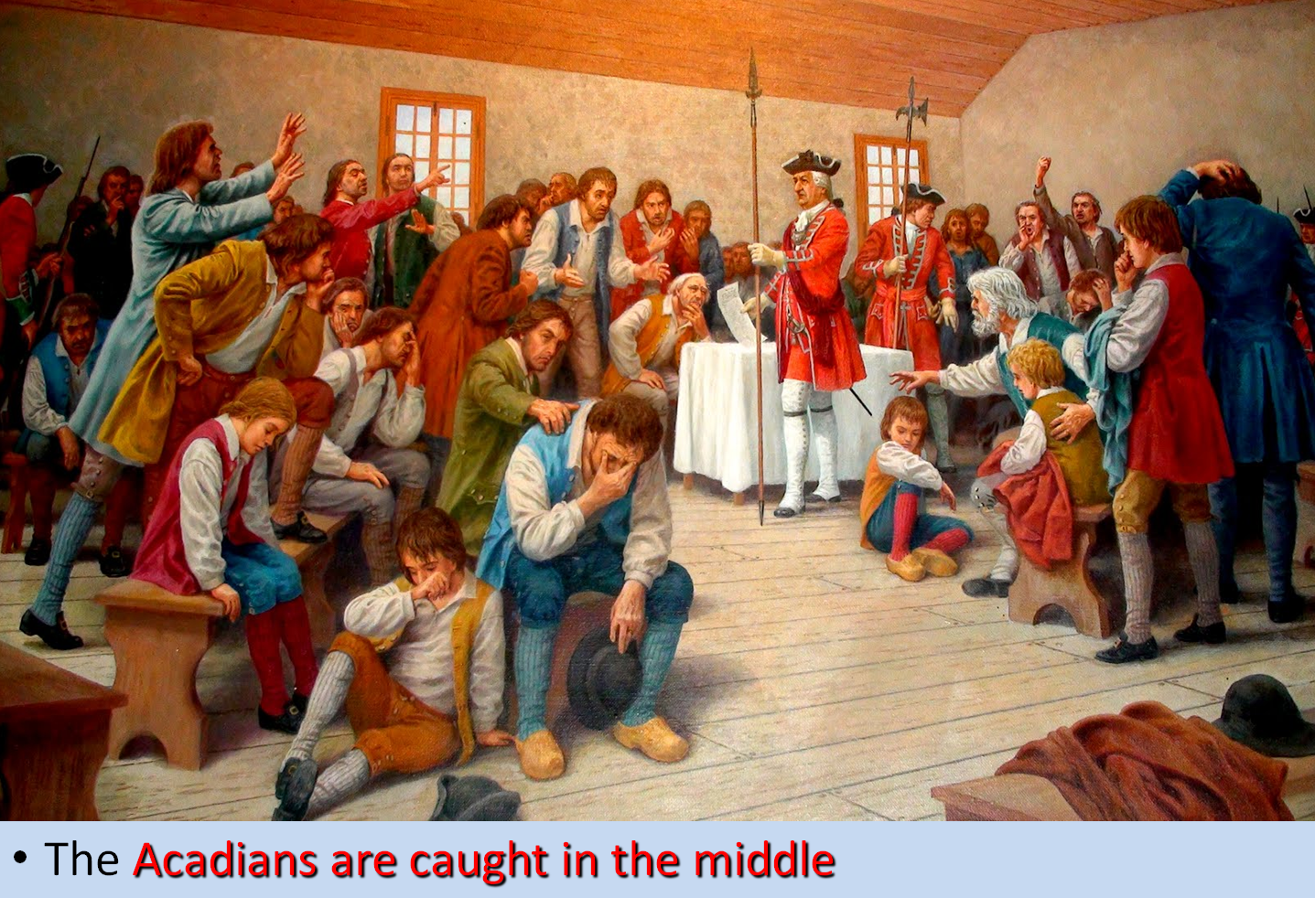
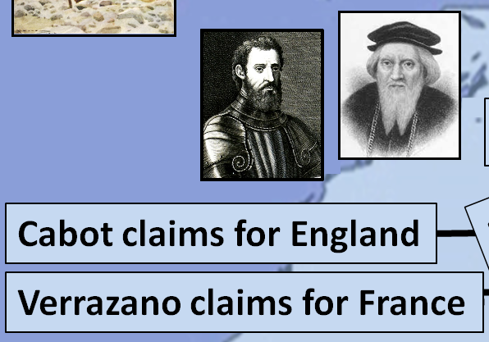
NEW FRANCE GEOPOLITICAL SETTING - EUROPEANS
A
?
ACADIA
ACADIANS
FRANCE
ENGLAND

Slide 26
NEW FRANCE GEOPOLITICAL SETTING – 1ST PEOPLE
NEW FRANCE GEOPOLITICAL SETTING - EUROPEANS
A

Slide 27
French Migration to Acadie
Session 2: French Migration to Acadie
1600-1717
1600-1717
FRENCH MIGRATION TO
Acadia (acadie)
1600-1755
A

Slide 28
ACADIA: 1604-1755
1604-1755 is time of turmoil as:
Empires fight over this land; Six colonial wars are fought
Acadians struggle to survive, grow, prosper, AND stay neutral
Today we will look at 8 of the 10 segments of this time
A

Slide 29
1-ACADIA: 1604-1607
ET=0YRS
Acadia is established in 1604 as a proprietary colony by Pierre Dugua
The ELAPSED TIME from 1604, the beginning of Acadia
Which
TIME SEGMENT this slide is about
The TIME involved in this slide
Which COUNTRY is ruling Acadia at this time
Who is
Pierre Dugua?
A
Notes:
Ile St. Croix (present-day Dorchet Island, Maine)

Slide 30
Pierre Dugua,
Sieur de mons

Slide 31
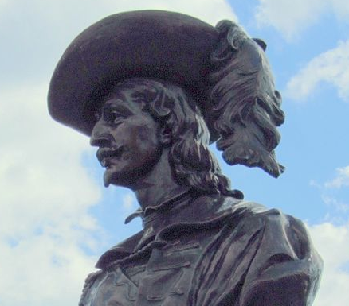
PIERRE DUGUA (du Gua), SIEUR DE MONS
1603 – King Henry IV grants Dugua
exclusive rights to colonize specific area of North America
monopoly of fur trade for these territories
names him Lt. General for Acadia & New France
1604 – Dugua organizes an
A
https://commons.wikimedia.org/w/index.php?curid=7823146
expedition, with François Gravé Du Pont as senior officer & Samuel de Champlain, the royal cartographer
Departs with 79 settlers. Enters Bay of Fundy & founds 1st permanent French settlement in Canada on Ile Sainte Croix. Due to a bad winter & scurvy, loses 50% of settlers
Notes:
Dugua promises to bring 60 new colonists each yr to New France
https://www.cbc.ca/history/EPCONTENTSE1EP2CH4PA2LE.html
In 1604, Champlain and de Monts set out for Acadia, the name given by the French to the region that roughly corresponds to today's Maritime provinces. They decided to spend the winter on the island of Ste. Croix, but the decimation of a great number of the men by an outbreak of scurvy and fierce winds, prompted the colonists to seek a milder climate in the south. They followed the Atlantic coast southwards down to the port of Nausset, present day Cape Cod, not very far from the mouth of the Hudson.
Various attempts to disembark led to violent attacks by natives. On the beach, the French were riddled with wounds by an assault of arrows. The crew buried their dead in graves marked with wooden crosses, then got back on the ship. The natives came out of the forest, dug up the dead and threw the crosses into the sea.
De Monts and Champlain returned to the Bay of Fundy, where they built a new settlement: Port-Royal. De Monts then went back to France to reassure his partners, who blamed him for investing too heavily in settlements to the detriment of the fur trade.
Champlain sought ways to offset the effects of winter depression among his men and so created the Order of Good Cheer. They organized banquets with hunting spoils and staged a play called The Theatre of Neptune in New France, by Marc Lescarbot. The writer Lescarbot, who sojourned with Champlain, became in 1609 the first historian of Canada with his book A History of New France.

Slide 32
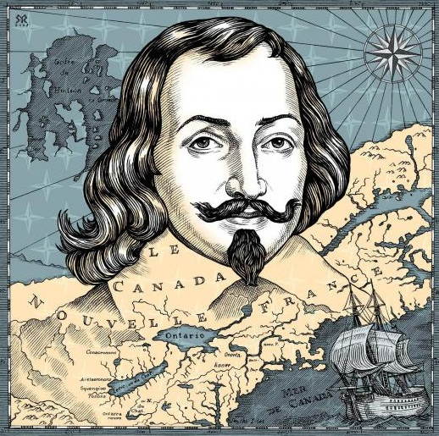
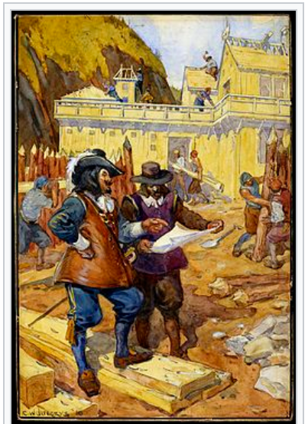
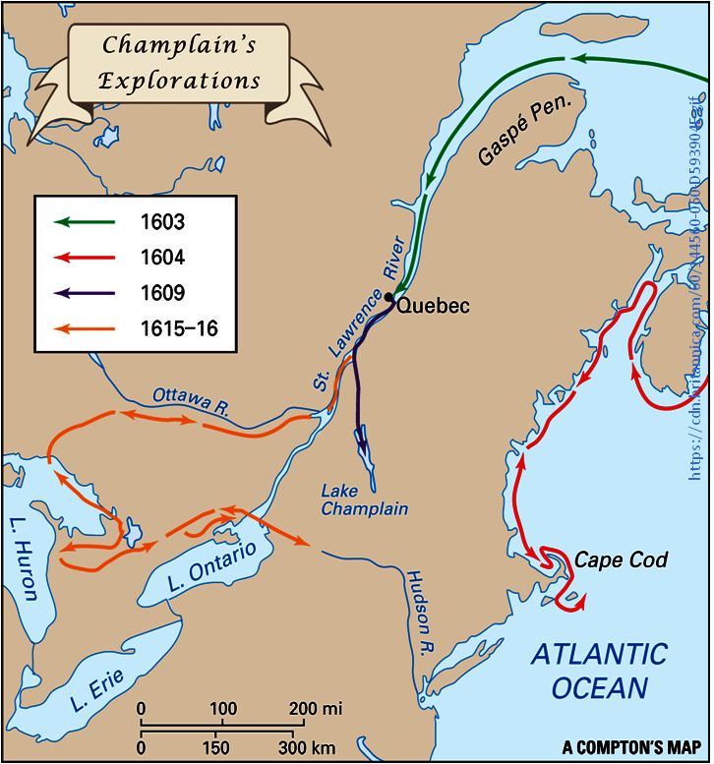
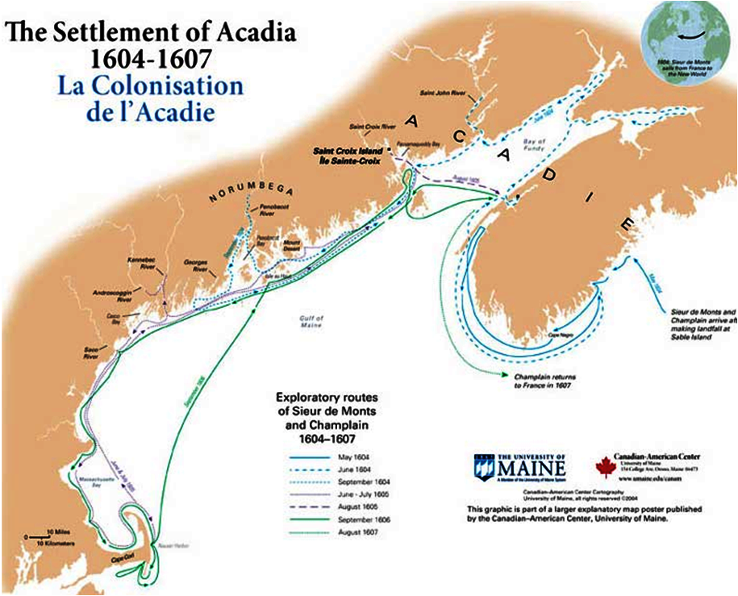
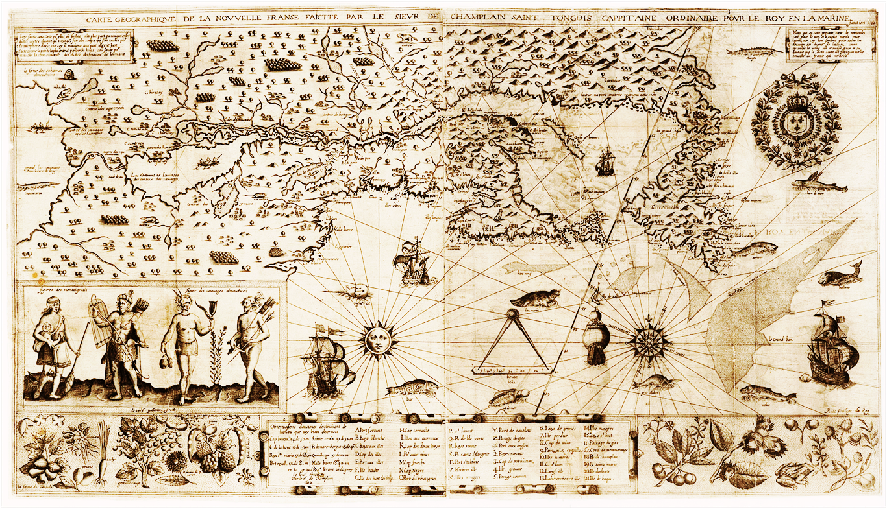
PIERRE DUGUA (du Gua), SIEUR DE MONS
Samuel de Champlain, the royal cartographer
1604-1607
participates in Dugua’s expedition
maps coastline of Acadia
1603 – King Henry IV grants Dugua
exclusive rights to colonize specific area of North America
monopoly of fur trade for these territories
names him Lt. General for Acadia & New France
1604 – Dugua organizes an
Continuing on about Pierre Dugua
1608 : establishes settlement
Habitation du Quebec
1615-1616: describes & maps
the Great Lakes
A
https://commons.wikimedia.org/w/index.php?curid=7823146
expedition, with François Gravé Du Pont as senior officer & Samuel de Champlain, the royal cartographer
Departs with 79 settlers. Enters Bay of Fundy & founds 1st permanent French settlement in Canada on Ile Sainte Croix. Due to a bad winter & scurvy, loses 50% of settlers
Samuel de Champlain, the royal cartographer
“the Father of New France”
Notes:
Dugua promises to bring 60 new colonists each yr to New France
https://www.cbc.ca/history/EPCONTENTSE1EP2CH4PA2LE.html
In 1604, Champlain and de Monts set out for Acadia, the name given by the French to the region that roughly corresponds to today's Maritime provinces. They decided to spend the winter on the island of Ste. Croix, but the decimation of a great number of the men by an outbreak of scurvy and fierce winds, prompted the colonists to seek a milder climate in the south. They followed the Atlantic coast southwards down to the port of Nausset, present day Cape Cod, not very far from the mouth of the Hudson.
Various attempts to disembark led to violent attacks by natives. On the beach, the French were riddled with wounds by an assault of arrows. The crew buried their dead in graves marked with wooden crosses, then got back on the ship. The natives came out of the forest, dug up the dead and threw the crosses into the sea.
De Monts and Champlain returned to the Bay of Fundy, where they built a new settlement: Port-Royal. De Monts then went back to France to reassure his partners, who blamed him for investing too heavily in settlements to the detriment of the fur trade.
Champlain sought ways to offset the effects of winter depression among his men and so created the Order of Good Cheer. They organized banquets with hunting spoils and staged a play called The Theatre of Neptune in New France, by Marc Lescarbot. The writer Lescarbot, who sojourned with Champlain, became in 1609 the first historian of Canada with his book A History of New France.

Slide 33
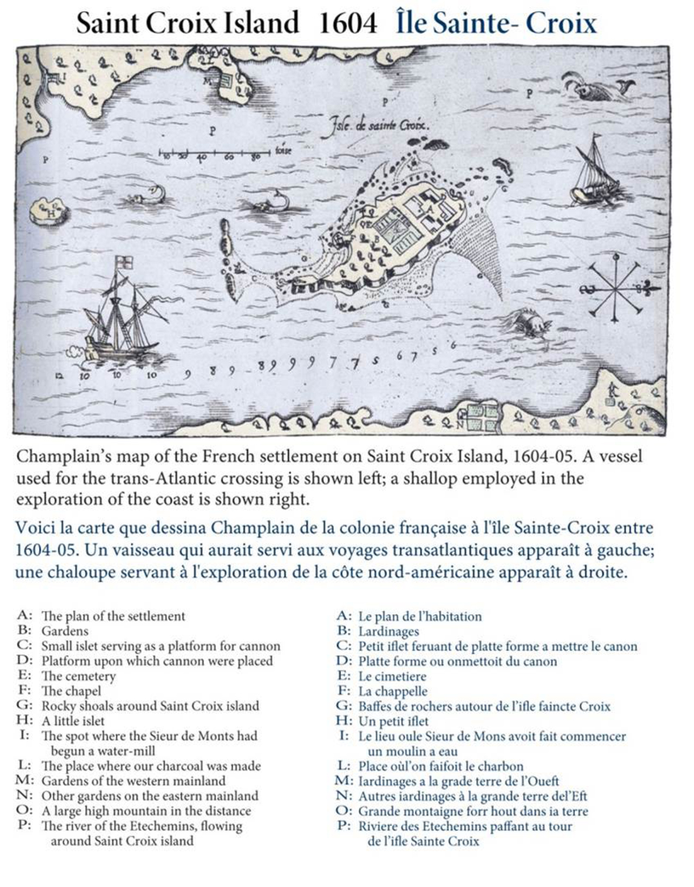
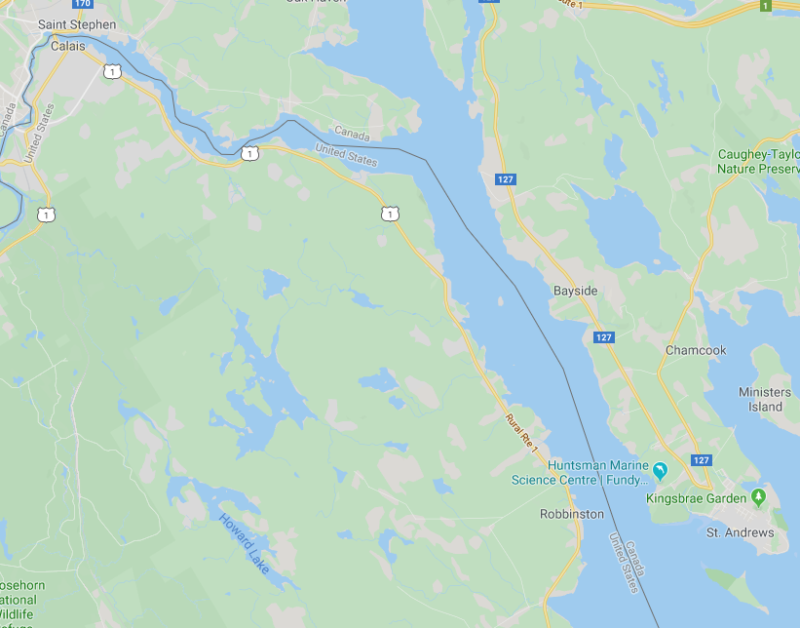
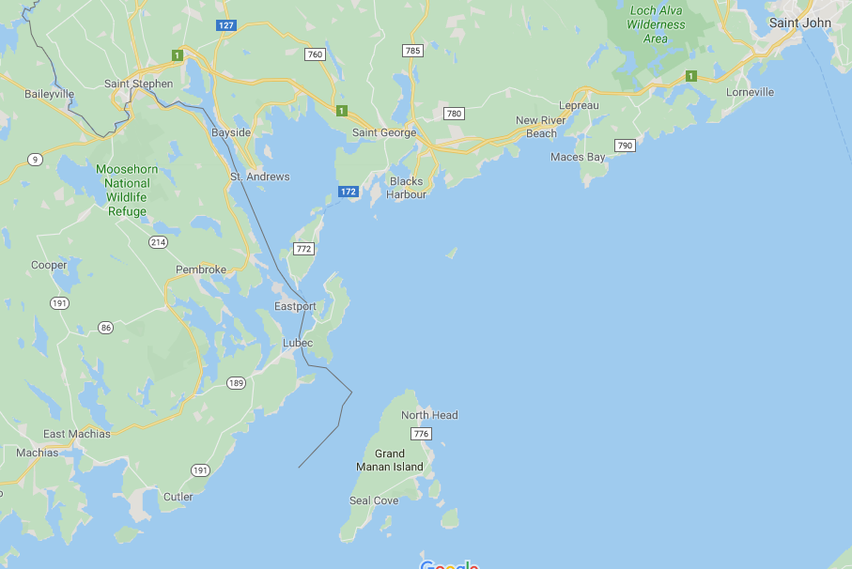
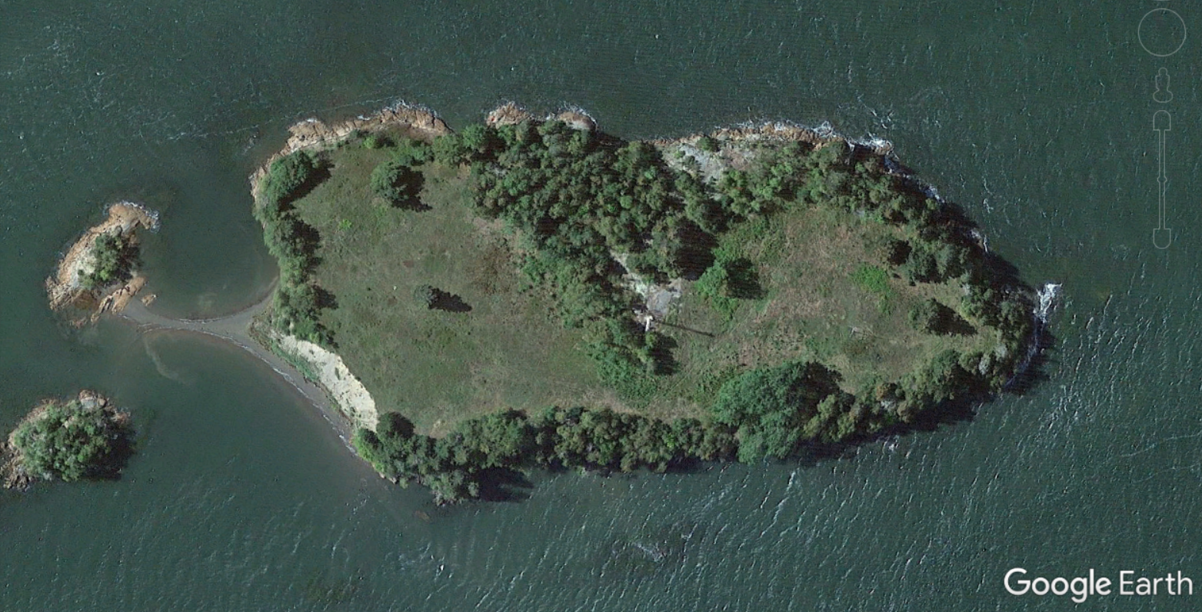
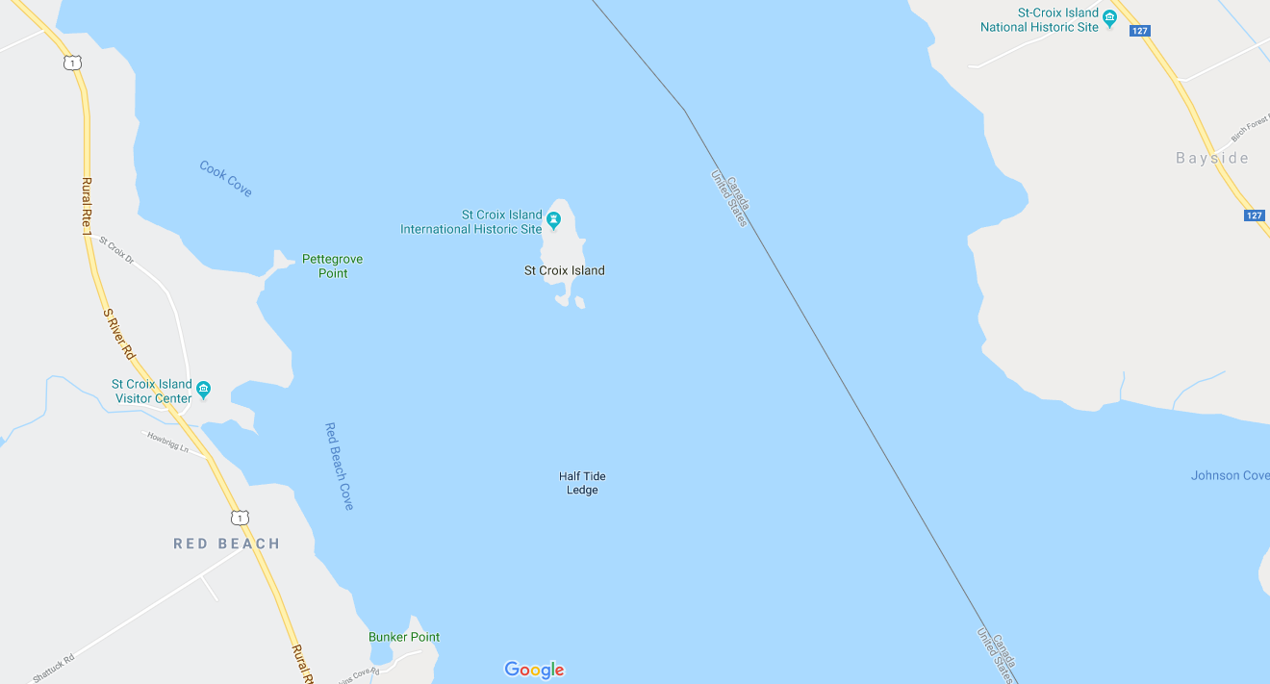
PIERRE DUGUA (du Gua), SIEUR DE MONS
He created the 1st permanent French settlement in Canada on Ile Sainte Croix
PRINCE EDWARD ISLAND
NEW BRUNSWICK
A
St Croix
BAY OF FUNDY
NOVA SCOTIA

Slide 34
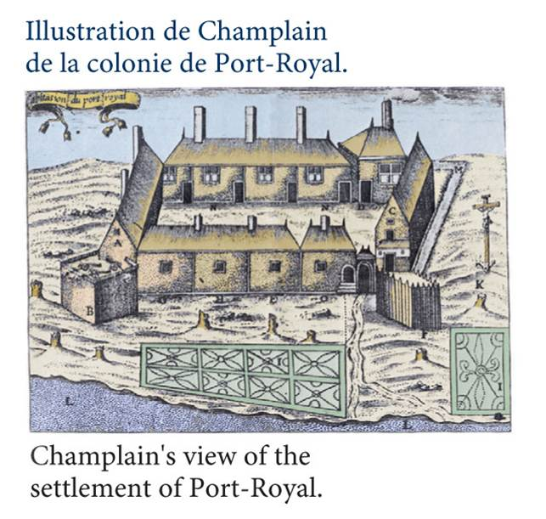
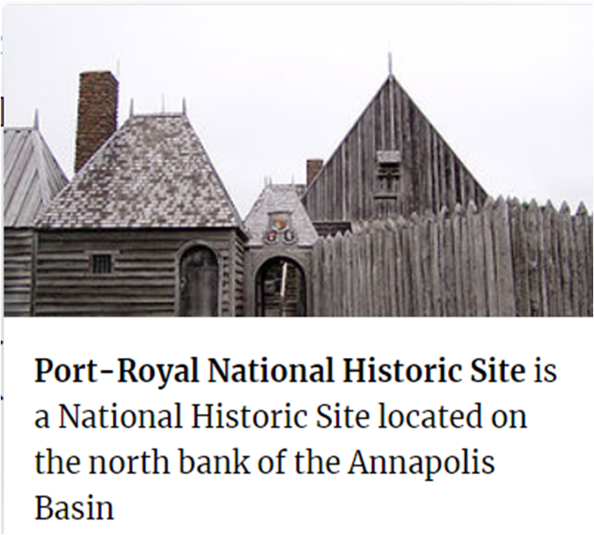
PIERRE DUGUA (du Gua), SIEUR DE MONS
1605 - Moves across Bay of Fundy &, establishes Port-Royal
A
St Croix
https://commons.wikimedia.org/w/index.php?curid=7823146
Port-Royal
Notes:
Luis Hébert

Slide 35
PIERRE DUGUA (du Gua), SIEUR DE MONS
1605 - Moves across Bay of Fundy & establishes Port Royal
Settlers meet Chief Membertou, of the First Nation’s Mi’kmaq tribe
https://commons.wikimedia.org/w/index.php?curid=7823146

Slide 36
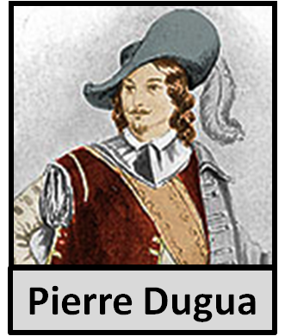
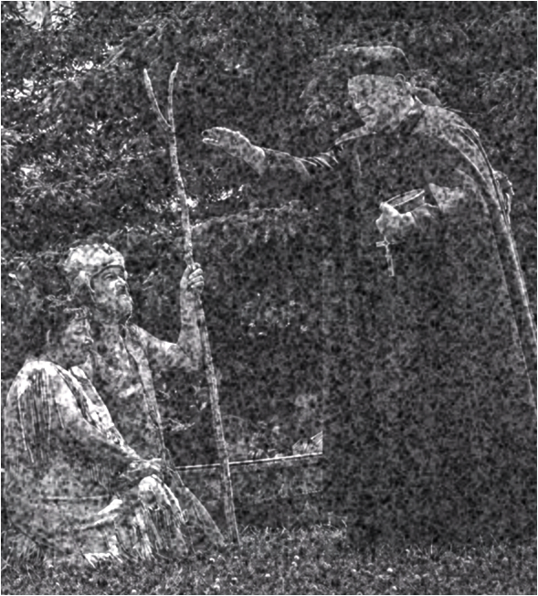
PIERRE DUGUA (du Gua), SIEUR DE MONS
Chief Membertou
Chief Henri Membertou
REMINDER: Membertou met Jacques
Cartier in 1534
1605 - age 95, Grand Chief of Mi’kmaq
- 1st native leader to be baptised
by French Catholics
- priest Jessé Fléché baptizes
Membertou & 21 members
of his family
- receives baptismal name in
honor of Henri IV of France
Chief Membertou
Continuing on with the story of Pierre Dugua
The beginning of the long friendship
between the Mi’kmaq & Acadiens

Slide 37
PIERRE DUGUA (du Gua), SIEUR DE MONS
1605 - Moves across Bay of Fundy & establishes Port Royal
Settlers meet Chief Membertou, of the First Nation’s Mi’kmaq tribe
1607 - King revokes monopoly; Dugua & settlers abandon colony & return to France; Mi’kmaq care for fort in their absence
https://commons.wikimedia.org/w/index.php?curid=7823146
Dugua plays both a direct & an indirect role in the founding of BOTH Port-Royal & Quebec
1610 – King appoints Dugua Governor of the city of Pons in France; Dugua retires in 1617 & dies in 1628

Slide 38
https://en.wikipedia.org/wiki/Henri_Membertou
Membertou became a good friend to the French. He first met the French when they arrived to build the Habitation at Port-Royal in 1605, at which time, according to the French lawyer and author Marc Lescarbot, he said he was over 100 and recalled meeting Jacques Cartier in 1534.
Both Lescarbot and explorer Samuel de Champlain wrote of having witnessed him conducting a funeral in 1606 for Panoniac, a fellow Mi'kmaw sakmow who had been killed by the Armouchiquois or Passamaquoddy tribe, of what is now Maine. Seeking revenge for this and similar acts of hostility, Membertou led 500 warriors in a raid on the Armouchiquois town, Chouacoet, present-day Saco, Maine, in July, 1607, killing 20 of their people, including two of their leaders, Onmechin and Marchin.
He is described by the Jesuit Pierre Biard as having maintained a beard, unlike other Mi'kmaq males who removed all facial hair. He was larger than the other males and despite his advanced age, had no grey or white hair. Also, unlike most sakmowk who were polygamous, Membertou had only one wife, who was baptised with the name of "Marie". Lescarbot records that the eldest son of Chief Membertou had the name Membertouchis (Membertouji'j, baptised Louis Membertou after the then-King of France, Louis XIII), while his second and third sons were called Actaudin (absent at the time of the baptism) and Actaudinech (Actaudinji'j, baptised Paul Membertou). He also had a daughter, given the name Marguerite.
After building their fort, the French left in 1607, leaving only two of their party behind, during which time Membertou took good care of the fort and them, meeting them upon their return in 1610.
On 24 June 1610 (Saint John the Baptist Day), Membertou became the first native leader to be baptised by the French, as a sign of alliance and good faith. The ceremony was carried out by priest Jessé Fléché, who went on to baptize all 21 members of Membertou's immediate family. It was then that Membertou was given the baptismal name Henri, after the late king of France, Henry IV. Membertou's Baptism was part of the entry by the Mi'kmaq into a relationship with the Catholic Church, known as the Mi'kmaw Concordat.
Membertou was very eager to become a proper Christian as soon as he was baptized. He wanted the missionaries to learn the Algonquian Mi'kmaq language so that he could be properly educated. Biard relates how, when Membertou's son Actaudin became gravely ill, he was prepared to sacrifice two or three dogs to precede him as messengers into the spirit world, but when Biard told him this was wrong, he did not, and Actaudin then recovered. However, in 1611, he contracted dysentery, one of the many infectious diseases spread in the New World by Europeans. By September 1611, he was very ill. Membertou insisted on being buried with his ancestors, something that bothered the missionaries. However; Membertou soon changed his mind and requested to be buried among the French. He died on 18 September 1611. In his final words, he charged his children to remain devout Christians.
In 2007 Canada Post issued a $0.52 stamp (domestic rate) in its "French Settlement in North America" series in honour of Chief Membertou.

Slide 39
PIERRE DUGUA (du Gua), SIEUR DE MONS
“Historians have said that Dugua, despite the tremendous contribution made by this far-seeing and broadminded individual to the development of Canada, has seldom been accorded his rightful place in accounts of its history. Here is the man who made possible so much of what Champlain accomplished. He it was who, inspired the making of a new France in North America; he sacrificed personal gain for a greater goal”
So back to the story of ACADIA
Dictionary of Canadian biography/Dictionnaire biographique du Canada
University of Toronto
https://commons.wikimedia.org/w/index.php?curid=7823146
Notes:
Quote is from the Canadian site http://www.biographi.ca/en/bio/du_gua_de_monts_pierre_1E.html

Slide 40
2-ACADIA: 1610-1629 (19)
ET=6YRS
1610 expedition also included Poutrincourt's 19-year-old son Charles de Biencourt de Saint-Just and a Catholic priest who set about himself the task of baptizing the local Mi'kmaq people, including their chief Membertou
Port
Royal
A
1610 – Port Royal is reoccupied by a previously acting governor of Acadia
fur trade is re-established, crops are sown, large concessions distributed
foundations for a permanent settlement begin

Slide 41
2-ACADIA: 1610-1629 (19)
ET=6YRS
1621 the government renamed Acadia Nova Scotia and moved in the Scottish settlers of Sir William Alexander (1629)
Port
Royal
A
Alexander's project of Scottish expansion was cut short in 1632 by the Treaty of Saint-Germain-en-Laye, which allowed France to regain Acadia.
1613 – Port Royal is partly destroyed after a raid by British privateers from VA
1628-29 – Colony is taken over by British; James I grants proprietary rights to Acadia

Slide 42
2-ACADIA: 1610-1629 (19)
ET=6YRS
Port
Royal
A
Each time the British take control, they demand that the Acadians take an oath of loyalty to the Crown; the Acadians decline but promise NEUTRALITY in any fight against French

Slide 43
3-ACADIA: 1629-1632 (3)
ET=25YRS
Port
Royal
A
---SABLE ISLAND---
27 miles long and
¾ mile wide at it’s widest
--- SABLE ISLAND---
237 MILES FROM LE HÈVE
NEAR CONTINENTAL SHELF
France appointed Charles La Tour as lieutenant-general of Acadia in 1631, however, and he built strongholds at Cape Sable and at the mouth of the Saint John River (Fort La Tour, later Saint John).
French colonists are driven away by the English
They relocate to Sable Island off the coast of Nova Scotia

Slide 44
3-ACADIA: 1629-1632 (3)
ET=25YRS
Port
Royal
A
Continued fur trading under acting governor Charles de St. Etienne de La Tour
Abandoned by France; NO military support, NO food,…NO NADA!

Slide 45
3-ACADIA: 1629-1632 (3)
ET=25YRS
Port
Royal
A
The Acadians, numbering about 50-100 must endure this barren environment
They must develop a frontier mentality & adapt rapidly. They learn to be self sufficient

Slide 46
3-ACADIA: 1629-1632 (3)
ET=25YRS
Port
Royal
A
1632 – The Anglo-French War (1627-1629) ends with a new Treaty
Treaty gives French control over Acadia once again
Notes:
At one point there were five hundred transient fishermen in the Le Heve settlement

Slide 47
4-ACADIA: 1632-1635 (3)
1632 – Newly appointed governor, Isaac de Razilly, lands at the mouth of the La Héve River, southeast Nova Scotia with 300 new settlers. They retake Port Royal and expel all but a handful of resident Scots.
While Razilly is re-establishing the monarchs authority over the colony, Cardinal Richelieu was undermining the power of the colonial governor by placing colonial figures of authority in competitive situations; Richelieu awards La Tour large concessions near the St. John River (prime fur trading area)
This competition sparks a bitter confrontation between La Tour & Razilly – a civil war!
Razilly dies in 1635 and his former lieutenant, Charles Menou d’Aulnay takes over the battle.
ET=28YRS
Who is
Isaac de Razilly?
Port
Royal
A
1632 – Newly appointed governor, Razilly, arrives mouth of the La Héve River
Isaac de Razilly
Most important, he brings 300 new settlers; organizes and retakes Port Royal
Notes:
At one point there were five hundred transient fishermen in the Le Heve settlement

Slide 48
Isaac de Razilly

Slide 49
ISAAC DE RAZILLY
Born in 1575 in Roiffé, France in Touraine next to the region of the Poitou
Roiffé is only 8 mi north of Loudun
A
Notes:
Cardinal Richelieu , Razilly’s neighbor from Touraine

Slide 50
ISAAC DE RAZILLY
ISAAC DE RAZILLY
Born in 1575 in Roiffé, France in Touraine next to the region of the Poitou
He became a captain of the French Royal Navy and completed 5 successful campaigns against Muslims pirates in Morocco
Nicknamed the “Wolf of France”
1625 defeated the English during the siege of La Rochelle and lost an eye
Drafts a military report to Cardinal Richelieu on the importance of keeping colonies in North America
1632 Richelieu appoints Razilly Lt. Gen. to head all trading & forts in New France
So back to the story of ACADIA
A
Notes:
Cardinal Richelieu , Razilly’s neighbor from Touraine

Slide 51
4-ACADIA: 1632-1635 (3)
ET=28YRS
Port
Royal
A
Razilly stays at Le Héve & his administration gets Acadia gets back on track
Isaac de Razilly
He builds a fort, chapel, store & houses for the new settlers

Slide 52
4-ACADIA: 1632-1635 (3)
ET=28YRS
Port
Royal
A
Within twelve months of Razilly's arrival, La Héve is a thriving trading post
the centre of the farming community, and a major port of call for a large fishing fleet

Slide 53
4-ACADIA: 1632-1635 (3)
ET=28YRS
Port
Royal
A
He builds strong trading relationships with Mi'kmaqs
Awaiting arrival of the first recorded migrant families from France 1636

Slide 54
1636 Passenger list

Slide 55
A
Notes:
The origin of our Acadian families, especially the oldest and largest among them, are but little known. For the entire period for which Acadia was colonized, only two passenger lists dating from 1636 and 1641, and one church register covering the years 1679 to 1686, are available to us. Our censuses, beginning in 1671, permit us to reconstruct the first three or four generations of each of our principal families
From https://www.acadian.org/genealogy/families/acadian-family-names/

Slide 56
DISTRIBUTION OF TRADES OF THE 1636 - PASSENGER LIST FOR THE VESSEL "ST. JEHAN”
A

Slide 57
DISTRIBUTION OF POINT OF ORIGINS OF THE 1636 - PASSENGER LIST FOR THE VESSEL "ST. JEHAN”
A

Slide 58
4-ACADIA: 1632-1635 (3)
ET=28YRS
Port
Royal
A
While Razilly re-establishes the monarch’s authority over the colony, Cardinal Richelieu, back in France, is undermining Razilly’s authority as colonial governor

Slide 59
4-ACADIA: 1632-1635 (3)
ET=28YRS
Port
Royal
A
Richelieu awards his friend, St. Etienne de La Tour, a large concession near St. John River
That concession area is prime fur trading area and is needed for Acadia to survive
Notes:
la Tour assigned as governor in 1631

Slide 60
4-ACADIA: 1632-1635 (3)
ET=28YRS
Port
Royal
A
Isaac de Razilly
Charles Menou d’Aulnay
This competition sparks a bitter confrontation between La Tour & Razilly –a civil war!
Razilly dies in 1635 and his former lieutenant, Charles Menou d’Aulnay takes over

Slide 61
5-ACADIA: 1635-1654 (19)
ET=31YRS
With the arrival of families, agricultural production was stabilized and adequate food and clothing became available.
Port
Royal
A
D’Aulnay moves Acadian capital to Port Royal; bringing 20 French families
An Acadien Civil War is fought between competing governors of Acadie

Slide 62
5-ACADIA: 1635-1654 (19)
ET=31YRS
Port
Royal
A
La Tour is a Protestant; d’Aulnay a Catholic
Conflict intensifies with personal animosity between the two governors

Slide 63
5-ACADIA: 1635-1654 (19)
ET=31YRS
PRINCIPLE MILITARY ACTIONS OF THE CIVIL WAR
Battle of Port Royal (1640)
Blockade of St. John (1642)
Battle of Penobscot (1643)
Battle of Port-Royal (1643)
Siege of St. John (1645)
Port
Royal
A
The Siege of Fort St. John, “Attacking the Fort” 1645, artist unknown
During the Siege of Fort St. John, La Tour’s wife, Françoise-Marie Jacquelin, valiantly leads her men only to watch them hung in defeat after 3 days of battle. She dies 3 weeks later
Fighting involved frequent skirmishes, blockages, fort-storming, burning of buildings, killing livestock & seizing furs, gunpowder & other supplies and the capture/recapture of trading posts

Slide 64
5-ACADIA: 1635-1654 (19)
ET=31YRS
Port
Royal
A
Acadians caught in the middle of the fighting appeal to the Regional French gov’t in Quebec or directly back to France. Their pleas are seldom, if at all, heard OR responded to

Slide 65
5-ACADIA: 1635-1654 (19)
ET=31YRS
Port
Royal
A
“The turbulent half-century in which Acadian society assumes its national character & the resulting Civil War, teaches the Acadians to think & act in their own best interests”

Slide 66
5-ACADIA: 1635-1654 (19)
ET=31YRS
Port
Royal
A
d'Aulnay successfully expels la Tour from his concession
But La Tour gets the last laugh as d'Aulnay drowns in a canoe accident…

Slide 67
5-ACADIA: 1635-1654 (19)
ET=31YRS
Port
Royal
A
And La Tour marries d’Aulnay’s widow only weeks after d’Aulnay’s death
During d’Aulnay’s reign as governor, Acadians start their dyke building systems

Slide 68
5-ACADIA: 1635-1654 (19)
ET=31YRS
DYKE & ABOITEAU SYSTEM
Port
Royal
A
This is system of automated marsh draining; converting salt marshes to croplands
Let’s look at how this system works

Slide 69
ABOITEAU &
DYKE SYSTEM
Notes:
RRR collection of notes from various sources:
What is dyke/aboiteau system
Invented by the Acadians a long time ago, the aboiteau is a system that allows water to be drawn out of the marshes without entering seawater. This device made it possible to clean up land so that it could then be cultivated. This system was not known to the English.
The tidal ranges along the Bay of Fundy are very large, in fact are the largest in the world and can range up to 15 metres. These high tides determine the height to which dykes have to be constructed. This large tidal range is advantageous during low tides because it enables land behind the dyke to be drained through an aboiteau without the aid of pumps
An aboiteau is basically a culvert with a flap gate on the downstream end. When water on the land side is higher than water on the tidal side, the gate opens and water will drain out. When water is higher on the tidal side, the gate closes and prevents salt was from flowing to the land side.
An aboiteau is a culvert through the wall of the dyke which allows fresh water through and prevents seawater from entering the marshland by a mechanical gate system
How does a dyke/aboiteau system work
They built earthen, sod covered dykes just tall enough (about 1.5 m) to keep out high water.
To drain the dyked marsh, they invented the aboiteau, a log sluice with a hinged gate inside it. The gate would open to let the fresh water out when the tide was low but close against the tide coming in. An aboiteau would be placed in a creek bed and covered with layers of brush and earth until the channel was blocked to an elevation above the level of the highest tides.
open ditches on dykeland have only a 30 cm drop over a distance of 300 metres
Why was a dyke/aboiteau system used
Then came the dykeland culture of the Acadians. In the 1630s a small band of French settlers dyked and drained a few acres of saltmarsh at Port Royal (present-day Annapolis Royal, Nova Scotia) and discovered that the new dykeland could produce abundant crops year after year without help of fertilizer.
tremendous tides, surging up the Bay of Fundy, spreading layer upon layer of silt over the shores of its sprawling estuaries and along the river banks. Over thousands of years, the tides built sediment to depths of more than 40 metres. On the surface, vast rippling mudflats stretched from low-tide line toward the upland, turning to saltmarsh where the high tides reached.
The soil basically is a silty clay loam type. These soils have high levels of natural fertility, good water holding capacity, level topography and are tone free.
dykeland soils are potentially some of the most productive agriculture soils in the Province, if intensively managed.
The dykelands supplied the basic needs of the Acadians so well that they largely avoided clearing the upland. In fact, when all available marsh had been dyked along the Annapolis River, the colony expanded to other marsh areas around the Bay rather than using available upland nearby
Who Started dyke/aboiteau system use
Farmland that could produce two tons of hay or 50 bushels of wheat in a season soon became the means of providing most of the colonists' food and clothing and allowed a distinct Acadian society to prosper and grow.
When did dyke/aboiteau system start in Acadie
Then came the dykeland culture of the Acadians. In the 1630s
Beginning close to the upland, the Acadians created a few acres of farmland at a time, extending the dyked land slowly toward the outer edge of the saltmarsh.
The New Englanders who settled on the vacant Acadian homesteads after the Expulsion were upland farmers unfamiliar with dykeland agriculture. They arrived to find dykelands flooded with saltwater by a severe storm in 1759 which had badly damaged dykes and aboiteaux.

Slide 70
ACADIAN DYKE & ABOITEAU SYSTEM
Acadians develop a technology that allows the draining of marshland to make fertile pastures
To the right is a depiction of what a cross-section of a dyke looks like
A
Because of the extreme range of tides (~50 ft), the earthwork dyke built at the marshland edge has to be tall
A tall stack of earth won’t hold for very long, so the Acadians invent civil engineering tricks to stack the earthworks & drain the marsh

Slide 71
ACADIAN DYKE & ABOITEAU SYSTEM
High Tide
A
River Bank
Acadian Civil Engineering innovations
Low Tide
Let’s understand how complicated this dyke is to build
To do that we need to start from the beginning
First the Acadians dig away part of the river bank making a “footing” and also dig deeper in the center; a “keyhole”
After a layer of cut up branches/small trees and mud & the Acadians add vertical “deadman” posts for stability
Add the brown horizontal boxes (we’ll talk about shortly) & more layers of cut up branches/small trees and mud
Then coat the outside with salt-marsh-grass-sod

Slide 72
ACADIAN DYKE & ABOITEAU SYSTEM
What was that brown box put at the base of the dyke?
It’s called an “ABOITEAU” in French or a “culvert with a flapper at the downstream end” in English (technically the aboiteau is both the culvert & the dike system)
Here’s how they were made
It was an innovation of it’s time and transformed Acadian crop production
Note the way the hinge is made & how it works
A
a

Slide 73
A

Slide 74
ACADIAN DYKE & ABOITEAU SYSTEM
Fresh Water drains into the ocean!
High Tide
A
Acadian Civil Engineering innovations
Low Tide
Low Tide
Now you know how it works, let’s get back to the dyke
And assume it’s low tide…
and it’s starting to RAIN!

Slide 75
ACADIAN DYKE & ABOITEAU SYSTEM
GRAND PRÉ RECLAIMED LAND
Are Aboiteaues still being used?
A
part of an aboiteau dated to 1689
Notes:
An aboiteau is a culvert through the wall of the dyke which allows fresh water through and prevents seawater from entering the marshland by a mechanical gate system. The marshland consists of 17,400 hectares (43,000 acres) protected by 241 kilometers of dykes and 260 aboiteau structures

Slide 76
ACADIAN DYKE & ABOITEAU SYSTEM
So back to the story of ACADIA
A
In 2014 the Canadian Society of Civil Engineers recognized the Aboiteau & Dyke system a national historic site

Slide 77
6-ACADIA: 1654-1670 (16)
ET=50YRS
Port
Royal
A
Reminder: La Tour and d’Aulnay caused a 5-year civil war in Acadia. The war ends and La Tour marries d’Aulnay’s widow; peace settles over Acadia…for now!

Slide 78
6-ACADIA: 1654-1670 (16)
ET=50YRS
Port
Royal
A
Intracolonial tranquility was short lived following cessation of the Civil War

Slide 79
6-ACADIA: 1654-1670 (16)
ET=50YRS
Port
Royal
A
1654 British Volunteers from Boston and 200 of Oliver Cromwell's soldiers seize Acadia and hold it for 16 years

Slide 80
6-ACADIA: 1654-1670 (16)
ET=50YRS
Port
Royal
A
Each time the British take control, they demand that the Acadians take an oath of loyalty to the Crown; the Acadians decline but promise NEUTRALITY in any fight against French

Slide 81
6-ACADIA: 1654-1670 (16)
ET=50YRS
Port
Royal
A
The frequency of British demands for Acadians to take an oath of loyalty to the Crown is increasing; British pressure on the Acadians is escalating

Slide 82
6-ACADIA: 1654-1670 (16)
ET=50YRS
Port
Royal
A
British occupation of Acadia from 1654 to 1670 serves as a catalyst to unify the formerly fractionalized Acadian population against a common foe – the British

Slide 83
6-ACADIA: 1654-1670 (16)
ET=50YRS
Port
Royal
A
Plaisance (Placentia) Newfoundland is 284 miles from the tip of Cape Breton, Nova Scotia
So, in the 1660s, France establishes a fishing colony at Plaisance in Newfoundland. Plenty of land and the absence of strict regulations allow the Acadians autonomy

Slide 84
7-ACADIA: 1670-1710 (40)
ET=66YRS
Port
Royal
A
Fort Pentagouët is about 150 miles from Port Royal. It is near the western border of Acadia which at the time was the Kennebec River, Maine
1670 Peace Treaty of Breda gives Acadia back to the French!
Fort Pentagouët becomes the Capital of Acadia for 6 yrs (this fort was erected by St. Etienne de la Tour years before)
Notes:
In 1667, the Treaty of Breda, which ended the Second Anglo-Dutch War, called for the return of Acadia to France.

Slide 85
7-ACADIA: 1670-1710 (40)
ET=66YRS
Port
Royal
A
Newly arriving settlers are dismayed at the development of all prime arable land in and around Port Royal

Slide 86
7-ACADIA: 1670-1710 (40)
ET=66YRS
Sources say that the families who lived at Grand Pré were: the Melanson, LeBlanc, Thériault, Hébert, Landry, Trahan, Bourque, Forest, Bourgeois, Doucet, Blanchard and Granger
http://www.acadian-home.org/Pre-Deport-Villages.html
Beaubassin
1671
Les Mines
1682
Bay of Fundy
Cobequid
1689
A
Grand Pré
1680
Pisiguit
1680
Port
Royal
They then seek opportunities at the newly founded Upper Bay of Fundy settlements: Beaubassin (1671), Grand Pré (1680), Pisiquid (1680), Les Mines (1682), and Cobequid (1689)
Notes:
Grand-Pré was founded in about 1680 by Pierre Melanson and Pierre Terriot
http://www.doucetfamily.org/heritage/Codfish.htm
In 1678, Jacques de Chambly was replaced as governor by Michel Leneuf de La Valliere de Beaubassin, a native of Acadia. During his administration, new Acadian settlements began to grow, partly because of new arrivals from France, but mostly because the Acadians had big families and the old settlements were getting a bit crowded.
Besides that, according to Charles Mahaffie, "A pioneer spirit moved them, though never very far. They were careful to limit their migrations to places washed by the familiar tides of the Bay of Fundy, and they began at the Isthmus of Chignecto, which ties the Nova Scotia Peninsula to the mainland at the top of the bay."
The first to move to that area was Jacques Bourgeois, a surgeon and farmer. In 1672, he led his own and five other families to the place that he called Beaubassin. In 1686, the census showed 127 Acadians living there.
In 1682, Pierre Melanson and Pierre Terriot moved to Grand Pr which means "big meadow." In later years, their settlement would be made famous by Henry Wadsworth Longfellow as the place from which Evangeline began her wanderings.
From Grand Pré, Acadians spread up the nearby Avon River to a place they called Pisiquid, now Windsor, and then to Cobequid, now Truro, at the end of the Minas Basin. This rich and lush area would eventually become the center of the Acadian population.
"It was not just the ample marshland that lured Acadians to Chignecto and Minas," according to Mahaffie. "In those relatively obscure places, they were less likely to attract attention. They preferred shadows to the glare of official light on their trade with the New Englanders who sailed their sloops and ketches every year to the far nooks and crannies of the Bay of Fundy. They probably hoped, too, that isolation would spare them the curse of war."
That was not to be. At first, there were simple trade squabbles. Just as at the very beginning, codfish were a big part of the problem.
"Newfoundland's Grand Bank is bigger," Mahaffie reports, "but for New England's 17th century fishermen, the Acadian banks were where money could be made quickly and conveniently. Codfish ran there 10 months of the year, and the ice-free coves and harbors of the Maine and Nova Scotia coasts are close by Boston, Salem, Marblehead, and Gloucester. Year after year, men of those and other ports made the short voyage and dried their catches on French territory treating Acadia as an extension of New England."
The French government wanted a piece of the action. Governor La Valliere and Governor Frontenac of Quebec negotiated a compromise: The French would allow the New Englanders to use Acadia's beaches, but they had to buy a license to do it. Officials in France didn't like the deal. A new company was formed there to claim and develop French fishing rights off Acadia's shores. Company men built a base at Chedabucto Bay in 1683.
Trouble started almost immediately. Under La Valliere's deal, New Englanders had been licensed to fish the waters and dry their cod ashore. The new company men did not recognize the licenses and La Valliere tried to intervene. The company men had him replaced by a new governor, Francois Marie Perrot, who took office in 1685, and in Mahaffie's estimation, "demonstrated that if the fortunes of France were to be saved, he was not the man to do it."
He had been governor of Montreal and was demoted to the Acadia post because of his illegal trading with New England. When he got to Acadia, he continued to do business with his old trading partners in New England, rather than the company formed in France.
Perrot's affinity for trade with New England lessened tensions between the English and French colonies, but also continued a dangerous trend. New Englanders began to think even more seriously about how much simpler things would be if only Acadia belonged to them.

Slide 87
7-ACADIA: 1670-1710 (40)
ET=66YRS
Beaubassin
1671
Les Mines
1682
Cobequid
1689
A
Grand Pré
1680
Pisiguit
1680
Port
Royal
In most cases relatives persuade pioneers to relocate to these outposts & frontier settlements became clusters of interrelated family units
Notes:
Grand-Pré was founded in about 1680 by Pierre Melanson and Pierre Terriot

Slide 88
7-ACADIA: 1670-1710 (40)
ET=66YRS
Beaubassin
1671
How is Acadian’s population evolving
Les Mines
1682
first official census, held in 1671, registered an Acadian population of more than 400 people, 200 of which lived in Port-Royal. In 1701 there were about 1400; in 1711, some 2500; in 1750, over 10 000; and in 1755, over 13 000 (Louisbourg excluded).
Cobequid
1689
A
Grand Pré
1680
Pisiguit
1680
Port
Royal
First official census, held in 1671, registers an Acadian population of more than 400 people; 200 in Port-Royal. In 1701 there are about 1400; in 1711, some 2500
Notes:
Grand-Pré was founded in about 1680 by Pierre Melanson and Pierre Terriot

Slide 89
POPULATION CENTERS CHANGING OVER TIME
A
YRS SINCE PREV. | EST. POPULATION
1605 | 10

Slide 90
POPULATION CENTERS CHANGING OVER TIME
A
YRS SINCE PREV. | EST. POPULATION
49 | 410

Slide 91
POPULATION CENTERS CHANGING OVER TIME
A
YRS SINCE PREV. | EST. POPULATION
32 | 980

Slide 92
POPULATION CENTERS CHANGING OVER TIME
A
YRS SINCE PREV. | EST. POPULATION
14 | 1,400

Slide 93
POPULATION CENTERS CHANGING OVER TIME
A
YRS SINCE PREV. | EST. POPULATION
50 | 9,000

Slide 94
ACADIAN POPULATION CHANGES OVER TIME
A

Slide 95
7-ACADIA: 1670-1710 (40)
ET=66YRS
While the Acadian population has slowly been increasing, what’s been happening globally
Port
Royal
A
Wars in Europe spill over to North America. From 1688 till 1763, more than a half century, of almost continuous warring between the British & French
War will continue to play havoc on Acadian life!
Notes:
England becomes British in 1707

Slide 96
7-ACADIA: 1670-1710 (40)
ET=66YRS
Port
Royal
A
Dutch navy captures the capital of Acadia, Fort Pentagouët Bay (Castine, Maine) and several other Acadian villages during the European Franco-Dutch War

Slide 97
7-ACADIA: 1670-1710 (40)
ET=66YRS
Port
Royal
A
Dutch imprison the Governor of Acadia. There are back and forth battles for 4 yrs and French regain Acadia in 1678

Slide 98
7-ACADIA: 1670-1710 (40)
ET=66YRS
Port
Royal
A
The Mi’kmaqs have considerable strength in their numbers. And the Mi'kmaq and the Acadians are allies through Catholicism and through numerous inter-marriages.

Slide 99
7-ACADIA: 1670-1710 (40)
ET=66YRS
Port
Royal
A
Mi'kmaq refuse to be considered subjects of the English and resist English expansion from the colonies. Mi’kmaqs living on Kennebec River (Maine) make incursions into New England

Slide 100
7-ACADIA: 1670-1710 (40)
ET=66YRS
King Williams War
(1688-1697)
Port
Royal
A
British retaliate and this leads to war with the British of New England as shown in this example. Knowing that the Acadians are friends with the Mi’kmaqs means also attacking Acadia

Slide 101
7-ACADIA: 1670-1710 (40)
ET=66YRS
Port
Royal
A
By the end of the war, natives are successful in killing more than 700 English and capturing over 250 along the Acadia/ New England border

Slide 102
Port Royal fell into English hands
Acadians at Mines & Beaubassin successfully engaged in guerrilla warfare against the British.
1713 France ceded Acadia to Britain through the Treaty of Utrecht
Under the terms of the Treaty, Acadians were permitted to leave the colony within one year and to transport their movable property to “any other place they shall think fit”
Those remaining under British Rule were guaranteed freedom of religion and full title to their lands and moveable possessions
In 1717, Acadians agreed upon terms under which they would accept British rule. Acadians generally believed that the colony’s destiny had not been resolved by the Treaty, that the English occupation would be short lived as it had before, and that French rule would ultimately be restored.
Hence, Acadians agreed to pledge their loyalty to England and to remain in the colony, which the English renamed Nova Scotia, under the following conditions:
Freedom to exercise their religion
Guaranteed neutrality in the inevitable future Franco-English colonial wars in order to avoid retributive raids by local French-allied Indians
Recognition by the colonial gov’t that the Acadians were, in fact, a distinct community.
Rather than decide to disagree and risk having to rule a hostile population of 2500 with only 500 men or agreeing to keep the Acadians around to provide supplies to the British garrison, the provincial governor, Richard Phillips, sailed to England in 1723
1726 Phillips’ surrogate, Lt. Gov Lawrence Armstrong demands unconditional oath of allegiance from the Acadian population.
A

Slide 103
8-ACADIA: 1710-1726 (16)
ET=106YRS
Port
Royal
A
Evacuation of Port Royal 1710 by CW Jefferys
The European War of the Spanish Succession renews European empire desires and in 1710 Port Royal falls into British hands again

Slide 104
8-ACADIA: 1710-1726 (16)
ET=106YRS
Port
Royal
A
Once again as the British take control and demand that the Acadians take an oath of loyalty to the Crown; the Acadians decline but promise NEUTRALITY in any fight against French

Slide 105
8-ACADIA: 1710-1726 (16)
ET=106YRS
Port
Royal
A
This constant threat is developing the social fabric of the Acadians; they’re becoming tighter knit, more clan-like, a people united by blood ties with common beliefs & aims

Slide 106
8-ACADIA: 1710-1726 (16)
ET=106YRS
Beaubassin
1671
Trying to stay neutral is becoming almost impossible. The Acadians are finally realizing that they need to take matters in their own hands, to create their own fate
Les Mines
1682
Port
Royal
A
Over the next two years, Acadians at LesMines & Beaubassin successfully engage in guerrilla warfare against the invaders. Acadians conduct a failed siege of their capital Port Royal

Slide 107
8-ACADIA: 1710-1726 (16)
ET=106YRS
BUT IT’S
TOO LATE!
Port
Royal
A
In 1713, France cedes all of Acadia to Britain through the Treaty of Utrecht. Terms of the Treaty, Acadians are permitted to leave within 1 yr and take all moveable possessions w/them

Slide 108
8-ACADIA: 1710-1726 (16)
ET=106YRS
Port
Royal
A
Furthermore, those who stay, supposedly, are guaranteed religious freedom & full title to their lands & possessions if they take the dreaded oath of allegiance to the Crown

Slide 109
8-ACADIA: 1710-1726 (16)
ET=106YRS
Port
Royal
A
The Peninsula is renamed “Nova Scotia”; Acadians foolishly believe that British occupation this time will be like all past occupations and that French rule will ultimately be restored

Slide 110
8-ACADIA: 1710-1726 (16)
ET=106YRS
Port
Royal
A
1717 - Acadians provide their list of demands if they would accept British rule (assuming English occupation would be short-lived):

Slide 111
8-ACADIA: 1710-1726 (16)
ET=106YRS
Port
Royal
A
Freedom to exercise their religion,
Guaranteed neutrality in case future Franco-English colonial wars in order to avoid retributive raids by local French-allied Indians

Slide 112
8-ACADIA: 1710-1726 (16)
ET=106YRS
Port
Royal
A
3) Recognition by the colonial gov’t that the Acadians are now, in fact, a distinct community – a distinct people

Slide 113
8-ACADIA: 1710-1726 (16)
ET=106YRS
Find out NEXT WEEK!
What will happen next??
Port
Royal
A
Local British governor accepts but doesn’t send the demand list to London. England is completely unaware of what their local governor has agreed to and ENGLAND HAS A DIFFERENT PLAN!

Slide 114
IN CLOSING
Expulsion of the Acadians enshrined in Longfellow's Poem, Evangeline, and is set in 1755 when the British forced the Acadians out of Nova Scotia.
The story begins with Emmeline LaBiche's (Evangeline) wedding day.
It is a very moving video depicting Longfellow’s poem which highlights the plight of the Acadian people
A couple are singled out; a couple deeply in love, who are caught up in the drama of the times.
Music & Song are by Canadian singer Marie-Jo Thério
This video is in French with English sub-titles.
Let’s see this legendary tale unfold…
https://www.youtube.com/watch?v=r0t04TVrzS0&ab_channel=DonnieBulliard

Slide 115
WANT TO SEE MORE…
Sandi & Rocky
The Vagabonds
All class material is
on our website at:
www.vagabondgeology.com

Slide 116
Session 2: French Migration to Acadie
1600-1717
QUESTIONS?

Slide 117
WEBSITE: www.VagabondGeology.com
Thank you for your attention

Slide 118
WEBSITE: www.VagabondGeology.com
REFERENCES
BOOKS
Acadian Redemption: From Beausoleil Broussard to the Queen’s Royal Proclamation
Warren Perrin, Andrepont Publishing, 2004
Acadie Then and Now Warren & Mary Perrin & Phil Comeau,
Andrepont Publishing, 2014
Cajun Families of the Atchafalaya Greg Guirard, Friesens of Canada, 1989
Evangeline, a Tale of Acadie Henry Wadsworth Longfellow,
Nimbus Publishing, 2003
The Founding of New Acadia, the Beginnings of Acadian Life in Louisiana
Carl Brasseaux, Louisiana State University Press, 1987
If They Could Talk, Acadiana’s Buildings & Their Biographies Mario Mamalakis, Lafayette Centennial Commission, 1983
They Tasted Bayou Water Maurine Bergerie, Firebird Press, 2000
CD MUSIC
Afternoon in Paris, Compass Productions 2005
Bayou Deluxe – Best of Michael Doucet & Beausoleil, Rhino Records 1993
Boudreau & Tibodeau, Mel Poitier, Cajun Heritage Productions 1997
A History of the Cajuns, Swallow Publications 2003
Ma Petite Femme, Lee Benoit, Old Man Records, 2005
Feet Don’t Fail Me Now, Rockin’ Dopsie & Zydeco Twisters, AIM 1995
Roots of Cajun, Master Song 2000
I’m a Woman, Rosie Ledet, Maison de Soul Records, 1999
DVD VIDEOS
Against the Tide: The Cajun People of Louisiana, Louisiana Public Broadcasting
Atchafalaya Swamp Revisited with Bill Rodman, Louisiana Public Broadcasting
Danser Avec Nous, Cal and Lou Courville, 2003
Grand-Pre’, Society for Promotion of Grand Pre, www.grand-pre.com
Where Tide and River Collide, www.centralnovascotia.com
CONTACTS
Warren Perrin, Acadian Museum 203 S. Broadway Erath, Louisiana
Perrin@plddo.com, 337-233-5832
Deanna Soriez, Acadian Museum 203 S. Broadway Erath, Louisiana
MUSEUMS
Acadian Culture Center of Jean Lafitte National Historic Park, 501 Fisher Road,
Lafayette, Louisiana
Acadian Museum, 23 Main Dr E, Miscouche, Prince Edward Island, Canada
Acadian Museum, 203 South Broadway St. Erath, Louisiana
Acadian Village, 200 Greenleaf Drive Lafayette, Louisiana
Capitol Park Museum, 660 N. Fourth St. Baton Rouge, Louisiana
Musée Acadien, University of Moncton 18, avenue Antonine-Maillet, Moncton, Ca
Grand-Pré National Historic Site, 2205 Grand Pré Rd, Grand Pré, Nova Scotia, Canada
Prairie Acadian Cultural Center, 250 Park Ave, Eunice, Louisiana
Vermillonville Heritage & Folklife Park, 300 Fisher Road, Lafayette, Louisiana
WEBSITES
www.en.wikipedia.org/wiki/Huguenots
www.en.wikipedia.org/wiki/Jacques_Cartier
www.en.wikipedia.org/wiki/John_Cabot
www.en.wikipedia.org/wiki/Mi%EA%9E%8Ckmaq
www.en.wikipedia.org/wiki/Pierre_Dugua,_Sieur_de_Mons
www.en.wikipedia.org/wiki/Religion_in_France
www.en.wikipedia.org/wiki/St._Lawrence_Iroquoians
www.en.wikipedia.org/wiki/Timeline_of_First_Nations_history
www.everyculture.com/multi/A-Br/Acadians.html
www.heritage.nf.ca/articles/aboriginal/beothuk.php
www.heritage.nf.ca/articles/aboriginal/mikmaq-history.php
www.historymuseum.ca/cmc/exhibitions/aborig/fp/fpz3c01e.html
www.hosted.learnquebec.ca/societies/societies/mikmaq-around-1980/the-mikmaq-gaspes-first-settlers/ www.inquestiatimes.blogspot.com/2013/04/acadian-prehistory-medieval-religion.html
www.mikmaweydebert.ca/home/ancestors-live-here/debert/an-ice-age-world/
www.mikmaweydebert.ca/home/ancestors-live-here/debert/understanding-and-protecting-the-sites/
www.mikmaweydebert.ca/home/wp-content/uploads/2015/06/Mikmawel_Tan_Telikinamuemk_Final_Online.pdf www.n.wikipedia.org/wiki/Timeline_of_First_Nations_history
www.nationalhumanitiescenter.org/pds/amerbegin/contact/text4/norse.pdf
www.novascotia.ca/abor/aboriginal-people/community-info/ www.novascotia.ca/museum/mikmaq/default.asp?section=thumb&page=17&region=&period=
www.poets.org/poem/evangeline-tale-acadie www.quora.com/Where-did-French-Acadians-originally-come-from www.thecanadianencyclopedia.ca/en/article/aboriginal-people-eastern-woodlands
www.thecanadianencyclopedia.ca/en/article/beothuk
www.thecanadianencyclopedia.ca/en/article/history-of-acadia
www.thecanadianencyclopedia.ca/en/article/micmac-mikmaq
www.thecanadianencyclopedia.ca/en/article/pierre-du-gua-de-monts
www.utpjournals.press/doi/abs/10.3138/9616-83R9-8772-1G2J
www.youtube.com/watch?v=cpvNH3jLuJA
http://1755.ca/perrin/perrin.htm http://geo.msu.edu/extra/geogmich/french_explorers.html http://homes.chass.utoronto.ca/~echist/lecnotes/hi4_am.htm http://inquestiatimes.blogspot.com/2013/04/acadian-prehistory-medieval-religion.html http://memory.loc.gov/cgi-bin/map_item.pl?data=/home/www/data/gmd/gmd3/g3321/g3321p/np000002.sid&style=gmd&itemLink=D?gmd:3:./temp/~ammem_YXlj::@@@mdb=aaodyssey,gmd,fmuever,mmorse,upboverbib&title=Map%20of%20the%20northeast%20coast%20of%20North%20America,%201607,%20drawn%20by%20Samuel%20de%20Champlain%20%3a%20a%20facsimile%20from%20the%20Library%20of%20Congress http://numerique.banq.qc.ca/ressources/details/cart?id=0005278852 http://portroyalhistory.org/ http://www.acadian-cajun.com/colorig.htm http://www.acadian-cajun.com/stcroix.htm http://www.acadian-home.org/frames.html http://www.axl.cefan.ulaval.ca/francophonie/Acadie-frontieres.htm http://www.axl.cefan.ulaval.ca/francophonie/Nlle-France-Acadie.htm http://www.biographi.ca/en/bio/du_gua_de_monts_pierre_1E.html http://www.biographi.ca/en/bio/grave_du_pont_francois_1E.html http://www.biographi.ca/en/bio/razilly_isaac_de_1E.html http://www.landscapeofgrandpre.ca/the-acadians-and-the-creation-of-the-dykeland-1680ndash1755.html http://www.lexicolatry.com/2013_06_01_archive.html http://www.pngmart.com/image/3204 http://www.portroyal.org/201/Port-Royal-History http://www.uppercanadahistory.ca/finna/finna6a.html https://acadian.org/picard.html https://commons.wikimedia.org/wiki/Category:Old_maps_of_New_France https://dictionary.reverso.net/french-english/ https://en.wikipedia.org/wiki/Acadia https://en.wikipedia.org/wiki/Acadian_Civil_War https://en.wikipedia.org/wiki/Beaver_Wars https://en.wikipedia.org/wiki/Cajuns https://en.wikipedia.org/wiki/Cajuns#cite_note-13 https://en.wikipedia.org/wiki/Canada_(New_France) https://en.wikipedia.org/wiki/Charles_de_Menou_d%27Aulnay https://en.wikipedia.org/wiki/Charles_de_Saint-%C3%89tienne_de_la_Tour https://en.wikipedia.org/wiki/Charles_Lawrence_(British_Army_officer) https://en.wikipedia.org/wiki/Colonial_empire https://en.wikipedia.org/wiki/Dummer%27s_War https://en.wikipedia.org/wiki/Empire https://en.wikipedia.org/wiki/Empire#/media/File:Modern_Empires.svg https://en.wikipedia.org/wiki/Expulsion_of_the_Acadians https://en.wikipedia.org/wiki/Father_Le_Loutre%27s_War https://en.wikipedia.org/wiki/Fort_Pentagouet https://en.wikipedia.org/wiki/Fran%C3%A7ois_Grav%C3%A9_Du_Pont https://en.wikipedia.org/wiki/France%E2%80%93United_Kingdom_relations https://en.wikipedia.org/wiki/French_and_Indian_War https://en.wikipedia.org/wiki/Grand_Banks_of_Newfoundland#/media/File:Grand_Banks.png https://en.wikipedia.org/wiki/History_of_Nova_Scotia https://en.wikipedia.org/wiki/History_of_the_Acadians https://en.wikipedia.org/wiki/Huguenot_rebellions https://en.wikipedia.org/wiki/Jamestown,_Virginia https://en.wikipedia.org/wiki/Jean_Ribault https://en.wikipedia.org/wiki/Joseph_Broussard https://en.wikipedia.org/wiki/Louis_H%C3%A9bert https://en.wikipedia.org/wiki/Penobscot_Bay https://en.wikipedia.org/wiki/Port-Royal_(Acadia) https://en.wikipedia.org/wiki/Seven_Years%27_War https://en.wikipedia.org/wiki/Siege_of_Louisbourg_(1758) https://en.wikipedia.org/wiki/St._Augustine,_Florida https://en.wikipedia.org/wiki/St._John%27s,_Newfoundland_and_Labrador https://en.wikipedia.org/wiki/Timeline_of_the_European_colonization_of_North_America https://fr.wikipedia.org/wiki/Acadie_(Nouvelle-France) https://fr.wikipedia.org/wiki/Charles_de_Menou_d%27Aulnay https://fr.wikipedia.org/wiki/Fichier:French_possessions_in_the_Americas_(1534-1803).png https://fr.wikipedia.org/wiki/Isaac_de_Razilly https://fr.wikipedia.org/wiki/New_Minas_(Nouvelle-%C3%89cosse) https://fr.wikipedia.org/wiki/Tadoussac https://fr.wikipedia.org/wiki/Vall%C3%A9e_d%27Annapolis https://ici.radio-canada.ca/recherche?pageNumber=1&q=aboiteau&sort=-relevance https://images.radio-canada.ca/v1/ici-premiere/perso/hdp-aboiteaux-1.jpg https://newfranceblog.wordpress.com/ https://novascotia.ca/agri/documents/Background-of-Dykelands.pdf https://novascotia.ca/agri/programs-and-services/industry-protection/#marshlands https://novascotia.ca/natr/wildlife/habitats/dykelands/ https://opentextbc.ca/preconfederation/chapter/4-2-acadia/ https://opentextbc.ca/preconfederation/chapter/4-8-louisiana-and-the-pays-den-haut/ https://riadzany.blogspot.com/2009/08/moorish-corsairs-history-of-sale.html https://smu.ca/academics/departments/geography-faculty-and-staff.html https://txpub.usgs.gov/DSS/streamer/web/ https://tylerdechamplain.weebly.com/timeline.html https://umaine.edu/canam/publications/st-croix/acadian-deportation-migration-resettlement/ https://umaine.edu/canam/publications/st-croix/champlain-and-the-settlement-of-acadia-1604-1607/ https://umaine.edu/canam/wp-content/uploads/sites/149/2009/10/Acadia-1750.jpg https://www.acadian.org/genealogy/families/trahan/ https://www.acadienouvelle.com/actualites/2017/10/19/piece-daboiteau-tricentenaire-exposee-a-lu-de-m/ https://www.ancient-origins.net/history-important-events/trailing-mayflower-iconic-ship-pilgrim-voyage-new-world-005954 https://www.britannica.com/biography/Charles-La-Tour https://www.cbc.ca/acadian/timeline.html https://www.cbc.ca/news/canada/new-brunswick/aboiteau-acadian-university-moncton-1.4361016 https://www.cwjefferys.ca/fishing-boats-17th-and-18th-centuries https://www.facebook.com/photo.php?fbid=10213702281225337&set=gm.2721276904601113&type=3&theater&ifg=1 https://www.lcbp.org/ https://www.mainehistory.org/PDF/poem_Evangeline.pdf https://www.medschool.lsuhsc.edu/genetics_center/louisiana/article_cajunhistory.htm https://www.sizes.com/units/arpent-quebec.htm https://www.slideshare.net/trco78638/acadian-culture-and-cajun-music https://www.thecanadianencyclopedia.ca/en/article/isaac-de-razilly https://www.thecanadianencyclopedia.ca/en/article/port-royal https://www.thestar.com/news/insight/2017/10/14/how-champlain-put-eastern-canada-on-the-map.html https://www.timetoast.com/timelines/exploration-and-colonization-5e31f2b1-c820-49c6-bddb-137e2c8d820c https://www.youtube.com/watch?v=CksFykEMEbI&feature=share&fbclid=IwAR2eZkRF8l5F0omOCuvKPvWaZxixICzKP0pjXtnZ57rjI_o2Jm0IWJ_ZGl0&ab_channel=KatieReesandPelican212 https://www.youtube.com/watch?v=ddmp0hMLT8o&ab_channel=JasonM%C3%A9lan%C3%A7on https://www.youtube.com/watch?v=ihwnTAFgaOA&ab_channel=Eileen https://www.youtube.com/watch?v=J4QtS_n49GU&ab_channel=PopFranco8090 https://www.youtube.com/watch?v=KbjrUAl3yBs&ab_channel=LearnLiberty https://www.youtube.com/watch?v=PcxeH-SW5-0&ab_channel=WandaHaugen https://www.youtube.com/watch?v=r0t04TVrzS0&ab_channel=DonnieBulliard https://www.youtube.com/watch?v=xaAMCDvpOn8&fbclid=IwAR31PSC-AxUdj8j0BZ4OW5ujb93QTRWuBHyYRcsthFXrSv162fxtt1yjTRo&ab_channel=RayBreaux
“Memories”
Dan Newton

Slide 119
USE OF COPYRIGHTED MATERIALS
FAIR USE NOTICE
This lecture may make use of copyrighted material the use of which has not always been specifically authorized by the copyright owner. This constitutes a “fair use” of any such copyrighted material as provided for in Section 107 of the US Copyright law.
In accordance with Title 17 U.S.C., Section 107, the material in this lecture is offered publicly and without profit, to our class attendees and to the public users of the internet for comment and nonprofit educational and informational purposes.
Copyright Disclaimer Under Section 107 of the Copyright Act 1976, allowance is made for “fair use” for purposes such as criticism, comment, news reporting, teaching, scholarship, and research. Fair use is a use permitted. No copyright(s) is/are claimed. The content is given for Study, Research, and Education purposes.
The lecturer(s) gains no profit from included content, so it falls under “Fair Use” guidelines: https://www.copyright.gov/title17/92chap1.html#107

