Slide 1
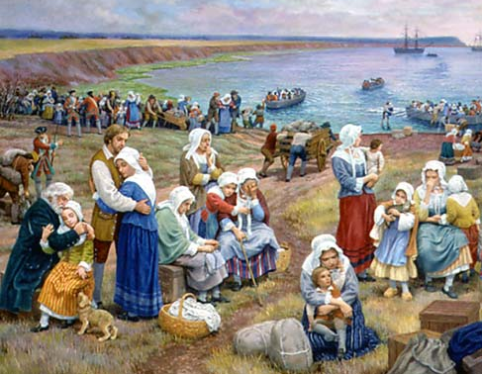
Migration Encore
Evangeline:
A Tale of Acadie
- Henry Wadsworth Longfellow
The Acadians
Soon o'er the yellow fields,
in silent and mournful procession, Came from the neighboring
hamlets and farms the Acadian women, Driving in ponderous wains
their household goods to the sea-shore,
Pausing and looking back
to gaze once more on their dwellings, Ere they were shut from sight
by the winding road and the woodland.
Close at their sides their children ran,
and urged on the oxen, While in their little hands they clasped
some fragments of playthings.
Thus to the Gaspereau's mouth they hurried
and there on the sea-beach Piled in confusion
lay the household goods of the peasants.
All day long between the shore and the ships
did the boats ply; All day long the wains came
laboring down from the village.
Late in the afternoon,
when the sun was near to his setting, Echoed far o'er the fields
came the roll of drums from the churchyard. Thither the women and children thronged.
On a sudden the church-doors opened,
and forth came the guard,
and marching in gloomy procession Followed the long-imprisoned, but patient,
Acadian farmers.
- Henry Wadsworth Longfellow

Slide 2
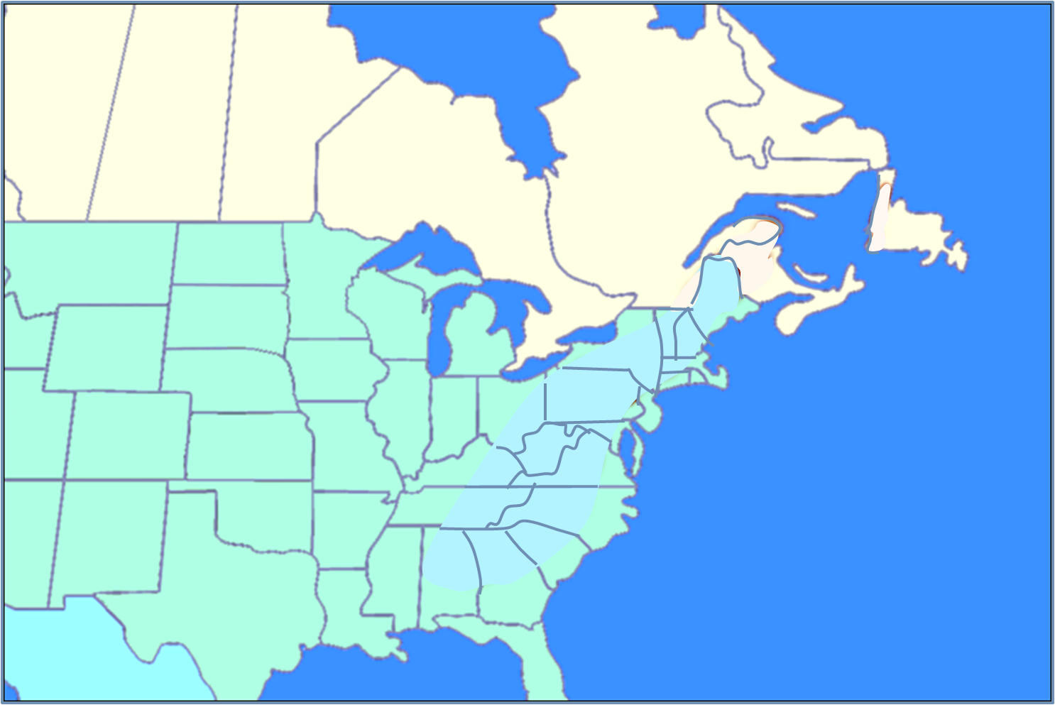
The Acadians
Migration Encore
The Acadians
Notes:
https://www.youtube.com/watch?v=07jF_EVink4

Slide 3
The Acadians
Week 1 Setting the Stage: Before 1600
Week 2 French Migration to Acadie: 1600-1717
Week 3 Le Grand Dérangement: 1717-1755
Week 4 The Acadien Diaspora: 1755-1800
Week 5 Acadians of Canada & Louisiana: 1800-1950
Week 6 Acadians Today: 1950-today

Slide 4
The Acadians
Session 3: Le Grand Dérangement
Week 1 Setting the Stage: Before 1600
Week 2 French Migration to Acadie: 1600-1717
Week 3 Le Grand Dérangement: 1717-1755
Week 4 The Acadien Diaspora: 1755-1800
Week 5 Acadians of Canada & Louisiana: 1800-1950
Week 6 Acadians Today: 1950-today
Le Grand Dérangement

Slide 5
Session 3: Le Grand Dérangement
1600-1717
TODAY’S TOPICS
OVERVIEW
ACADIA HISTORY
Quick Review
How the Acadians are evolving
Leadership issues
UNDERLYING MILITARY ISSUES
Finish Time Segments 8, 9, & 10
The Grand Dérangement
Where do the Acadians go now?
Civilian fighters
Famous guerrilla fighter
Military Action overview
Notes:
Military Background
- Wabanaki Confederacy
- Acadien Militia
- Priest Involvement
- Famous Guerrilla Fighter
- Reasons for Military Action
- Military Engagements Made
- Retaliatory Action

Slide 6
AN OVERVIEW
REVIEW LAST
WEEK KEY POINTS

Slide 7
KEY PLAYERS IN CREATION/DESTRUCTION OF ACADIE
Key Players
Pierre Dugua
Charles Lawrence
Samuel de Champlain
Joseph Broussard
Isaac de Razzily

Slide 8
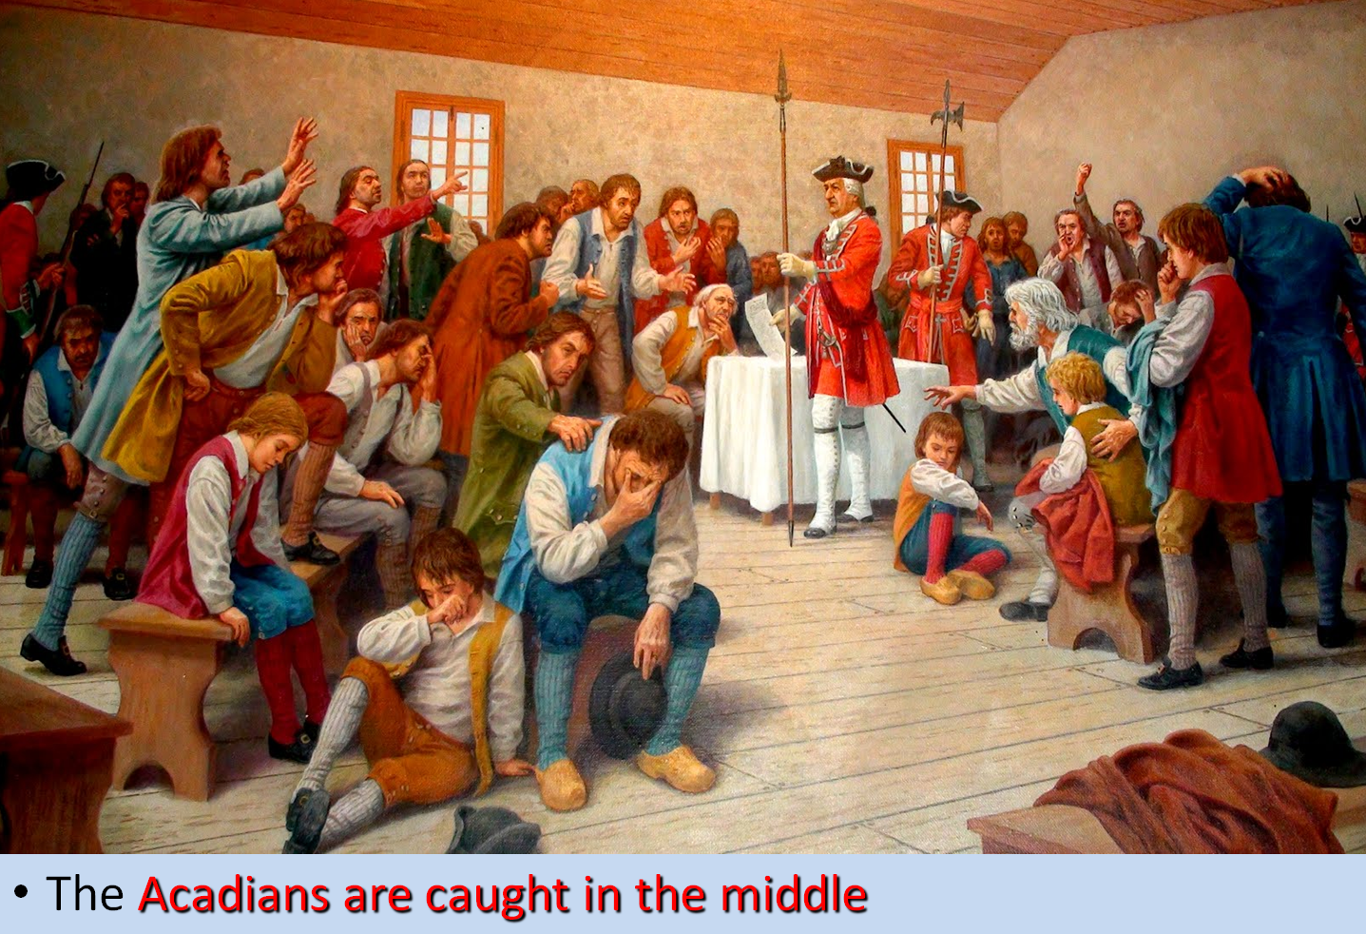
NEW FRANCE GEOPOLITICAL SETTING - EUROPEANS
AN INTERNATIONAL TUG-OF- WAR
A

Slide 9
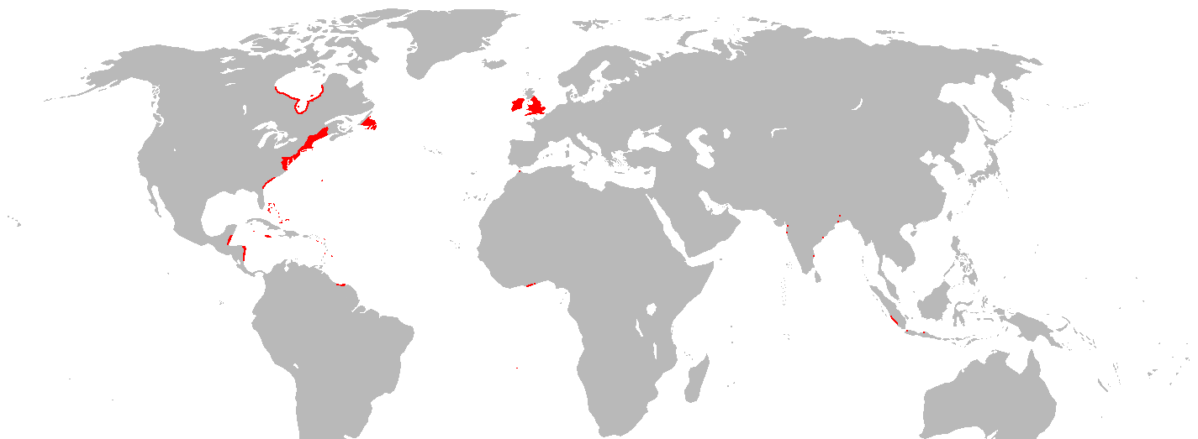
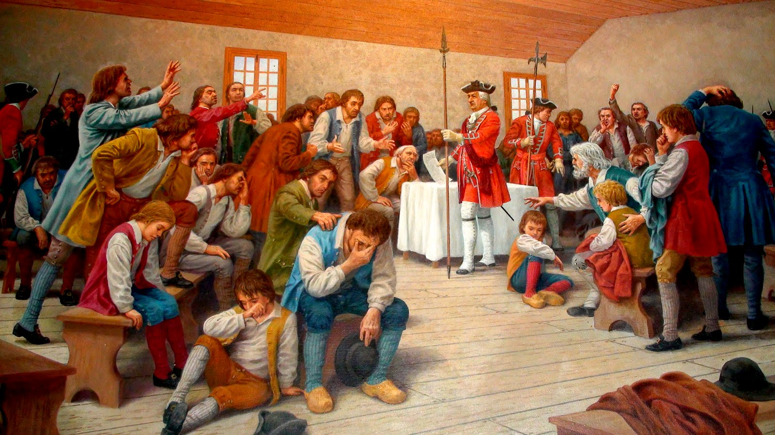
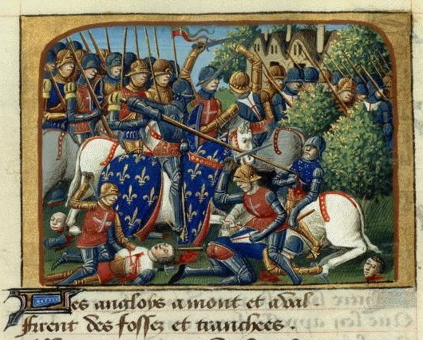
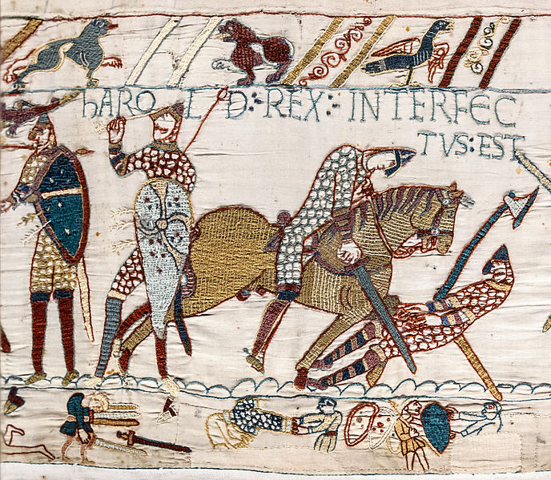
NEW FRANCE GEOPOLITICAL SETTING - EUROPEANS
"historic rivals“
From 1066, England & France were in various conflicts/ wars with each other
Most recent was the Hundred Year’s War: 1337–1453
A
English overseas possessions in 1700
Add to the history of rivalry, and increasing desire for global domination, empire building begins to spread and competition between these nations begins to increase
Armed conflict between France/England ebbs & flows in 17th/18th centuries
The Acadians are caught in the middle
Notes:
https://fr.wikipedia.org/wiki/Acadie_(Nouvelle-France)
La France , while grappling with the wars of religion , focuses late to the colonization of the Americas

Slide 10
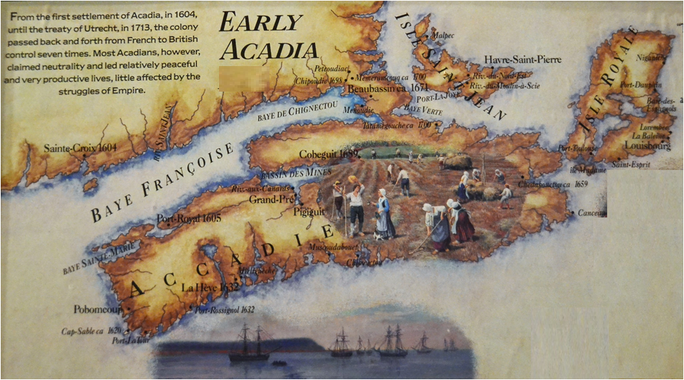
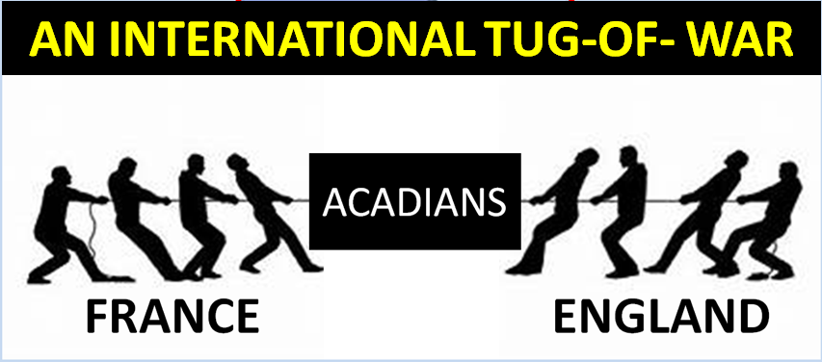
ACADIA: 1604-1755
1604-1755 is time of turmoil as:
Empires fight over this land; Six colonial wars are fought
Acadians struggle to survive, grow, prosper AND stay neutral
A

Slide 11
8-ACADIA: 1710-1726 (16)
ET=106YRS
Beaubassin
1671
Trying to stay neutral is becoming almost impossible. The Acadians are finally realizing that they need to take matters in their own hands, to create their own fate
Les Mines
1682
Port
Royal
A
1711-1713, Acadians at LesMines & Beaubassin successfully engage in guerrilla warfare against the invaders. Acadians conduct a failed siege of their capital Port Royal

Slide 12
8-ACADIA: 1710-1726 (16)
ET=106YRS
BUT IS IT
TOO LATE?
Port
Royal
A
1713-France cedes all of Acadia to Britain through the Treaty of Utrecht. Under the terms of the Treaty, Acadians are permitted to leave within 1 yr and take all moveable possessions w/them

Slide 13
8-ACADIA: 1710-1726 (16)
ET=106YRS
Port
Royal
A
Furthermore, those who stay, supposedly, are guaranteed religious freedom & full title to their lands & possessions if they take the dreaded oath of allegiance to the Crown

Slide 14
8-ACADIA: 1710-1726 (16)
ET=106YRS
Port
Royal
A
Acadians foolishly believe that British occupation this time will be like all past occupations and that French rule will ultimately be restored

Slide 15
8-ACADIA: 1710-1726 (16)
ET=106YRS
"One hundred of the Acadians (who) were born upon this continent & are perfectly at home in the woods, (and) can march upon snowshoes & understand the use of birch canoes, are of more value and service than five times their number of raw men newly arrived from Europe.”
Port
Royal
A
Governor of Nova Scotia writes to his superiors in London on November 24, 1714 regarding the dilemma the British faced…
Notes:
1710 – Stays British from this point on
From Jim Bradshaw’s journal Vetch wrote to his superiors in London on November 24, 1714, "One hundred of the Acadians (who) were born upon this continent and are perfectly at home in the woods, (and) can march upon snowshows and understand the use of birch canoes, are of more value and service than five times their number of raw men newly arrived from Europe. So their skill in the fishery, as well as the cultivating of the soil must make at once of Cape Breton the most powerful colony the French have in America, and to the greatest danger and damage to all the British colonies as well as the universal trade of Great Britain."

Slide 16
8-ACADIA: 1710-1726 (16)
ET=106YRS
"The removal of (the Acadians) and their cattle…would be a great addition to (some other) new colony, but it would wholly ruin Nova Scotia unless supplied by a British colony, which could not be done in several years. So, the Acadians with their stocks of cattle remaining here is very much for the advantage of the Crown."
Port
Royal
A
Governor of Nova Scotia also wrote to his Board of Trade in London regarding the dilemma the British faced…
Notes:
1710 – Stays British from this point on
From Jim Bradshaw’s journal He also wrote to the Board of Trade in London, "The removal of (the Acadians) and their cattle to Cape Breton would be a great addition to that new colony, so it would wholly ruin Nova Scotia unless supplied by a British colony, which could not be done in several years, so that the Acadians with their stocks of cattle remaining here is very much for the advantage of the Crown."

Slide 17
8-ACADIA: 1710-1726 (16)
ET=106YRS
Religious Freedom – Catholicism
Guaranteed neutrality in case future Franco-English colonial wars in order to avoid retributive raids by local French-allied 1st People
Recognition by the colonial gov’t that the Acadians are now, in fact, a distinct community – a distinct people
So, let us look at how the Acadians have evolved from French to Acadian…
Port
Royal
A
1717 - Acadians provide their list of demands if they would accept British rule (assuming English occupation would be short-lived):

Slide 18
Start of new material

Slide 19
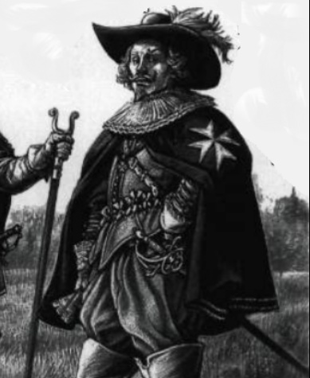
EVOLVING TRANSITION: FROM FRENCH TO ACADIEN
Constant British demands & threats are developing the social fabric of the Acadians
In 2014 the Canadian Society of Civil Engineers recognized the Aboiteau & Dyke system a national historic site
Difficult frontier demands Acadians develop a frontier mentality, to adapt rapidly & learn to be self sufficient
FRENCH
Wars in Europe spill over to North America. Half century, of almost continuous warring between the British & French
A
Constant changing ruler, teaches the Acadians to think & act in their own best interests”
Frequency of British demands for Acadians to take an oath of loyalty is increasing; British
French
Acadien

Slide 20
EVOLVING TRANSITION: FROM FRENCH TO ACADIEN
pressure on the Acadians is escalating
FRENCH
ACADIEN
Acadians are moving to the fringes of British control, to get away from their demands
Frontier settlements became clusters of inter-related families
A
The Acadians are becoming tighter knit, more clan-like, a people united with common beliefs & aims
Bingo! They’ve made it!
Acadians now demanding “Recognition that they are a community of distinct people”
French
Acadien
The Acadian Flag

Slide 21
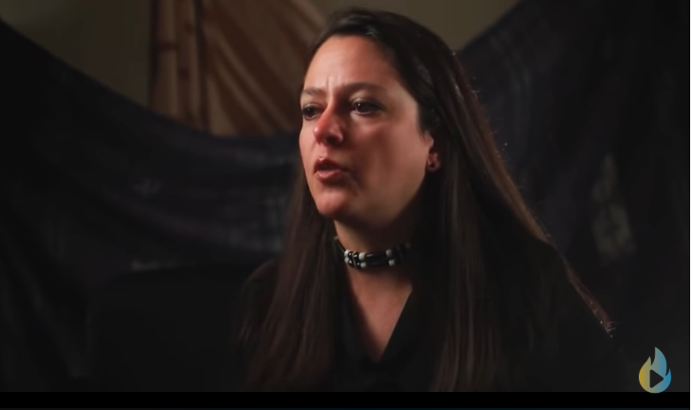
THOUGHTS ON THE ACADIANS
“The sad history of state-sponsored ethnic cleansing in North America begins with the story of the British expulsion of the Acadians in 1755”
So let us continue on with the History of Acadia…
Click on picture to watch a
5 min video
https://youtu.be/KbjrUAl3yBs
“To be left alone!”

Slide 22
1-ACADIA: 1604-1607
ET=0YRS
The ELAPSED TIME from 1604, the beginning of Acadia
Which
TIME SEGMENT this slide is about
The TIME involved in this slide
Which COUNTRY is ruling Acadia at this time
A
Notes:
Ile St. Croix (present-day Dorchet Island, Maine)

Slide 23
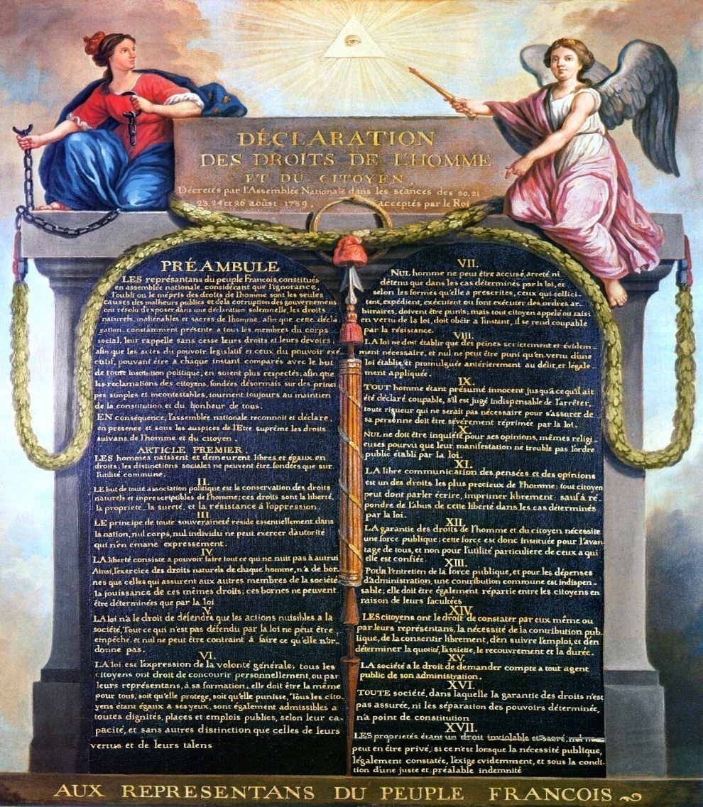
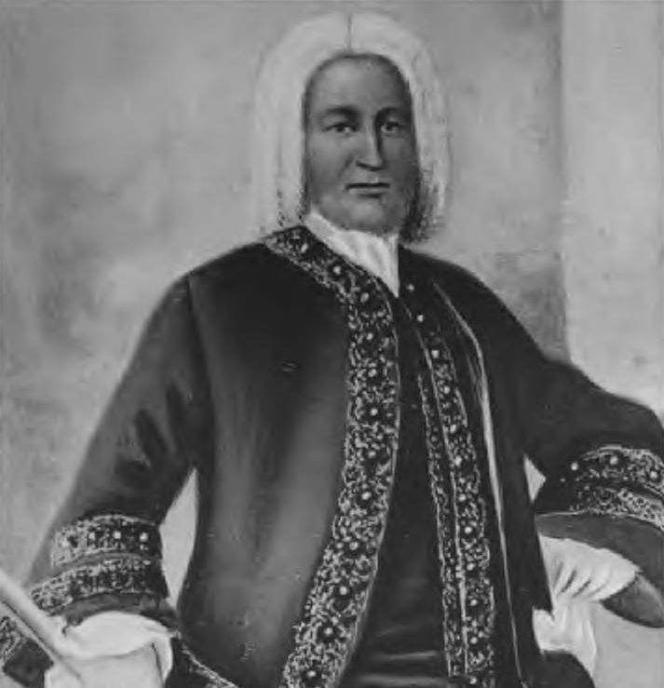
8-ACADIA: 1710-1726 (16)
ET=106YRS
The Acadian demands were in direct confrontation with the new British governor
He was anxious to impose unconditional oath of allegiance
Governor had only 500 men to defend all of Nova Scotia; unlikely to control the 2500 Acadians currently there
Lacking the necessary military
Speaking of Governors…
LIST OF DEMANDS
A
Governor Richard Phillips
force to compel submission and needing the food, firewood, & other critical supplies Acadians were supplying…
1722- Governor Phillips left for London; talks stalled for 3 yrs

Slide 24
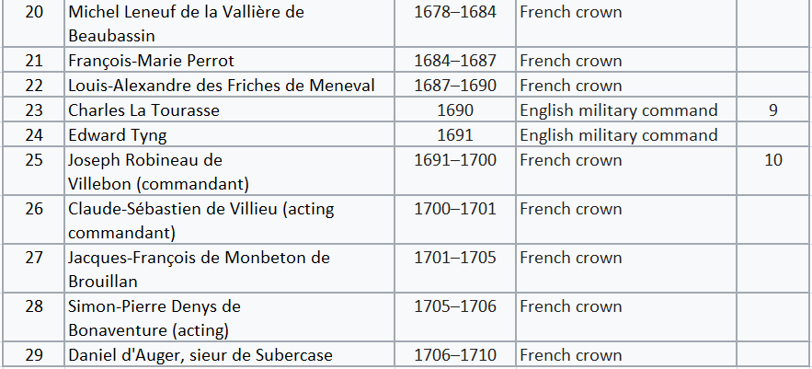
THREE PROBLEMS HERE
1-Number of Governor changes
29 times
2-Number of Changes in Ruling Country 10 times
3-Instances of 2 Governors at same time
4 instances covering 21 yrs of rule
Too many Countries, Too much Changing!
THREE PROBLEMS HERE
1-Number of Governor changes
2-Number of Changes in Ruling Country
3-Instances of 2 Governors at same time
Here is proof…

Slide 25
MILITARY OVERVIEW
Secondary “soldiers” not previously discussed

Slide 26
MILITARY OVERVIEW - SECONDARY SOLDIERS
Secondary “Soldiers”
1st Nations People
Acadian Militia
Guerrilla Fighters
Some Catholic Priests
Some Individual Acadians
Notes:
Military Background
- Wabanaki Confederacy
- Acadien Militia
- Priest Involvement
- Famous Guerrilla Fighter
- Reasons for Military Action
- Military Engagements Made
- Retaliatory Action

Slide 27
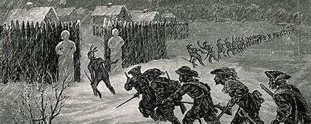
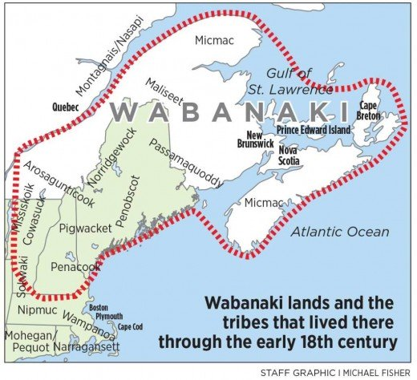
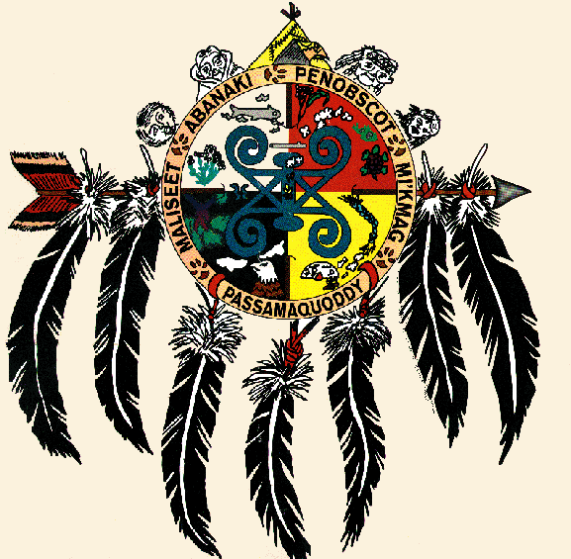
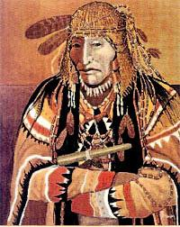
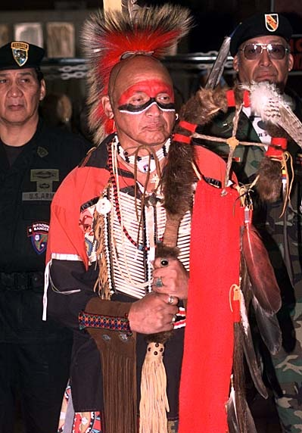
MILITARY OVERVIEW - Wabanaki Confederacy
1st Nations people of Canada had organized themselves into a loose confederation of tribes known as the ”Wabanaki Confederacy”
Consisted of Five principal Nations:Mi'kmaq,MaliseetPassamaquoddy, Abenaki, & Penobscot tribes
A
Abenaki Tribe
This Confederation, and in particular the Mi’kmaqs, were instrumental in assisting the Acadians in resisting encroachment of British either from the colonies or by British military in Nova Scotia
Notes:
https://en.wikipedia.org/wiki/Wabanaki_Confederacy
they jointly invited the colonization of Quebec City and LaHave and the formation of New France in 1603, in order to put French guns, ships, and forts between themselves and the powerful Mohawk people to the west.
Wabanaki soldiers from Canada are still permitted to join the US military. Many have done so in 21st-century conflicts, including the Afghanistan & Iraq Wars
https://en.wikipedia.org/wiki/Iroquois
Counter to the Wabanaki C were the Iroquois, known during the colonial years to the French as the Iroquois League, and later as the Iroquois Confederacy, and to the English as the Five Nations, comprising the Mohawk, Onondaga, Oneida, Cayuga, and Seneca. After 1722, they accepted the Tuscarora people from the Southeast into their confederacy, as they were also Iroquoian-speaking, and became known as the Six Nations.

Slide 28
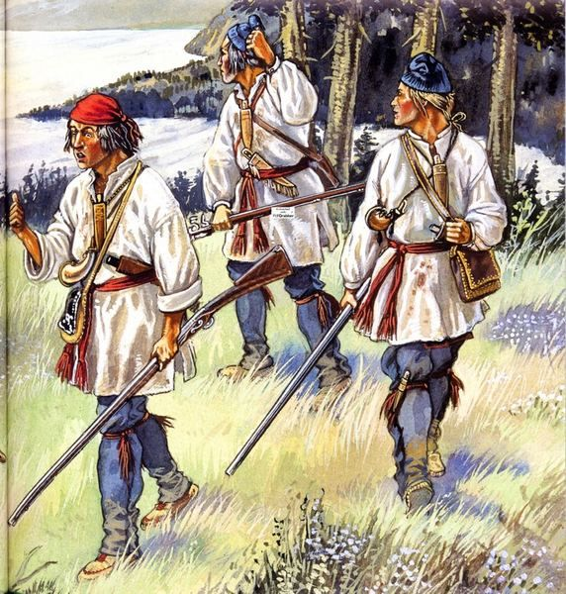
MILITARY OVERVIEW - Acadian militia
ET=106YRS
Acadians, being subject to almost continuous warring in their “backyard” over time, organized into militias
Their militias are units of Acadian, part-time, soldiers who fought in coordination with the Wabanaki Confederacy and French forces from Quebec or the Fortress of Louisbourg
Acadian militias were units of Acadian part-time soldiers who fought in coordination with the Wabanaki Confederacy (particularly the Mi'kmaq militias) and French forces during the colonial period, to defend Acadia against encroachment by the English (the British after 1707).^{[a]} Some other Acadians provided military intelligence, sanctuary, and logistical support to the resistance movement.
A
Objective is to defend Acadia against encroachment by the English (the British after 1707)
Some other Acadians provided military intelligence or sanctuary & logistical support to the resistance movement

Slide 29
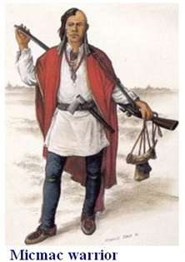
MILITARY OVERVIEW - Acadian militia
ET=106YRS
Acadian militia almost always, but not exclusively, fought side by side with the Mi’kmaqs of the Wabanaki Confederacy
Generally Acadians would only assemble their militias to defend themselves as the bulk of Acadians pledged to stay neutral
However, certain times required
Because of the strength of Acadian militia and Mi'kmaq militia,
British officer John Knox wrote:
"In the year 1757 we were said to be Masters of the province of Nova Scotia, or Acadia, which, however, was only an imaginary possession."
The Acadian militias achieved effective resistance for more than 75 years and through six wars before their eventual demise
A
Acadian actions that went beyond their pledge. These were times of perceived “fight for survival”
It was at those times that some Acadians, because of their small numbers, took to guerrilla warfare to fight the British

Slide 30
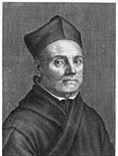
MILITARY OVERVIEW – french priest leadership
ET=106YRS
Sébastien Rale (January 20, 1657 – August 23, 1724)
Jesuit missionary
Started in the Ohio valley where he learned the Abenaki language & developed a French- Abenaki dictionary*
Next assignment was on border of Acadia and New England, the Kennebec River
Catholic priests who were brought over to the New World didn’t only proselytize & comfort the sick, they were, in some instances, de-facto Guerrilla Fighters!
Two best examples are
Fr. Jean-Louis La Tour &
Fr. Sébastien Rale
Let’s take a look at Fr. Rale
A
1694 On behalf of the French, he founded a mission to the Abenakis at Norridgewock (ME) & attended to eastern Abenaki 1st people
Notes:
Similar to talk a couple years ago about the Sylabary
http://www.biographi.ca/en/bio/rale_sebastien_2E.html
There he learned the Abenaki language and began his Abenaki-French dictionary, as is indicated on the first page of his manuscript, which is preserved at Harvard University.
Norridgewock (Narantsouak, today Old Point, South Madison, Me.)
killed 23 Aug. 1724

Slide 31
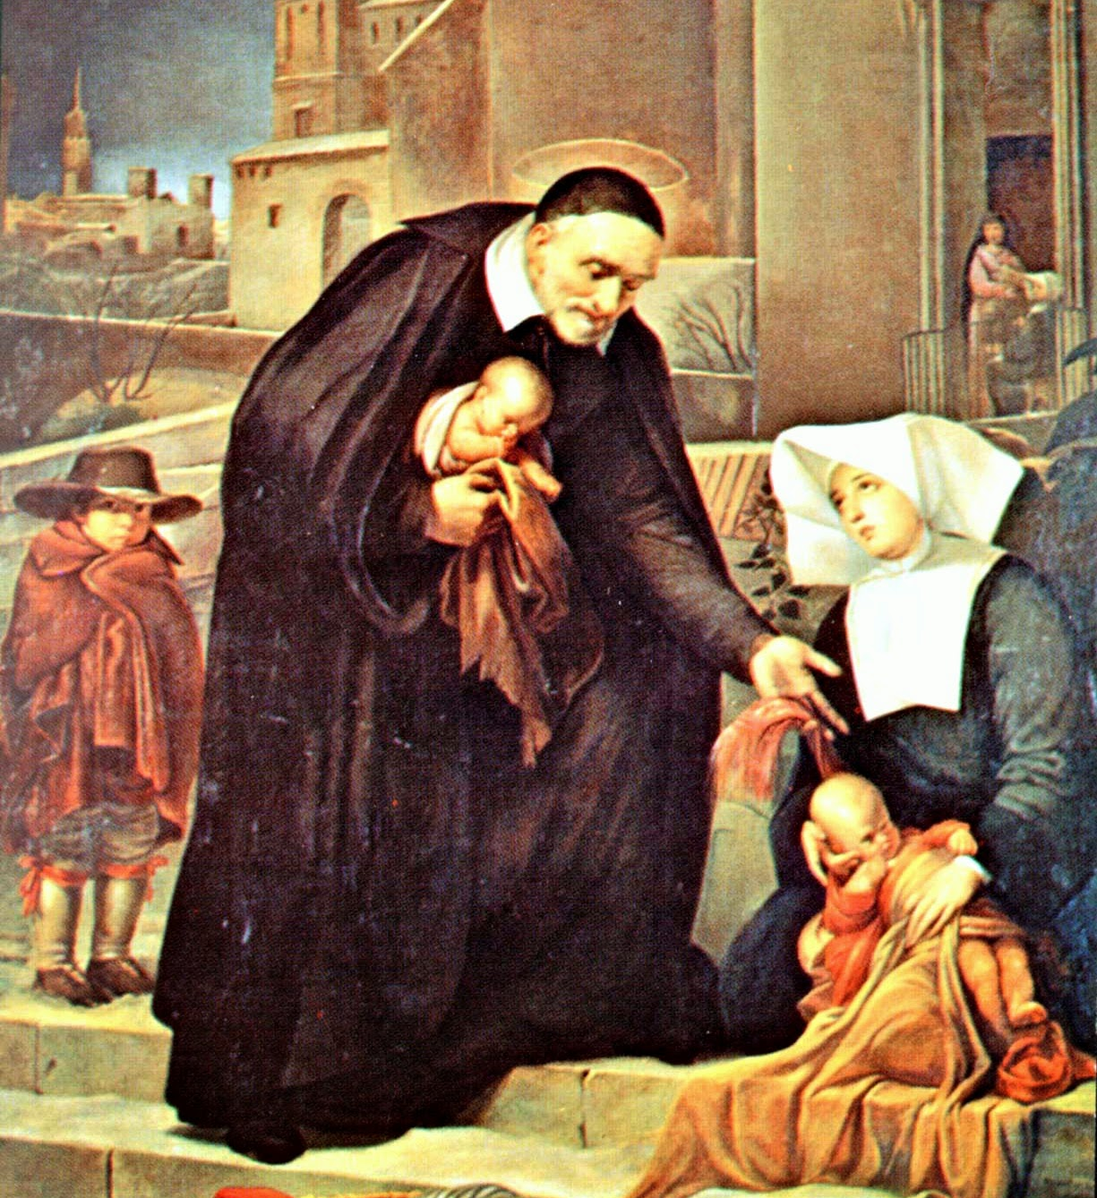
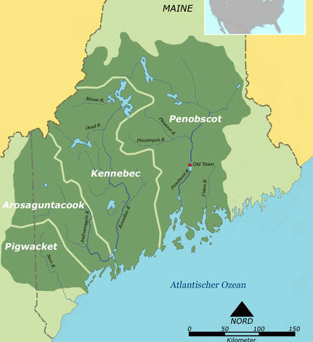
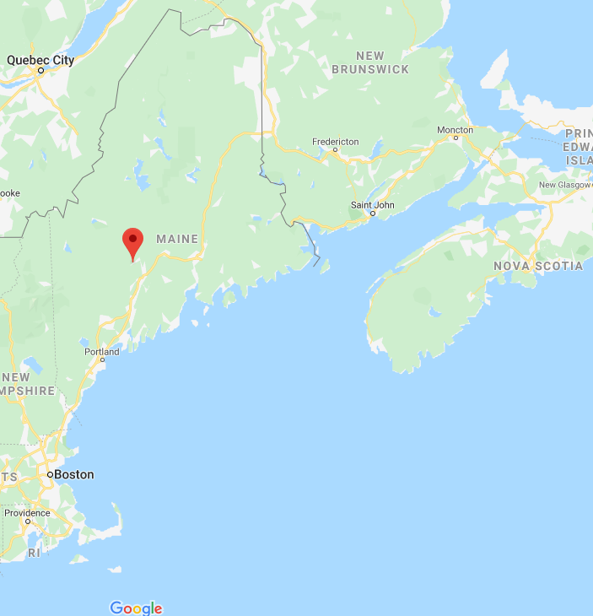
MILITARY OVERVIEW – french priest leadership
ET=106YRS
Abenakis trade with English, who are situated closer to them than are the French
But Abenakis remain attached to the French through their Catholic religious bonds
War of the Spanish Succession breaks out in Europe and spreads to Acadia
Governor of Boston calls the
A
EASTERN ABENAKI TERRITORY
Abenakis together at Casco Bay in 1703 and proposes to them that they remain neutral in this conflict
Fr. Rale said “I will give them only exhortations to peace”
Notes:
http://www.biographi.ca/en/bio/rale_sebastien_2E.html
There he learned the Abenaki language and began his Abenaki-French dictionary, as is indicated on the first page of his manuscript, which is preserved at Harvard University.
Norridgewock (Narantsouak, today Old Point, South Madison, Me.)
killed 23 Aug. 1724

Slide 32
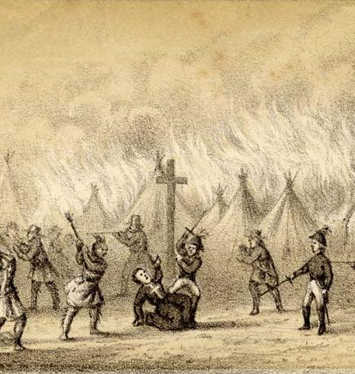
MILITARY OVERVIEW – french priest leadership
ET=106YRS
New England Colonists continue to settle in Wabanaki lands east of the Kennebec River, and the Wabanakis respond by stealing livestock
This leads to an undeclared war (Father Rale’s War as it became known)
British Gov. of Maine & Vermont claim Fr. Rale was
NB
Maine
A
Kennebec River, Maine
behind the Wabanakis attacks
Gov sends 300 troops to the Abenaki mission to capture Fr. Rale. During the war, Father Rale is killed by the British
Notes:
http://www.biographi.ca/en/bio/rale_sebastien_2E.html
There he learned the Abenaki language and began his Abenaki-French dictionary, as is indicated on the first page of his manuscript, which is preserved at Harvard University.
Norridgewock (Narantsouak, today Old Point, South Madison, Me.)
killed 23 Aug. 1724

Slide 33
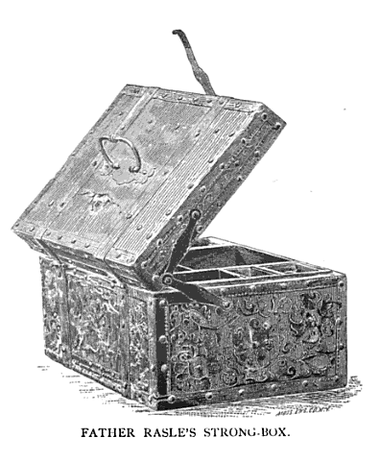
MILITARY OVERVIEW – french priest leadership
ET=106YRS
1st People population retreat from the Kennebec and Penobscot rivers to Quebec, and New Englanders take over much of the Maine territory
Going through Fr. Rale’s possessions, the British find a strongbox with a secret compartment
Compartment held letters to & from the French promising Fr.
NB
Maine
1st People retreat
to Quebec Province
A
Kennebec River, Maine
Rale enough ammunition to drive the Colonists out of Acadia
Fr. Rale’s political involvement had been discovered – he had been a guerrilla leader
Notes:
http://www.biographi.ca/en/bio/rale_sebastien_2E.html
There he learned the Abenaki language and began his Abenaki-French dictionary, as is indicated on the first page of his manuscript, which is preserved at Harvard University.
Norridgewock (Narantsouak, today Old Point, South Madison, Me.)
killed 23 Aug. 1724

Slide 34
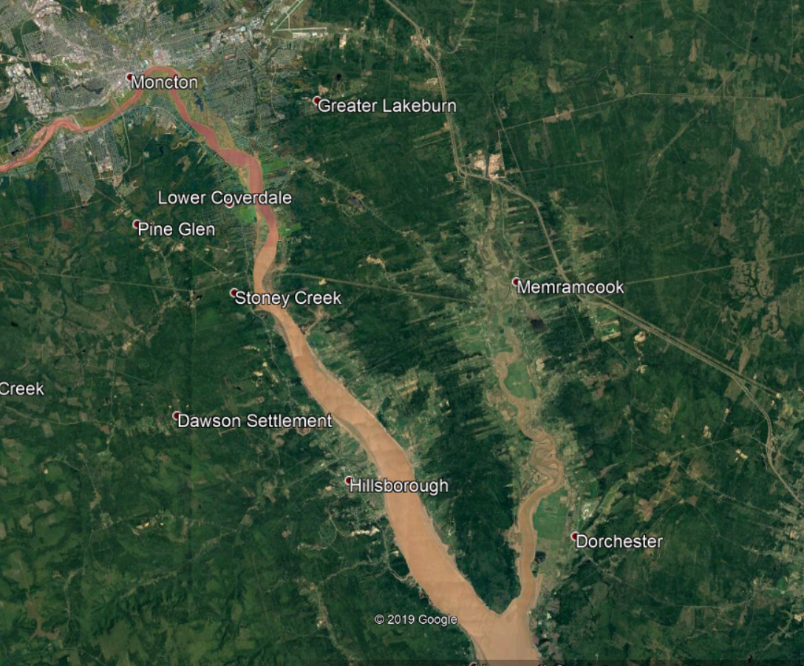
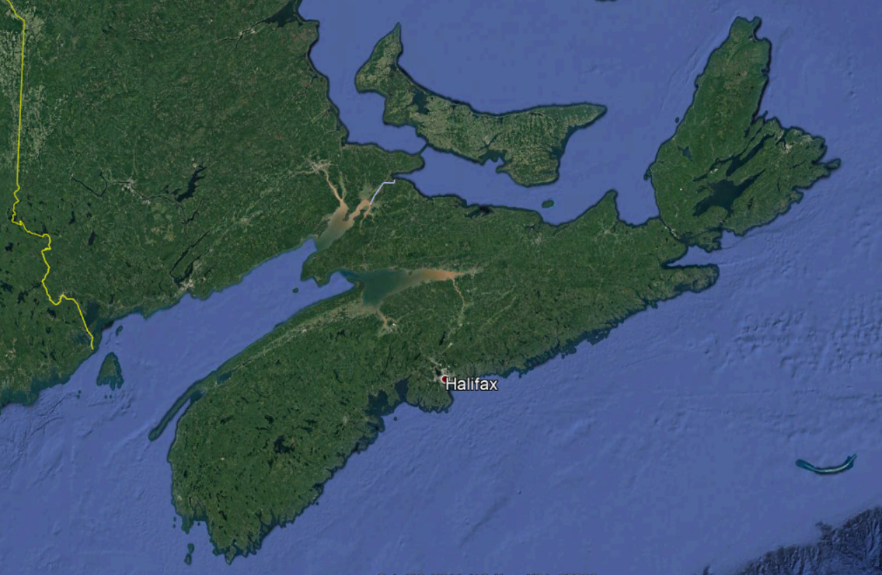
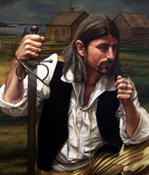
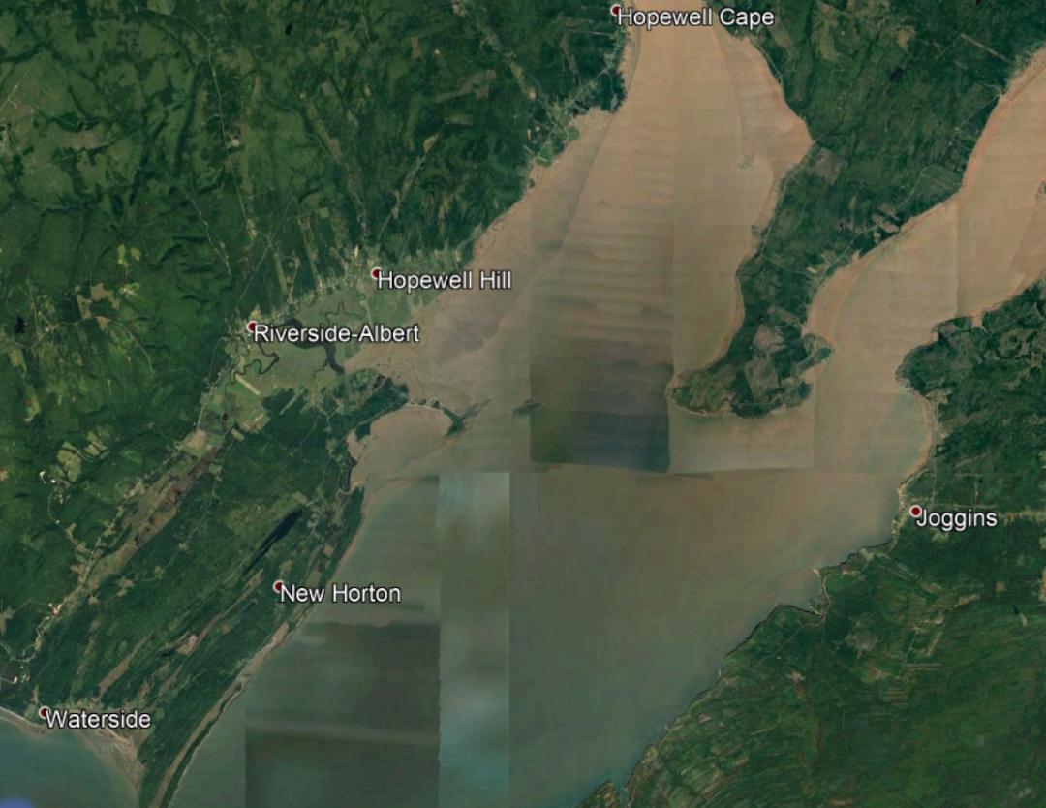
MILITARY OVERVIEW - JOSEPH BROUSSARD
1724 Broussard participated in a raid on Annapolis Royal, Nova Scotia (1724)
Broussard organized a Mi'kmaq and Acadian militias against the British through King George's War, Father Le Loutre's War and during the French and Indian War.
1747 he participated in and was later charged for his involvement with the Battle of Grand Pré.
leader of the Acadian people in Acadia; later Nova Scotia, Prince Edward Island, and New Brunswick.
1749 In an effort to stop the British movement into Acadia, in Broussard was involved in one of the first raids on Dartmouth, Nova Scotiad killing 20 British
After the loss of Acadia to the British, he eventually led the first group of Acadians to southern Louisiana in present-day United States.
1754, Beausoleil and a large band of Mi'kmaq and Acadians left Chignecto for Lawrencetown. They arrived in mid-May and in the night opened fired on the village. Beausoleil killed and scalped four British settlers and two soldiers. By August, as the raids continued, the residents and soldiers were withdrawn to Halifax.
Broussard is widely regarded as a hero and an important historical figure by both Acadians and Cajuns.
Broussard's 21st-century descendants include Célestine "Tina" Knowles (née Beyincé), her two daughters Beyoncé
also known as Beausoleil (English: Beautiful Sun),
Broussard was also active in the fight against Lieutenant Colonel Robert Monckton in the Battle of Beausejour
1755 With Le Loutre imprisoned after the Battle of Beausejour, Broussard became the leader of an armed resistance during the expulsion of the Acadians (1755–1764), leading assaults against the British on several occasions between 1755 and 1758 as part of the forces of Charles Deschamps de Boishébert et de Raffetot.^{[1]} After arming a ship in 1758, Broussard traveled through the upper Bay of Fundy region, where he attacked the British. His ship was seized in November 1758. He was then forced to flee, travelling first to the Miramichi and later imprisoned at Fort Edward in 1762. Finally, he was transferred and imprisoned with other Acadians in Halifax, Nova Scotia.
Joseph Broussard was born in Port-Royal, Acadia in 1702
His father was from Poitiers, France & his mother (a Richard) from Port-Royal, Acadia
He lived much of his life at Le Cran (today-Stoney Creek), Acadia along the Petitcodiac River with wife & 11 children
There is documented evidence
A
Joseph Broussard
1764 Released in 1764, the year after the signing of the Treaty of Paris, Broussard left Nova Scotia, along with his family and hundreds of other Acadians, to Saint-Domingue (present-day Haiti).^{[11]} Unable to adapt to the climate and diseases that was killing Acadians, he led the group to settle in Louisiana.^{[12]}
1765 He was among the first 200 Acadians to arrive in Louisiana on February 27, 1765, aboard the Santo Domingo.^{[13]} On April 8, 1765, he was appointed militia captain and commander of the "Acadians of the Atakapas" the area around present-day St. Martinville, La.^{[1]} Not long after his arrival, Joseph Broussard died near what is now St. Martinville at the presumed age of 63.
that Broussard was a guerrilla fighter from as early as 1724
He was definitely involved in basically all military actions in Acadia from 1754 to 1764
Notes:
Stoney Creek is 26.1 miles from mouth of River
Joseph Broussard
From Wikipedia, the free encyclopedia
Jump to navigationJump to searchFor the rice grower and miller in southeast Texas, see Joseph Eloi Broussard.
Joseph Broussard
Joseph Broussard, known as "Beausoleil". A portrait by Herb Roe.
Nickname(s)BeausoleilBorn1702 Port-Royal, Acadia, New France (present-day Annapolis Royal, Nova Scotia, Canada)Died1765 (aged 62–63) St. Martinville, Louisiana, New Spain (present-day Loreauville, Louisiana, U.S.)BuriedUnknown location near Loreauville, Louisiana
Led Acadians to Louisiana. Militia captain of the Acadians of the Atakapas^{[1]}Joseph Broussard (1702–1765), also known as Beausoleil (English: Beautiful Sun), was a leader of the Acadian people in Acadia; later Nova Scotia, Prince Edward Island, and New Brunswick. Broussard organized a Mi'kmaq and Acadian militias against the British through King George's War, Father Le Loutre's War and during the French and Indian War. After the loss of Acadia to the British, he eventually led the first group of Acadians to southern Louisiana in present-day United States. His name is sometimes presented as Joseph Gaurhept Broussard; this is likely the result of a transcription error.^{[2]} Broussard is widely regarded as a hero and an important historical figure by both Acadians and Cajuns.
Life[edit]
Broussard was born in Port-Royal, Nova Scotia in 1702 to Jean-François Broussard and Catherine Richard. His father came from Poitiers and his mother was born in Port Royal. He lived much of his life at Le Cran (present-day Stoney Creek, Albert County, New Brunswick), along the Petitcodiac River with his wife Agnes and their eleven children.
During Father Rale's War, Broussard participated in a raid on Annapolis Royal, Nova Scotia (1724).^{[3]}
King George's War[edit]
During King George's War, under the leadership of French priest Jean-Louis Le Loutre, Broussard began actively resisting the British occupation of Acadia. Broussard's forces often included Mi'kmaq allies in their resistance against the British. In 1747 he participated in and was later charged for his involvement with the Battle of Grand Pré. (see History of the Acadians)^{[1][4]}
Father Le Loutre's War[edit]
During Father Le Loutre's War, after the construction of Fort Beausejour in 1751, Broussard joined Jean-Louis Le Loutre at Beausejour. In an effort to stop the British movement into Acadia, in 1749 Broussard was involved in one of the first raids on Dartmouth, Nova Scotia which resulted in the deaths of five British settlers.^{[5]} The following year, Broussard was in the Battle at Chignecto and then shortly afterward he led sixty Mi'kmaq and Acadians to attack Dartmouth again, in what would be known as the "Dartmouth Massacre" (1751). Broussard and the others killed twenty British civilians and took more prisoners.^{[6]} Cornwallis temporarily abandoned plans to settle Dartmouth.^{[7]}
In late April 1754, Beausoleil and a large band of Mi'kmaq and Acadians left Chignecto for Lawrencetown. They arrived in mid-May and in the night opened fired on the village. Beausoleil killed and scalped four British settlers and two soldiers. By August, as the raids continued, the residents and soldiers were withdrawn to Halifax.^{[8]}
Capture of French ships Alcide and Lys off Newfoundland. The ships were carrying war supplies for Acadians and Mi'kmaq
In the Action of 8 June 1755, a naval battle off Cape Race, Newfoundland, on board the French ships Alcide and Lys were found 10,000 scalping knives for Acadians and Indians serving under Chief Jean-Baptiste Cope and Acadian Beausoleil as they continue to fight Father Le Loutre's War.^{[9]}
Broussard was also active in the fight against Lieutenant Colonel Robert Monckton in the Battle of Beausejour.^{[10]}
French and Indian War[edit]
With Le Loutre imprisoned after the Battle of Beausejour, Broussard became the leader of an armed resistance during the expulsion of the Acadians (1755–1764), leading assaults against the British on several occasions between 1755 and 1758 as part of the forces of Charles Deschamps de Boishébert et de Raffetot.^{[1]} After arming a ship in 1758, Broussard traveled through the upper Bay of Fundy region, where he attacked the British. His ship was seized in November 1758. He was then forced to flee, travelling first to the Miramichi and later imprisoned at Fort Edward in 1762. Finally, he was transferred and imprisoned with other Acadians in Halifax, Nova Scotia.
Arrival at Louisiana[edit]
Released in 1764, the year after the signing of the Treaty of Paris, Broussard left Nova Scotia, along with his family and hundreds of other Acadians, to Saint-Domingue (present-day Haiti).^{[11]} Unable to adapt to the climate and diseases that was killing Acadians, he led the group to settle in Louisiana.^{[12]}
He was among the first 200 Acadians to arrive in Louisiana on February 27, 1765, aboard the Santo Domingo.^{[13]} On April 8, 1765, he was appointed militia captain and commander of the "Acadians of the Atakapas" the area around present-day St. Martinville, La.^{[1]} Not long after his arrival, Joseph Broussard died near what is now St. Martinville at the presumed age of 63. The exact date of his death is unknown, but it is assumed to have been on or about October 20, 1765. Many of his descendants live in southern Louisiana and Nova Scotia.
Descendancy[edit]
Broussard's 21st-century descendants include Célestine "Tina" Knowles (née Beyincé), her two daughters Beyoncé and Solange, and also her four grandchildren Jules, Blue, Sir, and Rumi.^{[14]}
Modern cultural references[edit]
The Cajun music group BeauSoleil is named after him.
A New Brunswick group "Beausoleil Broussard" was very popular in the 1970s.
He is a character in the novel Banished from Our Home: The Acadian Diary of Angelique Richard, Grand-Pre, Acadia, 1755 (2004) by Sharon Stewart.
A dramatized, historically inaccurate version of Beausoleil is featured in the Acadian novel Pélagie-la-Charette, by Antonine Maillet.
Part of his militant Acadian hero story is told in the documentary feature "Zachary Richard, Cajun Heart" by Acadian director Phil Comeau.

Slide 35
MILITARY OVERVIEW - JOSEPH BROUSSARD
.
1749 In an effort to stop the British movement into Acadia, in Broussard was involved in one of the first raids on Dartmouth, Nova Scotiad killing 20 British
1747 he participated in and was later charged for his involvement with the Battle of Grand Pré.
1724 Broussard participated in a raid on Annapolis Royal, Nova Scotia (1724)
1754, Beausoleil and a large band of Mi'kmaq and Acadians left Chignecto for Lawrencetown. They arrived in mid-May and in the night opened fired on the village. Beausoleil killed and scalped four British settlers and two soldiers. By August, as the raids continued, the residents and soldiers were withdrawn to Halifax.
Broussard organized Mi'kmaq and Acadian militias against the British through King George's War, Father Le Loutre's War and during the French and Indian War
He was a leader of the Acadian people in Acadia (later Nova Scotia, Prince Edward Island, and New Brunswick)
Broussard was also active in the fight against Lieutenant Colonel Robert Monckton in the Battle of Beausejour
1755 With Le Loutre imprisoned after the Battle of Beausejour, Broussard became the leader of an armed resistance during the expulsion of the Acadians (1755–1764), leading assaults against the British on several occasions between 1755 and 1758 as part of the forces of Charles Deschamps de Boishébert et de Raffetot.^{[1]} After arming a ship in 1758, Broussard traveled through the upper Bay of Fundy region, where he attacked the British. His ship was seized in November 1758. He was then forced to flee, travelling first to the Miramichi and later imprisoned at Fort Edward in 1762. Finally, he was transferred and imprisoned with other Acadians in Halifax, Nova Scotia.
A
Joseph Broussard
After the loss of Acadia to the British, he eventually led the first group of Acadians to southern Louisiana
1764 Released in 1764, the year after the signing of the Treaty of Paris, Broussard left Nova Scotia, along with his family and hundreds of other Acadians, to Saint-Domingue (present-day Haiti).^{[11]} Unable to adapt to the climate and diseases that was killing Acadians, he led the group to settle in Louisiana.^{[12]}
1765 He was among the first 200 Acadians to arrive in Louisiana on February 27, 1765, aboard the Santo Domingo.^{[13]} On April 8, 1765, he was appointed militia captain and commander of the "Acadians of the Atakapas" the area around present-day St. Martinville, La.^{[1]} Not long after his arrival, Joseph Broussard died near what is now St. Martinville at the presumed age of 63.
Notes:
Stoney Creek is 26.1 miles from mouth of River
Joseph Broussard
From Wikipedia, the free encyclopedia
Jump to navigationJump to searchFor the rice grower and miller in southeast Texas, see Joseph Eloi Broussard.
Joseph Broussard
Joseph Broussard, known as "Beausoleil". A portrait by Herb Roe.
Nickname(s)BeausoleilBorn1702 Port-Royal, Acadia, New France (present-day Annapolis Royal, Nova Scotia, Canada)Died1765 (aged 62–63) St. Martinville, Louisiana, New Spain (present-day Loreauville, Louisiana, U.S.)BuriedUnknown location near Loreauville, Louisiana
Led Acadians to Louisiana. Militia captain of the Acadians of the Atakapas^{[1]}Joseph Broussard (1702–1765), also known as Beausoleil (English: Beautiful Sun), was a leader of the Acadian people in Acadia; later Nova Scotia, Prince Edward Island, and New Brunswick. Broussard organized a Mi'kmaq and Acadian militias against the British through King George's War, Father Le Loutre's War and during the French and Indian War. After the loss of Acadia to the British, he eventually led the first group of Acadians to southern Louisiana in present-day United States. His name is sometimes presented as Joseph Gaurhept Broussard; this is likely the result of a transcription error.^{[2]} Broussard is widely regarded as a hero and an important historical figure by both Acadians and Cajuns.
Life[edit]
Broussard was born in Port-Royal, Nova Scotia in 1702 to Jean-François Broussard and Catherine Richard. His father came from Poitiers and his mother was born in Port Royal. He lived much of his life at Le Cran (present-day Stoney Creek, Albert County, New Brunswick), along the Petitcodiac River with his wife Agnes and their eleven children.
During Father Rale's War, Broussard participated in a raid on Annapolis Royal, Nova Scotia (1724).^{[3]}
King George's War[edit]
During King George's War, under the leadership of French priest Jean-Louis Le Loutre, Broussard began actively resisting the British occupation of Acadia. Broussard's forces often included Mi'kmaq allies in their resistance against the British. In 1747 he participated in and was later charged for his involvement with the Battle of Grand Pré. (see History of the Acadians)^{[1][4]}
Father Le Loutre's War[edit]
During Father Le Loutre's War, after the construction of Fort Beausejour in 1751, Broussard joined Jean-Louis Le Loutre at Beausejour. In an effort to stop the British movement into Acadia, in 1749 Broussard was involved in one of the first raids on Dartmouth, Nova Scotia which resulted in the deaths of five British settlers.^{[5]} The following year, Broussard was in the Battle at Chignecto and then shortly afterward he led sixty Mi'kmaq and Acadians to attack Dartmouth again, in what would be known as the "Dartmouth Massacre" (1751). Broussard and the others killed twenty British civilians and took more prisoners.^{[6]} Cornwallis temporarily abandoned plans to settle Dartmouth.^{[7]}
In late April 1754, Beausoleil and a large band of Mi'kmaq and Acadians left Chignecto for Lawrencetown. They arrived in mid-May and in the night opened fired on the village. Beausoleil killed and scalped four British settlers and two soldiers. By August, as the raids continued, the residents and soldiers were withdrawn to Halifax.^{[8]}
Capture of French ships Alcide and Lys off Newfoundland. The ships were carrying war supplies for Acadians and Mi'kmaq
In the Action of 8 June 1755, a naval battle off Cape Race, Newfoundland, on board the French ships Alcide and Lys were found 10,000 scalping knives for Acadians and Indians serving under Chief Jean-Baptiste Cope and Acadian Beausoleil as they continue to fight Father Le Loutre's War.^{[9]}
Broussard was also active in the fight against Lieutenant Colonel Robert Monckton in the Battle of Beausejour.^{[10]}
French and Indian War[edit]
With Le Loutre imprisoned after the Battle of Beausejour, Broussard became the leader of an armed resistance during the expulsion of the Acadians (1755–1764), leading assaults against the British on several occasions between 1755 and 1758 as part of the forces of Charles Deschamps de Boishébert et de Raffetot.^{[1]} After arming a ship in 1758, Broussard traveled through the upper Bay of Fundy region, where he attacked the British. His ship was seized in November 1758. He was then forced to flee, travelling first to the Miramichi and later imprisoned at Fort Edward in 1762. Finally, he was transferred and imprisoned with other Acadians in Halifax, Nova Scotia.
Arrival at Louisiana[edit]
Released in 1764, the year after the signing of the Treaty of Paris, Broussard left Nova Scotia, along with his family and hundreds of other Acadians, to Saint-Domingue (present-day Haiti).^{[11]} Unable to adapt to the climate and diseases that was killing Acadians, he led the group to settle in Louisiana.^{[12]}
He was among the first 200 Acadians to arrive in Louisiana on February 27, 1765, aboard the Santo Domingo.^{[13]} On April 8, 1765, he was appointed militia captain and commander of the "Acadians of the Atakapas" the area around present-day St. Martinville, La.^{[1]} Not long after his arrival, Joseph Broussard died near what is now St. Martinville at the presumed age of 63. The exact date of his death is unknown, but it is assumed to have been on or about October 20, 1765. Many of his descendants live in southern Louisiana and Nova Scotia.
Descendancy[edit]
Broussard's 21st-century descendants include Célestine "Tina" Knowles (née Beyincé), her two daughters Beyoncé and Solange, and also her four grandchildren Jules, Blue, Sir, and Rumi.^{[14]}
Modern cultural references[edit]
The Cajun music group BeauSoleil is named after him.
A New Brunswick group "Beausoleil Broussard" was very popular in the 1970s.
He is a character in the novel Banished from Our Home: The Acadian Diary of Angelique Richard, Grand-Pre, Acadia, 1755 (2004) by Sharon Stewart.
A dramatized, historically inaccurate version of Beausoleil is featured in the Acadian novel Pélagie-la-Charette, by Antonine Maillet.
Part of his militant Acadian hero story is told in the documentary feature "Zachary Richard, Cajun Heart" by Acadian director Phil Comeau.

Slide 36
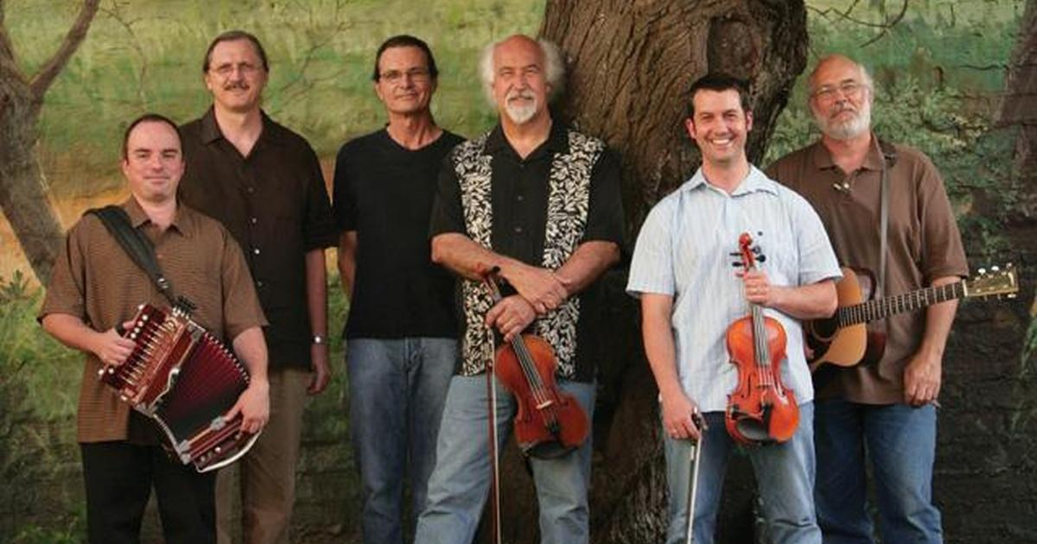
MILITARY OVERVIEW - JOSEPH BROUSSARD
.
1749 In an effort to stop the British movement into Acadia, in Broussard was involved in one of the first raids on Dartmouth, Nova Scotiad killing 20 British
1747 he participated in and was later charged for his involvement with the Battle of Grand Pré.
1724 Broussard participated in a raid on Annapolis Royal, Nova Scotia (1724)
1754, Beausoleil and a large band of Mi'kmaq and Acadians left Chignecto for Lawrencetown. They arrived in mid-May and in the night opened fired on the village. Beausoleil killed and scalped four British settlers and two soldiers. By August, as the raids continued, the residents and soldiers were withdrawn to Halifax.
Broussard is widely regarded as a hero and an important historical figure by the Acadians
Broussard's 21st-century descendants include Célestine "Tina" Knowles & her two daughters, one of whom is: Beyoncé (yes, that one!)
His “nom de guerre” means “Beautiful Sun”…
Broussard was also active in the fight against Lieutenant Colonel Robert Monckton in the Battle of Beausejour
1755 With Le Loutre imprisoned after the Battle of Beausejour, Broussard became the leader of an armed resistance during the expulsion of the Acadians (1755–1764), leading assaults against the British on several occasions between 1755 and 1758 as part of the forces of Charles Deschamps de Boishébert et de Raffetot.^{[1]} After arming a ship in 1758, Broussard traveled through the upper Bay of Fundy region, where he attacked the British. His ship was seized in November 1758. He was then forced to flee, travelling first to the Miramichi and later imprisoned at Fort Edward in 1762. Finally, he was transferred and imprisoned with other Acadians in Halifax, Nova Scotia.
A
Joseph Broussard
“Beausoleil”
1764 Released in 1764, the year after the signing of the Treaty of Paris, Broussard left Nova Scotia, along with his family and hundreds of other Acadians, to Saint-Domingue (present-day Haiti).^{[11]} Unable to adapt to the climate and diseases that was killing Acadians, he led the group to settle in Louisiana.^{[12]}
1765 He was among the first 200 Acadians to arrive in Louisiana on February 27, 1765, aboard the Santo Domingo.^{[13]} On April 8, 1765, he was appointed militia captain and commander of the "Acadians of the Atakapas" the area around present-day St. Martinville, La.^{[1]} Not long after his arrival, Joseph Broussard died near what is now St. Martinville at the presumed age of 63.
Notes:
Stoney Creek is 26.1 miles from mouth of River
Joseph Broussard
From Wikipedia, the free encyclopedia
Jump to navigationJump to searchFor the rice grower and miller in southeast Texas, see Joseph Eloi Broussard.
Joseph Broussard
Joseph Broussard, known as "Beausoleil". A portrait by Herb Roe.
Nickname(s)BeausoleilBorn1702 Port-Royal, Acadia, New France (present-day Annapolis Royal, Nova Scotia, Canada)Died1765 (aged 62–63) St. Martinville, Louisiana, New Spain (present-day Loreauville, Louisiana, U.S.)BuriedUnknown location near Loreauville, Louisiana
Led Acadians to Louisiana. Militia captain of the Acadians of the Atakapas^{[1]}Joseph Broussard (1702–1765), also known as Beausoleil (English: Beautiful Sun), was a leader of the Acadian people in Acadia; later Nova Scotia, Prince Edward Island, and New Brunswick. Broussard organized a Mi'kmaq and Acadian militias against the British through King George's War, Father Le Loutre's War and during the French and Indian War. After the loss of Acadia to the British, he eventually led the first group of Acadians to southern Louisiana in present-day United States. His name is sometimes presented as Joseph Gaurhept Broussard; this is likely the result of a transcription error.^{[2]} Broussard is widely regarded as a hero and an important historical figure by both Acadians and Cajuns.
Life[edit]
Broussard was born in Port-Royal, Nova Scotia in 1702 to Jean-François Broussard and Catherine Richard. His father came from Poitiers and his mother was born in Port Royal. He lived much of his life at Le Cran (present-day Stoney Creek, Albert County, New Brunswick), along the Petitcodiac River with his wife Agnes and their eleven children.
During Father Rale's War, Broussard participated in a raid on Annapolis Royal, Nova Scotia (1724).^{[3]}
King George's War[edit]
During King George's War, under the leadership of French priest Jean-Louis Le Loutre, Broussard began actively resisting the British occupation of Acadia. Broussard's forces often included Mi'kmaq allies in their resistance against the British. In 1747 he participated in and was later charged for his involvement with the Battle of Grand Pré. (see History of the Acadians)^{[1][4]}
Father Le Loutre's War[edit]
During Father Le Loutre's War, after the construction of Fort Beausejour in 1751, Broussard joined Jean-Louis Le Loutre at Beausejour. In an effort to stop the British movement into Acadia, in 1749 Broussard was involved in one of the first raids on Dartmouth, Nova Scotia which resulted in the deaths of five British settlers.^{[5]} The following year, Broussard was in the Battle at Chignecto and then shortly afterward he led sixty Mi'kmaq and Acadians to attack Dartmouth again, in what would be known as the "Dartmouth Massacre" (1751). Broussard and the others killed twenty British civilians and took more prisoners.^{[6]} Cornwallis temporarily abandoned plans to settle Dartmouth.^{[7]}
In late April 1754, Beausoleil and a large band of Mi'kmaq and Acadians left Chignecto for Lawrencetown. They arrived in mid-May and in the night opened fired on the village. Beausoleil killed and scalped four British settlers and two soldiers. By August, as the raids continued, the residents and soldiers were withdrawn to Halifax.^{[8]}
Capture of French ships Alcide and Lys off Newfoundland. The ships were carrying war supplies for Acadians and Mi'kmaq
In the Action of 8 June 1755, a naval battle off Cape Race, Newfoundland, on board the French ships Alcide and Lys were found 10,000 scalping knives for Acadians and Indians serving under Chief Jean-Baptiste Cope and Acadian Beausoleil as they continue to fight Father Le Loutre's War.^{[9]}
Broussard was also active in the fight against Lieutenant Colonel Robert Monckton in the Battle of Beausejour.^{[10]}
French and Indian War[edit]
With Le Loutre imprisoned after the Battle of Beausejour, Broussard became the leader of an armed resistance during the expulsion of the Acadians (1755–1764), leading assaults against the British on several occasions between 1755 and 1758 as part of the forces of Charles Deschamps de Boishébert et de Raffetot.^{[1]} After arming a ship in 1758, Broussard traveled through the upper Bay of Fundy region, where he attacked the British. His ship was seized in November 1758. He was then forced to flee, travelling first to the Miramichi and later imprisoned at Fort Edward in 1762. Finally, he was transferred and imprisoned with other Acadians in Halifax, Nova Scotia.
Arrival at Louisiana[edit]
Released in 1764, the year after the signing of the Treaty of Paris, Broussard left Nova Scotia, along with his family and hundreds of other Acadians, to Saint-Domingue (present-day Haiti).^{[11]} Unable to adapt to the climate and diseases that was killing Acadians, he led the group to settle in Louisiana.^{[12]}
He was among the first 200 Acadians to arrive in Louisiana on February 27, 1765, aboard the Santo Domingo.^{[13]} On April 8, 1765, he was appointed militia captain and commander of the "Acadians of the Atakapas" the area around present-day St. Martinville, La.^{[1]} Not long after his arrival, Joseph Broussard died near what is now St. Martinville at the presumed age of 63. The exact date of his death is unknown, but it is assumed to have been on or about October 20, 1765. Many of his descendants live in southern Louisiana and Nova Scotia.
Descendancy[edit]
Broussard's 21st-century descendants include Célestine "Tina" Knowles (née Beyincé), her two daughters Beyoncé and Solange, and also her four grandchildren Jules, Blue, Sir, and Rumi.^{[14]}
Modern cultural references[edit]
The Cajun music group BeauSoleil is named after him.
A New Brunswick group "Beausoleil Broussard" was very popular in the 1970s.
He is a character in the novel Banished from Our Home: The Acadian Diary of Angelique Richard, Grand-Pre, Acadia, 1755 (2004) by Sharon Stewart.
A dramatized, historically inaccurate version of Beausoleil is featured in the Acadian novel Pélagie-la-Charette, by Antonine Maillet.
Part of his militant Acadian hero story is told in the documentary feature "Zachary Richard, Cajun Heart" by Acadian director Phil Comeau.
Beausoleil, the Cajun Band, won a Grammy in 2008

Slide 37
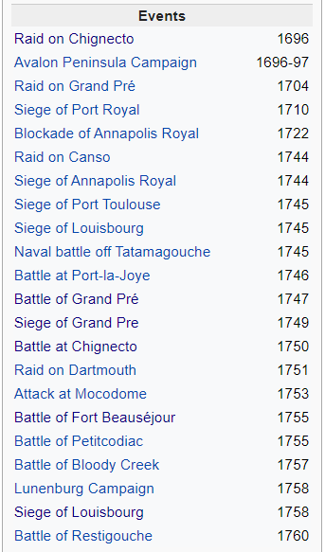
MILITARY OVERVIEW - ENGAGEMENTS
Rather than look at each “engagement” I tried to look at a bigger pictures of why the military actions between parties took place. Here’s what I found…
Notes:
01-The Acadians resisted during the Raid on Chignecto (1696). Colonel Benjamin Church and four hundred men (50 to 150 of whom were Indians, likely Iroquois) arrived offshore of Beaubassin on September 20. When they came ashore, the Acadians and Mi’kmaq opened fire on them. Church lost a lieutenant and several of his men.^{[4]} They managed to get ashore and surprise the Acadians. Many fled while one confronted Church with papers showing they had signed an oath of allegiance in 1690 to the English King. Church was unconvinced, especially after he discovered the proclamation heralding the French success at Pemaquid posted on the church door.
02-After the Siege of Pemaquid (1696), d'Iberville led a force of 124 Canadians, Acadians, Mi’kmaq and Abenaki in the Avalon Peninsula Campaign. They destroyed almost every British settlement in Newfoundland, killed more than 100 British and captured many more. They deported almost 500 British colonists to Britain or France.
06-Raid on Canso (1718) - The Squirrel Affair

Slide 38
REASONS FOR MILITARY ACTION
1-Military strategy
2-Encroaching Settlers
3-Retaliation
-Protect/Shut off supplies/re-supplies
-Control entry ports to one’s own territory
-Set up own supply base in enemy’s backyard
-Monitor, Control, & Protect populace
Each conflict is one of 3 types…
-1st People don’t consider themselves subjects to anyone; they will protect their “homelands”
-Acadians consider Acadia their lands despite Britain having rec’d it via a Treaty
-If your enemy did any of the above to you, then you might presume the right to retaliate

Slide 39
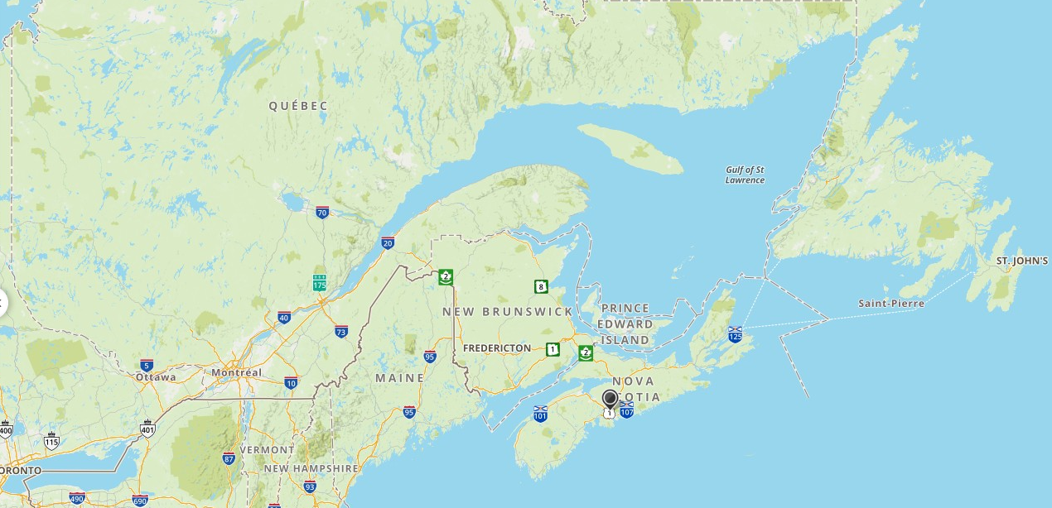
REASONS FOR MILITARY ACTION
A
Quebec City
1608
Major Military
(Ohio Valley)
B
Acadie
1605
C
Fishing
Grounds
Fortress Louisbourg
1719
British 1713
Colonies

Slide 40
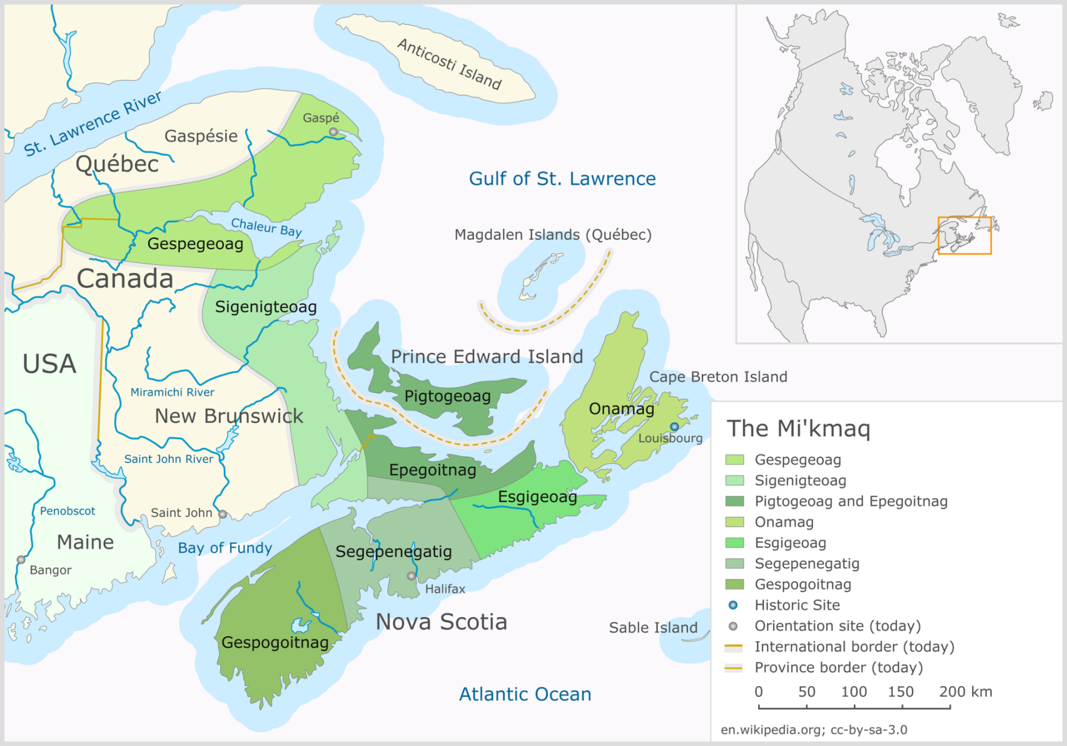
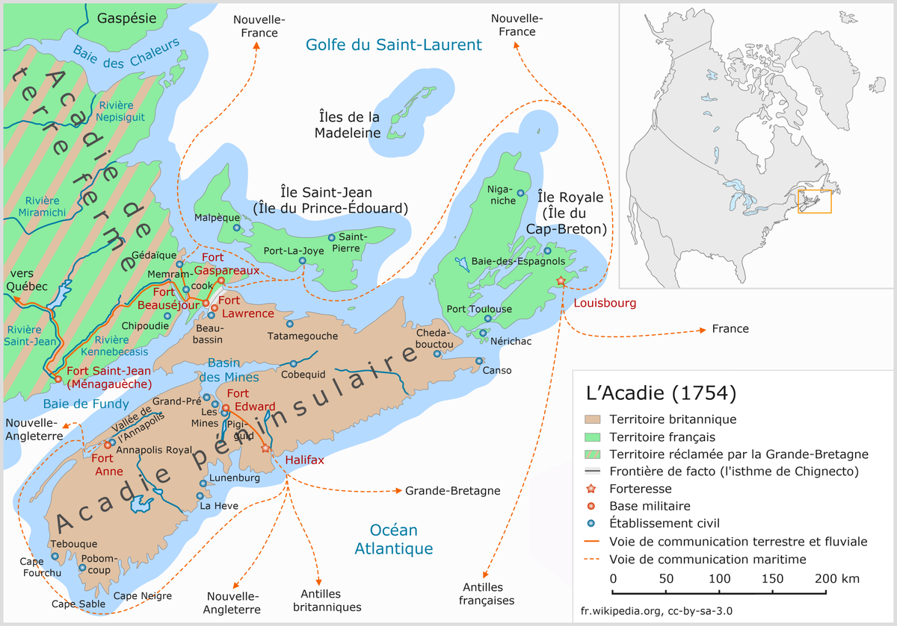
REASONS FOR MILITARY ACTION
1-Military strategy
2-Encroaching Settlers
3-Retaliation
-Protect/Shut off supplies/re-supplies
-Control entry ports to one’s own territory
-Set up own supply base in enemy’s backyard
-Monitor, Control, & Protect populace
Mi’kmaq Territory
-If your enemy did any of the above to you, then you might presume the right to retaliate

Slide 41
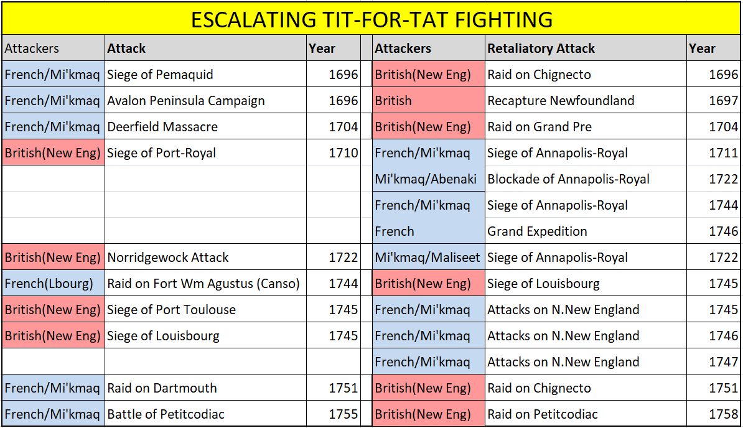
MILITARY OVERVIEW – ESCALATING ACTION

Slide 42
MILITARY OVERVIEW - ENGAGEMENTS
Offensive Party in
Engagement:
British = 11
French = 9
Joint =1
Mi’kmaq=1
So, in analyzing Acadia’s major battles, 3 reasons stand out
1-Strategic
2-Settlement Encroachment
3-Retaliation
Strategic
12
Encroach.
5
Retaliation
5
Notes:
01-The Acadians resisted during the Raid on Chignecto (1696). Colonel Benjamin Church and four hundred men (50 to 150 of whom were Indians, likely Iroquois) arrived offshore of Beaubassin on September 20. When they came ashore, the Acadians and Mi’kmaq opened fire on them. Church lost a lieutenant and several of his men.^{[4]} They managed to get ashore and surprise the Acadians. Many fled while one confronted Church with papers showing they had signed an oath of allegiance in 1690 to the English King. Church was unconvinced, especially after he discovered the proclamation heralding the French success at Pemaquid posted on the church door.
02-After the Siege of Pemaquid (1696), d'Iberville led a force of 124 Canadians, Acadians, Mi’kmaq and Abenaki in the Avalon Peninsula Campaign. They destroyed almost every British settlement in Newfoundland, killed more than 100 British and captured many more. They deported almost 500 British colonists to Britain or France.
06-Raid on Canso (1718) - The Squirrel Affair

Slide 43
CONTINUING WITH THE HISTORY OF ACADIA

Slide 44
8-ACADIA: 1710-1726 (16)
ET=106YRS
Annapolis Royal
Port
Royal
A
1710 – Port Royal is defeated by the British
1713 – Annapolis Royal is built and becomes NS’ capital
Notes:
1710 – Stays British from this point on

Slide 45
8-ACADIA: 1710-1726 (16)
ET=106YRS
Here’s a sidenote on the life of the Acadians
Annapolis Royal
A
By 1725, Acadian settlements had spread across Nova Scotia, to Isle St. Jean, to Isle Royale,and to the north side of Baye Francoise (New Brunswick)
Notes:
1710 – Stays British from this point on

Slide 46
8-ACADIA: 1710-1726 (16)
ET=106YRS
Annapolis Royal
A
The Acadians, in adapting to this frontier environment for over 100 yrs, supplemented their agricultural harvests with shellfishing/fishing in summer & hunting/trapping in winter
Notes:
1710 – Stays British from this point on

Slide 47
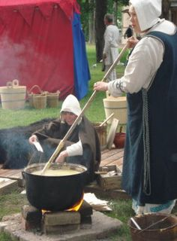
8-ACADIA: 1710-1726 (16)
ET=106YRS
Annapolis Royal
A
During the long winters, Acadian women produced woolen & linen fabric, clothing, soap & candles. Men made maple syrup, brewed beer, made wooden furniture & tools
Notes:
1710 – Stays British from this point on

Slide 48
8-ACADIA: 1710-1726 (16)
ET=106YRS
Annapolis Royal
A
1726 Phillips’ surrogate, Lt. Gov Lawrence Armstrong demanded unconditional oath of allegiance from the Acadians (BTW committed suicide at Annapolis Royal 1739)
Notes:
1710 – Stays British from this point on

Slide 49
8-ACADIA: 1710-1726 (16)
ET=106YRS
Annapolis Royal
A
Once again the Acadians refused* but guaranteed that they would remain neutral in any fight between French & English
Notes:
* The Acadians actually don’t refuse. What the documents indicate is that the Acadians say that they will take the oath if the British can guarantee their safety with the Wabanakis who will see the Acadians as traitors and try to kill them. Of course the British can’t “guarantee” safety on the frontier, so the British are stumped

Slide 50
9-ACADIA: 1727-1747 (20)
ET=123YRS
Annapolis Royal
A
1729 - Phillips returns to Annapolis Royal and through devious means achieves the success that has proved elusive to the British for 20 yrs!
Notes:
From https://www.cbc.ca/history/EPCONTENTSE1EP3CH4PA1LE.html
Governor Richard Philipps informed London in 1720 that the Acadians "will never swear the oath of allegiance, no more than they will leave the country." The Board of Trade replied to him: "As to the French inhabitants of Nova Scotia... we are apprehensive they will never become good subjects to His Majesty... for which reason we are of opinion they ought to be removed as soon as the Forces which we have proposed to be sent your protection shall arrive in Nova Scotia ... but you are not to attempt this expulsion without His Majesty's positive order."
Nothing happened for ten years, and by 1730, the Acadian population had doubled. Philipps wrote that "they constitute a powerful group, which like Noah's offspring are spreading across the face of the province." Philipps and his assistant, Lawrence Armstrong, wanted to solve the problem by satisfying both their superiors and their subjects. They managed to get the Acadians to take the oath, on the condition that they were exempted from the duty of bearing arms. This clause appeared in the documents that the habitants had to sign. Philipps recommended that it be "written in the margin, next to the French translation, in the hopes of overcoming their repulsion, little by little." However, it was not included in the oath itself, which read,"I promise and swear by my Faith as a Christian that I will be entirely faithful and will truly obey His Majesty King George II, whom I acknowledge as the sovereign lord of Acadia or Nova Scotia, so help me God."
There is no doubt that the promise not to bear arms was made. Father Charles de Goudalie de Grand-Pré and Alexandre Bourg Belle-Humeur, a notary, were witnesses: "We witness that His Excellency Lord Richard Philipps... has promised the inhabitants of Mines and the surrounding area that he will exempt them from the requirement to bear arms and to make war against the French and the Indians... and that the said French have engaged themselves and promised never to take up arms in case of war against the kingdom of England."
Philipps could reassure London that four thousand Acadians had taken the oath. For their part, the Acadians believed they had found a way to protect themselves from the whims of empires, at the same time preserving their religion and language.
From 1730 on, the English called the Acadians "neutrals" or "French neutrals".

Slide 51
9-ACADIA: 1727-1747 (20)
ET=123YRS
Annapolis Royal
A
Phillips assures the Acadians that the British gov’t has approved their demand for neutrality in the event of Franco-English hostilities – this is a lie; England is unaware of this lie

Slide 52
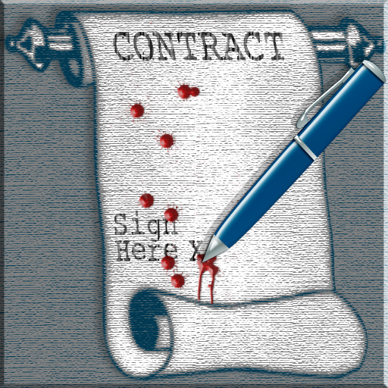
9-ACADIA: 1727-1747 (20)
ET=123YRS
CONDITIONAL OATH
Annapolis Royal
A
On the basis of these verbal assurances, Acadians FINALLY take a CONDITIONAL oath to the British Crown, provided they are not required to fight French or 1st Nations

Slide 53
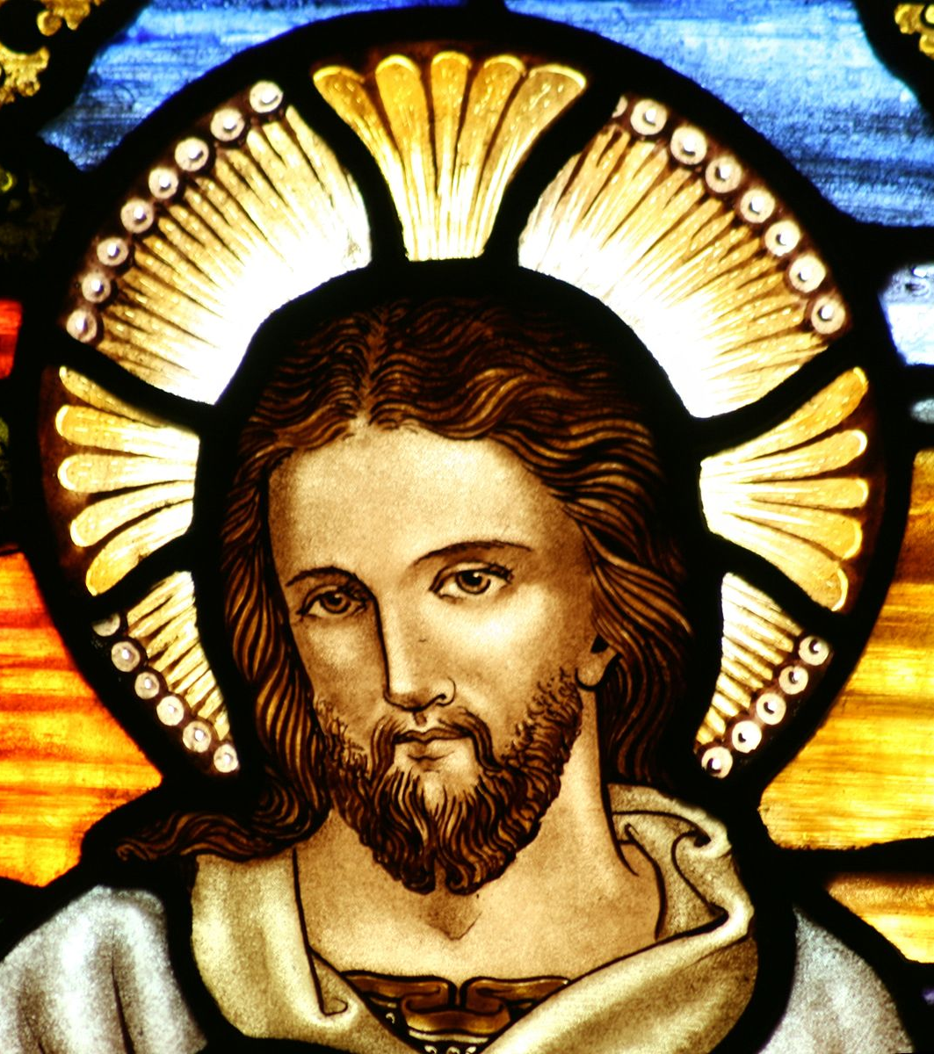
9-ACADIA: 1727-1747 (20)
ET=123YRS
Annapolis Royal
A
The Acadians believe they have found a way to protect themselves from the whims of empires & at the same time, preserve their religion and language

Slide 54
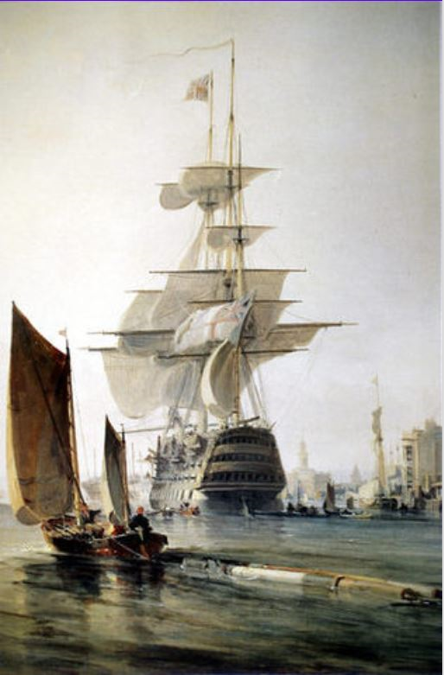
9-ACADIA: 1727-1747 (20)
ET=123YRS
Annapolis Royal
A
Armed with Acadian signatures, Phillips returns to England and presents the signatures as evidence that the Acadians have given their UNCONDITIONAL allegiance to the Crown

Slide 55
9-ACADIA: 1727-1747 (20)
ET=123YRS
Annapolis Royal
A
From 1730 onwards, the English refer to the Acadians as the “French neutrals”; This “convention of 1730” lays ground work for future Anglo-Acadian misunderstandings/ confrontations

Slide 56
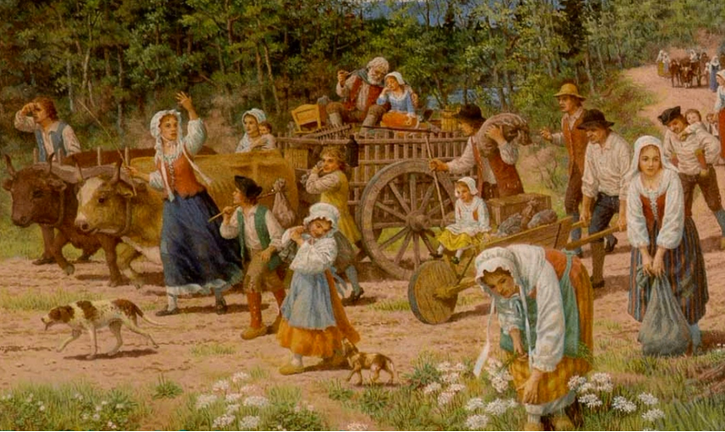
9-ACADIA: 1727-1747 (20)
ET=123YRS
Annapolis Royal
A
By 1731 both sides believe that their dispute has been settled; tension eases, life returns to normal English rule (meaning, little if any change in Acadians’ daily lives)

Slide 57
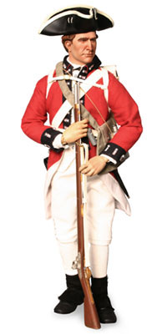
9-ACADIA: 1727-1747 (20)
ET=123YRS
Grains
CUSTOMER
Timber
ACADIANS SUPPLY
Annapolis Royal
A
Milk cows
Cattle
When British demand that Acadians supply firewood, meat or grain, or build roads or survey land, through procrastination or arguments, they foil British demands

Slide 58
9-ACADIA: 1727-1747 (20)
ET=123YRS
Annapolis Royal
A
Increasingly, provincial administrators are labeling Acadians as “ungovernable” & “contemptuous.” Acadian’s desire to be left alone & how they are dealing with British may backfire

Slide 59
10-ACADIA: 1748-1755 (7)
Neighboring French lacked the means of wrestling the colony from English hands & British were incapable of protecting the colonists from Franco-Indian incursions
Annapolis was twice attacked by French-Canadians & French-Canadians captured a British garrison at Mines in 1747
ET=144YRS
Speaking of fortresses,
let’s review the Military Bases situation in Acadia
Chignecto Isthmus
Annapolis Royal
A
1750 - With Europe’s renewed interest in Acadia, additional fortresses at strategic points on the Chignecto Isthmus are being constructed

Slide 60
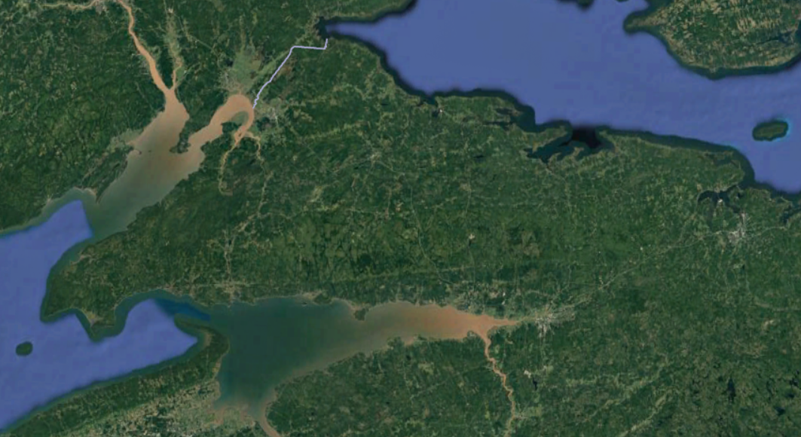
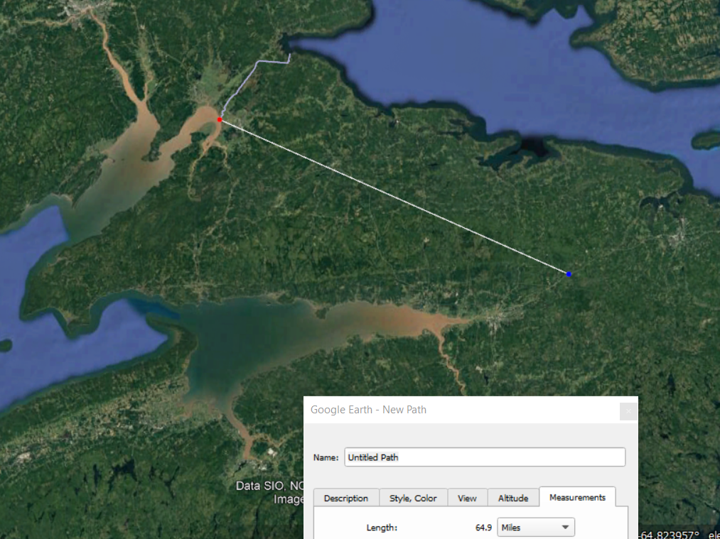
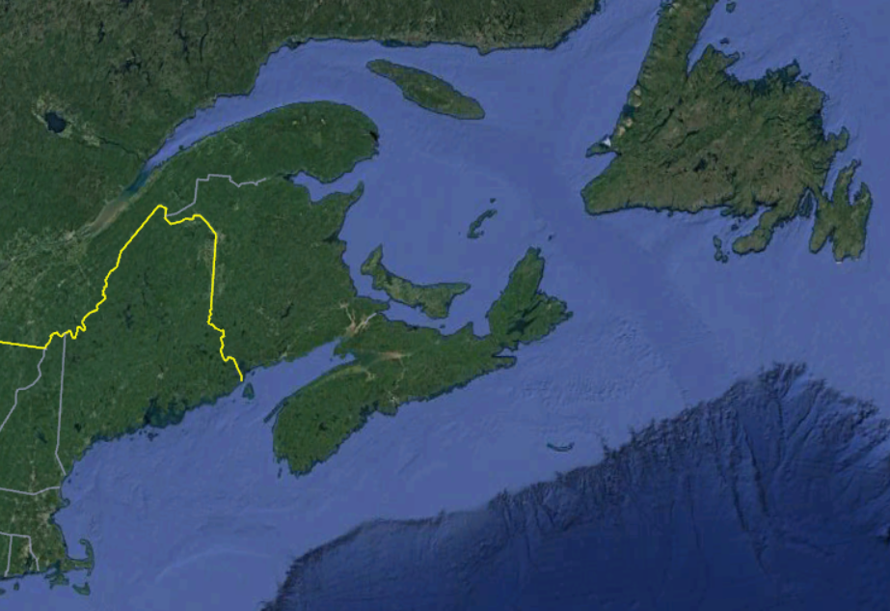
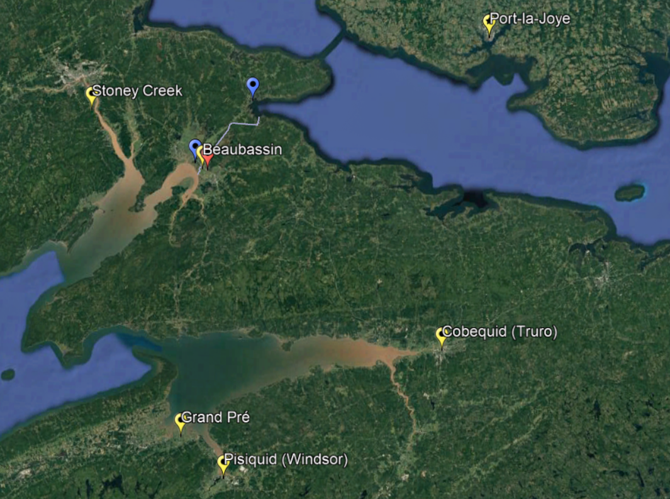
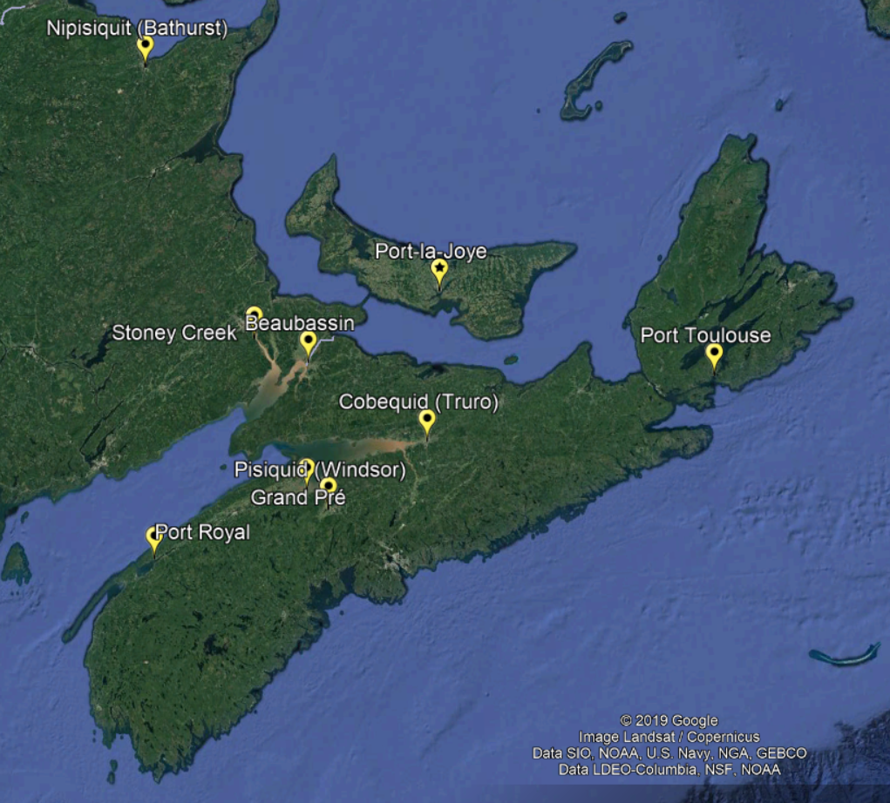
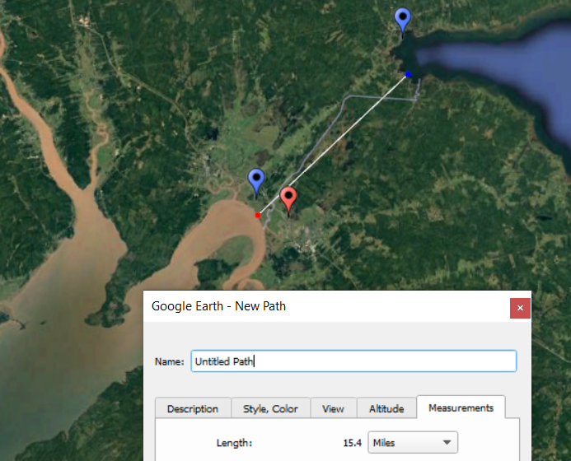
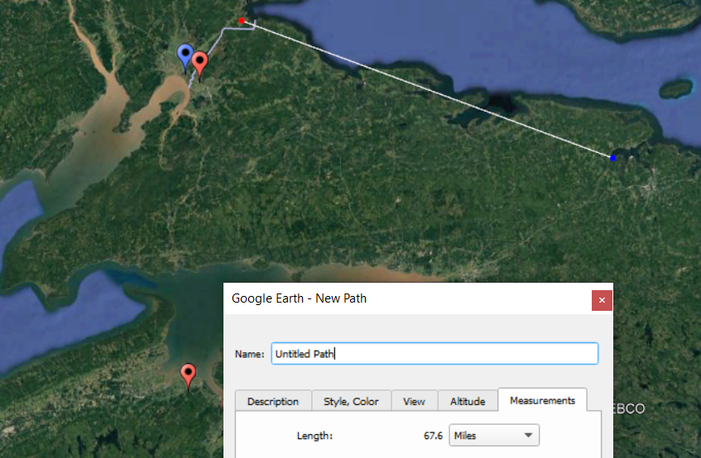
MILITARY BASES IN ACADIA (NOVA SCOTIA)
All land movement of military supplies between Fortress Louisbourg & Quebec have to pass thru this narrow isthmus
67
MILES
NEW BRUNSWICK
ISTHMUS OF CHIGNECTO
15
MILES
NEWFOUNDLAND
ISTHMUS OF CHIGNECTO
NOVA SCOTIA
33
MILES

Slide 61
MILITARY BASES IN ACADIA
Yellow = French Villages
Blue = French Forts
Red = British Forts
Fort Lawrence
What did these frontier forts look like?
Farming
Fortress Louisbourg
Tall “fence”
Look at how close these two forts are…
https://commons.wikimedia.org/w/index.php?curid=12863556
Notes:
Forts are 2 ½ miles apart according to Google Earth
From Fortress Louisbourg to Quebec City is 675 miles!

Slide 62
MILITARY BASES IN ACADIA
Believe palisades would have vertical timber like this rather than horizontal as shown previously
Port Royal
Fort Beauséjour
Annapolis Basin
TYPICAL FRONTIER FORT DESIGN

Slide 63
10-ACADIA: 1748-1755 (7)
ET=144YRS
Annapolis Royal
A
1749 - Fully cognizant of the strategic importance of Nova Scotia & France’s continuing threats to the region, British are determined to hold the colony at all costs
Notes:
George is the most recent British monarch born outside Great Britain: he was born and brought up in northern Germany. The Act of Settlement 1701 and the Acts of Union 1707 positioned his grandmother, Sophia of Hanover, and her Protestant descendants to inherit the British throne. After the deaths of Sophia and Anne, Queen of Great Britain, in 1714, his father, the Elector of Hanover, became George I of Great Britain.

Slide 64
10-ACADIA: 1748-1755 (7)
ET=144YRS
Fort George
Annapolis Royal
A
Fort George
Chebucto Harbor
Chebucto (Halifax) Harbor
Governor Edward Cornwallis
1749 – British appoints Edward Cornwallis as Governor of Nova Scotia. He arrives in Chebucto Harbor with 15 ships carrying 2,500 new settlers & proceeds to build Fort George
Notes:
Fort Beauséjour (French pronunciation: ​[fɔʁ boseʒuʁ]) is a large, five-bastioned star fort
The British Government appointed Cornwallis as Governor of Nova Scotia with the task of establishing a new British settlement to counter France's Fortress Louisbourg. In this period, governors were frequently selected from senior officers. He sailed from England aboard HMS Sphinx on 14 May 1749, followed by a settlement expedition of 15 vessels (including HMS Baltimore and HMS Winchelsea) carrying about 2500 settlers. Cornwallis arrived at Chebucto Harbour on 21 June 1749, followed by the rest of the fleet five days later. The expedition suffered only one death during the passage, due to careful preparations, good ventilation on the ships, and good luck. This was remarkable at a time when the lengthy transatlantic expeditions regularly lost large numbers of persons to infectious disease.^{[15]}
Cornwallis immediately had to decide where to site the town. Settlement organizers in England had recommended Point Pleasant, due to its close access to the ocean and ease of defence. His naval advisers opposed this site because it lacked shelter and had shallows preventing the docking of ocean-going ships. They wanted the town to be located at the head of Bedford Basin, a sheltered location with deep water. Others favoured Dartmouth.
Cornwallis decided to land the settlers and build the town at the site of present-day Downtown Halifax; it was halfway up the harbour with deep water, and protected by a natural, defensible hill (later known as Citadel Hill). By 24 July, the plans of the town had been drawn up. In August lots were drawn to award settlers their town plots in a settlement that was to be named "Halifax" after Lord Halifax, the President of the Board of Trade and Plantations. Lord Halifax (likely his staff) had drawn up the expedition plans for the British Government
Cornwallis sought to project British military power throughout Nova Scotia by establishing forts in the largest Acadian communities, at Pisiguit (Windsor) (Fort Edward), Grand Pré (Fort Vieux Logis), and Chignecto (Fort Lawrence). The French erected forts at present- day Saint John, Chignecto (Fort Beauséjour), and Port Elgin, New Brunswick. The fighting started when Acadians and Mi'kmaq responded by attacking the British at Chignecto, Canso and Dartmouth.
since the city was founded by the English in 1749, and were referred to as Fort George—but only the third fort (built between 1794 and 1800) was officially named Fort George.

Slide 65
10-ACADIA: 1748-1755 (7)
ET=144YRS
Plan of the New Town of Halifax, Nova Scotia
Annapolis Royal
A
Walled City
HALIFAX
Water
Typical Blockhouse
https://archive.lib.msu.edu/maps/MSU-Scanned/Canada/132-d-A-1749-detail.jpg
1749 - English port of Halifax was established & fortified; Internal British communications were improved
Notes:
Interconnected blockhouses
The establishment of Halifax marked the beginning of Father Le Loutre's War. The war began when Edward Cornwallis arrived to establish Halifax with 13 transports and a sloop of war on June 21, 1749
By unilaterally establishing Halifax, the British were violating earlier treaties with the Mi'kmaq (1726), which were signed after Father Rale's War.^{[10]} Cornwallis brought along 1,176 settlers and their families. To guard against Mi'kmaq, Acadian and French attacks on the new Protestant settlements, British fortifications were erected in Halifax (Citadel Hill) (1749), Bedford (Fort Sackville) (1749), Dartmouth (1750), and Lawrencetown (1754), all areas within the modern-day Regional Municipality. St. Margaret's Bay was first settled by French-speaking Foreign Protestants at French Village, Nova Scotia who migrated from Lunenburg, Nova Scotia during the American Revolution.

Slide 66
10-ACADIA: 1748-1755 (7)
ET=144YRS
Annapolis Royal
A
Halifax
Lunenburg
Cornwallis also moves the capital of Nova Scotia to Halifax & settles a large number of German Protestant at Lunenberg, Nova Scotia

Slide 67
10-ACADIA: 1748-1755 (7)
ET=144YRS
A
Halifax
With the growing transformation of Acadia, now Nova Scotia, into a vast military complex comes the emergence of a siege mentality among British leadership

Slide 68
10-ACADIA: 1748-1755 (7)
ET=144YRS
A
Halifax
By unilaterally establishing Halifax, the Mi'kmaq believed the British were violating earlier treaties (1726), which were signed after Father Rale's War

Slide 69
10-ACADIA: 1748-1755 (7)
ET=144YRS
A
Halifax
Bulk of Acadians failed to perceive the gravity of escalating tensions & continued to be neutral

Slide 70
10-ACADIA: 1748-1755 (7)
ET=144YRS
A
Halifax
1750- Fr. Louis Le Loutre, acting in cooperation with the French governor of Louisbourg (site of a French Fort) hatched a shrewd plan to force Beaubassin Acadian village over to French side
Notes:
https://www.pc.gc.ca/en/lhn-nhs/ns/beaubassin/info
the village was a major Acadian settlement on the Isthmus of Chignecto, a pivotal place in the 17th and 18th century North American geopolitical struggle between the British and French empires
In the spring of 1750, the Governor of Nova Scotia, General Edward Cornwallis, ordered Major Charles Lawrence to push the French troops out of the Chignecto region, and in late spring, Lawrence landed with 400 men in the swamps west of Beaubassin. Lawrence was unable to take the Beaubassin Ridge, but nevertheless witnessed the burning of Beaubassin – apparently by the French themselves. The burning of Beaubassin and the militarization of the Isthmus by the French and the British radically changed the geopolitical situation because, soon thereafter, the Acadians fled en masse to French territory or, locally, to refuge on Beauséjour Ridge.

Slide 71
10-ACADIA: 1748-1755 (7)
ET=144YRS
A
Halifax
He orders his Mi’kmaq Indian disciples to destroy the Acadian village of Beaubassin, which they did. Resulting defection of between 2,000 to 4,000 Acadians into French-held territory

Slide 72
10-ACADIA: 1748-1755 (7)
ET=144YRS
A
Halifax
This promoted reciprocal measures to maintain control over the Acadians. Governor Cornwallis revived the long-dormant issue of unconditional Acadian oath of allegiance to Britain

Slide 73
10-ACADIA: 1748-1755 (7)
ET=144YRS
Shediak Peninsula
Isle St. Jean
A
Halifax
1750-This prompted 2,000-4,000 Acadians to secure British passports for the French-held Shediak Peninsula & Ile St. Jean, abandoned their farms & flee English regulation of their lives

Slide 74
10-ACADIA: 1748-1755 (7)
ET=144YRS
Grains
CUSTOMER
Timber
ACADIANS SUPPLY
BRITISH SUPPLY
A
Milk cows
Halifax
Cattle
With establishment of Halifax military complex, Acadians are no longer a vital cog in garrison’s chain of supply and British attitudes toward the Acadians consequently change dramatically

Slide 75
10-ACADIA: 1748-1755 (7)
ET=144YRS
A
Halifax
Acadians become more reluctant to pledge their unconditional loyalty to Britain while the British were never more adamant about the necessity of such an agreement

Slide 76
10-ACADIA: 1748-1755 (7)
ET=144YRS
A
Halifax
English governor begins to view the Acadians more and more as a potentially dangerous ‘foreign” population within British territory

Slide 77
10-ACADIA: 1748-1755 (7)
ET=144YRS
A
Halifax
And views the Acadian rejection of the oath of allegiance as a demonstration of pro-French sympathy

Slide 78
10-ACADIA: 1748-1755 (7)
ET=144YRS
A
Halifax
Major Charles Lawrence
1754 – Next Governor of Nova Scotia is Major Charles Lawrence. Acadian’s continuing defiance will soon have tragic results

Slide 79
MAJOR CHARLES LAWRENCE – NEW GOVERNOR
1724 Broussard participated in a raid on Annapolis Royal, Nova Scotia (1724)
1747 he participated in and was later charged for his involvement with the Battle of Grand Pré.
1749 In an effort to stop the British movement into Acadia, in Broussard was involved in one of the first raids on Dartmouth, Nova Scotiad killing 20 British
1754, Beausoleil and a large band of Mi'kmaq and Acadians left Chignecto for Lawrencetown. They arrived in mid-May and in the night opened fired on the village. Beausoleil killed and scalped four British settlers and two soldiers. By August, as the raids continued, the residents and soldiers were withdrawn to Halifax.
A
Broussard was also active in the fight against Lieutenant Colonel Robert Monckton in the Battle of Beausejour
Born in Plymouth, England in 1709
1733 – Received Commission; Served in the West Indies & England’s War Office
1749 - Transfers to Nova Scotia; participates in Battle of Chignecto; oversees building of Fort Lawrence in 1750
Lawrence was seen as a "competent", "efficient" officer with a "service record that had earned him fairly rapid promotion, a person of considerable administrative talent who was trusted by all
BUT HISTORY HAS RECORDED HIM AS THE GOVERNOR THAT…
ISSUES THE DEPORTATION NOTICE THAT ALL ACADIANS ARE TO LEAVE IMMEDIATELY FROM NOVA SCOTIAN SOIL
1755 With Le Loutre imprisoned after the Battle of Beausejour, Broussard became the leader of an armed resistance during the expulsion of the Acadians (1755–1764), leading assaults against the British on several occasions between 1755 and 1758 as part of the forces of Charles Deschamps de Boishébert et de Raffetot.^{[1]} After arming a ship in 1758, Broussard traveled through the upper Bay of Fundy region, where he attacked the British. His ship was seized in November 1758. He was then forced to flee, travelling first to the Miramichi and later imprisoned at Fort Edward in 1762. Finally, he was transferred and imprisoned with other Acadians in Halifax, Nova Scotia.
1758 Key participant in the Siege of the Louisbourg Fortress
1759 Commissions armed navy patrols around Nova Scotia
1760 Dies of pneumonia in Halifax & is buried under St. Paul’s Church
1764 Released in 1764, the year after the signing of the Treaty of Paris, Broussard left Nova Scotia, along with his family and hundreds of other Acadians, to Saint-Domingue (present-day Haiti).^{[11]} Unable to adapt to the climate and diseases that was killing Acadians, he led the group to settle in Louisiana.^{[12]}
1765 He was among the first 200 Acadians to arrive in Louisiana on February 27, 1765, aboard the Santo Domingo.^{[13]} On April 8, 1765, he was appointed militia captain and commander of the "Acadians of the Atakapas" the area around present-day St. Martinville, La.^{[1]} Not long after his arrival, Joseph Broussard died near what is now St. Martinville at the presumed age of 63.
Notes:
Stoney Creek is 26.1 miles from mouth of River
Joseph Broussard
From Wikipedia, the free encyclopedia
Jump to navigationJump to searchFor the rice grower and miller in southeast Texas, see Joseph Eloi Broussard.
Joseph Broussard
Joseph Broussard, known as "Beausoleil". A portrait by Herb Roe.
Nickname(s)BeausoleilBorn1702 Port-Royal, Acadia, New France (present-day Annapolis Royal, Nova Scotia, Canada)Died1765 (aged 62–63) St. Martinville, Louisiana, New Spain (present-day Loreauville, Louisiana, U.S.)BuriedUnknown location near Loreauville, Louisiana
Led Acadians to Louisiana. Militia captain of the Acadians of the Atakapas^{[1]}Joseph Broussard (1702–1765), also known as Beausoleil (English: Beautiful Sun), was a leader of the Acadian people in Acadia; later Nova Scotia, Prince Edward Island, and New Brunswick. Broussard organized a Mi'kmaq and Acadian militias against the British through King George's War, Father Le Loutre's War and during the French and Indian War. After the loss of Acadia to the British, he eventually led the first group of Acadians to southern Louisiana in present-day United States. His name is sometimes presented as Joseph Gaurhept Broussard; this is likely the result of a transcription error.^{[2]} Broussard is widely regarded as a hero and an important historical figure by both Acadians and Cajuns.
Life[edit]
Broussard was born in Port-Royal, Nova Scotia in 1702 to Jean-François Broussard and Catherine Richard. His father came from Poitiers and his mother was born in Port Royal. He lived much of his life at Le Cran (present-day Stoney Creek, Albert County, New Brunswick), along the Petitcodiac River with his wife Agnes and their eleven children.
During Father Rale's War, Broussard participated in a raid on Annapolis Royal, Nova Scotia (1724).^{[3]}
King George's War[edit]
During King George's War, under the leadership of French priest Jean-Louis Le Loutre, Broussard began actively resisting the British occupation of Acadia. Broussard's forces often included Mi'kmaq allies in their resistance against the British. In 1747 he participated in and was later charged for his involvement with the Battle of Grand Pré. (see History of the Acadians)^{[1][4]}
Father Le Loutre's War[edit]
During Father Le Loutre's War, after the construction of Fort Beausejour in 1751, Broussard joined Jean-Louis Le Loutre at Beausejour. In an effort to stop the British movement into Acadia, in 1749 Broussard was involved in one of the first raids on Dartmouth, Nova Scotia which resulted in the deaths of five British settlers.^{[5]} The following year, Broussard was in the Battle at Chignecto and then shortly afterward he led sixty Mi'kmaq and Acadians to attack Dartmouth again, in what would be known as the "Dartmouth Massacre" (1751). Broussard and the others killed twenty British civilians and took more prisoners.^{[6]} Cornwallis temporarily abandoned plans to settle Dartmouth.^{[7]}
In late April 1754, Beausoleil and a large band of Mi'kmaq and Acadians left Chignecto for Lawrencetown. They arrived in mid-May and in the night opened fired on the village. Beausoleil killed and scalped four British settlers and two soldiers. By August, as the raids continued, the residents and soldiers were withdrawn to Halifax.^{[8]}
Capture of French ships Alcide and Lys off Newfoundland. The ships were carrying war supplies for Acadians and Mi'kmaq
In the Action of 8 June 1755, a naval battle off Cape Race, Newfoundland, on board the French ships Alcide and Lys were found 10,000 scalping knives for Acadians and Indians serving under Chief Jean-Baptiste Cope and Acadian Beausoleil as they continue to fight Father Le Loutre's War.^{[9]}
Broussard was also active in the fight against Lieutenant Colonel Robert Monckton in the Battle of Beausejour.^{[10]}
French and Indian War[edit]
With Le Loutre imprisoned after the Battle of Beausejour, Broussard became the leader of an armed resistance during the expulsion of the Acadians (1755–1764), leading assaults against the British on several occasions between 1755 and 1758 as part of the forces of Charles Deschamps de Boishébert et de Raffetot.^{[1]} After arming a ship in 1758, Broussard traveled through the upper Bay of Fundy region, where he attacked the British. His ship was seized in November 1758. He was then forced to flee, travelling first to the Miramichi and later imprisoned at Fort Edward in 1762. Finally, he was transferred and imprisoned with other Acadians in Halifax, Nova Scotia.
Arrival at Louisiana[edit]
Released in 1764, the year after the signing of the Treaty of Paris, Broussard left Nova Scotia, along with his family and hundreds of other Acadians, to Saint-Domingue (present-day Haiti).^{[11]} Unable to adapt to the climate and diseases that was killing Acadians, he led the group to settle in Louisiana.^{[12]}
He was among the first 200 Acadians to arrive in Louisiana on February 27, 1765, aboard the Santo Domingo.^{[13]} On April 8, 1765, he was appointed militia captain and commander of the "Acadians of the Atakapas" the area around present-day St. Martinville, La.^{[1]} Not long after his arrival, Joseph Broussard died near what is now St. Martinville at the presumed age of 63. The exact date of his death is unknown, but it is assumed to have been on or about October 20, 1765. Many of his descendants live in southern Louisiana and Nova Scotia.
Descendancy[edit]
Broussard's 21st-century descendants include Célestine "Tina" Knowles (née Beyincé), her two daughters Beyoncé and Solange, and also her four grandchildren Jules, Blue, Sir, and Rumi.^{[14]}
Modern cultural references[edit]
The Cajun music group BeauSoleil is named after him.
A New Brunswick group "Beausoleil Broussard" was very popular in the 1970s.
He is a character in the novel Banished from Our Home: The Acadian Diary of Angelique Richard, Grand-Pre, Acadia, 1755 (2004) by Sharon Stewart.
A dramatized, historically inaccurate version of Beausoleil is featured in the Acadian novel Pélagie-la-Charette, by Antonine Maillet.
Part of his militant Acadian hero story is told in the documentary feature "Zachary Richard, Cajun Heart" by Acadian director Phil Comeau.

Slide 80
ET=151YRS 1755 - THE GRAND DÉRANGEMENT
Also known as the Expulsion of the Acadians, the Great Upheaval, the Great Expulsion, & the Great Deportation
Without making distinctions between the Acadians who had been neutral and those who
A
had resisted the occupation of Acadia, the British governor Charles Lawrence & Nova Scotia Council ordered ALL Acadians to be expelled from ACADIA
It was a forced removal by the British of Acadians from the Canadian Maritimes – an ETHNIC CLEANSING!

Slide 81
ET=151YRS 1755 - THE GRAND DÉRANGEMENT
June - A convoy from Boston of 31 transports & three warships carrying nearly 2,000 New England provincial troops and 270 British regulars drop anchor near Fort Beausejour
The Fort had been de-manned on advice from
Fort Beauséjour
A
Thomas Pochon (turned out he was a paid British spy) and the Fort currently had only 150 soldiers
British, led by Lt. Col. Robert Monckton, dropped one large bomb into the fort, killing many, and the fort surrendered; fort was renamed Fort Cumberland
Notes:
Battle of Fort Beauséjour[edit]
Main article: Battle of Fort Beauséjour
The French position may have been undermined by Thomas Pichon, a clerk at the fort. The British commandant at Fort Lawrence paid Pichon for information about French activities. Pichon provided accounts of French activities, plans of forts and an outline of the steps necessary for capture, which Lieutenant-Colonel Robert Monckton later used in the attacks. Pichon delayed the strengthening of Beauséjour by advising that the British would not attack that year.^{[10]}
Fort Beauséjour and cathedral by John Hamilton (1755)
A convoy of 31 transports and three warships left Boston on 19 May 1755, carrying nearly 2,000 New England provincial troops and 270 British regulars, and dropped anchor near the mouth of the Missaguash River on 2 June.^{[11]} The next day the troops, under the command of Lieutenant-Colonel Robert Monckton of the regular army, disembarked a few kilometres from Fort Beauséjour. To defend the fort, Commander Louis Du Pont Duchambon de Vergor had only 150 soldiers from the Compagnies franches de la Marine and a dozen canonniers-bombardiers. On June 16, a large English bomb went through the roof of a casemate and killed many of its occupants. Vergor laid down his weapons. The fort was surrendered, and renamed Fort Cumberland. The next day Fort Gaspereau was surrendered without being attacked. The fall of these forts settled the boundary dispute in favour of the British and marked the beginning of the Expulsion of the Acadians.^{[9]}
The minister of Marine, Machault, had good reason to believe the forts had been "very ill defended" and Vergor was summoned before a court martial at Quebec in September 1757 but was acquitted.

Slide 82
ET=151YRS 1755 - THE GRAND DÉRANGEMENT
June – 400 Acadians had been told to meet at Ft. Beauséjour to discuss “conservation of farms”;
they were captured and sent into exile without seeing their families again
Monckton continued NE
Isthmus of Chignecto
and captured French Fort Gaspareaux – now the British controlled the Chignecto Isthmus
Jul – Lt. Col Lawrence & his Council made the decision to deport the Acadians because he had strong support from his Council who were recent immigrants from New England and who coveted Acadian lands!
Notes:
Not included: (from https://en.wikipedia.org/wiki/Battle_of_Petitcodiac)
Charles Deschamps de Boishébert was a French militia commander who became a resistance leader. Based in the Miramichi River valley, he helped Acadians fleeing the British deportation operations escape to Quebec. After the fall of Beausejour, Monckton sent a naval squaldorn to evict him from the satellite fort at the mouth of the Saint John River. Knowing that he could not defend his position, Boishebert destroyed the fort.^{[3]} When he received word that the British were planning an expedition to the Petitcodiac River, he hurried to Chipoudy, where he organized 120 Acadians, Maliseets and Mi'kmaq into a guerrilla fighting force.
August 28, Monckton sent Major Joseph Frye with an expedition of 200 provincial militia from Fort Cumberland in two armed sloops, with instructions to clear Acadians settlements on the Petitcodiac River.^{[3]} After setting the buildings on fire at Shepody, New Brunswick, they began moving up the river, torching settlements and taking prisoners along the way
On September 2, the expedition began these clearing operations on settlements in and around the Village-des-Blanchard. While the main body worked on the eastern bank of the river, a detachment of fifty or sixty under John Indicot was despatched to the western bank.^{[5]} When they set fire to the village church, Boishébert and three hundred men attacked.^{[3]} The British retreated behind a dyke and were in a near panic when Frye landed with the remainder of the force and took command. After three hours of spirited fighting, Frye eventually extracted the force to the boats and retreated. Twenty two British were killed and another six were wounded.^{[6]} Ranger Joseph Gorham was wounded in the battle.
The battle was a stinging defeat for the British. Abbe Le Guerne wrote that it "made the English tremble more than all the cannons of Beausejour."^{[8]} For many of the provincial fighters this was their first experience with combat and over 50 percent of those who participated became casualties.^{[9]}
The battle was the first bright spot for the Acadians. Boishebert rescued thirty Acadian families and brought off several fields worth of crops and supplies.^{[10]} Charles Deschamps de Boishébert et de Raffetot's created an Acadian refugee camp known as "Camp de l'Espérance", on Beaubears Island near present-day Miramichi, New Brunswick. The Acadians also managed to reach camps Baie des Chaleurs and the Restigouche River.^{[11]} On the Restigouche River, Boishébert refugee camp was at Petit-Rochelle (present-day Pointe-à-la-Croix, Quebec).^{[12]} Boishebert also led Acadians against the British in the 1759 siege of Quebec.
The British would return three years later to destroy the village again for the final time in the Petitcodiac River Campaign (1758).
The site is now marked by a National Historic Sites and Monument plaque.

Slide 83
ET=151YRS 1755 - THE GRAND DÉRANGEMENT
British begin rounding up and deporting more of the local Acadian population
Using Fort Cumberland as a base, British troops and colonial militia made forays into the surrounding countryside, rounding up
Acadians and destroying their settlements. Some Acadians surrendered, while others fled from the coastal communities into the interior
Oct – Convoy of 8 British naval transports carrying 1,782 prisoners leave Chignecto Basin. Acadians of Chignecto are considered the most rebellious and are sent furthest away
Notes:
Tentatmar is 4 mi NW of Fort Beausejour
Following the expulsion of the Acadians the British needed to repopulate the colony. The first wave of immigration was the New England Planters who were invited and encouraged with land grants. The Sackville area was abandoned for six years after the expulsion of the Acadians until 1761 when 25 families from Rhode Island settled on the vacated Acadian farms, followed in 1763 by a group of 13 from Swansea, Massachusetts, who formed the first Baptist church in Canada, but subsequently returned to New England. In 1763 the population was 20 families on 200 acres of cleared (probably by the Acadians) upland, and also marshlands. A 1767 census gives the population as 349, of which 343 Americans.
The Yorkshire Emigration started in 1772 and lasted about three years.^{[7]} They arrived too late to occupy the vacated Acadian farms which had already been granted to the New Englanders. However many New Englanders did not stay, and sold the land on to the British immigrants

Slide 84
ET=151YRS 1755 - THE GRAND DÉRANGEMENT
On leaving the area, Mockton burns down all Acadian villages to prevent return
Sep - all men and boys over the age of 10 in Grand Pré are ordered to gather in the church to hear "His Majesty's intentions.“ 418 Acadians arrived at the Church. The
Church is locked. The Deportation announcement read. All their land and cattle are confiscated.
British officer wrote “Women, in great distress, carried newborns or their youngest children. Others pulled carts with their household effects and crippled parents. It is a scene of confusion, despair and desolation”
Notes:
Tentatmar is 4 mi NW of Fort Beausejour
Following the expulsion of the Acadians the British needed to repopulate the colony. The first wave of immigration was the New England Planters who were invited and encouraged with land grants. The Sackville area was abandoned for six years after the expulsion of the Acadians until 1761 when 25 families from Rhode Island settled on the vacated Acadian farms, followed in 1763 by a group of 13 from Swansea, Massachusetts, who formed the first Baptist church in Canada, but subsequently returned to New England. In 1763 the population was 20 families on 200 acres of cleared (probably by the Acadians) upland, and also marshlands. A 1767 census gives the population as 349, of which 343 Americans.
The Yorkshire Emigration started in 1772 and lasted about three years.^{[7]} They arrived too late to occupy the vacated Acadian farms which had already been granted to the New Englanders. However many New Englanders did not stay, and sold the land on to the British immigrants
From https://en.wikipedia.org/wiki/Expulsion_of_the_Acadians
The Acadians and Mi'kmaq resisted in the Chignecto region and were victorious in the Battle of Petitcodiac (1755).^{[16]} In the spring of 1756, a wood-gathering party from Fort Monckton (former Fort Gaspareaux) was ambushed and nine were scalped.^{[28]} In April 1757, the same band of Acadian and Mi'kmaq partisans raided Fort Edward and Fort Cumberland near present-day Jolicure, New Brunswick, killing and scalping two men and taking two prisoners.^{[29]} July 20, 1757, Mi'kmaq killed 23 and captured two of Gorham's rangers outside Fort Cumberland.^{[30][31]} In March 1758, forty Acadians and Mi'kmaq attacked a schooner at Fort Cumberland and killed its master and two sailors.^{[32]} In the winter of 1759, the Mi'kmaq ambushed five British soldiers on patrol while they were crossing a bridge near Fort Cumberland. They were ritually scalped and their bodies mutilated as was common in frontier warfare.^{[33]} During the night of April 4, 1759, a force of Acadians and French in canoes captured the transport. At dawn they attacked the ship Moncton and chased it for five hours down the Bay of Fundy. Although Moncton escaped, one of its crew was killed and two were wounded.^{[31]}
Charles Deschamps de Boishébert et de Raffetot
In September 1756, a group of 100 Acadians ambushed a party of thirteen soldiers who were working outside Fort Edward at Piziquid. Seven were taken prisoner and six escaped back to the fort.^{[34]} In April 1757, a band of Acadian and Mi'kmaq partisans raided a warehouse near Fort Edward, killed thirteen British soldiers, took what provisions they could carry and set fire to the building. Days later, the same partisans raided Fort Cumberland.^{[29]} By November 1756, French Officer Lotbinière wrote about the difficulty of recapturing Fort Beausejour: "The English have deprived us of a great advantage by removing the French families that were settled there on their different plantations; thus we would have to make new settlements."^{[35]}
The Acadians and Mi'kmaq fought in the Annapolis region. They were victorious in the Battle of Bloody Creek (1757).^{[36]} Acadians being deported from Annapolis Royal on the ship Pembroke rebelled against the British crew, took over the ship and sailed to land. In December 1757, while cutting firewood near Fort Anne, John Weatherspoon was captured by Natives—presumably Mi'kmaq— and was carried away to the mouth of the Miramichi River, from where he was sold or traded to the French, taken to Quebec and was held until late in 1759 and the Battle of the Plains of Abraham, when General Wolfe's forces prevailed.

Slide 85
ET=151YRS 1755 - THE GRAND DÉRANGEMENT
Loading confusion caused some women to be loaded onto ships other than the ones that carried their husbands and children
Entire families, believing that they were separating for only a few days, would
be so widely dispersed that they would never meet again.
Oct – Over 2,000 inhabitants of Les Mines area (Grand-Pre, Pisiquid, Riveiere-aux-Canards) were deported aboard 14 ships (more in Dec aboard 4 ships)
On departure, 276 barns, 255 homes, 11 mills and 1 church are burned down
Notes:
Tentatmar is 4 mi NW of Fort Beausejour
Following the expulsion of the Acadians the British needed to repopulate the colony. The first wave of immigration was the New England Planters who were invited and encouraged with land grants. The Sackville area was abandoned for six years after the expulsion of the Acadians until 1761 when 25 families from Rhode Island settled on the vacated Acadian farms, followed in 1763 by a group of 13 from Swansea, Massachusetts, who formed the first Baptist church in Canada, but subsequently returned to New England. In 1763 the population was 20 families on 200 acres of cleared (probably by the Acadians) upland, and also marshlands. A 1767 census gives the population as 349, of which 343 Americans.
The Yorkshire Emigration started in 1772 and lasted about three years.^{[7]} They arrived too late to occupy the vacated Acadian farms which had already been granted to the New Englanders. However many New Englanders did not stay, and sold the land on to the British immigrants

Slide 86
ET=151YRS 1755 - THE GRAND DÉRANGEMENT
Nov – The village of Tentatmar (Sackville) is destroyed; the church and 97 other buildings in surrounding villages are torched - Approx. 3,000 Acadians flee from SE New Brunswick
Nov - 700 British troops, attacked twenty houses at Memramcook, arrested the Acadians and killed two hundred head of livestock to deprive the French of supplies
Some Acadians tried to escape the expulsion by retreating to the St. John and Petitcodiac rivers, and the Miramichi in New Brunswick.
Notes:
Tentatmar is 4 mi NW of Fort Beausejour
Following the expulsion of the Acadians the British needed to repopulate the colony. The first wave of immigration was the New England Planters who were invited and encouraged with land grants. The Sackville area was abandoned for six years after the expulsion of the Acadians until 1761 when 25 families from Rhode Island settled on the vacated Acadian farms, followed in 1763 by a group of 13 from Swansea, Massachusetts, who formed the first Baptist church in Canada, but subsequently returned to New England. In 1763 the population was 20 families on 200 acres of cleared (probably by the Acadians) upland, and also marshlands. A 1767 census gives the population as 349, of which 343 Americans.
The Yorkshire Emigration started in 1772 and lasted about three years.^{[7]} They arrived too late to occupy the vacated Acadian farms which had already been granted to the New Englanders. However many New Englanders did not stay, and sold the land on to the British immigrants

Slide 87
ET=151YRS 1755 - THE GRAND DÉRANGEMENT
(They are rounded up in the 1758 Deportation Campaign)
Dec – 1,755 Acadians in Annapolis Royal area were deported aboard 6 ships
Acadians on one of the ships rebelled, took over
the ship, sailed to land and were rescued by Mi’kmaqs
1756 – Acadians of Cap de Sable were next
Notes:
Tentatmar is 4 mi NW of Fort Beausejour
Following the expulsion of the Acadians the British needed to repopulate the colony. The first wave of immigration was the New England Planters who were invited and encouraged with land grants. The Sackville area was abandoned for six years after the expulsion of the Acadians until 1761 when 25 families from Rhode Island settled on the vacated Acadian farms, followed in 1763 by a group of 13 from Swansea, Massachusetts, who formed the first Baptist church in Canada, but subsequently returned to New England. In 1763 the population was 20 families on 200 acres of cleared (probably by the Acadians) upland, and also marshlands. A 1767 census gives the population as 349, of which 343 Americans.
The Yorkshire Emigration started in 1772 and lasted about three years.^{[7]} They arrived too late to occupy the vacated Acadian farms which had already been granted to the New Englanders. However many New Englanders did not stay, and sold the land on to the British immigrants

Slide 88
ET=151YRS 1755 - THE GRAND DÉRANGEMENT
Of the 14,100 Acadians in the region, approximately 11,500 Acadians were deported; approx. 2,600 hid from deportation
Thousands of Acadians died in the expulsions, mainly from diseases and
A
drowning when ships were lost at sea
Result of the Expulsion was devastating to both the primarily civilian population and the economy of the region
But it did achieve their military goals of defeating Fortress Louisbourg and weakening the Mi'kmaq and Acadian militias
Notes:
After Britain won the French and Indian War, between 1759 and 1768, about 8,000 New England Planters responded to Governor Charles Lawrence's request for settlers from the New England colonies.

Slide 89
ET=151YRS 1755 - THE GRAND DÉRANGEMENT
American poet Henry Wadsworth Longfellow memorialized the expulsion in the popular poem, Evangeline, about the plight of a fictional character, which spread awareness of the expulsion
A
There is a memorial to the deported Acadians at Hortonville, Grand- Pré

Slide 90
ENDING
Find out NEXT WEEK!
BUT WHERE DO THE ACADIANS GO?

Slide 91
NEXT WEEK…
Week 4
The Acadien Diaspora: 1755-1800

Slide 92
WANT TO SEE MORE…
Sandi & Rocky
The Vagabonds
All class material is
on our website at:
www.vagabondgeology.com

Slide 93
IN CLOSING
Expulsion of the Acadians enshrined in Longfellow's Poem, Evangeline, and is set in 1755 when the British forced the Acadians out of Nova Scotia.
The story begins with Emmeline LaBiche's (Evangeline) wedding day.
It is a very moving video depicting Longfellow’s poem which highlights the plight of the Acadian people
A couple are singled out; a couple deeply in love, who are caught up in the drama of the times.
Music & Song are by Canadian singer Marie-Jo Thério
This video is in French with English sub-titles.
Let’s see this legendary tale unfold…
(Evangeline is pronounced in French like
“e-VON-ga-lean-a”
in the song)
https://www.youtube.com/watch?v=r0t04TVrzS0&ab_channel=DonnieBulliard

Slide 94
Session 2: French Migration to Acadie
1600-1717
QUESTIONS?

Slide 95
WEBSITE: www.VagabondGeology.com
Thank you for your attention

Slide 96
WEBSITE: www.VagabondGeology.com
REFERENCES
BOOKS
Acadian Redemption: From Beausoleil Broussard to the Queen’s Royal Proclamation
Warren Perrin, Andrepont Publishing, 2004
Acadie Then and Now Warren & Mary Perrin & Phil Comeau,
Andrepont Publishing, 2014
Cajun Families of the Atchafalaya Greg Guirard, Friesens of Canada, 1989
Evangeline, a Tale of Acadie Henry Wadsworth Longfellow,
Nimbus Publishing, 2003
The Founding of New Acadia, the Beginnings of Acadian Life in Louisiana
Carl Brasseaux, Louisiana State University Press, 1987
If They Could Talk, Acadiana’s Buildings & Their Biographies Mario Mamalakis, Lafayette Centennial Commission, 1983
They Tasted Bayou Water Maurine Bergerie, Firebird Press, 2000
CD MUSIC
Afternoon in Paris, Compass Productions 2005
Bayou Deluxe – Best of Michael Doucet & Beausoleil, Rhino Records 1993
Boudreau & Tibodeau, Mel Poitier, Cajun Heritage Productions 1997
A History of the Cajuns, Swallow Publications 2003
Ma Petite Femme, Lee Benoit, Old Man Records, 2005
Feet Don’t Fail Me Now, Rockin’ Dopsie & Zydeco Twisters, AIM 1995
Roots of Cajun, Master Song 2000
I’m a Woman, Rosie Ledet, Maison de Soul Records, 1999
DVD VIDEOS
Against the Tide: The Cajun People of Louisiana, Louisiana Public Broadcasting
Atchafalaya Swamp Revisited with Bill Rodman, Louisiana Public Broadcasting
Danser Avec Nous, Cal and Lou Courville, 2003
Grand-Pre’, Society for Promotion of Grand Pre, www.grand-pre.com
Where Tide and River Collide, www.centralnovascotia.com
CONTACTS
Warren Perrin, Acadian Museum 203 S. Broadway Erath, Louisiana
Perrin@plddo.com, 337-233-5832
Deanna Soriez, Acadian Museum 203 S. Broadway Erath, Louisiana
MUSEUMS
Acadian Culture Center of Jean Lafitte National Historic Park, 501 Fisher Road,
Lafayette, Louisiana
Acadian Museum, 23 Main Dr E, Miscouche, Prince Edward Island, Canada
Acadian Museum, 203 South Broadway St. Erath, Louisiana
Acadian Village, 200 Greenleaf Drive Lafayette, Louisiana
Capitol Park Museum, 660 N. Fourth St. Baton Rouge, Louisiana
Musée Acadien, University of Moncton 18, avenue Antonine-Maillet, Moncton, Ca
Grand-Pré National Historic Site, 2205 Grand Pré Rd, Grand Pré, Nova Scotia, Canada
Prairie Acadian Cultural Center, 250 Park Ave, Eunice, Louisiana
Vermillonville Heritage & Folklife Park, 300 Fisher Road, Lafayette, Louisiana
WEBSITES
www.en.wikipedia.org/wiki/Huguenots
www.en.wikipedia.org/wiki/Jacques_Cartier
www.en.wikipedia.org/wiki/John_Cabot
www.en.wikipedia.org/wiki/Mi%EA%9E%8Ckmaq
www.en.wikipedia.org/wiki/Pierre_Dugua,_Sieur_de_Mons
www.en.wikipedia.org/wiki/Religion_in_France
www.en.wikipedia.org/wiki/St._Lawrence_Iroquoians
www.en.wikipedia.org/wiki/Timeline_of_First_Nations_history
www.everyculture.com/multi/A-Br/Acadians.html
www.heritage.nf.ca/articles/aboriginal/beothuk.php
www.heritage.nf.ca/articles/aboriginal/mikmaq-history.php
www.historymuseum.ca/cmc/exhibitions/aborig/fp/fpz3c01e.html
www.hosted.learnquebec.ca/societies/societies/mikmaq-around-1980/the-mikmaq-gaspes-first-settlers/ www.inquestiatimes.blogspot.com/2013/04/acadian-prehistory-medieval-religion.html
www.mikmaweydebert.ca/home/ancestors-live-here/debert/an-ice-age-world/
www.mikmaweydebert.ca/home/ancestors-live-here/debert/understanding-and-protecting-the-sites/
www.mikmaweydebert.ca/home/wp-content/uploads/2015/06/Mikmawel_Tan_Telikinamuemk_Final_Online.pdf www.n.wikipedia.org/wiki/Timeline_of_First_Nations_history
www.nationalhumanitiescenter.org/pds/amerbegin/contact/text4/norse.pdf
www.novascotia.ca/abor/aboriginal-people/community-info/ www.novascotia.ca/museum/mikmaq/default.asp?section=thumb&page=17&region=&period=
www.poets.org/poem/evangeline-tale-acadie www.quora.com/Where-did-French-Acadians-originally-come-from www.thecanadianencyclopedia.ca/en/article/aboriginal-people-eastern-woodlands
www.thecanadianencyclopedia.ca/en/article/beothuk
www.thecanadianencyclopedia.ca/en/article/history-of-acadia
www.thecanadianencyclopedia.ca/en/article/micmac-mikmaq
www.thecanadianencyclopedia.ca/en/article/pierre-du-gua-de-monts
www.utpjournals.press/doi/abs/10.3138/9616-83R9-8772-1G2J
www.youtube.com/watch?v=cpvNH3jLuJA
http://1755.ca/perrin/perrin.htm http://geo.msu.edu/extra/geogmich/french_explorers.html http://homes.chass.utoronto.ca/~echist/lecnotes/hi4_am.htm http://inquestiatimes.blogspot.com/2013/04/acadian-prehistory-medieval-religion.html http://memory.loc.gov/cgi-bin/map_item.pl?data=/home/www/data/gmd/gmd3/g3321/g3321p/np000002.sid&style=gmd&itemLink=D?gmd:3:./temp/~ammem_YXlj::@@@mdb=aaodyssey,gmd,fmuever,mmorse,upboverbib&title=Map%20of%20the%20northeast%20coast%20of%20North%20America,%201607,%20drawn%20by%20Samuel%20de%20Champlain%20%3a%20a%20facsimile%20from%20the%20Library%20of%20Congress http://numerique.banq.qc.ca/ressources/details/cart?id=0005278852 http://portroyalhistory.org/ http://www.acadian-cajun.com/colorig.htm http://www.acadian-cajun.com/stcroix.htm http://www.acadian-home.org/frames.html http://www.axl.cefan.ulaval.ca/francophonie/Acadie-frontieres.htm http://www.axl.cefan.ulaval.ca/francophonie/Nlle-France-Acadie.htm http://www.biographi.ca/en/bio/du_gua_de_monts_pierre_1E.html http://www.biographi.ca/en/bio/grave_du_pont_francois_1E.html http://www.biographi.ca/en/bio/razilly_isaac_de_1E.html http://www.landscapeofgrandpre.ca/the-acadians-and-the-creation-of-the-dykeland-1680ndash1755.html http://www.lexicolatry.com/2013_06_01_archive.html http://www.pngmart.com/image/3204 http://www.portroyal.org/201/Port-Royal-History http://www.uppercanadahistory.ca/finna/finna6a.html https://acadian.org/picard.html https://commons.wikimedia.org/wiki/Category:Old_maps_of_New_France https://dictionary.reverso.net/french-english/ https://en.wikipedia.org/wiki/Acadia https://en.wikipedia.org/wiki/Acadian_Civil_War https://en.wikipedia.org/wiki/Beaver_Wars https://en.wikipedia.org/wiki/Cajuns https://en.wikipedia.org/wiki/Cajuns#cite_note-13 https://en.wikipedia.org/wiki/Canada_(New_France) https://en.wikipedia.org/wiki/Charles_de_Menou_d%27Aulnay https://en.wikipedia.org/wiki/Charles_de_Saint-%C3%89tienne_de_la_Tour https://en.wikipedia.org/wiki/Charles_Lawrence_(British_Army_officer) https://en.wikipedia.org/wiki/Colonial_empire https://en.wikipedia.org/wiki/Dummer%27s_War https://en.wikipedia.org/wiki/Empire https://en.wikipedia.org/wiki/Empire#/media/File:Modern_Empires.svg https://en.wikipedia.org/wiki/Expulsion_of_the_Acadians https://en.wikipedia.org/wiki/Father_Le_Loutre%27s_War https://en.wikipedia.org/wiki/Fort_Pentagouet https://en.wikipedia.org/wiki/Fran%C3%A7ois_Grav%C3%A9_Du_Pont https://en.wikipedia.org/wiki/France%E2%80%93United_Kingdom_relations https://en.wikipedia.org/wiki/French_and_Indian_War https://en.wikipedia.org/wiki/Grand_Banks_of_Newfoundland#/media/File:Grand_Banks.png https://en.wikipedia.org/wiki/History_of_Nova_Scotia https://en.wikipedia.org/wiki/History_of_the_Acadians https://en.wikipedia.org/wiki/Huguenot_rebellions https://en.wikipedia.org/wiki/Jamestown,_Virginia https://en.wikipedia.org/wiki/Jean_Ribault https://en.wikipedia.org/wiki/Joseph_Broussard https://en.wikipedia.org/wiki/Louis_H%C3%A9bert https://en.wikipedia.org/wiki/Penobscot_Bay https://en.wikipedia.org/wiki/Port-Royal_(Acadia) https://en.wikipedia.org/wiki/Seven_Years%27_War https://en.wikipedia.org/wiki/Siege_of_Louisbourg_(1758) https://en.wikipedia.org/wiki/St._Augustine,_Florida https://en.wikipedia.org/wiki/St._John%27s,_Newfoundland_and_Labrador https://en.wikipedia.org/wiki/Timeline_of_the_European_colonization_of_North_America https://fr.wikipedia.org/wiki/Acadie_(Nouvelle-France) https://fr.wikipedia.org/wiki/Charles_de_Menou_d%27Aulnay https://fr.wikipedia.org/wiki/Fichier:French_possessions_in_the_Americas_(1534-1803).png https://fr.wikipedia.org/wiki/Isaac_de_Razilly https://fr.wikipedia.org/wiki/New_Minas_(Nouvelle-%C3%89cosse) https://fr.wikipedia.org/wiki/Tadoussac https://fr.wikipedia.org/wiki/Vall%C3%A9e_d%27Annapolis https://ici.radio-canada.ca/recherche?pageNumber=1&q=aboiteau&sort=-relevance https://images.radio-canada.ca/v1/ici-premiere/perso/hdp-aboiteaux-1.jpg https://newfranceblog.wordpress.com/ https://novascotia.ca/agri/documents/Background-of-Dykelands.pdf https://novascotia.ca/agri/programs-and-services/industry-protection/#marshlands https://novascotia.ca/natr/wildlife/habitats/dykelands/ https://opentextbc.ca/preconfederation/chapter/4-2-acadia/ https://opentextbc.ca/preconfederation/chapter/4-8-louisiana-and-the-pays-den-haut/ https://riadzany.blogspot.com/2009/08/moorish-corsairs-history-of-sale.html https://smu.ca/academics/departments/geography-faculty-and-staff.html https://txpub.usgs.gov/DSS/streamer/web/ https://tylerdechamplain.weebly.com/timeline.html https://umaine.edu/canam/publications/st-croix/acadian-deportation-migration-resettlement/ https://umaine.edu/canam/publications/st-croix/champlain-and-the-settlement-of-acadia-1604-1607/ https://umaine.edu/canam/wp-content/uploads/sites/149/2009/10/Acadia-1750.jpg https://www.acadian.org/genealogy/families/trahan/ https://www.acadienouvelle.com/actualites/2017/10/19/piece-daboiteau-tricentenaire-exposee-a-lu-de-m/ https://www.ancient-origins.net/history-important-events/trailing-mayflower-iconic-ship-pilgrim-voyage-new-world-005954 https://www.britannica.com/biography/Charles-La-Tour https://www.cbc.ca/acadian/timeline.html https://www.cbc.ca/news/canada/new-brunswick/aboiteau-acadian-university-moncton-1.4361016 https://www.cwjefferys.ca/fishing-boats-17th-and-18th-centuries https://www.facebook.com/photo.php?fbid=10213702281225337&set=gm.2721276904601113&type=3&theater&ifg=1 https://www.lcbp.org/ https://www.mainehistory.org/PDF/poem_Evangeline.pdf https://www.medschool.lsuhsc.edu/genetics_center/louisiana/article_cajunhistory.htm https://www.sizes.com/units/arpent-quebec.htm https://www.slideshare.net/trco78638/acadian-culture-and-cajun-music https://www.thecanadianencyclopedia.ca/en/article/isaac-de-razilly https://www.thecanadianencyclopedia.ca/en/article/port-royal https://www.thestar.com/news/insight/2017/10/14/how-champlain-put-eastern-canada-on-the-map.html https://www.timetoast.com/timelines/exploration-and-colonization-5e31f2b1-c820-49c6-bddb-137e2c8d820c https://www.youtube.com/watch?v=CksFykEMEbI&feature=share&fbclid=IwAR2eZkRF8l5F0omOCuvKPvWaZxixICzKP0pjXtnZ57rjI_o2Jm0IWJ_ZGl0&ab_channel=KatieReesandPelican212 https://www.youtube.com/watch?v=ddmp0hMLT8o&ab_channel=JasonM%C3%A9lan%C3%A7on https://www.youtube.com/watch?v=ihwnTAFgaOA&ab_channel=Eileen https://www.youtube.com/watch?v=J4QtS_n49GU&ab_channel=PopFranco8090 https://www.youtube.com/watch?v=KbjrUAl3yBs&ab_channel=LearnLiberty https://www.youtube.com/watch?v=PcxeH-SW5-0&ab_channel=WandaHaugen https://www.youtube.com/watch?v=r0t04TVrzS0&ab_channel=DonnieBulliard https://www.youtube.com/watch?v=xaAMCDvpOn8&fbclid=IwAR31PSC-AxUdj8j0BZ4OW5ujb93QTRWuBHyYRcsthFXrSv162fxtt1yjTRo&ab_channel=RayBreaux

Slide 97
End of talk
Extra slides follow

Slide 98
USE OF COPYRIGHTED MATERIALS
FAIR USE NOTICE
This lecture may make use of copyrighted material the use of which has not always been specifically authorized by the copyright owner. This constitutes a “fair use” of any such copyrighted material as provided for in Section 107 of the US Copyright law.
In accordance with Title 17 U.S.C., Section 107, the material in this lecture is offered publicly and without profit, to our class attendees and to the public users of the internet for comment and nonprofit educational and informational purposes.
Copyright Disclaimer Under Section 107 of the Copyright Act 1976, allowance is made for “fair use” for purposes such as criticism, comment, news reporting, teaching, scholarship, and research. Fair use is a use permitted. No copyright(s) is/are claimed. The content is given for Study, Research, and Education purposes.
The lecturer(s) gains no profit from included content, so it falls under “Fair Use” guidelines: https://www.copyright.gov/title17/92chap1.html#107

