Slide 1
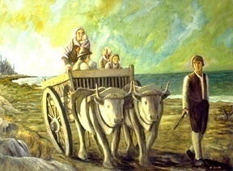
Migration Encore:
The Acadians
Evangeline:
A Tale of Acadie
- Henry Wadsworth Longfellow
Many a weary year had passed
since the burning of Grand-Pré,
When on the falling tide
the freighted vessels departed,
Bearing a nation,
with all its household goods, into exile.
Exile without an end,
and without an example in story.
Far asunder, on separate coasts,
the Acadians landed;
Scattered were they, like flakes of snow
when the wind from the northeast
Strikes aslant through the fogs
that darken the Banks of Newfoundland.
Friendless, homeless, hopeless,
they wandered from city to city,
From the cold lakes of the North
to sultry Southern savannas,
From the bleak shores of the sea
to the lands where the Father of Waters
Seizes the hills in his hands,
and drags them down to the ocean,
Deep in their sands to bury
the scattered bones of the mammoth.
Friends they sought and homes;
and many - despairing, heartbroken -
Asked of the earth but a grave,
and no longer a friend nor a fireside. Written, their history stands
on tablets of stone in the churchyards.
- Henry Wadsworth Longfellow

Slide 2
https://www.hwlongfellow.org/poems_poem.php?pid=269
Evangeline, by Henry Wadsworth Longfellow
Many a weary year had passed since the burning of Grand-Pré,
When on the falling tide the freighted vessels departed,
Bearing a nation, with all its household goods, into exile,
Exile without an end, and without an example in story.
Far asunder, on separate coasts, the Acadians landed;
Scattered were they, like flakes of snow when the wind from the northeast
Strikes aslant through the fogs that darken the Banks of Newfoundland.
Friendless, homeless, hopeless, they wandered from city to city,
From the cold lakes of the North to sultry Southern savannas,--
From the bleak shores of the sea to the lands where the Father of Waters
Seizes the hills in his hands, and drags them down to the ocean,
Deep in their sands to bury the scattered bones of the mammoth.
Friends they sought and homes; and many, despairing, heartbroken,
Asked of the earth but a grave, and no longer a friend nor a fireside.
Written their history stands on tablets of stone in the churchyards.

Slide 3
SENIOR UNIVERSITY - Winter 2020
"MIGRATION ENCORE - The Acadians“
WEEK 4 THE ACADIEN DIASPORA: 1755-1800 (SBP)
Evangeline Poem: " Many a weary year.... they wandered from city to city" https://www.hwlongfellow.org/poems_poem.php?pid=301
Definition of Diaspora (Acadie, p 28)
` https://en.wikipedia.org/wiki/Expulsion_of_the_Acadians
https://www.canadiangeographic.ca/article/mapping-acadian-deportations MAPS 5, 8
https://umaine.edu/canam/publications/st-croix/acadian-deportation-migration-resettlement/ maps!
Distinction between Nova Scotia, PEI, and New Brunswick (Acadie, p 12)
Acadiens in Nova Scotia not French citizens, sent to British Colonies & Britain
1755- Paul Landry/wife/5 children in Connecticut (Acadie, p vi)
1755 - Madeline LeBlanc - deported to Mass, returned, heroine (Acadie, p 22)
Acadiens in PEI/NB were French citizens, sent to France ???? check this??
Dispersal - locations, numbers, impact https://en.wikipedia.org/wiki/Expulsion_of_the_Acadians
1st wave: deportation destinations (British Colonies) -MA, CT, NY, PA, MA, SC
2nd wave: directly to France & Britain
Destinations & numbers in dispersals
1755-1758 (Acadie, map p15)
1758-1816 (Acadie, map p 16-17)
Return to Canada Provinces
- 1764: British gov't permits return of Acadiens to British colonies (where, how many)
Migration to Louisiana - how, why, how many, where
Evangeline Poem: "Into the golden stream.... prairies of fair Opelousas" https://www.hwlongfellow.org/poems_poem.php?pid=302
1756-1785 - Acadians settle Louisiana
Districts – Attackapas, Opalousis
Evangeline Poem: "Welcome once more, my friends.... and your cattle."....
"they who before were as strangers... common country together"
https://www.hwlongfellow.org/poems_poem.php?pid=303
Story of Breaux family and founding of Pont Breaux -
1771: Firmin Breaux buys land - https://www.cajuncountry.org/breaux-bridge.php
1799: Firmin builds suspension foot bridge over Bayou Teche
1810: son Agricole builds vehicular bridge over bayou
1829: Agricole's widow, Scholastique Picou Breaux founds town of Pont Breaux
(Acadie, p 25)
http://breauxbridgela.net/project/scholastique-p-breaux/ Music: SONG OF DEPORTATION: RÉVEILLE (English translation: Wake Up) - by Zachary Richard (1976)
(use Richard singing in French w/English scrolling - https://www.youtube.com/watch?v=3_AescSs6GA)
(END WITH: WILL THE ACADIANS SUCCEED IN THEIR NEW LANDS??)

Slide 4
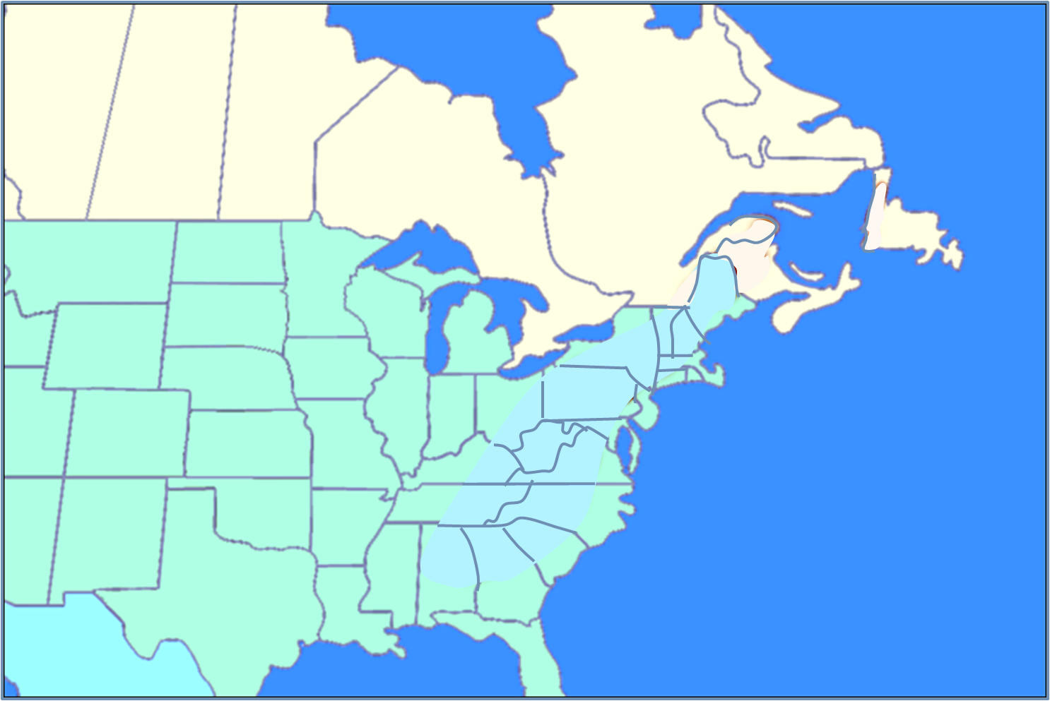
The Acadians
Migration Encore:
The Acadians
Acadie
?
No Acadiens will go
directly to Louisiana
Acadiana
Notes:
Diaspora = die-ass’-pora

Slide 5
The Acadians
The Acadien Diaspora
?
Week 1 Setting the Stage: Before 1600
Week 2 French Migration to Acadie: 1600-1755
Week 3 Le Grand Dérangement: 1755-1756
Week 4 The Acadien Diaspora: 1755-1800
Week 5 Acadians of Canada & Louisiana: 1800-1950
Week 6 Acadians Today: 1950-today
Acadie
The Acadien Diaspora
?

Slide 6
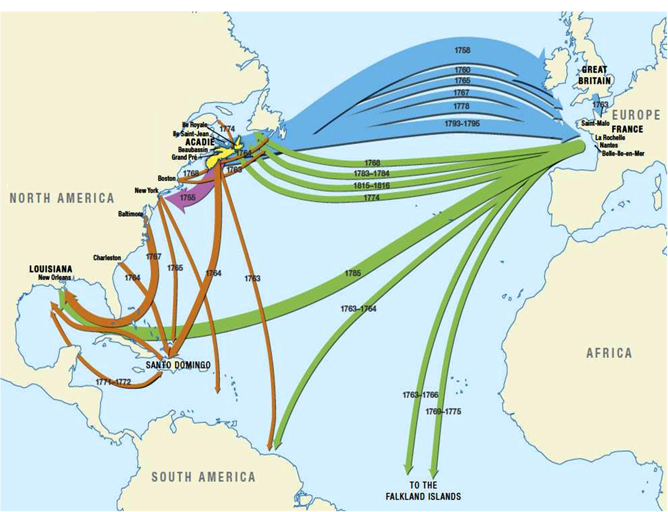
The Acadien Diaspora
?
WHEN
scattering of people
from their homeland
When do they leave?
How many will migrate?
When
Acadie
Where will they go?
?
What will they find?

Slide 7
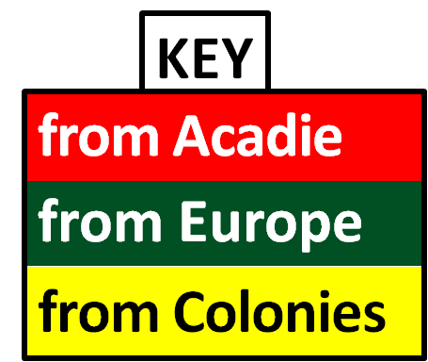
The Acadien Diaspora
1755
WHEN
KEY
from Acadie
from Europe
Let’s watch it happen . . .
from Colonies

Slide 8
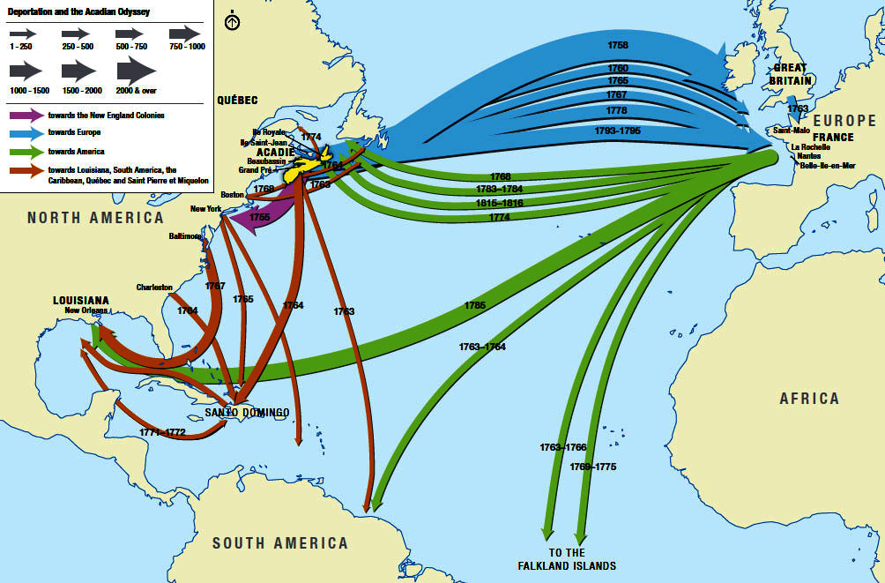
https://cdnhistorybits.wordpress.com/2016/12/13/was-the-acadian-expulsion-justified/

Slide 9
The Acadien Diaspora
1755
1756
1757
1758
1759
1760
1761
1762
1763
1764
WHEN
1st

Slide 10
The Acadien Diaspora
1764
1765
1766
1767
WHEN
First
Acadians

Slide 11
The Acadien Diaspora
1767
1768
1769
WHEN
First
return to
Acadie

Slide 12
The Acadien Diaspora
1769
1770
1771
1772
1773
1774
1775
1776
1777
1778
WHEN

Slide 13
The Acadien Diaspora
1778
1779
1780
1781
1782
1783
1784
1785
WHEN

Slide 14
The Acadien Diaspora
= 60 YEARS!
1785
1793
1815
1755-
WHEN

Slide 15
The Acadien Diaspora
= 60 YEARS!
Line width indicates number of people

Slide 16
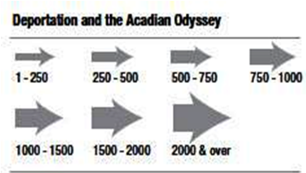
The Acadien Diaspora
- how many
1-250
2000 & over
Line width indicates number of people

Slide 17
Acadian Diaspora: The Destinations
The Acadien Diaspora
- how many
+2000
1000
1000
750
1000
250
500
+ 250
250
1500
FEW
>7000
2000
3000
750
250
750
750
FEW
750
>2000
500
2000
3500
4750
500
1000
1500
750
500
2000
Deportations
Deportations
> 11,000
750
500
750
750
1000
500
Migrations
Migrations
10,750
+1250
750
750 +
1250
1500

Slide 18
Acadian Diaspora: The Destinations
The Journeys
other
Canada
750
FEW
NEW ACADIE
France
3000
FEW
Colonies
4750
LOUISIANA
SAINT-DOMINGUE
MARTINIQUE
1000
500
FRENCH
GUIANA
FALKAND
ISLANDS
1250
1500

Slide 19
Seven Years’ War The Pariahs
Acadian Diaspora: The Destinations
The Journeys
WORLD ACADIENS .
Seven Years’ War The Pariahs
- American Colonies
- Great Britain
Post-War Imperialism The Migrants
- France
- Tropics
- Falkland Islands
Nation Building The Settlers
- British Canada
- Spanish Louisiana
Seven Years’ War The Pariahs

Slide 20
https://en.wikipedia.org/wiki/Seven_Years%27_War
The Seven Years' War was a global war fought between 1756 and 1763. It involved all five European great powers of the time plus many of the middle powers and spanned five continents, affecting Europe, the Americas, West Africa, India, and the Philippines. The conflict split Europe into two coalitions: one was led by the Kingdom of Great Britain and included the Kingdom of Prussia, the Kingdom of Portugal, the Electorate of Brunswick-Lüneburg (also named Hanover), and a few other small German states; while the other was led by the Kingdom of France and included the Austrian-led Holy Roman Empire, including the Electorate of Saxony and most of the smaller German states, the Russian Empire (until 1762), the Kingdom of Spain, and Sweden. The Dutch Republic, Denmark-Norway, the Italian States, and the Ottoman Empire did not participate. Meanwhile, in India, some regional polities within the increasingly fragmented Mughal Empire, with the support of the French, failed to defeat a British attempt to conquer Bengal.
Although Anglo-French skirmishes over their American colonies had begun in 1754, with what became known in the United States as the French and Indian War, the large-scale conflict that drew in most of the European powers was centered on Austria's desire to recover Silesia from Prussia. Seeing the opportunity to curtail Britain's and Prussia's ever-growing might, France and Austria put aside their ancient rivalry to form a grand coalition of their own, bringing most of the other European powers to their side. Faced with this sudden turn of events, Britain aligned itself with Prussia, in a series of political manoeuvres known as the Diplomatic Revolution. However, French efforts ended in failure when the Anglo-Prussian coalition prevailed, and Britain's rise as among the world's predominant powers destroyed France's supremacy in Europe, thus altering the European balance of power.
The war ended with the Treaty of Paris between France, Spain and Great Britain and the Treaty of Hubertusburg between Saxony, Austria and Prussia, in 1763. The war was successful for Great Britain, which gained the bulk of New France in North America, Spanish Florida, some individual Caribbean islands in the West Indies, the colony of Senegal on the West African coast, and superiority over the French trading outposts on the Indian subcontinent.
The Seven Years' War was perhaps the first true world war, having taken place almost 160 years before World War I, and influenced many major events later around the globe. The war restructured not only the European political order, but also affected events all around the world, paving the way for the beginning of later British world supremacy in the 19th century, the rise of Prussia in Germany (eventually replacing Austria as the leading German State), the beginning of tensions in British North America, as well as a clear sign of France's eventual turmoil. It was characterized in Europe by sieges and the arson of towns as well as open battles with heavy losses.

Slide 21
https://www.history.com/topics/france/seven-years-war
The Seven Years’ War (1756-1763) was a global conflict that spanned five continents, though it was known in America as the “French and Indian War.” After years of skirmishes between England and France in North America, England officially declared war on France in 1756, setting off what Winston Churchill later called “the first world war.” While the French, British, and Spanish battled over colonies in the New World, Frederick the Great of Prussia faced off against Austria, France, Russia and Sweden. The Seven Year’s War ended with two treaties. The Treaty of Hubertusburg granted Silesia to Prussia and enhanced Frederick the Great’s Power. The Treaty of Paris between France, Spain and Great Britain drew colonial lines largely in favor of the British, an outcome that would later influence the French to intervene in the war for American Independence.
The Seven Years’ War picked up where the War of the Austrian Succession left off in 1748: with increasing levels of hostility between Prussia, led by Frederick the Great, and Russia. The Treaty of Aix-La-Chapelle, or Treaty of Aachen, had taken Silesia from Austria and given it to Prussia, prompting Russia to worry about Frederick’s growing influence in the region. Frederick, for his part, welcomed another war where he could gain even more territory. With tensions mounting between the superpowers, Europe’s system of alliances shifted in what came to be known as the “diplomatic revolution”: Russia soon allied itself with France and Austria against Britain, Prussia and Saxony.

Slide 22
Seven Years’ War The Pariahs
1755
GLOBAL CONFLICT: 1756 – 1763
for control of Silesia
Great Britain (Prussia, Portugal, Hanover)
versus
France (Austria, Spain, Russia, Sweden)
The Acadiens have refused to:
- sign an oath of allegiance to Britain
- fight against the French
- give up their Catholic religion
French-Indian War
NORTH AMERICAN COMPONENT
Great Britain versus France
over ownership of the colonies
The British will deport the Acadiens

Slide 23
Seven Years’ War The Pariahs
1755
Where can they be sent?
England
War is looming in Europe . . .
British ships dare not
enter French territory
Acadiens are British subjects,
Acadiens can’t return to France
Acadiens will be sent to English territory
Colonies
The British will deport the Acadiens

Slide 24
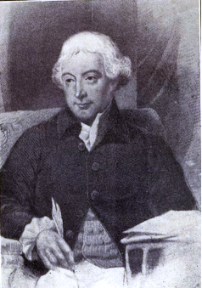
Seven Years’ War The Pariahs
1755
Nova Scotia’s
Governor Lawrence
writes to the Colonies:
England
“. . . by advice of
His Majesty's Council,
it is judged a necessary, and the only practicable measure, to rid (ourselves) of
the neutral French . . . to divide them among
the Colonies, where they may be of some use,
and possibly in time become faithful subjects.”
Colonies
Acadiens
The British will deport the Acadiens

Slide 25
https://archive.org/stream/jstor-4242196/4242196_djvu.txt
(From a copy of the proceedings in Council— Virginia Archives.
At a Council held Novem r 13, 1755.
present:
The Governor, John Blair, Philip Grymes, Philip Ludwell,
Esq., Mr. Commissary, William Byrd, Esq.
His Honour communicated to the Board a letter from the
Governor of Novia Scotia dated from Halifax the nth of Au-
gust, signifying that by advice of His Majesty's Council it is
judged a necessary, and the only practicable measure, to rid
themselves of the neutral French there, to divide them among
the Colonies, where they may be of some use, and possibly in
time become faithful subjects. With a Letter from Mr. Balfour
at Hampton, advising of the arrival of two vessels with about
390 of the said French, and that four sail more are hourly ex-
pected, who, it is presumed, will bring in upwards of six hun-
dred more.
Upon which the governor desiring the opinion and advice of
the Board, in what manner it would be most adviseable to dis-
pose of, and divide them through the several counties, and how
they could be subsisted. It was the advice of the Board that
his Honor would defer the consideration of so important an In-
cident till a fuller Council could be assembled. Whereupon the
governor acquainted them he would order the Councill to be
summoned to meet on Thursday next to deliberate upon and
determine an affair of such great consequence to this Country.
THE ACADIANS IN VIRGINIA. 387
At a Council held Novem' 20th, 1755.
present :
The Governor, John Blair, Philip Grymes, Peter Randolph,
Philip Ludwell, Esq", Mr. Commissary, William Byrd, Esq.
The Letter from Governor Lawrence was again read with an
account of the number of French Neutrals now arrived in
Hampton Road from the Bay of Fundy, which was produced by
his Honour, who desired the Council maturely to deliberate on
this momentous affair, and advise him what measures it would
be most prudent for him to pursue. Upon which it was the
advice of the Council that his Honor would be pleased to post-
pone the determination of this affair, till some proper Persons
were sent down to Enquire particularly into the number of
Families these people consisted of, and into their circumstances,
also to learn whether they were willing to take the oath of Alle-
giance to his Majesty without any Reservation, would conform
themselves to the Laws of this Country, and not transgress the
limits assigned them without the Governor's permission.
Whereupon it was proposed to Philip Ludwell, Esq. , and the
Commissary to visit these French, to make such Inquiry and put
such Proposals to them, who readily accepted thereof.
Copy — Teste:
At a Council held Nov' 22d, 1755.
present:
The Governor, John Blair, Thomas Nelson, Philip Grymes,
Peter Randolph, Philip Ludwell, Mr. Commissary, William
Byrd, Esq.
Philip Ludwell, Esq', reported that he with Mr. Commissary
appointed to visit the Vessels arrived from Nova Scotia with the
Neutral French had been on bord of four sloops and one schooner,
and inquired particularly into the number and circumstances of
the said Neutral French, an account whereof he presented at the
Board; with a Paper signed by the said French importing their
submission and adherence to His Majesty and promising fidelity
to him. Whereupon it was the opinion and advice of the Board
that the said People be landed disposed of and subsisted as fol-
lows, viz: That one of the said vessels be ordered to Richmond
at the Falls of James River, that the French on board two of
the said vessels be landed at Hampton; and that the other two
be sent to Norfolk. That Mr. Balfour at Hampton and Mr.
Stewart at Norfolk be appointed and directed to provide Houses
for them ; that they be allowed 4'" of flour and 2 lb of beef, or
pork per week each person, that the said Mr. Balfour and
Mr. Stewart be ordered to supply them regularly with that
allowance and to see that they behave themselves in an orderly
manner.
Report concerning the Neutral French & proceedings thereon
in Council, 22 Nov', 1755.
[Like most of the English Colonies in North America, Vir-
ginia had a part in the melancholy story of the Acadians. A
small part is true; but one which has been so grossly mis-
represented by a recent writer, that an opportunity to correct
his statements is welcome. The expulsion, in 1755, of the
Acadians — the Neutral French as they were called at the time
— from their homes in Nova Scotia by the command of the
English authorities is familiar history ; made better known by
"Evangeline." About the middle of November, 1755, several
vessels, despatched by Governor Lawrence of Nova Scotia, and
containing 1,140 of these exiles arrived in Hampton Roads.
There had been no notice of their coming; but as has been seen,
the Governor and Council of Virginia took prompt action. The
letters of Governor Dinwiddie, in the " Dinwiddie Papers/'
published by the Virginia Historical Society, contain frequent
reference to this subject. The Governor states that the arrival
of 1 140 French Neutrals, sent without warning by Governor
Lawrence of Nova Scotia had caused great discontent among
the people of Virginia, where there were no Roman Catho-
lics. He had much difficulty in inducing the Council to re-
ceive them, and only carried it by one vote. M. Edouard
Richard (a gentleman who appears to think that he alone takes
a just and correct view of this part of American history and
that Parkman and everybody else is in the wrong) says in his
recent work on Acadia, that the Virginians refused to allow the
1500 [really 1140] exiles to land, and that "neither disease,
which was making frightful havoc among this crowd of human
beings huddled together in the holds of the dreadfully overladen
ships, nor any other considerations " could induce the Virgin-
ians to change their determination. "They (the Virginians)
addressed to the authorities such vigorous protests that all these
exiles, after being several weeks on board the vessels, were told
to set sail for England." The fact is, that the Acadians arrived
in Virginia about the middle of November, 1755, and were pro-
bably sent to England some time in April or May, 1756, and it
is evident from the proceedings in the case that they were not
confined to ships; but spent this time on shore. On March 29,
1756, the House of Burgesses petitioned Governor Dinwiddie to
have the Neutral French sent to Great Britain, stating that the As-
sembly would bear the expense. The Governor replied that he
would carry out their wishes, and asked that they appoint persons
to ' ' make provision for their subsistence, from this time till their
embarkation," and that "those gentlemen may agree for proper
vessels to transport them." The Assembly passed an act appro-
priating ,£5000, and appointing a committee, consisting of Peyton
Randolph and others on behalf of the Assembly, to contract
with persons to transport the Neutral French to Great Britain.
So it is evident that these unfortunate exiles were not confined
to the ships they came in, but were on shore for five or six
months, and were sent away on different ships from those they
came in. Plainly, in one instance, at least M. Richard is
mistaken.]

Slide 26
http://faculty.marianopolis.edu/c.belanger/quebechistory/encyclopedia/SevenYearsWar-TheAcadianExiles.htm
Lawrence, in his instructions to the governors of the colonies to which he had sent the exiles, said that they were ‘to be received and disposed of in such a manner as may best answer our design of preventing their reunion' as a people. It was not intended to tear apart families and friends, but, owing to the scarcity of vessels and the inadequate arrangements for the deportation, there were many cruel separations.
The treatment of the exiles in the colonies varied according to circumstances. In some instances the younger men and women were bound out to service for periods varying from three to twelve weeks. In others they were left free to maintain themselves by their own efforts, the state to provide for such as were incapable, through age or infirmity, of performing manual labour. Hundreds of those who were placed under control escaped and wandered, footsore and half clad, from town to town in the hope of meeting their relatives or of finding means to return to their former homes. Little record has been preserved of the journeyings of these unfortunates or of the sufferings they endured.

Slide 27
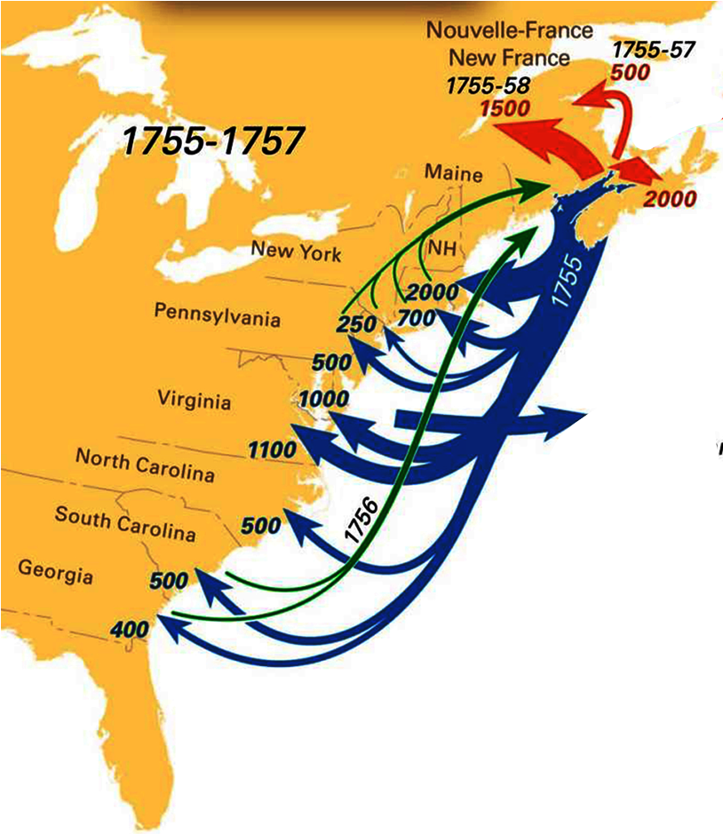
Seven Years’ War The Pariahs
1755
?
>2000
6950
1755
deportation
1756
migration
1755
flight
The British will deport the Acadiens

Slide 28
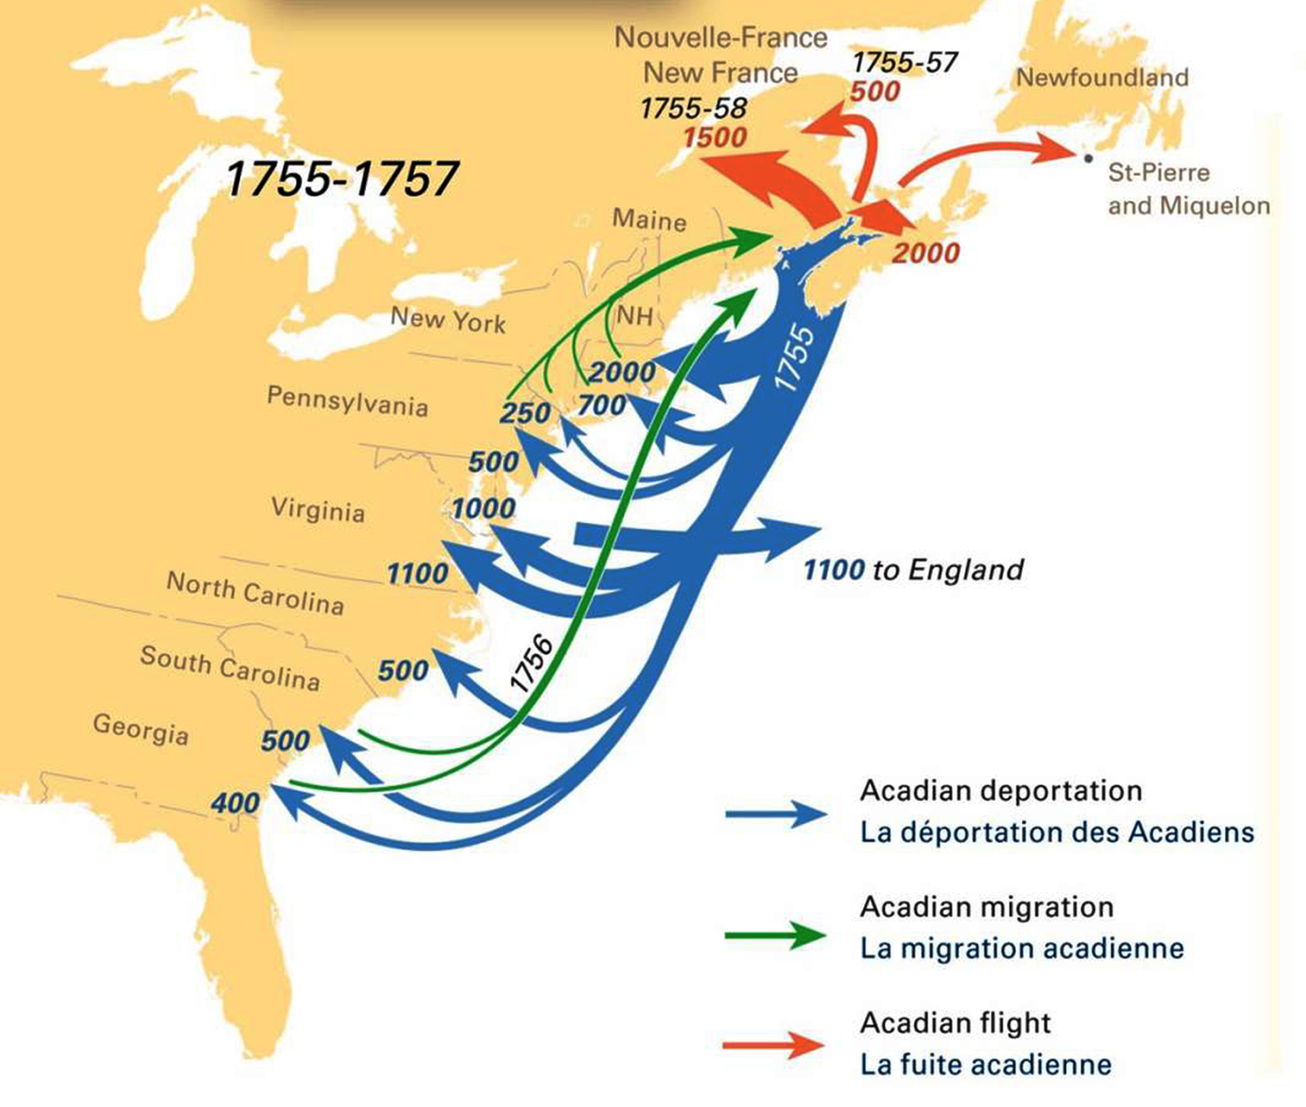
https://umaine.edu/canam/publications/st-croix/acadian-deportation-migration-resettlement/

Slide 29
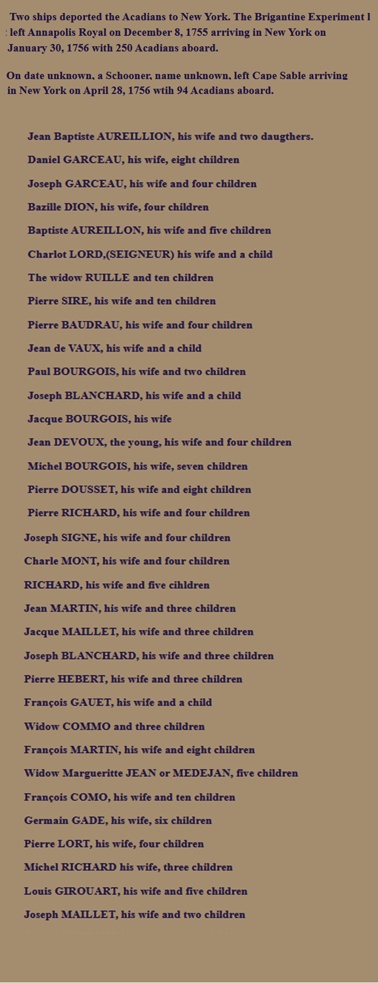
Seven Years’ War The Pariahs
www.acadian-home.org
6950
1755
deportation
1756
migration
1755
flight
Notes:
Data and pictures from: http://www.acadian-home.org/

Slide 30
http://www.acadian-home.org/acadians-new-york.html
www.acadian-home.org

Slide 31
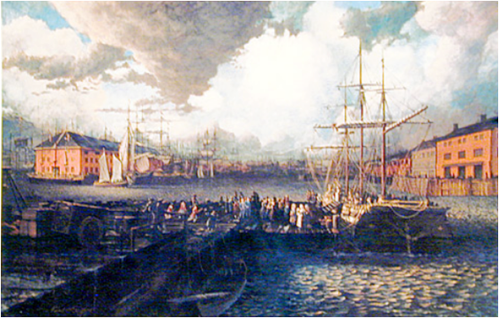
Seven Years’ War The Pariahs
COLONY SHIPS PEOPLE
Mass. 6 > 900
Conn. 7 >1000
Connecticut Harbor
Acadians arriving MA
1755
deportation
1756
migration
1755
flight
Notes:
Data and pictures from: http://www.acadian-home.org/

Slide 32
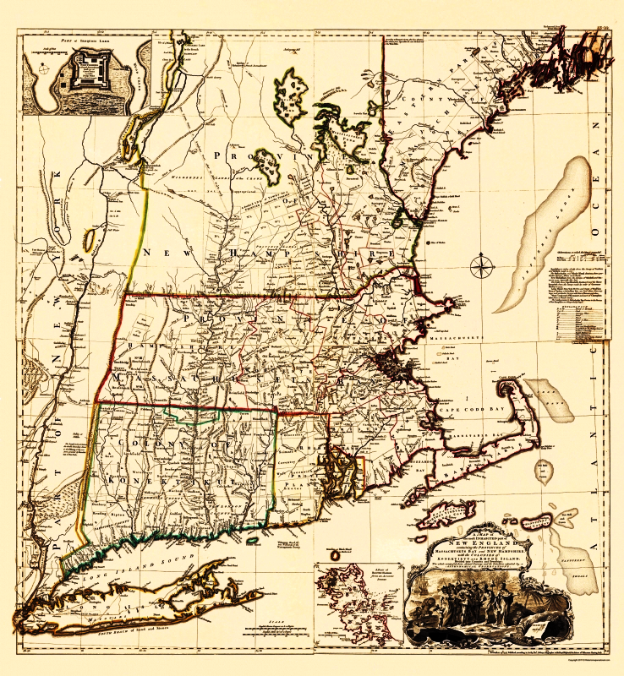
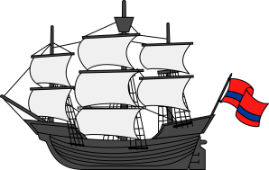
Seven Years’ War The Pariahs
Elisha Stoddard & the Landry Family
COLONY SHIPS PEOPLE
Mass. 6 > 900
Conn. 7 >1000
1755
NH
MA
RI
Paul Landry, his brother, & their wives
Connecticut Harbor
Woodbury
CT
1755
deportation
1756
migration
1755
flight
elder Landry, age 76, with 7 grandchildren
to Maryland

Slide 33
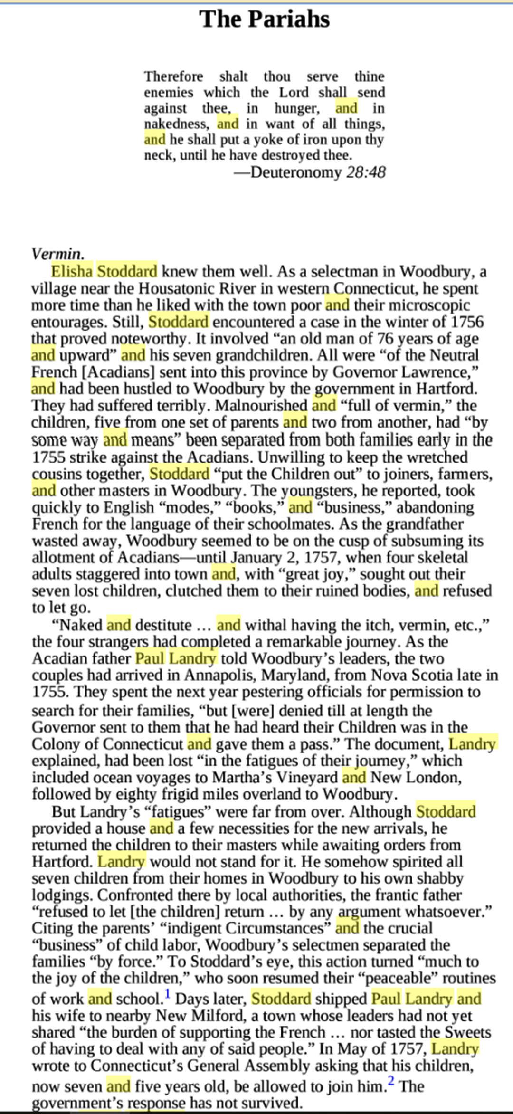
https://erenow.net/modern/aneighteenthcenturyhistory/4.php

Slide 34
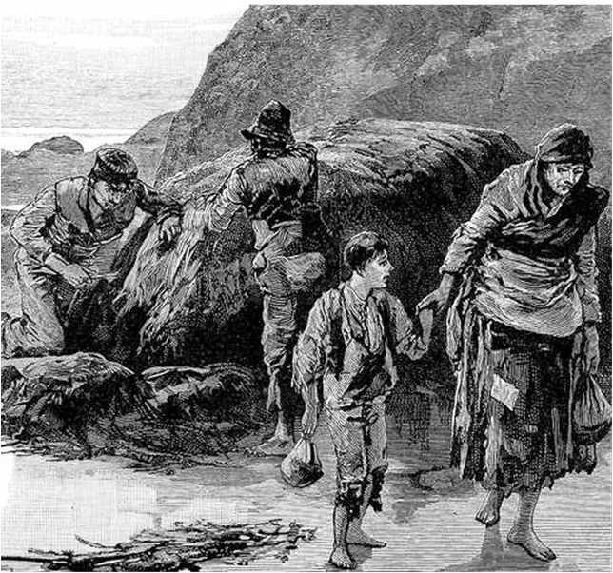
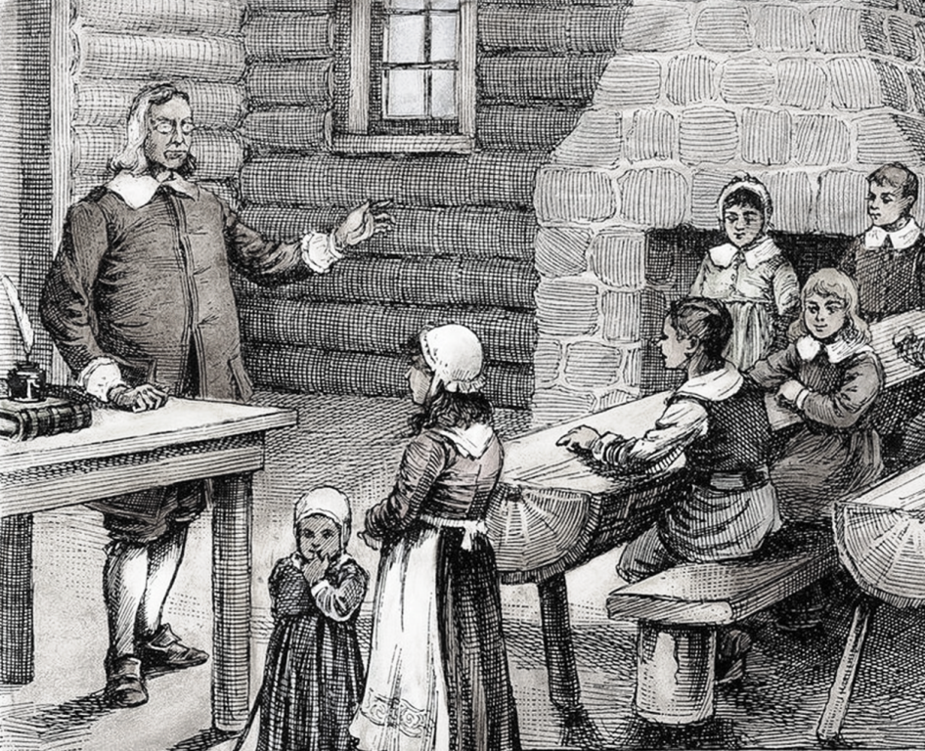
Seven Years’ War The Pariahs
Elisha Stoddard & the Landry Family
Elisha Stoddard reports:
Paul Landry reports:
- family is malnourished and “full of vermin”
- Grandfather Landry “wastes away”
- Elisha places children with English farmers & craftsmen
- children “take quickly to English modes…books…business”
- they abandon French for “language of their schoolmates”
Woodbury
elder Landry, age 76, with 7 grandchildren

Slide 35
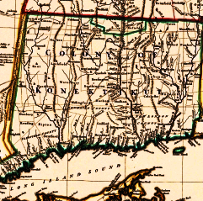
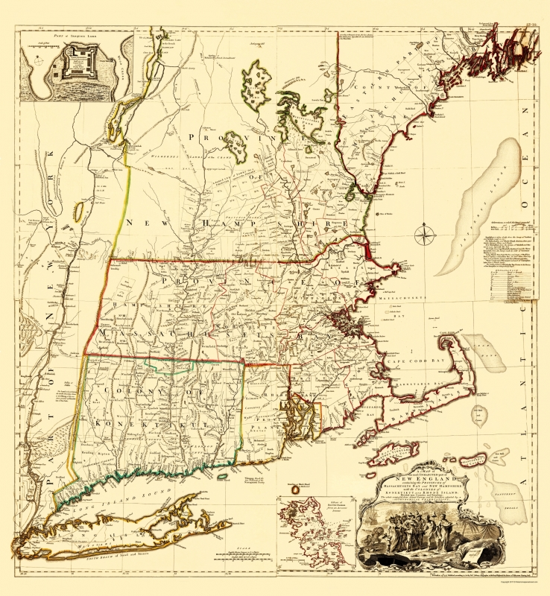
https://www.mapsofthepast.com/n-england-mass-bay-n-hampshire-conn-rhode-isl-1755.html

Slide 36
Seven Years’ War The Pariahs
Elisha Stoddard & the Landry Family
Paul Landry reports:
- winter 1755, the couples arrived in Annapolis, MD
- they beg MD governor for permission to search
- winter 1756, receive pass to leave MD for search
Woodbury
New London
Martha’s
Vineyard

Slide 37
Seven Years’ War The Pariahs
Elisha Stoddard & the Landry Family
COLONY OF
Woodbury
KONEKTIKUT
Woodbury

Slide 38
Seven Years’ War The Pariahs
Elisha Stoddard & the Landry Family
- families are reunited
- Elisha provides dwelling for parents
?
- he returns children to foster care
- Paul Landry kidnaps children
New Milford
- Elisha ‘forcibly removes’ the children
Woodbury
no evidence!
- Elisha deports Paul, brother, & wives to New Milford
- Paul petitions CT governor for children’s return

Slide 39
Seven Years’ War The Pariahs
Elisha Stoddard & the Landry Family
COLONY SHIPS PEOPLE
Mass. 6 > 900
Conn. 7 >1000
N.Y. 2 ~ 340
Penn. 5 >1000
Virginia 7 1500
N.C. 1 50
S.C. 6 ~ 950
Georgia 2 400
COLONY SHIPS PEOPLE
Mass. 6 > 900
Conn. 7 >1000
?
New Milford
Woodbury
no evidence!
1755
deportation
1756
migration
- Elisha deports Paul, brother, & wives to New Milford
36
>6,000
1755
flight
- Paul petitions CT governor for children’s return
Notes:
Data and pictures from: http://www.acadian-home.org/

Slide 40
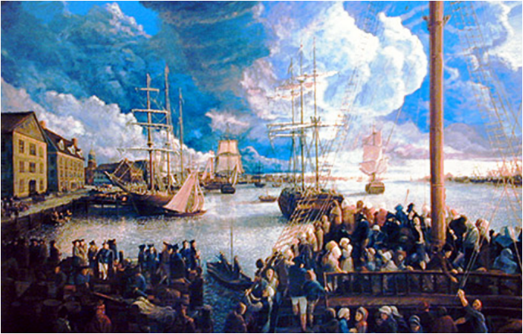
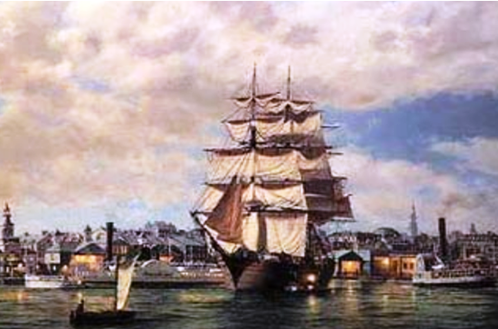
Seven Years’ War The Pariahs
COLONY SHIPS PEOPLE
Mass. 6 > 900
Conn. 7 >1000
N.Y. 2 ~ 340
Penn. 5 >1000
Virginia 7 1500
New York Harbor
Acadians arriving PA
1755
deportation
1756
migration
1755
flight
Notes:
Data and pictures from: http://www.acadian-home.org/

Slide 41
Seven Years’ War The Pariahs
COLONY SHIPS PEOPLE
Mass. 6 > 900
Conn. 7 >1000
N.Y. 2 ~ 340
Penn. 5 >1000
Virginia 7 1500
to
England
refuses to accept Acadiens
- detained in Williamsburg
hundreds die of disease
& malnutrition
- the rest exiled to England
1755
deportation
1756
migration
1755
flight
Notes:
Data and pictures from: http://www.acadian-home.org/

Slide 42
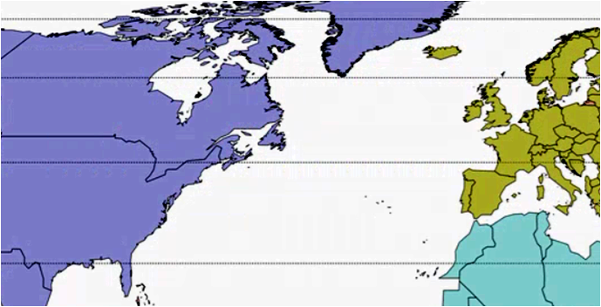
Seven Years’ War The Pariahs
1000 exiled to England . . .
COLONY SHIPS PEOPLE
Mass. 6 > 900
Conn. 7 >1000
N.Y. 2 ~ 340
Penn. 5 >1000
Virginia 7 1500
to
England
refuses to accept Acadiens
- detained in Williamsburg
hundreds die of disease
& malnutrition
- the rest exiled to England
1755
deportation
1756
migration
1755
flight
Notes:
Data and pictures from: http://www.acadian-home.org/

Slide 43
Seven Years’ War The Pariahs
1000 exiled to England . . .
ENGLAND
VIRGINIA

Slide 44
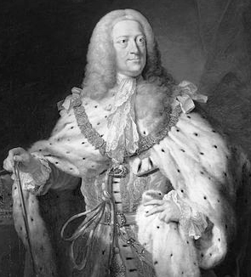
Seven Years’ War The Pariahs
1000 exiled to England . . .
- delivered to coastal towns
- housed in warehouses or slums
- ‘royal dole’ of monthly subsistence
- soon, hundreds die of smallpox
- some petition for better treatment
- 1758: 7 ships leave from Acadie
Liverpool
Penryn, Wales
1000
Bristol
Southampton
Falmouth

Slide 45
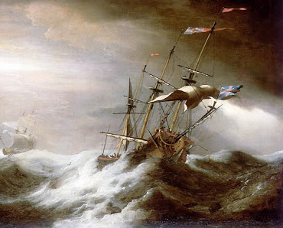
Seven Years’ War The Pariahs
1000 exiled to England . . .
- delivered to coastal towns
- housed in warehouses or slums
- ‘royal dole’ of monthly subsistence
- soon, hundreds die of smallpox
- some petition for better treatment
- 1758: 7 ships leave from Acadie
integration into colonies is failing
English deport directly to England
Noel & Marie Dorion w/sons & wives,
& 30 grandchildren board Duke William
storm 30 miles from destination
three ships sink, ~1000 drown
all members of Dorion family are lost
4 ships of Acadians arrive in Europe
1000
3000

Slide 46
https://en.wikipedia.org/wiki/Duke_William_(ship)
Louisbourg fell to the British on July 26, 1758 and within two weeks a deportation order was issued for the Acadians of Île Saint-Jean (Prince Edward Island). The English authorities had given up on their earlier attempts to assimilate the Acadians into the thirteen colonies and now wanted them returned directly to France.
On October 20, 1758, Duke William left Île Saint-Jean for France with over 360 Acadians on board. The ship sailed in a convoy with nine other vessels, two of which were Violet (with over 280 Acadians) and Ruby (with approximately 310 Acadians).[7] The ship sailed through the Canso Strait and moored off Canso, Nova Scotia, for almost a month because of foul weather. During the time in Canso, the Acadians helped the ship narrowly escape a raid by the Mi'kmaq.
On November 25, Duke William sailed out of the bay of Canso. On the third day at sea there was a storm and Duke William became separated from the other two ships. Ruby ran aground in a storm on Pico Island in the Azores, which caused the death of 213 of the Acadians on board.
Almost two weeks after the ships were separated, late in the day on December 10, Duke William re-encountered Violet. Violet was sinking; during the night Duke William sprung a leak and the Acadians assisted at the pumps. In the morning on December 11, after a brief squall, Violet sank with all the Acadians on board.
The Acadians and crew on Duke William tried for three days to pump the water from her. Captain Nichols recorded: "We continued in this dismal situation three days; the ship, notwithstanding our endeavours, full of water, and expected to sink every minute."[4] Captain Nichols reports that he gave up and announced to the Acadians and crew: "I told them we must be content with our fate; and as we sure certain we had done our duty, we should submit to Providence, to the Almighty will, with pious resignation."[4]
Despite this resignation, Captain Nichols dispatched both the long boat and cutter that were on board so that they might approach any passing vessels. On the morning of December 13, two English vessels were within sight of Duke William. Captain Nichols records: "I went and acquainted the priest [Girrard] and the old gentleman [Noel Doiron] with the good news. The old man took me in his aged arms, and cried for joy."[4] The ships did not stop. During the possible rescue, Duke William almost got separated from the long boat and the cutter. As the long boat and cutter returned, a Danish ship appeared in the distance. Again those aboard thought they were saved, but the Danish ship, like those before, sailed away from them.
Ship's boats in the 18th century were designed for work, not lifesaving.[8] Intended to load cargo and supplies as well as shuttle people ashore, the three small boats aboard Duke William could hold only a handful of those aboard.
Captain Nichols then recorded Noel Doiron's decision:
About half an hour after, the old gentleman [Noel Doiron] came to me, crying; he took me in his arms, and said he came with the voice of the whole people, to desire that I and my men would endeavour to save our lives, in our boats; and as they could not carry them, they would on no consideration be the means of drowning us. They were well convinced, by all our behaviour, that we had done everything in our power for their preservation, but that God Almighty had ordained them to be drowned, and they hoped that we should be able to get safe ashore.
I must acknowledge that such gratitude, for having done only our duty, in endeavouring to save their lives as well as our own, astonished me. I replied that there were no hopes of life, and, as we had all embarked in the same unhappy voyage, we would all take the same chance. I thought we ought to share the same fate. He said that should not be; and if I did not acquaint my people with their offer, I should have their lives to answer for.
The two boats on board were lowered into the English channel carrying only the Captain, his crew, and the parish priest Girrard. Upon lowering the life boats, Noel Doiron sharply reprimanded a fellow Acadian Jean-Pierre LeBlanc for trying to board a lifeboat while abandoning his wife and children. As Priest Girrard got in the lifeboat he saluted Noel Doiron. After Captain Nichols could no longer see the ship, four Acadians got into a third boat and arrived safely in Falmouth, England.
Duke William sank about 20 leagues (97 km; 52 mi) from the coast of France shortly after 4:00 p.m. on December 13, 1758. Noel Doiron, his wife, Marie, five of their children with their spouses and over thirty grandchildren were lost – 120 family members in total.

Slide 47
Seven Years’ War The Pariahs
1000 exiled to England . . .
COLONY SHIPS PEOPLE
Mass. 6 > 900
Conn. 7 >1000
N.Y. 2 ~ 340
Penn. 5 >1000
Virginia 7 1500
- delivered to coastal towns
- housed in warehouses or slums
- ‘royal dole’ of monthly subsistence
- soon, hundreds die of smallpox
- some petition for better treatment
- 1758: 7 ships leave from Acadie
. . . dream of freedom
in France
1755
deportation
3000
1756
migration
1755
flight

Slide 48
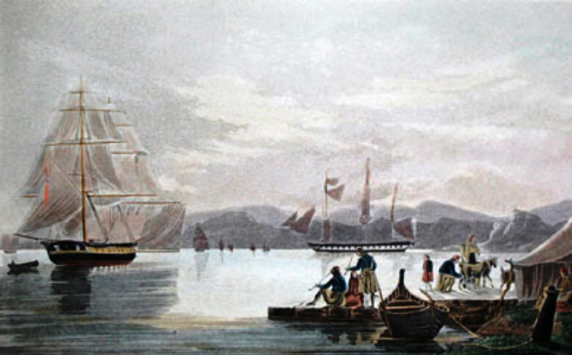
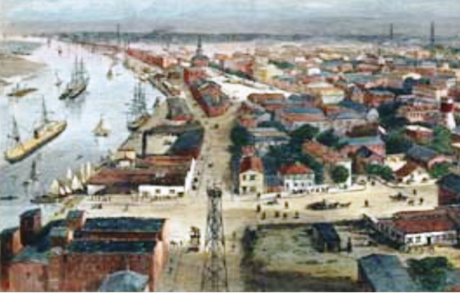
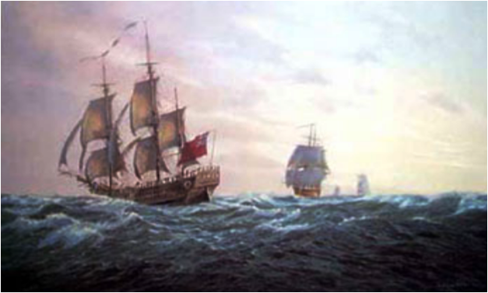
Seven Years’ War The Pariahs
COLONY SHIPS PEOPLE
Mass. 6 > 900
Conn. 7 >1000
N.Y. 2 ~ 340
Penn. 5 >1000
Virginia 7 1500
N.C. 1 50
S.C. 6 ~ 950
Georgia 2 400
Georgia Harbor
Ships to South Carolina
North Carolina Port
6950
6000-7000
1755
deportation
1756
migration
6140
36
6,140
1755
flight
Notes:
Data and pictures from: http://www.acadian-home.org/

Slide 49
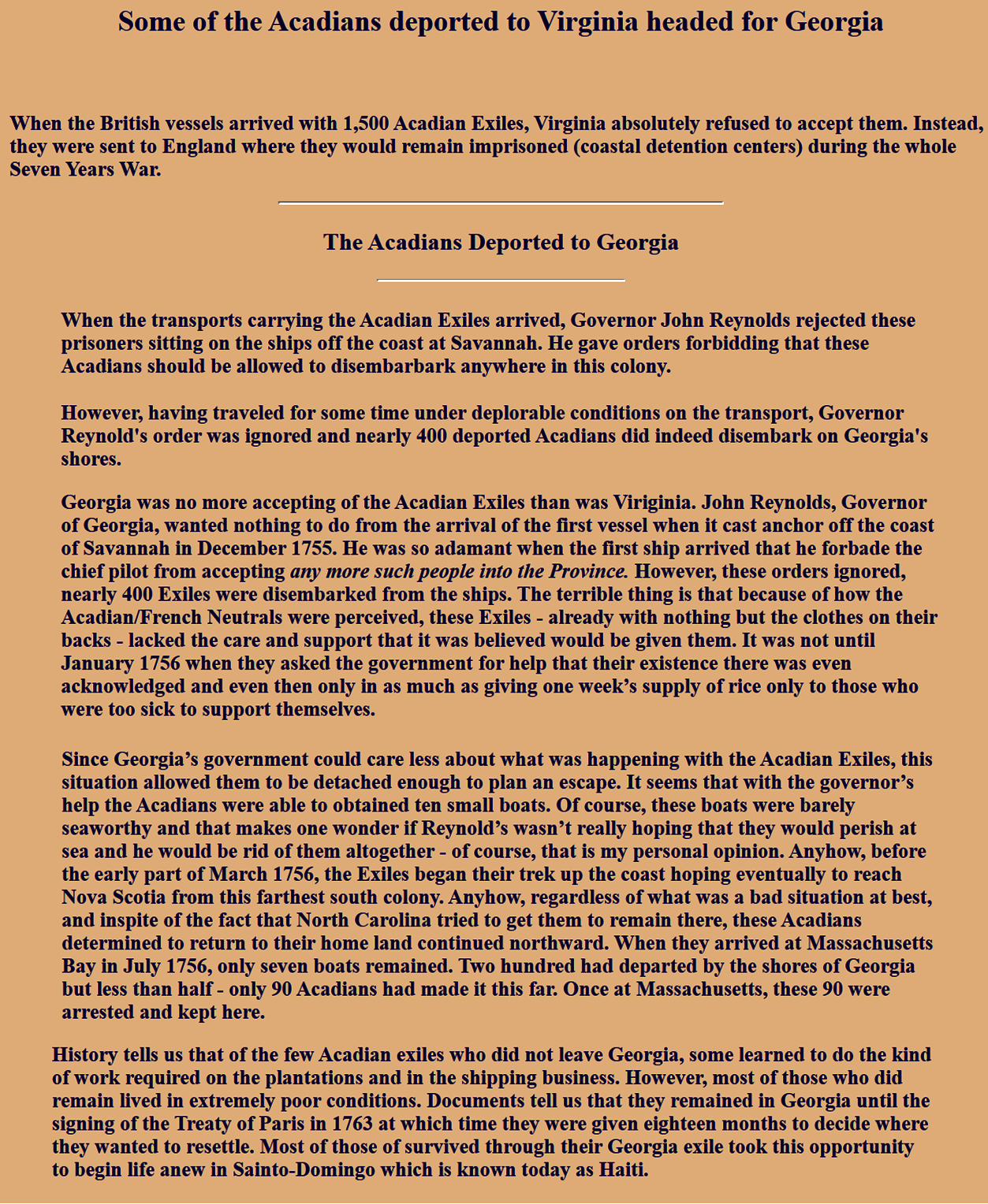
http://www.acadian-home.org/acadians-georgia.html

Slide 50
https://en.wikipedia.org/wiki/Expulsion_of_the_Acadians
Once the Acadians refused to sign an oath of allegiance to Britain, which would make them loyal to the crown, the British Lieutenant Governor, Charles Lawrence, as well as the Nova Scotia Council on July 28, 1755 made the decision to deport the Acadians.[25] The British deportation campaigns began on August 11, 1755. Throughout the expulsion, Acadians and the Wabanaki Confederacy continued a guerrilla war against the British in response to British aggression which had been continuous since 1744.
In the first wave of the expulsion, most Acadian exiles were assigned to rural communities in Massachusetts, Connecticut, New York, Pennsylvania, Maryland and South Carolina. In general, they refused to stay where they were put and large numbers migrated to the colonial port cities where they gathered in isolated, impoverished French-speaking Catholic neighborhoods, the sort of communities Britain's colonial officials tried to discourage. More worryingly for the British authorities, some Acadians threatened to migrate north to French-controlled regions, including the Saint John River, Île Royale (Cape Breton Island), the coasts of the Gulf of St. Lawrence and Canada.
Maryland
Approximately 1,000 Acadians went to the Colony of Maryland, where they lived in a section of Baltimore that became known as French Town. The Irish Catholics were reported to have shown charity to the Acadians by taking orphaned children into their homes.
Massachusetts
Approximately 2,000 Acadians disembarked at the Colony of Massachusetts. There were several families deported to the Province of Maine, a large, but sparsely populated exclave of the colony of Massachusetts. For four long winter months, William Shirley, who had ordered their deportation, had not allowed them to disembark and as a result, half died of cold and starvation aboard the ships. Children were taken away from their parents and were distributed to various families throughout Massachusetts. The government also arranged the adoption of orphaned children and provided subsidies for housing and food for a year.
Connecticut
The Colony of Connecticut prepared for the arrival of 700 Acadians. Like Maryland, the Connecticut legislature declared that "[the Acadians] be made welcome, helped and settled under the most advantageous conditions, or if they have to be sent away, measures be taken for their transfer."
Pennsylvania and Virginia
The Colony of Pennsylvania accommodated 500 Acadians. Because they arrived unexpectedly, the Acadians had to remain in port on their vessels for months. The Colony of Virginia refused to accept the Acadians on grounds that no notice was given of their arrival. They were detained at Williamsburg, where hundreds died from disease and malnutrition. They were then sent to Britain where they were held as prisoners until the Treaty of Paris in 1763.
Carolinas and Georgia
The Acadians who had offered the most resistance to the British—particularly those who had been at Chignecto—were reported to have been sent to the southernmost colonies (the Carolinas and the Colony of Georgia), where about 1,400 Acadians settled and were "subsidized" and put to work on plantations.
Under the leadership of Jacques Maurice Vigneau of Baie Verte, the majority of the Acadians in Georgia received a passport from Governor Reynolds. Without such passports, travel between borders was not allowed. As soon as the Acadians bearing passports from Georgia reached the Carolinas, the colonies granted passports to the Acadians in their territories. Along with these papers, the Acadians were given two vessels. After running aground numerous times in the ships, some Acadians returned to the Bay of Fundy. Along the way, they were captured and imprisoned. Only 900 managed to return to Acadia, less than half of those who had begun the voyage. Others also tried to return home. The South Carolina Gazette reported that in February, about thirty Acadians fled the island to which they were confined and escaped their pursuers. Alexandre Broussard, brother of the famed resistance leader Joseph Broussard, dit Beausoleil, was among them. About a dozen are recorded to have returned to Acadia after an overland journey of 4,200 miles.

Slide 51
Seven Years’ War The Pariahs
1756
REVERSE MIGRATION
need exit passports
2 ships (Ga & SC)
overland (PA,NY,MA,CT)
>1000 Acadiens
PA, NY, MA, CT
1755-1758
ACADIAN FLIGHT
to New France
to Gaspé Peninsula
to Île Saint-Jean
~4000 Acadiens
South Carolina
1755
deportation
Georgia
1756
migration
1755
flight
Notes:
Data and pictures from: http://www.acadian-home.org/

Slide 52
http://www.acadian-home.org/Paul-Delaney-Chronology.html

Slide 53
https://en.wikipedia.org/wiki/History_of_the_Acadians
Some Acadians escaped into the woods and lived with the Mi'kmaq; some bands of partisans fought the British, including a group led by Joseph Broussard, known as "Beausoleil", along the Petitcodiac River of New Brunswick. Some followed the coast northward, facing famine and disease. Some were recaptured, facing deportation or imprisonment at Fort Beausejour (renamed Fort Cumberland) until 1763.
Some Acadians became indentured servants in the British colonies. Massachusetts passed a law in November 1755 placing the Acadians under the custody of "justices of the peace and overseers of the poor"; Pennsylvania, Maryland, and Connecticut adopted similar laws. The Province of Virginia under Robert Dinwiddie initially agreed to resettle about one thousand Acadians who arrived in the colony but later ordered most deported to England, writing that the "French people" were "intestine enemies" that were "murdering and scalping our frontier Settlers".
In 1758, after the fall of Louisbourg, over 3,000 Acadians were deported to northern France. Resettlement attempts were tried in Châtellerault, Nantes, and Belle Île off Brittany. The French islands of St. Pierre and Miquelon near Newfoundland became a safe harbor for many Acadian families until they were once again deported by the British in 1778 and 1793

Slide 54
https://en.wikipedia.org/wiki/Expulsion_of_the_Acadians
Because the British believed their policy of sending the Acadians to the Thirteen Colonies had failed, they deported the Acadians to France during the second wave of the Expulsion.
The second wave of the expulsion began with the French defeat at the Siege of Louisbourg (1758). Thousands of Acadians were deported from Île Saint-Jean (Prince Edward Island) and Île Royale (Cape Breton Island). The Île Saint-Jean Campaign resulted in the largest percentage of deaths of the deported Acadians. The sinking of the ships Violet (with about 280 persons aboard) and Duke William (with over 360 persons aboard) marked the highest numbers of fatalities during the expulsion. By the time the second wave of the expulsion had begun, the British had discarded their policy of relocating the Acadians to the Thirteen Colonies, and had begun deporting them directly to France. In 1758, hundreds of Île Royale Acadians fled to one of Boishebert's refugee camps south of Baie des Chaleurs.

Slide 55
Seven Years’ War The Pariahs
Where will the Acadiens go?
WORLD ACADIENS .
Seven Years’ War The Pariahs
- American Colonies
- Great Britain
- French Acadie
1763 - France loses war & most of empire
countries devastated
huge debts
- British Nova Scotia
Acadiens are unwelcome
long history of conflict
Catholics vs Protestant
competition for work
The British will deport the Acadiens

Slide 56
Where will the Acadiens go?
Post-War Imperialism The Migrants
WORLD ACADIENS .
Seven Years’ War The Pariahs
- American Colonies
- Great Britain
- British Nova Scotia
Post-War Imperialism The Migrants
- France
- Tropics
- Falkland Islands
Post-war Imperialism The Migrants

Slide 57
https://www.wikiwand.com/en/French_colonial_empire#/overview
The French colonial empire constituted the overseas colonies, protectorates and mandate territories that came under French rule from the 16th century onward. A distinction is generally made between the "first colonial empire," that existed until 1814, by which time most of it had been lost, and the "second colonial empire", which began with the conquest of Algiers in 1830. The second colonial empire came to an end after the loss in later wars of Indochina (1954) and Algeria (1962), and relatively peaceful de-colonizations elsewhere after 1960.
The main competition included Spain, Portugal, the Dutch United Provinces and later Kingdom of Britain . France began to establish colonies in North America, the Caribbean and India in the 17th century. A series of wars with Britain and others resulted in France losing nearly all of its conquests by 1814.

Slide 58
https://history.state.gov/milestones/1750-1775/treaty-of-paris
The Treaty of Paris of 1763 ended the French and Indian War/Seven Years’ War between Great Britain and France, as well as their respective allies. In the terms of the treaty, France gave up all its territories in mainland North America, effectively ending any foreign military threat to the British colonies there.
During the war, British forces had scored important overseas victories against France: not only had the British conquered French Canada, they also won victories in India, and captured French island colonies in the Caribbean. In March of 1762, French King Louis XV issued a formal call for peace talks.
The British Government was also interested in ending the war. The Seven Years’ War had been enormously expensive, and the Government had to finance the war with debt. Creditors were beginning to doubt Great Britain’s ability to pay back the loans it had floated on financial markets. In addition, British King George II had died in 1760, and his successor George III was more amenable to ending the war.
Initial attempts at negotiating a peace settlement failed, and instead French and Spanish diplomats signed the Family Compact, a treaty that brought Spain into the war against Britain. British Prime Minister Lord Bute continued secret and informal talks with French diplomat Étienne-François de Stainville, duc de Choiseul, and they came to an unofficial agreement in June, 1762. Bute promised fairly generous terms, and the two countries agreed to an exchange of ambassadors in September.
By the time the formal negotiations began, the situation had changed. News had reached Europe of the British capture of Havana, and with it the Spanish colony of Cuba. Spanish King Charles III refused to agree to a treaty that would require Spain to cede Cuba, but the British Parliament would never ratify a treaty that did not reflect British territorial gains made during the war.
Facing this dilemma, French negotiator Choiseul proposed a solution that redistributed American territory between France, Spain and Great Britain. Under Choiseul’s plan, Britain would gain all French territory east of the Mississippi, while Spain would retain Cuba in exchange for handing Florida over to Great Britain. French territories west of the Mississippi would become Spanish, along with the port of New Orleans. In return for these cessions, along with territory in India, Africa, and the Mediterranean island of Minorca, France would regain the Caribbean islands that British forces had captured during the war. The British Government also promised to allow French Canadians to freely practice Catholicism and provided for French fishing rights off Newfoundland.
Choiseul preferred to keep the small Caribbean islands of Martinique, Guadeloupe, and St. Lucia rather than hold on to the vast territory stretching from Louisiana to Canada. This decision was motivated by the fact that the islands’ sugar industry was enormously profitable. In contrast, Canada had been a drain on the French treasury. The loss of Canada, while lamentable to French officials, made sense from a mercantile perspective.
The diplomats completed their negotiations and signed the preliminary Treaty of Paris on November 3, 1762. Spanish and French negotiators also signed the Treaty of San Ildefonso at the same time, which confirmed the cession of French Louisiana to Spain.
Although British King George III and his ministers were in favor of the treaty, it was unpopular with the British public. However, the treaty contained enough concessions to war hawks that the British Parliament ratified the Treaty of Paris by a majority of 319 to 64, and the treaty went into effect on February 10, 1763.
For Anglo-American colonists, the treaty was a theoretical success. By confirming the conquest of Canada and extending British possessions to the Mississippi, the colonists no longer had to worry about the threat of a French invasion. For the American Indians in what had been frontier territory, the treaty proved disastrous. They could no longer pursue what had been a largely effective strategy of playing the French and British against each other to extract the most favorable terms of alliance and preserve their lands against encroachment by Anglo-American colonists.
Despite what seemed like a success, the Treaty of Paris ultimately encouraged dissension between Anglo-American colonists and the British Government because their interests in North America no longer coincided. The British Government no longer wanted to maintain an expensive military presence, and its attempts to manage a post-treaty frontier policy that would balance colonists’ and Indians’ interests would prove ineffective and even counterproductive. Coupled with differences between the imperial government and colonists on how to levy taxes to pay for debts on wartime expenses, the Treaty of Paris ultimately set the colonists on the path towards seeking independence, even as it seemed to make the British Empire stronger than ever.

Slide 59
http://www.acadian-cajun.com/exga.htm
When the war ended, the 1763 treaty offered an 18 month period during which they could resettle to French territory. Most of the Acadians left in Georgia at this time migrated seem to have gone to South Carolina and sailed for Saint Domingue. A list was made on Aug. 23, 1763 listing the Acadians in South Carolina, and a letter with the list noted they were from Savannah, GA. Of the 400 acadians that arrived there, 185 were left at that time.
An August 25, 1763, the Georgia Gazette had an article that noted the Acadians had boarded a sloop headed for Monte Cristi, St. Domingue. About 21 more Acadians left on Dec. 21 in the sloop Savannah Packet for New Orleans (via Mobile). We know they were in Mobile on Jan. 22, 1764 because the marriage of Jean POIRIER & Madeleine RICHARD was blessed on that day.
The last of these Acadians (44 of them) left the second week of January 1764 on the Polly and Deborah and sailed to Cap Francois, St. Domingue. Some of those seem to have joined other Acadians in going to Louisiana.

Slide 60
Post-War Imperialism The Migrants
1763
Where are the Acadians now?
– to recover from the war:
France must . . . .
return Acadiens in England to France
revive French colonies for economy
Acadiens must . . . .
- escape British oppression
- reunite scattered communities

Slide 61
https://en.wikipedia.org/wiki/Expulsion_of_the_Acadians
After the Siege of Louisbourg (1758), the British began to deport the Acadians directly to France rather than to the British colonies. Some Acadians deported to France never reached their destination. Almost 1,000 died when the transport ships Duke William, Violet, and Ruby sank in 1758 en route from Île Saint-Jean (Prince Edward Island) to France. About 3,000 Acadian refugees eventually gathered in France's port cities and went to Nantes.[citation needed] Many Acadians who were sent to Britain were housed in crowded warehouses and subject to plagues due to the close conditions, while others were allowed to join communities and live normal lives.[94] In France, 78 Acadian families were repatriated to Belle-Île-en-Mer off the western coast of Brittany after the Treaty of Paris. The most serious resettlement attempt was made by Louis XV, who offered 2 acres (8,100 m2) of land in the Poitou province to 626 Acadian families each, where they lived close together in a region they called La Grande Ligne ("The Great Road", also known as "the King's Highway"). About 1,500 Acadians accepted the offer, but the land turned out to be infertile, and by the end of 1775, most of them abandoned the province.
Acadians left France, under the influence of Henri Peyroux de la Coudreniere, to settle in Louisiana, which was then a colony of Spain. The British did not deport Acadians to Louisiana.
Louisiana was transferred to the Spanish government in 1762. Because of the good relations between France and Spain, and their common Catholic religion, some Acadians chose to take oaths of allegiance to the Spanish government. Soon the Acadians comprised the largest ethnic group in Louisiana. They settled first in areas along the Mississippi River, then later in the Atchafalaya Basin, and in the prairie lands to the west—a region later renamed Acadiana.
Some were sent to colonize places as diverse as French Guiana and the Falkland Islands under the direction of Louis Antoine de Bougainville; these latter efforts were unsuccessful. Others migrated to places like Saint-Domingue, and fled to New Orleans after the Haitian Revolution. The Louisiana population contributed to the founding of the modern Cajun population. (The French word "Acadien" evolved to "Cadien", then was anglicized as "Cajun".)
On July 11, 1764, the British government passed an order-in-council to permit Acadians to legally return to British territories, provided that they take an unqualified oath of allegiance. Some Acadians returned to Nova Scotia (which included present-day New Brunswick). Under the deportation orders, Acadian land tenure had been forfeited to the British crown and the returning Acadians no longer owned land. Beginning in 1760 much of their former land was distributed under grant to the New England Planters. The lack of available farmland compelled many Acadians to seek out a new livelihood as fishermen on the west coast of Nova Scotia, known as the French Shore.[103] The British authorities scattered other Acadians in small groups along the shores of the Atlantic Ocean and the Gulf of Saint Lawrence. It was not until the 1930s, with the advent of the Acadian co-operative movements, that the Acadians became less economically disadvantaged.[

Slide 62
Post-War Imperialism The Migrants
Great Britain
1763
British
Nova Scotia
Acadie
British Colonies
?
Acadiens will migrate to French lands

Slide 63
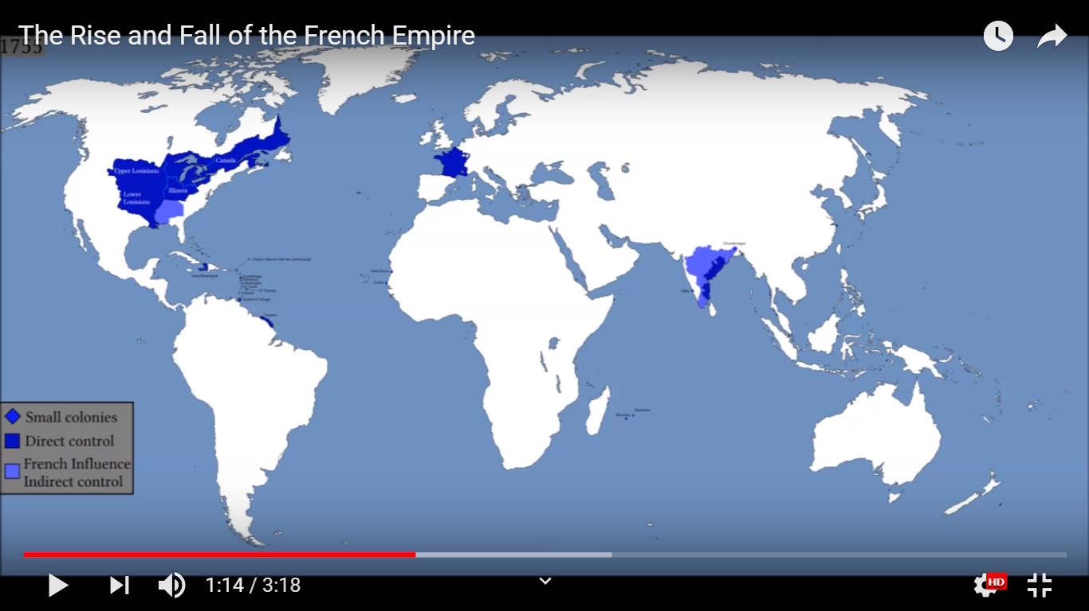
Post-War Imperialism The Migrants
Great Britain
1763
British
Nova Scotia
British Colonies
?
before
1755
Acadiens will migrate to French lands

Slide 64
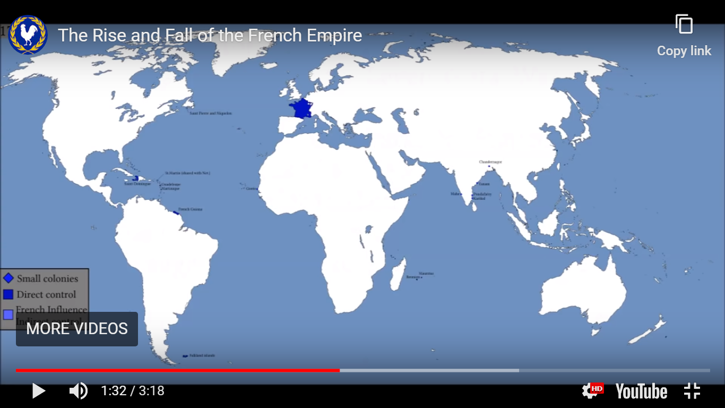
https://www.youtube.com/watch?v=DqcRau1dntg&feature=youtu.be

Slide 65
FRANCE
St. Domingue
Martinique
& Guadelupe
French Guiana
Falkland Islands
1763
after
1755
before
Acadiens will migrate to French lands
Notes:
St Domingue = San’-doe-mang Guadalupe = Gwa’-de-loup
Martinique = Mar’-tin-yeek Guiana = Ghee-ah’-nah

Slide 66
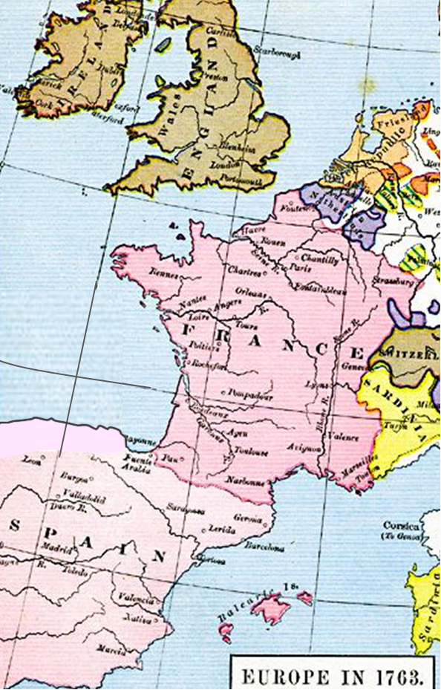
Post-War Imperialism The Migrants
after
1763
Acadiens will migrate to French lands

Slide 67
Post-War Imperialism The Migrants
1763: Acadiens in England remove to France
- gathered by the French Ambassador in London
- transported in wagon convoys to Southampton
- shipped across the Channel
- housed in old barracks along coast
- dispersed across northern France
- provided monthly subsistence
3000
Acadien farm families marginalized
& disenfranchised in urban cities
Where can these Acadians find new homes?

Slide 68
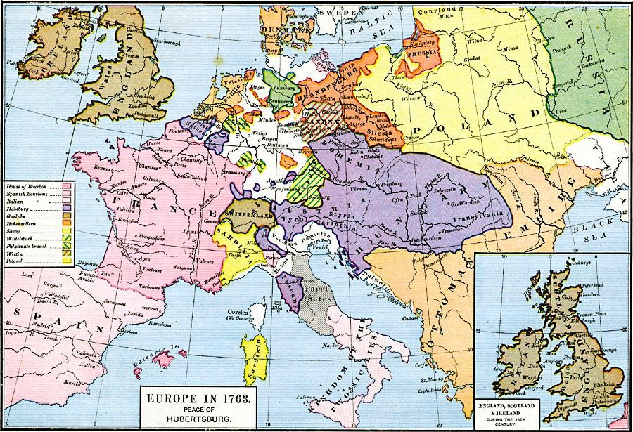
https://www.pinterest.com/pin/64457838393974681/

Slide 69
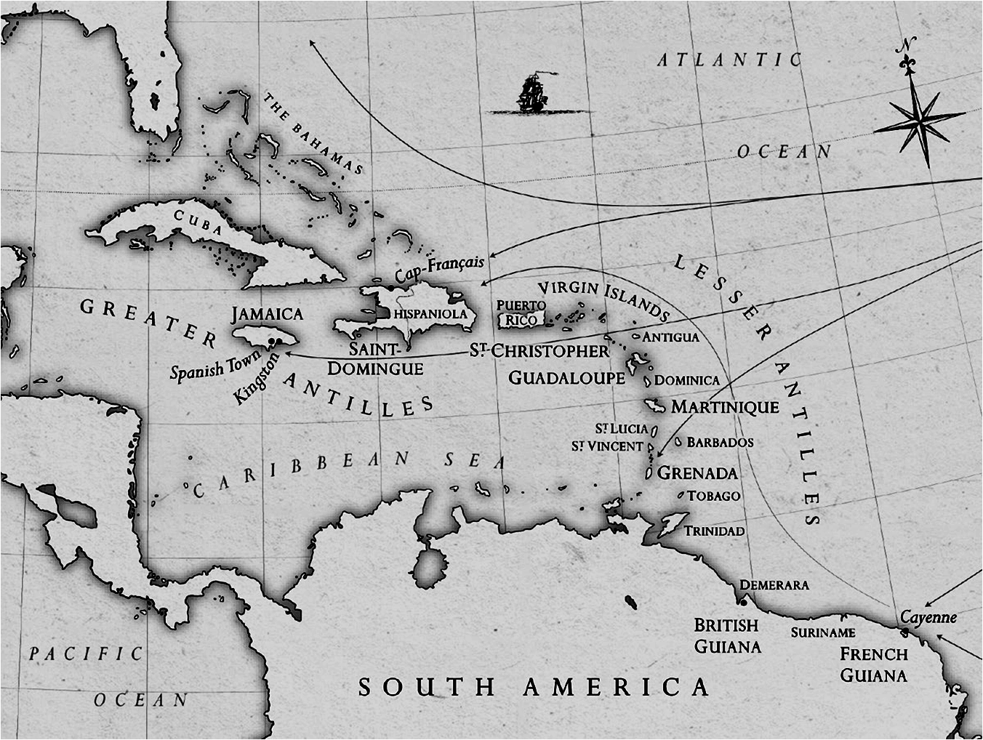
Post-War Imperialism The Migrants
1763: Acadiens in England remove to France
THE TROPICS
A T L A N T I C
- gathered by the French Ambassador in London
- transported in wagon convoys to Southampton
- shipped across the Channel
- housed in old barracks along coast
- dispersed across northern France
- provided monthly subsistence
3000
Acadien farm families marginalized
& disenfranchised in urban cities
Where can these Acadians find new homes?

Slide 70
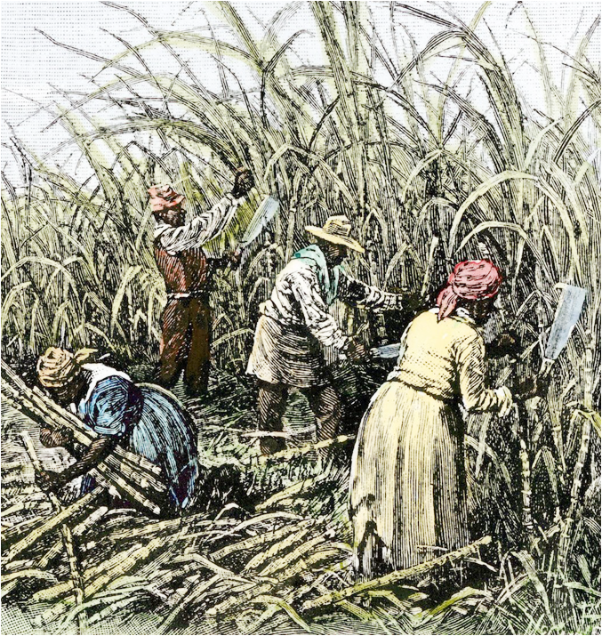
Post-War Imperialism The Migrants
THE TROPICS
1763
Florida
A T L A N T I C
Plan of French foreign minister:
conscript white colonists to minimize slavery
Saint Domingue
Guadalupe
Martinique
colonized by France mid-1600s
- sugar, tobacco, indigo, & cotton
- cultivation depends on slavery
French
Guiana
- ongoing slave unrest/insurrection

Slide 71
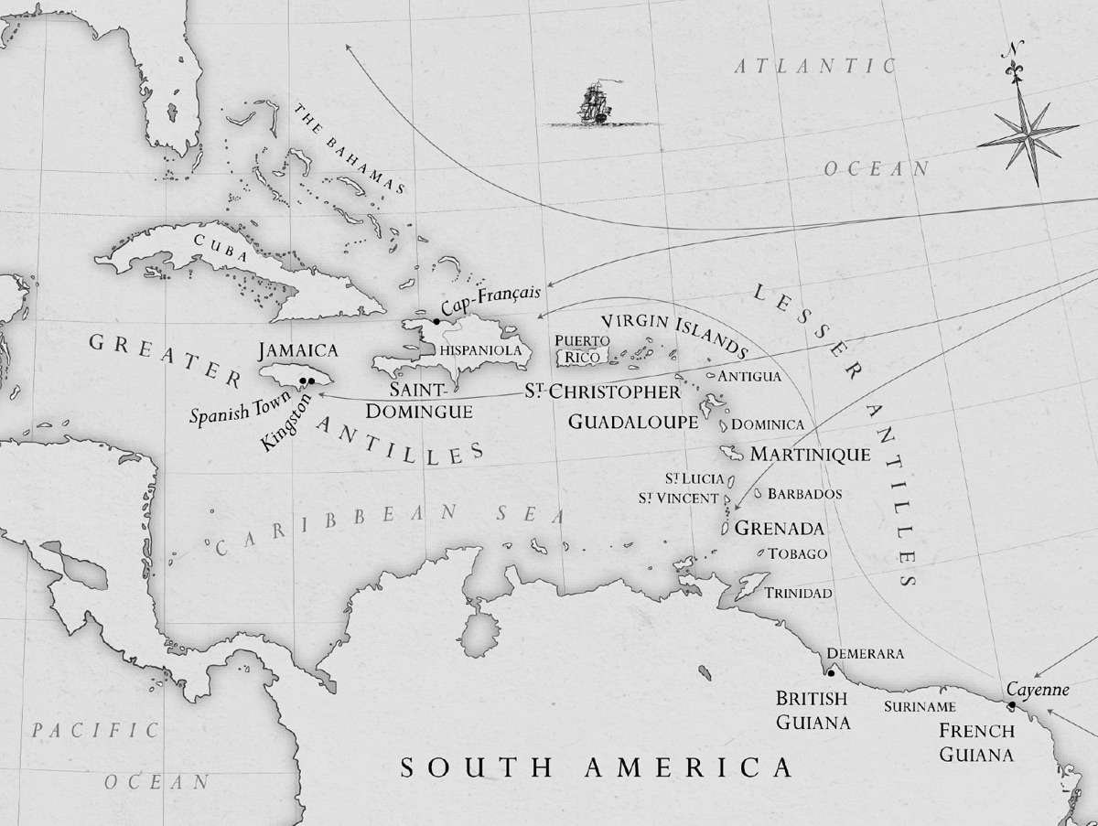
https://www.sup.org/books/extra/?id=27600&i=Introduction.html
Figure 2. The West Indies circa 1774. This book focuses on British territories, including Jamaica, Grenada, and Saint Christopher, and French territories, including Saint-Domingue (renamed the Republic of Haiti in 1804), Guadeloupe, Martinique, and Cayenne in French Guiana. Jamaica and Saint-Domingue were the most valuable eighteenth-century sugar islands and, consequently, hubs of plantation medicine and experimentation.

Slide 72
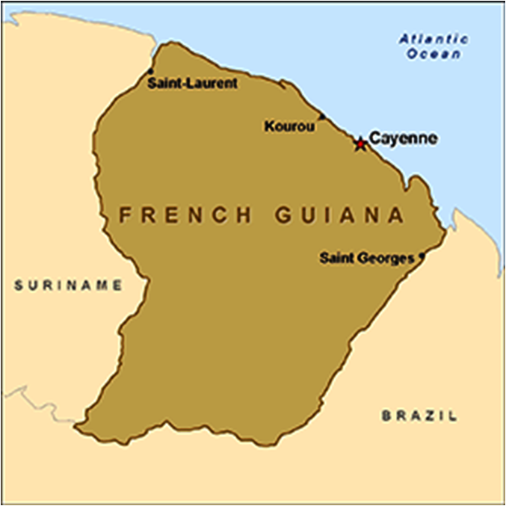
Post-War Imperialism The Migrants
THE TROPICS
1763
Florida
A T L A N T I C
Plan of French foreign minister:
conscript white colonists to minimize slavery
Plan of French foreign minister:
conscript white colonists to minimize slavery
French
Guiana

Slide 73
Post-War Imperialism The Migrants
THE TROPICS
1763
Plan of French foreign minister:
conscript white colonists to minimize slavery
grant European entrepreneurs
land & laborers
recruit peasants to work fields
provide peasants w/small plots
for personal cultivation
recruit peasants from Europe
- French Acadians: refusal
means loss of gov’t dole
- German peasants: enticed
with benefits

Slide 74
https://wwwnc.cdc.gov/travel/destinations/traveler/none/french-guiana

Slide 75
Post-War Imperialism The Migrants
THE TROPICS
1763
Plan of French foreign minister:
conscript white colonists to minimize slavery
Results
grant European entrepreneurs
land & laborers
recruit peasants to work fields
provide peasants w/small plots
for personal cultivation
recruit peasants from Europe
- French Acadians: refusal
means loss of gov’t dole
- German peasants: enticed
with benefits
~200 Acadians migrate
~11,000 Germans migrate
disaster: scurvy, dysentery,
smallpox, typhoid
9000-11,000 colonists die
100 Acadians survive; move
farther north; find success as
non-slave-holding farmers
Sinnamary
Kourou Colony
‘single deadliest episode in European colonization of Americas’

Slide 76
Post-War Imperialism The Migrants
THE TROPICS
1763
Florida
A T L A N T I C
Plan of French foreign minister:
conscript white colonists to minimize slavery
Results
~200 Acadians migrate
~11,000 Germans migrate
disaster: scurvy, dysentery,
smallpox, typhoid
9000-11,000 colonists die
100 Acadians survive; move
farther north; find success as
non-slave-holding farmers
Sinnamary
‘single deadliest episode in European colonization of Americas’
French
Guiana

Slide 77
Post-War Imperialism The Migrants
Florida
A T L A N T I C
Saint Domingue
French
Guiana

Slide 78
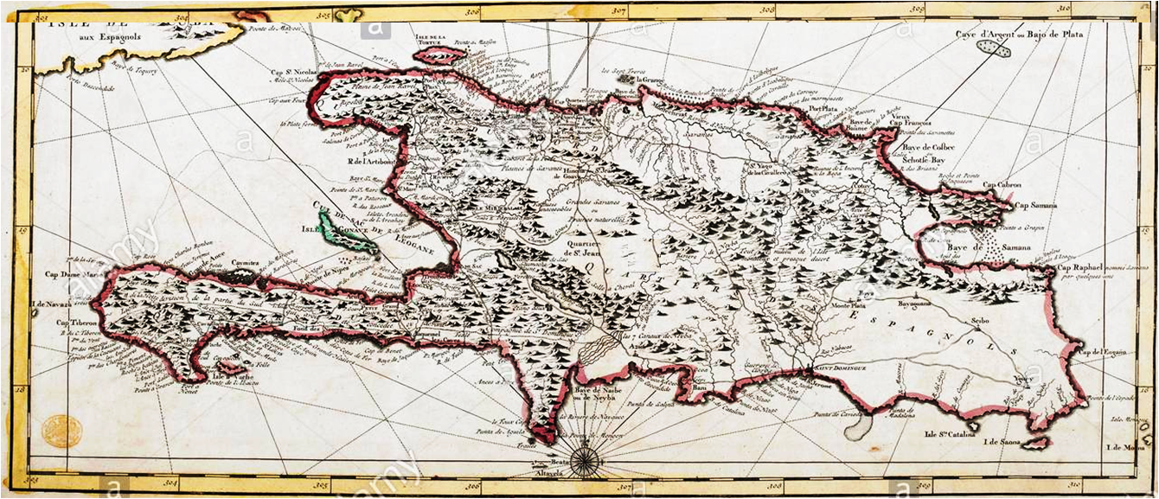
Post-War Imperialism The Migrants
1493 - 1ST settlement begun by Columbus
Florida
A T L A N T I C
Saint Domingue
HISPANIOLA

Slide 79
https://en.wikipedia.org/wiki/Hispaniola
Christopher Columbus first landed at Hispaniola on December 6, 1492 at a small bay he named San Nicolas, now called Môle-Saint-Nicolas on the north coast of present-day Haiti. He was welcomed in a friendly fashion by the indigenous people known as the Taino. Trading with the natives yielded more gold than they had come across previously on the other Caribbean islands and Columbus was led to believe that much more gold would be found inland. Before he could explore further, his flagship, the Santa Maria, ran aground and sank in the bay on December 24. With only two smaller ships remaining for the voyage home, Columbus built a fortified encampment, La Navidad, on the shore and left behind 21 crewman to await his return the following year.
Colonization began in earnest the following year when Columbus brought 1,300 men to Hispaniola in November 1493 with the intention of establishing a permanent settlement. They found the encampment at Navidad had been destroyed and all the crewmen left behind killed by the natives. Columbus decided to sail east in search of a better site to found a new settlement. In January 1494 they established La Isabela in present-day Dominican Republic.
As Spain conquered new regions on the mainland of the Americas (Spanish Main), its interest in Hispaniola waned, and the colony’s population grew slowly. By the early 17th century, the island and its smaller neighbors (notably Tortuga) became regular stopping points for Caribbean pirates. In 1606, the government of Philip III ordered all inhabitants of Hispaniola to move close to Santo Domingo, to avoid interaction with pirates. Rather than secure the island, his action meant that French, English, and Dutch pirates established their own bases on the abandoned north and west coasts of the island.
In 1665, French colonization of the island was officially recognized by King Louis XIV. The French colony was given the name Saint-Domingue. In the 1697 Treaty of Ryswick, Spain formally ceded the western third of the island to France. Saint-Domingue quickly came to overshadow the east in both wealth and population. Nicknamed the "Pearl of the Antilles", it became the richest and most prosperous colony in the West Indies, with a system of human slavery used to grow and harvest sugar cane during a time when European demand for sugar was high. Slavery kept prices low and profit was maximized. It was an important port in the Americas for goods and products flowing to and from France and Europe.
European colonists often died young due to tropical fevers, as well as from violent slave resistance in the late eighteenth century. In 1791, during the French Revolution, a major slave revolt broke out on Saint-Domingue. When the French Republic abolished slavery in the colonies on February 4, 1794, it was a European first.[38] The ex-slave army joined forces with France in its war against its European neighbors. In the second 1795 Treaty of Basel (July 22), Spain ceded the eastern two-thirds of the island of Hispaniola, later to become the Dominican Republic. French settlers had begun to colonize some areas in the Spanish side of the territory

Slide 80
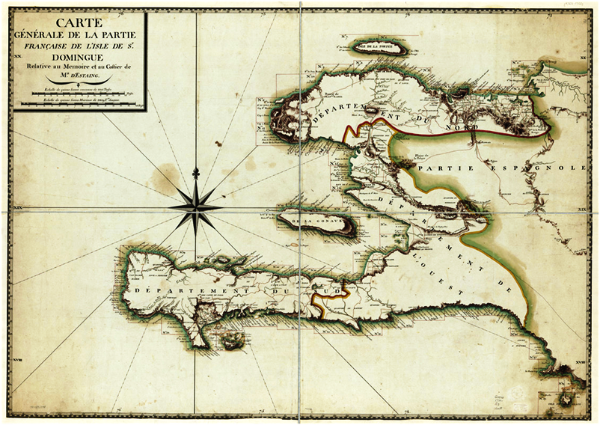
Post-War Imperialism The Migrants
1493 - 1ST settlement begun by Columbus
1697 - Spain ceded western 3rd of island to France
- French colony Saint-Domingue
SAINT-DOMINGUE
HISPANIOLA
SAINT-DOMINGUE

Slide 81
https://en.wikipedia.org/wiki/Saint-Domingue
French buccaneers established a settlement on the island of Tortuga in 1625 before going to Grande Terre (mainland). At first they survived by pirating ships, eating wild cattle and hogs, and selling hides to traders of all nations. Although the Spanish destroyed the buccaneers' settlements several times, on each occasion they returned due to an abundance of natural resources: hardwood trees, wild hogs and cattle, and fresh water. The settlement on Tortuga was officially established in 1659 under the commission of King Louis XIV.
In 1665, French colonization of the islands Hispaniola and Tortuga entailed slavery-based plantation agricultural activity such as growing coffee and cattle farming. It was officially recognized by King Louis XIV. Spain tacitly recognized the French presence in the western third of the island in the 1697 Treaty of Ryswick; the Spanish deliberately omitted direct reference to the island from the treaty, but they were never able to reclaim this territory from the French.
The economy of Saint-Domingue became focused on slave-based agricultural plantations. Saint-Domingue's black population quickly increased. They followed the example of neighboring Caribbean colonies in coercive treatment of the enslaved population. More cattle and slave agricultural holdings, coffee plantations and spice plantations were implemented, as well as fishing, cultivation of cocoa, coconuts, and snuff. Saint-Domingue quickly came to overshadow the previous colony in both wealth and population. Nicknamed the "Pearl of the Antilles," Saint-Domingue became the richest and most prosperous French colony in the West Indies, cementing its status as an important port in the Americas for goods and products flowing to and from France and Europe. Thus, the income and the taxes from slave-based sugar production became a major source of the French budget.
Among the first buccaneers was Bertrand D'Ogeron, who played a big part in the settlement of Saint-Domingue. He encouraged the planting of tobacco, which turned a population of buccaneers and freebooters, who had not acquiesced to royal authority until 1660, into a sedentary population. D'Orgeron also attracted many colonists from Martinique and Guadeloupe, including Jean Roy, Jean Hebert and his family, and Guillaume Barre and his family, who were driven out by the land pressure which was generated by the extension of the sugar plantations in those colonies. But in 1670, shortly after Cap-Français (later Cap-Haïtien) had been established, the crisis of tobacco intervened and a great number of places were abandoned. The rows of freebooting grew bigger; plundering raids, like those of Vera Cruz in 1683 or of Campêche in 1686, became increasingly numerous, and Jean-Baptiste Colbert, Marquis de Seignelay, elder son of Jean Baptist Colbert and at the time Minister of the Navy, brought back some order by taking a great number of measures, including the creation of plantations of indigo and of cane sugar. The first sugar windmill was built in 1685.
Prior to the Seven Years' War (1756–1763), the economy of Saint-Domingue gradually expanded, with sugar and, later, coffee becoming important export crops. After the war, which disrupted maritime commerce, the colony underwent rapid expansion. In 1767, it exported 72 million pounds of raw sugar and 51 million pounds of refined sugar, one million pounds of indigo, and two million pounds of cotton. Saint-Domingue became known as the "Pearl of the Antilles" — one of the richest colonies in the world in the 18th-century French empire. It was the greatest jewel in imperial France's mercantile crown. By the 1780s, Saint-Domingue produced about 40 percent of all the sugar and 60 percent of all the coffee consumed in Europe. This single colony, roughly the size of Hawaii or Belgium, produced more sugar and coffee than all of the British West Indies colonies combined, generating enormous revenue for the French government and enhancing its power.
The labor for these plantations was provided by an estimated 790,000 African slaves, accounting in 1783–1791 for a third of the entire Atlantic slave trade. Between 1764 and 1771, the average annual importation of slaves varied between 10,000 and 15,000; by 1786 it was about 28,000, and from 1787 onward, the colony received more than 40,000 slaves a year. However, the inability to maintain slave numbers without constant resupply from Africa meant the slave population in 1789 totaled to 500,000, ruled over by a white population that numbered only 32,000. At all times, a majority of slaves in the colony were African-born, as the brutal conditions of slavery and tropical diseases such as yellow fever prevented the population from experiencing growth through natural increase. African culture thus remained strong among slaves to the end of French rule. The folk religion of Vodou commingled Catholic liturgy and ritual with the beliefs and practices of the Vodun religion of Guinea, Congo and Dahomey. Slave traders scoured the Atlantic coast of Africa, and the slaves who arrived came from hundreds of different tribes, their languages often mutually incomprehensible
To regularize slavery, in 1685 Louis XIV had enacted the code noir, which accorded certain human rights to slaves and responsibilities to the master, who was obliged to feed, clothe and provide for the general well-being of his slaves. The code noir sanctioned corporal punishment but had provisions intended to regulate the administration of punishments. In any event, such protections were often ignored by white colonists.
Thousands of slaves found freedom by fleeing into the mountains, forming communities of maroons and raiding isolated plantations. The most famous was Mackandal, a one-armed slave, originally from the Guinea region of Africa, who escaped in 1751. A Vodou Houngan (priest), he united many of the different maroon bands. For the next six years, he staged successful raids while evading capture by the French. He and his followers reputedly killed more than 6,000 people. He preached a radical vision of destroying white colonization in Saint-Domingue. In 1758, after a failed plot to poison the drinking water of the planters, he was captured and burned alive at the public square in Cap-Français.
Until the mid-18th century, there were efforts made by the French Crown to found a stable French-European population in the colony, a difficult task because there were few European women there. From the 17th century to the mid-18th century, the Crown attempted to remedy this by sending women from France to Saint-Domingue and Martinique to marry the settlers. However, these women where rumoured to be former prostitutes from La Salpêtrière and the settlers complained about the system in 1713, stating that the women sent were not suitable, a complaint that was repeated in 1743. The system was consequently abandoned, and with it the plans for colonisation. In the later half of the 18th century, it was common and accepted that a Frenchman during his stay of a few years would enjoy the sexual services of a black local, and would live with her.
Saint-Domingue had the largest and wealthiest free population of color in the Caribbean; they were known as the gens de couleur. The royal census of 1789 counted roughly 25,000 such persons. While many free population of color were former slaves, most members of this class were mulattoes, of mixed French/European and African ancestry. Typically, they were the descendants of the enslaved women and French colonists. As in New Orleans, a system of plaçage developed, in which white men had a kind of common-law marriage with slave or free mistresses, and provided for them with a dowry, sometimes freedom, and often education or apprenticeships for their mixed-race children. Some such descendants of planters inherited considerable property. As their numbers grew, they were made subject to discriminatory colonial legislation. Statutes forbade gens de couleur from taking up certain professions, marrying whites, wearing European clothing, carrying swords or firearms in public, or attending social functions where whites were present.
The regulations did not restrict their purchase of land, and many accumulated substantial holdings and became slave owners. By 1789, they owned one-third of the plantation property and one-quarter of the slaves of Saint-Domingue. Central to the rise of the gens de couleur planter class was the growing importance of coffee, which thrived on the marginal hillside plots to which they were often relegated. The largest concentration of gens de couleur was in the southern peninsula. This was the last region of the colony to be settled, owing to its distance from Atlantic shipping lanes and its formidable terrain, with the highest mountain range in the Caribbean. In the parish of Jérémie, the free population of color formed the majority of the population. Many lived in Port-au-Prince as well, which became an economic center in the South of the island.

Slide 82
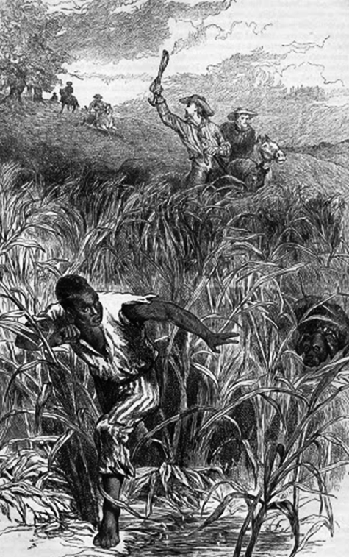
Post-War Imperialism The Migrants
1711 - France established colonial capital of Cap Francois
- slave-based sugar plantations developed
1700s – treated brutally, slaves began poisoning colonists
- escaped slaves (maroons) formed outlaw enclaves
SAINT-DOMINGUE
1763 – French decide to develop isolated NW, without slaves
1764 - 600 Acadiens are recruited from N.S. & Am. colonies
- arrive by sea to capital, then to far northwest
- build Môle-Saint-Nicolas (breakwater or rampart)

Slide 83
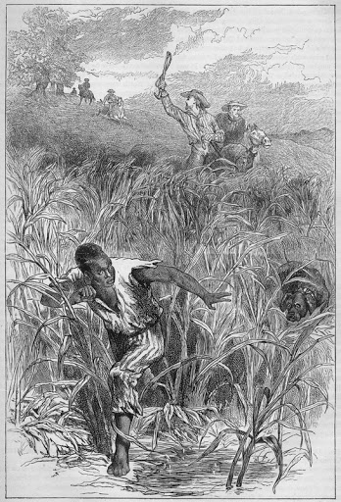
https://collections.leventhalmap.org/search/commonwealth:q524nd38h
https://en.wikipedia.org/wiki/Saint-Domingue_expedition
HISPANIOLA

Slide 84
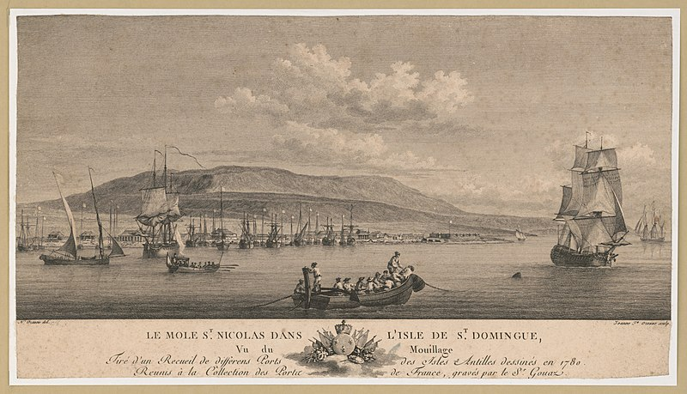
https://commons.wikimedia.org/wiki/File:Le_mole_St._Nicolas_dans_l%27isle_de_St._Domingue,_vu_du_mouillage_-_N._Ozanne_del._;_Jeanne_Fa._Ozanne_sculp._LCCN2004672475.jpg

Slide 85
Post-War Imperialism The Migrants
20% of Acadiens on Domingue die in 1st year
A T L A N T I C
French transfer 1000 Germans from French Guiana to assist
remaining Acadiens endure & integrate into Saint Dominque
SAINT-DOMINGUE
Saint Domingue
Acadien migration to the Tropics

Slide 86
Post-War Imperialism The Migrants
way-station for European explorers/traders to the Pacific
20% of Acadiens on Domingue die in 1st year
A T L A N T I C
French transfer 1000 Germans from French Guiana to assist
FRANCE
remaining Acadiens endure & integrate into Saint Dominque
St. Domingue
Martinique
Saint Domingue
French Guiana
WHY?
Acadien migration to the Tropics
Acadien migration to the Falklands
Notes:
St Domingue = San’-doe-mang Guadalupe = Gwa’-de-loup
Martinique = Mar’-tin-yeek Guiana = Ghee-ah’-nah

Slide 87
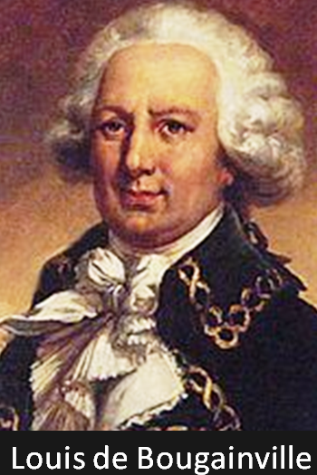
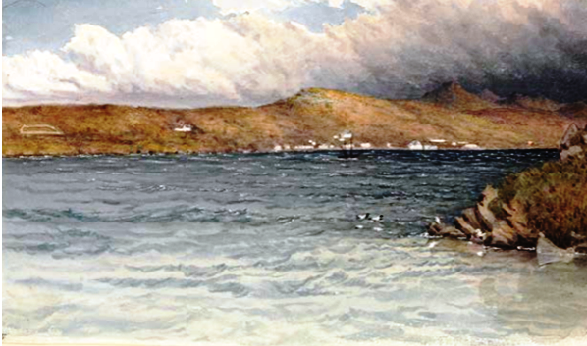
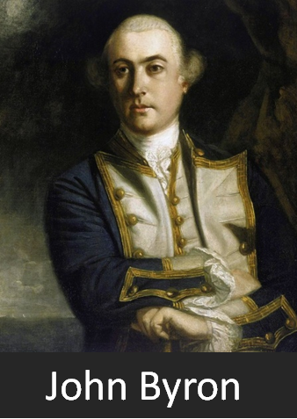
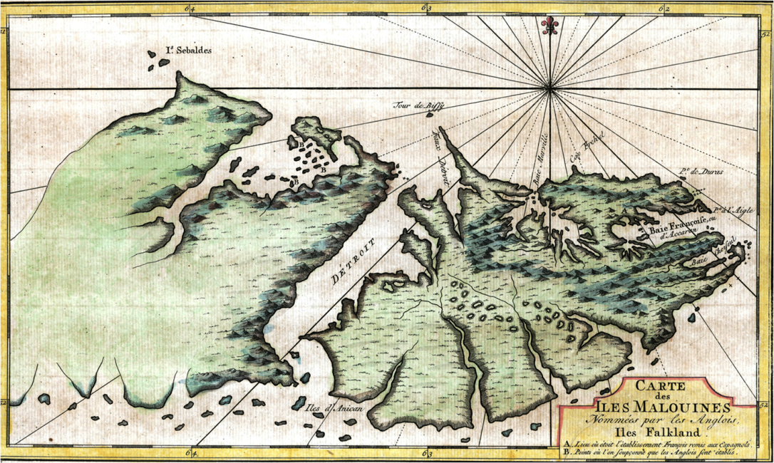
Post-War Imperialism The Migrants
1763: 150 Acadiens join Louis de Bougainville
to develop 1st settlement on Iles Malouines
FRANCE
islands named for French town of St Malo
climate & boggy soil similar to Acadie
colony thrives w/fort, housing, & farms
1765: Bougainville brings 2nd Acadien group
British threat
Fort Louis
Acadien migration to the Falklands
Notes:
St Domingue = San’-doe-mang Guadalupe = Gwa’-de-loup
Martinique = Mar’-tin-yeek Guiana = Ghee-ah’-nah

Slide 88
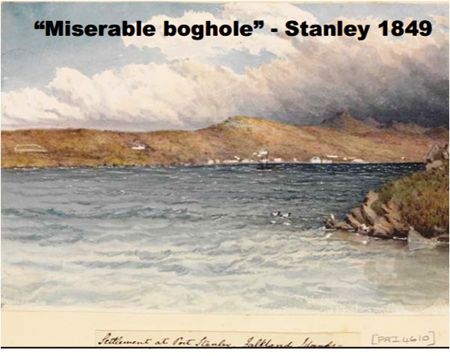
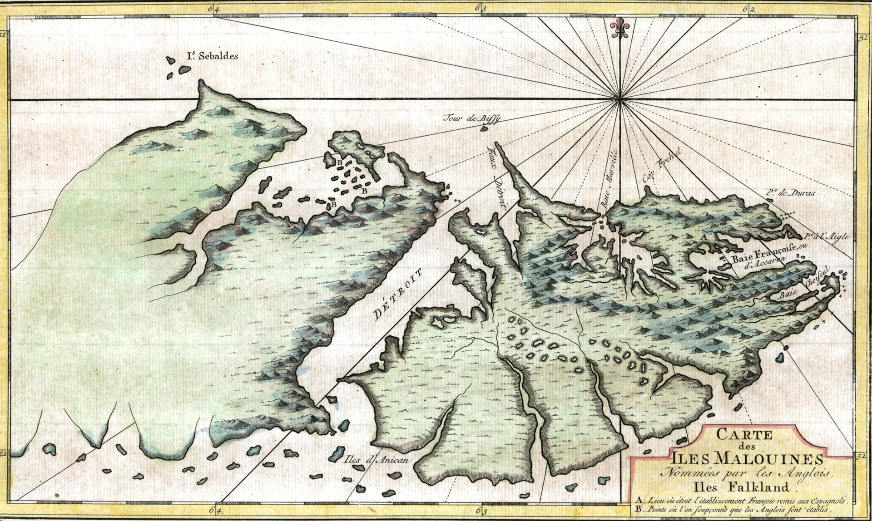
http://www.asiapacificms.com/articles/argentine_sovereignty/falklands_map_mid.jpg

Slide 89
https://en.wikipedia.org/wiki/Falkland_Islands
Although Fuegians from Patagonia may have visited the Falkland Islands in prehistoric times, the islands were uninhabited when Europeans first discovered them. Claims of discovery date back to the 16th century, but no consensus exists on whether early explorers discovered the Falklands or other islands in the South Atlantic. The first recorded landing on the islands is attributed to English captain John Strong, who, en route to Peru's and Chile's littoral in 1690, discovered the Falkland Sound and noted the islands' water and game.
The Falklands remained uninhabited until the 1764 establishment of Port Louis on East Falkland by French captain Louis Antoine de Bougainville, and the 1766 foundation of Port Egmont on Saunders Island by British captain John MacBride. Whether or not the settlements were aware of each other's existence is debated by historians. In 1766, France surrendered its claim on the Falklands to Spain, which renamed the French colony Puerto Soledad the following year. Problems began when Spain discovered and captured Port Egmont in 1770. War was narrowly avoided by its restitution to Britain in 1771.
Both the British and Spanish settlements coexisted in the archipelago until 1774, when Britain's new economic and strategic considerations led it to voluntarily withdraw from the islands, leaving a plaque claiming the Falklands for King George III. Spain's Viceroyalty of the Río de la Plata became the only governmental presence in the territory. West Falkland was left abandoned, and Puerto Soledad became mostly a prison camp. Amid the British invasions of the Río de la Plata during the Napoleonic Wars in Europe, the islands' governor evacuated the archipelago in 1806; Spain's remaining colonial garrison followed suit in 1811, except for gauchos and fishermen who remained voluntarily.

Slide 90
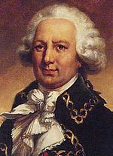
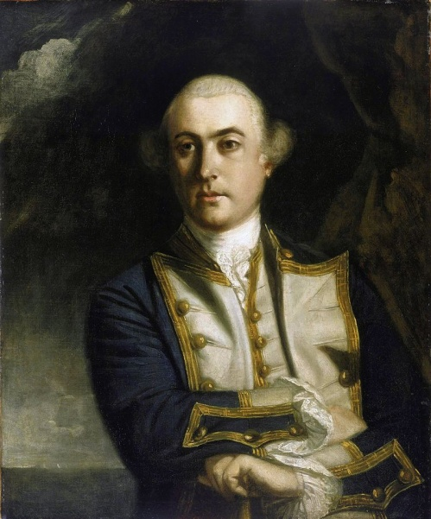
https://en.wikipedia.org/wiki/Timeline_of_the_history_of_the_Falkland_Islands
1764: Louis de Bougainville (France) founded a naval base at Port Louis, East Falkland. The French named them the Îles Malouines, so-called from when the islands were briefly occupied by fishermen from St Malo. Many of the settlers were Acadians left homeless by the Great Expulsion in Nova Scotia.
1765: Ignorant of de Bougainville's presence, John Byron (Great Britain) claims Saunders Island and other islands for Britain. Britain builds a settlement on Saunders Island the following year.
1766: France and Spain reach agreement: French forces are to leave, and Spain agrees to pay for the installations built by de Bougainville.
1767: Fort St Louis is formally transferred to the Spanish Crown and renamed Puerto Soledad. Bougainville receives compensation for his efforts in establishing the colony. The first Spanish Governor, Don Felipe Ruiz Puente, is appointed.
1769: British and Spanish ships encounter one another whilst surveying the island. Each accuse the other of having no lawful reason for being in the islands.
1770: Falkland Crisis: Five Spanish ships arrive at Port Egmont with over 1400 troops under the command of General Madariaga. The British are forced to abandon Port Egmont and threaten war.
1771: That dispute was settled, with Spain retaining Puerto Soledad and Great Britain Port Egmont. Spain returns all goods and chattels seized and makes restitution. The Spanish later claim a secret agreement was reached whereby the British would leave the island, this is denied by the British and no documentary proof of the agreement has ever been produced.
Louis de Bougainville
John Byron

Slide 91
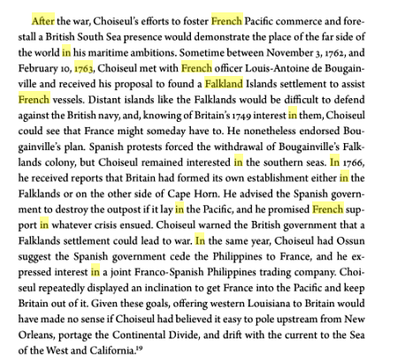
https://books.google.com/books?id=0DDqCQAAQBAJ&pg=PA376&lpg=PA376&dq=falkland+in+french+empire+after+1763&source=bl&ots=EHKB__fHo1&sig=ACfU3U0ObQBREzhdIE8fcf3g6TOxLu57ig&hl=en&ppis=_e&sa=X&ved=2ahUKEwjEsOH4zb3nAhVNIKwKHdWQD_wQ6AEwDHoECAkQAQ#v=onepage&q=falkland%20in%20french%20empire%20after%201763&f=false

Slide 92
https://www.falklandsbiographies.org/biographies/364
PERNETTY, ANTOINE-JOSEPH (or Pernety)
French priest and naturalist, was born in Roanne (Loire) on 13 February 1716. As a Benedictine monk, he had been attached since 1730 to the Abbey of St Maur at St Germain des Prés, then just outside Paris. When BOUGAINVILLE was planning his expedition to the Falklands, Pernetty was recommended to him as chaplain by the Duc de Choiseul (the senior French statesman after whom Choiseul Sound was named), as an artist well versed in natural history, obliging, eager to please and a friend to all. Pernetty held some highly original opinions and had already published a Benedictine manual, a dictionary of painters and sculptors and a book unveiling the fables of ancient Egypt and Greece.
Pernetty's narrative of the voyage and of his stay on the Islands while the settlement of Fort St Louis (Port Louis) was being established was first published in French in Berlin in 1769, then in a much revised edition in Paris in 1770, followed by two English editions in 1771 and 1773. It is a charming and informative book, very much a personal account, enhanced with folding maps and engravings. The French title of 1770 is quite short: Histoire d' un voyage aux îles malouines fait en 1763 et 1764, avec des observations sur le détroit de Magellan et sur les Patagons, while the English one reads: The history of a voyage to the Malouine (or Falkland) Islands made in 1763 and 1764, under the command of M. de Bougainville, in order to form a settlement there; and of his two voyages to the Streights of Magellan, with an account of the Patagonians... In his 'advertisement to the reader' the English editor hoped that the work would meet with the approbation of the public and listed what changes had been made, mainly in the way of additional maps and a rearrangement of the plates.
The narrative begins: 'I left Paris on the 17th of August 1763 at two o'clock in the afternoon ...' so that the reader is straight away in Pernetty's company before the departure of the Aigle and the Sphinx. His narrative of the outward voyage is always interesting, but cannot detain us here, except perhaps to note his vivid description of 'crossing the Line' (the Equator) while 'Bon-homme la Ligne, lord governor of these latitudes' and his court held sway. Of the Falkland Islands, which he explored a little on his own, encountering at one stage 'an animal of terrible appearance and astonishing size' (presumably a male sea-elephant), Pernetty wrote:
In the quarter of island which we saw, the land everywhere presents a very agreeable aspect. Mountains, or rather eminences which we called mountains, encompass plains further than the eye can see, divided by little rising grounds and hills which communicate by gentle declivities. At the foot of each, a rivulet, more or less considerable, runs in winding mazes, and discharges itself into the sea through the innumerable creeks of the bays.
He protested to Bougainville about the burning (for clearance) of one of the islands in what is now Berkeley Sound, in which 200 penguins died. His fears that the whole 'continent' would catch fire and that game would be destroyed, were further aroused when Bougainville took no notice and set fire to areas of the main island. On one occasion Pernetty went ashore to shoot geese, but got his powder wet so that, on discovering a path nine or ten inches wide, he was in fear of attack by unseen natives of the Islands (supposing that such people existed). He then fixed his bayonet. (The track must have been made by foxes.) It may have been Pernetty's idea to erect a cross on one of the hills, which was named 'Mountain of the Cross'.
He was much interested in the natural history of the Iles Malouines, and on finding the quartzite rocks too hard to examine, he concentrated on the flora and fauna. He tells us that he stuffed some bird specimens with moss and presented them later to the Abbey of St Maur to be placed in its cabinet of curiosities. He remarks on the beauty of the living birds' eyes. The folding plates at the end of the English edition of his narrative depict fishes, birds, a 'sea-wolf' (presumably a leopard seal), a 'sea-lion', a sea-elephant and some smaller creatures and plants. Perhaps the most interesting of the other illustrations is 'A view of Fort St Louis at Acarron Bay', under which is 'A Plan of Acarron Bay...' Another fine plate is a chart of: Hawkins's Maiden-land and [called] afterwards FALKLAND'S ISLANDS, then by the French Isles Nouvelles & Isles Malouines, by the Dutch Nova Belgica and lately by the Spaniards of Buenos-ayres Yslas de Magallanes.
Before Bougainville's two ships departed from the Islands, a ceremony took place at Fort St Louis, in which Dom Pernetty must have officiated as priest. All present, including the 28 Acadians who were to form the colony, sang the Te Deum, but the wind blew too strongly for a full mass. 'Vive le Roy' was shouted seven times and the commission of King Louis XV was delivered to Monsieur de NERVILLE, appointing him governor. Interestingly, towards the end of Pernetty's book, he prints a letter from de Nerville, dated 25 April 1765, giving an account of the colony and its progress during the succeeding months.
Pernetty made unsuccessful attempts to get the rules of the Benedictine order relaxed, but had to accept his nomination in April 1768 by Pope Clement XIII as abbot of Burgen in Westphalia in north eastern Germany. Later on in 1782, he took up the post of librarian to King Frederick the Great of Prussia, in Berlin. At least three of his books were published there. As one familiar with the occult, alchemy and the Swedenborgian rite, created by the Swedish theosophist Emmanuel Swedenborg, he co-founded the Société des Illuminés d'Avignon in 1786. It seems that the chateau of La Tour Vaucros was put at his disposal by the then Marquess and it became, in the words of its present owner, the focus of 'mystical, philosophical and cultural encounters'. Pernetty died at his brother's house in Valence (Drôme) on 16 October 1801.

Slide 93
Post-War Imperialism The Migrants
1763: 150 Acadiens join Louis de Bougainville
to develop 1st settlement on Iles Malouines
1765: John Byron claims Islands for Britain
1766: English colonizes Sanders Island
islands named for French town of St Malo
to avoid conflict with England, France cedes
its claim to Falklands to Spain
climate & boggy soil similar to Acadie
1767: Fort Louis renamed Puerto Soledad
colony thrives w/fort, housing, & farms
Acadiens can stay or return to France
1765: Bougainville brings 2nd Acadien group
a few Acadiens (~38) stay on the Falklands
Fort Egmont
British threat
Puerto
Soledad
Fort Louis
Notes:
St Domingue = San’-doe-mang Guadalupe = Gwa’-de-loup
Martinique = Mar’-tin-yeek Guiana = Ghee-ah’-nah

Slide 94
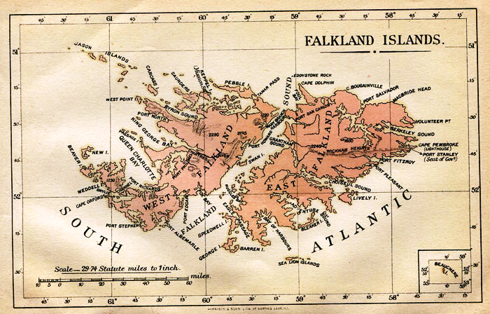
https://en.wikipedia.org/wiki/Port_William,_Falkland_Islands

Slide 95
Post-War Imperialism The Migrants
1765: John Byron claims Islands for Britain
1767
: Where are they now?
1766: English colonizes Sanders Island
to avoid conflict with England, France cedes
its claim to Falklands to Spain
1767: Fort Louis renamed Puerto Soledad
1767
Acadiens can stay or return to France
a few Acadiens (~38) stay on the Falklands
Fort Egmont
Puerto
Soledad
Notes:
St Domingue = San’-doe-mang Guadalupe = Gwa’-de-loup
Martinique = Mar’-tin-yeek Guiana = Ghee-ah’-nah

Slide 96
Post-War Imperialism The Migrants
Where will the Acadiens go?
: Where are they now?
Great Britain
1763
1767
1763-
1767
British
Nova Scotia
France
TROPICS are unsuccessful:
- disease
- climate
- environment
British Colonies
FALKLANDS unsuccessful:
political disruption
St. Domingue
Martinque
Guiana
Falklands

Slide 97
Nation Building The Settlers
Where will the Acadiens go?
WORLD ACADIENS .
Seven Years’ War The Pariahs
- American Colonies
- Great Britain
- British Nova Scotia
Post-War Imperialism The Migrants
- France
- Tropics
- Falkland Islands
Nation Building The Settlers
- British Canada
- Spanish Louisiana
Nation Building The Settlers

Slide 98
Nation Building The Settlers
New World land claims . . . .
need settlers to develop & protect claims
welcome hardy, hard-working Acadiens
Acadiens . . . .
want to reunite families/communities
need to find a new homeland

Slide 99
Nation Building The Settlers
PRE-1763
1763 – Treaty of Paris
New World land claims . . . .
need settlers to develop & protect claims
welcome hardy, hard-working Acadiens
Acadie
Nova Scotia
Acadiens . . . .
want to reunite families/communities
need to find a new homeland

Slide 100
POST-1763
.
PRE-1763
.

Slide 101
Nation Building The Settlers
Spanish Lands
1763 – Treaty of Paris
Building Colonial Empires
British
Spanish

Slide 102
http://www.landscapeofgrandpre.ca/deportation-and-new-settlement-1755ndash1810.html
Acadians had settled in Louisiana as early as 1764. Some families came from Nova Scotia via Santo Domingo, in 1764–1765, while most of the other families went directly from Maryland and from other Anglo-American colonies, through the Caribbean. They were joined in 1785 by the large group from France that had not succeeded in resettling among the French. Acadians were concentrated principally in southern Louisiana and exerted much influence in politics and in the economy.

Slide 103
https://www.thecanadianencyclopedia.ca/en/article/the-deportation-of-the-acadians-feature
Between 1755 and 1763, approximately 10,000 Acadians were deported. They were shipped to many points around the Atlantic. Large numbers were landed in the English colonies, others in France or the Caribbean. Thousands died of disease or starvation in the squalid conditions on board ship. To make matters worse, the inhabitants of the English colonies, who had not been informed of the imminent arrival of disease-ridden refugees, were furious. Many Acadians were forced, like the legendary Evangeline of Longfellow's poem, to wander interminably in search of loved ones or a home.
Although the Acadians were not actually shipped to Louisiana by the British, many were attracted to the area by the familiarity of the language and remained to develop the culture now known as "Cajun.“
The migrations of the Acadians to a new Acadia continued into the 1820s. Throughout the ordeal they maintained their sense of identity, as indeed they do today ‒ a remarkable demonstration of human will in the face of cruelty.
Some Acadians resisted, notably Joseph Beausoleil Brossard, who launched a number of retaliatory raids against the British troops. Many escaped to the forests, where the British continued to hunt them down for the next five years. A group of 1,500 fled for New France, others to Cape Breton and the upper reaches of the Peticoudiac River. Of some 3,100 Acadians deported after the fall of Louisbourg in 1758, an estimated 1,649 died by drowning or disease, a fatality rate of 53 per cent

Slide 104
Nation Building The Settlers
Spanish Lands
1682: early European explorations; France claimed region
1718: French founded New Orleans, hundreds of colonists
1763: 7 Years’ War ends – France cedes Louisiana to Spain
1764: Acadians begin migration to Louisiana
Where do they come from?
MAP OF LOUISIANA
COUNTRY OF LOUISIANA
CARTE DE LOUISIANE
PAYS DE LOUISIANE

Slide 105
https://www.louisiana101.com/rr_flag_history.html
Bourbon Spain [1769] 1769 Spanish Governor Alejandro O'Reilly finally established firm control of Louisiana for Spain. O'Reilly divided the province into 12 administrative districts called posts and 22 ecclesiastical parishes. The system of posts died with the end of Spanish rule, but parishes ultimately persisted as the primary county-level administrative unit under territorial and state governments.
French Tri-Color [1803] 1800 Spain officially returned the Louisiana territory West of the Mississippi to France by the secret Treaty of San Ildefonso to avoid the continued deficits the colony caused and the growing possibility that Spain might have to fight the restless Americans to retain control of the lands. (France did not actually take control until November 1803.)
U.S. Flag of 15 Stars [1803] "The Star Spangled Banner" 1803 The United States purchased from Napoleon the territory of Louisiana for $15,000,000. Upon concluding the purchase Robert Livingston, America's Minister to France, said of the transfer, "We have lived long, but this is the noblest work of our whole lives ... From this day the United States will take their place among the powers of the first rank ... The instruments which we have just signed will cause no tears to be shed; they prepare ages of happiness for innumerable generations of human creatures."

Slide 106
https://en.wikipedia.org/wiki/Louisiana_(New_France)
Lower Louisiana consisted of lands in the Lower Mississippi River watershed, including settlements in what are now the U.S. states of Arkansas, Louisiana, Mississippi, and Alabama. The French first explored it in the 1660s, and a few trading posts were established in the following years; serious attempt at settlement began with the establishment of Fort Maurepas, near modern Biloxi, Mississippi, in 1699. A colonial government soon emerged, with its capital originally at Mobile, later at Biloxi and finally at New Orleans (in 1722, four years after the city's founding). The government was led by a governor-general, and Louisiana became an increasingly important colony in the early 18th century.
The earliest settlers of Upper Louisiana mostly came from French Canada, while Lower Louisiana was colonized by people from all over the French colonial empire, with various waves coming from Canada, France, and the French West Indies.

Slide 107
https://www.genealogyblog.com/?p=35059
Acadian-Cajun Timeline, 1603-1805
1718. La Nouvelle-Orleans (New Orleans) was founded by Jean-Baptiste Le Moyne (Sieur de Bienville). It was named for Philippe II, Duke of Orleans, the Regent of France. That year saw hundreds of French colonists arriving in Louisiana.
1719. Baton Rouge was established by the French as a military post.
1721 Arkansas Post. French and German colonists abandoned Arkansas Post, the largest settlement of all of French Louisiana. As a failed farming community, Arkansas Post was typical of the French efforts to colonize North America south of the Great Lakes. Arkansas Post continued as a trading post, and the French presence in the Mississippi Basin now became one of mostly single French fur trappers and traders paddling their canoes from one trading post to the next.
1721 German Coast. A group of German immigrants, who had first settled at Arkansas Post, acquired farm land on the east side of the Mississippi River north of New Orleans. Many of them were formerly of the German-speaking Alsace-Lorraine area of France. They easily adapted themselves to the French culture of Louisiana, and later intermarried with the French Acadians coming into the same area. Their main settlements were at Karlstein, Hoffen, Mariental, and Augsburg, all part of the German Coast. The farms they operated were to become the main source of food for New Orleans for decades.
1755-1758 Expulsion of the Acadians. At the beginning of the French and Indian War, the British completed their conquest of Acadia, and in 1755, began forcibly removing Acadians from their homes. (The British remembered the forced deportations imposed by the French against the English in Newfoundland back in 1696). The first expulsions were to the lower British colonies but in 1758 they began transporting Acadians back to France. Those Acadians who avoided deportation made their way to other French-speaking areas, such as present Québec, present New Brunswick, or present Maine. For an historical reference to the era, re-read Longfellow’s poem, “Evangeline,” which was based on the events of the Acadian expulsions.
1763. The Treaty of Paris of 1763 ended the French and Indian War (it was called the Seven Years War in Canada and Europe). France was the big loser, and lost virtually all of its remaining North American claims. The areas east of the Mississippi and all of Acadia/Nova Scotia and Québec were lost to Britain; the areas west of the Mississippi went to Spain. After the Treaty of Paris, George III issued a proclamation renaming the Province of Québec as the Province of Canada. He also issued the Proclamation Line of 1763, in which Indian Reserves were established west of the Appalachian Mountain Range, limiting western migrations by all of the British colonies. Soon after the treaty, all French military personnel left their North American posts. But, French civilian settlements continued in Lower Louisiana, such as New Orleans, Baton Rouge, Arkansas Post, and Natchez; and in Upper Louisiana, such as Prairie du Chien, Kaskaskia, and Vincennes. Spain did not take military control of Spanish Louisiana until 1766 (at New Orleans) and 1770 (at St. Louis).
1764-1765 Acadian Coast. Per terms of the Treaty of Paris, the British were given the right to remove the remaining French Acadians, but agreed to provide resettlement assistance. The destinations were not always clear, and the displaced Acadians were sometimes loaded onto ships headed to Boston, New York, Baltimore, Norfolk, Charleston, Savannah, or Mobile. After a few initial families made their way to New Orleans via Mobile in early 1764, several shiploads of Acadians arrived in New Orleans in early 1765. Their first settlements were on the west side of the Mississippi River, near the present areas of St. James and Ascension Parishes. That first area became known as the Acadian Coast. Today there are 22 parishes of Louisiana considered part of Acadiana, a modern description of the region of southern Louisiana west of the Mississippi River first settled by French Acadians. For more details on the first Acadians in Louisiana, visit the Acadian-Cajun Genealogy & History website.
See www.acadian-cajun.com/hiscaj2b.htm.
1766. Antonio de Ulloa became the first Spanish governor of Louisiana, headquartered at New Orleans. He was a brilliant scientist (discoverer of the element Platinum), highly regarded by Spanish Royalty, but rose to his highest level of incompetence as a military leader.
1768. The Louisiana Rebellion of 1768 was an attempt by a combined armed force of French Acadians, French Creoles and German Coast settlers around New Orleans to stop the handover of French La Louisiane to Spain. The rebels forced Spanish Governor de Ulloa to leave New Orleans and return to Spain, but his replacement Alejandro O’Reilly was able to crush the rebellion. O’Reilly, an Irishman turned Cuban, was responsible for establishing military rule in Spanish Louisiana.
1777-1778. During the Revolutionary War, a number of French-speaking Acadians from Louisiana joined their counterparts from the leftover French settlements of Kaskaskia and Vincennes. They were added to the Virginia Militia force commanded by General George Rogers Clark. General Clark later noted that the fiercely anti-British fighters he gained from the French communities contributed greatly to his monumental victories against the British in the conquest of the Old Northwest.
1783 United States of America. The treaty of Paris of 1783 first recognized the United States as an independent nation, with borders from the Atlantic Ocean to the Mississippi River, and from present Maine to Georgia. The treaty also reaffirmed the claims of Britain to present Canada; and Spain’s claim to East Florida, West Florida, New Spain (including Nuevo Mexico & Tejas), and Louisiana west of the Mississippi River.
1800-1802 Louisiana. In Europe, Napoleon defeated the Spanish in battle and gained title to Louisiana again after trading them a couple of duchies in Italy. However, Napoleon found that his troops in the Caribbean were under siege and unable to provide much help in establishing a French government in Louisiana. Several months later, when American emissaries showed up in Paris trying to buy New Orleans from him, Napoleon decided to unload the entire tract. – legally described as “the drainage of the Mississippi and Missouri Rivers.”
1803 Louisiana Purchase. President Thomas Jefferson urged Congress to vote in favor, and the U.S. purchased the huge area from France, doubling the size of the United States. But, disputed claims to areas of Lower Louisiana now existed between Spain and the U.S., in particular, the area between the Red River and Sabine River in present Louisiana; and the area of West Florida, east of the Mississippi River.
1804-1805. In 1804, Congress divided the Louisiana Purchase into two jurisdictions: Louisiana District and Orleans Territory. The latter had north and south bounds the same as the present state of Louisiana, but did not include its present Florida Parishes, and its northwest corner extended on an indefinite line west into Spanish Tejas. The first capital of Orleans Territory was New Orleans. For a year, Louisiana District was attached to Indiana Territory for judicial administration, but became Louisiana Territory with its own Governor on July 4, 1805. St. Louis was the first capital of Louisiana Territory.
1812. April 30th. The same area as old Orleans Territory became Louisiana, the 18th state in the Union. New Orleans became the first state capital.
1812. June 4th. Louisiana Territory was renamed Missouri Territory. For about five weeks in 1812, a Louisiana Territory and a State of Louisiana existed at the same time.

Slide 108
Nation Building The Settlers
Acadian migration to Louisiana
Spanish Lands
1682: early European explorations; France claimed region
1718: French founded of New Orleans, hundreds of colonists
1763: 7 Years’ War ends – France cedes Louisiana to Spain
1764: Acadians begin migration to Louisiana
Acadian migration to Louisiana

Slide 109
Acadian migration to Louisiana
Spanish Lands
: 1764-1772
Where do they come from?
1764: Nova Scotia
‘Beausoleil’ released from prison
hires a ship to sail to Illinois
wife dies in St. Domingue
continue to New Orleans
Joseph Broussard
Gulf of Mexico
Spanish welcome them to Louisiana

Slide 110
Acadian migration to Louisiana
Spanish Lands
: 1764-1772
Where do they come from?
1764: Nova Scotia
1764: Nova Scotia
1767: British Colonies
‘Beausoleil’ released from prison
hires a ship to sail to Illinois
1771: Saint Domingue
wife dies in St. Domingue
continue to New Orleans
Joseph Broussard
Opelousas District
Attakapas District
Spanish welcome them to Louisiana

Slide 111
Acadian migration to Louisiana
Spanish Lands
: 1764-1772
Where do they come from?
1764: Nova Scotia
1767: British Colonies
1771: Saint Domingue
NEXT WEEK . . .
Cajuns of Acadiana
Opelousas District
Attakapas District
together in south Louisiana, how will they live?

Slide 113
https://3.bp.blogspot.com
18 Century Opelousas Region - 1701- 1800
Opelousas takes its name from the Native American tribe Appalousa, who had occupied the area before European contact. In 1719, the French sent the first military to the Territory, when Ensign Nicolas Chauvin de la Frénière and two others were sent to patrol the area.
Poste des Opelousas - 1720
In 1720 the French colonial government established the Poste des Opelousas near the headwaters of Teche as a major trading organization for the developing area. The French encouraged immigration to Opelousas Post. as they were interested in the vast prairie region west of the Atchafalaya Basin.
By the early 1730s, French Courier du Bois were exploring the prairie region west of the Atchafalaya Basin to study the possibility of establishing a strategic trading point in the area to counter the Spanish presence to the west.
By 1738 French traders were dealing regularly" with Indians of the region.
In December 1738, two French entrepreneurs, Jean-Joseph Le Kintrek dit Dupont, a former jailer at New Orleans, and Joseph Blanpain, established a partnership that created an Indian trading venture in the area, which lasted until 1744. Le Kintrek is "the first European settler in the Opelousas post."
The Indian trade proved to be profitable, and other traders followed, including André Massé and Jacques-Guillaume Courtableau, Le Kintrek's son-in-law. Both of which established cattle ranches along the Bayou Teche, where an off chute of the Bayou Teche flowed to the Atchafalaya River. The stream between became known as Bayou Courtableau, after Jacques-Guillaume Courtableau.
Le Poste Des Attkapas À La Louisiane 1763
The Opelousas post was so successful that the French officially established the Attakapas District (St Martinville) to control trade in the lower Teche area and to expand the trade with the Indians of the open prairies area.
The official “Poste des Attakapas (St. Martinville), located thirty miles below Opelousas, was established in 1763, though like the Opelousas settlement, the Attakapas had resident settlers that dated from an earlier time.
A Vacherie
From the French word, Vache for Cow, a Vacherie is a Cajun French term for cattle fields. Cattle were brought to the New World by the Spanish soon after 1492. The term black cattle appears several times in descriptions of the cattle on the Teche, it is an archaic term of that time, and it refers to range cattle, i.e. free roaming, not to beasts of a certain color.
The cattle of the Teche Vacherie’s were longhorns which were about half-wild, easily adaptable to almost any climate and native grasses. These cattle differed from those in the old world, their long horns which are generally about two and a half feet long, with their long shanks and feet, when seen from a distance, they look more like deer than like cows and oxen their usual red-brown color add to the illusion.
The high alluvial ridges of the Bayou Teche, seasonal flooded meadows between the ridges and bluffs on the west side of the Teche provided a natural range for raising livestock.
By early 1760’s most of the vast country of Opelousas - Attakapas region was taken up by only four or five Vacherie’s, very spread out and quite large, with absentee landowners and some were very poorly cared for. The prairie grasses were tall, and the cattle could roam au large, no fences confining them. Branding took the place of fences.
1720 – 1765 Vacherie’s around Attakapas post - Fausse Point
Census records clearly show considerable land and cattle ownership in this area of Louisiana before the arrival of the Acadians. For the most part, early habitation in the district was inhabited only by cattle drovers. There were very few permanent settlers, the few small landowners in the area got their Attakapas lands through purchase or occupancy and use; they did not have royal concessions at that time.
The Middle Teche Valley
The Attakapas Post had the best habitat for cattle. Bayou Teche created both the bluff and the Teche Ridge between thirty-five hundred and twenty-five hundred years ago when carrying the combined flows of the Mississippi and Atchafalaya rivers.
The annual high-water flow cut the bluff that marks the western edge of the Atchafalaya Basin and created broad levees, forming the Teche Ridge as a cordon of high land within the basin. To the west, Bayou Tortue and the Vermillion River drained the back swamps during low water periods.
The bluffs provided better pasture and grazing land than the swamps between the Mississippi River and eastern Atchafalaya basin. The Attakapas & Opelousas Post quickly became the primary suppliers for beef by the colonist in New Orleans.
he arrival of the Acadians in Attakapas District - 1765
The First groups of Acadian exiles to America (1764) were settled on the Mississippi River at Bayou Lafourche. An area known as the Acadian Coast. Those Acadians who remained along the Mississippi and Bayou Lafourche adapted to the task of adapting their agricultural practices to Louisiana's long growing season and high annual precipitation levels. They placed ever-increasing emphasis on agricultural production.
The second group of Acadian exiles to America were sent to the Attakapas region. Some historians believe this was part of a grand plan by the new Spanish government.
Two hundred Acadian immigrants arrived in Louisiana in 1765, led by Joseph Broussard dit Beausoleil and his older brother Alexandre. Spanish Governor Aubry received those Acadians; he believed they would die in misery if he did not do something to help them. It happened that they were former residents of the Chignecto Isthmus area of Novia Scotia, which was a sparsely wooded region and was known as the heart of the Acadian cattle industry in Novia Scotia.
Governor Aubrey wanted to buttress the emerging cattle industry along the Teche to provide meat for New Orleans. Here was his chance. Historians say Aubrey induced Juan Antonio Dauterive, who wanted to be a major cattle producer and already owned concessions on the Teche and at Bayou Goula on the Mississippi to make a pact with new Acadians.
A win/win situation for the Governor, his interest was to expand and sustain the colony. Help the new Acadian colonist immigrants survive, and help Juan Antonio Dauterive, become a major cattle producer in the colony like he wanted to be.
Other historians think it was just ‘fait compli’ that the Acadians ended up in the Attakapas.
The Dauterive Compact:
In April of 1765 Antoine Bernard Dauterive, Aubry, the Governor of Louisiana, the new Acadians settlers, and Andre Masse´ entered into an agreement to raise cattle on what until then had been the Masse´ Vacherie.
Dauterive made the compact with eight Acadian “chiefs” including Joseph dit Beausoleil Broussard, Alexandre Broussard, Joseph Guilbeau, Jean Dugas, Olivier Thibodeau, Jean-Baptiste Broussard, Pierre Arseneau, and Victor Broussard. These eight leaders are thought to have been acting for their comrades that were not present at the formal meeting attended by the governor.
Dauterive agreed to furnish five cows and one bull to each willing Acadian, once the newcomers were on the western frontier. After six years, Dauterive would get half their herds’ increases. From their shares, the Acadians would also return to Dauterive his initial investment
With the agreement signed the second major group of Acadians to reach Louisiana made their way to the Attkapas, via boat trip up the Mississippi, to Bayou Plaquemine across the Atchafalaya Swamp to the Bayou Teche.

Slide 114
http://blog.bayoupigeon.com/
In May of 1765, the Acadians, led by Joseph Broussard dit Beausoleil and the Acadians, arrived on the Bayou Teche.
There was one problem, the new colonists did not settle on the ceded land of Dauterive and Masse along Bayou Teche as they had apparently agreed to do back in New Orleans. The Acadians instead decided to settle farther down Bayou Teche along the Fausse Pointe, an odd-shaped peninsula formed by an extreme oxbow of the Teche.
The Acadian Attakapas settlements lay on both banks of the lower Teche at what came to be called Fausse Pointe, le premier camp d'en bas, or the first place lower down; le dernier camp d'en bas, or the last place lower down.
MUCH MORE ON-LINE….

Slide 115
https://3.bp.blogspot.com

Slide 117
http://www.acadian-cajun.com/exla.htm
Louisiana had long been a French colony. But after the war with Spain, and subsequent treaty, it was turned over to Spain. When the first Acadians arrived in April of 1764, Louisiana was owned by Spain but still retained all of its French culture. It is usually written that those first arrivals consisted of 20 Acadians who had been in New York and their relatives recently released from Fort Edwards, Nova Scotia ... but I've found recent evidence that they came from the American colonies. They were settled along the Mississippi River around the boundary of St. John and St. James parishes.
In late February of 1765, 193 more Acadians arrived from Halifax via Saint Domingue. This group had originally intended to settle at Saint Domingue. When they heard of the troubles on the island, they altered the plan. They were to go to Saint Domingue and pick up the Acadians already there. Then they would all head up the Mississippi River and settle in the Illinois area. When they arrived at Saint Domingue, they found the Acadians sick, dead, and unable to afford passage to Louisiana. They had money, or so they thought; they had 47,000 livres in Canadian card money which would be practically worthless. [The Saint Domingue Refugees in Louisiana, Brasseaux, Conrad] So the Halifax Acadians, led by Joseph Broussard dit Beausoleil, took another ship to Louisiana. When they arrived in New Orleans, they were seed grain (for 6 months), a gun, and tools with which to clear the land. They were also led to the Attakapas area and given land. A former military engineer, Louis Andry, guided them and helped them to get settled.
At first, it took some getting used to; the local commander gave them a bad time. They also had to adjust to the semi-tropical climate. Some died of malaria and yellow fever that first year. But within a decade, they had made a comfortable home for themselves. When the Spanish governor Ulloa visited in 1766, they asked him if they could invite their relatives to join them. They were looking to form a “New Acadia.” Even though Ulloa gave them a “let’s wait and see” answer, they went ahead and sent out letters inviting their friends and relatives.
As the letters made their rounds, Acadians decided to make the trip. At least 689 of the 1050 Acadians in Maryland and Pennsylvania boarded ships at Chesapeake Bay and sailed to Louisiana. They were welcomed by authorities and offered land and assistance. Acadians from Maryland (200 of them) were sent to St. James parish. A group of 80 Halifax Acadians who arrived late were sent to St. James in May of 1765. Things seemed okay at that point. But things soon changed.
Acadians that followed were forcibly dispersed. As Pennsylvania and Maryland Acadians arrived, they were settled according to the Spanish defense strategy. After May 1766, they were settled at sites along the Mississippi River at key border points of the English / Spanish territory. After all, the Spanish thought, there was no love lost between the Acadians and the English. They would make a good “buffer.”
In July of 1767, 210 Acadians were settled at St. Gabriel. In February of 1768, 149 new settlers (in 29 families) were sent to San Luis de Natchez (near Vidalia, LA). They had sailed from Port Tobacco, Maryland on Dec. 17, 1767 aboard the Jane under Capt. Richard Ryder. This forced settlement caused the Acadians to be upset with Ulloa. In fact, they supported the removal of Ulloa in the New Orleans rebellion of 1768. The new governor, O’Reilly, allowed the San Luis de Natchez Acadians to travel to the Acadian Coast in December of 1769.
From 1768 to 1785, virtually no new Acadian settlers arrived in Louisiana. Perhaps they were afraid due to the Spanish-Acadian conflict over settlement areas, or they could have feared the instability in the area after the 1768 rebellion. It seems one small group of Acadians made it to Louisiana in 1770. But the next significant arrival of Acadians would not occur until 1785.
In 1770, 30 Acadians arrived along the Mississippi River below Bayou Plaqueminea. They had been sailing on the Britain and gone through shipboard starvation, a mutiny, shipwreck, imprisonment, and forced labor in Texas (which was still Spanish). The made a 420 mile journey over land to Natchitoches. They didn’t want to stay there, however, and were allowed to go to the Iberville area (and later to Opelousas).
Meanwhile, letters written by the early Acadian settlers in Louisiana had reached the Acadians in France. It took a while to work out things with the Acadians, the French government, and the Spanish government. When Henri Peyroux returned to France from Louisiana, he enlisted the help of Acadian Olivier Theriot to encourage the other Acadians to sign up to travel to Louisiana. Gradually, more and more Acadians signed on to the idea. In 1785, about 1600 Acadians traveled to Louisiana on seven ships ... courtesy of the Spanish government.
Upon arriving in New Orleans, they were housed in converted warehouses until they recuperated. Delegates were sent out to inspect possible settlement sites. Most of them (84%) went along with their delegates’ decision, though some settled elsewhere. Four of the seven groups primarily settled in the Bayou Lafourche area. Two of the seven groups primarily settled along the Mississippi River south of Baton Rouge. The seventh group primarily settled along lower Bayou des Ecores (present-day Thompson’s Creek). When a hurricane washed away the Bayou des Ecores settlement in 1794, they joined their fellow Acadians along Bayou Lafourche.
The final group of Acadians arrived in 1788. A schooner, captained by Joseph Gravois, brought 19 Acadians from St. Pierre to Louisiana.
When the 10,000 Saint Domingue refugees arrived in New Orleans in 1809, there were probably some Acadians in that group. Since they were forced to stay in New Orleans, any Acadian culture left in them was merged into the melting pot of New Orleans cultures.
To sum up the Acadian arrivals in Louisiana: 20 came from New York in 1764, about 311 came from Halifax in 1764-65, about 689 came from Maryland and Pennsylvania in 1766-70, about 1600 came from France in 1785, and 19 came from St. Pierre in 1788. More came in over the years, but documentation on their arrival is still being sought.

Slide 118
https://64parishes.org/entry/french-colonial-louisiana
French colonial Louisiana refers to the first century of permanent European settlement in the Lower Mississippi Valley. Native Americans, Europeans, and Africans contributed to the development of a complex frontier society at the geographic nexus of the Americas. Although the French regime considered Louisiana to be a failed colonial enterprise, the diverse peoples of the territory proved essential to the nature of imperial relations among French, Spanish, English, and American interests during the eighteenth century. The multicultural composition of the Lower Mississippi Valley remained strong even after the cession of Louisiana to Spain in 1763, the retrocession to France in 1800, and the Louisiana Purchase in 1803, effectively making the state of Louisiana both representative of the diversity of the United States and unique for its distinctive colonial past.
The First French Settlements, 1699–1713
Following the War of the League of Augsburg (1688–1697), Louis XIV of France moved aggressively to expand French territories, and the French minister of the marine Louis de Phélypeaux, Comte de Pontchartrain, secretly made plans to establish French posts in Louisiana. In doing so, Pontchartrain intended to undermine the colonial interests of the English, Dutch, and Spanish along the coast of the Gulf of Mexico. Pierre Le Moyne d’Iberville et d’Ardillières led the first French expedition to the vicinity of present-day Biloxi in 1699, followed by a year of exploring the Mississippi and Red River Valleys and making contact with the Natchez and other petites nations. In 1702 Iberville moved the colony’s base of operations to Mobile, where roughly 140 French speakers hoped to develop closer trade and military ties with the Choctaw and Chickasaw in order to check British expansion. Before permanently leaving Louisiana, Iberville vested considerable authority in his brother Jean-Baptiste Le Moyne, sieur de Bienville, and his cousin Pierre Charles Le Sueur.
French Crown officials paid little attention to the needs of Lower Louisiana during the early 1700s because of their involvement in the War of Spanish Succession (1701–1714). Lacking official support, Iberville and his elite associates were unable to implement the conventional French mercantilist practice of exploiting natural resources (furs, minerals, cash crops) from colonial territories. To compensate for supply shortages, French colonists relied heavily on the slave labor and agricultural acumen of neighboring Native American groups. To protect against the slave raids and military advances of British-allied tribes such as the Creek, Native American villages in the vicinity of Mobile developed close working relationships with the French. The Choctaw and Chickasaw were especially influential in how the French developed strategies to defend against British encroachment throughout frontier areas east of the Mississippi River. The close interconnectedness of Native Americans and Europeans during this early colonization phase convinced historian Daniel Usner to describe French colonial Louisiana as a “frontier exchange economy” influenced by local and regional networks as well as transatlantic and global movements.
A 1708 census recorded 339 individuals in the French colony: 60 Canadian coureurs des bois (woods runners or backwoodsmen); 122 soldiers, seamen, and craftsmen employed by the Crown; and 157 Indian slaves and European men, women, and children. A handful of Catholic missionary priests traveled through or settled in the colony, though with limited success at evangelizing Native Americans and gaining support from the French laity. With no clear leader, the political organization of Louisiana bore modest resemblance to Canada, its neighbor to the north. Bienville, then a teenager, functioned as the commander of Mobile until Pontchartrain sent the ordonnateur (commissary) Bernard Diron d’Artaguette to investigate and expel the Le Moyne family from Louisiana. Quite the opposite happened, as Bienville became acting governor in 1711, later replaced in 1713 by the founder of Detroit, Sieur Antoine de la Mothe Cadillac, as the first official governor of Louisiana.
Companies and Slavery, 1713–1729
Antoine Crozat, councilor and financial secretary to Louis XIV (1638–1715), received a fifteen-year commercial monopoly over Louisiana in 1712. Crozat attempted to organize the colonial government of Louisiana according to Canadian standards by dividing military and civil affairs among the three offices of commandant, governor, and ordonnateur. He also created a court known as the Superior Council. Technically, Crozat’s company fell under the authority of the governor of Canada, while church matters remained under the jurisdiction of the bishop of Quebec. In reality, daily life in Lower Louisiana remained largely independent of Canadian oversight.
The European population increased from approximately 200 to 500 inhabitants during the Crozat years (1713–1717). Fur trading remained the primary source of income for the colony. There were also rather unsuccessful attempts, first, to trade with Spanish and French West Indian posts, and, second, to harvest silk, indigo, and other cash crops. Louis Juchereau de St. Denis conducted an expedition up the Red River, resulting in the establishment of a French post at Natchitoches. Cadillac made a similar trip in search of lead mines, which resulted in the foundation of Fort Rosalie near present-day Natchez. The French also benefited from the start of the Yamasee War in 1715, a conflict between colonial South Carolina and Native Americans, which took the attention of the English away from making military and economic alliances with the Creek and Chickasaw.
Crozat pulled out of the company contract in 1717. The Scotsman John Law then assumed control over all commercial affairs in Louisiana under the auspices of the Company of the West, later called the Company of the Indies. Law obtained the company charter as part of a larger scheme to transition France to a paper currency system, reduce the Crown’s debt and restore its credit, and bring wealth to Law and his business associates. Law’s financial plan ultimately failed in 1720, when the so-called “Mississippi Bubble” burst.
Despite the company’s failures, Law’s investment in Louisiana amounted to considerable changes in the organization and composition of the colony, which lasted through the 1720s. Bienville moved the colonial capital from Mobile to New Orleans in 1718. Historian Shannon Lee Dawdy described early New Orleans as a “rogue,” “wild,” even “savage” colonial city in the sense that its leading elite inhabitants tried and largely failed to translate their Enlightenment ideals of social order to the swampy banks of the Mississippi River. Memoirs and letters of early residents abound on the topic of New Orleans’s lack of urbanity and wealth of problems.
Outside New Orleans, the company granted land concessions to wealthy Frenchmen along the Mississippi River. Upstart settlers and established elites smuggled trade goods throughout the Mississippi Valley and Caribbean in order to avoid the mercantilist policies of the French Crown. The growing labor force was made up of peasants and indentured servants (petits gens) from France and Alsace, impressed criminals (forçats), Swiss mercenaries and poorly trained French soldiers, and women from Parisian hospitals and asylums, ultimately raising the European population of Louisiana to around 5,000 by 1721. However, the number of European settlers dropped to fewer than 2,000 by the end of the 1720s, due largely to high death rates and the decision of many to abandon the colony.
Roman Catholic priests and nuns contributed to the social development of French colonial Louisiana throughout the early eighteenth century. Paul du Ru, a Jesuit priest, attempted to establish missions among the petites nations, or small tribes, of the Lower Mississippi Valley during Iberville’s brief tenure in Louisiana. Several priests of the Foreign Mission worked as missionaries among Native Americans and chaplains among French settlers. The bishop of Quebec granted ecclesiastical jurisdiction over the European population (and those enslaved by Europeans) of Lower Louisiana to the Capuchins. The Jesuits, in turn, were responsible for the missionization of Native Americans outside the confines of French posts. This bipartite organization of the clergy led to considerable conflict, often resulting in the deterioration of Indian missions and lay-clerical relations.
Nicolas-Ignace de Beaubois (1689–1770), Jesuit superior of Lower Louisiana, established a permanent male missionary presence in and around New Orleans in 1727. A troupe of twelve Ursuline nuns also arrived at New Orleans in 1727. Marie Madeline Hachard, the youngest of the women in habits, left a record of her life as a missionary, which was published in France for the edification of young women. In addition to their roles as religious leaders, Catholic priests and nuns busied themselves with mundane aspects of life in French colonial Louisiana. They bought and sold slaves. They negotiated with company and Crown officials for salaries, property, and power. In short, their experiences were not entirely different from those of other European settlers.
The forced migration of approximately 6,000 enslaved Africans constituted the most significant demographic alteration to French colonial Louisiana during the 1720s. Approximately two-thirds of the enslaved came from the Senegambian region of West Africa, while the rest came from the Bight of Benin and Angola. They brought with them knowledge of rice, corn, tobacco, cotton, and indigo cultivation, as well as an assortment of technologies and skills related to craftsmanship, all of which were considered useful for the development of a fledgling colony in the Americas. African slaves interacted with Indian slaves on a daily and intimate basis, effectively undermining the intention of French masters to control the thoughts and actions of their human property. In 1724 French officials implemented the Code Noir in hopes of regulating the everyday lives of enslaved and free people of African descent in Louisiana, much as governments had done in other French colonies throughout the Caribbean. Such regulatory efforts produced mixed results, with many enslaved Africans taking advantage of the frontier conditions of Louisiana by creating runaway communities (le marronage) in cypress swamps (la ciprière) throughout the Lower Mississippi Valley and possibly planning slave revolts against their white masters.
By 1732 enslaved Africans accounted for approximately 65 percent of the total population of Louisiana. The large majority of African slaves lived on private plantations along the Mississippi River away from New Orleans. African slaves, most of whom worked on the plantations of the governor and the company, made up 12 percent of New Orleans’s population in 1726. Only one slave ship arrived at Louisiana after 1736, thus setting the stage for the development of what historian Gwendolyn Midlo Hall called an “Afro-Creole” culture in eighteenth-century Louisiana. People of African descent born in the colony, or Afro-Creoles, would constitute more than 50 percent of the total population of Louisiana by the end of the French colonial period in 1769.
Military and Economic Difficulties, 1729–1754
Economic development in French colonial Louisiana remained limited during the 1720s. The company established Fort Chartres as a way to advance the fur trade in the Illinois Country, only to be greatly disrupted during the wars between the French and the Fox Indians of the late 1720s. English encroachment upon the fur trade in present-day Mississippi and Alabama also diminished French influence among neighboring petites nations. And despite the marginally successful cultivation of tobacco near Fort Rosalie, the so-called Natchez Revolt of 1729 contributed to an economic downturn in Lower Louisiana that lasted through the 1730s.
On the morning of November 28, 1729, Natchez warriors killed more than 200 French men, women, and children, and captured around 300 African slaves and 50 French women and children. Rumors of a Natchez conspiracy against Fort Rosalie preceded the attack, in which some enslaved Africans played a role. Approximately 10 percent of Louisiana’s white population died in the attack. The French government responded to the Natchez revolt by disbanding the company and reclaiming Crown authority over Louisiana. Under the leadership of Bienville and with the assistance of the Illinois, Tunica, and other Native American groups, French soldiers spent the next decade conducting a series of military campaigns against the Natchez and Chickasaw. The French had two chief objectives: first, to exterminate what remained of the Natchez, and second, to punish the Chickasaw for harboring Natchez refugees and trading with the English.
Military expeditions against the Natchez and Chickasaw produced mixed results. French forces failed to achieve any clear victories over the Chickasaw, while their ties with the Choctaw became ever more tenuous. At the same time, French officials attempted to revitalize the economy of Louisiana by encouraging the production of tobacco and trade with French ports such as La Rochelle and Bordeaux, again with only moderate success. Inflation of the currency and poor weather, including a devastating hurricane, did not make their jobs any easier. Much of the blame for the colony’s decline fell upon Bienville, who was finally replaced as governor in 1742 by the Marquis Pierre de Rigaud de Vaudreuil de Cavagnial. By 1746, the population of French colonial Louisiana had shrunk to approximately 3,200 whites and 4,730 blacks, due primarily to the return of many settlers to France, the low number of new European immigrants, the near cessation of the importation of African slaves, and low levels of reproduction among both European and African populations.
With the governorship of Vaudreuil came a previously unattained level of prosperity in Lower Louisiana. From 1744 to 1755, colonial leaders realized increases both in trade and population, this despite French involvement in the War of Jenkins’ Ear (1739–1742) and the War of Austrian Succession (1740–1748). Some large plantation owners along the Mississippi River replaced tobacco with the more profitable indigo, though small-scale farming of other cash crops and lumbering continued. Louisiana merchants enhanced trade with Spanish ports in Cuba, Mexico, and Florida. Trade between Dauphin Island (near Mobile) and Pensacola, in particular, remained strong through much of the 1750s. Some historians estimate a 50 percent increase in population during this period, due primarily to the arrival of fils de cassette (coffer girls), Alsatians, and French soldiers. Most Europeans lived in the vicinities of New Orleans, Mobile, or Natchez. The increase in plantation productivity also marked an increase in the importation of slaves, most of whom came from the French West Indies.
Disputes among the Choctaw, Chickasaw, French, and English increased during the
1740s and 1750s. Red Shoe, a Choctaw chief, encouraged portions of the Choctaw nation and the Alabamas to trade with the English. Vaudreuil, in an attempt to undermine Red Shoe’s intentions, organized a diplomatic ceremony for around 1,200 Choctaw to meet with French officials in 1746. Tension reached a high point when Red Shoe killed three French traders and Vaudreuil called for revenge. A Choctaw warrior ultimately assassinated Red Shoe. By 1747, the Choctaws were at war with each other, as villages drew battle lines according to English or French alliances. It was not until the French provided their Choctaw allies with sufficient supplies that a modicum of peace was restored in 1750. However, major military conflict between the French and Chickasaw resumed in 1752 when Vaudreuil ordered assaults on Chickasaw villages in present-day northern Alabama and Mississippi. The Chickasaw effectively repelled the French expedition with the help of the English.
The End of French Rule, 1754–1769
Louis Billouart, Chevalier de Kerlerec, arrived at New Orleans in 1753. Three interrelated matters dominated the administration of the new governor: internal politics, French-Indian relations, and the Seven Years’ War (1754–1763, also called the French and Indian War). Kerlerec’s Indian policy got off to a rocky start when he hosted a meeting with the Choctaw at Mobile but failed to offer his guests sufficient gifts and trade goods. The deplorable state of Louisiana’s forts and soldiery convinced Kerlerec that he would need the assistance of the Native American population if he wanted to protect the imperial interests of the French against the English. Reinforcements of questionable quality arrived at intervals during the 1750s and early 1760s, along with the new ordonnateur Vincent Gaspar Pierre de Rochemore. Rochemore and Kerlerec, though rivals, convinced segments of the Choctaw, Alabamas, Upper Creek, and Cherokee to disrupt the Chickasaw-English alliance throughout the frontiers of the American interior. Insufficient supplies made it difficult for Kerlerec to compete with English traders and soldiers coming out of South Carolina.
The 1760s saw the ousting of Rochemore as ordonnateur and the appointment of Denis-Nicolas Foucault as his replacement. Moreover, Jean Jacques Blaise d’Abbadie replaced Kerlerec as governor. D’Abbadie’s instructions from the Crown were clear: Begin liquidating French holdings in Lower Louisiana in accordance with treaties following the Seven Years’ War. After several years of diplomatic negotiations, the French convinced the Spanish to ally themselves against British interests in Europe and the Americas. The secret signing of the 1762 Treaty of Fontainebleau involved France’s Louis XV promising Spain’s Charles III the territory of Louisiana (including Illinois) and the so-called Isle of Orleans. However, the 1763 Treaty of Paris, which actually ended the Seven Years’ War, granted territories west of the Mississippi River (including New Orleans) to the Spanish and eastern territories (including Baton Rouge) to the English. Coinciding with the cession of French Louisiana was the suppression of the Jesuit order in 1763, which resulted in the expulsion of all but one Jesuit (Michel Baudouin) from the Lower Mississippi Valley.
It is not entirely clear why Louis XV so willingly ceded Louisiana to Spain. Most historians cite Louis XV’s interest in strengthening Franco-Spanish ties and relinquishing control over an economically burdensome colony. Regardless, the decision to cede Louisiana to Spain had little immediate impact on the local population. Approximately 1,500 people of European descent and 2,000 people of African descent resided in and around New Orleans in 1766. Pointe Coupée and Natchitoches also remained important French settlements after the cession of Louisiana to Spain. French trading continued throughout frontier regions west of the Mississippi River. A complex network of plantations lined the Mississippi River from the Balize (near the mouth of the Mississippi River in present-day Plaquemines Parish) through the German Coast (just above New Orleans in present-day St. Charles Parish) to Natchez. Levees, both natural and manmade, protected plantations from frequent inundation and functioned as a sort of road for overland travel. In 1766, St. Gabriel (just above Bayou La Fourche) became the site of one of the first Acadian settlements in Louisiana. Acadians continued to migrate farther west via the Atchafalaya River to the Opelousas and Attakapas districts of southwestern Louisiana during the late 1760s. Several frontier posts dotted the banks of the Mississippi River above the Arkansas River in the Illinois Country, including Cape Girardeau, Kaskaskia, Ste. Geneviève, and St. Louis.
French Creole inhabitants, and especially a small group of elite power holders, proved highly influential during the tenure of the first Spanish governor Antonio de Ulloa from 1764 to 1768. Major Charles Philippe Aubry, the French director-general of Louisiana, and Nicolas Foucault, the ordonnateur, remained the effective administrators of the colony until Ulloa enacted a dual Spanish-French administration in early 1767. Prior to then, Ulloa did not proclaim Spanish dominion over Louisiana and allowed the French flag to remain flying over the city of approximately 3,500 inhabitants. The passage of strict trade regulations by the Spanish in 1768 led Foucault and the powerful French Creole oligarchy to consider an insurrection. Ulloa left soon thereafter, only to be replaced by General Alejandro O’Reilly with orders to suppress what came to be known as the Insurrection of 1768. Joined by more than 2,000 troops, O’Reilly conducted a bloodless reoccupation of New Orleans later that year and proceeded to implement Spanish colonial institutions in Louisiana with the aid of Luís de Unzaga y Amezaga, the future governor of the colony.
French Influence in Spanish Colonial Louisiana, 1769–1800
The influence of Creole inhabitants (people of French and African descent born in Louisiana) remained strong during the first decade of Spanish control. Outside New Orleans, the colonial administration of Spanish Louisiana largely fell to the commandants of eleven posts (or districts) stretching along the Mississippi River from present-day Ascension Parish in the south to present-day St. Louis in the north. The francophone Creole population both resisted and adapted to the colonial reforms of Unzaga, although adaptation was initially difficult because of the onset of an economic depression during the early 1770s. British influence among Native American groups in Lower Louisiana persisted during the Spanish colonial period. Spanish officials attempted to curtail British advances and conduct Indian affairs according to French modes of gift-giving ceremonies, trade partnerships, and military alliances. Moreover, during a particularly disruptive ecclesiastical battle between French and Spanish Capuchins, Unzaga demonstrated an interest in reinforcing the religious customs of the French clergy. In 1777, Unzaga left office as governor of Louisiana in the wake of British operations in the Gulf of Mexico that were linked to the American Revolution.
Bernardo de Gálvez, the gubernatorial successor to Unzaga, oversaw the gradual but thorough reconciliation of the francophone population of Lower Louisiana to Spanish rule throughout the late 1770s and early 1780s. He introduced more than 1,500 Canary Islanders, or Isleños, and 500 Malagueños to Spanish Louisiana by 1779, many of whom would participate in military expeditions against British forces in West Florida. He also granted Creole Louisianans permission to conduct trade with ports in the West Indies and France. Francophone militiamen played a crucial role in Spanish campaigns against British forts at Baton Rouge, Mobile, Pensacola, and Natchez. These and other posts would ultimately come under Spanish occupation, resulting in an Anglo-Spanish treaty of 1783 that left much of the Mississippi Valley and territory south of the Ohio River to the Spanish.
Esteban Rodríguez Miró y Sabater, formerly Gálvez’s second-in-command during the West Florida campaigns, became acting governor of Louisiana in 1782. He oversaw several immigration schemes that served to dilute the French Creole population of Spanish Louisiana. Approximately 1,600 Acadians arrived at New Orleans in 1785, many of whom joined their kin in the Opelousas and Attakapas districts. Anglophone non-Catholics of the Natchez district represented a second major migration group to inhabit Spanish Louisiana during the 1780s. Ultimately Miró permitted approximately 3,500 former British subjects to make their residences in the tobacco-rich area of Natchez as long as they swore allegiance to the Spanish Crown and promised to baptize their children in the Catholic Church. By 1784, the total population of Spanish Louisiana was 32,000, up from 18,000 in 1777. The number had increased to more than 42,000 by 1788. Miró continued to entice new immigrants to Louisiana after a fire destroyed much of New Orleans in 1788, thus raising the population to around 48,000 by 1795. Though significantly greater than the rate of growth during the French colonial period, these numbers paled in comparison to a place like Kentucky, where the population increased from 30,000 in 1785 to more than 70,000 in 1790.
Francisco Luis Héctor, barón de Carondelet, became governor of Spanish Louisiana and West Florida in 1791. He continued Miró’s policy of asserting Spanish control of the Mississippi River from the Gulf of Mexico to the Ohio River. In addition to the threat of American territorial expansion, Carondelet faced increasing discontent among the francophone inhabitants of Louisiana following the French Revolution of 1789, the Haitian Revolution of 1791, and Spain’s declaration of war against France in 1793. Rumors of slave insurrections and a French invasion were common during the 1790s. Tension reached a high point in 1795 when Carondelet violently suppressed a slave conspiracy in Pointe Coupée. Edmond-Charles Genêt, French ambassador to the United States, also added to the worries of Carondelet with his plan, though never executed, to raise an army of Americans and French forces against Spanish Louisiana.
With the signing of the Treaty of San Lorenzo (also known as Pinckney’s Treaty) in 1795, Spain recognized the United States’s claim to territories east of the Mississippi River and shipping rights along the river. Delays in the implementation of the treaty lasted until 1798. In the meantime, Spanish and French officials negotiated a retrocession of Louisiana to France, culminating in an agreement of terms with the Third Treaty of San Ildefonso on October 1, 1800. Spain delayed the retrocession of Spanish territories west of the Mississippi River (including New Orleans but not including West Florida), to the dismay of Napoleon Bonaparte who was also handling a difficult military campaign in Haiti. By 1803, Napoleon had decided against expanding France’s empire in the Americas. Under pressure from Robert R. Livingston, the US minister to France, and James Monroe, a special agent sent to France by Secretary of State James Madison, Napoleon agreed to the Louisiana Purchase for 60 million francs on May 2, 1803. President Thomas Jefferson promptly ordered the Mississippi territorial governor William C. C. Claiborne to handle the transfer of the Louisiana Territory from Spanish to American control on December 20, 1803.

Slide 119
Acadian migration to Louisiana
Nation Building The Settlers
Spanish Lands
: 1764-1772
1763 – Treaty of Paris
Building Colonial Empires
NEXT WEEK . . .
British
Spanish
Cajuns of Acadiana
together in south Louisiana, how will they live?

Slide 120
Nation Building The Settlers
British Lands
1763 – Treaty of Paris
Building Colonial Empires
British
Acadien Settlements 1755
Spanish

Slide 121
http://www.landscapeofgrandpre.ca/deportation-and-new-settlement-1755ndash1810.html
Once the Acadians were removed from their lands, the British endeavored to attract settlers from New England. In late 1758 and early 1759, they issued inducements to attract land-hungry settlers from those colonies. The colonists, known collectively as the New England Planters, arrived in 1760 at Grand Pré, an area they knew by reputation to be a highly productive agricultural district (see Figure 2–35). What they found instead was that a large portion of the dykeland was submerged.
After the Acadians were forcibly removed from Grand Pré in 1755, no one was left to carry out routine repairs on the dykes. In November 1759, a great storm struck at the peak of the 18.03-year Saros cycle, when tides are unusually high in the Bay of Fundy and Minas Basin. A sea surge broke the dyke walls at Grand Pré in several places alongside the Gaspereau River, and sea water flooded a large portion of the eastern and western sections of the dykeland. Some of the dykes that had protected earlier enclosures were still intact and stopped the water from invading the entire dykeland.
In 1759, the British authorities subdivided Nova Scotia into counties for administrative purposes. The County of Kings covered a large area along the Bay of Fundy, including the Minas Basin. The county was divided into three townships: Cornwallis, Horton, and Falmouth. Grand Pré fell within the jurisdiction of the township of Horton. It had the largest amount of dykeland – over 2000 hectares (5000 acres) – and included 1200 more hectares of cleared upland. These conditions were ideal for an agricultural settlement.
The authorities drew up plans for a town in Horton township based on their typical colonial settlement pattern, a rectilinear town grid with central squares, perched on the highest point of land. For Grand Pré, renamed Horton except for the vast marsh that retained its original French name, the town plot was laid out on the hills adjacent to Horton Landing nearest to the Gaspereau River. The settlers were allocated four types of land: a parcel in the town plot, a parcel of cleared upland, a parcel of dykeland and a woodlot. The New England Planters were directed to settle the town and to relocate existing buildings and erect new ones.
The first order of business for the British authorities was to take possession of the dykelands, redistribute them to the new farmers, and ensure that the farmers acquired the skills they needed to maintain the dykes. The interior sections of the Acadian-created dykeland were still protected by dykes, and the authorities immediately distributed them to individual farmers. The sections that had been flooded with seawater in 1759 posed a greater challenge. New England Planters had no experience with dyke building and dykeland farming practices before they arrived in Grand Pré. The British authorities turned to imprisoned Acadians, some of whom were at nearby Fort Edward, for advice, assistance and labour.
New England Planters were at first not as successful farmers as their predecessors. They knew nothing about drainage on the dykelands, the little need for manure on those lands, the value of ploughing in autumn rather than in spring, and crop rotation, all practices that arose from an understanding of the environmental conditions of an intertidal dykeland. Over time, thanks to the knowledge and techniques they learned from the imprisoned Acadians, the newcomers who settled on the uplands at Horton eventually became master dyke builders themselves.
The British settlement pattern proved inefficient for the farmers. The four types of land they had been allocated were often scattered across the landscape. As a result, many parcels of land were sold or exchanged. Most farmers wanted to live on their best land, not in a town plot on a promontory. The New England Planters quickly understood the efficiency of the Acadian settlement pattern. As they were under no threat from the French or the Mi’kmaq after the fall of the Fortress of Louisbourg in 1758 and Québec in 1759, they abandoned the town plot in favour of the dispersed and linear Acadian settlement pattern along the dykeland. They continued the Acadian relationship between the living space on the uplands, the primary farmland on the dykeland, and the woodlots for building materials. The New England Planters expanded the living space farther upland, erecting churches and community halls, and settled on Long Island as well. By 1817, the Governor of Nova Scotia Lord Dalhousie would note, “There is no town of Horton; it is a scattered settlement of neat common houses, small farmers, but rich in their way of life.”
It is noteworthy that the Acadian pattern of local ownership and control over the dykeland would be continued when the New England Planters took over Grand Pré in 1760. In fact, the first legislation relating to dykeland was passed by the government of Nova Scotia as early as 1760. It provided for a group of owners to appoint commissions and a Commissioner of Sewers for each dykeland in Nova Scotia. This recognized that building and effectively maintaining dykelands can only be done collectively and locally (see Figure 2–36). The Commissioner would decide what work was required and arrange for labour and the raising of all funds to meet costs associated with keeping the dykes in repair. The farmers would share expenses for dyke maintenance. They would also appoint from among themselves individuals to assess the size and value of dykelands, to “police” the dykelands and monitor the condition of the fields, to verify fences and enclosures, and to perform other similar duties of common interest.
As time went by, the New England Planter settlements at Horton and elsewhere put down deep roots. Much of Horton itself would, in the 20th century, see its name revert to what the Acadians had called it: Grand Pré. Wherever they settled, the New England Planters and their descendants exerted an influence on Nova Scotia’s culture, politics, landscape, and architecture. The best-known standing buildings in Grand Pré associated with the New England Planters are the Crane house (1767), the Calkin house (1768), and the Covenanter Church, constructed between 1804 and 1811. Nearby Acadia University, in Wolfville, also has a link with the New England Planters, although it dates from a few generations later. A Prime Minister of Canada, Sir Robert Borden (1854–1937), is probably the best-known New England Planter descendant. He was born and raised in the village of Grand Pré.

Slide 122
https://en.wikipedia.org/wiki/James_Murray_(British_Army_officer,_born_1721)
General James Murray FRS (1721-1794) was a British soldier, whose lengthy career included service as colonial administrator and governor of the Province of Quebec and later as Governor of Minorca from 1778 to 1782. His term in Quebec was notably successful, and marked with excellent relationships with the conquered French-Canadians, who were reassured of their traditional rights and customs.
In October 1760, he became military governor of the district of Quebec and became the first civil governor of the Province of Quebec on 4 October 1763. He was promoted Major-General on 26 March 1765. As governor he was sympathetic to the French-Canadians, favoring them over British merchants who came to settle in the wake of the conquest. He allowed the continuance of French civil law because at the time the French outnumbered the British 25:1 and he needed to be careful not to incite discontent or rebellion. The dissatisfaction of British settlers led to his recall in 1766 (although he remained governor in name until 1768), but his precedents were preserved in the Quebec Act of 1774.
https://en.wikipedia.org/wiki/Quebec_Act
The Quebec Act of 1774, formally known as the British North America (Quebec) Act 1774, was an act of the Parliament of Great Britain setting procedures of governance in the Province of Quebec. The Act's principal components were:
The province's territory was expanded to take over part of the Indian Reserve, including much of what is now southern Ontario, Illinois, Indiana, Michigan, Ohio, Wisconsin, and parts of Minnesota.
Reference to the Protestant faith was removed from the oath of allegiance.
It guaranteed free practice of the Catholic faith.
It restored the use of the French civil law for matters of private law, except that, in accordance with the English common law, it granted unlimited freedom of testation. It maintained English common law for matters of public law, including administrative appeals, court procedure, and criminal prosecution.
It restored the Catholic Church's right to impose tithes.
The Act had wide-ranging effects, both in Quebec itself as well as in the Thirteen Colonies. In Quebec, English-speaking immigrants from Britain and the southern colonies objected to a variety of its provisions, which they saw as a removal of certain political freedoms. Canadiens varied in their reaction; the land-owning seigneurs and ecclesiastics for example were generally happy with its provisions.

Slide 123
http://www.landscapeofgrandpre.ca/deportation-and-new-settlement-1755ndash1810.html
After the fall of New France in 1760, the authorities in Nova Scotia did not wish to have the Acadians back, even though the British no longer deemed the French to be a threat. Authorities in other parts of Canada needed settlers and were open to attracting the Acadians. The Governor of Québec, James Murray, was one who pursued that idea. In a 1761 letter to Jonathan Belcher, the Lieutenant Governor of Nova Scotia at the time, Murray wrote that Belcher would be ill advised to allow the Acadians back to the lands they had vacated. He argued that it “... must renew to them in all succeeding Generations the miseries the present one has endured & will perhaps alienate for ever their affections from its Government, however just & equitable it may be.” Nova Scotia’s need for settlers prevailed, however, and in 1764 the British authorities gave Acadians leave to settle there again, with certain conditions attached to their return: they could not settle on the lands they had once occupied, and they could not concentrate in large numbers. This latter condition was to prevent them from forming a community. Some 1600, or a little more than 10 per cent of the pre-Deportation Acadian population, decided to settle in Nova Scotia and the two neighboring maritime provinces.
In Québec, the Acadians settled in every corner of the province starting in the late 1760s. Mostly concentrated along the St. Lawrence River, they progressively settled in other areas where agriculture was predominant. The province of Québec is where the largest Acadian population was living by the end of the 18th century. Because of the similarities in religion, language, and social status with the Canadiens (French Canadians, today’s Québecois), the Acadians easily integrated into mainstream society. The Acadians who lived in the province embraced the struggle for the rights of French speakers that drove politics and social discourse in Québec throughout the 19th and 20th centuries. Despite their integration, these communities maintained an awareness of their ancestry and contact with the Acadian communities of eastern Canada. In the late 19th century, delegates from those communities in Québec attended the national Acadian conventions held in New Brunswick. The largest population of Acadian ancestry is still in Québec.

Slide 124
https://en.wikipedia.org/wiki/History_of_the_Acadians
Re-establishing in Nova Scotia
After the end of the Seven Years' War in 1763, Acadians were allowed to return to Nova Scotia as long as they did not settle in any one area in large numbers; they were not permitted to resettle in the areas of Port Royal or Grand-Pré. Some Acadians resettled along the Nova Scotia coast and remain scattered across Nova Scotia to this day. Many dispersed Acadians looked for other homes. Beginning in 1764, groups of Acadians began to arrive in Louisiana (which had passed to Spanish control in 1762). They eventually became known as Cajuns.
Beginning in the 1770s, many Acadians were encouraged to return through the policies of Nova Scotia Governor Michael Francklin, who guaranteed Catholic worship, land grants and issued a promise that there would be no second expulsion (At this time, Nova Scotia included present-day New Brunswick). However the fertile Acadian dykelands had been resettled by New England Planters, who were soon followed by Loyalists who further occupied former Acadian lands. Returning Acadians and those families who had escaped expulsion had to settle in other parts of Nova Scotia and New Brunswick, in most cases isolated and infertile lands. The new Acadian settlements were forced to focus more on fishery and later forestry.
https://en.wikipedia.org/wiki/Michael_Francklin
Michael Francklin or Franklin (1733–1782) served as Nova Scotia's Lieutenant Governor from 1766-1772. Born in Poole, England, Francklin immigrated to Halifax, Nova Scotia in 1752. He worked as a trader and merchant, initially in association with Joshua Maugher.
During Father Le Loutre's War, Michael Francklin was captured by a Mi'kmaw raiding party in 1754 and held captive for three months in which he learned the Mi'kmaw language and developed an appreciation for native culture.
Francklin represented Lunenburg County from 1759 to 1760 and Halifax County from 1761 to 1762 in the Nova Scotia House of Assembly. In 1762, he was named to the Nova Scotia Council. In the early 1770s, he o played an important role in assisting the return of Acadians after the Expulsion of the Acadians by guaranteeing Catholic worship, land grants and a promise that there would be no second expulsion.
https://umaine.edu/canam/publications/st-croix/acadian-deportation-migration-resettlement/
Those Acadians who returned to Nova Scotia in the 1780s and 1790s found their former settlements occupied by American settlers and Loyalists. As a result, the Acadians occupied new areas in western Nova Scotia, Cape Breton Island, Prince Edward Island, the eastern shore of New Brunswick, and the Gaspé Peninsula. In these areas, they drew a living from farming, inshore fishing, lumbering, and shipbuilding.
The 200l Canadian census reports 40,000 people of Acadian descent in the Maritime Provinces. Rural Acadian settlements typically comprise houses dispersed along a principal street, a large Roman Catholic church, and distinctive vernacular housing. Cultural centers proclaim the vitality of Acadian culture. Acadians also have moved into urban areas, particularly Halifax and Moncton.

Slide 125
https://montrealrampage.com/1764-return-of-the-acadians-other-quebec-curios/
The British authorities were the ones that ordered the mass deportation of the Acadians starting in 1755, but they would also be the ones to allow their returns. Deportations would continue as late as 1764, but we know that the Acadians were allowed to return this very same year as well. However, this would also come at a price: swearing an oath of allegiance to Britain.
History tells us that the population of the Acadian Peninsula increased by roughly five hundred people between 1758 and 1765 (1200 people to 1700) due to returning Acadians from Massachusetts. Ultimately, when the Acadians who wished to return to their old homes had finally made it back, it would mean a tough road ahead. It would be natural for the Acadians to perhaps seek out their old homes, but the territory had since been given to British colonists who usurped the land where the Acadians used to live; in addition, one of the conditions of their return would be to disperse themselves in their old territory. Returning Acadians would settle in places such as Prince Edward Island, western Nova Scotia, and, it might come as no surprise due to the name, L’Acadie in the newly-named Province of Quebec, in lands that would be impoverished, soil-wise, compared to their old homes. For many Acadians, farming was key to their well-being, and with little help from the British, many Acadians would unfortunately sink into poverty. They would work as helpers to the fisherman in the area,. From 1764 onwards, the growth rate of the Acadians would gradually increase, and starting from 1771, they would start to increase roughly each year by 2.5%.
Acadians would arguably have a better time in Louisiana, where, starting in 1765, they would start emigrating. In comparison to the New England territories, in Louisiana, the Acadians would be able to thrive not as ancestors but as equals. Louisiana was formerly a French territory, but had been ceded to the Spanish after the Seven Years’ War; the Spanish governor let the Acadians keep their religion and their language. Roughly 3000 Acadians would emigrate to Louisiana in the 1760s, with 1500 coming to the area at the end of America’s war for independence. Descendants of the Acadians, the Cajuns (“Cadiens”), still highly influence Louisiana’s culture today.

Slide 126
https://en.wikipedia.org/wiki/Expulsion_of_the_Acadians
Nova Scotia
On July 11, 1764, the British government passed an order-in-council to permit Acadians to legally return to British territories, provided that they take an unqualified oath of allegiance. Some Acadians returned to Nova Scotia (which included present-day New Brunswick). Under the deportation orders, Acadian land tenure had been forfeited to the British crown and the returning Acadians no longer owned land. Beginning in 1760 much of their former land was distributed under grant to the New England Planters. The lack of available farmland compelled many Acadians to seek out a new livelihood as fishermen on the west coast of Nova Scotia, known as the French Shore.[103] The British authorities scattered other Acadians in small groups along the shores of the Atlantic Ocean and the Gulf of Saint Lawrence. It was not until the 1930s, with the advent of the Acadian co-operative movements, that the Acadians became less economically disadvantaged.
Louisiana
Acadians left France, under the influence of Henri Peyroux de la Coudreniere, to settle in Louisiana, which was then a colony of Spain. The British did not deport Acadians to Louisiana.
Louisiana was transferred to the Spanish government in 1762. Because of the good relations between France and Spain, and their common Catholic religion, some Acadians chose to take oaths of allegiance to the Spanish government. Soon the Acadians comprised the largest ethnic group in Louisiana. They settled first in areas along the Mississippi River, then later in the Atchafalaya Basin, and in the prairie lands to the west—a region later renamed Acadiana.
Some were sent to colonize places as diverse as French Guiana and the Falkland Islands under the direction of Louis Antoine de Bougainville; these latter efforts were unsuccessful. Others migrated to places like Saint-Domingue, and fled to New Orleans after the Haitian Revolution. The Louisiana population contributed to the founding of the modern Cajun population. (The French word "Acadien" evolved to "Cadien", then was anglicized as "Cajun".)

Slide 127
https://en.wikipedia.org/wiki/Expulsion_of_the_Acadians
On July 11, 1764, the British government passed an order-in-council to permit Acadians to legally return to British territories, provided that they take an unqualified oath of allegiance. Some Acadians returned to Nova Scotia (which included present-day New Brunswick). Under the deportation orders, Acadian land tenure had been forfeited to the British crown and the returning Acadians no longer owned land. Beginning in 1760 much of their former land was distributed under grant to the New England Planters. The lack of available farmland compelled many Acadians to seek out a new livelihood as fishermen on the west coast of Nova Scotia, known as the French Shore. The British authorities scattered other Acadians in small groups along the shores of the Atlantic Ocean and the Gulf of Saint Lawrence. It was not until the 1930s, with the advent of the Acadian co-operative movements, that the Acadians became less economically disadvantaged.

Slide 128
Nation Building The Settlers
British Lands
: 1768-1815 many return
1764 - British invite Acadiens to return, with restrictions:
may not settle on lands they had occupied
may not concentrate in large numbers - must scatter
Guarantees to Acadiens:
1763
Acadien Settlements 1755
Catholic worship
land grants
no 2nd expulsion
from France
from Boston

Slide 129
Nation Building The Settlers
British Lands
: 1768-1815 many return
Scattered on the edges of the colonies; how will they live?
1764 - British invite Acadiens to return, with restrictions:
may not settle on lands they had occupied
may not concentrate in large numbers - must scatter
NEXT WEEK . . .
Guarantees to Acadiens:
1763
Acadien Settlements 1755
Catholic worship
land grants
no 2nd expulsion
Canadian Maritimes

Slide 130
https://www.canadiangeographic.ca/article/mapping-acadian-deportations

Slide 131
Nation Building The Settlers
British Lands
: 1768-1815 many return
1764-1800
NEXT WEEK . . .
Canadian Maritimes

Slide 132
http://www.acadian-home.org/Paul-Delaney-Chronology.html

Slide 133
Next week . . . .
Nation Building The Settlers
WEBSITE: www.VagabondGeology.com
1764-1800
Acadian
Maritimes
>3000
France
British Colonies
The
New
Homelands
Acadiana
>4000
St. Domingue
Martinque
Guiana
Falklands

Slide 134
WEBSITE: www.VagabondGeology.com
REFERENCES
BOOKS
The Acadian Diaspora
Christopher Hodson Oxford University Press 2012
Acadian Redemption: From Beausoleil Broussard to the Queen’s Royal Proclamation
Warren Perrin, Andrepont Publishing, 2004
Acadian To Cajun: Transformation of a People Carl Brasseaux
University Press of Mississippi 1992
Acadie Then and Now Warren & Mary Perrin & Phil Comeau,
Andrepont Publishing, 2014
Cajun Families of the Atchafalaya Greg Guirard, Friesens of Canada, 1989
Evangeline, a Tale of Acadie Henry Wadsworth Longfellow,
Nimbus Publishing, 2003
The Founding of New Acadia, the Beginnings of Acadian Life in Louisiana
Carl Brasseaux, Louisiana State University Press, 1987
The History of the Acadians of Louisiana Zachary Richard
U of Louisiana at Lafayette Press, 2013
If They Could Talk, Acadiana’s Buildings & Their Biographies
Mario Mamalakis, Lafayette Centennial Commission, 1983
They Tasted Bayou Water Maurine Bergerie
Firebird Press, 2000
The Truth about the Cajuns
Trent Angers, Acadian House Publishing, 1998
CD MUSIC
Afternoon in Paris, Compass Productions 2005
Bayou Deluxe – Best of Michael Doucet & Beausoleil, Rhino Records 1993
Boudreau & Tibodeau, Mel Potier, Cajun Heritage Productions 1997
A History of the Cajuns, Charlo, Swallow Publications 2003
Ma Petite Femme, Lee Benoit, Old Man Records, 2005
Feet Don’t Fail Me Now, Rockin’ Dorsie & Zydeco Twisters, AIM 1995
Roots of Cajun, Master Song 2000
I’m a Woman, Rosie Ledet, Maison de Soul Records, 1999
DVD VIDEOS
Against the Tide: The Cajun People of Louisiana, Louisiana Public Broadcasting
Atchafalaya Swamp Revisited with Bill Rodman, Louisiana Public Broadcasting
Danser Avec Nous, Cal and Lou Courville, 2003
Grand-Pre’, Society for Promotion of Grand Pre, www.grand-pre.com
Where Tide and River Collide, www.centralnovascotia.com
CONTACTS
Jodie Bacque, Jean Lafitte Nat’l Historic Park – Acadian Cultural Center
jodie_bacque@nps.gov 337-232-0789 ext 203
501 Fisher Rd Lafayette, Louisiana
Lou & Cal Courville, Dance Instructors www.dancecajun.com
Lafayette, Louisiana 337-234-6709
Warren Perrin, Acadian Museum Perrin@plddo.com,
203 S. Broadway Erath, Louisiana 337-233-5832
Anita????, Prairie Acadian Cultural Center
250 West Park Avenue Eunice, Louisiana 337-457-8499
Angela Rathle, Supervisory Park Ranger
Wetlands Acadian Cultural Center, Nat’l Historic Park & Preserve
314 St. Mary Street Thibodaux, La 985-448-1375
Deanna Soriez, Acadian Museum
203 S. Broadway Erath, Louisiana 337-233-5832a
MUSEUMS
Acadian Culture Center of Jean Lafitte National Historic Park, 501 Fisher Road,
Lafayette, Louisiana
Acadian Museum, 23 Main Dr E, Miscouche, Prince Edward Island, Canada
Acadian Museum, 203 South Broadway St. Erath, Louisiana
Acadian Village, 200 Greenleaf Drive Lafayette, Louisiana
Capitol Park Museum, 660 N. Fourth St. Baton Rouge, Louisiana
Musée Acadien, University of Moncton 18, avenue Antonine-Maillet, Moncton, Ca
Grand-Pré National Historic Site, 2205 Grand Pré Rd, Grand Pré, Nova Scotia, Canada
Prairie Acadian Cultural Center, 250 Park Ave, Eunice, Louisiana
Vermilionville Heritage & Folklife Park, 300 Fisher Road, Lafayette, Louisiana
WEBSITES
www.64parishes.org/entry/french-colonial-louisiana www.acadian-cajun.com/exga.htm www.acadian-home.org/ www.acadian-home.org/acadians-georgia.html www.acadian-home.org/acadians-new-york.html www.acadian-home.org/Paul-Delaney-Chronology.html www.aculty.marianopolis.edu/c.belanger/quebechistory/encyclopedia/SevenYearsWar-TheAcadianExiles.htm www.archive.org/stream/jstor-4242196/4242196_djvu.txt www.asiapacificms.com/articles/argentine_sovereignty/falklands_map_mid.jpg www.breauxbridgela.net/project/scholastique-p-breaux/ www.canadiangeographic.ca/article/mapping-acadian-deportations www.cdnhistorybits.wordpress.com/2016/12/13/was-the-acadian-expulsion-justified/ www.collections.leventhalmap.org/search/commonwealth:q524nd38h www.en.wikipedia.org/wiki/Expulsion_of_the_Acadians www.en.wikipedia.org/wiki/Falkland_Islands www.en.wikipedia.org/wiki/Hispaniola www.en.wikipedia.org/wiki/History_of_the_Acadians www.en.wikipedia.org/wiki/James_Murray_(British_Army_officer,_born_1721) www.en.wikipedia.org/wiki/Saint-Domingue www.en.wikipedia.org/wiki/Saint-Domingue_expedition www.en.wikipedia.org/wiki/Seven_Years%27_War www.en.wikipedia.org/wiki/Timeline_of_the_history_of_the_Falkland_Islands www.erenow.net/modern/aneighteenthcenturyhistory/4.php www.everyculture.com/multi/A-Br/Acadians.html www.falklandsbiographies.org/biographies/364 www.genealogyblog.com/?p=35059 www.history.com/topics/france/seven-years-war www.history.state.gov/milestones/1750-1775/treaty-of-paris www.hwlongfellow.org/poems_poem.php?pid=269 www.hwlongfellow.org/poems_poem.php?pid=301 www.landscapeofgrandpre.ca/deportation-and-new-settlement-1755ndash1810.html www.mapsofthepast.com/n-england-mass-bay-n-hampshire-conn-rhode-isl-1755.html www.montrealrampage.com/1764-return-of-the-acadians-other-quebec-curios/ www.myneworleans.com/the-legacy-of-native-acadiana/ www.nc.cdc.gov/travel/destinations/traveler/none/french-guiana www.pinterest.com/pin/64457838393974681/ www.poets.org/poem/evangeline-tale-acadie www.quora.com/Where-did-French-Acadians-originally-come-from www.slideplayer.com/slide/766922/2/images/8/Early+Acadian+Settlement+in+Louisiana.jpg www.sup.org/books/extra/?id=27600&i=Introduction.html www.thecajuns.com/acadcoas.htm
www.thecanadianencyclopedia.ca/en/article/history-of-acadia
www.thecanadianencyclopedia.ca/en/article/the-deportation-of-the-acadians-feature www.umaine.edu/canam/publications/st-croix/acadian-deportation-migration-resettlement/ www.wikiwand.com/en/French_colonial_empire#/overview www.youtube.com/watch?v=DqcRau1dntg&feature=youtu.be
DISPLACED
Composer:
Ron Baines
‘Existential Excitement’

Slide 135
Next week . . . .
Nation Building The Settlers
1764-1800
Acadian
Maritimes
>3000
France
British Colonies
The
New
Homelands
Acadiana
>4000
St. Domingue
Martinque
Guiana
Falklands

Slide 136
Next week . . . .
WEBSITE: www.VagabondGeology.com
REFERENCES
BOOKS
The Acadian Diaspora
Christopher Hodson Oxford University Press 2012
Acadian Redemption: From Beausoleil Broussard to the Queen’s Royal Proclamation
Warren Perrin, Andrepont Publishing, 2004
Acadian To Cajun: Transformation of a People Carl Brasseaux
University Press of Mississippi 1992
Acadie Then and Now Warren & Mary Perrin & Phil Comeau,
Andrepont Publishing, 2014
Cajun Families of the Atchafalaya Greg Guirard, Friesens of Canada, 1989
Evangeline, a Tale of Acadie Henry Wadsworth Longfellow,
Nimbus Publishing, 2003
The Founding of New Acadia, the Beginnings of Acadian Life in Louisiana
Carl Brasseaux, Louisiana State University Press, 1987
The History of the Acadians of Louisiana Zachary Richard
U of Louisiana at Lafayette Press, 2013
If They Could Talk, Acadiana’s Buildings & Their Biographies
Mario Mamalakis, Lafayette Centennial Commission, 1983
They Tasted Bayou Water Maurine Bergerie
Firebird Press, 2000
The Truth about the Cajuns
Trent Angers, Acadian House Publishing, 1998
CD MUSIC
Afternoon in Paris, Compass Productions 2005
Bayou Deluxe – Best of Michael Doucet & Beausoleil, Rhino Records 1993
Boudreau & Tibodeau, Mel Potier, Cajun Heritage Productions 1997
A History of the Cajuns, Charlo, Swallow Publications 2003
Ma Petite Femme, Lee Benoit, Old Man Records, 2005
Feet Don’t Fail Me Now, Rockin’ Dorsie & Zydeco Twisters, AIM 1995
Roots of Cajun, Master Song 2000
I’m a Woman, Rosie Ledet, Maison de Soul Records, 1999
DVD VIDEOS
Against the Tide: The Cajun People of Louisiana, Louisiana Public Broadcasting
Atchafalaya Swamp Revisited with Bill Rodman, Louisiana Public Broadcasting
Danser Avec Nous, Cal and Lou Courville, 2003
Grand-Pre’, Society for Promotion of Grand Pre, www.grand-pre.com
Where Tide and River Collide, www.centralnovascotia.com
CONTACTS
Jodie Bacque, Jean Lafitte Nat’l Historic Park – Acadian Cultural Center
jodie_bacque@nps.gov 337-232-0789 ext 203
501 Fisher Rd Lafayette, Louisiana
Lou & Cal Courville, Dance Instructors www.dancecajun.com
Lafayette, Louisiana 337-234-6709
Warren Perrin, Acadian Museum Perrin@plddo.com,
203 S. Broadway Erath, Louisiana 337-233-5832
Anita????, Prairie Acadian Cultural Center
250 West Park Avenue Eunice, Louisiana 337-457-8499
Angela Rathle, Supervisory Park Ranger
Wetlands Acadian Cultural Center, Nat’l Historic Park & Preserve
314 St. Mary Street Thibodaux, La 985-448-1375
Deanna Soriez, Acadian Museum
203 S. Broadway Erath, Louisiana 337-233-5832a
MUSEUMS
Acadian Culture Center of Jean Lafitte National Historic Park, 501 Fisher Road,
Lafayette, Louisiana
Acadian Museum, 23 Main Dr E, Miscouche, Prince Edward Island, Canada
Acadian Museum, 203 South Broadway St. Erath, Louisiana
Acadian Village, 200 Greenleaf Drive Lafayette, Louisiana
Capitol Park Museum, 660 N. Fourth St. Baton Rouge, Louisiana
Musée Acadien, University of Moncton 18, avenue Antonine-Maillet, Moncton, Ca
Grand-Pré National Historic Site, 2205 Grand Pré Rd, Grand Pré, Nova Scotia, Canada
Prairie Acadian Cultural Center, 250 Park Ave, Eunice, Louisiana
Vermilionville Heritage & Folklife Park, 300 Fisher Road, Lafayette, Louisiana
WEBSITES
www.64parishes.org/entry/french-colonial-louisiana www.acadian-cajun.com/exga.htm www.acadian-home.org/ www.acadian-home.org/acadians-georgia.html www.acadian-home.org/acadians-new-york.html www.acadian-home.org/Paul-Delaney-Chronology.html www.aculty.marianopolis.edu/c.belanger/quebechistory/encyclopedia/SevenYearsWar-TheAcadianExiles.htm www.archive.org/stream/jstor-4242196/4242196_djvu.txt www.asiapacificms.com/articles/argentine_sovereignty/falklands_map_mid.jpg www.breauxbridgela.net/project/scholastique-p-breaux/ www.canadiangeographic.ca/article/mapping-acadian-deportations www.cdnhistorybits.wordpress.com/2016/12/13/was-the-acadian-expulsion-justified/ www.collections.leventhalmap.org/search/commonwealth:q524nd38h www.en.wikipedia.org/wiki/Expulsion_of_the_Acadians www.en.wikipedia.org/wiki/Falkland_Islands www.en.wikipedia.org/wiki/Hispaniola www.en.wikipedia.org/wiki/History_of_the_Acadians www.en.wikipedia.org/wiki/James_Murray_(British_Army_officer,_born_1721) www.en.wikipedia.org/wiki/Saint-Domingue www.en.wikipedia.org/wiki/Saint-Domingue_expedition www.en.wikipedia.org/wiki/Seven_Years%27_War www.en.wikipedia.org/wiki/Timeline_of_the_history_of_the_Falkland_Islands www.erenow.net/modern/aneighteenthcenturyhistory/4.php www.everyculture.com/multi/A-Br/Acadians.html www.falklandsbiographies.org/biographies/364 www.genealogyblog.com/?p=35059 www.history.com/topics/france/seven-years-war www.history.state.gov/milestones/1750-1775/treaty-of-paris www.hwlongfellow.org/poems_poem.php?pid=269 www.hwlongfellow.org/poems_poem.php?pid=301 www.landscapeofgrandpre.ca/deportation-and-new-settlement-1755ndash1810.html www.mapsofthepast.com/n-england-mass-bay-n-hampshire-conn-rhode-isl-1755.html www.montrealrampage.com/1764-return-of-the-acadians-other-quebec-curios/ www.myneworleans.com/the-legacy-of-native-acadiana/ www.nc.cdc.gov/travel/destinations/traveler/none/french-guiana www.pinterest.com/pin/64457838393974681/ www.poets.org/poem/evangeline-tale-acadie www.quora.com/Where-did-French-Acadians-originally-come-from www.slideplayer.com/slide/766922/2/images/8/Early+Acadian+Settlement+in+Louisiana.jpg www.sup.org/books/extra/?id=27600&i=Introduction.html www.thecajuns.com/acadcoas.htm
www.thecanadianencyclopedia.ca/en/article/history-of-acadia
www.thecanadianencyclopedia.ca/en/article/the-deportation-of-the-acadians-feature www.umaine.edu/canam/publications/st-croix/acadian-deportation-migration-resettlement/ www.wikiwand.com/en/French_colonial_empire#/overview www.youtube.com/watch?v=DqcRau1dntg&feature=youtu.be

