Slide 1
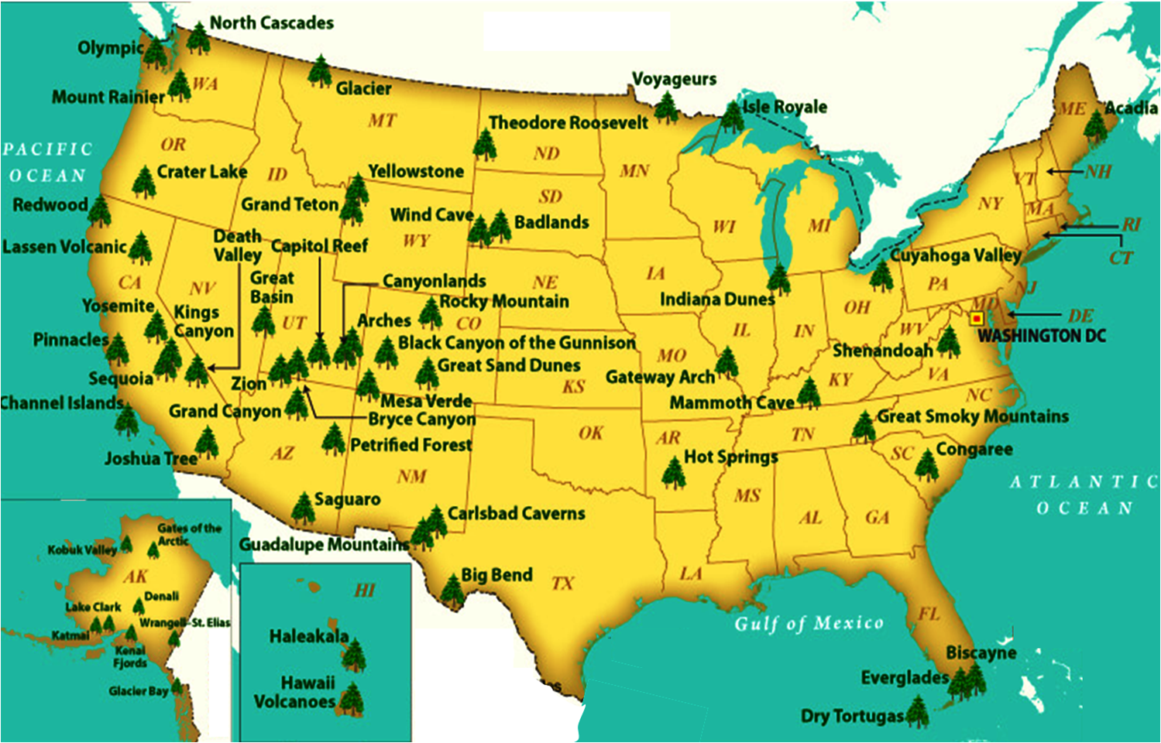
NATIONAL TREASURES
New River
White Sands
IN OUR NATURAL WONDERS

Slide 2
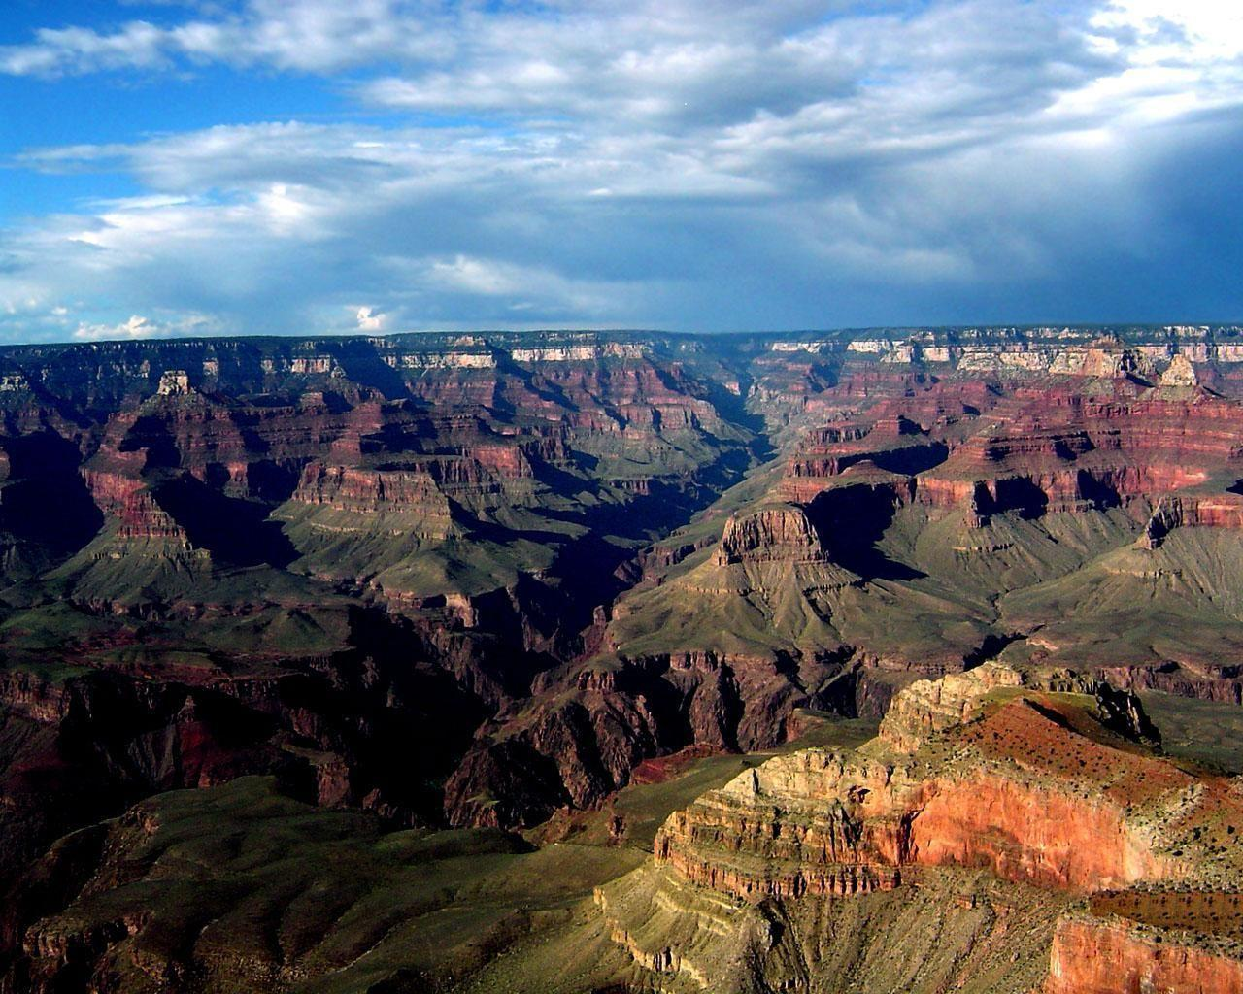
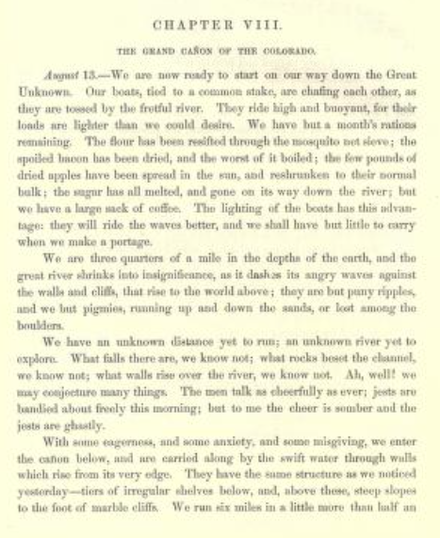
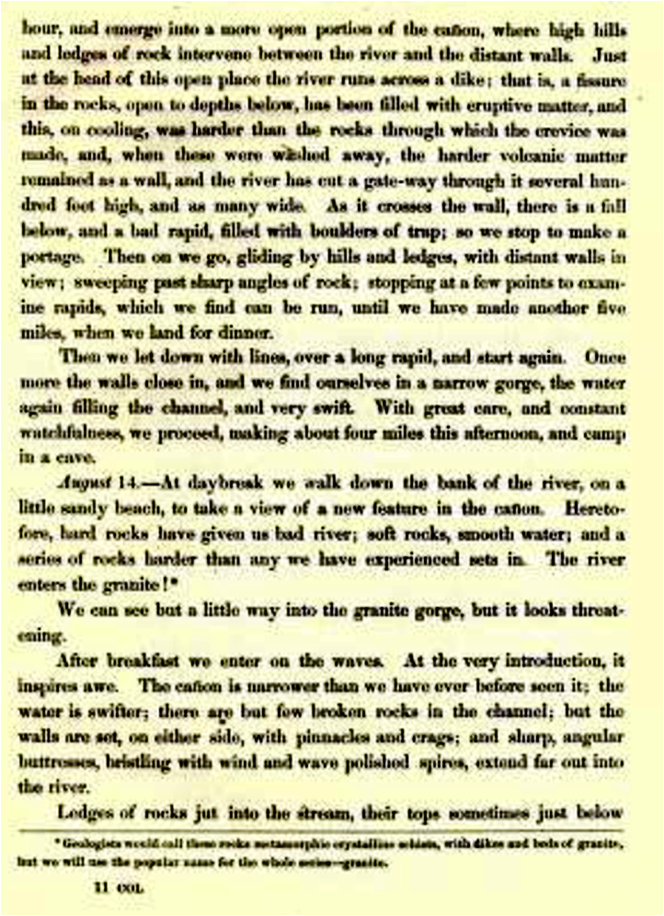
In 1869, a world-class explorer enters the spectacular and dangerous chute of the Grand Canyon, sight unseen. One of the first
Euro-Americans ever to lay eyes on
this massive canyon. . . until now!
From the journal of JOHN WESLEY POWELL
here’s how his Canyon adventure starts . . .
The
Grand
Canyon
Chapter viii
THE Grand Canyon of the Colorado
August 13 - We are now ready to start on our way down the Great Unknown. Our boats . . . ride high and buoyant, for their loads are lighter than we could desire. We have but a month’s rations remaining. The flour has been re-sifted through the mosquito net; the spoiled bacon has been dried, and the worst of it boiled; the few pounds of dried apples have been spread in the sun, and re-shrunken to their normal bulk; the sugar has all melted, and gone on its way down the river; but we have a large sack of coffee. The lighting of the boats has this advantage: they will ride the waves better, and we shall have but little to carry when we make a portage.
We are three quarters of a mile in the depths of the earth, and the great river shrinks into insignificance, as it clashes its angry waves against the walls and cliffs, that rise to the world above; they are but puny ripples, and we but pigmies, running up and down the sands, or lost among the boulders.
We have an unknown distance yet to run; an unknown river yet to explore. What falls there are, we know not; what rocks beset the channel, we know not; what walls rise over the river, we know not. Ah, well! . . .
With some eagerness, and some anxiety, and some misgiving, we enter the canyon below, and are carried along by the swift water through walls which rise to its very edge. They have the same structure as we noticed yesterday - tiers of irregular shelves below, and above these, steep slopes to the foot of marble cliffs. We run six miles in a little more than half an hour, and emerge into a more open portion of the canyon, where high hills and ledges of rock intervene between the river and the distant walls.
. . . Then on we go, gliding by the hills and ledges, with distant walls in view; sweeping past sharp angles of rock; stopping at a few points to examine rapids, which we find can be run, until we have made another five miles, when we land for dinner.
Then we let down [our boats] with lines, over a long rapids, and start again. Once more the walls close in, and we find ourselves in a narrow gorge, the water again filling the channel, and very swift. With great care, and constant watchfulness, we proceed, making about four miles this afternoon, and camp in a cave.
August 14. . . The River enters the granite! We can see but a little way into the granite gorge, but it looks threatening.
After breakfast we enter the waves. At the very introduction, it inspires awe! The canyon is narrower than we have ever before seen it; the water is swifter, there are but few broken rocks in the channel; but the walls are set, on either side, with pinnacles and crags; and sharp, angular buttresses, bristling with wind and wave polished spires, extend far out into the river.
Ledges of rocks jut into the stream, their tops sometimes just below the surface, sometimes rising few or many feet above; and island ledges, and island pinnacles, and island towers break the swift course of the stream into chutes, and eddies, and whirlpools. We soon reach a place where a creek comes in from the left, and just below, the channel is choked with boulders, which have washed down this lateral canyon forming a dam, over which there is a fall of thirty or forty feet; but on the boulders we can get foot-hold, and we make portage.
Three more such dams are found; over one we make portage; at the other two we find chutes, through which we can run.
As we proceed, the granite rises higher, until nearly a thousand feet of the lower part of the walls are composed of this rock.
About eleven o’clock we hear a great roar ahead, and approach it very cautiously. The sound grows louder and louder as we run, and at last we find ourselves above a long, broken fall, with ledges and pinnacles of rock obstructing the river. There is a descent of, perhaps, seventy or eighty feet in a third of a mile and the rushing waters break into great waves on the rocks, and lash themselves into a mad, white foam.

Slide 3
The Colorado Plateau
NATIONAL TREASURES
Week 1 – Setting the Stage
Week 2 – Escalante & 3 Archaeologic Sites
Week 3 – Arches &
Canyonlands
Week 4 – Bryce Canyon
& Zion
Week 5 – Grand Canyon
Week 6 – Future of the Plateau
New River
White Sands
IN OUR NATURAL WONDERS

Slide 4
GRAND CANYON PHYSIOGRAPHIC PROVINCE
TODAY’S TOPICS
Week 4 geology
New geology
Hot Spot & Volcanics
Nonconformity
Plate Tectonic ?
Plateau Edge-Basin & Range Faulting
Depositional states
Park area overview
Size
Regions
Highlights
Park History
John W. Powell
INTRO
OVERVIEW
of the Grand Canyon
FORMATION of the Grand Canyon
Geology studied
New geology
Size / Early Visitors
John Wesley Powell
History / Mining
Weather/Air Quality
Fauna / Flora
Waterfalls/Rapids
Deaths/Architecture
Elevation Profile
Rock Layers
Stratigraphy
Uplift
Age of Canyon
Formation Theory
Photos

Slide 5
Earth’s
Make-up
Supercontinents
Formation/Breakup
Plate
Movements
Micro-continents &
Exotic Terranes
Geologic
Timescale
Cratonic
Development
Orogenies
Plate
Tectonics
Orientation
Other
Rock
Deformation
Components
Of Geologic
Study
Geologic
Structures
Rocks
Earth’s
Storybook
Rock Cycle
Sedimentary
Sequences
Rock Types
General
Surface
Processes
Radical
Surface
Processes
Fossil Record
Unconformities
Weathering
Earthquakes
Rift Zones
Water
Erosion
Evaporation
Volcanoes
Ice
Hot Spots
Deposition:
Geosynclines
Wind
Basalt Floods

Slide 6
NEW GEOLOGY TOPICS
Added tools from Structural Geology
The different types of Volcanoes
Putting Geologic Time in perspective

Slide 7
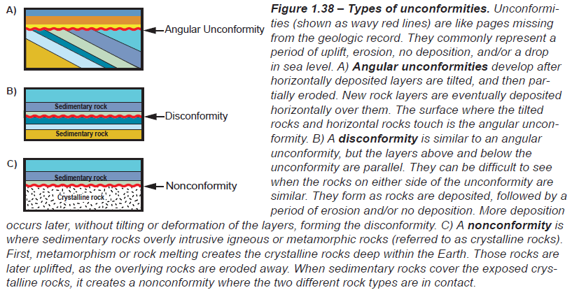
STRUCTURAL GEOLOGY - UNCONFORMITIES
What’s an UNCONFORMITY?
“A buried surface (erosional or non-depositional) separating two rock strata of different ages, indicating that sediment deposition was not continuous” (layer(s) missing!)
Like the missing pages from the geologic record book; a break in the
3 TYPES OF UNCONFORMITY
1
2
1
Angular Unconformity:
Contact point between horizontally deposited layers, tilted, &younger layers deposited on top with missing deposits in between
Disconformity:
Contact point between horizontally deposited old and young layers with missing deposits in between
Nonconformity:
Contact point between horizontal layers deposited over igneous or metamorphic rocks with missing deposits in between
3
1
2
3
2
3
10 9 8 7 6 5
5
5
6
7

Slide 8
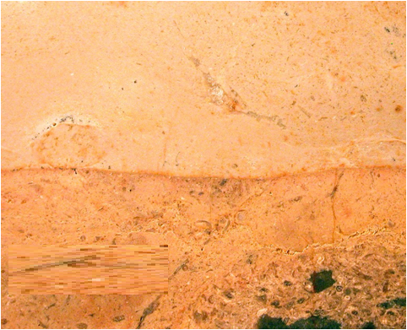
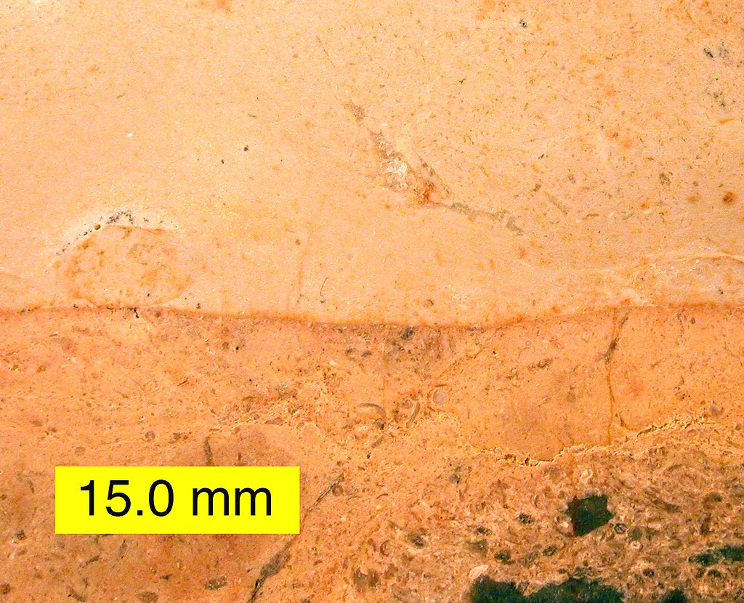
An example of an unconformity IN TX
134 Ma Edwards Limestone
299 Ma Limestone
165 million years are missing!
WHAT KIND OF UNCONFORMITY IS THIS?
Disconformity with the Lower Cretaceous Edwards Formation overlying a Lower Permian limestone; hiatus is about 165 million years; Texas.
A DISCONFORMITY!
Notes:
Unconformity
From Wikipedia, the free encyclopedia
Jump to navigationJump to search
Hutton's Unconformity at Jedburgh, Scotland, illustrated by John Clerk in 1787 and photographed in 2003.
An unconformity is a buried erosional or non-depositional surface separating two rock masses or strata of different ages, indicating that sediment deposition was not continuous. In general, the older layer was exposed to erosion for an interval of time before deposition of the younger layer, but the term is used to describe any break in the sedimentary geologic record. The significance of angular unconformity (see below) was shown by James Hutton, who found examples of Hutton's Unconformity at Jedburgh in 1787 and at Siccar Point in 1788.^{[1][2]}
The rocks above an unconformity are younger than the rocks beneath (unless the sequence has been overturned). An unconformity represents time during which no sediments were preserved in a region or were subsequently eroded before the next deposition. The local record for that time interval is missing and geologists must use other clues to discover that part of the geologic history of that area. The interval of geologic time not represented is called a hiatus. It is a kind of relative dating.
Contents
Types[edit]
Disconformity[edit]
Disconformity
A disconformity is an unconformity between parallel layers of sedimentary rocks which represents a period of erosion or non-deposition.^{[3]} Disconformities are marked by features of subaerial erosion. This type of erosion can leave channels and paleosols in the rock record.^{[4]}
Nonconformity[edit]
Nonconformity
A nonconformity exists between sedimentary rocks and metamorphic or igneous rocks when the sedimentary rock lies above and was deposited on the pre-existing and eroded metamorphic or igneous rock. Namely, if the rock below the break is igneous or has lost its bedding due to metamorphism, the plane of juncture is a nonconformity.^{[5]}
Angular unconformity[edit]
Angular unconformity
An angular unconformity is an unconformity where horizontally parallel strata of sedimentary rock are deposited on tilted and eroded layers, producing an angular discordance with the overlying horizontal layers. The whole sequence may later be deformed and tilted by further orogenic activity. A typical case history is presented by the paleotectonic evolution of the Briançonnais realm (Swiss and French Prealps) during the Jurassic.^{[6][7]}
Paraconformity[edit]
Paraconformity
A paraconformity is a type of unconformity in which the sedimentary layers above and below the unconformity are parallel, but there is no obvious erosional break between them. A break in sedimentation is indicated, for example, by fossil evidence. It is also called nondepositional unconformity or pseudoconformity.^{[8][9]} Short paraconformities are called diastems.
Buttress unconformity[edit]
A buttress unconformity also known as onlap unconformity, occurs when younger bedding is deposited against older strata thus influencing its bedding structure.^{[10]}
Blended unconformity[edit]
A blended unconformity is a type of disconformity or nonconformity with no distinct separation plane or contact, sometimes consisting of soils, paleosols, or beds of pebbles derived from the underlying rock.^{[11]}

Slide 9
An example of an unconformity IN TX

Slide 10
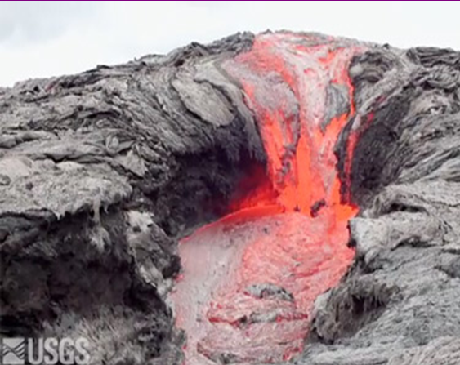
VOLCANOES
“A volcano is an opening, or rupture, in a planet's surface or crust, which allows hot magma, volcanic ash and gases to escape from below the surface”

Slide 11
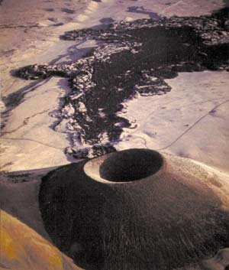
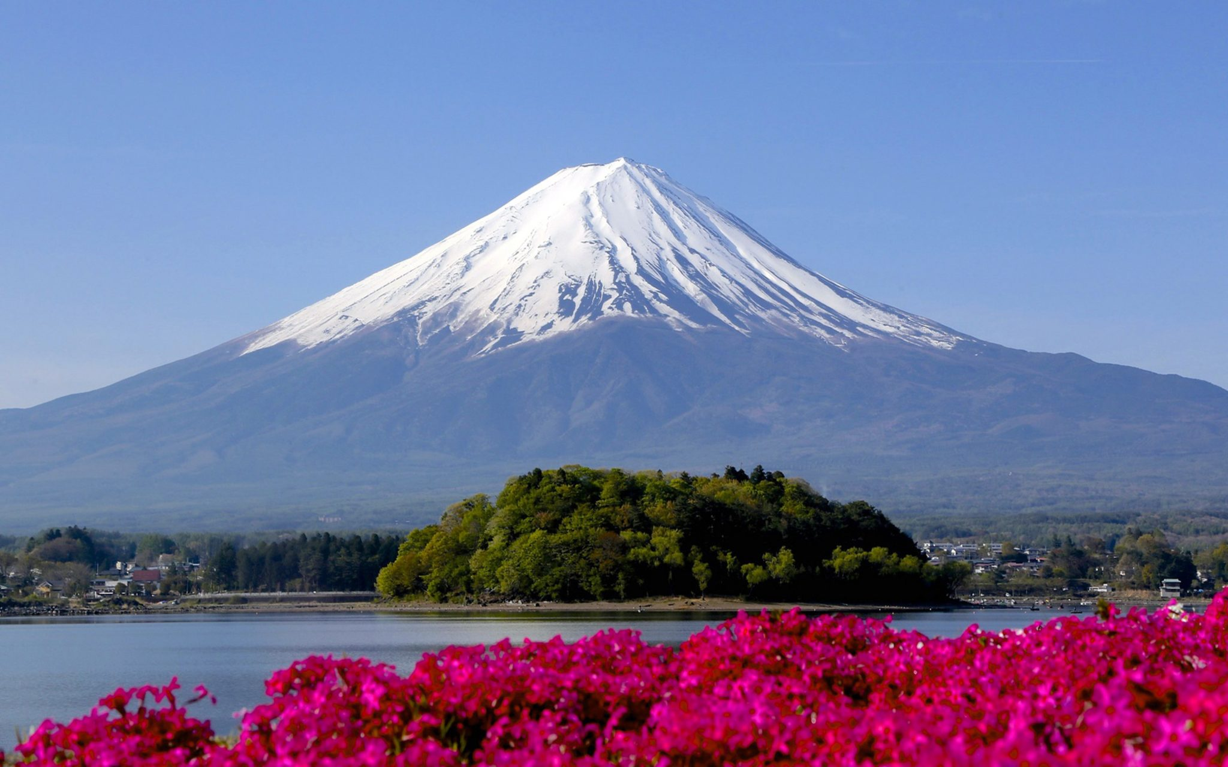
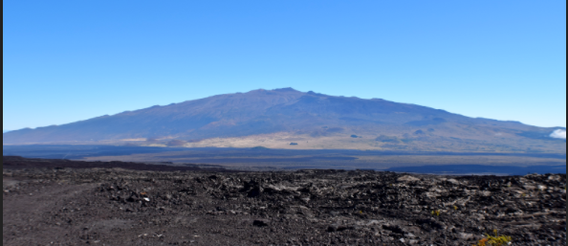
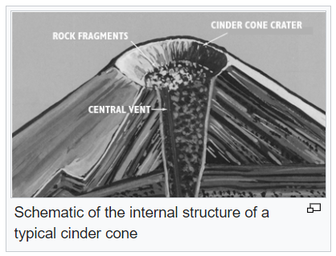
VOLCANOES
3 TYPES OF VOLCANIC
STRUCTURES
Mount Fuji, Japanese Fuji-san
12,388 feet
60 mi from Tokyo
Stratovolcano
Shield Volcano
Cinder Cones
Tall, conical volcano built up by many layers (strata) of thick, hardened, viscous lavas and other volcanic debris
Sometimes called “Composite” volcanoes
Very explosive
Ex: Mt. Fuji, Krakatoa, Mt. Vesuvius
Resembling a warrior's shield (wide, low profile)
Low viscosity magma that flows long distances
Known for erupting for decades/centuries or longer
Is much wider than tall
Ex: Mauna Loa
a steep conical hill of loose pyroclastic fragments, such as volcanic clinkers, volcanic ash, or cinder that has been built around a volcanic vent
Cinder cones are also commonly found on the flanks of shield volcanoes, & stratovolcanoes
Ex: Paricutin (Mexixo)
http://www.wikipedia.org/Types of volcanic eruptions - Wikipedia, the free encyclopedia.mht
Notes:
A stratovolcano, also known as a composite volcano,^{[1]} is a tall, conical volcano built up by many layers (strata) of hardened lava, tephra, pumice, and volcanic ash. Unlike shield volcanoes, stratovolcanoes are characterized by a steep profile and periodic, explosive eruptions and quiet eruptions. The lava that flows from stratovolcanoes typically cools and hardens before spreading far due to high viscosity. The magma forming this lava is often felsic, having high-to-intermediate levels of silica (as in rhyolite, dacite, or andesite), with lesser amounts of less-viscous mafic magma. Extensive felsic lava flows are uncommon, but have travelled as far as 15 km (9.3 mi).^{[2]}
Stratovolcanoes are sometimes called "composite volcanoes" because of their composite layered structure built up from sequential outpourings of eruptive materials. They are among the most common types of volcanoes, in contrast to the less common shield volcanoes. Two famous stratovolcanoes are Krakatoa, best known for its catastrophic eruption in 1883 and Vesuvius, famous for its destruction of the towns Pompeii and Herculaneum in 79 A.D.
Stratovolcanoes are common at subduction zones, forming chains along plate tectonic boundaries where oceanic crust is drawn under continental crust (Continental Arc Volcanism, e.g. Cascade Range, central Andes) or another oceanic plate (Island arc Volcanism, e.g. Japan, Aleutian Islands). The magma that forms stratovolcanoes rises when water trapped both in hydrated minerals and in the porous basalt rock of the upper oceanic crust, is released into mantle rock of the asthenosphere above the sinking oceanic slab. The release of water from hydrated minerals is termed "dewatering," and occurs at specific pressures and temperatures for each mineral, as the plate descends to greater depths. The water freed from the rock lowers the melting point of the overlying mantle rock, which then undergoes partial melting and rises due to its lighter density relative to the surrounding mantle rock, and pools temporarily at the base of the lithosphere. The magma then rises through the crust, incorporating silica-rich crustal rock, leading to a final intermediate composition (see Classification of igneous rock). When the magma nears the top surface, it pools in a magma chamber under or within the volcano. There, the relatively low pressure allows water and other volatiles (mainly CO₂, SO₂, Cl₂, and H₂O) dissolved in the magma to escape from solution, as occurs when a bottle of carbonated water is opened, releasing CO₂. Once a critical volume of magma and gas accumulates, the obstacle (mass blockage) of the volcanic cone is overcome, leading to a sudden explosive eruption
Cinder refers to the pyroclastic fragments, which is composed of rock. Cinder cones are also known as ash cones.
Cinder cones are the type of volcano that is formed by pyroclastic fragments like volcanic ashes, solidified lava pieces, volcanic clinkers, pumice and hot gases. These volcanoes are formed around the volcanic vent and are known to be the simplest form of a volcano. Cinder cones are formed when the gas-charged lava is blown with a great force into the air; it breaks into small fragments and solidifies. This solidified material builds up a circular or oval-shaped cone with a bowl-shaped crater at the top. They grow rapidly and in some cases it’s been recorded that cinder cones grow up 1,000 feet. Ash cones are found along the flanks of shield volcanoes, and the main reason for the formation of cinder cone volcanoes are the massive eruptions of mafic rock fragments and lava. Most of the cinder cones erupt only once and may form as flank vents on larger volcanoes or occur on their own.

Slide 12
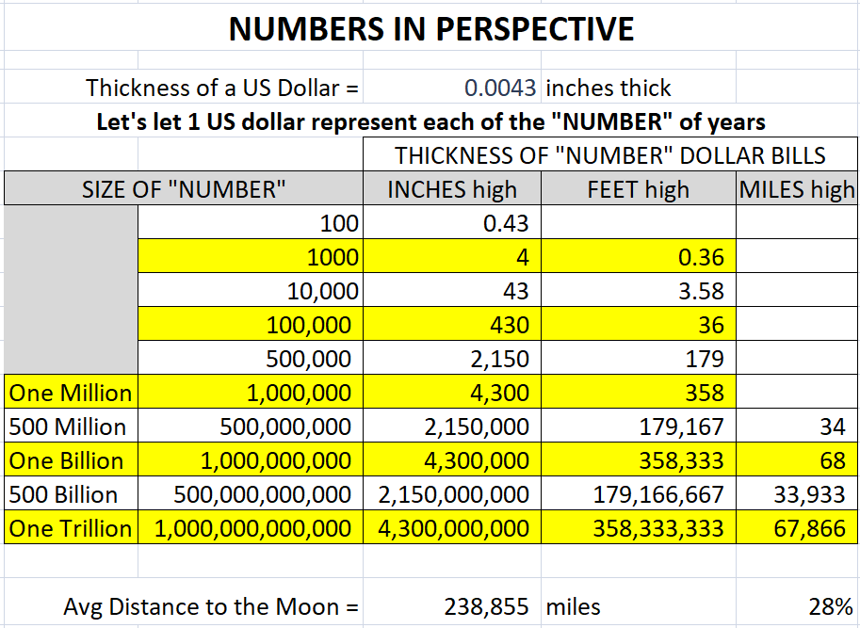
Geologic time in perspective
Notes:
68,000 miles is a little more than ¼ of the way to the moon (avg 252k miles)

Slide 13
PARK OVERVIEW

Slide 14
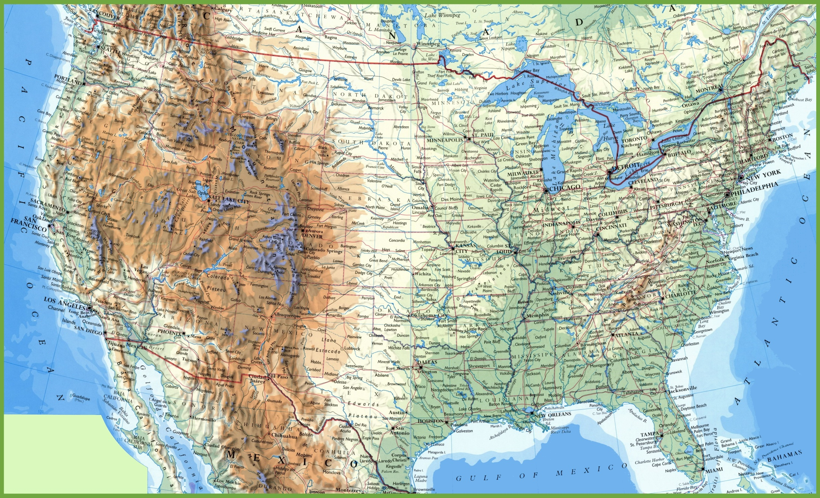
Location of National Parks for Today’s Discussion
UTAH
COLORADO
a
ARIZONA
NEW MEXICO

Slide 15
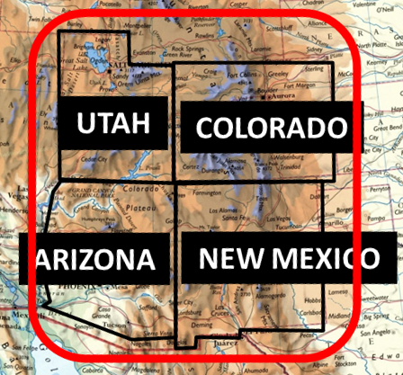
Location of National Parks for Today’s Discussion
UTAH
COLORADO
a
ARIZONA
NEW MEXICO

Slide 16
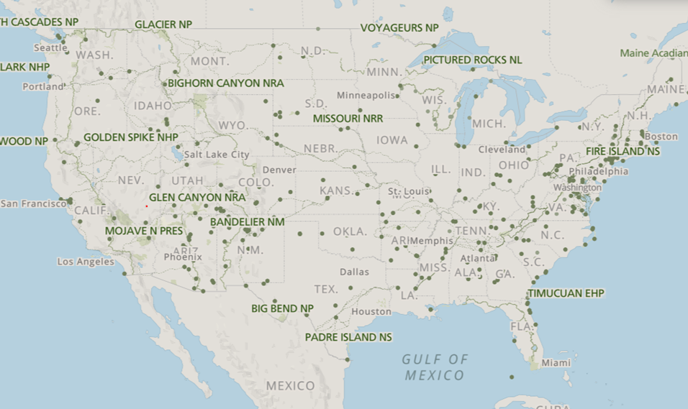
Colorado Plateau Province
Location of National Parks for Today’s Discussion
UTAH
COLORADO
a
ARIZONA
NEW MEXICO

Slide 17
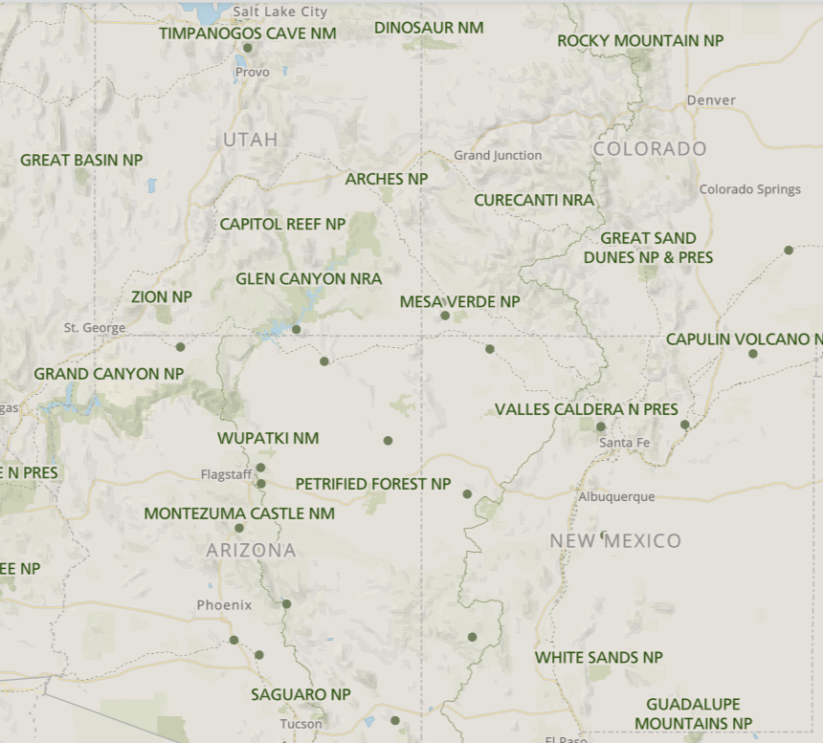
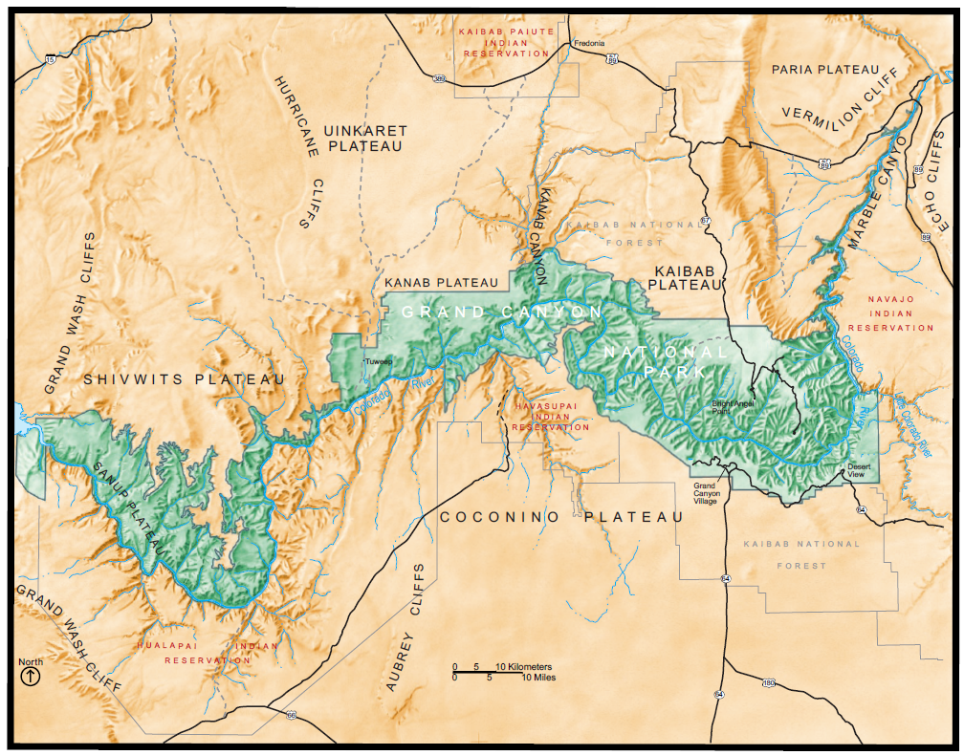
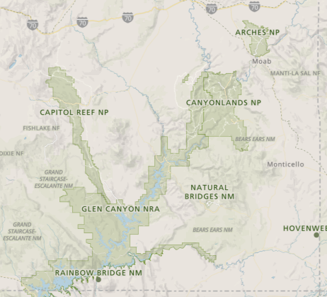
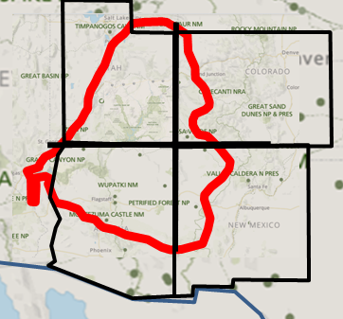
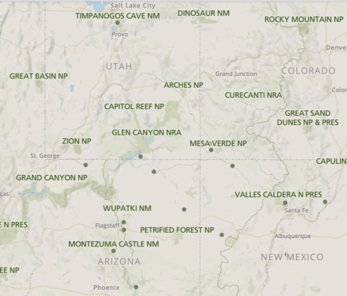
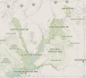
Colorado Plateau Province
Location of National Parks for Today’s Discussion
UTAH
COLORADO
a
ARIZONA
NEW MEXICO

Slide 18
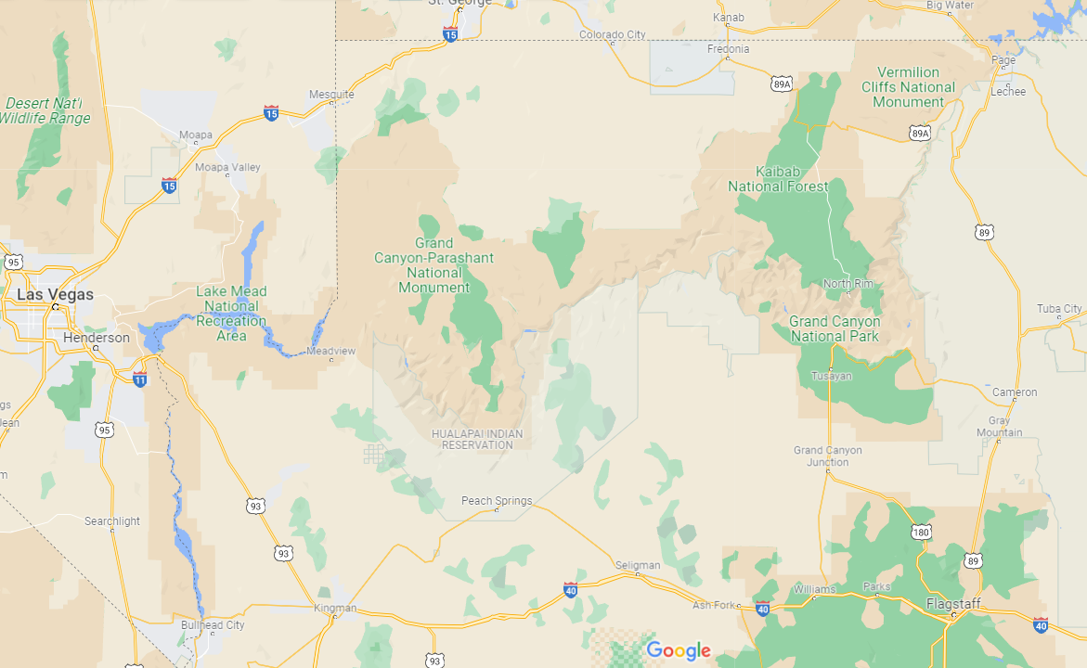
Grand canyon national park overview
From Bryce Canyon & Zion via 89
4 SECTIONS OF THE PARK
From Page, AZ via 89
To North Rim on 89A, then 67
From B.C. or Zion
To N. Rim
Colorado River
To S. Rim
Havasu Falls
North
Rim
a
From Las Vegas via 93 to Kingmen, then either Route 66 or I-40 east then 64 to South Rim
South
Rim
From Cameron via 64
From Flagstaff or Phoenix via 180 then
To South Rim on 64
West
Little Colorado River
From N
Flagstaff, Phoenix
Las Vegas

Slide 19
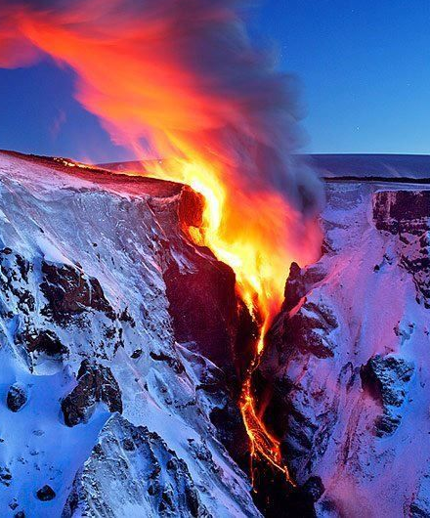
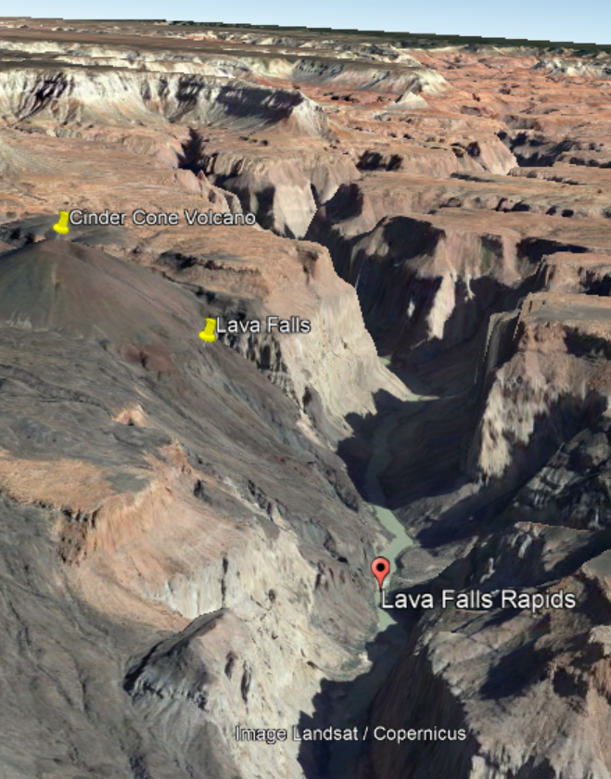
Grand canyon national park overview
Paria
Uinkaret
Let’s look at some physical features of this map
Kaibab
Kanab
Havasu Falls
Shivwits
North
Rim
a
Cinder Cone Volcano & Lava Falls
South
Rim
West
Coconino

Slide 20
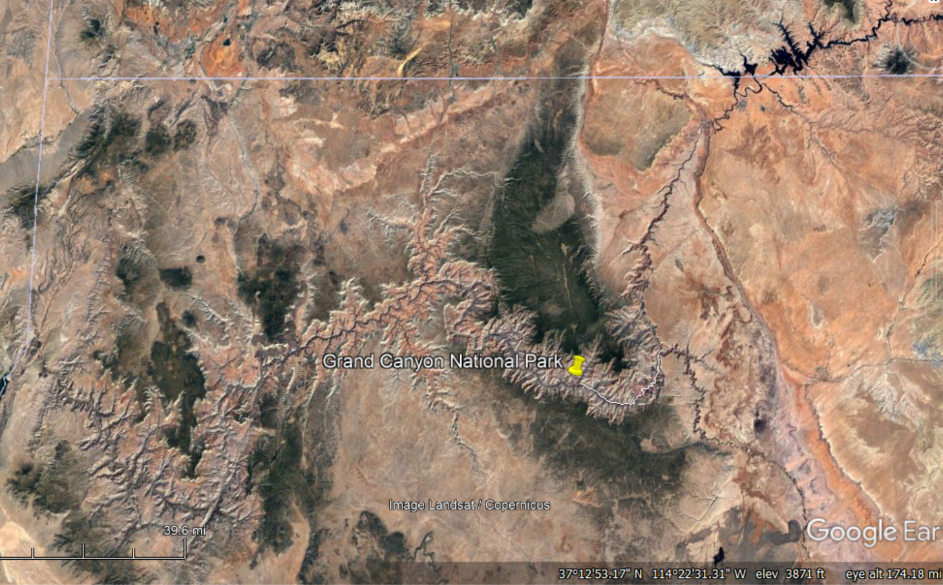
PLATEAUS OF THE REGION

Slide 21
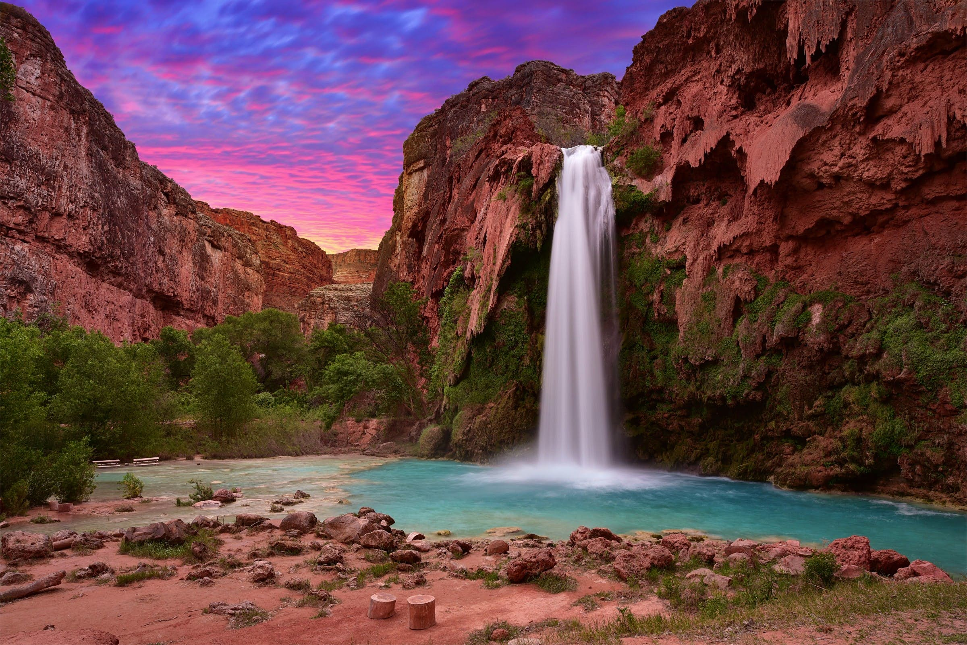
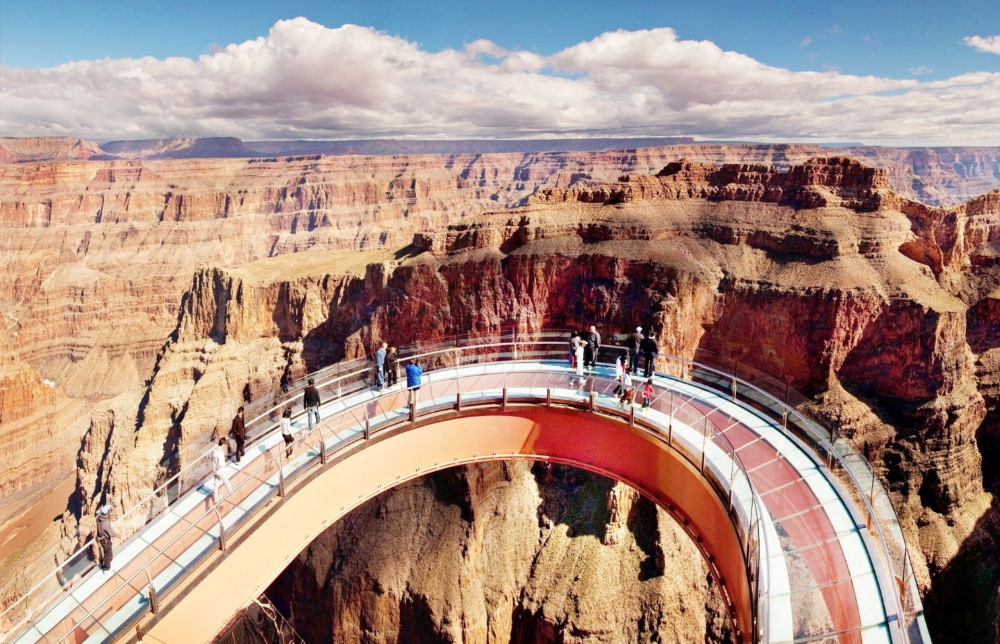
Grand canyon national park overview
ANOTHER IMPORTANT SECTION - NATIVE AMERICAN NATIONS -
Navajo Nation
a
Havasupai Nation
“All Havasupai tourism has reopened! Will honor 2020 & 2021 reservations first
Hualapai Nation
Notes:
2023 – Havasu Falls, the famous waterfall found in the red rock canyon near Supai, Arizona, is reopening after being off-limits to the public for nearly three years. Found in a remote part of the Havasupai Indian Reservation, the cascade, which requires a special permit issued by the tribe to see, was initially closed due to the pandemic.
“With limited access to meaningful healthcare, closing the reservation was the best way to keep our community safe and healthy,” wrote the tribe on its website. The reservation remained shut to travelers in 2022 due to flooding that wiped out some of the trails and bridges used to access the falls.
But now the natural wonder is welcoming visitors again—with some stipulations.
While reservations have long been challenging, getting to the ethereal falls isn’t easy either. AllTrails, a trail guide and maps website, ranks the trek as “challenging.” The out-and-back trail is 24.5 miles round trip. It starts at Hualapai Hilltop on the rim of the Grand Canyon and requires hiking down into the canyon and back up (which sees more than 3,000 feet of elevation gain).
“Make sure you are fit, athletic, well hydrated, and prepared for a difficult desert hike,” the National Park Service says on its website. It adds that temperatures in the summer regularly reach 100 degrees Fahrenheit, so hikers should have a gallon of water with them, at minimum. If temperatures exceed 115 degrees Fahrenheit, the trails are closed.
Because hiking at night isn’t permitted, visitors must book a stay at the campground or the Havasupai Lodge.

Slide 22
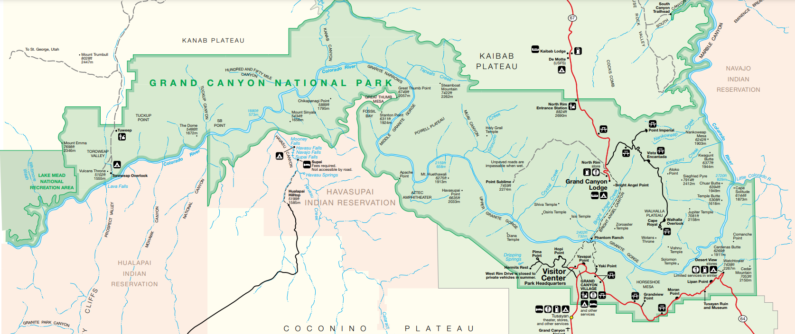
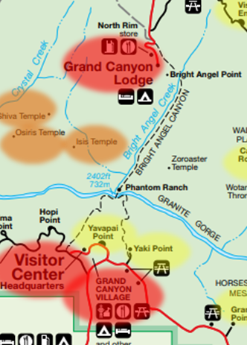
Grand canyon national park overview
Visitor Center, Lodge, Entry
½ mi from River Crossing
Visitor Overlook
Hiker Overlook
Geologic Highlight

Slide 23
Grand canyon national park overview
The Grand Canyon is
277 mi long
Up to 18 mi wide
6,093 ft deep
Nearly two billion years of Earth's geological history exposed by down-cutting of the Colorado River
SIZE/AGE/
1ST PEOPLE
a
Currently accepted hypothesis is that the Colorado River established its course through the area about 5 to 6 mya
Native Americans inhabited area for thousands of years. Researchers have believed that the Ancestral Puebloans are ancestors of the modern Pueblo peoples

Slide 24
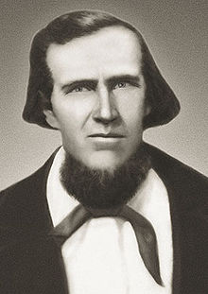
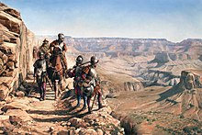
Grand canyon national park overview
1540 - First Europeans saw the Canyon; Coronado Expedition
No Europeans visited canyon again for more than 200 yrs
1776 -Two Spaniards traveled along north rim in search of a route from Santa Fe to CA
EARLY VISITORS
1826 – James Pattie, with group of trappers and mountain men, were probably next European to reach Canyon
1850s – Jacob Hamblin, a Mormon missionary, was sent by Brigham Young to locate suitable river crossing sites in the Canyon (One site becomes Lee’s Ferry of today)
Notes:
Jacob Hamblin (April 6, 1819 – August 31, 1886) was a Western pioneer, a Mormon missionary for The Church of Jesus Christ of Latter-day Saints, and a diplomat to various Native American tribes of the Southwest and Great Basin. He aided European-American settlement of large areas of southern Utah and northern Arizona, where he was seen as an honest broker between Latter-day Saint settlers and the Natives. He is sometimes referred to as the "Buckskin Apostle," or the "Apostle to the Lamanites."^{[1]} In 1958, he was inducted into the Hall of Great Westerners of the National Cowboy & Western Heritage Museum
Hamblin was born in Salem, Ohio, to a family of farmers. He grew up learning farming. He was baptized a member of The Church of Jesus Christ of Latter Day Saints on March 3, 1842, at the age of 22

Slide 25
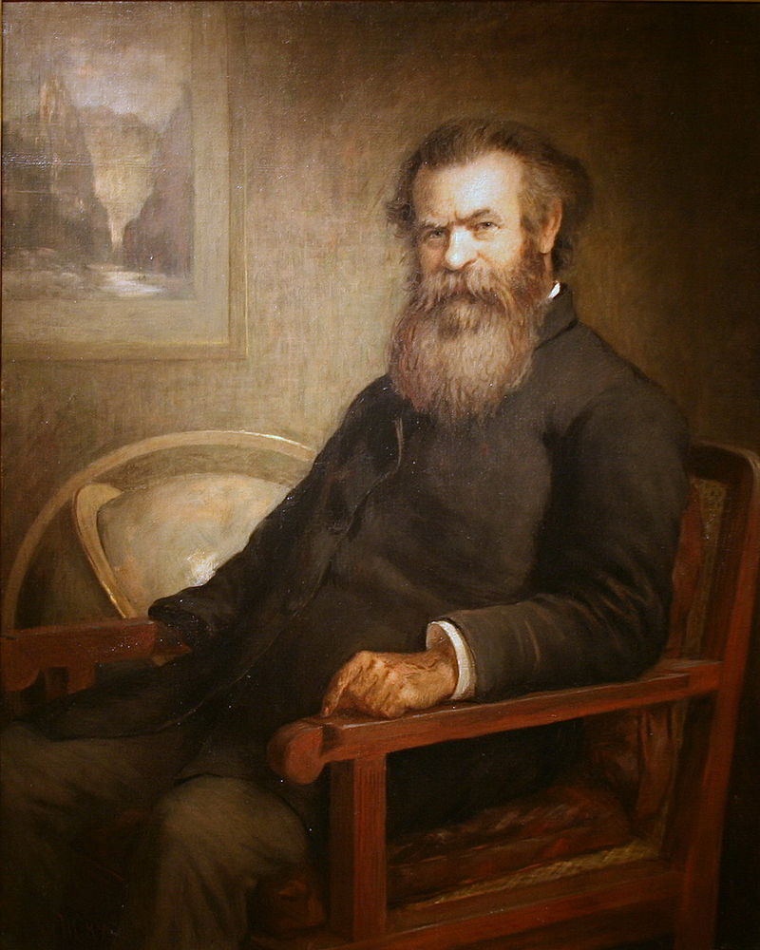
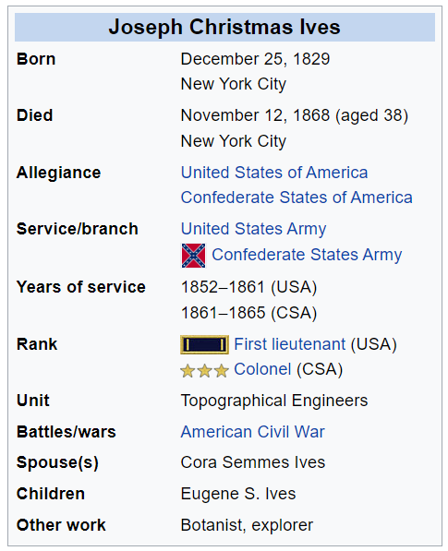
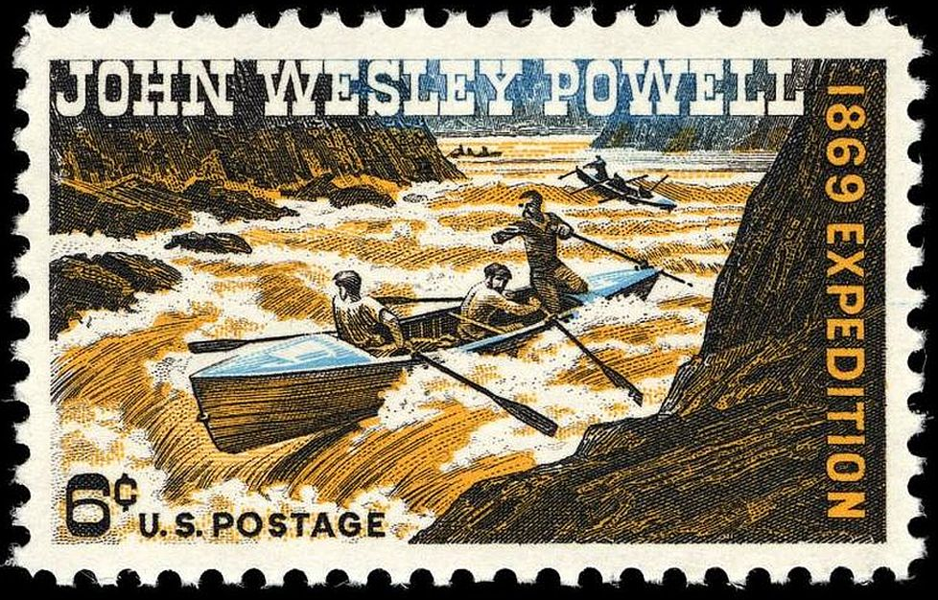
Grand canyon national park overview
1857 - Lieutenant Joseph Ives leads an expedition to assess the feasibility of an up-river navigation from the Gulf of California
Ives party may have been the first Europeans who traveled eastwards along the south
EARLY VISITORS
rim. In 1861 he publishes a report to the Senate on the "Colorado River of the West“
1869, Major John Wesley Powell led the first government sponsored expedition down the Colorado River and through the Grand Canyon; writes a book about adventure
Who was this
Major Powell?

Slide 26
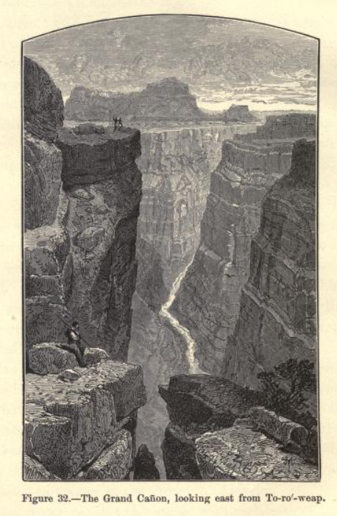
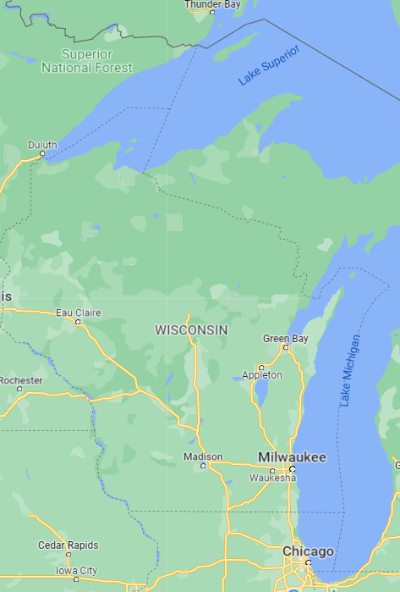
John wesley powell
Born in Mount Morris, New York in 1834; Died in 1902
Named after John Wesley, the founder of Methodism in America
Famous American geologist, U.S. Army soldier, explorer of American West & Professor at Illinois Wesleyan University
As a young man, he spent four months walking across Wisconsin

Slide 27
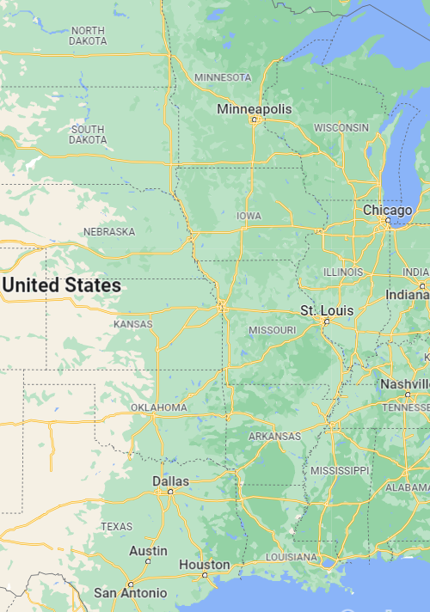
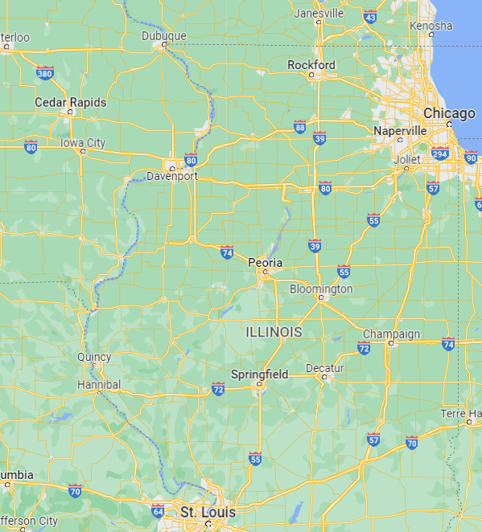
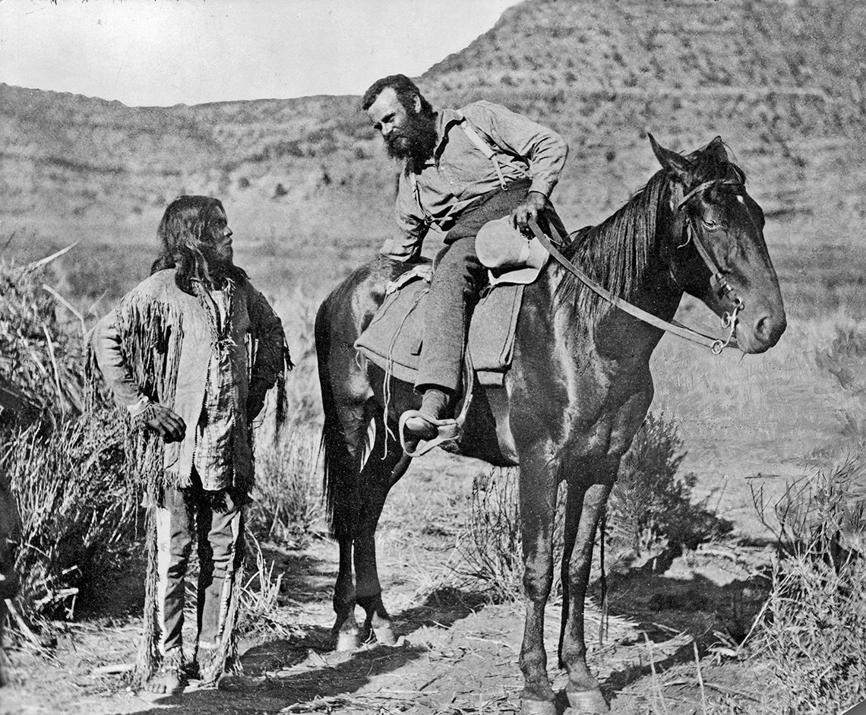
John wesley powell
1856- he rowed the Mississippi from Minnesota, to the sea
1857-he rowed down the Ohio River to MS River…then rowed up MS River to St. Louis
1858- he rowed down the IL River, then up MS & the Des Moines River to central IA
1862 – Major J.W. Powell lost his right arm in the Battle of Shiloh in the Civil War
In 1859, at age 25, he was elected to the Illinois Natural History Society.

Slide 28
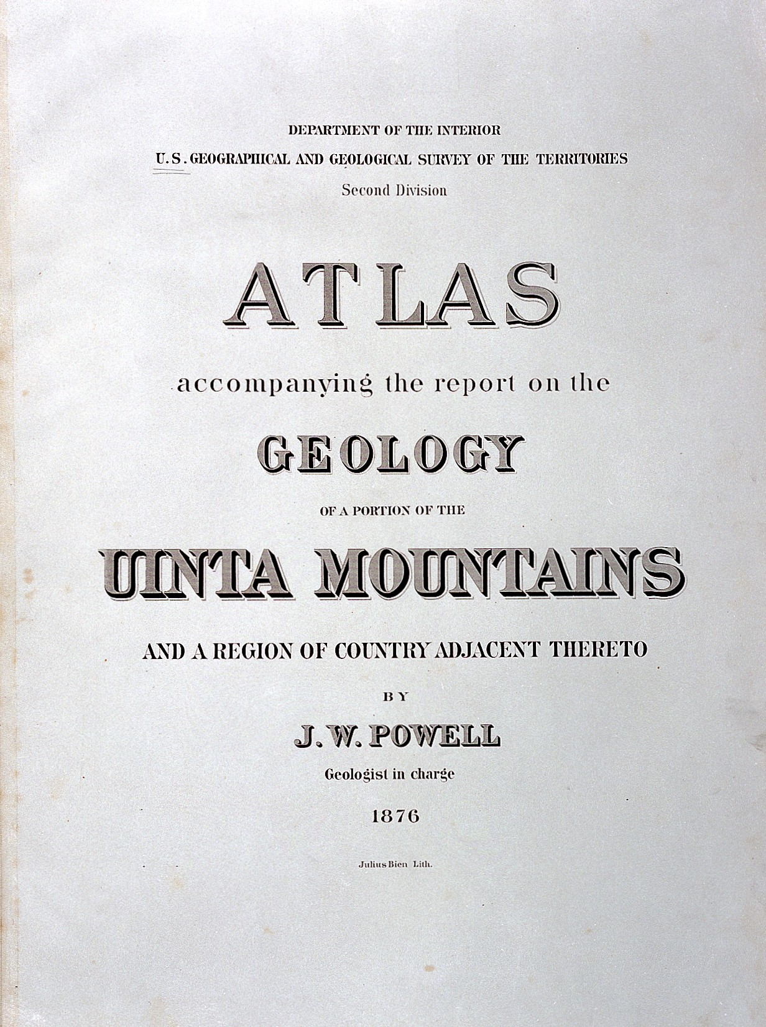
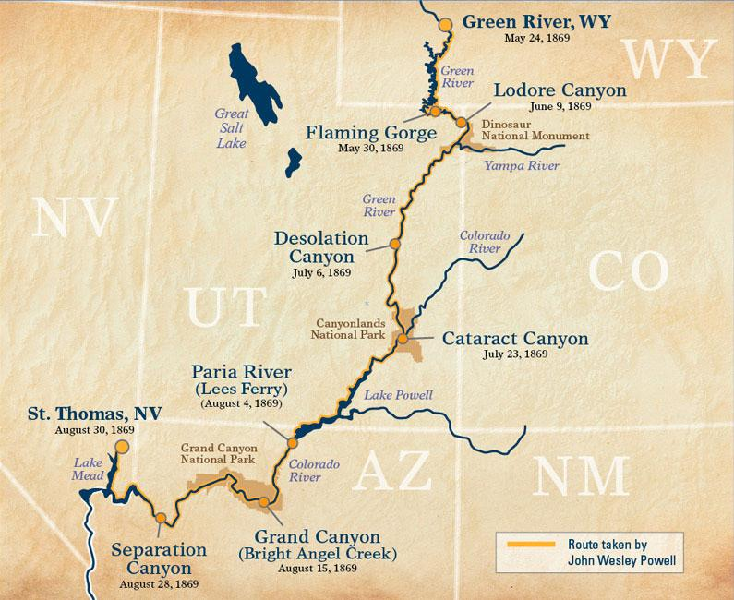
John wesley powell
Powell served as second director of the U.S. Geological Survey (1881–1894)
He became the first director of the Bureau of Ethnology at the Smithsonian Institution
Famous for his 1869 geographic expedition down the Colorado River through the Grand Canyon
Major Powell names the “Grand Canyon” (had been called the “Big Canyon”)
Here are some selected stories about his Grand Canyon Adventure…

Slide 29
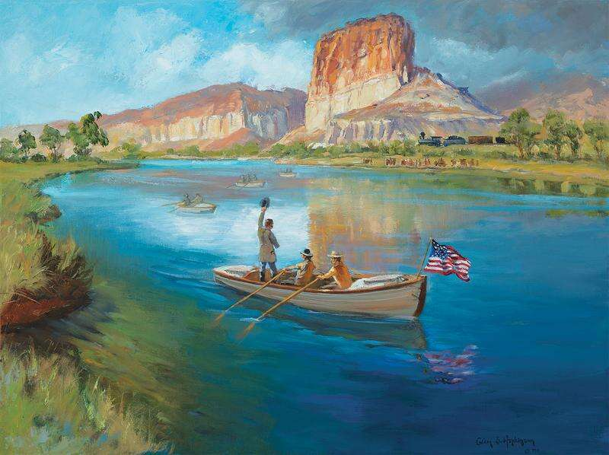
Powell’s expedition down the colorado
As soon as the Union Pacific transcontinental railroad was completed, Maj. John Wesley Powell was there at Green River, Wyoming, to off-load four wooden boats and begin his epic journey down the Green River to the Grand (now Colorado) River to make his way through the Grand Canyon. Today, a Wyoming state park includes Expedition Island, which commemorates other historic boat trips. Powell’s launch in May 24, 1869, was the first.

Slide 30
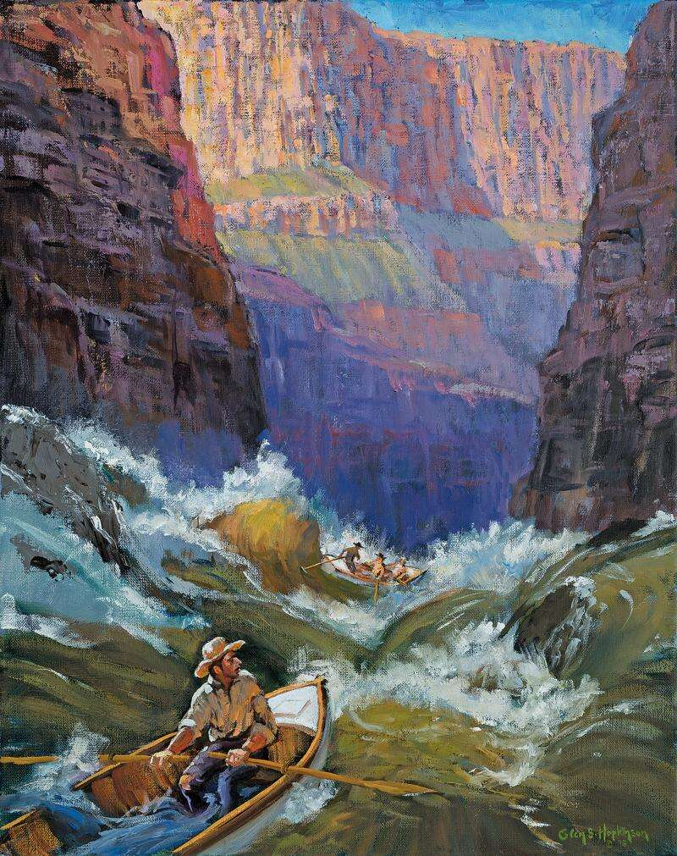
Powell’s expedition down the colorado
In Powell’s time, the Grand Canyon began at the confluence of the Grand (now the Colorado) River with Little Colorado River. In his most famous lines from his book, he wrote that at that location on Aug. 13, 1869, “We are now ready to start our way down the Great Unknown ... we have an unknown distance yet to run, an unknown river to explore. What falls there are, we know not. What rocks beset the channel, we know not ...”

Slide 31
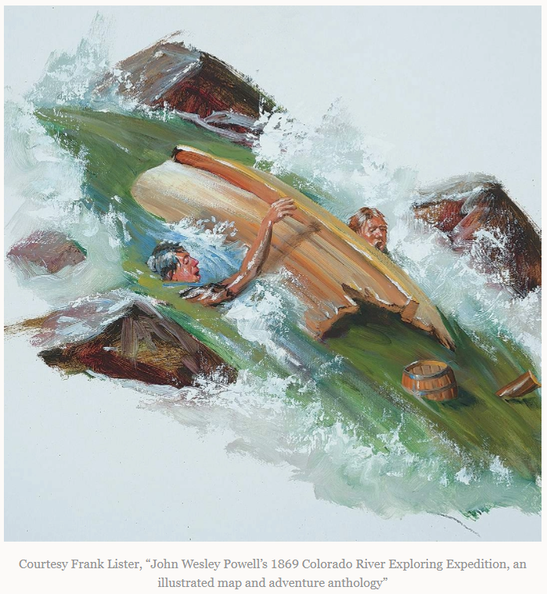
Powell’s expedition down the colorado
And so, 21 feet of oak dropped into the first rapid, lined up to perfection for the first boulder. Bow to the bull’s eye, the three men soared into the air before their baptism in cataclysmal froth. Somehow, they managed to swim back to the skiff before it rushed downstream for the next boulder. This time it swung broadside with a death wish, and with impeccable aim the rock snapped the boat “quite in two” as Powell put it.
Powell wrote, “We are as glad to shake hands with them as though they had been on a voyage around the world, and wrecked on a distant coast.”
However Powell’s relief wouldn’t last long. In the No-Name was a third of the 10-month food supply, the three men’s additional belongings, a few guns, and most importantly— the barometers. Without these instruments, the expedition had lost its entire purpose to map The Great Unknown.

Slide 32
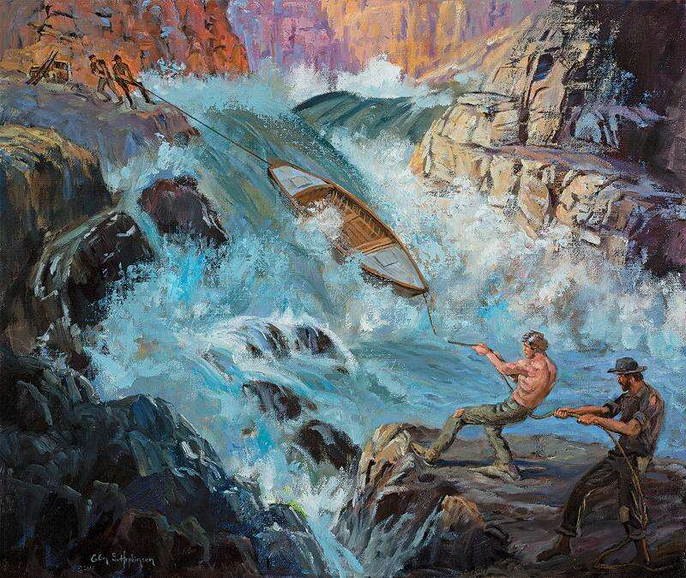
Powell’s expedition down the colorado
Early in their expedition, John Wesley Powell’s men smashed one of their four wooden boats at Disaster Falls in Colorado’s “Canyon of Lodore”. With only three boats left, Powell was forced to take precautions. In the subsequent days and months, he had his men do the backbreaking work of unloading their hundreds of pounds of supplies, portaging the supplies around rapids, and then lining the empty boats through the most difficult rapids

Slide 33
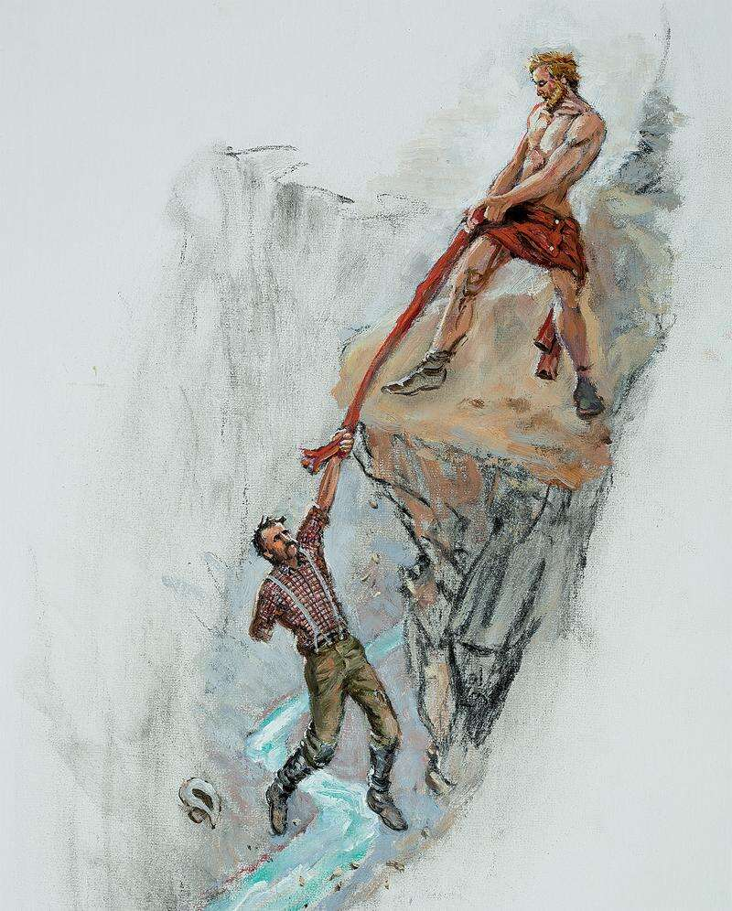
Powell’s expedition down the colorado
A dramatic scene in Powell’s account of his trip through the Grand Canyon was when he was stuck on a cliff face. He was hiking with another boatman but they had forgotten to bring rope. The boatman above him took off his clothes and used his long johns as a makeshift rope & lowered them down. Powell leaned back with his only arm and grabbed the dangling long johns. He wrote, “and thus I am saved”
BACK TO THE PARK OVERVIEW

Slide 34
Grand canyon national park overview
1893 – the Grand Canyon was designated a Forest Reserve
1906 -The Grand Canyon was designated a Game Preserve
1908 - It was designated a National Monument
(Measures to protect Grand
WHEN CREATED
a
Canyon for future generations took a lengthy and crooked course, allowing alert individuals plenty time to establish private land claims before 1908)
1919 - The Grand Canyon was finally established as America’s 17th National Park

Slide 35
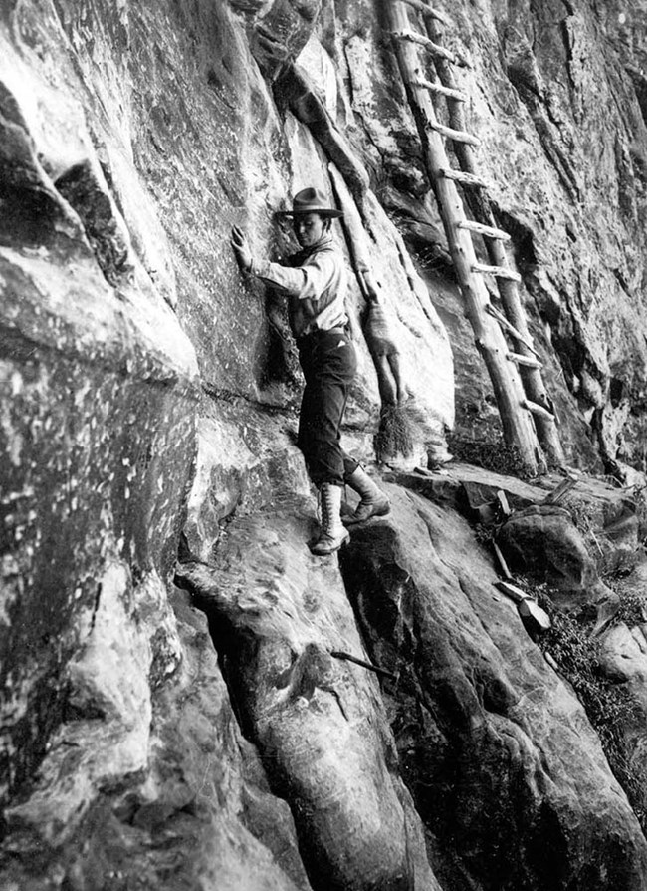
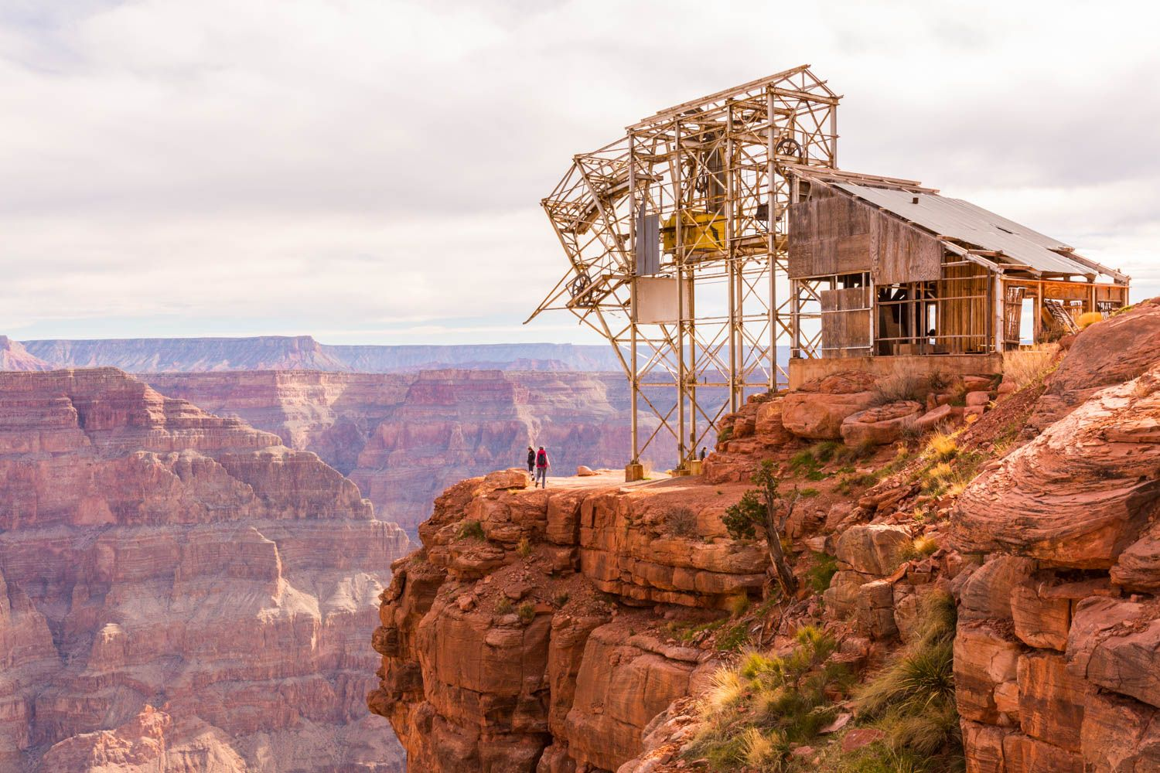
Grand canyon national park overview
Historically, copper, silver, and uranium had been mined in the Grand Canyon
First registered mine in 1893 was the “Orphan Mine” (2 mi from today’s village). Entrance was 1,000 ft down the wall of the Canyon (led
MINING
to beginnings of Bright Angel Trail)
Bat Cave Mine was site of significant investment to extract guano commercially in the 1950s - but small volumes &low price made the project unsuccessful. An aerial ropeway was built to take the guano to the south rim from "Guano Point"

Slide 36
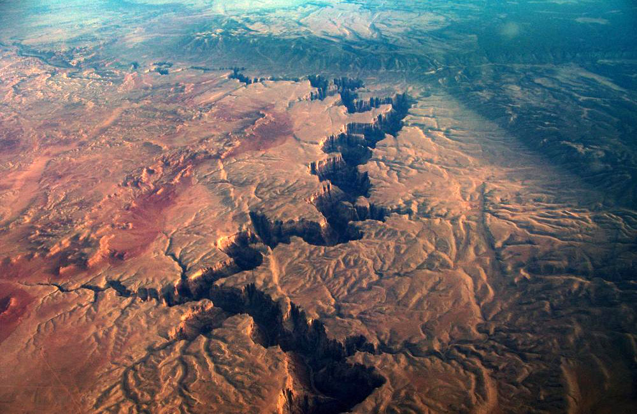
Grand canyon national park overview
Not the deepest canyon in the world but it is known for its visually overwhelming size and its intricate and colorful landscape
Geologically, it is significant because of the thick sequence of ancient
WHY IMPRESSIVE
a
rocks that are well preserved/exposed in walls of canyon
These rock layers record much of the early geologic history of the North American continent
Park is so large that it can be seen from space

Slide 37
Grand canyon national park overview
The North Rim is 1,000 ft higher than the South Rim
Rain/snow that falls on North Rim drains into the Canyon
Rain/snow that falls on South Rim drains away from the Canyon
North Rim is eroding away
NORTH VS SOUTH RIM
a
faster than the South Rim & South Rim tends to have steeper canyon walls
South Rim is usually open year long; North Rim is limited during winter season due to road closures

Slide 38
Grand canyon national park overview
Weather in the Canyon varies according to elevation
Forested rims receive winter snowfall; the inner gorge rarely does
Substantial precipitation occurs 2X annually; winter snowfall & summer monsoon
WEATHER;
AIR QUALITY
a
South Rim receives 16” & 60” snow; North Rim 27” & 144” snow; Phantom Ranch 8”,snow rarely
Temps in the inner gorge exceed 100ºF; rim winter minimums below 0ºF
Air Quality is some of the finest in the US…until it’s not!
Notes:
South Rim buildings
There are several historic buildings located along the South Rim with most in the vicinity of Grand Canyon Village.
Desert View Watchtower in 2004
Buckey O'Neill Cabin was built during the 1890s by William Owen "Buckey" O'Neill. He built the cabin because of a copper deposit that was nearby. He had several occupations such as miner, judge, politician, author and tour guide. This cabin is the longest continually standing structure on the South Rim. It is currently used as a guest house; booking is required well in advance.
Kolb Studio was built in 1904 by brothers Ellsworth and Emery Kolb. They were photographers who made a living by photographing visitors walking down the Bright Angel Trail. In 1911, the Kolb brothers filmed their journey down the Green and Colorado Rivers. Emery Kolb showed this movie regularly in his studio until 1976 when he died at the age of 95. Today the building serves as an art gallery and exhibit.
The El Tovar Hotel was built in 1905 and is the most luxurious lodging on the South Rim. The hotel consists of 4 stories with a rustic chalet appearance called "National Park Rustic." It was designed by Charles Whittlesley. A gift shop and restaurant are located inside the hotel.
Hopi House was built by Mary Jane Colter in 1905. It is based on structures that were built in an ancient Hopi settlement called Old Oraibi, located on the Third Mesa in eastern Arizona. It served as a residence for the Hopi Indians who sold arts and crafts to South Rim visitors.
Verkamp's Curios, which stands next to the Hopi House, was built by John Verkamp in 1905. He sold arts and crafts as well as souvenirs. Until September 2008, it was run by his descendants; in November 2008, the building reopened as a visitor center focusing on the history of the Grand Canyon Village community.
1923-built steam locomotive No. 4960 at the Grand Canyon Depot
Grand Canyon Railway Depot was completed in 1910 and contains 2 levels. Gordon Chappell, Regional Historian for the Park Service, claims that this depot building is one of only three log-cabin-style train stations currently standing, out of fourteen ever built in the U.S.^{[44]} The depot is the northern terminus of the Grand Canyon Railway which begins in Williams, Arizona.
Lookout Studio, another Mary Colter design, was built in 1914. Photography, artwork, books, souvenirs, and rock and fossil specimens are sold here. A great view of Bright Angel Trail can be seen here.
Desert View Watchtower, one of Mary Colter's best-known works, was built in 1932. Situated at the far eastern end of the South Rim, 27 miles (43 km) from Grand Canyon Village, the tower stands 70 feet (21 m) tall. The top of the tower is 7,522 feet (2,293 m) above sea level, the highest point on the South Rim. It offers one of the few full views of the bottom of the canyon and the Colorado River. It was designed to mimic Ancestral Puebloans watchtowers, though, with four levels, it is significantly taller than historical towers.^{[45]}
Bright Angel Lodge was built of logs and stone in 1935. Mary Colter designed the lodge and it was built by the Fred Harvey Company. Inside the lodge is a small museum honoring Fred Harvey (June 27, 1835 – February 9, 1901), who played a major role in popularizing the Grand Canyon. In the History Room is a stone fireplace layered in the same sequence as those in the canyon.

Slide 39
Grand canyon national park overview
Mojave Desert influences western sections of Canyon
Sonoran Desert vegetation covers the eastern sections
Ponderosa & Pinyon Pine forest grows on both rims
Natural seeps & springs from the Canyon walls are home to
FLORA
a
11% of all plant found in the Park
North facing slopes receive ~1/3 the normal amt of sunlight so vegetation is similar to northern latitudes
South facing slopes receive full sunlight & are covered by vegetation typical of the Sonoran desert
Notes:
South Rim buildings
There are several historic buildings located along the South Rim with most in the vicinity of Grand Canyon Village.
Desert View Watchtower in 2004
Buckey O'Neill Cabin was built during the 1890s by William Owen "Buckey" O'Neill. He built the cabin because of a copper deposit that was nearby. He had several occupations such as miner, judge, politician, author and tour guide. This cabin is the longest continually standing structure on the South Rim. It is currently used as a guest house; booking is required well in advance.
Kolb Studio was built in 1904 by brothers Ellsworth and Emery Kolb. They were photographers who made a living by photographing visitors walking down the Bright Angel Trail. In 1911, the Kolb brothers filmed their journey down the Green and Colorado Rivers. Emery Kolb showed this movie regularly in his studio until 1976 when he died at the age of 95. Today the building serves as an art gallery and exhibit.
The El Tovar Hotel was built in 1905 and is the most luxurious lodging on the South Rim. The hotel consists of 4 stories with a rustic chalet appearance called "National Park Rustic." It was designed by Charles Whittlesley. A gift shop and restaurant are located inside the hotel.
Hopi House was built by Mary Jane Colter in 1905. It is based on structures that were built in an ancient Hopi settlement called Old Oraibi, located on the Third Mesa in eastern Arizona. It served as a residence for the Hopi Indians who sold arts and crafts to South Rim visitors.
Verkamp's Curios, which stands next to the Hopi House, was built by John Verkamp in 1905. He sold arts and crafts as well as souvenirs. Until September 2008, it was run by his descendants; in November 2008, the building reopened as a visitor center focusing on the history of the Grand Canyon Village community.
1923-built steam locomotive No. 4960 at the Grand Canyon Depot
Grand Canyon Railway Depot was completed in 1910 and contains 2 levels. Gordon Chappell, Regional Historian for the Park Service, claims that this depot building is one of only three log-cabin-style train stations currently standing, out of fourteen ever built in the U.S.^{[44]} The depot is the northern terminus of the Grand Canyon Railway which begins in Williams, Arizona.
Lookout Studio, another Mary Colter design, was built in 1914. Photography, artwork, books, souvenirs, and rock and fossil specimens are sold here. A great view of Bright Angel Trail can be seen here.
Desert View Watchtower, one of Mary Colter's best-known works, was built in 1932. Situated at the far eastern end of the South Rim, 27 miles (43 km) from Grand Canyon Village, the tower stands 70 feet (21 m) tall. The top of the tower is 7,522 feet (2,293 m) above sea level, the highest point on the South Rim. It offers one of the few full views of the bottom of the canyon and the Colorado River. It was designed to mimic Ancestral Puebloans watchtowers, though, with four levels, it is significantly taller than historical towers.^{[45]}
Bright Angel Lodge was built of logs and stone in 1935. Mary Colter designed the lodge and it was built by the Fred Harvey Company. Inside the lodge is a small museum honoring Fred Harvey (June 27, 1835 – February 9, 1901), who played a major role in popularizing the Grand Canyon. In the History Room is a stone fireplace layered in the same sequence as those in the canyon.

Slide 40
Grand canyon national park overview
Giant Desert Hairy Scorpion
The Canyon itself acts as a natural habitat corridor between the east & west sides of the park
90 mammal species along the River corridor (18 rodents; 22 bats)
500 feral burros removed
In the River is an endangered fish species called
Humpback Chub
FAUNA
Gopher Tortoise
a
Big Horn Sheep on Bright Angel Trail
Away from the inner canyon, bison roam free near the pines
in the early 1980s, bighorn sheep numbers have rebounded
Other species along the River include the giant desert hairy scorpion, gopher tortoise, and stream orchid
Gila monsters and 6 species of rattlesnakes recorded
172 wild California condors are regulars in the Park
Stream Orchid
California Condor
Notes:
South Rim buildings
There are several historic buildings located along the South Rim with most in the vicinity of Grand Canyon Village.
Desert View Watchtower in 2004
Buckey O'Neill Cabin was built during the 1890s by William Owen "Buckey" O'Neill. He built the cabin because of a copper deposit that was nearby. He had several occupations such as miner, judge, politician, author and tour guide. This cabin is the longest continually standing structure on the South Rim. It is currently used as a guest house; booking is required well in advance.
Kolb Studio was built in 1904 by brothers Ellsworth and Emery Kolb. They were photographers who made a living by photographing visitors walking down the Bright Angel Trail. In 1911, the Kolb brothers filmed their journey down the Green and Colorado Rivers. Emery Kolb showed this movie regularly in his studio until 1976 when he died at the age of 95. Today the building serves as an art gallery and exhibit.
The El Tovar Hotel was built in 1905 and is the most luxurious lodging on the South Rim. The hotel consists of 4 stories with a rustic chalet appearance called "National Park Rustic." It was designed by Charles Whittlesley. A gift shop and restaurant are located inside the hotel.
Hopi House was built by Mary Jane Colter in 1905. It is based on structures that were built in an ancient Hopi settlement called Old Oraibi, located on the Third Mesa in eastern Arizona. It served as a residence for the Hopi Indians who sold arts and crafts to South Rim visitors.
Verkamp's Curios, which stands next to the Hopi House, was built by John Verkamp in 1905. He sold arts and crafts as well as souvenirs. Until September 2008, it was run by his descendants; in November 2008, the building reopened as a visitor center focusing on the history of the Grand Canyon Village community.
1923-built steam locomotive No. 4960 at the Grand Canyon Depot
Grand Canyon Railway Depot was completed in 1910 and contains 2 levels. Gordon Chappell, Regional Historian for the Park Service, claims that this depot building is one of only three log-cabin-style train stations currently standing, out of fourteen ever built in the U.S.^{[44]} The depot is the northern terminus of the Grand Canyon Railway which begins in Williams, Arizona.
Lookout Studio, another Mary Colter design, was built in 1914. Photography, artwork, books, souvenirs, and rock and fossil specimens are sold here. A great view of Bright Angel Trail can be seen here.
Desert View Watchtower, one of Mary Colter's best-known works, was built in 1932. Situated at the far eastern end of the South Rim, 27 miles (43 km) from Grand Canyon Village, the tower stands 70 feet (21 m) tall. The top of the tower is 7,522 feet (2,293 m) above sea level, the highest point on the South Rim. It offers one of the few full views of the bottom of the canyon and the Colorado River. It was designed to mimic Ancestral Puebloans watchtowers, though, with four levels, it is significantly taller than historical towers.^{[45]}
Bright Angel Lodge was built of logs and stone in 1935. Mary Colter designed the lodge and it was built by the Fred Harvey Company. Inside the lodge is a small museum honoring Fred Harvey (June 27, 1835 – February 9, 1901), who played a major role in popularizing the Grand Canyon. In the History Room is a stone fireplace layered in the same sequence as those in the canyon.

Slide 41
ECOLOGY – WILDLIFE HABITATS
There are approximately 355 bird, 89 mammal, 47 reptile, 9 amphibian, 17 fish (including five native species), and thousands of aquatic and terrestrial invertebrate species in the park.
Grand Canyon National Park spans nearly 8,000 ft. in elevation, from the Mohave desertscrub regions along the Colorado River in the park's western end to the Kaibab Plateau's subalpine conifer forests on the North Rim. As a result, three broad wildlife habitats exist: the Colorado River corridor and inner canyon riparian areas (Riparian), inner canyon desert uplands (Desert Scrub), and the coniferous forests (Coniferous Forest). The individual animal species found in each of these habitats are discussed under their specific animal subcategory.

Slide 42
Grand canyon national park overview
WATERFALLS
On the topic of water…

Slide 43
Grand canyon national park overview
COLORADO RIVER RAPIDS IN THE GRAND CANYON
No. | Mile 000.0 – Lee's Ferry
1 | Mile 000.2 – Paria River Riffle (1)
2 | Mile 002.8 – Cathedral Wash (2)
3 | Mile 004.2 – Navajo Bridges
4 | Mile 008.0 – Badger Creek Rapid (5) – First significant rapid in Marble Canyon with a large pour over in the center right.
5 | Mile 011.4 – Soap Creek Rapid (5)
6 | Mile 012.1 – Brown's Riffle (2) On July 9, 1889, the President of the Denver, Colorado Canyon and Pacific Railroad, Frank Mason Brown, drowned at this point when the boat he was in capsized. He was not wearing a life jacket.[1]
7 | Mile 014.5 – Sheer Wall Rapid (2)
8 | Mile 017.1 – House Rock Rapid (7) – The first major rapid in Marble Canyon. A large hole on the left side of the river forms at most water levels, necessitating a right run.
9 | Mile 017.7 – Redneck Rapid (3)
10 | Mile 020.7 – North Canyon Rapid (5) (beginning of the "Roaring 20's")
11 | Mile 021.4 – 21 Mile Rapid (5)
12 | Mile 023.2 – 23 Mile Rapid (4) A sharp lateral on the right has flipped many a raft here.
13 | Mile 023.5 – 23.5 Mile Rapid (4)
14 | Mile 024.4 – 24 Mile (Georgie) Rapid (6)
15 | Mile 024.7 – 24.5 Mile Rapid (6) On July 8, 1949, 79-year-old Albert "Bert" Loper had a heart attack and died in this rapid while rowing his boat Grand Canyon.
16 | Mile 025.1 – 25 Mile (Hansbrough-Richards) Rapid (6) This rapid is named for two more men of the Brown Stanton expedition, Peter Hansbrough and Henry Richards, also not wearing life jackets, who drowned at this rapid on Monday, July 15, 1889.
17 | Mile 025.7 – Cave Springs Rapid (5)
18 | Mile 026.8 – 27 Mile (Tiger Wash) Rapid (5)
19 | Mile 029.4 – 29 Mile Rapid (2), Silver Grotto, and Shinumo Wash Camp
20 | Mile 030.4 – Fence Fault Rapid (3)
21 | Mile 032.0 – Stanton's Cave
22 | Mile 032.2 – Vasey's Paradise
23 | Mile 033.2 – No rapid – site of the proposed Redwall Dam
24 | Mile 033.3 – Redwall Cavern – A very large alcove in the Redwall Sandstone at river level. Very popular stop for river trips.
25 | Mile 035.0 – Nautiloid Canyon
26 | Mile 036.0 – The Bridge of Sighs; this is one of the few Grand Canyon arches visible from the river.
27 | Mile 036.3 – 36 Mile Rapid (4)
28 | Mile 039.7 – No rapid – site of the proposed Marble Canyon Damsite.
29 | Mile 043.3 – Anasazi Bridge
30 | Mile 044.0 – President Harding Rapid (4) – The river splits around a large rock in the middle of the river.
31 | Mile 052.4 – Nankoweap Rapid (3)
32 | Mile 056.3 – Kwagunt Rapid (5)
33 | Mile 060.1 – 60 Mile Rapid (4)
34 | Mile 061.7 – Little Colorado River Confluence.
35 | Mile 065.1 – Carbon Creek
36 | Mile 065.9 – Lava Canyon (Chuar) Rapid (4)
37 | Mile 069.0 – Tanner Rapid (6), terminus of the Tanner Trail and the Tanner Graben
38 | Mile 069.9 – Basalt Rapid (6) This rapid has a sharp pour-over on the left at low water.
39 | Mile 072.9 – Unkar Rapid (6)
40 | Mile 073.6 – 73.6 Mile Riffle (4) This rapid has some exposed boulders on the left.
41 | Mile 075.3 – Escalante Creek Rapid (4)
42 | Mile 075.8 – 75 Mile (Nevills) Rapid (4)
43 | Mile 077.1 – Hance Rapid (8) – Multiple large rocks constrict the channel and form powerful hydraulics; terminus of the Hance Trail.
44 | Mile 079.1 – Sockdolager Rapid (7) – (Sockdolager is an archaic slang word for knockout blow.)
45 | Mile 082.1 – Grapevine Rapid (7)
46 | Mile 084.1 – 83 Mile Rapid (4)
47 | Mile 085.3 – Zoroaster Rapid (5)
48 | Mile 085.8 – 85 Mile Rapid (3)
49 | Mile 088.1 – Black Suspension Bridge (Kaibab Bridge) and Phantom Ranch boat beach, where the South Kaibab Trail crosses the river
50 | Mile 088.3 – Bright Angel Rapid (3), Bright Angel Creek and Bright Angel Bridge, where the River Trail begins
51 | Mile 089.5 – Pipe Creek Rapid (3), where the River Trail ends and continues towards the South Rim as the Bright Angel Trail
52 | Mile 090.8 – Horn Creek Rapid (8) – At lower water, forms very large waves and hydraulics and is one of the most difficult rapids in the canyon requiring a right to left downstream pull to miss a rock ledge on river right.
53 | Mile 093.1 – Salt Creek Rapid (3)
54 | Mile 093.9 – Granite Rapid (8) – One of the more difficult rapids with a strong push of hydraulics to the wall on river right.
55 | Mile 095.5 – Hermit Rapid (8) – Perhaps the strongest hydraulics and biggest waves in the canyon; terminus of the Hermit Trail
56 | Mile 097.1 – Boucher Rapid (4)
57 | Mile 098.2 – Crystal Rapid (8) – [1] Several very large holes followed by a dangerous rock garden at bottom of rapids in mid channel. Formed in 1966 when a flash flood of Crystal Canyon washed debris into the river. The beginning of a series of rapids called "the gems."
58 | Mile 099.7 – Tuna Creek Rapid (6)
59 | Mile 100.0 – Lower Tuna (Willie's Necktie) Rapid (4)
60 | Mile 100.4 – Nixon Rock Rapid (3) – This just right of center boulder can be passed on the right or the left.
61 | Mile 101.1 – Agate Rapid (3)
62 | Mile 101.8 – Sapphire Rapid (7)
63 | Mile 102.6 – Turquoise Rapid (3)
64 | Mile 104.5 – Emerald Rapid (5)
65 | Mile 105.2 – Ruby Rapid (5)
66 | Mile 106.5 – Serpentine Rapid (7)
67 | Mile 108.3 – Beach and trailhead for the South Bass Trail.
68 | Mile 108.4 – Bass Rapid (4)
69 | Mile 109.3 – Shinumo Rapid (4)
70 | Mile 109.6 – 109 Mile Rapid (2) This sleeper of a rapid has sharp schist fins on river right.
71 | Mile 110.0 – 110 Mile Rapid (3)
72 | Mile 111.4 – Hakatai Rapid (4)
73 | Mile 112.8 – Walthenberg Rapid (6)
74 | Mile 113.6 – 113 Mile Rock (2)
75 | Mile 117.2 – Elves Chasm – A popular side canyon with a small clear-flowing stream with waterfalls and multiple pools.
76 | Mile 119.3 – 119 Mile Rapid (2)
77 | Mile 120.6 – Blacktail Rapid (3)
78 | Mile 122.2 – Mile 122 Rapid (4)
79 | Mile 123.3 – Forster Rapid (5)
80 | Mile 124.1 – 124.1 Mile Rapid (3)
81 | Mile 125.0 – 125 Mile Rapid (3)
82 | Mile 125.5 – Fossil Rapid (5)
83 | Mile 126.4 – 126.4 Mile Rapid (3)
84 | Mile 127.5 – 127 Mile Rapid (3)
85 | Mile 129.2 – 128 Mile Rapid (4)
86 | Mile 129.7 – Specter Rapid (6)
87 | Mile 131.1 – Bedrock Rapid (7) – The river splits around a very large rock outcropping. Going left of the rock is not recommended.
88 | Mile 132.3 – Deubendorff Rapid (7) – Has multiple large holes and pourovers on the left and center
89 | Mile 134.3 – Tapeats Rapid (5)
90 | Mile 134.3 – Tapeats Creek – A large creek entering at river right. A popular hike up Tapeats Creek leads to Thunder River.
91 | Mile 135.4 – 135 Mile (Helicopter Eddy) Rapid (3)
92 | Mile 135.6 – Granite Narrows. This is the narrowest location of the river at 76 feet.
93 | Mile 136.9 – Deer Creek Falls – A popular stop, both for the falls themselves and for hikes up to the "narrows" and the "throne room."
94 | Mile 138.4 – Doris Rapid (4)
95 | Mile 139.2 – 138.5 Mile Rapid (3)
96 | Mile 139.7 – Fishtail Rapid (4)
97 | Mile 141.7 – 141 Mile Rapid (2)
98 | Mile 144.0 – Kanab Rapid (3)
99 | Mile 148.4 – Matkatamiba Rapid (2) Matkatamiba Canyon is a popular, short hike up a narrow, winding slot canyon with a perennial stream.
100 | Mile 150.2 – Upset Rapid (8)
101 | Mile 154.0 – Sinyala Rapid (2)
102 | Mile 157.3 – Havasu Canyon is a beautiful turquoise-watered side canyon. Havasu Canyon Rapid (3) follows immediately downstream.
103 | Mile 165.0 – 164 Mile Rapid (2)
104 | Mile 167.0 – National Rapid (2)
105 | Mile 168.5 – Fern Glen Rapid (2)
106 | Mile 171.9 – Gateway Rapid (3)
107 | Mile 179.7 – Lava Falls Rapid (9) – Also known as Vulcan Rapid, is perhaps the most difficult, if short, run in the entire canyon. It is on the east edge of the Uinkaret volcanic field.[4]
108 | Mile 180.1 – Lower Lava Rapid (4)
109 | Mile 186.0 – 185 Mile Rapid (2)
110 | Mile 187.4 – Whitmore Helipad is where most concessions passengers end their trip by helicopter take-out.
111 | Mile 188.3 – Whitmore Rapid (3)
112 | Mile 205.6 – 205 Mile (Kolb) Rapid (6)
113 | Mile 209.2 – 209 Mile Rapid (5) This rapid has a large hole in the middle of the rapid.
114 | Mile 212.5 – Little Bastard (LB) Rapid (3)
115 | Mile 213.3 – Pumpkin Spring
116 | Mile 216.0 – Three Springs Rapid (2)
117 | Mile 217.8 – 217 Mile Rapid (5)
118 | Mile 219.6 – Trail Canyon (Ducky Eater) Rapid (2) Cross-river hydraulics can flip small inflatable kayaks here.
119 | Mile 220.7 – Granite Spring Rapid (2)
120 | Mile 223.7 – 224 Mile Rapid (3)
121 | Mile 225.9 – Diamond Creek Rapid (4)
122 | Mile 225.9 – Diamond Creek Take-out/Put-in. This is the first location downriver from Lee's Ferry where a road reaches the Colorado River. The road is prone to flash flood by Diamond Creek in monsoon season. This is the only takeout for Grand Canyon boating trips above Lake Mead when the lake is high, however, recently the lake has been lower, allowing the Colorado River to flow all the way past the take out at Pearce Ferry, Lake Mead.
123 | Mile 228.2 – 228.2 Mile Rapid (3)
124 | Mile 229.3 – Travertine Rapid (2)
125 | Mile 231.2 – 231 Mile Rapid (5)
126 | Mile 232.5 – 232 Mile (Killer Fang Falls) Rapid (4–7) – Bessie Hyde of the 1928 Disappearance of Glen and Bessie Hyde wrote in her journal up to this rapid. Her journal was located in her abandoned sweep scow below this rapid.
127 | Mile 233.9 – 234 Mile Rapid (5)
128 | Mile 235.3 – Bridge Canyon Rapid (4)
129 | Mile 236.0 – Gneiss Canyon Rapid (5)
130 | Mile 239.5 – Separation Rapid (1)
131 | Mile 280.5 – Pearce Ferry Take-out at Pearce Ferry, Lake Mead, is the first take-out point for river trips traveling through the entire Grand Canyon. This Take-Out (on Lake Mead) has been recently renovated, making it operational at low reservoir levels. With the appearance of Pearce Ferry Rapid, this take-out has become preferred, as the rapid just below is often considered unrunnable, though this is always changing.
132 | Mile 280.8 – Pearce Ferry Rapid (unrunnable; class VI on the International Scale of River Difficulty) This rapid was created in 2007 when the level of Lake Mead went below 1138 feet. Lake Mead was over 70 feet deep here in 2000. This rapid is formed by the Colorado River running full force into a hillside. It is a must-scout for any river runners continuing to the next take-out on Lake Mead at South Cove. It is currently considered to be unrunnable.[6]
133 | Mile 297.0 – South Cove Take-Out (in Lake Mead)
132 TOTAL RAPIDS

Slide 44
Grand canyon national park overview
Park gets approx. 6 million visitors per year
Visitor Statistics:
83% USA (CA, AZ, TX,FL, NY)
17% Foreign (Canada, UK, Japan, Germany, Netherlands)
A 1956 air crash over the
VISITORS
a
Canyon left 128 passengers and crew dead and wreckage over the eastern section of the Park
With this many people visiting and visiting a park with no handrail guards AND a drop of 6,000 feet, you would expect some fatalities…
Notes:
South Rim buildings
There are several historic buildings located along the South Rim with most in the vicinity of Grand Canyon Village.
Desert View Watchtower in 2004
Buckey O'Neill Cabin was built during the 1890s by William Owen "Buckey" O'Neill. He built the cabin because of a copper deposit that was nearby. He had several occupations such as miner, judge, politician, author and tour guide. This cabin is the longest continually standing structure on the South Rim. It is currently used as a guest house; booking is required well in advance.
Kolb Studio was built in 1904 by brothers Ellsworth and Emery Kolb. They were photographers who made a living by photographing visitors walking down the Bright Angel Trail. In 1911, the Kolb brothers filmed their journey down the Green and Colorado Rivers. Emery Kolb showed this movie regularly in his studio until 1976 when he died at the age of 95. Today the building serves as an art gallery and exhibit.
The El Tovar Hotel was built in 1905 and is the most luxurious lodging on the South Rim. The hotel consists of 4 stories with a rustic chalet appearance called "National Park Rustic." It was designed by Charles Whittlesley. A gift shop and restaurant are located inside the hotel.
Hopi House was built by Mary Jane Colter in 1905. It is based on structures that were built in an ancient Hopi settlement called Old Oraibi, located on the Third Mesa in eastern Arizona. It served as a residence for the Hopi Indians who sold arts and crafts to South Rim visitors.
Verkamp's Curios, which stands next to the Hopi House, was built by John Verkamp in 1905. He sold arts and crafts as well as souvenirs. Until September 2008, it was run by his descendants; in November 2008, the building reopened as a visitor center focusing on the history of the Grand Canyon Village community.
1923-built steam locomotive No. 4960 at the Grand Canyon Depot
Grand Canyon Railway Depot was completed in 1910 and contains 2 levels. Gordon Chappell, Regional Historian for the Park Service, claims that this depot building is one of only three log-cabin-style train stations currently standing, out of fourteen ever built in the U.S.^{[44]} The depot is the northern terminus of the Grand Canyon Railway which begins in Williams, Arizona.
Lookout Studio, another Mary Colter design, was built in 1914. Photography, artwork, books, souvenirs, and rock and fossil specimens are sold here. A great view of Bright Angel Trail can be seen here.
Desert View Watchtower, one of Mary Colter's best-known works, was built in 1932. Situated at the far eastern end of the South Rim, 27 miles (43 km) from Grand Canyon Village, the tower stands 70 feet (21 m) tall. The top of the tower is 7,522 feet (2,293 m) above sea level, the highest point on the South Rim. It offers one of the few full views of the bottom of the canyon and the Colorado River. It was designed to mimic Ancestral Puebloans watchtowers, though, with four levels, it is significantly taller than historical towers.^{[45]}
Bright Angel Lodge was built of logs and stone in 1935. Mary Colter designed the lodge and it was built by the Fred Harvey Company. Inside the lodge is a small museum honoring Fred Harvey (June 27, 1835 – February 9, 1901), who played a major role in popularizing the Grand Canyon. In the History Room is a stone fireplace layered in the same sequence as those in the canyon.

Slide 45
Grand canyon national park overview
2000-2009 Grand Canyon NP Death by Source
(lightening strike; rock fall, crushed by falling mule, etc.
DEATHS
(medical: dehydration, heart attack; hypothermia, etc)
2:18 video to follow

Slide 46
Grand canyon national park overview
2:18 - Accidents

Slide 47
Grand canyon national park overview
Historic Architecture
Geologic Time Walking Path
Geology Mus. & Kaibab Trailhead
Visitor Center
Havasu Falls
North
Rim
a
South
Rim
West
Every meter walked = 1 million years
Trails
Hermit
Bright Angel

Slide 48
SIDE NOTE: LASER-CUT TOPOGRAPHIC MAP

Slide 49
Grand canyon national park overview
Several historic building along South Rim:
Kolb Studio – 1904
El Tovar Hotel – 1905 (by C. Whittlesley)
Hopi House – 1905 (by Mary Jane Colter)
ARCHITECTURE
One last Overview item,
ELEVATION PROFILES
of the Grand Canyon NP
a
Grand Canyon Railway Depot – 1910 (only 1 of 3 log cabin-styled train stations still standing out of 14 built)
Lookout studio – 1914 (by M.J. Colter)
Bright Angel Lodge – 1935 (by M.J. Colter)
Desert View Watchtower – 1932 (by M.J. Colter) (off-map)
BTW, Buckey O’Neill Cabin – 1890’s – still in use (off-map)
Notes:
South Rim buildings
There are several historic buildings located along the South Rim with most in the vicinity of Grand Canyon Village.
Desert View Watchtower in 2004
Buckey O'Neill Cabin was built during the 1890s by William Owen "Buckey" O'Neill. He built the cabin because of a copper deposit that was nearby. He had several occupations such as miner, judge, politician, author and tour guide. This cabin is the longest continually standing structure on the South Rim. It is currently used as a guest house; booking is required well in advance.
Kolb Studio was built in 1904 by brothers Ellsworth and Emery Kolb. They were photographers who made a living by photographing visitors walking down the Bright Angel Trail. In 1911, the Kolb brothers filmed their journey down the Green and Colorado Rivers. Emery Kolb showed this movie regularly in his studio until 1976 when he died at the age of 95. Today the building serves as an art gallery and exhibit.
The El Tovar Hotel was built in 1905 and is the most luxurious lodging on the South Rim. The hotel consists of 4 stories with a rustic chalet appearance called "National Park Rustic." It was designed by Charles Whittlesley. A gift shop and restaurant are located inside the hotel.
Hopi House was built by Mary Jane Colter in 1905. It is based on structures that were built in an ancient Hopi settlement called Old Oraibi, located on the Third Mesa in eastern Arizona. It served as a residence for the Hopi Indians who sold arts and crafts to South Rim visitors.
Verkamp's Curios, which stands next to the Hopi House, was built by John Verkamp in 1905. He sold arts and crafts as well as souvenirs. Until September 2008, it was run by his descendants; in November 2008, the building reopened as a visitor center focusing on the history of the Grand Canyon Village community.
1923-built steam locomotive No. 4960 at the Grand Canyon Depot
Grand Canyon Railway Depot was completed in 1910 and contains 2 levels. Gordon Chappell, Regional Historian for the Park Service, claims that this depot building is one of only three log-cabin-style train stations currently standing, out of fourteen ever built in the U.S.^{[44]} The depot is the northern terminus of the Grand Canyon Railway which begins in Williams, Arizona.
Lookout Studio, another Mary Colter design, was built in 1914. Photography, artwork, books, souvenirs, and rock and fossil specimens are sold here. A great view of Bright Angel Trail can be seen here.
Desert View Watchtower, one of Mary Colter's best-known works, was built in 1932. Situated at the far eastern end of the South Rim, 27 miles (43 km) from Grand Canyon Village, the tower stands 70 feet (21 m) tall. The top of the tower is 7,522 feet (2,293 m) above sea level, the highest point on the South Rim. It offers one of the few full views of the bottom of the canyon and the Colorado River. It was designed to mimic Ancestral Puebloans watchtowers, though, with four levels, it is significantly taller than historical towers.^{[45]}
Bright Angel Lodge was built of logs and stone in 1935. Mary Colter designed the lodge and it was built by the Fred Harvey Company. Inside the lodge is a small museum honoring Fred Harvey (June 27, 1835 – February 9, 1901), who played a major role in popularizing the Grand Canyon. In the History Room is a stone fireplace layered in the same sequence as those in the canyon.

Slide 50
GRAND CANYON NP – ELEVATION PROFILE
W
E

Slide 51
GRAND CANYON NP – ELEVATION PROFILE
North Rim is eroding back much faster than South Rim
South
North
BUT, volume of eroded material from each side is vastly different!
What does that tell us??
Cliff face angle of weathering & erosion is about the same
Elevation Difference between North & South Rim=1,275ft

Slide 52
GRAND CANYON NP – ELEVATION PROFILE
This red line is the first 60 miles of the Colorado River in the Grand Canyon
381 ft
This section Colorado River is descending at 6.4 feet per mile

Slide 53
GRAND CANYON NP – ELEVATION PROFILE
How did the
Colorado River
form the
Grand Canyon?
This red line is the next 26 miles of the Colorado River in the Grand Canyon
283 ft
This section Colorado River is descending at 11 feet per mile!

Slide 54
It starts with understanding the sedimentary rocks of the Canyon
2:22

Slide 55
2:22-Rock Deposition (video 2)

Slide 57
Grand canyon stratigraphy

Slide 58
GRAND CANYON STRATIGRAPHY – GREAT UNCONFORMITY
A- Deposits are laid down over basement rock
B- Basement rock is fractured, faulted, and tilted
C- Previous deposits are eroded away from top down (leaving some sediments on west of the fault)
D- New deposits are laid down over basement rock & its remaining sedimentary basins (note wavy line)
E- Grand Canyon is down-cut to reveal Great Unconformity
The wavy line represents a BILLION yrs of missing layers
-THE GREAT UNCONFORMITY-

Slide 59
Grand canyon stratigraphy
All are very soft (relatively) rock, easy to cut with a pressure washer…
Limestone
Mixed
Sandstone
Shale
But, how were these rocks pushed 7,000 ft up?

Slide 60
2:49 – Uplift
Video 3A

Slide 61
FORMATION OF THE GRAND CANYON
Rocks of the Grand Canyon were laid down from 1.8 billion years ago until about 70 million years ago (mya)
Starting about 70 mya, at the start of the Laramide Orogeny, compression of the North American Plate started to lift up the region we now know as the Colorado Plateau
The Plateau was raised to about 7,000 feet above sea level!
This raising process probably took some 30 million years!
This height above sea level set stage for canyon formation
How to figure out when the Colorado River start cutting the Grand Canyon?
Notes:
Geologists call the process of canyon formation downcutting. Downcutting occurs as a river carves out a canyon or valley, cutting down into the earth and eroding away rock.
Downcutting happens during flooding. When large amounts of water are moved through a river channel, large rocks and boulders are carried too. These rocks act like chisels, chipping off pieces of the riverbed as they bounce along.

Slide 62
1:59 – Age of GC
Video 4

Slide 63
FORMATION OF THE GRAND CANYON
The Colorado River formed, about 5-6 mya, as a result of the Rocky Mtns also being formed and it began to flow south over the region of today’s Grand Canyon
As it flowed over the soft, relatively soft sedimentary rock layers, it eroded the limestone, sandstone and shale layers carrying away the debris
After down-cutting about 1 mile it ran into very hard metamorphic & igneous rocks
Notes:
Geologists call the process of canyon formation downcutting. Downcutting occurs as a river carves out a canyon or valley, cutting down into the earth and eroding away rock.
Downcutting happens during flooding. When large amounts of water are moved through a river channel, large rocks and boulders are carried too. These rocks act like chisels, chipping off pieces of the riverbed as they bounce along.

Slide 64
FORMATION OF THE GRAND CANYON
Weathering and erosion of the sides of the canyon continued for millions of years gradually widening the canyon
Weathering & erosion processes like ice wedging and mass movements (rock falls) kept moving the material into the river and the river then carried it away during floods
Another process involved overloading the wall rocks so they fail…
Notes:
Geologists call the process of canyon formation downcutting. Downcutting occurs as a river carves out a canyon or valley, cutting down into the earth and eroding away rock.
Downcutting happens during flooding. When large amounts of water are moved through a river channel, large rocks and boulders are carried too. These rocks act like chisels, chipping off pieces of the riverbed as they bounce along.

Slide 65
FORMATION OF THE GRAND CANYON
Limestone
Sandstone
Shale
Back to the
formation story
The walls of the Grand Canyon are made up of alternating layers of shale, limestone, sandstone and mixtures of these
In situations where limestone or sandstone is above shale, as the soft shale layer erodes away, it leaves the harder layer above with an overhang
The overhang grows while shale erodes until such point that the weight of the overhang overloads the rock & it fractures.Then the process of creating overhang starts again
Figure 3.4 – Erosion of canyon walls. a) Alternating hard
and soft rock layers create the stair-step shape of the walls of
Grand Canyon. b) Because soft layers erode easier and faster,
they undercut the hard layers above, leaving them no support
from below. c) The harder rocks eventually break off in large
chunks, which could cause a mass movement. This begins the
process over, exposing the soft layer to erosional processes
and gradually widening the canyon.

Slide 66
FORMATION OF THE GRAND CANYON
What if there is an alternate explanation
??
Weathering and erosion of the sides of the canyon continued for millions of years gradually widening the canyon
Weathering and erosion processes like ice wedging and mass movements (rock falls) kept moving the material into the river and the river would then carry it away during floods
AND THAT’S HOW THE GRAND CANYON WAS FORMED!
Or was it?
Hummm…
Notes:
Geologists call the process of canyon formation downcutting. Downcutting occurs as a river carves out a canyon or valley, cutting down into the earth and eroding away rock.
Downcutting happens during flooding. When large amounts of water are moved through a river channel, large rocks and boulders are carried too. These rocks act like chisels, chipping off pieces of the riverbed as they bounce along.

Slide 67
Grand canyon formation
The Giant Puzzle: The Colorado River and Grand Canyon
It is clear that the Colorado River carved Grand Canyon, but exactly how the river
came to be is a big puzzle that geologists are still piecing together. Unfortunately, so
many critical pieces of the puzzle are missing and gone forever. There are just too many
gaps in the geologic record between the formation of the rocks, uplift, and erosion, and
the carving of the canyon. Somewhere in these gaps lie the pieces geologists need to
complete the puzzle.
Geologists are stuck working with very little data to help them resolve the history
of a complicated river system. One of the biggest problems they face when trying
to understand the history of a river is that the river itself tends to wash away much of the crucial evidence. In the case of Grand
Canyon, the Colorado River has removed
most of the rocks and river deposits that
would help geologists clearly understand
the development of the canyon. Often
times what evidence is found is inconclusive
and only serves to create more
questions. An additional problem is that
the study area, which includes Grand
Canyon and the entire Colorado River
drainage system, is enormous (Fig. 2.31).
The whole Colorado Plateau and some of
the surrounding land must be thoroughly
covered looking for any small, helpful
clue. The rugged terrain of Grand Canyon
alone is 277 river miles (446 km) long, 5
to 18 miles (8-29 km) wide, and about one
mile (1.6 km) deep.
Another obstacle geologists face is
the large amount of time that has passed
and the intense erosion that has occurred
since the uplift of the Colorado Plateau
and the formation of the Colorado River.
The river system could be as old as the
Colorado Plateau (as much as 70 million
years old) as suggested by early geologists
like John Wesley Powell and G.K.
Gilbert. It is also possible that the river
flowed in other locations before entering the Grand Canyon region, and the river has
since changed its course. The past 70 million years worth of erosion and other geologic
processes has severely hindered the establishment of a solid hypothesis for the river’s formation and later canyon carving.
The Colorado River begins in the Rocky Mountains of Colorado more than 10,000 feet above sea level
It drains an area of about 242,000 sq mi
How the Colorado River cut the Grand Canyon is still a big puzzle to geologists
So many critical pieces of the puzzle are missing and gone forever…gaps in the geologic record
The Colorado River Basin

Slide 68
Grand canyon formation
The Giant Puzzle: The Colorado River and Grand Canyon
It is clear that the Colorado River carved Grand Canyon, but exactly how the river
came to be is a big puzzle that geologists are still piecing together. Unfortunately, so
many critical pieces of the puzzle are missing and gone forever. There are just too many
gaps in the geologic record between the formation of the rocks, uplift, and erosion, and
the carving of the canyon. Somewhere in these gaps lie the pieces geologists need to
complete the puzzle.
Geologists are stuck working with very little data to help them resolve the history
of a complicated river system. One of the biggest problems they face when trying
to understand the history of a river is that the river itself tends to wash away much of the crucial evidence. In the case of Grand
Canyon, the Colorado River has removed
most of the rocks and river deposits that
would help geologists clearly understand
the development of the canyon. Often
times what evidence is found is inconclusive
and only serves to create more
questions. An additional problem is that
the study area, which includes Grand
Canyon and the entire Colorado River
drainage system, is enormous (Fig. 2.31).
The whole Colorado Plateau and some of
the surrounding land must be thoroughly
covered looking for any small, helpful
clue. Another obstacle geologists face is
the large amount of time that has passed
and the intense erosion that has occurred
since the uplift of the Colorado Plateau
and the formation of the Colorado River.
The river system could be as old as the
Colorado Plateau (as much as 70 million
years old) as suggested by early geologists
like John Wesley Powell and G.K.
Gilbert. It is also possible that the river
flowed in other locations before entering the Grand Canyon region, and the river has
since changed its course. The past 70 million years worth of erosion and other geologic
processes has severely hindered the establishment of a solid hypothesis for the river’s formation and later canyon carving.
What geologic information that might have been has been washed away by the river
It’s possible that the Colorado River flowed NORTH before ever flowing SOUTH
It’s possible that the Colorado River was naturally dammed by an uplifted plateau or a massive volcanic lava flow
Theories abound!
The Colorado River Basin

Slide 69
1:18 How did it form
Video 1

Slide 70
Grand canyon formation
In 2000, 80 geologists involved in studies of the Grand Canyon region gathered at Grand Canyon National Park
For three days, they presented and discussed new findings related to the development of Grand Canyon
They reviewed various hypotheses for how the canyon formed and the timing of events leading up to its formation
Of all the hypotheses discussed, none was completely accepted
1:18
The Colorado River Basin
Geologists don’t have all the answers… From June 7 to 9, 2000, about
80 geologists involved in studies of the Grand Canyon region gathered
at Grand Canyon National Park. For three days, they presented and discussed
new findings related to the development of Grand Canyon. They
reviewed various hypotheses for how the canyon formed and the timing
of events leading up to its formation. Of all the hypotheses discussed,
none was completely accepted. And it may be quite some time before a
consensus is reached. The only thing that is certain is that the river did
it! One way or another, between 5 and 6 million years ago, the Colorado
River began to carve this spectacular landscape we know today as Grand
Canyon.

Slide 71
6:18 – Spillover Theory
Video 5

Slide 72
GRAND CANYON FORMATION-SPILLOVER THEORY
Paleo-lake
Bidahochi

Slide 73
THEORY IS SIMILAR to MEGA-FLOOD STORY IN NW
ICE DAM
LAKE FORMS
Only time will tell if the
“Spill-over” Theory for the formation of the Grand Canyon is accepted…stay tuned!
SCOURS THE SCABLANDS
WASHINGTON
IDAHO
MONTANA
Let’s move on to some photos of this wonderful National Park!
MOVED HOUSE-SIZED BOULDERS 750 MILES
OREGON
During the last ice age, an ice dam formed Glacial Lake Missoula
The lake is estimated to be 2,000 ft deep…and then it broke!
Ice Age Floods of Change
At the end of the last Ice Age, 18,000 to 15,000 years ago, an ice dam in northern Idaho created glacial Lake Missoula stretching 3,000 square miles around Missoula, Montana. The dam burst and released flood waters across Washington, down the Columbia River into Oregon, before reaching the Pacific ocean. Forever changing the lives and landscape of Pacific Northwest.

Slide 74
Grand canyon national park panorama
Automatic
DO NOT CLICK
1 Panorama
w/restart
of music –
Music ends
After 2 slides -
see note on
this slide
Notes:
Music starts here and will play for 2 slides – I tried to make it go 4 slides; no – it times out

Slide 75
Grand canyon a dreaming…
Automatic
DO NOT CLICK
20 Pics –
6sec/slide
https://www.mtdemocrat.com/prospecting/artist-appreciates-grand-canyon-national-park/

Slide 76
Grand canyon a dreaming…
Automatic
DO NOT CLICK
1 Pic w/start
of music –
Music stops
After 2 slides-
see note on
this slide
Notes:
Sandi, this is a placeholder to start music – do not delete….If you try to put music in slide 77 with all the photos, then the photos won’t start until after the music finishes. Other way is to figure out a time delay for EACH photo. Easier to just start music on slide before and end it after 2 slides (at the end of this one)

Slide 77
Grand canyon a dreaming…
8 Pic
Music ends at
End of this
Slide –
see note on
this slide
Say goodbye to
GRAND CANYON NP
NEXT YEAR . . .

Slide 78
NATIONAL TREASURES
Exotic Terranes of the West Coast
PART 2
New River
White Sands
NEXT YEAR . . .
IN OUR NATURAL WONDERS

Slide 79
WEBSITE: www.VagabondGeology.com
Sandi & Rocky
The Vagabonds
WANT TO SEE MORE…
All class material is on our website

Slide 80
A big thanks to these friends . . . .
Audio Visual:
Nestor Cordova
Mike Sanchez
NOVA
Class Moderator:
Susan Moore

Slide 81
A big thanks to these friends . . . .
Audio Visual:
Nestor Cordova
Mike Sanchez
SAGE
Class Moderator:
Darrell Hanshaw

Slide 82
WEBSITE: www.VagabondGeology.com
“Time Passes By”
REFERENCES
BOOKS
Undaunted, The Miracle of the Hole in the Wall Pioneers, by Gerald Lund, 2009, Anchor Point LLC
Official Guide to America’s National Parks, Fodor’s 12th Edition, 2004
Roadside Geology of New Mexico, Halka Cronic, Mountain Press Publishing, 1987
Colorado Rockhounding, Stephen M. Voynick, Mountain Press Publishing, 9th printing, 2011
Colorado, A Four Seasons Guide 2nd Edition, Fodor’s, 1996
Tour Book: Colorado and Utah, AAA, 2014
Tour Book: Colorado and Utah, AAA, 2007
Arizona: Complete Guide, Fodor’s, 1994
Utah: Complete Guide 1st Edition, Fommer’s, 1996
Utah Handbook 4th Edition, Bill Weir & Robert Blake, 1996
Chaco: a Cultural Legacy, Michal Strutin, Western Nat’l Parks Assoc, 1994
Geology and America’s National Park Areas, Brooks B. Ellwood, Prentice Hall, 1996
The Evolution of North America, Phillips B. King, Princeton University Press, 1977
WEBSITES
https://ehillerman.unm.edu/node/3050#sthash.MiqpgxNP.dpbs
https://en.wikipedia.org/wiki/Geology_of_the_United_States- Geology of the Colorado Plateau
https://watershed.ucdavis.edu/education/classes/files/content/page/1%20Trexler%20- %20Tectonic%20Evolution%20of%20the%20Colorado%20Plateau_0.pdf
http://www.riversimulator.org/Resources/NPS/FoosPlateauGeology.pdf
https://www.outdoorproject.com/articles/history-stone-basic-geology-colorado-plateau
volcanism in the Plateau
https://agupubs.onlinelibrary.wiley.com/doi/full/10.1002/2014GC005641
https://www.moabhappenings.com/Archives/Geology201803MoabAndTheColoradoPlateau.htm
https://en.wikipedia.org/wiki/Chaco_Culture_National_Historical_Park
https://www.nps.gov/articles/coloradoplateaus.htm
https://www.nps.gov/common/uploads/photogallery/nri/park/geology/49177B13-1DD8-B71B- 0BF120CC77B24F45/49177B13-1DD8-B71B-0BF120CC77B24F45-large.jpg
https://www.outdoorproject.com/articles/history-stone-basic-geology-colorado-plateau
https://en.wikipedia.org/wiki/National_Conservation_Lands
https://en.wikipedia.org/wiki/Grand_Staircase%E2%80%93Escalante_National_Monument
https://www.nps.gov/grca/learn/education/human-history.htm
https://en.wikipedia.org/wiki/Canyons_of_the_Ancients_National_Monument
https://en.wikipedia.org/wiki/Grand_Staircase%E2%80%93Escalante_National_Monument
https://en.wikipedia.org/wiki/John_F._Asmus
https://www.nps.gov/articles/cany-rock-markings-photo.htm
https://www.legacy.com/us/obituaries/thereporter/name/bud-turner-obituary?id=20387615
http://archives.lib.byu.edu/agents/people/15686
https://en.wikipedia.org/wiki/Bryce_Canyon_National_Park
https://books.google.com/books?id=xZd9AgAAQBAJ&pg=PA236&lpg=PA236&dq=Chief+Tau-gu+history&source=bl&ots=opo1vz_8f&sig=ACfU3U27Ac5PTUBU6kfIUn9q6t9L69ayAw&hl=en&sa=X&ved=2ahUKEwj1mrCM7L70AhUMk2oFHROTBgkQ6AF6BAgIEAM#v=onepage&q=Chief%20Taugu%20history&f=false
https://www.azcentral.com/story/travel/arizona/grand-canyon/2019/02/22/grand-canyon-pioneers-powell-kolb-harvey-colter/2782343002/
https://www.nps.gov/azru/learn/management/upload/Aztec-Chaco-Fact-Sheet-2021-508.pdf
Kathy Mattea
REFERENCES – GRAND CANYON
https://en.wikipedia.org/wiki/Grand_Canyon_National_Park
https://en.wikipedia.org/wiki/Grand_Canyon (good site)
https://www.nps.gov/grca/index.htm
https://www.nps.gov/grca/learn/nature/grca-geology.htm
https://irma.nps.gov/DataStore/Reference/Profile/2194454
https://www.azquotes.com/quote/
https://www.doi.gov/blog/10-john-muir-quotes-that-ll-inspire-you-explore-america-s-great-outdoors
https://www.thewanderlustwithin.com/best-john-muir-quotes/
https://www.pinterest.co.uk/pin/68742475530/
Wildly Colorful Geologic Maps of National Parks (And How to Read Them) | WIRED
https://d9-wret.s3.us-west-2.amazonaws.com/assets/palladium/production/s3fs-public/atoms/files/GrandCanyonGeologicMap.pdf
https://written-in-stone-seen-through-my-lens.blogspot.com/search/label/Grand%20Canyon
https://en.wikipedia.org/wiki/Plate_tectonics
http://snobear.colorado.edu/Markw/Mountains/03/week3.html
https://www.slideserve.com/iren/plate-tectonics-a-scientific-revolution-unfolds-chapter-7
https://repositories.lib.utexas.edu/handle/2152/65419
http://www.livinglifefully.com/nature2.html
https://www.us-parks.com/grand-canyon-national-park/inner-canyon.html
https://www.us-parks.com/grand-canyon-national-park/animals.html
https://www.e-education.psu.edu/marcellus/node/872
https://duckduckgo.com/?q=thickness+of+US+dollar+bill&atb=v1-1&ia=web
http://photographyblogger.net/9-stunning-photos-of-grand-canyon-national-park/
https://en.wikipedia.org/wiki/John_Wesley_Powell
https://www.durangoherald.com/articles/mancos-mapmaker-chronicles-john-wesley-powells-epic-1869-journey/
https://www.earthdate.org/node/108
http://www.ronwatters.com/OLNotes6.html
https://mitchellarchives.com/jw-powell-explores-the-grand-canyon.htm
https://archive.org/details/explorationofcol00smitrich/page/n461/mode/2up?view=theater
https://storymaps.arcgis.com/stories/5d938df495b243469c84f18eba1b2ee5
https://www.mygrandcanyonpark.com/park/places/park-access-overview/
https://www.thepublicopinion.com/story/news/2019/03/28/ourist-falls-thousands-of-feet-into-grand-canyon-while-attempting-to-take-a-photo/44383735/
https://en.wikipedia.org/wiki/Mary_Colter
https://pom-static-national-park-trips.s3.amazonaws.com/public/GC-TP2022x.pdf
https://www.worldatlas.com/articles/grand-canyon-national-park-arizona-unique-places-around-the-world.html
https://www.mtdemocrat.com/prospecting/artist-appreciates-grand-canyon-national-park/
https://www.researchgate.net/publication/48925135_Unroofing_incision_and_uplift_history_of_the_southwestern_Colorado_Plateau_from_apatite_U-ThHe_thermochronometry
https://www.youtube.com/watch?v=LjsV2F04slE&ab_channel=UltrarunningHistory
https://www.pbs.org/wgbh/americanexperience/films/canyon/
https://earthobservatory.nasa.gov/images/80948/exploring-the-grand-canyon
https://www.pbs.org/wgbh/americanexperience/features/canyon-john-wesley-powell-chronology/
https://www.pbs.org/wgbh/americanexperience/features/canyon-john-wesley-powells-first-expedition/
http://azgs.az.gov/Hazards_ocr/volcanos/Volcanic%20History%20of%20Arizona-1986.pdf
https://clarkscience8.weebly.com/hot-spots.html
http://geology.com/usgs/hawaiian-hot-spot/
https://en.wikipedia.org/wiki/Unconformity
https://pubs.usgs.gov/gip/dynamic/hotspots.html
http://www.mantleplumes.org/
https://volcanoandearthquakescience.weebly.com/volcano-and-lava-types.html
https://en.wikipedia.org/wiki/Uinkaret_volcanic_field
https://en.wikipedia.org/wiki/Navajo_Nation
https://www.nps.gov/grca/learn/historyculture/miners.htm
https://www.arcgis.com/apps/StorytellingTextLegend/index.html?appid=0d41baefd133497db0a10018af579b5a
https://www.bloomberg.com/news/articles/2015-05-26/this-grim-map-shows-how-people-have-died-at-the-grand-canyon
https://wereintherockies.com/how-many-people-have-died-in-the-grand-canyon/
https://waterfallsofthegrandcanyon.com/grand-canyon-waterfalls/
https://www.thecanyon.com/havasupai-falls
http://doloreslibrary.org/event/burros-of-grand-canyon-national-park/
https://www.npca.org/articles/1409-the-burro-quandary
https://en.wikipedia.org/wiki/San_Francisco_volcanic_field
https://en.wikipedia.org/wiki/Cinder_cone
https://www.nps.gov/grca/planyourvisit/the-trail-of-time.htm
https://en.wikipedia.org/wiki/Grand_Canyon_Depot
http://repository.azgs.az.gov/sites/default/files/dlio/files/nid2003/leighty_grandcanyonstratigraphy14a1-sept3-pm-logo.pdf (excellent Stratigraphy!)
https://en.wikipedia.org/wiki/Cardenas_Basalt
https://www.wbur.org/hereandnow/2019/08/12/grand-canyon-national-park-centennial

Slide 83
RRR Web References
THESE ARE EMBEDDED IN THE FINAL MUSIC SLIDE ABOVE
REFERENCES – GRAND CANYON
https://en.wikipedia.org/wiki/Grand_Canyon_National_Park
https://en.wikipedia.org/wiki/Grand_Canyon (good site)
https://www.nps.gov/grca/index.htm
https://www.nps.gov/grca/learn/nature/grca-geology.htm
https://irma.nps.gov/DataStore/Reference/Profile/2194454
https://www.azquotes.com/quote/
https://www.doi.gov/blog/10-john-muir-quotes-that-ll-inspire-you-explore-america-s-great-outdoors
https://www.thewanderlustwithin.com/best-john-muir-quotes/
https://www.pinterest.co.uk/pin/68742475530/
Wildly Colorful Geologic Maps of National Parks (And How to Read Them) | WIRED
https://d9-wret.s3.us-west-2.amazonaws.com/assets/palladium/production/s3fs-public/atoms/files/GrandCanyonGeologicMap.pdf
https://written-in-stone-seen-through-my-lens.blogspot.com/search/label/Grand%20Canyon
https://en.wikipedia.org/wiki/Plate_tectonics
http://snobear.colorado.edu/Markw/Mountains/03/week3.html
https://www.slideserve.com/iren/plate-tectonics-a-scientific-revolution-unfolds-chapter-7
https://repositories.lib.utexas.edu/handle/2152/65419
http://www.livinglifefully.com/nature2.html
https://www.us-parks.com/grand-canyon-national-park/inner-canyon.html
https://www.us-parks.com/grand-canyon-national-park/animals.html
https://www.e-education.psu.edu/marcellus/node/872
https://duckduckgo.com/?q=thickness+of+US+dollar+bill&atb=v1-1&ia=web
http://photographyblogger.net/9-stunning-photos-of-grand-canyon-national-park/
https://en.wikipedia.org/wiki/John_Wesley_Powell
https://www.durangoherald.com/articles/mancos-mapmaker-chronicles-john-wesley-powells-epic-1869-journey/
https://www.earthdate.org/node/108
http://www.ronwatters.com/OLNotes6.html
https://mitchellarchives.com/jw-powell-explores-the-grand-canyon.htm
https://archive.org/details/explorationofcol00smitrich/page/n461/mode/2up?view=theater
https://storymaps.arcgis.com/stories/5d938df495b243469c84f18eba1b2ee5
https://www.mygrandcanyonpark.com/park/places/park-access-overview/
https://www.thepublicopinion.com/story/news/2019/03/28/ourist-falls-thousands-of-feet-into-grand-canyon-while-attempting-to-take-a-photo/44383735/
https://en.wikipedia.org/wiki/Mary_Colter
https://pom-static-national-park-trips.s3.amazonaws.com/public/GC-TP2022x.pdf
https://www.worldatlas.com/articles/grand-canyon-national-park-arizona-unique-places-around-the-world.html
https://www.mtdemocrat.com/prospecting/artist-appreciates-grand-canyon-national-park/
https://www.researchgate.net/publication/48925135_Unroofing_incision_and_uplift_history_of_the_southwestern_Colorado_Plateau_from_apatite_U-ThHe_thermochronometry
https://www.youtube.com/watch?v=LjsV2F04slE&ab_channel=UltrarunningHistory
https://www.pbs.org/wgbh/americanexperience/films/canyon/
https://earthobservatory.nasa.gov/images/80948/exploring-the-grand-canyon
https://www.pbs.org/wgbh/americanexperience/features/canyon-john-wesley-powell-chronology/
https://www.pbs.org/wgbh/americanexperience/features/canyon-john-wesley-powells-first-expedition/
http://azgs.az.gov/Hazards_ocr/volcanos/Volcanic%20History%20of%20Arizona-1986.pdf
https://clarkscience8.weebly.com/hot-spots.html
http://geology.com/usgs/hawaiian-hot-spot/
https://en.wikipedia.org/wiki/Unconformity
https://pubs.usgs.gov/gip/dynamic/hotspots.html
http://www.mantleplumes.org/
https://volcanoandearthquakescience.weebly.com/volcano-and-lava-types.html
https://en.wikipedia.org/wiki/Uinkaret_volcanic_field
https://en.wikipedia.org/wiki/Navajo_Nation
https://www.nps.gov/grca/learn/historyculture/miners.htm
https://www.arcgis.com/apps/StorytellingTextLegend/index.html?appid=0d41baefd133497db0a10018af579b5a
https://www.bloomberg.com/news/articles/2015-05-26/this-grim-map-shows-how-people-have-died-at-the-grand-canyon
https://wereintherockies.com/how-many-people-have-died-in-the-grand-canyon/
https://waterfallsofthegrandcanyon.com/grand-canyon-waterfalls/
https://www.thecanyon.com/havasupai-falls
http://doloreslibrary.org/event/burros-of-grand-canyon-national-park/
https://www.npca.org/articles/1409-the-burro-quandary
https://en.wikipedia.org/wiki/San_Francisco_volcanic_field
https://en.wikipedia.org/wiki/Cinder_cone
https://www.nps.gov/grca/planyourvisit/the-trail-of-time.htm
https://en.wikipedia.org/wiki/Grand_Canyon_Depot
http://repository.azgs.az.gov/sites/default/files/dlio/files/nid2003/leighty_grandcanyonstratigraphy14a1-sept3-pm-logo.pdf (excellent Stratigraphy!)
https://en.wikipedia.org/wiki/Cardenas_Basalt
https://www.wbur.org/hereandnow/2019/08/12/grand-canyon-national-park-centennial

Slide 84
USE OF COPYRIGHTED MATERIALS
FAIR USE NOTICE
This lecture may make use of copyrighted material the use of which has not always been specifically authorized by the copyright owner. This constitutes a “fair use” of any such copyrighted material as provided for in Section 107 of the US Copyright law.
In accordance with Title 17 U.S.C., Section 107, the material in this lecture is offered publicly and without profit, to our class attendees and to the public users of the internet for comment and nonprofit educational and informational purposes.
Copyright Disclaimer Under Section 107 of the Copyright Act 1976, allowance is made for “fair use” for purposes such as criticism, comment, news reporting, teaching, scholarship, and research. Fair use is a use permitted. No copyright(s) is/are claimed. The content is given for Study, Research, and Education purposes.
The lecturer(s) gains no profit from included content, so it falls under “Fair Use” guidelines: https://www.copyright.gov/title17/92chap1.html#107

