Slide 1
Rocks of Africa
rocks at the surface are igneous or metamorphic (except yellow & blue)
old
old
Why is this important?
recent

Slide 2
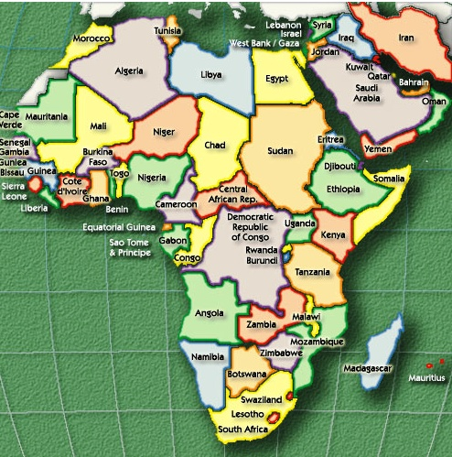
VAGABONDS TRAMP EAST AFRICA
Week 6
ancient people
& the Nile
EGYPT
Week 5
Great Rift Valley
Week 4
footprints & chimpanzees
KENYA
TANZANIA
Week 3
Kilimanjaro & Serengeti
Week 2
Victoria Falls & Zambezi
ZIMBABWE
Week 1
life in Africa

