Slide 1
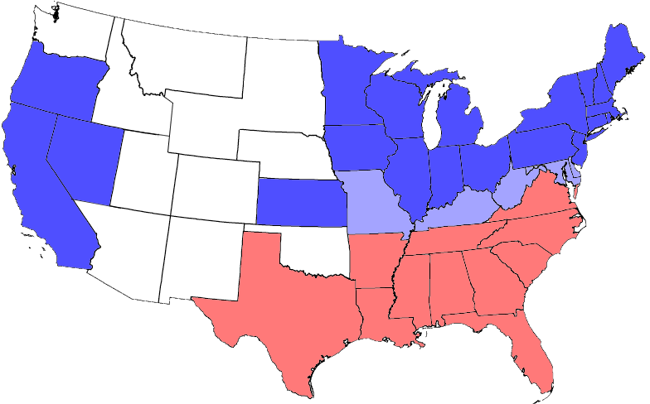
The Country Divided
So far . . .
Geology
and the
American Civil War
States of the USA
States of the CSA
Border States

Slide 2
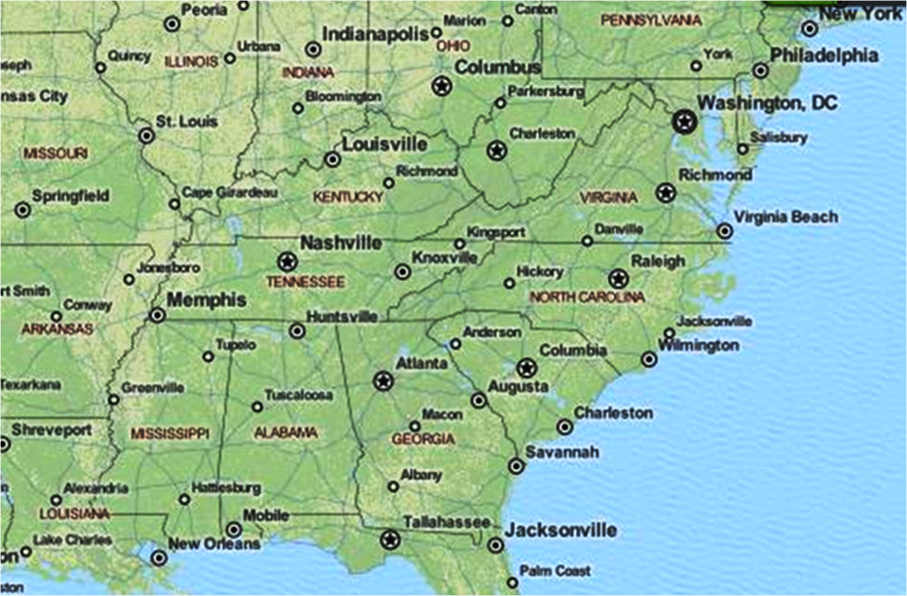
So far . . .

Slide 3
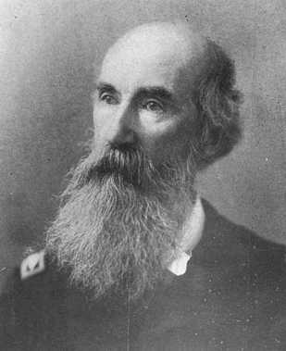
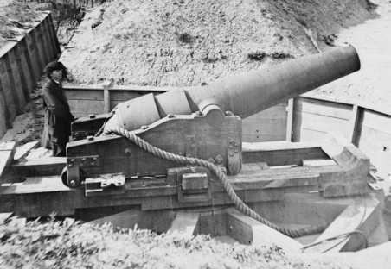
So far . . .
Week 1 – iron resources
Cornwall
Iron Furnace
Week 2 – battles of 1861
John Mercer Brooke
Tannehill
Iron Works

Slide 4
So far . . .
Week 1 – iron resources
Week 2 – battles of 1861
1st Bull Run
James Hanger
1st Land Campaign
PGT Beauregard
Fort Sumter

Slide 5
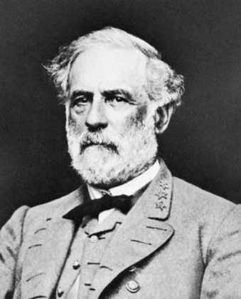
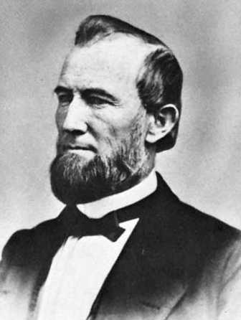
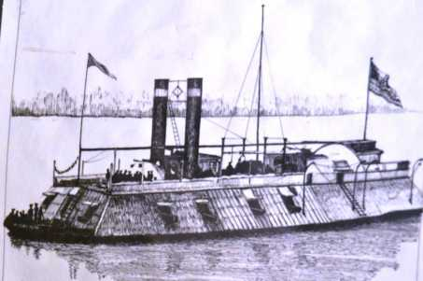
So far . . .
Week 1 – iron resources
Week 2 – battles of 1861
1st Bull Run
Antietam
Harpers Ferry
Week 3 – battles of 1862
1st Land Campaign
2nd Bull Run
Fort Donelson
&
Fort Henry
General Robert E. Lee
James Buchanan Eads
Shiloh
Major General U. S. Grant
Fort Sumter

Slide 6
So far . . .
Week 1 – iron resources
Week 2 – battles of 1861
Antietam
Harpers Ferry
Week 3 – battles of 1862
Week 4 – battles of 1863
2nd Bull Run
Fort Donelson
&
Fort Henry
General Robert E. Lee
Shiloh

Slide 7
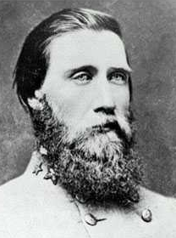
So far . . .
Week 1 – iron resources
Gettysburg
Week 2 – battles of 1861
Week 3 – battles of 1862
Chancellorsville
Week 4 – battles of 1863
John Bell Hood
Fredericksburg
Chattanooga
Chickamauga
Major General U. S. Grant
General Robert E. Lee
Vicksburg
Port Hudson

Slide 8
So far . . .
Week 1 – iron resources
Gettysburg
Week 2 – battles of 1861
Week 3 – battles of 1862
Chancellorsville
Week 4 – battles of 1863
Fredericksburg
Week 5 – battles of 1864
Chattanooga
Chickamauga
Vicksburg
Port Hudson

Slide 9
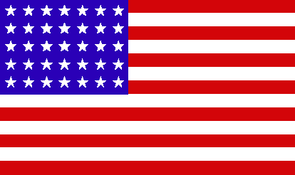
So far . . .
What’s ahead?
Week 1 – iron resources
Week 2 – battles of 1861
Wilderness
Week 3 – battles of 1862
?
Spotsylvania
Week 4 – battles of 1863
Cold Harbor
Petersburg
Week 5 – battles of 1864
Anna River
Major General U. S. Grant
General Robert E. Lee
John Bell Hood
SSEE
TENNE
MARCH
TO
THE
SEA

Slide 10
What’s ahead?
Week 1 – iron resources
Elmira Prison
Week 2 – battles of 1861
Wilderness
Week 3 – battles of 1862
Spotsylvania
Week 4 – battles of 1863
Richmond
Cold Harbor
Petersburg
Week 5 – battles of 1864
Appomattox
Anna River
Week 6 – Civil War ends
MARCH
CAROLINAS
TO
THE
SEA
Andersonville Prison

Slide 11
What’s ahead?
The Civil War Ends!
Week 1 – iron resources
Elmira Prison
Week 2 – battles of 1861
Week 3 – battles of 1862
Week 4 – battles of 1863
Week 5 – battles of 1864
Week 6 – Civil War ends
The Civil War Ends!
Andersonville Prison

Slide 12
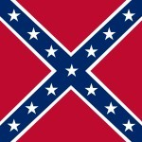
The Civil War Ends!
1st
The Confederate flag
^
BATTLE
‘Stars and Bars’ March 4, 1861 – May 1, 1863
too similar to the US flag!
March 4 – May 21, 1861
May 21, 1861 – July 2, 1861
July 2, 1861 – November 28, 1861
November 28, 1861 – May 1, 1863

Slide 13
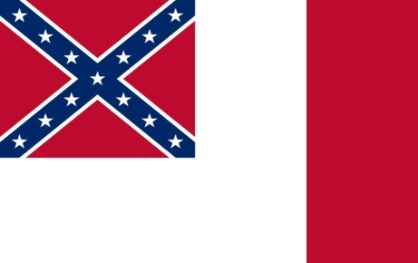
The Civil War Ends!
Carolinas Campaign
2nd
LAST
The Confederate flag
^
BATTLE
‘Stainless Banner’ May 1, 1863 – March 4, 1865
‘Blood Stained Banner’ March 5, 1865
could appear to be
flag of truce

Slide 14
The Civil War Ends!
The Civil War Ends!
Carolinas Campaign
UNION OBJECTIVES:
- break the Confederate capacity for war;
destroy crops, livestock, & civilian property
- join Grant in Virginia to defeat R.E. Lee & ANV
Remember last week?
Nov-Dec 1864
MARCH
CAROLINAS
TO
Jan-Mar 1865
THE
SEA
Savannah

Slide 15
Carolinas Campaign
Jan-Mar 1865
CAROLINAS

Slide 16
Carolinas Campaign
Jan-Mar 1865
Petersburg
V I r g I n I a
N o r t h C a r o l I n a
S o u t h
C a r o l i n a
G e o r g I a
Savannah

Slide 17
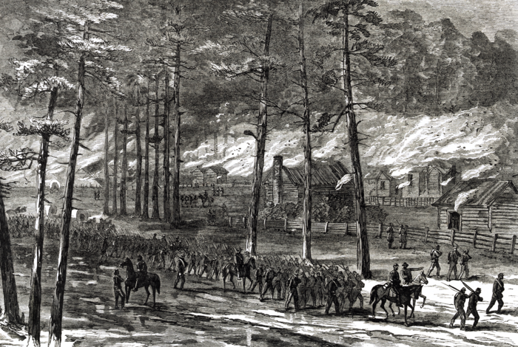
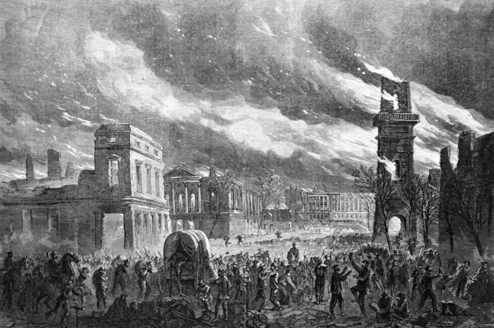
Carolinas Campaign
Siege of Petersburg
Jan-Mar 1865
Petersburg
meanwhile . . . .
Mar 24: capture Goldsburo, N.C.
Mar 11: capture Fayetteville, N.C.
Mar 3: capture Cheraw S.C.
Feb 16: capture & burn Columbia
Jan 15: sea-land
capture of
Fort Fisher
Feb 1: burn McPhersonville
Jan 17: depart Savannah
Savannah
Notes:
Carolina Campaign: Union troops marched 425 miles in 50 days, fighting against Confederate General Joseph Johnston & Army of Tennessee

Slide 18
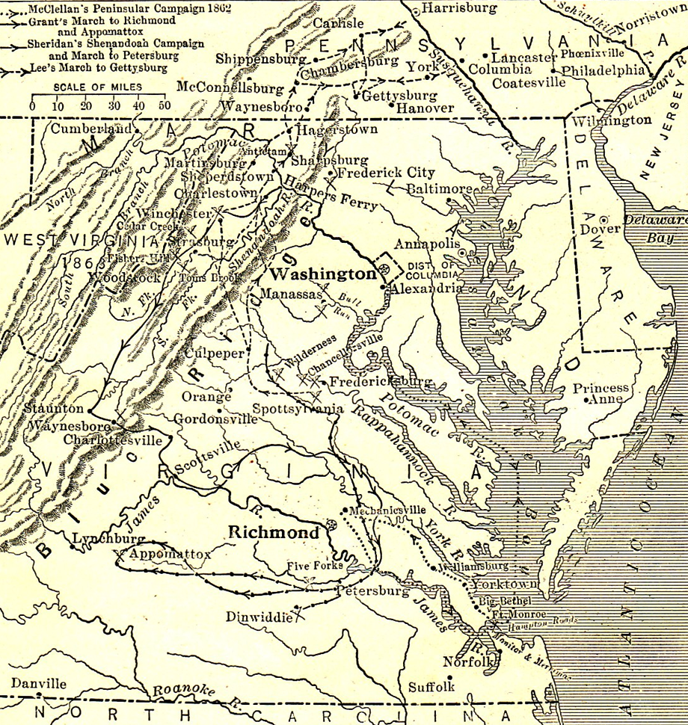
Siege of Petersburg
Washington
Richmond
VIRGINIA

Slide 19
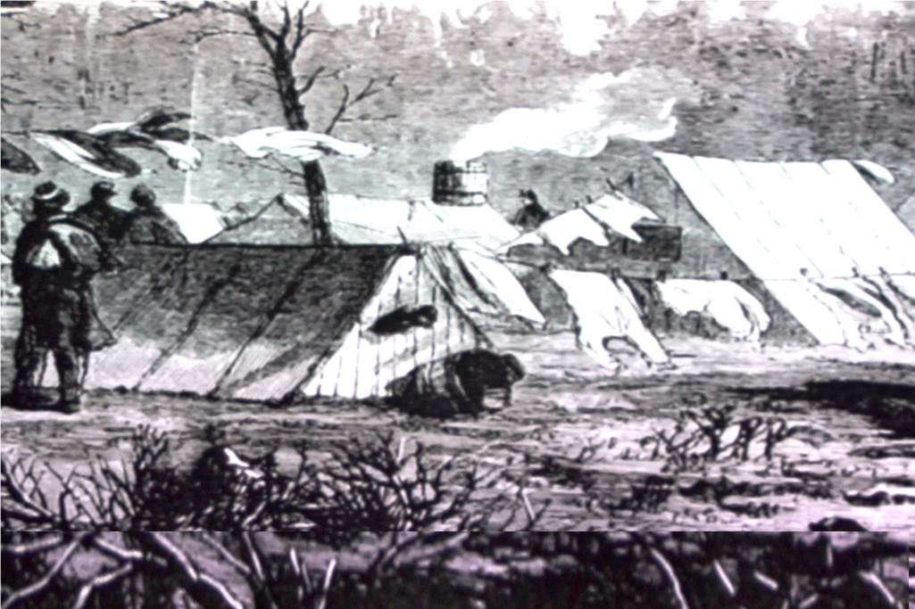
ends!
Siege of Petersburg
Remember last week?
May-June 1864: battles south toward Richmond
June 15, 1864: siege of Petersburg began
Washington
Rappahannock River
Wilderness
Spotsylvania
Anna River
James River
ColdHarbor
Richmond
Petersburg
VIRGINIA
We left the armies here in winter 1864!

Slide 20
Siege of Petersburg ends!
Washington
Richmond
Petersburg
VIRGINIA

Slide 21
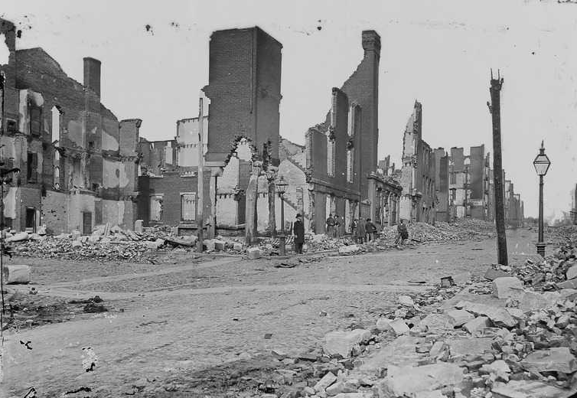
Siege of Petersburg ends!
R.E. Lee’s plan for survival . . .
March 25: Confederates attack Fort Stedman, repulsed
James River
April 2: R.E. Lee & ANV abandon Petersburg;
President Davis & gov’t abandon Richmond;
Confederates set fire to military warehouses
Richmond
Petersburg
April 3: Union troops occupy Petersburg & Richmond
April 2: Union assaults Petersburg fortifications
April 1: Union cuts last rail line to Petersburg at Five Forks
Richmond after the fire

Slide 22
R.E. Lee’s plan for survival . . .
What happens . . .
- move troops to Amelia Courthouse for
resupply by rail from Richmond
- proceed to Danville to meet army from south
Richmond
Amelia Courthouse
Petersburg
Danville

Slide 23
What happens . . .
April 3-9, 1865
No food arrives at Ameila. Lee delays march
Union catches up and blocks access to Danville
Appomattox
Richmond
Amelia Courthouse
x
April 9, 1865
Confederate General Robert E. Lee
surrenders the Army of Northern Virginia
to Union General Ulysses S. Grant
Petersburg
Danville

Slide 24
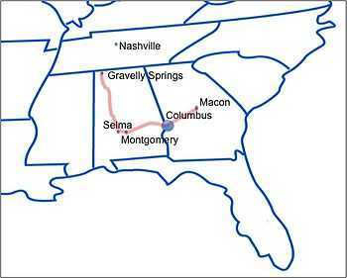
Final battles
April 16- Columbus (WILSON’S RAID)
After the Union victory in the Battle of Nashville (December 15–16, 1864), Union General George H. Thomas gave orders to General James H. Wilson to march into the heart of the Deep South to bring the Confederacy to its knees by destroying all of their supply centers such as Selma, Alabama, and Columbus, Georgia.
The Battle of Columbus, Georgia (April 16, 1865), also known as the Battle of Girard, Alabama (now Phenix City, Alabama) is widely regarded to be the last battle of the American Civil War.^{[1][2][3][4][5]} The Georgia state government officially declared this battle the "last battle of the war between the states."^{[6]} In the Official Records, the Battle of Columbus is referred to as the "closing conflict of the war."^{[7]}This battle was also the last conflict as part of a campaign through Alabama and Georgia, called Wilson's Raid.
May 12-13 - Palmito Ranch
The Battle of Palmito Ranch in Texas occurred after the Battle of Columbus, but the engagement at Palmito Ranch occurred after Johnston's surrender to Sherman (April 26, 1865) and after the Confederacy dissolved on May 5. Like the war's first big battle at First Bull Run, which also yielded little gain for either side, the battle is recorded as a Confederate victory.^{[19]} Two weeks later, Texan forces surrendered formally on May 26, 1865; Confederate General Edmund Kirby Smith surrendered his forces in the Trans-Mississippi Department on June 2. Most senior Confederate commanders in Texas (including Smith, Walker, Slaughter, and Ford) and many troops and equipment fled across the border to Mexico, possibly to ally with Imperial French forces, or Mexican forces with Benito Juárez.

Slide 25
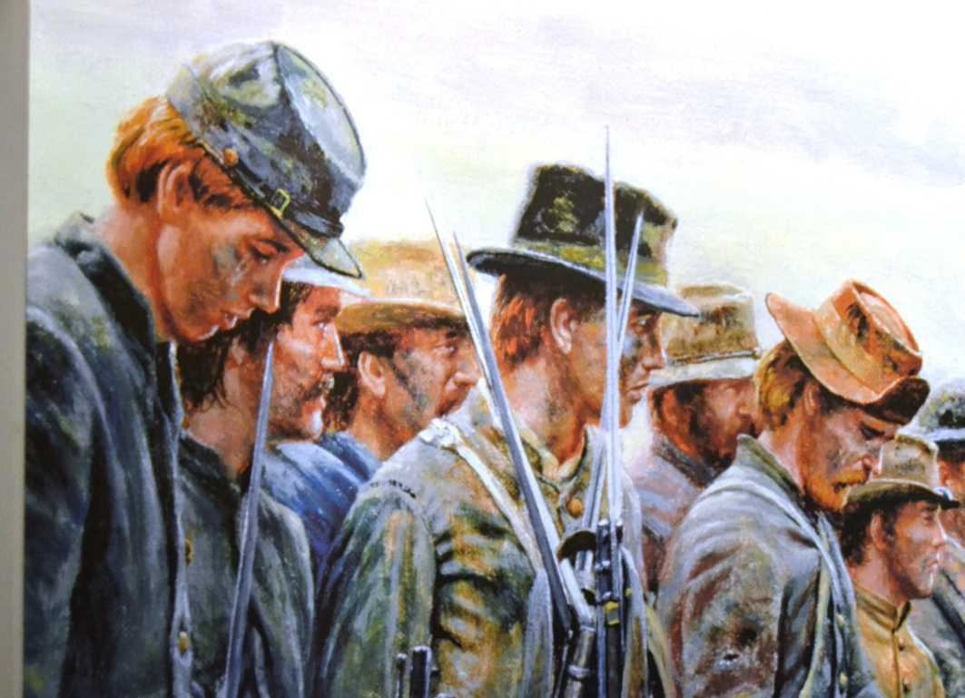
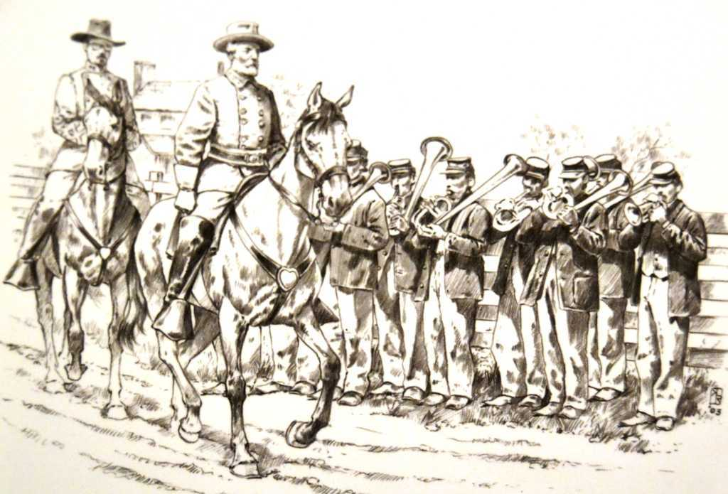
What happens . . .
Appomattox
April 9, 1865
Confederate General Robert E. Lee
surrenders the Army of Northern Virginia
to Union General Ulysses S. Grant
‘. . . surrender at Appomattox seemed to usher in a new life in a new world.
We had lived through the war.
There was nobody trying to shoot at us, and nobody for us to shoot at.
Our guns were gone,
our country was gone,
our very entity seemed to be destroyed.
We were no longer soldiers,
and had no orders to obey,
nothing to do and nowhere to go.”
- Confederate Colonel E. Porter Alexander

Slide 26
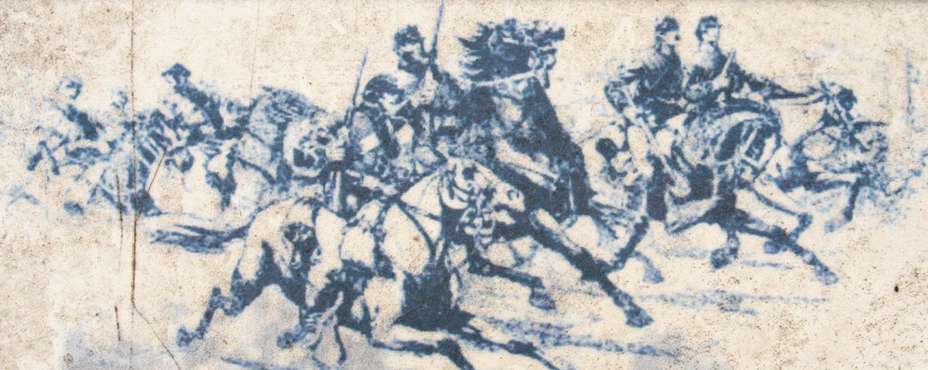
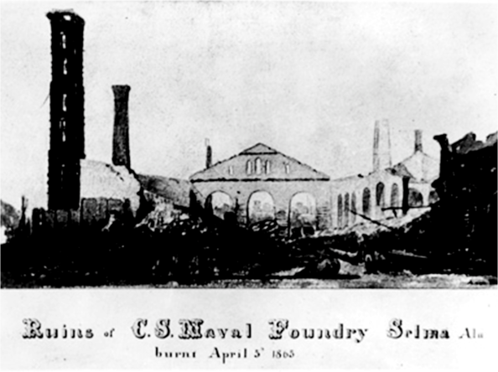
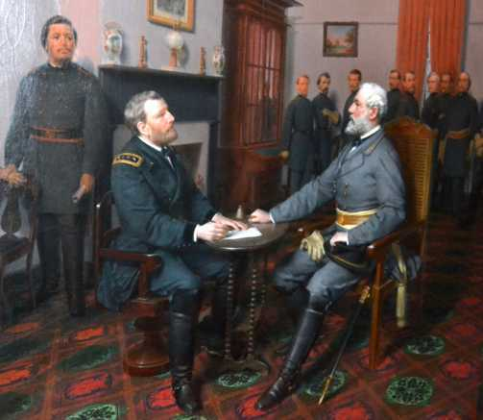
‘. . . surrender at Appomattox seemed to usher in a new life in a new world.
We had lived through the war.
There was nobody trying to shoot at us, and nobody for us to shoot at.
Our guns were gone,
our country was gone,
our very entity seemed to be destroyed.
We were no longer soldiers,
and had no orders to obey,
nothing to do and nowhere to go.”
- Confederate Colonel E. Porter Alexander
Final battles of the Civil War
Grant
April 9, 1865:
Lee surrenders to Grant
at Appomattox, VA
Wilson
April 16, 1865:
last battle of Civil War
at Columbus, GA
Wilson’s Raid: March-April 1865
Notes:
Major General James Wilson led approximately 13,500 men in three divisions. His principal opponent was Lt. Gen. Nathan Bedford Forrest, whose Cavalry Corps of the Department of Alabama, Mississippi, and East Louisiana consisted of about 2,500 troopers.

Slide 27
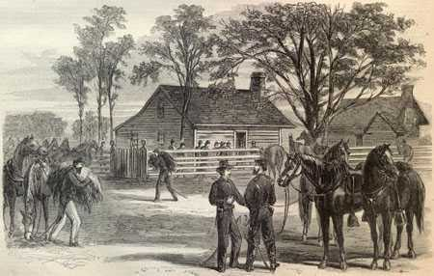
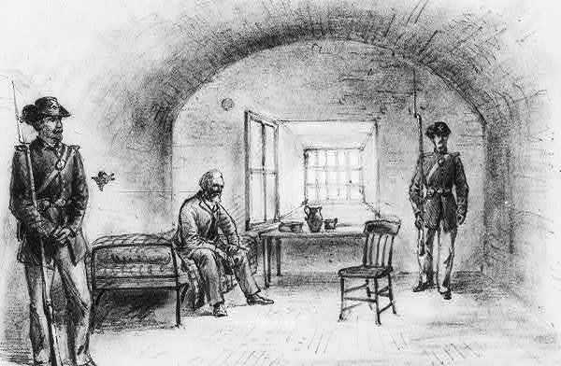
Southern Assets
Final battles of the Civil War
Confederate surrender at Durham NC
Grant
April 9, 1865:
Lee surrenders to Grant
at Appomattox, VA
Southern Assets are destroyed!
Southern Assets
April 26, 1865:
Confederates surrender
GA, SC, NC, FL
to Sherman at Durham, NC
Wilson
April 16, 1865:
last battle of Civil War
at Columbus, GA
Sherman
May 10, 1864: Wilson captures
Jefferson Davis in Irwinville, GA

Slide 28
Southern Assets
Union Strategy that Won the War
RAILROADS
RIVERS
SEAPORTS

Slide 29
Union Strategy that Won the War
RESULTS: Battles of 1865
control/destroy
RAILROADS
RIVERS
gain control
SEAPORTS
blockade
What are the results?

Slide 30
RESULTS: Battles of 1865
strength: 8,500
casualties: 350
Fort Fisher
strength: 800
casualties: 300
strength: 89,000
casualties: 4,800
Carolinas Campaign
strength: 15,000
casualties: 7,188
Appomattox Campaign
strength: 11,000
casualties: 6,266
surrendered: 26,500
strength: 21,000
casualties: 9,700
Wilson’s
Raid
strength: 2,500
casualties: 1,200
strength: 13,500
casualties: 725

Slide 31
RESULTS: Battles of 1865
For the Union
- U.S Grant succeeds in destroying the ANV
- Sherman leaves a path of destruction through
the Carolinas
- Wilson destroys furnaces, founderies, factories
For the Confederacy
- widespread destruction of infrastructure,
railroads, cities throughout the South
Let’s summarize . . . .

Slide 32
1860
1861
November
December
Fort Sumter – Civil War Begins
Davis inaugurated President of CSA
Lincoln elected President of USA
Lincoln blockades CSA ports
Battle of Phillippi
1st Bull Run
Wilson’s Creek
7 southern
states secede
from USA
Ball’s Bluff
Dranesville
4 states
secede
Dec -- Feb
April--May
July 21
Aug 10
Oct 20
April 12
June 3
Dec 20
Nov 6, 1860
Feb 18
April 19
Let’s summarize . . . .

Slide 33
1860
1862
1861
January
December
November
December
Fort Sumter – Civil War Begins
Davis inaugurated President of CSA
Lincoln elected President of USA
Lincoln blockades CSA ports
Battle of Phillippi
1st Bull Run
Wilson’s Creek
7 southern
states secede
from USA
Ball’s Bluff
Dranesville
4 states
secede
Dec -- Feb
April--May
July 21
Aug 10
Oct 20
April 12
June 3
Dec 20
Nov 6, 1860
Feb 18
April 19

Slide 34
1862
January
December
WESTERN THEATER
EASTERN THEATER
Harpers Ferry
Occupation of Baton Rouge
Battle of Fort Donelson
Capture of New Orleans
Battle Fredericksburg
‘Merrimac’ & Monitor
Battle of Fort Henry
Battle 2nd Bull Run
Battle of Memphis
Battle of Antietam
Battle of Shiloh
RIVER BATTLES
Valley & Peninsula
Aug 28-30
Sept 17
Dec 11-13
Feb 6
Mar 8-9
June 6
Feb 12-16
April 6-7
May 29
Apr 18-May 1
Sept 13-15

Slide 35
1862
1863
January
December
January
December
Harpers Ferry
Occupation of Baton Rouge
Battle of Fort Donelson
Capture of New Orleans
Battle Fredericksburg
‘Merrimac’ & Monitor
Battle of Fort Henry
Battle 2nd Bull Run
Battle of Memphis
Battle of Antietam
Battle of Shiloh
RIVER BATTLES
Valley & Peninsula
Aug 28-30
Sept 17
Dec 11-13
Feb 6
Mar 8-9
June 6
Feb 12-16
April 6-7
May 29
Apr 18-May 1
Sept 13-15

Slide 36
1863
January
December
WESTERN THEATER
EASTERN THEATER
X
West Virginia joins the Union
X
Battle & Siege of Port Hudson
Battle of Chickmauga (siege)
Battle & Siege of Vicksburg
2nd Confederate flag
Emancipation Proclamation
Battle of Chancellorsville
Battle of Gettysburg
Battle of
Chattanooga
Knoxville
Jan 1
May 1-3
June 20
Sept 18-20
Nov 24-25
Sept 2-9
Mar 29- July 4
May 8 - Jul 9
July 1-3

Slide 37
1864
1863
January
January
December
December
West Virginia re-joins the Union
Battle of Chickmauga (siege)
Battle & Siege of Port Hudson
Battle & Siege of Vicksburg
Emancipation Proclamation
Battle of Chancellorsville
Battle of Gettysburg
Battle of
Chattanooga
Knoxville
Jan 1
May 1-3
June 20
Sept 18-20
Nov 24-25
Sept 2-9
Mar 29- July 4
May 8 - Jul 9
July 1-3

Slide 38
1864
January
December
WESTERN THEATER
EASTERN THEATER
James Hanger get contract
for prosthetics
Georgia (Atlanta) Campaign
Battle of Wilderness
Hood’s Tennessee
Battle of Spotsylvania
Battle of North Anna
Battle of Cold Harbor
March to Sea
Siege of Petersburg
May 7-Sept 1
May 5-??
March
May 5-6
Jun 15-???
Nov 15-DEC 23
May 8-21
May 23-26
Sept 18-Dec 27
May 31-Jun 12

Slide 39
1864
1865
January
January
December
December
James Hanger get contract
for prosthetics
Georgia (Atlanta) Campaign
Battle of Wilderness
Hood’s Tennessee
Battle of Spotsylvania
Battle of North Anna
Battle of Cold Harbor
March to Sea
Siege of Petersburg
May 7-Sept 1
May 5-??
March
May 5-6
Jun 15-???
Nov 15-DEC 23
May 8-21
May 23-26
Sept 18-Dec 27
May 31-Jun 12

Slide 40
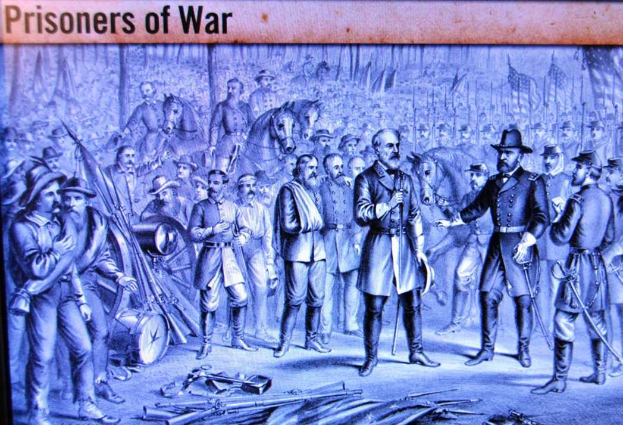
What is the human cost?
1865
January
December
Battle of Petersburg
Wilson’s Alabama Raid
Richmond surrenders
Last Confederate Flag
Sherman’s Carolinas Campaign
Appomattox Campaign
Lee & ANV surrender
Last Battle - Columbus, GA
Jefferson Davis surrenders
Jan-Mar
Mar-Apr
May 10
April 16
April 9
March 5
April 3-9
April 3
April 1-2

Slide 41
What is the human cost?
Prisoners of War
Loss of Life

Slide 42
Prisoners of War
Dix-Hill Cartel
METHODS FOR HANDING PRISONERS
Dix-Hill Cartel
Prison Camps

Slide 43
Prisoners of War
Dix-Hill Cartel
1862 agreement for trading prisoners according to value of rank
equal rank → equal rank
or equivalents:
Corporal or Sergeant → 2 Privates
Lieutenant → 3 Privates
|
|
|
|
Commanding General → 60 Privates

Slide 44
Prisoners of War
Dix-Hill Cartel
Exchanges take place . . .
- Battlefield Exchange: between commanders of opposing sides when a battle is over
- Parole & Exchange: a temporary release
until a trade can be arranged
- paroled prisoner may not work in
any military capacity until exchanged
- a prisoner must be paroled
if not exchanged within 10 days

Slide 45
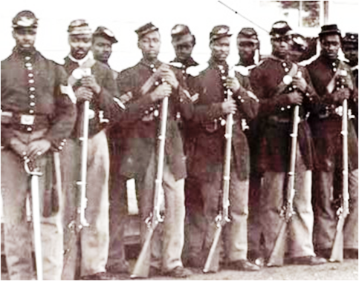
Prisoners of War
Dix-Hill Cartel
fails!
For a year ‘parole & exchange’ works
- prisoners are exchanged in weeks or months
- most Confederate prisoners return to duty
- many Union prisoners are mustered out
Mid-1863: black Union regiments are formed
Union: ‘no distinction between white and
colored prisoners in exchange’
Confederacy: ‘the right to send slaves back to
slavery as property recaptured’

Slide 46
Prisoners of War
Dix-Hill Cartel
METHODS FOR HANDING PRISONERS
Prison Camps
Dix-Hill Cartel
Prison Camps

Slide 47
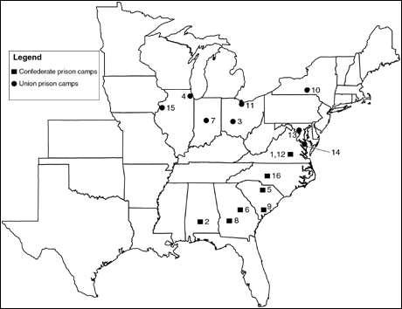
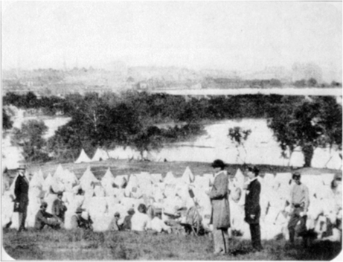
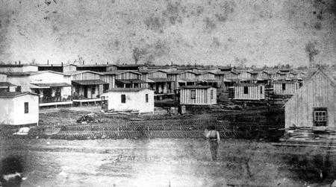
Prisoners of War
Elmira Prison Camp
Prison Camps
over 100 prisons are used during the Civil War
Confederacy builds open stockades
Union builds enclosed barracks
CONFEDERATE
Elmira
UNION
Belle Isle, Virginia
Camp Chase - Ohio
Problems
overcrowding – poor sanitation – poor diet
Andersonville

Slide 48
Elmira Prison Camp
- 30 acres located in Elmira, NY
- originally a Union recruiting/training depot
- prison camp July 6, 1864 – Sept 27, 1865
Prison Camps
CONFEDERATE
UNION

Slide 49
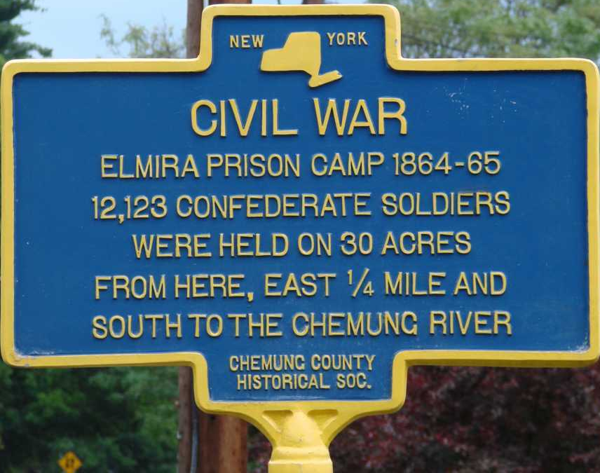
Elmira Prison Camp
- 30 acres located in Elmira, NY
- originally a Union recruiting/training depot
- prison camp July 6, 1864 – Sept 27, 1865
- barrack space for 5,000 prisoners
- 12,000 prisoners are housed here
- many live in tents near the Chemung River
through exposure, malnutrition, lack of medical care, unsanitary conditions, & disease
24% of prisoners die

Slide 50
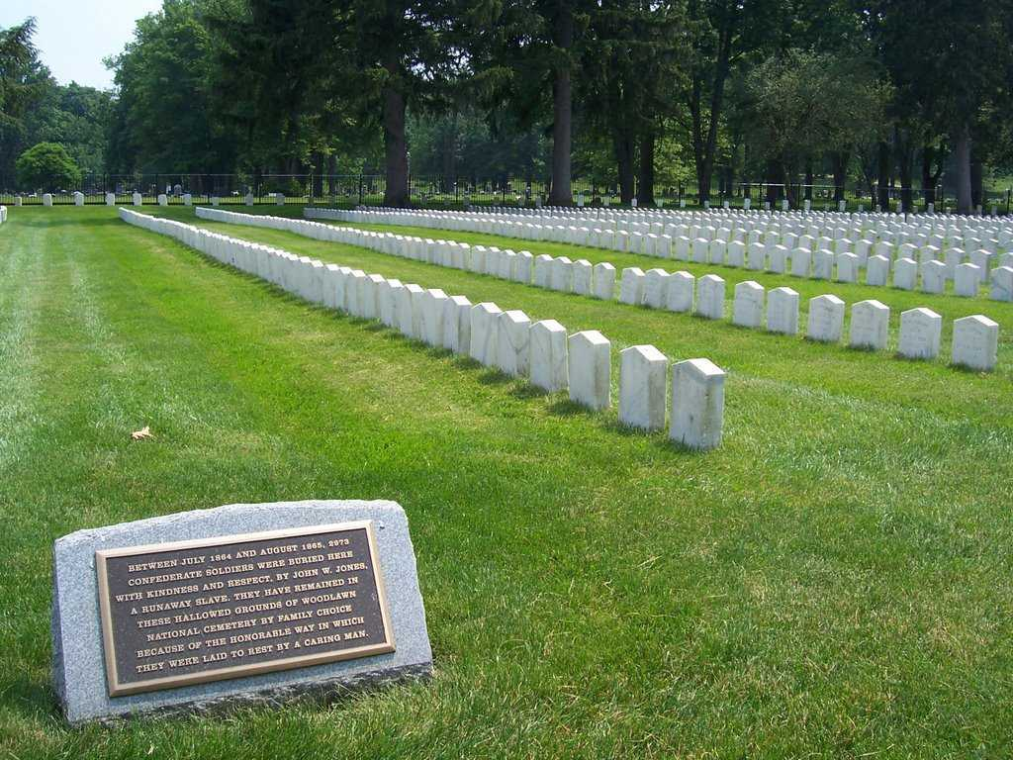
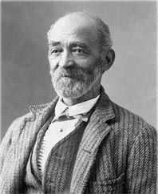
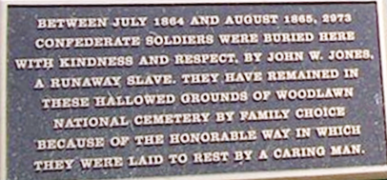
Elmira Prison Camp
Woodlawn National Cemetery
In 1907 the Federal government placed headstones on these Confederate graves with names & regiments found in John Jones meticulous records

Slide 51
Woodlawn National Cemetery
Prisoners of War
Andersonville Prison Camp
Prison Camps
CONFEDERATE
Elmira
UNION
Andersonville
In 1907 the Federal government placed headstones on these Confederate graves with names & regiments found in John Jones meticulous records

Slide 52
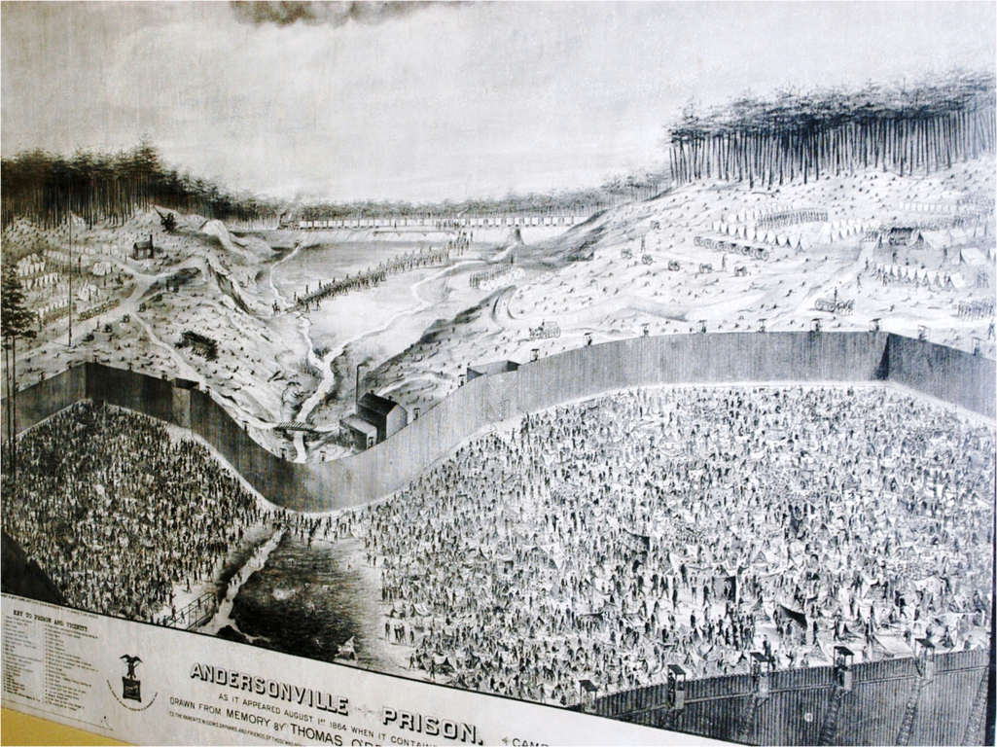
Andersonville Prison Camp
- ‘Camp Sumter’ in Andersonville, Georgia
Prison Camps
- built to relieve crowding in Richmond prisons
CONFEDERATE
- operates February 1864 – April 1865
UNION
STOCKADE

Slide 53
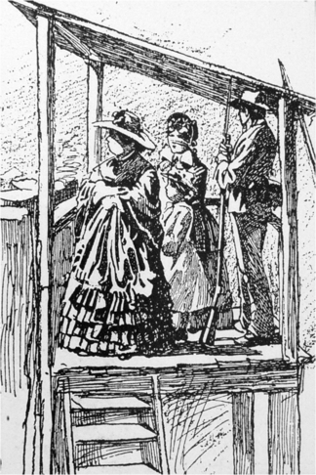
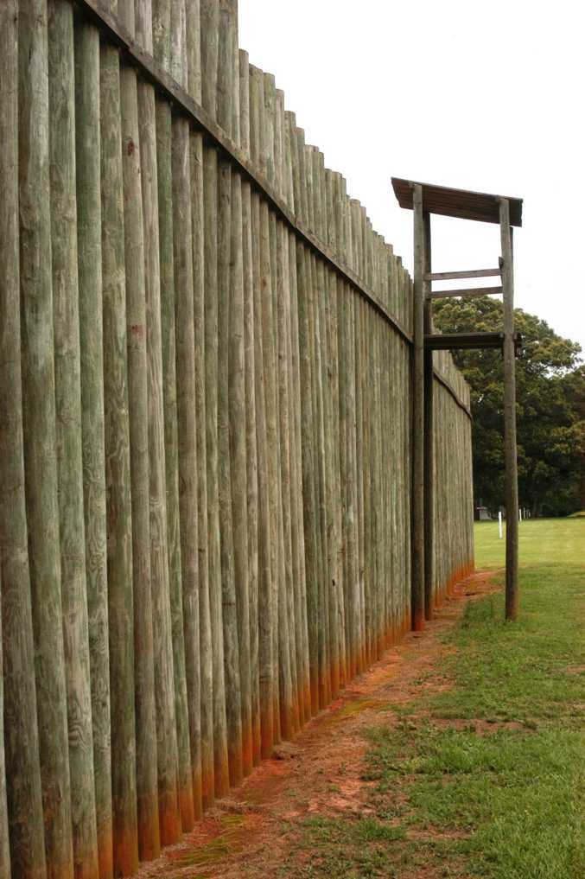
Andersonville Prison Camp
town’s people gawk at the prisoners

Slide 54
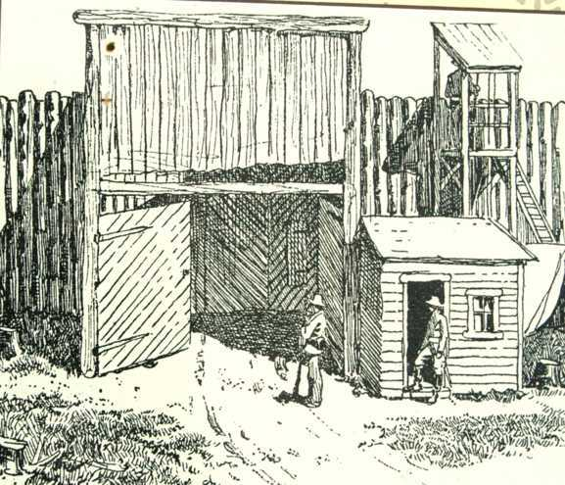
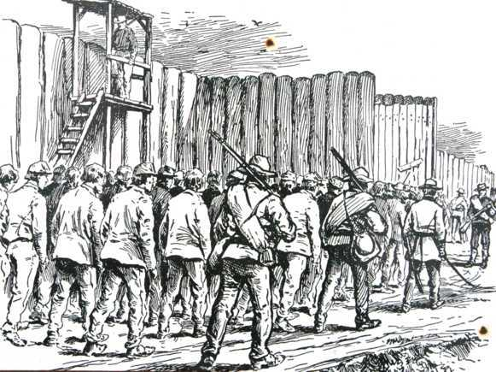
Andersonville Prison Camp
rail station
gate
prison yard

Slide 55
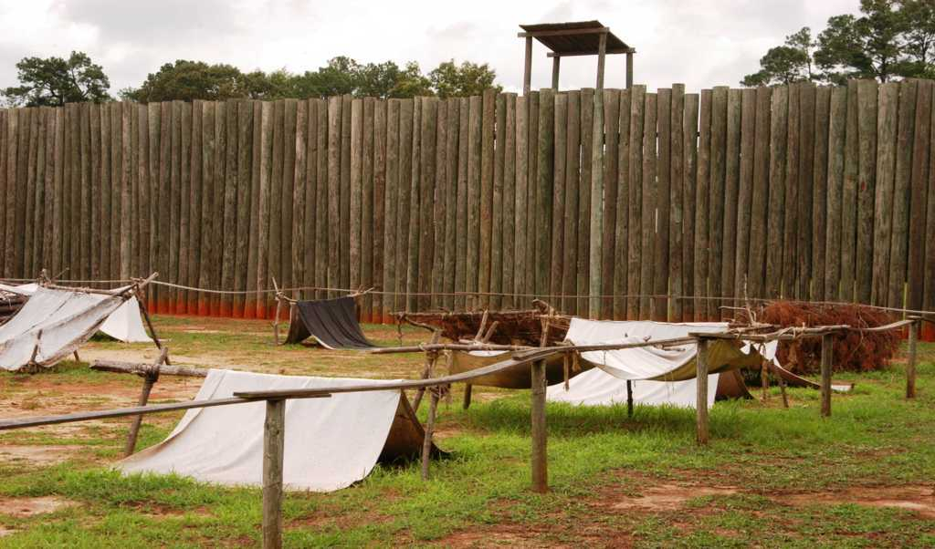
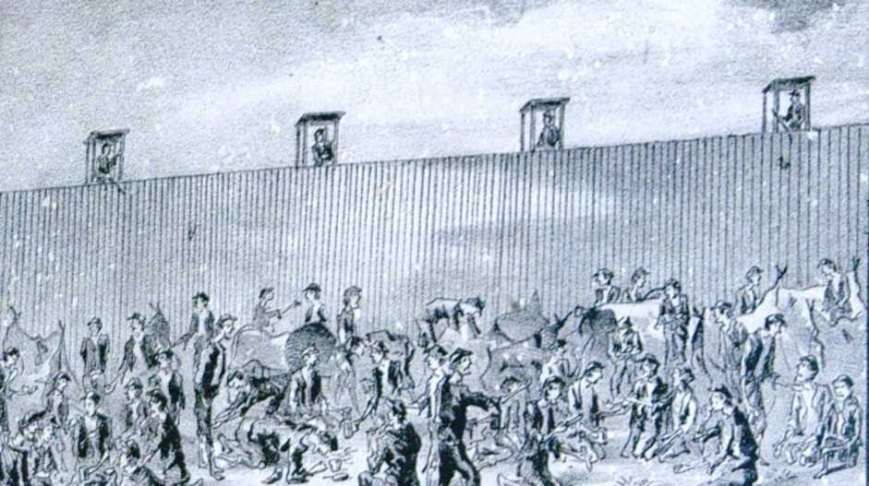
Andersonville Prison Camp
No shelter is provided;
prisoners make tents from tattered blankets
Sweetwater Creek
- drinking water
- latrine
25²ft/prisoner
(size of a double bed)
prison yard
45,000 prisoners
in 26 acres
Notes:
4,3560’sq/acre = 1,132560’sq/26 acres divide by 45000 prisoners=25’sq/prisoner

Slide 56
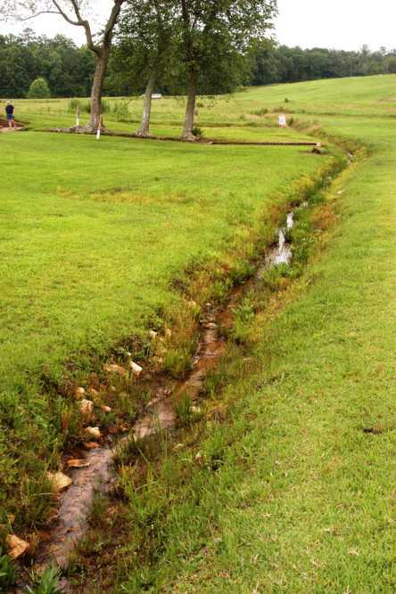
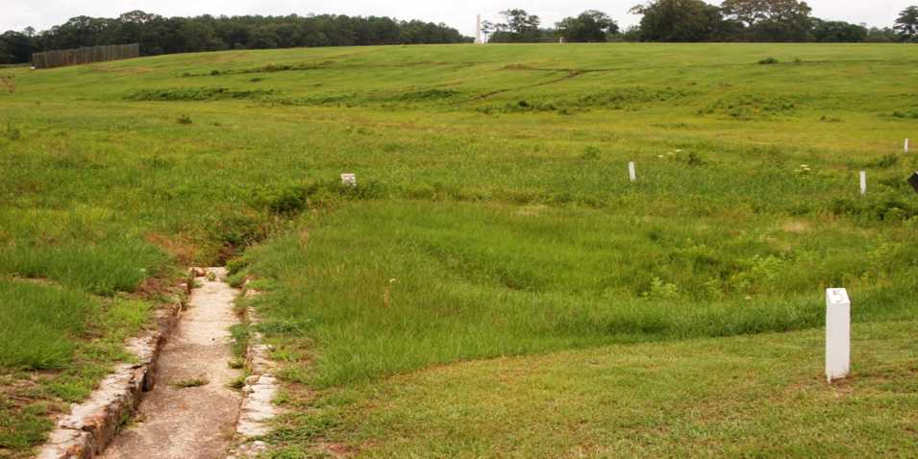
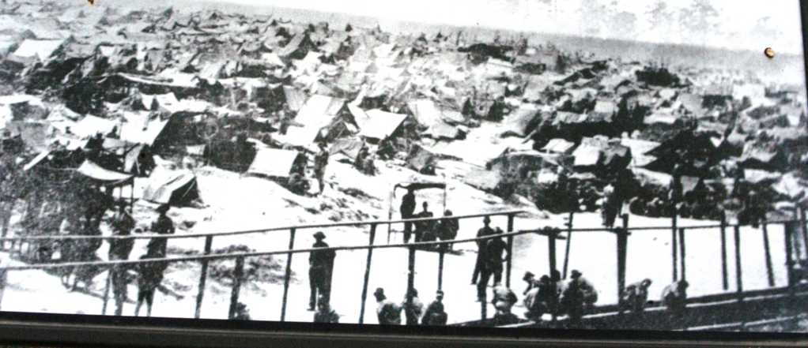
Andersonville Prison Camp
Sweetwater Creek
- drinking water
- latrine

Slide 57
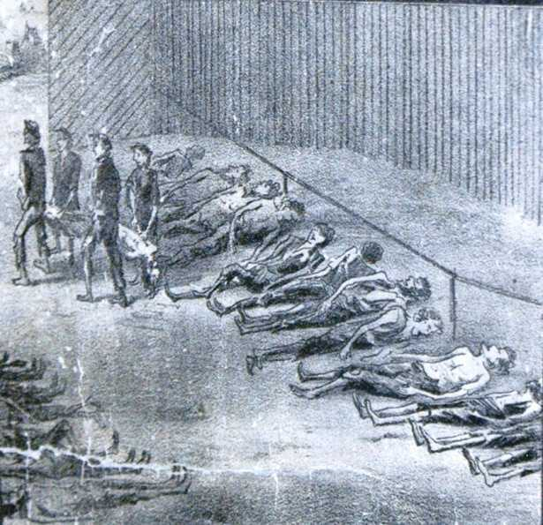
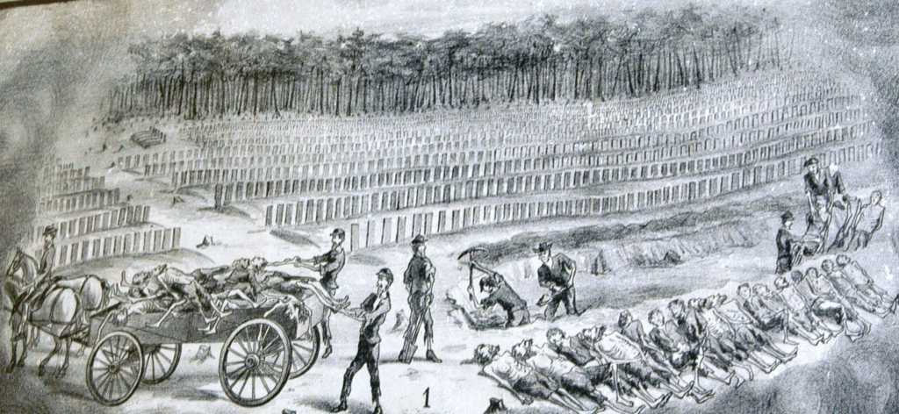
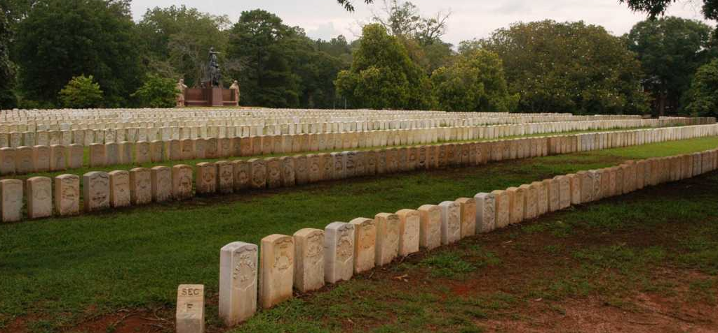
Andersonville Prison Camp
13,000 prisoners die at Camp Sumter
29% death rate
50-100 prisoners die each day
Sweetwater Creek
- drinking water
- latrine

Slide 58
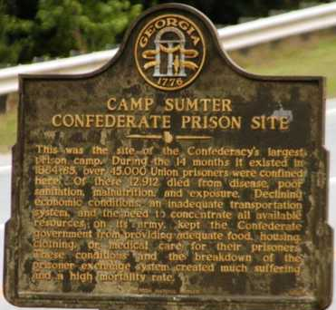
Andersonville Prison Camp
PRISONER STATISTICS

Slide 59
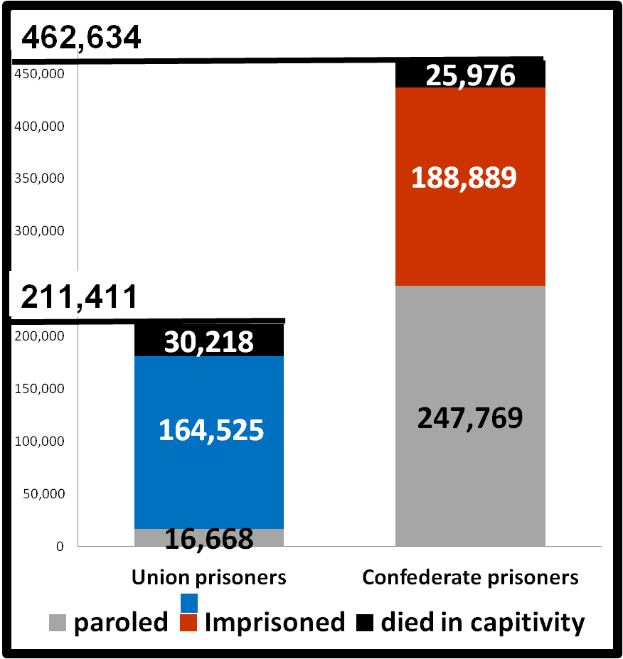
PRISONER STATISTICS
Deaths
CONFEDERATE
>56,000
Mortality Rate
12%
UNION
16%

Slide 60
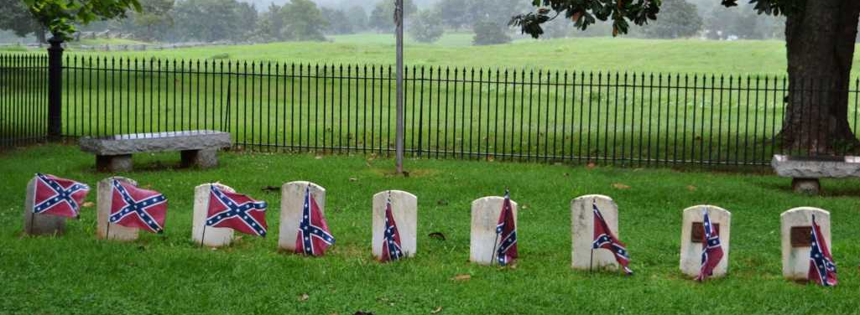
PRISONER STATISTICS
Lives Lost in the Civil War
PRISON
Deaths
CONFEDERATE
>56,000
Prison Deaths . . . . . .
Mortality Rate
Battlefield Deaths. . .
???
12%
UNION
16%
let’s look at the battles we’ve studied

Slide 61
http://tigger.uic.edu/~rjensen/prisons.htm
Deaths of Confederate prisoners of war . . . . .26,436 Deaths of Union prisoners of war . . . . . . . 22,576 Number of Confederate prisoners of war . . . . . 220,000 Number of Union prisoners of war about . . . . . 126,950
" According to the best information now obtainable, from both Union and
Confederate records, it appears that 211,411 Union soldiers were captured
during the civil war, of which number 16,668
were paroled on the field and 30,218 died while in captivity;
and that 462,634 Confederate soldiers were captured during that war,
of which number 247,769 were paroled on the field and 25,976 died while in captivity.“
Thus the mortality was a little over 12 per cent. at the North and 15% at the South. Taking into account the better hospitals, more skilful physicians, the ample supply of medicines and the abundance of food at the North and the exceptionally high death-rate at Andersonville.
written by James Ford Rhodes 100 years ago

Slide 62
Lives Lost in the Civil War
BATTLE |  | UNION |  | CONFE | DERATE
 | strength | casualties | killed | strength | Casualties | killed
EASTERN THEATER
1st Bull Run | 35,000 | 2,896 | 460 | 32,000 | 1,982 | 387
2nd Bull Run | 75,000 | 16,154 | 1,724 | 48,500 | 9,197 | 1,481
Antietam | 75,500 | 12,401 | 2,108 | 38,000 | 10,316 | 1,546
Fredericksburg | 120,000 | 12,600 | 1,284 | 78,000 | 5,300 | 608
Chancellorsville | 133,000 | 17,200 | 1,606 | 60,000 | 13,300 | 1,665
Gettysburg | 97,000 | 23,000 | 3,100 | 72,000 | 28,000 | 4,700
Wilderness | 118,000 | 17,000 | 2,300 | 64,000 | 10,000 | 1,500
Spotsylvania | 100,000 | 18,000 | 2,700 | 52,000 | 12,000 | 3,200
Anna River | 68,000 | 2,600 | -- | 53,000 | 2,000 | --
Cold Harbor | 108,000 | 13,000 | 1,800 | 59,000 | 3,900 | 400
Petersburg | 70,000 | 15,184 | 2,192 | 36,000 | 5,491 | 561
Appomattox Campg | 21,000 | 9,700 | -- | 11,000 | 6,266 | --
AVERAGE | 85,042 | 13,311 | 1,927 | 50,292 | 8,979 | 1,605
SUB-TOTAL |  |  | 19,274 |  |  | 16,048
WESTERN THEATER
Henry/Donalson | 21,500 | 2,832 | 500 | 14,000 | 1,487 | 257
Shiloh | 65,000 | 13,047 | 1,754 | 44,699 | 10,697 | 1,728
Vicksburg | 77,000 | 10,100 | ?? | 33,000 | 9,100 | ??
Port Hudson | 40,000 | 5,000 | ?? | 7,500 | 700 | ??
Chickamauga | 62,000 | 16,107 | 1,657 | 65,000 | 18,454 | 2,312
Chattanooga | 56,000 | 5,824 | 753 | 44,000 | 6,667 | 361
Atlanta Campgn | 112,000 | 31,687 | 4,423 | 65,000 | 34,979 | 3,044
Tennessee Campg | 26,000 | 53,000 | 580 | 40,000 | 12,000 | 3,000
Savannah Campg | 62,000 | 900 | ?? | 13,000 | 1,200 | ??
Fort Fisher | 8,500 | 350 | ?? | 800 | 300 | ??
Carolinas Campg | 89,000 | 4,800 | ?? | 15,000 | 7,188 | ??
Wilson's Raid | 13,500 | 725 | ?? | 2,500 | 1,200 | ??
AVERAGE | 54,600 | 12,849 | 1,853 | 28,580 | 9,179 | 2,179
SUB-TOTAL |  |  | 7,413 |  |  | 8,717
TOTAL (east+west) |  |  | 26,687 |  |  | 24,765
UNION
CONFEDERATE
killed
killed
EASTERN THEATER > 35,000 killed
19,274
16,048

Slide 63
Lives Lost in the Civil War
BATTLE |  | UNION |  | CONFE | DERATE
 | strength | casualties | killed | strength | Casualties | killed
EASTERN THEATER
1st Bull Run | 35,000 | 2,896 | 460 | 32,000 | 1,982 | 387
2nd Bull Run | 75,000 | 16,154 | 1,724 | 48,500 | 9,197 | 1,481
Antietam | 75,500 | 12,401 | 2,108 | 38,000 | 10,316 | 1,546
Fredericksburg | 120,000 | 12,600 | 1,284 | 78,000 | 5,300 | 608
Chancellorsville | 133,000 | 17,200 | 1,606 | 60,000 | 13,300 | 1,665
Gettysburg | 97,000 | 23,000 | 3,100 | 72,000 | 28,000 | 4,700
Wilderness | 118,000 | 17,000 | 2,300 | 64,000 | 10,000 | 1,500
Spotsylvania | 100,000 | 18,000 | 2,700 | 52,000 | 12,000 | 3,200
Anna River | 68,000 | 2,600 | -- | 53,000 | 2,000 | --
Cold Harbor | 108,000 | 13,000 | 1,800 | 59,000 | 3,900 | 400
Petersburg | 70,000 | 15,184 | 2,192 | 36,000 | 5,491 | 561
Appomattox Campg | 21,000 | 9,700 | -- | 11,000 | 6,266 | --
AVERAGE | 85,042 | 13,311 | 1,927 | 50,292 | 8,979 | 1,605
SUB-TOTAL |  |  | 19,274 |  |  | 16,048
WESTERN THEATER
Henry/Donalson | 21,500 | 2,832 | 500 | 14,000 | 1,487 | 257
Shiloh | 65,000 | 13,047 | 1,754 | 44,699 | 10,697 | 1,728
Vicksburg | 77,000 | 10,100 | ?? | 33,000 | 9,100 | ??
Port Hudson | 40,000 | 5,000 | ?? | 7,500 | 700 | ??
Chickamauga | 62,000 | 16,107 | 1,657 | 65,000 | 18,454 | 2,312
Chattanooga | 56,000 | 5,824 | 753 | 44,000 | 6,667 | 361
Atlanta Campgn | 112,000 | 31,687 | 4,423 | 65,000 | 34,979 | 3,044
Tennessee Campg | 26,000 | 53,000 | 580 | 40,000 | 12,000 | 3,000
Savannah Campg | 62,000 | 900 | ?? | 13,000 | 1,200 | ??
Fort Fisher | 8,500 | 350 | ?? | 800 | 300 | ??
Carolinas Campg | 89,000 | 4,800 | ?? | 15,000 | 7,188 | ??
Wilson's Raid | 13,500 | 725 | ?? | 2,500 | 1,200 | ??
AVERAGE | 54,600 | 12,849 | 1,853 | 28,580 | 9,179 | 2,179
SUB-TOTAL |  |  | 7,413 |  |  | 8,717
TOTAL (east+west) |  |  | 26,687 |  |  | 24,765
BATTLE |  | UNION |  | CONFE | DERATE
 | strength | casualties | killed | strength | Casualties | killed
EASTERN THEATER > 35,000 killed

Slide 64
BATTLE |  | UNION |  | CONFE | DERATE
 | strength | casualties | killed | strength | Casualties | killed
EASTERN THEATER
1st Bull Run | 35,000 | 2,896 | 460 | 32,000 | 1,982 | 387
2nd Bull Run | 75,000 | 16,154 | 1,724 | 48,500 | 9,197 | 1,481
Antietam | 75,500 | 12,401 | 2,108 | 38,000 | 10,316 | 1,546
Fredericksburg | 120,000 | 12,600 | 1,284 | 78,000 | 5,300 | 608
Chancellorsville | 133,000 | 17,200 | 1,606 | 60,000 | 13,300 | 1,665
Gettysburg | 97,000 | 23,000 | 3,100 | 72,000 | 28,000 | 4,700
Wilderness | 118,000 | 17,000 | 2,300 | 64,000 | 10,000 | 1,500
Spotsylvania | 100,000 | 18,000 | 2,700 | 52,000 | 12,000 | 3,200
Anna River | 68,000 | 2,600 | -- | 53,000 | 2,000 | --
Cold Harbor | 108,000 | 13,000 | 1,800 | 59,000 | 3,900 | 400
Petersburg | 70,000 | 15,184 | 2,192 | 36,000 | 5,491 | 561
Appomattox Campg | 21,000 | 9,700 | -- | 11,000 | 6,266 | --
AVERAGE | 85,042 | 13,311 | 1,927 | 50,292 | 8,979 | 1,605
SUB-TOTAL |  |  | 19,274 |  |  | 16,048
WESTERN THEATER
Henry/Donalson | 21,500 | 2,832 | 500 | 14,000 | 1,487 | 257
Shiloh | 65,000 | 13,047 | 1,754 | 44,699 | 10,697 | 1,728
Vicksburg | 77,000 | 10,100 | ?? | 33,000 | 9,100 | ??
Port Hudson | 40,000 | 5,000 | ?? | 7,500 | 700 | ??
Chickamauga | 62,000 | 16,107 | 1,657 | 65,000 | 18,454 | 2,312
Chattanooga | 56,000 | 5,824 | 753 | 44,000 | 6,667 | 361
Atlanta Campgn | 112,000 | 31,687 | 4,423 | 65,000 | 34,979 | 3,044
Tennessee Campg | 26,000 | 53,000 | 580 | 40,000 | 12,000 | 3,000
Savannah Campg | 62,000 | 900 | ?? | 13,000 | 1,200 | ??
Fort Fisher | 8,500 | 350 | ?? | 800 | 300 | ??
Carolinas Campg | 89,000 | 4,800 | ?? | 15,000 | 7,188 | ??
Wilson's Raid | 13,500 | 725 | ?? | 2,500 | 1,200 | ??
AVERAGE | 54,600 | 12,849 | 1,853 | 28,580 | 9,179 | 2,179
SUB-TOTAL |  |  | 7,413 |  |  | 8,717
TOTAL (east+west) |  |  | 26,687 |  |  | 24,765
Lives Lost in the Civil War
BATTLE |  | UNION |  | CONFE | DERATE
 | strength | casualties | killed | strength | Casualties | killed
UNION
CONFEDERATE
killed
killed
WESTERN THEATER > 16,000 killed
7,413
8,717

Slide 65
BATTLE |  | UNION |  | CONFE | DERATE
 | strength | casualties | killed | strength | Casualties | killed
EASTERN THEATER
1st Bull Run | 35,000 | 2,896 | 460 | 32,000 | 1,982 | 387
2nd Bull Run | 75,000 | 16,154 | 1,724 | 48,500 | 9,197 | 1,481
Antietam | 75,500 | 12,401 | 2,108 | 38,000 | 10,316 | 1,546
Fredericksburg | 120,000 | 12,600 | 1,284 | 78,000 | 5,300 | 608
Chancellorsville | 133,000 | 17,200 | 1,606 | 60,000 | 13,300 | 1,665
Gettysburg | 97,000 | 23,000 | 3,100 | 72,000 | 28,000 | 4,700
Wilderness | 118,000 | 17,000 | 2,300 | 64,000 | 10,000 | 1,500
Spotsylvania | 100,000 | 18,000 | 2,700 | 52,000 | 12,000 | 3,200
Anna River | 68,000 | 2,600 | -- | 53,000 | 2,000 | --
Cold Harbor | 108,000 | 13,000 | 1,800 | 59,000 | 3,900 | 400
Petersburg | 70,000 | 15,184 | 2,192 | 36,000 | 5,491 | 561
Appomattox Campg | 21,000 | 9,700 | -- | 11,000 | 6,266 | --
AVERAGE | 85,042 | 13,311 | 1,927 | 50,292 | 8,979 | 1,605
SUB-TOTAL |  |  | 19,274 |  |  | 16,048
WESTERN THEATER
Henry/Donalson | 21,500 | 2,832 | 500 | 14,000 | 1,487 | 257
Shiloh | 65,000 | 13,047 | 1,754 | 44,699 | 10,697 | 1,728
Vicksburg | 77,000 | 10,100 | ?? | 33,000 | 9,100 | ??
Port Hudson | 40,000 | 5,000 | ?? | 7,500 | 700 | ??
Chickamauga | 62,000 | 16,107 | 1,657 | 65,000 | 18,454 | 2,312
Chattanooga | 56,000 | 5,824 | 753 | 44,000 | 6,667 | 361
Atlanta Campgn | 112,000 | 31,687 | 4,423 | 65,000 | 34,979 | 3,044
Tennessee Campg | 26,000 | 53,000 | 580 | 40,000 | 12,000 | 3,000
Savannah Campg | 62,000 | 900 | ?? | 13,000 | 1,200 | ??
Fort Fisher | 8,500 | 350 | ?? | 800 | 300 | ??
Carolinas Campg | 89,000 | 4,800 | ?? | 15,000 | 7,188 | ??
Wilson's Raid | 13,500 | 725 | ?? | 2,500 | 1,200 | ??
AVERAGE | 54,600 | 12,849 | 1,853 | 28,580 | 9,179 | 2,179
SUB-TOTAL |  |  | 7,413 |  |  | 8,717
TOTAL (east+west) |  |  | 26,687 |  |  | 24,765
Lives Lost in the Civil War
BATTLE |  | UNION |  | CONFE | DERATE
 | strength | casualties | killed | strength | Casualties | killed
WESTERN THEATER > 16,000 killed

Slide 66
Lives Lost in the Civil War
BATTLE |  | UNION |  | CONFE | DERATE
 | strength | casualties | killed | strength | Casualties | killed
UNION
CONFEDERATE
TOTAL (east+west) |  |  | 26,687 |  |  | 24,765
TOTAL
26,687
24,765
Total killed
in the battles we studied:
>51,000

Slide 67
Lives Lost in the Civil War
>56,000
Prison Deaths . . . . . .
Battlefield Deaths. . .
???
battles we studied . . . . . > 51,000
other battles. . . . . . . . . . ???

Slide 68
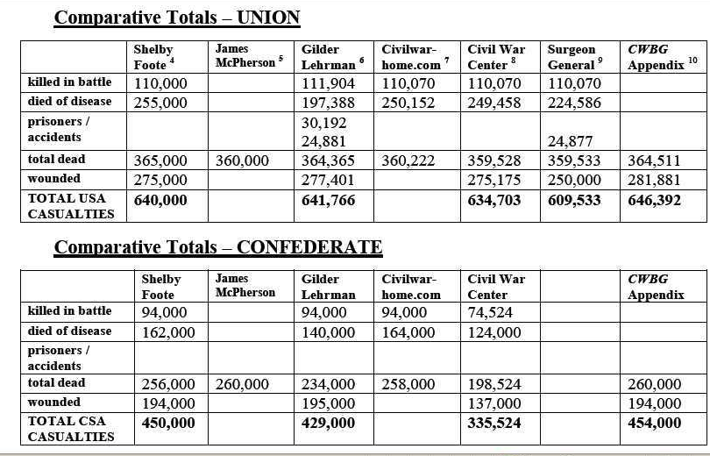
Lives Lost in the Civil War
UNION
Historians
>110,000
killed in battle
>204,000
CONFEDERATE
Historians
94,000
killed in battle

Slide 69
Lives Lost in the Civil War
>56,000
Prison Deaths . . . . . .
>204,000
Battlefield Deaths. . .
???
25%
battles we studied . . . . . > 51,000
>153,000
other battles. . . . . . . . . . ???
Disease, accidents . .
???

Slide 70
Lives Lost in the Civil War
UNION
>225,000
disease
>360,000
CONFEDERATE
>135,000
disease

Slide 71
Lives Lost in the Civil War
>56,000
Prison Deaths . . . . . .
Battlefield Deaths. . .
>204,000
battles we studied . . . . . > 51,000
>153,000
other battles. . . . . . . . . . ???
Disease, accidents . .
>360,000
>360,000
???
TOTAL LIVES LOST: >620,000

Slide 72
Lives Lost in the Civil War
What is the cost to each side?
MORTALITY RATE?
4,137,000 soldiers fighting:
620,000 deaths = 15%
800,000 deaths = 19%
>56,000
Prison Deaths . . . . . .
Battlefield Deaths. . .
>204,000
battles we studied . . . . . > 51,000
recent research indicates higher loss
>153,000
other battles. . . . . . . . . . ???
Disease, accidents . .
>370,000
>800,000
TOTAL LIVES LOST: >620,000

Slide 73
What is the cost to each side?
UNION
>360,000
total dead
CONFEDERATE
>620,000
260,000
total dead

Slide 74
What is the cost to each side?
total population: 31,200,000
total deaths: 620,000
= 2%
United States of America
Today: 2% would be 6 MILLION Americans
Confederate States of America

Slide 75
What is the cost to each side?
How does the Civil War compare to other American wars?
total population: 31,200,000
killed → 360,000
= 1.6%
X 31,200,000 → 22,152,000
United States of America
killed → 260,000
= 4.6%
Confederate States of America
X 31,200,000 → 5,616,000

Slide 76
How does the Civil War compare to other American wars?
What a terrible price!
but . . 3,500,000 soldiers didn’t die
What happens to them after the war?
James Buchanan
PGT Beauregard
American soldiers who died in each war
U. S. Grant
R. E. Lee
620,000
405,000
REVOLUTIONARY
WAR
215,000
VIETNAM
WAR
John Mercer Brooke
James Hanger
John Bell Hood
Civil War
WW1
WW2

Slide 77
QUIZ
What happens to them after the war?
Ulysses S. Grant
5→E
Ohio born 1822
West Point educated, Rank 21:39
serves in US military until 1854
7 years of unsuccessful business
1861: re-joins Union military
commander in Western theater
Donelson-Shiloh-Vicksburg
commander of all Union armies
commander in Eastern theater
Gettysburg-wilderness-Petersburg
- commander at Appomattox
1868-1876: president of the United States
died 1885 – Mt McGregor, NY
LEGACY: effective military strategies;
supported equal rights in the USA

Slide 78
Robert E. Lee
QUIZ
6→C
Virginia born (1807)
West Point educated (rank 2:46)
Career military officer
Head of West Point (1852-55)
refused command of Union Army
1861: joined the Confederate Army
commander ANV: 2nd Bull Run,
Antietam, Fredericksburg,
Chancellorsville, Gettysburg,
Wilderness-Petersburg,
- surrendered at Appomattox
1865-1870: president of Washington College
died 1870: Lexington, Va
LEGACY: military leadership & reconciliation

Slide 79
Pierre Gustave Toutant Beauregard
QUIZ
2→A
- Louisiana born (1818)
- West Point graduate (rank: 2 of 45)
- head of West Point until Civil War
- 1861 resigned from US Army
- 1st Confederate brigadier general
- commanded defenses at Charleston
- commander at 1st Manassas
- took command at Shiloh
- commander of Dep’t of West
- defended Petersburg
1865-1870: president of 2 railroad companies
1877-1892: supervisor of Louisiana lottery
died 1893: New Orleans, La
LEGACY: early dev’mt streetcar overhead cables
Notes:
in the late 19th century, desire for a mode of transit more swift and powerful than horses but without the disruptive effects of locomotives resulted in a number of systems being tried out. No higher resolution available.
Experimental systems included overhead cable propulsion (with a cable clamp patented by P.G.T. Beauregard in 1869 later being adapted for the San Francisco cable car system)

Slide 80
John Bell Hood
QUIZ
7→G
Kentucky born 1831
West Point educated (rank 44:52)
career military in US Army
1861: joins Confederate Army
head of Hood’s Texas Brigade
Eastern Theater: Peninsula, 2nd
Manassas, Antietam,
Fredericksburg, Gettysburg
Western Theater: Chickamauga,
Atlanta, Tennessee campaign
after the war: cotton & insurance in Louisiana
died 1879: New Orleans, Louisiana
LEGACY: Hood County, Tx & Fort Hood Army Base
Notes:
The Monument to Hood's Brigade, designed by sculptor Pompeo Coppini, was dedicated in the Texas State Capitol grounds on October 27, 1910. The monument consists of a 44-foot tall gray granite shaft, hand-carved with quotes by prominent Confederate leaders, topped by an approximately 9-foot bronze statue of a Confederate soldier. The Texas Brigade, also often referred to as Hood's Brigade, was an infantry brigade in the Confederate States Army that, mostly under the leadership of John Bell Hood, distinguished itself for its fierce tenacity and fighting capability during the American Civil War

Slide 81
John Mercer Brooke
QUIZ
1→D
- sailor & scientist
- trained in US Naval Academy
1861: resigned from US Navy;
1861: Commander in CSA Navy
established CSA Naval Academy
designed Brooke rifled cannon
designed CSA ironclad CSS Virginia
1865-1898: physics professor at VMI
died 1906: Lexington, Va
LEGACY: deep sea sounding & sampling device
led to undersea transatlantic cable

Slide 82
James Buchanan Eads
QUIZ
What happened to the 7‘City Class’ river boats?
4→B
- Indiana born (1820)
- mostly self-educated
- civil engineer & inventor
- business of river salvage
- 1861: built Union river gun boats
7 river iron-clads in 5 months
called “City Class” gunboats
1867 - 1874: built 1st steel truss bridge at St Louis over the
Mississippi River
died 1887: Nassau, Bahamas
LEGACY: bridge still in use & designated a National
Historic Landmark in 1967
Notes:
Eads designed and built the first road and rail bridge to cross the Mississippi River at St. Louis. The Eads Bridge, constructed from 1867 through 1874, was the first bridge of a significant size with steel as its primary material, and it was the longest arch bridge in the world when completed. Eads was the first bridge builder to employ the cantilever method, which allowed steam boat traffic to continue using the river during construction. The bridge is still in use today, carrying both automobile and light rail traffic over the river.

Slide 83
What happened to the 7‘City Class’ river boats?
all participated in the Western Theater river battles
2 were sunk by Confederate underwater mines
5 were sold for scrap after the Civil War
USS Cairo is on display at Vicksburg Nat’l Military Park

Slide 84
James Hanger
QUIZ
3→F
1906: incorporated as J.E. Hanger Company
1861 - enlists in Confederate Army (18 years old)
- wounded/captured at Phillippi
- released & returns home with a ‘peg’ leg
- designs/builds/patents a new artificial leg
- opens a limb factory in Staunton, Va
- contracted to supply prosthetics for CSA
1900’s: provided limbs for WWI armies
died 1919: Washington D.C.
LEGACY: headquarters in Austin, Texas
world’s leading provider of prosthetics
Notes:
Continuing to manufacture the “Hanger Limb” after the Civil War, he received a contract from the Commonwealth of Virginia to furnish the prosthetic to the state’s wounded veterans. In 1871, he obtained the first of several U.S. Patents related to production of the artificial leg. The business moved to Washington, D.C. in 1888 and quickly branched out to other U.S. cities; incorporating as the J.E. Hanger Company in 1906. Offices were opened in Europe during World War I so the company could provide artificial limbs to both the French and English armies.
Although James Edward Hanger would pass away in Washington, D.C. on June 9, 1919, his business would continue to thrive. With his six sons assuming control of the company, the firm expanded well beyond its humble beginnings of a single leg made out of barrel staves. More than one hundred and fifty years later, Hanger, Inc. remains a leading provider of prosthetic and orthotic devices in the United States. Public co. on New York Stock Exchange

Slide 85
so we say ‘goodbye’ to our new friends
James Hanger
QUIZ
3→F
1906: incorporated as J.E. Hanger Company
1900’s: provided limbs for WWI armies
died 1919: Washington D.C.
LEGACY: headquarters in Austin, Texas
world’s leading provider of prosthetics

Slide 86
so we say ‘goodbye’ to our new friends
TWO MOVIES TOMORROW!
and a big thanks to these friends . . . .
Tuesday morning 9:00-10:00
Baptist Church E-103
Audio-visual Team:
Lynn Lidell
Chuck Puckhaber
Classroom Assistants:
Margaret Raper
Mert Darling

Slide 87
The Civil War is over
“With malice toward none, with charity for all,
with firmness in the right
as God gives us to see the right,
let us strive on to finish the work we are in,
to bind up the nation’s wounds,
to care for him who shall have borne the battle and for his widow and his orphan,
to do all which may achieve and cherish
a just and lasting peace
among ourselves and with all nations.”
- Abraham Lincoln, Second Inaugural Address

Slide 88
REFERENCES
Andersonville National Historic Site
Appomattox National Historical Park Visitors Center & Historical Village
Atlanta History Museum, ‘Turning Points’ Exhibit
Petersburg National Battlefield & Museum
Petersburg National Battlefield Five Forks Museum
American Civil War Places Julie Shively, 1999, Ideals Publication
Battle Cry of Freedom James McPherson, Oxford U. Press, 1988
‘Eyewitness to the Civil War’ National Geographic Magazine, May 2012
Historical Atlas of the Civil War John McDonald, 2010, Chartwell Books
National Prisoner of War Museum. At Andersonville National Historic Site
The Civil War: A Narrative Shelby Foote (3 volume audio CD)
http://www.usflag.org/
http://en.wikipedia.org/wiki/John_Mercer_Brooke
http://briannomi.files.wordpress.com/2008/10/hoodmaingate.jpg
http://en.wikipedia.org/wiki/File:426_on_StCharles.jpg
http://leearchive.wlu.edu/papers/books/recollections/images/01.jpg
http://en.wikipedia.org/wiki/James_Buchanan_Eads
http://bridgepros.com/projects/eads/
http://www.tshaonline.org/handbook/online/articles/qkh02
http://farm9.staticflickr.com/8468/8087669775_560d059747_h.jpg
http://www.flickr.com/photos/wallyg/8087669775/
http://www.hanger.com/Pages/default.aspx
http://en.wikipedia.org/wiki/Carolinas_Campaign
http://www.pbs.org/civilwar/war/map18.html
http://en.wikipedia.org/wiki/Siege_of_Petersburg
http://www.civilwar.org/education/history/warfare-and-logistics/warfare/richmond.html
http://en.wikipedia.org/wiki/Appomattox_Campaign
http://www.nps.gov/apco/appomattox-campaign.htm
http://en.wikipedia.org/wiki/Battle_of_Appomattox_Court_House
http://en.wikipedia.org/wiki/Battle_of_Columbus_(1865)
http://upload.wikimedia.org/wikipedia/commons/7/76/Jefferson_davis_fort_monroe_capture.jpg
http://en.wikipedia.org/wiki/Battle_of_Palmito_Ranch
http://www.brcweb.com/alplm/BRC_Counting_Casualties.pdf
http://www.chemunghistory.com/prisoncamp.html
http://en.wikipedia.org/wiki/Dix%E2%80%93Hill_Cartel
http://tigger.uic.edu/~rjensen/prisons.htm
http://news.nationalgeographic.com/news/2003/07/0701_030701_civilwarprisons.html
http://en.wikipedia.org/wiki/American_Civil_War_prison_camps
http://en.wikipedia.org/wiki/Woodlawn_National_Cemetery
http://www.civilwaralbum.com/misc18/jones1.htm
http://www.cem.va.gov/cems/nchp/woodlawn.asp
http://en.wikipedia.org/wiki/Henry_Wirz

