Slide 1
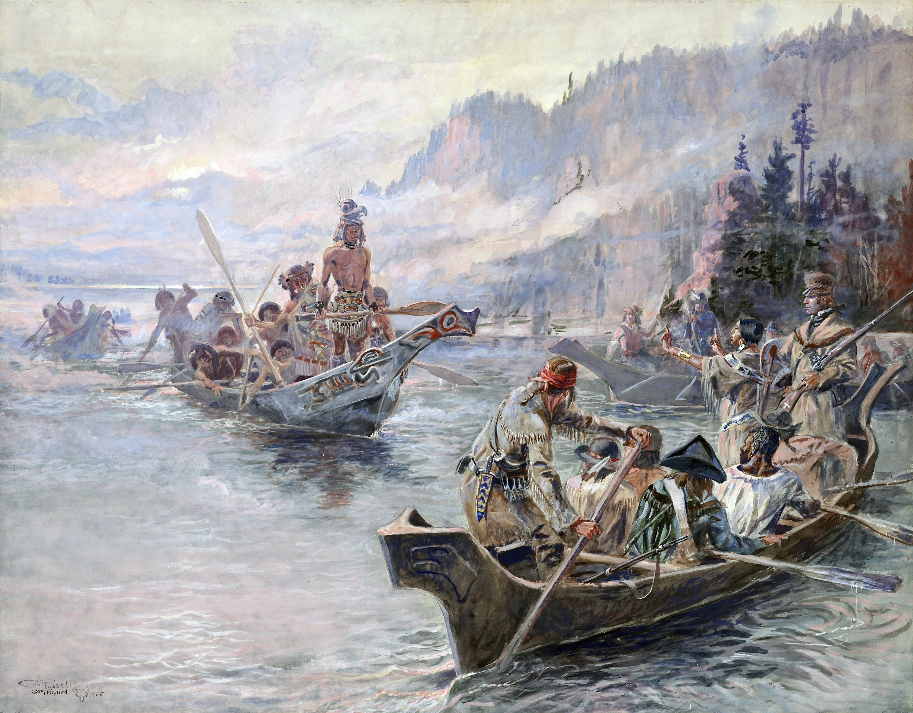
Northwest Journey - Corps of Discovery
Lewis and Clark Expedition
Southwest Journeys – Trail of Tears, Santa Fe Trail
West Coast Journeys – Oregon, California Trails
‘Westward Journeys’
Three Year Trilogy . . .

Slide 2
Week 1 - SETTING THE STAGE (SBP)
Geology: introduction to North American Mountains & Rivers
- Weathering & Erosion
- Rock cycle
- Definition of Sedimentary, Metamorphic, Igneous Rocks
History/Culture/People: North America - European arrival/migration to 1802
- Native Americans
- Paleo Indians to Historic Indians - timeline and evolution
- Indian tribes in 1802 (populations, areas, etc)
- focus on Teton Sioux, Mandan/Haditas, Shoshone, Nez Perce, Clapsop
- European Americans
- European discovery
- 13 colonies in ’76 to # states in 1802 (population, distribution, etc)
- American Revolution and development of USA to 1802
- Introduce people involved with Corps
- Thomas Jefferson

Slide 3
Session 1: Setting the Stage
Northwest Journey - Corps of Discovery
Lewis and Clark Expedition
Session 1: Setting the Stage
Session 1: Setting the Stage
Session 2: The Corps Is Formed
Session 3: The River Trip Begins
Session 4: Over the Rockies
Session 5: To the Pacific
Session 6: The Legend Begins

Slide 4
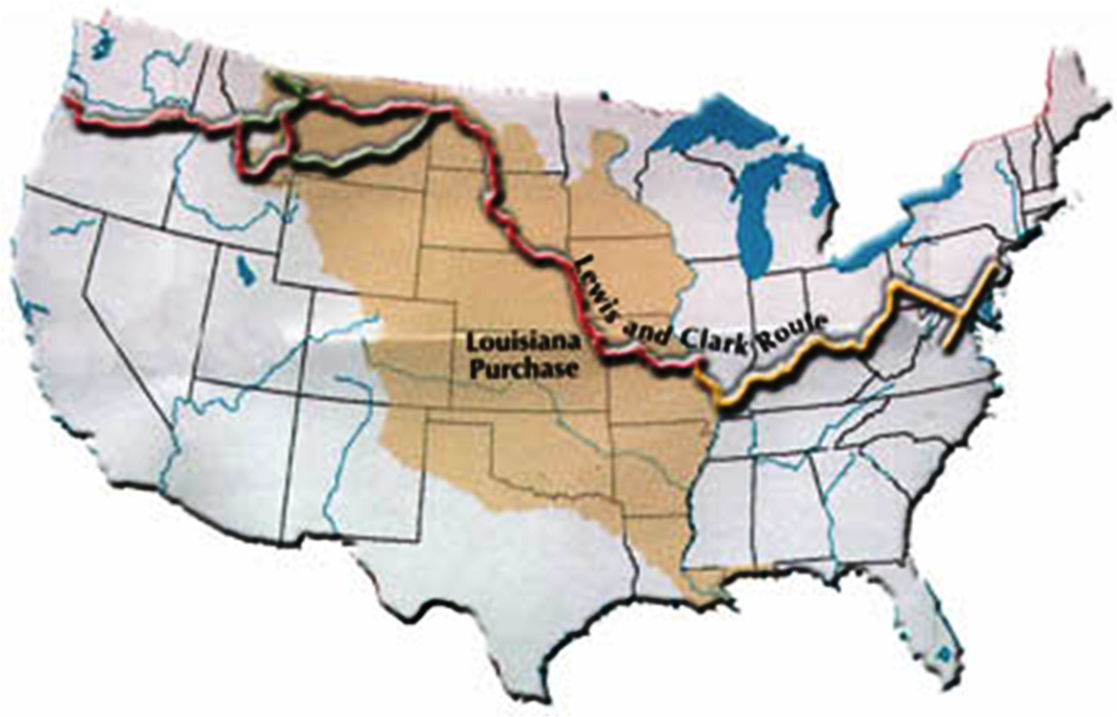
Session 1: Setting the Stage
Setting the Stage
To the Pacific
Over the Mountains
River Trip Begins
Corps Is Formed

Slide 5
Session 1: Setting the Stage
North American Continent
Setting the Stage
North American Continent
- Landforms
- Rivers
People, Cultures, & History
- Native Americans
- European Americans
North American Continent

Slide 6
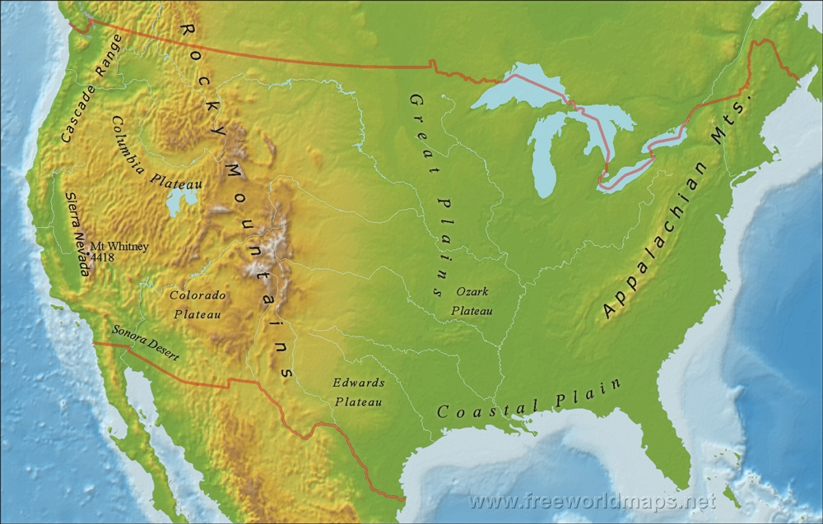
North American Continent
PHYSIOGRAPHIC MAP
: physical landforms & features of the earth
Columbia
Plateau
Great Plains
Appalachian Mountains
Rocky Mountains

Slide 7
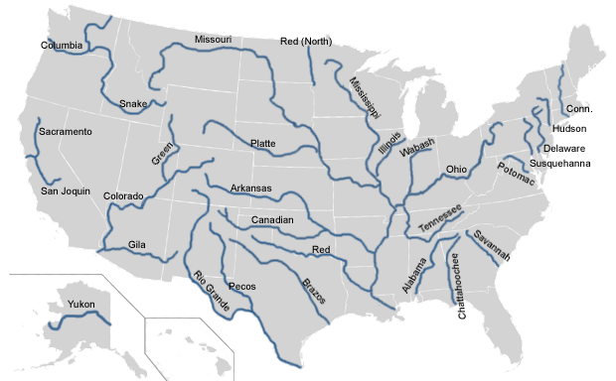
North American Continent
MAJOR RIVERS OF USA
PHYSIOGRAPHIC MAP
: physical landforms & features of the earth
Columbia
Snake
Missouri
Ohio
Mississippi

Slide 8
North American Continent
MAJOR RIVERS OF USA
PHYSIOGRAPHIC MAP
Columbia
Snake
Rocky Mtns
Great Plains
Columbia
Plateau
Missouri
Ohio
Appalachian Mtns
Mississippi
Why are these landforms and rivers here?

Slide 9
North American Continent
PHYSIOGRAPHIC MAP
GEOLOGY
Columbia
Snake
Rocky Mtns
Great Plains
Columbia
Plateau
Missouri
Ohio
Appalachian Mtns
Mississippi
Why are these landforms and rivers here?

Slide 10
North American Continent
GEOLOGY
Weathering & Erosion
Rock Cycle
Plate Tectonics
Glaciation
Today
Session 2
Session 3
Why are these landforms and rivers here?

Slide 11
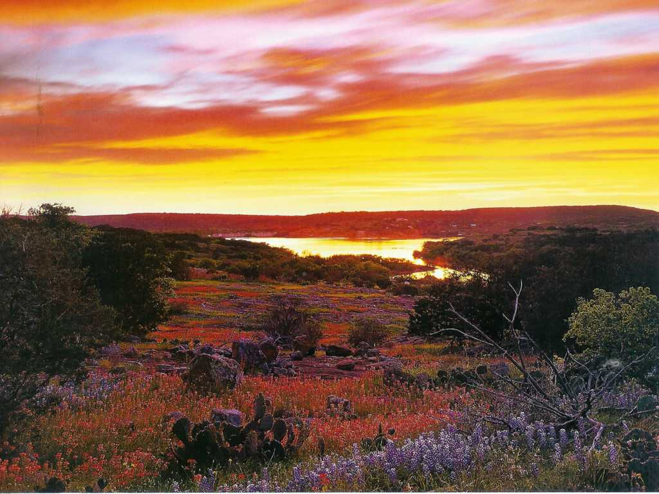
North American Continent
Weathering & Erosion
GEOLOGY
Weathering & Erosion
Weathering & Erosion
Rock Cycle
Plate Tectonics
Glaciation
Weathering: the destruction of rocks
that creates soil & rock debris

Slide 12
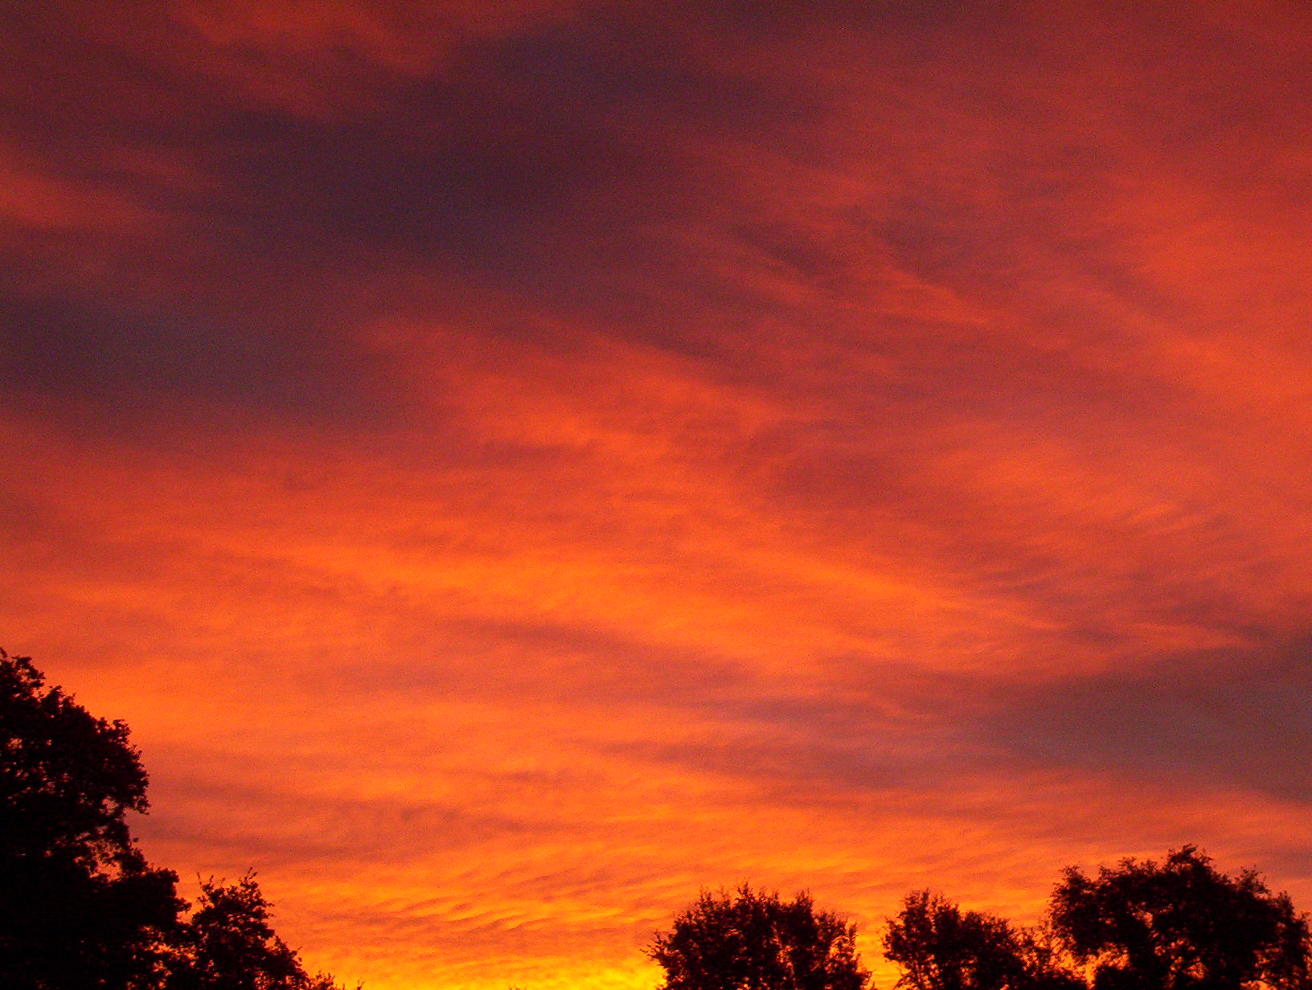
Weathering & Erosion
causes of weathering . . .
Water
Sun Light
Weathering: the destruction of rocks
that creates soil & rock debris
Heating and Cooling
Acids
TIME - TIME - TIME

Slide 13
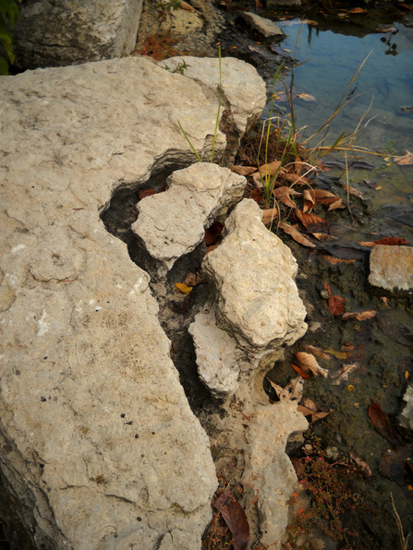
Weathering & Erosion
causes of weathering . . .
Water
Sun Light
abrasion by . . .
falling rain
flowing streams
rivers
Heating and Cooling
Acids
TIME - TIME - TIME

Slide 14
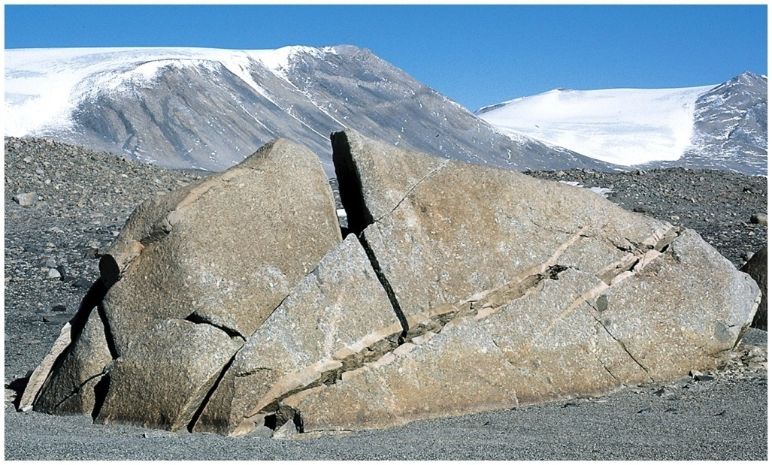
Weathering & Erosion
causes of weathering . . .
Water
Sun Light
. . . . radiation

Slide 15
Weathering & Erosion
causes of weathering . . .
Water
Sun Light
Heating and Cooling
. . . daily expansion
& contraction

Slide 16
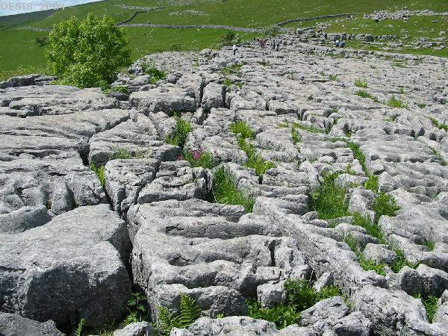
Weathering & Erosion
causes of weathering . . .
Water
Sun Light
Heating and Cooling
Acids
Acid Rain (natural)
Humic Acid (plant decay)
Notes:
http://teach.albion.edu/jjn10/chemical-weathering/
Rocks can be subjected to dissolution, the process by which a mineral completely dissolves in water. Dissolution is an especially effective method of chemical weathering in rocks that contain either magnesium carbonate or calcium carbonate, two substances which are easily dissolved by water or other acidic solutions. (Most commonly, the weak acid in question is carbonic acid, the result of a reaction between carbon dioxide and water. However, other weak acids are possible.

Slide 17
Weathering & Erosion
causes of weathering . . .
Water
Want more details?
Sun Light
Heating and Cooling
Acids
Check out our hidden slides?
GEOLOGIC TIME!
TIME -TIME - TIME

Slide 18
https://soils.ifas.ufl.edu/faculty/grunwald/teaching/eSoilScience/weathering.shtml
Primary minerals and rocks are disintegrated in fragments due to physical weathering. This leads to environmental conditions (e.g. a higher surface area) that favor chemical weathering. There are several forms of physical weathering:
Abrasion: Water carrying suspended rock fragments has a scouring action on surfaces. Examples are the grinding action of glaciers, gravel, pebbles and boulders moved along and constantly abraded by fast-flowing streams. Particles carried by wind also have a 'sand-blasting effect'.
Wetting and drying: Water penetrates into rocks and reacts with their constituent minerals.
Freezing and thawing: When water is trapped in the rock (or in cracks) repeatedly freezing and thawing results in forces of expansion and contraction (when water freezes, the increase in its volume is about 9 %).
Thermal expansion and contraction of minerals: Rocks are composed of different kind of minerals. When heated up by solar radiation each different mineral will expand and contract a different amount at a different rate with surface-temperature fluctuations. With time, the stresses produced are sufficient to weaken the bonds along grain boundaries, and thus flaking of fragments.
For instance, the difference in temperature in desert environments or mountain regions may range from 30 - 50 degrees C between day and night. Rocks are heated and cooled from the outside by change in solar radiation, which results in high temperature gradients inside and outside of the rocks (the heat conductivity of rocks is very low).
Pressure unloading or pressure-release jointing: There is a reduction in pressure on a rock due to removal of overlying material. This allows rocks to split along planes of weakness, called joints.
Crystallization: In arid environments, water evaporates at the surface of rocks and crystals form from dissolved minerals. Over time, the crystals grow (They expand their volume) and exert a force great enough to separate mineral grains and break up rocks.
Action of organisms: They aid in the physical disintegration of rocks.
Plant roots: They aid in the physical disintegration of rocks. Pressures exerted by roots during growth are able to rupture rocks.

Slide 19
Weathering & Erosion
the products of weathering . . .
causes of weathering . . .
Want more details?
Weathering: the destruction of rocks
that creates soil & rock debris
Check out our hidden slides?

Slide 20
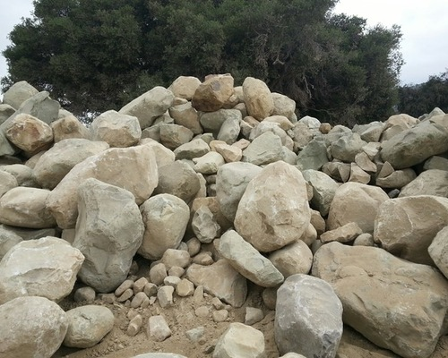
Weathering & Erosion
the products of weathering . . .
Soils & Rock Debris
Weathering: the destruction of rocks
that creates soil & rock debris

Slide 21
Weathering & Erosion
the products of weathering . . .
Soils & Rock Debris
Size classification:
boulders
cobbles
pebbles
sand
silt
clay

Slide 22
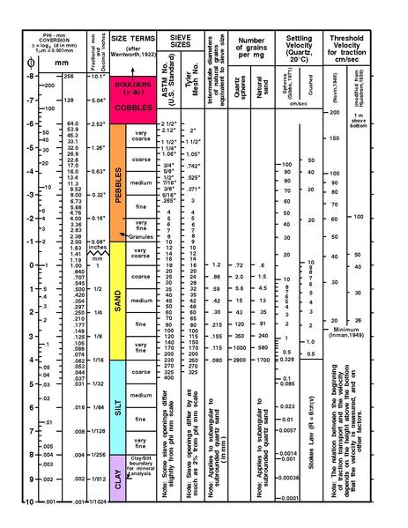
Weathering & Erosion
the products of weathering . . .
Soils & Rock Debris
Size classification:
boulders
cobbles
pebbles
sand
silt
clay

Slide 23
Weathering & Erosion
1
mm
the products of weathering . . .
Soils & Rock Debris
Size classification:
boulders
cobbles
pebbles
sand
silt
clay
10”
BOULDER
SAND
CLAY
1/512 mm

Slide 24
Weathering & Erosion
the products of weathering . . .
Soils & Rock Debris
Size classification:
boulders
cobbles
pebbles
sand
silt
clay
Weathering: the destruction of rocks
that creates soil & rock debris
Erosion: the process of moving
weathered debris toward the oceans

Slide 25
Weathering & Erosion
The principal function of streams & rivers:
deliver weathered debris to the oceans
Weathering: the destruction of rocks
that creates soil & rock debris
Erosion: the process of moving
weathered debris toward the oceans

Slide 26
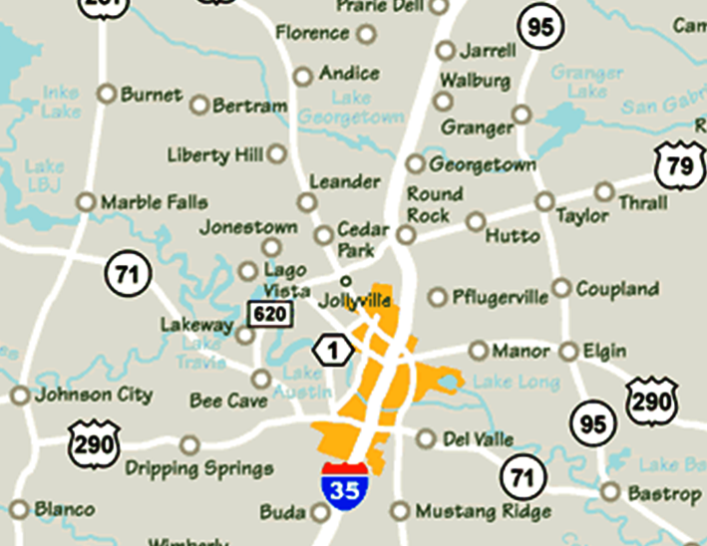
Weathering & Erosion
Let‘s see a local example….
The principal function of streams & rivers:
deliver weathered debris to the oceans
Austin

Slide 27
Weathering & Erosion
Let‘s see a local example….
cross-section
Austin

Slide 28
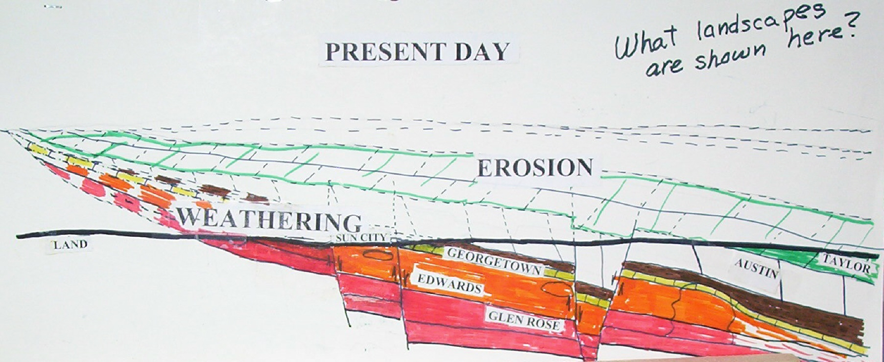
Weathering & Erosion
Land surface
65 million years ago
Liberty Hill
Taylor
Present day
Land surface
Rocks are weathered & debris moved by rivers to the Gulf of Mexico
Layers of sedimentary rocks 145 to 65 million years old
Land surface
LIMESTONE LAYERS
Continental Crust –
metamorphic & igneous rocks

Slide 29
Weathering & Erosion
Let‘s look at the big picture….
The North American Continent

Slide 30
Weathering & Erosion
rivers move rock debris to continental margins
rock debris accumulates
as layers of sediments
Continents are
destroyed by
Weathering & Erosion

Slide 31
North American Continent
Weathering & Erosion
GEOLOGY
rivers move rock debris to continental margins
rock debris accumulates
as layers of sediments
Weathering & Erosion
Rock Cycle
Plate Tectonics
Glaciation
Continents are
destroyed by
Weathering & Erosion

Slide 32
North American Continent
Rock types and the rock cycle
GEOLOGY
Weathering & Erosion
Rock Cycle
Plate Tectonics
Glaciation
Rock Cycle

Slide 33
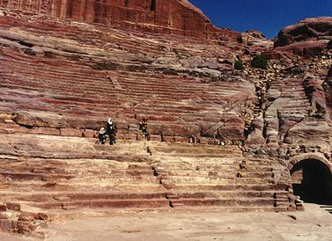
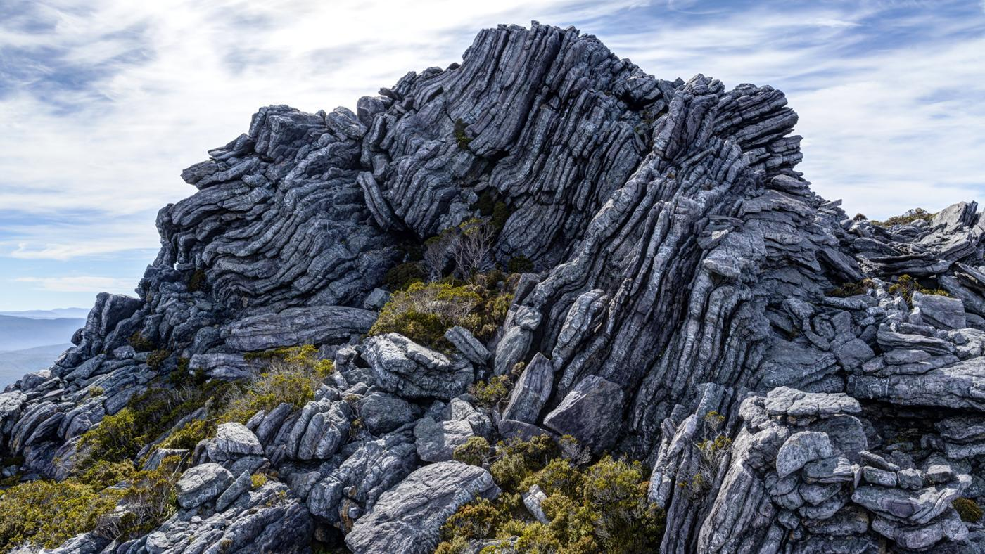
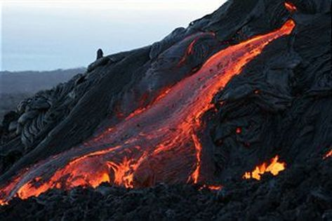
Rock types and the rock cycle
Three Types of Rocks make up the Earth’s Crust
Sedimentary Rocks
Metamorphic Rocks
Igneous Rocks

Slide 34
https://en.wikipedia.org/wiki/sedimentary_rock
Sedimentary rocks are formed by the deposition and subsequent cementation of that material at the Earth's surface and within bodies of water. Sedimentation is the collective name for processes that cause mineral and/or organic particles (detritus) to settle in place. The particles that form a sedimentary rock by accumulating are called sediment. Before being deposited, the sediment was formed by weathering and erosion from the source area, and then transported to the place of deposition by water, wind, ice, or glaciers. Sedimentation may also occur as minerals precipitate from water solution or shells of aquatic creatures settle out of suspension.
ttps://www.reference.com/science/can-metamorphic-rocks-found-3dd4f3f23f019b44
Metamorphic rocks are most often found in mountainous regions though they can be seen wherever there are signs of geological upheaval in an area. This type of rock is formed by the transformation of another rock type, a change that is usually triggered by tremendous heat, pressure or other violent phenomena. The forces that cause metamorphic rocks to form are so great that they change not only the appearance but also the chemical composition of an existing rock.
https://en.wikipedia.org/wiki/igneous_rock
Igneous rock is formed through the cooling and solidification of magma or lava. The magma can be derived from partial melts of existing rocks in either a planet's mantle or crust. Typically, the melting is caused by one or more of three processes: an increase in temperature, a decrease in pressure, or a change in composition. Solidification into rock occurs either below the surface as intrusive rocks or on the surface as extrusive
rocks.

Slide 35
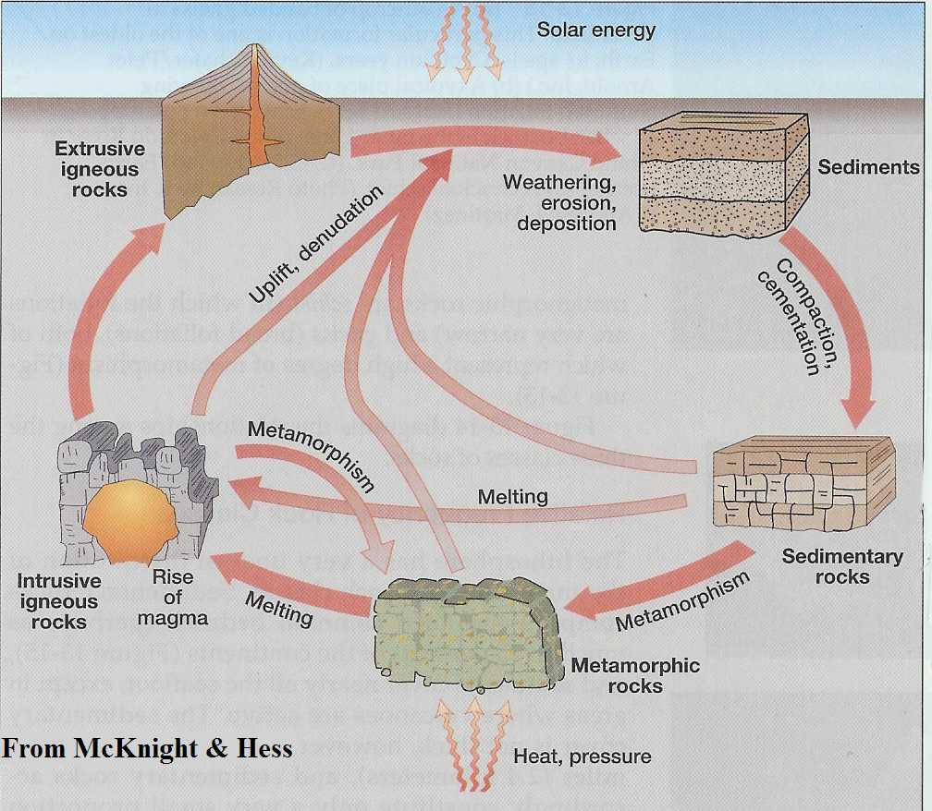
Rock types and the rock cycle
The Rock Cycle
Three Types of Rocks make up the Earth’s Crust
Sedimentary Rocks
Metamorphic Rocks
Igneous Rocks
SURFACE
DEPTH

Slide 36
The Rock Cycle
weathering,
erosion
Sediments
seashells & shell debris
Burial:
heat
pressure
sand
clay (mud)
Sedimentary
Rocks

Slide 37
The Rock Cycle
weathering,
erosion
Sediments
limestone
Shells & shell debris
Burial:
heat
pressure
sandstone
Sand
shale
Clay (mud)
Sedimentary
Rocks
Common Sedimentary Rock Types

Slide 38
The Rock Cycle
weathering,
erosion
Sediments to
Sedimentary Rocks
Sedimentary Rocks
to
Metamorphic Rocks
partial melting

Slide 39
The Rock Cycle
weathering,
erosion
Sediments to
Sedimentary Rocks
limestone
sandstone
Sedimentary Rocks
to
Metamorphic Rocks
Marble
shale
Quartzite
Slate
partial melting
Common Metamorphic Rocks

Slide 40
The Rock Cycle
weathering,
erosion
Sediments to
Sedimentary Rocks
Metamorphic
Rocks to
Igneous
Rocks
Sedimentary
Rocks to
Metamorphic
Rocks
complete melting

Slide 41
The Rock Cycle
weathering,
erosion
BASALT
Sediments to
Sedimentary Rocks
Metamorphic
Rocks to
Igneous
Rocks
GRANITE
Sedimentary
Rocks to
Metamorphic
Rocks
complete melting

Slide 42
North American Continent
The Rock Cycle
GEOLOGY
weathering,
erosion
Weathering & Erosion
Rock Cycle
Plate Tectonics
Glaciation
Sediments to
Sedimentary Rocks
Metamorphic
Rocks to
Igneous
Rocks
Sedimentary
Rocks to
Metamorphic
Rocks

Slide 43
North American Continent
GEOLOGY
Weathering & Erosion
Rock Cycle
Weathering & Erosion
Rock Cycle
Plate Tectonics
Glaciation
LATER
SESSIONS
How do these processes impact

Slide 44
North American Continent
PHYSIOGRAPHIC MAP
: physical landforms & features of the earth
GEOLOGY
Weathering & Erosion
Rock Cycle
Appalachian Mountains
Rocky Mountains
How do these processes impact

Slide 45
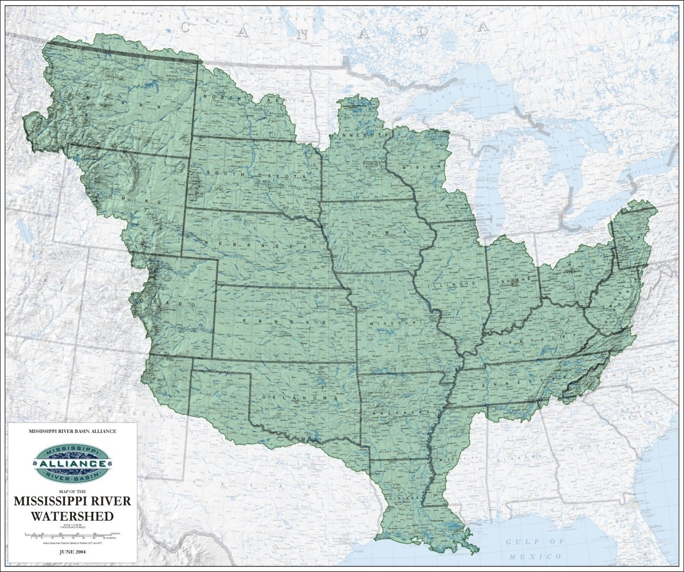
North American Continent
PHYSIOGRAPHIC MAP
: physical landforms & features of the earth
Appalachian Mountains
Rocky Mountains

Slide 46
North American Continent
Rivers move weathered debris toward the oceans
How will this impact the Corps of Discovery?

Slide 47
North American Continent
Rivers move weathered debris toward the oceans
large, dense rock debris drop to the river bottom first
smaller, less dense rock debris next
very small particles of suspended sediments last
mountains
Boulders
Cobbles
Pebbles
Gravel
Sand
ocean
river
Silt
Clay
How will this impact the Corps of Discovery?

Slide 48
North American Continent
Rivers move weathered debris toward the oceans
large, dense rock debris drop to the river bottom first
smaller, less dense rock debris next
very small particles of suspended sediments last
UP-STREAM: near the headwaters, the river bottom should be large sediments: boulders and cobbles
DOWN-STREAM: near mouth of river, the river bottom should be small sediments: gravels, sands, silts
river
We’ll investigate this phenomena
How will this impact the Corps of Discovery?

Slide 49
https://www.davis.k12.ut.us/cms/lib09/UT01001306/Centricity/domain/10573/7th%20grade/Sediment%20Sorting%20PPT.pdf
Rivers, streams, and oceans carry sediments and deposit them on the basis of density and size and shape. Large, round, dense sediments deposit first; small, flat, less dense sediments second; finally small particles of suspended sediment fall.

Slide 50
North American Continent
Rivers move weathered debris toward the oceans
We’ll investigate this phenomena

Slide 51
Native Americans
Session 1: Setting the Stage
North American Continent
Setting the Stage
Rivers move weathered debris toward the oceans
North American Continent
- Landforms
- Rivers
People, Cultures, & History
- Native Americans
- European Americans
Native Americans
We’ll investigate this phenomena

Slide 52
Native Americans
Archeological Periods
Paleo .. . . . . . . 15,000 - 8,000 YBP
Archaic . . . . . . 9,000 - 3,000 YBP
Woodland . . . . 3,000 YBP -European contact
Mississippian . . 800 - 1600 CE
Historic . . . from European contact to present
Archeological Periods
Paleo
Where did they come from?
What was their culture?

Slide 53
https://en.wikipedia.org/wiki/List_of_archaeological_periods_(North_America)
North American archaeological periods divides the history of pre-Columbian North America into a number of named successive eras or periods, from the earliest-known human habitation through to the early Colonial period which followed the European colonization of the Americas.
One of the most enduring classifications of archaeological periods and cultures was established in Gordon Willey and Philip Phillips' 1958 book Method and Theory in American Archaeology. They divided the archaeological record in the Americas into 5 phases, only three of which applied to North America. The use of these divisions has diminished in most of North America due to the development of local classifications with more elaborate breakdowns of times.
The Paleo-Indians stage and/or Lithic stage
The Archaic stage
Post-archaic stage - At this point the North American classifications system differs from the rest of the Americas. For more details on the five major stages, still used in Mesoamerican archaeology, see Mesoamerican chronology and Archaeology of the Americas.

Slide 54
Native Americans
Native Americans – Paleo Period
North American Migration Theories
LAND BRIDGE
from Asia
Archeological Periods
Paleo
SEA CROSSING
from Europe
Paleo
COASTAL
from Asia
Where did they come from?
What was their culture?
migration during the last glacial episode
20,000 (??) – 12,000 YBP
Clovis and Pre-Clovis People
from Smithsonian

Slide 55
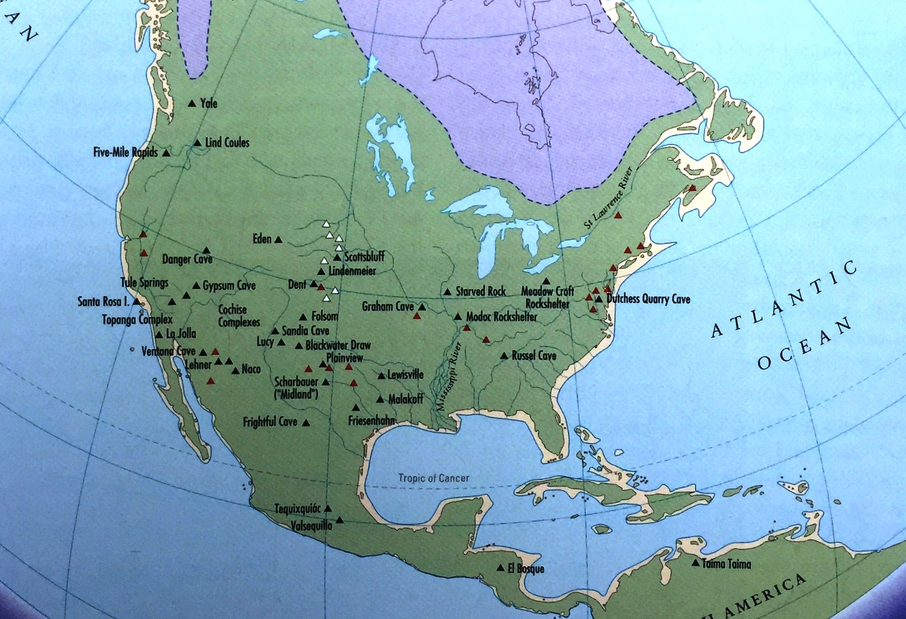
North American Migration Theories
Native Americans – Paleo Period
archeological sites of Clovis hunters
LAND BRIDGE
from Asia
SEA CROSSING
from Europe
COASTAL
from Asia
migration during the last glacial episode
20,000 (??) – 12,000 YBP
Clovis and Pre-Clovis People
from Smithsonian

Slide 56
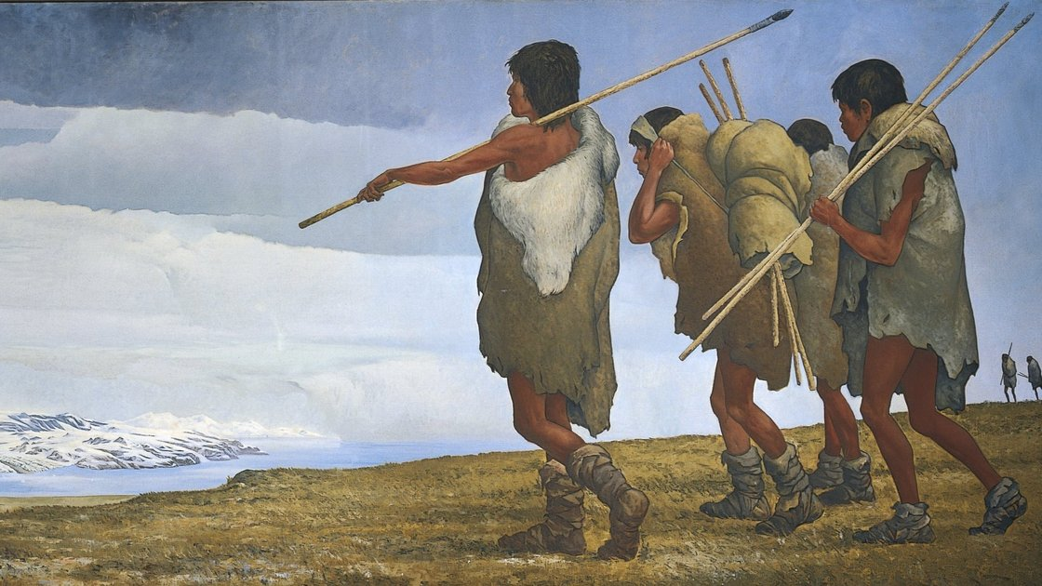
Native Americans – Paleo Period
archeological sites of Clovis hunters
HUNTER-GATHERERS
stone tool users
- spear points
- microblades
- hammerstones
foraging strategy:
mammoth
mastadon
smaller animals
some flora

Slide 57
https://en.wikipedia.org/wiki/Paleo-Indians
Paleoindians or Paleoamericans is a classification term given to the first peoples who entered, and subsequently inhabited, the Americas during the final glacial episodes of the late Pleistocene period. The prefix "paleo-" comes from the Greek adjective palaios (παλαιός), meaning "old" or "ancient". The term "Paleo-Indians" applies specifically to the lithic period in the Western Hemisphere and is distinct from the term "Paleolithic".
Evidence suggests big-animal hunters crossed the Bering Strait from Eurasia into North America over a land and ice bridge (Beringia), that existed between 45,000-12,000 BCE (47,000-14,000 BP). Small isolated groups of hunter-gatherers migrated alongside herds of large herbivores far into Alaska. From 16,500-13,500 BCE (18,500-15,500 BP), ice-free corridors developed along the Pacific coast and valleys of North America. This allowed animals, followed by humans, to migrate south into the interior. The people went on foot or used primitive boats along the coastline. The precise dates and routes of the peopling of the New World are subject to ongoing debate.
Stone tools, particularly projectile points and scrapers, are the primary evidence of the earliest human activity in the Americas. Crafted lithic flaked tools are used by archaeologists and anthropologists to classify cultural periods. Scientific evidence links Indigenous Americans to Asian peoples, specifically eastern Siberian populations. Indigenous peoples of the Americas have been linked to Siberian populations by linguistic factors, the distribution of blood types, and in genetic composition as reflected by molecular data, such as DNA.
Between 8000-7000 BCE (10,000-9,000 years BP) the climate stabilized, leading to a rise in population and lithic technology advances, resulting in more sedentary lifestyle.
The specifics of Paleo-Indian migration to and throughout the Americas, including the exact dates and routes traveled, are subject to ongoing research and discussion. The traditional theory has been that these early migrants moved into the Beringia land bridge between eastern Siberia and present-day Alaska around 40,000 – 17,000 years ago, when sea levels were significantly lowered due to the Quaternary glaciation. These people are believed to have followed herds of now-extinct pleistocene megafauna along ice-free corridors that stretched between the Laurentide and Cordilleran ice sheets. Another route proposed is that, either on foot or using primitive boats, they migrated down the Pacific coast to South America. Evidence of the latter would since have been covered by a sea level rise of hundreds of meters following the last ice age.
Archaeologists contend that Paleo-Indians migration out of Beringia (western Alaska), ranges from 40,000 to around 16,500 years ago. This time range is a source of debate and promises to continue as such for years to come. The few agreements achieved to date are the origin from Central Asia, with widespread habitation of the Americas during the end of the last glacial period, or more specifically what is known as the late glacial maximum, around 16,000–13,000 years before present. However, alternative theories about the origins of Paleoindians exist, including migration from Europe.

Slide 58
https://en.wikipedia.org/wiki/Paleo-Indians
The Clovis culture, appearing around 11,500 BCE (13,500 BP), undoubtedly did not rely exclusively on megafauna for subsistence. Instead, they employed a mixed foraging strategy that included smaller terrestrial game, aquatic animals, and a variety of flora Paleo-Indian groups were efficient hunters and carried a variety of tools. These included highly efficient fluted style spear points, as well as microblades used for butchering and hide processing. Projectile points and hammerstones made from many sources are found traded or moved to new locations. Stone tools were traded and/or left behind from North Dakota and Northwest Territories, to Montana and Wyoming. Trade routes also have been found from the British Columbia Interior to the coast of California.
http://news.ku.dk/all_news/2012/2012.7/clovis_eske_science/
The Clovis First Theory is put to rest at Paisley Caves
DNA ANALYSIS
Who were the first humans to enter the North American continent? Were they humans who founded what is known as the Clovis culture over 13,000 years ago? Or did other, totally unrelated peoples precede the Clovis immigrants? This issue has been intensely, if not bitterly debated for decades. The Clovis culture has been seen as the cradle of North American indigenous culture. Now new international research shows that people of another culture and technology were present concurrently or even previous to those of Clovis. Scientists have added a new and dramatic chapter to the history of the peopling of the Americas striking a deadly blow to the “Clovis First” theory that has dominated pre-historic American archaeology for so long. The sensational results are published in the international journal Science.
The evidence for a pre-13,000 year old, non-Clovis culture in North America includes obsidian and chert artifacts known as Western Stemmed projectile points, and DNA-profiling of dried human excrement — more accurately known as coprolites. Both obsidian projectile points and coprolites were excavated from sediments in the Paisley Caves.
Previous investigations found that human coprolites in the caves predated the Clovis culture by over 1,000 years; however, critics questioned the interpretations by saying that the cave strata had not been sufficiently examined and that no Clovis-age stone tools had been found with the coprolites.
Critics also questioned whether or not younger DNA could have been washed down through the cave’s sediments, thereby contaminating non-human coprolites with more recent human DNA. If true, evidence for pre-Clovis human presence would have been bogus.
The new study refutes every one of the critics’ arguments and uses overwhelming archaeological, stratigraphic, DNA and radiocarbon evidence to conclusively state that humans — and ones totally unrelated to Clovis peoples — were present at Paisley Caves over a millennium before Clovis.
The new results severely contrast with the “Clovis First” theory for early peopling of the Americas. The Clovis First hypothesis states that no humans existed in the Americas prior to Clovis, which dates from 13,000 years ago, and that the distinct Clovis lithic technology is the mother technology of all other stone artifact types later occurring in the New World.
This theory has been predominant since the first evidence of human presence in America was found in 1932 at the Clovis type locality in Blackwater Draw, just outside the village of Clovis in New Mexico. But now this praised and respected foundation of American prehistory has been overthrown.
"One of the central questions has been whether the technological evolution of hunting tools such as dart and spearheads can be attributed solely to the Clovis culture and the knowledge that these people brought from the old world. During our excavations in the Paisley Caves we’ve found a completely different type of dart points. But these new points are of a completely different construction from those found in the Clovis culture. As our radiocarbon dating shows, the new finds are as old, or possibly older than the Clovis finds, this proves that the Clovis culture cannot have been the 'Mother technology' for all other technologies in America. Our results show, that America was colonized by multiple cultures at the same time. And some perhaps even earlier than Clovis."

Slide 59
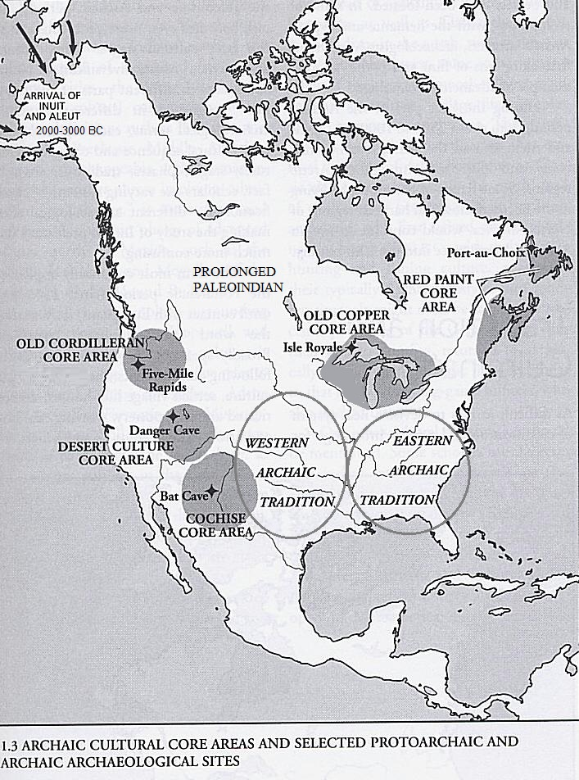

Slide 60
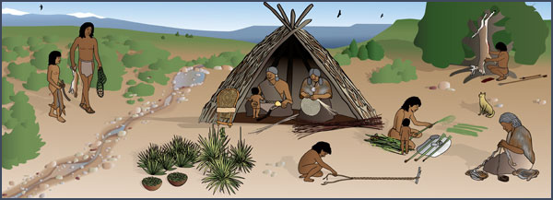
Native Americans – Paleo Period
Archaic Period
SUBSISTENCE ECONOMY
About 10,000 years ago . . .
HUNTER-GATHERERS
stone tool users
- spear points
- microblades
- hammerstones
foraging strategy:
mammoth
mastadon
smaller animals
some flora
glaciers melt . . . . temperatures rise . . . .
large animals become extinct

Slide 61
Native Americans – Archaic Period
Archaic Period
SUBSISTENCE ECONOMY
transitional period
- from hunting mega-fauna to
hunting smaller game
- from gathering flora to
growing food (late Archaic)
territories became smaller, more defined
distinct local traditions developed
- beginnings of pottery making
SUBSISTENCE ECONOMY

Slide 62
https://en.wikipedia.org/wiki/Archaic_period_in_North_America
In the classification of Archaeological cultures of North America, the Archaic period or "Meso-Indian period" in North America, accepted to be from around 8000 to 2000 BCE in the sequence of North American pre-Columbian cultural stages, is a period defined by the archaic stage of cultural development. The Archaic stage is characterized by subsistence economies supported through the exploitation of nuts, seeds, and shellfish. As its ending is defined by the adoption of sedentary farming, this date can vary significantly across the Americas.
https://www.crowcanyon.org/EducationProducts/peoples_mesa_verde/archaic_overview.asp
The change from the Paleoindian period to the Archaic period did not happen overnight. Over a period of many centuries, the environment gradually became more similar to what we are accustomed to today. The warmer and drier conditions contributed to the extinction of the megafauna that had roamed North America during the Paleoindian period. And some scientists believe that intensive hunting by humans may have further hastened the extinction of several species such as mammoths, mastodons, and an ancient form of bison.
So how did Archaic peoples adjust to their changing world? Although they continued their nomadic, hunter-gatherer lifestyle, their prey consisted entirely of animals familiar to us today: deer, elk, bighorn sheep, rabbits, and rodents. In addition, Archaic peoples became increasingly dependent on wild plant foods to round out their diet. And, late in the Archaic period, corn and squash made their first appearance on the Colorado Plateau, although the introduction of these domesticated plants did not have a major impact on lifeways until the subsequent periods.
As human populations increased throughout North America during the Archaic period, the territories of individual bands became smaller and more clearly defined than was the case during the Paleoindian period. And with groups ranging in smaller areas, distinct local traditions began to develop, as reflected in the different styles of artifacts and houses dating from this period.

Slide 63
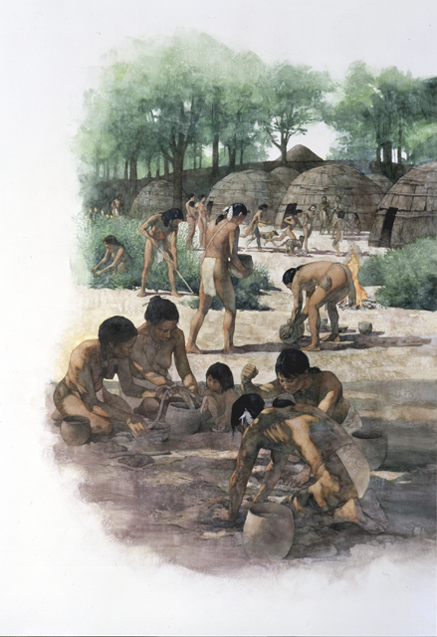
Native Americans – Archaic Period
Archaic Period
Woodland Period
SUBSISTENCE ECONOMY
transitional period
- from hunting mega-fauna to
hunting smaller game
- from gathering flora to
growing food (late Archaic)
territories became smaller, more defined
distinct local traditions developed
- beginnings of pottery making
3,000 YEARS AGO . . .
Focused in eastern North America
on-going development of:
- permanent settlements
- shelter construction
- stone and bone tools
- leather crafting
- textile manufacture
ALSO
- increasing use of
horticulture
- diversification in
pottery skills

Slide 64
https://en.wikipedia.org/wiki/Woodland_period
In the classification of Archaeological cultures of North America, the Woodland period of North American pre-Columbian cultures spanned a period from roughly 1000 BCE to European contact in the eastern part of North America, with some archaeologists distinguishing the Mississippian period, from 1000 CE to European contact as a separate period. The term "Woodland Period" was introduced in the 1930s as a generic term for prehistoric sites falling between the Archaic hunter-gatherers and the agriculturalist Mississippian cultures. The Eastern Woodlands cultural region covers what is now eastern Canada south of the Subarctic region, the eastern United States, along to the Gulf of Mexico.
This period is variously considered a developmental stage, a time period, a suite of technological adaptations or "traits," and a "family tree" of cultures related to earlier Archaic cultures. It can be characterized as a chronological and cultural manifestation without any massive changes in a short time but instead having a continuous development in stone and bone tools, leather crafting, textile manufacture, cultivation, and shelter construction. Many Woodland peoples used spears and atlatls until the end of the period, when they were replaced by bows and arrows; however, Southeastern Woodland peoples also used blowguns.
The most cited technological distinction of this period was the widespread use of pottery (although pottery manufacture had arisen during the Archaic period in some places), and the diversification of pottery forms, decorations, and manufacturing practices. The increasing use of horticulture and the development of the Eastern Agricultural Complex, consisting of weedy seed plants as well as gourd cultivation, also meant that groups became less mobile over time and, in some times and places, people lived in permanently occupied villages and cities. Intensive agriculture characterizes the Mississippian period from ca. 1000-1400 CE and may have continued up to European contact, around 500 years ago. Eastern Woodland's lived in wigwams and longhouses.
http://mcclungmuseum.utk.edu/2009/01/01/prehistoric-american-indians/
The Woodland period has been broadly characterized by the manufacture of pottery, the beginnings of intensive agriculture, and the construction of burial mounds and ceremonial earthworks (Figure 15). The shift from an Archaic period way of life to that of Woodland culture did not occur everywhere at the same time. Changes that had begun in the Archaic culminated in the Woodland and increasing population necessitated changes in political and social organization. As with the Archaic, the Woodland period is divided by archaeologists into Early (3000–2200 YBP), Middle (2200–1600 YBP), and Late 1600–1100 YBP).

Slide 65
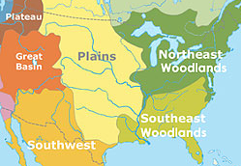
Native Americans – Archaic Period
Woodland Period
Focused in eastern North America
Woodlands

Slide 66
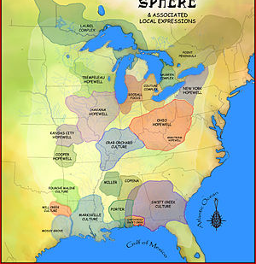
Native Americans – Archaic Period
Woodland Period
Focused in eastern North America
Middle Woodland Period (2200-1500 YBP)
Woodlands
development of:
separate cultural groups
regional trade networks

Slide 67
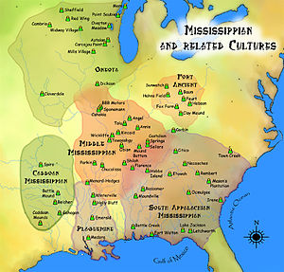
Native Americans – Archaic Period
Woodland Period
Mississippian
Focused in eastern North America
about 800 years ago . . .
Middle Woodland Period (2200-1500 YBP)
Woodlands
development of:
separate cultural groups
regional trade networks

Slide 68
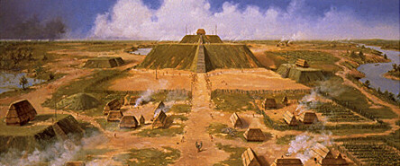
Native Americans – Archaic Period
Mississippian
about 800 years ago . . .
Mound Building Culture
Middle Woodland Period (2200-1500 YBP)
earthen platform mounds for temples,
council buildings, elite residences
open plazas (social, religious, political activities)
Woodlands
Cohokia (Illinois)

Slide 69
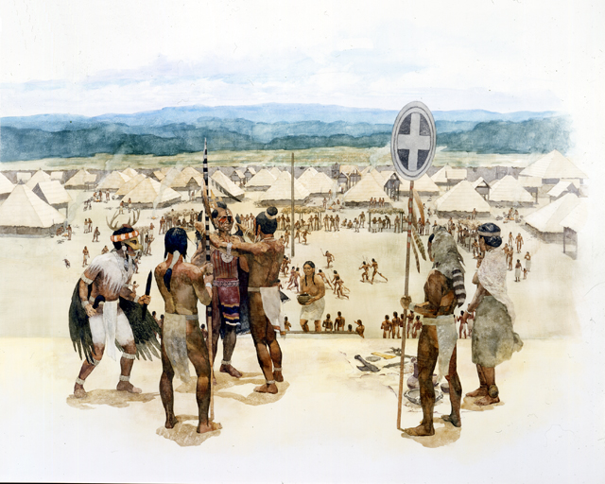
Native Americans – Archaic Period
Mississippian
Mound Building Culture
earthen platform mounds for temples,
council buildings, elite residences
open plazas (social, religious, political activities)
increased warfare
elaborate religious ceremonies, symbolism
emergence of organized chiefdoms
increased population
Notes:
Caholia: Quaternary Science Reviews, "Between AD 1050 and 1100, Cahokia's population increased from between 1400 and 2800 people to between 10,200 and 15,300 people".^{[15]} an estimate that applies only to a 1.8 km2 high density central occupation area.^{[16]} Archaeologists estimate the city's population at between 6,000 and 40,000 at its peak

Slide 70
https://en.wikipedia.org/wiki/Mississippian_culture
The Mississippian culture was a mound-building Native American civilization archeologists date from approximately 800 CE to 1600 CE, varying regionally.
It was composed of a series of urban settlements and satellite villages (suburbs) linked together by a loose trading network, the largest city being Cahokia, believed to be a major religious center. The civilisation flourished from the southern shores of the Great Lakes at Western New York and Western Pennsylvania in what is now the Eastern Midwest, extending south-southwest into the lower Mississippi Valley and wrapping easterly around the southern foot of the Appalachians barrier range into what is now the Southeastern United States.
The Mississippian way of life began to develop in the Mississippi River Valley (for which it is named). Cultures in the tributary Tennessee River Valley may have also begun to develop Mississippian characteristics at this point. Almost all dated Mississippian sites predate 1539–1540 (when Hernando de Soto explored the area), with notable exceptions being Natchez communities that maintained Mississippian cultural practices into the 18th century.
The Mississippi stage is usually divided into three or more chronological periods. Each period is an arbitrary historical distinction varying regionally. At a particular site, each period may be considered to begin earlier or later, depending on the speed of adoption or development of given Mississippian traits. The "Mississippi period" should not be confused with the "Mississippian culture". The Mississippi period is the chronological stage, while Mississippian culture refers to the cultural similarities that characterize this society.
The Early Mississippi period (c. 1000–1200 CE) had just transitioned from the Late Woodland period way of life (500–1000). Different groups abandoned tribal lifeways for increasing complexity, sedentism, centralization, and agriculture. Production of surplus corn and attractions of the regional chiefdoms led to rapid population concentrations in major centers.
The Middle Mississippi period (c. 1200–1400) is the apex of the Mississippi era. The expansion of the great metropolis and ceremonial complex at Cahokia (in present-day Illinois), the formation of other complex chiefdoms, and the spread and development of SECC art and symbolism are characteristic changes of this period. The Mississippian traits listed above came to be widespread throughout the region.
The Late Mississippi period (c. 1400–1540) is characterized by increasing warfare, political turmoil, and population movement. The population of Cahokia dispersed early in this period (1350–1400), perhaps migrating to other rising political centers. More defensive structures are often seen at sites, and sometimes a decline in mound-building and large scale, public ceremonialism. Although some areas continued an essentially Middle Mississippian culture until the first significant contact with Europeans, the population of most areas had dispersed or were experiencing severe social stress by 1500. Along with the contemporaneous Ancestral Pueblo peoples, these cultural collapses coincide with the global climate change of the Little Ice Age. Scholars theorize drought and the reduction of maize agriculture, together with possible deforestation and overhunting by the concentrated populations, forced them to move away from major sites. This period ended with European contact in the 16th century.
A number of cultural traits are recognized as being characteristic of the Mississippians. Although not all Mississippian peoples practiced all of the following activities, they were distinct from their ancestors in adoption of some or all of these traits.
The construction of large, truncated earthwork pyramid mounds, or platform mounds. Such mounds were usually square, rectangular, or occasionally circular. Structures (domestic houses, temples, burial buildings, or other) were usually constructed atop such mounds.
Maize-based agriculture. In most places, the development of Mississippian culture coincided with adoption of comparatively large-scale, intensive maize agriculture, which supported larger populations and craft specialization.
The adoption and use of riverine (or more rarely marine) shells as tempering agents in their shell tempered pottery.
Widespread trade networks extending as far west as the Rockies, north to the Great Lakes, south to the Gulf of Mexico, and east to the Atlantic Ocean.
The development of the chiefdom or complex chiefdom level of social complexity.
The development of institutionalized social inequality.
A centralization of control of combined political and religious power in the hands of few or one.
The beginnings of a settlement hierarchy, in which one major center (with mounds) has clear influence or control over a number of lesser communities, which may or may not possess a smaller number of mounds.
The adoption of the paraphernalia of the Southeastern Ceremonial Complex (SECC), also called the Southern Cult. This is the belief system of the Mississippians as we know it. SECC items are found in Mississippian-culture sites from Wisconsin (see Aztalan State Park) to the Gulf Coast, and from Florida to Arkansas and Oklahoma. The SECC was frequently tied in to ritual game-playing, as with chunkey.
The Mississippians had no writing system or stone architecture. They worked naturally occurring metal deposits, such as hammering and annealing copper for ritual objects like Mississippian copper plates and other decorations, but did not smelt iron or practice bronze metallurgy.

Slide 71
http://mcclungmuseum.utk.edu/2009/01/01/prehistoric-american-indians/
At its peak, the Mississippian tradition is characterized by the following: (1) the construction of earthen platform mounds on which were erected temples, elite residences, and council buildings; (2) the arrangement of mounds and individual household structures around open plazas; (3) increased population and more stable settlements than in the preceding Woodland period; (4) the emergence of organized chiefdoms; (5) increased warfare; (6) elaborate and well developed religious ceremonialism and symbolism; (7) a dependence upon new and improved strains of corn and the introduction of beans; and (8) morphological changes in ceramics and a fluorescence in ceramic styles.
Increasing social complexity and population density had resulted in a sociopolitical level called a chiefdom. In such a system, social organization was clearly stratified with one’s position defined by hereditary ranking. The chief and his lineage and related lineages were set off from the rest of the people, forming in a sense a hereditary nobility. Certain sites became centers from which the chief would coordinate social, economic, and religious activities. These centers were connected through a web of alliances and were also ranked, with lesser centers subject to a principal chief at a primary town.
In the Mississippian period warfare and alliances for war were a way of life. Need for protection from raids is apparent in the construction of palisades and bastions around villages. While competition for limited prime agricultural land may have been a reason for warfare, the more likely motive is that warfare provided warriors a means for upward mobility within a ranked society. Revenge and retaliation generated by alliances and kinship ties maintained frequent hostilities.

Slide 72
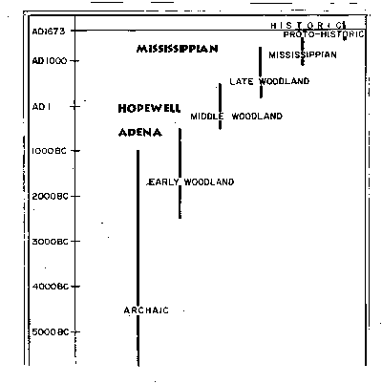
http://helios.acomp.usf.edu/~esearfos/archaeology.htm
The height of moundbuilder culture (Mississippian) can be traced back to earlier forms in the region. Large earthworks did not just appear fully formed as though a result of some outside influence. The names given to the groups of earliest moundbuilders are Adena and Hopewell. The following is a brief description of the development of these cultures as understood through archaeology.
The Adena culture was the inheritor of two archaic cultures of the Midwest, the Red Paint People (or Moorehead burial tradition) in the New England Area and the Old Copper culture in the Great Lakes area who both built small burial mounds. As the name implies the Old Copper culture also mined natural copper nuggets in mining pits.
The Adena people were hunters and gatherers who migrated between seasonal camps. Their buria practices included cremation for common people and burial of higher ranking people in large conical mounds with elaborate grave goods. Not much is known about the everyday life of the Adena people because very few settlements have been unearthed. Since they migrated often, their villages made little archaeological impact on the landscape. They are, however, called Ohio's first farmers since they are known to have cultivated sunflower and squash.
The Hopewell culture continued the large burial mound tradition and also built
monumental earthworks in the shape of circles, squares, and other geometric shapes.
It has been noted that these earthworks are often aligned with astronomical events such
as the solstice sunrises and northernmost and southernmost moonrises. The Hopewell a
lso built road-like formations that linked some of their sites...presumably for migration
from summer-oriented observatories to winter-oriented ones (Little 2001). Hopewell
artifacts, pottery especially, are generally of higher quality than Adena items. They are
also known for their extensive trade contacts, as evidenced from materials found at
Hopewell sites that ranged from the Rocky Mountains to the Atlantic Ocean to the Gulf
of Mexico.
The Hopewell peoples also farmed sunflower and squash and maize as a minor crop. Some see the introduction of maize as evidence of Mexican influence. They also worked in naturally occurring (non-smelted) copper, silver, and iron. The Hopewell cultures are famous for their animal-shaped effigy mounds and carved animal artifacts
Mississippian culture was marked by the formation of large sedentary settlements, even cities such as Moundville in Alabama and Cahokia in Missouri. They built the largest mounds and created their cities around and upon these flat-topped mounds. Their cities also included log palisades to demarcate the elite section from the common settlement.
The Mississippian cultures relied much more heavily on maize farming than their Hopewell precursors. The surplus food production gained by such widespread farming of river floodplains is what allowed the creation of cities with an elite class that did not participate in sustenance activities. Thus, Mississippian culture is marked by the emergence of a more stratified social order within the community, and even within communities with surrounding villages providing food and materials for the central city.
Mississippian artifacts also exhibit evidence of a vast trading network. Marine shells are a somewhat common find in their sites. Their pottery, which became more varied in form, also commonly included shell tempering. Tempering of clay is the addition of foreign material to reduce the amount of shrinkage and cracking during the firing process. The chiefs of Mississippian centers may have used especially fine artifacts in shell or flint as gifts and status symbols.
Notes:
http://helios.acomp.usf.edu/~esearfos/archaeology.htm

Slide 73
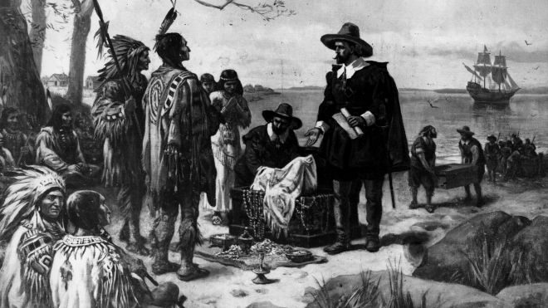
Native Americans – Archaic Period
Mississippian
Historic Period
Mississippian
from 1st contact with Europeans
about 500 years ago . . .
increased warfare
elaborate religious ceremonies, symbolism
emergence of organized chiefdoms
increased population

Slide 74
Native Americans – Archaic Period
Historic Period
Historic Period
from 1st contact with Europeans

Slide 75
Native Americans – Archaic Period
Mississippian
Historic Period
from 1st contact with Europeans
How many Native Americans were there?
diverse customs, culture, & dialects
clan-oriented and communal
clan history primarily oral
religious beliefs focused on nature
hunter/gatherer & agricultural based
extensive trade among various groups
broad, formal contact among clans -- both
friendly and hostile

Slide 76
http://www.encyclopedia.com/history/news-wires-white-papers-and-books/1600-1754-native-americans-overview
1600-1754: Native Americans: Overview
The People. In 1492 the native population of North America north of the Rio Grande was seven million to ten million. These people grouped themselves into approximately six hundred tribes and spoke diverse dialects. European colonists initially encountered Native Americans in three distinct regions. Eastern Woodland tribes included the Five Nations of the Iroquois Confederacy, Abenakis, Shawnees, Delawares, Micmacs, Mahicans, and Pequots. Some of these tribes were sedentary hunter-gathers while others grew maize (corn), beans, and squash. In the Southeast white settlers came into contact with Powhatans, Catawbas, Cherokees, Creeks, Natchez, Choctaws, and Chickasaws; these people were primarily agriculturalists. Pueblos, Zunis, Navajos, and Hopis represented some of the adobe-dwelling bands in the arid Southwest. Regardless of their differences, these groups shared some common characteristics. For Native Americans the family, clan, and village represented the most important social groups. In addition, religions revolved around the belief that all of nature was alive, pulsating with spiritual power.
Contact. When the various European nations reached the New World the encounters were predictably diverse. Culture, climate, and the location and timing of the contact all affected the nature of the experience. One common factor was disease, as large numbers of native peoples succumbed to the microbes that the Europeans unwittingly carried with them in virtually every encounter. Massive population declines undoubtedly placed great stress on economic, social, political, and religious systems of native peoples. From 1492 until the Revolutionary War, trade was a central theme of interaction between natives and Europeans. This relationship shifted over time, transforming native life by drawing North America into a web of global economic connections. The process began when the first traders offered textiles, glass, and metal products in exchange for beaver pelts and buffalo robes. The transactions did not end until Europeans had virtually dispossessed the native people of the land that produced the goods the foreigners desired. Relations between the different European nations and native peoples were often complex and contradictory. Spanish colonists developed a reputation for harsh treatment, but because the Spanish sent almost no women to the New World, Spanish men often intermarried with native women. The French have been portrayed as sensitive to the culture of native peoples, but under their influence, the Fox were all but destroyed.
Exchanges. In general, the interaction of native North Americans and Europeans began with a period of initial goodwill and trade, followed by armed conflicts in which native warriors demonstrated great courage, organization, and skill. Eventually, however, superior weaponry produced victory for the colonists. Throughout the period 1600 to 1754 the interaction was marked by biological, cultural, and material exchanges. Europeans were expected to bring “Indian presents” (glass beads, mirrors, hatchets, kettles, etc.) to any major negotiations, as a sign of their goodwill. These gifts were precursors to trade relationships that marked permanent change in native societies. By removing militant native leaders and replacing them with more-amenable rulers, the Spanish were able to take power and extract the gold and silver that made Central and South America attractive to Europeans. Spaniards sent priests to Christianize native peoples even as they stole their land and exploited their labor. Europeans initially mistook the natives of the Caribbean islands for inhabitants of Asia, the continent Columbus had expected to find, and called them Indians. Struck by the peoples’ nudity and gentility, some Europeans considered them to be members of the lost tribes of Israel and the New World as the physical location of the Garden of Eden. As conflicts led to violence and colonization spread to the mainland, however, the view of Indians as naive innocents soon gave way to an image of native peoples as satanic fiends bent on the destruction of white colonists. Europeans engaged in formal academic debates on the nature of Native Americans and where they fit into the world.

Slide 77
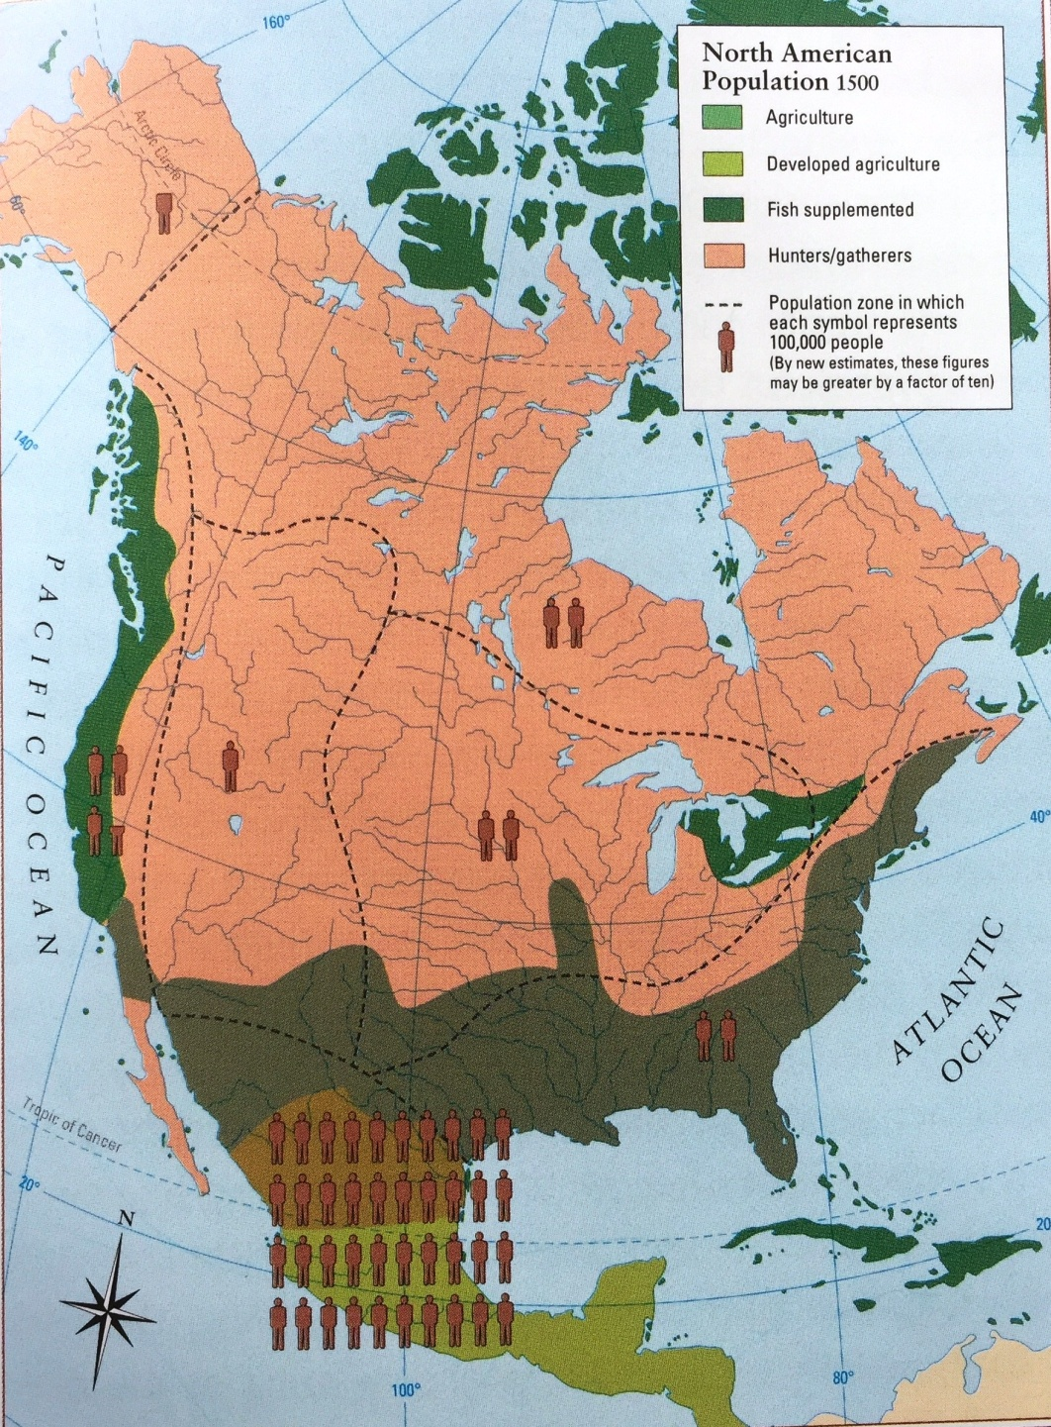
Native Americans – Archaic Period
Mississippian
Historic Period
How many Native Americans were there?

Slide 78
Native Americans – Archaic Period
Mississippian
Historic Period
How many Native Americans were there?
250,000-2.5M
5million-50million
600,000-6M
Agriculture
200,000-2M
Fishing
Hunt/Gather
4M-40M

Slide 79
https://en.wikipedia.org/wiki/Population_history_of_indigenous_peoples_of_the_Americas
The population figure for indigenous peoples in the Americas before the 1492 voyage of Christopher Columbus has proven difficult to establish. Scholars rely on archaeological data and written records from settlers from the Old World. Most scholars writing at the end of the 19th century estimated that the pre-Columbian population was as low as 10 million; by the end of the 20th century most scholars gravitated to a middle estimate of around 50 million, with some historians arguing for an estimate of 100 million or more. Contact with the New World led to the European colonization of the Americas, in which millions of immigrants from the Old World eventually settled in the New World.
Given the fragmentary nature of the evidence, even semi-accurate pre-Columbian population figures are impossible to obtain. Scholars have varied widely on the estimated size of the indigenous populations prior to colonization and on the effects of European contact. Estimates are made by extrapolations from small bits of data. In 1976, geographer William Denevan used the existing estimates to derive a "consensus count" of about 54 million people of whom just under 4 million were north of the Rio Grande. Nonetheless, more recent estimates still range widely with the median of 40 million when all studies are taken into consideration.
Using an estimate of approximately 37 million people in Mexico, Central and South America in 1492 (including 6 million in the Aztec Empire, 5-10 million in the Mayan States, 11 million in what is now Brazil, and 12 million in the Inca Empire). The figures for the Mayan region are wildly inflated even for the Classical Period 250-900 A.D. and even more so after the collapse of the civilization by 1100, South and North. The population of Mexico may have been 8-12 total after all regions are considered. However these figures do not give estimates for the populations in Mexico outside the Aztec Empire; nor for populations outside the Incan. the lowest estimates give a death toll due from disease of 90% by the end of the 17th century (nine million people in 1650). Latin America would match its 15th-century population early in the 19th century; it numbered 17 million in 1800, 30 million in 1850, 61 million in 1900, 105 million in 1930, 218 million in 1960, 361 million in 1980, and 563 million in 2005. In the last three decades of the 16th century, the population of present-day Mexico dropped to about one million people. The Maya population is today estimated at six million, which is about the same as at the end of the 15th century, according to some estimates. In what is now Brazil, the indigenous population declined from a pre-Columbian high of an estimated four million to some 300,000.
While it is difficult to determine exactly how many Natives lived in North America before Columbus, estimates range from a low of 2.1 million to 7 million people to a high of 18 million.
The Aboriginal population of Canada during the late 15th century is estimated to have been between 200,000 and two million, with a figure of 500,000 currently accepted by Canada's Royal Commission on Aboriginal Health. Repeated outbreaks of Old World infectious diseases such as influenza, measles and smallpox (to which they had no natural immunity), were the main cause of depopulation. This combined with other factors such as dispossession from European/Canadian settlements and numerous violent conflicts resulted in a forty- to eighty-percent aboriginal population decrease after contact. For example, during the late 1630s, smallpox killed over half of the Wyandot (Huron), who controlled most of the early North American fur trade in what became Canada. They were reduced to fewer than 10,000 people.
Historian David Henige has argued that many population figures are the result of arbitrary formulas selectively applied to numbers from unreliable historical sources. He believes this is a weakness unrecognized by several contributors to the field, and insists there is not sufficient evidence to produce population numbers that have any real meaning. He characterizes the modern trend of high estimates as "pseudo-scientific number-crunching." Henige does not advocate a low population estimate, but argues that the scanty and unreliable nature of the evidence renders broad estimates inevitably suspect, saying "high counters" (as he calls them) have been particularly flagrant in their misuse of sources. Many population studies acknowledge the inherent difficulties in producing reliable statistics, given the scarcity of hard data.
The population debate has often had ideological underpinnings. Low estimates were sometimes reflective of European notions of cultural and racial superiority. Historian Francis Jennings argued, "Scholarly wisdom long held that Indians were so inferior in mind and works that they could not possibly have created or sustained large populations."
The indigenous population of the Americas in 1492 was not necessarily at a high point and may actually have been in decline in some areas. Indigenous populations in most areas of the Americas reached a low point by the early 20th century. In most cases, populations have since begun to climb. n The fact is that nobody knows. The 20 or more studies and population figures are given "Native American Population though the Ages" Archive World Historia 2009. The medium figure is 40 million for North and South America, where it was more or less before ideological considerations inflated the figures from the 1970s.
According to Noble David Cook, a community of scholars have recently, albeit slowly, "been quietly accumulating piece by piece data on early epidemics in the Americas and their relation to subjugation of native peoples." They now believe that widespread epidemic disease, to which the natives had no prior exposure or resistance, was the primary cause of the massive population decline of the Native Americans. Earlier explanations for the population decline of the American natives include the European immigrants' accounts of the brutal practices of the Spanish conquistadores, as recorded by the Spanish themselves. This was applied through the encomienda which was a system ostensibly set up to protect people from warring tribes as well as to teach them the Spanish language and the Catholic religion, but in practice was tantamount to serfdom and slavery.

Slide 80
http://www.let.rug.nl/usa/outlines/history-2005/early-america/native-american-cultures.php
The America that greeted the first Europeans was, thus, far from an empty wilderness. It is now thought that as many people lived in the Western Hemisphere as in Western Europe at that time -- about 40 million. Estimates of the number of Native Americans living in what is now the United States at the onset of European colonization range from two to 18 million, with most historians tending toward the lower figure. What is certain is the devastating effect that European disease had on the indigenous population practically from the time of initial contact. Smallpox, in particular, ravaged whole communities and is thought to have been a much more direct cause of the precipitous decline in the Indian population in the 1600s than the numerous wars and skirmishes with European settlers.
Indian customs and culture at the time were extraordinarily diverse, as could be expected, given the expanse of the land and the many different environments to which they had adapted. Some generalizations, however, are possible. Most tribes, particularly in the wooded eastern region and the Midwest, combined aspects of hunting, gathering, and the cultivation of maize and other products for their food supplies. In many cases, the women were responsible for farming and the distribution of food, while the men hunted and participated in war.
By all accounts, Native-American society in North America was closely tied to the land. Identification with nature and the elements was integral to religious beliefs. Their life was essentially clan-oriented and communal, with children allowed more freedom and tolerance than was the European custom of the day.
Although some North American tribes developed a type of hieroglyphics to preserve certain texts, Native-American culture was primarily oral, with a high value placed on the recounting of tales and dreams. Clearly, there was a good deal of trade among various groups and strong evidence exists that neighboring tribes maintained extensive and formal relations -- both friendly and hostile.

Slide 81
Native Americans – Archaic Period
Mississippian
Historic Period
How many Native Americans were there?
Where were they living?
Tribes in North America at early European Contact
about six hundred tribes
5million-50million
c. 1500
Let’s summarize!

Slide 82
Native Americans – Archaic Period
Native American Timeline
Mississippian
Historic Period
PALEO PERIOD
WOODLAND
ARCHAIC PERIOD
MISSISSIPPPIAN
Let’s summarize!
800
15,000?
9,000
3,000
500
8,000
500
Migration
into
Americas
Arrival
of
Europeans
TIME (Years Before Present)

Slide 83
Session 1: Setting the Stage
Setting the Stage
Native American Timeline
North American Continent
- Landforms
- Rivers
People, Cultures, & History
- Native Americans
- European Americans
PALEO PERIOD
WOODLAND
ARCHAIC PERIOD
MISSISSIPPPIAN
800
15,000
9,000
3,000
500
8,000
500
Migration
into
Americas
Arrival
of
Europeans
TIME (Years Before Present)

Slide 84
Session 1: Setting the Stage
European Americans
Setting the Stage
North American Continent
- Landforms
- Rivers
People, Cultures, & History
- Native Americans
- European Americans
European Americans

Slide 85
EUROPEAN EXPLORATIONS
1000- Lief Erickson – New Foundland
1492 - Columbus – East Indies (sp)
1524 – giovanni Verazanno (fr)
1528 – Narvaez (sp)
1534 – Jacques Cartier (fr)
1539-43 – de Soto (sp)
1539 – Diaz
1540-42 – Coronado (sp)
1540-43 – Roberval (fr)
1542 – Cabrillo (sp)
1549 – missionaries into Fl (sp)
1564 – colony @ Santa Elena SC
1565 –colony @ St Augustine
1581 – missionaries into NM (sp)
1604 – Champlain (fr)
1607 – colony @ Jamestown
1608 – colony @ Quebec
1610 – colony @ Santa Fe
1620 – Pilgrims @ Plymouth Colony
CONTACT BETWEEN COLONISTS & NATIVE AMERICANS
1636 – Perquot War, taking/selling of Indian slaves
1675 – 1st Indian War (English colonists vs Indians)
1689 – 2ND Indian War (France vs England w/Indian Allies)
1758 – 1st Indian reservation established in NJ
1763 - Declaration of 1763 – Indian lands reserved west of Applachians
1763 – Treaty of Paris – lands to Mississippi R from France to England
1783 – Treaty of Paris – end of Revolutionary War, land cedes

Slide 86
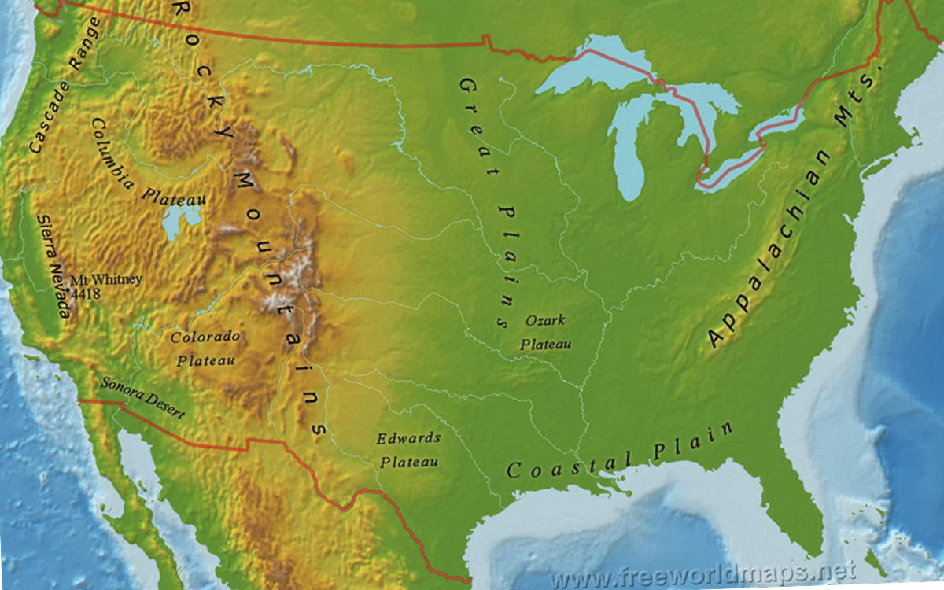
European Americans
1000: Vikings explore New Foundland coast
1492: Columbus’ 4 voyages to explore/settle
Carribean Islands for Spain
1524: G. Verrazzano explores east coast for France
1528-1605: Spanish explore/settle the south

Slide 87
http://www.u-s-history.com/pages/h1004.html
European explorers were the first to encounter indigenous peoples of the New World. The first contact may have occurred when Thorvald, brother of Leif Eriksson, died in a skirmish with natives near Vinland in present-day Newfoundland. Thorvald may have been the first European to die and be buried in America.
Nearly five centuries later, word that Christopher Columbus had discovered what was believed to be a western approach to the East Indies spread through Europe, which energized other nations to dispatch explorers. Like Columbus, they were searching for gold, silver, spices and other valuables. They also were looking for new lands to claim for their empires. They quickly realized that what Columbus had actually found was another world altogether.
The Europeans came to the New World with underlying assumptions, some based on what would later be called Manifest Destiny, others based on Christian beliefs. Some, including Columbus, believed it was God's design to convert non-Christians everywhere. Extracting wealth from the New World was justifiable because the peoples there were heathen. Imprecations against Native Americans were sanctioned because they were Satan's own, and it followed that their cultures could be crippled as well.
By and large, indigenous peoples first welcomed European explorers, and trade was a hallmark of their relationship from the beginning. The natives introduced the Europeans to such plants as maize, potatoes, other edible plants, and tobacco. The Europeans introduced the Native Americans to horses, guns, and alcohol, among other things.
Contact would wreak radical changes in Native American lifeways through the impact of trade, missionary influence, intermarriage, disease, enslavement, defeat in battle, forced relocation to reservations, and acculturation.

Slide 88
European Americans
1528-1605: Spanish explore/settle the south
1534-1605: French explore/settle northeast N.A.
1607-1642: British explore/settle east coast
What happens to the Native Americans

Slide 89
1795
The Treaty of Greenville - This treaty marked the end of an undeclared and multi-tribal war begun in the late 1770s and led by the Shawnee who fought to resist American expansion into Ohio. In 1795, over a thousand Indian delegates ceded two-thirds of present-day Ohio, part of Indiana, and the sites where the modern cities of Detroit, Toledo, and Chicago are currently situated. The Indians, in return, were promised a permanent boundary between their lands and American territory.
1802
Federal law prohibits the sale of liquor to Indians.
1803
The Louisiana Purchase adds to the United States French territory from the Gulf of Mexico to the Northwest.
1803
The Lewis and Clark expedition begins its exploration of the West.
European Americans
1492
When Christopher Columbus first came in contact with native people, he wrote: "They all go around as naked as their mothers bore them; and also the women." He also noted that "they could easily be commanded and made to work, to sow and to do whatever might be needed, to build towns and be taught to wear clothes and adopt our ways," and, "they are the best people in the world and above all the gentlest."
1600's
Europeans of the time held steadfastly to the belief that their introduced diseases were acts of God being done in their behalf. One settler proclaimed while speaking about the deaths of Native Americans, "Their enterprise failed, for it pleased God to effect these Indians with such a deadly sickness, that out of every 1000, over 950 of them had died, and many of them lay rotting above the ground for lack of burial.“
May 14, 1607
Jamestown is founded in Virginia by the colonists of the London Company. By the end of the year, starvation and disease reduce the original 105 settlers to just 32 survivors. Captain John Smith is captured by Native American Chief Powhatan and saved from death by the chief's daughter, Pocahontas.July 3, 1607 On July 3, Indians brought maize, beans, squash, and fresh and smoked meat to the Jamestown colony. As at Plymouth years later, the colonists and their diseases would eventually exterminate them.
1611
Former Dutch lawyer Adrian Block explores Manhattan Island in the ship Tiger. He returned to Europe with a cargo of furs and two kidnapped Indians, whom he named Orson and Valentine.
1616
A smallpox epidemic decimates the Native American population in New England.
May, 1616
Virginia's Deputy Governor George Yeardley and a group of men kill 20 - 40 Chickahominy Indians. It was under Yeardley’s leadership that friendly relations between the Chickahominy and the colony ended.
1621
One of the first treaties between colonists and Native Americans is signed as the Plymouth Pilgrims enact a peace pact with the Wampanoag Tribe, with the aid of Squanto, an English speaking Native American.
1622-44
Powhatan Wars - Following an initial period of peaceful relations in Virginia, a twelve year conflict left many natives and colonists dead.
1626
Peter Minuit, a Dutch colonist, buys Manhattan island from Native Americans for 60 guilders (about $24) and names the island New Amsterdam.
1636-37
Pequot War - Taking place in Connecticut and Rhode Island, the death of a colonist eventually led to the destruction of 600-700 natives. The remainder were sold into slavery in Bermuda.
May 26, 1637
Captains John Mason and John Underhill attacked and burned Pequot forts at Mystic, Connecticut, massacring 600 Indians and starting the Pequot War.
June 5, 1637
English settlers in New England massacred a Pequot Indian village.
1639
Captain William Pierce of Salem, Massachusetts sailed to the West Indies and exchanged Indian slaves for black slaves.
1675-1676
King Philip's War - Sometimes called Metacom's War, was an armed conflict between Native American inhabitants of present-day southern New England and English colonists and their Native American allies.
July 30, 1676
Bacon's Rebellion - Tobacco planters led by Nathaniel Bacon ask for and are denied permission to attack the Susquehannock Indians, who have been conducting raids on colonists' settlement. Enraged at Governor Berkeley's refusal, the colonists burn Jamestown and kill many Indians before order is restored in October.
1689-1697
King William's War - The first of the French and Indian Wars, this conflict was fought between England, France, and their respective American Indian allies in the colonies of Canada (New France), Acadia, and New England. It was also known as the Second Indian War (the first having been King Philip's War).
June 23, 1704
Former Governor of South Carolina, James Moore, led a force of 50 British, and 1,000 Creek Indians against Spanish settlements. They attacked a Mission in Northwestern Florida. They took many Indians as slaves and killed Father Manuel de Mendoza.
1709
A slave market was erected at the foot of Wall Street in New York City. Here African-Americans and Indians -- men, women and children were daily declared the property of the highest cash bidder.
1711
Hostilities break out between Native Americans and settlers in North Carolina after the massacre of settlers there. The conflict, known as the Tuscarora War, under the leadership of Chief Hancock, attacked several settlements, killing settlers and destroying farms for the next two years. In 1713, James Moore and Yamasee warriors defeated the raiders.
1715-1718
The Yamasee War occurs in southern Carolina, which came close to exterminating white settlements in their region.
1716
South Carolina settlers and their Cherokee allies attack and defeat the Yamassee.
1725
Ten sleeping Indians were scalped by whites in New Hampshire for a bounty.
1745
Upon hearing of an impending French and Indian attack upon the Ulster county frontiers, Europeans massacred several Indian families in their wigwams at Walden in the Hudson River Valley.
April 8, 1756
Governor Robert Morris declared war on the Delaware and Shawnee Indians. Included in his war declaration was "The Scalp Act,” which put a bounty on the scalps of Indian men, women and boys.
August 1, 1758
The first Indian reservation in North America was established by the New Jersey Colonial Assembly.
1776-1794
Chickamauga Wars - A series of conflicts that were a continuation of the Cherokee struggle against white encroachment. Led by Dragging Canoe, who was called the Chickamauga by colonials, the Cherokee fought white settlers in Tennessee, Kentucky, Virginia, North Carolina, South Carolina, and Georgia.
1781
Smallpox wiped out more than half the Piegan Blackfoot.
1789
Indian Commerce Clause of the Constitution is added stating "The Congress shall have Power...to regulate Commerce with foreign Nations, and among the several States, and with the Indian tribes." This clause is generally seen as the principal basis for the federal government's broad power over Indians. Indian affairs assignation. Indian agents, who were appointed as the federal government's liaison with tribes, fell under jurisdiction of the War Department. The Indian agents were empowered to negotiate treaties with the tribes.
1790
The Indian Trade and Intercourse Act is passed, placing nearly all interaction between Indians and non-Indians under federal, rather than state control, established the boundaries of Indian country, protected Indian lands against non-Indian aggression, subjected trading with Indians to federal regulation, and stipulated that injuries against Indians by non-Indians was a federal crime. The conduct of Indian among themselves, while in Indian country, was left entirely to the tribes. These Acts were renewed periodically until 1834.
March 1, 1790
The first U.S. Census count included slaves and free African-Americans, but Indians were not included.
Pre-1795
Trading begins between Native Americans and French and Spanish merchants from St. Louis, Missouri.
1792
On November 6, George Washington, in his fourth annual address to Congress, expressed dissatisfaction that "Indian hostilities” had not stopped in the young country’s frontier, north of the Ohio River.
European Americans
1760-62
Cherokee Uprising - A breakdown in relations between the British and the Cherokee leads to a general uprising in present-day Tennessee, Virginia and the Carolinas.
1763
The Proclamation of 1763, signed by King George III of England, prohibits any English settlement west of the Appalachian Mountains and requires those already settled in those regions to return east in an attempt to ease tensions with Native Americans.
May, 1763
The Ottawa Indians under Chief Pontiac begin all-out warfare against the British west of Niagara, New York, destroying several British forts and conducting a siege against the British at Detroit, Michigan. In August, Pontiac's forces are defeated by the British near Pittsburgh, Pennsylvania. The siege of Detroit ends in November, but hostilities between the British and Chief Pontiac continue for several years.
December 8, 1763
An organization compensating settlers for losses resulting from Indian raids was created by Indian Commissioner Sir William Johnson.
December 14, 1763
A vigilante group called the Paxton Boys in Pennsylvanis kill 20 peaceful Susquehannock in response to Pontiac’s Rebellion.
December 27, 1763
A troop of 50 armed men entered the Workhouse at Lancaster, Pennsylvania, and hacked to death the only 14 surviving Conestoga Indians (the rest of the tribe having been similarly dispensed with, 13 days earlier).
May 25, 1776
The Continental Congress resolved that it was "highly expedient to engage Indians in service of the United Colonies," and authorized recruiting 2,000 paid auxiliaries. The program was a dismal failure, as virtually every tribe refused to fight for the colonists.
July 21, 1776
Cherokee Indians attacked a settlement in western North Carolina. Militia forces retaliated by destroying a nearby Cherokee village.
1772-1780
Eighty percent of the Arikara died of smallpox, measles, etc.
WAR
slavery
indian uprising
WAR
treaty
1528-1605: Spanish explore/settle the south
1534-1605: French explore/settle northeast N.A.
slavery
1607-1642: British explore/settle east coast
Slave market
liquor prohibition
smallpox
introduced diseases
WAR
massacres
colonists massacred
Louisiana Purchase
Indian Commerce Clause
What happens to the Native Americans
slavery
sharing food
Lewis & Clark Expedition!
settlers’ compensated
WAR
WAR
Indian Trade Act
Indians scalped
Indians killed
Indian raids
smallpox
Indians massacred
indian attack
WAR
trade
20 killed
WAR
smallpox, measles
1st indian reservation
peace pact
WAR

Slide 90
http://www.legendsofamerica.com/na-timeline.html
1492
When Christopher Columbus first came in contact with native people, he wrote: "They all go around as naked as their mothers bore them; and also the women." He also noted that "they could easily be commanded and made to work, to sow and to do whatever might be needed, to build towns and be taught to wear clothes and adopt our ways," and, "they are the best people in the world and above all the gentlest."
1600's
Europeans of the time held steadfastly to the belief that their introduced diseases were acts of God being done in their behalf. One settler proclaimed while speaking about the deaths of Native Americans, "Their enterprise failed, for it pleased God to effect these Indians with such a deadly sickness, that out of every 1000, over 950 of them had died, and many of them lay rotting above the ground for lack of burial.“
May 14, 1607
Jamestown is founded in Virginia by the colonists of the London Company. By the end of the year, starvation and disease reduce the original 105 settlers to just 32 survivors. Captain John Smith is captured by Native American Chief Powhatan and saved from death by the chief's daughter, Pocahontas.July 3, 1607 On July 3, Indians brought maize, beans, squash, and fresh and smoked meat to the Jamestown colony. As at Plymouth years later, the colonists and their diseases would eventually exterminate them.
1611
Former Dutch lawyer Adrian Block explores Manhattan Island in the ship Tiger. He returned to Europe with a cargo of furs and two kidnapped Indians, whom he named Orson and Valentine.
1616
A smallpox epidemic decimates the Native American population in New England.
May, 1616
Virginia's Deputy Governor George Yeardley and a group of men kill 20 - 40 Chickahominy Indians. It was under Yeardley’s leadership that friendly relations between the Chickahominy and the colony ended.
1621
One of the first treaties between colonists and Native Americans is signed as the Plymouth Pilgrims enact a peace pact with the Wampanoag Tribe, with the aid of Squanto, an English speaking Native American.
1622-44
Powhatan Wars - Following an initial period of peaceful relations in Virginia, a twelve year conflict left many natives and colonists dead.
1626
Peter Minuit, a Dutch colonist, buys Manhattan island from Native Americans for 60 guilders (about $24) and names the island New Amsterdam.
1636-37
Pequot War - Taking place in Connecticut and Rhode Island, the death of a colonist eventually led to the destruction of 600-700 natives. The remainder were sold into slavery in Bermuda.
May 26, 1637
Captains John Mason and John Underhill attacked and burned Pequot forts at Mystic, Connecticut, massacring 600 Indians and starting the Pequot War.
June 5, 1637
English settlers in New England massacred a Pequot Indian village.
1639
Captain William Pierce of Salem, Massachusetts sailed to the West Indies and exchanged Indian slaves for black slaves.
1675-1676
King Philip's War - Sometimes called Metacom's War, was an armed conflict between Native American inhabitants of present-day southern New England and English colonists and their Native American allies.
July 30, 1676
Bacon's Rebellion - Tobacco planters led by Nathaniel Bacon ask for and are denied permission to attack the Susquehannock Indians, who have been conducting raids on colonists' settlement. Enraged at Governor Berkeley's refusal, the colonists burn Jamestown and kill many Indians before order is restored in October.
1689-1697
King William's War - The first of the French and Indian Wars, this conflict was fought between England, France, and their respective American Indian allies in the colonies of Canada (New France), Acadia, and New England. It was also known as the Second Indian War (the first having been King Philip's War).
1689-1763
The French and Indian War, a conflict between France and Britain for possession of North America, rages for decades. For various motivations, most Algonquian tribes allied with the French; the Iroquois with the British.
June 23, 1704
Former Governor of South Carolina, James Moore, led a force of 50 British, and 1,000 Creek Indians against Spanish settlements. They attacked a Mission in Northwestern Florida. They took many Indians as slaves and killed Father Manuel de Mendoza.
1709
A slave market was erected at the foot of Wall Street in New York City. Here African-Americans and Indians -- men, women and children were daily declared the property of the highest cash bidder.
1711
Hostilities break out between Native Americans and settlers in North Carolina after the massacre of settlers there. The conflict, known as the Tuscarora War, under the leadership of Chief Hancock, attacked several settlements, killing settlers and destroying farms for the next two years. In 1713, James Moore and Yamasee warriors defeated the raiders.
1715-1718
The Yamasee War occurs in southern Carolina, which came close to exterminating white settlements in their region.
1716
South Carolina settlers and their Cherokee allies attack and defeat the Yamassee.
1725
Ten sleeping Indians were scalped by whites in New Hampshire for a bounty.
1745
Upon hearing of an impending French and Indian attack upon the Ulster county frontiers, Europeans massacred several Indian families in their wigwams at Walden in the Hudson River Valley.
April 8, 1756
Governor Robert Morris declared war on the Delaware and Shawnee Indians. Included in his war declaration was "The Scalp Act,” which put a bounty on the scalps of Indian men, women and boys.
August 1, 1758
The first Indian reservation in North America was established by the New Jersey Colonial Assembly.
1760-62
Cherokee Uprising - A breakdown in relations between the British and the Cherokee leads to a general uprising in present-day Tennessee, Virginia and the Carolinas.
1763
The Proclamation of 1763, signed by King George III of England, prohibits any English settlement west of the Appalachian Mountains and requires those already settled in those regions to return east in an attempt to ease tensions with Native Americans.
May, 1763
The Ottawa Indians under Chief Pontiac begin all-out warfare against the British west of Niagara, New York, destroying several British forts and conducting a siege against the British at Detroit, Michigan. In August, Pontiac's forces are defeated by the British near Pittsburgh, Pennsylvania. The siege of Detroit ends in November, but hostilities between the British and Chief Pontiac continue for several years.
December 8, 1763
An organization compensating settlers for losses resulting from Indian raids was created by Indian Commissioner Sir William Johnson.
December 14, 1763
A vigilante group called the Paxton Boys in Pennsylvania kill 20 peaceful Susquehannock in response to Pontiac's Rebellion.
December 27, 1763
A troop of 50 armed men entered the Workhouse at Lancaster, Pennsylvania, and hacked to death the only 14 surviving Conestoga Indians (the rest of the tribe having been similarly dispensed with, 13 days earlier).
May 25, 1776
The Continental Congress resolved that it was "highly expedient to engage Indians in service of the United Colonies," and authorized recruiting 2,000 paid auxiliaries. The program was a dismal failure, as virtually every tribe refused to fight for the colonists.
July 21, 1776
Cherokee Indians attacked a settlement in western North Carolina. Militia forces retaliated by destroying a nearby Cherokee village.
1772-1780
Eighty percent of the Arikara died of smallpox, measles, etc.
1776-1794
Chickamauga Wars - A series of conflicts that were a continuation of the Cherokee struggle against white encroachment. Led by Dragging Canoe, who was called the Chickamauga by colonials, the Cherokee fought white settlers in Tennessee, Kentucky, Virginia, North Carolina, South Carolina, and Georgia.1781Smallpox wiped out more than half the Piegan Blackfoot.
1789
Indian Commerce Clause of the Constitution is added stating "The Congress shall have Power...to regulate Commerce with foreign Nations, and among the several States, and with the Indian tribes." This clause is generally seen as the principal basis for the federal government's broad power over Indians. Indian affairs assignation. Indian agents, who were appointed as the federal government's liaison with tribes, fell under jurisdiction of the War Department. The Indian agents were empowered to negotiate treaties with the tribes.
1790
The Indian Trade and Intercourse Act is passed, placing nearly all interaction between Indians and non-Indians under federal, rather than state control, established the boundaries of Indian country, protected Indian lands against non-Indian aggression, subjected trading with Indians to federal regulation, and stipulated that injuries against Indians by non-Indians was a federal crime. The conduct of Indian among themselves, while in Indian country, was left entirely to the tribes. These Acts were renewed periodically until 1834.
March 1, 1790
The first U.S. Census count included slaves and free African-Americans, but Indians were not included.
Pre-1795
Trading begins between Native Americans and French and Spanish merchants from St. Louis, Missouri.
1792
On November 6, George Washington, in his fourth annual address to Congress, expressed dissatisfaction that "Indian hostilities” had not stopped in the young country’s frontier, north of the Ohio River.
1795
The Treaty of Greenville - This treaty marked the end of an undeclared and multi-tribal war begun in the late 1770s and led by the Shawnee who fought to resist American expansion into Ohio. In 1795, over a thousand Indian delegates ceded two-thirds of present-day Ohio, part of Indiana, and the sites where the modern cities of Detroit, Toledo, and Chicago are currently situated. TheIndians, in return, were promised a permanent boundary between their lands and American territory.
1802
Federal law prohibits the sale of liquor to Indians.
1803
The Louisiana Purchase adds to the United States French territory from the Gulf of Mexico to the Northwest.
The Lewis and Clark expedition begins its exploration of the West.

Slide 91
European Americans
1528-1605: Spanish explore/settle the south
1534-1605: French explore/settle northeast N.A.
1607-1642: British explore/settle east coast
Contact with Europeans causes radical change
- horses, guns, alcohol
- missionary influence
- disease: population reduction to 90%
- enslavement
- defeat in battle
- intermarriage
- forced relocation to reservations
- acculturation
What happens to the Native Americans
Notes:
https://history.state.gov/milestones/1750-1775/treaty-of-paris
The Treaty of Paris of 1763 ended the French and Indian War/Seven Years' War between Great Britain and France, as well as their respective allies. In the terms of the treaty, France gave up all its territories in mainland North America, effectively ending any foreign military threat to the British colonies there.

Slide 92
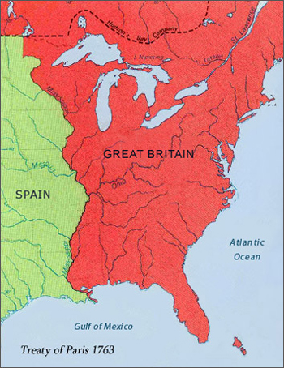
European Americans
British Proclamation Line of 1763
Treaty of Paris 1763
1528-1605: Spanish explore/settle the south
1534-1605: French explore/settle northeast N.A.
Seven Years' War ends
between Great Britain
and France
France gives up all its
territories in mainland
North America
British territory extends
to Mississippi River
eliminates foreign military
threat to the British
colonies
1607-1642: British explore/settle east coast
Notes:
https://history.state.gov/milestones/1750-1775/treaty-of-paris
The Treaty of Paris of 1763 ended the French and Indian War/Seven Years' War between Great Britain and France, as well as their respective allies. In the terms of the treaty, France gave up all its territories in mainland North America, effectively ending any foreign military threat to the British colonies there.

Slide 93
https://history.state.gov/milestones/1750-1775/treaty-of-paris
The Treaty of Paris of 1763 ended the French and Indian War/Seven Years' War between Great Britain and France, as well as their respective allies. In the terms of the treaty, France gave up all its territories in mainland North America, effectively ending any foreign military threat to the British colonies there.
https://en.wikipedia.org/wiki/Treaty_of_Paris_(1763)
The Treaty of Paris, also known as the Treaty of 1763, was signed on 10 February 1763 by the kingdoms of Great Britain, France and Spain, with Portugal in agreement, after Great Britain's victory over France and Spain during the Seven Years' War.
The signing of the treaty formally ended the Seven Years' War, known as the French and Indian War in the North American theatre, and marked the beginning of an era of British dominance outside Europe. Great Britain and France each returned much of the territory that they had captured during the war, but Great Britain gained much of France's possessions in North America. Additionally, Great Britain agreed to protect Roman Catholicism in the New World. The treaty did not involve Prussia and Austria as they signed a separate agreement, the Treaty of Hubertusburg, five days later.
During the war, Great Britain had conquered the French colonies of Canada, Guadeloupe, Saint Lucia, Dominica, Grenada, Saint Vincent and the Grenadines, and Tobago, the French "factories" (trading posts) in India, the slave-trading station at Gorée, the Sénégal River and its settlements, and the Spanish colonies of Manilia in the Philippines) and Havana in Cuba). France had captured Minorca and British trading posts in Sumatra, while Spain had captured the border fortress of Almeida in Portugal, and Colonia del Sacramento in South America.
In the treaty, most of these territories were restored to their original owners, but not all: Britain made considerable gains. France and Spain restored all their conquests to Britain and Portugal. Britain restored Manila and Havana to Spain, and Guadeloupe, Martinique, Saint Lucia, Gorée, and the Indian factories to France.^{[4]} In return, France ceded Canada, Dominica, Grenada, Saint Vincent and the Grenadines, and Tobago to Britain. France also ceded the eastern half of French Louisiana to Britain; that is, the area from the Mississippi River to the Appalachian Mountains.
Spain ceded Florida to Britain. France had already secretly given Louisiana to Spain in the Treaty of Fontainebleau (1762). In addition, while France regained its factories in India, France recognized British clients as the rulers of key Indian native states, and pledged not to send troops to Bengal. Britain agreed to demolish its fortifications in British Honduras (now Belize), but retained a logwood-cutting colony there. Britain confirmed the right of its new subjects to practice Catholicism.
France ceded all of its territory in mainland North America, but retained fishing rights off Newfoundland and the two small islands of Saint Pierre and Miquelon, where its fishermen could dry their catch. In turn France gained the return of its sugar colony, Guadeloupe, which it considered more valuable than Canada. Voltaire had notoriously dismissed Canada as "Quelques arpents de neige", "A few acres of snow".
The Treaty of Paris is frequently noted as the point at which France gave Louisiana to Spain. The transfer, however, occurred with the Treaty of Fontainebleau (1762) but was not publicly announced until 1764. The Treaty of Paris was to give Britain the east side of the Mississippi (including Baton Rouge, Louisiana, which was to be part of the British territory of West Florida). New Orleans on the east side remained in French hands (albeit temporarily). The Mississippi River corridor in what is modern day Louisiana was to be reunited following the Louisiana Purchase in 1803 and the Adams–Onís Treaty in 1819.

Slide 94
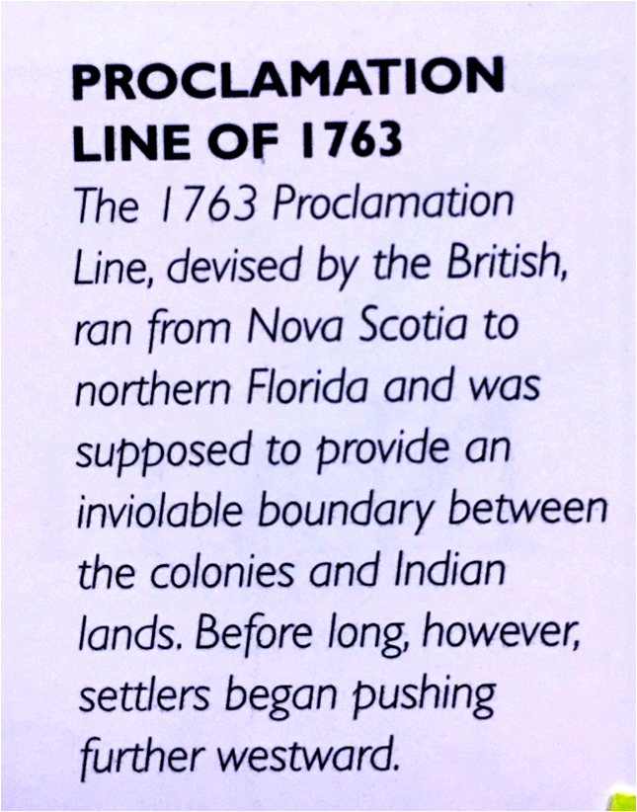
European Americans
British Proclamation Line of 1763

Slide 95
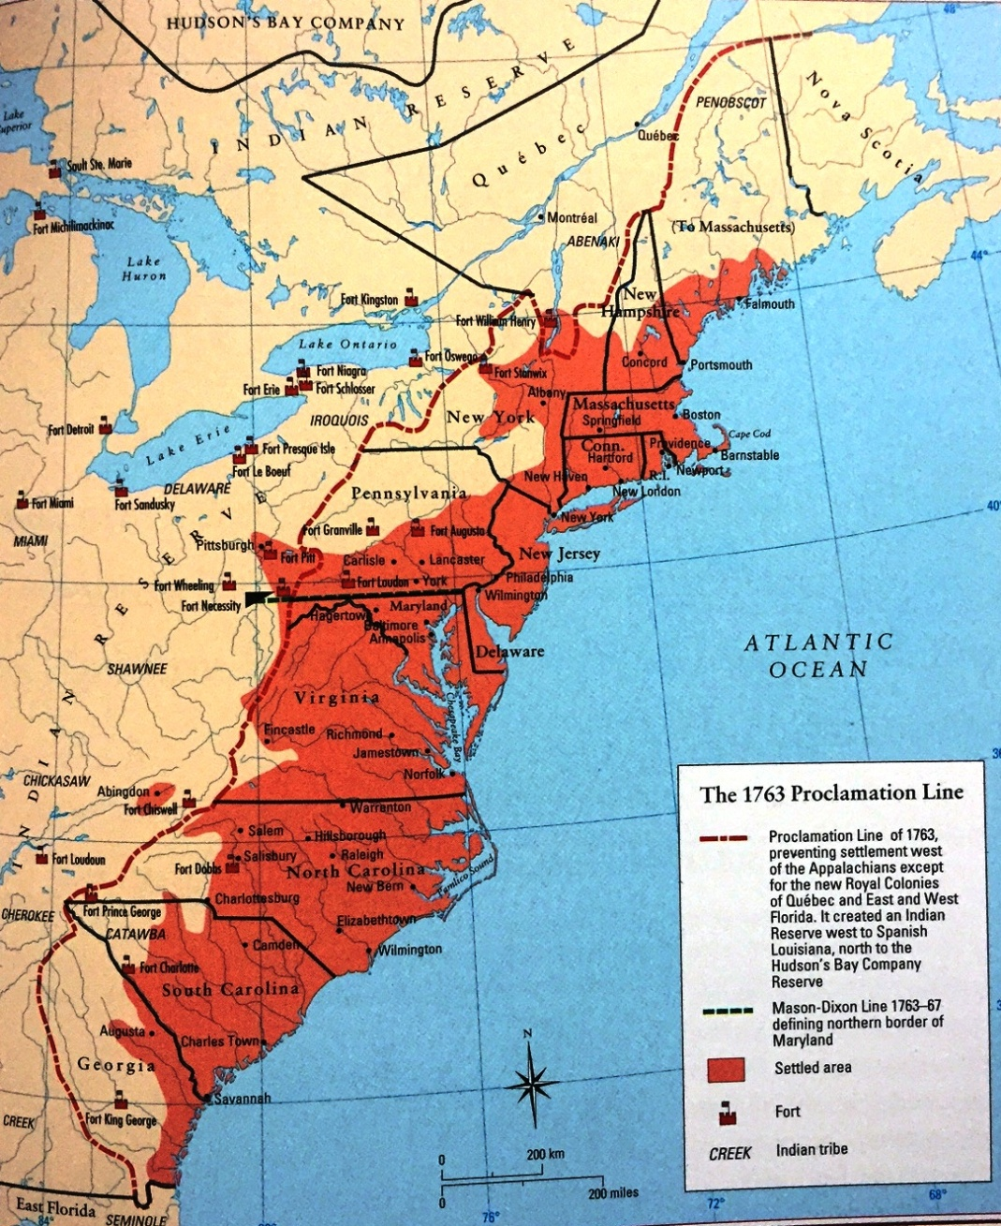
European Americans
British Proclamation Line of 1763

Slide 96
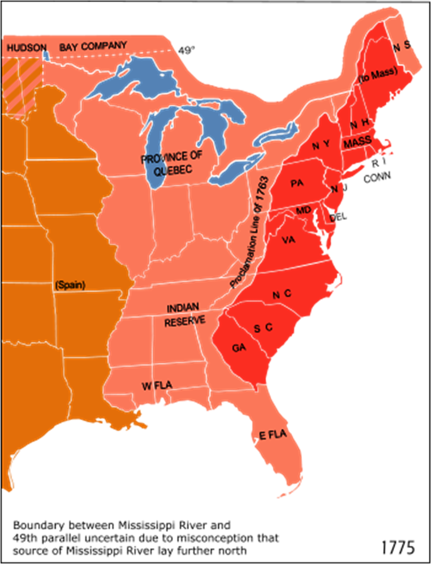
European Americans
WAR OF INDEPENDENCE
British Proclamation Line of 1763
12 years later . . . . 1775
- 1783
1775
Spain
Indian Reserve
13 British
Colonies

Slide 97
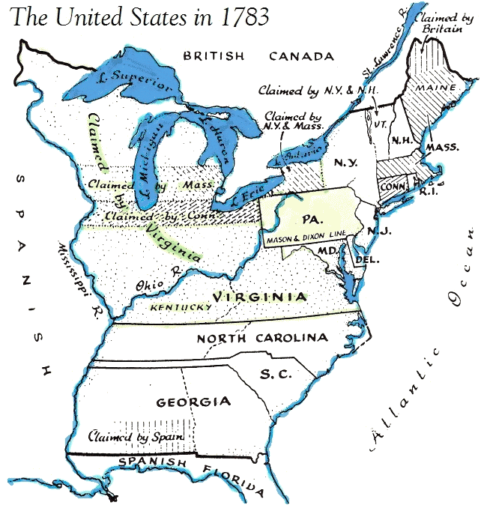
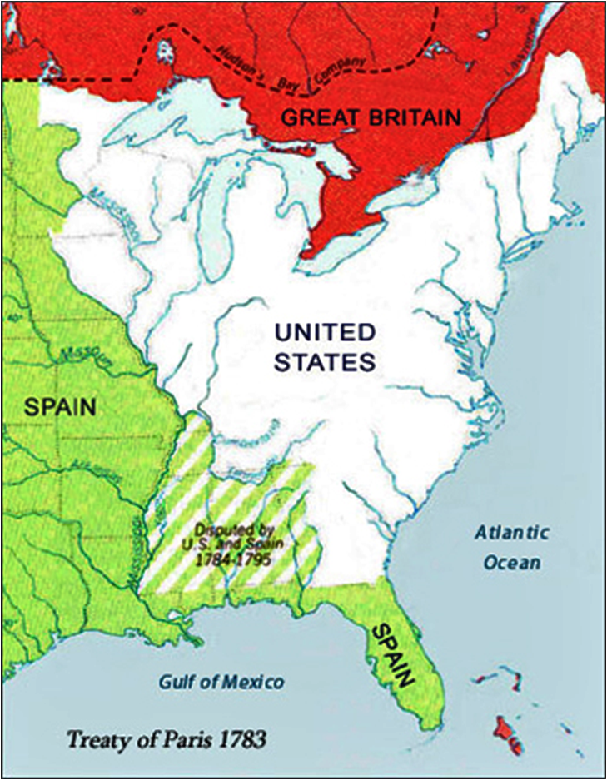
The United States
WAR OF INDEPENDENCE
Treaty of Paris
1775
1783
- 1783
ends the conflict
Sp
GREAT BRITIAN
SPAIN
Notes:
https://en.wikipedia.org/wiki/Treaty_of_Paris_(1783)
The Treaty of Paris, signed in Paris by representatives of King George III of Great Britain and representatives of the United States of America on September 3, 1783, ended the American Revolutionary War. The treaty set the boundaries between the British Empire and the new country, on lines "exceedingly generous" to the United States.^{[2]} Details included fishing rights and restoration of property and prisoners of war.

Slide 98
https://en.wikipedia.org/wiki/Treaty_of_Paris_(1783)
The Treaty of Paris, signed in Paris by representatives of King George III of Great Britain and representatives of the United States of America on September 3, 1783, ended the American Revolutionary War. The treaty set the boundaries between the British Empire and the new country, on lines "exceedingly generous" to the United States. Details included fishing rights and restoration of property and prisoners of war.
This treaty, along with the separate peace treaties between Great Britain and the nations that supported the American cause—France, Spain, and the Dutch Republic—are known collectively as the Peace of Paris.
Regarding the American Treaty, the key episodes came in September, 1782, when the French Foreign Minister Vergennes proposed a solution that was strongly opposed by his ally the United States. France was exhausted by the war, and everyone wanted peace except Spain, which insisted on continuing the war until it could capture Gibraltar from the British. Vergennes came up with the deal that Spain would accept instead of Gibraltar. The United States would gain its independence but be confined to the area east of the Appalachian Mountains. Britain would take the area north of the Ohio River. In the area south of that would be set up an independent Indian state under Spanish control. It would be an Indian barrier state.
However, the Americans realized that they could get a better deal directly from London. John Jay promptly told the British that he was willing to negotiate directly with them, cutting off France and Spain. The British Prime Minister Lord Shelburn agreed. He was in full charge of the British negotiations (some of which took place in his study at Lansdowne House, now a bar in the Lansdowne Club) and he now saw a chance to split the United States away from France and make the new country a valuable economic partner. The western terms were that the United States would gain all of the area east of the Mississippi River, north of Florida, and south of Canada. The northern boundary would be almost the same as today. The United States would gain fishing rights off Canadian coasts, and agreed to allow British merchants and Loyalists to try to recover their property. It was a highly favorable treaty for the United States, and deliberately so from the British point of view. Prime Minister Shelburne foresaw highly profitable two-way trade between Britain and the rapidly growing United States, as indeed came to pass.
Great Britain also signed separate agreements with France and Spain, and (provisionally) with the Netherlands. In the treaty with Spain, the territories of East and West Florida were ceded to Spain (without a clear northern boundary, resulting in a territorial dispute resolved by the Treaty of Madrid in 1795). Spain also received the island of Minorca; the Bahama Islands, Grenada, and Montserrat, captured by the French and Spanish, were returned to Britain. The treaty with France was mostly about exchanges of captured territory (France's only net gains were the island of Tobago, and Senegal in Africa), but also reinforced earlier treaties, guaranteeing fishing rights off Newfoundland. Dutch possessions in the East Indies, captured in 1781, were returned by Britain to the Netherlands in exchange for trading privileges in the Dutch East Indies, by a treaty which was not finalized until 1784.
The United States Congress of the Confederation ratified the Treaty of Paris on January 14, 1784. Copies were sent back to Europe for ratification by the other parties involved, the first reaching France in March 1784. British ratification occurred on April 9, 1784, and the ratified versions were exchanged in Paris on May 12, 1784.
https://www.quora.com/What-were-the-boundaries-of-the-u-s-in-1783
The Treaty of Paris that ended the American Revolutionary War was signed in 1783 and, in part, created the recognized boundaries of the United States. In general, this included almost all of the current United States east of the Mississippi river with a few exceptions - Florida belonged to Spain and Vermont was, at the time, an independent republic.
If only things were so simple.
One problem was that the definition of the southern boundary in the Treaty of Paris did not match current agreements with Spain, and this led to disputes over what are now parts of Alabama and Mississippi.
Another was that the treaty assumed that the Mississippi River flowed farther north than it really did, and created some impossible configurations in the vicinity of northern Minnesota.
Border disputes arose south of Lake Superior and along northern Maine, that would not be resolved for quite some time.
Lastly, there is the question of exactly what the United States was at that point. The treaty recognized all of the 13 original colonies as being part of the US, but the individual states did not all ratify the new US Constitution until 1789, so some may argue that from the time period of 1783 - 1789, the country we now know as the United States did not yet exist and that the individual colonies were de facto independent until that time.

Slide 99
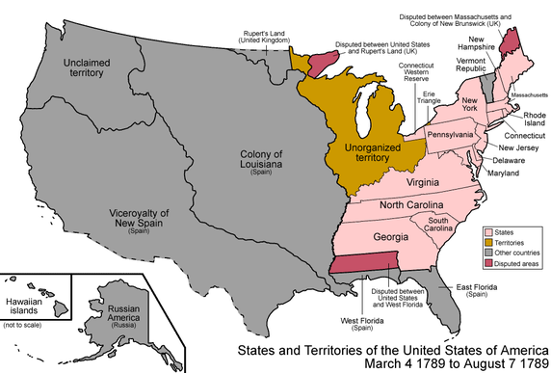
1783
1784
1785
1786
1787
1788
1789
The United States
GREAT BRITIAN
SPAIN

Slide 100
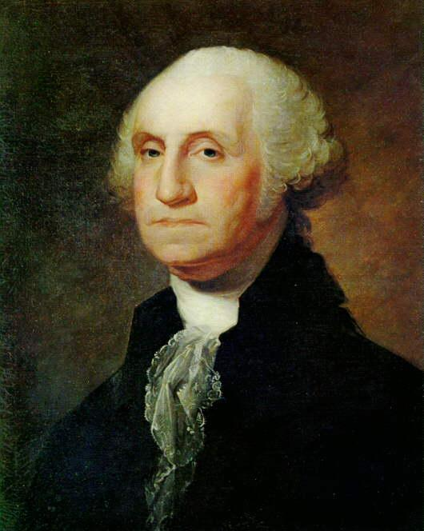
1789
The United States
Population of USA: 3.9 Million
w/UK
w/UK
Vermont
Republic
NOTE:
- Native Americans were not identified until 1860
- On reservations they were not counted until 1900
UK
UNCLAIMED
SPAIN
SPAIN
SPAIN
w/Spain
George Washington

Slide 101
https://en.wikipedia.org/wiki/George_Washington
George Washington (1732 - 1799) was an American politician and soldier who served as the first President of the United States from 1789 to 1797 and was one of the Founding Fathers of the United States. He served as Commander-in-Chief of the Continental Army during the American Revolutionary War, and later presided over the 1787 convention that drafted the United States Constitution. He is popularly considered the driving force behind the nation's establishment and came to be known as the "father of the country," both during his lifetime and to this day.
Washington was widely admired for his strong leadership qualities and was unanimously elected president by the Electoral College in the first two national elections. He oversaw the creation of a strong, well-financed national government that maintained neutrality in the French Revolutionary Wars, suppressed the Whiskey Rebellion, and won acceptance among Americans of all types. Washington's incumbency established many precedents still in use today, such as the cabinet system, the inaugural address, and the title Mr. President. His retirement from office after two terms established a tradition that lasted until 1940 when Franklin Delano Roosevelt won an unprecedented third term. The 22nd Amendment (1951) now limits the president to two elected terms.
He was born into the provincial gentry of Colonial Virginia to a family of wealthy planters who owned tobacco plantations and slaves, which he inherited. In his youth, he became a senior officer in the colonial militia during the first stages of the French and Indian War. In 1775, the Second Continental Congress commissioned him as commander-in-chief of the Continental Army in the American Revolution. In that command, Washington forced the British out of Boston in 1776 but was defeated and nearly captured later that year when he lost New York City.
After crossing the Delaware River in the middle of winter, he defeated the British in two battles (Trenton and Princeton), retook New Jersey, and restored momentum to the Patriot cause. His strategy enabled Continental forces to capture two major British armies at Saratoga in 1777 and Yorktown in 1781. Historians laud Washington for the selection and supervision of his generals; preservation and command of the army; coordination with the Congress, state governors, and their militia; and attention to supplies, logistics, and training. In battle, however, Washington was repeatedly outmaneuvered by British generals with larger armies.
After victory had been finalized in 1783, Washington resigned as commander-in-chief rather than seize power, proving his opposition to dictatorship and his commitment to American republicanism. Washington presided over the Constitutional Convention in 1787, which devised a new form of federal government for the United States. Following his election as president in 1789, he worked to unify rival factions in the fledgling nation. He supported Alexander Hamilton's programs to satisfy all debts, federal and state, established a permanent seat of government, implemented an effective tax system, and created a national bank. In avoiding war with Great Britain, he guaranteed a decade of peace and profitable trade by securing the Jay Treaty in 1795, despite intense opposition from the Jeffersonians. He remained non-partisan, never joining the Federalist Party, although he largely supported its policies. Washington's Farewell Address was an influential primer on civic virtue, warning against partisanship, sectionalism, and involvement in foreign wars. He retired from the presidency in 1797, returning to his home and plantation at Mount Vernon.
Upon his death, Washington was eulogized as "first in war, first in peace, and first in the hearts of his countrymen" by Representative Henry Lee III of Virginia. He was revered in life and in death; scholarly and public polling consistently ranks him among the top three presidents in American history. He has been depicted and remembered in monuments, public works, currency, and other dedications to the present day.

Slide 102
https://www.archives.gov/research/census/native-americans/1790-1930.html
Microfilmed Records, Records in the National Archives Catalog, and Additional Resources
Prior to 1900 few Indians are included in the decennial Federal census. Indians are not identified in the 1790-1840 censuses. In 1860, Indians living in the general population are identified for the first time. Nearly all of the 1890 census schedules were destroyed as the result of the fire at the Department of Commerce in 1921.
Beginning with the 1900 census, Indians are enumerated on reservations as well as in the general population. For information on other Bureau of the Census Indian schedules, see American Indians in Bureau of the Census Records, Selected Records Relating to Enumeration of Pueblo Indians, 1790-1939, and Selected Microfilm Pertaining to Eastern Cherokee Enumeration.
Indexes: Usually, it is necessary to consult a name index for a particular federal census to find an Indian ancestor. These indexes are available for nearly all states and territories,
https://www.census.gov/history/www/genealogy/decennial_census_records/censuses_of_american_indians.html
Censuses of American Indians
Prior to 1900, few Indians are included in the decennial federal census. Indians are not identified in the 1790-1840 censuses. In 1860, Indians living in the general population are identified for the first time. Nearly all of the 1890 census schedules were destroyed as a result of the fire at the Department of Commerce in 1921.
Beginning with the 1900 census, Indians are enumerated on reservations as well as in the general population.
Available Records:
Enumeration of Pueblo Indians: 1850-1870 New Mexico Territory Censuses: Arranged by county, then village or Pueblo. The schedules provide name, relation to head of household, and often, age. Although the indication of race is often unreliable, many Pueblo are listed as non-White. The racial designation of inhabitants of Taos Pueblo, for example, is "copper" in the 1850 Census and "Indian" in the 1860 and 1870 Censuses. Not all Pueblo are included in the book indexes.
1857 Shawnee Census. A census of the Shawnee Indians tribe was taken as part of the Kansas Territorial Censuses, 1855-1859. At the end of roll 1 of the 1857 census is a census of Shawnee Indians in Kansas Territory, taken in conjunction with the treaty made with the tribe on May 10, 1854. The census is in two parts. Each part has a rough alphabetical index preceding it. In the index to part one, personal information such as relationships to other enumerated Shawnees has been added beside some of the names. In the census of Johnson County in 1858, Shawnee Indians in Shawnee County are listed. There is no name index for this census.
1880 Special Census of Indians. A complete list of the tribes included in this census is found at the beginning of roll 1. There is no name index for this census. Section 8 of the census act of March 3, 1879 (20 Stat. 475), authorized the Census Bureau to enumerate all Indians not taxed; that is, those on reservations or in unsettled areas. With the budget provided, the Census Bureau undertook enumerations in Washington Territory, Dakota Territory, and California. The Census Bureau used a special Indian population schedule containing 48 questions.
Enumerations were completed for the following reservations in Washington Territory:
Roll 1—Tulalip and Port Madison
Roll 2—Swinomish, Muckleshoot, and Lummi
Roll 3—Yakima
An enumeration was completed for the following reservation in Dakota Territory:
Roll 4—Standing Rock
An enumeration was completed for the following reservation in California:
Roll 5—Round Valley
Microfilm Publication Title: 1880
1890 Census Report. The Report on Indians Taxed and Indians Not Taxed in the United States (Except Alaska) at the Eleventh Census, 1890 (1894) (see 1890, Final Reports consists of statistical summaries followed by descriptions of each tribe. These descriptions are arranged by state and usually include the number of people on the reservation, the location of the reservation as well as a description of the schools, sources of income, health problems, and religion. Photographs of buildings and people are interspersed throughout. Information on individuals is very rare.
1907 Census of Seminole County, Oklahoma. This census was taken pursuant to a presidential directive ordering a census of the population of Indian Territory and the Territory of Oklahoma prior to their admittance to the Union as the State of Oklahoma. Only the schedules for Seminole County, in what was then Indian Territory, survive. Enumerators were to identify Indians by "In" in the color or race column. There is no name index for this census.

Slide 103
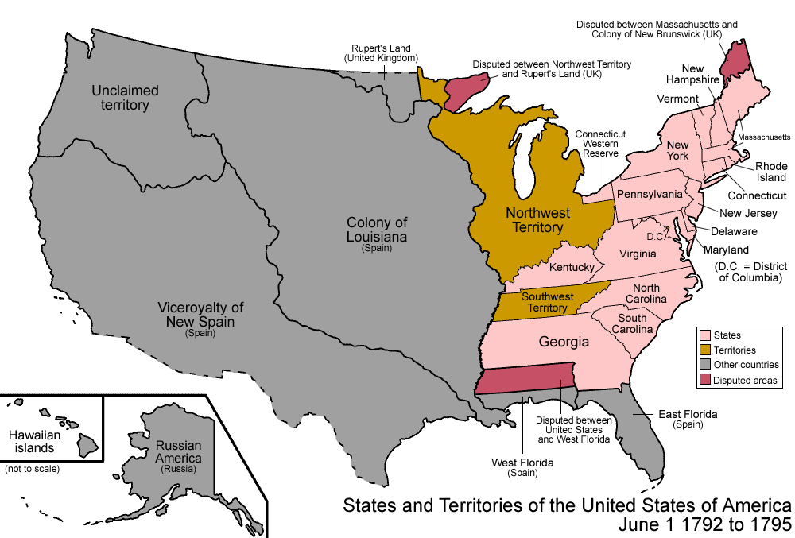
1791
1792
1790
1789
The United States
Population of USA: 3.9 Million
Population of USA: 4.2 Million
NOTE:
- Native Americans were not identified until 1860
- On reservations they were not counted until 1900
George Washington

Slide 104
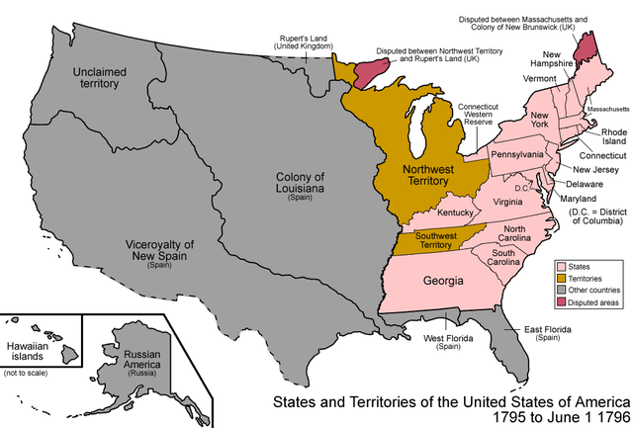
1794
1795
1792
1793
The United States
Population of USA: 4.2 Million
Population of USA: 4.6 Million
George Washington

Slide 105
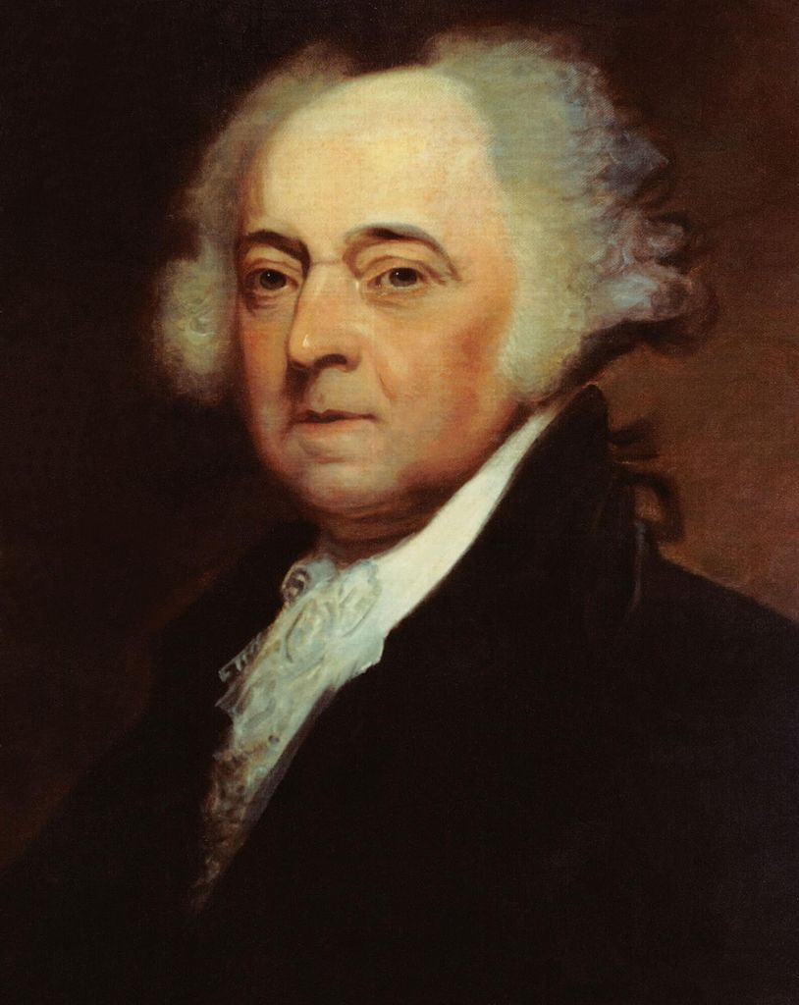
1797
1798
1795
1796
1799
1800
The United States
Population of USA: 4.6 Million
Population of USA: 5.3 Million
FRANCE
SPAIN
George Washington
John Adams

Slide 106
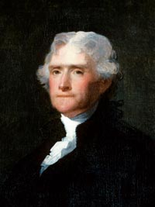
1800
1801
The United States
Population of USA: 5.3 Million
FRANCE
Thomas Jefferson
John Adams

Slide 107
1801
Thomas Jefferson
The United States
Thomas Jefferson

Slide 108
TIME LINE FOR THOMAS JEFFERSON
1743 – born a British subject in Colony of Virginia
1757 (age 14) – father died, Jefferson inherited 5000 acres @ Monticello
1762-64 – attended/graduated College of William and Mary
1767 – admitted to Virginia bar, briefly practiced law
1768 – began constructing Monticello
1770 – moved into Monticello
1772 – married his 3rd cousin, Mary Wayles Skelton
1772-1782 – Thomas/Mary had 6 children, 2 survived to adulthood
1782 – Mary died at age 33
1775 – represented Virginia in the 2nd Continental Congress
1776 - primary author of Declaration of Independence
1776-1783 – Revolutionary War
1790-1793 - Secretary of State for George Washington
1797-1801 – 2nd vice-president of USA under John Adams
1801-1809 – 3rd president of USA

Slide 109
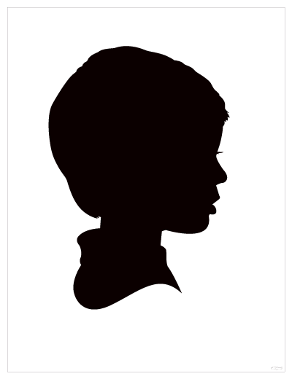
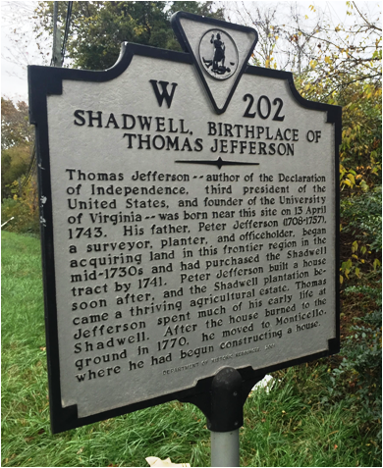
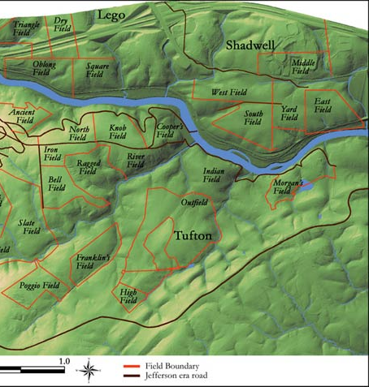
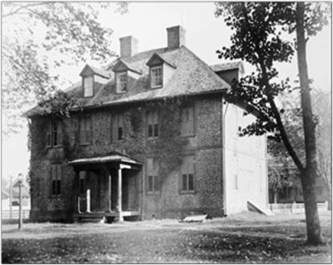
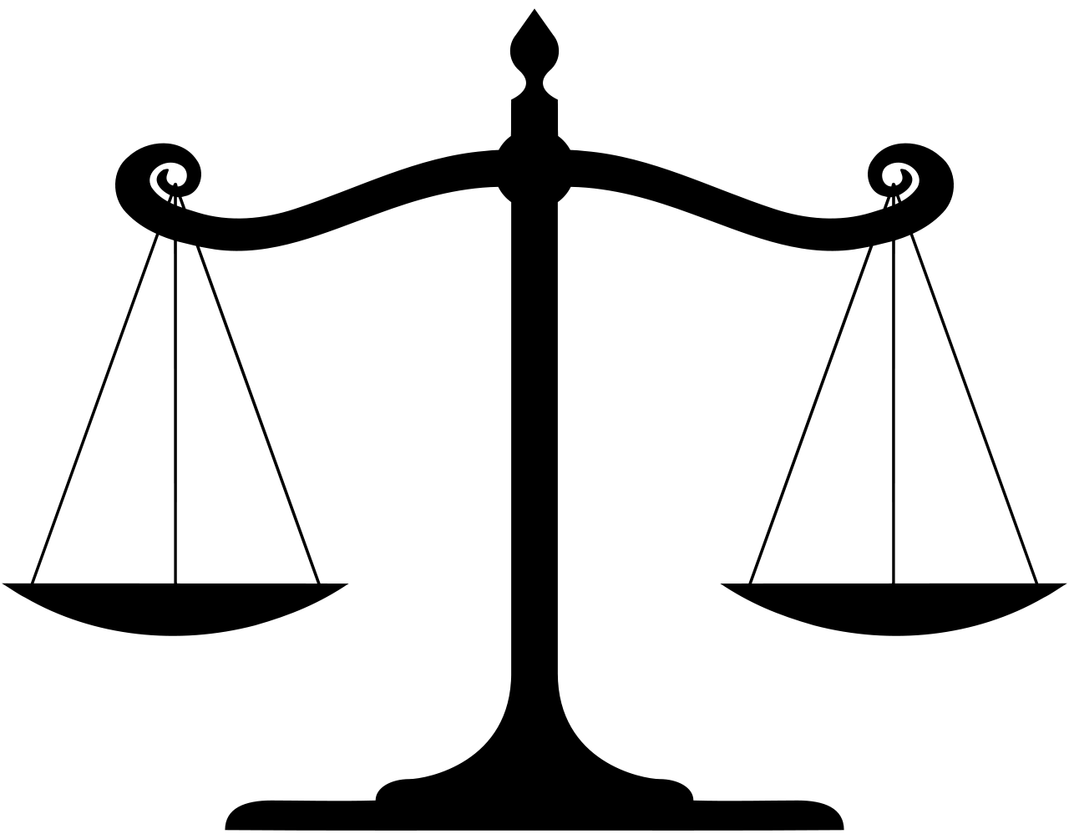
Thomas Jefferson
1743: born a British subject in Colony of Virginia
age 14: inherits 5000 acre plantation
at Monticello after father’s death
age 19-21: attends College of William and Mary
age 24: admitted to Virginia bar, practices law
Thomas Jefferson

Slide 110
https://en.wikipedia.org/wiki/Thomas_Jefferson
Thomas Jefferson was born on April 13, 1743 (April 2, 1743), at the family home in Shadwell in the Colony of Virginia, the third of ten children. He was of English and possibly Welsh descent and was born a British subject. His father Peter Jefferson was a planter and surveyor who died when Jefferson was fourteen; his mother was Jane Randolph. Peter Jefferson moved his family to Tuckahoe Plantation in 1745 upon the death of a friend who had named him guardian of his children. The Jeffersons returned to Shadwell in 1752, where Peter died in 1757; his estate was divided between his sons Thomas and Randolph. Thomas inherited approximately 5,000 acres (2,000 ha; 7.8 sq mi) of land, including Monticello. He assumed full authority over his property at age 21.
Jefferson began his childhood education beside the Randolph children with tutors at Tuckahoe. In 1752, he began attending a local school run by a Scottish Presbyterian minister. At age nine, he started studying Latin, Greek, and French; he learned to ride horses and began nature studies. He was taught from 1758 to 1760 by Reverend James Maury near Gordonsville, Virginia, where he studied history, science, and the classics while boarding with Maury's family.
Jefferson entered the College of William & Mary in Williamsburg, Virginia, at age 16 and studied mathematics, metaphysics, and philosophy under Professor William Small. Small introduced him to the British Empiricists including John Locke, Francis Bacon, and Isaac Newton. Jefferson improved his French and Greek and his skill at the violin. He graduated two years after starting in 1762. He read the law under Professor George Wythe's tutelage to obtain his law license, while working as a law clerk in Wythe's office. He also read a wide variety of English classics and political works.
Jefferson was admitted to the Virginia bar in 1767 and then lived with his mother at Shadwell. In addition to practicing law, Jefferson represented Albemarle County as a delegate in the Virginia House of Burgesses from 1769 until 1775. He pursued reforms to slavery. He introduced legislation in 1769 allowing masters to take control over the emancipation of slaves, taking discretion away from the royal Governor and General Court. He persuaded his cousin Richard Bland to spearhead the legislation's passage, but reaction was strongly negative.
Jefferson took seven cases for freedom-seeking slaves and waived his fee for one client, who claimed that he should be freed before the statutory age of thirty-one required for emancipation in cases with inter-racial grandparents. He invoked Natural Law to argue, "everyone comes into the world with a right to his own person and using it at his own will ... This is what is called personal liberty, and is given him by the author of nature, because it is necessary for his own sustenance." The judge cut him off and ruled against his client. As a consolation, Jefferson gave his client some money, conceivably used to aid his escape shortly thereafter. He later incorporated this sentiment into the Declaration of Independence. He also took on 68 cases for the General Court of Virginia in 1767, in addition to three notable cases: Howell v. Netherland (1770), Bolling v. Bolling (1771), and Blair v. Blair (1772).
The British Parliament passed the Intolerable Acts in 1774, and Jefferson wrote a resolution calling for a "Day of Fasting and Prayer" in protest, as well as a boycott of all British goods. His resolution was later expanded into A Summary View of the Rights of British America, in which he argued that people have the right to govern themselves.
In 1768, Jefferson began constructing his primary residence Monticello (Italian for "Little Mountain") on a hilltop overlooking his 5,000-acre plantation. Construction was done mostly by local masons and carpenters, assisted by Jefferson's slaves.
He moved into the South Pavilion in 1770. Turning Monticello into a neoclassical masterpiece in the Palladian style was his perennial project.
On January 1, 1772, Jefferson married his third cousin Martha Wayles Skelton, the 23-year-old widow of Bathurst Skelton, and she moved into the South Pavilion. She was a frequent hostess for Jefferson and managed the large household. Biographer Dumas Malone described the marriage as the happiest period of Jefferson's life. Martha read widely, did fine needlework, and was a skilled pianist; Jefferson often accompanied her on the violin or cello. During their ten years of marriage, Martha bore six children: Martha "Patsy" (1772–1836); Jane (1774–1775); a son who lived for only a few weeks in 1777; Mary Wayles "Polly" (1778–1804); Lucy Elizabeth (1780–1781); and another Lucy Elizabeth (1782–1785). Only Martha and Mary survived more than a few years.

Slide 111
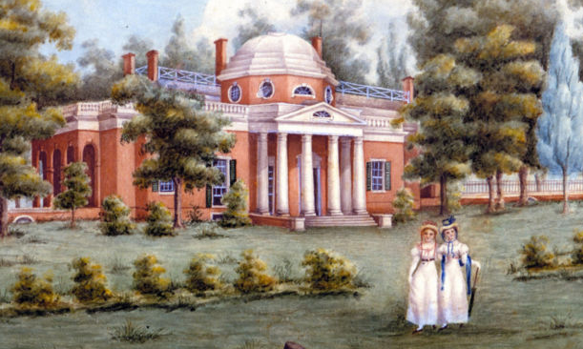
Thomas Jefferson
1743: born a British subject in Colony of Virginia
age 14: inherits 5000 acre plantation
at Monticello after father’s death
age 19-21: attends College of William and Mary
age 24: admitted to Virginia bar, practices law
age 25: begins construction at Monticello
age 27: moves into Monticello
age 29: marries 3rd cousin, Martha Wayles Skelton
age 29-39: the couple has 6 children, 2 survive
age 39: wife Martha dies at age 33
Thomas Jefferson
Shortly before her death,
Martha extracts a promise that
Thomas will never marry again

Slide 112
http://classroom.monticello.org/kids/resources/profile/84/Martha-Wayles-Jefferson-Jeffersons-wife/
Martha Wayles Jefferson, Jefferson's wife
1748 - 1782
Only a few facts are known about Thomas Jefferson’s wife. There are no letters written by her. There are no pictures of her.
Martha Wayles was born October 19, 1748 in Charles City County, Virginia. She married Thomas Jefferson in 1772 on New Year’s Day. She was twenty-three years old. Martha shared with Jefferson a love of music and record-keeping.
Martha gave birth to six children. Two daughters and a son died as infants. In 1782, her daughter Lucy was born. Four months later, Martha died. She was thirty-three years old. Lucy died two years later from whooping cough. Only two daughters, Martha and Mary, lived to become adults.
Thomas Jefferson loved his home and his wife. He believed that his "heart would be happier enjoying the affections of a family fireside." He was overcome with sadness by his wife’s death.

Slide 113
Thomas Jefferson
1743: born a British subject in Colony of Virginia
age 14: inherits 5000 acre plantation
at Monticello after father’s death
age 19-21: attends College of William and Mary
age 24: admitted to Virginia bar, practices law
age 25: begins construction at Monticello
age 27: moves into Monticello
age 29: marries 3rd cousin, Martha Wayles Skelton
age 29-39: the couple has 6 children, 2 survive
age 39: wife Martha dies at age 33
Thomas Jefferson
age 32: represents Virginia in the 2nd Continental Congress in (1775)
age 33: primary author of Declaration of Independence (1776)
age 33-40: Revolutionary War years (1776-1783)
age 47-50: Secretary of State for George Washington (1790-1793)
age 54-58: Vice-President of USA under John Adams (1797-1801)
age 58: elected 3rd president of USA - 1801
Shortly before her death,
Martha extracts a promise that
Thomas will never marry again

Slide 114
https://en.wikipedia.org/wiki/Thomas_Jefferson
Jefferson was the primary author of the Declaration of Independence. At age 33, he was one of the youngest delegates to the Second Continental Congress beginning in 1775 at the outbreak of the American Revolutionary War, where a formal declaration of independence from Britain was overwhelmingly favored. Jefferson chose his words for the Declaration in June 1775, shortly after the war had begun, where the idea of Independence from Britain had long since become popular among the colonies. He was also inspired by the Enlightenment ideals of the sanctity of the individual, as well as by the writings of Locke and Montesquieu.
He sought out John Adams who had emerged as a leader of the Congress. They became close friends and Adams supported Jefferson's appointment to the Committee of Five formed to draft a declaration of independence in furtherance of the Lee Resolution passed by the Congress, which declared the United Colonies independent. The committee initially thought that Adams should write the document, but Adams persuaded the committee to choose Jefferson.
Jefferson consulted with other committee members over the next seventeen days, and drew on his own proposed draft of the Virginia Constitution, George Mason's draft of the Virginia Declaration of Rights, and other sources. The other committee members made some changes, and a final draft was presented to the Congress on June 28, 1776.
The declaration was introduced on Friday, June 28, and congress began debate over its contents on Monday, July 1, resulting in the omission of a fourth of the text, including a passage critical of King George III and the slave trade. Jefferson resented the changes, but he did not speak publicly about the revisions. On July 4, 1776, the Congress ratified the Declaration, and delegates signed it on August 2; in doing so, they were committing an act of treason against the Crown. Jefferson's preamble is regarded as an enduring statement of human rights, and the phrase "all men are created equal" has been called "one of the best-known sentences in the English language" containing "the most potent and consequential words in American history“
At the start of the Revolution, Jefferson was a Colonel and was named commander of the Albemarle County Militia on September 26, 1775. He was then elected to the Virginia House of Delegates for Albemarle County in September 1776, when finalizing a state constitution was a priority.[ For nearly three years, he assisted with the constitution and was especially proud of his Bill for Establishing Religious Freedom, which forbade state support of religious institutions or enforcement of religious doctrine. The bill failed to pass, as did his legislation to disestablish the Anglican church, but both were later revived by James Madison.
In 1778, Jefferson was given the task of revising the state's laws. He drafted 126 bills in three years, including laws to streamline the judicial system. Jefferson's proposed statutes provided for general education, which he considered the basis of "republican government". He had become alarmed that Virginia's powerful landed gentry were becoming a hereditary aristocracy. He took the lead in abolishing what he called "feudal and unnatural distinctions." He targeted laws such as entail and primogeniture by which the oldest son inherited all the land. The entail laws made it perpetual: the one who inherited the land could not sell it, but had to bequeath it to his oldest son. As a result, increasingly large plantations, worked by white tenant farmers and by black slaves, gained in size and wealth and political power in the eastern ("Tidewater") tobacco areas. During the Revolutionary era, all such laws were repealed by the states that had them.
Jefferson was elected governor for one-year terms in 1779 and 1780. He transferred the state capital from Williamsburg to Richmond, and introduced measures for public education, religious freedom, and revision of inheritance laws.
During General Benedict Arnold's 1781 invasion of Virginia, Jefferson escaped Richmond just ahead of the British forces, and the city was burned to the ground. General Charles Cornwallis that spring dispatched a cavalry force led by Banastre Tarleton to capture Jefferson and members of the Assembly at Monticello, but Jack Jouett of the Virginia militia thwarted the British plan. Jefferson escaped to Poplar Forest, his plantation to the west. When the General Assembly reconvened in June 1781, it conducted an inquiry into Jefferson's actions which eventually concluded that Jefferson had acted with honor—but he was not re-elected.
The United States formed a Congress of the Confederation following victory in the Revolutionary War and a peace treaty with Great Britain in 1783, to which Jefferson was appointed as a Virginia delegate. He was a member of the committee setting foreign exchange rates and recommended an American currency based on the decimal system which was adopted. He advised formation of the Committee of the States to fill the power vacuum when Congress was in recess. The Committee met when Congress adjourned, but disagreements rendered it dysfunctional.
In the Congress's 1783–84 session, Jefferson acted as chairman of committees to establish a viable system of government for the new Republic and to propose a policy for the settlement of the western territories. Jefferson was the principal author of the Land Ordinance of 1784, whereby Virginia ceded to the national government the vast area that it claimed northwest of the Ohio River. He insisted that this territory should not be used as colonial territory by any of the thirteen states, but that it should be divided into sections which could become states. He plotted borders for nine new states in their initial stages and wrote an ordinance banning slavery in all the nation's territories. Congress made extensive revisions, including rejection of the ban on slavery. The provisions banning slavery were known later as the "Jefferson Proviso;" they were modified and implemented three years later in the Northwest Ordinance of 1787 and became the law for the entire Northwest. Jefferson was sent by the Congress of the Confederation to join Benjamin Franklin and John Adams as ministers in Europe for negotiation of trade agreements with England, Spain, and France. Some believed that the recently widowed Jefferson was depressed and that the assignment would distract him from his wife's death. With his young daughter Patsy and two servants, he departed in July 1784, arriving in Paris the next month. French foreign minister Count de Vergennes commented, "You replace Monsieur Franklin, I hear." Jefferson replied, "I succeed. No man can replace him.“ Franklin resigned as minister in March 1785 and departed in July.

Slide 115
https://en.wikipedia.org/wiki/Thomas_Jefferson
Soon after returning from France, Jefferson accepted Washington's invitation to serve as Secretary of State. Jefferson had initially expected to return to France, but Washington insisted that he be on his new Cabinet. Pressing issues at this time were the national debt and the permanent location of the capital. Jefferson opposed a national debt, preferring that each state retire its own, in contrast to Secretary of the Treasury Alexander Hamilton, who desired consolidation of various states' debts by the federal government. Hamilton also had bold plans to establish the national credit and a national bank, but Jefferson strenuously opposed this and attempted to undermine his agenda, which nearly led Washington to dismiss him from his cabinet. Jefferson later left the cabinet voluntarily; Washington never forgave him, and never spoke to him again.
The second major issue was the capital's permanent location. Hamilton favored a capital close to the major commercial centers of the Northeast, while Washington, Jefferson, and other agrarians wanted it located to the south. After lengthy deadlock, the Compromise of 1790 was struck, permanently locating the capital on the Potomac River, and the federal government assumed the war debts of all thirteen states.
been suffering from migraines and he was tired of Hamilton in-fighting. In May 1792, Jefferson was alarmed at the political rivalries taking shape; he wrote to Washington, urging him to run for re-election that year as a unifying influence. He urged the president to rally the citizenry to a party that would defend democracy against the corrupting influence of banks and monied interests, as espoused by the Federalists. Historians recognize this letter as the earliest delineation of Democratic-Republican Party principles. Jefferson, Madison, and other Democratic-Republican organizers favored states' rights and local control and opposed federal concentration of power, whereas Hamilton sought more power for the federal government.
Jefferson supported France against Britain when the two nations fought in 1793, though his arguments in the Cabinet were undercut by French Revolutionary envoy Edmond-Charles Genêt's open scorn for President Washington. In his discussions with British Minister George Hammond, Jefferson tried unsuccessfully to persuade the British to acknowledge their violation of the Treaty of Paris, to vacate their posts in the Northwest, and to compensate the U.S. for slaves whom the British had freed at the end of the war. Seeking a return to private life, Jefferson resigned the cabinet position in December 1793, perhaps to bolster his political influence from outside the administration.
In the presidential campaign of 1796, Jefferson lost the electoral college vote to Federalist John Adams by 71–68 and was elected vice president because of a mistake in voting for Adams' running mate. As presiding officer of the Senate, he assumed a more passive role than his predecessor John Adams. He allowed the Senate to freely conduct debates and confined his participation to procedural issues, which he called an "honorable and easy" role. Jefferson had previously studied parliamentary law and procedure for forty years, making him unusually well qualified to serve as presiding officer. In 1800, he published his assembled notes on Senate procedure as A Manual of Parliamentary Practice.
Jefferson held four confidential talks with French consul Joseph Létombe in the spring of 1797 where he attacked Adams, predicting that his rival would serve only one term. He also encouraged France to invade England, and advised Létombe to stall any American envoys sent to Paris by instructing him to "listen to them and then drag out the negotiations at length and mollify them by the urbanity of the proceedings.“ This toughened the tone that the French government adopted toward the Adams administration. After Adams' initial peace envoys were rebuffed, Jefferson and his supporters lobbied for the release of papers related to the incident, called the XYZ Affair after the letters used to disguise the identities of the French officials involved. However, the tactic backfired when it was revealed that French officials had demanded bribes, rallying public support against France. The U.S. began an undeclared naval war with France known as the Quasi-War.
During the Adams presidency, the Federalists rebuilt the military, levied new taxes, and enacted the Alien and Sedition Acts. Jefferson believed that these laws were intended to suppress Democratic-Republicans, rather than prosecute enemy aliens, and considered them unconstitutional. To rally opposition, he and James Madison anonymously wrote the Kentucky and Virginia Resolutions, declaring that the federal government had no right to exercise powers not specifically delegated to it by the states. The resolutions followed the "interposition" approach of Madison, in which states may shield their citizens from federal laws that they deem unconstitutional. Jefferson advocated nullification, allowing states to invalidate federal laws altogether. Jefferson warned that, "unless arrested at the threshold", the Alien and Sedition Acts would "necessarily drive these states into revolution and blood".
Historian Ron Chernow claims that "the theoretical damage of the Kentucky and Virginia Resolutions was deep and lasting, and was a recipe for disunion", contributing to the American Civil War as well as later events. Washington was so appalled by the resolutions that he told Patrick Henry that, if "systematically and pertinaciously pursued", the resolutions would "dissolve the union or produce coercion."
Jefferson and Madison moved to Philadelphia and founded the National Gazette in 1791, along with poet and writer Phillip Freneau, in an effort to counter Hamilton's Federalist policies, which Hamilton was promoting through the influential Federalist newspaper the Gazette of the United States. The National Gazette made particular criticism of the policies promoted by Alexander Hamilton, often through anonymous essays signed by the pen name Brutus at Jefferson's urging, which were actually written by Madison.
Jefferson had always admired Washington's leadership skills but felt that his Federalist party was leading the country in the wrong direction. Jefferson thought it wise not to attend his funeral in 1799 because of acute differences with Washington while serving as Secretary of State, and remained at Monticello.

Slide 116
https://en.wikipedia.org/wiki/Thomas_Jefferson
In the 1800 presidential election, Jefferson contended once more against Federalist John Adams. Adams' campaign was weakened by unpopular taxes and vicious Federalist infighting over his actions in the Quasi-War. Republicans pointed to the Alien and Sedition Acts and accused the Federalists of being secret monarchists, while Federalists charged that Jefferson was a godless libertine in thrall to the French. Historian Joyce Appleby said the election was "one of the most acrimonious in the annals of American history".
Republicans ultimately won more electoral college votes, but Jefferson and his vice-presidential candidate Aaron Burr unexpectedly received an equal total. Due to the tie, the election was decided by the Federalist-dominated House of Representatives. Hamilton lobbied Federalist representatives on Jefferson's behalf, believing him a lesser political evil than Burr. On February 17, 1801, after thirty-six ballots, the House elected Jefferson president and Burr vice president.
The win was marked by Republican celebrations throughout the country. Some of Jefferson's opponents argued that he owed his victory over Adams to the South's inflated number of electors, due to counting slaves as partial population under the Three-Fifths Compromise." Others alleged that Jefferson secured James Asheton Bayard's tie-breaking electoral vote by guaranteeing the retention of various Federalist posts in the government. Jefferson disputed the allegation, and the historical record is inconclusive.
The transition proceeded smoothly, marking a watershed in American history. As historian Gordon S. Wood writes, "it was one of the first popular elections in modern history that resulted in the peaceful transfer of power from one 'party' to another.
Jefferson was sworn in by Chief Justice John Marshall at the new Capitol in Washington, D.C. on March 4, 1801. In contrast to his predecessors, Jefferson exhibited a dislike of formal etiquette; he arrived alone on horseback without escort, dressed plainly and, after dismounting, retired his own horse to the nearby stable. His inaugural address struck a note of reconciliation, declaring, "We have been called by different names brethren of the same principle. We are all Republicans, we are all Federalists.“ Ideologically, Jefferson stressed "equal and exact justice to all men", minority rights, and freedom of speech, religion, and press. He said that a free and democratic government was "the strongest government on earth." He nominated moderate Republicans to his cabinet: James Madison as Secretary of State, Henry Dearborn as Secretary of War, Levi Lincoln as Attorney General, and Robert Smith as Secretary of the Navy.
Upon assuming office, he first confronted an $83 million national debt. He began dismantling Hamilton's Federalist fiscal system with help from Secretary of Treasury Albert Gallatin. Jefferson's administration eliminated the whiskey excise and other taxes after closing "unnecessary offices" and cutting "useless establishments and expenses". They attempted to disassemble the national bank and its effect of increasing national debt, but were dissuaded by Gallatin. Jefferson shrank the Navy, deeming it unnecessary in peacetime. Instead, he incorporated a fleet of inexpensive gunboats used only for defense with the idea that they would not provoke foreign hostilities. After two terms, he had lowered the national debt from $83 million to $57 million.
Jefferson pardoned several of those imprisoned under the Alien and Sedition Acts. Congressional Republicans repealed the Judiciary Act of 1801, which removed nearly all of Adams' "midnight judges" from office. A subsequent appointment battle led to the Supreme Court's landmark decision in Marbury v. Madison, asserting judicial review over executive branch actions. Jefferson appointed three Supreme Court justices: William Johnson (1804), Henry Brockholst Livingston (1807), and Thomas Todd (1807).
Jefferson strongly felt the need for a national military university, producing an officer engineering corps for a national defense based on the advancement of the sciences, rather than having to rely on foreign sources for top grade engineers with questionable loyalty. He signed the Military Peace Establishment Act on March 16, 1802, thus founding the United States Military Academ at West Point. The Act documented in 29 sections a new set of laws and limits for the military. Jefferson was also hoping to bring reform to the Executive branch, replacing Federalists and active opponents throughout the officer corps to promote Republican values.

Slide 117
1801
1801
Thomas Jefferson
The United States
Thomas Jefferson
age 32: represents Virginia in the 2nd Continental Congress in (1775)
age 33: primary author of Declaration of Independence (1776)
age 33-40: Revolutionary War years (1776-1783)
age 47-50: Secretary of State for George Washington (1790-1793)
age 54-58: Vice-President of USA under John Adams (1797-1801)
age 58: elected 3rd president of USA - 1801
Thomas Jefferson
1801

Slide 118
1801
1802
The United States
Population of USA: 5.6 Million
- 90% live east of the mountains
UNITED STATES
OF
AMERICA
~600,000
~5,000,000
Thomas Jefferson

Slide 119
1802
1803
The United States
NEXT SESSION!
What will happen in ?
Population of USA: 5.6 Million
UNITED KINGDOM
- 90% live east of the mountains
unclaimed
Northwest Passage
Louisiana Purchase
Corps of Discovery
meet Seaman!
SPAIN
FRANCE
UNITED STATES
OF
AMERICA
~600,000
~5,000,000
SPAIN
Thomas Jefferson

Slide 120
1802
1803
The United States
NEXT SESSION!
What will happen in ?
UNITED KINGDOM
John
Colter
David
Thompson
SPAIN
FRANCE
Jean
Batiste
Shekeke
Kameaweit
John
Colter
Patrick
Gass
Reuben
Field

Slide 121
our website: www.VagabondGeology.com
REFERENCES
MUSEUMS
Lewis &Clark Boat House Center, 1050 S. Riverside Drive, St. Charles, MO
Camp River Dubois State Historical Site, One Lewis & Clark Trail, Hartford, IL
Missouri History Museum, Forest Park, St. Louis , MO
Arrow Rock State Historic Site, Arrow Rock, MO
Fort Osage National Historic Landmark, 107 Osage Street, Sibley, MO
National Frontier Trails Center, 318 West Pacific, Independence, MO
Frontier Army Museum, Metropolitan Ave @ 4th St, Fort Leavenworth KS
Independence Park, 990 Skyway Highway, Atchinson, KS
Pony Express Museum, 914 Penn Street, St. Joseph, MO
Missouri River Basin Lewis &Clark Interpretative Museum, 100 Valmont Dr, Nebraska City, NE
Western Historic Trails Center, 3434 Richard Downing Ave, Council Bluffs, IA
Lewis &Clark Nat'l Historic Trail Headquarters, 601 Riverfront Drive, Omaha, NE
Fort Atkinson State Historic Park, 201 S 7th St, Fort Calhoun, NE
Lewis & Clark State Park, Onawa, IA
Sergeant Floyd Monument, I-29 exit 143, Sioux City, IA
Lewis &Clark Interpretative Center, Larson Park Rd, Sioux City, IA
Lewis & Clark Visitor Center, Lewis and Clark Lake, Yankton, SD
Spirit Mound, Hy 19, 6 miles north Vermillion, SD
Lewis &Clark Keel Boat Center, I-90 exit 263/265 Chamberlain, SD
Akta Lakota Museum, 1301 N Main St, Chamberlain, SD
Fort Abe Lincoln State Park & On-A-Slant Indian Village, 480 Fort Lincoln Rd, Mandan, ND
Lewis &Clark Interpretive Center & Fort Mandan, 2576 8th St SW, Washburn, ND
Knife River Indian Villages Nat’l Historic Site & Big Hidatsa Village Site, County Rd 37, Stanton, ND
Three Affiliated Tribes Museum, 404 Frontage Road, New Town, ND
Missouri-Yellowstone Confluence Interpretive Center, 15349 39th NW, Williston, ND
Fort Buford State Historic Site, 15349 39th NW, Williston, ND
Fort Union Trading Post Nat’l Historic Site, 15550 Hwy. 1804, Williston, ND
Missouri Breaks Interpretive Center, 701 7th Street, Fort Benton, Montana
Lewis & Clark National Historic Trail Interpretive Center, Giant Springs Heritage SP, Great Falls, MT
Missouri Headwaters State Park & Nat'l Historic Landmark, Hwy 286 @ Hwy205, Three Forks, MT
Beaverhead Rock State Park, Hwy 41 south 14 miles from Twin Bridges, MT
Clark's Lookout State Park, 25 Clark's Lookout Rd, Dillon, MT
Travelers' Rest Nat’l Historic Landmark, US 93 one mile south of Lolo, Montana
Lolo Pass Visitor Center, Clearwater National Forest, US-12, ID
Nez Perce Nat’l Historic Park, 39063 US Hwy 95, Spalding, ID
Whitman Mission Nat’l Historic Site, 328 Whitman Mission Rd, Walla Walla, WA
Sacajawea State Park Interpretative Center, 2503 Sacajawea Park Rd, Pasco, WA
Columbia Gorge Discovery Center, 5000 Discovery Dr, The Dalles, OR
Columbia Gorge Interpretive Center, 990 SW Rock Creek Dr, Stevenson, WA
Lewis & Clark State Recreation Site, 1 Jordan Rd, Troutdale, OR
Fort Clatsop Nat'l Memorial, 92343 Fort Clatsop Road, Astoria, OR
Clark's Dismal Nitch, Route 401 east of Astoria-Megler Bridge, WA
Cape Disappointment State Park, 244 Robert Gray Dr, Ilwaco, WA
Columbia Pacific Heritage Museum, 115 SE Lake Street, Ilwaco WA.
Salt Works & End of Trail Monument, Ave U Seaside, OR
Fort Stevens State Park, 100 Peter Iredale Rd, Hammond, OR
PERSONAL CONTACTS
James Harlan, Arrow Rock SHS, HarlanJ@Missouri.edu
James Denny, Arrow Rock SHS, denny2386@gmail.com
Susan Juza, Historian, Fort Atkinson sjuzaA@yahoo.com
Ranger Ryan, (intern), L&C National Park Visitor Center
Rob Hanna, Park Ranger, Fort Mandan, rhanna@nd.gov
WEBSITES
https://soils.ifas.ufl.edu/faculty/grunwald/teaching/eSoilScience/weathering.shtml
http://teach.albion.edu/jjn10/chemical-weathering/
https://en.wikipedia.org/wiki/sedimentary_rock
ttps://www.reference.com/science/can-metamorphic-rocks-found-3dd4f3f23f019b44
https://en.wikipedia.org/wiki/igneous_rock
https://en.wikipedia.org/wiki/List_of_archaeological_periods_(North_America)
https://en.wikipedia.org/wiki/Paleo-Indians
https://en.wikipedia.org/wiki/Paleo-Indians
http://news.ku.dk/all_news/2012/2012.7/clovis_eske_science/
https://en.wikipedia.org/wiki/Archaic_period_in_North_America
https://www.crowcanyon.org/EducationProducts/peoples_mesa_verde/archaic_overview.asp
https://en.wikipedia.org/wiki/Woodland_period
http://mcclungmuseum.utk.edu/2009/01/01/prehistoric-american-indians/
https://en.wikipedia.org/wiki/Mississippian_culture
http://mcclungmuseum.utk.edu/2009/01/01/prehistoric-american-indians/
http://www.encyclopedia.com/history/news-wires-white-papers-and-books/1600-1754-native-americans-overview
https://en.wikipedia.org/wiki/Population_history_of_indigenous_peoples_of_the_Americas
http://www.let.rug.nl/usa/outlines/history-2005/early-america/native-american-cultures.php
http://www.u-s-history.com/pages/h1004.html
http://www.legendsofamerica.com/na-timeline.html
https://en.wikipedia.org/wiki/Treaty_of_Paris_(1783)
https://www.archives.gov/research/census/native-americans/1790-1930.html
https://www.census.gov/history/www/genealogy/decennial_census_records/censuses_of_american_indians.html
http://www.nps.gov/nr/travel/lewisandclark/index.htm
http://classroom.monticello.org/kids/resources/profile/84/Martha-Wayles-Jefferson-Jeffersons-wife/
http://classroom.monticello.org/kids/gallery/image/374/School-Lessons-in-the-South-Square-Room/
http://classroom.monticello.org/kids/gallery/image/375/Building-Monticello/
BOOKS
Along the Trail with Lewis & Clark, Fifer & Soderberg
Atlas of Native Americans, Dr Ian Barnes,Chartwell Books, 2015
The Geologic Story of the Great Plains, Donald Trimble, The Printers, Inc; 2013
George Drouillard, Skarsten
Lewis & Clark An Illustrated History, Duncan & Burns
The Lewis and Clark Journals, Editor Gary Moulton, University of Nebraska Press, 2003
Mayflower, Nathaniel Philbrick, Penguin Group, 2006
Northwest Exposure: A Geologic Story of the Northwest, David Alt & Donald Hyndman, Mountain Press, 1995
Sacajawea, Howard
Seaman's Journal, Eubank
Sheheke: Mandan & Indian Diplomat, Potter
Traveling the Lewis & Clark Trail , Fanselow
VIDEOS
Across the Great Divide
Beavers: Biggest Dam Movie You Ever Saw
Clatsop Winter Story
Fossil Lake
Great Ice Age Floods
Hagerman Fossil Beds
Ice Age Fossils
Lewis & Clark: Confluence of Time & Courage
Lewis & Clark: Great Journey West
Lewis & Clark: Pathways
Maxidiwiac
Nez Perce: Portrait of a People
Of One Heart
People of the Upper Missouri: the Mandans
Sculpted by Floods
White Cliffs, Wild River

Slide 122
This
‘Westward Journeys’
‘Westward Journeys’

